Slide 1
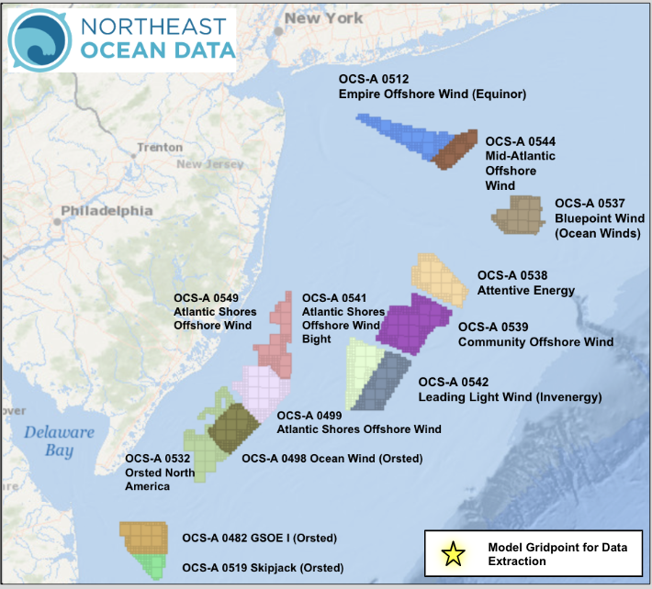
RUWRF 3km Four-Year Wind Energy Analysis
OCS-A 0512 (40.295N, 73.314W)

Slide 2
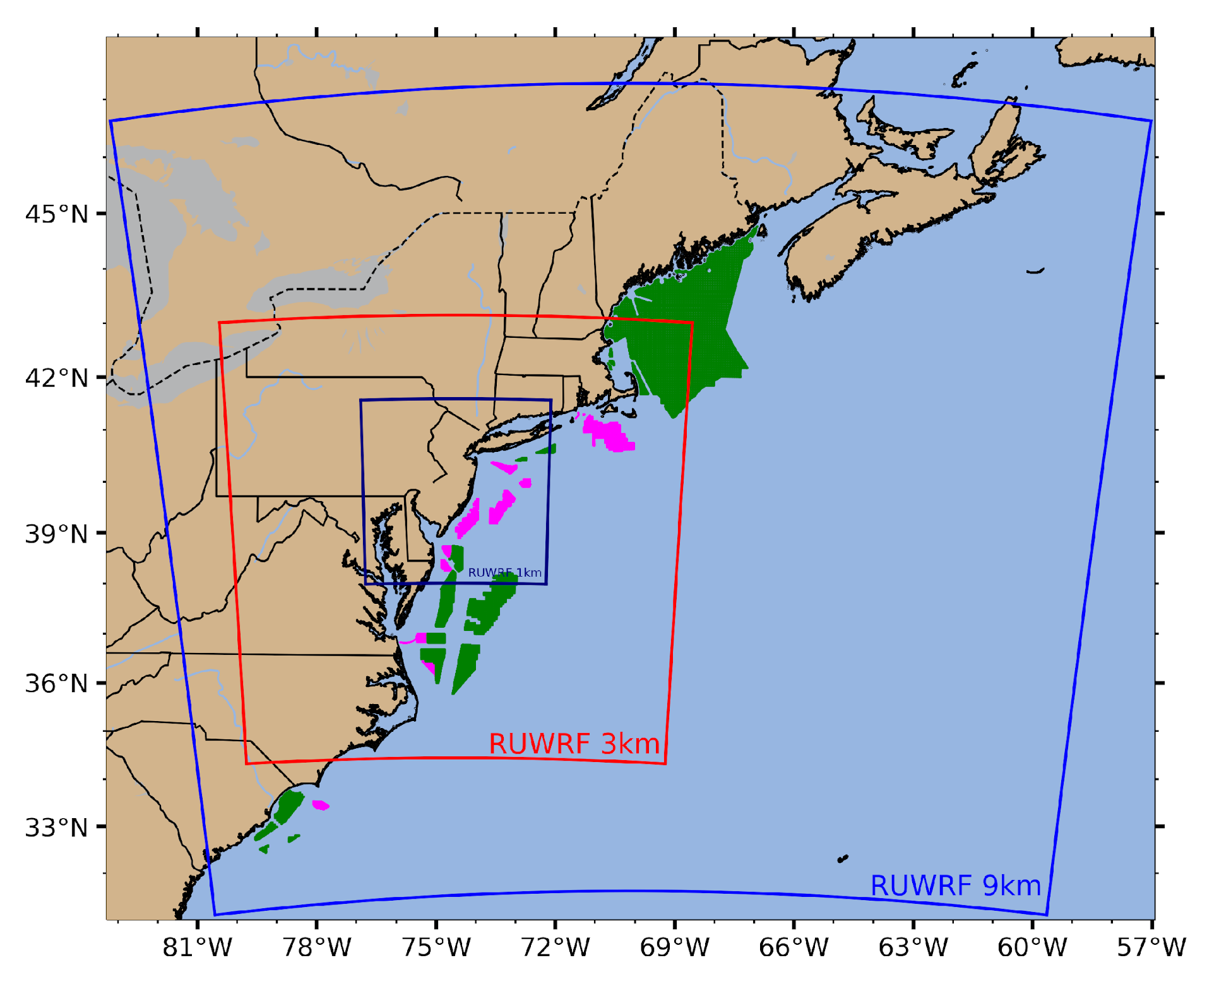
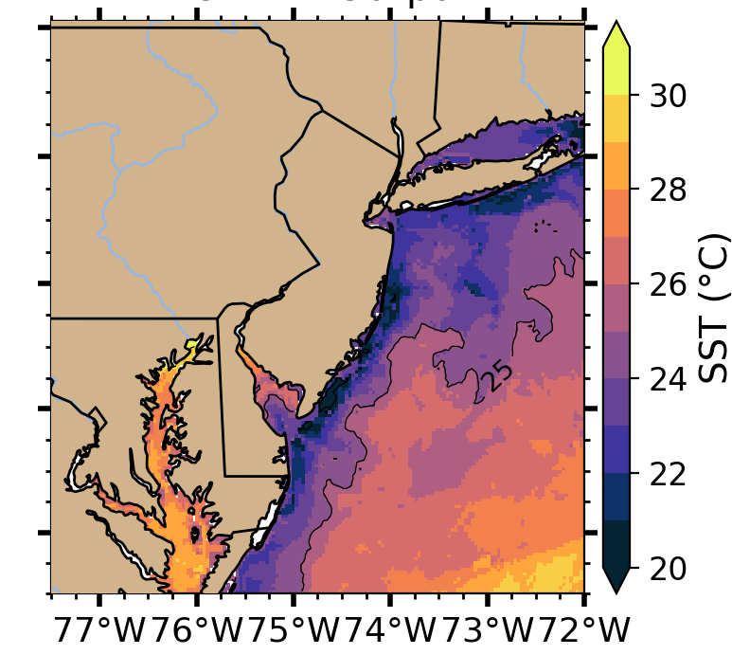
RUCOOL NJBPU Project Overview – The Coastal Ocean impacts New Jersey’s Weather
RUCOOL – NJBPU Project Fast Facts:
Model simulations generated using RUWRF – “digital twin” approach
  Evaluated by and optimized with NREL in 2019 (NREL Report)
  Validation documents performance equivalent to or better than evolving national products
  Full 4-D dataset is available for applications and research
  4+ year dataset for 3km grid (Dec 2018 - Feb 2023)
RUWRF Key Features
  Triple nested (9 km, 3 km, 1 km) within U.S. global model
  Sea Surface Temperature boundary condition generated by RUCOOL using state-of-the-art satellite systems (Murphy et al., 2021); GOES upwelling-preserving SST input: http://ruwrf-archive.marine.rutgers.edu/erddap/griddap/goes_24h_composite.graph
  Accounts for essential ocean features (upwelling) and essential atmospheric structures (seabreeze)
The model output used in the following figures is extracted from a single gridpoint in the middle of your lease area at 160 meters, the approximate 15 MW wind turbine hub height.
  Power production calculated from estimated wind speed using a 15 MW NREL Power curve (https://github.com/NREL/turbine-models/blob/master/Offshore/IEA_15MW_240_RWT.csv)

Slide 3
RUWRF Seasonal Wind (top row) and Power (bottom row) Roses Grouped by Year at Hub-height (160m)

Slide 4
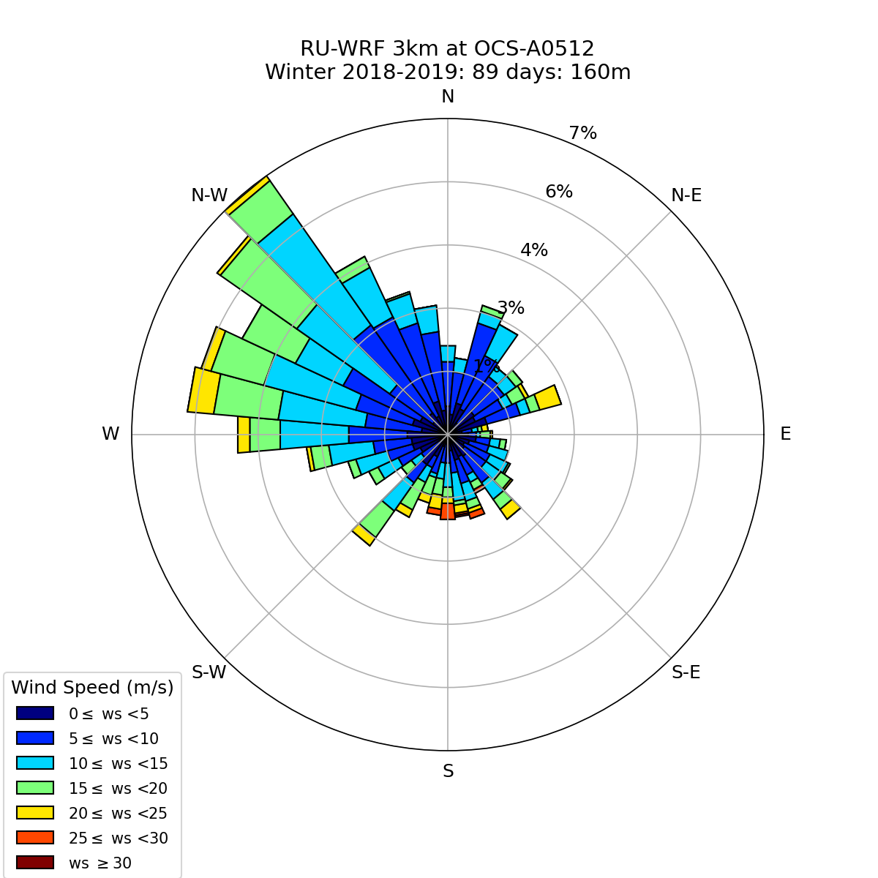
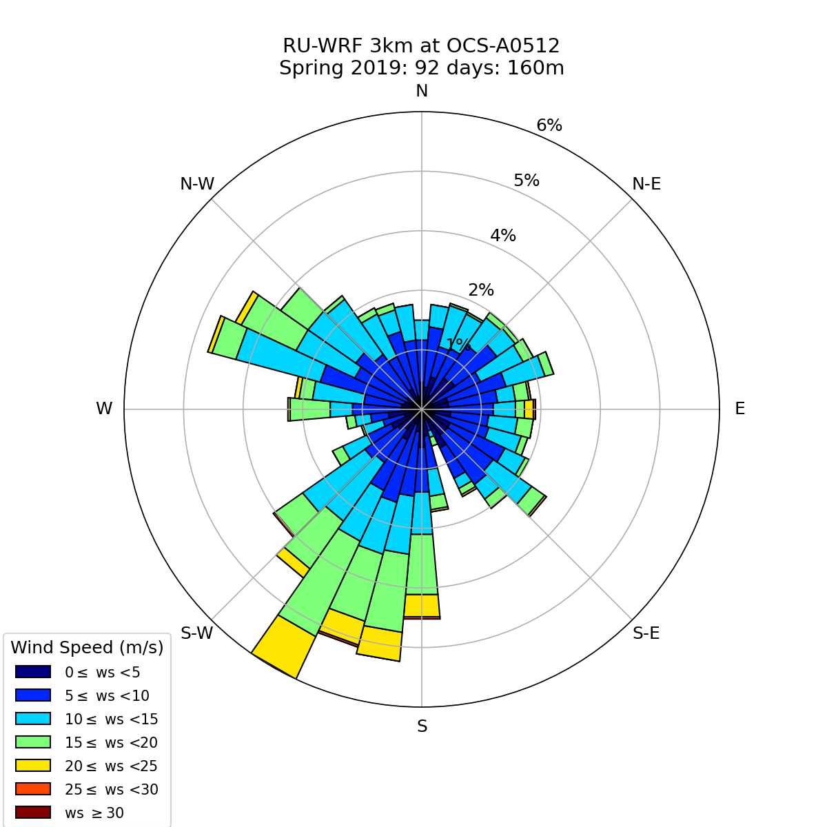
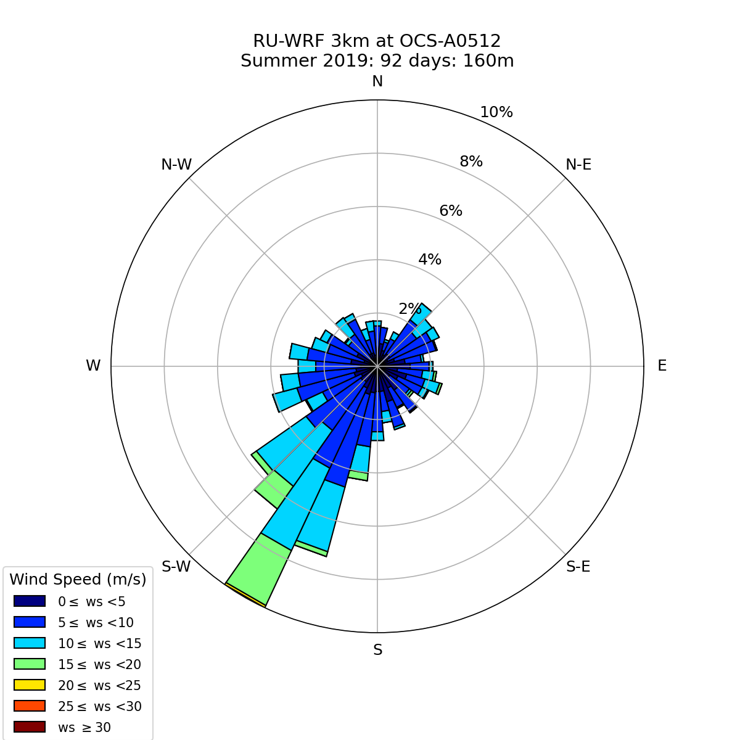
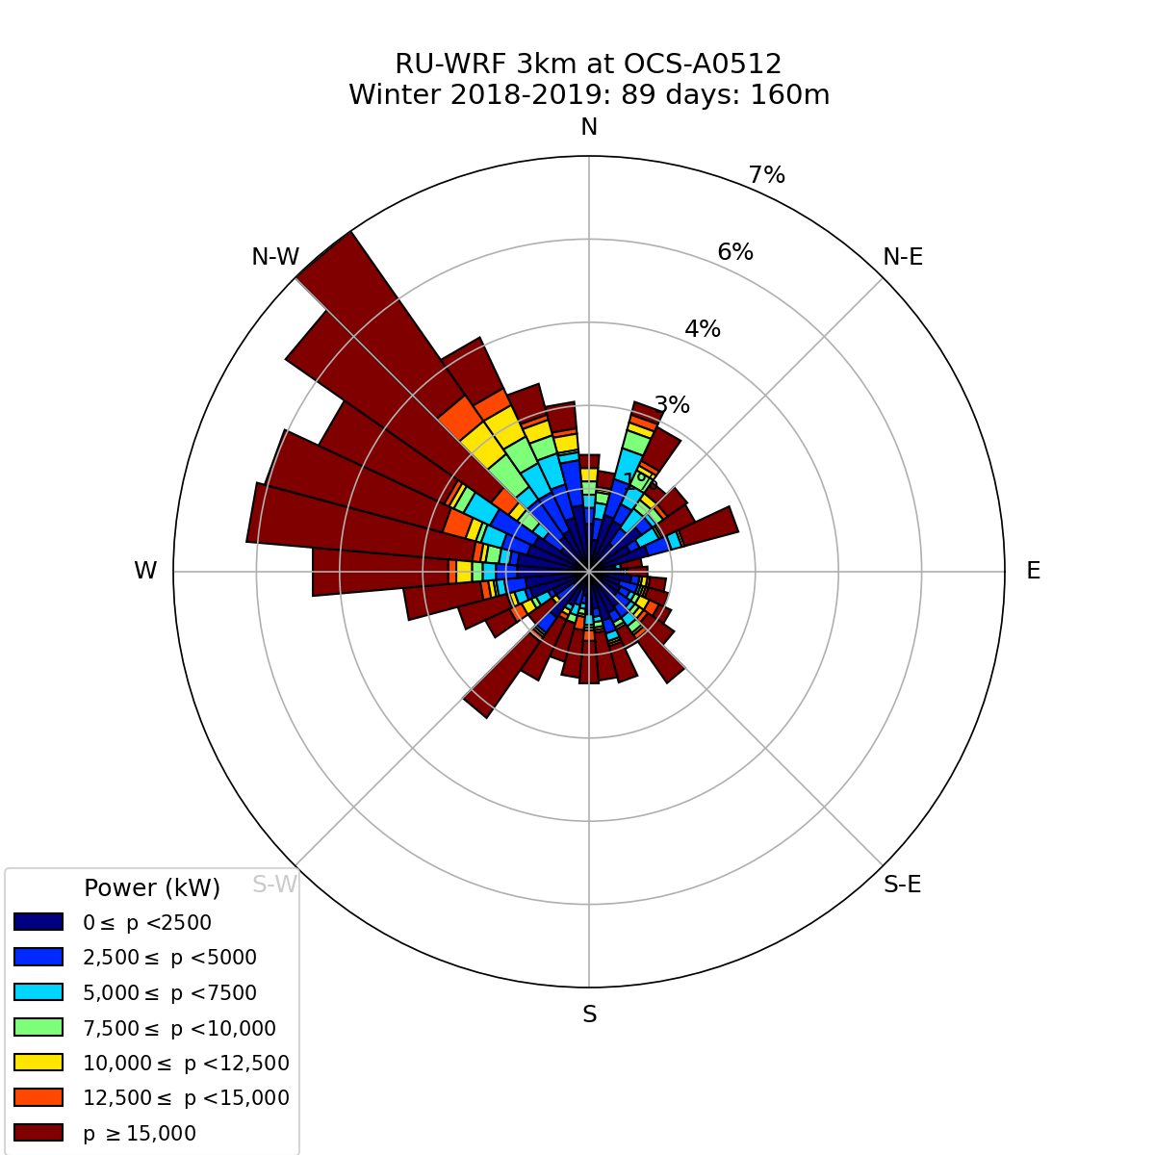
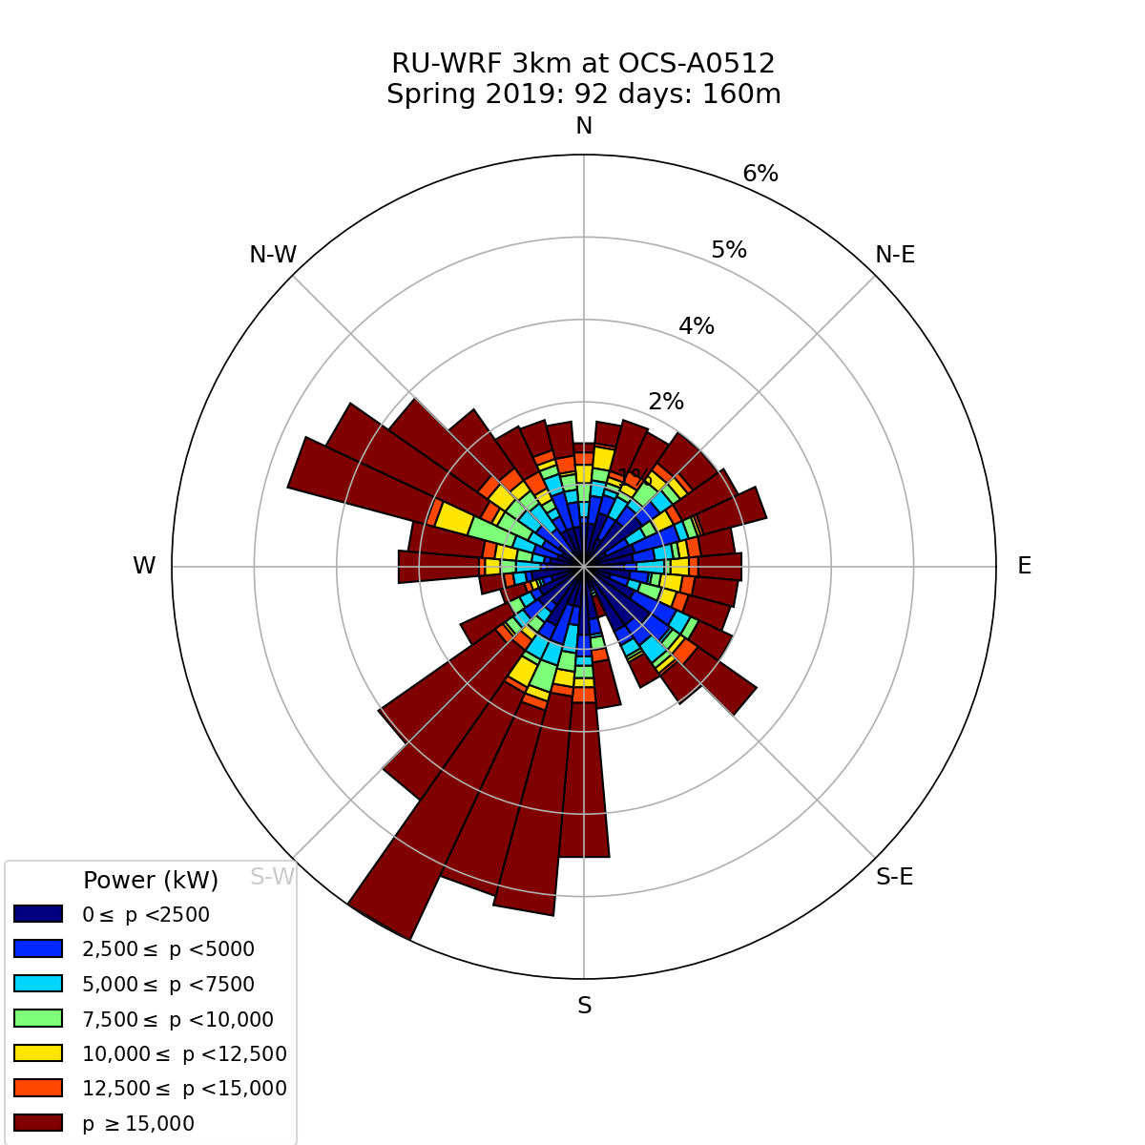
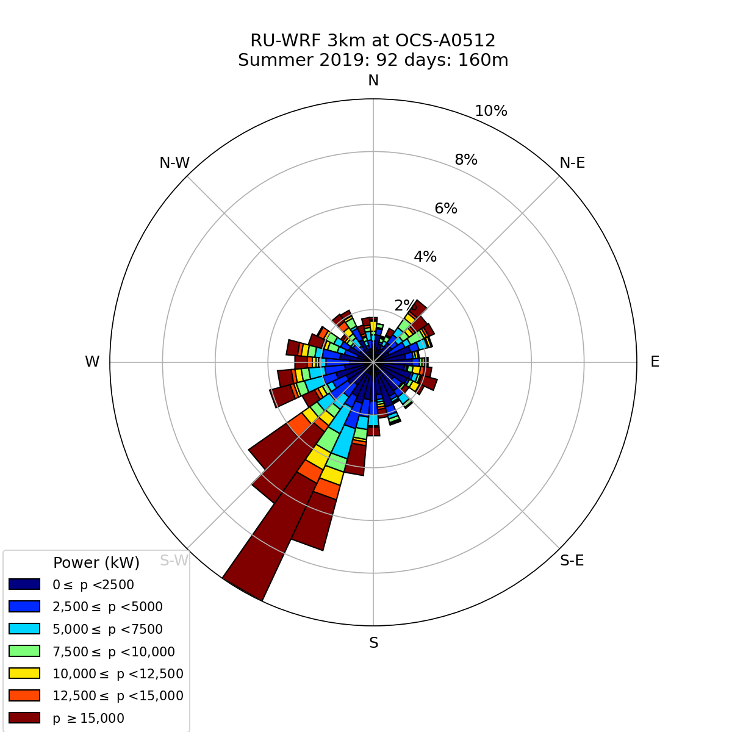
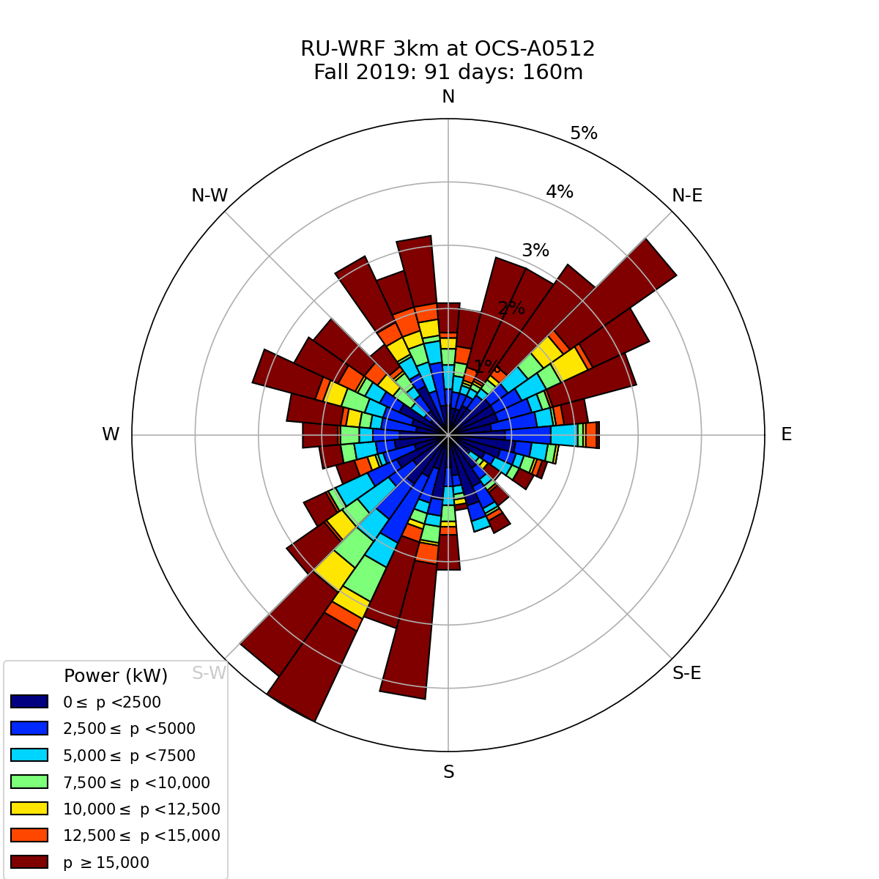
Winter
2019
Spring
Summer
Fall
Wind Speed
Power
Notes:
RUWRF Seasonal Wind and Power Roses at 160 meters
Winter: December of the previous year and January and February of the labeled year.
Spring: March-May
Summer: June-August
Fall: September-November

Slide 5
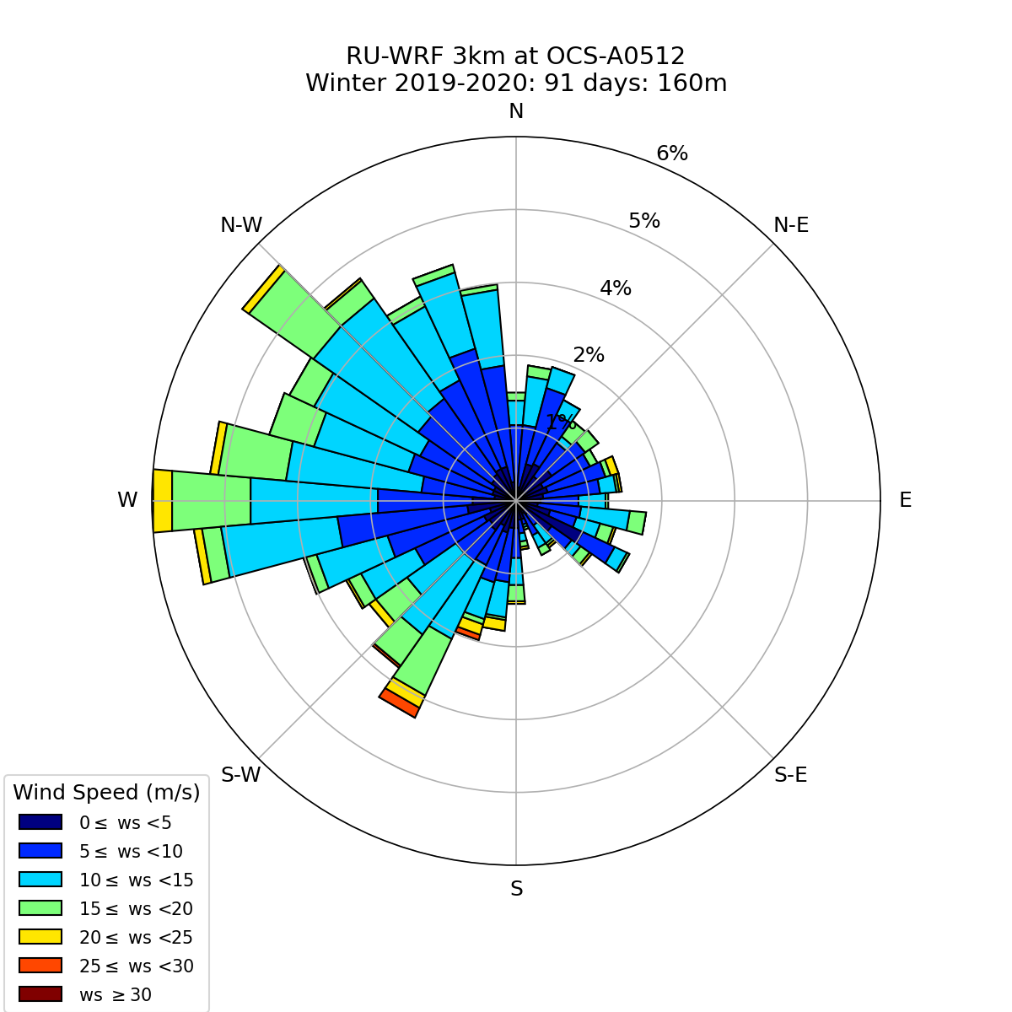
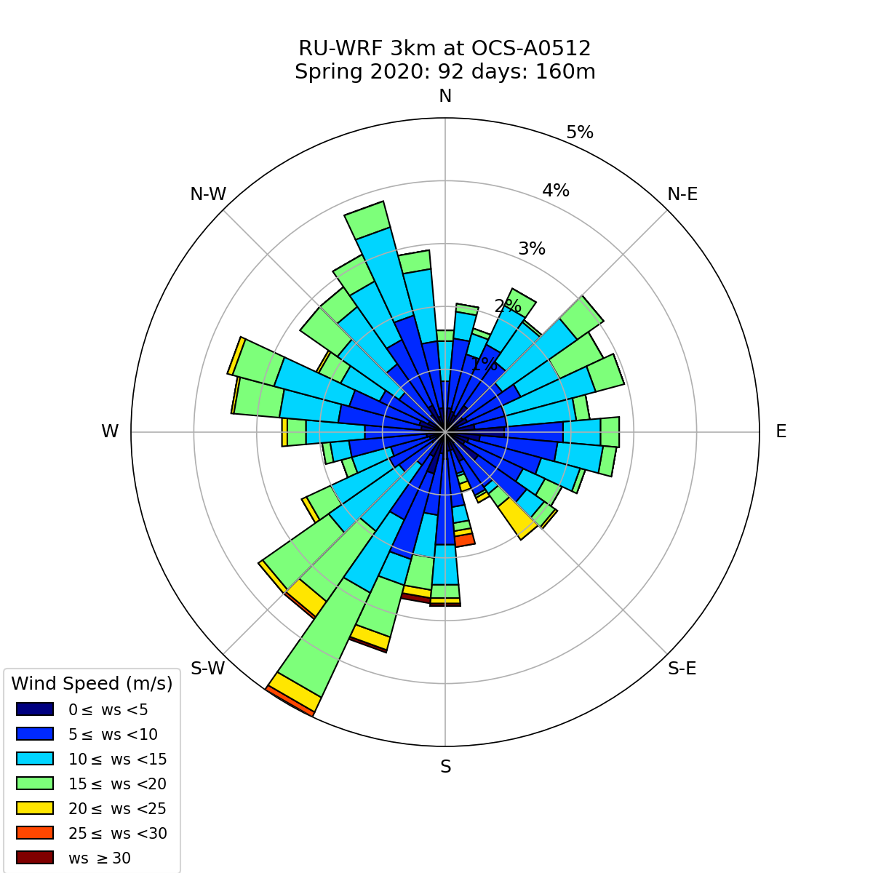
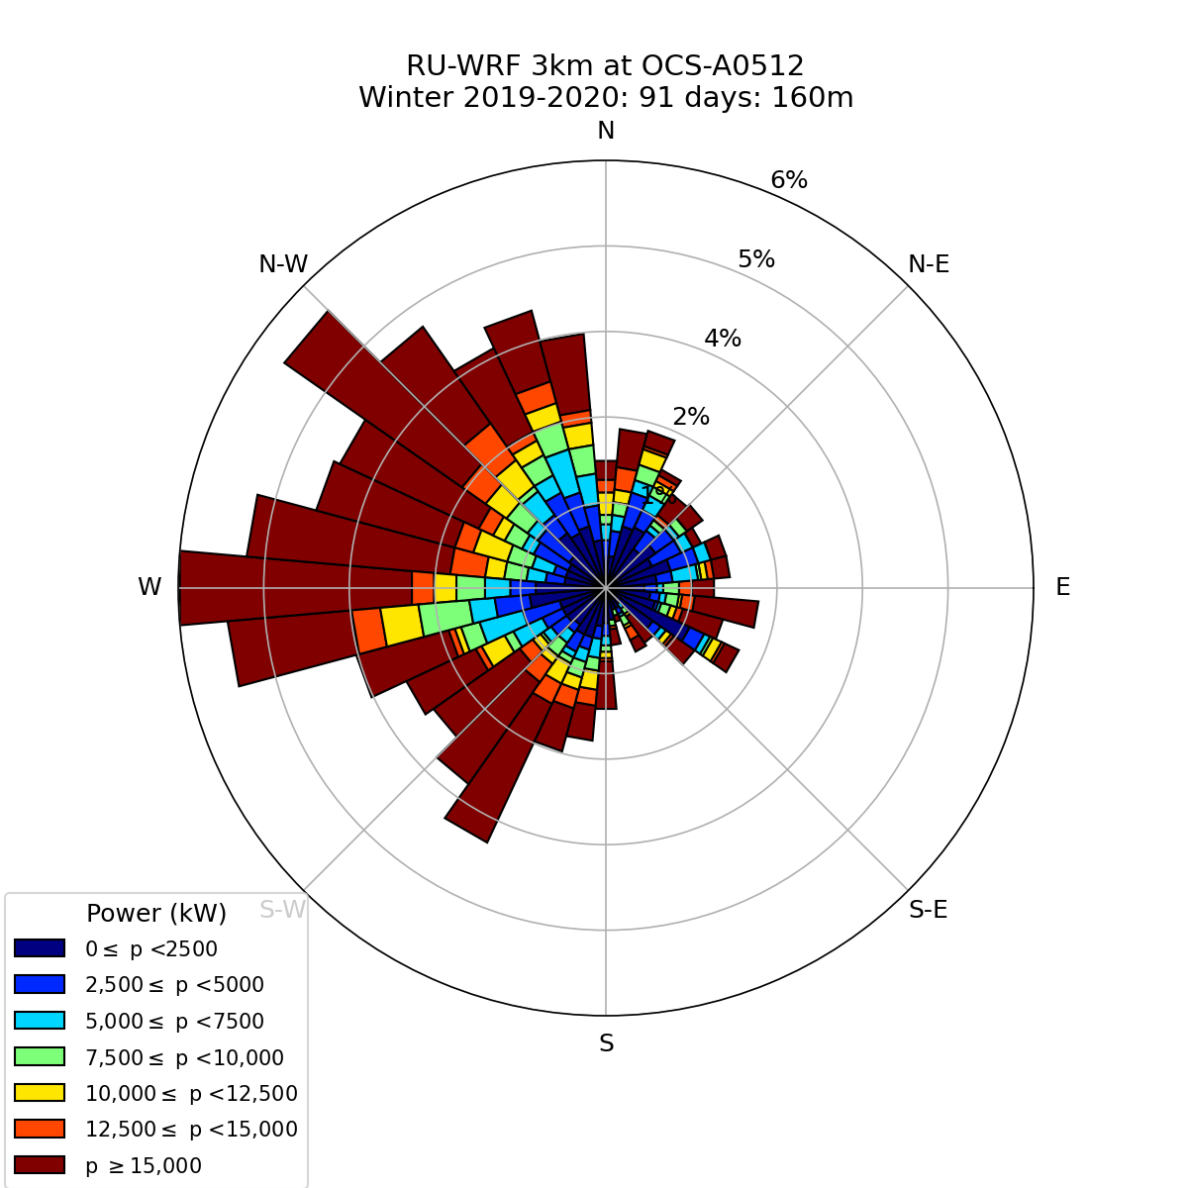
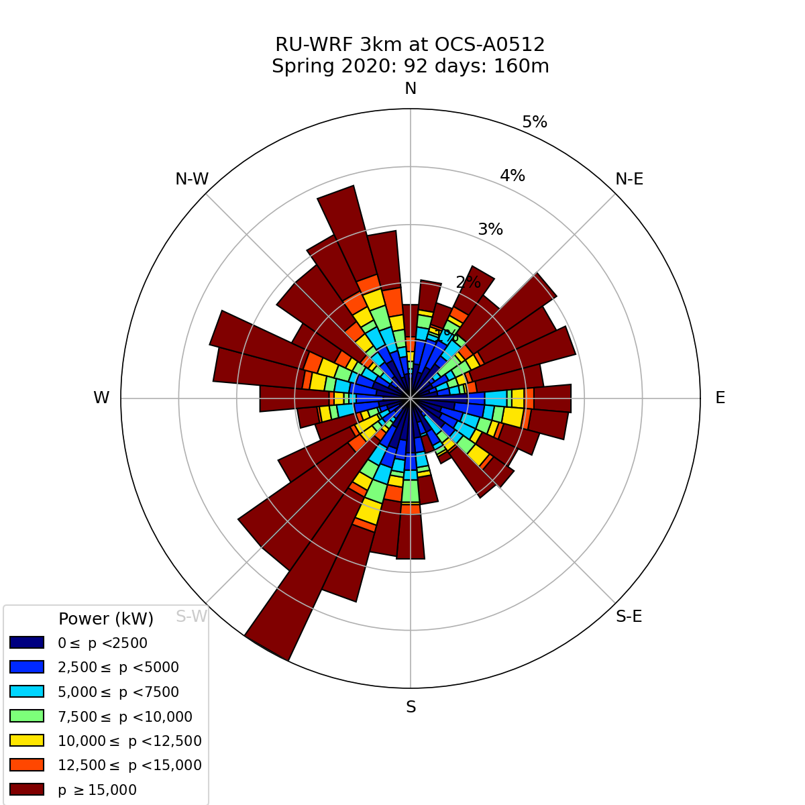
Winter
2020
Spring
Summer
Fall
Wind Speed
Power
Notes:
RUWRF Seasonal Wind and Power Roses at 160 meters
Winter: December of the previous year and January and February of the labeled year.
Spring: March-May
Summer: June-August
Fall: September-November

Slide 6
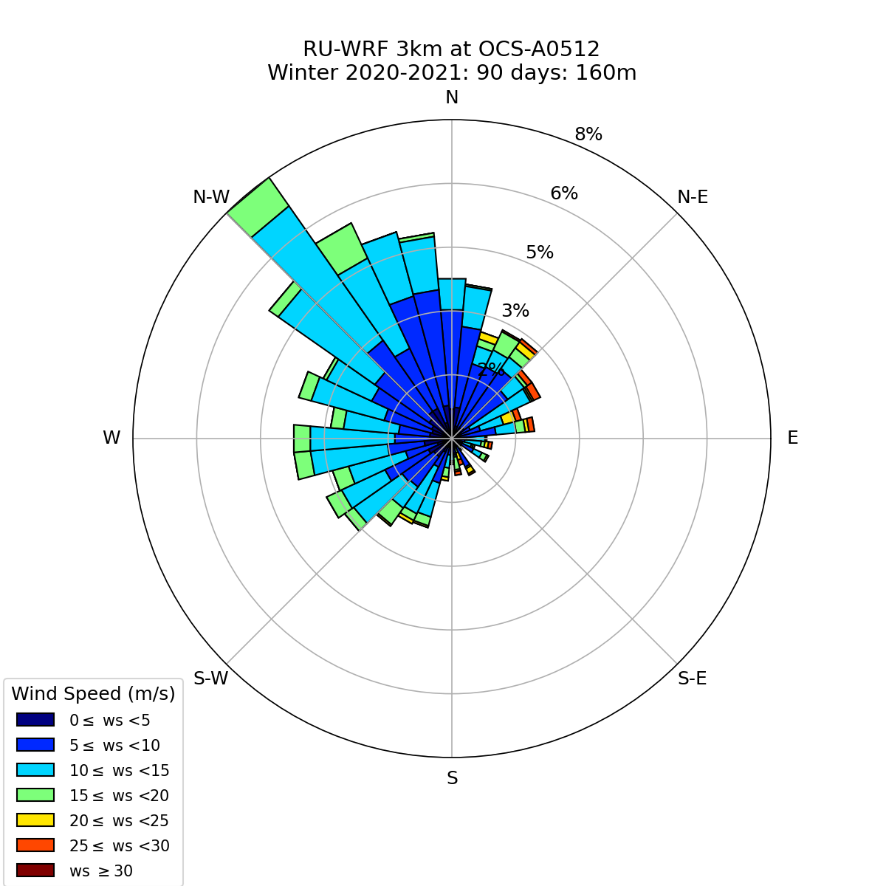
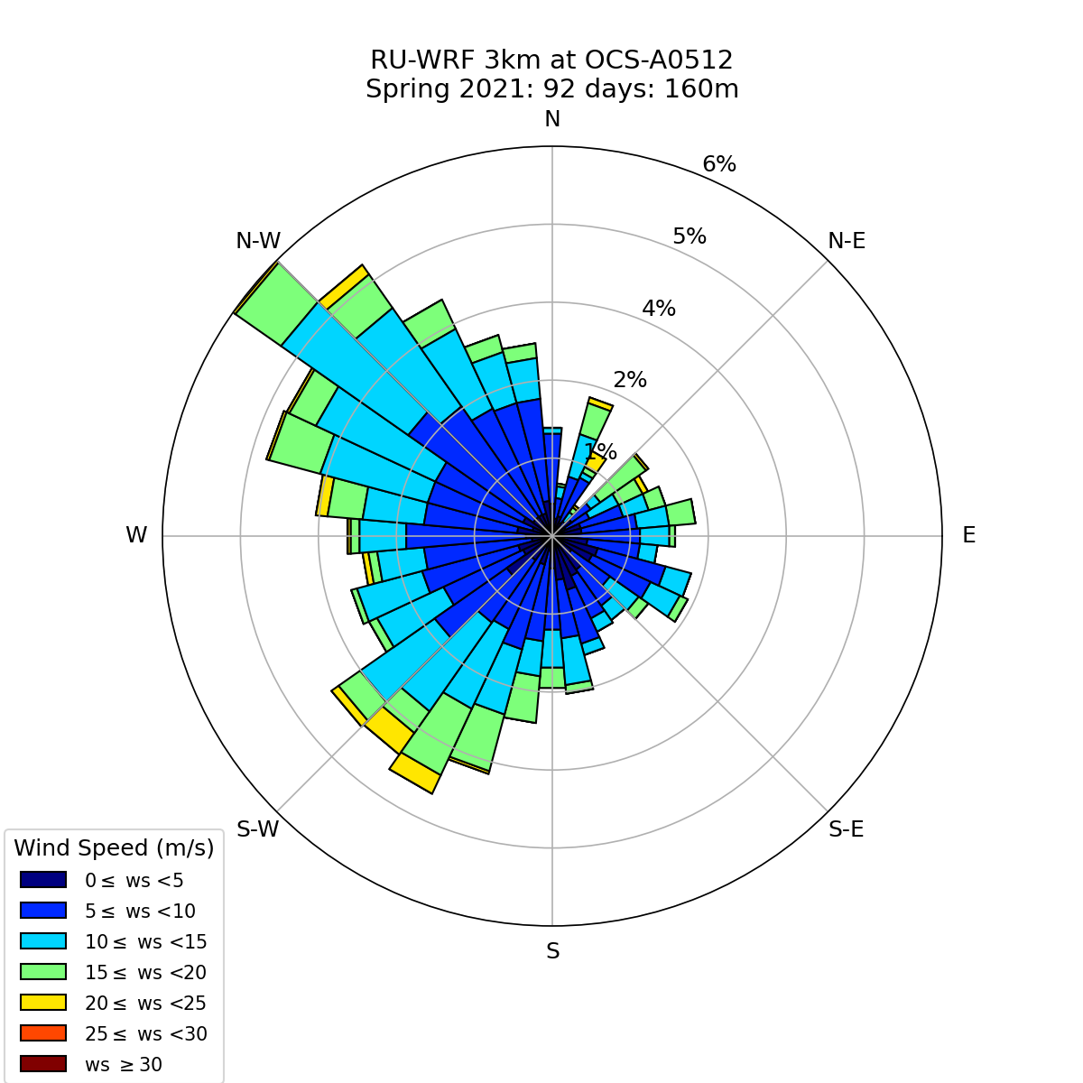
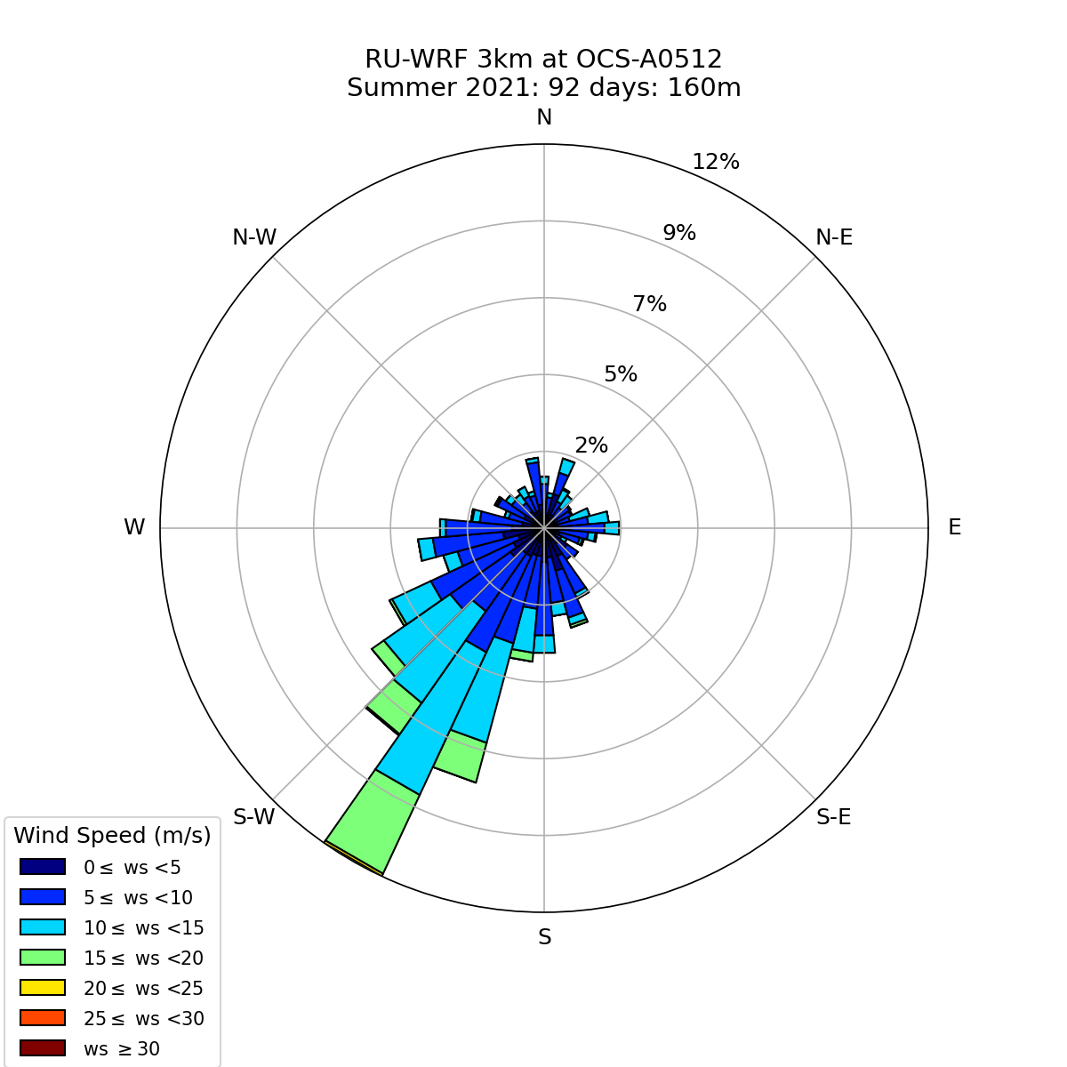
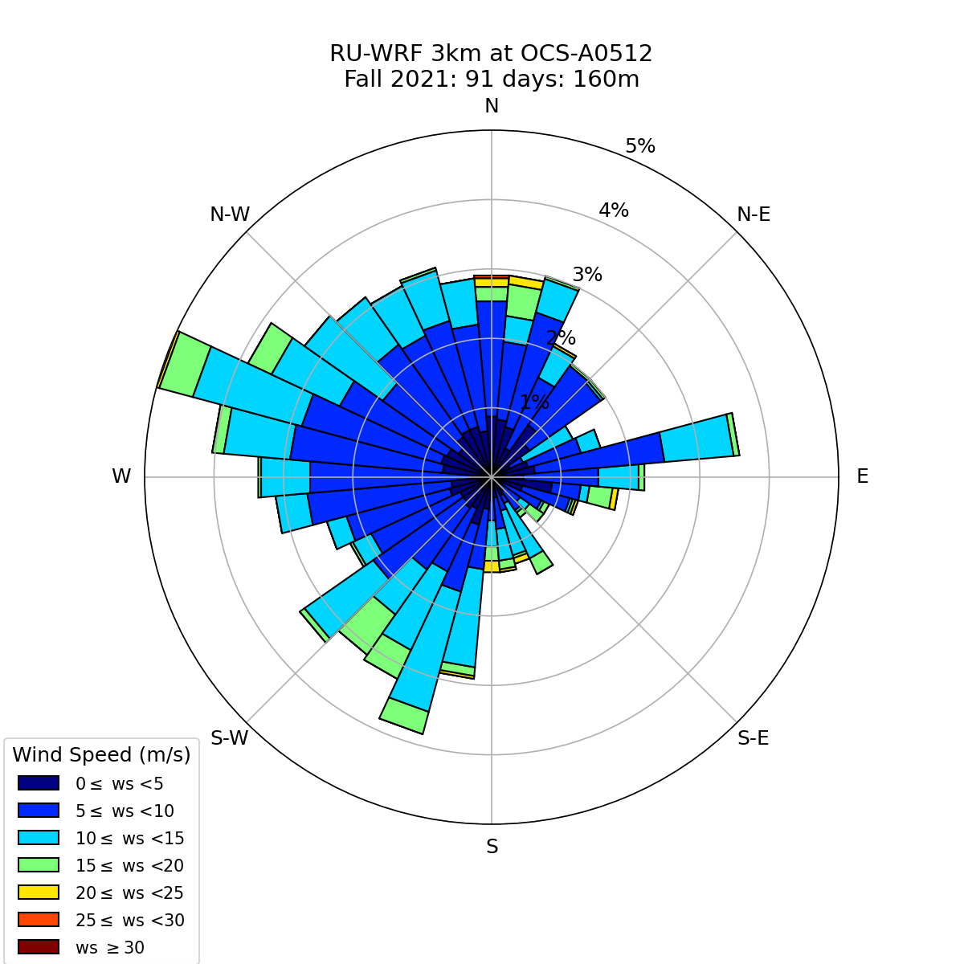
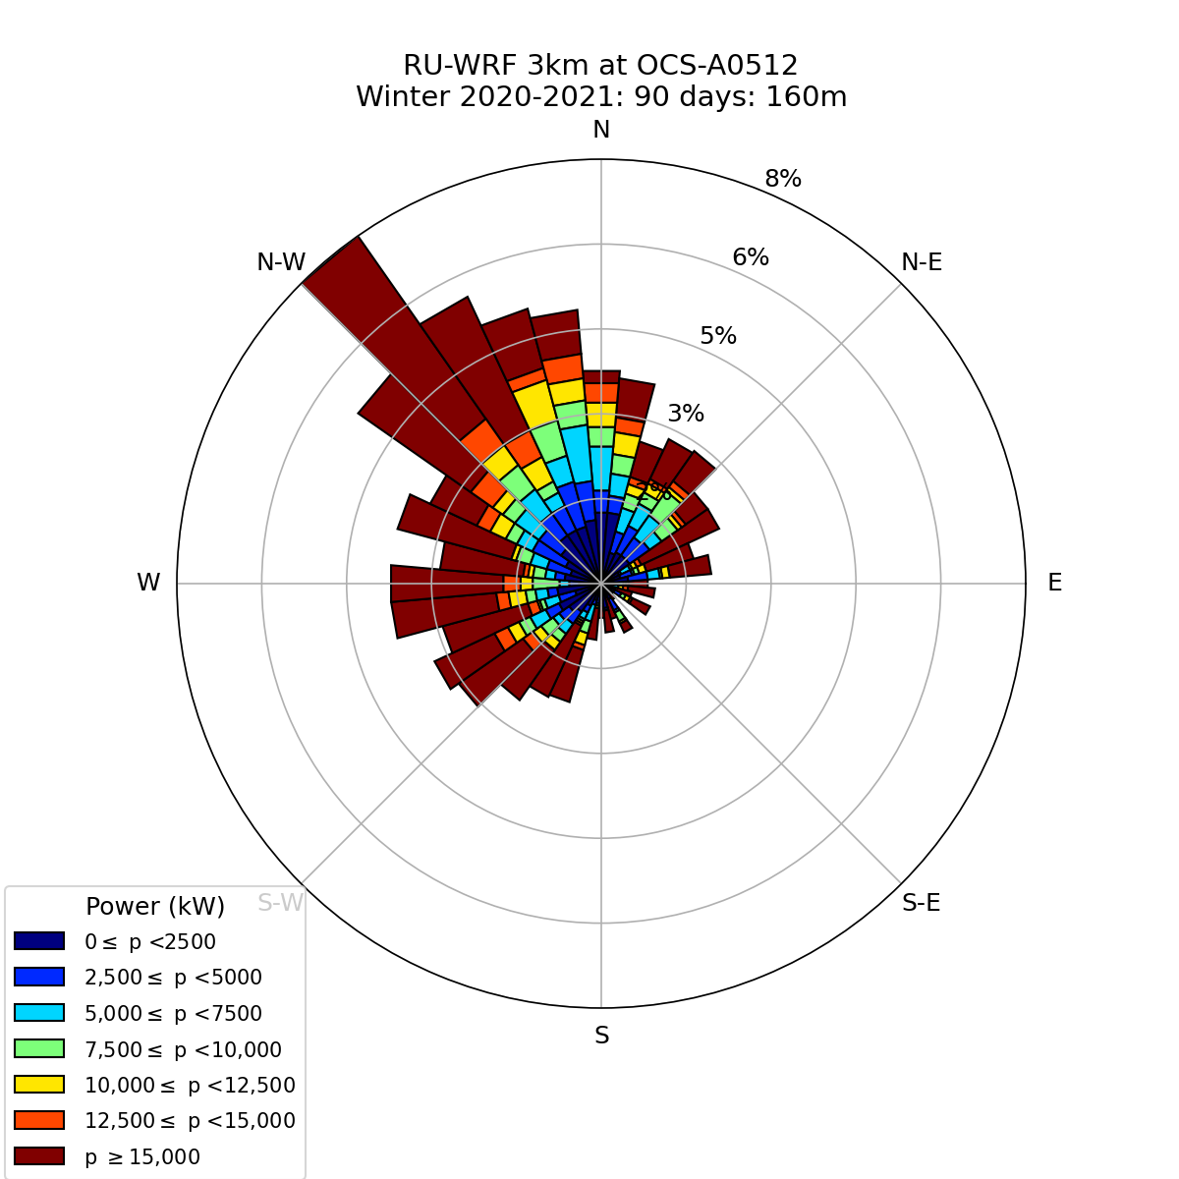
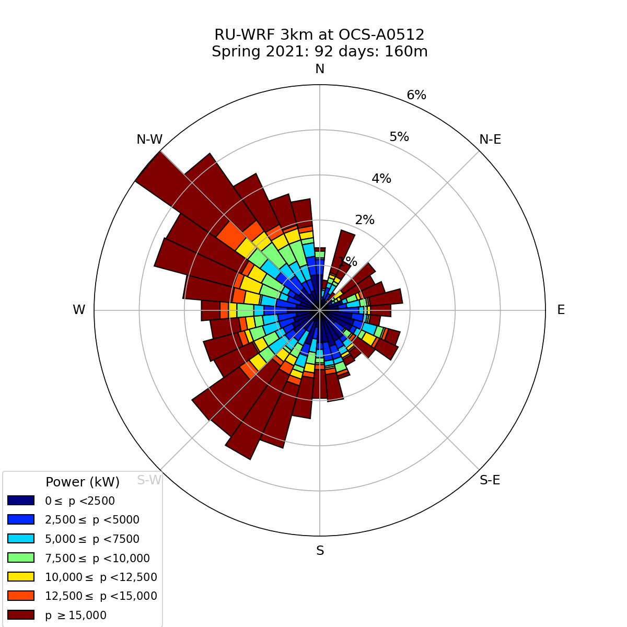
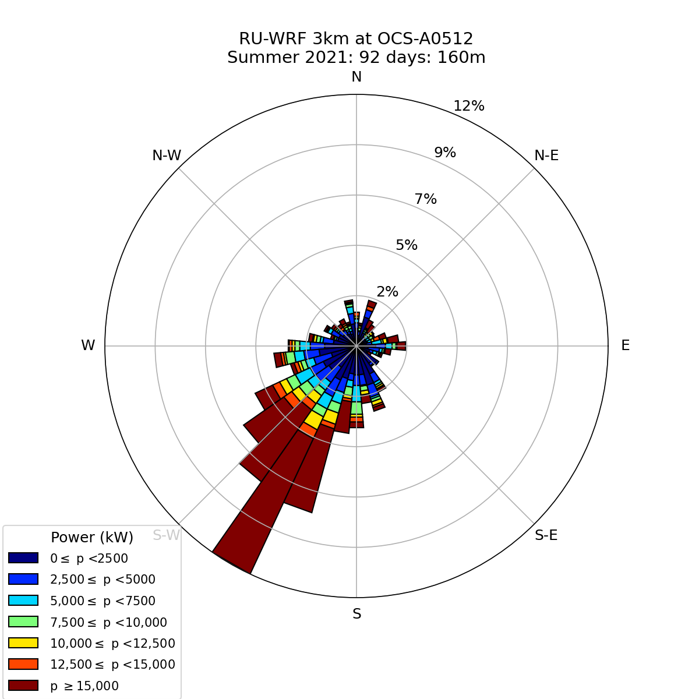
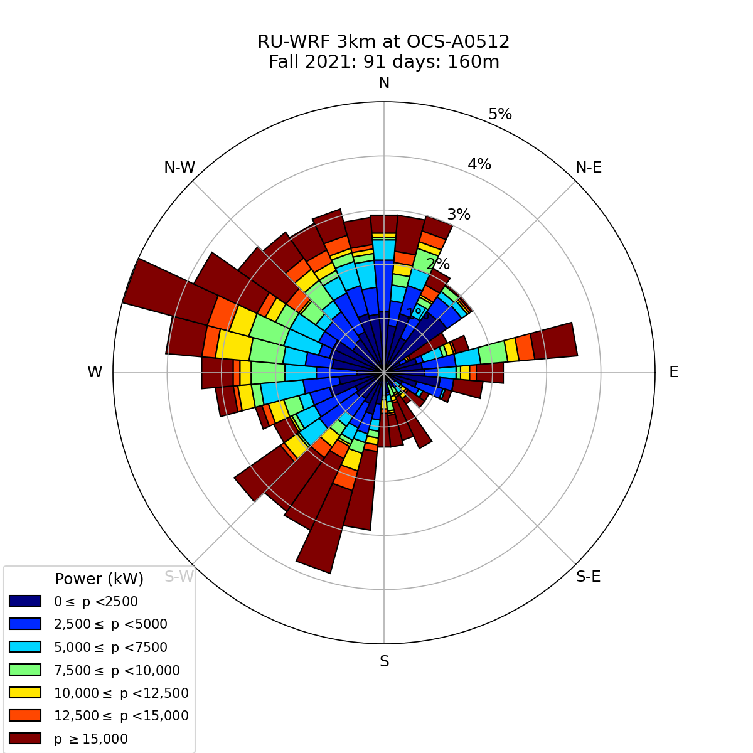
Winter
2021
Spring
Summer
Fall
Wind Speed
Power
Notes:
RUWRF Seasonal Wind and Power Roses at 160 meters
Winter: December of the previous year and January and February of the labeled year.
Spring: March-May
Summer: June-August
Fall: September-November

Slide 7
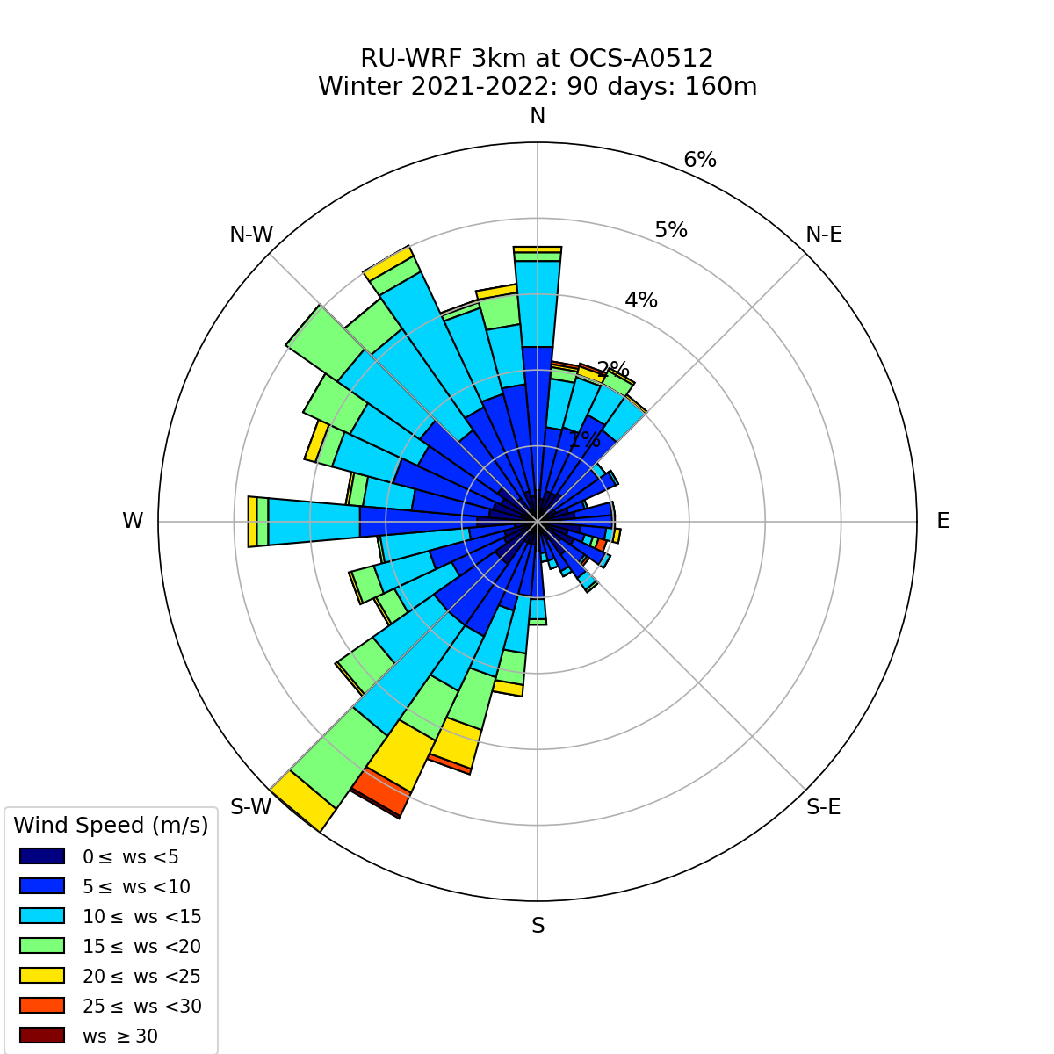
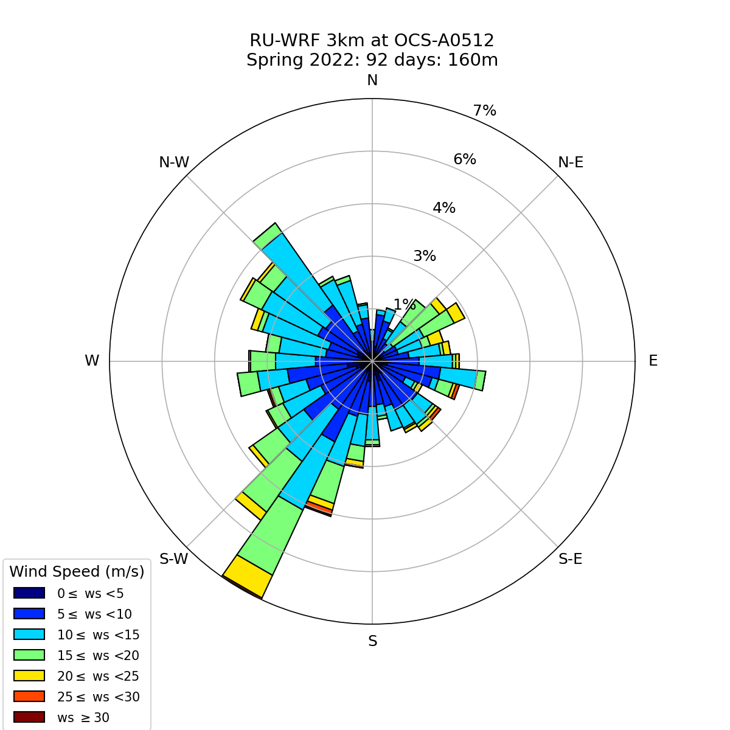
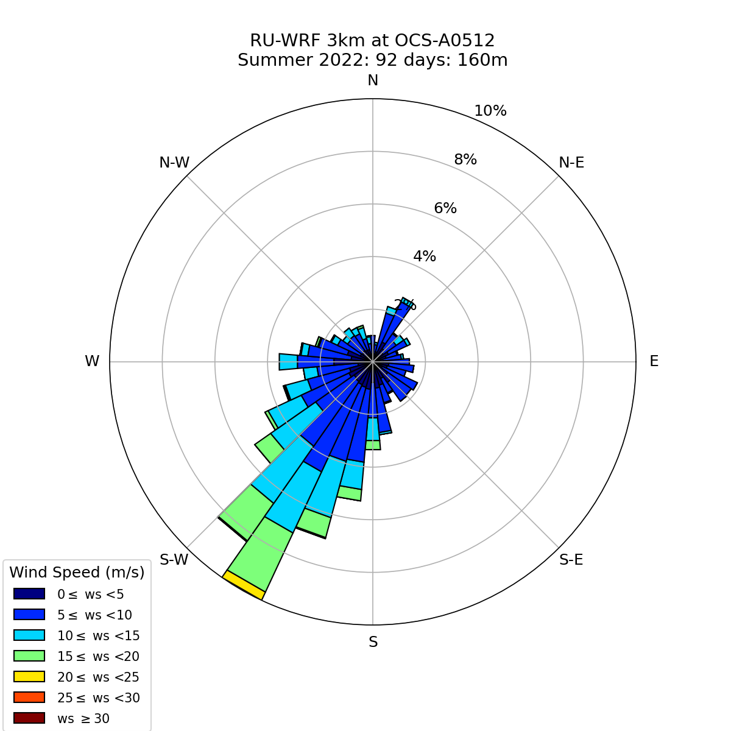
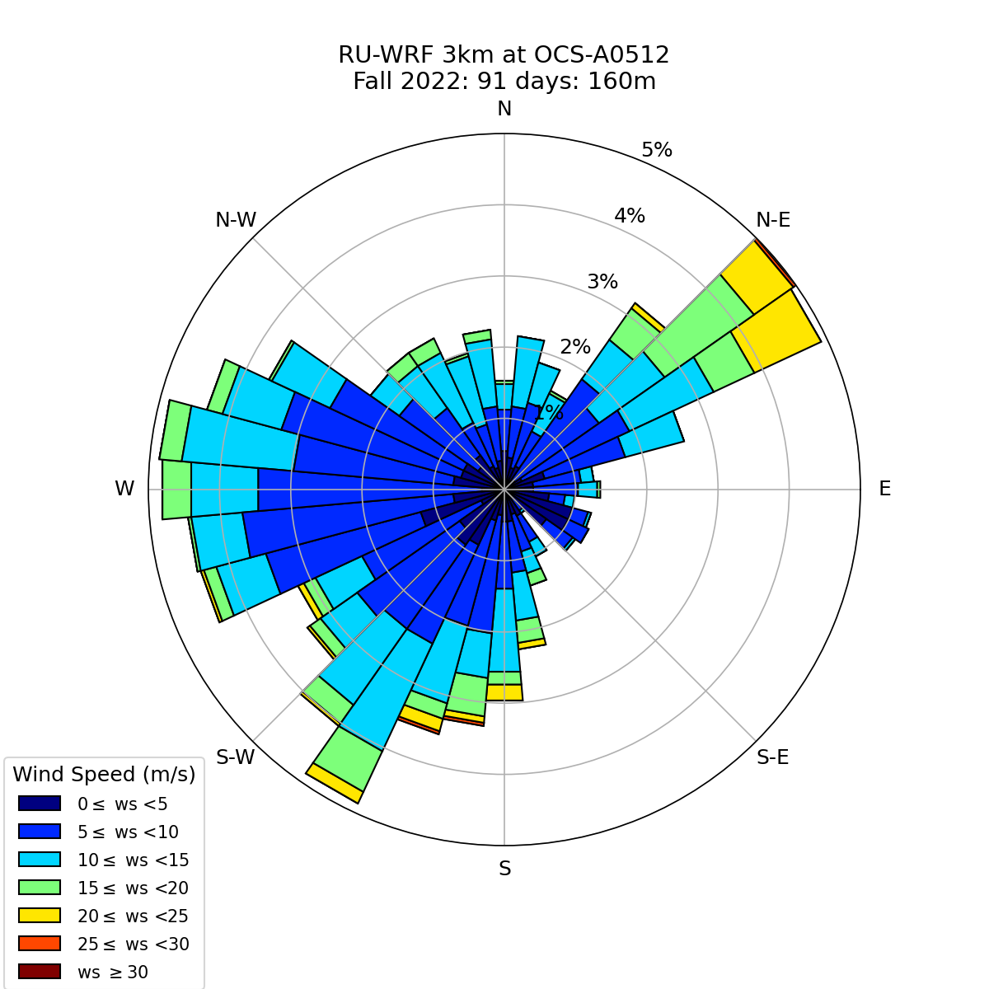
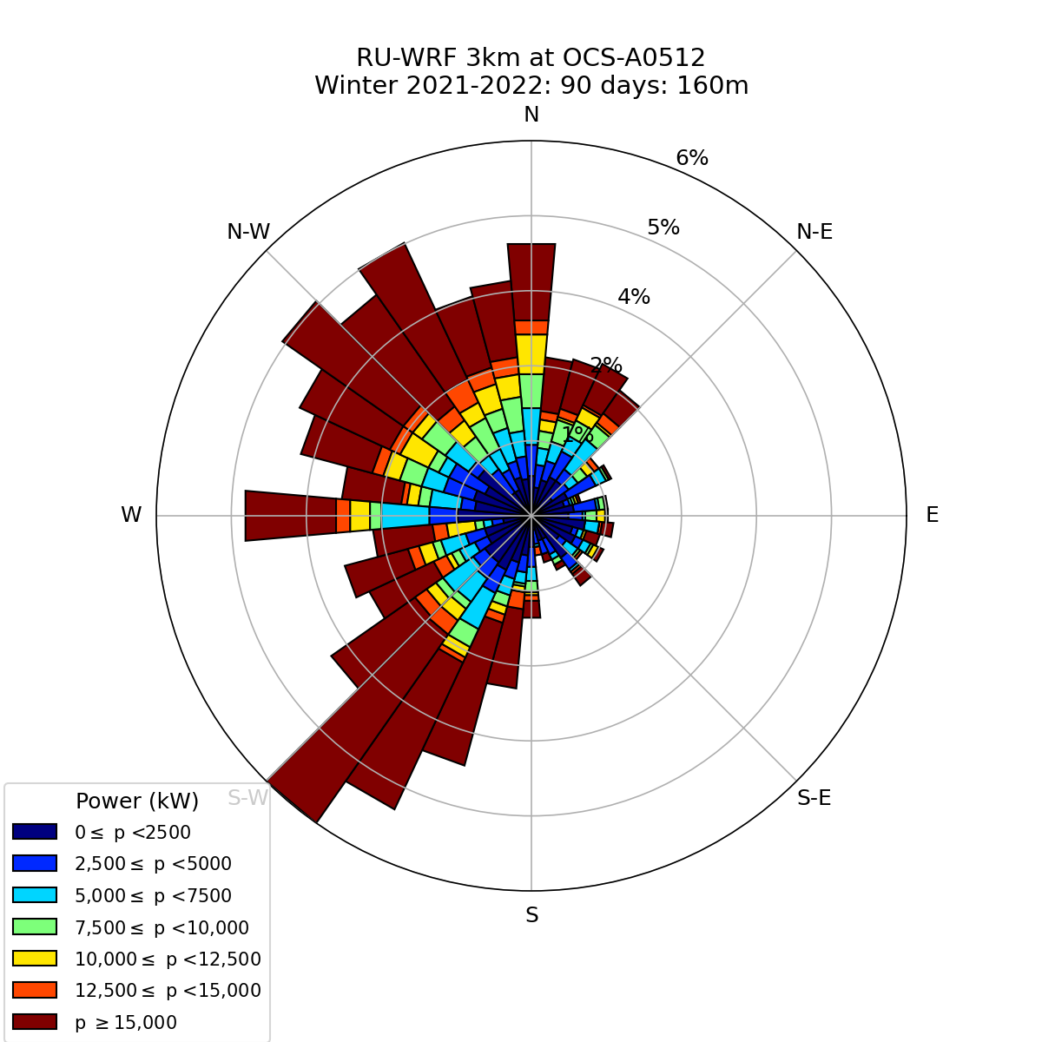
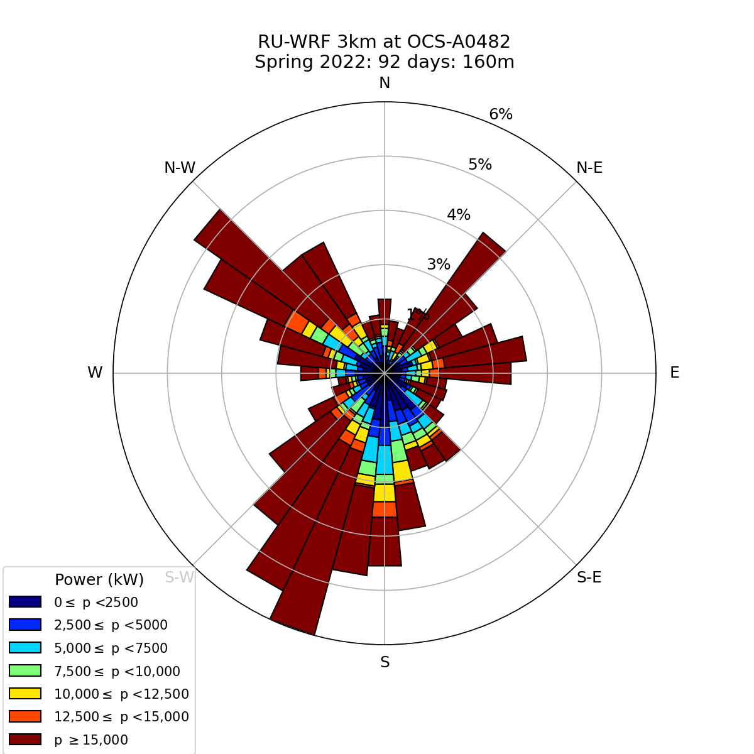
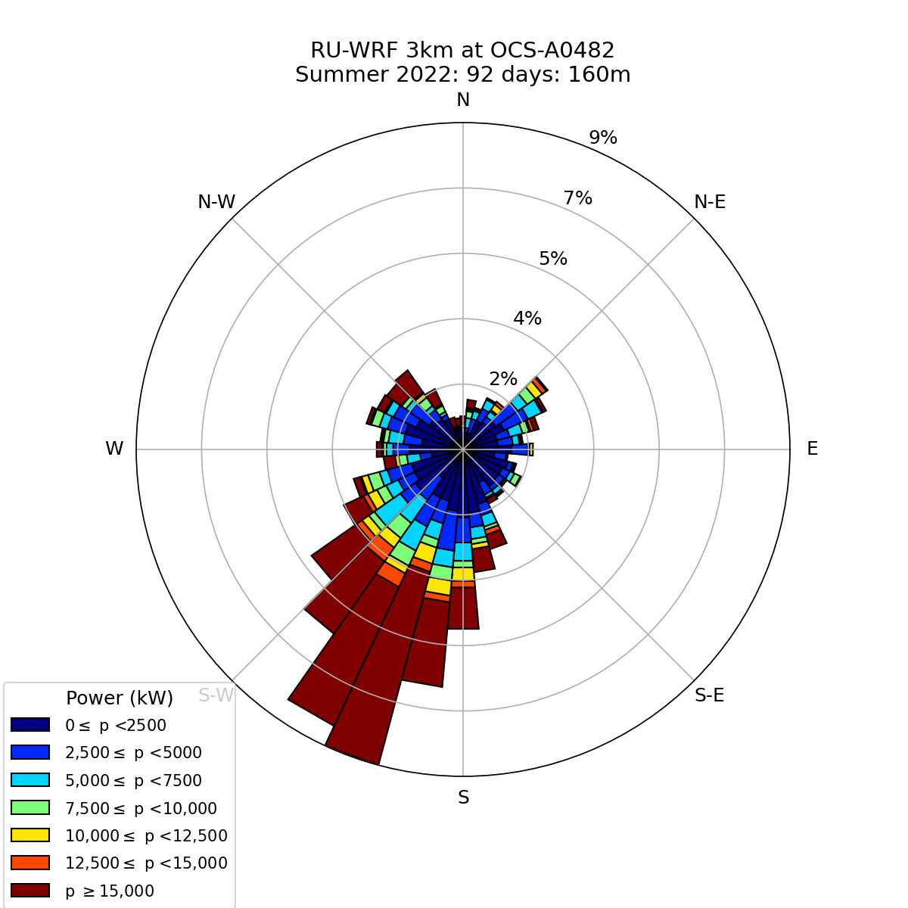
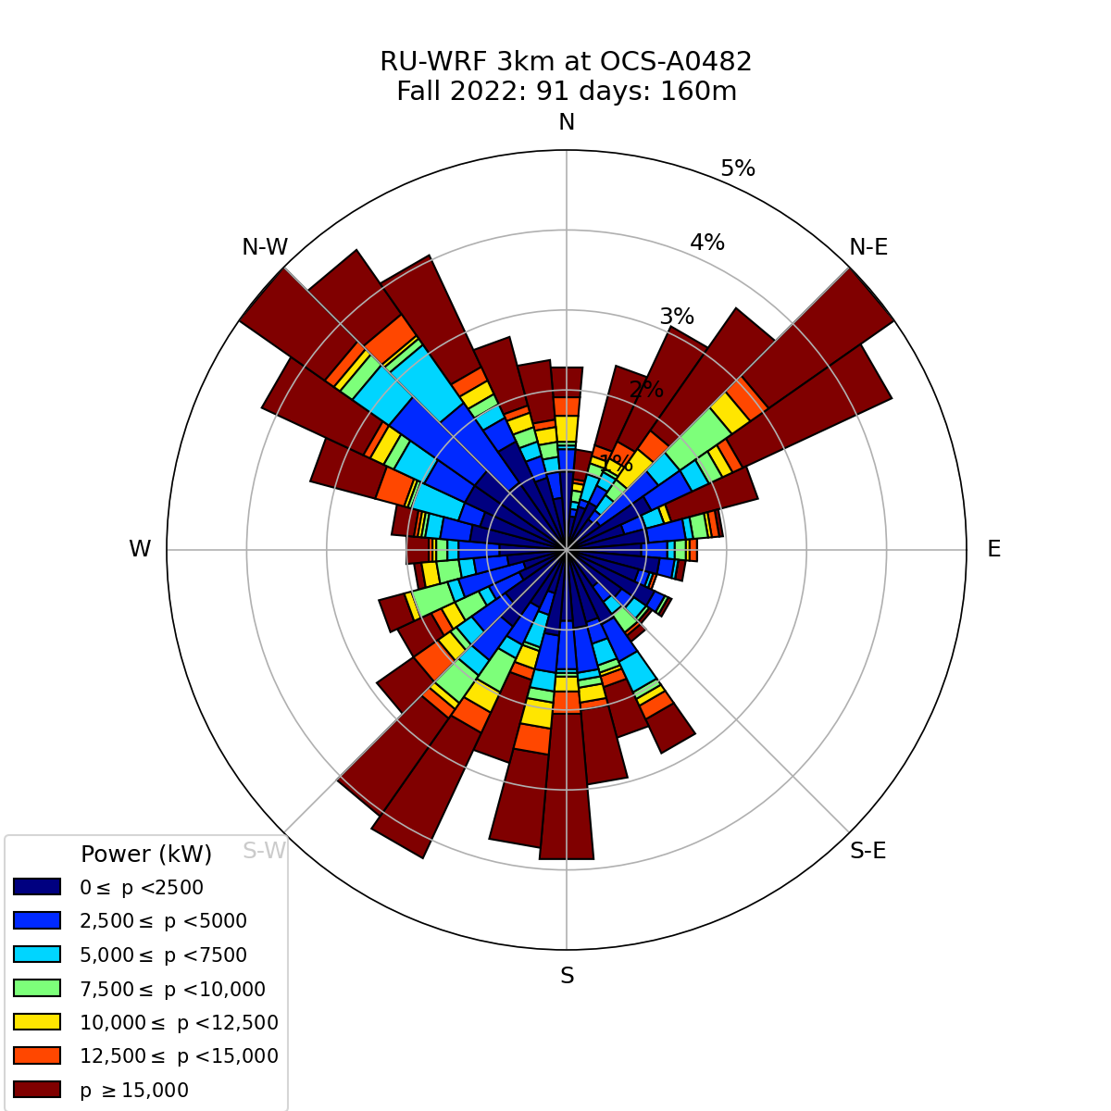
Winter
2022
Spring
Summer
Fall
Wind Speed
Power
Notes:
RUWRF Seasonal Wind and Power Roses at 160 meters
Winter: December of the previous year and January and February of the labeled year.
Spring: March-May
Summer: June-August
Fall: September-November

Slide 8
Four-year Monthly Aggregated
Wind (top row) & Power (bottom row)
Roses at Hub-height (160m)

Slide 9
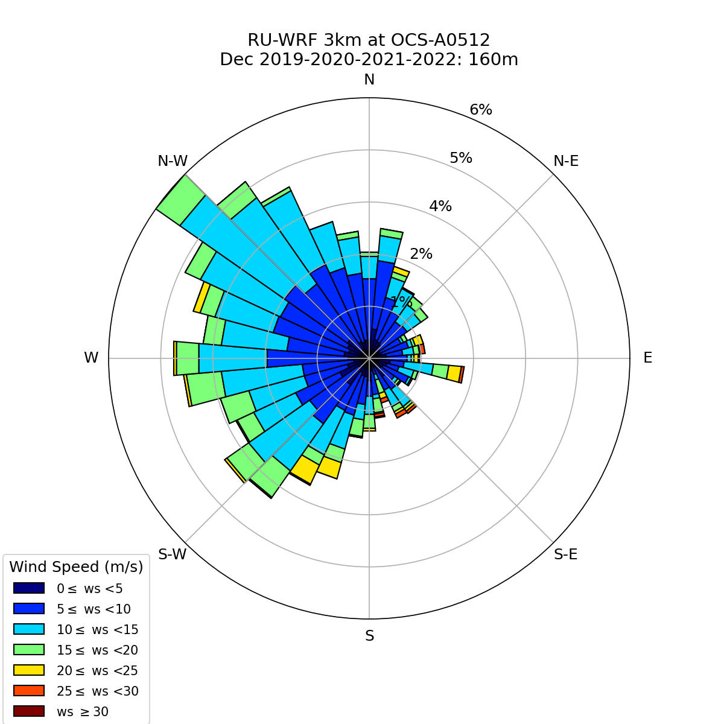
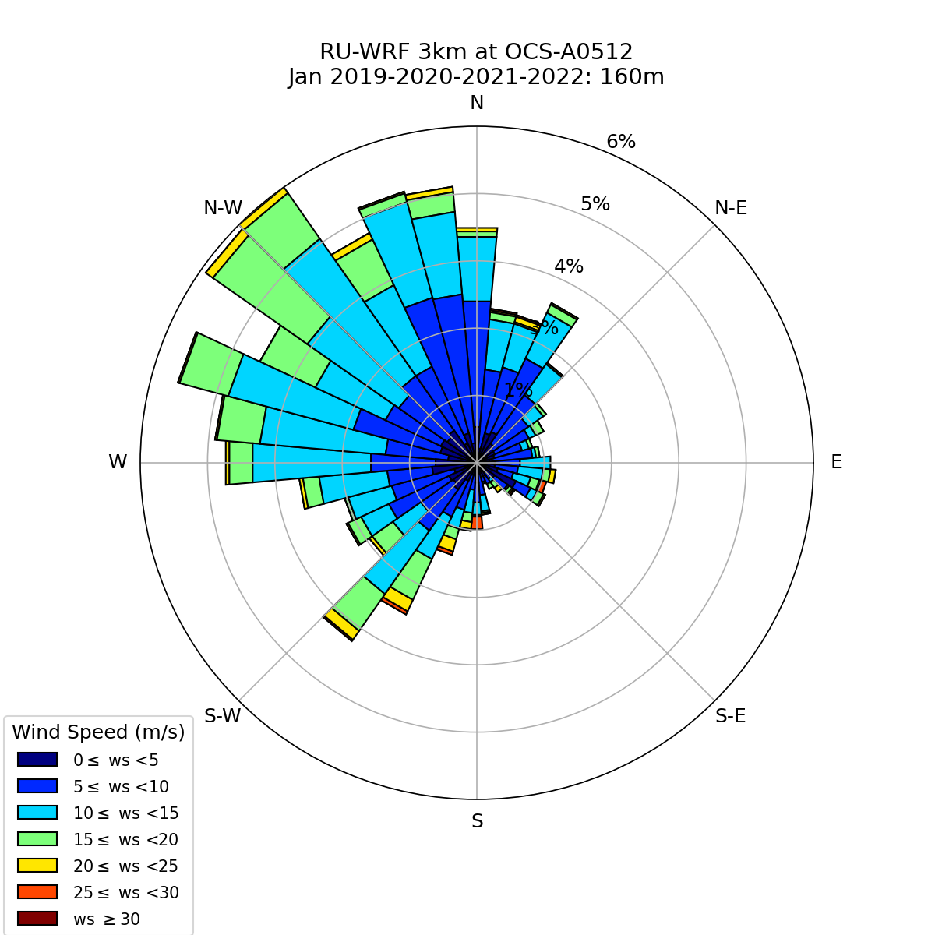
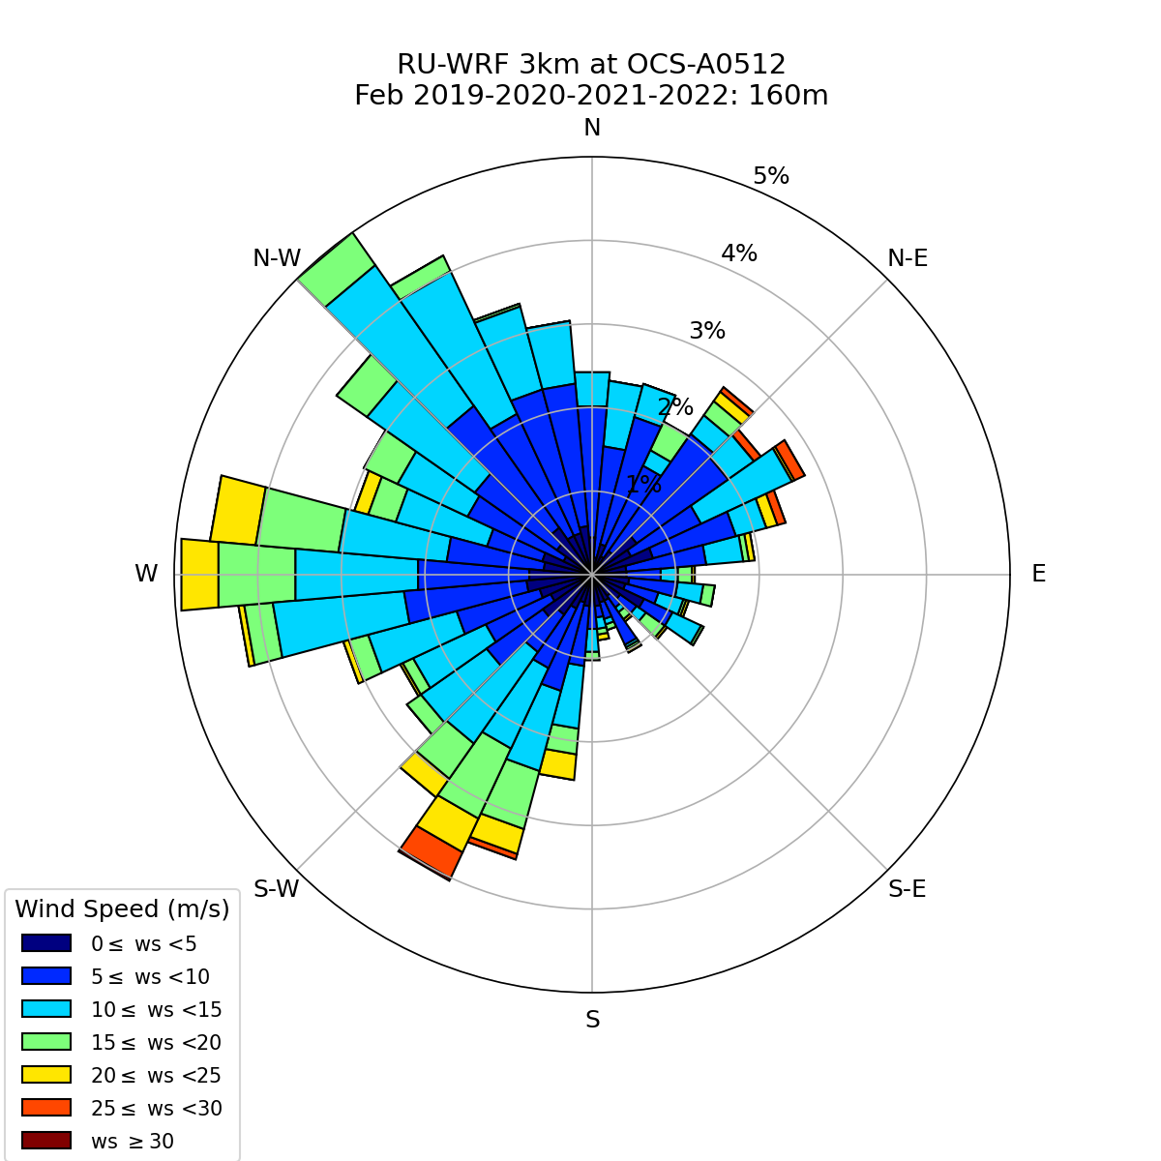
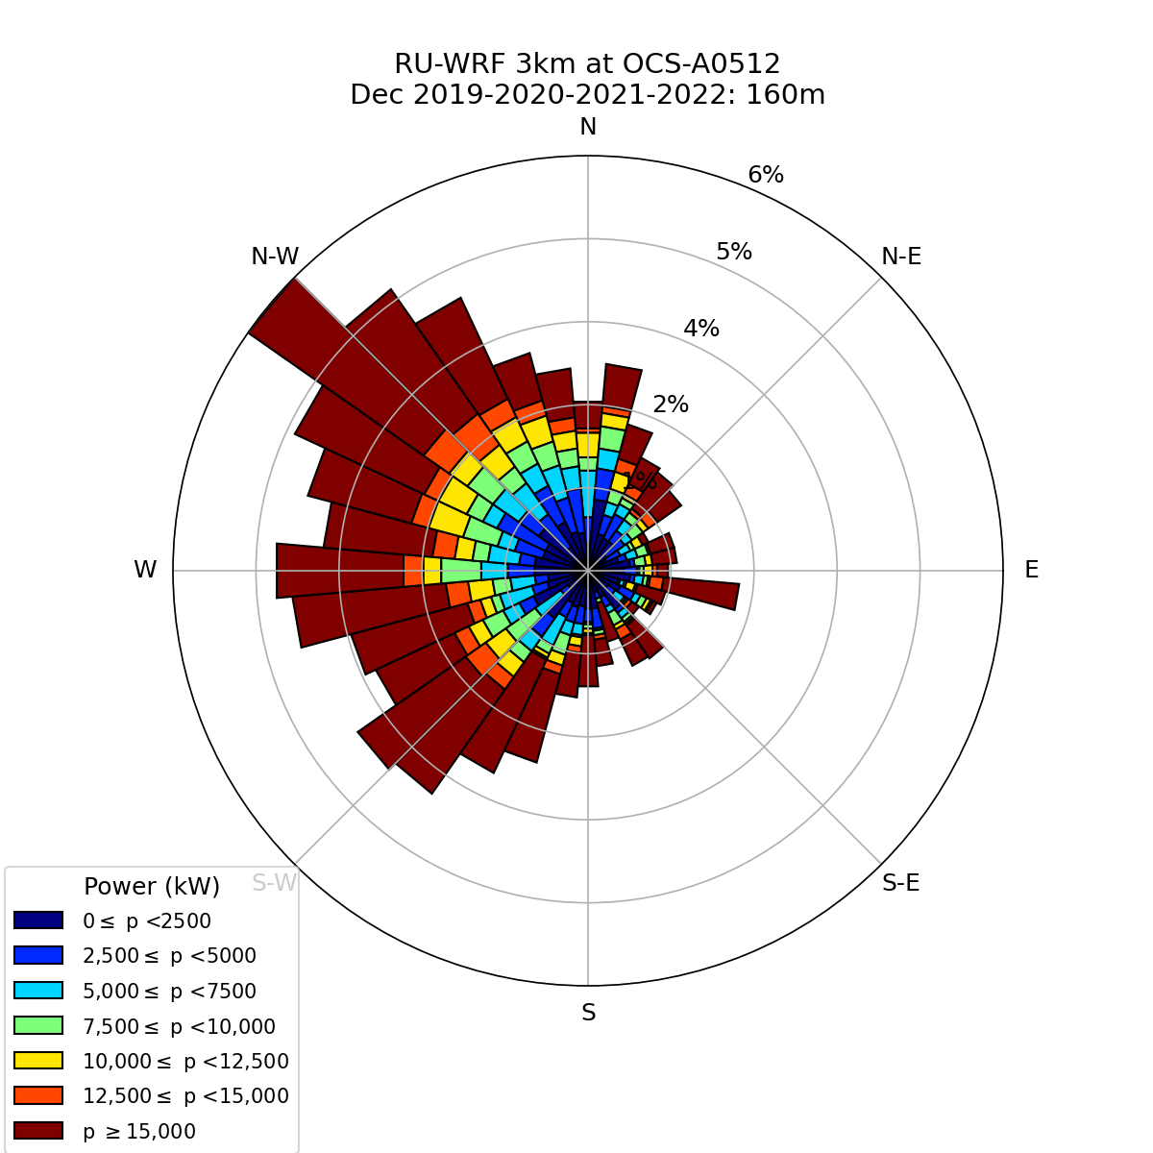
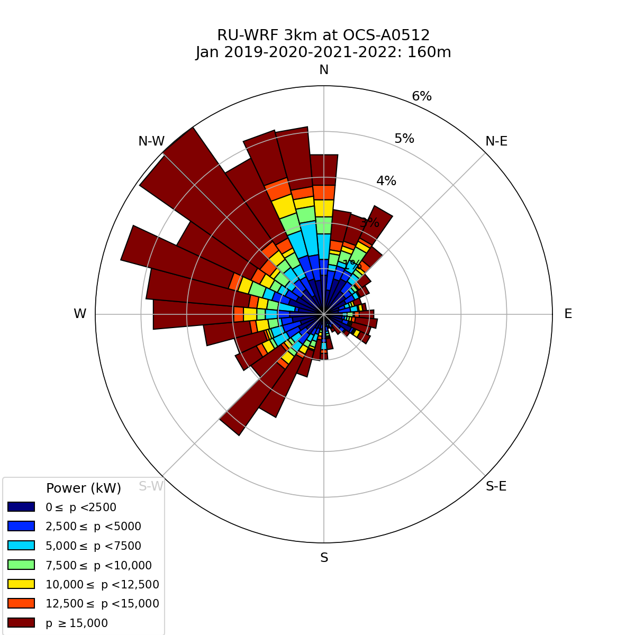
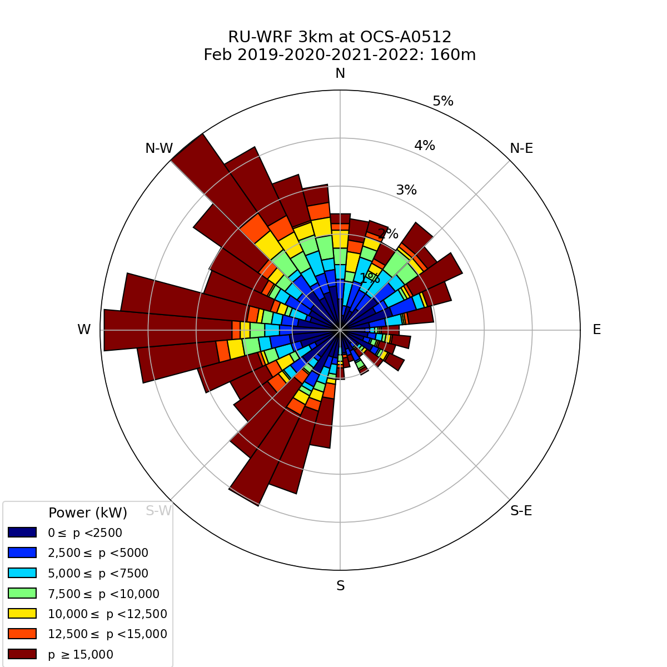
Winter
December
January
February
Wind Speed
Power
Notes:
Four-year (2019-2022) Monthly Aggregated Wind and Power Roses at Hub-height (160m)

Slide 10
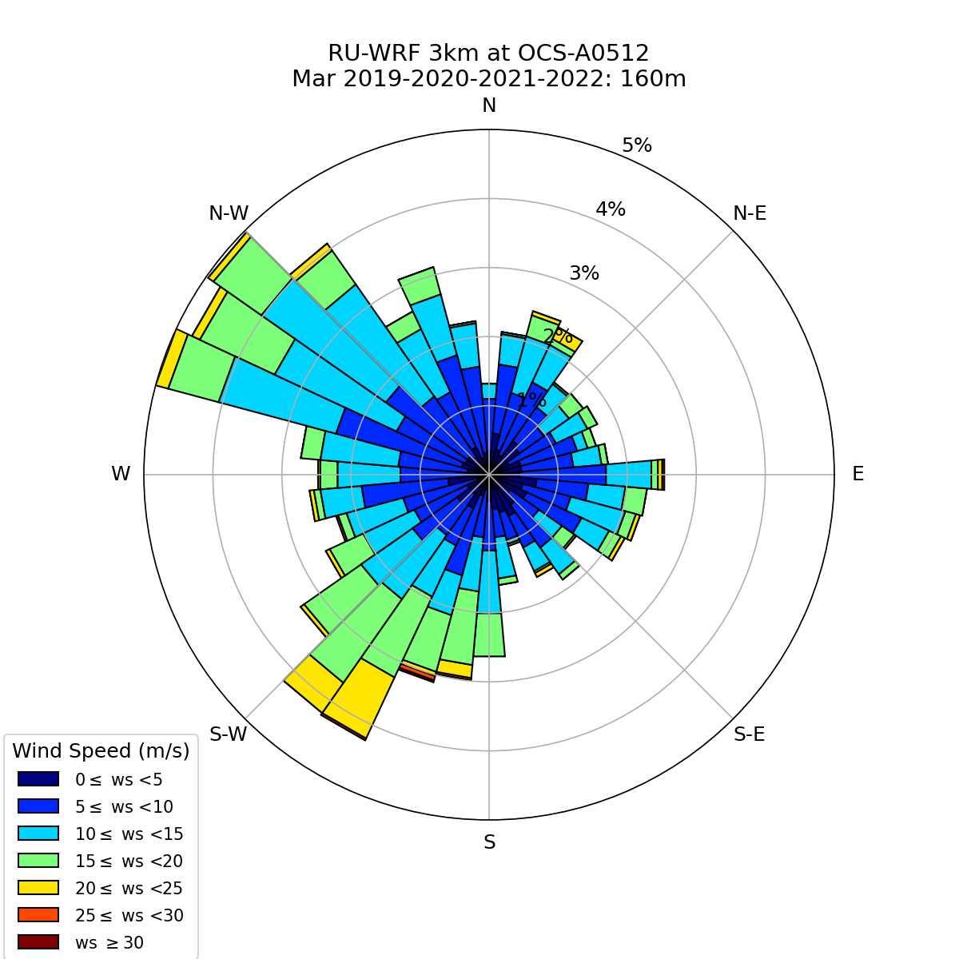
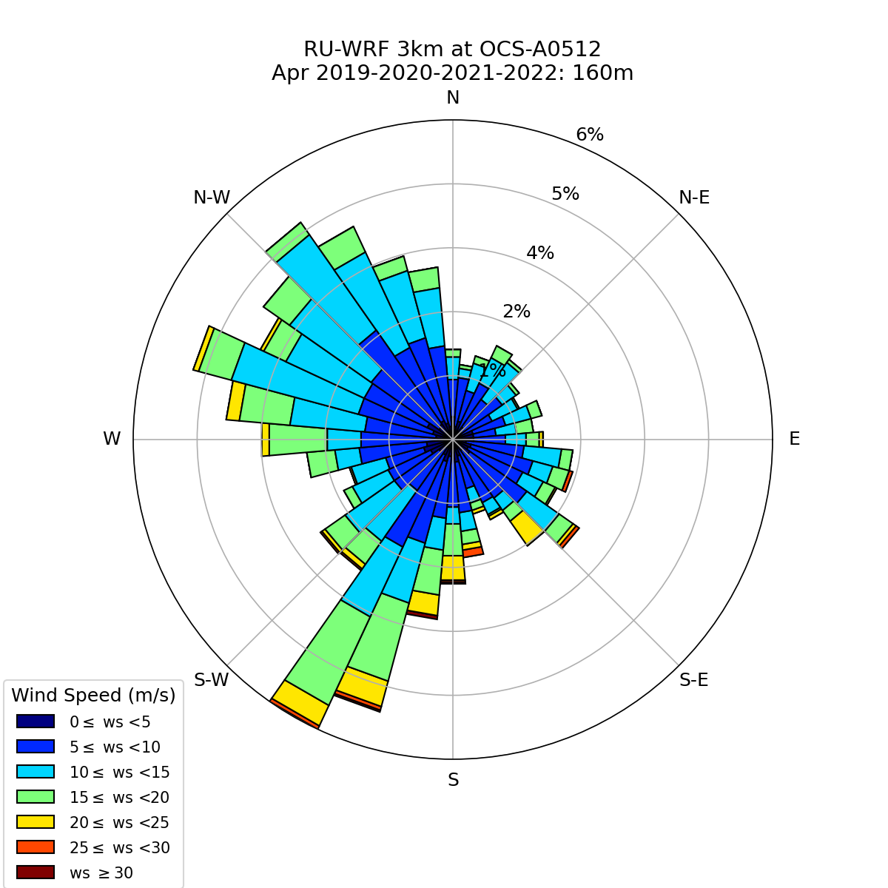
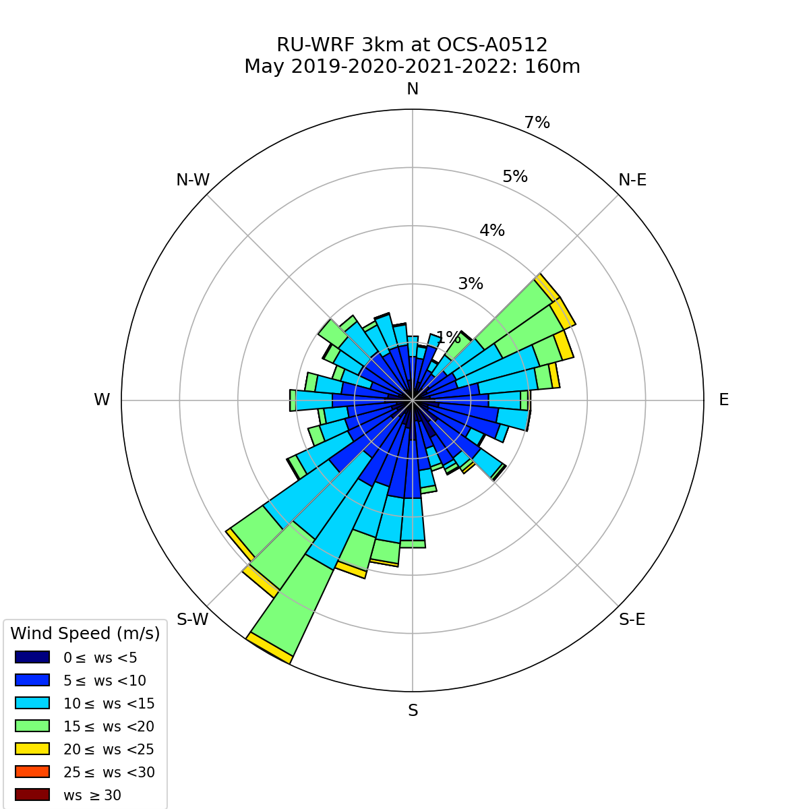
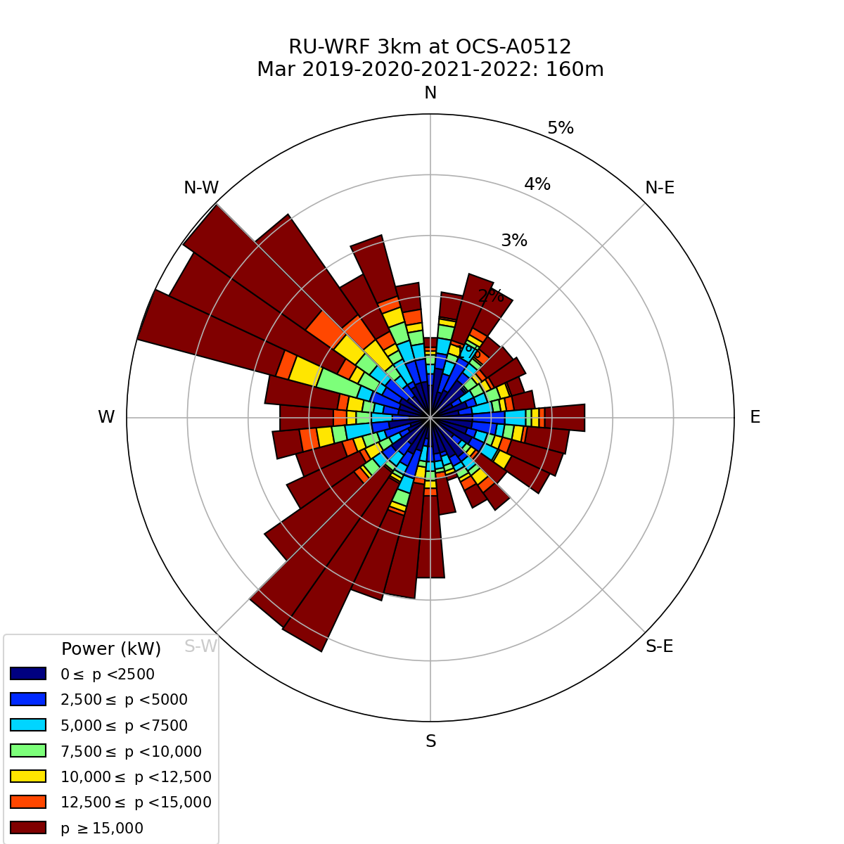
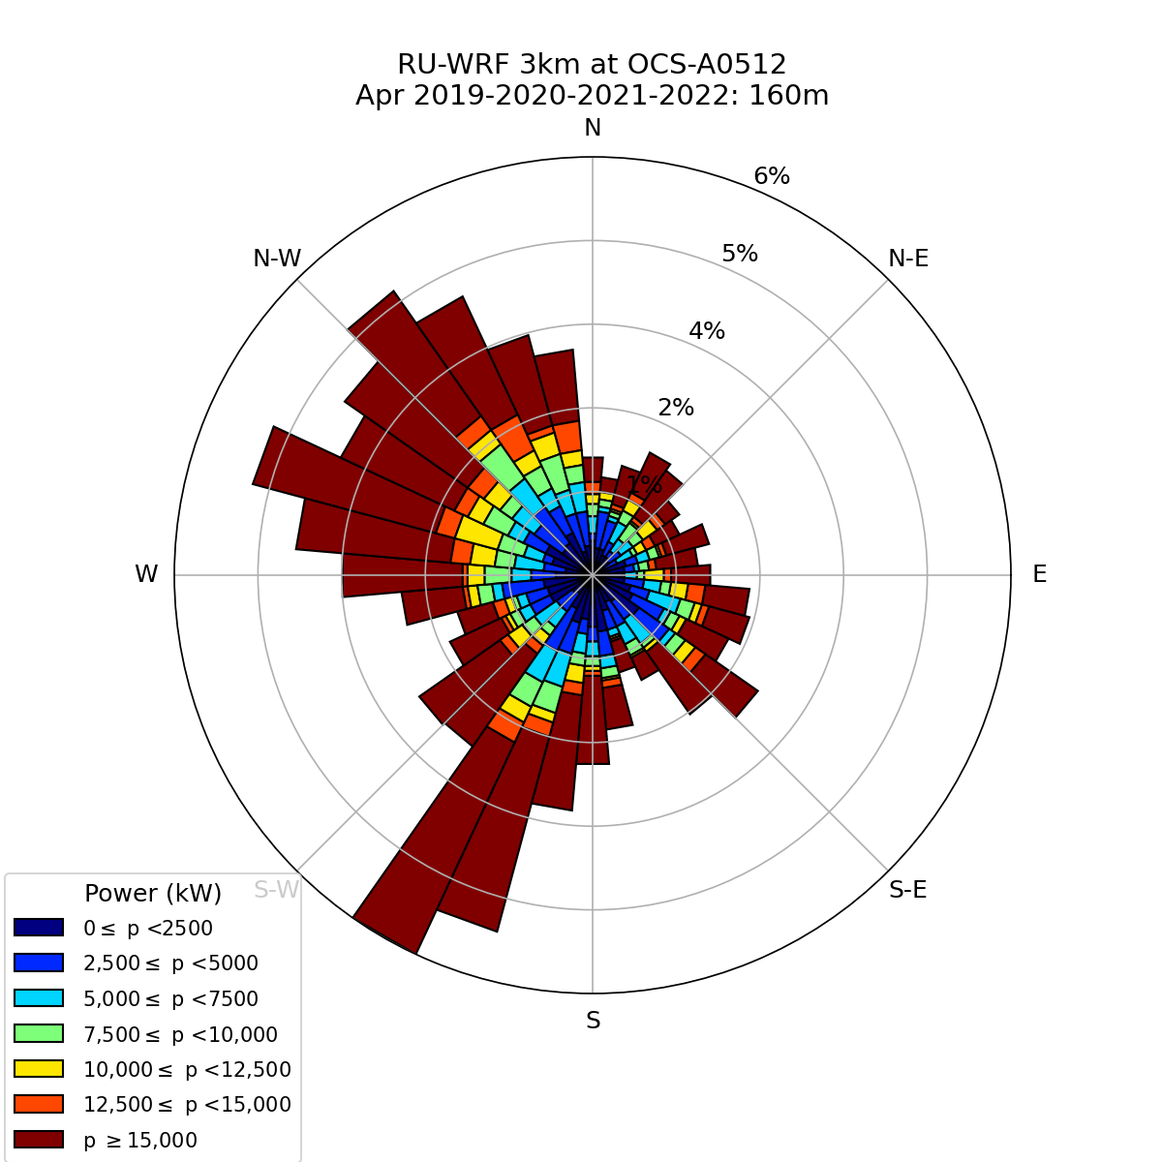
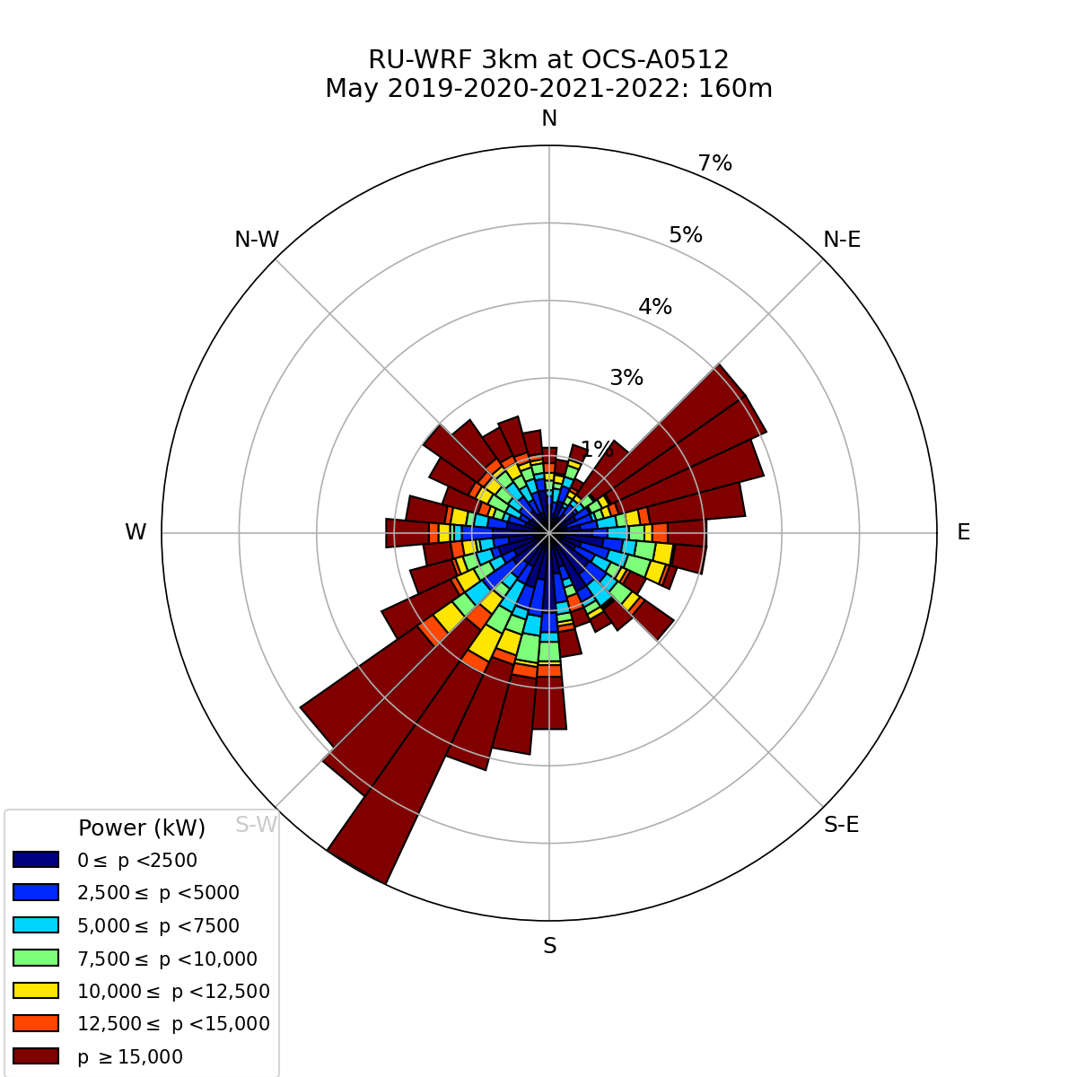
Spring
March
April
May
Wind Speed
Power
Notes:
Four-year (2019-2022) Monthly Aggregated Wind and Power Roses at Hub-height (160m)

Slide 11


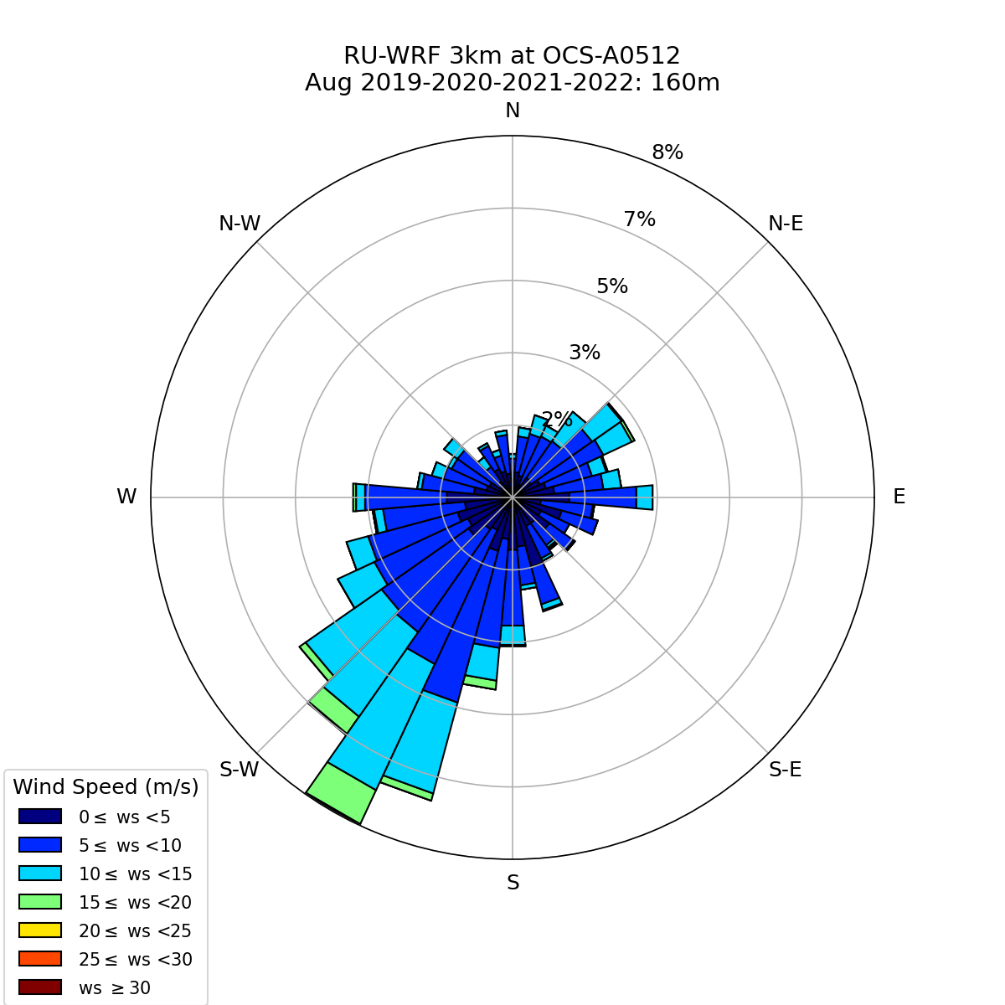
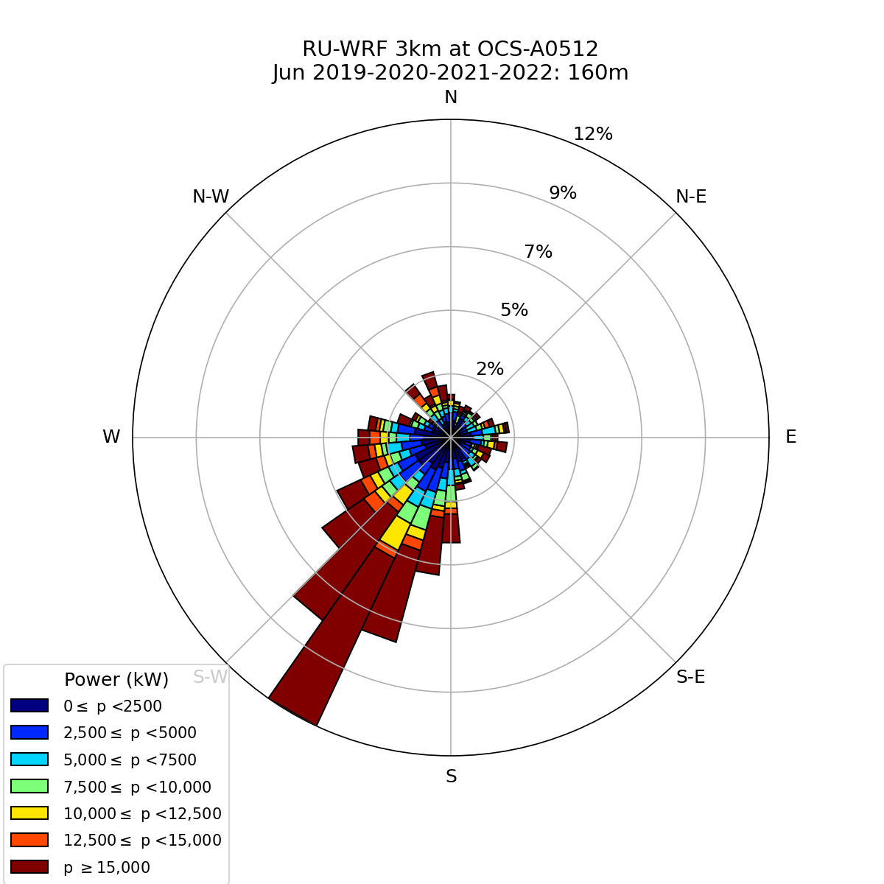
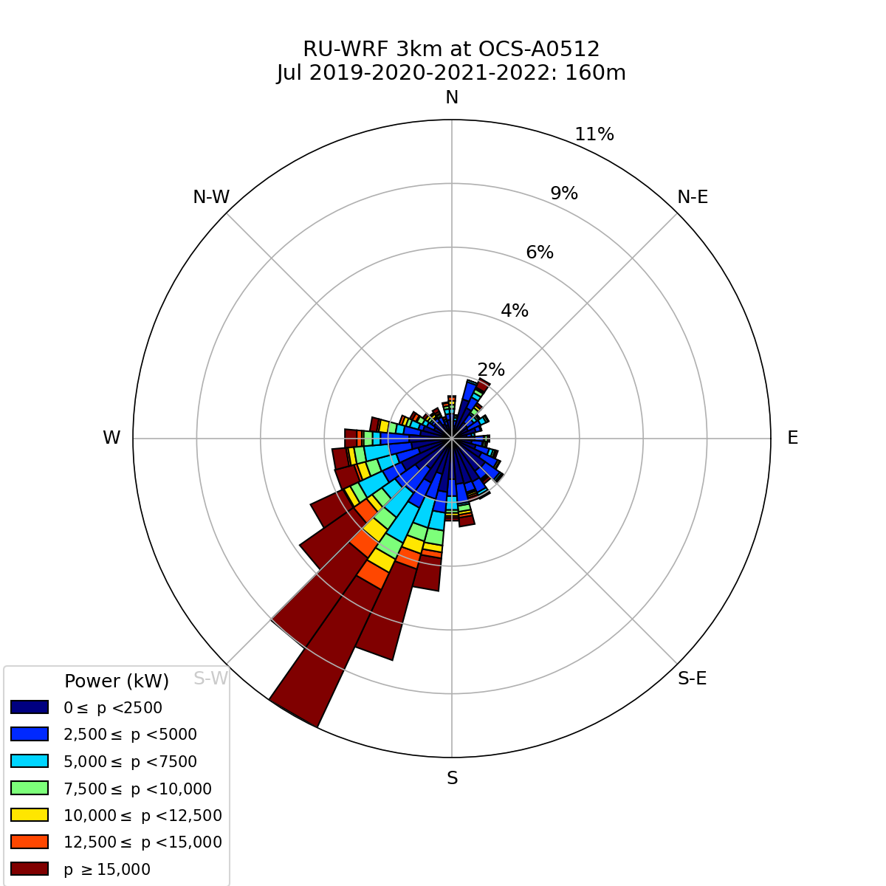
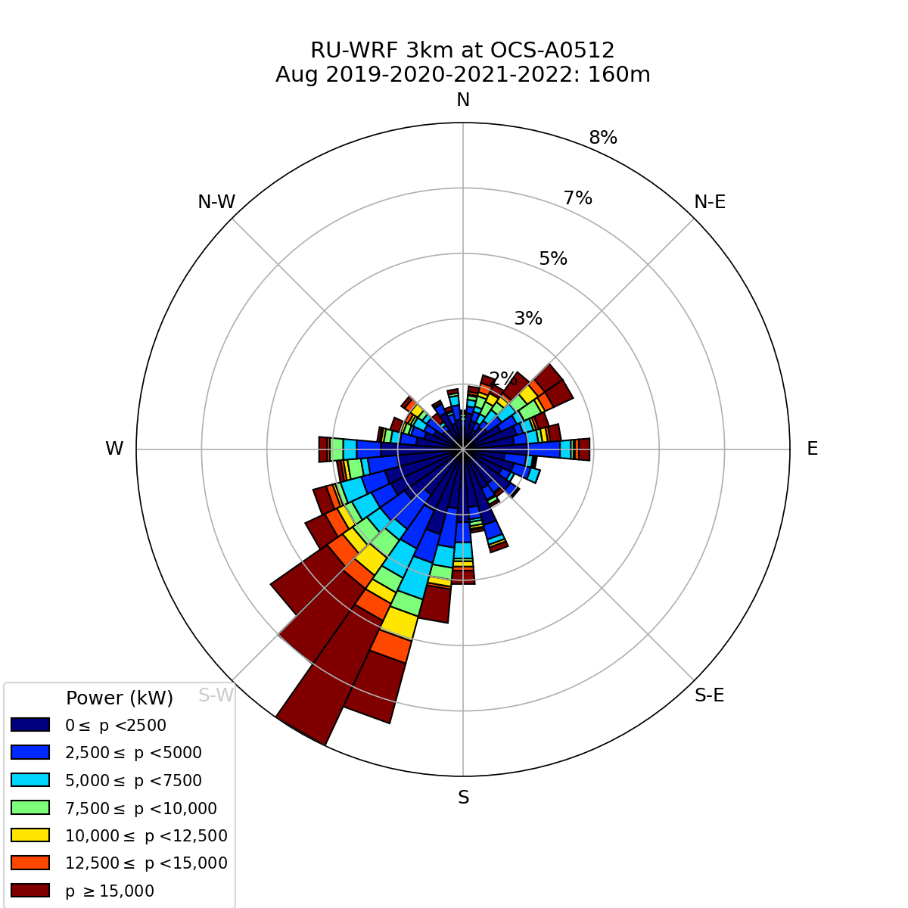
Summer
June
July
August
Wind Speed
Power
Notes:
Four-year (2019-2022) Monthly Aggregated Wind and Power Roses at Hub-height (160m)

Slide 12
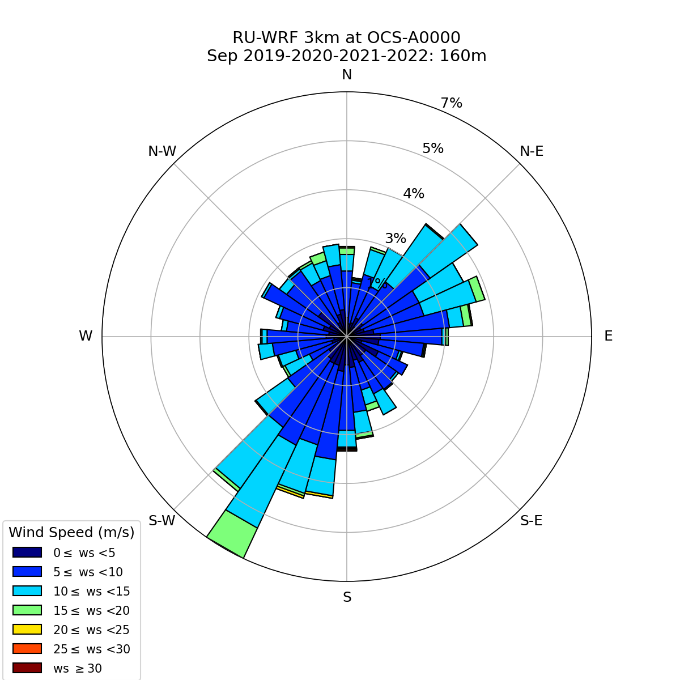
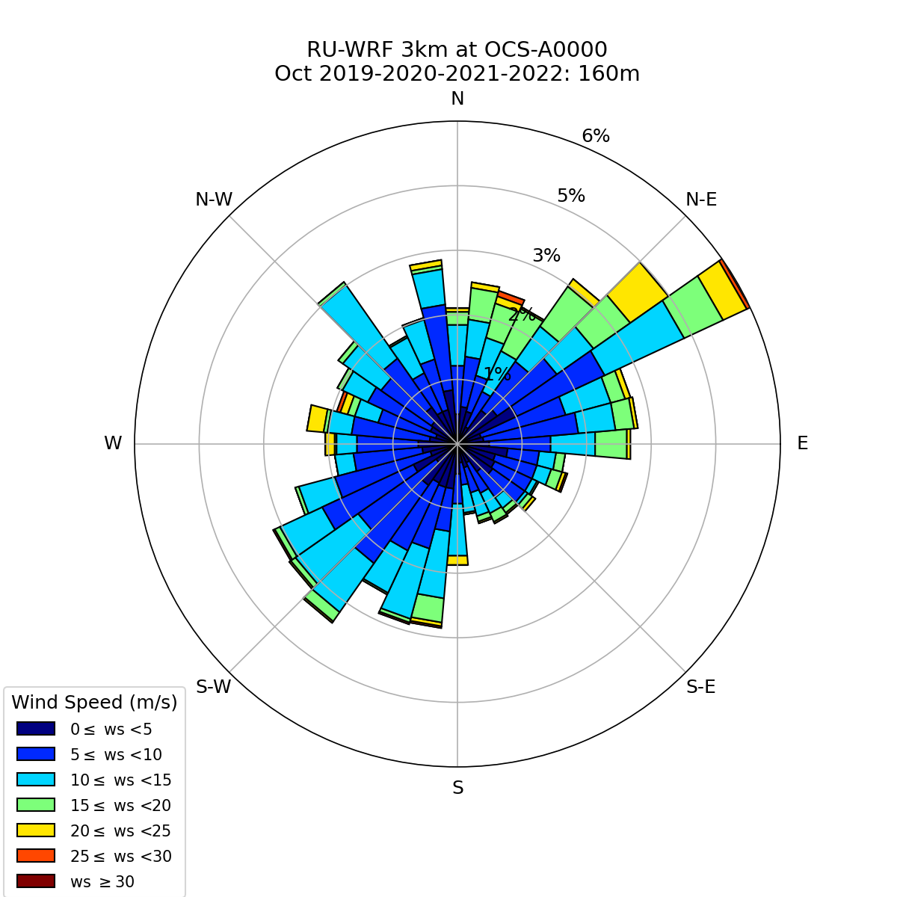
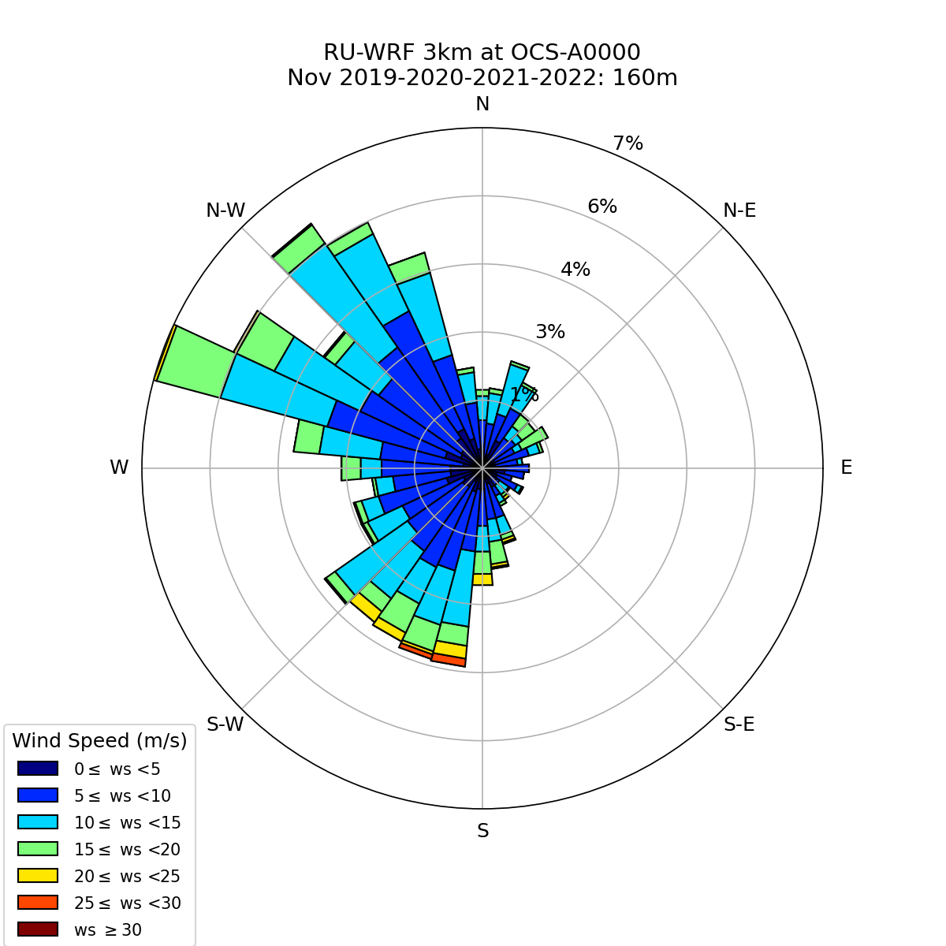
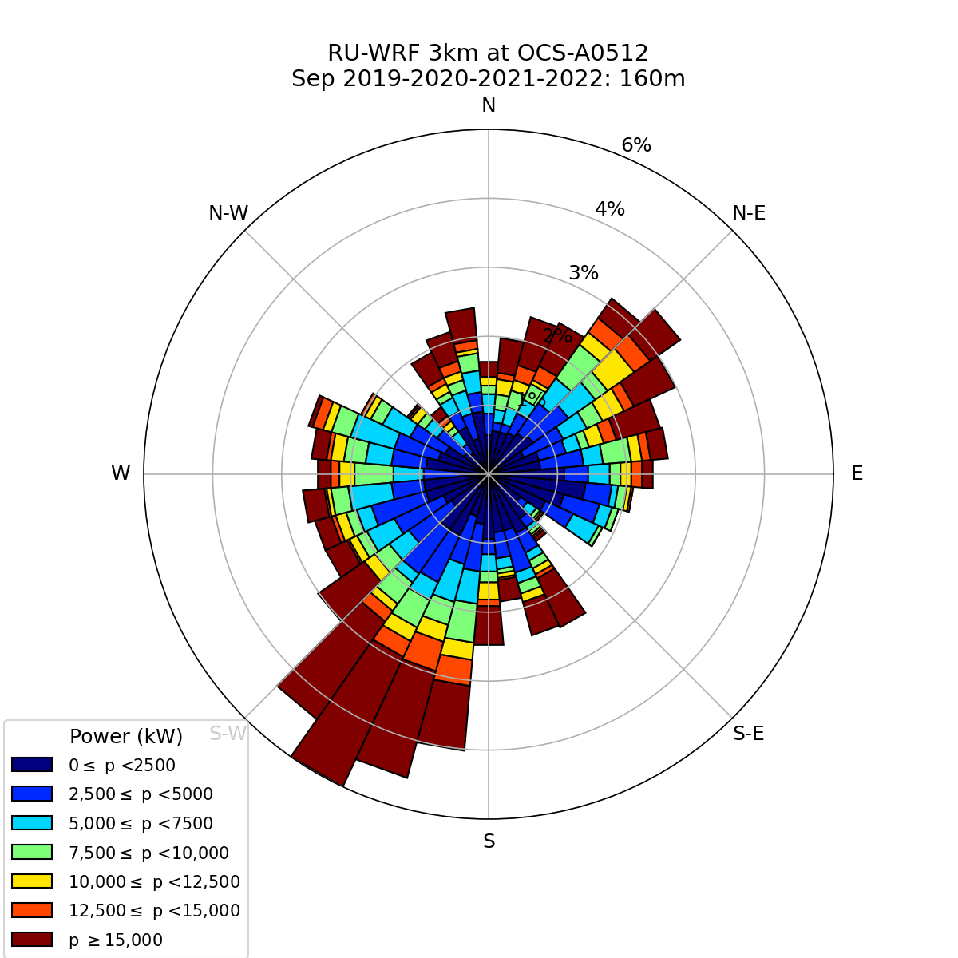


Fall
September
October
November
Wind Speed
Power
Notes:
Four-year (2019-2022) Monthly Aggregated Wind and Power Roses at Hub-height (160m)

Slide 13


Individual Month Wind and Power Roses
Wind and Power roses for each individual month throughout the 4-year dataset can be viewed and downloaded in the “Monthly Roses” folder

Slide 14

​​
Seasonal Hub-height (160m) Wind Speed Estimates
Notes:
Seasonal 160m wind speed estimates for December 2018 through February 2023. Box plots include interquartile range with the 25th to 75th percentile represented by the box. The horizontal bars represent the median, and triangles represent the mean. X’s indicate outliers outside the 1.5 X IQR range (whiskers).
Winter: December of the previous year and January and February of the labeled year.
Spring: March-May
Summer: June-August
Fall: September-November

Slide 15

Seasonal Hub-height (160m) Power Estimates
Notes:
Seasonal 160m power estimates for December 2018 through February 2023. Box plots include interquartile range with the 25th to 75th percentile represented by the box. The horizontal bars represent the median, and triangles represent the mean. X’s indicate outliers outside the 1.5 X IQR range (whiskers).
Winter: December of the previous year and January and February of the labeled year.
Spring: March-May
Summer: June-August
Fall: September-November

Slide 16


Annual Power (15MW) and Wind Speed Heatmaps
Notes:
Heatmap showing weekly-binned wind speed (left) and power (right) data density for December 2018 through November 2022, deeper shades of red indicating higher data density. Light blue dots indicate cells where the data density exceeds the maximum for the red colormap, with translucent dark blue circles indicating the scale it has been exceeded by (eg if the radius of the translucent dark blue circle is 5x the radius of the light blue dot, that cell has 5x the data density of the deepest red cells).

Slide 17

Hourly Seasonal Wind Speed Variability (160m)
Notes:
Boxplot showing the seasonal variability of wind speed for every hour throughout the day. Box plots include interquartile range with the 25th to 75th percentile represented by the box. The horizontal bars represent the median, and diamonds represent the mean. O’s indicate outliers outside the 1.5 X IQR range (whiskers). A sample figure is given.

Slide 18

Hourly Seasonal Power Variability (160m)
Notes:
Boxplot showing the seasonal variability of power for every hour throughout the day. Box plots include interquartile range with the 25th to 75th percentile represented by the box. The horizontal bars represent the median, and diamonds represent the mean. O’s indicate outliers outside the 1.5 X IQR range (whiskers). A sample figure is given.

Slide 19

Four-year Monthly Aggregated Hourly Wind Speed Variability (160m)
Notes:
Boxplot showing the four-year monthly aggregated variability of power for every hour throughout the day. Box plots include interquartile range with the 25th to 75th percentile represented by the box. The horizontal bars represent the median, and diamonds represent the mean. O’s indicate outliers outside the 1.5 X IQR range (whiskers). A sample figure is given.

Slide 20

Four-year Monthly Aggregated Hourly Power Variability (160m)
Notes:
Boxplot showing the four-year monthly aggregated variability of power for every hour throughout the day. Box plots include interquartile range with the 25th to 75th percentile represented by the box. The horizontal bars represent the median, and diamonds represent the mean. O’s indicate outliers outside the 1.5 X IQR range (whiskers). A sample figure is given.

Slide 21

Hourly Wind Speed Variability (160m) by Individual Month
Notes:
Boxplot showing the variability of wind speed for every hour throughout the day for individual months. Box plots include interquartile range with the 25th to 75th percentile represented by the box. The horizontal bars represent the median, and diamonds represent the mean. O’s indicate outliers outside the 1.5 X IQR range (whiskers). A sample figure is given.

Slide 22

Hourly Power Variation (160m) by Individual Month
Notes:
Boxplot showing the variability of wind speed for every hour throughout the day for individual months. Box plots include interquartile range with the 25th to 75th percentile represented by the box. The horizontal bars represent the median, and diamonds represent the mean. O’s indicate outliers outside the 1.5 X IQR range (whiskers). A sample figure is given.

Slide 23
For Questions and Concerns about the figures and data please feel free to contact us.
Email: offshorewind@marine.rutgers.edu

