Slide 1
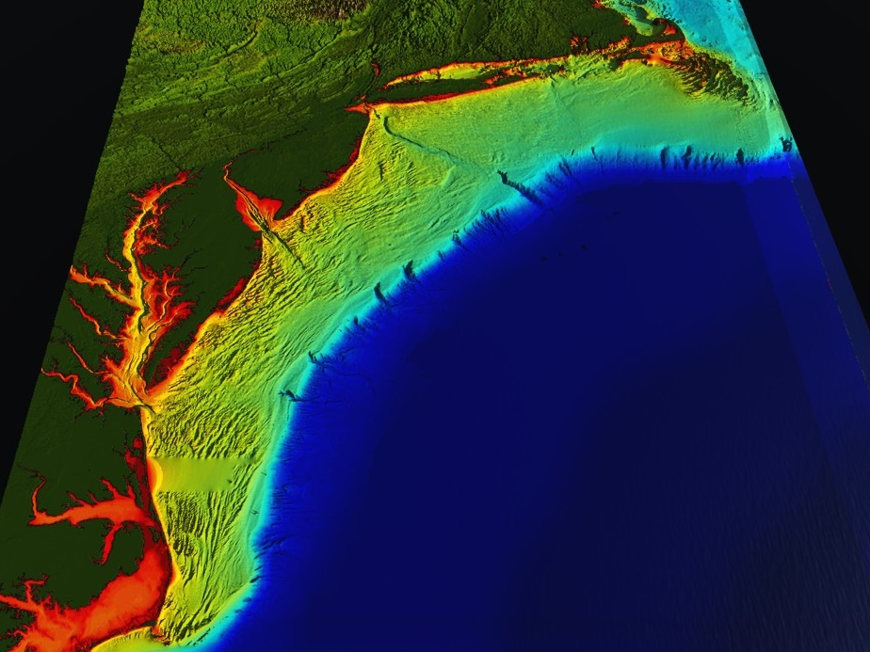






Mid-Atlantic Bight (1000 km Cape to Cape)
78 Million People (1/4 of U.S.)
Cape
Cod
U..
Coastal Ocean Processes & Feedback on Landfalling Hurricanes & Typhoons
Sandy
Irene + 10
Jose
Scott Glenn, Travis Miles,
Maria Aristizabal, Joe Brodie, Greg Seroka, Cliff Watkins, Oscar Schofield, Grace Saba,
Josh Kohut, Hugh Roarty (Rutgers)
+ Many More
Hurricanes
Cape
Hatteras
Notes:
1

Slide 2
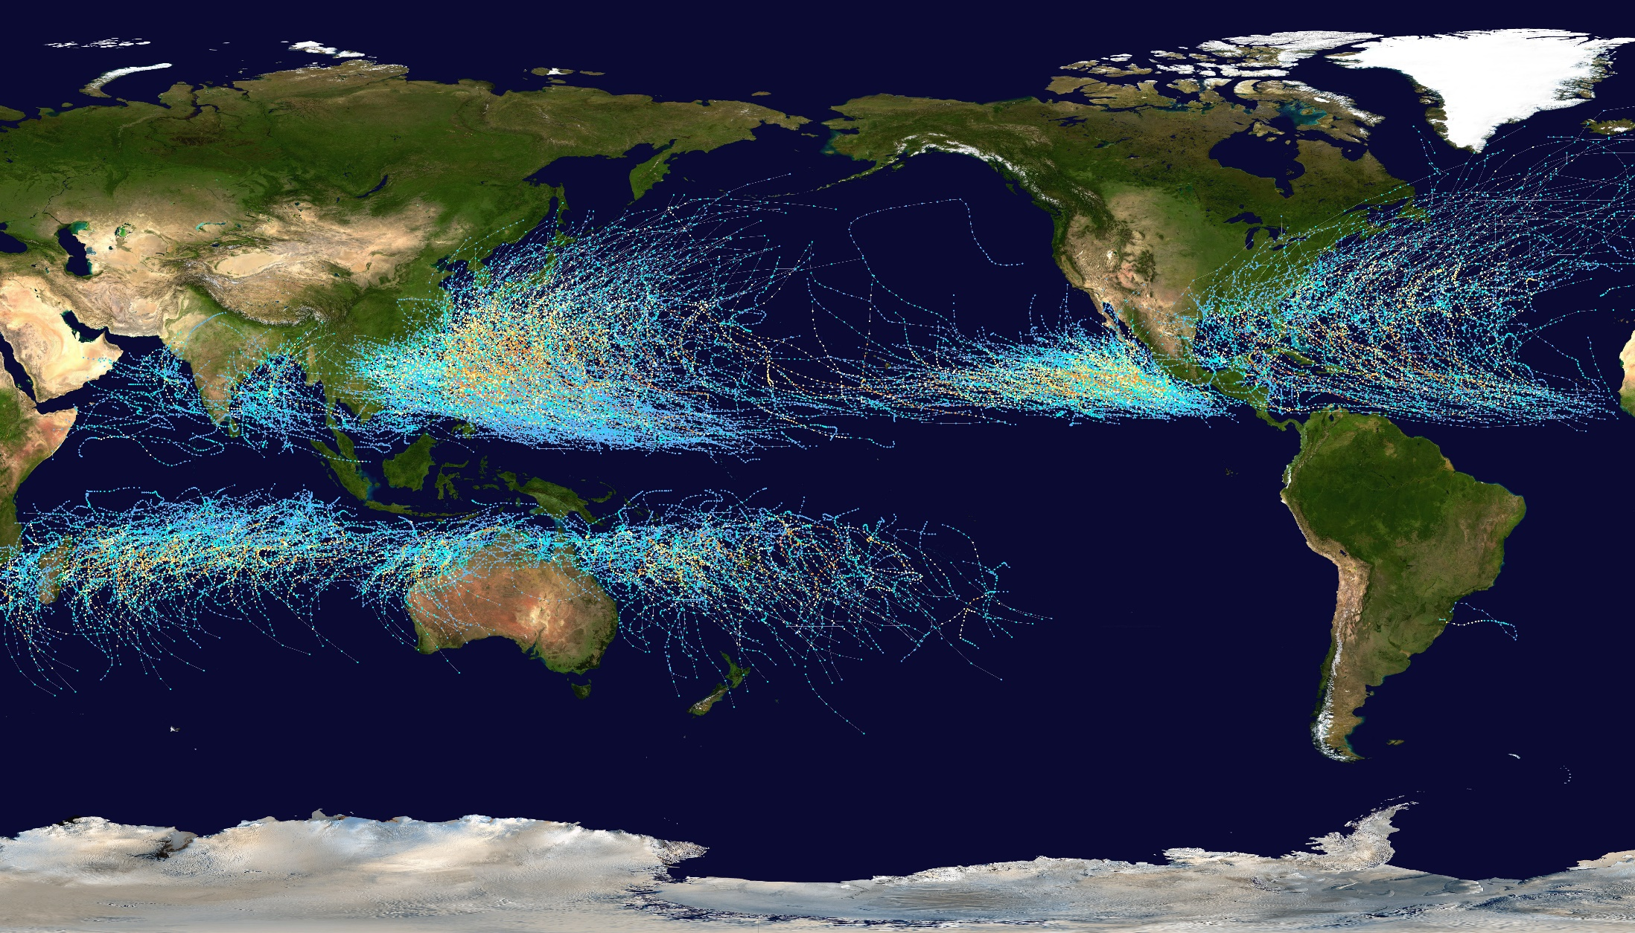
Why Study Tropical Cyclones?

Slide 3
Why Study Tropical Cyclones?
NOAA National Centers for Environmental Information (NCEI) U.S. Billion-Dollar Weather and Climate Disasters (2018). https://www.ncdc.noaa.gov/billions/

Slide 4
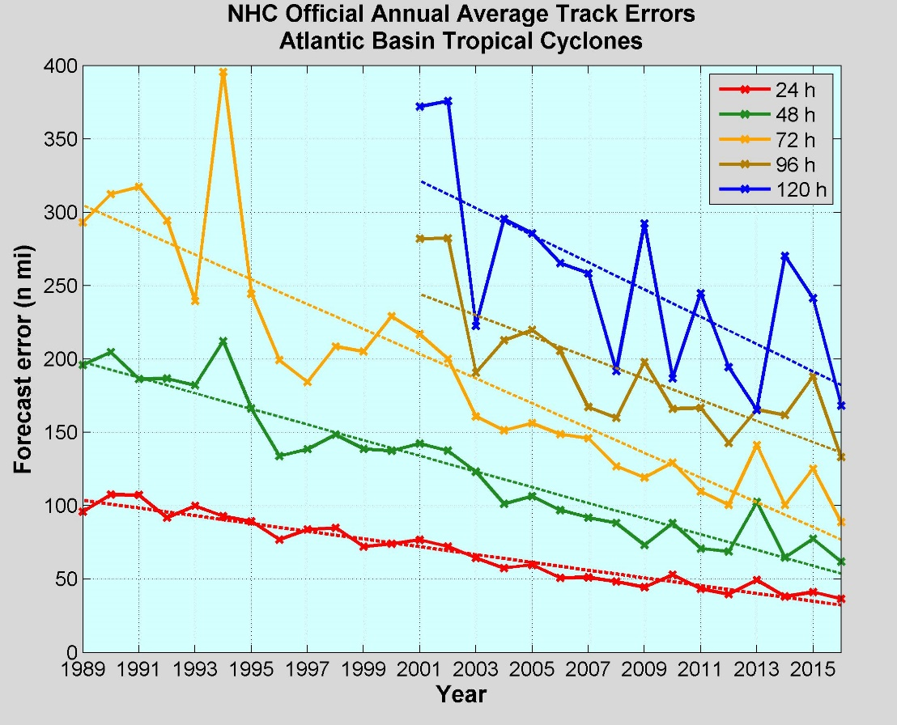
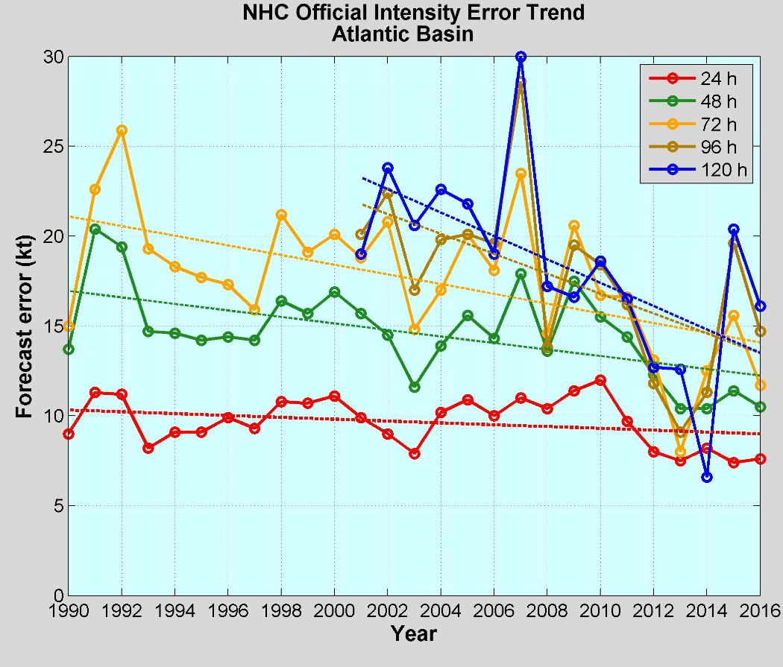
Average Track Errors:
Atlantic Basin
Average Intensity Errors:
Atlantic Basin
Limitations on Hurricane Intensity Improvement
Computing resources and model resolution (Rotunno et al., 2009)
Poor understanding of the atmospheric boundary layer (Nolan et al., 2009; Andreas et al., 2015)
Difficulty in modeling the upper ocean response to storm forcing (Yablonsky and Ginis, 2009).
Cangialosi and Franklin 2017

Slide 5
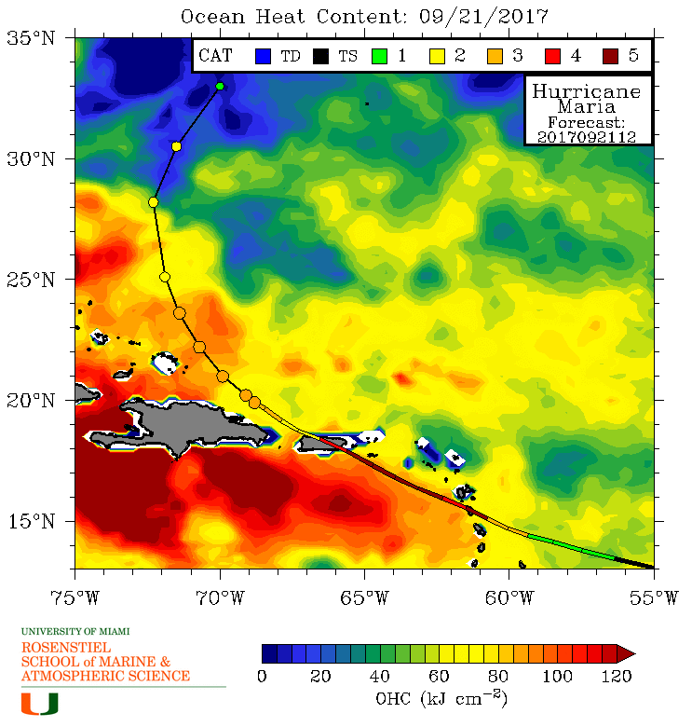
Hurricane Intensity is modulated by upper ocean heat content
Rapid intensification of Hurricane Maria over warm ocean water

Slide 6
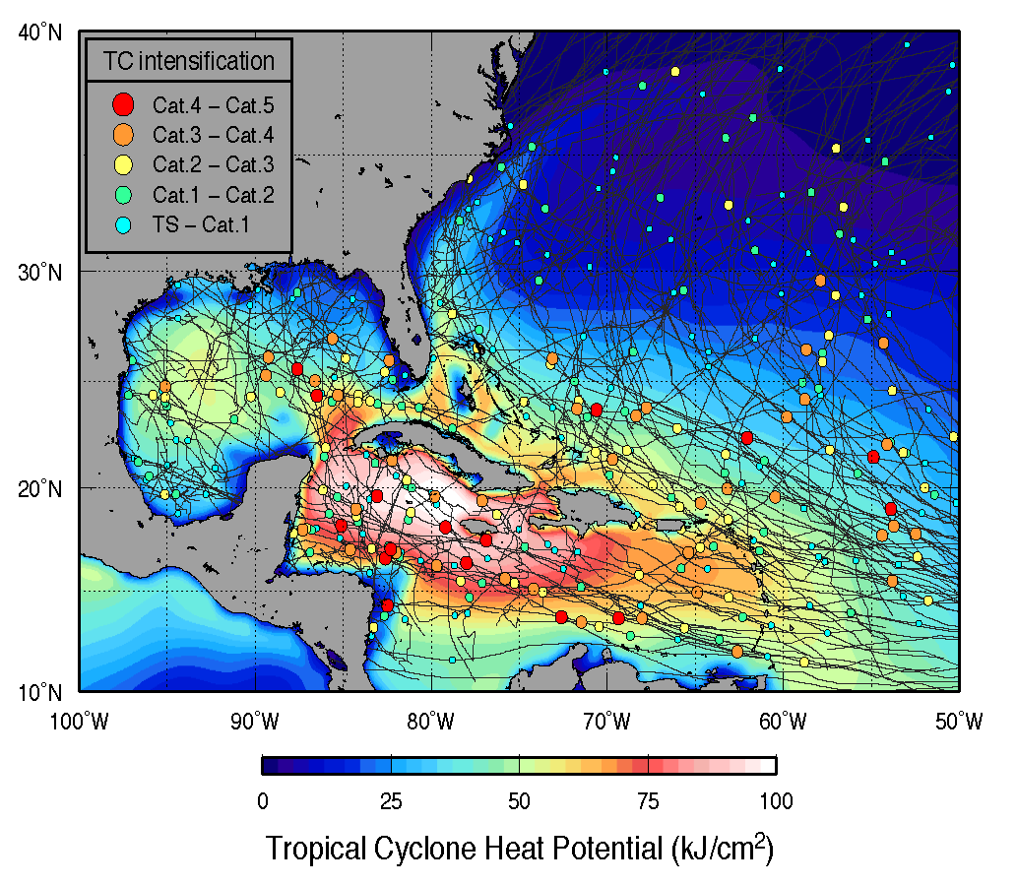

Hurricane Intensity is modulated by upper ocean heat content

Slide 7
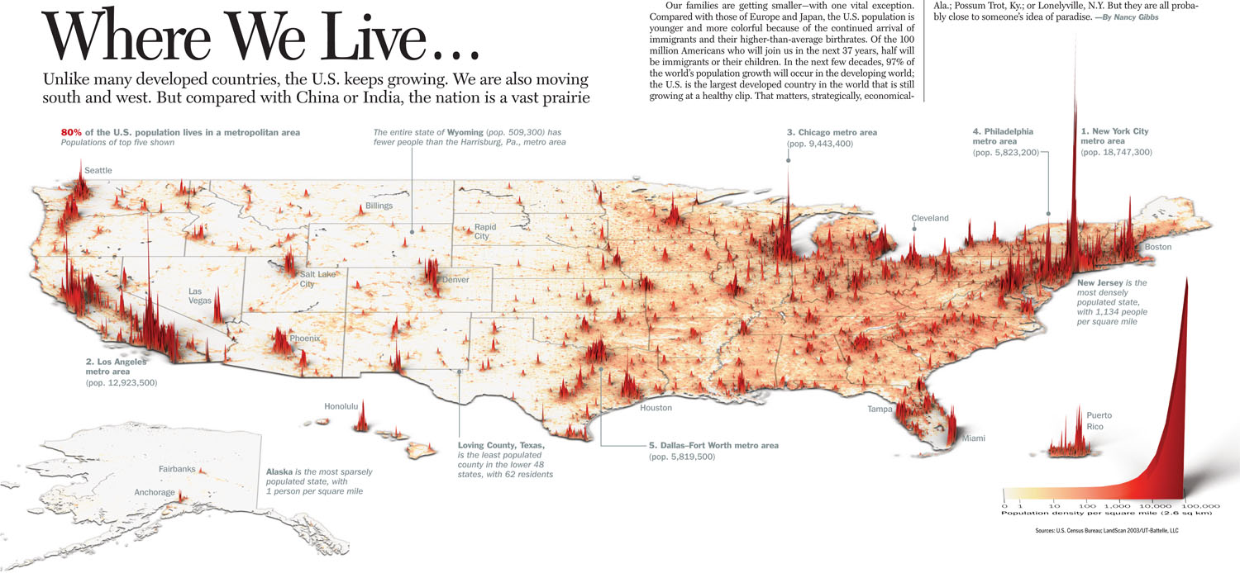
Coastal Drivers
Dense Populations
Majority of U.S. GDP
Navy Ports
Commercial Ports
Fishing Fleets
Energy
Many others…
Coastal Stressors
Water quality
Hurricanes & Winter Storms
Flooding and Sea Level Rise
Hypoxia
Intense multi-use waterways
Urbanized coasts
Many others…

Slide 8
Hurricane | Year | Month | Category Max | Damage Billions $ | Deaths
Katrina | 2005 | August | 3 | $165.0 | 1,833
Harvey | 2017 | August | 4 | $127.5 | 89
Maria | 2017 | September | 4 | $91.8 | **65
Sandy | 2012 | October | 3 | $72.2 | 159
Irma | 2017 | September | 4 | $51.0 | 97
Andrew | 1992 | August | 5 | $49.1 | 61
Florence* | 2018 | September | 4 | $38-$50 | 51
Ike | 2008 | September | 2 | $35.7 | 112
Ivan | 2004 | September | 3 | $27.9 | 57
Wilma | 2005 | October | 3 | $25.1 | 35
Rita | 2005 | September | 3 | $24.4 | 119
Charley | 2004 | August | 4 | $21.8 | 35
Hugo | 1989 | September | 4 | $18.7 | 86
Irene | 2011 | August | 1 | $15.4 | 45
Frances | 2004 | September | 2 | $13.3 | 48
Allison | 2001 | June | TS | $12.3 | 43
Matthew | 2016 | October | 4 | $10.6 | 49
Jeanne | 2004 | September | 3 | $10.2 | 28
Floyd | 1999 | Floyd | 2 | $9.9 | 77
U.S. Billion-Dollar Weather and Climate Disasters (2018)
https://www.ncdc.noaa.gov/billions/
*Moody’s Analytics, Sept 21 Estimate
**GWU/UPR Estimate 2,658-3,290

Slide 9
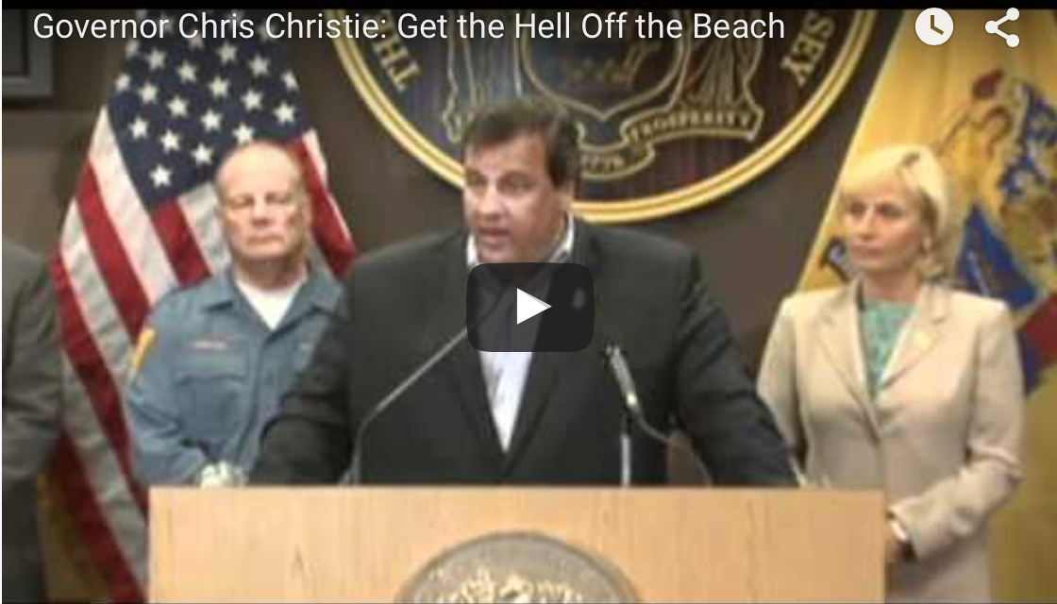
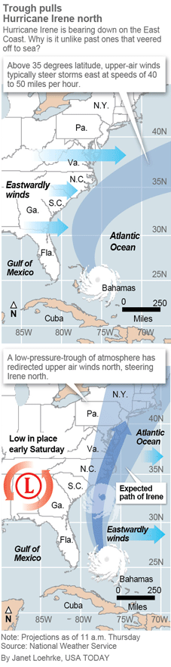
Pre-Irene Storm Warnings
Over 2 million people ordered to “flee the storm’s path”.
President Obama: Shaping up to be a “historic hurricane” and urged residents to “be prepared for the worst”. “Don’t wait. Don’t delay.”
New Jersey Governor Christie: Ordered evacuation of 1 million people - “Get the hell off the beach”. “Do not waste any more time working on your tan”.
New York Mayor Blumberg: “Staying behind is dangerous, staying behind is foolish, and its against the law”. “The time to leave is right now”. The bridges, streets and subways were nearly empty ahead of a nearly unprecedented mass transit shutdown.

Slide 10
AP PHOTO/MEL EVANS
Notes:
Can I improve this picture?

Slide 11
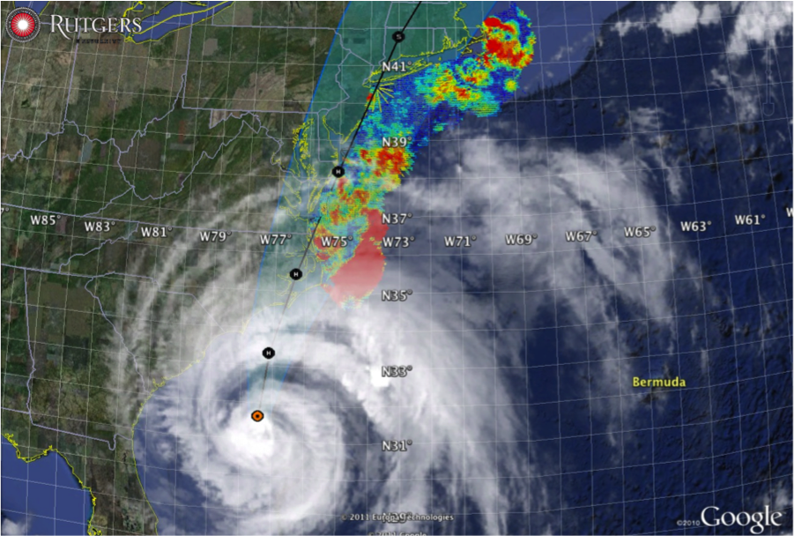
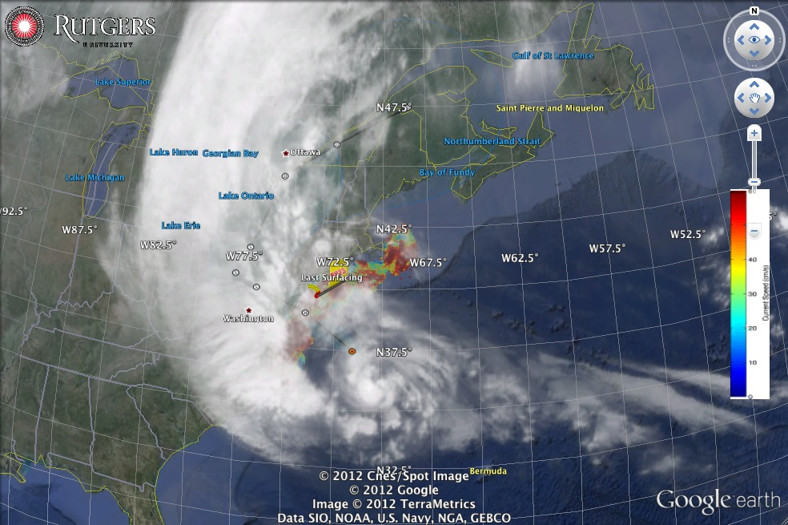
Hurricane Irene
August 28, 2011
NOAA/NHC Damage:
>$15 Billion, #14.
Track Accurate;
Intensity Over-predicted.
Avila & Cangialosi, 2012, Tropical Cyclone Report
Hurricane Sandy
October 29, 2012
NOAA/NHC Damage:
>$72 Billion, #4.
Track Accurate;
Surge Under-predicted.
Georgas et al., 2014, J. of Extr. Even.
Colle et al., 2015, J. Mar. Sci. & Engr.

Slide 12


















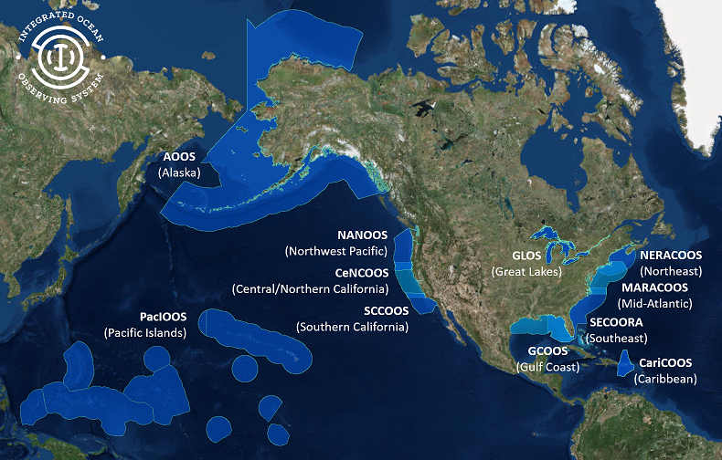
U.S. Integrated Oean Observing System (IOOS)
Partnership effort that leverages dispersed national investments to deliver ocean, coastal and Great Lakes data relevant to decision-makers.
  Global Component
  US contribution to Global Ocean Observing System (GOOS)
  1 of 15 Regional Alliances of GOOS
  National Component
  17 Federal agencies
Regional Component
  11 Regional Associations
    Stakeholder driven
    Academia, state/local/tribal government, private industry
    Government Certified
Notes:
NOAA is the Lead Federal Agency
US IOOS program office is within NOAA, but intended to be a multi agency network and federal to non-federal so we use the term U.S. IOOS.
Additional Background:
US IOOS is a national endeavor and spans from global to coastal, with federal and non-federal partners. The majority of non-federal partners are represented by 11 Regional Associations (RAs) that represent the US EEZ and Great Lakes.

Slide 13
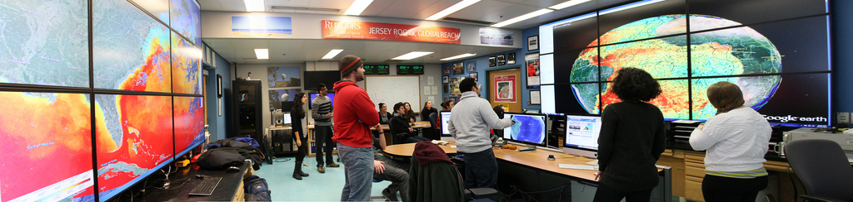
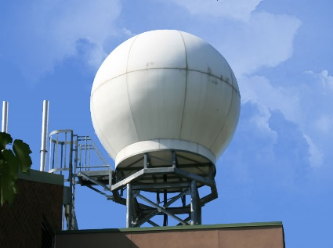
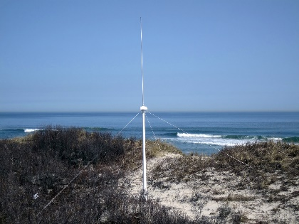
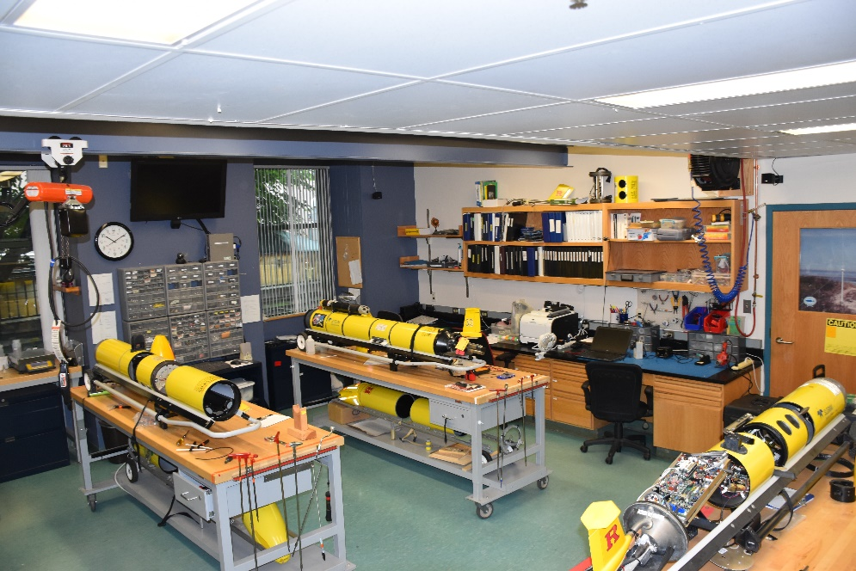
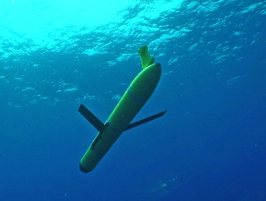
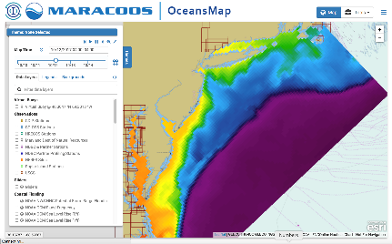
Rutgers University - Center for Ocean Observing Leadership
MARACOOS – A regional implementation of an integrated network
Satellite Receivers
46 Site CODAR Network
468 Glider
Deployments
Ocean
Modeling
Glider Lab
Notes:
13
All of this gets combined into our overall operations, research, and educational initiatives in the “COOL Room,” shown here (with a class in the background)
Thanks to many partners

Slide 14
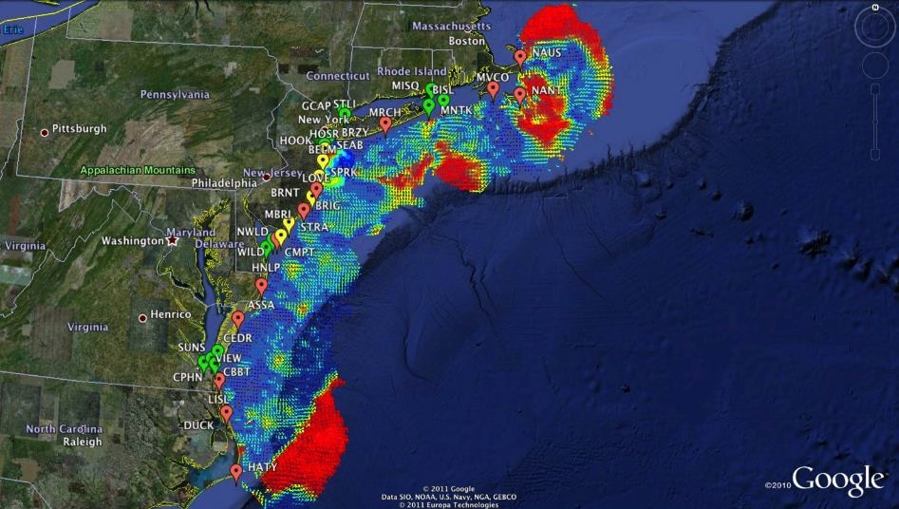

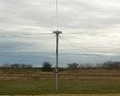
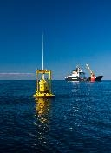
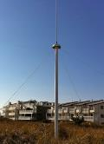

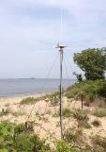









Mid-Atlantic Bight HF Radar Network
1000 km
Cape to Cape
Mid-Atlantic HF Radar Network
17 Long-Range CODARs
8 Medium-Range CODARs
16 Short-Range CODARs
41 Total CODARs in Region
+5 CODARs Roaming
46 Total CODARs
Triple Nested, Multi-static, Multi-use
Industry Partner: CODAR Ocean Sensors

Slide 15
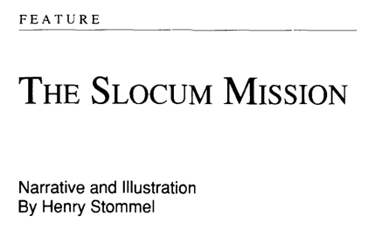
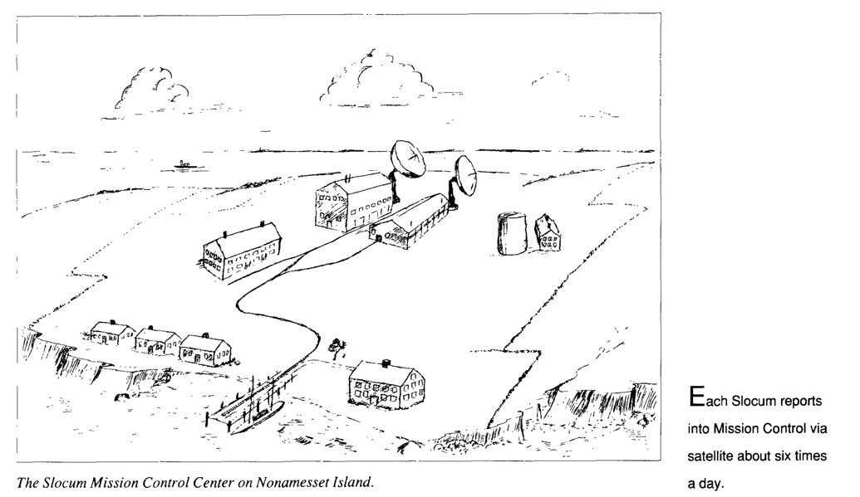
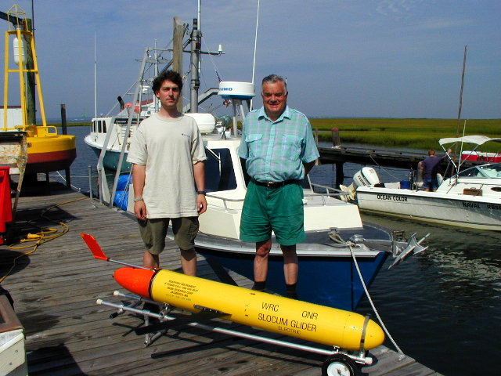
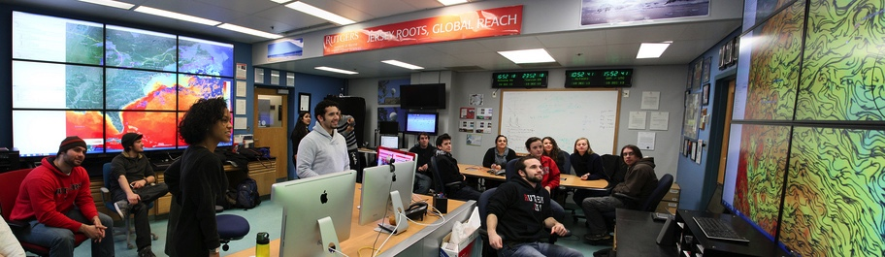
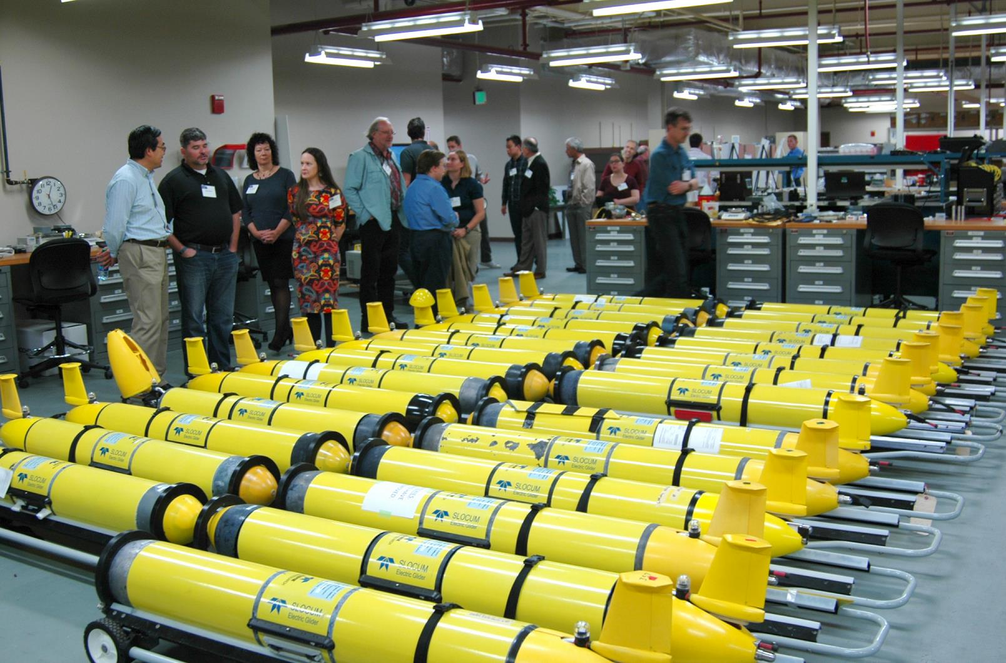
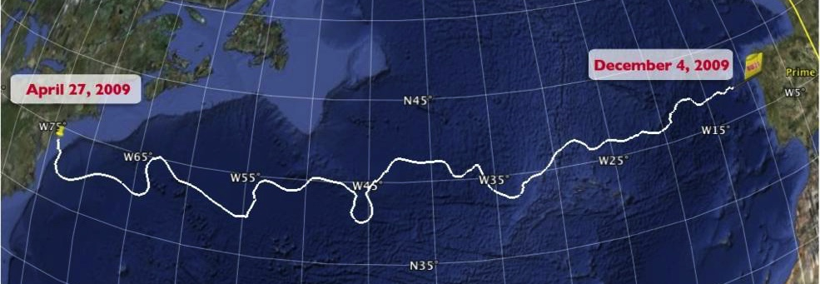

Technology Center for Slocum Robotic Underwater Gliders
1989 Science Fiction Article
1999
First Slocum deployed at Sea
2009 First Atlantic Crossing
2018 Navy Fleet grows >150
Notes:
Gliders from Teledyne Webb Research
First deployment: off the end of the dock, tied to a rope in case it didn’t come back.
The “Challenger” mission, which was largely student coordinated throughout the crossing
Currently circumnavigating the Indian Ocean
RU COOL now operates a fleet of 32 (33) gliders, making it the largest academic operator in the world

Slide 16
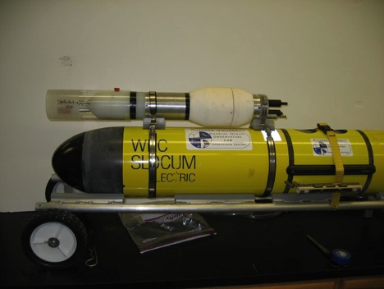
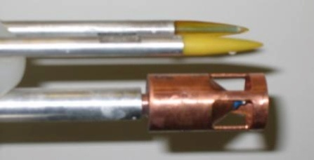
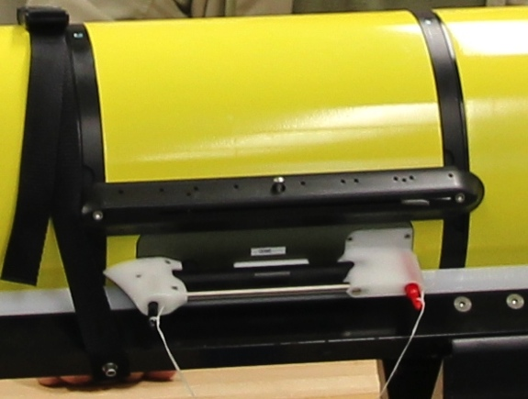
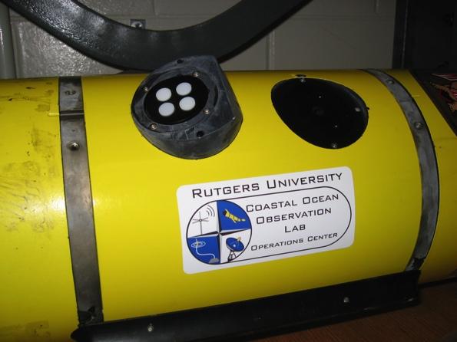
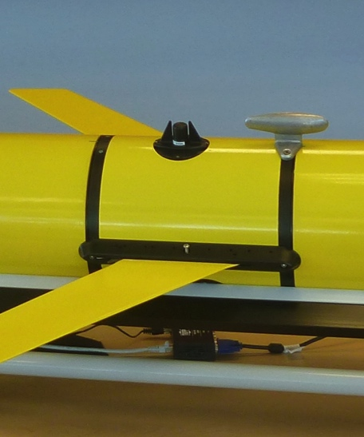
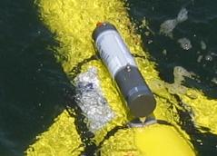
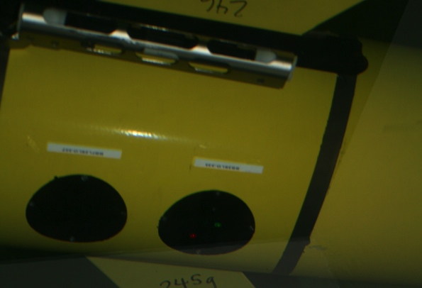
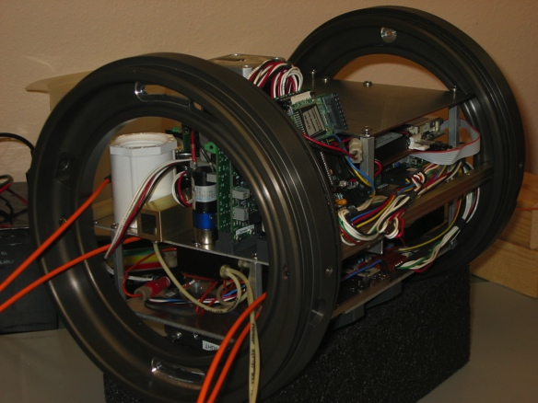
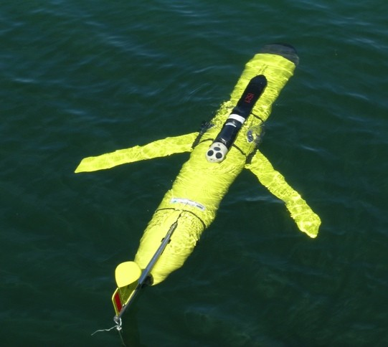
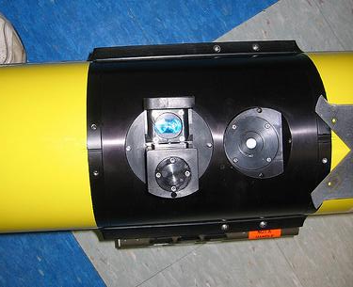
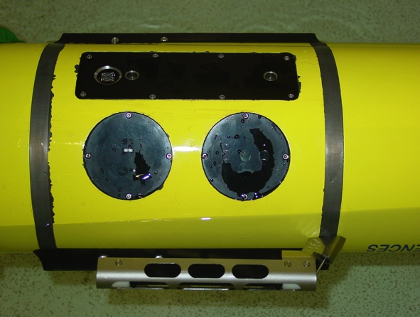

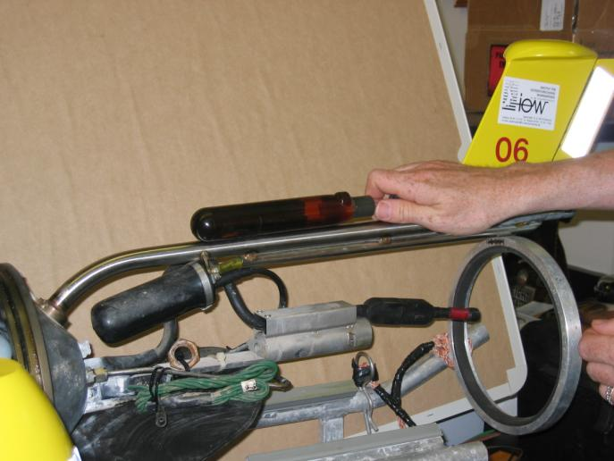
Glider Sensors
Inside Payload Bay or External

Slide 17

Storm Gliders - Key Reference List
Glenn, Jones, Twardowski, Bowers, Kerfoot, Kohut, Webb, Schofield, 2008. Glider observations of sediment resuspension in a Middle Atlantic Bight fall transition storm. Limnology and Oceanography 53(5, Part 2): 2180-2196.
Miles, Glenn, Schofield, 2013. Temporal and spatial variability in fall storm induced sediment resuspension on the Mid-Atlantic Bight. Continental Shelf Research 63, Supplement: S36-S49.
Miles, Seroka, Kohut, Glenn, 2015. Glider observations and modeling sediment transport in Hurricane Sandy. JGR Oceans, DOI: 10.1002/2014JC010474
Glenn, Miles, Seroka, Xu, Forney, Yu, Roarty, Schofield, Kohut, 2016. Stratified coastal ocean interactions with tropical storms, Nature Communications, March 8, 2016, 1-10, DOI:10.1038/ncomms10887.
Seroka, Miles, Xu, Kohut, Schofield & Glenn, 2016. Hurricane Irene Sensitivity to Stratified Coastal Ocean Cooling, Monthly Weather Review, 144(9) 3507-3530.
Seroka, Miles, Xu, Kohut, Schofield & Glenn, 2017. Rapid shelf-wide cooling response of a stratified coastal ocean to hurricanes. JGR-Oceans: Special Section on Ocean Responses and Feedbacks to Tropical Cyclones, DOI:10.1002/2017JC012756.
Miles, Seroka & Glenn, 2017. Coastal ocean circulation during Hurricane Sandy, J. Geophysical Res. - Oceans, 122(9) DOI:10.1002/2017JC013031.
Sea-Bottom Interface
Air-Sea Interface

Slide 18
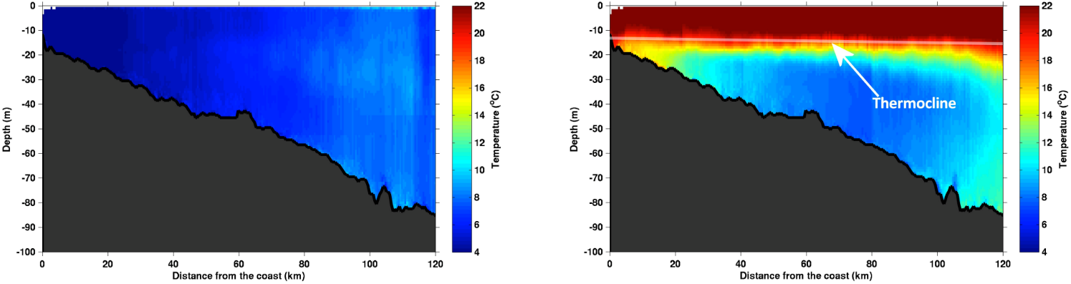
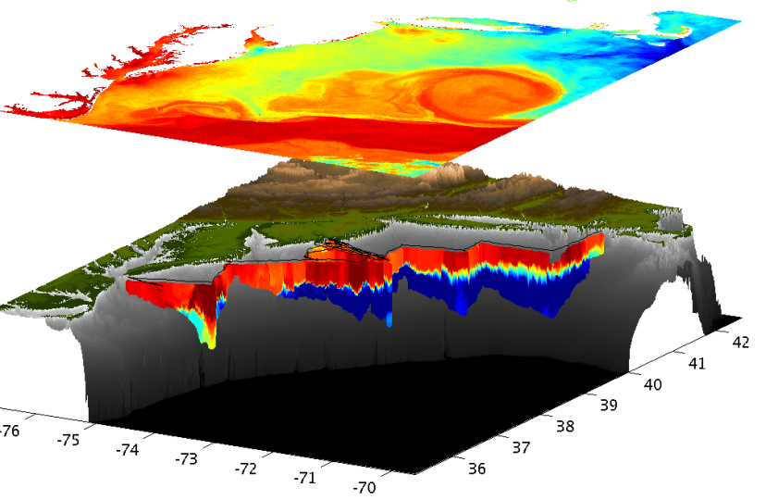
Essential Ocean Feature - Mid-Atlantic’s Cold Pool
An unseen cold bottom layer beneath a warm summer surface layer
Mid Atlantic
Winter (1-layer)
Mid Atlantic
Summer (2-layers)
Cold Pool
Satellite SST
Assimilated into Regional
Ocean Models
Glider Zig-Zags
or Triangles
Bottom Temperature
To characterize the Cold Pool, we need ocean observations that are “fit for purpose”

Slide 19
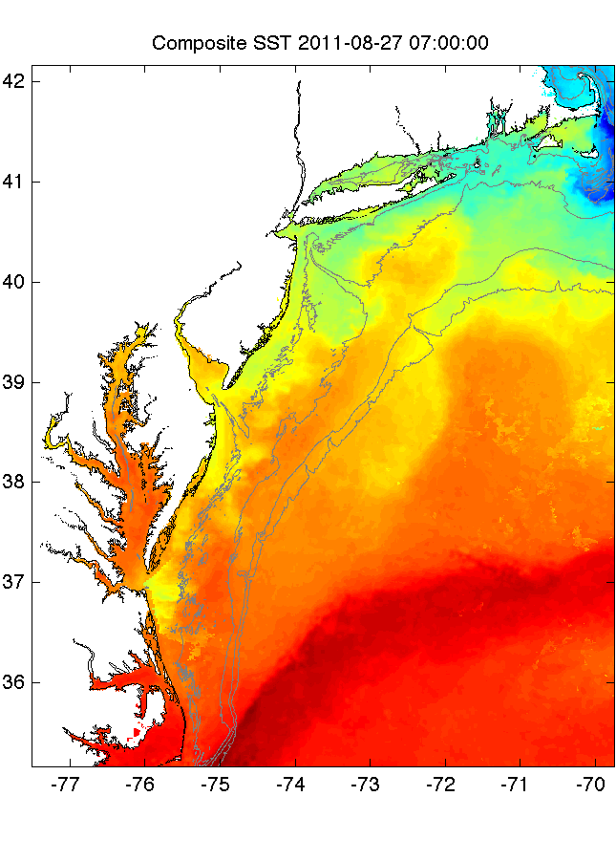
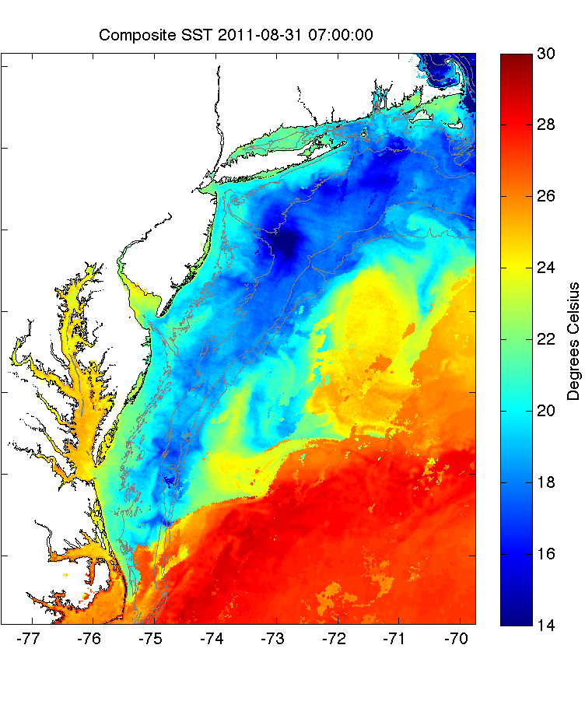
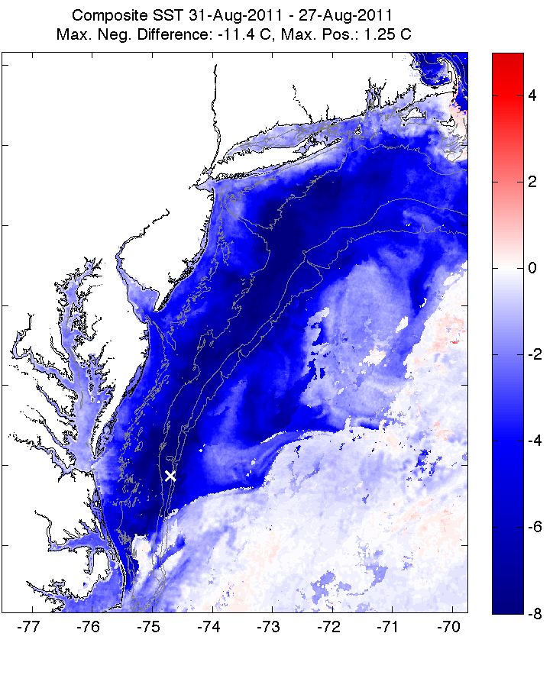
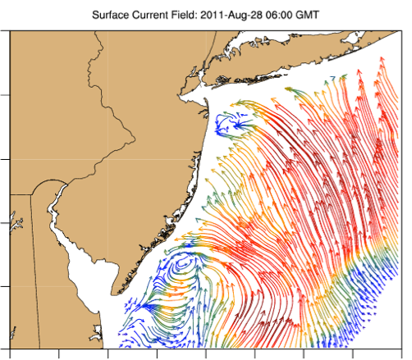
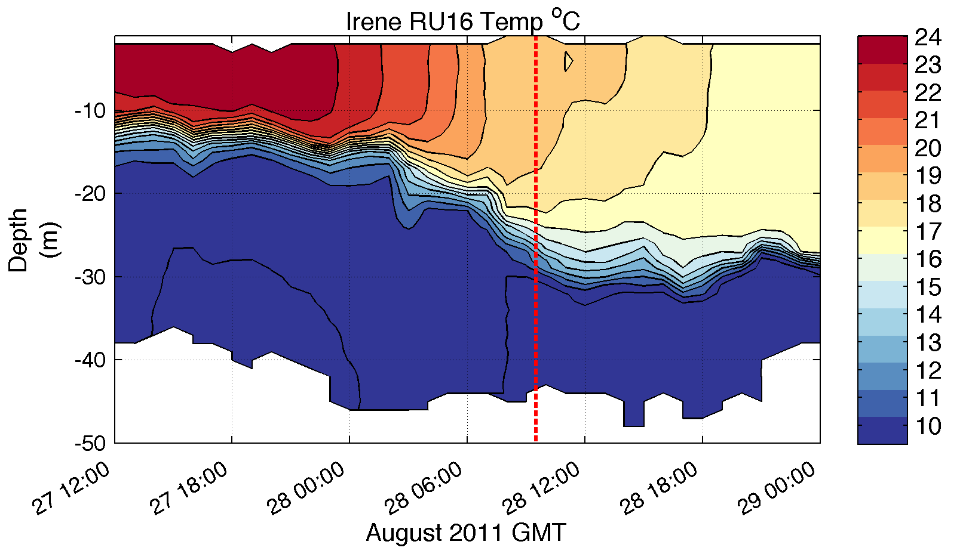
Pre-Irene
Post-Irene
Difference
11C max Cooling
WHAT?
Satellite
SST
WHEN? Glider Temperature
WHY?
HF Radar
Currents
Eye Passage
Essential Ocean Processes:
Ahead of eye center – Vertical Shear > Mixing > Cooling

Slide 20
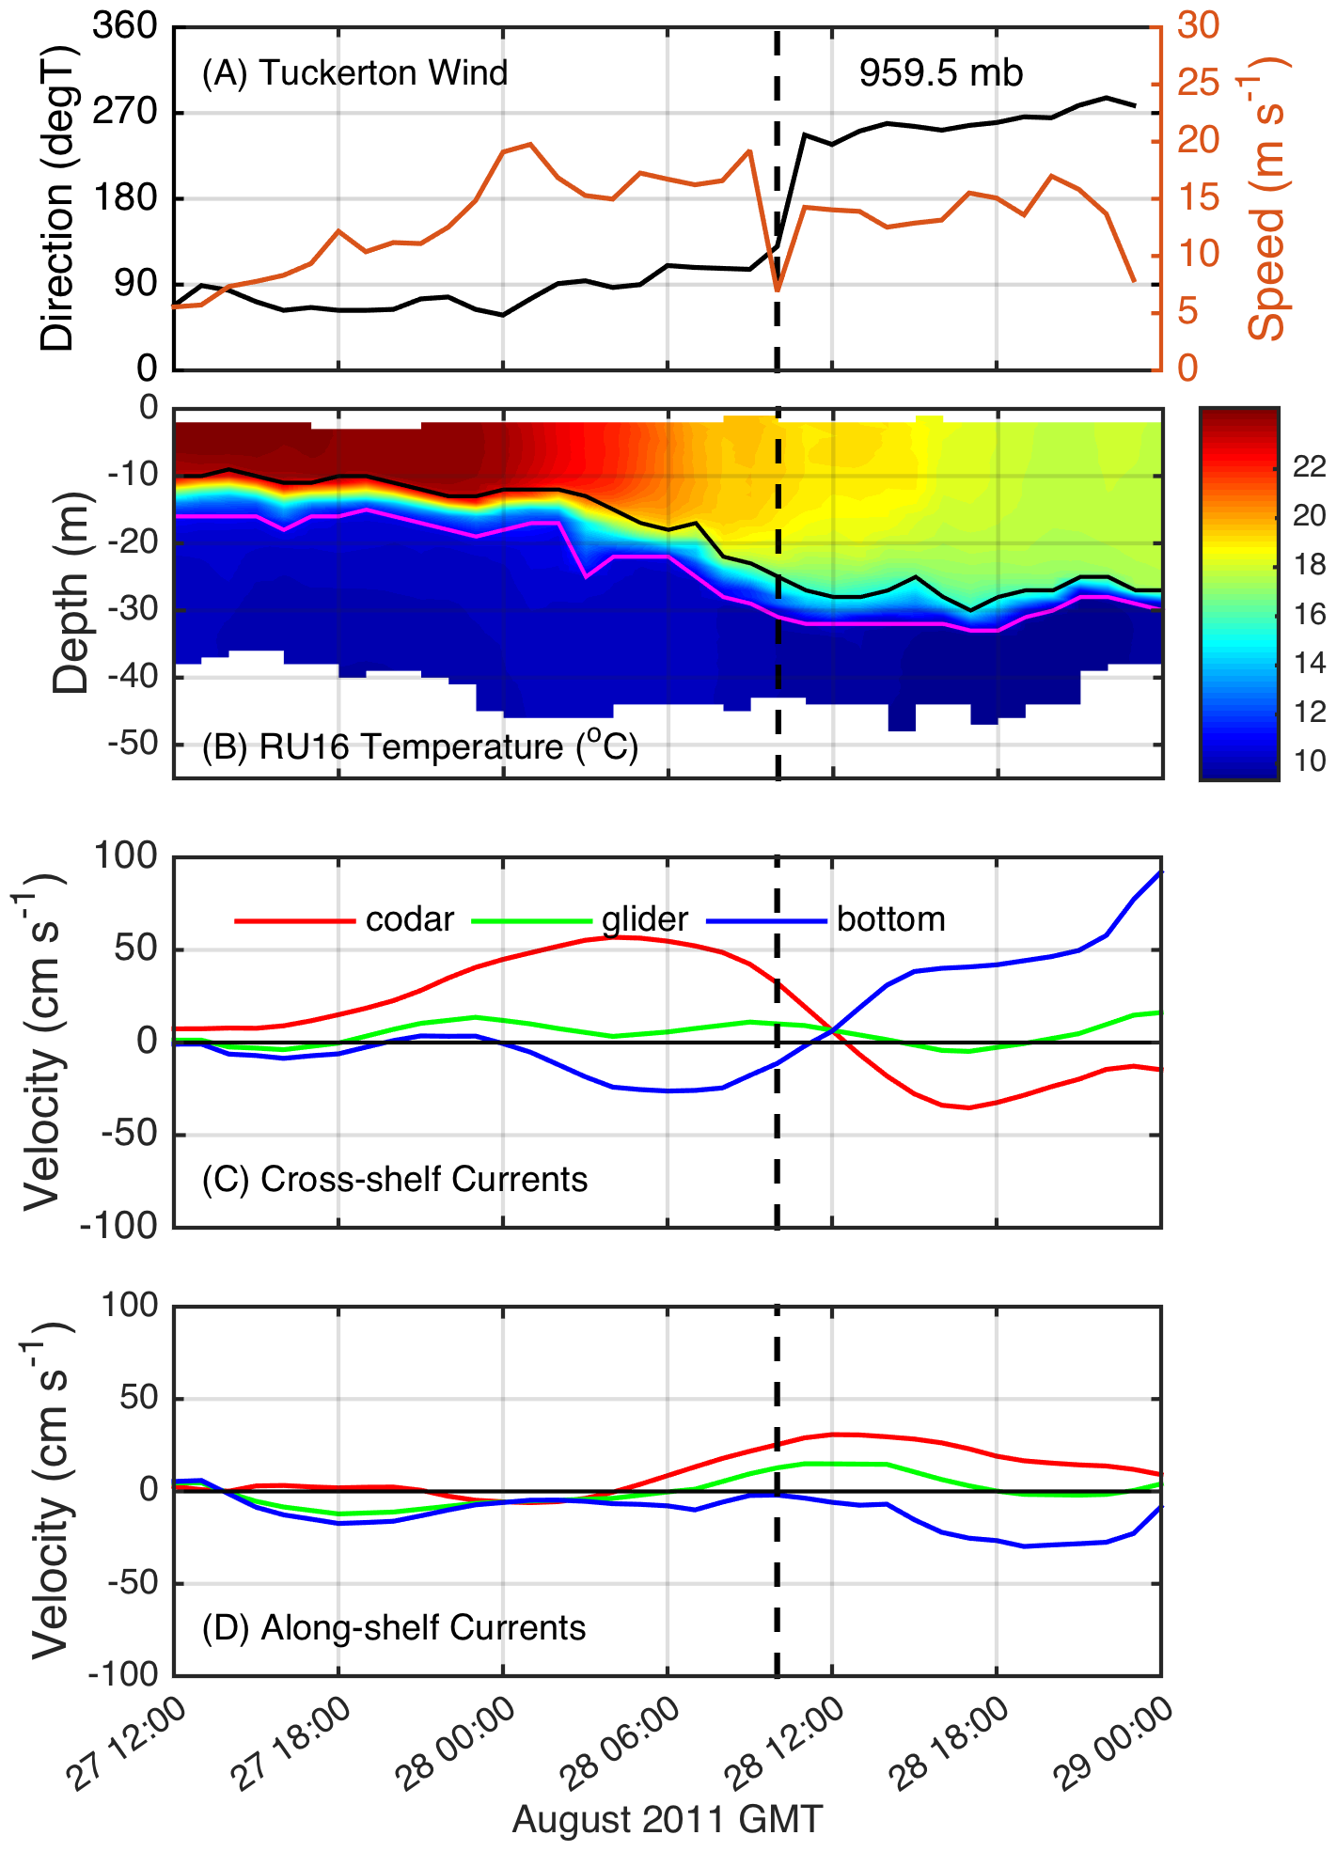
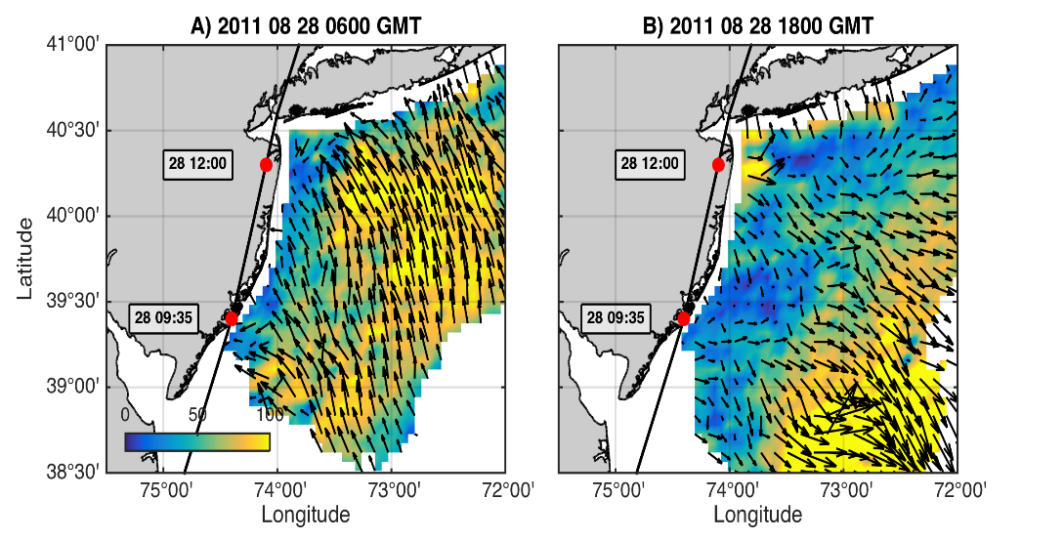

Coastal Baroclinic Circulation
Before Eye
After Eye
Before Eye After Eye
Glider Track, Model Grid
& Bathymetry
Storm Period in Blue

Slide 21

ROMS Model Results at Glider Location
Coastal Baroclinic Circulation Enhances Mixing & Cooling

Slide 22

ROMS Model Results at Glider Location
Temperature Diagnostic Equations – Mixing Dominates Advection

Slide 23


Alongshelf Buoy Array
Ahead-of-eye-center (AOEC) cooling signal in Irene
South
Eye passage
98%
SST
SST
82%
76%
90%
North
Seroka et al. 2016

Slide 24

Hurricane Irene SST
Satellite AVHRR vs. ROMS Model
Before
Notes:
2

Slide 25

Hurricane Irene SST
Satellite AVHRR vs. ROMS Model
After
SST comparison
Notes:
3

Slide 26

Hurricane Irene SST
Satellite AVHRR vs. ROMS Model
Difference
SST cooling
Notes:
4

Slide 27


Essential Ocean Processes IRENE - Onshore WS vs. Offshore PG
+offshore
m s⁻²
-onshore
Seroka et al. 2017
Notes:
15

Slide 28


Essential Ocean Processes IRENE: Vertical Mixing & SST Cooling
AOEC SST cooling
Downwelling
Upwelling
Seroka et al. 2017.
Notes:
10

Slide 29







WRF Atmospheric Forecast Sensitivity Study – >130 tests
Warm Ocean
Boundary Condition
Cat 1 Hurricane
Tropical Storm
Cold Ocean
Boundary Condition
IMPACT?
>10 knots reduction in peak wind speed

Slide 30



SST within 25 km of eye & impact on air-sea heat flux
Warm
Cold
Northern Buoy
26C
Central Buoy

Slide 31




NARR
WARM SST
COLD SST
WRF Heat Flux Comparison to
North American Regional Reanalysis
Wind
Latent heat flux
Sensible heat flux

Slide 32


WRF 250-850 hPa Wind Shear
NARR
WARM SST
COLD SST
August 28
00:00 Z
August 28
12:00 Z

Slide 33


WRF Dry air intrusion (700 mb specific humidity)
NARR
WARM SST
COLD SST
August 28
00:00 Z
August 28
12:00 Z
Notes:
SST sensitivity is not affecting or not being affected by humidity

Slide 34

WRF Model Sensitivity Study
Over 130 model runs
Paired to compare sensitivities
Central pressure & max wind
Sensitivity to SST greatest
Seroka, Miles, Xu, Kohut, Schofield & Glenn,
Hurricane Irene Sensitivity to Stratified Coastal Ocean Cooling, Monthly Weather Review, 2016

Slide 35

We use an implementation of the Advanced Circulation Model (ADCIRC) finite element unstructured mesh forced by winds from RUWRF. This mesh was designed originally for the Federal Emergency Management Agency (FEMA) Region II Coastal Surge Study.
Federal Emergency Management Agency (FEMA). Region II Coastal Storm Surge Project: Mesh Development; Federal Emergency Management Agency: Washington, DC, USA, 2014.

Slide 36



Maximum water level: Warm Run
Maximum water level: Cold Run
1.9 m
1.4 m

Slide 37




Slide 38
Irene Essential Ocean Process
Ahead of eye cooling also observed in:
10 MAB Hurricanes
1 Yellow Sea Typhoon
Glenn et al. 2016 Nature Communications
Hurricane Sandy
October 29, 2012
NOAA/NHC Damage:
>$68 Billion.
Track Accurate;
Surge Under-predicted.
Georgas et al., 2014, J. of Extr. Even.
Colle et al., 2015, J. Mar. Sci. & Engr.

Slide 39




Superstorm Sandy: 1 Day Before Landfall

Slide 40

Superstorm Sandy: 1 Day Before Landfall

Slide 41


Potential Energy Anomaly (…; Simpson, 1981; …)
For our coastal application:
= (bottom pressure factor) x (stratification factor)
Non-dimensional PEA (the stratification factor) becomes:

Slide 42

Hurricane Sandy Potential Energy Anomaly
Well-mixed
Non-dimensional
PEA
Essential Ocean Process:
Ahead of eye center advection
Stratification Factor
PEA
Stratified

Slide 43

New Scientific Understanding:
Two types of coastal ocean response
to Mid Atlantic hurricanes discovered
The essential ocean feature is
  the Mid Atlantic Cold Pool.
The essential ocean processes are
  (a) ahead-of-eye cooling vs.
  (b) ahead-of-eye advection.
Including these essential ocean features and processes in the ocean component of coupled hurricane forecast models is essential for improving intensity forecasts for landfalling Mid Atlantic hurricanes.
For the 2018 hurricane season –
  Operational HWRF will use GOFS 3.0 + POM
  Experimental HWF will use GOFS 3.1
+ Monthly Weather Review (2016)
+ JGR-Oceans (2017)
+ JGR-Oceans (2017)

Slide 44






Slide 45








Improved satellite SST product revealed ahead-of-eye cooling was not captured by:
standard satellite product
ocean models used for forecasting hurricane intensity
MARACOOS SST
RTG HR SST
NAM model
HWRF-POM
low res
HWRF-HYCOM
medium res
BEFORE IRENE
AFTER IRENE
Notes:
Caveats: different atmospheric forcing, etc.
Rutgers SST: 2km, RTG: 1/12 deg, ~9 km, HWRF-POM: 18km, HWRF-HYCOM: 1/12 deg, ~9km

Slide 46






HWRF Cross-shelf Transects
HWRF-POM
Before
HWRF-HYCOM
Before
Before
After
HWRF-POM
After
HWRF-HYCOM
After
RU16 Glider
Thank you to Hyun-Sook Kim and Zhan Zhang for providing HWRF data
Observed bathymetry from NOAA National Geophysical Data Center, U.S. Coastal Relief Model, Retrieved date goes here, http://www.ngdc.noaa.gov/mgg/coastal/crm.html

Slide 47







Hurricane Hermine Response: CINAR/MARACOOS Glider Fleet Launched, 9/2016
Glider
HYCOM
RTOFS

Slide 48




Navy Global Ocean Forecast System (GOFS):
Temperature below summer thermocline in 2017
Operational GOFS 3.0
OpTest of GOFS 3.1
No Cold Pool
Well Defined
Cold Pool
Nearly Isothermal Shelf
Two Thermal layers on Shelf

Slide 49




Since
1946
Hurricane Sentinels – Starting 2018

Slide 50

Collaborative Partnerships
IOOS, Navy, NOAA (many), GCOOS, CARICOOS, SECOORA, MARACOOS, UVI, UPR, USM, Skidaway, Umass, UDel, Caribbean Wind, RPS-ASA, UNC, Skidaway, Shell, RU
Thanks to the Navy: 108 gliders deployed!
Thanks Ben for jumping in and hitting the ground running
Deployment field support, and back end support.
1st year of IOOS funded position for glider/model comparisons
All going through the IOOS Glider DAC to public and GTS: Thanks to glider DAC team. John, Ben, Ben, Bob, Becky
Glider teams doing awesome work with little resources.

Slide 51

Hurricane Sentinel Gliders deployed in 3 Picket Lines
Florence
Helene
Isaac
>30 Hurricane Sentinel Gliders from the Navy, NOAA, NSF, Academic & Industry Partners
reporting ocean conditions through the U.S. IOOS Glider Data Assembly Center (DAC)
ahead of Hurricanes Florence, Isaac and Helene on September 11, 2018.

Slide 52

Model Glider Comparisons: Deep Ocean
All Models within 1ºC

Slide 53


Model Glider Comparisons: South Atlantic Bight
All Models within 3ºC
Notes:
Within 3C, but water column heat content issues could be significant.

Slide 54

Model Glider Comparisons: Mid Atlantic Bight
All Models within… 12ºC!
This will create large issues with forecasting water column heat content

Slide 55

Ramses is a UNC glider operated by SKIO for NSF PEACH

Slide 56


Mid Atlantic Glider Picket Line Today
2 IOOS + 1 NJDEP Gliders Deployed

Slide 57

Science is irrefutable (quote from NOAA)
  MAB has at least two types of rapid ocean responses to hurricanes, each with a different feedback on intensity
Integrated Ocean-Atmosphere Observation & Forecast systems:
  Provides a structure for shared investments
Operations > Research > Operations Cycle
  Proven approach for enhancements & growth

