Slide 1





78 Million People (1/4 of U.S.)
1000 km Cape to Cape
U..
Middle Atlantic
Regional Association
Coastal
Ocean Observing System
Cape
Cod
Forecasting Stratified
Coastal Ocean Response and Feedback on Hurricane Intensity
Sandy
Irene + 10
Jose
Scott Glenn, Travis Miles,
Joe Brodie, Cliff Watkins,
Greg Seroka, Hugh Roarty,
Oscar Schofield, Josh Kohut (Rutgers)
Pat Hogan, Greg Jacobs,
Dick Crout (NRL)
Cape
Hatteras
Notes:
1

Slide 2

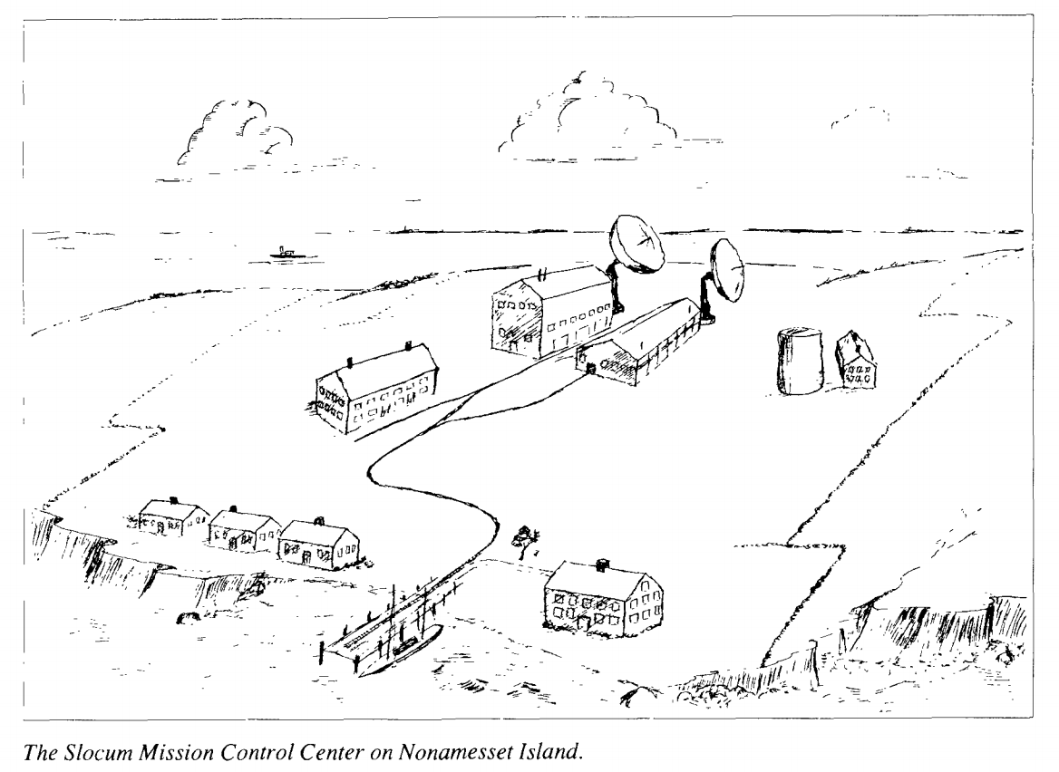
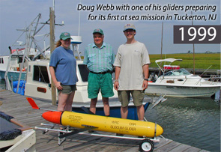
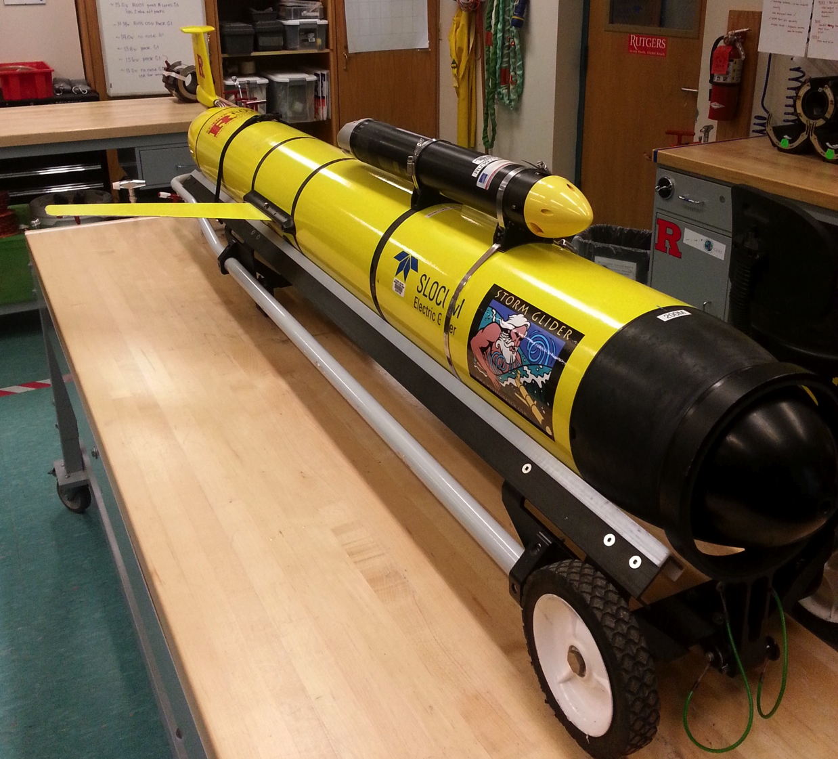
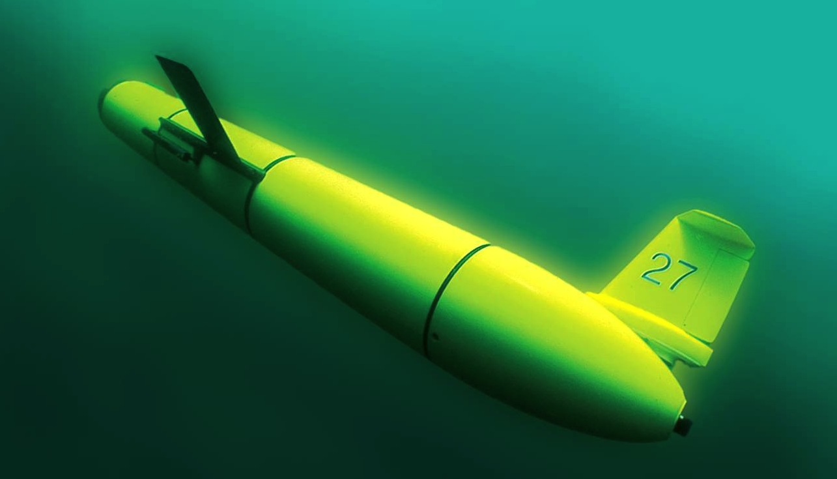
Slocum Glider Development
From Henry Stommel,
“The Slocum Mission”, a component of WOOS
1989 – Slocum Gliders in Science Fiction
1999 – Slocum Gliders in Salt Water
2009 – Slocum Glider Crosses Atlantic
2019 – Slocum Storm Gliders …

Slide 3

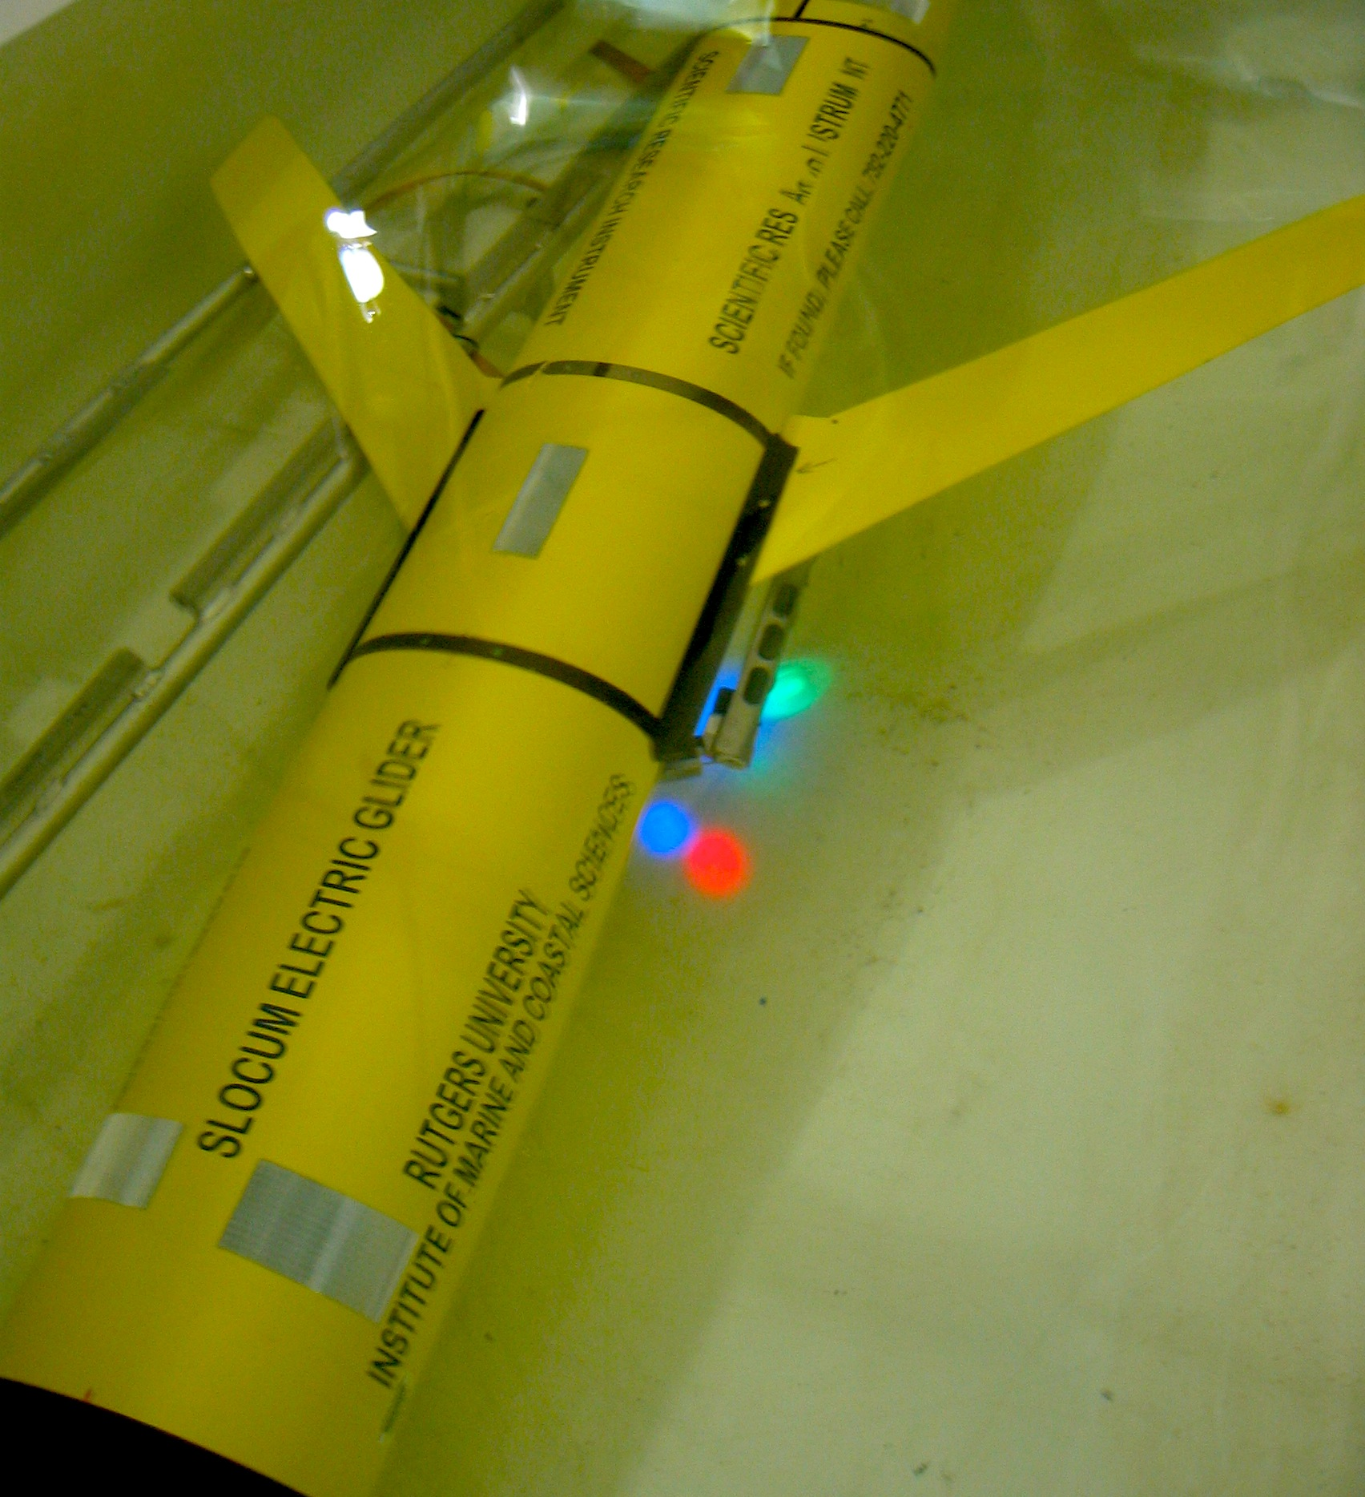
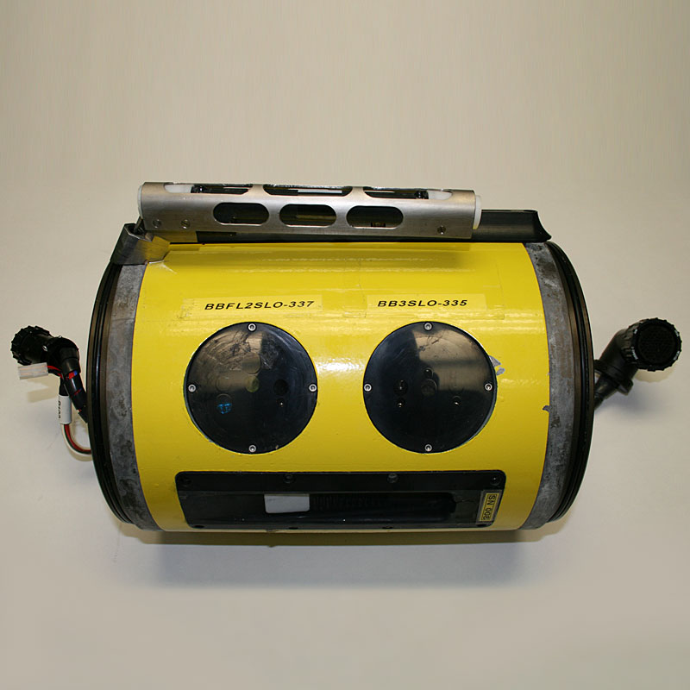
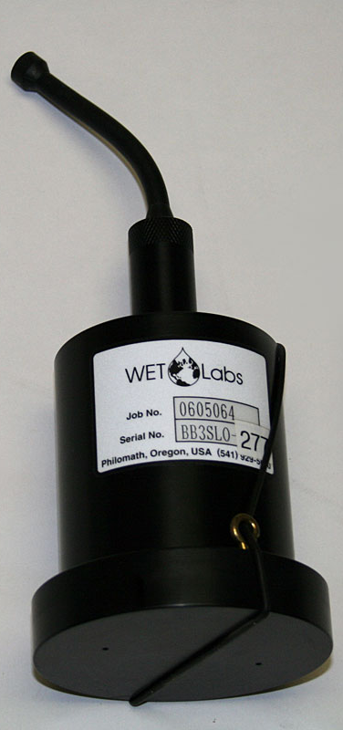

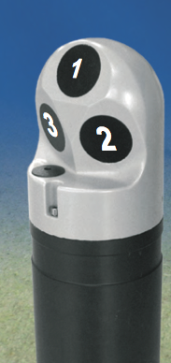
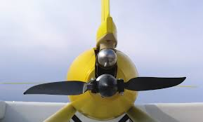
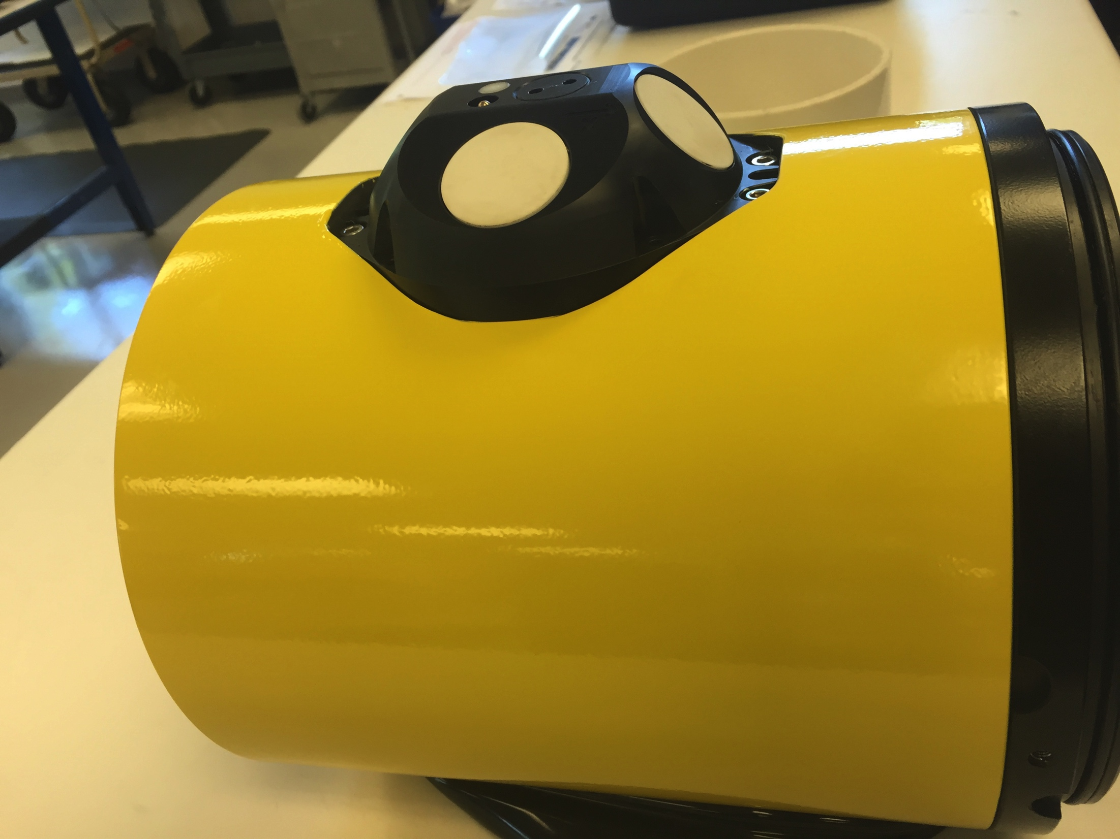
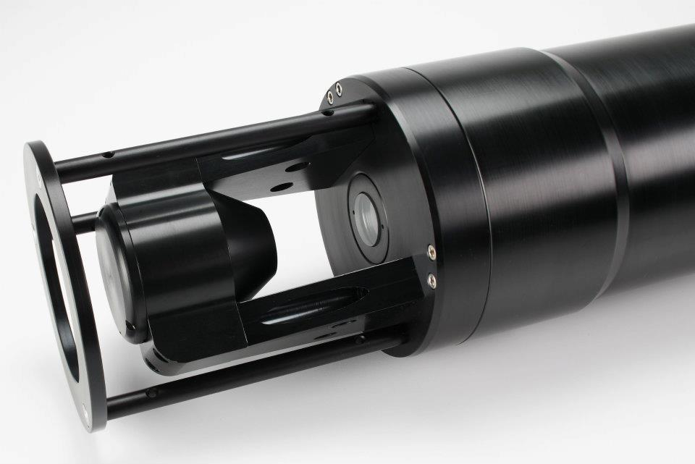
Storm Glider Development
Storm Glider (v1)
Un-pumped Seabird Conductivity Temperature Depth (CTD), Wetlabs ECOpuck (CDOM, Chlorophyll, Backscatter), Aandera Optode (Oxygen)
Storm Glider (v2)
Pumped CTD, Externally mounted Nortek Aquadopp Current Profiler, accelerometer test for waves,
extended battery bay
Storm Glider (v3)
Integrated current profilers, waves, expanded capacity buoyancy pumps, thruster, rechargeable batteries, integrated LISST-200X particle sizer (sediment, oil droplet, phytoplankton)
Notes:
Need ONR and GoMRI

Slide 4
Storm Gliders - Key Reference List
Glenn, Jones, Twardowski, Bowers, Kerfoot, Kohut, Webb, Schofield, 2008. Glider observations of sediment resuspension in a Middle Atlantic Bight fall transition storm. Limnology and Oceanography 53(5, Part 2): 2180-2196.
Miles, Glenn, Schofield, 2013. Temporal and spatial variability in fall storm induced sediment resuspension on the Mid-Atlantic Bight. Continental Shelf Research 63, Supplement: S36-S49.
Miles, Seroka, Kohut, Glenn, 2015. Glider observations and modeling sediment transport in Hurricane Sandy. JGR Oceans, DOI: 10.1002/2014JC010474
Glenn, Miles, Seroka, Xu, Forney, Yu, Roarty, Schofield, Kohut, 2016. Stratified coastal ocean interactions with tropical storms, Nature Communications, March 8, 2016, 1-10, DOI:10.1038/ncomms10887.
Seroka, Miles, Xu, Kohut, Schofield & Glenn, 2016. Hurricane Irene Sensitivity to Stratified Coastal Ocean Cooling, Monthly Weather Review, 144(9) 3507-3530.
Seroka, Miles, Xu, Kohut, Schofield & Glenn, 2017. Rapid shelf-wide cooling response of a stratified coastal ocean to hurricanes. JGR-Oceans: Special Section on Ocean Responses and Feedbacks to Tropical Cyclones, DOI:10.1002/2017JC012756.
Miles, Seroka & Glenn, 2017. Coastal ocean circulation during Hurricane Sandy, J. Geophysical Res. - Oceans, 122(9) DOI:10.1002/2017JC013031.
Sea-Bottom Interface
Air-Sea Interface

Slide 5
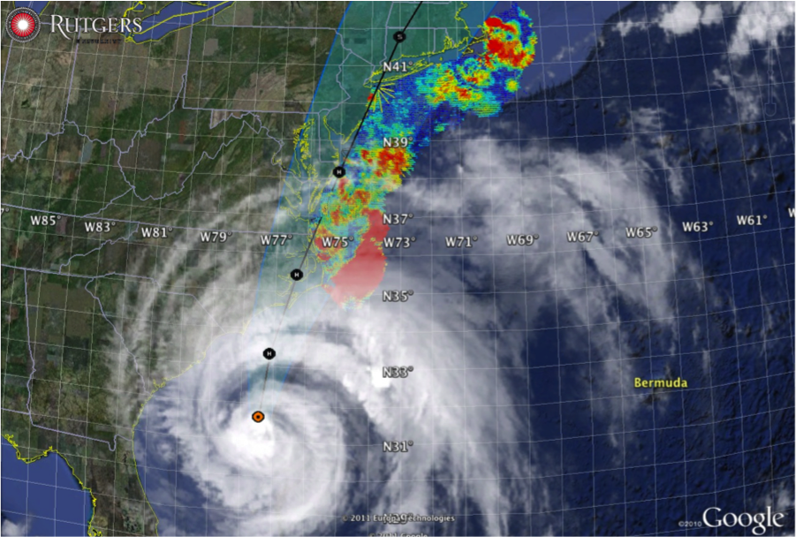

Hurricane Irene
August 28, 2011
NOAA/NHC Damage:
>$16 Billion.
Track Accurate;
Intensity Over-predicted.
Avila & Cangialosi, 2012, Tropical Cyclone Report
Hurricane Sandy
October 29, 2012
NOAA/NHC Damage:
>$68 Billion.
Track Accurate;
Surge Under-predicted.
Georgas et al., 2014, J. of Extr. Even.
Colle et al., 2015, J. Mar. Sci. & Engr.

Slide 6
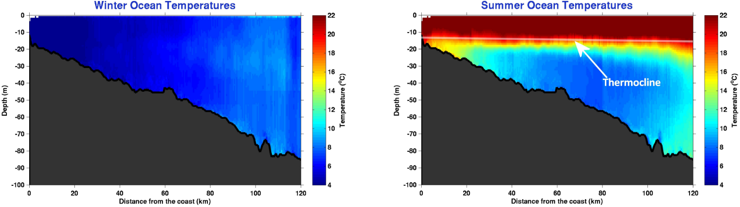
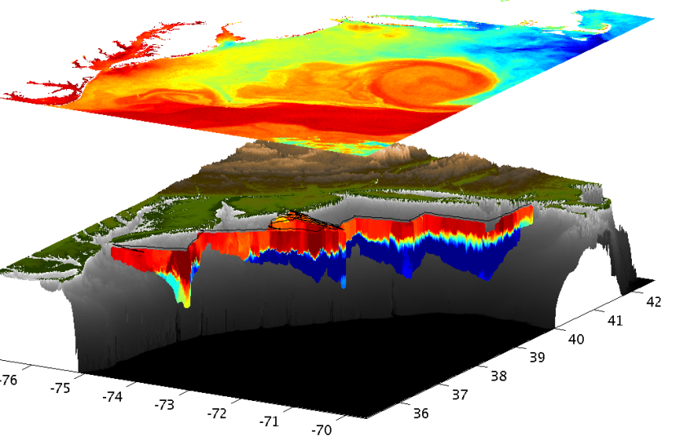
Essential Ocean Feature - Mid-Atlantic’s Cold Pool
An unseen cold bottom layer beneath a warm summer surface layer
Mid Atlantic
Winter (1-layer)
Mid Atlantic
Summer (2-layers)
Cold Pool
Satellite SST
Assimilated into Regional
Ocean Models
Glider Zig-Zags
or Triangles
Bottom Temperature
Why unseen? Satellites cannot see below surface, Argo Floats do not extend into shallow water

Slide 7
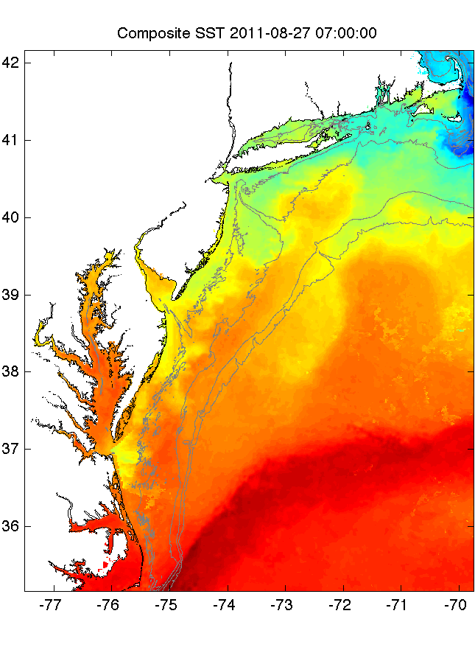
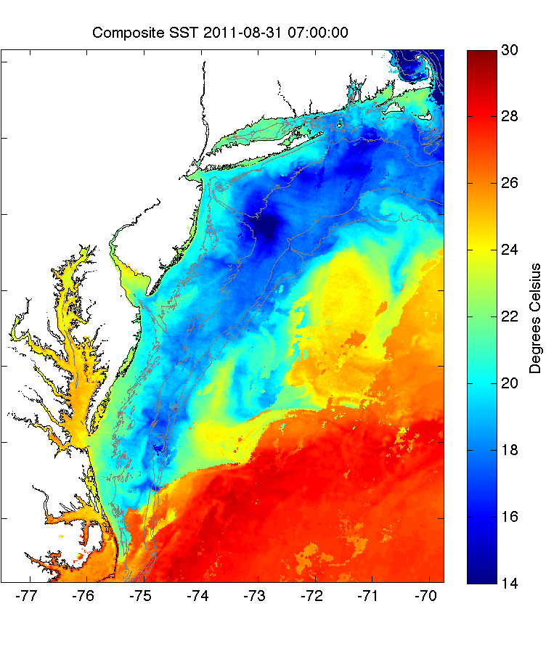
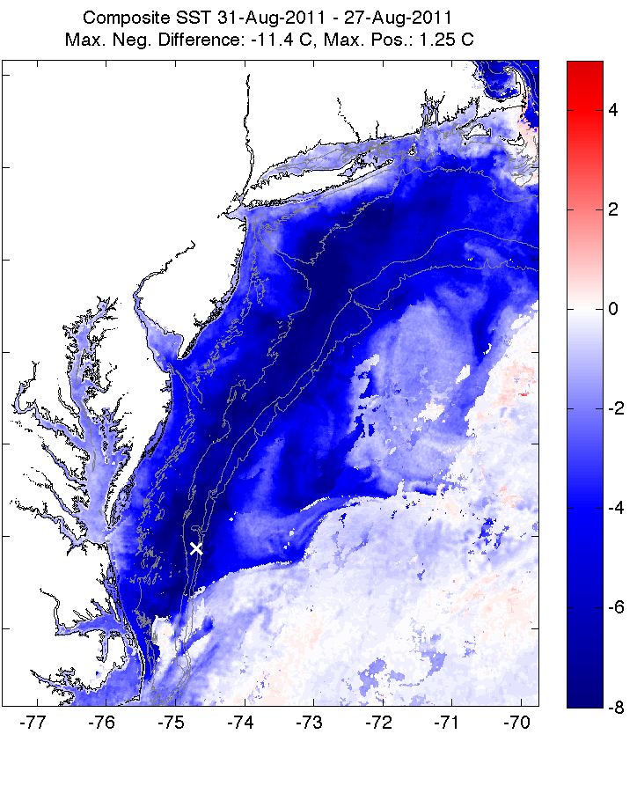
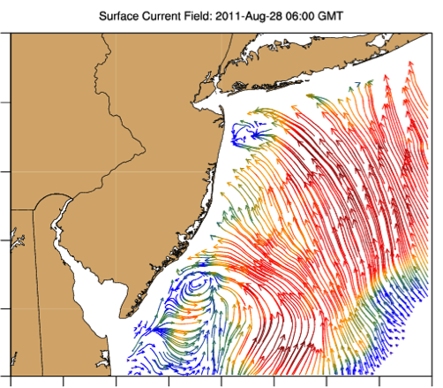
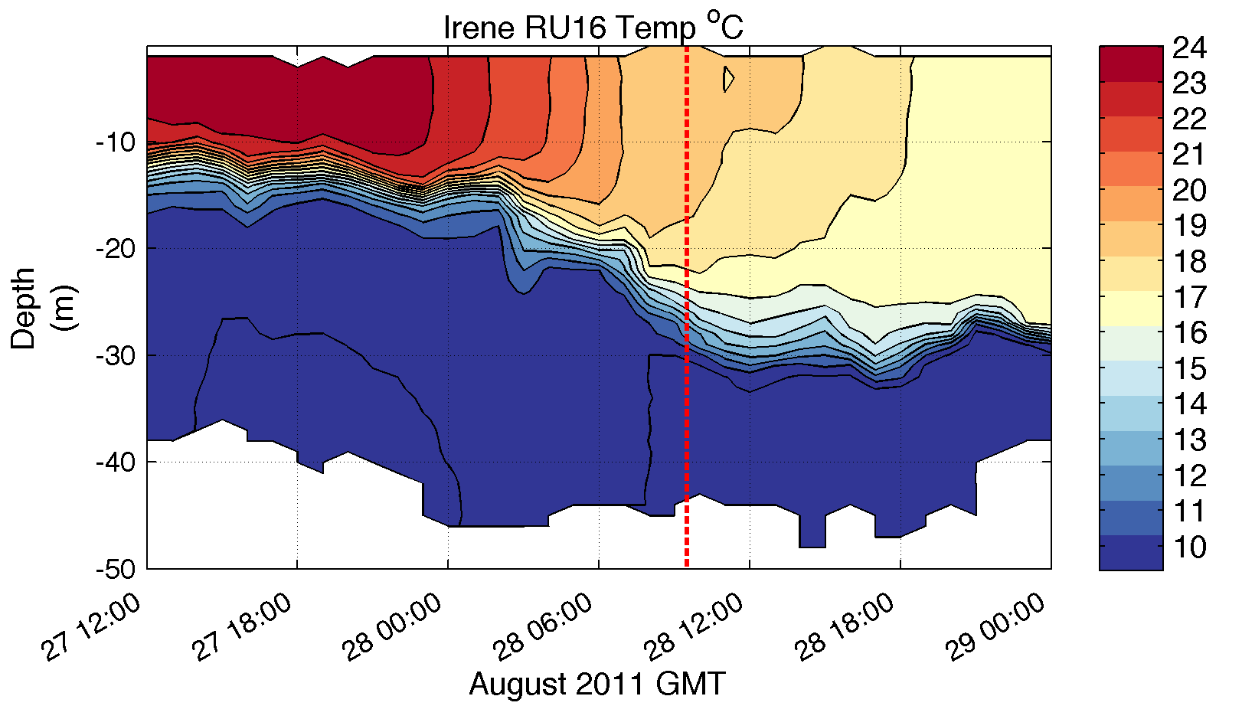
Pre-Irene
Post-Irene
Difference
11C max Cooling
WHAT?
Satellite
SST
WHEN? Glider Temperature
WHY?
HF Radar
Currents
Eye Passage

Slide 8
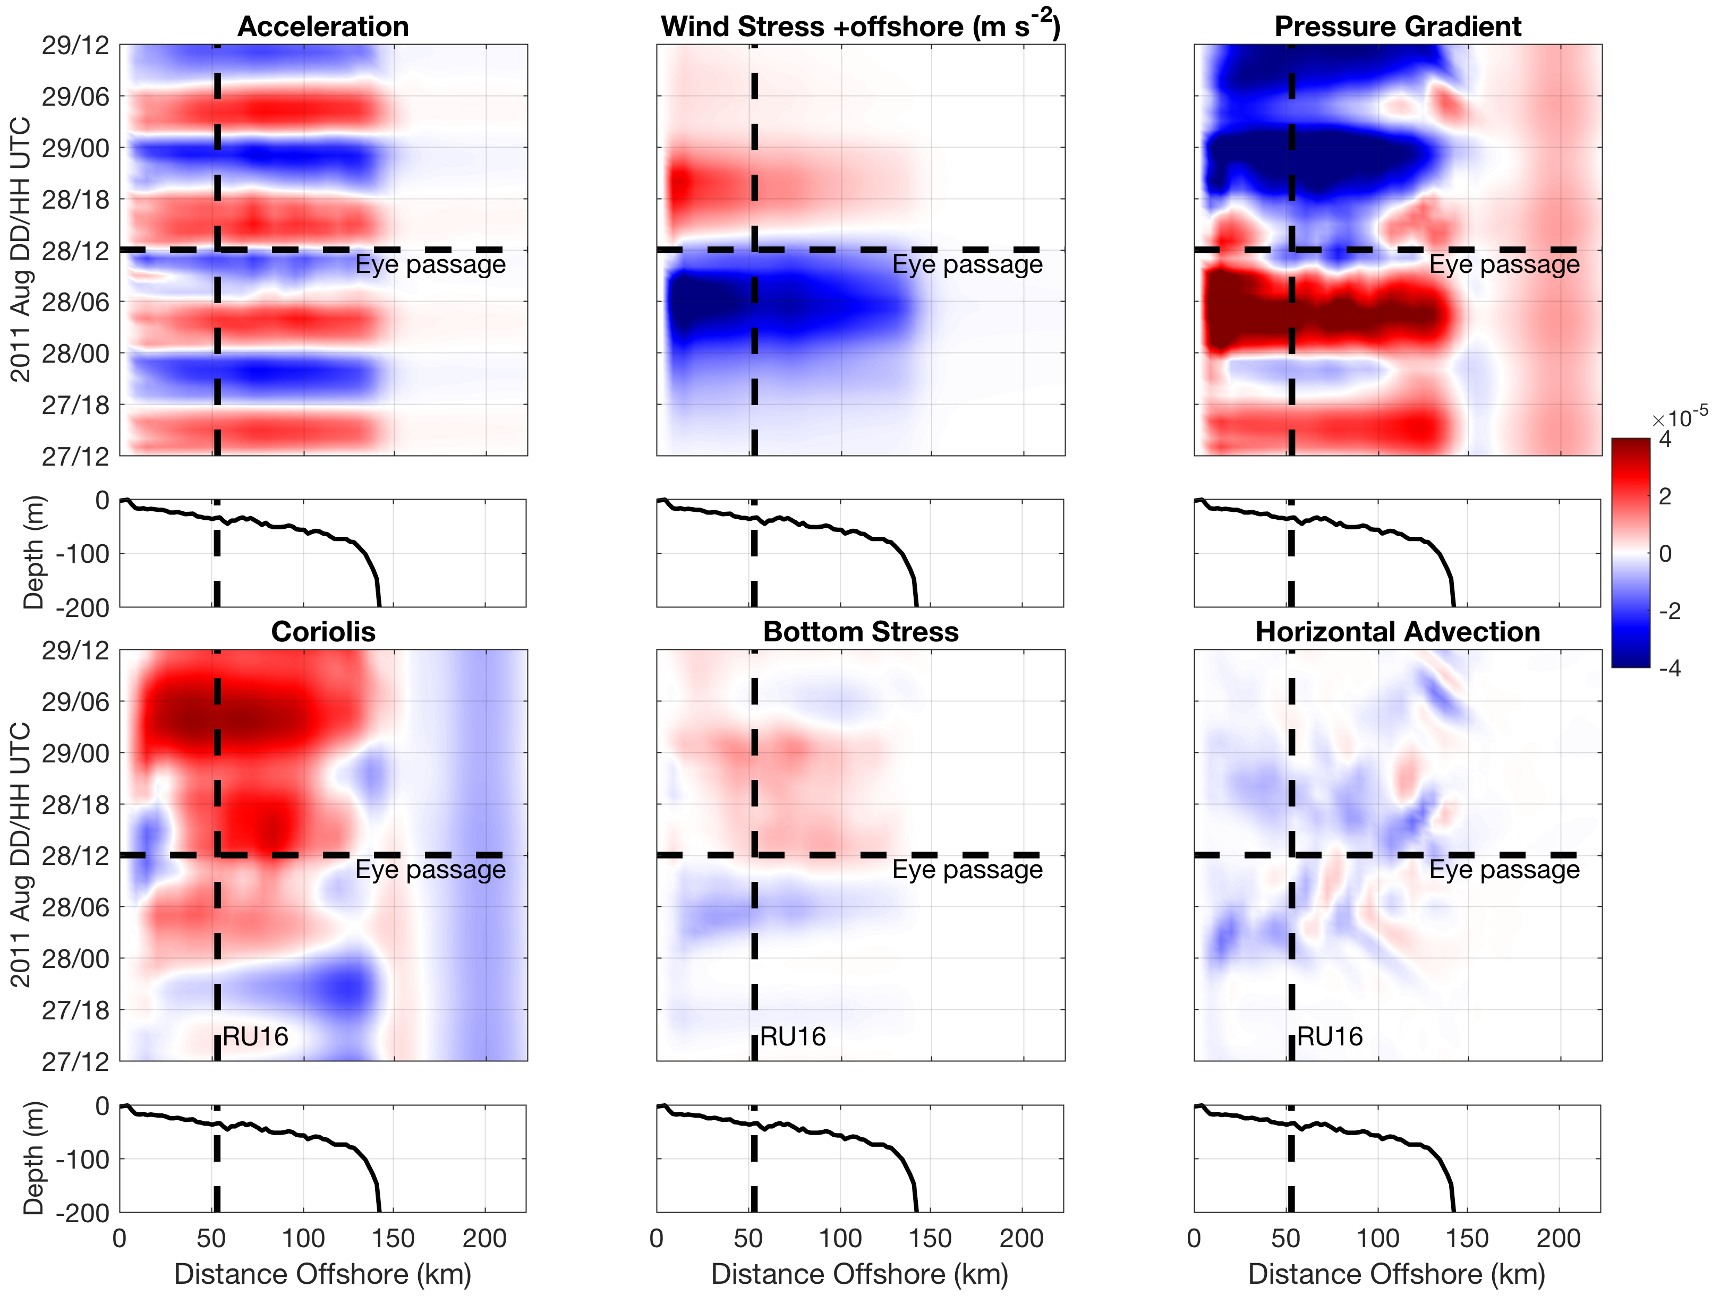
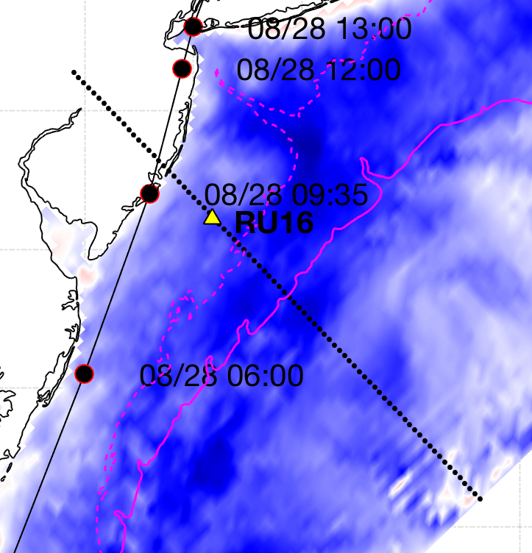
Essential Ocean Processes IRENE - Onshore WS vs. Offshore PG
+offshore
m s⁻²
-onshore
Seroka et al. 2017
Notes:
15

Slide 9
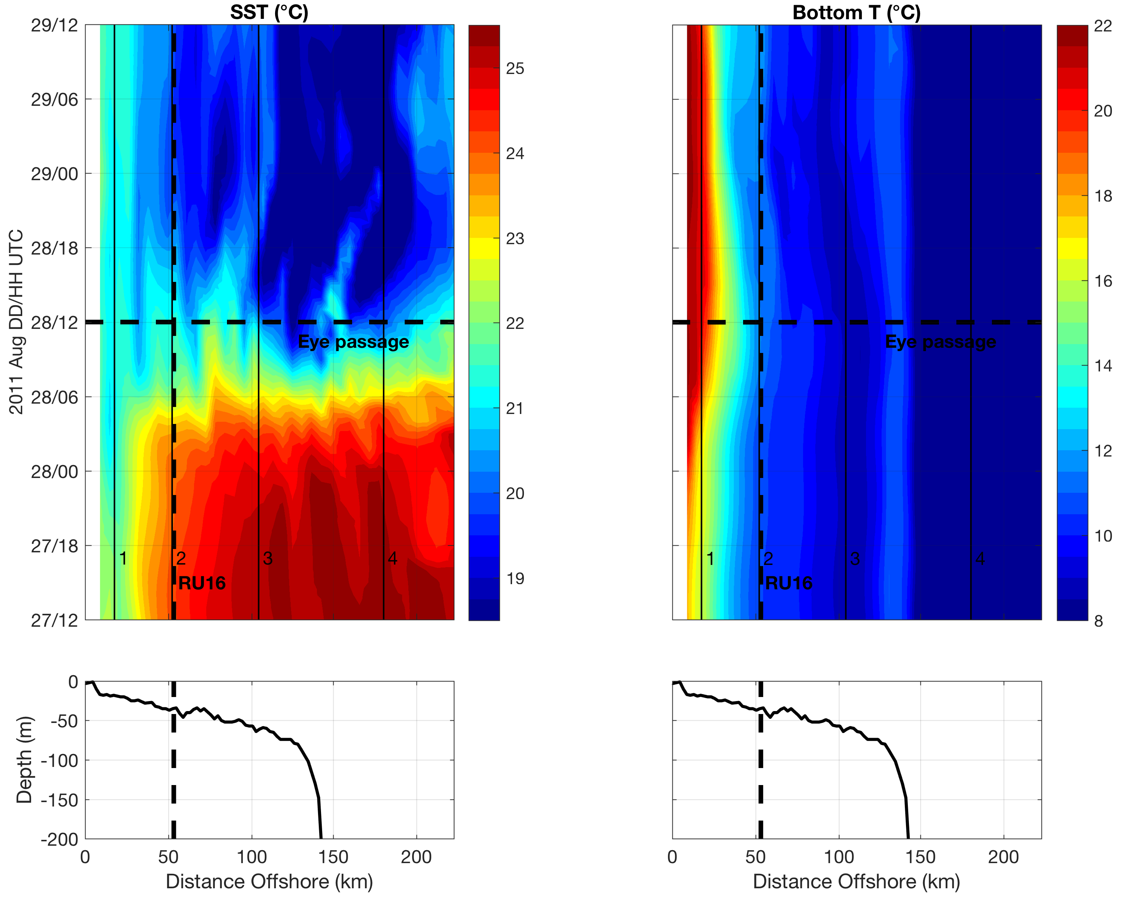
Essential Ocean Processes IRENE: Vertical Mixing & SST Cooling
AOEC SST cooling
Downwelling
Upwelling
Seroka et al. 2017.
Notes:
10

Slide 10
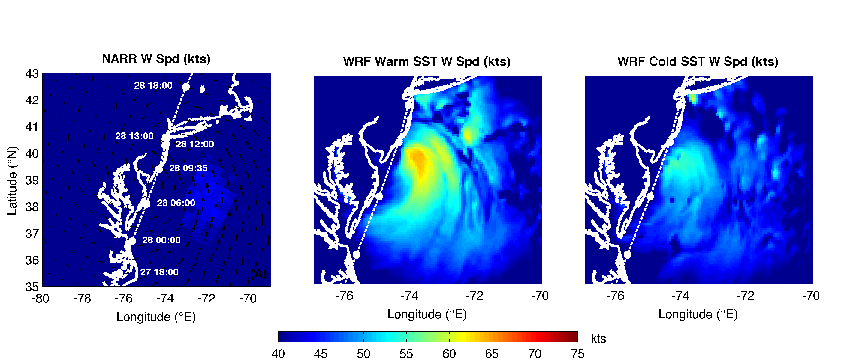
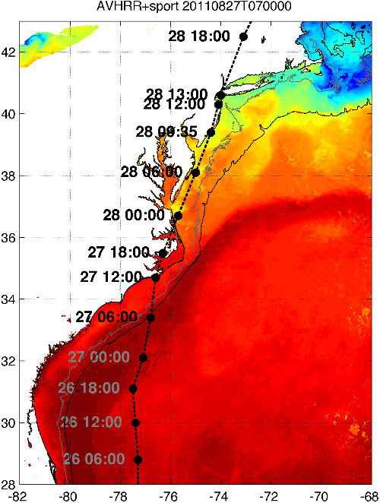
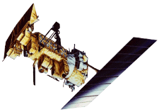

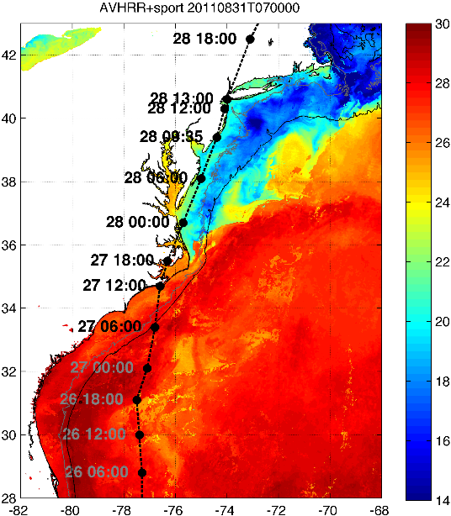

WRF Atmospheric Forecast Sensitivity Study – >130 tests
Warm Ocean
Boundary Condition
Cat 1 Hurricane
Tropical Storm
Cold Ocean
Boundary Condition
IMPACT?
>10 knots reduction in peak wind speed

Slide 11
Hurricane Irene
August 28, 2011
NOAA/NHC Damage:
>$16 Billion.
Track Accurate;
Intensity Over-predicted.
Avila & Cangialosi, 2012, Tropical Cyclone Report
Hurricane Sandy
October 29, 2012
NOAA/NHC Damage:
>$68 Billion.
Track Accurate;
Surge Under-predicted.
Georgas et al., 2014, J. of Extr. Even.
Colle et al., 2015, J. Mar. Sci. & Engr.

Slide 12
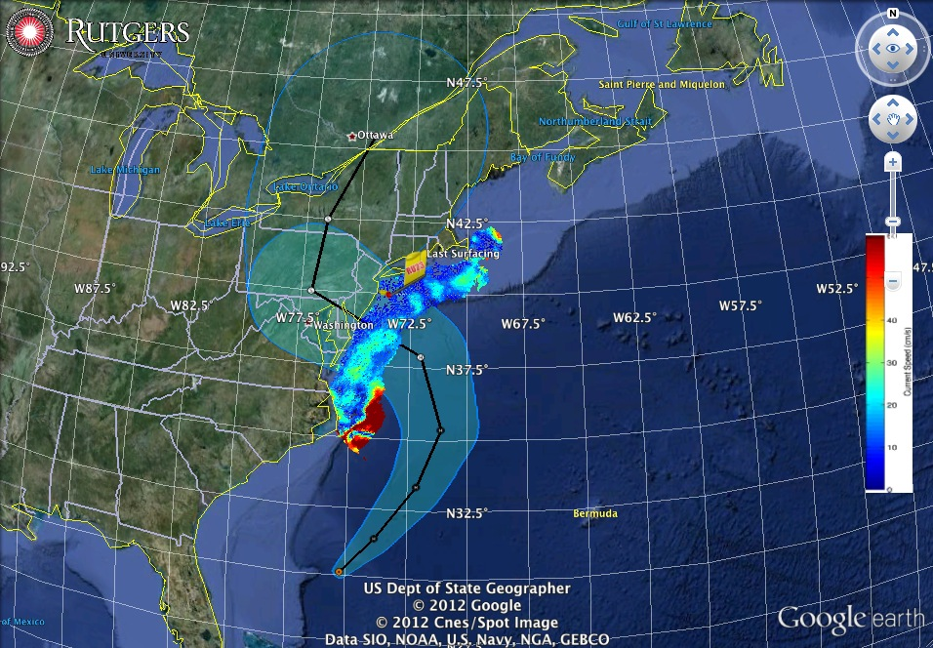
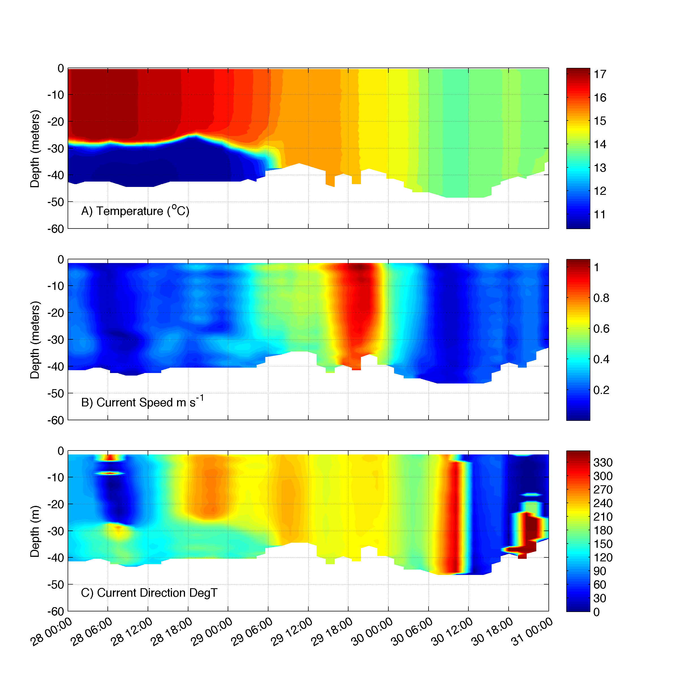
Superstorm Sandy: 2 Days Before Landfall

Slide 13
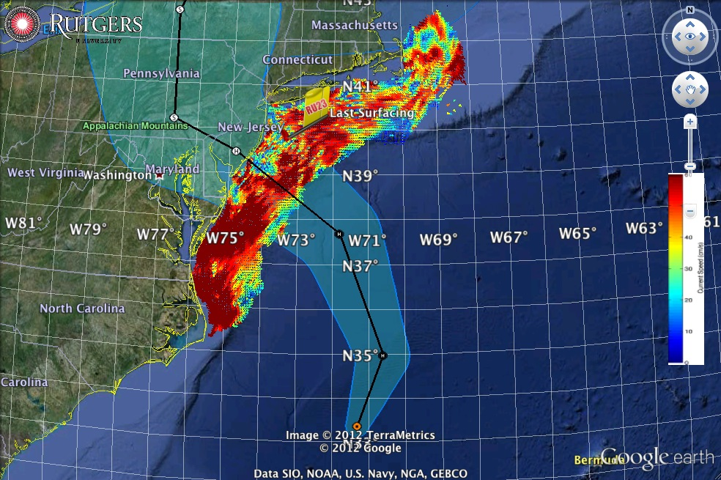
Superstorm Sandy: 1 Day Before Landfall

Slide 14
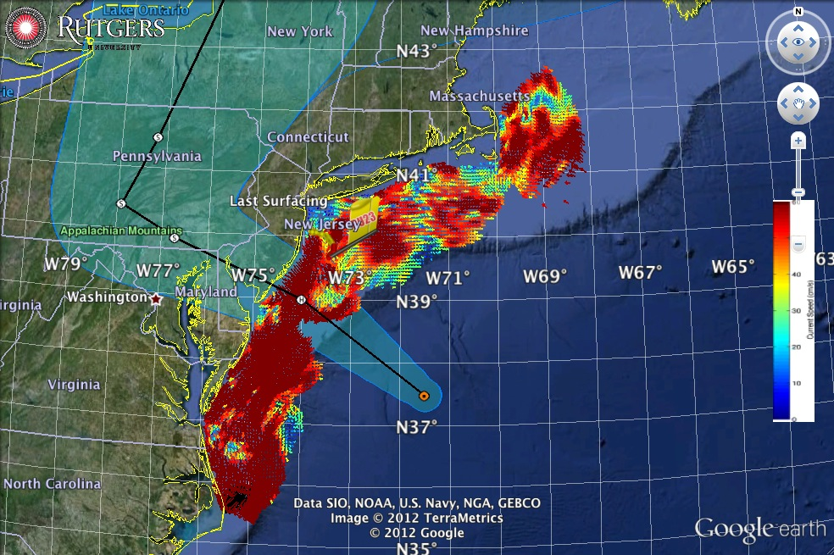
Superstorm Sandy: Morning Before Landfall

Slide 15
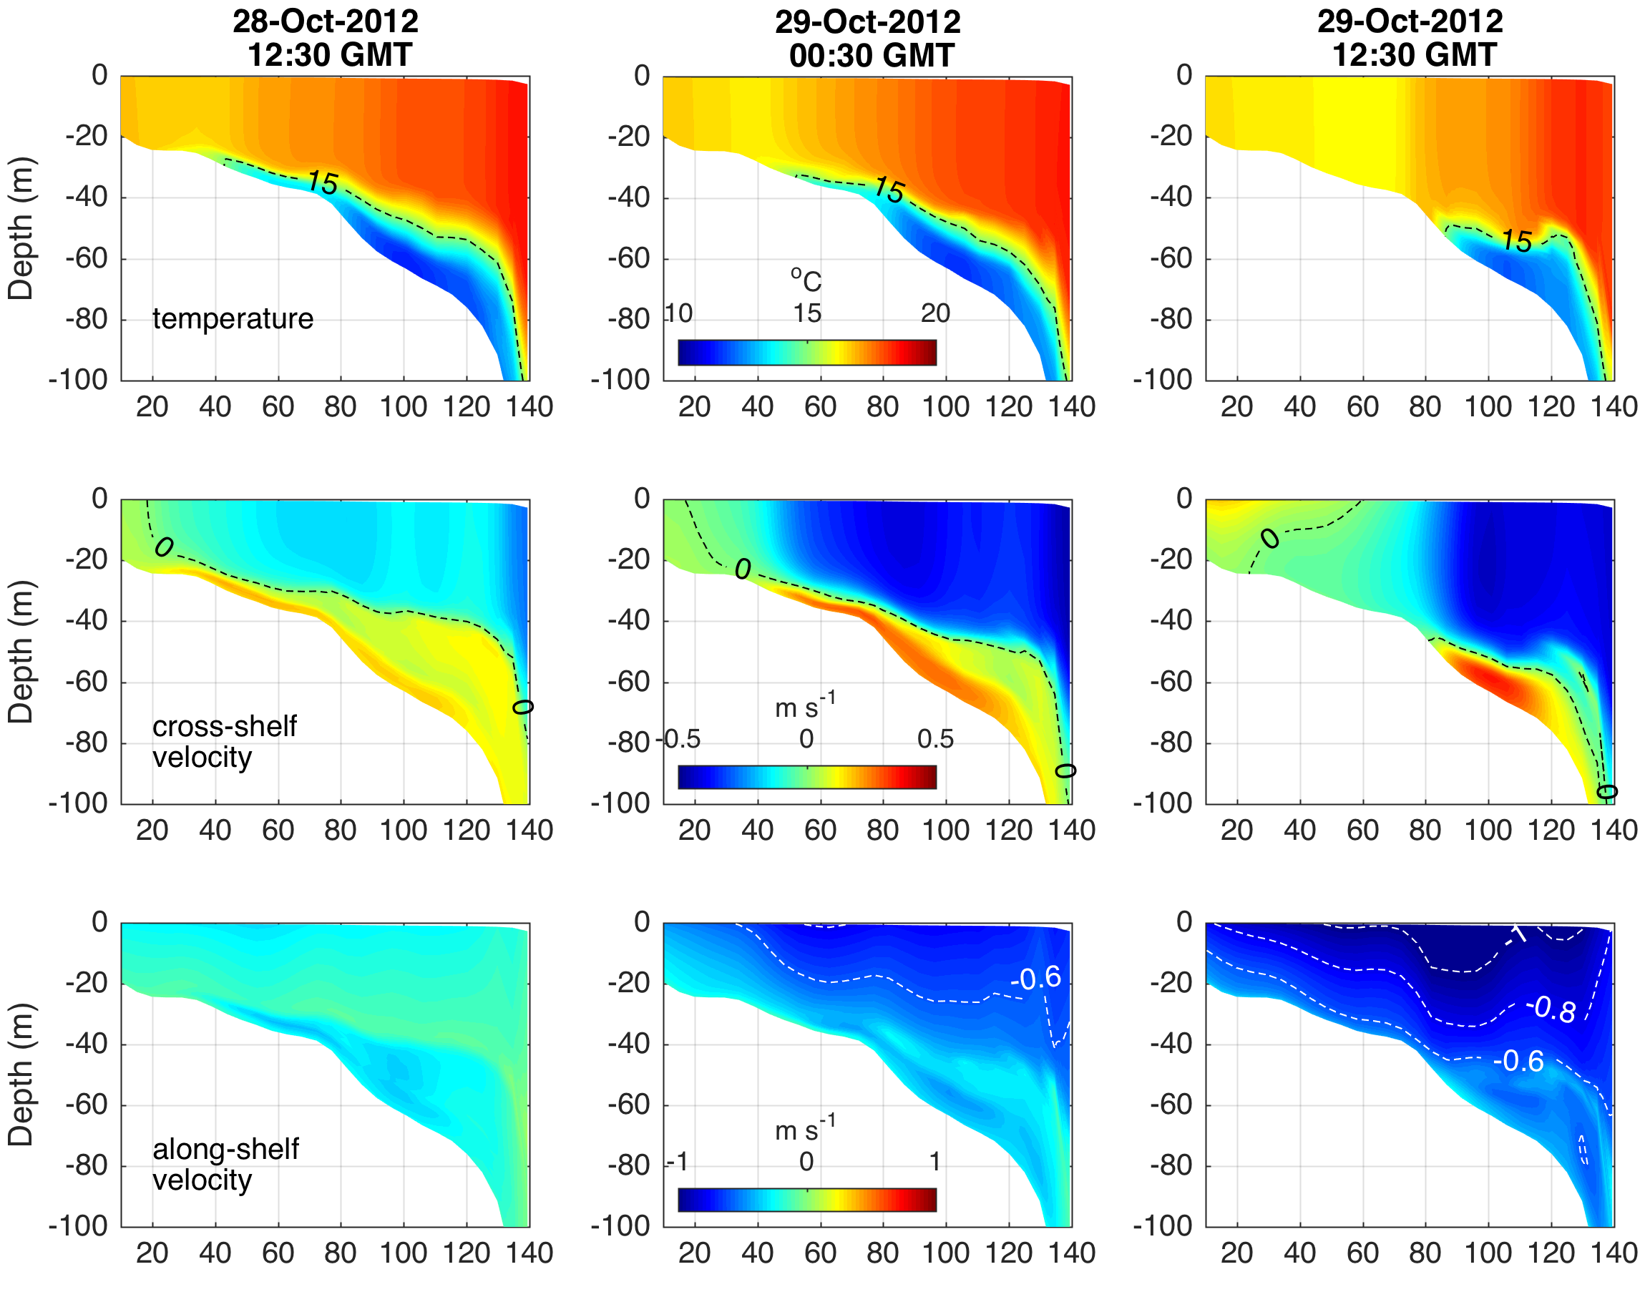
Hurricane Sandy
ROMS
Cross-Section
32 Hrs
Pre-Landfall
20 Hrs
Pre-Landfall
8 Hrs
Pre-Landfall
Temperature
Cross-shelf
Velocity
Along-shelf
Velocity
Distance Offshore (km)

Slide 16
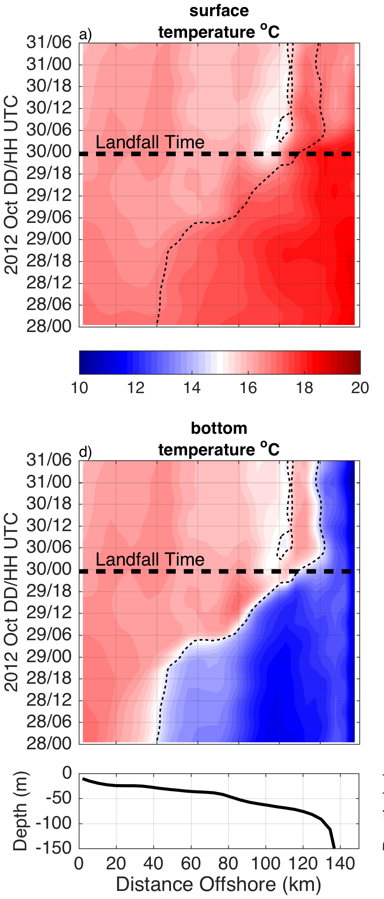
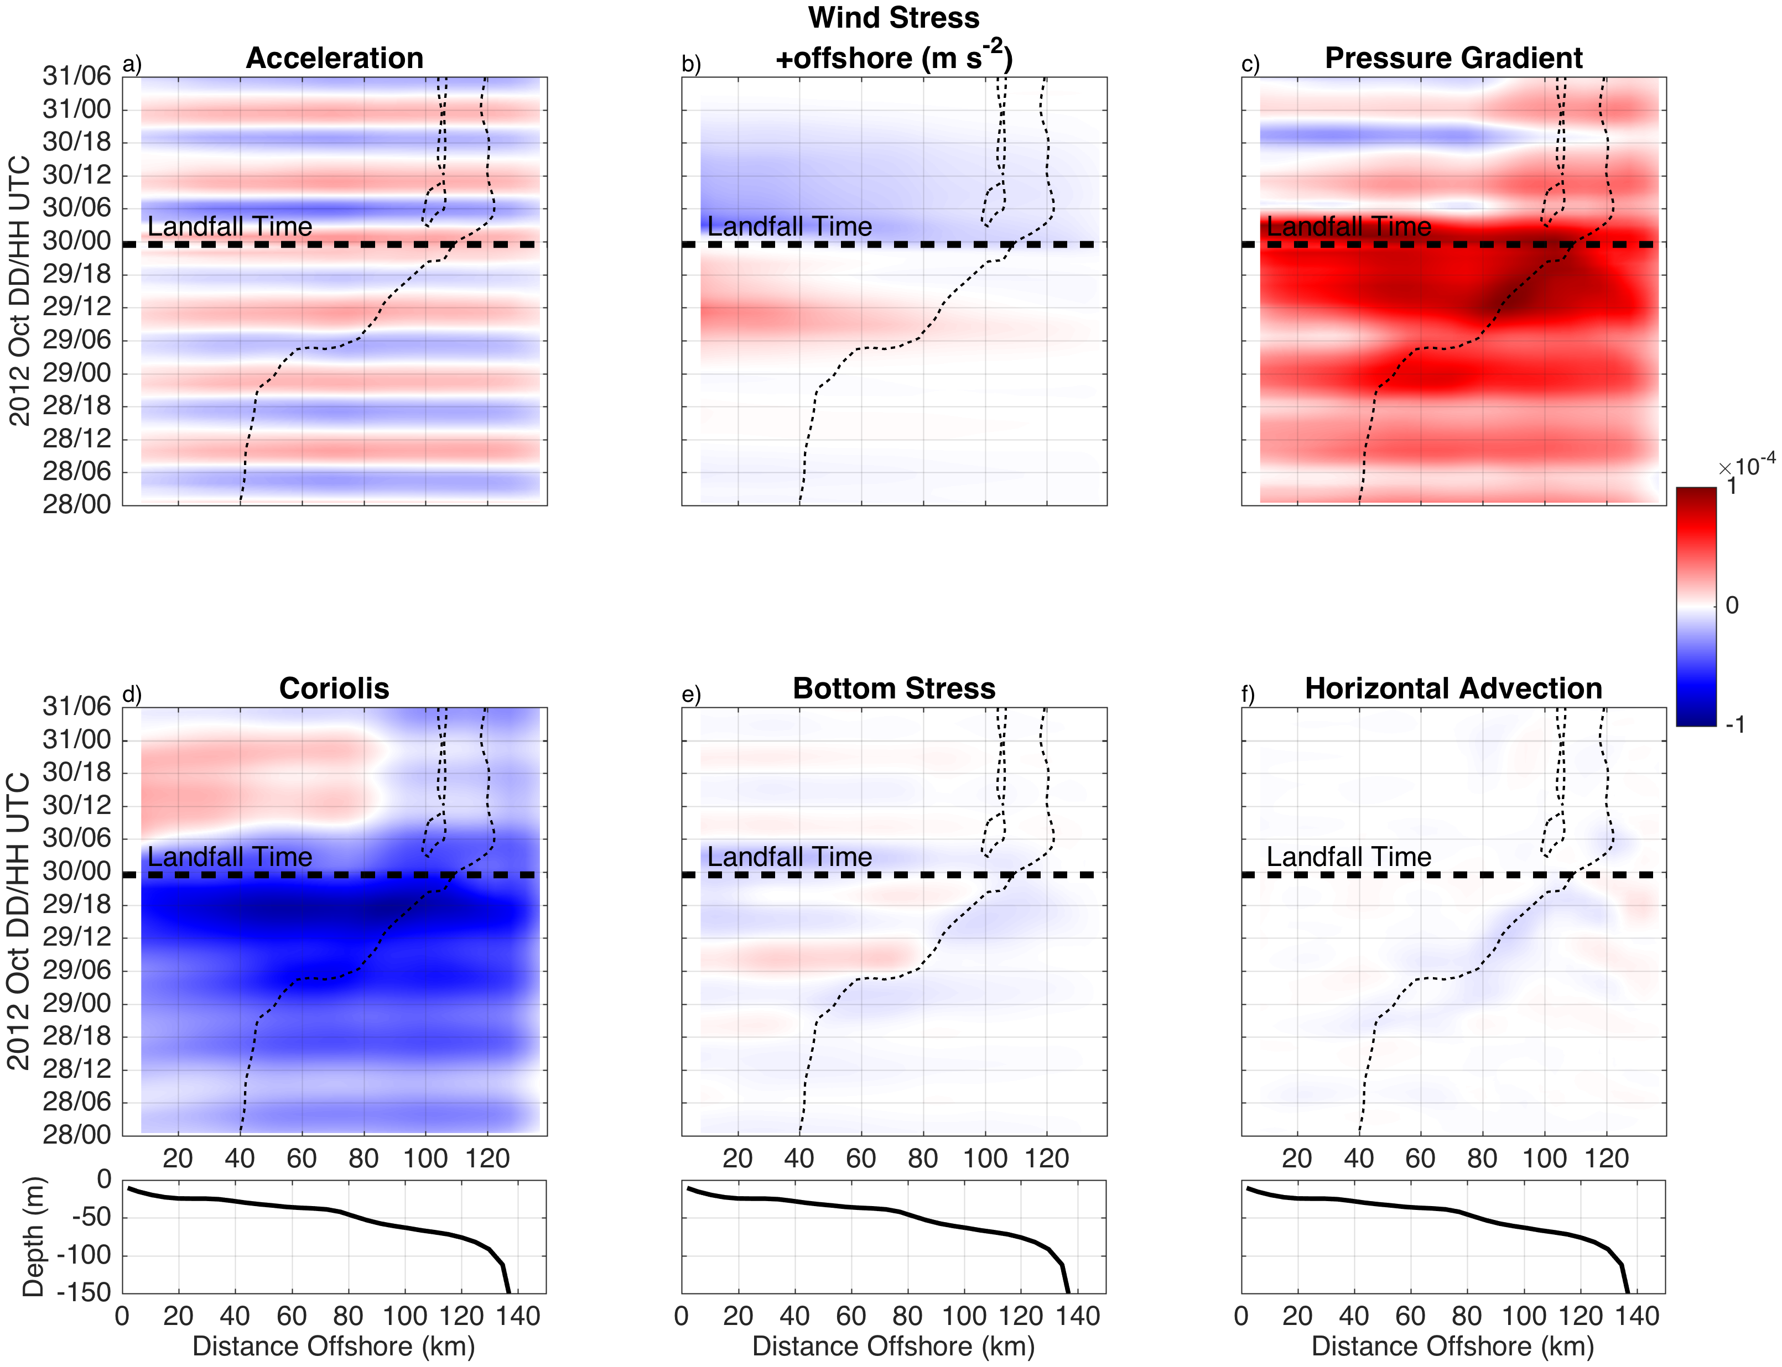
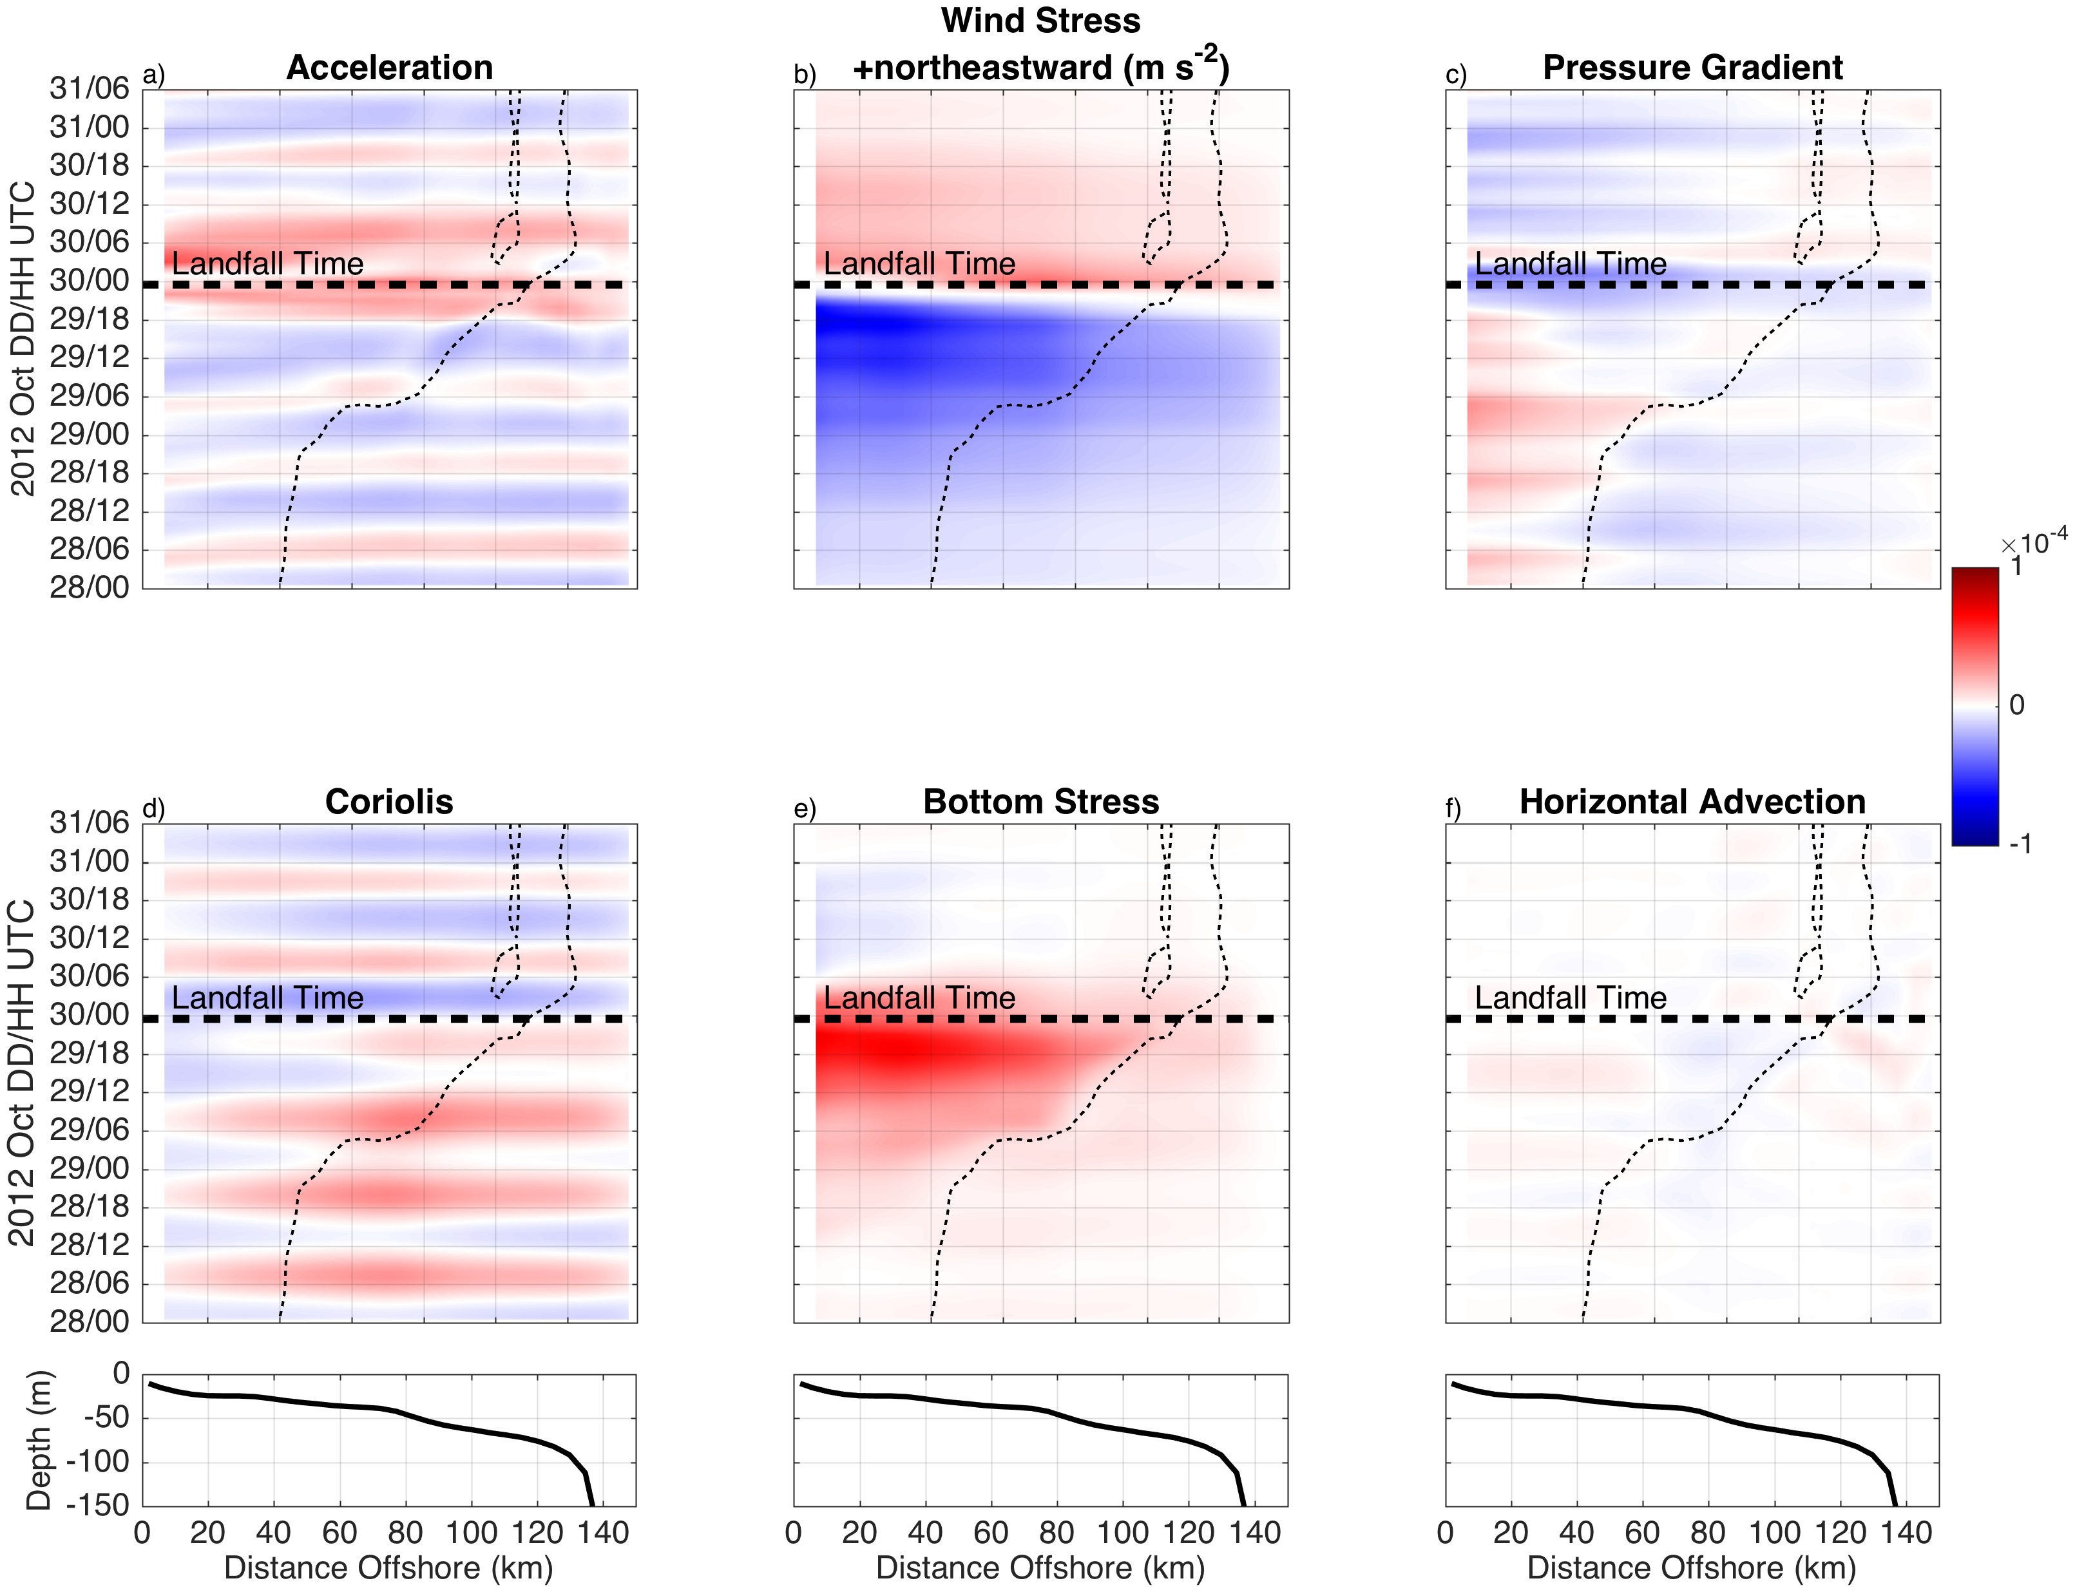
Essential Ocean Processes SANDY Alongshore WS vs BS, Downwelling
Surface T
Cross-shelf Force Balance
Along-shelf Force Balance
Bottom T

Slide 17
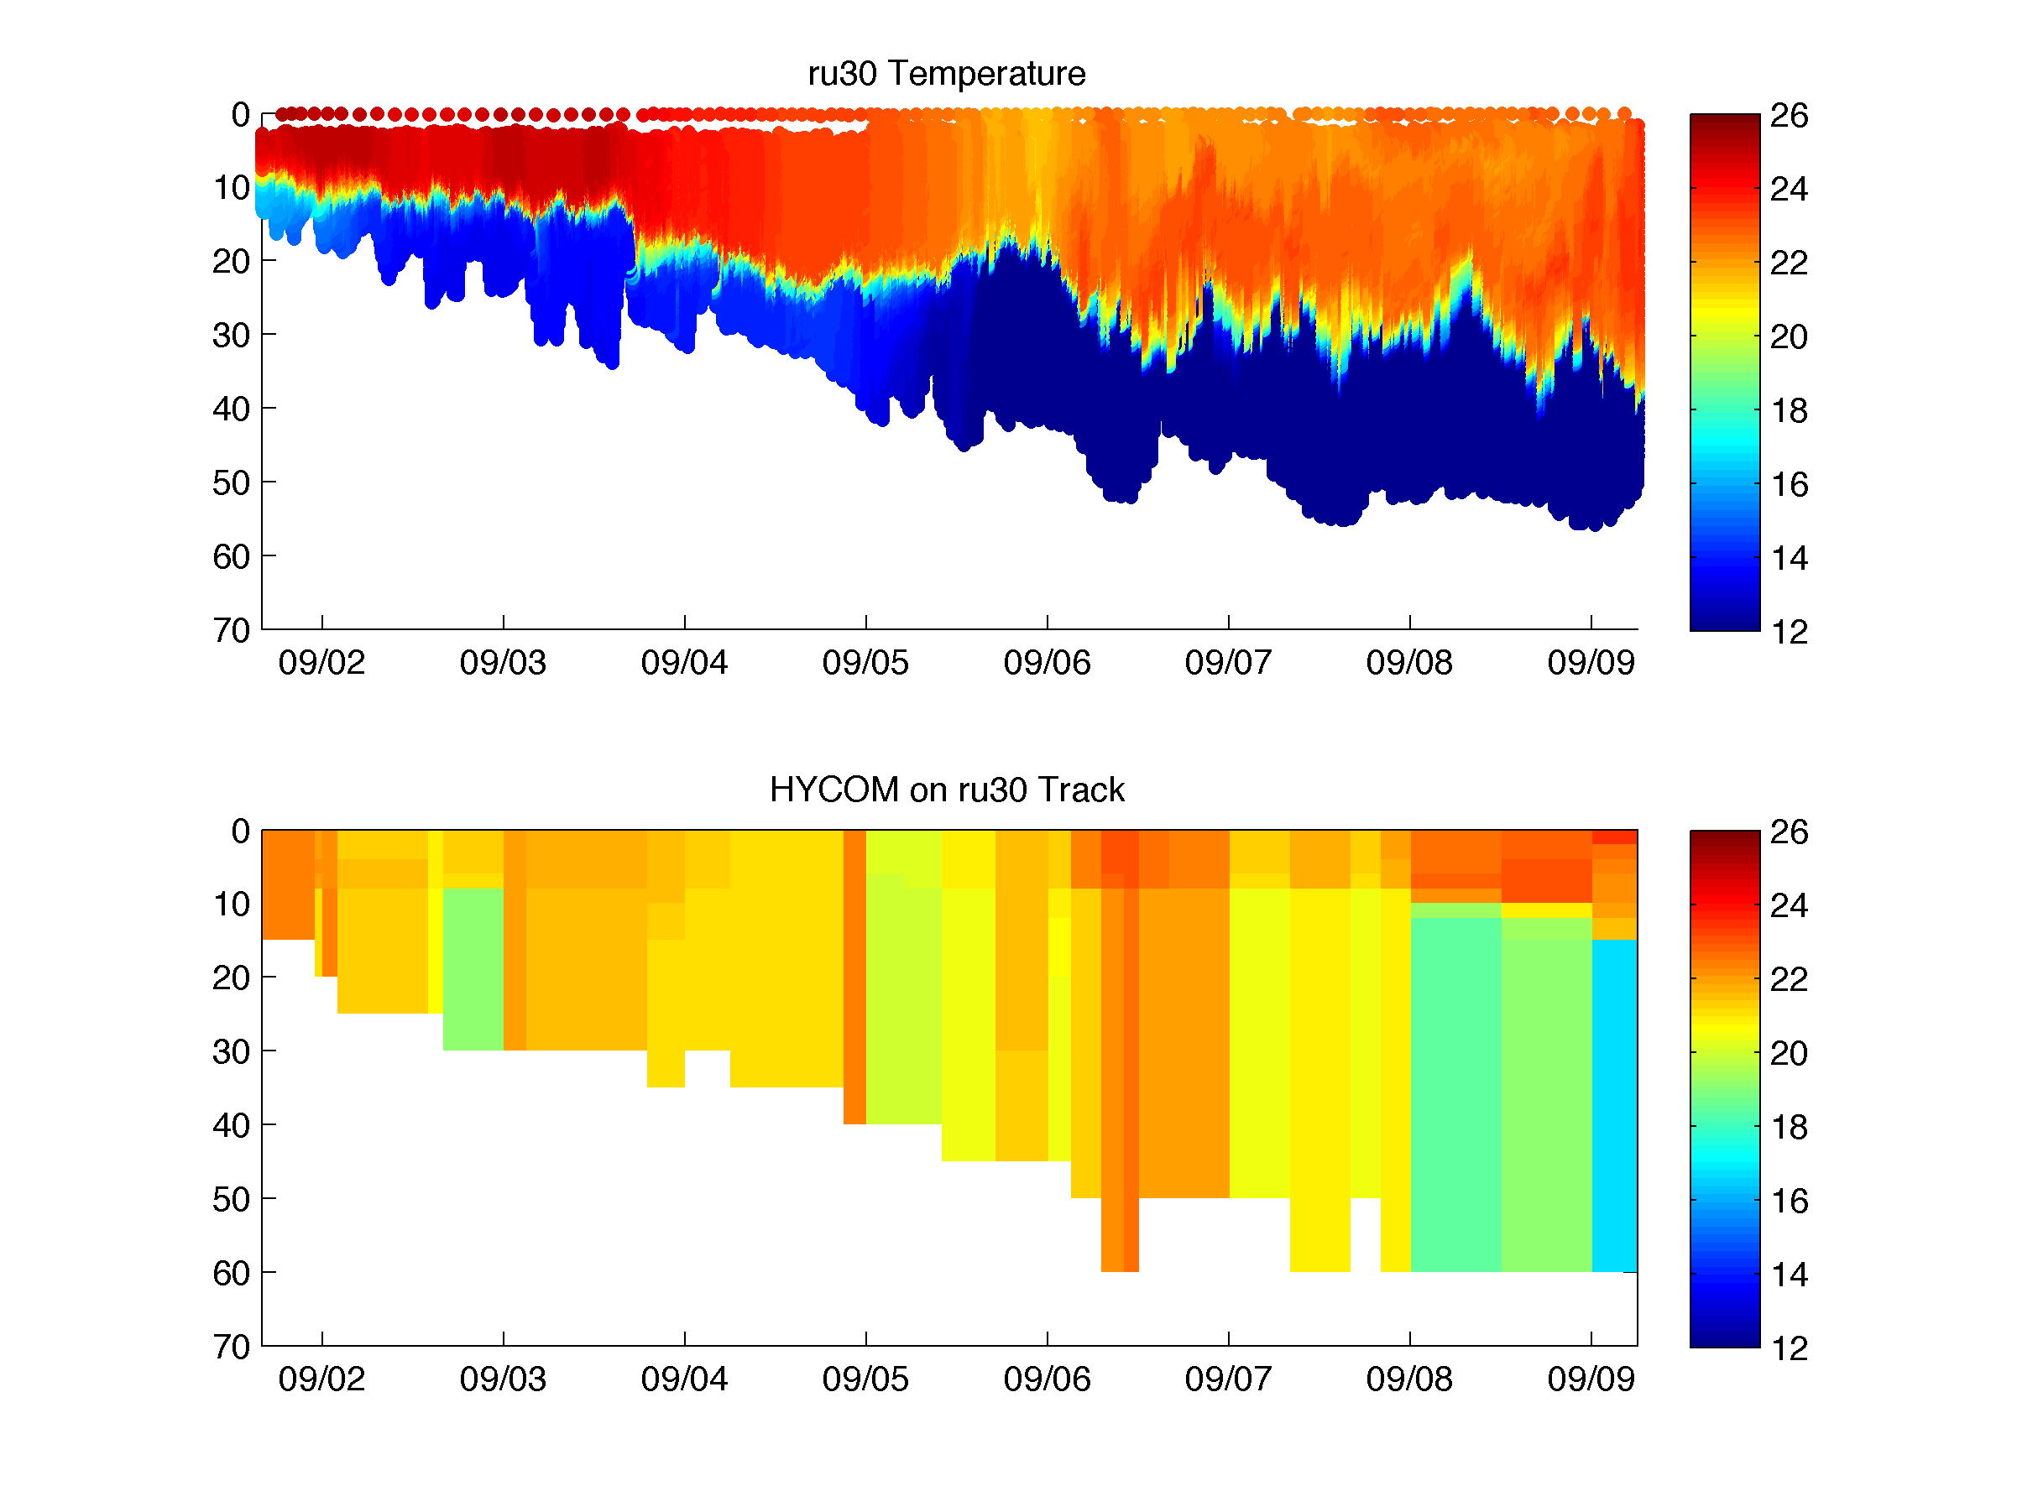
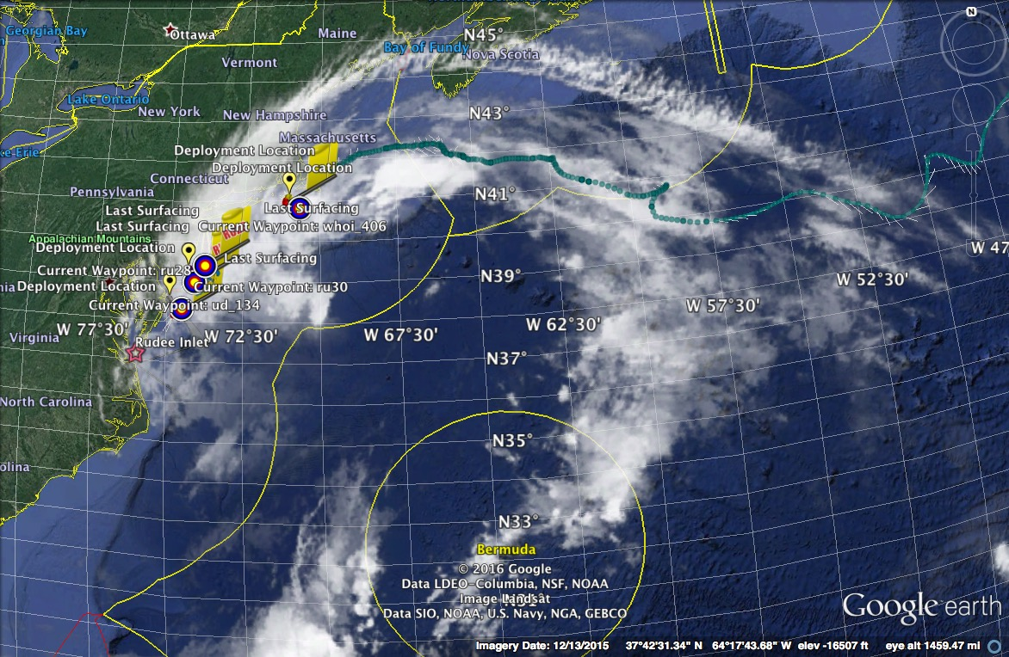
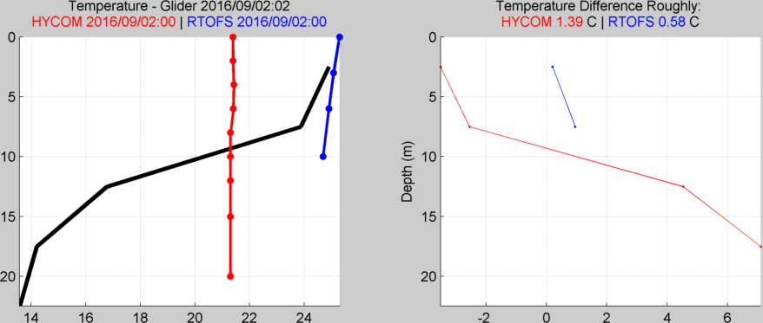
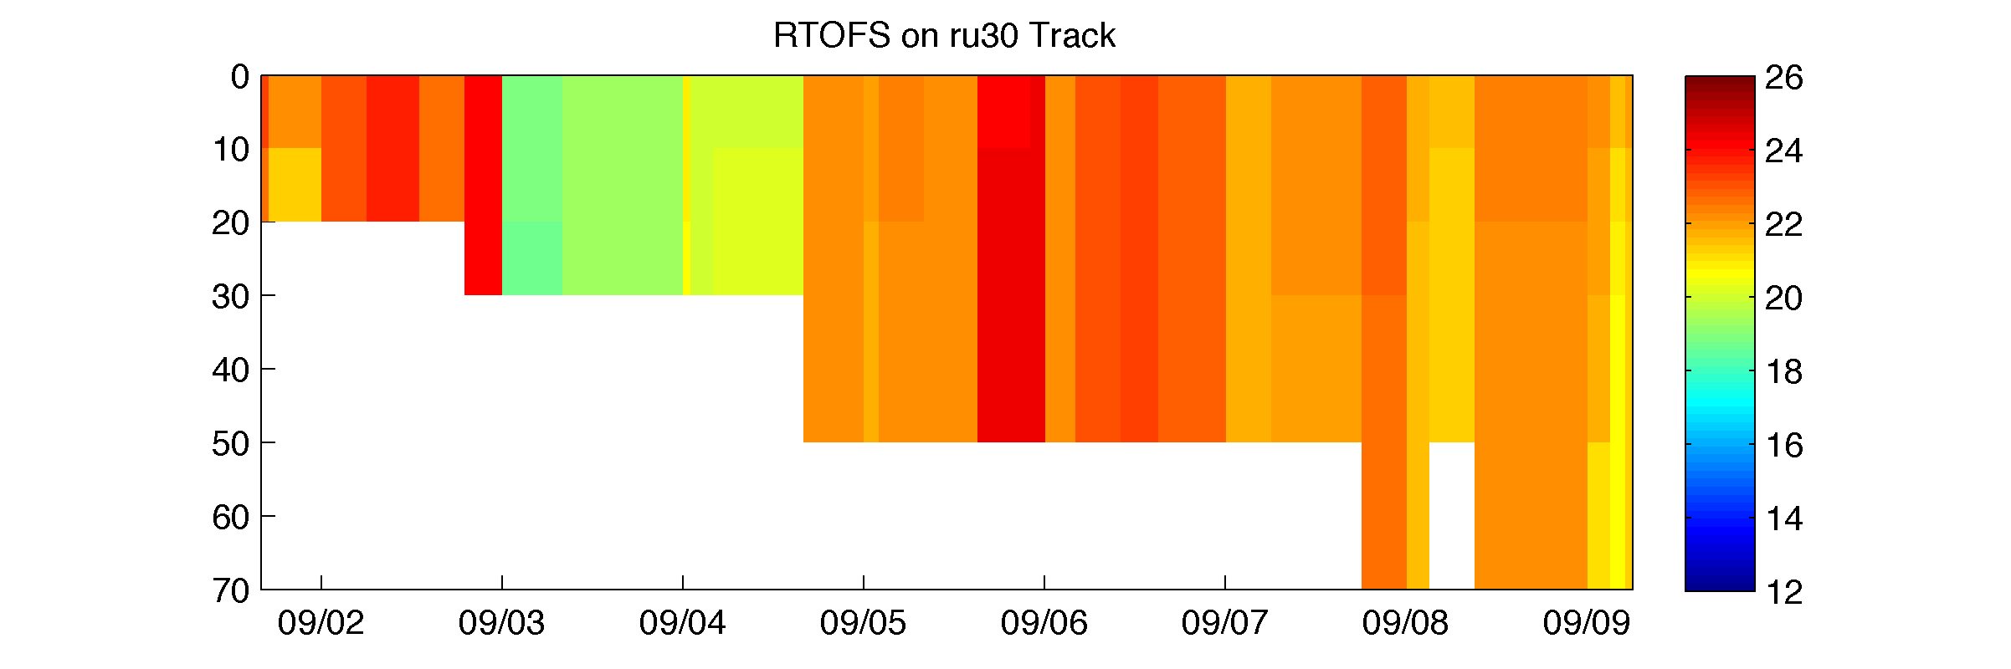
Hurricane Hermine Response: CINAR/MARACOOS Glider Fleet Launched, 9/2016
Storm Glider
HYCOM
RTOFS

Slide 18
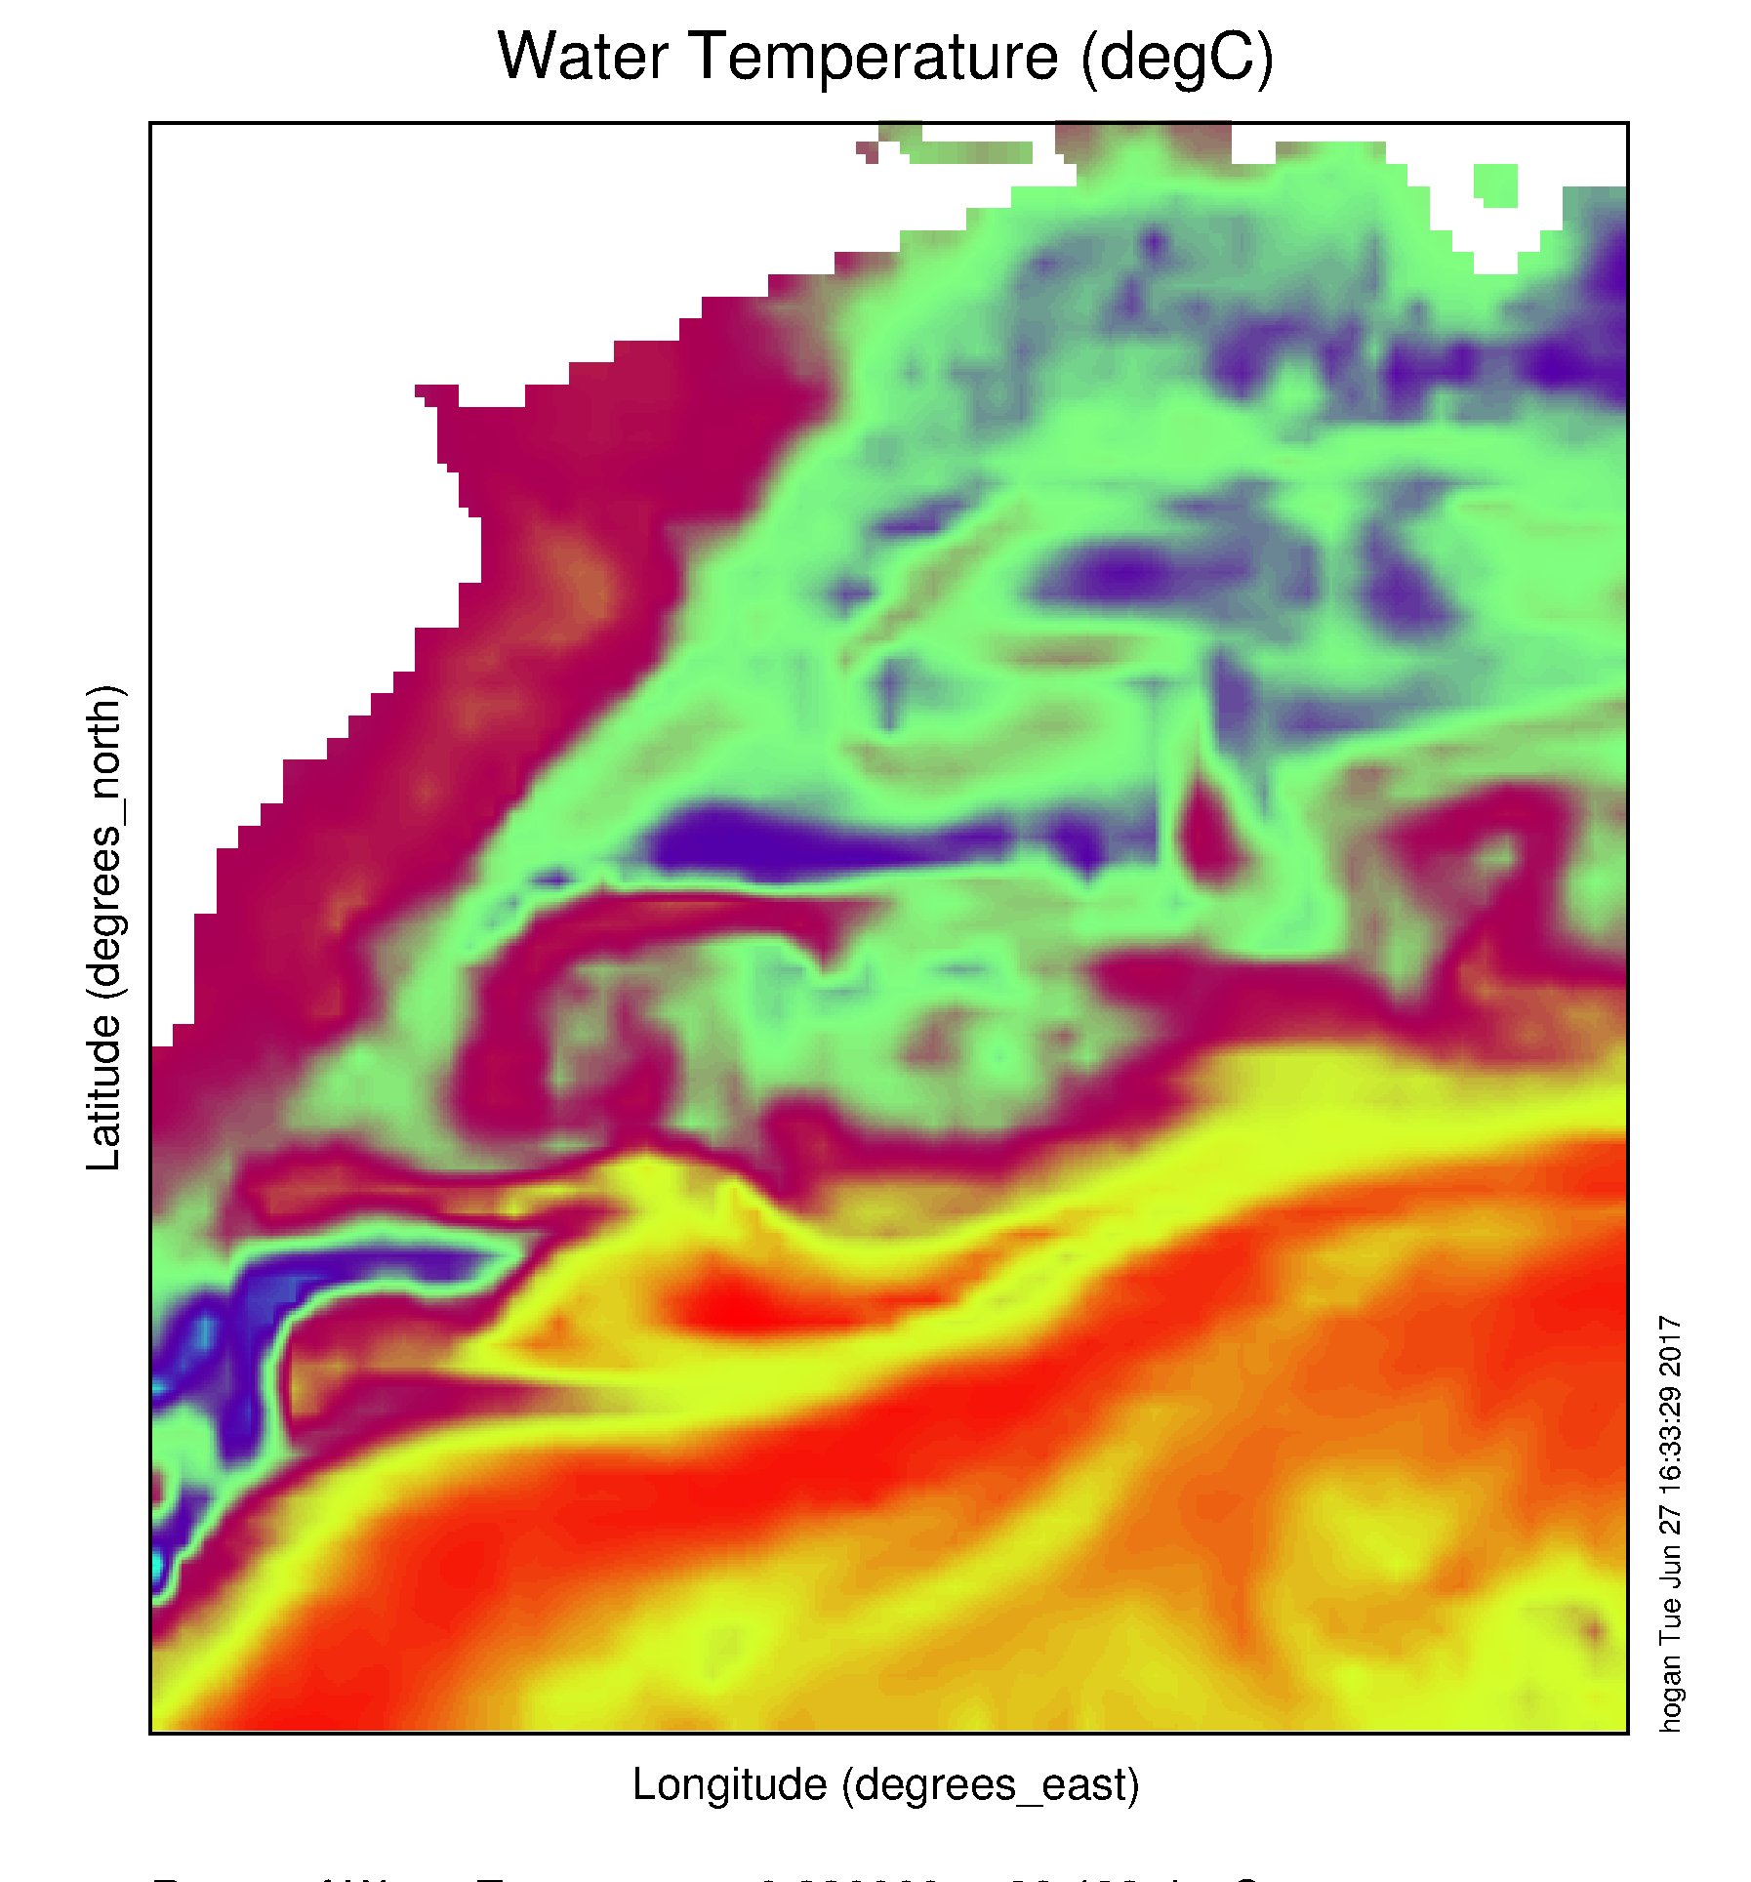
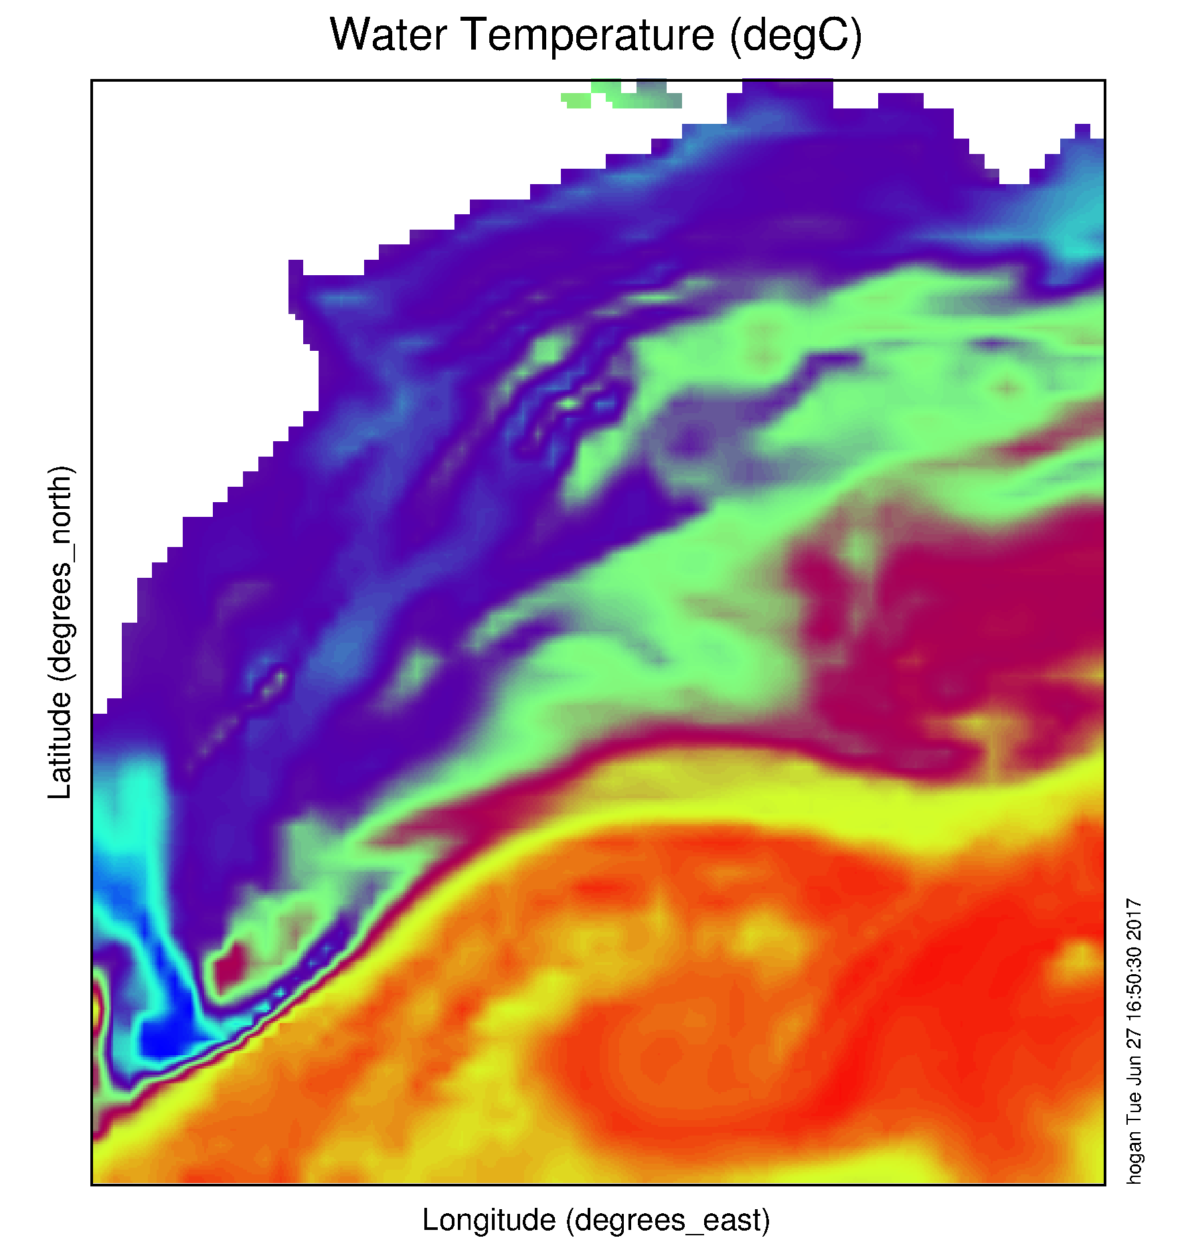
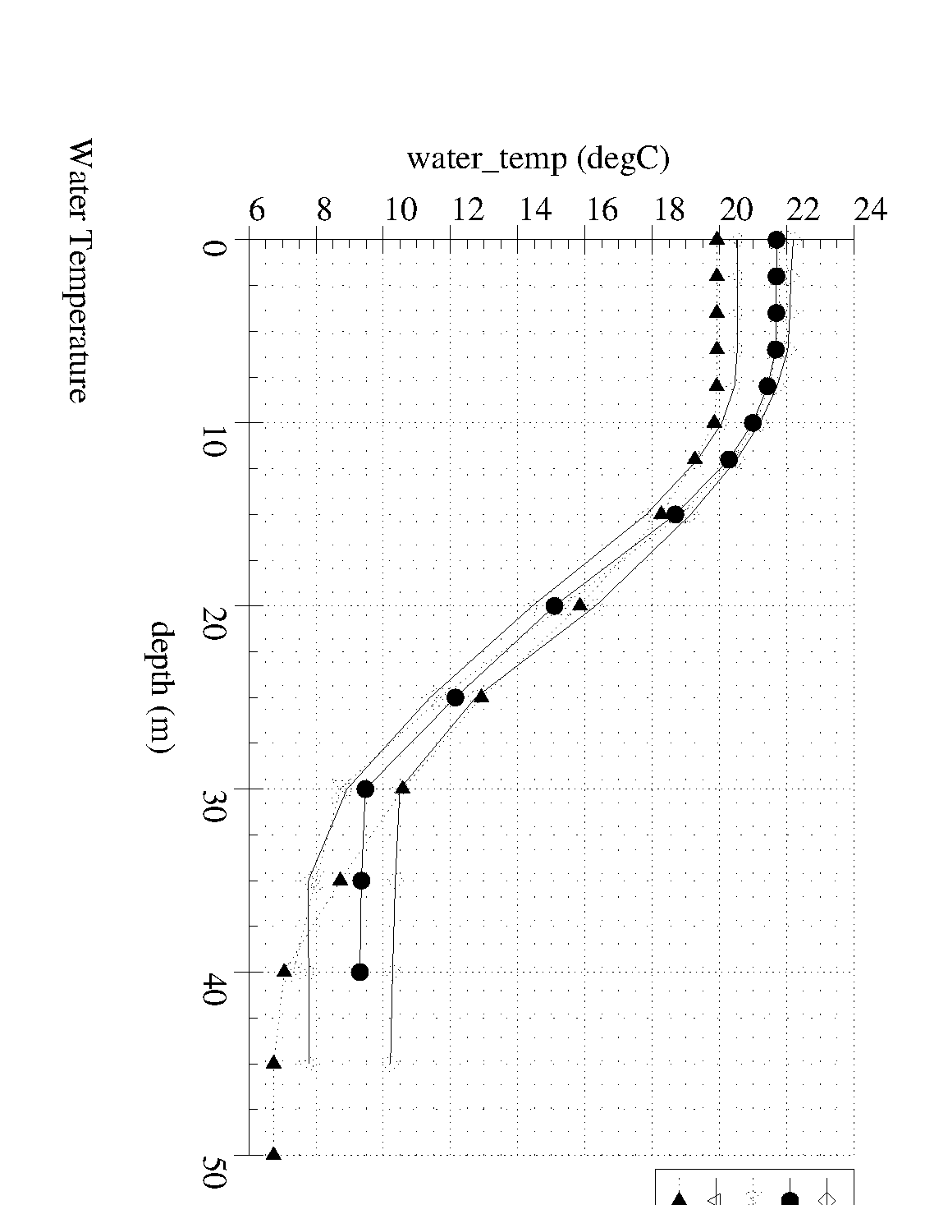
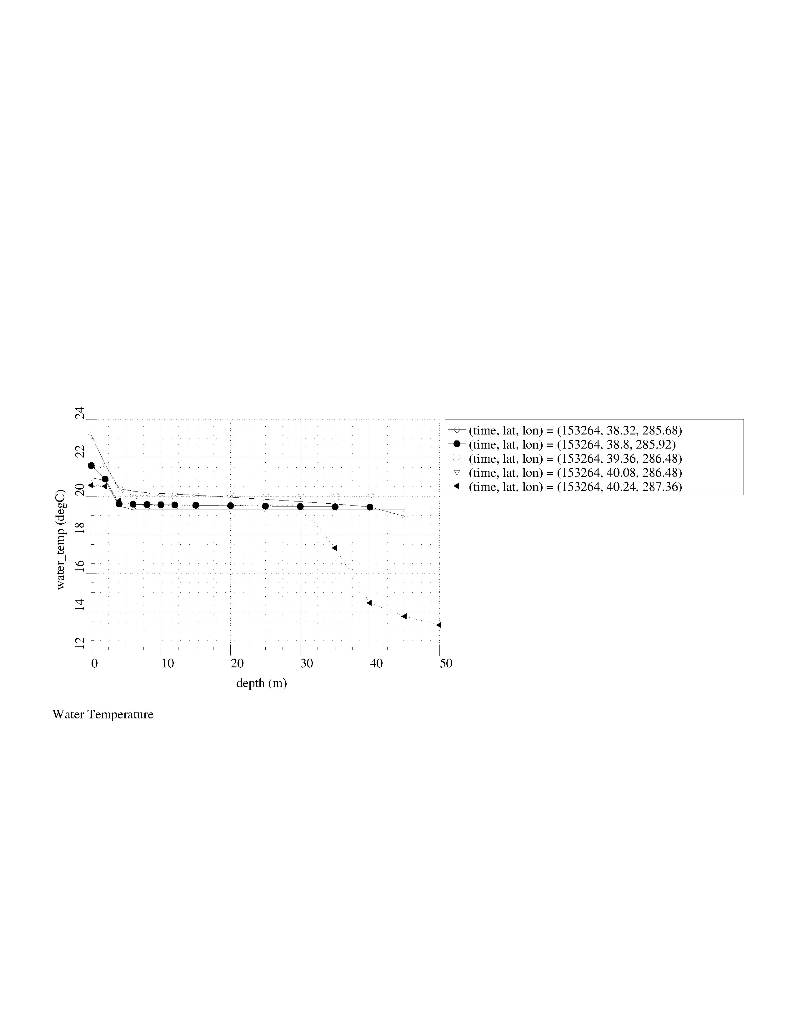
Navy Global Ocean Forecast System (GOFS):
Temperature below summer thermocline in 2017
Operational GOFS 3.0
OpTest of GOFS 3.1
No Cold Pool
Well Defined
Cold Pool
Nearly Isothermal Shelf
Two Thermal layers on Shelf

Slide 19
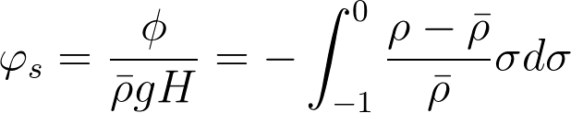
Potential Energy Anomaly (…; Simpson, 1981; …)
For our coastal application a non-dimensional potential energy anomaly:
Essentially a parameter representing the energy required to overturn the water column.

Slide 20
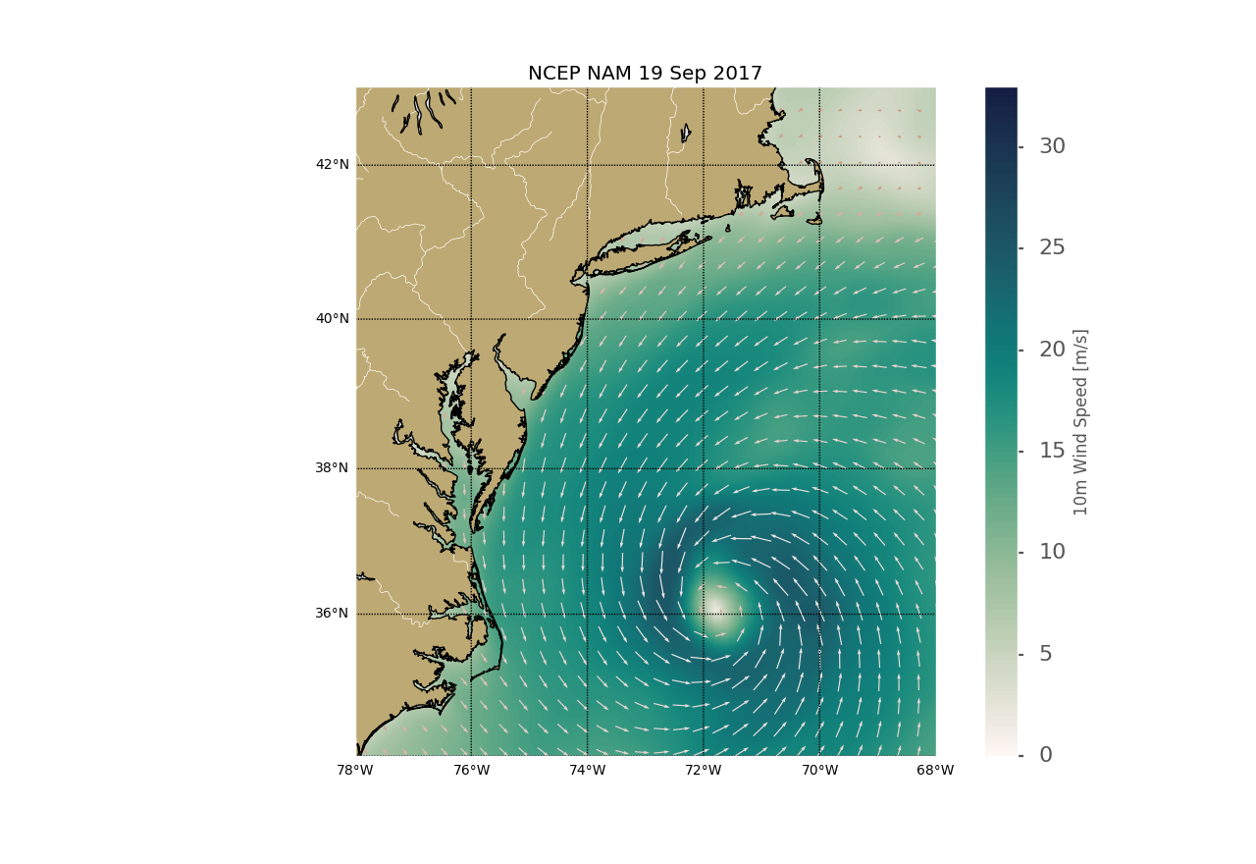
Hurricane Jose

Slide 21
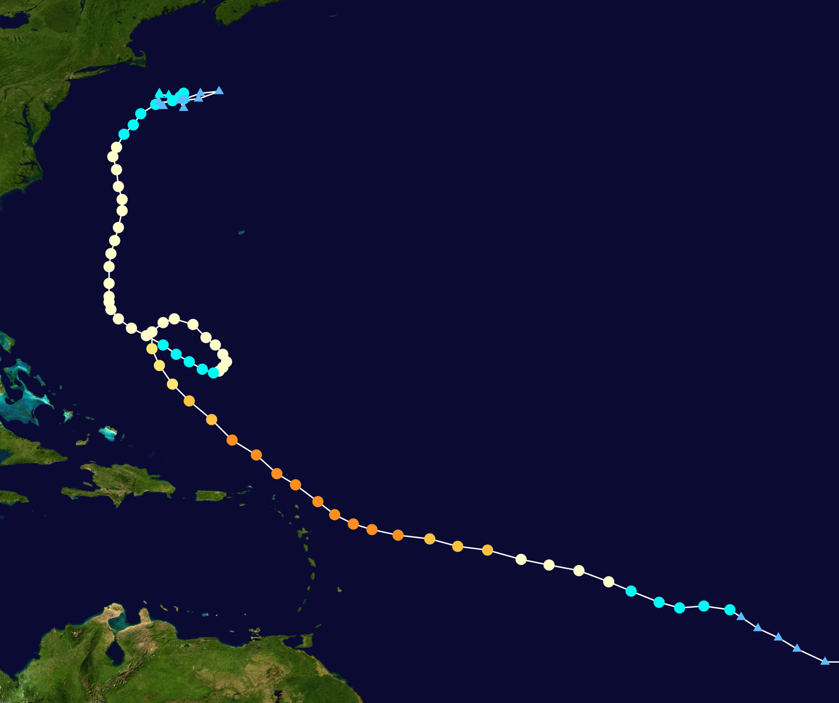
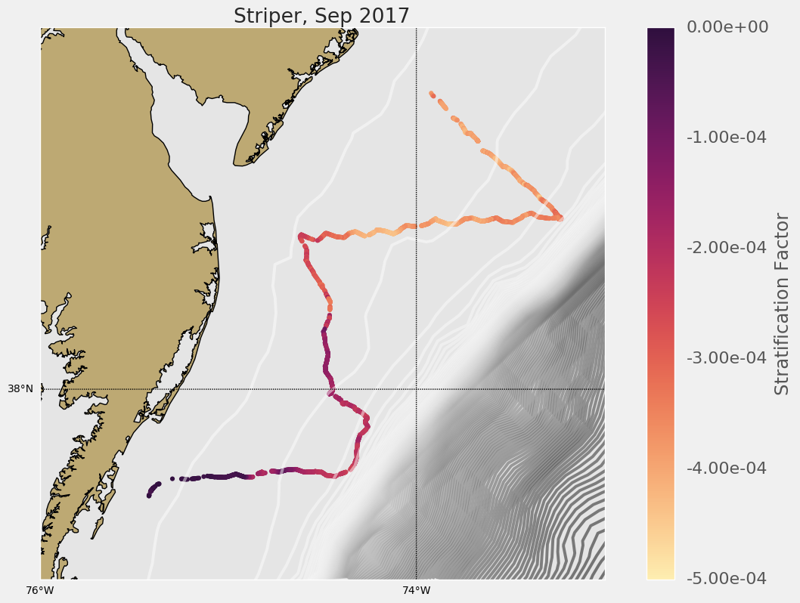
UMaryland
Storm Glider
07-27 Sep 2017
Hurricane
Jose
05-21 Sept
2017

Slide 22
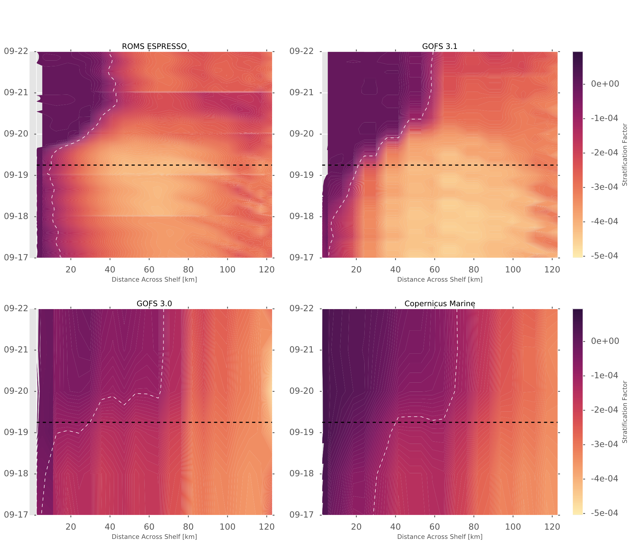
Hovmoller Stratification Across New Jersey Shelf
Eye passage
ROMS
GOFS 3.1
GOFS 3.0
CMEMS

Slide 23
Mid Atlantic Hurricanes: Storm Glider-inspired Science
Essential Ocean Features – Bottom Cold Pool hidden by a thin layer of warm surface water
Two types of hurricanes –
(1) Over the Shelf Tracks – Irene, Barry, …..
(2) Offshore Tracks – Sandy, Jose, …
In both types of hurricanes, the ocean can evolve rapidly, on the same time scale as the hurricane, resulting in feedbacks that impact intensity
Essential Ocean Processes – two types with different impacts
Irene-type – cross-shelf wind stress vs pressure gradient, two layer flow, shear induced mixing across the thermocline, cooling of the surface layer, ocean acts to de-intensify the storm
Sandy-type – alongshore windstress vs bottom stress, classic downwelling, cold pool advection offshore, single warm layer left behind, ocean acts to intensify the storm

Slide 24
Mid Atlantic Hurricanes: Storm Glider-inspired Operations
For the Mid Atlantic, the Essential Ocean Features, and the Essential Ocean Processes, required to forecast the ocean’s impact on hurricane intensity are not found in most of the operational ocean models.
GOFS 3.1 initialization of RTOFS appears to be an important exception.
2018 Experimental HWRF is coupled to the GOFS 3.1 version of RTOFS
It is critical to deploy a picket line of sentinel storm gliders this hurricane season to properly evaluate the Experimental vs Operational HWRF
If we do this, when we return to OI in 2020, the bottom of slide 2 may say:
2019 – Slocum Storm Glider picket line supports Operational Hurricane Forecasting

