Slide 1
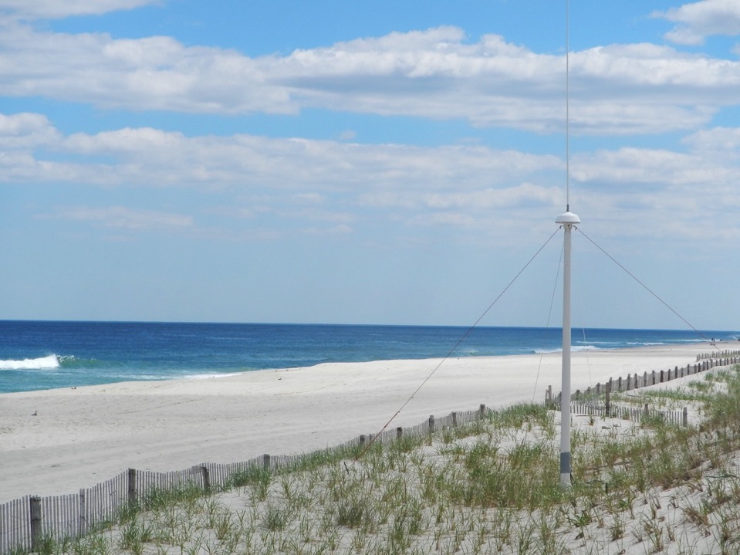








Two Decades (1998-2018) of Surface Current Measurements on the Mid Atlantic Continental Shelf
Hugh Roarty Josh Kohut Mike Smith Laura Nazzaro
Ethan Handel
Travis Miles
Joe Brodie
Scott Glenn
Larry Atkinson
Teresa Updyke
Donglai Gong
Wendell Brown
Harvey Seim
Mike Muglia
Calypso
April 18, 2018
Qawra, Malta

Slide 2
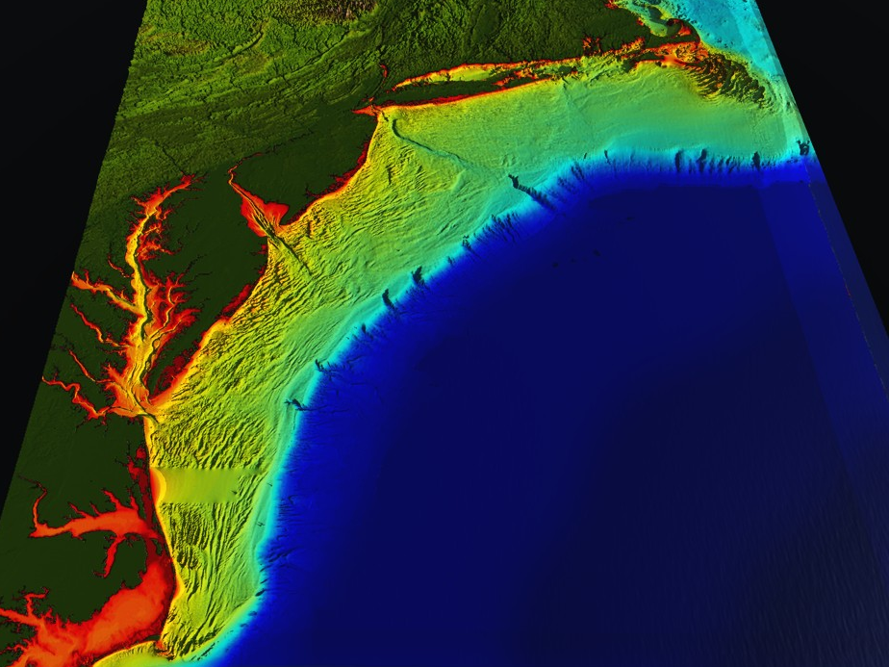



















RI
U..
Middle Atlantic
Regional Association
Coastal
Ocean Observing System
10 States - 78 Million People
1000 km Cape to Cape
CT
Cape
Cod
MA
NY
PA
NJ
MARACOOS:
An Integrated, Sustained & Certified Real-time Observation and Forecast System
DE
MD
VA
NC
Cape
Hatteras
Notes:
2

Slide 3
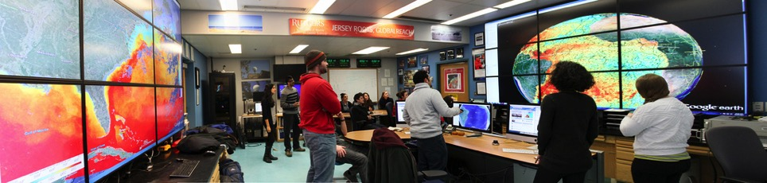

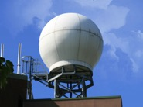
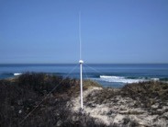
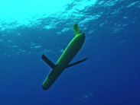
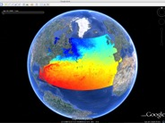















Rutgers University - Coastal Ocean Observation Lab
Observatory Operations, Data Fusion & Training Center
L-Band & X-Band Satellite Receivers
CODAR Network
Glider Fleet
3-D Nowcasts
& Forecasts
Notes:
3

Slide 4






MARACOOS Integration Matrix
Integration Matrix: Capabilities Support Multiple Themes
Regional Priority Themes | Regional Observation & Modeling Capabilities
 | Weather Mesonet | HF Radar Network | Statistical STPS | Satellite Imagery | Glider Surveys | Dynamical Ocean Forecasts
Theme 1. Maritime Commerce & Safety | Operational Input to USCG SAROPS | Operational input to USCG SAROPS | Operational input to USCG SAROPS | SST for survivability planning | Assimilation dataset for forecast models | Surface currents for SAROPS
Theme 2. Fisheries | Weather forecast ensemble validation | Circulation and divergence maps for habitat |  | SST & Color for habitat | Subsurface T & S for habitat | 3-D fields of T, S, circulation for habitat
Theme 3. Public Health & Water Quality | Winds for transport, river plumes, & upwelling | Surface currents for floatables, bacteria, spill response | Surface currents for floatables, bacteria, spill response | Ocean color for river plumes | Nearshore dissolved oxygen surveys | Surface currents for floatables, bacteria, spill response
Theme 4. Coastal Flooding | Weather forecast ensemble validation | Assimilation dataset for forecast models |  | SSTs assimilation into forecast models | Assimilation dataset for forecast models | Nested forecast ensembles
Theme 5. Offshore Energy | Historical analysis & wind model validation | Historical current analysis & wind model validation |  | Historical analysis surface fronts & plumes for siting | Historical analysis of subsurface fronts & plumes | Coupled ocean-atmosphere models for resource estimates

Slide 5
MARACOOS Integration Matrix
Integration Matrix: Capabilities Support Multiple Themes
Regional Priority Themes | Regional Observation & Modeling Capabilities
 | Weather Mesonet | HF Radar Network | Statistical STPS | Satellite Imagery | Glider Surveys | Dynamical Ocean Forecasts
Theme 1. Maritime Commerce & Safety | Operational Input to USCG SAROPS | Operational input to USCG SAROPS | Operational input to USCG SAROPS | SST for survivability planning | Assimilation dataset for forecast models | Surface currents for SAROPS
Theme 2. Fisheries | Weather forecast ensemble validation | Circulation and divergence maps for habitat |  | SST & Color for habitat | Subsurface T & S for habitat | 3-D fields of T, S, circulation for habitat
Theme 3. Public Health & Water Quality | Winds for transport, river plumes, & upwelling | Surface currents for floatables, bacteria, spill response | Surface currents for floatables, bacteria, spill response | Ocean color for river plumes | Nearshore dissolved oxygen surveys | Surface currents for floatables, bacteria, spill response
Theme 4. Coastal Flooding | Weather forecast ensemble validation | Assimilation dataset for forecast models |  | SSTs assimilation into forecast models | Assimilation dataset for forecast models | Nested forecast ensembles
Theme 5. Offshore Energy | Historical analysis & wind model validation | Historical current analysis & wind model validation |  | Historical analysis surface fronts & plumes for siting | Historical analysis of subsurface fronts & plumes | Coupled ocean-atmosphere models for resource estimates
+ Long-term Scientific Archive

Slide 6
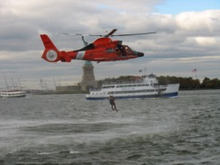
Search And Rescue Cases
in MARACOOS Region
U.S. Coast Guard Search And Rescue Data, FY2014
 | Bays, Rivers, Near Shore (< 3 NM) | Offshore (> 3 NM to 200 NM) | Total
Cases | 2,433 | 247 | 2,688
Lives Saved | 500 | 96 | 596
Lives Assisted | 3,332 | 319 | 3,651
Lives Lost | 160 | 14 | 174

Slide 7
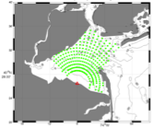
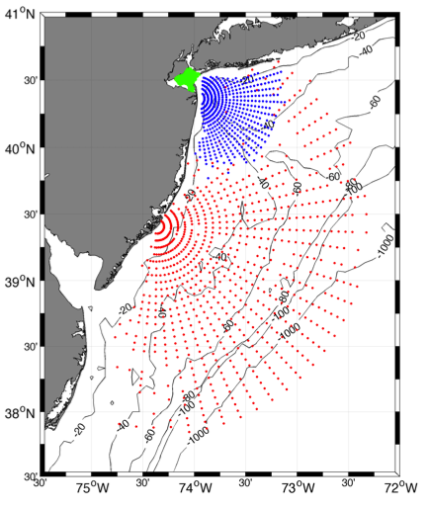
Surface Current Mapping Capability
25 MHz
Radar λ: 12 m Ocean λ: 6 m
Range: >30 km Resolution: 1 km
13 MHz
Radar λ: 23 m Ocean λ: 12 m
Range: >80 km Resolution: 3 km
05 MHz
Radar λ: 60m Ocean λ: 30 m
Range: >180 km Resolution: 6 km

Slide 8
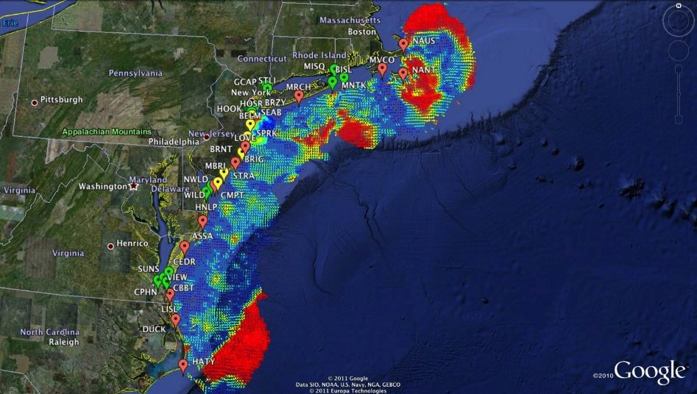

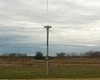
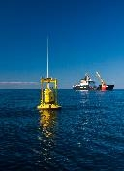
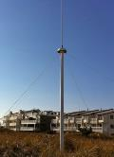

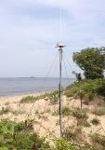





Mid-Atlantic Bight HF Radar Network
1000 km
Cape to Cape
Mid-Atlantic HF Radar Network
17 Long-Range CODARs
8 Medium-Range CODARs
16 Short-Range CODARs
41 Total CODARs in Region
+5 CODARs Roaming
46 Total CODARs
Triple Nested, Multi-static, Multi-use
Industry Partner: CODAR Ocean Sensors

Slide 9
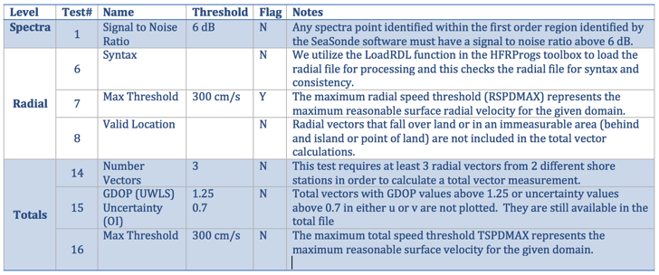

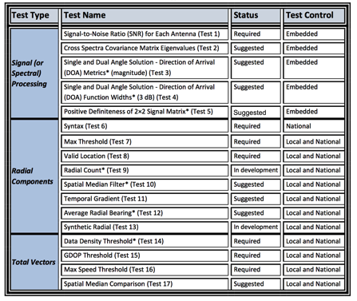
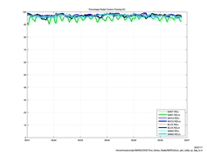
HFR Data Quality Assurance/Quality Control (QA/QC)
Regional Information Coordination Entity -
RICE
From
QARTOD
Manual for
HF Radar
Plotting QC flags in real time

Slide 10
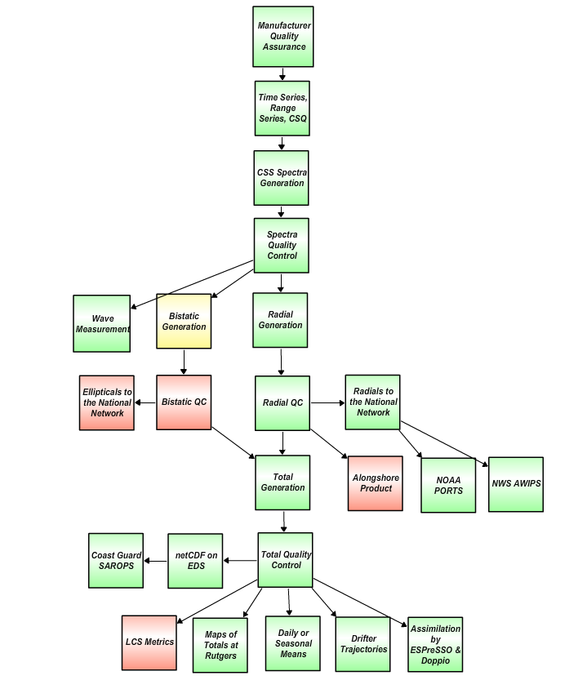
HF Radar Data Real Time Flow Chart
Nov. 2017
For IOOS HFR DAC
Quality Assurance
Manufacturer recommended Antenna Patterns not older than 1 year
Weekly 11-point remote site inspections
Physical site inspection every 6 months
Level 0
QARTOD
R Test 1: SNR Ratio, Filter < 7dB
S Test 2: Cross Spectra Covariance Matrix Eigenvalue
S Test 3: Direction of Arrival Magnitude
S Test 4: Direction of Arrival Signal Width
S Test 5: Positive Definiteness 2x2 Signal Matrix
Requires SeaSonde Radial Metric Processing
Level 1
R Test 6: Syntax, Filter
R Test 7: Max Threshold, Filter > 150 cm/s (13/25 MHz) 300 cm/s (5 MHz)
R Test 8: Radial Valid Location, Filter
D Test 9: Radial Count, Filter < 300
S Test 10: Spatial Median Test
S Test 11: Temporal Gradient
S Test 12: Average Radial Bearing
S Test 13: Synthetic Radial
Level 2
R Test 14: Data Density Threshold, Filter, At least 3 vectors from 2 separate stations
R Test 15: GDOP, OI Uncertainty, Flag > 0.6 in U or V Velocity
R Test 16: Max. Speed Threshold , Filter > 150 cm/s (13/25 MHz) 300 cm/s (5 MHz)
S Test 17: Spatial Median Test
R Required
SR Strongly Recommended
S Suggested
D Development
Level 3
Green – Operational
Yellow – Development
Red - Planned
Level 4
Data levels defined by NASA Earth Science Reference Handbook ( 2006, p.31)

Slide 11
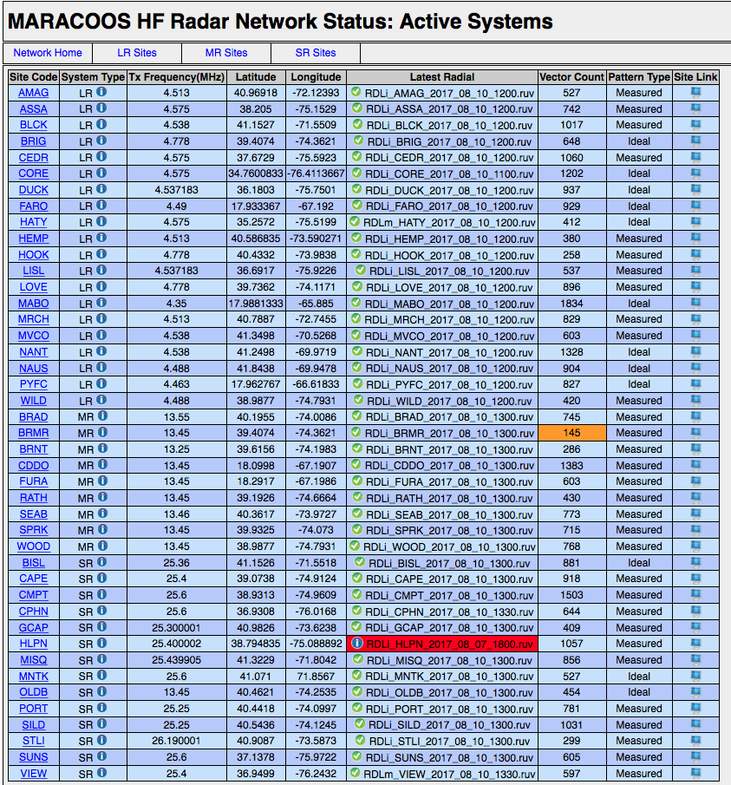
Automated
Radial Diagnostic
Displays Most Recent Radial File
If radial count drops below 200
If radial file older than 12 hours
Displays Preferred Radial Type for Total Processing

Slide 12
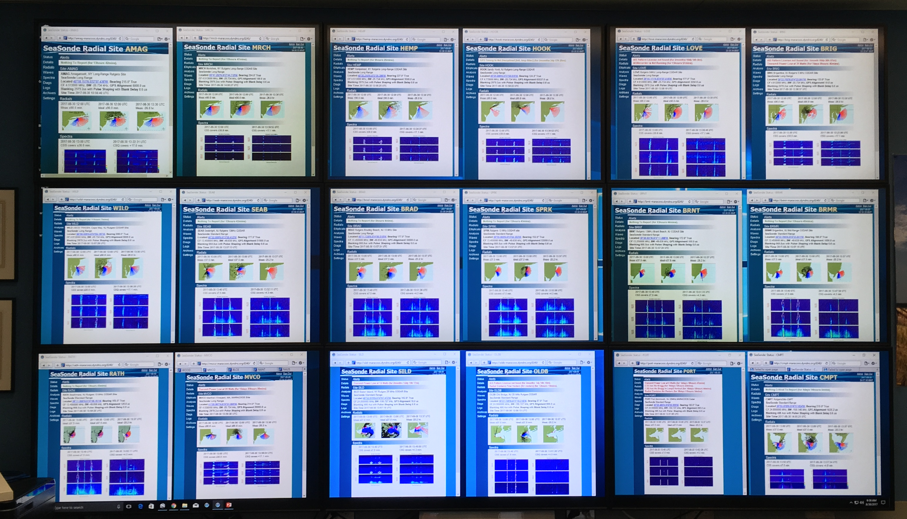
Radial Web Server
Human in the Loop QA/QC
Rutgers COOLroom CODAR Wall

Slide 13
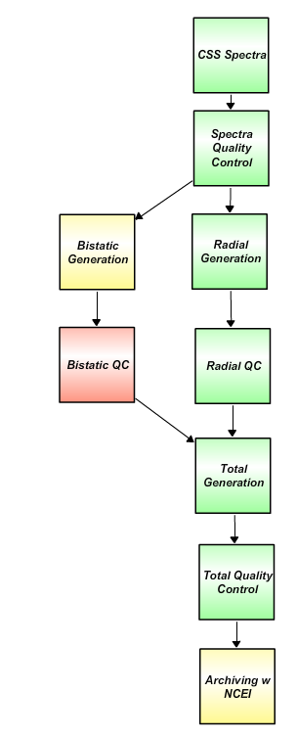
HF Radar Data Delayed Mode Flow Chart
Nov. 2017
For NCEI Archive
Level 0
Plot hardware diagnostic data to identify questionable time periods.
Plot radial diagnostic data to identify questionable time periods.
Determine what stations need to be reprocessed for specific time periods
Generate reprocessing time line with appropriate file type (ideal or measured) and antenna patterns.
Generate archived best radial data set.
Create totals from best radial data set.
Level 1
Level 2
Level 3
Green – Operational
Yellow – Development
Red - Planned
Level 4
Data levels defined by NASA Earth Science Reference Handbook ( 2006, p.31)

Slide 14
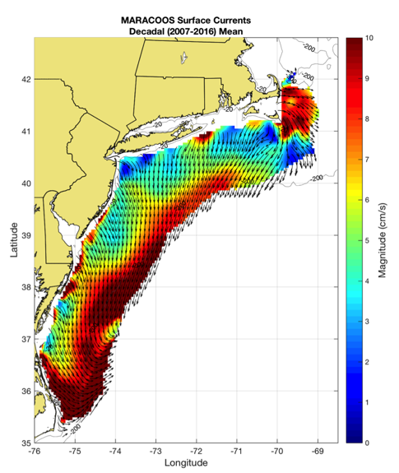
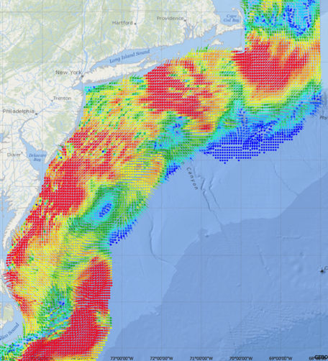
Generate Surface Current Maps Every Hour for a Decade
5 MHz- 17 Stations
13 MHz- 7 Stations
25 MHz- 16 Stations
Outside- 6 Stations
TOTAL – 46 Stations
Winter Storm Jonas
2016/01/23 20:00 UTC
Real-time
Hourly Maps for
Search And Rescue
Delayed Mode
Decadal Mean Currents
for Scientific Analysis

Slide 15
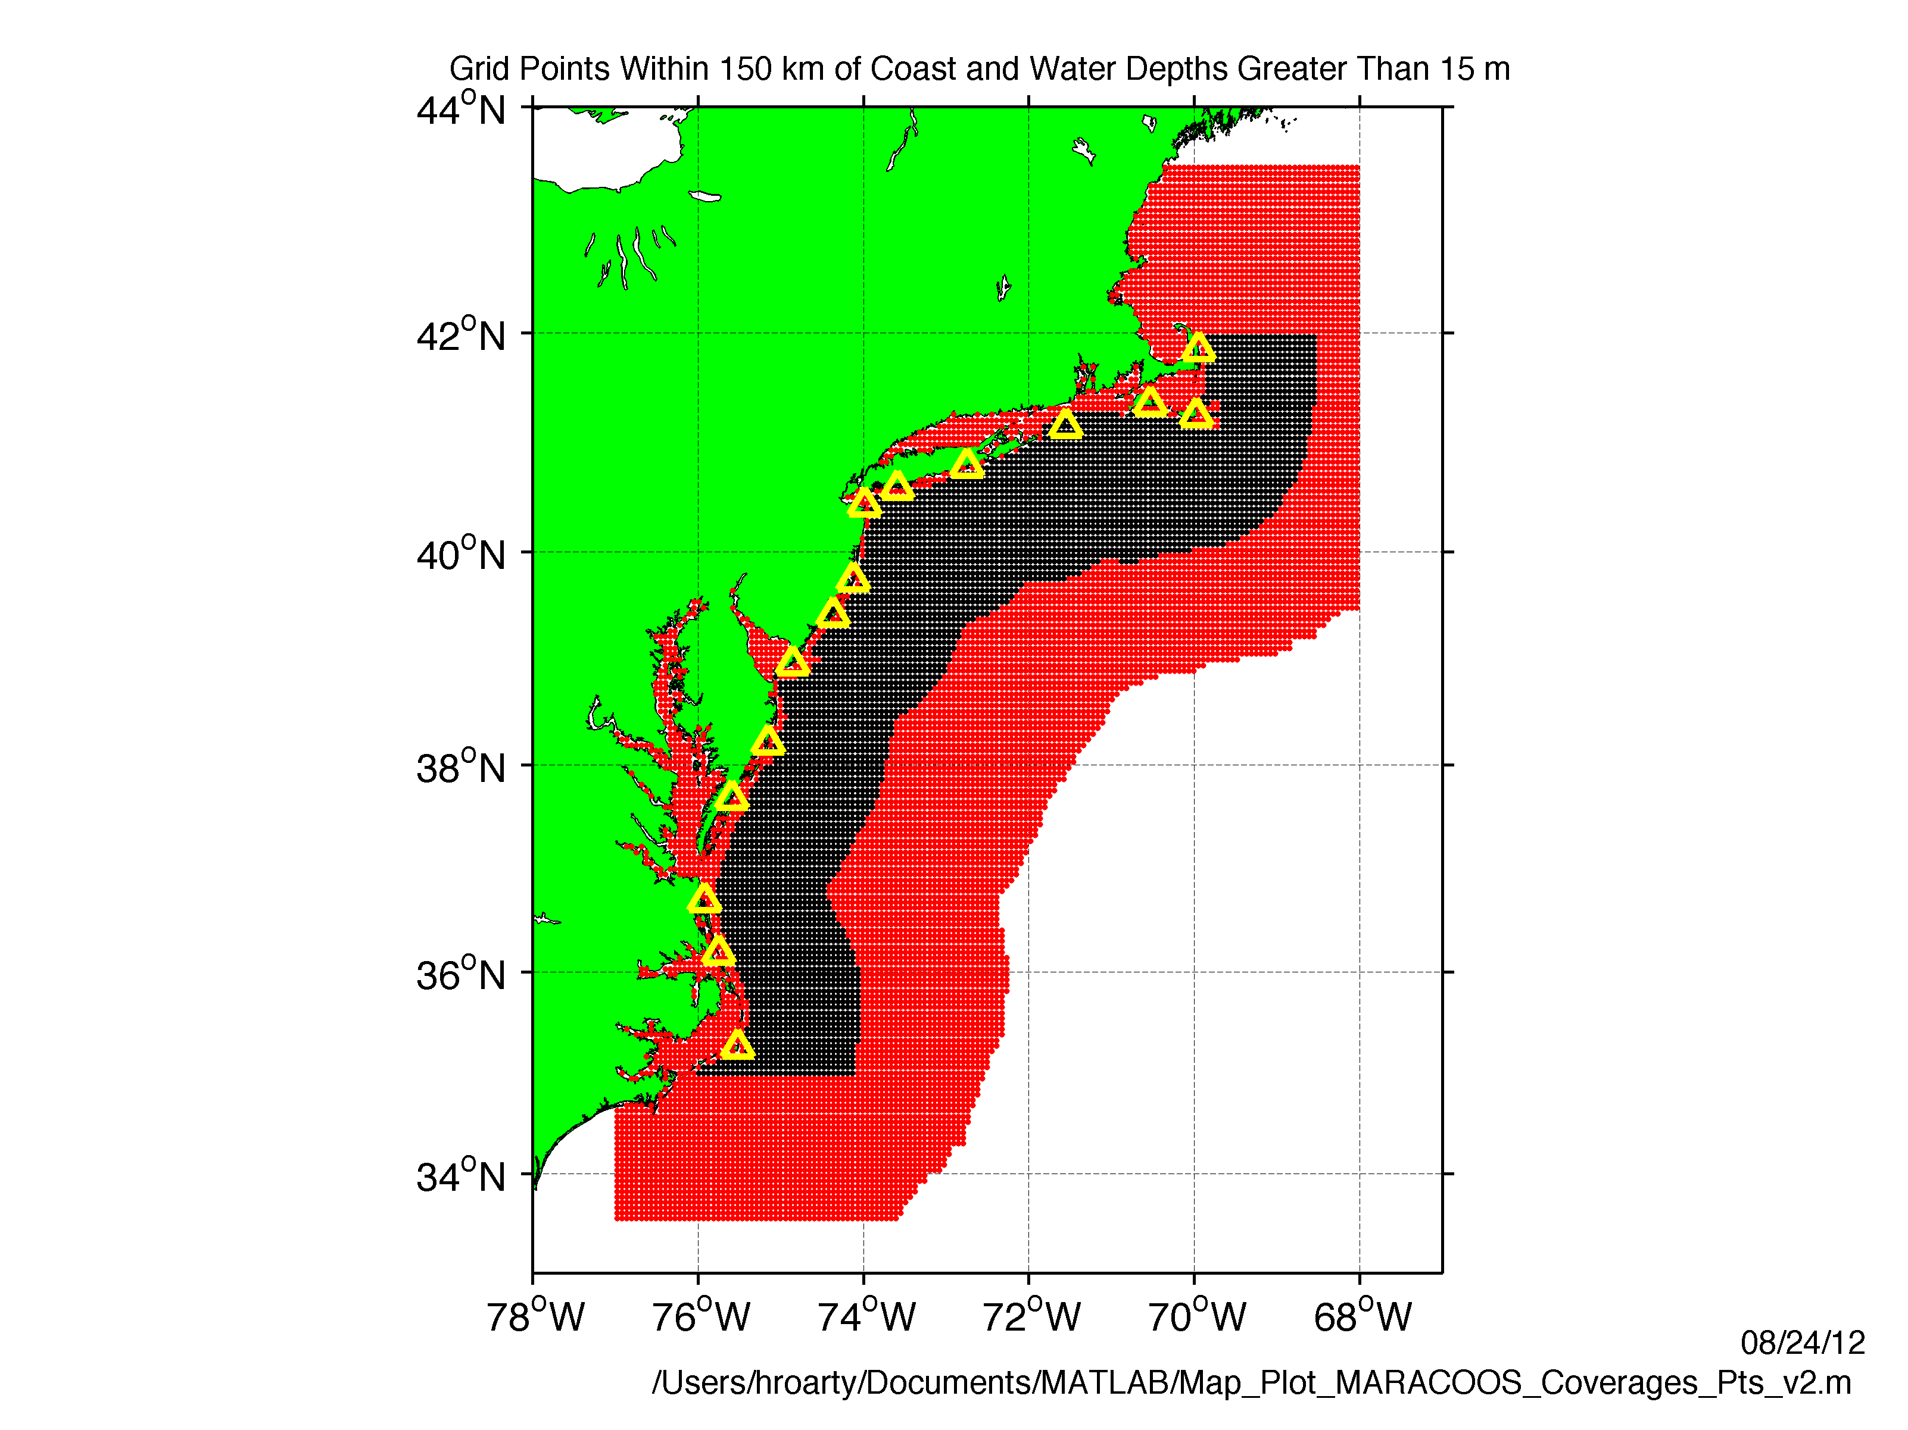
Grid Points for USCG 80-80 Metric
U.S. Coast Guard
HF Radar Metrics
Data quality: Produce better results than existing products (Proven in the USCG tests)
2) Data availability:
Total Current Vectors:
80% Spatial Coverage
80% of the Time
USCG SAR Grid
National HFR Grid

Slide 16
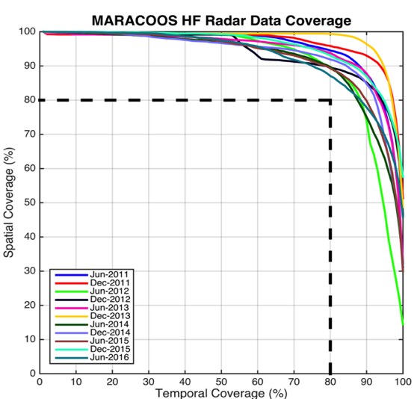
Search And Rescue Data Availability Metrics
MARACOOS 17-Site Long Range Network:
Consistently exceeds U.S. Coast Guard 80-80 Metric
80 % spatial coverage 80% of the time
Achieved through site resiliency and active spares approach.
Accomplished with 2.5 Field Technicians
Every
6 Months since 2011

Slide 17
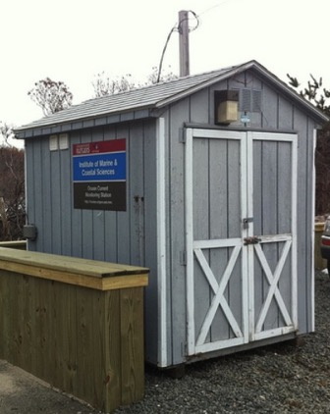
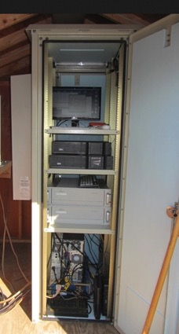
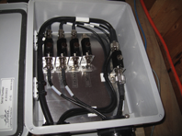
Resilient CODAR Shore Site: Phase 1
Shed, Enclosure, Tx/Rx, Comms, Power, GPS, AIS
monitor
computer & external hard drive
A.C. unit
UPS system
transmitter
receiver
Two lines of Communication
Shed
Enclosure
Lightning Protection

Slide 18
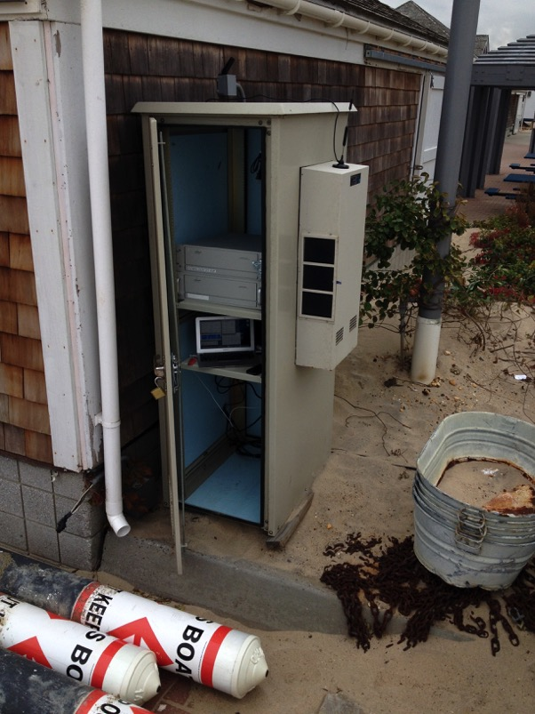
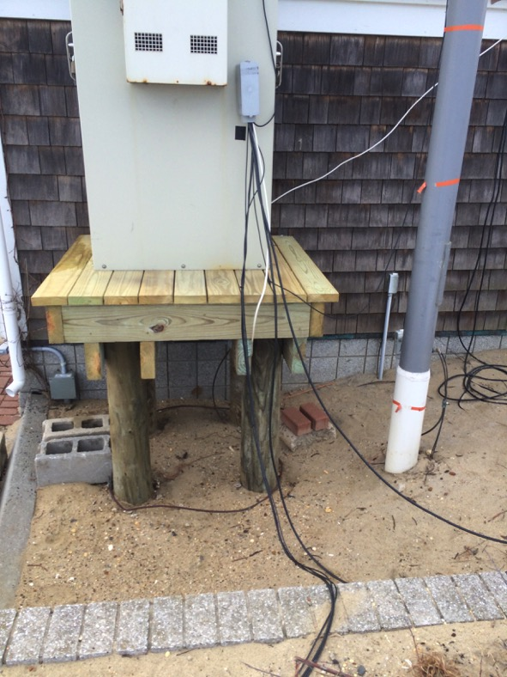
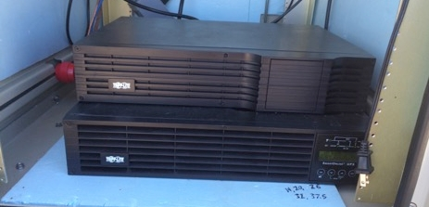
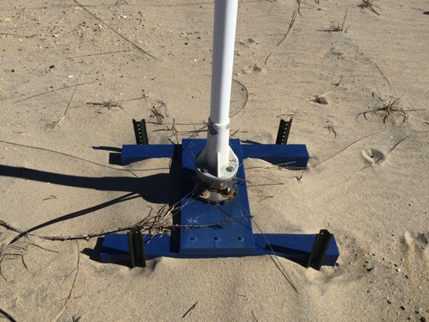
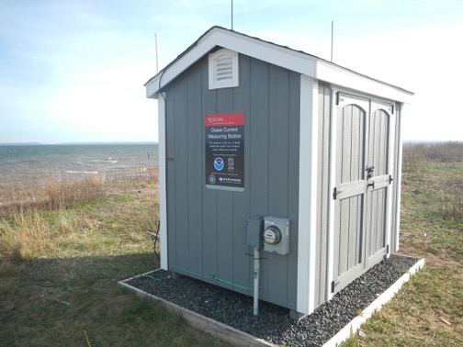
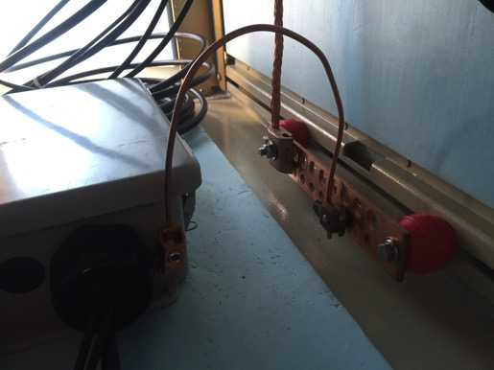
Resilient CODAR Shore Site: Phase 2
Raised Platforms
Shed Lightning Protection
Uninterruptible Power Supplies
Antenna Bases 6’ Deep
Radar Lightning Protection
BEFORE
AFTER

Slide 19
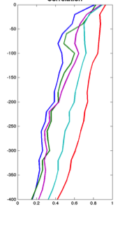
Rutgers ROMS 4DVAR uses all available data
from a modern coastal ocean observing system
  more and diverse data is better (T, S, u, sea level)
  bias correction to OBC and MDT is essential
Useful subsurface skill for real-time applications:
  4 days for temperature and salinity;
  1-2 days for velocity
Future directions: variational methods for
observing system design; coupling; ecosystems
correlation
Forward model
Forward model
after bias removal
Data assimilation
analysis/hindcast
depth
2-day forecast
4-day forecast
Bottom temperature
Data used [… real-time SOURCE]
*THREDDS Data Server
72-hour forecast NAM 0Z cycle at 2 am EST [NCEP NOMADS]
RU regional CODAR hourly [RU TDS*]
RU glider T,S [RU TDS]
USGS daily average flow available 11:00 EST [USGS waterdata]
AVHRR IR passes 6-8 per day [MARACOOS TDS]
REMSS MW-IR blended SST daily average [NASA PO-DAAC]
HYCOM NCODA 7-day forecast updated daily [NRL]
Jason-2, CryoSat, AltiKa along-track altimeter OGDR [RADS.nl]
SOOP XBT/CTD, Argo floats, on GTS [NOAA OSMC ERDDAP]

Slide 20
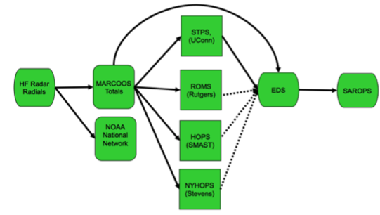
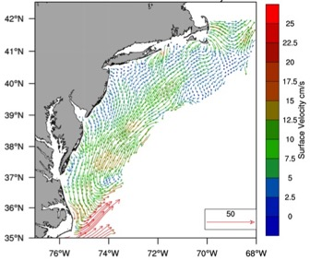

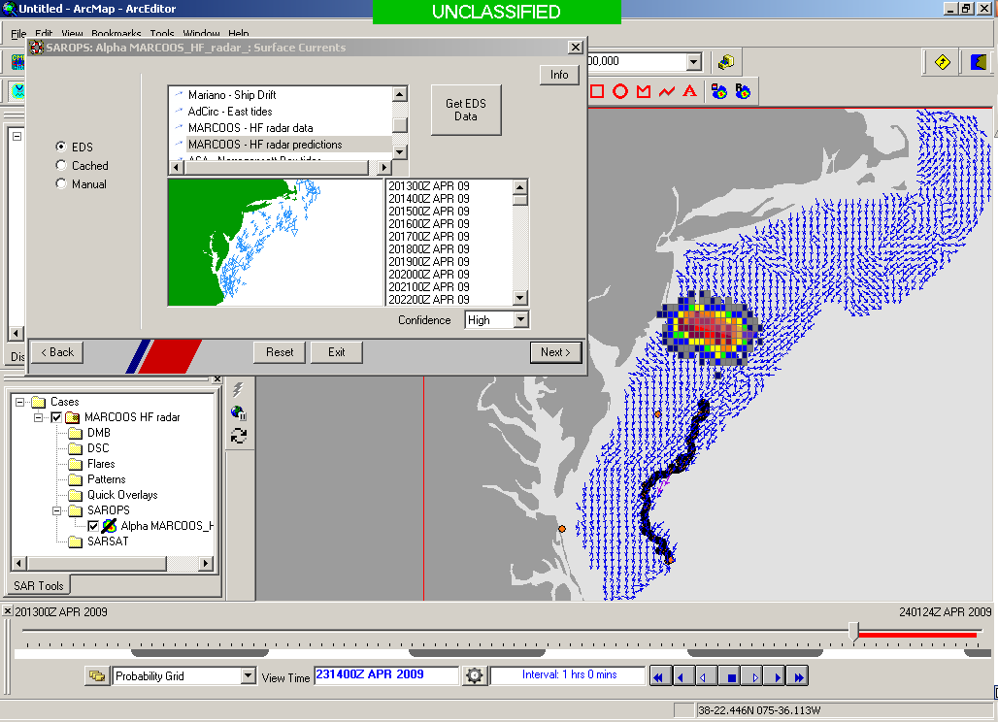
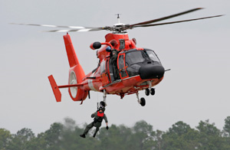

Transition Objective –
Operational Use of HF Radar Surface Currents for Search And Rescue
Surface Currents
Data Acquisition
Data Product Generation & Management
Search And Rescue Optimal Planning System (SAROPS)

Slide 21

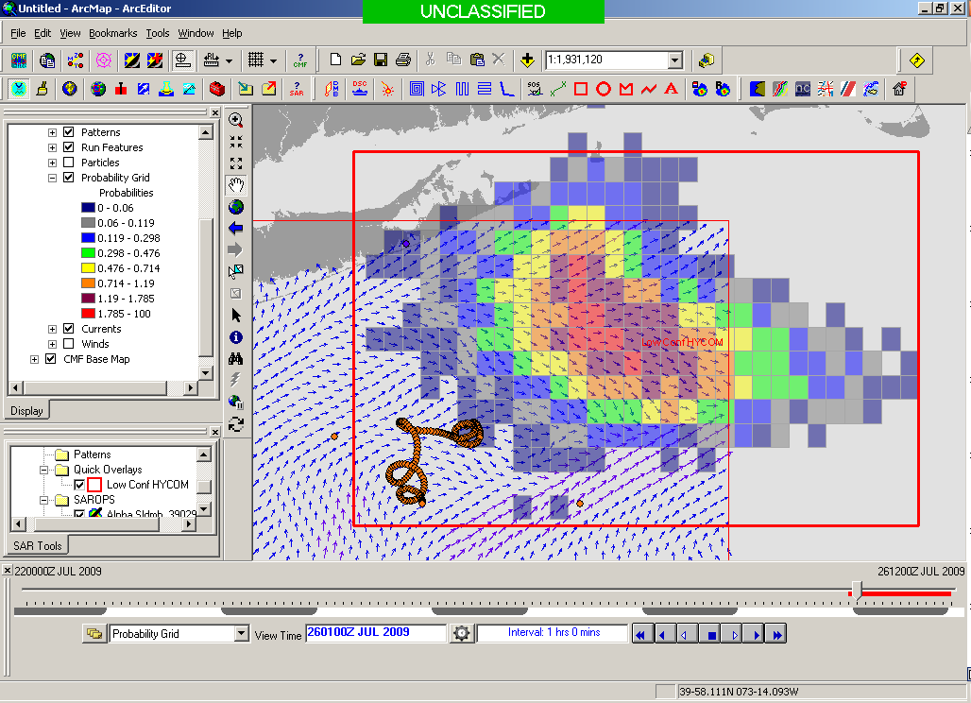
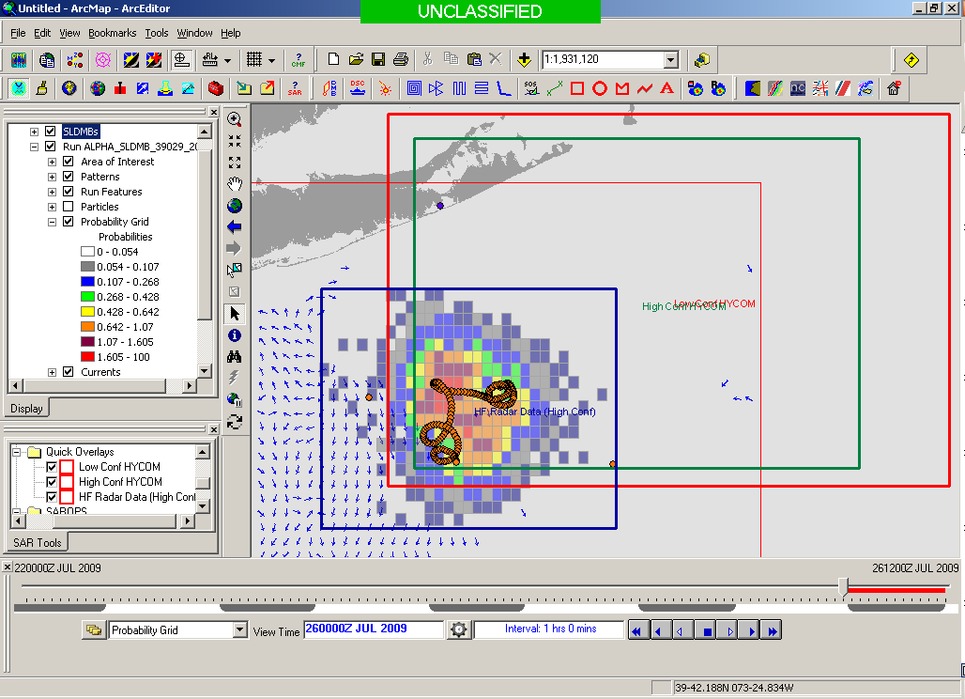
USCG Evaluation Process -
5000 Virtual Drifters & 1 Real Drifter:
Compare Search Areas after X Hours
154 km
100 km
232 km
123 km
HYCOM @ 96 Hours
Search Area = 36,000 km²
CODAR @ 96 Hours
Search Area = 12,000 km²
Notes:
HYCOM (Low Conf) 48 hours

Slide 22

May 4, 2009: After a year of USCG testing, NOAA announces on
U.S. Department of Commerce Website that
MARACOOS CODAR is Operational in USCG SAROPS
2009-2010 Activity:
Bring all
sustained regional-scale HFR networks up to operational status in USCG SAROPS
3 West Coast Regions for
California & Oregon are ready.

Slide 23
2011-2014 2016-2017
USCG SAROPS Ocean Current Product Requests
Global HYCOM Products – Always there “100-100” metric
HF Radar Data & Statistical Predictions – #8
Assimilative Regional Espresso ROMS - not on the list
Global HYCOM Products – Still Always there “100-100” metric
HF Radar Data & Statistical Predictions – up to #6
Assimilative Regional Espresso ROMS - up to #4

Slide 24
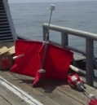
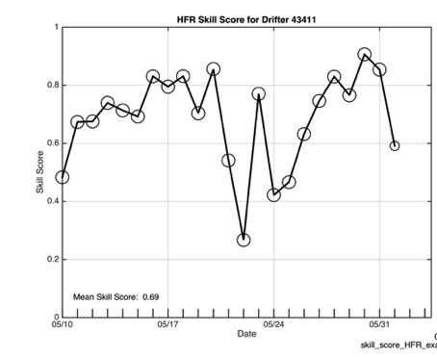
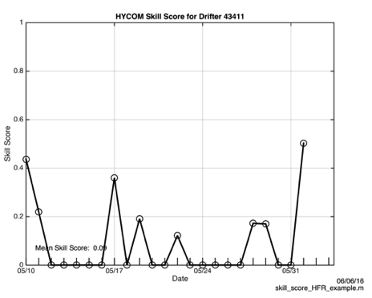
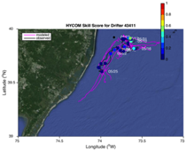
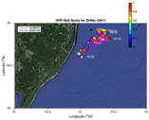
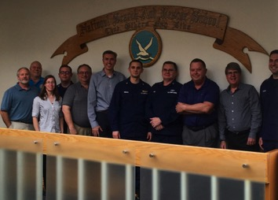
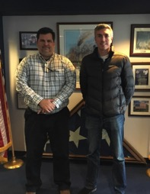


2016 Surface Current Drifter Skill Score
Navy HYCOM Region 1
No HFR Assimilation
HFR Data
Active Education & Outreach to USCG Users of the HFR Data & Data Assimilative Products
National Search and Rescue School
Yorktown, VA
January 19, 2017
Coast Guard Sector NY
Staten Island, NY
March 21, 2017

Slide 25
Coast Guard Wind & Current Data Requests
Requests June 1 to December 1, 2017

Slide 26
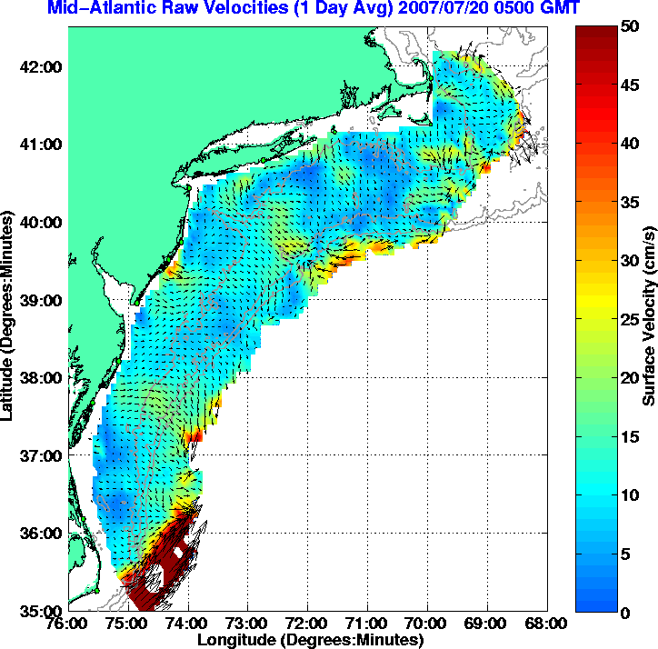

12 Stations
17

Slide 27

Decadal Mean
Detided using t_tide
30 hour low pass filter applied
50% temporal coverage per year required
Major Features:
Shelf Slope Front
4 River Outflows
Notes:
Like previous studies flow is alongshelf and towards the south
As observed by Steve Lentz The flow speed increases with water depth reaching a maximum at the shelf break
You can also observe this low velocity zone near the bight apex that was first observed by Donglai Gong in his 2010 paper of the surface currents on the NJ shelf

Slide 28
Inter-Annual Variability
Variability between years averaged over the decade
Tides not included

Slide 29
Intra-Annual Variability
Variability within a year averaged over the decade
Tides not included

Slide 30

Intra-Annual Variability
Average 10-year intra-annual Variability: Winter, Spring, Summer, Autumn
Winter
Spring
Summer
Autumn
Notes:
Seasonal varibaility of the temperature, break up the
Inter is same varibaility is in the alongshelf
Add river discharge for season in the winter wind plot

Slide 31


Autumn Mean
September, October and November
River Forcing
Wind Forcing

Slide 32
Mean Buoy Winds
Fall 2009 Outlier

Slide 33

Autumn 2009:
Dominant Role of the Wind
2009 Flow is Alongshelf
Autumn Mean

Slide 34

River Discharge Fall Means – 2011 Outlier

Slide 35

Autumn 2011:
Dominant Role of the Rivers
River Forcing
2011 Flow is Cross-shelf
Autumn Mean

Slide 36

Two Decades of Surface Current Measurements Over the Mid Atlantic Continental Shelf
Original installation motivated by Search And Rescue
Additional societal benefits enabled by the real-time data
Highest quality delayed-mode data improves scientific understanding for all

Slide 37

What can we do together?
Collaborate in the Global HF Radar Network forum http://global-hfradar.org/
Testbed for continuous improvements of upstream operations and advanced capabilities (multi-static, AIS pattern measurements, QC evaluation ….) – sharing new pathways to success
Testbed for demonstrations of new downstream products – sharing our lessons learned on user engagement
Contributing to scientific understanding for the common good – sharing our students.

