Slide 1
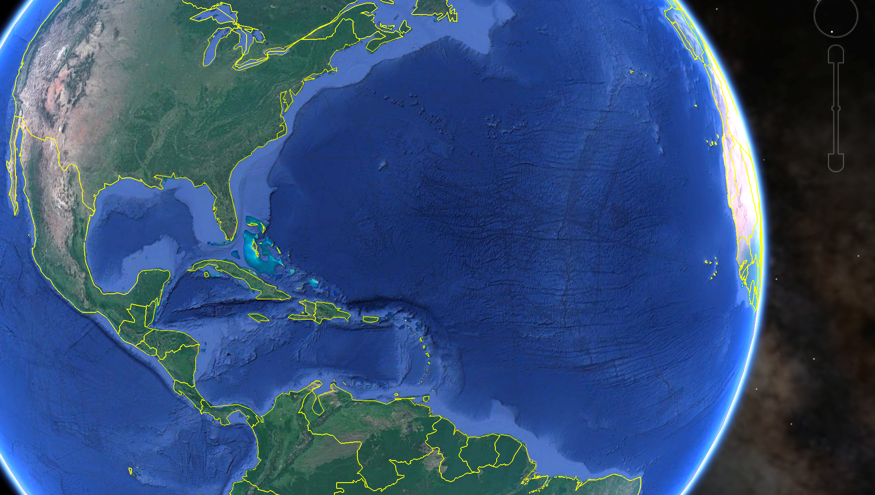



Expanding Partnerships for
Integrated and Sustained
Ocean Observing in the
Caribbean-Mesoamerican Corridor:
Promoting Ocean Health to meet the UN Sustainable Development Goals
Scott Glenn (RU)
Travis Miles (RU)
Anthony Knap (TAMU)
Steve DiMarco (TAMU)
Stephan Howden (USM)
Nick Shay (UM)
MECAS2018
La Havana, Cuba

Slide 2
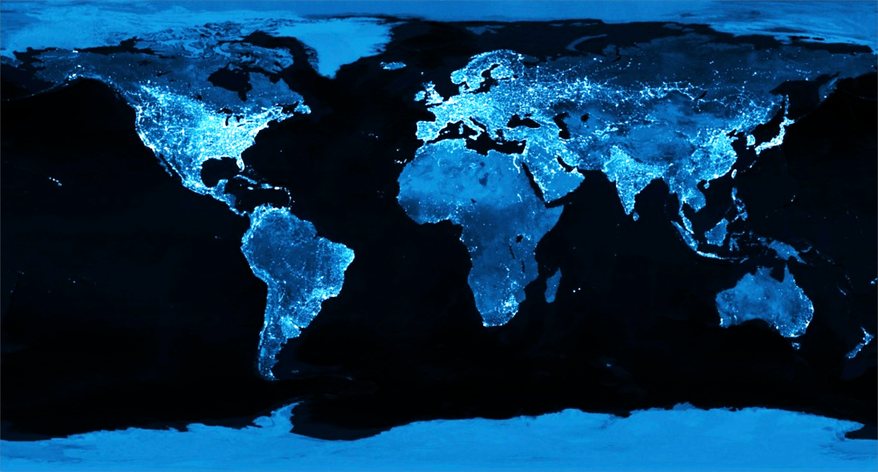
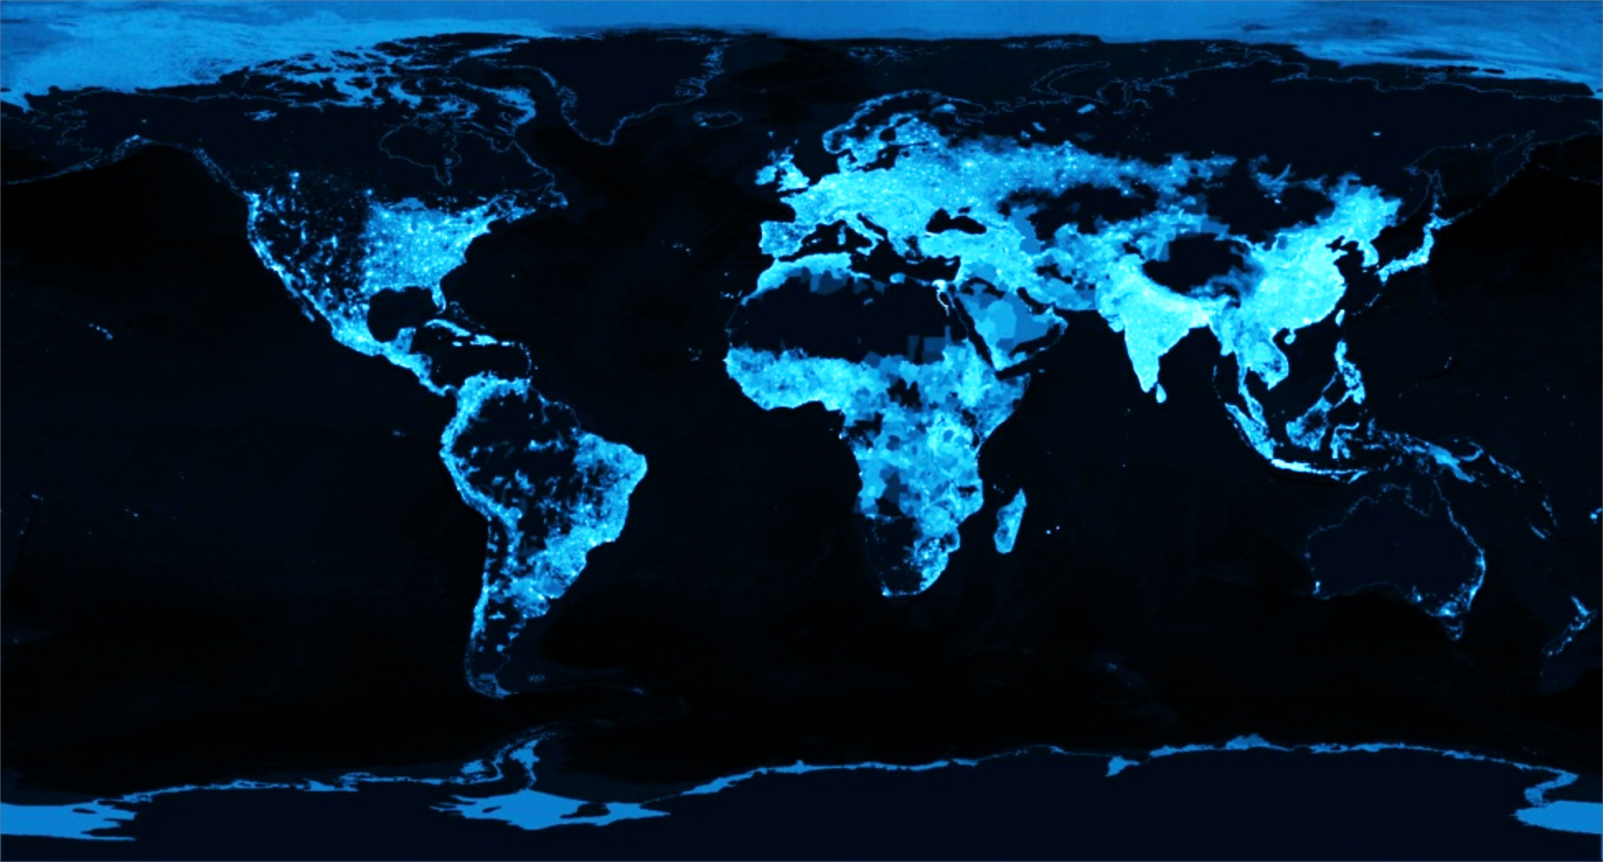
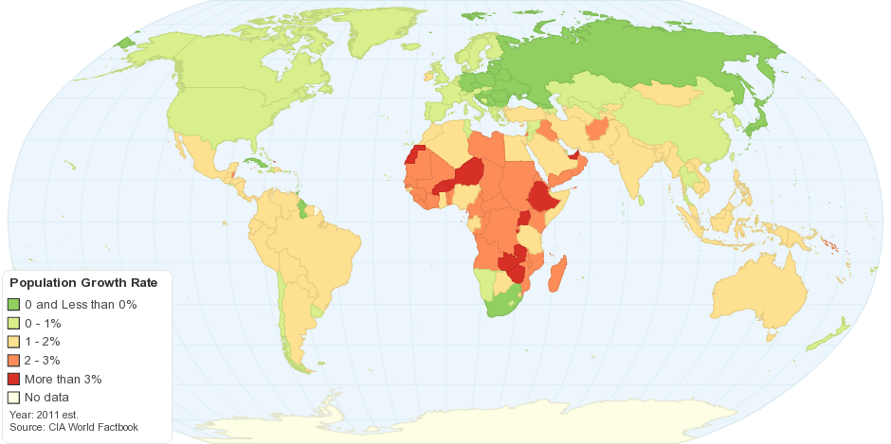
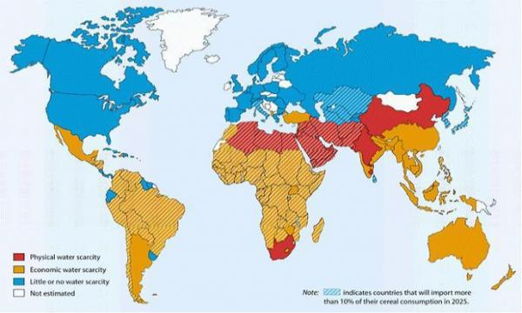
Our Student’s Grand Challenge
During the Professional Lifetimes of Today’s Students, …
The Earth at Night
Global Population
…Transform This…
…Into This…
Projected Population Growth
Projected Water Scarcity
…While the Human Population is Growing…
…And the Earth is Changing.

Slide 3

United Nation’s Global Call to Action
UN’s Sustainable Development Goals (SDGs)
21st Conference of the Parties (COP21) of the United Nations Framework Convention on Climate Change (UNFCCC)
Sendai Framework for Disaster Risk Reduction
Samoa Pathway for Small Island Developing States (SIDS)

Slide 4
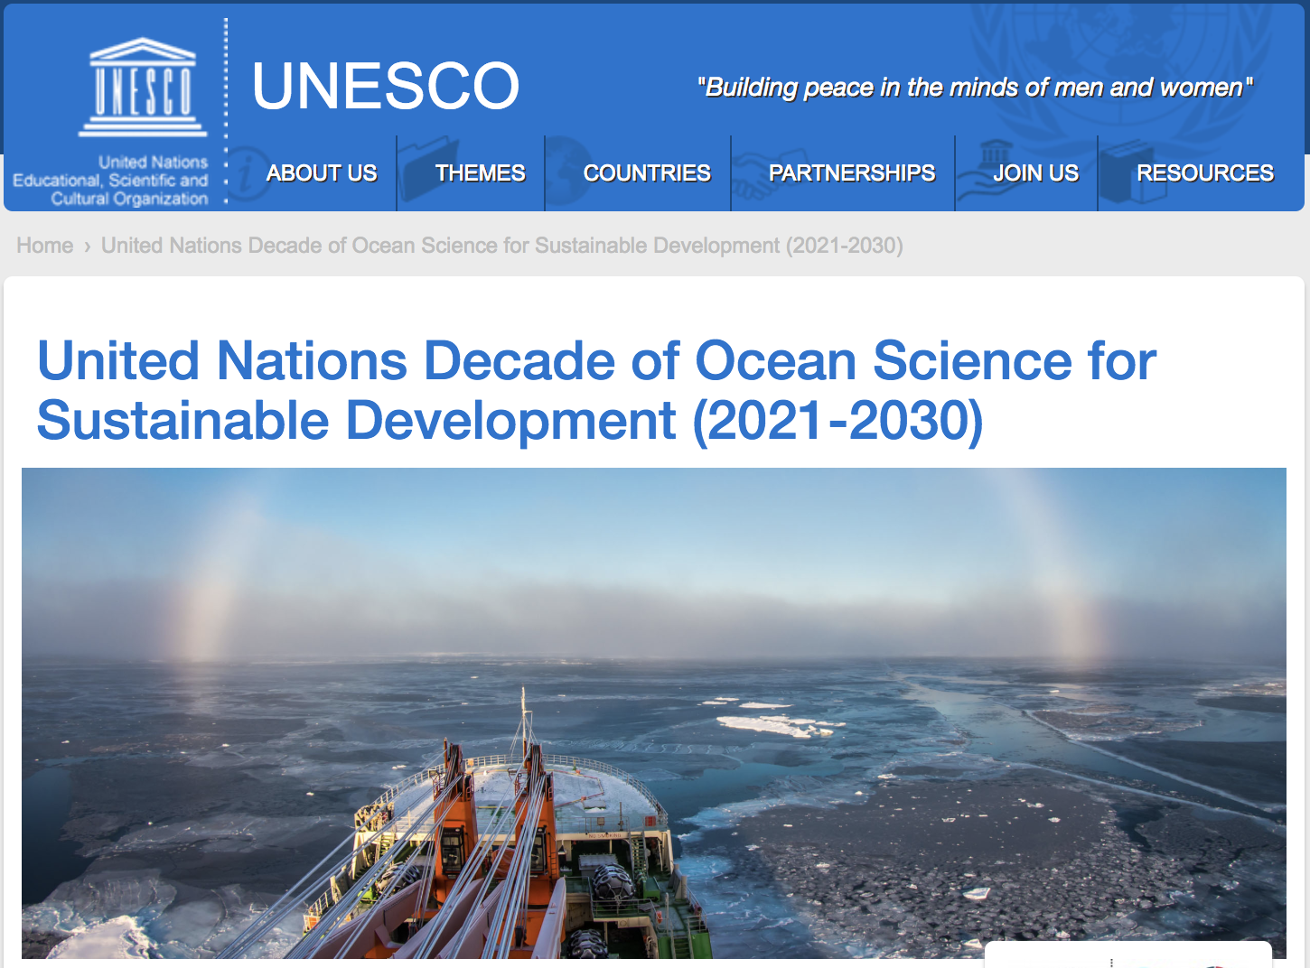
Intergovernmental
Oceanographic
Commission (IOC):
“2nd Ocean Decade”
Planning Phase
2018-2021
The Ocean we need for the Planet we want:
Enhancing sustainable use of ocean and marine resources
Expanding use of knowledge about the ocean conditions
Supporting the development of the ocean economy
Sustainable management of coastal ecosystems
Increasing scientific knowledge
Achieving integrated observations and data sharing

Slide 5
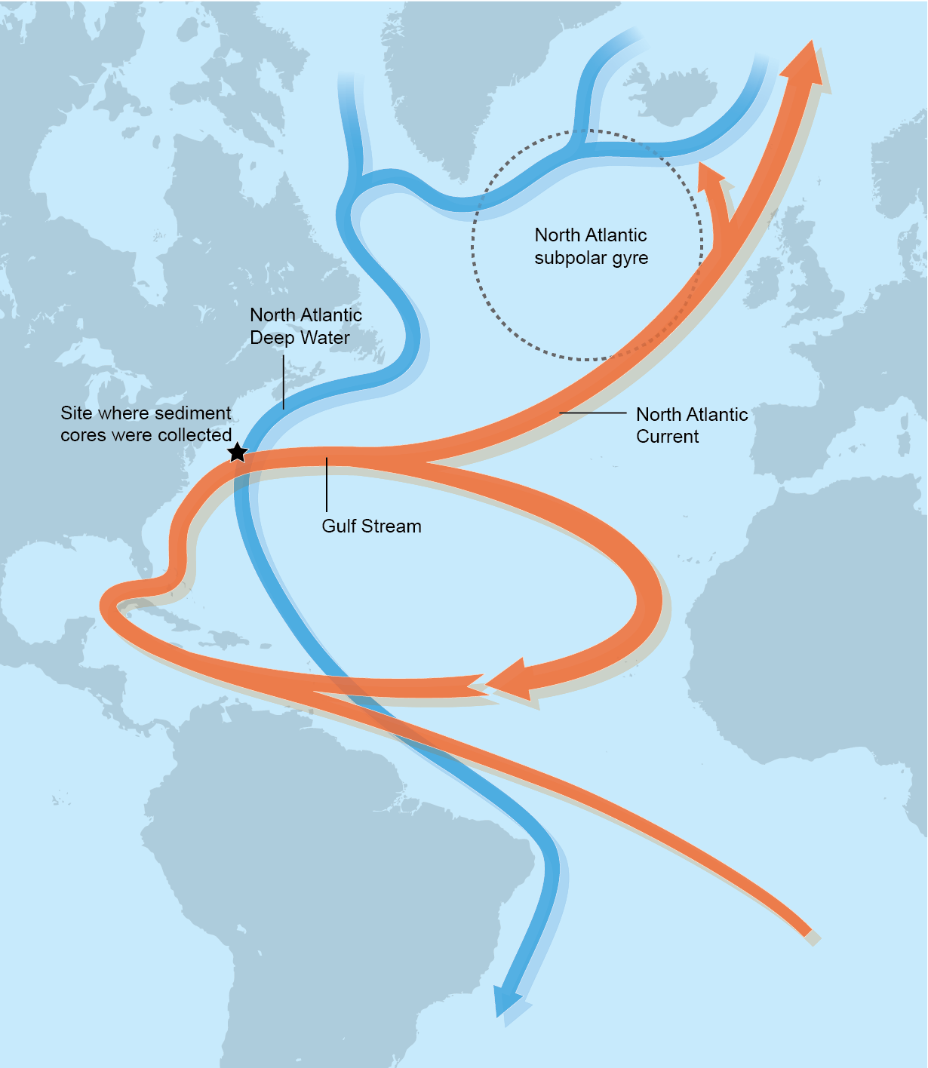
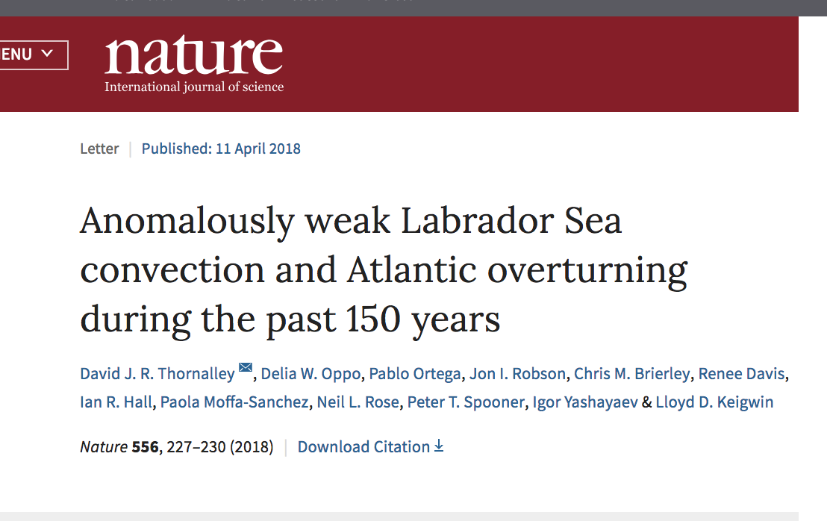
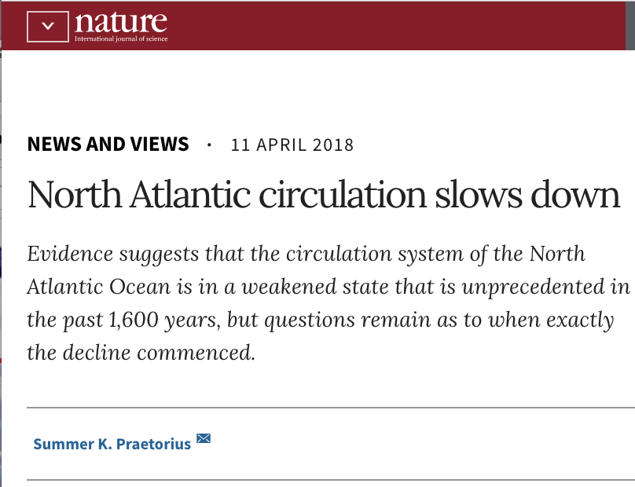
Atlantic Meridional Overturning Circulation (AMOC)
Cold Deep
Water Transported South
Published 11 April 2018:
Warm Surface
Water Transported North

Slide 6
NOAA Historical Hurricane Tracks: 1851 - previous season
Upper Ocean Heat Content modulates Hurricane Intensity

Slide 7
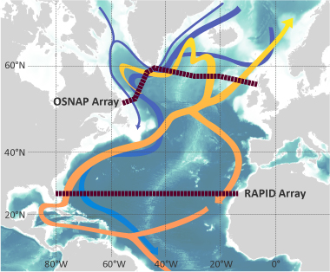
Atlantic Meridional Overturning Circulation (AMOC)
How do we currently monitor heat transport?
The RAPID Array
Moorings & Ships – Expensive & Limited

Slide 8
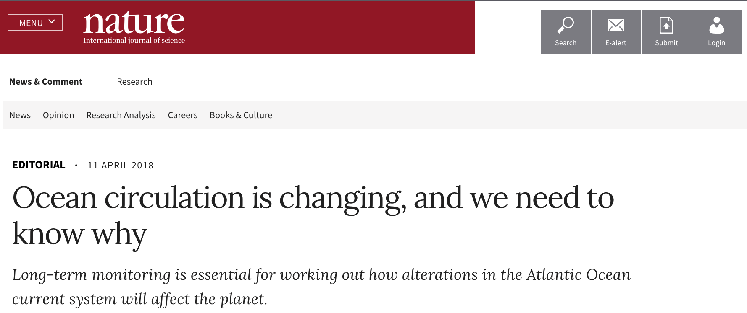
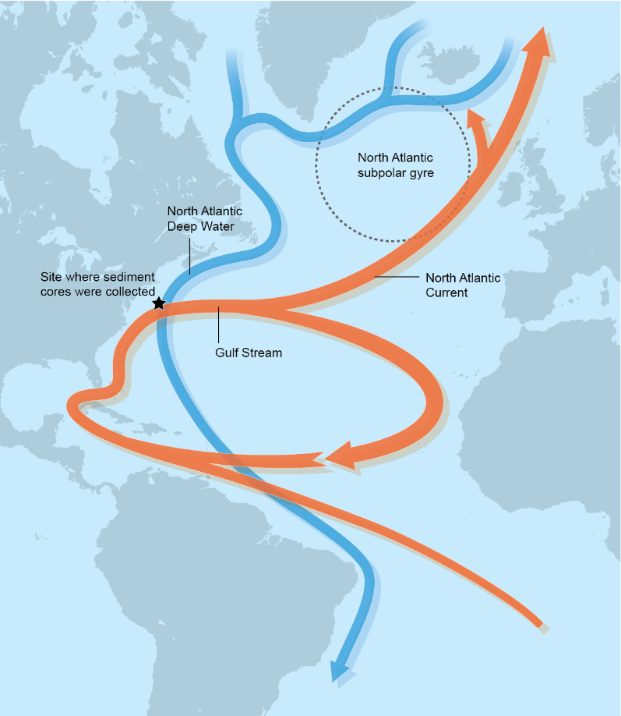
Published 11 April 2018
Nature Editorial Observations & Recommendations:
The Oceans are the most under-sampled component of the Earth system
United Nations sustainable development goal promoting ocean health
Long term measurements of circulation strength are needed
Regional & national ocean observing efforts coordinated through the Global Ocean Observing System (GOOS)

Slide 9

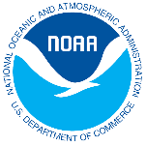


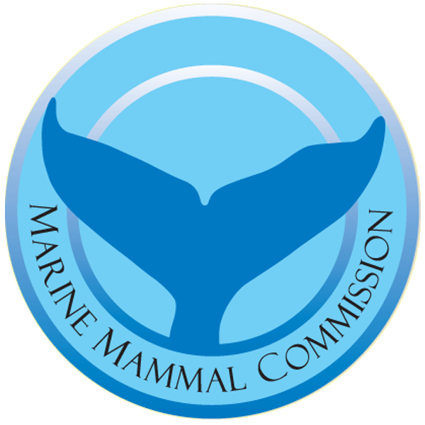

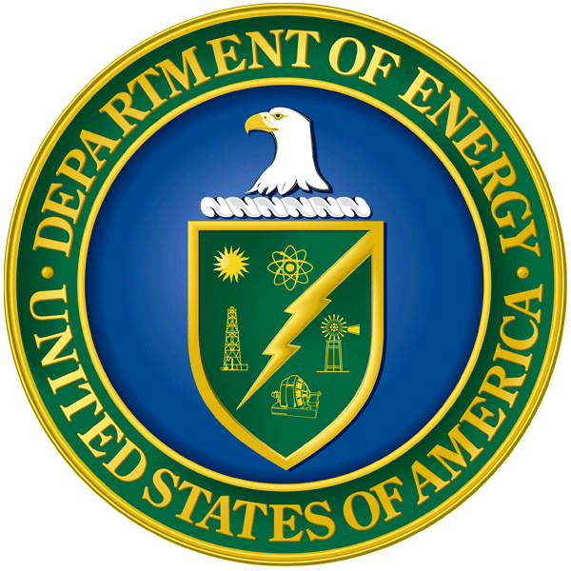
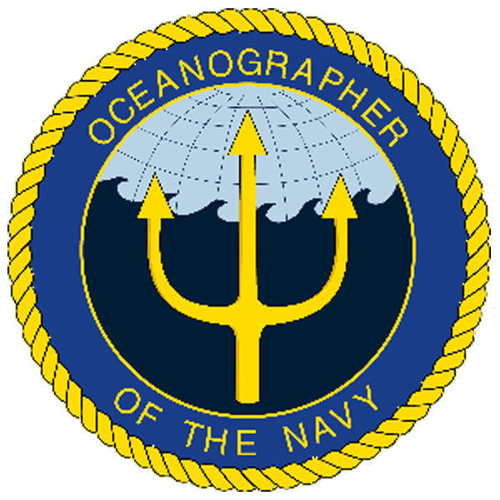
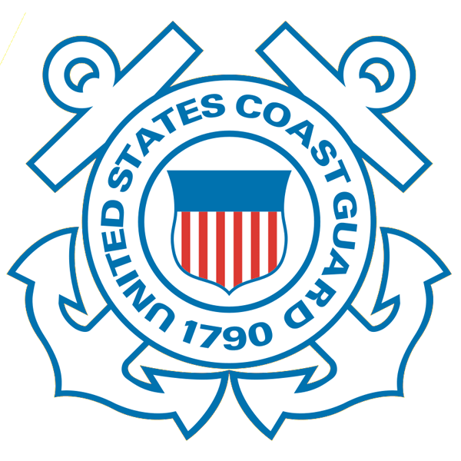




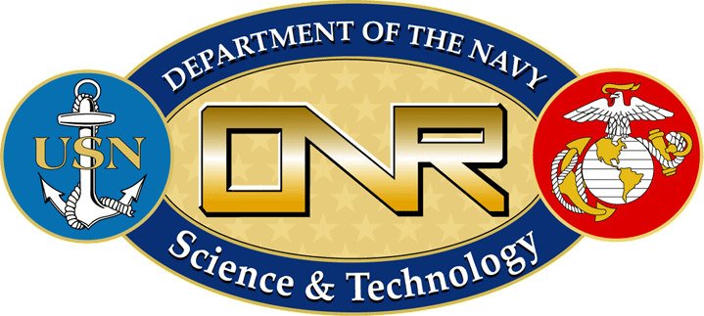




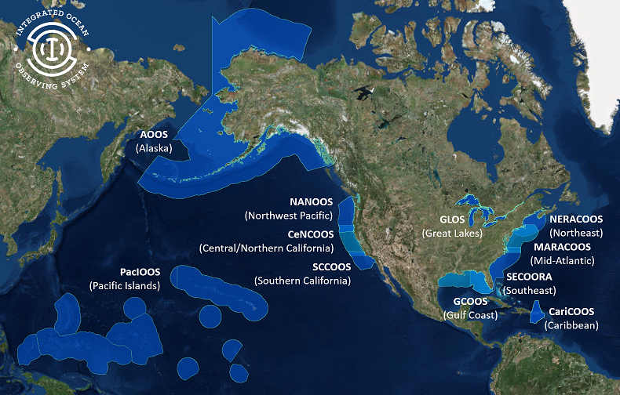
U.S. Integrated Ocean Observing System (IOOS)
Partnership effort that leverages dispersed national investments to deliver ocean, coastal and Great Lakes data relevant to decision-makers.
  Global Component
  US contribution to Global Ocean Observing System (GOOS)
  1 of 15 Regional Alliances of GOOS
  National Component
  17 Federal agencies
Regional Component
  11 Regional Associations
    Stakeholder driven
    Academia, state/local/tribal government, private industry
Notes:
NOAA is the Lead Federal Agency
US IOOS program office is within NOAA, but intended to be a multi agency network and federal to non-federal so we use the term U.S. IOOS.
Additional Background:
US IOOS is a national endeavor and spans from global to coastal, with federal and non-federal partners. The majority of non-federal partners are represented by 11 Regional Associations (RAs) that represent the US EEZ and Great Lakes.

Slide 10
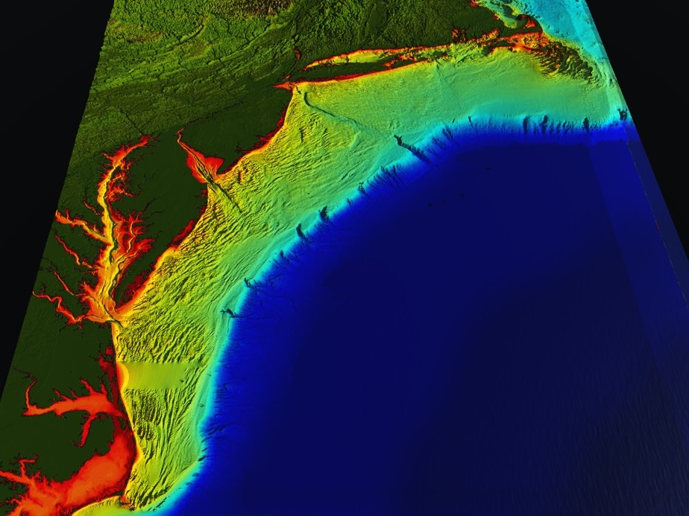
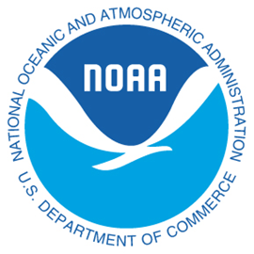



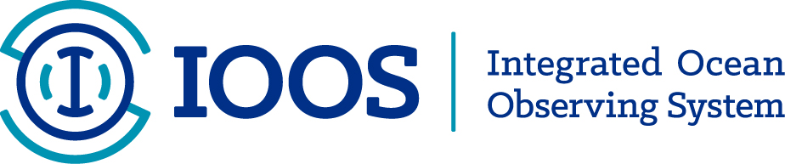

Mid-Atlantic Bight (1000 km Cape to Cape)
78 Million People (1/4 of U.S.)
Cape
Cod
U..
Mid-Atlantic Regional Association Coastal Ocean Observing System
A Sustained, Integrated & Certified
Ocean-Atmosphere
Observation & Forecast System
Cape
Hatteras
Notes:
10

Slide 11
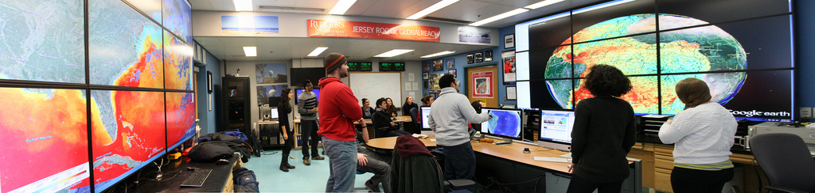
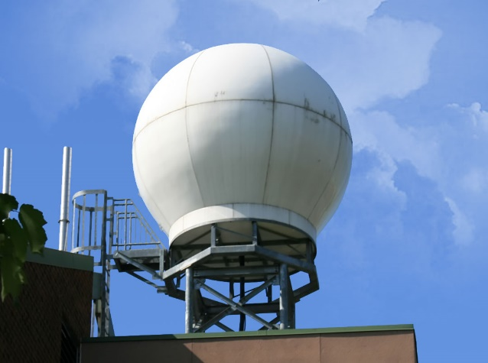
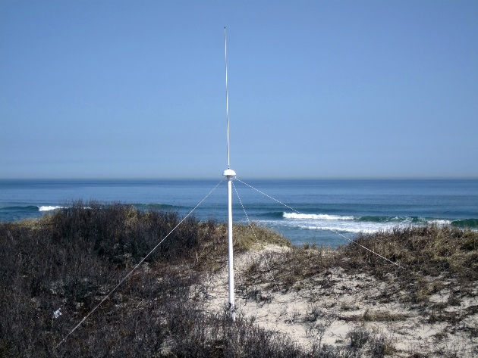
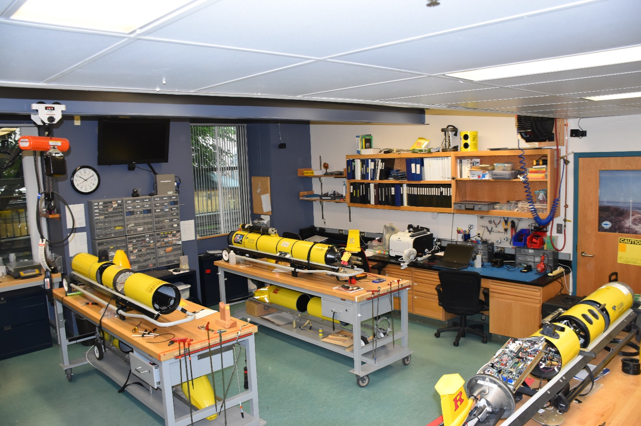
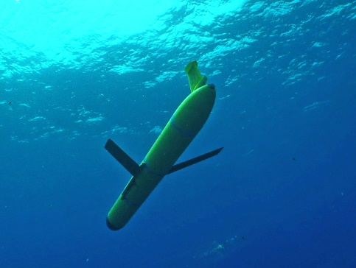
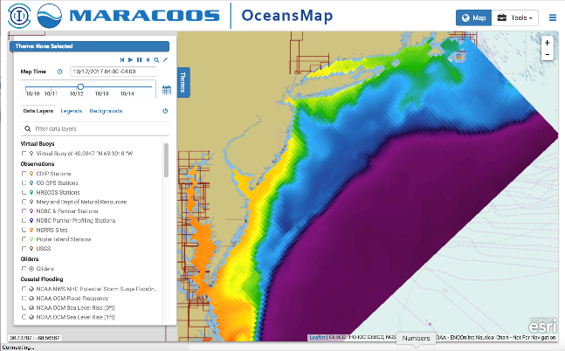
Rutgers University
Center for Ocean Observing Leadership
Satellite Receivers
46 Site CODAR Network
468 Glider
Deployments
Ocean
Modeling
Glider Lab
Notes:
11
All of this gets combined into our overall operations, research, and educational initiatives in the “COOL Room,” shown here (with a class in the background)
Thanks to many partners

Slide 12
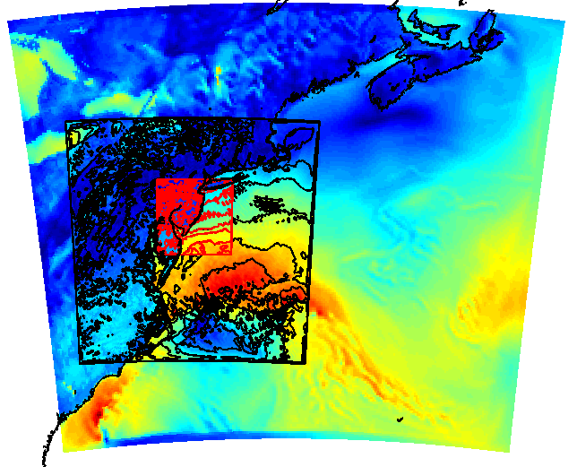
Rutgers University
Center for Ocean Observing Leadership
RU-WRF Domains
9km
3km
1km
Satellite Receivers
46 Site CODAR Network
468 Glider
Deployments
Ocean
Forecasts
Atmospheric Forecasts
Notes:
12
All of this gets combined into our overall operations, research, and educational initiatives in the “COOL Room,” shown here (with a class in the background)
Thanks to many partners

Slide 13
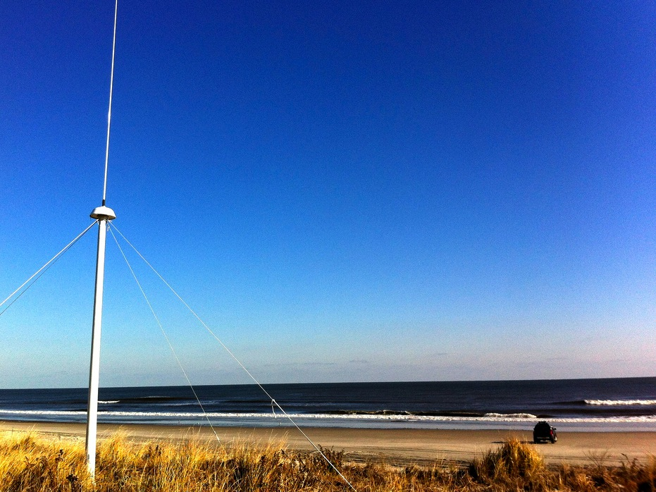
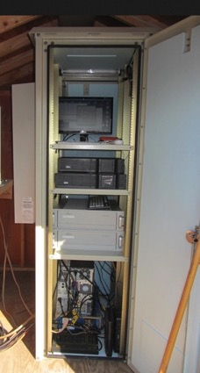
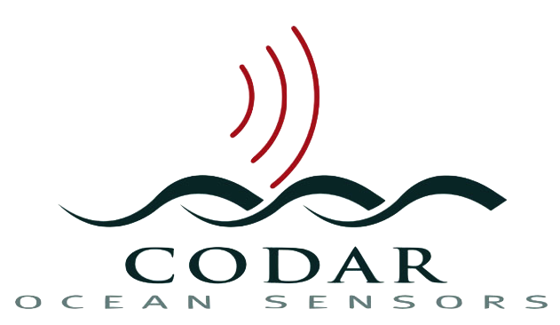
13 MHz Transmit and Receive Antenna
Weathertight SeaSonde Enclosure
Doppler shift gives ocean currents
monitor
computer & external hard drive
A.C. unit
UPS system
transmitter
receiver
lightning protection
two lines of Communication
4 m
SeaSonde
HF Radar

Slide 14
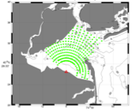
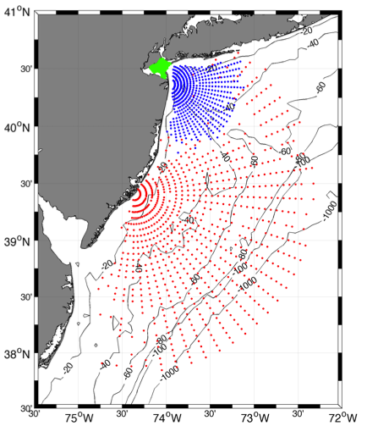



Individual HF Radar Sites
Generate Radial Vector Surface Current Maps
25 MHz
Radar λ: 12 m Ocean λ: 6 m
Range: >30 km Resolution: 1 km
13 MHz
Radar λ: 23 m Ocean λ: 12 m
Range: >80 km Resolution: 3 km
05 MHz
Radar λ: 60m Ocean λ: 30 m
Range: >180 km Resolution: 6 km

Slide 15
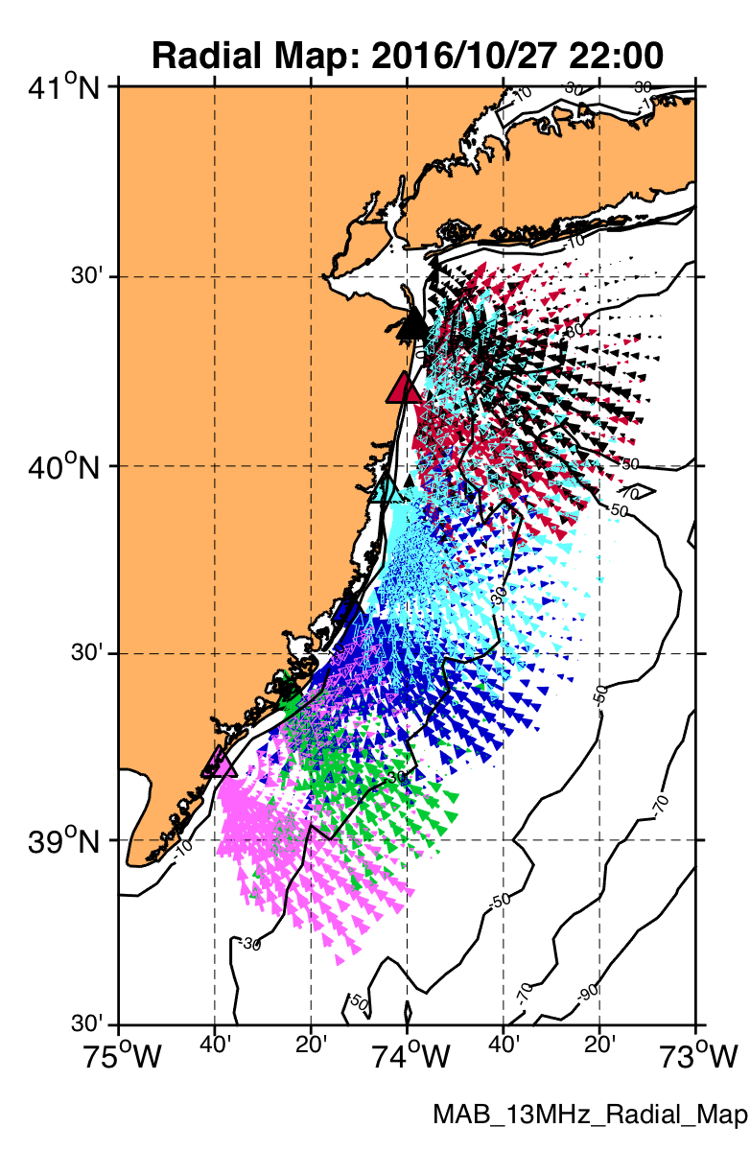
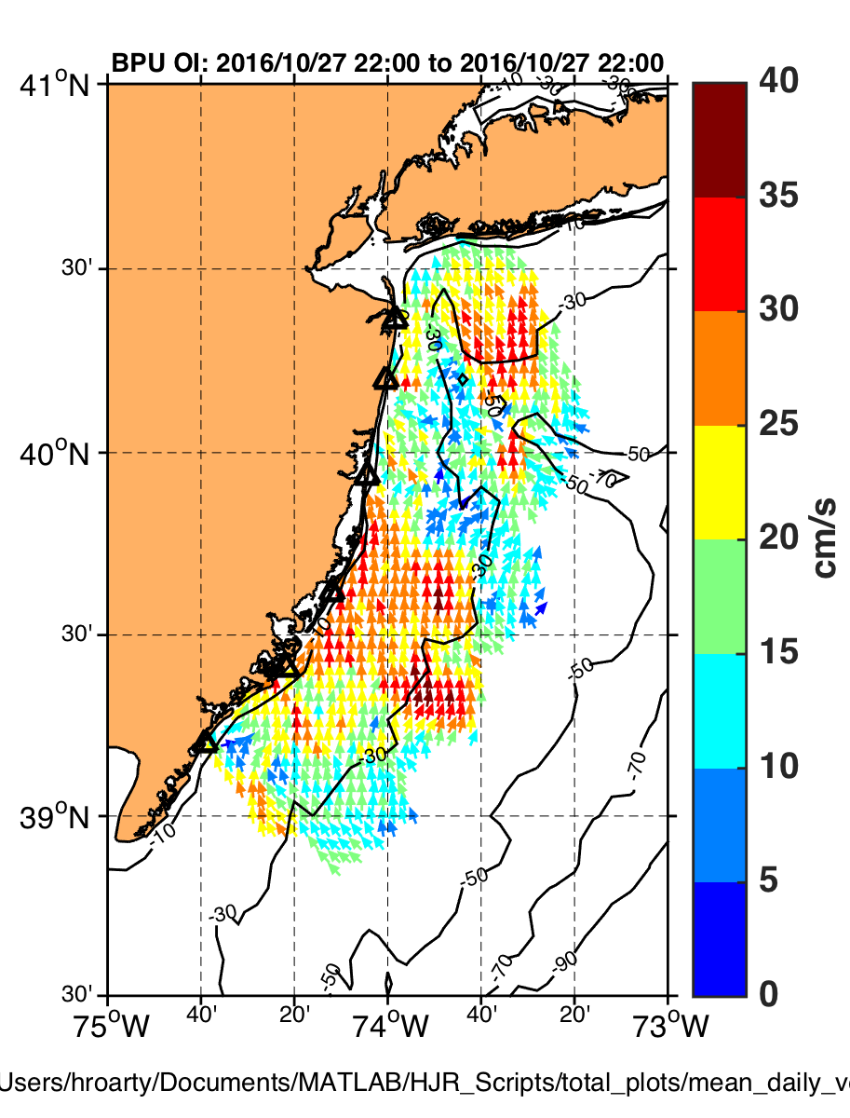
Radial Current
Vectors from Multiple Sites
Combined into Total Vectors
by UWLS or OI

Slide 16
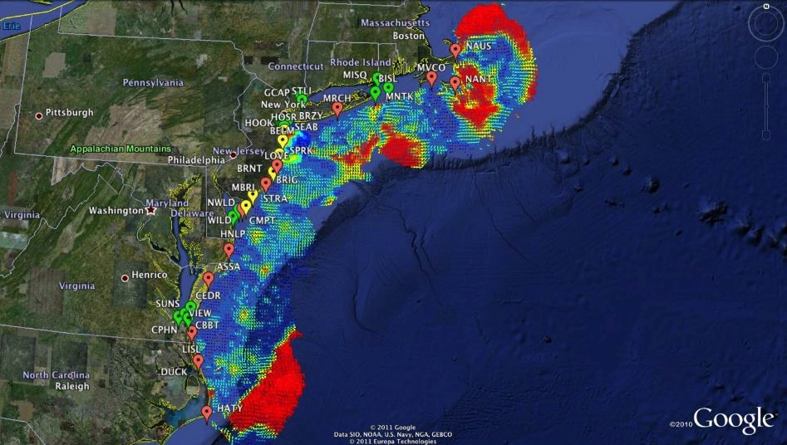

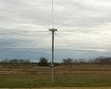
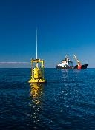
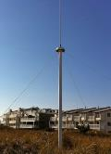

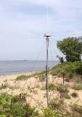






Mid-Atlantic Bight HF Radar Network
Generates Total Vector Surface Current Maps
1000 km
Cape to Cape
Mid-Atlantic HF Radar Network
17 Long-Range CODARs
8 Medium-Range CODARs
16 Short-Range CODARs
41 Total CODARs in Region
+5 CODARs Roaming
46 Total CODARs
Triple Nested, Multi-static, Multi-use
Industry Partner: CODAR Ocean Sensors

Slide 17
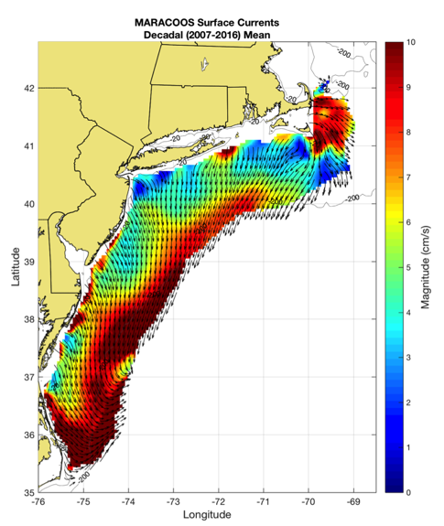
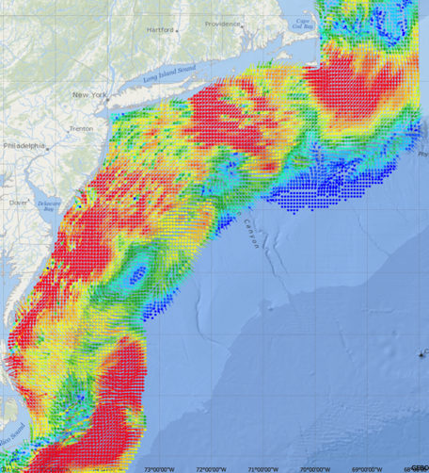
Mid-Atlantic Bight HF Radar Network
Generated Surface Current Maps Every Hour for a Decade
5 MHz- 17 Stations
13 MHz- 7 Stations
25 MHz- 16 Stations
Outside- 6 Stations
TOTAL – 46 Stations
Winter Storm Jonas
2016/01/23 20:00 UTC
Hourly Maps for
Search And Rescue,
Water Quality & Spill Response
Decadal Mean Currents
for Scientific Analysis

Slide 18






MARACOOS Integration Matrix
Integration Matrix: Capabilities Support Multiple Themes
Regional Priority Themes | Regional Observation & Modeling Capabilities
 | Weather Mesonet | HF Radar Network | Statistical STPS | Satellite Imagery | Glider Surveys | Dynamical Ocean Forecasts
Theme 1. Maritime Commerce & Safety | Operational Input to USCG SAROPS | Operational input to USCG SAROPS | Operational input to USCG SAROPS | SST for survivability planning | Assimilation dataset for forecast models | Surface currents for SAROPS
Theme 2. Fisheries | Weather forecast ensemble validation | Circulation and divergence maps for habitat |  | SST & Color for habitat | Subsurface T & S for habitat | 3-D fields of T, S, circulation for habitat
Theme 3. Public Health & Water Quality | Winds for transport, river plumes, & upwelling | Surface currents for floatables, bacteria, spill response | Surface currents for floatables, bacteria, spill response | Ocean color for river plumes | Nearshore dissolved oxygen surveys | Surface currents for floatables, bacteria, spill response
Theme 4. Coastal Flooding | Weather forecast ensemble validation | Assimilation dataset for forecast models |  | SSTs assimilation into forecast models | Assimilation dataset for forecast models | Nested forecast ensembles
Theme 5. Offshore Energy | Historical analysis & wind model validation | Historical current analysis & wind model validation |  | Historical analysis surface fronts & plumes for siting | Historical analysis of subsurface fronts & plumes | Coupled ocean-atmosphere models for resource estimates

Slide 19
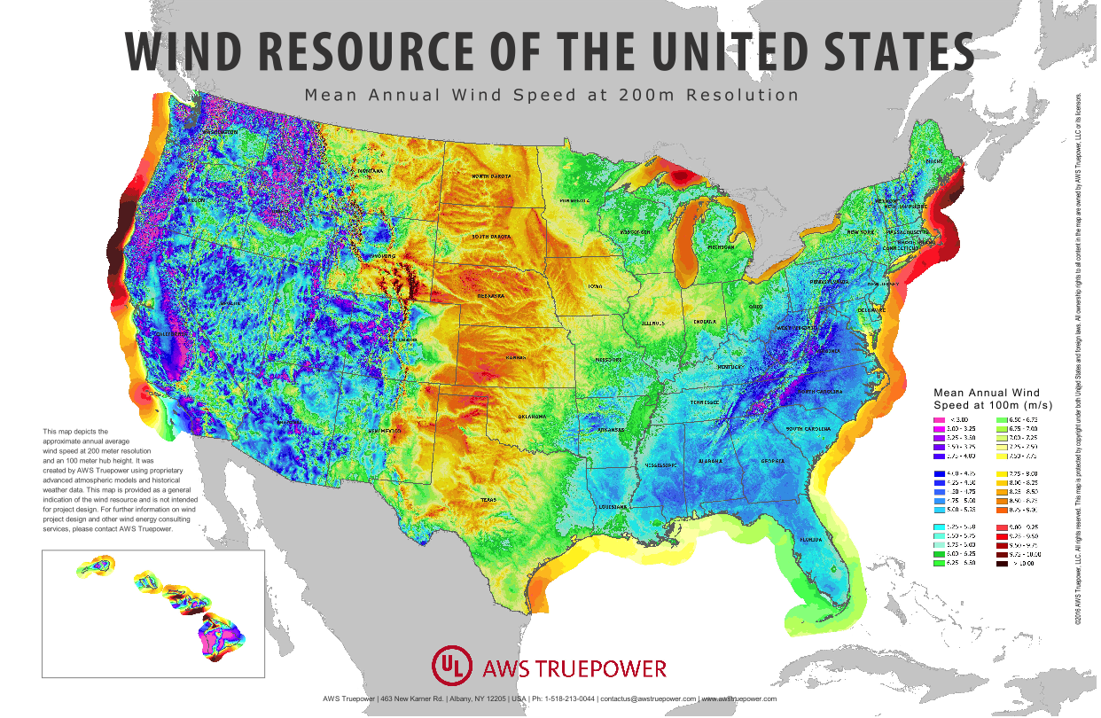
Rapid Growth in Offshore Wind Energy Development
Mid Atlantic
1) Wind Resource
2) Energy Market
3) Shallow Shelf

Slide 20
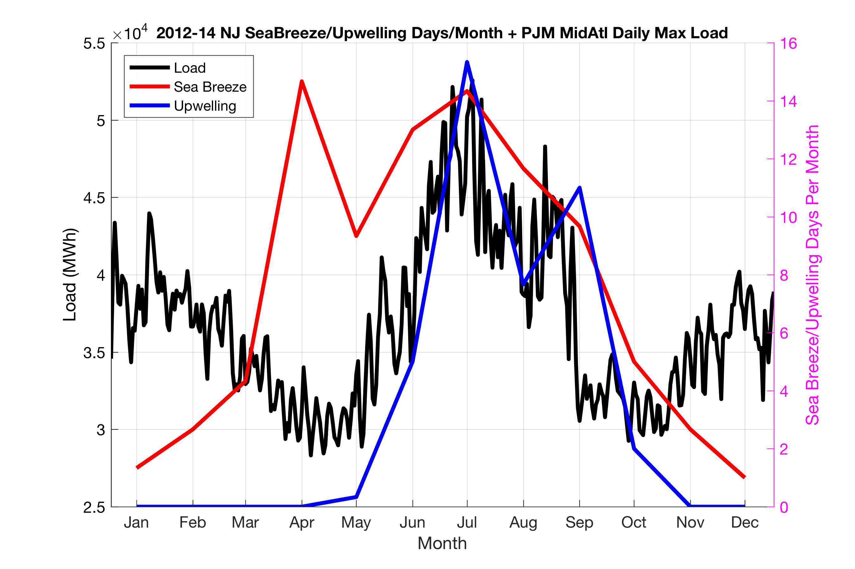
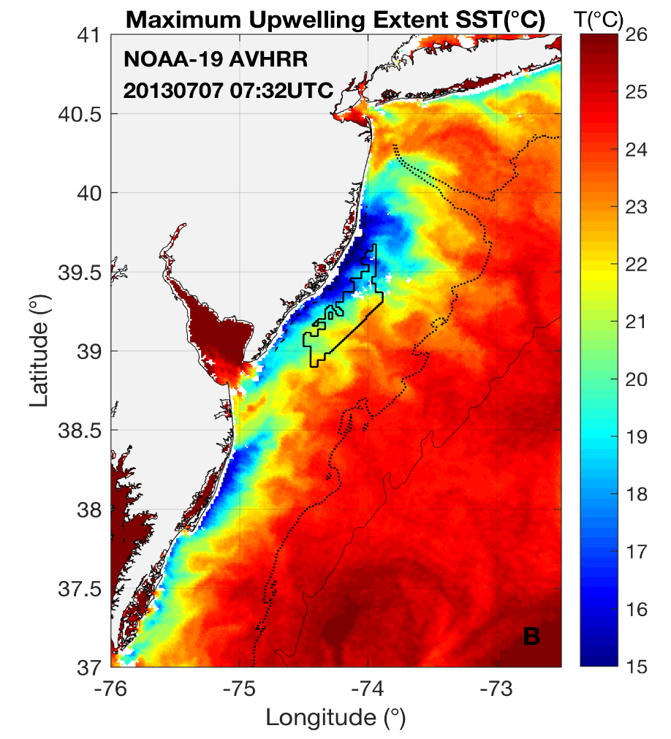
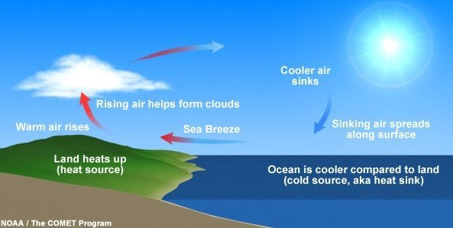
Mid-Atlantic Power Use & Wind Resource are Variable
Power Use
Coastal Upwelling
Seabreeze

Slide 21
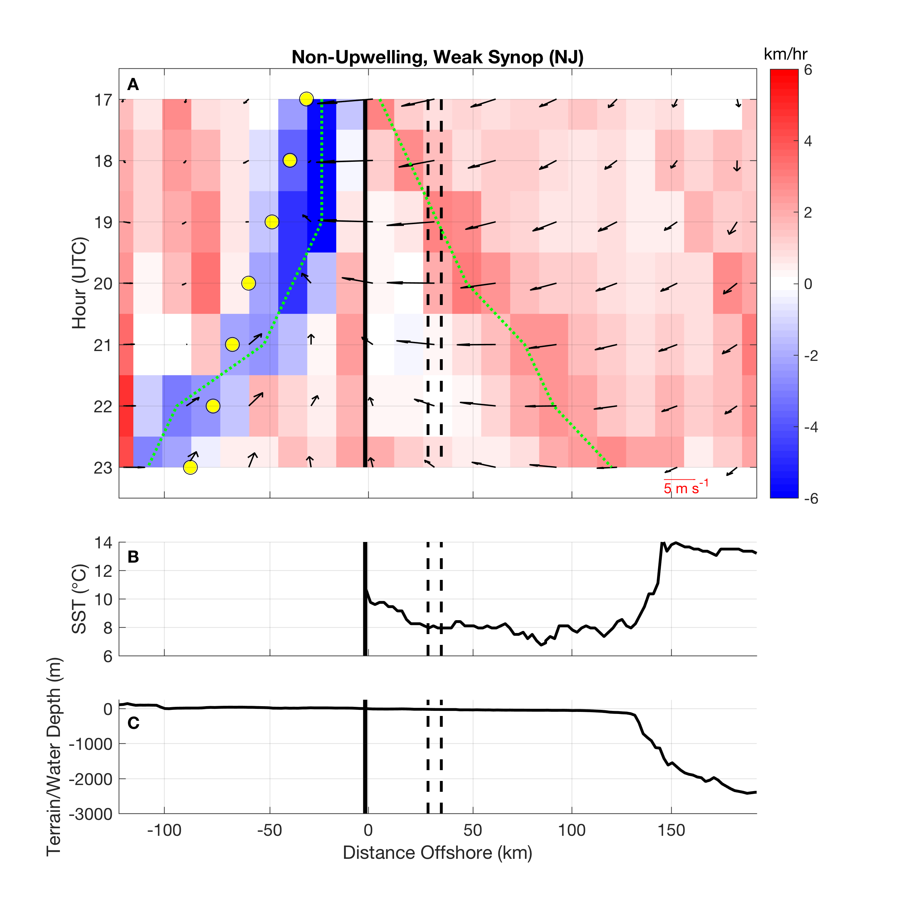
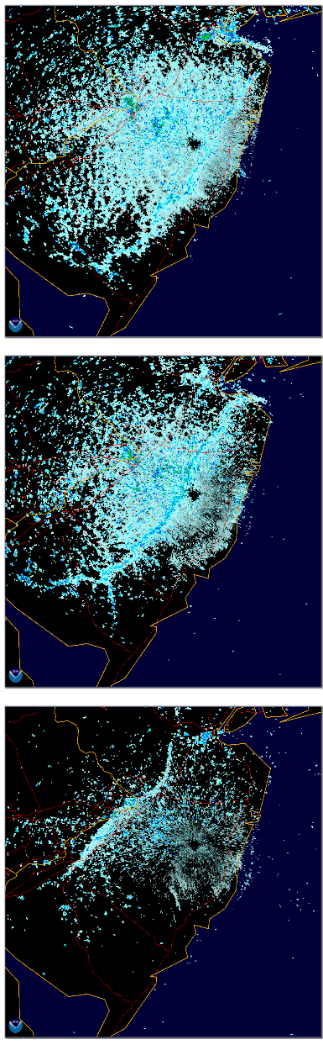
Application of RU-WRF Seabreeze Frontal Tracking w/LCS
JGR-
Atmos
Time
Onshore Side:
Human Health
Offshore Side:
Wind Energy
Coast

Slide 22
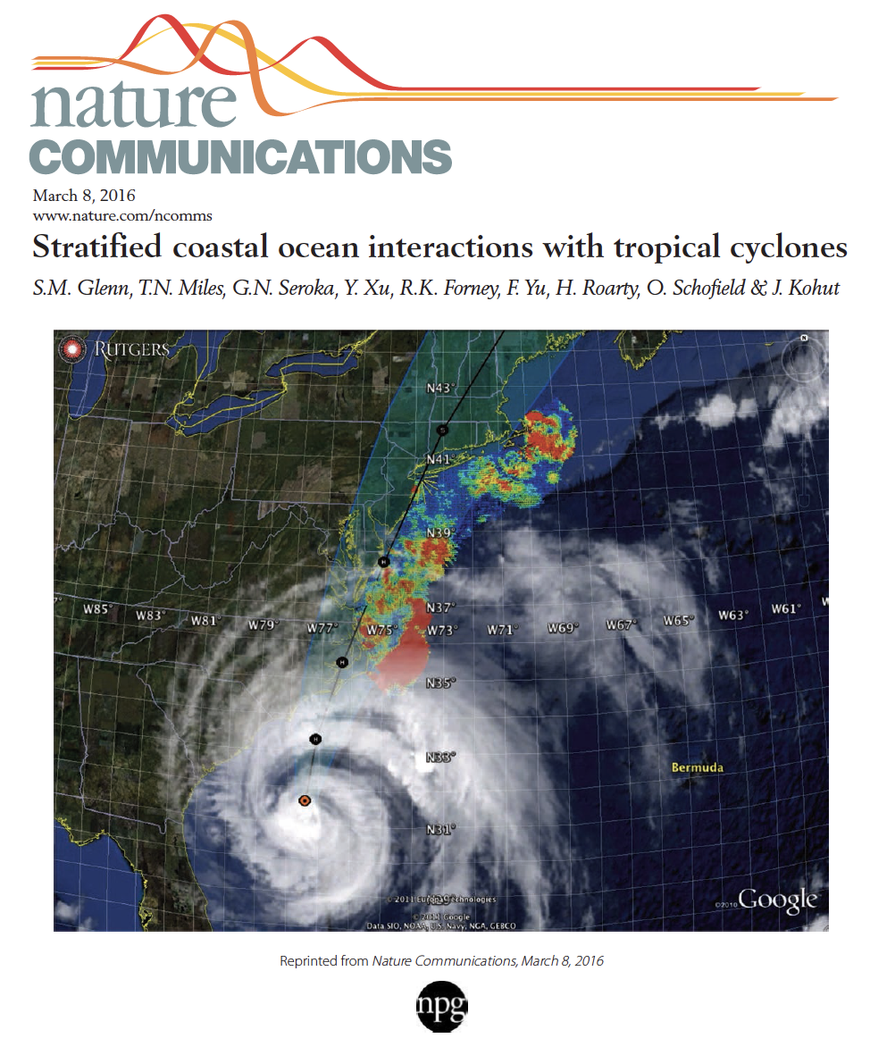
New Scientific Understanding:
Two types of coastal ocean response
to Mid Atlantic hurricanes discovered
The essential ocean features are
  Seasonally warmed surface water
  Persistent Cold Pool bottom water.
The essential ocean processes are
  (a) ahead-of-eye mixing/cooling
  (b) ahead-of-eye advection.
The essential ocean impacts on the atmosphere are
  (a) ocean mixing/cooling reduces storm intensity - Irene
  (b) offshore advection acts to increase intensity - Sandy
+ Monthly Weather Review (2016)
+ JGR-Oceans (2017)
+ JGR-Oceans (2017)

Slide 23

Hurricane Irene –
WRF Model Sensitivity Study
Over 130 model runs
Paired to compare sensitivities
Central pressure & max wind
Sensitivity to SST greatest
Monthly Weather Review (2016)
Notes:
This shows that, for the first time in 30 years there is the potential to dramatically increase forecast intensity at landfall, by including

Slide 24


Project Title: Sustained ocean observations with underwater gliders in support of hurricane intensity forecasts (2018-2020)
Storm Glider Picket Lines

Slide 25


WMO/IOC JCOMM Global HF Radar Network
MARACOOS
> IOOS > GOOS
I
IOCARIBE
> GOOS
http://global-hfradar.org/

Slide 26
NASEM Loop Current Recommendations:
#3) Install HFRs on the oil platforms in the northern Gulf of Mexico
#10) Install HFRs for the Loop Current Outflow
#11) Install HFRs for the Loop Current Inflow
#3
#10
#11

Slide 27

CODAR SeaSondes in the Gulf of Mexico: Existing

Slide 28

CODAR SeaSondes in the Gulf of Mexico: Existing+Proposed
La Havana
Cabo San Antonio

Slide 29




Many Ocean Observing Education & Training Opportunities

Slide 30

Summary
Caribbean Corridor is a key component of the global climate system – AMOC heat transport, hurricane intensity
UN Decade of Ocean Science for Sustainable Development begins in 2021 – Provides a framework for partnership
We can expand GOOS partnerships now – HFR operations & education programs
CODAR SeaSonde
Mona Island, Puerto Rico
Rutgers & UPRM Partnership

