Slide 1



MARACOOS Operations Overview
November 2018
Michael Crowley
MARACOOS Technical Director

Slide 2
MARACOOS Core Organization: Operations
Operations
M. Crowley
Technical Dir.
HF-Radar
Gliders
Data Processing
DMAC
H. Roarty
HF-Radar Dir.
D. Aragon
Glider Lead
Satellite
J. Kerfoot
QC Gliders
K. Knee
DMAC
M. Shatley
Satellite Data
T. Garner
Asst. HF-Radar Dir.
C. Haldeman
Gliders & HW
L. Nazzaro
Glider & Satellite Data
B. Fratantonio
Ocean Eng. & Software
E. Handel
HF-Radar Tech.
N. Waite
Glider Tech.
M. Smith
HF-Radar & Glider Data
B. McKenna
Meteorology & Software
T. Fake
HF-Radar Tech.
J. Hudson
Glider Tech
Modeling
H. Wang
Data Processing
C. Morse
Sr. Software Dev.
J. Levin
Modeling
R. Arena
HF-Radar Tech. & Gliders
Matt’s Student
Glider Tech
C. Adams
Software Dev.
Numerous people at partner institutions are heavily leveraged while not receiving funding
Notes:
Multitasking for many people
I also assist with satellite work (Laura too)
About 7.5 FTEs in operations. In kind Just at R 500-700

Slide 3
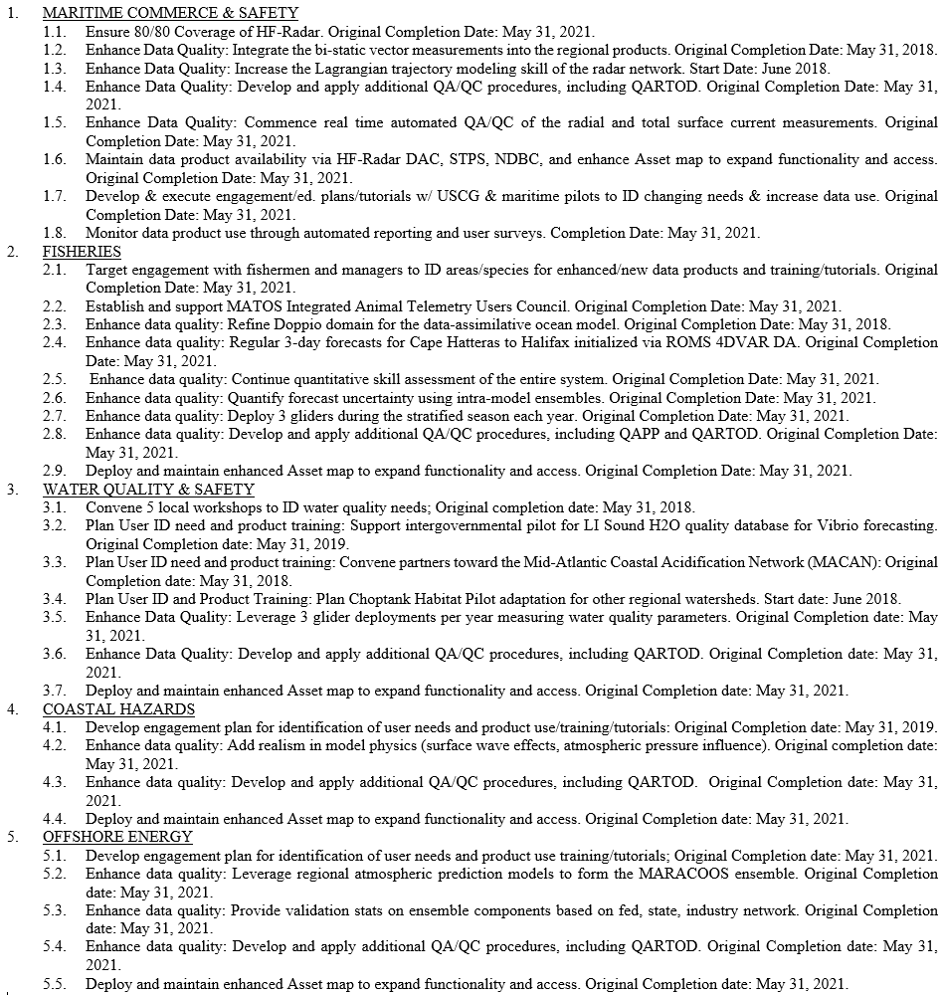
MARACOOS Milestones
The 2016 MARACOOS proposal included 33 milestones for each of the five themes:
  Maritime Safety & Commerce
  Fisheries
  Water Quality and Safety
  Coastal Hazards
  Offshore Energy
Status (June 2018):
Starting FY19: 2
Completed: 3
On Schedule: 25
Delayed: 3
Notes:
Everyone on the previous slide reports up to metrics defined in proposal. Each of the 33 are reported to every 6 months. Delayed are: 1.2 bi static codar data integration (6 month delay, expect completion this winter), 2.6 Quantify forecast uncertainty using intra-model ensembles (delayed to leverage OTT funds, still expect to complete in 2021), 3.1 convene water quality workshops (change of engagement personnel)

Slide 4
Operations Data Flow
External
(GTS, NDBC, NCEI)
Satellites
Products
MARACOOS
Partners Institutions
Federal
State
Private
MARACOOS DMAC
IOOS DACs
HF-Radar
Gliders
External
Models
Notes:
General overview of data flow, dmac, and availability. External is GTS and NDBC etc, satellite is comprehensive view

Slide 5
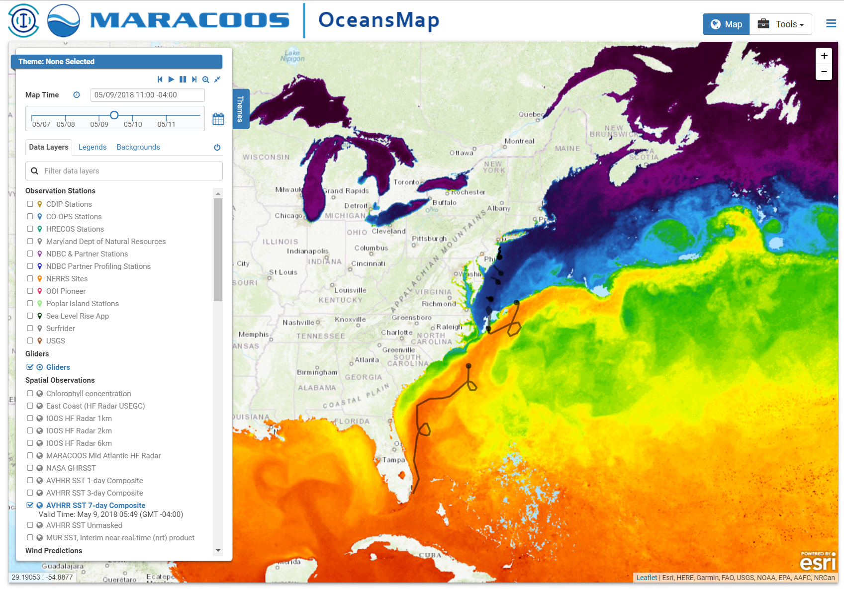
MARACOOS Satellite Data
UDel/RU redundancy – provides for 100% uptime, and alleviates scheduling conflicts
Satellites
  NOAA Polars
  MODIS Aqua & Terra
  Metop-A & B
  NPP VIIRS
  GOES East
Key Real-Time Products
  Climatology
  Coldest Pixel
  Anomalies
  Water Masses
Key Customers
  Fisheries, Energy, SAR, Weather Predictions

Slide 6
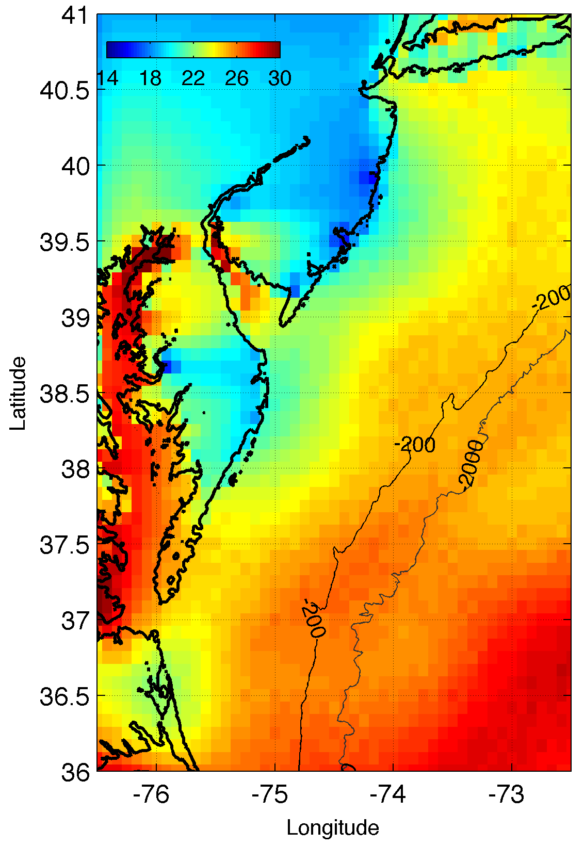
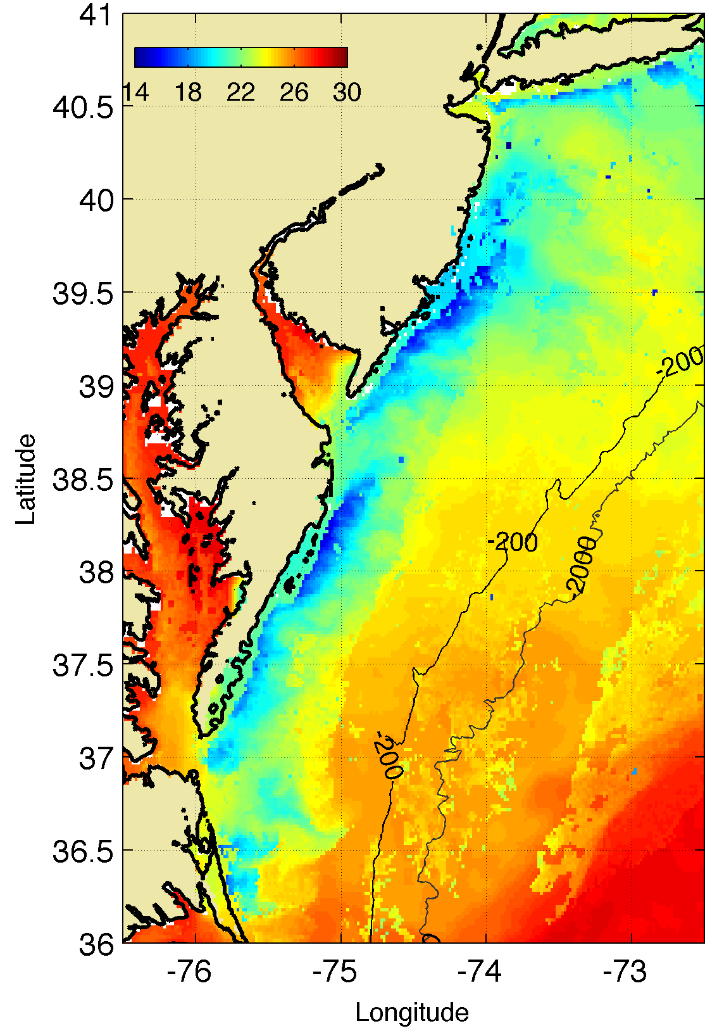
Satellites: Coldest Pixel Composite - Upwelling
Regional Coldest Dark Pixel Composite SST
Captures Coastal Upwelling
Example: 8 July 2013 Upwelling up to 6C SST Difference
RTG SST
Coldest Dark
Pixel SST
Standard National
Satellite
Sea Surface Temperature
(SST) Product
Regional
Satellite
Sea Surface Temperature
(SST) Product

Slide 7
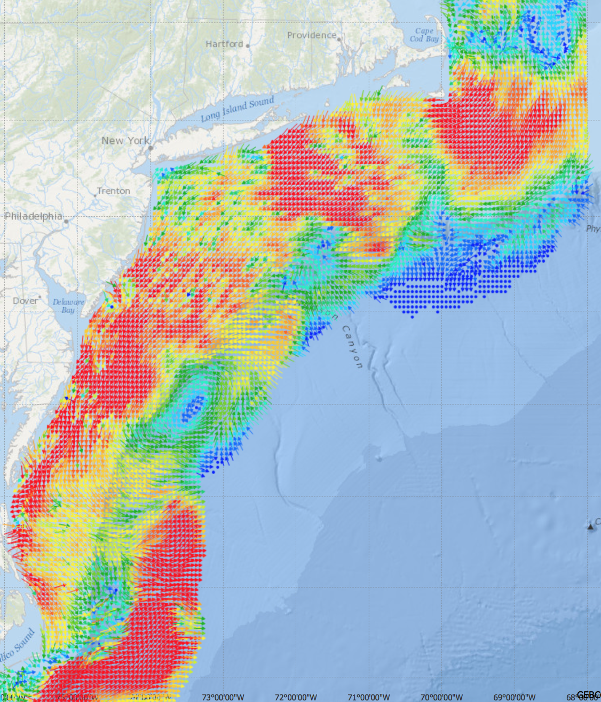
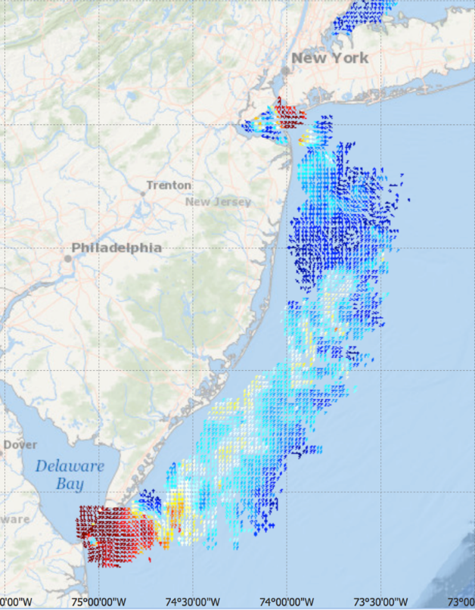
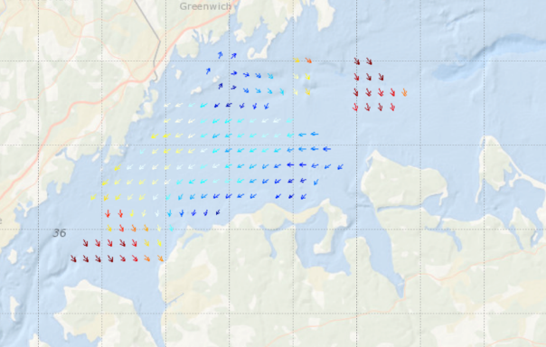
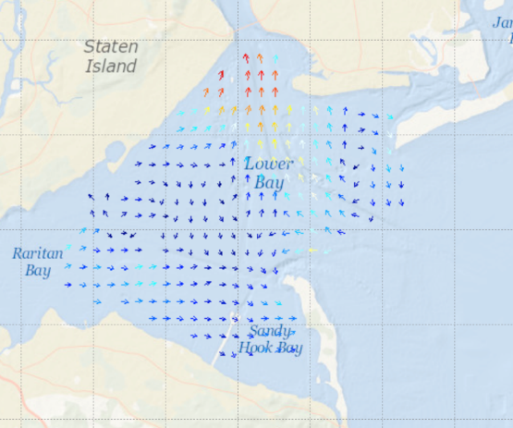
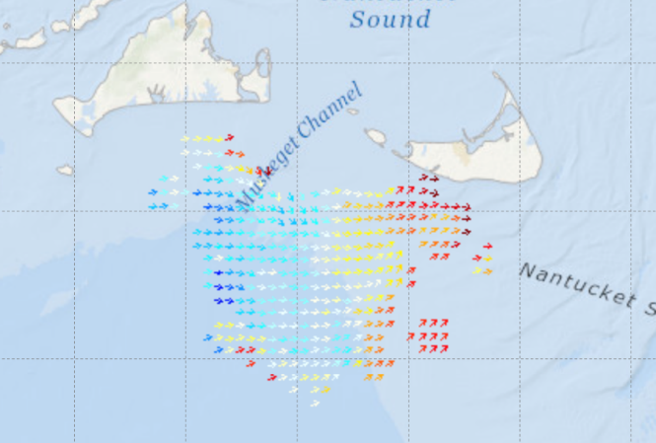
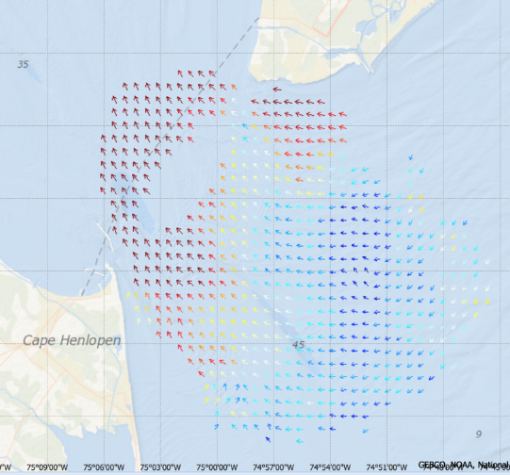

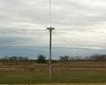
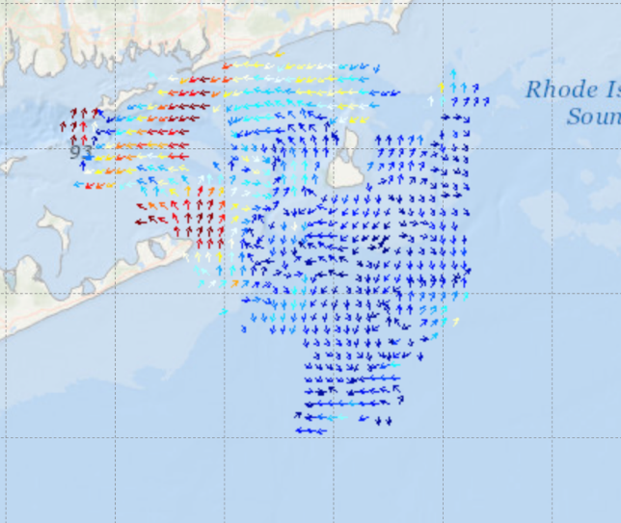
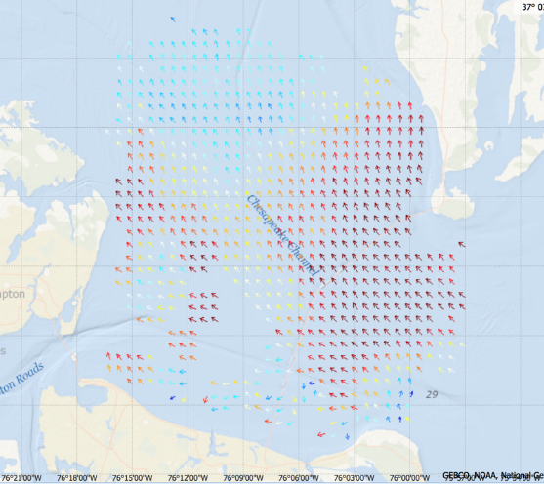
High Frequency Radar Network
Long Range Network
Western Long Island Sound
5 MHz- 17 Stations
13 MHz- 8 Stations
25 MHz- 16 Stations
TOTAL – 41 Stations
New Jersey 13 MHz
New York Harbor
Key Customers
SAR
Inundation
Maritime
Water Quality
Muskeget Channel
Delaware Bay
Block Island Sound
Chesapeake Bay
Challenge: Aging infrastructure
Notes:
3 types of networks with 3 resolutions
The mid range also measure wave height just offshore.
The network has aging infrastructure that needs to be upgraded. Several sites are > 10 years old.

Slide 8
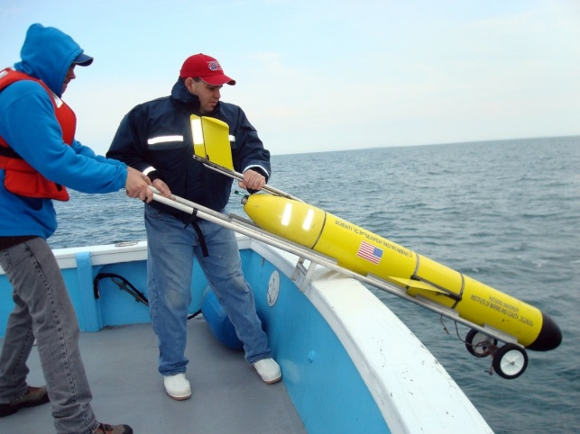
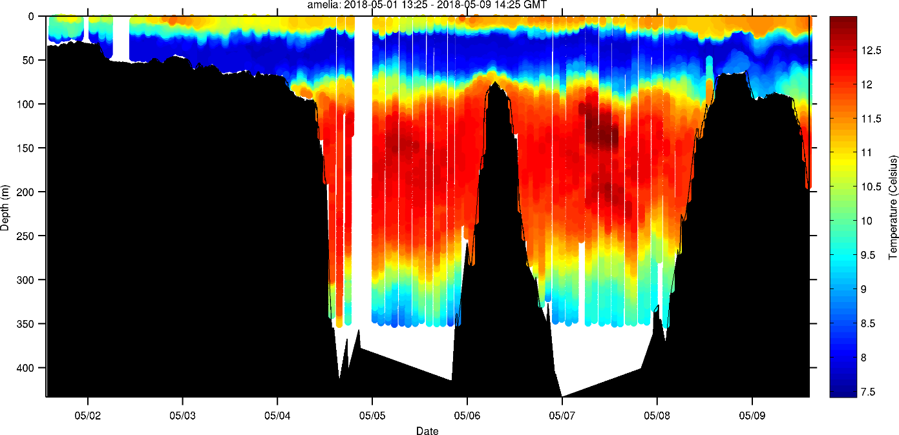
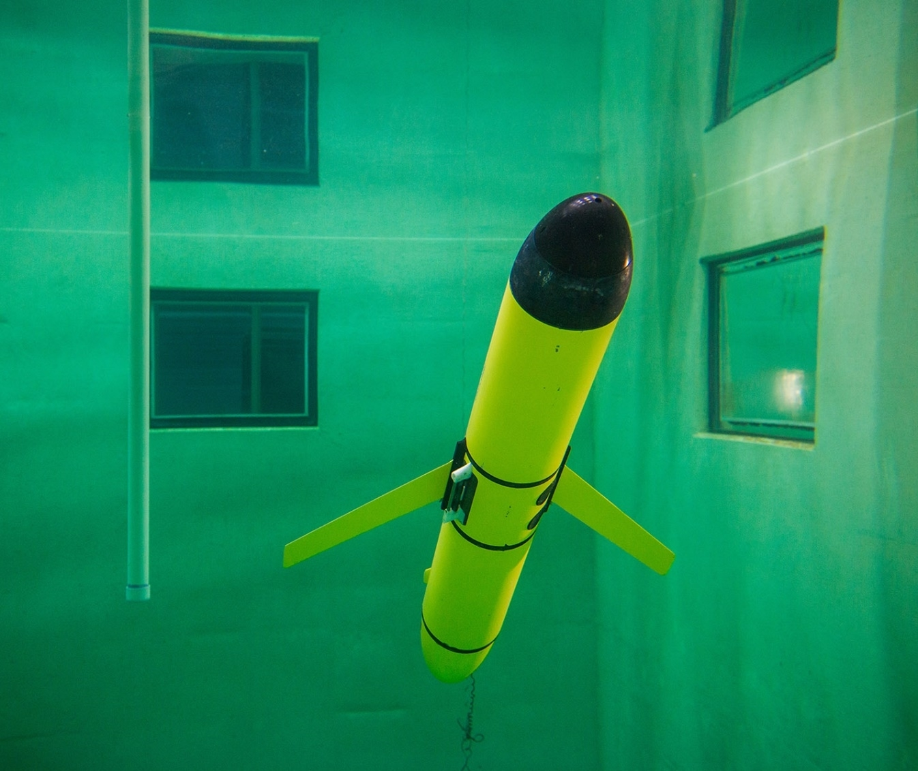
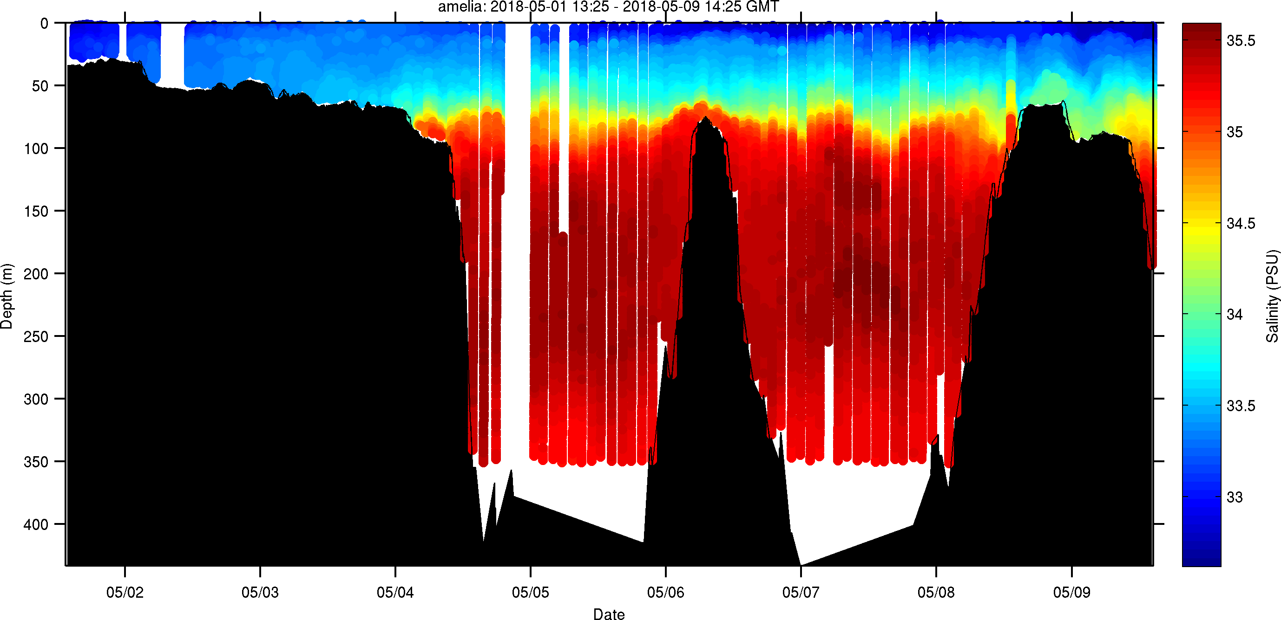
MARACOOS Gliders 2018
MARACOOS funded 5 glider deployments in MAB, 1 in SAB
YTD: MARACOOS 239 days, 4322km (1 deployment remains)

Slide 9
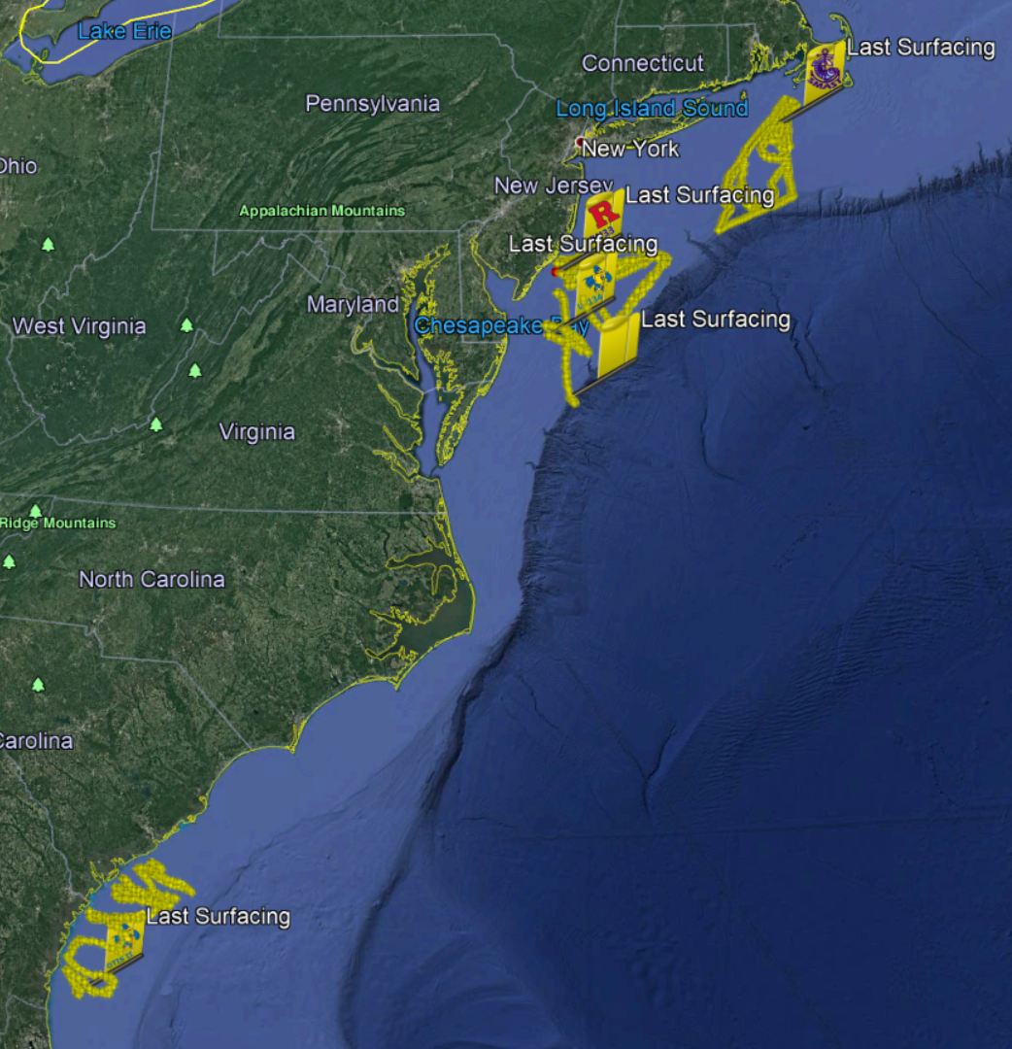
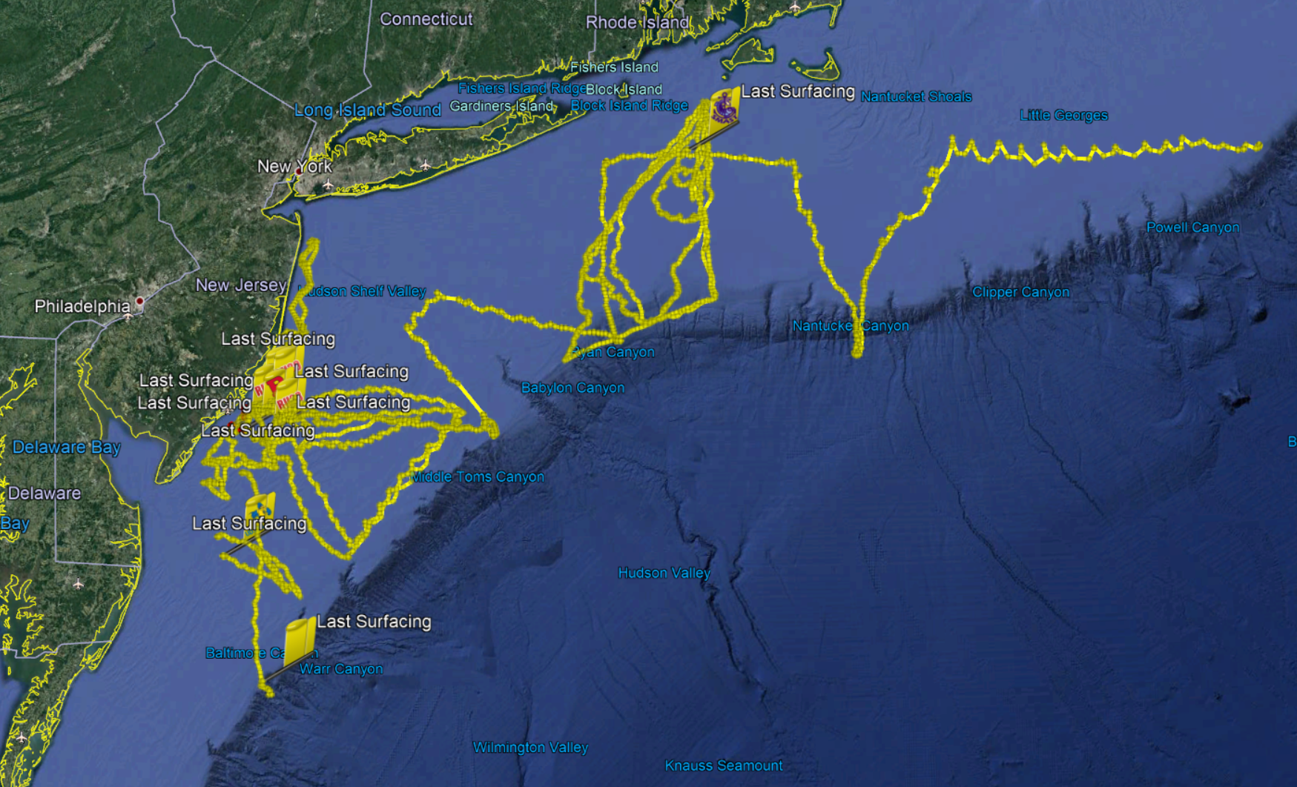
2018 MAB Glider Deployments
Key Customers
Water Quality
Fisheries
Hurricanes
MARACOOS
Measurements include temperature, salinity, depth, O2, optics, sediment, zooplankton, currents, waves, pH
MARACOOS Partners
Challenge: Aging infrastructure
Notes:
We have a large fleet, but much if it needs significant upgrades due to age, and newer sensors (pH, ZPLSC) can only be used on G2 gliders.

Slide 10
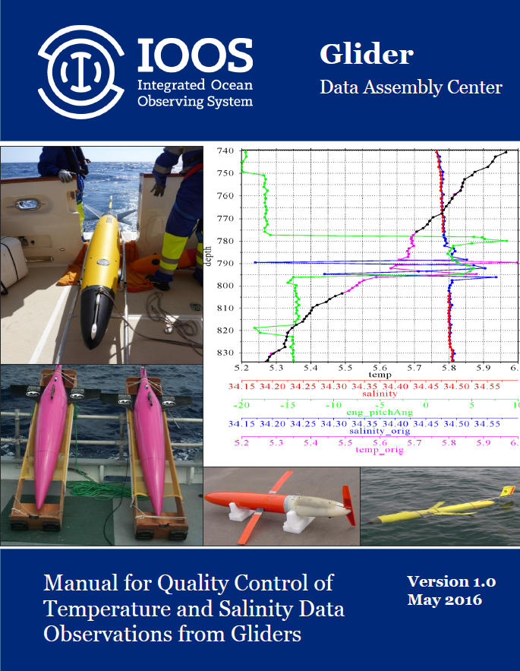
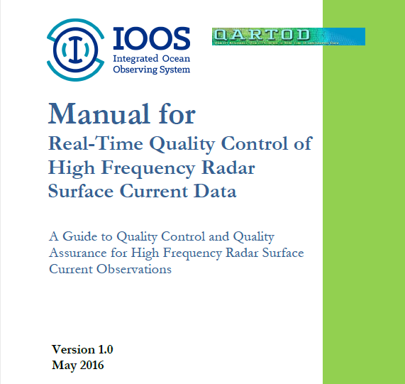

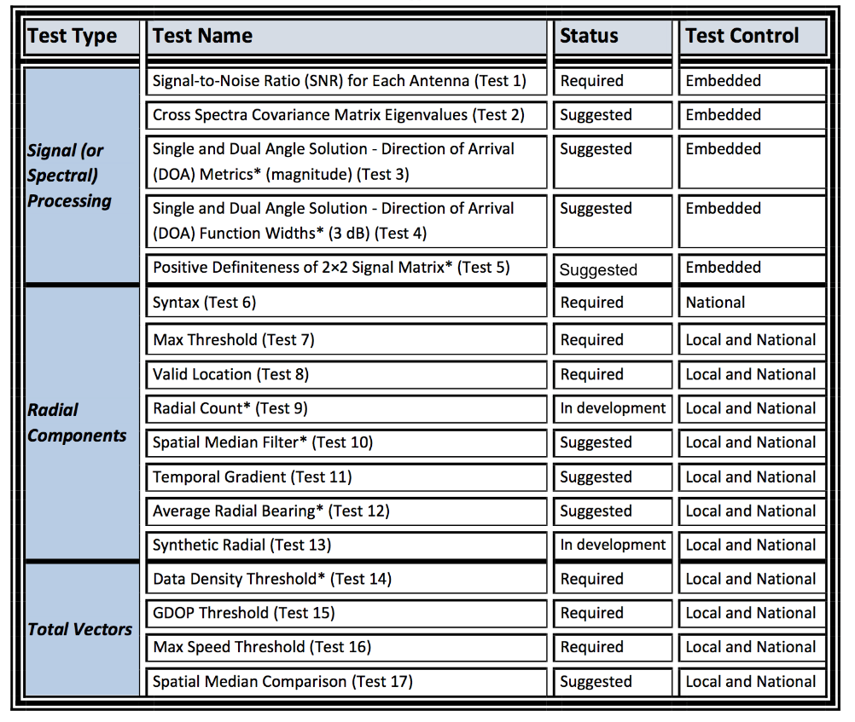
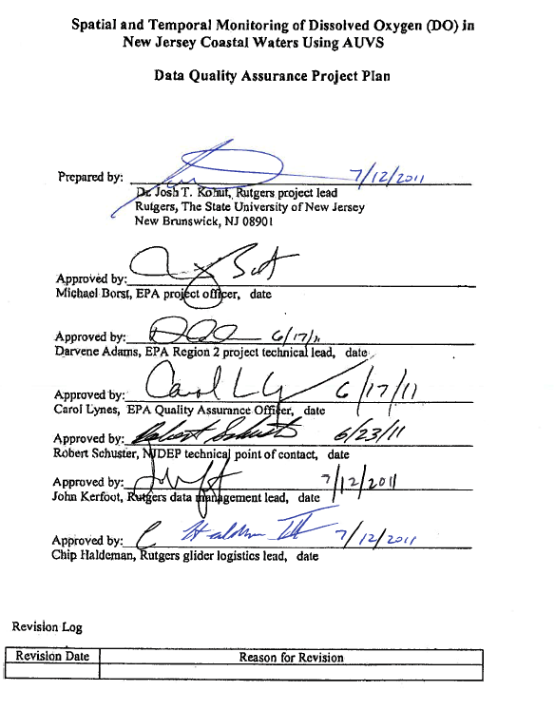
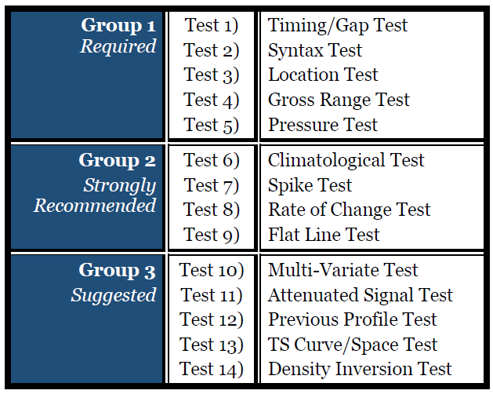
QARTOD QC Tests
QARTOD
EPA Quality Assurance Project Plan:
Glider Mission Planning
SeaBird CTD
Aanderra Optode 3835
Documents for pre- & post- deployment glider, CTD & DO
From
QARTOD
Manual for
HF Radar
.
Notes:
We also need to make sure that anything served through OceansMap has QC applied

Slide 11
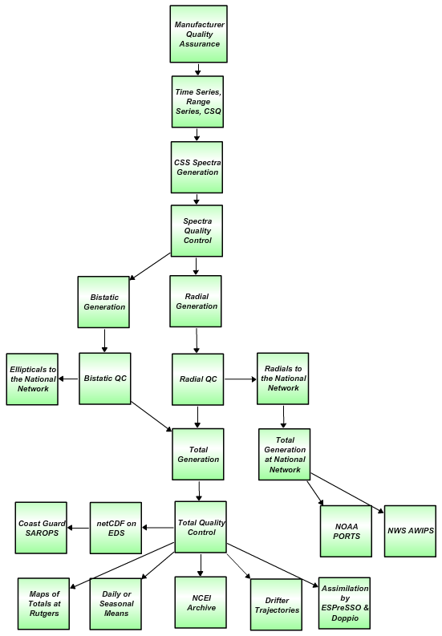
HF Radar Data Real Time & Delayed Mode Flow Chart
Quality Assurance
Manufacturer recommended Antenna Patterns not older than 1 year
Weekly 11-point remote site inspections
Physical site inspection every 6 months
Level 0
Automated QARTOD
Test 1: SNR Ratio, Filter < 7dB
Human In The Loop
Visual inspection of first order line settings performance on capturing Bragg scatter
Analyze antenna amplitude and phase along with spectra SNR and noise floor to identify reprocessing intervals and reprocess
Level 1
Test 6: Syntax, Filter
Test 7: Max Threshold, Filter > 150 cm/s (13/25 MHz) 300 cm/s (5 MHz)
Test 8: Radial Valid Location, Filter
Visual inspection of hourly radial files
Identify radial gaps due to communication latency and fill
Analyze radial diagnostic plots (average radial bearing, radial coverage) to identify errors for reprocessing
Check to see that gaps are not introduced into the reprocessed data set
Level 2
Test 14: Data Density Threshold, Filter, At least 3 vectors from 2 separate stations
Test 15: GDOP, OI Uncertainty, Flag > 0.6 in U or V Velocity
Test 16: Max. Speed Threshold , Filter > 150 cm/s (13/25 MHz) 300 cm/s (5 MHz)
Visual inspection of hourly total files
Visual inspection of the reprocessed hourly total files
Level 3
Level 4
Data levels defined by NASA Earth Science Reference Handbook ( 2006, p.31)
.

Slide 12
Operations Data Flow
External
(GTS, NDBC, NCEI)
Satellites
Products
MARACOOS
Partners Institutions
Federal
State
Private
MARACOOS DMAC
IOOS DACs
HF-Radar
Gliders
External
Models
Notes:
External is GTS and NDBC etc, satellite is comprehensive view

Slide 13

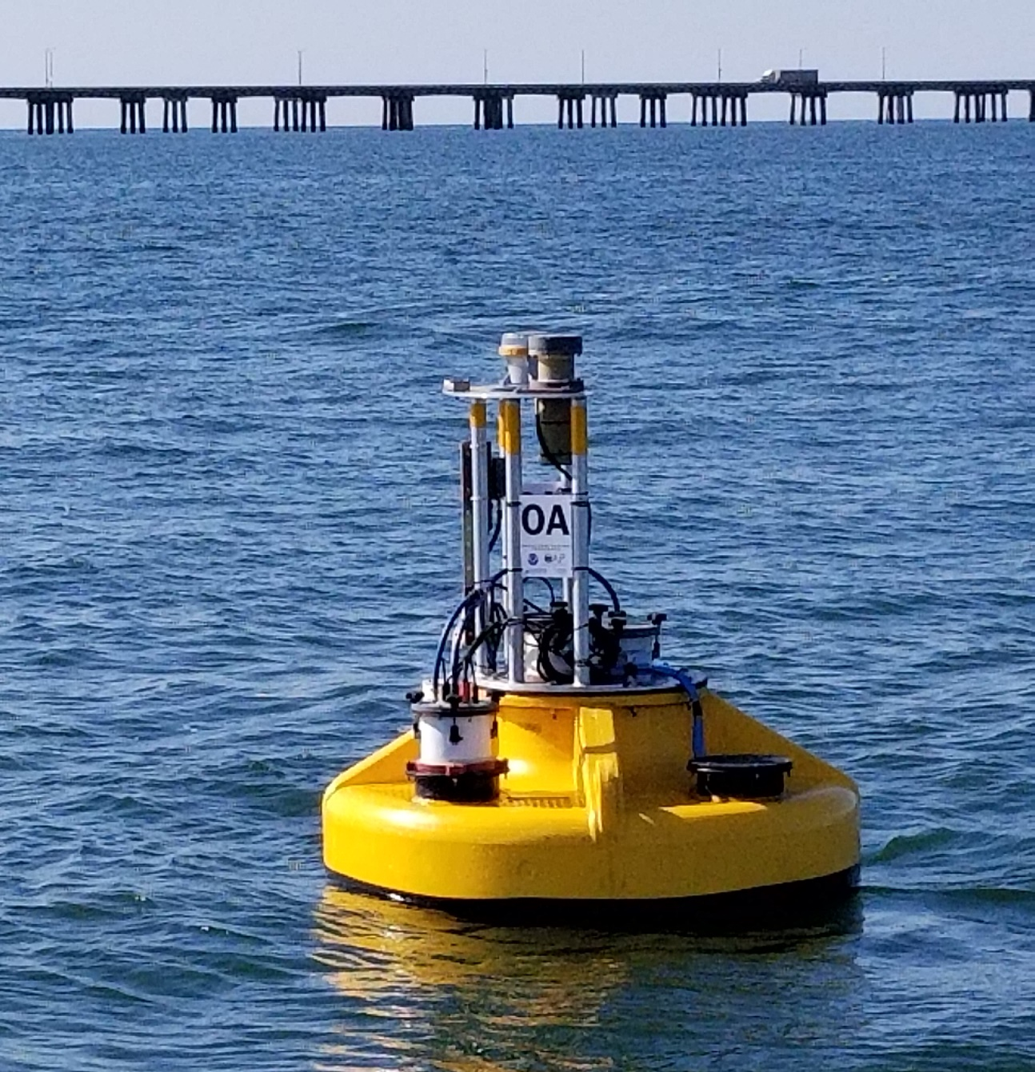





External datasets available through MARACOOS
CBIBS
CO-OPS Stations
CDIP
HRECOS
Maryland DNR
NDBC Buoys
Poplar Island
PH Buoy
Surfrider (citizen science)
How?
  Meetings, regional engagement,
  prioritize based on MARACOOS needs, costs, lift estimate
5 April 2018 Caribbean Wind LLC

Slide 14
Operations Data Flow
External
(GTS, NDBC, NCEI)
Satellites
Products
MARACOOS
Partners Institutions
Federal
State
Private
MARACOOS DMAC
IOOS DACs
HF-Radar
Gliders
External
Models
Notes:
External is GTS and NDBC etc, satellite is comprehensive view

Slide 15
Operations Data Flow
External
(GTS, NDBC, NCEI)
Satellites
Products
MARACOOS
Partners Institutions
Federal
State
Private
MARACOOS DMAC
IOOS DACs
HF-Radar
Gliders
External
Models
Notes:
External is GTS and NDBC etc, satellite is comprehensive view

Slide 16
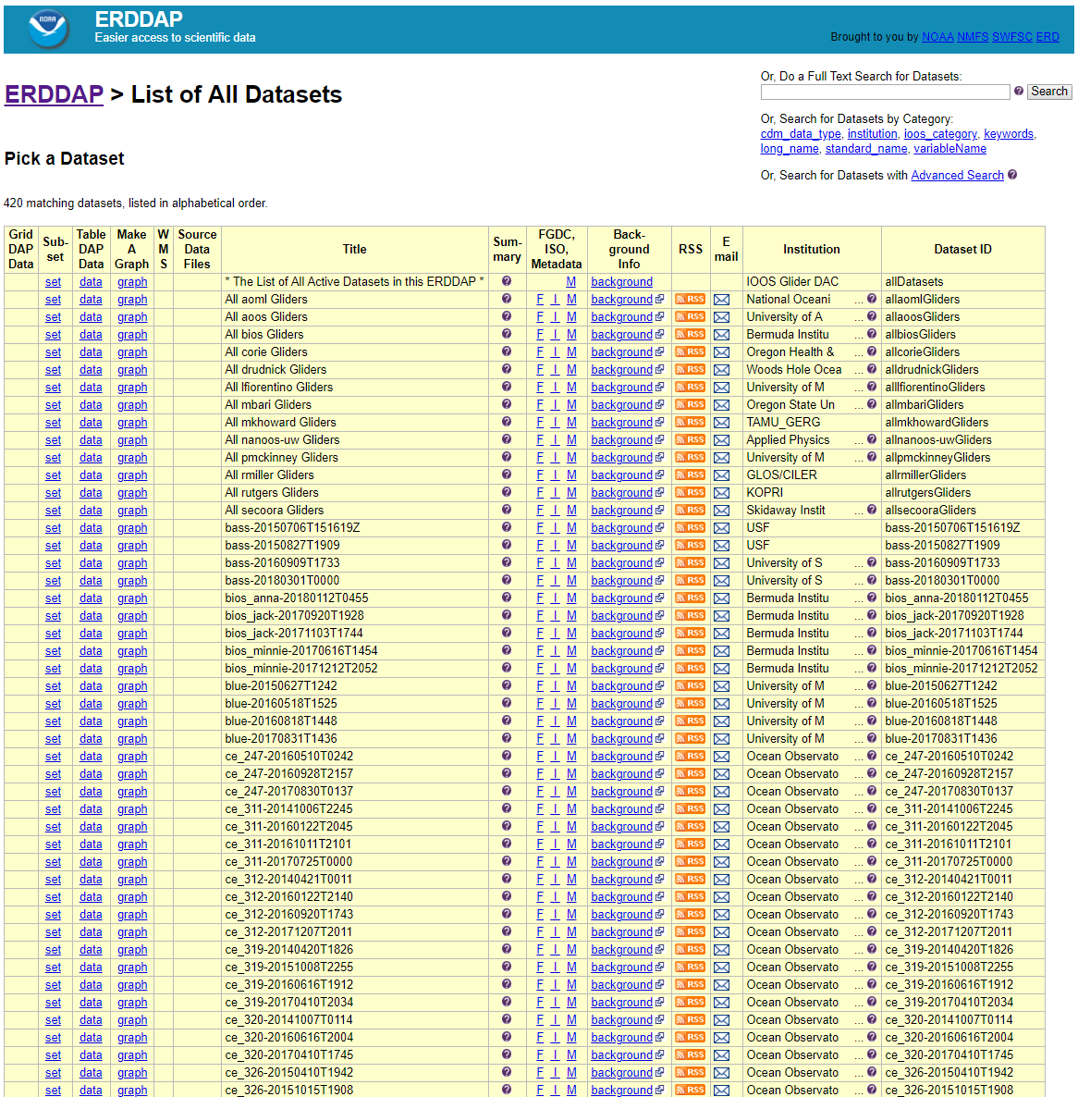
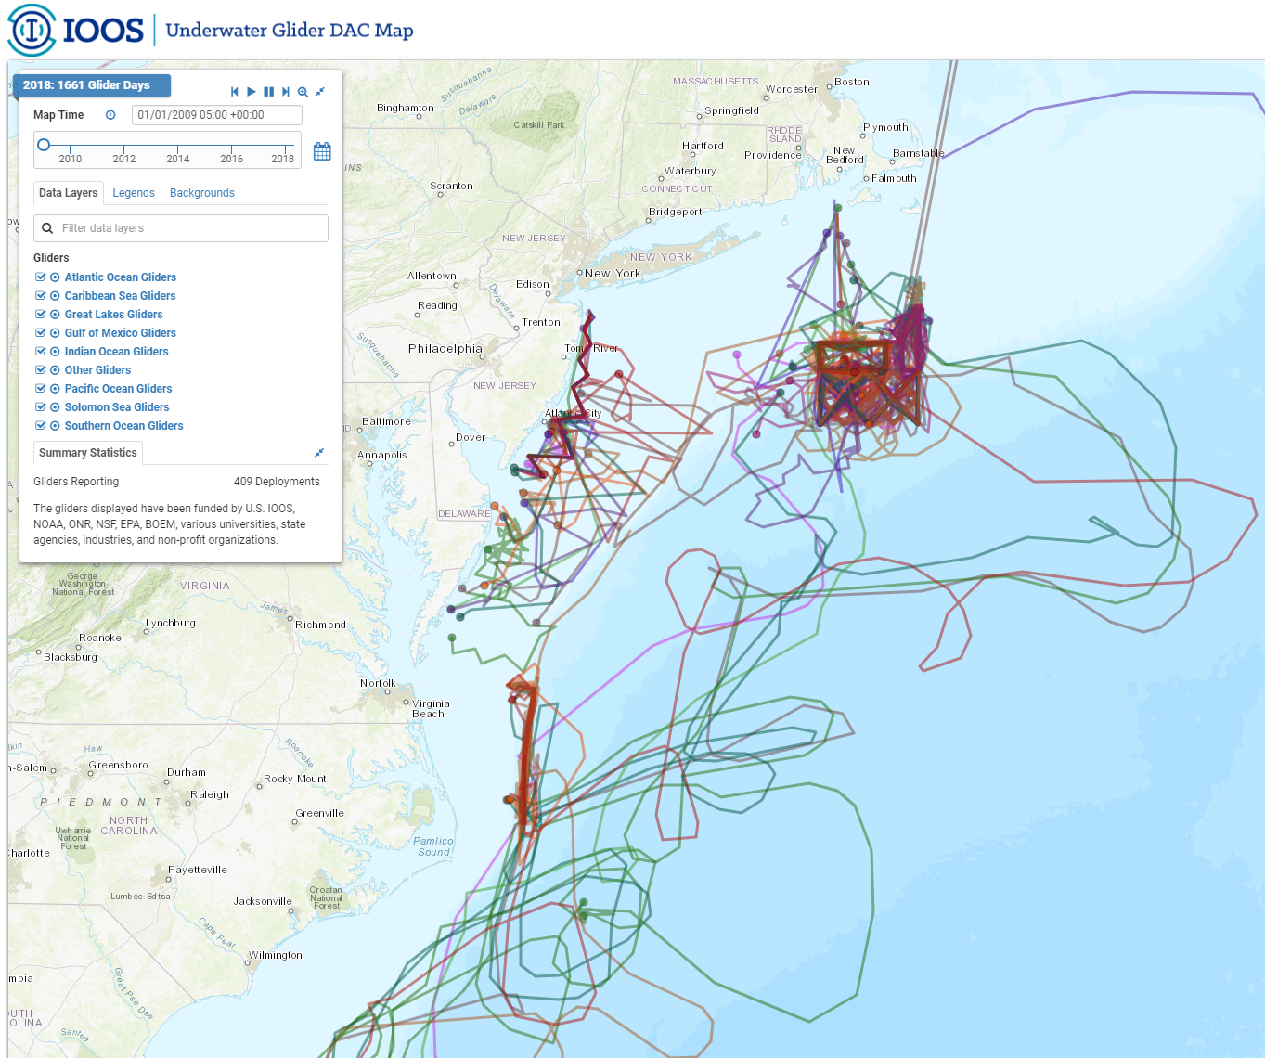
Glider DAC
Users: Federal, State and local gov’t, public
Goals:
Consolidate all glider data into one location
Make data available to the GTS
Deliver data to the world!
ERDDAP Server
Notes:
Funding for the glider DAC work comes through MARACOOS (RPS and Rutgers leads).
Much more than just IOOS gliders.

Slide 17
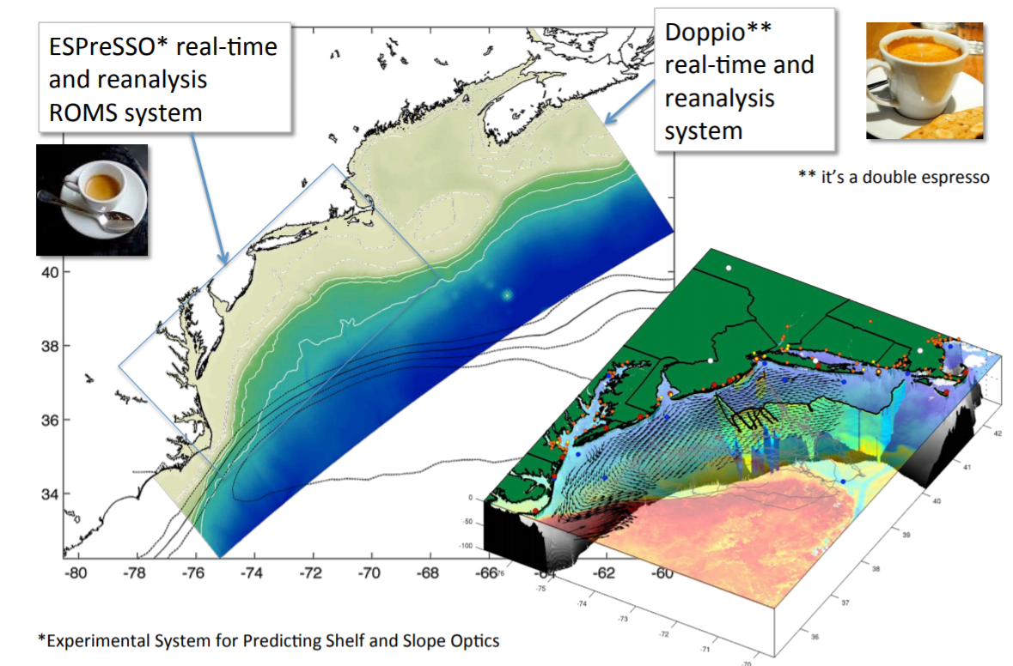
Prediction - Innovation - Espresso becomes Doppio
Notes:
Quick history on going from 3 to 1 model, Full region, high resolution, shrunk as focus on data acquisition.

Slide 18
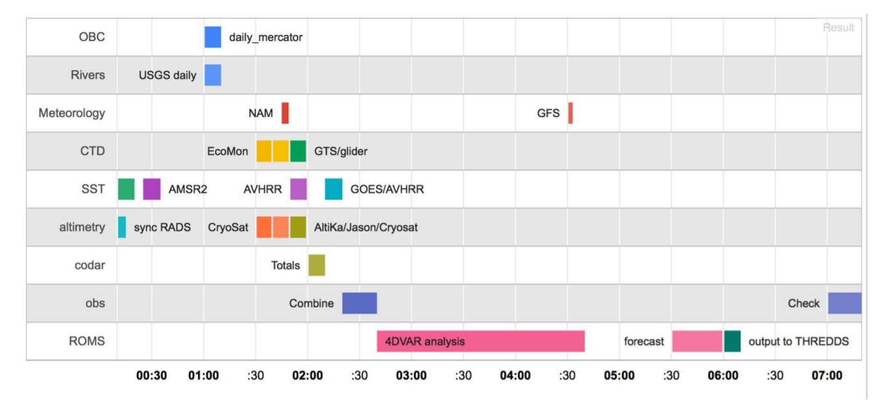
Doppio Data Assimilation
Notes:
Assimilation into the model is key. Our data is key. Both for improving predictions and for validating the model post forecast

Slide 19
The MARACOOS Technical Director

Slide 20
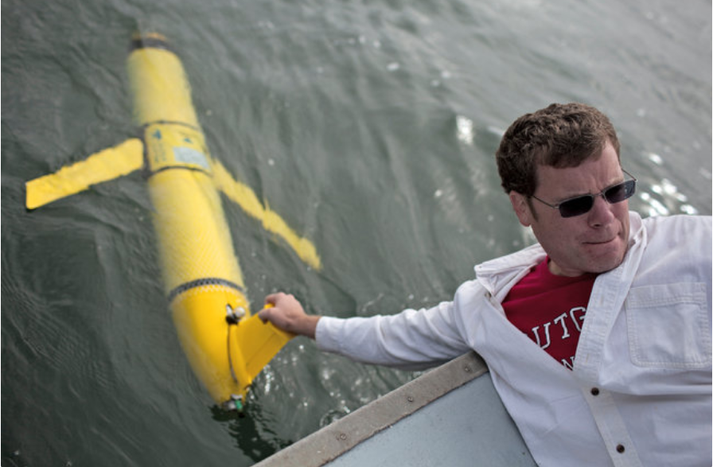
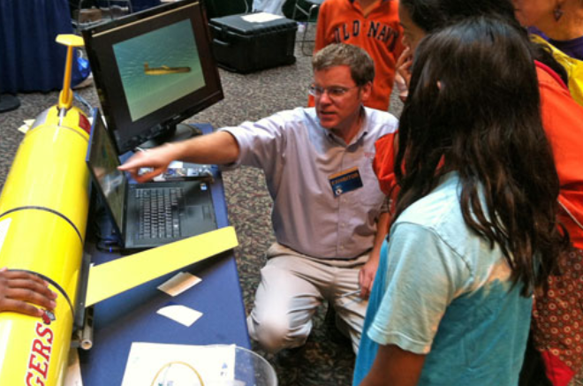
MARACOOS Technical Director
  Internal communications
    10 years of operations calls
    Mgmt, Science, technology, budgets
  Financials and contracts
    13 subs, 27 accounts, tracking
    Annual descope/budget
  Operations Management
    Operations Milestones
  QA/QC (all technologies)
  Cross RA/IOOS Operations/Comms
    Hurricanes, HF-Radar, Glider DAC
  Semi-Annual Reports and Addendums
  Meetings
    Regional, Technical, Board, IOOS
  Ad hoc IOOS requests
  Engagement
Notes:
Shifted from 15% funded to 50% funded October 1

Slide 21
Financials: MARACOOS Partner Account Details
Both core and directed funding
Notes:
Additions of directed funding over the years, and a change in the way reporting must be done as of December 17, have significantly increased demand

Slide 22
Operations through Summer 2019
  Delivering to milestones
    Following Strategic Ops Plan
  Communications
    Operations calls
    HF-Radar/Glider calls
    IOOS calls
  Reporting
  Financial Reviews
  Next Descope (SOW)
  Troubleshooting (storms)
  Host Glider User Group 2/Euro Glider Operators Meeting

Slide 23
ADDITIONAL SLIDES

Slide 24
Financials: Growing Directed Funding
Notes:
Note that there is a community of scientists and technicians being funded directly.

Slide 25
MARACOOS Unfunded Contributors
People who contribute time toward the MARACOOS effort
Many are scientists that guide/drive tasking such as data analysis, QC & sampling strategies
Larry Atkinson, Old Dominion
Bill Boicourt, U. Maryland
Joe Brodie, Rutgers
Wendell Brown, UMass Dartmouth
Scott Glenn, Rutgers
Donglai Gong, VIMS
Anthony Kirincich, WHOI
Travis Miles, Rutgers
Jim O’Donnell, U. Connecticut
Matt Oliver, U. Delaware
Grace Saba, Rutgers
Oscar Schofield, Rutgers
David Ullman, U. Rhode Island
John Wilkin, Rutgers
Patty Gillen, Rutgers
Steve Levenson, Rutgers
RU Grants & Contracts
Key to the success of MARACOOS
Notes:
These are central to development and growth of MARACOOS. Contribute to science planning, technical oversight, engagement, additional funding, expansion, bi-weekly calls,
Patty, Steve and Mike receive state support for MARACOOS.
Waived fees
Grants and contracts (Melissa, etc)

Slide 26
Financials: Big Picture
Big Picture: 70% of core funding is for salary
Approximately 10.5 FTEs

Slide 27






What is Operations?
Regional Priority Themes | Regional Observation & Modeling Capabilities
 | Weather Mesonet | HF Radar Network | Statistical STPS | Satellite Imagery | Glider Surveys | Dynamical Ocean Forecasts
Theme 1. Maritime Safety | Operational Input to USCG SAROPS | Operational input to USCG SAROPS | Operational input to USCG SAROPS | SST for survivability planning | Assimilation dataset for forecast models | Surface currents for SAROPS
Theme 2. Fisheries | Weather forecast ensemble validation | Circulation and divergence maps for habitat |  | SST & Color for habitat | Subsurface T & S for habitat | 3-D fields of T, S, circulation for habitat
Theme 3. Water Quality | Winds for transport, river plumes, & upwelling | Surface currents for floatables, bacteria, spill response | Surface currents for floatables, bacteria, spill response | Ocean color for river plumes | Nearshore dissolved oxygen surveys | Surface currents for floatables, bacteria, spill response
Theme 4. Coastal Inundation | Weather forecast ensemble validation | Current forecast model validation |  | SSTs assimilation into forecast models | Assimilation dataset for forecast models | Nested forecast ensembles
Theme 5. Energy | Historical analysis & wind model validation | Historical current analysis & wind model validation |  | Historical analysis surface fronts & plumes for siting | Historical analysis of subsurface fronts & plumes | Coupled ocean-atmosphere models for resource estimates
X

Slide 28
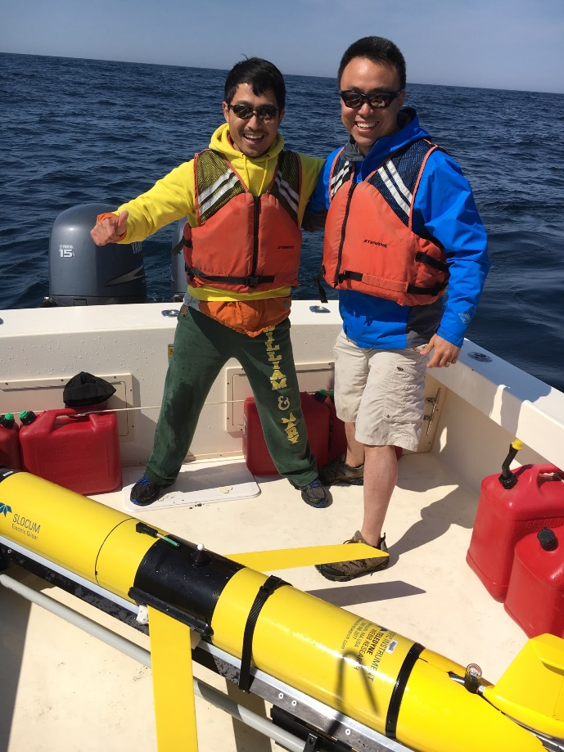
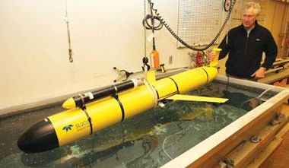
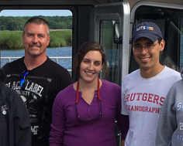
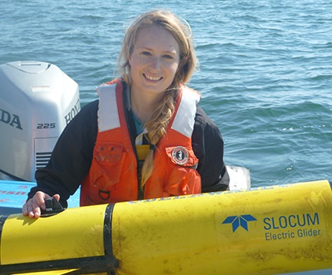
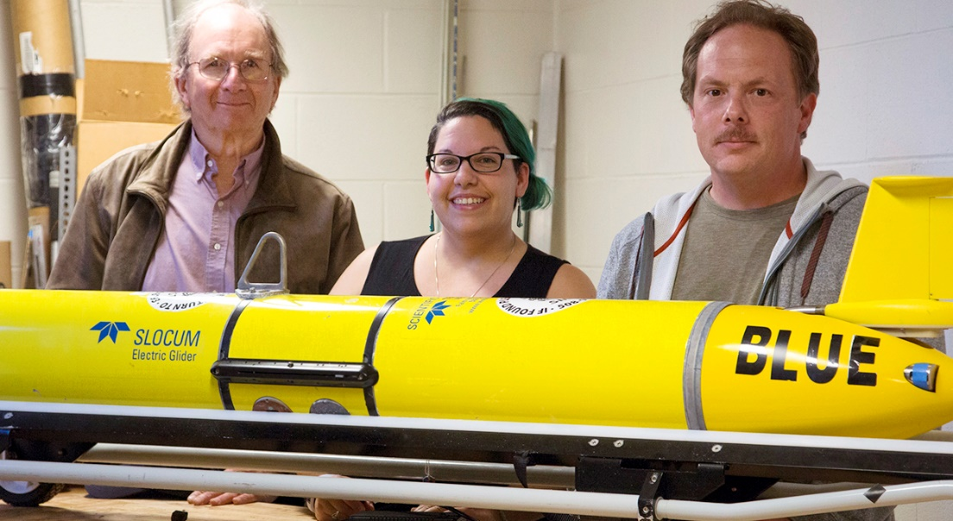
Glider Success Statistics: Comparing apples to apples
  Europe** (Brito 2014) 50% success deep gliders, 59% shallow (Slocum, Sea, Spray)
  OOI approximately 56% success (Slocum)
  Scripps 84% (79%) success (Spray)
  Rutgers 84% (79%) success (Slocum)
  Why the success gap?
Notes:
The success is due to the team. And I mean the specific experts.

