Slide 1
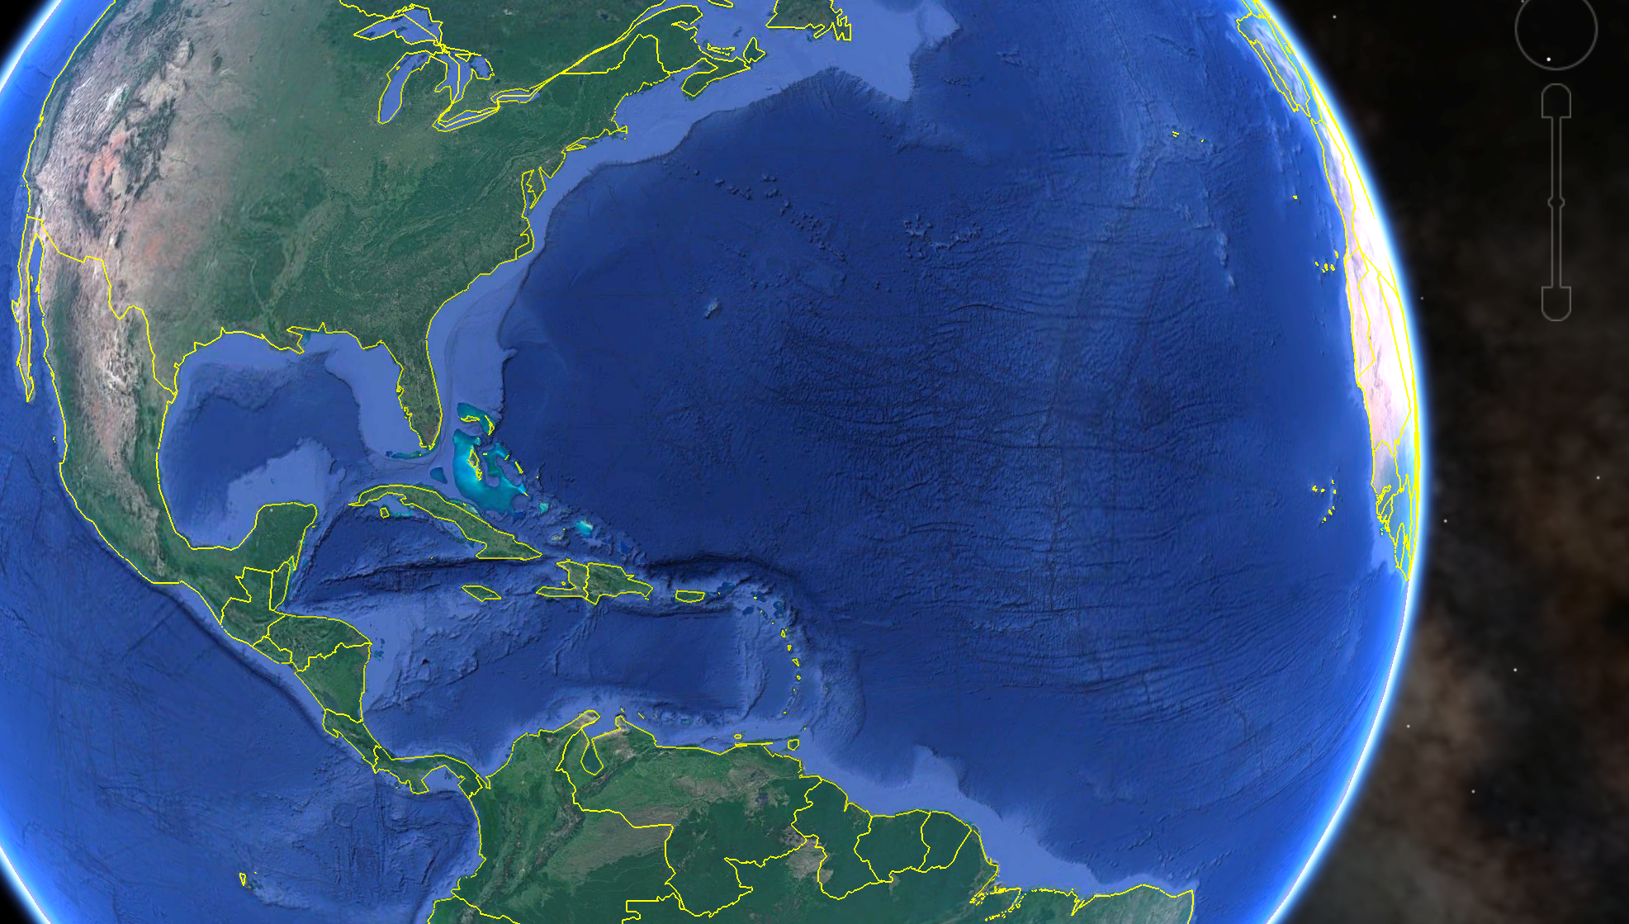
















Leveraging Hurricane Expertise
Asia-
Pacific
MARACOOS
Fall Board Meeting
November 19-20, 2019
Hurricane Initiative
Update
Contributors:
Scott Glenn,
Travis Miles,
Maria Aristizabal
+ many others
(56 Institutions)
Indian
Ocean

Slide 2
NOAA Historical Hurricane Tracks: 1851 - previous season

Slide 3
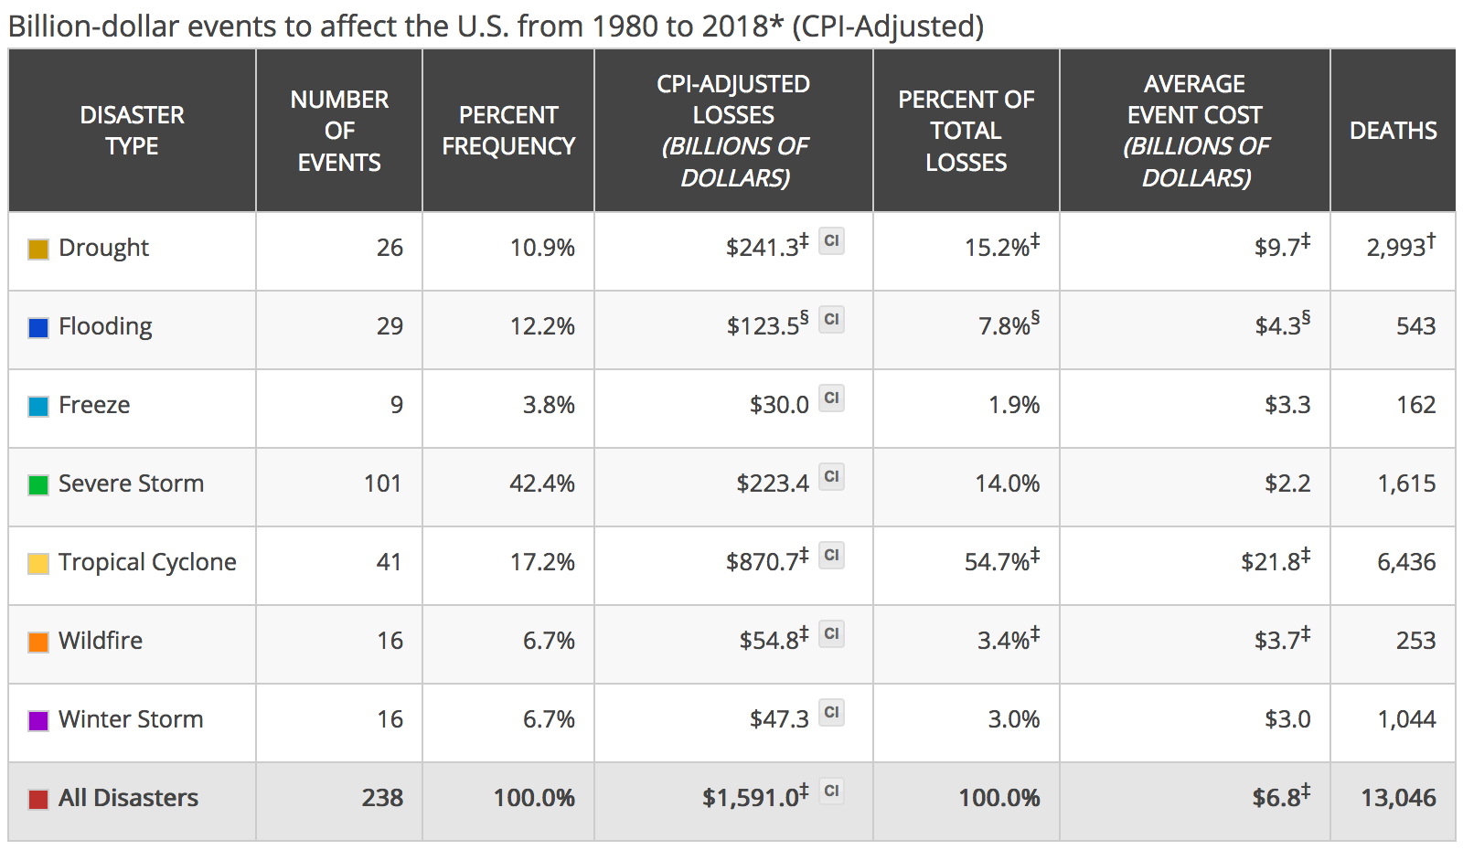
NOAA Historical Hurricane Tracks: 1851 - previous season
Hurricanes cause damage and deaths similar to all other natural disasters combined!
Source: NOAA National Centers for Environmental Information (NCEI) U.S. Billion-Dollar
Weather and Climate Disasters (2018). https://www.ncdc.noaa.gov/billions/

Slide 4
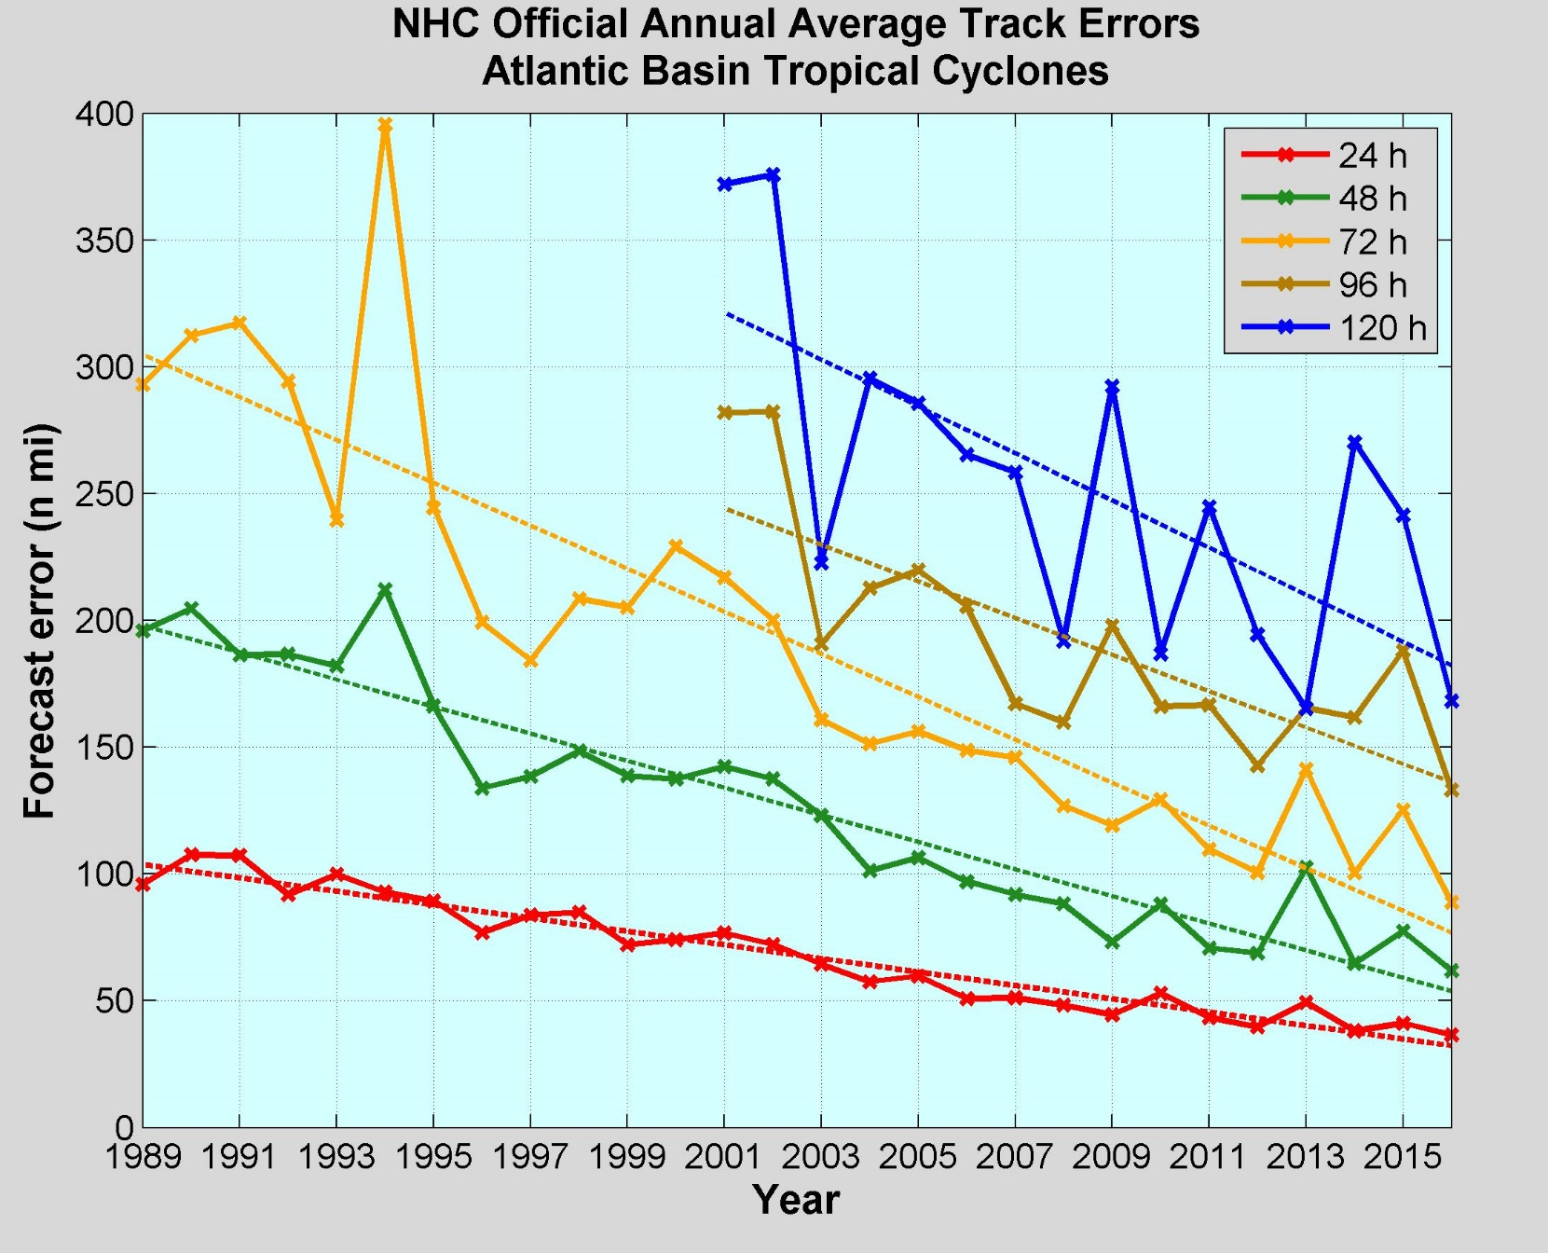
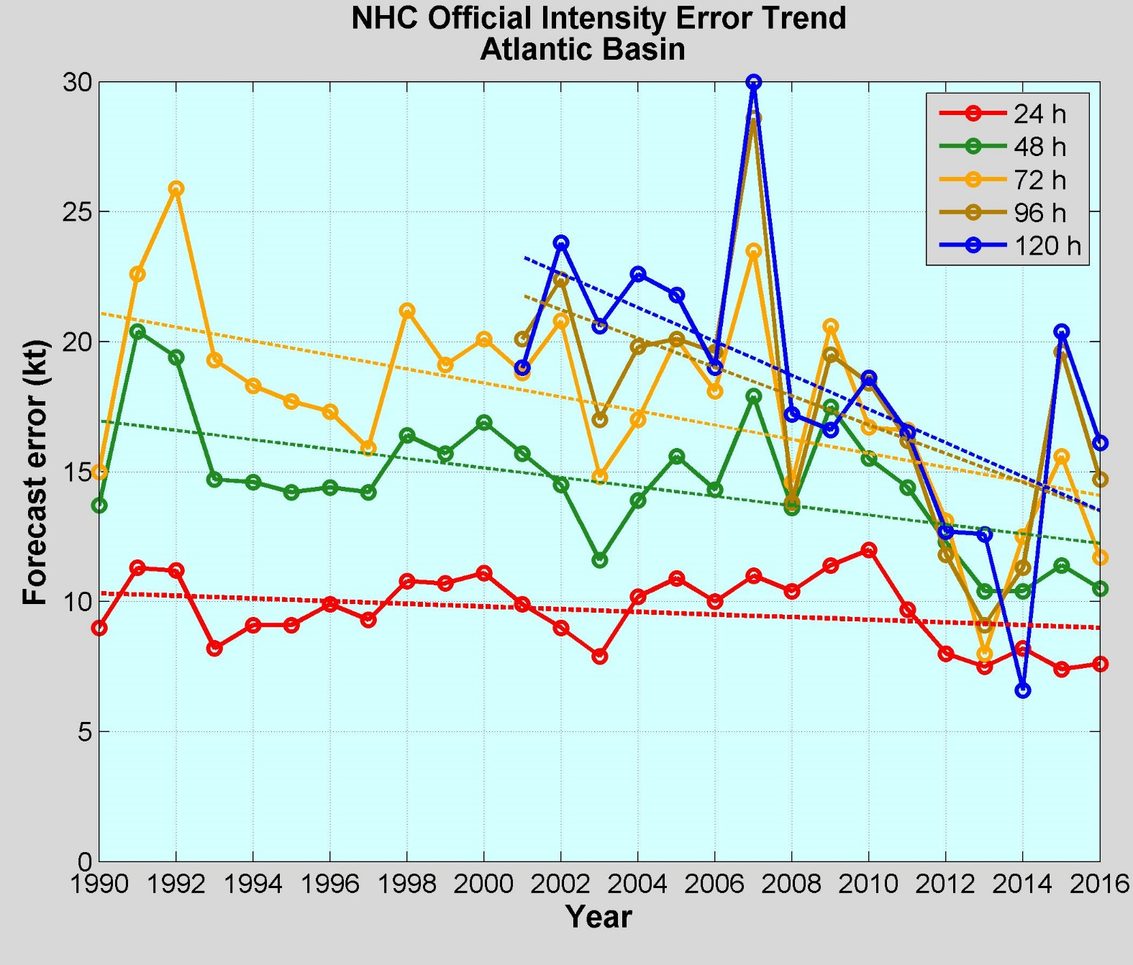
NOAA Annual Operational Suite Review
Average Track Errors:
Atlantic Basin
Average Intensity Errors:
Atlantic Basin
Factor of 2-4 improvement
20%-30% improvement
Limitations on Hurricane Intensity Improvement
Computing resources and model resolution (Rotunno et al., 2009)
Poor understanding of the atmospheric boundary layer (Nolan et al., 2009; Andreas et al., 2015)
Difficulty in modeling the upper ocean response to storm forcing (Yablonsky and Ginis, 2009).
Cangialosi and Franklin 2017

Slide 5
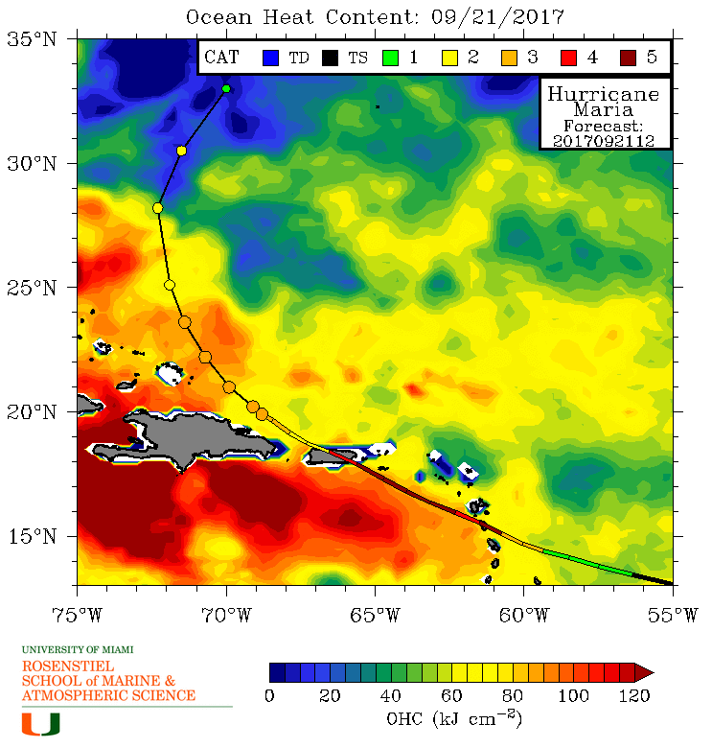
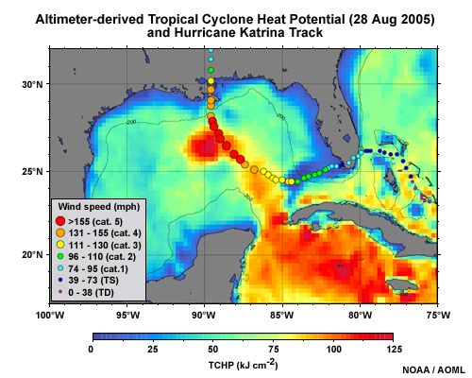
Hurricane Intensity is modulated by upper ocean heat content
Rapid intensification of Hurricanes Katrina & Maria over a warm ocean

Slide 6
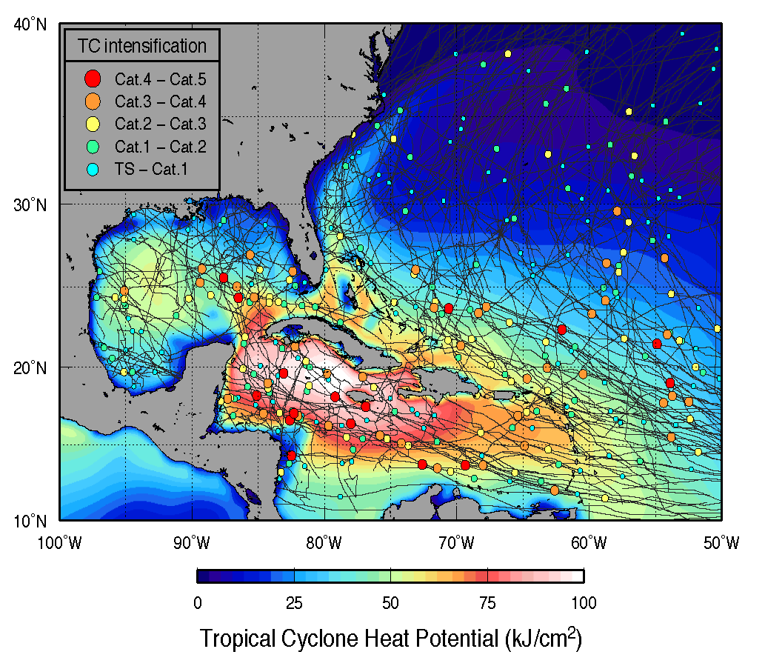

Hurricane Intensity is modulated by upper ocean heat content
Modulation by Air-Sea Fluxes

Slide 7
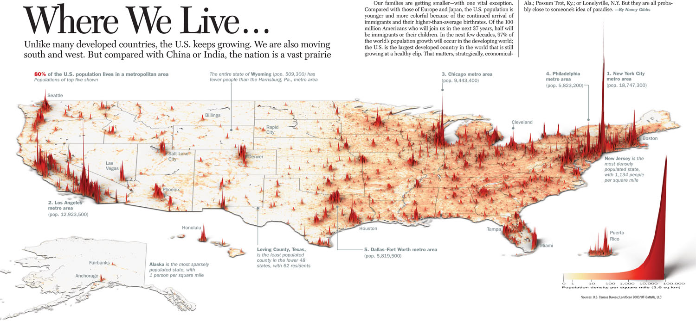
Mid Atlantic – 78 Million People, ~25% of U.S. Population
Coastal Drivers
Dense Populations
Majority of U.S. GDP
Navy Ports
Commercial Ports
Fishing Fleets
Energy
Many others…
Coastal Stressors
Water quality
Hurricanes & Winter Storms
Flooding and Sea Level Rise
Hypoxia
Intense multi-use waterways
Urbanized coasts
Many others…

Slide 8
Hurricane | Year | Month | Category Max | Damage Billions $ | Deaths
Katrina | 2005 | August | 3 | $165.0 | 1,833
Harvey | 2017 | August | 4 | $127.5 | 89
Maria | 2017 | September | 4 | $91.8 | **65
Sandy | 2012 | October | 3 | $72.2 | 159
Irma | 2017 | September | 4 | $51.0 | 97
Andrew | 1992 | August | 5 | $49.1 | 61
Florence* | 2018 | September | 4 | $38-$50 | 51
Ike | 2008 | September | 2 | $35.7 | 112
Ivan | 2004 | September | 3 | $27.9 | 57
Wilma | 2005 | October | 3 | $25.1 | 35
Michael | 2018 | October | 4 | $25 | 36
Rita | 2005 | September | 3 | $24.4 | 119
Charley | 2004 | August | 4 | $21.8 | 35
Hugo | 1989 | September | 4 | $18.7 | 86
Irene | 2011 | August | 1 | $15.4 | 45
Frances | 2004 | September | 2 | $13.3 | 48
Allison | 2001 | June | TS | $12.3 | 43
Matthew | 2016 | October | 4 | $10.6 | 49
Jeanne | 2004 | September | 3 | $10.2 | 28
Floyd | 1999 | Floyd | 2 | $9.9 | 77
U.S. Billion-Dollar Weather and Climate Disasters (2018)
https://www.ncdc.noaa.gov/billions/
*Moody’s Analytics, Sept 21 Estimate
**GWU/UPR Estimate 2,658-3,290
Michael Estimates

Slide 9
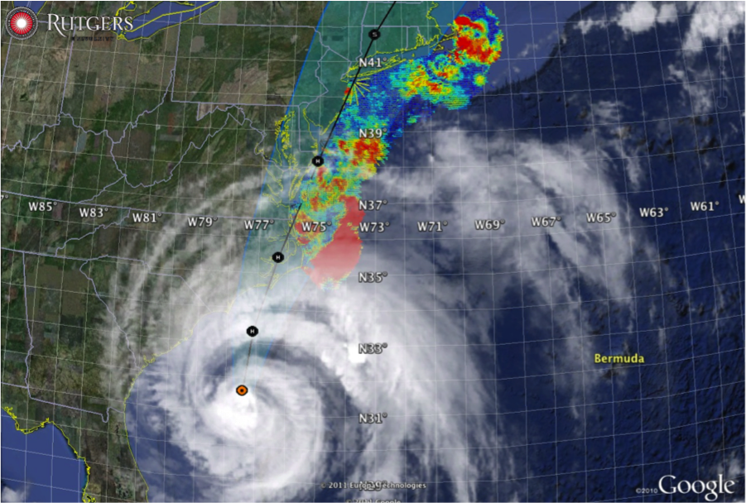
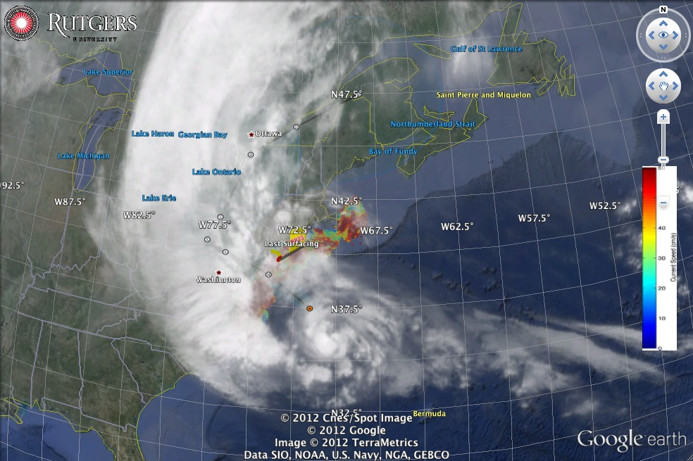



Hurricane Irene
August 28, 2011
NOAA/NHC Damage:
>$15 Billion, #15.
Track Accurate;
Intensity Over-predicted.
Avila & Cangialosi, 2012, Tropical Cyclone Report
Hurricane Sandy
October 29, 2012
NOAA/NHC Damage:
>$72 Billion, #4.
Track Accurate;
Surge Under-predicted.
Georgas et al., 2014, J. of Extr. Even.
Colle et al., 2015, J. Mar. Sci. & Engr.

Slide 10
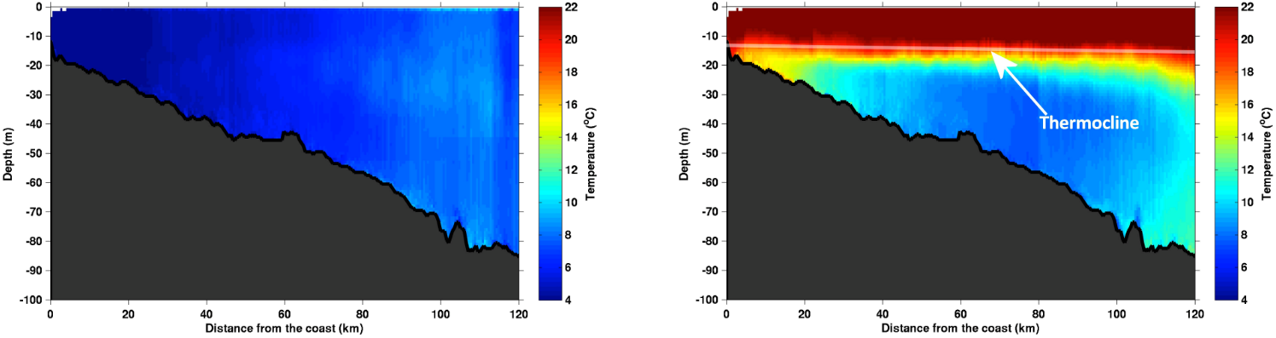
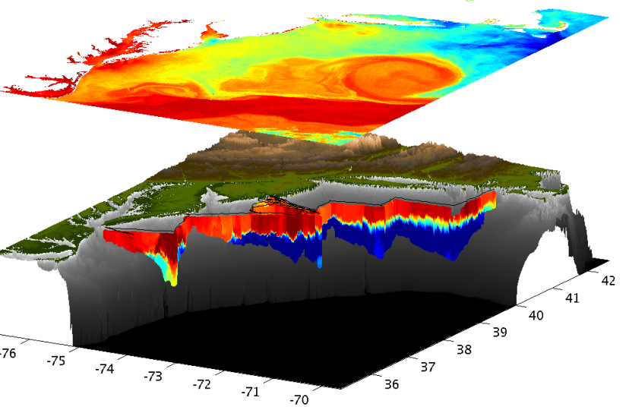
Essential Ocean Feature - Mid-Atlantic’s Cold Pool
An unseen cold bottom layer beneath a warm summer surface layer
Mid Atlantic
Winter (1-layer)
Mid Atlantic
Summer (2-layers)
Cold Pool
Satellite SST
Assimilated into Regional
Ocean Models
Glider Zig-Zags
or Triangles
Bottom Temperature
To characterize the Cold Pool, we need ocean observations that are “fit for purpose”

Slide 11
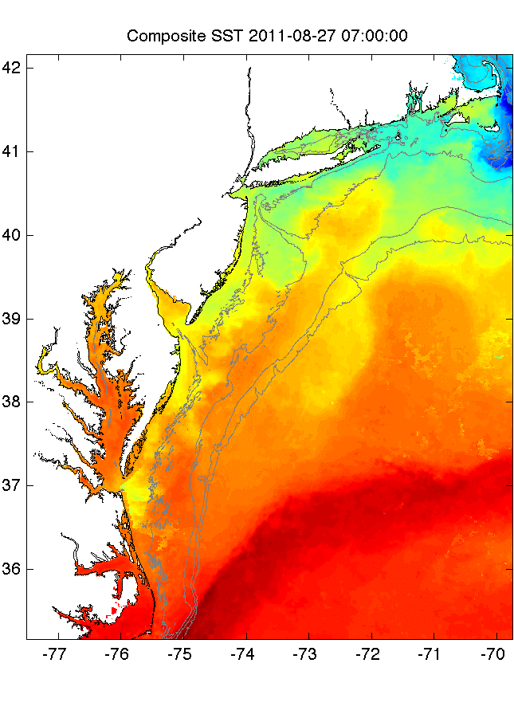
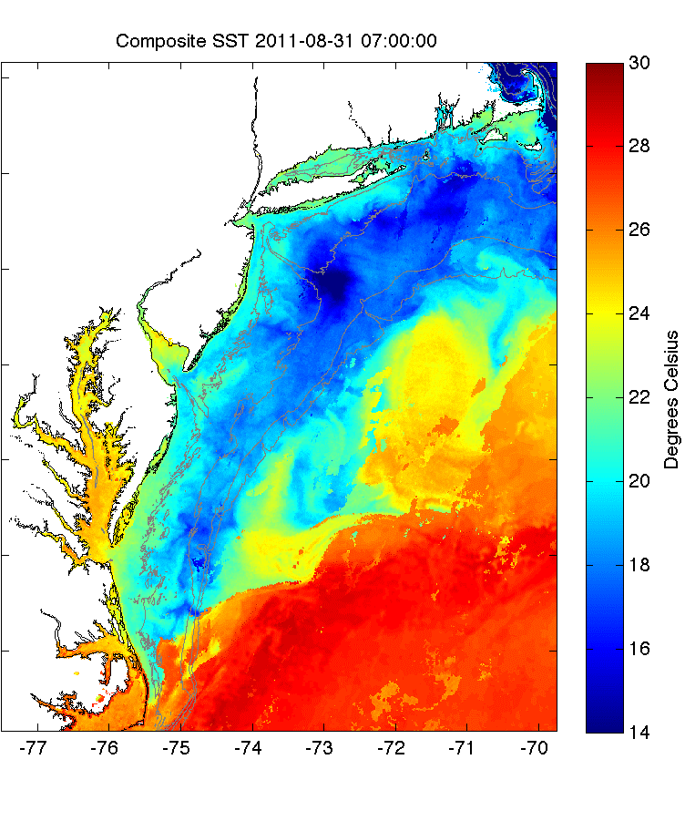
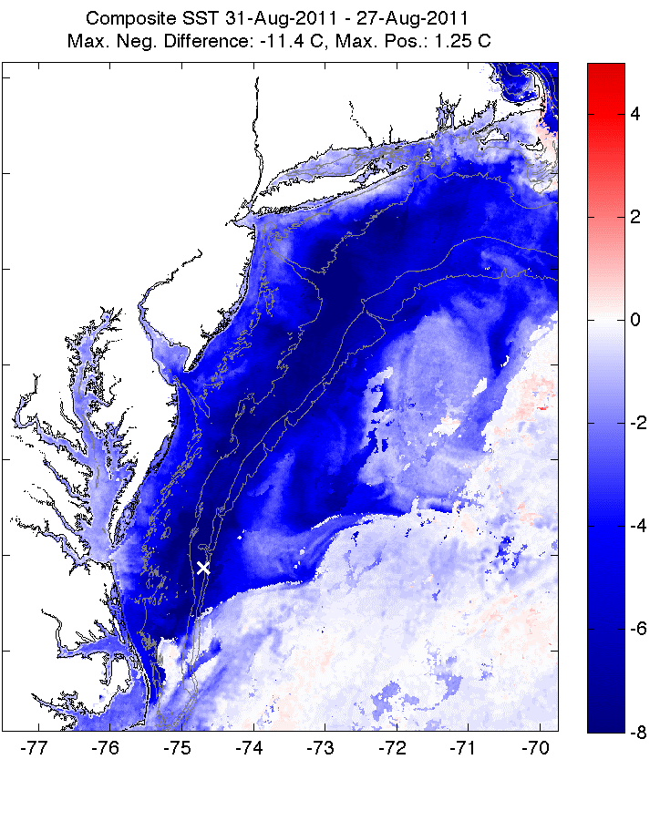
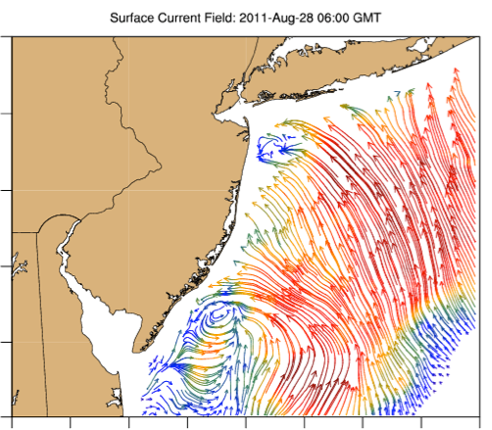
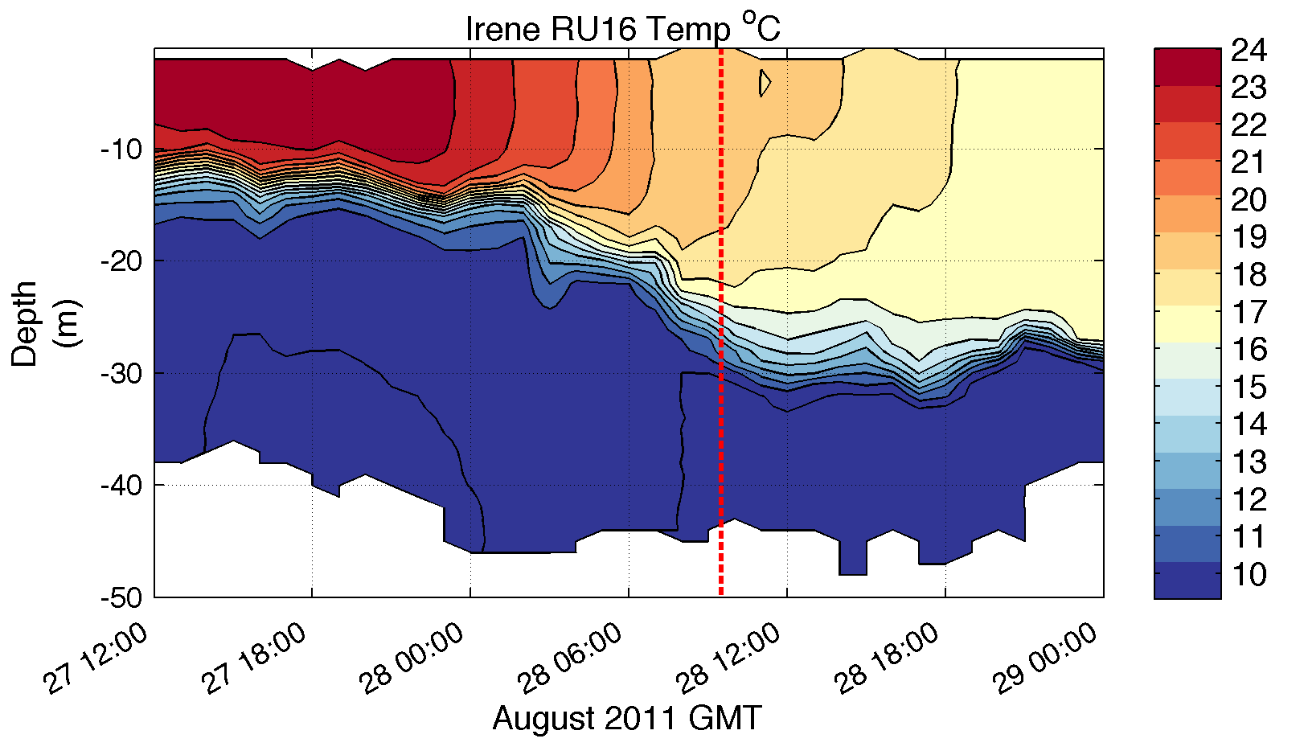
Pre-Irene
Post-Irene
Difference
11C max Cooling
WHAT?
Satellite
SST
WHEN? Glider Temperature
WHY?
HF Radar
Currents
Eye Passage
Essential Ocean Processes:
Ahead of eye center – Vertical Shear > Mixing > Cooling > Reduced Intensity > Reduced Surge

Slide 12
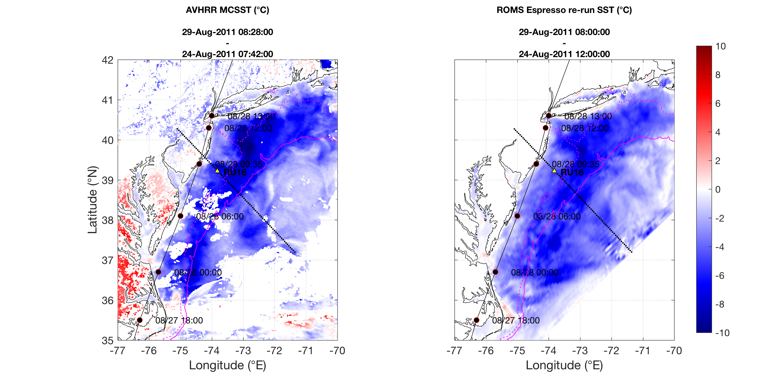
Hurricane Irene SST Difference (Before-After)
Satellite AVHRR vs. ROMS Model
Difference
SST cooling
Notes:
4

Slide 13
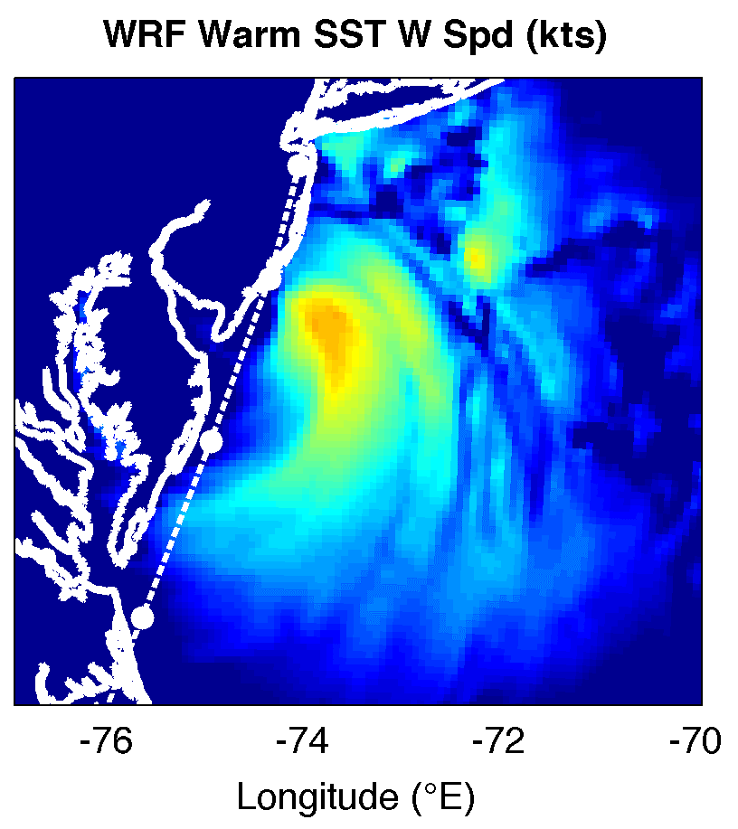
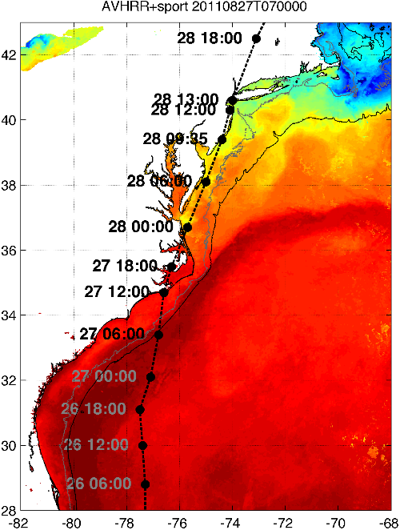
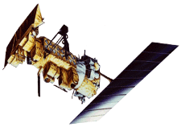

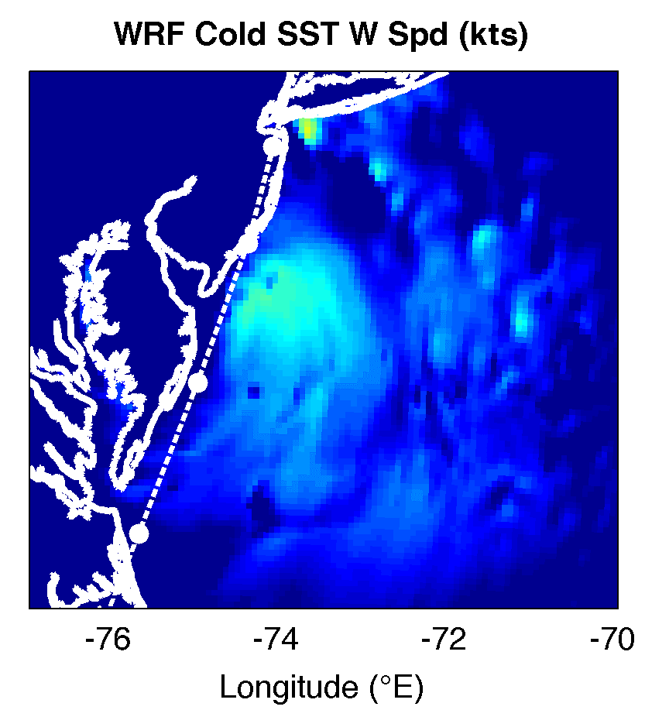
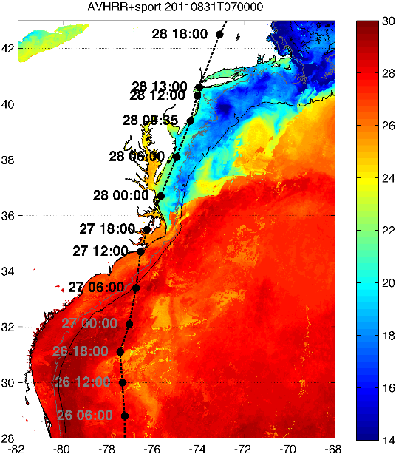

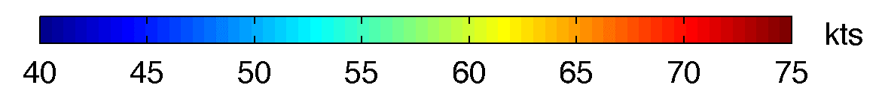
WRF Atmospheric Forecast Sensitivity Study – >130 tests
Warm Ocean
Boundary Condition
Cat 1 Hurricane
Tropical Storm
Cold Ocean
Boundary Condition
IMPACT?
>10 knots reduction in peak wind speed

Slide 14
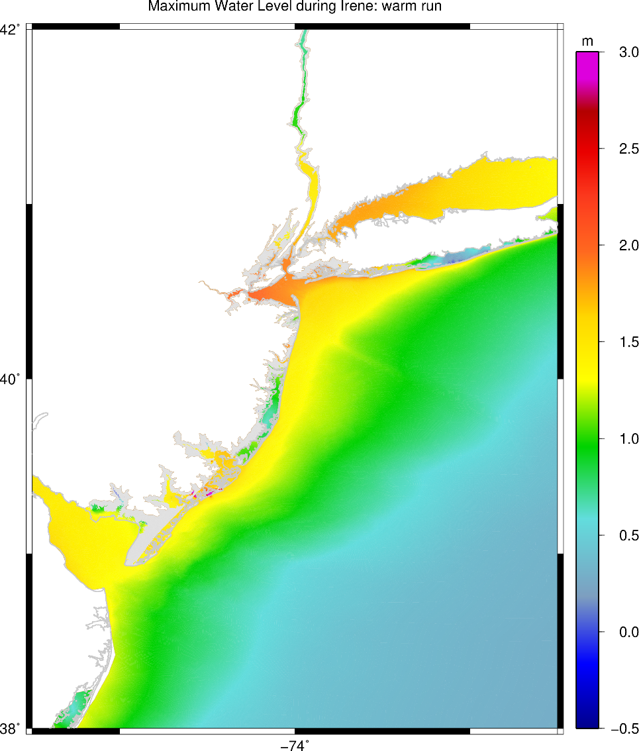
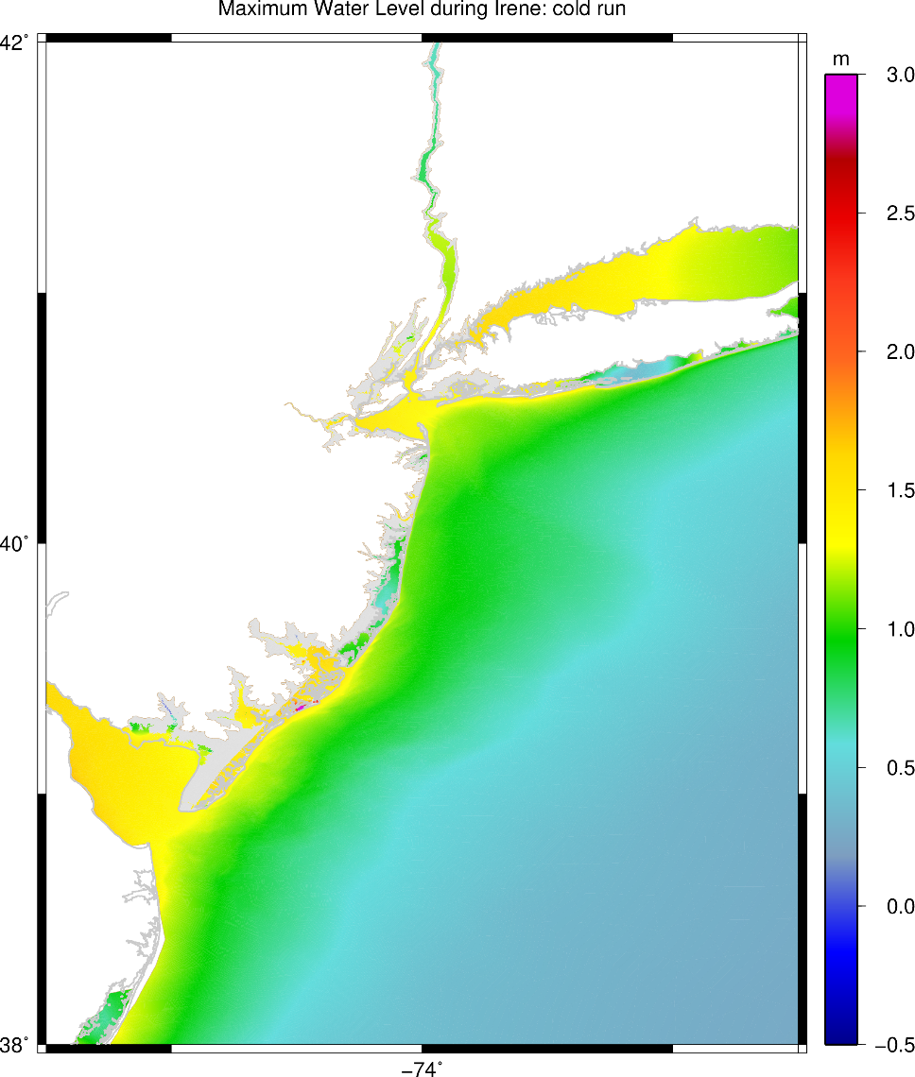
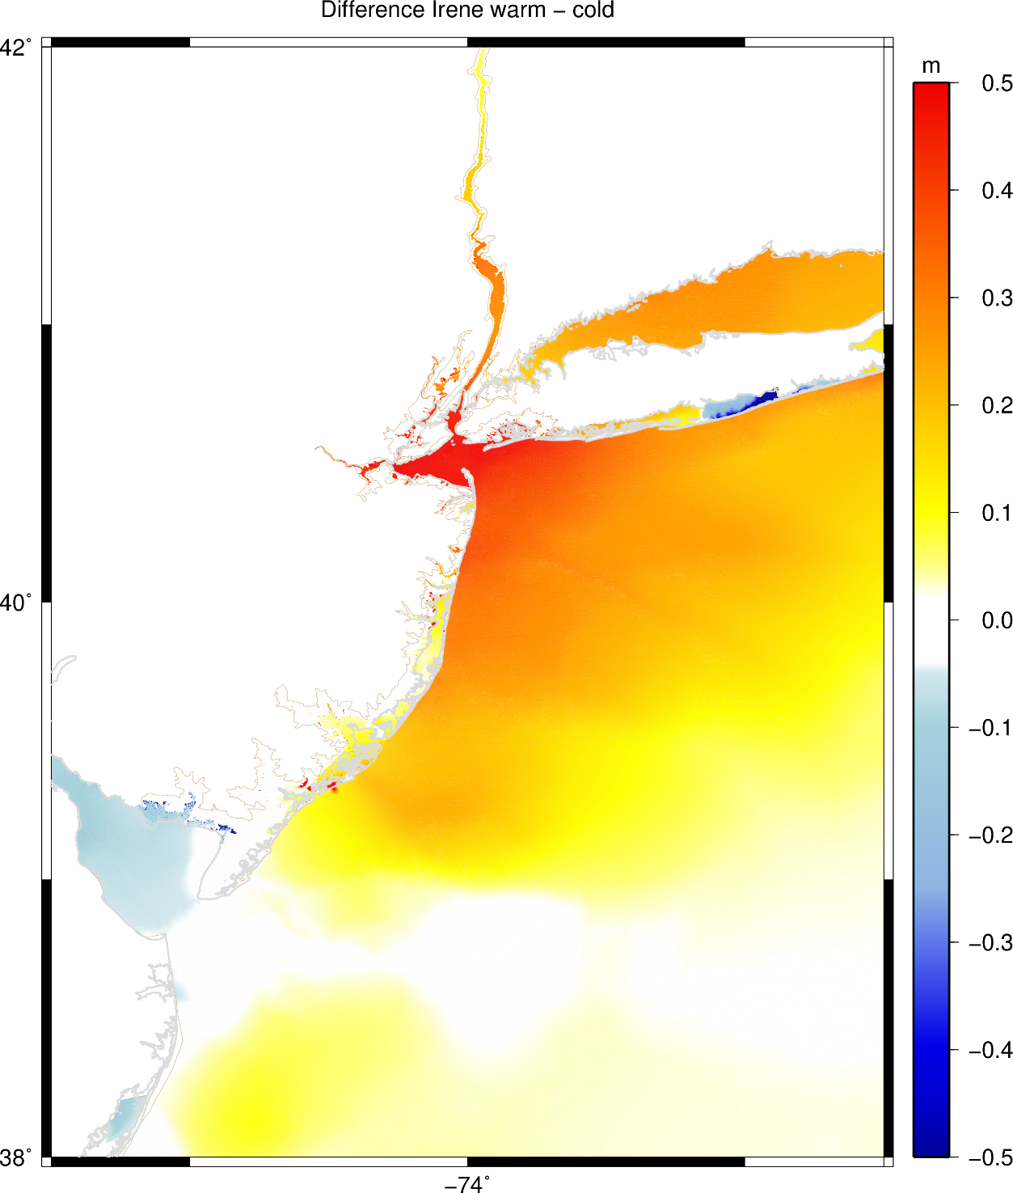
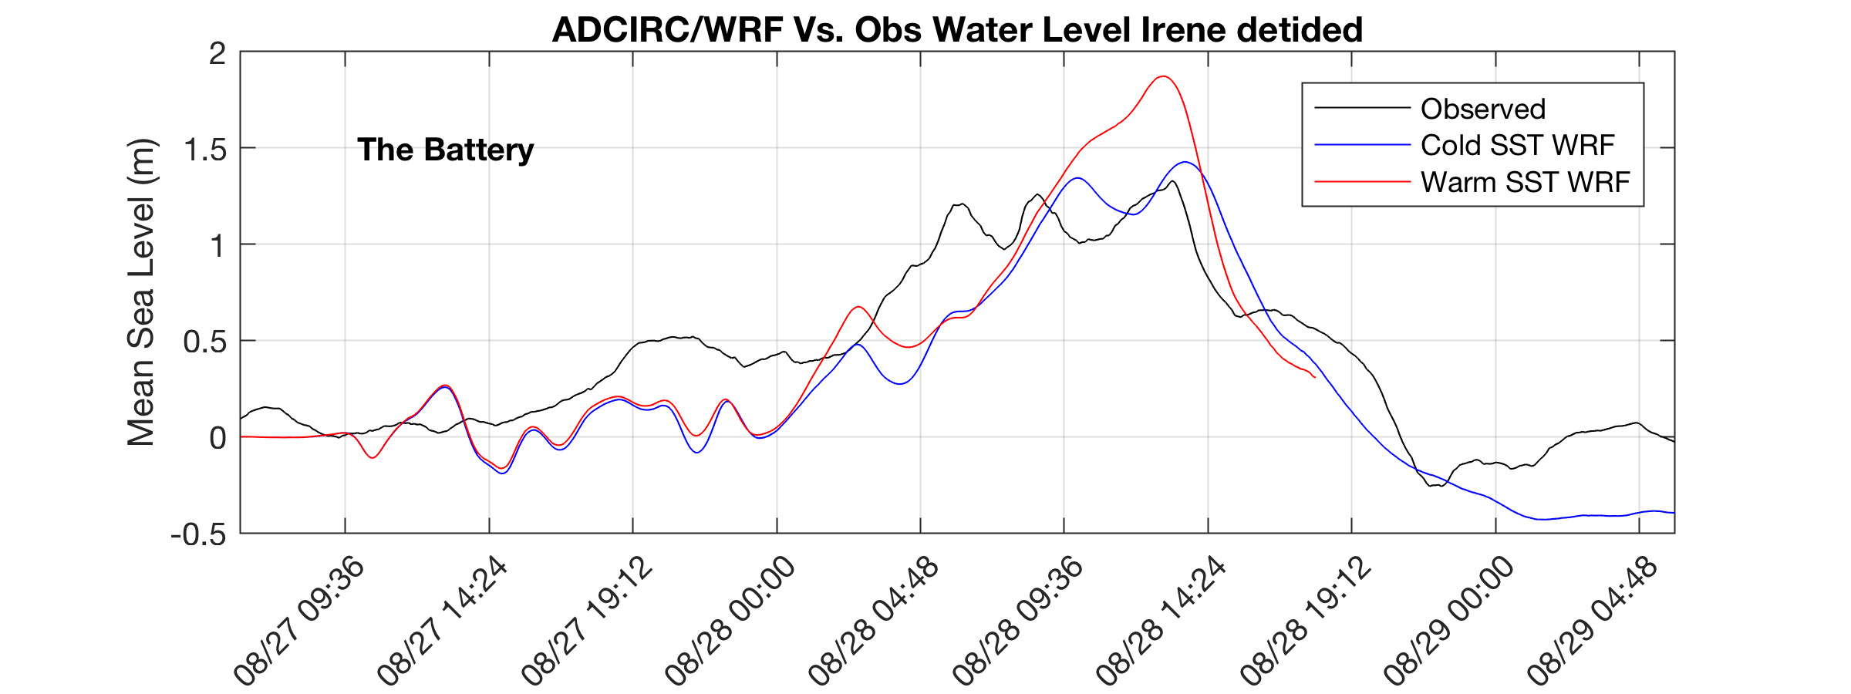
ADCIRC Storm Surge Model driven by RUWRF winds
Maximum water level:
Warm Run
Maximum water level:
Cold Run
Water Level Difference (m)
Warm - Cold
1.9 m
1.4 m

Slide 15
Irene Essential Ocean Process
Ahead of eye mixing/cooling
also observed in:
10 MAB Hurricanes
1 Yellow Sea Typhoon
Glenn et al. 2016 Nature Communications
Hurricane Sandy
October 29, 2012
NOAA/NHC Damage:
>$68 Billion.
Track Accurate;
Surge Under-predicted.
Georgas et al., 2014, J. of Extr. Even.
Colle et al., 2015, J. Mar. Sci. & Engr.

Slide 16
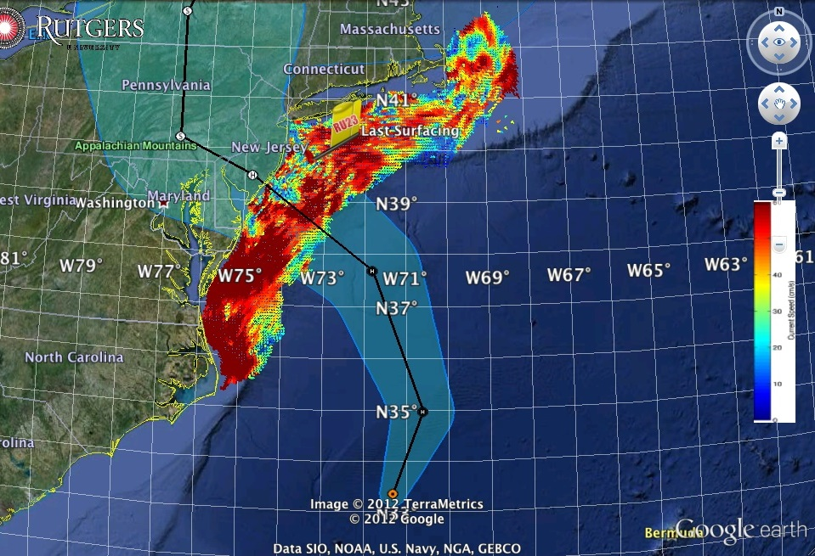
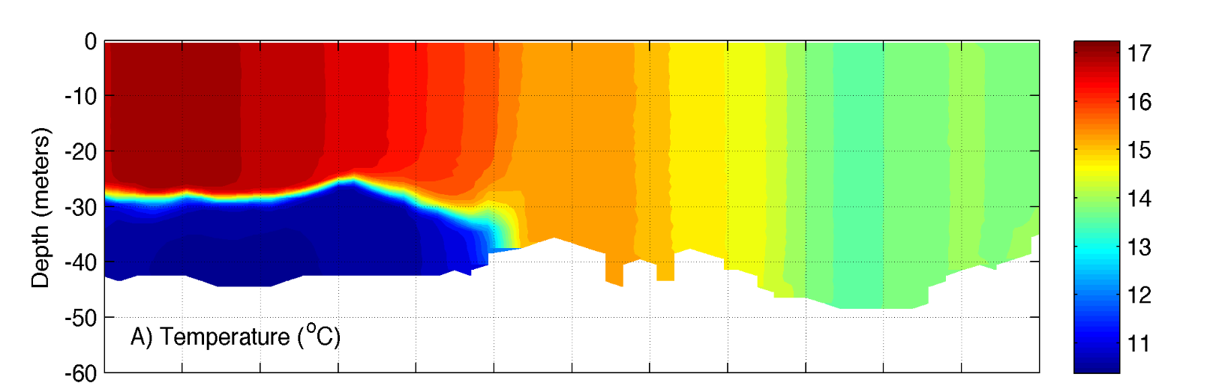
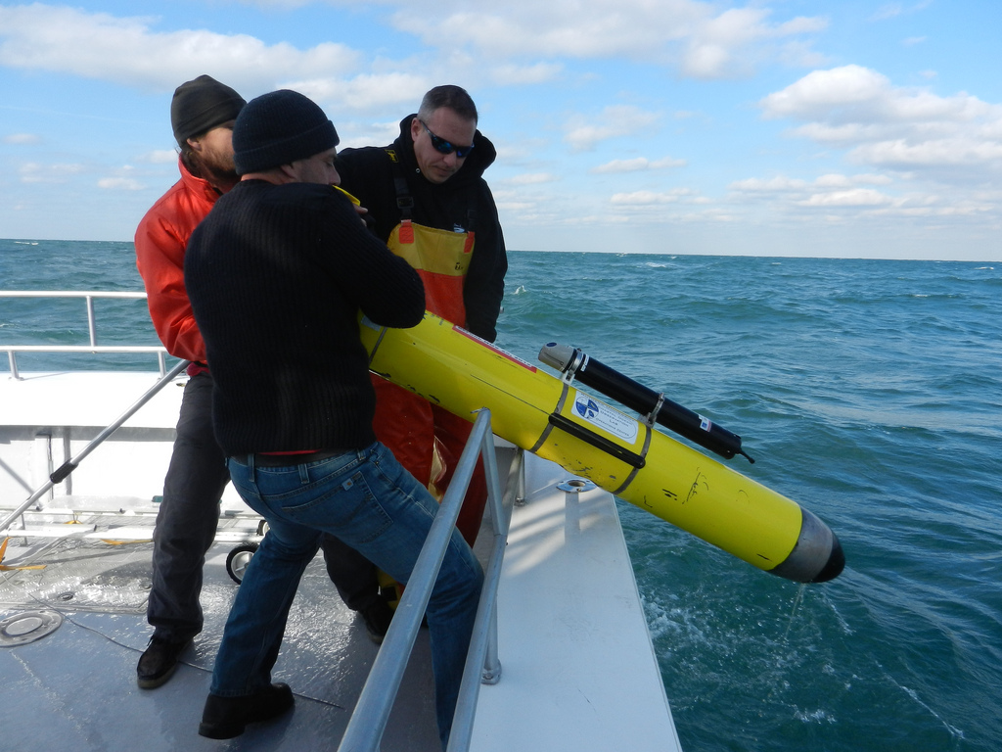

Superstorm Sandy: 1 Day Before Landfall

Slide 17
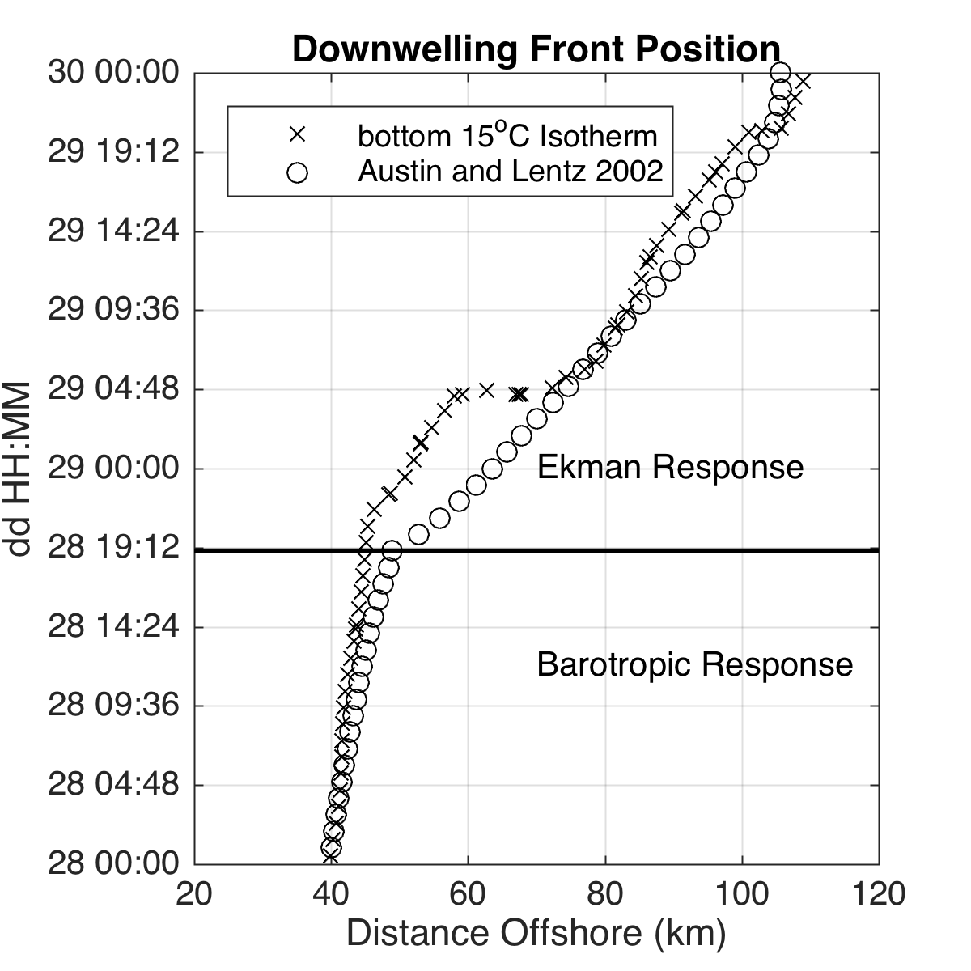
Superstorm Sandy: 1 Day Before Landfall

Slide 18
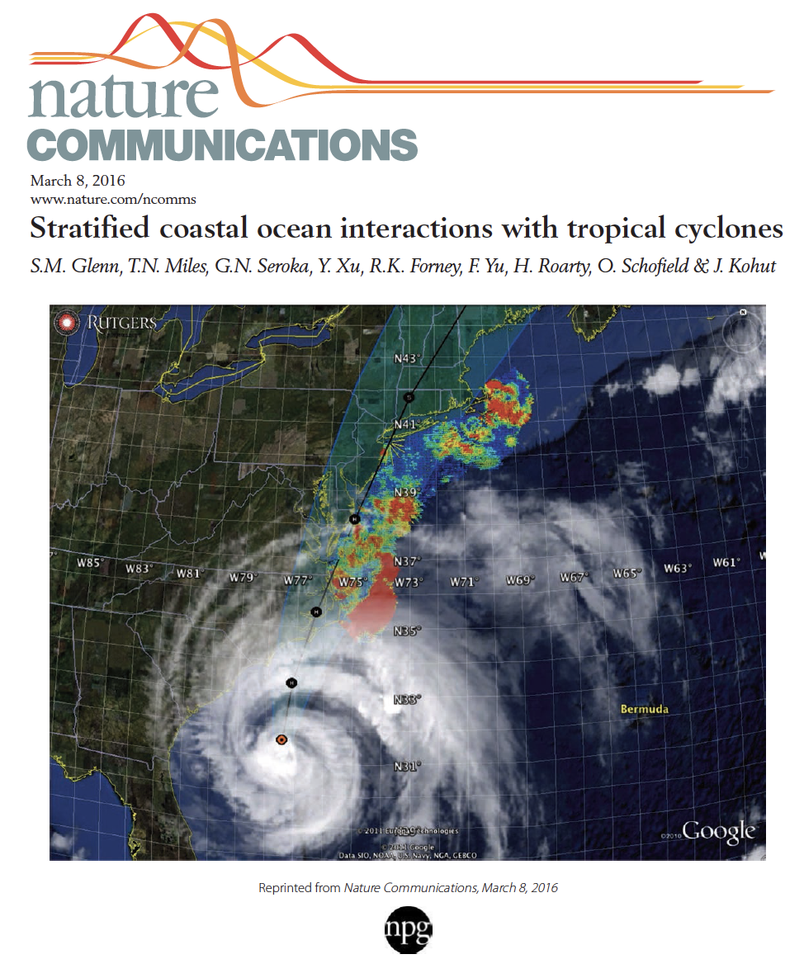


New Scientific Understanding:
Two types of coastal ocean response
to Mid Atlantic hurricanes discovered
The essential ocean features are
  Seasonally warmed surface water
  Persistent Cold Pool bottom water
The essential ocean processes are
  (a) ahead-of-eye mixing/cooling
  (b) ahead-of-eye downwelling
The essential ocean impacts on the atmosphere are
  (a) ocean mixing/cooling reduces storm intensity - Irene
  (b) offshore advection acts to increase intensity - Sandy
+ Monthly Weather Review (2016)
+ JGR-Oceans (2017)
+ JGR-Oceans (2017)

Slide 19

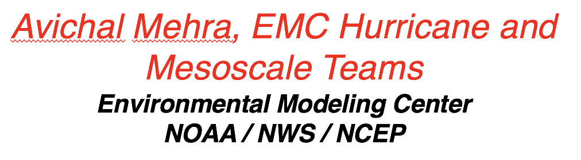


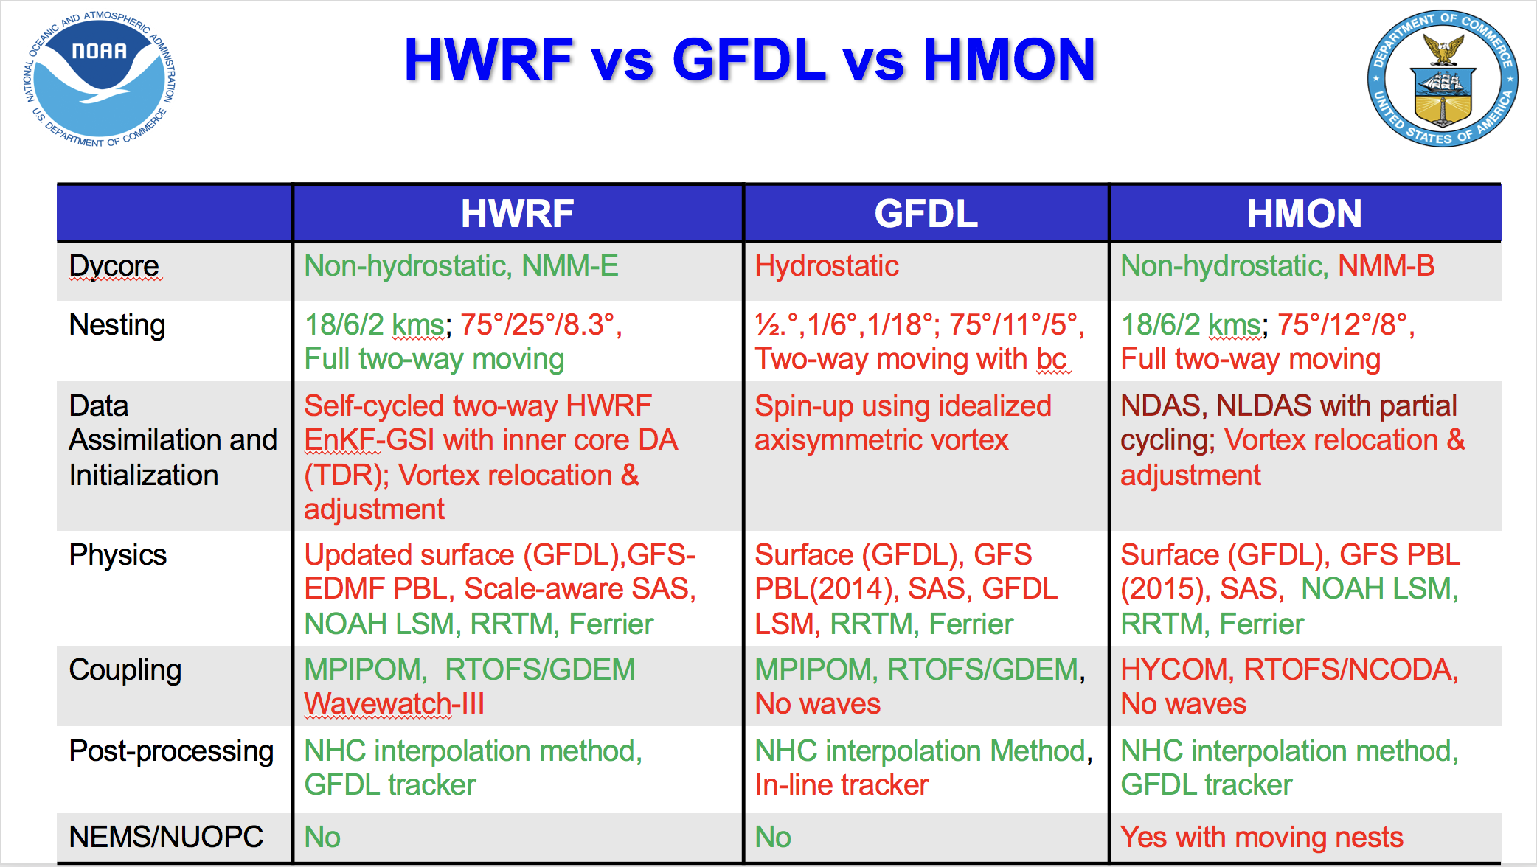

Slide 20
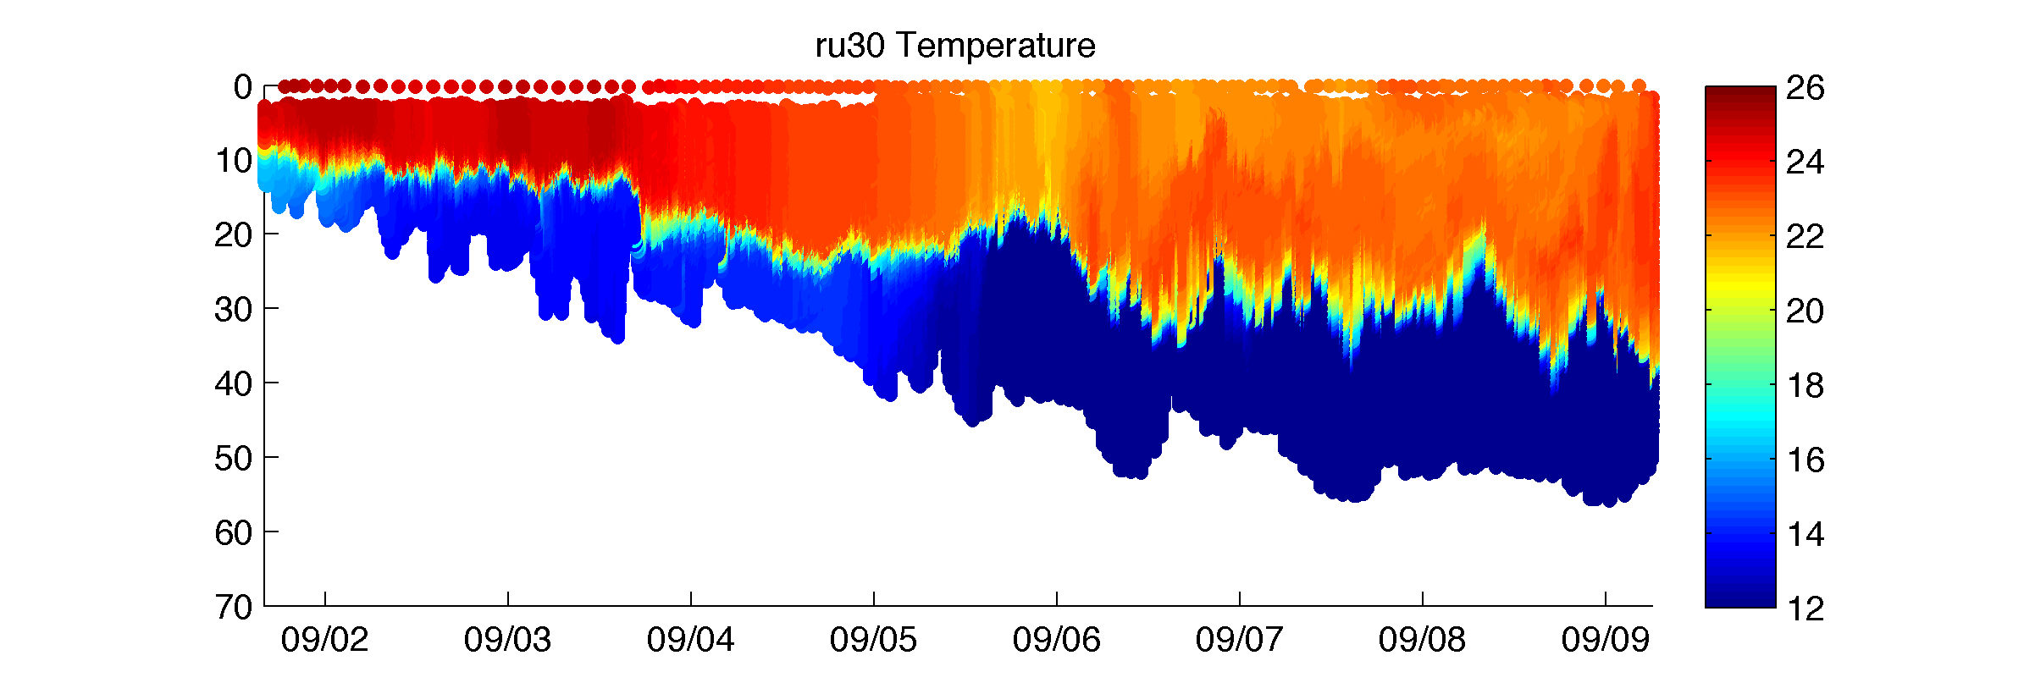
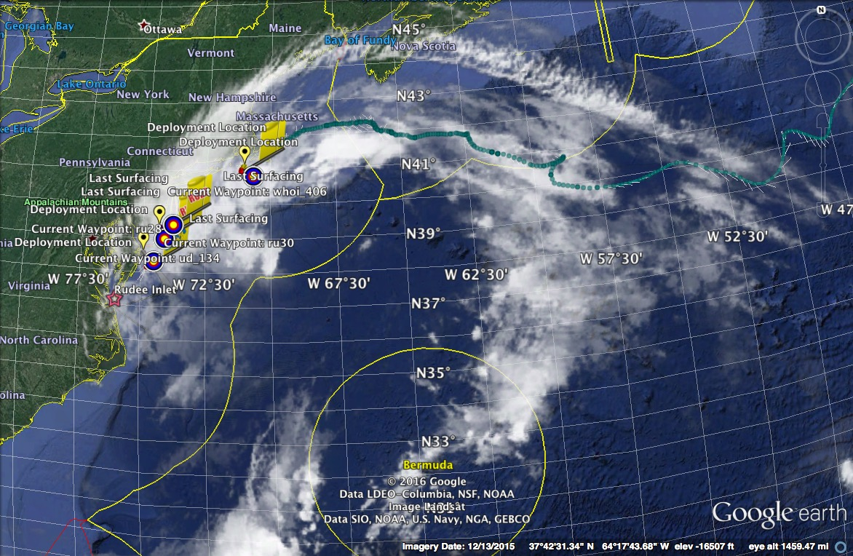
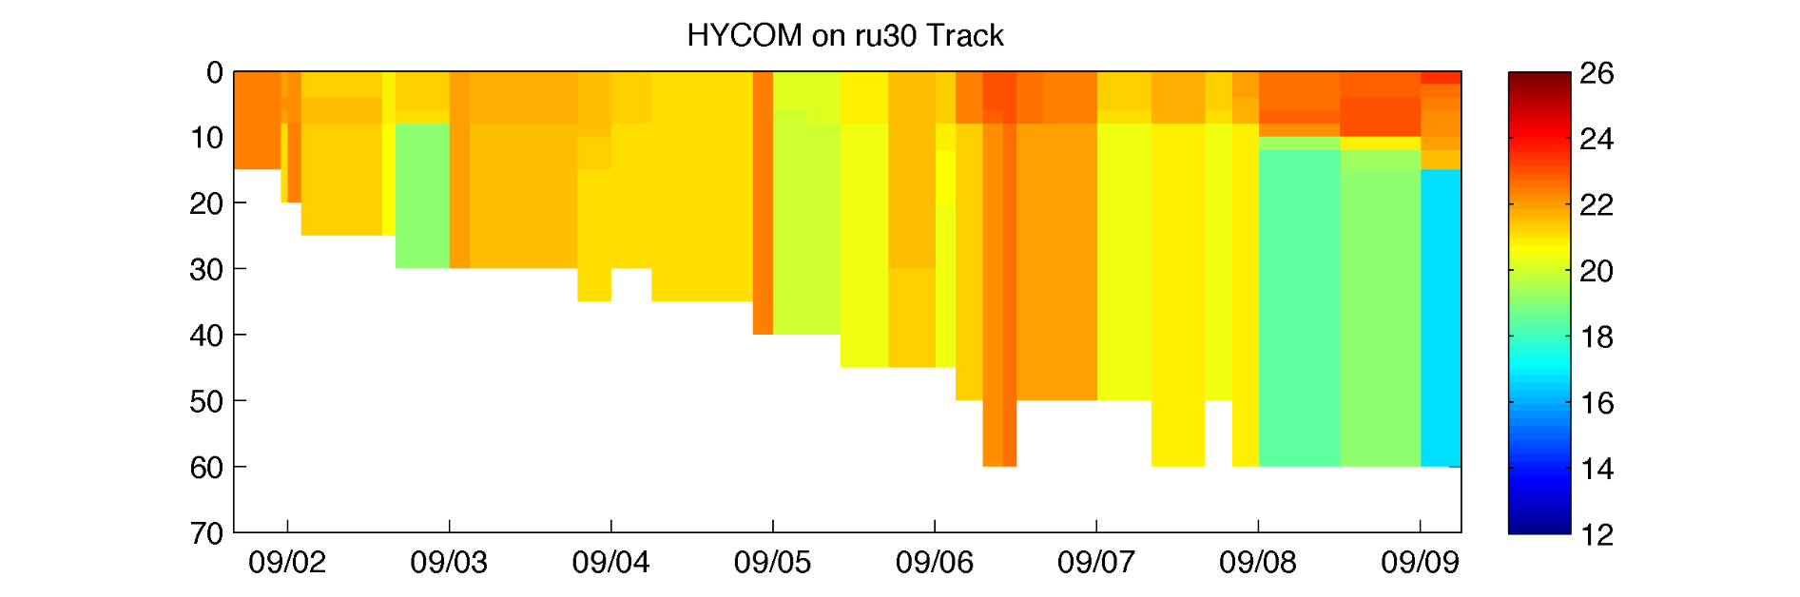
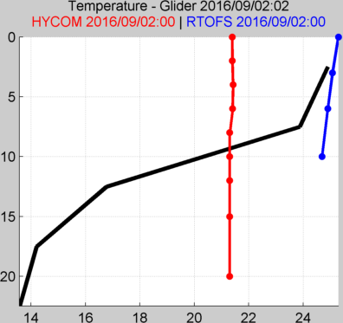
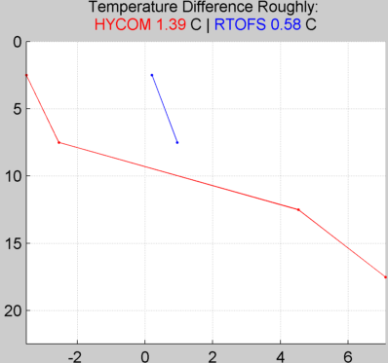
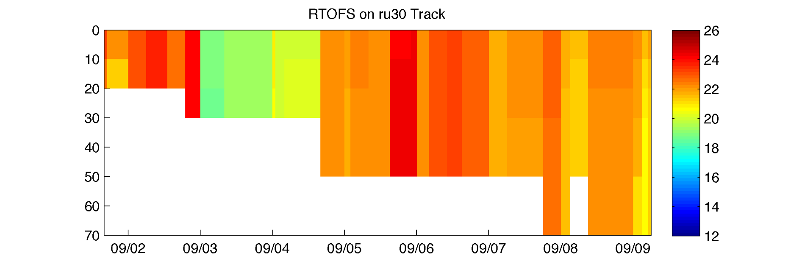
Hurricane Hermine Response: CINAR/MARACOOS Glider Fleet Launched, 9/2016
Glider
HYCOM
RTOFS

Slide 21
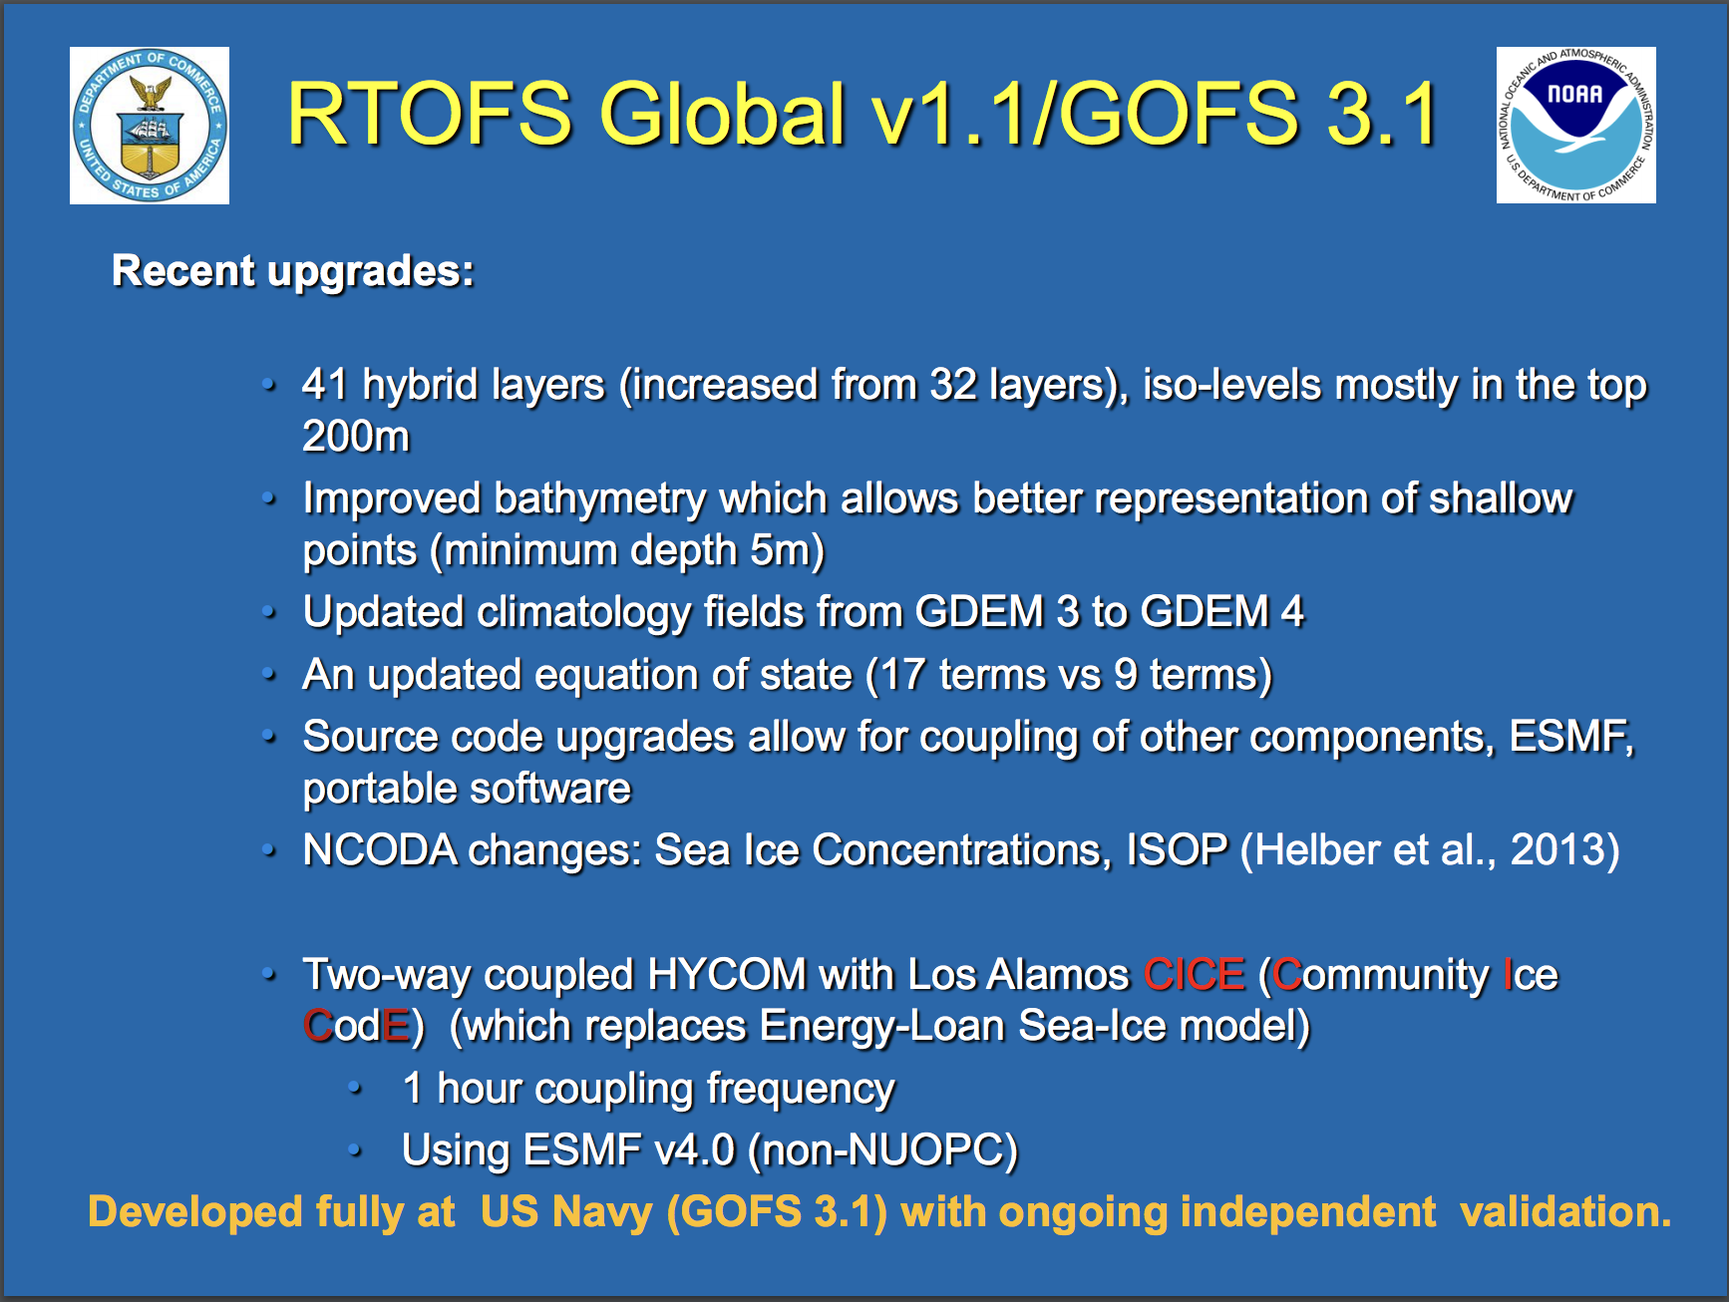
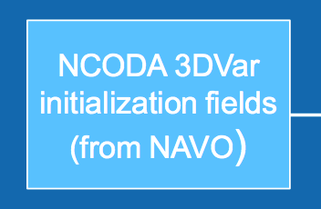
Navy Coupled Ocean Data Assimilation
Data Assimilation once per day
Satellite SST Maps
Satellite Altimetry – through ISOP
CTD profiles – numerous sources and rules

Slide 22
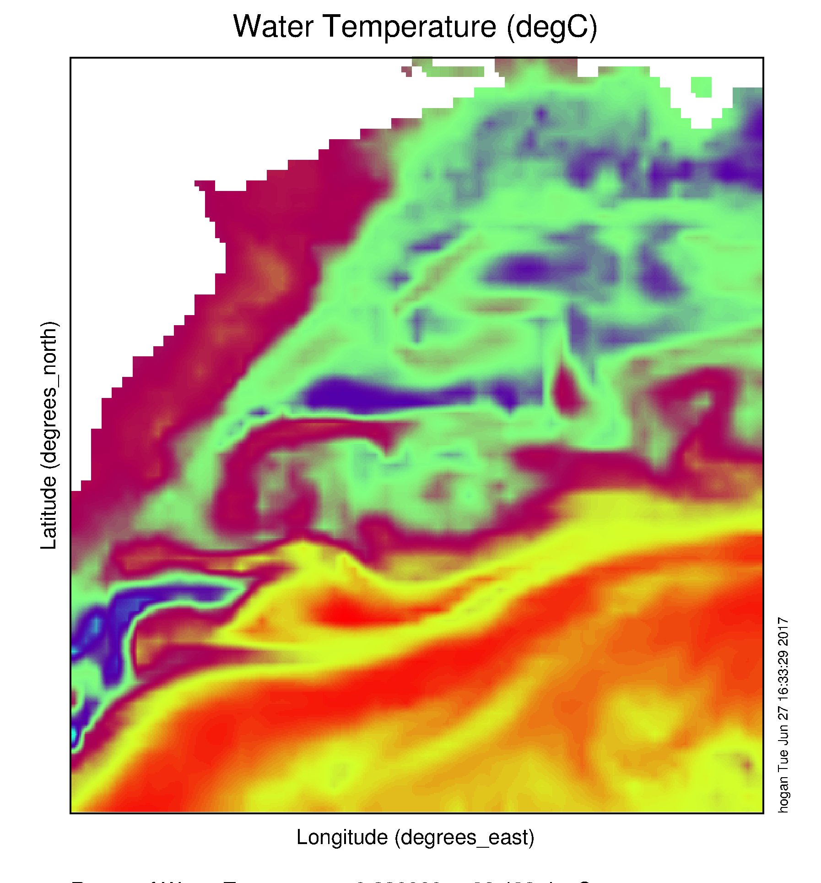
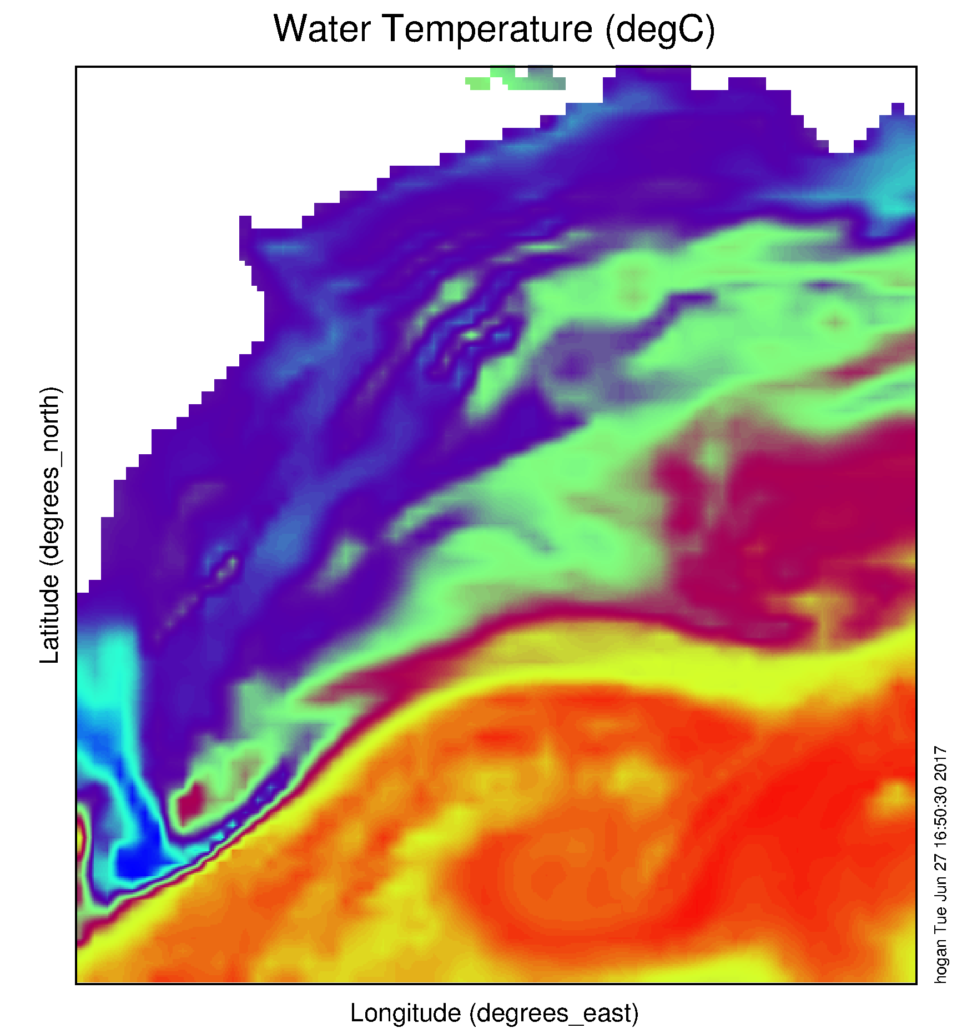
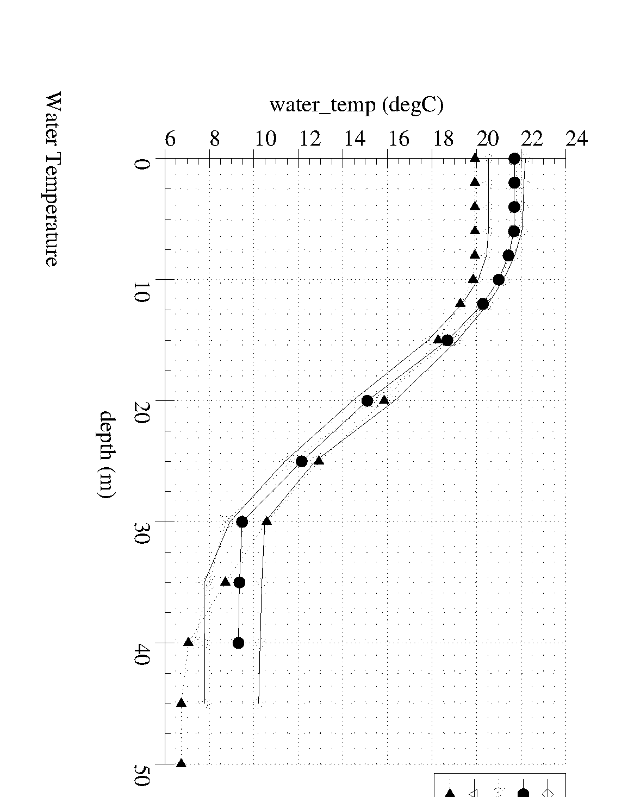
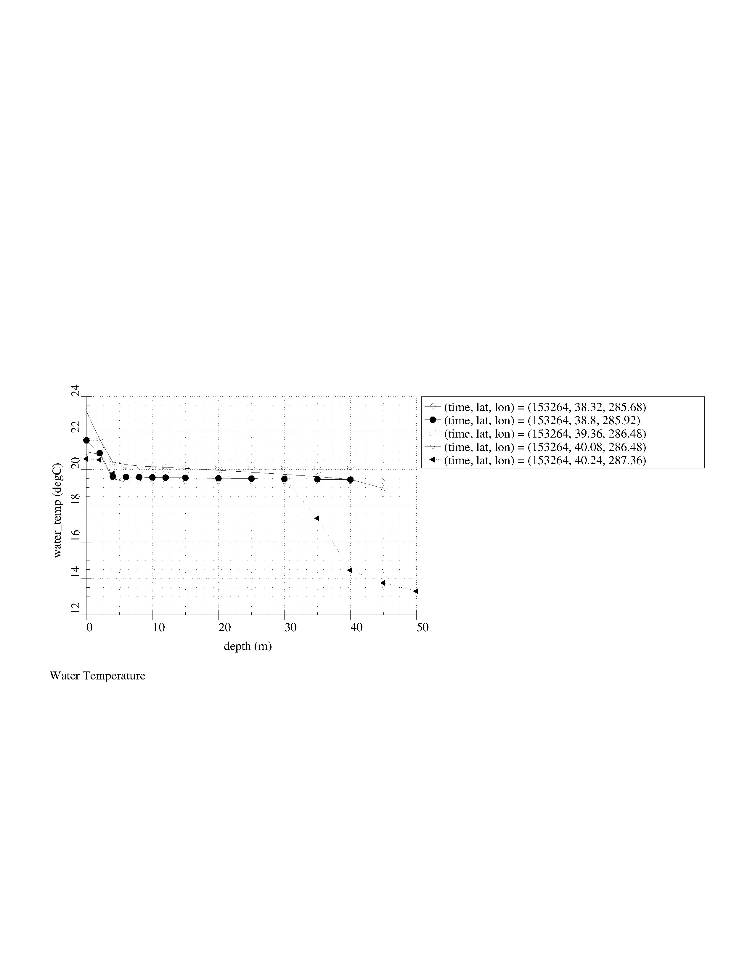
Navy Global Ocean Forecast System (GOFS):
Temperature below summer thermocline in 2017
Operational GOFS 3.0
OpTest of GOFS 3.1
No Cold Pool
Well Defined
Cold Pool
Nearly Isothermal Shelf
Two Thermal layers on Shelf

Slide 23

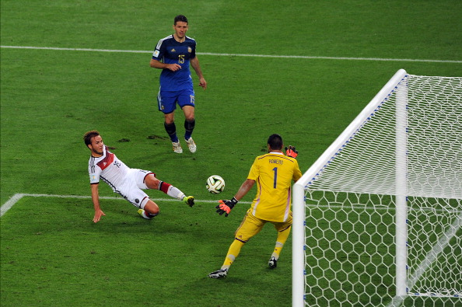
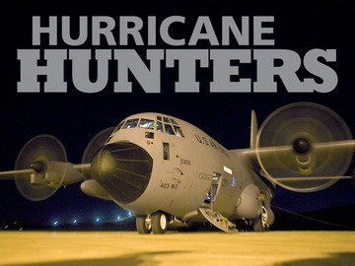
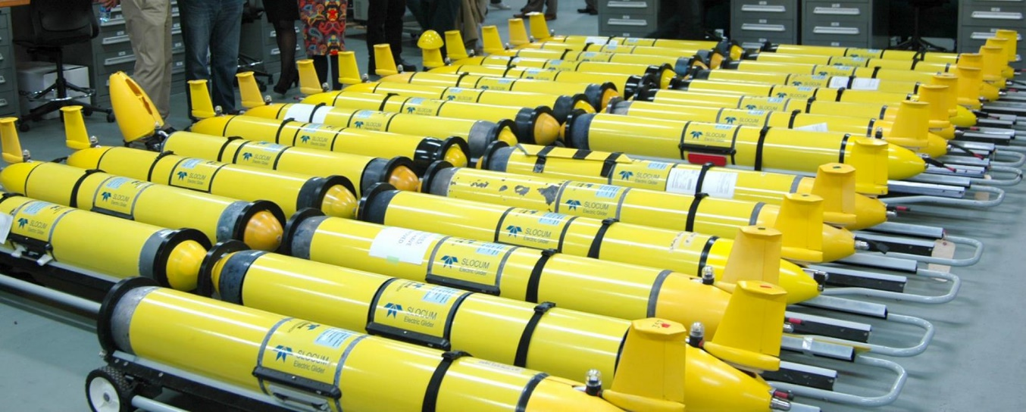
Since
1946
HURRICANE SENTINELS
Starting 2018

Slide 24
2018 Hurricane Activities
January – Hurricane Supplemental Proposal – OAR, AOML, CINAR, IOOS - 5 MAB Gliders
February – HFIP Hurricane Talk – at AOML
February - Ocean Sciences Hurricane Talk – Formulate IOOS/OAR Plans
March - Oceanology International Hurricane Talk – Refine IOOS/OAR Plans
March – Navy/Shell Glider collaboration in Gulf of Mexico - Confirmed
May – Navy/NOAA collaboration for 10 Gliders in the Caribbean – Confirmed
June – India/US Colloquium, NIO/OAR, Goa, India
June – Navy/NOAA collaboration in Mid Atlantic – Canceled – Lack of Assets
June - IOOS support for Navy glider deployments/recoveries + 2 gliders in MAB
July – Annex 20 to Navy/NOAA MOA for Hurricane Sentinel Gliders
July - IOOS tiger team for getting Navy Gliders into Glider DAC & onto GTS
July – WMO/DBCP/JCOMM Ocean Observing/Typhoon Meeting – Hainan, China
July – MECAS 2018 – Loop Current for Improved Hurricane Forecasts, Havana, Cuba
August - Travis deploys 5 Navy gliders in USVI, Chip deploys 2 Navy gliders in PR
August - Typhoon Glider Deployment, Jeju Island, KIOST + OAR JPA
September - IOOS Support for Dr. Maria Aristizabal for evaluation of operational models
September - Hurricane email list transitioned to Hurricane Blog
October – VIMS Talk, OCEANS 2018 Charleston IOOS Hurricane Panel & UUV Town Hall
November – MarCuba2018 – Loop Current for Improved Hurricane Forecasts, Havana
November - (a)HFIP OMITTS Talk (b) CNMOC Brief (c) NOAA/Navy Leadership Brief

Slide 25

Hurricane Sentinel Gliders deployed in 3 Picket Lines
Florence
Helene
Isaac
>30 Hurricane Sentinel Gliders from the Navy, NOAA, NSF, Academic & Industry Partners
reporting ocean conditions through the U.S. IOOS Glider Data Assembly Center (DAC)
ahead of Hurricanes Florence, Isaac and Helene on September 11, 2018.

Slide 26

2018 Hurricane Season – 61 Gliders in IOOS Glider DAC

Slide 27

2018 Hurricane Season – 61 Gliders in IOOS Glider DAC

Slide 28

2018 Hurricane Season – >123,000 Profiles in Glider DAC

Slide 29



Caribbean – NG467

Slide 30

Caribbean – NG467

Slide 31



Hurricane Michael – NG288
Michael

Slide 32


Hurricane Michael – NG288

Slide 33


Hurricane Michael – NG288 vs GOFS 3.1
DRAFT

Slide 34



Hurricane Michael – NG288 - Temperature Increments
From NCODA

Slide 35


Hurricane Michael – NG288 - Assimilation Windows

Slide 36


Hurricane Florence – RU33 – T & S Time Series
Change vertical ticks

Slide 37

Hurricane Florence – RU33 – T & S Profiles
Advanced QA/QC:
Thermal Inertia of Salinity Sensor

Slide 38


Hurricane Florence – RU33 – Temperature Increments

Slide 39


Hurricane Florence – RU33 – Assimilation Windows

Slide 40
Next Steps – Now through Start of 2019 Hurricane Season
Questions:
What is the impact of the gliders on the NCODA/GOFS/RTOFS ocean forecast? The hurricane track and intensity forecast? The hurricane impact forecast?
Can we propose changes to improve NCODA for NOAA Hurricane Forecasting?
Where do we want to deploy gliders in the 2019 Hurricane Season?
Partnership Approach:
Deploy/Recover Gliders – 2018 Hurricane Season - Completed
Model/Data Comparisons – Fall - Ongoing
Collaborative Deep Dive into Critical Components – Winter
Joint Recommendations for 2019 Hurricane Season - Spring
In-person Tiger Team events (through Hurricane Initiative) with
  IOOS/OAR (Silver Spring)
  Navy Scientists (NRL Stennis, NRL Monterey)
  NOAA Operational Center (NCEP – College Park)
  Research Centers (AOML, GFDL, VIMS, UMiami)
  HFIP/OMITT/NHC (Miami)

Slide 41
Next Steps – Now through Start of 2019 Hurricane Season
What we need:
Actual data-denial experiments with the operational modeling suite
Move from a volunteer Interagency Tiger Team to a resourced Interagency Tiger Team.
  Navy funds for Navy researchers
  NOAA funds for NOAA researchers
  Transition through HFIP consistent with WRFIA
Increased funding for the IOOS Glider DAC.
Sustained Hurricane Sentinel glider operations through IOOS
  Includes 5 Hurricane Sentinel gliders in the MAB
  Plus other regional needs
Permission for gliders to roam the Caribbean - IOCARIBE

