Slide 1


Combining Regional Atmospheric Modeling and Ocean Observations for Assessing NJ’s Offshore Wind Resource
Dr. Scott Glenn
Co-Authors:
Dr. Joseph F. Brodie; Dr. Rich Dunk, CCM;
Dr. Travis N. Miles; Dr. Greg Seroka

Slide 2


The RUCOOL Offshore Wind Team
>80 Years Core Team Experience
Joseph Brodie
Director of Atmospheric Research, RUCOOL
Meteorologist focusing on Mid-Atlantic offshore wind research both at RU and while at UD.
B.S. – Meteorology
Ph.D. – Coupled Atmosphere-Ocean Research
Stop by his poster tonight on forecasting wind ramp events!
Travis Miles
Assistant Research Professor, RUCOOL
Marine meteorologist studying hurricanes, storms, and impacts for offshore wind.
B.S. – Meteorology
Ph.D. – Coupled Atmosphere-Ocean Research
Rich Dunk
Principal Meteorologist/Owner, AquaWind LLC
Certified Consulting Meteorologist (CCM) with decades of experience in the NJ energy sector.
Rutgers Meteorology Professor

Slide 3
Rutgers University Offshore Wind Team:
Integrated Modeling Platform & Experience Chain
Atmospheric Models
Economic Models
Environmental Models
Electricity Market Model
NJ Macroeconomic Model
2. Hourly
Wind
Turbine
Energy
Production
(MWh)
DMCS
3. PJM
Energy UC &
Dispatch
(Dayzer)
CEEEP
9. Reduced
Air Emissions including CO₂ & GHGs - and related
Health Impacts
SEBS
5. Wholesale
OSW
Electricity
Revenue
($/MWh)
CEEEP
Specific OSW application
4. PJM
Capacity
Model
($/MW-day)
CEEEP
7. OREC ∆
Cost
($/MWh)
CEEEP
-
11. Market
Impacts
RECON
6. Wholesale
OSW
Electricity
Cost
($/MWh)
CEEEP
+
10. Air Pollutants
Non-
Market
Impacts
SEBS
1. Hourly
Wind
Speeds
DMCS
=
8. NJ State
Economic
Impact
RECON
12. Net
Impacts
RECON & CEEEP
Notes:
Not sure about this one – useful info, however, on applications

Slide 4

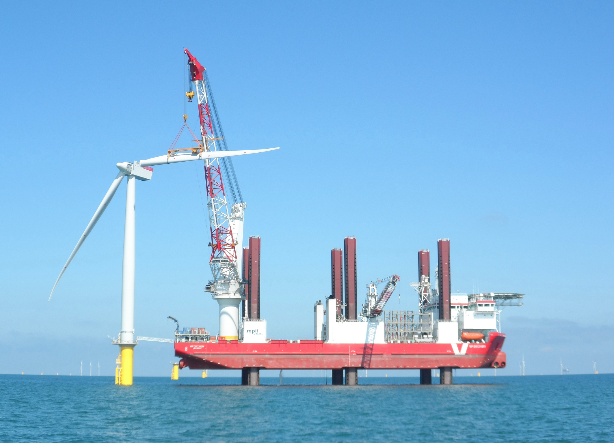
RU-WRF: A Multi-Use Atmospheric Model
Hourly met variable output: includes winds at multiple heights, which can be used for power resource assessment.
Model can also be used for operational forecasting applications:
  Severe weather forecasting for construction, O&M procedures.
  PJM grid management.
  Energy market trading.

Slide 5
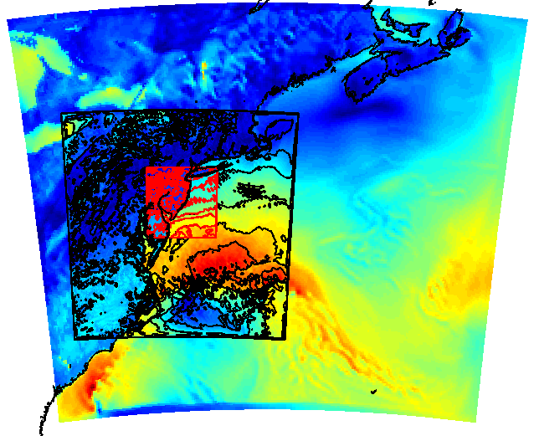
Real-Time Weather Modeling RU-WRF
Run Continuously 2011 – Present
Triple nested: 9km-3km-1km
  9km: 0, 6, 12, 18Z cycles
  3km: 0, 12Z cycles
  1km: 0Z cycle (Research Mode)
Hourly forecast:
  9km: out 5 days
  3km: out 2 days
  1km: out 1 days
Lateral Boundary Conditions:
  9km: 0.25 degree Global Forecast System
  3km: RU-WRF 9km
  1km: RU-WRF 3km
Vertical Levels:
  40 levels more tightly packed near the surface.
Surface Boundary Condition:
  RUCOOL Coldest Dark Pixel Composite (Details Later)
RU-WRF Domains
9km
3km
1km
Notes:
Not coupled to ocean (yet), but includes SST data using our unique coldest pixel algorithm that removes clouds, yet retains cold upwelling
We currently only run the 0Z run, but with new compute resources, might be adding cycles
Composite of NASA-SPoRT and AVHRR SST data
Made publicly available on our website
Several groups using RU-WRF data to run ocean models

Slide 6
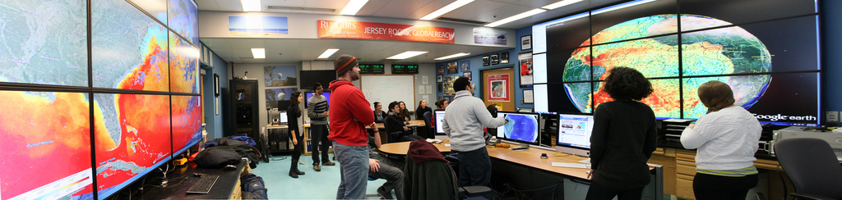

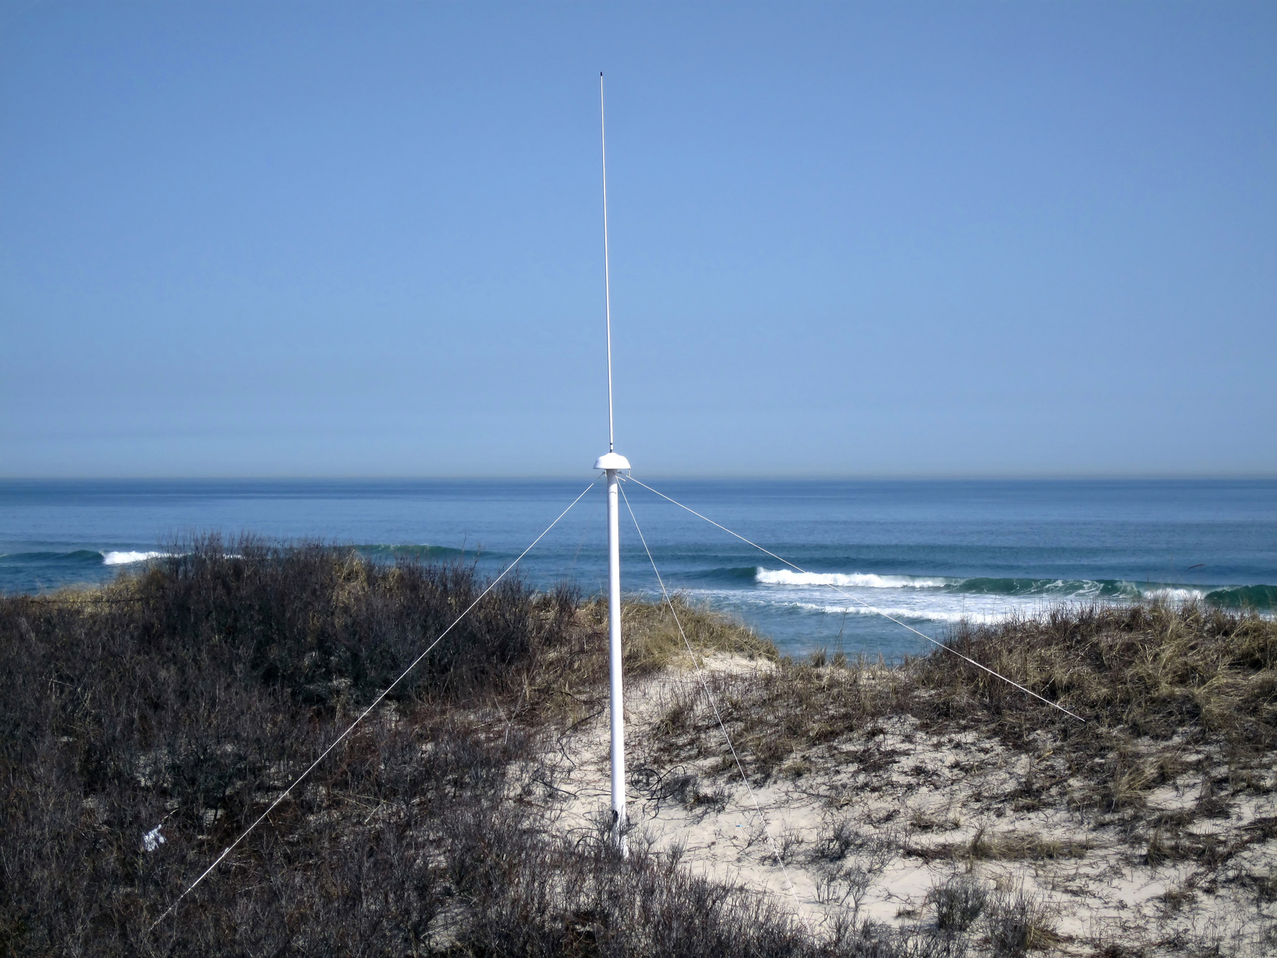
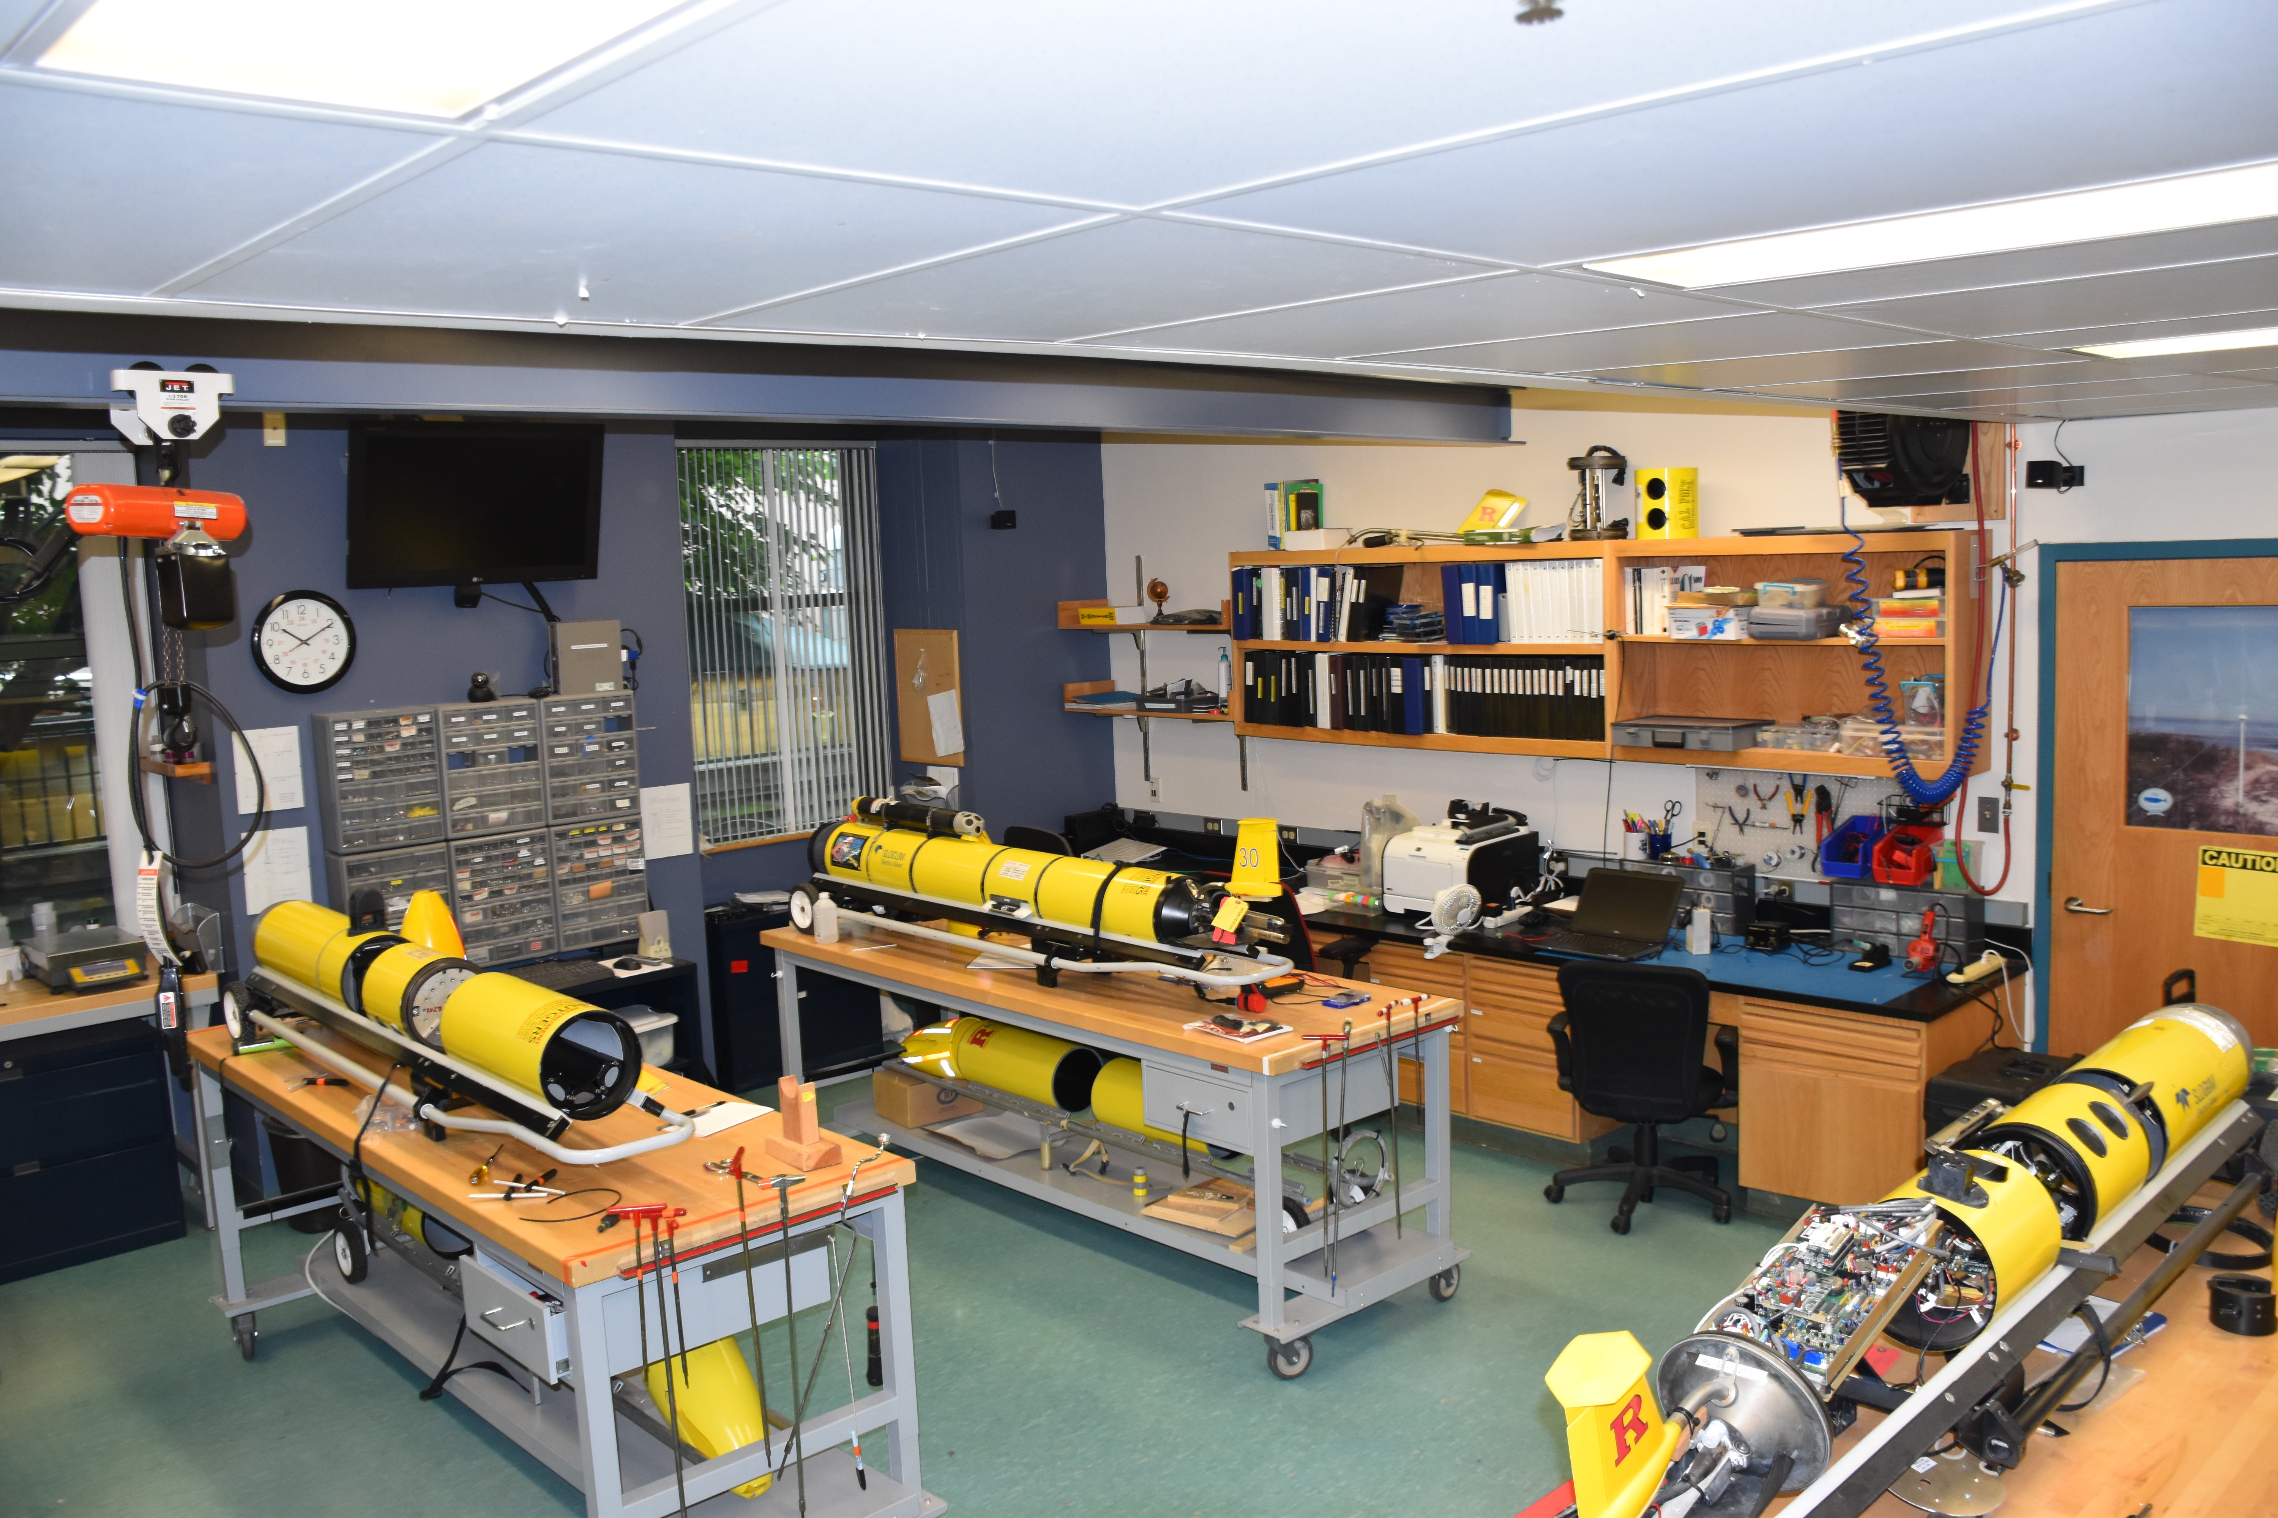
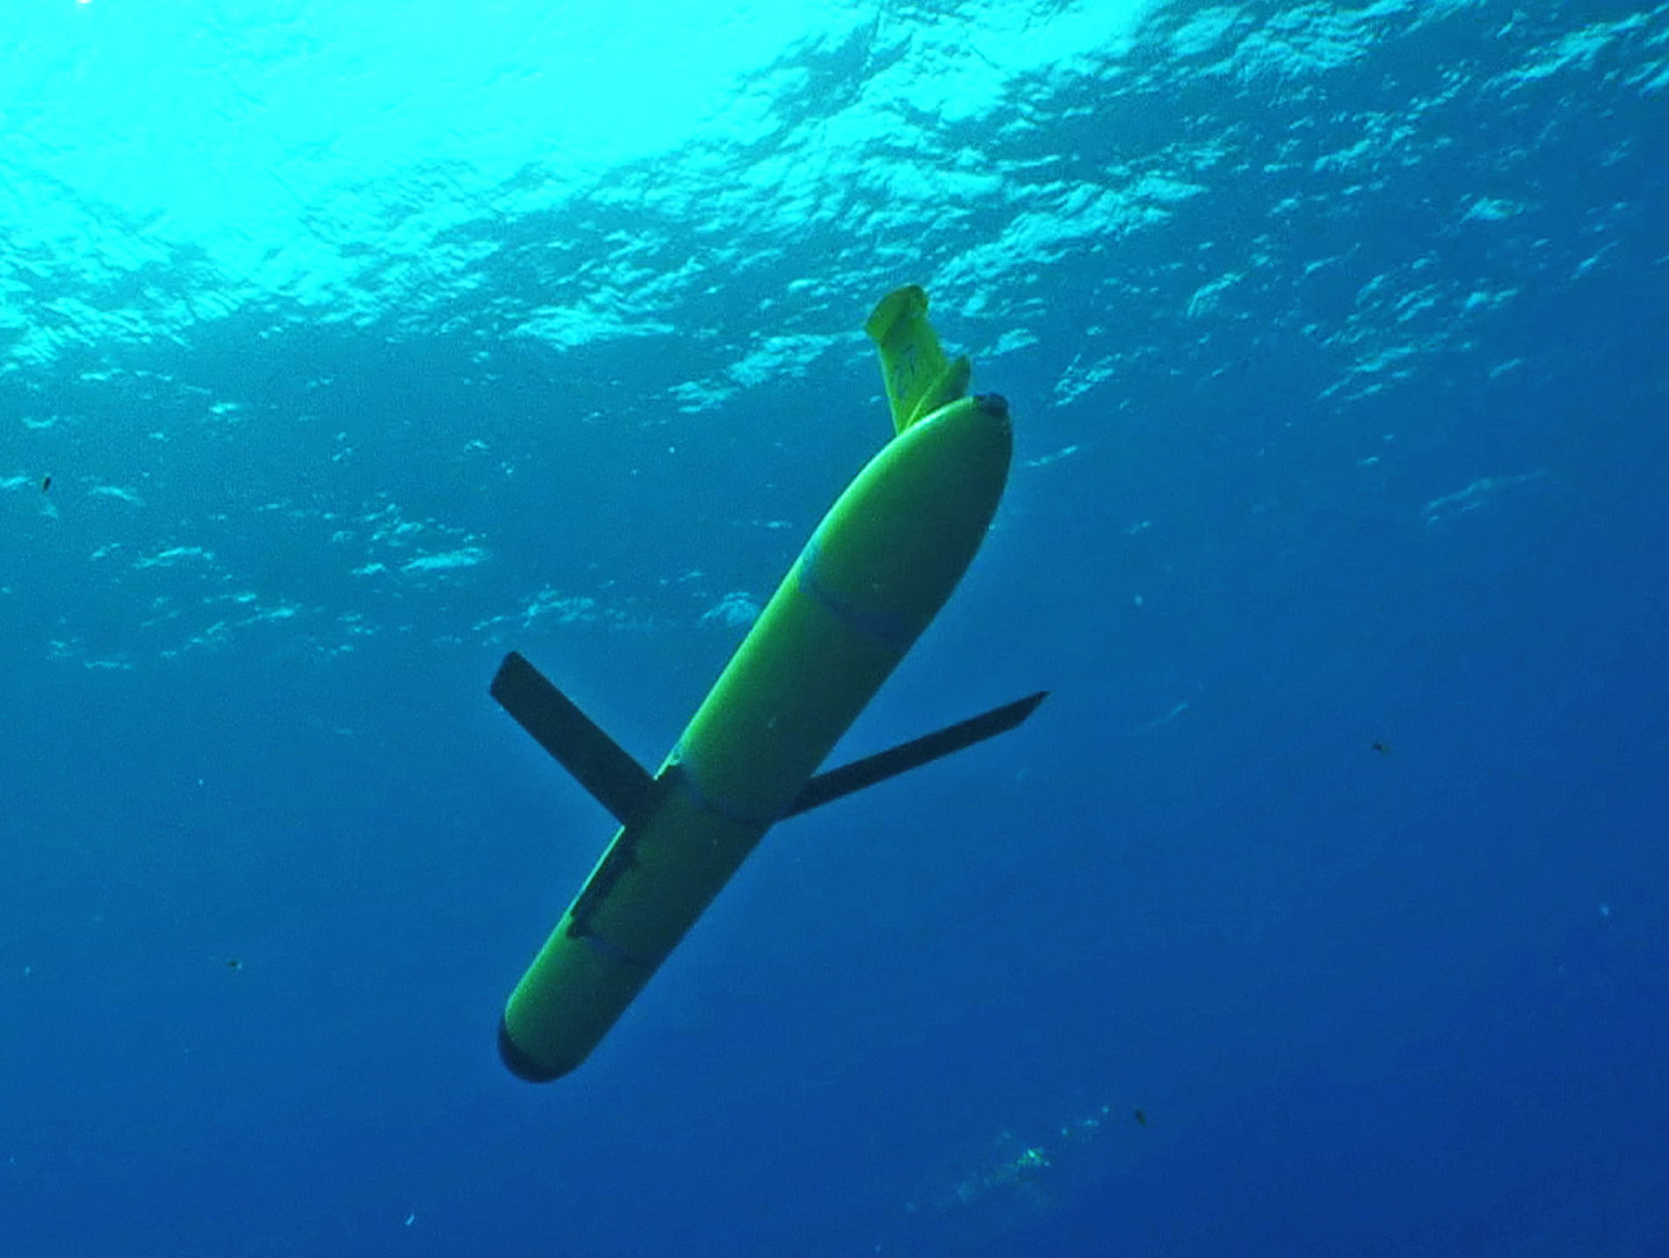
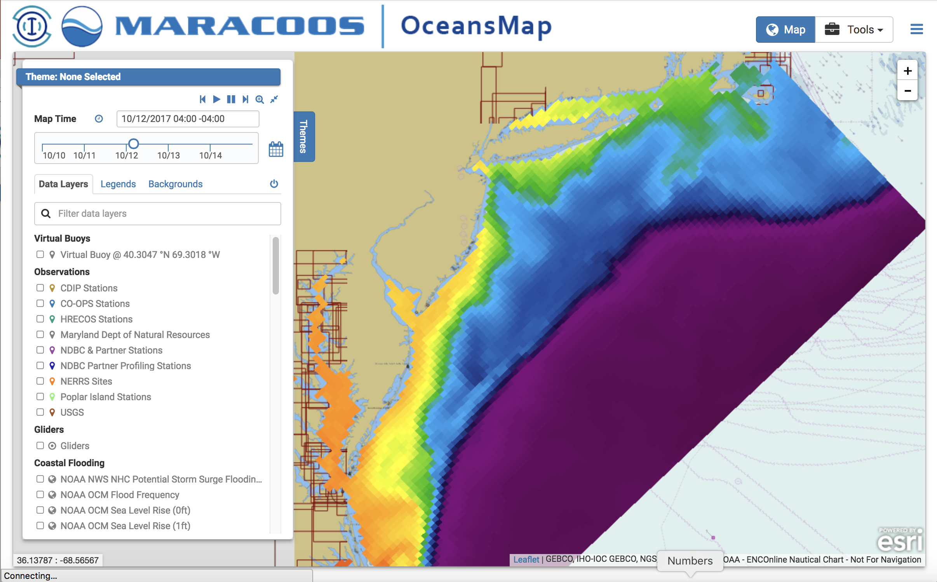
Rutgers University - Center for Ocean Observing Leadership
MARACOOS – A forum to bring forward the best science & technology
Satellite Receivers
46 Site CODAR Network
468 Glider
Deployments
Ocean
Modeling
Glider Lab
Notes:
6
All of this gets combined into our overall operations, research, and educational initiatives in the “COOL Room,” shown here (with a class in the background)
Thanks to many partners

Slide 7
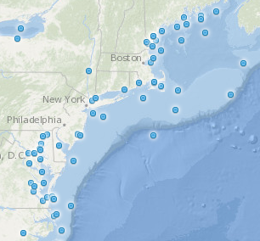
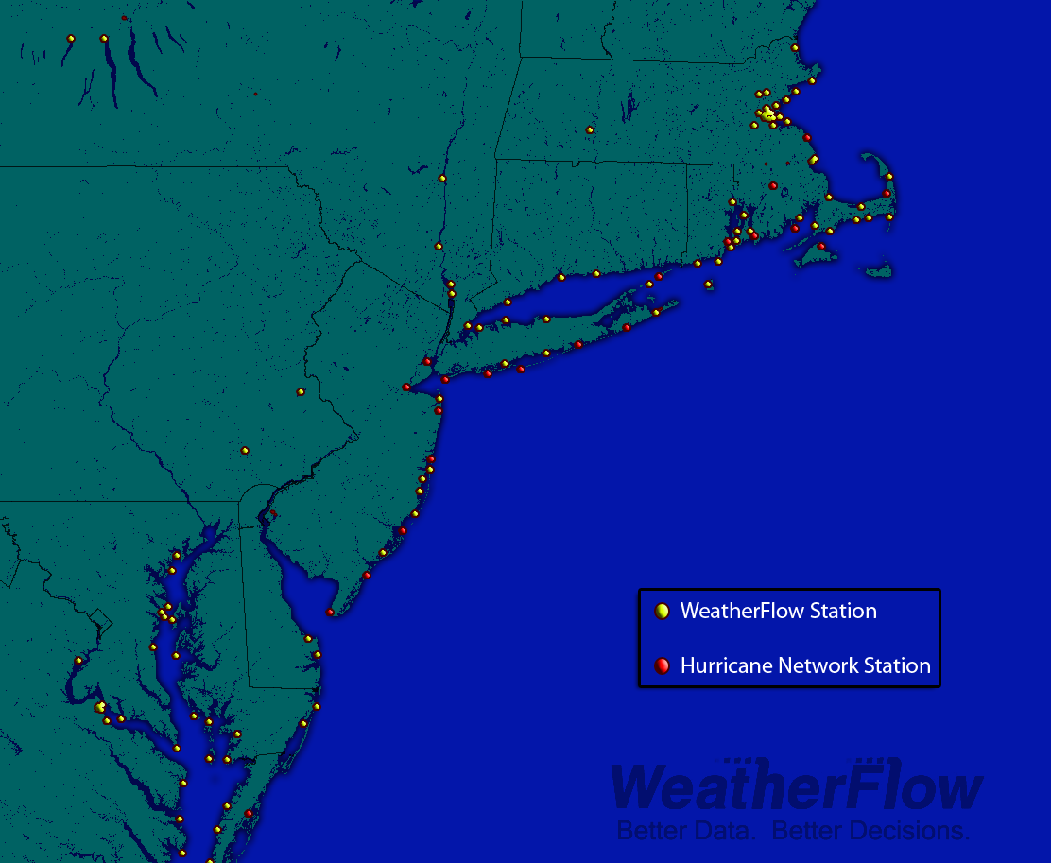
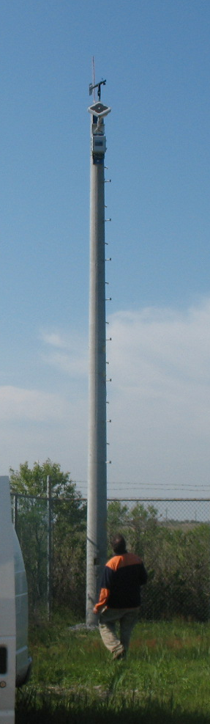
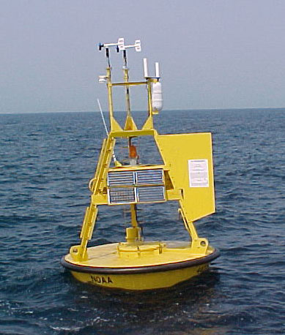

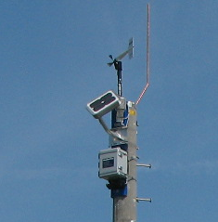
NDBC
Backbone
> 50 sites
Spatial Validation Weather Networks
Regional Industry
Enhancement
> 100 sites
Notes:
Coastal met obs to compliment existing NOAA/NDBC resources.
One tower at our site in Tuckerton

Slide 8
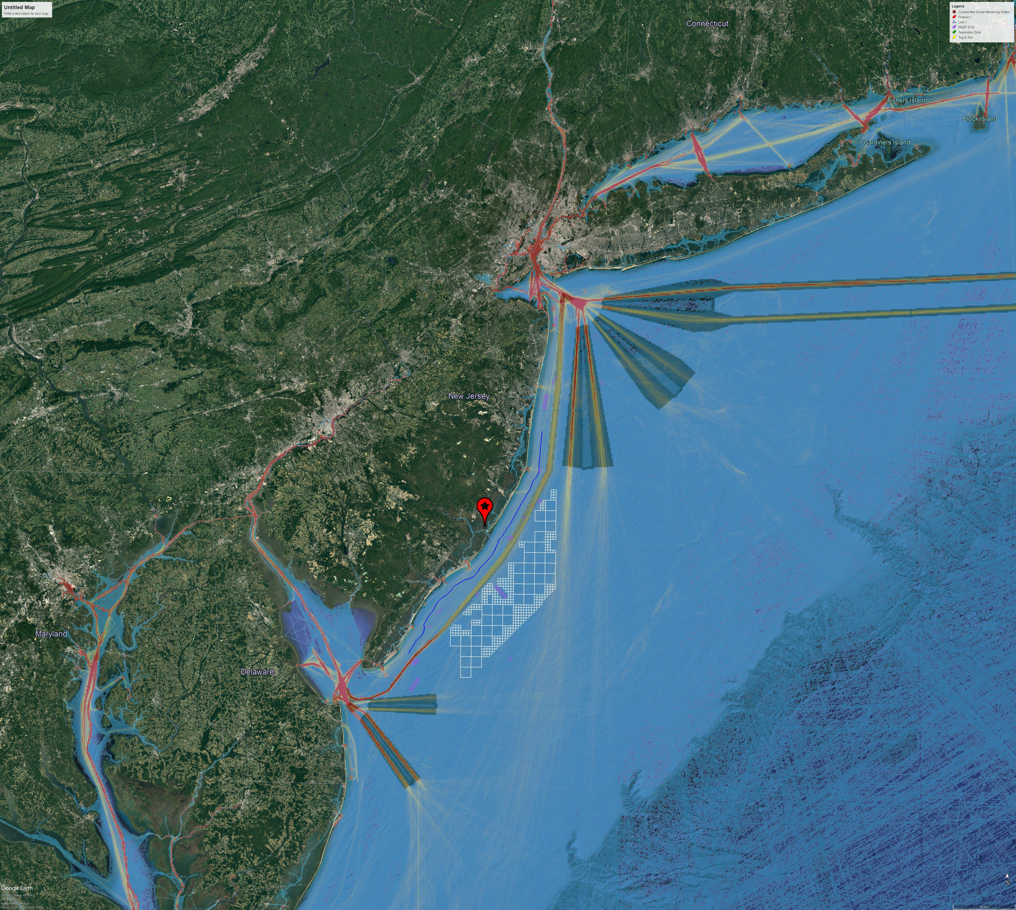
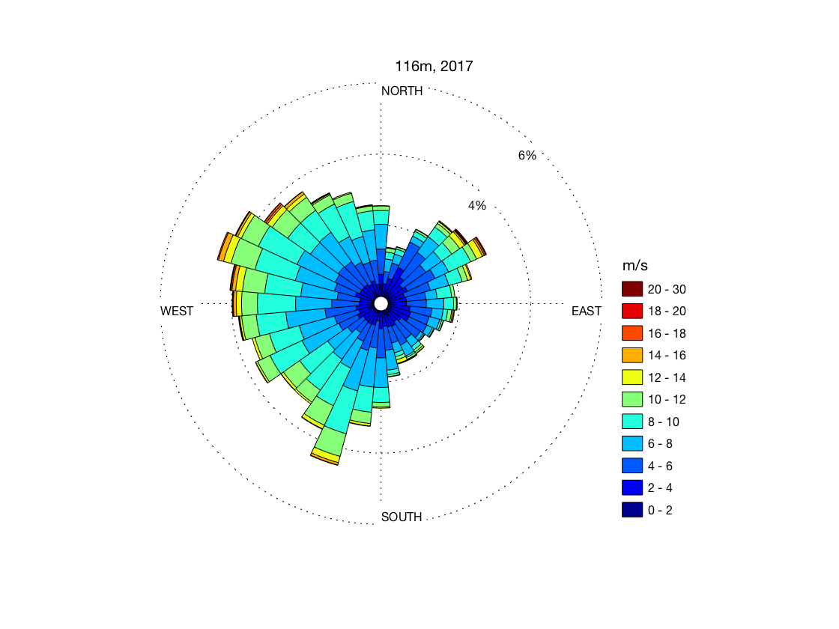
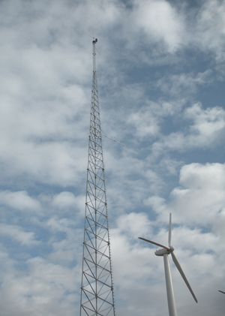
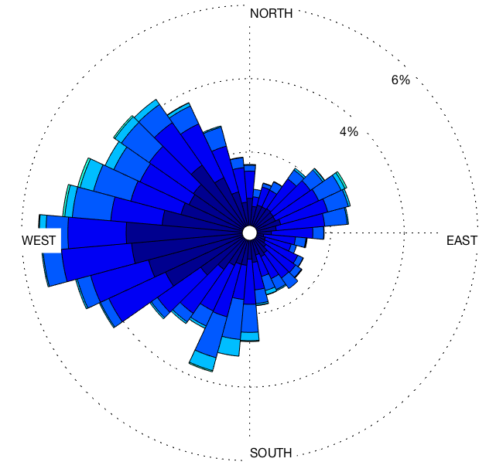
Vertical Validation with Tall Met Towers:
Important Resource, Limited Availability
116 m
Sample
Turbine rated speed
10 m
Tower location

Slide 9
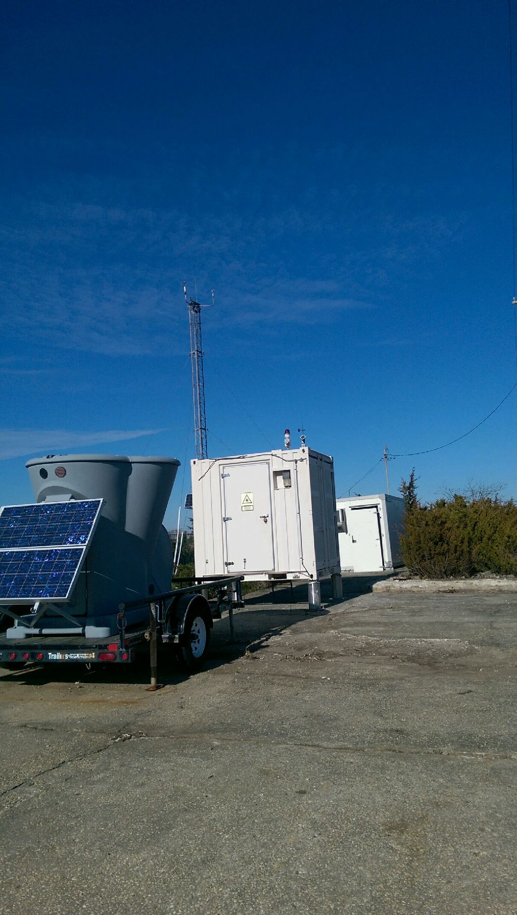
Process Validation with a Dedicated Coastal
Metocean Monitoring Site
Located at the Rutgers Marine Field Station near Atlantic City, NJ
12 m meteorological tower
Triton SODAR
Lockheed WindTracer scanning LIDAR (coming soon)
18km
Notes:
Tower: temp (2 heights)/RH, pressure, sonic and cup anemometers (10 m), radiometer, managed by WeatherFlow
Located in NJ DEP protected marshland, excellent for observing the coastal atmosphere.
WindTracer will allow us to perform scans out into the offshore wind energy lease areas
WindTracer also will allow for capturing the sea breeze spatially and at height

Slide 10
RU-WRF Captures Observed
Wind Distribution
Q-Q Plot, 2012-2016
Accurate resource assessments rely on correctly capturing the wind distribution
RU-WRF effectively captures the distribution of wind speeds off of NJ
At speeds above 12.5 m/s, our sample turbine is at full power
12.5 m/s turbine rated speed
Notes:
Shows how well the model predicts each 1% of the wind distribution

Slide 11
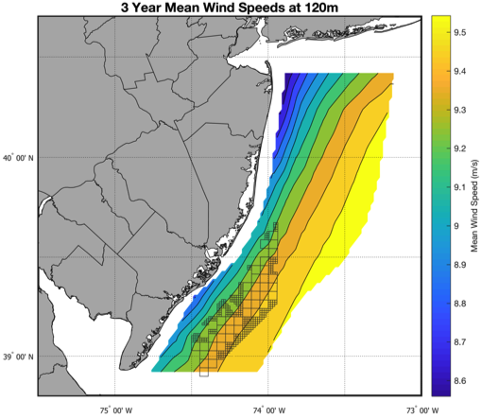
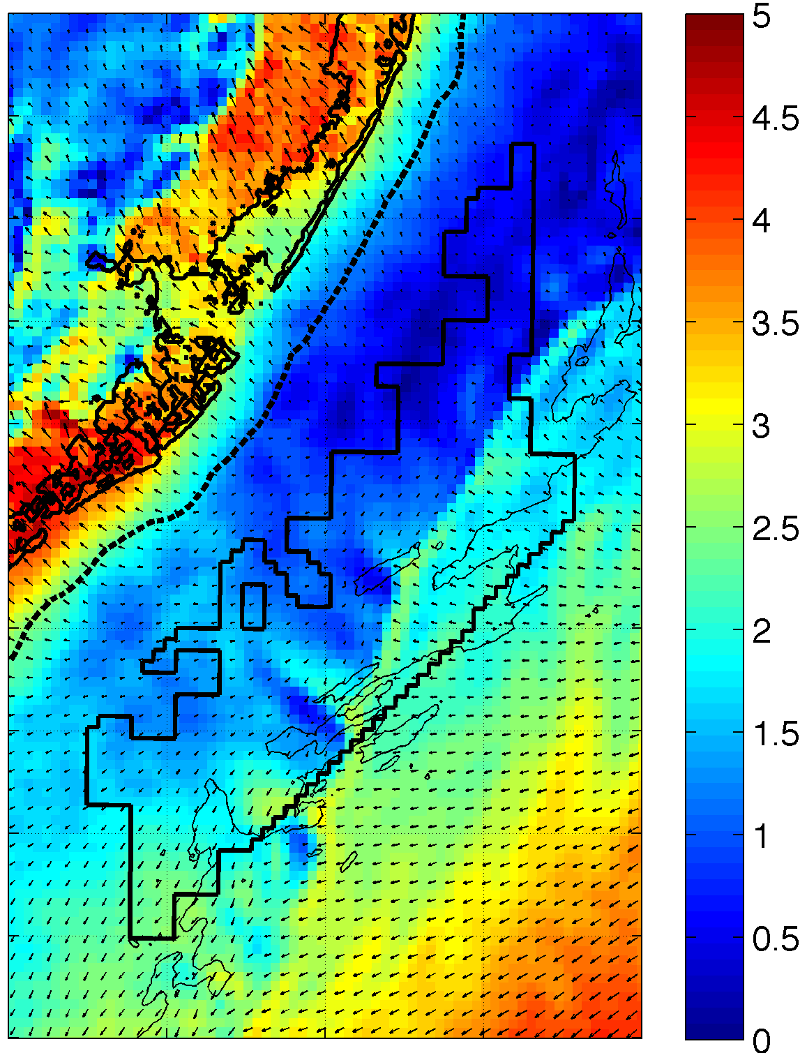
RU-WRF Wind Resource
3 Year Mean
One Hour Sample
Modeling at 3km grid spacing, 10m height
8.5 to 9.5 m/s
Hourly winds
Notes:
See the speed gradient a bit more clearly

Slide 12
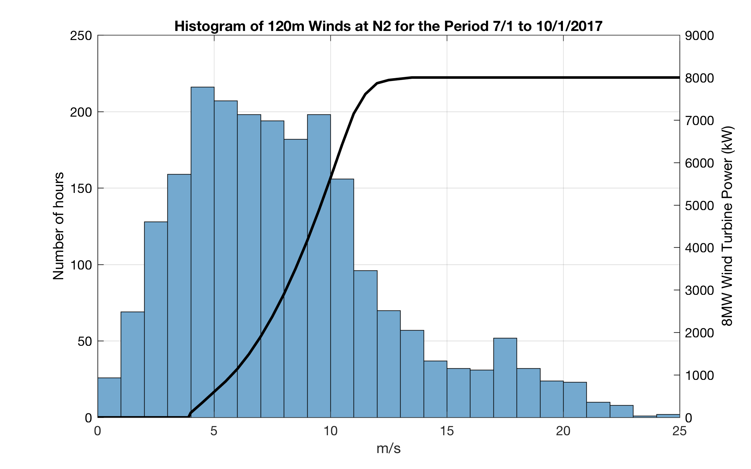
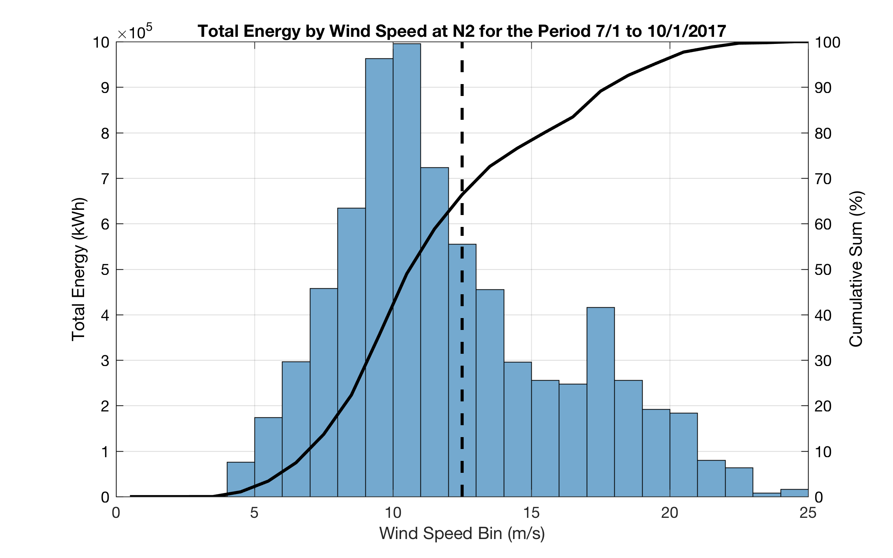
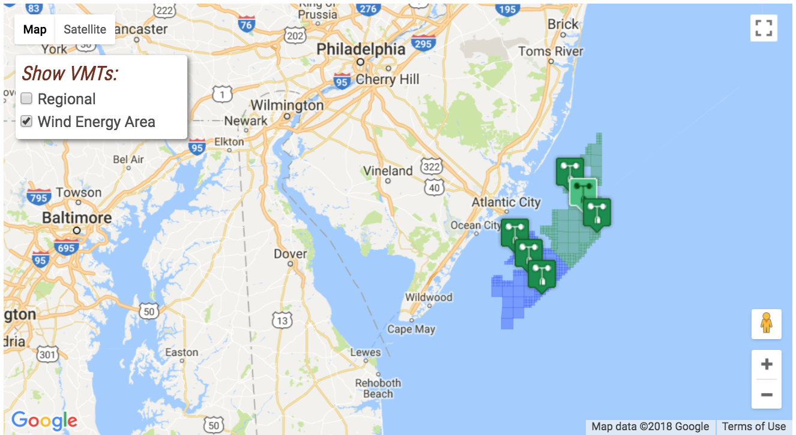
NJ WEA Wind Resource
8 MW wind turbine
12.5 m/s rated speed
2/3 of energy extracted below turbine rated speed
Virtual Met Tower
Notes:
Wind: first plot shows histogram of winds for a recent quarter, along with the power curve for an 8 MW wind turbine
Point out rated speed of 12.5 m/s
Bottom shows cumulative distribution of energy based on those winds. 33% of the power occurs when the turbine is producing full power.
Highlights the importance of getting the winds right, since power is cube of wind, so a 1 m/s wind speed difference on the curve could be a 1500 MW difference in power (20%)

Slide 13
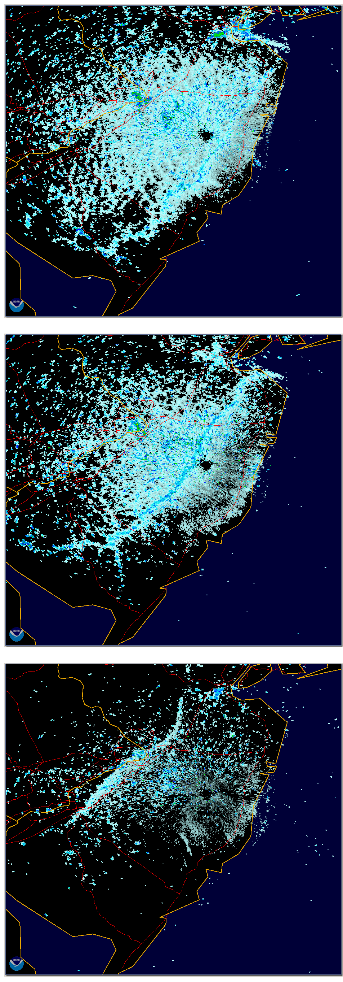
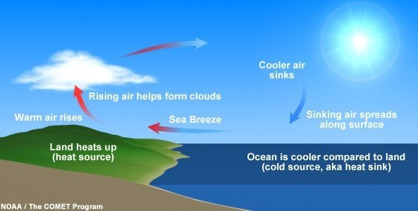
Sea breezes are common;
Driven by land-sea temperature difference
Depending on height and strength of the return flow, and the location of the subsidence zone, turbines could experience different winds throughout the rotor layer
NWS Mt Holly radar
20 Jun 2000

Slide 14
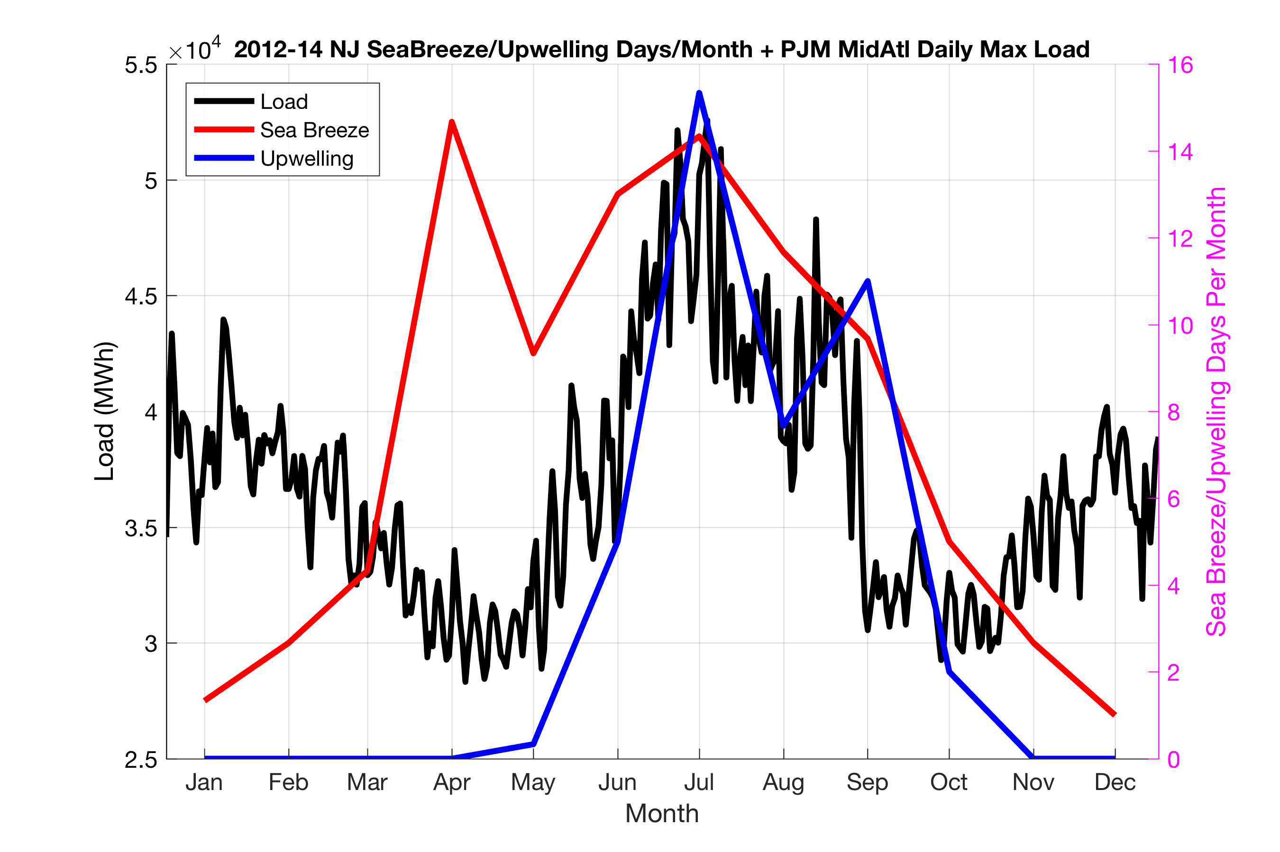
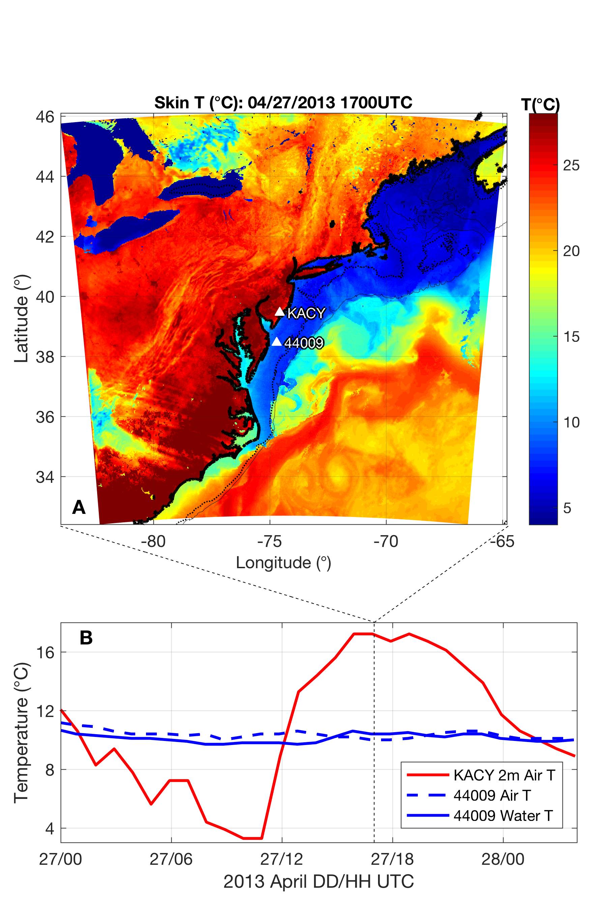
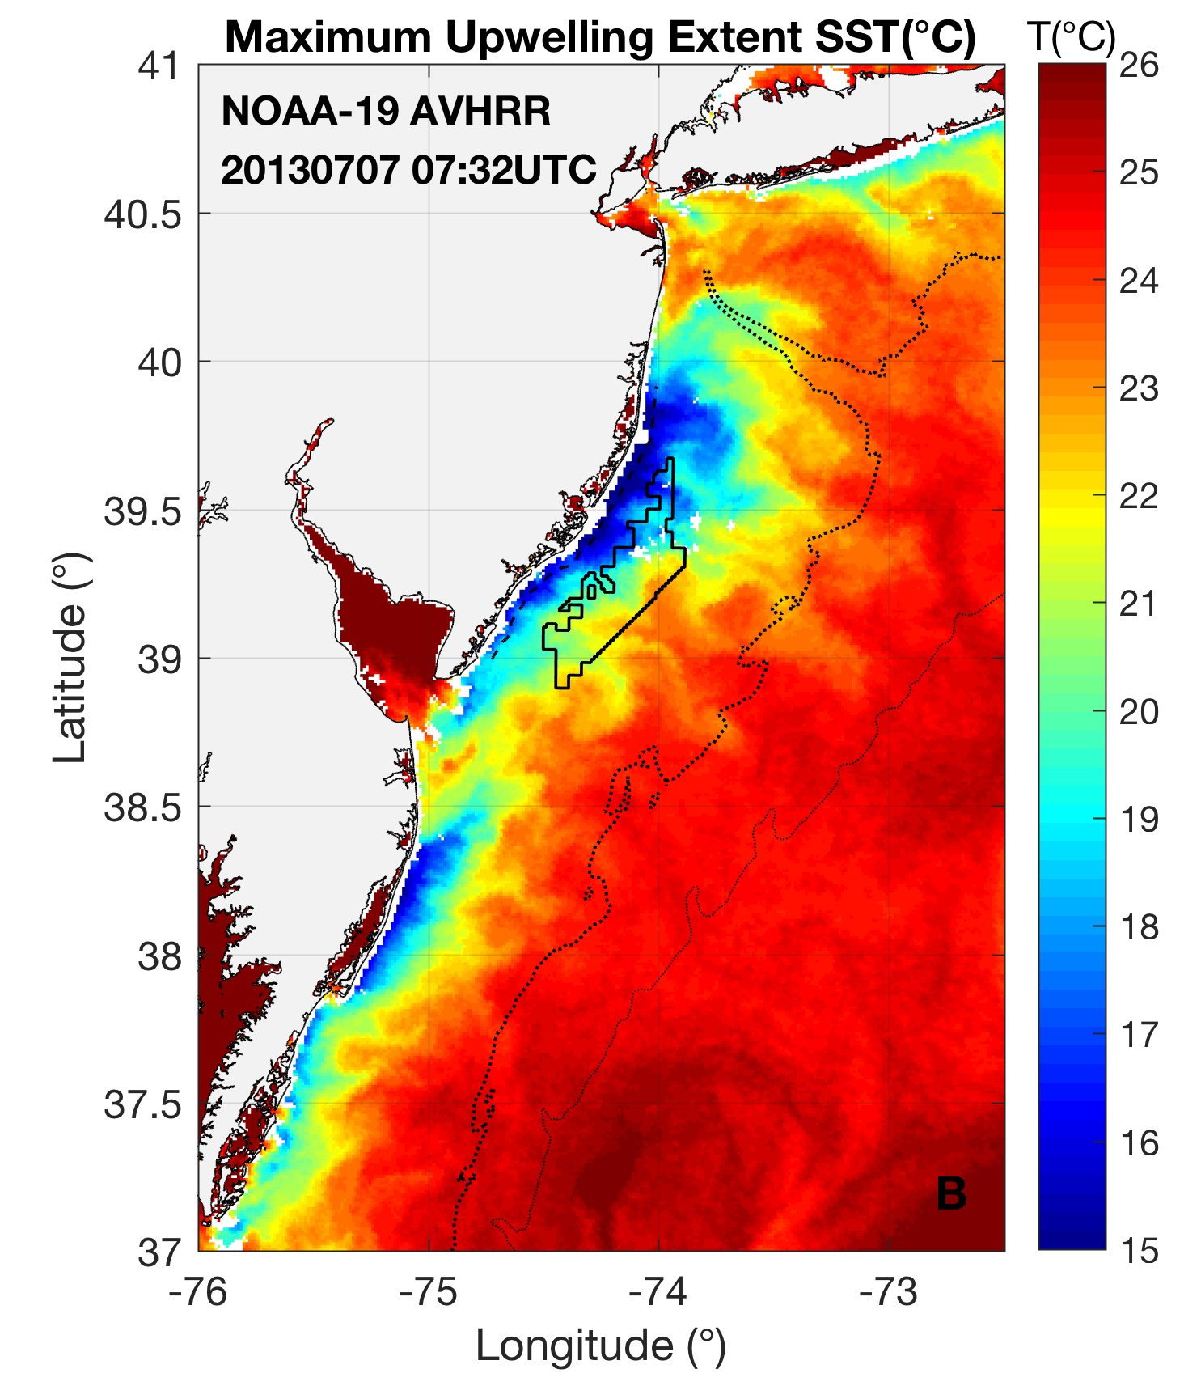
Sea breezes and upwelling, coincident with electricity demand
Notes:
NJ sea breeze and coastal upwelling coincident with peak electricity demand
-Sea breeze time of day (afternoon/evening) is also coincident with peak demand time of day (5-7 pm)
Set up Case 1, upwelling sensitivity

Slide 15
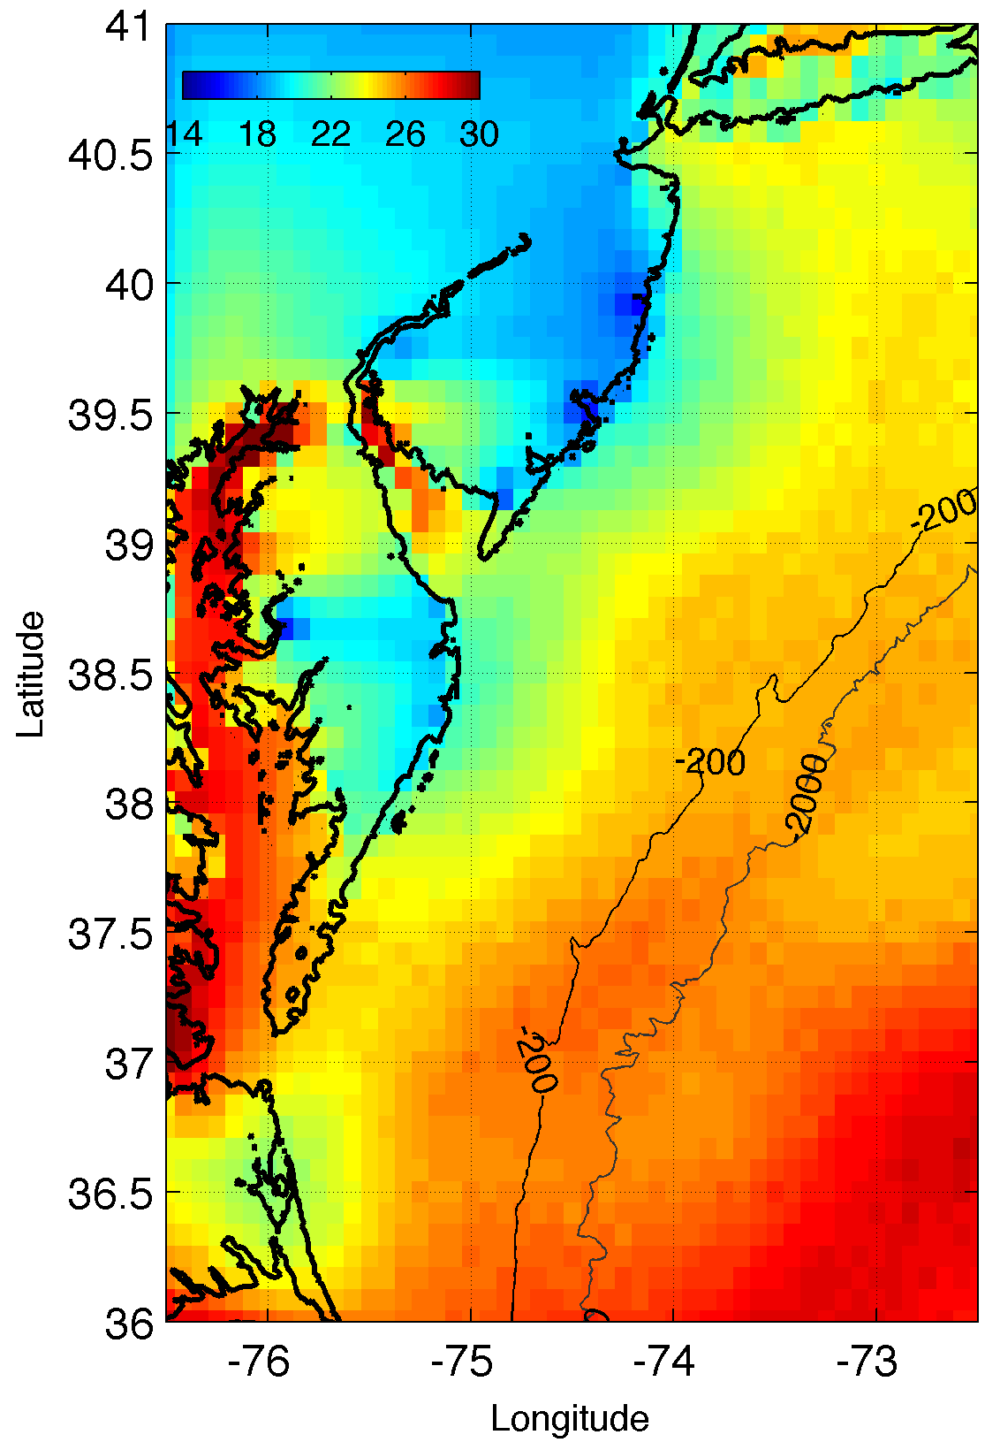
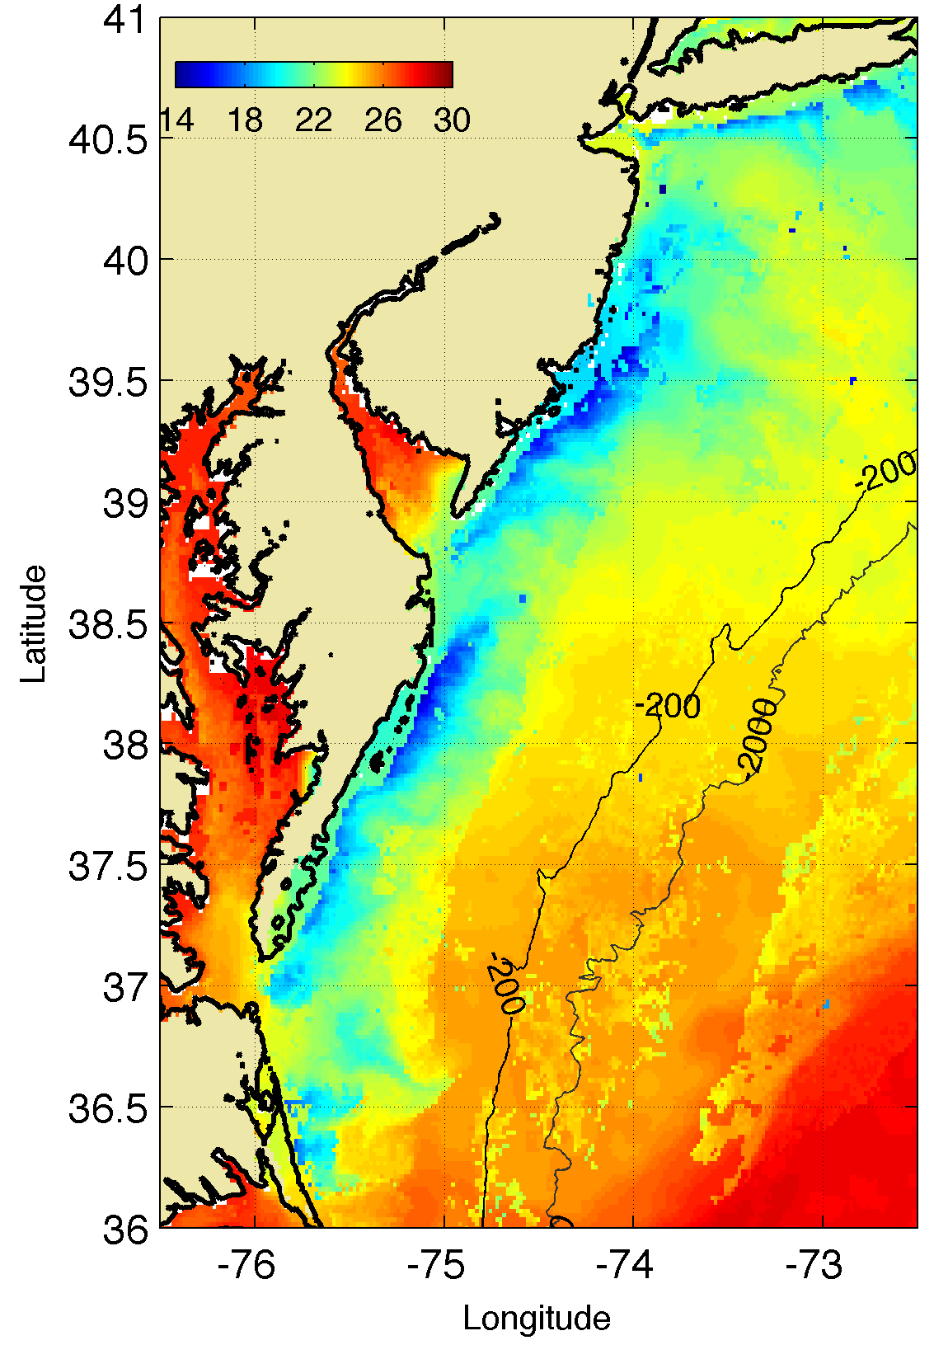
Regional Coldest Dark Pixel Composite SST
Captures Coastal Upwelling
Example:
8 July 2013 Upwelling
Standard National
Satellite
Sea Surface Temperature
(SST) Product
Rutgers
Regional
Satellite
Sea Surface Temperature
(SST) Product
RTG SST
Coldest Pixel
SST
Notes:
Composite of NASA-SPoRT and AVHRR SST data

Slide 16
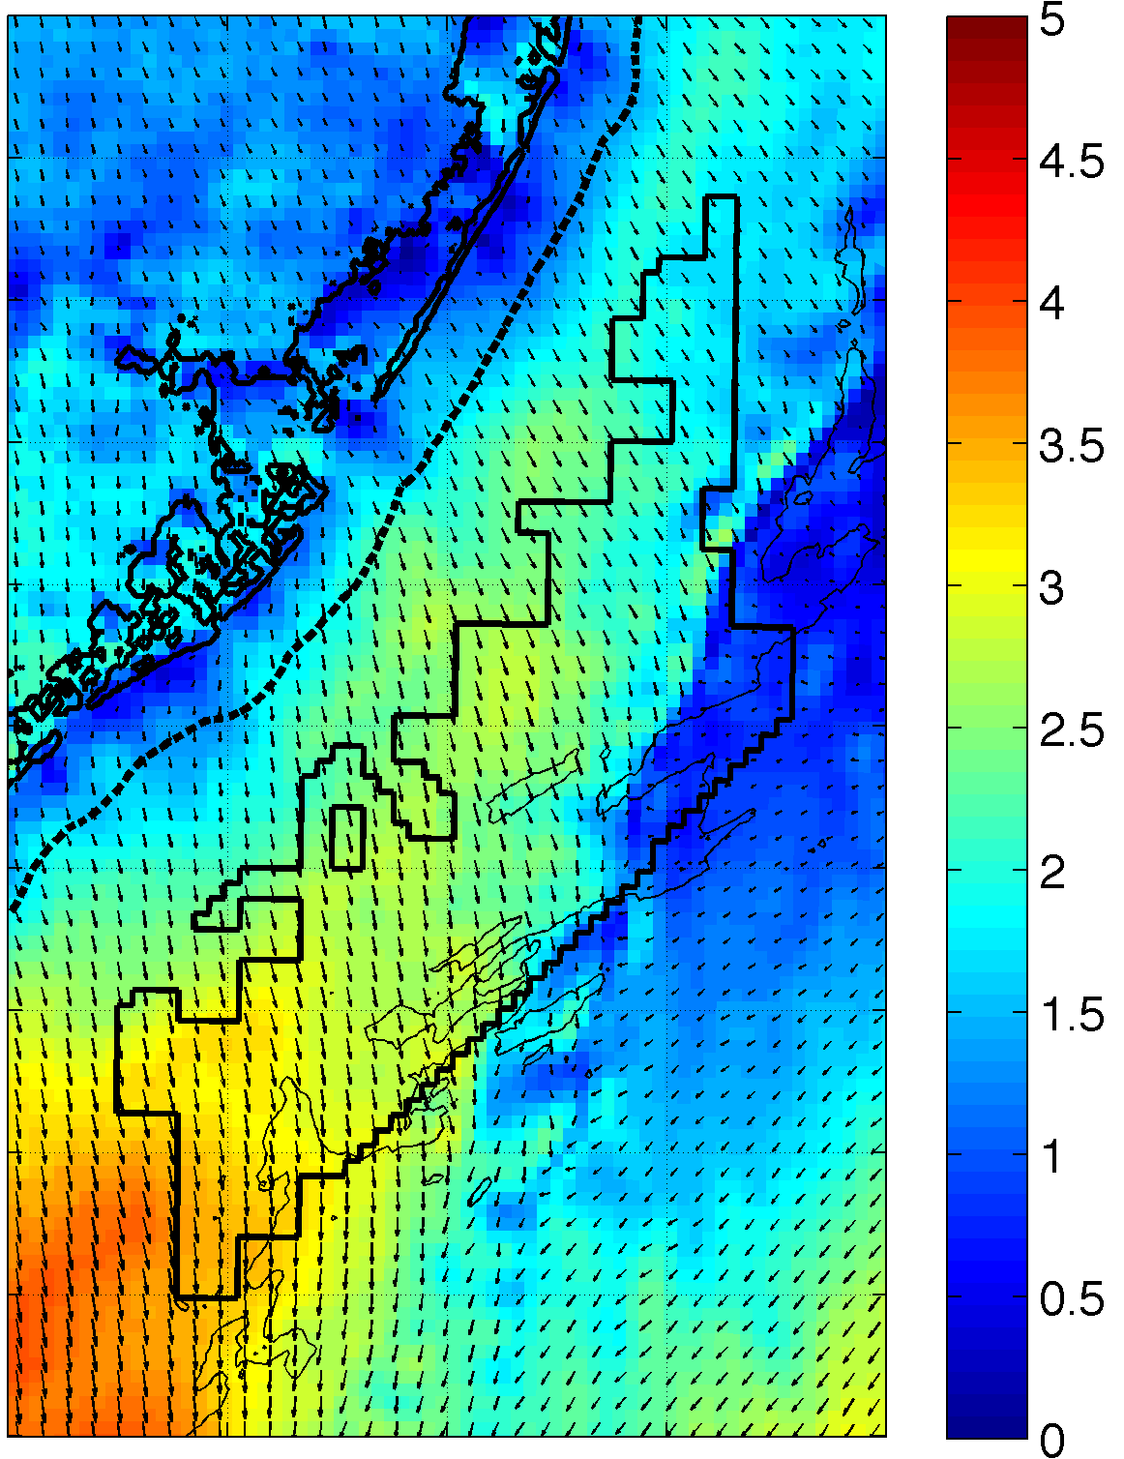
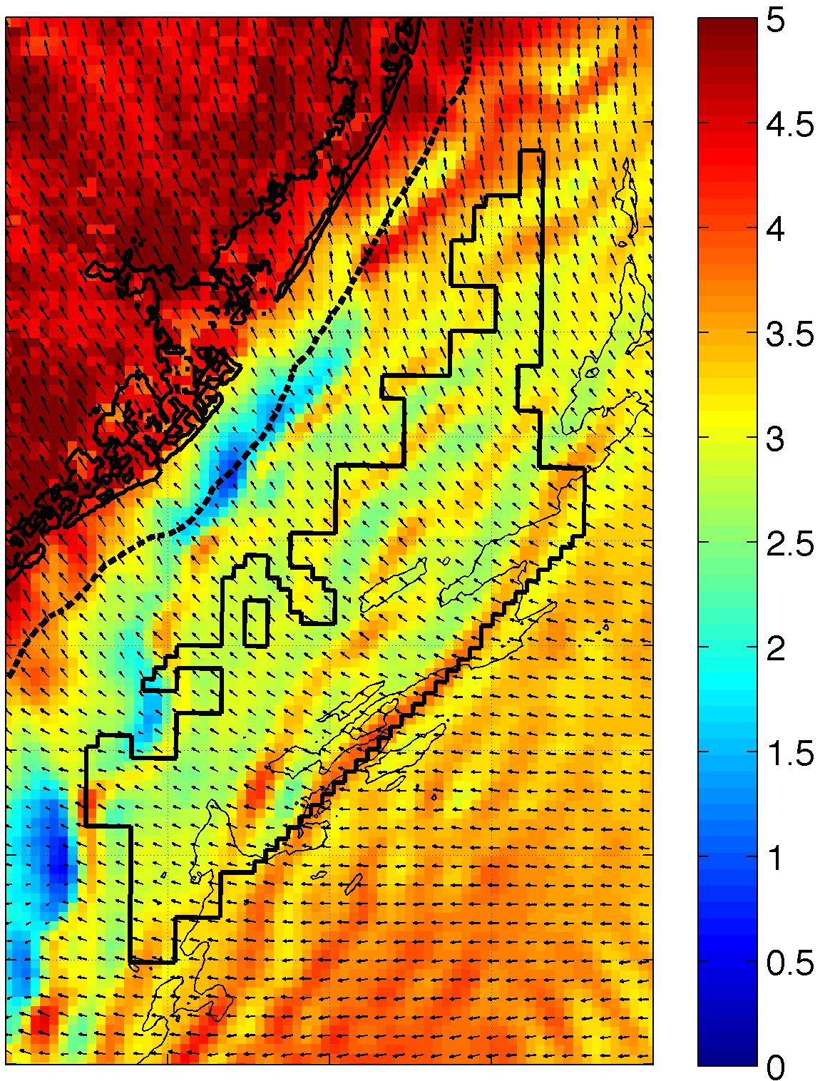
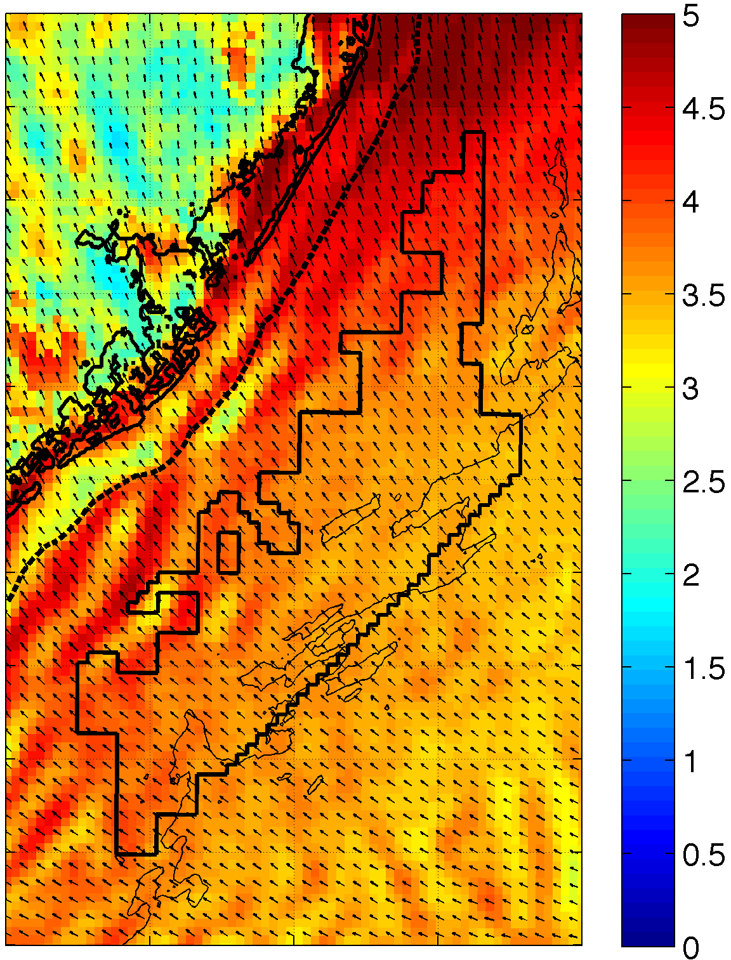
RU-WRF Capturing Sea Breeze Evolution
September 12, 2012 10m Winds
Sea breeze develops
14:00
17:00
Winds weaken at surface in WEA closer to coast
Sea breeze has propagated west; winds pick up in WEA again
20:00
23:00
WEA winds strengthen as overnight begins
Notes:
Largest sources of variability during peak energy demand period during summer
Resolution of model is capable of resolving these processes – captures seabreeze, changes through time, not static
Two different cases
Shows that there can be a north-south variability in seabreeze

Slide 17
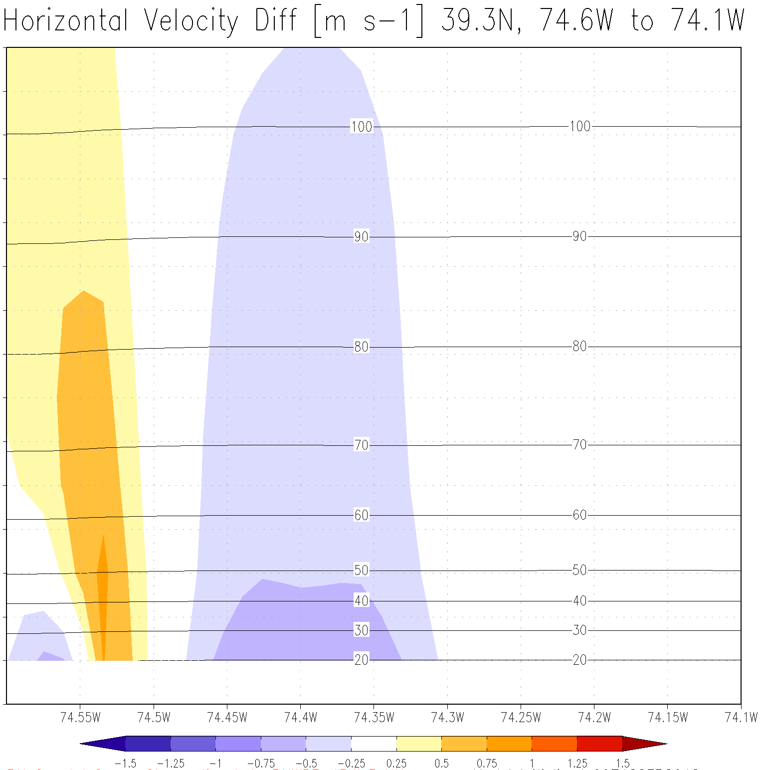

Wind Sensitivity to Coastal Upwelling
RU-WRF Marine Atmospheric Boundary Layer (MABL) Simulation
Land
Sea
110+ m
Snapshot of Wind Speed difference between upwelling SST and non-upwelling SST
30-40 m
50 km offshore
Notes:
Upwelling sensitivity
-w/ and w/out upwelling
Draw line for coastline
Blue, upwelling casues slower winds (blue area over coastal upwelling)
Orange, upwelling causes increased winds nearshore during this case.

Slide 18
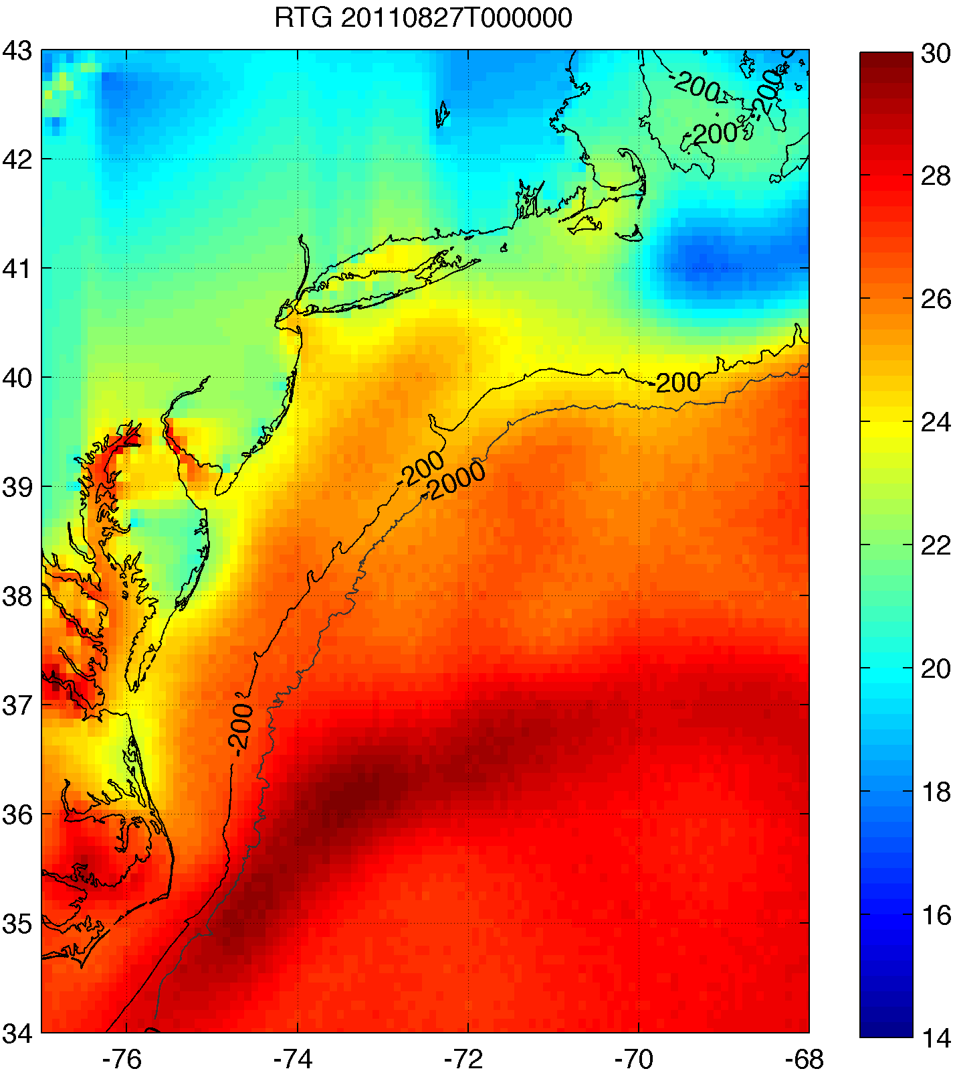
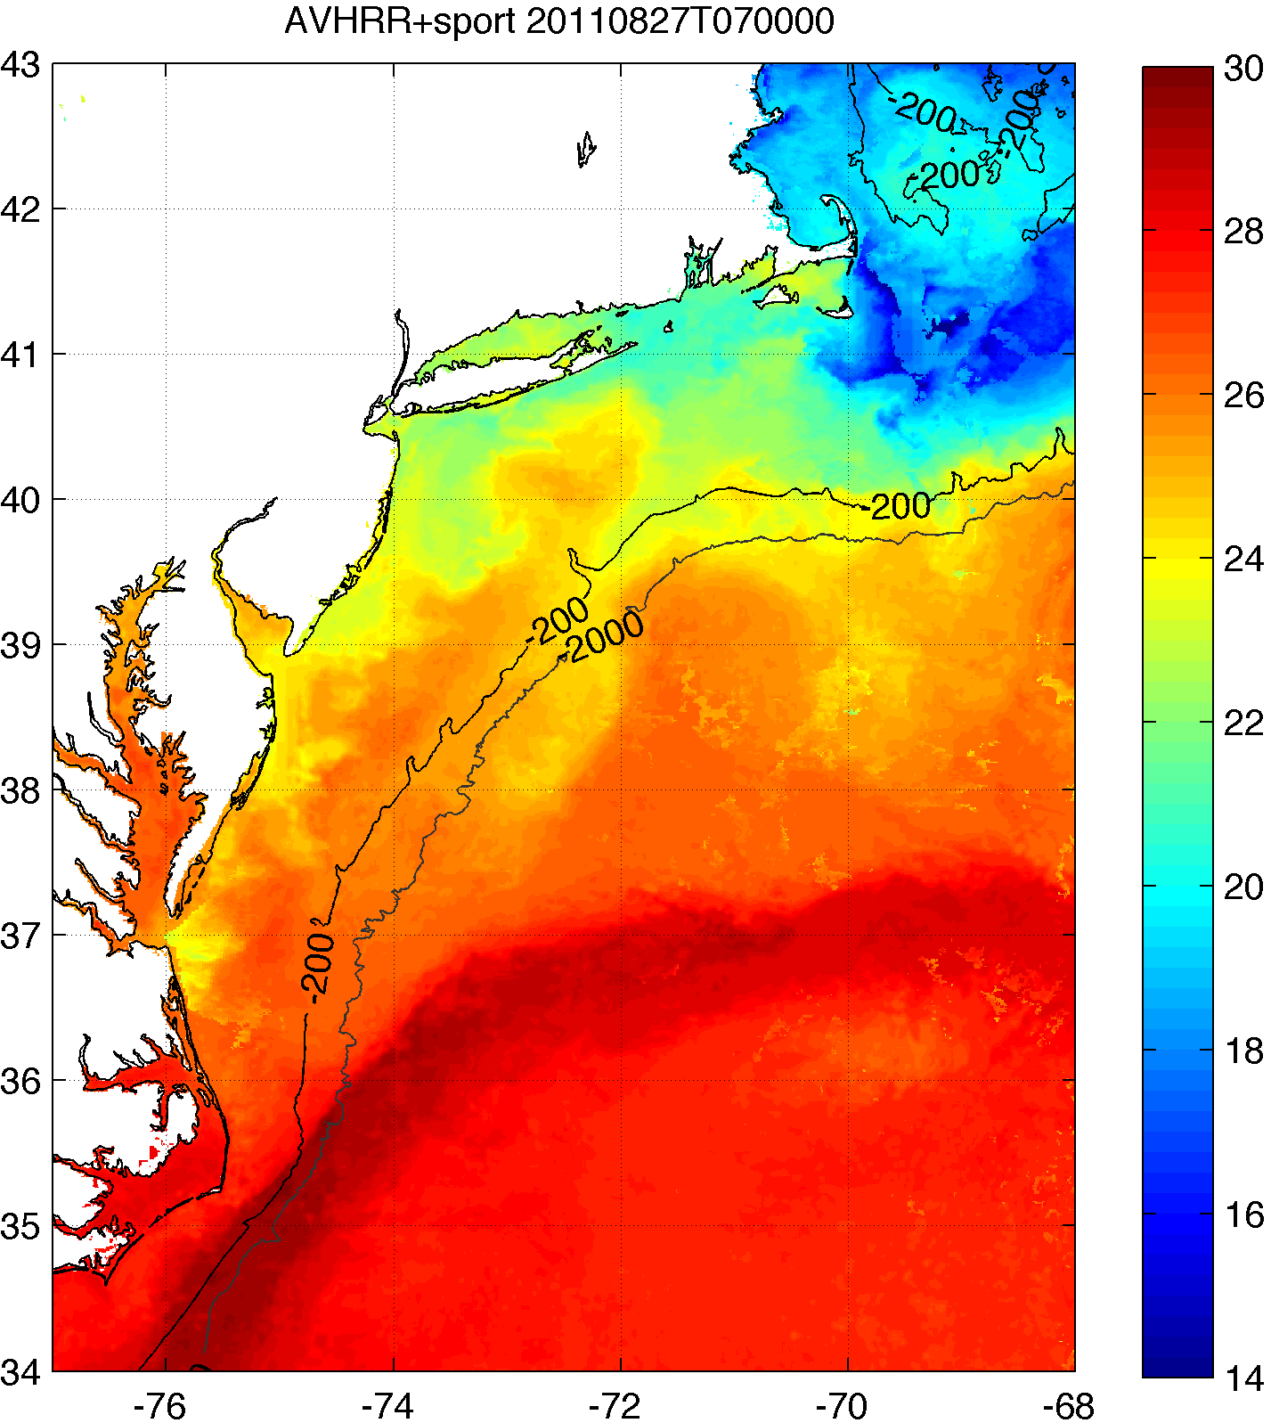
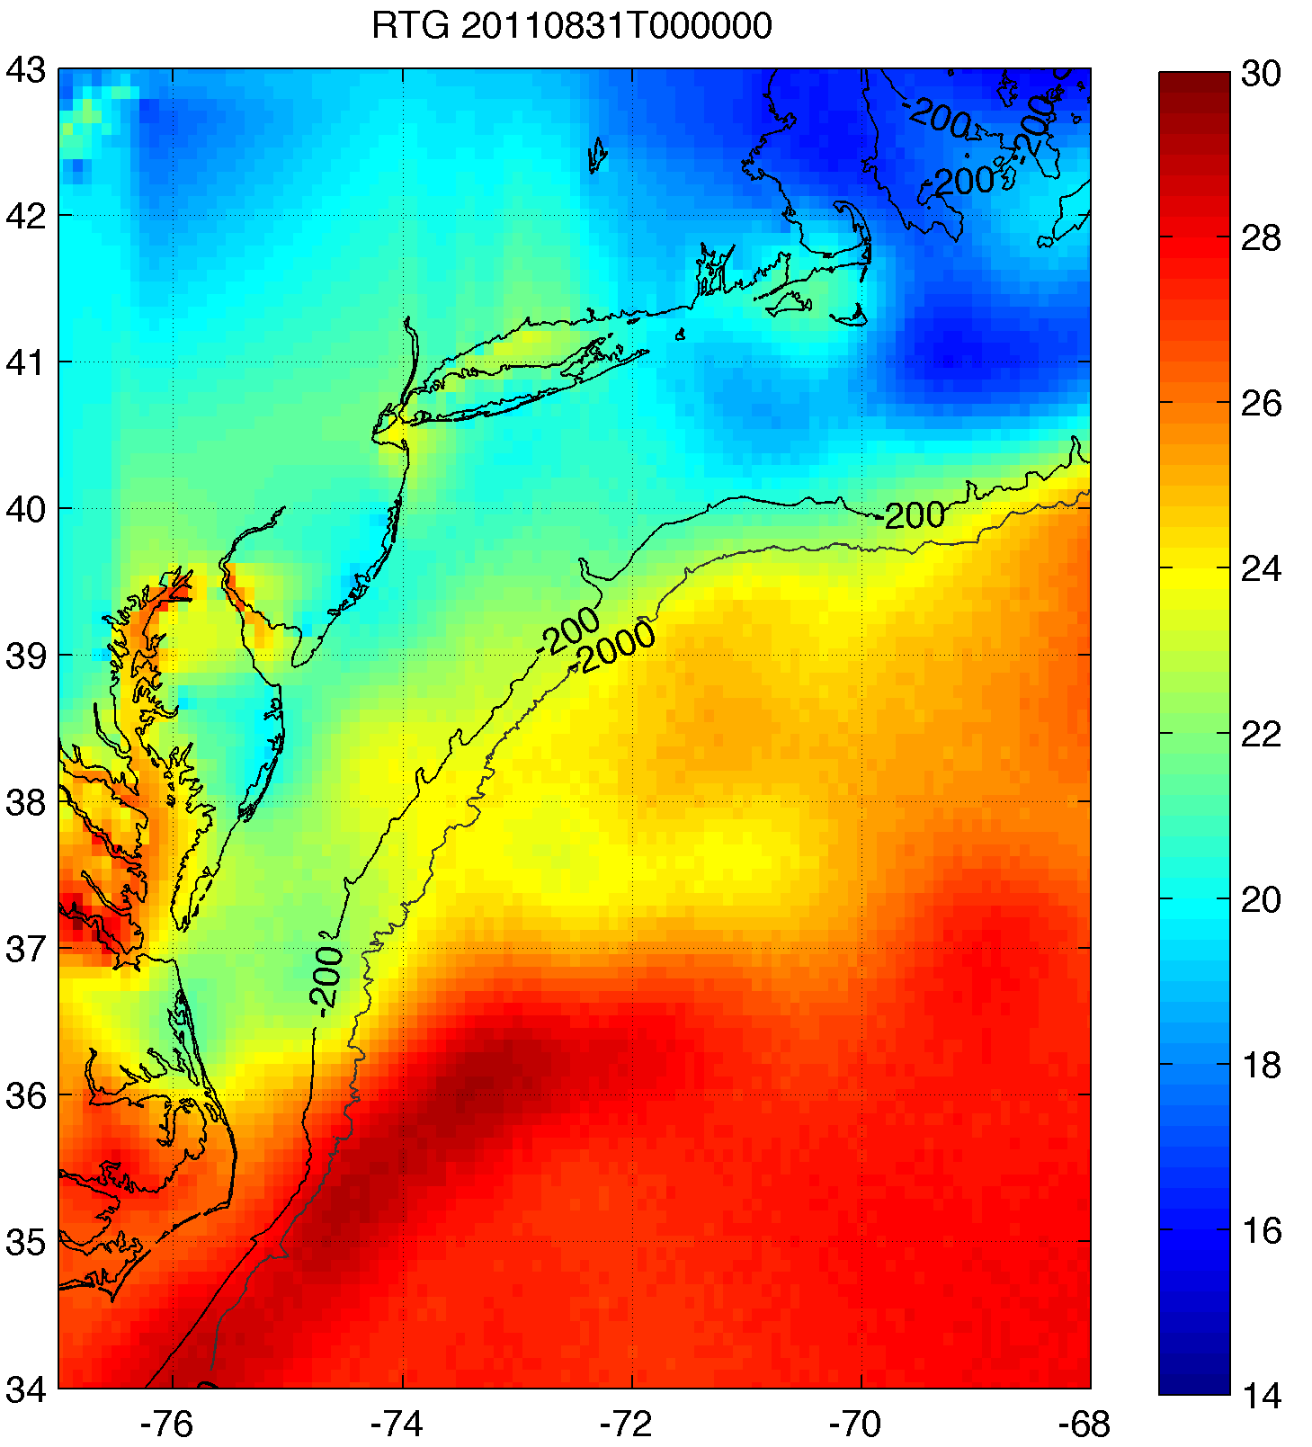
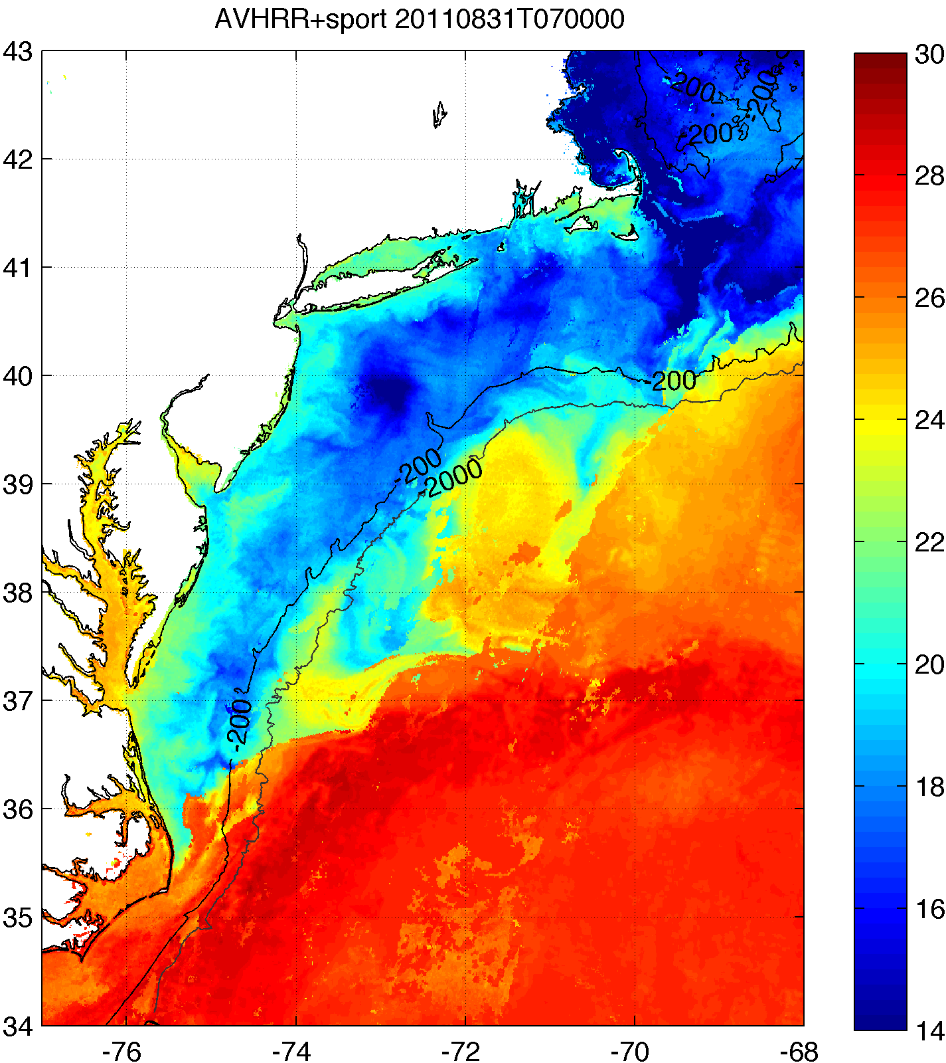
Coldest Dark Pixel SST Also Captures
Hurricane-Driven Cooling
Standard National SST
Rutgers Regional SST
BEFORE IRENE
Example:
Hurricane Irene
August 2011
AFTER IRENE
Notes:
Composite of NASA-SPoRT and AVHRR SST data

Slide 19
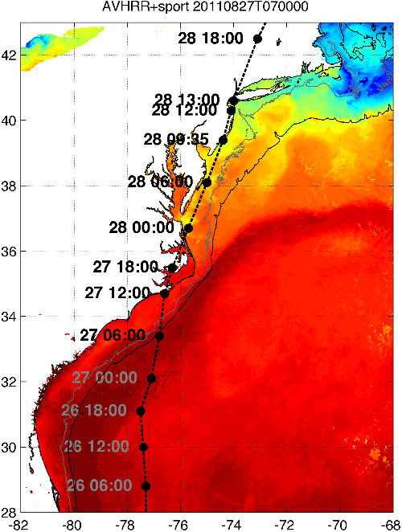
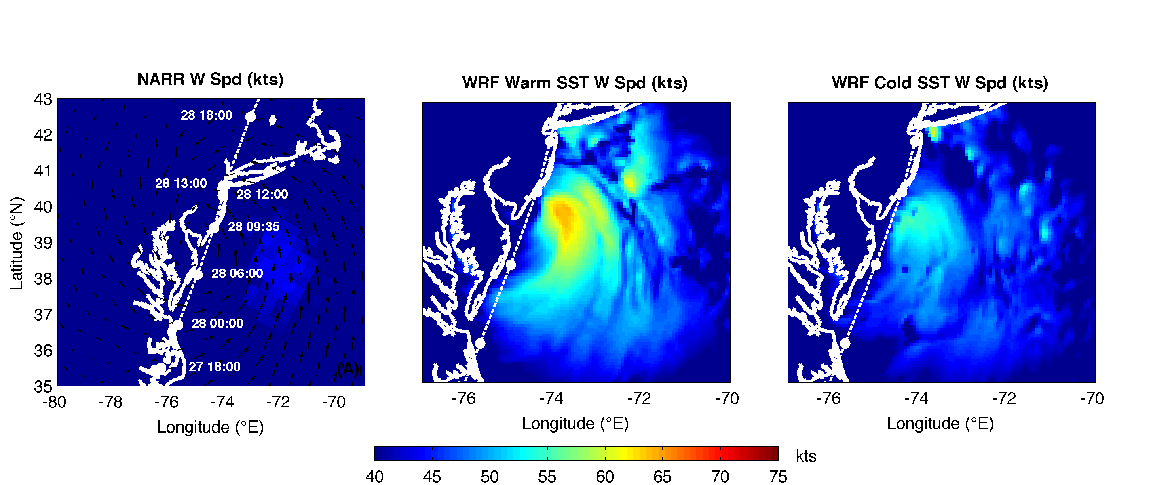
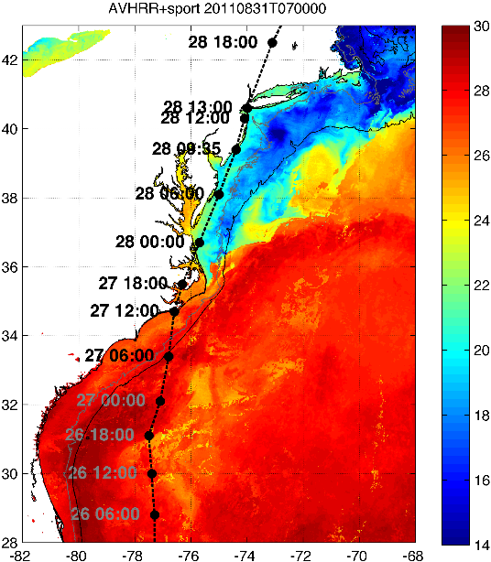
Cold Water Influences Coastal Storms
Hurricane Irene – Aug 2011
Warm Ocean
Cat I
Hurricane
Cold Ocean
Trop Storm
Notes:
Idealized Irene simulations - one with warm ocean, one with cold ocean
10 kt reduction using cold coastal waters after the storm

Slide 20
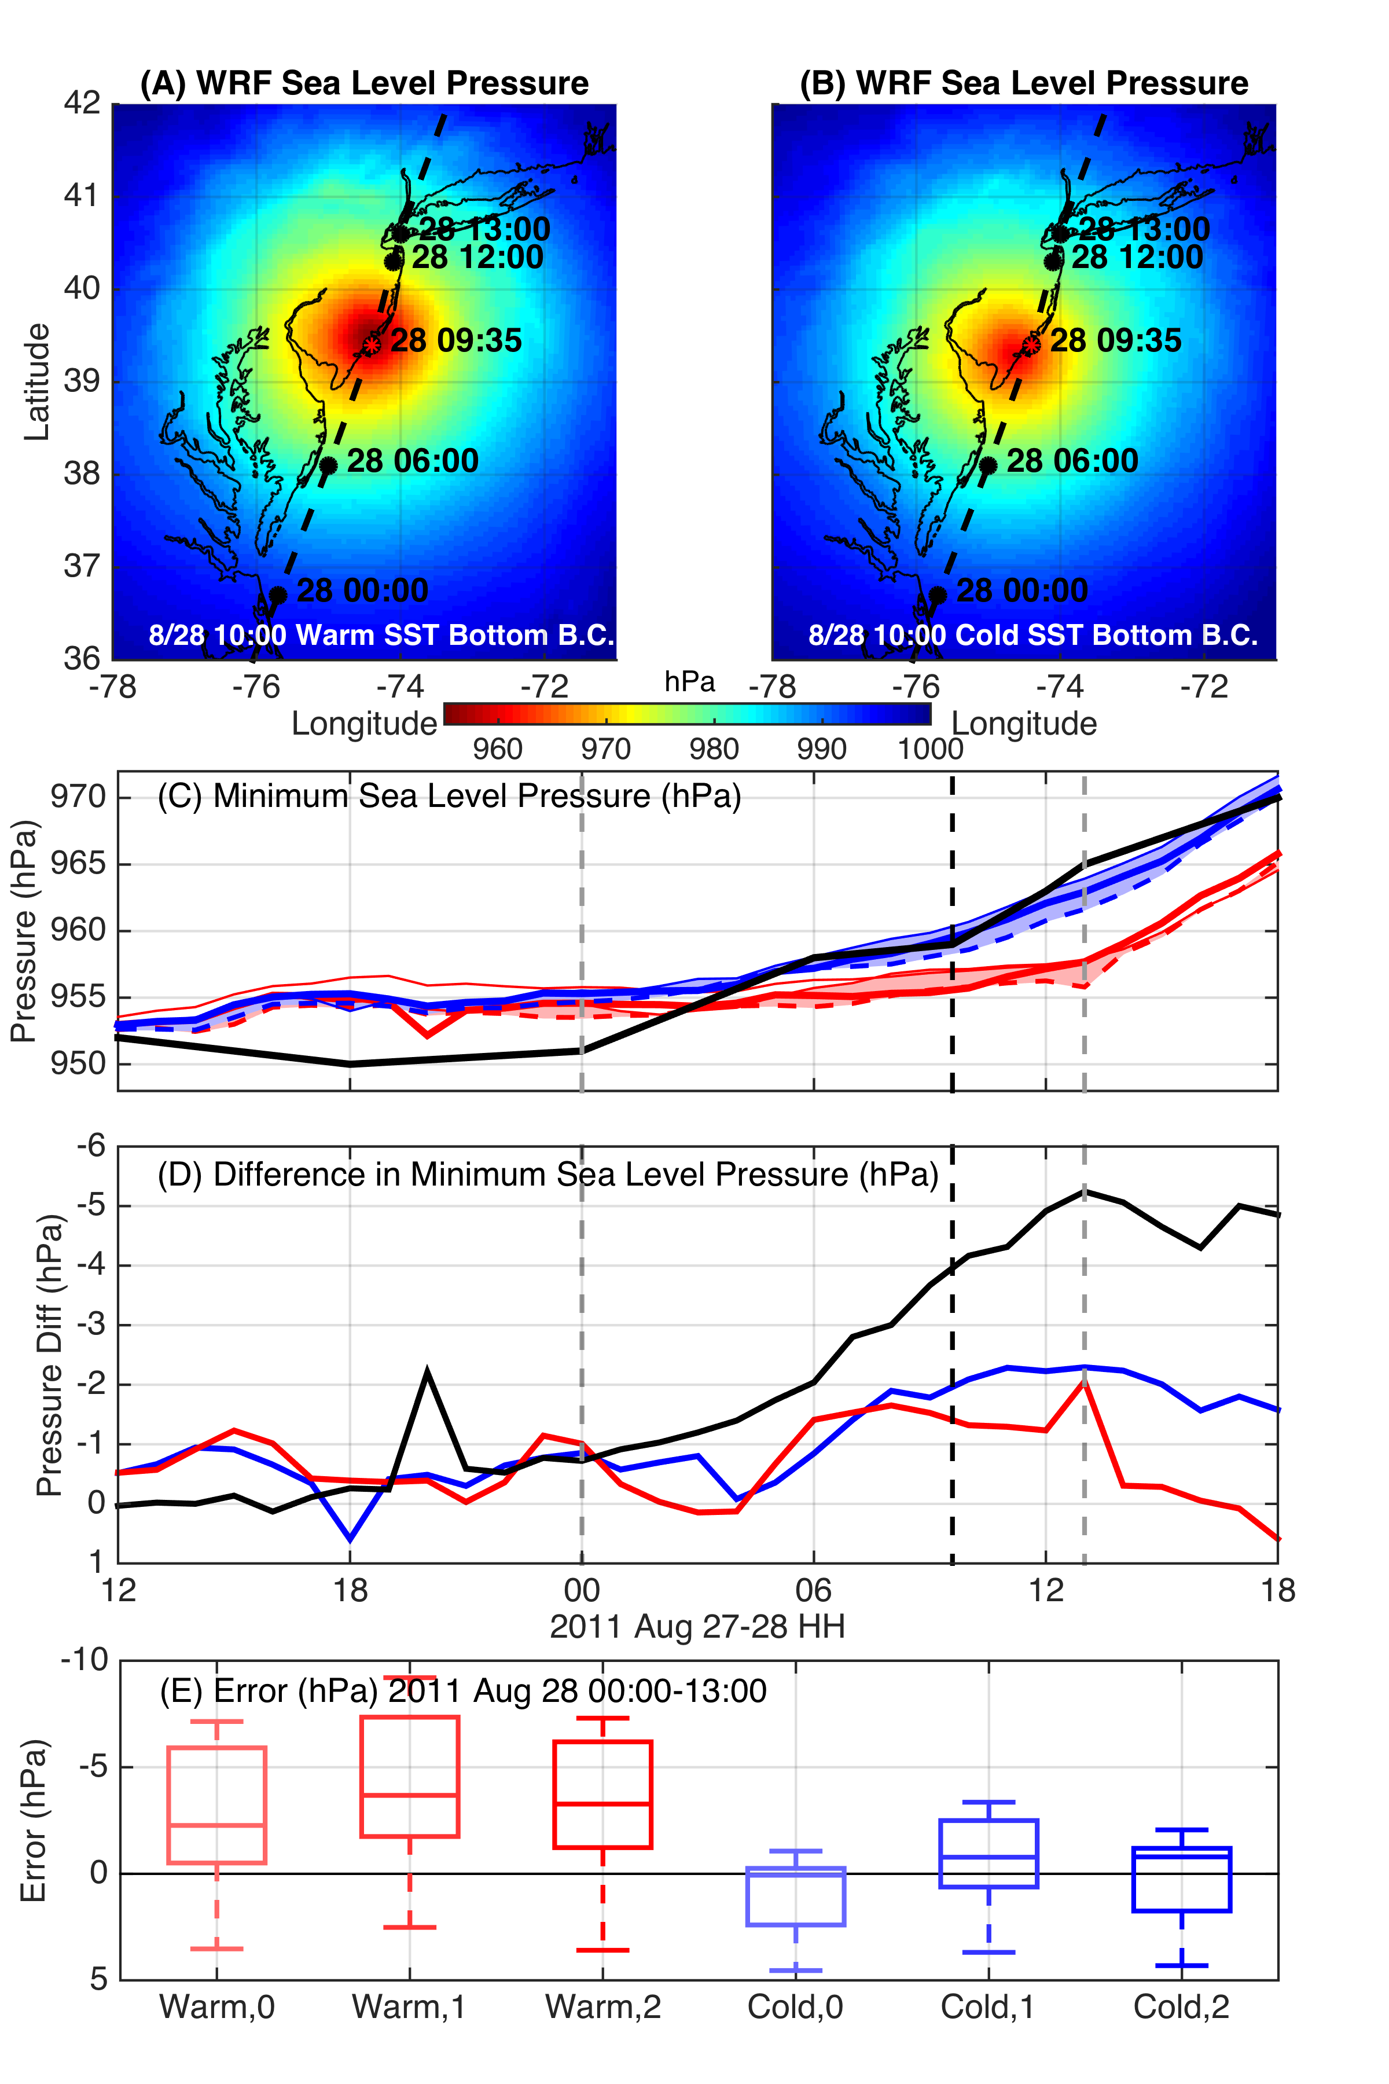
WRF Model Sensitivity Study
Over 130 model runs
Paired to compare sensitivities
Central pressure & max wind
Sensitivity to SST greatest
Seroka, Miles, Xu, Kohut, Schofield & Glenn,
Hurricane Irene Sensitivity to Stratified Coastal Ocean Cooling, Monthly Weather Review, 2016

Slide 21

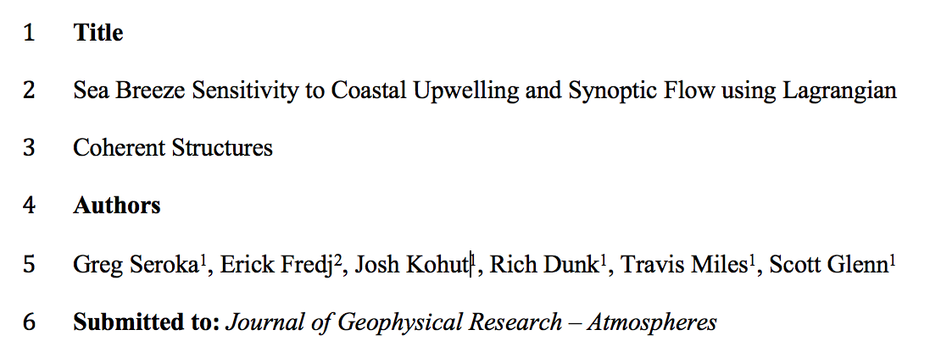
Summary
Real-time regional-scale atmospheric modeling with RU-WRF since 2011.
Supported by a world-class regional metocean observation and forecasting network.
Proven impacts on sea-breeze, storm and hurricane forecasting, a valuable asset for offshore wind energy
Poster Session Tonight

