Slide 1
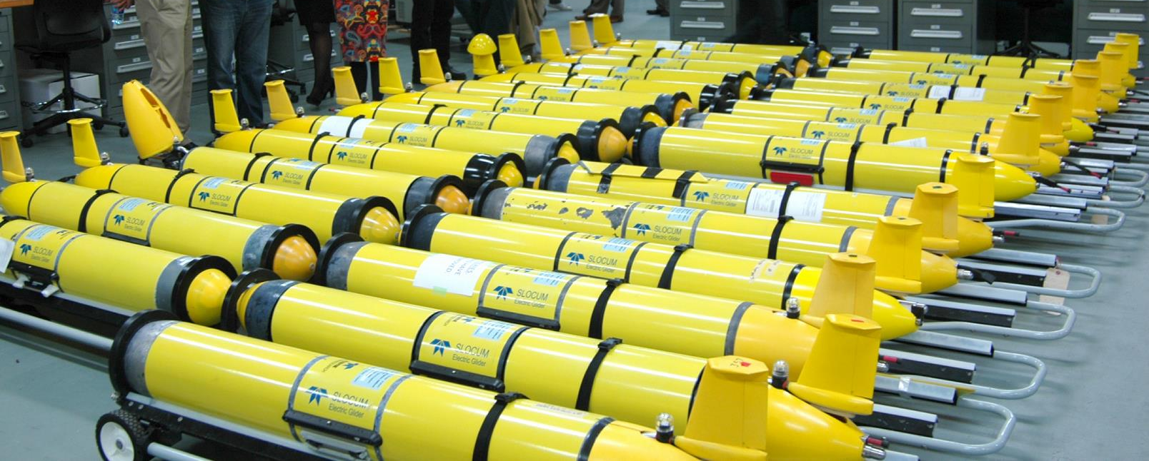
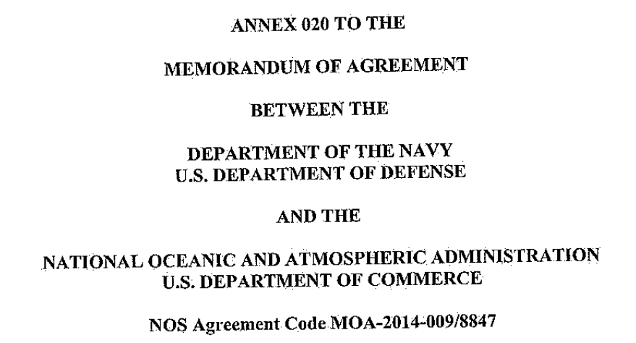
Hurricane Sentinel Glider Fleet: 2018 Initial Results
Scott Glenn, Travis Miles, Maria Aristizabal
(Rutgers, MARACOOS, IOOS, CINAR…)
Gustavo Goni (AOML)
+ Many Others

Slide 2
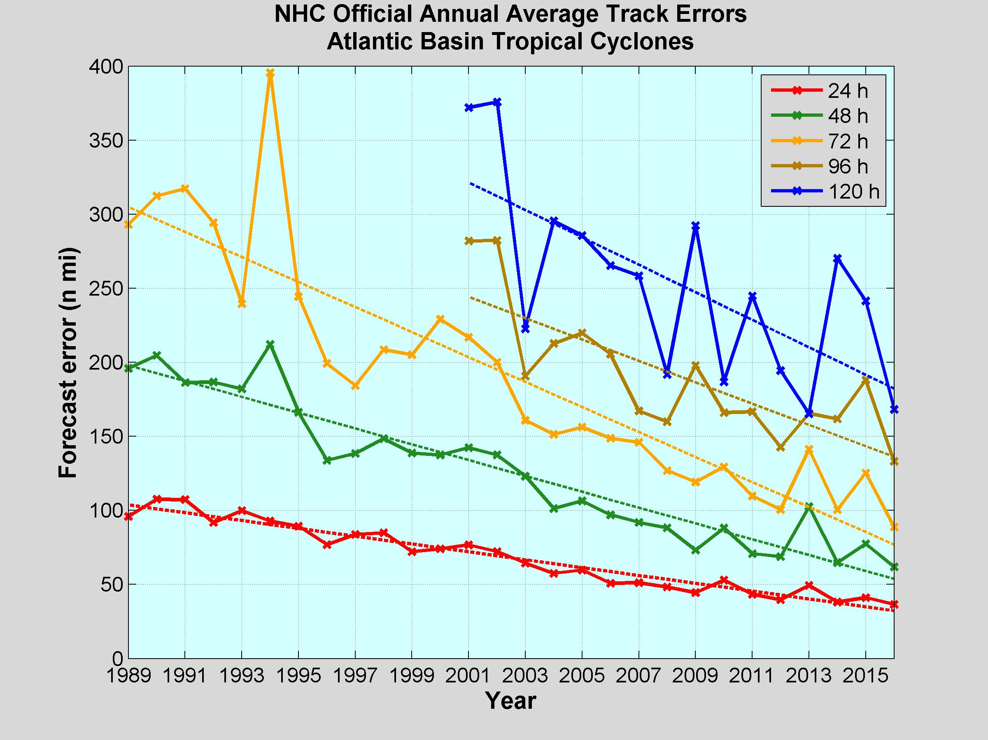
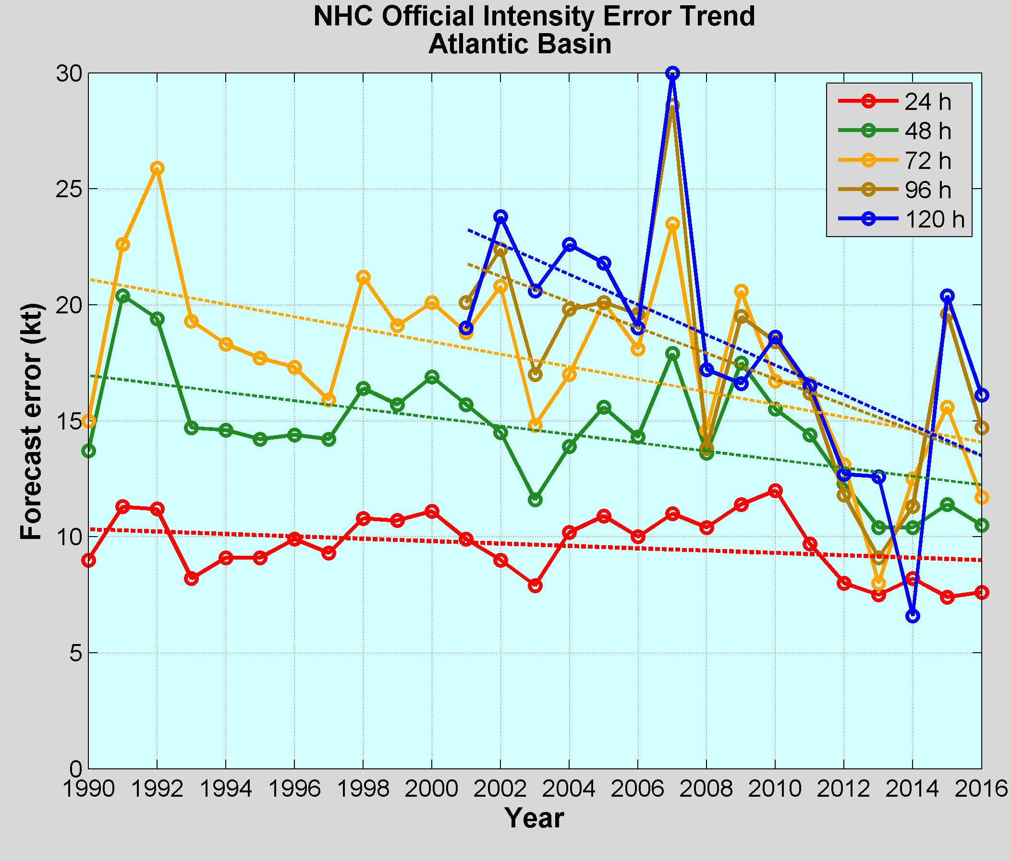
NOAA Annual Operational Suite Review
Average Track Errors:
Atlantic Basin
Average Intensity Errors:
Atlantic Basin
Factor of 2-4 improvement
20%-30% improvement
Limitations on Hurricane Intensity Improvement
Computing resources and model resolution (Rotunno et al., 2009)
Poor understanding of the atmospheric boundary layer (Nolan et al., 2009; Andreas et al., 2015)
Difficulty in modeling the upper ocean response to storm forcing (Yablonsky and Ginis, 2009).
Cangialosi and Franklin 2017

Slide 3
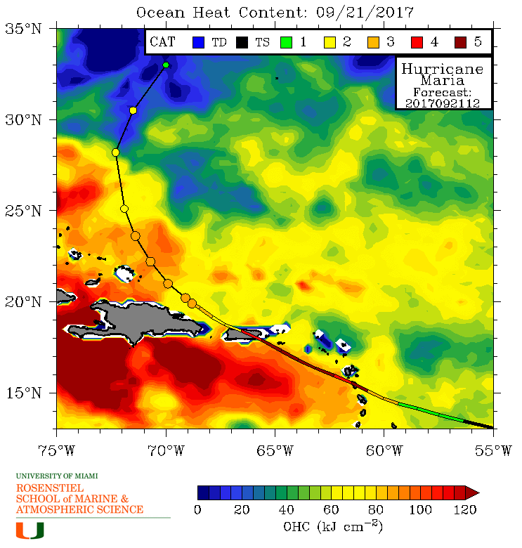
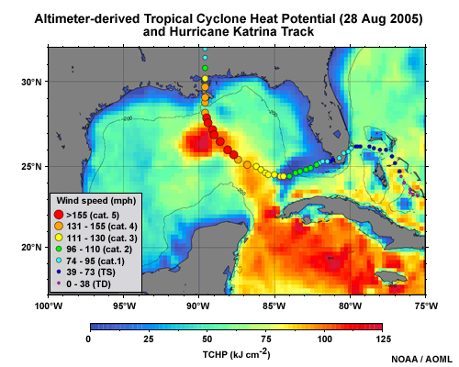
Rapid intensification of Hurricanes Katrina & Maria
Ocean’s impact on Intensity Forecasts:
A) through the upper ocean heat content (model initial condition),
B) the transfer of heat across the air-sea interface (model response and feedback).

Slide 5
Navy Coupled Ocean Data Assimilation
Data Assimilation once per day
Satellite SST Maps
Satellite Altimetry – through ISOP
CTD profiles – numerous sources and rules

Slide 6
NOAA Historical Hurricane Tracks: 1851 - previous season
North Atlantic Testbed for the Hurricane Sentinel Glider Lines

Slide 7
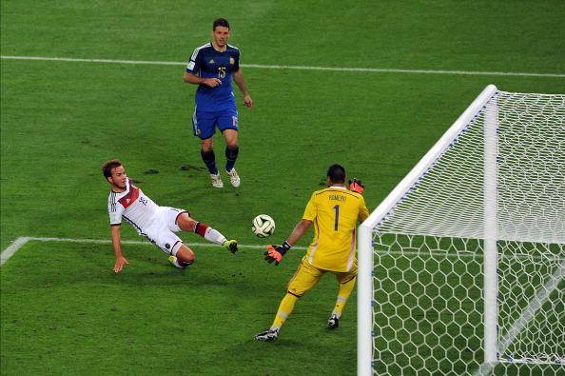
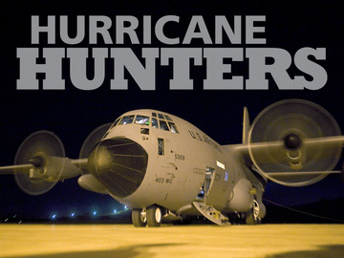
Since
1946
HURRICANE SENTINELS
Starting 2018

Slide 8
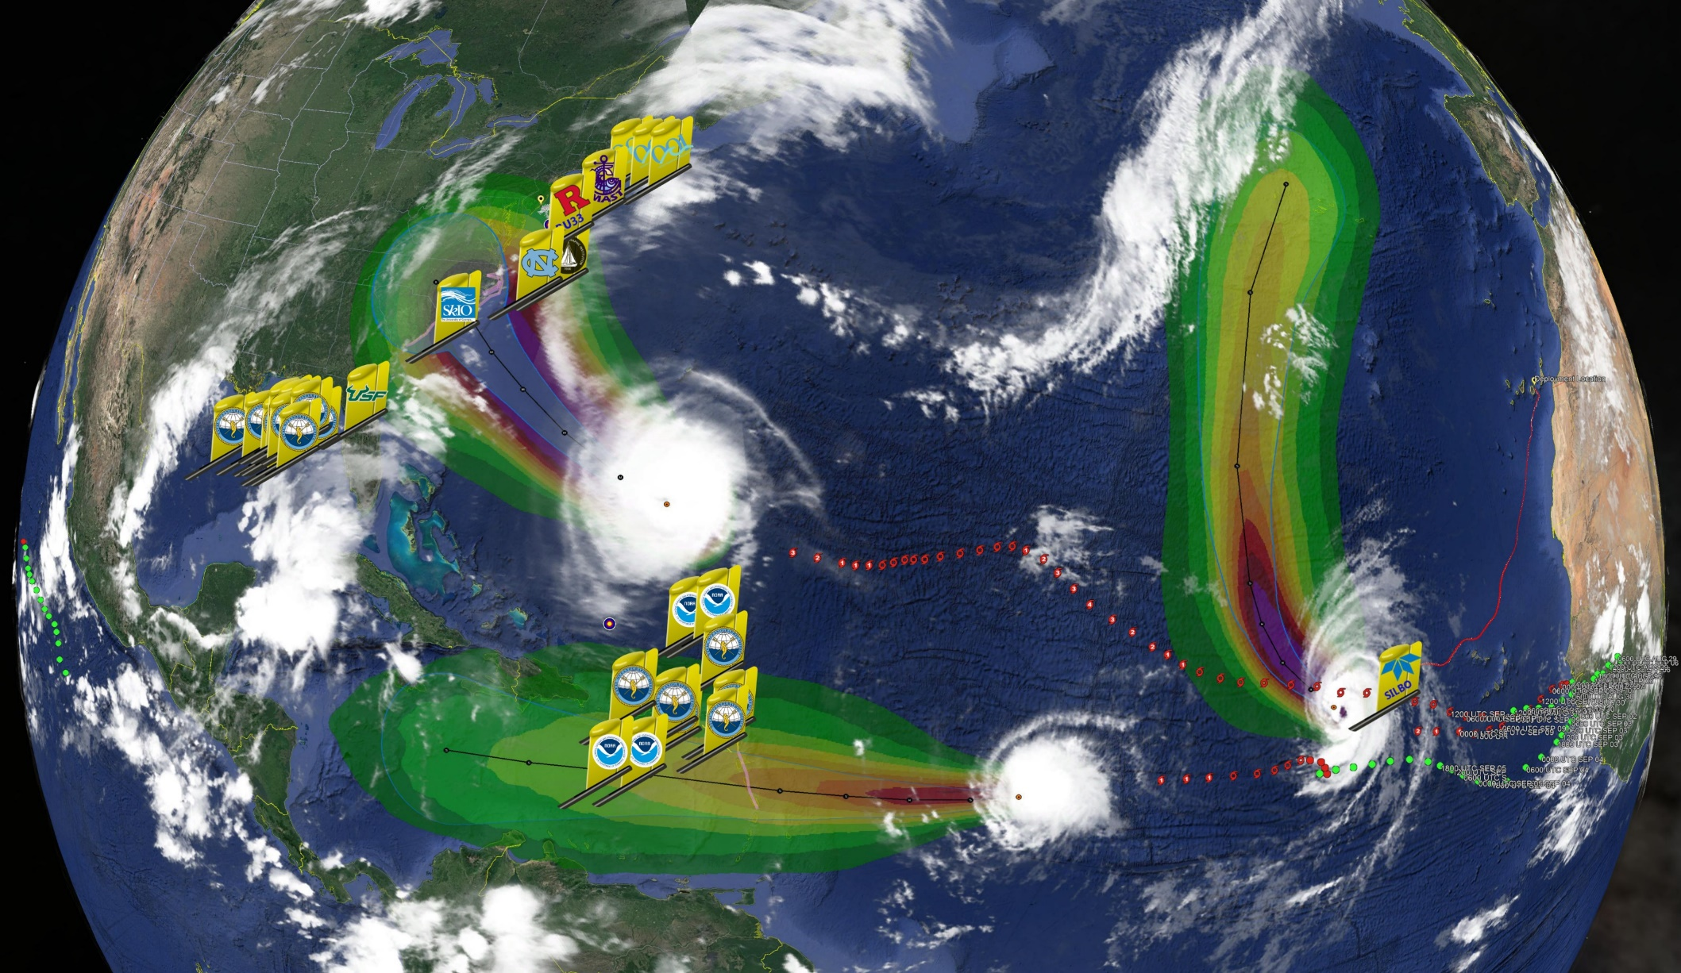
Hurricane Sentinel Gliders deployed in 3 Picket Lines
Florence
Helene
Isaac
>30 Hurricane Sentinel Gliders from the Navy, NOAA, NSF, Academic & Industry Partners
reporting ocean conditions through the U.S. IOOS Glider Data Assembly Center (DAC)
ahead of Hurricanes Florence, Isaac and Helene on September 11, 2018.

Slide 9
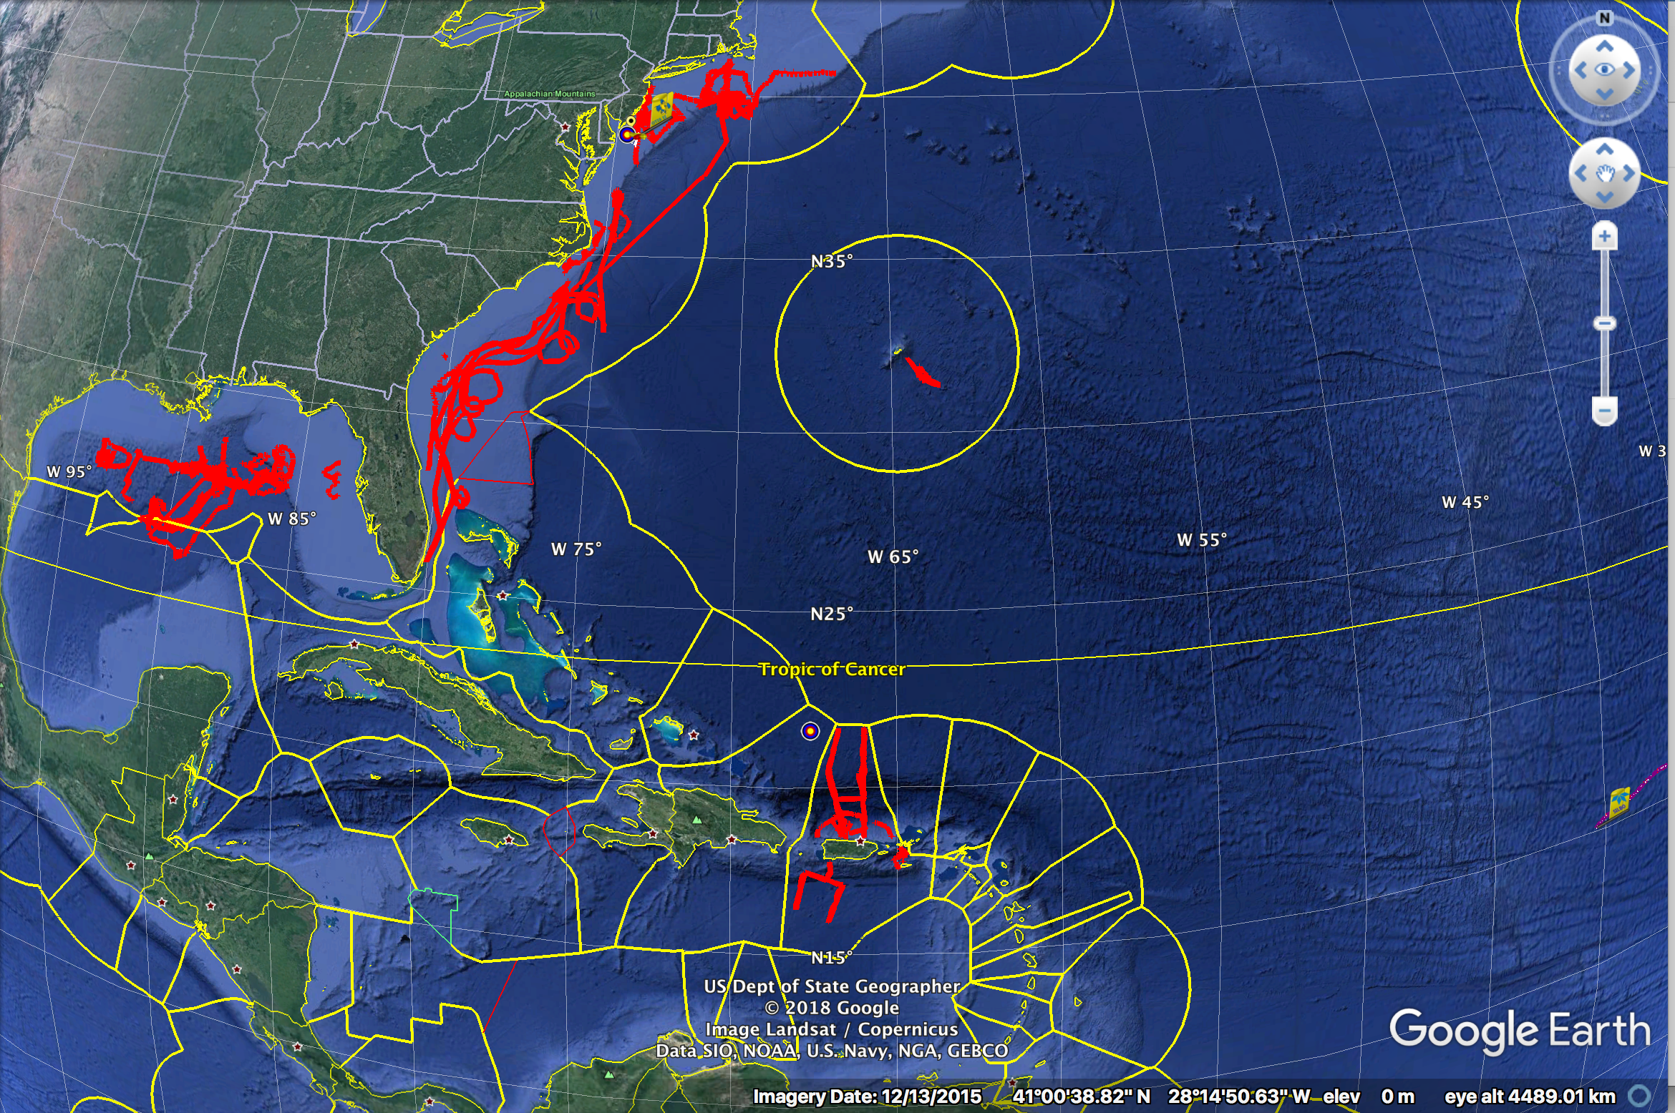
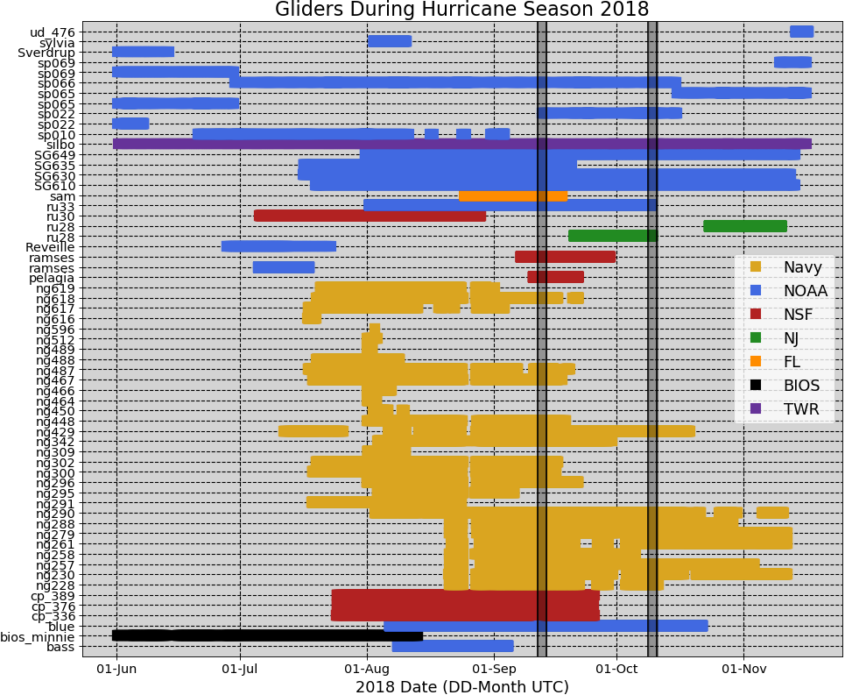
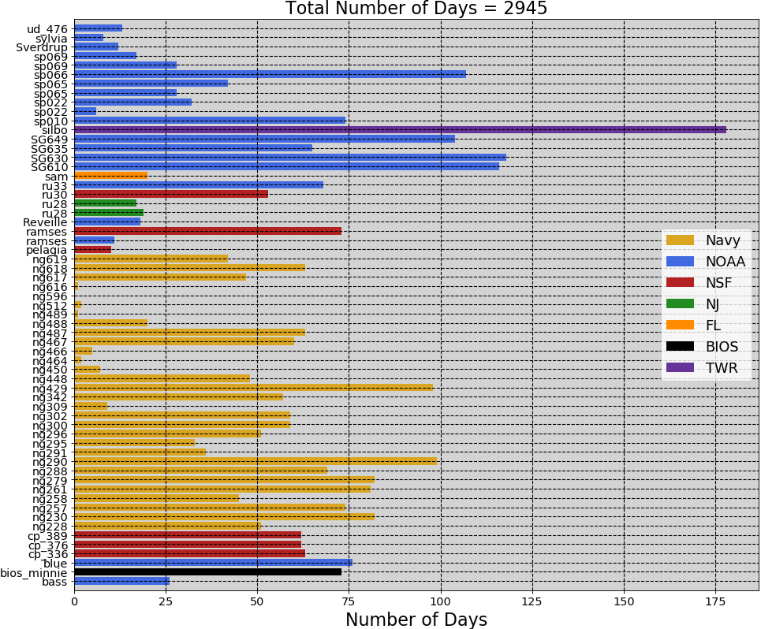
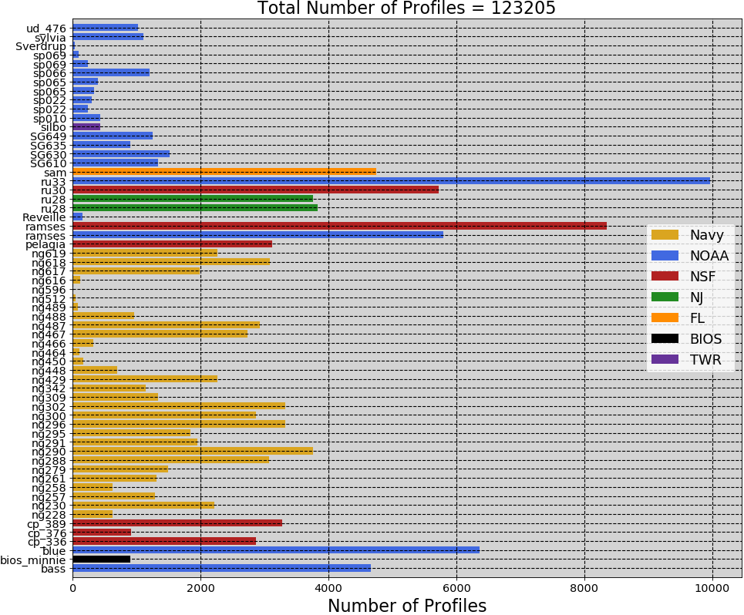
2018 Hurricane Season – 61 Gliders in IOOS Glider DAC
Florence
Michael
2945
Glider
Days
123,205
Glider
Profiles

Slide 10
2018 Hurricane Season – 7841 Argo Profiles in Database
Argo profiles June 1 – November 30, 2018

Slide 11
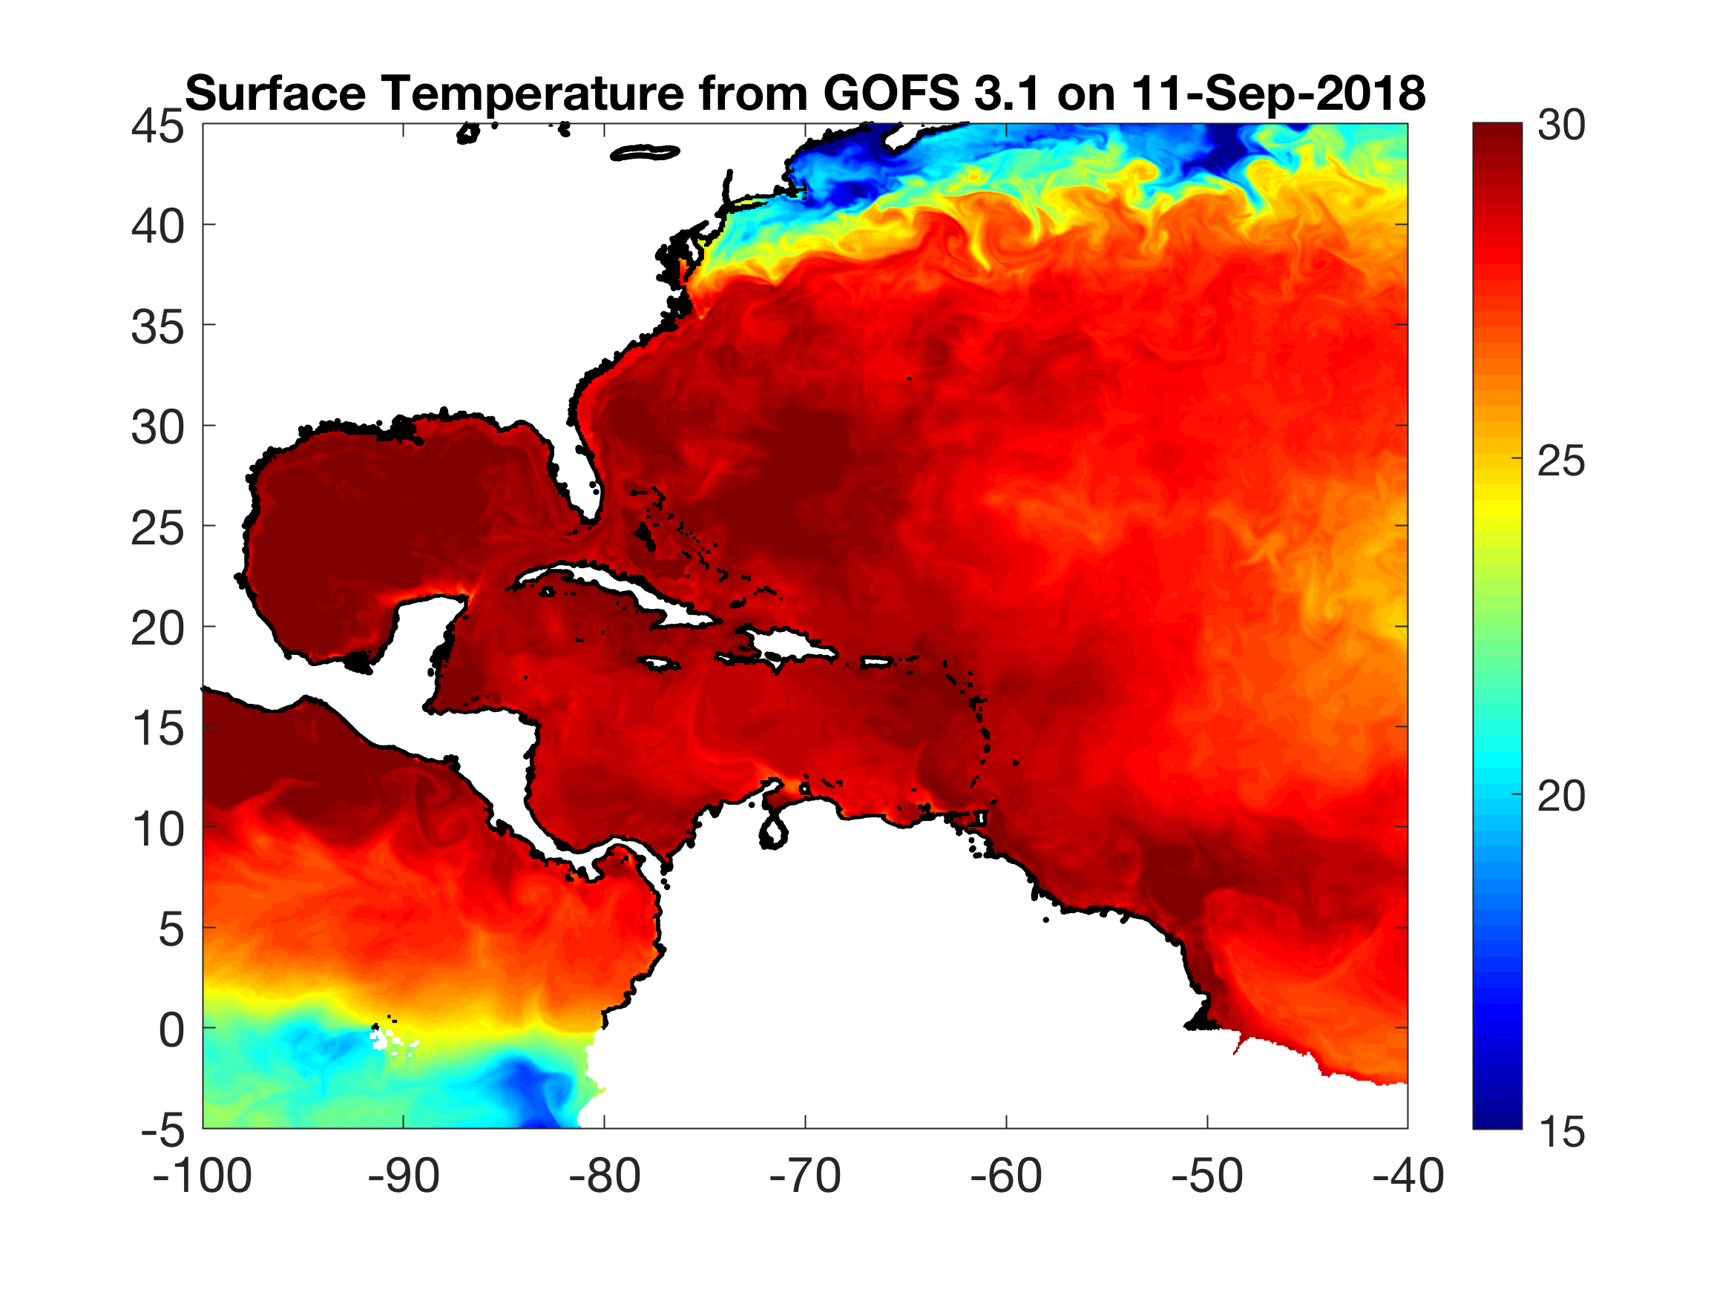
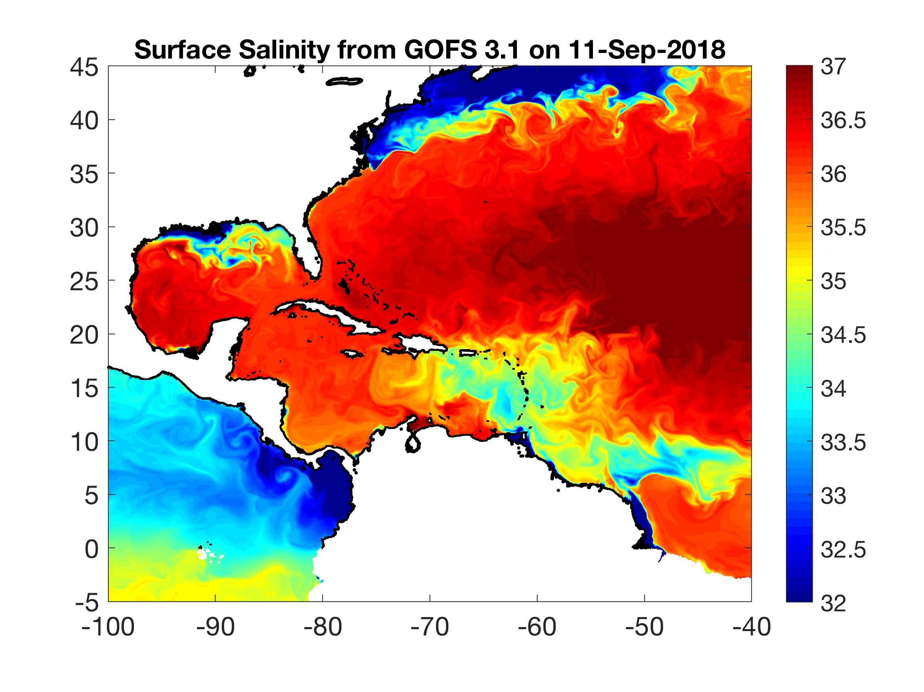
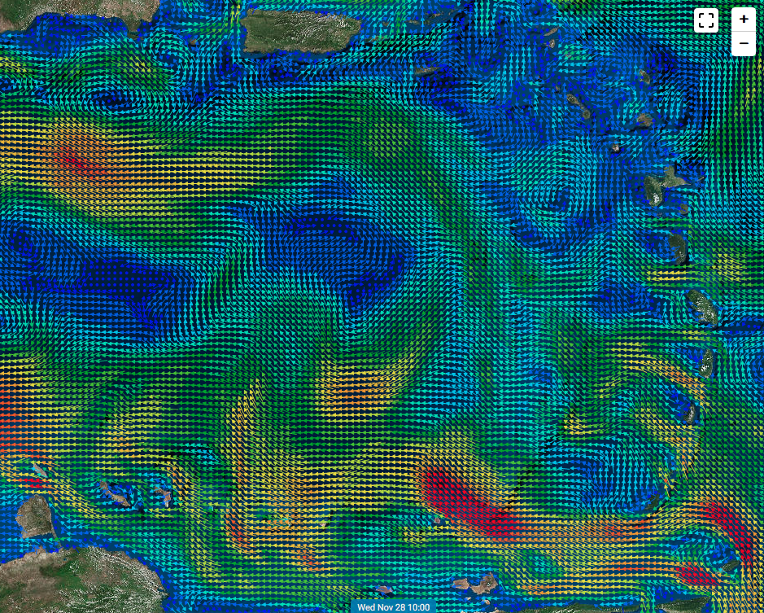
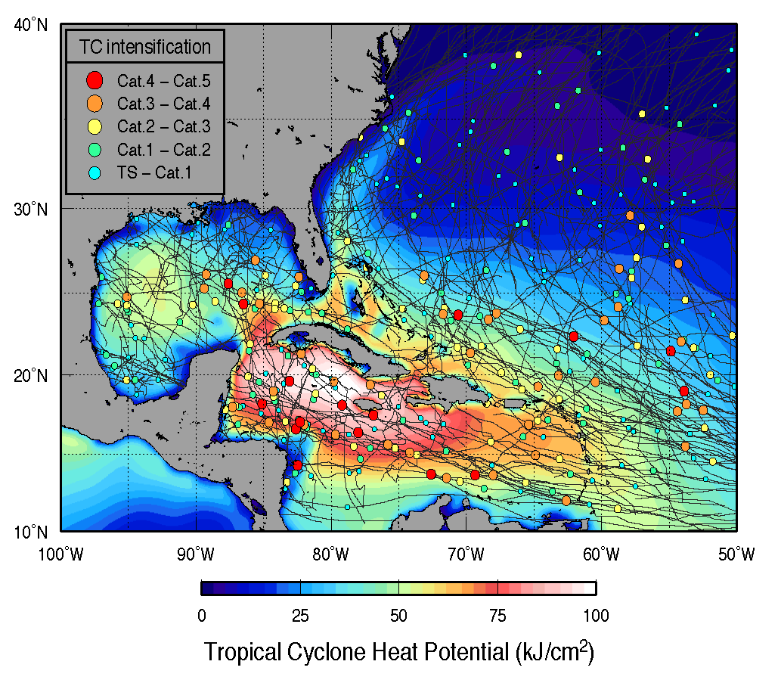
SST, SSS, Upper Ocean Heat Potential and Caribbean Glider Deployments
Surface Temperature
Surface Salinity
Heat Content
Transport through the Passages

Slide 12
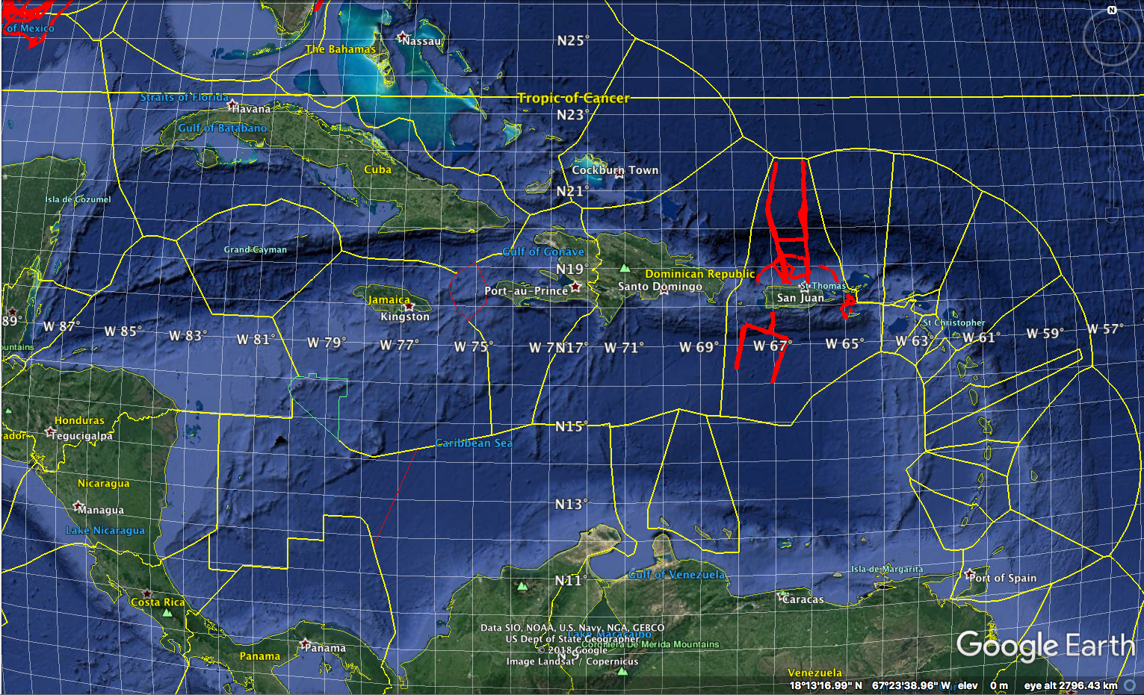
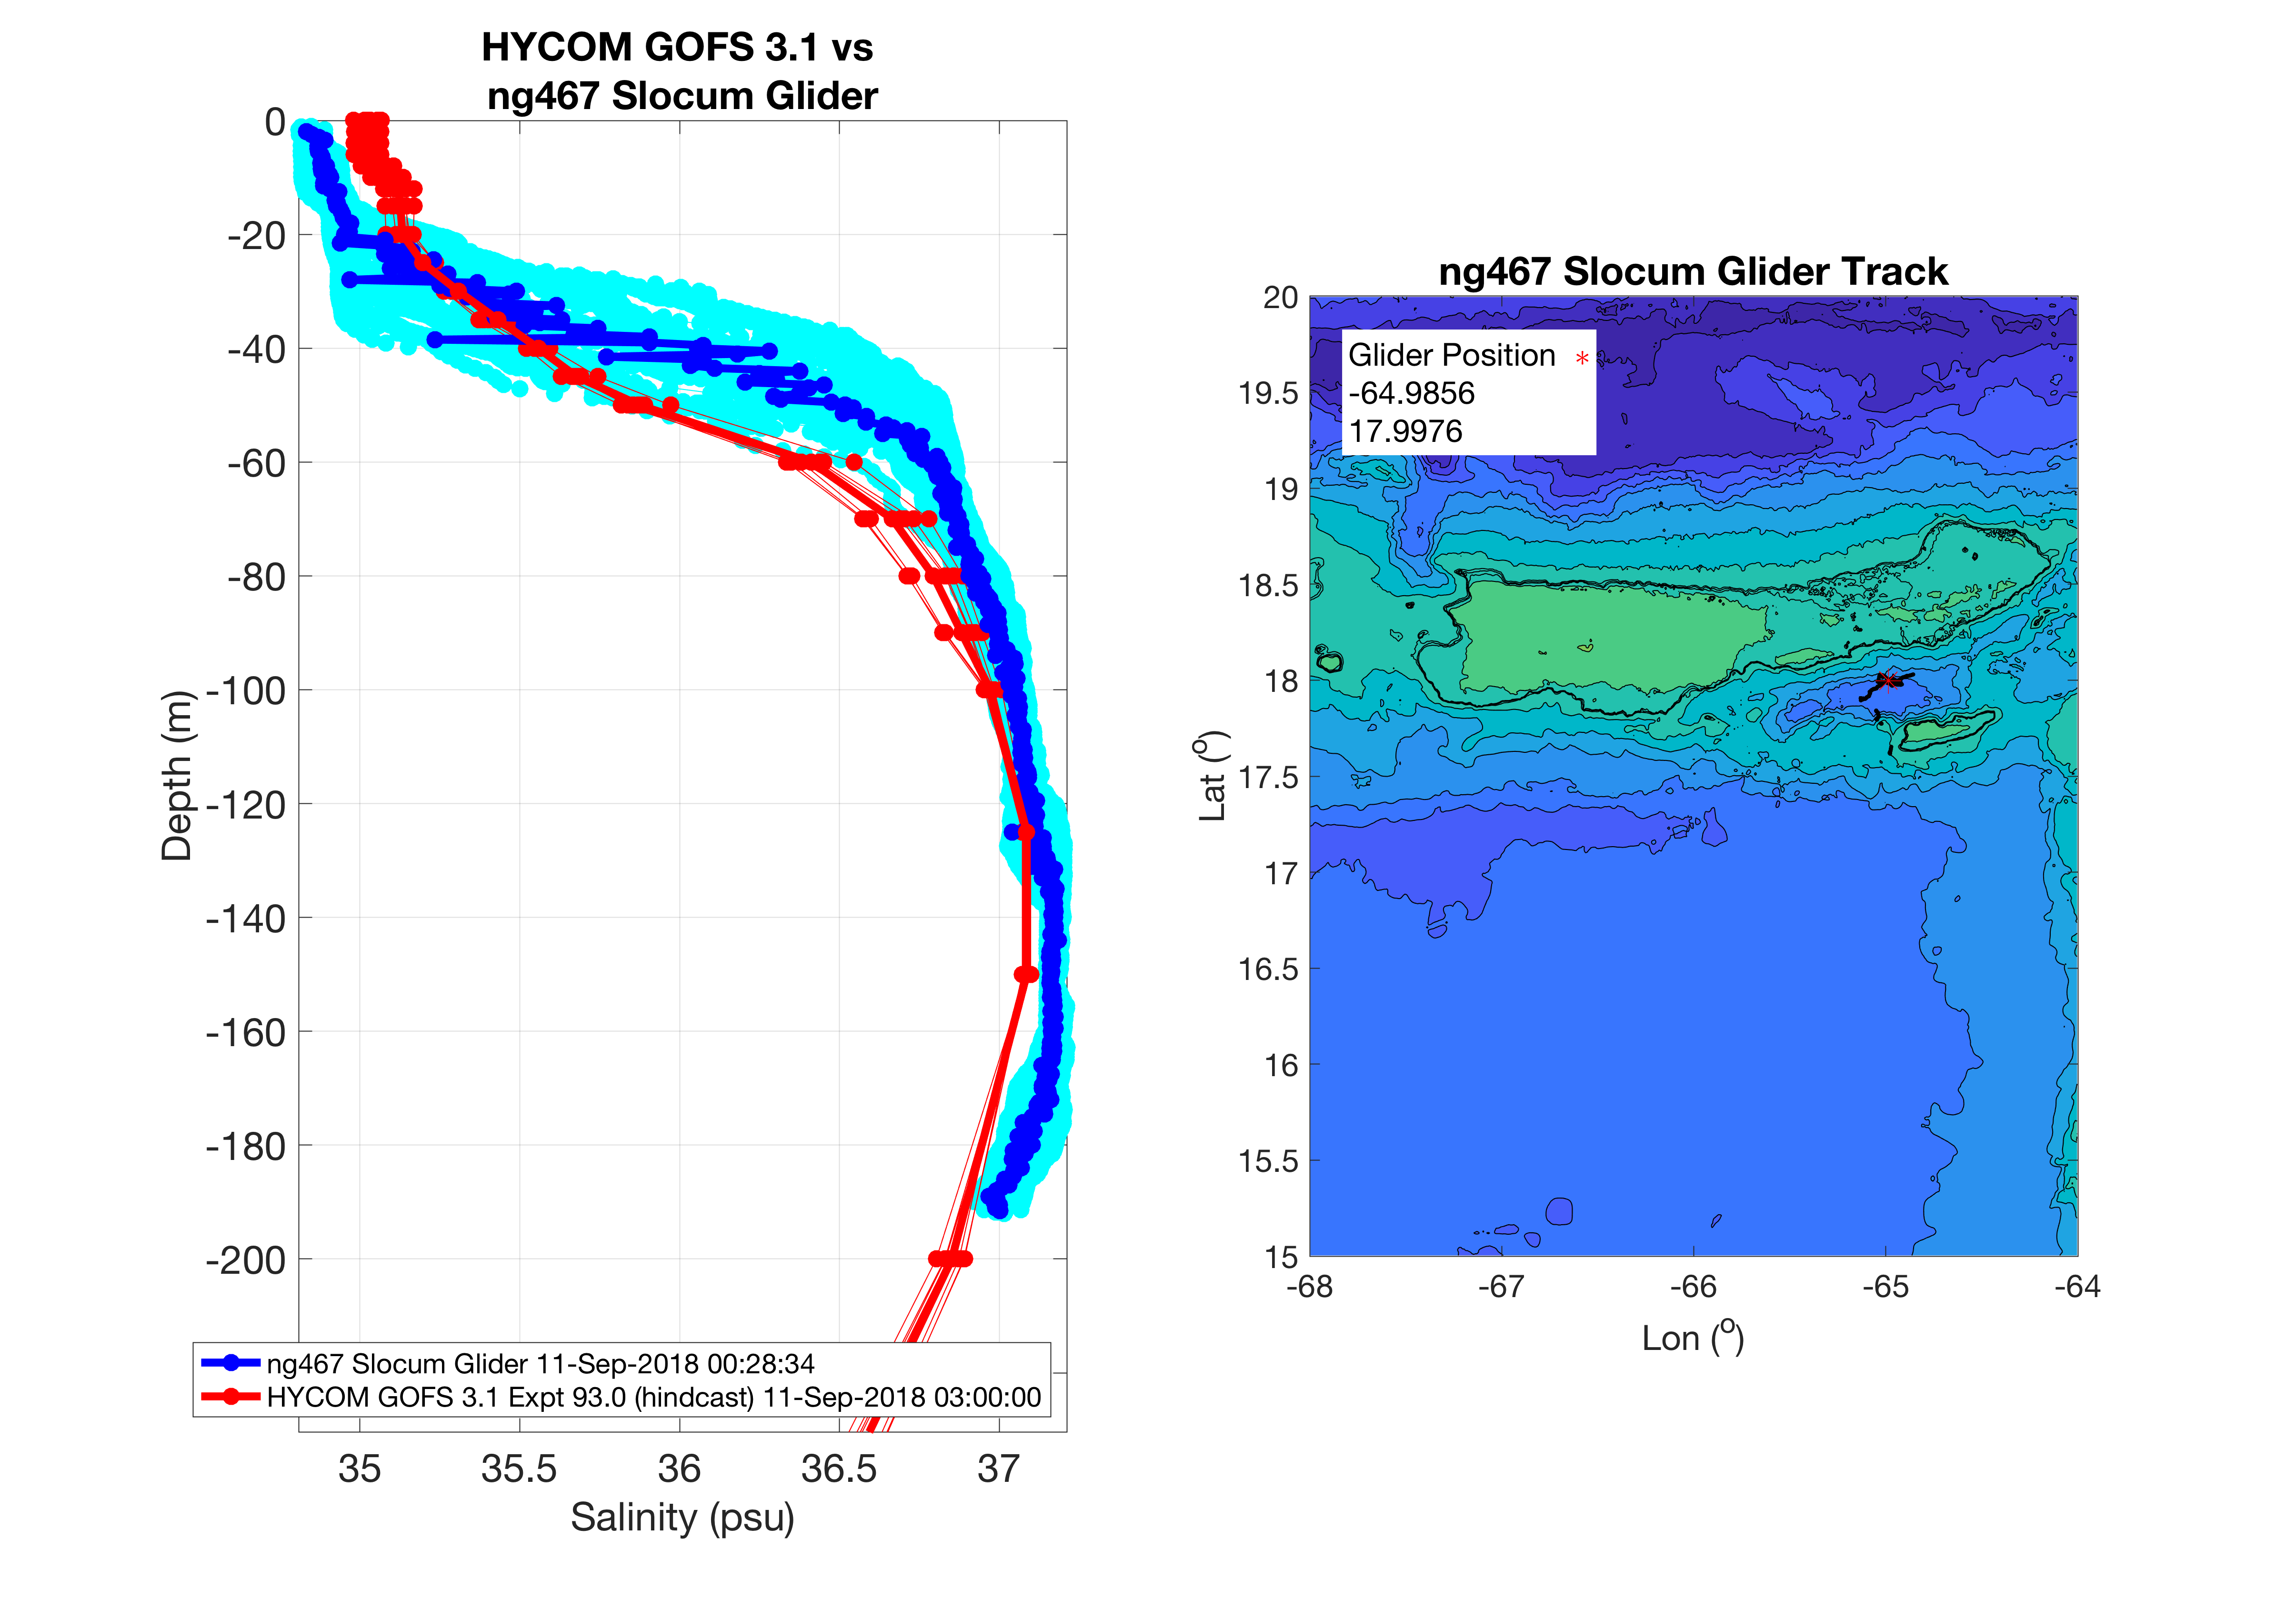
USVI Gliders - NG467 – Temperature & Salinity
Model
Glider
NG467
Temperature
Salinity

Slide 13
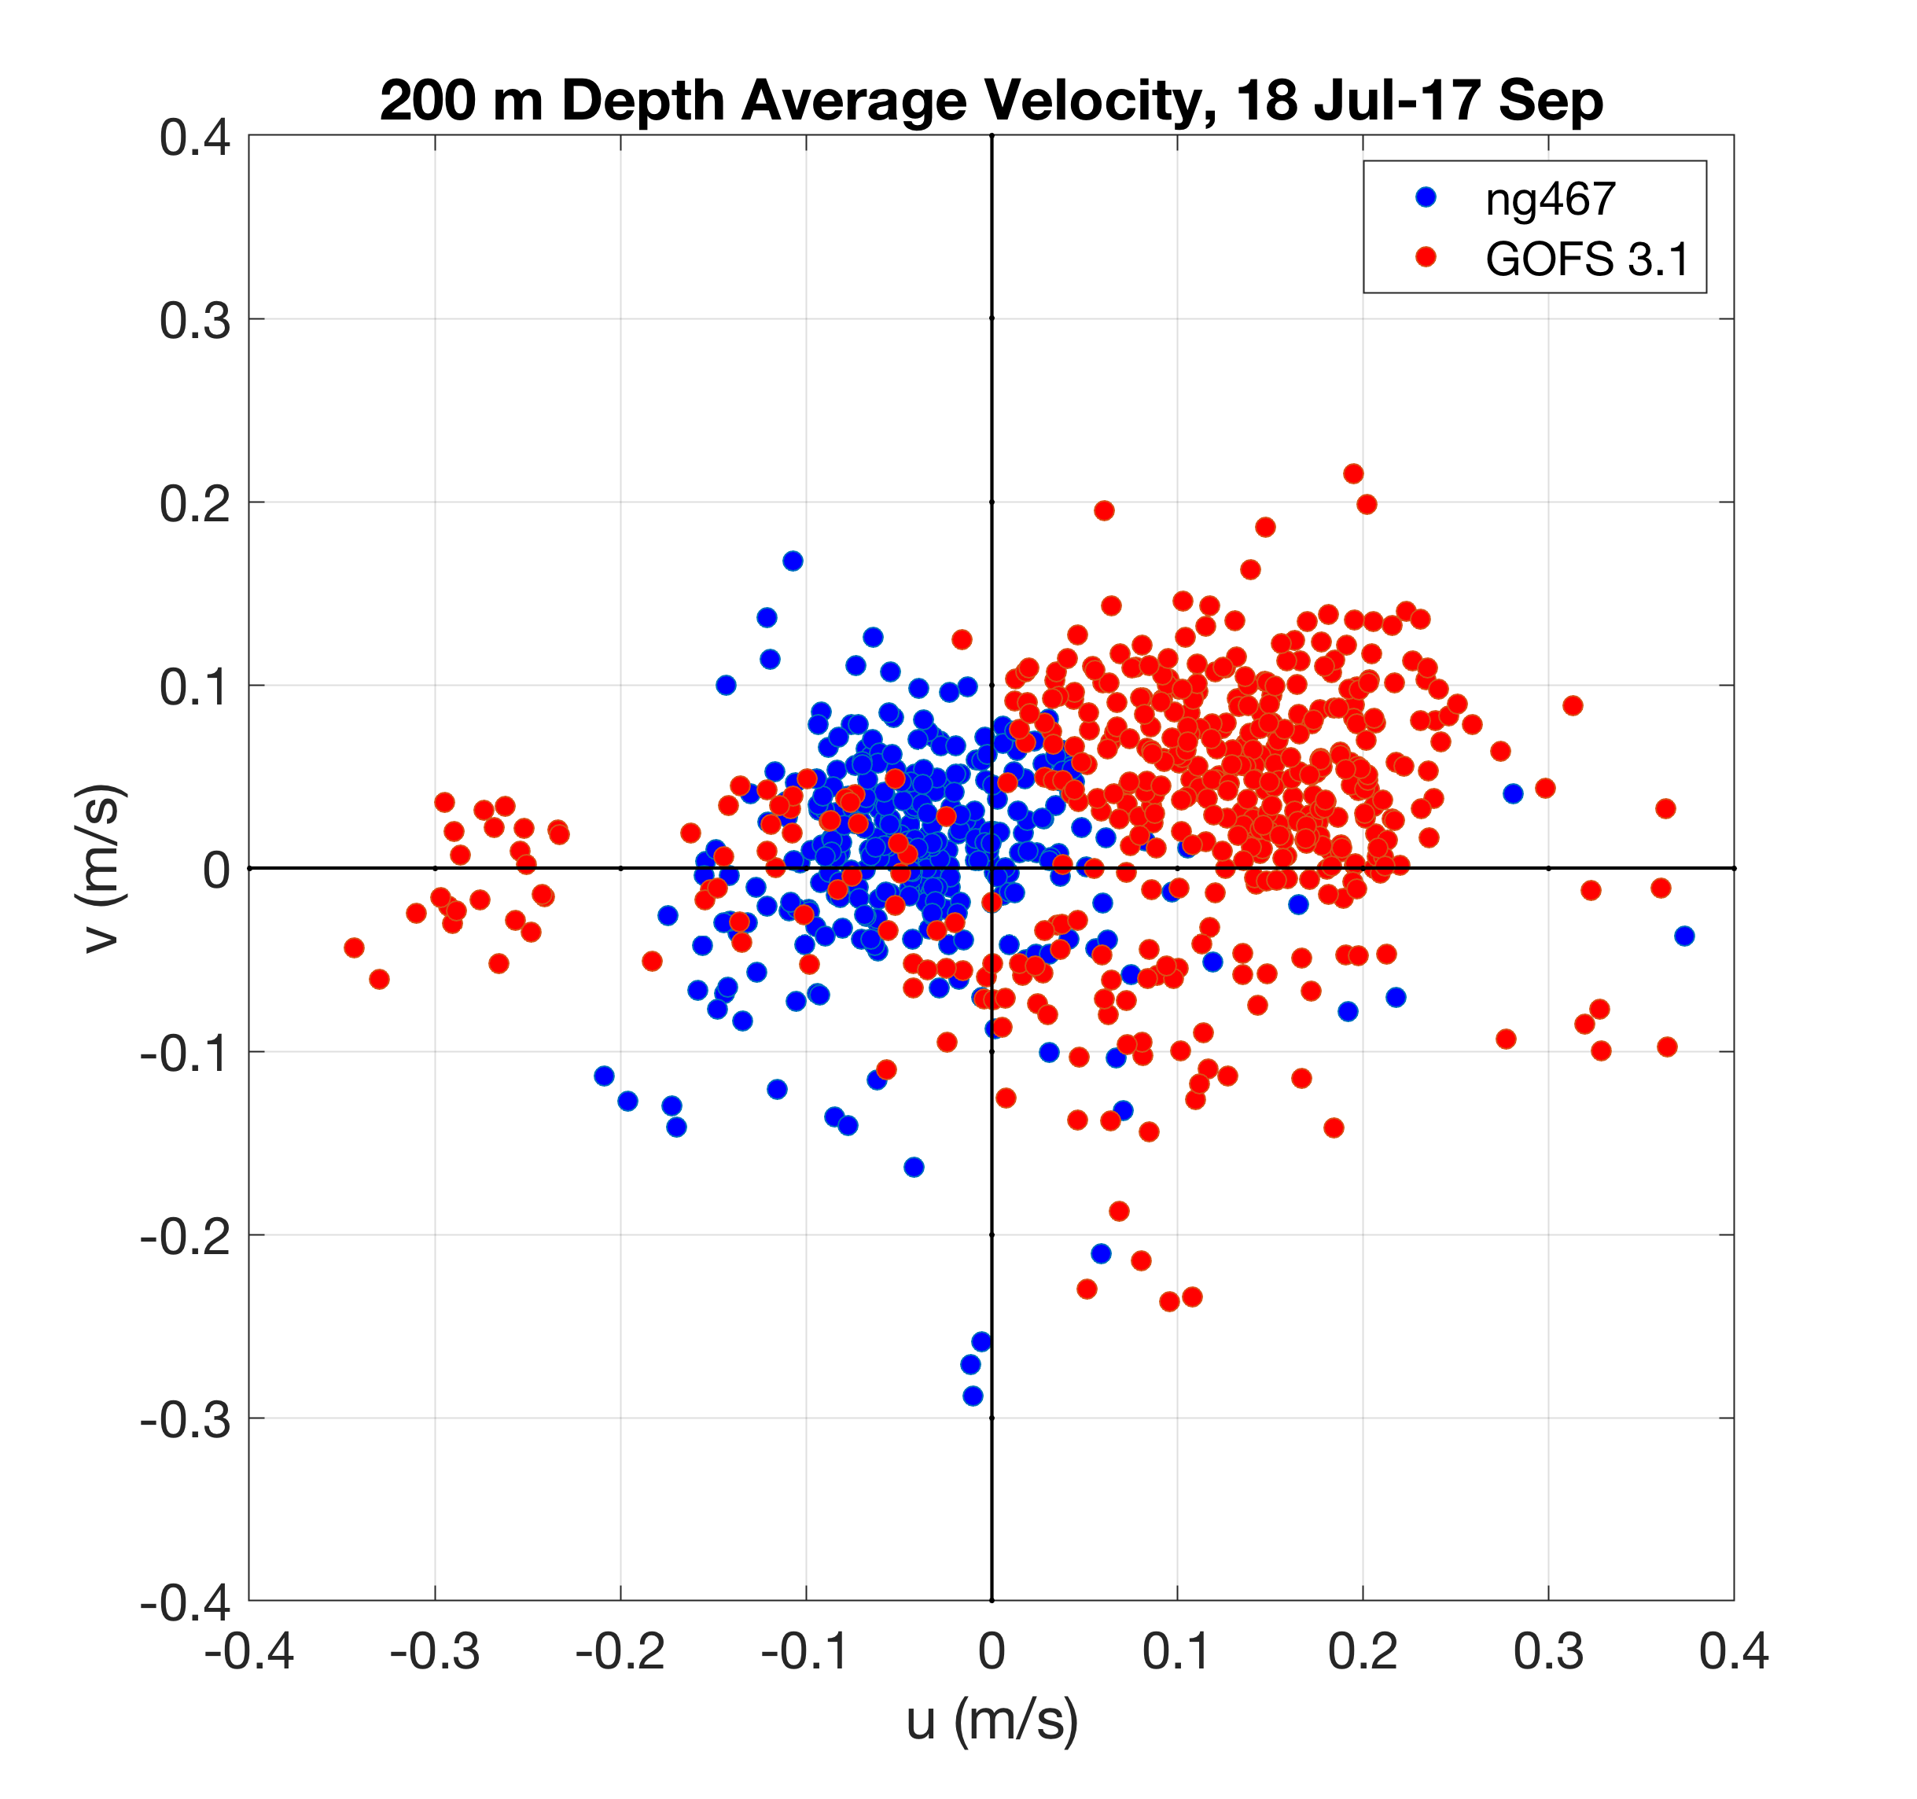
USVI Gliders - NG467 - Currents
Navy glider monitoring
for 2 months of the
flow through the passages:
St Thomas & St Croix
Glider flow to west
Model flow to east

Slide 14
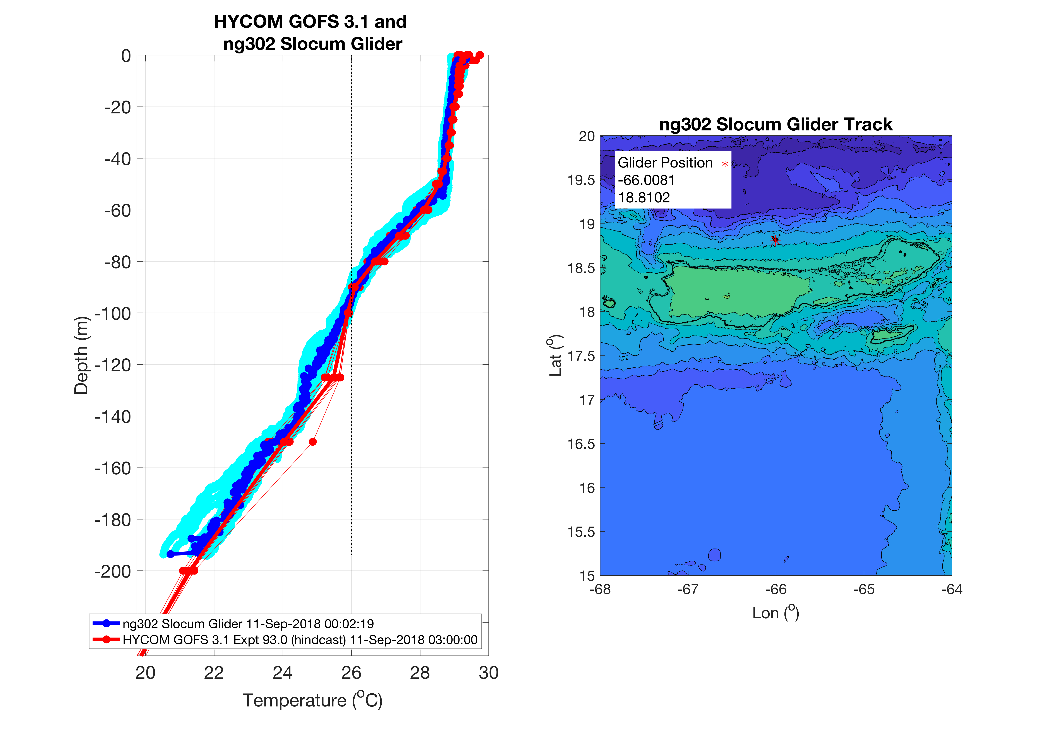
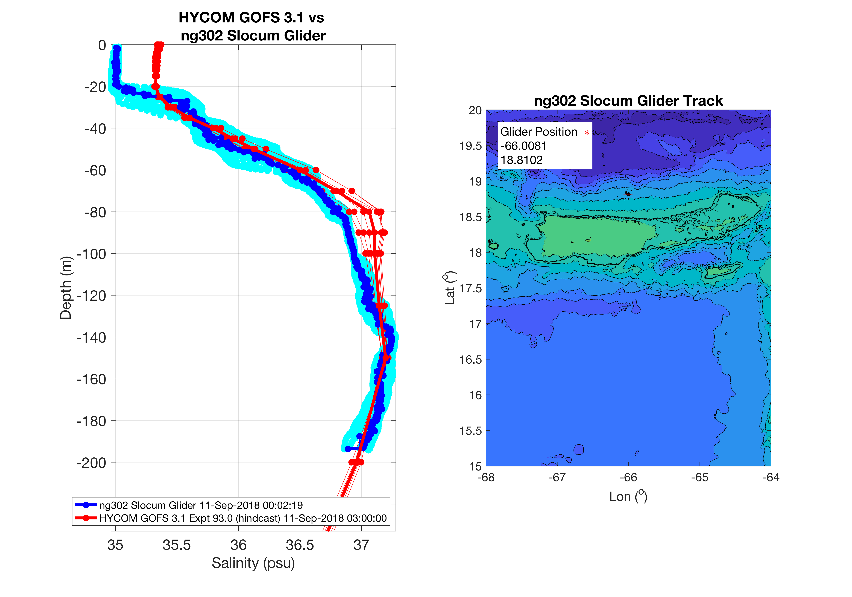
USVI Gliders - NG302 – Temperature & Salinity
Barrier Layer under predicted by model
Model
NG288
Glider
Temperature
Salinity

Slide 15
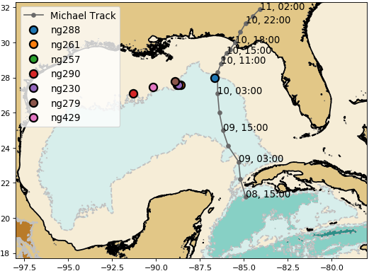
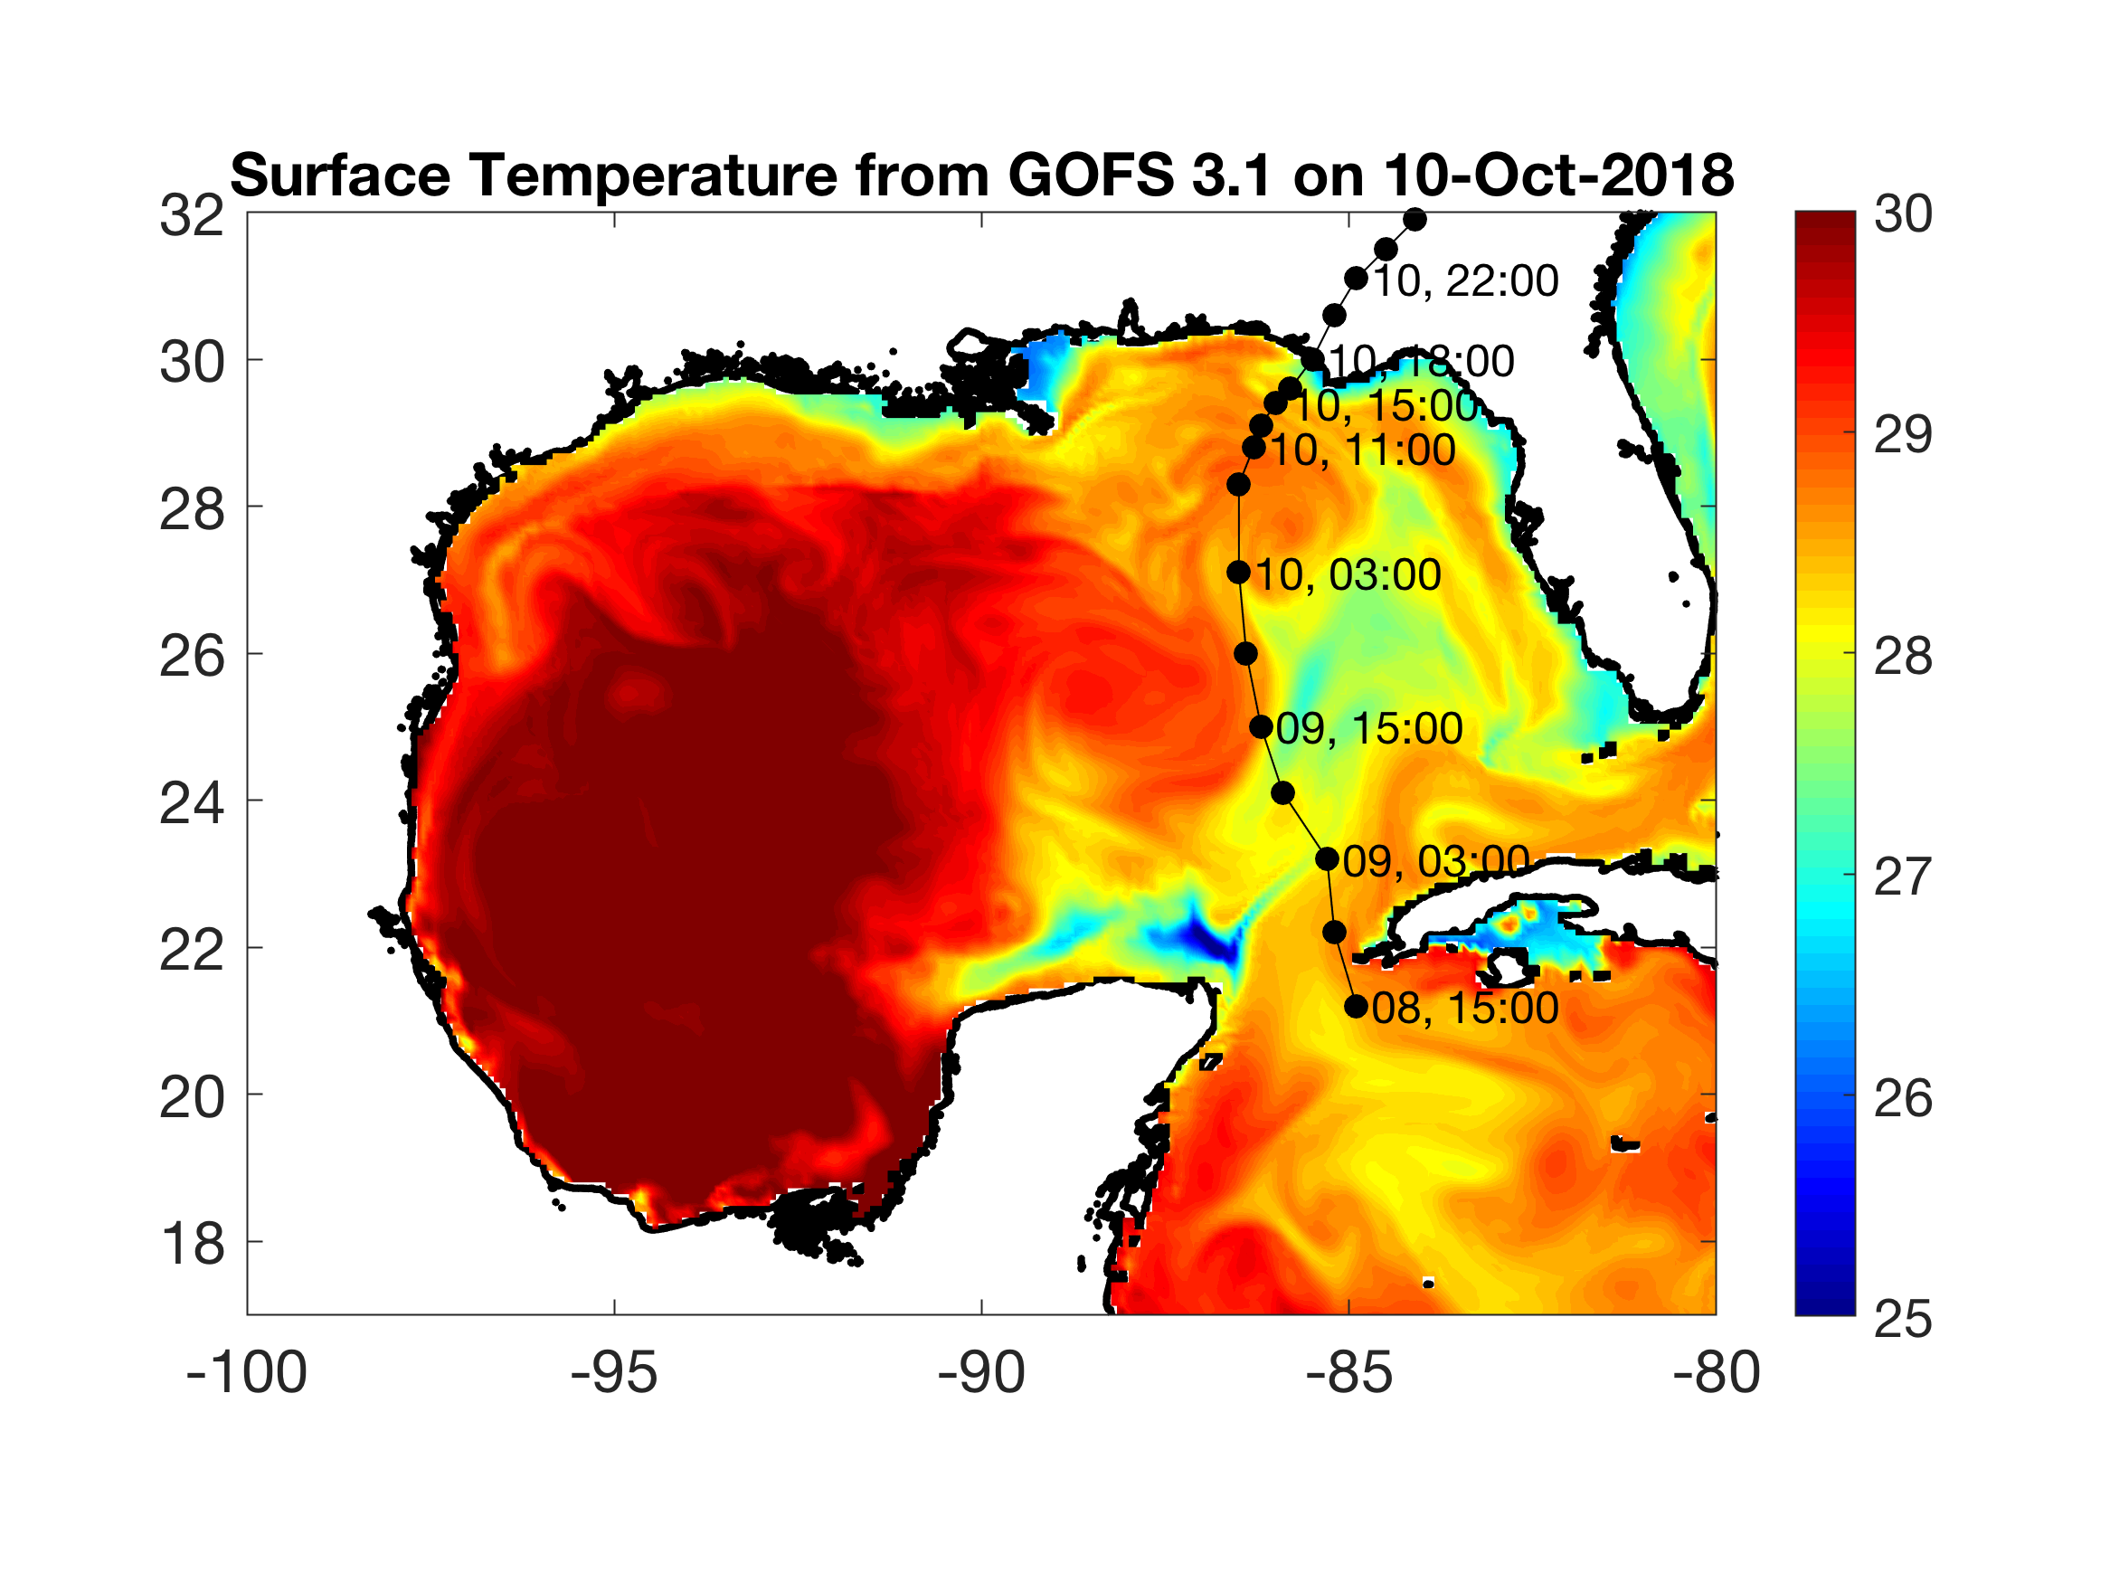
Hurricane Michael – NG288
Model
Glider

Slide 16
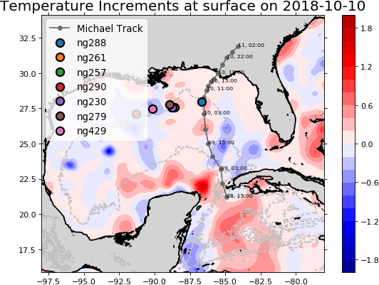
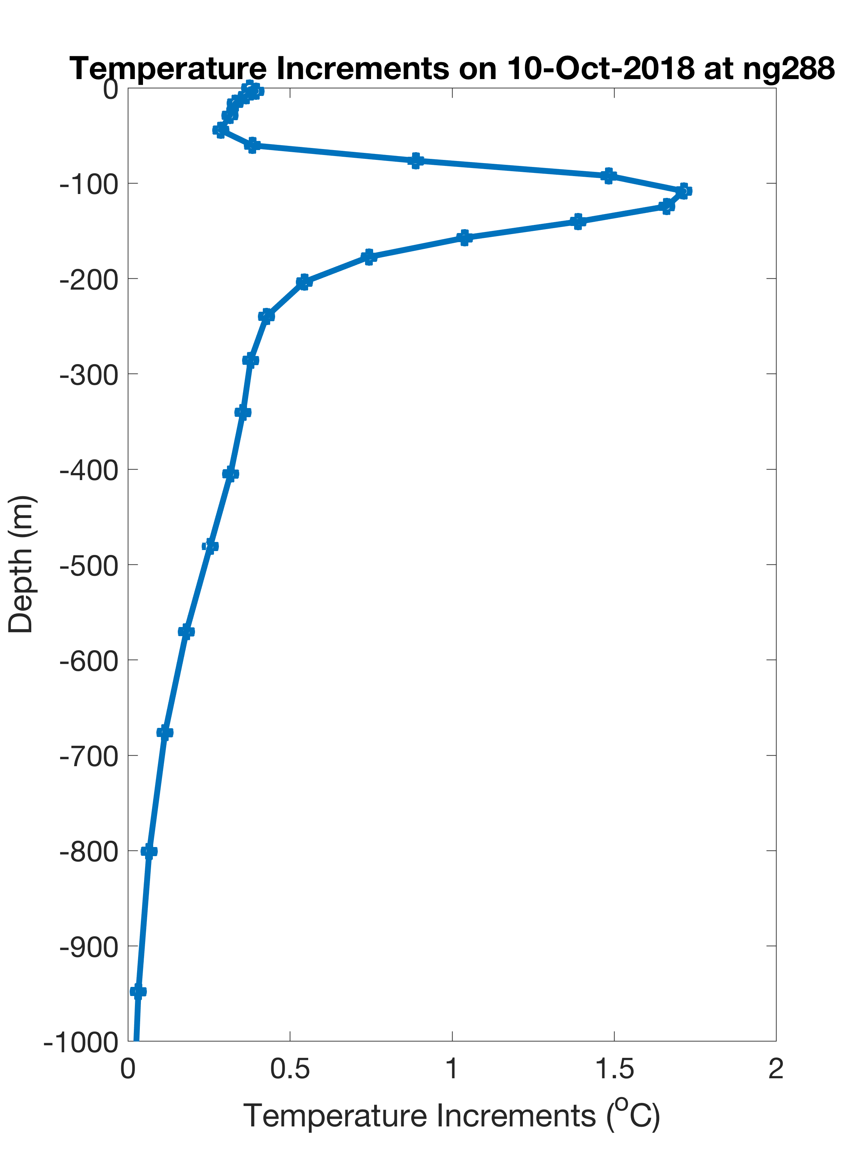
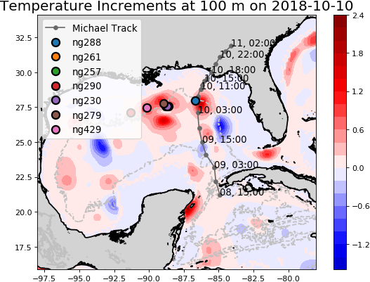
Hurricane Michael – NG288 - Temperature Increments
From NCODA

Slide 17
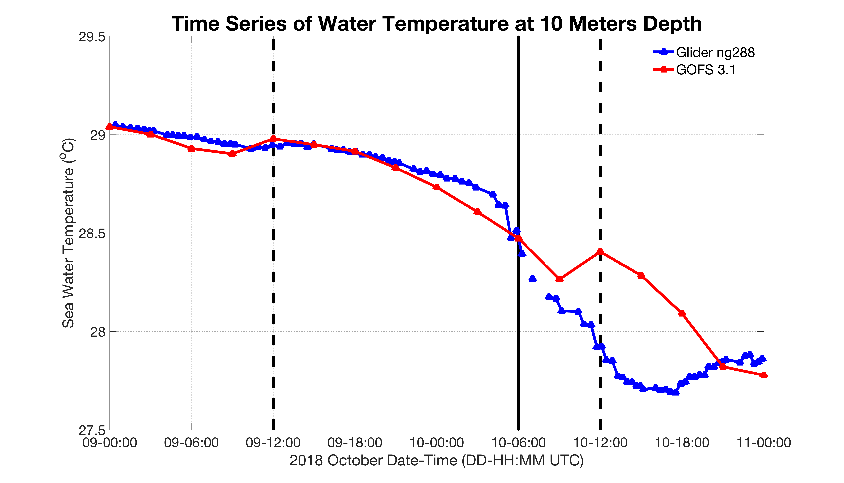
Hurricane Michael – NG288 vs GOFS 3.1
DRAFT
Impact of Data Assimilation on
Near Surface Water Temperature at 10 m
Model
Glider
Michael
Assimilation Times
Model Surface Temperature stays warm for too long during a rapid change

Slide 18
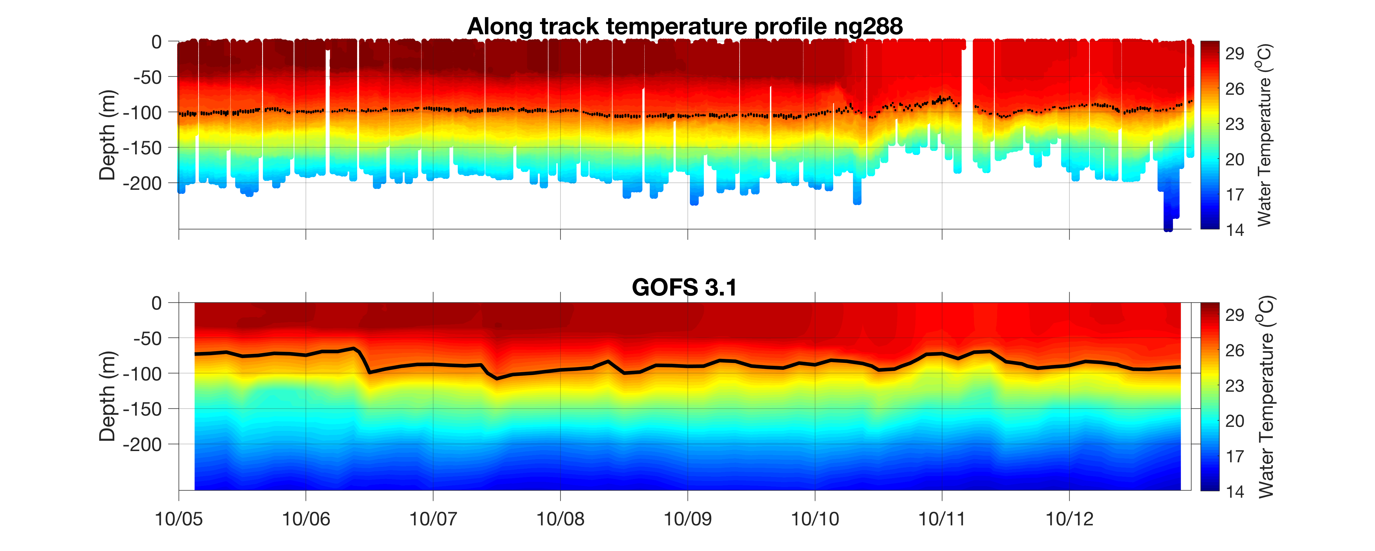
Hurricane Michael – NG288 - Assimilation Windows
Glider
26C
Michael
Model
26C
Assimilation windows
in Gray
Temp
at
100 m
Glider
Model

Slide 19
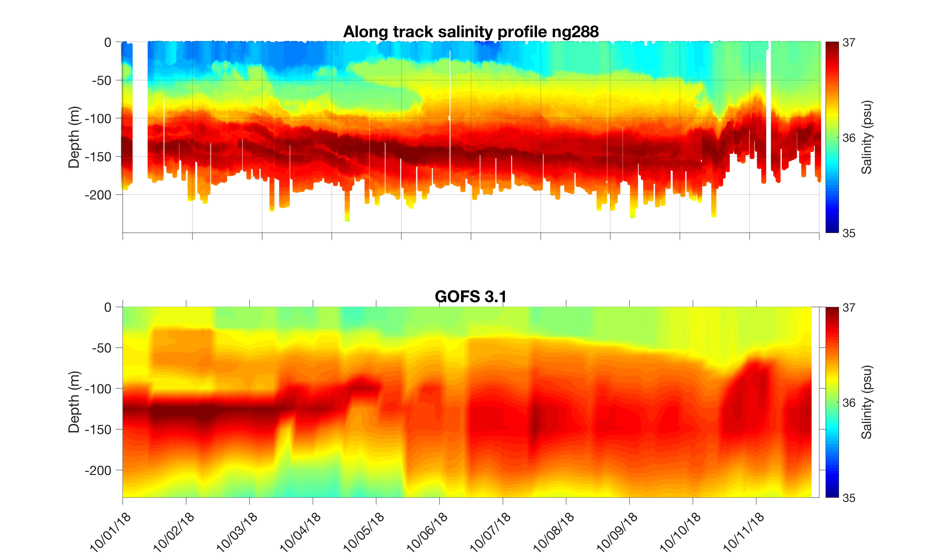
Hurricane Michael – NG288 - Salinity
Glider
Model
Detailed study of why model salinity is high at surface and low at depth is still underway

Slide 20
Next Steps – Now through Start of 2019 Hurricane Season
Questions:
What is the impact of the gliders on the NCODA/GOFS/RTOFS ocean forecast? The hurricane track and intensity forecast? The hurricane impact forecast?
Can we propose changes to improve NCODA for Operational Forecasting?
Where do we want to deploy gliders in the 2019 Hurricane Season?
Partnership Approach:
Deploy/Recover Gliders – 2018 Hurricane Season - Completed
Model/Data Comparisons – Fall - Ongoing
Collaborative Deep Dive into Critical Components – Winter
Joint Recommendations for 2019 Hurricane Season - Spring
In-person Tiger Team events with
NOAA/Navy (Silver Spring, Stennis) - 29 Nov
Navy Scientists (NRL Stennis, NRL Monterey) - Ongoing
NOAA Operational Center (NCEP – College Park) – Winter
Research Centers (AOML, GFDL, VIMS, UMiami) - Winter
HFIP/OMITT/NHC (Miami) – Spring
Joint Hurricane Glider Planning Meeting (TBD) - Spring
EGO Global Glider Meeting (Rutgers) - May

Slide 21
Next Steps – Now through Start of 2019 Hurricane Season
What we need:
NCODA data-denial assimilation experiments with the operational modeling suite in addition to ongoing research experiments
Move from a volunteer Interagency Tiger Team to a resourced Interagency Tiger Team for data assimilation (NCODA updates, 3DVAR to 4DVAR, …)
Joint funding for NOPP-style partnerships
Transition through HFIP consistent with WRFIA
Increased support for the IOOS Glider DAC as an interagency resource
Expanded NOAA & Navy collaborations/support for Hurricane Sentinel glider fleet operations in the Hurricane-Impacted Regions (Caribbean, Gulf, SAB, MAB, …)
Permission for gliders to roam the Caribbean – Through International Bilateral Agreements and WMO/IOC/GOOS/IOCARIBE

