Slide 1
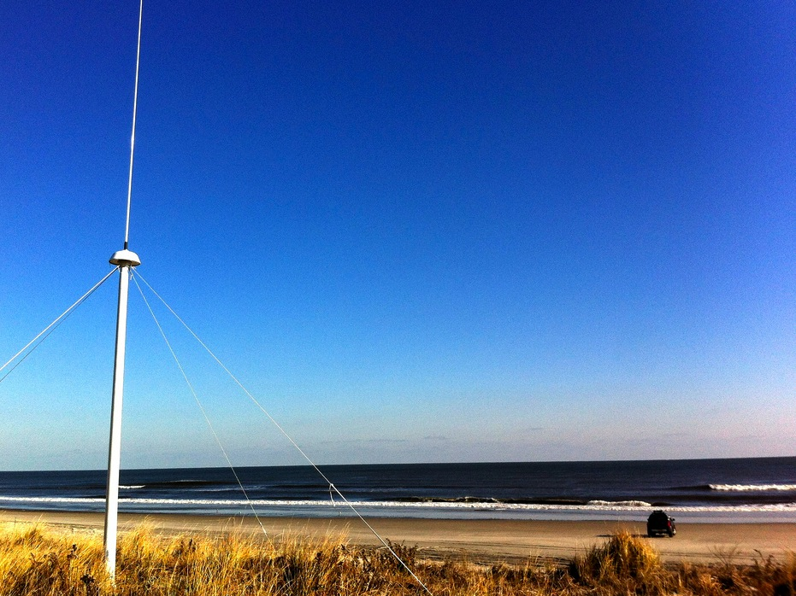
Integrated Ocean Observing Systems &
Applications to Hurricanes & Typhoons:
1) HF Radar & Irene + 10 + Muifa
Scott Glenn
2) Gliders & Sandy + Jose
Travis Miles
Rutgers University, New Brunswick, NJ, USA
Third DBCP Pacific Islands Training Workshop on
Ocean Observations and Data Applications
Fifth JCOMM Marine Instrument Workshop for Asia-Pacific Region
Hai Kou China, 09-12 July 2018

Slide 2


















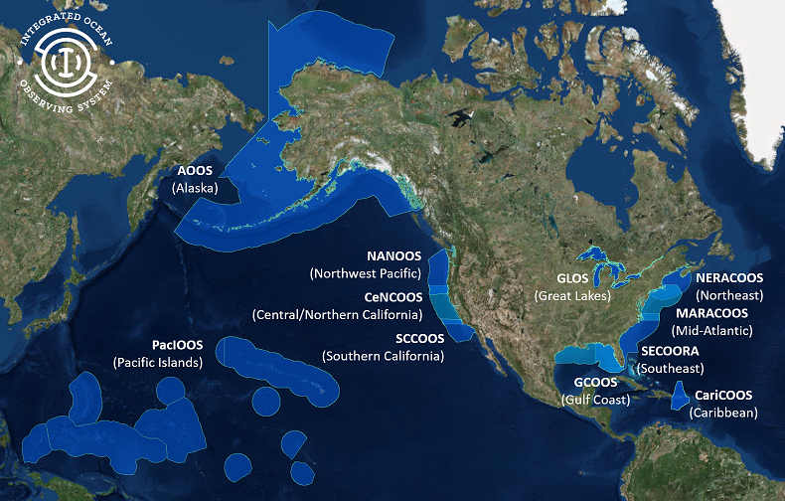
U.S. Integrated Ocean Observing System (IOOS)
Partnership effort that leverages dispersed national investments to deliver ocean, coastal and Great Lakes data relevant to decision-makers.
  Global Component
  US contribution to Global Ocean Observing System (GOOS)
  1 of 15 Regional Alliances of GOOS
  National Component
  17 Federal agencies
Regional Component
  11 Regional Associations
    Stakeholder driven
    Academia, state/local/tribal government, private industry
Notes:
NOAA is the Lead Federal Agency
US IOOS program office is within NOAA, but intended to be a multi agency network and federal to non-federal so we use the term U.S. IOOS.
Additional Background:
US IOOS is a national endeavor and spans from global to coastal, with federal and non-federal partners. The majority of non-federal partners are represented by 11 Regional Associations (RAs) that represent the US EEZ and Great Lakes.

Slide 3
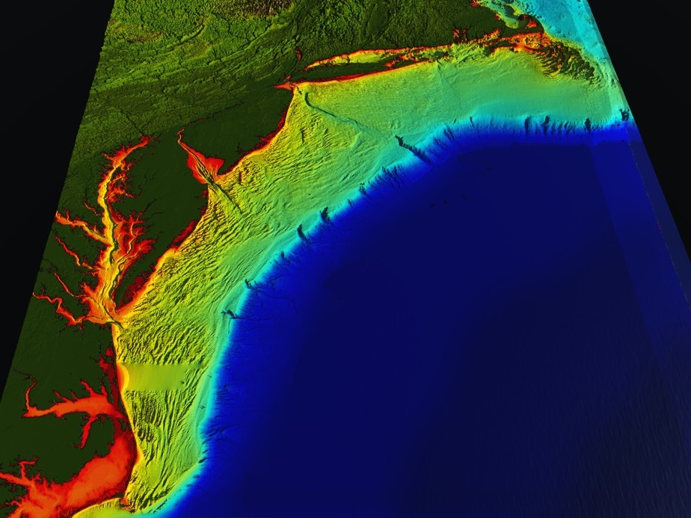






Mid-Atlantic Bight (1000 km Cape to Cape)
78 Million People (1/4 of U.S.)
Cape
Cod
U..
Mid-Atlantic Regional Association Coastal Ocean Observing System (MARACOOS)
A Sustained, Integrated & Certified
Ocean-Atmosphere
Observation & Forecast System
Cape
Hatteras
Notes:
3

Slide 4
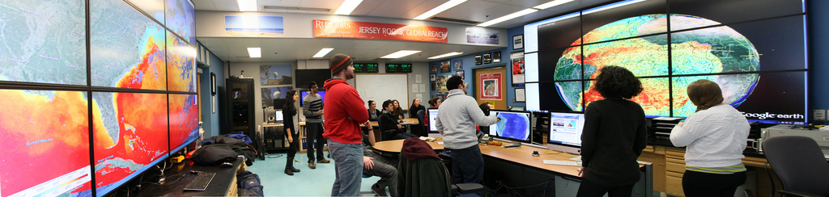
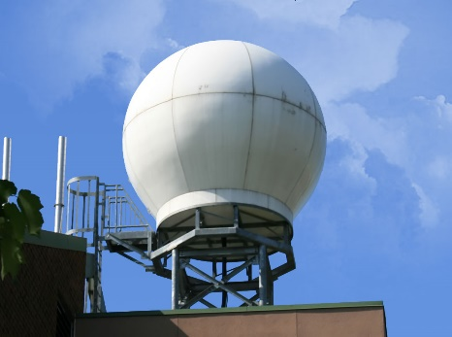
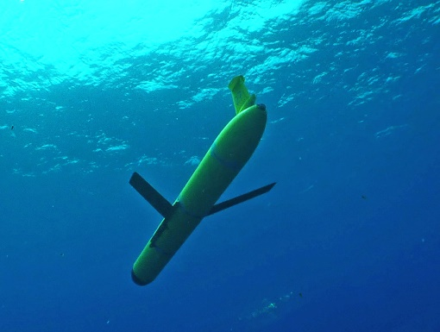
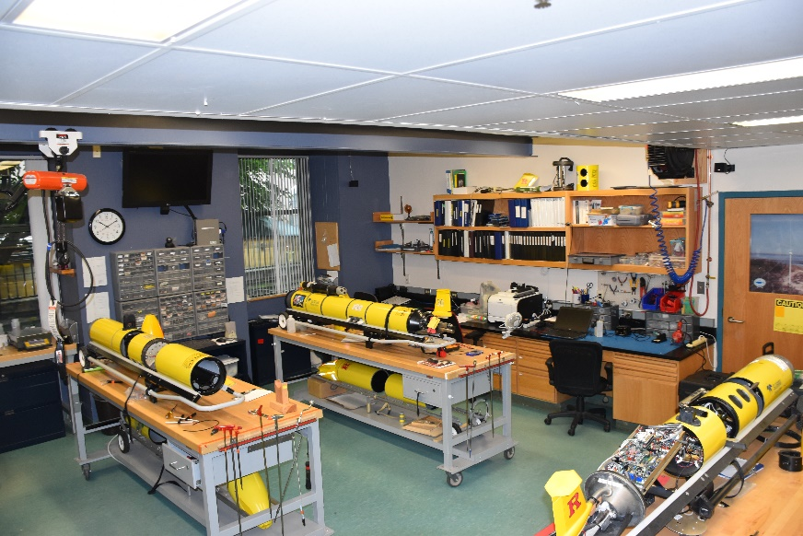
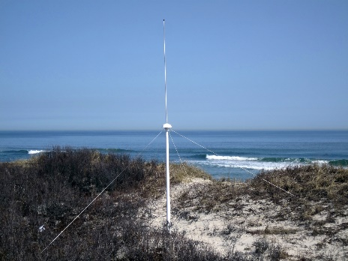
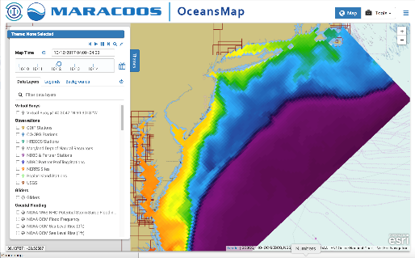
Rutgers University - Center for Ocean Observing Leadership
Satellite Receivers
Under-
water
Glider
Fleet
46 Site CODAR Network
Ocean
Forecasts
Glider Lab
Notes:
4
All of this gets combined into our overall operations, research, and educational initiatives in the “COOL Room,” shown here (with a class in the background)
Thanks to many partners

Slide 5
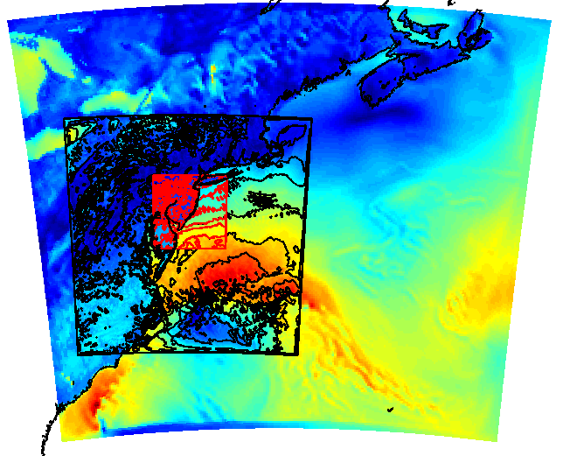
Rutgers University - Center for Ocean Observing Leadership
Satellite Receivers
RU-WRF Domains
9km
Under-
water
Glider
Fleet
3km
1km
46 Site CODAR Network
Ocean
Forecasts
Atmospheric Forecasts
Notes:
5
All of this gets combined into our overall operations, research, and educational initiatives in the “COOL Room,” shown here (with a class in the background)
Thanks to many partners

Slide 6
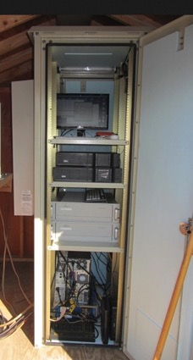

13 MHz Transmit and Receive Antenna
Weathertight SeaSonde Enclosure
Doppler shift gives ocean currents
monitor
computer & external hard drive
A.C. unit
UPS system
transmitter
receiver
lightning protection
two lines of Communication
4 m
SeaSonde
HF Radar

Slide 7
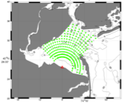
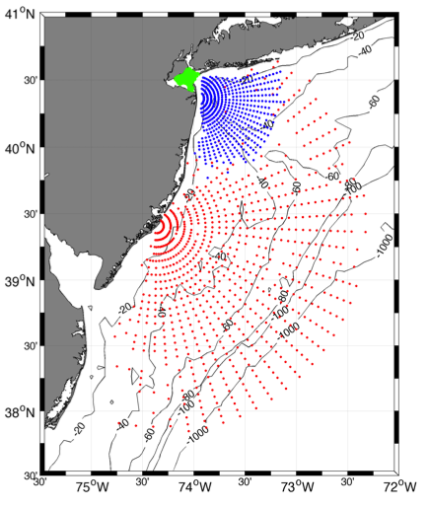



Individual HF Radar Sites
Generate Radial Vector Surface Current Maps
25 MHz
Radar λ: 12 m Ocean λ: 6 m
Range: >30 km Resolution: 1 km
13 MHz
Radar λ: 24 m Ocean λ: 12 m
Range: >80 km Resolution: 3 km
05 MHz
Radar λ: 60m Ocean λ: 30 m
Range: >180 km Resolution: 6 km

Slide 8
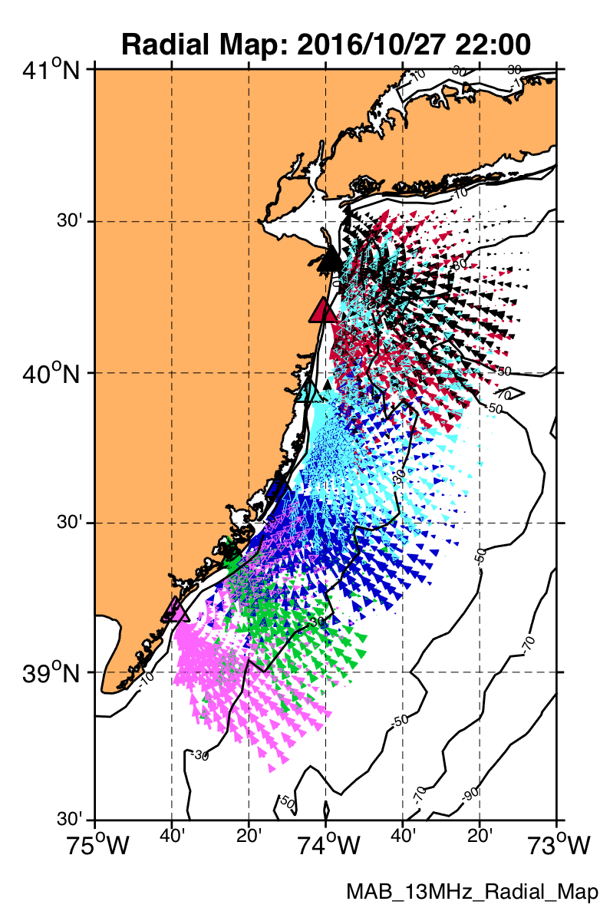
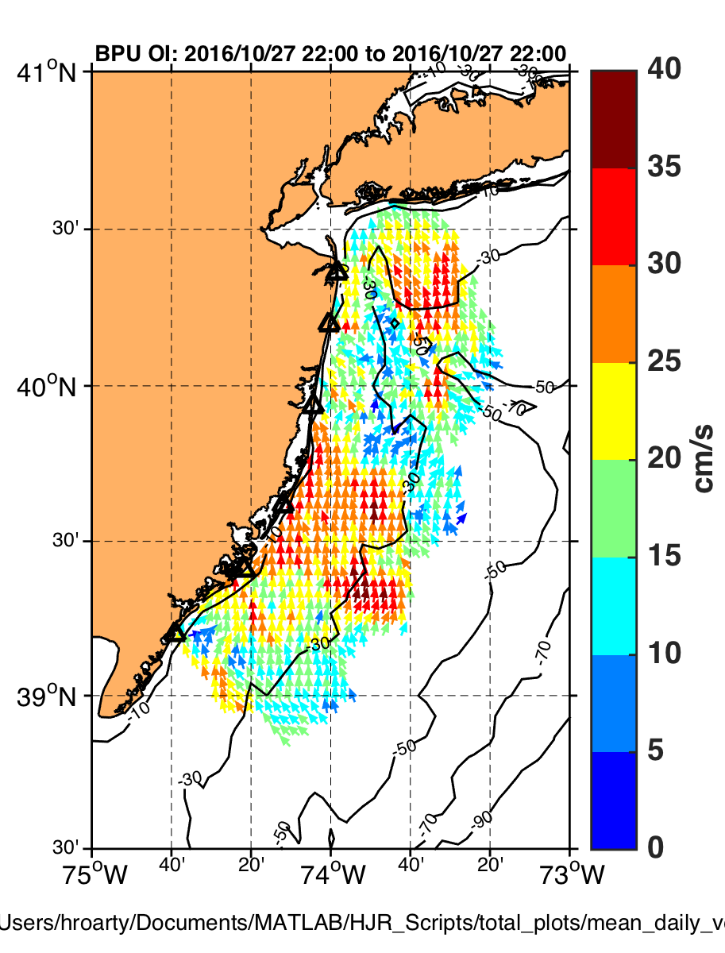
Radial Current
Vectors from Multiple Sites
Combined into Total Vectors
by UWLS or OI

Slide 9
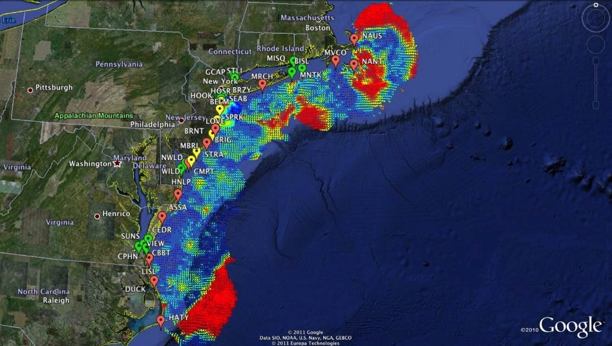

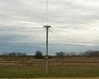
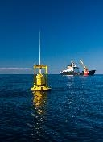
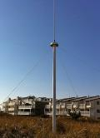

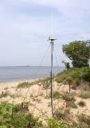






Mid-Atlantic Bight HF Radar Network
Generates Total Vector Surface Current Maps
1000 km
Cape to Cape
Mid-Atlantic HF Radar Network
17 Long-Range CODARs
8 Medium-Range CODARs
16 Short-Range CODARs
41 Total CODARs Fixed
+5 CODARs Roaming
46 Total CODARs
Triple Nested, Multi-static, Multi-use
Industry Partner: CODAR Ocean Sensors

Slide 10
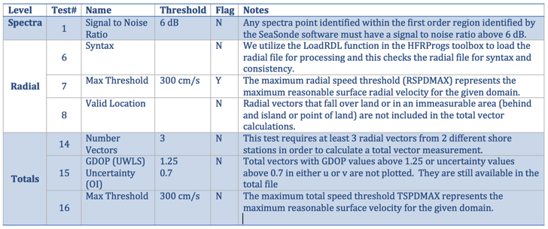

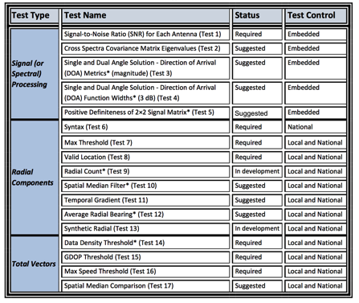
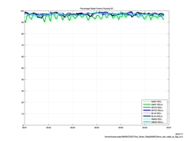
HFR Data Quality Assurance/Quality Control (QA/QC)
Regional Information Coordination Entity -
RICE
From
QARTOD
Manual for
HF Radar
Plotting QC flags in real time

Slide 11
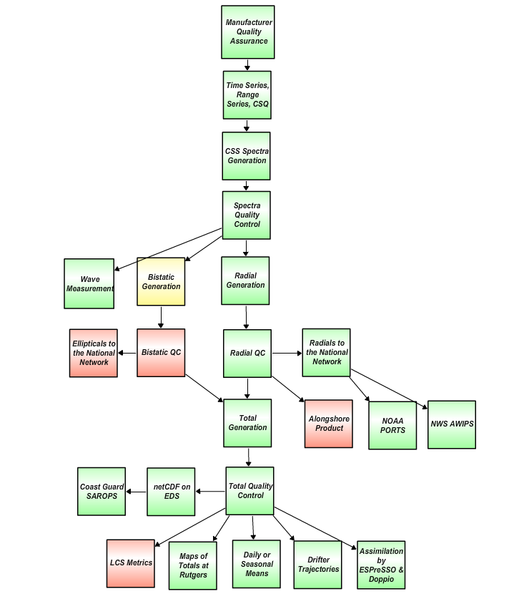
HF Radar Data Real Time Flow Chart
Nov. 2017
For IOOS HFR DAC
Quality Assurance
Manufacturer recommended Antenna Patterns not older than 1 year
Weekly 11-point remote site inspections
Physical site inspection every 6 months
Level 0
QARTOD
R Test 1: SNR Ratio, Filter < 7dB
S Test 2: Cross Spectra Covariance Matrix Eigenvalue
S Test 3: Direction of Arrival Magnitude
S Test 4: Direction of Arrival Signal Width
S Test 5: Positive Definiteness 2x2 Signal Matrix
Requires SeaSonde Radial Metric Processing
Level 1
R Test 6: Syntax, Filter
R Test 7: Max Threshold, Filter > 150 cm/s (13/25 MHz) 300 cm/s (5 MHz)
R Test 8: Radial Valid Location, Filter
D Test 9: Radial Count, Filter < 300
S Test 10: Spatial Median Test
S Test 11: Temporal Gradient
S Test 12: Average Radial Bearing
S Test 13: Synthetic Radial
Level 2
R Test 14: Data Density Threshold, Filter, At least 3 vectors from 2 separate stations
R Test 15: GDOP, OI Uncertainty, Flag > 0.6 in U or V Velocity
R Test 16: Max. Speed Threshold , Filter > 150 cm/s (13/25 MHz) 300 cm/s (5 MHz)
S Test 17: Spatial Median Test
R Required
SR Strongly Recommended
S Suggested
D Development
Level 3
Green – Operational
Yellow – Development
Red - Planned
Level 4
Data levels defined by NASA Earth Science Reference Handbook ( 2006, p.31)

Slide 12
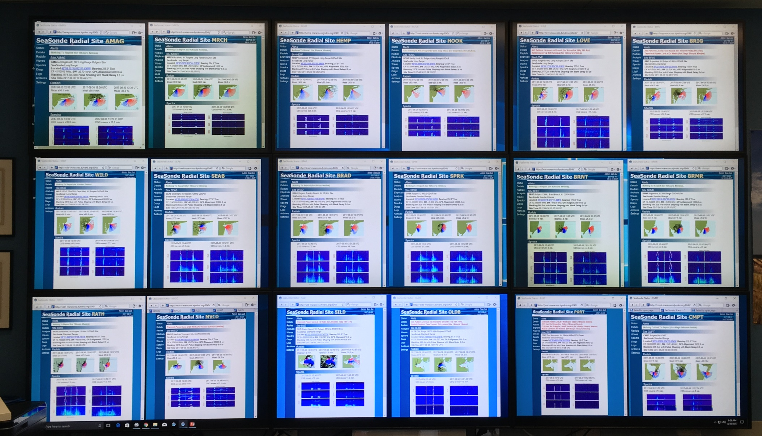
Radial Web Server
Human in the Loop QA/QC
Rutgers COOLroom CODAR Wall

Slide 13
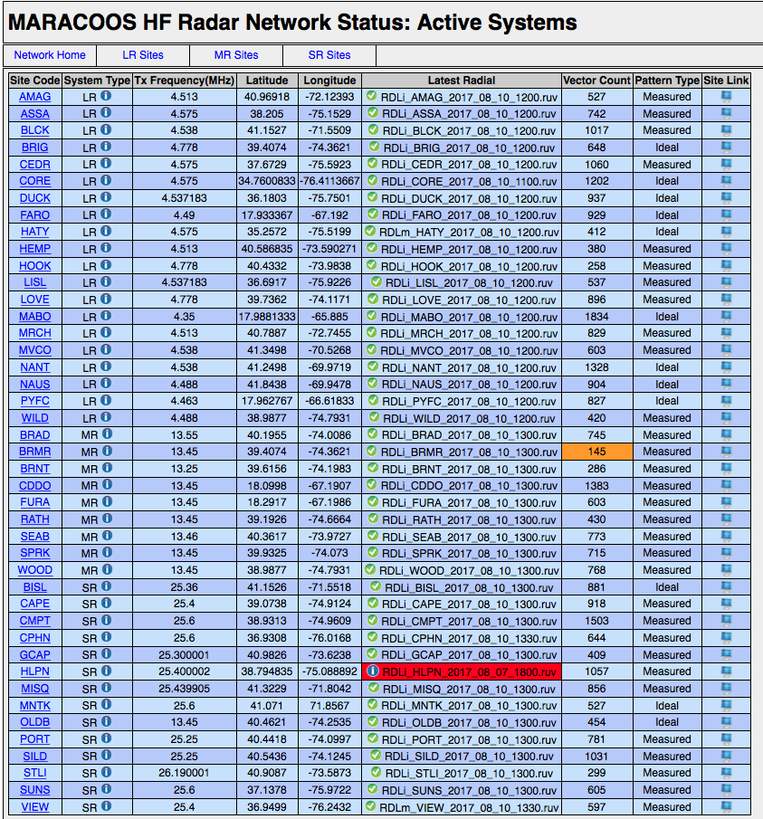
Radial Diagnostic
Displays Most Recent Radial File
If radial count drops below 200
If radial file older than 12 hours
Displays Preferred Radial Type for Total Processing

Slide 14
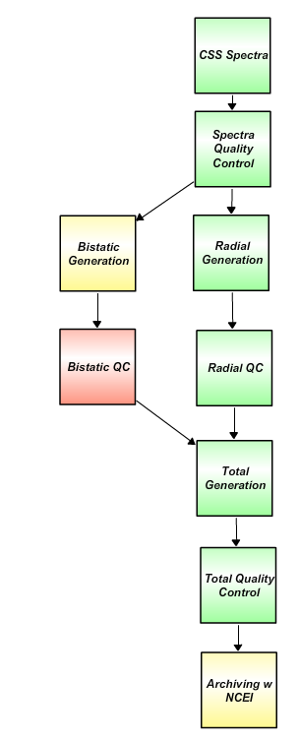
HF Radar Data Delayed Mode Flow Chart
Nov. 2017
For NCEI Archive
Level 0
Plot hardware diagnostic data to identify questionable time periods.
Plot radial diagnostic data to identify questionable time periods.
Determine what stations need to be reprocessed for specific time periods
Generate reprocessing time line with appropriate file type (ideal or measured) and antenna patterns.
Generate archived best radial data set.
Create totals from best radial data set.
Level 1
Level 2
Level 3
Green – Operational
Yellow – Development
Red - Planned
Level 4
Data levels defined by NASA Earth Science Reference Handbook ( 2006, p.31)

Slide 15
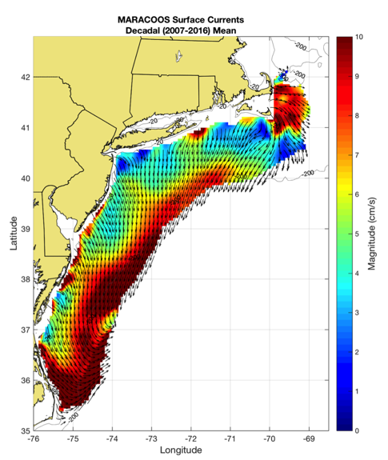
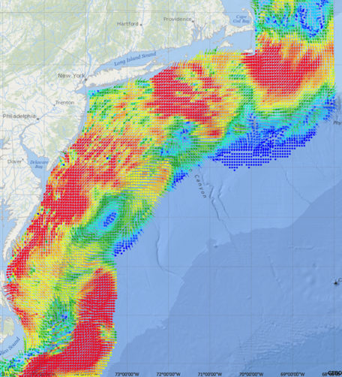
Mid-Atlantic Bight HF Radar Network
Generates Surface Current Maps every hour for over a decade
5 MHz- 17 Stations
13 MHz- 7 Stations
25 MHz- 16 Stations
Outside- 6 Stations
TOTAL – 46 Stations
Winter Storm Jonas
2016/01/23 20:00 UTC
Delayed-mode
Post-processed Maps to NCEI Archive
for Scientific Analysis:
ex., Decadal Mean Currents
Near Real-Time
Hourly Maps for
Search And Rescue,
Water Quality,
Spill Response, …

Slide 16
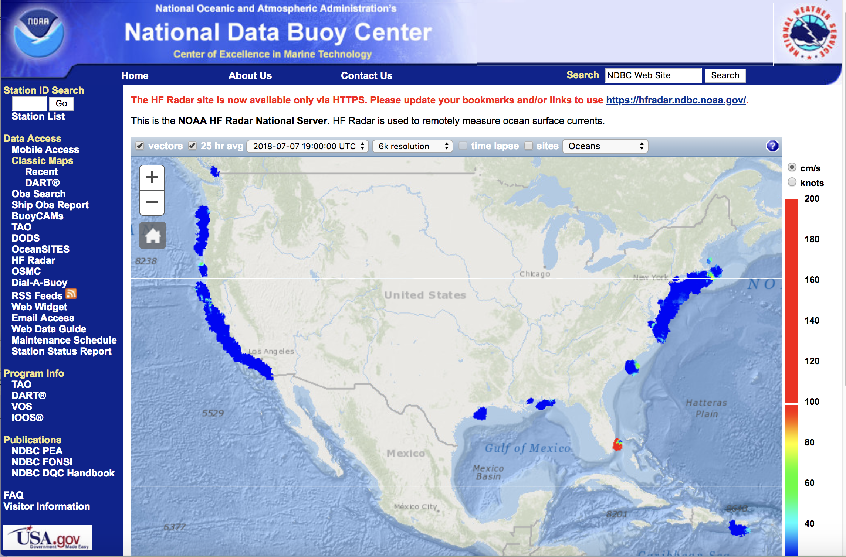
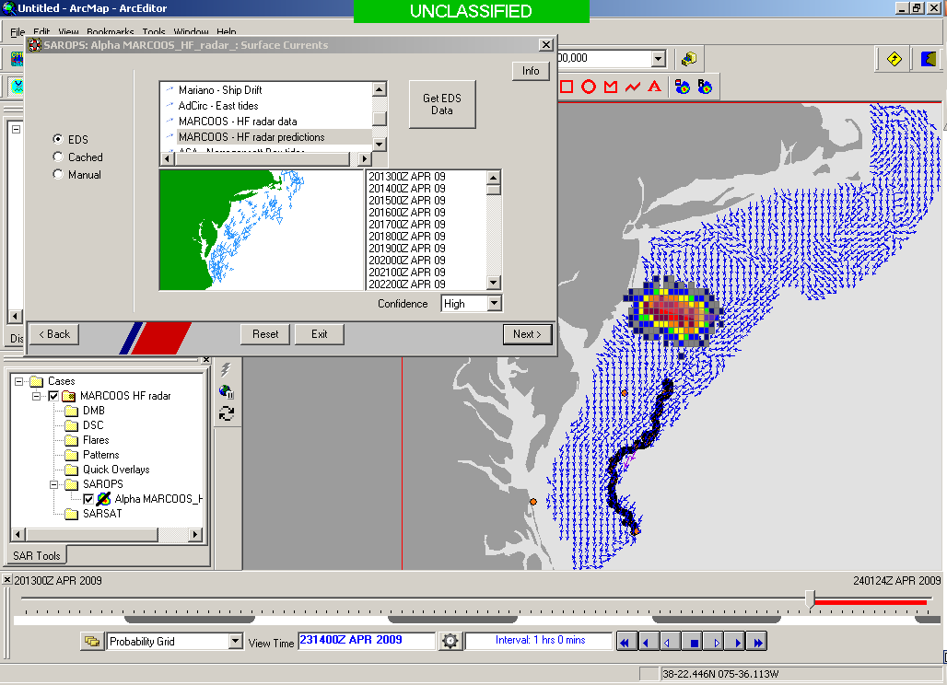

U.S. National HF Radar Network
Search And Rescue Optimal Planning System
(SAROPS)

Slide 17
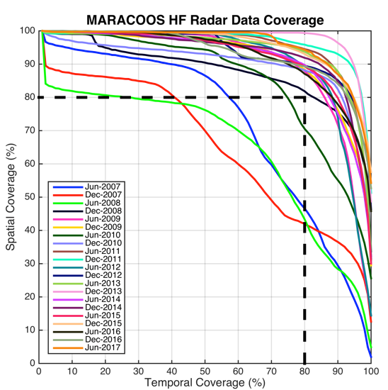
Search And Rescue Data Availability Metrics
MARACOOS 17-Site Long Range Network:
Consistently exceeds U.S. Coast Guard 80-80 Metric
80 % spatial coverage 80% of the time
Achieved through site resiliency and active spares approach.
Accomplished with 2.5 Field Technicians
Every
6 Months since 2007

Slide 18
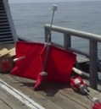
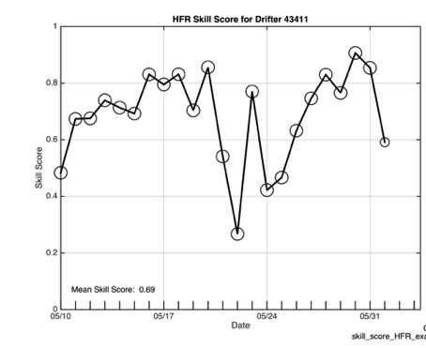
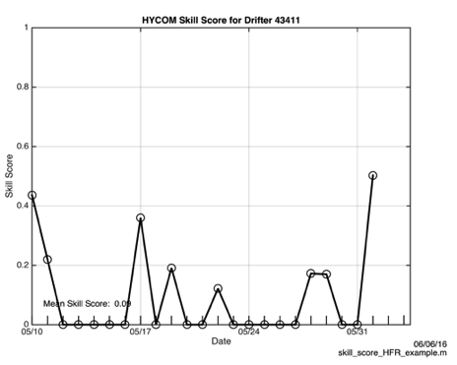
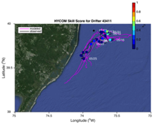
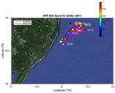
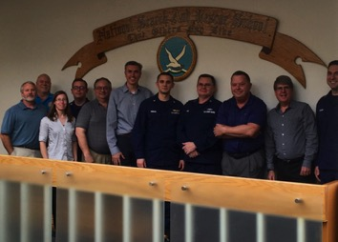
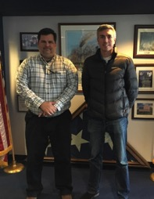


2016 Surface Current Drifter Skill Score
Navy HYCOM Region 1
No HFR Assimilation
HFR Data
Active Education & Outreach to USCG Users of the HFR Data & Data Assimilative Products
National Search and Rescue School
Yorktown, VA
January 19, 2017
Coast Guard Sector NY
Staten Island, NY
March 21, 2017

Slide 19
Coast Guard Wind & Current Data Requests
USCG SAROPS requests June 1 to December 1, 2017

Slide 20
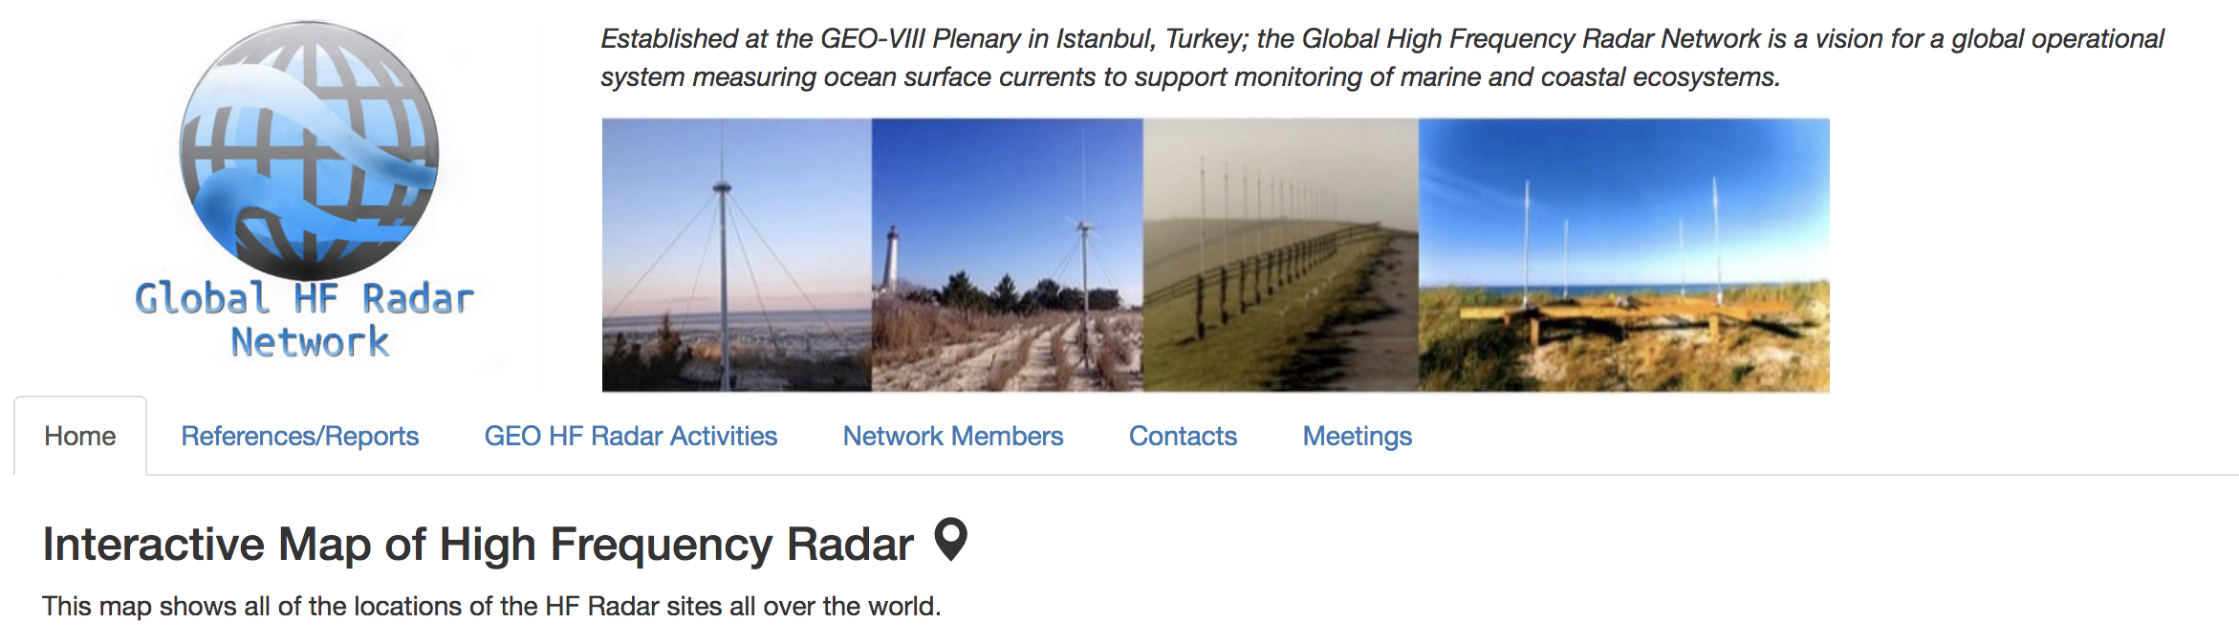
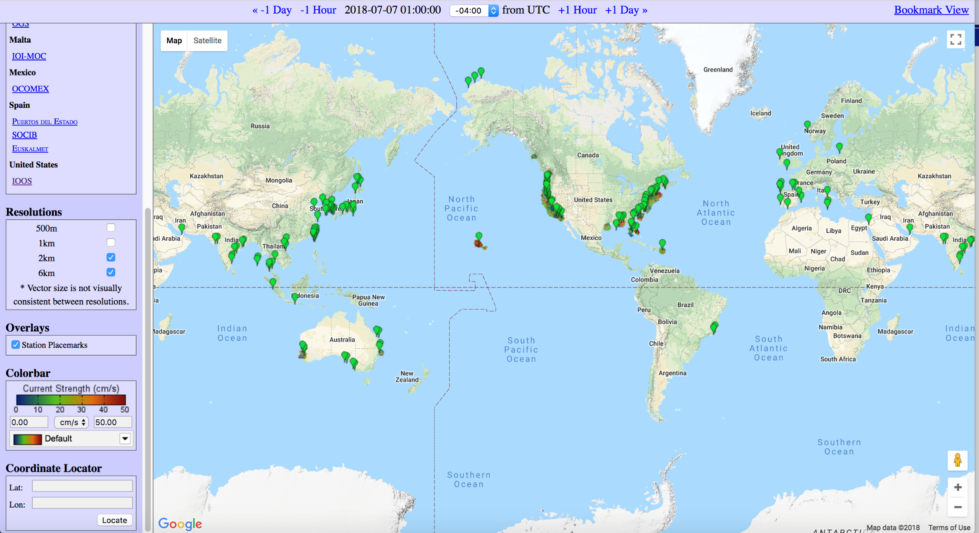
WMO & IOC JCOMM Global HF Radar Network

Slide 21
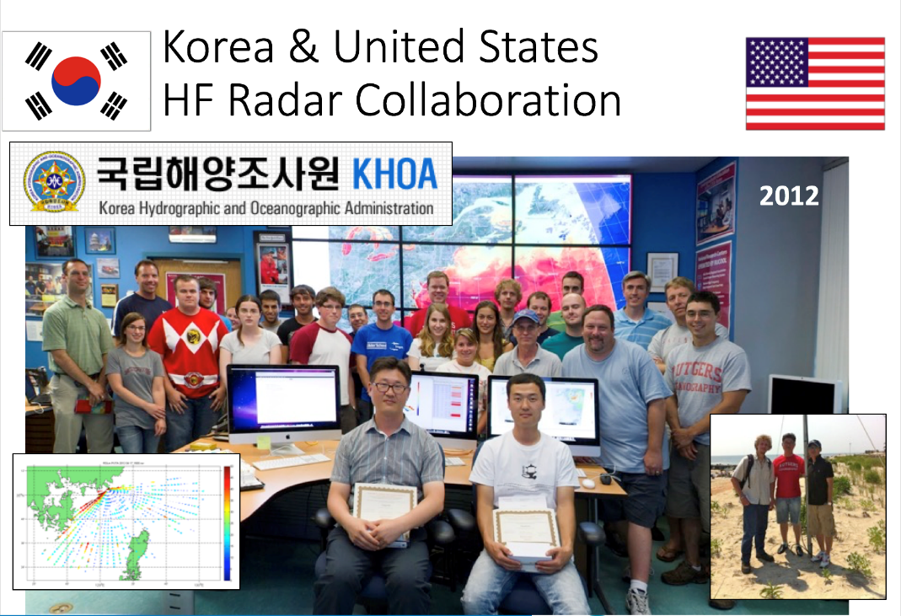
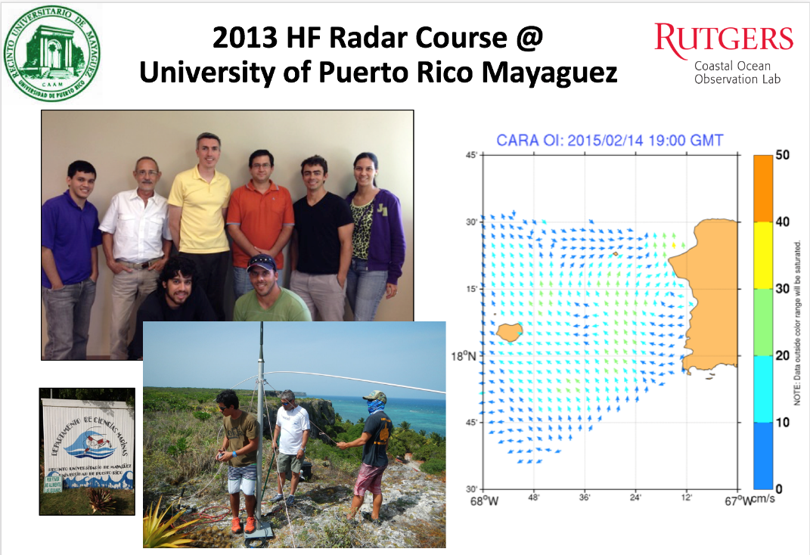
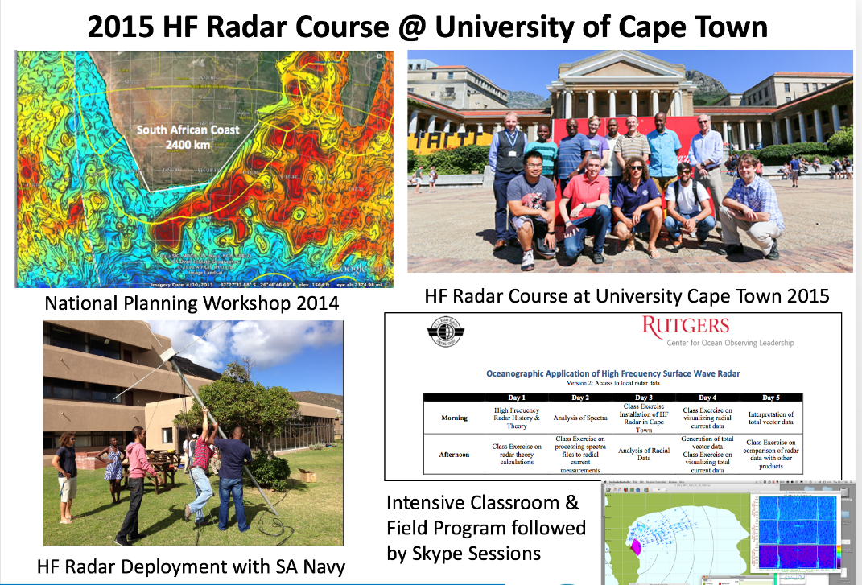
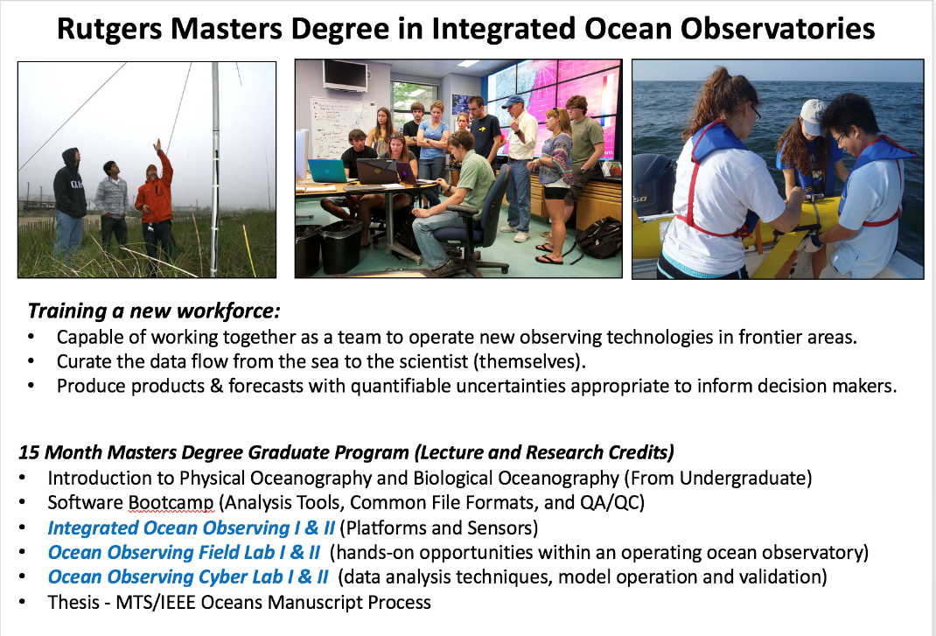
Promoting the Global Network through Education & Training

Slide 22
Mid-Atlantic Bight (1000 km Cape to Cape)
78 Million People (1/4 of U.S.)
Cape
Cod
U..
Stratified
Coastal Ocean Response and Feedbacks on Hurricane Intensity
Sandy
Irene + 10
Jose
Scott Glenn, Travis Miles,
Joe Brodie, Cliff Watkins,
Greg Seroka, Hugh Roarty,
Oscar Schofield, Josh Kohut (Rutgers)
Cape
Hatteras
Notes:
22

Slide 23
Key Storm Glider Reference List
Glenn, Jones, Twardowski, Bowers, Kerfoot, Kohut, Webb, Schofield, 2008. Glider observations of sediment resuspension in a Middle Atlantic Bight fall transition storm. Limnology and Oceanography 53(5, Part 2): 2180-2196.
Miles, Glenn, Schofield, 2013. Temporal and spatial variability in fall storm induced sediment resuspension on the Mid-Atlantic Bight. Continental Shelf Research 63, Supplement: S36-S49.
Miles, Seroka, Kohut, Glenn, 2015. Glider observations and modeling sediment transport in Hurricane Sandy. JGR Oceans, DOI: 10.1002/2014JC010474
Glenn, Miles, Seroka, Xu, Forney, Yu, Roarty, Schofield, Kohut, 2016. Stratified coastal ocean interactions with tropical storms, Nature Communications, March 8, 2016, 1-10, DOI:10.1038/ncomms10887.
Seroka, Miles, Xu, Kohut, Schofield & Glenn, 2016. Hurricane Irene Sensitivity to Stratified Coastal Ocean Cooling, Monthly Weather Review, 144(9) 3507-3530.
Seroka, Miles, Xu, Kohut, Schofield & Glenn, 2017. Rapid shelf-wide cooling response of a stratified coastal ocean to hurricanes. JGR-Oceans: Special Section on Ocean Responses and Feedbacks to Tropical Cyclones, DOI:10.1002/2017JC012756.
Miles, Seroka & Glenn, 2017. Coastal ocean circulation during Hurricane Sandy, J. Geophysical Res. - Oceans, 122(9) DOI:10.1002/2017JC013031.
Sea-Bottom Interface
Air-Sea Interface

Slide 24
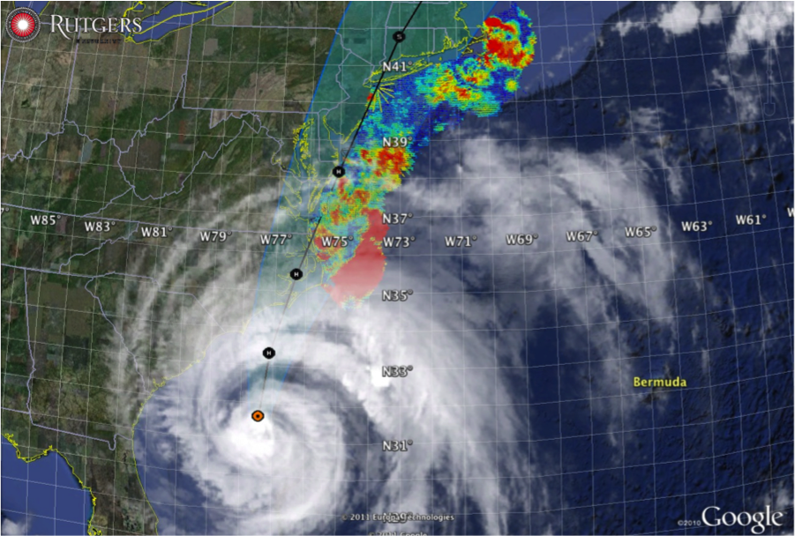
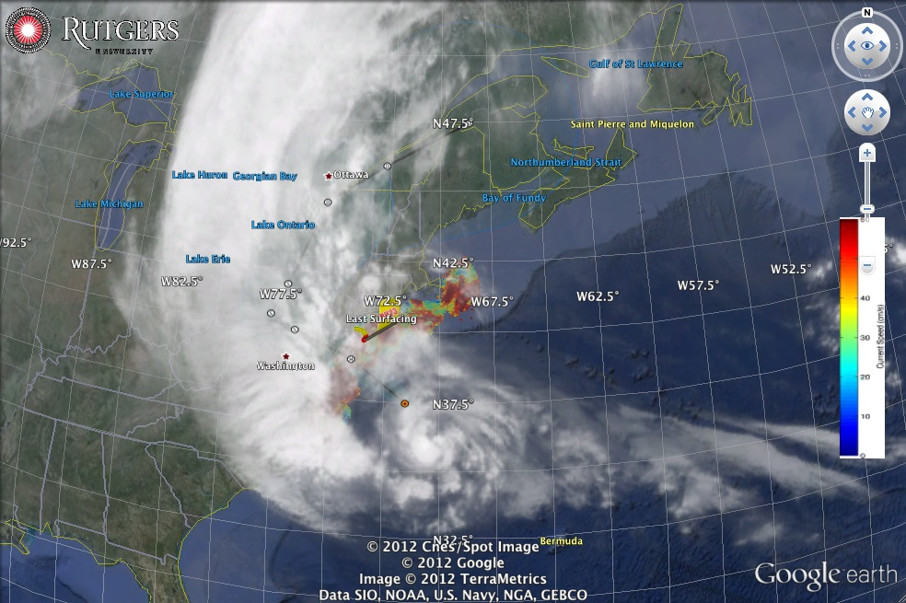
Hurricane Irene
August 28, 2011
NOAA/NHC Damage:
>$16 Billion.
Track Accurate;
Intensity Over-predicted.
Avila & Cangialosi, 2012, Tropical Cyclone Report
Hurricane Sandy
October 29, 2012
NOAA/NHC Damage:
>$68 Billion.
Track Accurate;
Surge Under-predicted.
Georgas et al., 2014, J. of Extr. Even.
Colle et al., 2015, J. Mar. Sci. & Engr.

Slide 25
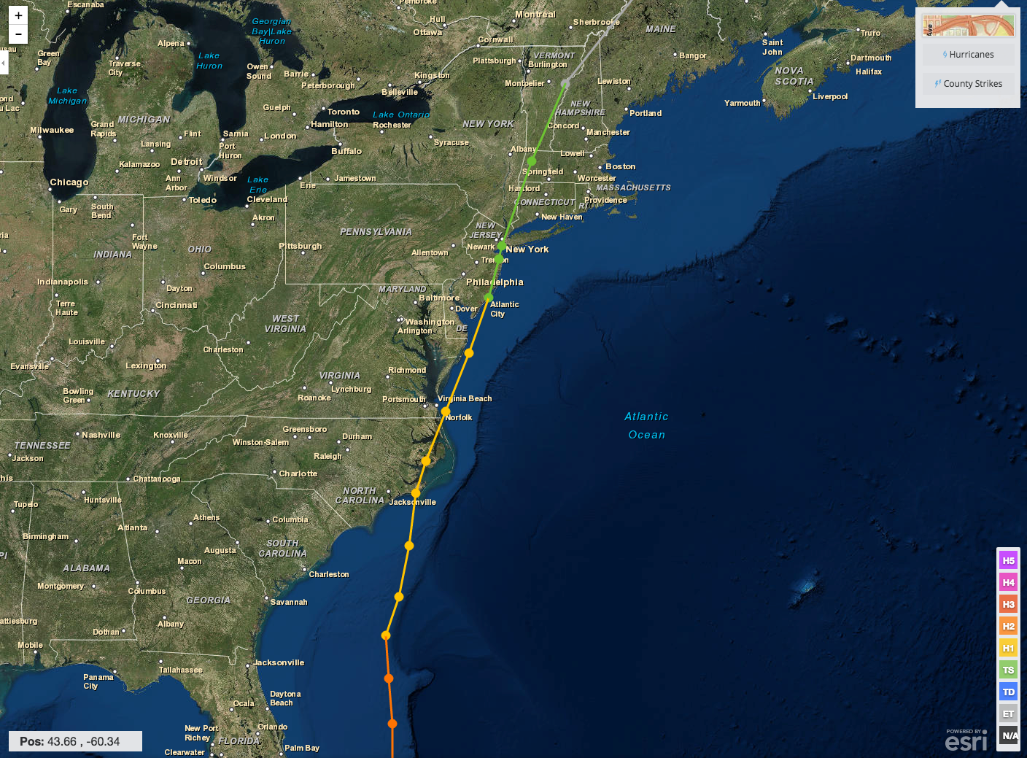
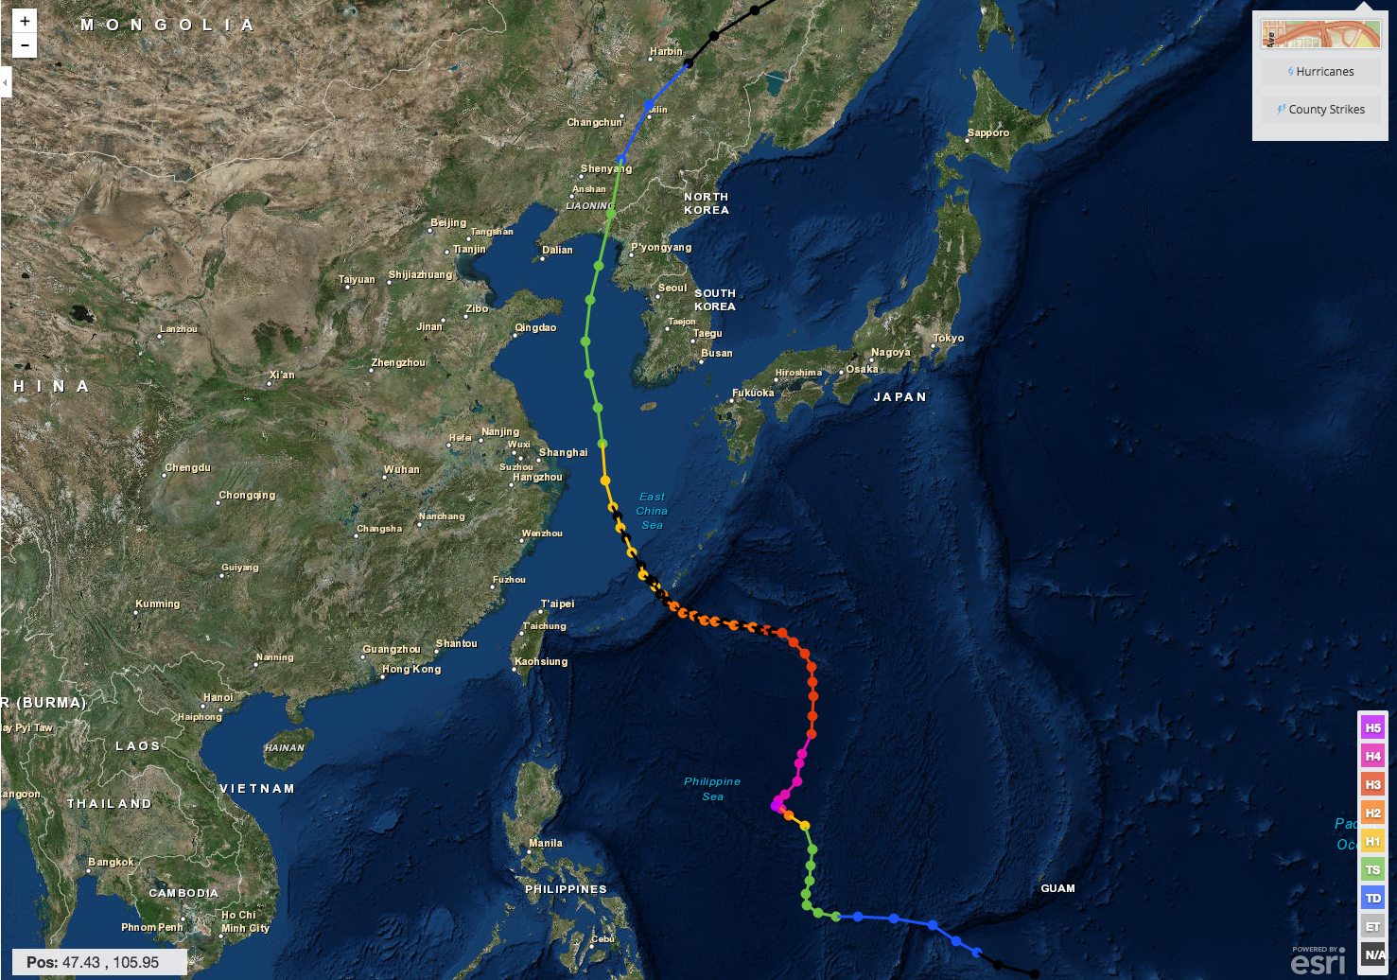
Hurricane Irene & Super-Typhoon Muifa:
What do these summer of 2011 storms have in common?
Track was accurate, Intensity was over-predicted
Hurricane Irene
26-29 August 2011
Super-Typhoon Muifa
26 July - 9 August 2011

Slide 26
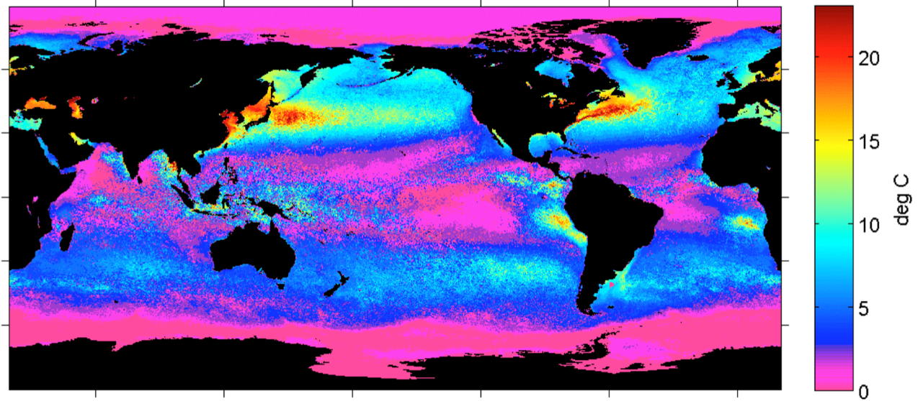
Earth’s northern mid-latitude sea surface temperatures (SSTs) undergo large seasonal cycles
Summer-Winter SST Difference (1995-2005)
Schofield et al. 1998
Ramya Ramadurai, 2009
Notes:
Earth’s northern mid-latitudes undergo large seasonal cycles, not only in the atmosphere but also in the ocean.
Within the ocean, this seasonal cycle is especially pronounced over the western continental boundaries often characterized by broad continental shelves and proximity to coastal population centers [Schofield et al., 2008].
Figure 1. Global ocean temperature contrast between winter and summer months, which were designated based on the mean seasonal temperatures
measured with the AVHRR satellite. Data were taken between 1995 and 2005. The grey shades on the land masses indicate human
populations (dark grey = high human populations).

Slide 27


Essential Ocean Feature - Mid-Atlantic’s Cold Pool
An unseen cold bottom layer beneath a warm summer surface layer
Mid Atlantic
Winter (1-layer)
Mid Atlantic
Summer (2-layers)
Cold Pool
Satellite SST
Assimilated into Regional
Ocean Models
Glider Zig-Zags
or Triangles
Bottom Temperature
To characterize the Cold Pool, we need ocean observations that are “fit for purpose”

Slide 28

Essential Ocean Feature - Mid-Atlantic’s Cold Pool
An unseen cold bottom layer beneath a warm summer surface layer
Mid Atlantic
Winter (1-layer)
Mid Atlantic
Summer (2-layers)
Cold Pool
Mid- Atlantic’s Cold Pool
Yellow Sea’s Cold Bottom Water Mass
Cold Bottom Water Mass
Yellow Sea
Summer
Yellow Sea
Summer
Cold Bottom Water Mass
Why unseen? Satellites cannot see below surface, Argo Floats do not extend into shallow water

Slide 29





Pre-Irene
Post-Irene
Difference
11C max Cooling
WHAT?
Satellite
SST
WHEN? Glider Temperature
WHY?
HF Radar
Currents
Eye Passage
Essential Ocean Processes:
Ahead of eye center – Vertical Shear > Mixing > Cooling

Slide 30



Summer Tropical Cyclones Tracks over the Continental Shelf
26 Typhoons since 1985
11 Hurricanes since 1985

Slide 31


Hurricanes Crossing the MAB in Stratified Season
Observed Ahead-of-Eye-Center Cooling (NDBC)
Super-Typhoons crossing the Yellow Sea in Stratified Season
Observed Ahead-of-Eye-Center Cooling (Fei Yu & Yi Xu)

Slide 32







WRF Atmospheric Forecast Sensitivity Study – >130 tests
Warm Ocean
Boundary Condition
Cat 1 Hurricane
Tropical Storm
Cold Ocean
Boundary Condition
IMPACT?
>10 knots reduction in peak wind speed

Slide 33

Hurricane Irene –
WRF Model Sensitivity Study
Over 130 model runs
Paired to compare sensitivities
Central pressure & max wind
Sensitivity to SST greatest
Monthly Weather Review (2016)
Notes:
This shows that, for the first time in 30 years there is the potential to dramatically increase forecast intensity at landfall, by including

Slide 34

Hurricane Irene
Direct Wind Forcing
Inertial Response

Slide 35

Mixed Layer Depth from HF radar
(Pollard and Millard, 1974; Cliff Watkins, Ph.D. Thesis)
Hurricane Irene:
P&M 1974: Simple model uses mixed layer depth & wind to predict inertial amplitude
CW 2018: Invert model to use forecast wind & HF Radar inertial amplitude to predict mixed layer depth

Slide 36

New Scientific Understanding:
Two types of coastal ocean response
to Mid Atlantic hurricanes discovered
The essential ocean features are
  Seasonally warmed surface water
  Persistent Cold Pool bottom water.
The essential ocean processes are
  (a) ahead-of-eye mixing/cooling
  (b)
The essential ocean impacts on the atmosphere are
  (a) ocean mixing/cooling reduces storm intensity - Irene
  (b)
+ Monthly Weather Review (2016)
+ JGR-Oceans (2017)
+ JGR-Oceans (2017)

Slide 37
NOAA Historical Hurricane Tracks: 1851 - previous season
Upper Ocean Heat Content modulates Hurricane Intensity

Slide 38





Slide 39


WMO/IOC JCOMM Global HF Radar Network
MARACOOS
> IOOS > GOOS
I
IOCARIBE
> GOOS
http://global-hfradar.org/

Slide 40

CODAR SeaSondes in the Gulf of Mexico: Existing

Slide 41

CODAR SeaSondes in the Gulf of Mexico: Existing+Proposed
La Havana
Cabo San Antonio

Slide 42

Typhoon and Tropical Cyclone Tracks: Asia-Pacific Region

Slide 43

WMO/IOC JCOMM Global HF Radar Network:
Asia-Pacific Region

Slide 44



http://orca2018.official.jp/
Program
Surface Currents, HF Radar Networks, Antenna Distortion, Doppler Spectra, Surface Waves, Tsunami and Data Sharing

Slide 45

Intergovernmental
Oceanographic
Commission (IOC):
“2nd Ocean Decade”
Planning Phase
2018-2021
The Ocean we need for the Future we want:
Enhancing sustainable use of ocean and marine resources
Expanding use of knowledge about the ocean conditions
Supporting the development of the ocean economy
Sustainable management of coastal ecosystems
Increasing scientific knowledge
Achieving integrated observations and data sharing - GOOS
Thank
You

