Slide 1
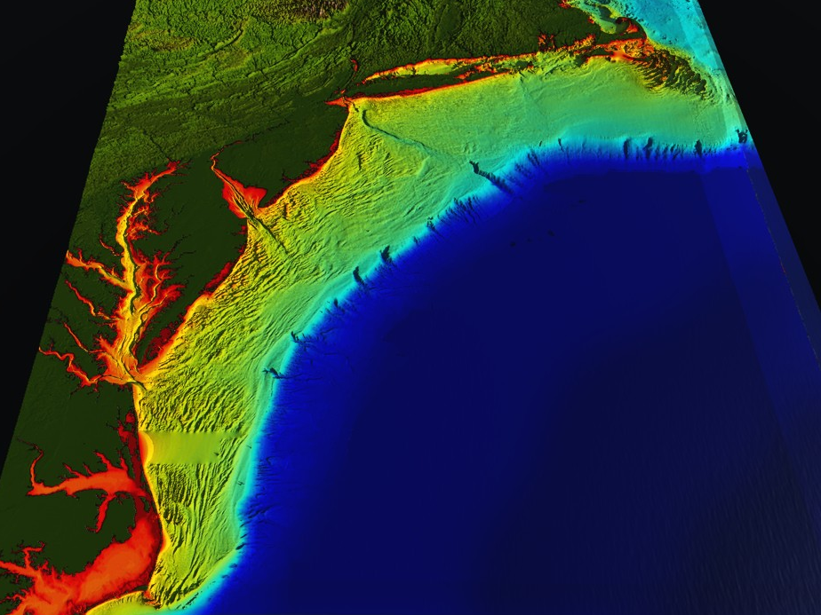
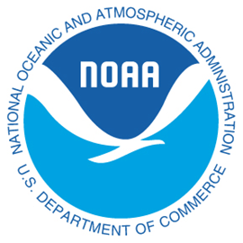




Mid-Atlantic Bight (1000 km Cape to Cape)
78 Million People (1/4 of U.S.)
Cape
Cod
U..
Integrated
Ocean-Atmosphere Observing and Forecasting
Sandy
Irene + 10
Jose
Scott Glenn, Travis Miles,
Oscar Schofield, Grace Saba,
Josh Kohut, Joe Brodie,
Hugh Roarty, Mike Crowley
Cliff Watkins, Greg Seroka
(Rutgers)
+ Many More
Hurricanes
Cape
Hatteras
Notes:
1

Slide 2







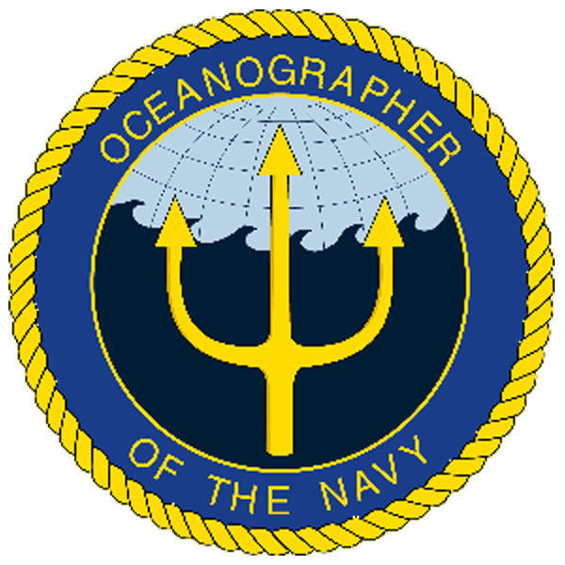
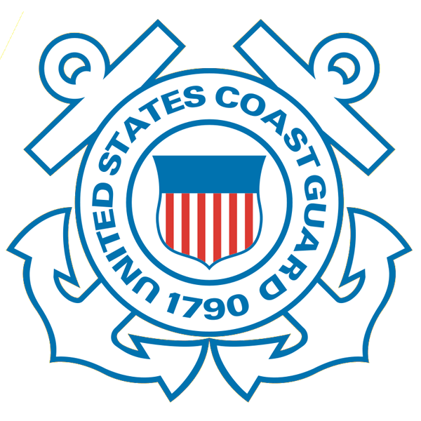









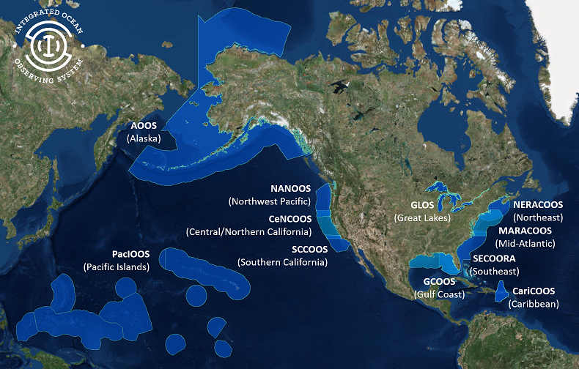
U.S. Integrated Oean Observing System (IOOS)
Partnership effort that leverages dispersed national investments to deliver ocean, coastal and Great Lakes data relevant to decision-makers.
  Global Component
  US contribution to Global Ocean Observing System (GOOS)
  1 of 15 Regional Alliances of GOOS
  National Component
  17 Federal agencies
Regional Component
  11 Regional Associations
    Stakeholder driven
    Academia, state/local/tribal government, private industry
Notes:
NOAA is the Lead Federal Agency
US IOOS program office is within NOAA, but intended to be a multi agency network and federal to non-federal so we use the term U.S. IOOS.
Additional Background:
US IOOS is a national endeavor and spans from global to coastal, with federal and non-federal partners. The majority of non-federal partners are represented by 11 Regional Associations (RAs) that represent the US EEZ and Great Lakes.

Slide 3
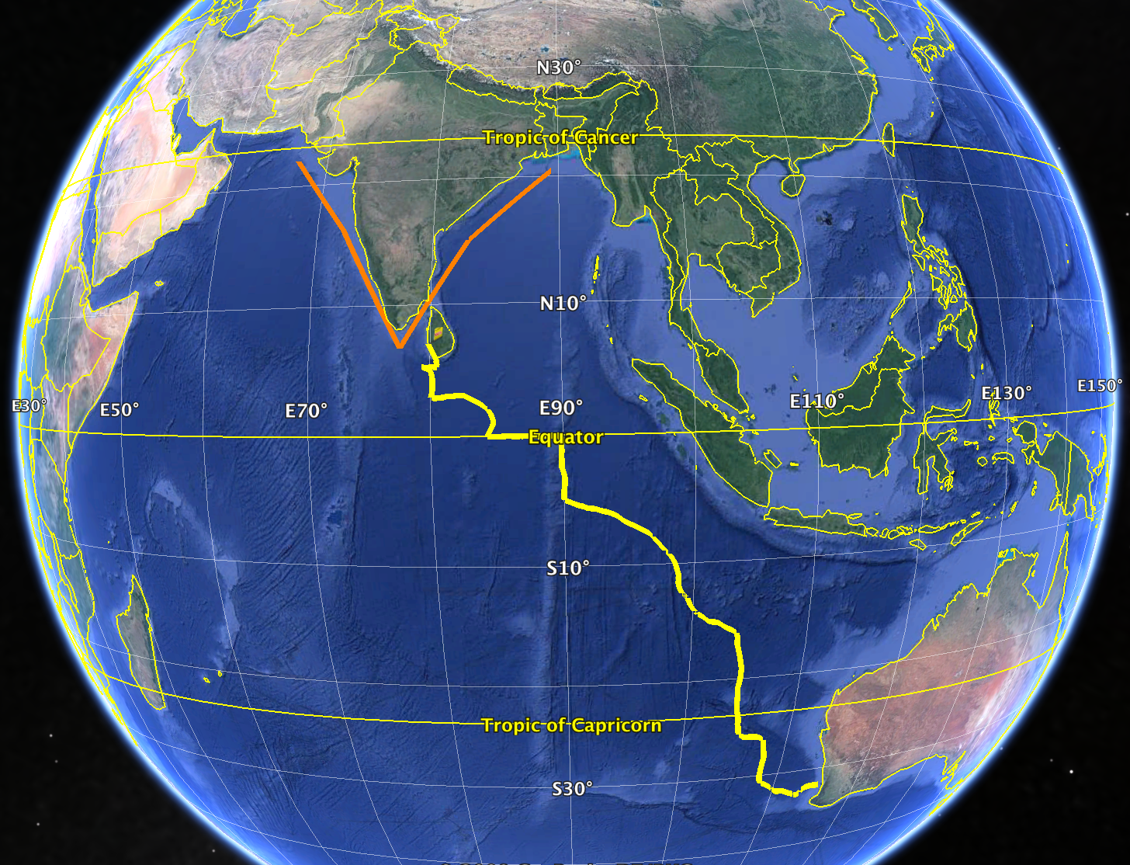
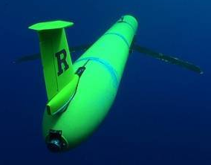


Many Nations with Similar Regional, National and International Interests
2000 km
2000 km

Slide 4
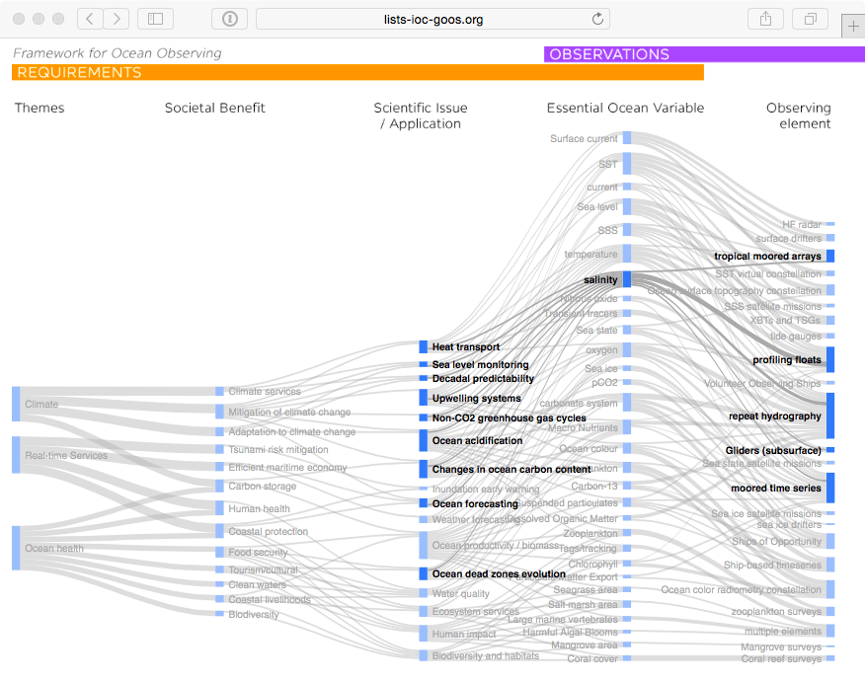

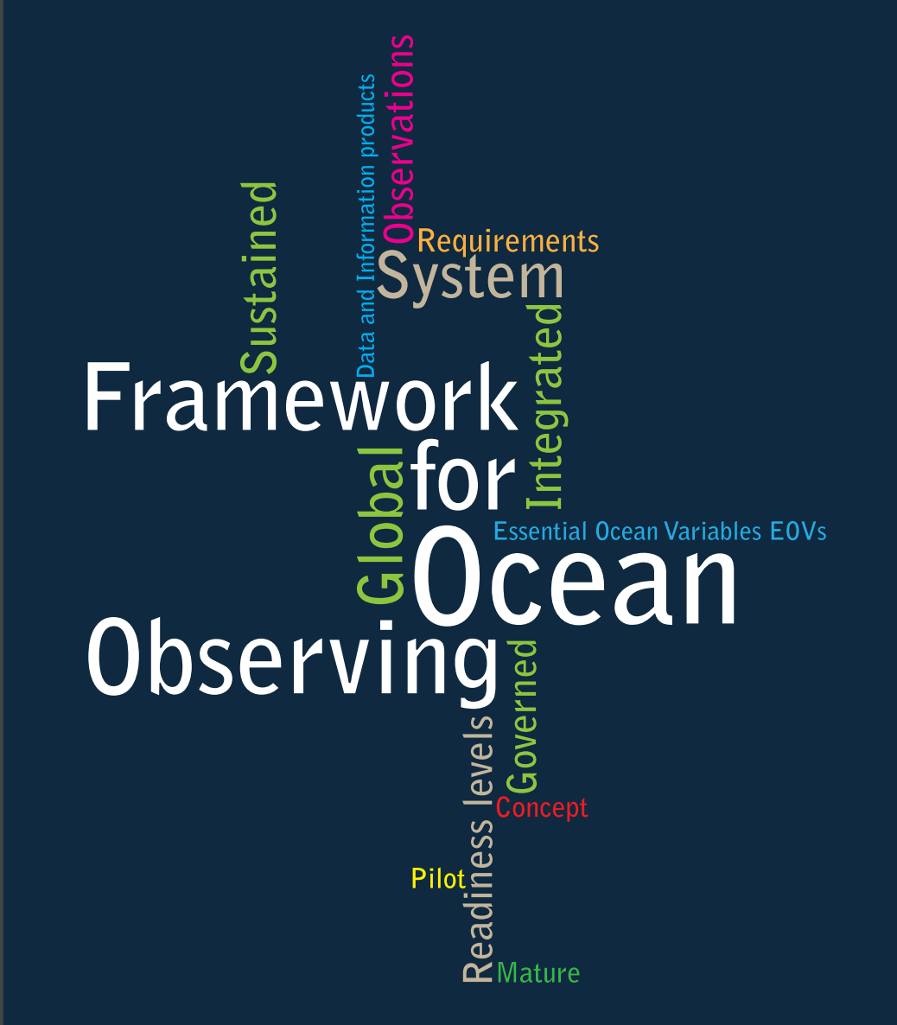

GOOS Strategic Mapping
New GOOS
Observing Elements:
1) HF Radar
2) OceanGliders
Notes:
This activity will allow us to improve a Strategic Mapping of GOOS, which is shown here linking the three major societal drivers of GOOS: climate, services, and ocean health; with the societal benefits informed by sustained ocean data; the scientific issue, application, or product needed; the Essential Ocean Variable we need to capture; and the type of observing element contributing to the measure of these variables.
We can track how any particular observing platform measures a number of variables, feeding products and applications that deliver societal benefit.
A major message from this complicated diagram is that there are many interconnections. Many observations have multiple lifetimes – multiple uses. With growing sensor capability we are increasingly building an integrated observing system. And there is a tremendous needs for the coordination activities that make this system as efficient and effective as possible.
Behind each of the nodes in this mapping that we continue to build is a specification sheet with additional information on the global groups and standards and best practices information.
Each GOOS Regional Alliance or national effort will have its own variant of this mapping, based on local priorities and capacities.

Slide 5
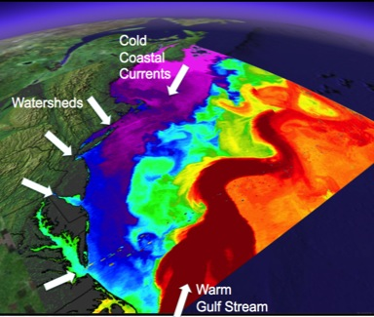
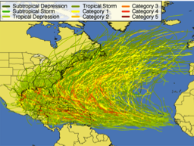
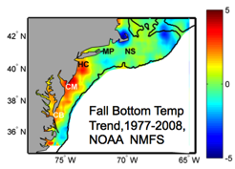
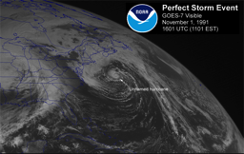
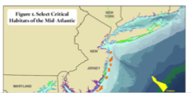
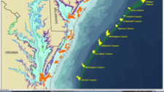
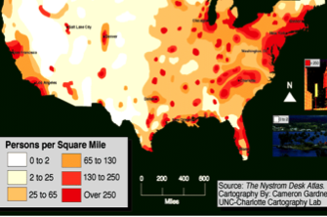
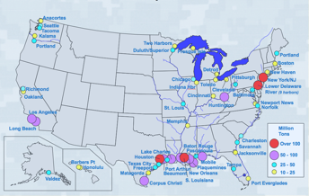
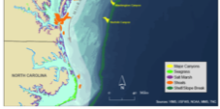
Mid-Atlantic Regional Drivers for Society & Economy
Tropical Storms
Climate Change
Ocean Circulation
Critical Habitat
Northeasters
Ports
Population

Slide 6
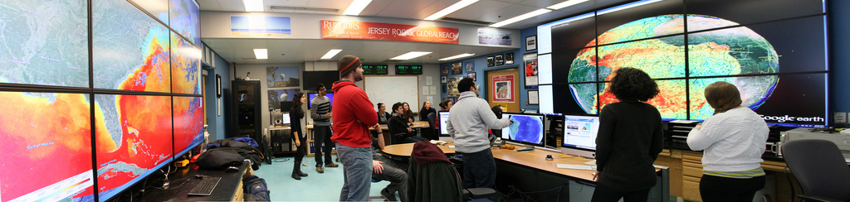
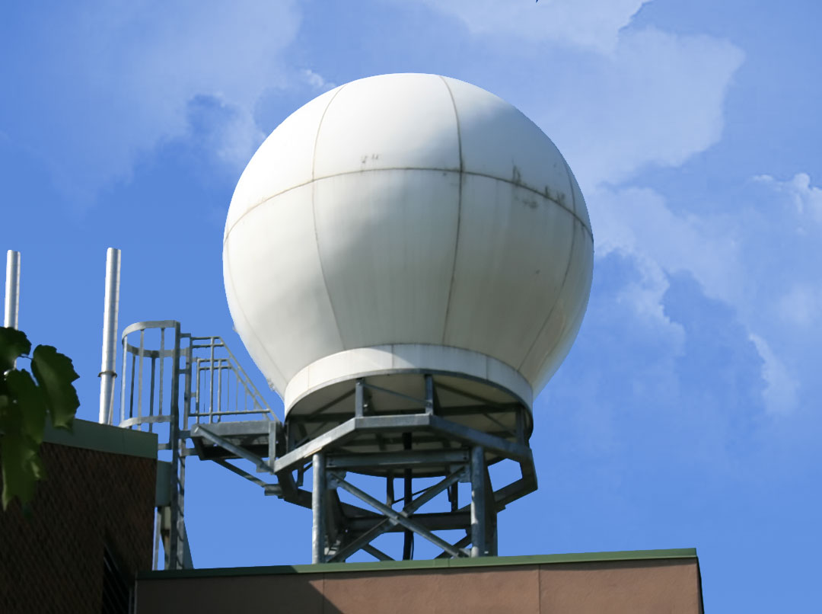
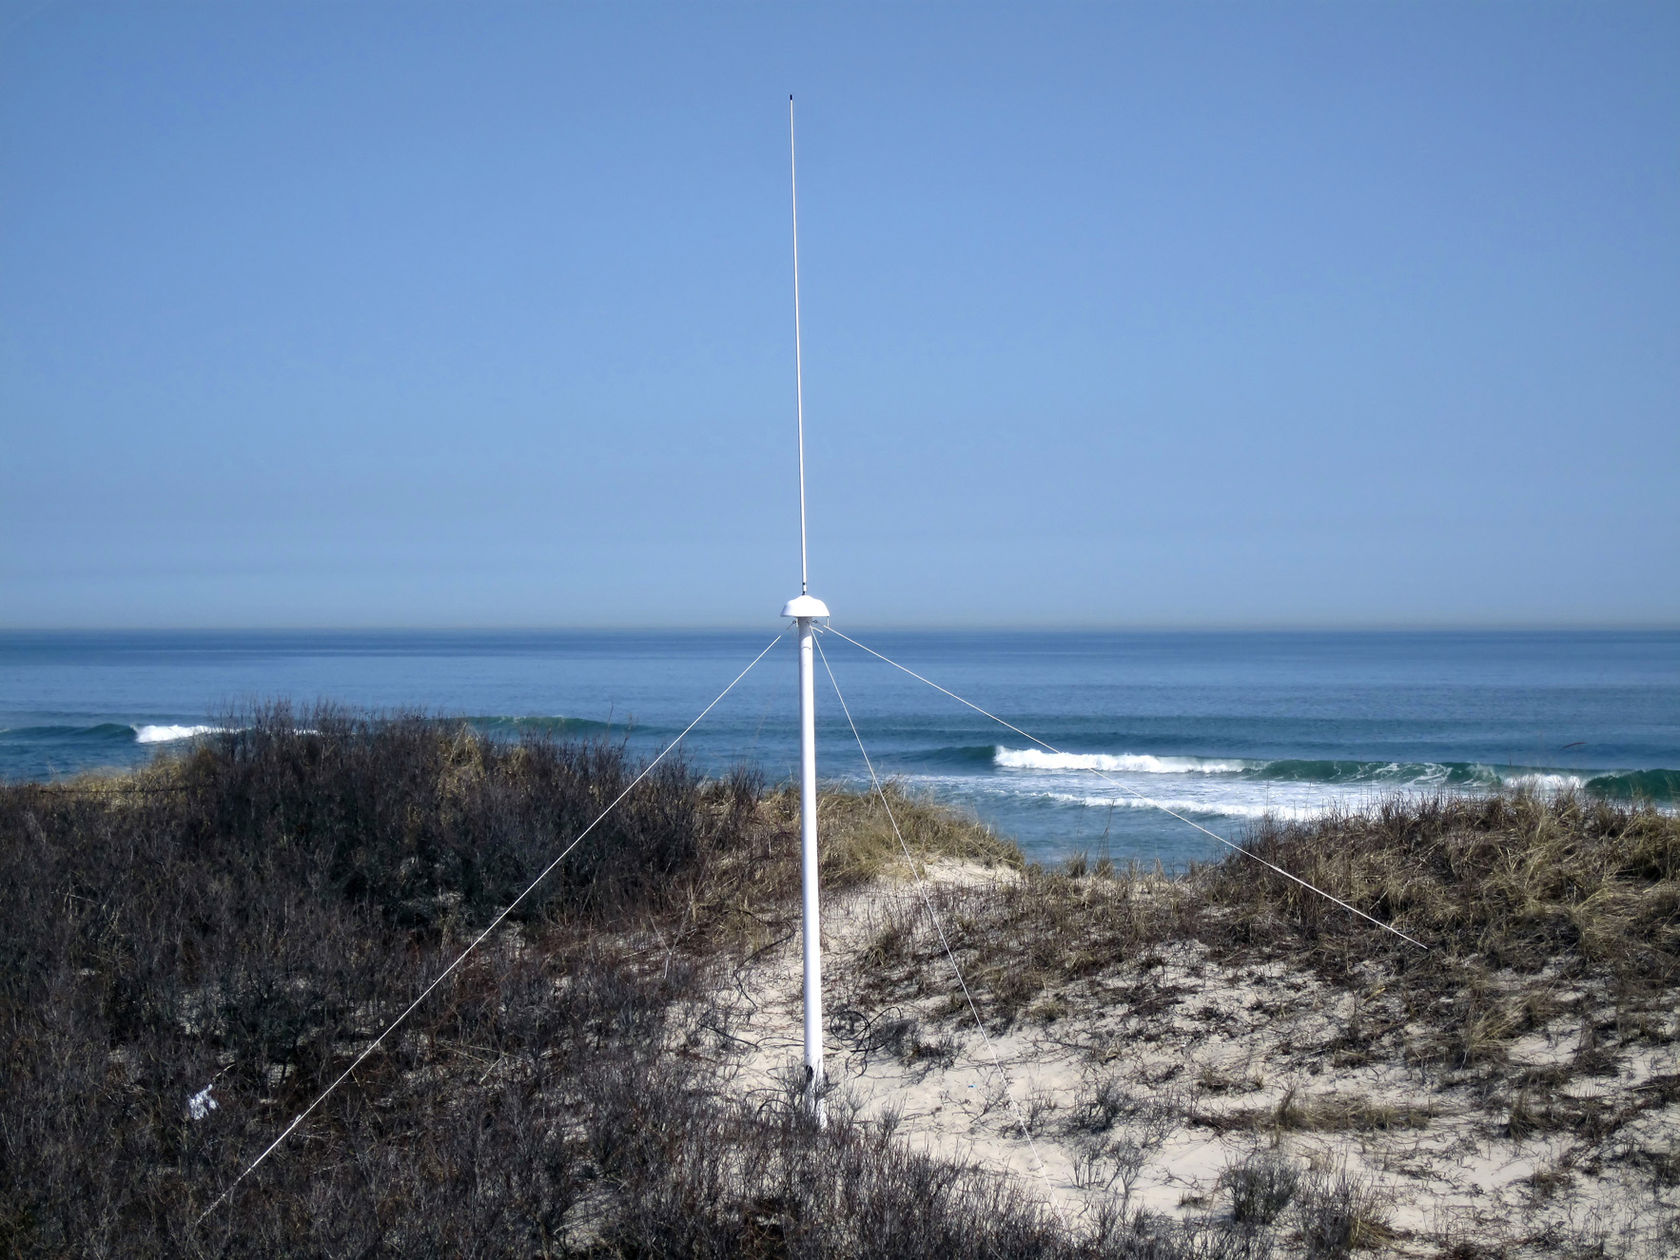
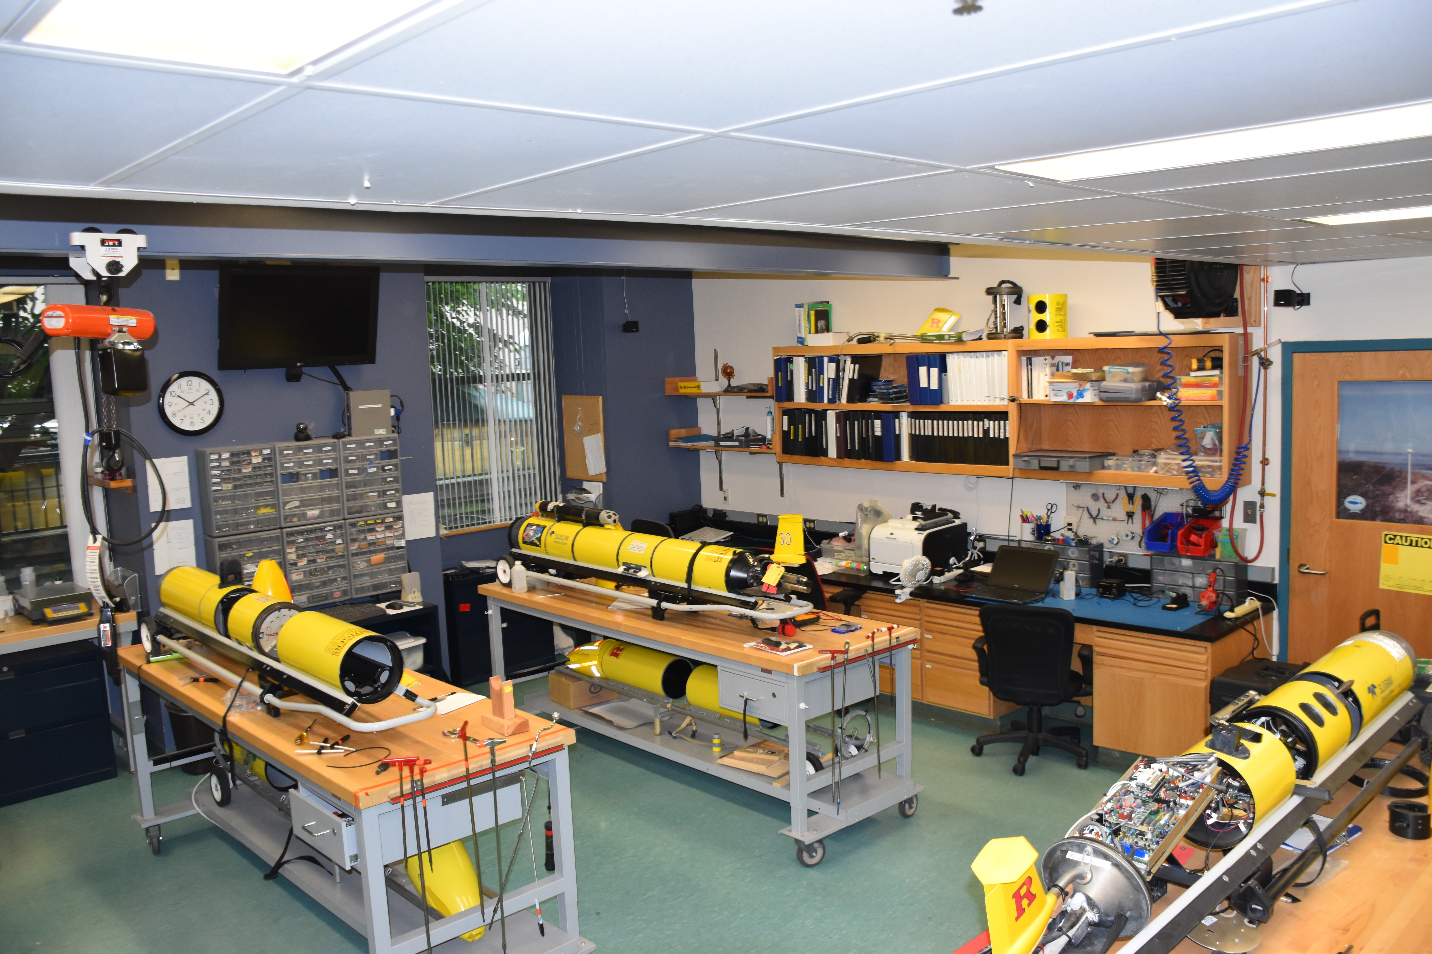
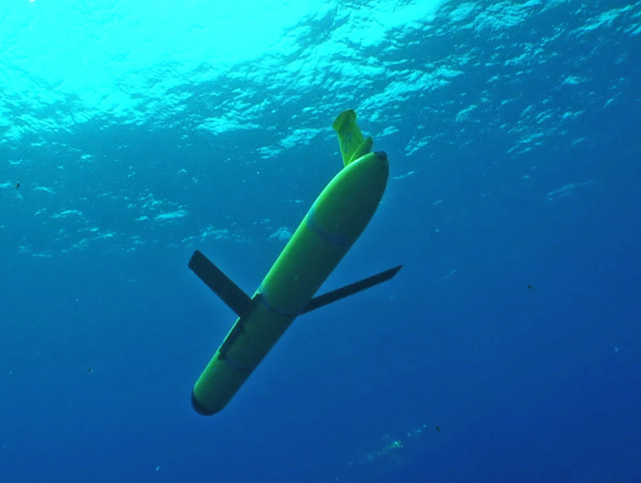
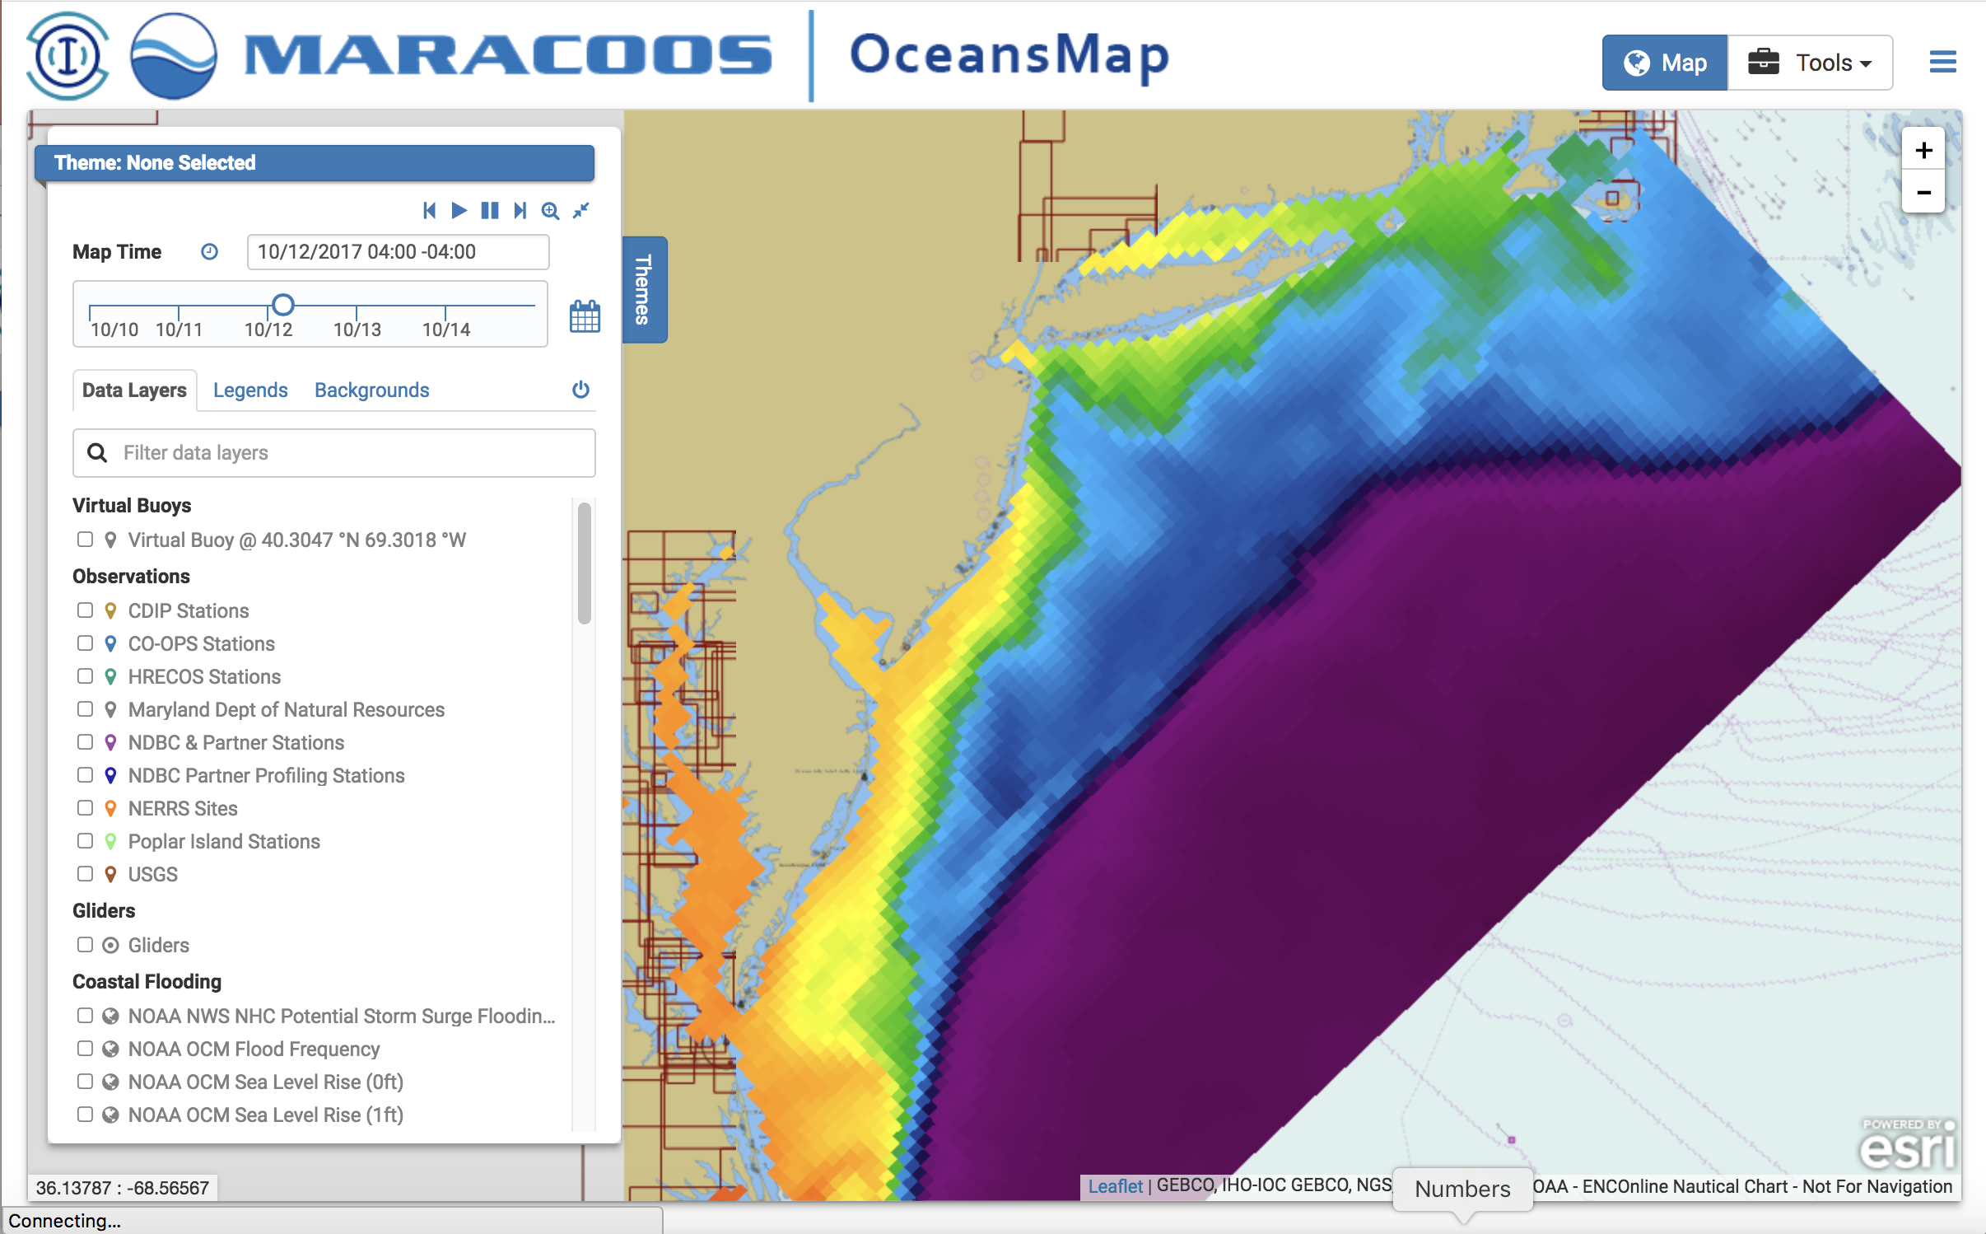
Rutgers University - Center for Ocean Observing Leadership
MARACOOS – A regional implementation of an integrated network
Satellite Receivers
46 Site CODAR Network
468 Glider
Deployments
Ocean
Modeling
Glider Lab
Notes:
6
All of this gets combined into our overall operations, research, and educational initiatives in the “COOL Room,” shown here (with a class in the background)
Thanks to many partners

Slide 7
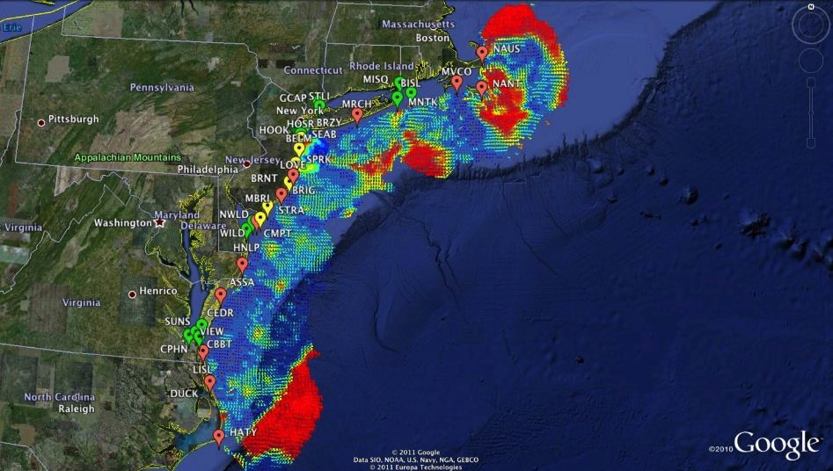

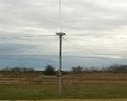
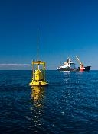
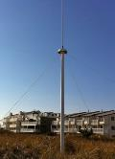

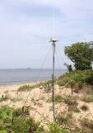









Mid-Atlantic Bight HF Radar Network
1000 km
Cape to Cape
Mid-Atlantic HF Radar Network
17 Long-Range CODARs
8 Medium-Range CODARs
16 Short-Range CODARs
41 Total CODARs in Region
+5 CODARs Roaming
46 Total CODARs
Triple Nested, Multi-static, Multi-use
Industry Partner: CODAR Ocean Sensors

Slide 8
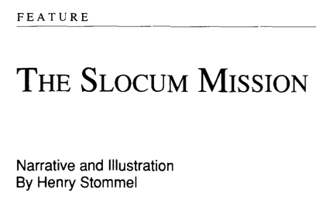
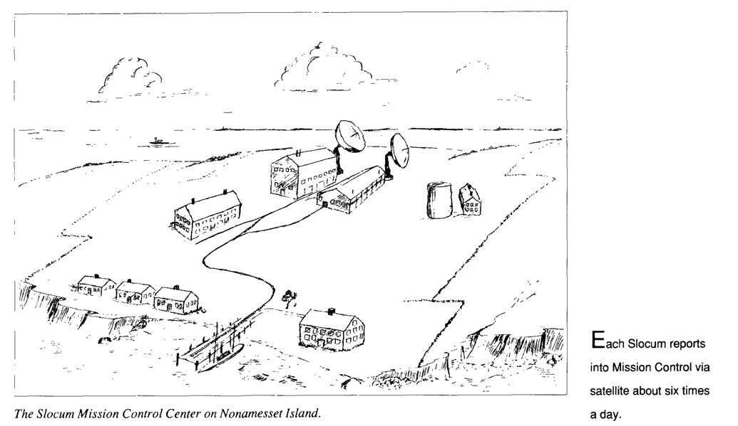
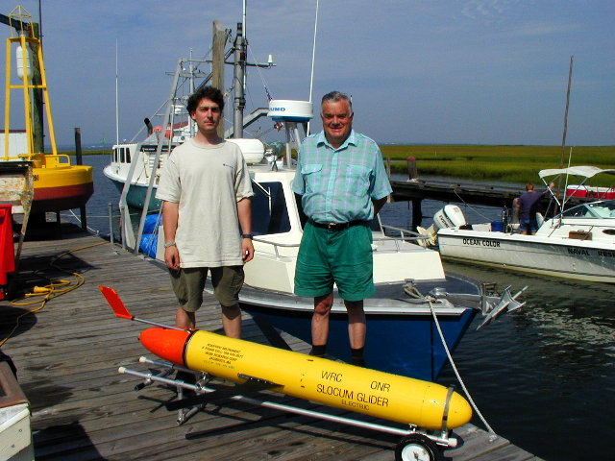
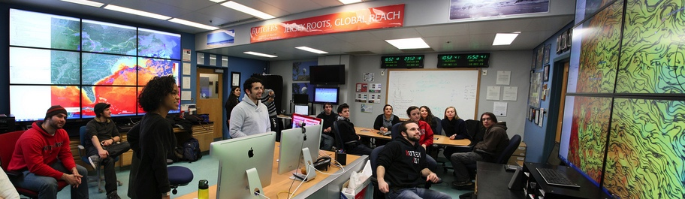
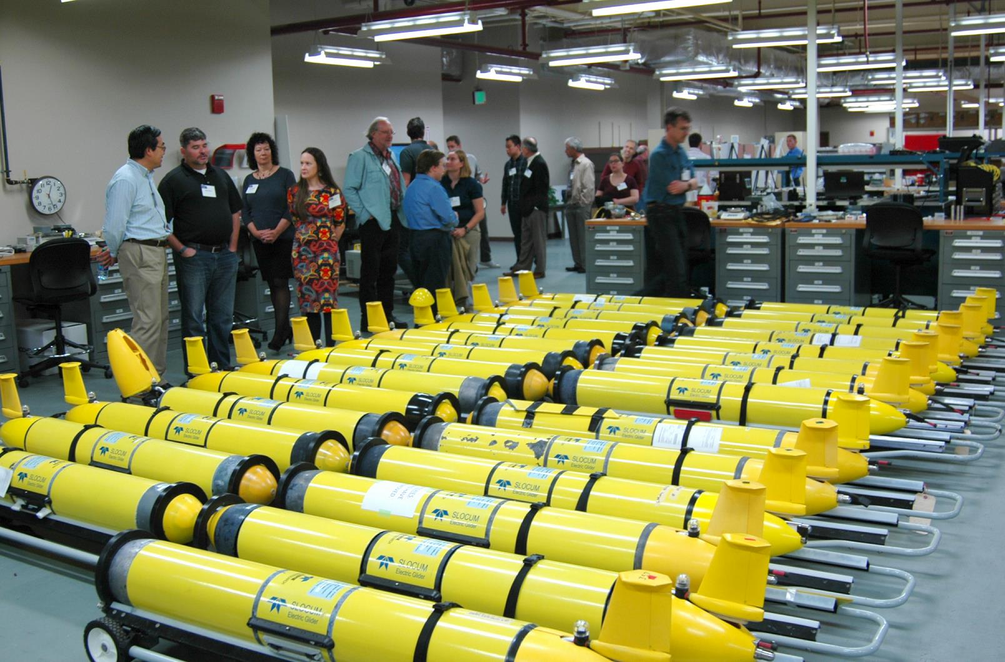
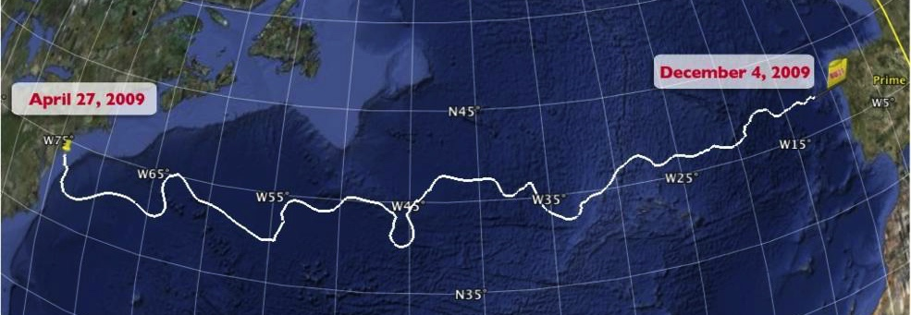

Technology Center for Slocum Robotic Underwater Gliders
1989 Science Fiction Article
1999
First Slocum deployed at Sea
2009 First Atlantic Crossing
2018 Navy Fleet grows >150
Notes:
Gliders from Teledyne Webb Research
First deployment: off the end of the dock, tied to a rope in case it didn’t come back.
The “Challenger” mission, which was largely student coordinated throughout the crossing
Currently circumnavigating the Indian Ocean
RU COOL now operates a fleet of 32 (33) gliders, making it the largest academic operator in the world

Slide 9
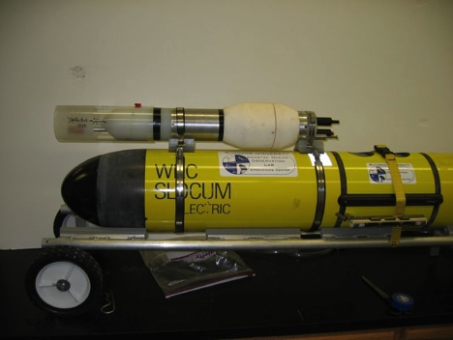
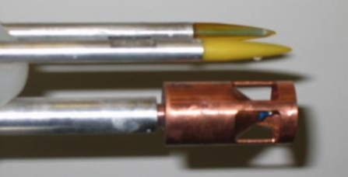
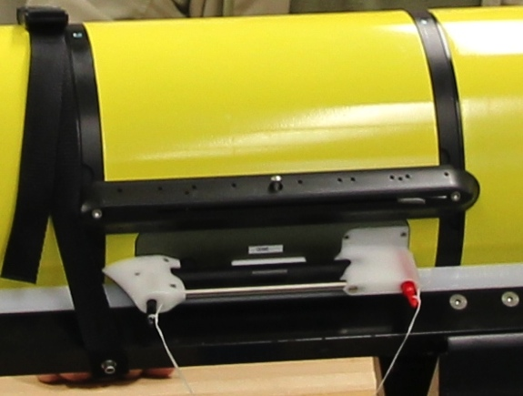
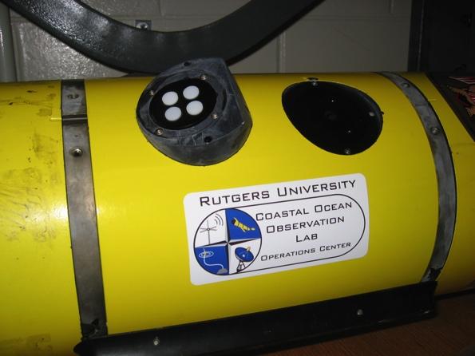
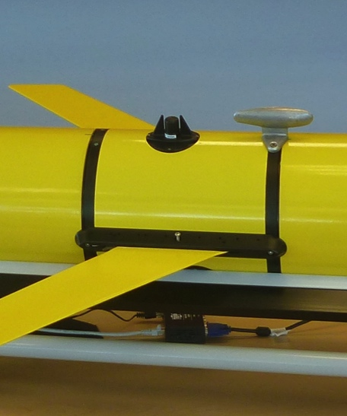
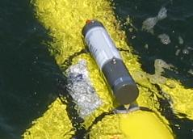
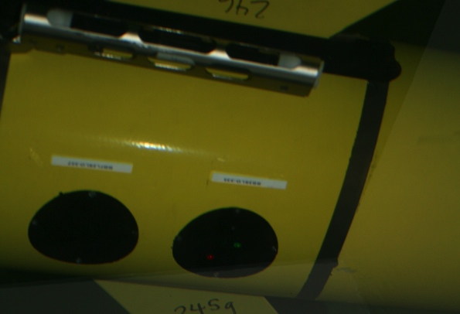
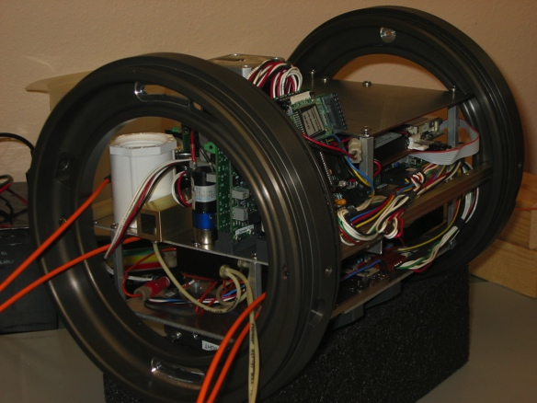
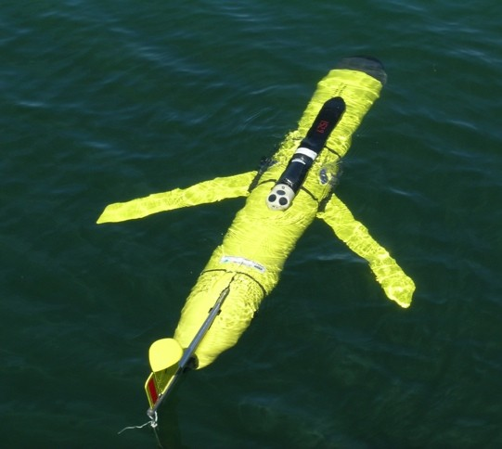
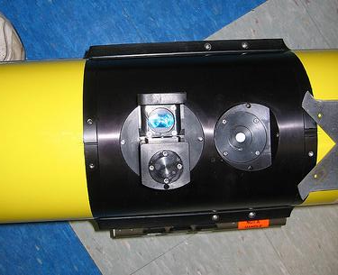
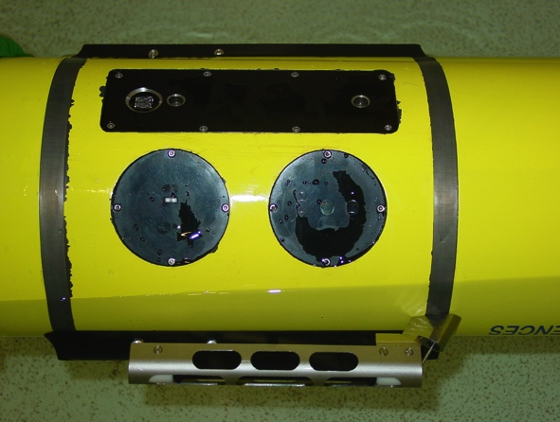

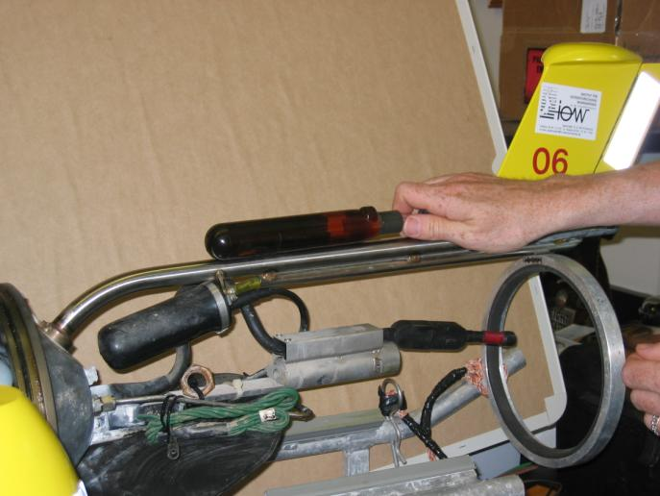
Glider Sensors
Inside Payload Bay or External

Slide 10






MARACOOS Integration Matrix
Integration Matrix: Capabilities Support Multiple Themes
Regional Priority Themes | Regional Observation & Modeling Capabilities
 | Weather Mesonet | HF Radar Network | Statistical STPS | Satellite Imagery | Glider Surveys | Dynamical Ocean Forecasts
Theme 1. Maritime Commerce & Safety | Operational Input to USCG SAROPS | Operational input to USCG SAROPS | Operational input to USCG SAROPS | SST for survivability planning | Assimilation dataset for forecast models | Surface currents for SAROPS
Theme 2. Fisheries | Weather forecast ensemble validation | Circulation and divergence maps for habitat |  | SST & Color for habitat | Subsurface T & S for habitat | 3-D fields of T, S, circulation for habitat
Theme 3. Public Health & Water Quality | Winds for transport, river plumes, & upwelling | Surface currents for floatables, bacteria, spill response | Surface currents for floatables, bacteria, spill response | Ocean color for river plumes | Nearshore dissolved oxygen surveys | Surface currents for floatables, bacteria, spill response
Theme 4. Coastal Flooding | Weather forecast ensemble validation | Assimilation dataset for forecast models |  | SSTs assimilation into forecast models | Assimilation dataset for forecast models | Nested forecast ensembles
Theme 5. Offshore Energy | Historical analysis & wind model validation | Historical current analysis & wind model validation |  | Historical analysis surface fronts & plumes for siting | Historical analysis of subsurface fronts & plumes | Coupled ocean-atmosphere models for resource estimates

Slide 11
MARACOOS Integration Matrix
Integration Matrix: Capabilities Support Multiple Themes
Regional Priority Themes | Regional Observation & Modeling Capabilities
 | Weather Mesonet | HF Radar Network | Statistical STPS | Satellite Imagery | Glider Surveys | Dynamical Ocean Forecasts
Theme 1. Maritime Commerce & Safety | Operational Input to USCG SAROPS | Operational input to USCG SAROPS | Operational input to USCG SAROPS | SST for survivability planning | Assimilation dataset for forecast models | Surface currents for SAROPS
Theme 2. Fisheries | Weather forecast ensemble validation | Circulation and divergence maps for habitat |  | SST & Color for habitat | Subsurface T & S for habitat | 3-D fields of T, S, circulation for habitat
Theme 3. Public Health & Water Quality | Winds for transport, river plumes, & upwelling | Surface currents for floatables, bacteria, spill response | Surface currents for floatables, bacteria, spill response | Ocean color for river plumes | Nearshore dissolved oxygen surveys | Surface currents for floatables, bacteria, spill response
Theme 4. Coastal Flooding | Weather forecast ensemble validation | Assimilation dataset for forecast models |  | SSTs assimilation into forecast models | Assimilation dataset for forecast models | Nested forecast ensembles
Theme 5. Offshore Energy | Historical analysis & wind model validation | Historical current analysis & wind model validation |  | Historical analysis surface fronts & plumes for siting | Historical analysis of subsurface fronts & plumes | Coupled ocean-atmosphere models for resource estimates

Slide 12
MARACOOS Integration Matrix
Integration Matrix: Capabilities Support Multiple Themes
Regional Priority Themes | Regional Observation & Modeling Capabilities
 | Weather Mesonet | HF Radar Network | Statistical STPS | Satellite Imagery | Glider Surveys | Dynamical Ocean Forecasts
Theme 1. Maritime Commerce & Safety | Operational Input to USCG SAROPS | Operational input to USCG SAROPS | Operational input to USCG SAROPS | SST for survivability planning | Assimilation dataset for forecast models | Surface currents for SAROPS
Theme 2. Fisheries | Weather forecast ensemble validation | Circulation and divergence maps for habitat |  | SST & Color for habitat | Subsurface T & S for habitat | 3-D fields of T, S, circulation for habitat
Theme 3. Public Health & Water Quality | Winds for transport, river plumes, & upwelling | Surface currents for floatables, bacteria, spill response | Surface currents for floatables, bacteria, spill response | Ocean color for river plumes | Nearshore dissolved oxygen surveys | Surface currents for floatables, bacteria, spill response
Theme 4. Coastal Flooding | Weather forecast ensemble validation | Assimilation dataset for forecast models |  | SSTs assimilation into forecast models | Assimilation dataset for forecast models | Nested forecast ensembles
Theme 5. Offshore Energy | Historical analysis & wind model validation | Historical current analysis & wind model validation |  | Historical analysis surface fronts & plumes for siting | Historical analysis of subsurface fronts & plumes | Coupled ocean-atmosphere models for resource estimates

Slide 13
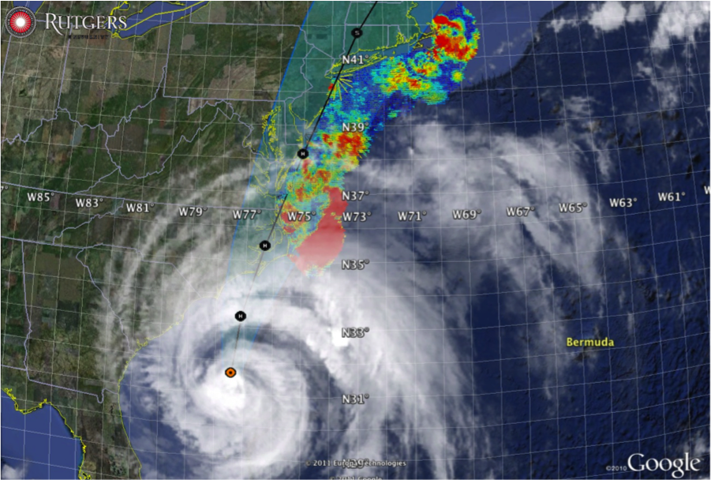
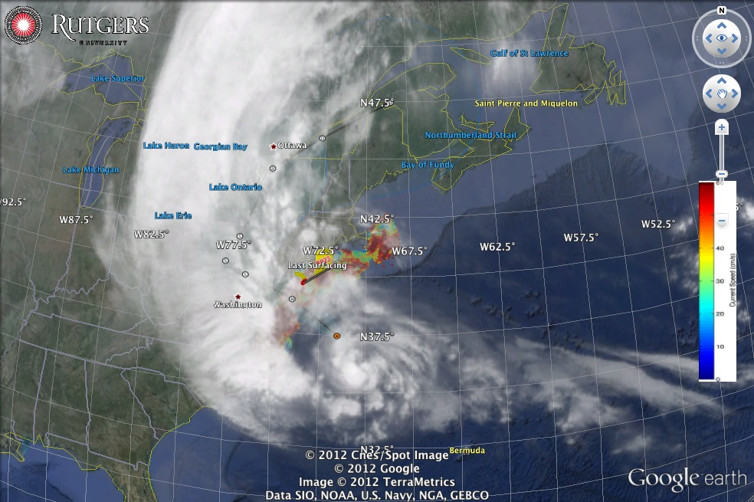
Hurricane Irene
August 28, 2011
NOAA/NHC Damage:
>$16 Billion.
Track Accurate;
Intensity Over-predicted.
Avila & Cangialosi, 2012, Tropical Cyclone Report
Hurricane Sandy
October 29, 2012
NOAA/NHC Damage:
>$68 Billion.
Track Accurate;
Surge Under-predicted.
Georgas et al., 2014, J. of Extr. Even.
Colle et al., 2015, J. Mar. Sci. & Engr.

Slide 14
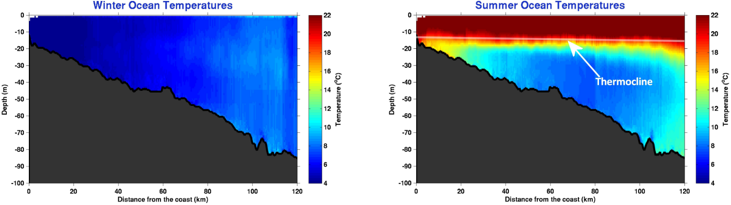

Essential Ocean Feature - Mid-Atlantic’s Cold Pool
An unseen cold bottom layer beneath a warm summer surface layer
Mid Atlantic
Winter (1-layer)
Mid Atlantic
Summer (2-layers)
Cold Pool
Satellite SST
Assimilated into Regional
Ocean Models
Glider Zig-Zags
or Triangles
Bottom Temperature
To characterize the Cold Pool, we need ocean observations that are “fit for purpose”

Slide 15





Pre-Irene
Post-Irene
Difference
11C max Cooling
WHAT?
Satellite
SST
WHEN? Glider Temperature
WHY?
HF Radar
Currents
Eye Passage
Essential Ocean Processes:
Ahead of eye center – Vertical Shear > Mixing > Cooling

Slide 16






WRF Atmospheric Forecast Sensitivity Study – >130 tests
Warm Ocean
Boundary Condition
Cat 1 Hurricane
Tropical Storm
Cold Ocean
Boundary Condition
IMPACT?
>10 knots reduction in peak wind speed

Slide 17
Irene Essential Ocean Process
Ahead of eye cooling also observed in:
10 MAB Hurricanes
1 Yellow Sea Typhoon
Glenn et al. 2016 Nature Communications
Hurricane Sandy
October 29, 2012
NOAA/NHC Damage:
>$68 Billion.
Track Accurate;
Surge Under-predicted.
Georgas et al., 2014, J. of Extr. Even.
Colle et al., 2015, J. Mar. Sci. & Engr.

Slide 18




Superstorm Sandy: 1 Day Before Landfall

Slide 19

Superstorm Sandy: 1 Day Before Landfall

Slide 20



Hurricane Sandy Potential Energy Anomaly
Well-mixed
Non-dimensional
PEA
Essential Ocean Process:
Ahead of eye center advection
Stratification Factor
PEA
Stratified

Slide 21

New Scientific Understanding:
Two types of coastal ocean response
to Mid Atlantic hurricanes discovered
The essential ocean feature is
  the Mid Atlantic Cold Pool.
The essential ocean processes are
  (a) ahead-of-eye cooling vs.
  (b) ahead-of-eye advection.
Including these essential ocean features and processes in the ocean component of coupled hurricane forecast models is essential for improving intensity forecasts for landfalling Mid Atlantic hurricanes.
For the 2018 hurricane season –
  Operational HWRF will use GOFS 3.0 + POM
  Experimental HWF will use GOFS 3.1
+ Monthly Weather Review (2016)
+ JGR-Oceans (2017)
+ JGR-Oceans (2017)

Slide 22




Navy Global Ocean Forecast System (GOFS):
Temperature below summer thermocline in 2017
Operational GOFS 3.0
OpTest of GOFS 3.1
No Cold Pool
Well Defined
Cold Pool
Nearly Isothermal Shelf
Two Thermal layers on Shelf

Slide 23


Project Title: Sustained ocean observations with underwater gliders in support of hurricane intensity forecasts (2019 and 2020)
Storm Glider Picket Lines

Slide 24

Integrated Ocean-Atmosphere Observation & Forecast systems:
  Provides a structure for shared investments in Society & the Economy
Operations > Research > Engagement > Operations Cycle
  Proven approach for enhancements & growth
Glider picket lines & improved oceans in coupled forecast models
  Improve hurricane and tropical cyclone forecasts - our Noble Goal
  Benefits multiplied through the Integration Matrix

