Slide 1
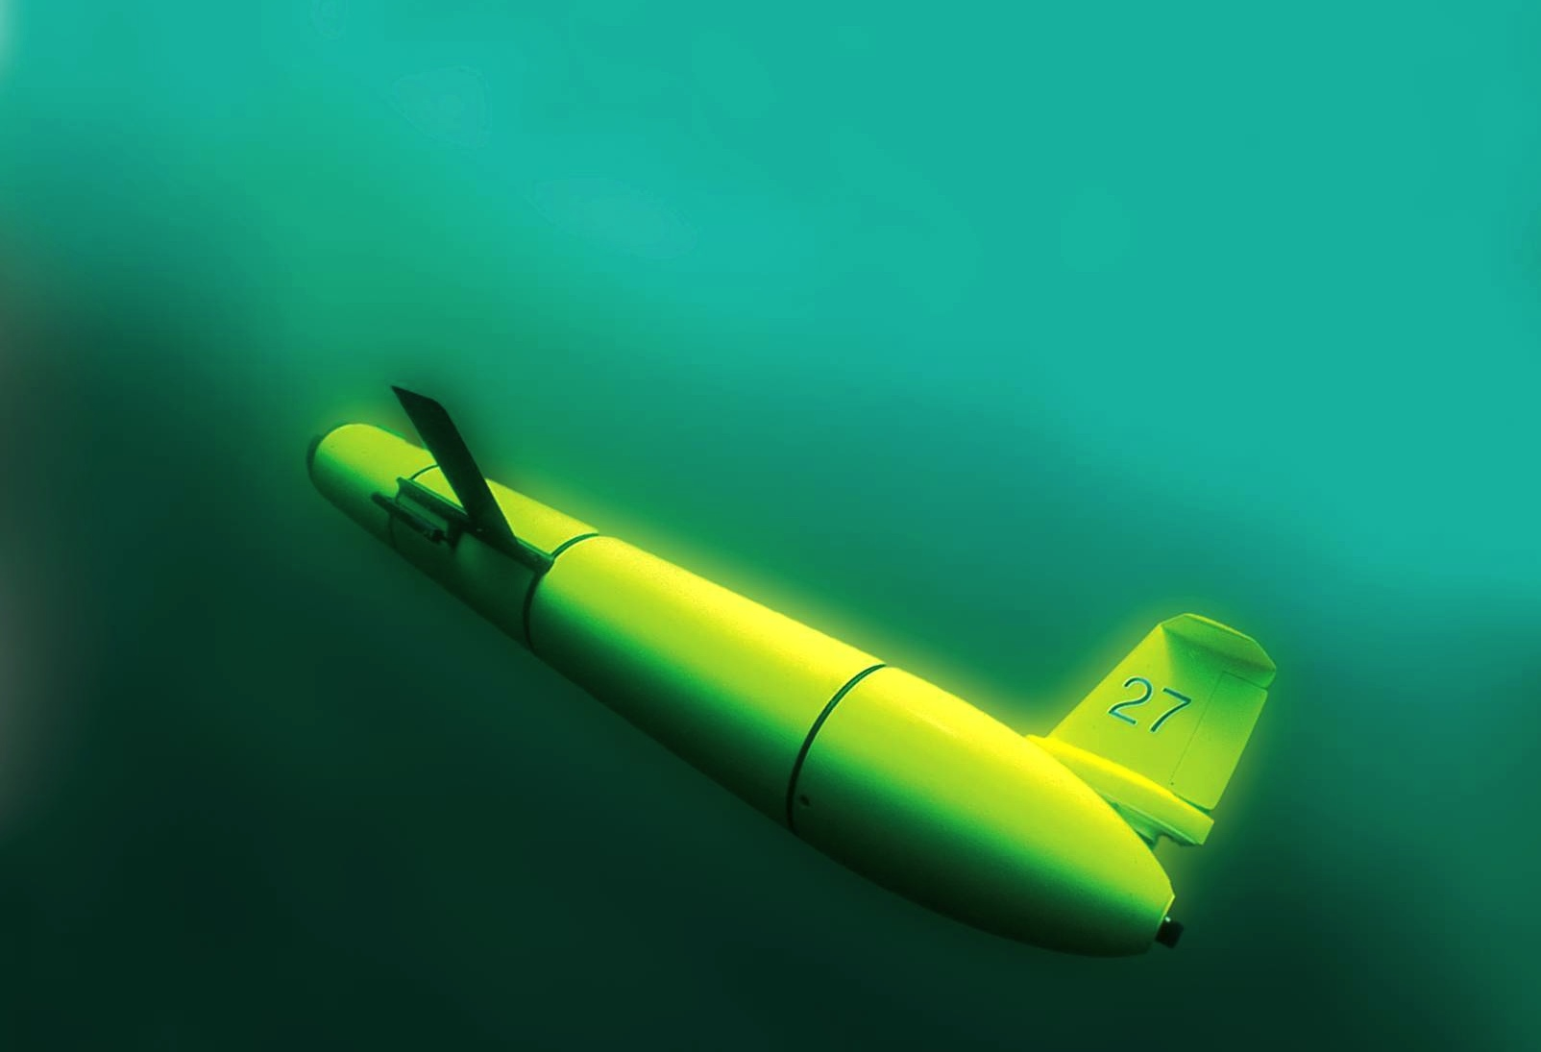
ROV, AUV & Manned Submersible Operations….
…. Well, maybe not so much on the Manned Submersibles…
Mike Crowley, Oscar Schofield, & Scott Glenn on behalf of many!!!
Take home messages
  We have new ways of doing oceanography
  Platforms are mature, we need sensors
  Sensor webs, no longer about one technology
  Educate the world!

Slide 2

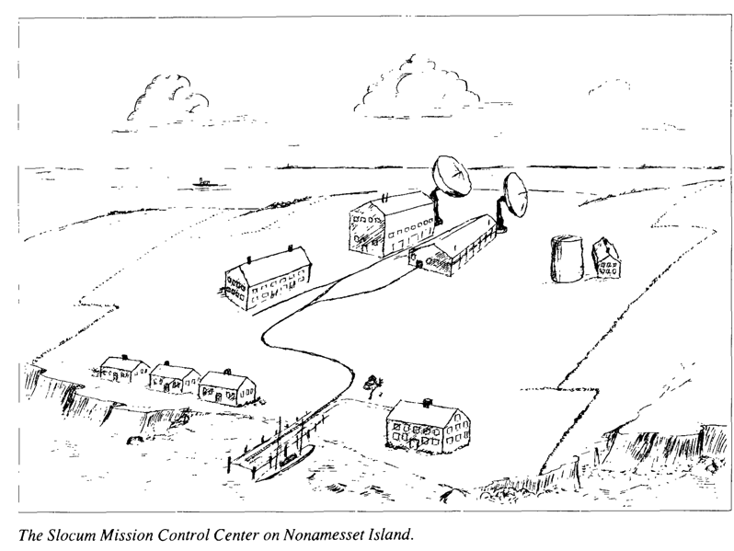
Oscar’s biased timeline on how much has changed in ocean robotics (people) that inspired him
Pliestocene
Late 1980’s
Early 1990’s
Early 2000’s
Early 2000’s
AOSN and LEO-15 alternating coastal experiments
Ray Smith measuring UV under ice with an ROV
Late 1990’s
Late 2000’s
Early 2000’s
Dad (JPL scientist)
built Osc a Star Trek consul
and watched bad TV
ARGO begins to be deployed
Stommel’s backyard neighbor Doug Webb realizes Henry’s vision
Stommel’s Bold Vision
In TOS
Chris von Alt & Jim Bellingham building AUVs
1989

Slide 3
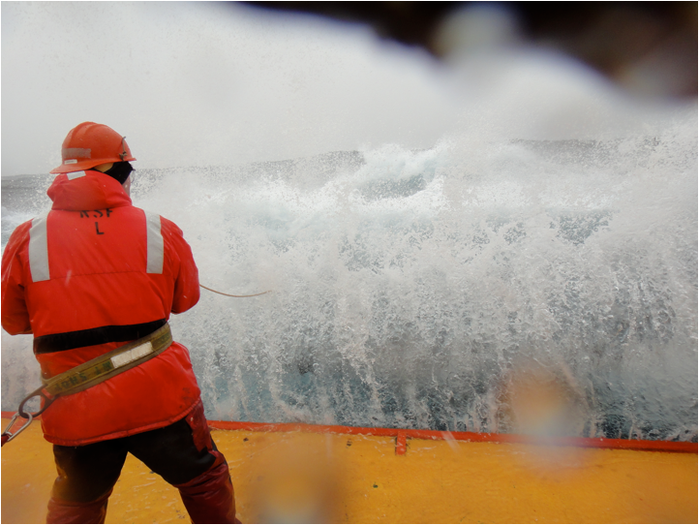
WHY?
-Humans at sea have limits
-Sustain a presence at sea

Slide 4
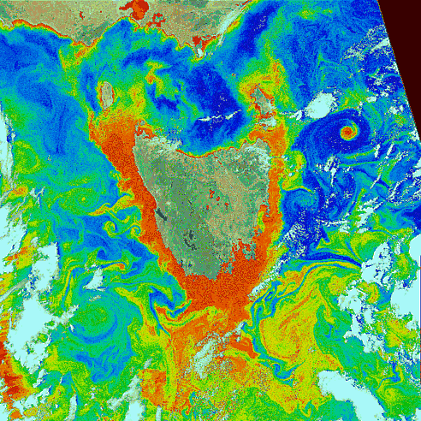
WHY?
-Sampling Space
-Cost Effective
GSFC, NASA (thanks Tommy Dickey)
Schofield et al. 2007
Sample this with a ship……..
Scalable technology……..

Slide 5
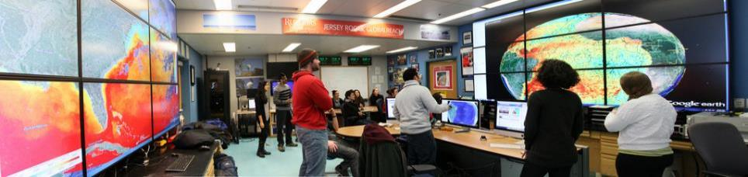
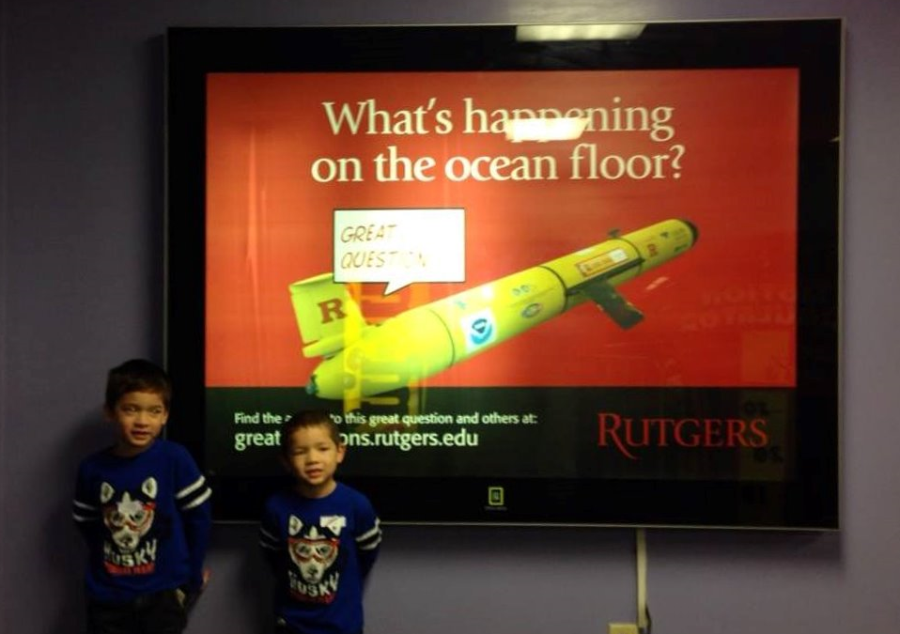
Why?
We have students
We have kids
In 2050, they will be 55-60 years old

Slide 6
The platforms
(aka cool underwater robots)

Slide 7
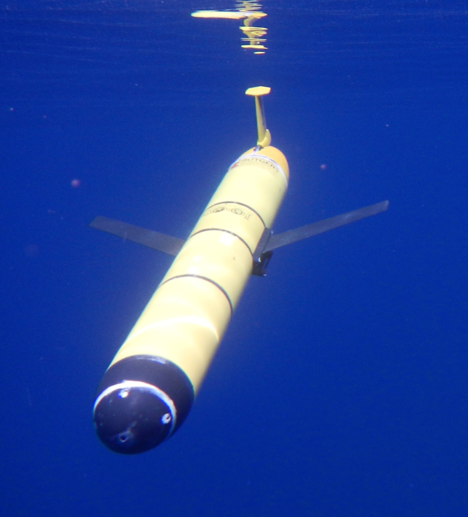
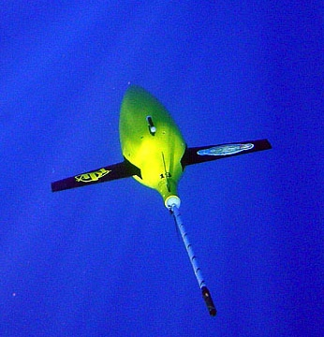
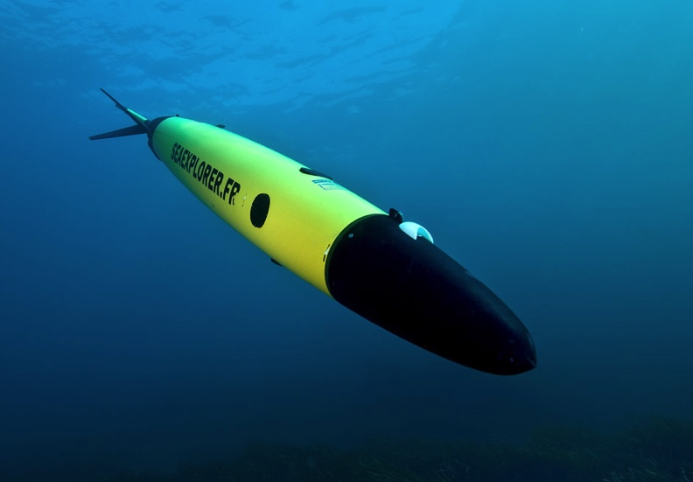
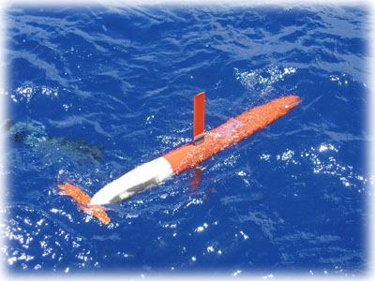
Robotics Revolution: Commercially Available Gliders
Slocum Glider
Seaglider
Seaexplorer
Glider
Spray Glider

Slide 8
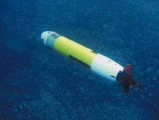
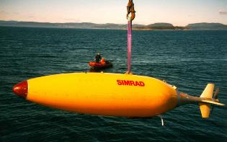
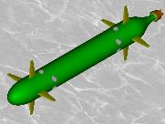
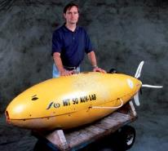
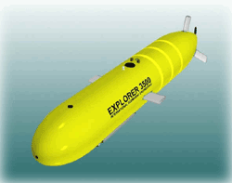
Propeller Systems Diverse highly varied and we can sample the ocean interior
Highly capable of studying boundary problems, high resolution sampling, and in general capable of collecting a wider range of data

Slide 9
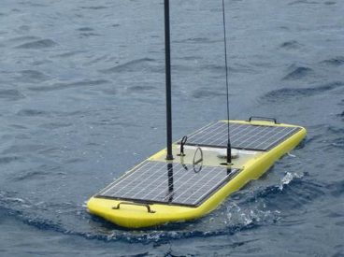
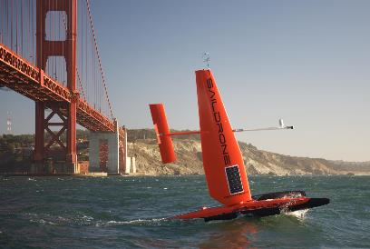
Surface vehicles rapidly maturing! We can sample the interface
Wave Glider
Sail Drone

Slide 10
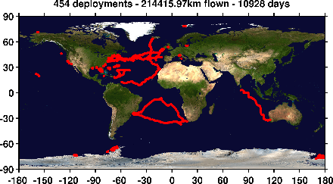
A small group can have a big footprint as the platforms are robust
Rutgers COOL deployments
As of August 9, 2017

Slide 11
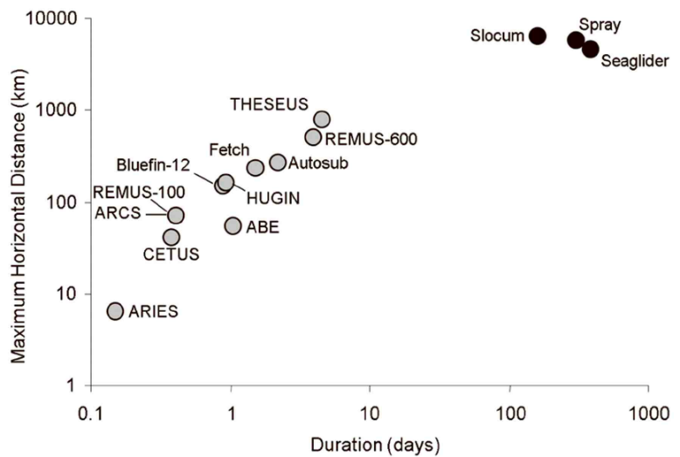
The basic differences between gliders and propeller driven AUVs
Waveglider
Moline & Schofield 2009
Moline et al. 2009
Moline et al. 2009
Moline et al. 2009
Moline et al. 2009

Slide 12
So the platforms are maturing.
What about the instruments?

Slide 13
Existing, In Development, Future Instrumentation
Notes:
Green exist, orange in development, red are further off.

Slide 14

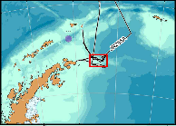
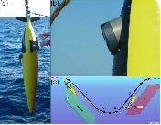
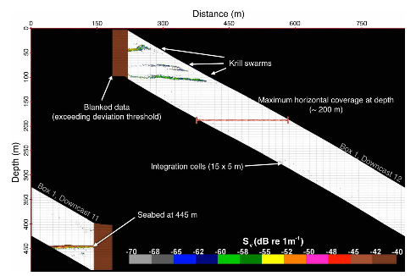
Active acoustics to map macro-zooplankton community and concentration
Guihen et al. 2014

Slide 15
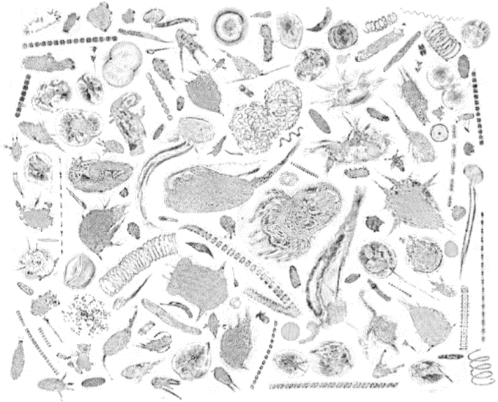
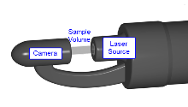
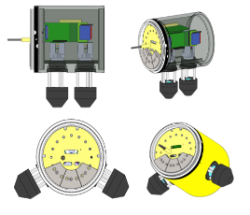
Coming soon (2-4 years) micro- and small zooplankton imaging
Holographic images from Monterey
by an AUV
Design strategies are underway
Thanks to James Bellingham (WHOI)
Don’t forget the FlowCytobot
Notes:
3d views of images. Flow cytobot takes images and identifies the critters.

Slide 16
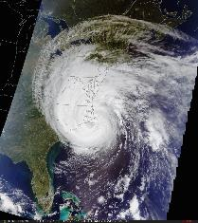
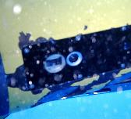
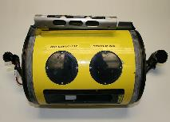
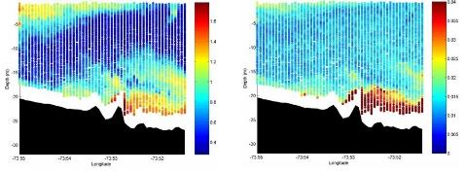
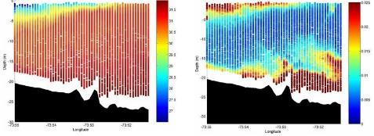
Glider’s provide insight into the nature of phytoplankton composition
c_{b650}
C_{b650}/b_{b650}
Empirical algorithms
%Mineral (in situ)
salinity
b_{b650}

Slide 17
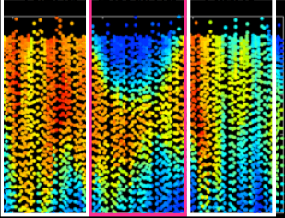
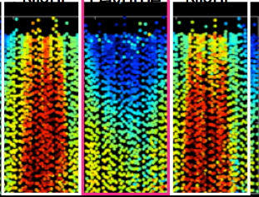
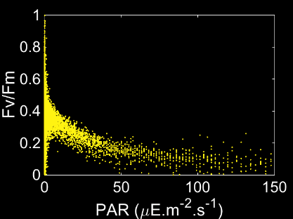
The ability to look at phytoplankton physiology and rate processes
PROXY FOR BIOMASS
HEALTH
Night
Daytime
Night
Night
Daytime
Night
0
0
25
25
50
50
02/20
Time (month/day)
02/21
02/20
Time (month/day)
02/21
0
4000
8000
0
0.3
0.6
Biomass Proxy (Fm)
Quantum Yield of Photosynthesis (Fv/Fm)

Slide 18
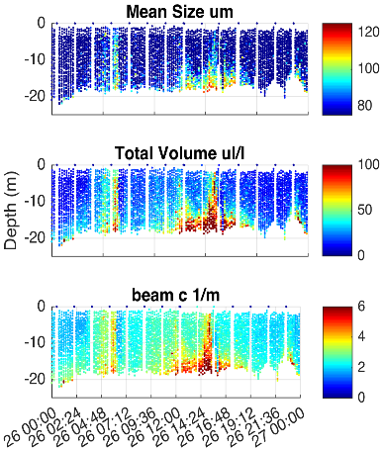
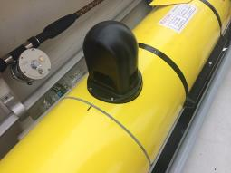



LISST Glider Integration
Thanks to Travis Miles
Notes:
particle size distribution and volume concentration. It also records the optical transmission, pressure and temperature.

Slide 19
Rutgers and WHOI collaboration: September deployment being tested
Notes:
Graces project

Slide 20
Using multiple platforms to gain a complete understanding of the science

Slide 21
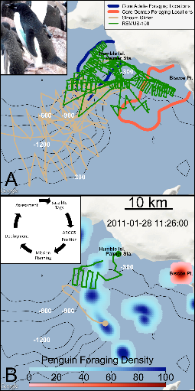
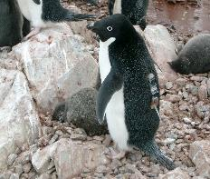
Multi-Platform dynamic analysis of penguin foraging in space
climatologies
Real-time

Slide 22
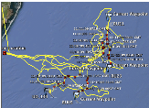

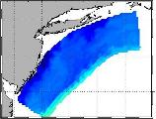
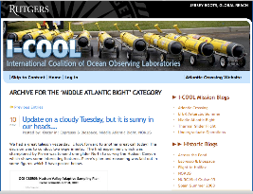
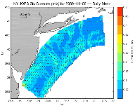
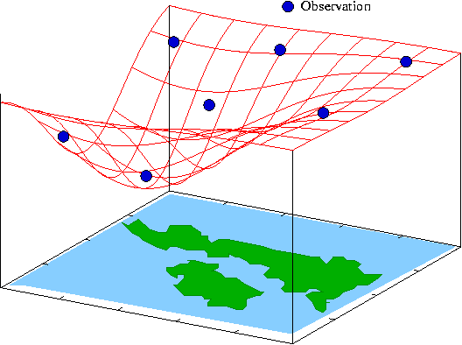
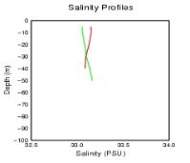
FUTURE: MACHINE TO MACHINE NETWORKS (TEST NOV. 2009)
Design, Testing and Deploy
Observatory (simulated) data
Models
Sensor &
Platform
~3 km
~100 m
Virtual Ocean
Data Assimilation
Data
Analysis
Science Questions & Drivers
Data Synthesis: Nowcast & Data Impact
Schofield et al. 2009
Notes:
No human in the loop. Models send gliders info on best location to move to for sampling fronts, gliders sample data which is assimilated back into models, which update forecasts which are then used to redirect glider paths.

Slide 23
What are the realities of using these remote gliders and UAVs?

Slide 24
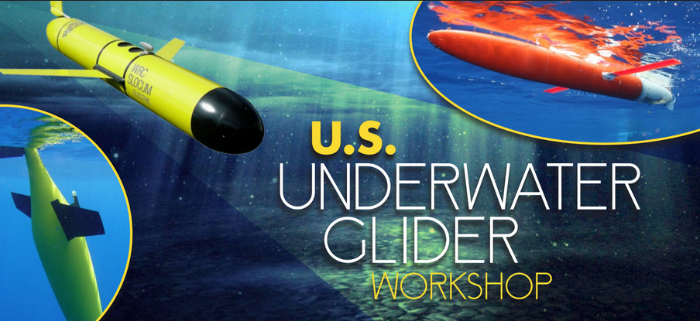
OPERATIONAL RELIABILITY WORKING GROUP
Chair: Mike Crowley, Rutgers University
Courtesy of the US Underwater Glider Workshop
January 2017

Slide 25
Ingredients for Successful Deployments
Some (not all) keys for success:
  A single person or small team prepares, deploys and pilots (communication)
  75-100% time focused on gliders
  Regional expertise or do your homework
    Fishermen
    shallow bathymetry
    Currents
    Fresh water (river outflows, ice melt)
    Wrecks
    sea ice
    shipping lanes
    Models
    HF-RADAR
    Satellite
Courtesy of the US Underwater Glider Workshop
January 2017

Slide 26
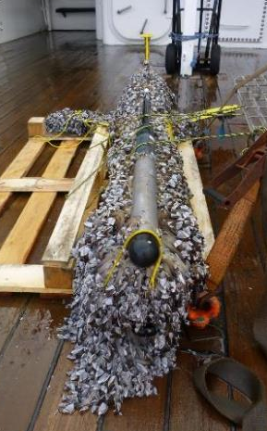
Causes of Failure
  Inexperienced people/lack of available prep time/rush
    Time between deployments
  Deployment team separate from prep team, not focused solely on glider work
  Biofouling or biological impact (shark, remora)
  Leaks
  Sensor failure (eg. ctd pump, or a pressure leak)
  Buoyancy (fresh water lens)
  Length of deployment (up to a year difficult, biology happens)
  90 day cutoff (battery)
  Damage in shipping
  Environment challenges (currents), Weather
  Deployment impact (ship hits glider)
  Loss of steering
  Buoyancy pump
  Air bladder
  Ship strike
  Underwater hazards (crab traps, fishing gear, wrecks)
  Fishermen (pick up)
  Software bugs
  Quality Control of Data, Calibration
Courtesy of the US Underwater Glider Workshop
January 2017

Slide 27
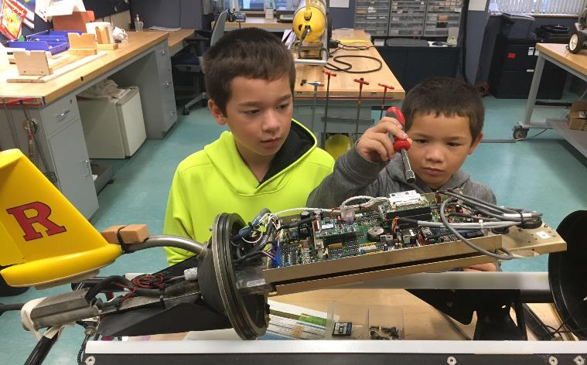
Success path: Start training early!

Slide 28
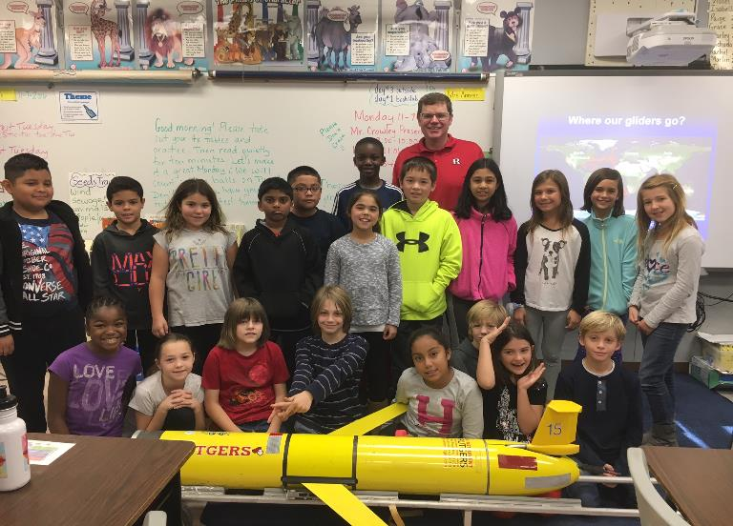
Why? It’s about the future

