Slide 1
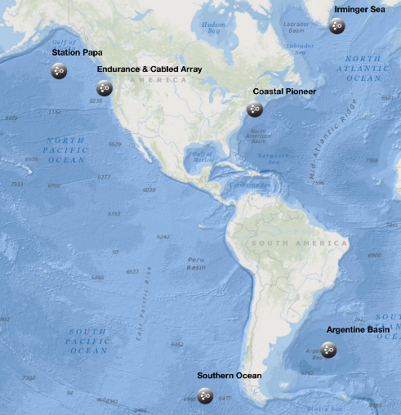
OOI Data Quality Procedures and Tools
M. Vardaro, M. Crowley, L. Belabbassi, L. Garzio, J. Kerfoot, F. Knuth, S. Lichtenwalner, M. Smith
Rutgers University, New Brunswick, NJ
Notes:
This is the entire Rutgers team

Slide 2
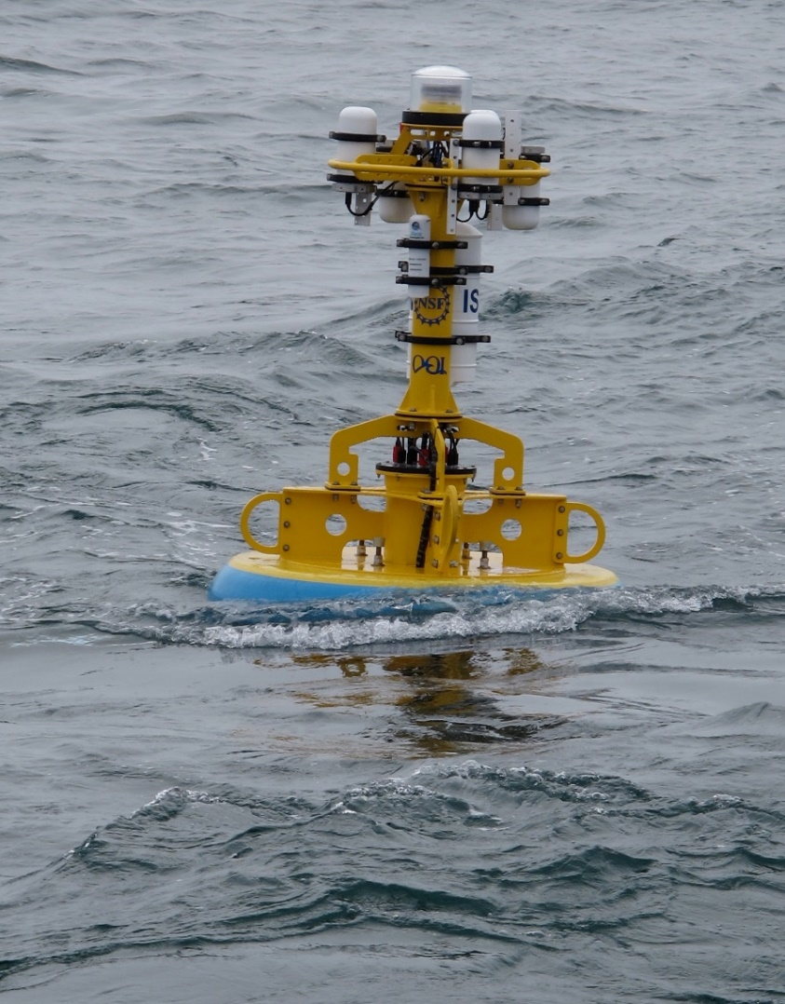
Overview
Data Flow & Products
Data Review Procedures
Periodic Reviews & Documentation
Next Steps
Conclusions

Slide 3
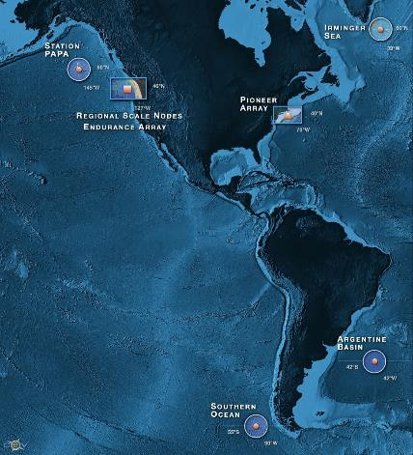
OOI By the Numbers
7
57
31
1227
>2500
>100K
4.5 Data Evaluators
Arrays
Stable Platforms
Moorings, Profilers, Nodes
Mobile Assets
Gliders, AUVs
Instruments (~850 deployed)
Science Data Products
Science/Engineering Data Products
Notes:
There is a ton of data in the OOI. 4.5 people do “QC”, but many other tasks

Slide 4
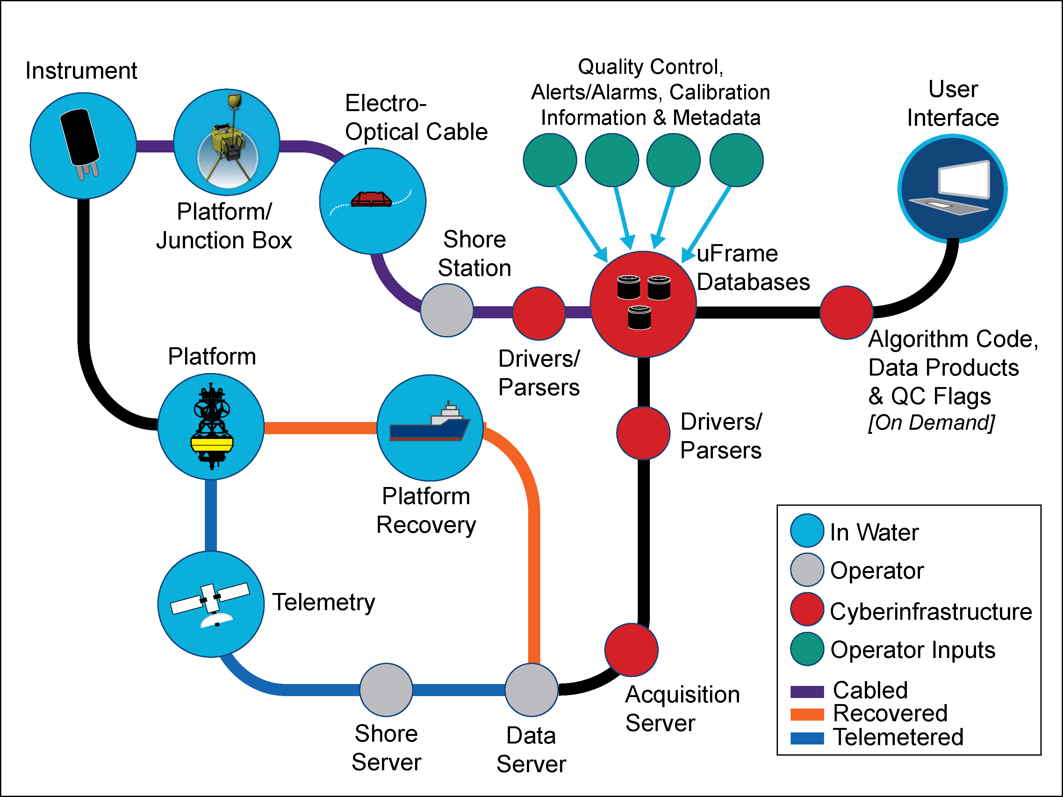
Data Flow Chart
Data types:
Telemetered Data
Recovered Data
Streamed Data
Shipboard Data
Metadata (CF 1.6)
Data product levels:
Raw, L0, L1, L2
Notes:
A significant amount of meta data goes into getting that ctd temp out.

Slide 5
OOI Data Product Levels
Raw data: The datasets as they are received from the instrument
May contain multiple L0, L1, or L2 parameters, data for multiple sensors, and be in native sensor units
Always persisted and archived by the OOI
Example: format 0 binary file from an SBE-37IM on a Global Flanking Mooring.
Level 0 (L0): Unprocessed, parsed data parameter that is in instrument/sensor units and resolution
Sensor by sensor (unpacked and/or de-interleaved) and available in OOI supported formats (e.g., NetCDF)
Always persisted and archived by the OOI
Example: SBE-37IM Temperature portion of the hex string
Level 1 (L1): Data parameter that has been calibrated and is in scientific units
Created on-demand via user synchronous or asynchronous request
Actions to transform Level 0 to Level 1 data are captured and presented in the metadata of the Level 1 data
Example: SBE-37IM Temperature converted from hex to binary and scaled to produce degrees C
Level 2 (L2): Derived data parameter created via an algorithm that draws on multiple L1 data products
Created on-demand via user synchronous or asynchronous request
Products may come from the same or separate instruments; data from all instruments are provided during download
Example: SBE-37IM Density and Salinity
Notes:
If an algorithm uses data streams from multiple instruments to produce L2 products, data from all relevant instruments will be provided during download

Slide 6
OOI Data Status
All available telemetered and recovered data are being ingested and made accessible for download**
Rutgers CI currently storing >340TB of raw data, including ~100 TB HD video (so video ≈ 30% of total data)
~150TB are publicly available via the raw data archive
~14TB of processed data ready for product generation
All known issues have been annotated. Unless otherwise remarked, the data have not been validated against in situ samples taken by instrumentation external to the system.
Notes:
Current issue with ingestion of recovered datasets being worked on

Slide 7
Overview
Data Flow & Products
Data Review Procedures
Periodic Reviews & Documentation
Next Steps
Conclusions

Slide 8
Data Team Primary Goals
Monitor the operational status of data flowing through the OOI system
Ensure the availability of OOI datasets in the system (raw, processed, derived, and cruise)
Ensure that data delivered by the system meets quality guidelines
Report operational statistics on data availability, data quality, and issue resolution

Slide 9
Data Team Tasks
CI Data Review
Environmental and Raw Data Review
Ingestion
Helpdesk
Stats
Data Team Portal
UI Testing
ERDDAP
Download Plot Check Data
Run Raw in Vendor Software
Build Ingest Automation
Answer Questions
Monitor Raw Data Delivery
Data Availability Timelines
TestFixes and New Features
Set up Back End
Make Annotations
Compare to CI Output
Set up Recurring Ingestion
Instrument Pages
Monitor Real-time Ingestion
Display Daily Stats
Suggest New UI Features
Set up Front End
Create Data Issue Tickets
Processes Environmental Data
Ingest Missing Data
Tutorials
Parse MIO Operational Stats
Create UI Issue Tickets
Ingest Data
Asset Mgmt Updates
Compare to CI Output
Workshops
Conferences Publications
Produce Daily Resolution
Fix QC Algorithms
2018 Early Career Workshops

Slide 10
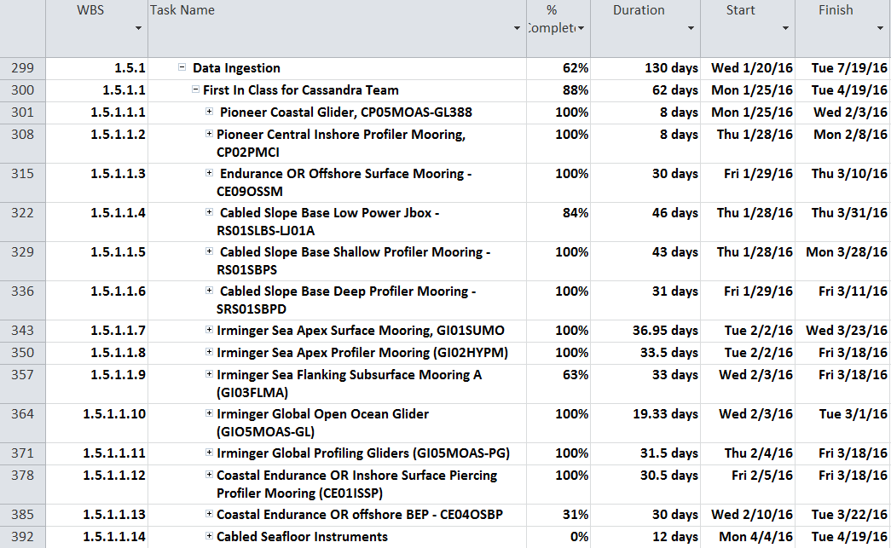
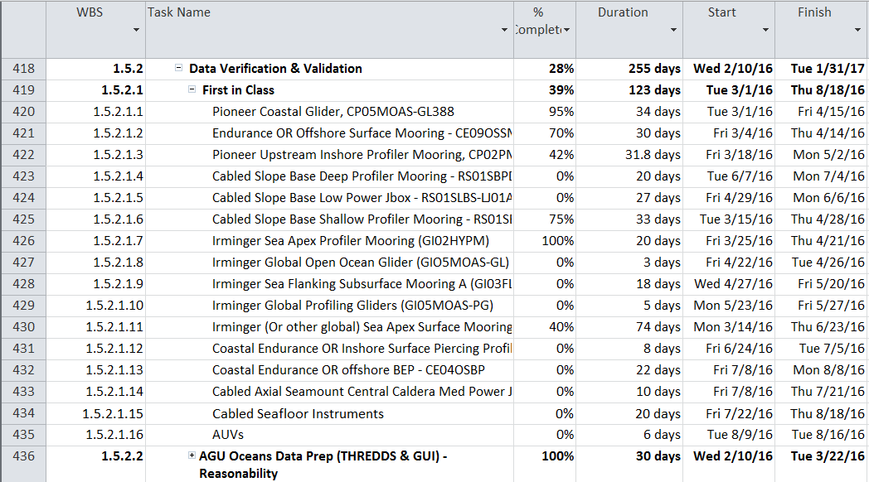
First in Class Reviews: Jan-Aug 2016
One example of each data stream (ingestion completed by Systems team)
Review of 1207 (467 science) streams completed in August 2016
Tested parsers, algorithms, ingestion, asset management and data product creation

Slide 11
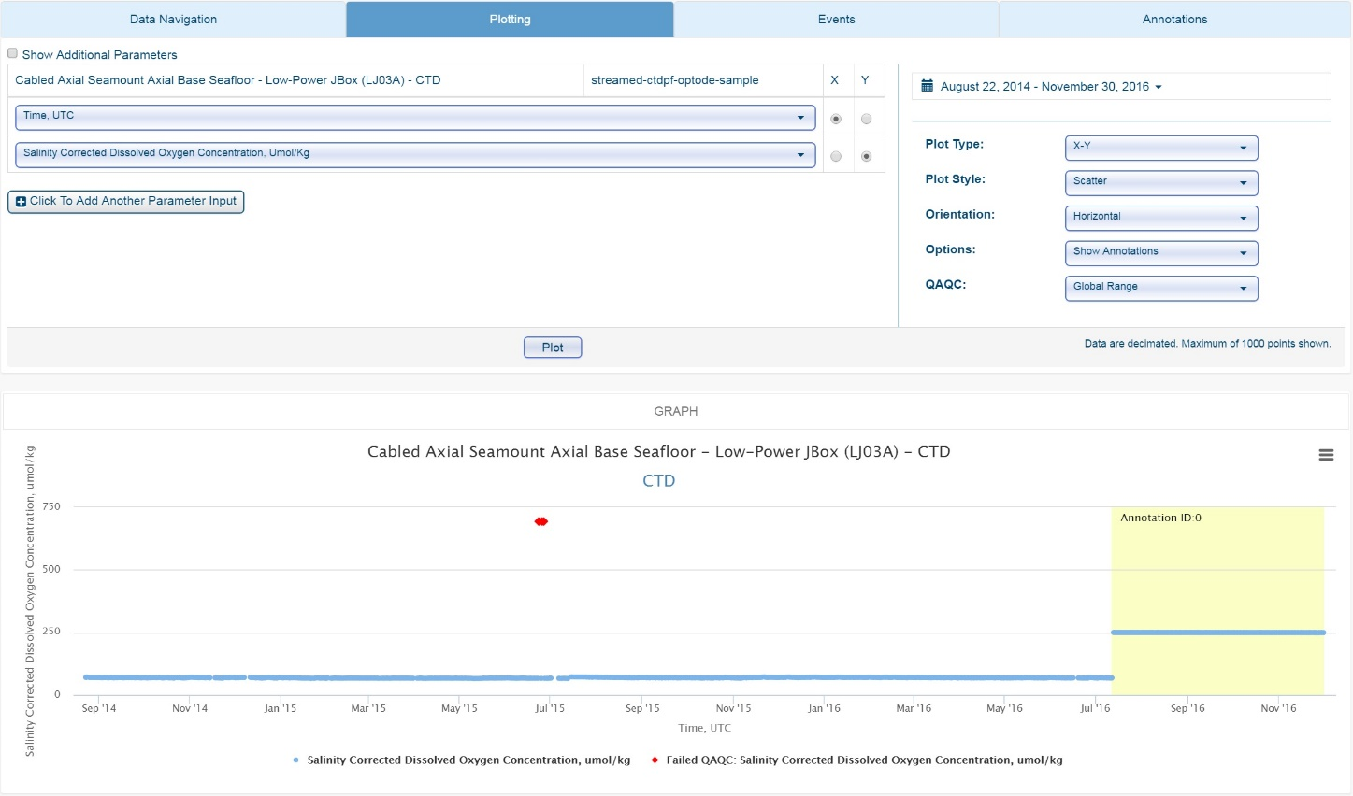
Data Annotation
Annotations are the primary means of communication between data team and users
Annotations can be directly entered via the GUI for specified data streams
Annotation text appears in a tab on the data catalog/plotting page
Annotation time ranges can be shown on plots (via “Options” interface)
Annotations also included in downloaded data

Slide 12
Rest in Class Data Review Workflow
Visual Assessment
Data Availability
Data Quality
Investigate Gaps
and QC failures
M2M Request
Plot Data File
Summary Report
Annotate in GitHub
Subsite – Operational Status
Node – Operational Status
Instrument – Operational Status
Stream - Availability
Parameter – Quality & Availability
Automated tests
Parameter Level
Global range
Stuck Value
Spike Test
Fill values
NaNs
Gap Check
Stream Level
Start and End Date
Lat/Lon
Duplicate Timestamps
Parameter Availability
Instrument Level
Deployment time range
Push to System

Slide 13
OOI Automated QC Procedures
6 automated QC algorithms can produce 7 flags (including logical “or” which combines flags) which are plottable and are included in downloaded files
Coded based on specifications written by OOI Project Scientists, derived from QARTOD manuals and other observatory experiences
Algorithms refer to “lookup tables” assembled by OOI Project Scientists with input from subject matter experts: https://github.com/ooi-integration/qc-lookup
Global Range Test
Local Range Test
Spike Test
Stuck Value Test
Trend Test
Temporal Gradient Test
Spatial Gradient Test (Profile)

Slide 14
QARTOD/OOI QC Comparison
OOI Test | OOI Description | QARTOD Equivalent | QARTOD Recommendation (from manuals) | Notes
Global Range Test | Data are flagged unless they fall within valid world ocean ranges or instrument limits | Gross Range | Only considers manufacturer-defined sensor and calibration limits | Different tests, different names. Currently operational.
Spike Test | Deviation from mean compared to 2*N neighboring points | Spike | N=1, default threshold is based on the rate of change distribution from previous data sets | Roughly identical, same nomenclature. Currently operational.
Stuck Value Test | If 2 neighboring values differ by less than the resolution of the sensor for more than N repetitions, data are flagged | Stuck Sensor | Manual suggests 3 consecutive points for a stuck sensor suspect flag and 5 for a fail flag. | QARTOD manual suggestion may be too low for well-mixed portions of the water column. Under evaluation.
Local Range Test | Data are flagged unless they fall within locally valid site-specific or depth ranges. Interpolates thresholds between depth and season intervals | Local Range | Starts with constant limits for each depth/season interval | Roughly identical, same nomenclature. OOI Local ranges are still being established.
Gradient Test | If d(data)/d(t) > a set threshold, following points fail until one falls within limit (TOLDAT). First data point assumed good unless “good” starting data (STARTDAT) point is defined. | Rate of Change | QARTOD recommends two neighboring points and does not incorporate TOLDAT or STARTDAT values. | Different tests, different names. Under Evaluation, not operational
Trend Test | Data flagged as having trend if the SD of the residuals to a polynomial curve < original data, multiplied by a factor. Test for sensor drift. | N/A | No QARTOD equivalent | OOI only. Under Evaluation, not operational

Slide 15
NetCDF QC flags
NOTE: Results of the QC tests do not remove data.
Each parameter in a file has a corresponding *_qc_executed and *_qc_results variable
qc_executed indicates which tests were run
qc_results denotes which tests passed
Integer values can be converted to a binary that indicates which tests were run (1) or not (0), and which passed (1) or failed (0).
See example QC Python notebook or online guide (http://oceanobservatories.org/knowledgebase/interpreting-qc-variables-and-results/) for more details.
Notes:
Sage has a notebook that will talk about this – last bullet

Slide 16
Rest in Class Data Status Categories
Status | Description | QARTOD Code | QARTOD Description | Color
NOT_OPERATIONAL | Instrument not functional (no data expected) |  | Not operational
NOT_AVAILABLE | Instrument functional, data lost in transmission | 9 | Missing data
PENDING_INGEST | Instrument functional, data exists, Awaiting ingest
NOT_EVALUATED | Instrument functional, data exists, Awaiting evaluation | 2 | Not evaluated, not available or unknown
SUSPECT | Instrument functional, data exists and either failed a QC test or does not reflect environmental conditions | 3 | Questionable/suspect
FAIL | Instrument functional, data exists but is known to be bad due to known instrument or calibration error | 4 | Bad
PASS | Instrument functional, data exists, passed QC tests, is complete and looks reasonable | 1 | Good
GOOD | Instrument functional, data exists, passed QC tests, is complete and has undergone validation with shipboard datasets and reached the highest level of QC that the OOI can provide
Notes:
Color code indicates which color shows up in the annotation plot

Slide 17
Overview
Data Flow & Products
Data Review Procedures
Periodic Reviews & Documentation
Next Steps
Conclusions

Slide 18
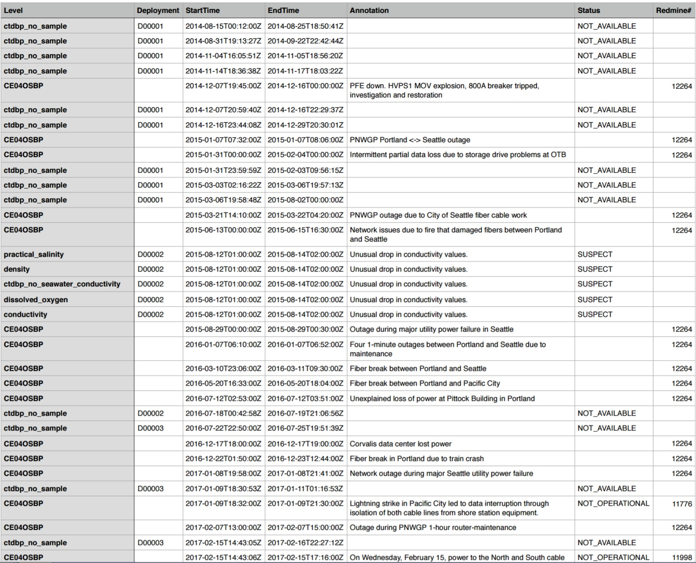
Examples of Reviews and Reporting
Quality Timeline
Annotation Text
Notes:
Types of reports and annotations, you will be tested on this.

Slide 19
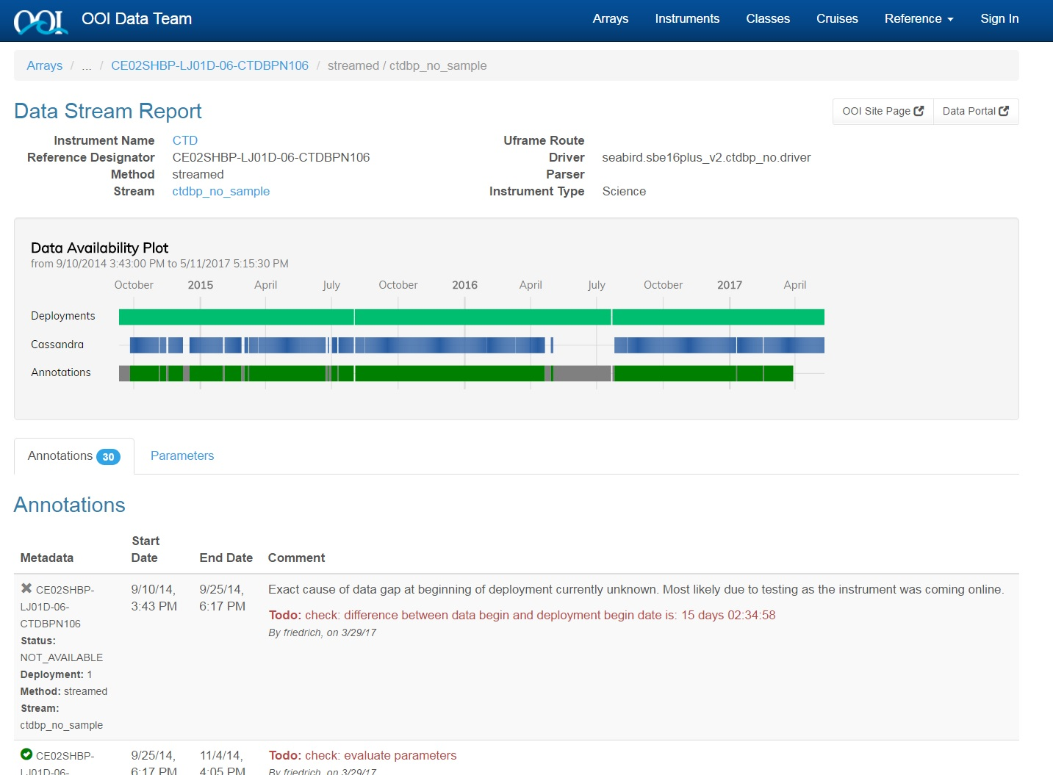
QC Database Tool
Used for reference & statistics
Includes status information, as well as a cruise data checklist
Includes testing/review capability
Annotation options
http://ooi.visualocean.net

Slide 20
Examples of QC Effort
Pressure offsets
(Bad cal values)
Drift
Biofouling
Damage
Video issues
Notes:
Pressure offset example. Bad pressure transducer. Using feedback from vendor, was able to do correction within the system. Figured out offset and corrected.

Slide 21
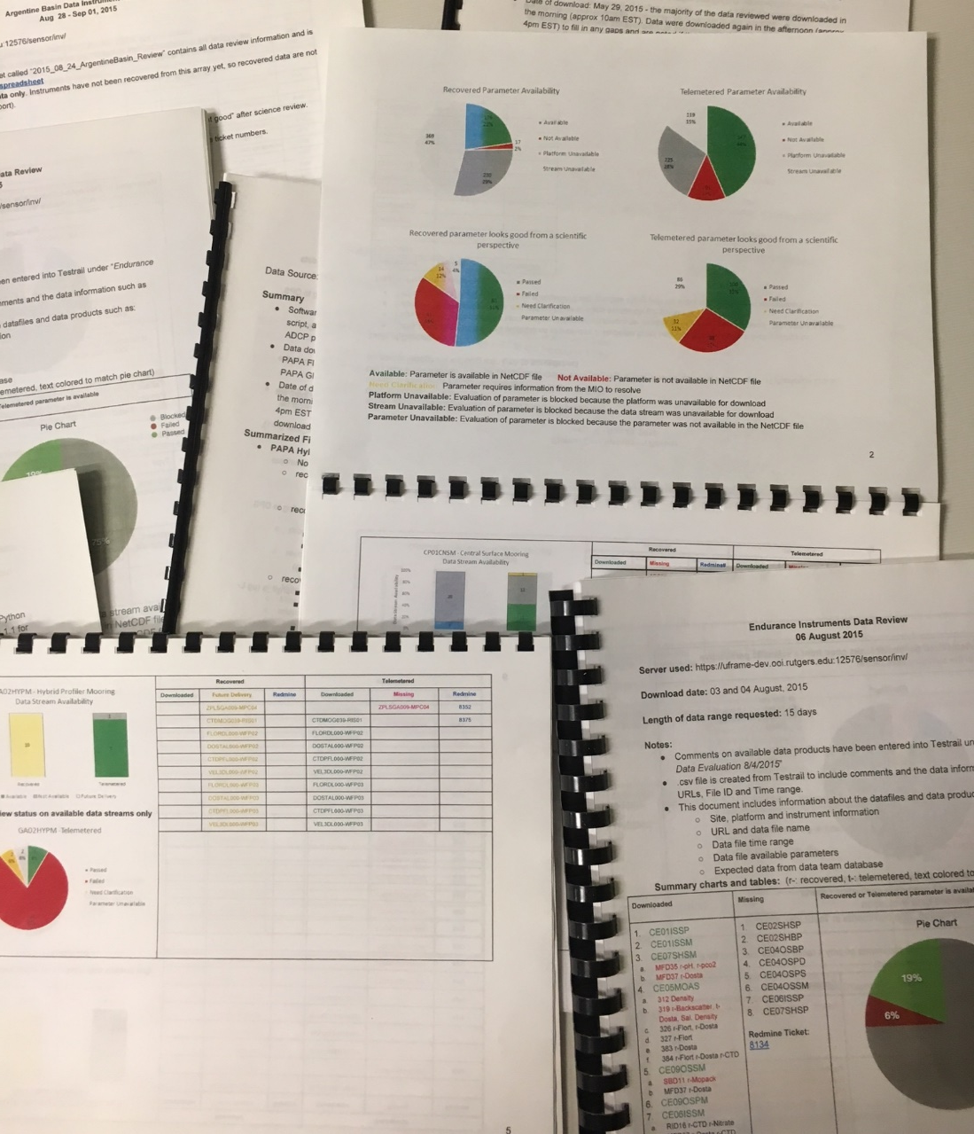
Deliverables
Data Availability Reports
(% completeness, streams/parameters reported, particles in the system)
Data Quality Reports
Redmine reporting
Issues found, investigations, and Help Desk open/closed
Deep dive investigation reports
Annotations (to users)
Download statistics

Slide 22
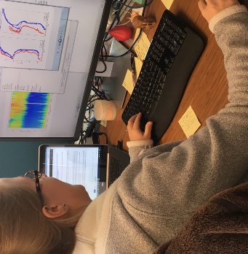
Data Evaluation Daily Activities
Review the end-to-end operational status of online instruments and investigate any outages (e.g. instrument, telemetry, parsing, or ingestion failures).
Review the operational status of other data archives (raw, cruise, ERDDAP)
Look into and resolve new system alerts**
Follow up on any issue requests from users (via Redmine)
Add annotations to notify users of operational status changes
Notes:
These were internal to the team, not system wide

Slide 23
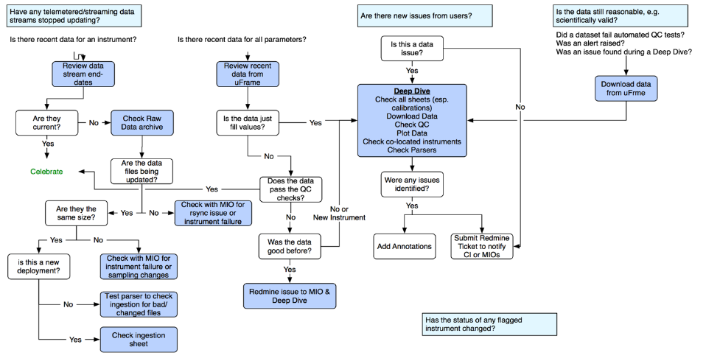
Daily Review Workflow
= Questions
= Actions
= Decision points
Notes:
Add legend “The Legend of the Data Team”

Slide 24
Overview
Data Flow & Products
Data Review Procedures
Periodic Reviews & Documentation
Next Steps*
Conclusions
Notes:
* We are recommending to 2.0

Slide 25
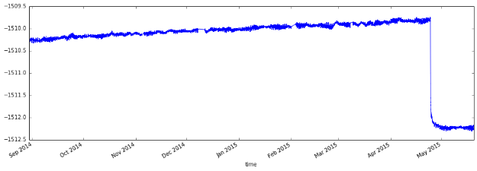
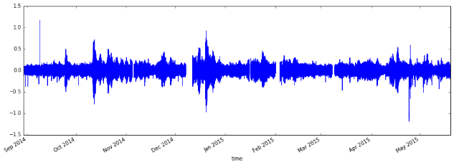
Data Availability and Completeness
Some derived data products are still being added to the system
Some products are available but do not show up in data catalog or cannot be plotted
Some products require additional processing (e.g. ZPLSC, HYDBB)
Seafloor Uplift and Deflation Mean Depth (BOTSFLU L2)
Seafloor Uplift and Deflation
5-min Rate of Depth Change (BOTSFLU L2)
Seafloor Uplift and Deflation 10-min Rate of Depth Change (BOTSFLU L2)
Notes:
Examples of data products that need to be added to the system

Slide 26
QC Challenges & Solutions
Local range values need statistical analysis of environmental data for each platform
Need to work with SMEs to analyze and apply ranges and test algorithm
Trend test may not work as designed, because it requires the system to compare data prior to the user request date – analysis ongoing
Gradient test is complicated to apply, requires 2D dataset – analysis ongoing
Spike test is currently very simple - needs tweaking to avoid false positives/negatives (especially in biological data) and to work with certain data types
Not all QC algorithms apply to all data products – ongoing review with SMEs
The QC algorithms do NOT trigger alerts in the system - Alerts/alarms only trigger when new data is telemetered/streamed
Can set alerts on L1/L2 data streams based on Global/Local range values

Slide 27
CI Priorities (through Sept 2018)
Data product creation: Hydrophone data, Osmosampler, pCO2 Flux, VADCP, interpolation issues
Data discovery: navigation of data catalog, missing pressure data, image galleries, stream name consistency
User experience: login fixes, interpolated plots, data download issues (missing status, provenance errors), status indicators and dashboard, addition of multiple-stream download
Quality control: data displayed outside deployment time range, QC lookup values, fill value support, improved annotations

Slide 28
Overview
Data Flow & Products
Data Review Procedures
Periodic Reviews & Documentation
Next Steps
Conclusions

Slide 29
Conclusions
A large amount of high quality data has been and continues to be collected, with high science value
Data review is our primary focus, given maturation of the system and control over data ingestion
Data team accelerating review via development of specialized tools
Short-term goals for improving data quality and delivery (medium- and long-term goals are in flux)
OOI is providing a curated, consistent data system delivering data and metadata to the community
Trust, but verify!

Slide 30
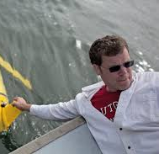
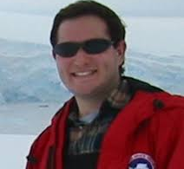
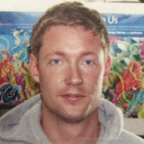
Rutgers Data Team
Mike Crowley
Mike Vardaro
Sage Lichtenwalner
John Kerfoot
Leila Belabassi
Mike Smith
Friedrich Knuth
Lori Garzio

Slide 31
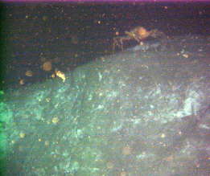
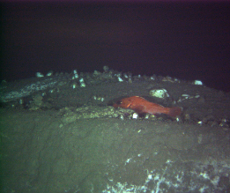
Questions?
OOI Main Web site: http://oceanobservatories.org
Data Portal: http://ooinet.oceanobservatories.org
Help Desk: help@oceanobservatories.org
Mike Vardaro, Data Manager, OOI CI Data Team
vardaro@marine.rutgers.edu
Mike Crowley, Program Manager, OOI CI Data Team
crowley@marine.rutgers.edu
Acknowledgements: NSF, COL, Rutgers University, University of Washington, WHOI, Oregon State University, Raytheon

Slide 32
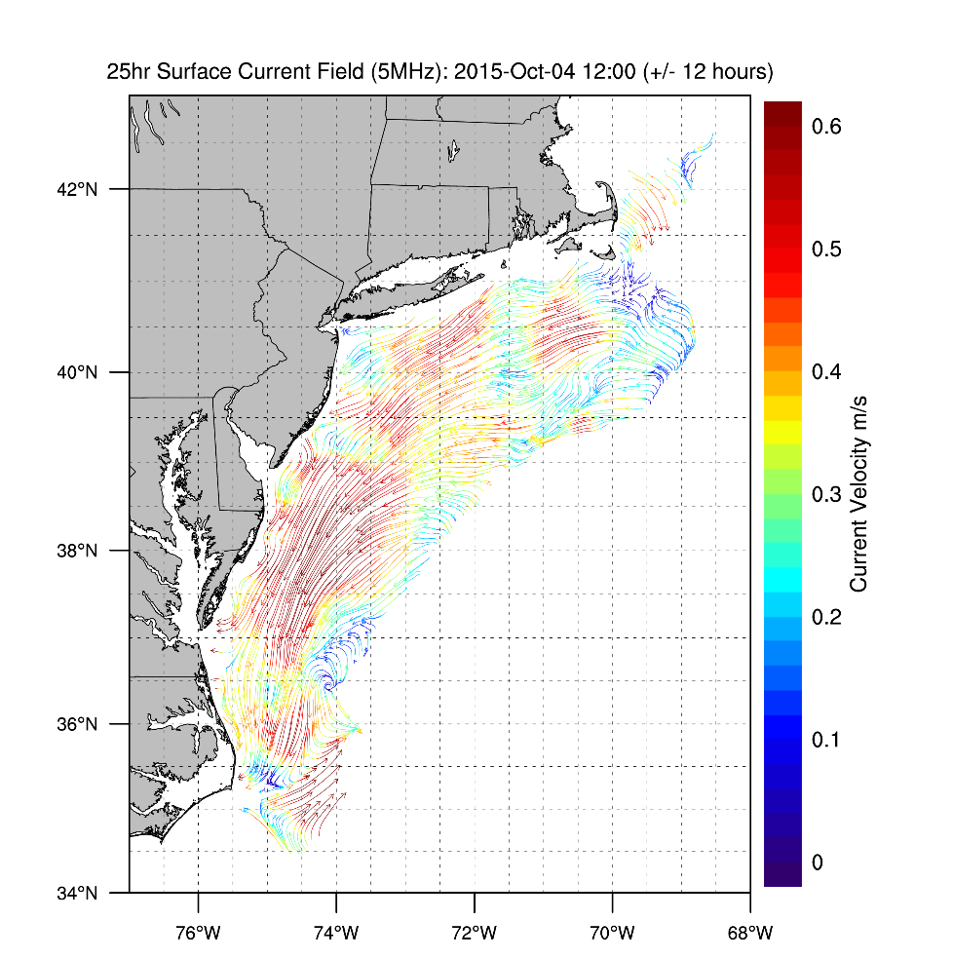
Science Evaluation: Are ocean features encountered real? Outside local range
Is this real?
Taking advantage of all assets, even non-NSF, to assess data quality
IOOS data shows presence
of warm core ring
IOOS data shows ocean response to storm
Notes:
Back to what they are doing at the workshop – SCIENCE!!!!!!!!!!!!!!!!!!!!!! Env Validation!!!!!!!!!!!!!!!!!

Slide 33
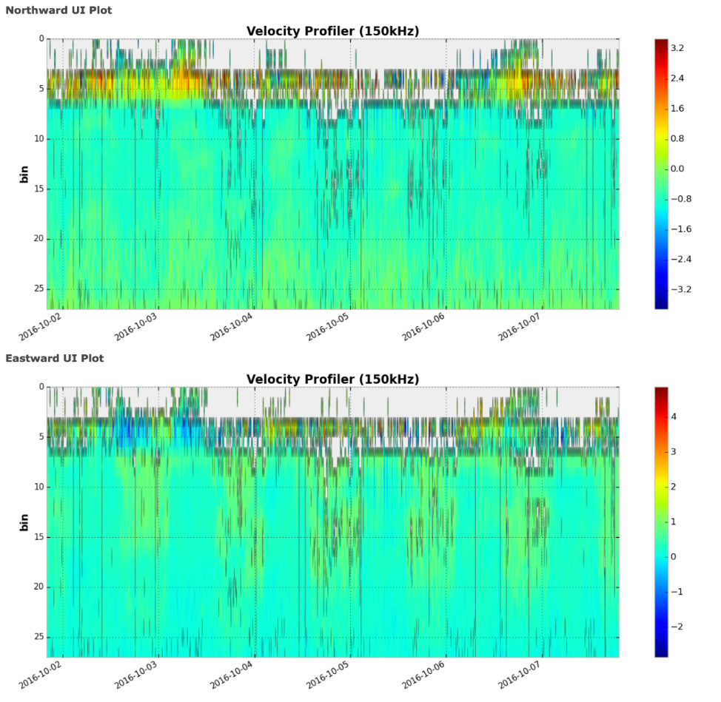
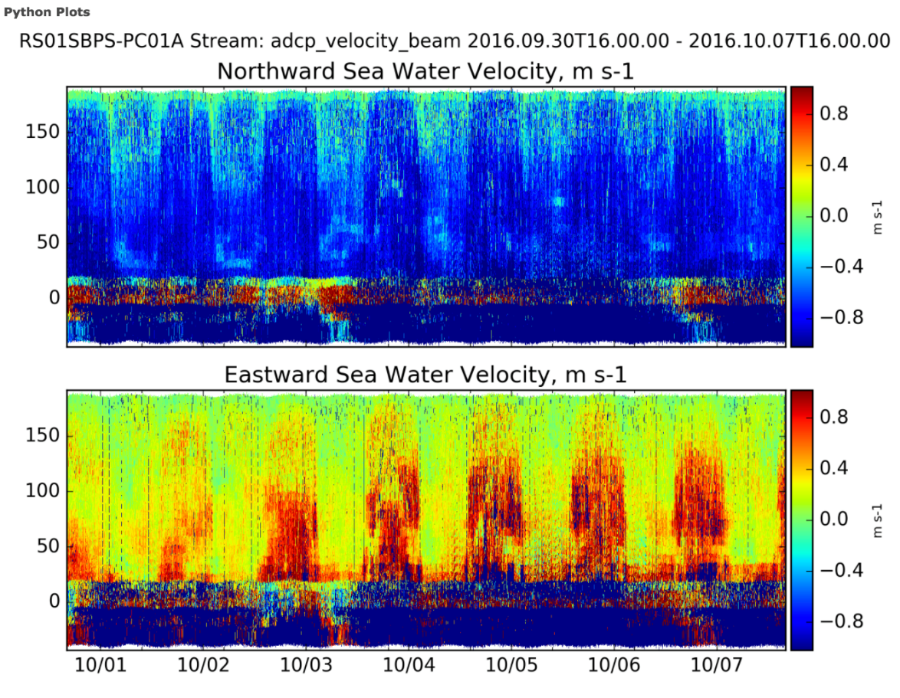
Adding capability to OOINet experience
Notes:
These are the zplsc plots. We need to get things like this into the system

Slide 34
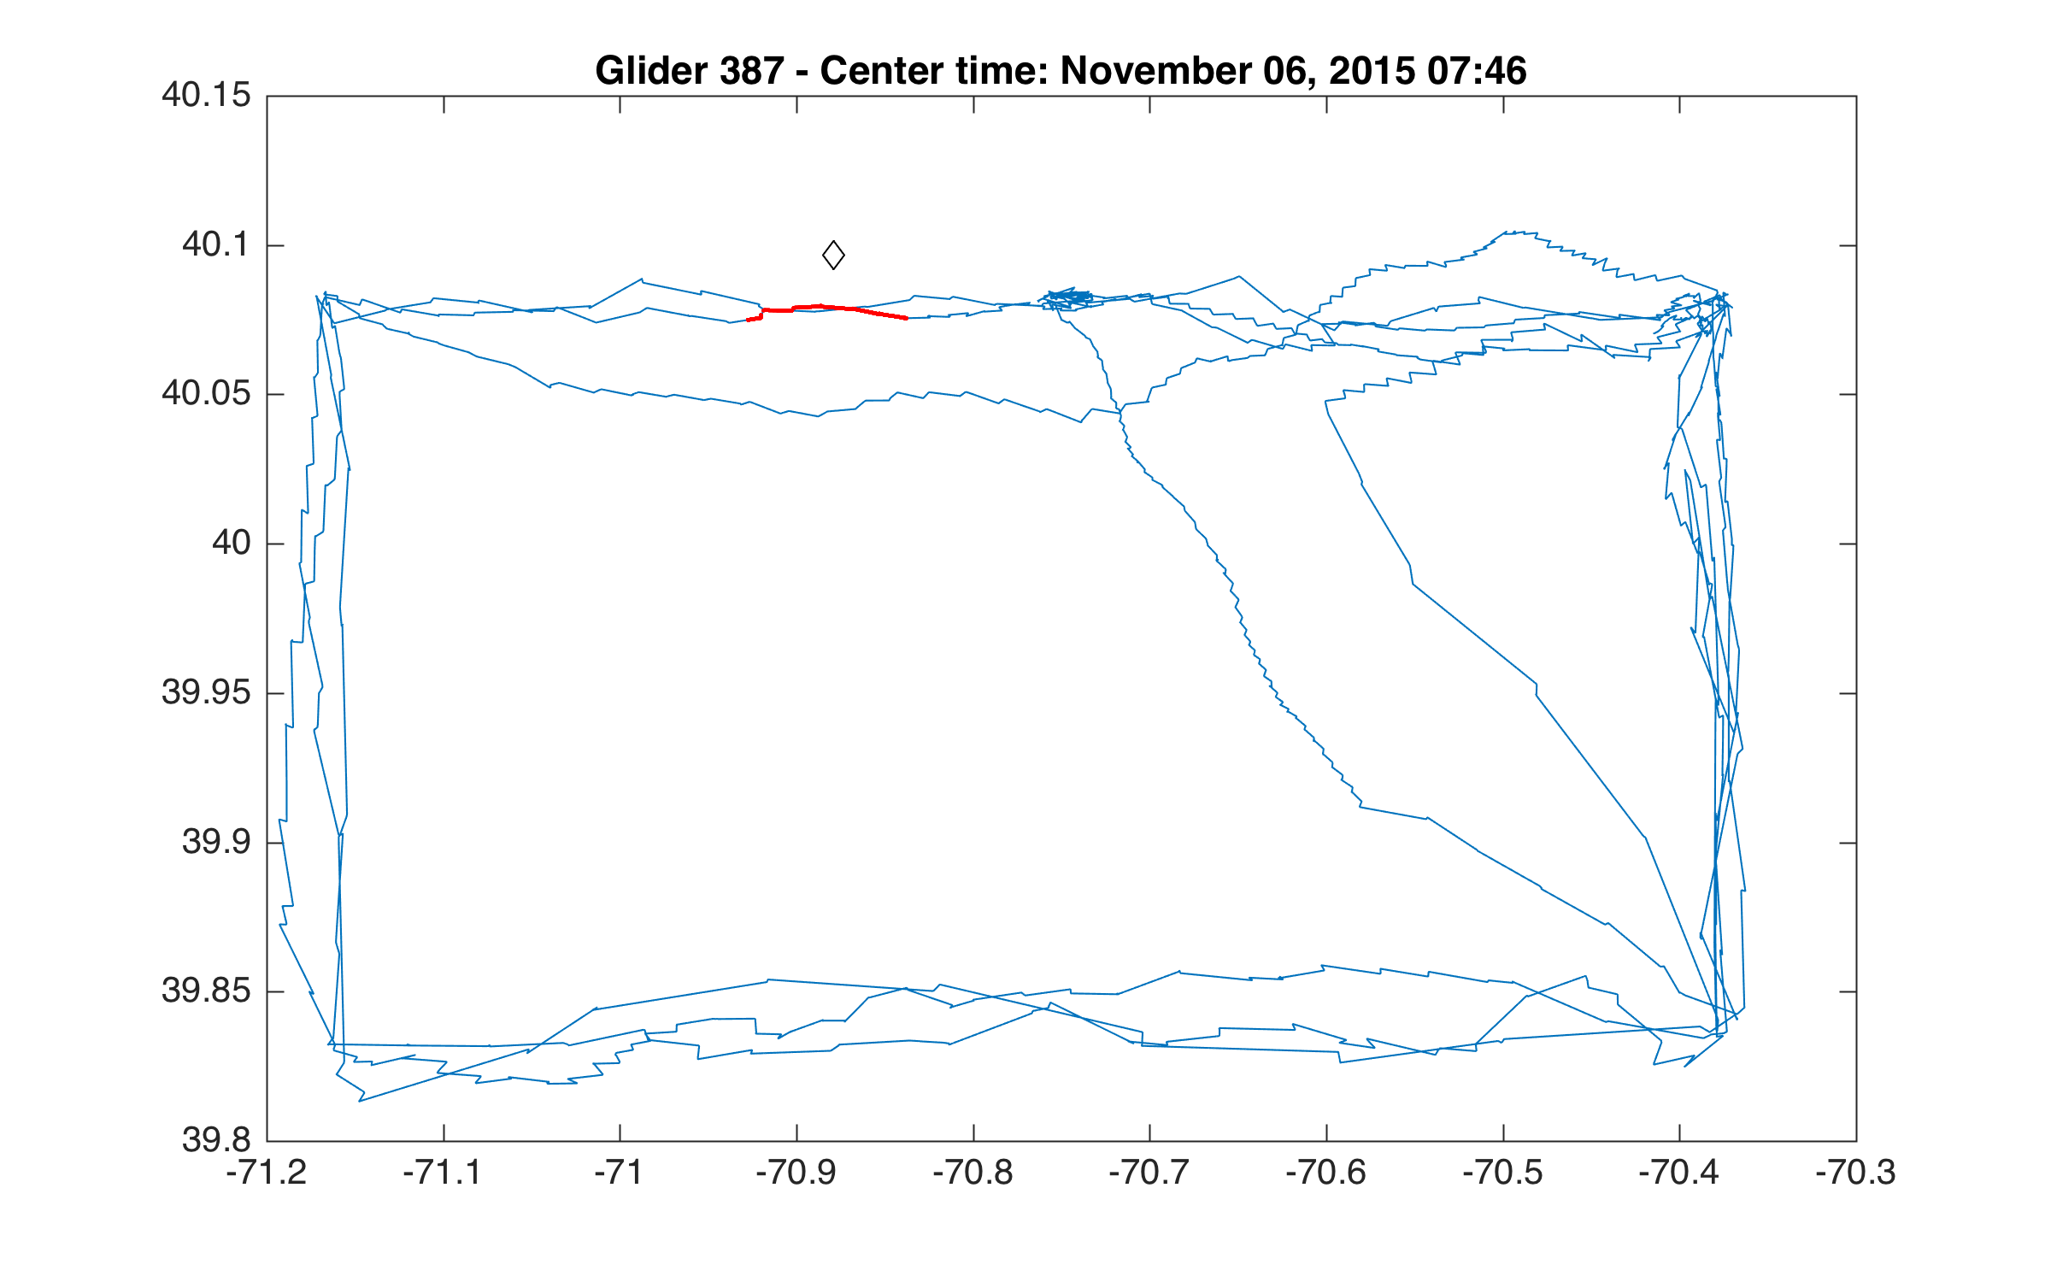
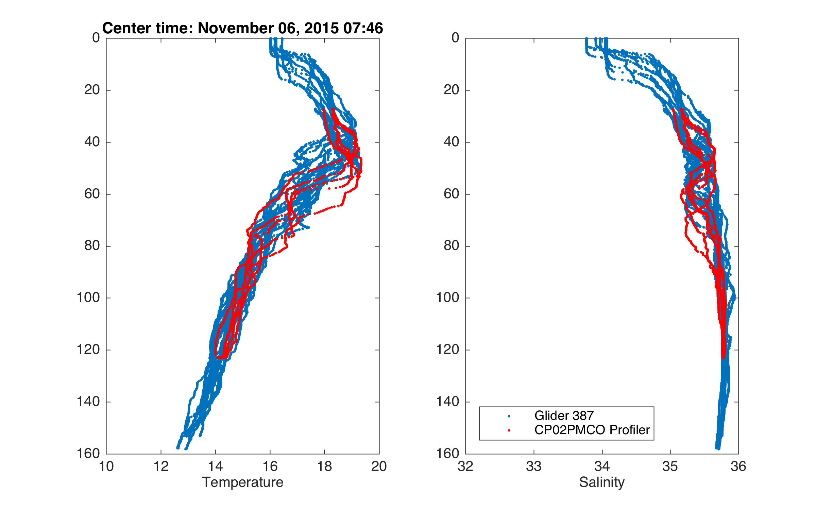
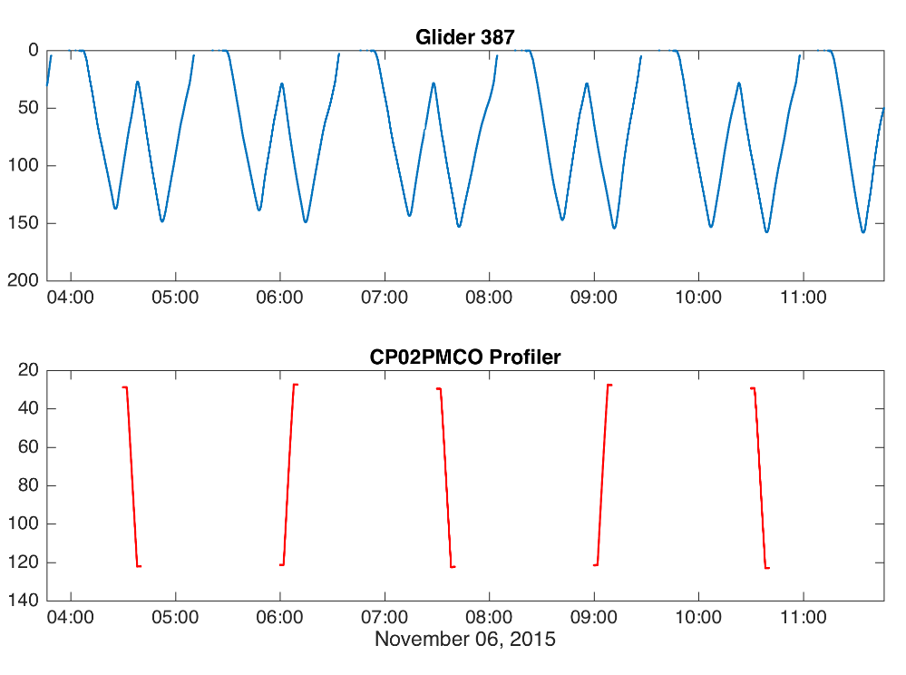
Vicarious Calibration - Comparisons enabled by ERDDAP
Glider 387
Comparison Segment
Concurrent profiles from Glider 387 and Coastal Pioneer Profiler Mooring
Co-located and concurrent Temperature and Salinity Profiles
Blue – Glider 387 Red – Coastal Pioneer Profiler Mooring

