Slide 1
Quality Data Delivery through an Integrated Ocean Observing System
MANY MANY MANY TEAMS OF PEOPLE!!!

Slide 2
Takeaways:
You are not in charge of the data acquisition
So much data out there
Trust, but verify!

Slide 3
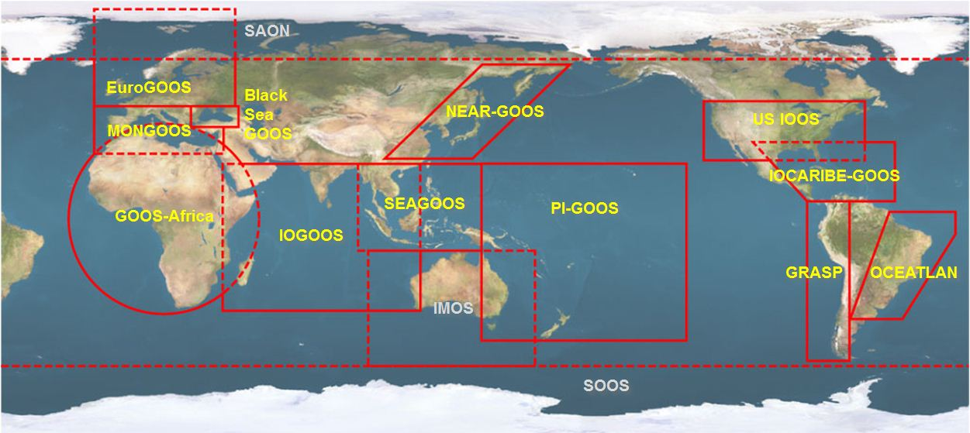





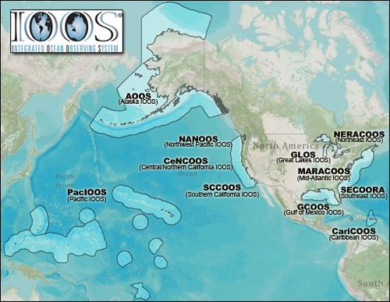













NOAA-led U.S. Integrated Ocean Observing System (IOOS)
Global Component
National Component
Regional Component
15 Regional Alliances in GOOS
Vessels -
Satellite
Satellite
CODAR
Ships/ Vessels
Glider
REMUS
Data Vis.
Modeling
Security
Leadership
Education
11 Regional Associations
17 U.S. Federal Agencies
Notes:
Going to give an example of QC using IOOS as there is high likelihood that there is data in an area of interest to you

Slide 4
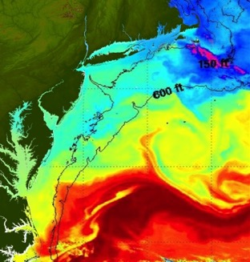
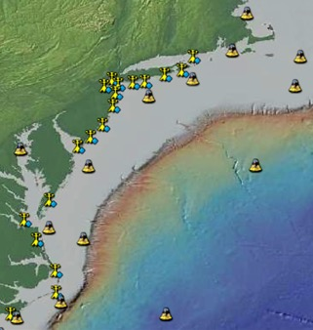
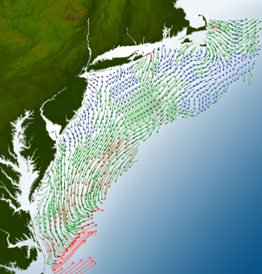
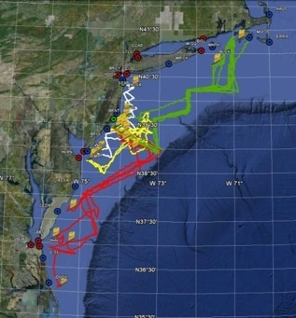
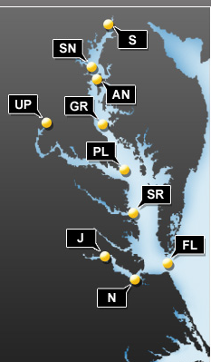
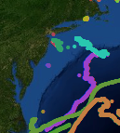
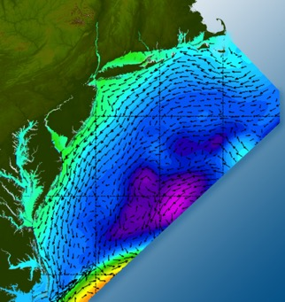
Integrated Observing and Prediction Networks
Satellites
Weather Stations
HF-Radar
Gliders
Buoys
Ocean Forecast Ensemble
Drifters

Slide 5

MARACOOS Certification
MARACOOS’ ability to achieve and consistently maintain federal data quality standards led to its certification as a Regional Information Coordination Entity (RICE) in December 2016.
What does that all mean?
Assures users that MARACOOS data meet or exceed federal standards for quality
Ensures that the data collected and distributed by the RICE are managed according to the best practices, as identified by NOAA.
MARACOOS.org/certification
Names names (me specifically)

Slide 6
MARACOOS Data Mgmt & Communication (DMAC)
The system includes:
management of in situ & remotely-sensed observation and model** data
data-model connections for comparison
data access services such as Thematic Real-time Environmental Distributed Data Services (THREDDS), Open-source Project for a Network Data Access Protocol (OPeNDAP)
common data formats such as NetCDF
delivery of data to operational users
Easy to acquire & track what QA/QC has been done
**Note: models are not certified
Notes:
Meant to be easy to acquire and track what QA/QC has been done

Slide 7
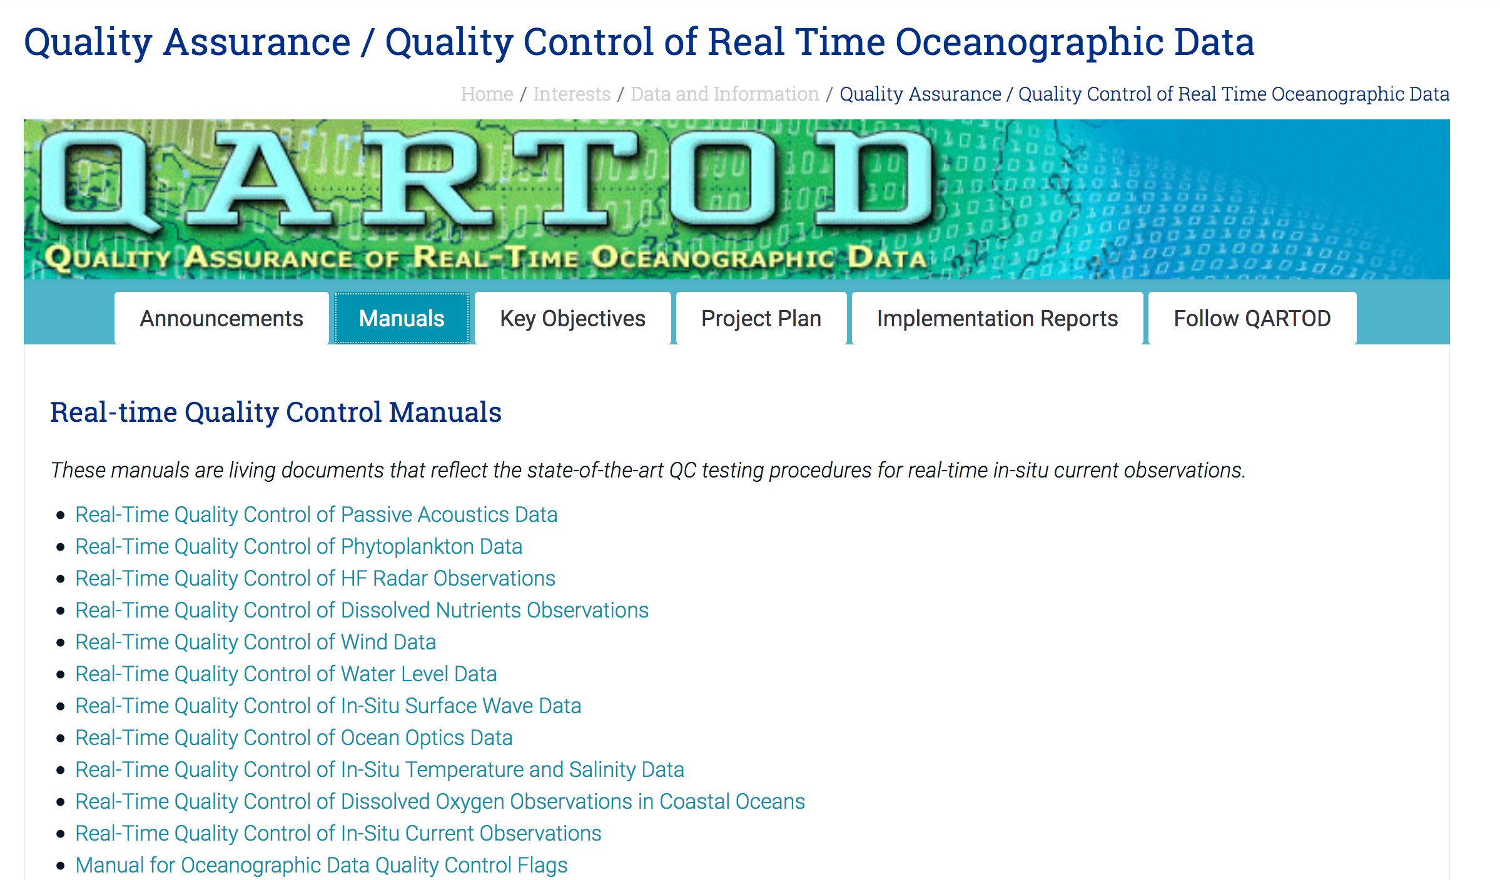
QARTOD: A Good Start but not Comprehensive
A good starting resource
Guidance for numerous instruments
https://ioos.noaa.gov/project/qartod/
POC: Mark Bushnell
Notes:
Lots of resources, even that you could apply on your own data. There is guidance out there for anyone to use for numerous instruments

Slide 8
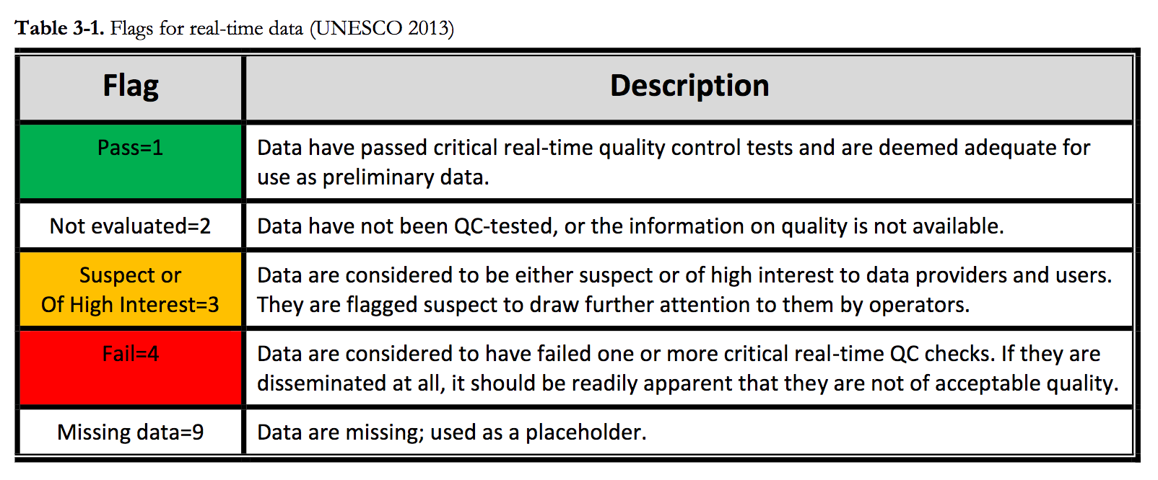
QARTOD: Example Quality Flags
Notes:
A common theme throughout the qartod is these flags

Slide 9
Data

Slide 10
There are MANY types. Today we are focusing on:
High Frequency Radar (HF Radar)
Ocean Gliders
Notes:
So much out there but only a little time today

Slide 11
HF-Radar

Slide 12
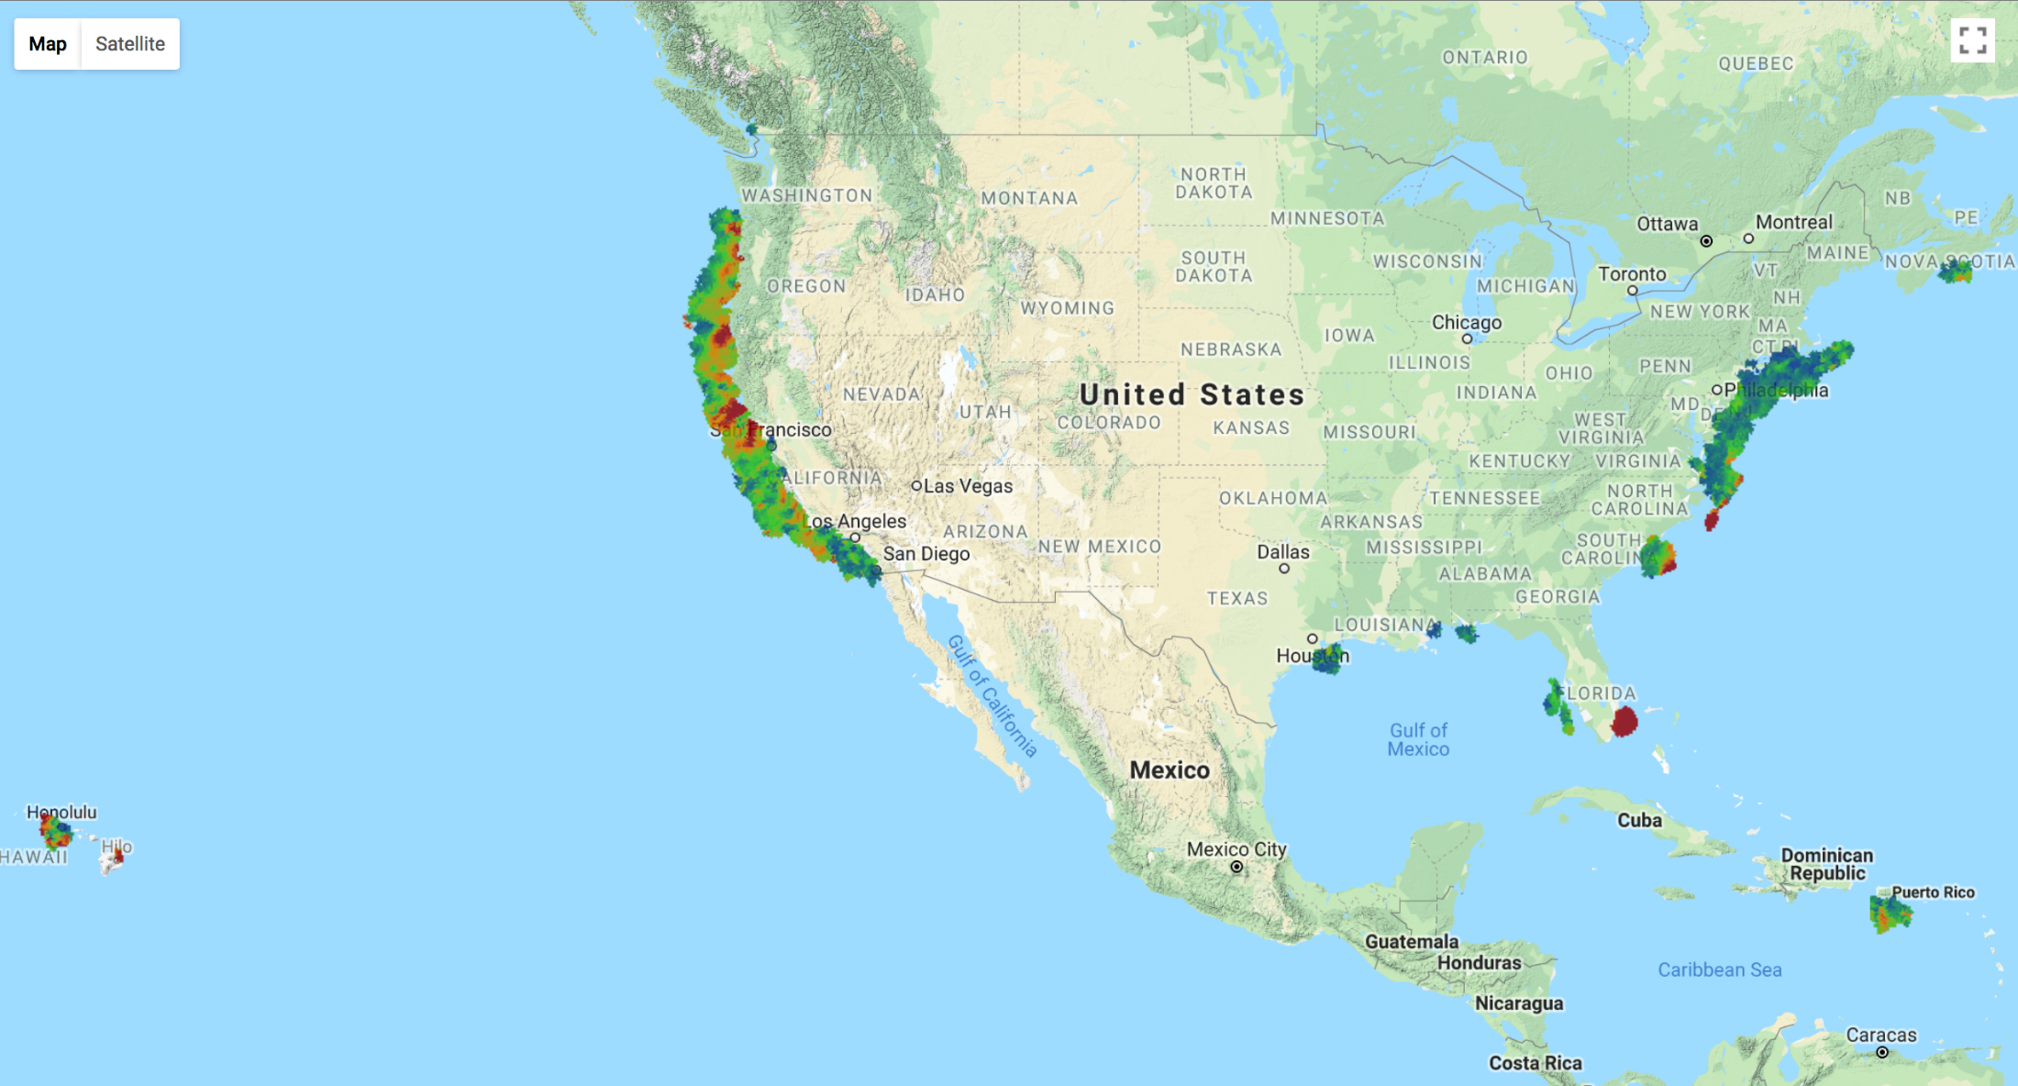
National Surface Current Mapping
Notes:
This data may be available to use and may be useful in your region

Slide 13
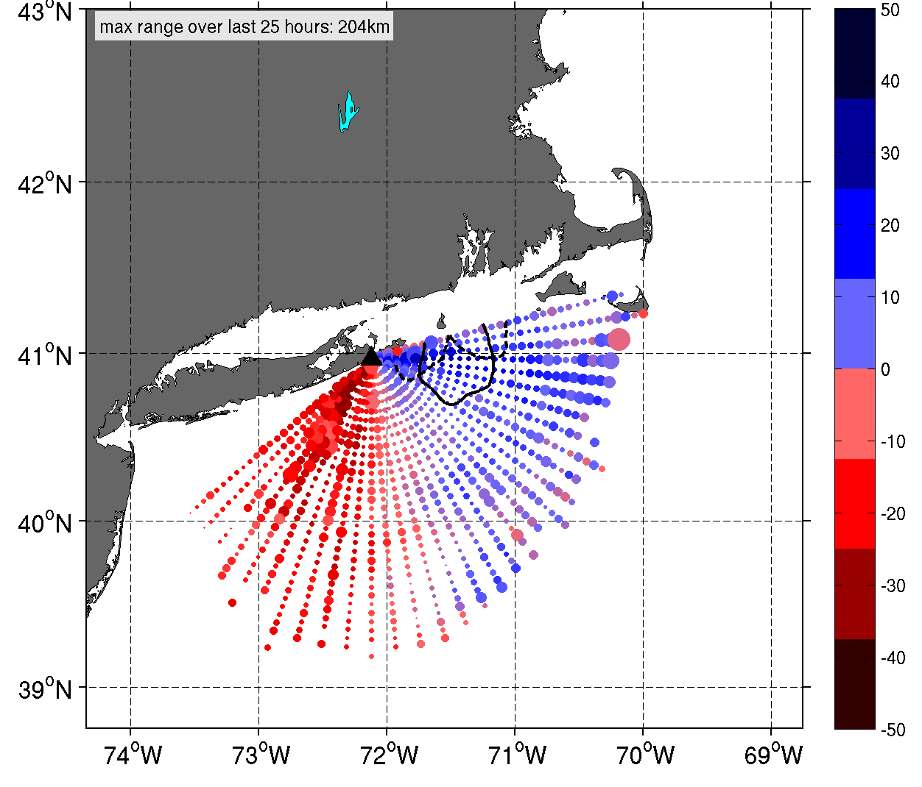
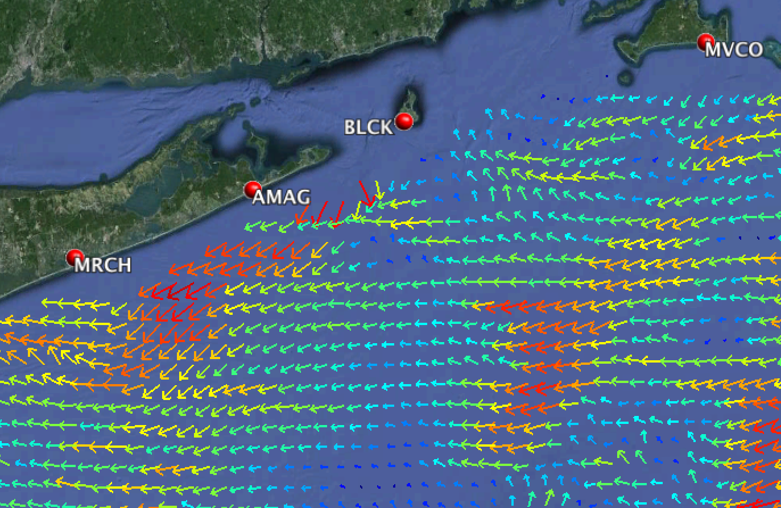
HF-Radar: Radials vs Vectors
Radials Total Vectors

Slide 14
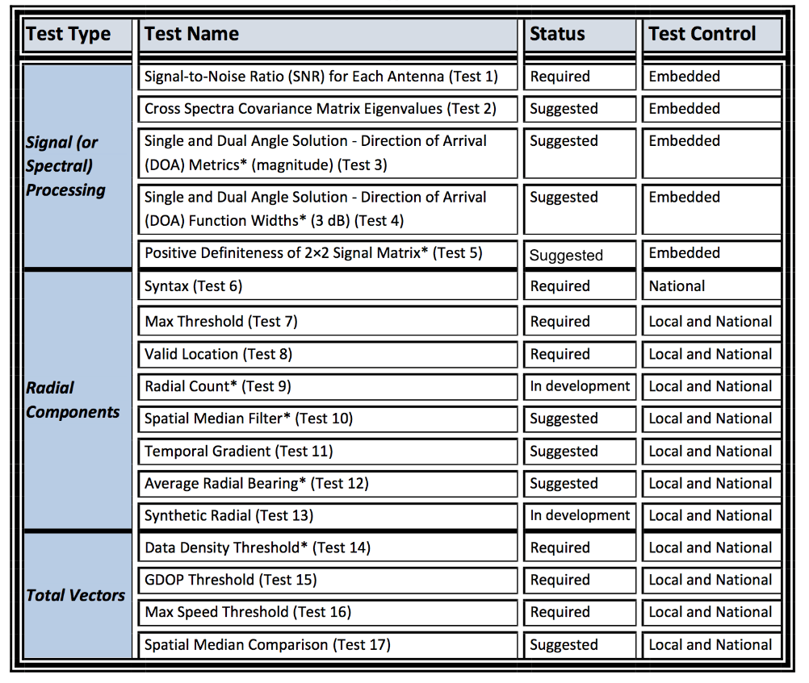
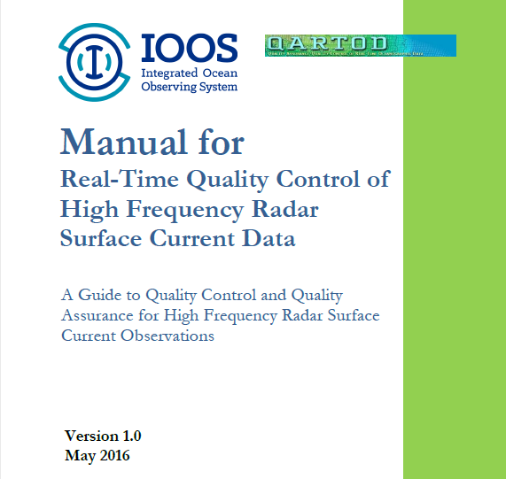
HF-Radar: QARTOD QC Tests
From
QARTOD
Manual for
HF Radar
Notes:
Location, syntax occur before any science qc Next slide shows location fail

Slide 15
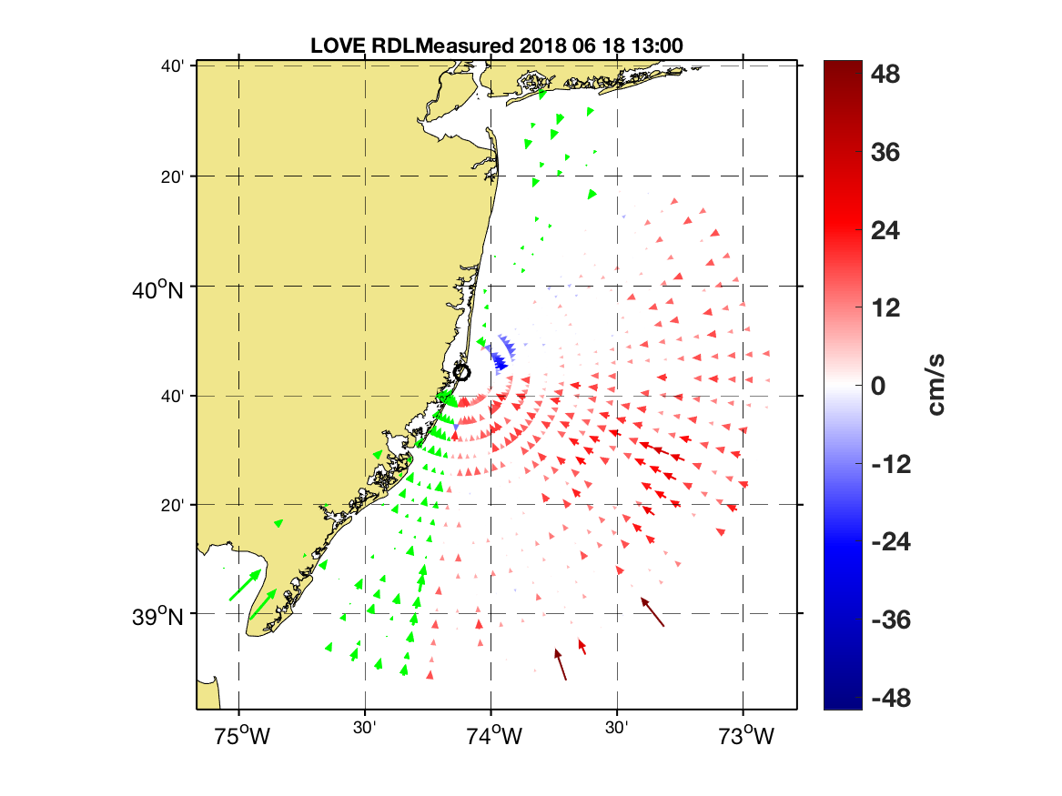
Green vectors are flagged by valid location (AngSeg) test.

Slide 16
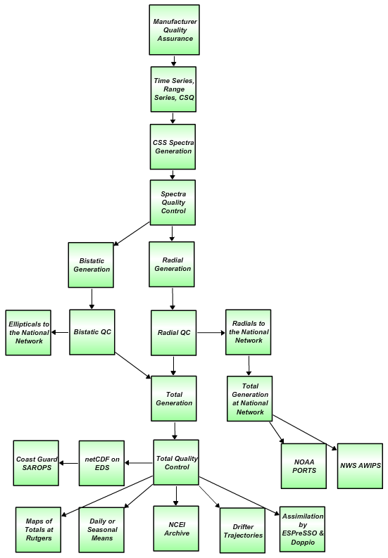
HF Radar Data Real Time & Delayed Mode Flow Chart
Quality Assurance
Manufacturer recommended Antenna Patterns not older than 1 year
Weekly 11-point remote site inspections
Physical site inspection every 6 months
.
Level 0
Automated QARTOD
Test 1: SNR Ratio, Filter < 7dB
Human In The Loop
Visual inspection of first order line settings performance on capturing Bragg scatter
Analyze antenna amplitude and phase along with spectra SNR and noise floor to identify reprocessing intervals and reprocess
Level 1
Test 6: Syntax, Filter
Test 7: Max Threshold, Filter > 150 cm/s (13/25 MHz) 300 cm/s (5 MHz)
Test 8: Radial Valid Location, Filter
Visual inspection of hourly radial files
Identify radial gaps due to communication latency and fill
Analyze radial diagnostic plots (average radial bearing, radial coverage) to identify errors for reprocessing
Check to see that gaps are not introduced into the reprocessed data set
Level 2
Test 14: Data Density Threshold, Filter, At least 3 vectors from 2 separate stations
Test 15: GDOP, OI Uncertainty, Flag > 0.6 in U or V Velocity
Test 16: Max. Speed Threshold , Filter > 150 cm/s (13/25 MHz) 300 cm/s (5 MHz)
Visual inspection of hourly total files
Visual inspection of the reprocessed hourly total files
Level 3
Level 4
Data levels defined by NASA Earth Science Reference Handbook ( 2006, p.31)
Notes:
Qartod is a start, but it’s not comprehensive. Qartod is real time. Here we se much more that is performed post processing for publication ready science data.

Slide 17
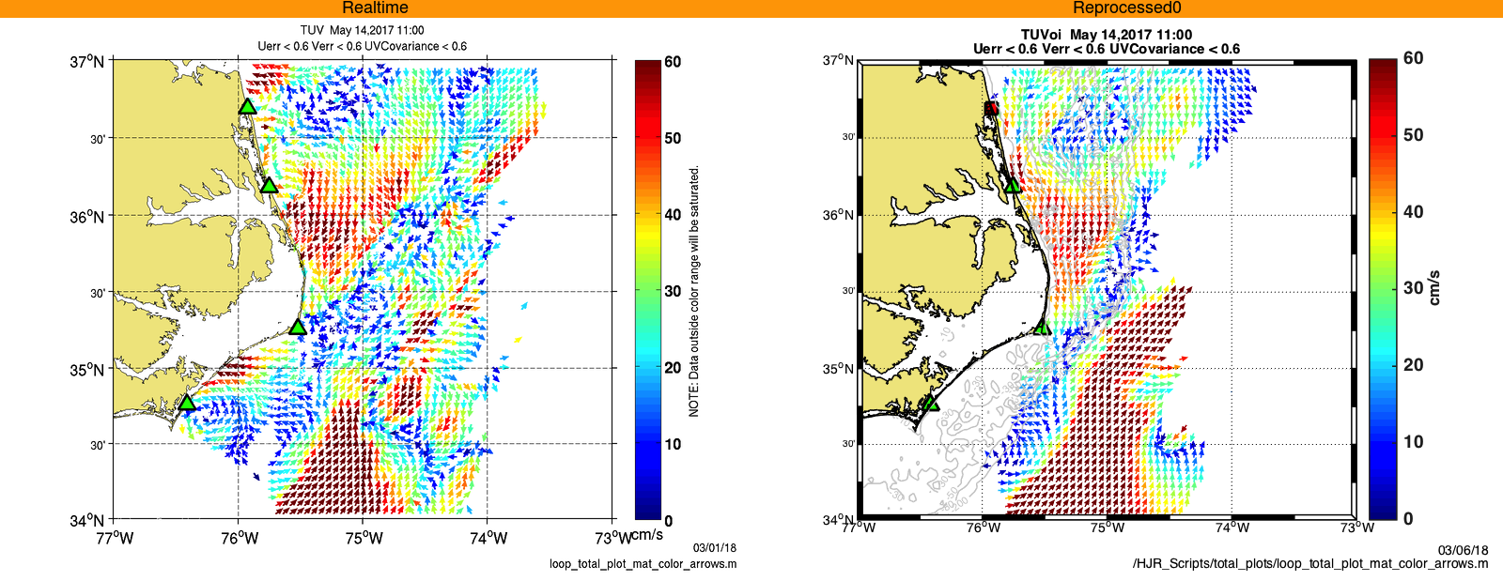
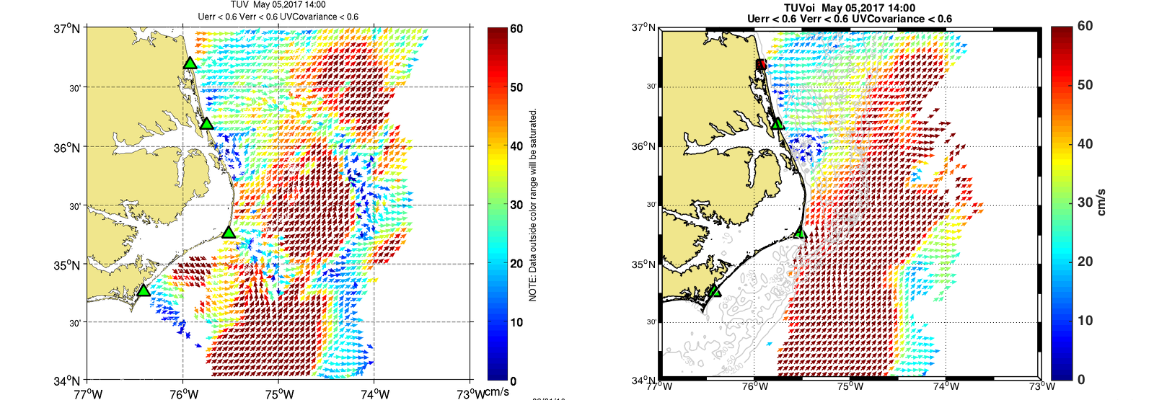
HFR QC: Real-time vs Delayed Mode Reprocessing
May 14, 2017
May 14, 2017
Real Time
Remember: We are certified
Reprocessed
May 5, 2017
May 5, 2017
Notes:
Left column is qartod passed test. The right has the human in the loop fix

Slide 18
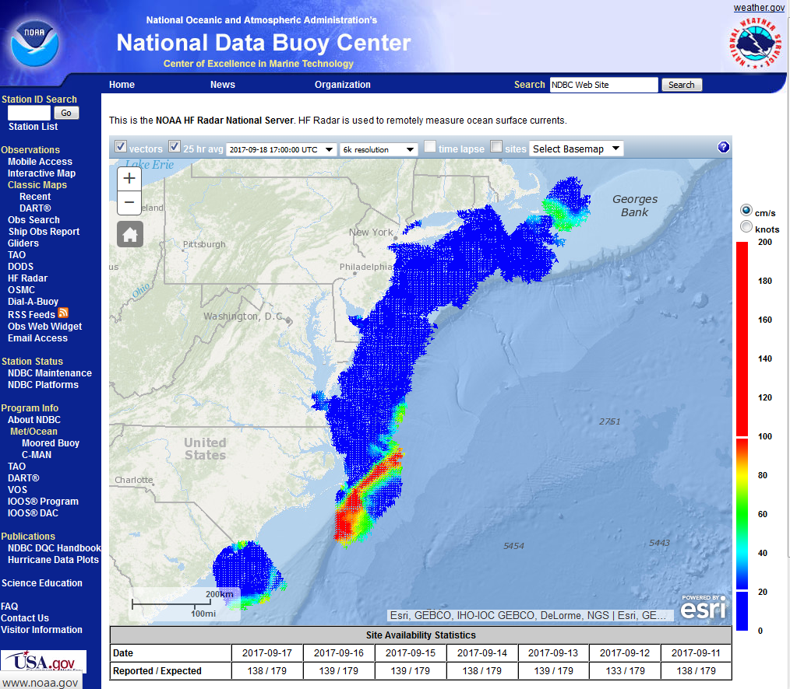
National HF-Radar Network
All data are archived through the national network
Hfradar.ndbc.noaa.gov
Notes:
Here is where codar data is located

Slide 19
Underwater Gliders

Slide 20
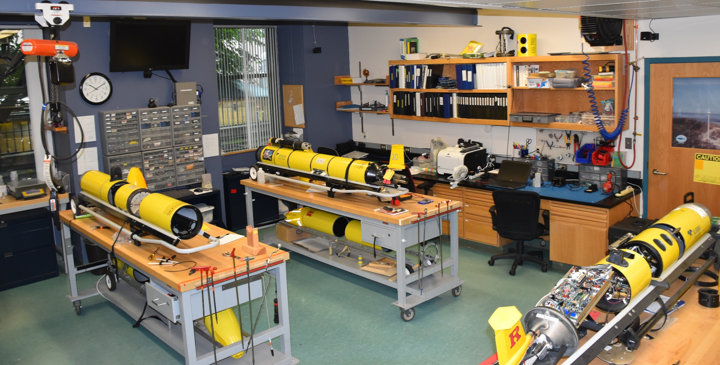
Gliders

Slide 21
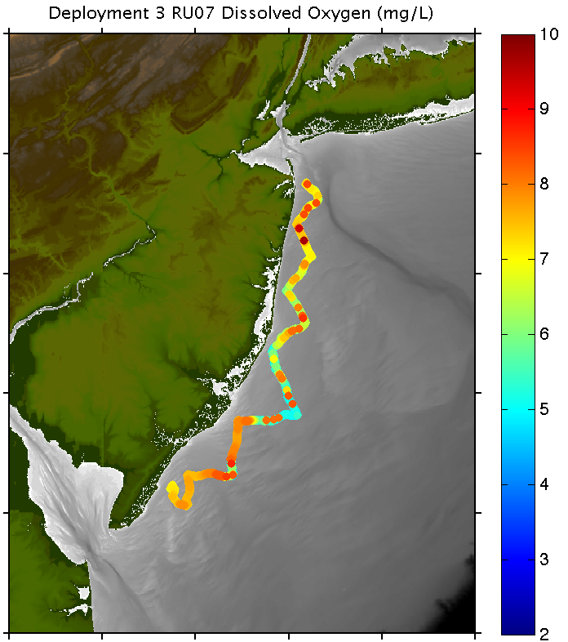
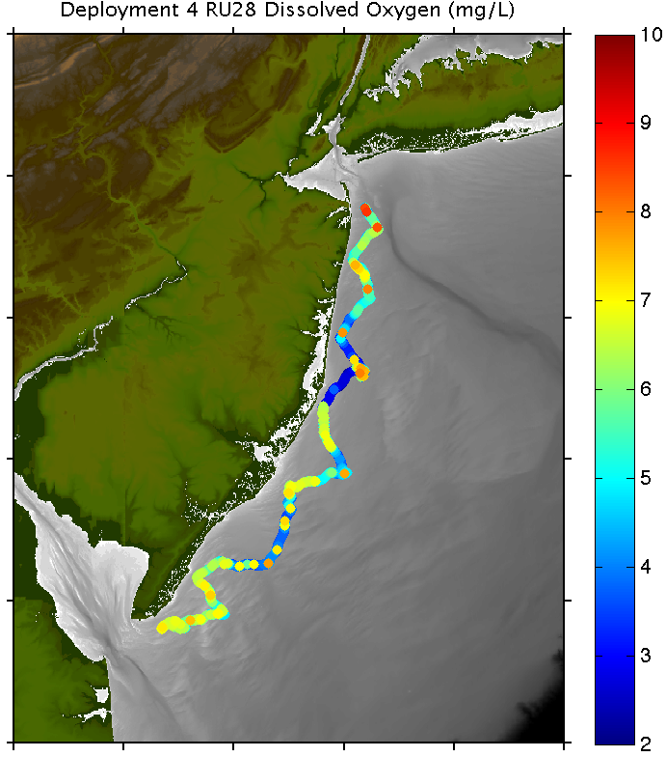


Monitoring Dissolved Oxygen Using Autonomous Gliders:
Notes:
NJDEP started this process for us. You cannot get any $$ unless you sign a QAPP

Slide 22
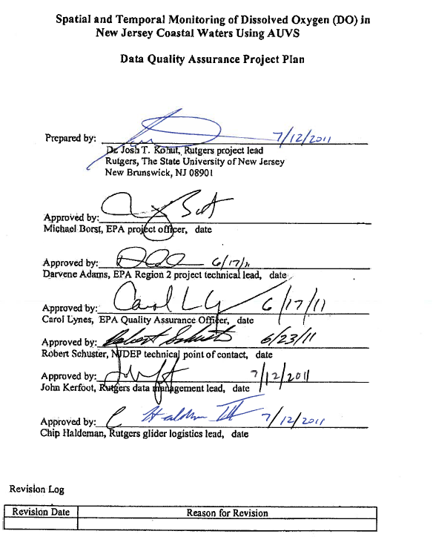
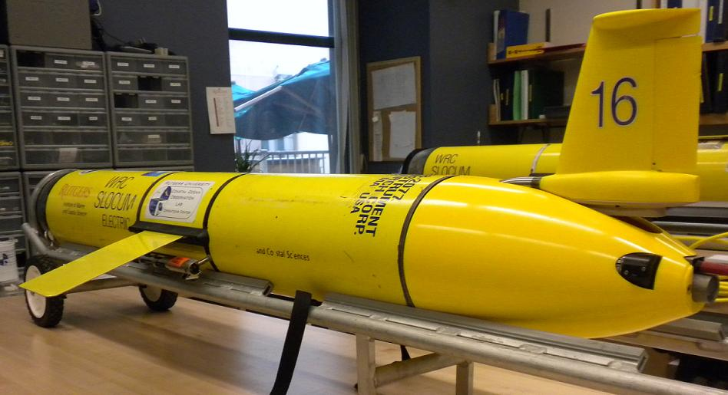
Autonomous Platforms:
Dissolved Oxygen
2011-2012
Quality Assurance Project Plan:
Glider Mission Planning
SeaBird CTD
Aanderra Optode 3835
Documents for pre- and
post- deployment glider, CTD and DO QA

Slide 23
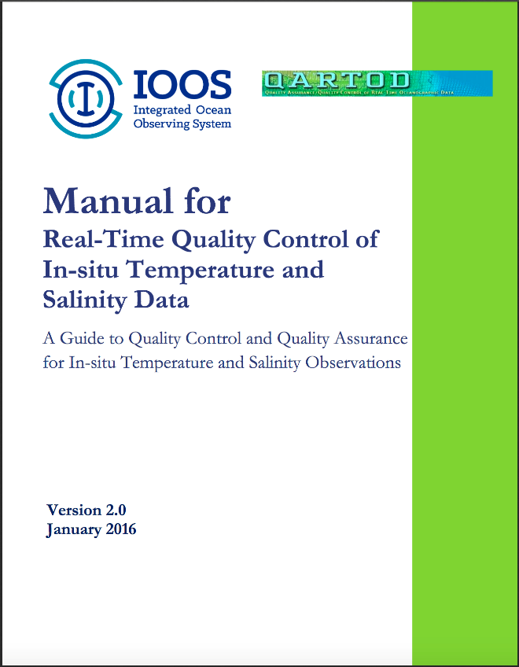
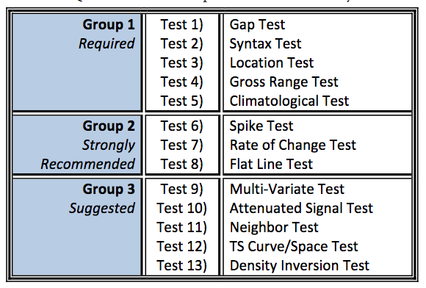
Glider Data QA/QC
EPA Quality Assurance Project Plan:
Glider Mission Planning
SeaBird CTD
Aanderra Optode 3835
Documents for pre- and
post- deployment glider, CTD and DO QA
QARTOD
Notes:
We are now combining QAPP with QARTOD

Slide 24
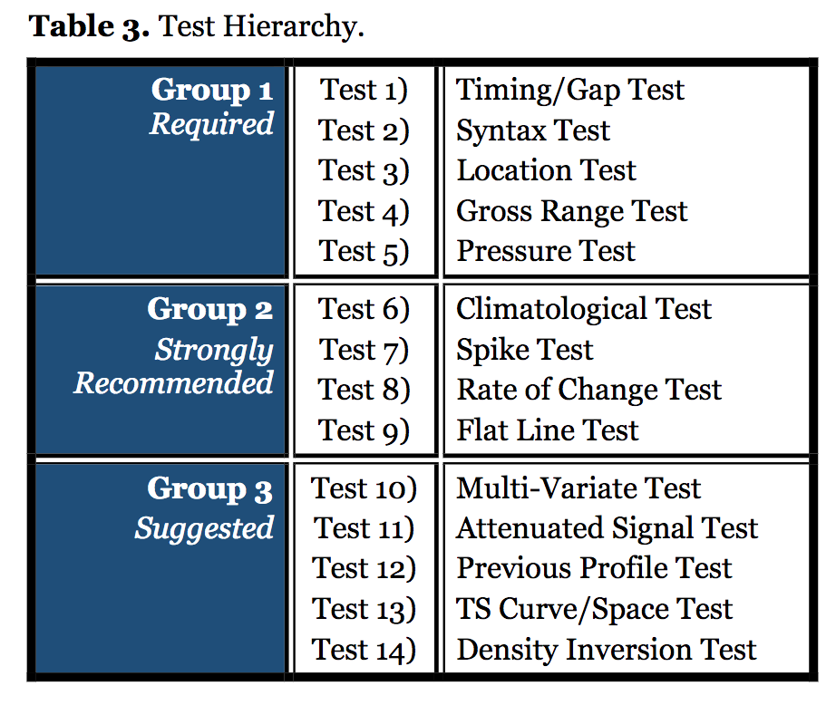
Was file received in reasonable amount of time compared to previous file?
Is file formatted correctly?
Did glider surface in reasonable location?
Is data within range the sensor can measure?
Does profile go continuously up or continuously down?
Is data reasonable for given region and season?
Is data point much higher/lower than surrounding points?
Does data increase/decrease too rapidly?
Is there too little (or no) variability in a series of data points (stuck sensor)?
Notes:
Here are the tests translated to English

Slide 25
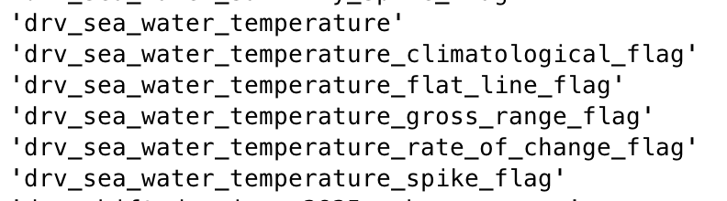
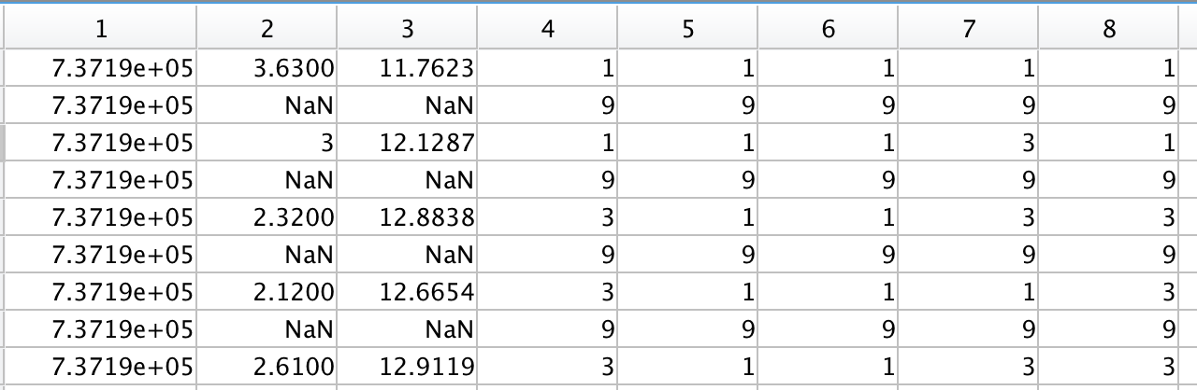
Flags are added as new sensors in glider deployment matlab file (dbd group)
Time
Depth
Temp
Climate Flag
Flat Line
Gross Range
ROC
Spike
Notes:
Here we are in the weeds of the file. 9 mean data is not there, 3 is suspect, 1 is good.

Slide 26
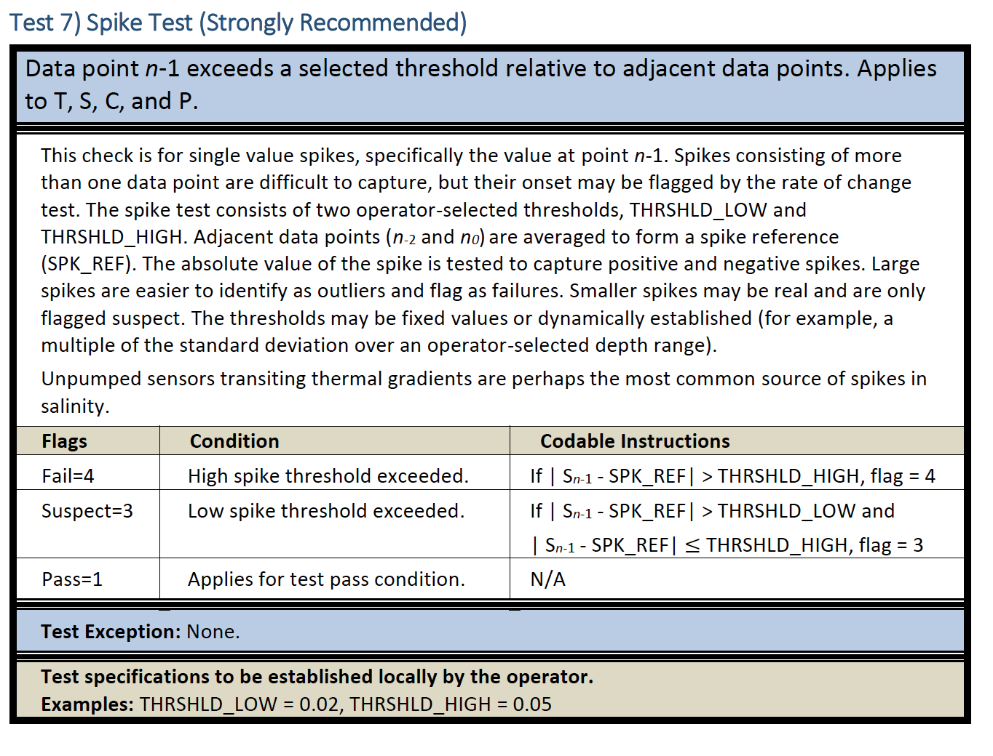
Notes:
Highlighted best spike example
The bottom 4 figures are actually 2 different profiles
If it’s inside the pink vertical lines, its ok, if its inside the red, is suspect, outside the red is bad

Slide 27
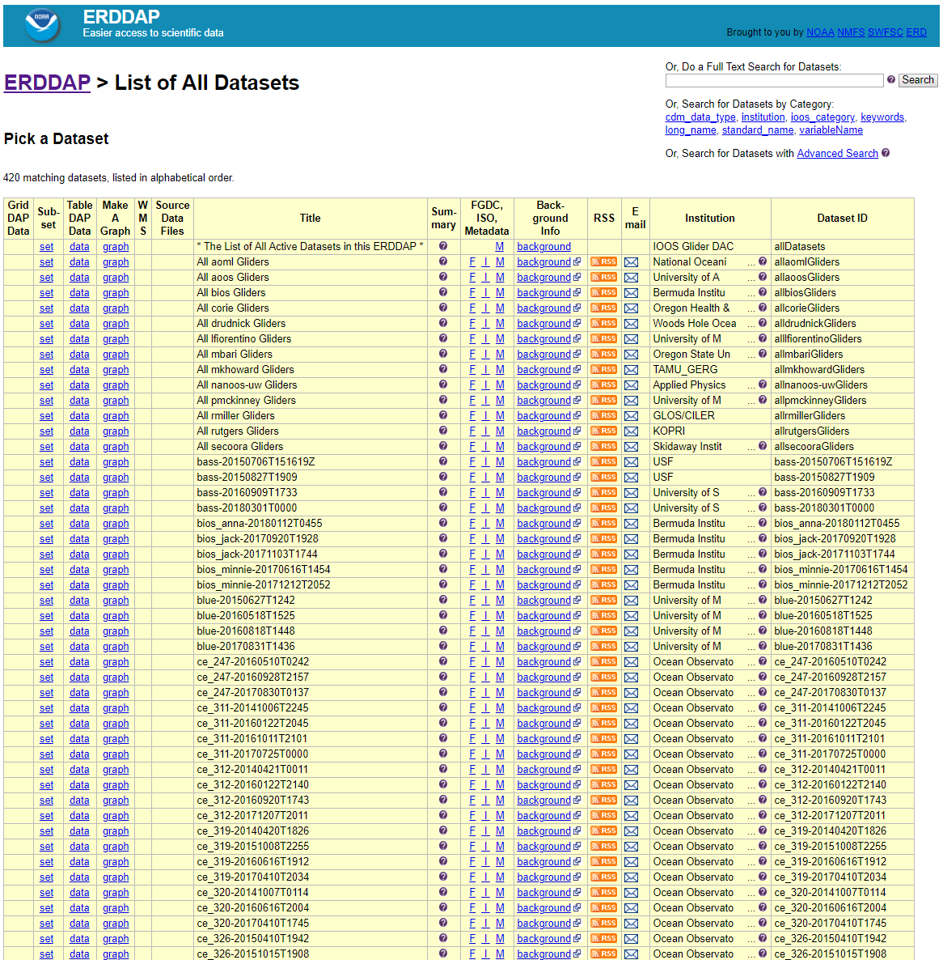
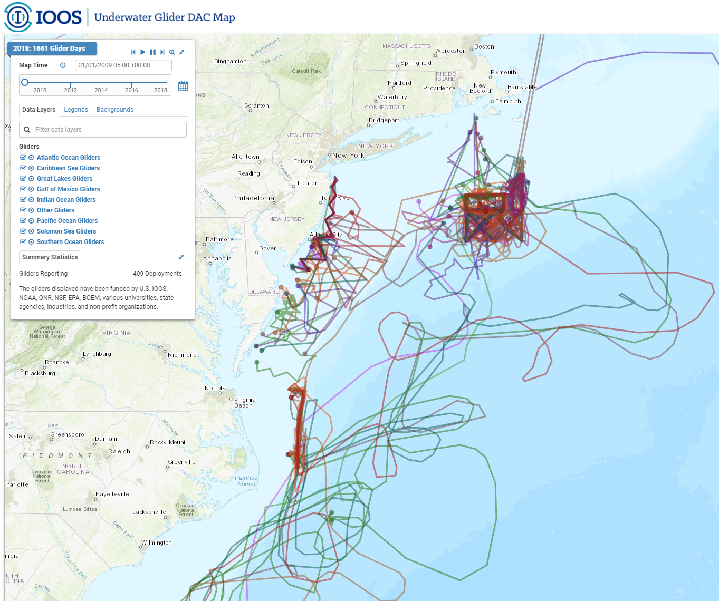
Glider DAC Support
Users: Federal, State and local gov’t, public
Goals:
Consolidate all glider data into one location
Make data available to the GTS
Deliver data to the world!
ERDDAP Server
https://gliders.ioos.us/

Slide 28

Summary
So much data, and all available for scientific use
Only an example of numerous datasets from partners available
Today, examples of single platform, multi-platform, Federal Government and external data QC were presented
Certified data! IOOS certifies data through QARTOD, SOPs, and confirm that external data have a QA/QC process in place.
Trust but verify!

