Slide 1
Data QA/QC in the IOOS Mid-Atlantic Regional Association Coastal Ocean Observing System
Mike Crowley, Kelly Knee, Mike Smith, Laura Nazzaro, Hugh Roarty, Matt Oliver, Gerhard Kuska, Josh Kohut, Scott Glenn
September 19, 2017 MTS Anchorage

Slide 2
The next 18 minutes
Overview of MARACOOS
Data access points
Data Management
QA/QC of gliders, HF-Radar and satellite data
QA/QC of external data sets
Take Home Message:
MARACOOS is a government certified data provider that performs QA/QC on ocean data products and makes them freely available through oceansmap.maracoos.org as well as a comprehensive THREDDS server.
MTS 2017 Anchorage
crowley@Rutgers.edu

Slide 3
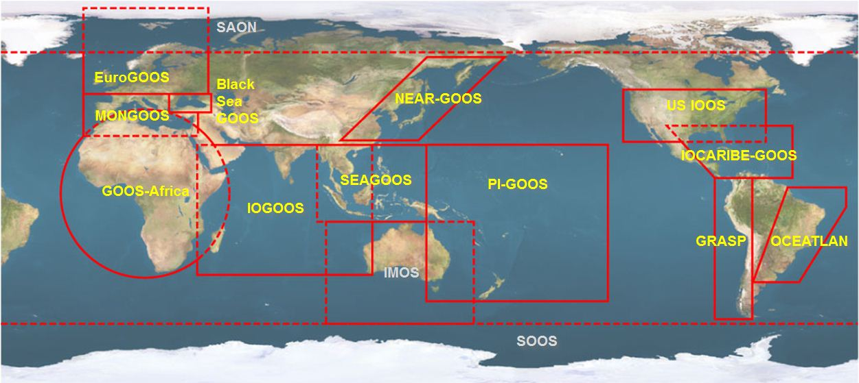
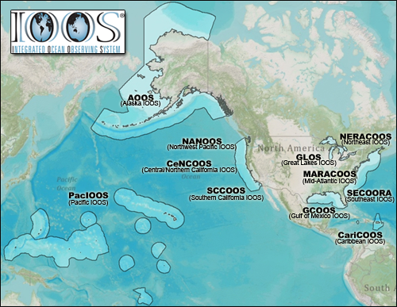
NOAA-led U.S. Integrated Ocean Observing System (IOOS)
Global Component
National Component
Regional Component
15 Regional Alliances in GOOS
Vessels -
Satellite
Satellite
CODAR
Ships/ Vessels
Glider
REMUS
Data Vis.
Modeling
Security
Leadership
Education
11 Regional Associations
17 U.S. Federal Agencies
MTS 2017 Anchorage
crowley@Rutgers.edu

Slide 4
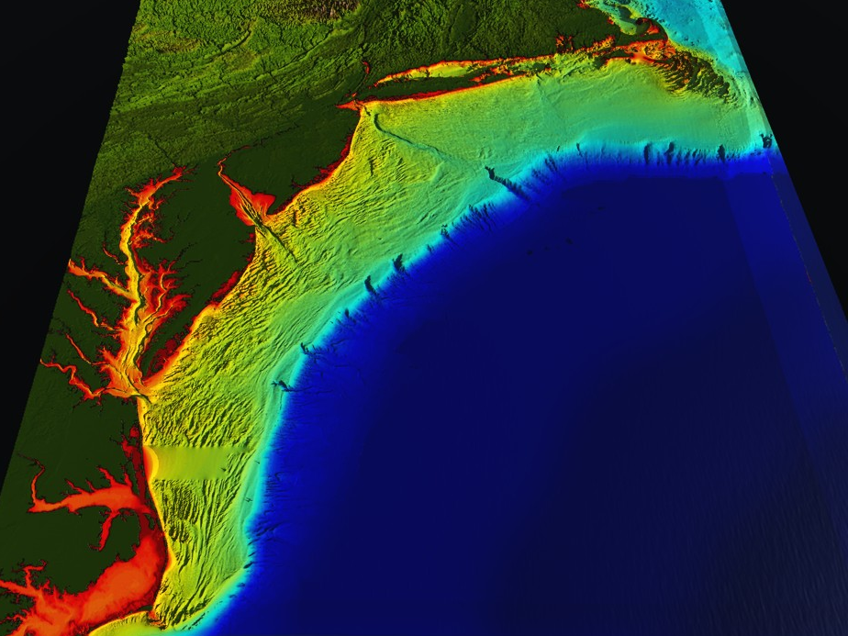
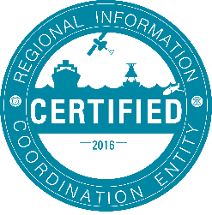
NOAA-led U.S. Integrated Ocean Observing System (IOOS)
RI
U..
Middle Atlantic
Regional Association
Coastal
Ocean Observing System
10 States - 76 Million People
1000 km Cape to Cape
CT
Cape
Cod
MA
NY
PA
NJ
DE
MD
MARACOOS:
An Integrated, Sustained & Certified Real-time Observation System
VA
501(c)3 association
25 universities
21 state/federal government agencies
18 private sector partners
12 non-governmental entities
NC
Cape
Hatteras
MTS 2017 Anchorage
crowley@Rutgers.edu

Slide 5
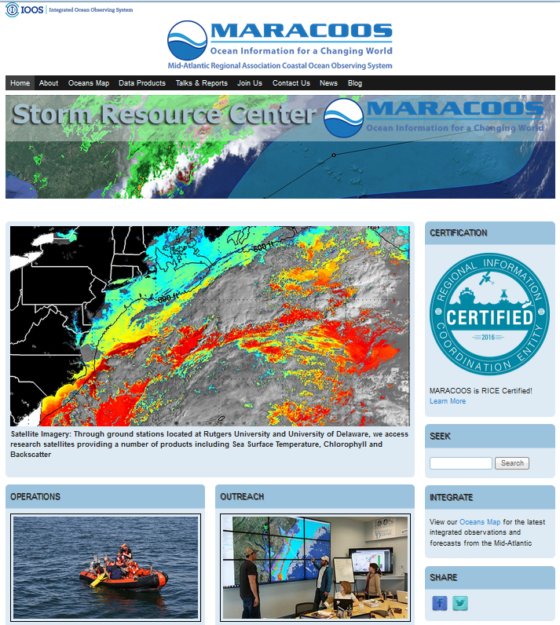
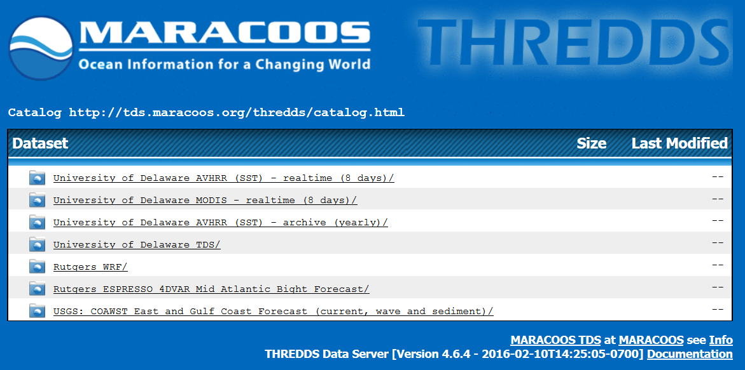
Data Access: MARACOOS.org
MTS 2017 Anchorage
crowley@Rutgers.edu

Slide 6
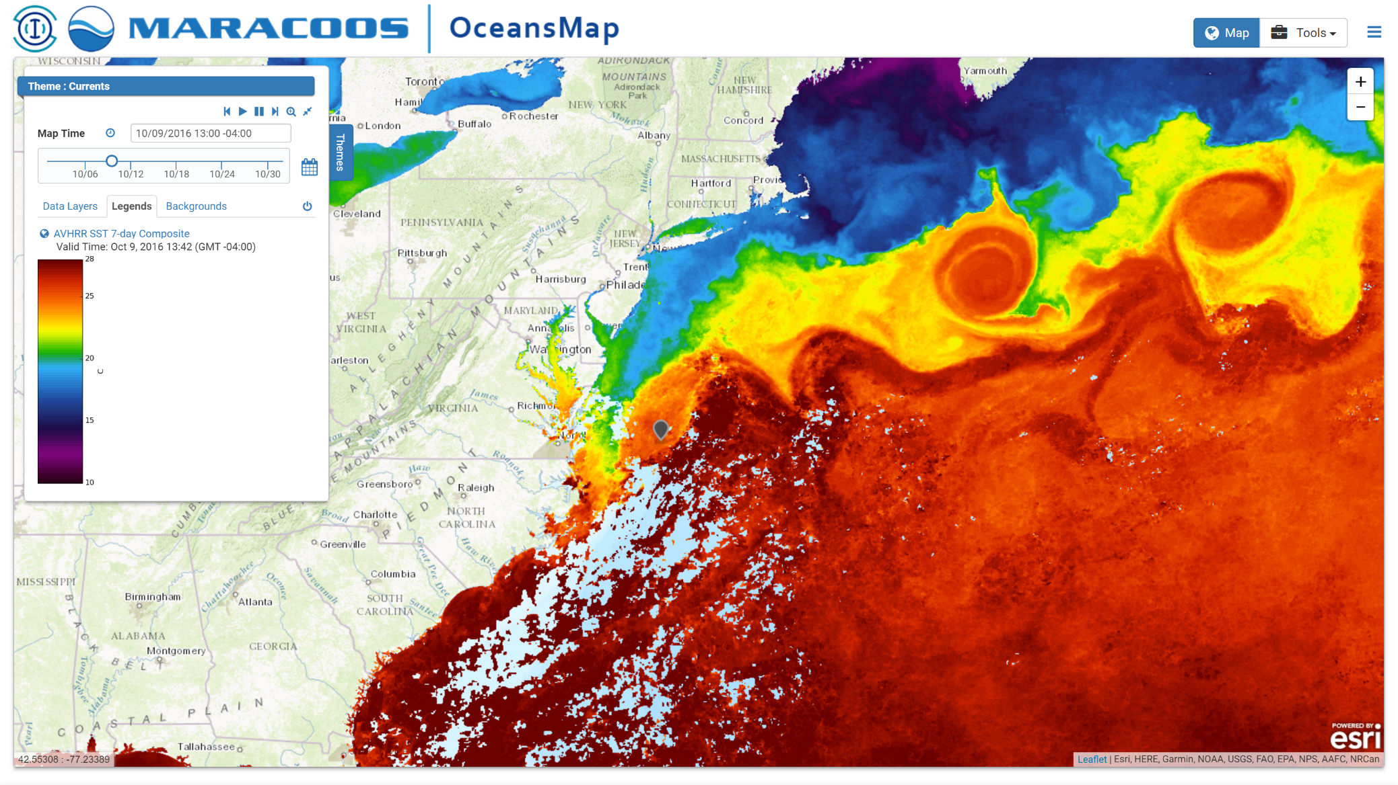
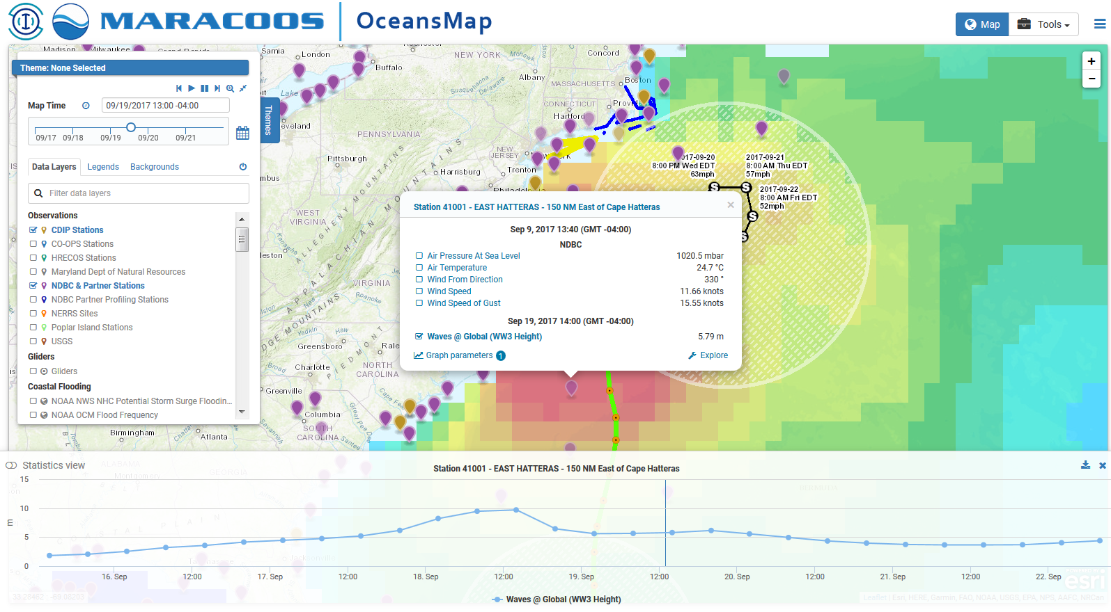
Oceansmap.maracoos.org
MTS 2017 Anchorage
crowley@Rutgers.edu

Slide 7
MARACOOS Certification
MARACOOS’ ability to achieve and consistently maintain federal data quality standards led to its certification as a Regional Information Coordination Entity (RICE) in December 2016.
What does that all mean?
Assures users that MARACOOS data meet or exceed federal standards for quality (names names!)
Ensures that the data collected and distributed by the RICE are managed according to the best practices, as identified by NOAA.
MARACOOS.org/certification
MTS 2017 Anchorage
crowley@Rutgers.edu

Slide 8
MARACOOS Data Mgmt & Communication (DMAC)
The system includes:
management of in situ & remotely-sensed observation and model** data
data-model connections for comparison
data access services such as Thematic Real-time Environmental Distributed Data Services (THREDDS), Open-source Project for a Network Data Access Protocol (OPeNDAP)
common data formats such as NetCDF
delivery of data to operational users
**Note: models are not certified
MTS 2017 Anchorage
crowley@Rutgers.edu

Slide 9
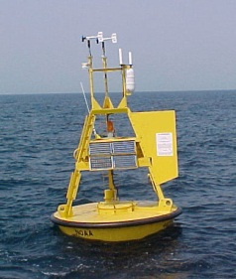
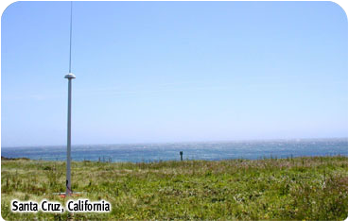
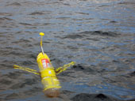
Data Assembly Center
The DAC includes:
data generated by MARACOOS partners (eg. Gliders)
data collected by non-partner organizations such as the Hudson River Environmental Conditions Observing System (HRECOS)
data from government providers: NDBC, CO-OPS, NERRS, USGS, CBIBS
MARACOOS data is delivered to national data assembly centers (DACs) (GliderDAC and the National HF-RADAR Network).
MTS 2017 Anchorage
crowley@Rutgers.edu

Slide 10
Data
MTS 2017 Anchorage
crowley@Rutgers.edu

Slide 11
There are MANY types. Today we are focusing on:
High Frequency Radar (HF Radar)
Ocean Gliders
Advanced Very High Resolution Radiometer (AVHRR),
Hudson River Environmental Conditions Observing System (HRECOS)
MTS 2017 Anchorage
crowley@Rutgers.edu

Slide 12
HF-Radar
MTS 2017 Anchorage
crowley@Rutgers.edu

Slide 13
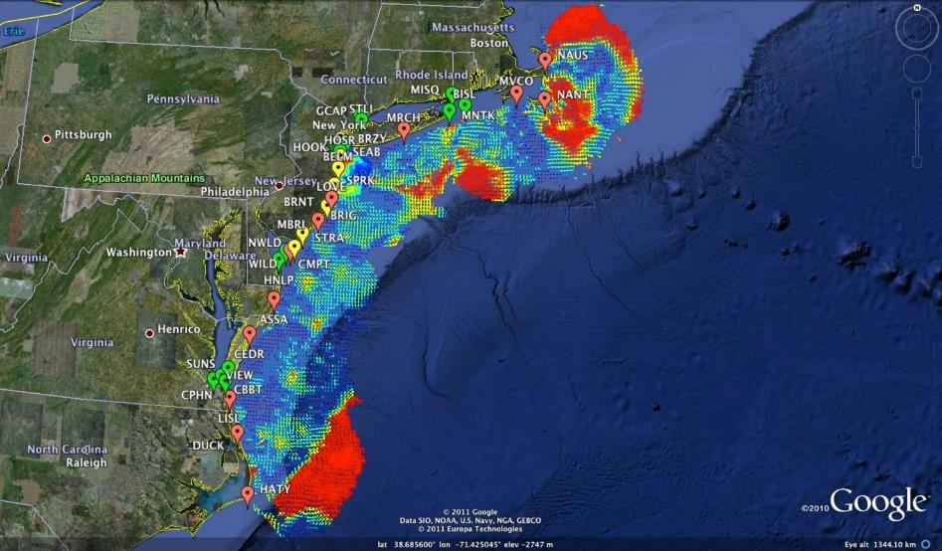
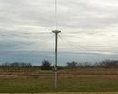
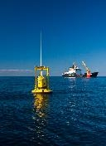
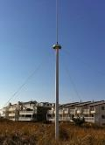
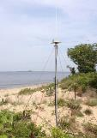
HF-Radar
Mid-Atlantic HF Radar Network
17 Long-Range CODARs
8 Medium-Range CODARs
16 Short-Range CODARs
41 Total CODARs in Region
+5 CODARs outside Region
46 Total CODARs
Hourly currents
Industry Partner: CODAR Ocean Sensors

Slide 14
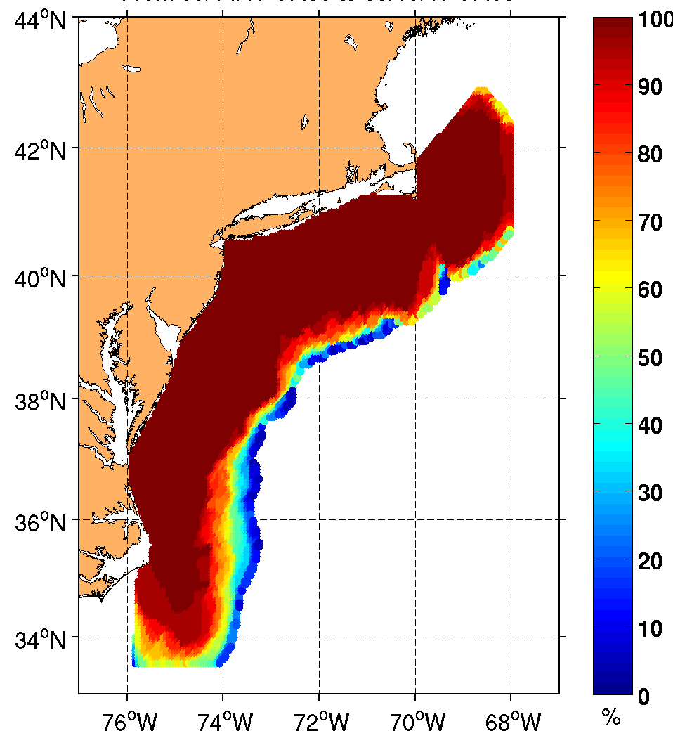
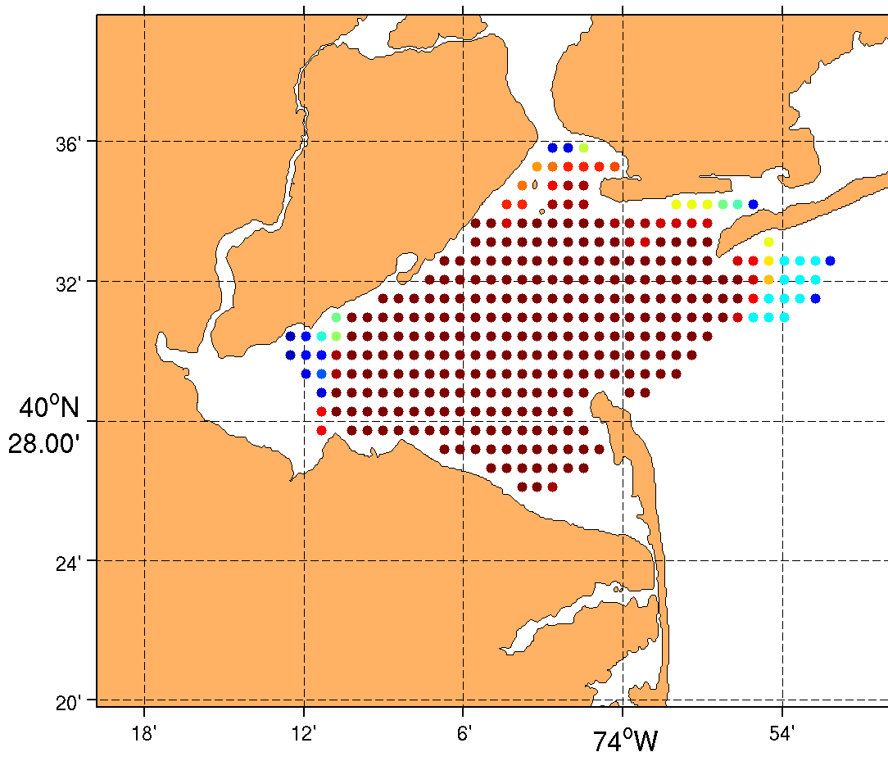
CODAR Coverage:
Long Range (6km) Medium Range (2.5km) Short Range (1km)
MTS 2017 Anchorage
crowley@Rutgers.edu

Slide 15
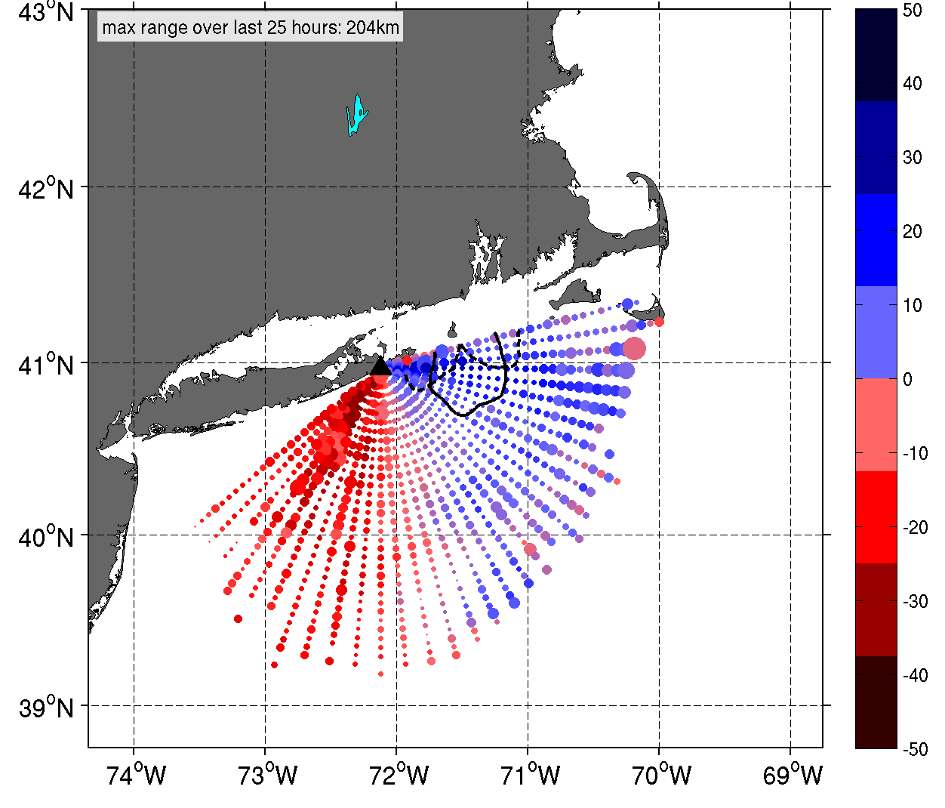
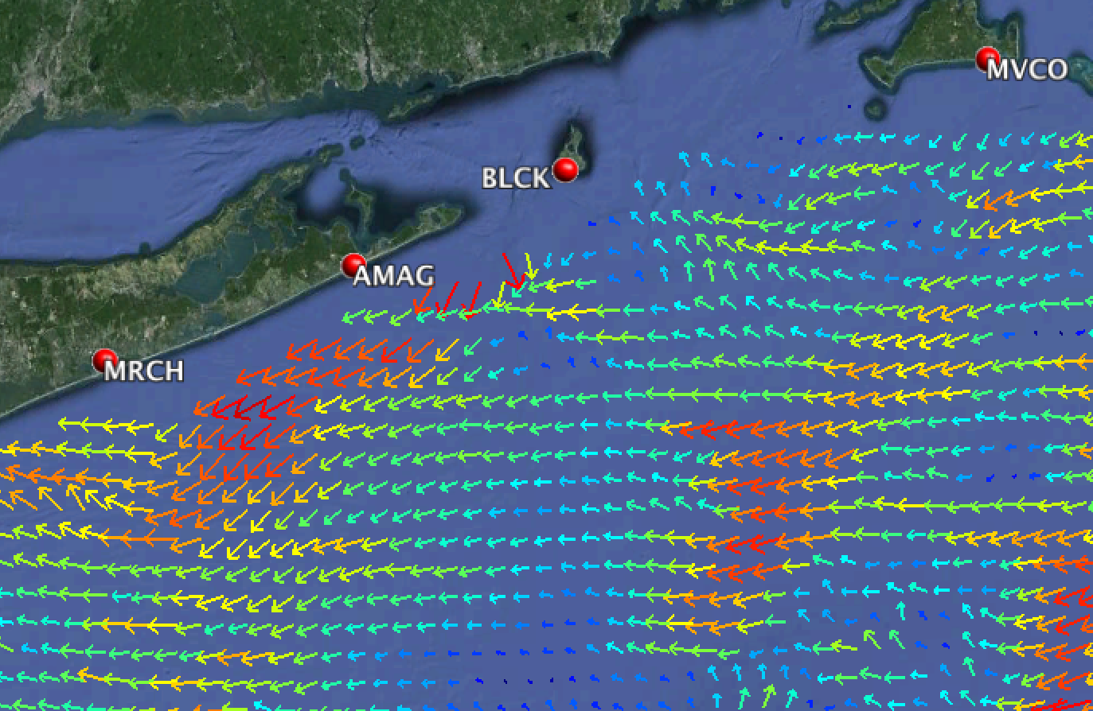
HF-Radar: Radials vs Vectors
Radials Total Vectors

Slide 16
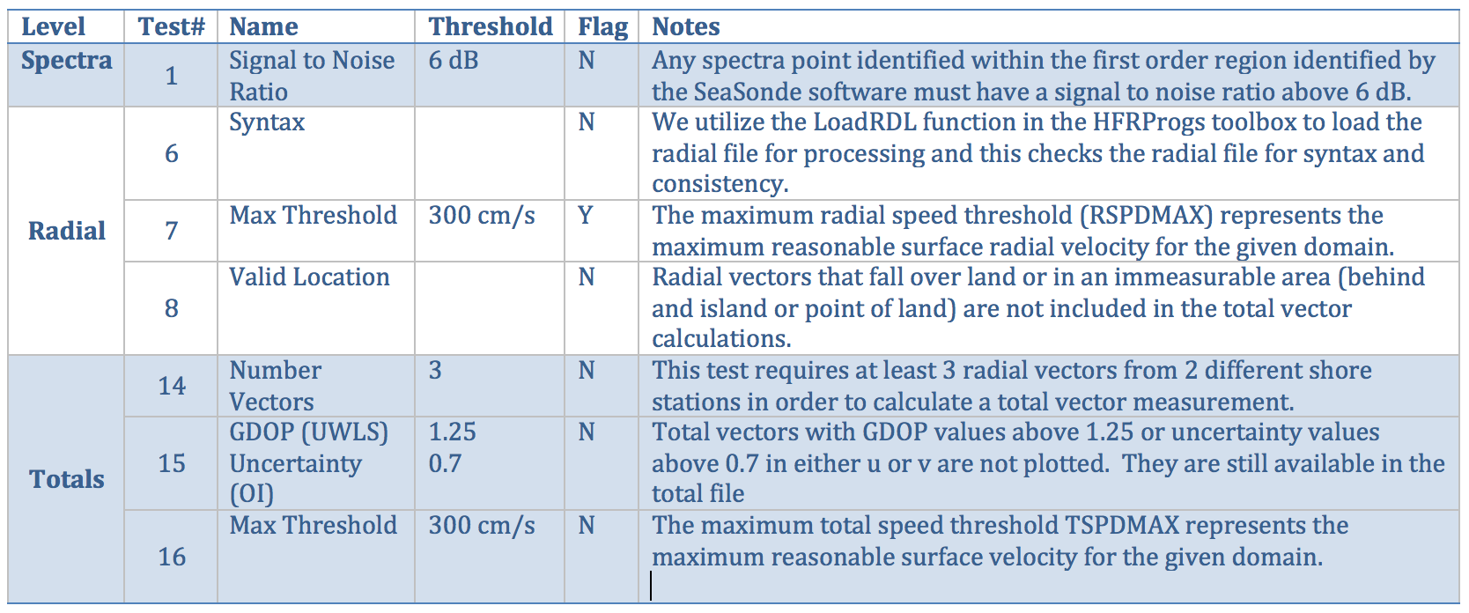
HF-Radar: Required QARTOD QC
All required QARTOD tests are enabled.

Slide 17
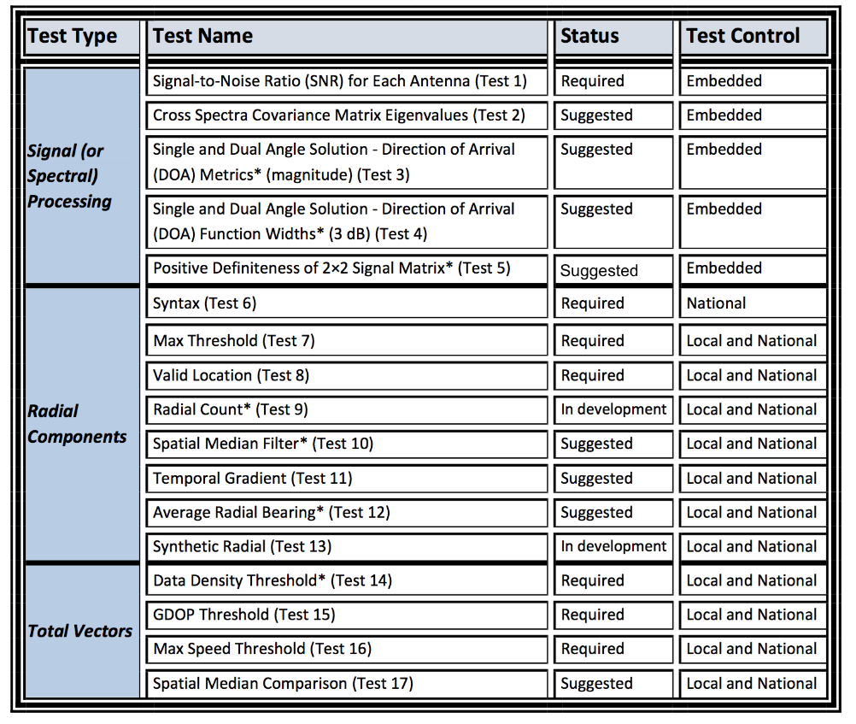
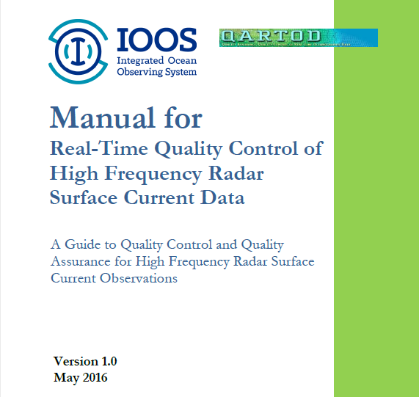
HF-Radar: QARTOD QC Tests
From
QARTOD
Manual for
HF Radar

Slide 18
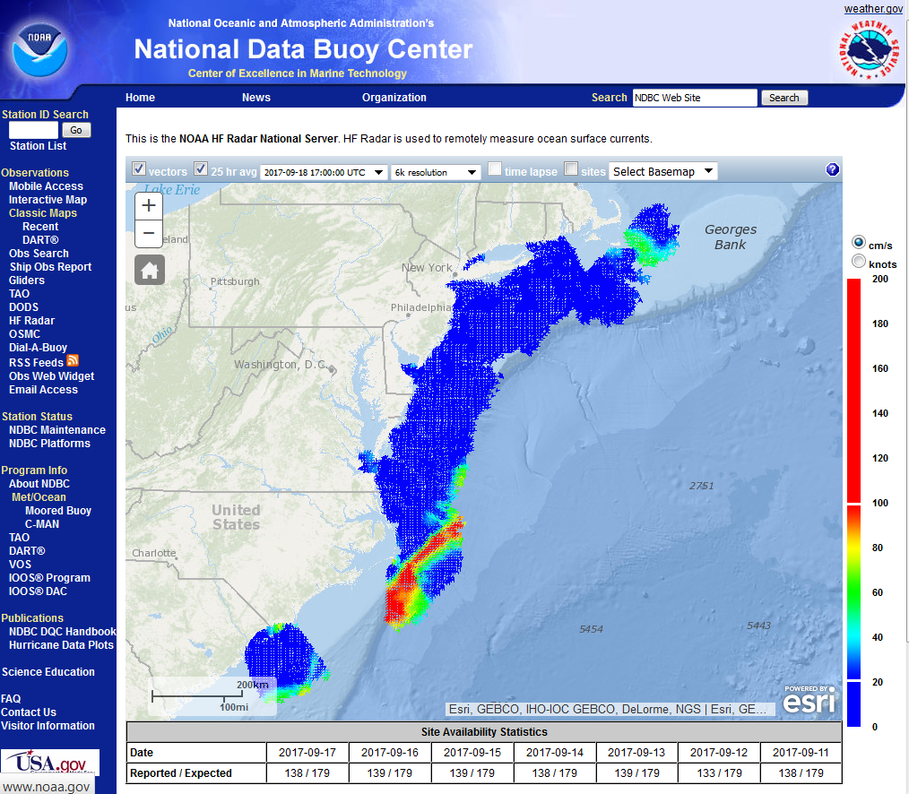
National HF-Radar Network
All data are archived through the national network
Hfradar.ndbc.noaa.gov

Slide 19
Underwater Gliders
MTS 2017 Anchorage
crowley@Rutgers.edu

Slide 20
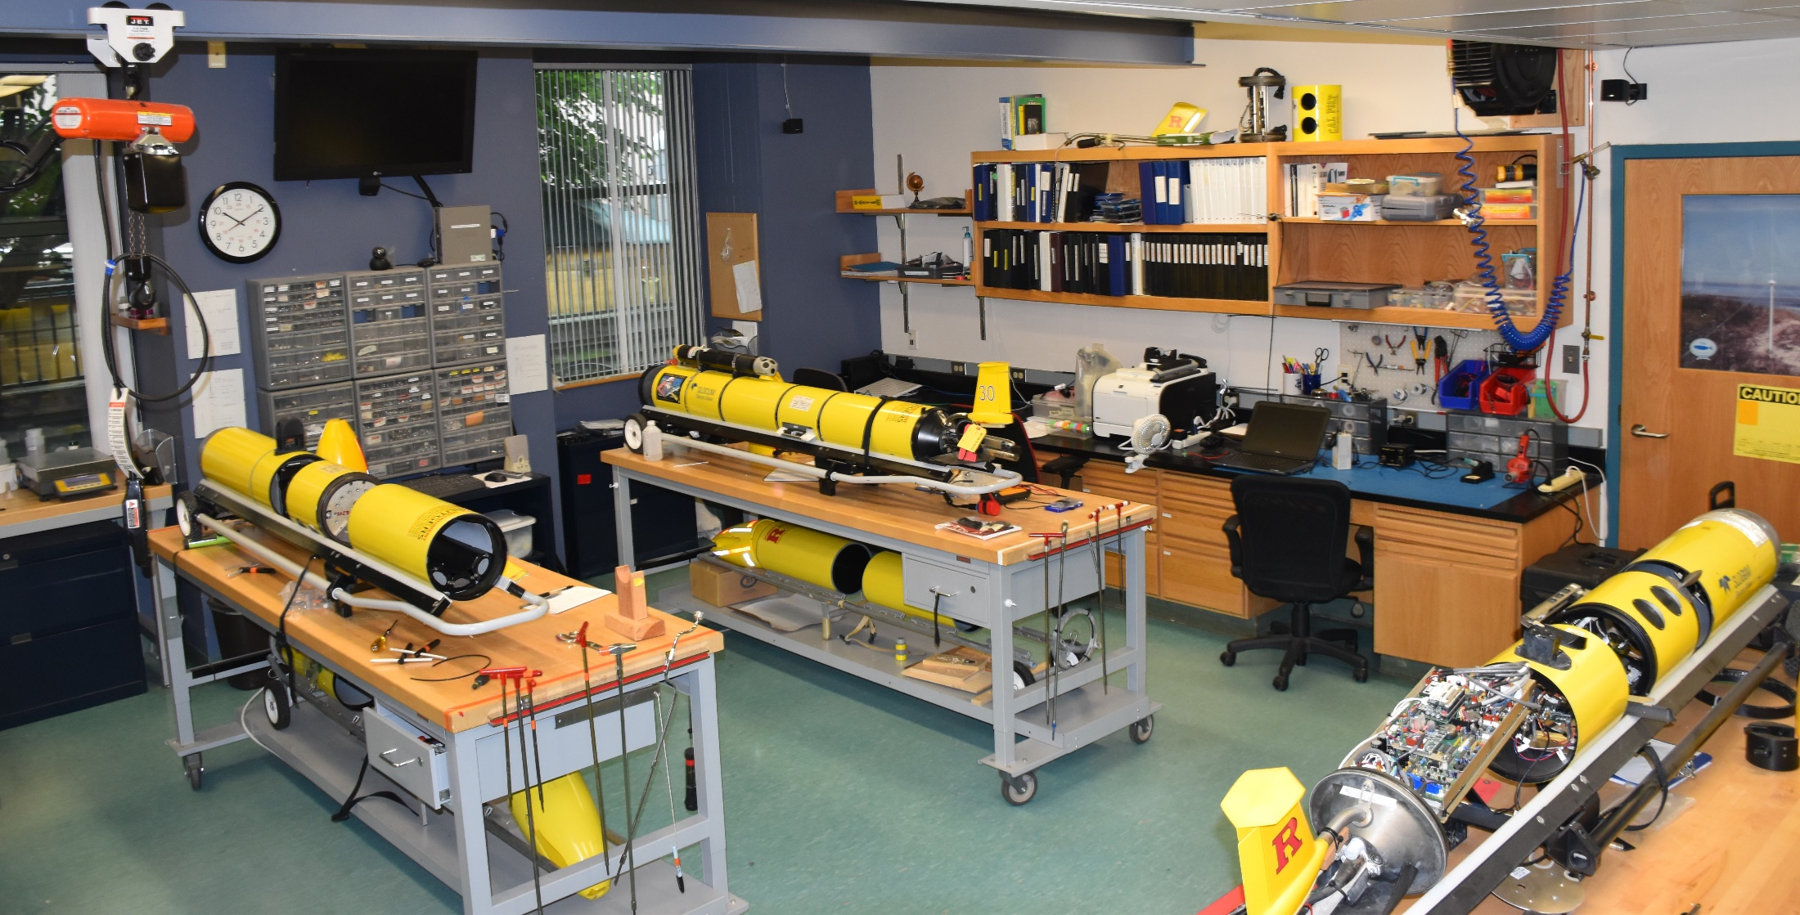
Gliders
MARACOOS leverages Teledyne Webb Slocum Gliders
MTS 2017 Anchorage
crowley@Rutgers.edu

Slide 21
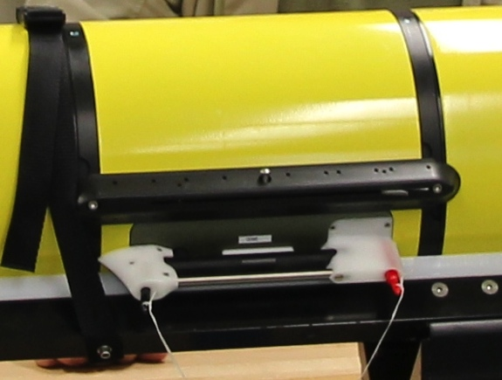
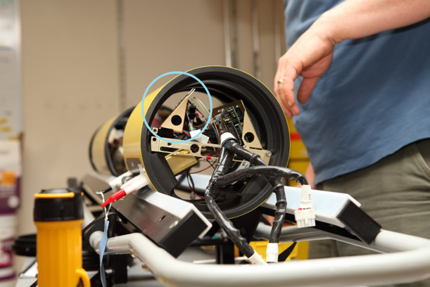
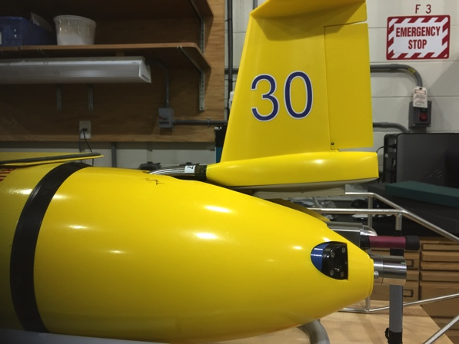
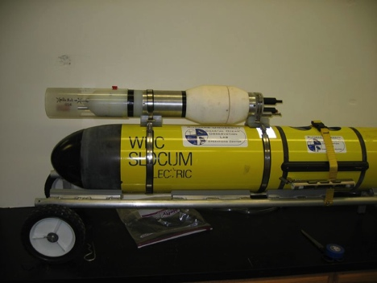
Glider Flexibility
Acoustic Modem
ADCP/DVL
Altimeter
Bathyphotometer (bioluminescence)
Beam Attenuation Meter
Echo Sounder
Optical Backscatter
Optical Attenuation
Oxygen
Conductivity, Temperature, Depth
Fish Tracking
Fluorometer
Hydrocarbon
Hydrophones
Nitrates
PAR sensor
Radiometer
Scattering Attenuation Meter
Spectrophotometer (red tide)
Turbulence
Wave Accelerometer
Internal Payload Bay
Internal
External Payload Area
External Mounted
MTS 2017 Anchorage
crowley@Rutgers.edu

Slide 22
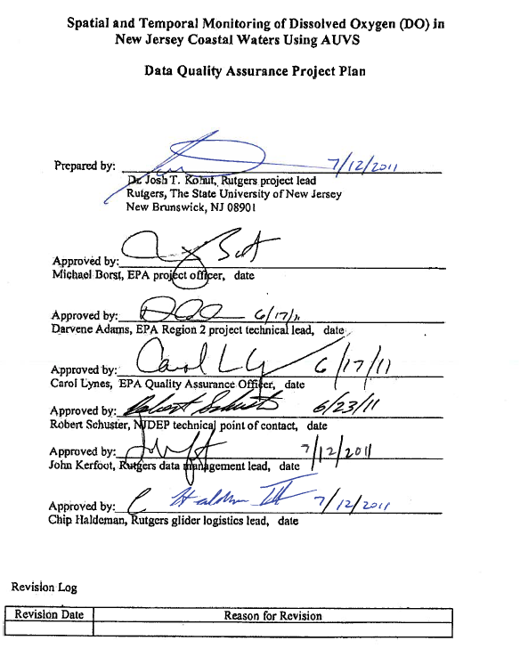
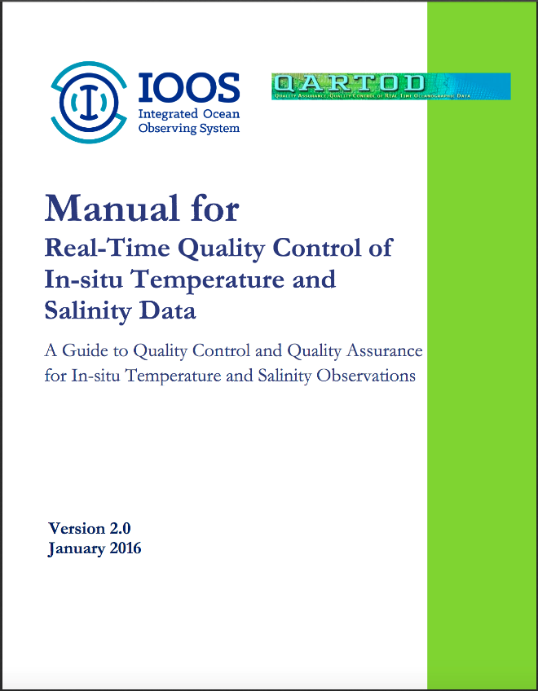
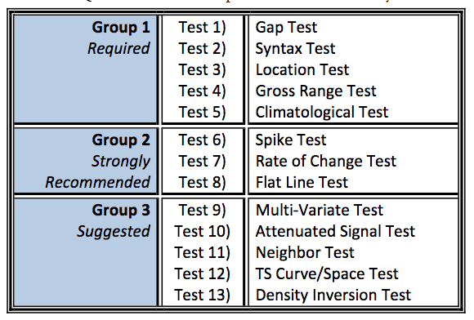
Glider Data QA/QC
EPA Quality Assurance Project Plan:
Glider Mission Planning
SeaBird CTD
Aanderra Optode 3835
Documents for pre- and
post- deployment glider, CTD and DO QA
QARTOD
MTS 2017 Anchorage
crowley@Rutgers.edu

Slide 23
Required Real-Time QARTOD Tests
Timing/Gap Test: data received in the expected time window
Syntax Test: data able to be translated to meaningful values
Location Test: data measured in the geographically expected location
Gross Range Test: valid instrument measurement range
Pressure
Temperature
Conductivity
Salinity
Pressure Test: monotonic increase/decrease in pressure records over the profile
MTS 2017 Anchorage
crowley@Rutgers.edu

Slide 24
Strongly Recommended Real-Time QARTOD Tests
Performed on Pressure, Temperature, Conductivity and Salinity
Climatological Test: values fall in an expected range. Currently, global values are used, but plans to use local ranges are in the works.
Spike Test: capture individual spikes in variable records. Large values marked as failing while smaller values marked as suspect.
Rate of Change Test: marks improbable time-based rate of change between successive records.
Flat Line Test: marks continuously repeated observations of the same value.
MTS 2017 Anchorage
crowley@Rutgers.edu

Slide 25
Suggested Real-Time QARTOD Tests
Future work, with the exception of #5, due to the relative sparseness of real-time data sets. May be implemented on delayed mode data sets in the future.
Multivariate Tests
Attenuated Signal Tests
Previous Profile Test
TS Curve/Space Test
Density Inversion Test
MTS 2017 Anchorage
crowley@Rutgers.edu

Slide 26
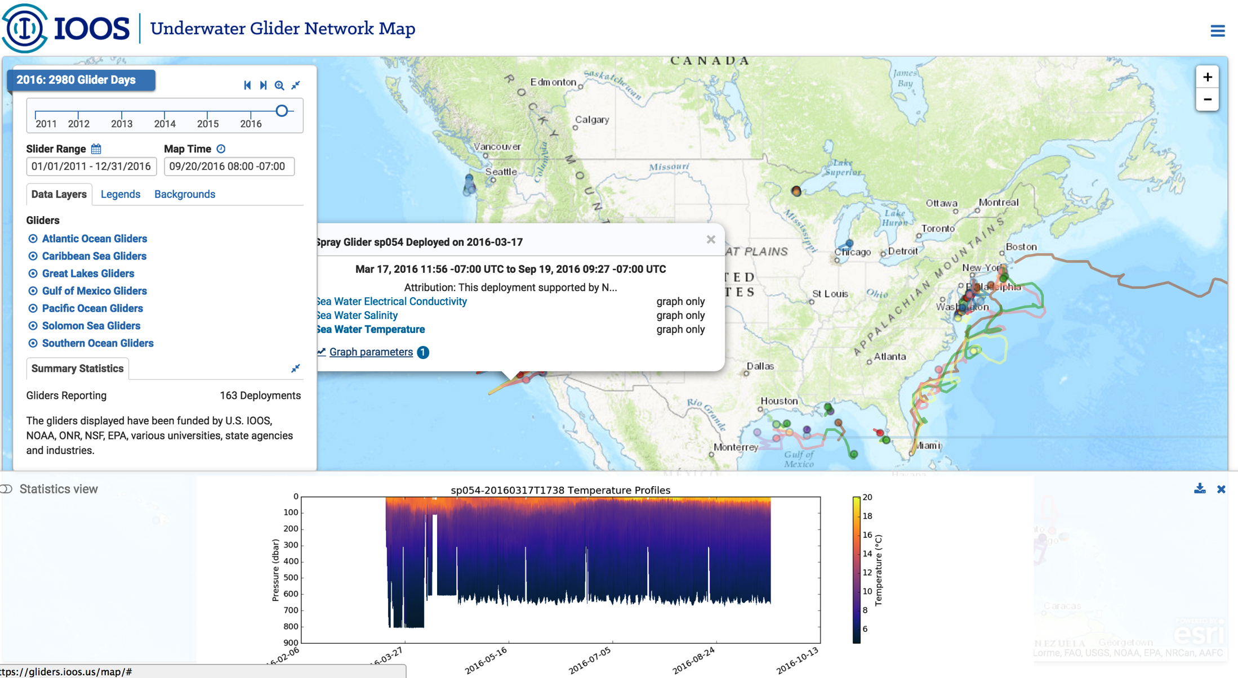
National Glider DAC
T/S Product Visualizations: https://gliders.ioos.us/map/
MTS 2017 Anchorage
crowley@Rutgers.edu

Slide 27
AVHRR Satellite Data
MTS 2017 Anchorage
crowley@Rutgers.edu

Slide 28
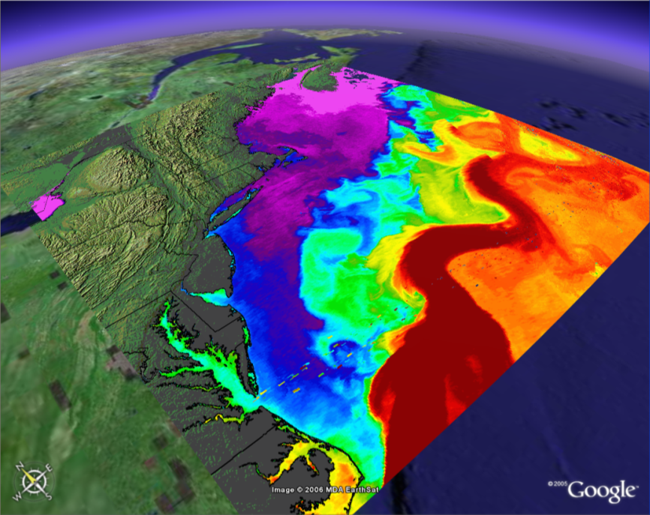
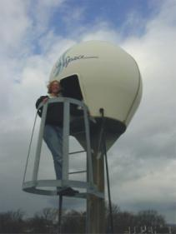
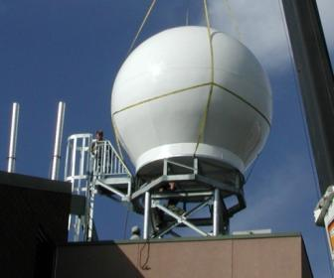
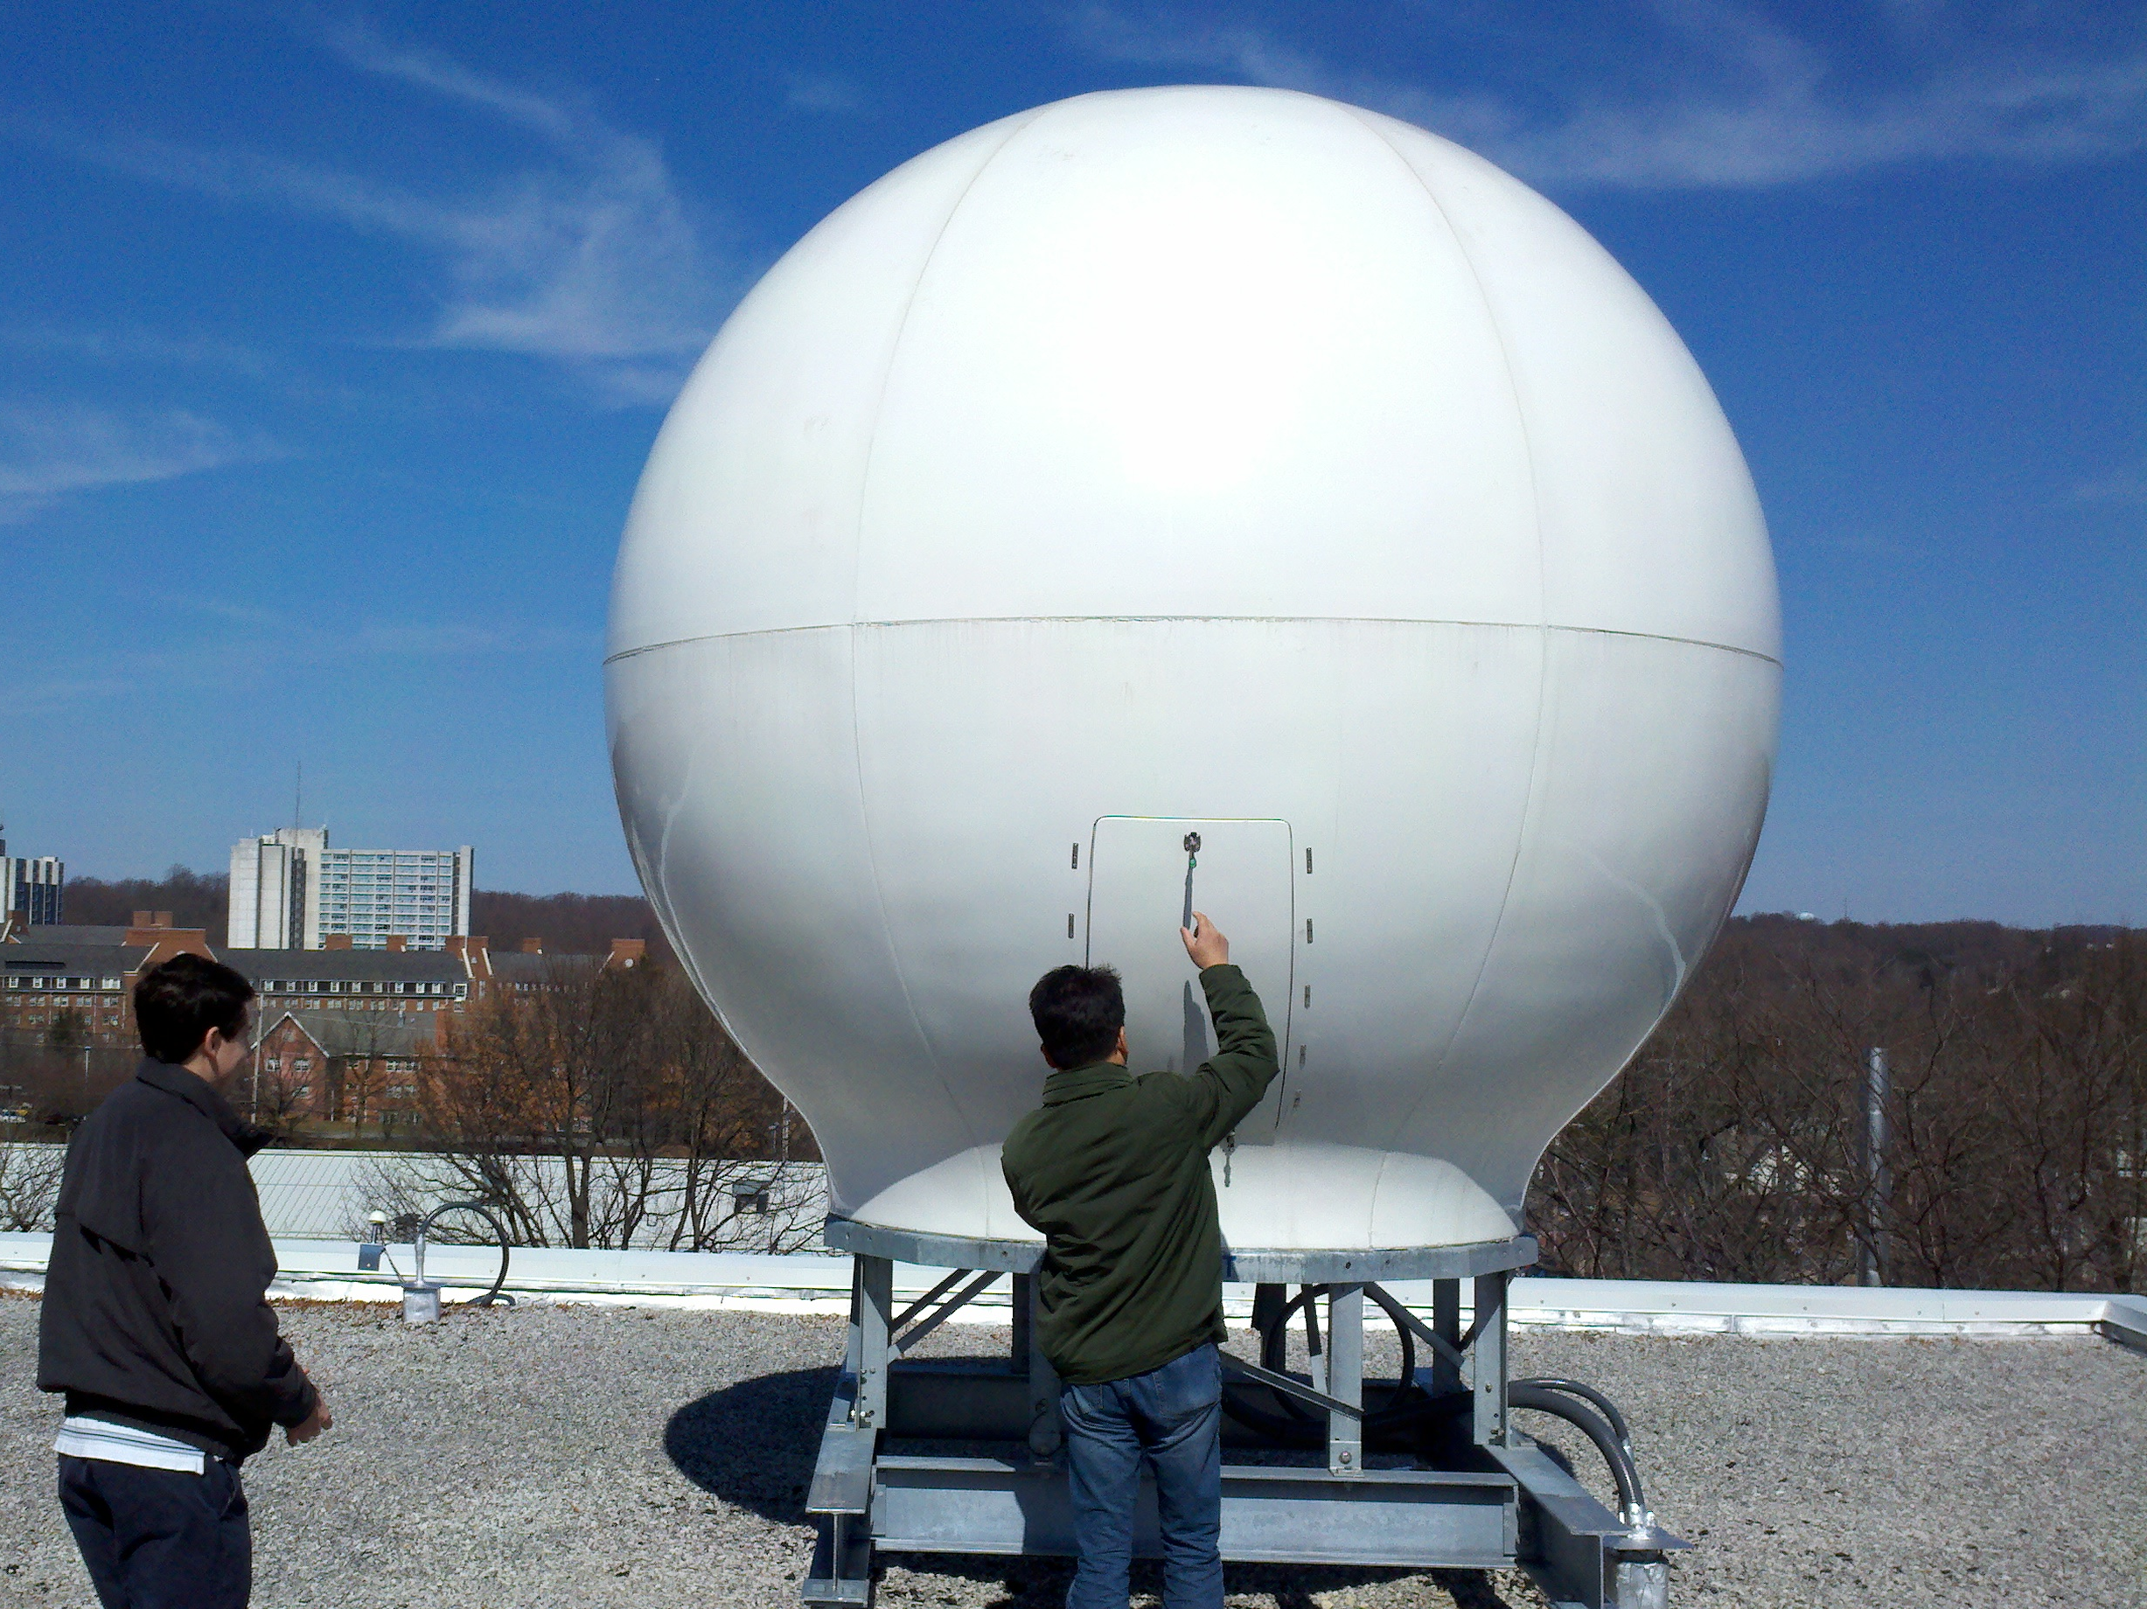
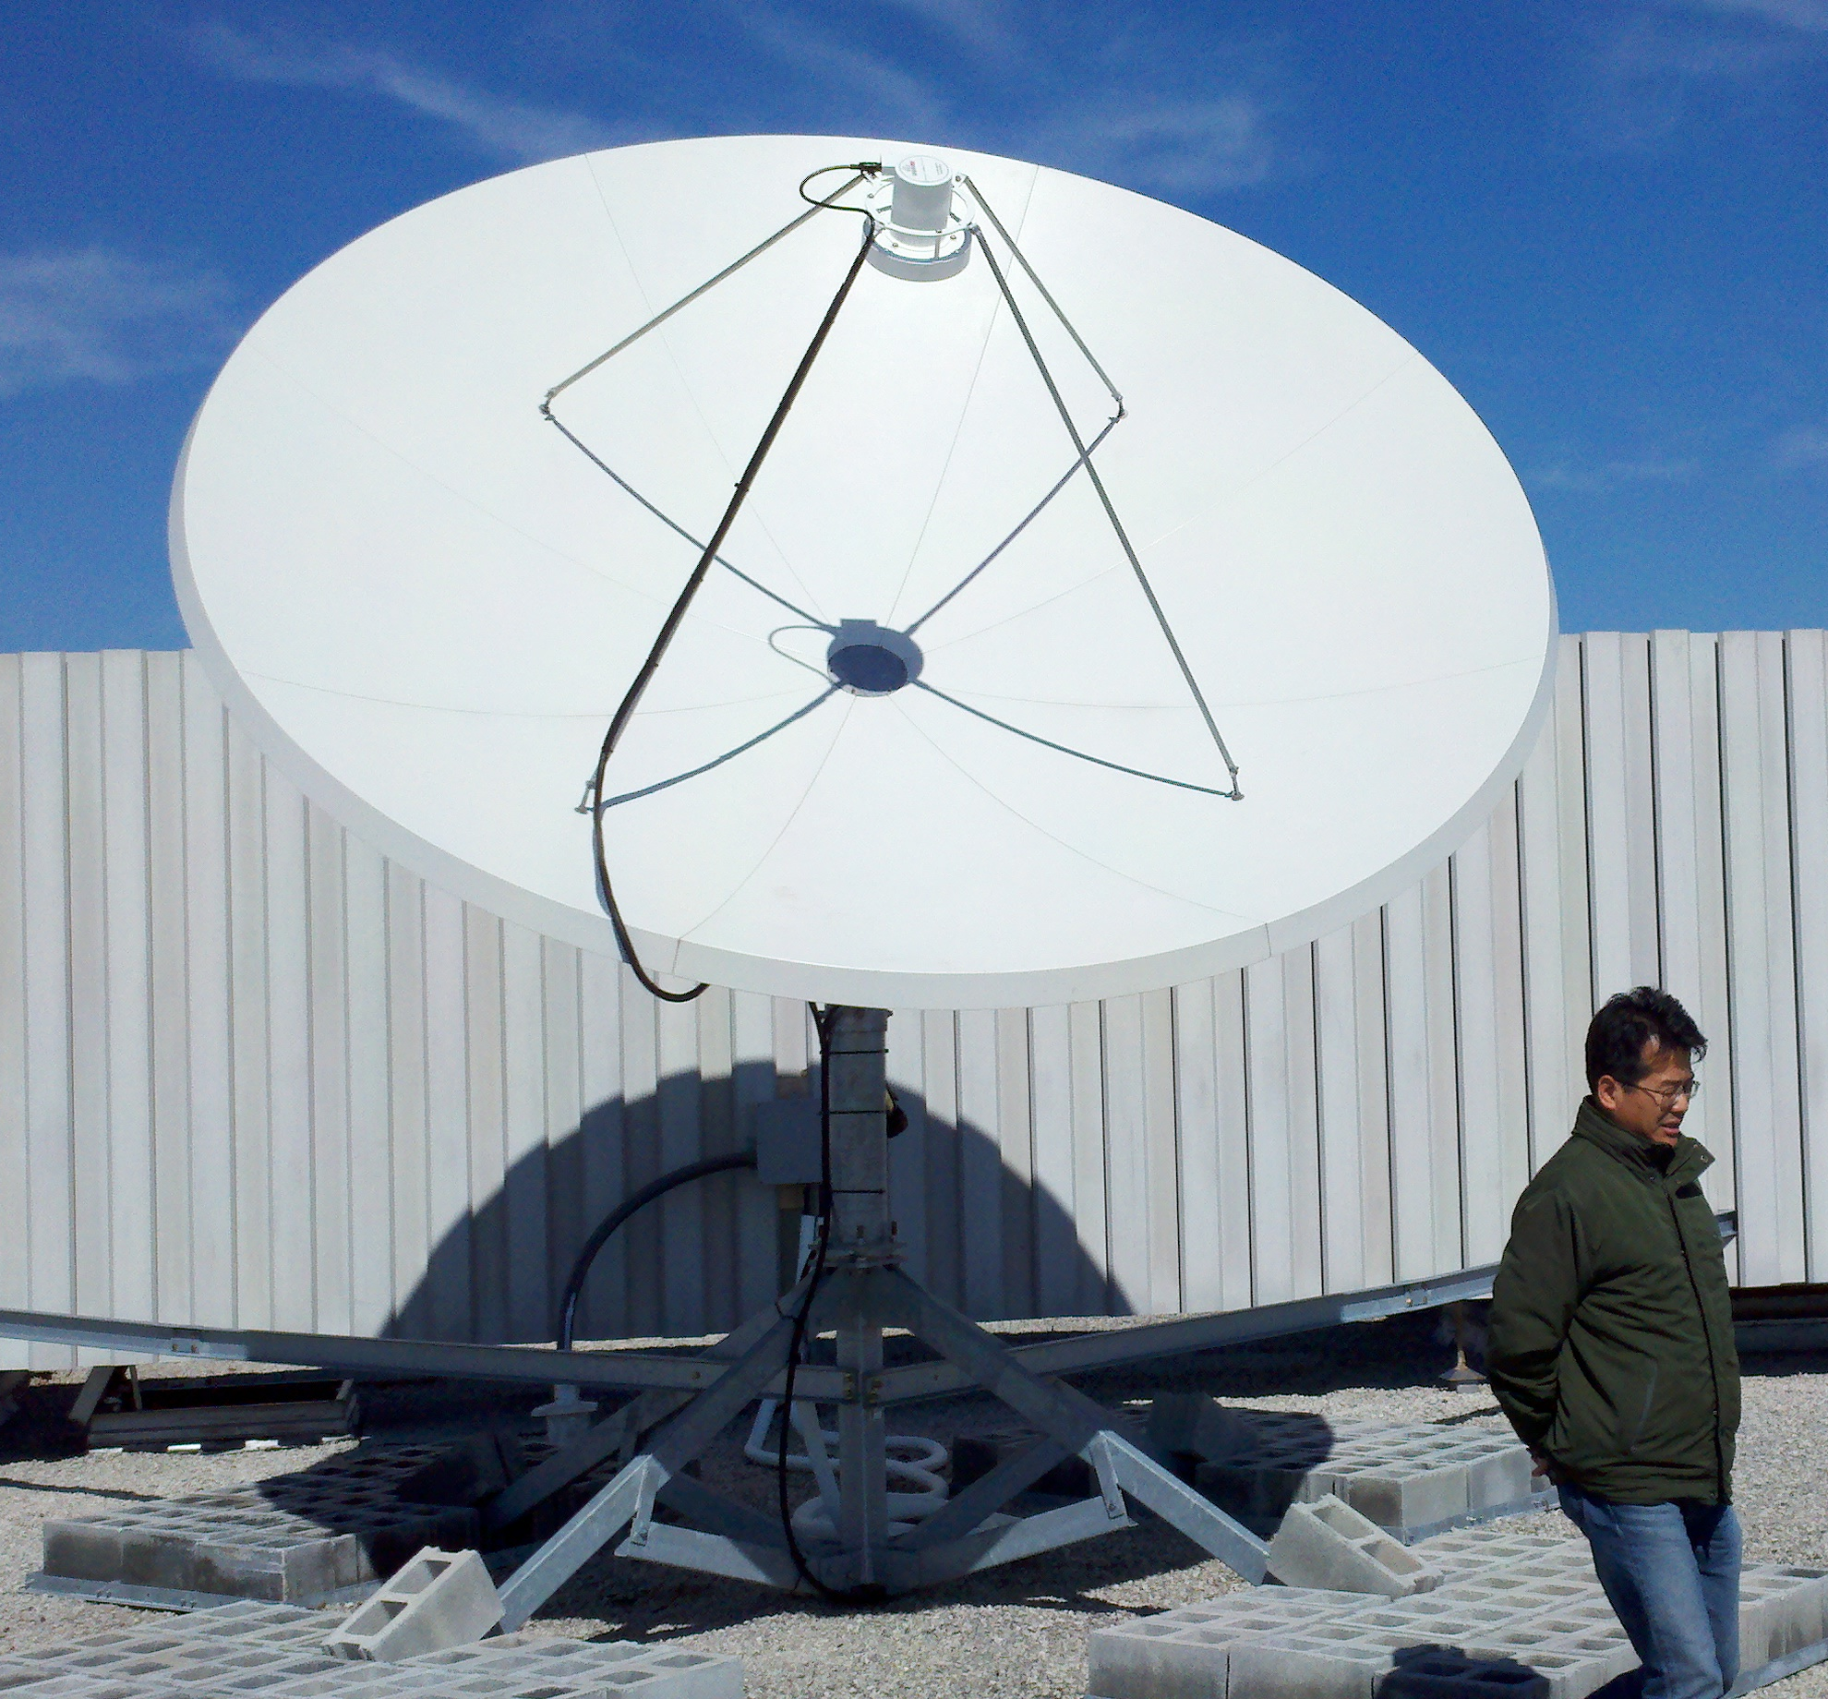
Satellites – MARACOOS Receiving Stations

Slide 29
AVHRR SST Data Workflow
Available products
Single Pass Aggregation: Annual aggregations of single passes, 2013 to present
Single Pass Individual Files: individual satellite passes, 2013 to present
1-day-Aggregation: annual aggregations of 1-day composites from 2013 to present
1-Day Individual Files: individual 1-day composites from 2013 to present
3-day-Aggregation: annual aggregations of 3-day composites from 2013 to present
3-Day Individual Files: individual 3-day composites from 2013 to present
7-day-Aggregation: annual aggregations of 7-day composites from 2013 to present
7-Day Individual Files: individual 7-day composites from 2013 to present
Dish
Satellite Raw Data
TeraScan
NCDF-3 Output SST
R
De-cloud/masking reprojection; Output NCDF-4
MARACOOS TDS

Slide 30
AVHRR SST: Automated QC Tests
Time Test: A measurement fails the time test if it is more than 2 degrees cooler than the mean of the satellite passes in the previous 72 hrs.
Climatology Test: A measurement fails if the temperature is more than 5 degrees colder than the climatologies from the NSIPP AVHRR Pathfinder and Erosion Global 9km SST Climatology.
Sequential time and climatology test: In this test, the previous 72 hours of satellite passes are first passed through a climatology test, then passed through the time test. It is a sequential test, rather than two independent tests.
Remember, data are flagged, NOT removed

Slide 31
AVHRR SST: Experimental Cloud Masking
Comparing satellite SST measurements with NDBC SST measurements.
205 sites compared, Jan 1, 2006 – September 14, 2014.
Additional visual inspection of each data set
For each site, a root mean square (RMS), bias and observation number statistic was calculated. only pixels that passed all tests), failed only the time test, or failed only the climatology test are kept in the regional de-clouding process.
Remember, data are flagged, NOT removed

Slide 32
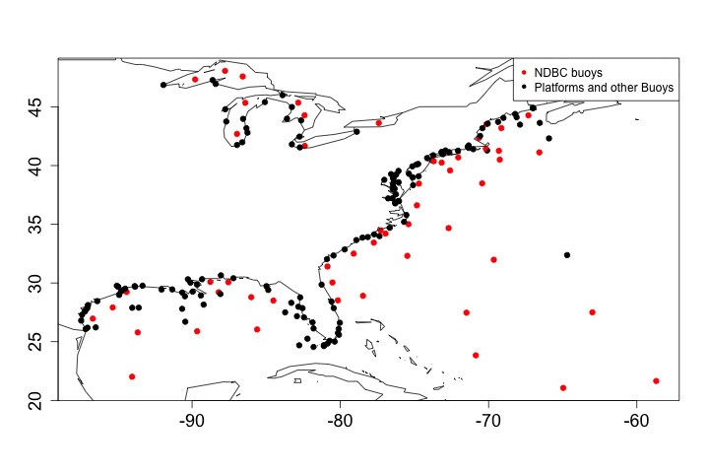
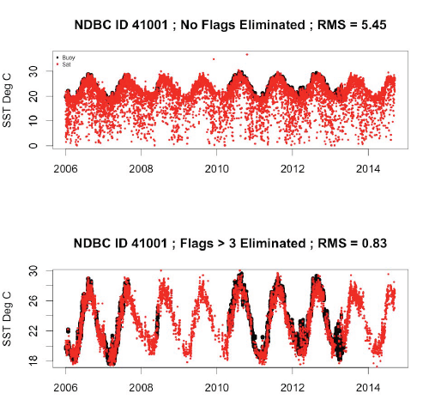
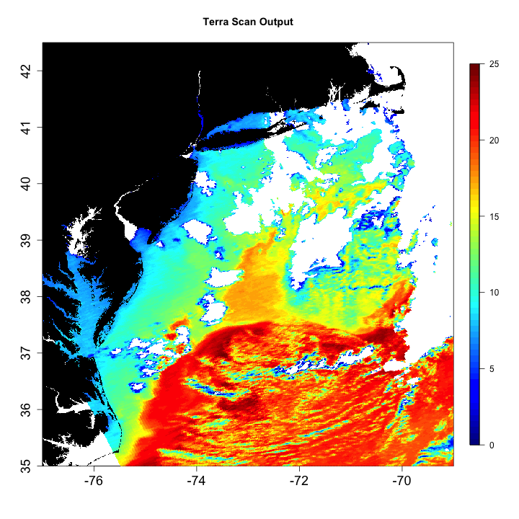
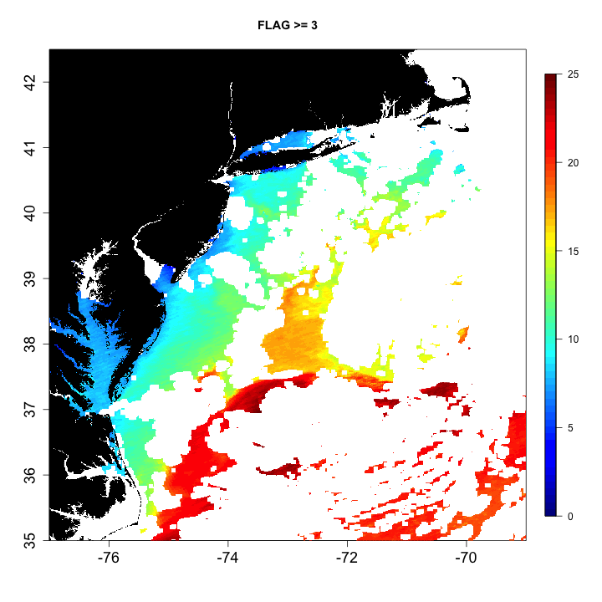
AVHRR – de-Clouded SST products
Comparing de-Clouded AVHRR to~200 NDBC buoys and platforms
NDBC 41001 as an example
(red dots satellite, black NDBC buoy
De-Clouding night imagery
De-Clouding
MTS 2017 Anchorage
crowley@Rutgers.edu

Slide 33
U.S. IOOS is…
External: Hudson Rivers Environmental Conditions Observing System
(HRECOS)
MTS 2017 Anchorage
crowley@Rutgers.edu

Slide 34
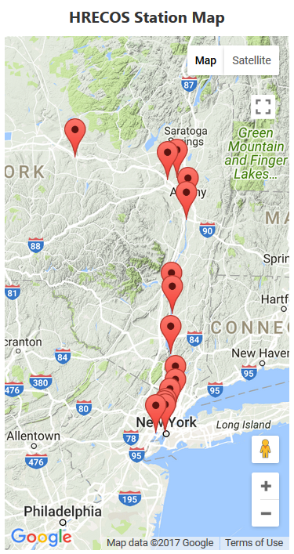
What is HRECOS
Continuous meteorological and water quality monitoring stations on the Mohawk and Hudson Rivers since 2008
Operated by a consortium of government, academic, and private institutions.
All stations operate year-round except the Mohawk at Ilion station due to seasonal drawdown in the canal
Data: water temperature, specific conductivity, salinity (calculated from specific conductivity and temperature), dissolved oxygen, depth, water elevation, pH, turbidity, air temperature, barometric pressure, relative humidity, wind speed, wind direction, radiation, and rainfall, collected at 15 min intervals.
MTS 2017 Anchorage
crowley@Rutgers.edu

Slide 35
HRECOS Initial QC
The HRECOS QAPP describes the objectives and criteria and specifies the measures and corrective actions used to ensure data quality.
Goal: accept at least 90% of total possible observations
Water quality sensors and weather stations are recalibrated if they do not meet the standards specified in the QAPP.
The data flags used for the automated real-time data flagging process are summarized in Table 1 and apply to all parameters.
Flag Value | Definition
0 | Acceptable data
5 | Data that demonstrate a significant increase or decrease from the previous value
6 | Flat-lined data
30 | Data outside three standard deviations of the seasonal mean
40 | Data outside four standard deviations of the seasonal mean
100 | Data outside the range of the instrument
MTS 2017 Anchorage
crowley@Rutgers.edu
Continuous meteorological and water quality monitoring stations on the Mohawk and Hudson Rivers since 2008
operated by a consortium of government, academic, and private institutions.
All stations operate year-round except the Mohawk at Ilion station due to seasonal drawdown in the canal
Data: water temperature, specific conductivity, salinity (calculated from specific conductivity and temperature), dissolved oxygen, depth, water elevation, pH, turbidity, air temperature, barometric pressure, relative humidity, wind speed, wind direction, radiation, and rainfall, collected at 15 min intervals.

Slide 36
HRECOS Final QC
Quarterly Review
Missing data added
The recorded data is also reviewed and flagged
Recalculates automatic flags using actual seasonal averages,
Run SOPs based on their documentation
Makes a final determination for the public record by applying the final flag values
Flag Value | Definition
0 | Data determined to be acceptable after a final review by the site manager
10000 | Suspicious data according to a final review by the site manager
20000 | Corrected data
500000 | Rejected data according to a final review by the site manager

Slide 37
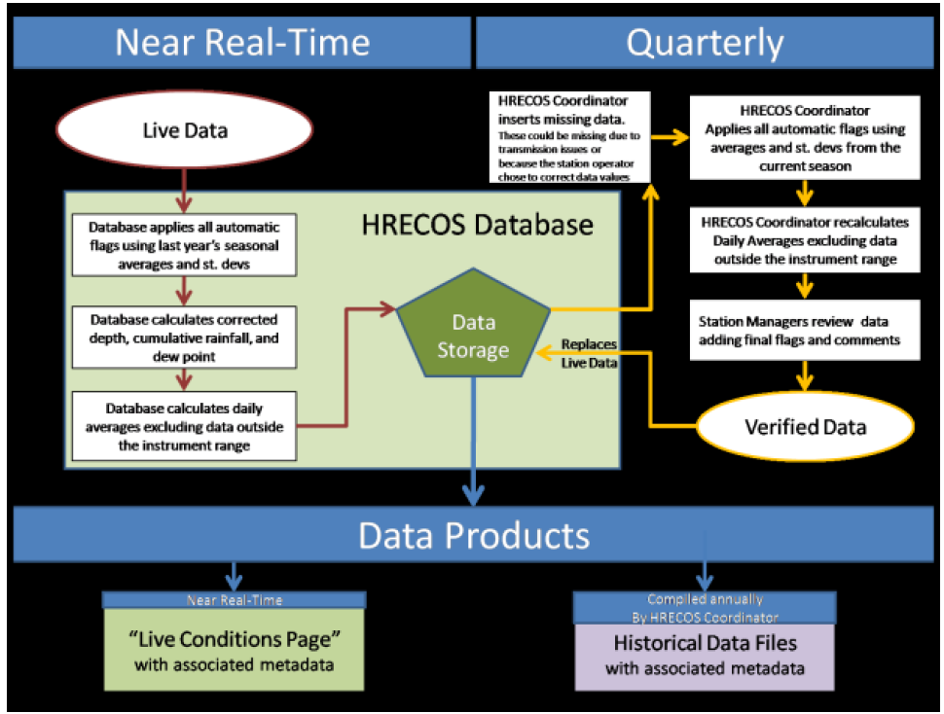
Overview of Real-Time & Quarterly Process
HRECOS has both an automated real-time flagging process and a manual quarterly process in place
MTS 2017 Anchorage
crowley@Rutgers.edu

Slide 38
Summary
So much data, and all available for public use
Only an example of numerous datasets from partners available
Any piece of this talk could have been a single 20 minute presentation
Today, examples of single platform, multi-platform, Federal Government and external data QC were presented
Certified data! We Certify our own through QARTOD, SOPs, and confirm that external data have a QA/QC process in place. Otherwise data is “citizen science”
Maracoos.org, Oceansmap.maracoos.org
crowley@Rutgers.edu
Thanks to US IOOS, my co-authors and the dozens of people that support the MARACOOS project
MTS 2017 Anchorage
crowley@Rutgers.edu

Slide 40
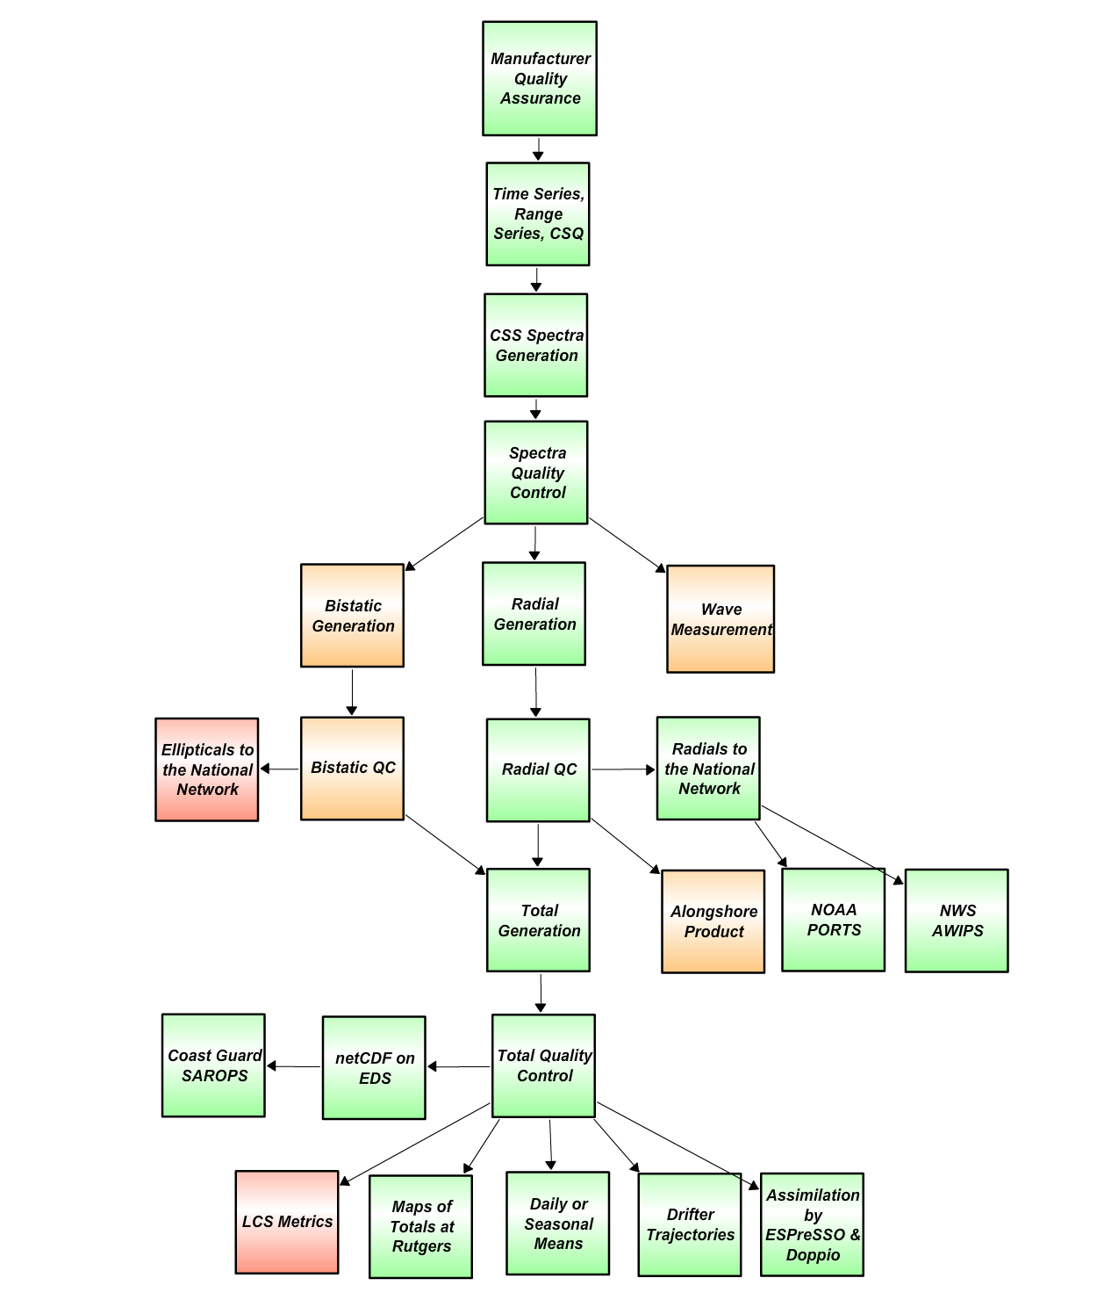
U.S. IOOS is…
HF Radar Data Flow Chart
Quality Control Steps
Green – Operational
Orange – Development
Red - Planned
Manufacturer recommended Antenna Patterns not older than 1 year
Level 0
Weekly 11-point remote site inspections
Physical site inspection every 6 months
Frequency
GPS Alignment
Visible Bragg
Interference
Sea Echo Phases
Forward/ Reflected Power
Terminal Errors
Chasis Temperature
Computer Memory Space
Ideal radial generatin
Measured radial generation
Level 1
QARTOD
Global range test (300 cm/s)
Local range Test (by station)
Stuck sensor (0.01 cm/s / 3 hours)
Gradient (18 cm/s•hr)
Spike (0.1 cm/s )
Filter based on manufacturer supplied uncertainty parameters
Human-in-the-loop visual inspection of radial data
Level 2
Global range test (300 cm/s)
Filter based on uncertainty values for each optimal interpolation vector after Kohut (2012)
Discrete Cosine Transform spatial filter after Fredj (2016)
Level 3
Level 4
Comparison of radar velocity with in situ drifters
Data levels defined by NASA Earth Science Reference Handbook ( 2006, p.31)
MTS 2017 Anchorage
crowley@Rutgers.edu

