Slide 1





78 Million People (1/4 of U.S.)
1000 km Cape to Cape
U..
Middle Atlantic
Regional Association
Coastal
Ocean Observing System
Cape
Cod
Stratified
Coastal Ocean Response and Feedbacks on Hurricane Intensity
Sandy
Irene + 10
Jose
Scott Glenn, Travis Miles,
Joe Brodie, Cliff Watkins,
Greg Seroka, Hugh Roarty,
Oscar Schofield, Josh Kohut (Rutgers)
Pat Hogan, Greg Jacobs,
Dick Crout (NRL)
Cape
Hatteras
Notes:
1

Slide 2
78 Million People (1/4 of U.S.)
1000 km Cape to Cape
U..
Middle Atlantic
Regional Association
Coastal
Ocean Observing System
Cape
Cod
Conclusions Up Front:
Irene + 10
Cross-shelf winds
Ahead of Eye Cooling
Rapid de-intensification (Irene)
Sandy & Jose
Alongshelf winds
Downwelling
Intensification (Sandy)
Sandy
Irene + 10
Jose
Cape
Hatteras
Notes:
2

Slide 3
Key Storm Glider Reference List
Glenn, Jones, Twardowski, Bowers, Kerfoot, Kohut, Webb, Schofield, 2008. Glider observations of sediment resuspension in a Middle Atlantic Bight fall transition storm. Limnology and Oceanography 53(5, Part 2): 2180-2196.
Miles, Glenn, Schofield, 2013. Temporal and spatial variability in fall storm induced sediment resuspension on the Mid-Atlantic Bight. Continental Shelf Research 63, Supplement: S36-S49.
Miles, Seroka, Kohut, Glenn, 2015. Glider observations and modeling sediment transport in Hurricane Sandy. JGR Oceans, DOI: 10.1002/2014JC010474
Glenn, Miles, Seroka, Xu, Forney, Yu, Roarty, Schofield, Kohut, 2016. Stratified coastal ocean interactions with tropical storms, Nature Communications, March 8, 2016, 1-10, DOI:10.1038/ncomms10887.
Seroka, Miles, Xu, Kohut, Schofield & Glenn, 2016. Hurricane Irene Sensitivity to Stratified Coastal Ocean Cooling, Monthly Weather Review, 144(9) 3507-3530.
Seroka, Miles, Xu, Kohut, Schofield & Glenn, 2017. Rapid shelf-wide cooling response of a stratified coastal ocean to hurricanes. JGR-Oceans: Special Section on Ocean Responses and Feedbacks to Tropical Cyclones, DOI:10.1002/2017JC012756.
Miles, Seroka & Glenn, 2017. Coastal ocean circulation during Hurricane Sandy, J. Geophysical Res. - Oceans, 122(9) DOI:10.1002/2017JC013031.
Sea-Bottom Interface
Air-Sea Interface

Slide 4
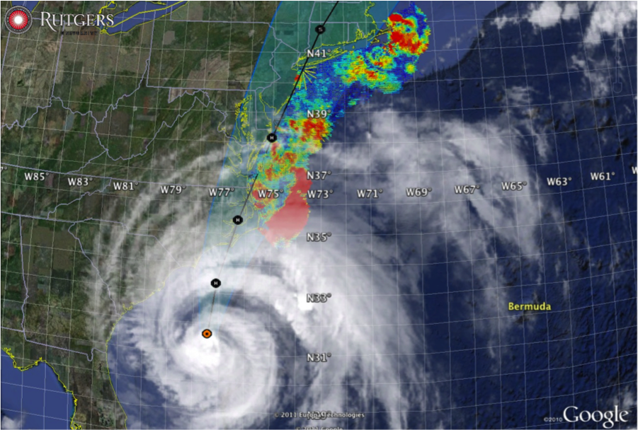

Hurricane Irene
August 28, 2011
NOAA/NHC Damage:
#7 with >$16 Billion.
Track Accurate;
Intensity Over-predicted.
Avila & Cangialosi, 2012, Tropical Cyclone Report
Hurricane Sandy
October 29, 2012
NOAA/NHC Damage:
#2 with >$68 Billion.
Track Accurate;
Surge Under-predicted.
Georgas et al., 2014, J. of Extr. Even.
Colle et al., 2015, J. Mar. Sci. & Engr.

Slide 5

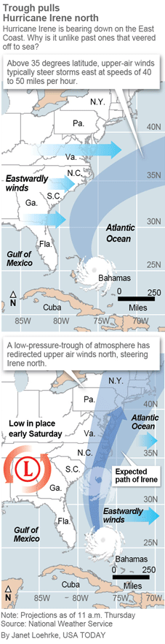
Pre-Irene Storm Warnings
Over 2 million people ordered to “flee the storm’s path”.
President Obama: Shaping up to be a “historic hurricane” and urged residents to “be prepared for the worst”. “Don’t wait. Don’t delay.”
New Jersey Governor Christie: Ordered evacuation of 1 million people - “Get the hell off the beach”. “Do not waste any more time working on your tan”.
New York Mayor Blumberg: “Staying behind is dangerous, staying behind is foolish, and its against the law”. “The time to leave is right now”. The bridges, streets and subways were nearly empty ahead of a nearly unprecedented mass transit shutdown.

Slide 6
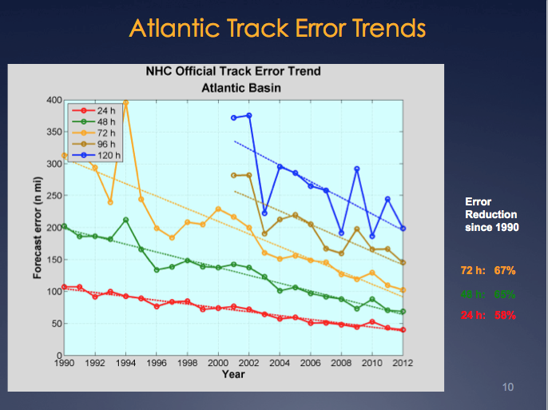
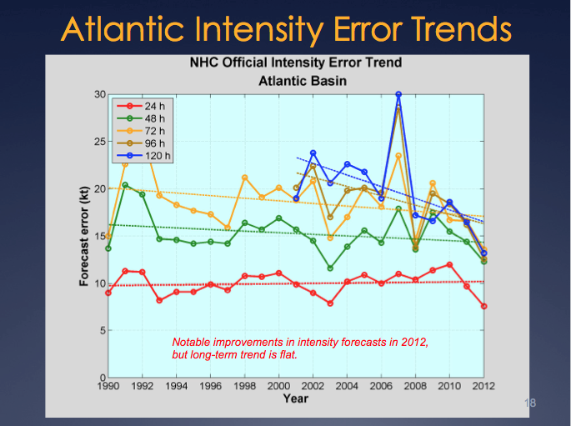
Motivation: Research to Operations to Research (R2O2R)
Track Error: Decreases in 20-Year Trend Intensity Error: - “Long-term trend is flat”
Track: Improvements attributed to Global Forecast Models & the Super-Ensemble.
Intensity: “…upper-ocean thermal structure can affect the evolution of storm intensity, …Unfortunately, the paucity of subsurface measurements limits our ability to assess the effect of upper-ocean variability on tropical cyclone intensity evolution.”
– Emanuel et al., (2004)
Production Suite Review: December 4, 2012

Slide 7
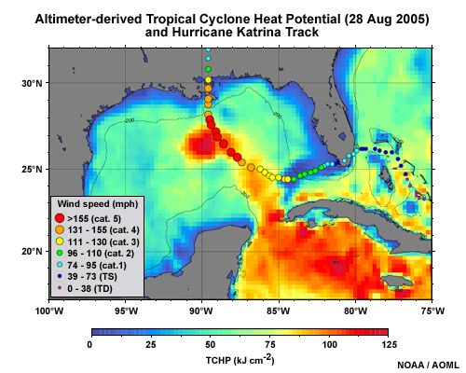

Hurricane Intensity is modulated by upper ocean heat content
Rapid intensification of Hurricane Katrina over warm ocean water

Slide 8
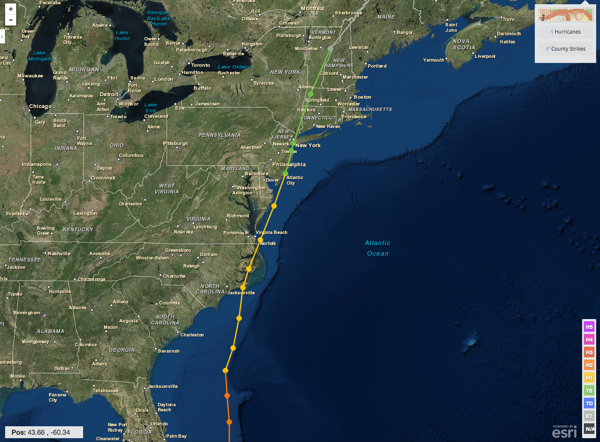
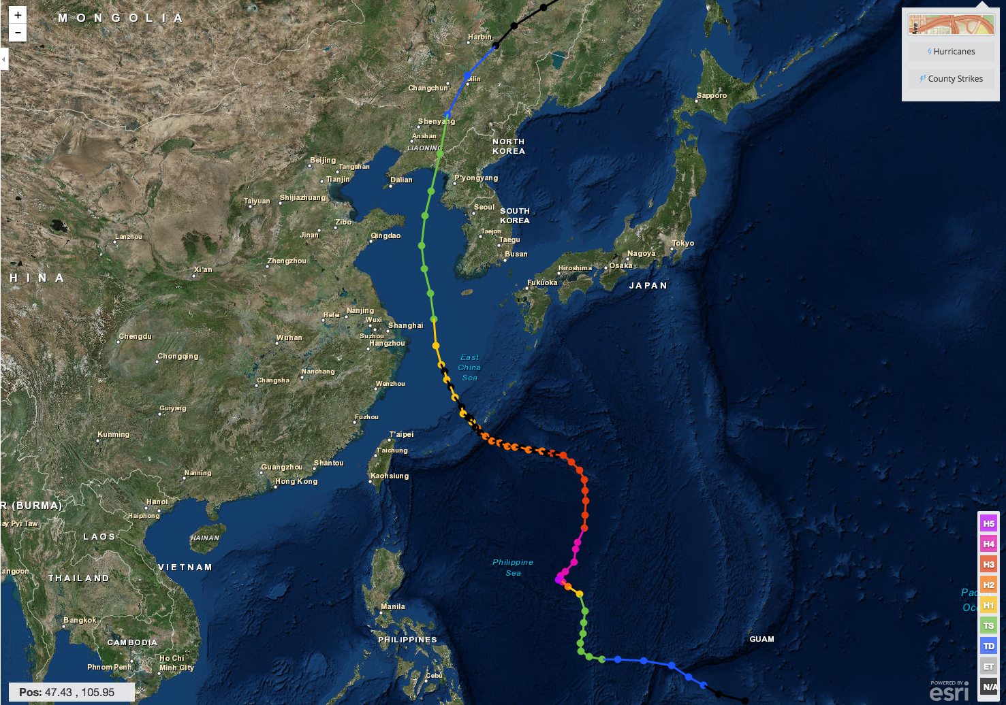
Hurricane Irene & Super-Typhoon Muifa:
What do these summer of 2011 storms have in common?
Hurricane Irene
26-29 August 2011
Super-Typhoon Muifa
26 July - 9 August 2011

Slide 9
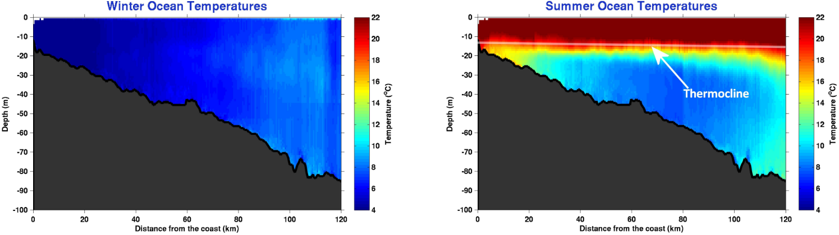
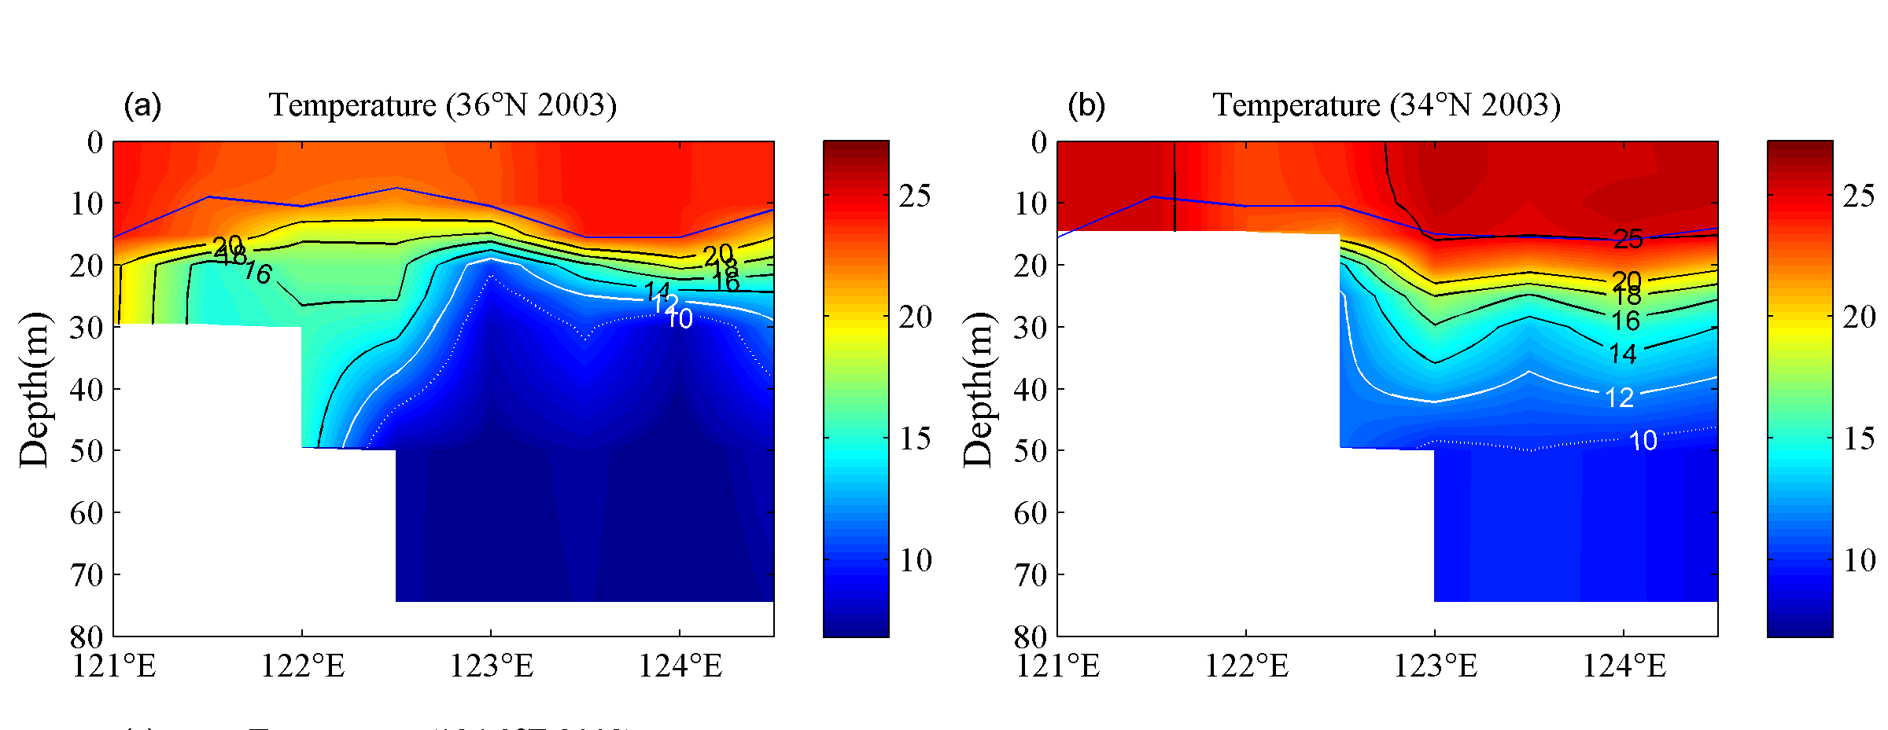
Essential Ocean Features - A highly stratified coastal ocean -
A warm surface layer + An unseen cold bottom layer
Mid Atlantic
Winter (1-layer)
Mid Atlantic
Summer (2-layers)
Cold Pool
Mid- Atlantic’s Cold Pool
Yellow Sea’s Cold Bottom Water Mass
Cold Bottom Water Mass
Yellow Sea
Summer
Yellow Sea
Summer
Cold Bottom Water Mass
Why unseen? Satellites cannot see below surface, Argo Floats do not extend into shallow water

Slide 10
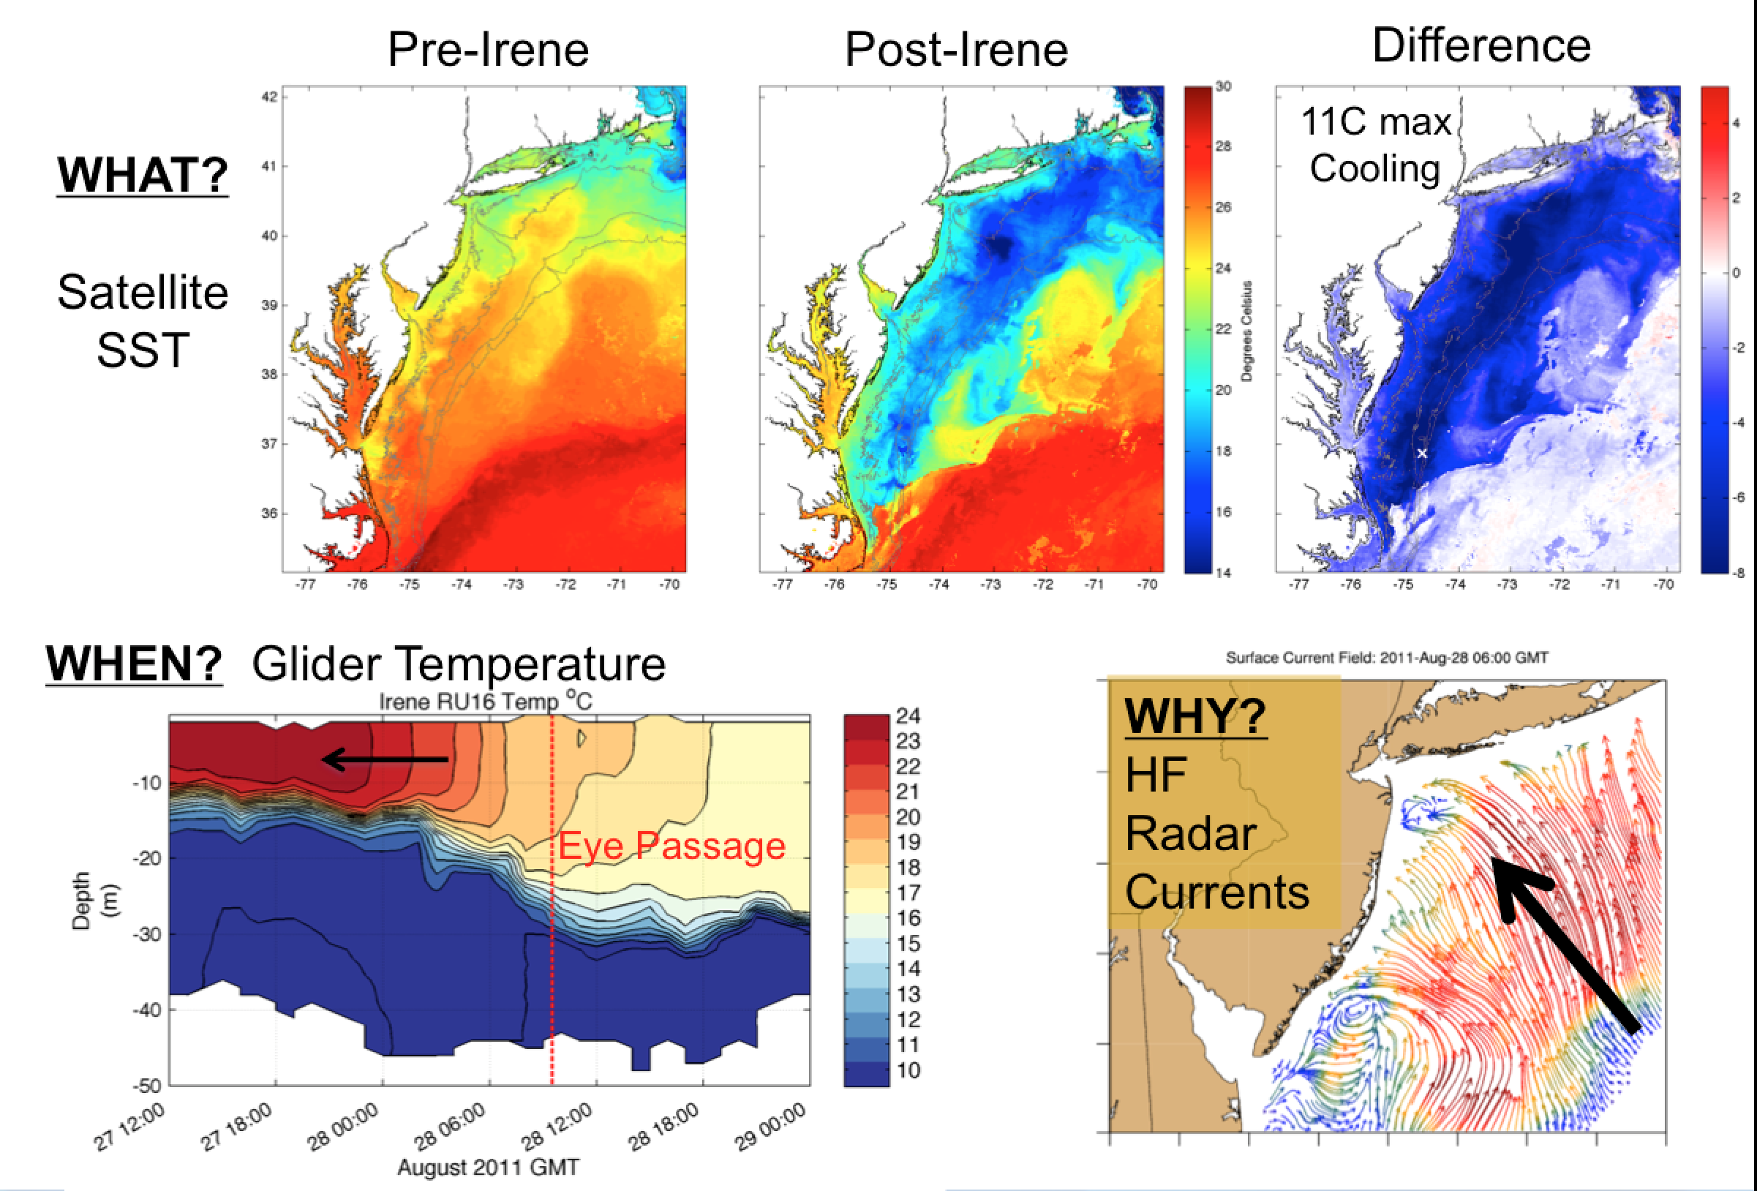

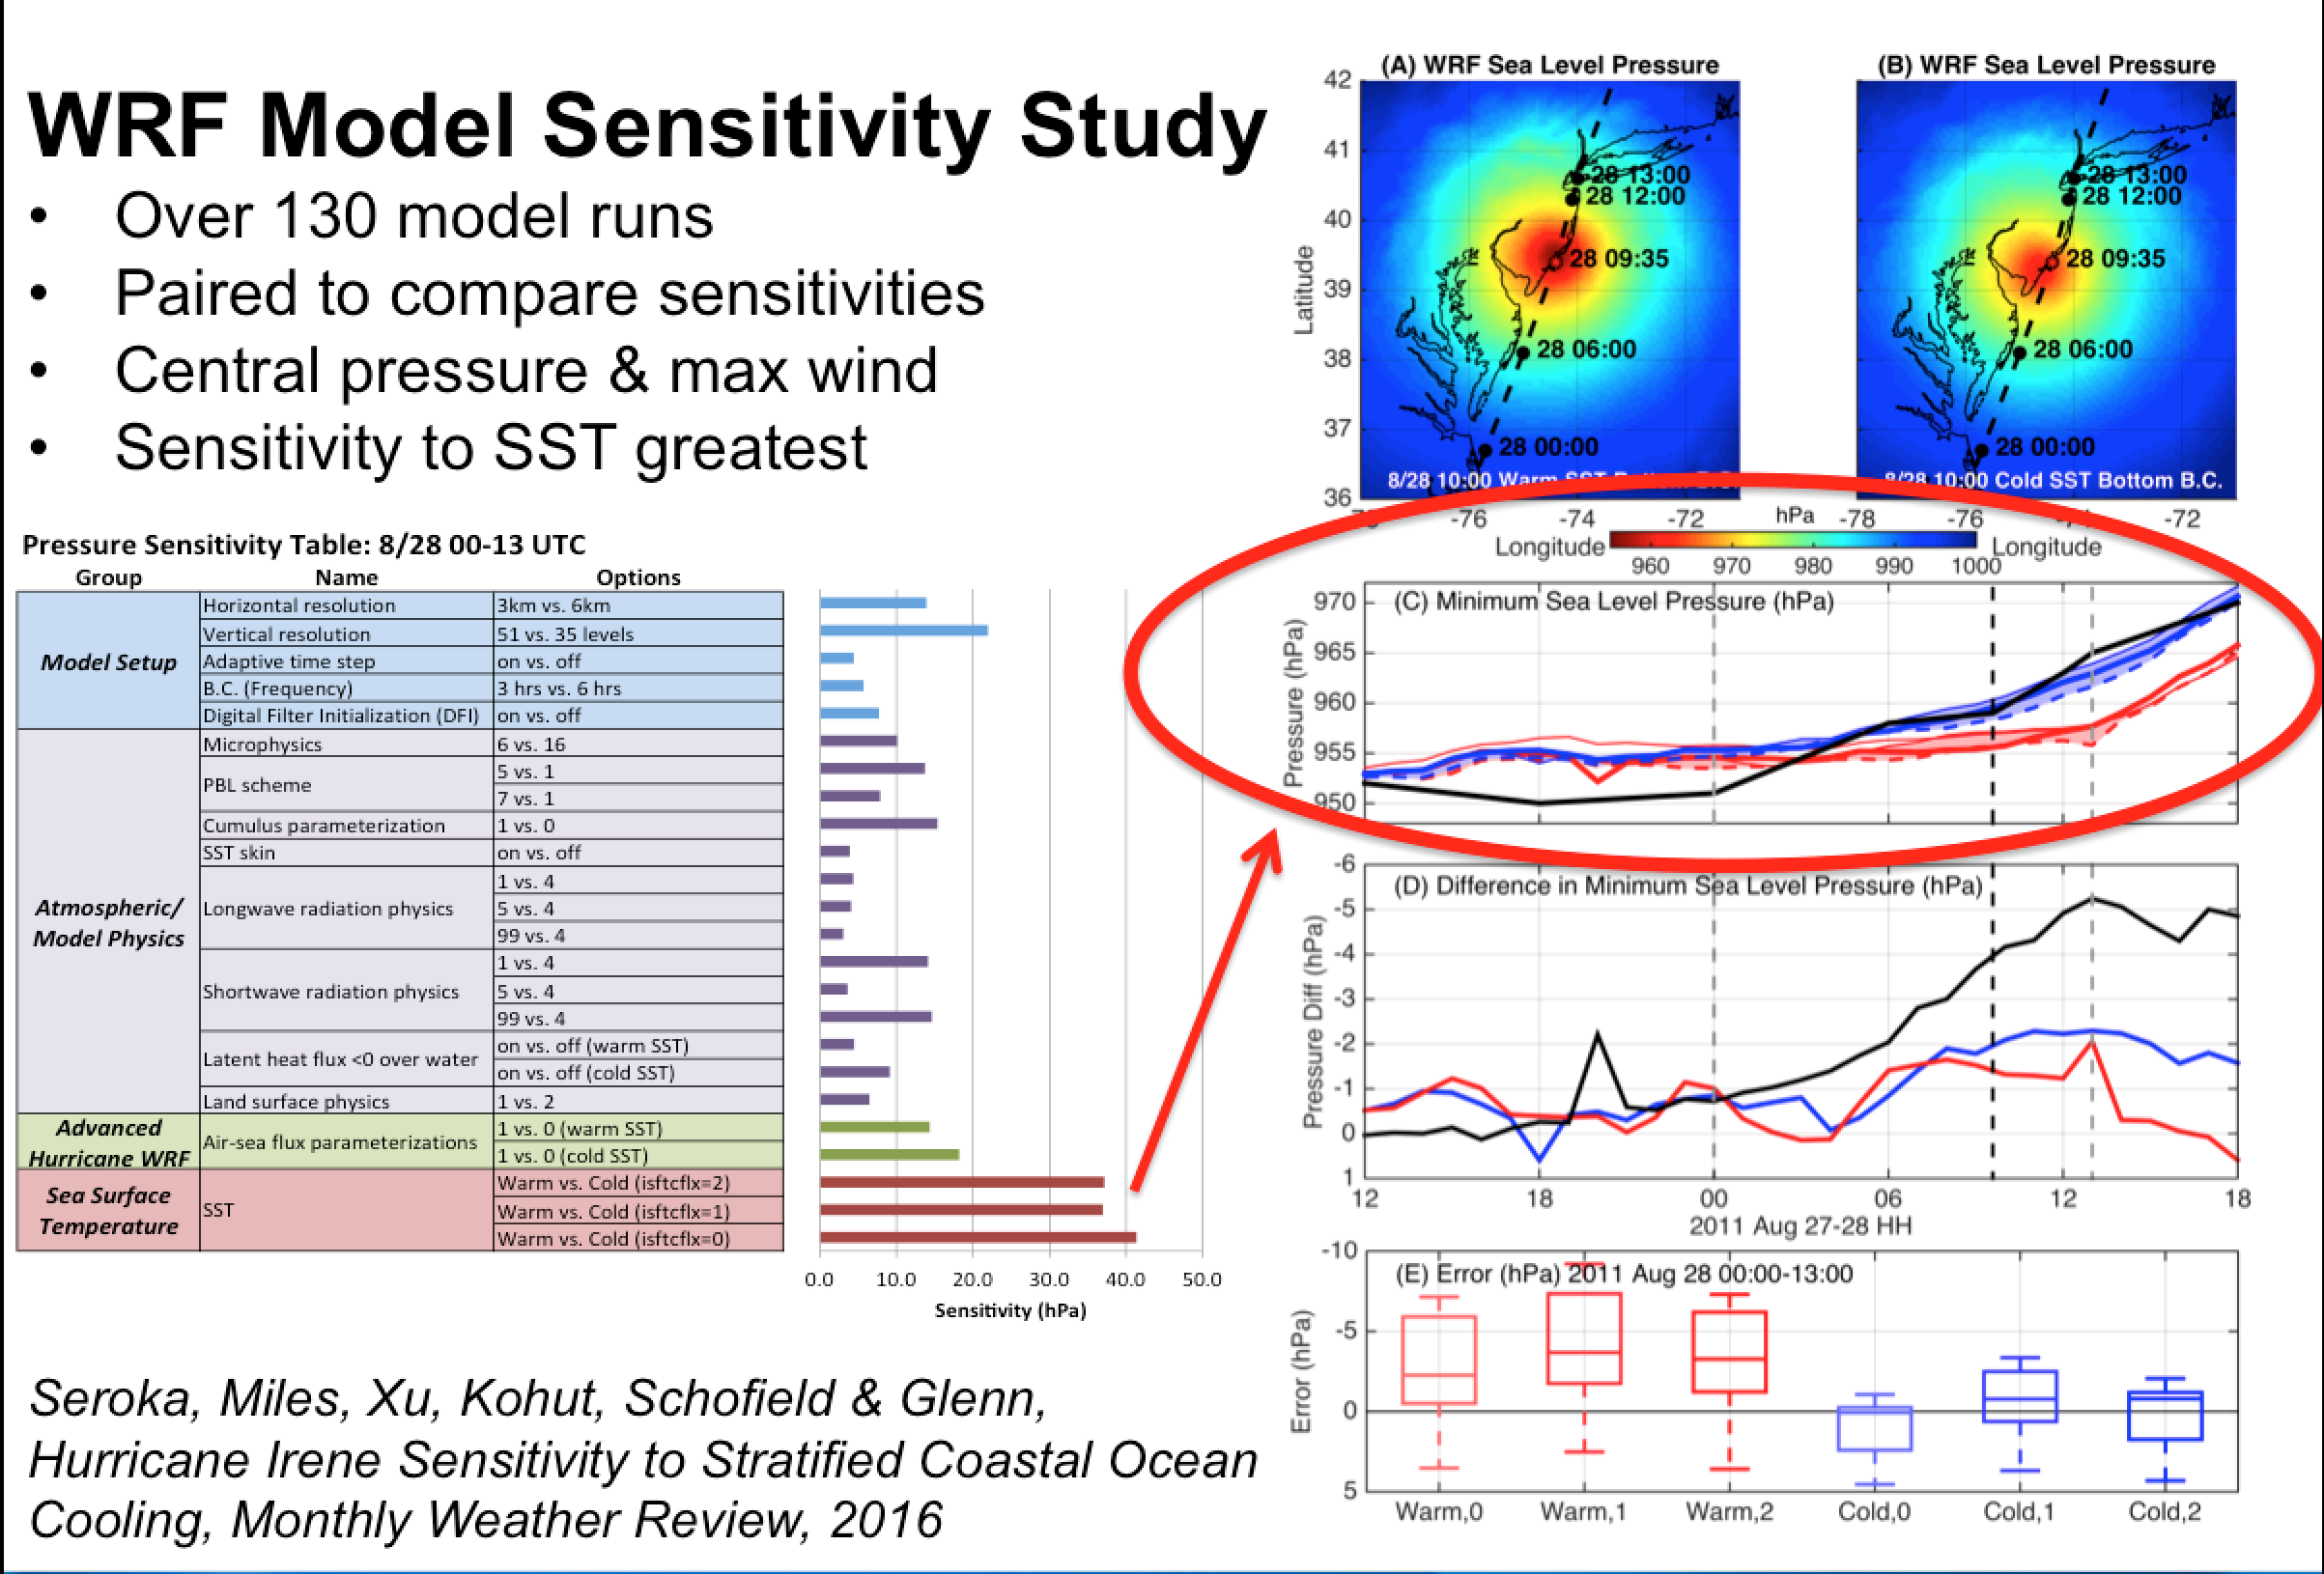
Essential Ocean Processes – Ahead of Eye Center Cooling
Missing process required for rapid de-intensification
r
Integrated
Ocean Observatory
identifies processes responsible for rapid ahead-of-eye cooling.
Atmospheric
model sensitivities identify ahead-of-eye cooling as the missing process for rapid de-intensification
NOAA OAR

Slide 11
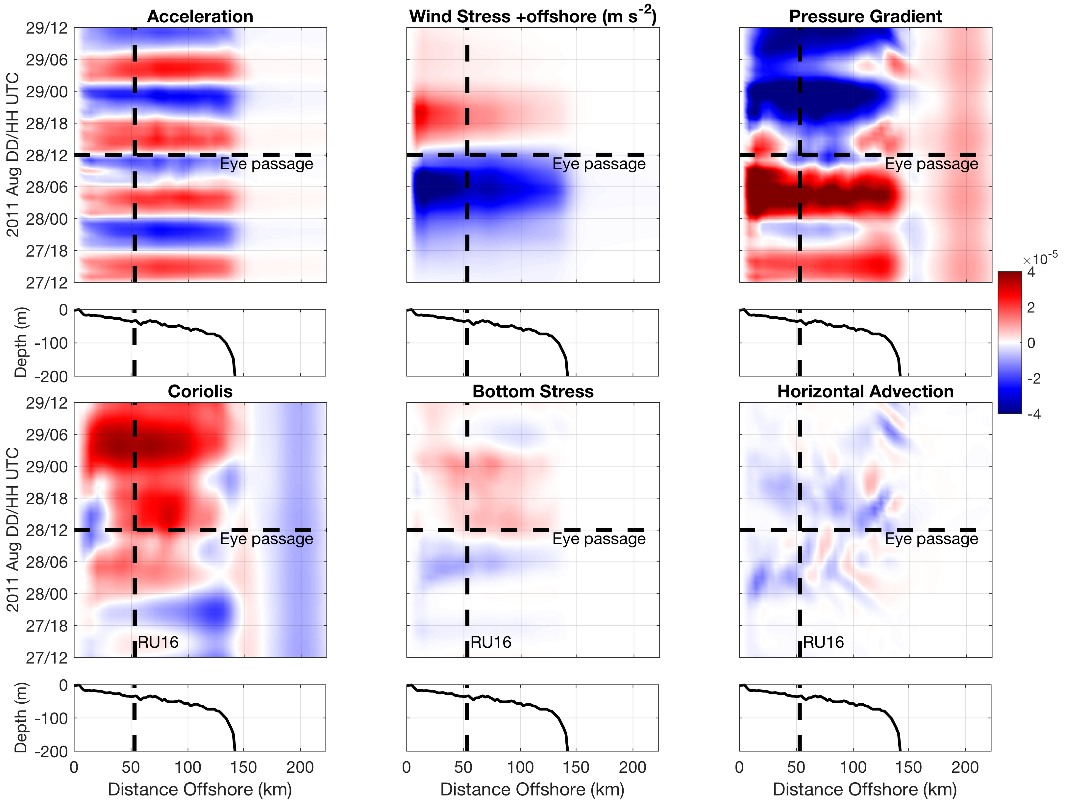
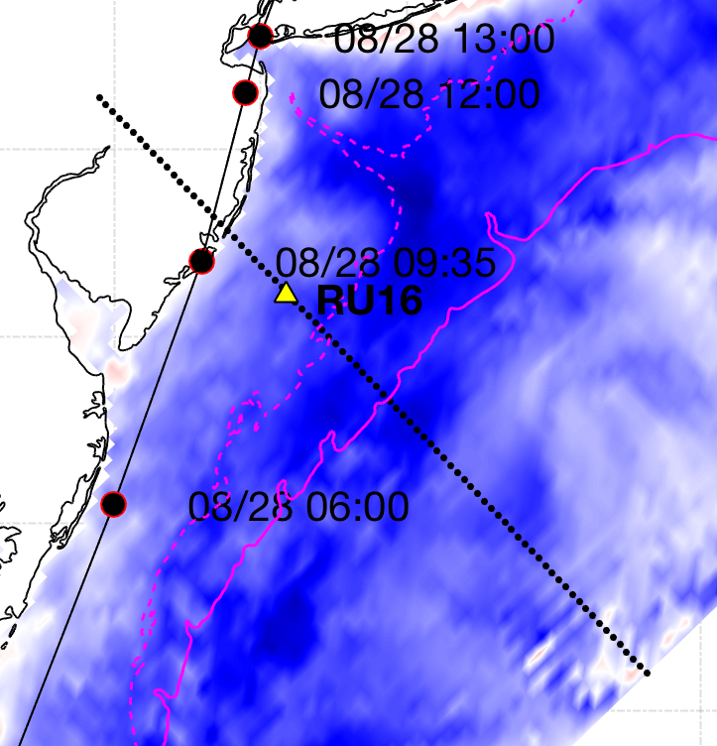
IRENE: ROMS Model Cross-shelf Section: onshore WS vs. offshore PG
+offshore
m s⁻²
-onshore
Seroka et al. 2017
Notes:
15

Slide 12
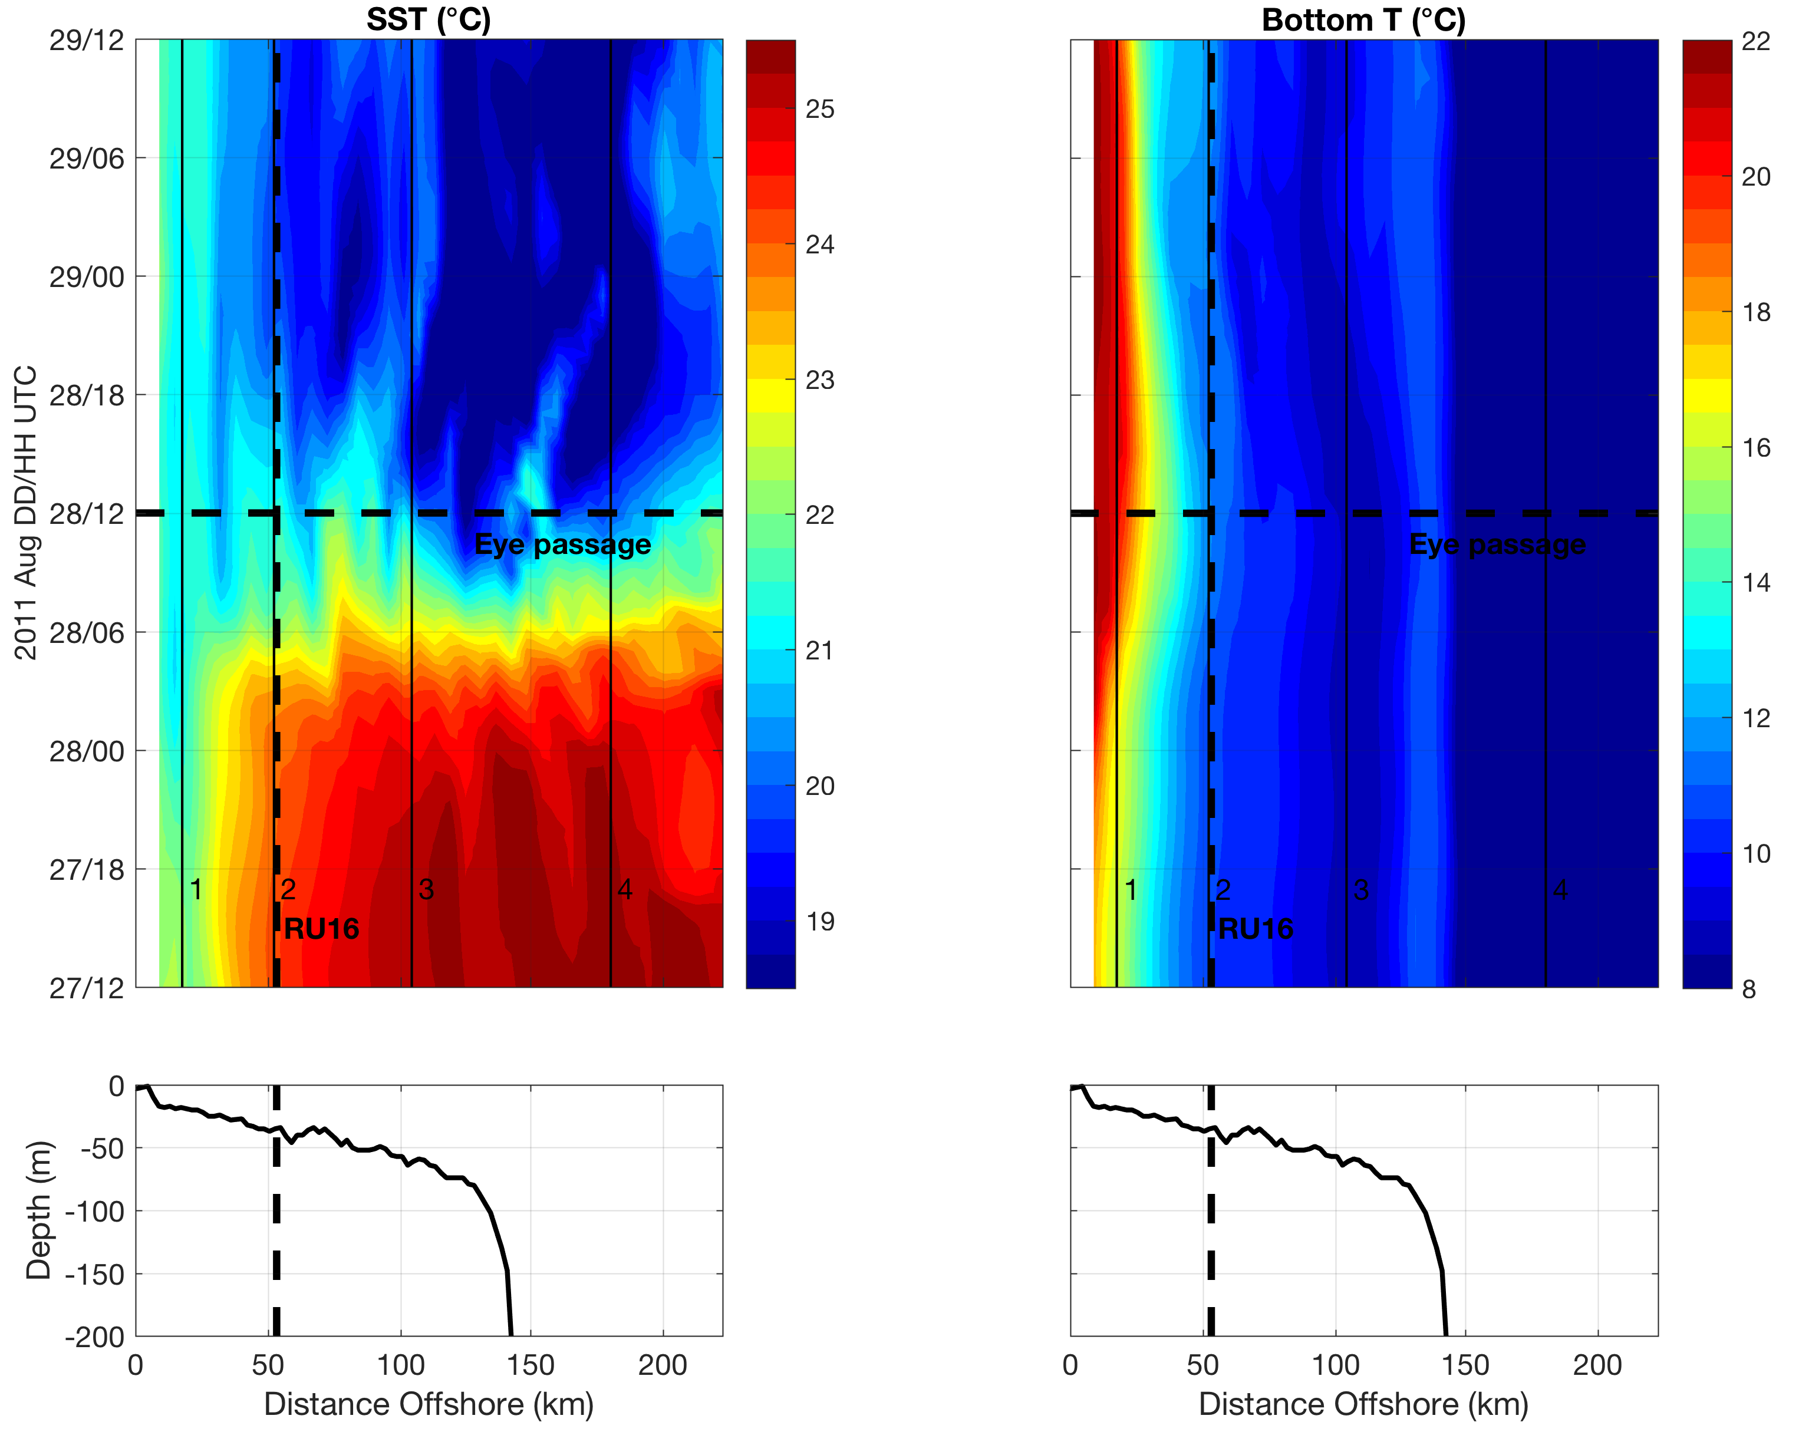
IRENE: ROMS Model Cross-shelf Section: SST cooling
AOEC SST cooling
Downwelling
Upwelling
Seroka et al. 2017.
Notes:
10

Slide 13
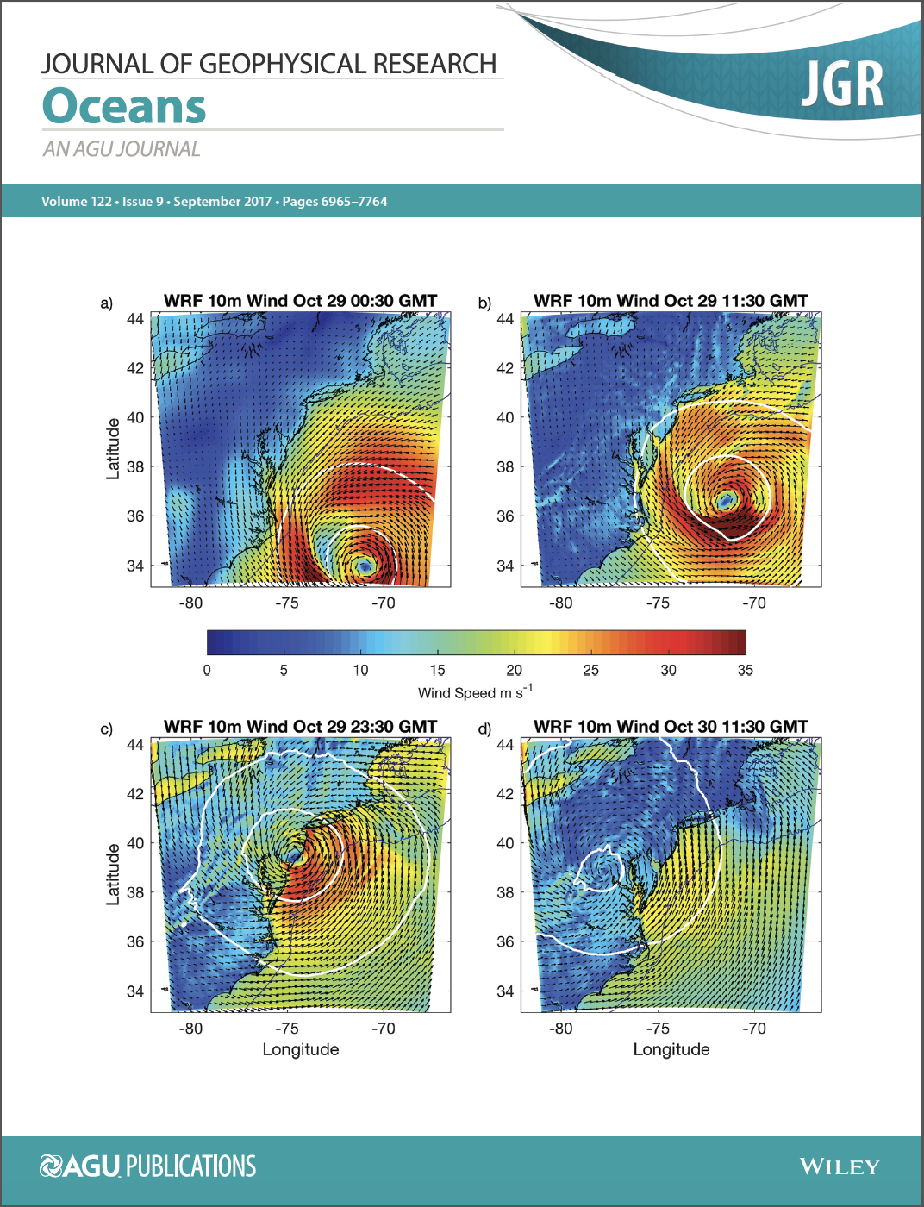
Hurricane Sandy
October 29, 2012
NOAA/NHC Damage:
#2 with >$60 Billion.
Minimum pressure – 948 mb
Storm surge over –14 ft. in NYC
Miles et al., 2017

Slide 14
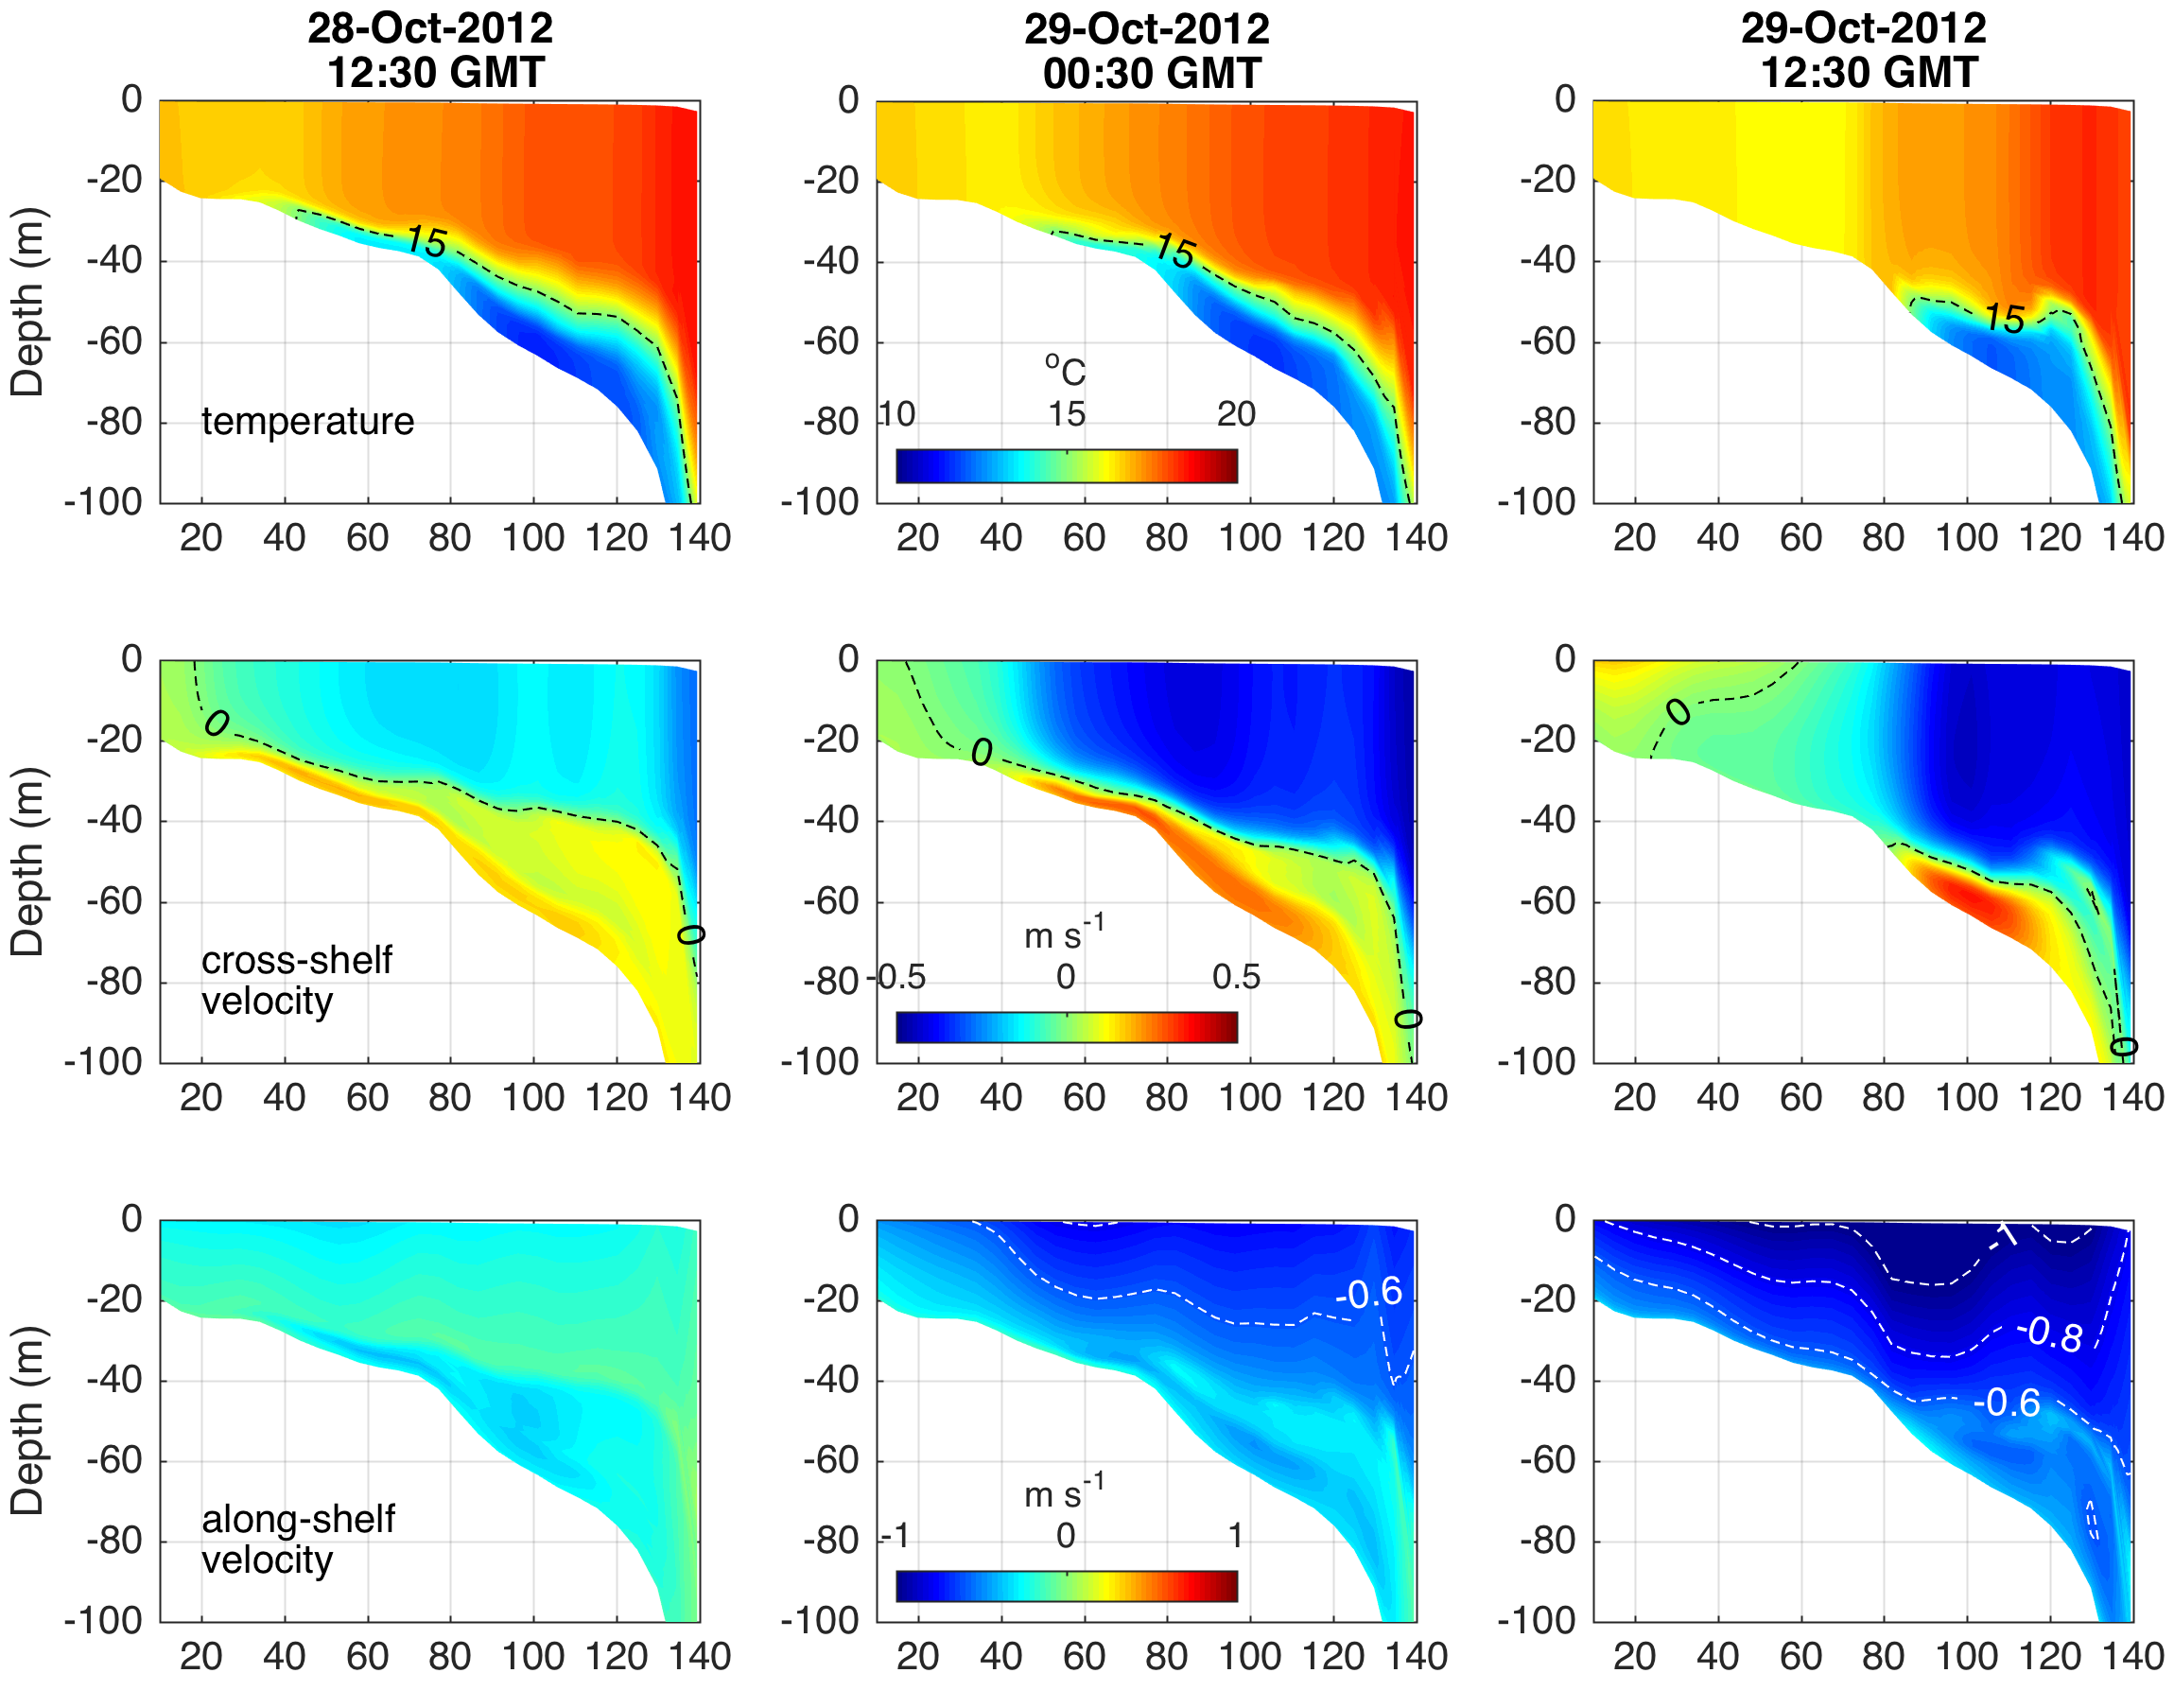
Hurricane Sandy
32 Hrs
Pre-Landfall
20 Hrs
Pre-Landfall
8 Hrs
Pre-Landfall
Temperature
Cross-shelf
Velocity
Along-shelf
Velocity
Distance Offshore (km)

Slide 15
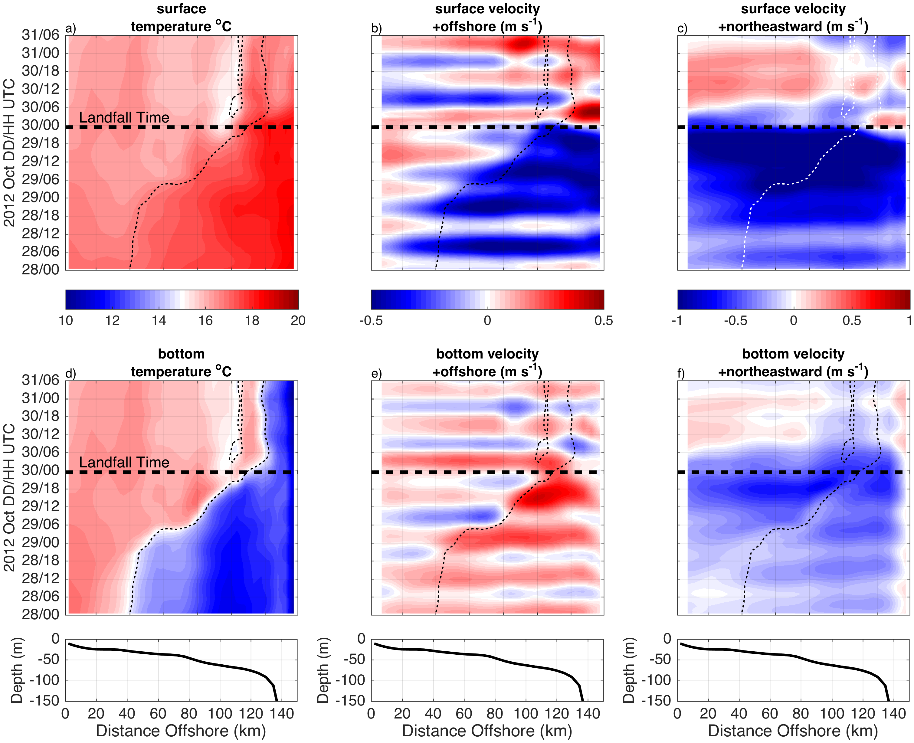
Surface T
Bottom T

Slide 16
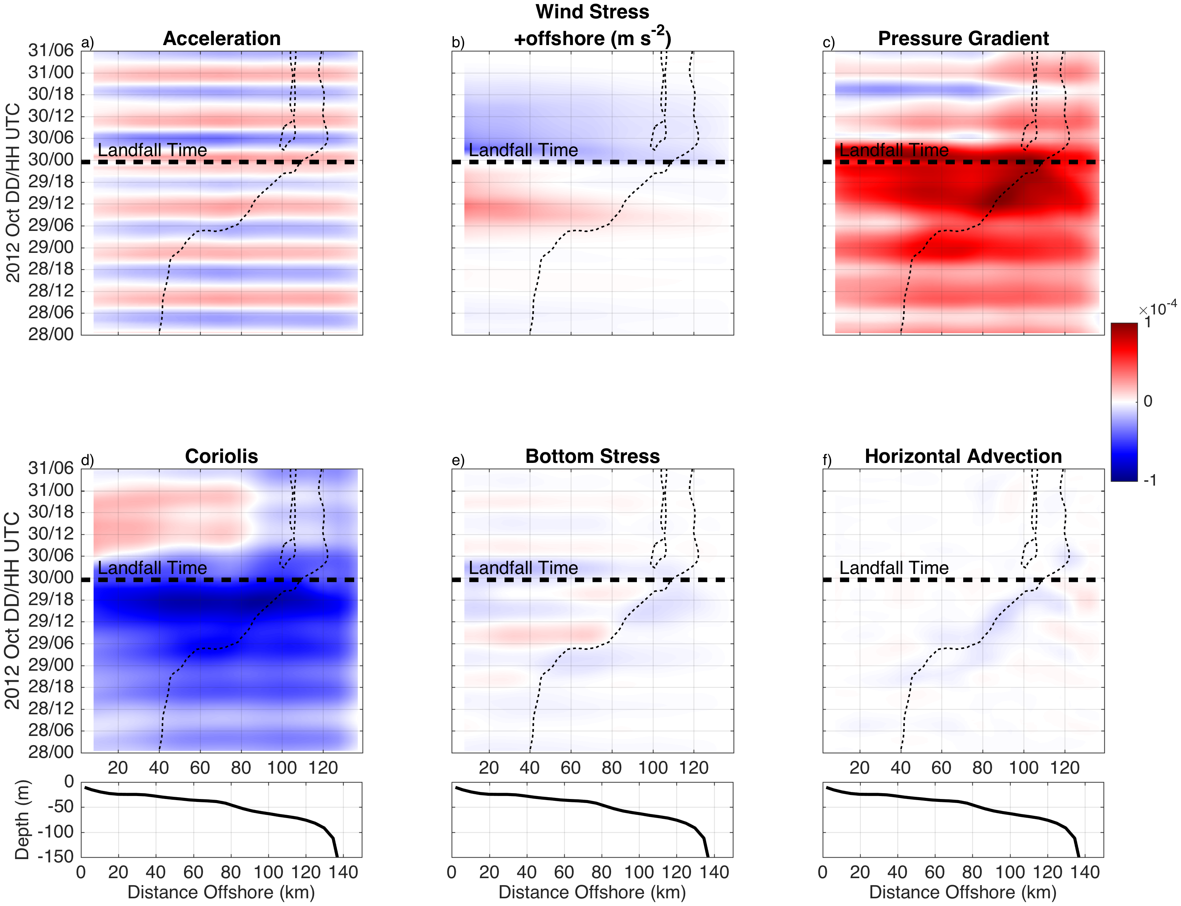
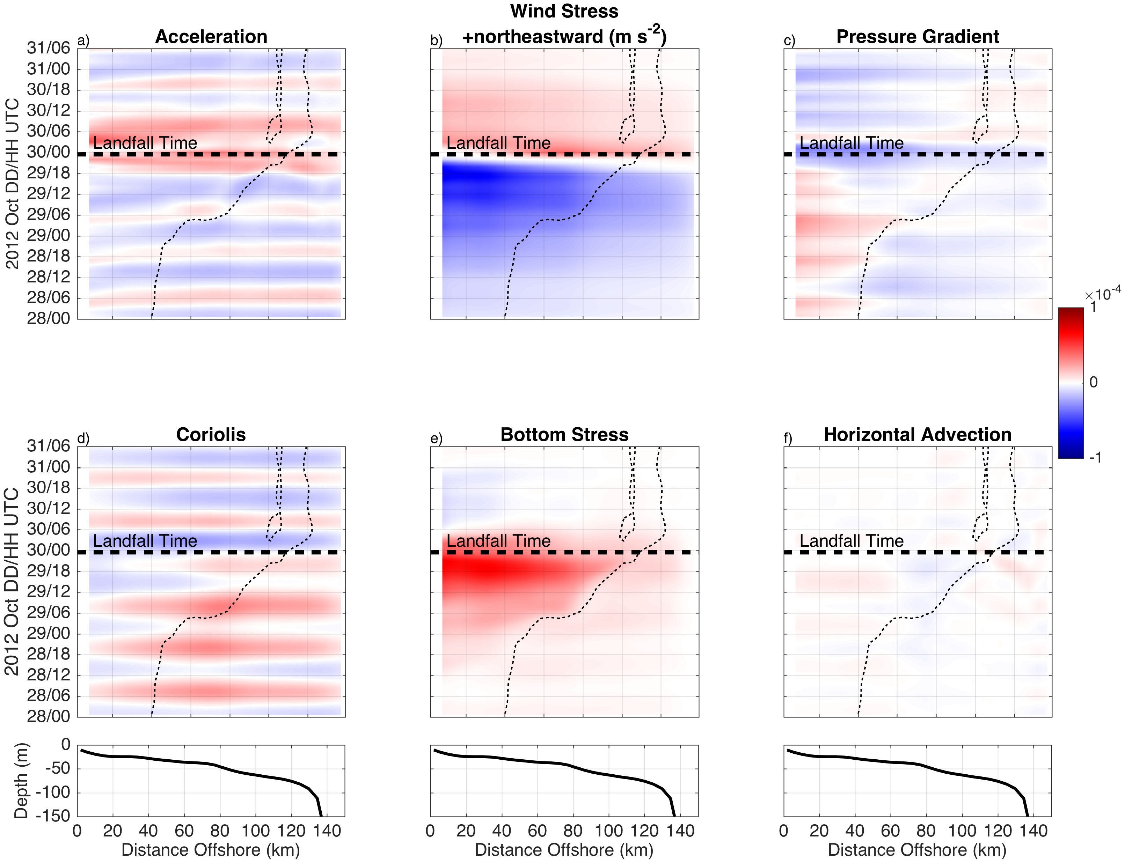
Surface T
Along-shelf Force Balance
Bottom T

Slide 17
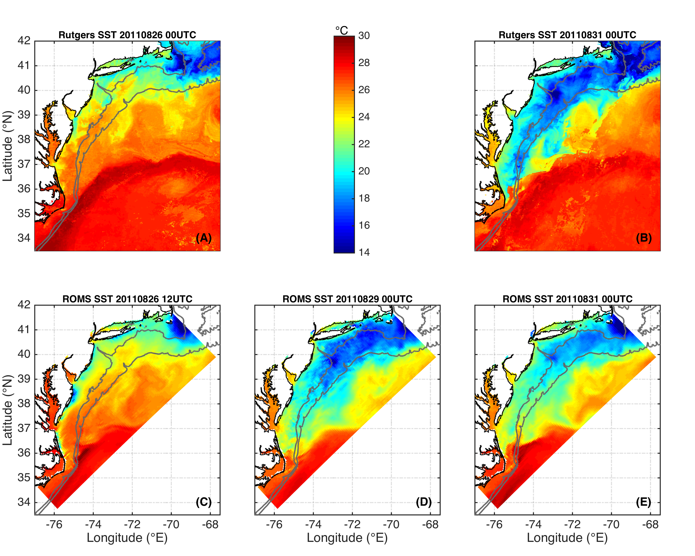
IRENE: ROMS Model Forecast with Glider Data Assimilation
Rutgers SST
Before
During
After
ROMS Forecast
Notes:
Coastal upwelling captured by Rutgers SST 08/26 but not 08/27. ROMS run started 08/26 at 12 UTC
Warm SST simulations used RTG 08/27 to simulate “operational NAM SST”. Figure 3 has 08/26 products plotted to show coastal upwelling

Slide 18
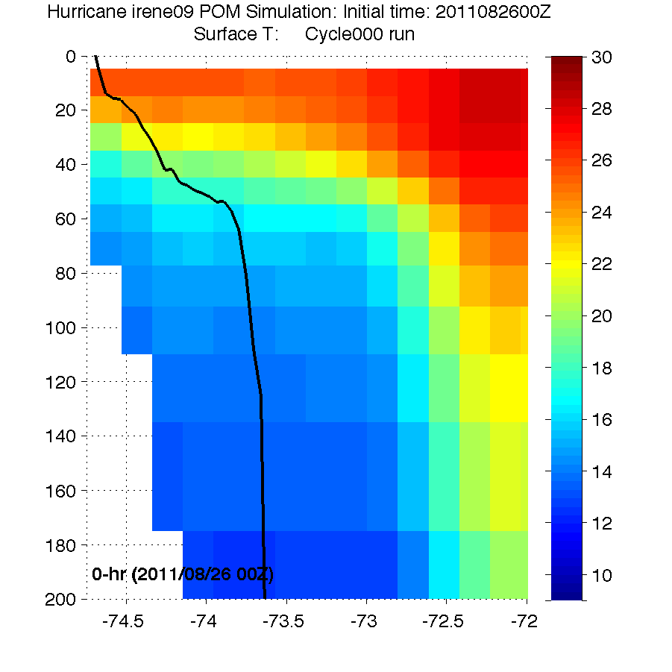
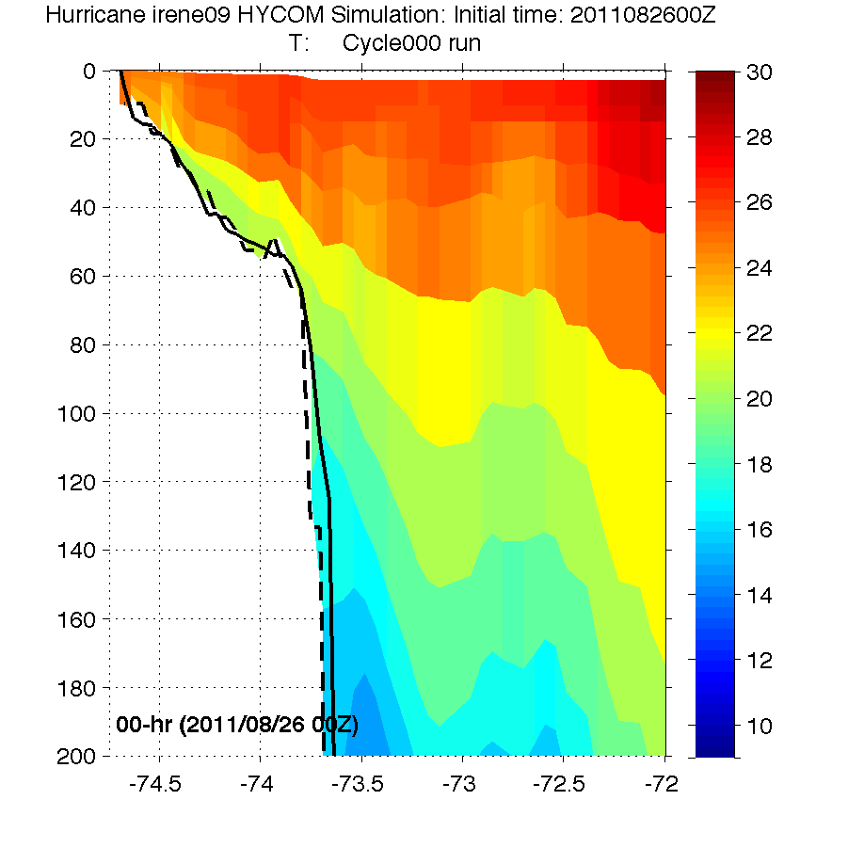
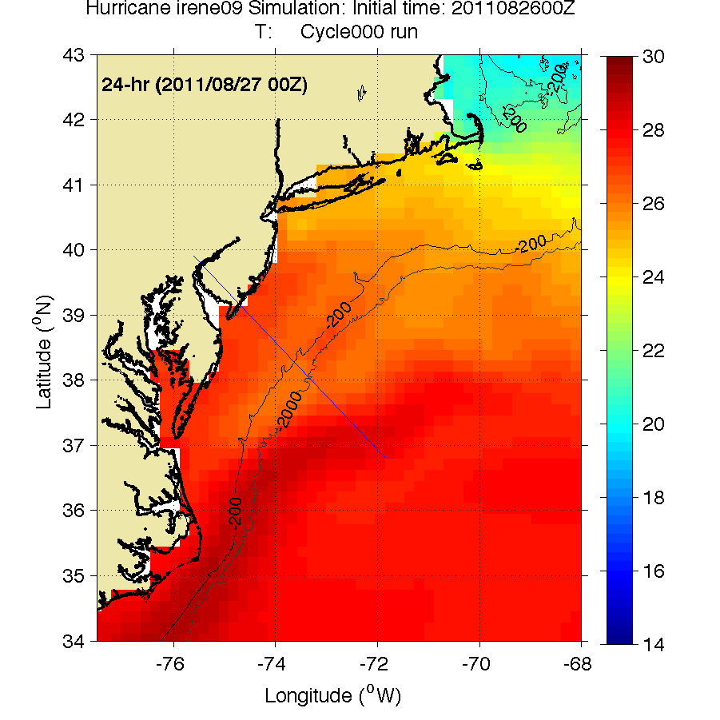
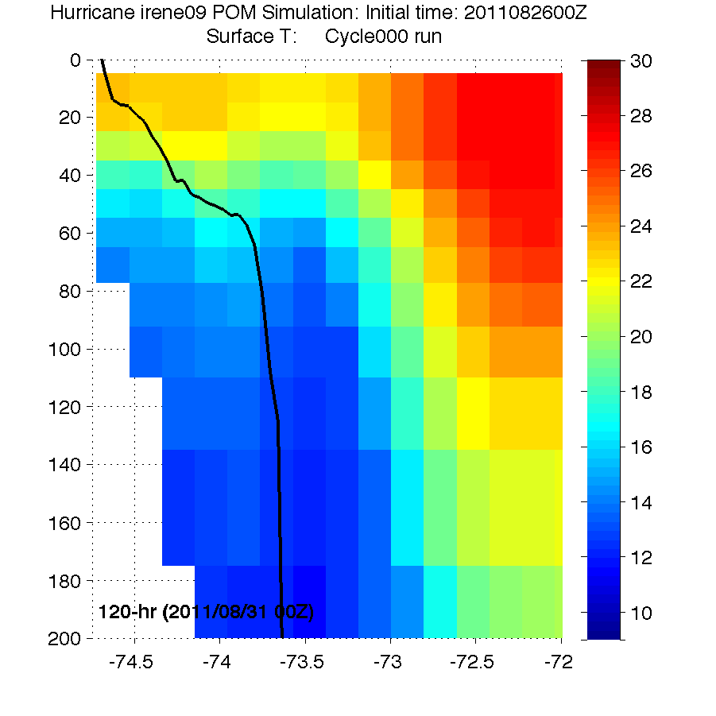
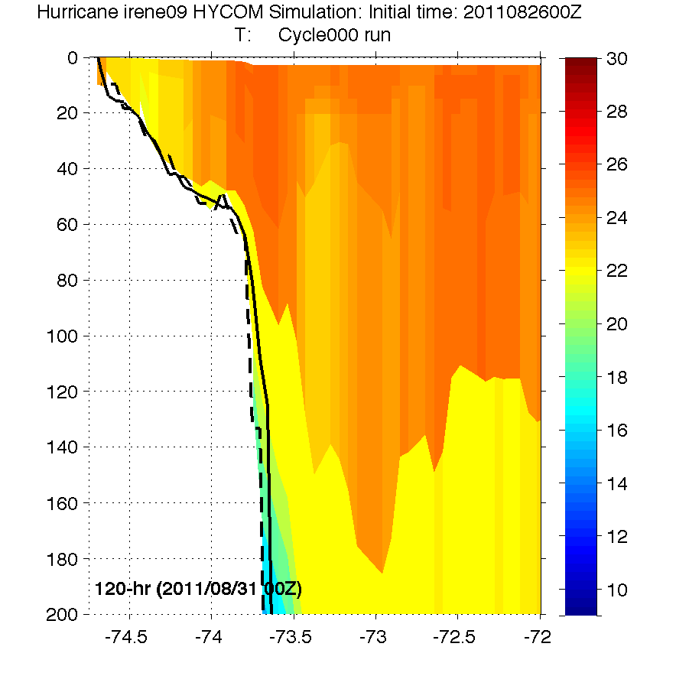
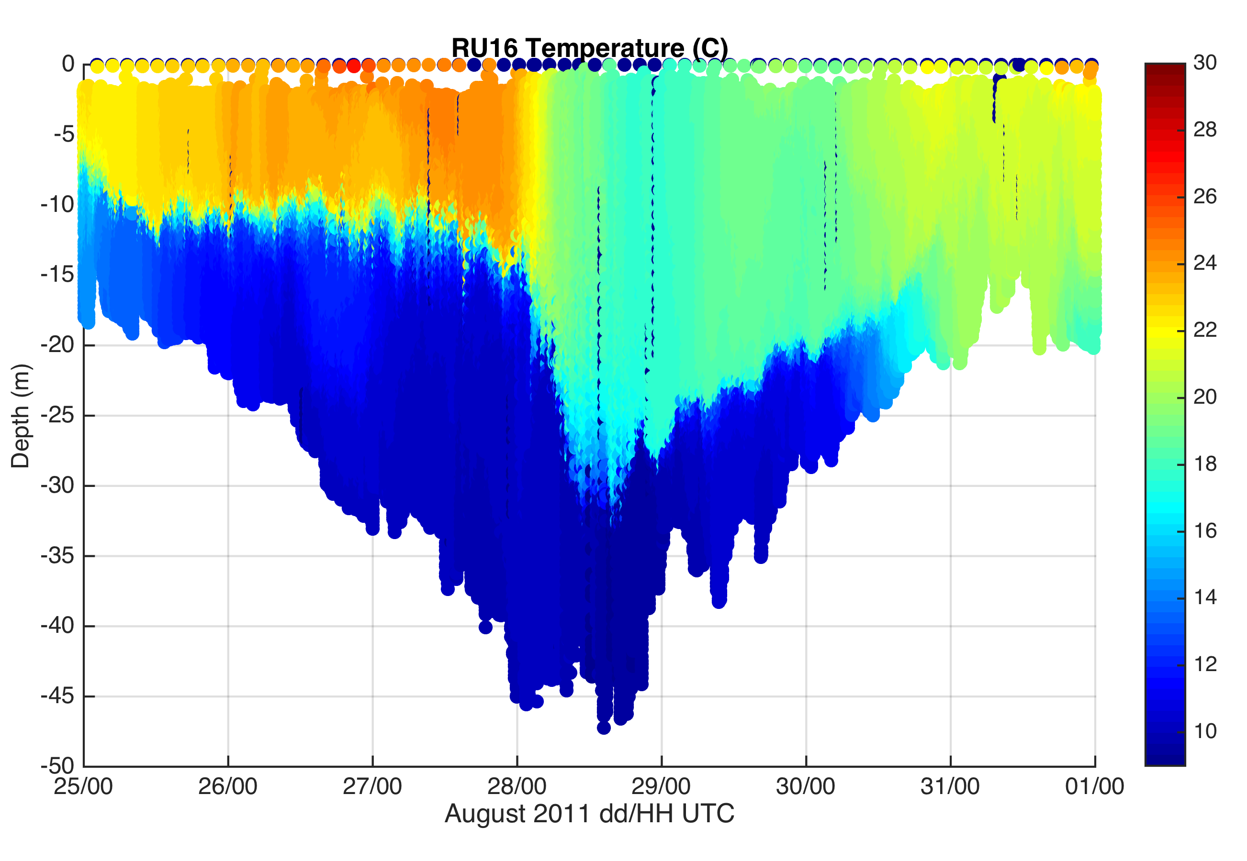
HWRF Cross-shelf Transects: Irene
HWRF-POM
Before
HWRF-HYCOM
Before
Before
After
HWRF-POM
After
HWRF-HYCOM
After
RU16 Glider
Thank you to Hyun-Sook Kim and Zhan Zhang for providing HWRF data
Observed bathymetry from NOAA National Geophysical Data Center, U.S. Coastal Relief Model, Retrieved date goes here, http://www.ngdc.noaa.gov/mgg/coastal/crm.html

Slide 19
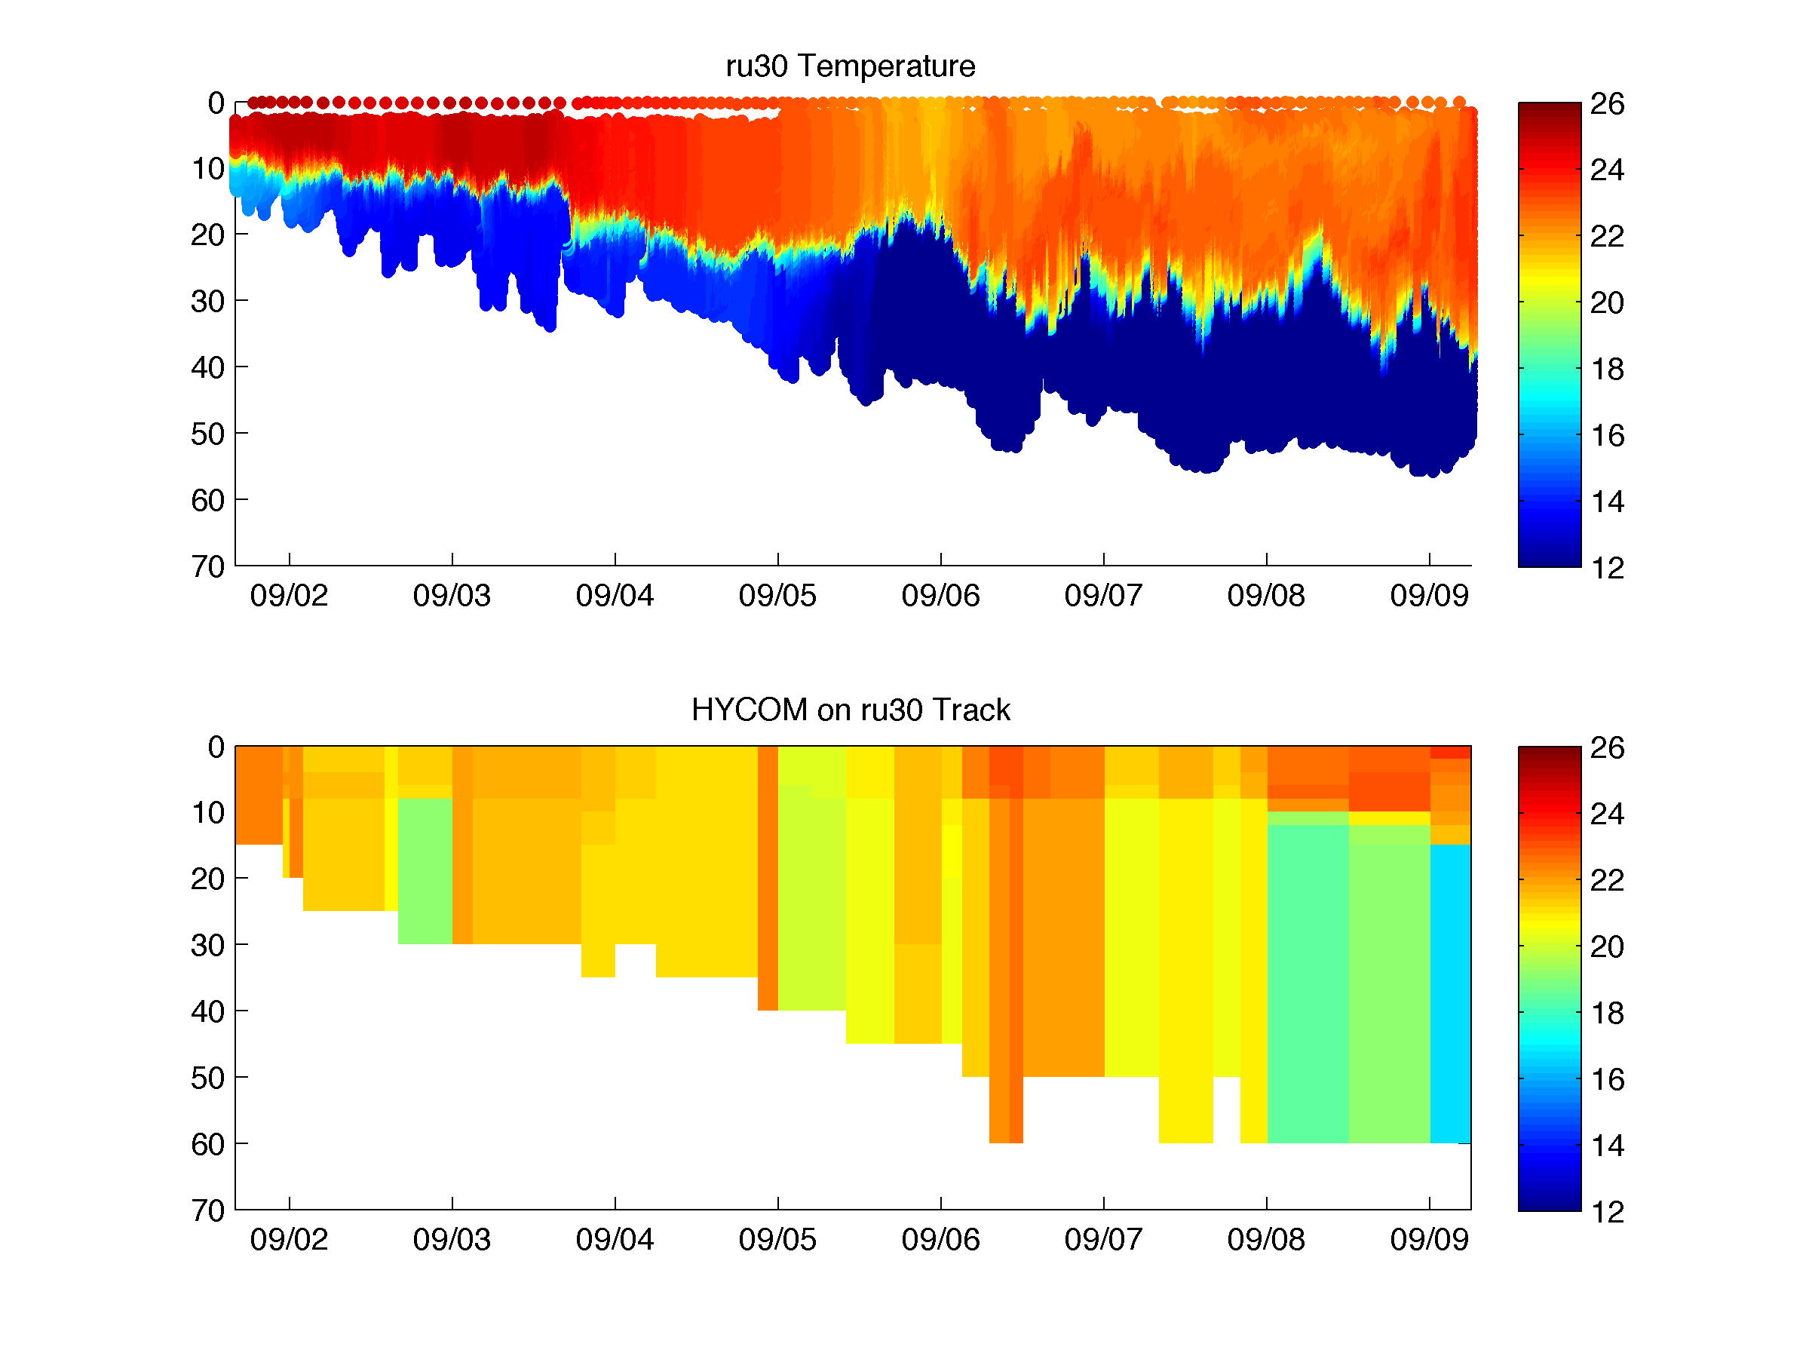
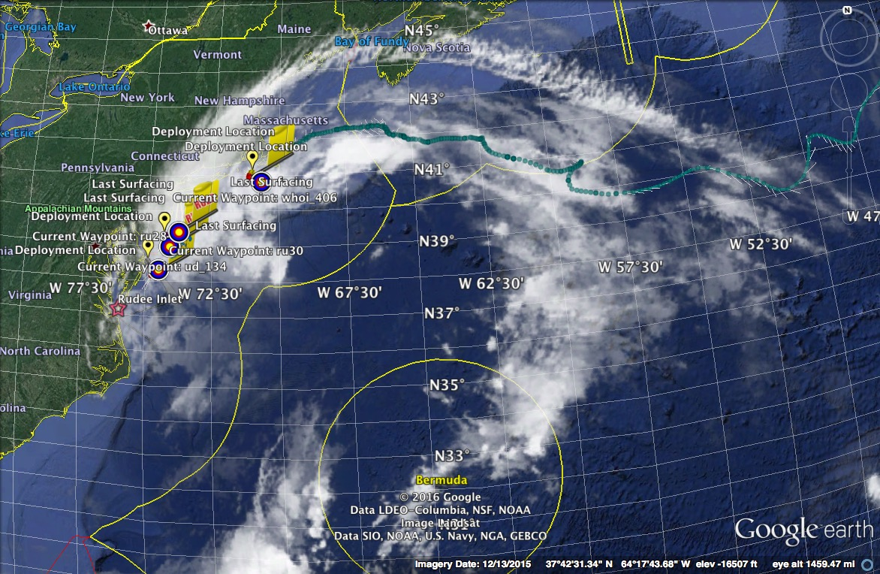
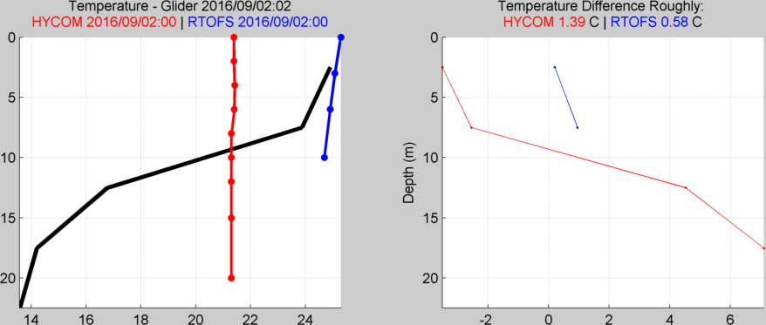
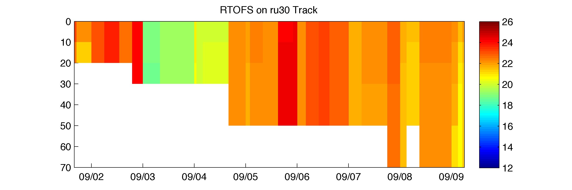
Hurricane Hermine Response: CINAR/MARACOOS Glider Fleet Launched, 9/2016
Glider
HYCOM
RTOFS

Slide 20
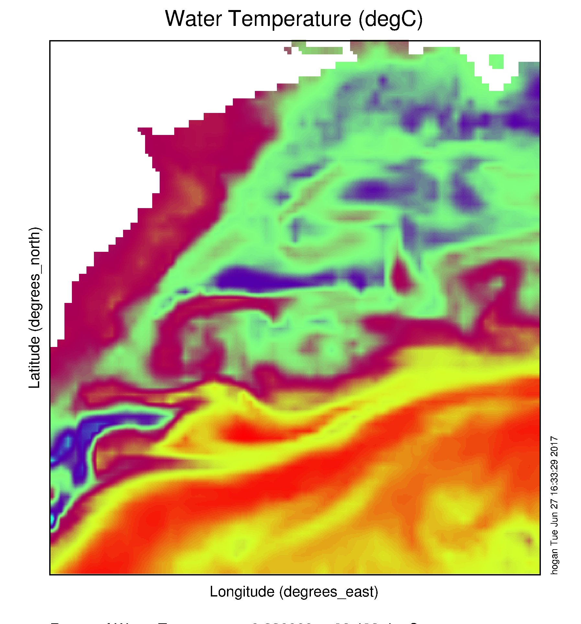
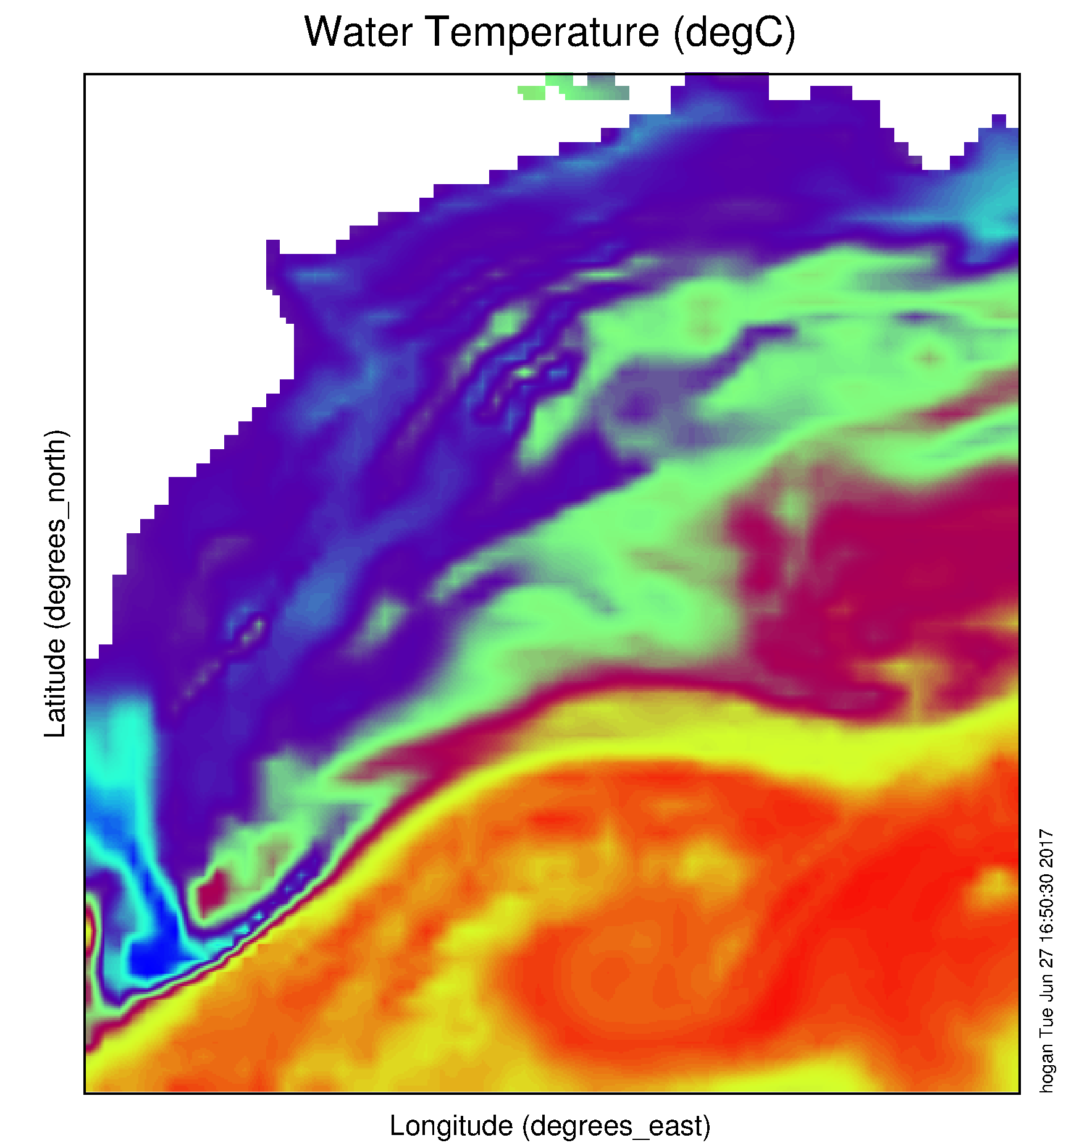
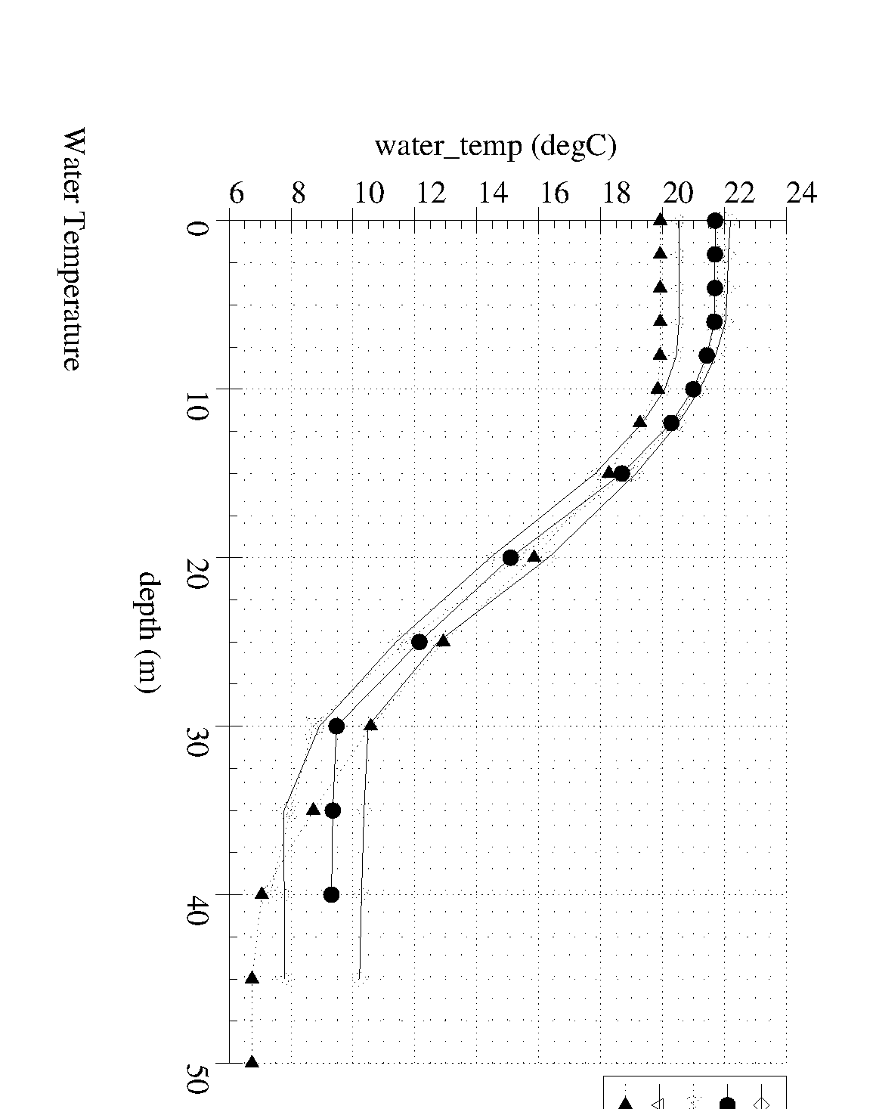
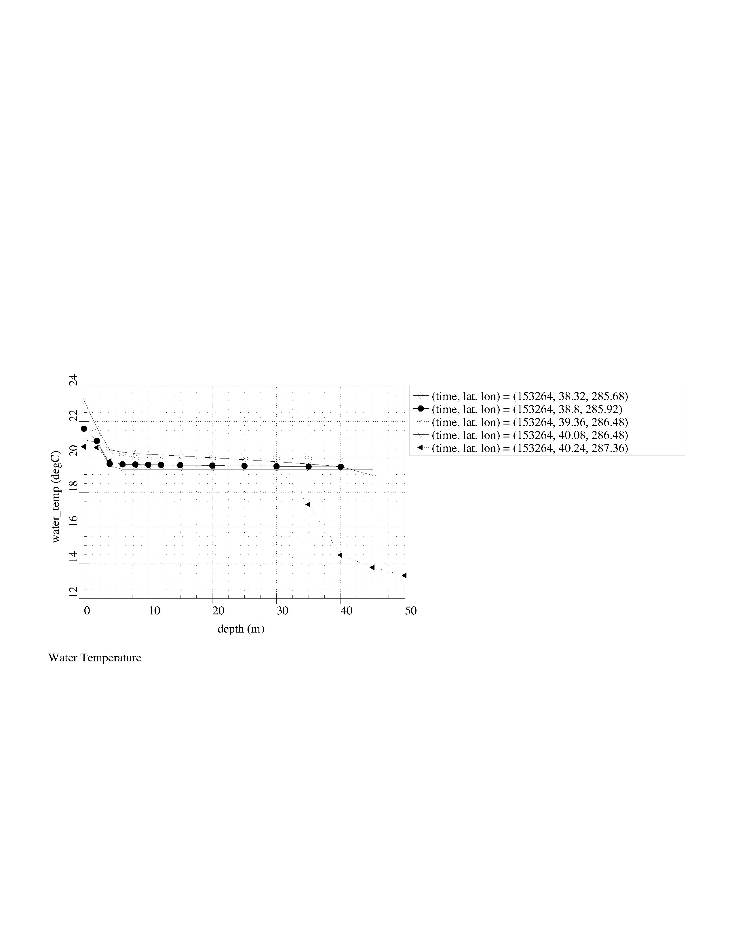
Navy Global HYCOM: T below summer thermocline
Operational GOFS 3.0
OpTest of GOFS 3.1
No Cold Pool
Well Defined
Cold Pool
Nearly Isothermal Shelf
Two Thermal layers on Shelf

Slide 21
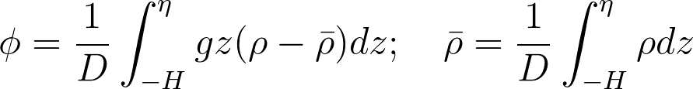

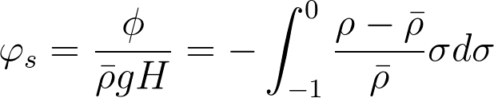
Potential Energy Anomaly (…; Simpson, 1981; …)
For our coastal application:
= (bottom pressure factor) x (stratification factor)
Non-dimensional PEA (the stratification factor) becomes:

Slide 22
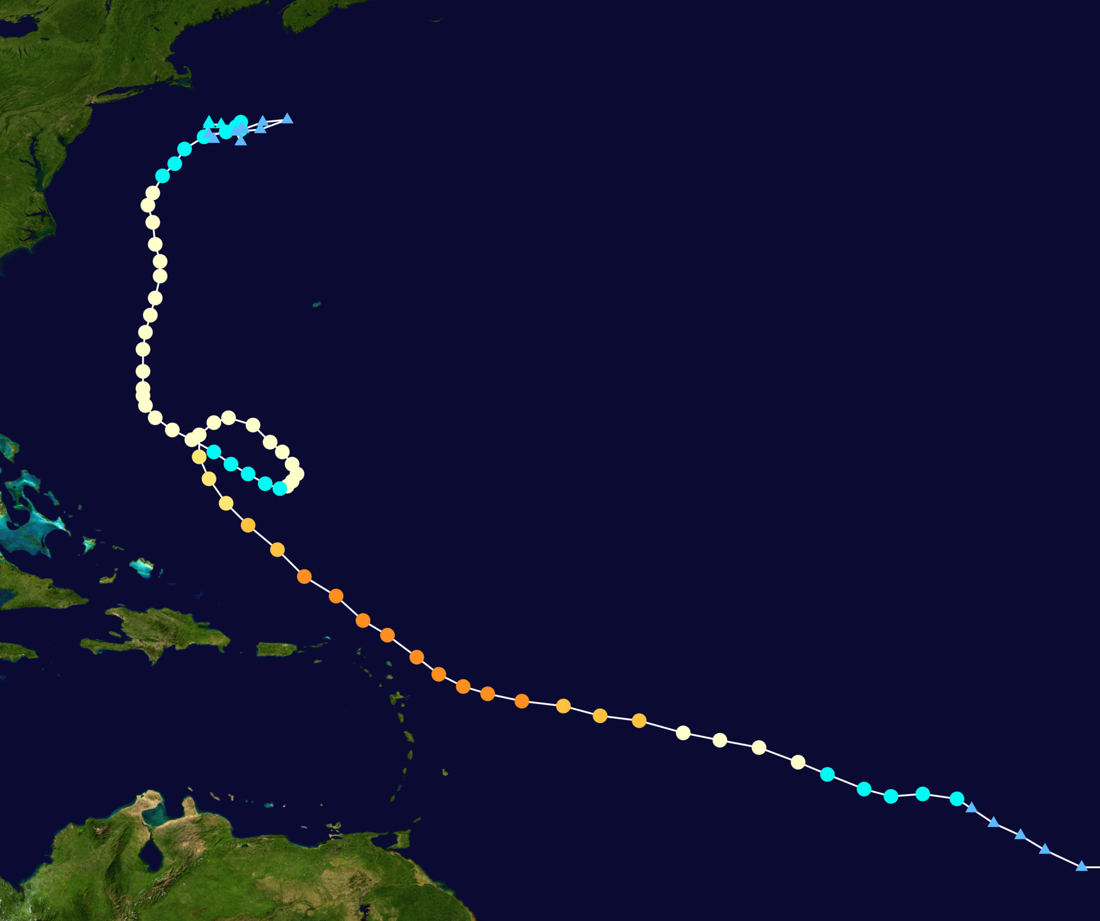
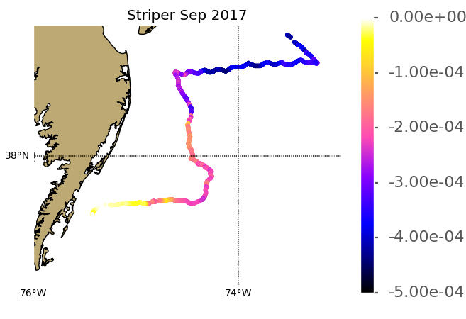
Glider
07-27
Sept
2017
Hurricane
Jose
05-21 Sept
2017

Slide 23
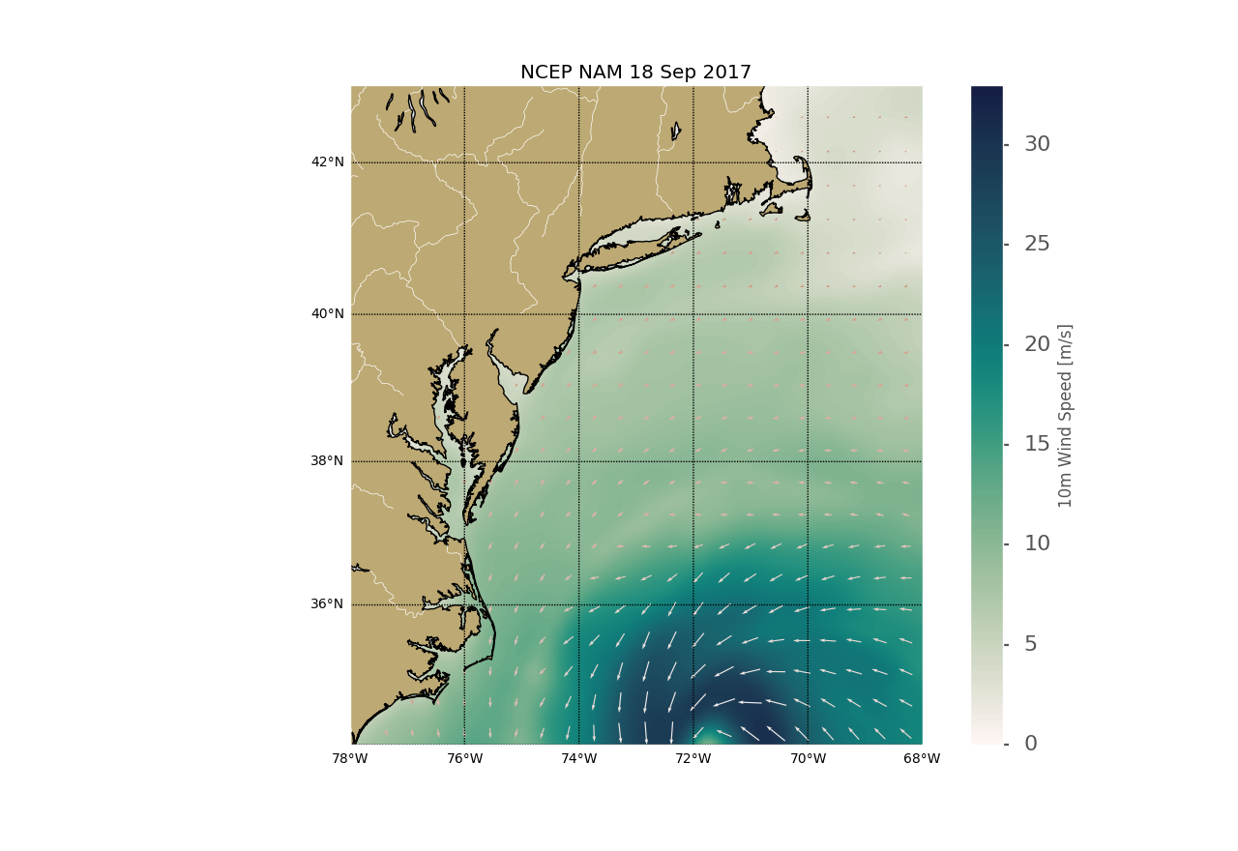
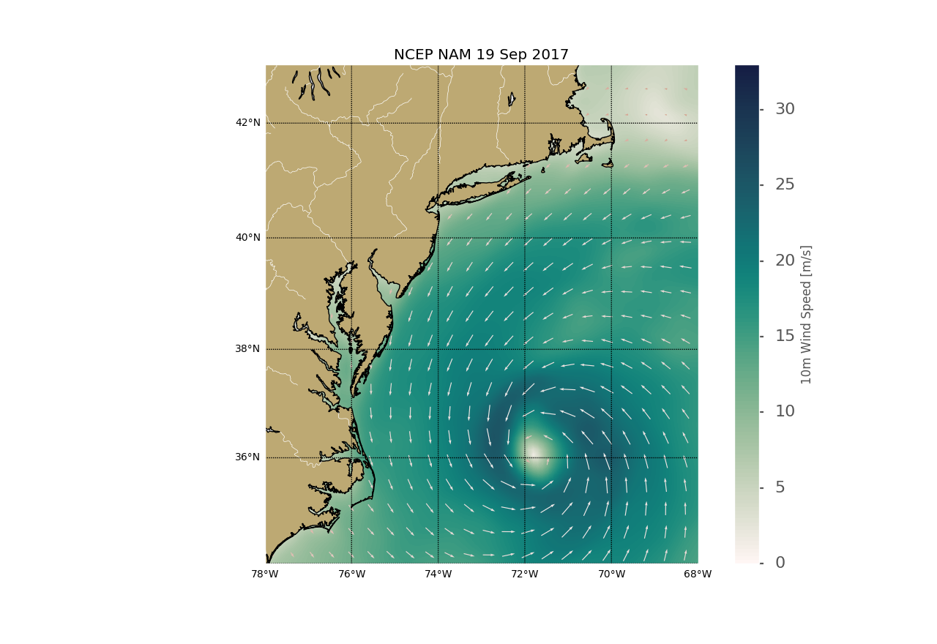
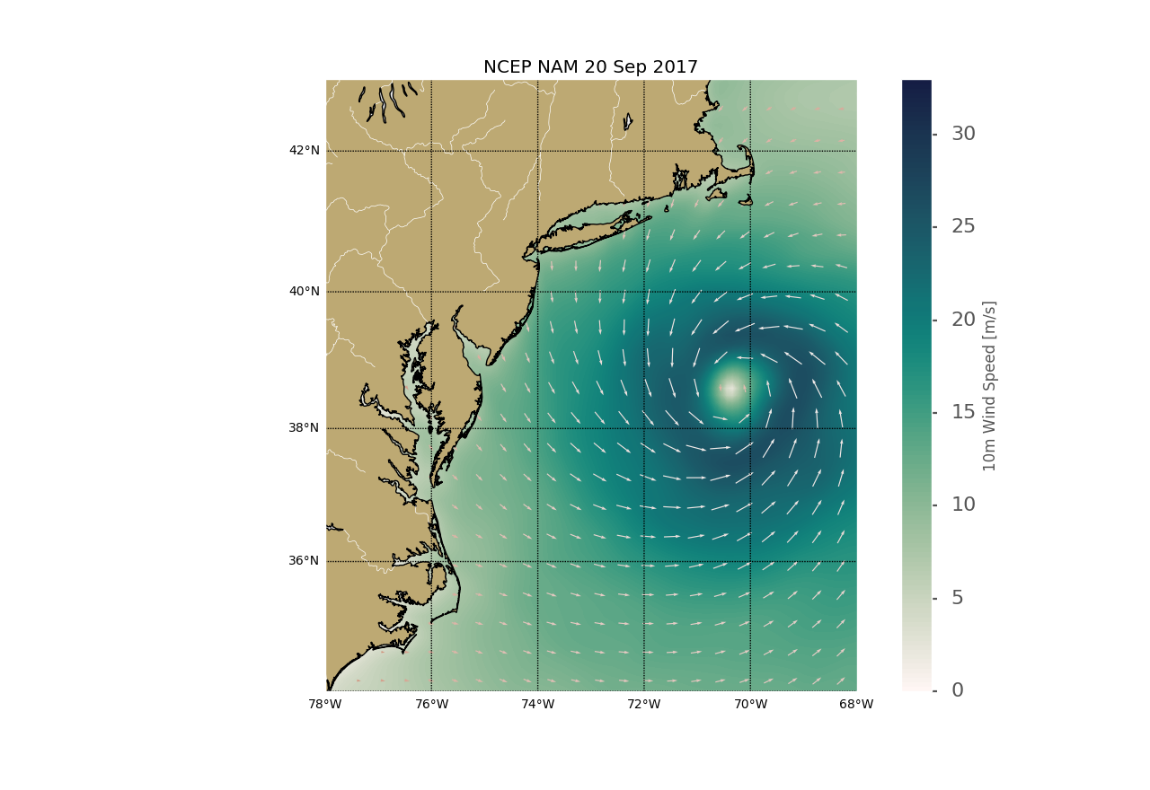
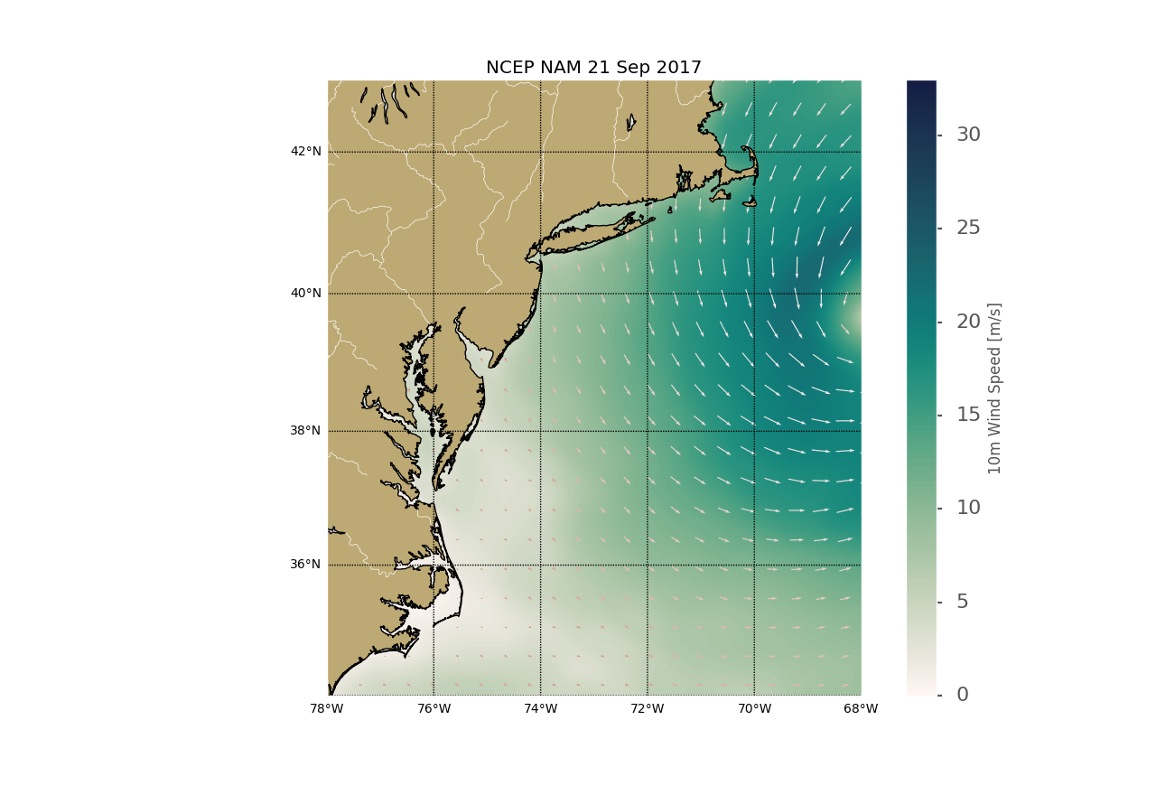
Hurricane Jose: NCEP NAM Winds, 18-21 Sept 2017

Slide 24
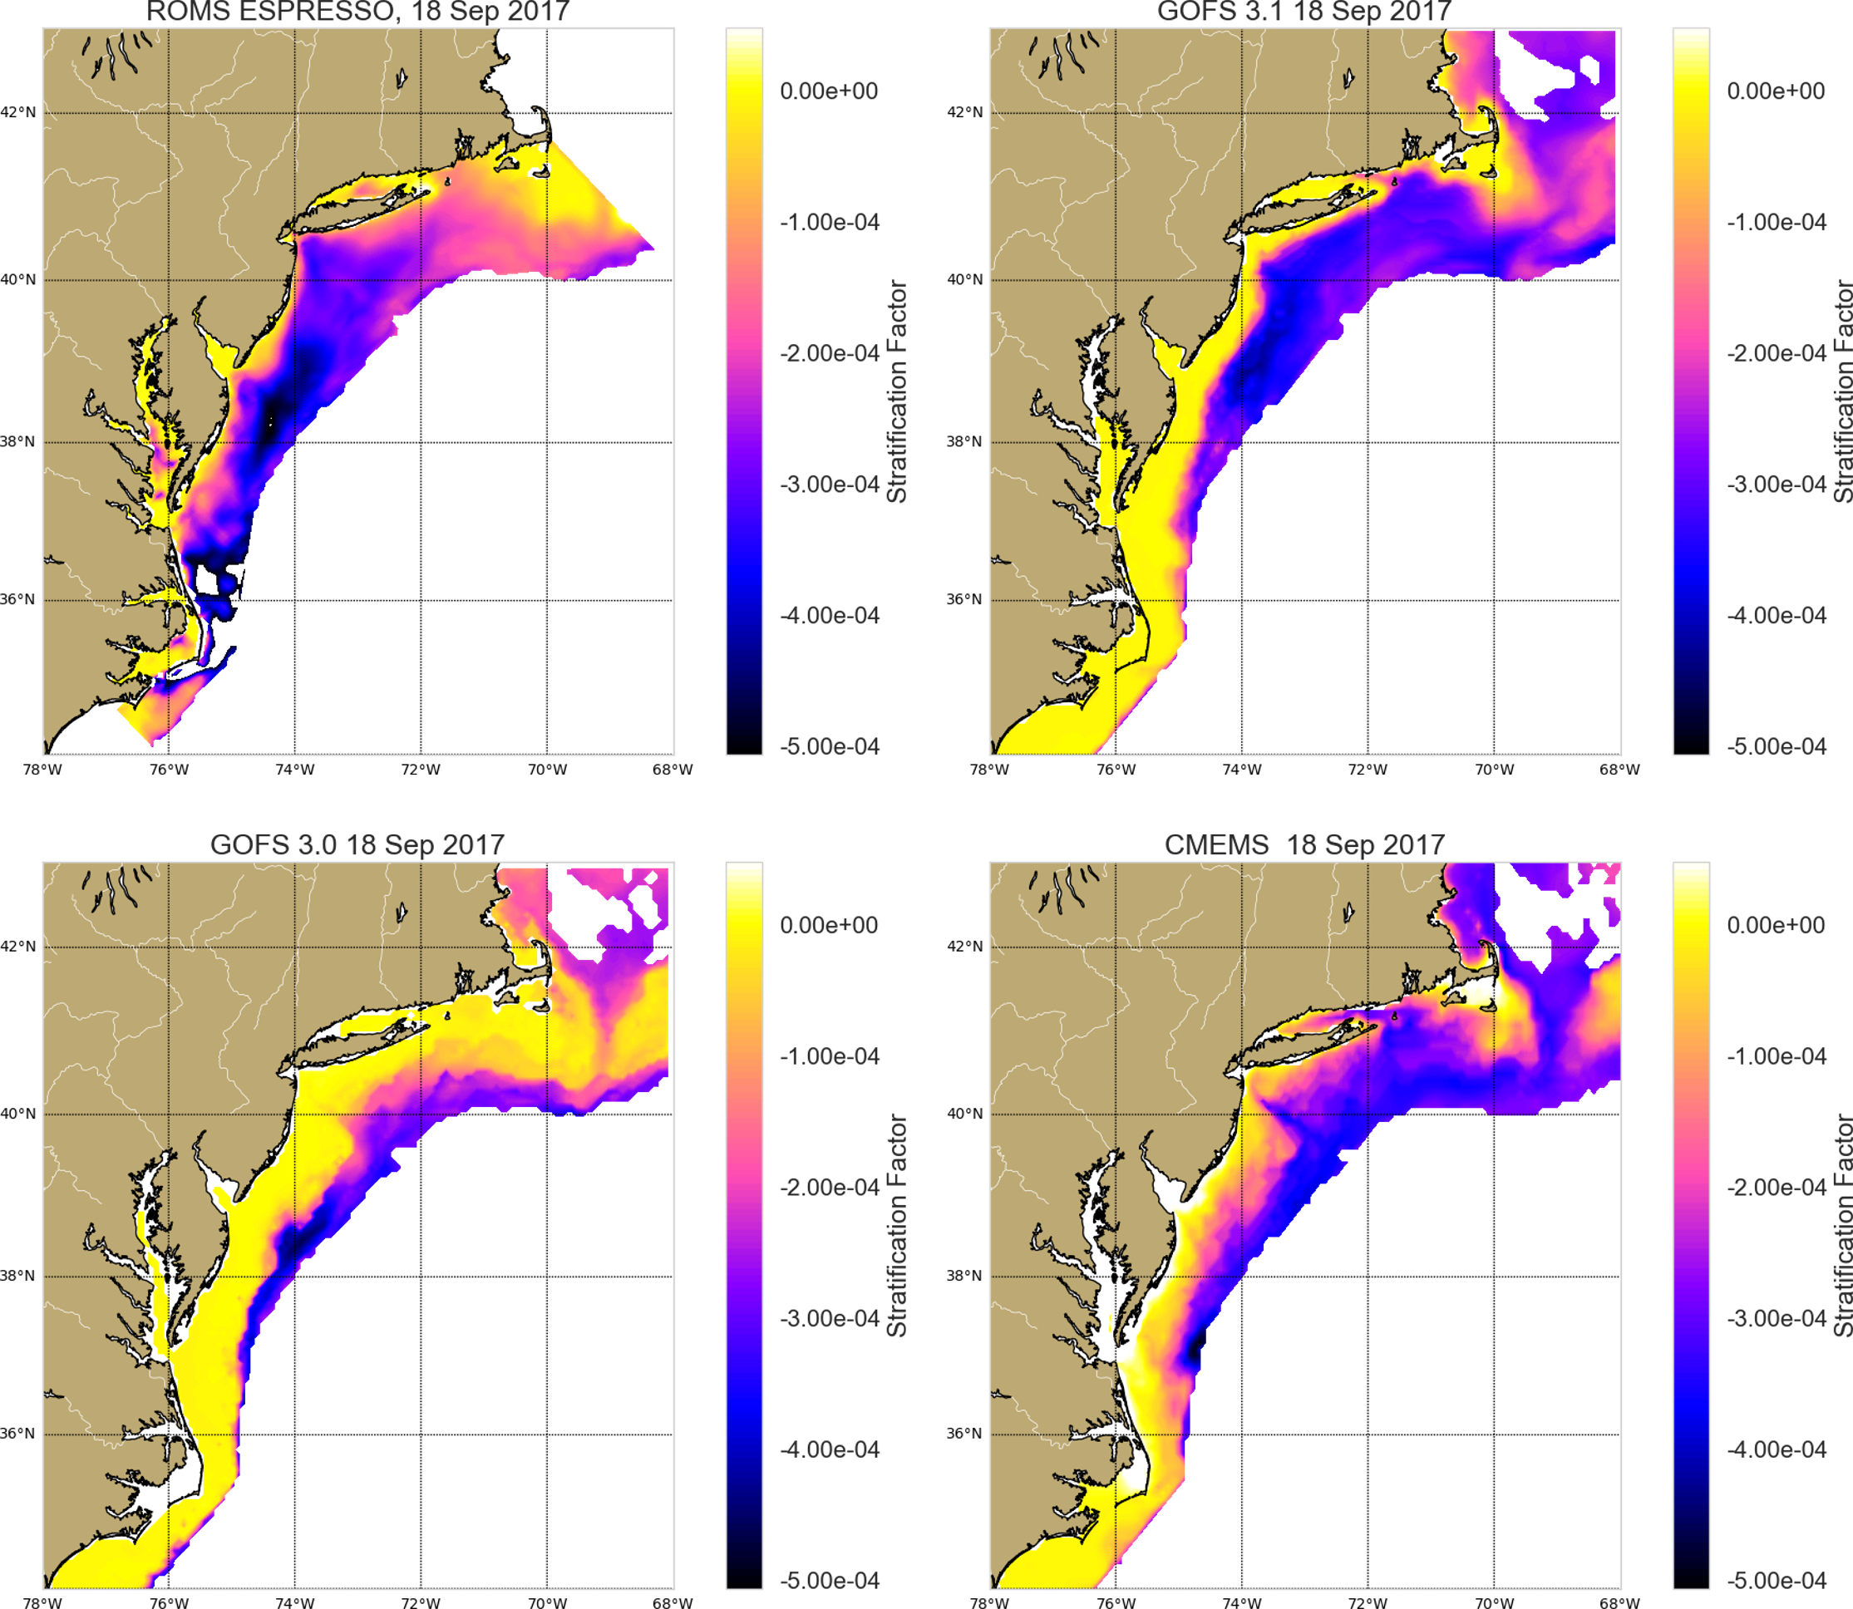
Hurricane Jose
Ocean Response
18 Sept 2017
ROMS
GOFS 3.1
GOFS 3.0
CMEMS

Slide 25
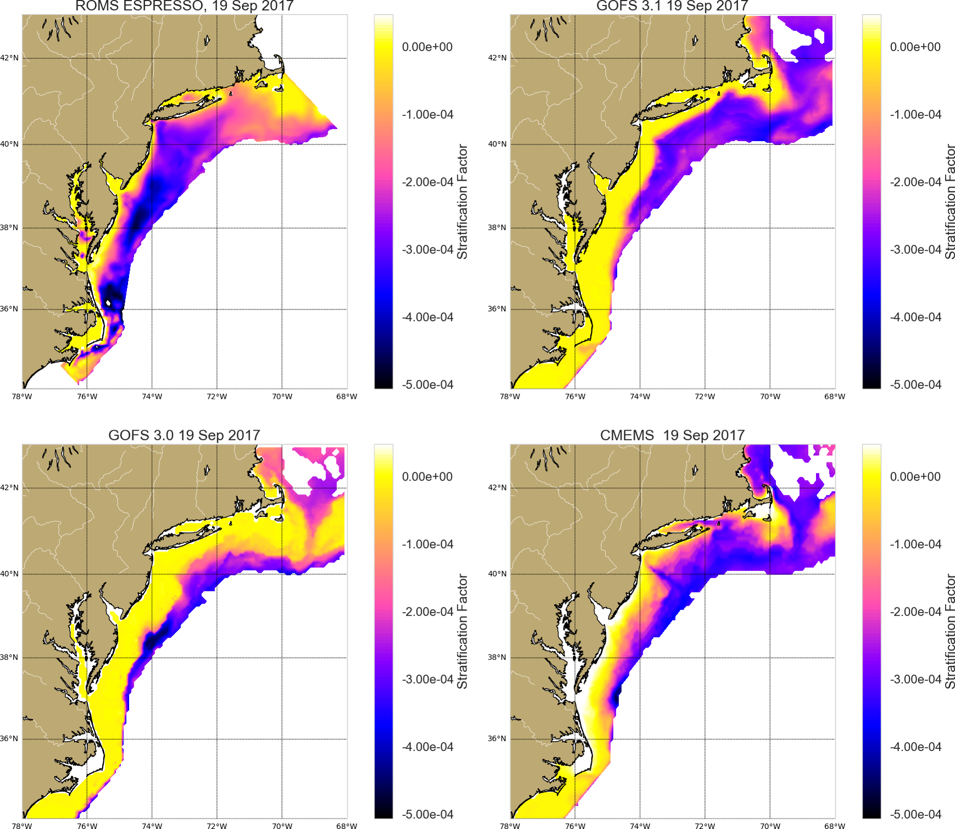
Hurricane Jose
Ocean Response
19 Sept 2017
ROMS
GOFS 3.1
GOFS 3.0
CMEMS

Slide 26
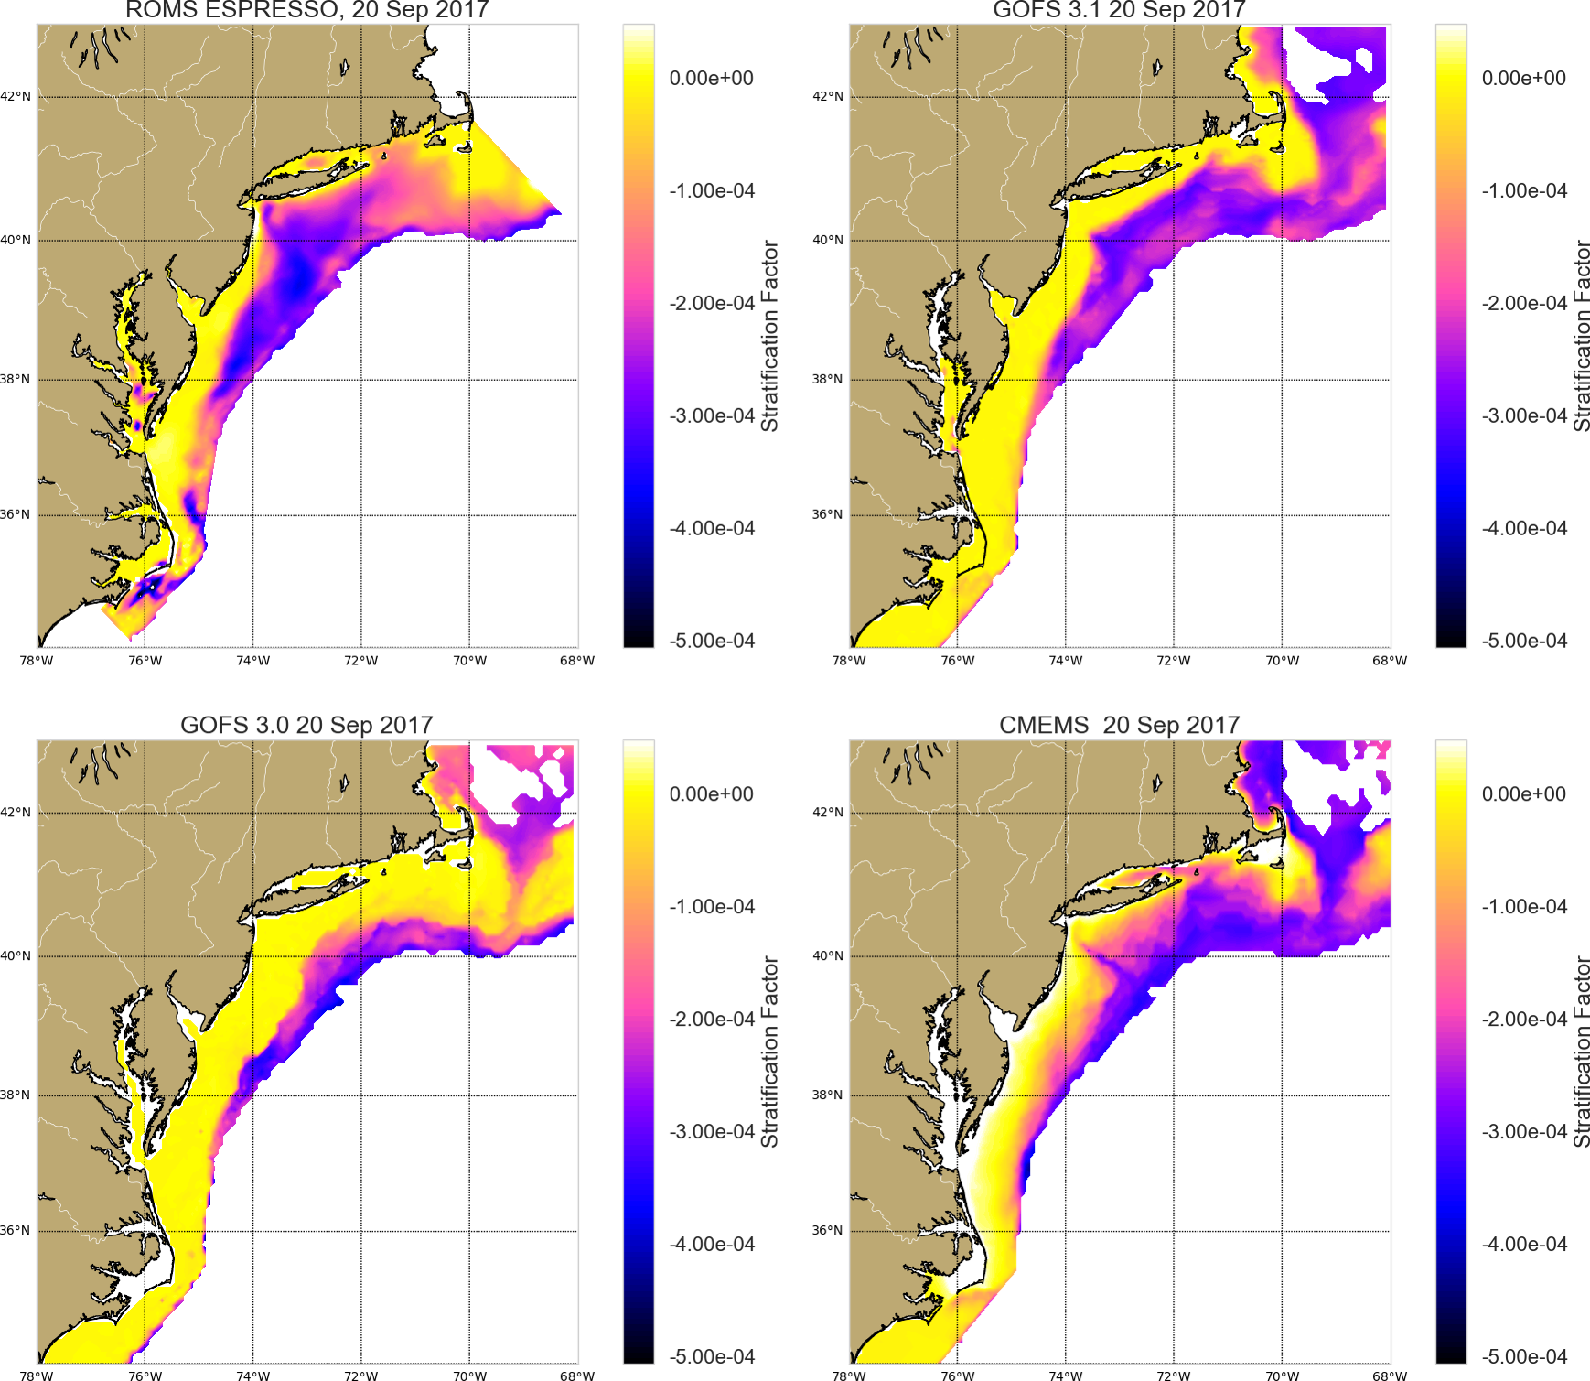
Hurricane Jose
Ocean Response
20 Sept 2017
ROMS
GOFS 3.1
GOFS 3.0
CMEMS

Slide 27

Hurricane Jose
Ocean Response
21 Sept 2017
ROMS
GOFS 3.1
GOFS 3.0
CMEMS

Slide 28
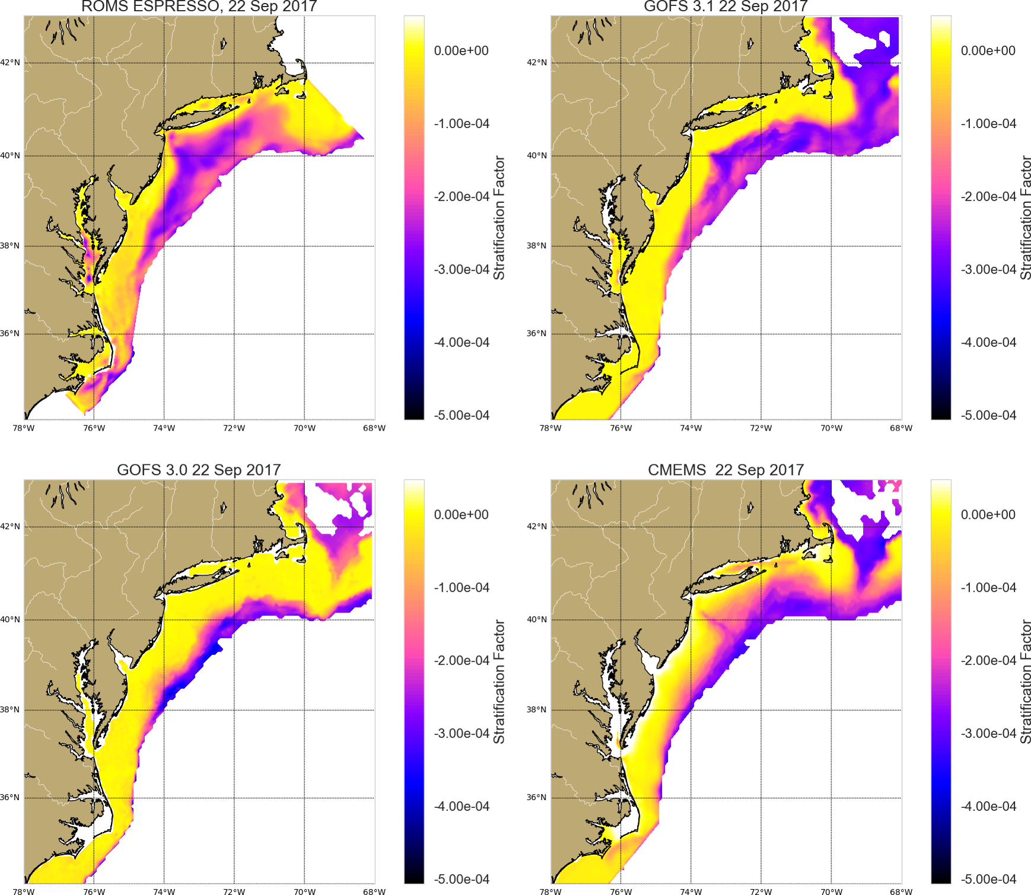
Hurricane Jose
Ocean Response
22 Sept 2017
ROMS
GOFS 3.1
GOFS 3.0
CMEMS

Slide 29
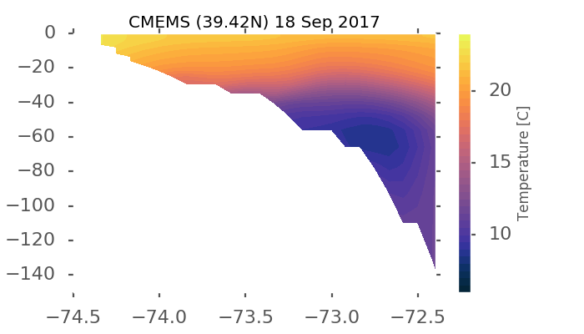
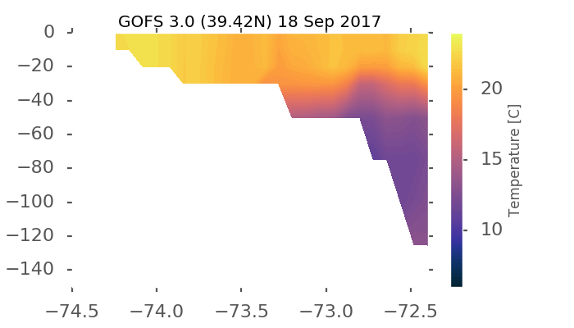
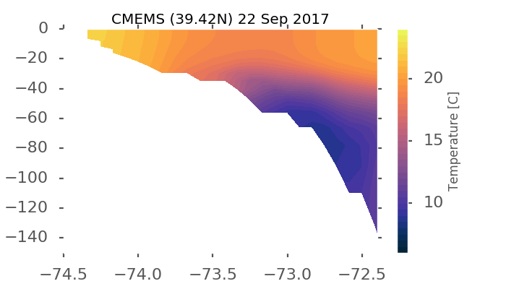
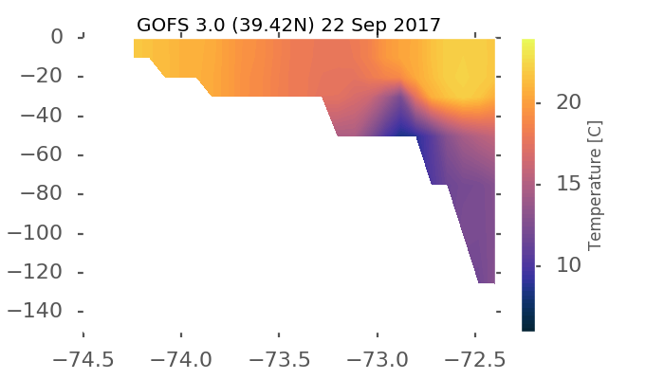
Model Temperature Sections Across New Jersey Shelf
CMEMS
18 Sept
GOFS 3.0
18 Sept
CMEMS
22 Sept
GOFS 3.0
22 Sept

Slide 30

Model Temperature Sections Across New Jersey Shelf
CMEMS
18 Sept
GOFS 3.1
18 Sept
CMEMS
22 Sept
GOFS 3.1
22 Sept

Slide 31

Research Summary:
Essential Ocean Features – Cold Pool
Essential Ocean Processes – Ahead of Eye Cooling vs Downwelling
Impact – Rapid de-intensification vs intensification
Operations Summary:
In the Mid-Atlantic GOFS 3.1 has the Essential Ocean Features & Processes for coupling to hurricane models.
Experimental HWRF will use GOFS 3.1 this hurricane season.
We need to keep the gliders deployed.

