Slide 1
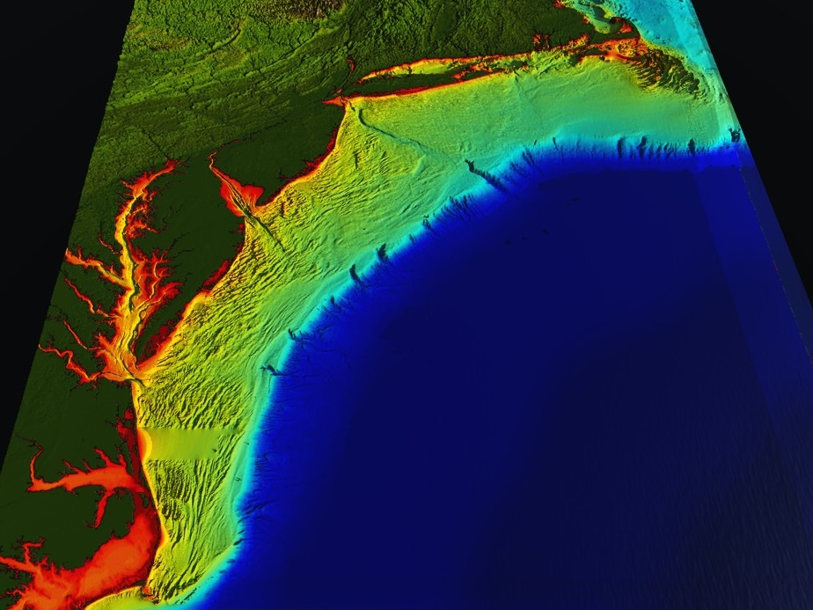


78 Million People (1/4 of U.S.)
1000 km Cape to Cape
U..
Middle Atlantic
Regional Association
Coastal
Ocean Observing System
Cape
Cod
Stratified
Coastal Ocean Interactions with
Tropical Cyclones
Sandy
Irene
Barry
Arthur
Scott Glenn, Travis Miles,
Greg Seroka, Hugh Roarty, Oscar Schofield, Josh Kohut (Rutgers),
Yi Xu (China) & Fei Yu (China)
Nature Communications (2016)
Monthly Weather Review (2016)
JGR Oceans (2017)
Hermine
Cape
Hatteras
Notes:
1

Slide 2
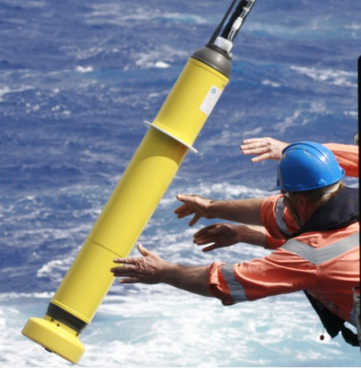
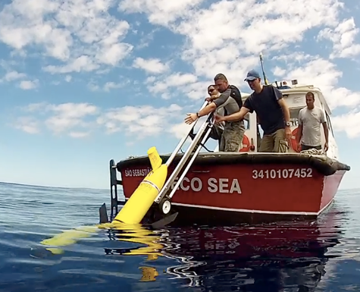
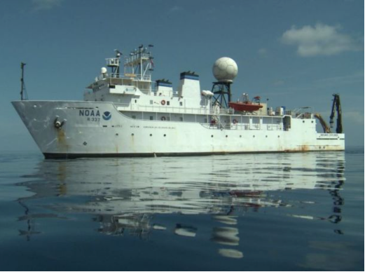
Mobile Subsurface Sampling Capabilities
Drifters
Gliders
Ships
Increasing Control, Capacity & Cost
Decreasing Endurance & Risk Tolerance

Slide 3
Key Storm Glider Reference List
Glenn, Jones, Twardowski, Bowers, Kerfoot, Kohut, Webb, Schofield, 2008. Glider observations of sediment resuspension in a Middle Atlantic Bight fall transition storm. Limnology and Oceanography 53(5, Part 2): 2180-2196.
Miles, Glenn, Schofield, 2013. Temporal and spatial variability in fall storm induced sediment resuspension on the Mid-Atlantic Bight. Continental Shelf Research 63, Supplement: S36-S49.
Miles, Seroka, Kohut, Glenn, 2015. Glider observations and modeling sediment transport in Hurricane Sandy. JGR Oceans, DOI: 10.1002/2014JC010474
Glenn, Miles, Seroka, Xu, Forney, Yu, Roarty, Schofield, Kohut, 2016. Stratified coastal ocean interactions with tropical storms, Nature Communications, March 8, 2016, 1-10, DOI:10.1038/ncomms10887.
Seroka, Miles, Xu, Kohut, Schofield & Glenn, 2016. Hurricane Irene Sensitivity to Stratified Coastal Ocean Cooling, Monthly Weather Review, 144(9) 3507-3530.
Seroka, Miles, Xu, Kohut, Schofield & Glenn, 2017. Rapid shelf-wide cooling response of a stratified coastal ocean to hurricanes. JGR-Oceans: Special Section on Ocean Responses and Feedbacks to Tropical Cyclones, DOI:10.1002/2017JC012756.
Miles, Seroka, Glenn, 2017. Coastal ocean circulation during Hurricane Sandy, J. Geophysical Res. - Oceans, accepted.
Sea-Bottom Interface
Air-Sea Interface

Slide 4
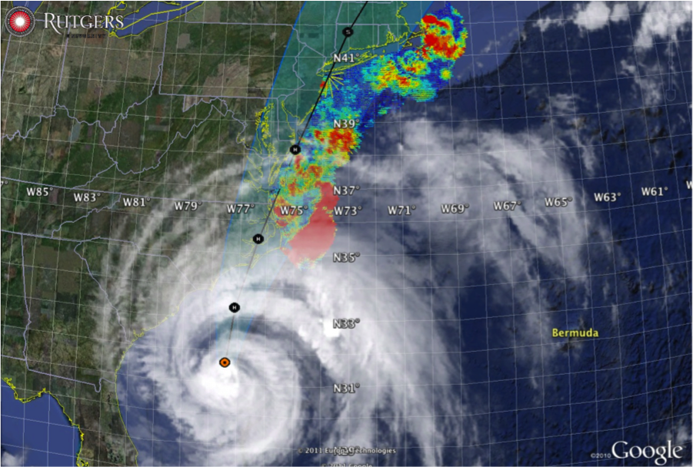
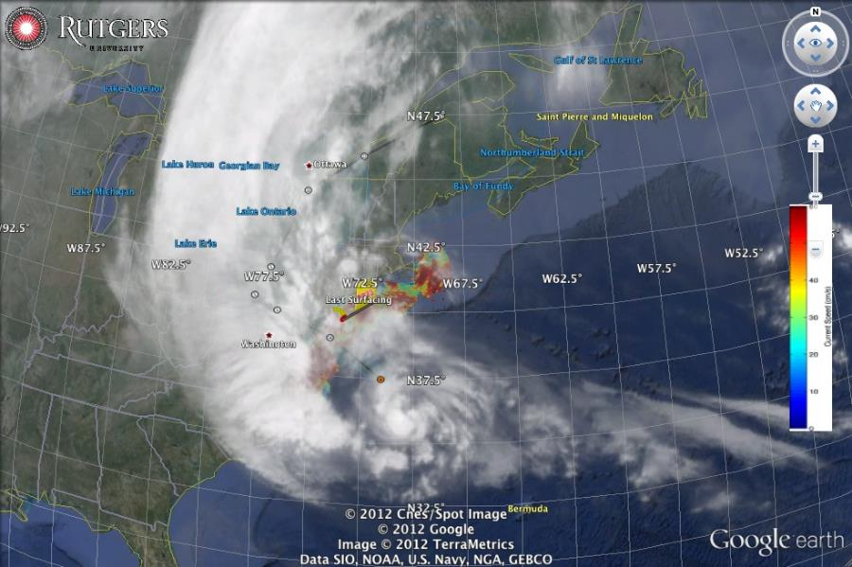
Hurricane Irene
August 28, 2011
NOAA/NHC Damage:
#7 with >$16 Billion.
Track Accurate;
Intensity Over-predicted.
Avila & Cangialosi, 2012, Tropical Cyclone Report
Hurricane Sandy
October 29, 2012
NOAA/NHC Damage:
#2 with >$68 Billion.
Track Accurate;
Surge Under-predicted.
Georgas et al., 2014, J. of Extr. Even.
Colle et al., 2015, J. Mar. Sci. & Engr.

Slide 5

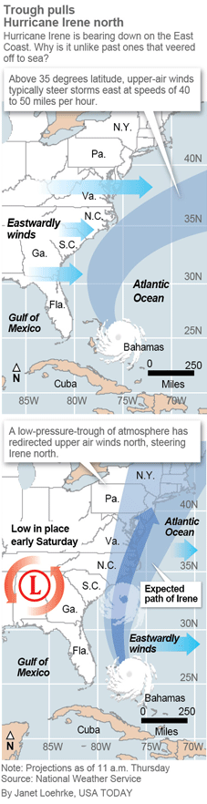
Pre-Irene Storm Warnings
Over 2 million people ordered to “flee the storm’s path”.
President Obama: Shaping up to be a “historic hurricane” and urged residents to “be prepared for the worst”. “Don’t wait. Don’t delay.”
New Jersey Governor Christie: Ordered evacuation of 1 million people - “Get the hell off the beach”. “Do not waste any more time working on your tan”.
New York Mayor Blumberg: “Staying behind is dangerous, staying behind is foolish, and its against the law”. “The time to leave is right now”. The bridges, streets and subways were nearly empty ahead of a nearly unprecedented mass transit shutdown.

Slide 6
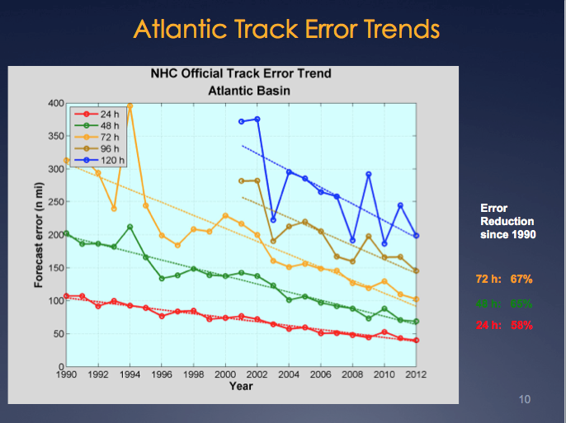
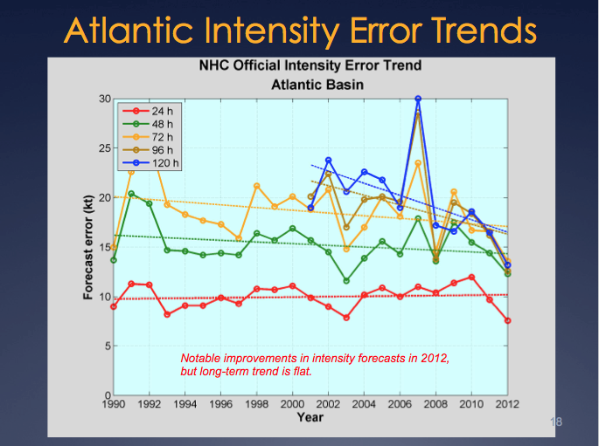
Motivation: Research to Operations to Research (R2O2R)
Track Error: Decreases in 20-Year Trend Intensity Error: - “Long-term trend is flat”
Track: Improvements attributed to Global Forecast Models & the Super-Ensemble.
Intensity: “…upper-ocean thermal structure can affect the evolution of storm intensity, …Unfortunately, the paucity of subsurface measurements limits our ability to assess the effect of upper-ocean variability on tropical cyclone intensity evolution.”
– Emanuel et al., (2004)
Production Suite Review: December 4, 2012

Slide 7
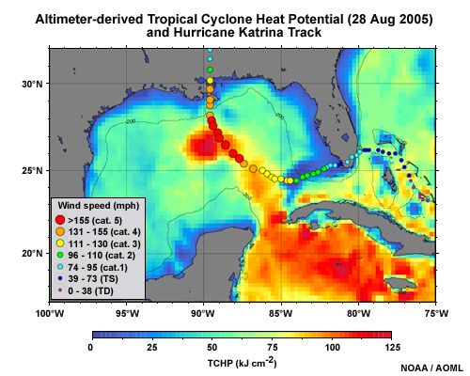

Hurricane Intensity is modulated by upper ocean heat content
Rapid intensification of Hurricane Katrina over warm ocean water

Slide 8
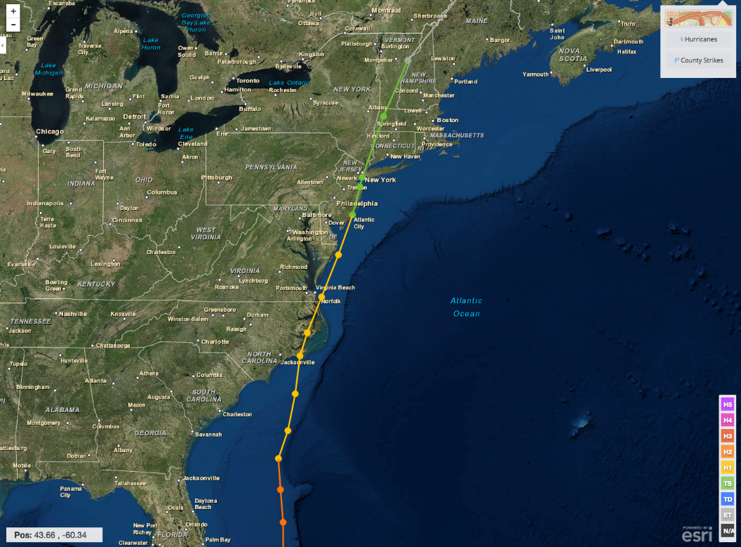
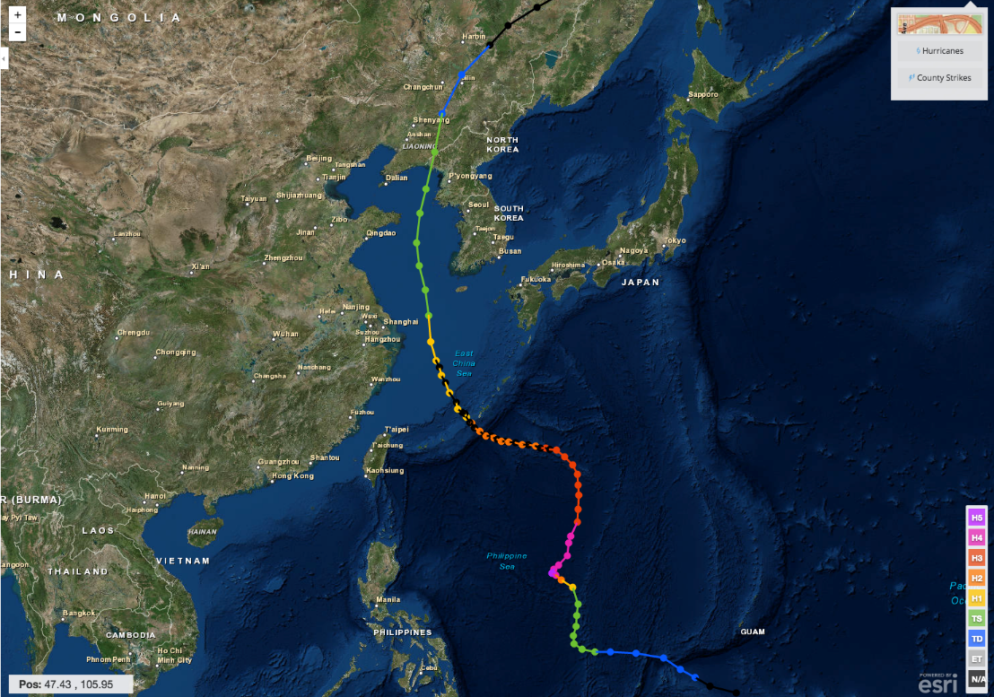
Hurricane Irene & Super-Typhoon Muifa:
What do these summer of 2011 storms have in common?
Hurricane Irene
26-29 August 2011
Super-Typhoon Muifa
26 July - 9 August 2011

Slide 9
Hurricane Irene & Super-Typhoon Muifa:
What do these summer of 2011 storms have in common?
In both cases, rapid de-intensification was not forecast
Hurricane Irene
26-29 August 2011
Super-Typhoon Muifa
26 July - 9 August 2011

Slide 10
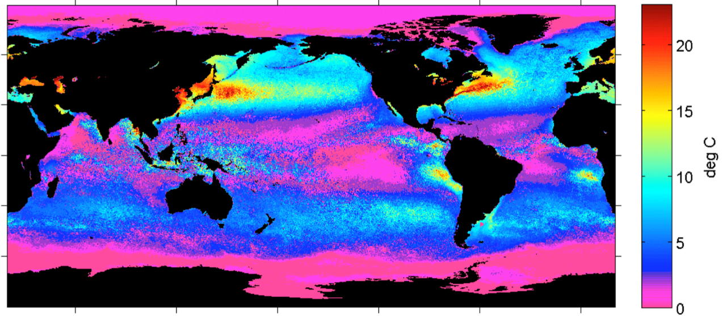
Earth’s northern mid-latitude sea surface temperatures (SSTs) undergo large seasonal cycles
Summer-Winter SST Difference (1995-2005)
Schofield et al. 1998
Ramya Ramadurai, 2009
Notes:
Earth’s northern mid-latitudes undergo large seasonal cycles, not only in the atmosphere but also in the ocean.
Within the ocean, this seasonal cycle is especially pronounced over the western continental boundaries often characterized by broad continental shelves and proximity to coastal population centers [Schofield et al., 2008].
Figure 1. Global ocean temperature contrast between winter and summer months, which were designated based on the mean seasonal temperatures
measured with the AVHRR satellite. Data were taken between 1995 and 2005. The grey shades on the land masses indicate human
populations (dark grey = high human populations).

Slide 11
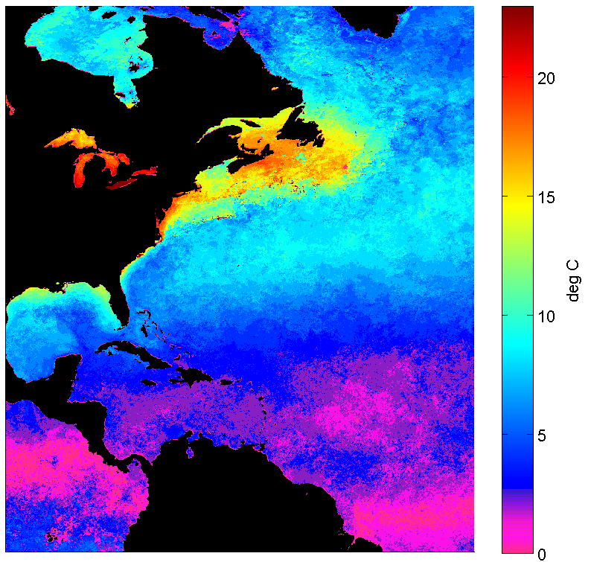
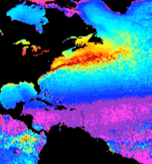
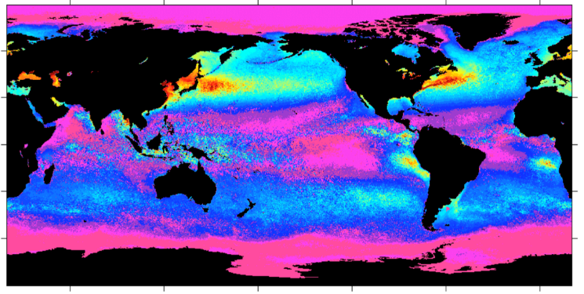
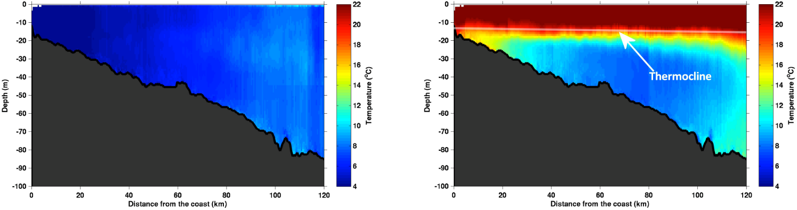
The U.S. Mid-Atlantic summer ocean is one of the most stratified in the world
Summer-Winter SST Difference
Cold Pool
Winter (1-layer)
Summer (2-layers)
Notes:
-1-slab moving in wind in winter, 2-layer moving in wind in summer- slippery surface layer
-SST seasonality and nearly constant bottom cold water results in 1-layer winter and 2-layer summer
The Mid-Atlantic Bight (MAB) of the eastern U.S. is located on one such broad continental shelf, with a large 20°C seasonal SST cycle.
This seasonality in the surface ocean results in a well-mixed and cold coastal ocean in the winter and a highly-stratified warm surface and cold bottom coastal ocean in the summer [Castelao et al., 2008], due to the presence of the summertime MAB Cold Pool at the bottom of the shelf water [Houghton et al., 1982].

Slide 12
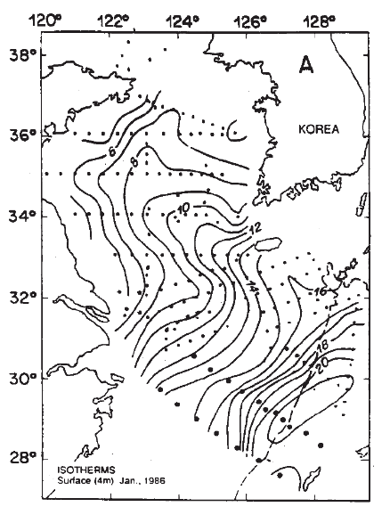
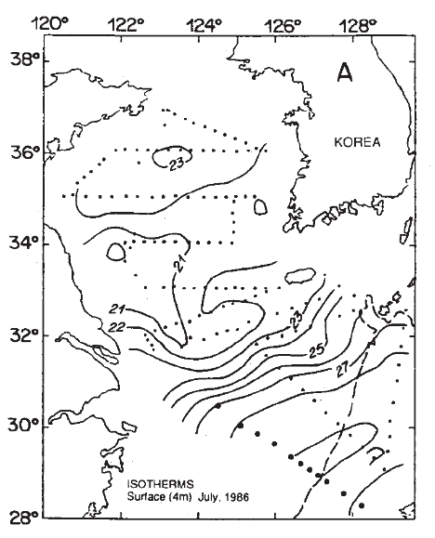
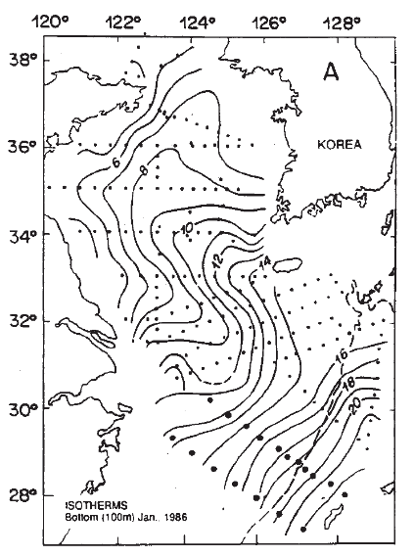
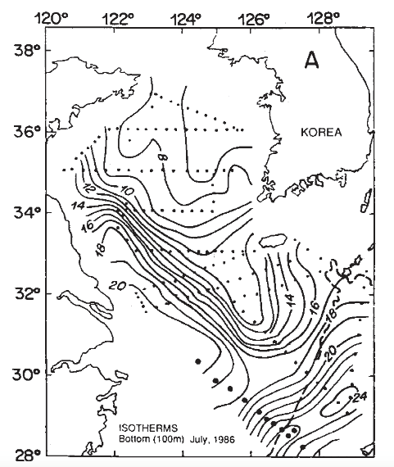
Yellow Sea Surface & Bottom Temperatures
Chen et al., CSR, 1994.
Shipboard survey data from 1986.
Winter
Surface Temp
6C-16C
Summer
Surface Temp
21C-27C
Winter Well Mixed
Summer Stratified
Winter
Bottom Temp
6C-16C
Summer
Bottom Temp
6C-16C

Slide 13
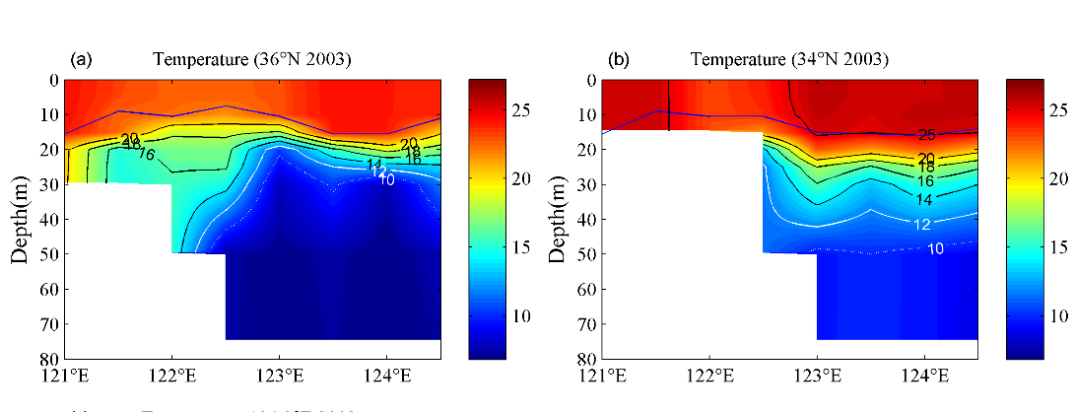



Summer heating produces a highly stratified ocean -
A warm surface layer + An unseen cold bottom layer
Mid Atlantic
Winter (1-layer)
Mid Atlantic
Summer (2-layers)
Cold Pool
Mid- Atlantic’s Cold Pool
Yellow Sea’s Cold Bottom Water Mass
Cold Bottom Water Mass
Yellow Sea
Summer
Yellow Sea
Summer
Cold Bottom Water Mass
Why unseen? Satellites cannot see below surface, Argo Floats do not extend into shallow water

Slide 14
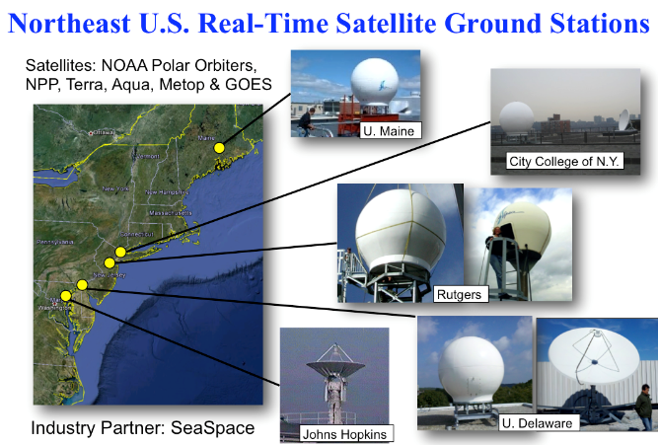
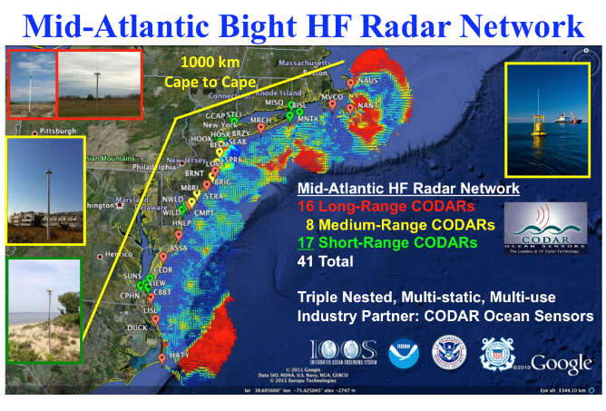
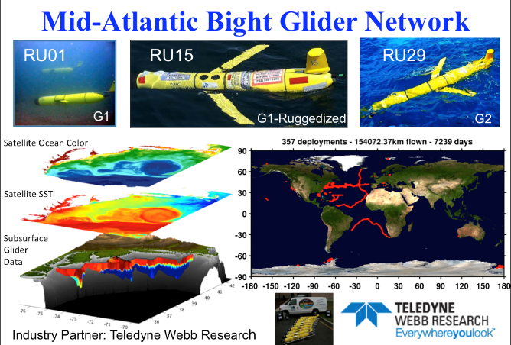
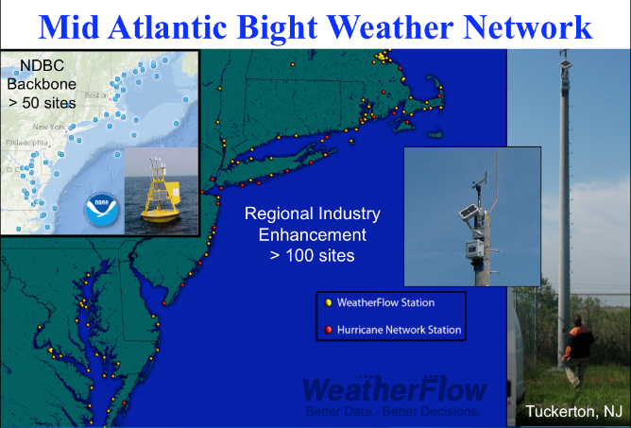
Mid-Atlantic Regional-Scale Observation Network

Slide 15
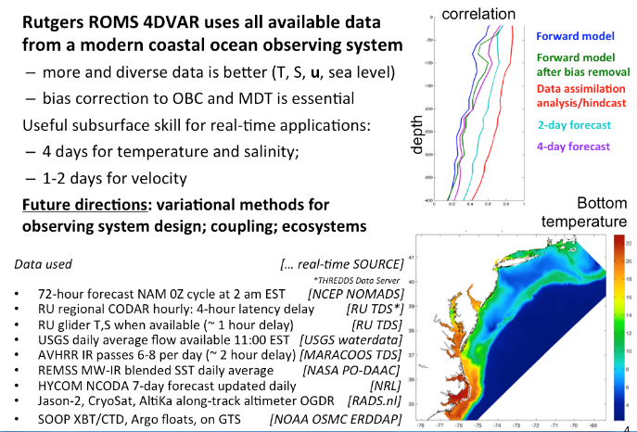
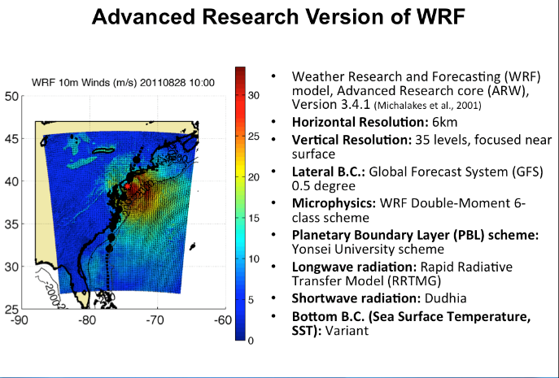
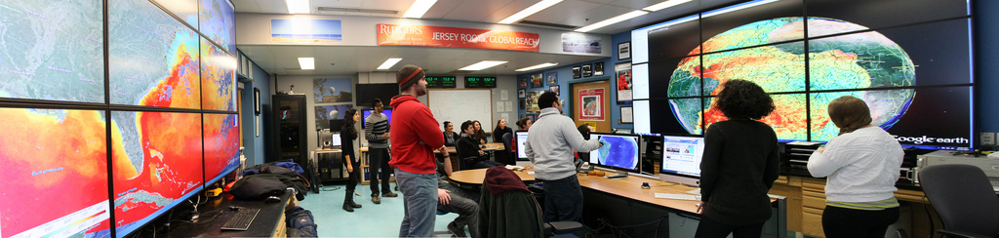
Mid-Atlantic Ensemble of Forecast Models Include:
Mid-Atlantic Operations Center @

Slide 16
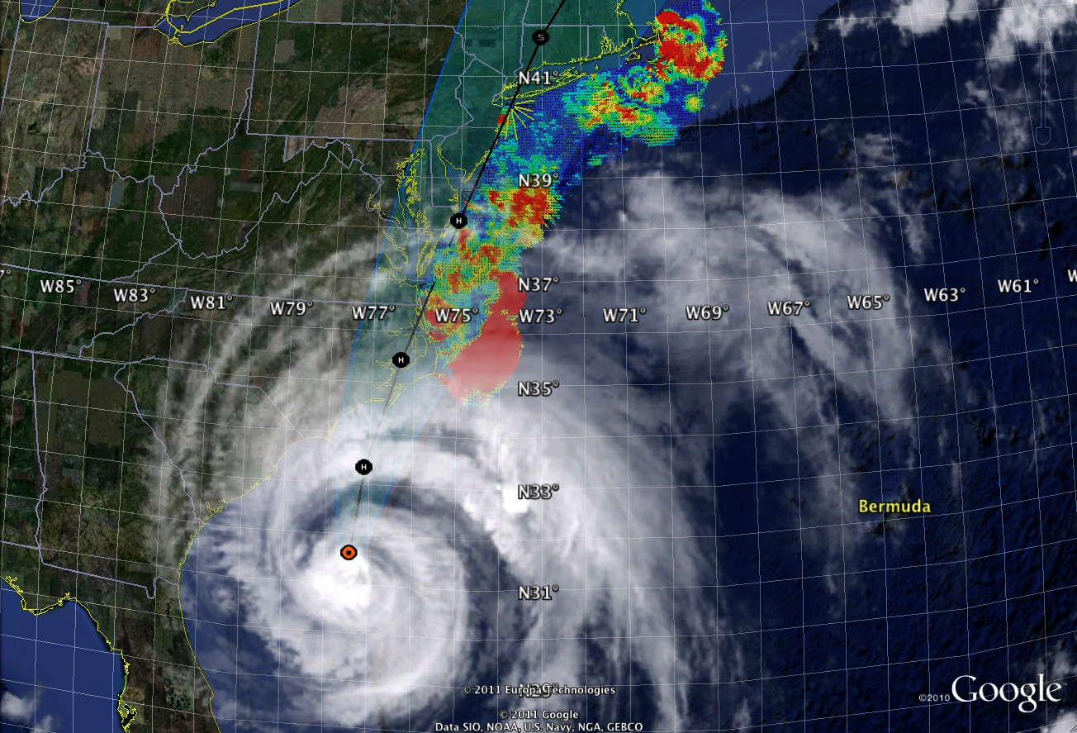
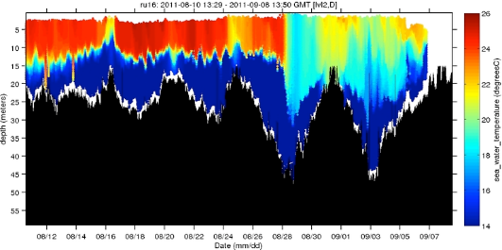
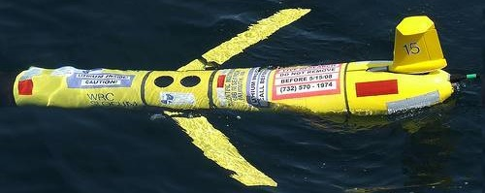
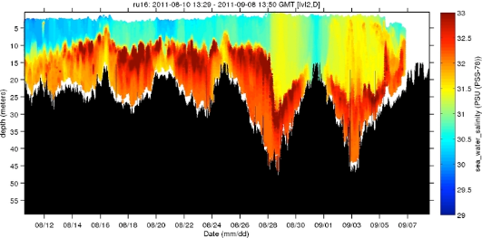
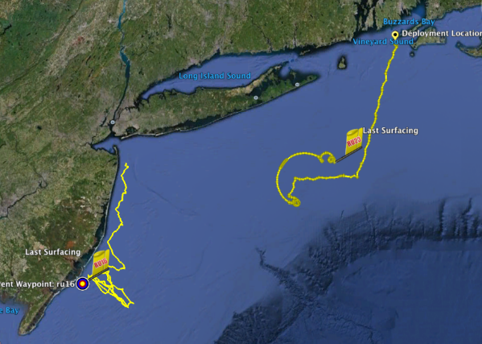
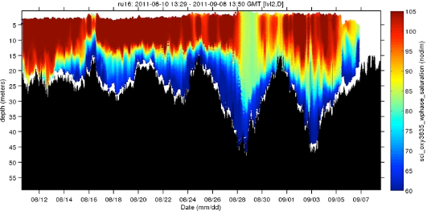
Hurricane Irene
August 27-28, 2011
NOAA/NHC:
Damage >$16B ( #7)
Track Accurate
Intensity Over-predicted
Hurricane Irene
0
26
depth
temperature
55
14
0
33
depth
salinity
55
29
0
105
depth
% oxygen
Two Gliders Deployed
55
60
8/12
date
9/07

Slide 17
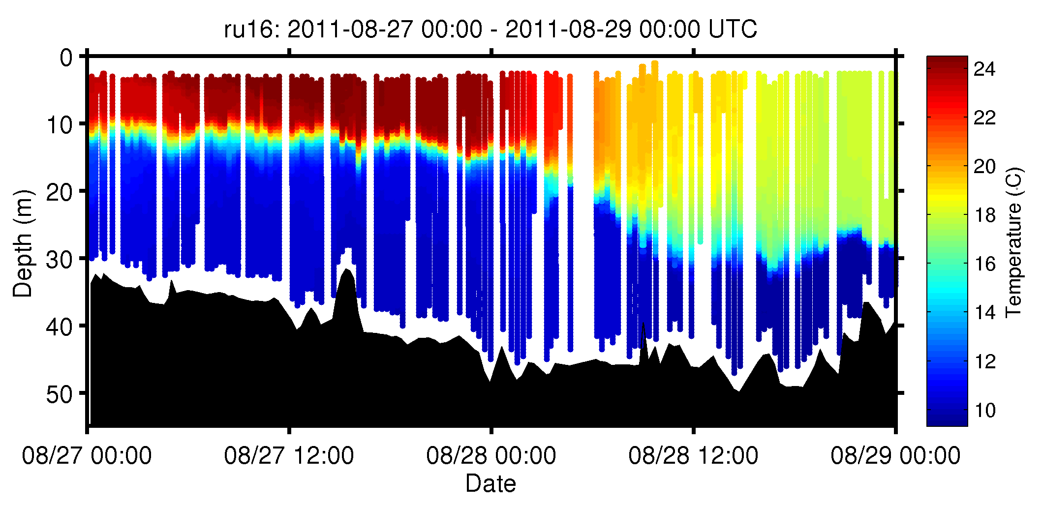
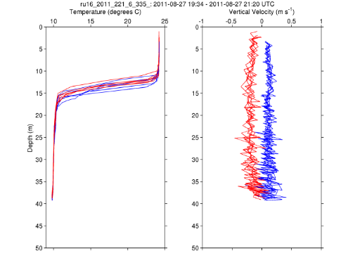
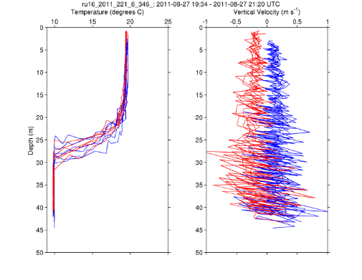
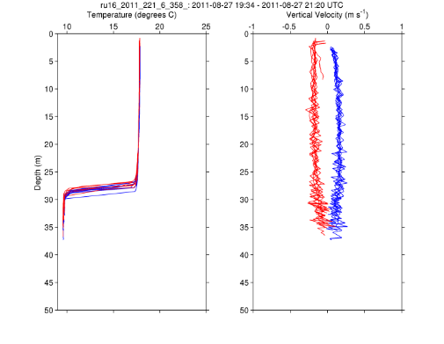
RU16
Temp.
Section
Upcast
Downcast
Temp. Vert. Vel.
Temp. Vert. Vel.
Temp. Vert. Vel.

Slide 18
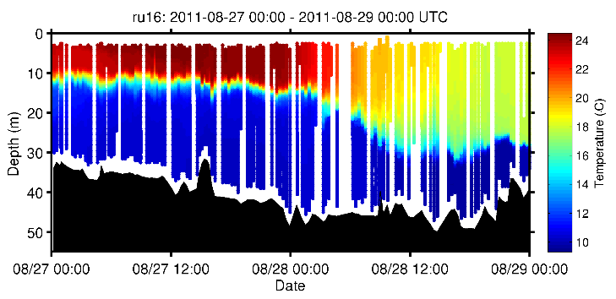
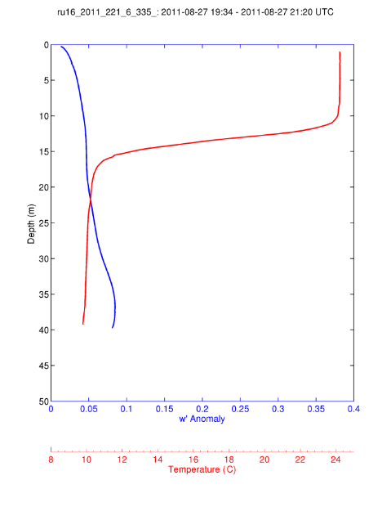
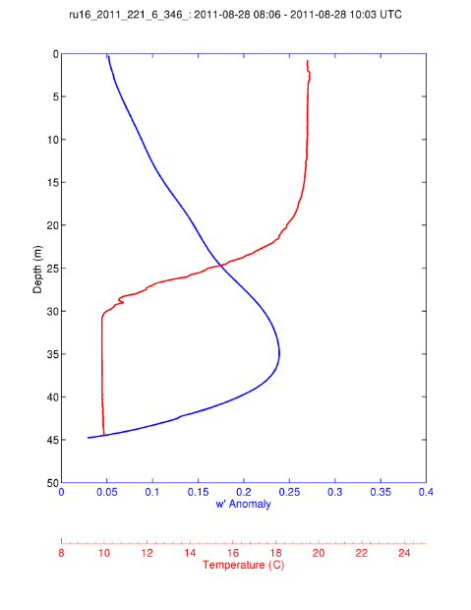
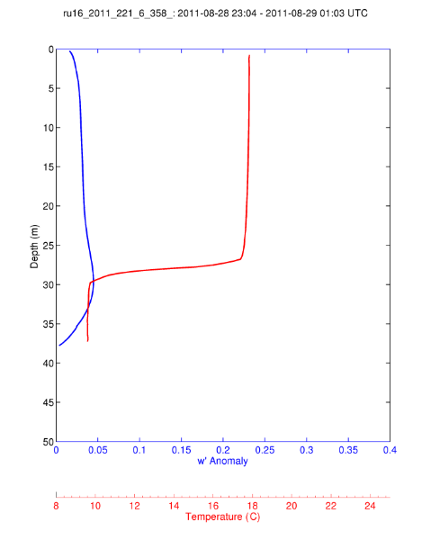
For Each 2-hour Segment:
1) Calculate the Average Temperature Profile
2) Calculate the Vertical Velocity Standard Deviation Profile and Smooth Vertically.
Temp
S.D. w’
During Irene
Pre-Irene
Post-Irene

Slide 19
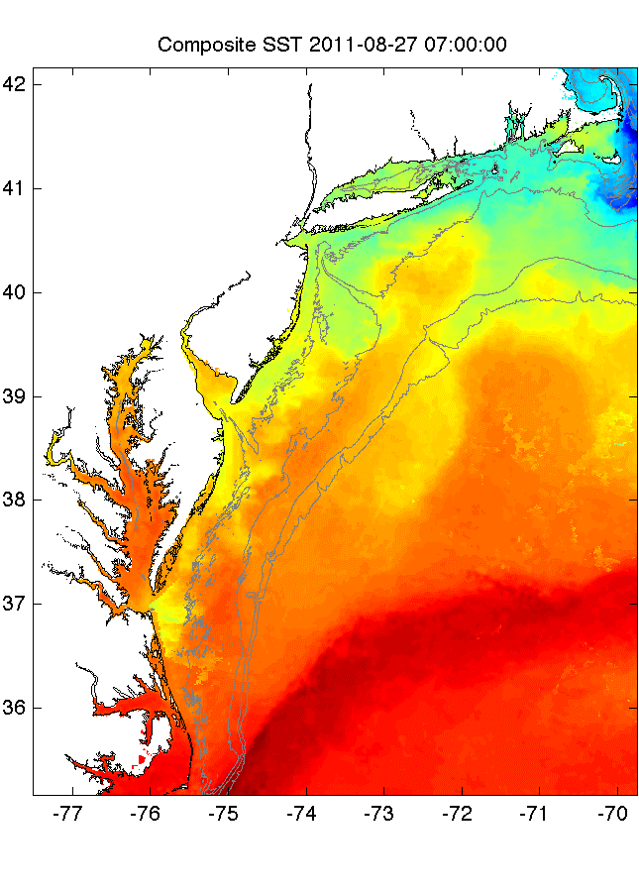
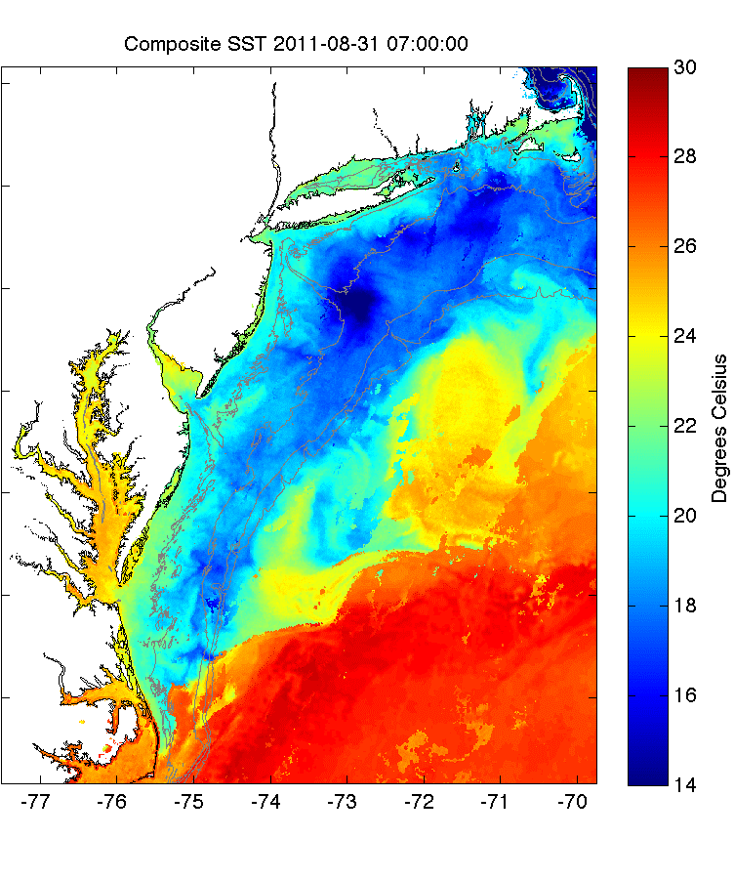
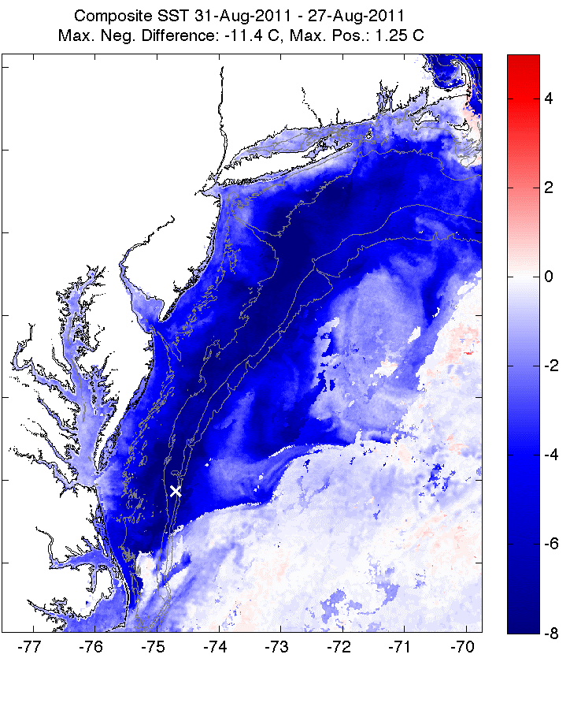
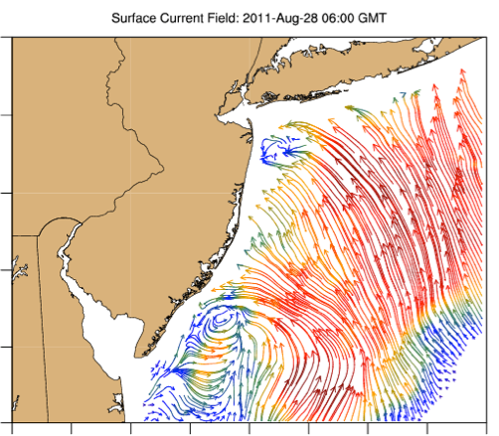
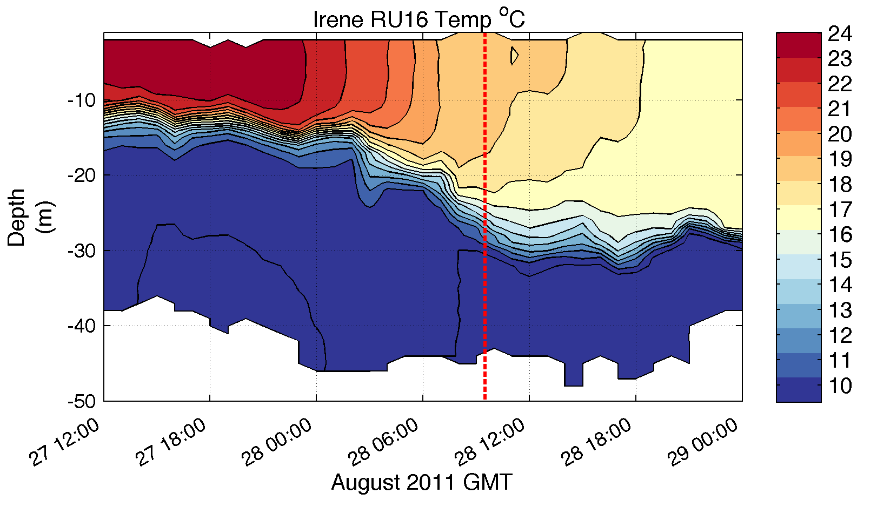
Pre-Irene
Post-Irene
Difference
11C max Cooling
WHAT?
Satellite
SST
WHEN? Glider Temperature
WHY?
HF Radar
Currents
Eye Passage
?

Slide 20
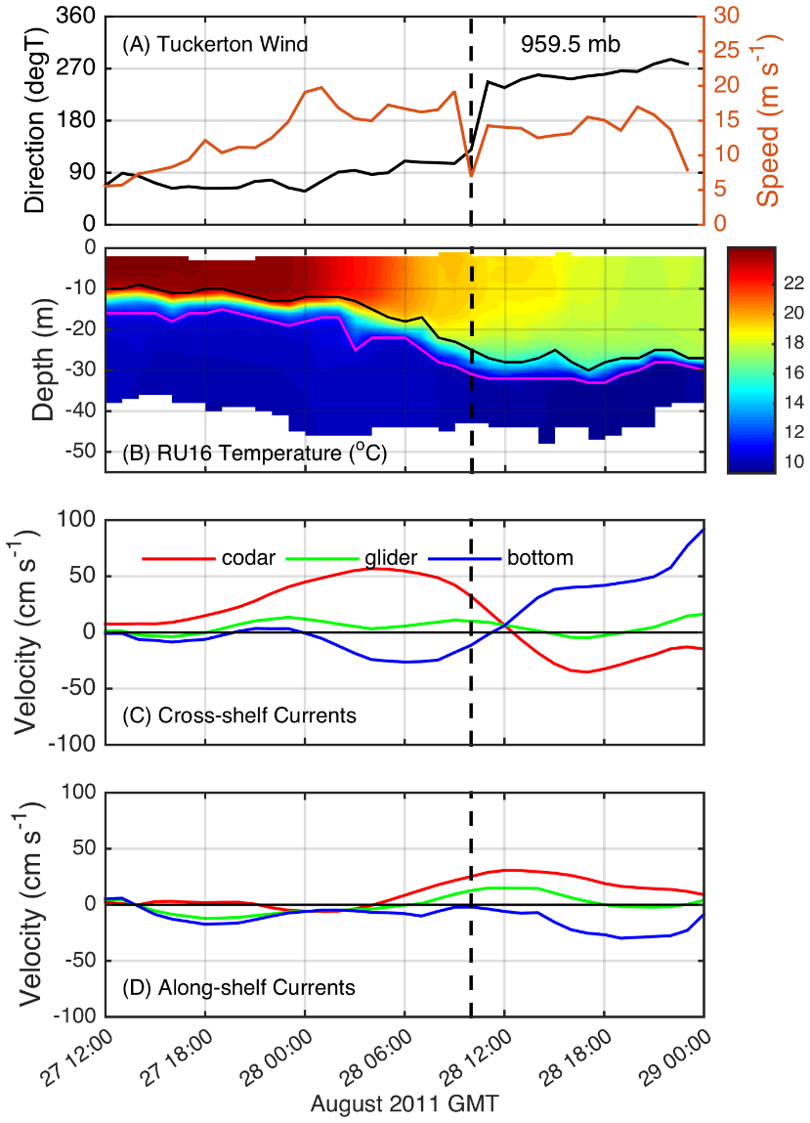
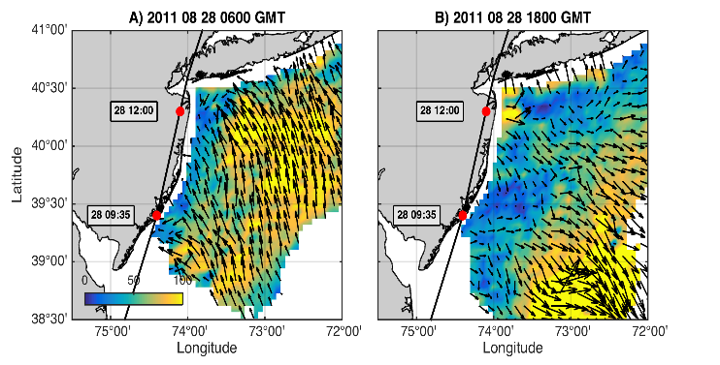

Coastal Baroclinic Circulation
Before Eye
After Eye
Before Eye After Eye
Glider Track, Model Grid
& Bathymetry
Storm Period in Blue

Slide 21

ROMS Model Results at Glider Location
Coastal Baroclinic Circulation Enhances Mixing & Cooling

Slide 22

ROMS Model Results at Glider Location
Temperature Diagnostic Equations – Mixing Dominates Advection

Slide 23


Alongshelf Buoy Array
Ahead-of-eye-center (AOEC) cooling signal in Irene
South
Eye passage
98%
SST
SST
82%
76%
90%
North
Seroka et al. 2016

Slide 24

Hurricane Irene SST
Satellite AVHRR vs. ROMS Model
Before
Notes:
2

Slide 25

Hurricane Irene SST
Satellite AVHRR vs. ROMS Model
After
SST comparison
Notes:
3

Slide 26

Hurricane Irene SST
Satellite AVHRR vs. ROMS Model
Difference
SST cooling
Notes:
4

Slide 27


ROMS Model Cross-shelf Section: SST cooling, downwelling bottom T
AOEC SST cooling
Downwelling
Upwelling
Seroka et al. in prep.
Notes:
10

Slide 28


ROMS Model Cross-shelf Section: onshore WS vs. offshore PG
+offshore
m s⁻²
-onshore
Seroka et al. in prep.
Notes:
15

Slide 29


Irene: Vertical diffusion cooling; tidal advection
@1: sfc cooling stops once bottom cold water gone
Notes:
24
-vertical mixing caused by what force balance in deep water? (quiescent deep bottom layer, so no opposing bottom layer for increased shear-driven mixing)

Slide 30

SST: 3-Day Coldest Dark-Pixel Composite
Preserves the coldest ocean features from Irene
Required 3 days (August 29-31) to fill in.

Slide 31



SST Response during Irene’s Inertial Tail
Significant SST cooling not observed.
In many locations SST warming observed.
August 29
SST
August 31
SST

Slide 32




Modeled Deepwater Cooling Processes in Hurricane Irene
Air-Sea Only
1-D Mixing
3-D PWP (Upwelling)

Slide 33


ROMS Vertical Shear between Surface and Bottom Layer
Moving Bottom Layer
Stagnent Bottom Layer
Continental
Shelf
Deep Water
Continental
Shelf
Deep Water
Seroka et al., JGR, 2017
Notes:
14
-would need to redo bottom layer to get above very bottom ROMS level affected by bottom stress (to see what shear looks like in deep water and compare quantitatively to shallow water)

Slide 34



Summer Tropical Cyclones Tracks over the Continental Shelf
26 Typhoons since 1985
11 Hurricanes since 1985

Slide 35

Historical Hurricanes Crossing the MAB in Stratified Season
Observed Ahead-of-Eye-Center Cooling
Buoy data from the 30-year NOAA NDBC Archive

Slide 36




Typhoon Muifa - Total Cooling Observed by Satellite
SST
Before
Muifa
Track
SST
After
SST
Difference
Up to 7C
From: Sun, Duan, Zhu, Wu, Zhang & Huang, Acta Oceanol. Sin., 2014

Slide 37



Typhoon Muifa:
Ahead-of-Eye-Center Cooling
observed by Coastal Buoy
Muifa
Track
Water Temperature
From: Fei Yu, Institute of Oceanology, Chinese Academy of Sciences
Yi Xu, State Key Laboratory of Estuarine & Coastal Research, East China Normal University
Nature Communications, 2016

Slide 38








Rutgers Atmospheric Forecast Sensitivity Study
Warm Ocean
Boundary Condition
Cat 1 Hurricane
Tropical Storm
Cold Ocean
Boundary Condition
IMPACT?
>10 knots reduction in peak wind speed

Slide 39



SST within 25 km of eye & impact on air-sea heat flux
Warm
Cold
Northern Buoy
26C
Central Buoy

Slide 40




NARR
WARM SST
COLD SST
WRF Heat Flux Comparison to
North American Regional Reanalysis
Wind
Latent heat flux
Sensible heat flux

Slide 41



ROMS Air-Sea Heat Flux into (+) Ocean
Eye Passage
From Yi Xu, 2017

Slide 42


WRF 250-850 hPa Wind Shear
NARR
WARM SST
COLD SST
August 28
00:00 Z
August 28
12:00 Z

Slide 43


WRF Dry air intrusion (700 mb specific humidity)
NARR
WARM SST
COLD SST
August 28
00:00 Z
August 28
12:00 Z
Notes:
SST sensitivity is not affecting or not being affected by humidity

Slide 44

WRF Model Sensitivity Study
Over 130 model runs
Paired to compare sensitivities
Central pressure & max wind
Sensitivity to SST greatest
Seroka, Miles, Xu, Kohut, Schofield & Glenn,
Hurricane Irene Sensitivity to Stratified Coastal Ocean Cooling, Monthly Weather Review, 2016

Slide 45









Improved satellite SST product revealed ahead-of-eye cooling was not captured by:
standard satellite product
ocean models used for forecasting hurricane intensity
MARACOOS SST
RTG HR SST
NAM model
HWRF-POM
low res
HWRF-HYCOM
medium res
BEFORE IRENE
AFTER IRENE
Notes:
Caveats: different atmospheric forcing, etc.
Rutgers SST: 2km, RTG: 1/12 deg, ~9 km, HWRF-POM: 18km, HWRF-HYCOM: 1/12 deg, ~9km

Slide 46






HWRF Cross-shelf Transects
HWRF-POM
Before
HWRF-HYCOM
Before
Before
After
HWRF-POM
After
HWRF-HYCOM
After
RU16 Glider
Thank you to Hyun-Sook Kim and Zhan Zhang for providing HWRF data
Observed bathymetry from NOAA National Geophysical Data Center, U.S. Coastal Relief Model, Retrieved date goes here, http://www.ngdc.noaa.gov/mgg/coastal/crm.html

Slide 47

ROMS Model Forecast with Glider Data Assimilation
Rutgers SST
Before
During
After
ROMS Forecast
Notes:
Coastal upwelling captured by Rutgers SST 08/26 but not 08/27. ROMS run started 08/26 at 12 UTC
Warm SST simulations used RTG 08/27 to simulate “operational NAM SST”. Figure 3 has 08/26 products plotted to show coastal upwelling

Slide 48

Sending Glider Data to the GTS for Assimilation in Operational Ocean Models
Leverage:
IOOS Glider DAC
NDBC QC & Upload
NOAA Observing System Monitoring Center (OSMC)
GTS Barriers to Overcome
40 m Depth Limitation
Number of Points per Profile

Slide 49







Hurricane Hermine Response: CINAR/MARACOOS Glider Fleet Launched, 9/2016
Glider
HYCOM
RTOFS

Slide 50






Slide 51




Navy Global HYCOM: T below summer thermocline
Operational GOFS 3.0
OpTest of GOFS 3.1
No Cold Pool
Well Defined
Cold Pool
Isopycnal Layers on Shelf
Sigma/Z-levels on Shelf

Slide 52


Hurricane Irene Track August 27-28, 2011
Research Summary:
Summer Storm
Strong Stratification
Coastal Response
Mixing Cooled Surface Ahead of Eye
Limited Intensity
Operations Summary:
Regional Ocean Models already resolve the Cold Pool
New Global Operational Models will resolve Cold Pool
Target for Glider Data Assimilation

Slide 53



Slide 54
Sentinel Hurricane Glider Fleet Deployment Regions

Slide 55

WMO/IOC JCOMM OceanGliders Task Teams:
Boundary Currents – Dan Rudnick & Craig Lee
Storms – Scott Glenn & Chari Pattiarachi
Deep Convection – Pierre Testor
Data Management - Dan Hayes

Slide 56



Potential Energy Anomaly (PEA) (Simpson, 1981; …)
For our coastal application:
= (bottom pressure factor) x (stratification factor)
Non-dimensional PEA (the stratification factor) becomes:

Slide 57


Glider
12-27
Sept
2017
Hurricane Maria
16 Sept -
3 Oct
2017

Slide 58

Hurricane Maria
Ocean Response
PEA
Stratification Factor
18 Sept 2017
ROMS
CMEMS
GOFS 3.0
GOFS 3.1

Slide 59

Hurricane Maria
Ocean Response
PEA
Stratification Factor
19 Sept 2017
ROMS
CMEMS
GOFS 3.0
GOFS 3.1

Slide 60

Hurricane Maria
Ocean Response
PEA
Stratification Factor
20 Sept 2017
ROMS
CMEMS
GOFS 3.0
GOFS 3.1

Slide 61

Hurricane Maria
Ocean Response
PEA
Stratification Factor
21 Sept 2017
ROMS
CMEMS
GOFS 3.0
GOFS 3.1

Slide 62

Hurricane Maria
Ocean Response
PEA
Stratification Factor
22 Sept 2017
ROMS
CMEMS
GOFS 3.0
GOFS 3.1

