Slide 1
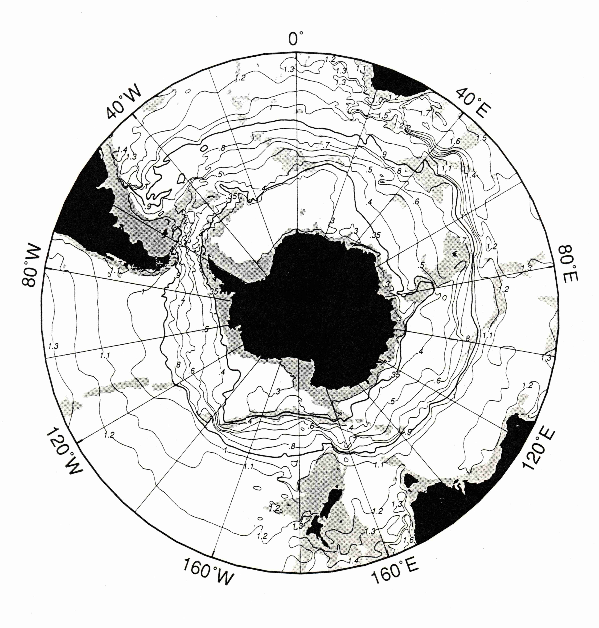
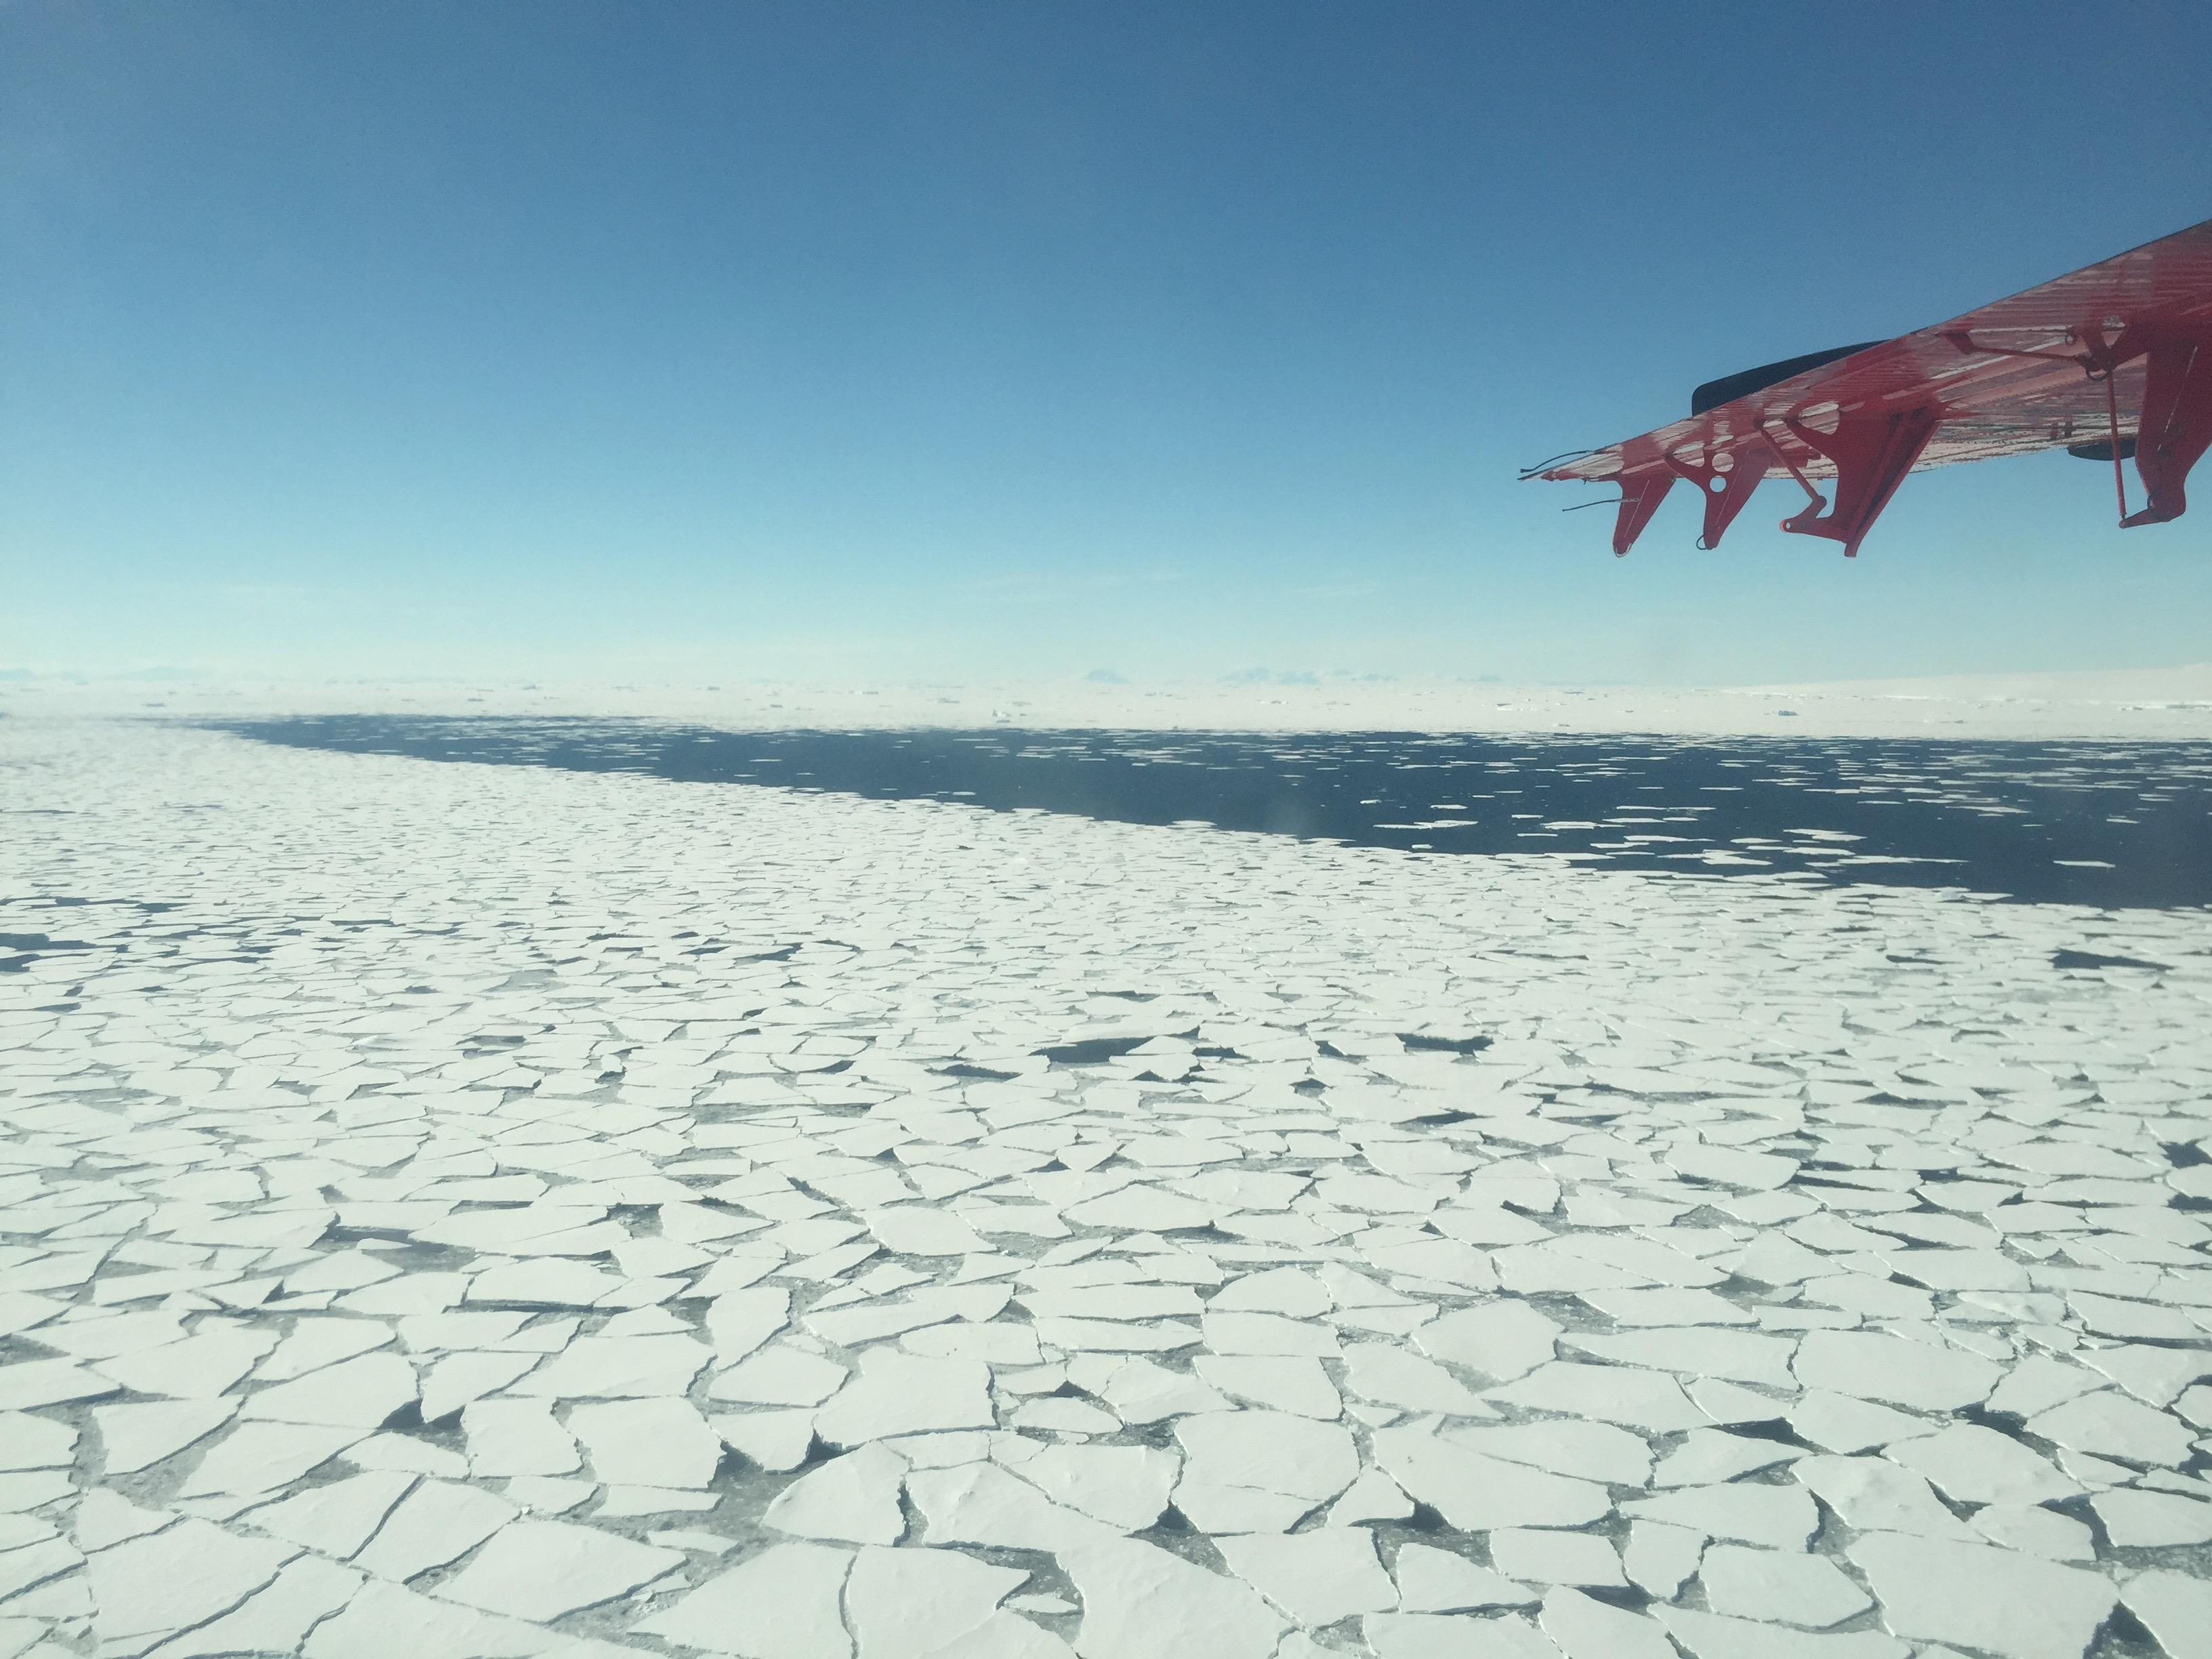
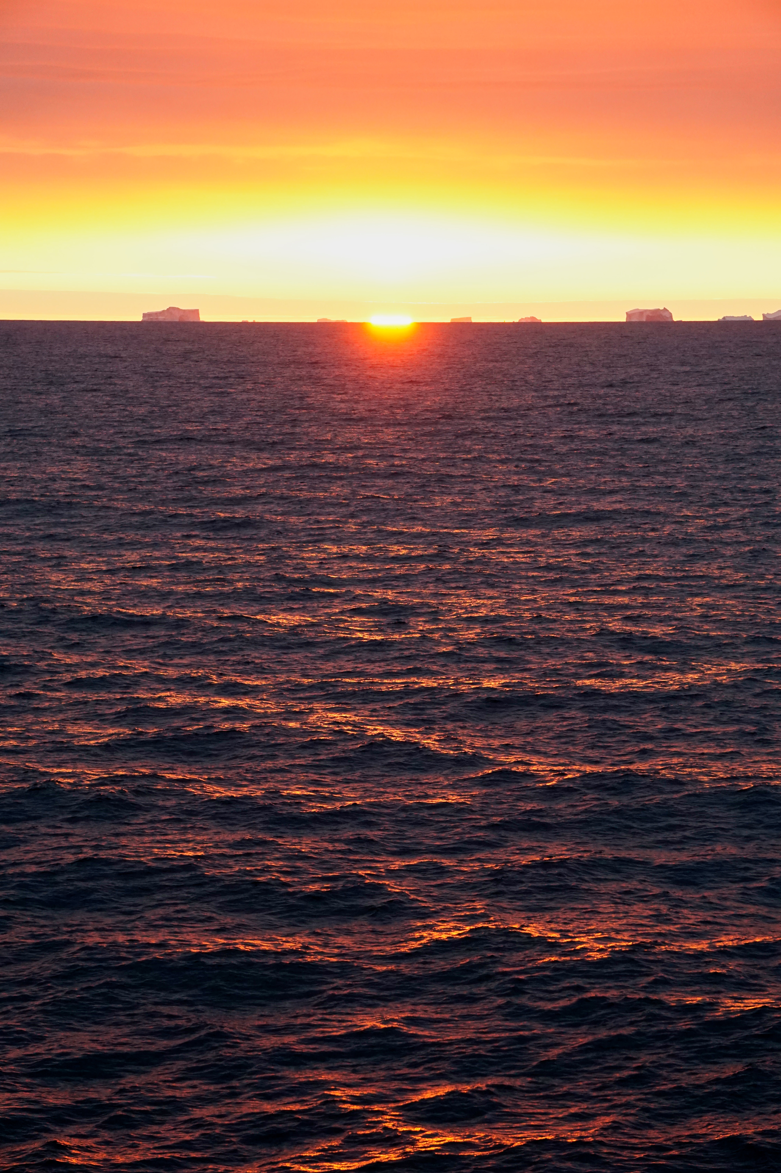
Foundation Species for the West Antarctic Peninsula
Features defining our system (seasonal sea ice & open water most of the sampling area deep,
very strong phenology (annually, 24 hr to no light), strong atmospheric interactions
Gray shading, < 300m
Doug Martinson, LDEO
Marginal Ice zone
Open water

Slide 2
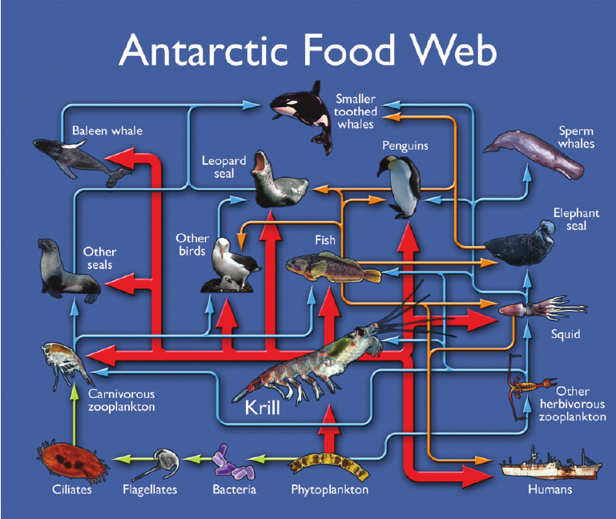
Working paradigm:
Antarctic Krill (E. superba) is the keystone
(foundation?) species for the Antarctic food-web
Major food source for majority of the food-web
Courtesy of British Antarctic Service

Slide 3
Heavy ice years result in protection from winter/early spring wind mixing (and the resulting with a deeper mixed layer) which drives higher primary productivity, combined with increased upper water column stratification
Saba et al. 2014 Nature Comm

Slide 4
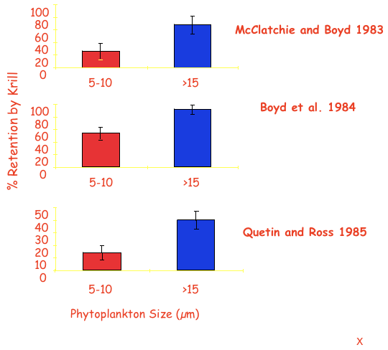
Two potential drivers for the krill: Food (amount-type-quality)
High winter
ice
Low winter
ice
Phyto Concentration
Particle Size Distribution
5%
9%
5%
Heavy winter ice year
Big Chlorophyll Year
16%
65%
160
% Diatoms
80
% Prasinophytes
Anomaly of
chlorophyll a (mg m⁻²)
% Haptophytes
0
% Flagellates
9%
4%
% Cryptophytes
-80
8%
1992
Years
2010
Low Chlorophyll Year
Low winter ice year
27%
52%
Cryptomonas cryophila

Slide 5
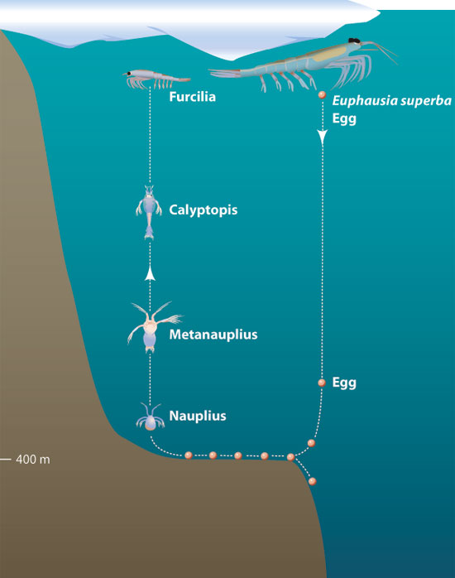
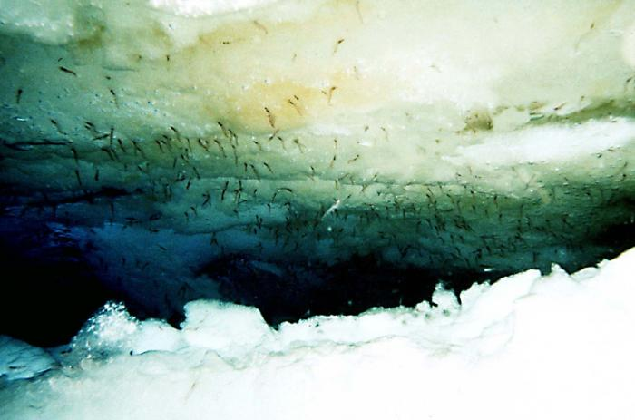
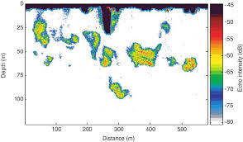
Two potential drivers for the krill: Breeding dynamics
Larval krill under ice (photo from Uwe Kils)
Jayne Doucette, WHOI
Brierly et al. Science

Slide 6
Rest of Food Web? Tightly Coupled Food Web & Penguin Diet Changes
High chl anomaly years result in high krill recruitment
immediately affecting penguin diet
Krill Size Distributions in Penguin Diet Samples
Saba et al (2014)

Slide 7
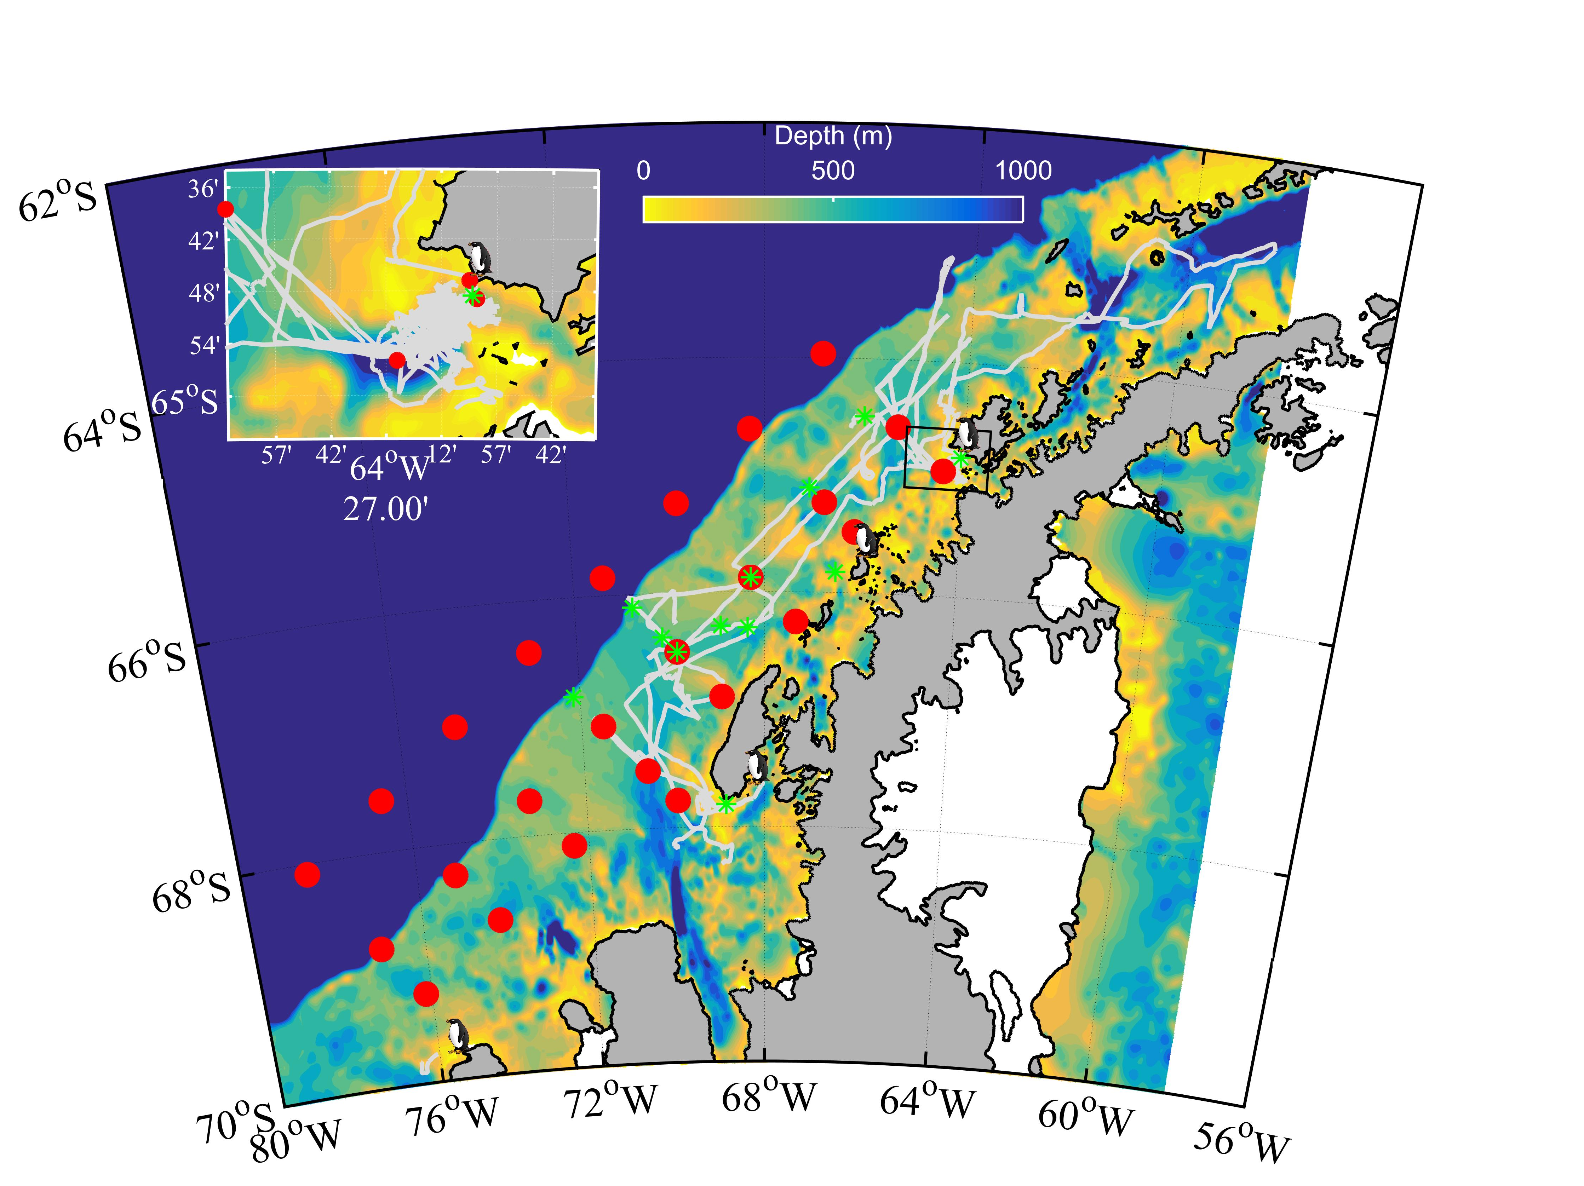
E. superba over time during LTER sampling
Warmer wet
subpolar
system
Cooler moist
polar
system

Slide 8
Theme: System is showing change
PAL LTER initiated
Forcing functions for the WAP: Position of the circumpolar current (heat engine), climate cycles (El Nino/La Nina – Southern Annular Mode), and long term anthropogenic forcing

