Slide 1
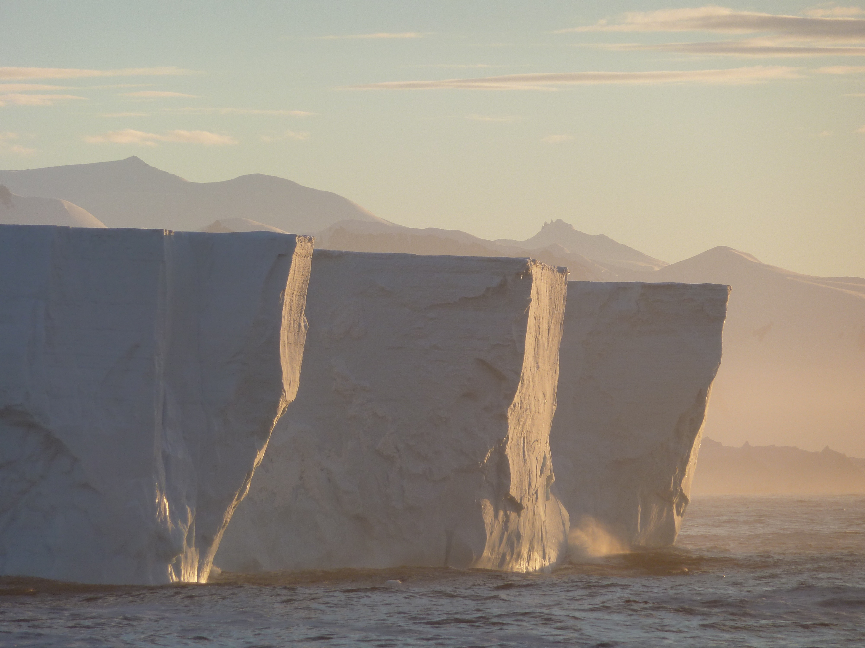


Biological dynamics along the West Antarctic Peninsula: How much can we extrapolate nearshore stations to shelf as a whole?
Oscar Schofield, Hugh Ducklow, Debbie Steinberg, Filipa Carvalho, Michael Brown, Nicole Waite
Funding Support from
National Science Foundation Palmer LTER
NASA Biogeochemistry Program
Gordon & Betty Moore Foundation

Slide 2
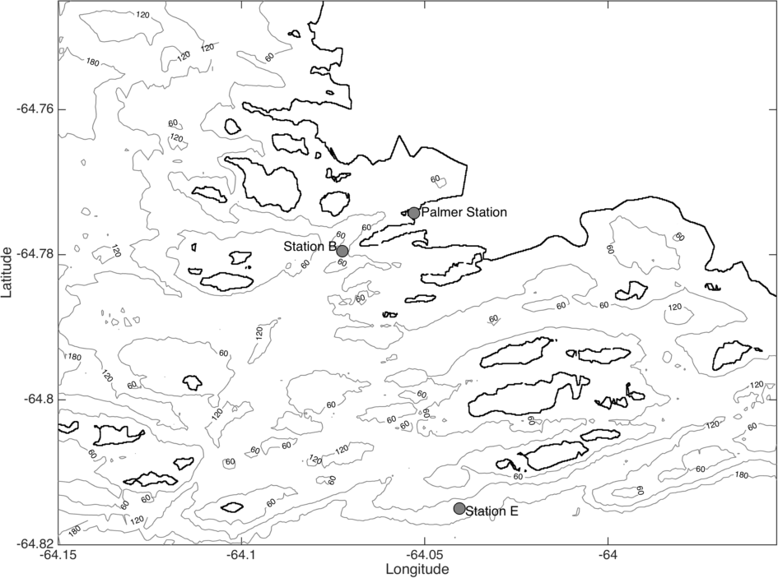

Palmer LTER just completed its 25th field season this last year
Approach:
Palmer
Annual time series measurements at Palmer Station, nominally October through March
Annual cruise spanning the Peninsula during month of January
Station and cruise is augmented with Slocum glider deployments
Active satellite and modeling program
Linked to education and outreach programs
For more Info:
Program website: http://pal.lternet.edu/
or
Program documentary available at Netflix or ITunes

Slide 3
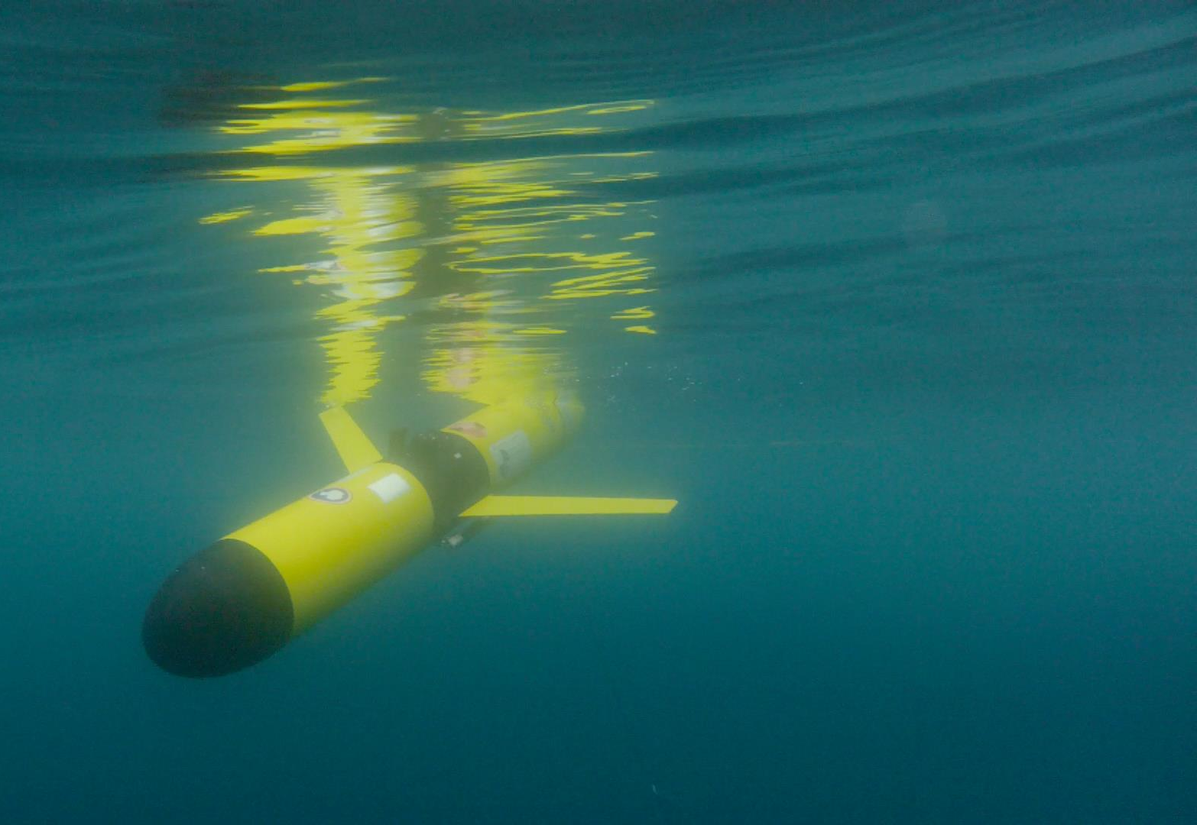
Phytoplankton blooms associated with shallower MLD. Shallower MLD consistently associated with lower salinity water (glacial and sea ice melt)
Carvalho et al. 2016 JGR

Slide 4
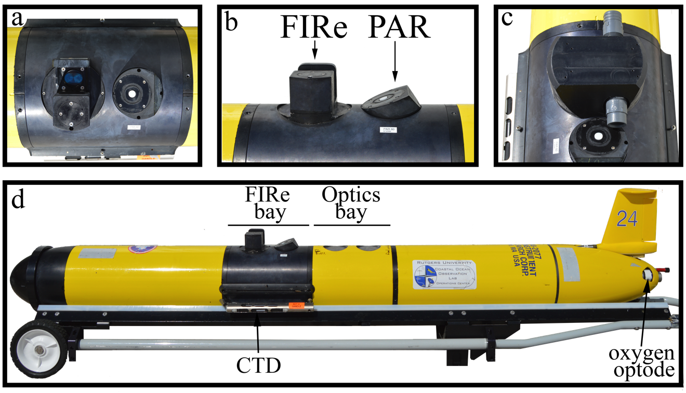
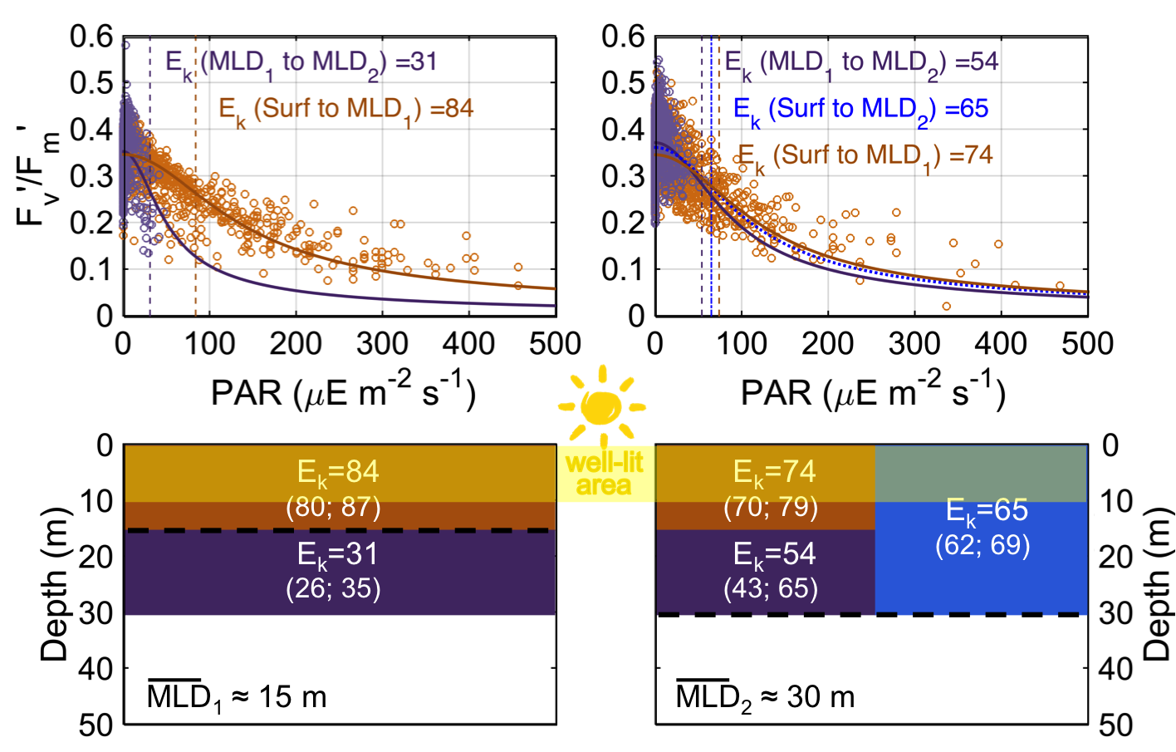
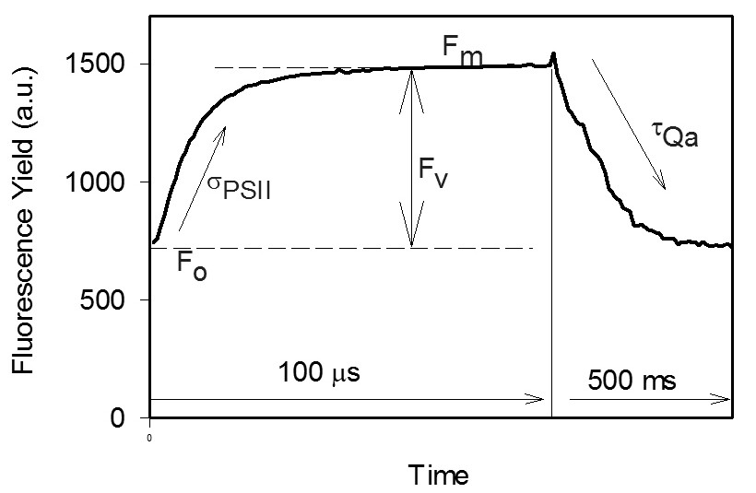
Phytoplankton actively photoacclimate to the mixing regime meaning 1) they are actively focused on optimizing photosynthetic machinery and 2) they have the nutrients to induce these physiological adjustments
Carvalho et al. submitted L&O methods

Slide 5
Schofield et al. 2017 DSR

Slide 6
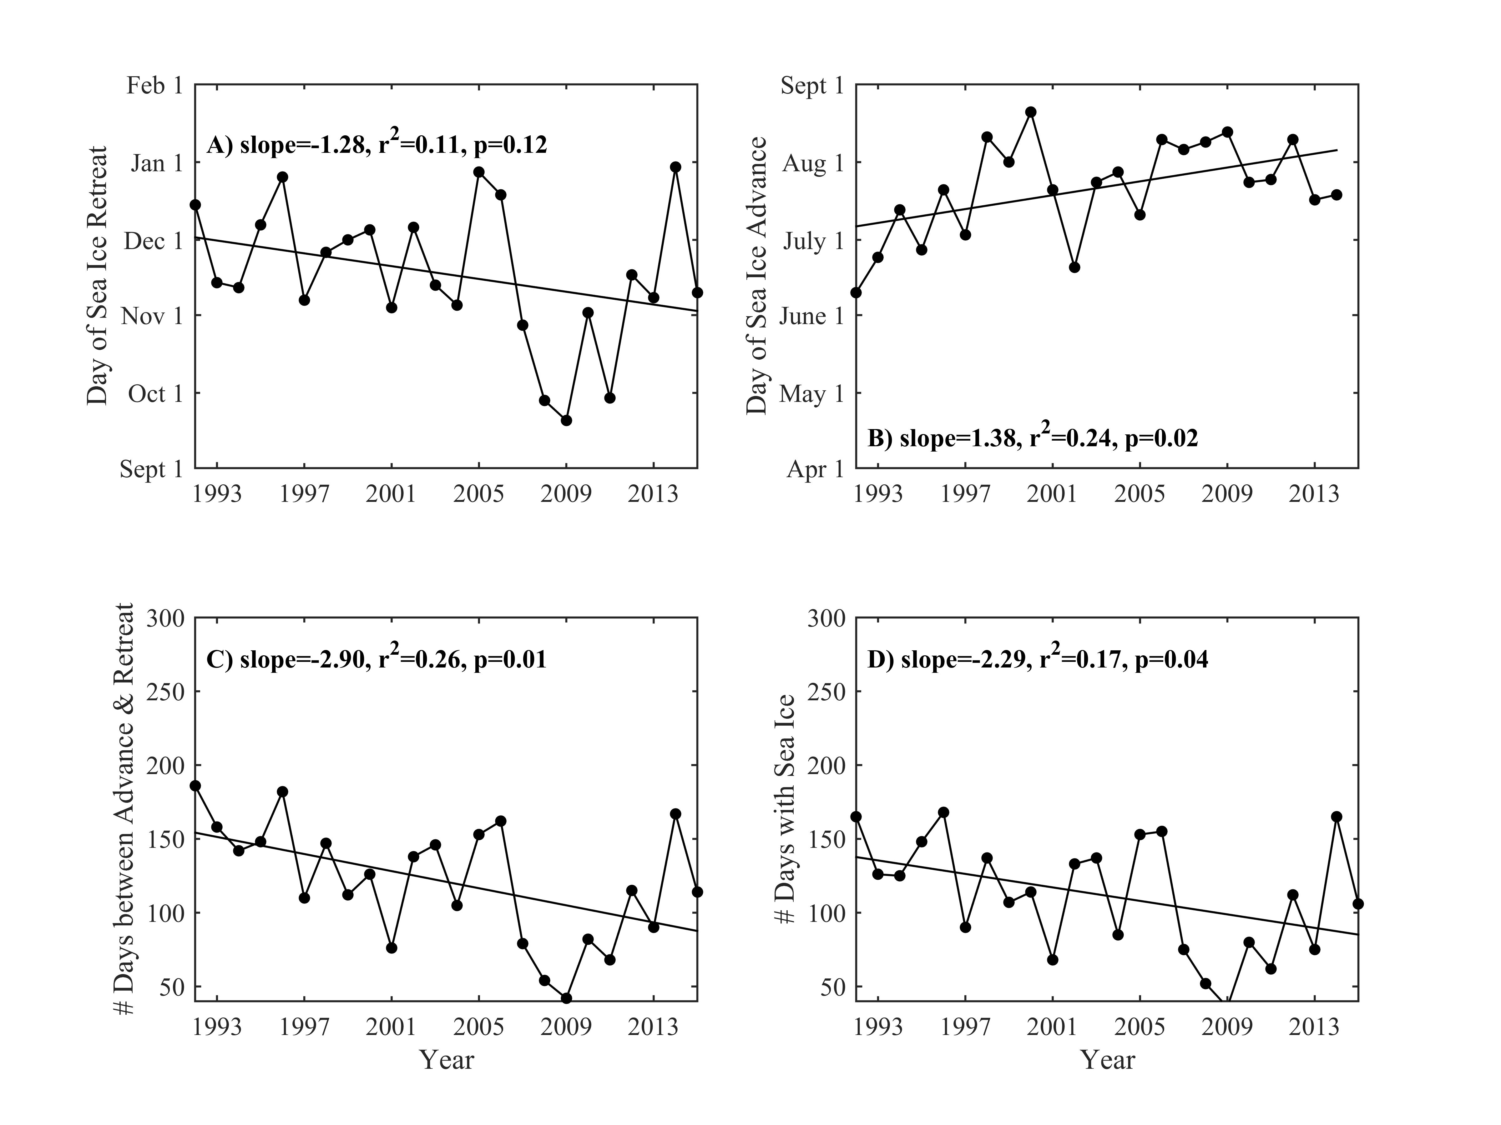

Slide 7
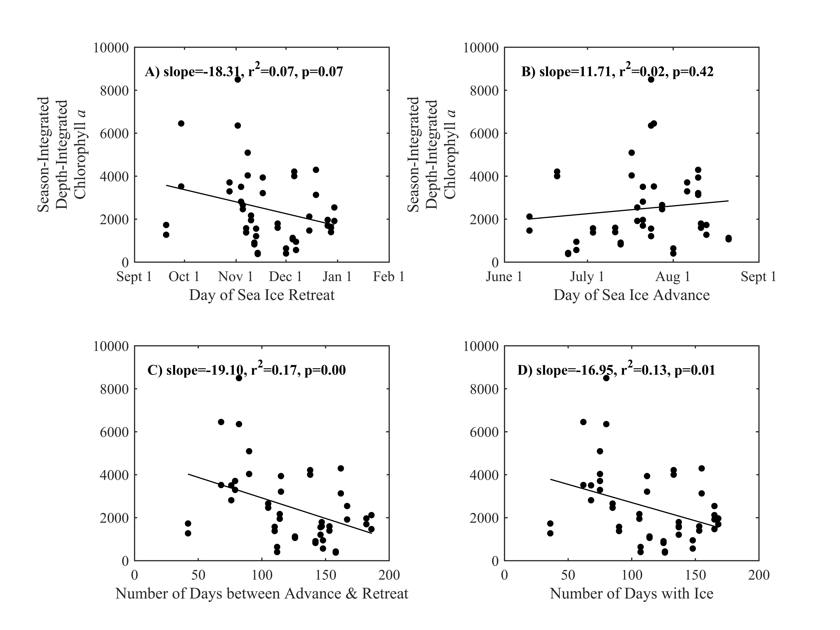
integrated

Slide 8
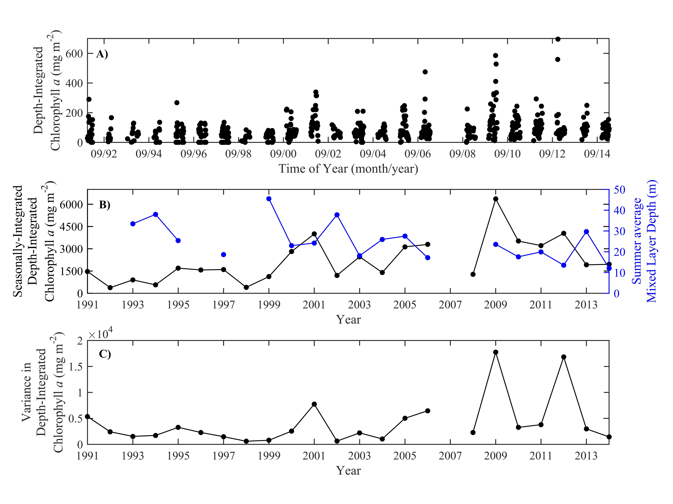
Schofield et al. 2017 DSR

Slide 9
Food web is tightly coupled. High chlorophyll anomaly years result in high krill recruitment and immediately affect krill diet
Saba et al. 2014 Nature Communications
Saba et al. Nature Comm 2014

Slide 10
5%
9%
High krill
recruitment according
to penguin diets
5%
Big Chlorophyll Year
16%
65%
160
% Diatoms
80
% Prasinophytes
Anomaly of
chlorophyll a (mg m⁻²)
% Haptophytes
0
% Flagellates
9%
4%
% Cryptophytes
-80
8%
Low Chlorophyll Year
Low krill
recruitment according
to penguin diets
27%
52%

Slide 12
Ice Melt

Slide 13
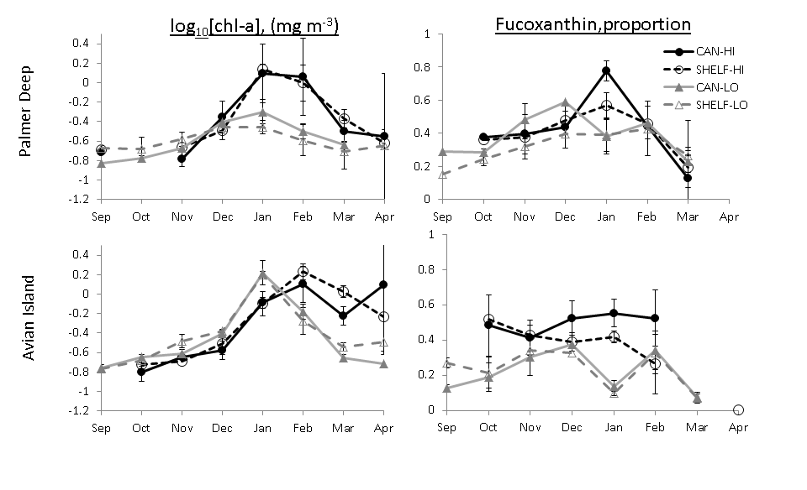
Lots of chlorophyll (no evidence of enhanced biomass)
but evidence of enhanced diatom presence
Kavanaugh et al. 2015

Slide 14
Thanks Sharon Stammerjohn

Slide 15
Shelf surveys using gliders for the physics
Cuoto et al. (revision resubmitted) JGR

Slide 16
The TS relationship does not hold for the ship grid

Slide 17
Phytoplankton communities along the WAP shelf
Regional differences
Relatively stable community
structure
Waite et al. in prep

Slide 18
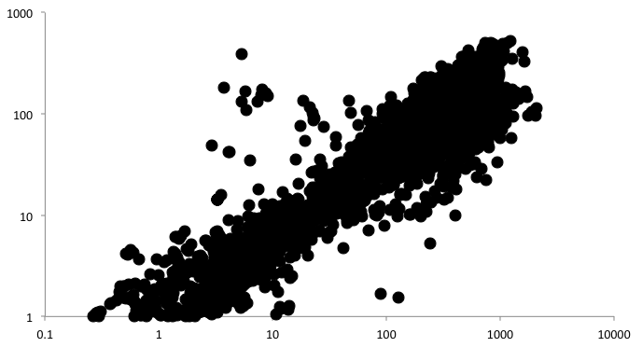
Diatoms remain the dominant taxa accounting for 63% of the variability in the chlorophyll a across the entire grid.
Fucoxanthin (ng L⁻¹)
Chlorophyll a (μg L⁻¹)

Slide 19
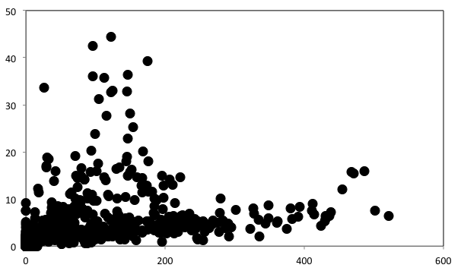
While not as clear as Palmer basin, generally the higher concentrations of cryptophytes are not associated with high concentrations of diatoms .
Alloxanthin (ng/L)
Fucoxanthin (ng/L)

Slide 21
Past studies suggest a hysteresis
with the penguins

Slide 22
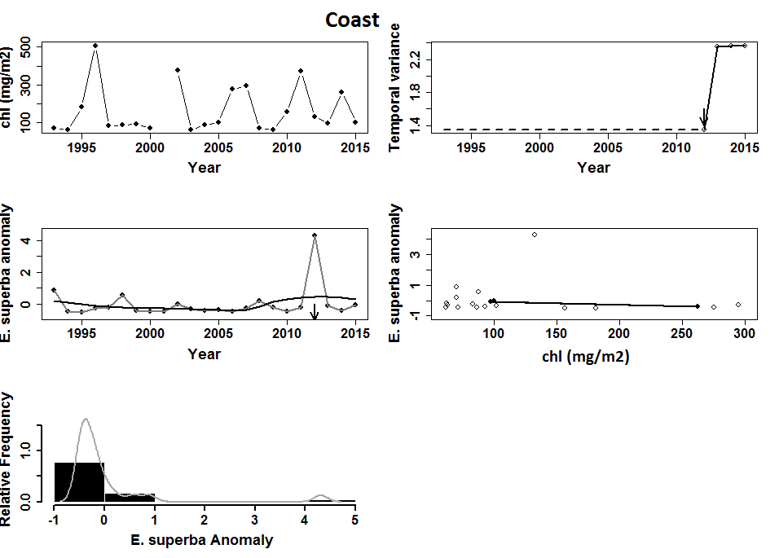

Slide 23
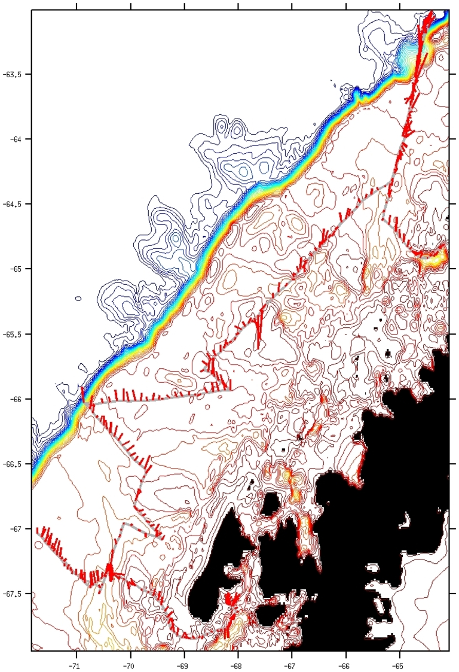
conclusions and path forward
-In coastal zones, MLD driver in phytoplankton biomass
-Recent increases in sea ice have resulted in an increase in chlorophyll
-At Palmer, cryptophytes and diatoms are the dominant players, but local patterns cannot be applied to the shelf
-Linear response ecosystem and not abrupt transition
conclusions and path forward (areas we hope to incorporate)
Glider mission profiles
Phytoplankton species via automated microscopy
Glider sensor expansion
starts this year
pending
to be submitted
pending
this year

