Slide 1
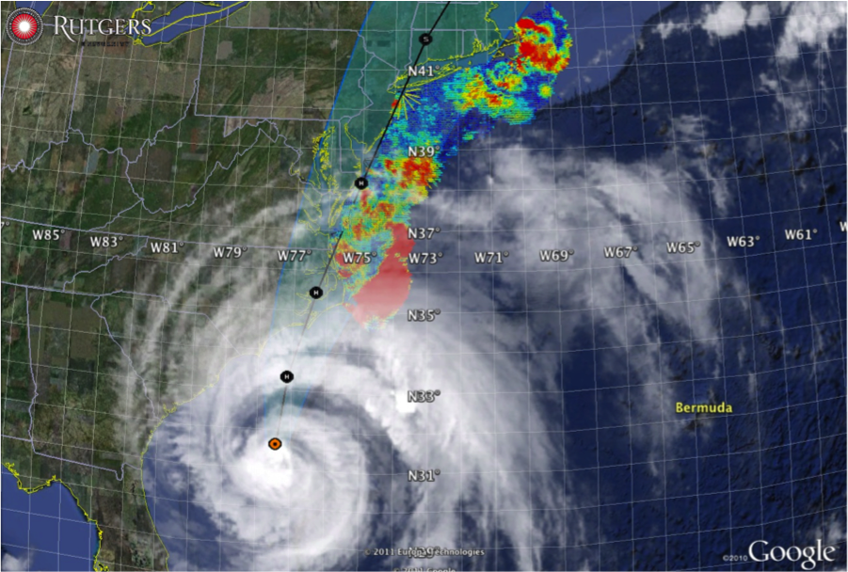
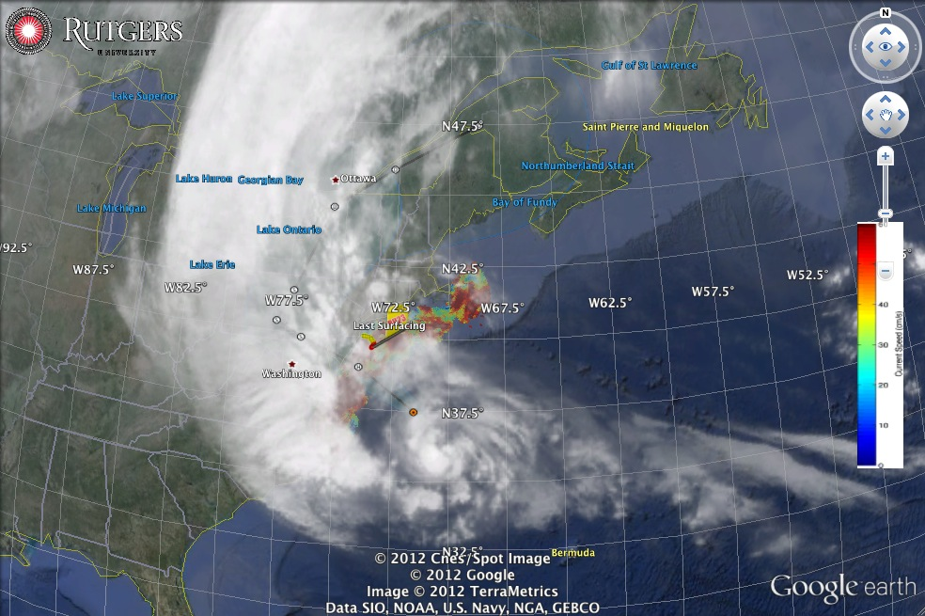
Hurricane Irene
August 28, 2011
NOAA/NHC Damage:
#7 with >$16 Billion.
Track Accurate;
Intensity Over-predicted.
Avila & Cangialosi, 2012, Tropical Cyclone Report
Hurricane Sandy
October 29, 2012
NOAA/NHC Damage:
#2 with >$68 Billion.
Track Accurate;
Surge Under-predicted.
Georgas et al., 2014, J. of Extr. Even.
Colle et al., 2015, J. Mar. Sci. & Engr.

Slide 2
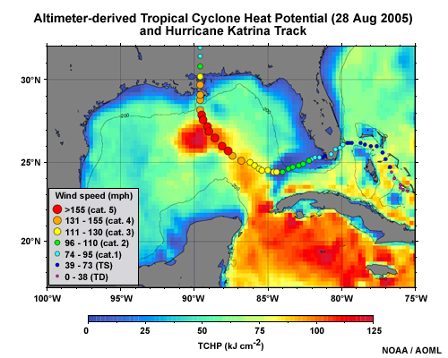
Steady Improvement
Intensity is modulated by the warm or cold ocean.
Initial coupling to ocean models was not helping.

Slide 3
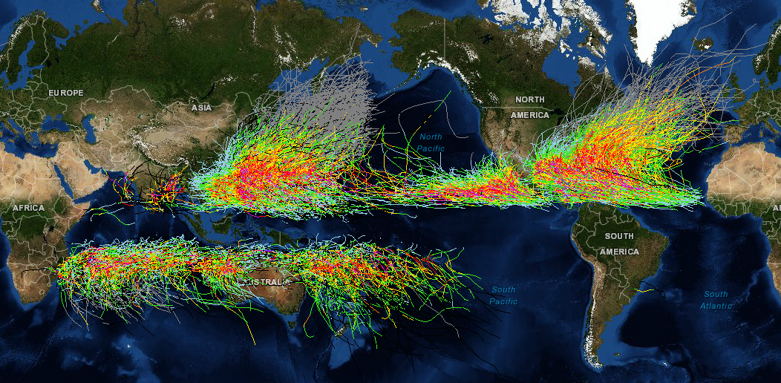
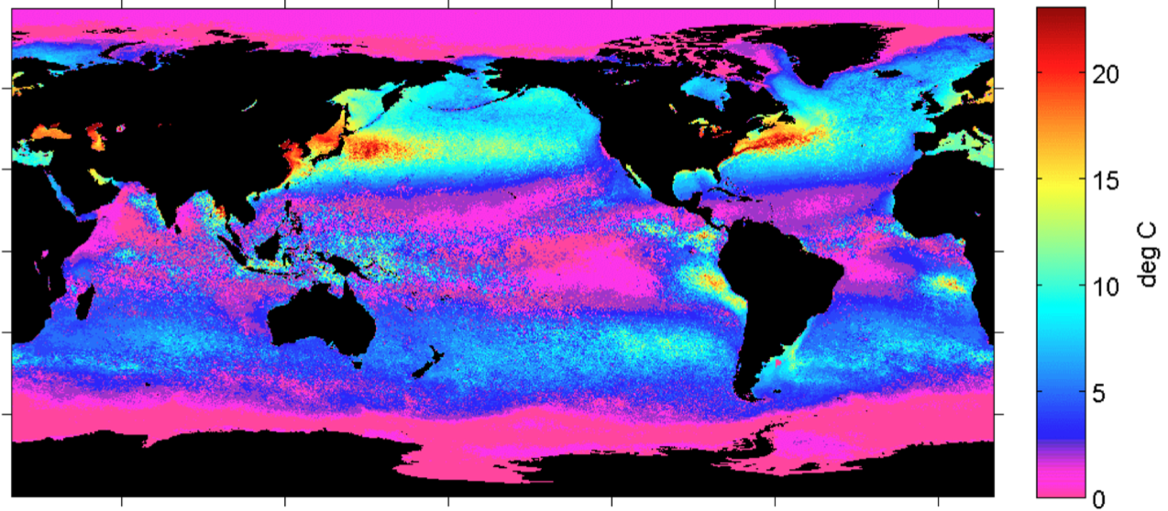
Tropical Cyclone Forecasting is a Global Issue for US Navy & NOAA
Typhoon & Cyclone
Damage measured in Deaths
Hurricane
Damage measured in Dollars
Tropical Cyclone Tracks & Intensities
Greatest Seasonal Cycle:
China
Korea
Japan
Greatest Seasonal Cycle:
Mid-Atlantic Northeast Canada
Summer – Winter Sea Surface Temperature Difference

Slide 4
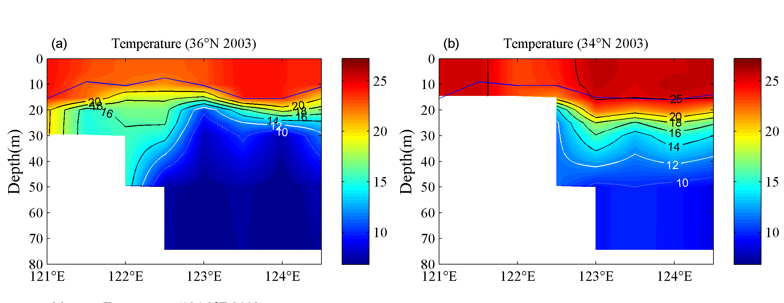
Summer heating produces a highly stratified ocean -
A warm surface layer + An unseen cold bottom layer
Mid Atlantic
Winter (1-layer)
Mid Atlantic
Summer (2-layers)
Cold Pool
Mid- Atlantic’s Cold Pool
Yellow Sea’s Cold Bottom Water Mass
Cold Bottom Water Mass
Yellow Sea
Summer
Yellow Sea
Summer
Cold Bottom Water Mass
Why unseen? Satellites cannot see below surface, Argo Floats do not extend into shallow water

Slide 5
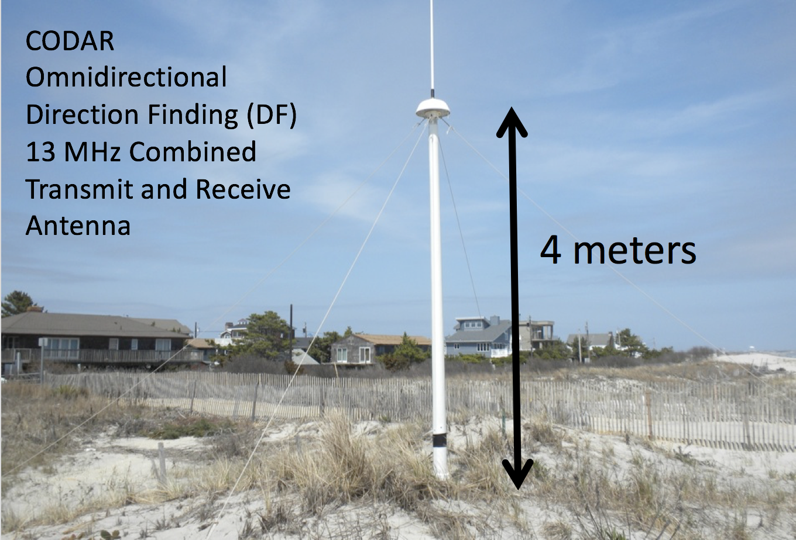
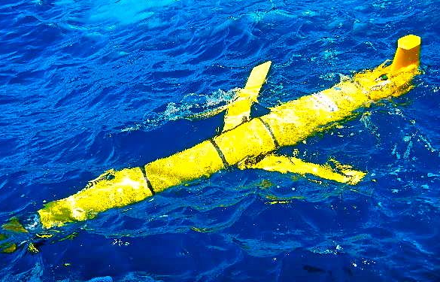
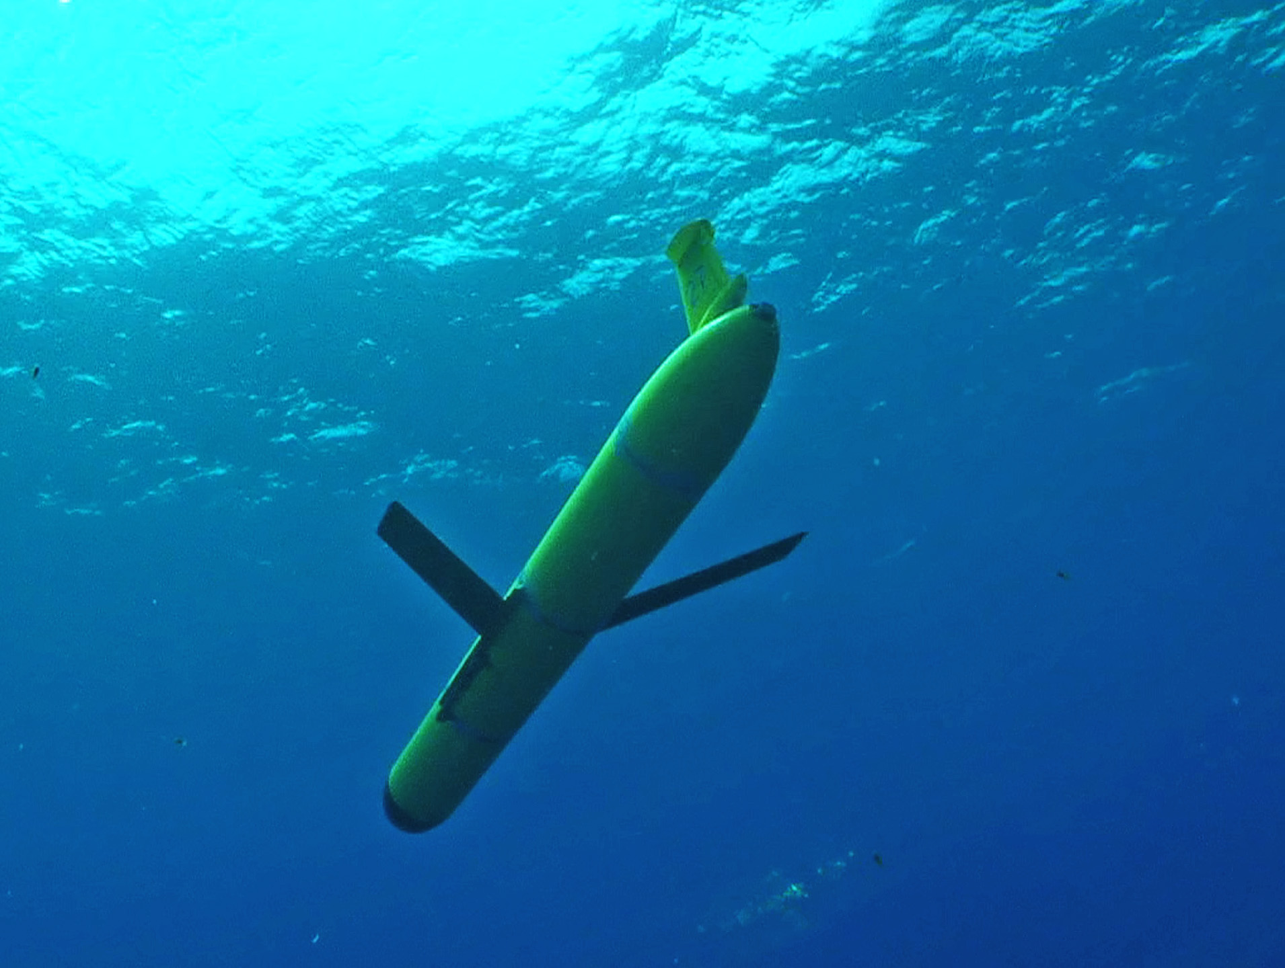
MARACOOS is Certified to Operate New Observing Technologies for US Government
CODAR HF Radar for Current Mapping
Slocum Underwater Glider for
Sustained Subsurface Profiling of
Temperature, Salinity, Currents, ….
Glider Communicating at Surface
Glider Profiling Subsurface

Slide 6
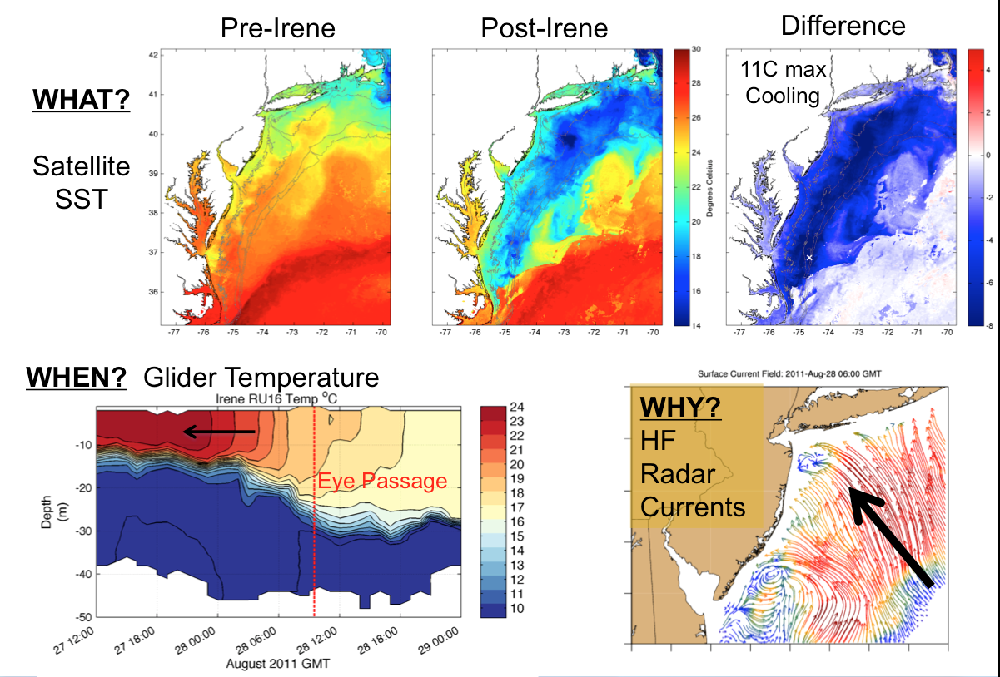
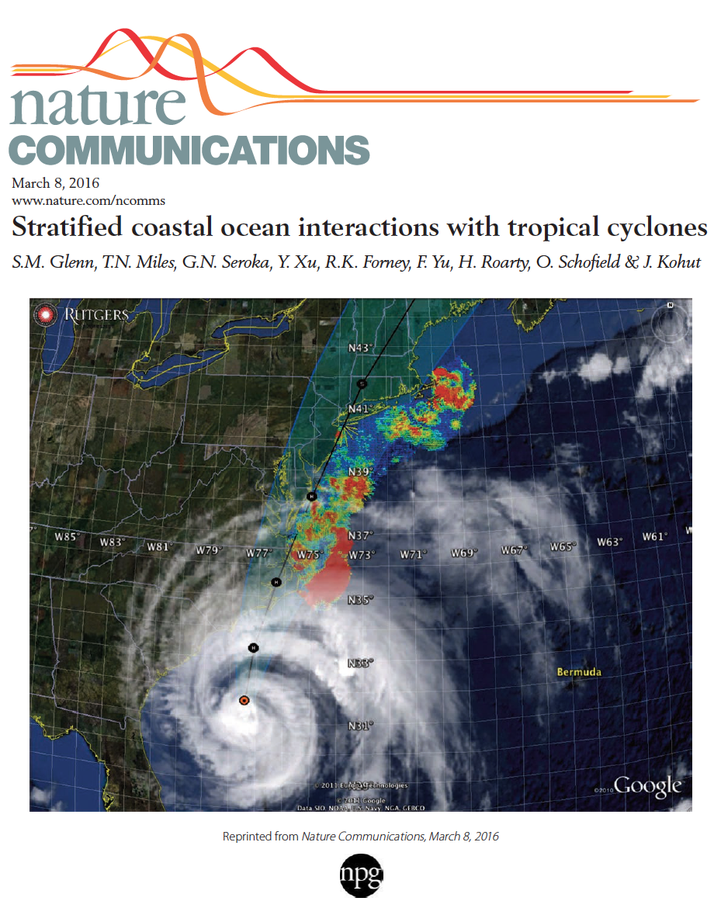
Operations to Research (O2R) Demonstrated
Integrated
Ocean Observatory
identifies processes responsible for rapid ahead-of-eye cooling.
Atmospheric
model sensitivities identify ahead-of-eye cooling as the missing process for rapid de-intensification
NOAA OAR

Slide 7
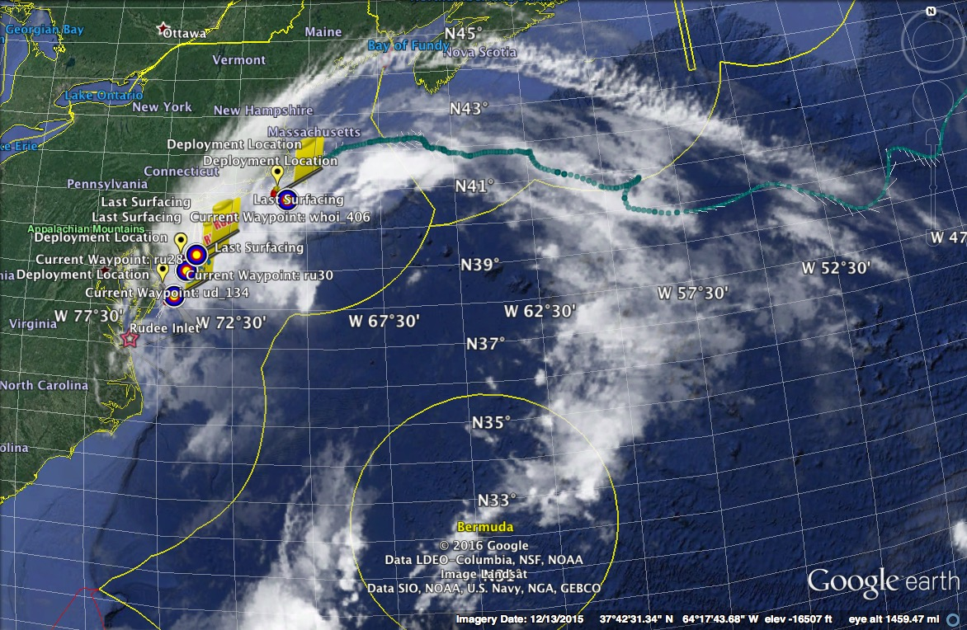
R2O - Hurricane Hermine Response - Glider Fleet Launched, 9/2016
Glider
HYCOM
RTOFS

Slide 8
R2O - Navy Global HYCOM: Temperature Below Summer Thermocline
Operational GOFS 3.0
OpTest of GOFS 3.1
No Cold Pool
Well Defined
Cold Pool
Isopycnal Layers on Shelf
Sigma/Z-levels on Shelf

Slide 9
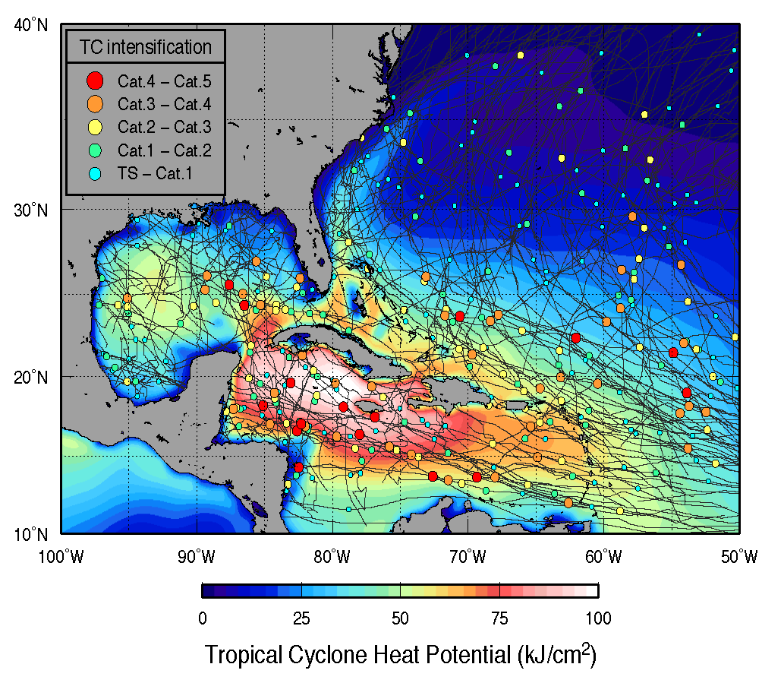

Slide 10
Oceanographers on the WRFIA hurricane team preparing the plan due April 2018
Sentinel Storm Gliders deployed as picket lines reporting subsurface ocean temperature profiles during hurricane season
Storm Glider Data Assimilation O2R2O cycle for the operational prediction models
What is needed?

