Slide 1
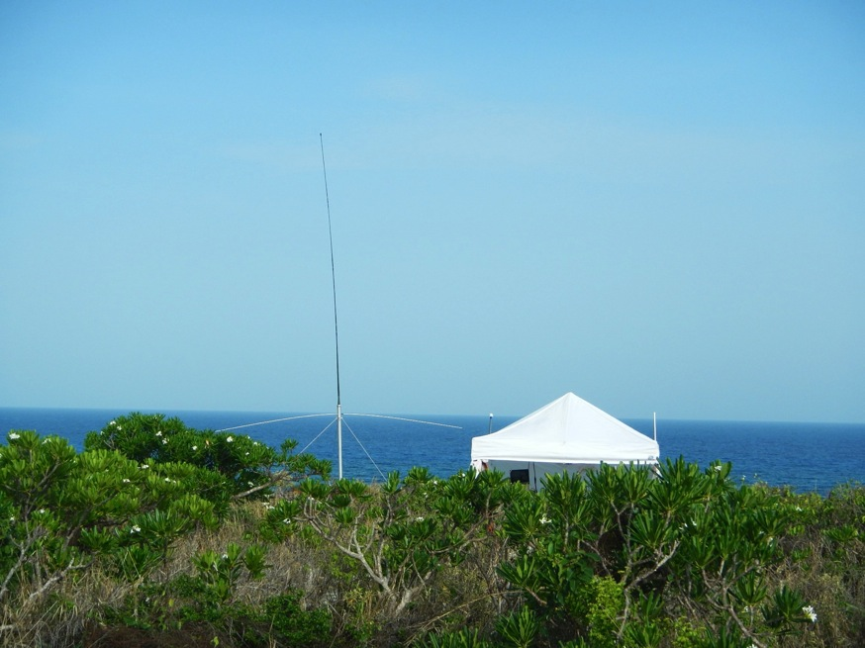
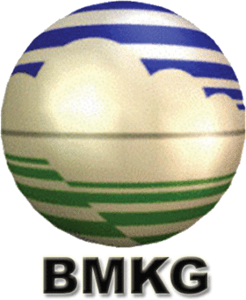

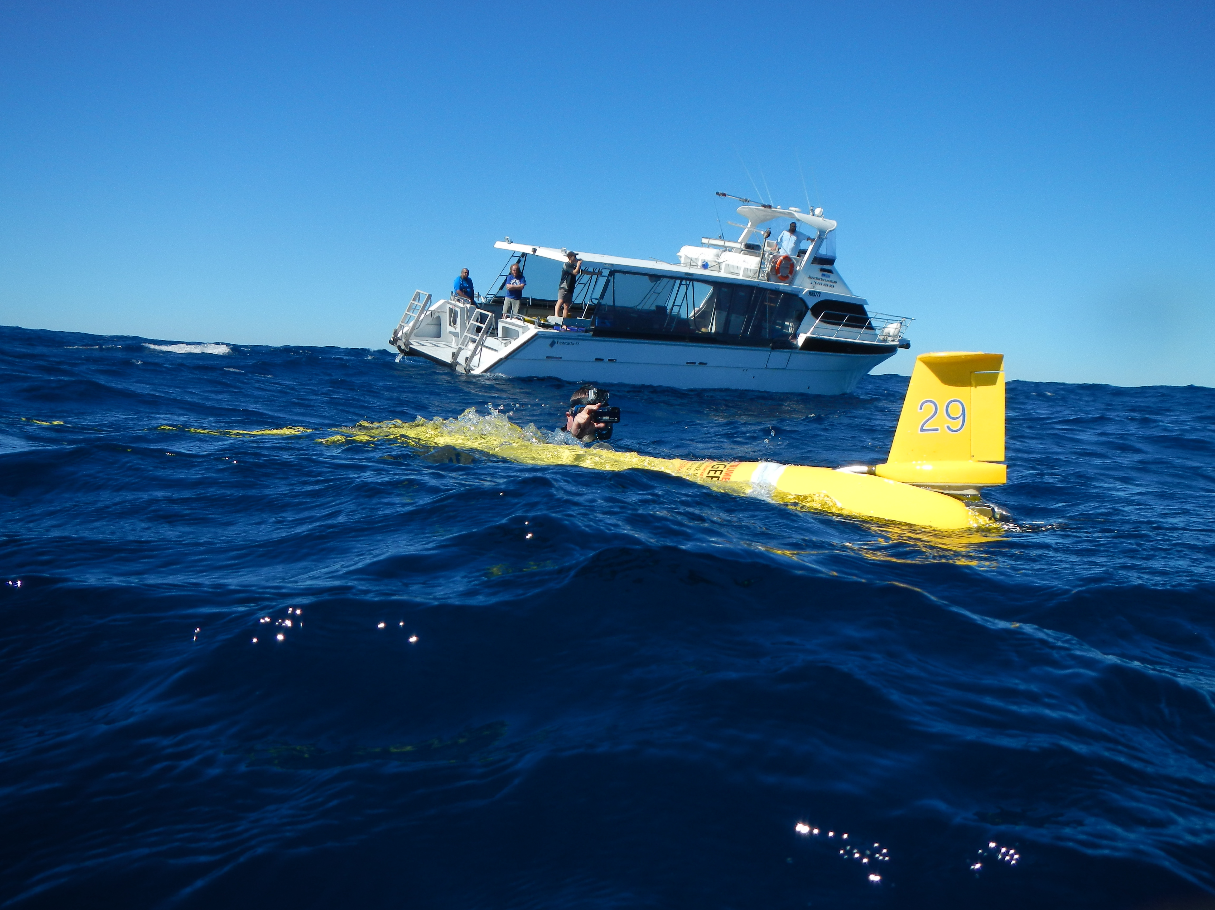



Globalizing HF Radar Networks & Underwater Glider Fleets to Improve
Ocean-Atmospheric Forecasts
12th Annual Indonesia – U.S.
Ocean and Climate Observations, Analysis and Applications Partnership Workshop
”The Role of Ocean Observations for Improving Subseaonal to Seasonal Forecasts in Indonesia”
Scott Glenn, Josh Kohut & Hugh Roarty
Rutgers University
New Brunswick, New Jersey, USA
CODAR HF Radar on
Mona Island, Puerto Rico
Slocum Glider deployment off Perth, Australia

Slide 2
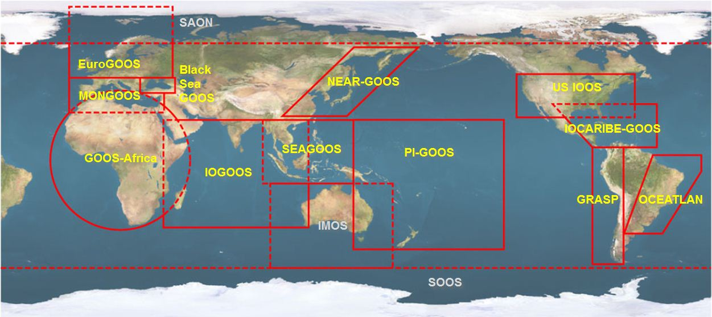





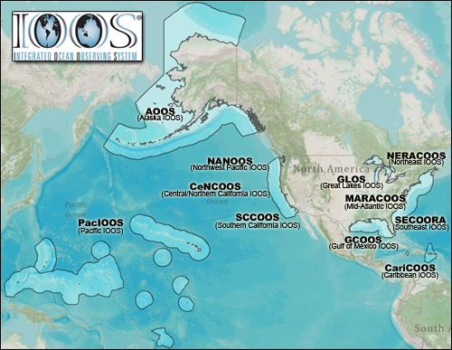


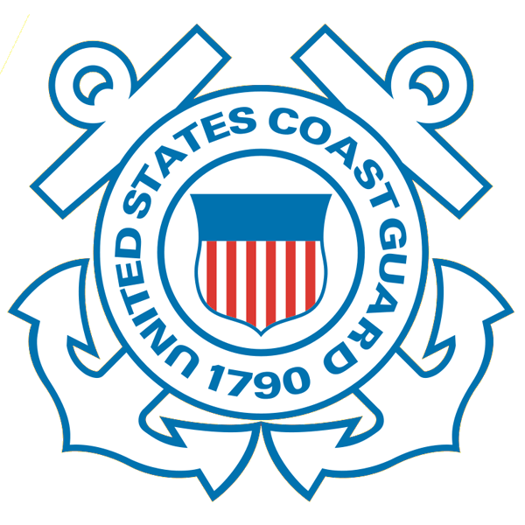










NOAA-led U.S. Integrated Ocean Observing System (IOOS)
Global Component
National Component
Regional Component
15 Regional Alliances in GOOS
Vessels -
Satellite
Satellite
CODAR
Ships/ Vessels
Glider
REMUS
Data Vis.
Modeling
Security
Leadership
Education
11 Regional Associations
17 U.S. Federal Agencies

Slide 3

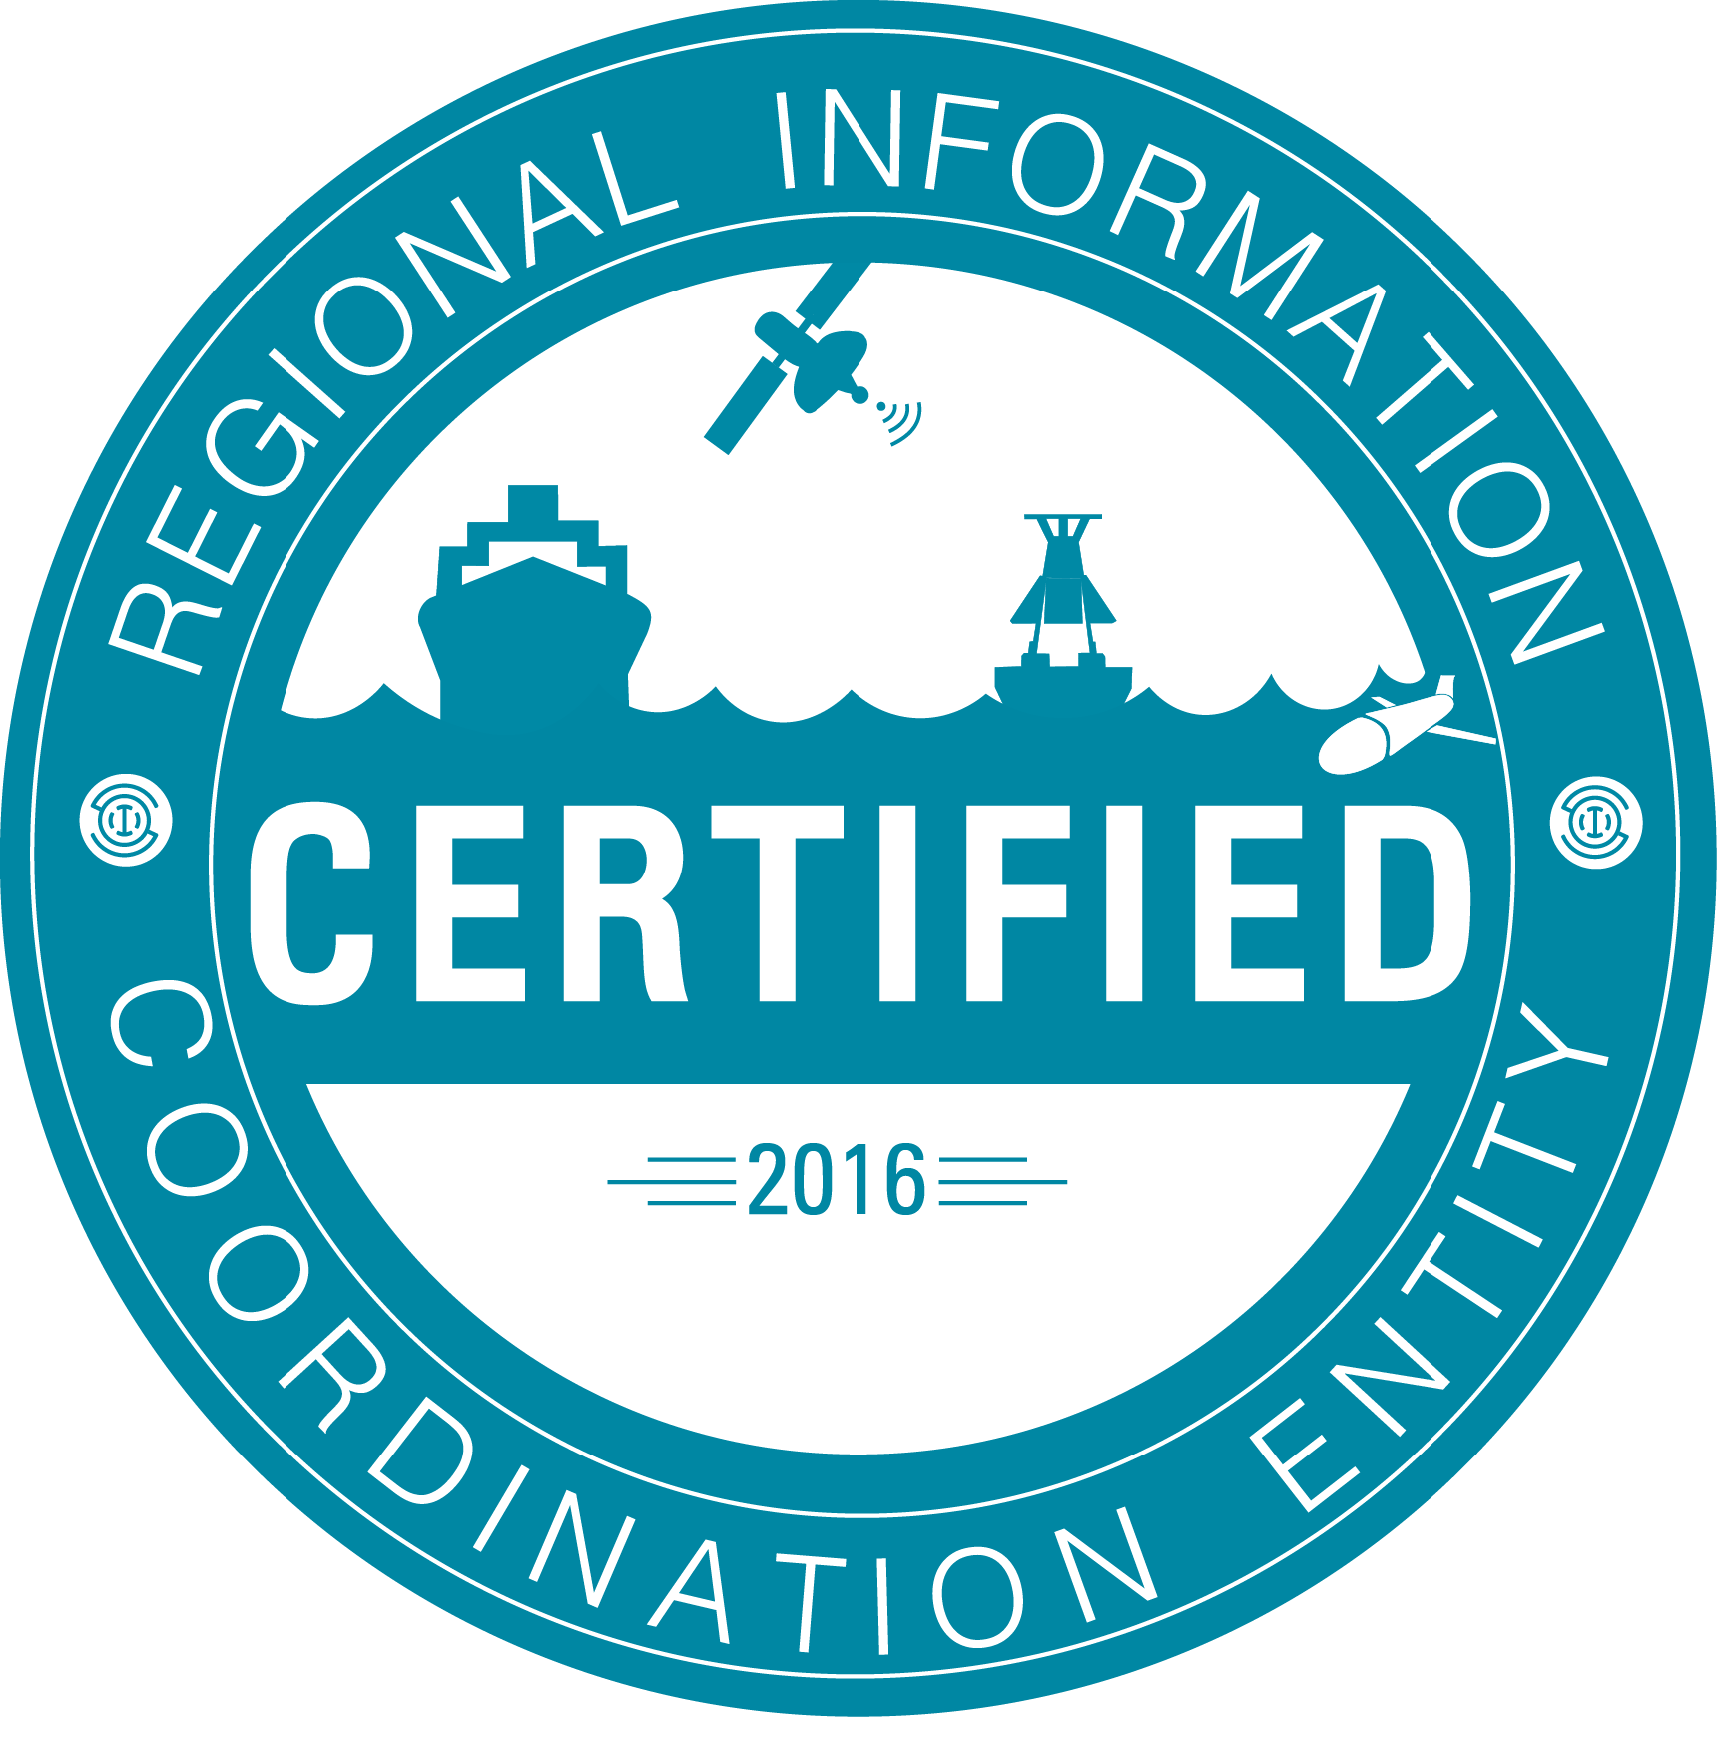













RI
U..
Middle Atlantic
Regional Association
Coastal
Ocean Observing System
10 States - 76 Million People
1000 km Cape to Cape
CT
Cape
Cod
MA
NY
PA
NJ
MARACOOS:
An Integrated, Sustained & Certified Real-time Observation and Forecast System
DE
MD
VA
NC
Cape
Hatteras
Notes:
3

Slide 4
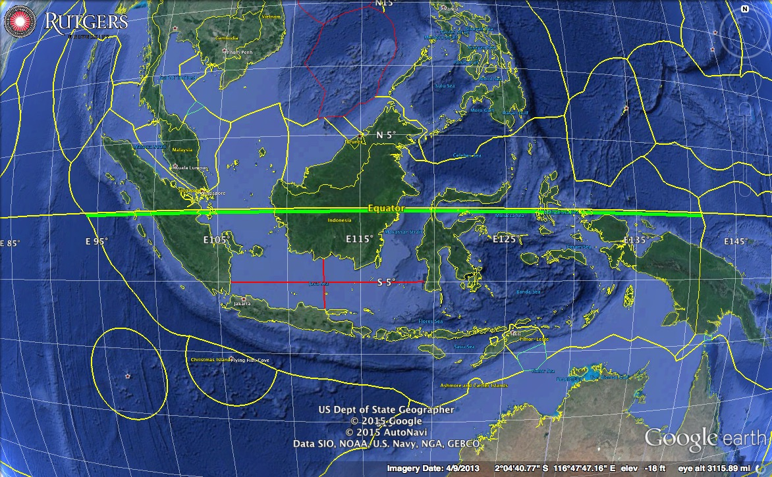
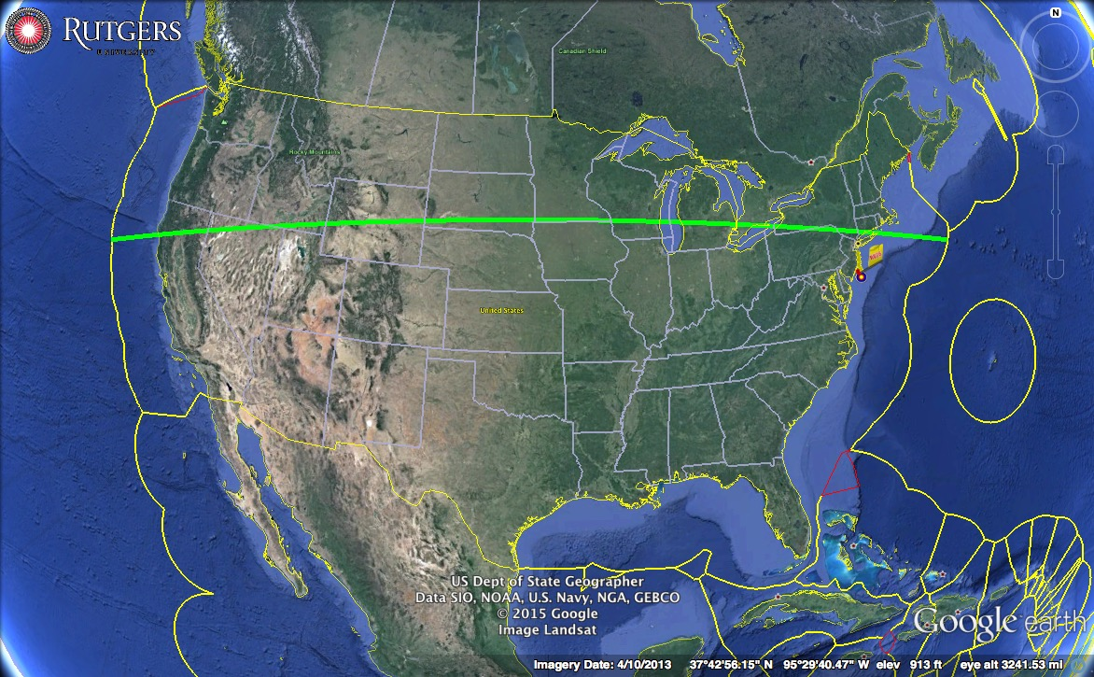
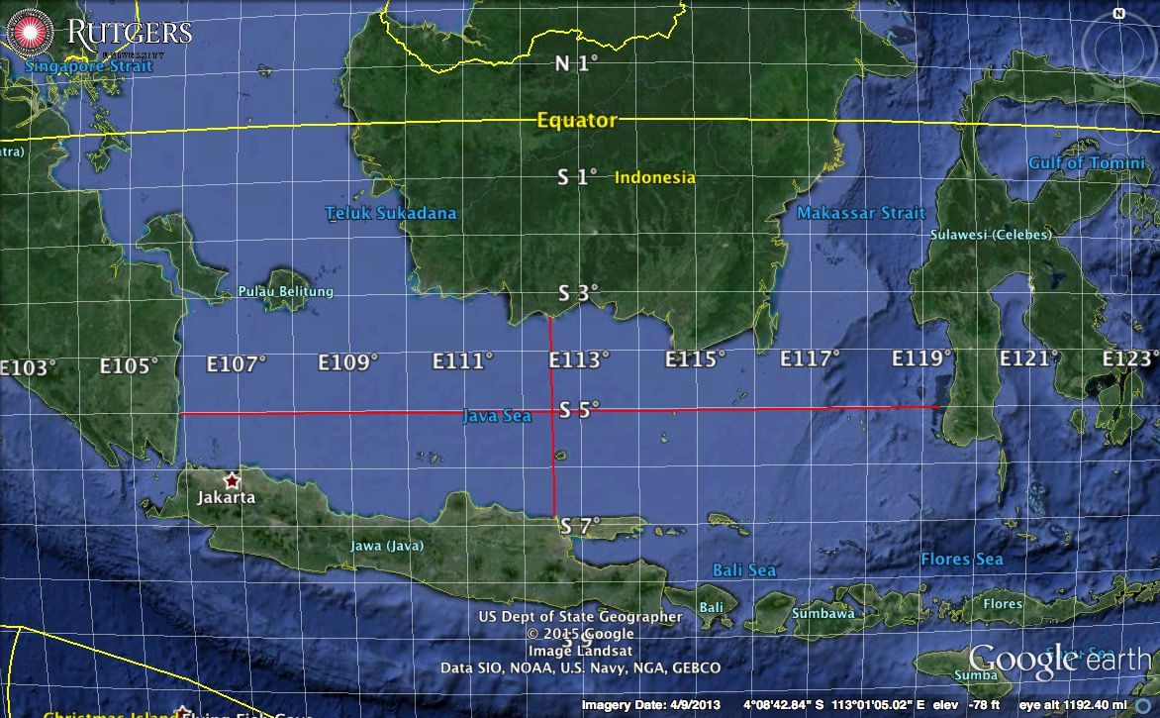
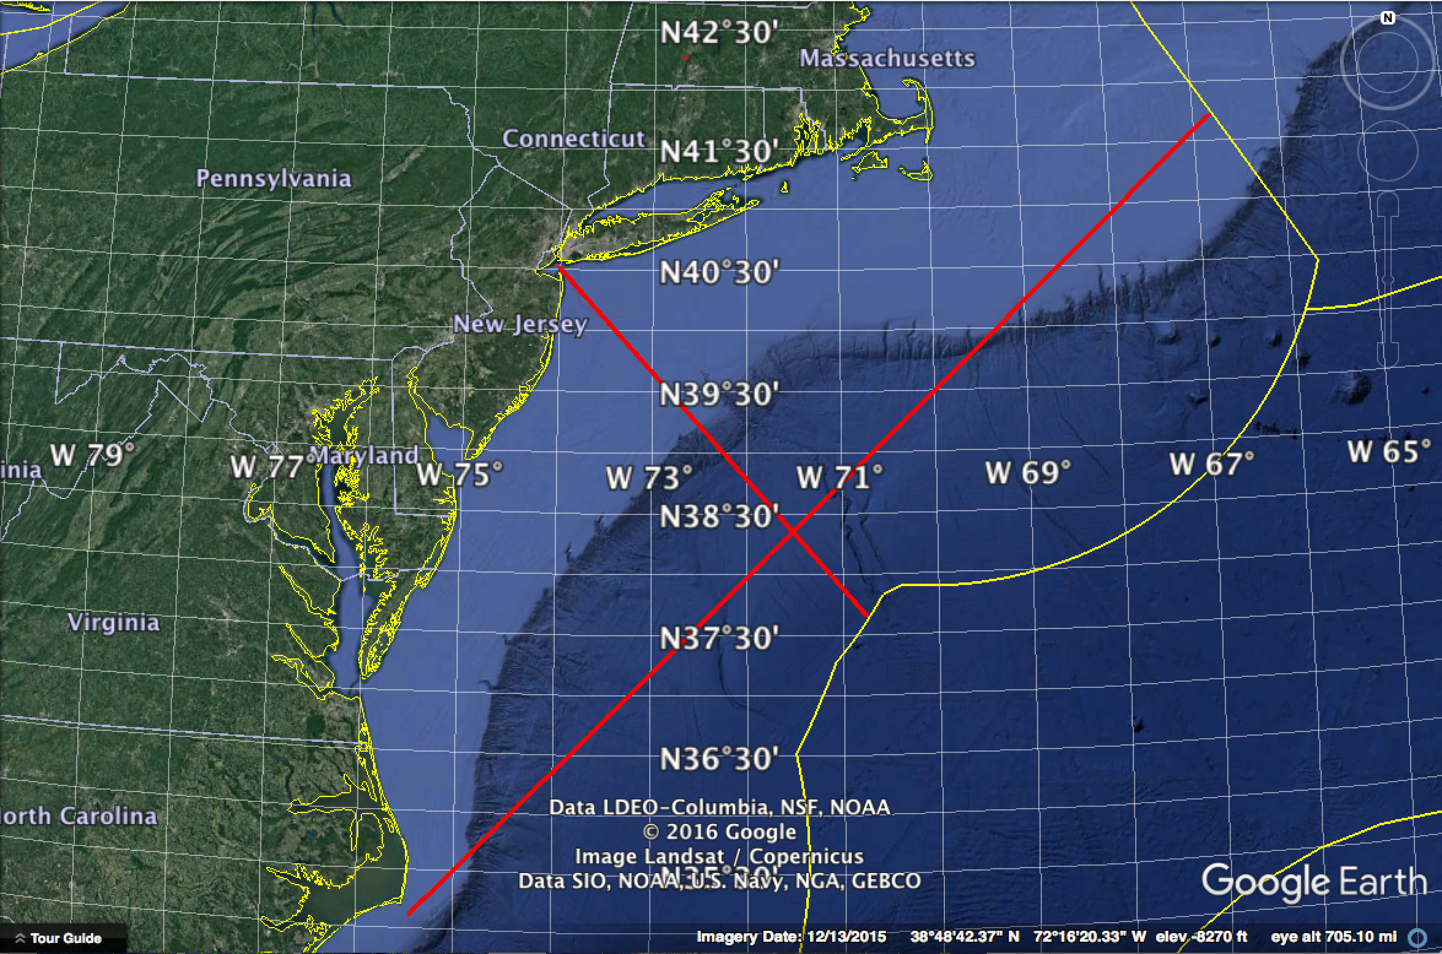
National & Regional Spatial Scales
5,250 km
5,250 km
Indonesia & Java Sea
United States & Mid Atlantic Bight
425 km
1,050 km
1,500 km
375 km

Slide 5
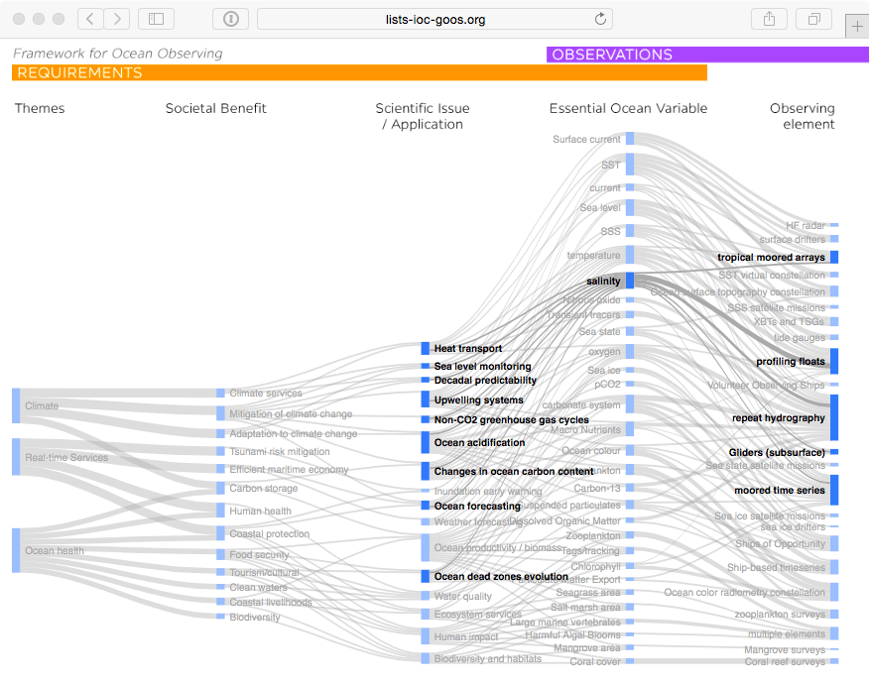

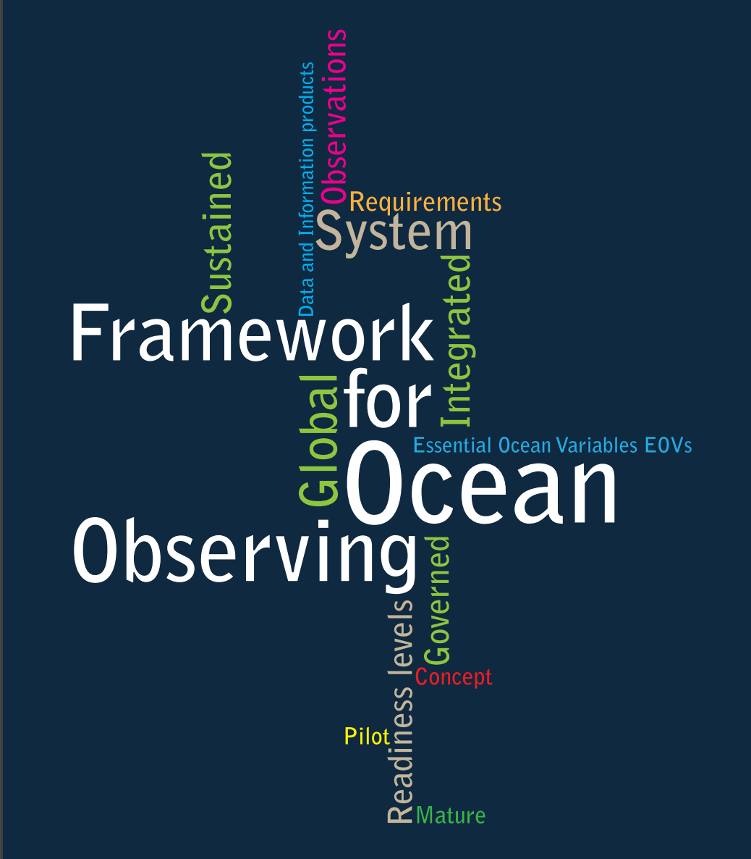

GOOS Strategic Mapping
Notes:
This activity will allow us to improve a Strategic Mapping of GOOS, which is shown here linking the three major societal drivers of GOOS: climate, services, and ocean health; with the societal benefits informed by sustained ocean data; the scientific issue, application, or product needed; the Essential Ocean Variable we need to capture; and the type of observing element contributing to the measure of these variables.
We can track how any particular observing platform measures a number of variables, feeding products and applications that deliver societal benefit.
A major message from this complicated diagram is that there are many interconnections. Many observations have multiple lifetimes – multiple uses. With growing sensor capability we are increasingly building an integrated observing system. And there is a tremendous needs for the coordination activities that make this system as efficient and effective as possible.
Behind each of the nodes in this mapping that we continue to build is a specification sheet with additional information on the global groups and standards and best practices information.
Each GOOS Regional Alliance or national effort will have its own variant of this mapping, based on local priorities and capacities.

Slide 6
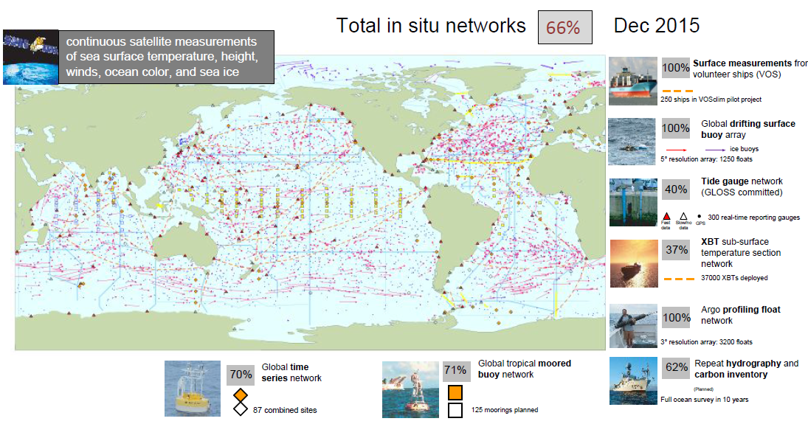


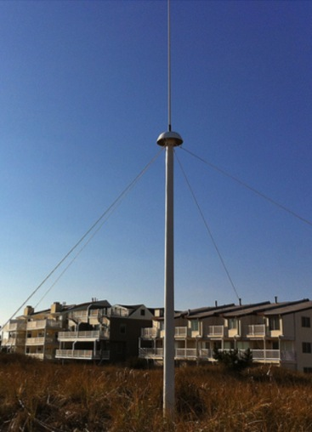
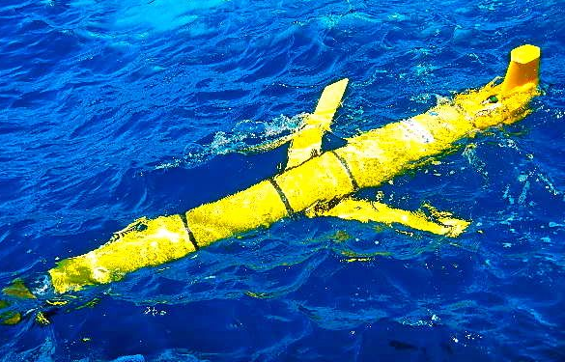
Global Ocean Observing System
Needs to be updated…
Now being added:
HF Radar & Gliders

Slide 7
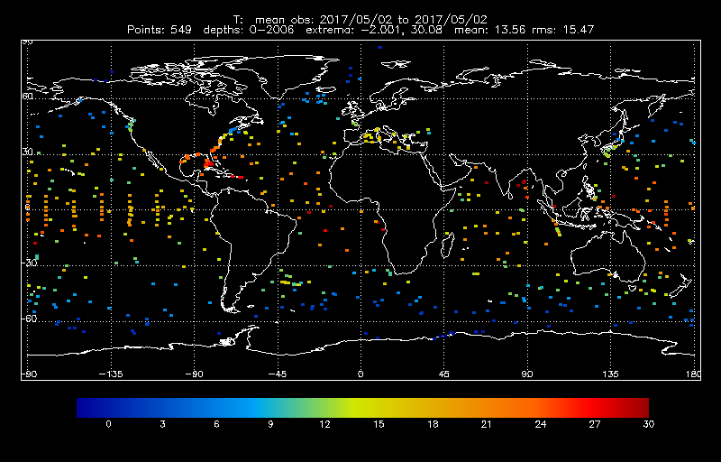
Sub-surface T coverage (over 24 hrs)

Slide 8

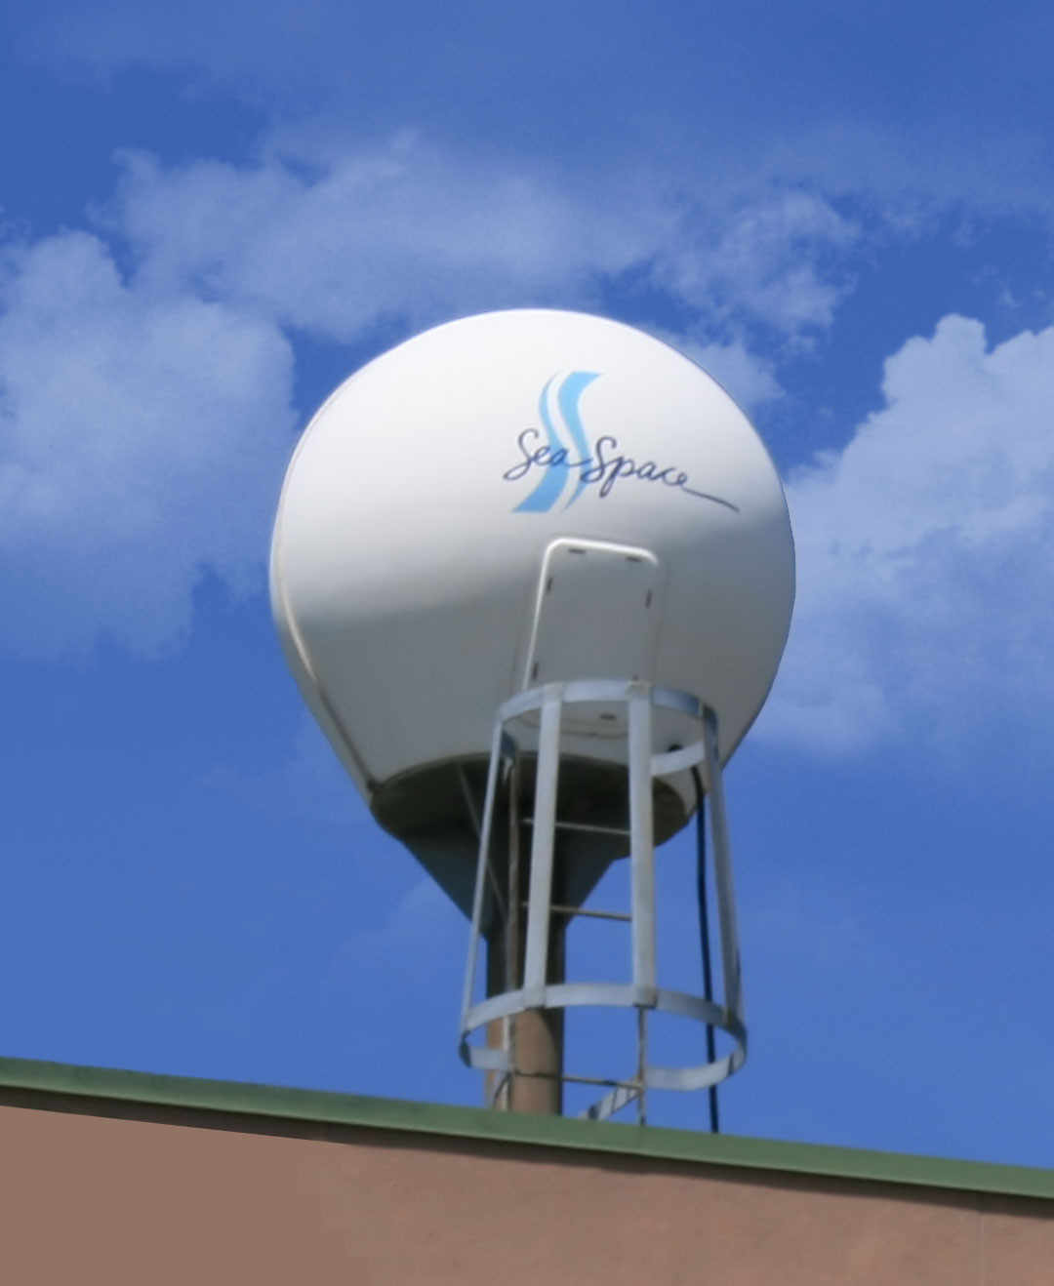
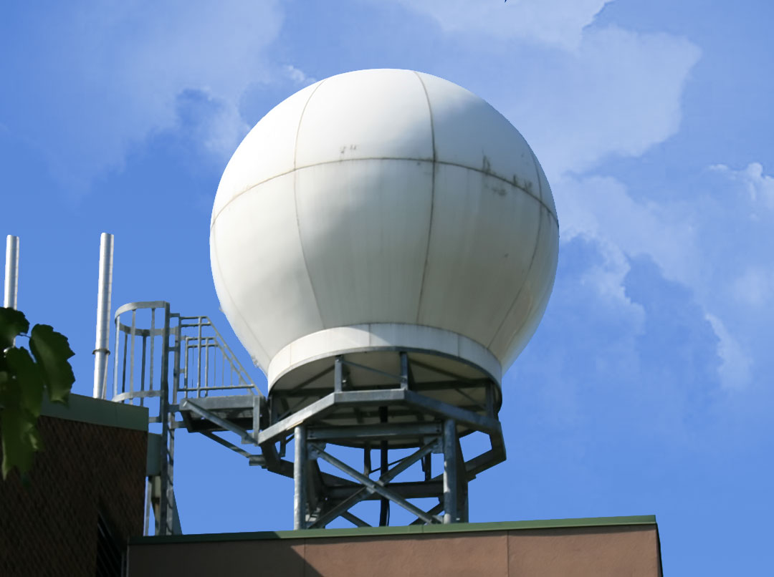
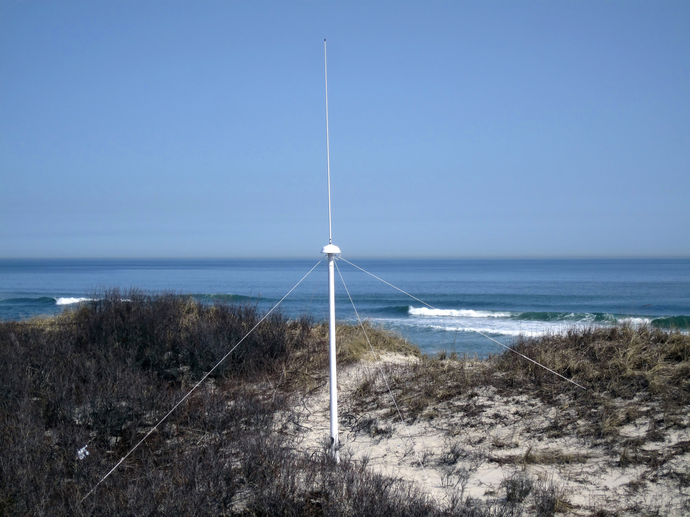
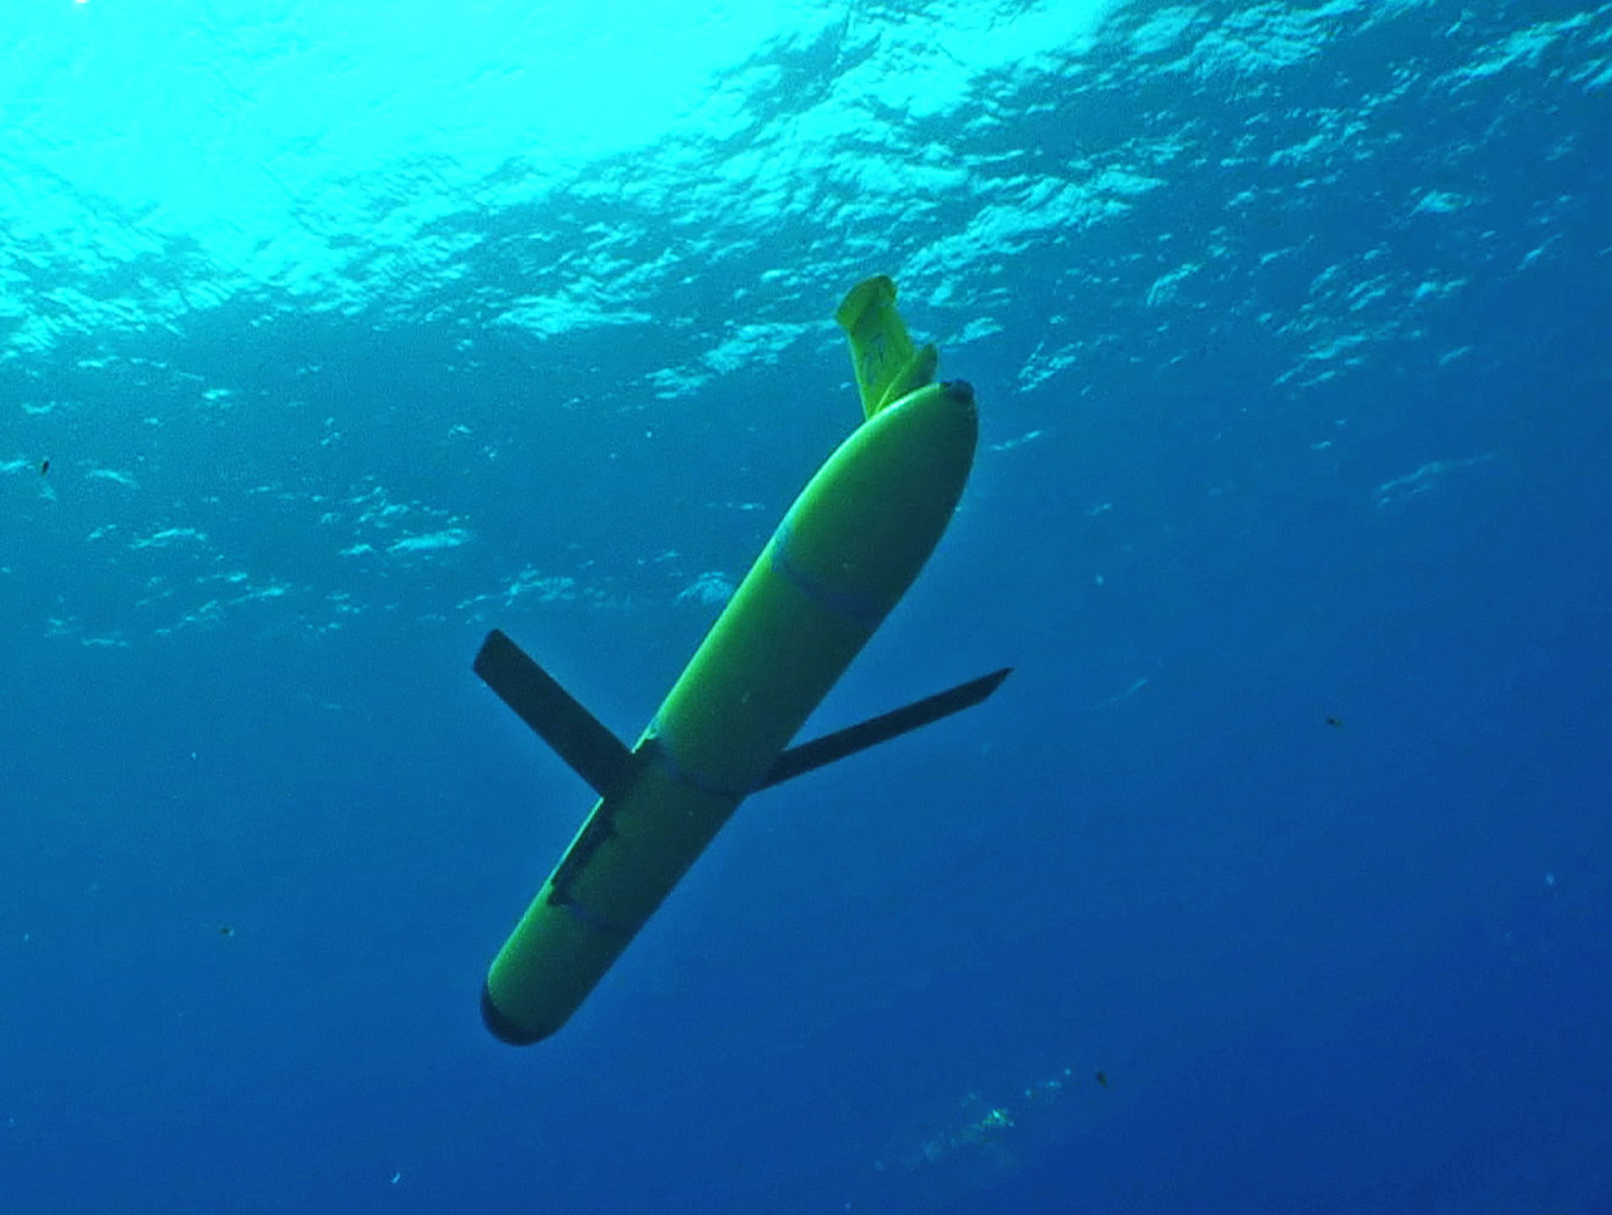
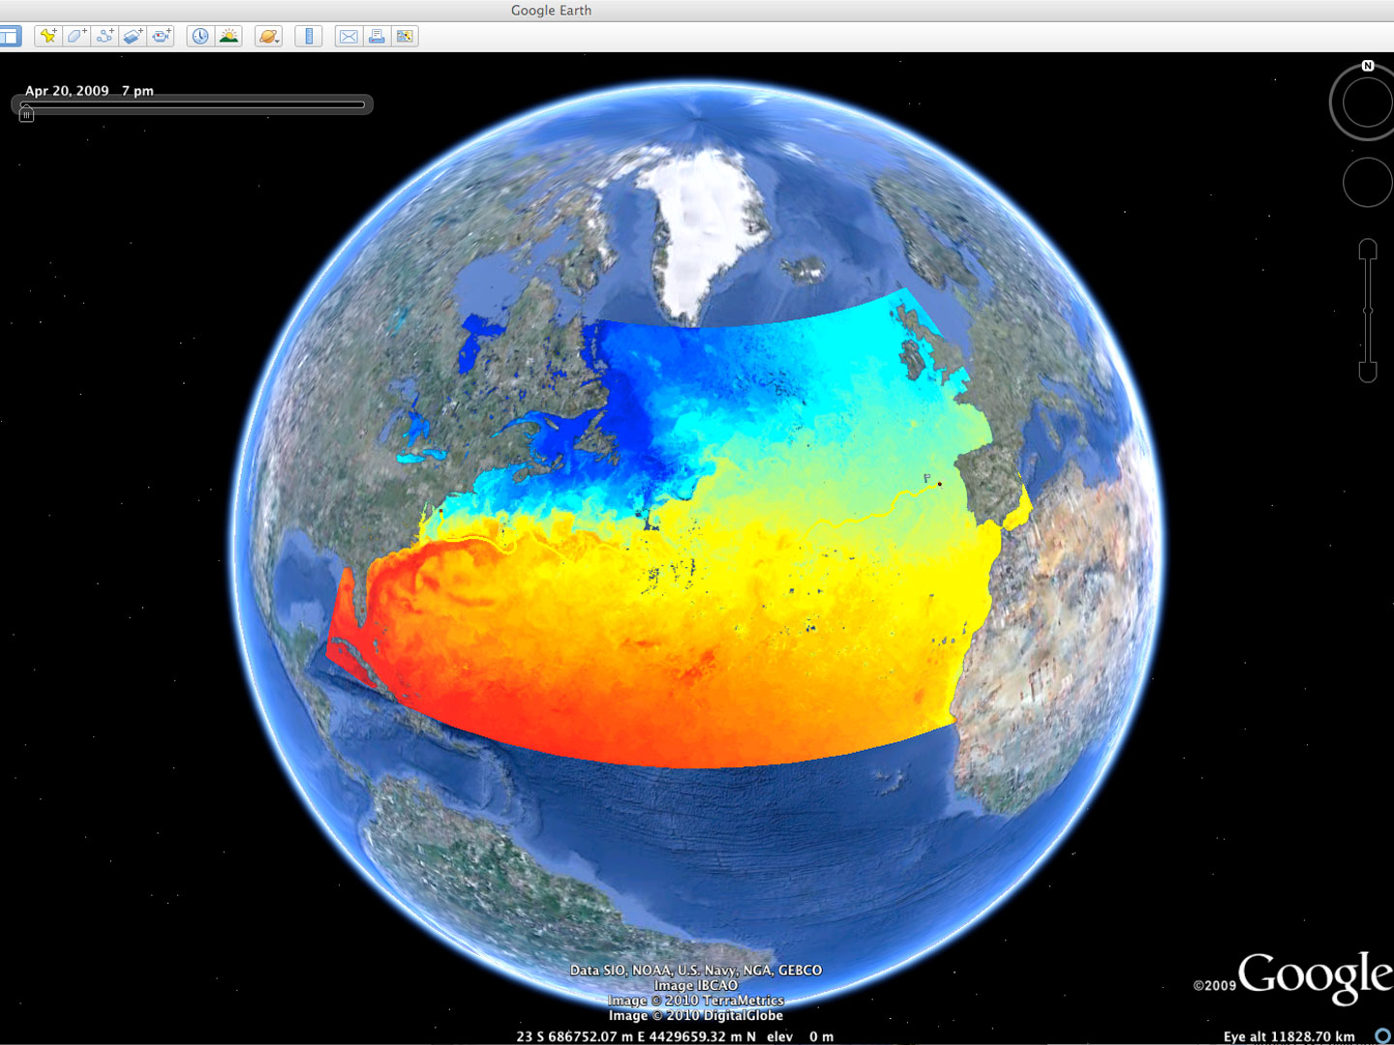


Rutgers University - Coastal Ocean Observation Lab
Observatory Operations, Data Fusion & Training Center
L-Band & X-Band Satellite Receivers
CODAR Network
Glider Fleet
3-D Nowcasts
& Forecasts
Notes:
8

Slide 9






MARACOOS Integration Matrix
Integration Matrix: Capabilities Support Multiple Themes
Regional Priority Themes | Regional Observation & Modeling Capabilities
 | Weather Mesonet | HF Radar Network | Statistical STPS | Satellite Imagery | Glider Surveys | Dynamical Ocean Forecasts
Theme 1. Maritime Commerce & Safety | Operational Input to USCG SAROPS | Operational input to USCG SAROPS | Operational input to USCG SAROPS | SST for survivability planning | Assimilation dataset for forecast models | Surface currents for SAROPS
Theme 2. Fisheries | Weather forecast ensemble validation | Circulation and divergence maps for habitat |  | SST & Color for habitat | Subsurface T & S for habitat | 3-D fields of T, S, circulation for habitat
Theme 3. Public Health & Water Quality | Winds for transport, river plumes, & upwelling | Surface currents for floatables, bacteria, spill response | Surface currents for floatables, bacteria, spill response | Ocean color for river plumes | Nearshore dissolved oxygen surveys | Surface currents for floatables, bacteria, spill response
Theme 4. Coastal Flooding | Weather forecast ensemble validation | Assimilation dataset for forecast models |  | SSTs assimilation into forecast models | Assimilation dataset for forecast models | Nested forecast ensembles
Theme 5. Offshore Energy | Historical analysis & wind model validation | Historical current analysis & wind model validation |  | Historical analysis surface fronts & plumes for siting | Historical analysis of subsurface fronts & plumes | Coupled ocean-atmosphere models for resource estimates

Slide 10
MARACOOS Integration Matrix
Integration Matrix: Capabilities Support Multiple Themes
Regional Priority Themes | Regional Observation & Modeling Capabilities
 | Weather Mesonet | HF Radar Network | Statistical STPS | Satellite Imagery | Glider Surveys | Dynamical Ocean Forecasts
Theme 1. Maritime Commerce & Safety | Operational Input to USCG SAROPS | Operational input to USCG SAROPS | Operational input to USCG SAROPS | SST for survivability planning | Assimilation dataset for forecast models | Surface currents for SAROPS
Theme 2. Fisheries | Weather forecast ensemble validation | Circulation and divergence maps for habitat |  | SST & Color for habitat | Subsurface T & S for habitat | 3-D fields of T, S, circulation for habitat
Theme 3. Public Health & Water Quality | Winds for transport, river plumes, & upwelling | Surface currents for floatables, bacteria, spill response | Surface currents for floatables, bacteria, spill response | Ocean color for river plumes | Nearshore dissolved oxygen surveys | Surface currents for floatables, bacteria, spill response
Theme 4. Coastal Flooding | Weather forecast ensemble validation | Assimilation dataset for forecast models |  | SSTs assimilation into forecast models | Assimilation dataset for forecast models | Nested forecast ensembles
Theme 5. Offshore Energy | Historical analysis & wind model validation | Historical current analysis & wind model validation |  | Historical analysis surface fronts & plumes for siting | Historical analysis of subsurface fronts & plumes | Coupled ocean-atmosphere models for resource estimates

Slide 11
MARACOOS Integration Matrix
Integration Matrix: Capabilities Support Multiple Themes
Regional Priority Themes | Regional Observation & Modeling Capabilities
 | Weather Mesonet | HF Radar Network | Statistical STPS | Satellite Imagery | Glider Surveys | Dynamical Ocean Forecasts
Theme 1. Maritime Commerce & Safety | Operational Input to USCG SAROPS | Operational input to USCG SAROPS | Operational input to USCG SAROPS | SST for survivability planning | Assimilation dataset for forecast models | Surface currents for SAROPS
Theme 2. Fisheries | Weather forecast ensemble validation | Circulation and divergence maps for habitat |  | SST & Color for habitat | Subsurface T & S for habitat | 3-D fields of T, S, circulation for habitat
Theme 3. Public Health & Water Quality | Winds for transport, river plumes, & upwelling | Surface currents for floatables, bacteria, spill response | Surface currents for floatables, bacteria, spill response | Ocean color for river plumes | Nearshore dissolved oxygen surveys | Surface currents for floatables, bacteria, spill response
Theme 4. Coastal Flooding | Weather forecast ensemble validation | Assimilation dataset for forecast models |  | SSTs assimilation into forecast models | Assimilation dataset for forecast models | Nested forecast ensembles
Theme 5. Offshore Energy | Historical analysis & wind model validation | Historical current analysis & wind model validation |  | Historical analysis surface fronts & plumes for siting | Historical analysis of subsurface fronts & plumes | Coupled ocean-atmosphere models for resource estimates

Slide 12
MARACOOS Integration Matrix
Integration Matrix: Capabilities Support Multiple Themes
Regional Priority Themes | Regional Observation & Modeling Capabilities
 | Weather Mesonet | HF Radar Network | Statistical STPS | Satellite Imagery | Glider Surveys | Dynamical Ocean Forecasts
Theme 1. Maritime Commerce & Safety | Operational Input to USCG SAROPS | Operational input to USCG SAROPS | Operational input to USCG SAROPS | SST for survivability planning | Assimilation dataset for forecast models | Surface currents for SAROPS
Theme 2. Fisheries | Weather forecast ensemble validation | Circulation and divergence maps for habitat |  | SST & Color for habitat | Subsurface T & S for habitat | 3-D fields of T, S, circulation for habitat
Theme 3. Public Health & Water Quality | Winds for transport, river plumes, & upwelling | Surface currents for floatables, bacteria, spill response | Surface currents for floatables, bacteria, spill response | Ocean color for river plumes | Nearshore dissolved oxygen surveys | Surface currents for floatables, bacteria, spill response
Theme 4. Coastal Flooding | Weather forecast ensemble validation | Assimilation dataset for forecast models |  | SSTs assimilation into forecast models | Assimilation dataset for forecast models | Nested forecast ensembles
Theme 5. Offshore Energy | Historical analysis & wind model validation | Historical current analysis & wind model validation |  | Historical analysis surface fronts & plumes for siting | Historical analysis of subsurface fronts & plumes | Coupled ocean-atmosphere models for resource estimates

Slide 13
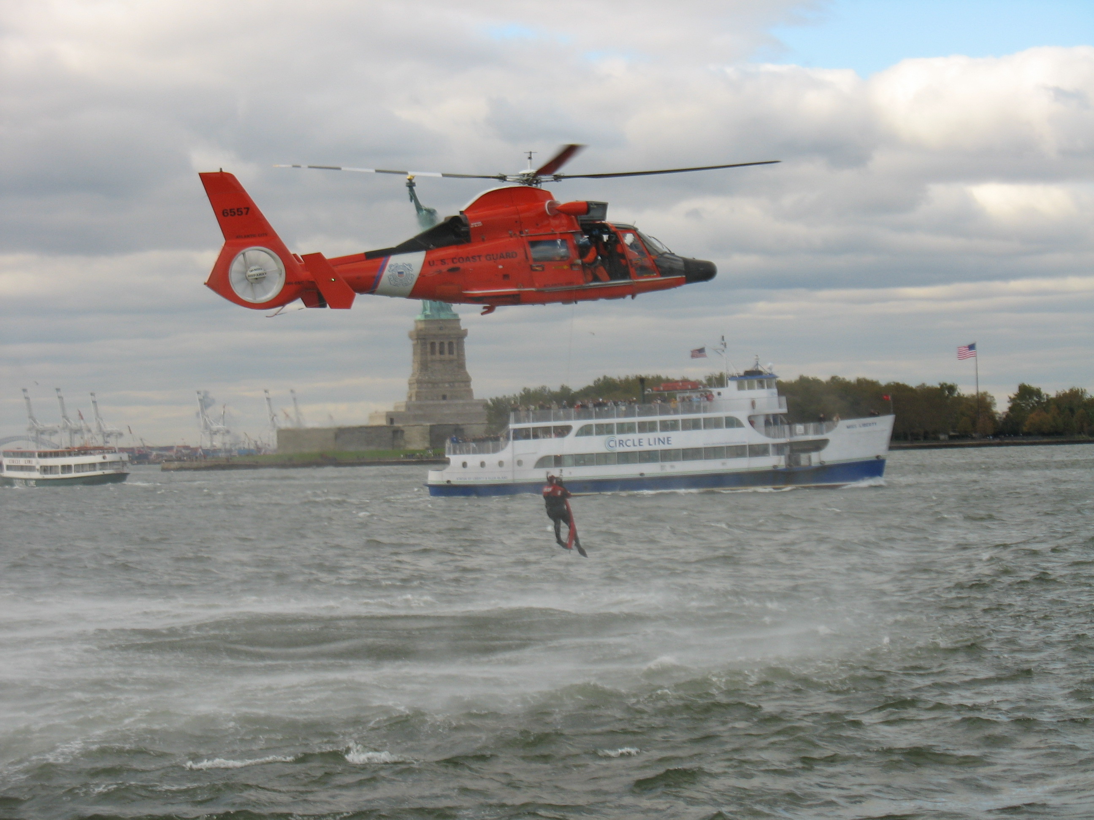
Search And Rescue Cases
in MARACOOS Region
U.S. Coast Guard Search And Rescue Data, FY2014
 | Bays, Rivers, Near Shore (< 3 NM) | Offshore (> 3 NM to 200 NM) | Total
Cases | 2,433 | 247 | 2,688
Lives Saved | 500 | 96 | 596
Lives Assisted | 3,332 | 319 | 3,651
Lives Lost | 160 | 14 | 174

Slide 14
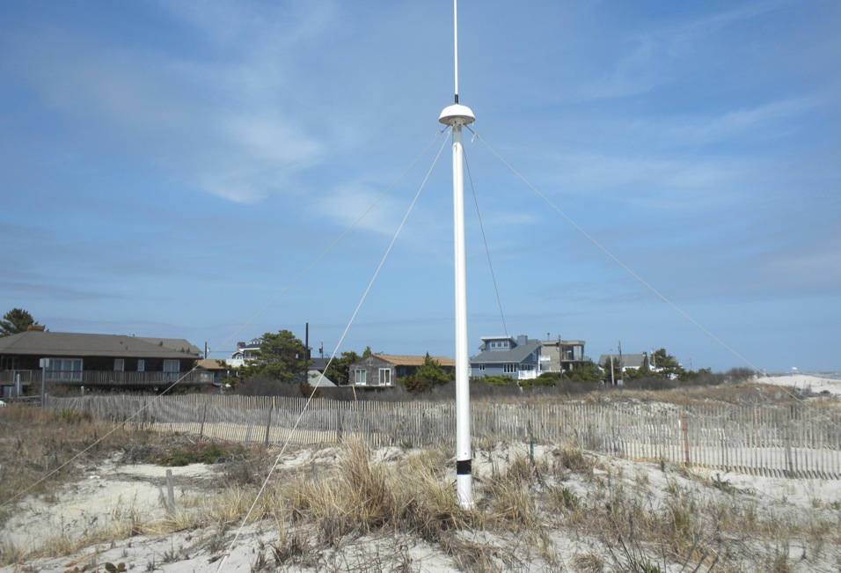
CODAR Omnidirectional
Direction Finding (DF)
13 MHz Combined
Transmit and Receive Antenna
4 meters

Slide 15
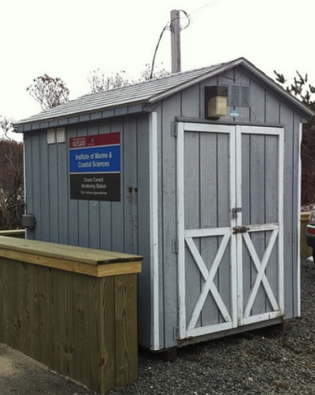
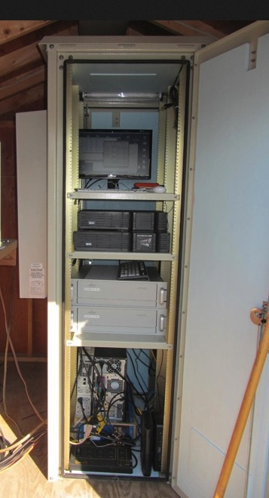
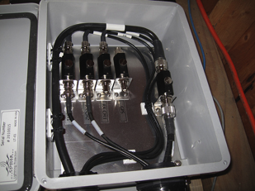
Resilient CODAR Shore Site:
Shed, Enclosure, Tx/Rx, Comms, Power, GPS, AIS
monitor
computer & external hard drive
A.C. unit
UPS system
transmitter
receiver
Two lines of Communication
Shed
Enclosure
Lightning Protection

Slide 16
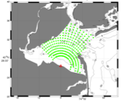
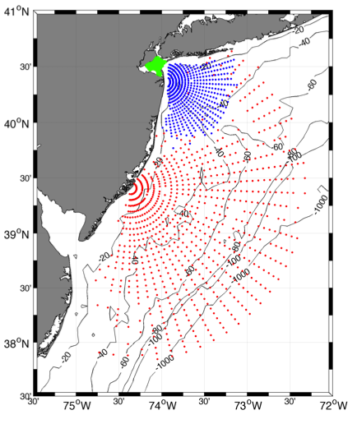
Surface Current Mapping Capability
25 MHz
Radar λ: 12 m Ocean λ: 6 m
Range: >30 km Resolution: 1 km
13 MHz
Radar λ: 23 m Ocean λ: 12 m
Range: >80 km Resolution: 3 km
05 MHz
Radar λ: 60m Ocean λ: 30 m
Range: >180 km Resolution: 6 km

Slide 17
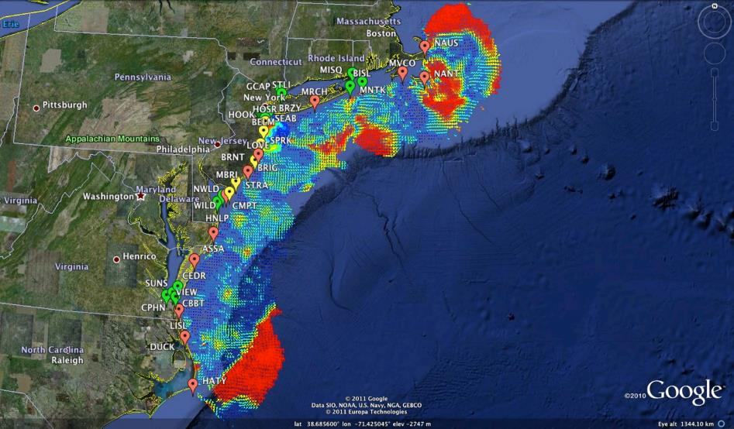

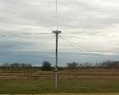
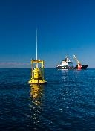
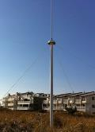

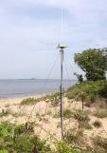
Mid-Atlantic Bight HF Radar Network
1000 km
Cape to Cape
Mid-Atlantic HF Radar Network
17 Long-Range CODARs
8 Medium-Range CODARs
16 Short-Range CODARs
41 Total CODARs in Region
+5 CODARs Roaming
46 Total CODARs
Triple Nested, Multi-static, Multi-use
Industry Partner: CODAR Ocean Sensors

Slide 18
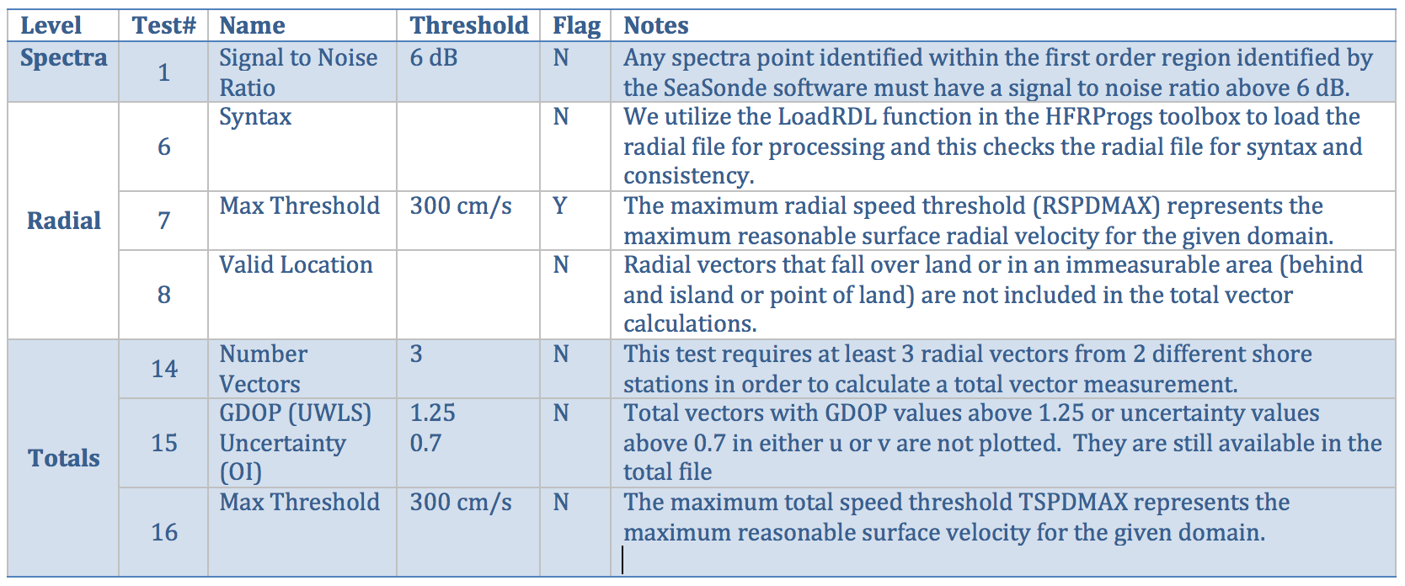
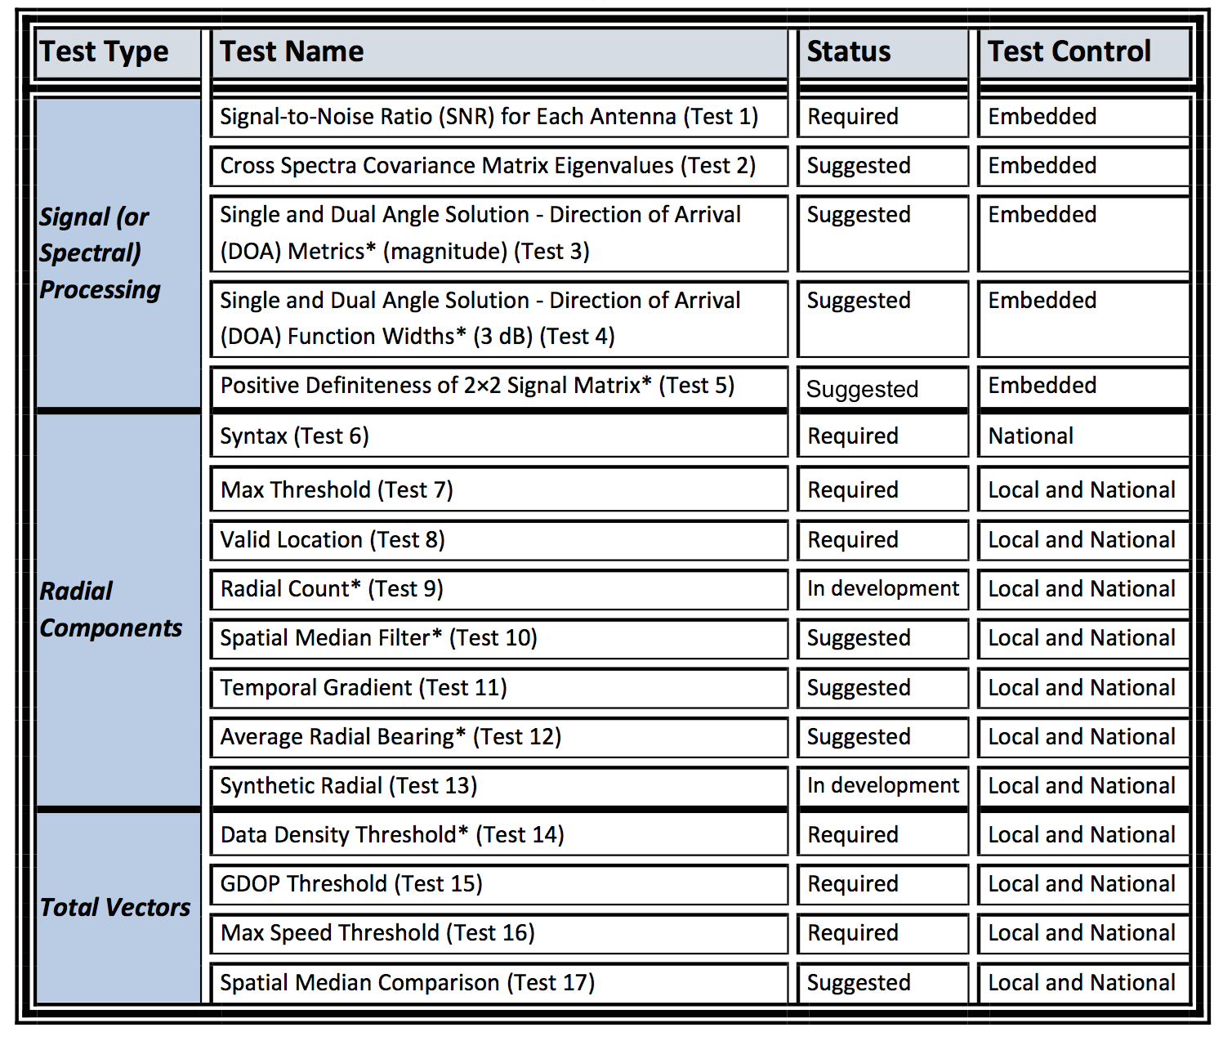
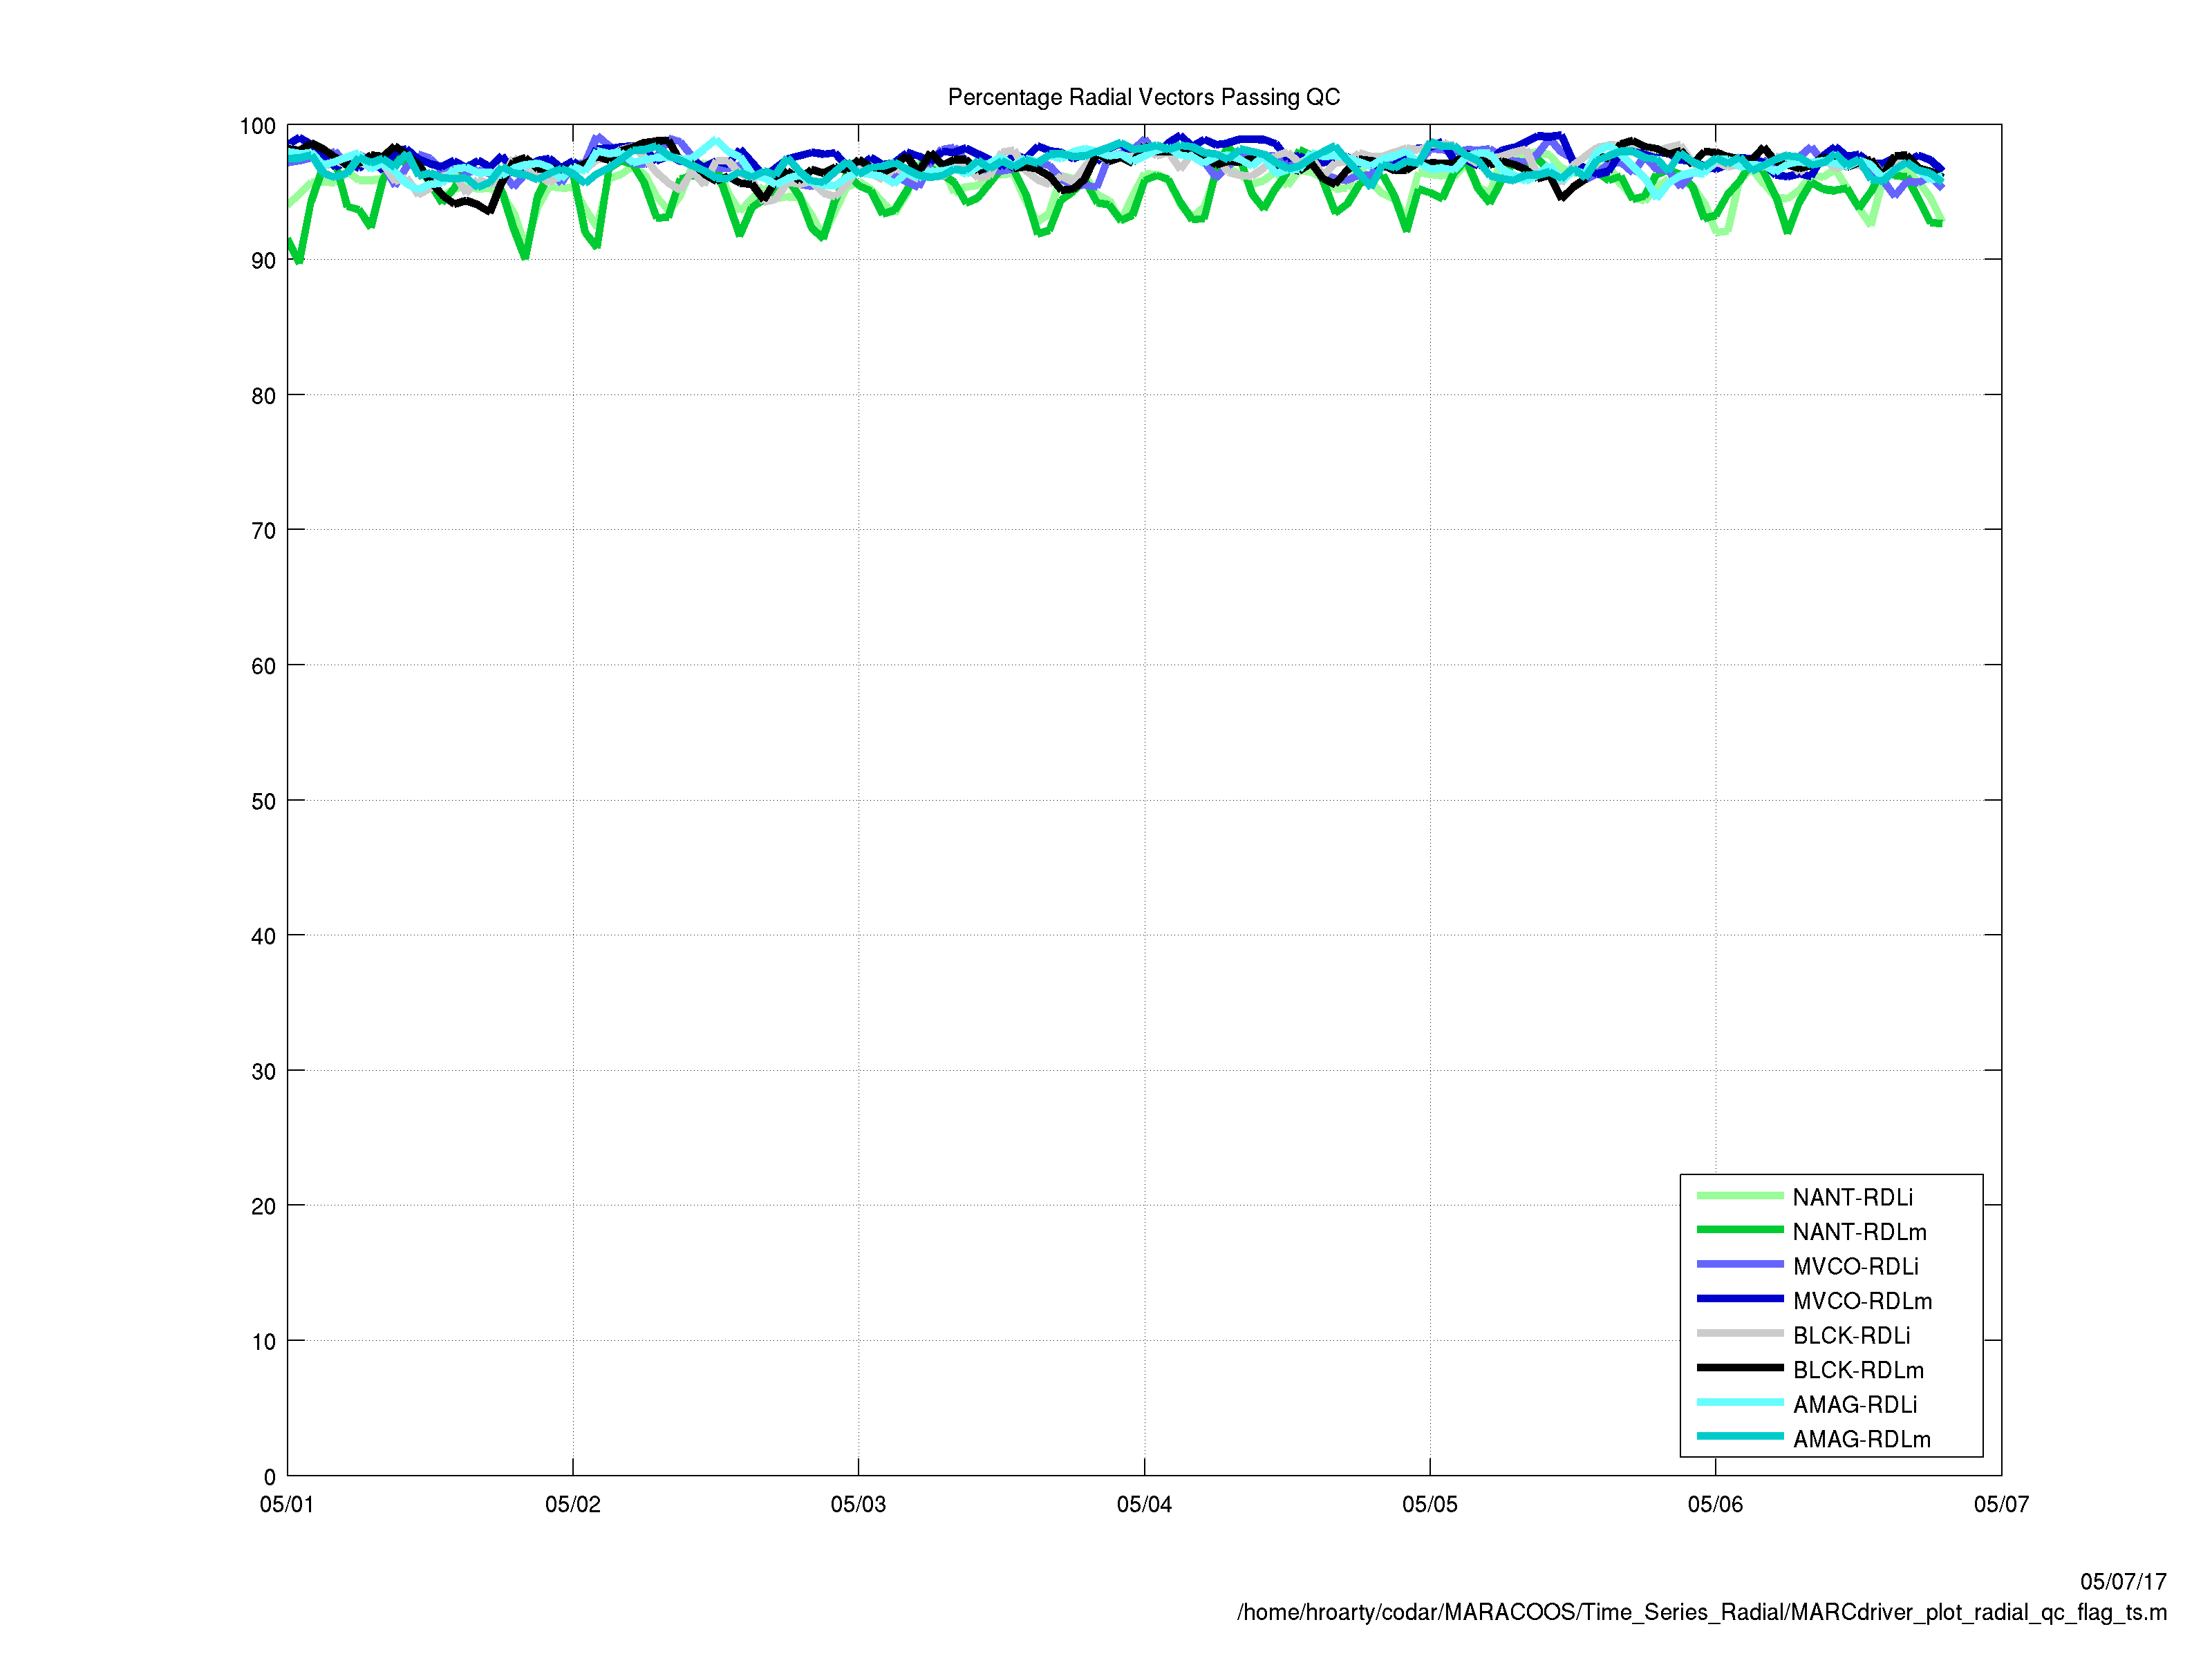
HFR Data Quality Assurance/Quality Control (QA/QC)
Regional Information Coordination Entity -
RICE
From
QARTOD
Manual for
HF Radar
Plotting QC flags in real time

Slide 19
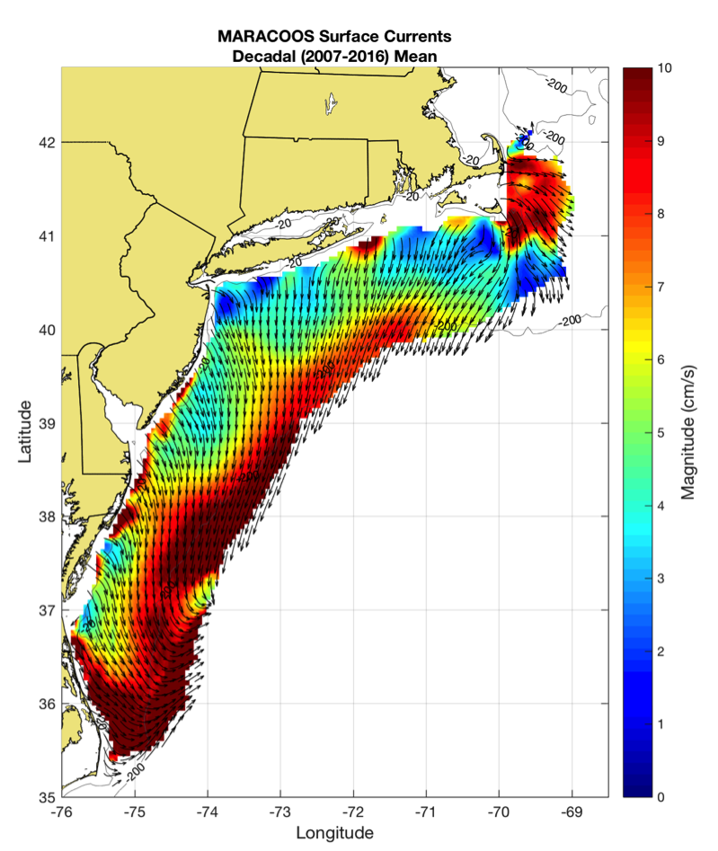
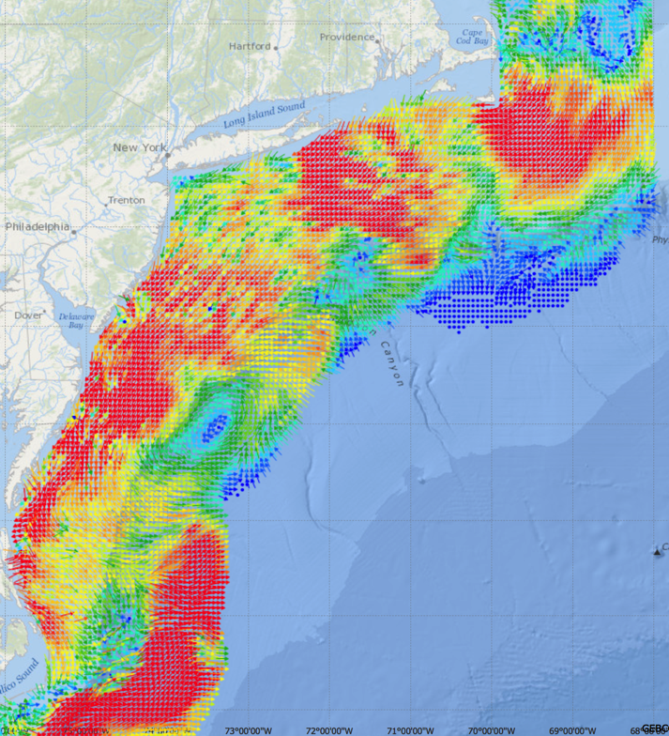
Generate Surface Current Maps Every Hour for a Decade
5 MHz- 17 Stations
13 MHz- 7 Stations
25 MHz- 16 Stations
Outside- 6 Stations
TOTAL – 46 Stations
Winter Storm Jonas
2016/01/23 20:00 UTC
Hourly Maps for
Search And Rescue
Decadal Mean Currents
for Spatial Planning

Slide 20
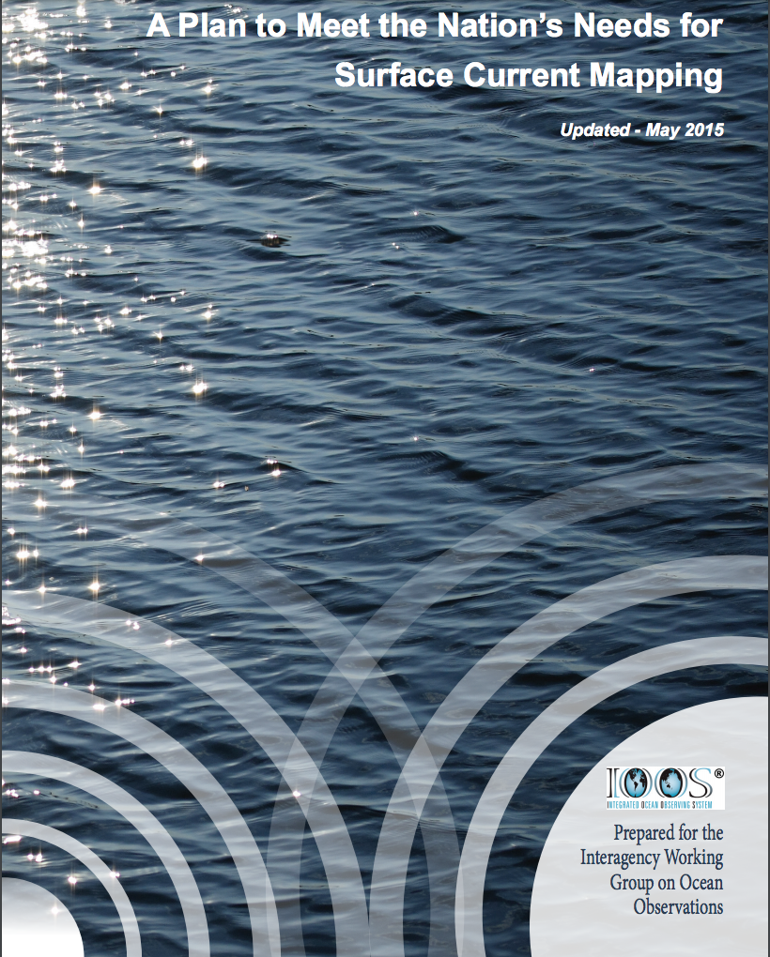
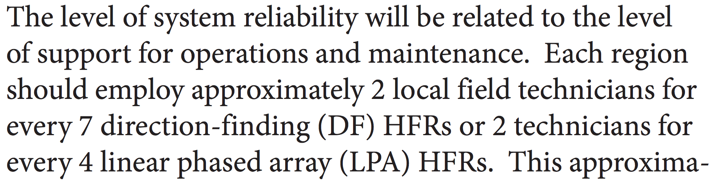
U.S. National Plan – Recommended HFR Technician Support
Updated: 2004, 2009 & 2015
https://ioos.noaa.gov/
wp-content/uploads/2015/09/
national_surface_current_plan.pdf
Page 15:
By these recommendations:
A network of 17 Omnidirectional DF HFRs requires 5 Technicians.
A network of 34 LPA HFRs requires 17 Technicians.

Slide 21
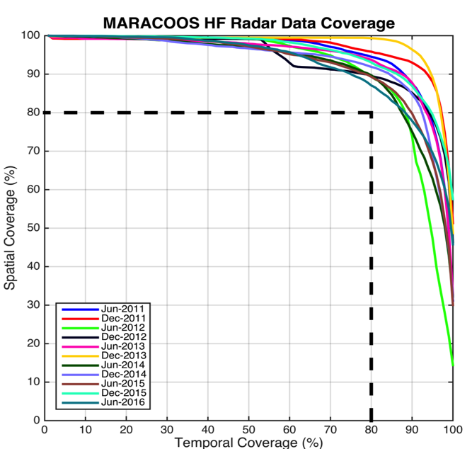
Search And Rescue Data Availability Metrics
MARACOOS 17-Site Long Range Network:
Consistently exceeds U.S. Coast Guard 80-80 Metric
80 % spatial coverage 80% of the time
Achieved through site resiliency and active spares approach.
Accomplished with 2.5 Field Technicians
Every
6 Months since 2011

Slide 22
2011-2014 2016-2017
USCG SAROPS Ocean Current Product Requests
Global HYCOM Products – Always there “100-100” metric
HF Radar Data & Statistical Predictions – #8
Assimilative Regional Espresso ROMS - not on the list
Global HYCOM Products – Still Always there “100-100” metric
HF Radar Data & Statistical Predictions – up to #6
Assimilative Regional Espresso ROMS - up to #4

Slide 23
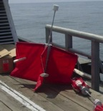
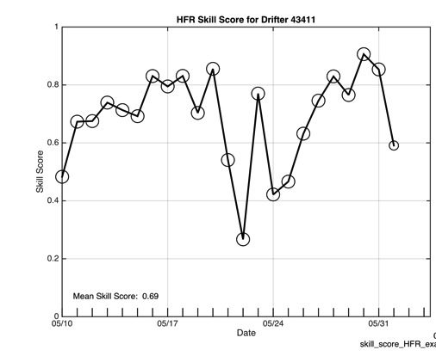
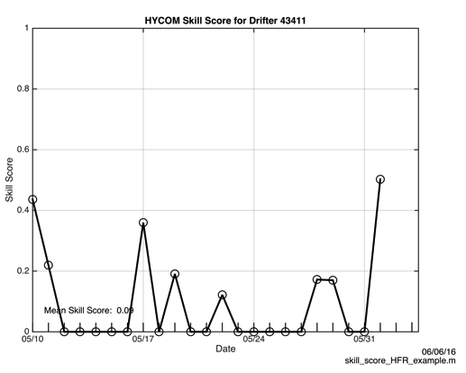
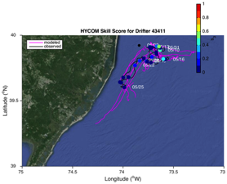
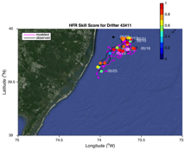
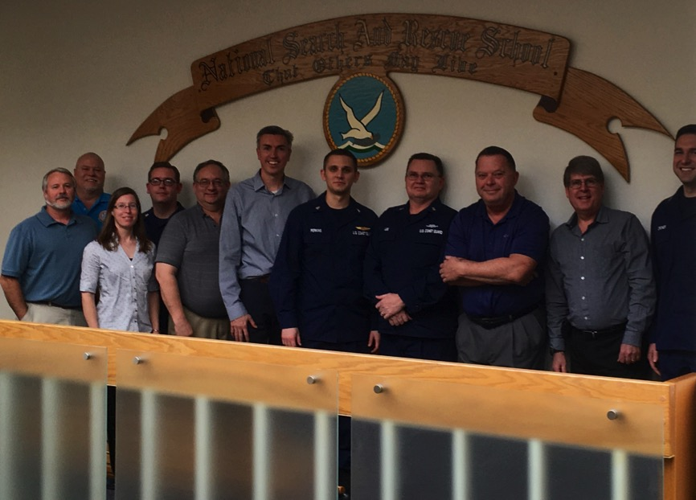
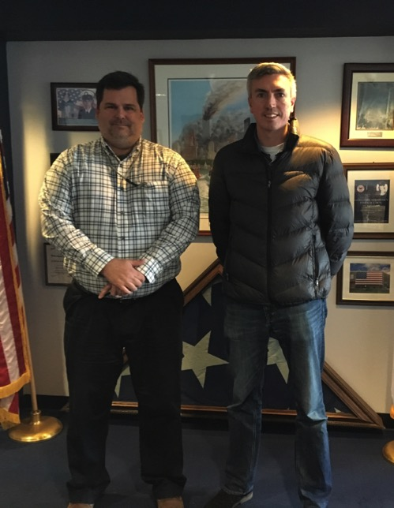


2016 Surface Current Drifter Skill Score
Navy HYCOM Region 1
No HFR Assimilation
HFR Data
Active Education & Outreach to USCG Users of the HFR Data & Data Assimilative Products
National Search and Rescue School
Yorktown, VA
January 19, 2017
Coast Guard Sector NY
Staten Island, NY
March 21, 2017

Slide 24

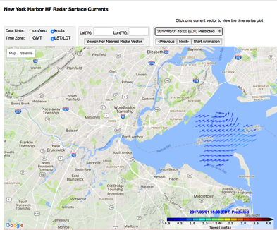





Nested High Resolution HF Radars in NOAA PORTS
5 MHz- 17 Stations
13 MHz- 7 Stations
25 MHz- 16 Stations
Outside- 6 Stations
TOTAL – 46 Stations
Winter Storm Jonas
2016/01/23 20:00 UTC

Slide 25



Medium Range HF Radar Network – Nearshore Waves
New Jersey 13 MHz
HFR wave observations combined with co-located Surfcams
Gap fills a sparse buoy network in regions of high variability & interest

Slide 26



Medium Range HF Radar Network – Tsunami Detection
June 13, 2013 Meteo-tsunami
New Jersey 13 MHz

Slide 27







Mid-Atlantic Bight Glider Fleet
RU01
RU15
RU29
G1
G1-Ruggedized
G2
Satellite Ocean Color
Satellite SST
Operated in water depths ranging from 1200 m to as shallow as 5 m
Subsurface
Glider
Data
Industry Partner: Teledyne Webb Research

Slide 28




Gliders are configurable with a wide variety of sensors
Acoustic Modem
ADCP/DVL
Altimeter
Bathyphotometer (bioluminescence)
Beam Attenuation Meter
Echo Sounder
Optical Backscatter
Optical Attenuation
Oxygen
Conductivity, Temperature, Depth
Fish Tracking
Fluorometer
Hydrocarbon
Hydrophones
Nitrates
PAR sensor
Radiometer
Scattering Attenuation Meter
Spectrophotometer (red tide)
Turbulence
Wave Accelerometer
Internal Payload Bay
Internal
External Payload Area
External Mounted

Slide 29

Rutgers Glider Lab

Slide 30



Rutgers 2003-2016 Glider Statistics

Slide 31




Glider Data QA/QC
Quality Assurance Project Plan:
Glider Mission Planning
SeaBird CTD
Aanderra Optode 3835
Documents for pre- and
post- deployment glider, CTD and DO QA
QARTOD

Slide 32

Rutgers ROMS 4DVAR uses all available data
from a modern coastal ocean observing system
  more and diverse data is better (T, S, u, sea level)
  bias correction to OBC and MDT is essential
Useful subsurface skill for real-time applications:
  4 days for temperature and salinity;
  1-2 days for velocity
Future directions: variational methods for
observing system design; coupling; ecosystems
correlation
Forward model
Forward model
after bias removal
Data assimilation
analysis/hindcast
depth
2-day forecast
4-day forecast
Bottom temperature
Data used [… real-time SOURCE]
*THREDDS Data Server
72-hour forecast NAM 0Z cycle at 2 am EST [NCEP NOMADS]
RU regional CODAR hourly [RU TDS*]
RU glider T,S [RU TDS]
USGS daily average flow available 11:00 EST [USGS waterdata]
AVHRR IR passes 6-8 per day [MARACOOS TDS]
REMSS MW-IR blended SST daily average [NASA PO-DAAC]
HYCOM NCODA 7-day forecast updated daily [NRL]
Jason-2, CryoSat, AltiKa along-track altimeter OGDR [RADS.nl]
SOOP XBT/CTD, Argo floats, on GTS [NOAA OSMC ERDDAP]

Slide 33


Hurricane Irene
August 27-28, 2011
NOAA/NHC:
Damage >$16B ( #7)
Track Accurate
Intensity Over-predicted
Two Gliders Deployed

Slide 34



Operations to Research (O2R) Demonstrated
Integrated
Ocean Observatory
identifies processes responsible for rapid ahead-of-eye cooling.
Atmospheric
model sensitivities identify ahead-of-eye cooling as the missing process for rapid de-intensification
NOAA OAR

Slide 35









Technologies Developed - Rapid Response Storm Glider – NOAA, ONR Gliders
Rapid Response Glider (v1)
Un-pumped Seabird Conductivity Temperature Depth (CTD), Wetlabs ECOpuck (CDOM, Chlorophyll, Backscatter), Aandera Optode (Oxygen).
Rapid Response Glider (v2)
Pumped CTD, Externally mounted Nortek Aquadopp Current Profiler, integrated accelerometer, extended battery bay, Thruster G1.
Rapid Response Glider (v3)
Integrated current profilers, expanded capacity buoyancy pumps, thruster G2, integrated LISST-200X particle sizer (sediment, oil droplet, phytoplankton, etc.).

Slide 36





R2O - Hurricane Hermine - Glider Fleet Launched, 9/2016
Glider RU30
HYCOM
RTOFS
Next Step: Data Assimilation

Slide 37





A Global Challenge – The Challenger Glider Mission
December 9, 2009 – Baiona, Spain
North Atlantic
NOAA OAR AA
Rick Spinrad’s
Global Glider Challenge:
Build a Global Glider Fleet
and Coordinate the First
Robotic Circumnavigation.
Revisit the Historic Track of the
HMS Challenger –
And inspire a global network
of students along the way.
HMS Challenger Voyage
First Scientific
Circumnavigation
1872-1876
128,000 km =
= 16 gliders
x 8,000 km/glider
South Atlantic

Slide 38



Challenger Glider Mission – Indian Ocean - 3 Legs Planned
5,200 km in
6.5 months
Contributions to the
Second International Indian Ocean Experiment (IIOE-2)
Data is shared Internationally through IMOS, IOOS, and GTS
Data is compared to mesoscale features in the Global Ocean Models
Students are Trained in glider piloting, data and model interpretation

Slide 39

Challenger Glider Mission – Leg 1 with BMKG Academy Students

Slide 40




Challenger Glider Mission: RU29 Leg from Perth to Sri Lanka
Track:
Nov 2016 - Present
Temperature Profile
Time Series
Salinity Profile Time Series
RAMA Rendezvous
Planned with BMKG in March, 2017
RU29 now 55 km south of RAMA 0S 90E
Will rapidly profile nearby for a few days
Suggestions welcomed
Real time data available – IOOS
Highest resolution data available at recovery

Slide 41

Glider Comparison to Ocean Model – Copernicus

Slide 42

Glider Comparison to Ocean Model - British

Slide 43

Glider Comparison to Ocean Model - HYCOM

Slide 44


Rutgers - Center for Ocean Observing Leadership:
Global Ocean Education Training Center
Undergraduate courses on Ocean Observing
International training opportunities through 1-2 month summer internships
On site/skype courses and training with international partners
Glider School – Spain
HF Radar School – South Africa

Slide 45



Rutgers Masters Degree in Integrated Ocean Observatories
Training a new workforce:
Capable of working together as a team to operate new observing technologies in frontier areas.
Curate the data flow from the sea to the scientist (themselves).
Produce products & forecasts with quantifiable uncertainties appropriate to inform decision makers.
15 Month Masters Degree Graduate Program (Lecture and Research Credits)
Introduction to Physical Oceanography and Biological Oceanography (From Undergraduate)
Software Bootcamp (Analysis Tools, Common File Formats, and QA/QC)
  Integrated Ocean Observing I & II (Platforms and Sensors)
  Ocean Observing Field Lab I & II (hands-on opportunities within an operating ocean observatory)
  Ocean Observing Cyber Lab I & II (data analysis techniques, model operation and validation)
  Thesis - MTS/IEEE Oceans Manuscript Process

Slide 46

Summary:
Integrated, Sustained and Certified Regional Ocean Observing Systems are operating in the U.S.
Transformational Observing Technologies (HF Radar & Gliders) Key to Success
Integrated approach demonstrates every day that knowledge of the ocean improves weather forecasts
Global Glider & HF Radar networks are forming – participation is welcomed
Indian Ocean Glider/Model Validation Mission ongoing – collaborators are welcomed
Workforce Training is ongoing – students are welcomed – BMKG Academy, Rutgers Masters Operational Oceanography

