Slide 1
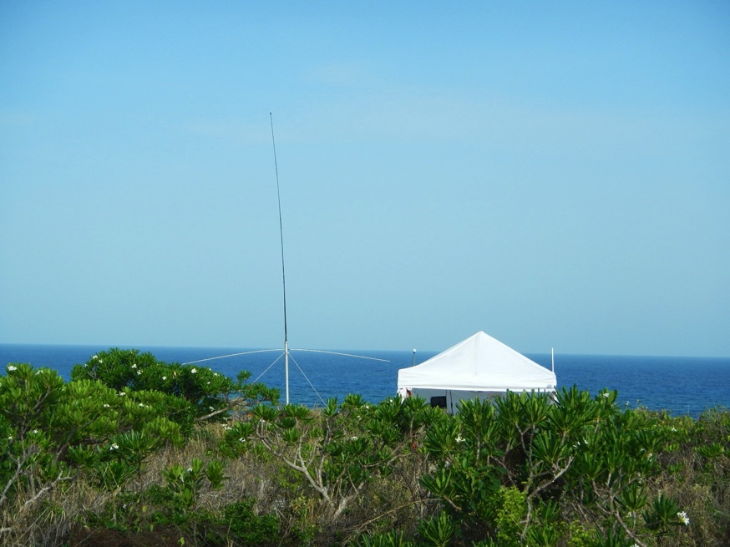
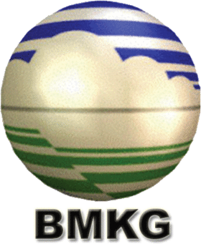
Globalizing Frontier Technologies for Integrated Ocean-Atmosphere Observing & Forecasting:
Promoting International Partnerships for Research, Education and Service to Society
Scott Glenn,
Josh Kohut &
Hugh Roarty
Rutgers University,
New Brunswick, New Jersey, USA
CODAR HF Radar on
Mona Island, Puerto Rico

Slide 2
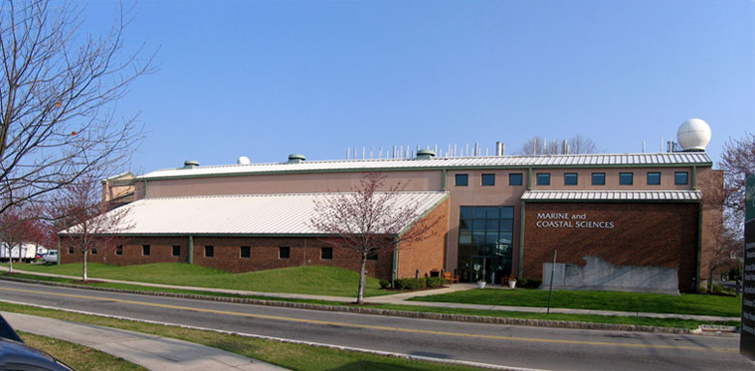

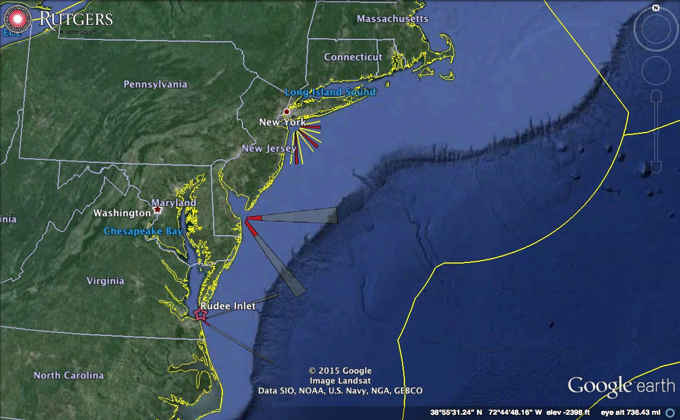
25 Years of Ocean Observing at:
Rutgers University (RU)
Center for Ocean Observing Leadership (COOL)
Department of Marine and Coastal Sciences (DMCS)
71 Dudley Road, New Brunswick, New Jersey, USA
http://rucool.marine.rutgers.edu
Dr. Scott Glenn
Distinguished Professor
MARACOOS Principal Investigator
U.S. Committee for IOC Chair
glenn@marine.rutgers.edu
Dr. Josh Kohut
Associate Professor
MARACOOS Fisheries Lead
Water Quality SAB
kohut@marine.rutgers.edu
Dr. Hugh Roarty
Operations Center Director
MARACOOS HFR Lead
GEO Global HFR Chair
hroarty@marine.rutgers.edu

Slide 3
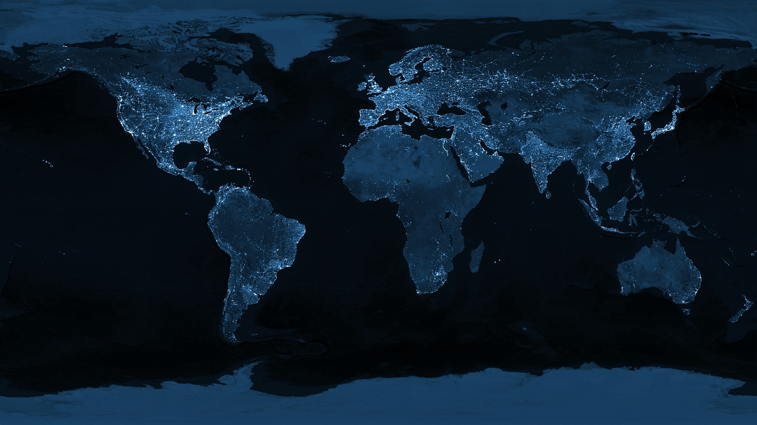
Our Student’s Grand Challenge: Transform This World
“The Earth at Night” as Observed from Space
Data Source: Defense Meteorological Satellites Program

Slide 4
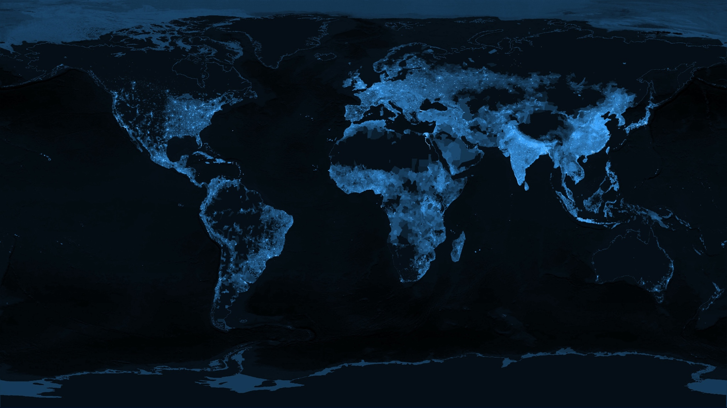
Into This World
“The Earth at Night” based on Global Population
Data Source: SEDAC

Slide 5
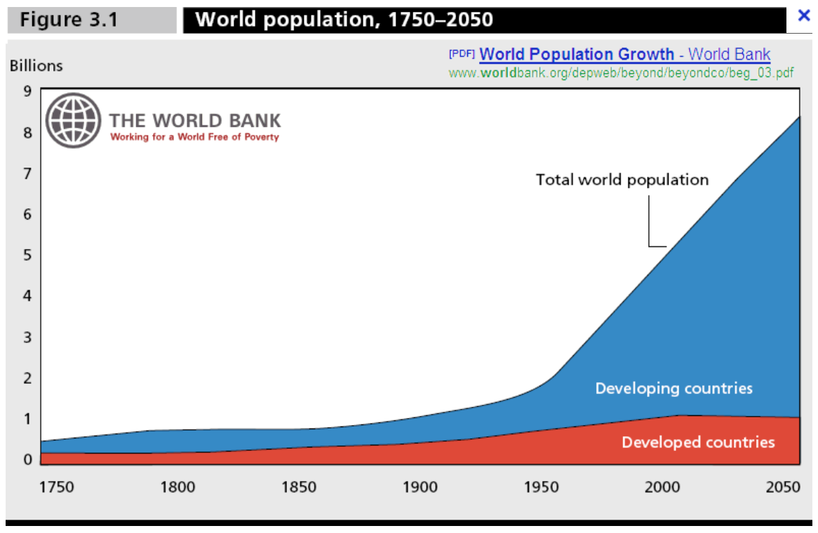
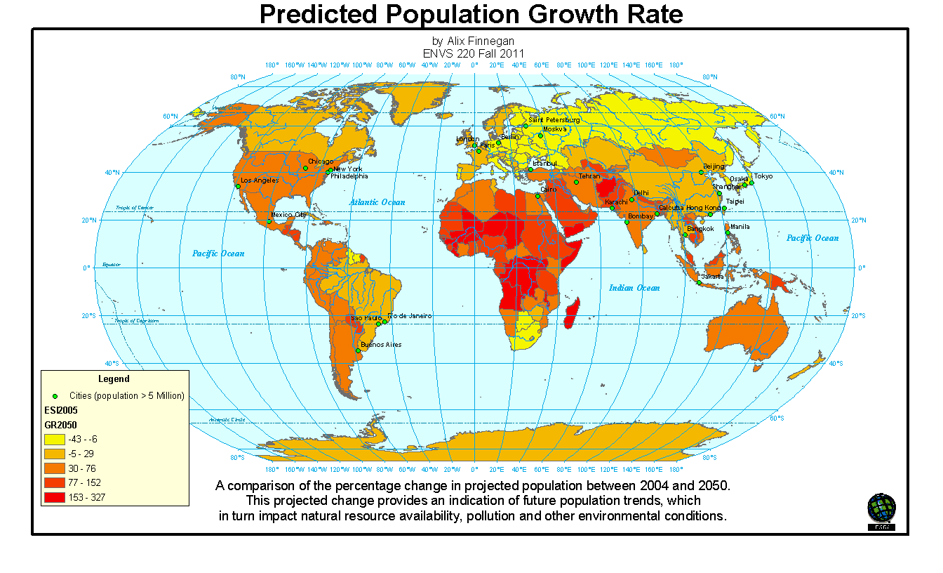
While the Population is Growing

Slide 6
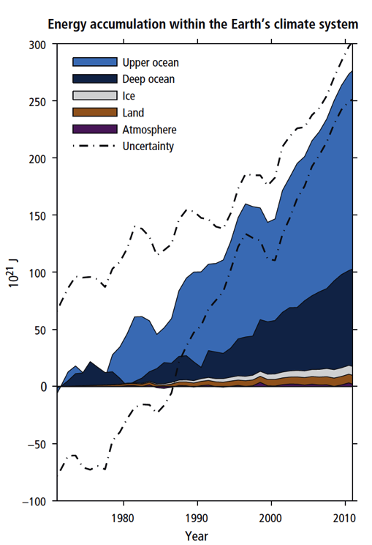
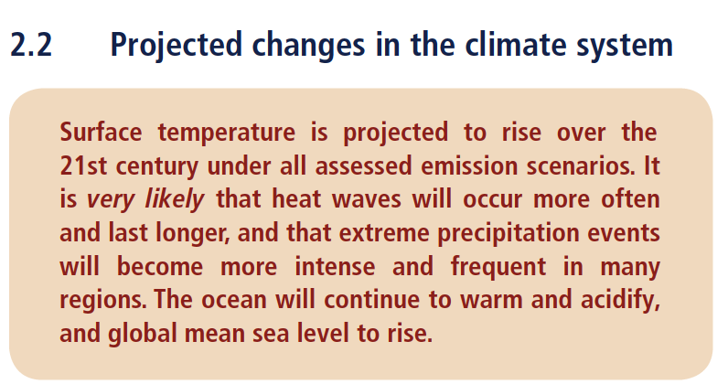
And the Earth is Changing
“Warming of the climate system is unequivocal”
“Ocean warming dominates the increase in energy stored in the climate system”
IPCC Fifth Assessment Report (AR5)

Slide 7
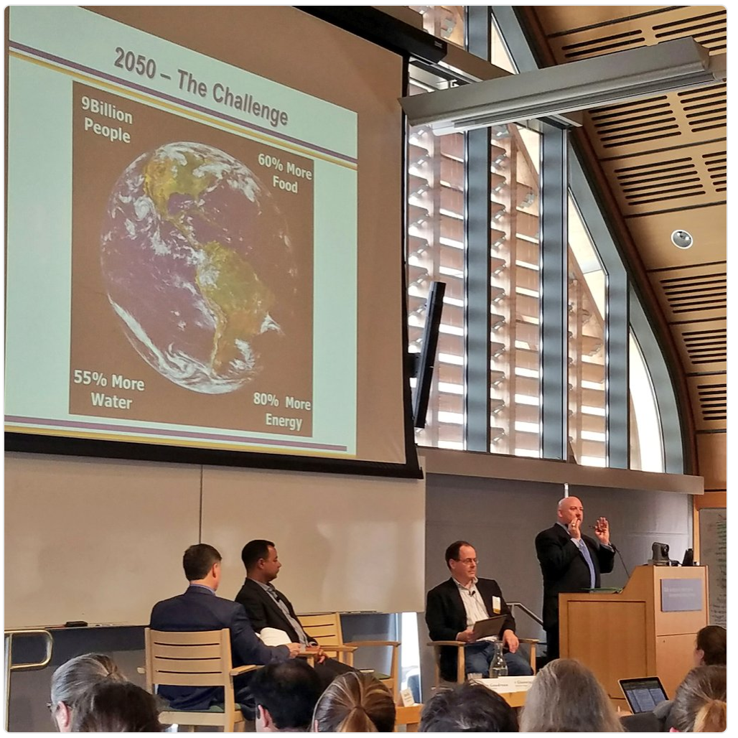

Slide 8
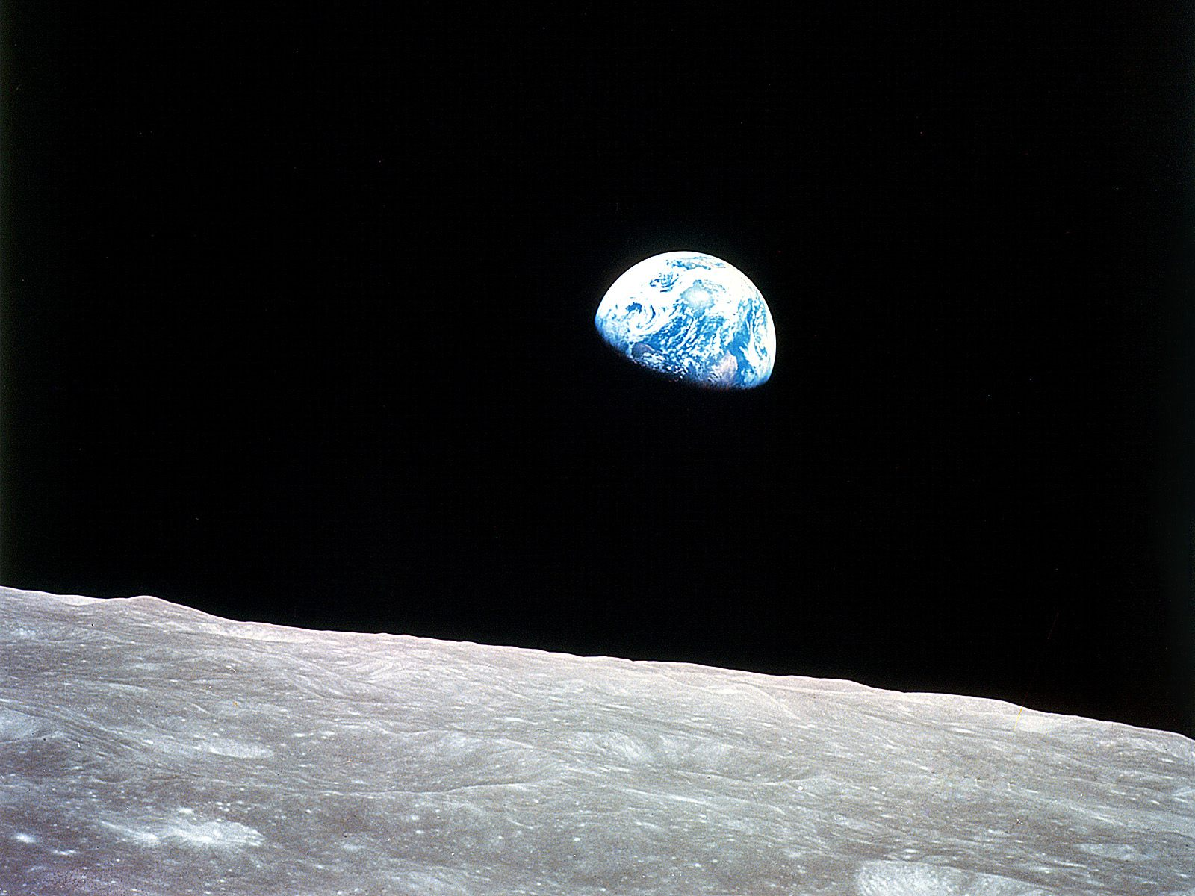

Solutions will involve the Sea
“No Water, No Life.
No Blue, No Green.”
- Sylvia Earle
Community College Graduate
First Hero of the Planet

Slide 9
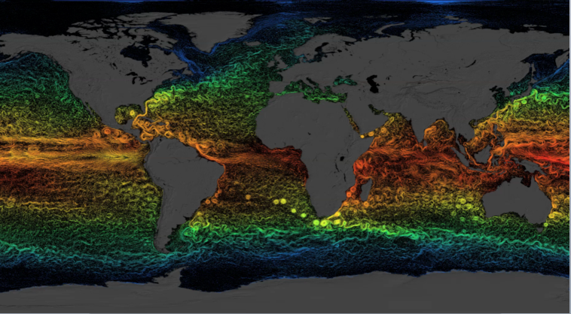
But the Ocean is Physically Complex & Biologically Diverse
Global circulation dominated by the Mesoscale

Slide 10
But the Ocean is Physically Complex & Biologically Diverse
61 Large Marine Ecosystems

Slide 11
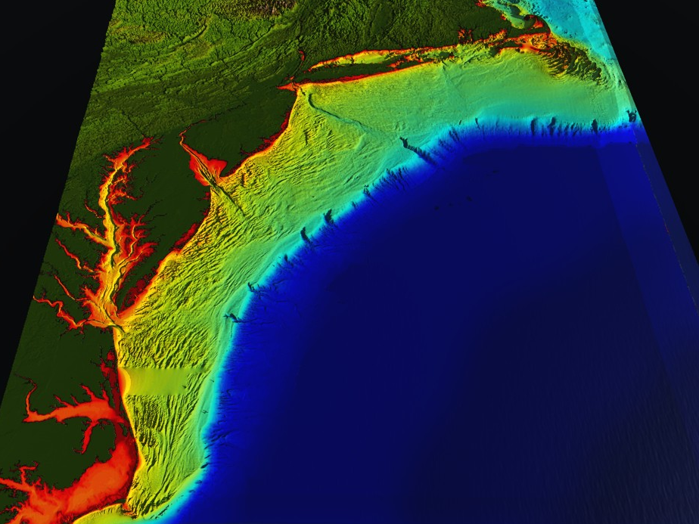
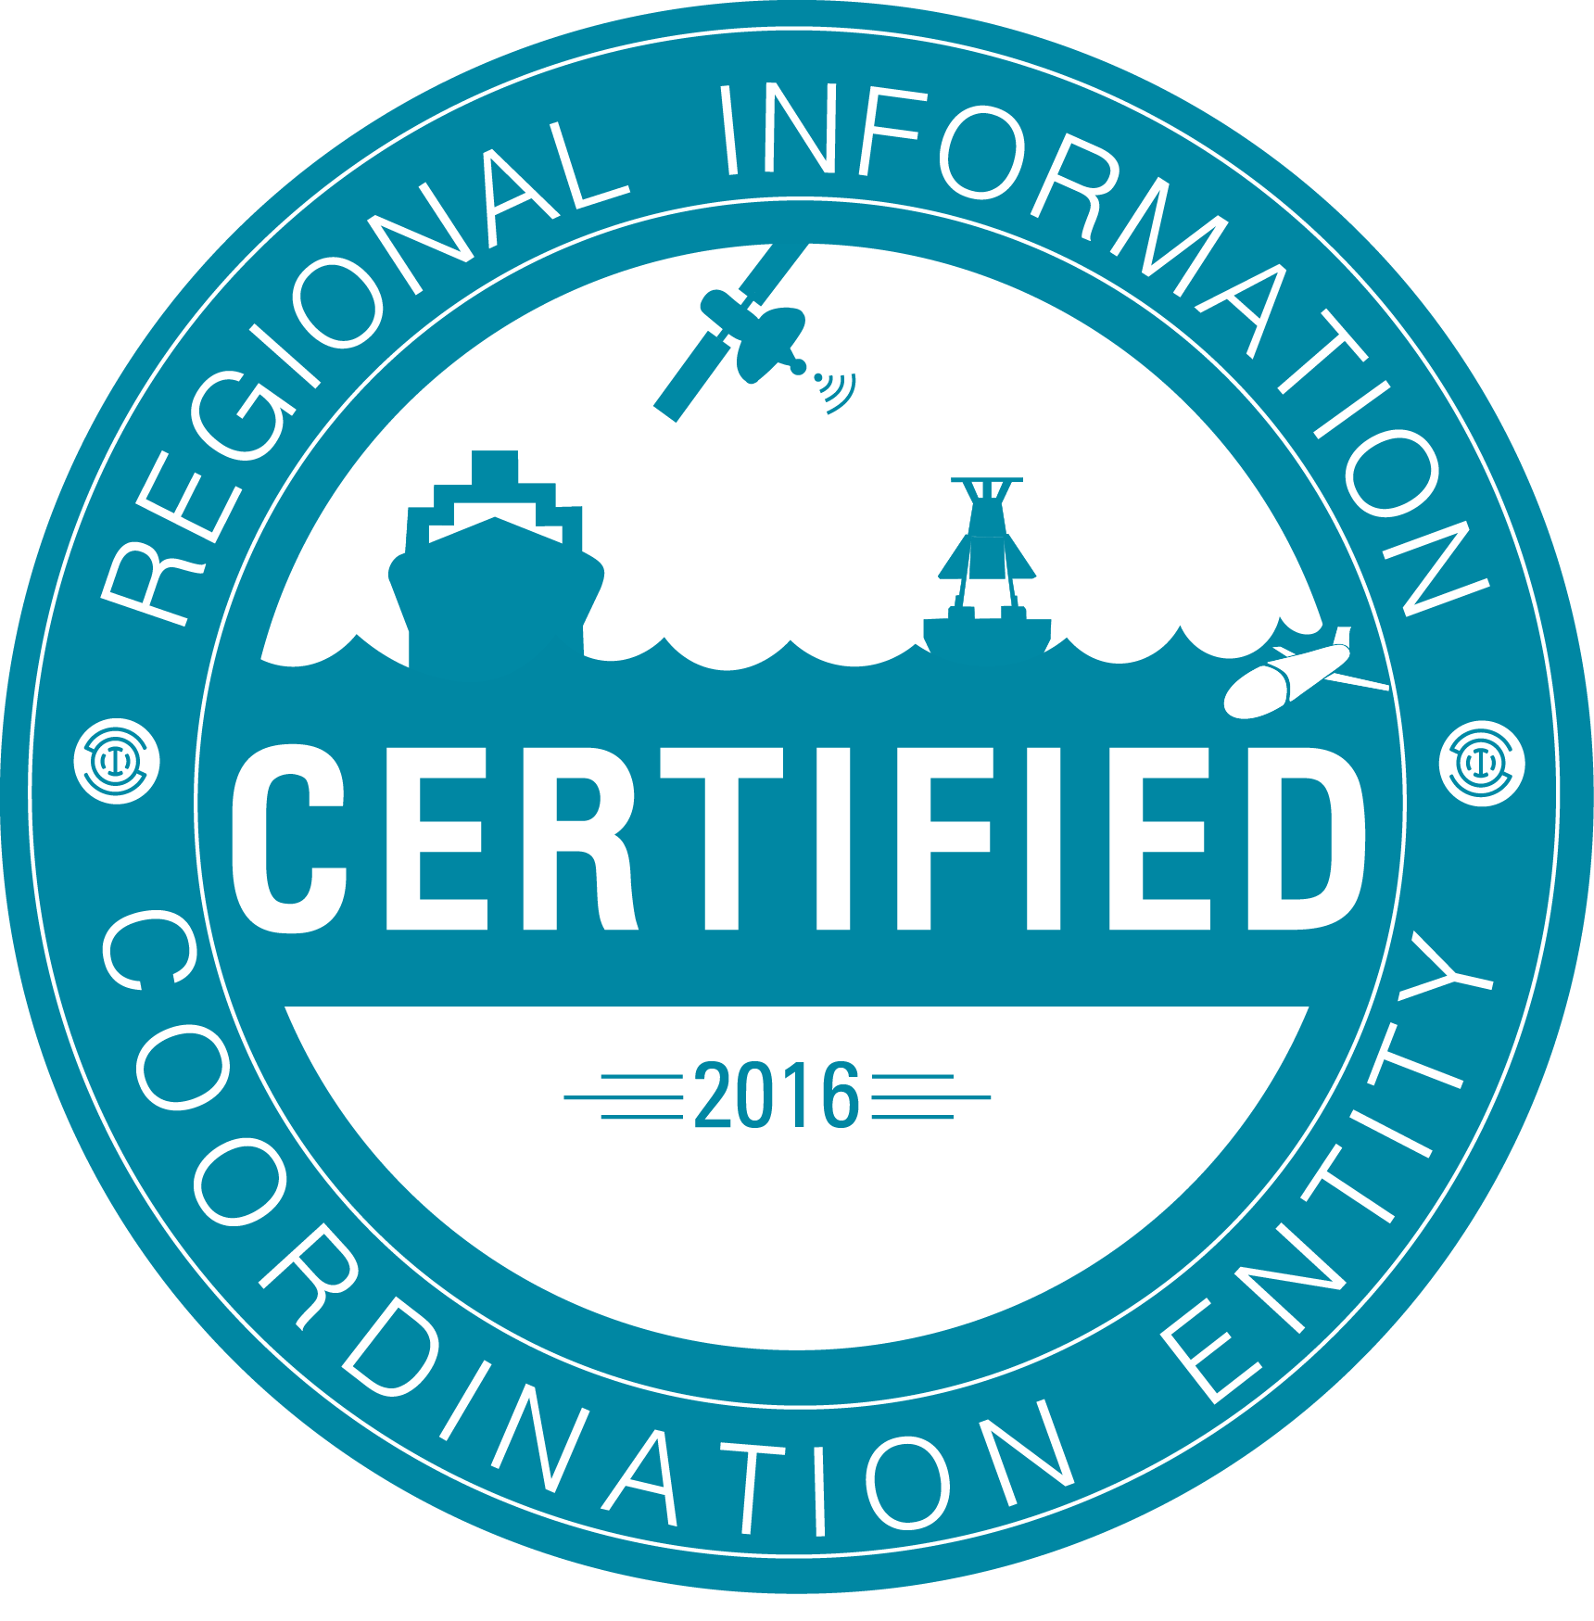

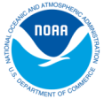


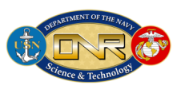


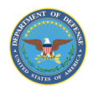




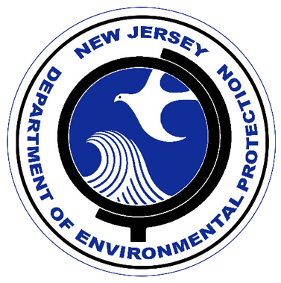


RI
U..
Middle Atlantic
Regional Association
Coastal
Ocean Observing System
10 States - 76 Million People
1000 km Cape to Cape
CT
Cape
Cod
MA
NY
PA
NJ
MARACOOS:
An Integrated, Sustained & Certified Real-time Observation and Forecast System
DE
MD
VA
NC
Cape
Hatteras
Notes:
11

Slide 12
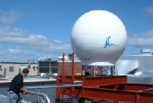
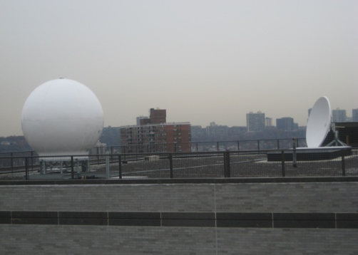
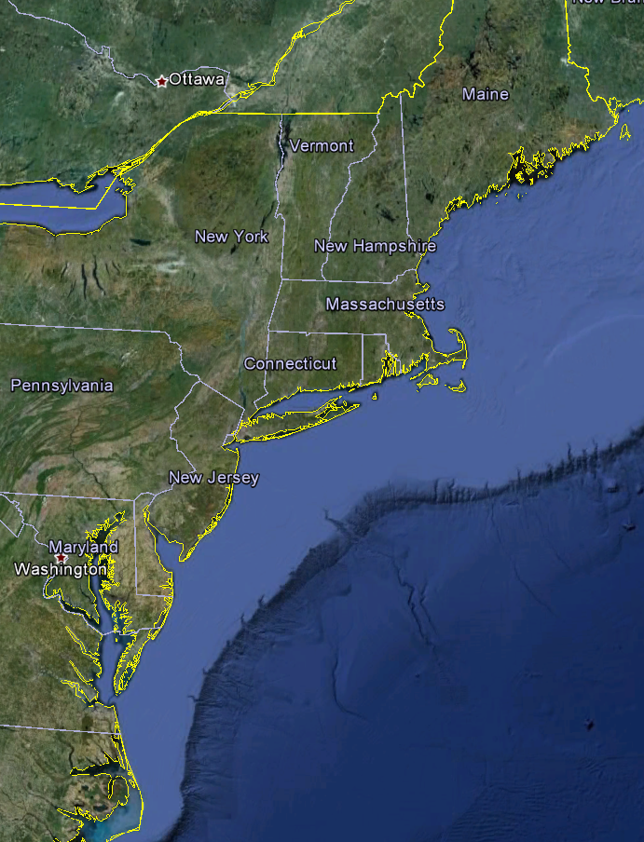
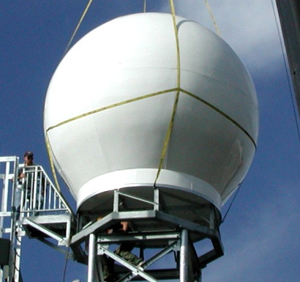
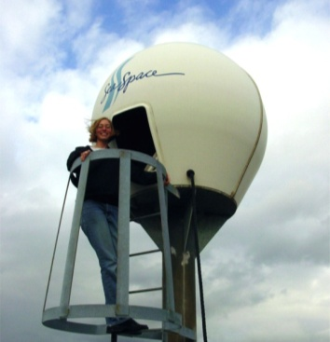
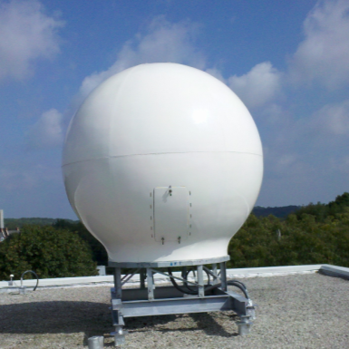
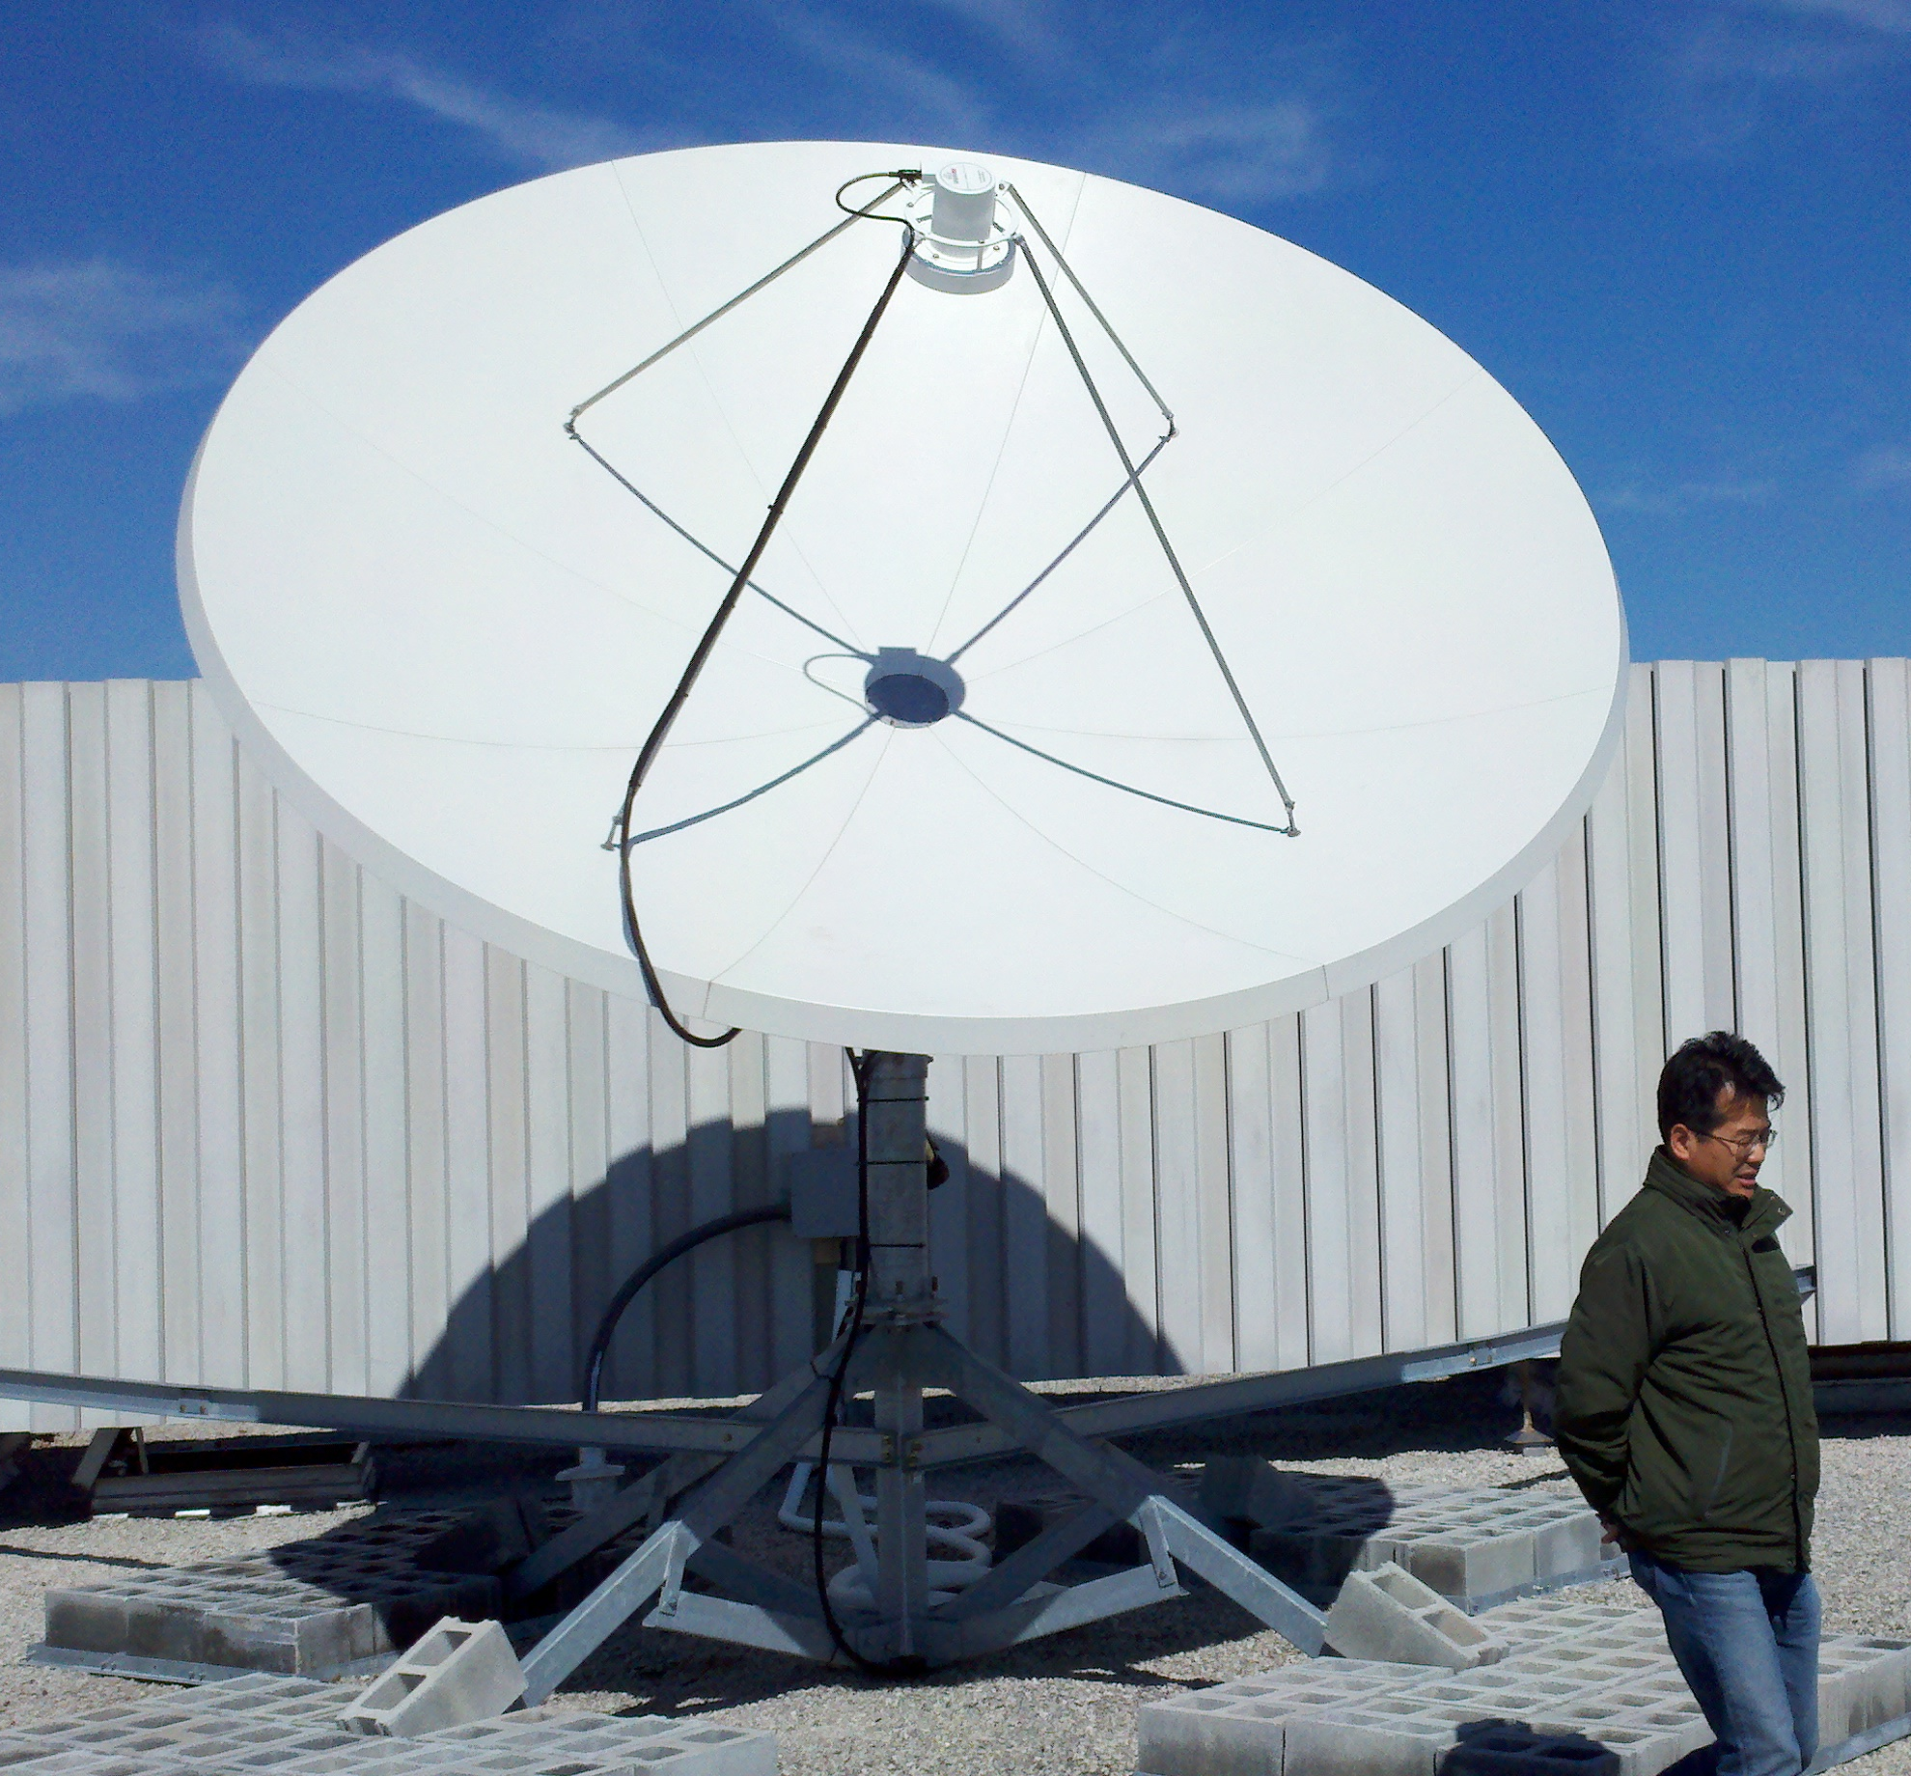
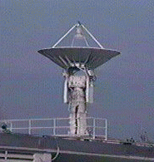

Real-Time Satellite Data Acquisition: Regional Groundstations
Satellites: NPP, Terra, Aqua, NOAA Polar Orbiters, Metop & GOES
U. Maine
City College of N.Y.
Rutgers
Industry Partner: SeaSpace
U. Delaware
Johns Hopkins

Slide 13
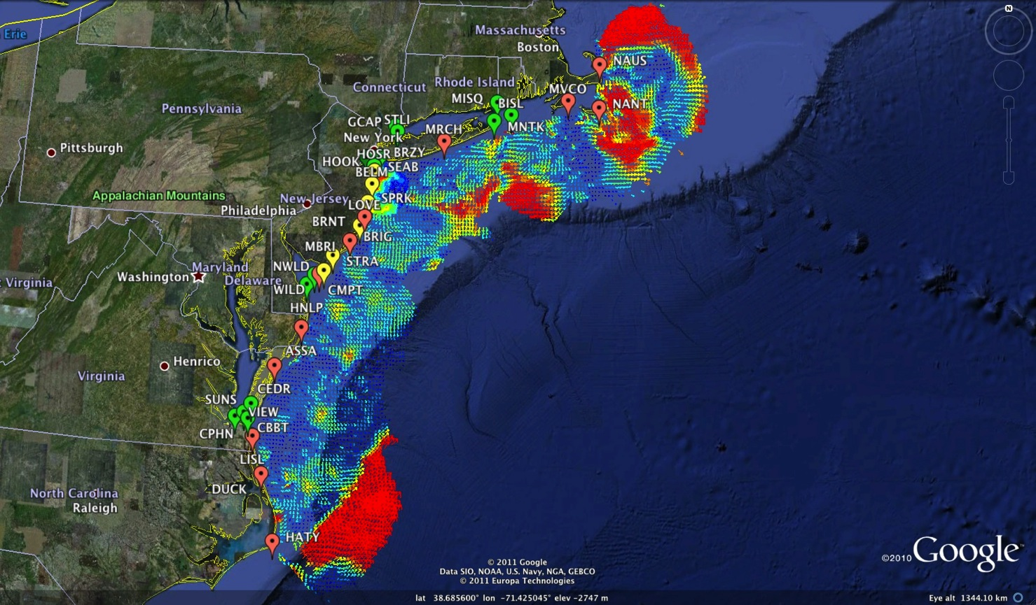
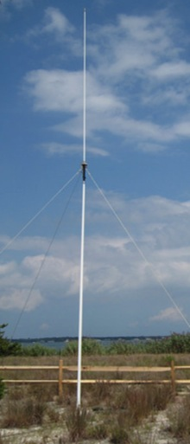
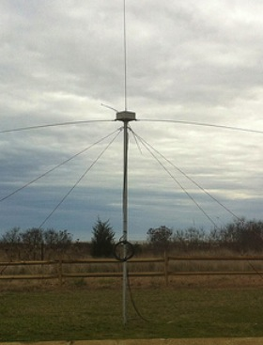
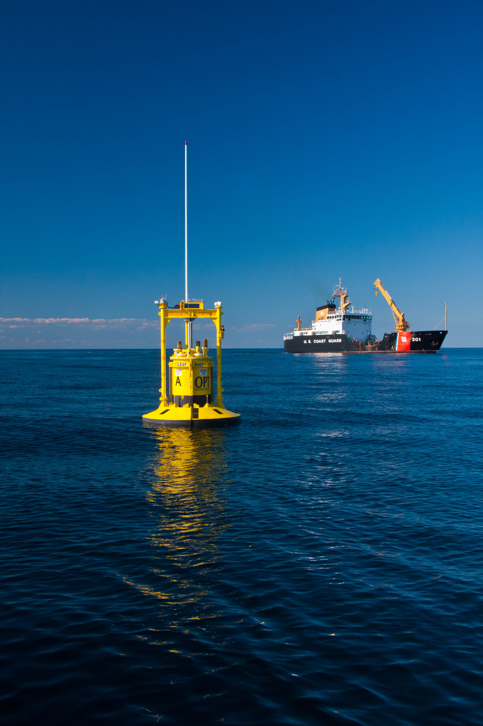
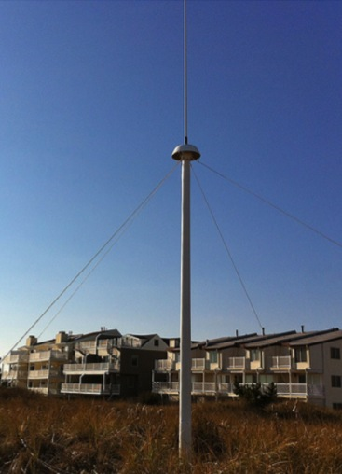
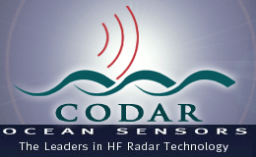
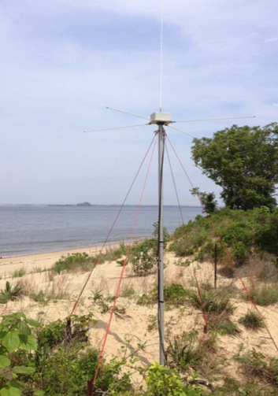
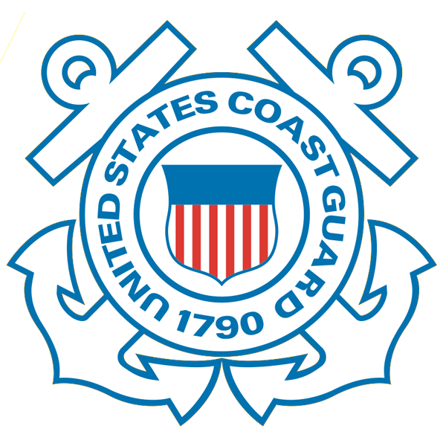
Mid-Atlantic Bight HF Radar Network
1000 km
Cape to Cape
Mid-Atlantic HF Radar Network
17 Long-Range CODARs
7 Medium-Range CODARs
17 Short-Range CODARs
41 Total CODARs in Region
+5 CODARs outside Region
46 Total CODARs
Triple Nested, Multi-static, Multi-use
Industry Partner: CODAR Ocean Sensors

Slide 14
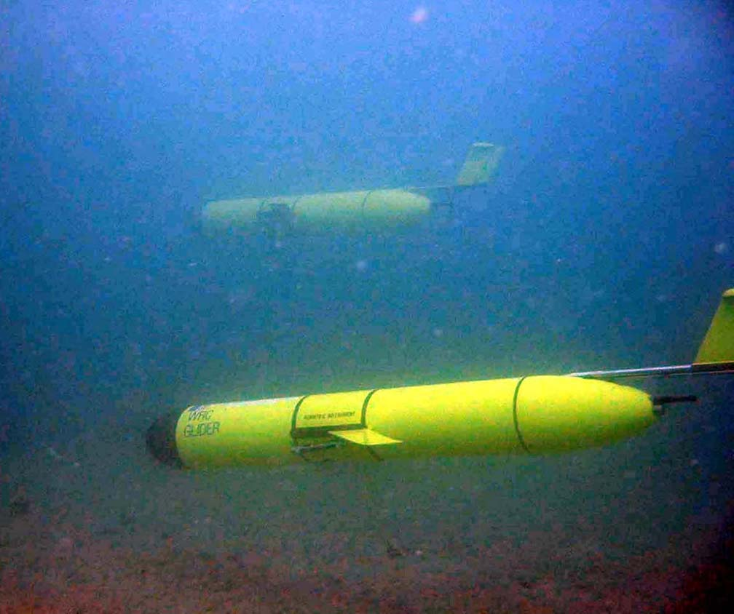
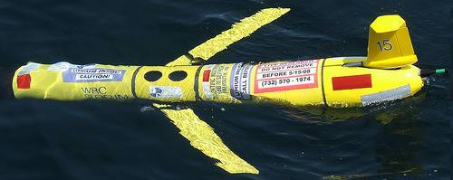
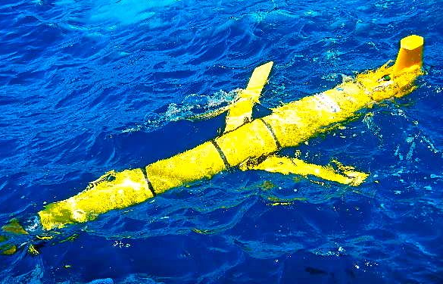
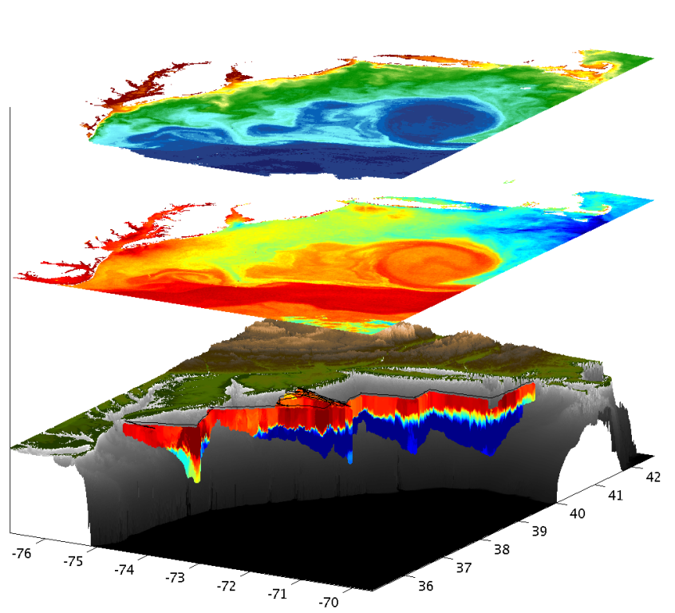
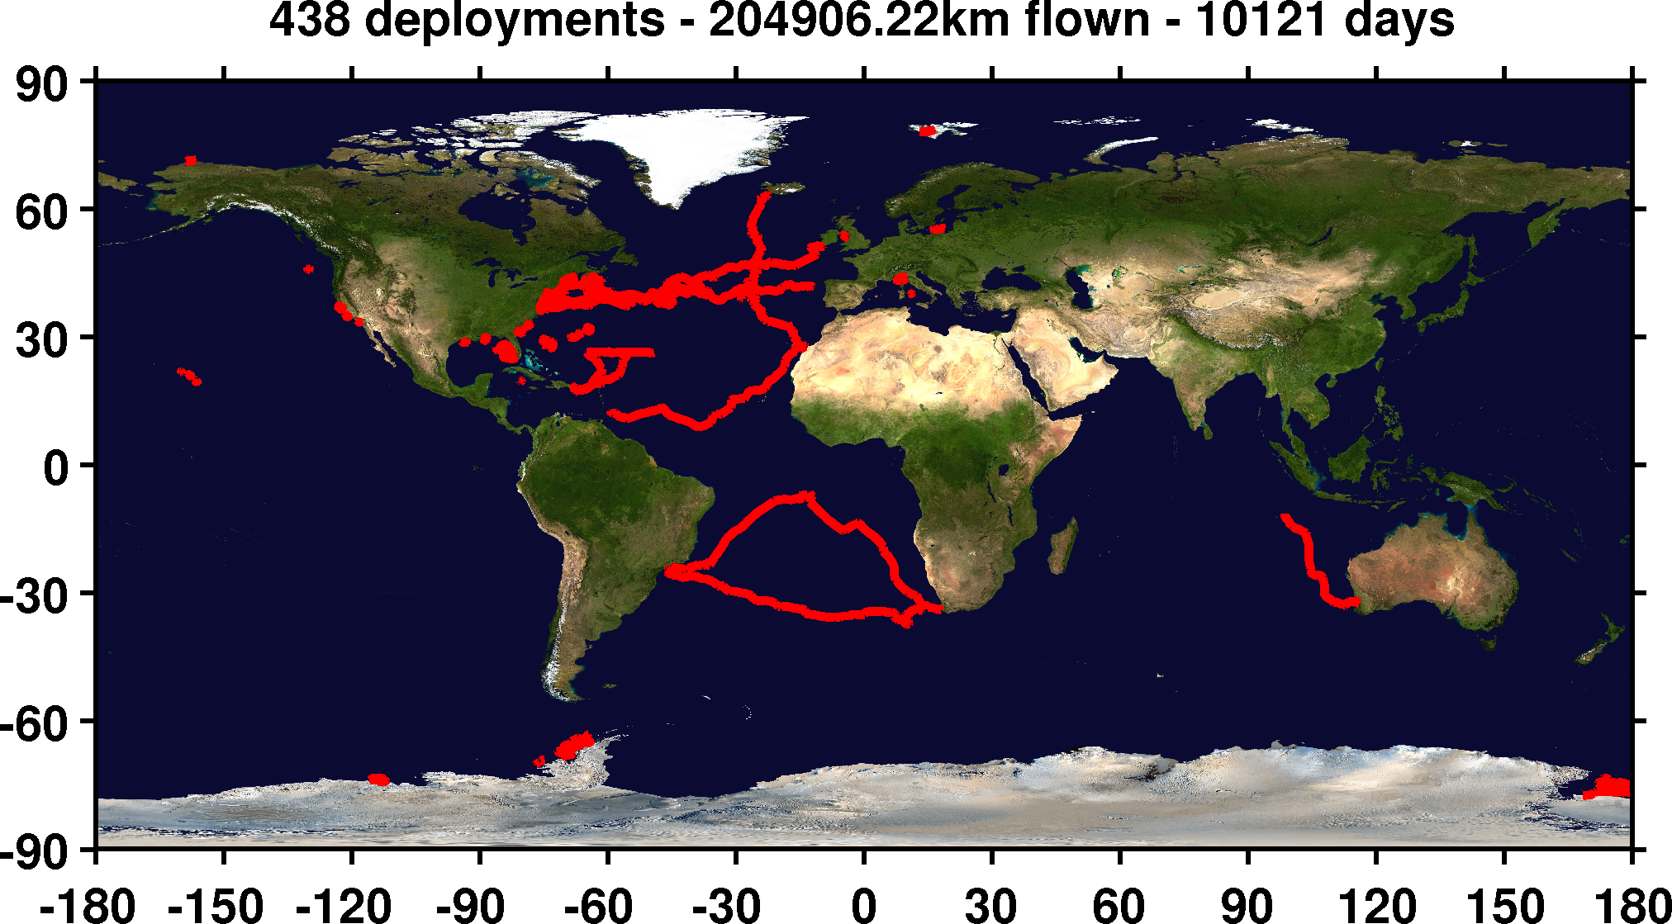
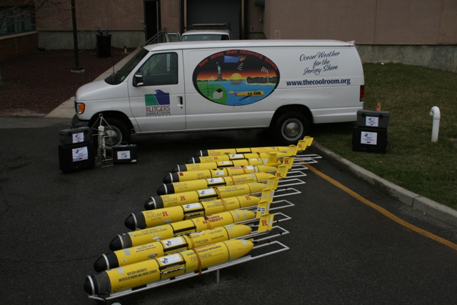

Mid-Atlantic Bight Glider Network
RU01
RU15
RU29
G1
G1-Ruggedized
G2
Satellite Ocean Color
Satellite SST
Subsurface
Glider
Data
Industry Partner: Teledyne Webb Research

Slide 15
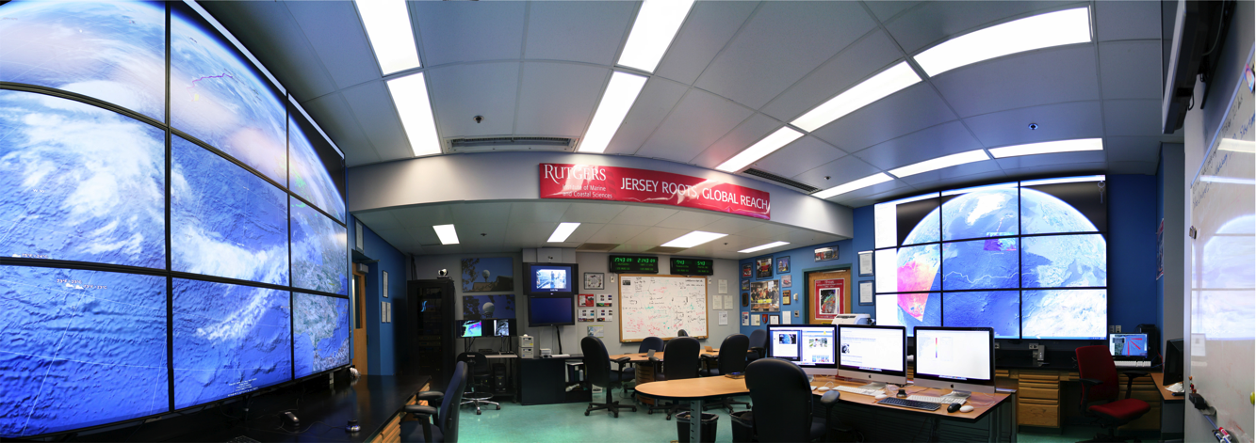
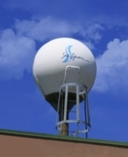
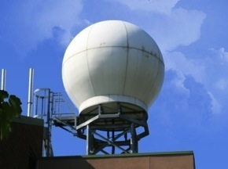
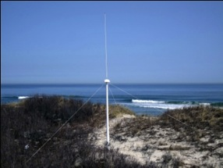
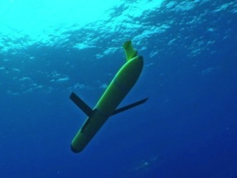
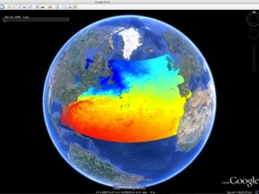
Rutgers - Center for Ocean Observing Leadership:
Observatory Operations Center
Satellite Data Acquisition Stations
CODAR Network
Glider Fleet
3-D Forecasts

Slide 16
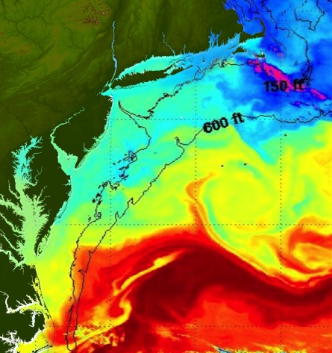
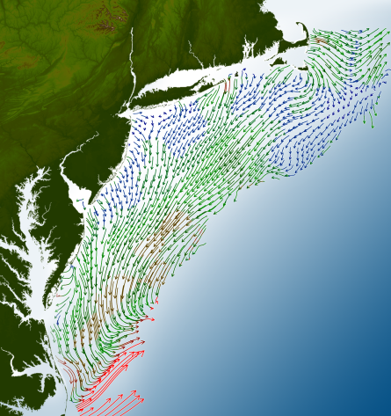
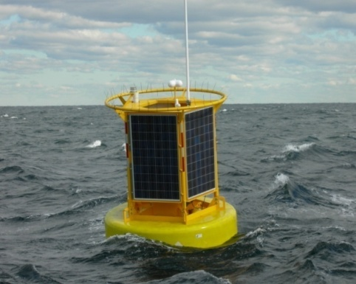





Regional Ocean Data Products
Satellites
HF radar
Gliders
Fixed Platforms
Assimilated by an Ensemble of Ocean Models
Ocean Forecasts coupled to Atmospheric Forecasts

Slide 17






A Global Challenge – The Challenger Glider Mission
December 9, 2009 – Baiona, Spain
North Atlantic
Ralph Rayner & Rick Spinrad’s Global Challenge:
Build a Global Glider Fleet
and Coordinate the First
Robotic Circumnavigation.
Revisit the Historic Track of the
HMS Challenger –
And inspire a global network
of students along the way.
HMS Challenger Voyage
First Scientific
Circumnavigation
1872-1876
128,000 km =
= 16 gliders
x 8,000 km/glider
South Atlantic

Slide 18

The Challenger Glider Mission – Present Status and Future Plans
Second International Indian Ocean Experiment (IIOE-2)
Data is shared Internationally through IMOS, IOOS, and GTS
Data is compared to mesoscale features in the Global Ocean Models
Students are Trained in glider piloting, data QA/QC, model interpretation

Slide 19


The Challenger Glider Mission – Present Status and Future Plans
3000 km to go
3500 km in 4.5 months

Slide 20

The Challenger Glider Mission – Present Status and Future Plans

Slide 21

The Challenger Glider Mission – Present Status and Future Plans

Slide 22

The Challenger Glider Mission – Deep Ocean Model Validation

Slide 23

The Challenger Glider Mission – Deep Ocean Model Validation

Slide 24

The Challenger Glider Mission – Deep Ocean Model Validation

Slide 25

The Challenger Glider Mission – Deep Ocean Model Validation
RTOFS (USA)
Copernicus (EU)
British (UK)

Slide 26

The Challenger Glider Mission – Glider Currents vs HYCOM Model

Slide 27

The Challenger Glider Mission – Glider Currents vs Copernicus Model

Slide 28


Rutgers - Center for Ocean Observing Leadership:
Global Ocean Education Training Center
Undergraduate courses on Ocean Observing
International training opportunities through 1-2 month internships
On site courses and training with international partners
Glider School – Spain
HF Radar School – South Africa
Climate - Indonesia

Slide 29



Operational Masters Degree in Integrated Ocean Observatories
Training a new workforce:
Capable of working together as a team to operate new observing technologies in frontier areas.
Curate the data flow from the sea to the scientist (themselves).
Produce products & forecasts with quantifiable uncertainties appropriate to inform decision makers.
15 Month Masters Degree Graduate Program (Lecture and Research Credits)
Introduction to Physical Oceanography and Biological Oceanography (From Undergraduate)
Software Bootcamp (Analysis Tools, Common File Formats, and QA/QC)
  Integrated Ocean Observing I & II (Platforms and Sensors)
  Ocean Observing Field Lab I & II (hands-on opportunities within an operating ocean observatory)
  Ocean Observing Cyber Lab I & II (data analysis techniques, model operation and validation)
  Thesis - MTS/IEEE Oceans Manuscript Process

Slide 30

Summary:
Integrated, Sustained and Certified Regional Ocean Observing Systems are operating in the U.S.
Transformational Observing Technologies (HF Radar & Gliders) Key to Success
Global HF Radar & International OceanGlider Networks are now being developed for GOOS
Many additional ways to participate – ORCA, EGO, Challenger, …
Workforce Training is essential – Rutgers new Masters program designed to fill the training gap
We look forward to working more with the Maritime Continent in the coming years

