Slide 1



78 Million People (1/4 of U.S.)
1000 km Cape to Cape
U..
Middle Atlantic
Regional Association
Coastal
Ocean Observing System
Cape
Cod
Stratified
Coastal Ocean Interactions with
Tropical Cyclones
Sandy
Irene
Barry
Scott Glenn, Travis Miles,
Greg Seroka, Robert Forney,
Hugh Roarty, Oscar Schofield, Josh Kohut (Rutgers),
Yi Xu (China) & Fei Yu (China)
Nature Communications (2016)
Arthur
Cape
Hatteras
Notes:
1

Slide 2
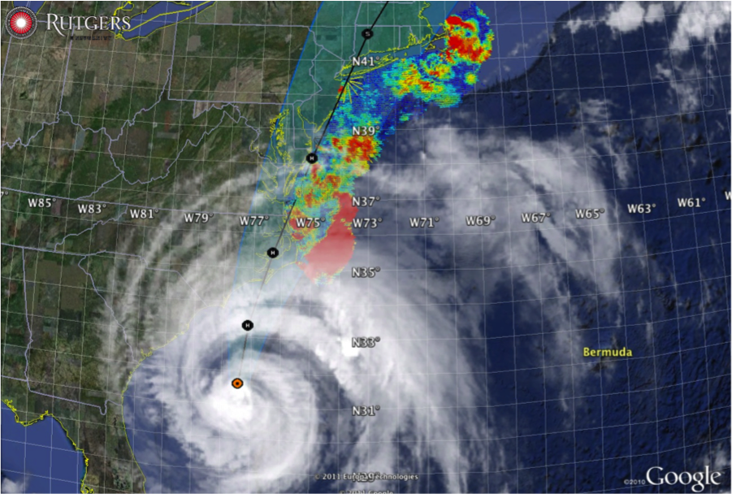

Hurricane Irene
August 26, 2011
NOAA/NHC Damage:
#7 with >$16 Billion.
Track Accurate;
Intensity Over-predicted.
Hurricane Sandy
October 29, 2012
NOAA/NHC Damage:
#2 with >$68 Billion.
Track Accurate;
Impact Under-predicted.

Slide 3
Hurricane Irene
August 26, 2011
Summer stratification
Coastal response
Mixing cooled surface
Limited intensity
Conclusion
(Up Front)
Hurricane Sandy
October 29, 2012
After Fall transition
Single layer ocean
No mixing/cooling
No intensity reduction

Slide 4
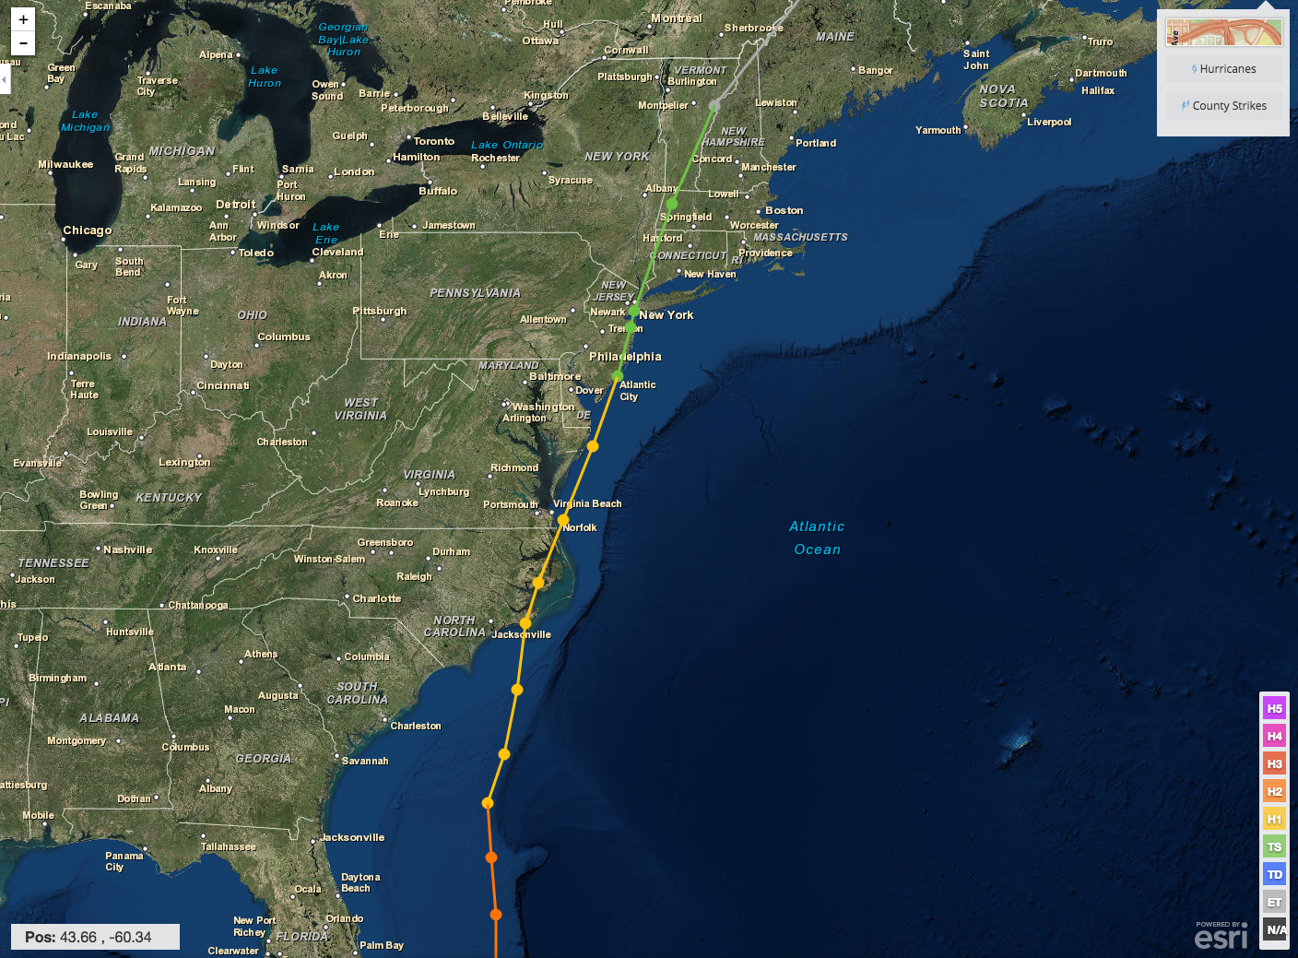
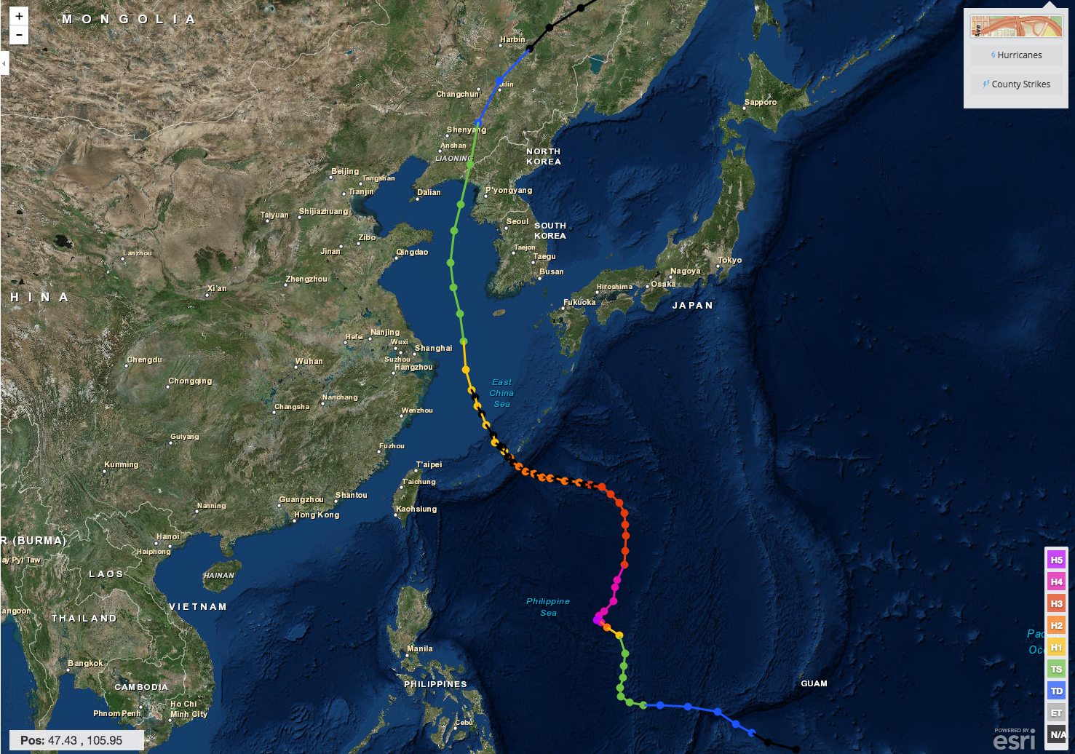
Hurricane Irene & Super-Typhoon Muifa:
What do these summer of 2011 storms have in common?
Hurricane Irene
26-29 August 2011
Super-Typhoon Muifa
26 July - 9 August 2011

Slide 5
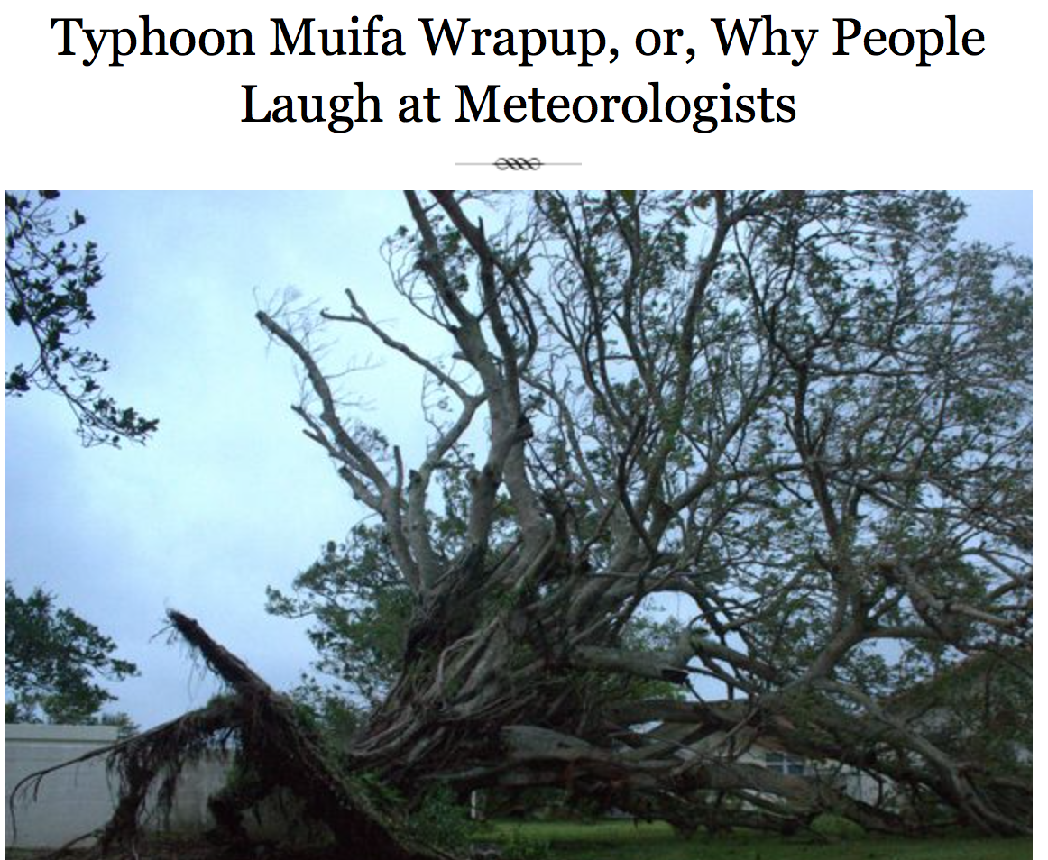
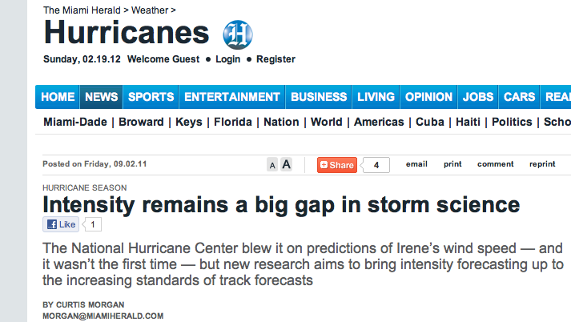

Pre-Irene warnings
2 million people ordered to “flee the storm’s path”.
President Obama: Shaping up to be a “historic hurricane” and urged residents to “be prepared for the worst”. “Don’t wait. Don’t delay.”
New Jersey Governor Christie: Ordered evacuation of 1 million people - “Get the hell off the beach”. “Do not waste any more time working on your tan”.
Pre-Muifa warnings
SHANGHAI Aug 6 (Reuters) - Chinese authorities evacuated more than 200,000 residents from eastern Zhejiang province and cancelled more than 200 flights, as the region braced itself for a typhoon that could be the worst in the area in years.
Post-Muifa blog entry
As Muifa moved toward us over the week, at first it looked like we were literally going to take a direct hit from a category 4 typhoon … gradually was downgraded to a 2, it started to seem like no big deal … Basically we started out worried and got less and less so as it moved toward us and were mostly grateful for the 4-day weekend…
Post-Irene
newspaper

Slide 6
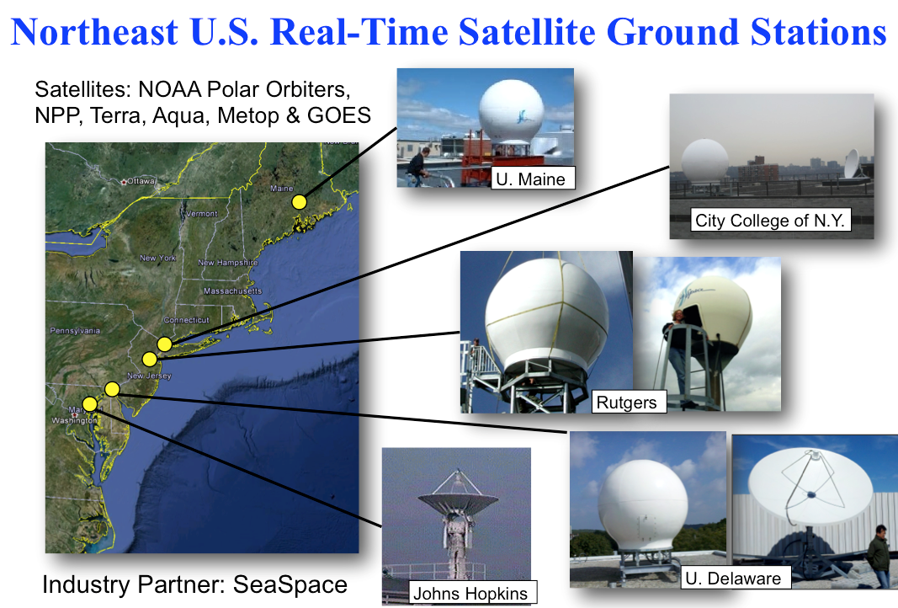
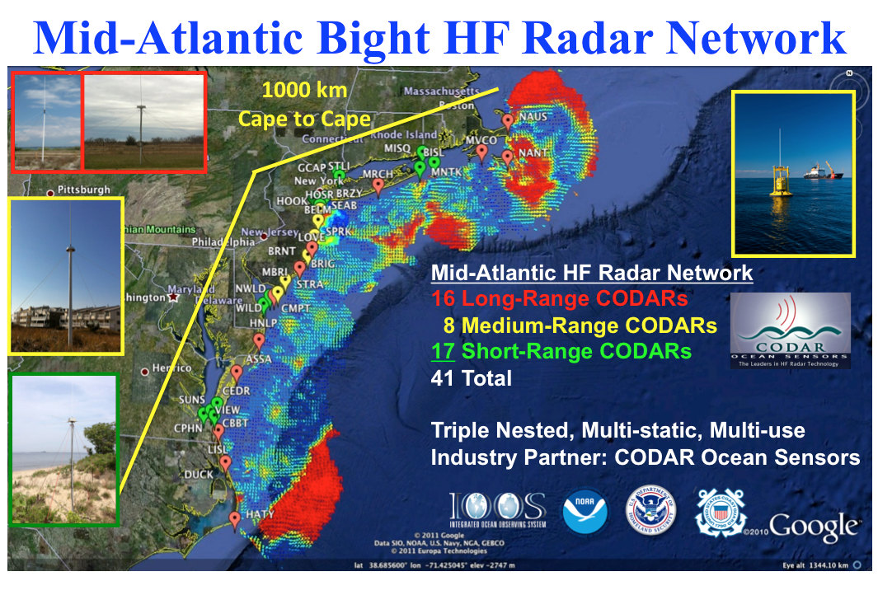
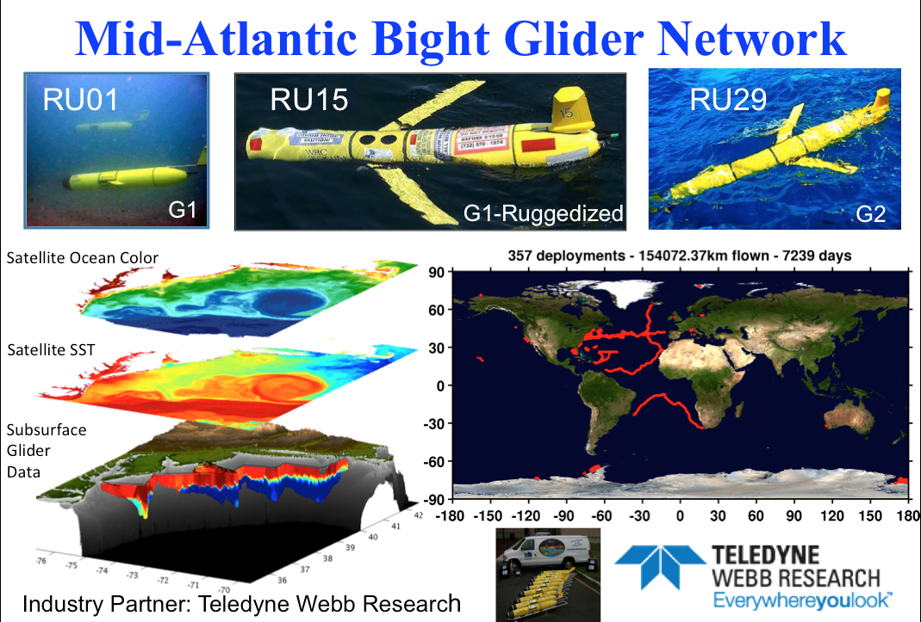
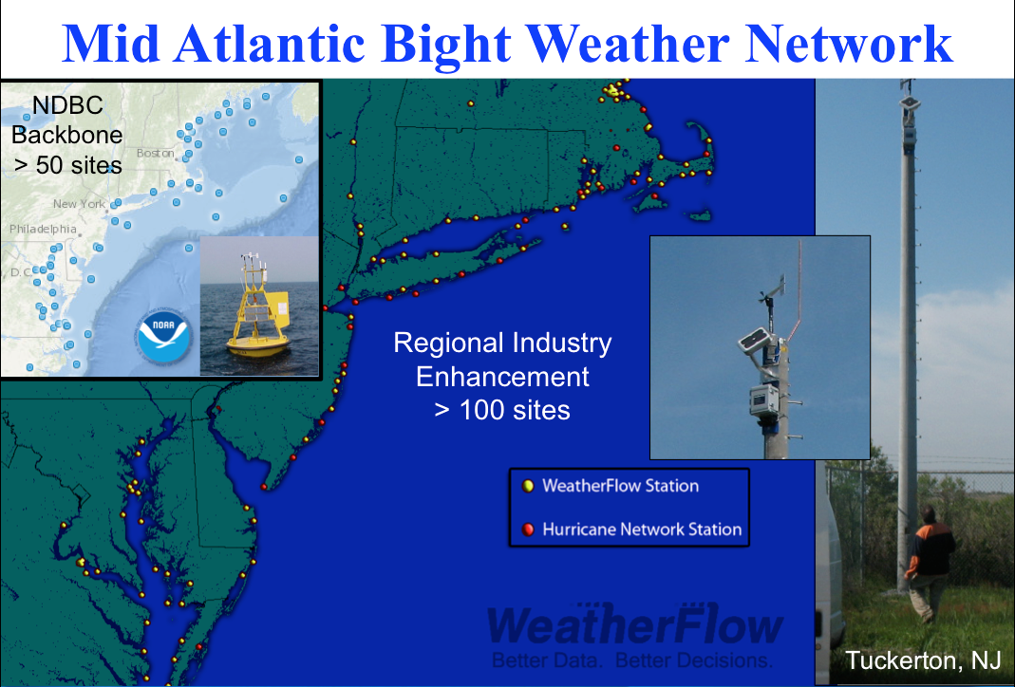
Mid-Atlantic Regional-Scale Observation Network

Slide 7
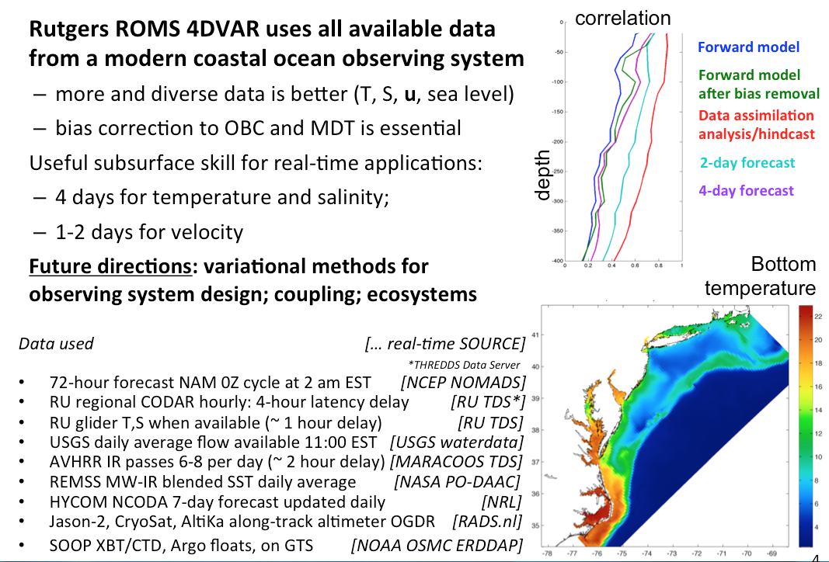
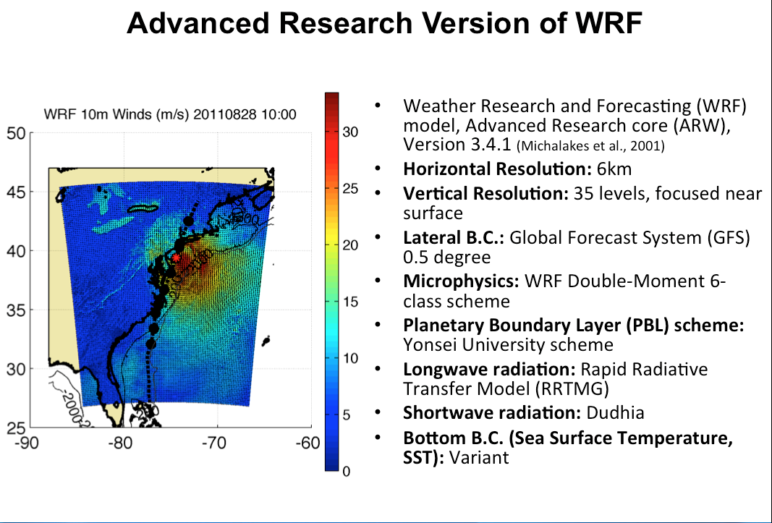

Mid-Atlantic Ensemble of Forecast Models Include:
Mid-Atlantic Operations Center @

Slide 8


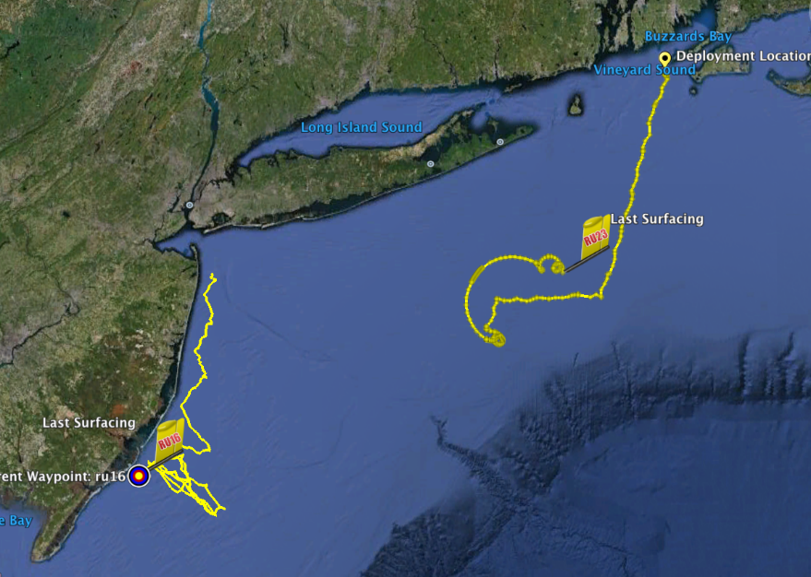
Hurricane Irene
August 27-28, 2011
Irene approaches the Mid Atlantic Bight
Coastal Observatory
Two Gliders Deployed

Slide 9
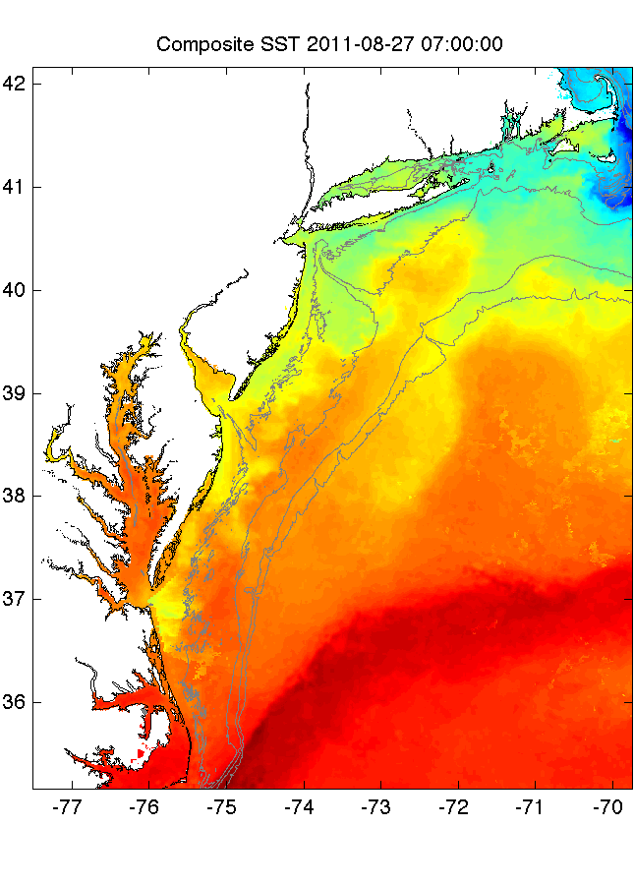
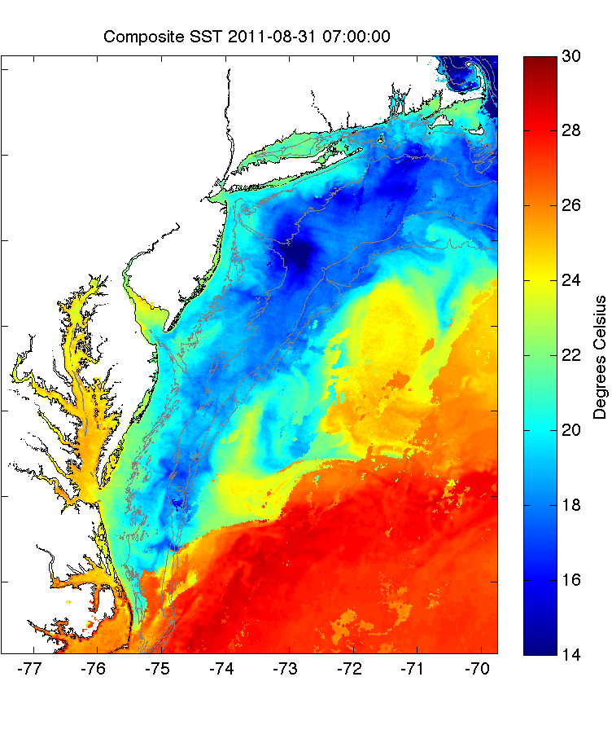
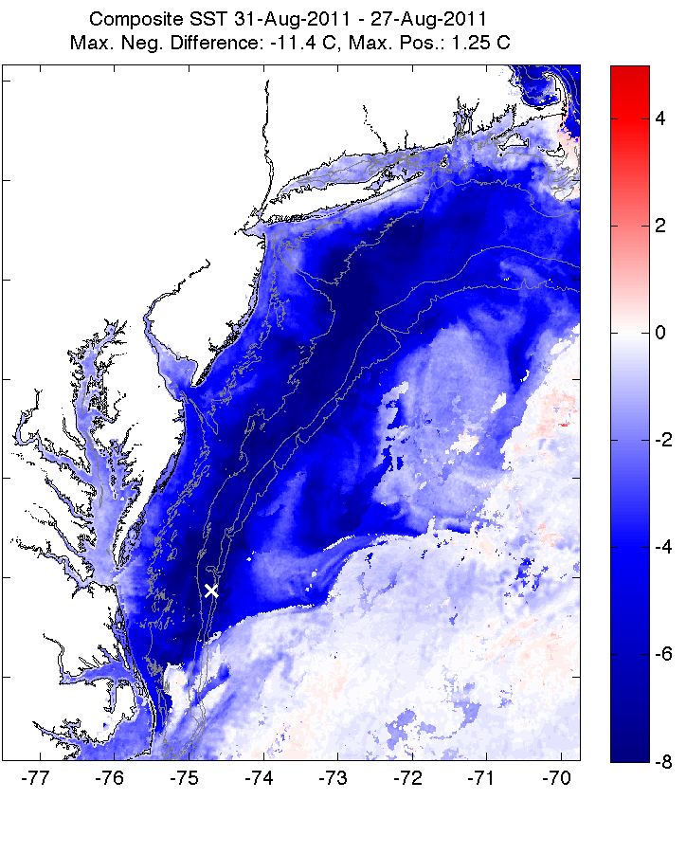
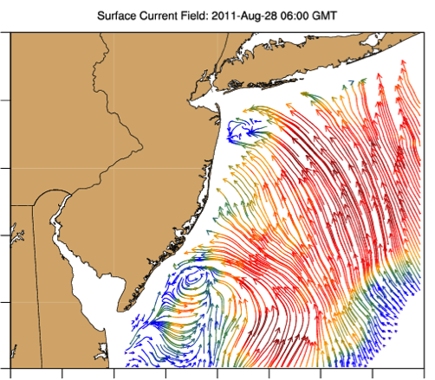
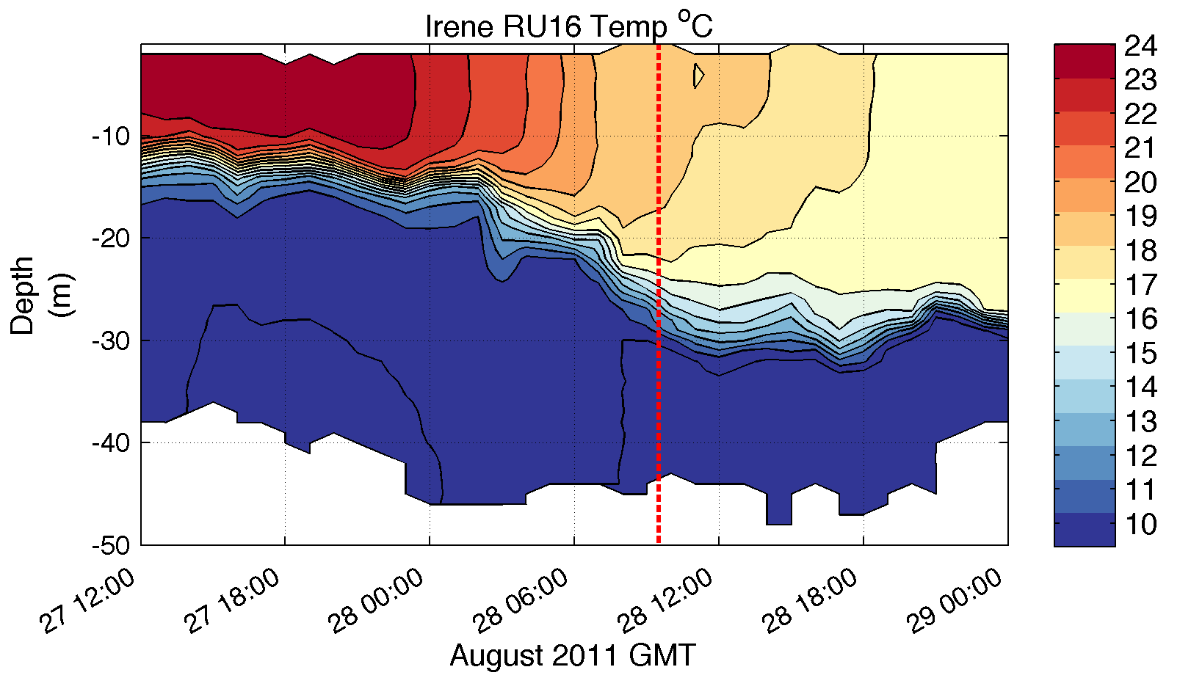
Pre-Irene
Post-Irene
Difference
11C max Cooling
WHAT?
Satellite
SST
WHEN? Glider Temperature
WHY?
HF Radar
Currents
Eye Passage
?

Slide 10
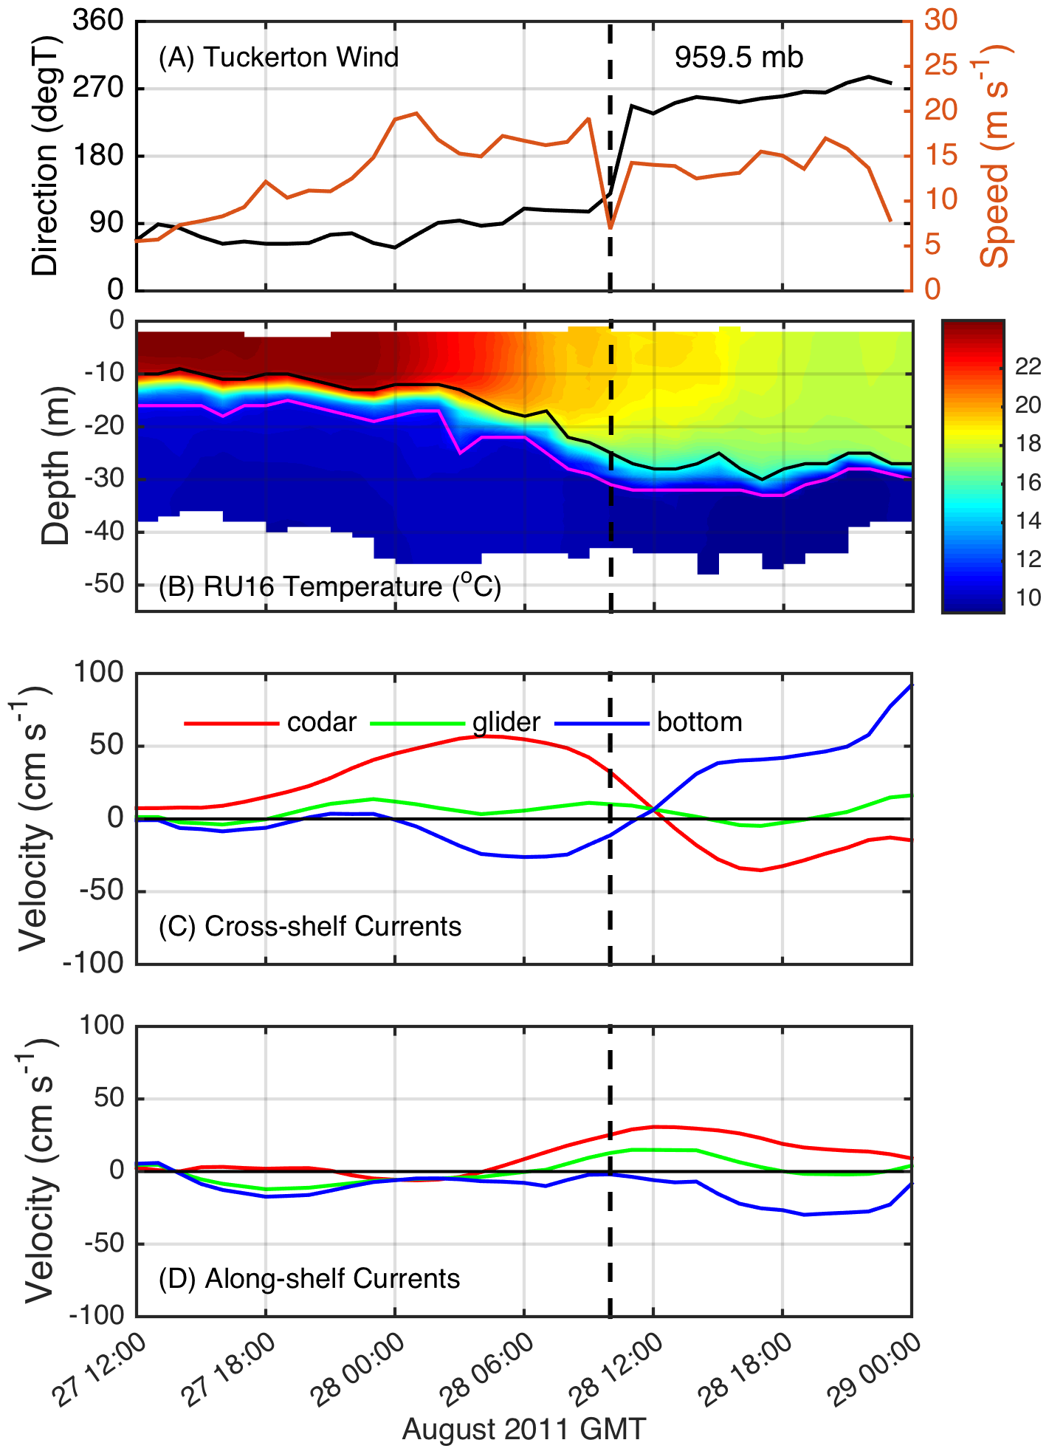
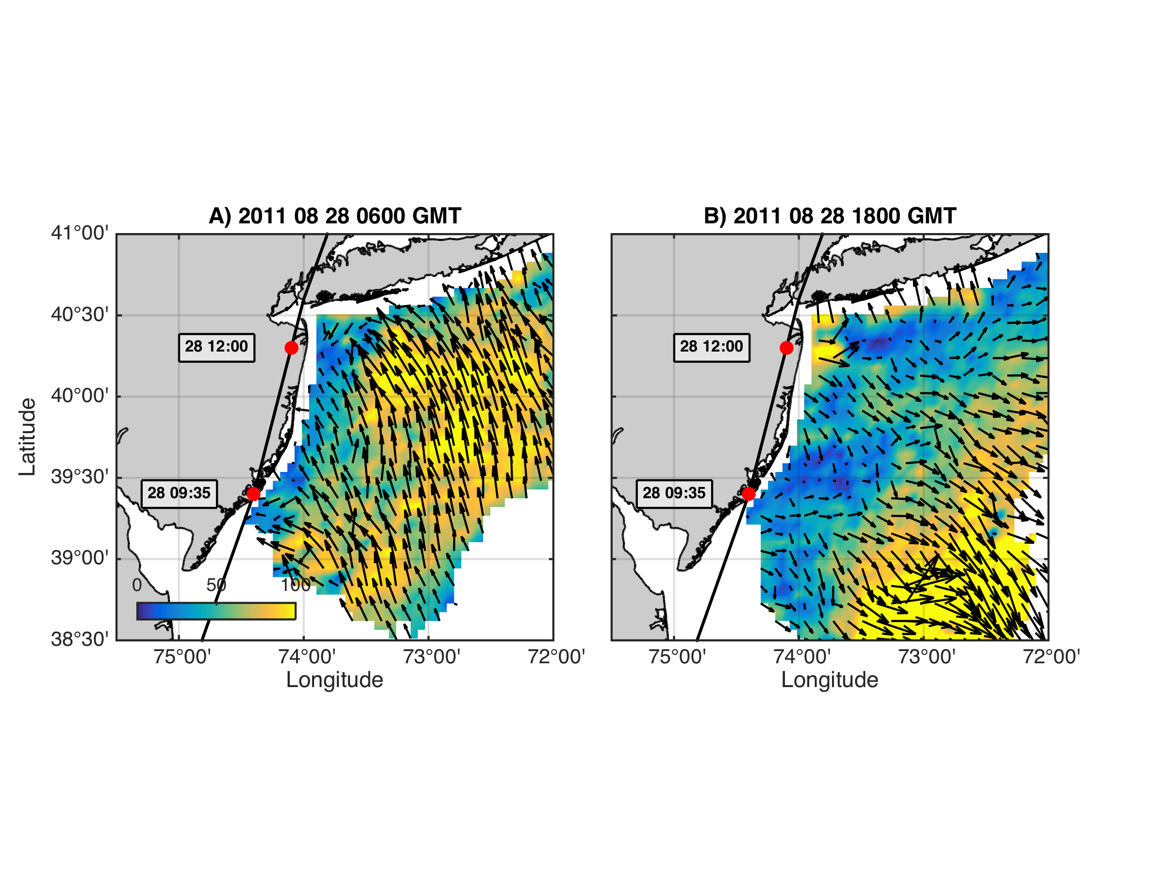
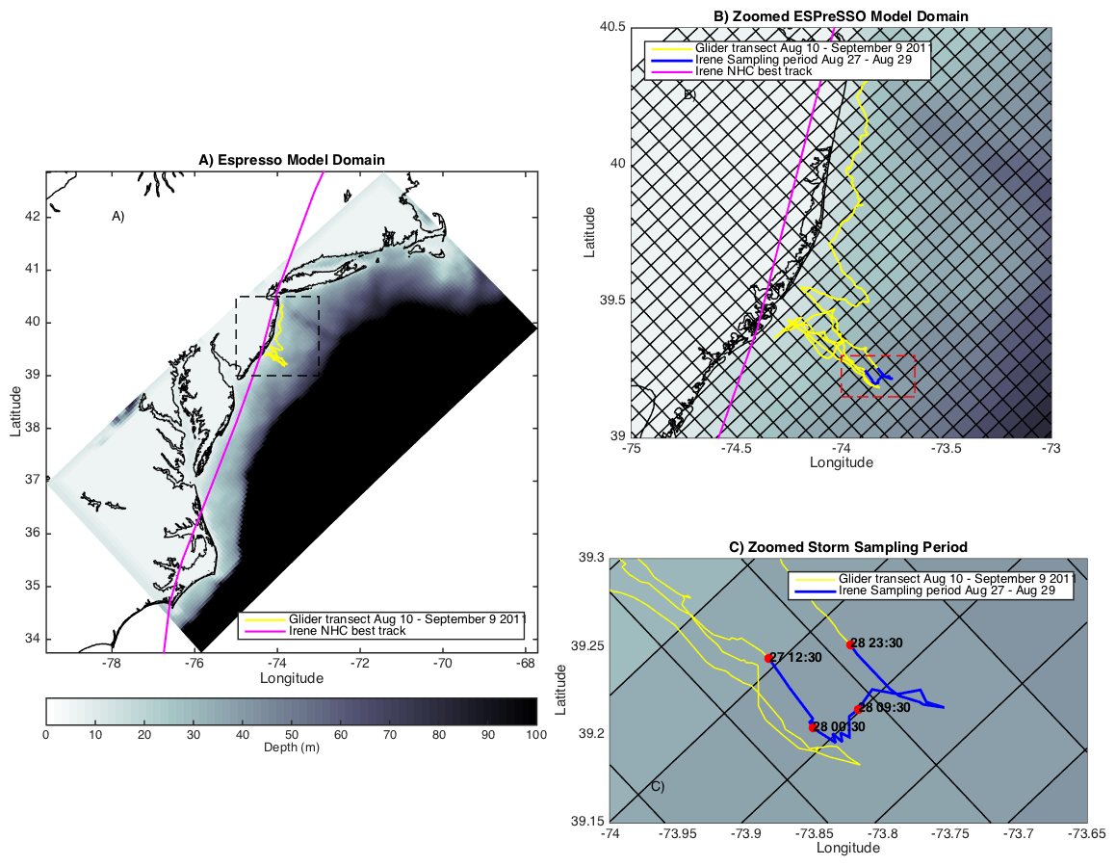
Coastal Baroclinic Circulation
Before Eye
After Eye
Before Eye After Eye
Glider Track, Model Grid
& Bathymetry
Storm Period in Blue

Slide 11
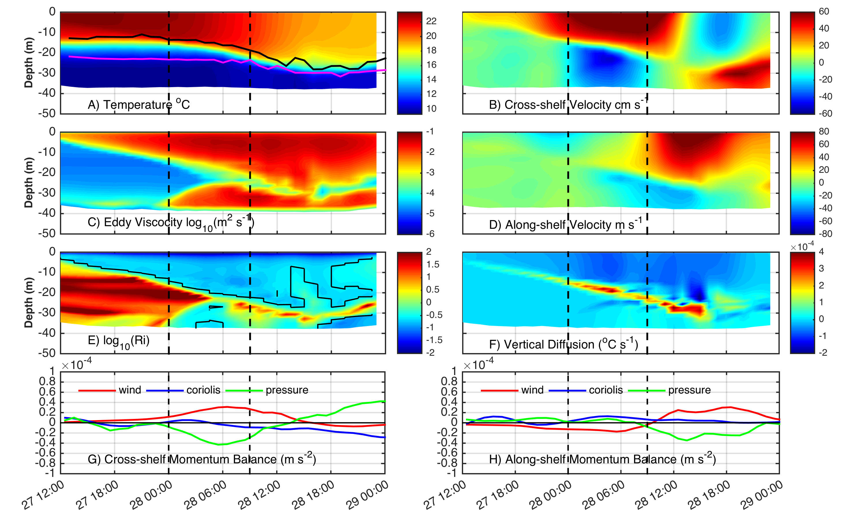
ROMS Model Results at Glider Location
Coastal Baroclinic Circulation Enhances Mixing & Cooling

Slide 12
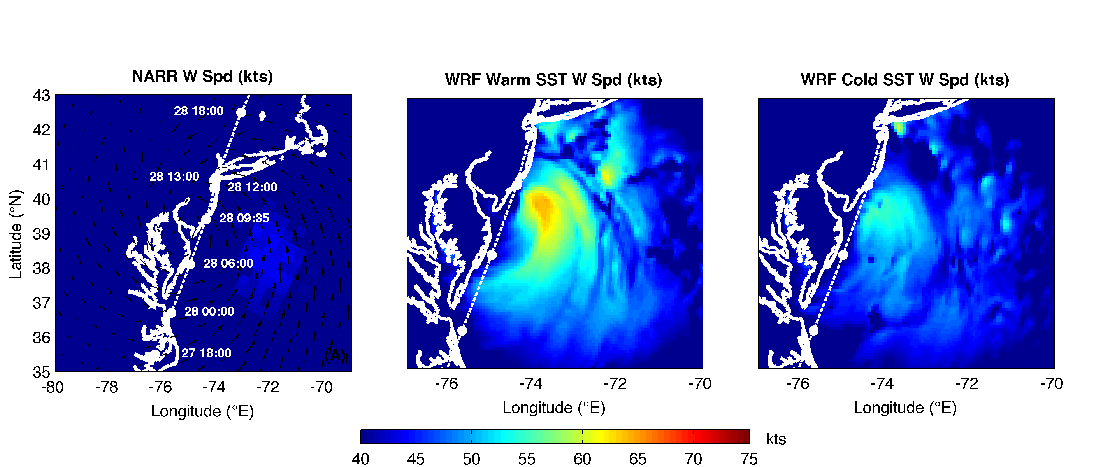
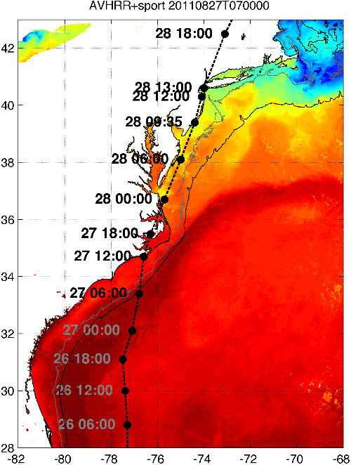


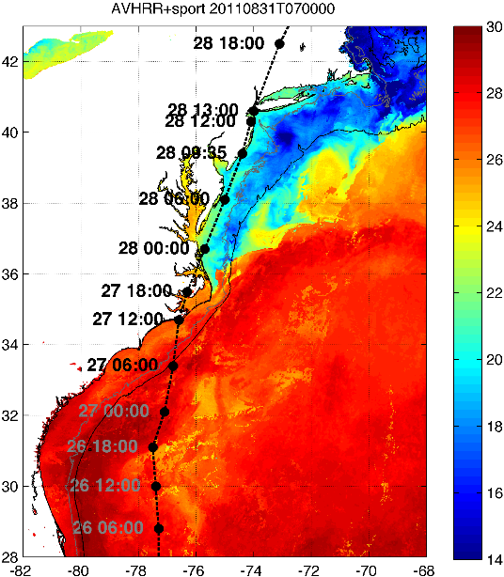

Rutgers Atmospheric Forecast Sensitivity Study
Warm Ocean
Boundary Condition
Cat 1 Hurricane
Tropical Storm
Cold Ocean
Boundary Condition
IMPACT?
>10 knots reduction in peak wind speed

Slide 13
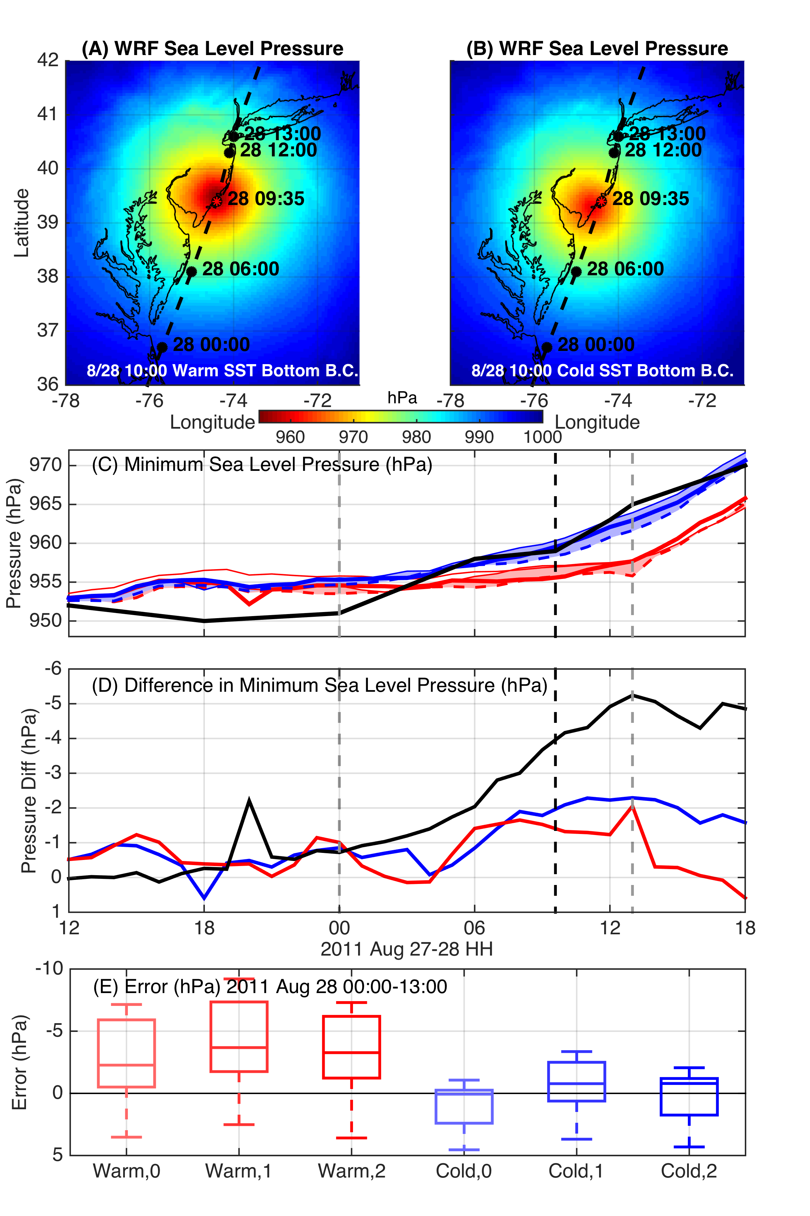
WRF Model Sensitivity Study
Over 130 model runs
Paired to compare sensitivities
Central pressure & max wind
Sensitivity to SST greatest
Seroka, Miles, Xu, Kohut, Schofield & Glenn,
Hurricane Irene Sensitivity to Stratified Coastal Ocean Cooling, Submitted to Monthly Weather Review

Slide 14
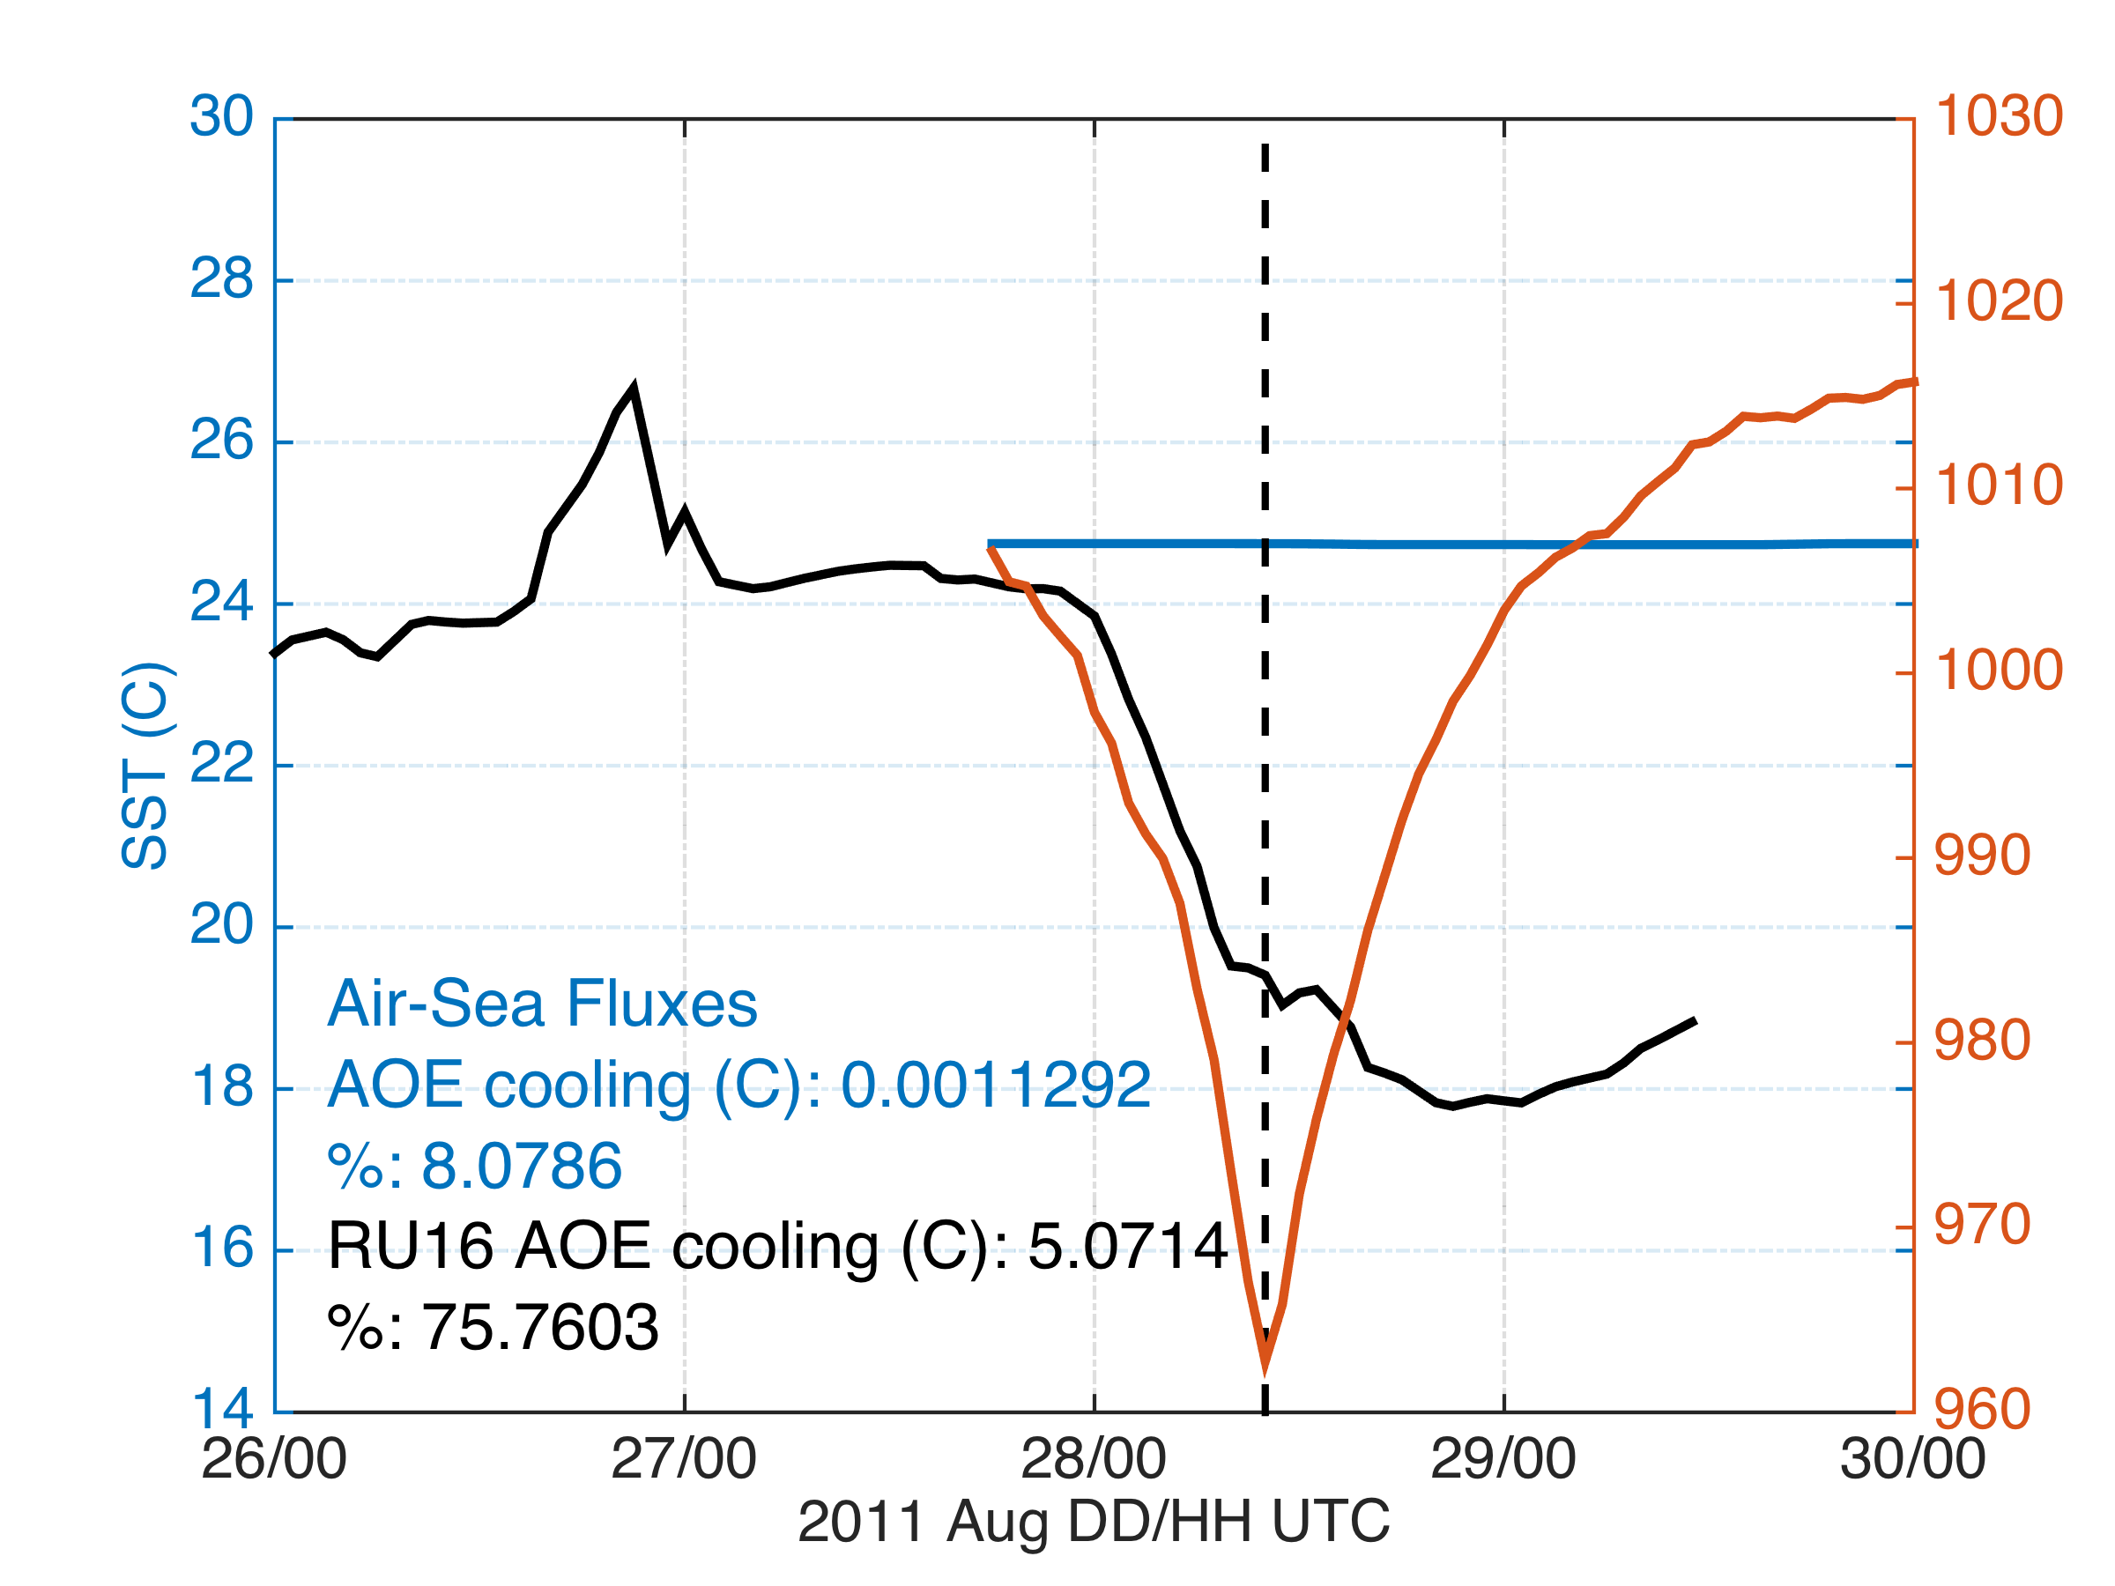
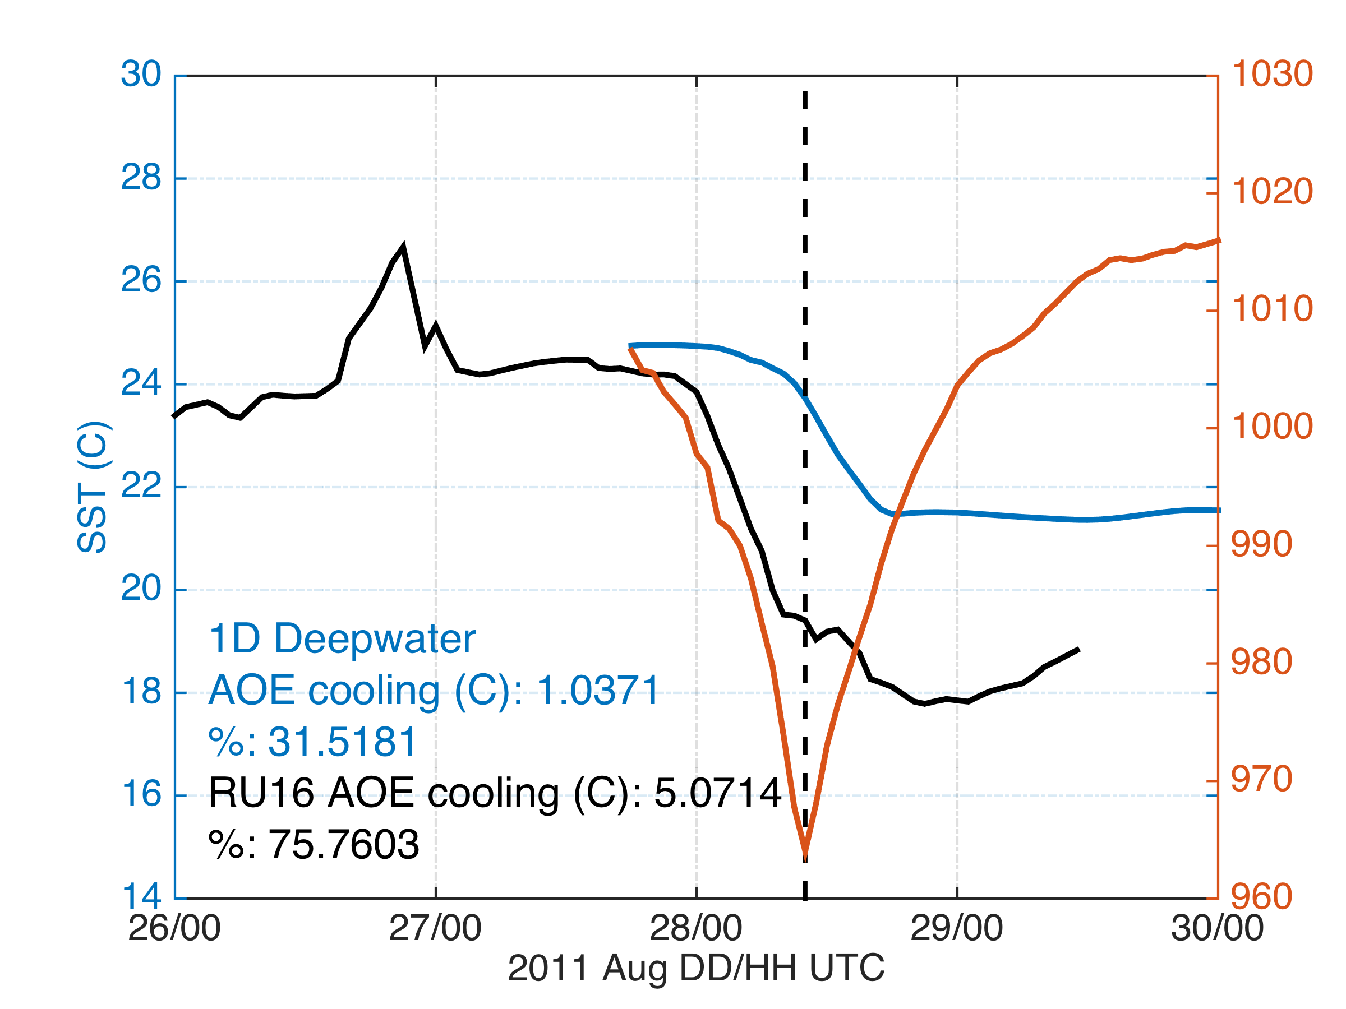
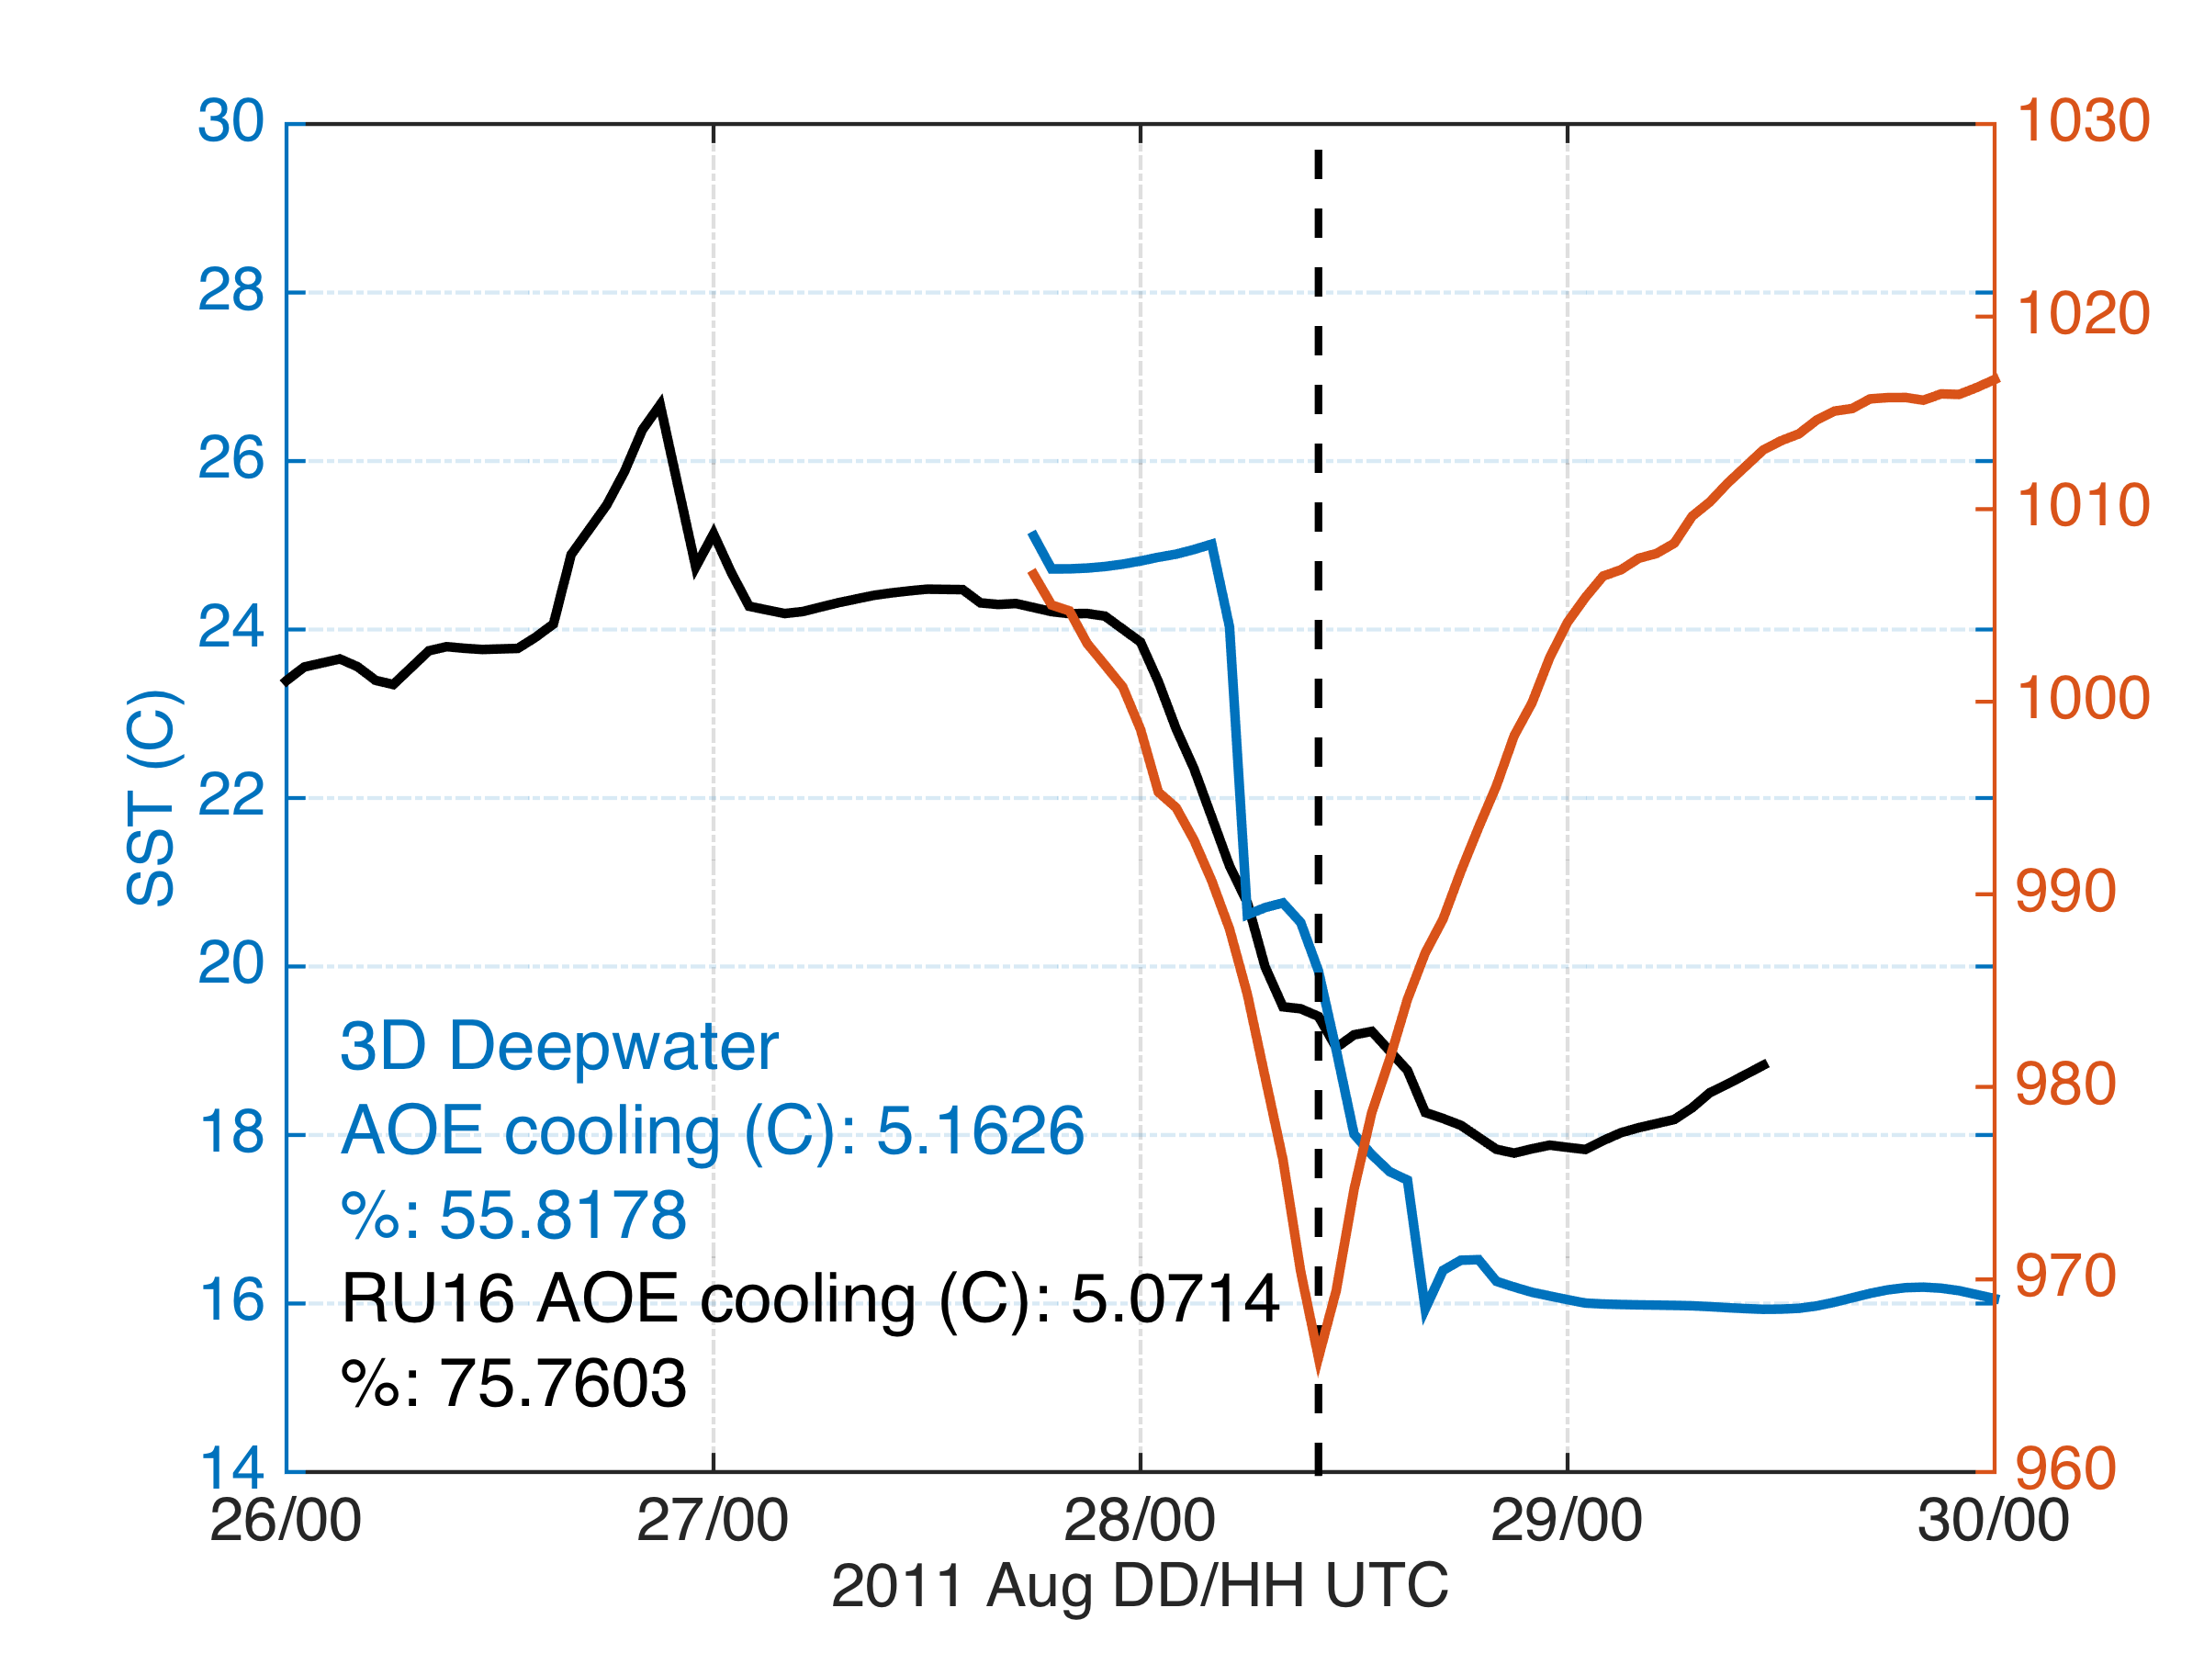
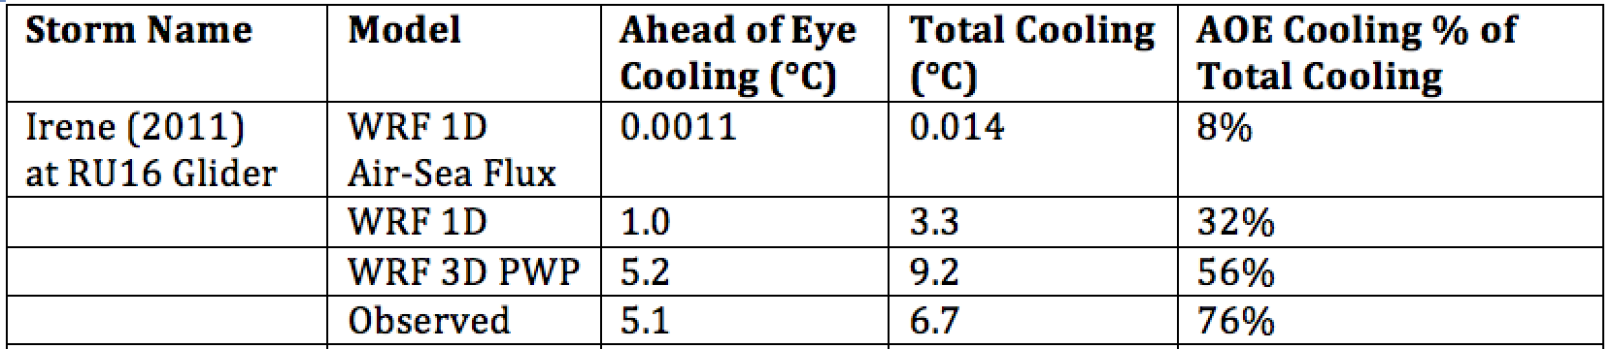
Modeled Deepwater Cooling Processes in Hurricane Irene
Thank you Jim Price
Air-Sea Only
1-D Mixing
3-D PWP (Upwelling)

Slide 15
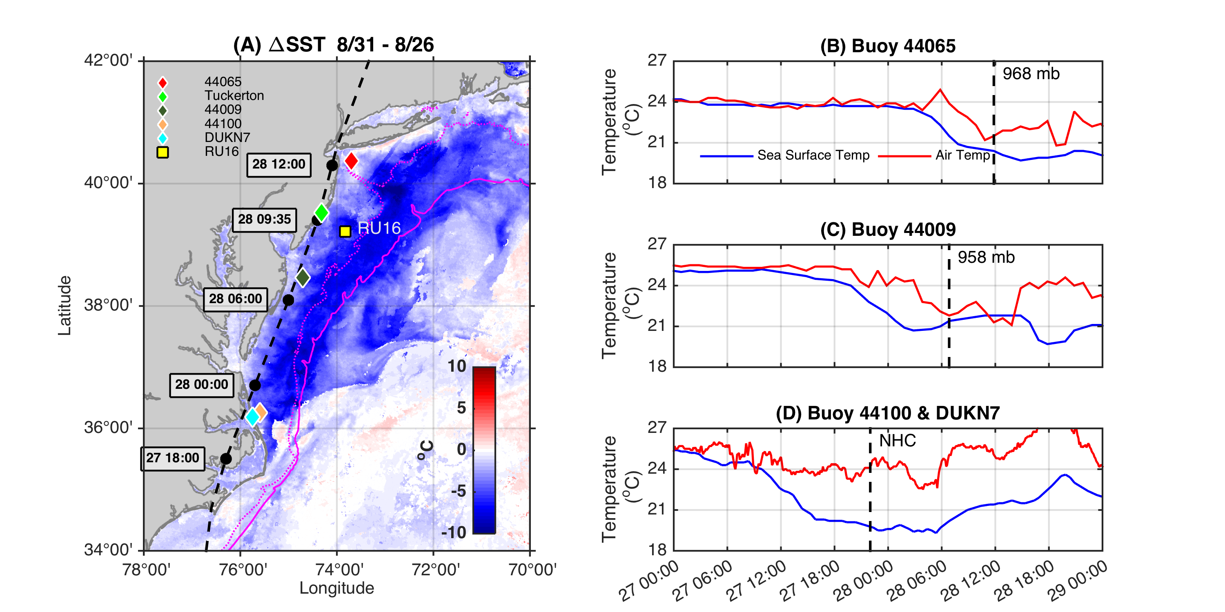
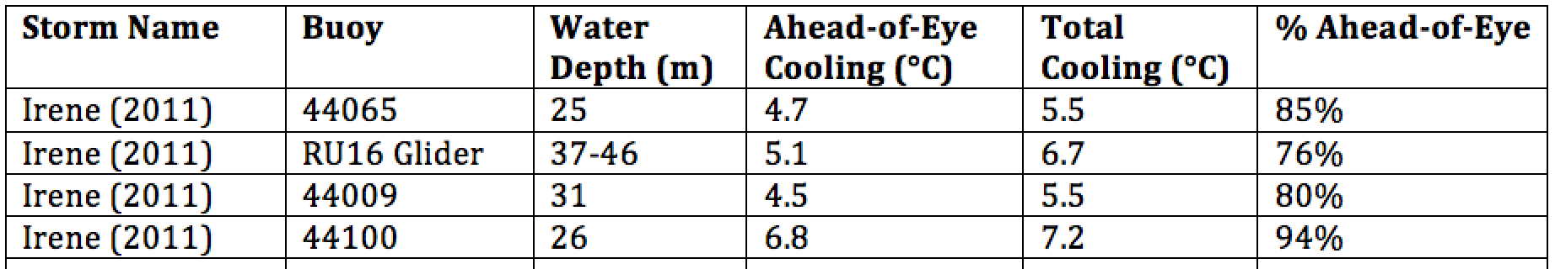
Observed Cooling in Hurricane Irene

Slide 16
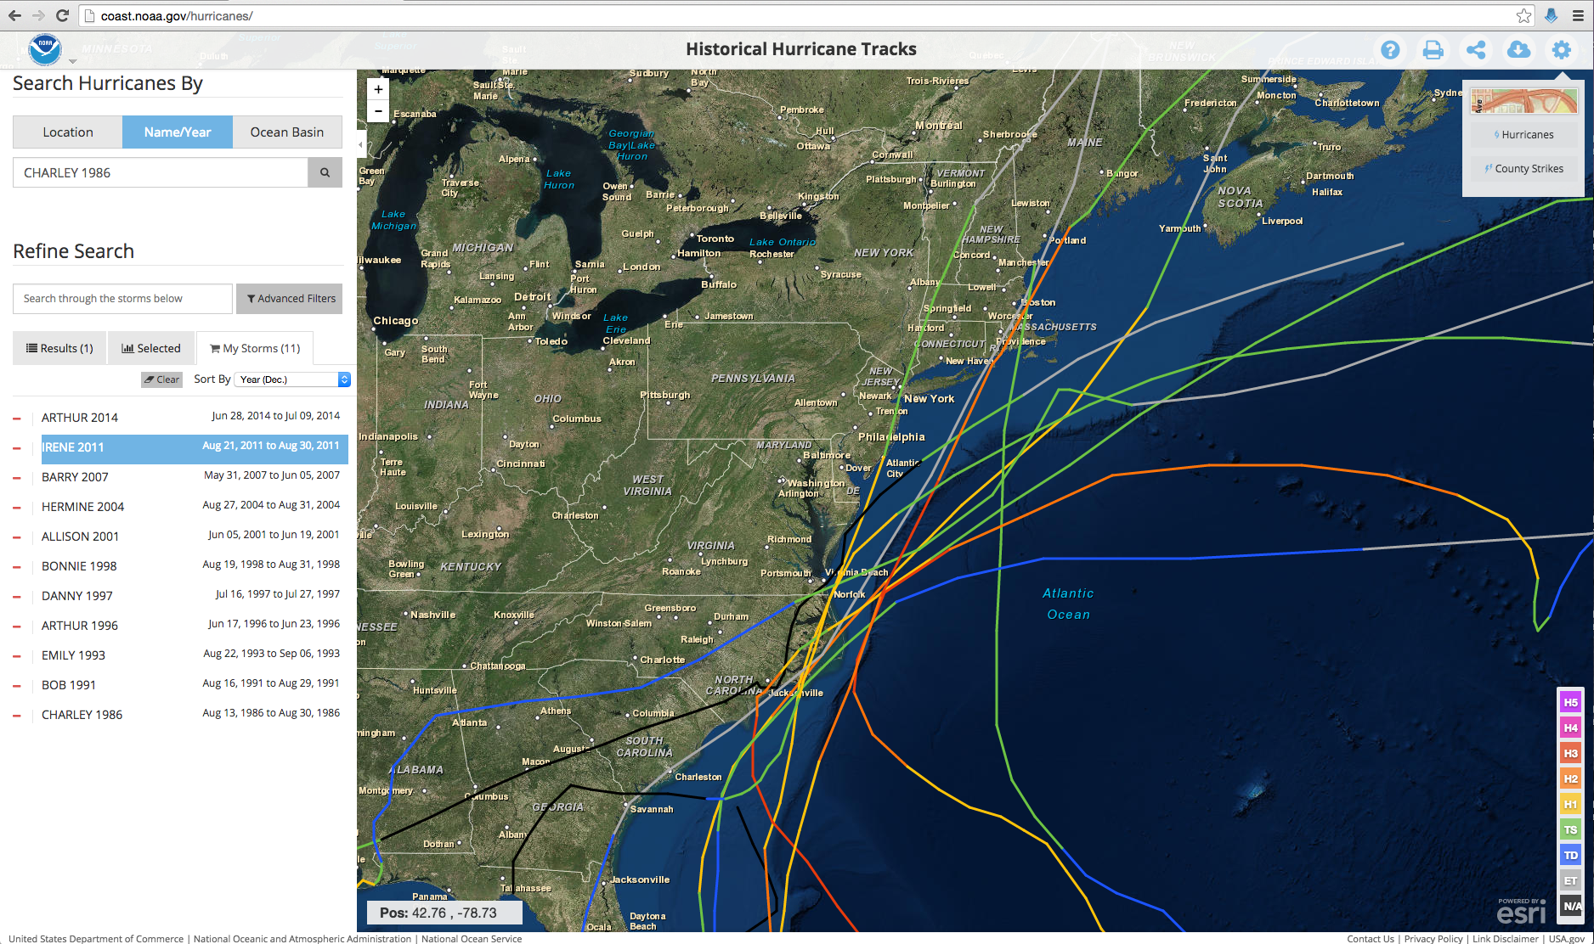
Historical Hurricanes Crossing the
Middle Atlantic Bight Continental Shelf in Stratified Season
Thank you
David Titley

Slide 17
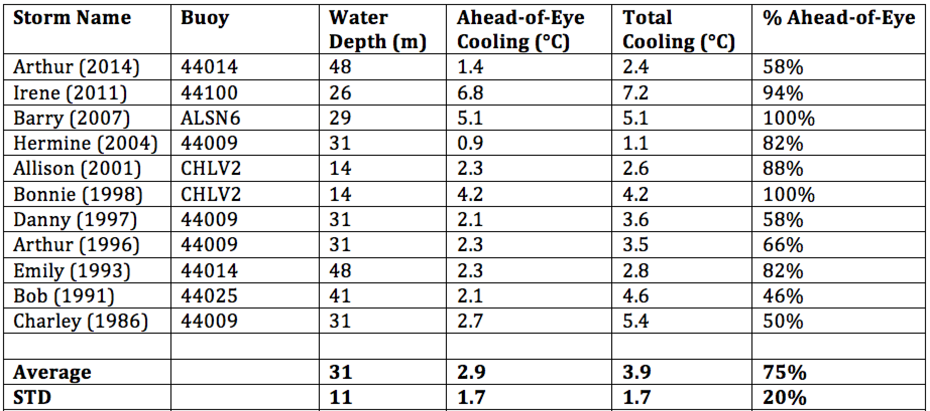
Historical Hurricanes Crossing the MAB in Stratified Season
Observed Ahead-of-Eye-Center Cooling

Slide 18
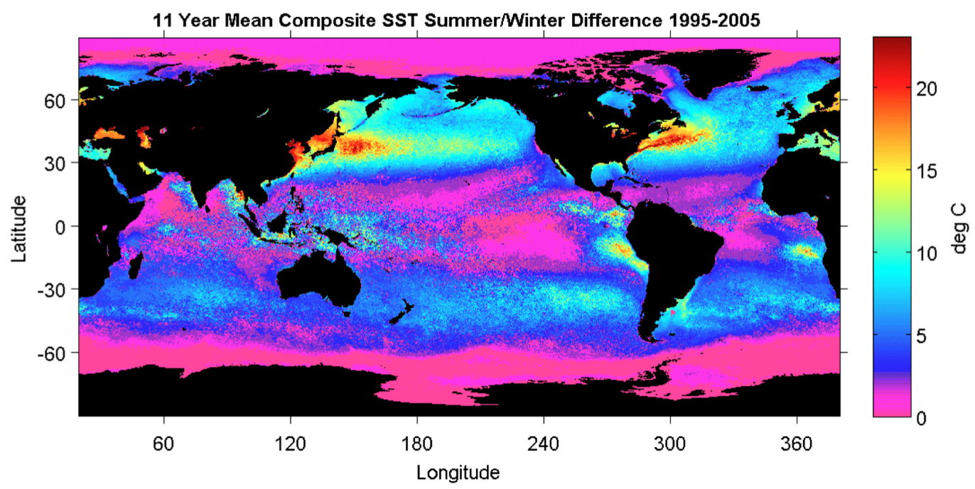
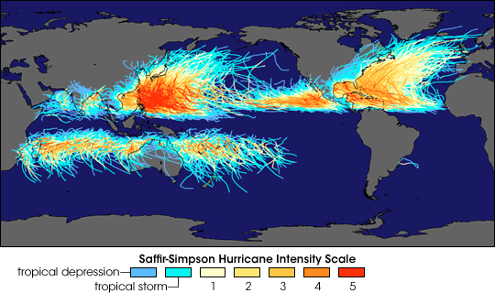
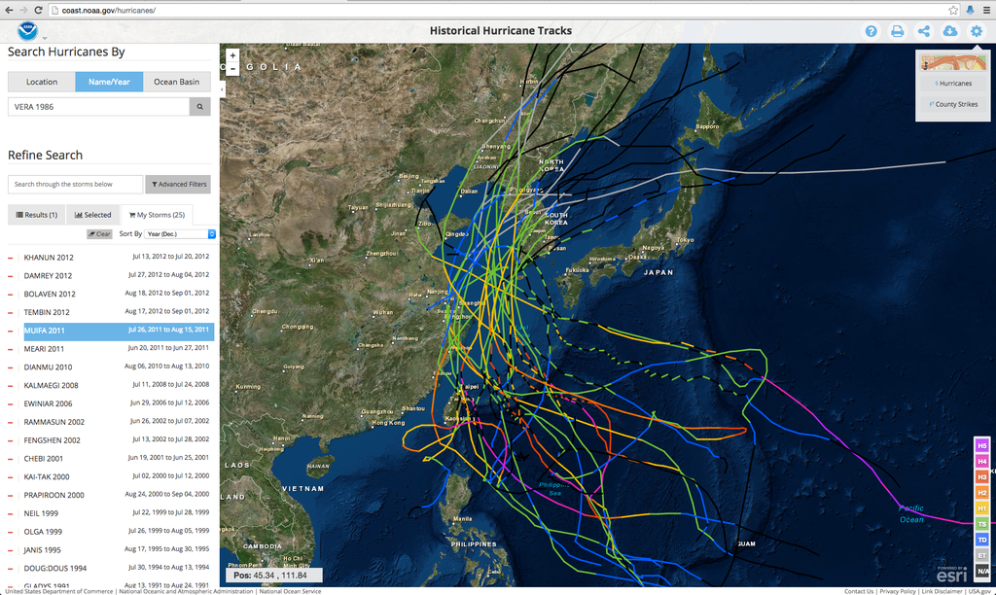
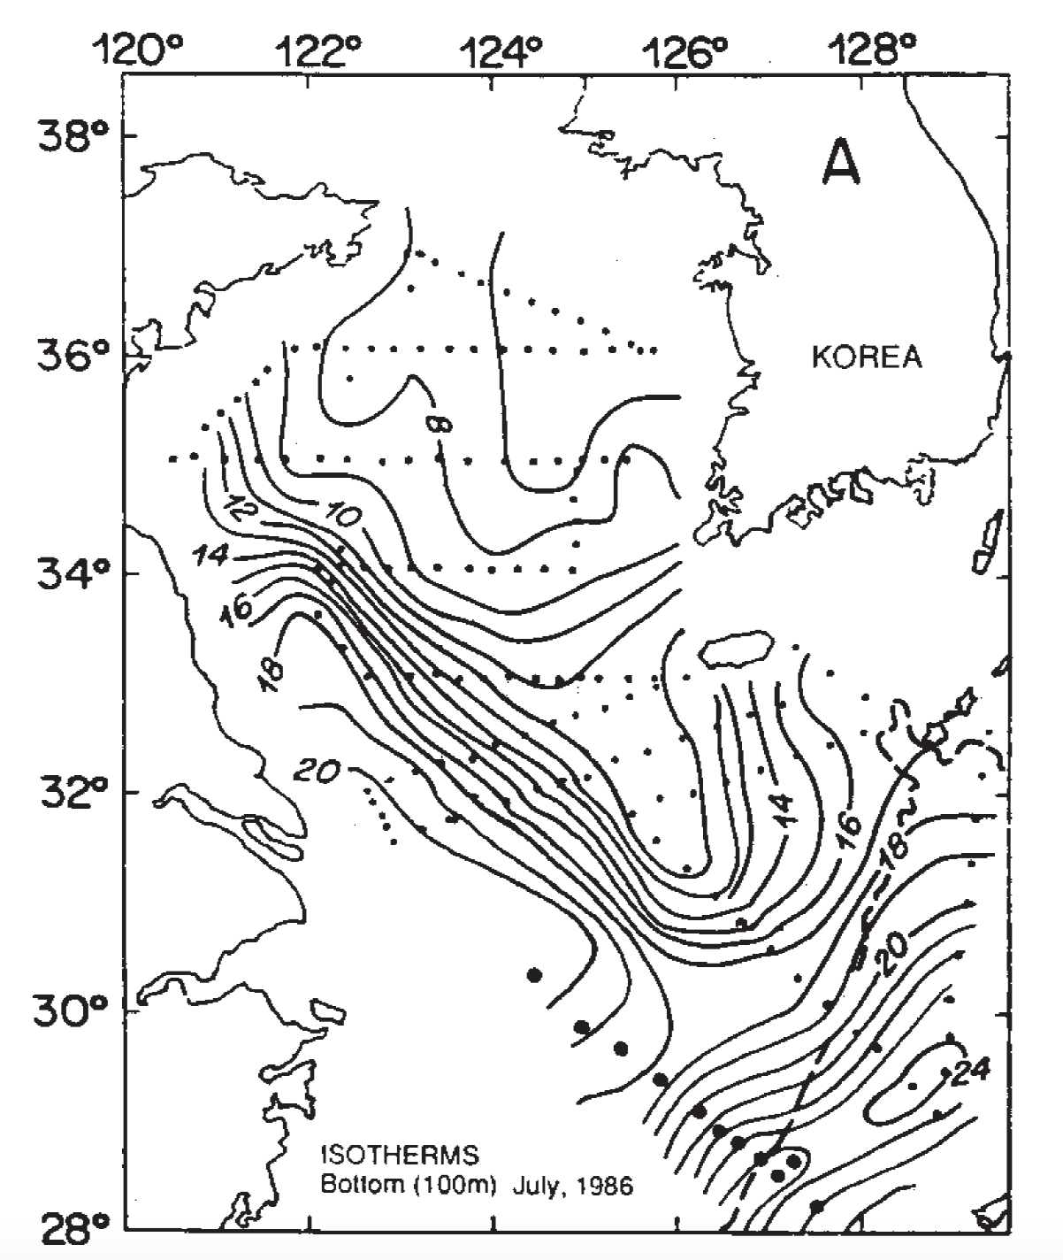
Historical Typhoons Crossing the Yellow Sea in the Stratified Season
Summer/Winter SST Difference
Ramya Ramadurai, 2009
Bottom Temp
26 Typhoons
tracked across northern East China Sea & Yellow Sea since 1985
Chen et al., CSR, 1992

Slide 19
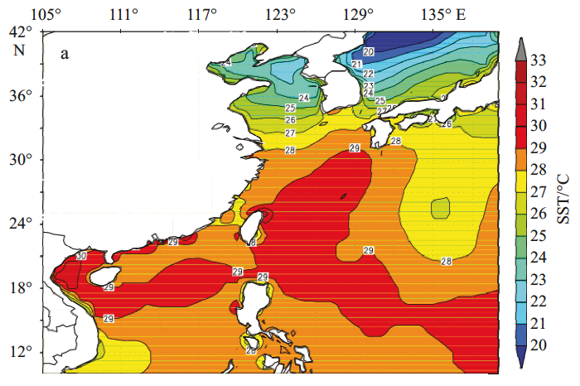
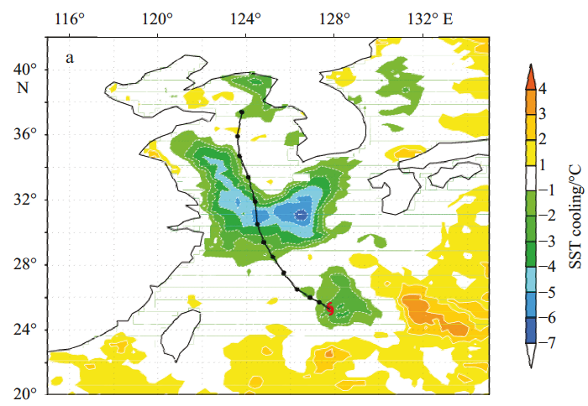
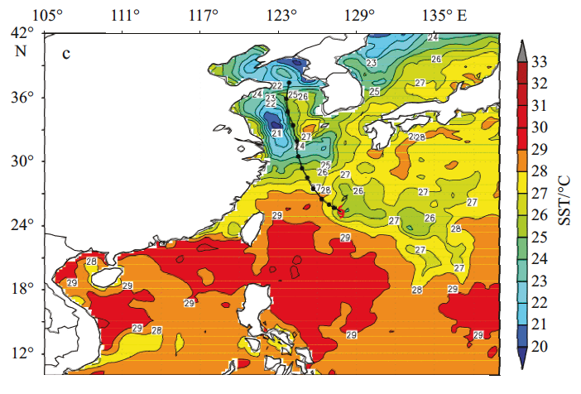
Typhoon Muifa - Total Cooling Observed by Satellite
SST
Before
Muifa
Track
SST
After
SST
Difference
Up to 7C
From: Sun, Duan, Zhu, Wu, Zhang & Huang, Acta Oceanol. Sin., 2014

Slide 20
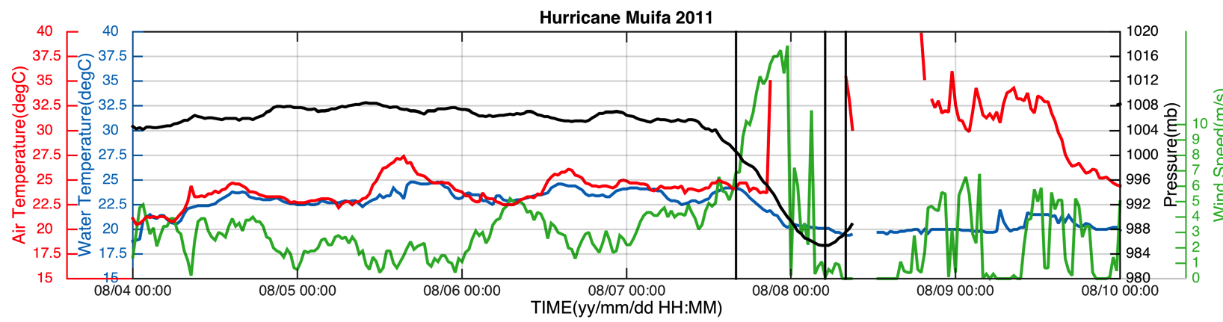
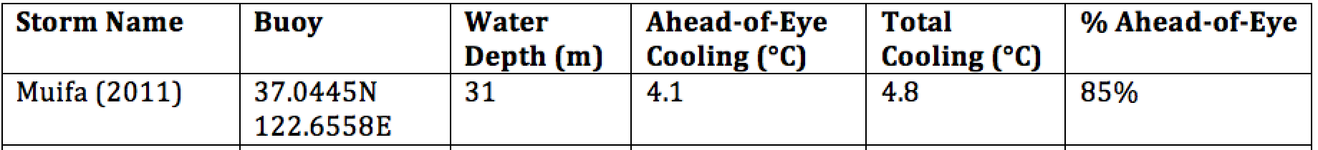
Typhoon Muifa:
Ahead-of-Eye-Center Cooling
observed by Coastal Buoy
Muifa
Track
From: Fei Yu, Institute of Oceanology, Chinese Academy of Sciences
Yi Xu, State Key Laboratory of Estuarine & Coastal Research, East China Normal University

Slide 21

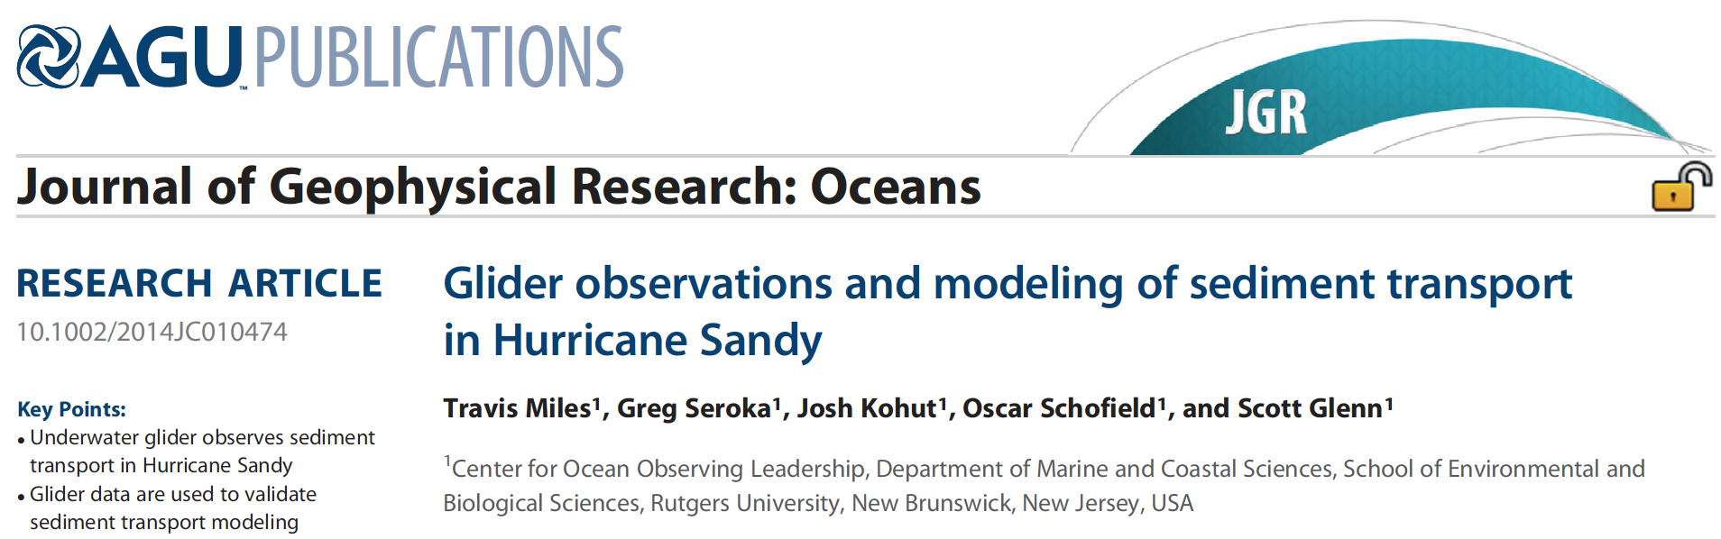
Hurricane Irene Track August 27-28, 2011
Summer Storm
Strong Stratification
Coastal Response
Mixing Cooled Surface
Limited Intensity
For more details on summer hurricanes,
see Greg Seroka’s Poster, A54C-2732:
For more details on fall hurricanes
(Sandy), see Travis Miles’ Paper:

