Slide 1
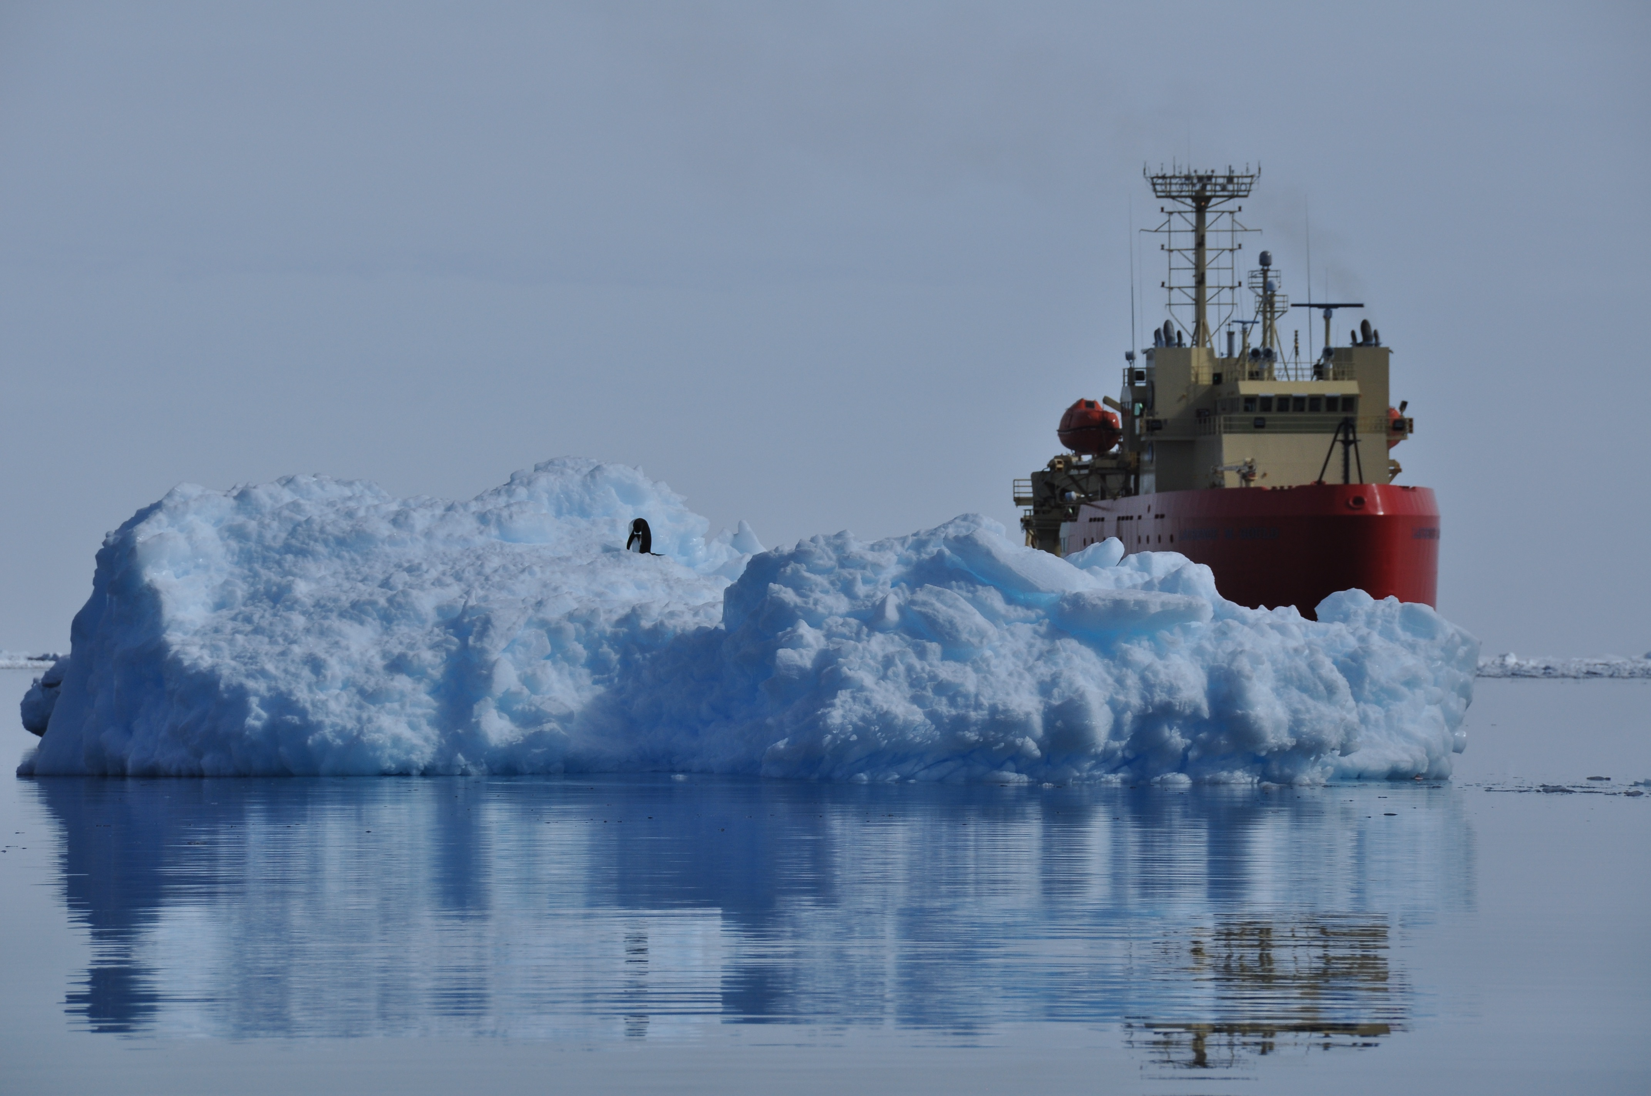

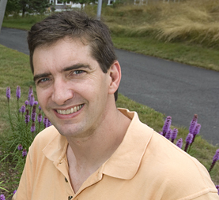
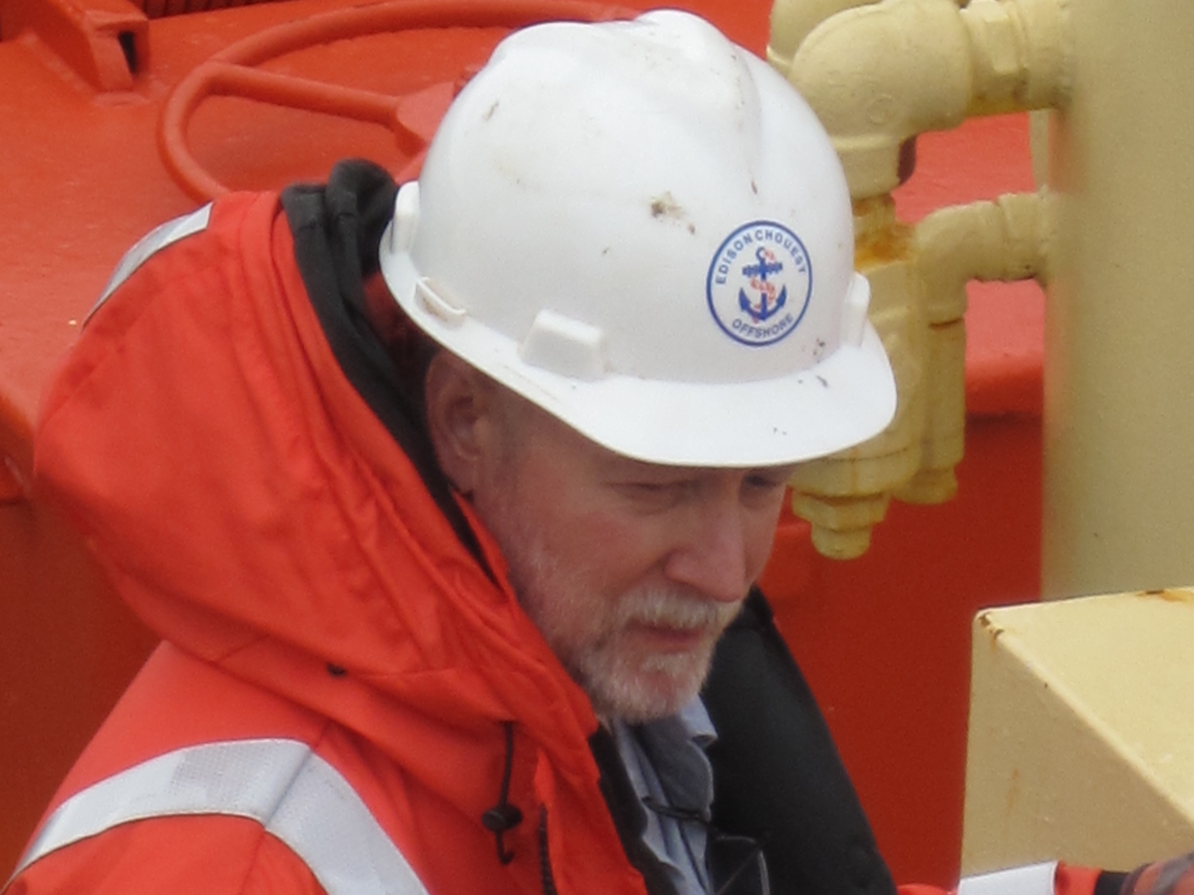
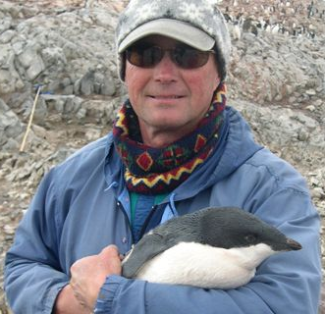
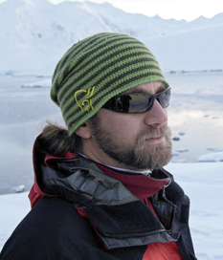
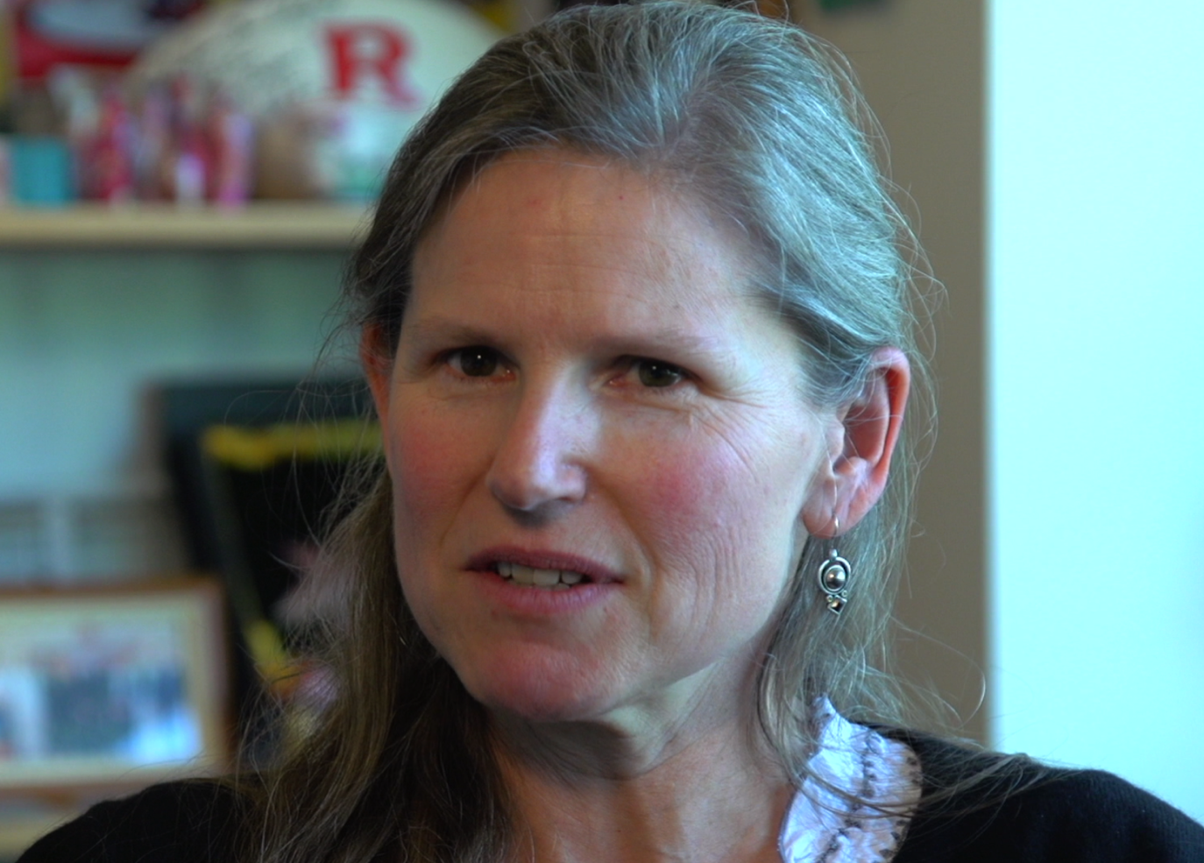
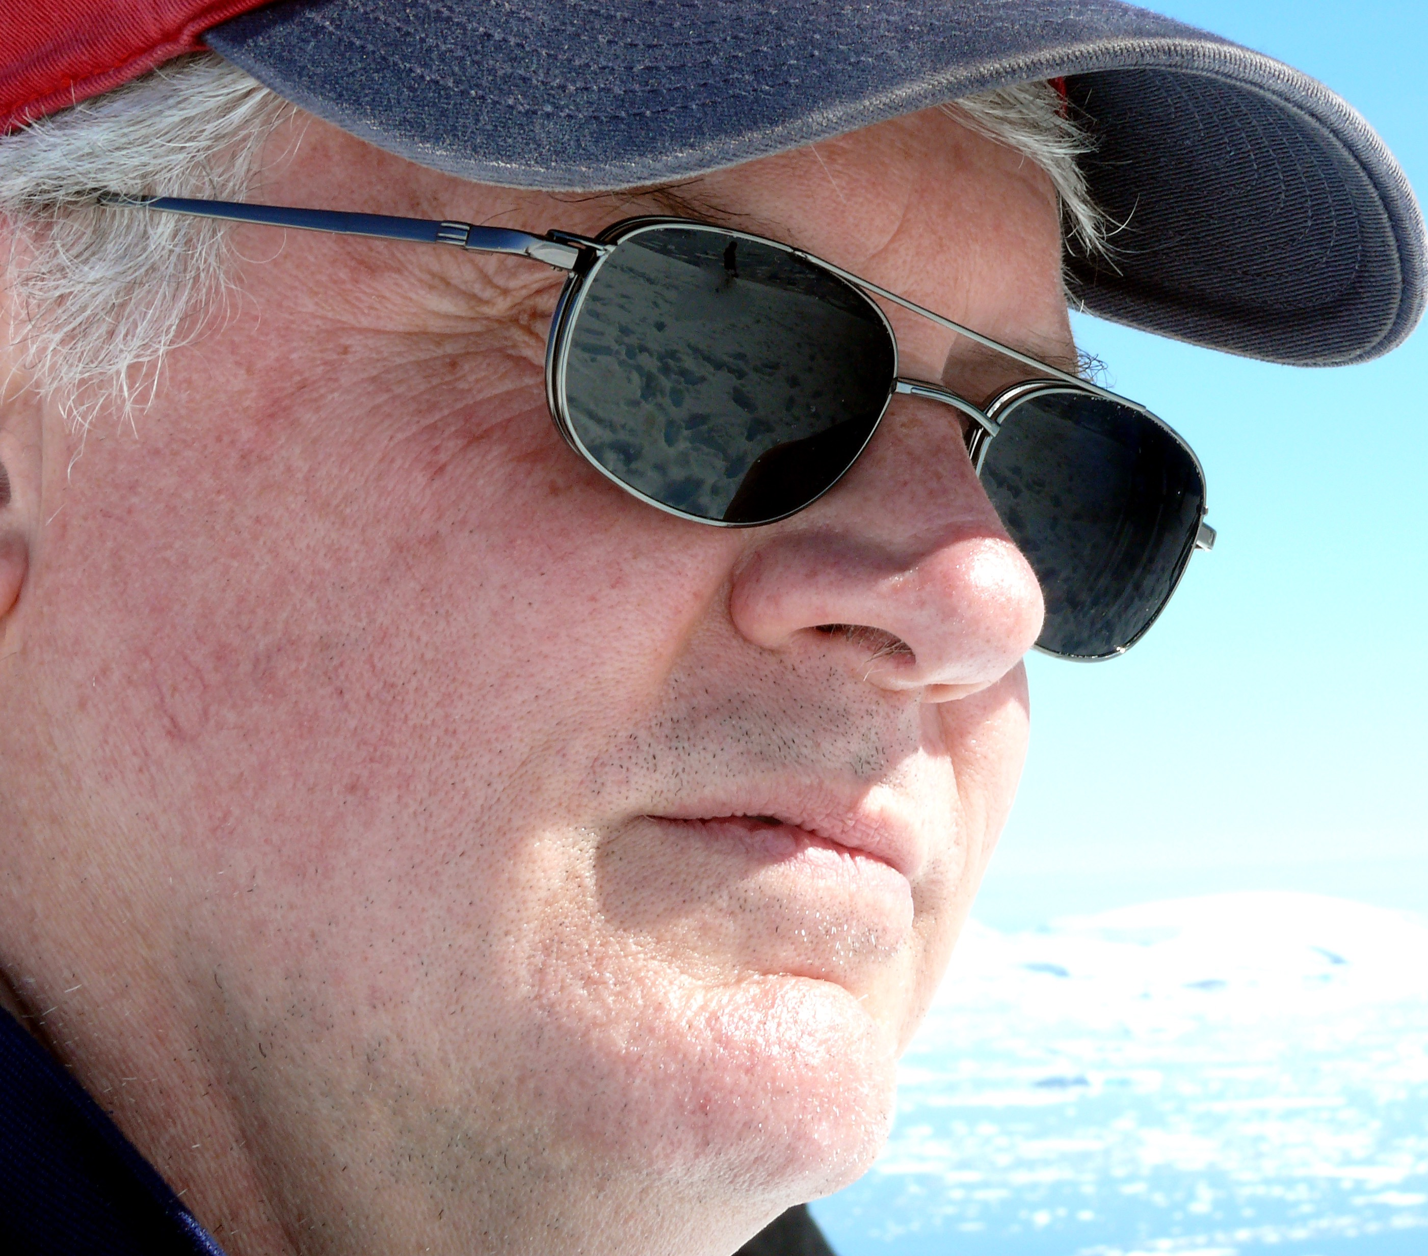
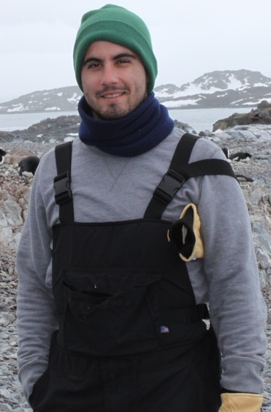
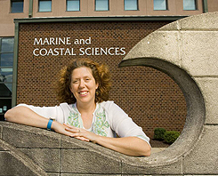
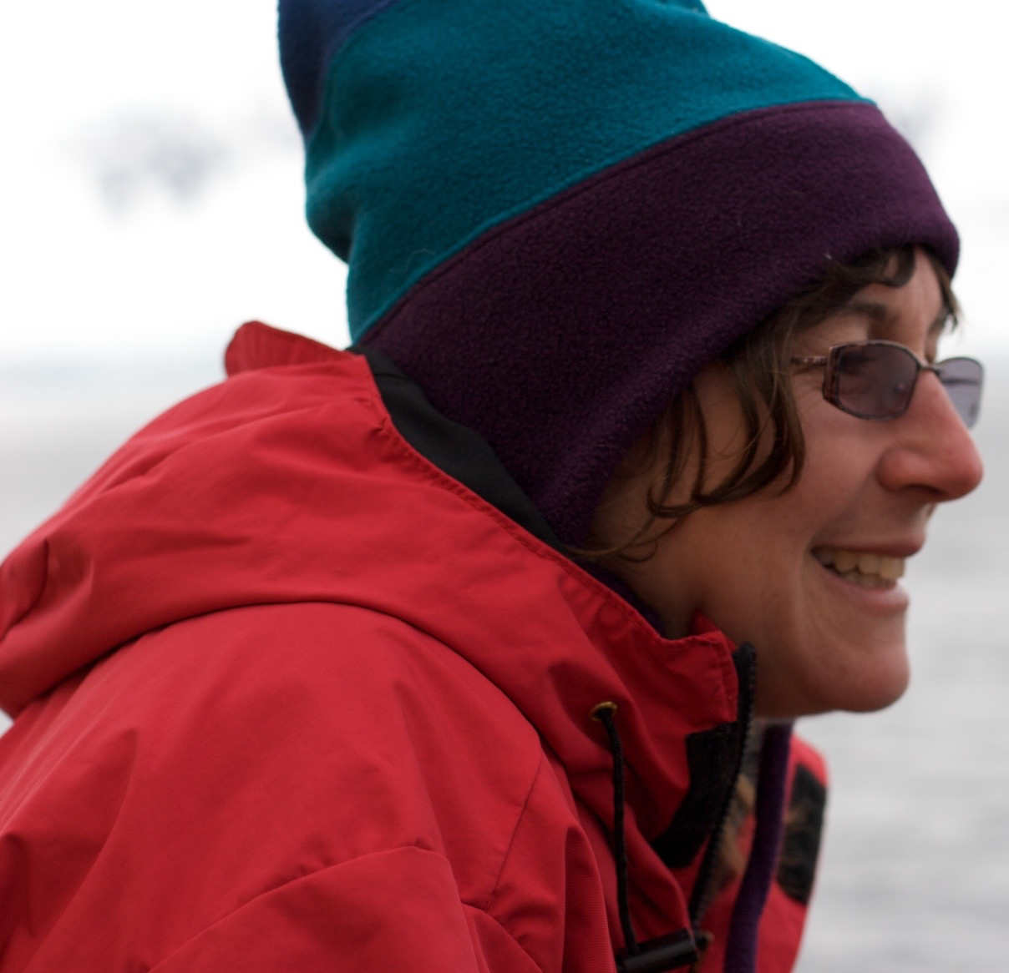
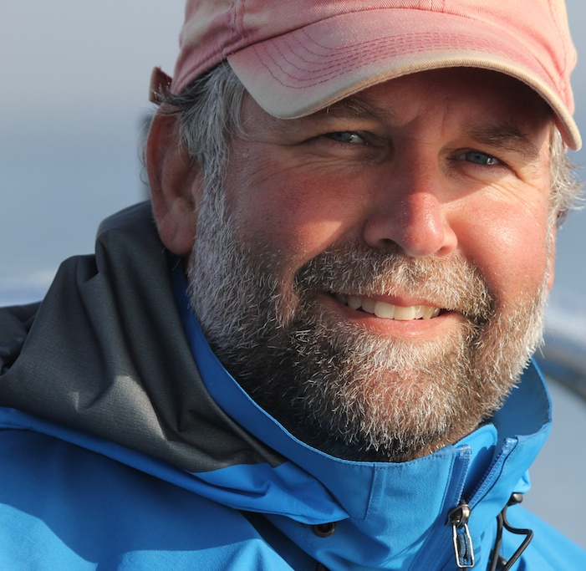
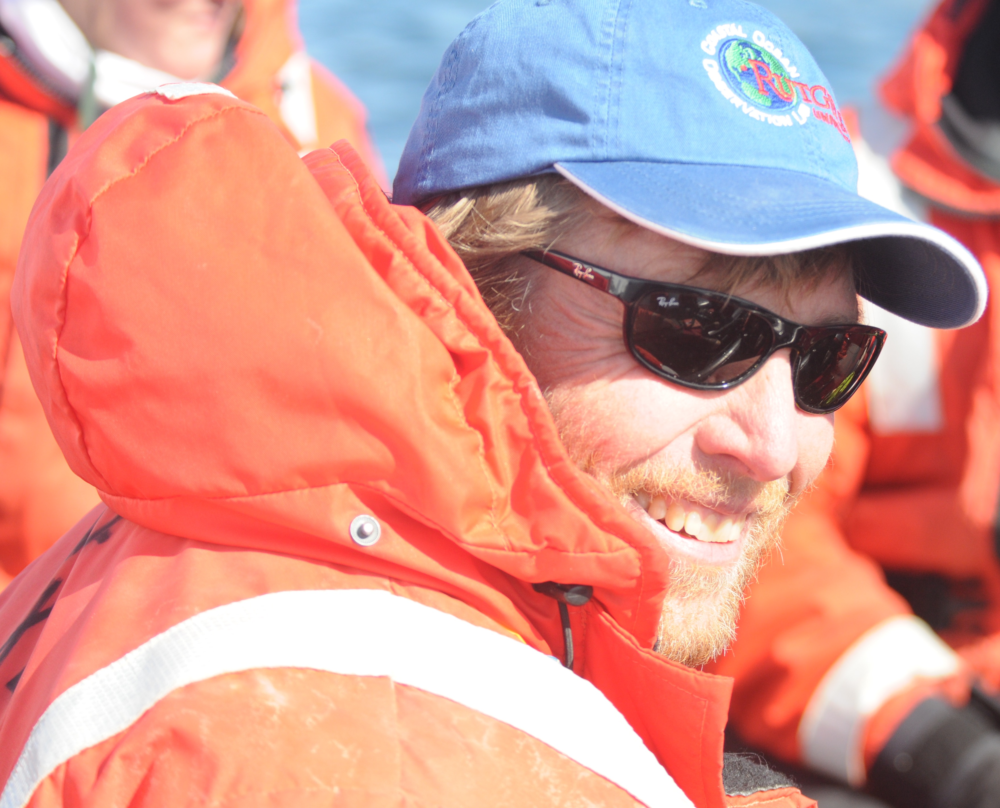

Decadal Dynamics in Phytoplankton Communities in the WAP
Oscar Schofield, Hugh Ducklow, Debbie Steinberg, Grace Saba, Travis Miles, Ana Filipa Carvalho, Nicole Couto, Nicole Waite, Alex Kahl, Zoe Finkel, Andrew Irwin, Vincent Saba
The
Team
Scott Doney
(Models, Biogeochem)
Doug Martinson
(Physical Ocean, Ice)
Sharon Stammerjohn
(Climate, Ice)
Bill Fraser
(Birds)
Ari Friedlaender
(Whales, Seals)
James Connors
(Data)
Dave Johnston
(Whales, Seals)
Oscar Schofield
(Phytoplankton)
Doug Nowacek
(Whales, Seals)
Hugh Ducklow PI
(Bacteria, Biogeochem)
Janice McDonnell
(Outreach)
Debbie Steinberg
(Zooplankton)

Slide 2

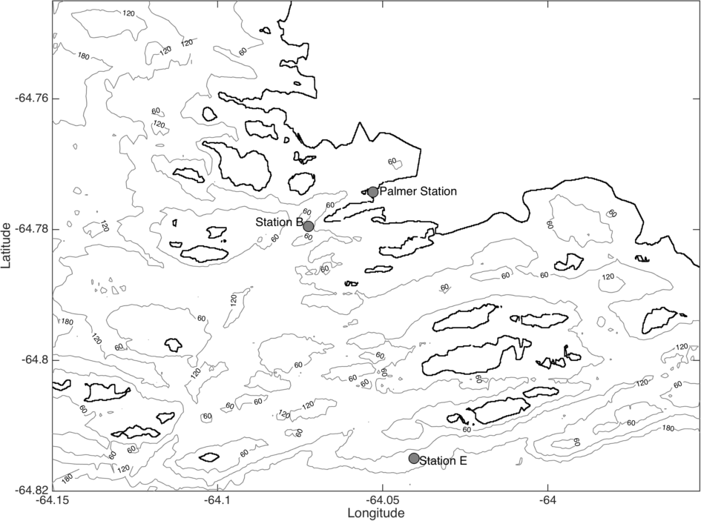

Sponsored by NSF, LTER is focused on understanding long term changes in the ecology and biogeochemistry of the marine system of the rapidly changing West Antarctic Peninsula. Currently conducting its 24 field season
Approach:
Palmer
Annual time series measurements at Palmer Station, nominally October through March
Annual cruise spanning the Peninsula during month of January
Station and cruise is augmented with Slocum glider deployments
Active satellite and modeling program
Linked to education and outreach programs
For more Info:
Program website: http://pal.lternet.edu/
or
Program documentary available at Netflix or ITunes

Slide 3
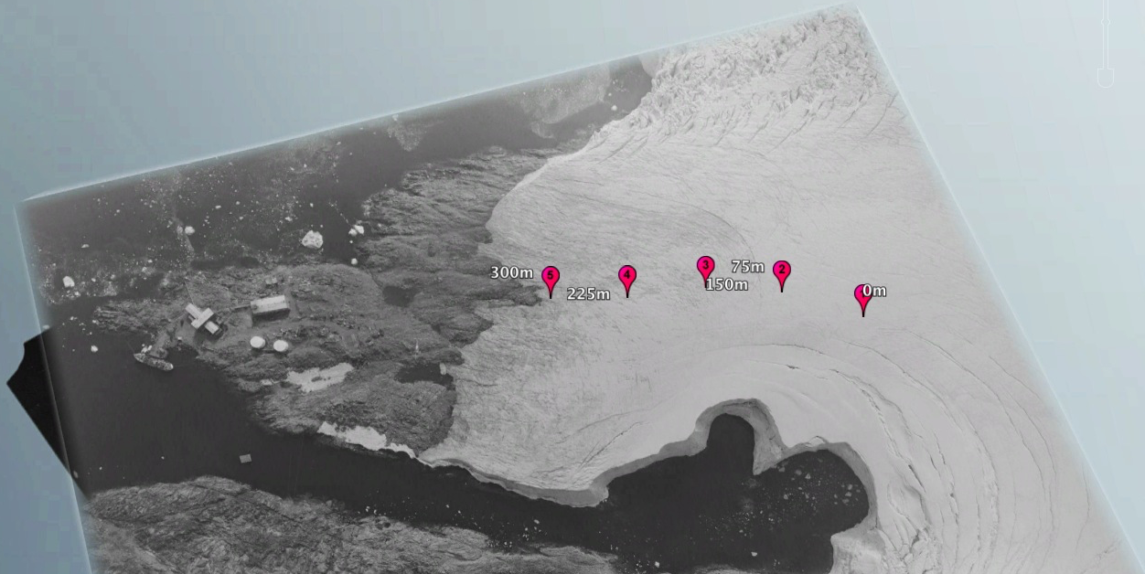
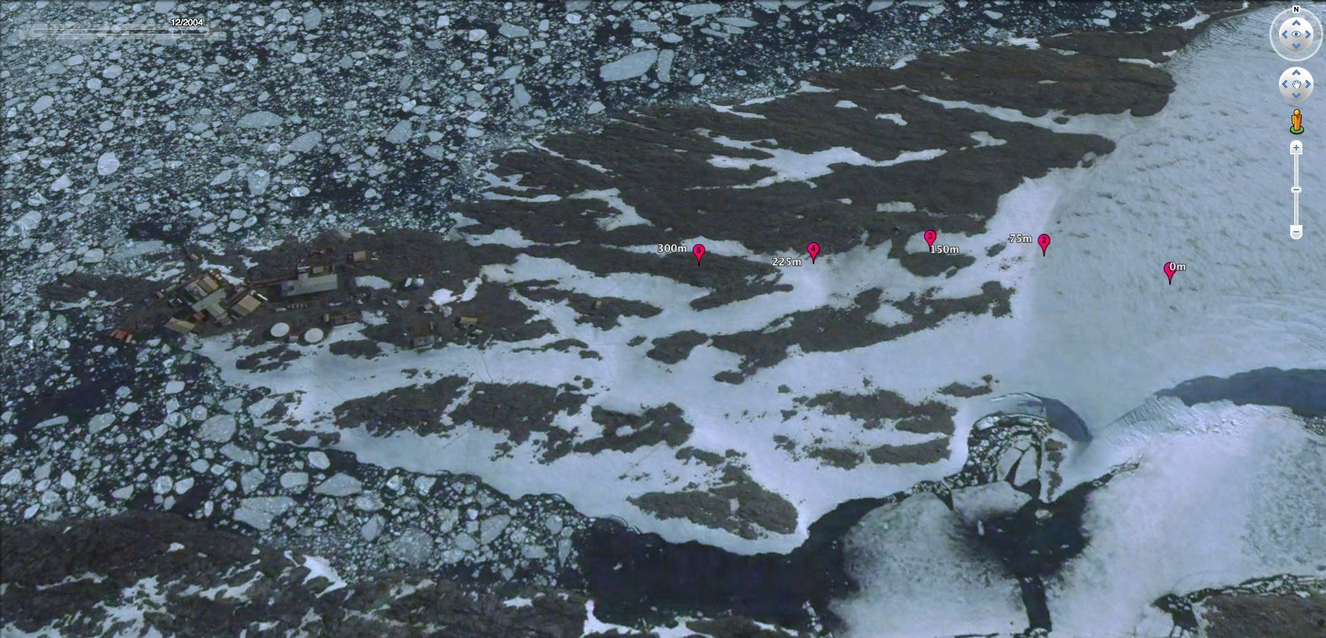
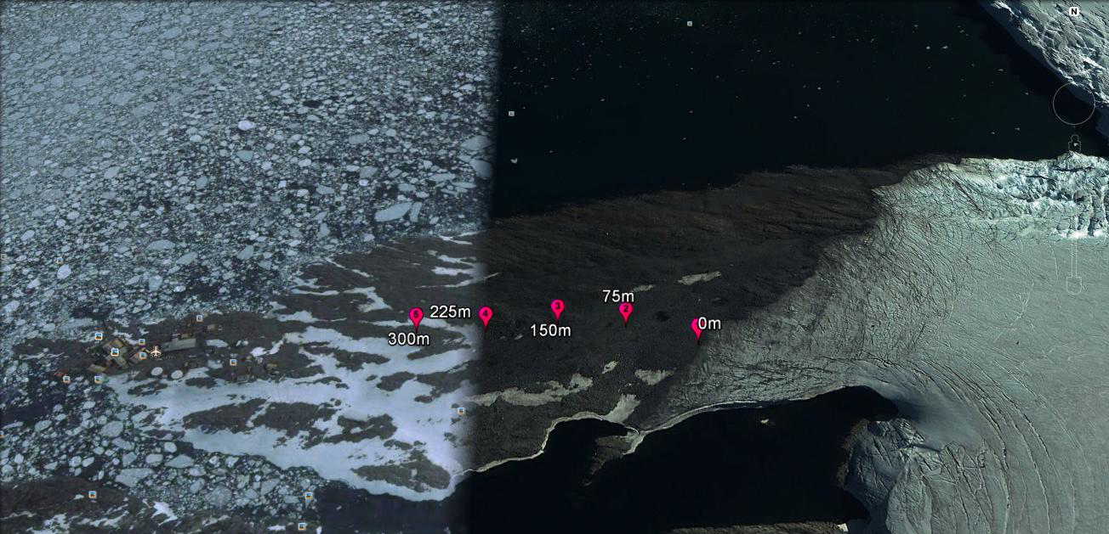
West Antarctic Peninsula is Exhibiting Significant Change
Winters Are Warming
Glaciers are retreating
Marr Glacier
1975
0
300
Palmer
Station
2004
0
300
Sea Ice retreating
10-year analysis of annual trends
Thanks M. Oliver
2014
0
300
See Stammerjohn et al. DSR 2008
Thanks to Dr. Natasja vanGestel

Slide 4
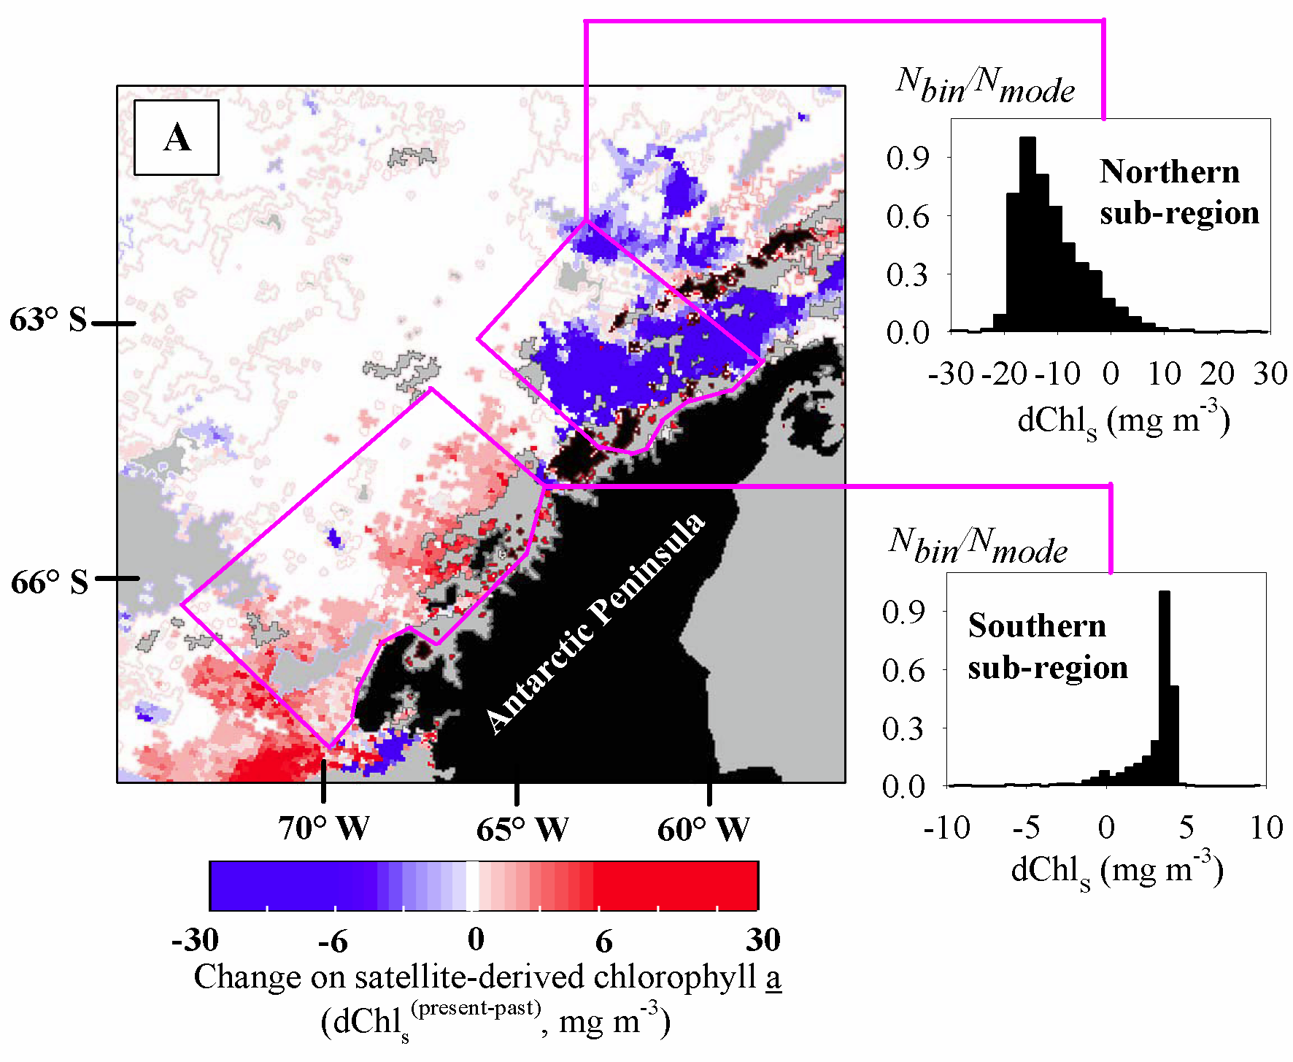
For Long (3 decades or more) West Antarctic Peninsula Ecosystems
are Exhibiting Significant Change
Phytoplankton
Penguins
-90%
+67%
Updated from Ducklow et al. 2007 Phil. Trans. R. Soc. B
Montes Hugo et al. 2014
Science

Slide 5
Food web is tightly coupled. High chlorophyll anomaly years result in high krill recruitment and immediately affect krill diet
Saba et al. 2014 Nature Communications
Saba et al. Nature Comm (2014)

Slide 6
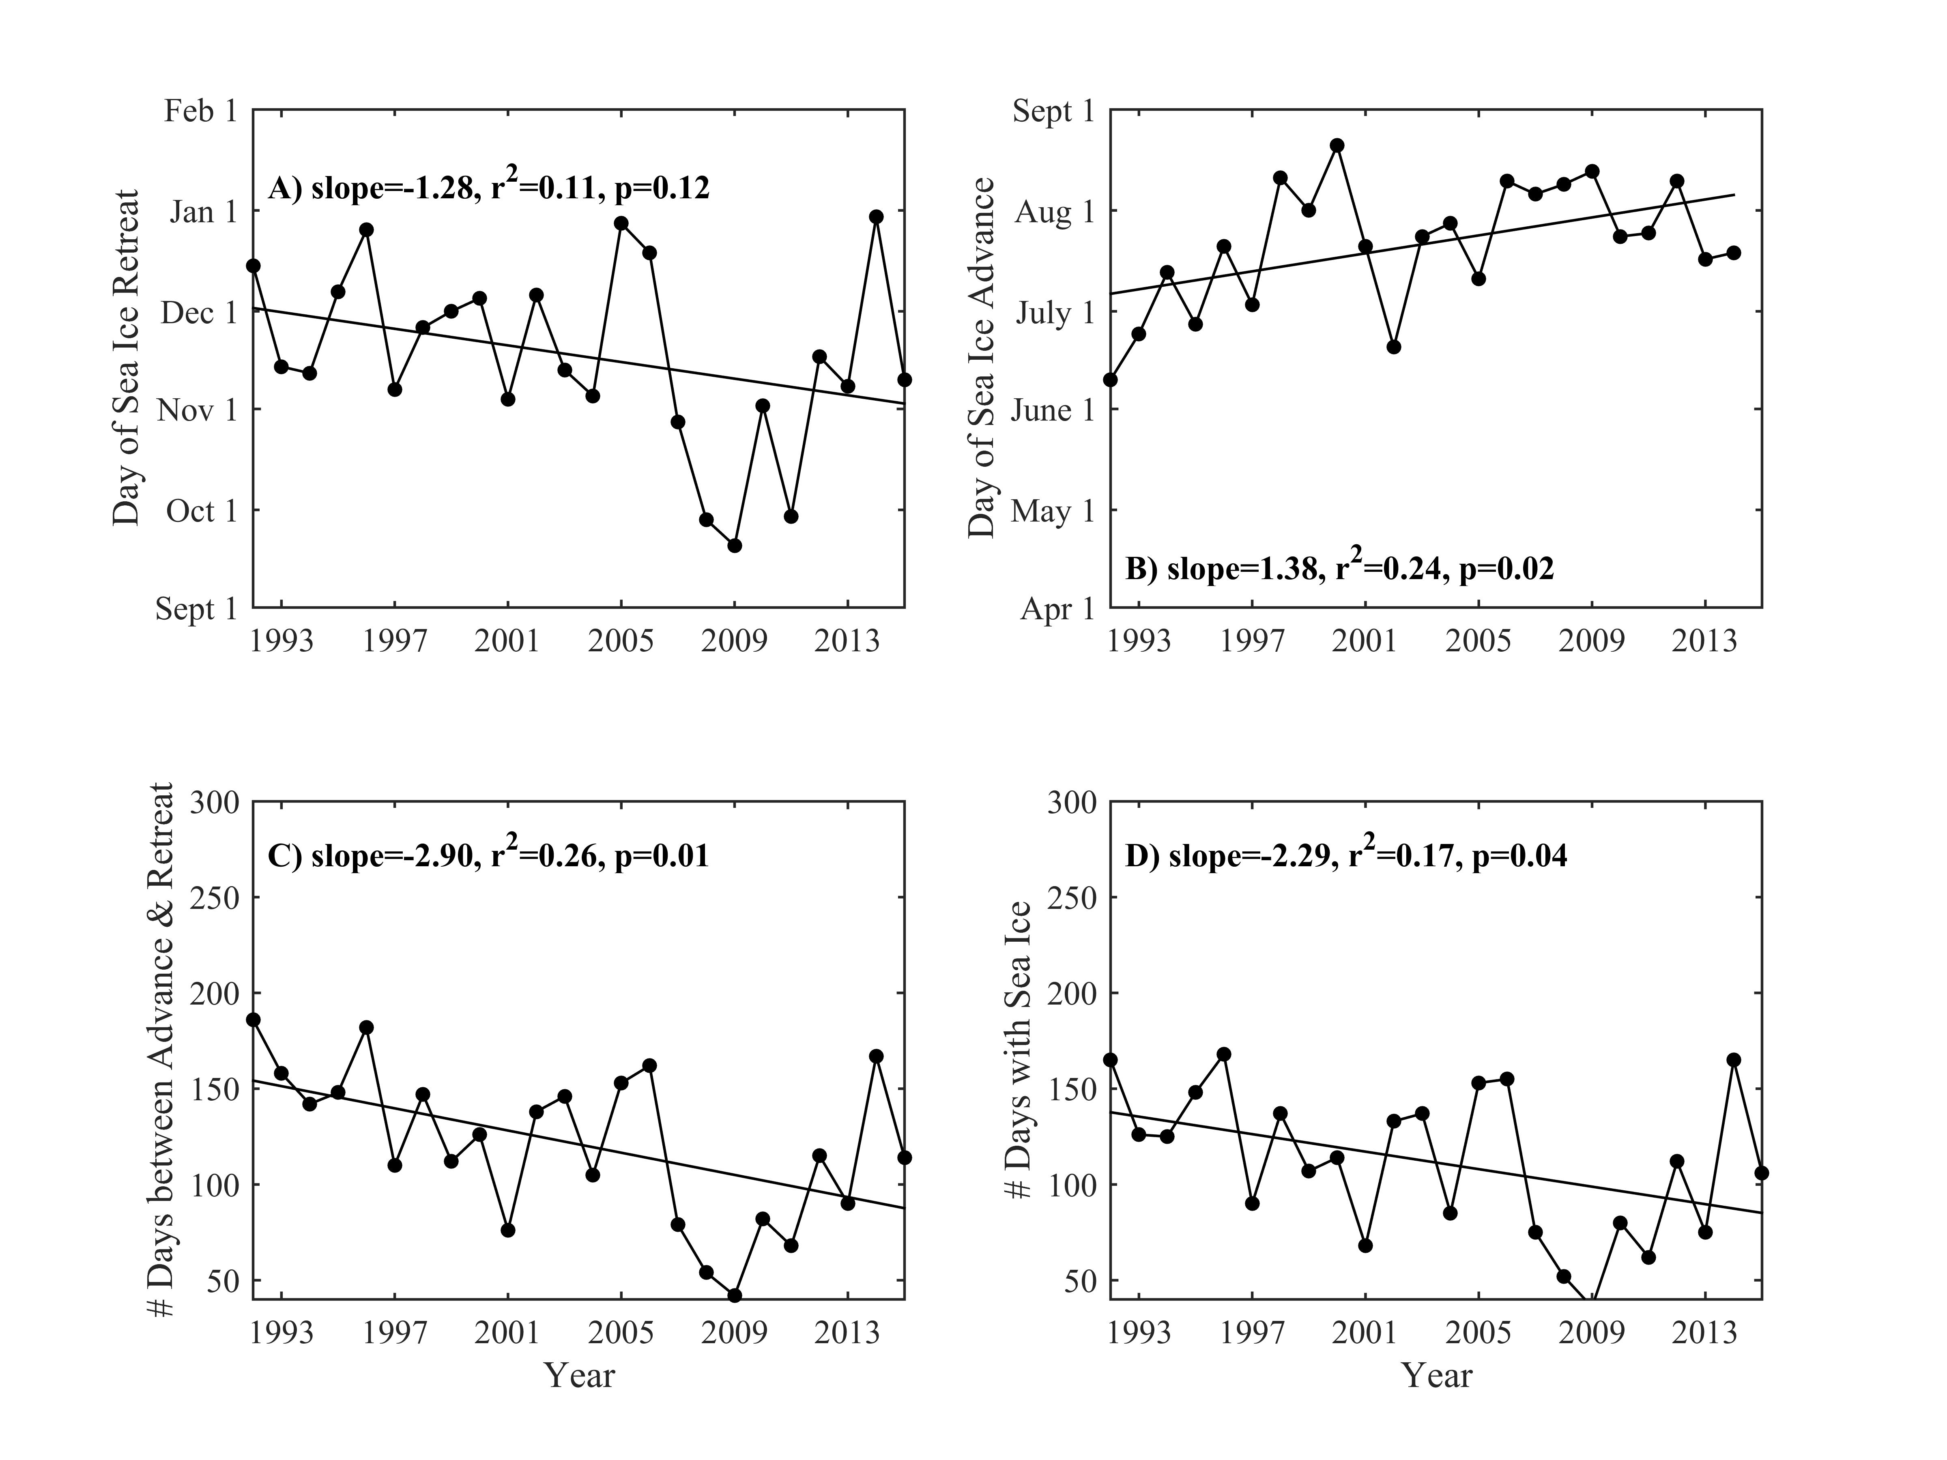

Slide 7
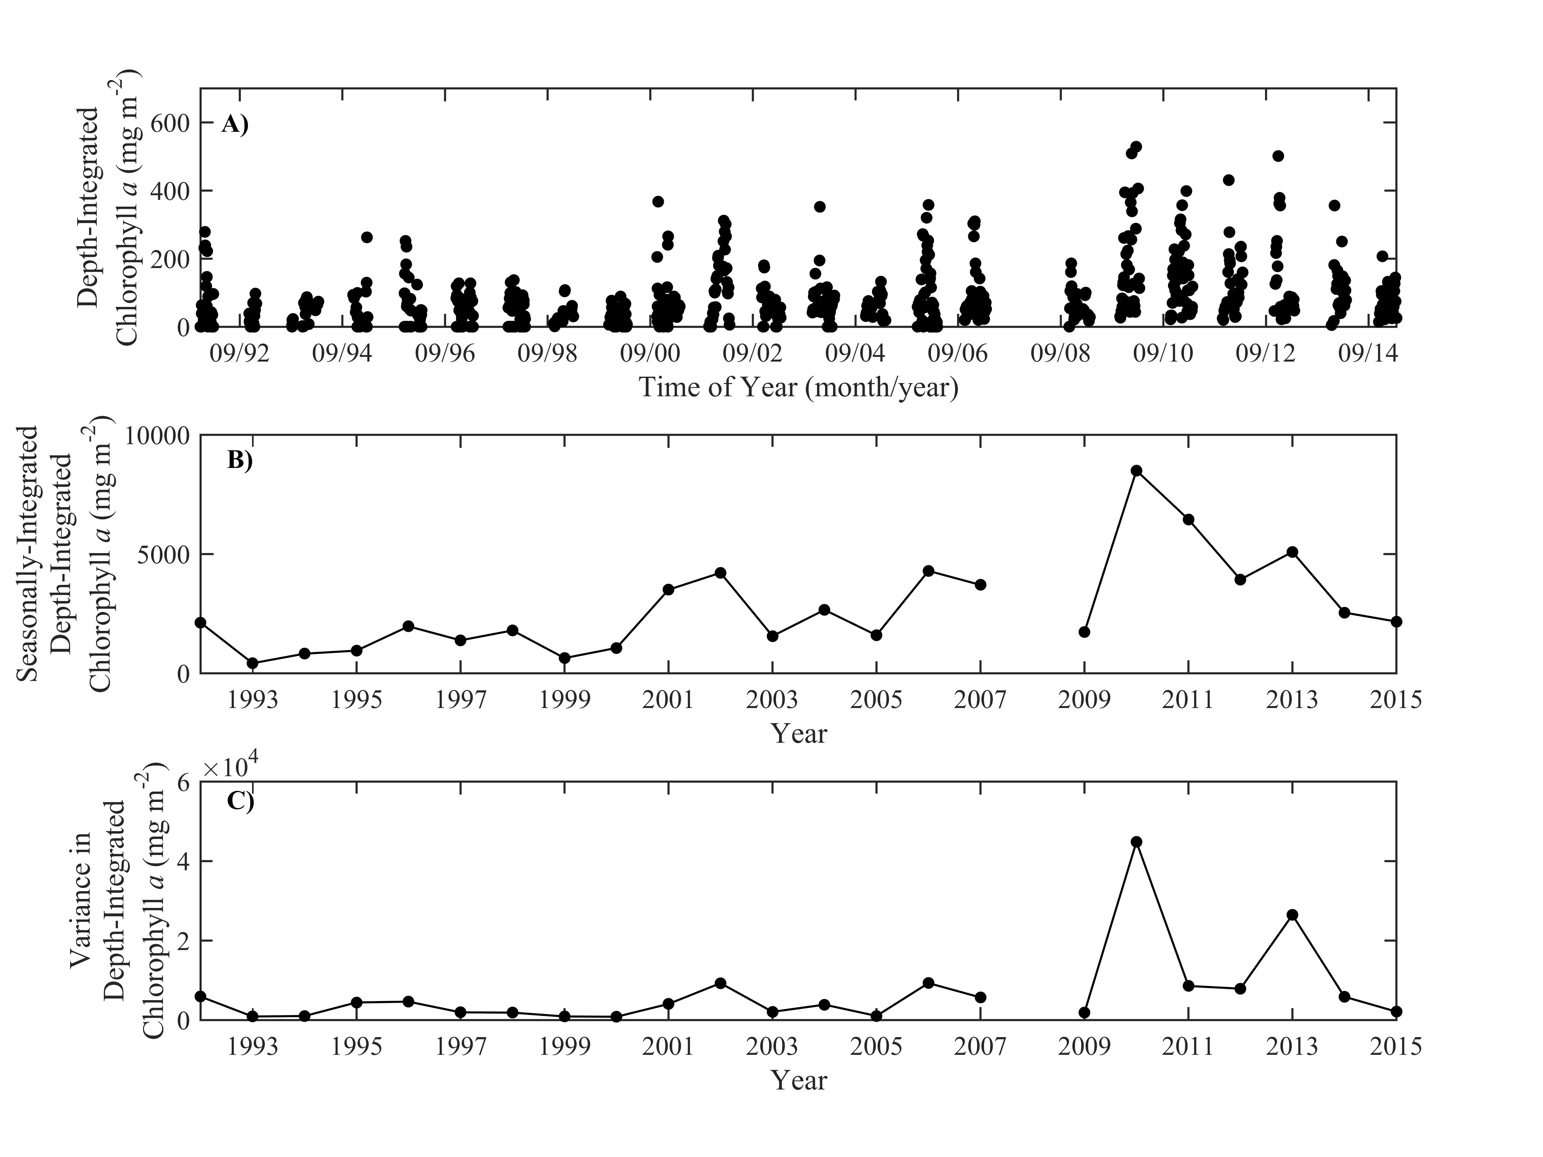

Slide 8
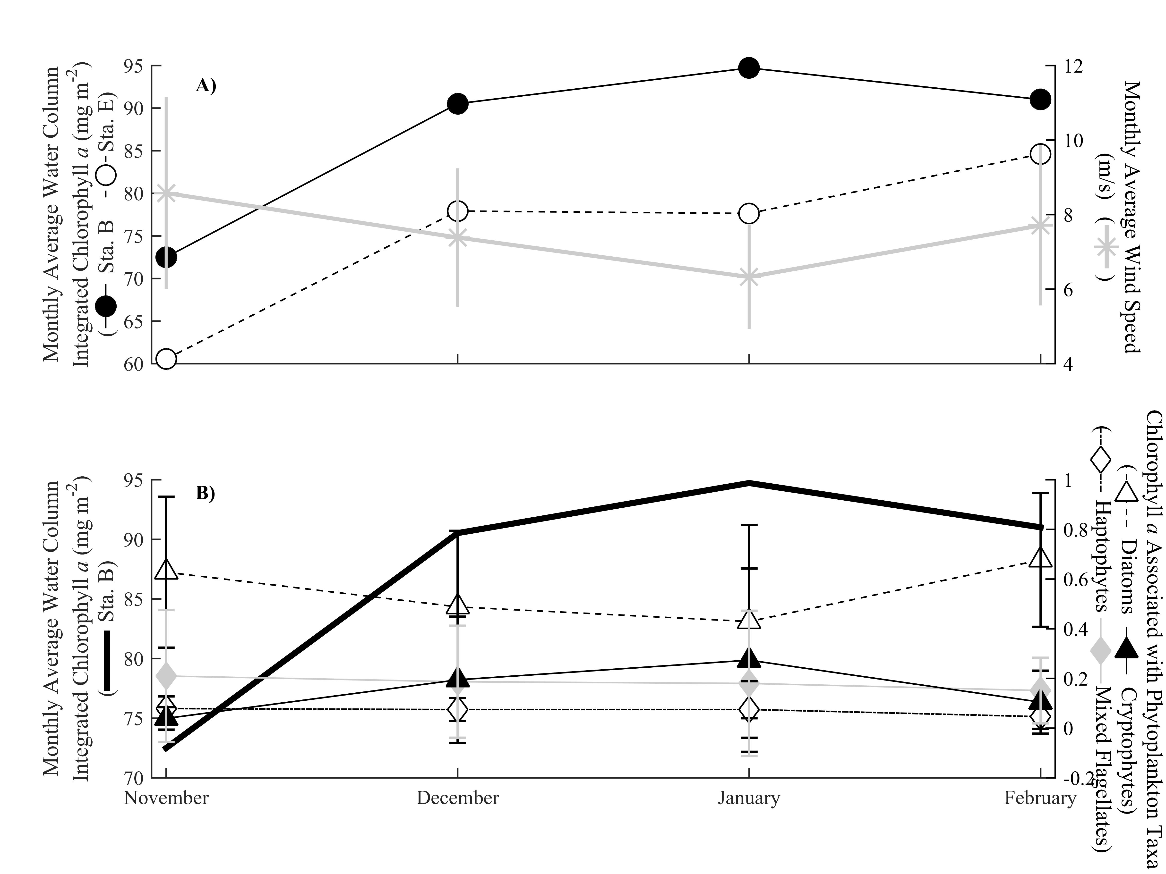

Slide 9
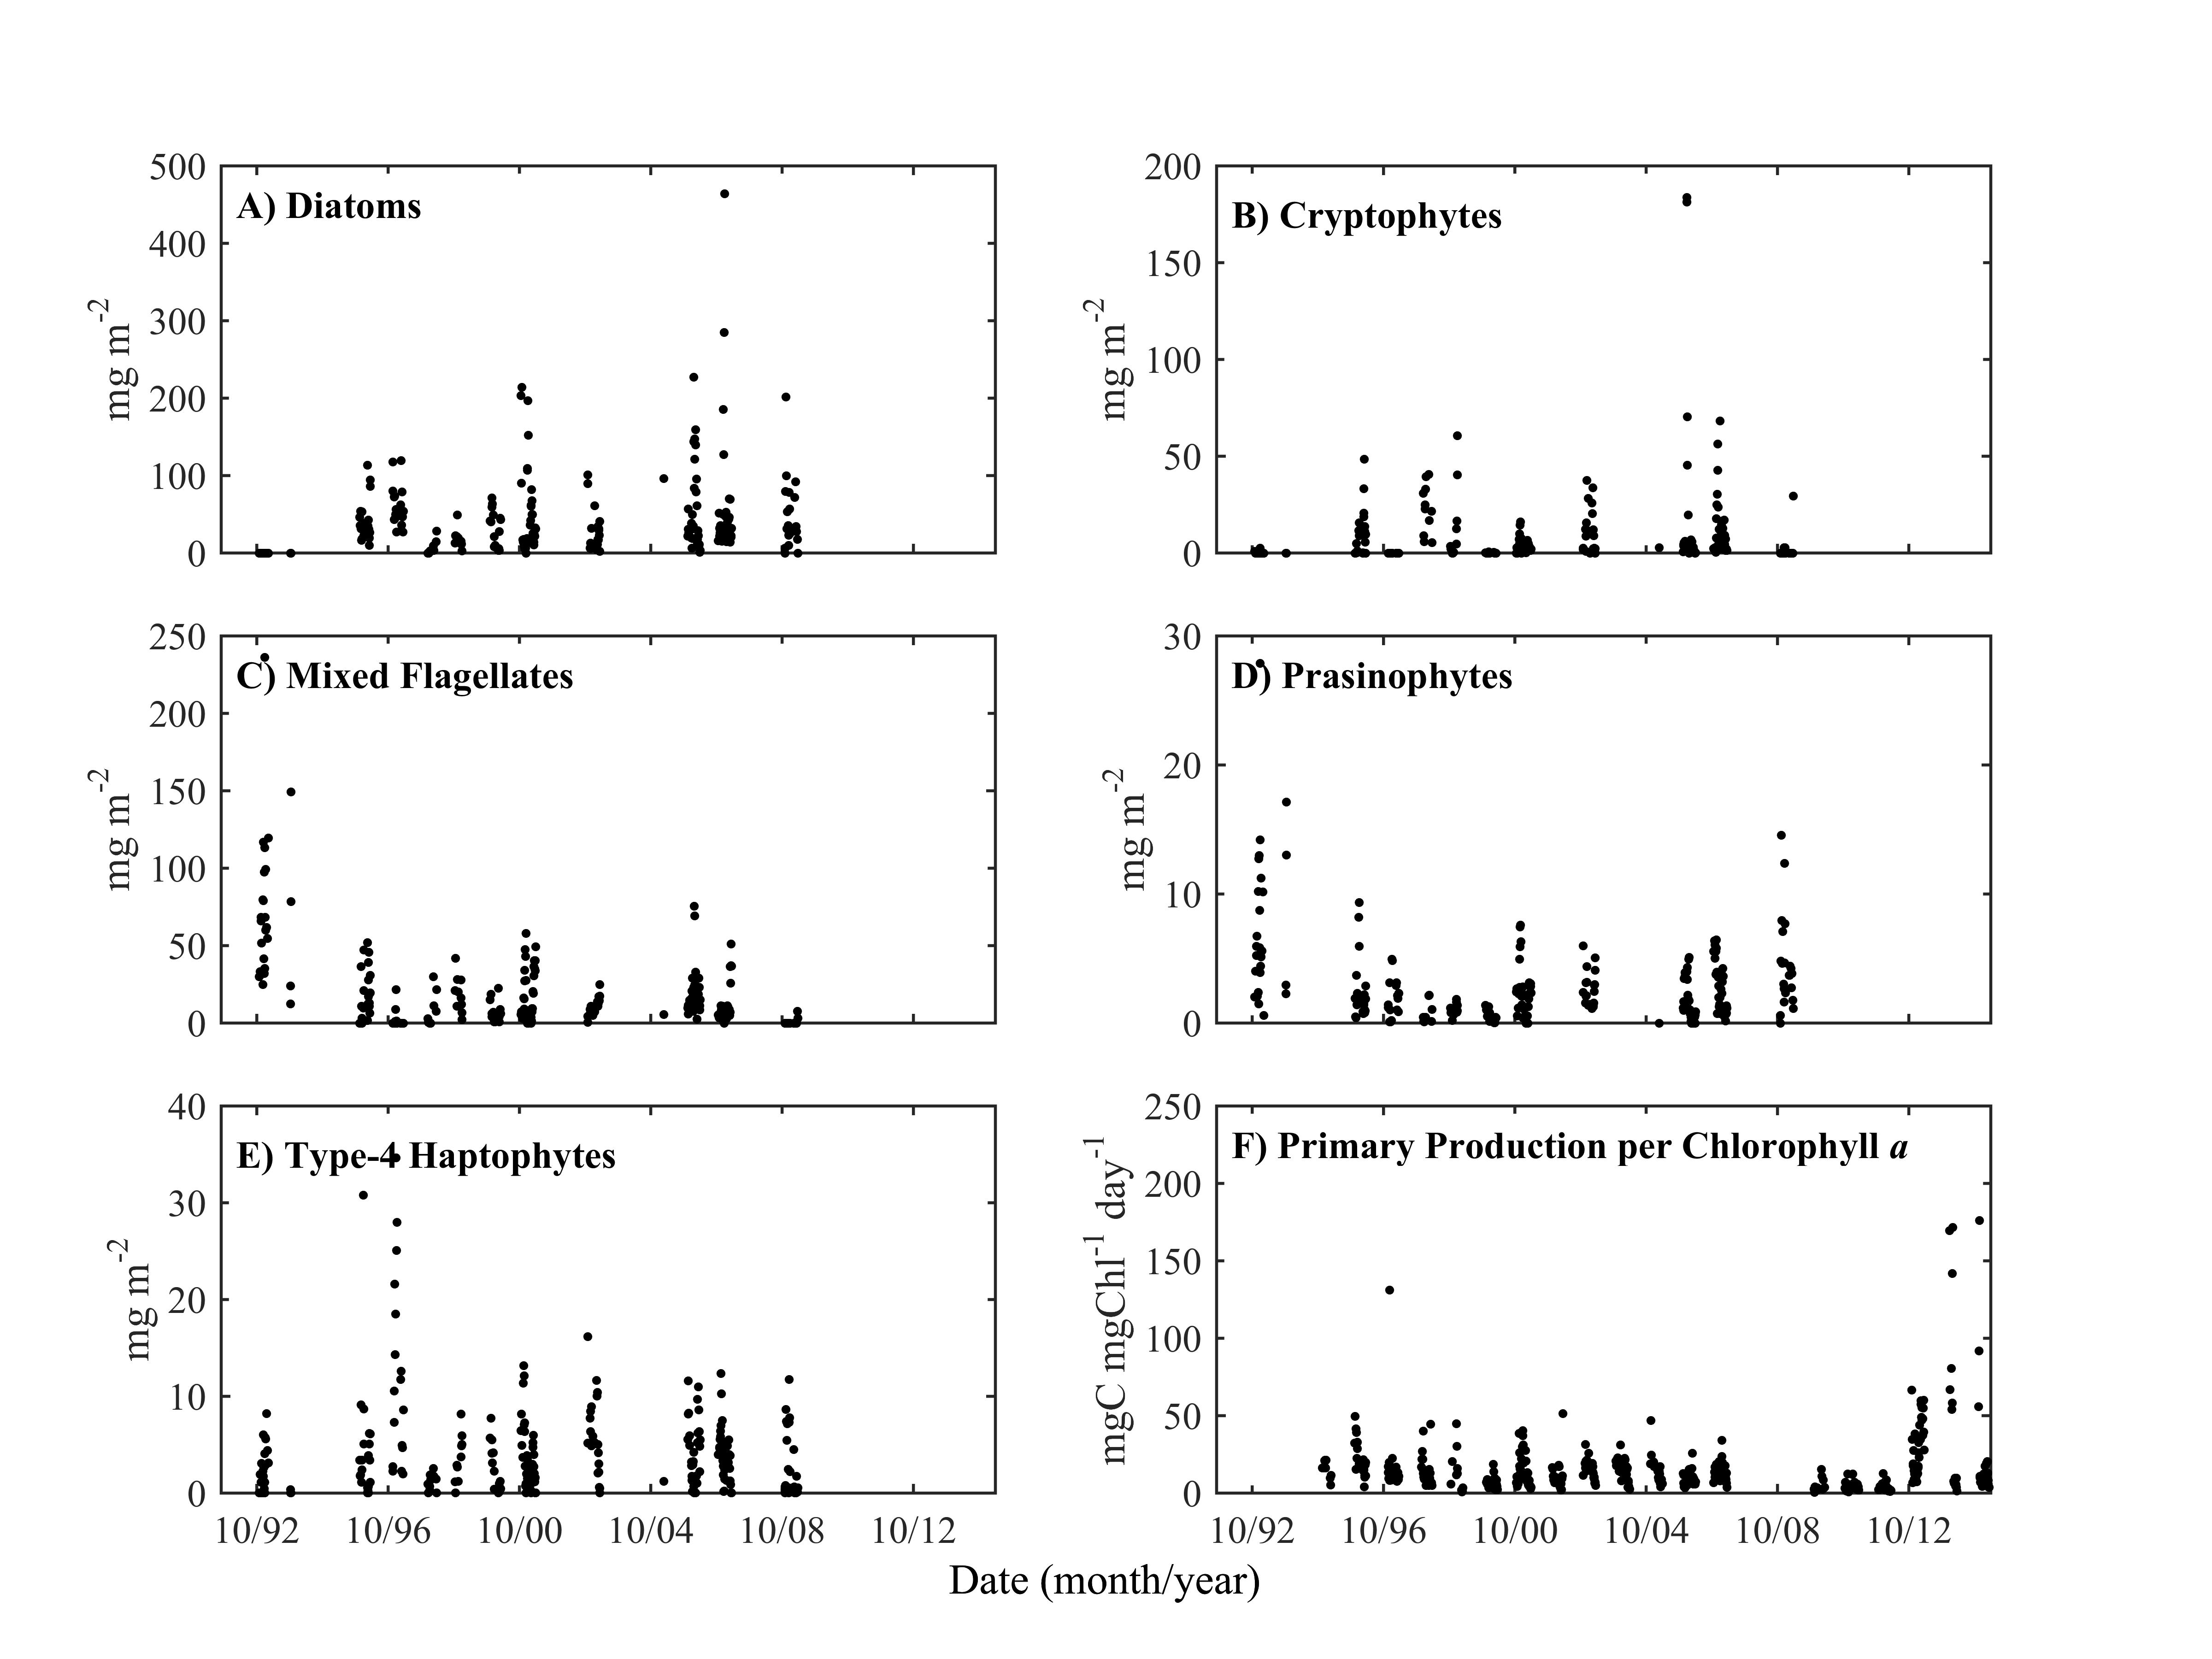

Slide 10
Picture of some the players
From satellite

Slide 12
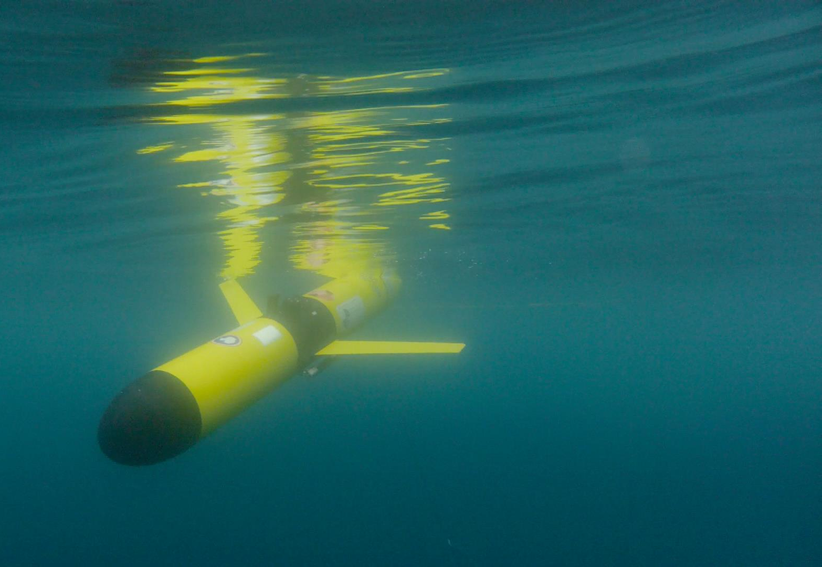
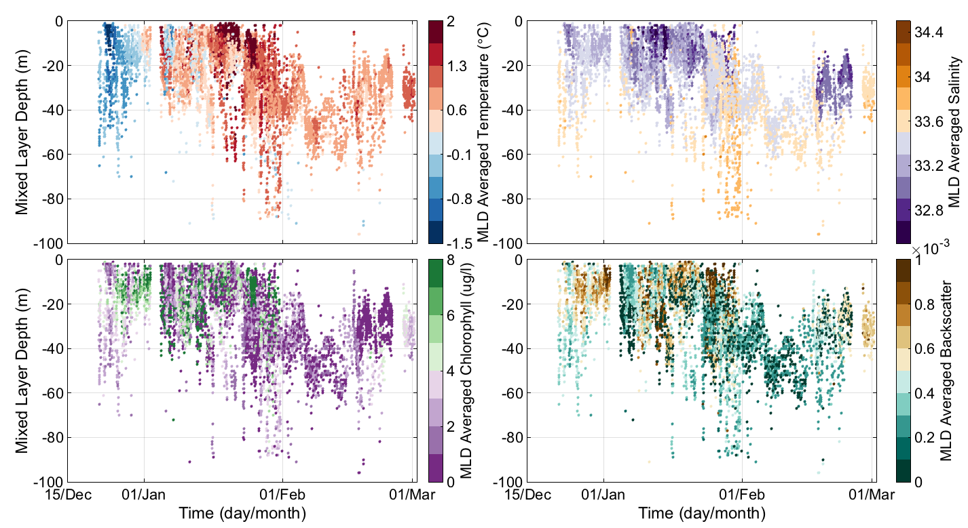
Phytoplankton blooms associated with shallower MLD. Shallower MLD consistently associated with lower salinity water (glacial and sea ice melt)

Slide 13
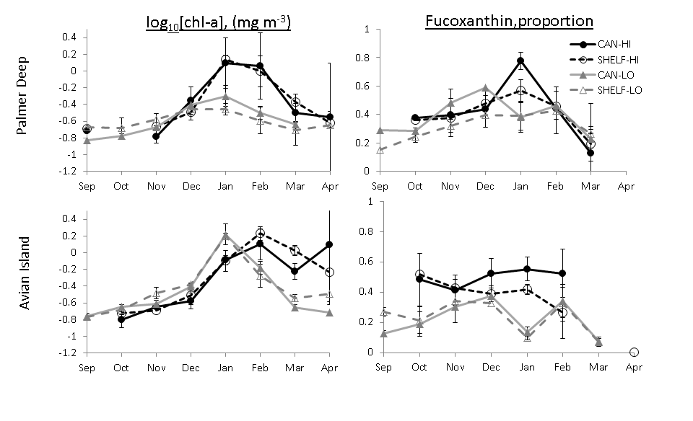
Lots of chlorophyll (no evidence of enhanced biomass)
but evidence of enhanced diatom presence
Kavanaugh et al. 2015

Slide 14
5%
9%
High krill
recruitment according
to penguin diets
5%
Big Chlorophyll Year
16%
65%
160
% Diatoms
80
% Prasinophytes
Anomaly of
chlorophyll a (mg m⁻²)
% Haptophytes
0
% Flagellates
9%
4%
% Cryptophytes
-80
8%
Low Chlorophyll Year
Low krill
recruitment according
to penguin diets
27%
52%

Slide 15
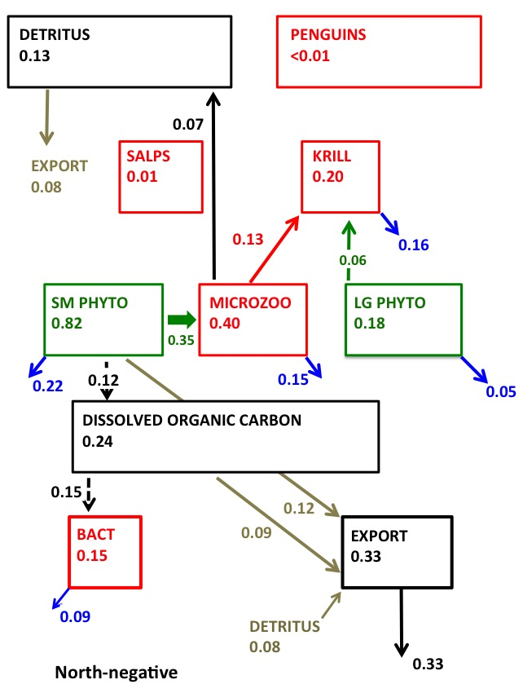
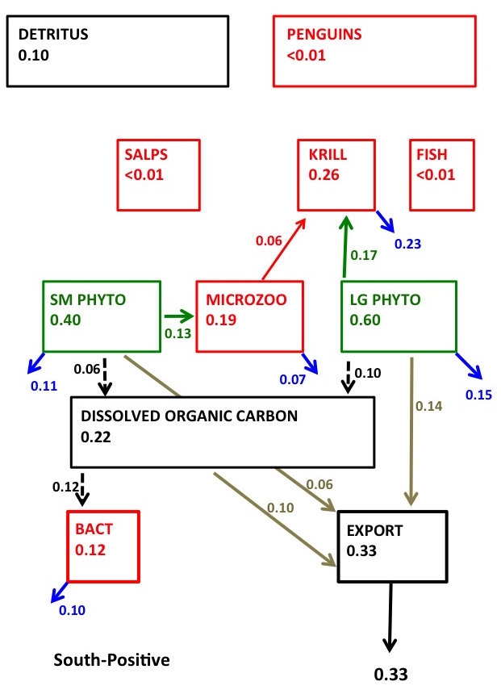
North-Low Chl vs South High Chl: Polar Opposite Regimes
Flows normalized to GPP; only flows < 5% GPP shown
Sevrine et al 2013

Slide 16
Ice Melt

Slide 17
The TS relationship does not hold for the ship grid

Slide 18
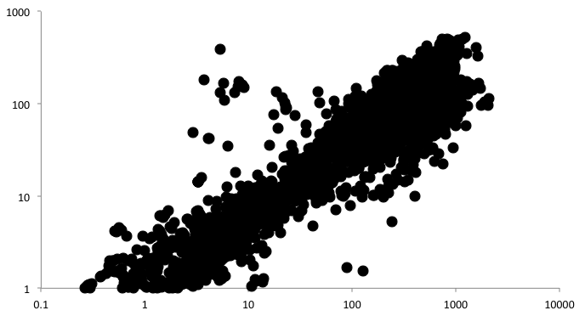
Diatoms remain the dominant taxa accounting for 63% of the variability in the chlorophyll a across the entire grid.
Fucoxanthin (ng L⁻¹)
Chlrophyll a (μg L⁻¹)

Slide 19
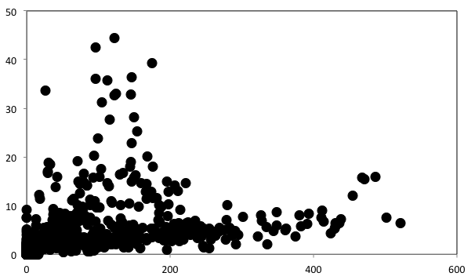
While not as clear as Palmer basin, generally the higher concentrations of cryptophytes are not associated with high concentrations of diatoms .
Alloxanthin (ng/L)
Fucoxanthin (ng/L)

Slide 20
Diatoms
Crypts

Slide 21
All cryptophytes are not the same

Slide 22
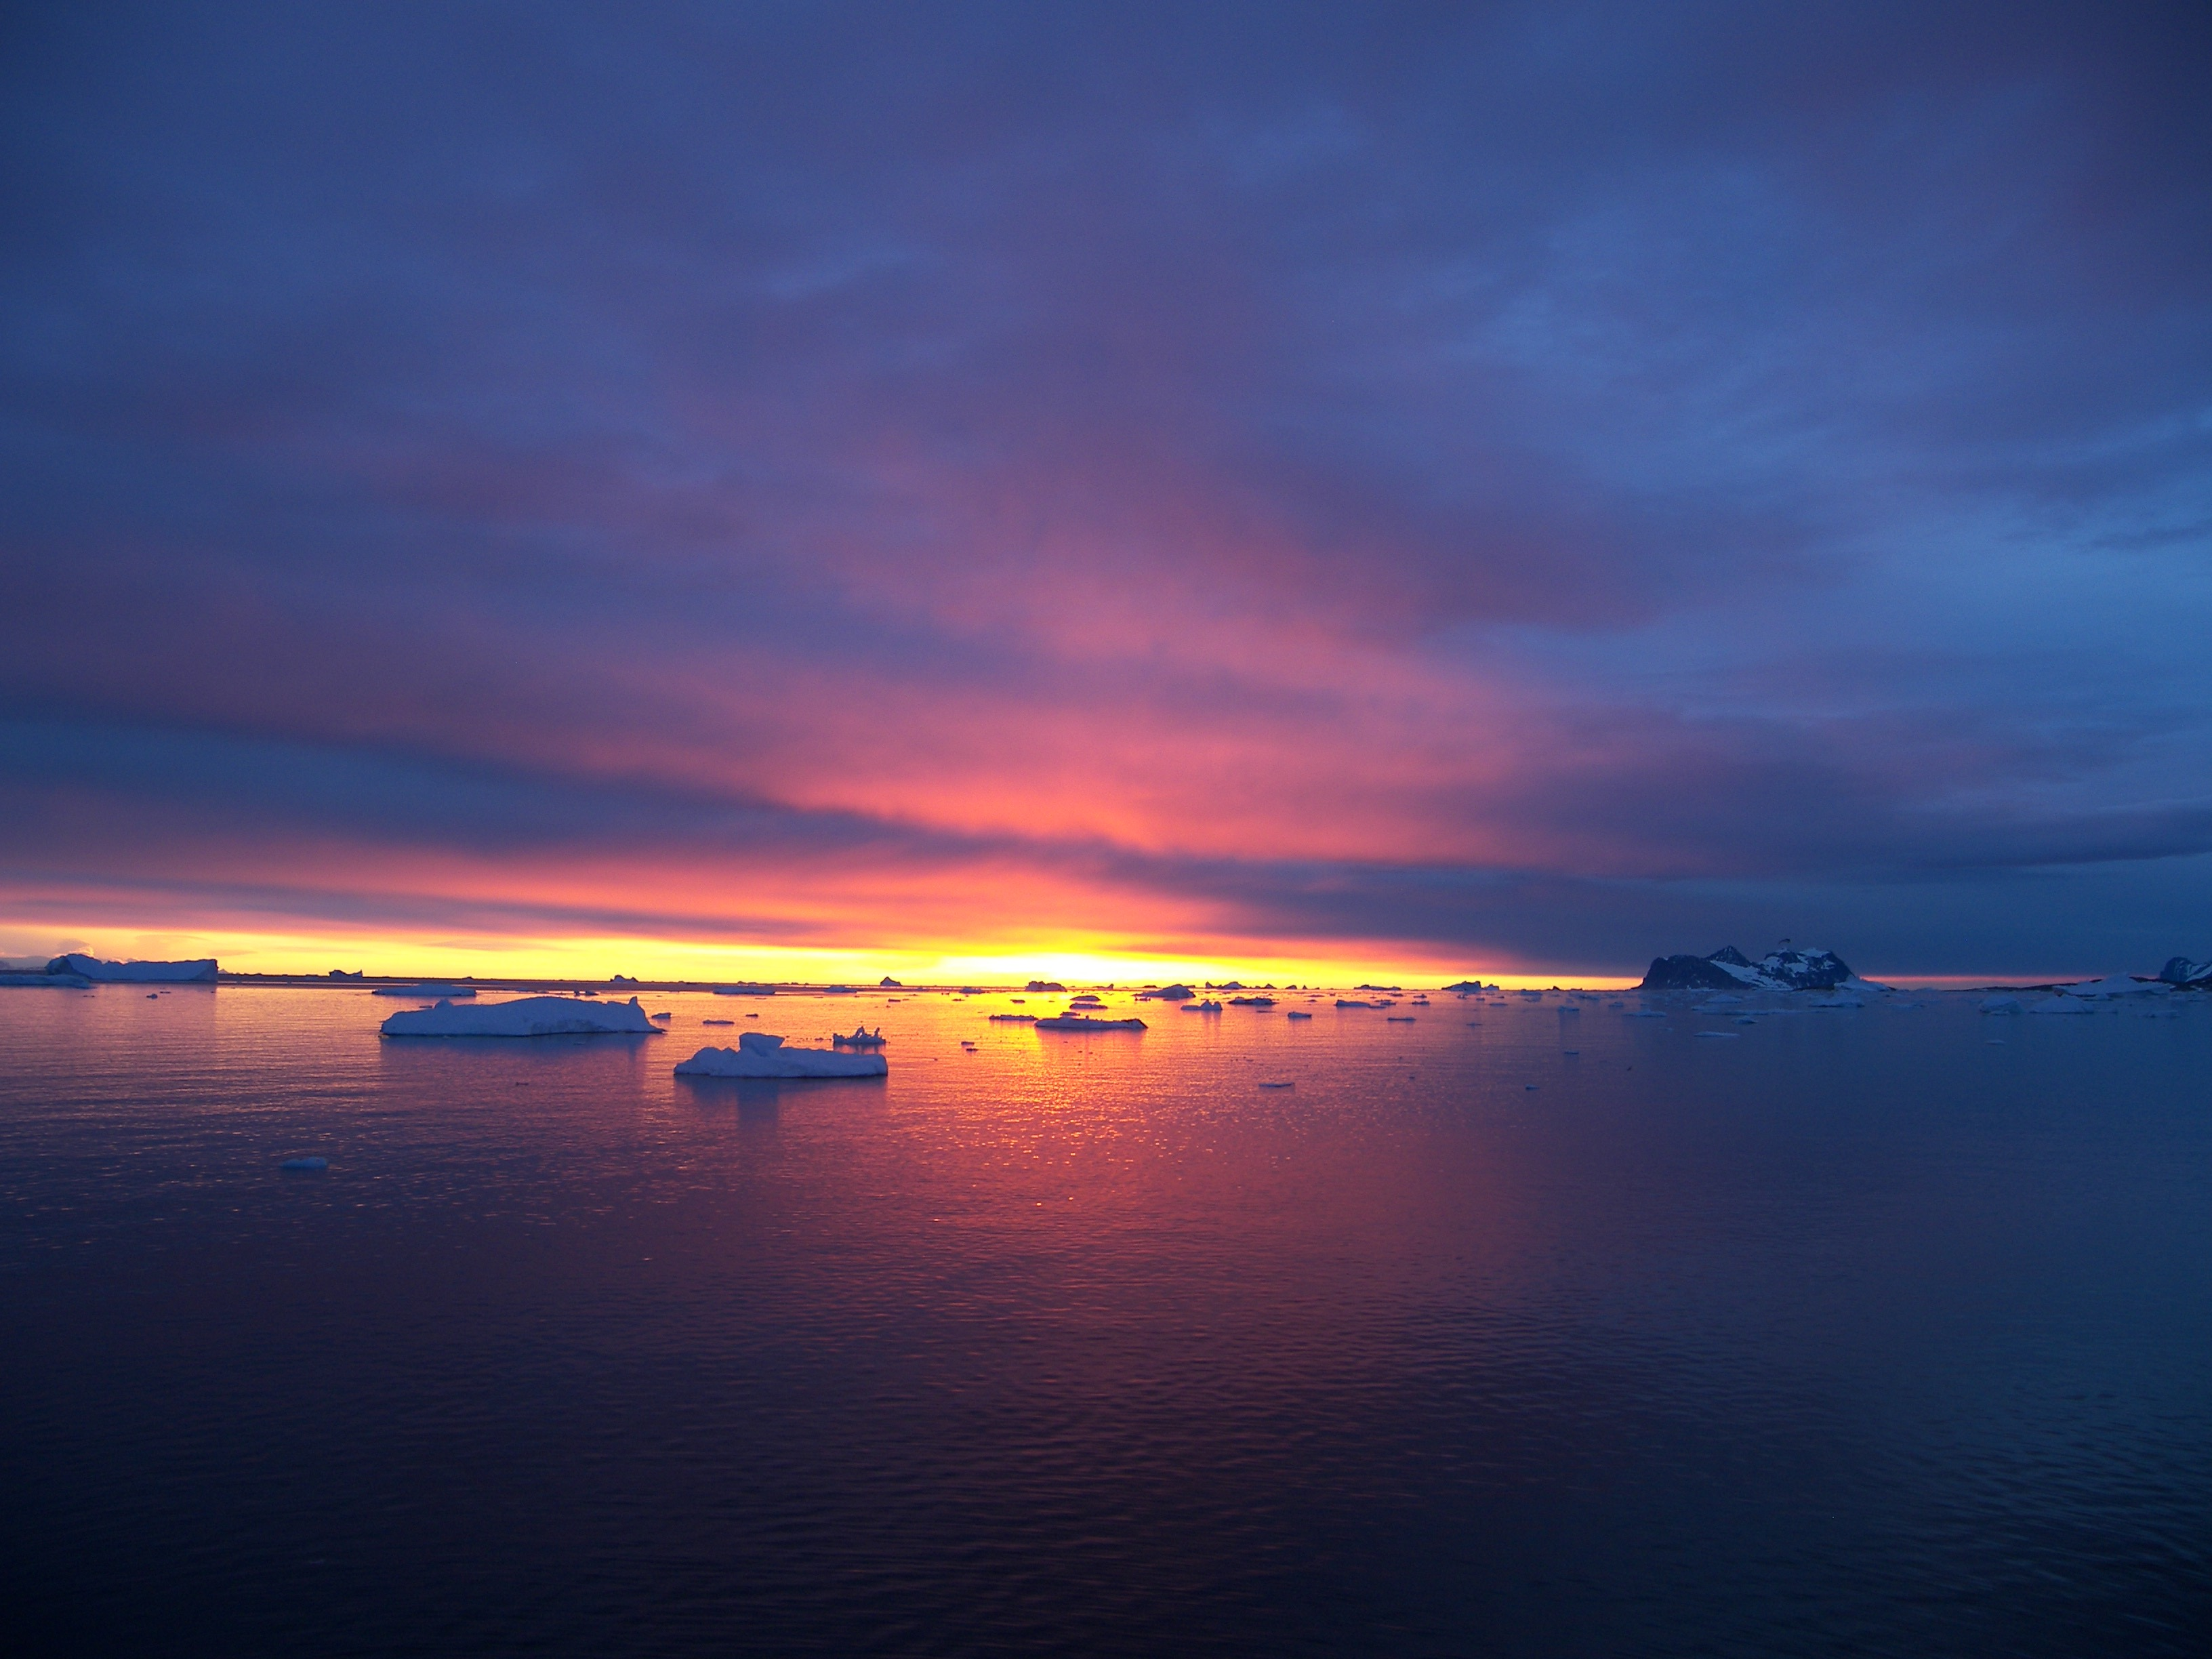
CONCLUSIONS
WAP is undergoing changes with the changes in the northern system are reflected in higher trophic levels.
Large chlorophyll blooms associated with shallower cold and fresh MLD. Diatom blooms at Palmer are dominated by either diatoms or cryptophytes. Cryptophytes are associated with cold fresher melt water.
These patterns do not apply for the full West Antarctic Peninsula which we believe reflects different cryptophyte species across the grid that must have different environmental niches.
LTERS are long term investments for many scientists, thanks to past Pis
Barbara Prezelin, John Klinck, Maria Vernet, Robin Ross, Langdon Quetin, Eileen Hoffman, Dave Karl, Ray Smith and MANY MANY others

