Slide 1




Updates on the goals and strategies for building a Southern Ocean Observing System (SOOS)
Notes:
Southern Ocean observing system or SOOS is a joint initiative of both SCAR and the Scientific Committee on oceanic research SCOR. SOOS was developed about 4 years ago, with the mission to …
The key part of this mission, and what all SOOS activities are focussed around, is sustaining and enhancing the collection and delivery of the observational data

Slide 2
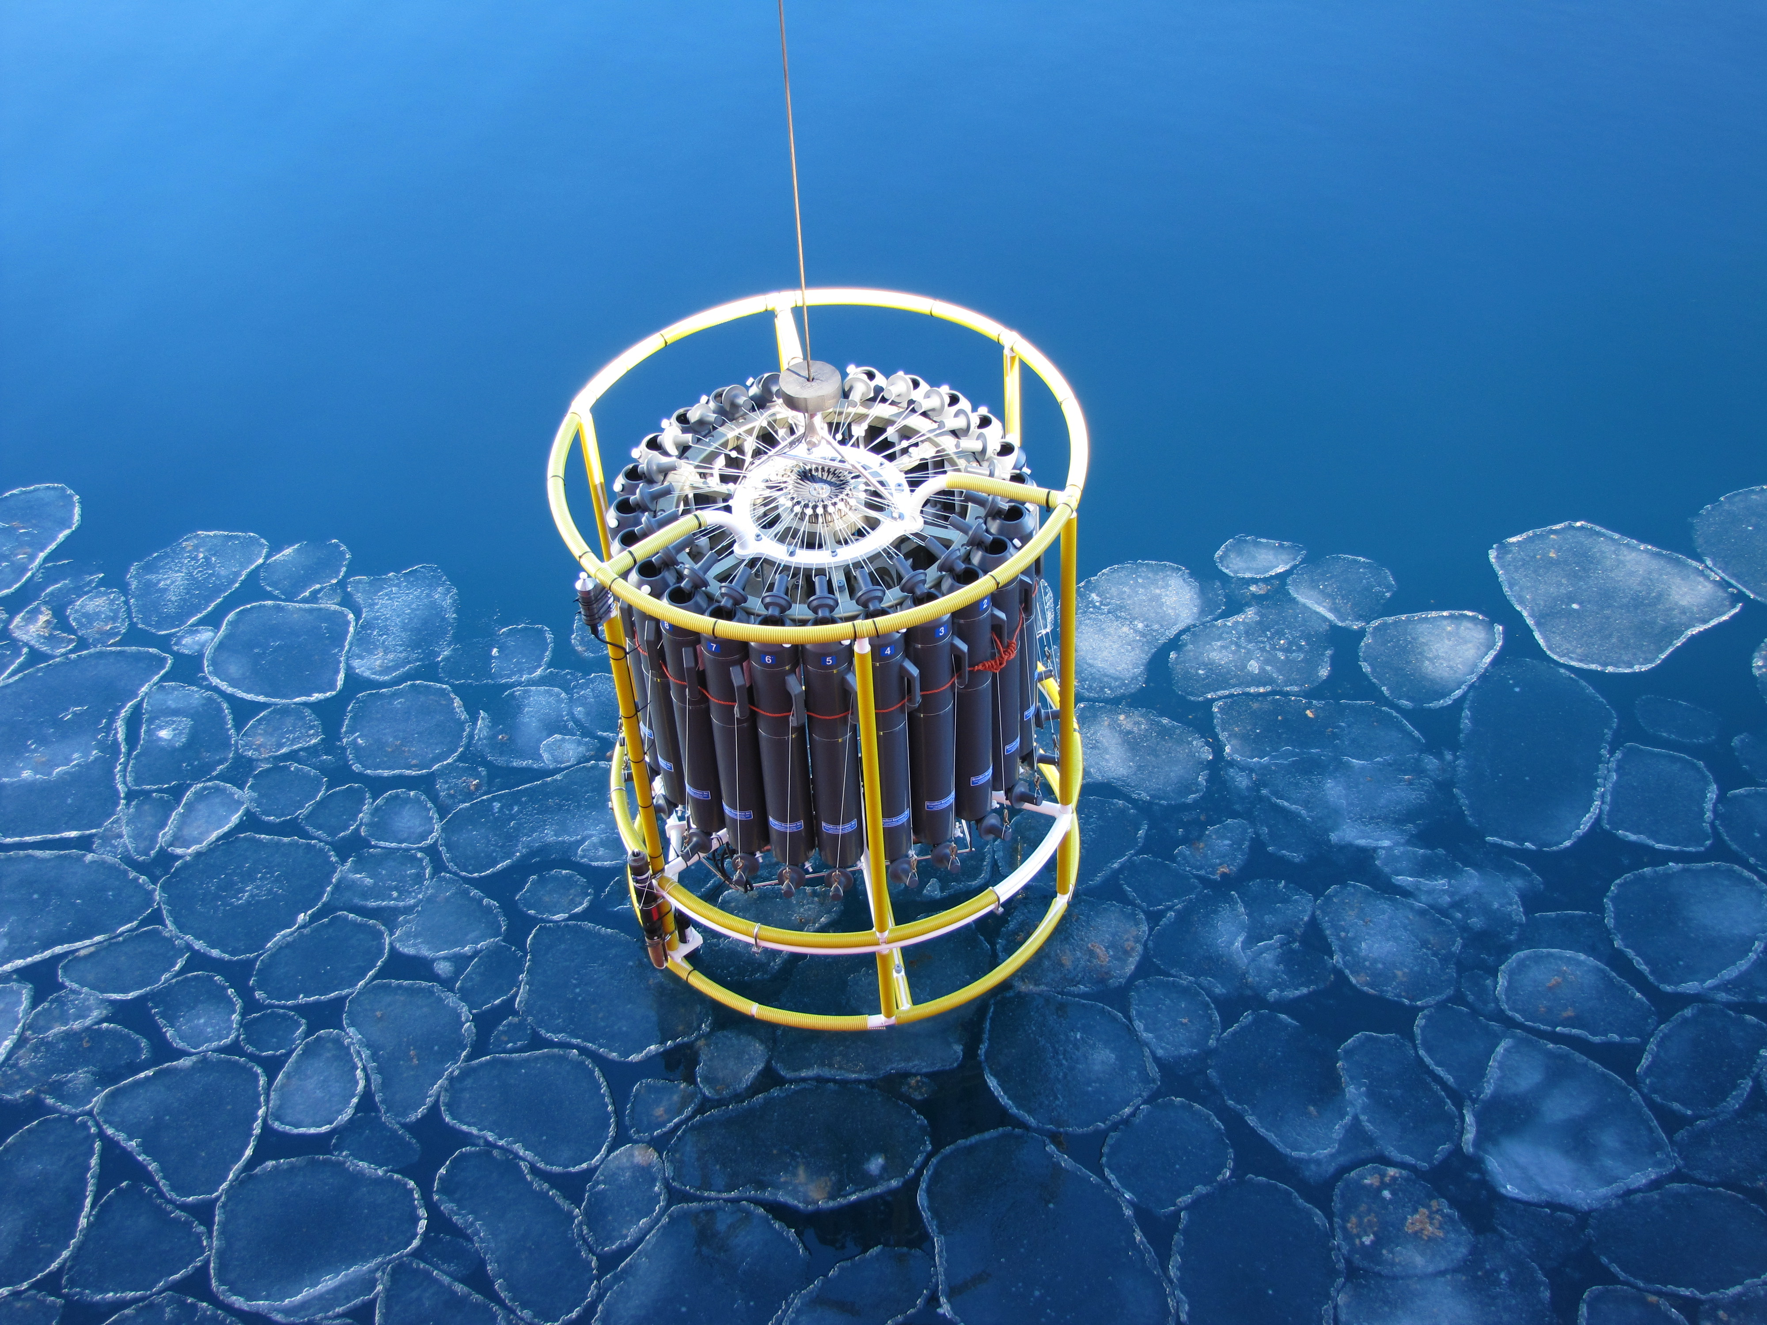
The Southern Ocean Observing System facilitates the collection and delivery of essential observations on variability and change of Southern Ocean systems to all international stakeholders, through design, advocacy, and implementation of cost-effective observing and data delivery systems.
B. Wallis AAD

Slide 3
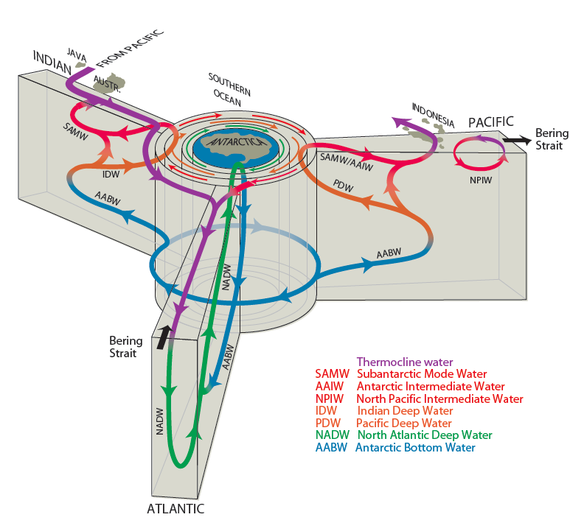
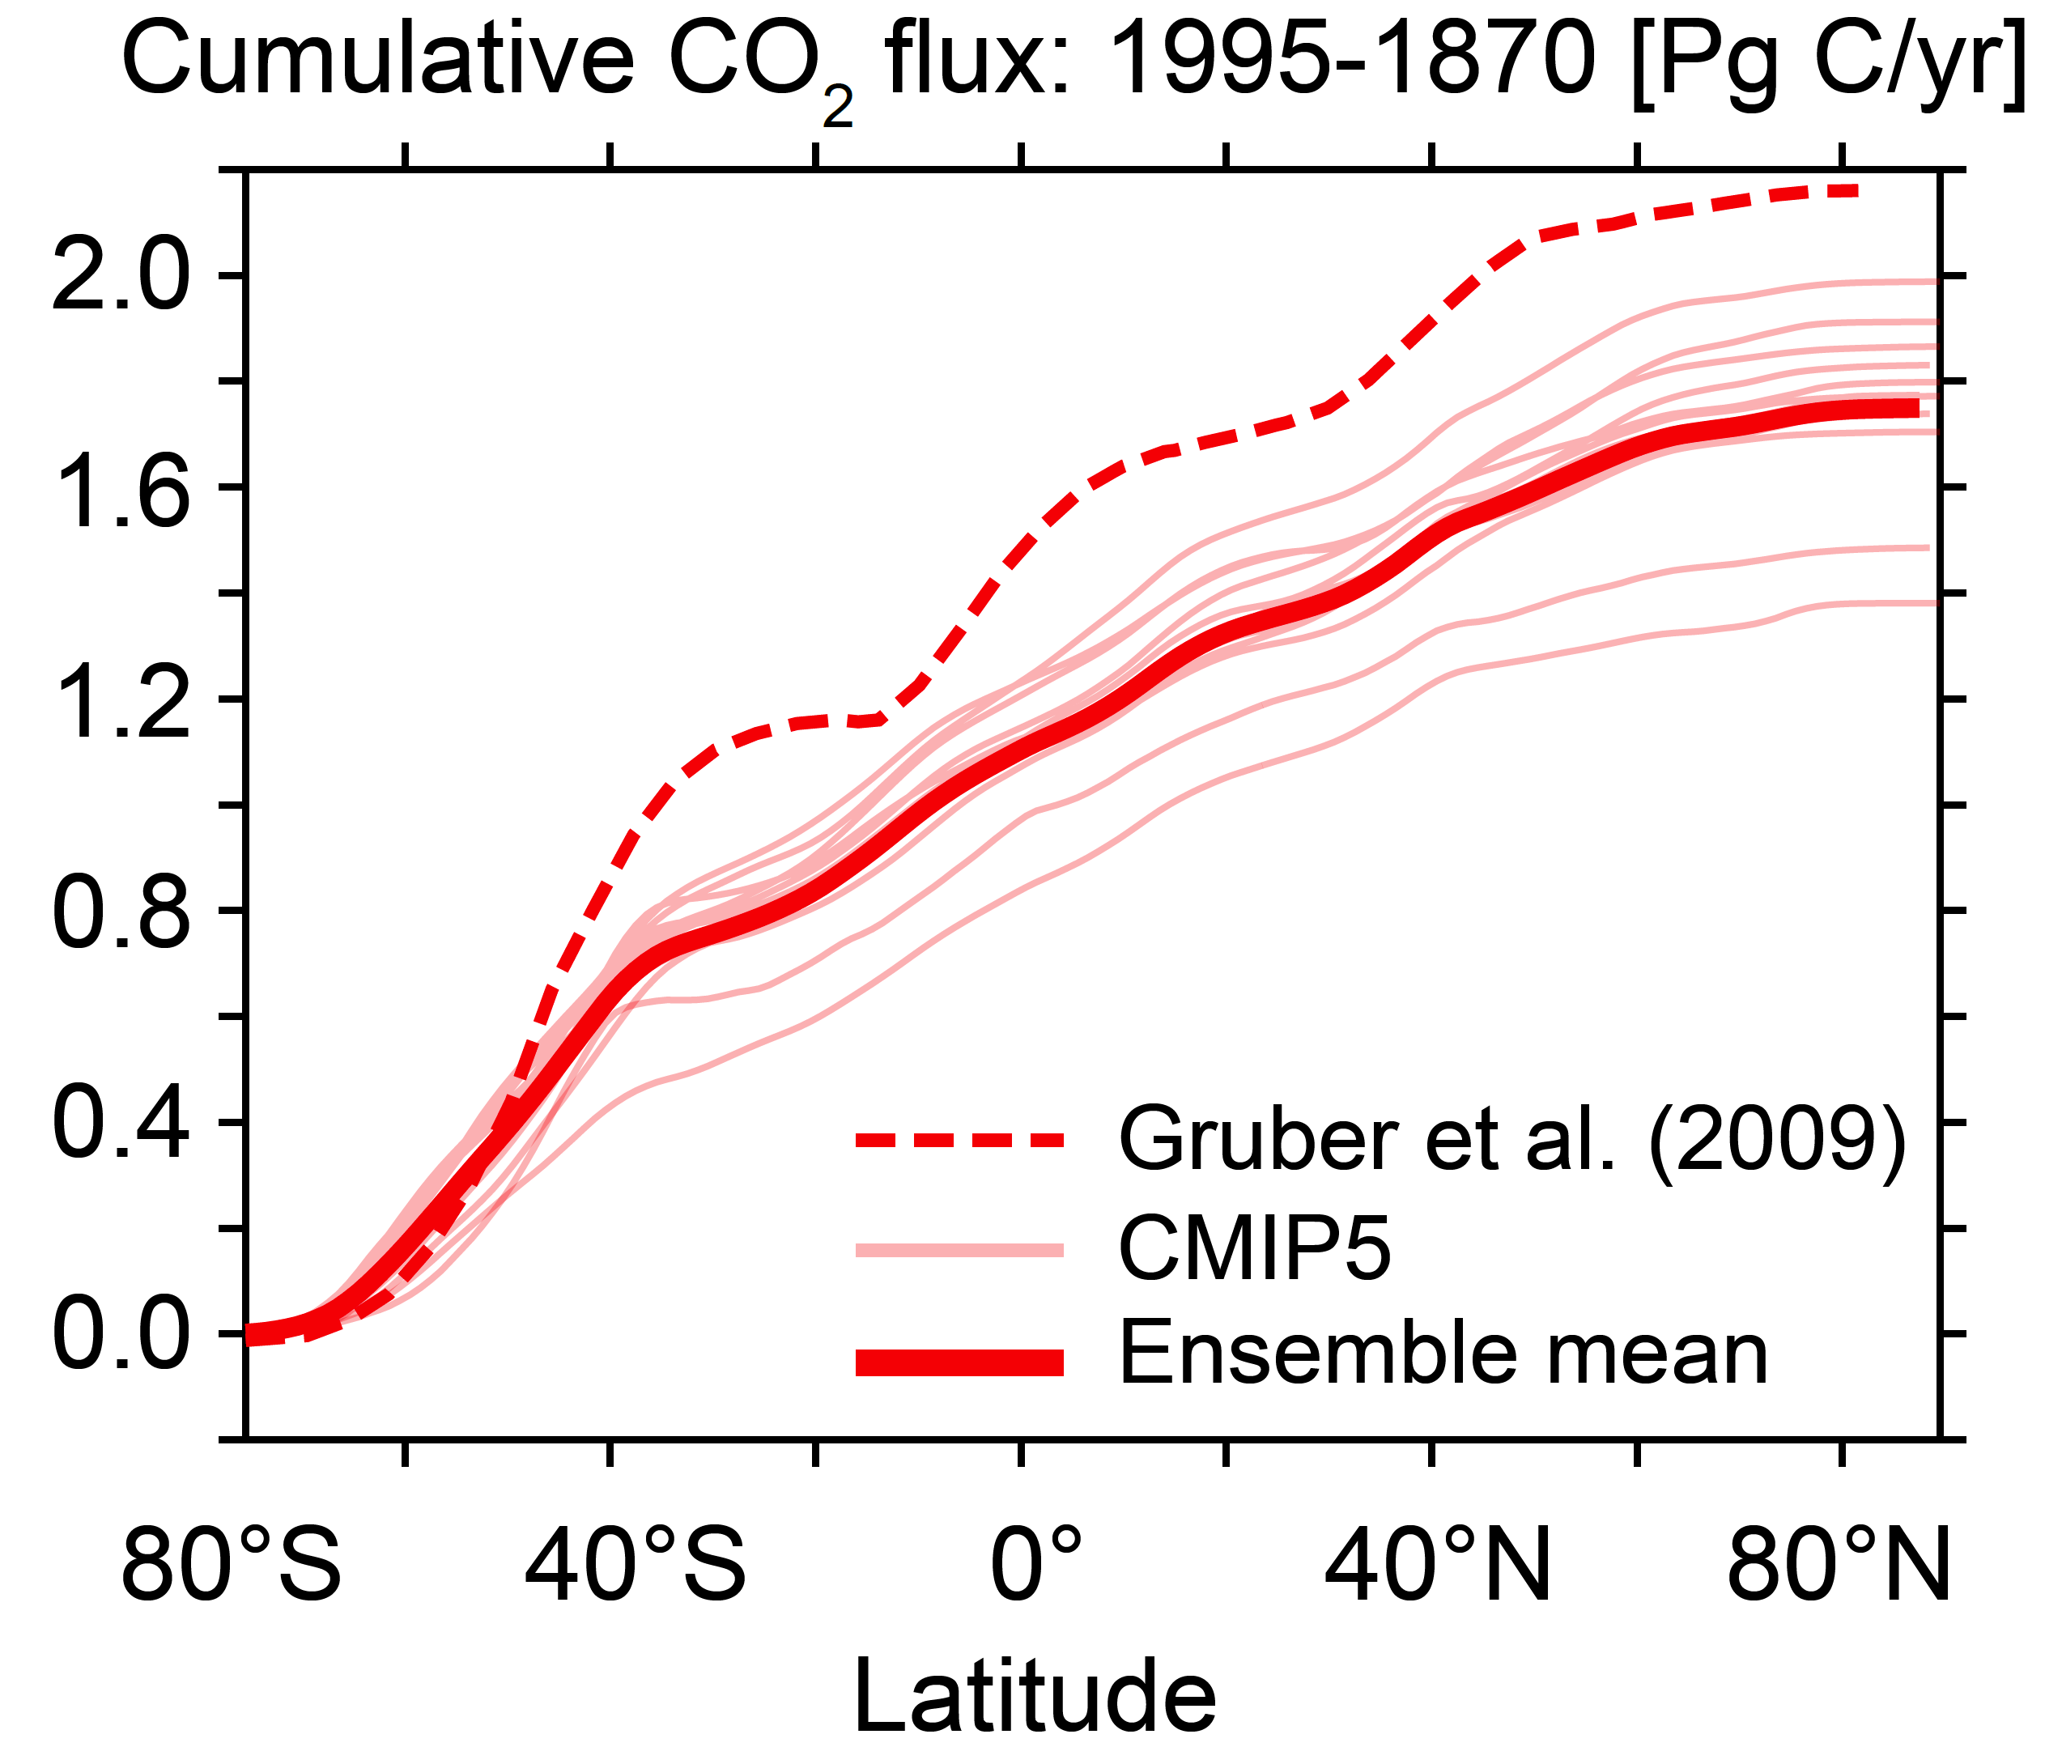
Why do we need SOOS?
Southern Ocean is central to the Earth’s metabolism
51%
Major region of deep ocean water mass formation. Associated with the upwelling of the basin deep water masses
Southern Ocean arguably takes up
~50% of global anthropogenic
carbon
Notes:
Why do we need sustained observation efforts, and why do we need more than what we are currently doing? Firstly need to appreciate the role that the Southern Ocean plays in the earth system – from movement of heat and freshwater around the globe, impacts on global sea levels, important role in drawdown of anthropogenic carbon and movement of productivity to northern waters, as well as significantly unique ecosystems and economically important species.

Slide 4
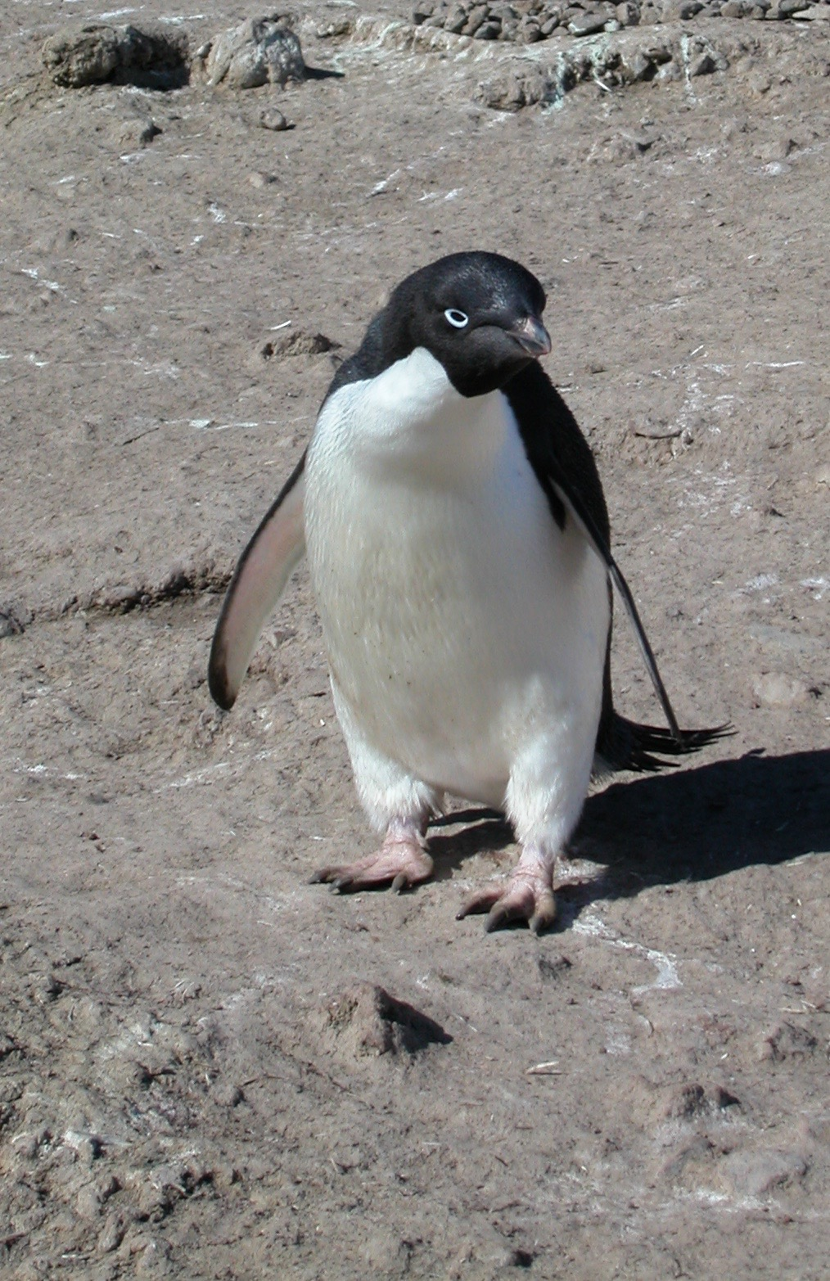
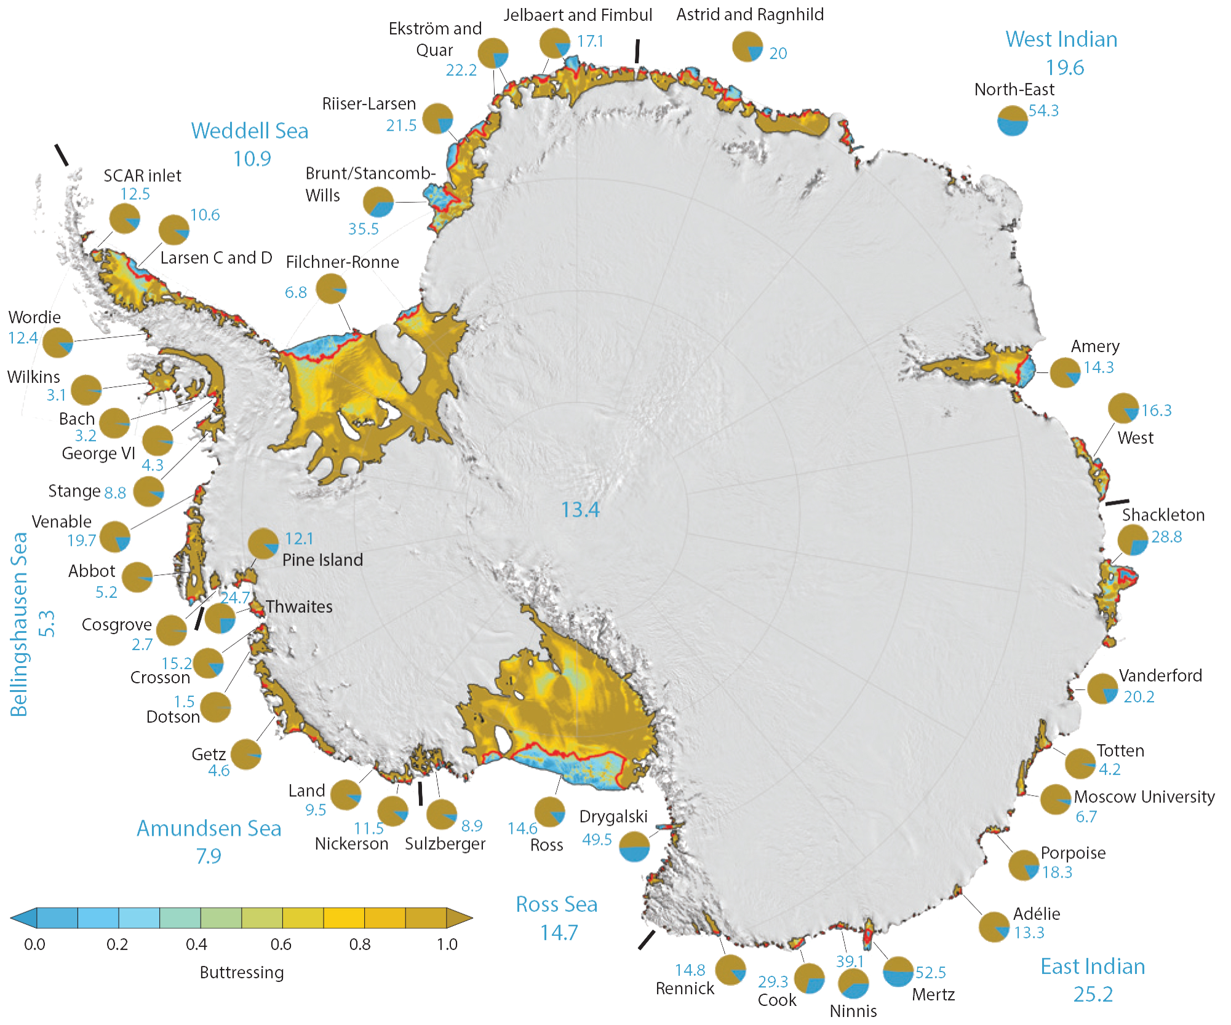
Why do we need SOOS?
Southern Ocean is changing
Fürst et al. (2016)
Ice sheets showing change, many nearing potential “tipping points”
Marine ecosystems exhibiting change, likely as response to regional changes in the physical system
Notes:
So the Southern Ocean is fundamental to the operation of the earth system, and the limited observations we have tell us that it is changing, and some of these changes will have global ramifications.

Slide 5
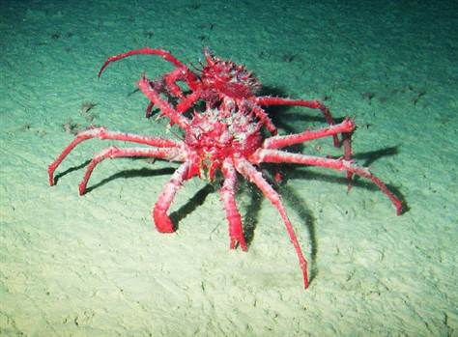
Why do we need SOOS?
Where is the Southern Ocean going
Collapsing Ice shelves?
Invasive species?
Greening continent?

Slide 6
The SOOS Vision
…ambitious, visionary, difficult
AND
Absolutely imperative if we are to collect and deliver the data needed to address these globally important challenges
Notes:
All currently working to answer these questions, but working in isolation, or not delivering benefits to the global community

Slide 7
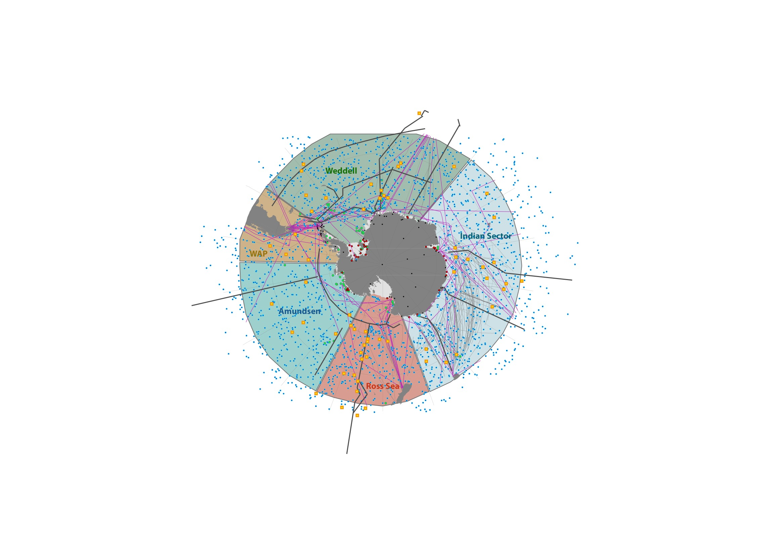
WAPITI (France, EU)
RAFOS moorings (Ger)
ROBOTICA (Japan)
ORCHESTRA (UK)
GOAL (Brazil)
Palmer LTER (USA)
RATS (UK)
JUBANY (ARGENTIVA/GERMANY)
Kerguelen Axis
(Aus, Jpn, Fr, USA)
Amundsen (Korea + USA, UK, Sweden
PIPERS (USA + Belgium, Aus, NZ

Slide 8
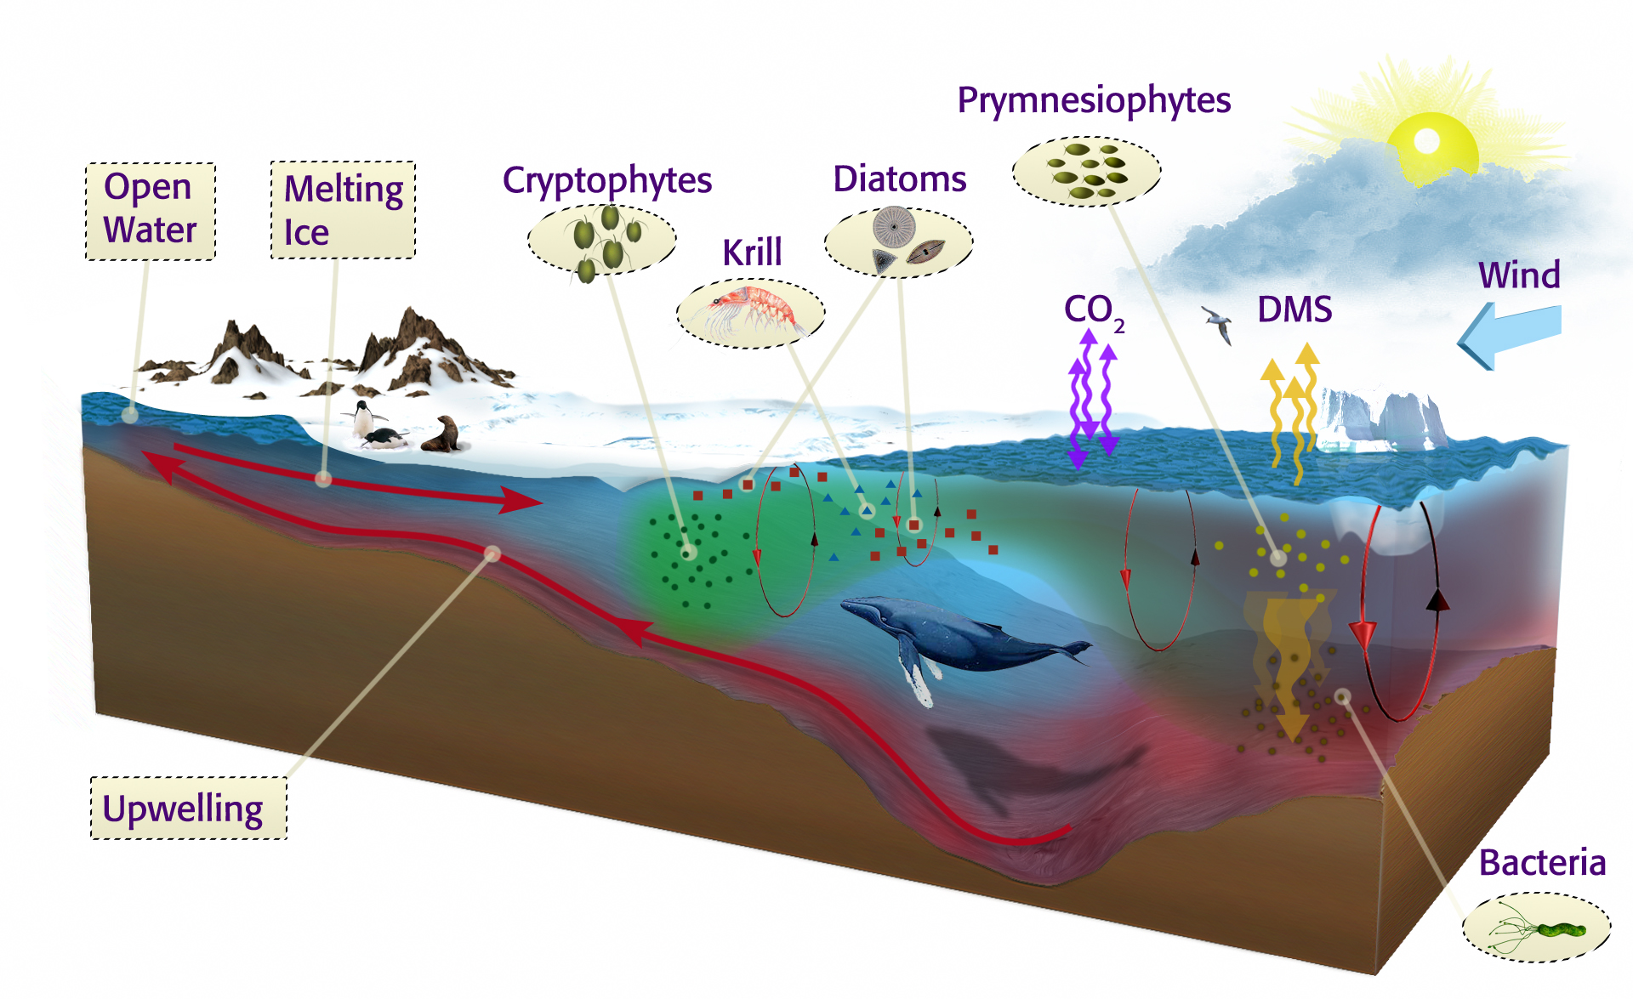
Leveraging national investments: Example from two programs
SOCCUM: Program focused on
biogeochemistry of ACC
WAP Programs focused on
biogeochemistry of ACC
Heat delivered by the ACC
structures the
continental shelf

Slide 9
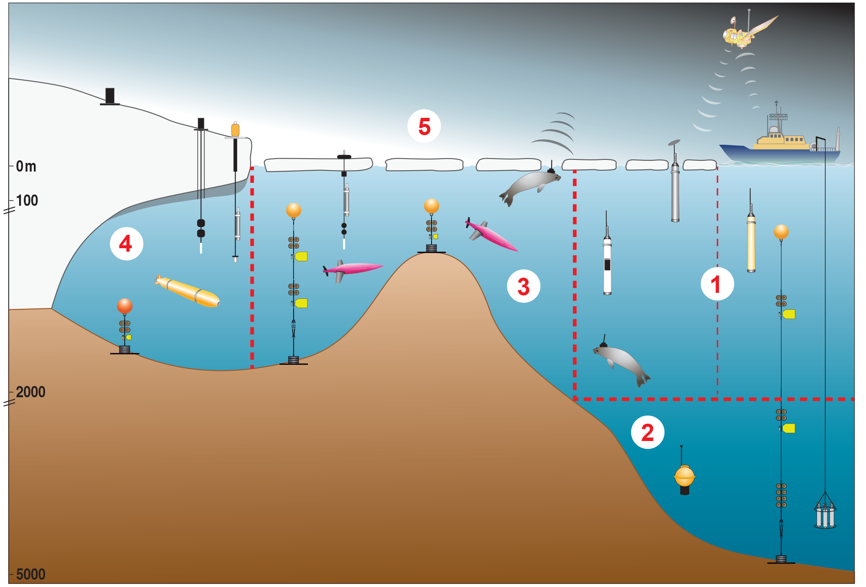
How are we going to get the data required to answer the key questions raised in Horizon Scan, IPCC and other reports?
Notes:
The problem is that we don’t have enough data available to us to really understand the mechanisms driving these changes. If we divide Southern Ocean into five sampling domains, only half of domain 1 is anywhere near sufficiently sampled, and even there only for physics at present.
We have so few long timeseries to show us the natural state and variability of the system, and it is therefore very difficult for us to say anything with confidence about how these systems will change under future scenarios, and the potential consequences of these changes not only for the earth system, but on operations, logistics and economic activities.
So how are we going to answer the key questions that were raised in the Horizon Scan initiative? And other initiatives like IPCC? The recent IPCC report highlighted a number of likely impacts in the Southern Ocean by 2030, such as acidification impacts on the benthos. This is only 15 years away, so by the time field campaigns even get started we are already at the point of having impacts.

Slide 10
SOOS Objectives
Facilitate the design and implementation of a comprehensive and multi-disciplinary observing system for the Southern Ocean
Advocate and guide the development of new observation technologies
Compile and encourage use of existing international standards and methodologies, and facilitate the development of new standards where required
Unify and enhance current observation efforts and leverage further resources across disciplines, and between nations and programmes
Facilitate linking of sustained long-term observations to provide a system of enhanced data discovery and delivery, utilising data centres and programmatic efforts combined with, as needed, purpose-built data management and storage systems
Provide services to communicate, coordinate, advocate and facilitate SOOS objectives and activities

Slide 11
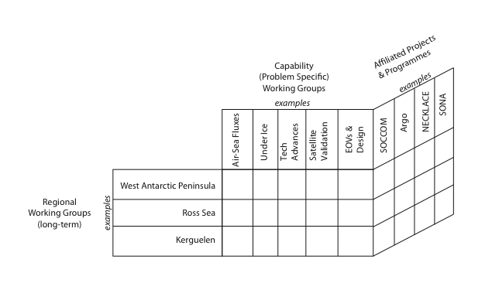
Priority Capability Working Group topics
Implementation of Under Ice strategy
Sensor development
Air-Sea Fluxes
System design
Satellite capabilities
Ships of Opportunity
Sound
Online proposals, reviewed by SSC, open to all interested.

Slide 12
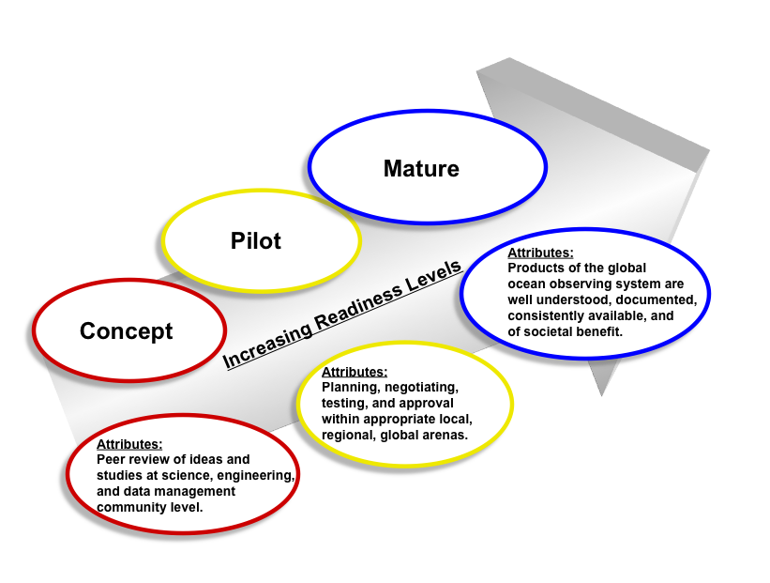
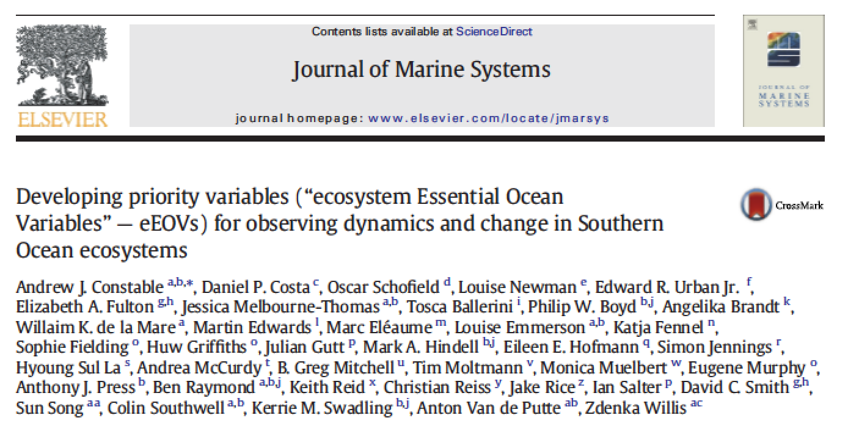
What are the essential ocean variables any system should measure?
Builds off of the Framework of Ocean Observations (FOO) which is the foundation for GOOS
✓
Physical Variables
✓
Chemical Variables
As of
spring
2016
Biological Variables

Slide 13
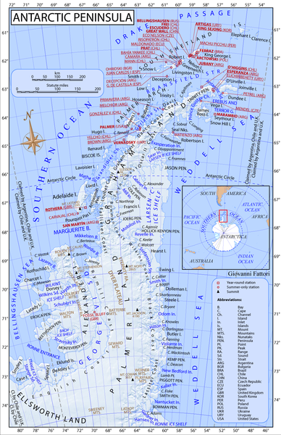
Working group of West Antarctic Peninsula: Focused on a region with significant history of observations, has existing infrastructure and potential for many nations to be involved.
Benefits: Logistically “easy”, that might be unified to implement best practices for measuring the EOVs
Antarctic Peninsula
Significant levels of infrastructure present
Many nations already work in region, therefore many international efforts that can be pulled together
Area of rapid change from physics to ecosystems driven by deep ocean.

Slide 14
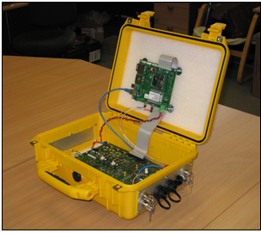
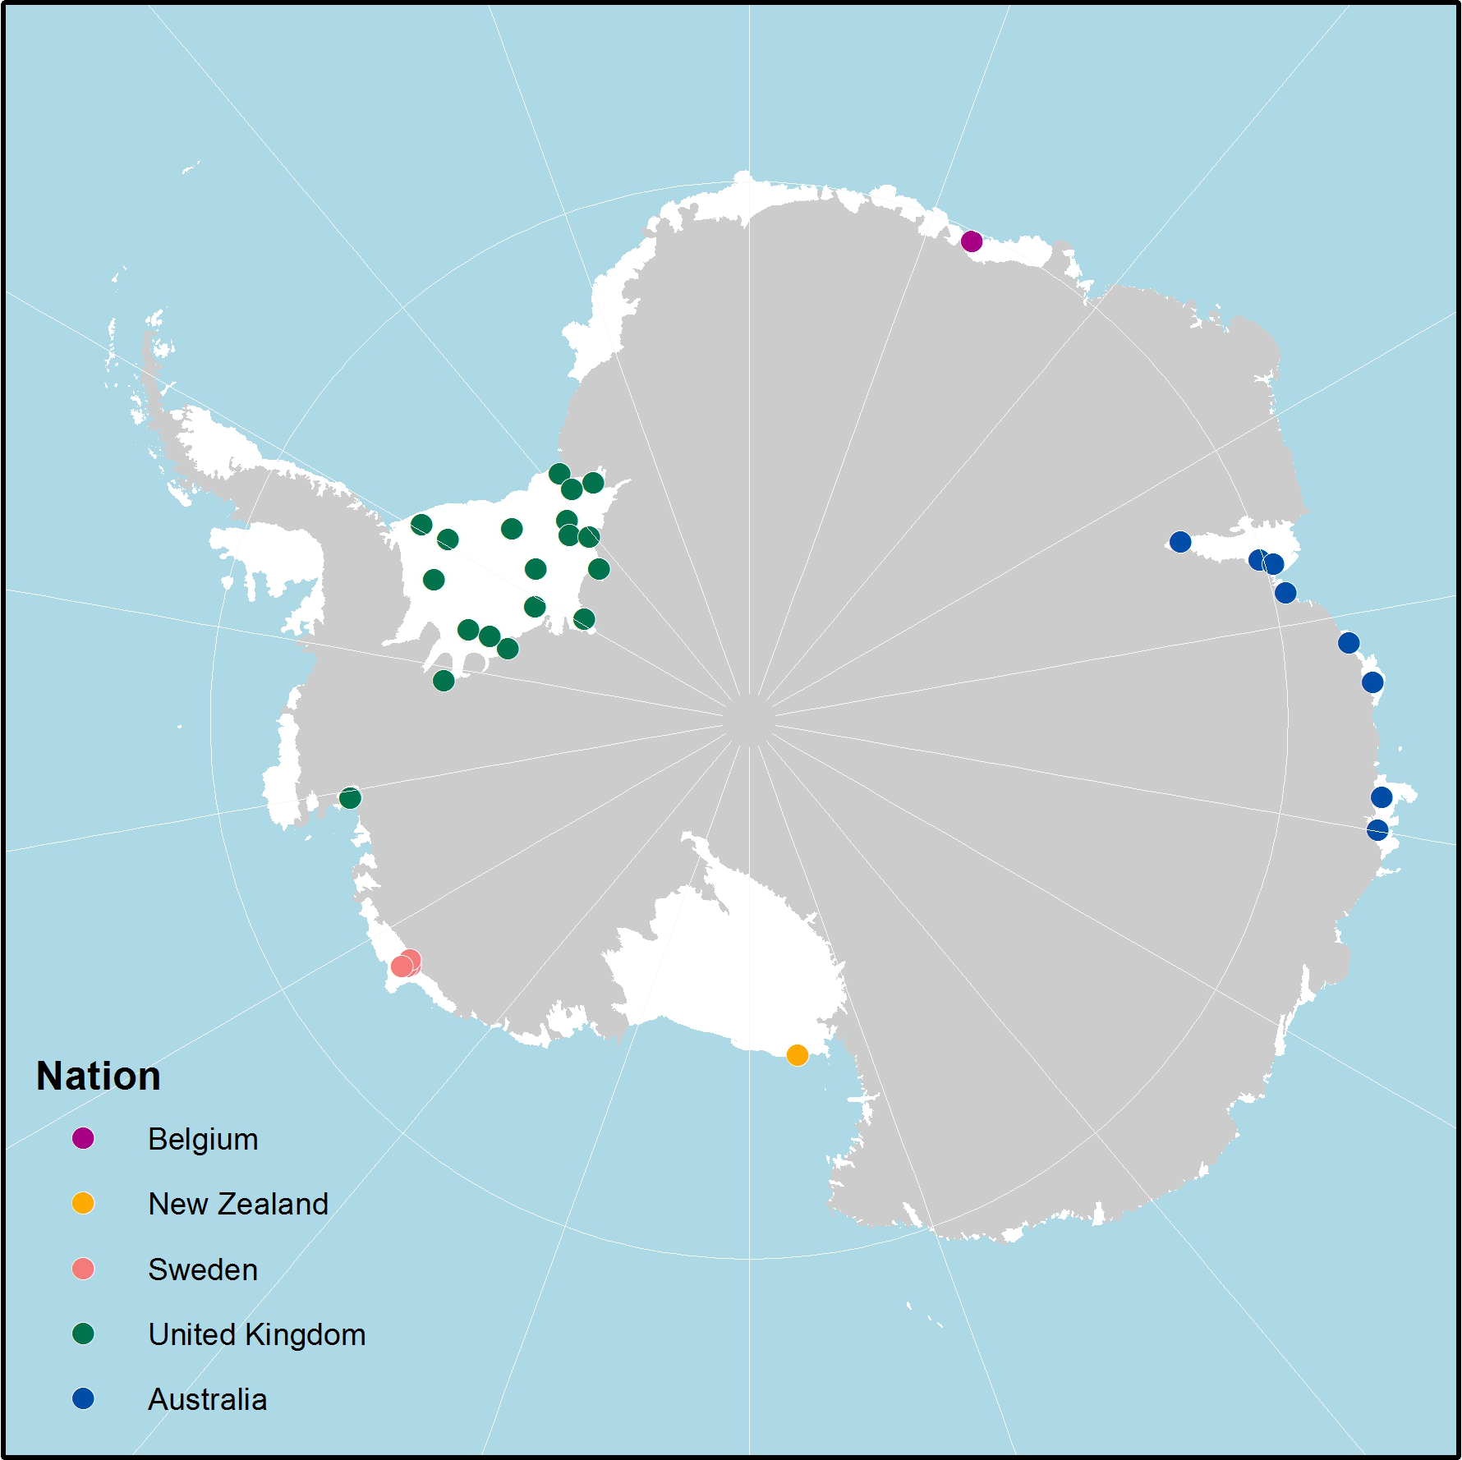
SOOS Endorsed, UK-led development of cheap, downward looking radar to measure ice-shelf thickness
SOOS is helping to coordinate the uptake of this technology by nations working on or near ice shelves to encourage circumpolar network of ice shelf melt observations over the next 5 years.
Workshop alongside FRISP meeting in October 2016, Sweden
NECKLACE

Slide 15
Progress so far against objectives
Task Teams:
Air-Sea Fluxes = Workshop 21-23rd Sept, Frascati, Italy (WCRP, ESA, SOOS)
Southern Ocean Satellite Data Requirements Community Report = Currently out for community review (SOOS-CliC-SCAR)
Ross Sea Observations = Report of international Ross Sea observational efforts, and identification of key gaps (Mike Williams et al.)
Under Ice Observations = International strategy for observations of the ocean in the sea-ice zone and under ice shelves

Slide 16
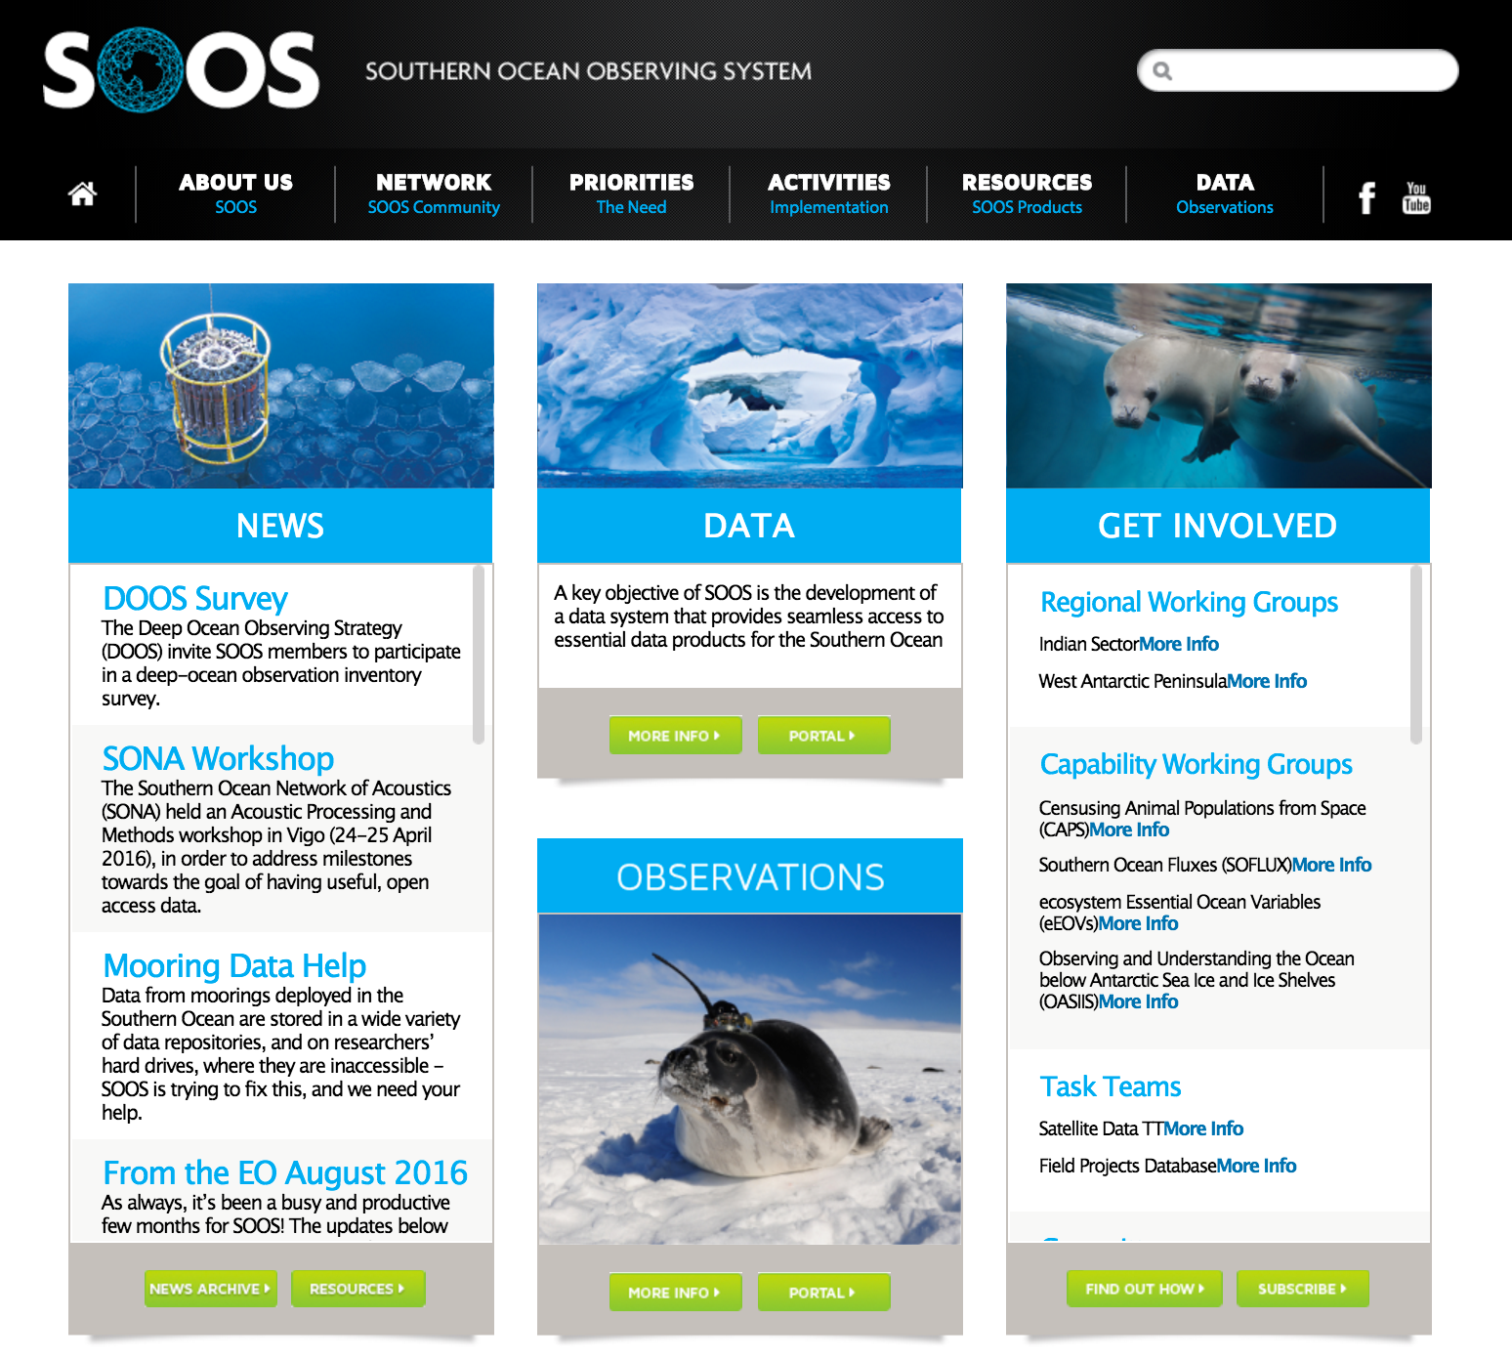

Slide 17

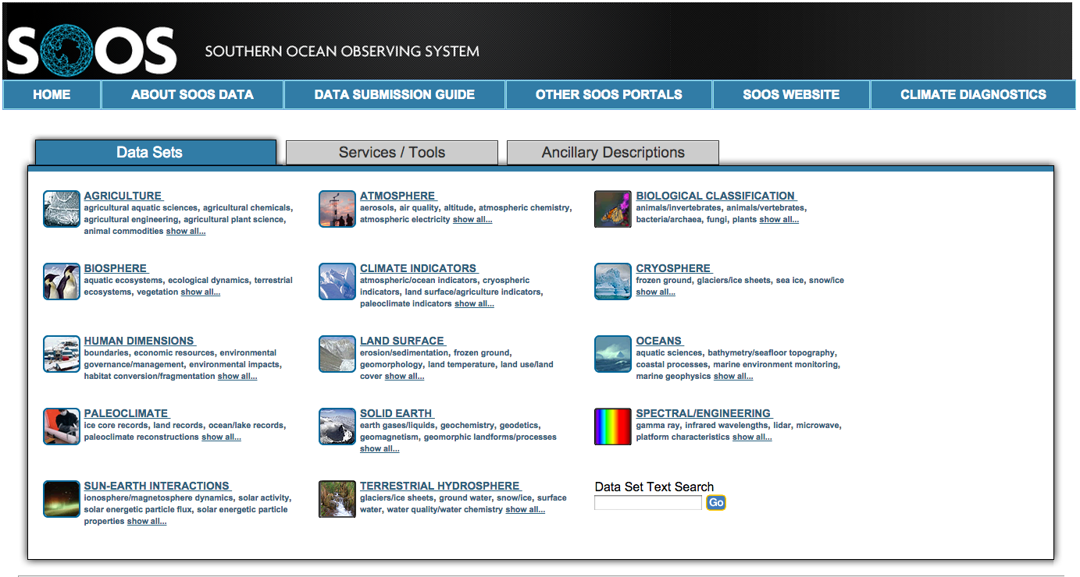
Progress so far against objectives
5) Data Discovery and Delivery
Notes:
Rutgers glider data,
Swedish Amundsen data
South African glider data
Italian Ross Sea mooring data

Slide 18
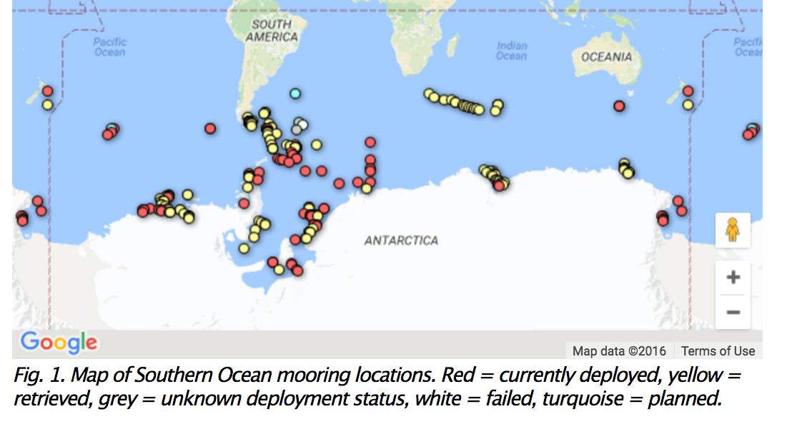
Shared resources + Shared output = global benefit
Notes:
As an example,
This map shows all of the moorings that have ever been deployed in the Southern Ocean. Many of these provide long time-series of important data. Some of the data is available on an individuals ftp server, or even worse perhaps USBs, some might be available at a national data centre, but no one researcher is going to hve the time to go to each of these individual repositories, or contact each individual PI to find out where the data is located. Beyond this issue, is then the issue of metadata quality. What questions could we answer on, for example, changes in bottom water formation or the impact of increased ice shelf melt on waterbodies if we had access to all of the data here. If we are to respond to the big questions, and if we are to be able to make statements on future change and consequences of that change, we have to start working together. Shared resources, shared outputs for shared global benefit.

Slide 19



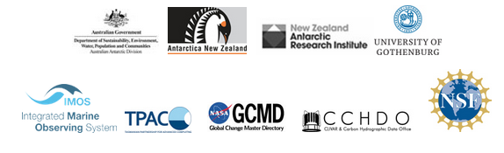
www.soos.aq

