Slide 1
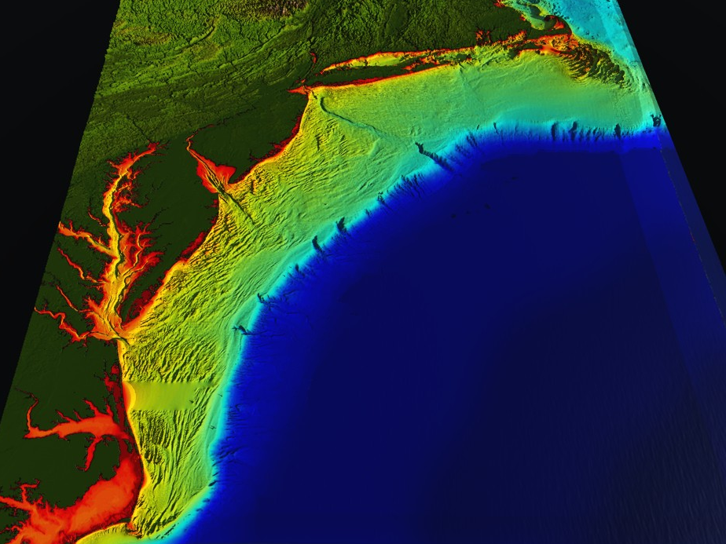


78 Million People (1/4 of U.S.)
1000 km Cape to Cape
U..
Middle Atlantic
Regional Association
Coastal
Ocean Observing System
Cape
Cod
Stratified
Coastal Ocean Interactions with
Tropical Cyclones
Sandy
Irene
Barry
Scott Glenn, Travis Miles,
Greg Seroka, Robert Forney,
Hugh Roarty, Oscar Schofield, Josh Kohut (Rutgers),
Yi Xu (China) & Fei Yu (China)
Nature Communications (2016)
Arthur
Hermine
Cape
Hatteras
Notes:
1

Slide 2
Key Storm Glider Reference List
Glenn, Jones, Twardowski, Bowers, Kerfoot, Kohut, Webb, Schofield, 2008. Glider observations of sediment resuspension in a Middle Atlantic Bight fall transition storm. Limnology and Oceanography 53(5, Part 2): 2180-2196.
Miles, Glenn, Schofield, 2013. Temporal and spatial variability in fall storm induced sediment resuspension on the Mid-Atlantic Bight. Continental Shelf Research 63, Supplement: S36-S49.
Miles, Seroka, Kohut, Glenn, 2015. Glider observations and modeling sediment transport in Hurricane Sandy. JGR Oceans, DOI: 10.1002/2014JC010474
Glenn, Miles, Seroka, Xu, Forney, Yu, Roarty, Schofield, Kohut, 2016. Stratified coastal ocean interactions with tropical storms, Nature Communications, DOI:10.1038/ncomms10887.
Seroka, Miles, Xu, Kohut, Schofield & Glenn, 2016. Hurricane Irene Sensitivity to Stratified Coastal Ocean Cooling, Monthly Weather Review, in press.
Seroka, Miles, Xu, Kohut, Schofield & Glenn, 2017. Rapid shelf-wide cooling response of a stratified coastal ocean to hurricanes, Submitted to JGR Oceans Special Issue on Tropical Cyclones.
Sea-Bottom Interface
Air-Sea Interface

Slide 3
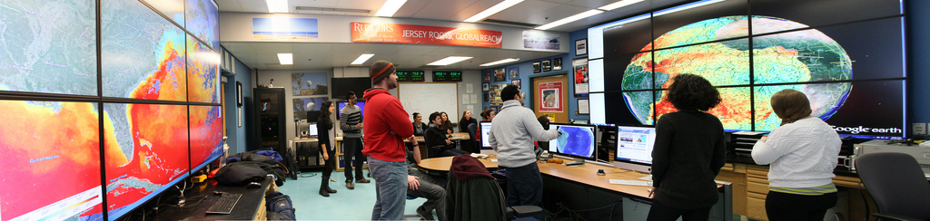
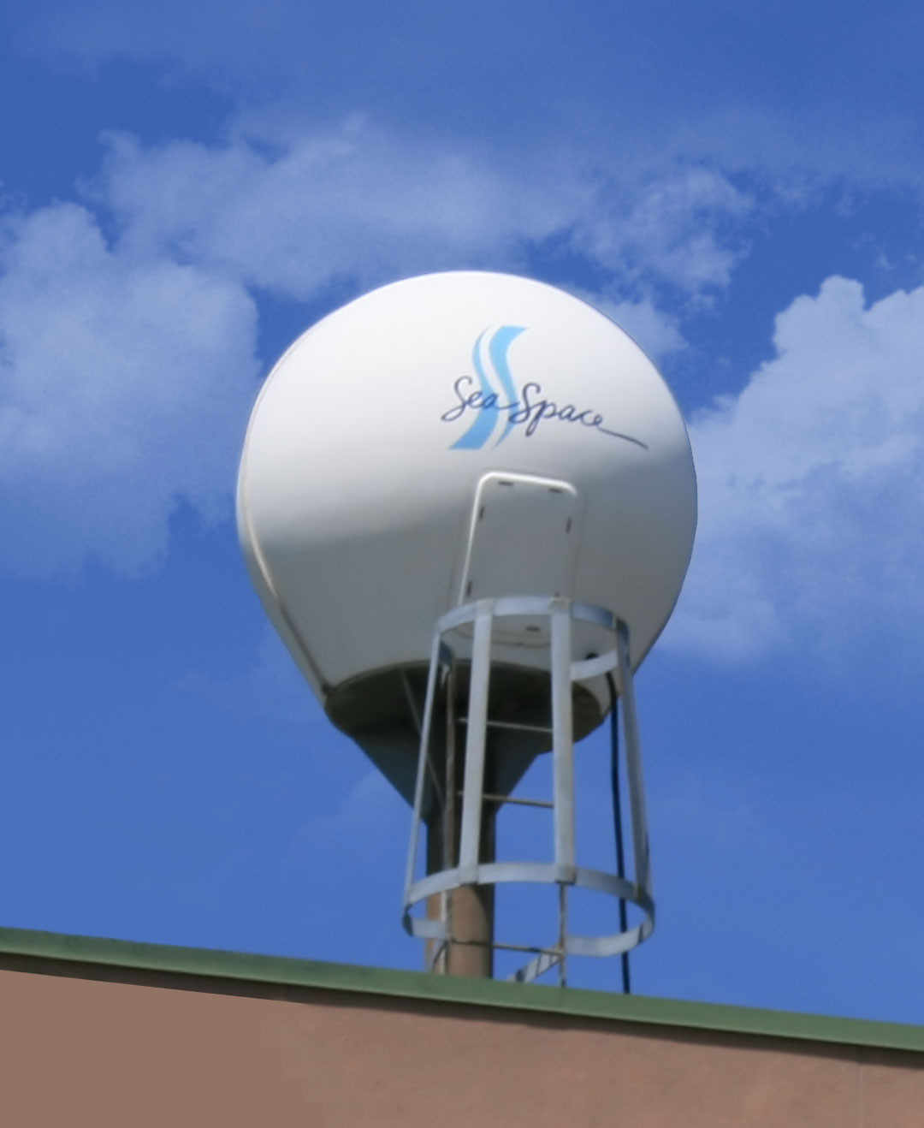

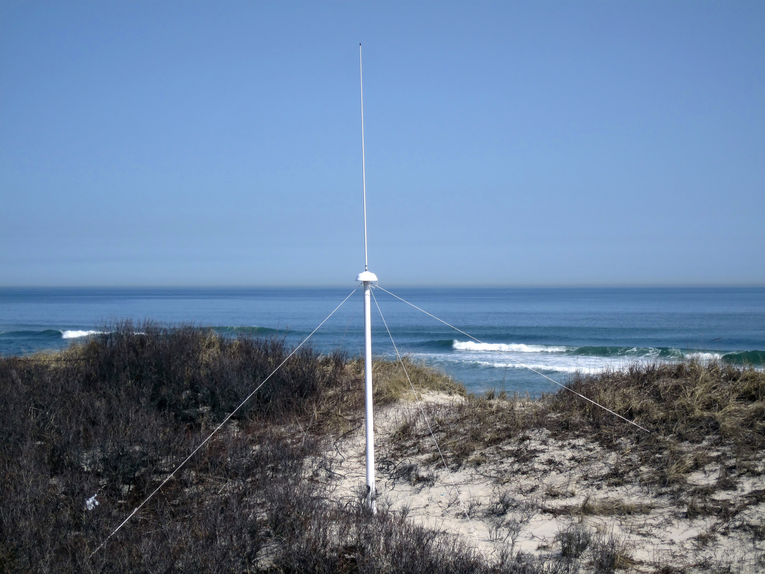
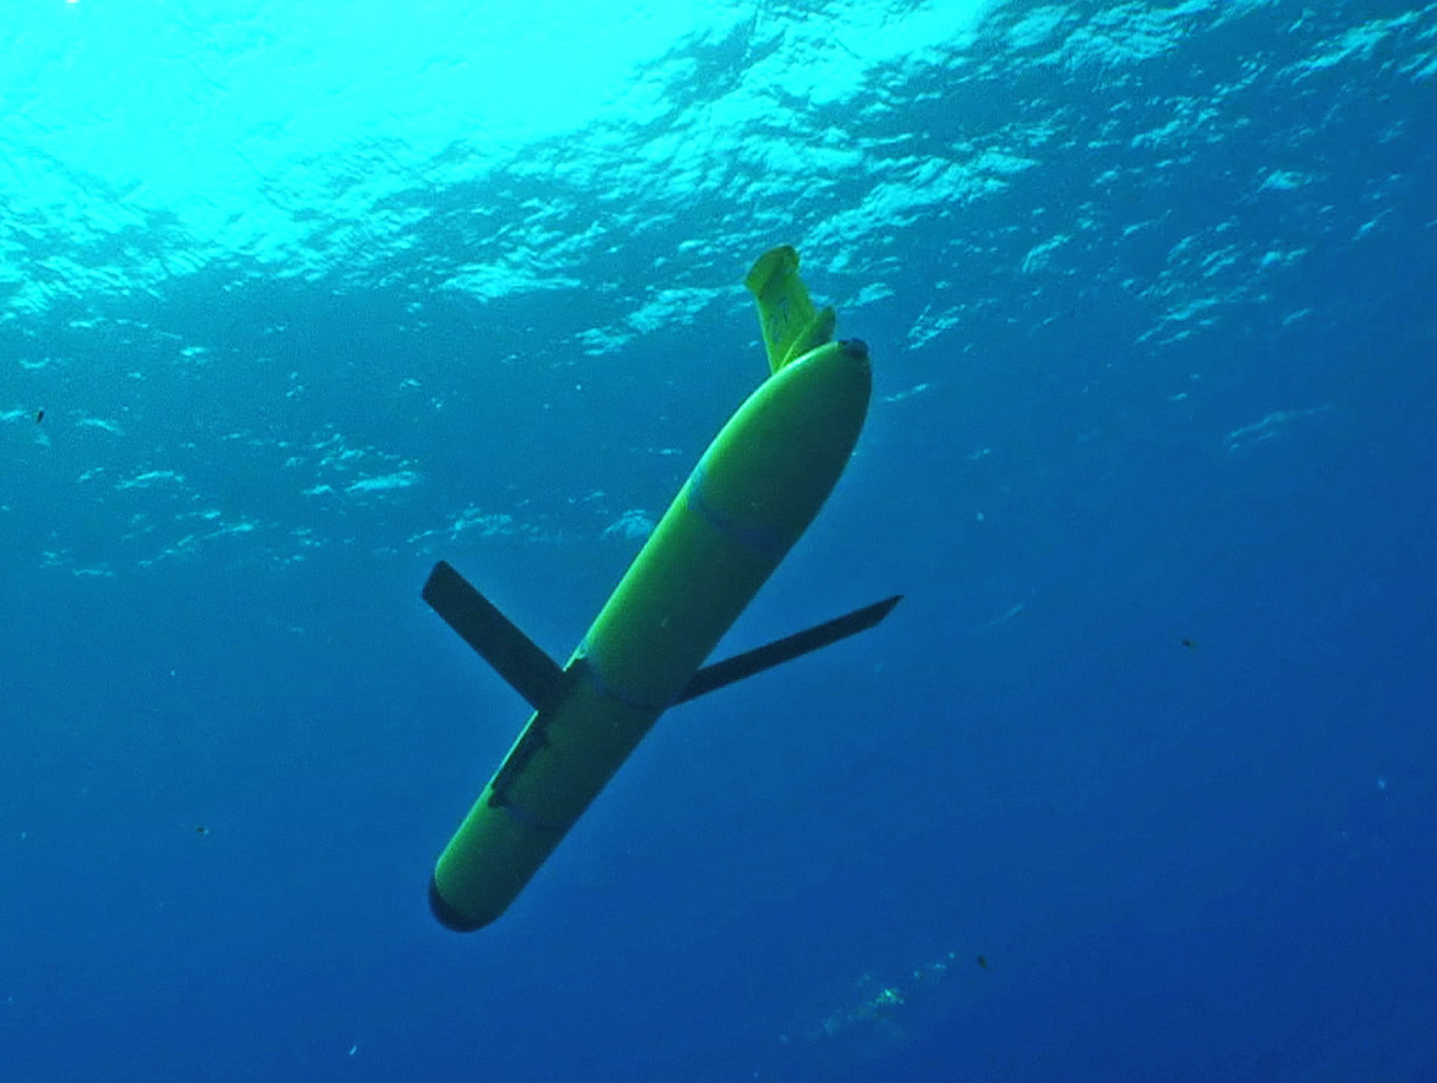
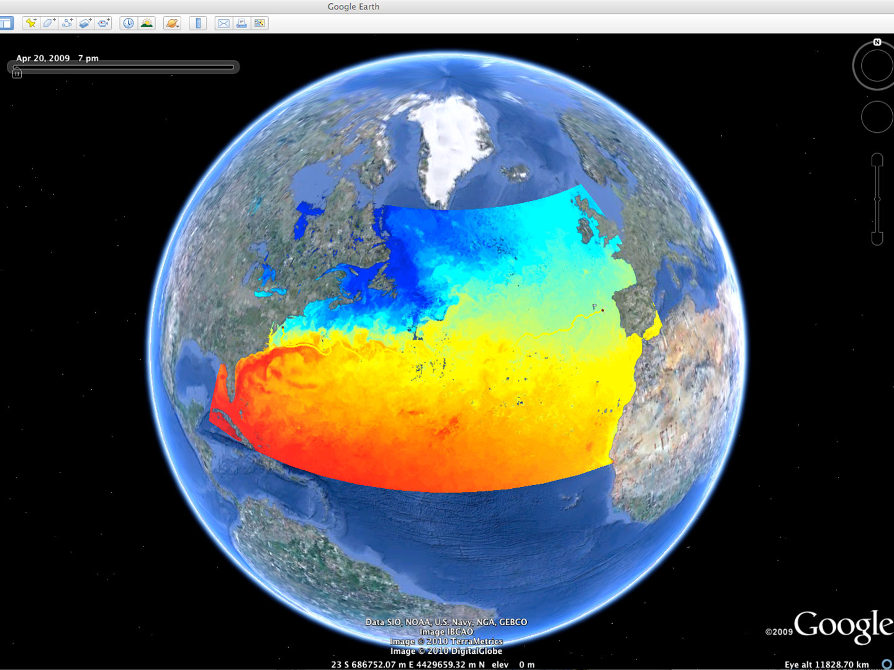












Gliders within a Sustained Ocean Observatory
Rutgers University - Coastal Ocean Observation Lab
Observatory Operations, Data Fusion & Training Center
L-Band & X-Band Satellite Receivers
CODAR Network
Glider Fleet
3-D Nowcasts
& Forecasts
Notes:
3

Slide 4
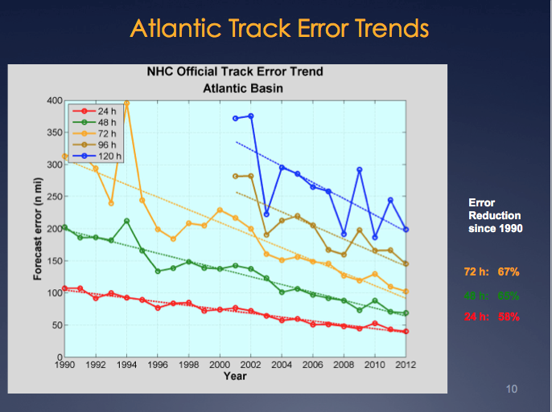
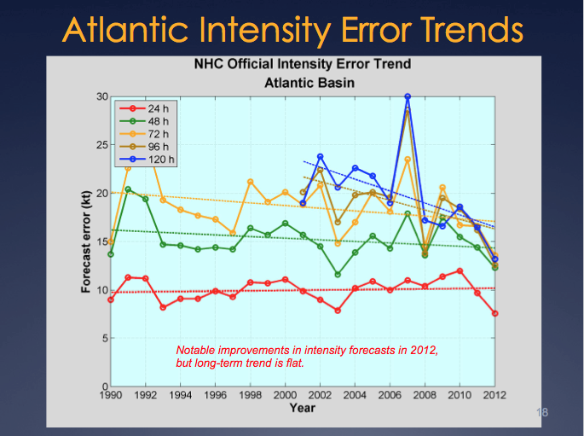
Motivation: Research to Operations to Research (R2O2R)
Track Error: Decreases in 20-Year Trend Intensity Error: - “Long-term trend is flat”
Track: Improvements attributed to Global Forecast Models & the Super-Ensemble.
Intensity: “…upper-ocean thermal structure can affect the evolution of storm intensity, …Unfortunately, the paucity of subsurface measurements limits our ability to assess the effect of upper-ocean variability on tropical cyclone intensity evolution.”
– Emanuel et al., (2004)
Production Suite Review: December 4, 2012

Slide 5
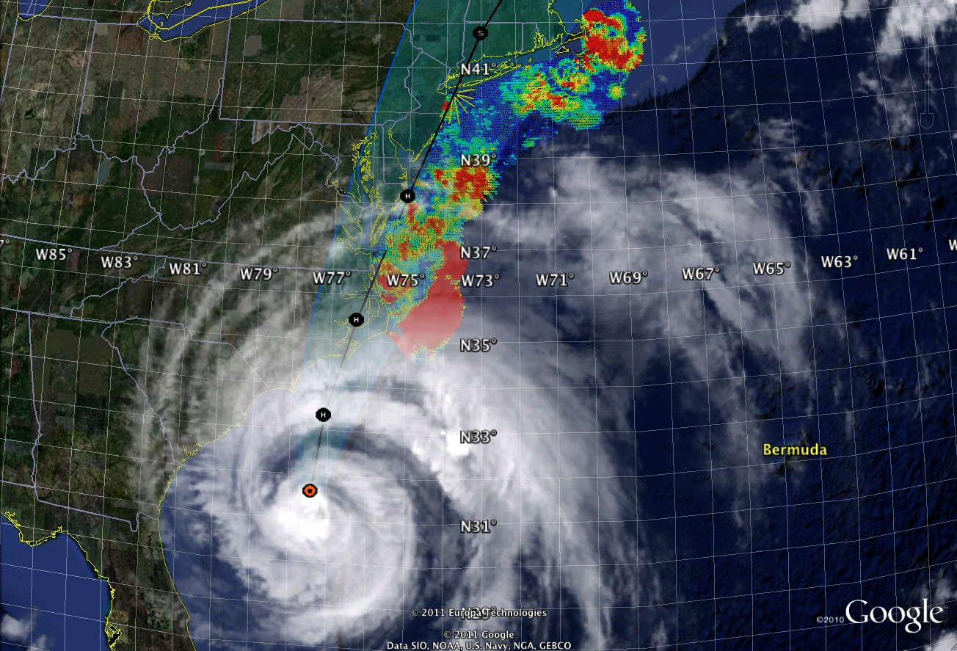
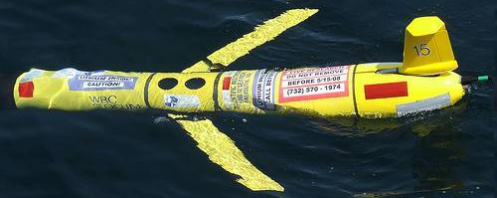
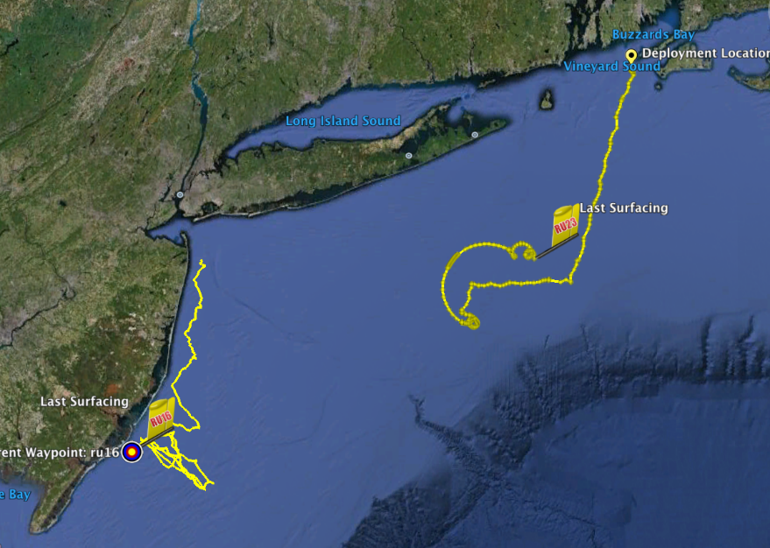
Hurricane Irene
August 27-28, 2011
NOAA/NHC:
Damage >$16B ( #7)
Track Accurate
Intensity Over-predicted
Two Gliders Deployed

Slide 6
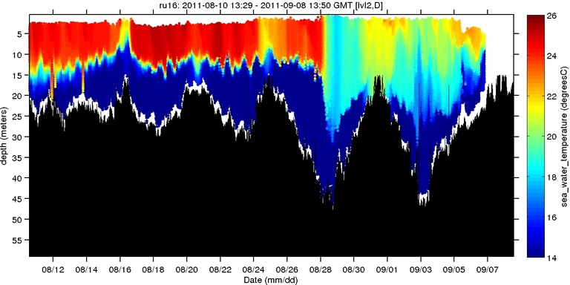
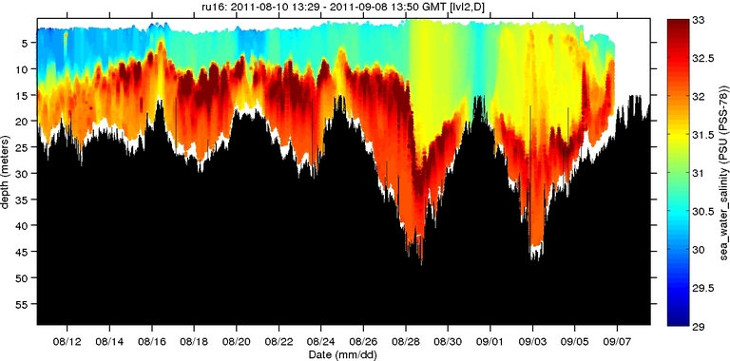
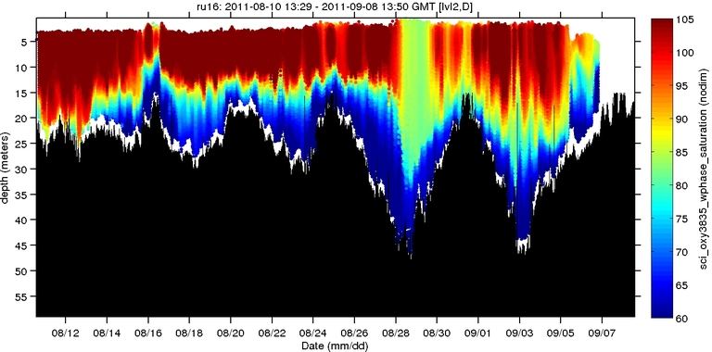
Hurricane Irene
August 27-28, 2011
NOAA/NHC:
Damage >$16B ( #7)
Track Accurate
Intensity Over-predicted
Hurricane Irene
0
26
depth
temperature
55
14
0
33
depth
salinity
55
29
0
105
depth
% oxygen
Two Gliders Deployed
55
60
8/12
date
9/07

Slide 7
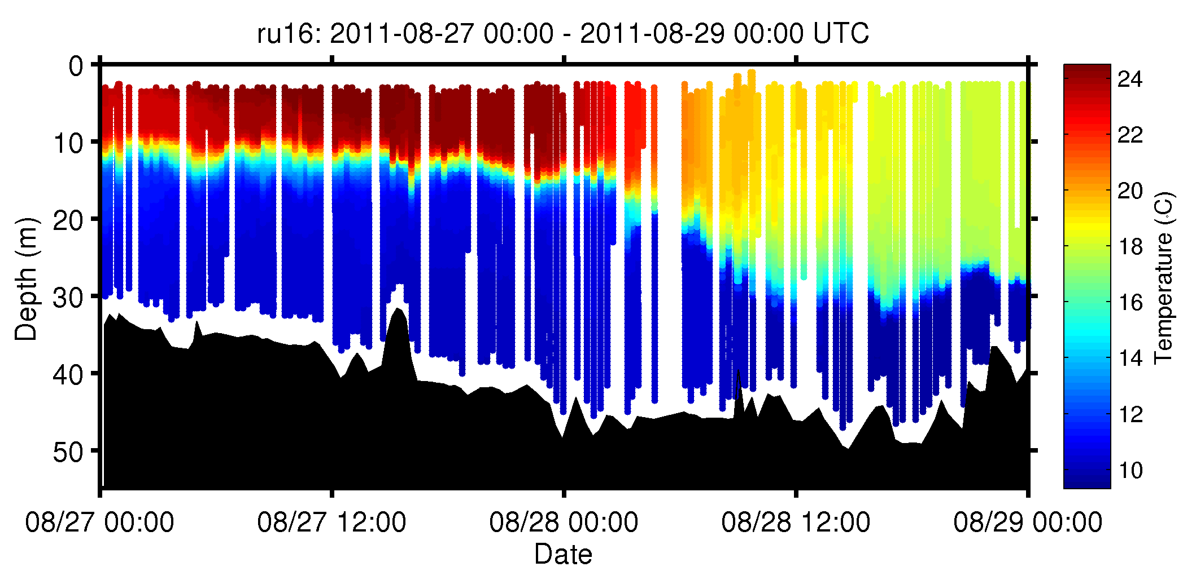
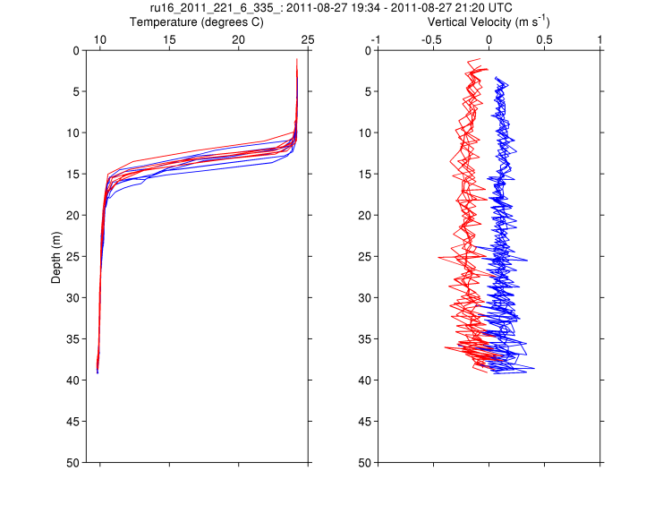
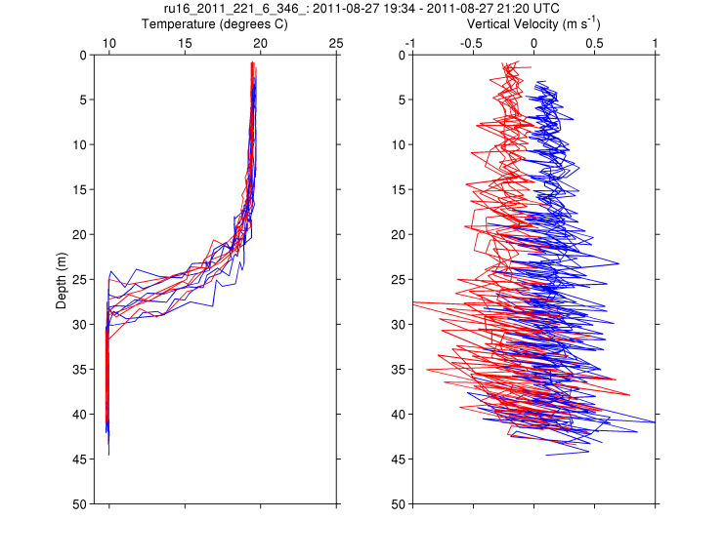
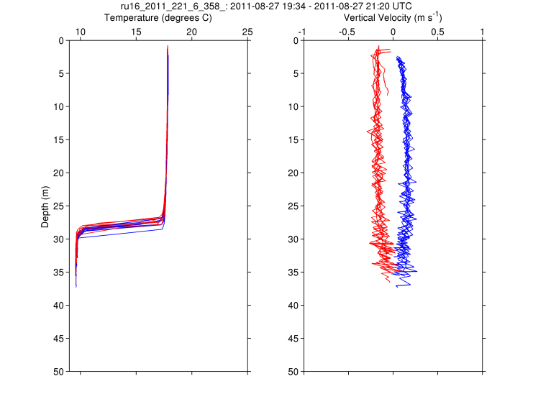
RU16
Temp.
Section
Upcast
Downcast
Temp. Vert. Vel.
Temp. Vert. Vel.
Temp. Vert. Vel.

Slide 8
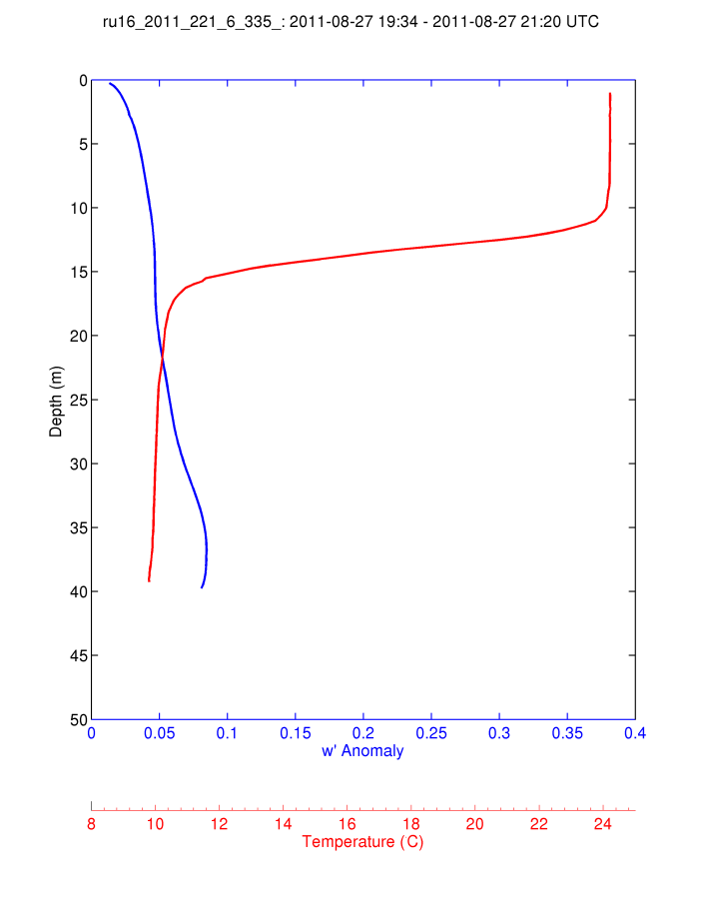
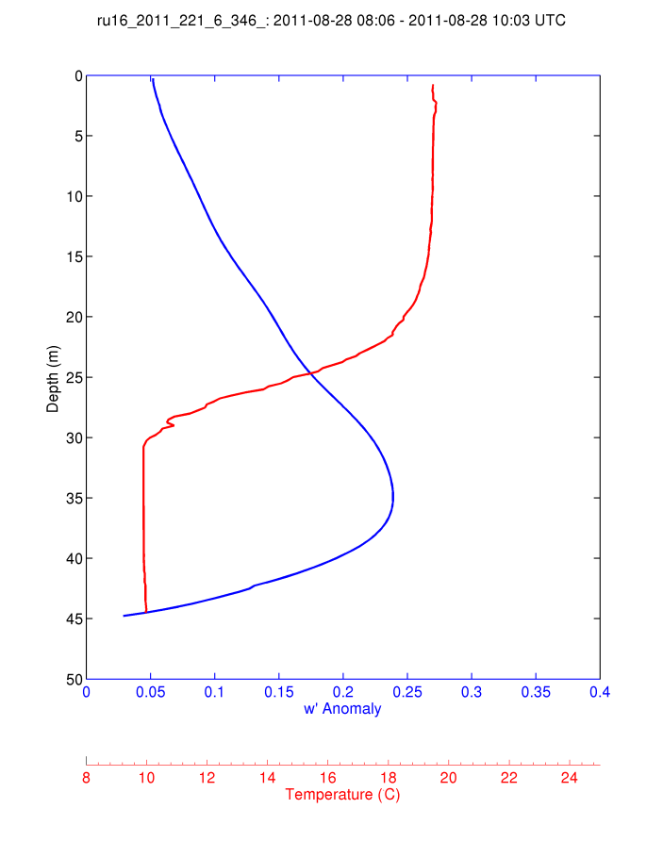
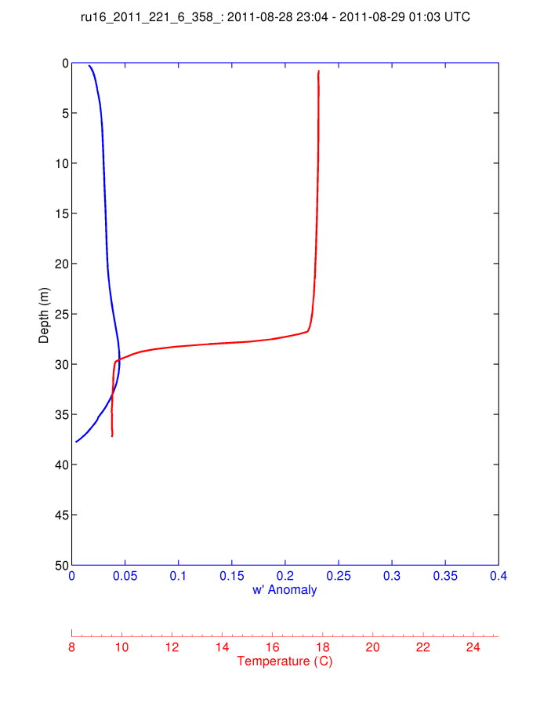
For Each 2-hour Segment:
1) Calculate the Average Temperature Profile
2) Calculate the Vertical Velocity Standard Deviation Profile and Smooth Vertically.
Temp
S.D. w’
Pre-Irene
During Irene
Post-Irene

Slide 9
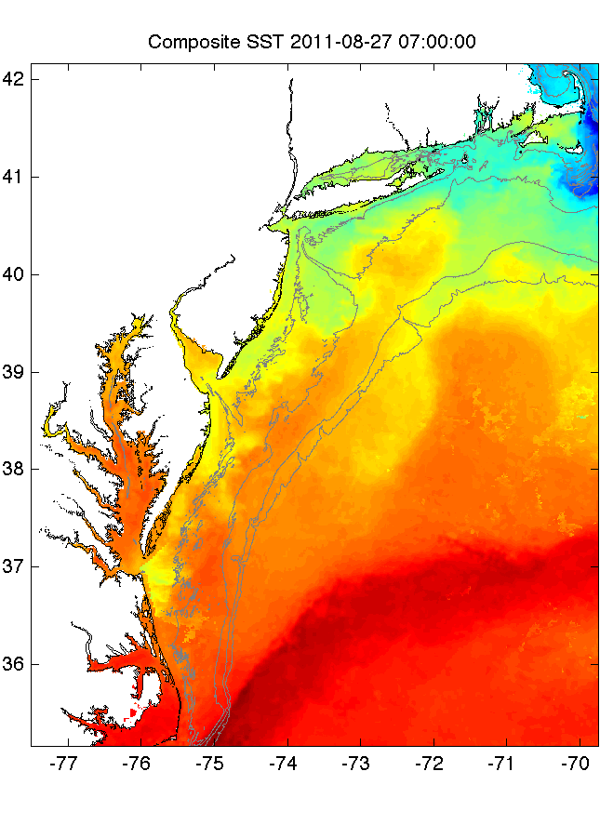
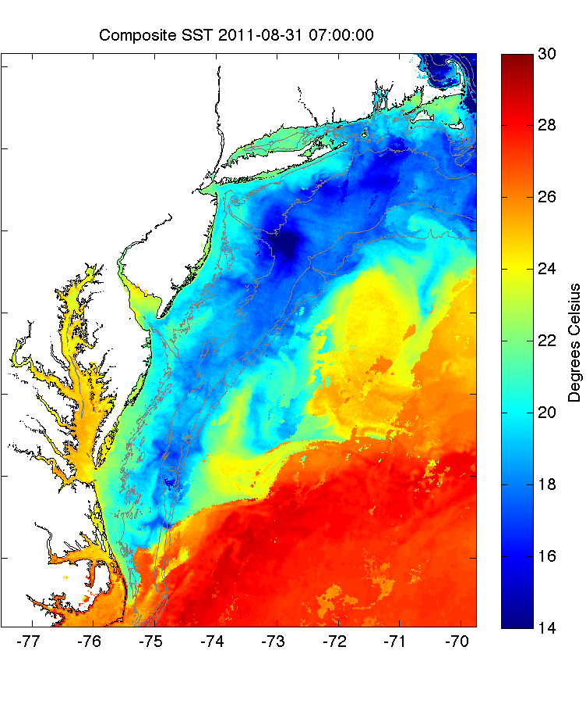
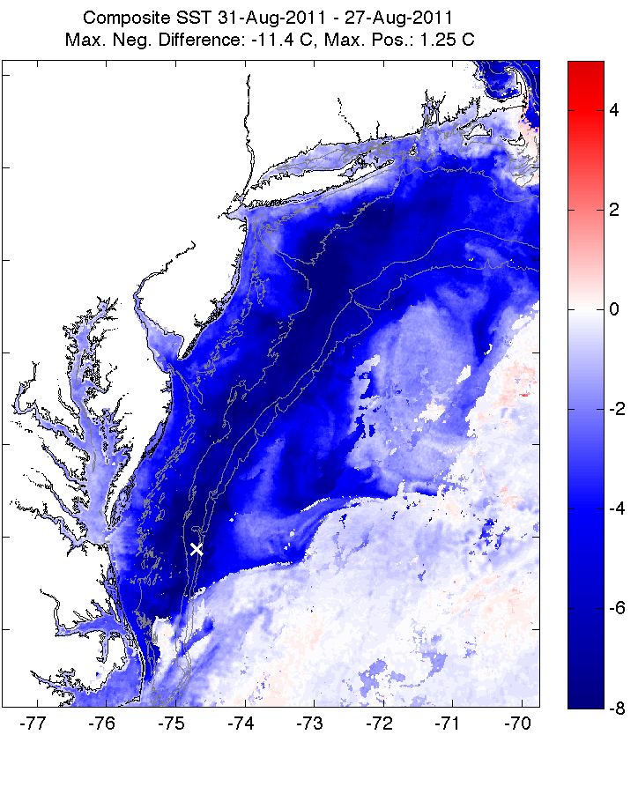
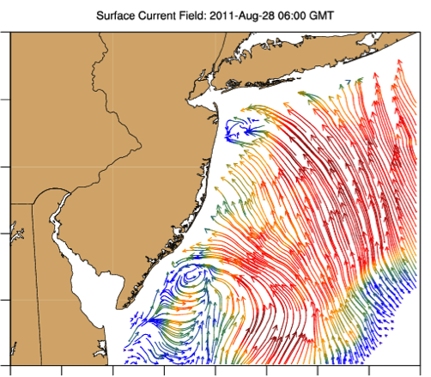
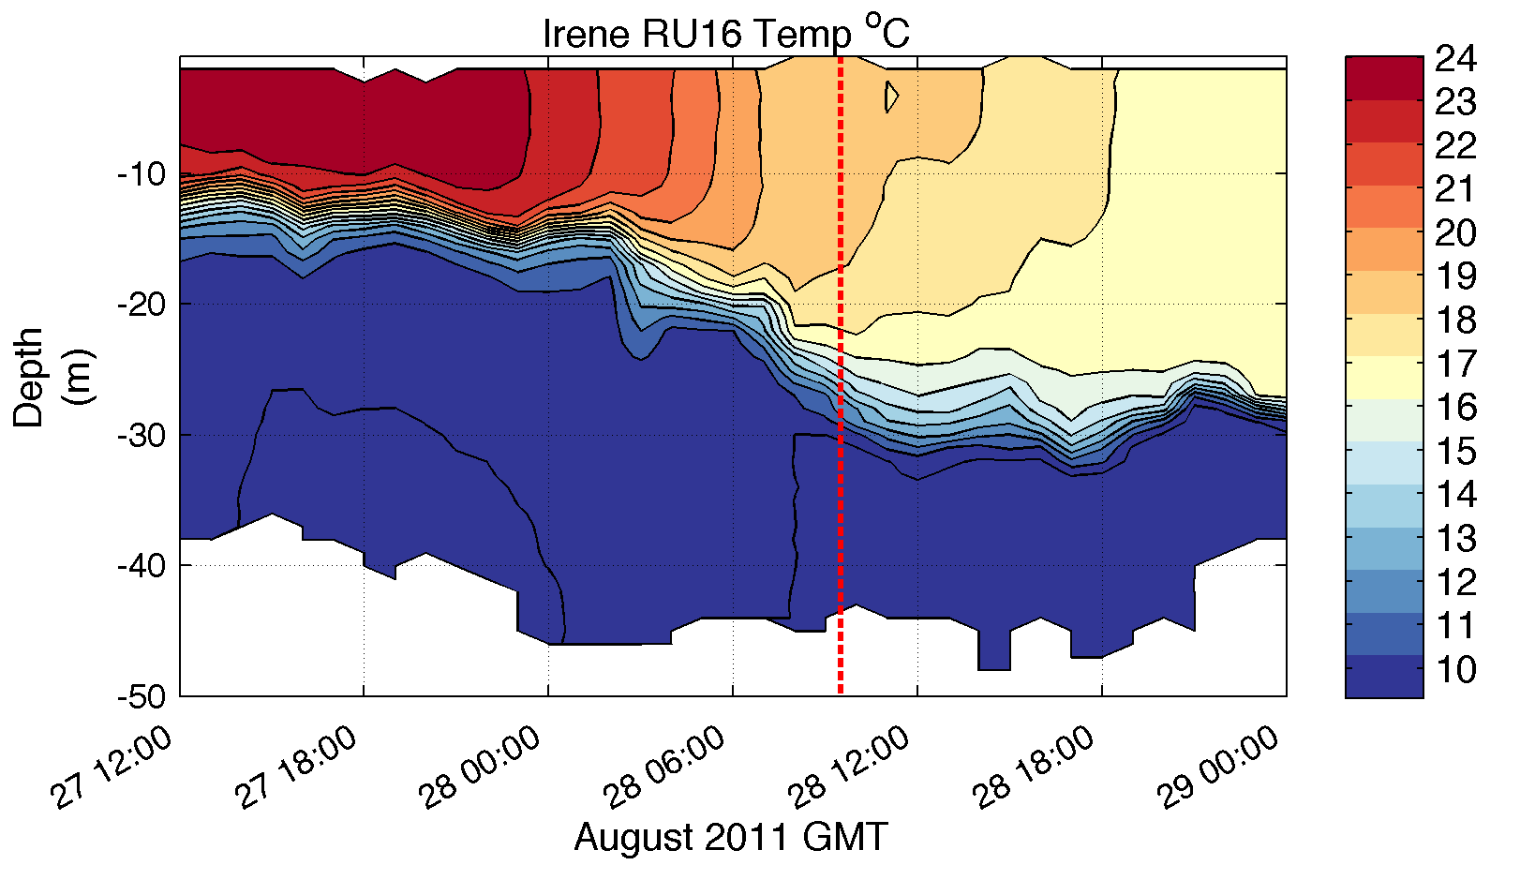
Pre-Irene
Post-Irene
Difference
11C max Cooling
WHAT?
Satellite
SST
WHEN? Glider Temperature
WHY?
HF Radar
Currents
Eye Passage
?

Slide 10
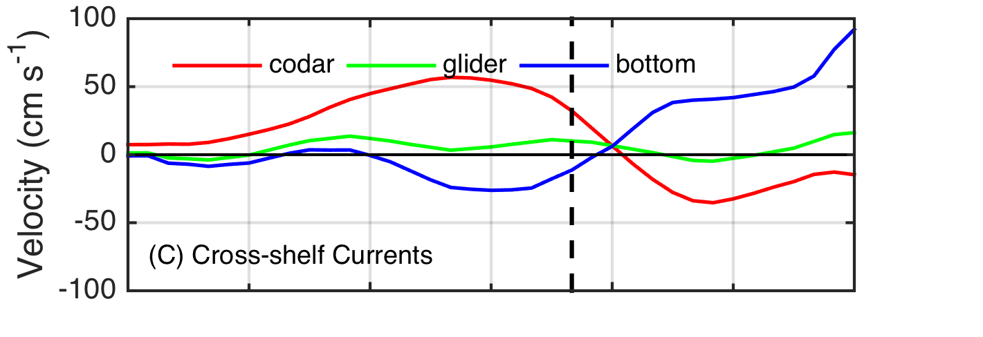
Pre-Irene
Post-Irene
Difference
11C max Cooling
WHAT?
Satellite
SST
WHEN? Glider Temperature
WHY?
HF Radar
Currents
Eye Passage

Slide 11
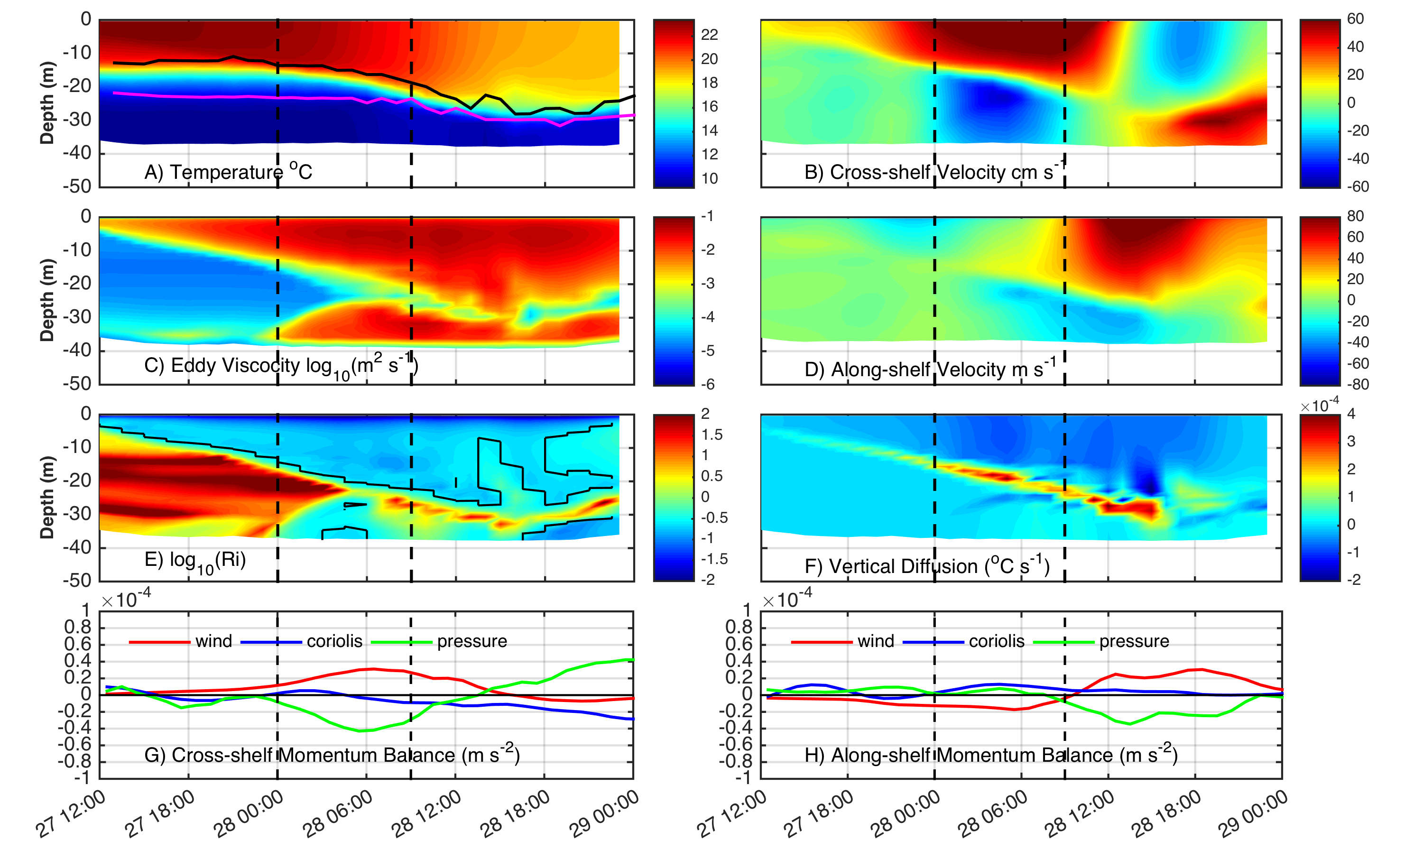
ROMS Model Results at Glider Location
Coastal Baroclinic Circulation Enhances Mixing & Cooling

Slide 12
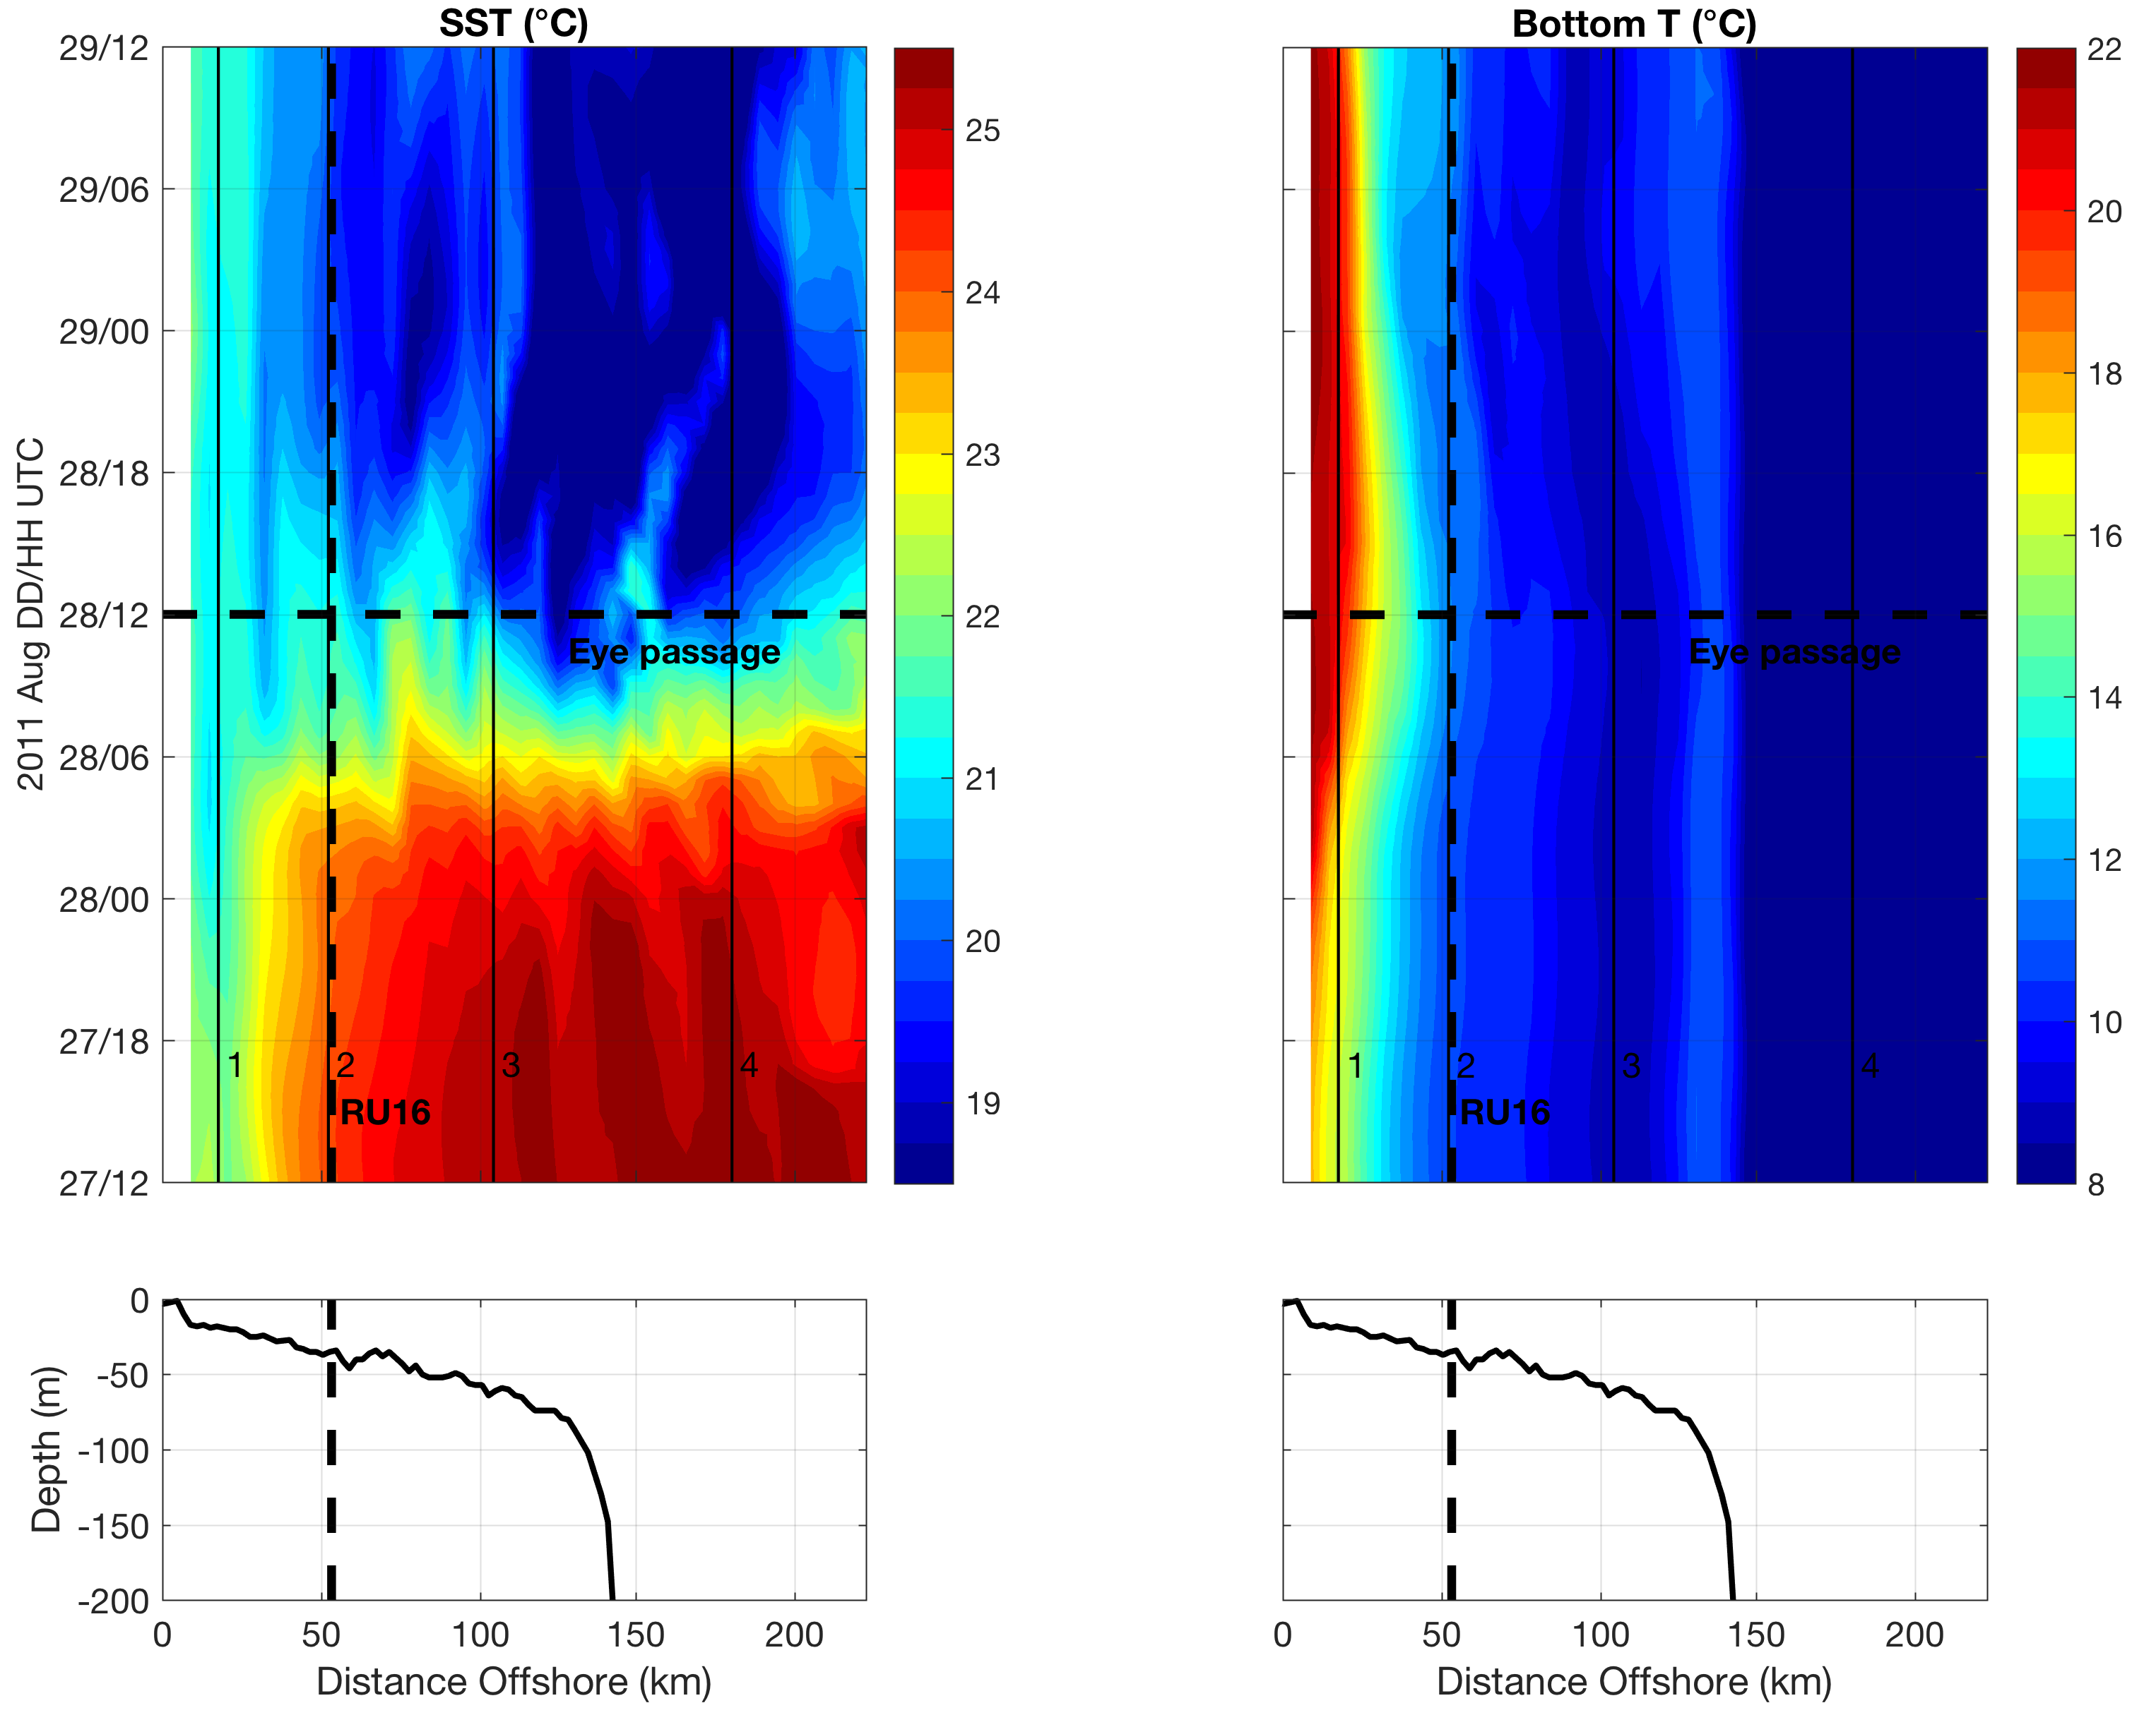
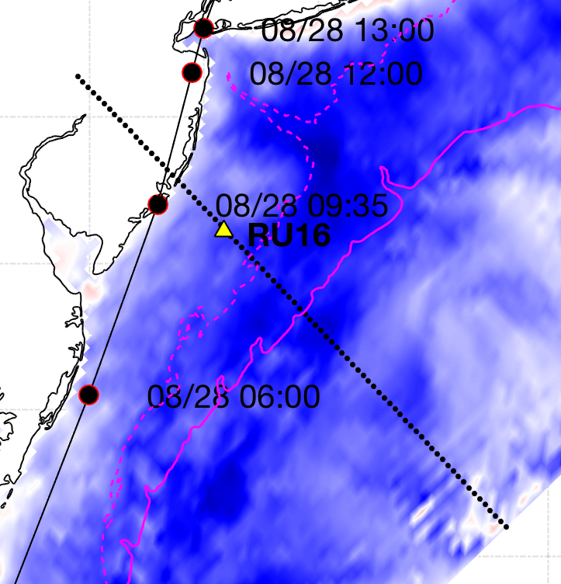
ROMS Model Cross-shelf Section: SST cooling, downwelling bottom T
AOEC SST cooling
Downwelling
Upwelling
Seroka et al. in prep.
Notes:
10

Slide 13
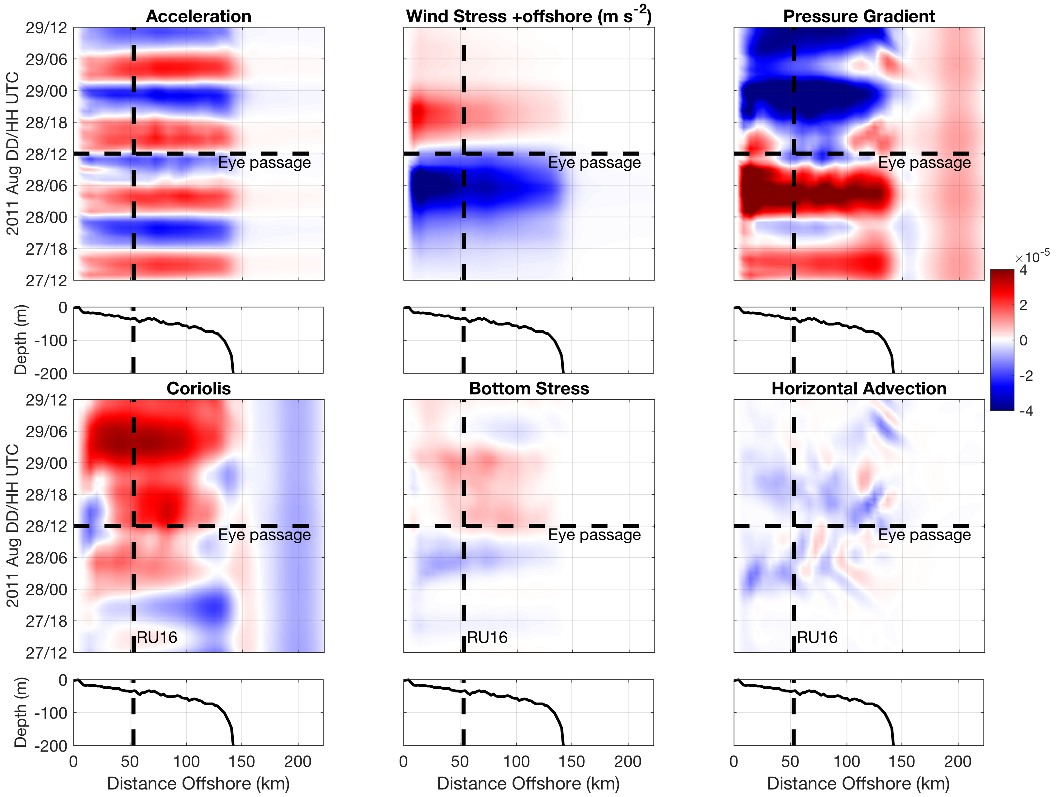
ROMS Model Cross-shelf Section: onshore WS vs. offshore PG
+offshore
m s⁻²
-onshore
Seroka et al. in prep.
Notes:
15

Slide 14
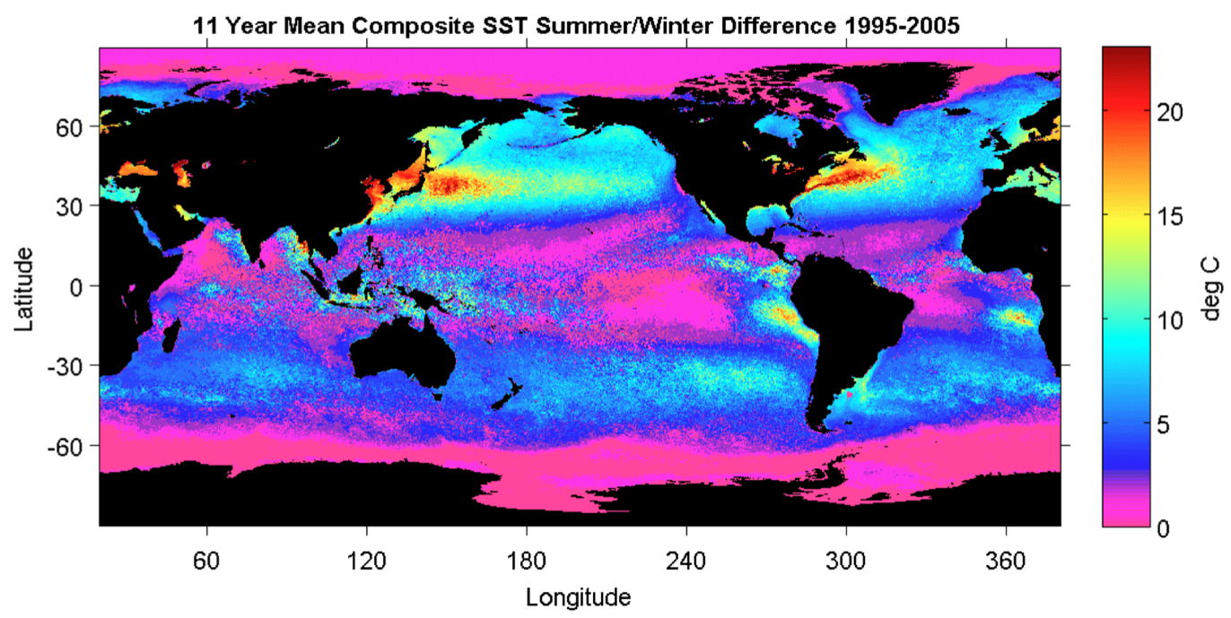
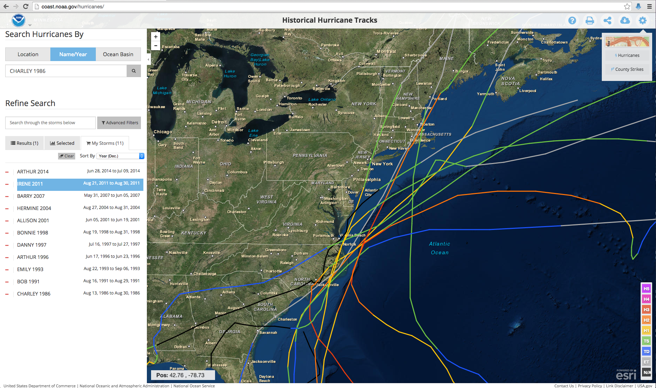
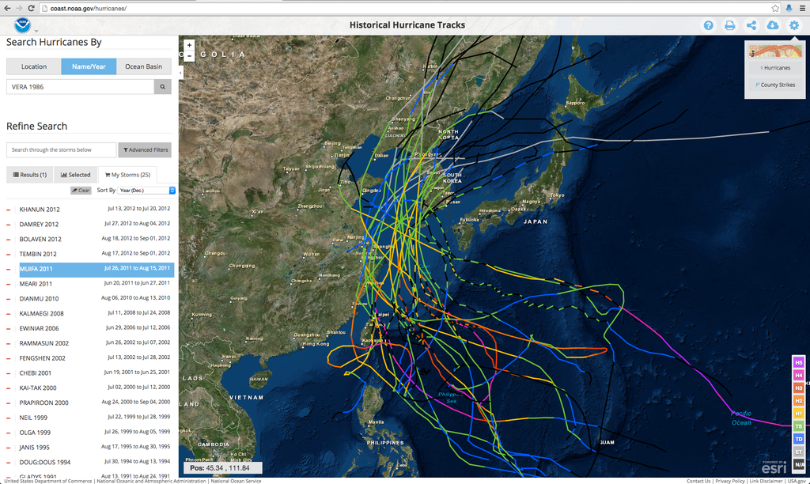
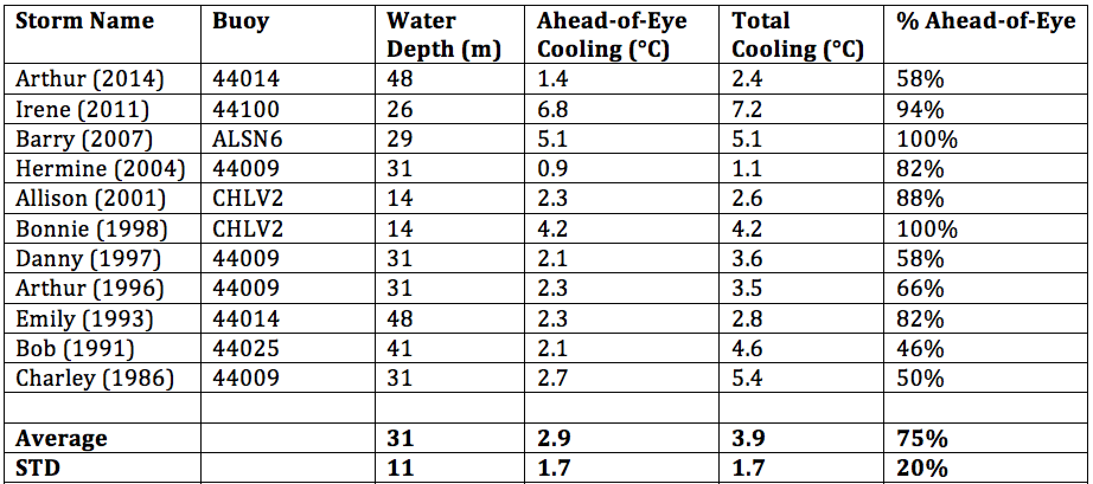
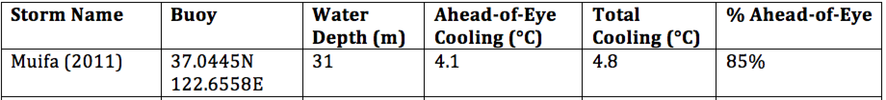
Ahead of Eye Center Cooling
Left: U.S. Mid-Atlantic
Right: East China & Yellow Seas
11 Hurricanes since 1985
26 Typhoons since 1985
AOE Center Cooling in Buoy Record:
Mid Atlantic Average: 75%
Super-typhoon Muifa: 85%
See Glenn et al., Nature Comms, 2016

Slide 15
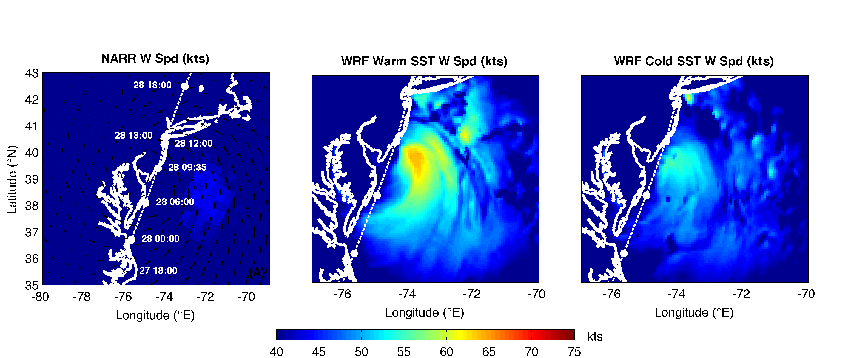
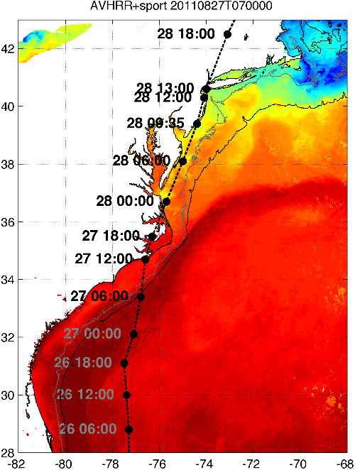
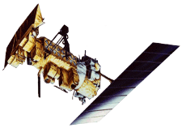

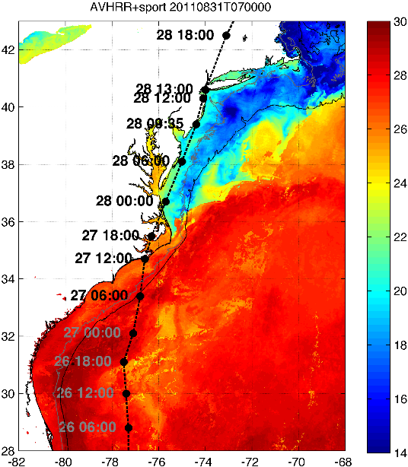

Rutgers Atmospheric Forecast Sensitivity Study
Warm Ocean
Boundary Condition
Cat 1 Hurricane
Tropical Storm
Cold Ocean
Boundary Condition
IMPACT?
>10 knots reduction in peak wind speed

Slide 16
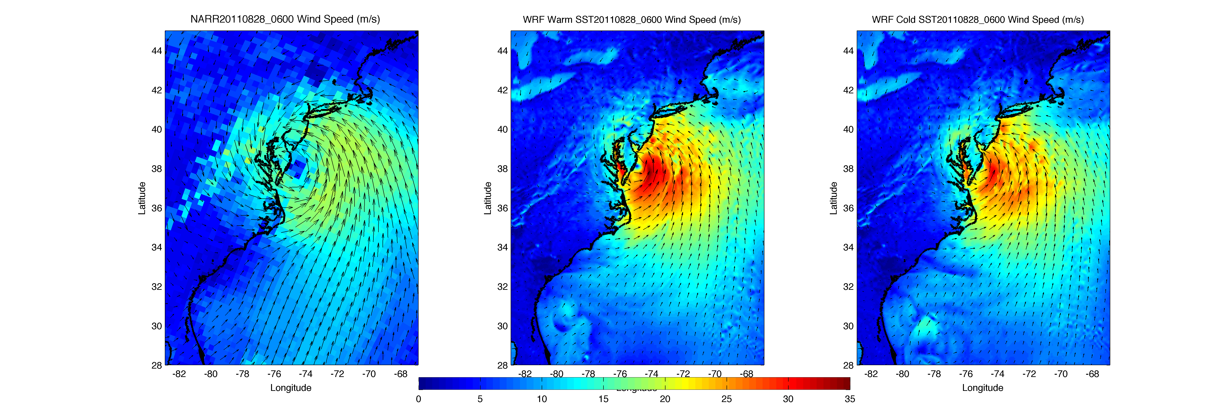
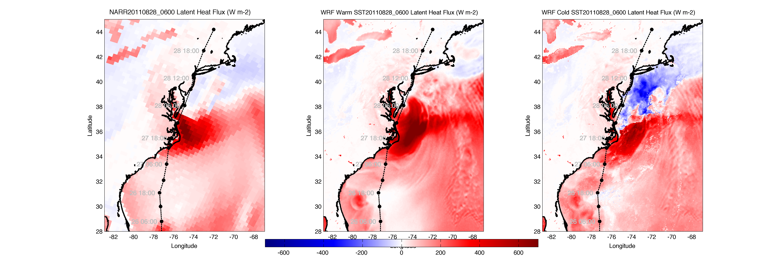
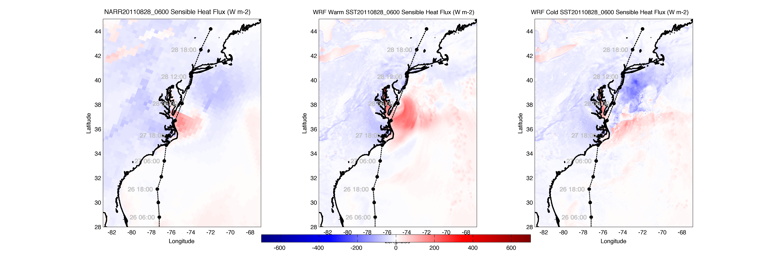
NARR
WARM SST
COLD SST
WRF Heat Flux Comparison to
North American Regional Reanalysis
Wind
Latent heat flux
MAB Heat Flux Changes Sign:
Warm SST +
Cold SST -
Sensible heat flux

Slide 17
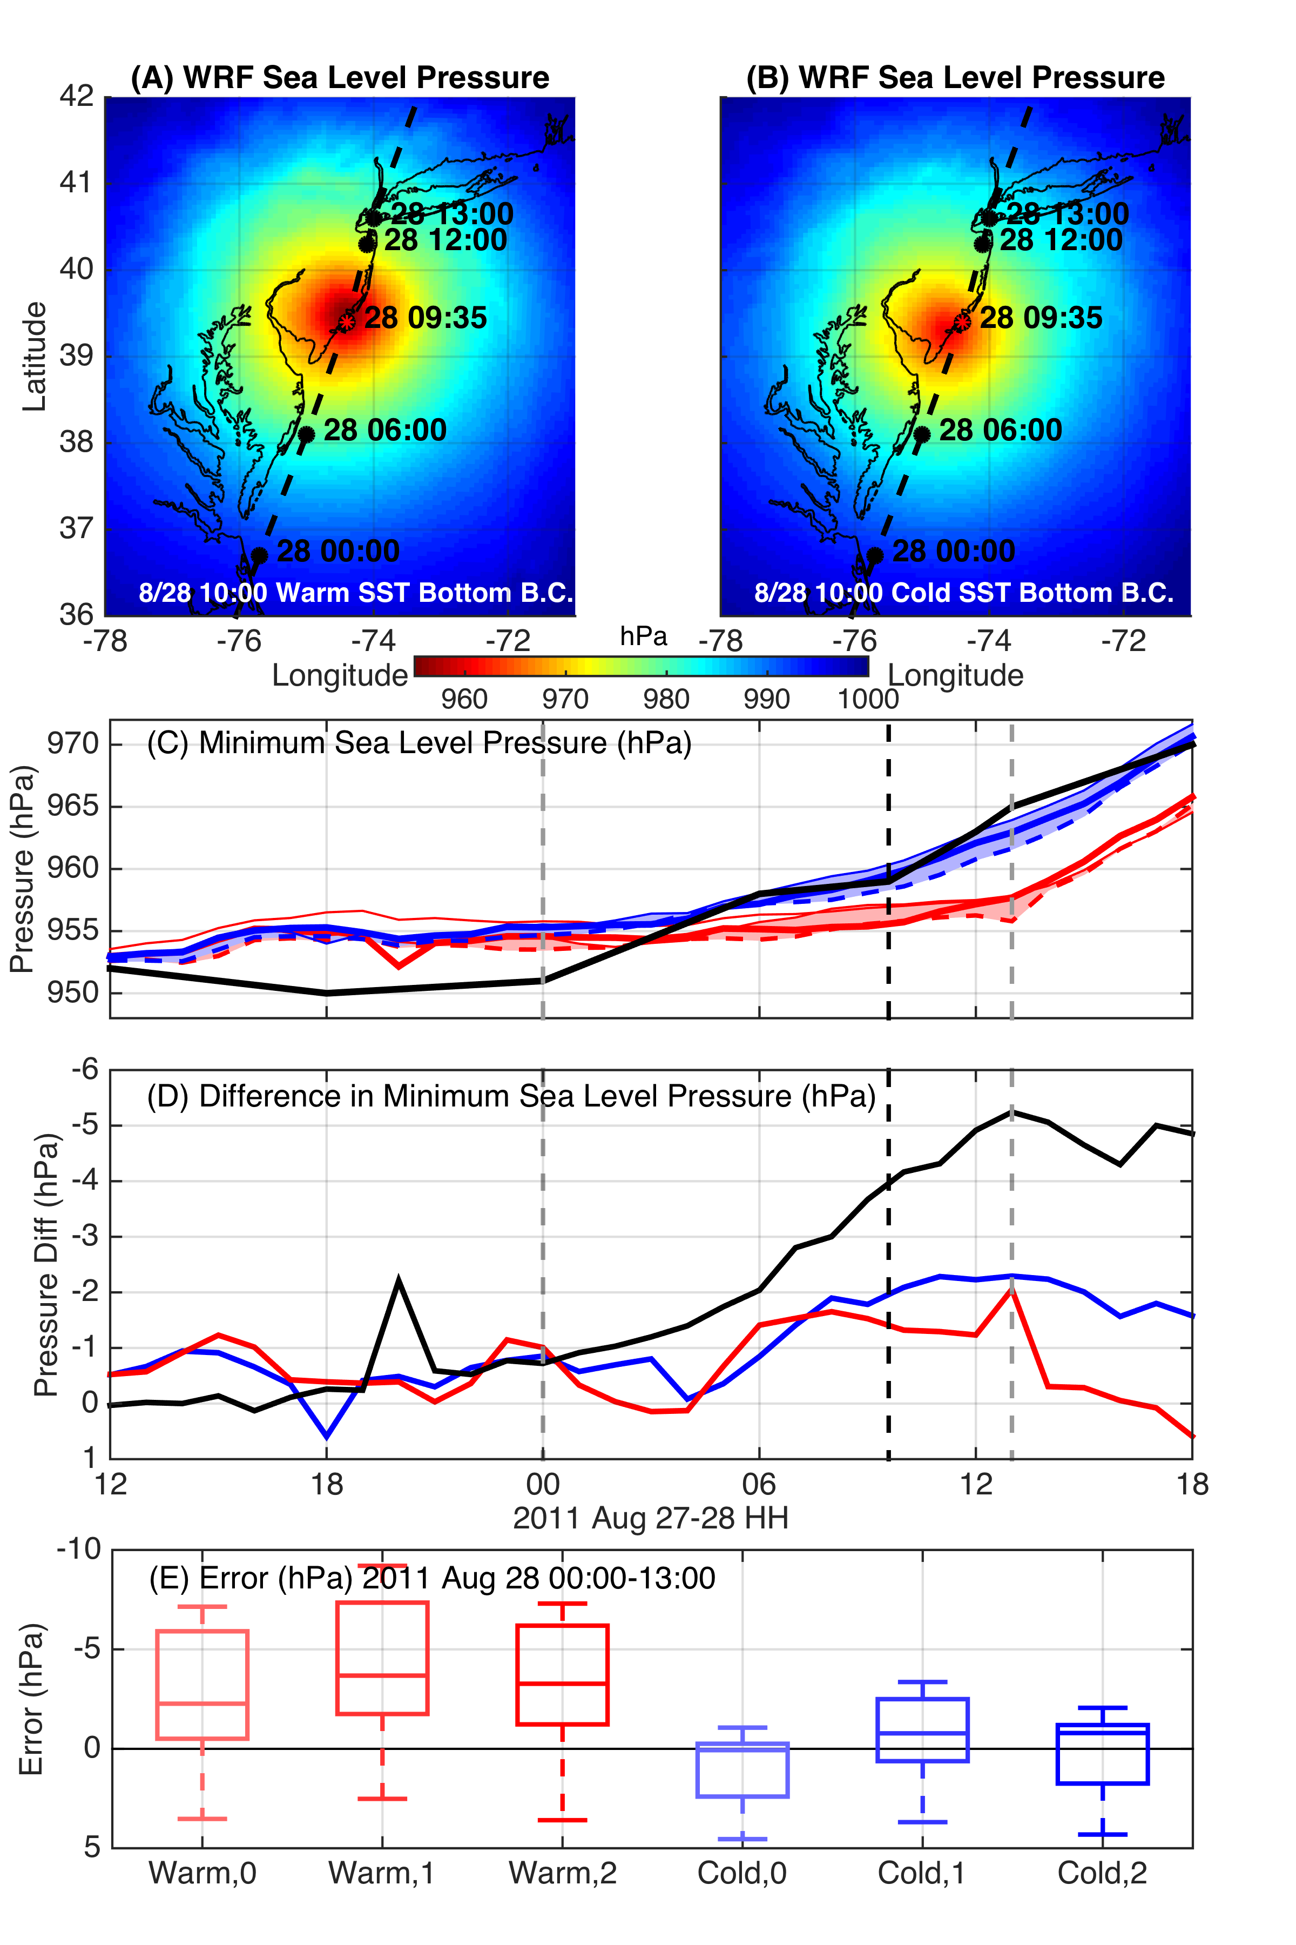
WRF Model Sensitivity Study
Over 130 model runs
Paired to compare sensitivities
Central pressure & max wind
Sensitivity to SST greatest
Seroka, Miles, Xu, Kohut, Schofield & Glenn,
Hurricane Irene Sensitivity to Stratified Coastal Ocean Cooling, Monthly Weather Review, 2016

Slide 18
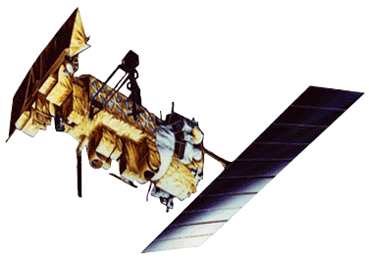
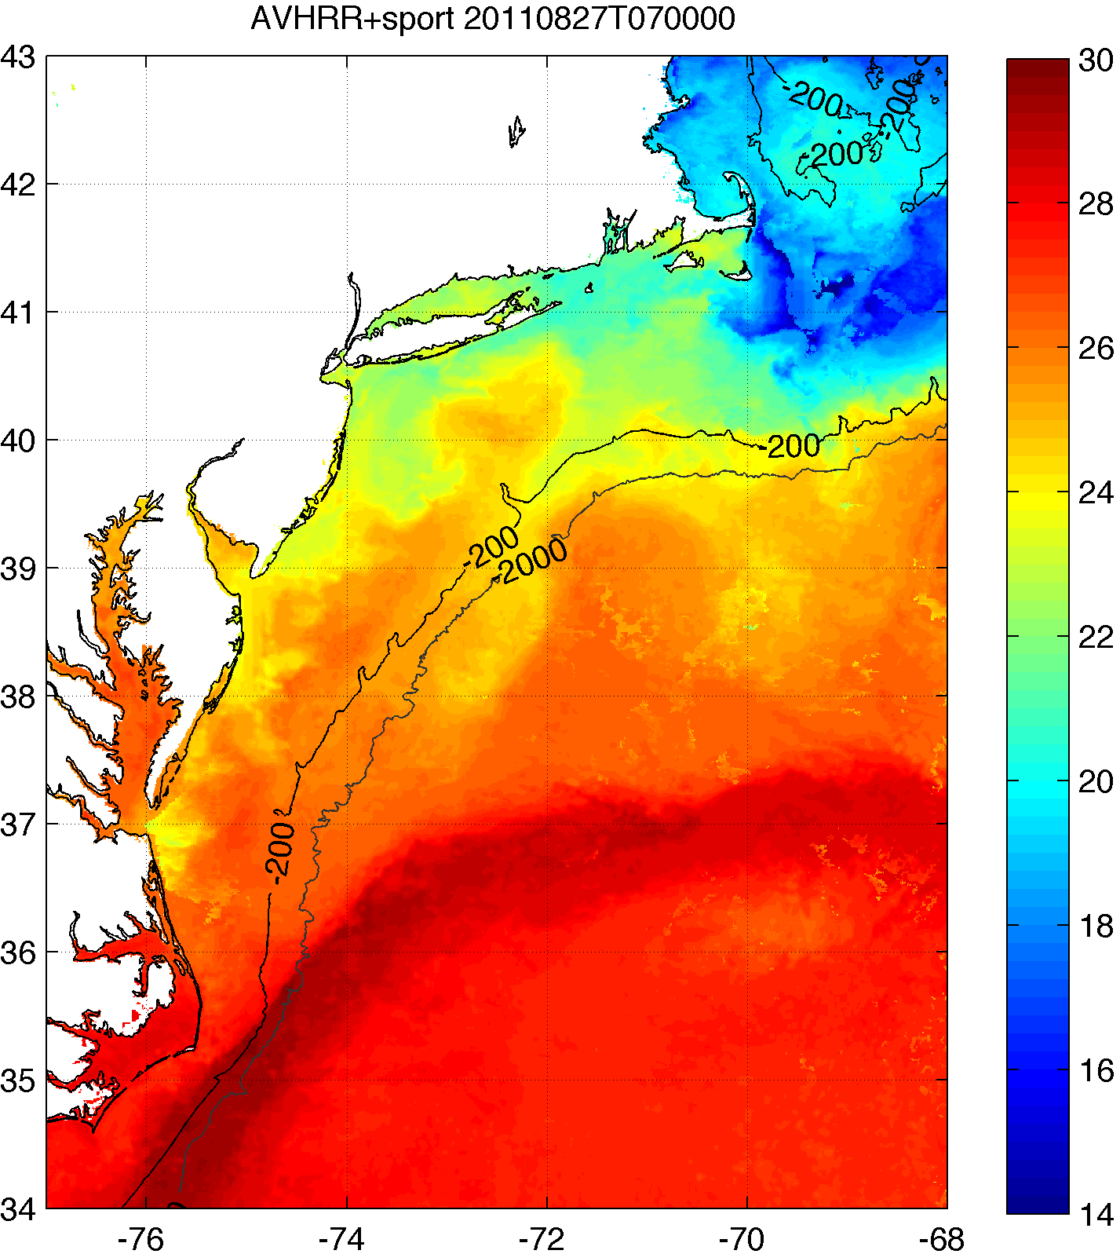
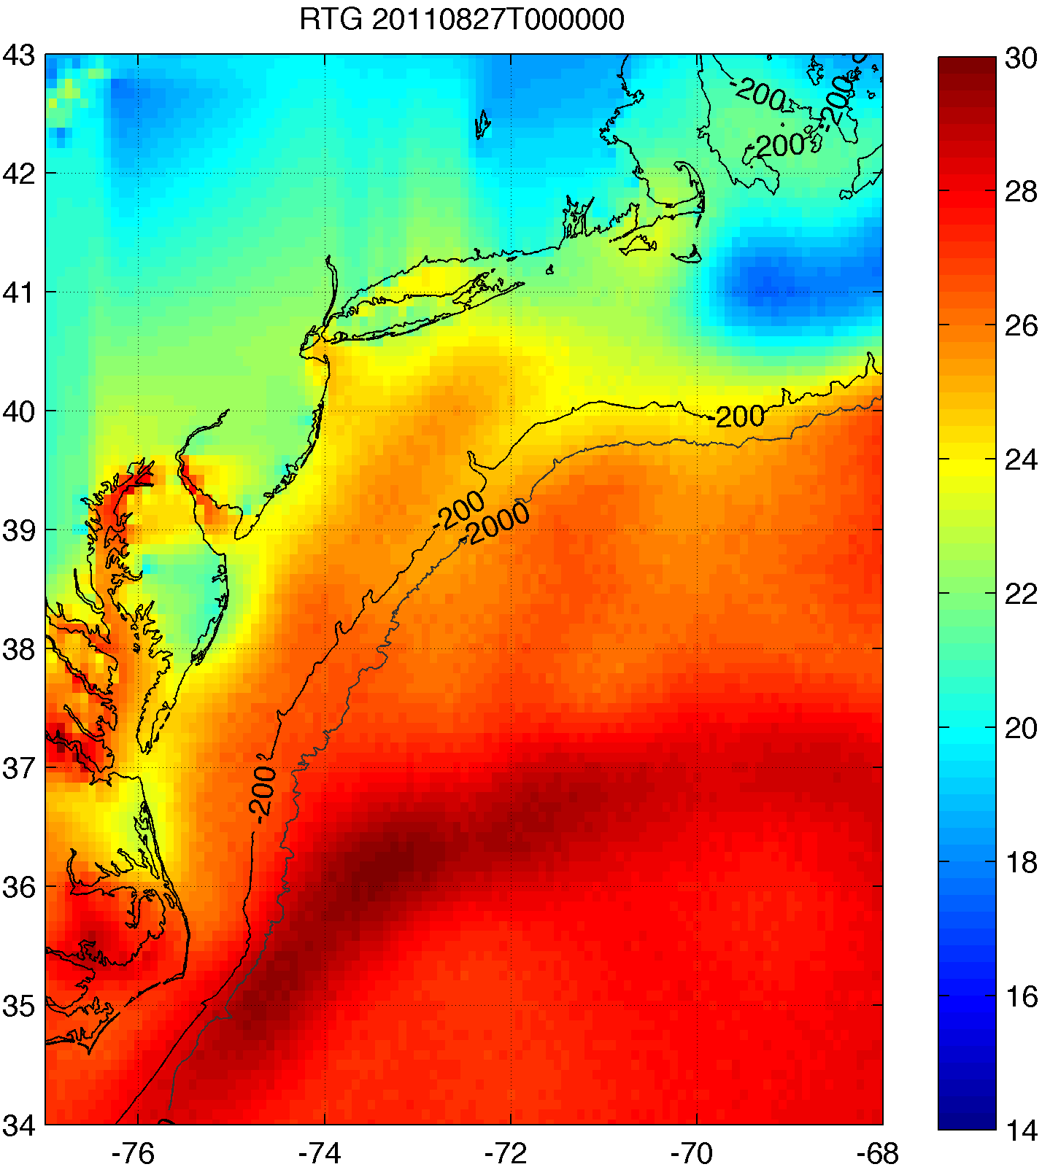
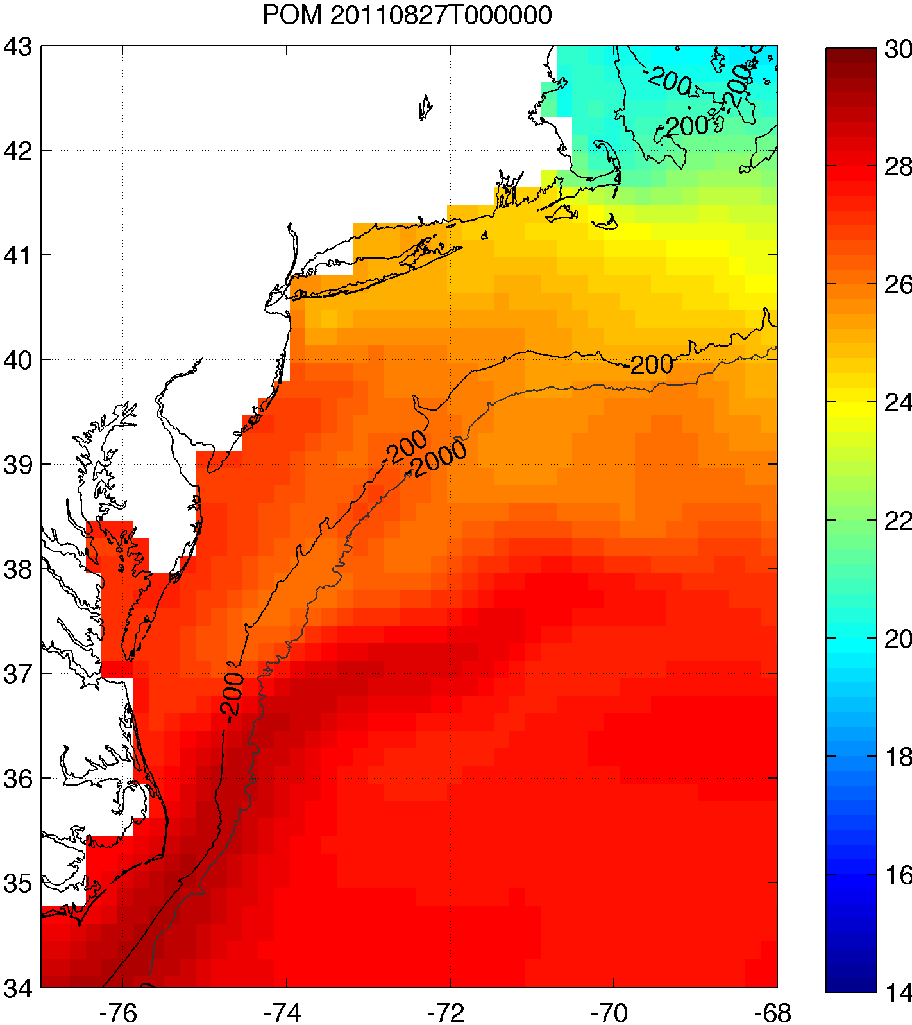
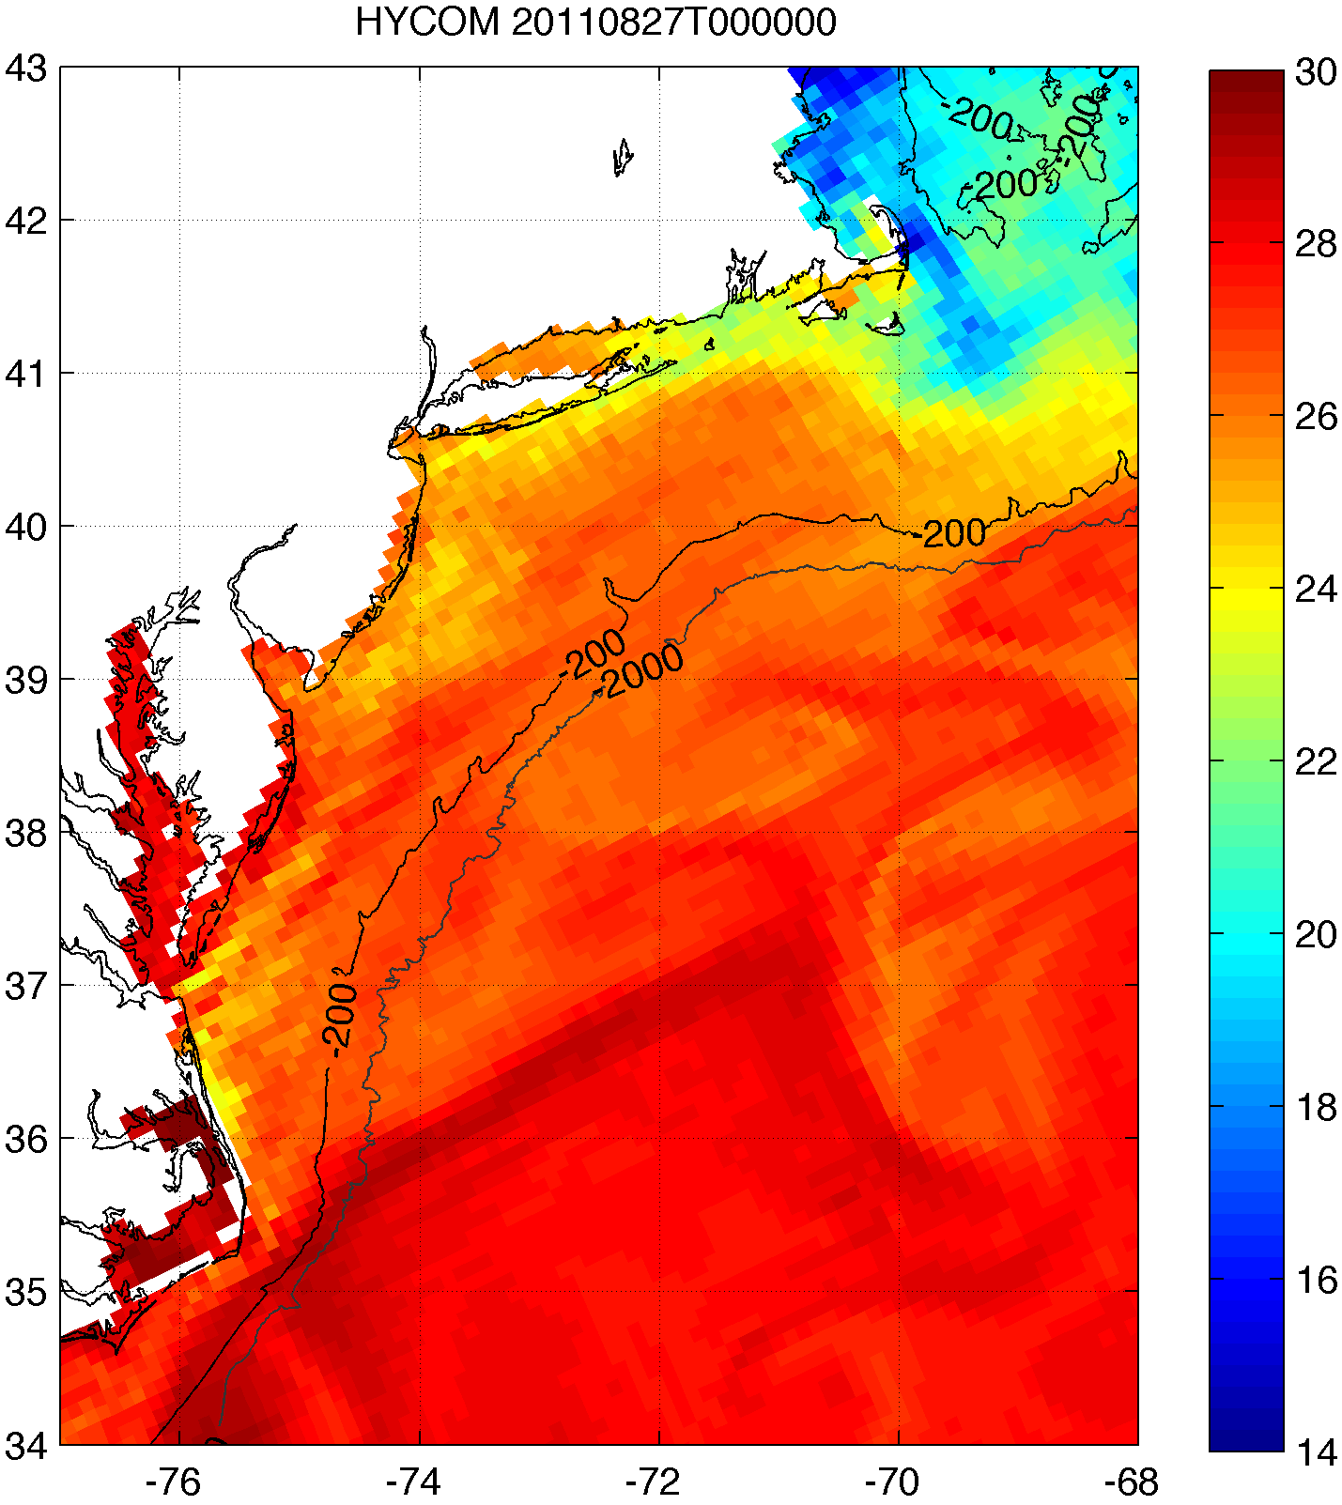
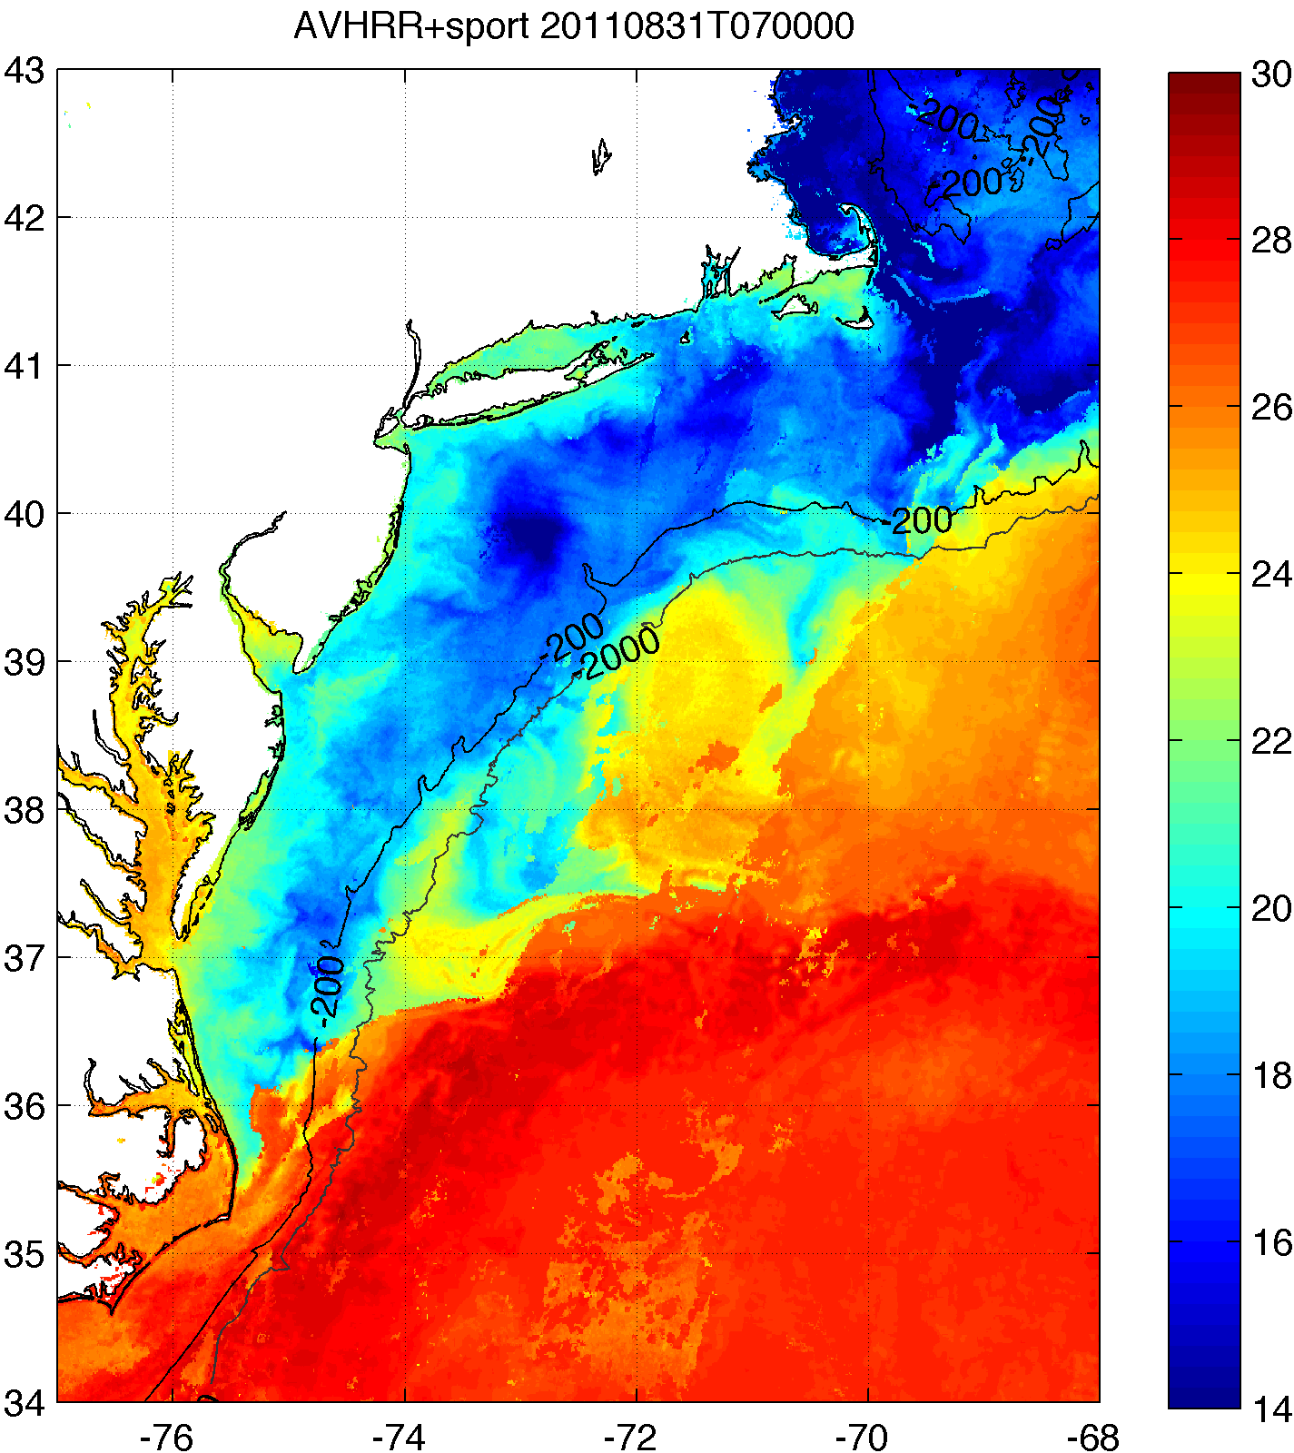



Improved satellite SST product revealed ahead-of-eye cooling was not captured by:
standard satellite product
ocean models used for forecasting hurricane intensity
MARACOOS SST
RTG HR SST
NAM model
HWRF-POM
low res
HWRF-HYCOM
medium res
BEFORE IRENE
AFTER IRENE
Notes:
Caveats: different atmospheric forcing, etc.
Rutgers SST: 2km, RTG: 1/12 deg, ~9 km, HWRF-POM: 18km, HWRF-HYCOM: 1/12 deg, ~9km

Slide 19




Hurricane Hermine Response: CINAR/MARACOOS Glider Fleet Launched, 9/2016
Glider
HYCOM
RTOFS

Slide 20


Hurricane Hermine Response: CINAR/MARACOOS Glider Fleet Launched, 9/2016
Glider RU30
HYCOM
RTOFS

Slide 21
Hurricane Irene Track August 27-28, 2011
Summary:
Summer Storm
Strong Stratification
Coastal Response
Mixing Cooled Surface
Limited Intensity

Slide 22


Growing Tropical Cyclone Global Glider Network
MARACOOS/CINAR
UMaine
WHOI
UMass
Rutgers
UMaryland
VIMS
NCEP
KIOST
2nd IO
SKLECR
IO
USM
NRL
BIOS
NTU
CariCOOS
UPRM
UVI
TWR
AOML
BMKGA
UCT
UWA
USP
Selected EGO Goals from Pierre Testor, Slide 4:
Coordination of ongoing research, and the conception of future research
Build Capacity to operate fleets of gliders at international level

