Slide 1







The Mid-Atlantic Coastal Ocean Observing System:
Application to Mean and Extreme Conditions
Scott Glenn & Hugh Roarty
Rutgers University

Slide 2
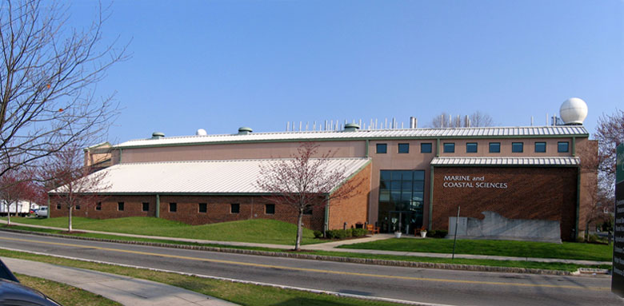
25 Years of Ocean Observing at:
Rutgers University (RU)
Center for Ocean Observation Leadership (COOL)
Department of Marine and Coastal Sciences (IMCS)
New Brunswick, New Jersey, USA
http://rucool.marine.rutgers.edu
Dr. Scott Glenn
Distinguished Professor
MARACOOS Principal Investigator
National HF Radar Steering Committee
glenn@marine.rutgers.edu
Dr. Hugh Roarty
Operations Center Director
MARACOOS HFR Coordinator
Global HF Radar Network Chair
hroarty@marine.rutgers.edu

Slide 3
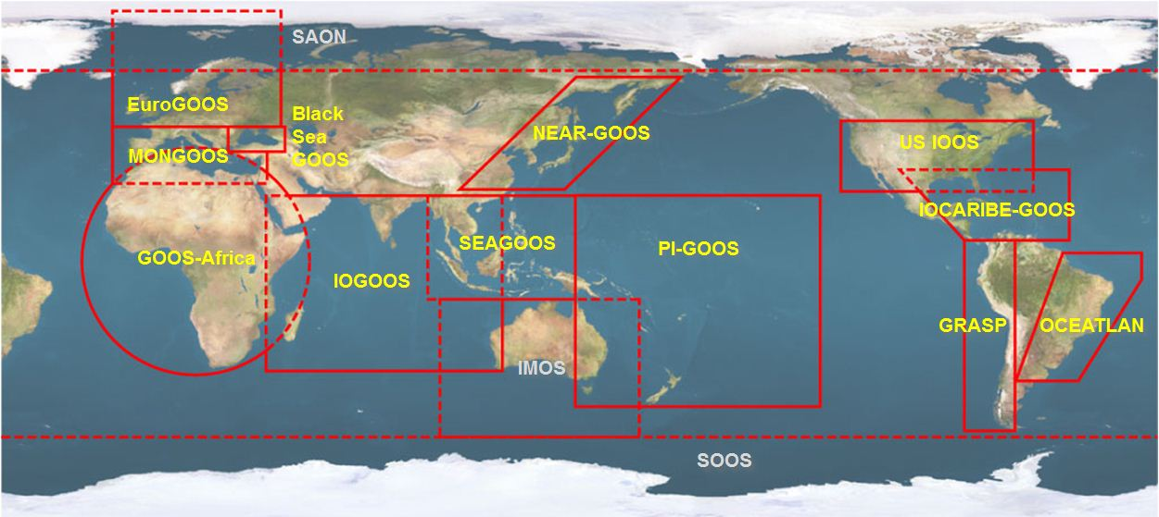





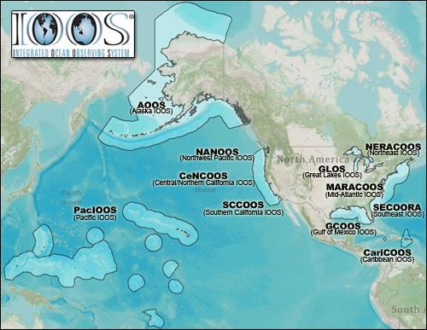













U.S. Integrated Ocean Observing System (IOOS)
Global Component
National Component
Regional Component
15 Regional Alliances in GOOS
Vessels -
Satellite
Satellite
CODAR
Ships/ Vessels
Glider
REMUS
Data Vis.
Modeling
Security
Leadership
Education
11 Regional Associations
17 U.S. Federal Agencies
Serving Society & Science
http://ioos.gov

Slide 4
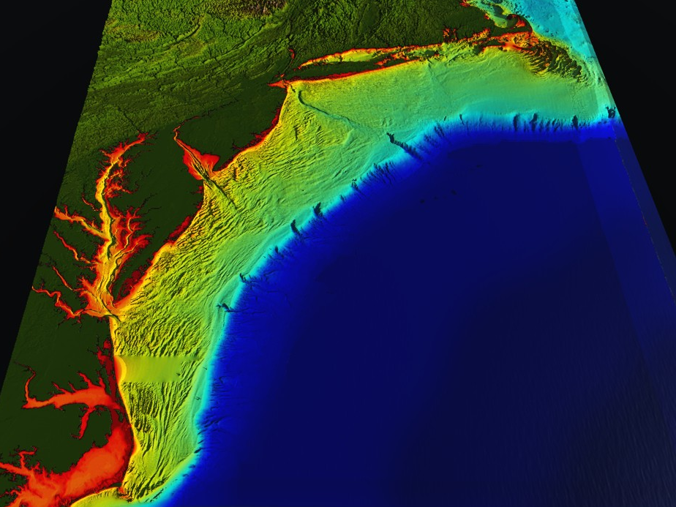















RI
U..
Middle Atlantic
Regional Association
Coastal
Ocean Observing System
78 Million People (1/4 of U.S.)
1000 km Cape to Cape
CT
Cape
Cod
MA
NY
PA
NJ
MARACOOS:
A Sustained Real-time Observation & Forecast System
DE
MD
>40 PIs
>20 Institutions
>50 Members
>2000 Contacts
Scott Glenn + Many
VA
NC
Cape
Hatteras
Notes:
4

Slide 5
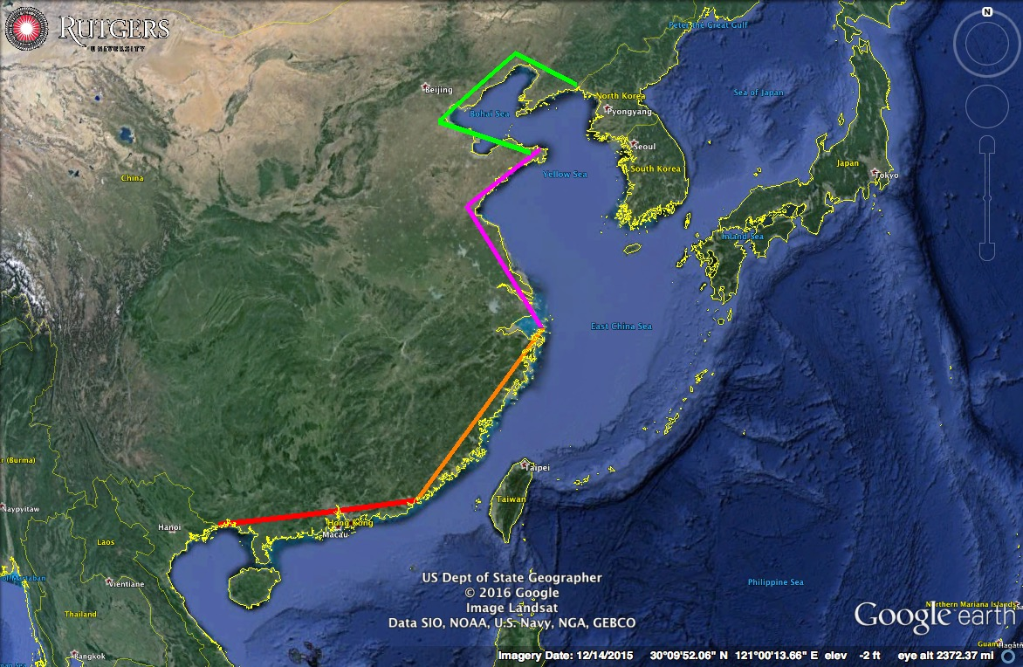
Coastal China:
Four ~1000 km
Regional Segments

Slide 6
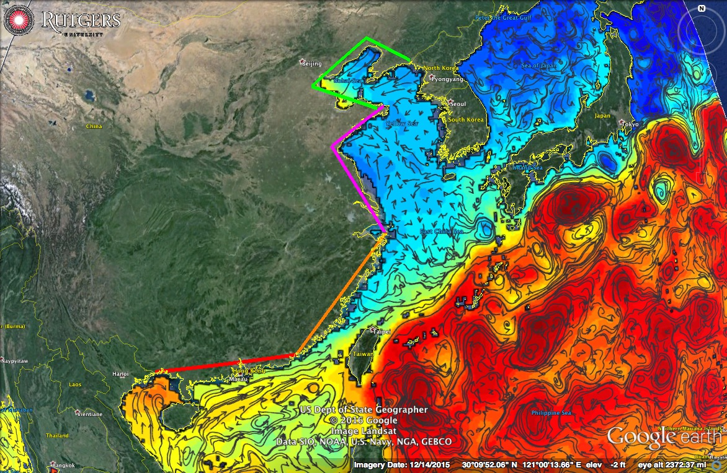
Coastal China:
Four ~1000 km
Regional Segments

Slide 7
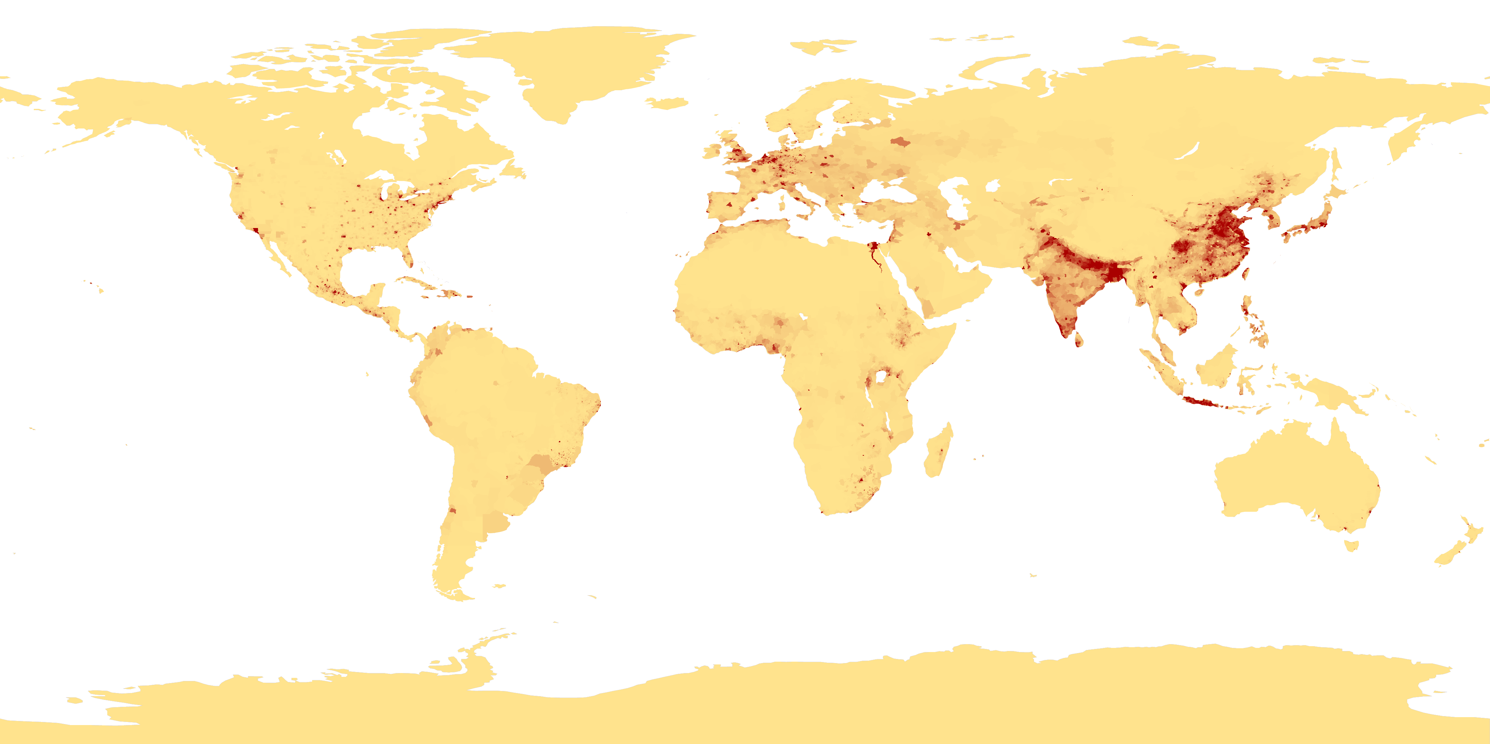
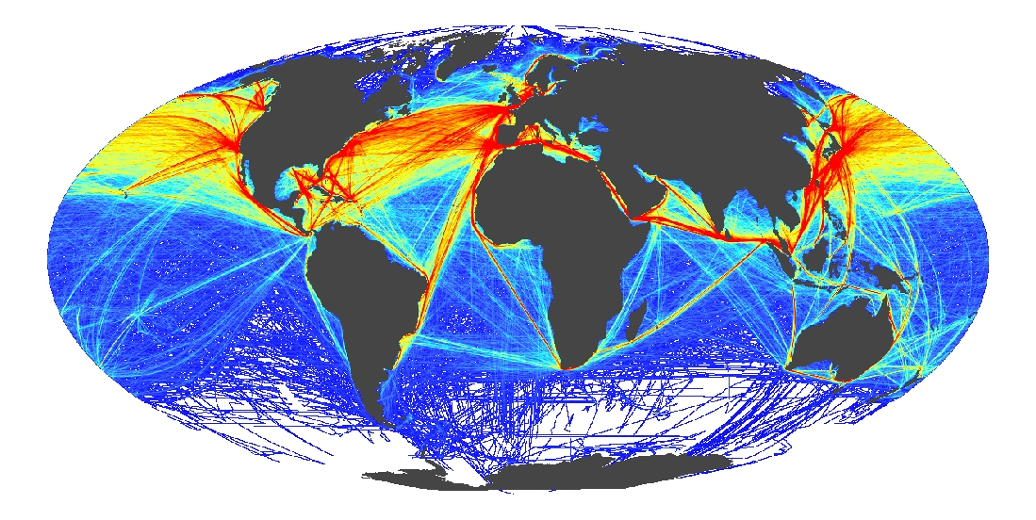
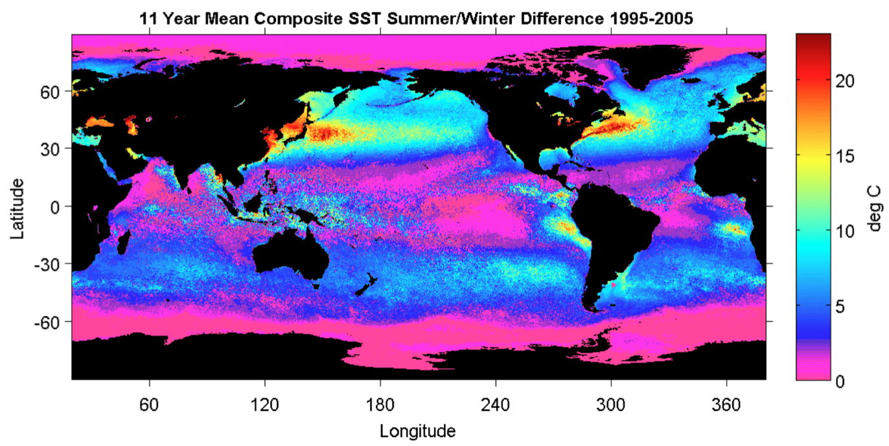
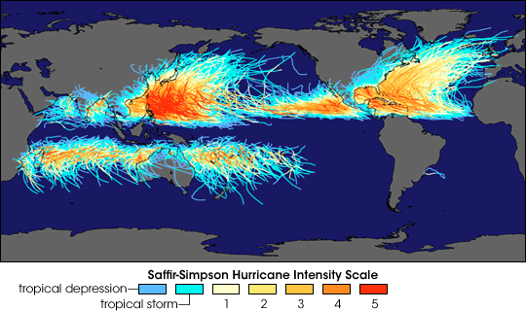
Global Drivers
Coastal Population Centers
International Commerce
Ocean Seasonality
Tropical Cyclones

Slide 8
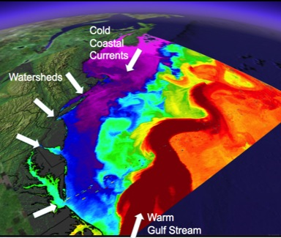
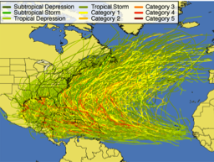
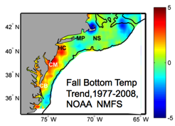
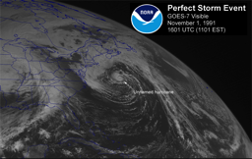
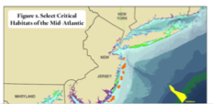
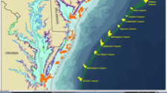
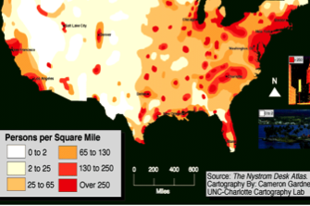
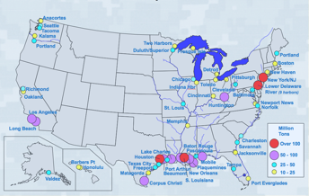
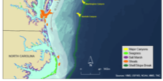
MID-ATLANTIC REGIONAL DRIVERS
Tropical Storms
Climate Change
Ocean Circulation
Critical Habitat
Northeasters
Population
Ports

Slide 9
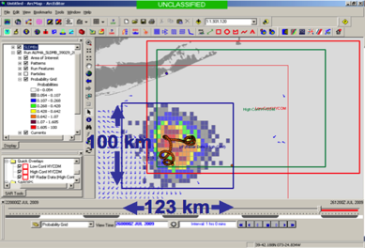
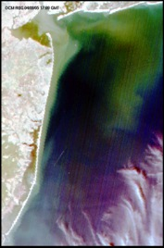
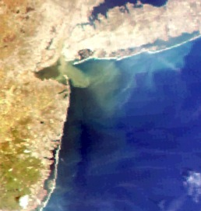
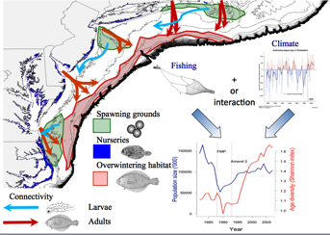
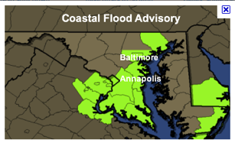
MARACOOS REGIONAL THEMES
1) Maritime Operations – Safety at Sea
3) Water Quality – a) Floatables, b) Hypoxia, c) Nutrients
2) Ecosystem Decision Support - Fisheries
5) Energy – Offshore Wind
4) Coastal Inundation - Flooding

Slide 10
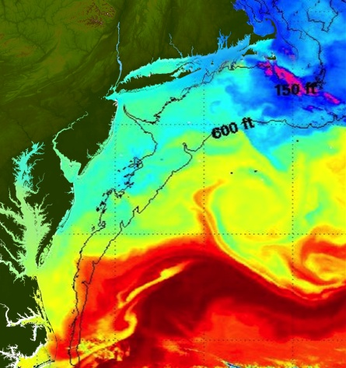
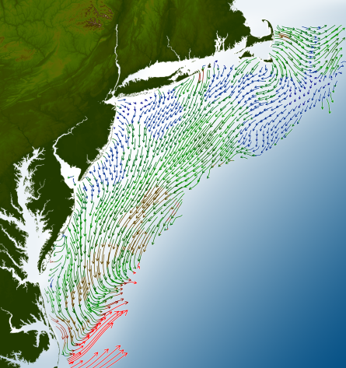
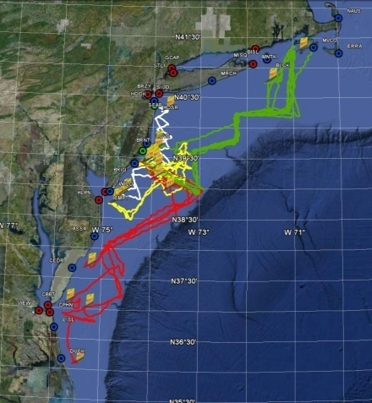
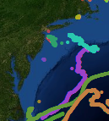
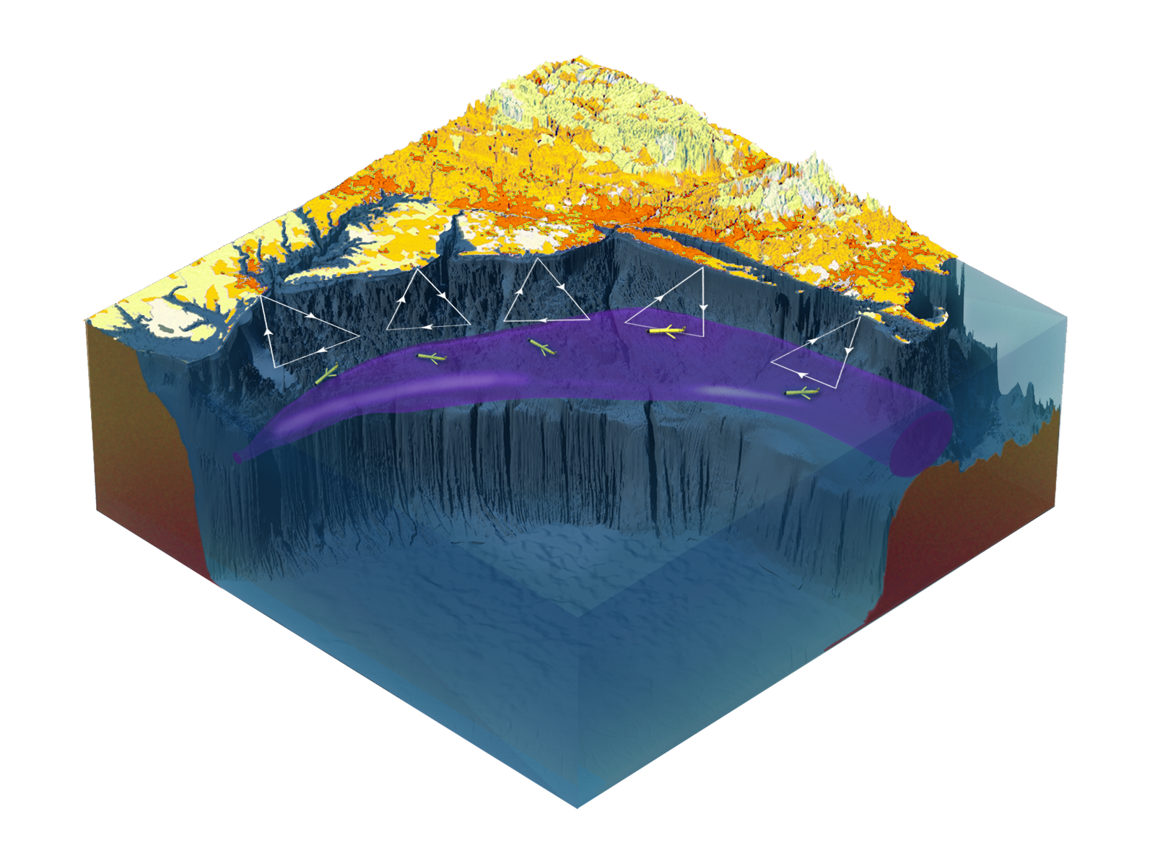

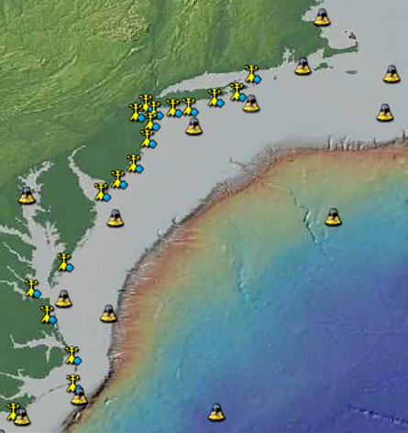
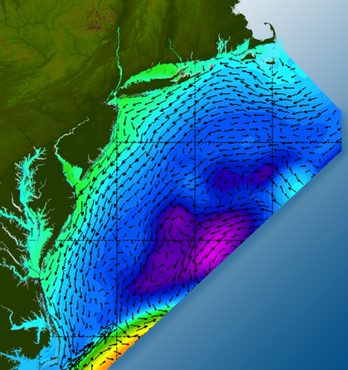

Satellites
HF-Radar
Gliders
Drifters
Population Density
To seek, discover & apply
new knowledge & understanding
of our coastal ocean
Weather Stations
Atmosphere & Ocean Forecast Ensembles
Notes:
Need to cut off cold pool in south and bend offshore
Need to experiment with dulling down the colors in the pop density. Maybe orange/tan to white like the box I put in?
Put gliders just below the lines in 3 of them, and increase their angles facing up and down randomly. I stuck in cheesy examples
I already put the shadow and 80% clear line around the two new maps in the upper right, so we are good there.

Slide 11
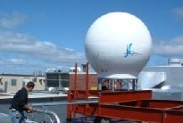
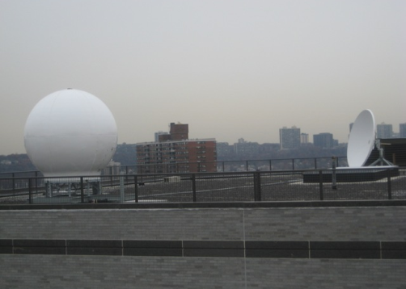
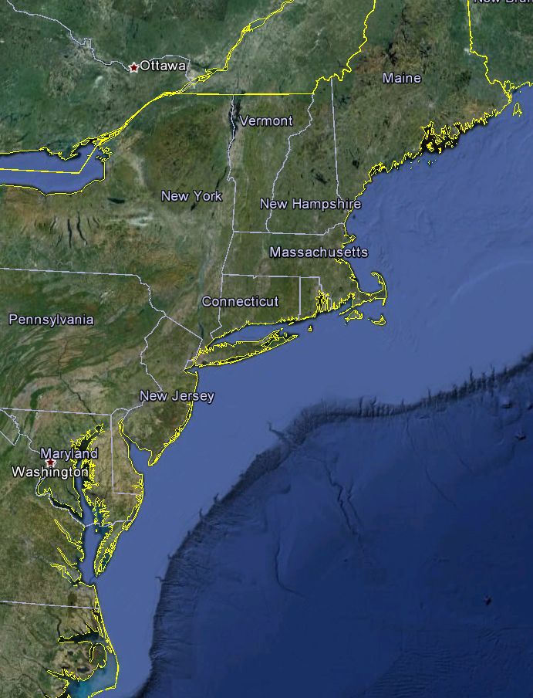
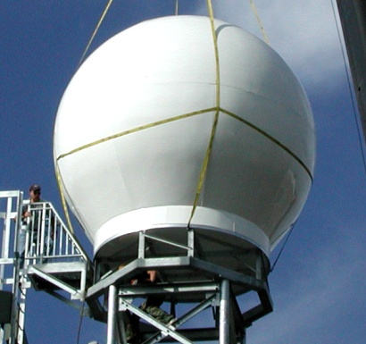
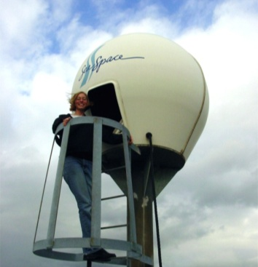
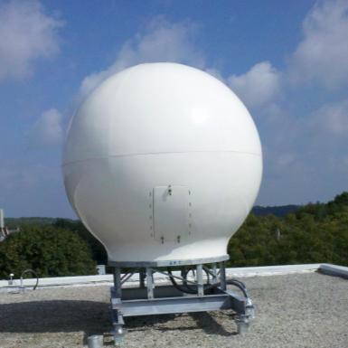
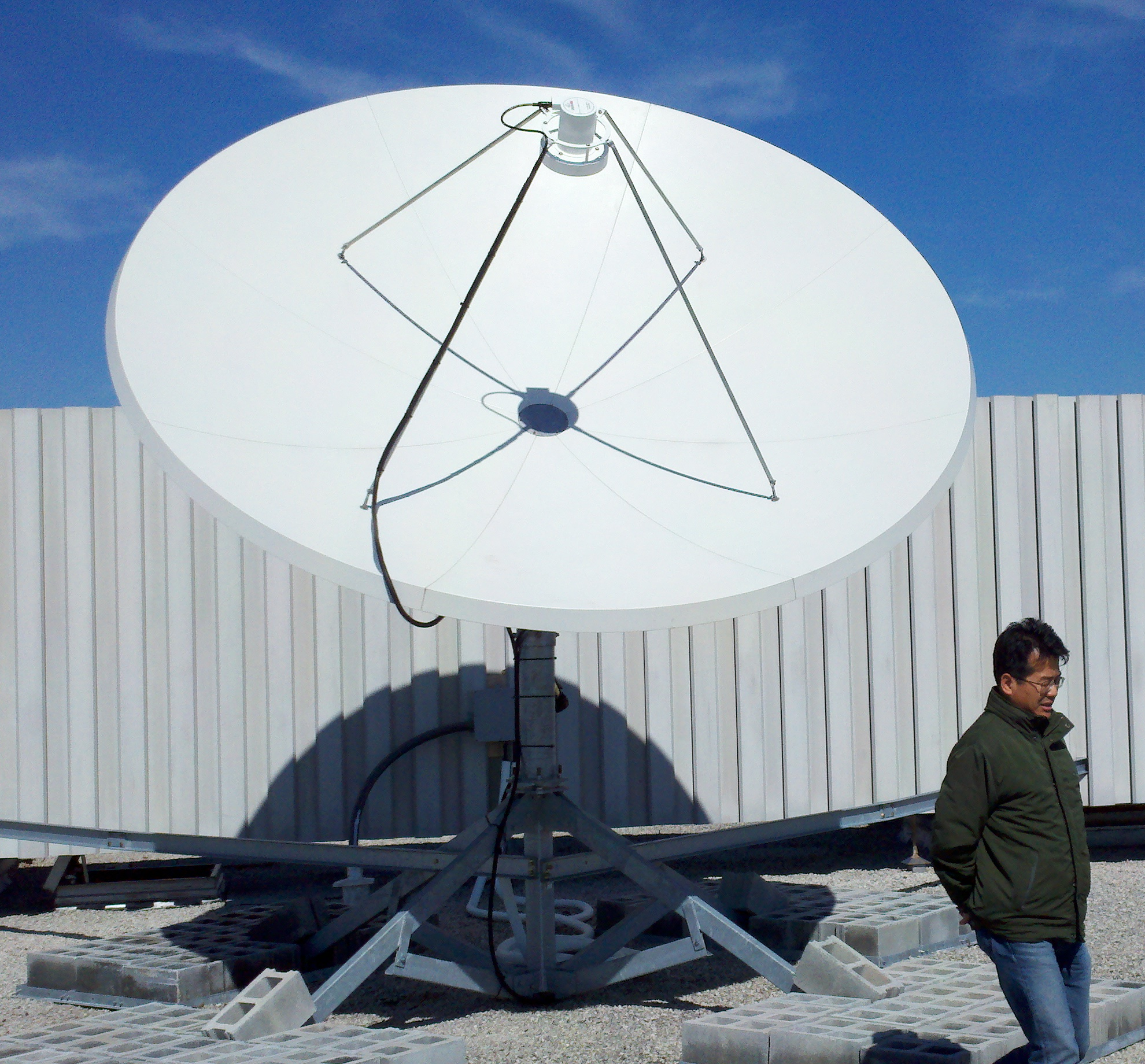
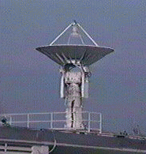

Real-Time Satellite Ground Stations in the Northeast U.S.
Satellites: NOAA Polar Orbiters, NPP, Terra, Aqua, Metop & GOES
U. Maine
City College of N.Y.
Rutgers
Industry
Partner
U. Delaware
Johns Hopkins

Slide 12
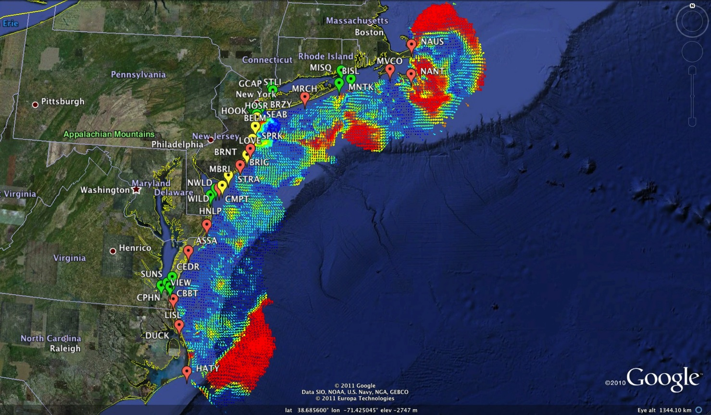
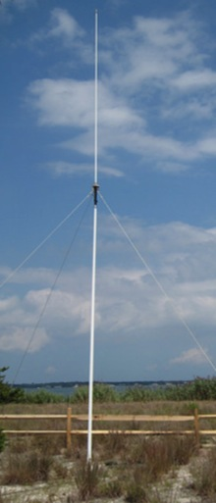
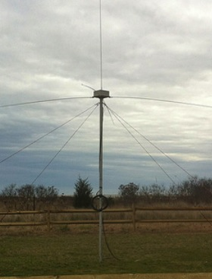
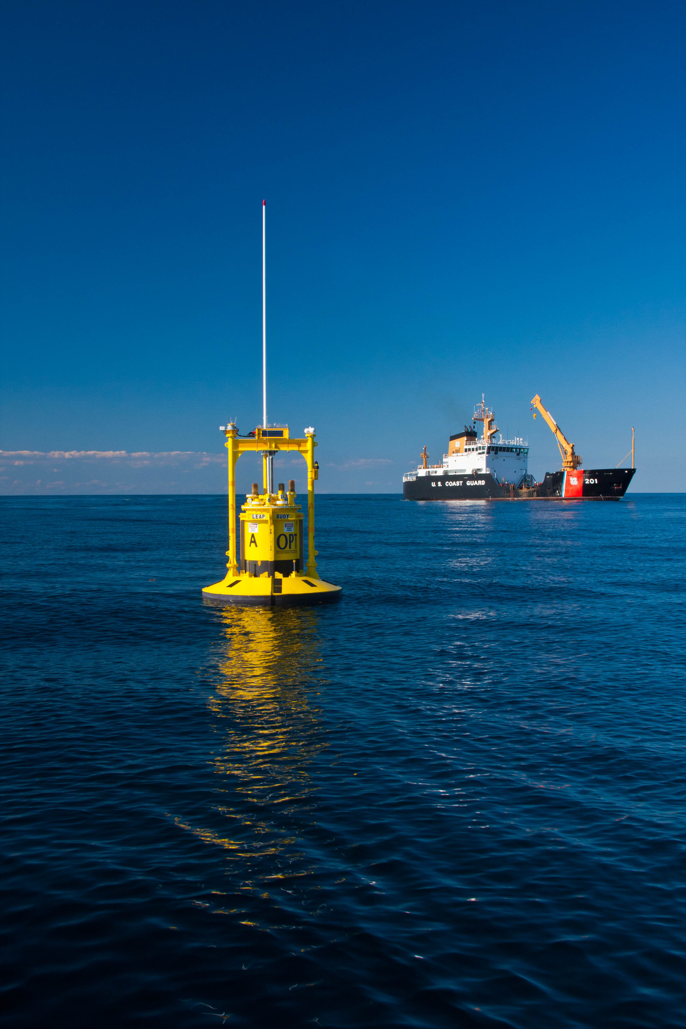
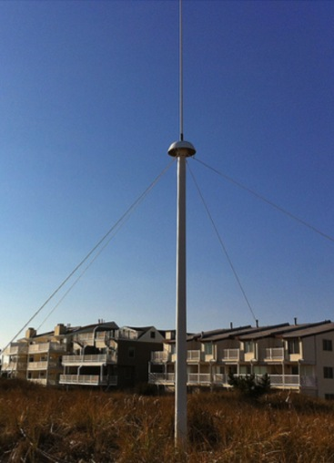
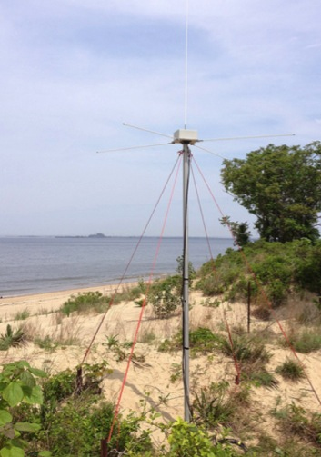
Mid-Atlantic Bight HF Radar Network
1000 km
Cape to Cape
Mid-Atlantic HF Radar Network
16 Long-Range CODARs
8 Medium-Range CODARs
17 Short-Range CODARs
41 Total (Pre-Sandy)
Triple Nested, Multi-static, Multi-use
Industry Partner: CODAR Ocean Sensors

Slide 13
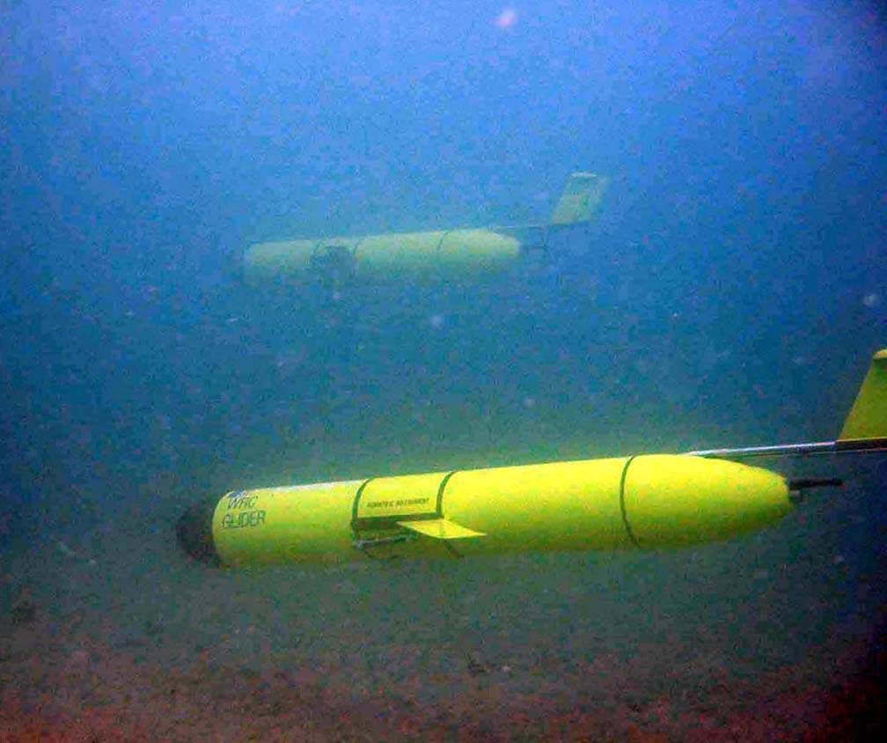
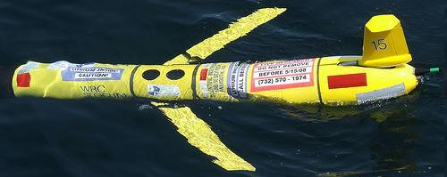
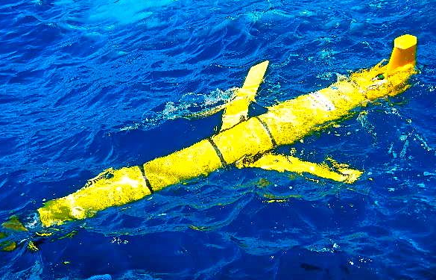
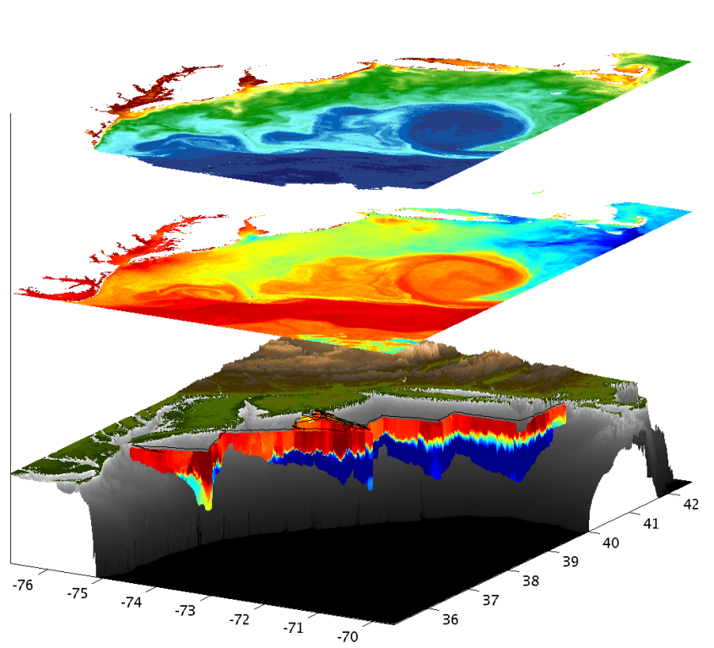
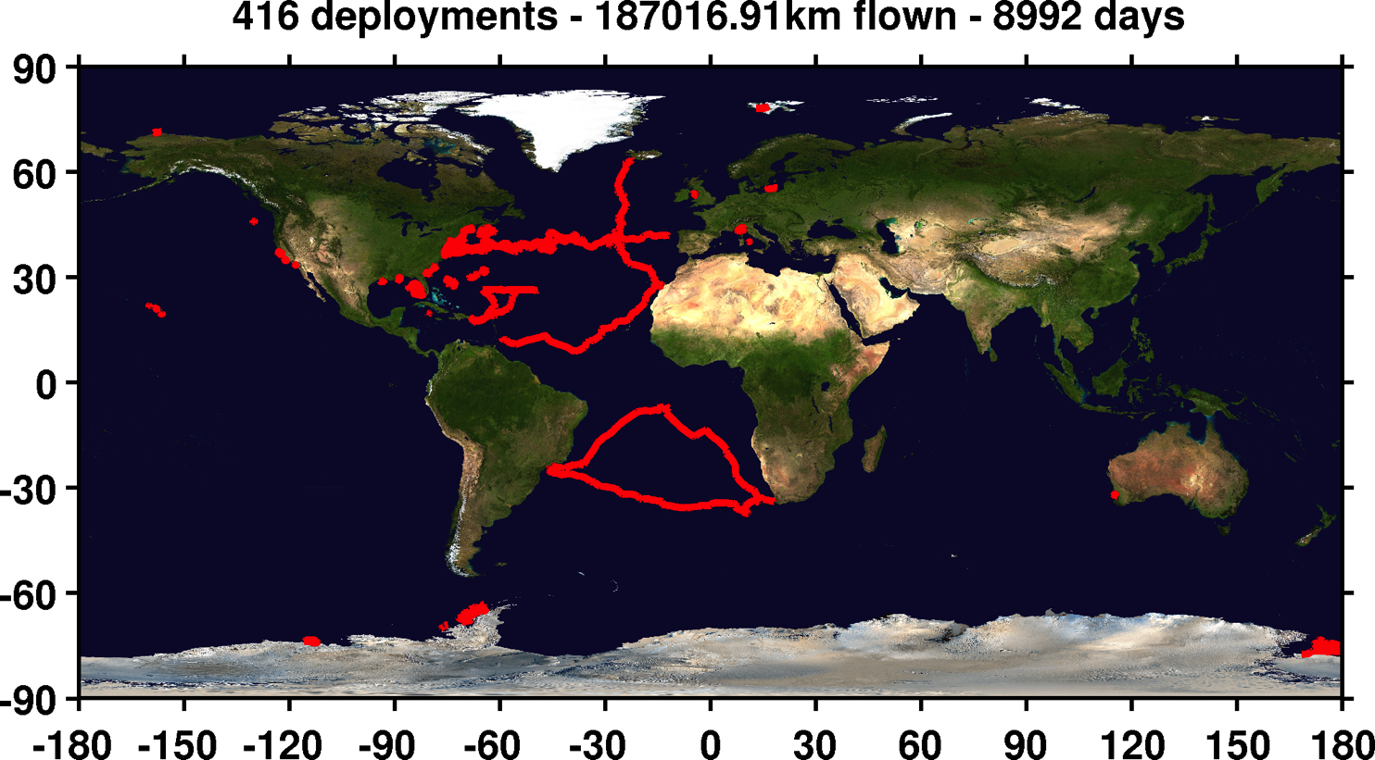

Mid-Atlantic Bight Glider Network
RU01
RU15
RU29
G1
G1-Ruggedized
G2
Satellite Ocean Color
Satellite SST
Subsurface
Glider
Data
Industry Partner: Teledyne Webb Research

Slide 14













Glider Sensors
Inside Payload Bay or External

Slide 15





NDBC
Backbone
> 50 sites
MARACOOS Weather Network
Regional Industry
Enhancement
> 100 sites

Slide 16

NDBC
Backbone
> 50 sites
MARACOOS Weather Network
MARACOOS
Weather Ensemble
3-7 Members
Verified with Coastal Observations

Slide 17

Advanced Research Version of WRF
Weather Research and Forecasting (WRF) model, Advanced Research core (ARW), Version 3.4.1 (Michalakes et al., 2001)
Horizontal Resolution: 6km
Vertical Resolution: 35 levels, focused near surface
Lateral B.C.: Global Forecast System (GFS) 0.5 degree
Microphysics: WRF Double-Moment 6-class scheme
Planetary Boundary Layer (PBL) scheme: Yonsei University scheme
Longwave radiation: Rapid Radiative Transfer Model (RRTMG)
Shortwave radiation: Dudhia
Bottom B.C. (Sea Surface Temperature, SST): Variant

Slide 18




Improved Predictive Modeling and Data Assimilation
1) STPS
U. Connecticut
2) NYHOPS
Stevens Institute of Technology
3) ROMS
Rutgers University
4) HOPS
U. Massachusetts, Dartmouth

Slide 19

Rutgers ROMS 4DVAR uses all available data
from a modern coastal ocean observing system
  more and diverse data is better (T, S, u, sea level)
  bias correction to OBC and MDT is essential
Useful subsurface skill for real-time applications:
  4 days for temperature and salinity;
  1-2 days for velocity
Future directions: variational methods for
observing system design; coupling; ecosystems
correlation
Forward model
Forward model
after bias removal
Data assimilation
analysis/hindcast
depth
2-day forecast
4-day forecast
Bottom temperature
Data used [… real-time SOURCE]
*THREDDS Data Server
72-hour forecast NAM 0Z cycle at 2 am EST [NCEP NOMADS]
RU regional CODAR hourly: 4-hour latency delay [RU TDS*]
RU glider T,S when available (~ 1 hour delay) [RU TDS]
USGS daily average flow available 11:00 EST [USGS waterdata]
AVHRR IR passes 6-8 per day (~ 2 hour delay) [MARACOOS TDS]
REMSS MW-IR blended SST daily average [NASA PO-DAAC]
HYCOM NCODA 7-day forecast updated daily [NRL]
Jason-2, CryoSat, AltiKa along-track altimeter OGDR [RADS.nl]
SOOP XBT/CTD, Argo floats, on GTS [NOAA OSMC ERDDAP]

Slide 20



Global Models & the Mid-Atlantic Shelf Cold Pool
Cold Pool
Glider Data compared to Global Model Forecasts
Summer 2013:
Mid-Atlantic
Temperature
Cold Pool?

Slide 21






Rutgers - Center for Ocean Observation Labs:
MARACOOS Operations Lab
Satellite Data Acquisition Stations
CODAR Network
Glider Fleet
3-D Forecasts

Slide 22



Rutgers - Center for Ocean Observation Labs:
Global Ocean Education Lab

Slide 23






Integration Matrix: Capabilities Support Multiple Themes
Regional Priority Themes | Regional Observation & Modeling Capabilities
 | Weather Mesonet | HF Radar Network | Statistical STPS | Satellite Imagery | Glider Surveys | Dynamical Ocean Forecasts
Theme 1. Maritime Safety | Operational Input to USCG SAROPS | Operational input to USCG SAROPS | Operational input to USCG SAROPS | SST for survivability planning | Assimilation dataset for forecast models | Surface currents for SAROPS
Theme 2. Ecological Decision Support | Weather forecast ensemble validation | Circulation and divergence maps for habitat |  | SST & Color for habitat | Subsurface T & S for habitat | 3-D fields of T, S, circulation for habitat
Theme 3. Water Quality | Winds for transport, river plumes, & upwelling | Surface currents for floatables, bacteria, spill response | Surface currents for floatables, bacteria, spill response | Ocean color for river plumes | Nearshore dissolved oxygen surveys | Surface currents for floatables, bacteria, spill response
Theme 4. Coastal Inundation | Weather forecast ensemble validation | Current forecast model validation |  | SSTs assimilation into forecast models | Assimilation dataset for forecast models | Nested forecast ensembles
Theme 5. Offshore Energy | Historical analysis & wind model validation | Historical current analysis & wind model validation |  | Historical analysis surface fronts & plumes for siting | Historical analysis of subsurface fronts & plumes | Coupled ocean-atmosphere models for resource estimates

Slide 24
Integration Matrix: Capabilities Support Multiple Themes
Regional Priority Themes | Regional Observation & Modeling Capabilities
 | Weather Mesonet | HF Radar Network | Statistical STPS | Satellite Imagery | Glider Surveys | Dynamical Ocean Forecasts
Theme 1. Maritime Safety | Operational Input to USCG SAROPS | Operational input to USCG SAROPS | Operational input to USCG SAROPS | SST for survivability planning | Assimilation dataset for forecast models | Surface currents for SAROPS
Theme 2. Ecological Decision Support | Weather forecast ensemble validation | Circulation and divergence maps for habitat |  | SST & Color for habitat | Subsurface T & S for habitat | 3-D fields of T, S, circulation for habitat
Theme 3. Water Quality | Winds for transport, river plumes, & upwelling | Surface currents for floatables, bacteria, spill response | Surface currents for floatables, bacteria, spill response | Ocean color for river plumes | Nearshore dissolved oxygen surveys | Surface currents for floatables, bacteria, spill response
Theme 4. Coastal Inundation | Weather forecast ensemble validation | Current forecast model validation |  | SSTs assimilation into forecast models | Assimilation dataset for forecast models | Nested forecast ensembles
Theme 5. Offshore Energy | Historical analysis & wind model validation | Historical current analysis & wind model validation |  | Historical analysis surface fronts & plumes for siting | Historical analysis of subsurface fronts & plumes | Coupled ocean-atmosphere models for resource estimates

Slide 25
Integration Matrix: Capabilities Support Multiple Themes
Regional Priority Themes | Regional Observation & Modeling Capabilities
 | Weather Mesonet | HF Radar Network | Statistical STPS | Satellite Imagery | Glider Surveys | Dynamical Ocean Forecasts
Theme 1. Maritime Safety | Operational Input to USCG SAROPS | Operational input to USCG SAROPS | Operational input to USCG SAROPS | SST for survivability planning | Assimilation dataset for forecast models | Surface currents for SAROPS
Theme 2. Ecological Decision Support | Weather forecast ensemble validation | Circulation and divergence maps for habitat |  | SST & Color for habitat | Subsurface T & S for habitat | 3-D fields of T, S, circulation for habitat
Theme 3. Water Quality | Winds for transport, river plumes, & upwelling | Surface currents for floatables, bacteria, spill response | Surface currents for floatables, bacteria, spill response | Ocean color for river plumes | Nearshore dissolved oxygen surveys | Surface currents for floatables, bacteria, spill response
Theme 4. Coastal Inundation | Weather forecast ensemble validation | Current forecast model validation |  | SSTs assimilation into forecast models | Assimilation dataset for forecast models | Nested forecast ensembles
Theme 5. Offshore Energy | Historical analysis & wind model validation | Historical current analysis & wind model validation |  | Historical analysis surface fronts & plumes for siting | Historical analysis of subsurface fronts & plumes | Coupled ocean-atmosphere models for resource estimates

Slide 26



Success Stories – Making a Difference
Optimizing HF Radar for SAR using USCG Surface Drifters
Art Allen
U.S. Coast Guard
Scott Glenn
Rutgers University
Mid-Atlantic Regional Association
Coastal Ocean Observing System

Slide 27




SLDMB Deployments
1 Jan 2006 – 31 Dec 2007
Notes:
Here are the initial deployment positions for our SLDMBs. From these records we selected only those that exceeded 4 days in length

Slide 28



Application to Search and Rescue
United States Coast Guard
Office of Search and Rescue
Point measurement vs. Field of measurements:
Hurricane Floyd Simulation
O(4)
O(>10)
Search area reduced by factor of 4 (>10)
Courtesy Art Allen, USCG Office of SAR

Slide 29


Status 2004

Slide 30


Status 2004

Slide 31





Transition Objective –
Operational Use of HF Radar Surface Currents for Search And Rescue
Surface Currents
Data Acquisition
Data Product Generation & Management
Search And Rescue Optimal Planning System (SAROPS)

Slide 32



5000 Virtual Drifters –
24 Hours Into Search
HYCOM
Low Confidence
CODAR
High Confidence
Notes:
HYCOM, (low Conf) 24 hrs

Slide 33


5000 Virtual Drifters –
48 Hours Into Search
HYCOM
Low Confidence
CODAR
High Confidence
Notes:
HYCOM, (low Conf) 24 hrs

Slide 34


5000 Virtual Drifters –
72 Hours Into Search
HYCOM
Low Confidence
CODAR
High Confidence
Notes:
HYCOM, (low Conf) 24 hrs

Slide 35


5000 Virtual Drifters –
96 Hours Into Search
HYCOM
Low Confidence
CODAR
High Confidence
Notes:
HYCOM, (low Conf) 24 hrs

Slide 36


5000 Virtual Drifters –
Search Area After 96 Hours
154 km
100 km
232 km
123 km
HYCOM
36,000 km²
CODAR
12,000 km²
Notes:
HYCOM (Low Conf) 48 hours

Slide 37

May 4, 2009: After a year of testing, NOAA Announces on
U.S. Department of Commerce Website that
MARACOOS CODAR is Operational in SAROPS
2009-2010 Activity:
Bring all
sustained regional-scale HFR networks up to operational status in USCG SAROPS
3 West Coast Regions for
California & Oregon are ready.

Slide 38


2010 Deepwater Horizon Oil Spill
Oil Transport Questions: Will the oil….
Come ashore in Louisiana?
Spread east to Texas or west to Mississippi, Alabama and Florida pan handle in the wind-driven coastal currents?
Enter the Loop Current and be transported downstream?
Hit the Florida Shelf and be driven shoreward by winds?
Ride the Loop Current south and hit the Florida Keys?
Be transported out of the Gulf of Mexico by the Gulf Stream and impact the East Coast?
Gulf of Mexico

Slide 39

Oil Spill Trajectory Forecasting
Ingested & distributed by IOOS national HF radar data servers at Scripps & NOAA/NDBC
Collected using CODAR SeaSonde® HF radar systems (USM, USF)
Chronology
2005 2006
2007
20 Apr
30 Apr
2 May
2 May – Cap of DWH Well
HFR support to COSCO Busan
HFR used daily for trajectory forecasting
Safe Seas Exercise West Coast
Data received by IOOS National Servers & NOAA/OR&R/ERD
Safe Sanctuaries Exercise, East Coast
USM: radars restored
2 of 3 USM radars: not operational, scheduled maintenance

Slide 40





Responding to Crisis: Deepwater Horizon
U.S. IOOS partnership demonstrated ability to:
Quickly deploy technologies: Gliders and HF radar, saving resources/improving safety
Models/Imagery ingested into NOAA/Navy models
Data assimilation improved spill response decision-making and public understanding
USM HFR
USF HFR
June 2
HFR validation of SABGOM Forecast combined with satellite detected oil slicks
Briefing Blog
127 Briefs
Web Portal
HFR data informed NOAA
trajectory forecasts

Slide 41
Feedback from the Deepwater Horizon
Incident Command Center
Composite of Satellite Observed Oil Spill Locations
“All - Greetings from Unified Area Command in New Orleans. I couldn't agree more - the IOOS community has acquitted itself very well during this entire incident. Not only has everyone provided valuable information - you have done it without getting in the way of the ongoing operations. It's been a pleasure to represent IOOS here and see all the great contributions from the larger IOOS community. “
- Sam Walker (IOOS representative to Deepwater Horizon Unified Command Center), June 18, 2010
“… AWESOME JOB - that call that we had last week was a very good thing. You are taking a huge burden off of the team here who is trying to simply capture the deluge of assets now being deployed. “
- Sam Walker (IOOS representative to Deepwater Horizon Unified Command Center), July 2, 2010
“…Thanks to everyone for all of your efforts to support the Response and the very professional and competent manner in which you have executed your efforts. IOOS has played a huge role in informing the modeling teams and the Unified Command through your extraordinary service. “
- Sam Walker (IOOS representative to Deepwater Horizon Unified Command Center), August 6, 2010

Slide 42

Feedback from the Deepwater Horizon
Incident Command Center
DHS S&T Impact Award
Composite of Satellite Observed Oil Spill Locations
“All - Greetings from Unified Area Command in New Orleans. I couldn't agree more - the IOOS community has acquitted itself very well during this entire incident. Not only has everyone provided valuable information - you have done it without getting in the way of the ongoing operations. It's been a pleasure to represent IOOS here and see all the great contributions from the larger IOOS community. “
- Sam Walker (IOOS representative to Deepwater Horizon Unified Command Center), June 18, 2010
We did not get in the way
“… AWESOME JOB - that call that we had last week was a very good thing. You are taking a huge burden off of the team here who is trying to simply capture the deluge of assets now being deployed. “
- Sam Walker (IOOS representative to Deepwater Horizon Unified Command Center), July 2, 2010
We reduced the burden
“…Thanks to everyone for all of your efforts to support the Response and the very professional and competent manner in which you have executed your efforts. IOOS has played a huge role in informing the modeling teams and the Unified Command through your extraordinary service. “
- Sam Walker (IOOS representative to Deepwater Horizon Unified Command Center), August 6, 2010
We informed modeling teams & leadership

Slide 43

From Page 10:
Also in support of oil spill response, NOAA requests a $5.0 million increase to implement the U.S. Integrated Ocean Observing System (IOOS®) Surface Current Mapping Plan using high frequency (HF) radar surface current measurements. HF radar provides information vital to oil spill response, national defense, homeland security, search and rescue operations, safe marine transportation, water quality and pollutant tracking, and harmful algal bloom forecasting.
www.legislative.noaa.gov/Testimony/Lubchenco033111.pdf

Slide 44


Sustained HFR Network Operations
Annual Coverage and Mean: 2006 to 2012

Slide 45

Grid Points for USCG 80-80 Metric
U.S. Coast Guard
HF Radar Metric
Total Current Vectors:
80% Spatial Coverage
80% of the Time
USCG SAR Grid
National HFR Grid

Slide 46

2009
2010
2008

Slide 47



Resilient CODAR Shore Site:
Shed, Enclosure, Tx/Rx, Comms, Power, GPS, AIS
monitor
computer & external hard drive
A.C. unit
UPS system
transmitter
receiver
Two lines of Communication
Shed
Enclosure
Lightning Protection

Slide 48

Acquisition & Installation and
Annual Technician Support cost
estimates based on the U.S.
National HF Radar Network
design parameters.
Active Spares Approach
Spares used to fill the largest gaps.
Improve data quality when all are running.
Improve network resiliency when one site goes down.
HFR Network Design Example:
1000 km / ( 75 km/segment )
= 13 Segments of Coast
Segment Color Key
Red > 90 km
90 km > Orange > 70 km
70 km > Green

Slide 49

MARACOOS Exceeds USCG 80-80 Metric
Through Improved Site Resiliency & Active Spares
With 1/3 of the U.S. IOOS Recommended Technician Support

Slide 50
EIGHT Year Mean
2006-2013

Slide 51


Slide 52

FIGURE 1: Mean surface currents from 2007-2013 as measured by the High Frequency Radar Network. The transects shown in Figure 3 are shown as the red polygons.

Slide 53

Figure 6: Time series of Anomalies of seasons SPEED

Slide 54


Slide 55

cm/s

Slide 56

cm/s

Slide 57

cm/s

Slide 58

cm/s

Slide 59

cm/s

Slide 60

cm/s

Slide 61

cm/s

Slide 62


Lentz (2008)

Slide 63

Lentz (2008)

Slide 64


Slide 65

Lentz (2008)
- - - - Chapman and Lentz (2005)

Slide 66

Lentz (2008)
- - - - Chapman and Lentz (2005)

Slide 67

Lentz (2008)
- - - - Chapman and Lentz (2005)

Slide 68

Lentz (2008)
- - - - Chapman and Lentz (2005)

Slide 69

Lentz (2008)
- - - - Chapman and Lentz (2005)

Slide 70

Lentz (2008)
- - - - Chapman and Lentz (2005)

Slide 71

Lentz (2008)
- - - - Chapman and Lentz (2005)

Slide 72



78 Million People (1/4 of U.S.)
1000 km Cape to Cape
U..
Middle Atlantic
Regional Association
Coastal
Ocean Observing System
Cape
Cod
Stratified
Coastal Ocean Interactions with
Tropical Cyclones
Sandy
Irene
Barry
Scott Glenn, Travis Miles,
Greg Seroka, Robert Forney,
Hugh Roarty, Oscar Schofield,
Josh Kohut (Rutgers),
Yi Xu (China) & Fei Yu (China)
Nature Communications (2016)
Arthur
Cape
Hatteras
Notes:
72

Slide 73


Hurricane Irene
August 28, 2011
NOAA/NHC Damage:
#7 with >$16 Billion.
Track Accurate;
Intensity Over-predicted.
Avila & Cangialosi, 2012, Tropical Cyclone Report
Hurricane Sandy
October 29, 2012
NOAA/NHC Damage:
#2 with >$68 Billion.
Track Accurate;
Surge Under-predicted.
Georgas et al., 2014, J. of Extr. Even.
Colle et al., 2015, J. Mar. Sci. & Engr.

Slide 74


Hurricane Irene & Super-Typhoon Muifa:
What do these summer of 2011 storms have in common?
Hurricane Irene
26-29 August 2011
Super-Typhoon Muifa
26 July - 9 August 2011

Slide 75


Hurricane Irene Track August 26-29 2011
Two Gliders Deployed

Slide 76





Pre-Irene
Post-Irene
Difference
11C max Cooling
WHAT?
Satellite
SST
WHEN? Glider Temperature
WHY?
HF Radar
Currents
Eye Passage

Slide 77



Coastal Baroclinic Circulation
HF Radar Surface Currents
Before Eye
After Eye
Before Eye After Eye
Glider Track, Model Grid
& Bathymetry
Storm Period in Blue

Slide 78

ROMS Model Results at Glider Location
Coastal Baroclinic Circulation Enhances Mixing & Cooling

Slide 79




Modeled Deepwater Cooling Processes in Hurricane Irene
Air-Sea Fluxes Only
1-D Mixing
3-D PWP (Upwelling)
Storm-induced cooling in deep water is often equally distributed between the front and back half of the storm (Price et al., 1981)

Slide 80

Ahead-of-Eye-Center Cooling in Irene:
Nearshore Buoy Observations
After - Before
85%
80%
94%

Slide 81






Rutgers Atmospheric Forecast Sensitivity Study
Warm Ocean
Boundary Condition
Cat 1 Hurricane
Tropical Storm
Cold Ocean
Boundary Condition
IMPACT?
>10 knots reduction in peak wind speed
Notes:
76-94% cooling ahead-of-eye
Average = 84% cooling ahead-of-eye

Slide 82

WRF Model Sensitivity Study
Over 140 model runs
Paired to compare sensitivities
Central pressure & max wind
Sensitivity to SST greatest
Seroka, Miles, Xu, Kohut, Schofield & Glenn,
Hurricane Irene Sensitivity to Stratified Coastal Ocean Cooling, In Review, Monthly Weather Review

Slide 83


Historical Hurricanes Crossing the
Middle Atlantic Bight Continental Shelf in Stratified Season

Slide 84

Ahead-of-Eye-
Center Cooling:
Water Temp
Air Temp
Air Press
Wind Speed
First
Three
Hurricanes
Objective criteria:
Hurricane eye over MAB continental shelf in stratified summer season (June-August)
Buoy must have air pressure, wind speed, water temperature (air temperature bonus)
First vertical line is warmest water temperature when wind speed exceeds 5 m/s
Center line is coolest temperature before pressure minimum
Last line is coolest temperature after pressure minimum & wind speed below 5 m/s

Slide 85

Historical Hurricanes Crossing the MAB in Stratified Season
Observed Ahead-of-Eye-Center Cooling
Storm-induced cooling in deep water is often equally distributed between the front and back half of the storm (Price et al., 1981)

Slide 86


Historical Typhoons Crossing the Yellow Sea in the Stratified Season
Summer/Winter SST Difference
Ramya Ramadurai, 2009
Bottom Temp
26 Typhoons
tracked across northern East China Sea & Yellow Sea since 1985
Chen et al., CSR, 1992

Slide 87



Typhoon Muifa - Total Cooling Observed by Satellite
SST
Before
Muifa
Track
SST
After
SST
Difference
Up to 7C
From: Sun, Duan, Zhu, Wu, Zhang & Huang, Acta Oceanol. Sin., 2014

Slide 88


Typhoon Muifa:
Ahead-of-Eye-Center Cooling
observed by Coastal Buoy
Muifa
Track
From: Fei Yu, Institute of Oceanology, Chinese Academy of Sciences
Yi Xu, State Key Laboratory of Estuarine & Coastal Research, East China Normal University

Slide 89
Hurricane Irene
August 26, 2011
Summer stratification
Coastal response
Mixing cooled surface
Limited intensity
Conclusion
Hurricane Sandy
October 29, 2012
After Fall transition
Single layer ocean
No mixing/cooling
No intensity reduction

Slide 90


Hurricane Irene
August 26, 2011
Glenn et al., Nat. Com., 2016
Conclusion
Hurricane Sandy
October 29, 2012
Miles et al., JGR, 2015

Slide 91



Potential for China-U.S. Collaborations in Typhoon Research
IOC/WMO Typhoon Conference - Hangzhou
Yanhui Wang, Center for Robotics & Vehicle Technology, Tianjin University
Coastal Ocean Radar Network (CORNet), Wuhan, Yi Chao
Yi Xu, East China Normal University Fei Yu, Institute of Oceanology
Dake Chen, Second Institute of Oceanography,
Mooring Array for Rapid Intensification

