Slide 1
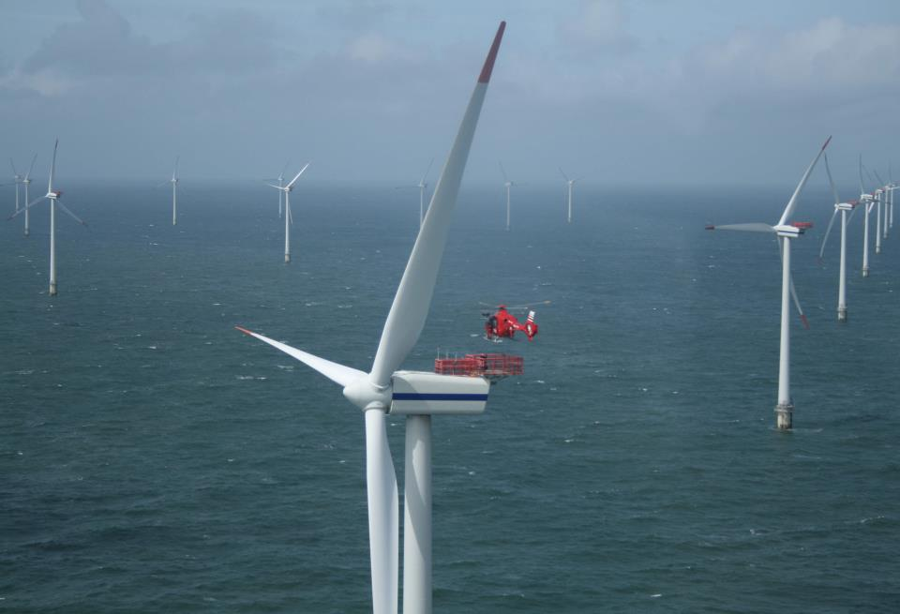
Sea Breeze, Coastal Upwelling Modeling to Support Offshore Wind Energy Planning and Operations
Greg Seroka¹, Erick Fredj², Travis Miles¹, Rich Dunk¹, Josh Kohut¹, Scott Glenn¹
¹
October 22, 2015 MTS/IEEE OCEANS ‘15
²

Slide 2
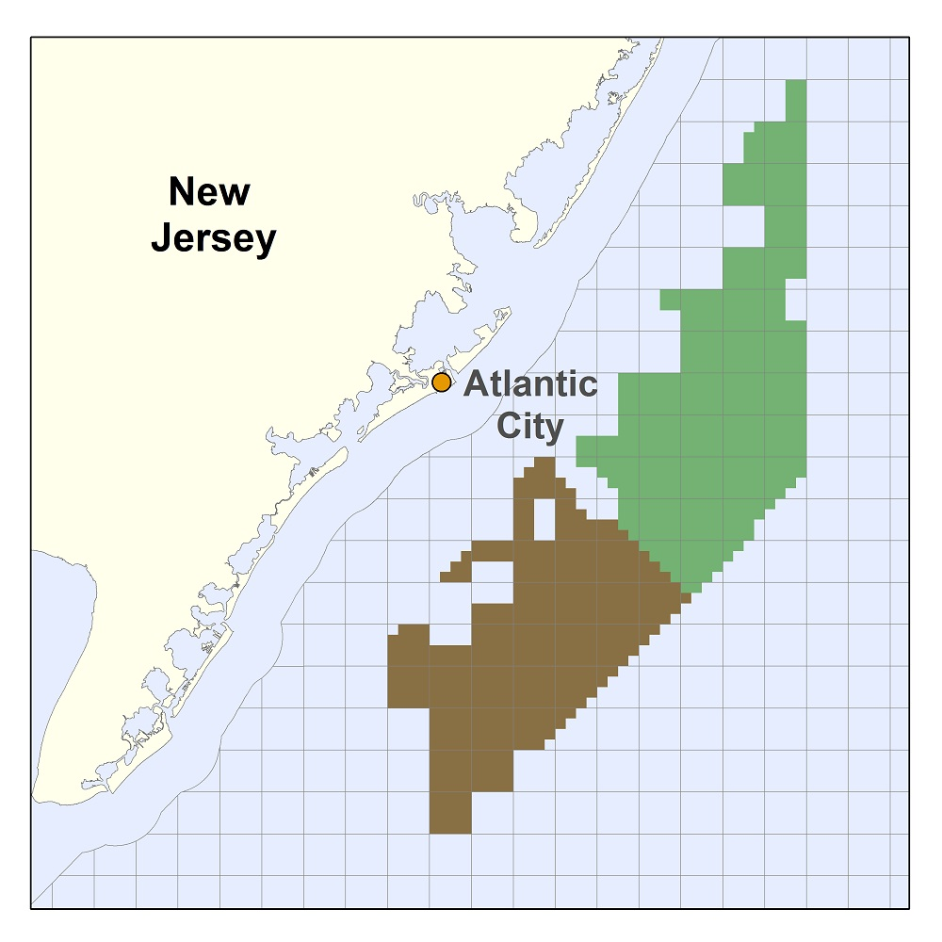
Introduction
On November 9, 2015, BOEM commercial lease auction for NJ will take place
Nearly 344,000 acres for leasing offshore wind (OSW)
5th competitive lease auction for OSW in U.S.
OSW developer(s) who win a lease zone will submit application to develop to NJ Board of Public Utilities (NJ BPU)
Must include wind resource assessment & economic analysis

Slide 3
Introduction
NJ BPU Offshore Wind Rules state:
“Applications shall account for…the coincidence between time of generation for the project and peak electricity demand.”
NJ sea breeze and coastal upwelling coincident with peak electricity demand
Relative Load
Frequency
Notes:
-Sea breeze time of day (afternoon/evening) is also coincident with peak demand time of day (5-7 pm)

Slide 4
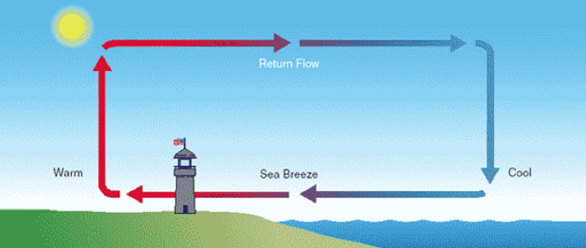
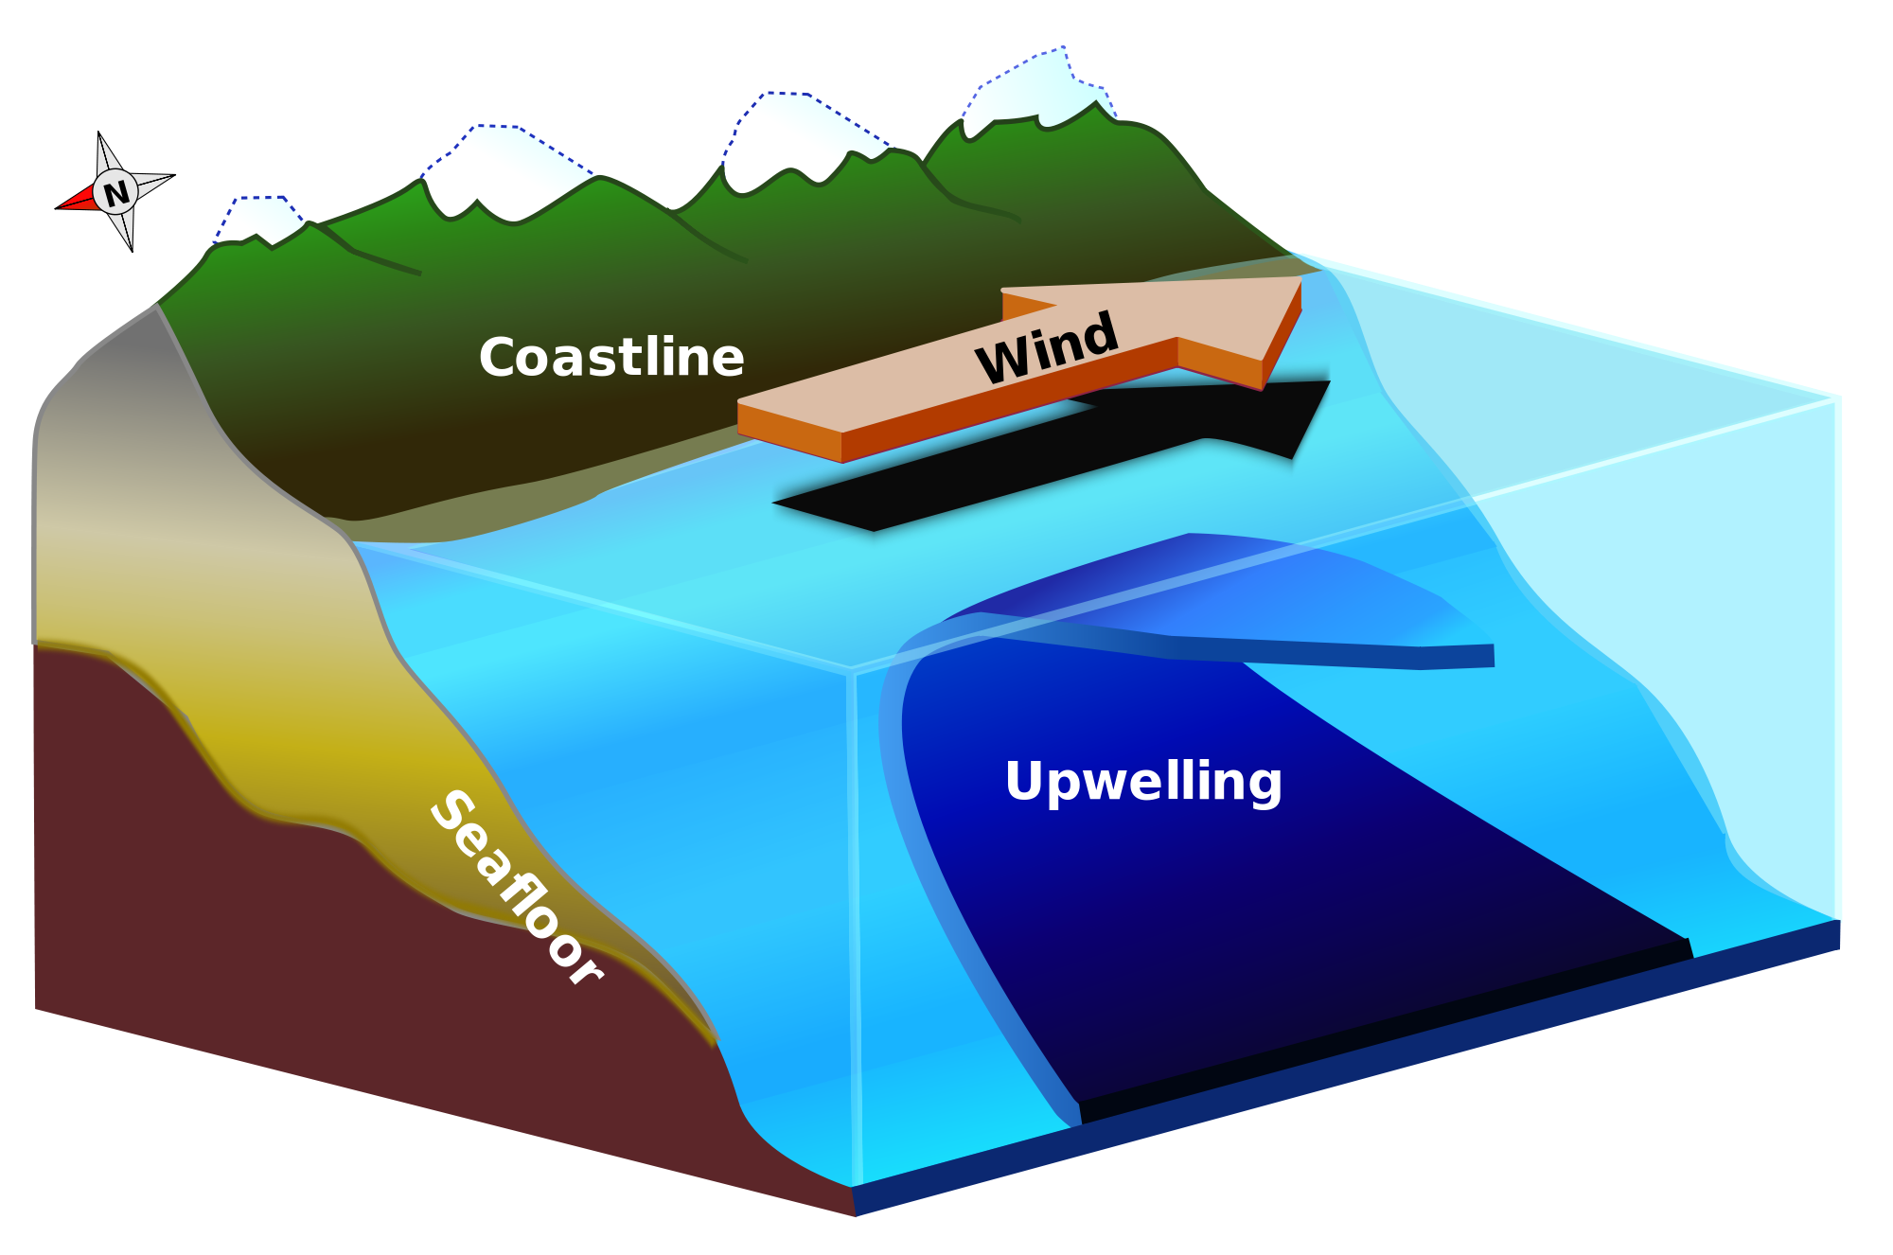
Introduction
Sea breeze
Coastal upwelling
Notes:
Cut-out speed of OSW turbines of 4 m/s (calm zone?)

Slide 5
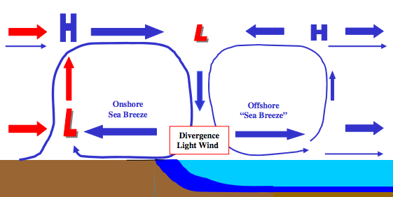
Introduction
Coastal upwelling + Sea breeze Hypothesis
Cold upwelling
Does this occur? With or without upwelling?

Slide 6
Introduction
Key Questions:
What effect does cold coastally-upwelled water have on the coastal/offshore wind resource?
What does the offshore component of the sea breeze look like? Secondary circulation (size, structure)? Offshore divergence?
Coastal upwelling
?

Slide 7
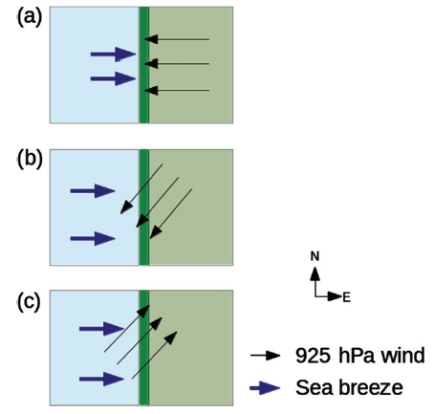
Materials and Methods
Satellite: state-of-the-science declouding and compositing technique designed by Rutgers to determine SST and resolve coastal upwelling
Model: 3km, 600m WRF-ARW 3.6.1; YSU PBL; MM5 Monin-Obukhov surface layer
Advantages (vs. offshore met tower): cost, spatial variability, prediction
Sea Breeze Cases:
July 7, 2013: corkscrew, strong upwelling
July 31, 2014: corkscrew, weak upwelling
April 27, 2013: pure, no upwelling
Coastal upwelling
Backdoor
Corkscrew
Pure
Notes:
Satellite: High res in space and time
Previous satellite SST products low in spatial or temporal resolution and are often warmest pixel composites for declouding; cannot resolve coastal upwelling
SST product is IR/near IR (AVHRR); SPoRT is IR/near IR as well
Model: NAM12km for boundary conditions
Cases: largest and longest lasting upwelling in NJ 2012-2014
20140731 case has similar ambient (outside upwelling) water T to 20130707

Slide 8
Part 1: Coastal upwelling

Slide 9
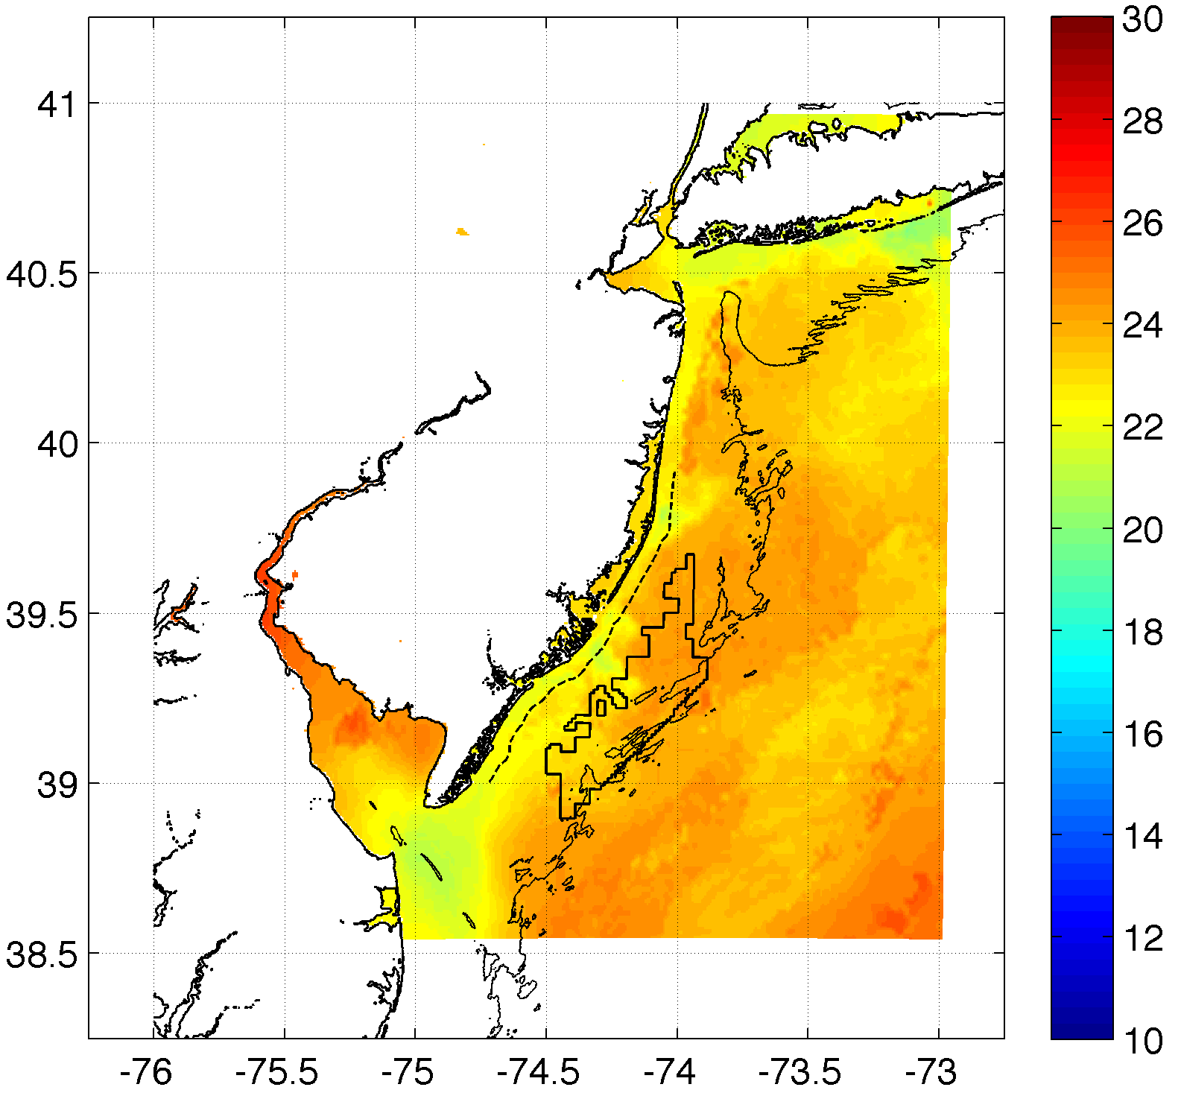
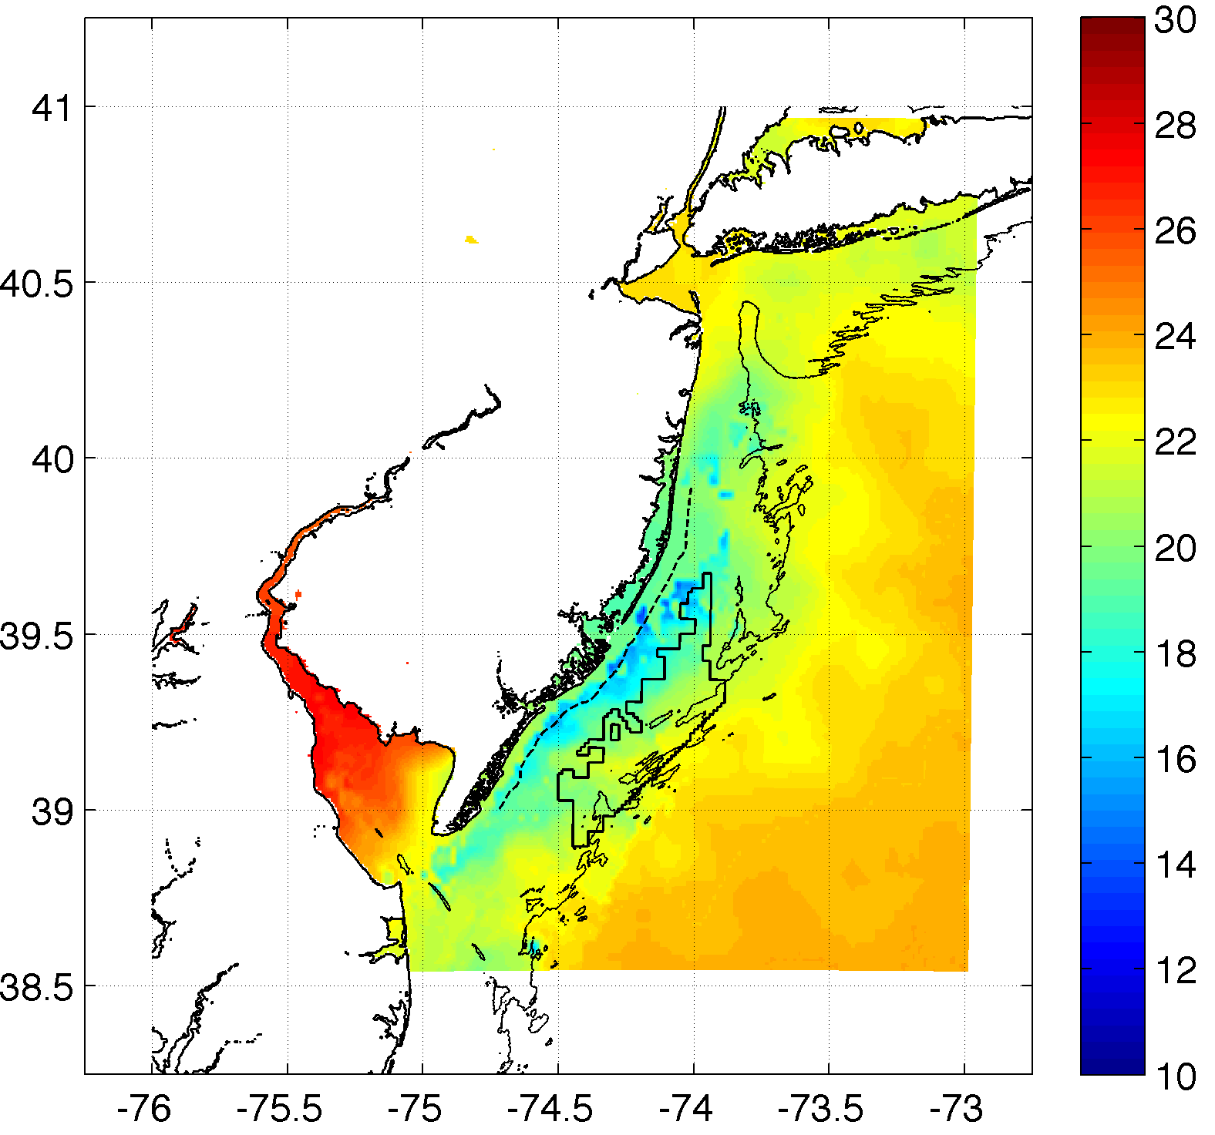
Methods
Weak upwelling (Actual)
Case 2: July 31, 2014: corkscrew, weak upwelling
Strong upwelling

Slide 10
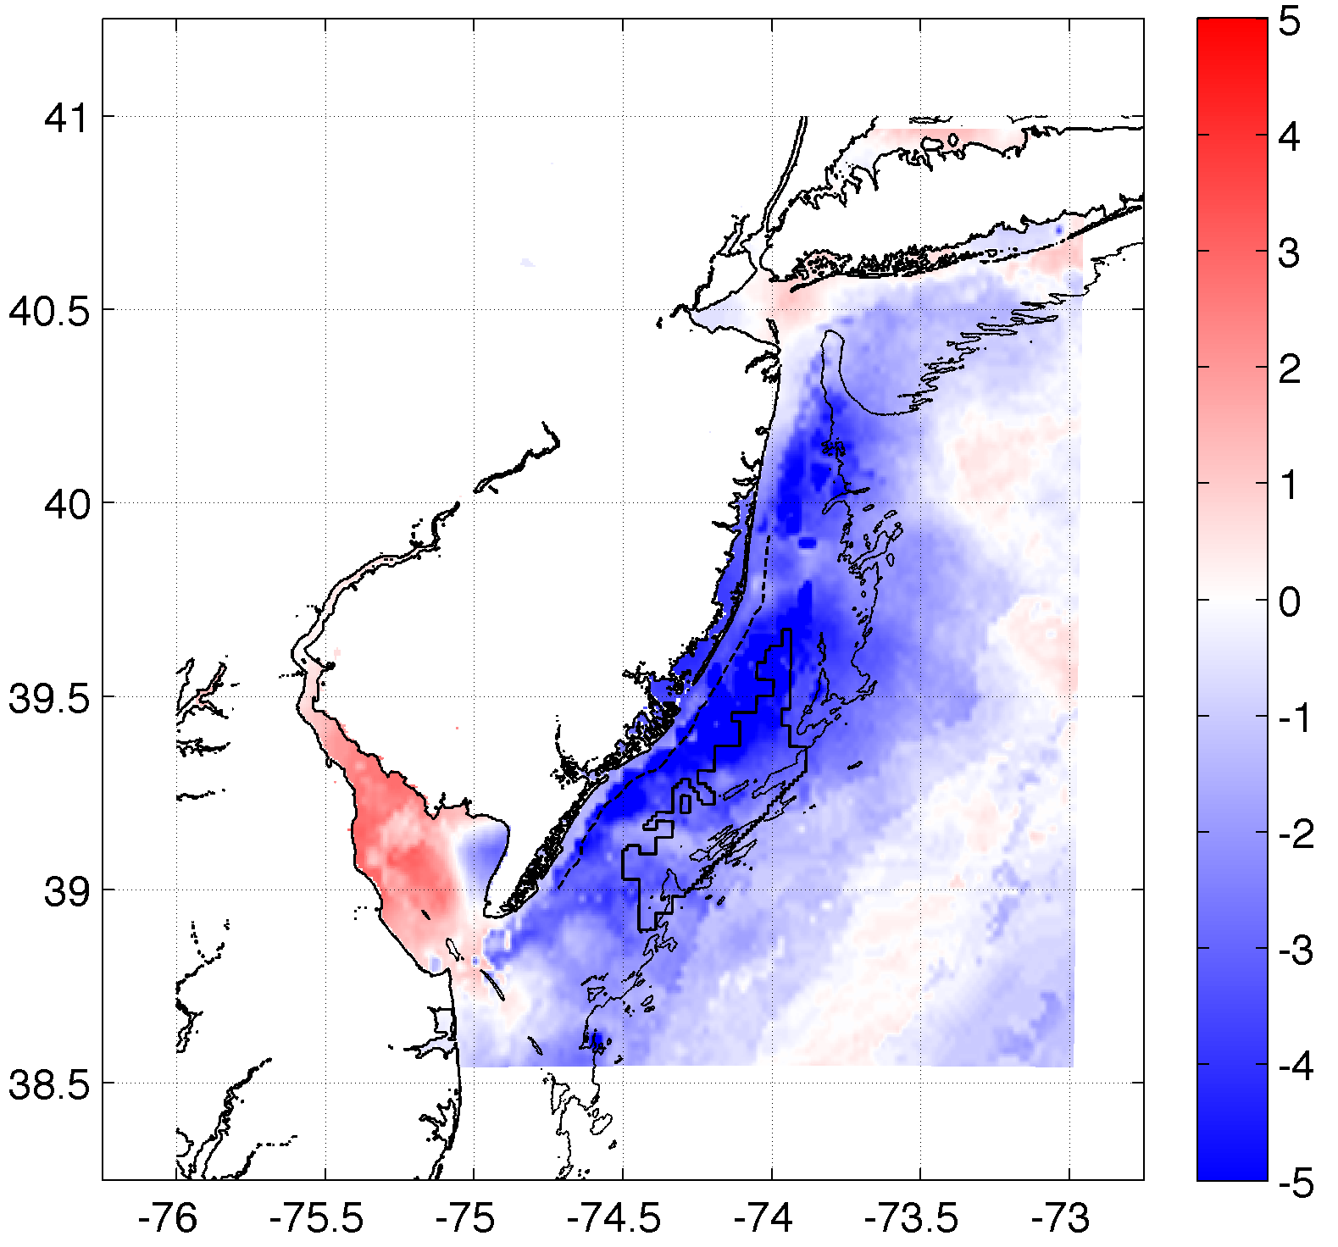
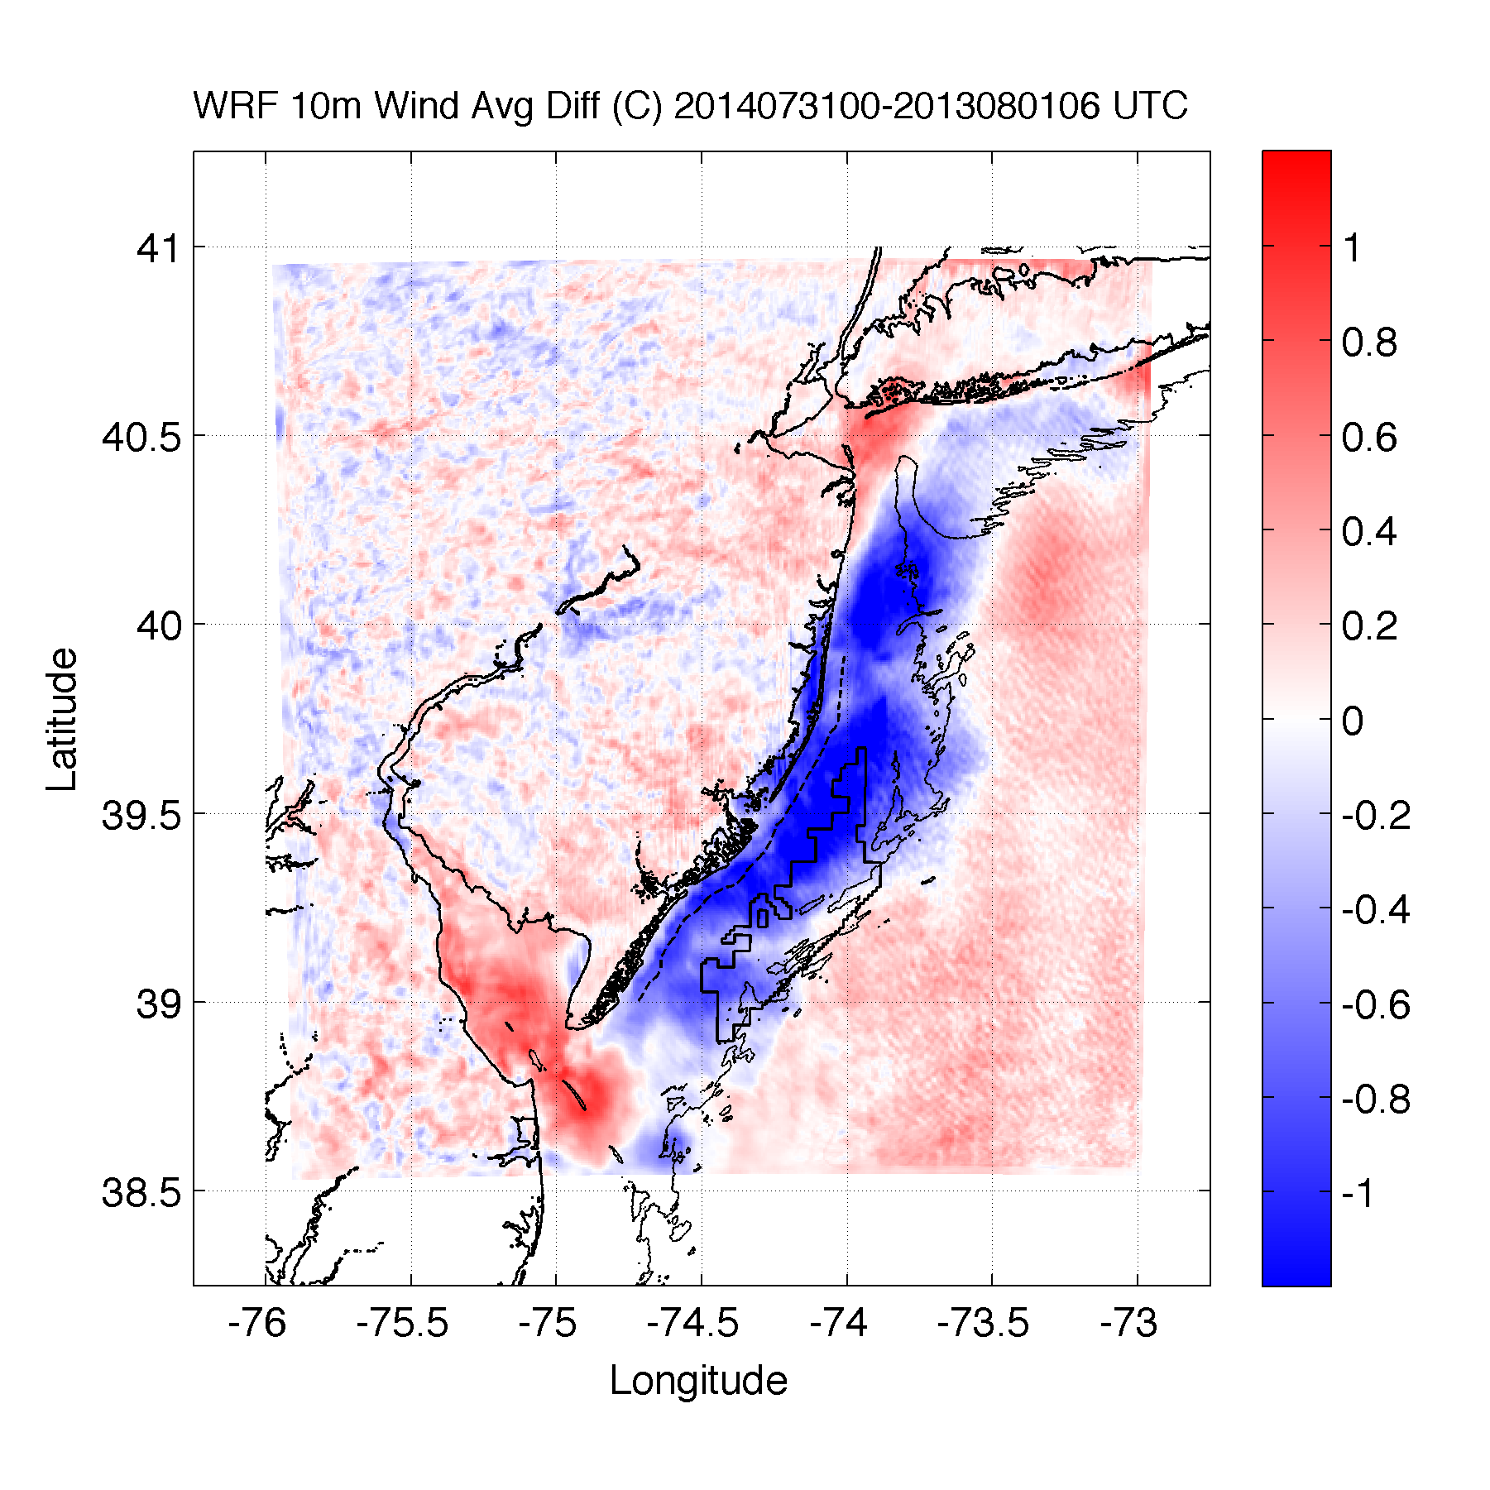
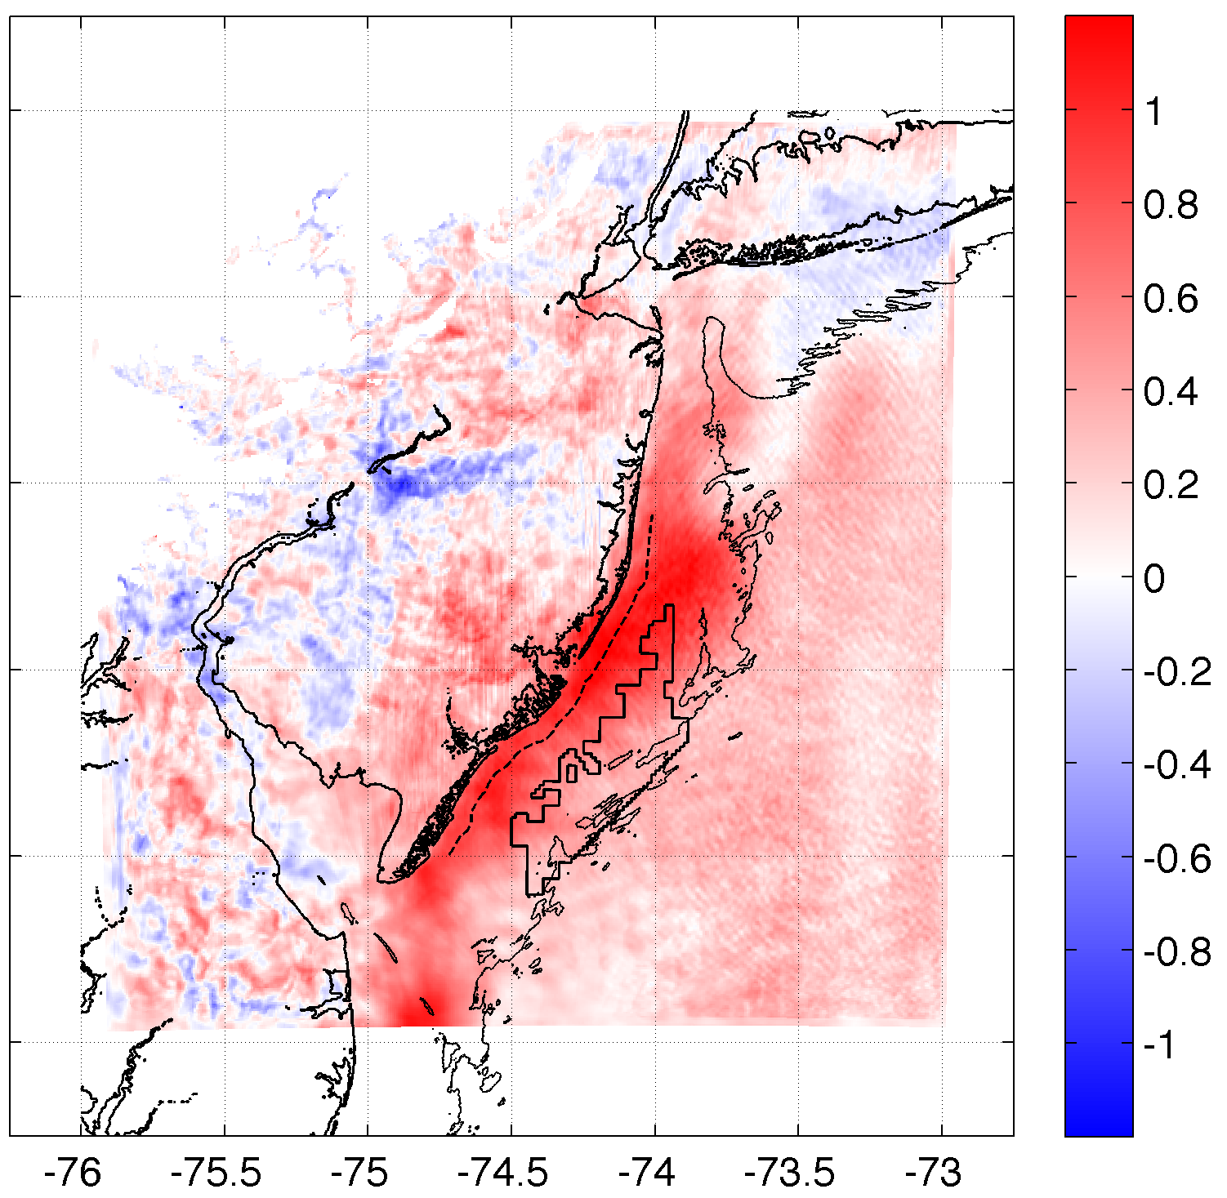
Results
Upwelling produces an inversion, decreasing 10m winds & increasing 100m hub height winds
SST Diff.
10m Wind Speed Diff.
100m Wind Speed Diff.
r²=0.61
r²=0.58
Case 2: 20140731

Slide 11
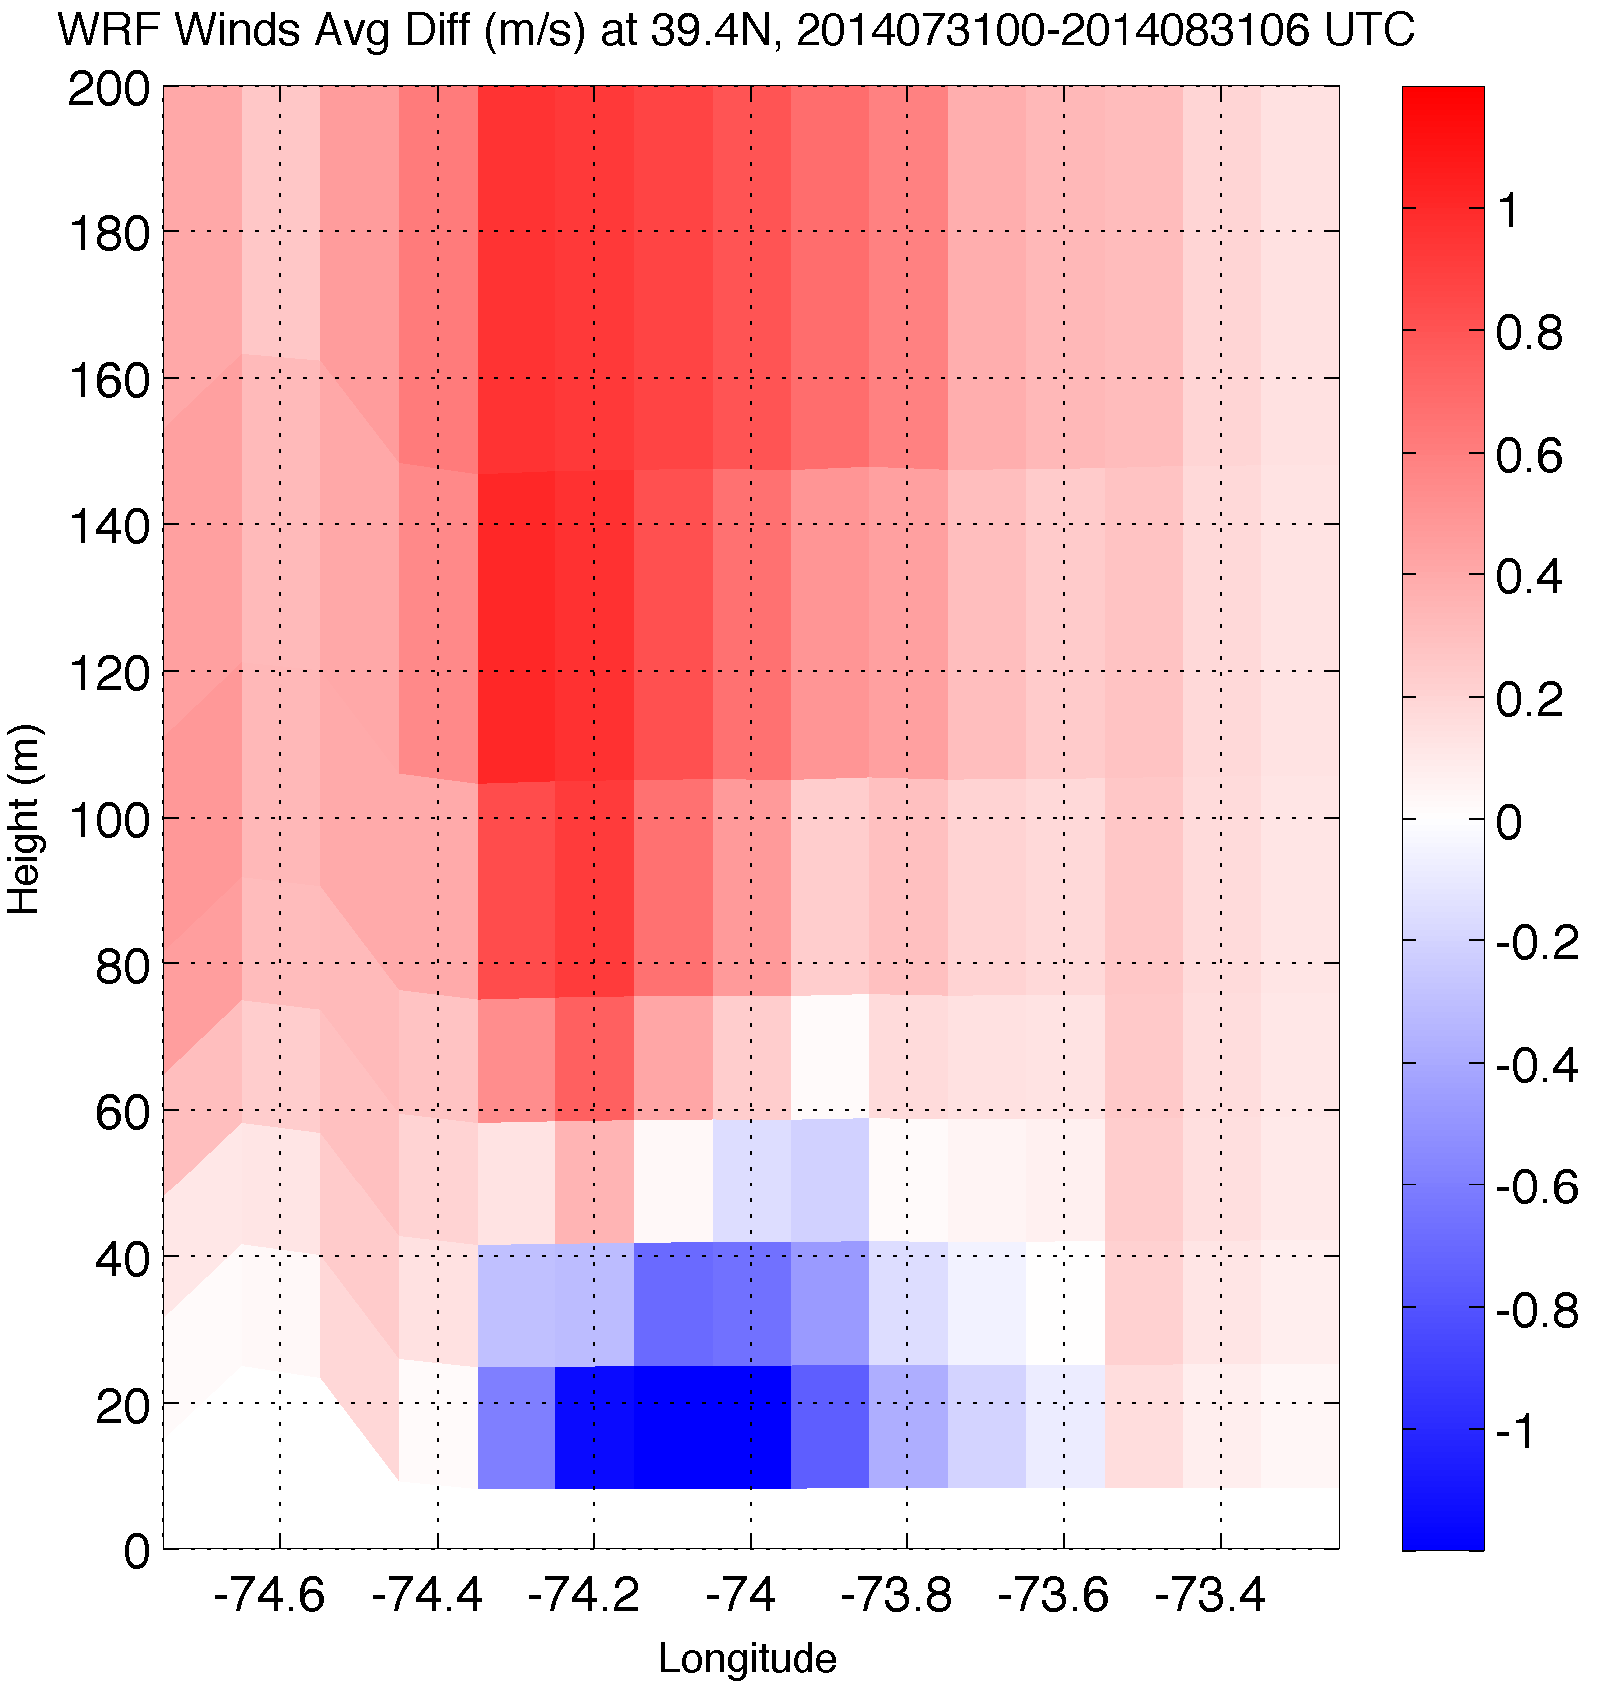
Upwelling produces an inversion, decreasing 10m winds & increasing 100m hub height winds
Results
Wind Speed Difference
10m Wind Speed Diff.
Case 2: 20140731

Slide 12
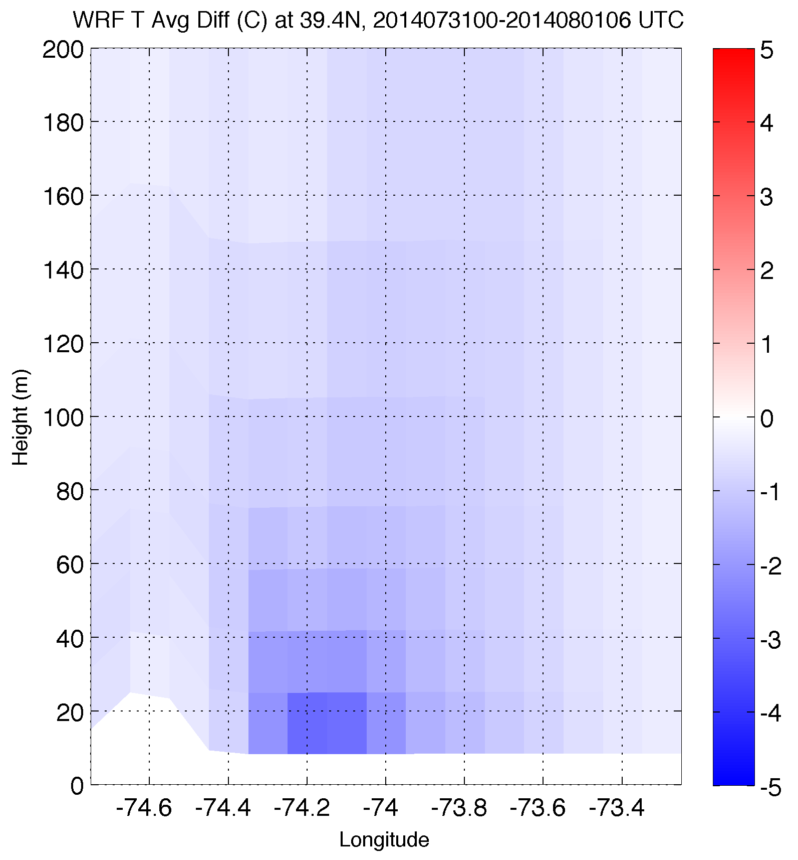
Upwelling produces an inversion, decreasing 10m winds & increasing 100m hub height winds
Results
Temperature Difference
10m Wind Speed Diff.
Case 2: 20140731

Slide 13
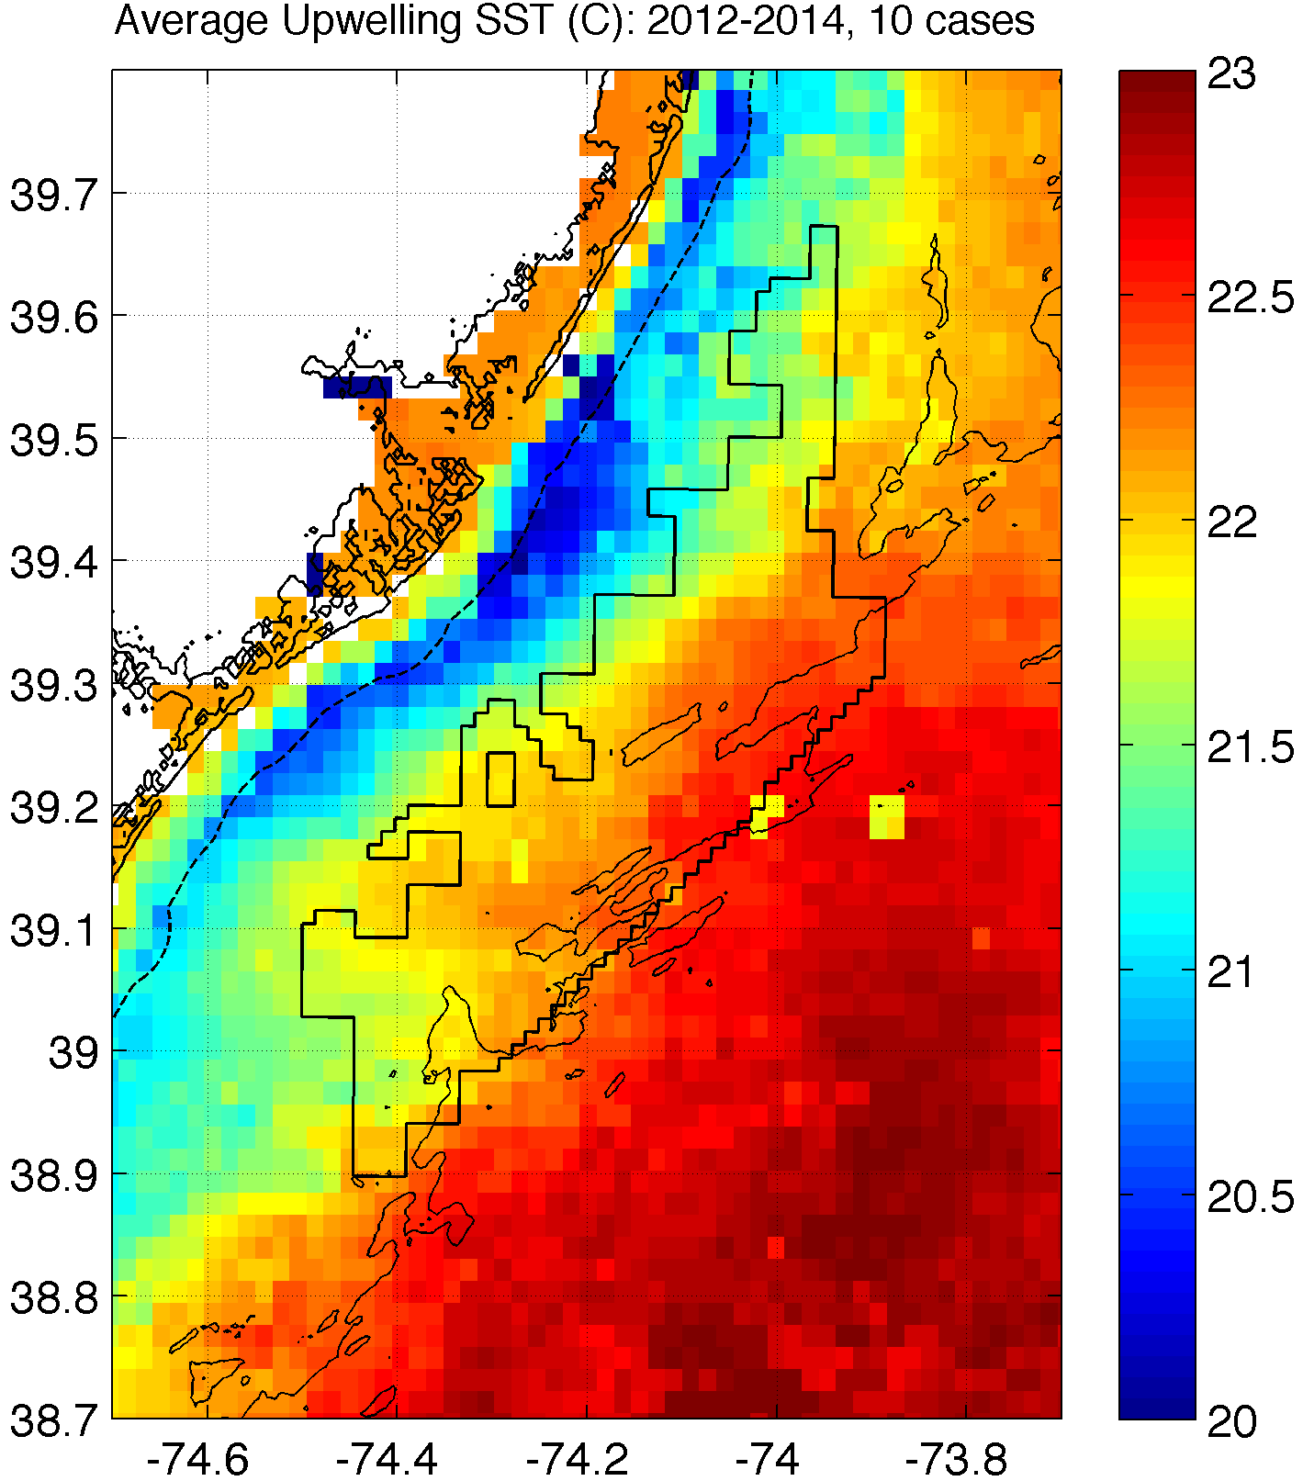
How will coastal upwelling affect the NJ WEA?
Notes:
Could expect similar inversions, impact on 100m winds over upwelling in this structure (affects NJ WEA!)
Need good ocean model to predict this correctly!

Slide 14
Part 2: Sea Breeze

Slide 15
Methods
Case 3: April 27, 2013: pure, no upwelling
Lagrangian Coherent Structures (LCSs)
LCSs are boundaries in a fluid that distinguish regions of differing dynamics (e.g. eddies, jets, fronts)
Particles move away from and along a repelling LCS (A), aggregate and move along attracting LCSs (B)
LCS maps identify convergence and divergence in a fluid flow (e.g. sea breeze)

Slide 16
Methods
Benefits of LCS
The Lagrangian measures are advantageous as they are frame independent and robust with respect to localized noise in the data.
Additionally, LCS analysis reveals coherent structures in more detail and with better clarity than streamline plots generated from 2D wind retrieval (Chan and Shao 2007; Tang et al. 2011)

Slide 17
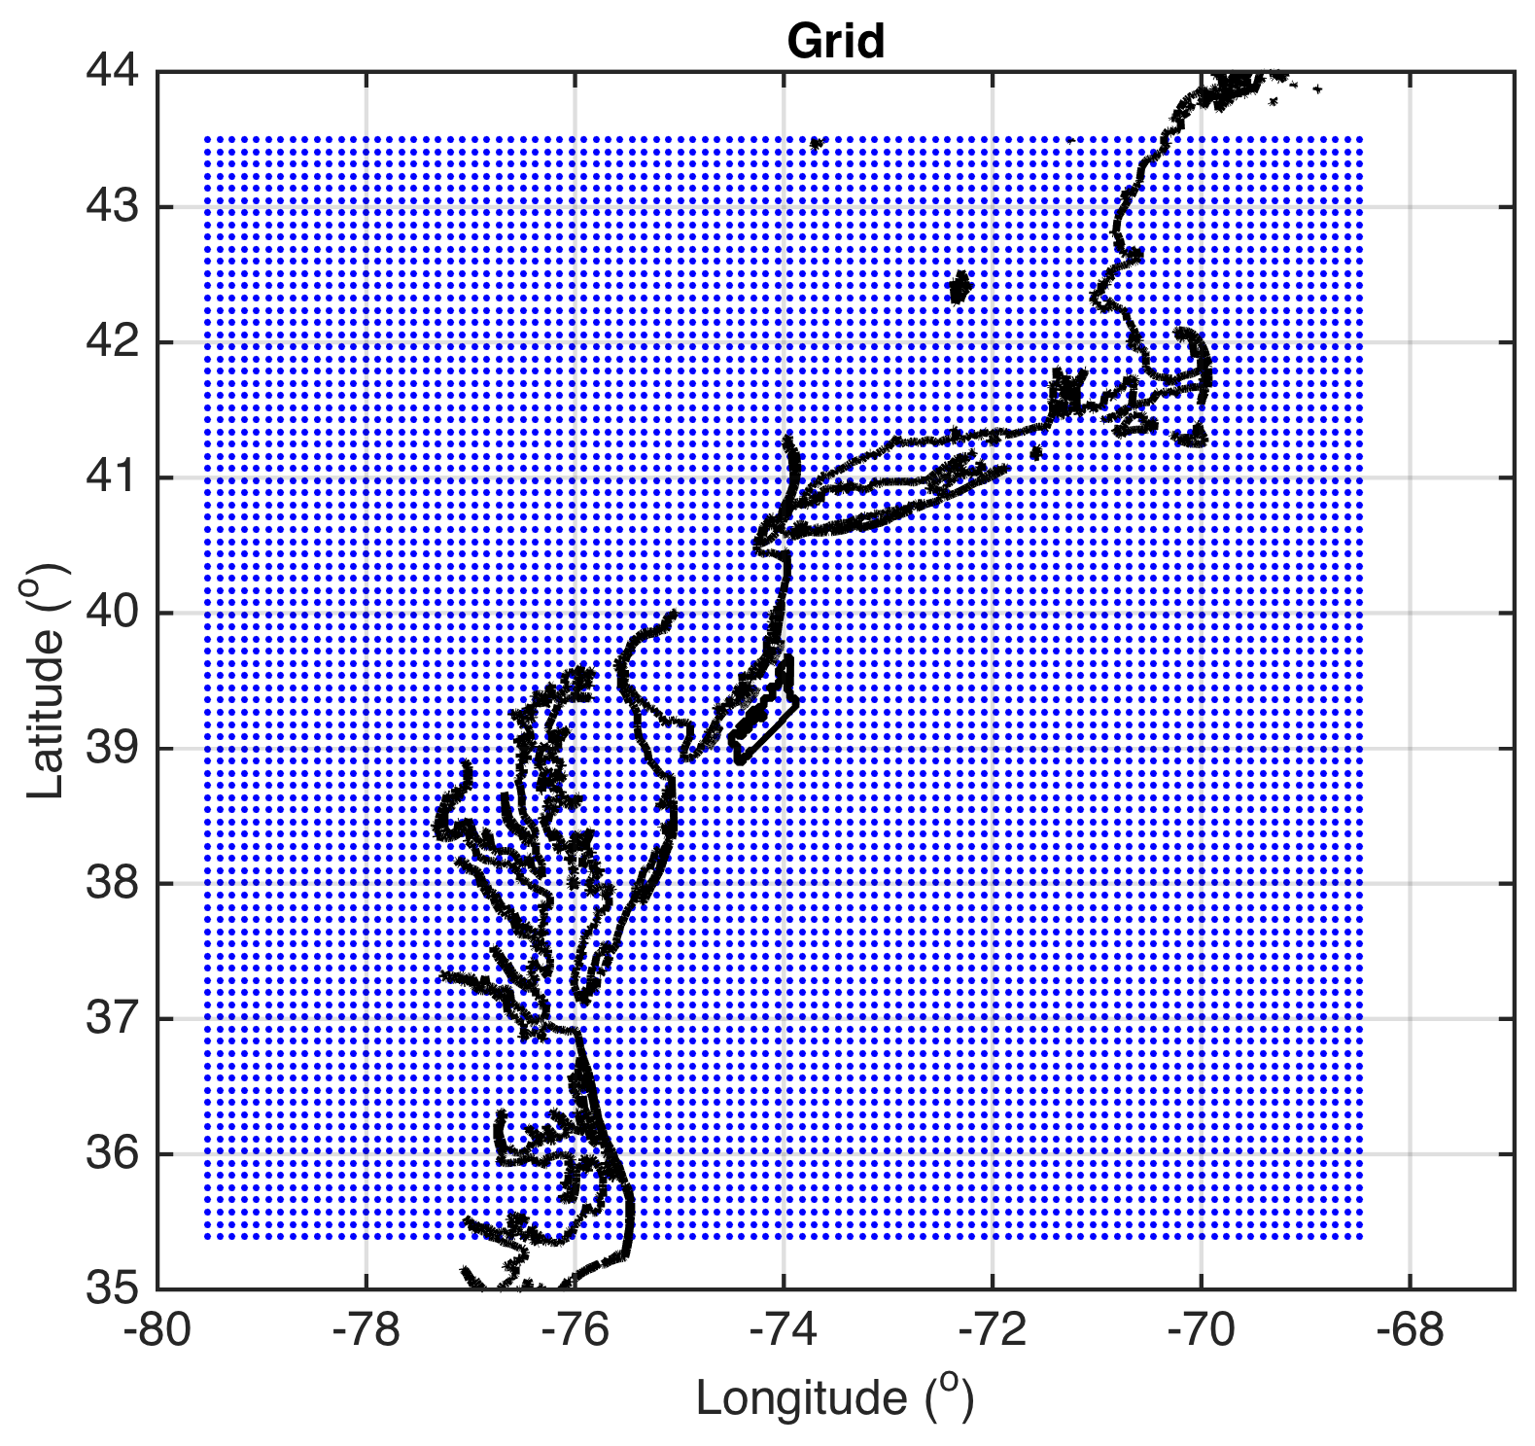
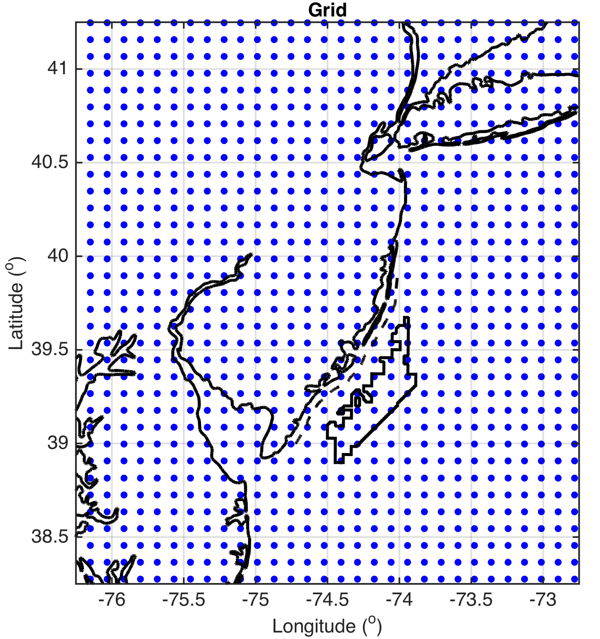
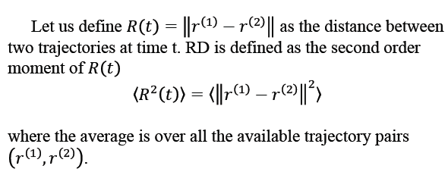
Methods
LCS Set-up
On 3km WRF winds
1800 UTC to 2300 UTC (peak sea breeze time)
10km grid spacing for tracer trajectories
Perform at these levels in WRF:
10, 50, 150, 500, 600, 700, 800, 900, 1000, 1500, 2000, 2500m (through marine boundary layer)
Use relative dispersion (RD) to identify LCSs

Slide 18
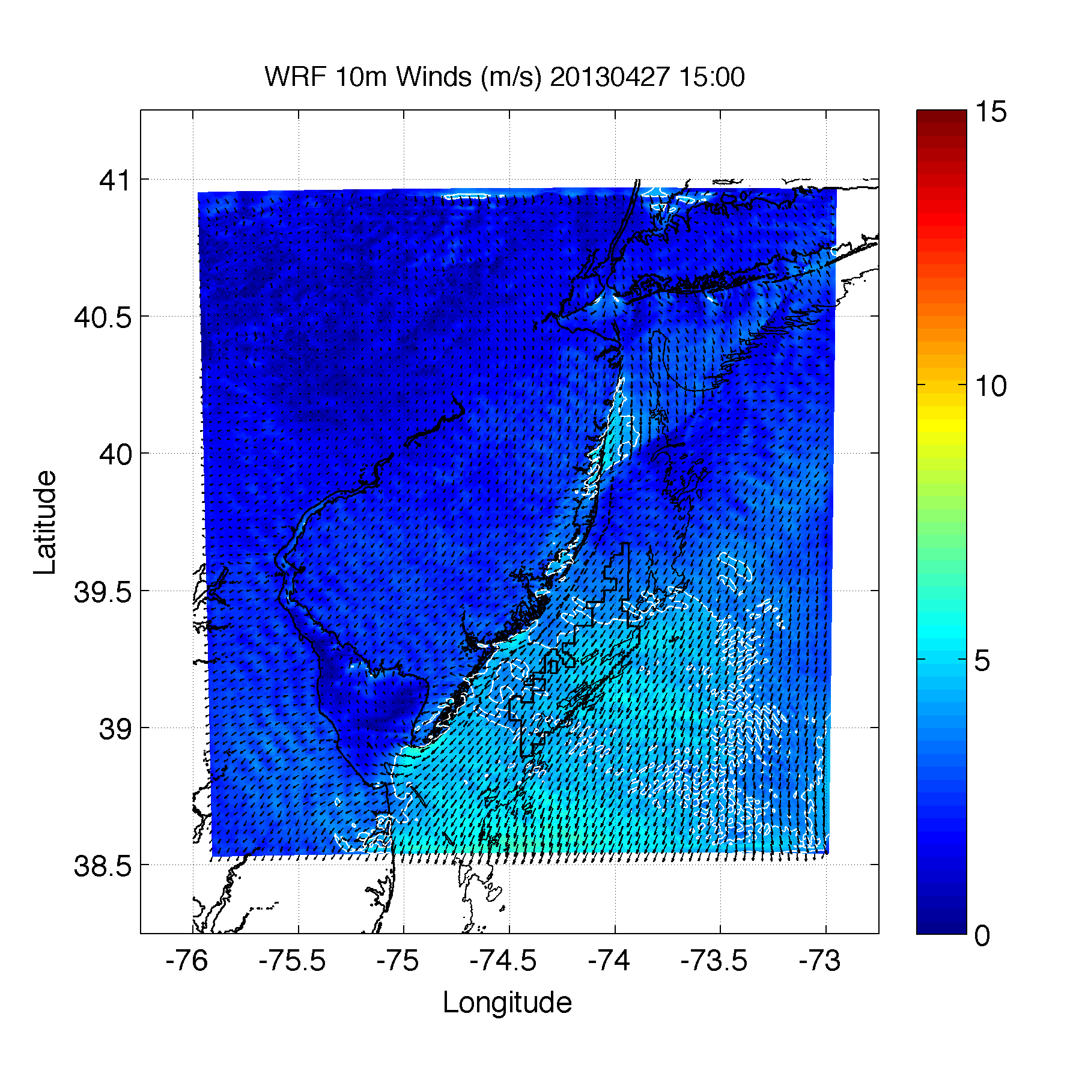
1500 UTC
1 km WRF simulation

Slide 19
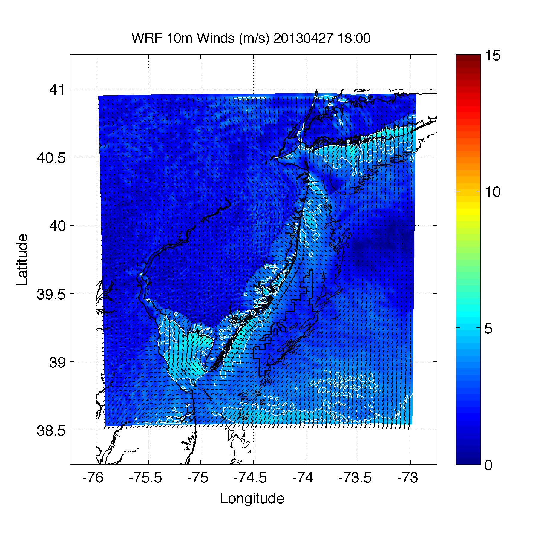
1800 UTC
1 km WRF simulation

Slide 20
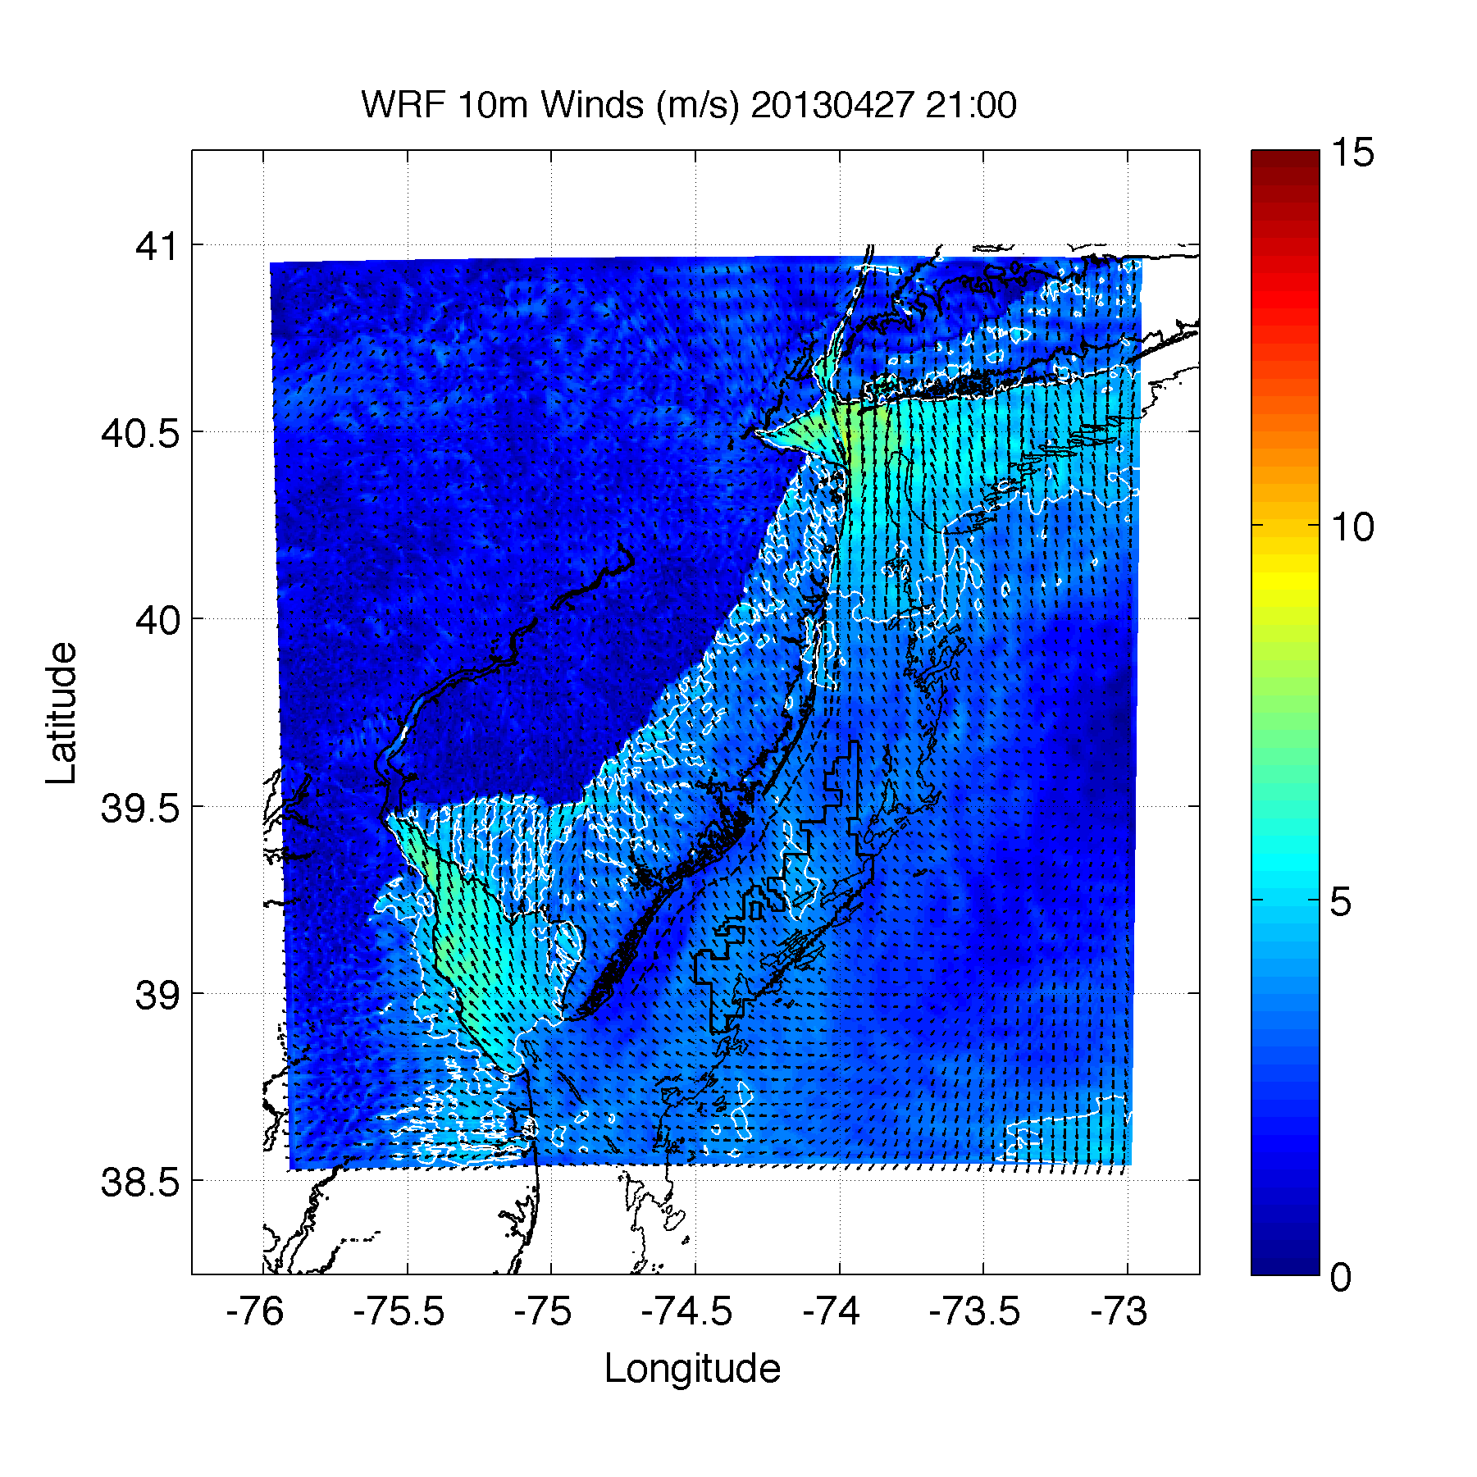
2100 UTC
1 km WRF simulation

Slide 21
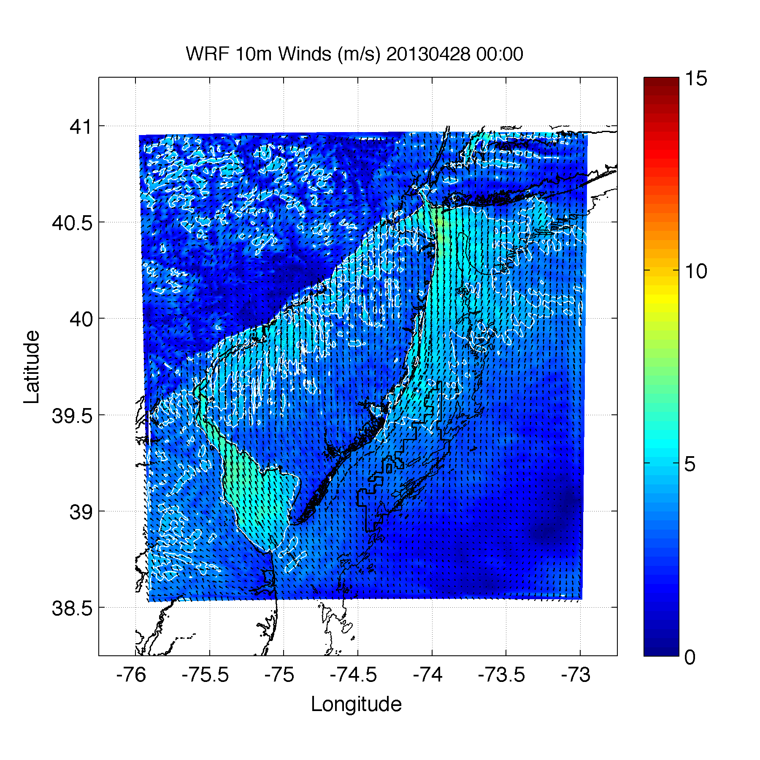
0000 UTC
1 km WRF simulation

Slide 22
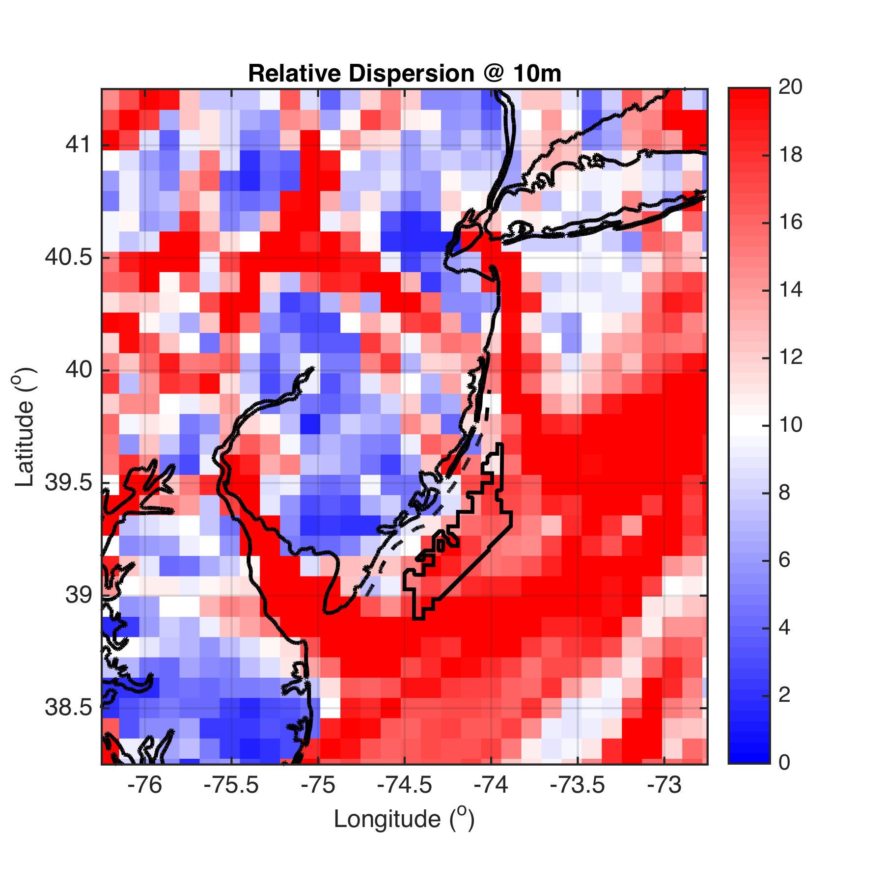
Results
10m

Slide 23
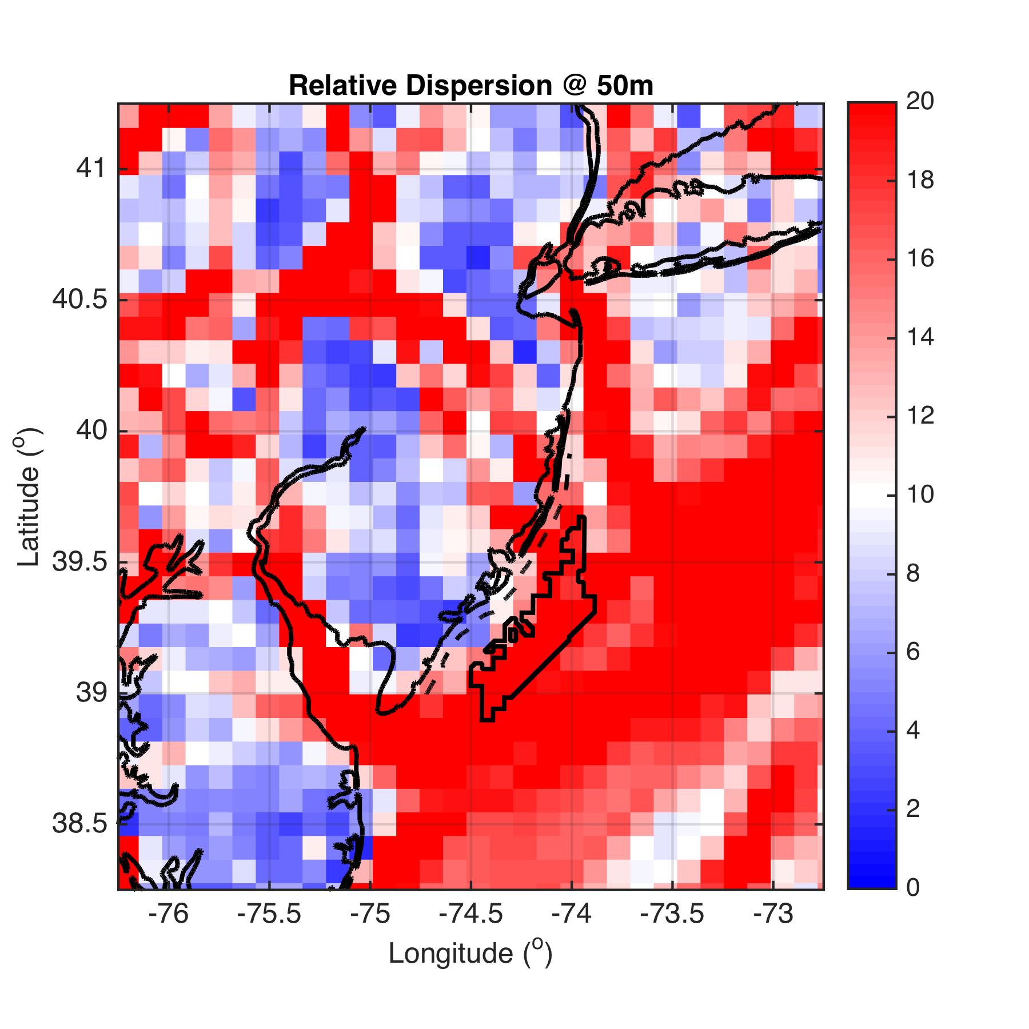
50m
Notes:
Blue red colorbar at +/- 10

Slide 24
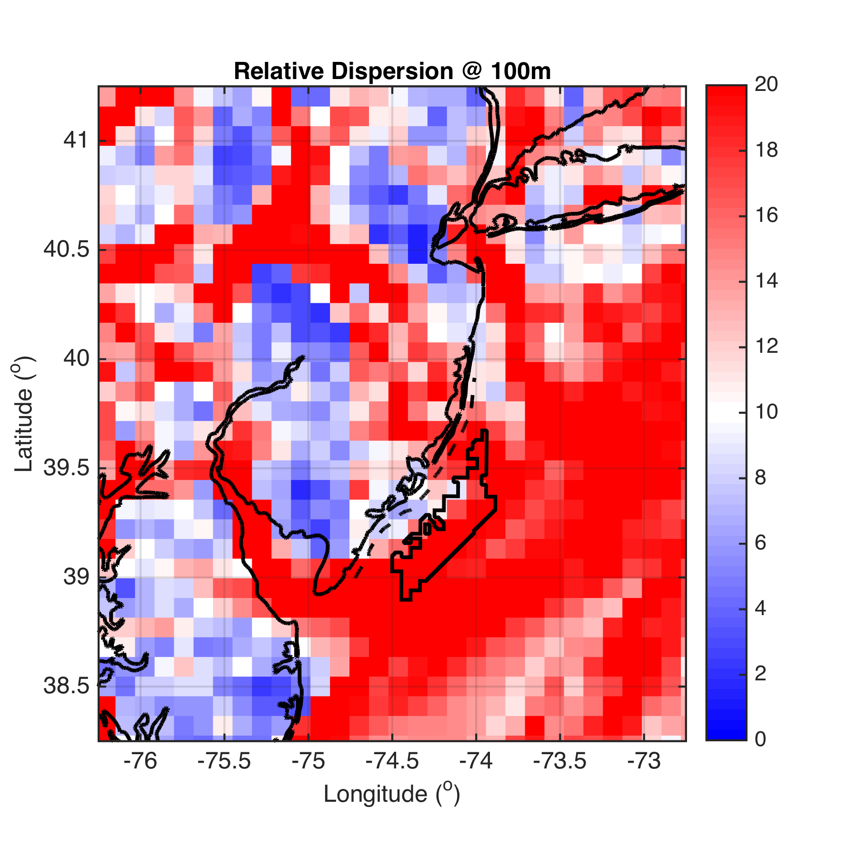
100m

Slide 25
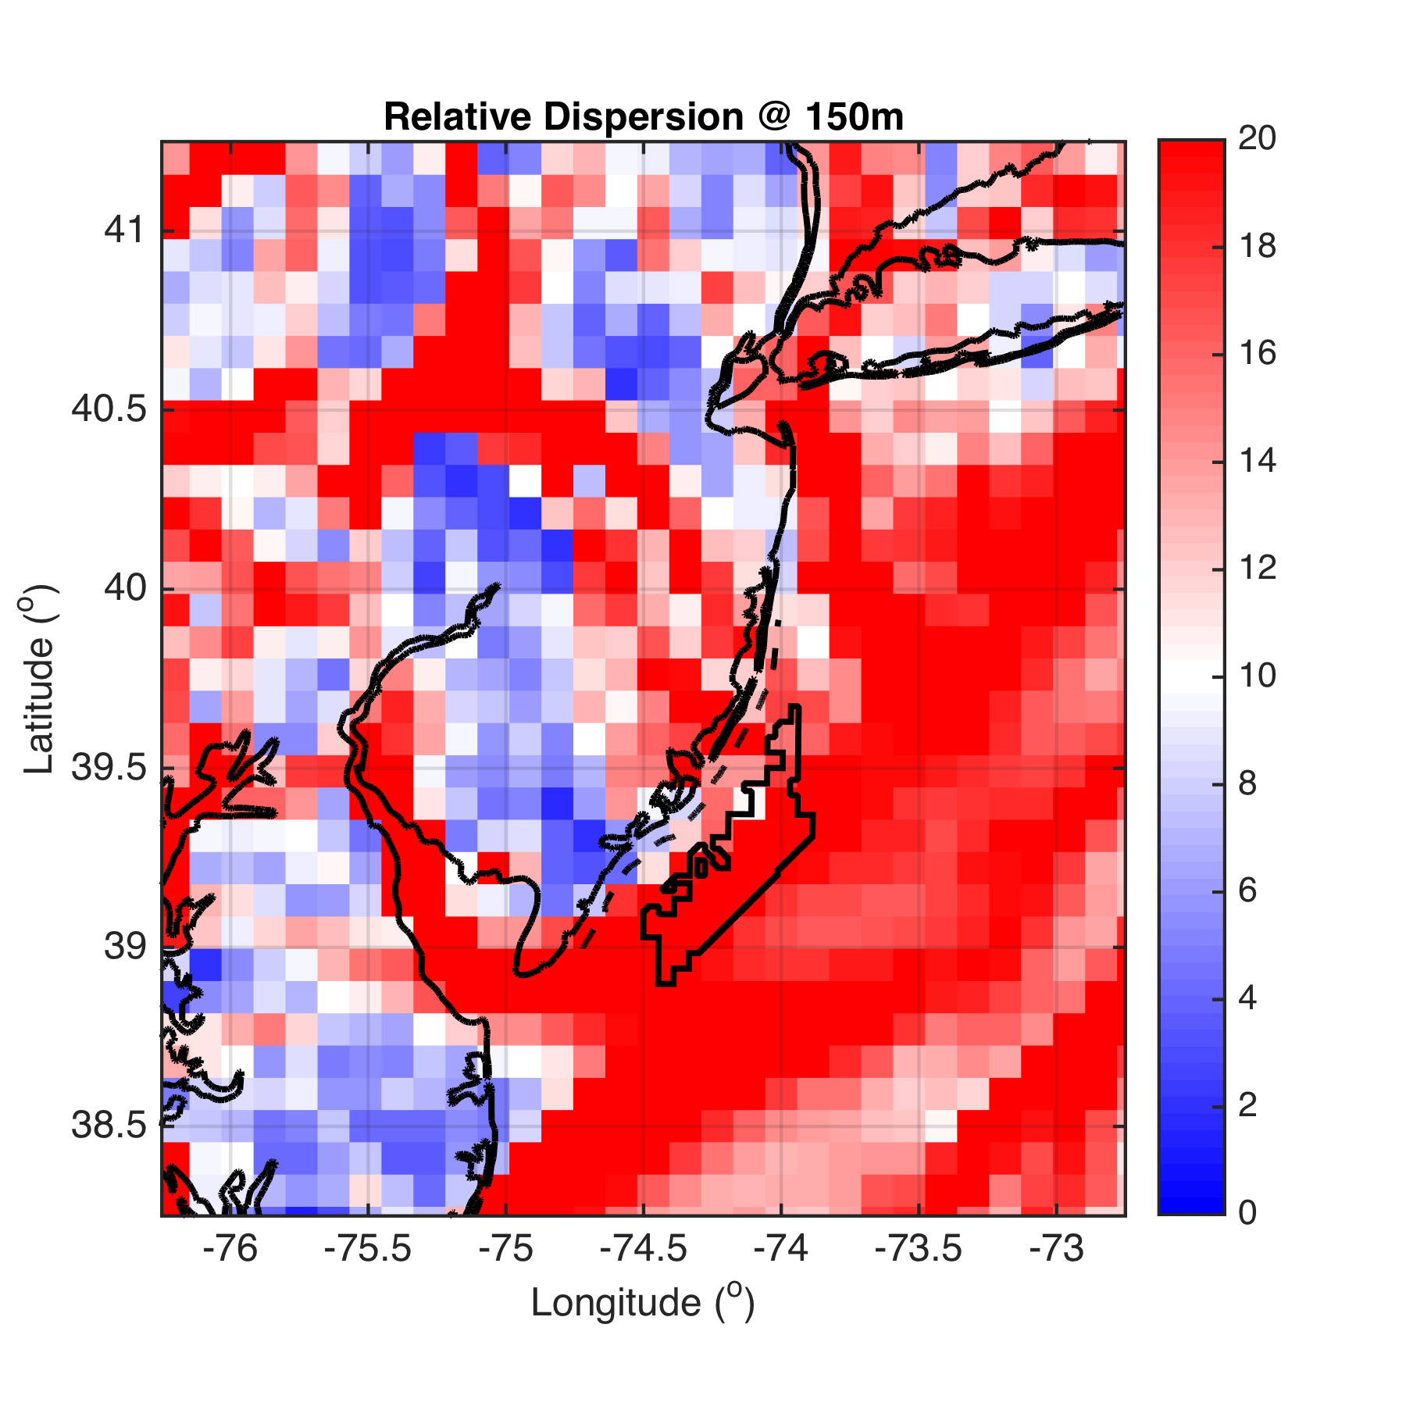
150m

Slide 26
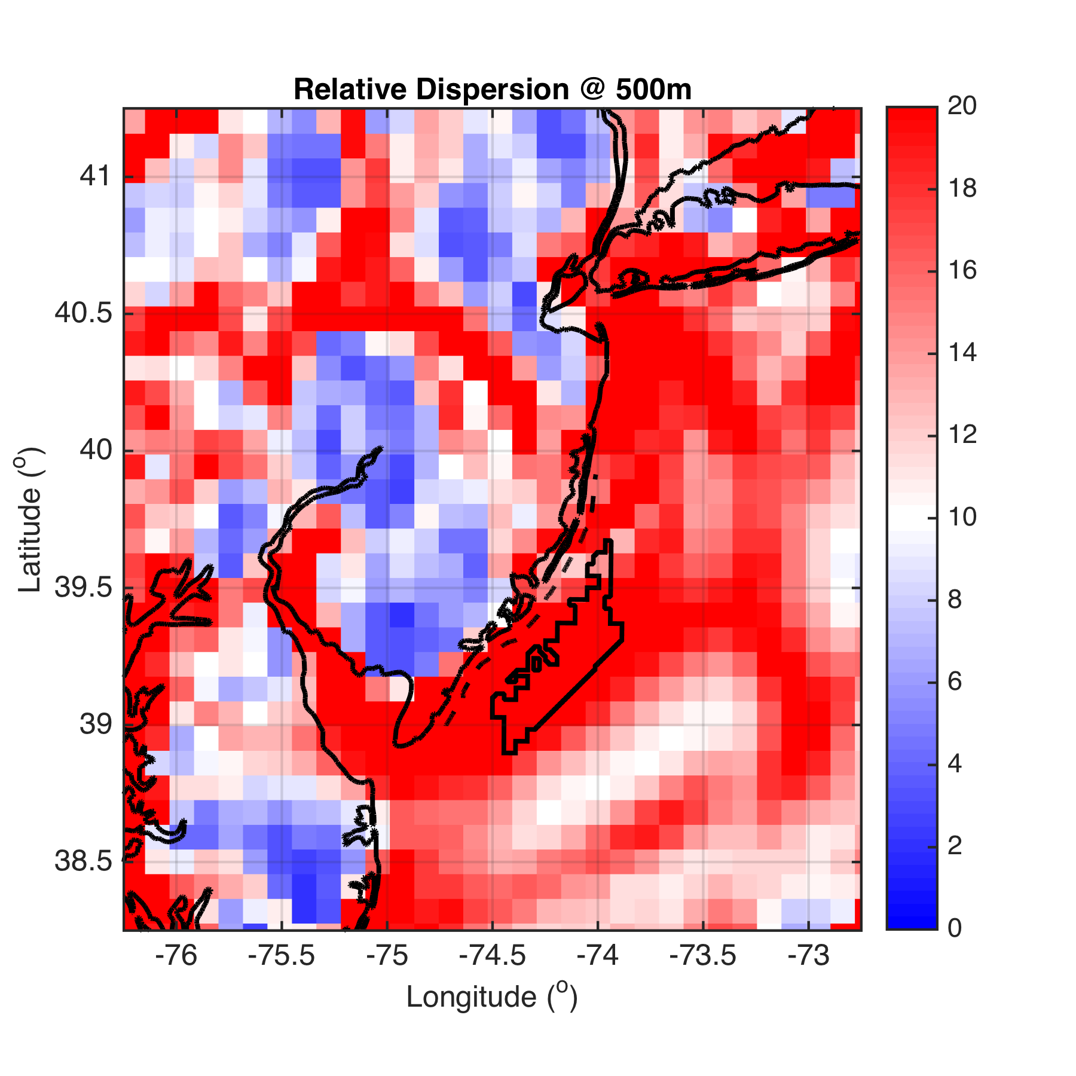
500m

Slide 27
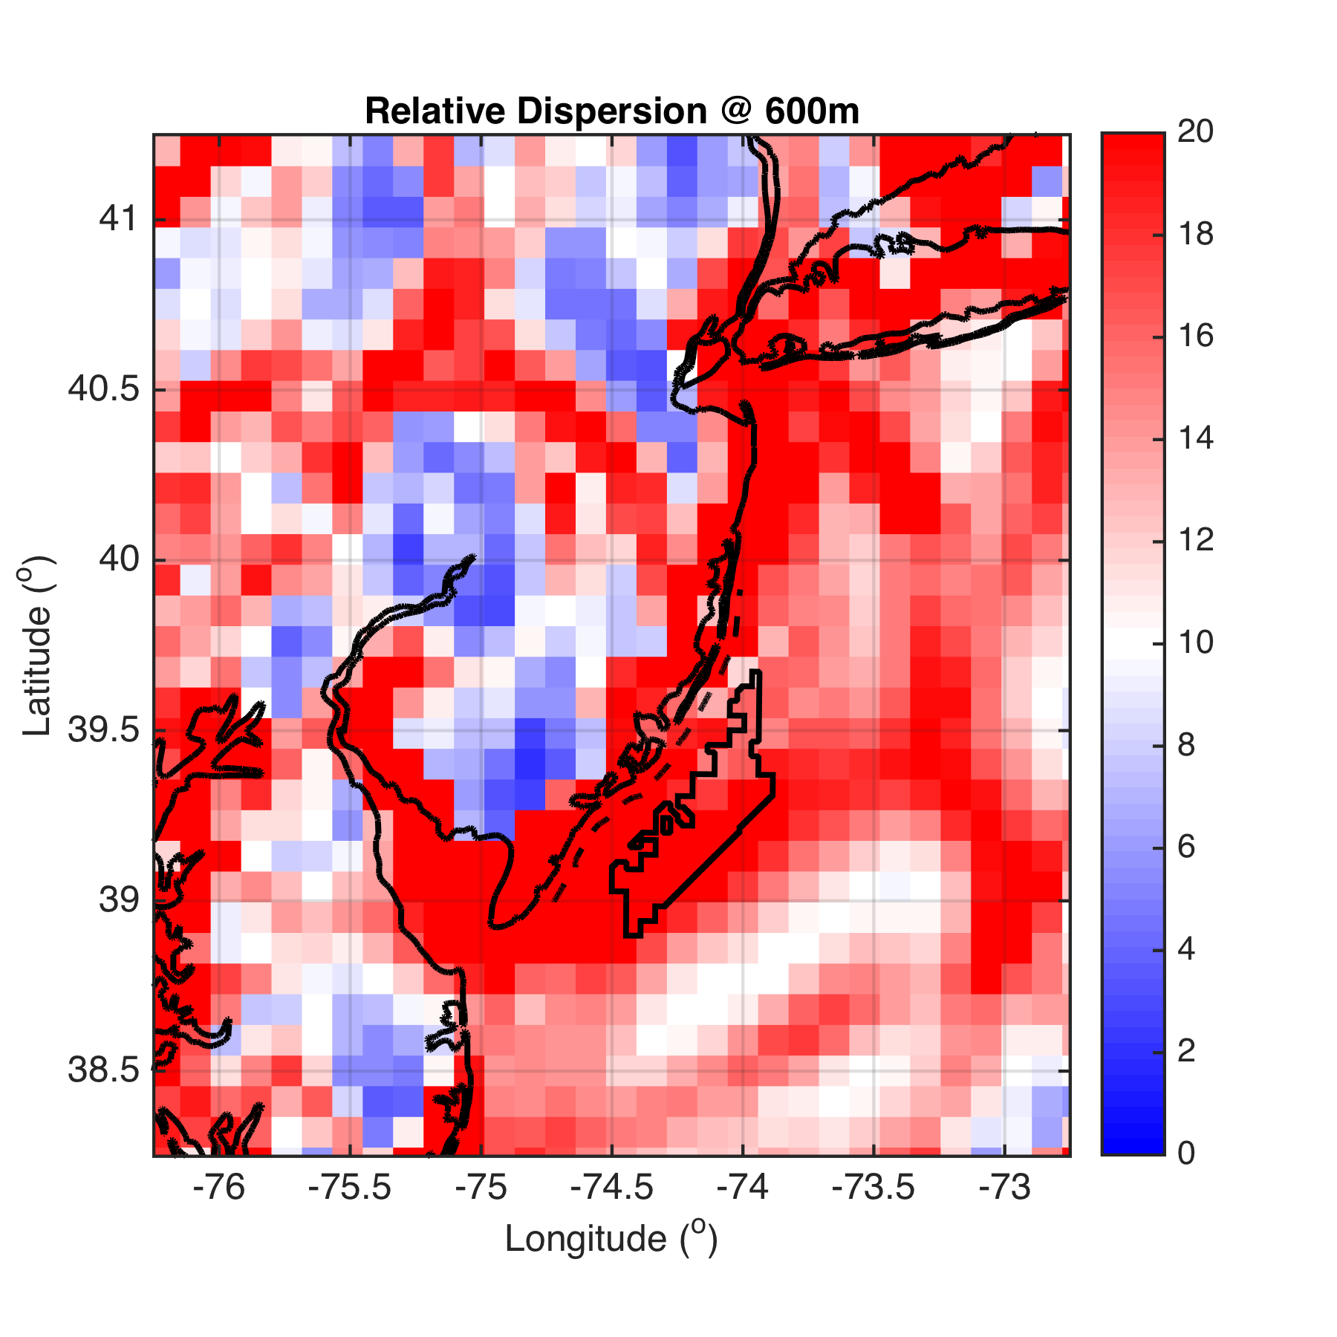
600m

Slide 28
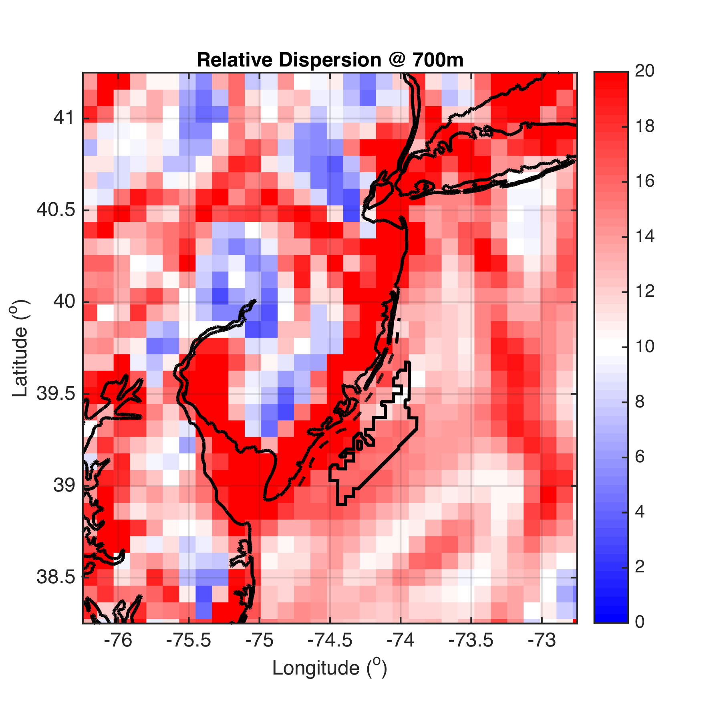
700m

Slide 29
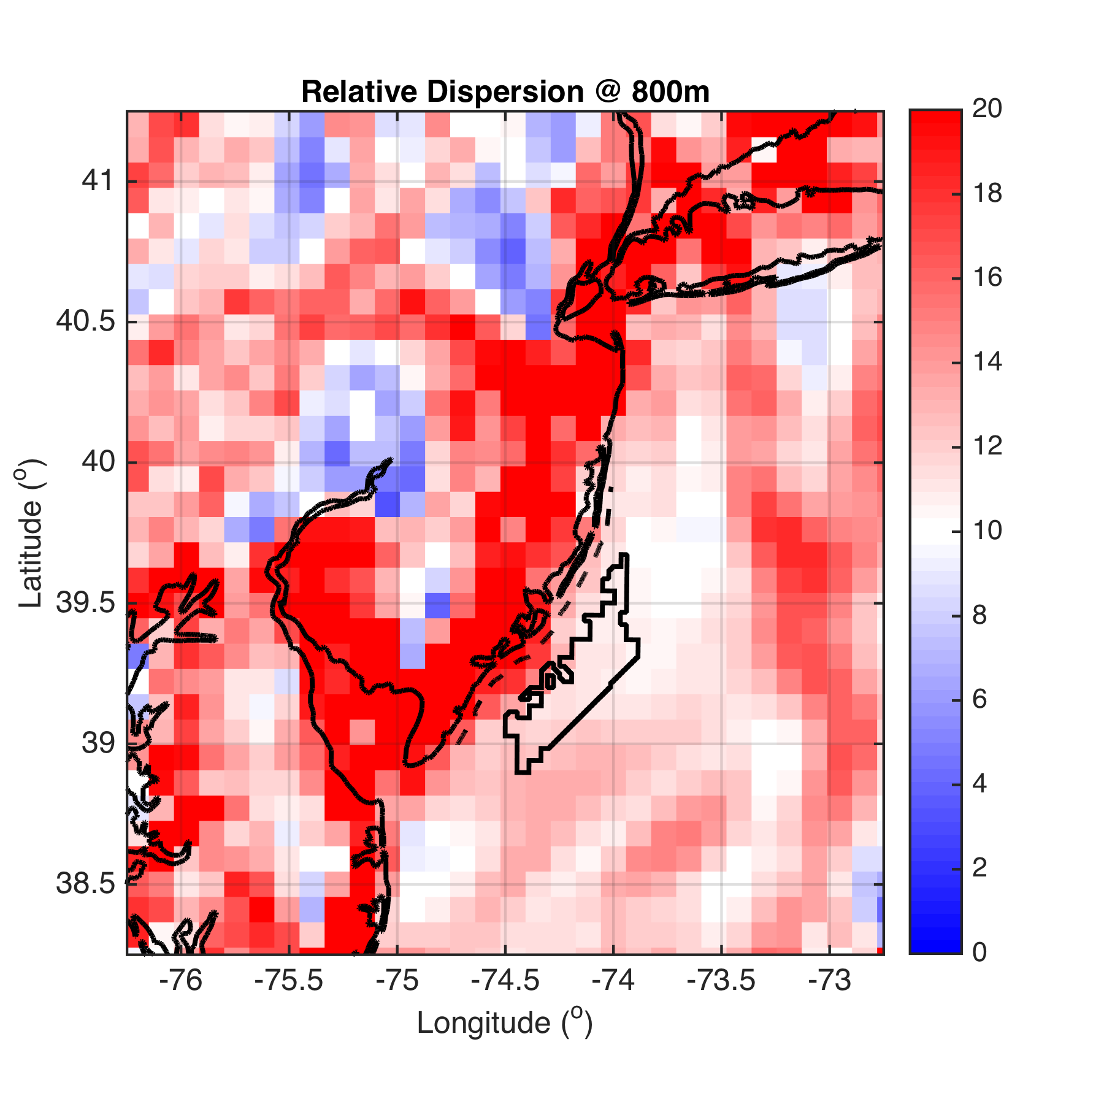
800m

Slide 30
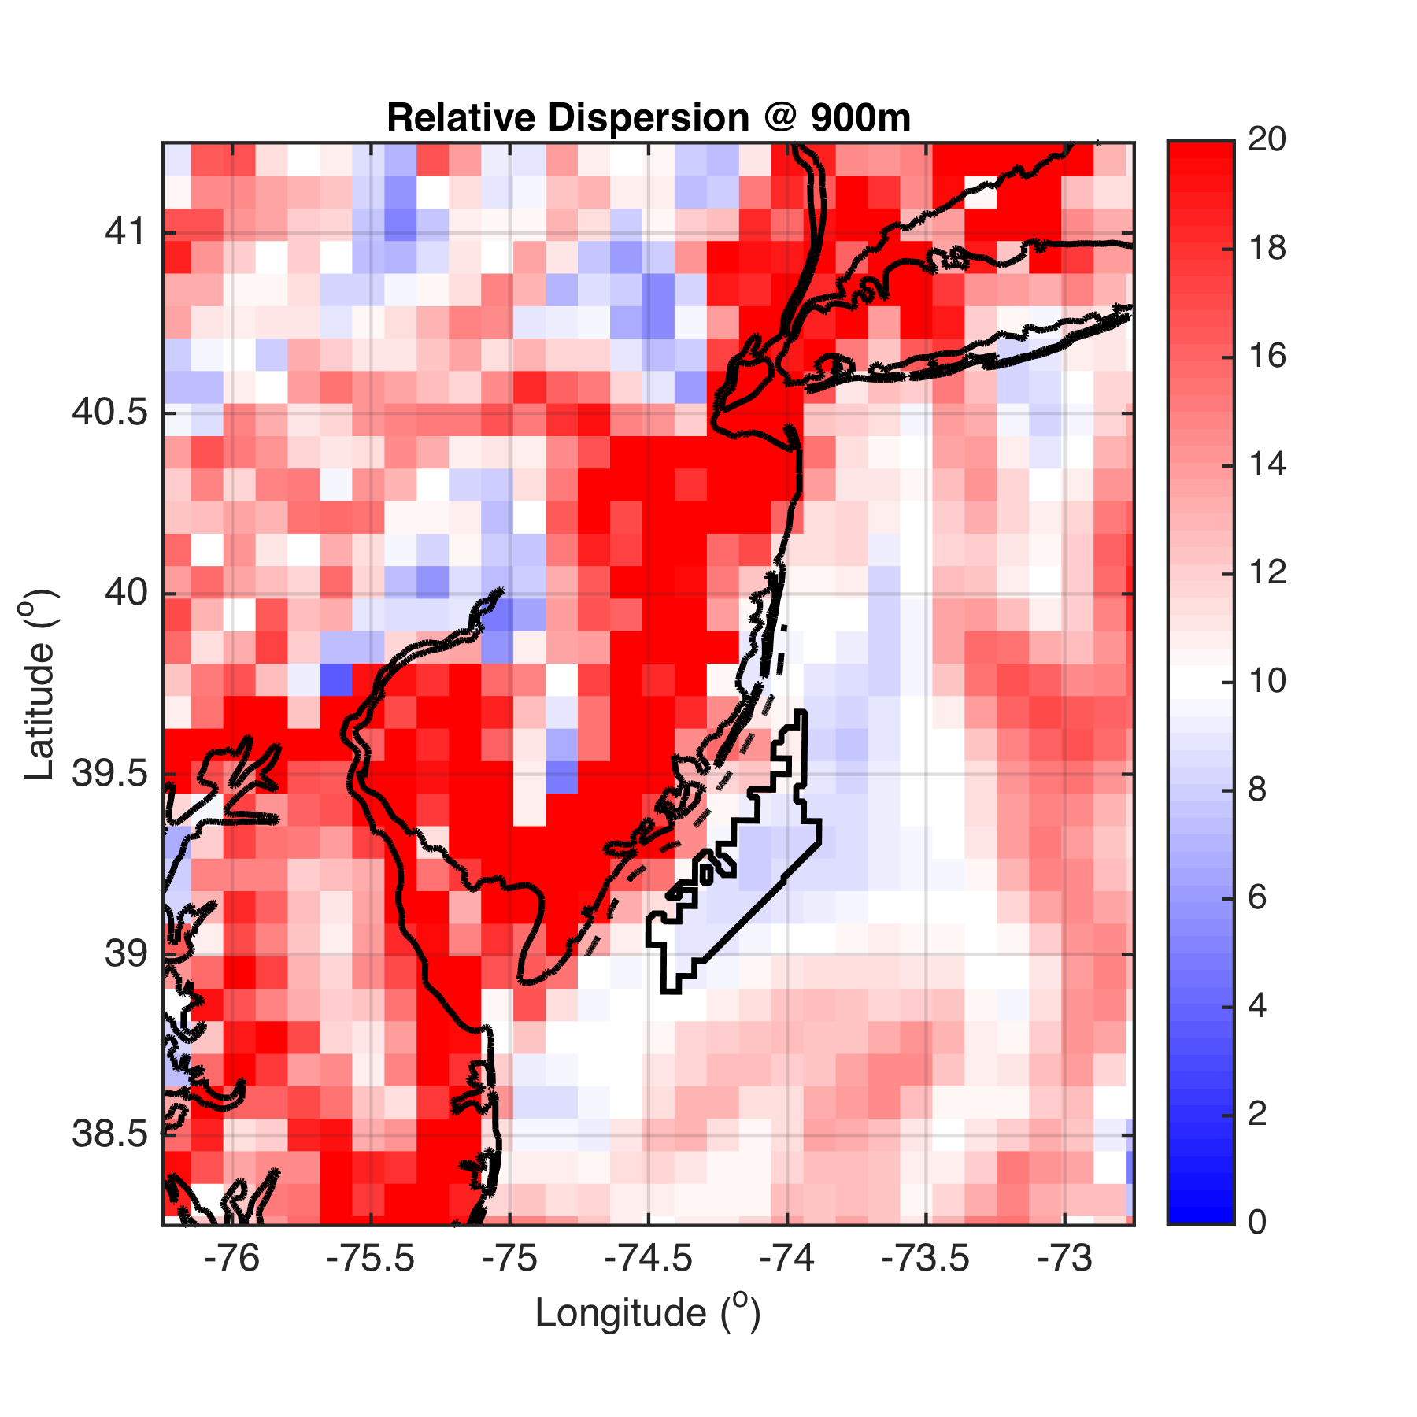
900m

Slide 31
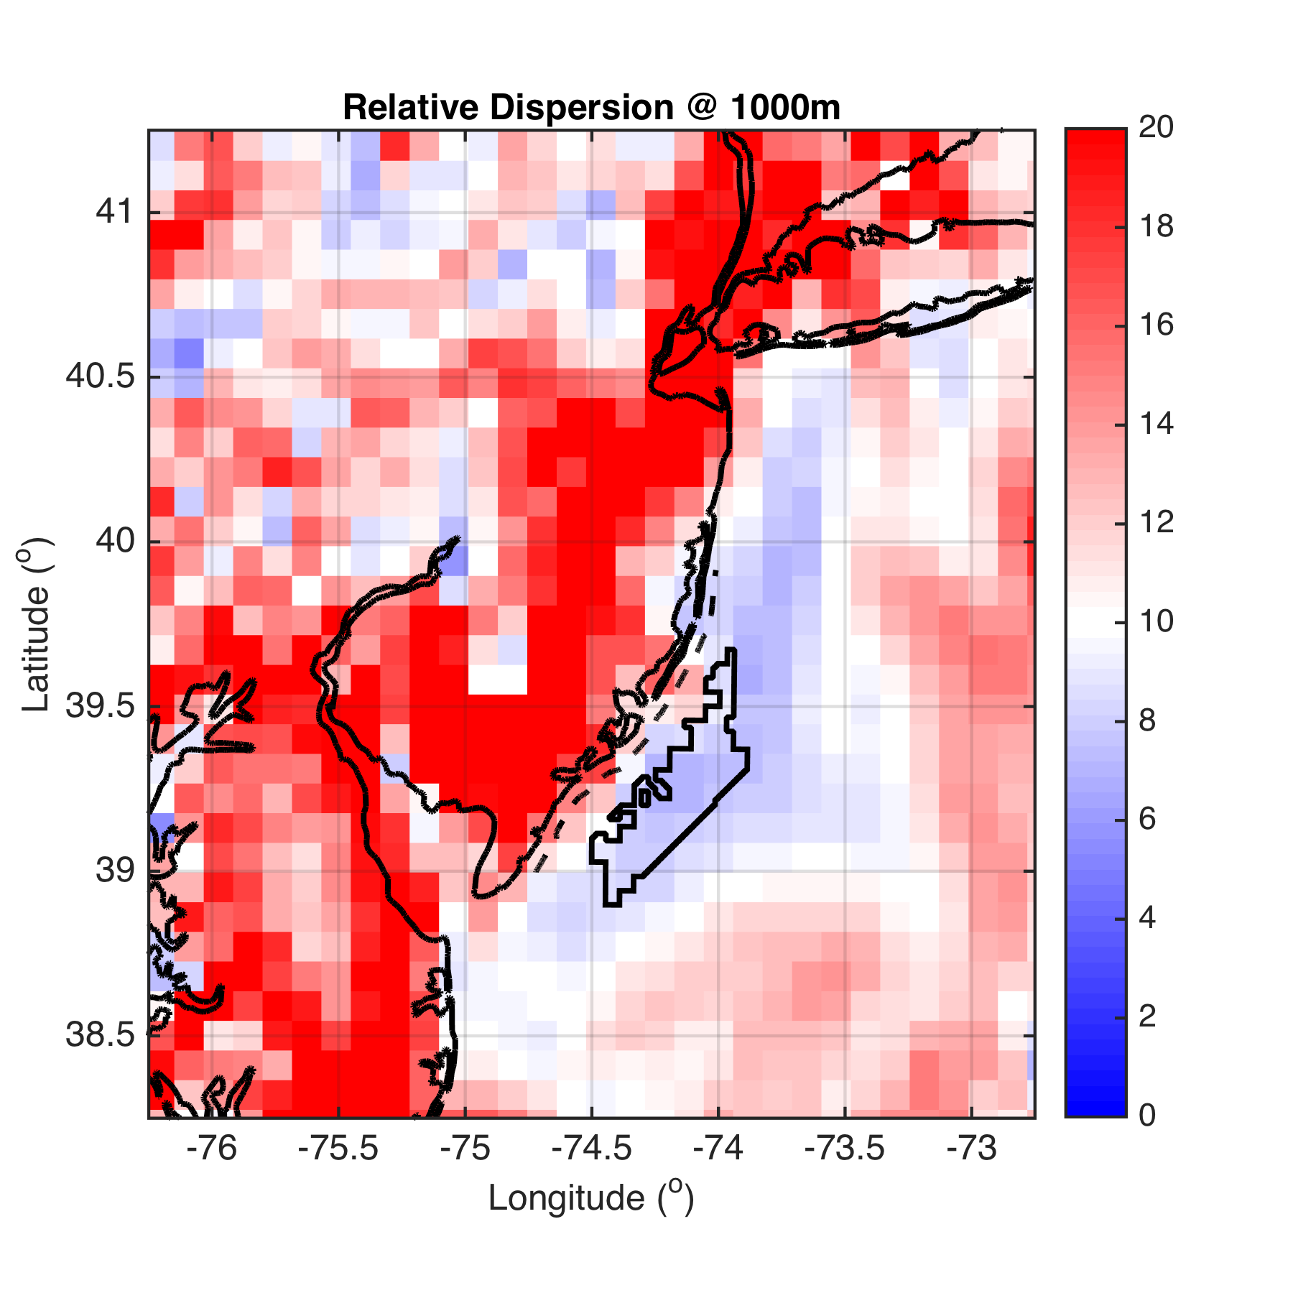
1000m

Slide 32
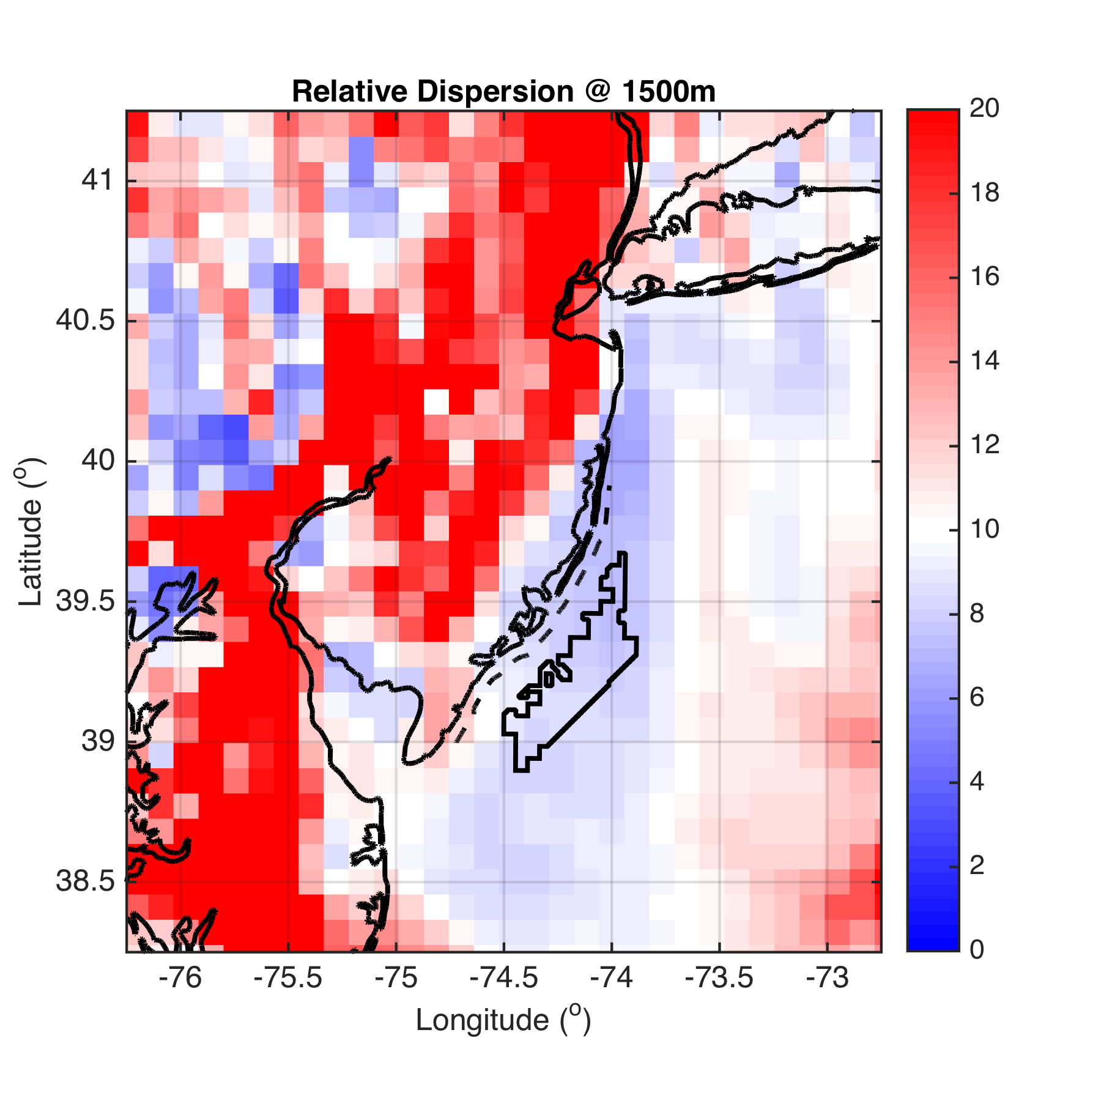
1500m

Slide 33
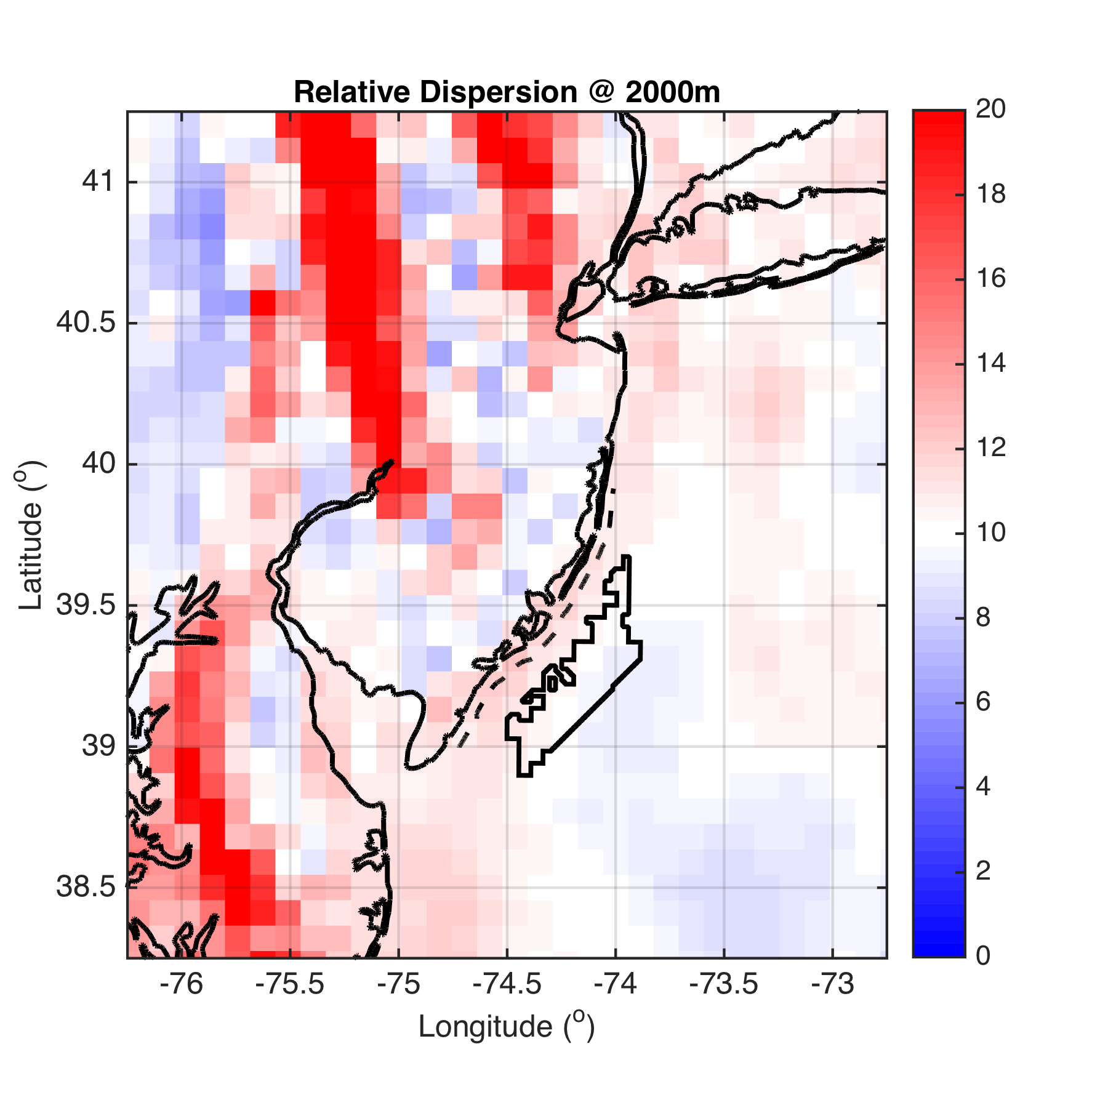
2000m

Slide 34
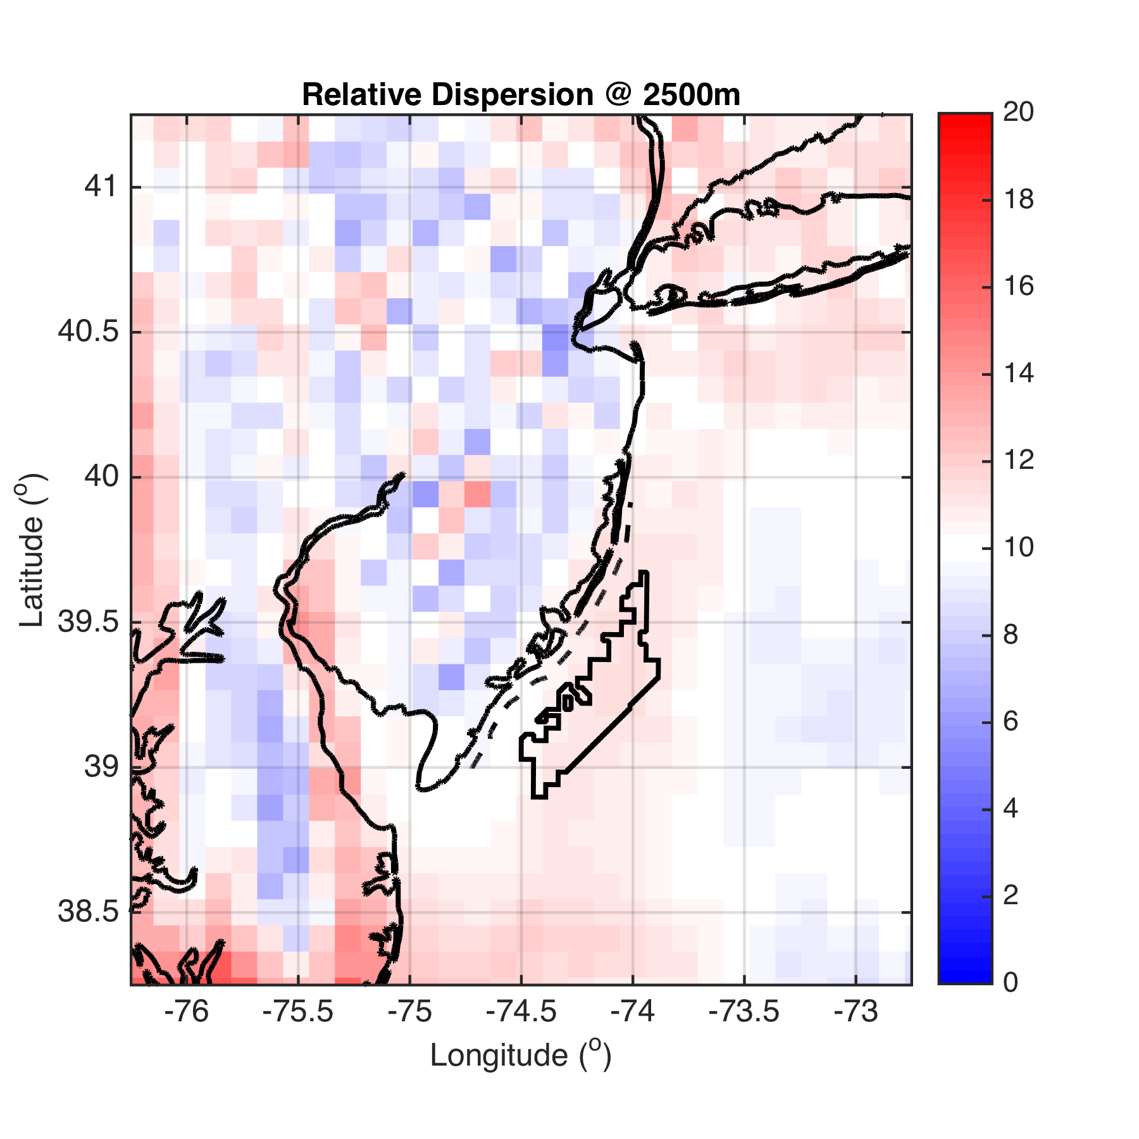
2500m

Slide 35
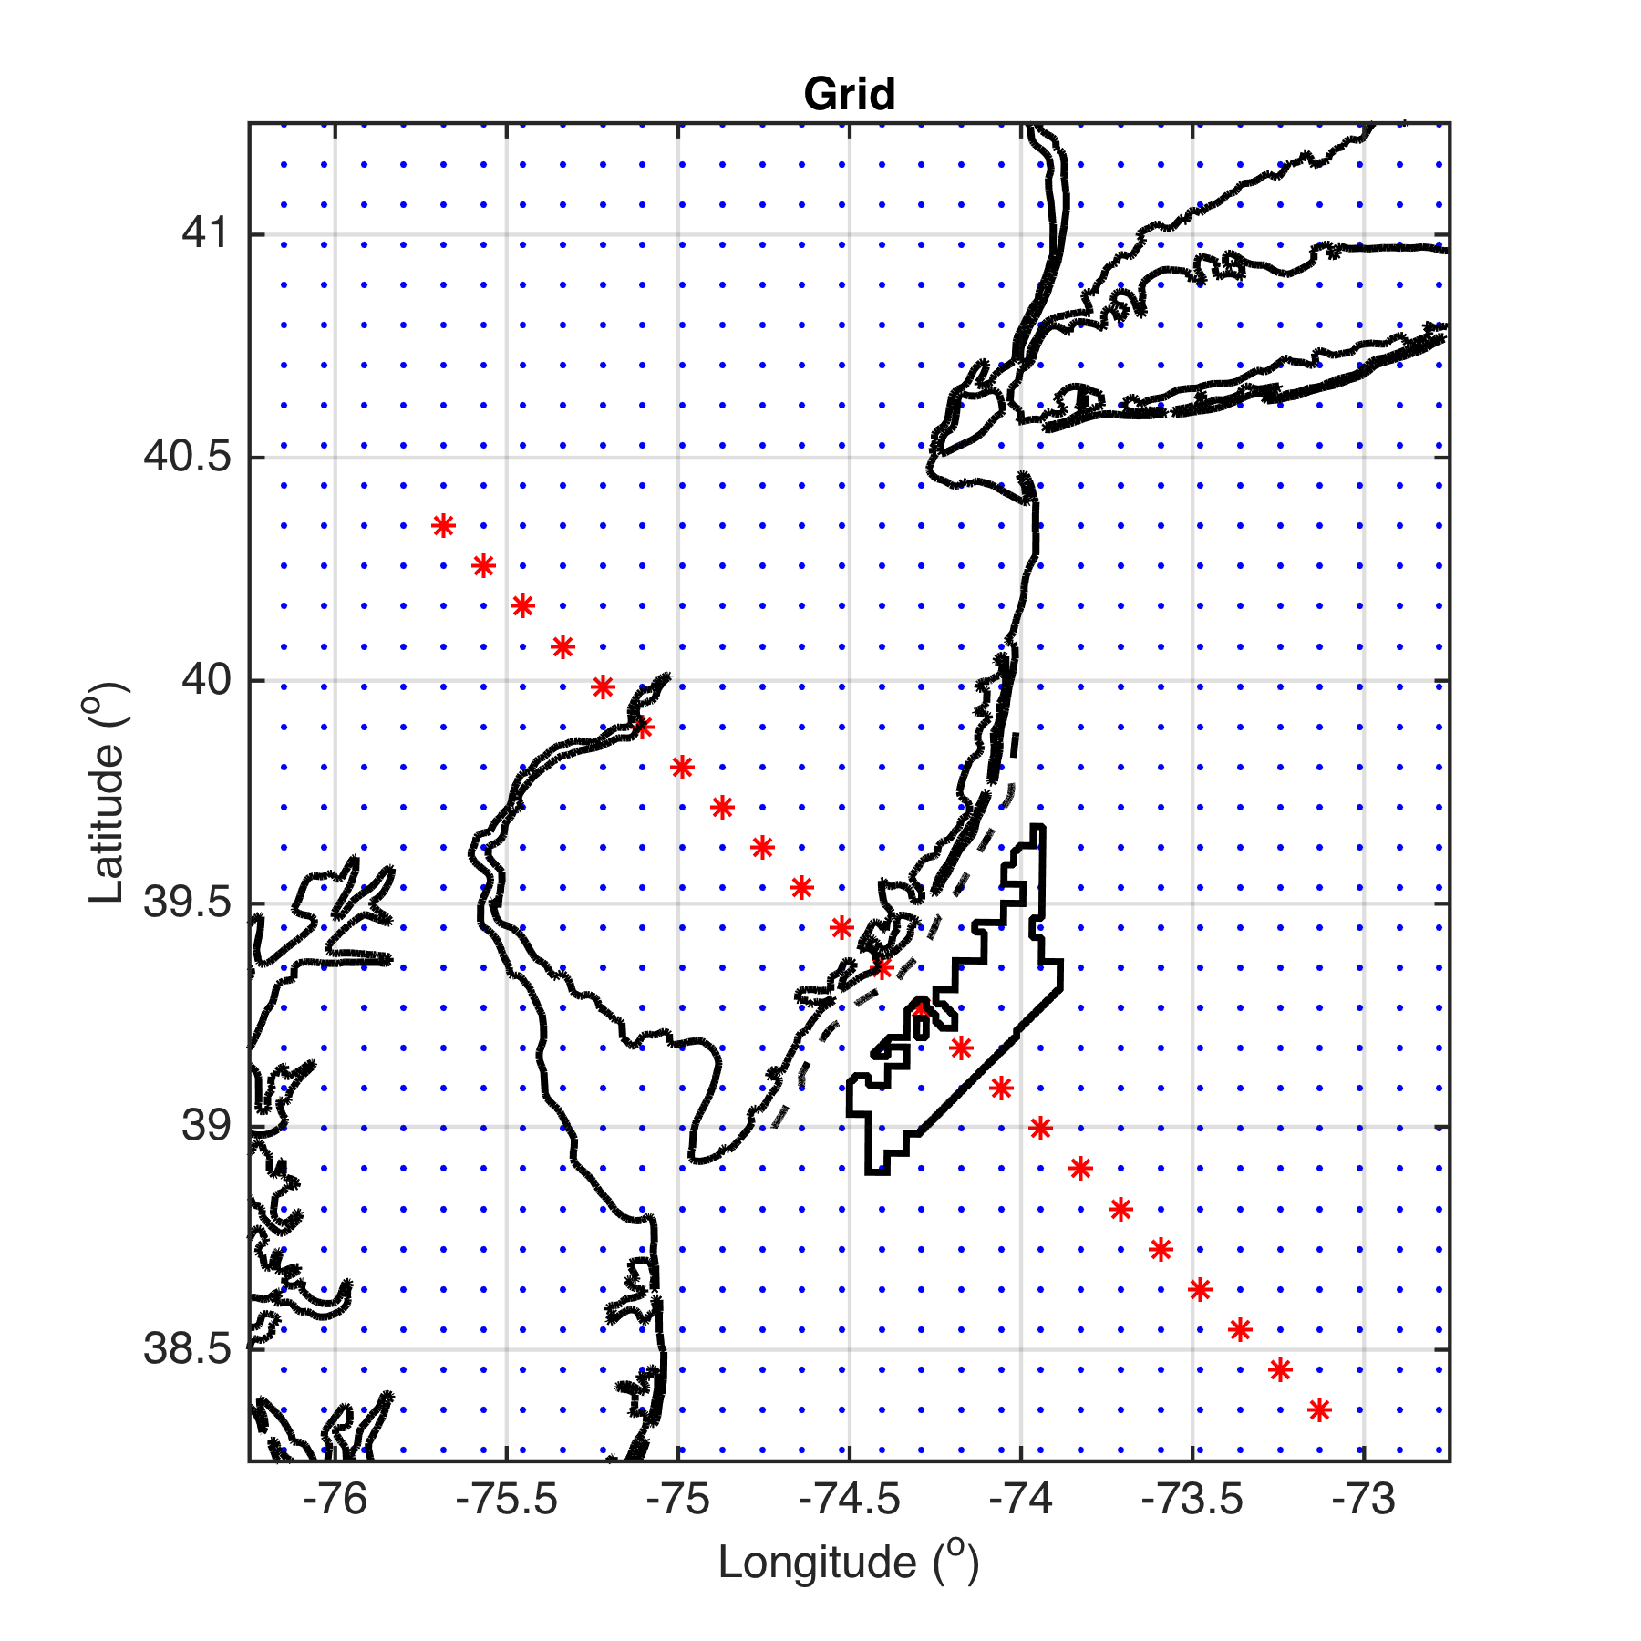
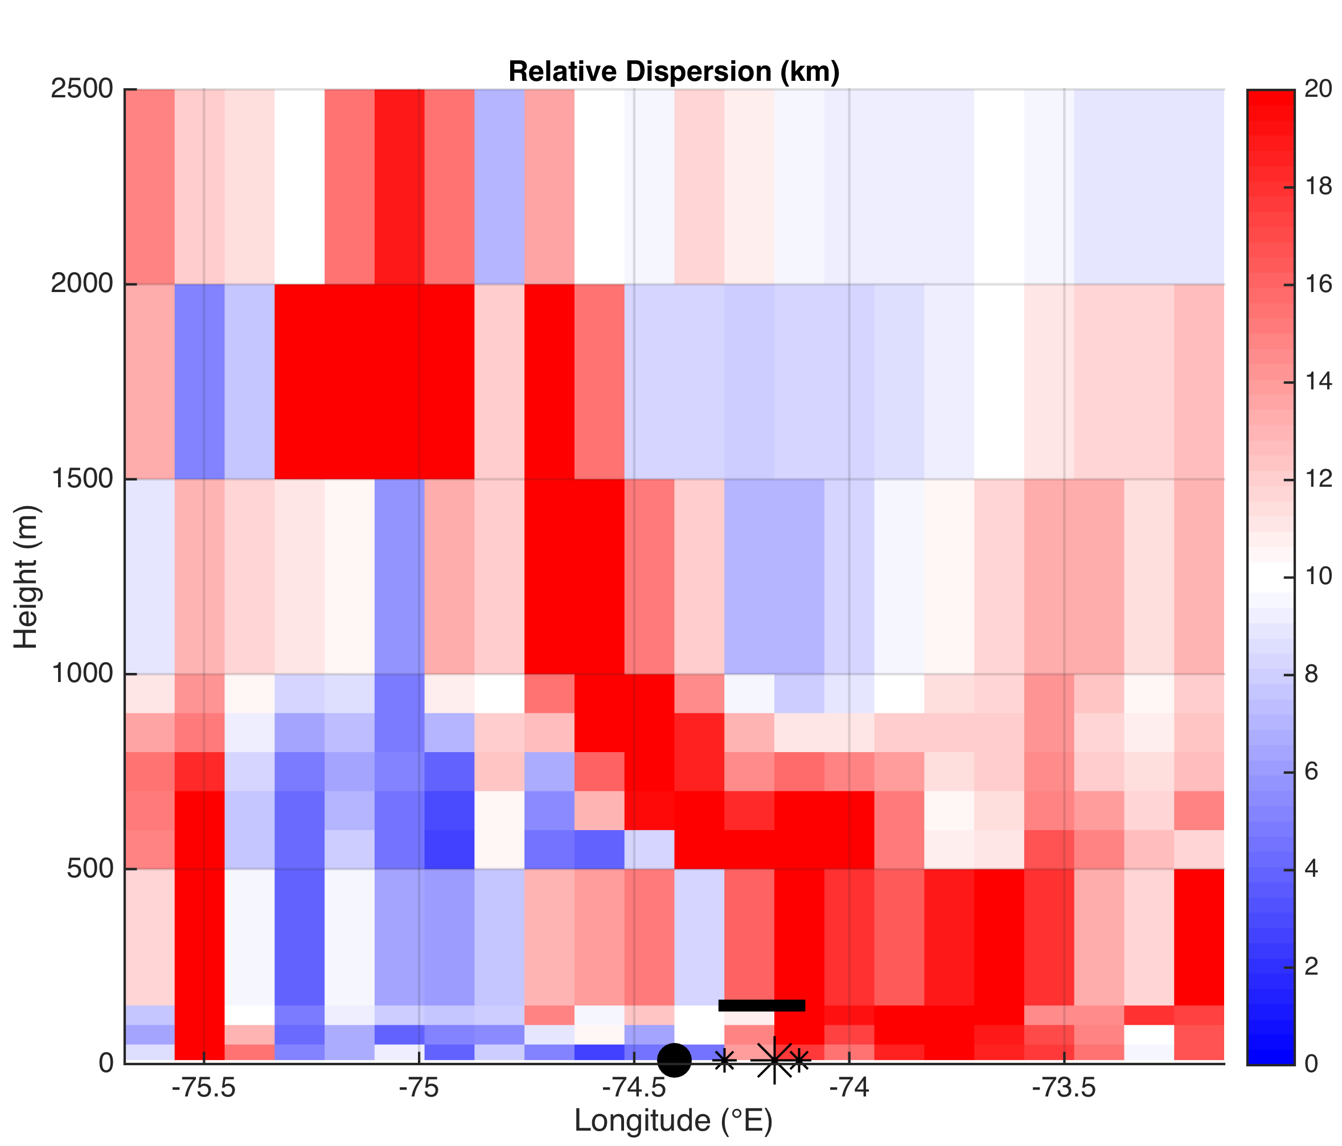
Vertical Cross Section
Top of wind turbine
Coastline
Wind Energy Area Bounds

Slide 36
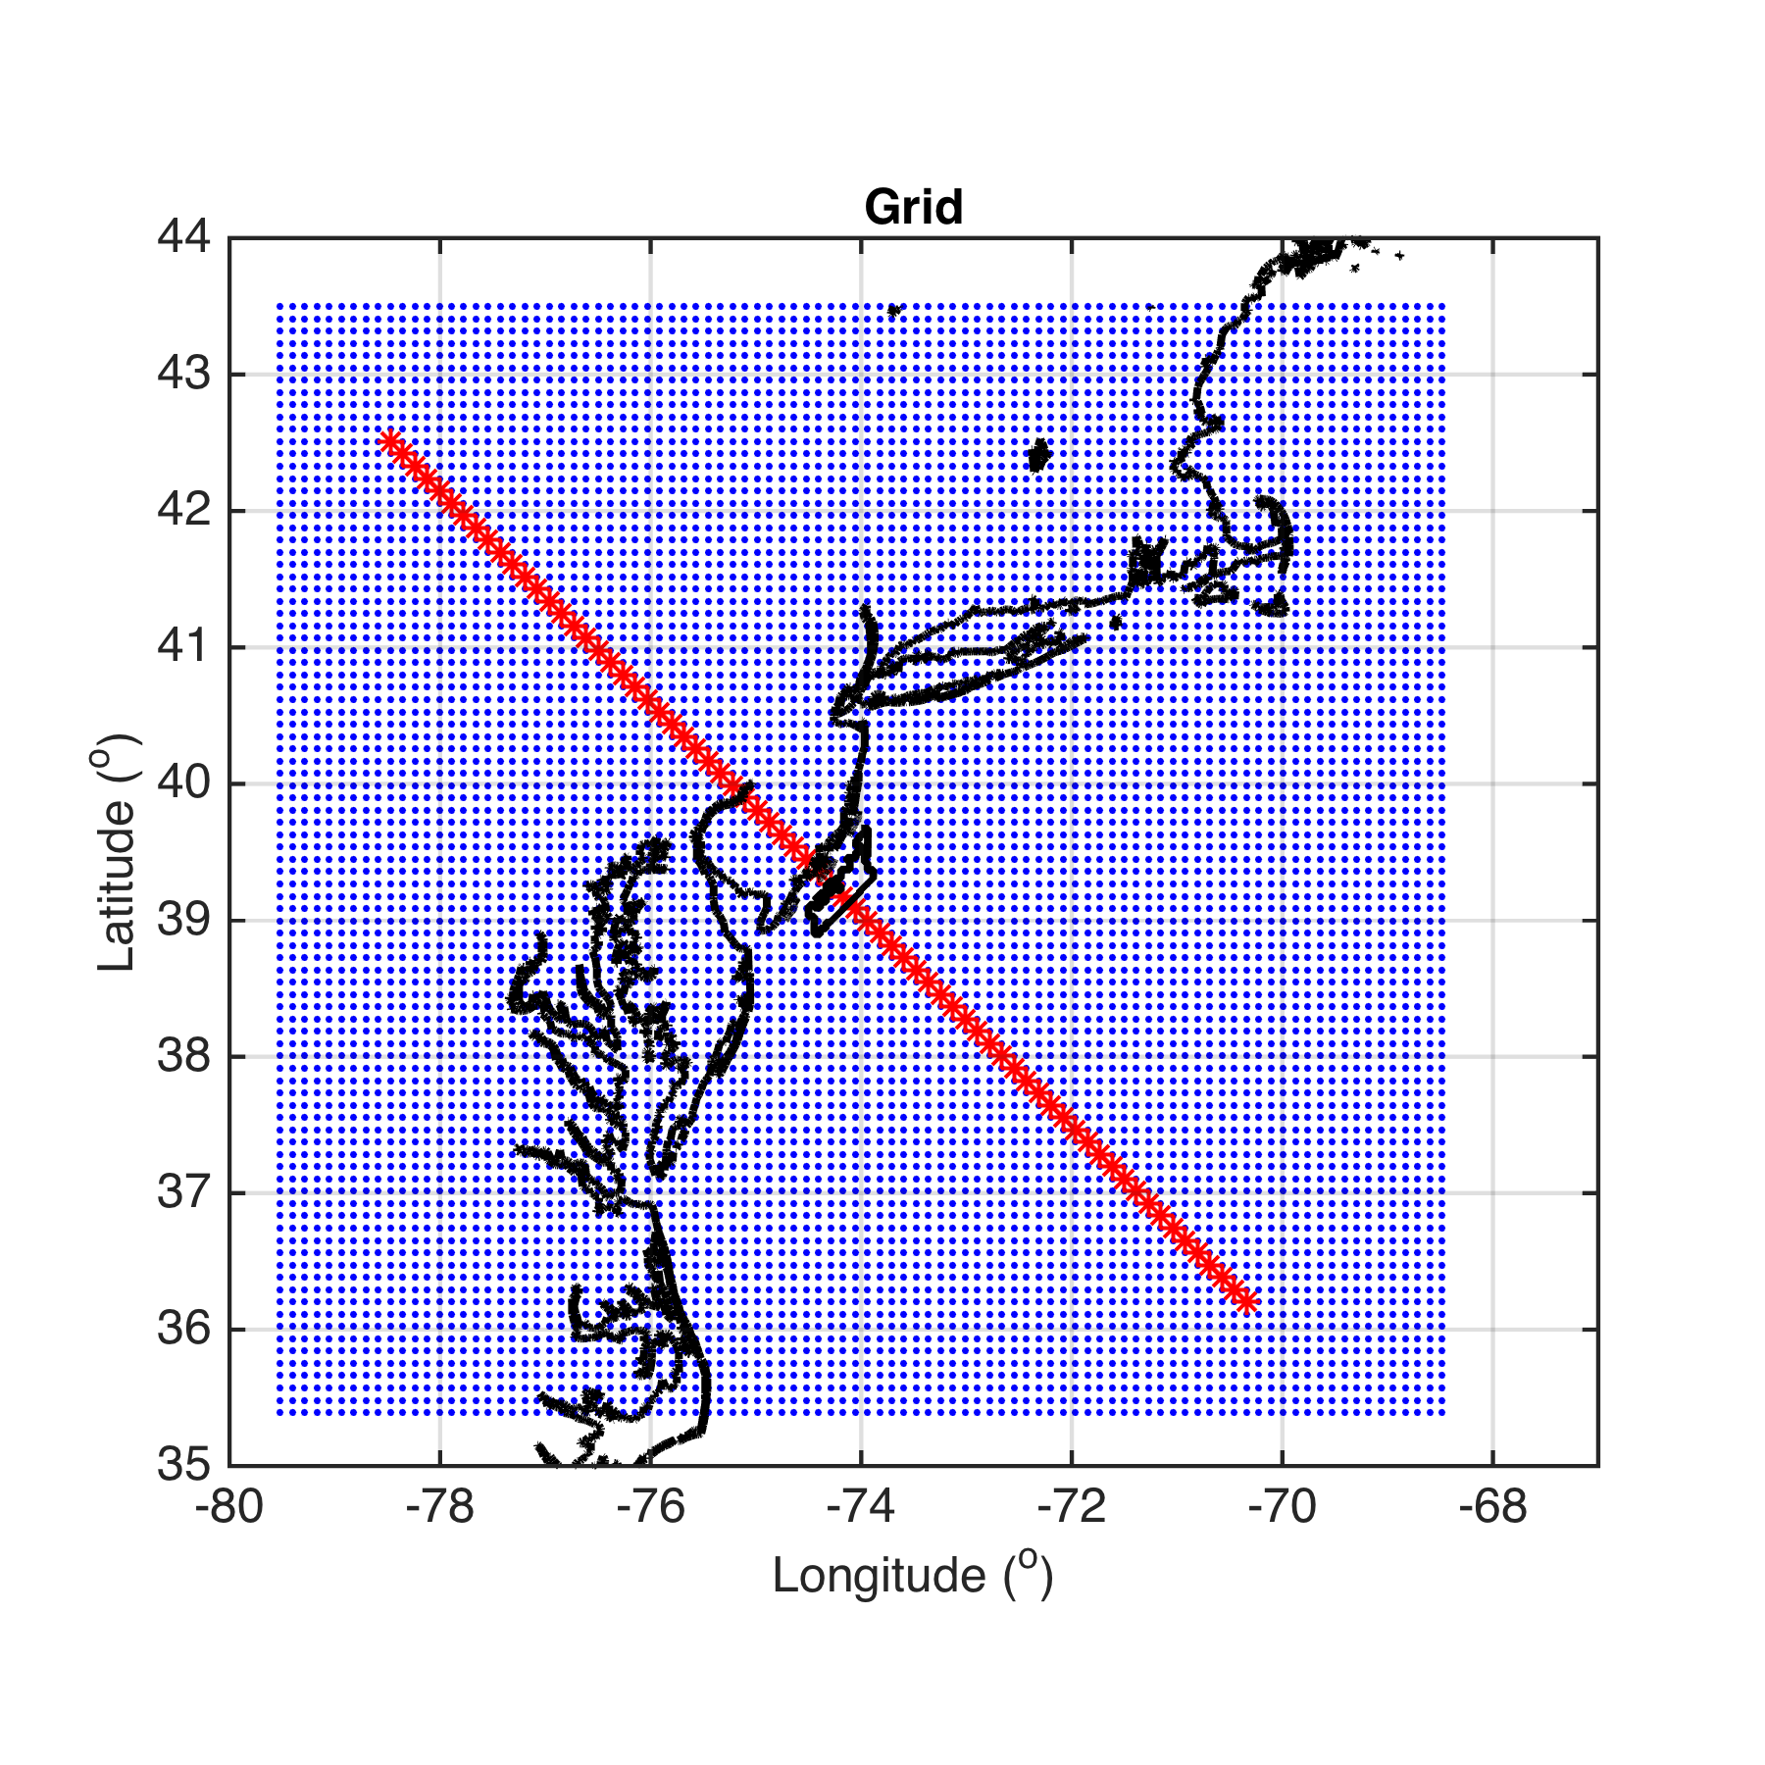
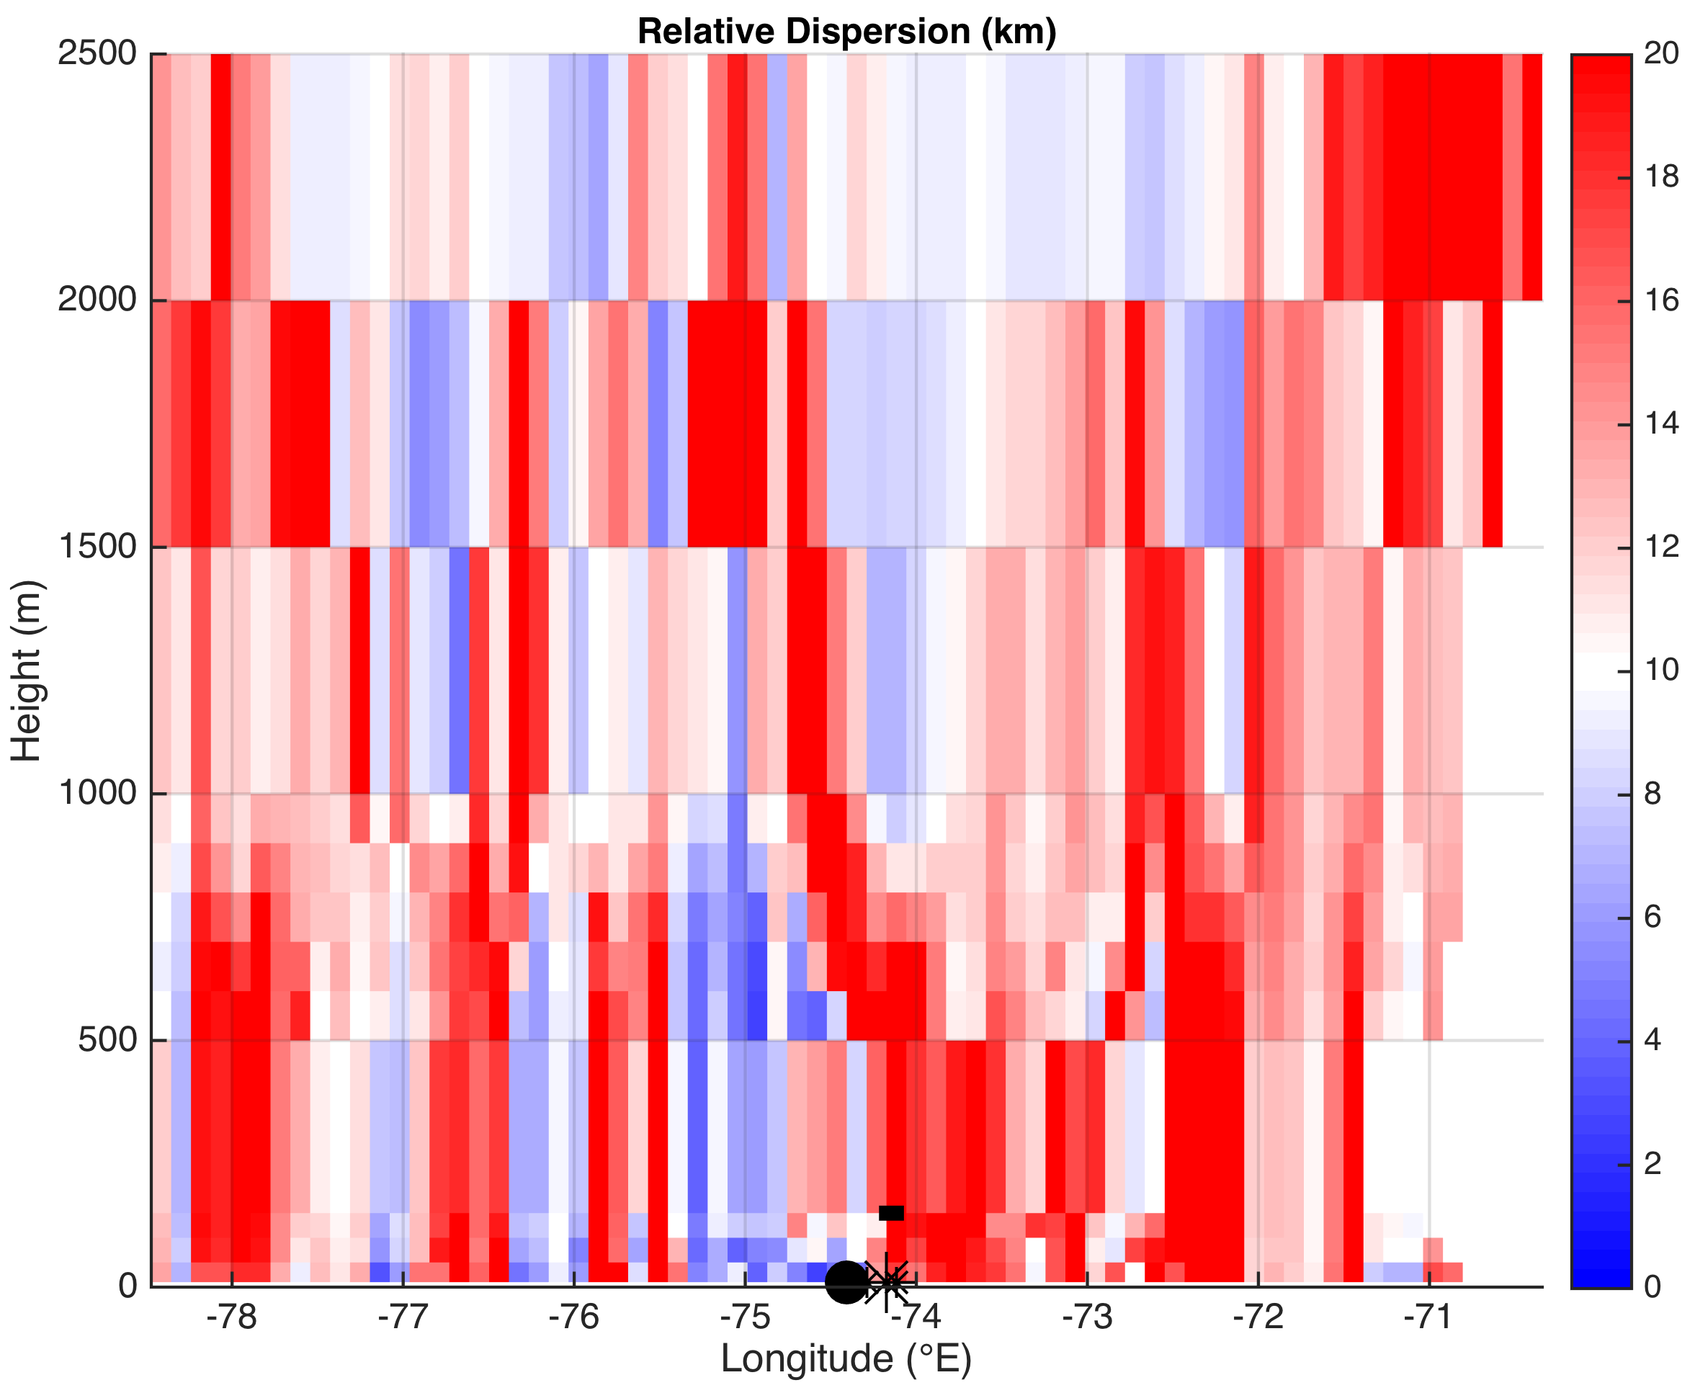
Vertical Cross Section
Top of wind turbine
Coastline
Wind Energy Area Bounds

Slide 37
Summary of Part 2 Results
Divergence is slanted with height, from surface offshore to aloft onshore (agrees with theory)
Reversal in divergence/convergence, and thus approximate height size of sea breeze cell, similar onshore and offshore
Offshore:
Divergence: 10 to ~700m
Convergence: ~700 to 2000m
Onshore:
Convergence: 10 to ~600m
Divergence: ~600 to 1500m

Slide 38
Future Work
Hourly LCS RD maps
Divergence aligned with inland frontal progression?
LCS predictive sea breeze index
e.g. offshore surface divergence, onshore surface convergence→ high enough value to get sea breeze? (quick, efficient forecasting method)
3D LCS
To account for vertical velocities
For vertical shear analysis (important for wind turbine engineering)

Slide 39
Thank you!

Slide 40
Extra Slides

Slide 41
Key Questions
Can we use LCS to more clearly identify and characterize (horizontal & vertical extent, duration, timing, etc.) key structures within the sea breeze (areas of divergence and convergence, fronts, return flow, over water subsidence, calm zones, circulation cells)?
More importantly for offshore wind, can we use LCS to detect areas of higher turbulence and wind shear within the sea breeze, especially offshore?

Slide 42
Sea Breeze Cases
Case 01: July 7-8, 2013
Corkscrew, strong upwelling
Case 02: July 31-August 1, 2014
Corkscrew, weak upwelling
Case 03: April 27-28, 2013
Pure, no upwelling
Pure
Corkscrew
Backdoor
Check 925 mb wind direction for sea breeze type

Slide 43
Sea Breeze Cases
Case 01 and Case 02:
Results coming soon
Case 03: April 27-28, 2013
Pure, no upwelling
Results presented here
Pure
Corkscrew
Backdoor
Check 925 mb wind direction for sea breeze type

Slide 44
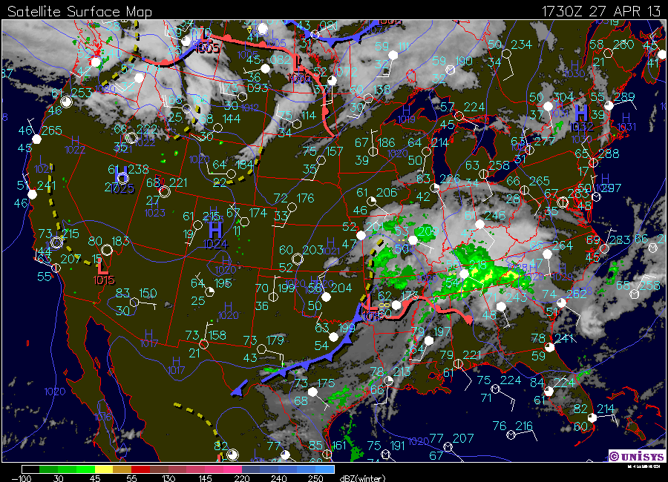
Case 03: April 27-28, 2013

Slide 45
WRF Setup
WRF-ARW 3.6.1
3km outer nest, 600m inner nest
North American Mesoscale (NAM) initial and boundary conditions
YSU PBL
Best PBL scheme for offshore 2m T in UK, no difference for offshore winds (Steele et al 2013)
MM5 Monin-Obukhov surface layer

Slide 46
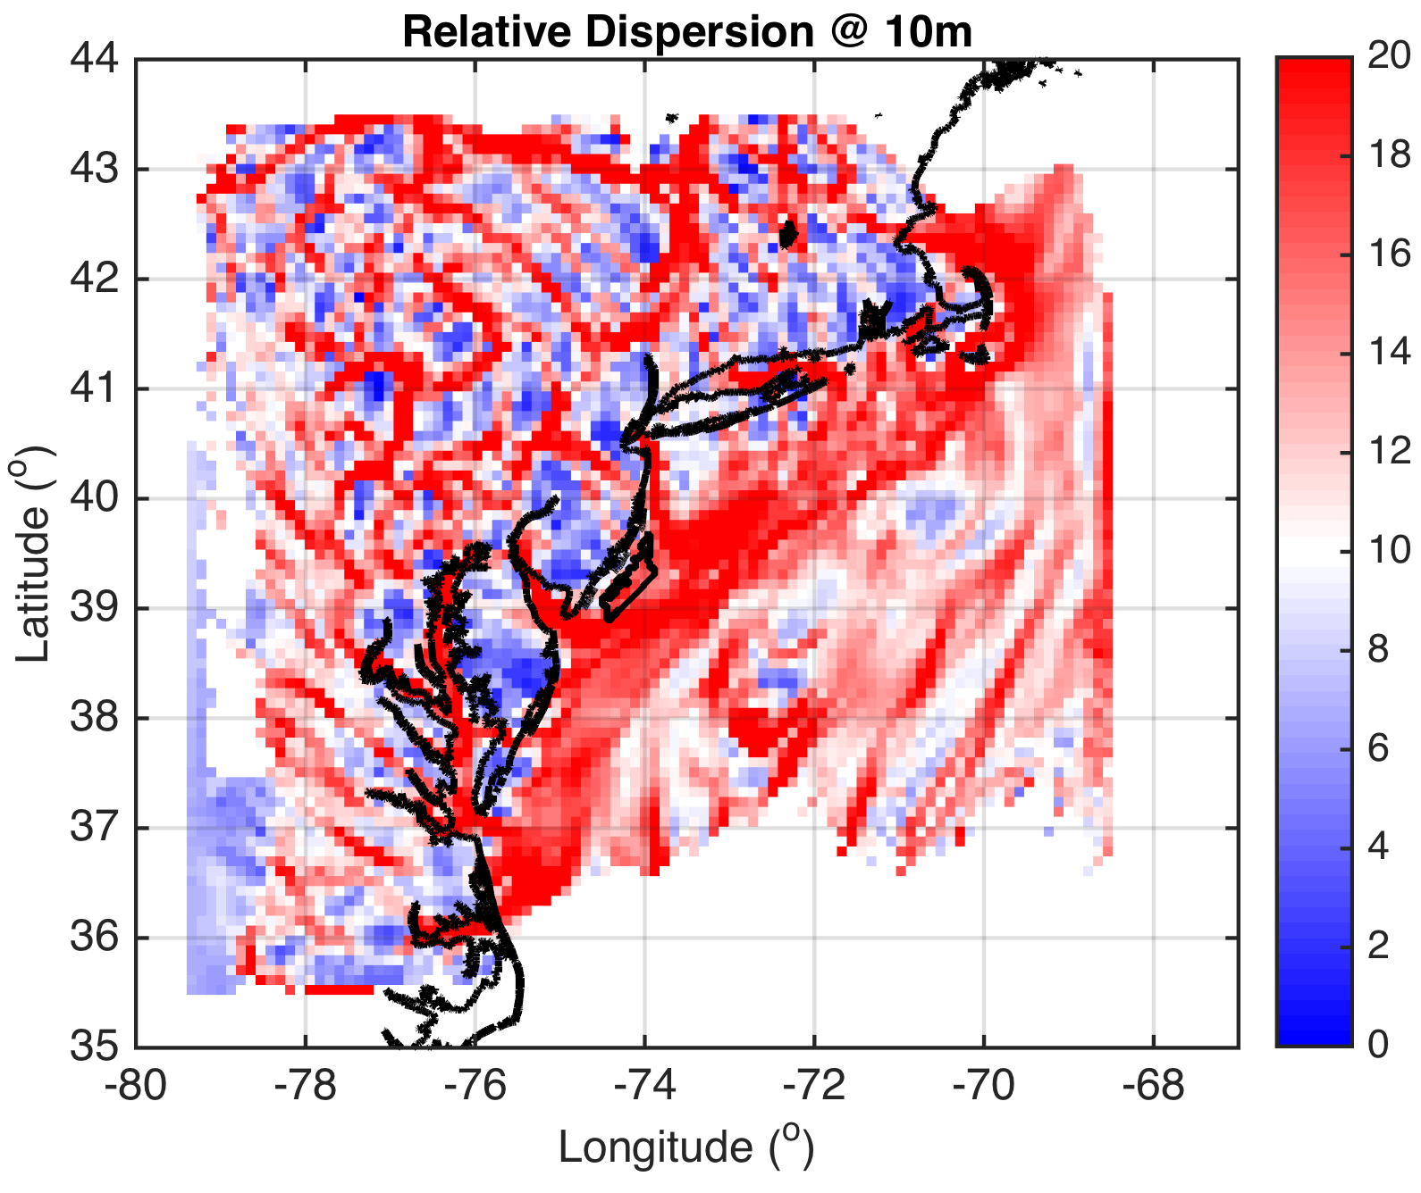
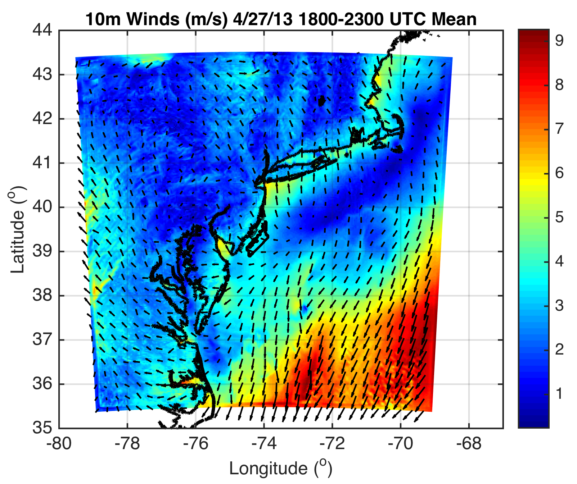
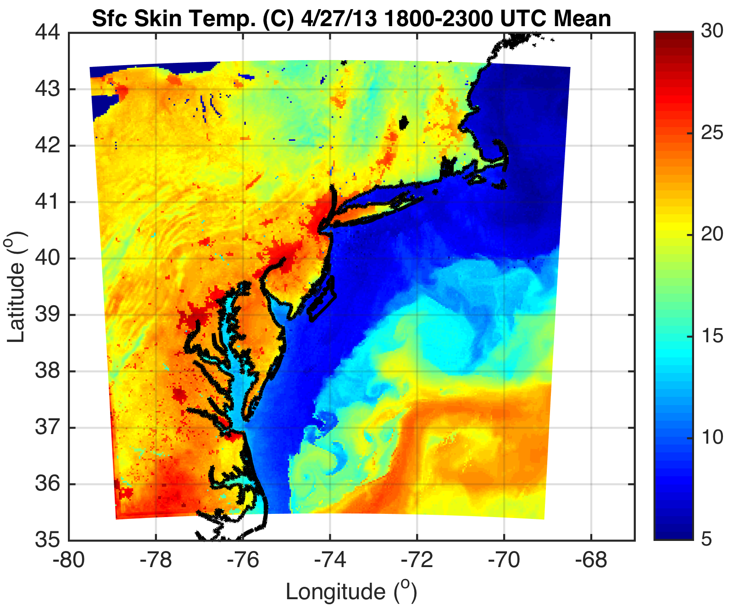
Why is RD heterogenous onshore and homogeneous offshore?

Slide 47
Therefore, speed of sea breeze front is nearly constant between 1900 and 2200 UTC
LCS linear interpolation assumption is valid→will gather hourly LCS output to determine temporal evolution of LCS

Slide 48
More Future Work
Offshore sea breeze extent (i.e. calm zone propagation offshore) sensitivity to PBL scheme?
YSU 21km, MYNN 0km offshore for one pure sea breeze case (Steele et al 2013)
Apply LCS to scanning LIDAR winds
Combine with WRF to get back (LIDAR) and forward (WRF) trajectories for real-time structure detection and automated turbulence and wind shear warning system for offshore wind

