Slide 1
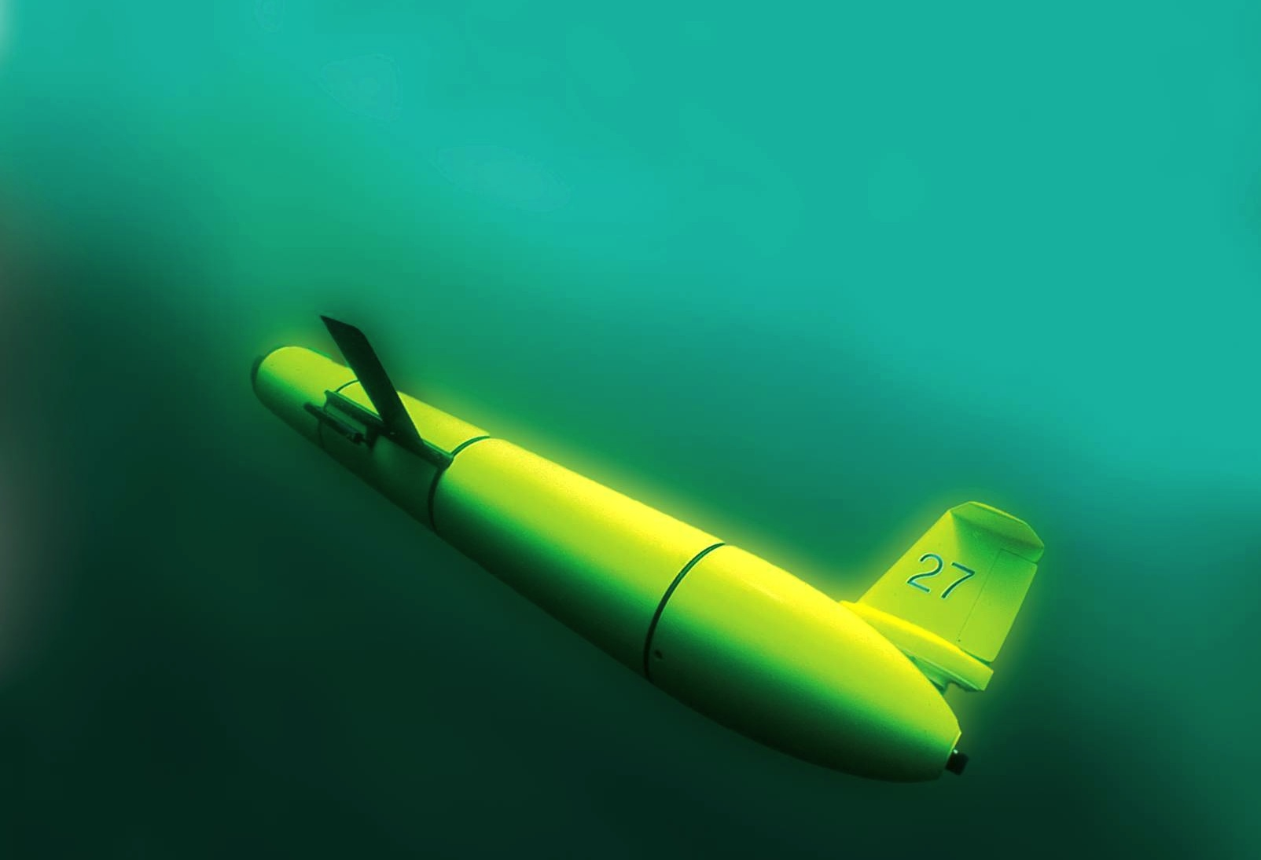
Panel Members:
Scott Glenn, Rutgers University (USA)
Pierre Testor, Centre National de la Recherche
Scientifique - CNRS (France)
Joaquin Tintore, Palma de Mallorca (Spain)
Karen Heywood, University of East Anglia (UK)
Alexander Proelss, Trier University (Germany)
Glider Challenge:
High Resolution for
4D Oceanic Measurements
UNESCO IOC Science Day, 17 June 2015

Slide 2
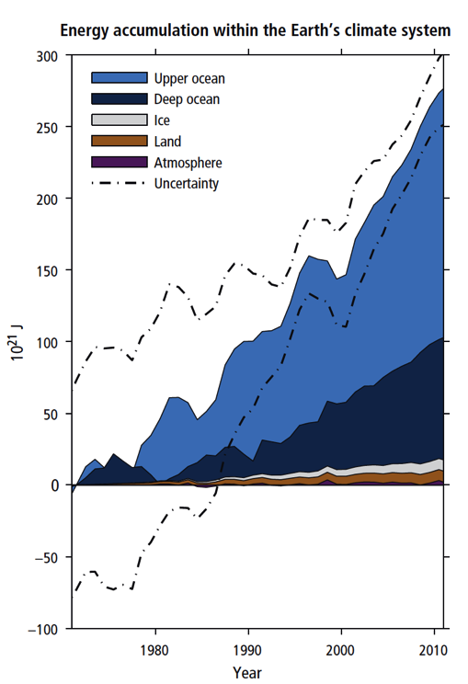
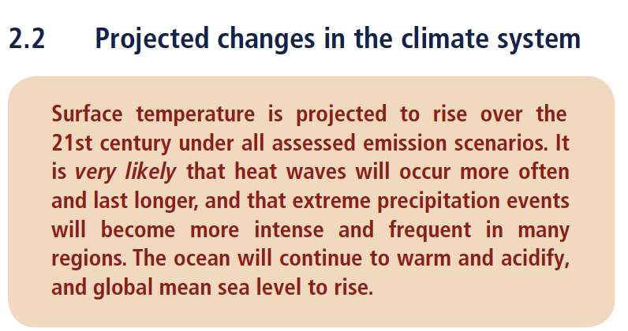
Grand Challenge: Earth is Changing, Population is Growing
“Ocean warming dominates the increase in energy stored in the climate system” --
“>90% of the energy accumulated between 1971 and 2010”
IPCC Fifth Assessment Report (AR5)

Slide 3
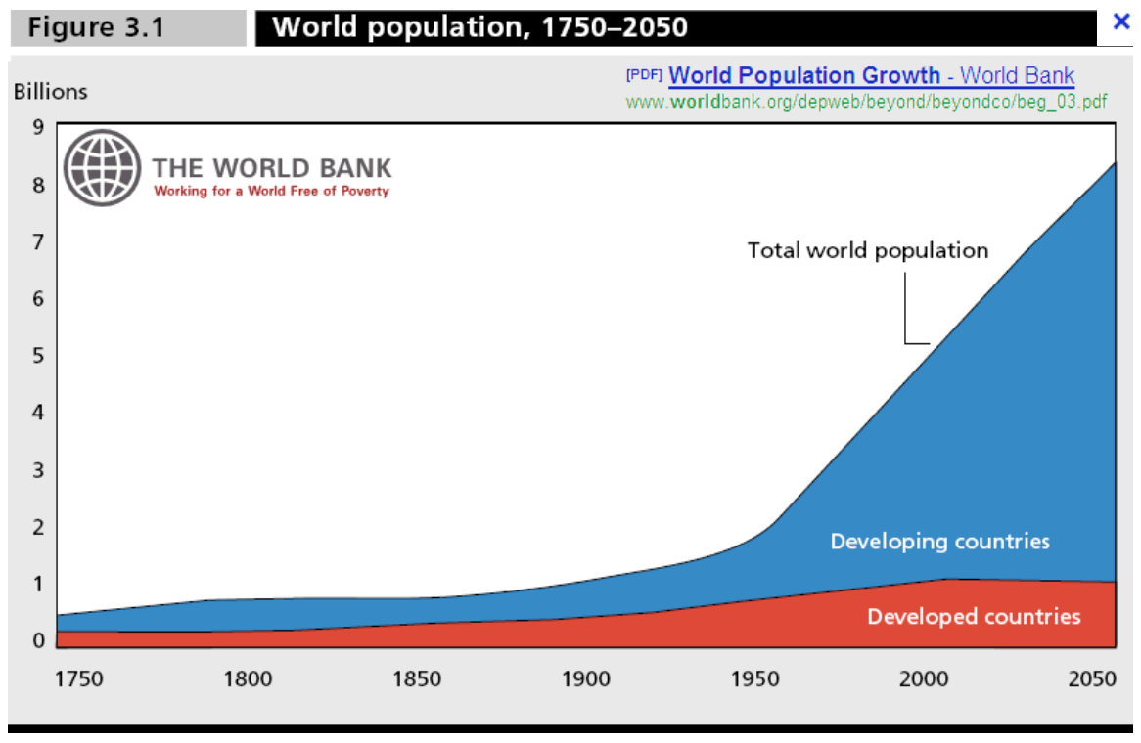
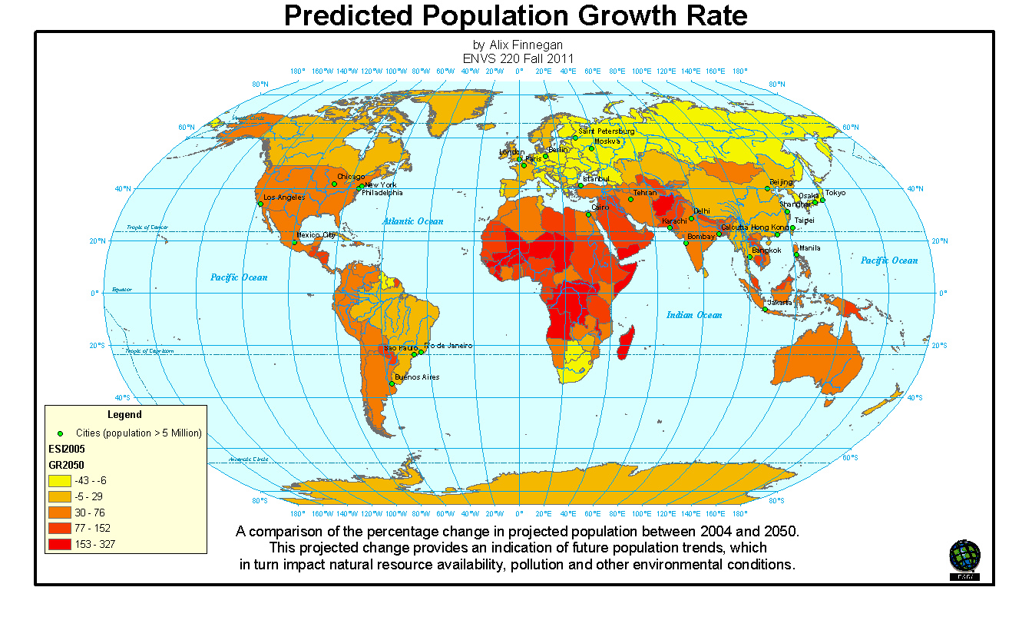
Grand Challenge: Earth is Changing, Population is Growing

Slide 4

Response: Mitigate and Adapt to a Changing Climate
Explore pathways for adaptation and mitigation with sustainable development
Builds on IPCC Fifth Assessment Report (AR5)
Preparation for 21st UNFCC Conference of the Parties (COP21) climate governance regime based on a low carbon, resilient development model
Oceans are a key component – absorbed 30% of anthropogenic CO2 and continue to acidify

Slide 5
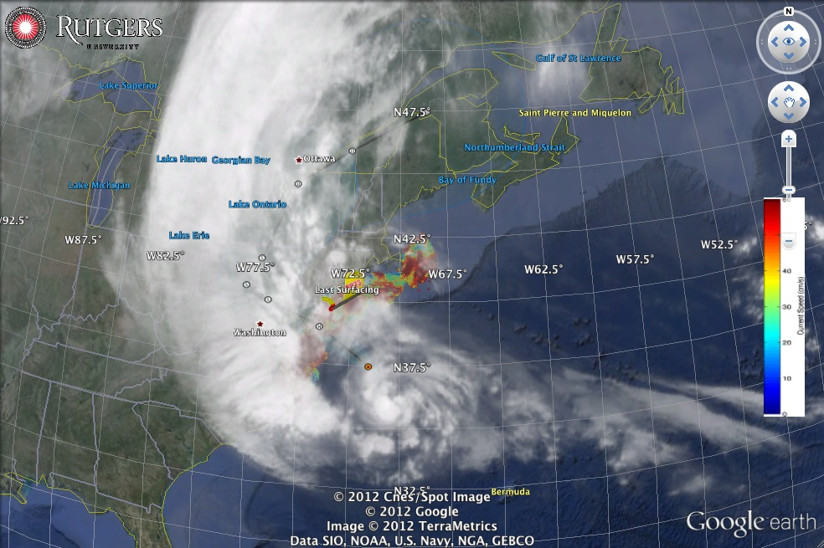
Response: Improve Severe Weather Warnings & Resiliency
Hurricane Sandy approaching U.S. East Coast

Slide 6
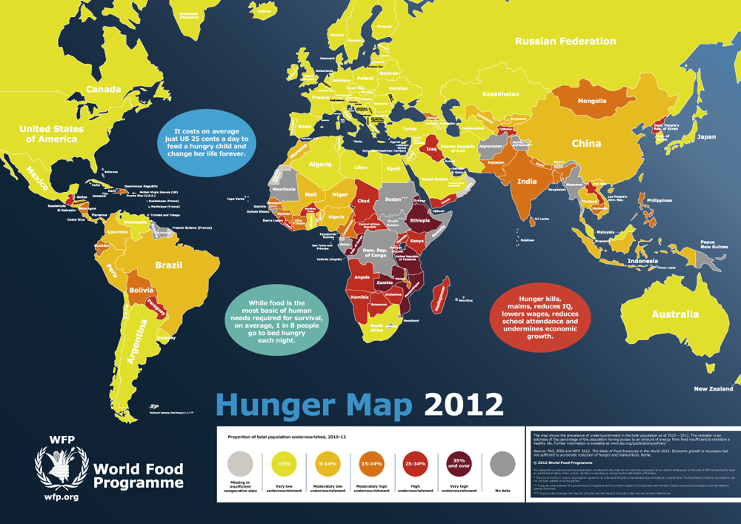
Response: Provide Food, Water and Energy Security

Slide 7
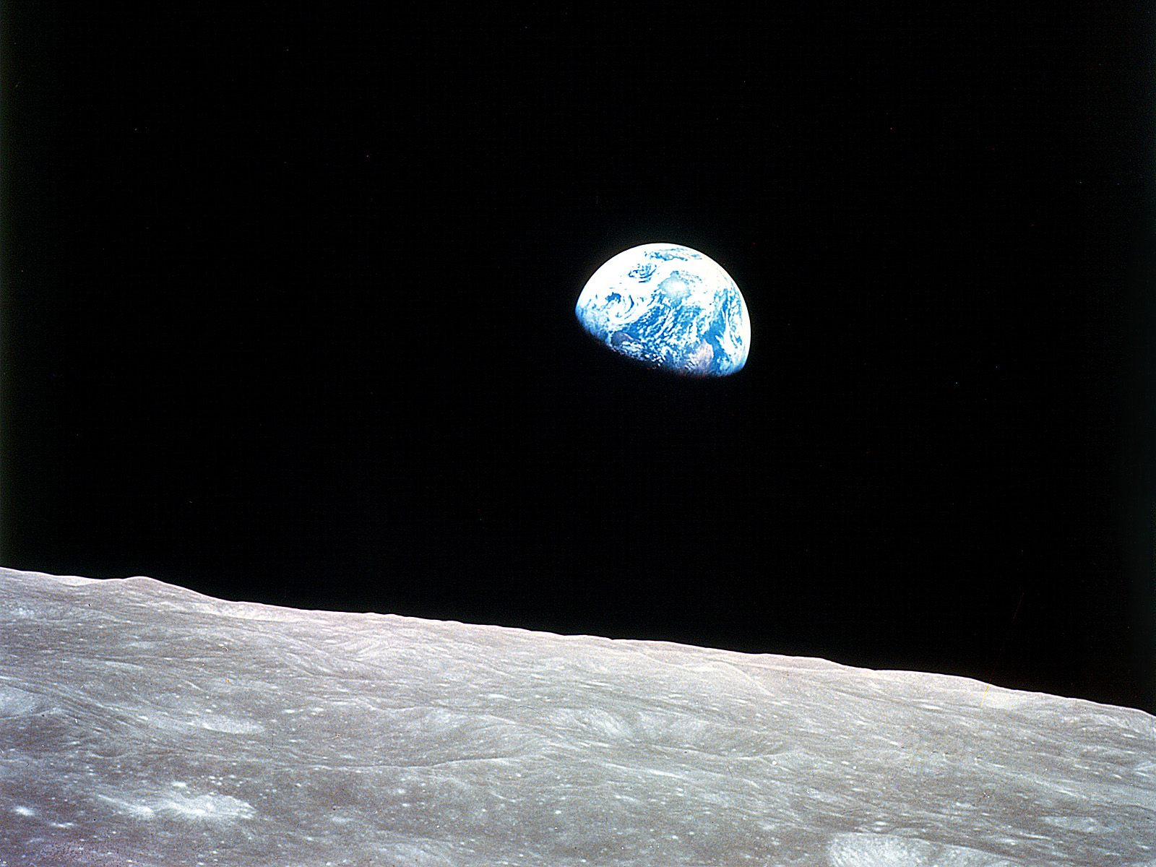

Solutions we must seek
will involve the Sea

Slide 8
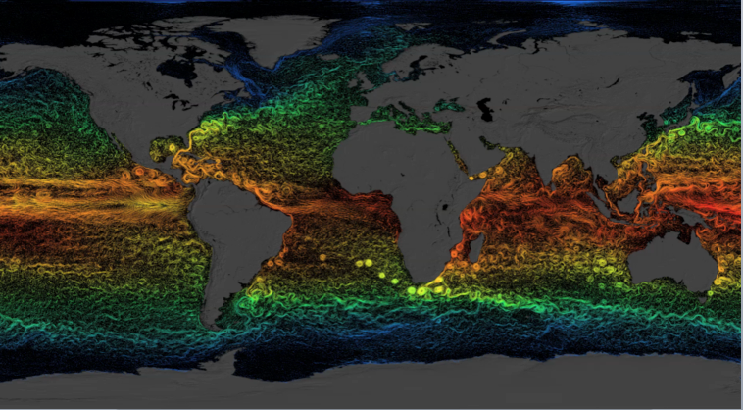
The Ocean is Physically Complex & Biologically Diverse
Global circulation dominated by the Mesoscale

Slide 9
The Ocean is Physically Complex & Biologically Diverse
61 Large Marine Ecosystems

Slide 10
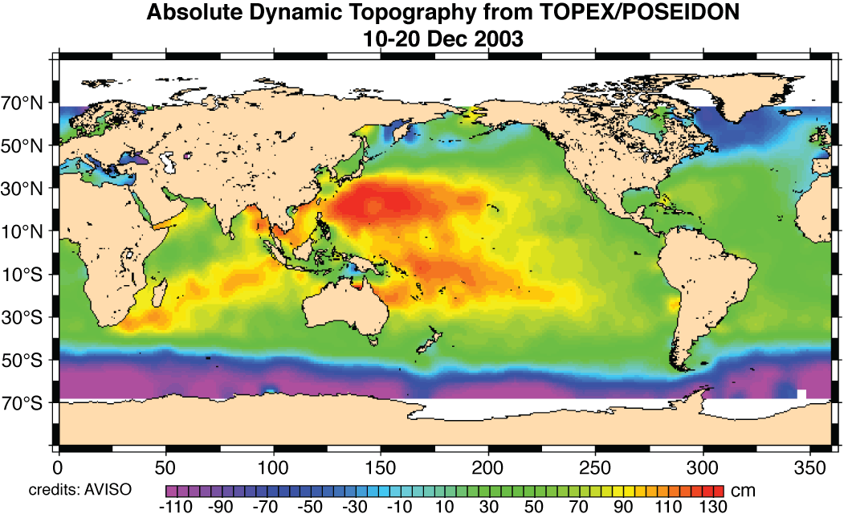
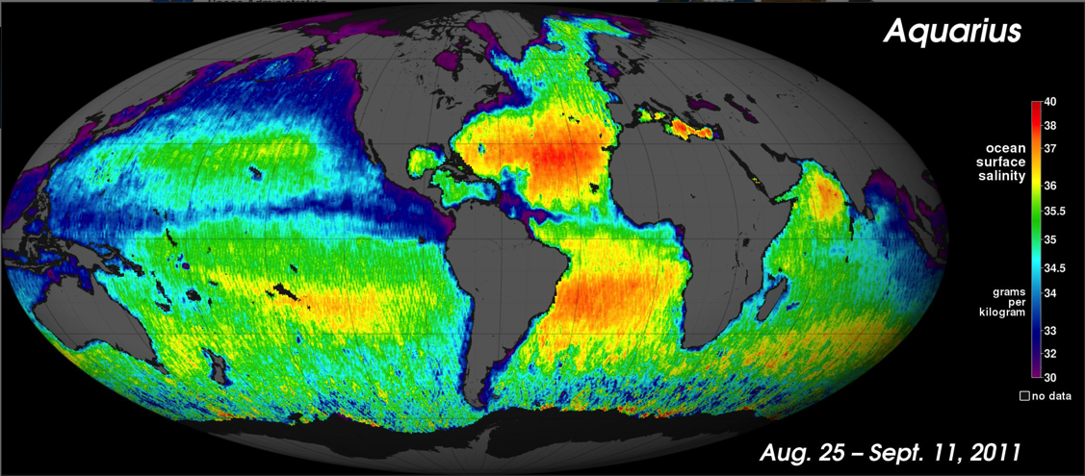
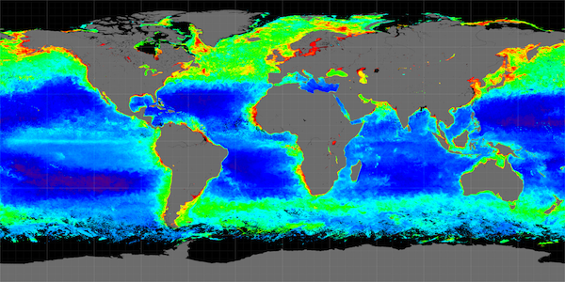
Satellite Revolution: Global coverage of the ocean surface
Sea Surface Temperature - SST
Sea Surface Height - SSH
Sea Surface Salinity - SSS
Near Surface Chlorophyll
Below the surface requires
in-water observations

Slide 11
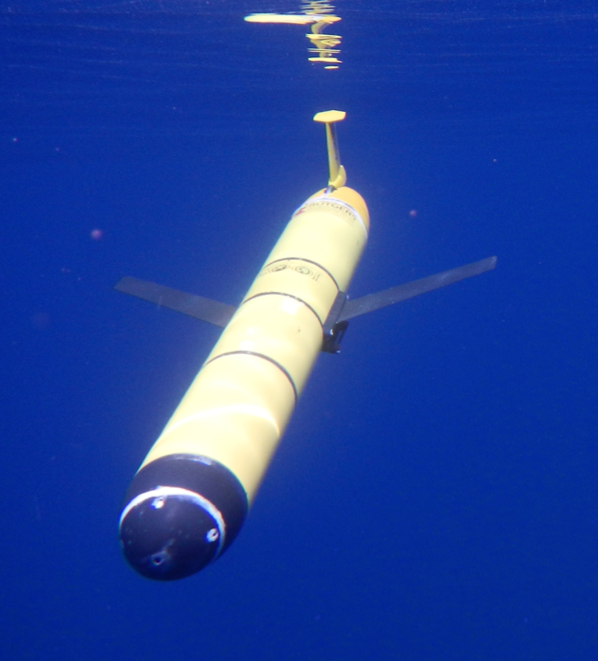
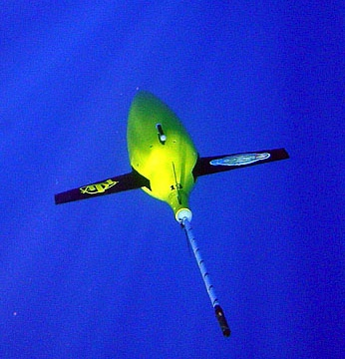
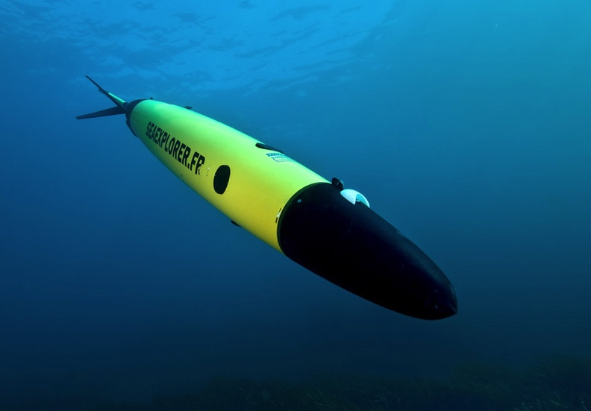
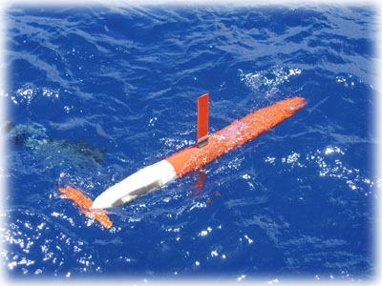
Robotics Revolution: Commercially Available Gliders
Slocum Glider
Seaglider
Seaexplorer
Glider
Spray Glider

Slide 12

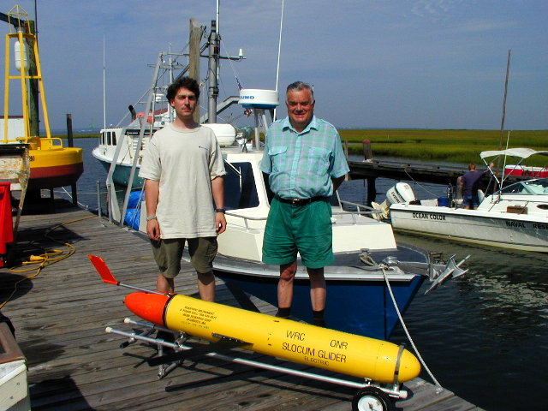
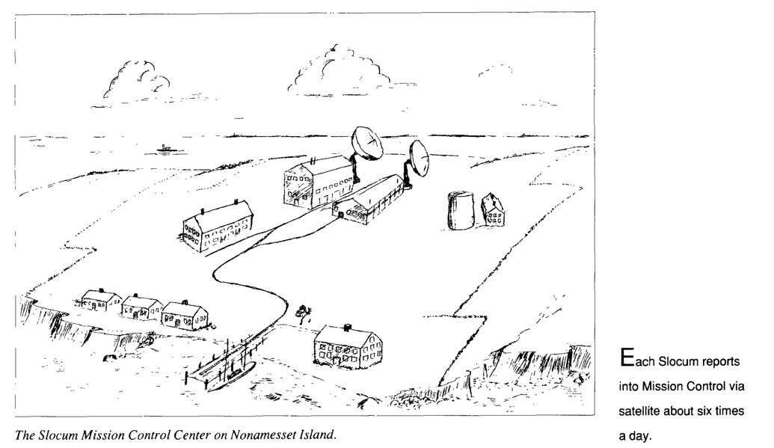
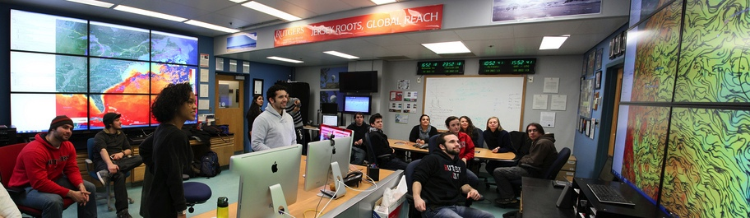
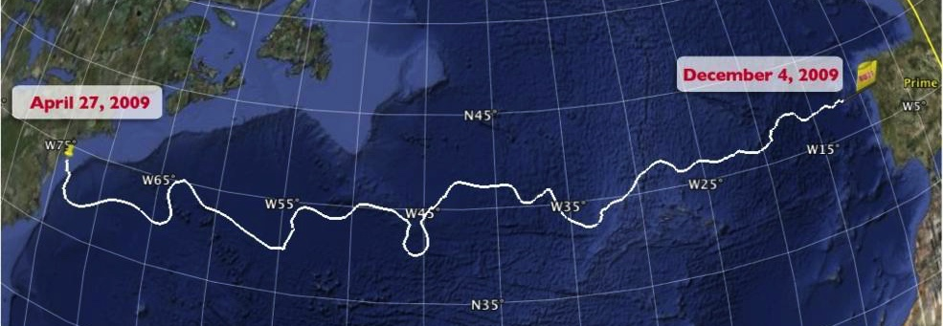
Underwater Gliders have Evolved Rapidly
1989 Science Fiction Article
1999
First Slocum deployed at Sea
2009
First Glider
crosses an Ocean Basin

Slide 13
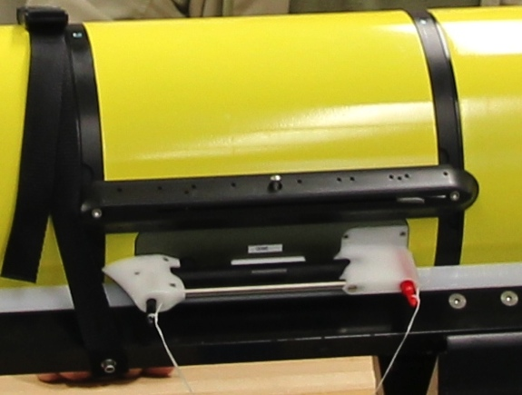
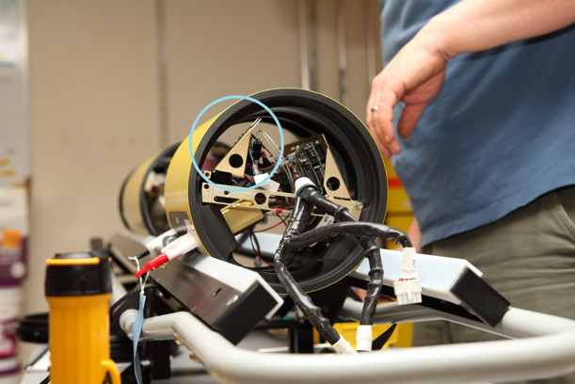
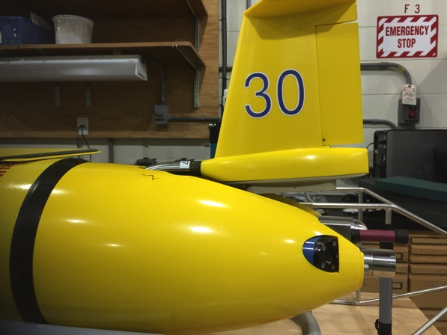
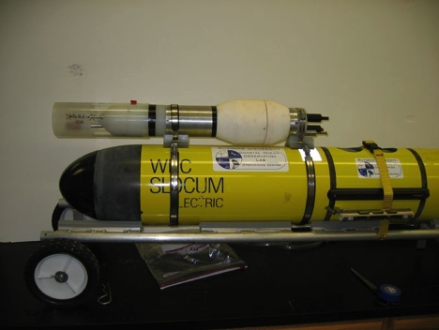
Gliders can carry a wide variety of sensors
Acoustic Modem
ADCP/DVL
Altimeter
Bathyphotometer (bioluminescence)
Beam Attenuation Meter
Echo Sounder
Optical Backscatter
Optical Attenuation
Oxygen
Conductivity, Temperature, Depth
Fish Tracking
Fluorometer
Hydrocarbon
Hydrophones
Nitrates
PAR sensor
Radiometer
Scattering Attenuation Meter
Spectrophotometer (red tide detection)
Turbulence
Wave Accelerometer
Internal Payload Bay
Internal
External Payload Area
External Mounted

Slide 14

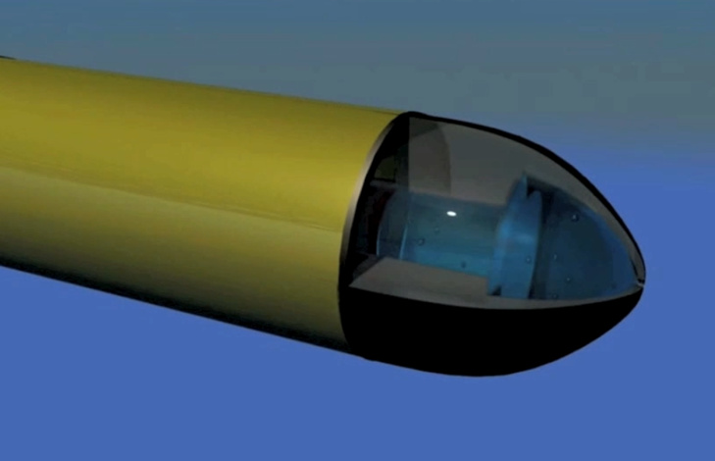
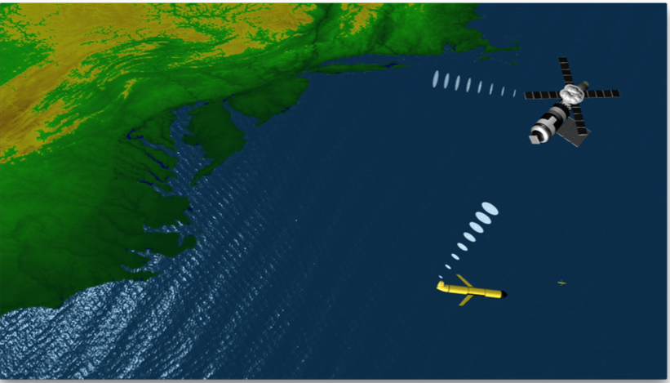
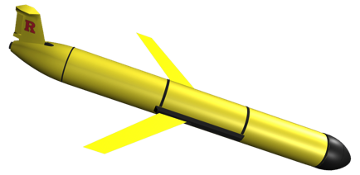
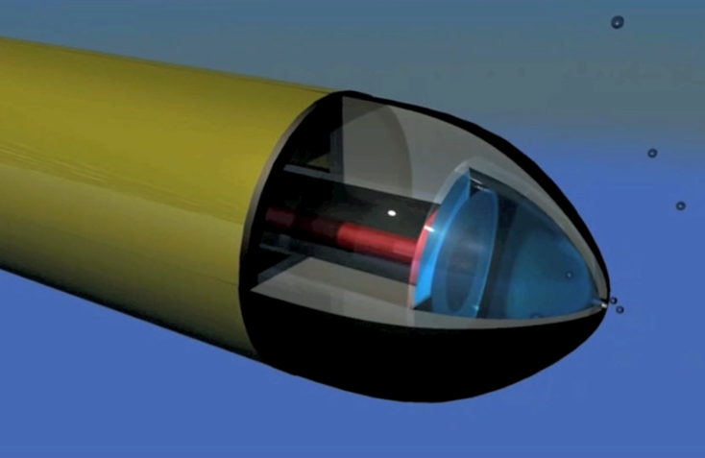
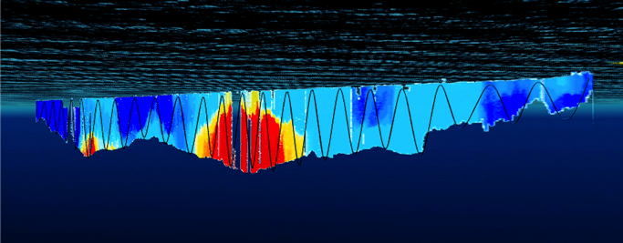
How an underwater Glider works…
At surface,
pump/diaphragm
decreases volume,
Glider descends
4. Glider surfaces,
acquires GPS,
communicates to
shore via satellite
3. Glider flies a saw tooth pattern,
collecting environmental data
along it’s path
2. At depth
pump/diaphragm
increases volume,
Glider ascends

Slide 15
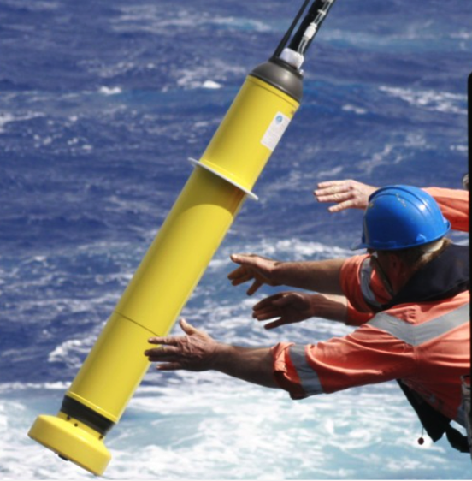
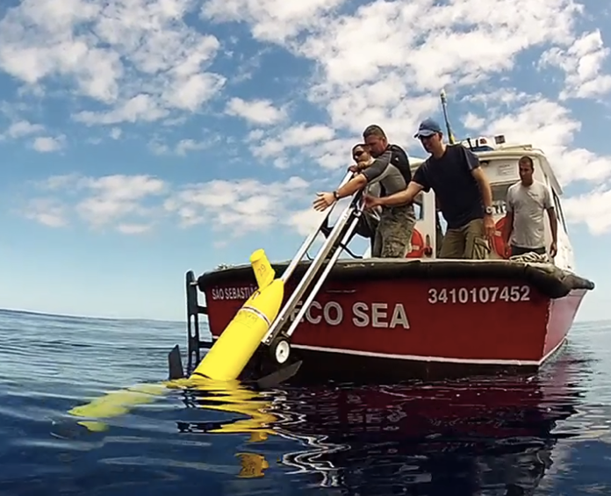
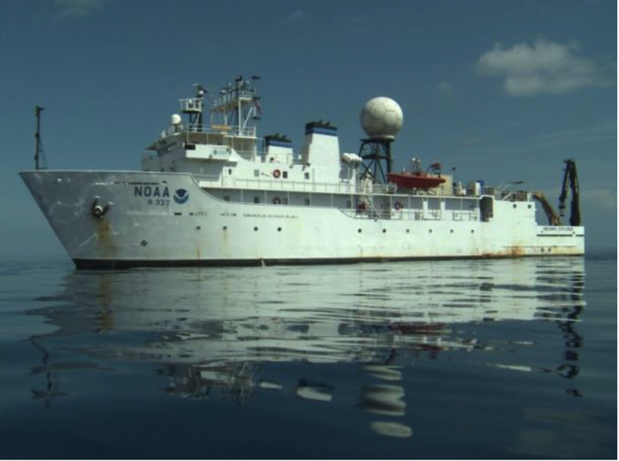
Mobile Subsurface Profile Observation Capabilities
Drifters
Gliders
Ships
Increasing Control, Capacity & Cost
Decreasing Endurance & Risk Tolerance

Slide 16
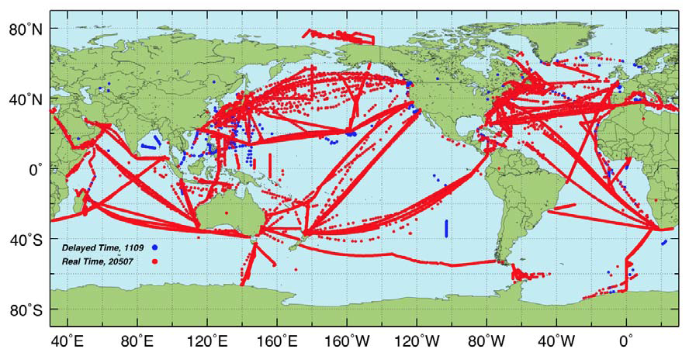
Sustained Subsurface Profile Observations
by Ships of Opportunity

Slide 17
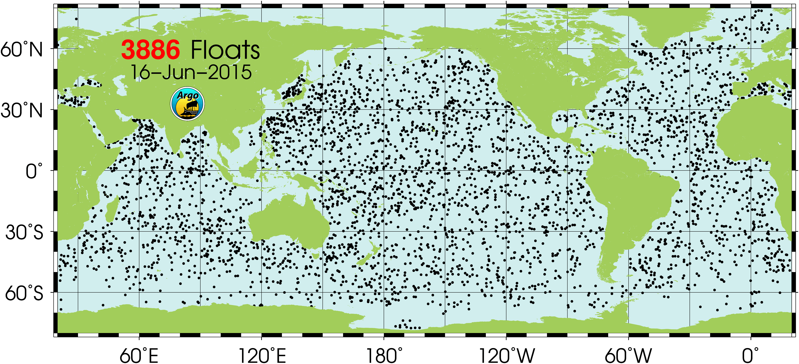
Sustained Subsurface Profile Observations
by Argo Drifters

Slide 18
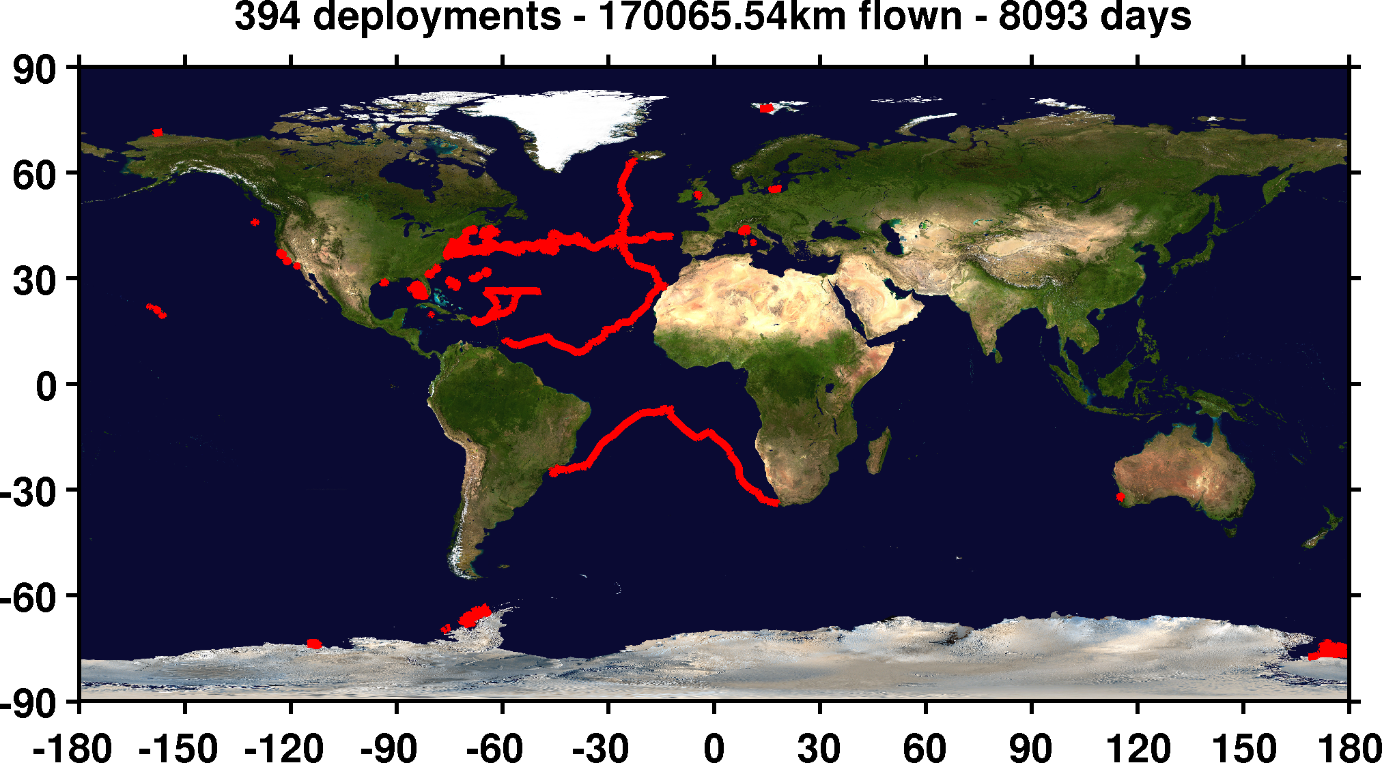
Sustained Subsurface Profile Observations
by Gliders - 1 Center

Slide 19
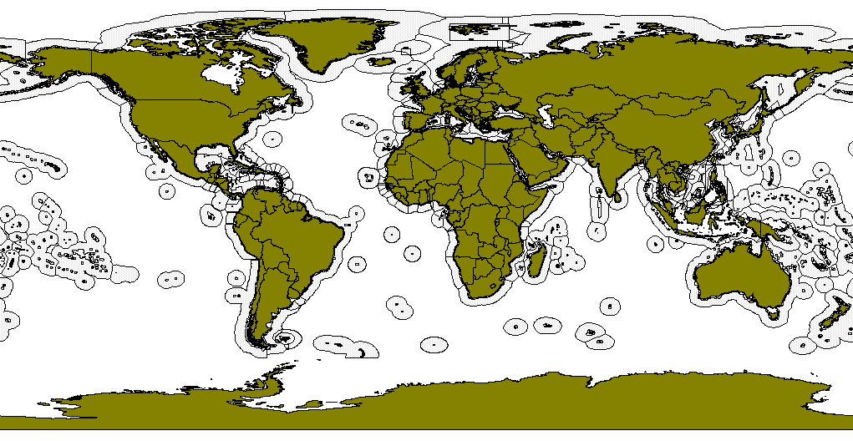
Large Marine Ecosystems & Exclusive Economic Zones
Gliders can fill the sustained coastal ocean profile sampling gap

Slide 20
Glider Challenge:
High Resolution for 4D Oceanic Measurements
Panel Presentations:
Pierre Testor – Building an international glider community and using gliders to resolve mesoscale and smaller features
Joaquin Tintore – Gliders as a sustained component of integrated observing and forecast systems
Karen Heywood – Gliders in remote and extreme environments
Alexandar Proelss – Legal aspects of glider operations
Discussion Points:
Where are the greatest needs for sustained 4-D oceanic measurements?
What are the barriers to progress?
What can we do together as an international community?
How can the IOC help?

