Slide 1

Climate change indicators
Benjamin P. Horton
Sea Level Research
Department of Marine and Coastal Science
Rutgers University bphorton@marine.rutgers.edu

Slide 2

National Academy of Sciences “changes observed over the last several decades are due to human activities”

Slide 3
American Association for the Advancement of Science
"Global warming is not a theory, it is a fact based on a growing torrent of information.”
"Scientific predictions of the impacts of increasing atmospheric concentrations of greenhouse gases from fossil fuels and deforestation match observed changes”

Slide 4
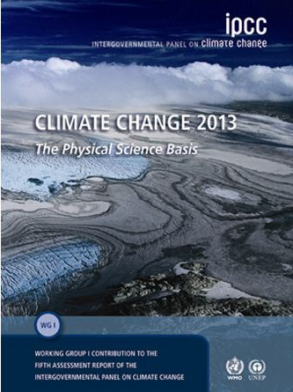
Intergovernmental Panel on Climate Change (IPCC)
"Warming of the climate system is unequivocal”
“There is a very high confidence that the globally averaged net effect of human activities since 1750 has been one of warming”

Slide 5
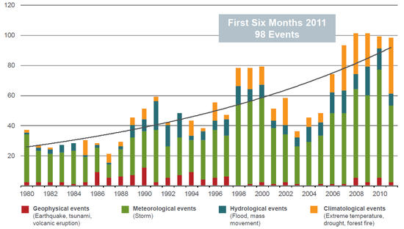
Munich Re (2011) Severe weather in North America:
“Climate­-driven changes are already evident over the last few decades …in North America”
“and the risks are changing faster than anywhere else”

Slide 6
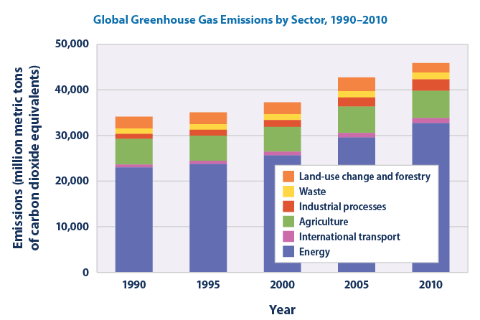
Global Greenhouse Gas Emissions

Slide 7
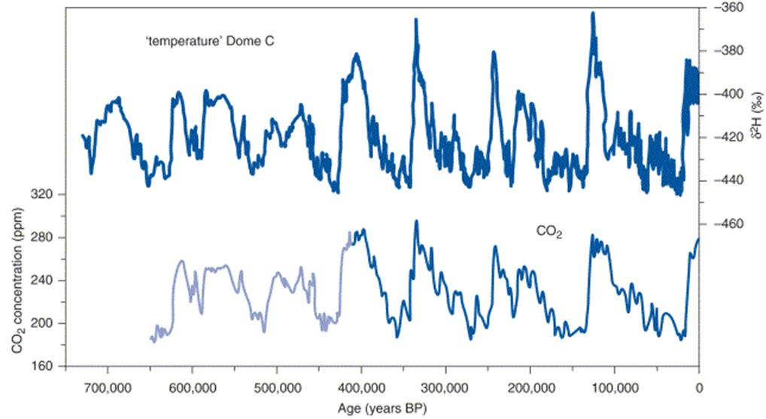
Relation between temperature and Carbon dioxide
Present day CO₂
(400 ppmv)

Slide 8
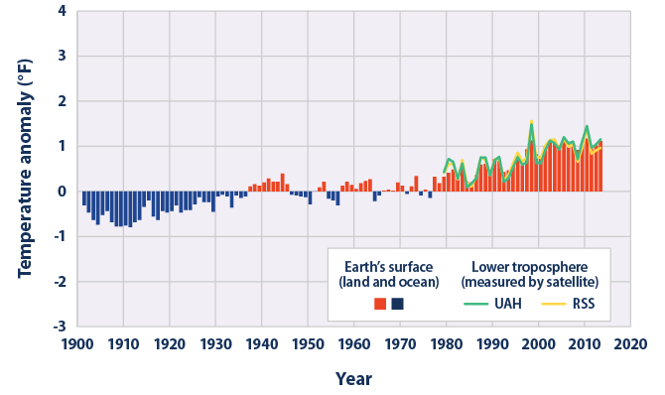
Temperatures Worldwide, 1901-2013

Slide 9
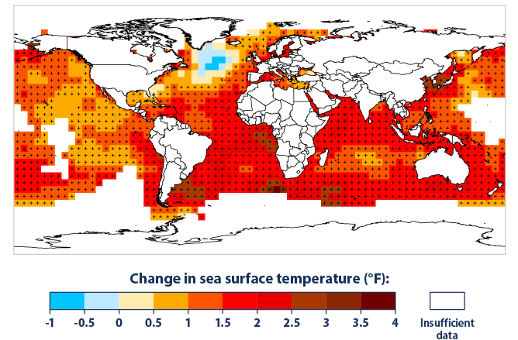
Sea surface temperature, 1901-2012

Slide 10
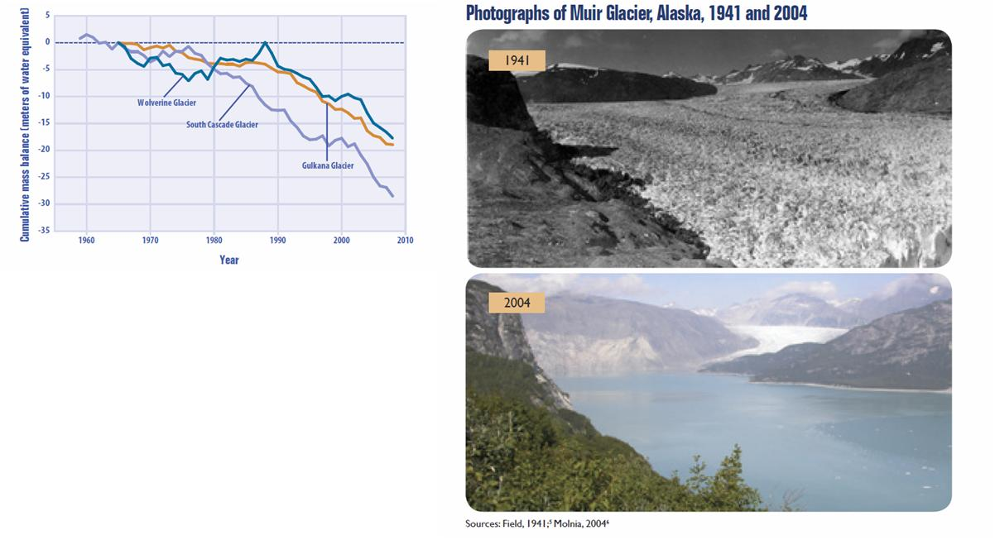
Melting Glaciers
Since 1960, glaciers worldwide have lost more than 2,000 cubic miles of water.
The rate at which glaciers are losing volume appears to have accelerated over roughly the last decade.

Slide 11
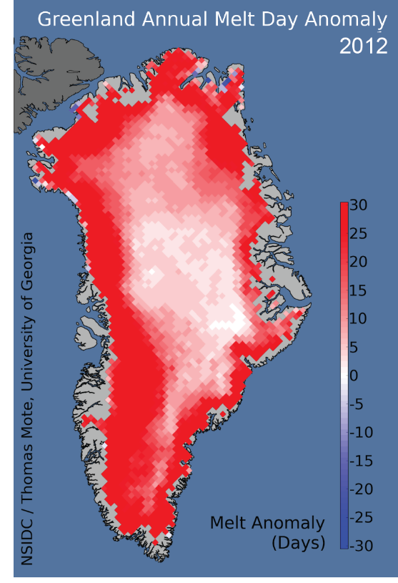
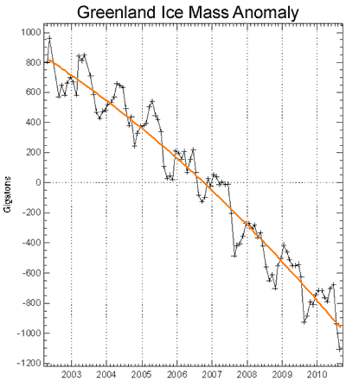
The Endangered Greenland Ice Sheet

Slide 12
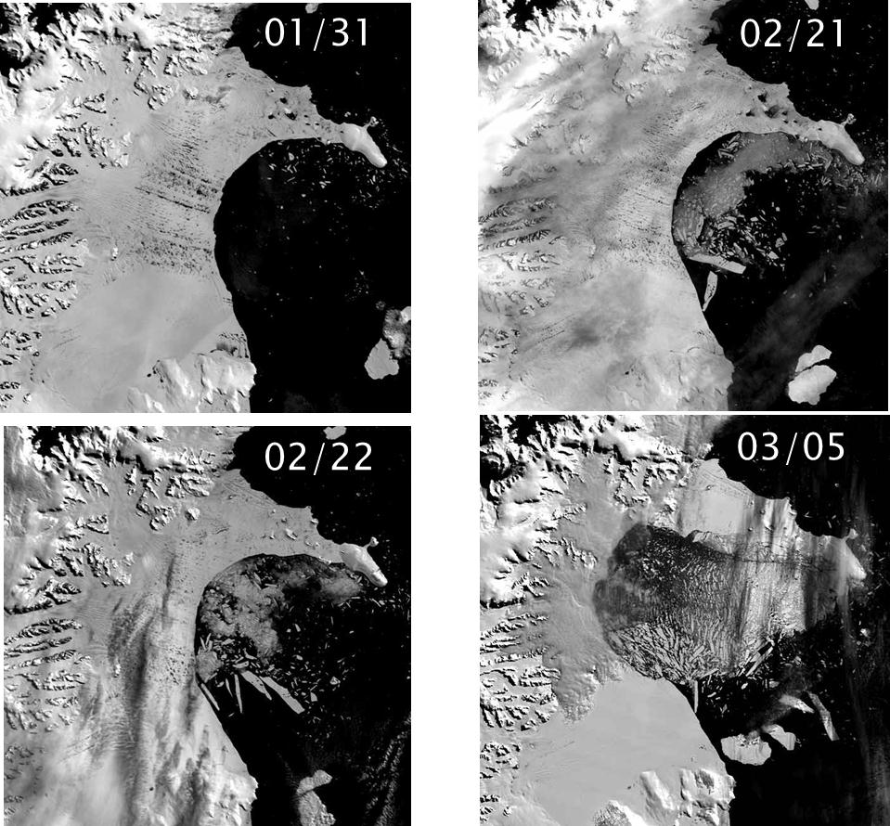
Collapsing Antarctica Ice Shelves!
From 31 January to 5 March the Larsen B sector collapsed and broke up,
3,250 km² of ice 220 m thick, disintegrated and collapsed in one season.
Larsen B had been stable for up to 12,000 years

Slide 13
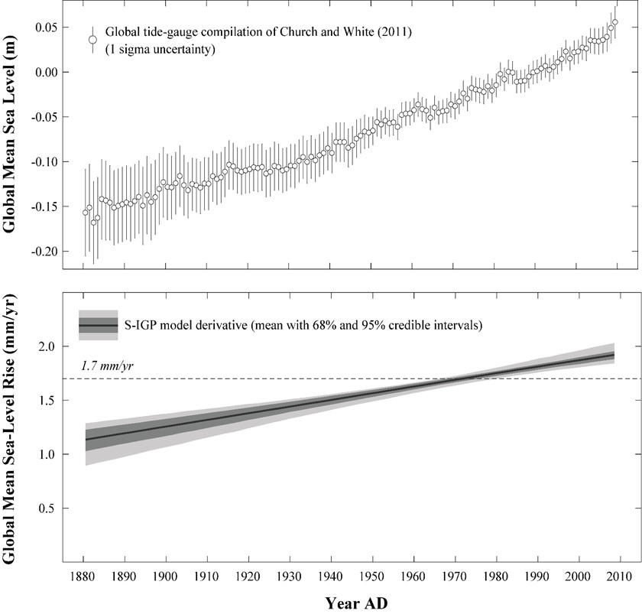
Rising Sea Levels
Sea-level
rise
Current sea level rise is about 3 mm/year worldwide and the rate is increasing
Rate of sea-level rise

Slide 14
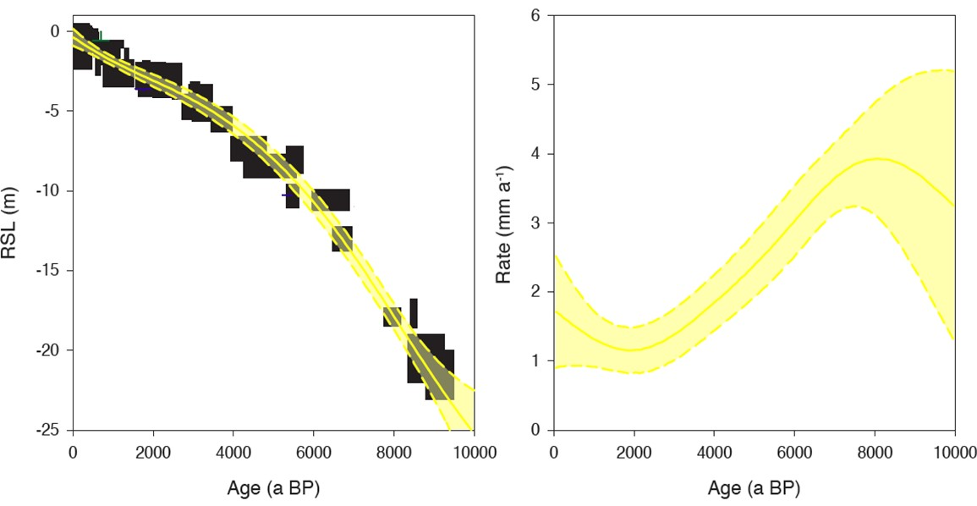
Rising Seas of the past
10,000 year record of sea-level change for New Jersey
Sea-level
rise
Rate of sea-level rise
Present day rate at Atlantic City

Slide 15
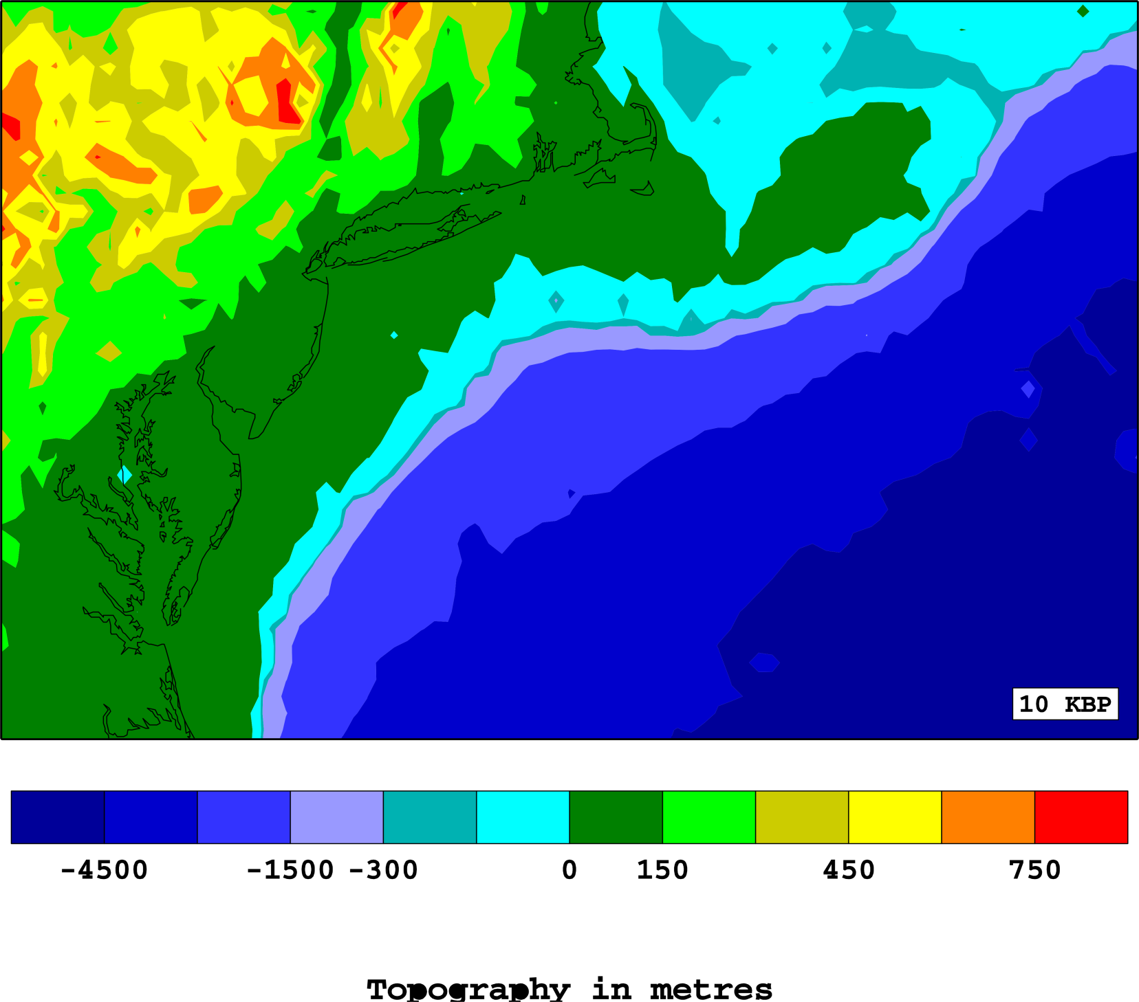
10,000 years ago

Slide 16
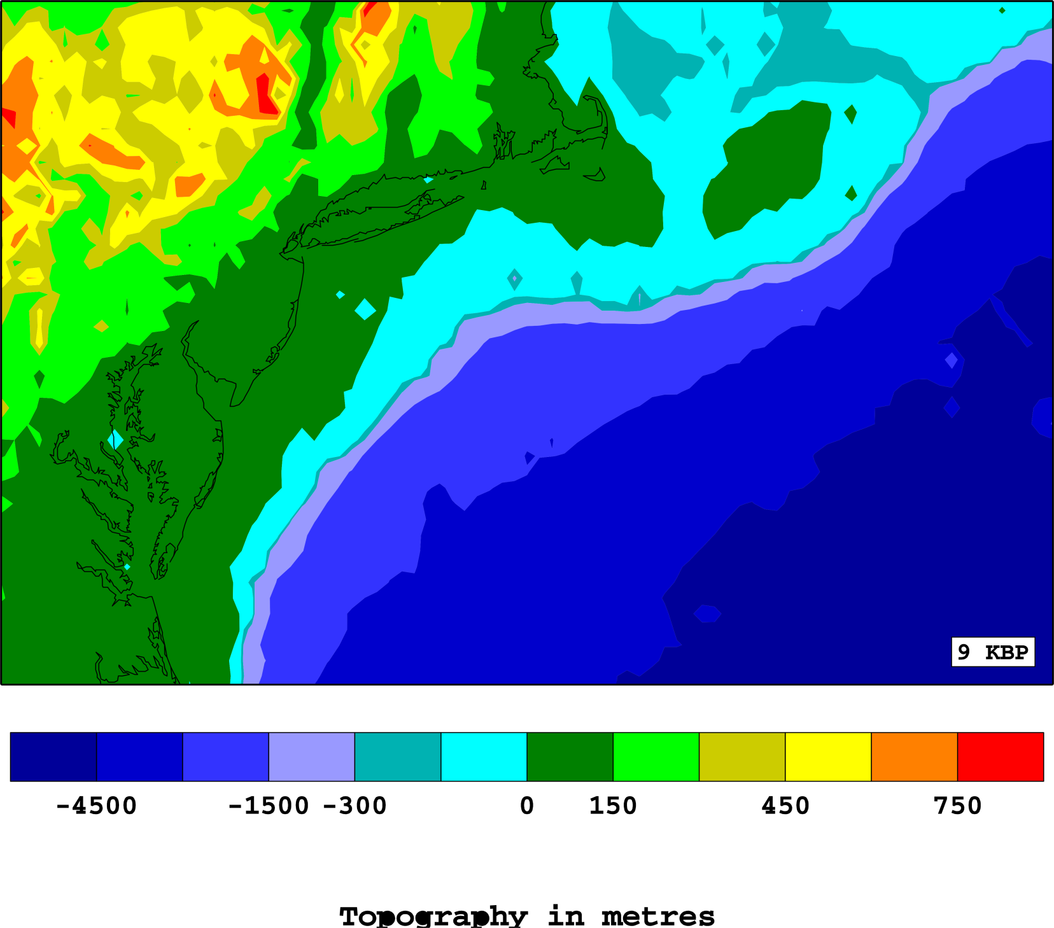
9,000 years ago

Slide 17
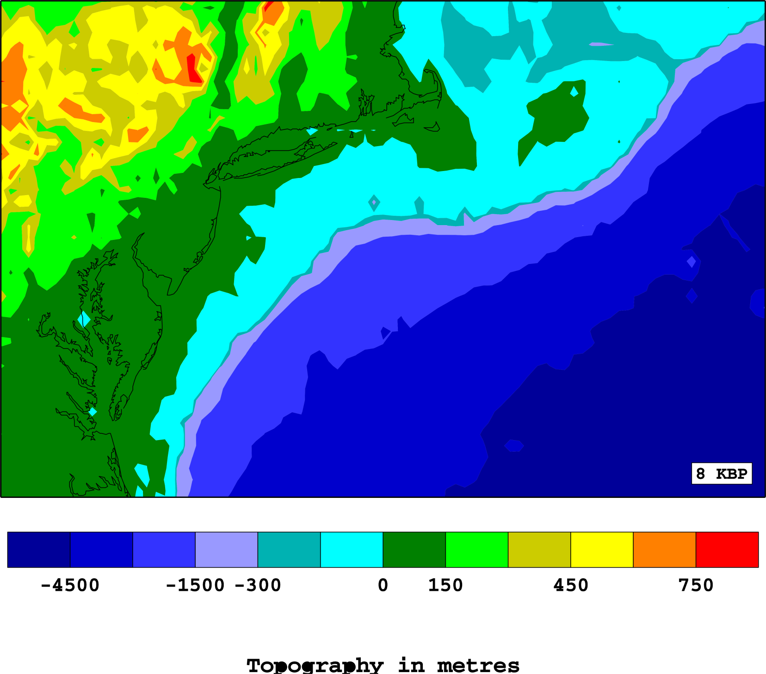
8,000 years ago

Slide 18
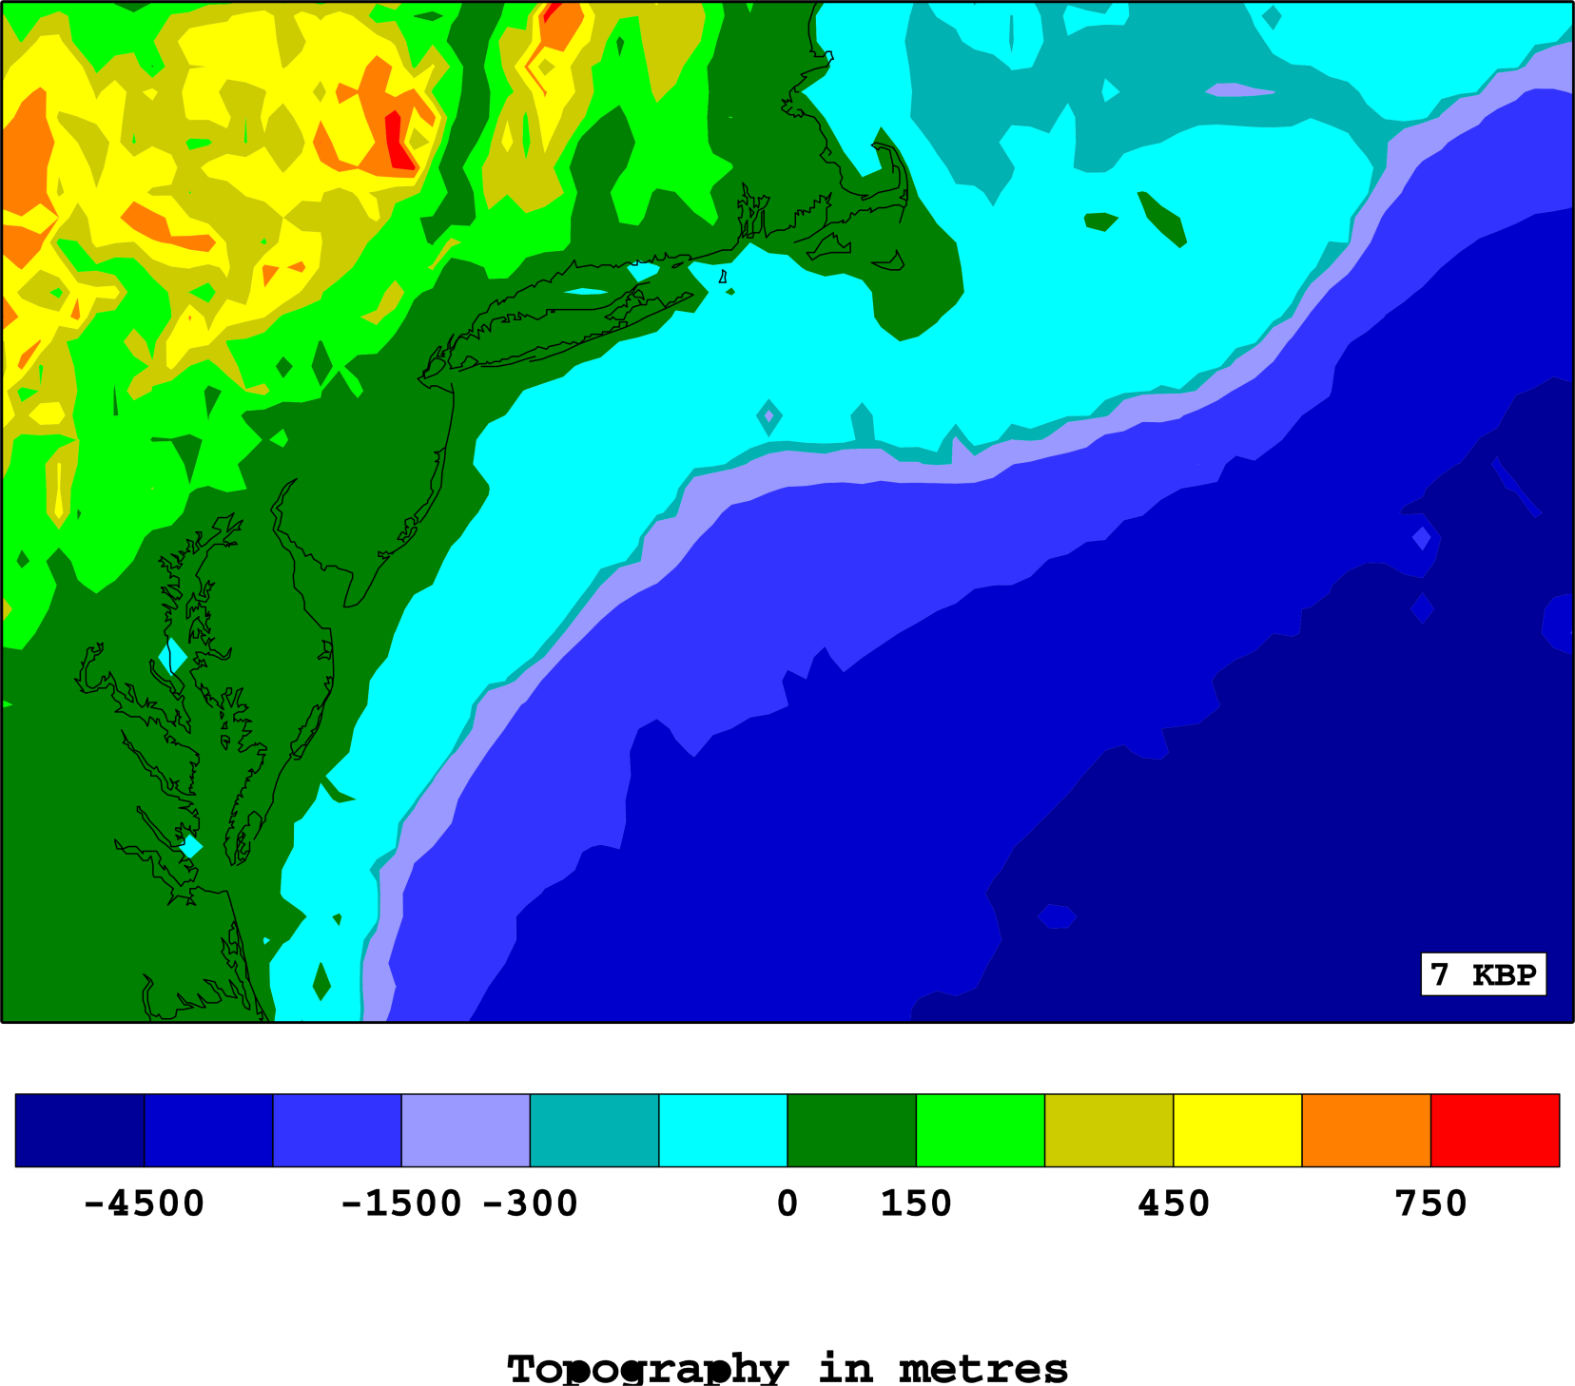
7,000 years ago

Slide 19
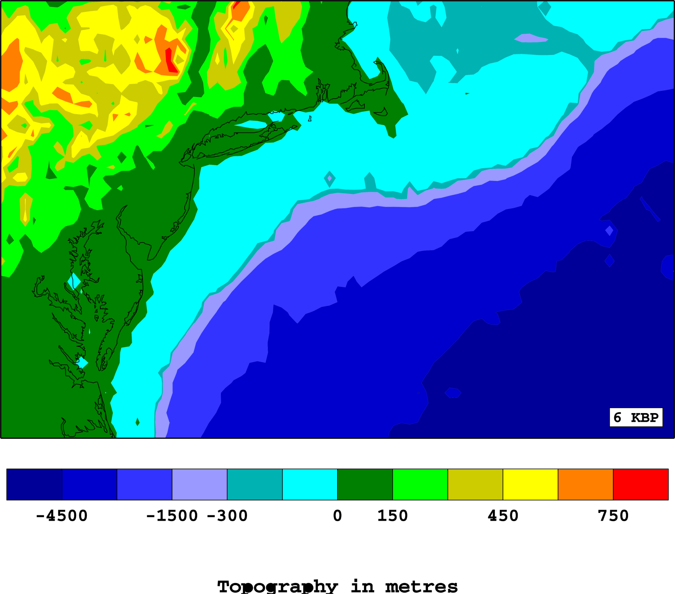
6,000 years ago

Slide 20
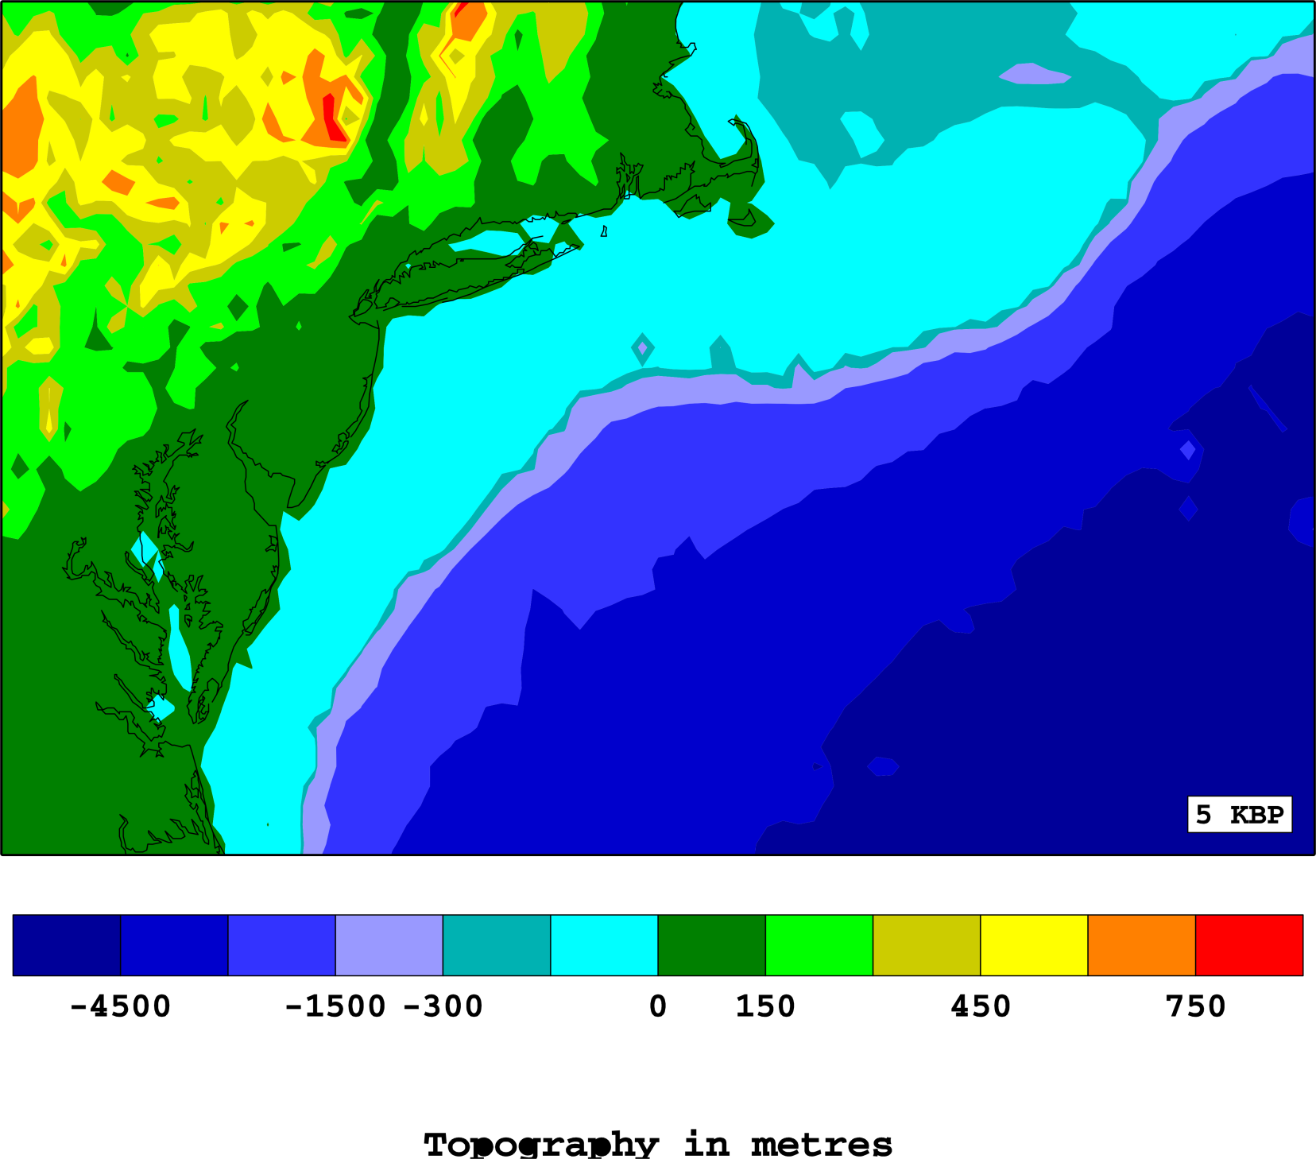
5,000 years ago

Slide 21
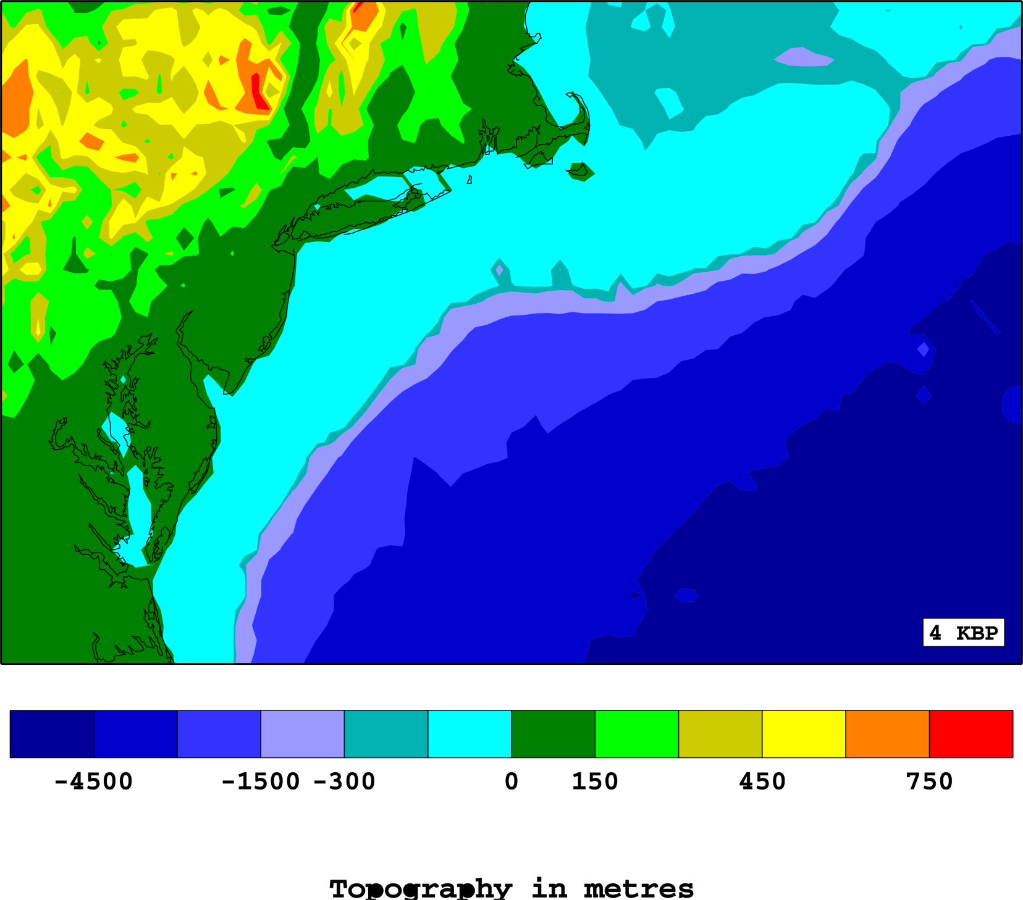
4,000 years ago

Slide 22
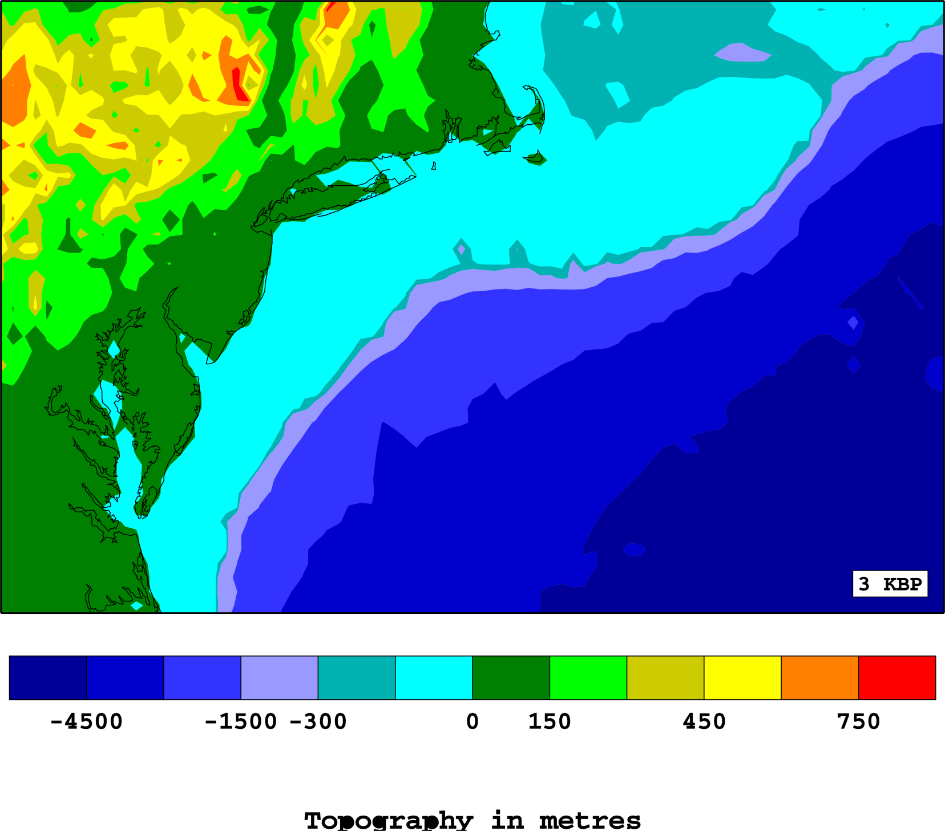
3,000 years ago

Slide 23

2,000 years ago

Slide 24
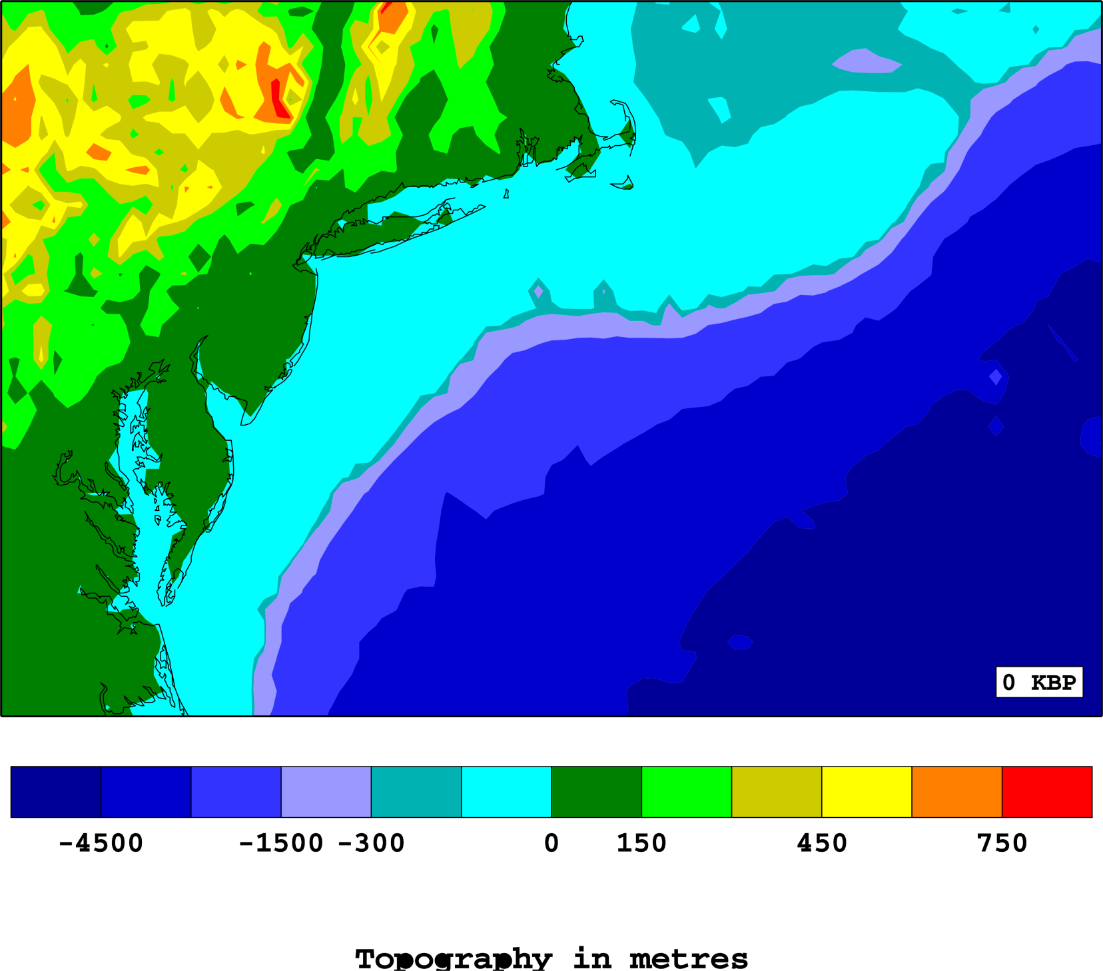

1,000 years ago

Slide 25
Present day

Slide 26
Rising Seas of the Common Era

Slide 27
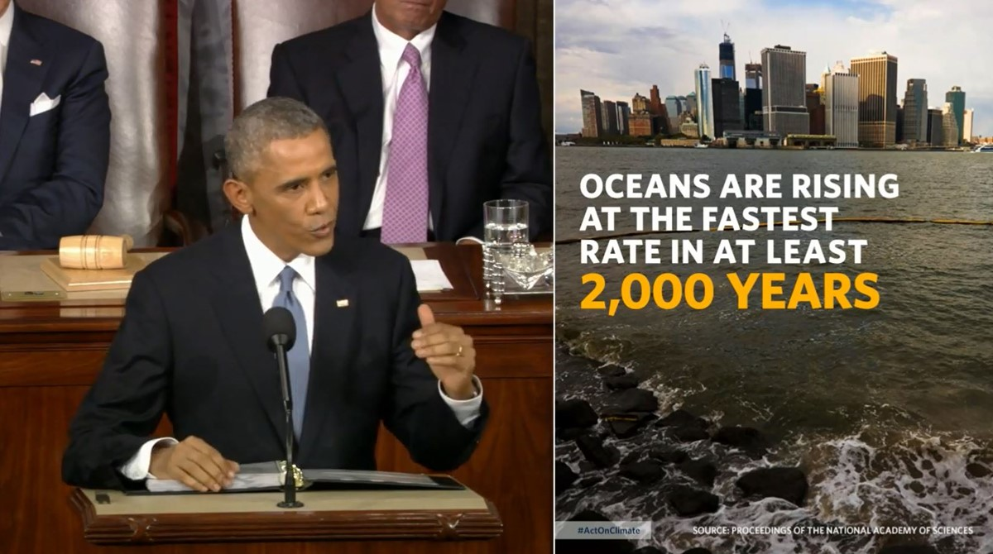
INFORMING POLICY: My PNAS paper on Common Era sea-level rise was referenced by President Obama in his 2015 State of the Union Address at the United States Capitol on January 20, 2015

Slide 28

BROADER OUTREACH:
Shored Up is a documentary that asks tough questions about our coastal communities and our relationship to the land. What will a rising sea do to our homes, our businesses, and the survival of our communities
Next showings:
Rutgers, 23rd April
Pennington Public Library 26th April

Slide 29
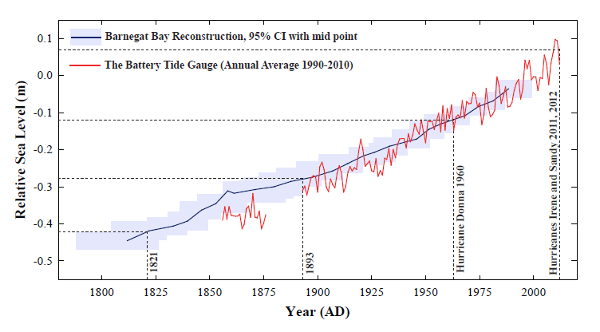
Rising baselines of landfalling hurricanes in NYC

Slide 30
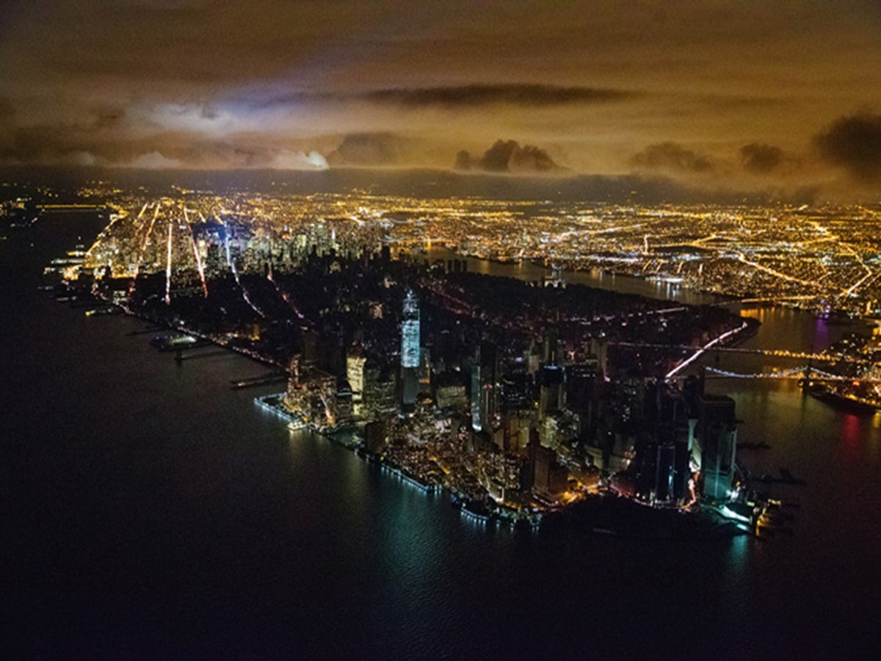
Hurricane Sandy in 2012
As the world warms, it may see more storms like Sandy. BUT It will certainly see higher seas

Slide 31
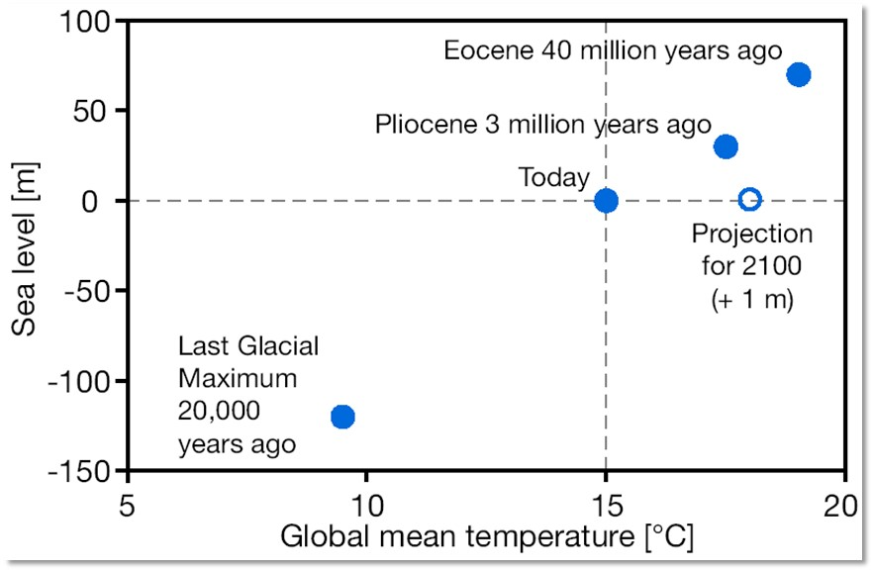
To summarize
U.S. Coast: 29% of the national population, including five of the ten largest cities, generating 45% of GDP ($6.6 trillion annually).
Eocene 120 thousand years ago

Slide 32
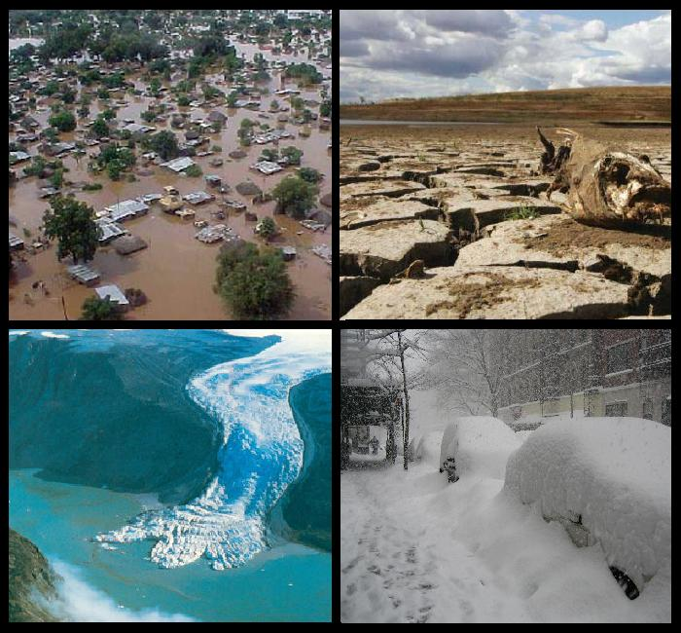
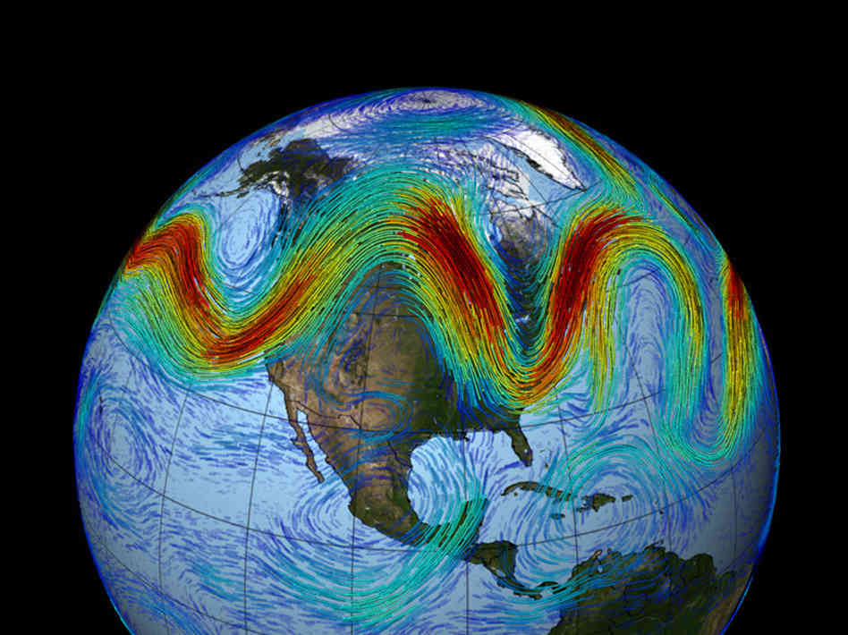
Crazier Weather and Climate Change:
Are They Connected?
Jennifer Francis
Department of Marine and Coastal Sciences

Slide 33
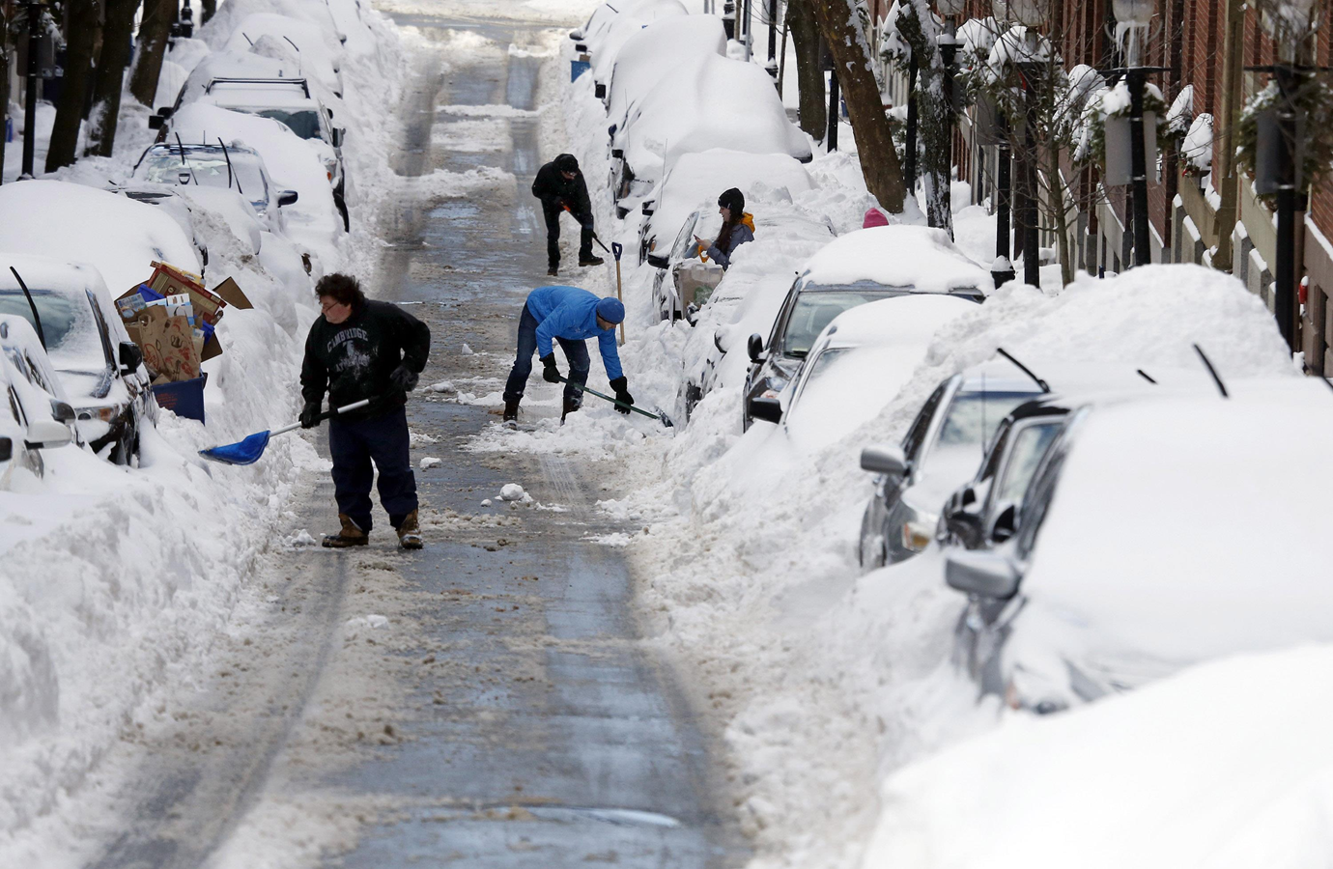
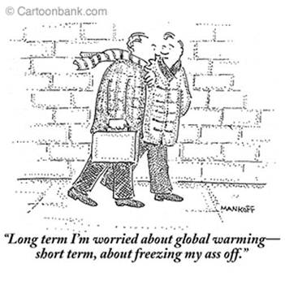
“Long term I’m worried about global warming –
Short term, about freezing my ass off.”
Boston
One of the many Boston snowstorms during winter 2015
The New Yorker

Slide 34
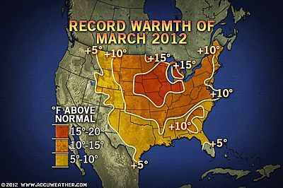

Slide 35
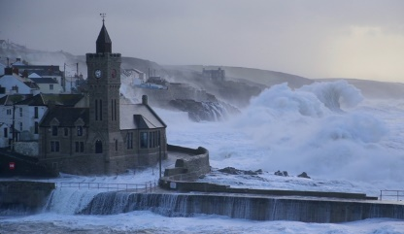
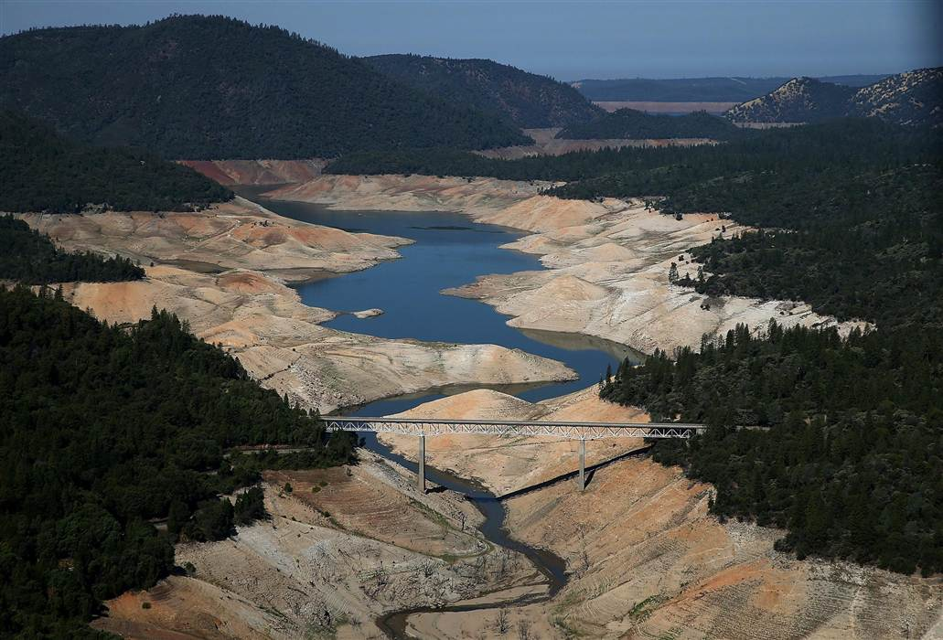
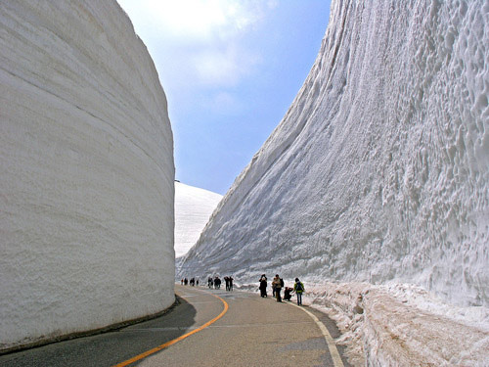
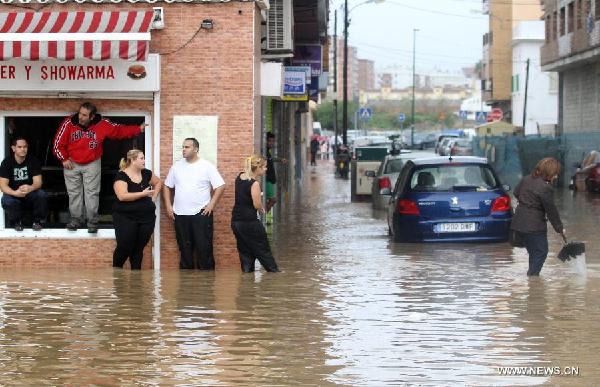
Extreme weather events are on the rise…
Extreme weather events are on the rise…
Extreme weather events are on the rise…
Extreme weather events are on the rise…
California 2015
Spain 2012
Japan 2012
U.K. Winters 2014, 2015

Slide 36
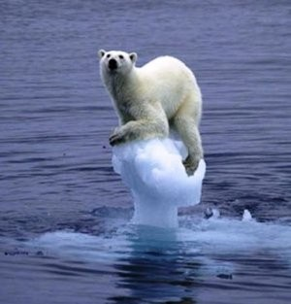
Is human-caused climate change
playing a role?
So, what the heck is going on??
YES!

Slide 37
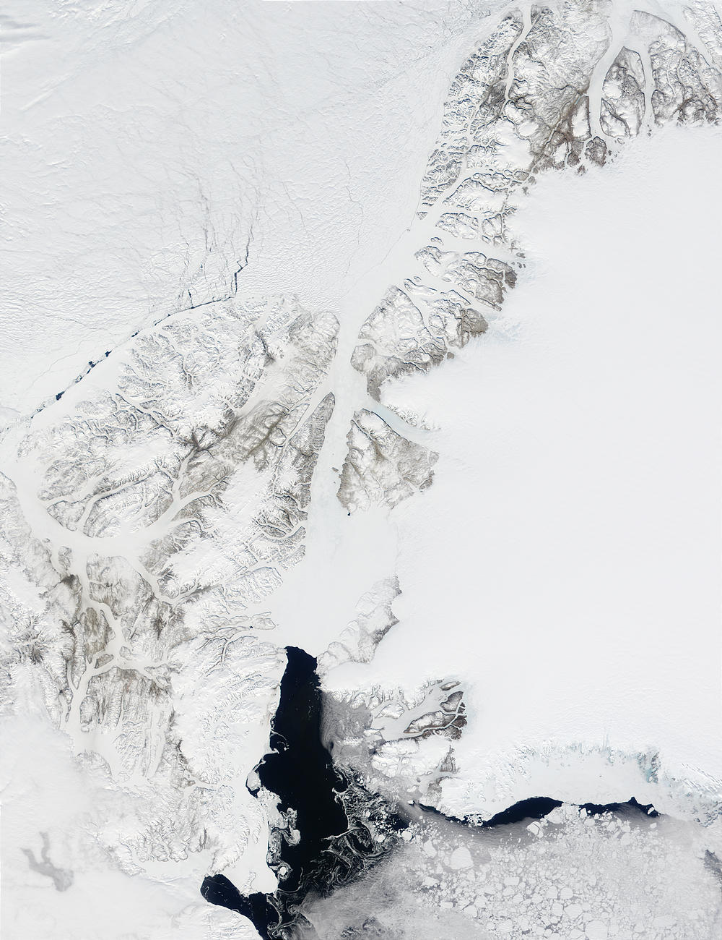
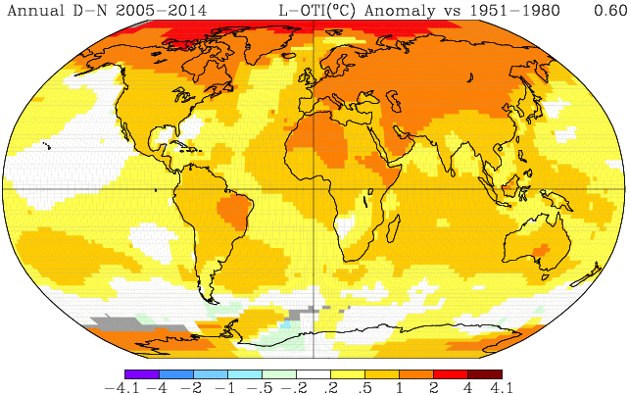
r i s i n g…
The Earth’s temperature is
although not evenly around the globe.
2005 to 2014
Surface Temperature
Difference from normal
From NASA/GISS

Slide 38
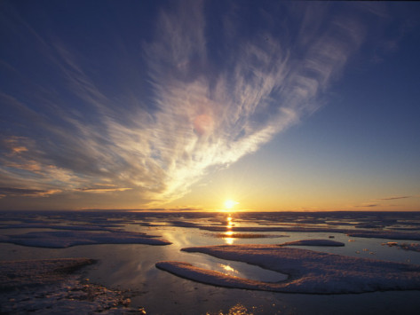
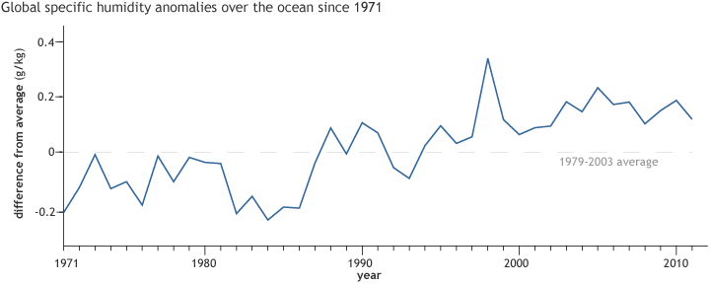
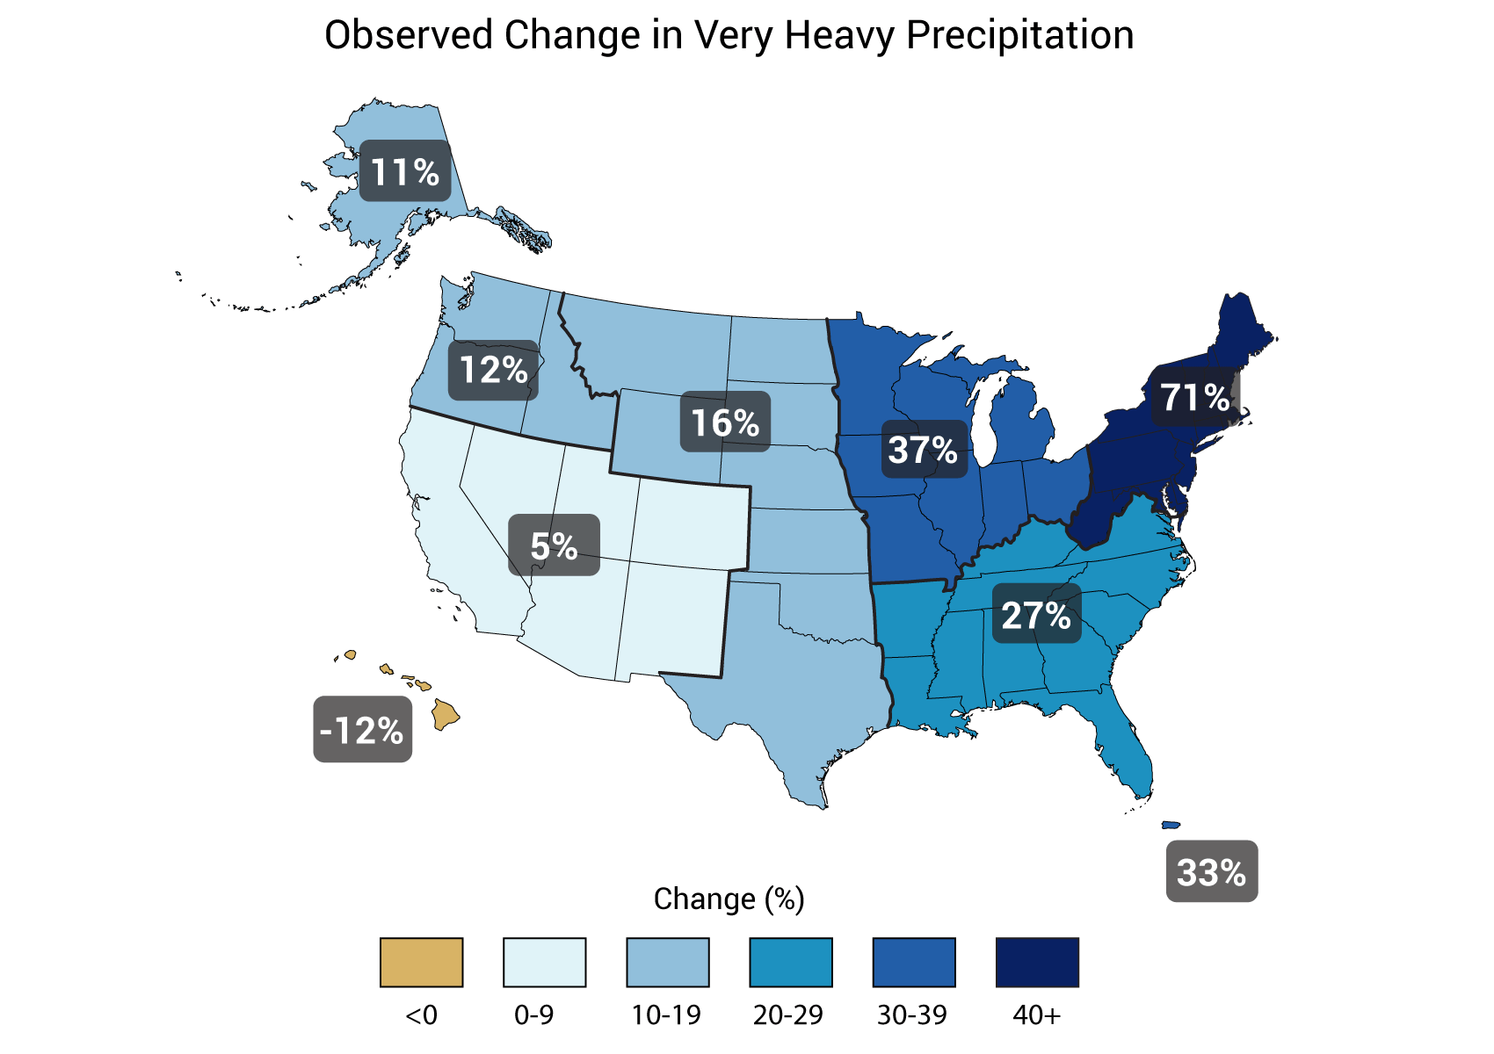
And the atmosphere is gaining moisture…
Global average humidity
…providing more fuel to energize storms, a stronger greenhouse effect…
…and more frequent heavy precipitation events
from ClimateWatch.noaa.gov

Slide 39
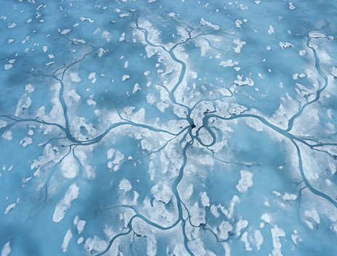
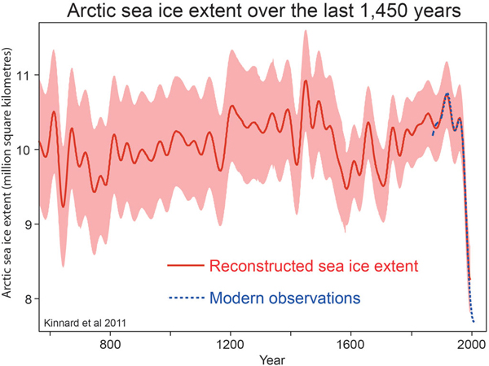
Arctic sea ice is disappearing…
*
2013, 2014
*
2012

Slide 40
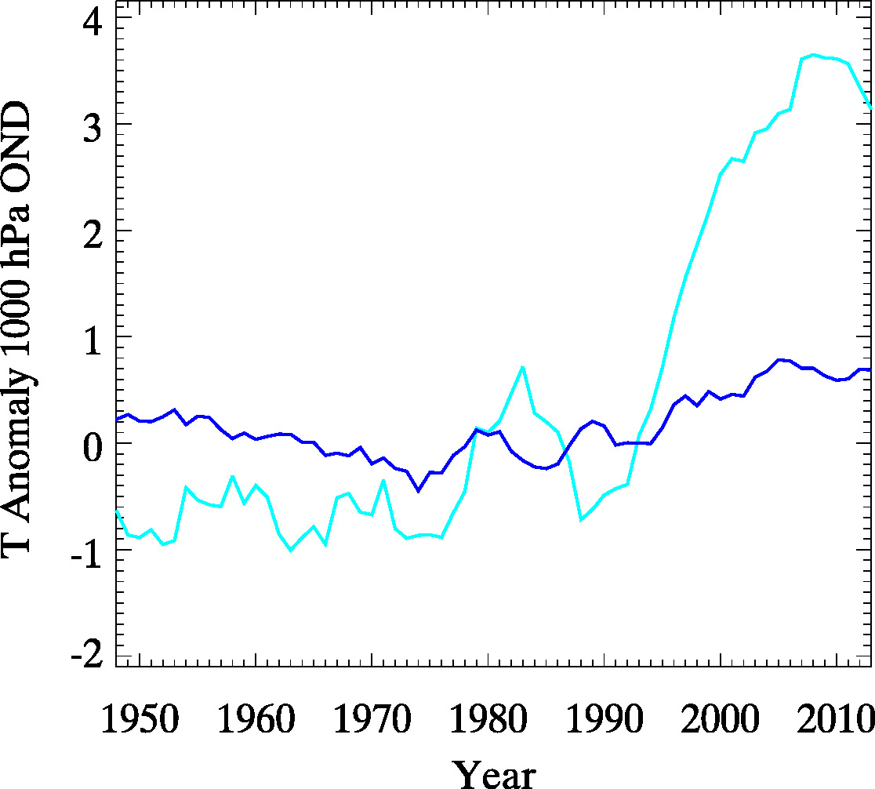
Leading to rapid Arctic warming…
Near-surface air temperature (Fall)
Arctic
Mid-
latitudes

Slide 41
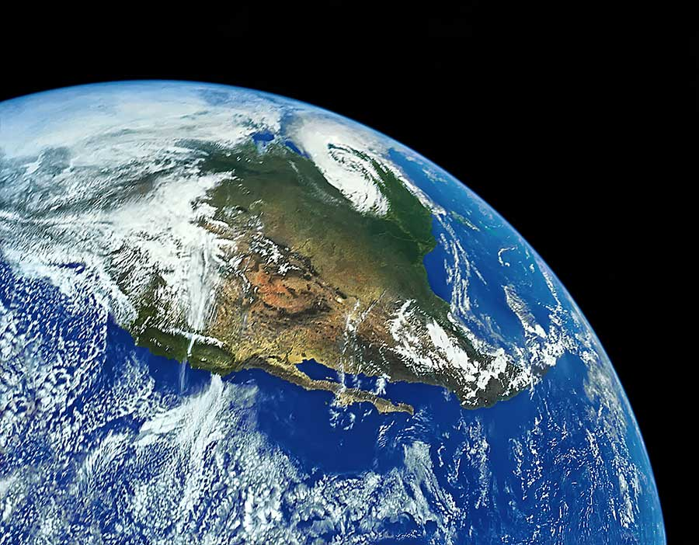
Consider a layer of atmosphere stretching from here (warm) to the Arctic (cold)
Because warm air expands, the layer will be thicker here than it is in the Arctic.
Air flows down this “hill”, turns to the right as the Earth spins, and creates the Jet Stream
COLD
As the Arctic warms faster, the hill flattens, and the jet stream weakens.
A weaker jet is a wavier jet.
WARM

Slide 42
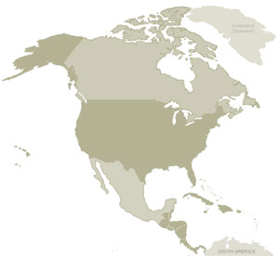
When the waves are small, they move eastward quickly.
When the waves are large, they shift eastward more slowly.

Slide 43
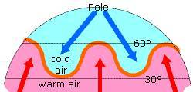
Why do we care about these waves?
The Jet Stream makes our weather
Jet stream
animation
Wet and
stormy
Dry and
settled

Slide 44
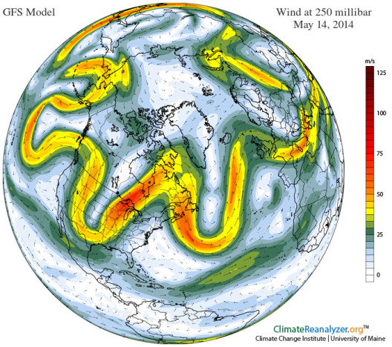
Is the jet stream
becoming wavier?

Slide 45
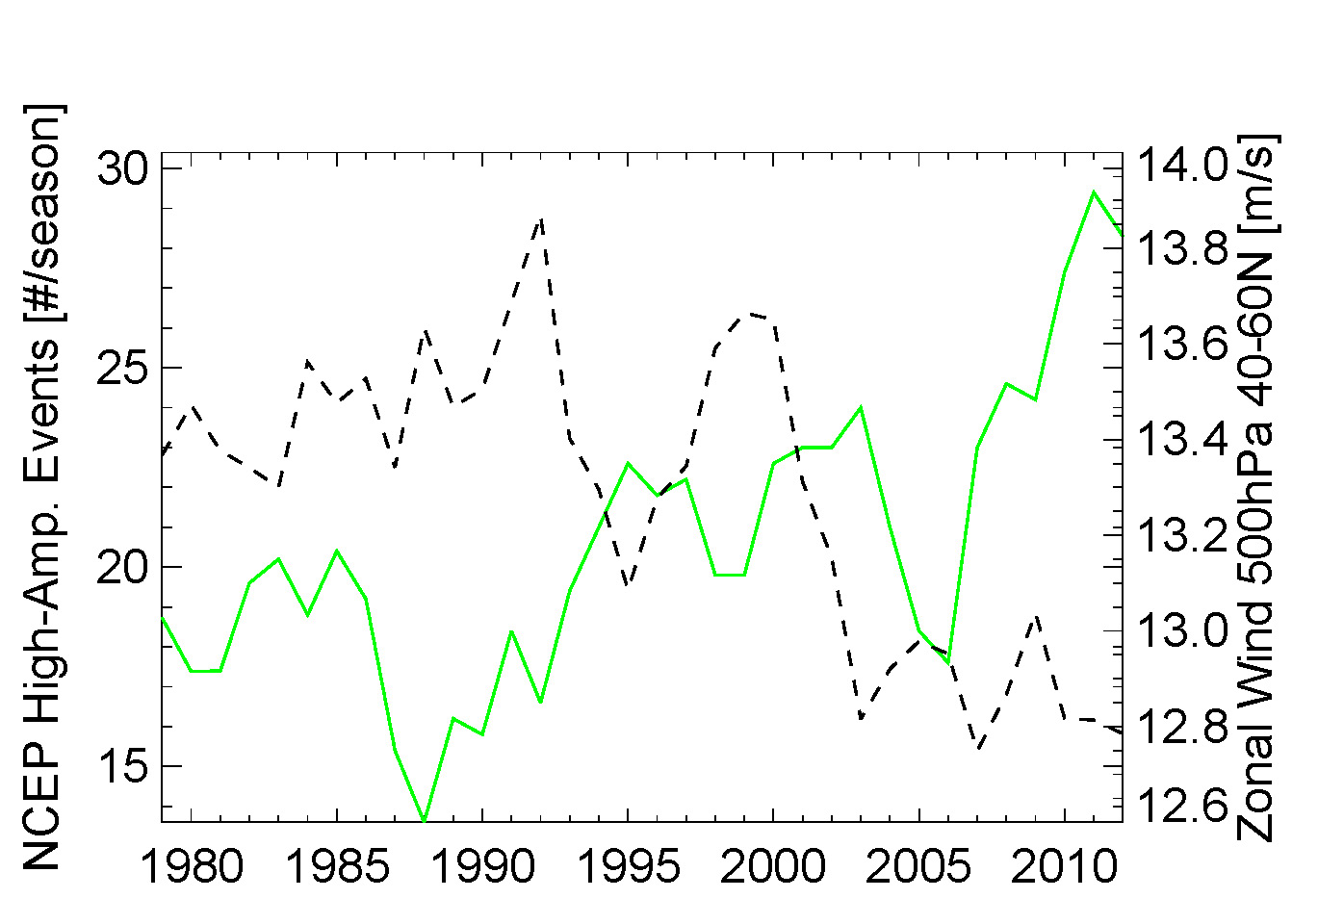
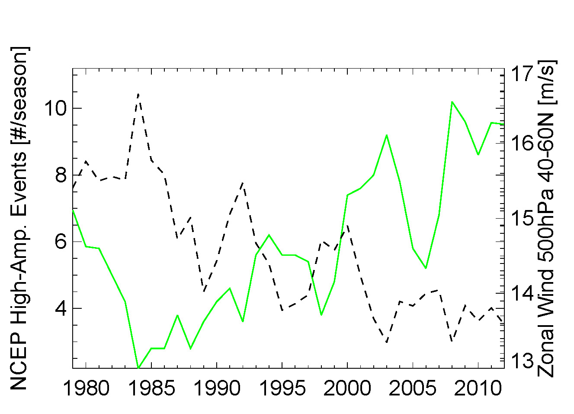
Wavy jet streams are happening more often
Fall (Oct-Dec) Northern Hemisphere
Fall (Oct-Dec) Northern Hemisphere
Fall (Oct-Dec) North Atlantic
High-amplitude waves
Upper-level westerly winds
Upper-level westerly winds

Slide 46
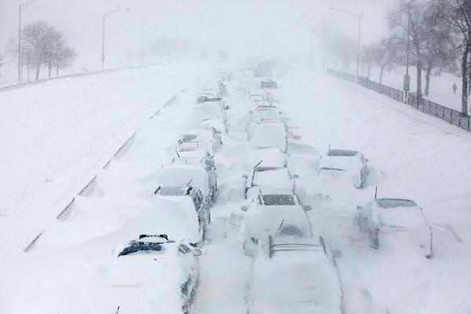
Do recent extreme weather events patterns fit this story?

Slide 47




March 2012
Feb. 1-14 2015
Surface Temp. differences from normal
Accuweather

Slide 48


Did Climate Change Contribute to Sandy?
YES! – In At Least 5 Ways
Sea level rise
Warmer oceans
Warmer air
More water vapor
Arctic sea ice loss?
Was block strengthened, extended northward, or prolonged by warm Arctic?
The Arctic was MUCH warmer than normal
We think so.
Blocking High

Slide 49

THANK-YOU !!
francis@imcs.rutgers.edu

Slide 50

RI
U..
10 States - 76 Million People
1000 km Cape to Cape
CT
Cape
Cod
MA
NY
Mid-Atlantic Region
PA
NJ
DE
MD
Rutgers
responds to
Hurricanes
Irene and Sandy
Sandy
Irene
VA
Scott Glenn + Many
Rutgers & Beyond
NC
Cape
Hatteras
Notes:
50

Slide 51


Hurricane Irene
August 28, 2011
NOAA/NHC Damage:
#7 with >$16 Billion.
Track Accurate;
Intensity Over-predicted.
Hurricane Sandy
October 29, 2012
NOAA/NHC Damage:
#2 with >$68 Billion.
Track Accurate;
Intensity Under-predicted.

Slide 52


National Hurricane Center: Track and Intensity Error
Forecast Track Error:
Steady improvement over 2 decades.
Forecast Intensity Error:
“long-term trend is flat”,
“little skill”.
Production Suite Review: December 4, 2012

Slide 53


Hurricane Irene in the News:
Track accurately forecast
days in advance.
Intensity (wind speed) was over-predicted.
Need to close the Intensity Science Gap!

Slide 54


Hurricane Intensity is modulated by upper ocean heat content
Rapid intensification of Katrina over warm ocean water

Slide 55

National Hurricane Center: Intensity Skill in 2012
But
adding the ocean model reduces forecast skill.
WE NEED A BETTER OCEAN!

Slide 56

















Rutgers University - Coastal Ocean Observation Lab
Observatory Operations, Data Fusion & Training Center
L-Band & X-Band Satellite Receivers
CODAR Network
Glider Fleet
3-D Nowcasts
& Forecasts
Notes:
56

Slide 57



Hurricane Irene Track August 26-29 2011
Two Gliders Deployed

Slide 58





Pre-Irene
Post-Irene
Difference
11C max Cooling
WHAT?
Rutgers
Satellite
Temperature
WHEN? Rutgers Glider Temperature
WHY?
Rutgers Radar
Currents
Eye Passage

Slide 59






Rutgers Atmospheric Forecast Sensitivity Study
Warm Ocean
Boundary Condition
Cat 1 Hurricane
Tropical Storm
Cold Ocean
Boundary Condition
IMPACT?
>10 knots reduction in peak wind speed

Slide 60
Hurricane Irene
August 26, 2011
Strong Stratification
Limited storm surge
Mixing cooled surface
Limited intensity
Hurricane Sandy
October 29, 2012
NOAA/NHC Damage:
#2 with >$60 Billion.
Track Accurate;
Intensity Under-predicted.

Slide 61

First Warning for Hurricane Sandy:
Monday, Oct 22, 1-week prior to landfall
Rutgers Response: Prepare the Network

Slide 62



Superstorm Sandy: 2 Days Before Landfall
Rutgers Student
Travis Miles

Slide 63

Superstorm Sandy: 1 Day Before Landfall

Slide 64

Superstorm Sandy: Morning Before Landfall

Slide 65

Superstorm Sandy: Landfall (20:00 Local)

Slide 66




Sandy’s
Under-predicted Impact

Slide 67
Hurricane Irene
August 26, 2011
Strong Stratification
Limited storm surge
Mixing cooled surface
Limited intensity
Hurricane Sandy
October 29, 2012
After fall transition
Single layer ocean
No mixing/cooling
No escape for surge

Slide 68





Path Forward
National Level:
Design & Build a new Storm Glider
Demonstrate a Rapid Response Capability
Embed a Rutgers Student in NCEP
Hurricane Arthur Response 2014
Greg
Seroka
Storm Glider RU30

Slide 69




Path Forward
State Level:
Establish the Nation’s First State Oceanographer
NJ State Senate
Introduced October 14, 2014
NJ State Assembly
Introduced January 12, 2015

Slide 70


Path Forward
University Level:
Changing the face of Oceanography
From the Raritan Initiative to the global Challenger Glider Mission

