Slide 1
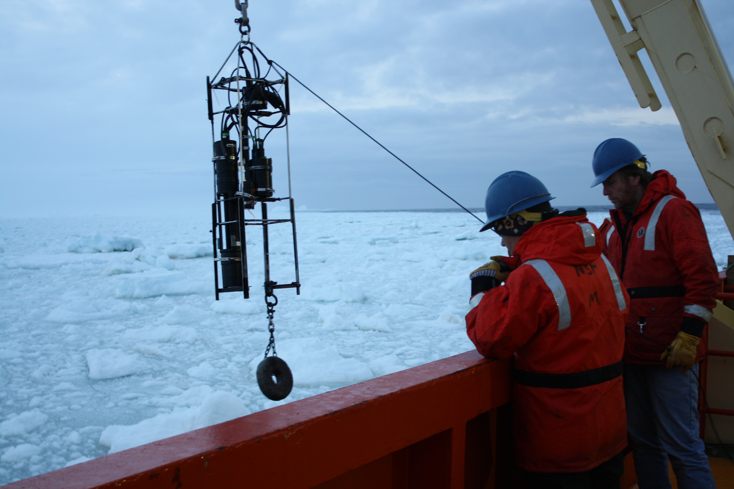
Other Relevant Ship Operations to ORCAS
-At each master station: Profiles of AC-9, Ecopuck to complement the Ship CTD (beam-c, oxygen, chlorophyll fluorescence. PAR)
-Selected stations spectral downwelling irradiance and upwelling radiance

Slide 2
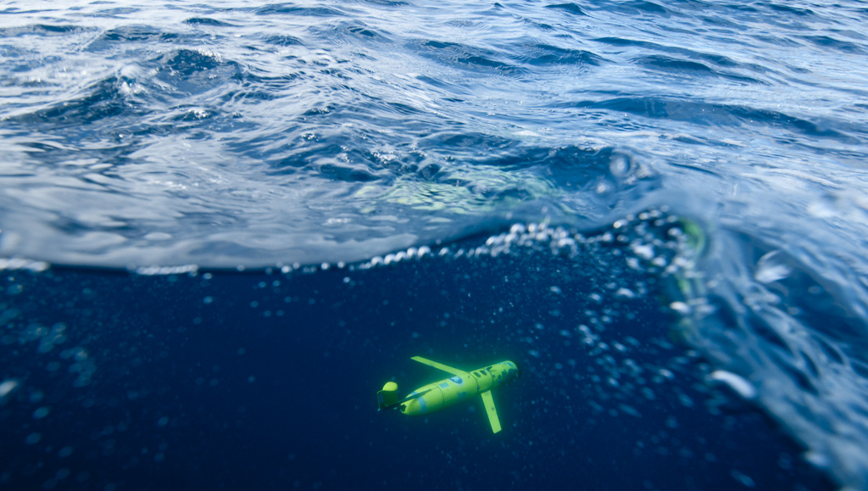
LTER Glider Operations

Slide 3
Two classes of glider (Slocum) operations
Coastal gliders operations (200 meter class) (42 missions since 2006). Research focus on:
  -physical regulation of the nearshore phytoplankton blooms
  -photophysiology of phytoplankton
  -processes regulating penguin foraging
Deep gliders operations (2000 meter class) (6missions since 2009). Research focus on:
  -shelf-wide transport of the circumpolar current across the WAP shelf
  -subsurface eddy dynamics

Slide 4
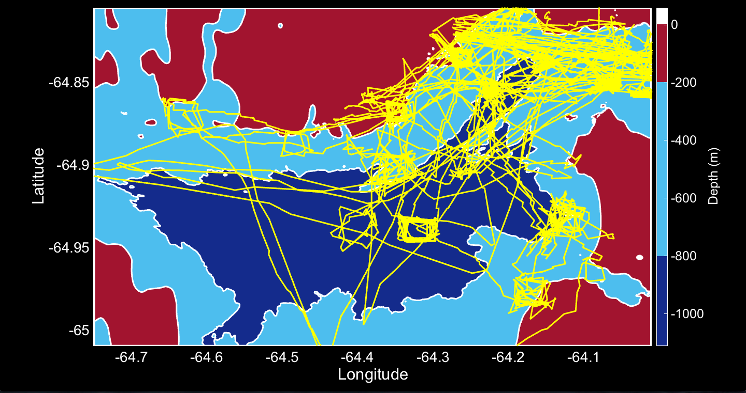
Glider Operations in the Palmer Deep Canyon
Standard package include CTD, WetLabs Ecopuck. Anderra Optode

Slide 5
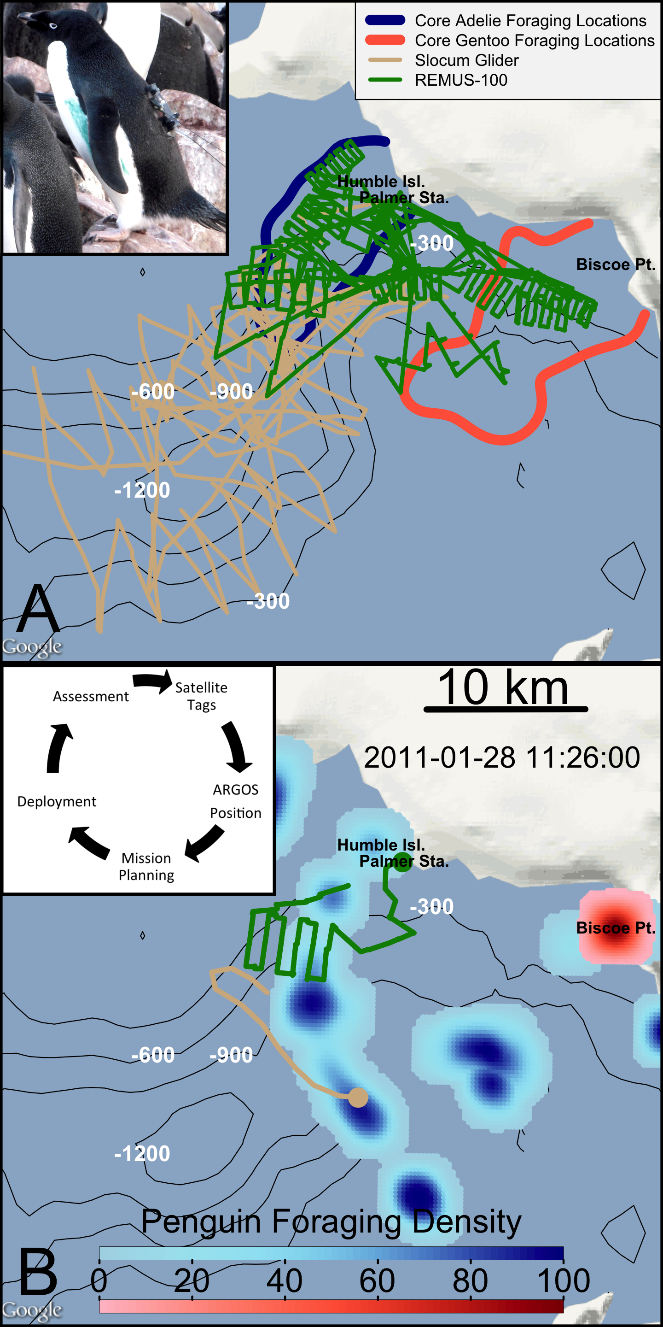
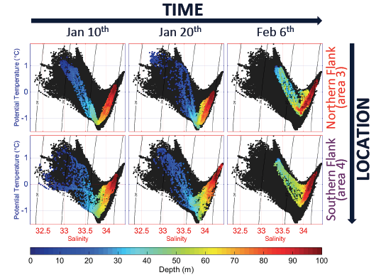
Coastal Research Applications

Slide 6
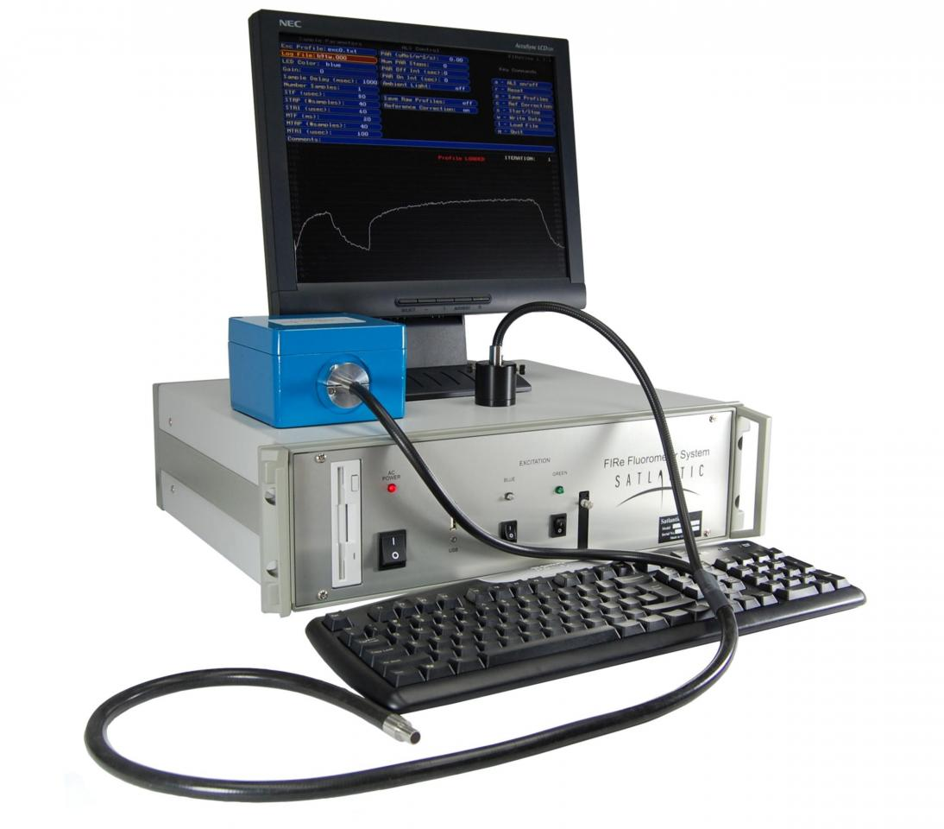
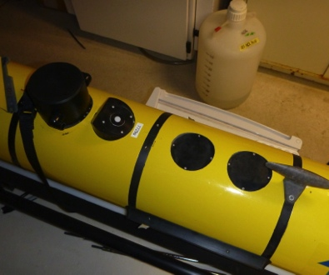
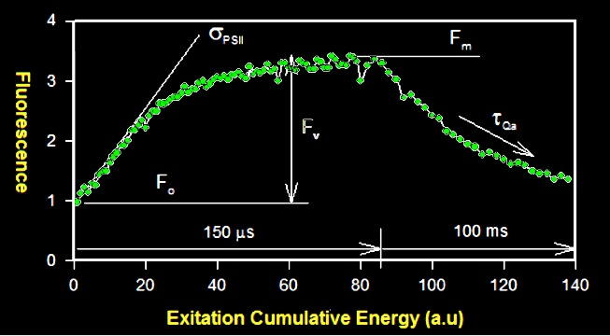
Fluorescence Induction and Relaxation Sensor
Iluz & Dubinsky, 2013

Slide 7
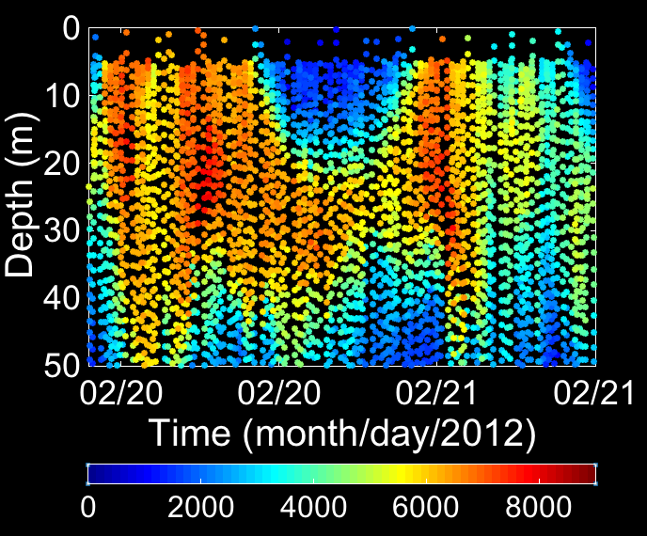
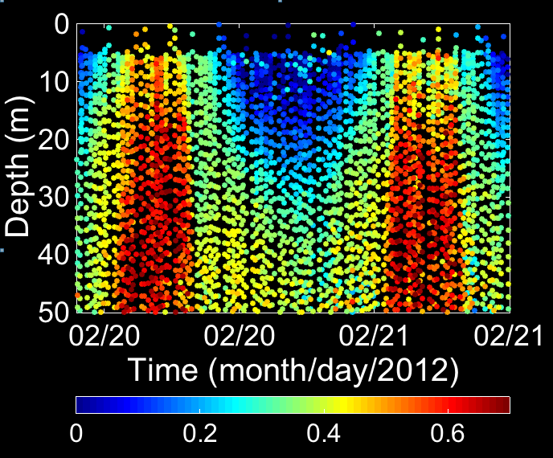
Daytime decreases Photosynthetic Efficiency
(non-Photochemical quenching)
Night
Daytime
Night
Night
Daytime
Night
Biomass Proxy (Fm)
Quantum Yield of Photosynthesis (Fv/Fm)

Slide 8
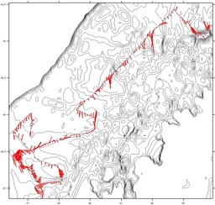
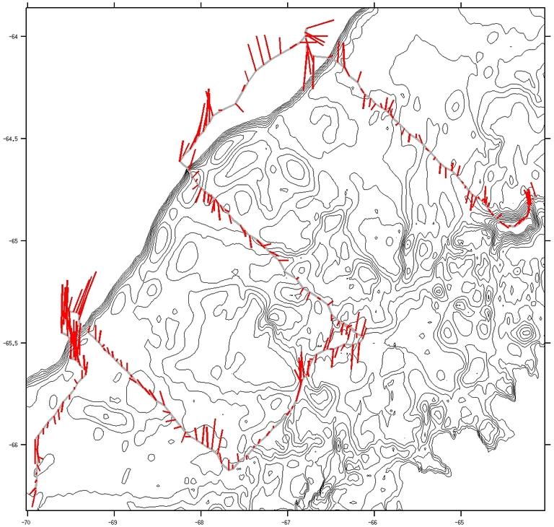
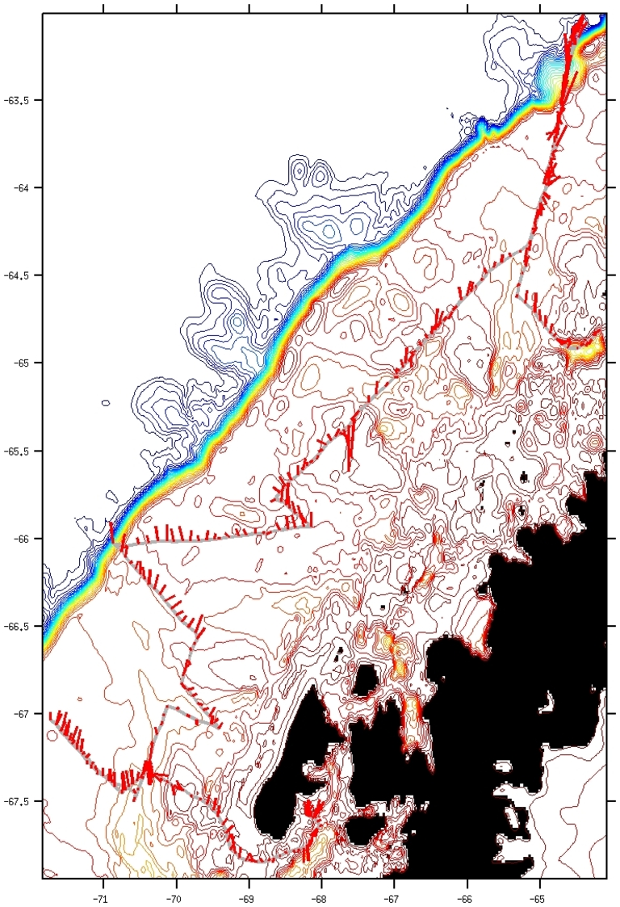
Glider Operations on the WAP
C) Link Stations
w/ no Ship
A) Adaptive
Sampling
B) Mow the
lawn
Standard package include CTD, WetLabs Ecopuck. Anderra Optode, NORTEK ADCP

