Slide 1
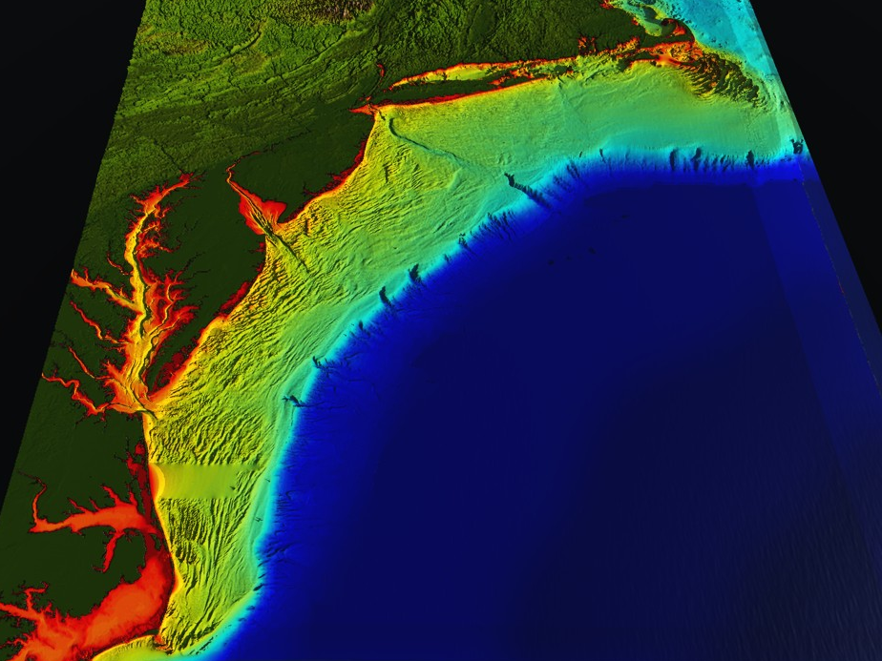
RI
U..
Middle Atlantic
Regional Association
Coastal
Ocean Observing System
10 States - 76 Million People
1000 km Cape to Cape
CT
Cape
Cod
MA
NY
PA
NJ
U.S. IOOS and CINAR Respond to
Hurricanes Irene, Sandy, Arthur & Beyond
DE
MD
Sandy
>40 PIs
>20 Institutions
>50 Members
>2000 Contacts
Irene
Arthur
VA
Travis Miles, Greg Seroka,
Robert Forney, Scott Glenn, Hugh Roarty, Laura Palamara,
Josh Kohut, Oscar Schofield,
Yi Xu and Fei Yu
NC
Cape
Hatteras
Notes:
1

Slide 2
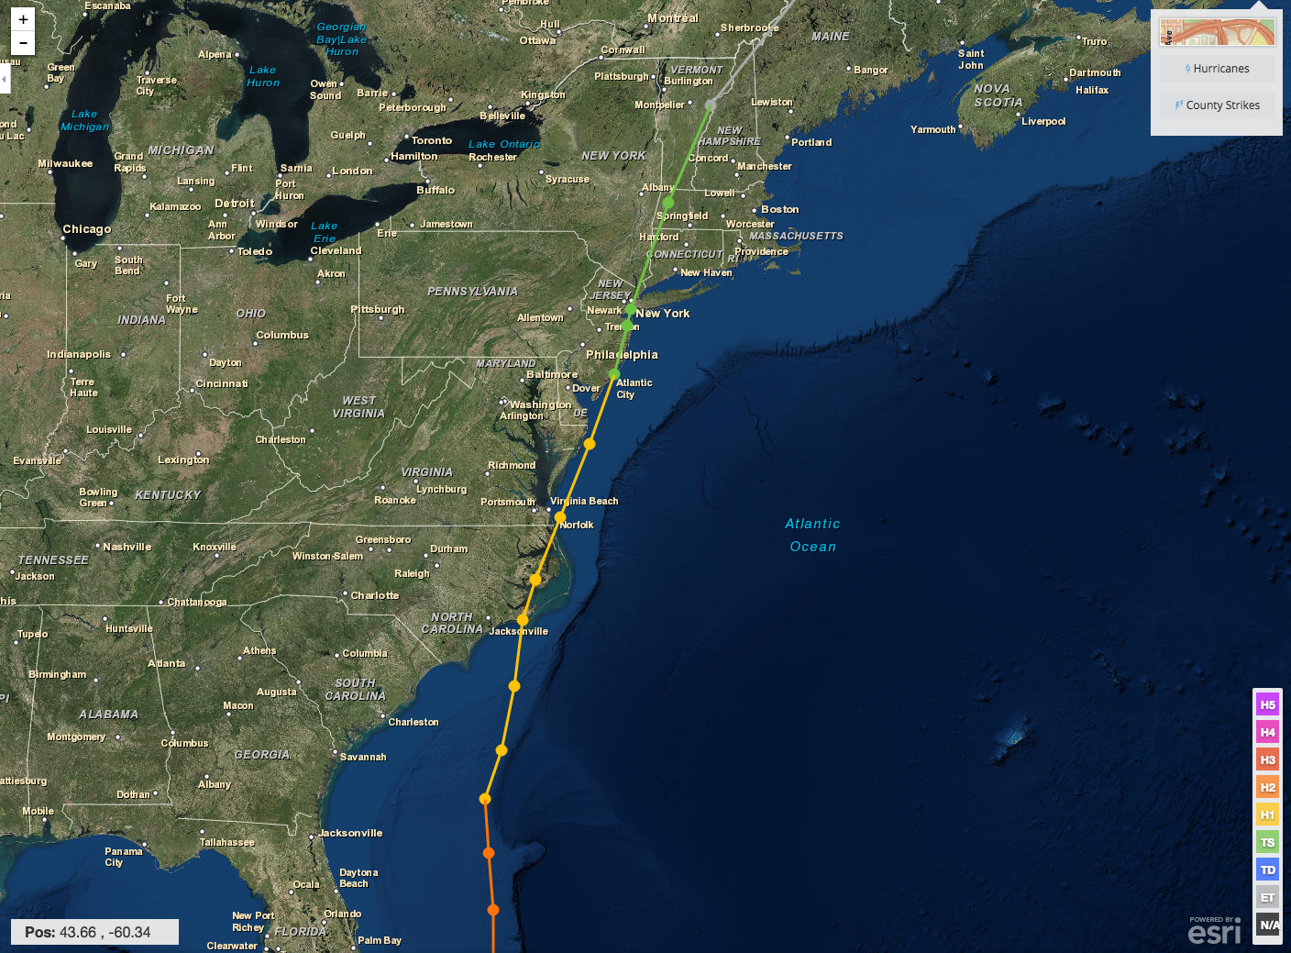
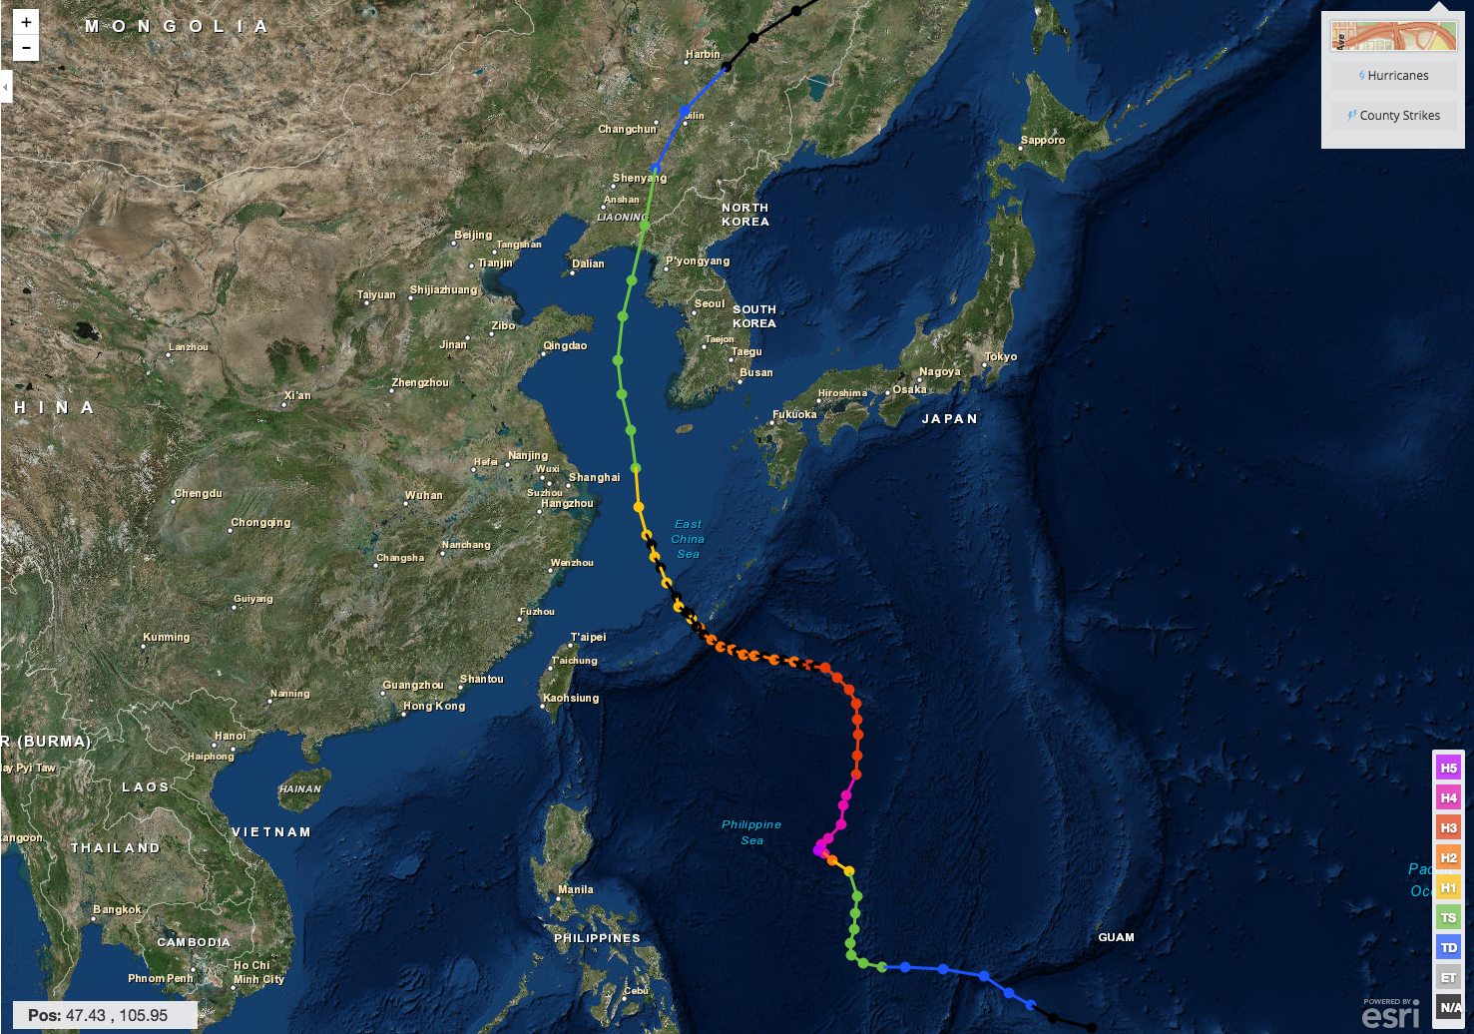
Hurricane Irene & Super-Typhoon Muifa:
What do these 2 storms have in common?
Hurricane Irene
26-29 August 2011
Super-Typhoon Muifa
26 July - 9 August 2011

Slide 3
Pre-Irene Storm Warnings
Over 2 million people ordered to “flee the storm’s path”.
President Obama: Shaping up to be a “historic hurricane” and urged residents to “be prepared for the worst”. “Don’t wait. Don’t delay.”
New Jersey Governor Christie: Ordered evacuation of 1 million people - “Get the hell off the beach”. “Do not waste any more time working on your tan”.
New York Mayor Blumberg: “Staying behind is dangerous, staying behind is foolish, and its against the law”. “The time to leave is right now”. The bridges, streets and subways were nearly empty ahead of a nearly unprecedented mass transit shutdown.

Slide 4
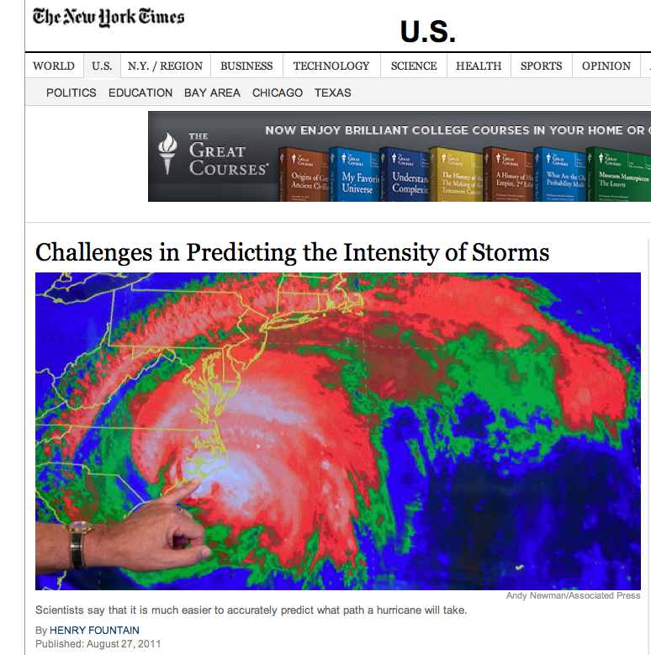
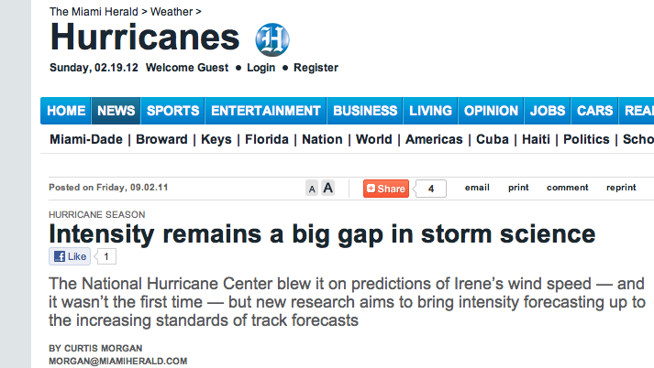
Post-Irene Analysis:
Track accurately forecast
days in advance.
Intensity (wind speed), and the resulting impacts, were over-predicted.
Need to close the Intensity Science Gap!

Slide 5
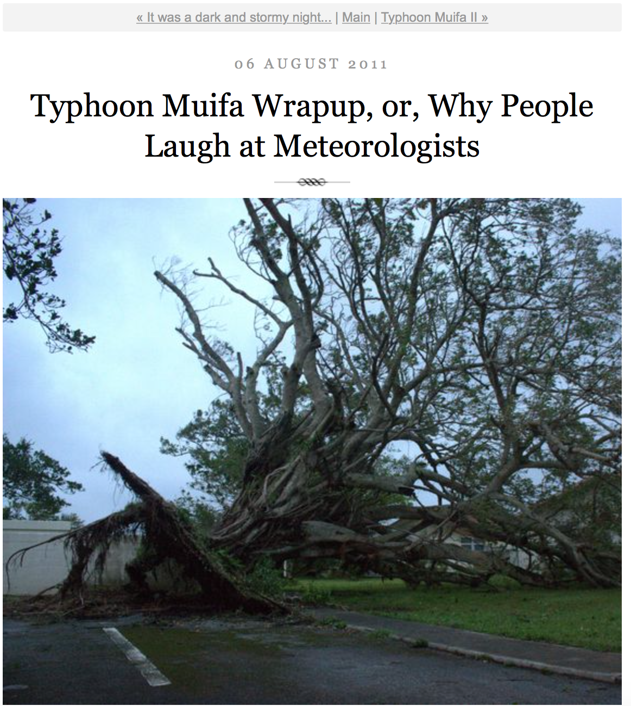
Pre-Muifa preparation:
SHANGHAI Aug 6 (Reuters) - Chinese authorities evacuated more than 200,000 residents from eastern Zhejiang province and cancelled more than 200 flights, as the region braced itself for a typhoon that could be the worst in the area in years.
Post-Muifa Blog entry:
As Muifa moved toward us over the week, at first it looked like we were literally going to take a direct hit from a category 4 typhoon … gradually was downgraded to a 2, it started to seem like no big deal … Basically we started out worried and got less and less so as it moved toward us and were mostly grateful for the 4-day weekend…

Slide 6
National Hurricane Center: Track and Intensity Error
Forecast Track Error:
Steady improvement over 2 decades.
Forecast Intensity Error:
“long-term trend is flat”,
“little skill”.
Production Suite Review: December 4, 2012

Slide 7
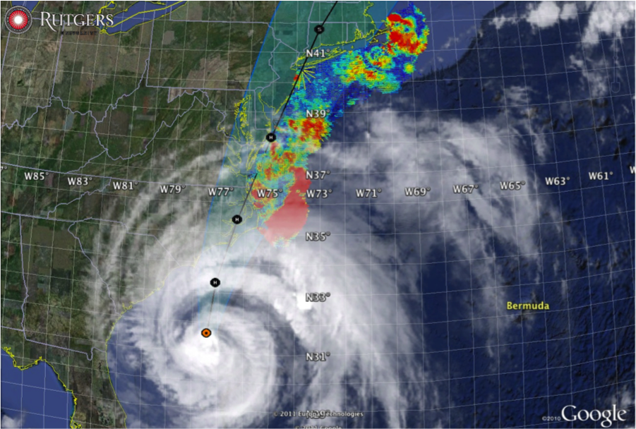
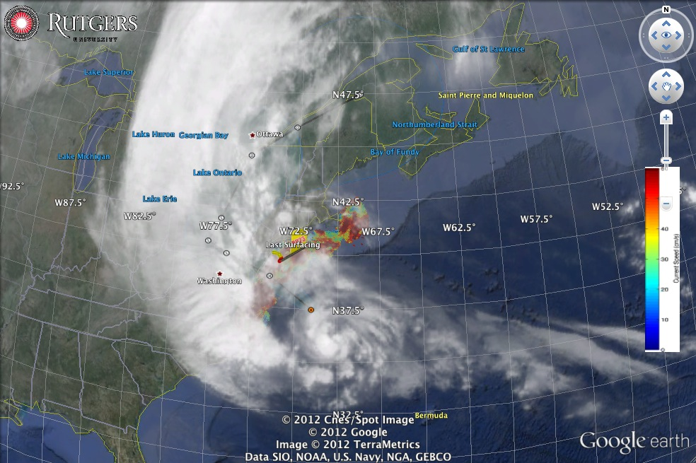
Hurricane Irene
August 28, 2011
NOAA/NHC Damage:
#7 with >$16 Billion.
Track Accurate;
Intensity Over-predicted.
Hurricane Sandy
October 29, 2012
NOAA/NHC Damage:
#2 with >$68 Billion.
Track Accurate;
Impact Under-predicted.

Slide 8
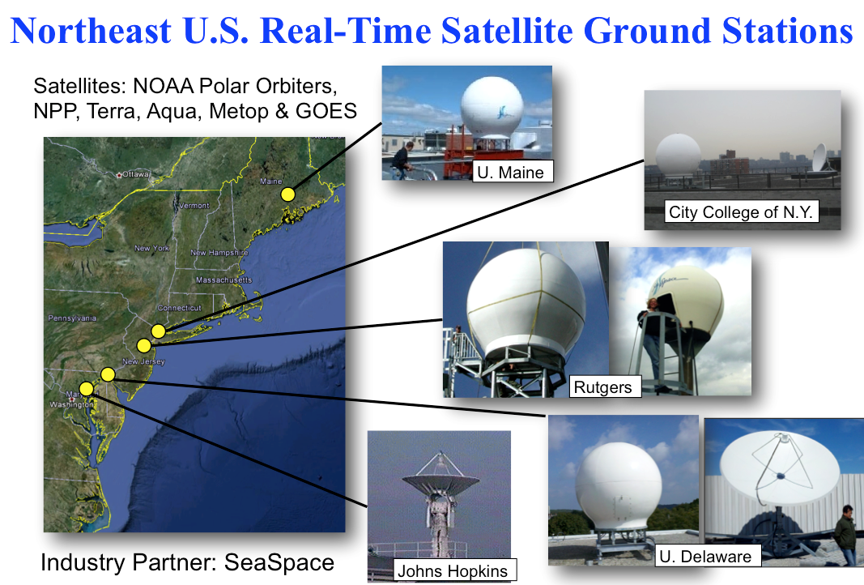
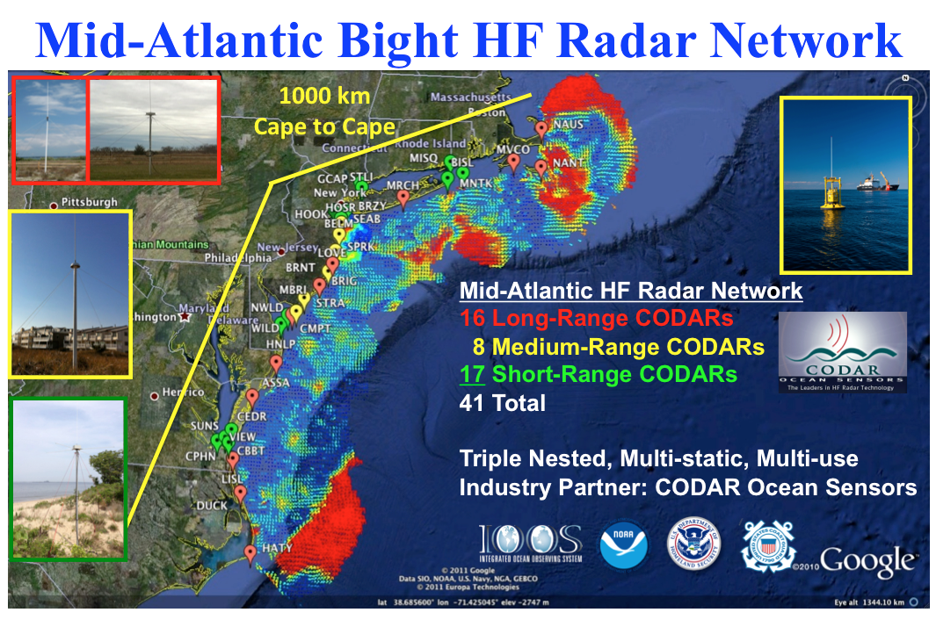
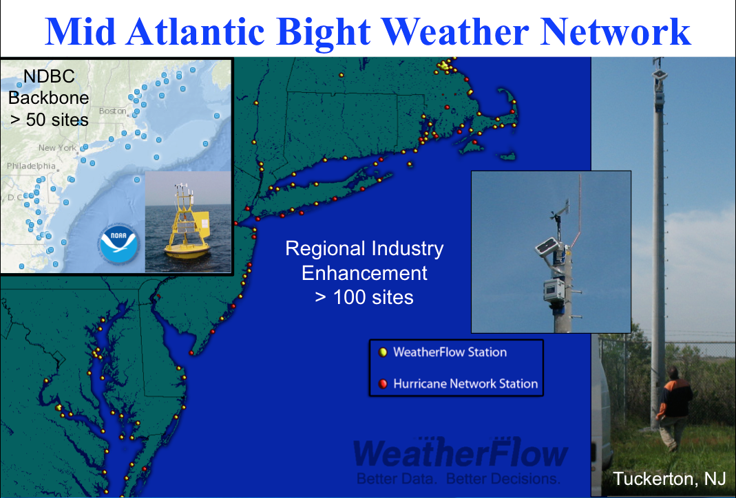
Mid-Atlantic Regional-Scale Observation Network

Slide 9
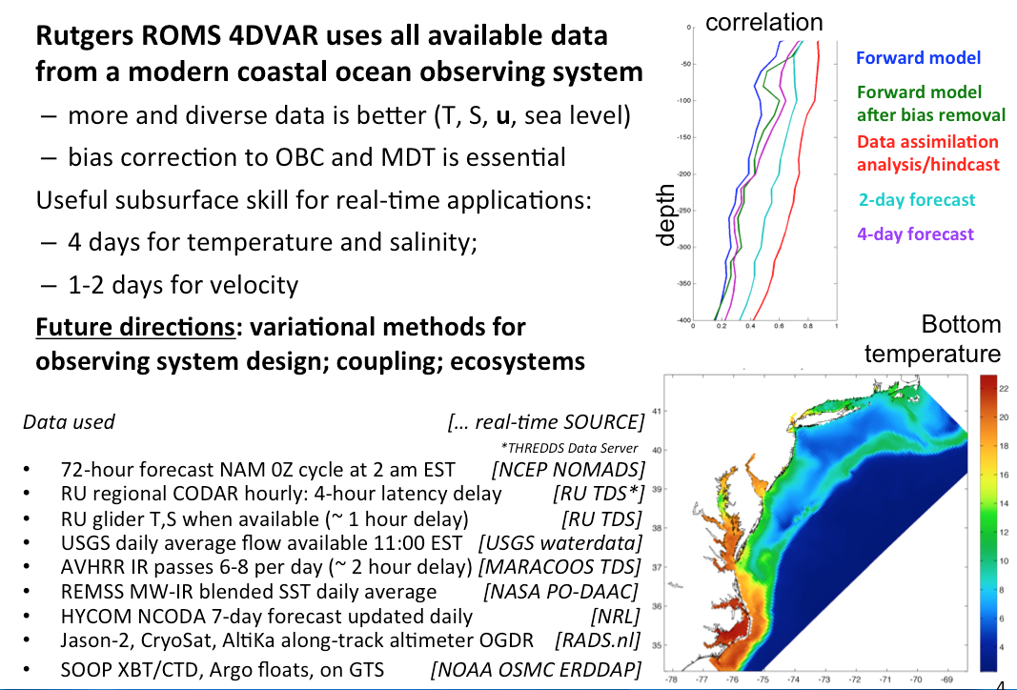
Mid-Atlantic Ensemble of Forecast Models Include:
Mid-Atlantic Operations Center @ Rutgers

Slide 10
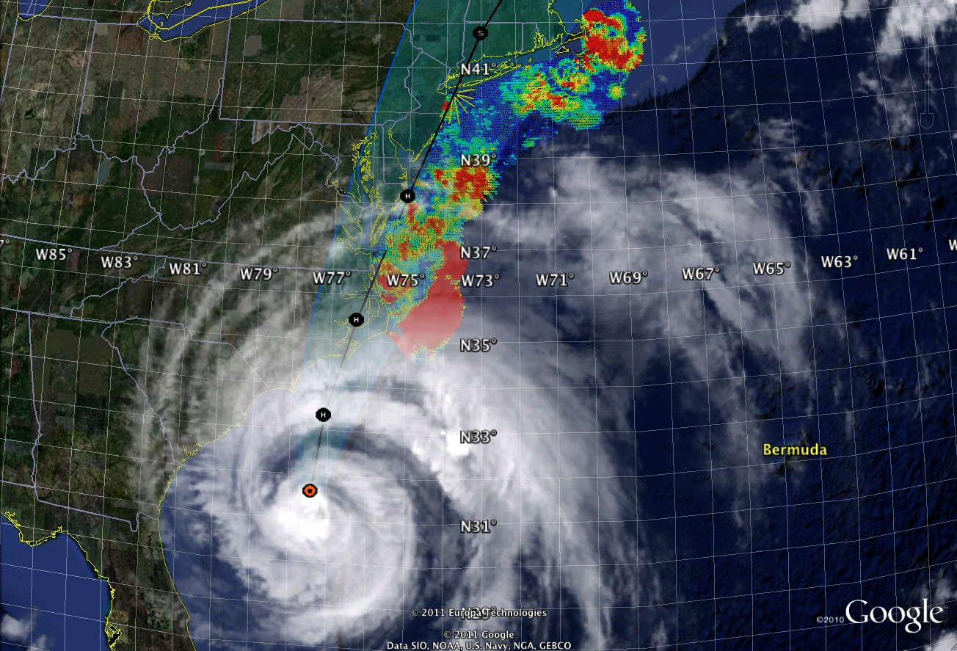
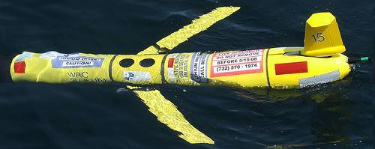
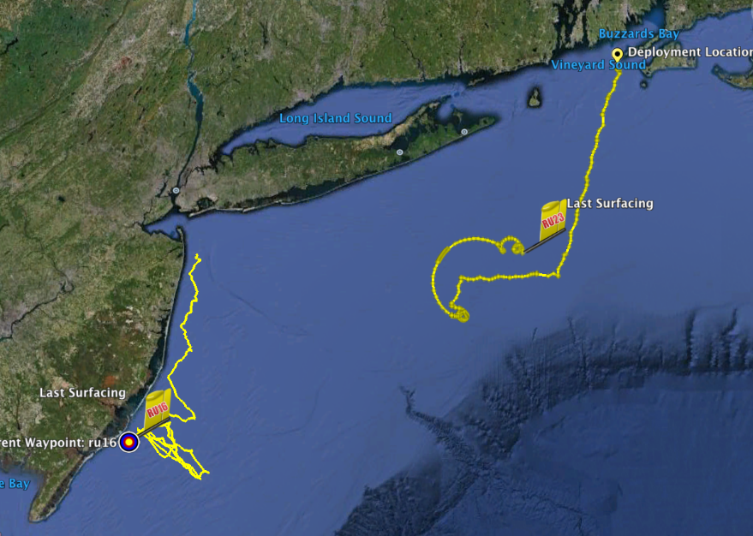
Hurricane Irene Track August 26-29 2011
Two Gliders Deployed

Slide 11
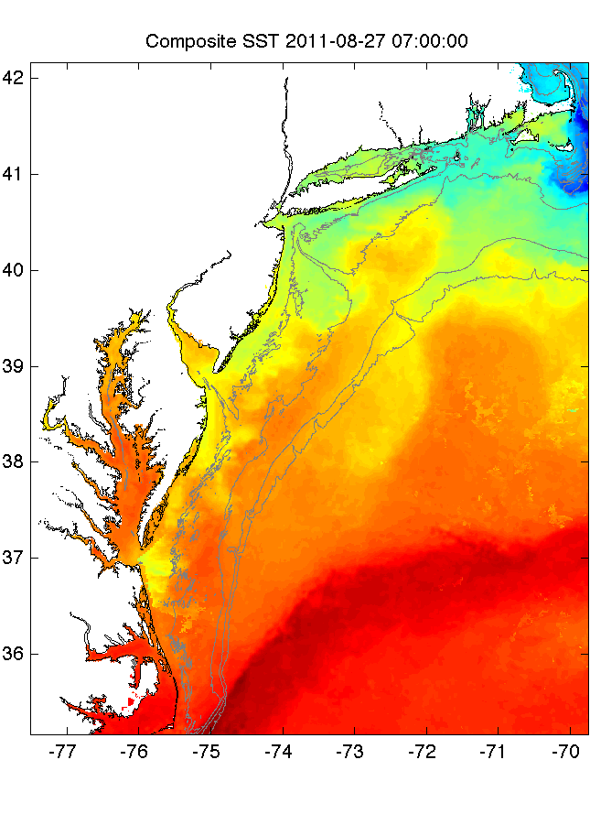
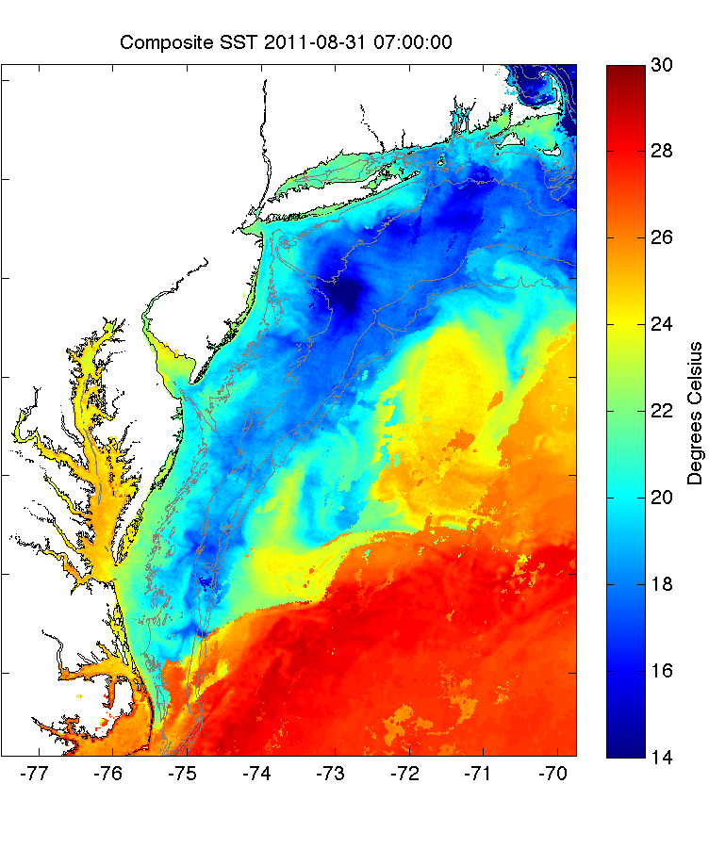
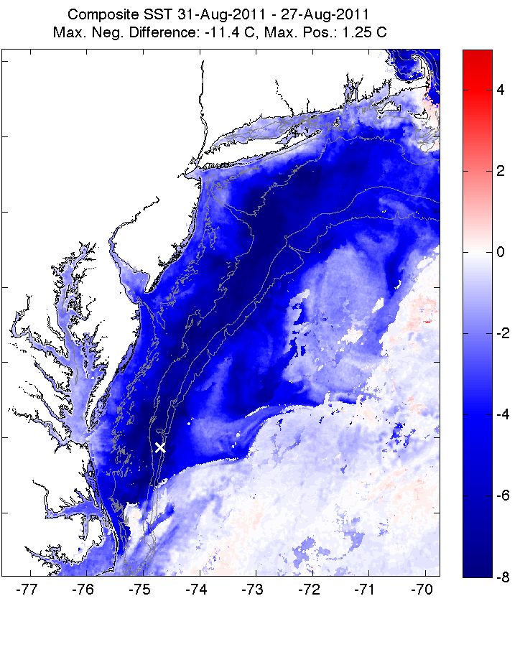
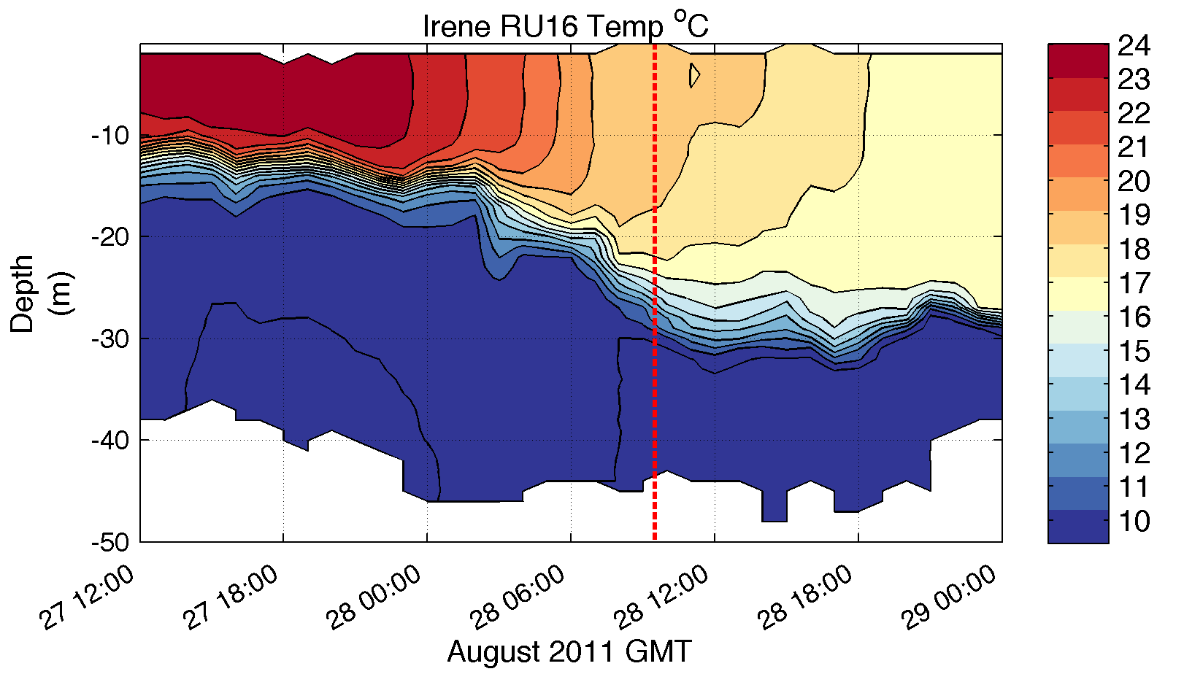
Pre-Irene
Post-Irene
Difference
11C max Cooling
WHAT?
Rutgers
Satellite
Temperature
WHEN? Rutgers Glider Temperature
WHY?
Rutgers Radar
Currents
Eye Passage

Slide 12
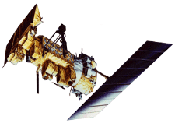
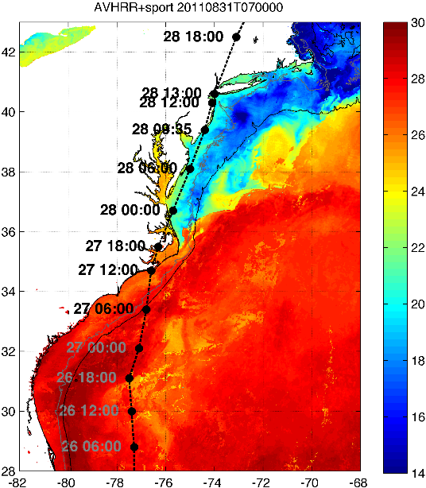
Rutgers Atmospheric Forecast Sensitivity Study
Warm Ocean
Boundary Condition
Cat 1 Hurricane
Tropical Storm
Cold Ocean
Boundary Condition
IMPACT?
>10 knots reduction in peak wind speed

Slide 13
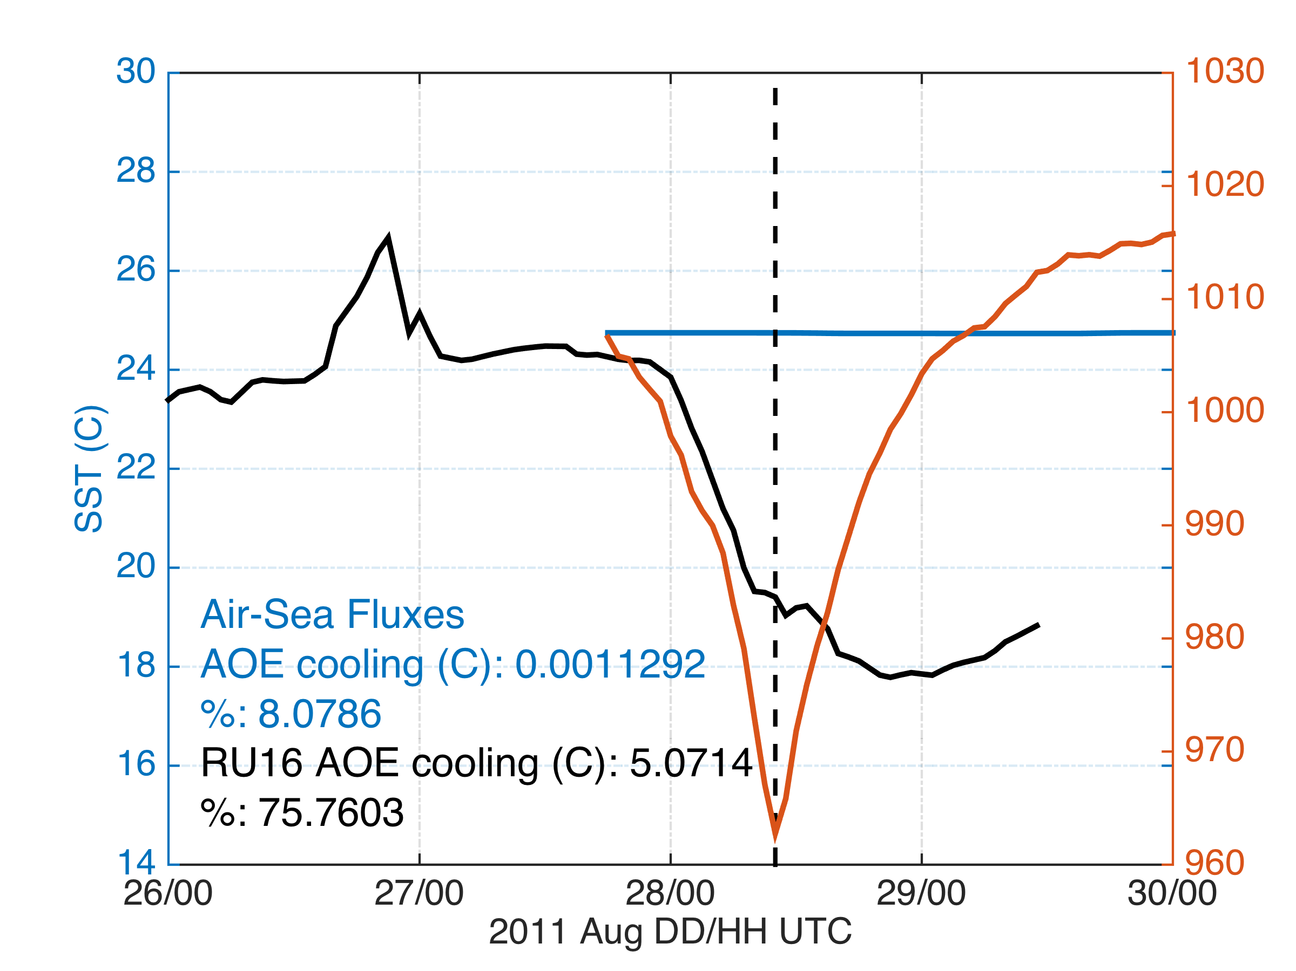
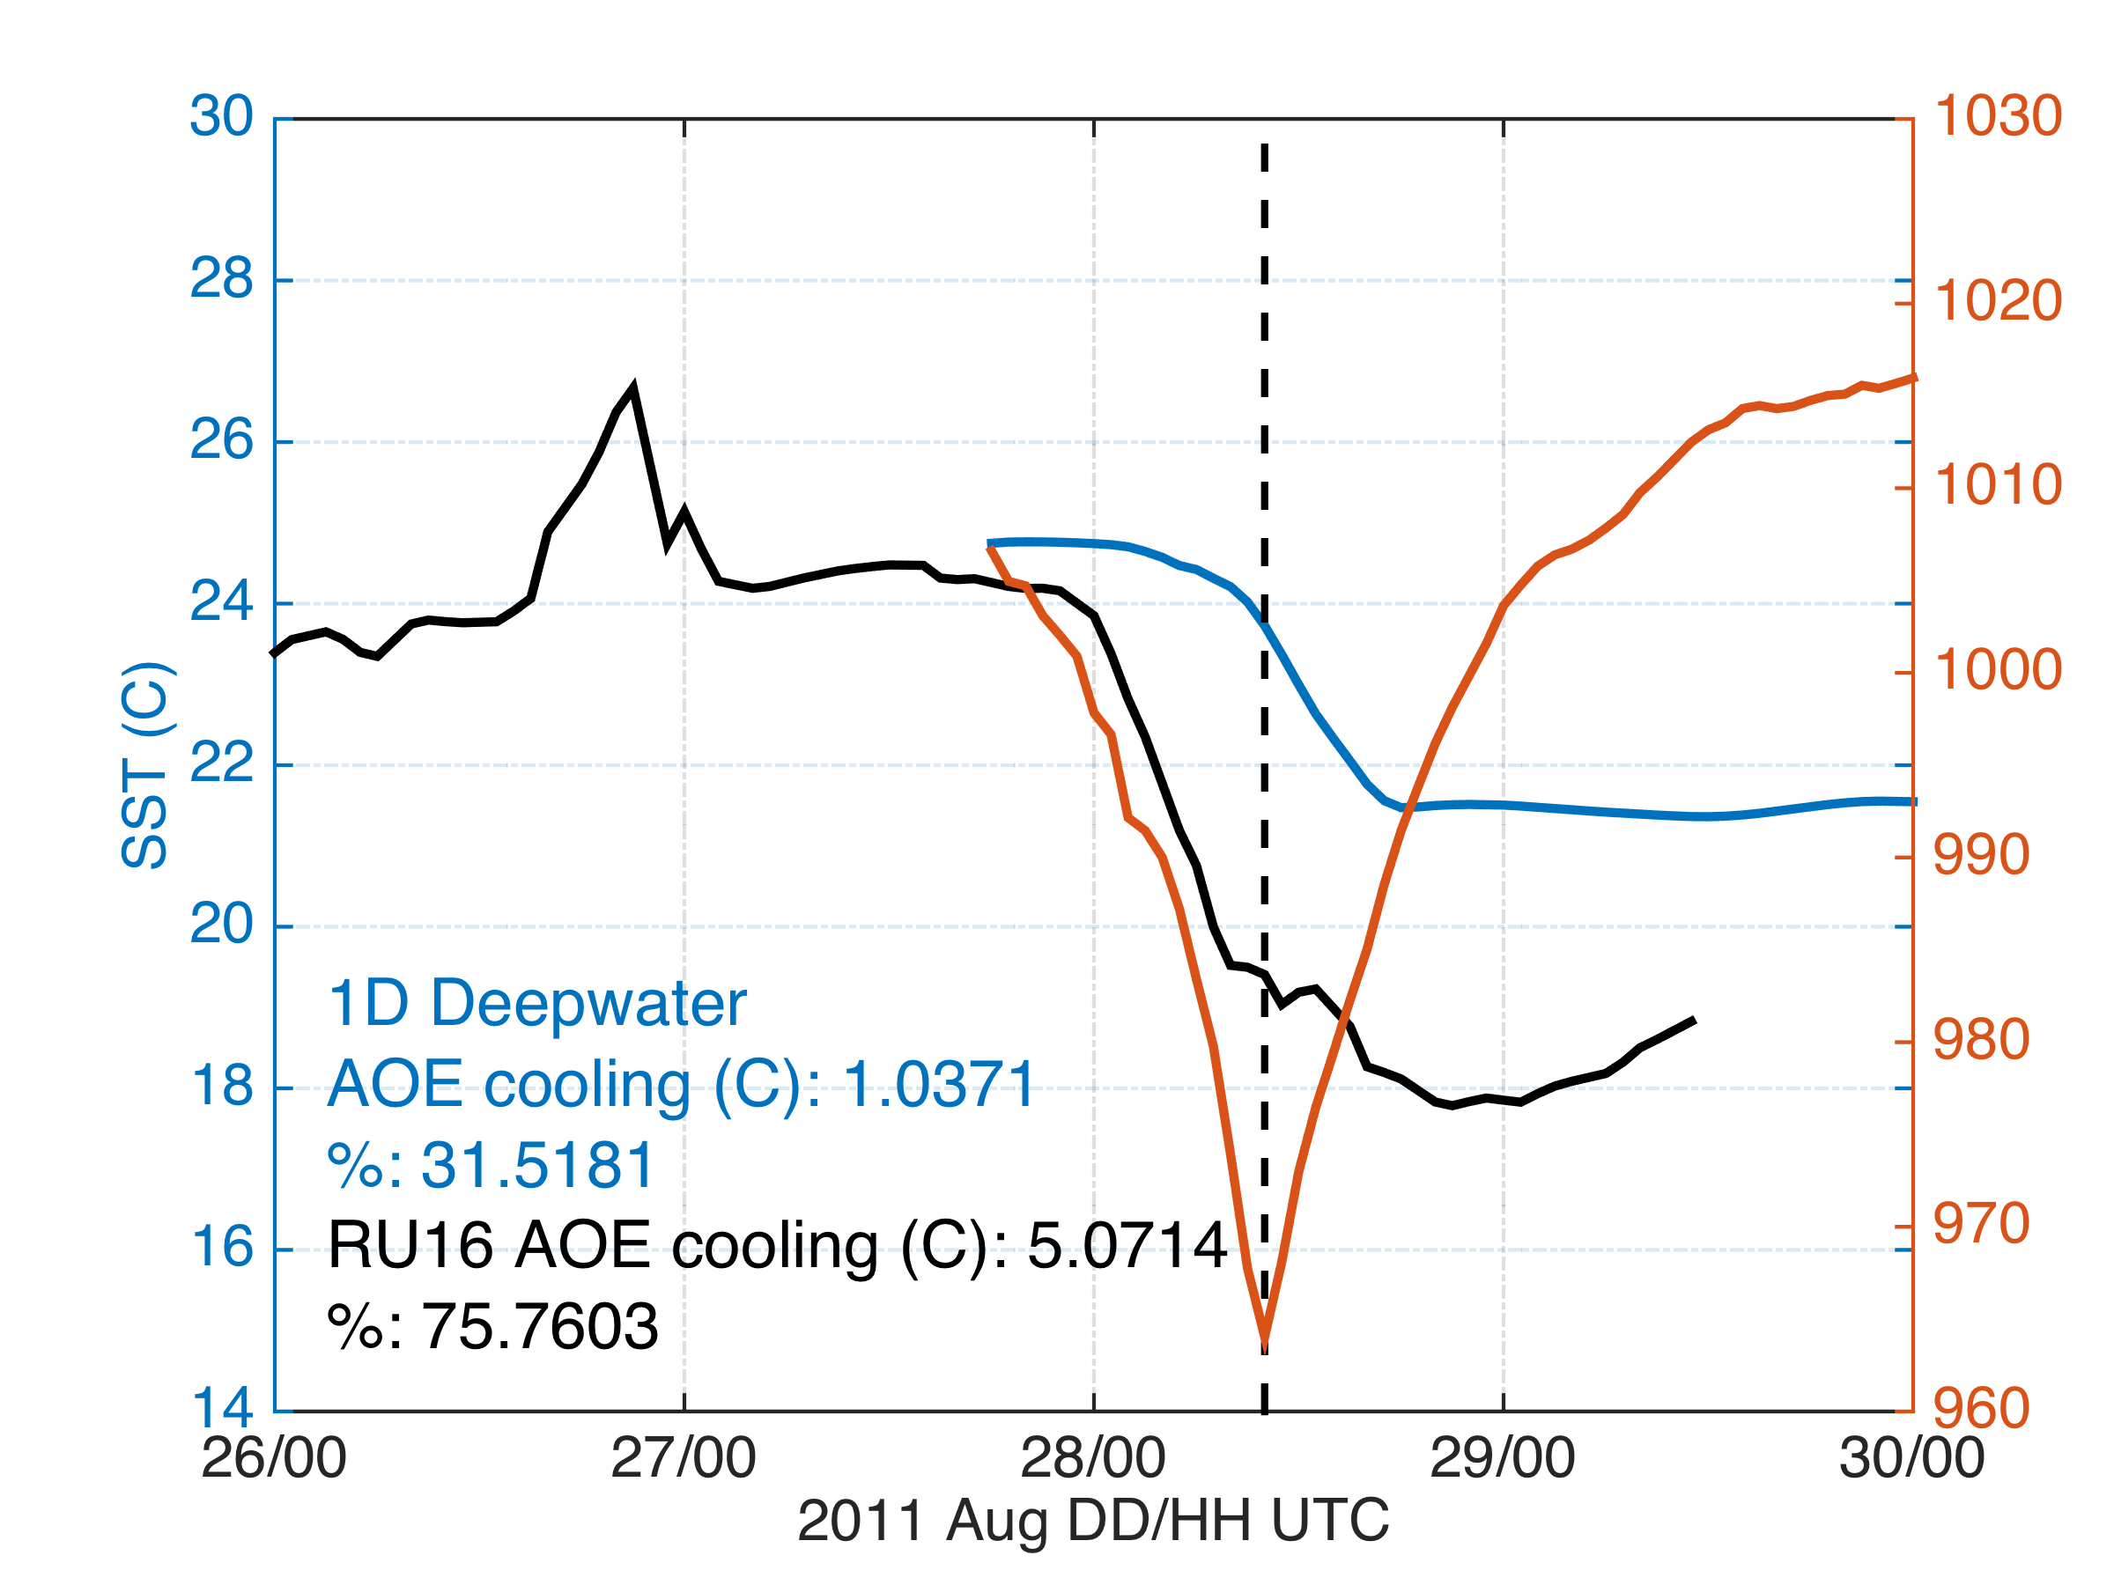
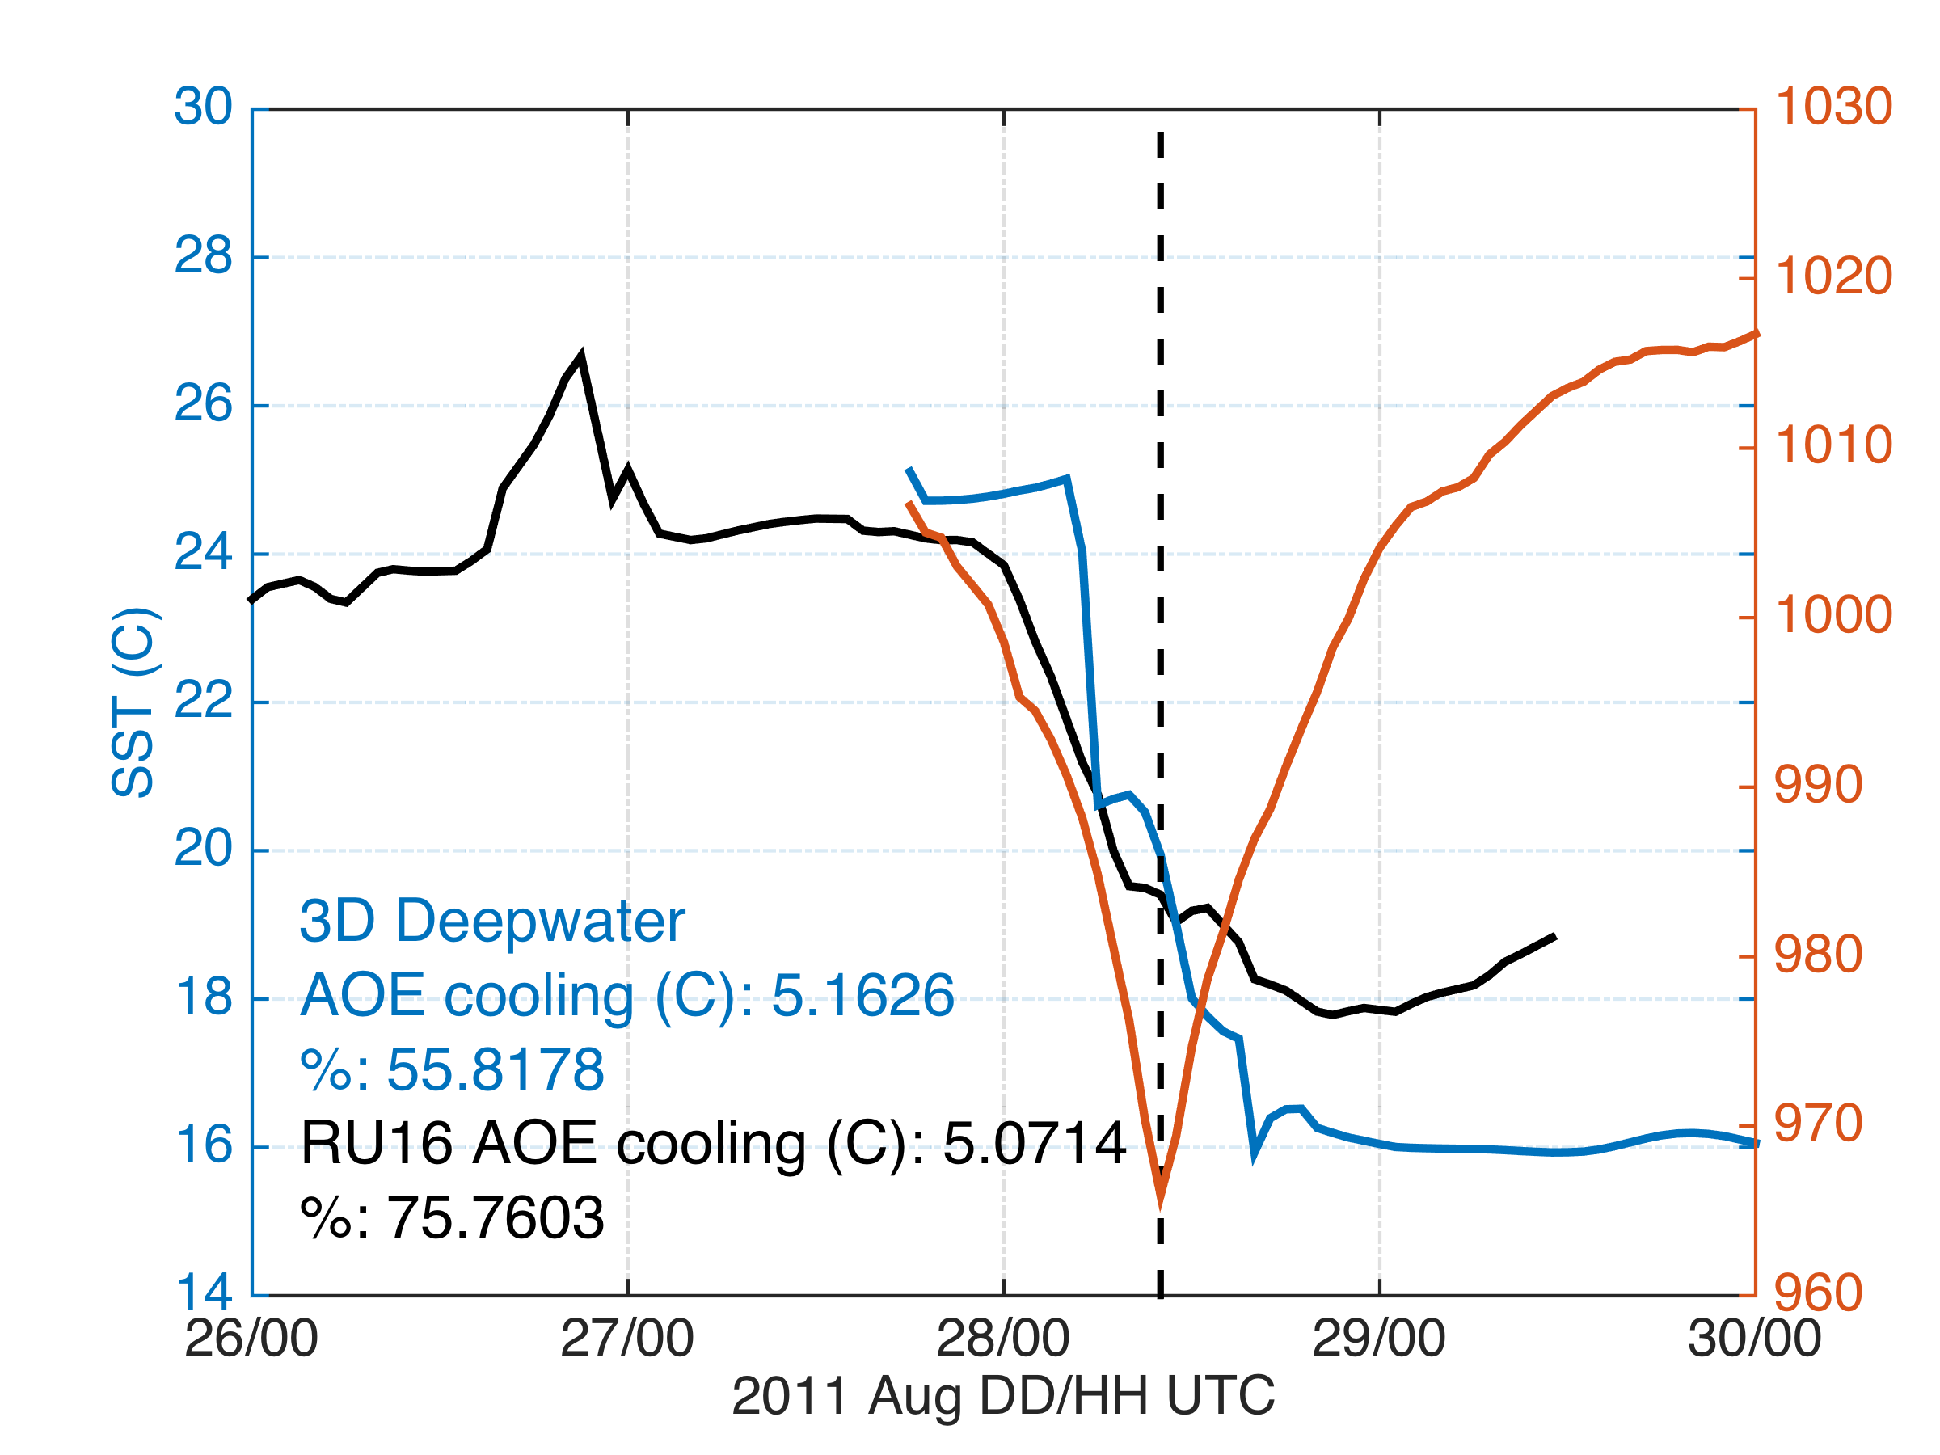
Modeled Deepwater Cooling Processes in Hurricane Irene
Air-Sea Only
1-D Mixing
3-D PWP (Upwelling)

Slide 14
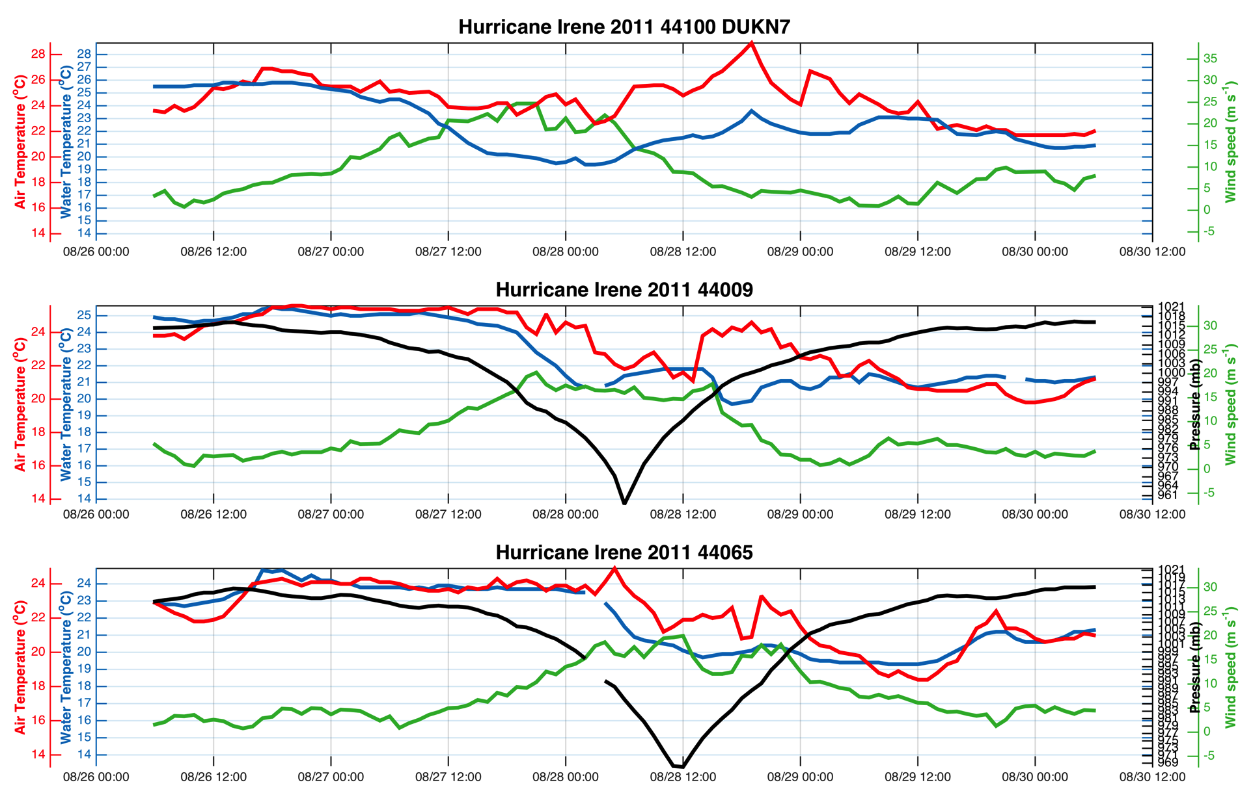
Observed Cooling in Hurricane Irene

Slide 15
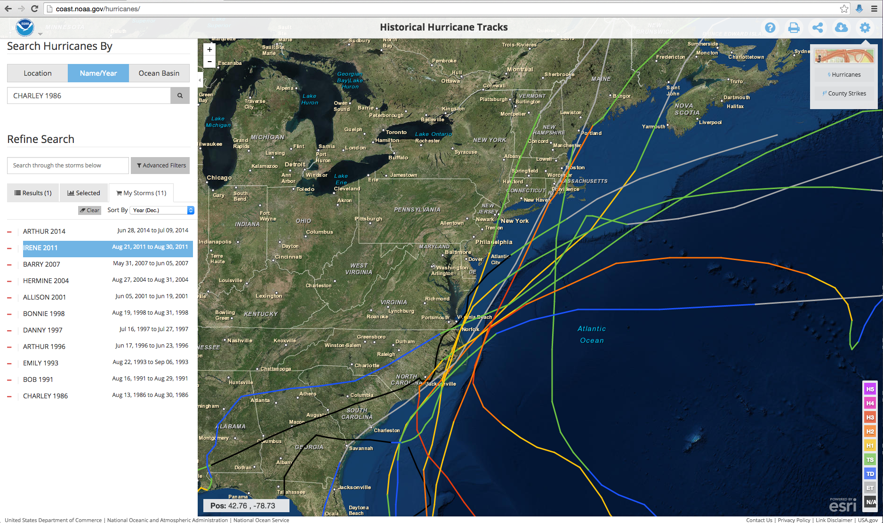
Historical Hurricanes Crossing the MAB in Stratified Season

Slide 16
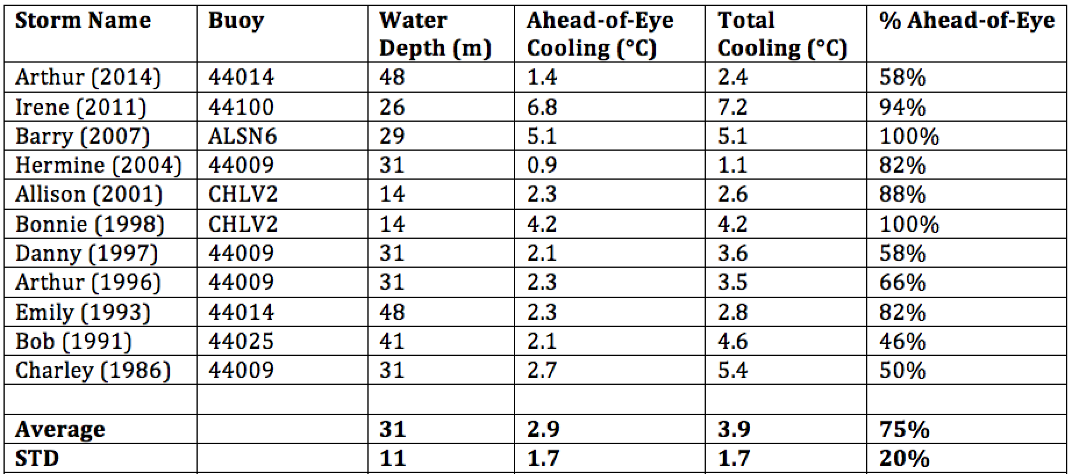
Historical Hurricanes Crossing the MAB in Stratified Season
Observed Ahead-of-Eye Cooling

Slide 17
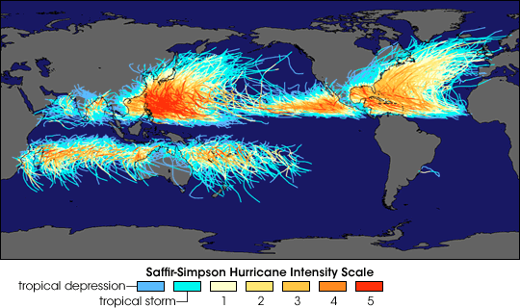
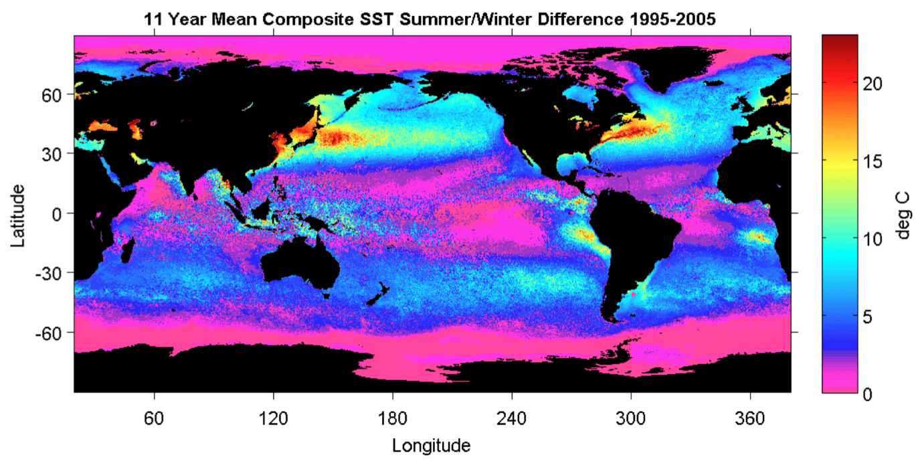
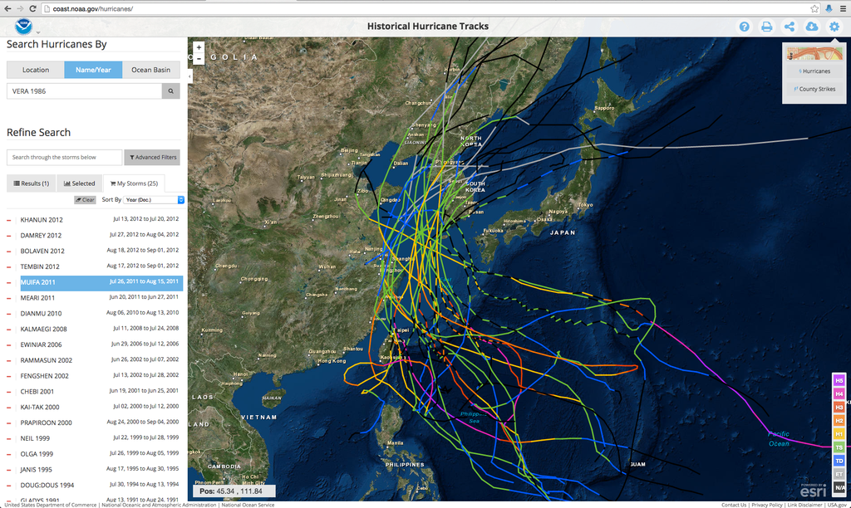
Historical Typhoons Crossing the Yellow Sea in Stratified Season

Slide 18
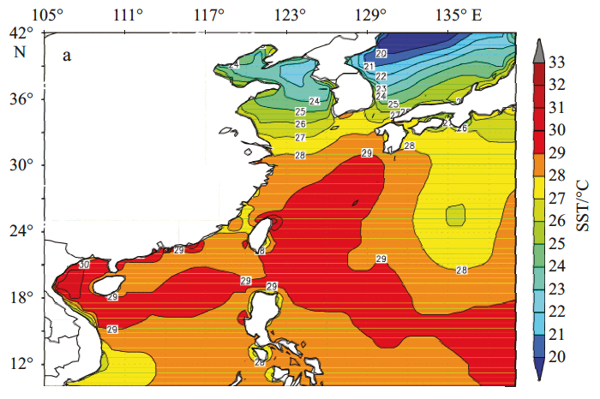
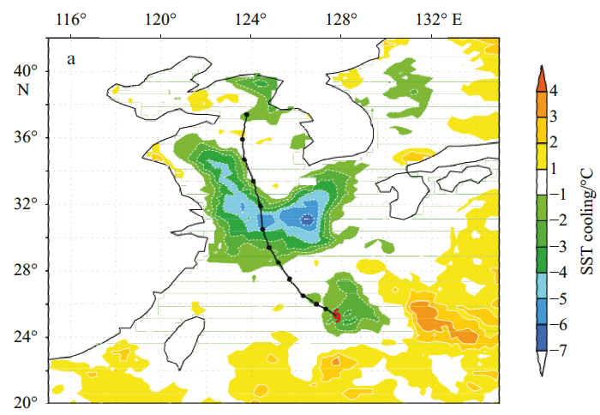
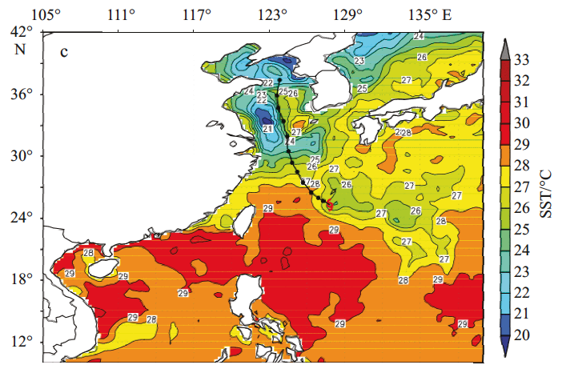
Typhoon Mufia - Total Cooling Observed by Satellite
Before
After
Before

Slide 19
Typhoon Mufia:
Ahead-of-Eye Cooling
observed by
Coastal Buoy

Slide 20
Hurricane Irene
August 26, 2011
Strong Stratification
Coastal Response
Mixing cooled surface
Limited intensity
Hurricane Sandy
October 29, 2012
NOAA/NHC Damage:
#2 with >$60 Billion.
Track Accurate;
Intensity Under-predicted.

Slide 21
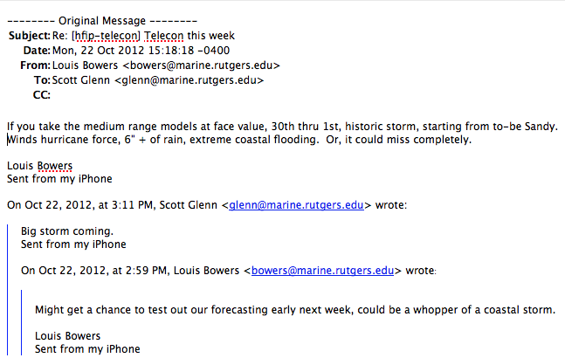
First Warning for Hurricane Sandy:
Monday, Oct 22, 1-week prior to landfall
IOOS Response: Prepare the Network

Slide 22
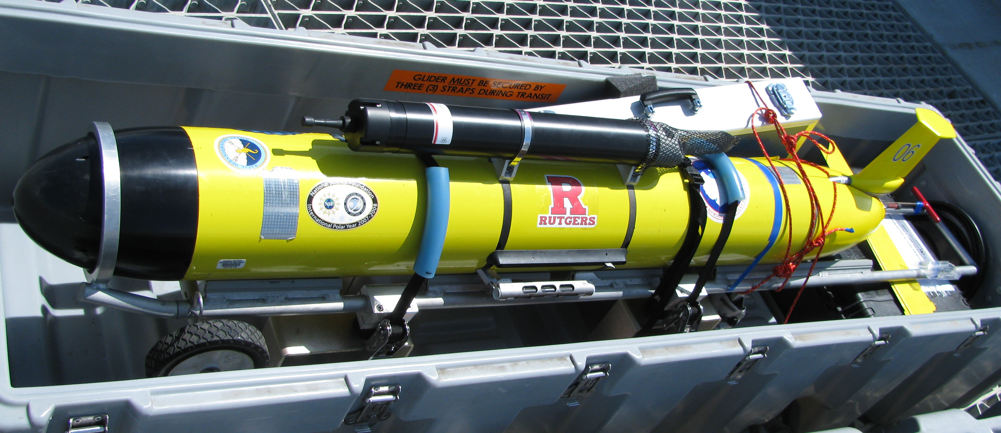
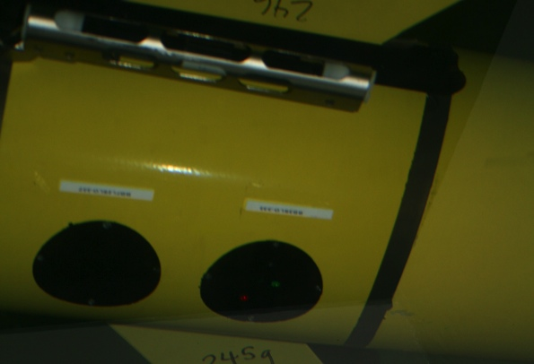
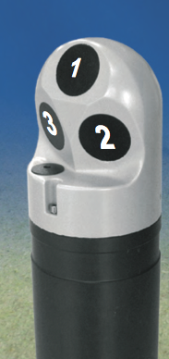
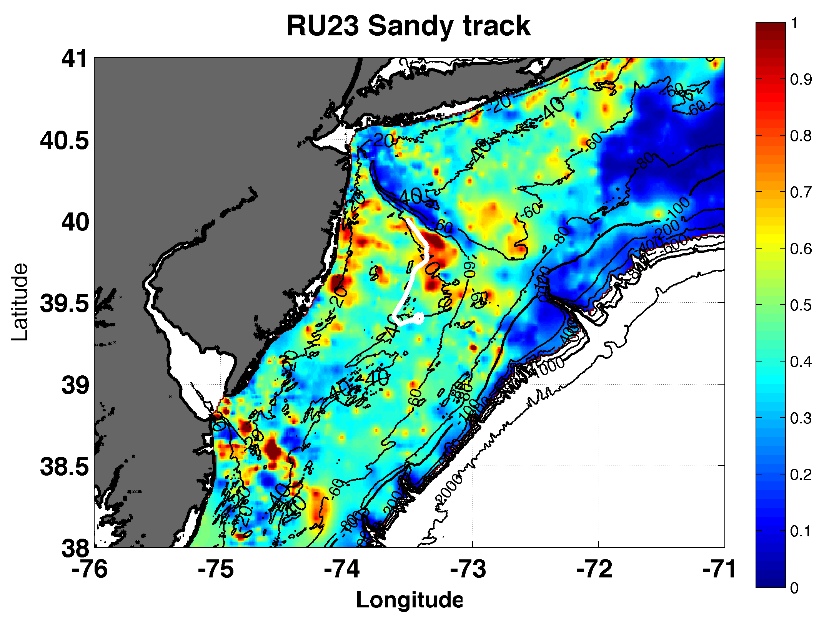
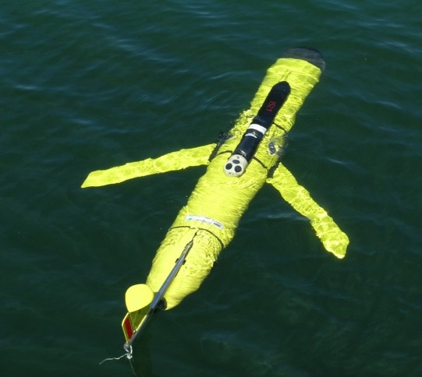
Prepare and Launch the Storm Glider

Slide 23
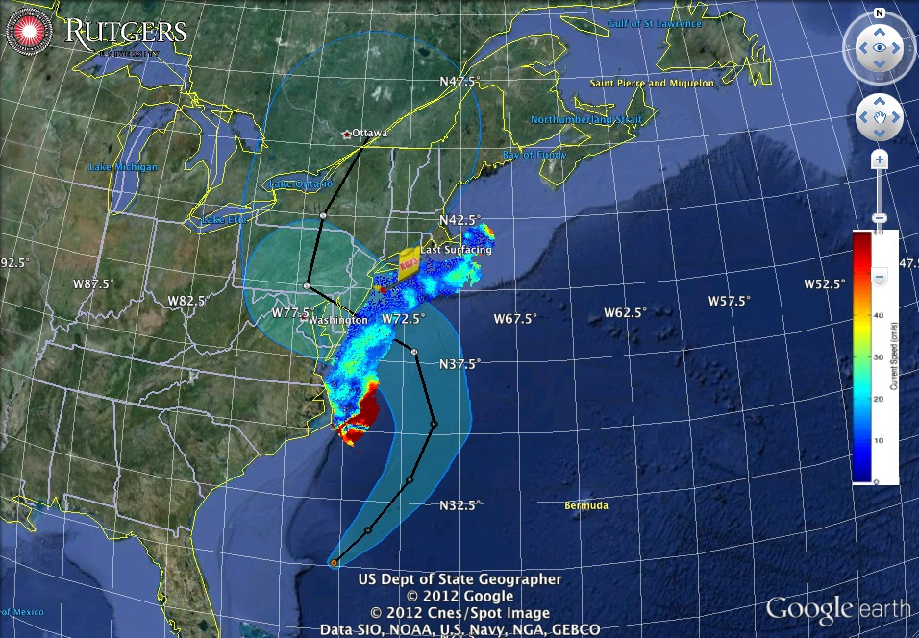
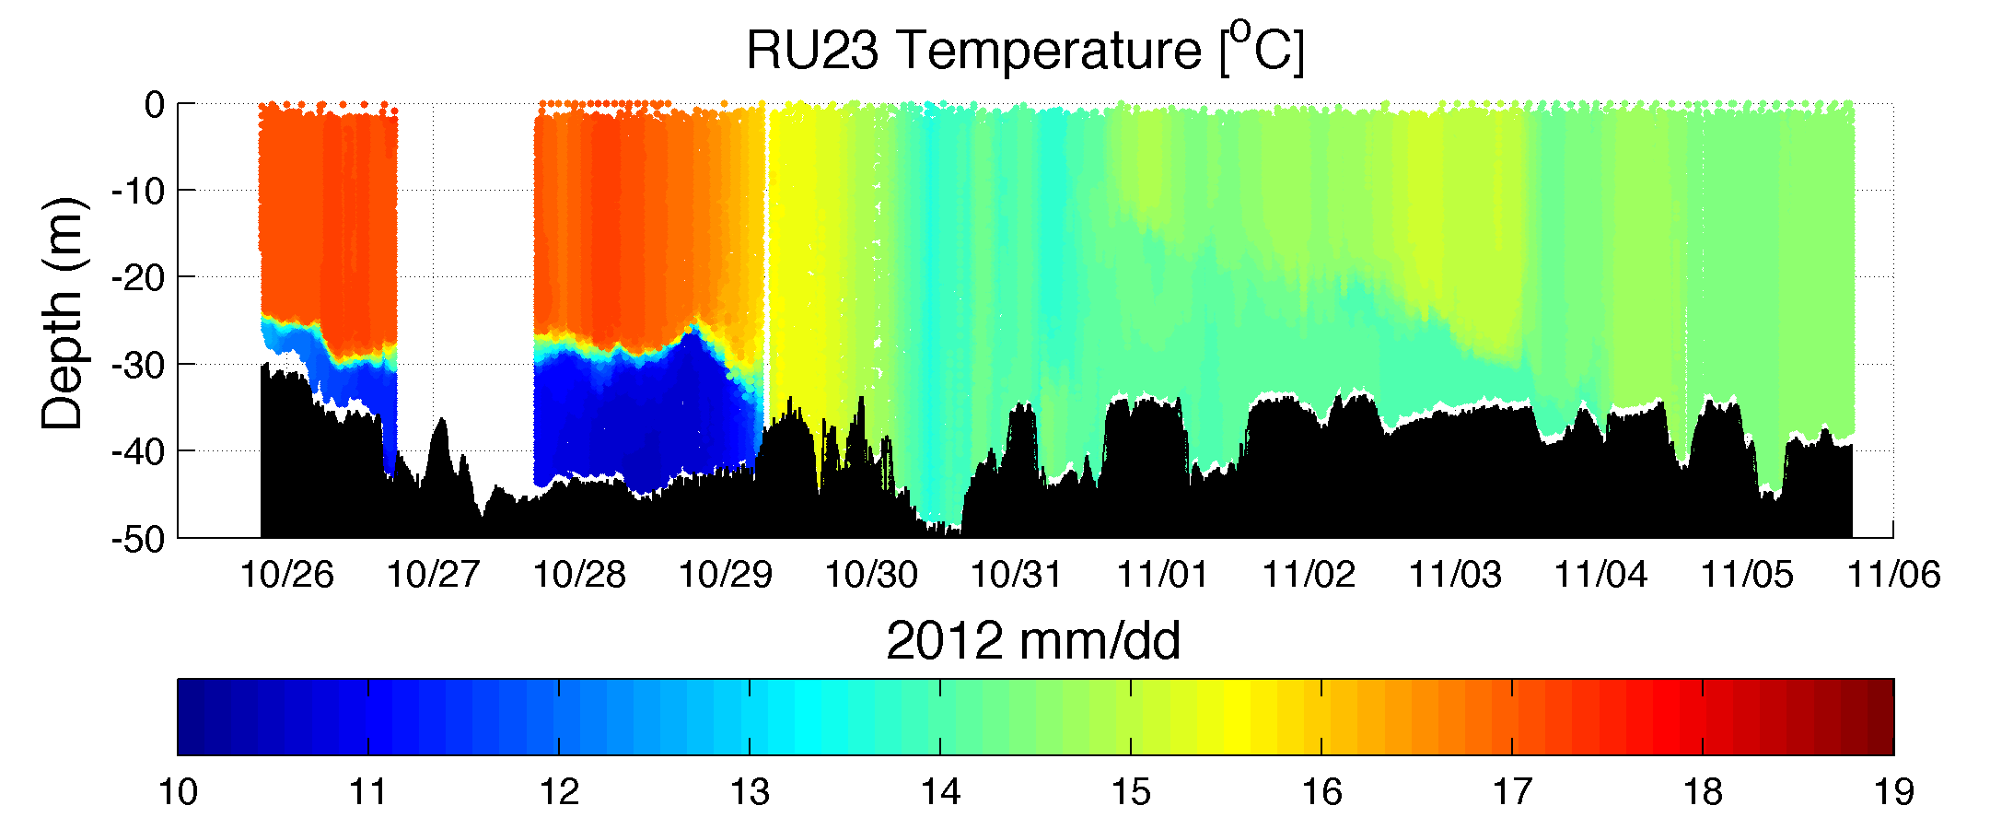
Superstorm Sandy: 2 Days Before Landfall

Slide 24
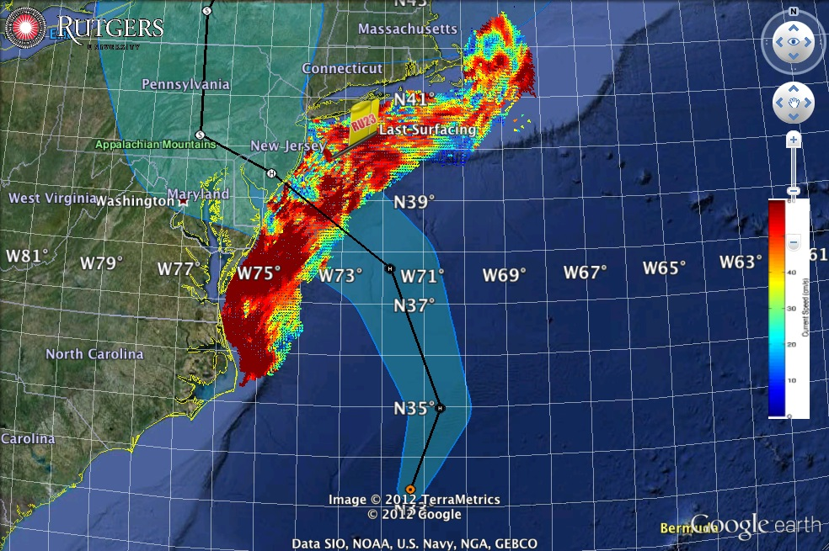
Superstorm Sandy: 1 Day Before Landfall

Slide 25
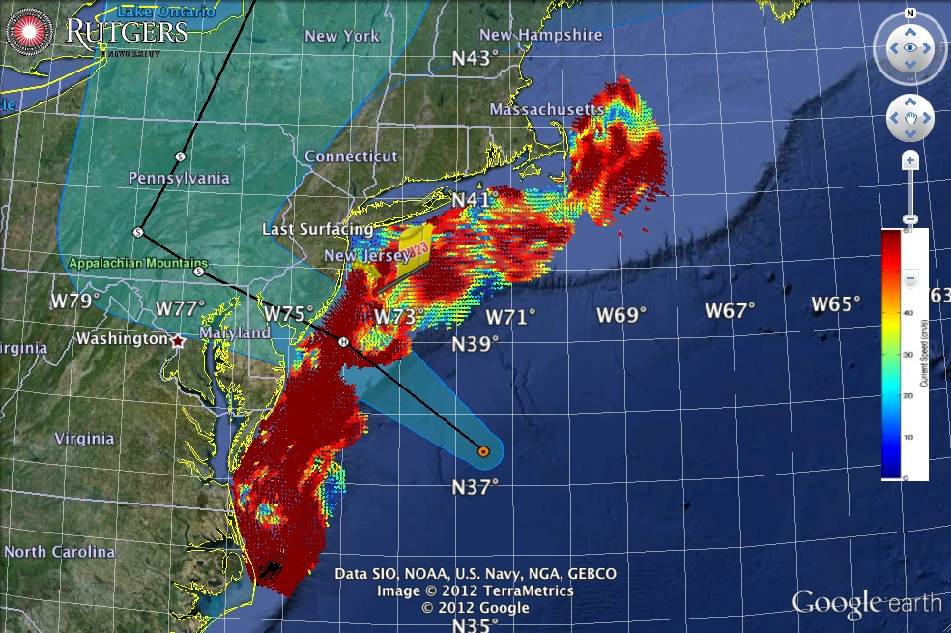
Superstorm Sandy: Morning Before Landfall

Slide 26
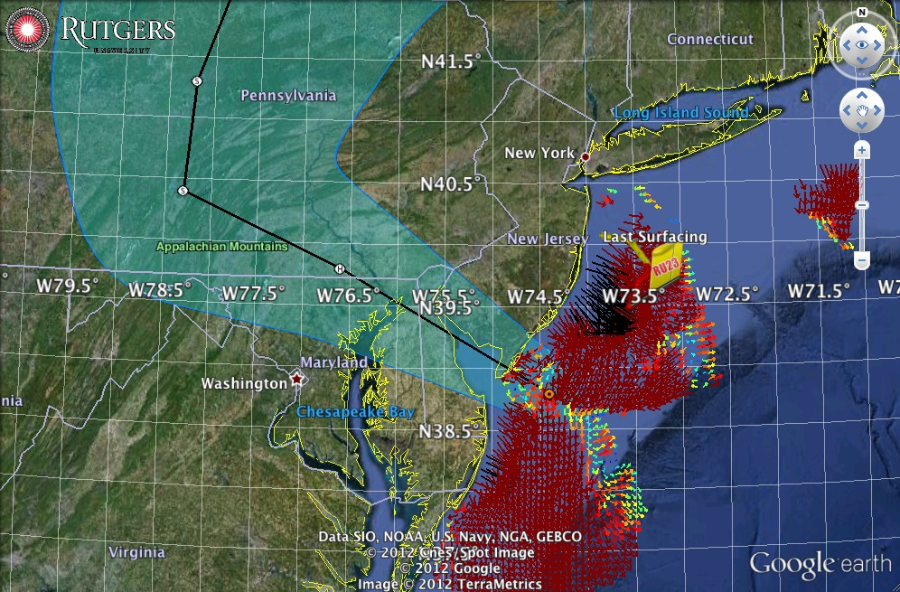
Superstorm Sandy: Landfall (20:00 Local)

Slide 27
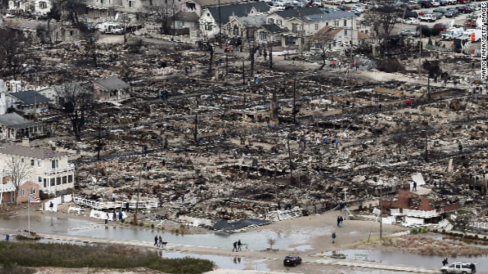
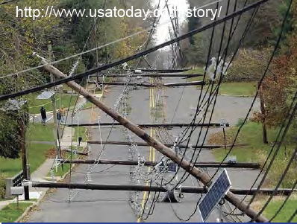
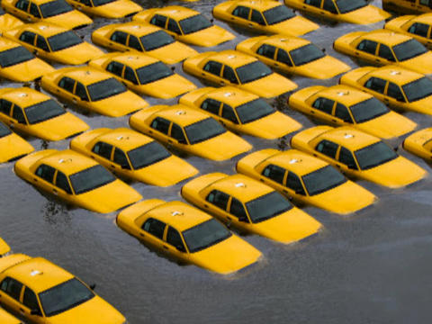
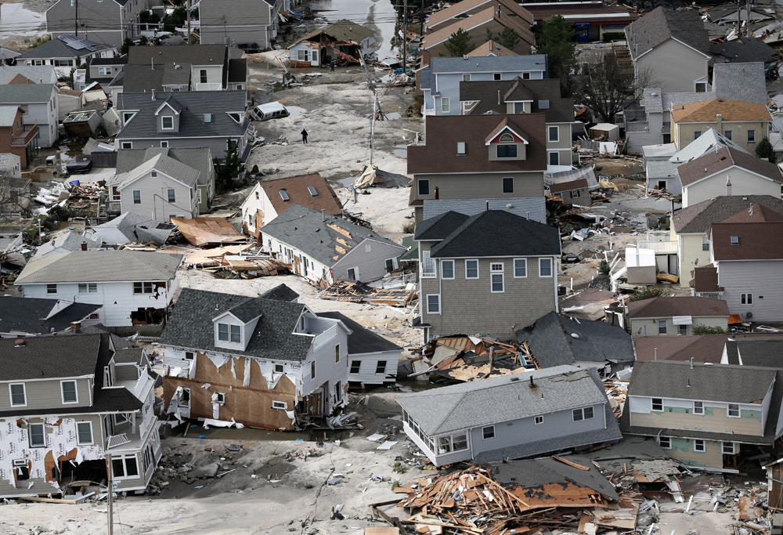
Sandy’s
Under-predicted Impact

Slide 28
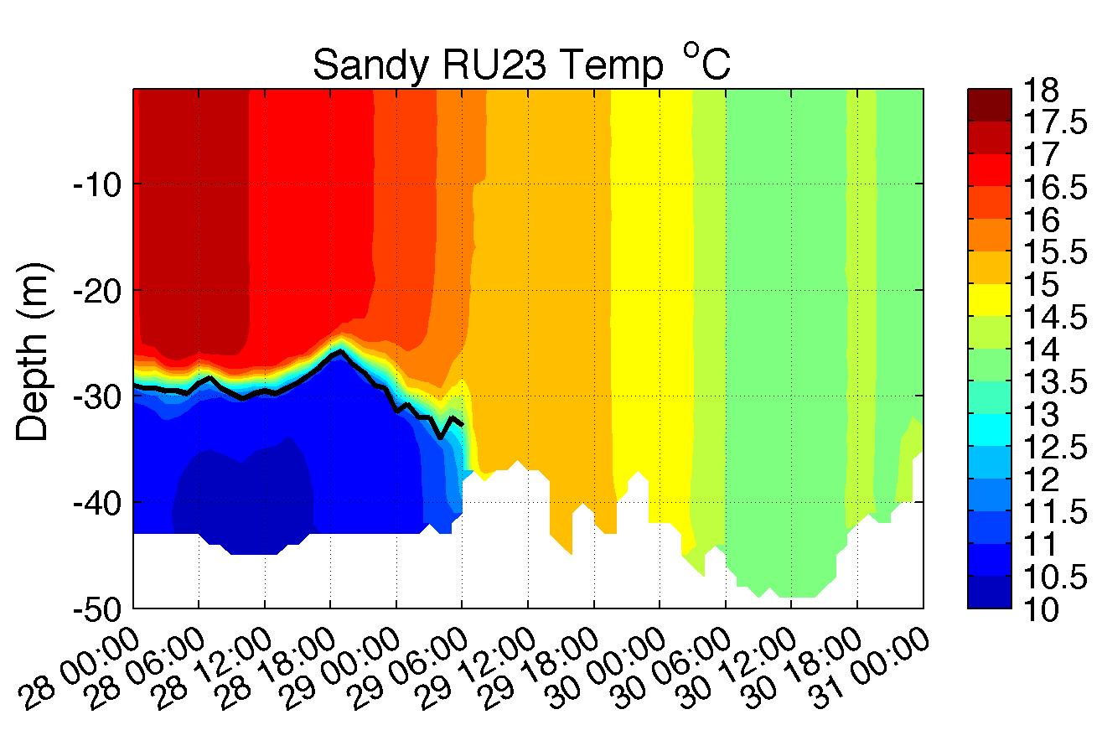
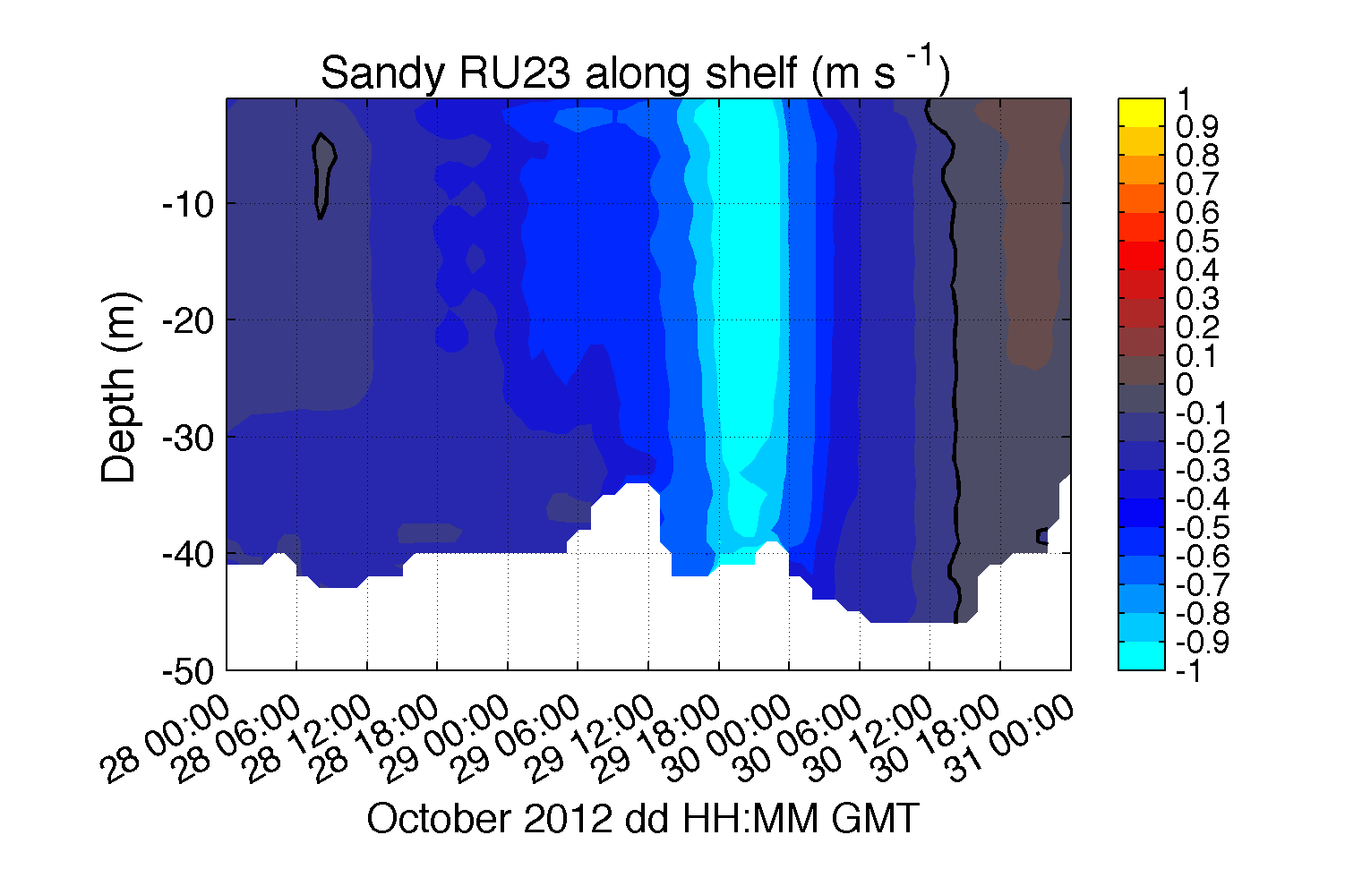
Glider Observations of Subsurface Response

Slide 29
Glider - ROMS Comparison: Suspended Sediment, Backscatter & Transport

Slide 30
ROMS Total Suspended Sediment

Slide 31
ROMS Total Change in Bed Thickness

Slide 32
Hurricane Irene
August 26, 2011
Strong Stratification
Coastal Response
Mixing cooled surface
Limited intensity
Hurricane Sandy
October 29, 2012
After fall transition
Single layer ocean
No mixing/cooling
Sediment Transport

Slide 33
UMaine
GMRI
WHOI
Storm Glider
CTD, ECOpuck
Optode, Aquadopp
Accelerometer,
Power Bay
Rutgers
UMaryland

