Slide 1
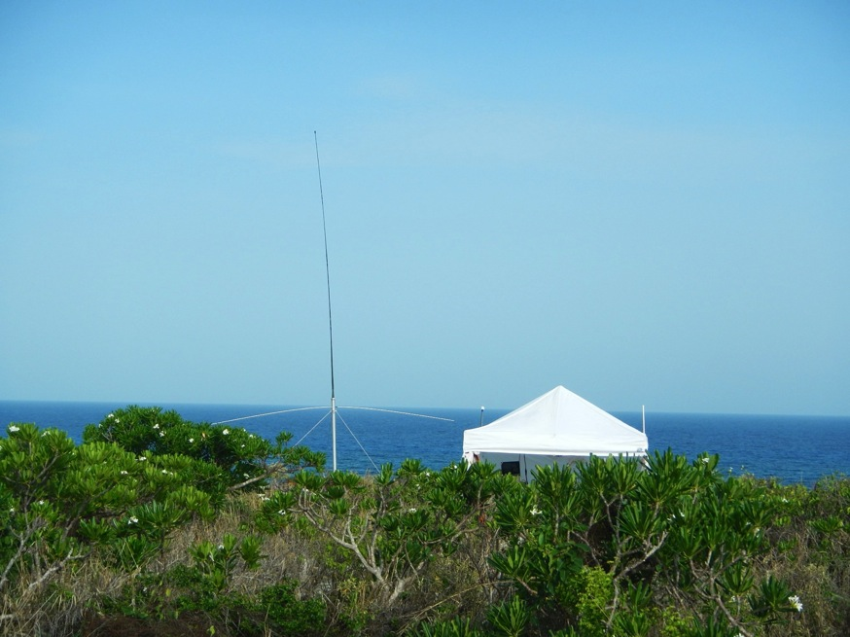
Globalizing Frontier Technologies for Integrated Ocean-Atmosphere Observing & Forecasting:
Promoting Indonesia-U.S. Partnerships for Research, Education and Service to Society
Scott Glenn,
Josh Kohut &
Hugh Roarty
Rutgers University,
New Brunswick, New Jersey, USA
CODAR HF Radar on
Mona Island, Puerto Rico

Slide 2
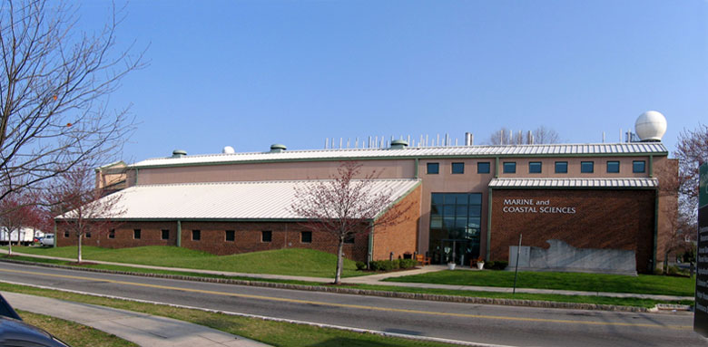

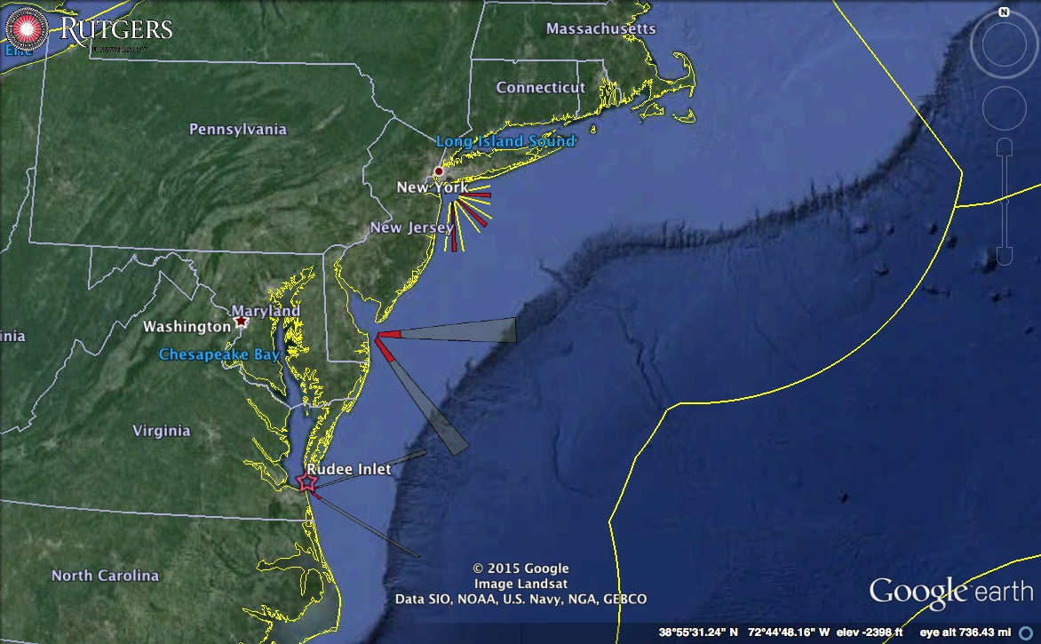
25 Years of Ocean Observing at:
Rutgers University (RU)
Center for Ocean Observing Leadership (COOL)
Department of Marine and Coastal Sciences (DMCS)
71 Dudley Road, New Brunswick, New Jersey, USA
http://rucool.marine.rutgers.edu
Dr. Scott Glenn
Distinguished Professor
MARACOOS Principal Investigator
U.S. Committee for IOC Chair
glenn@marine.rutgers.edu
Dr. Josh Kohut
Associate Professor
MARACOOS Fisheries Lead
Water Quality SAB
kohut@marine.rutgers.edu
Dr. Hugh Roarty
Operations Center Director
MARACOOS HFR Lead
GEO Global HFR Chair
hroarty@marine.rutgers.edu

Slide 3
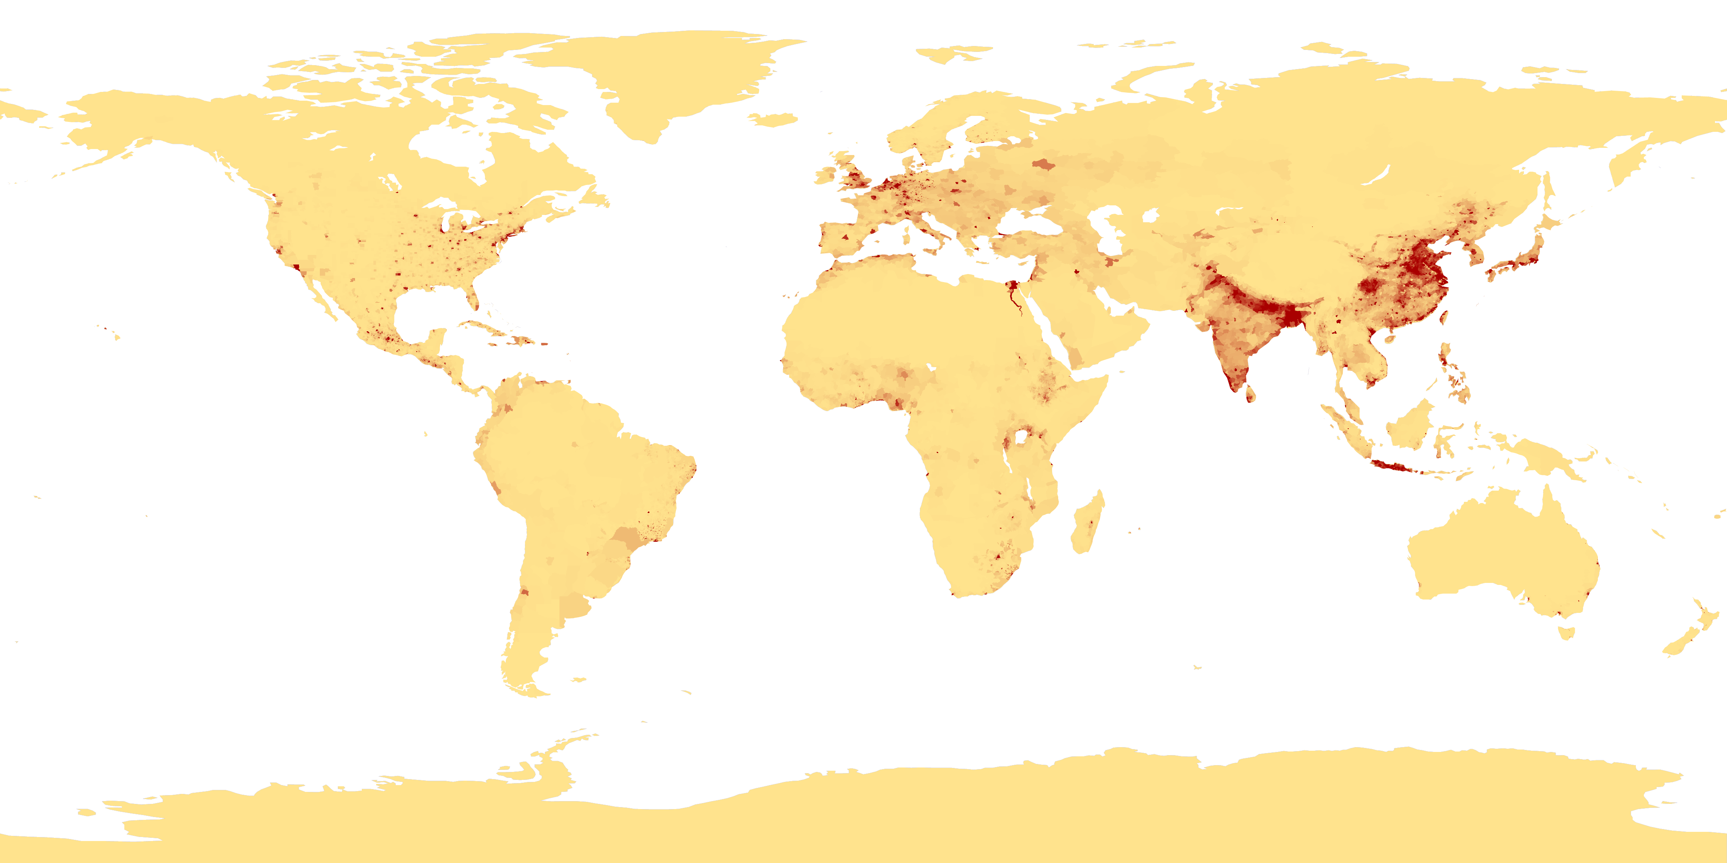
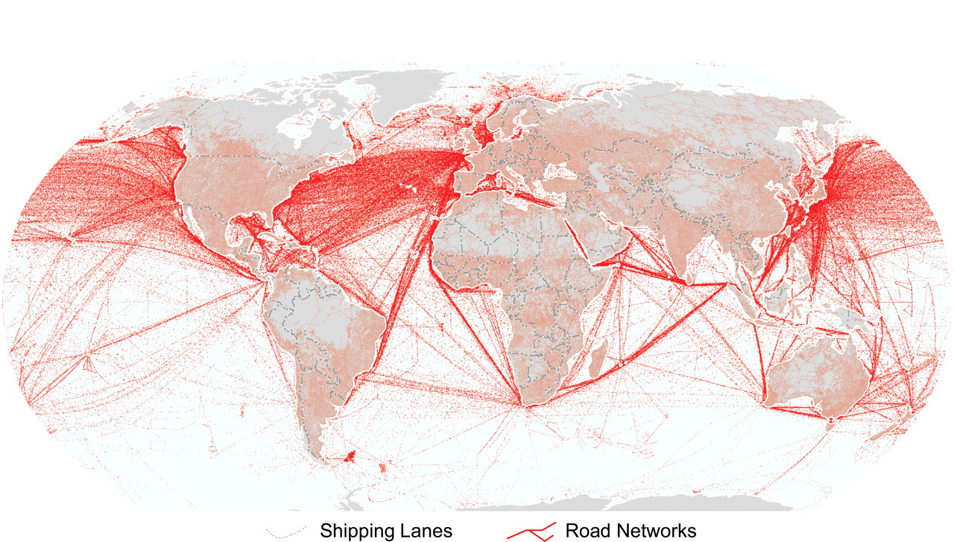
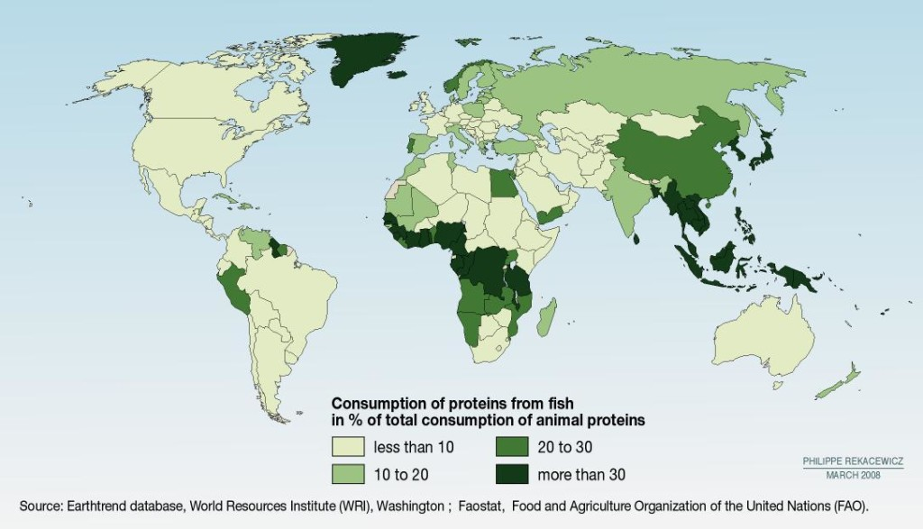
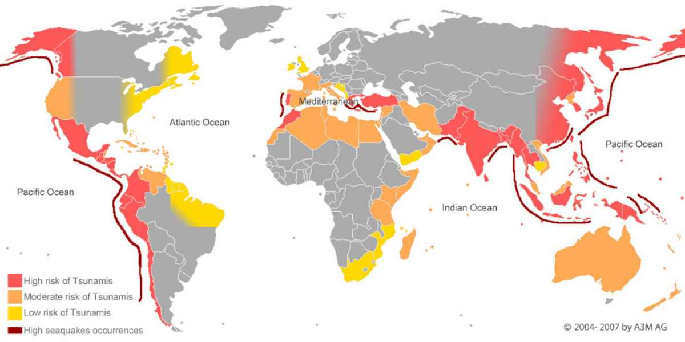
Societal Drivers
Coastal Population Centers
International Commerce
Fish Consumption
Tsunami Risk

Slide 4
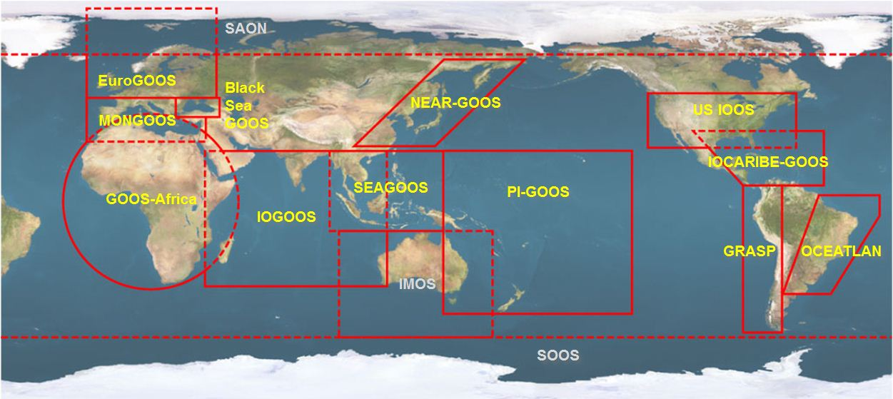





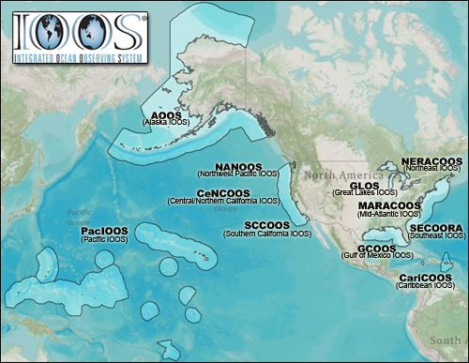













U.S. Integrated Ocean Observing System (IOOS)
Global Component
National Component
Regional Component
15 Regional Alliances in GOOS
Vessels -
Satellite
Satellite
CODAR
Ships/ Vessels
Glider
REMUS
Data Vis.
Modeling
Security
Leadership
Education
11 Regional Associations
17 U.S. Federal Agencies
Serving Society & Science
http://ioos.gov

Slide 5
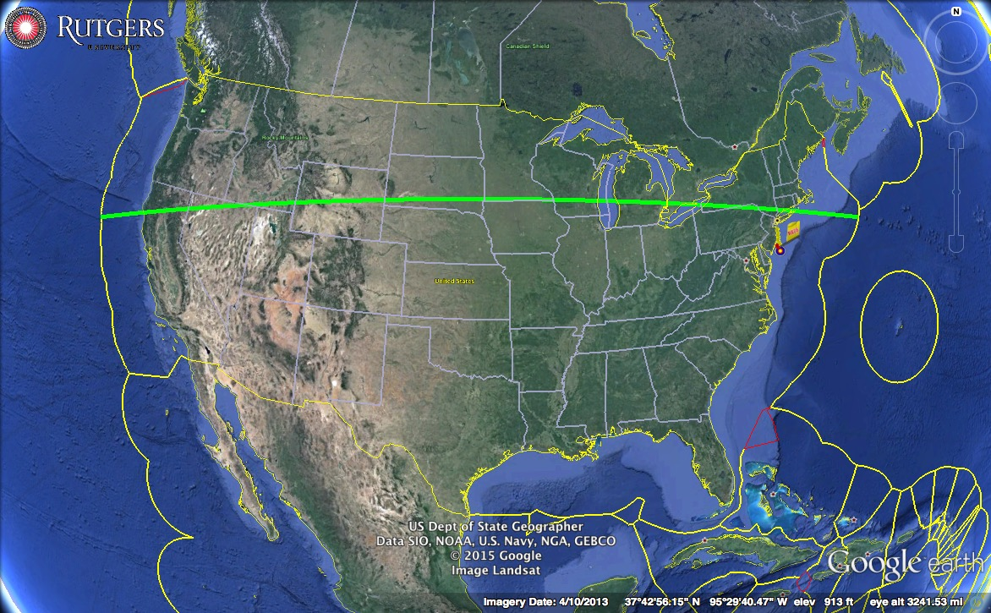
United States - National Scale
5,250 km

Slide 6
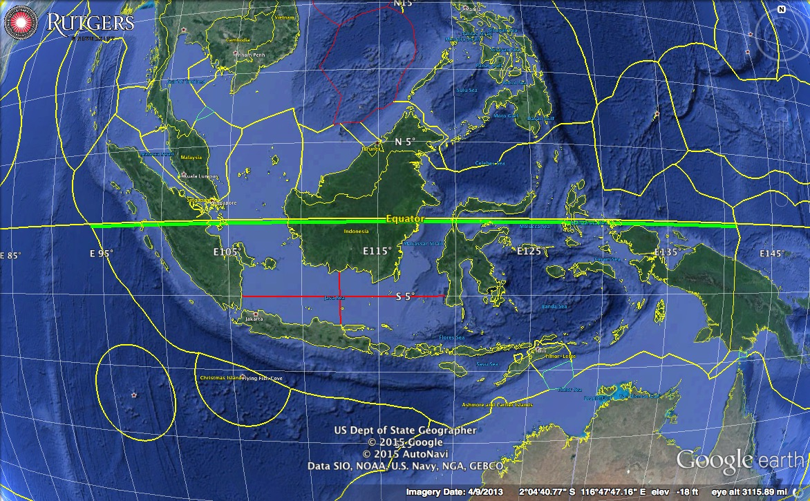
Indonesia - National Scale
5,250 km

Slide 7
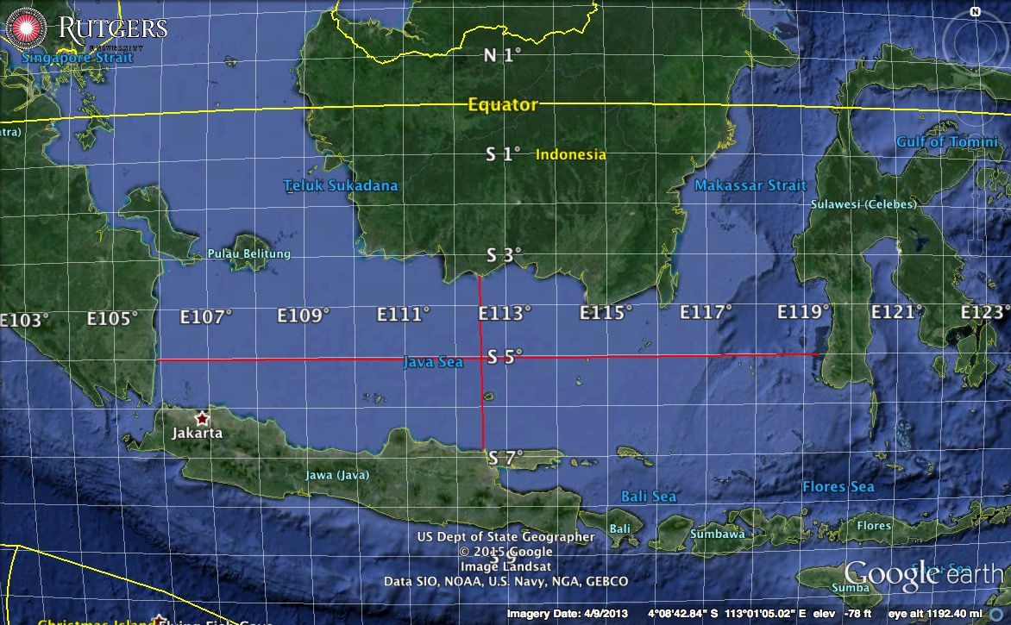
Java Sea - Regional Scale
1,500 km
375 km

Slide 8
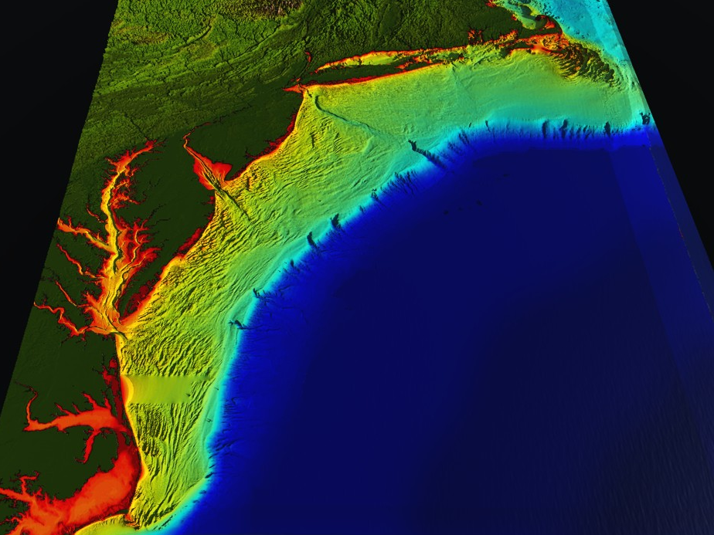















RI
U..
Middle Atlantic
Regional Association
Coastal
Ocean Observing System
10 States - 76 Million People
1000 km Cape to Cape
CT
Cape
Cod
MA
NY
PA
NJ
MARACOOS:
An Integrated & Sustained Real-time Observation and Forecast System
DE
>40 PIs
>20 Institutions
>50 Members
>2000 Contacts
MD
VA
NC
Cape
Hatteras
Notes:
8

Slide 9
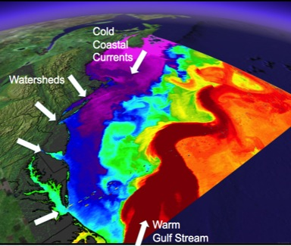
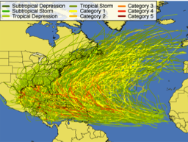
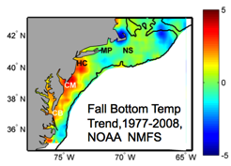
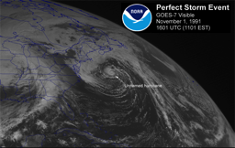
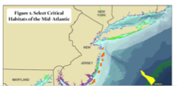
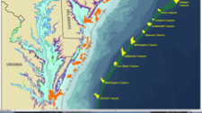
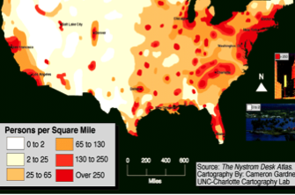
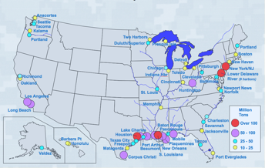
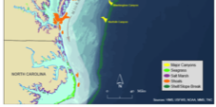
MID-ATLANTIC REGIONAL DRIVERS
Tropical Storms
Climate Change
Ocean Circulation
Critical Habitat
Northeasters
Population
Ports

Slide 10
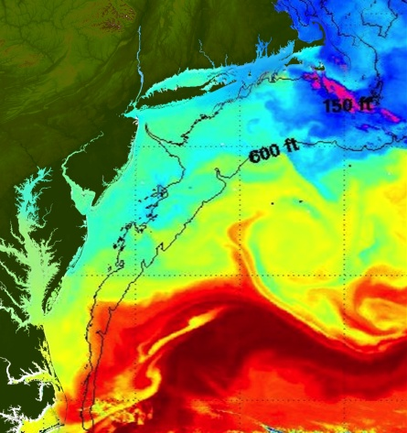
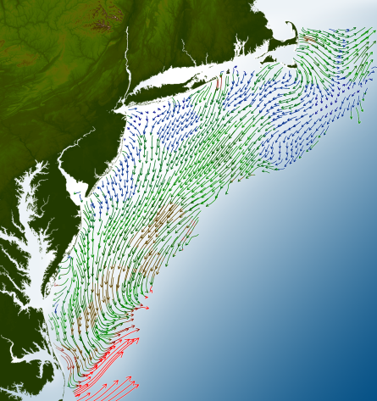
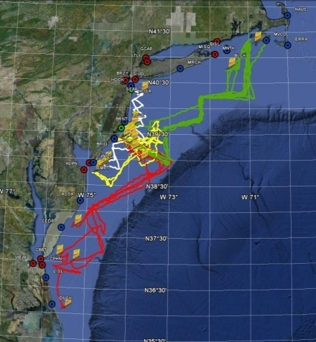
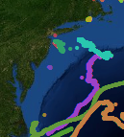
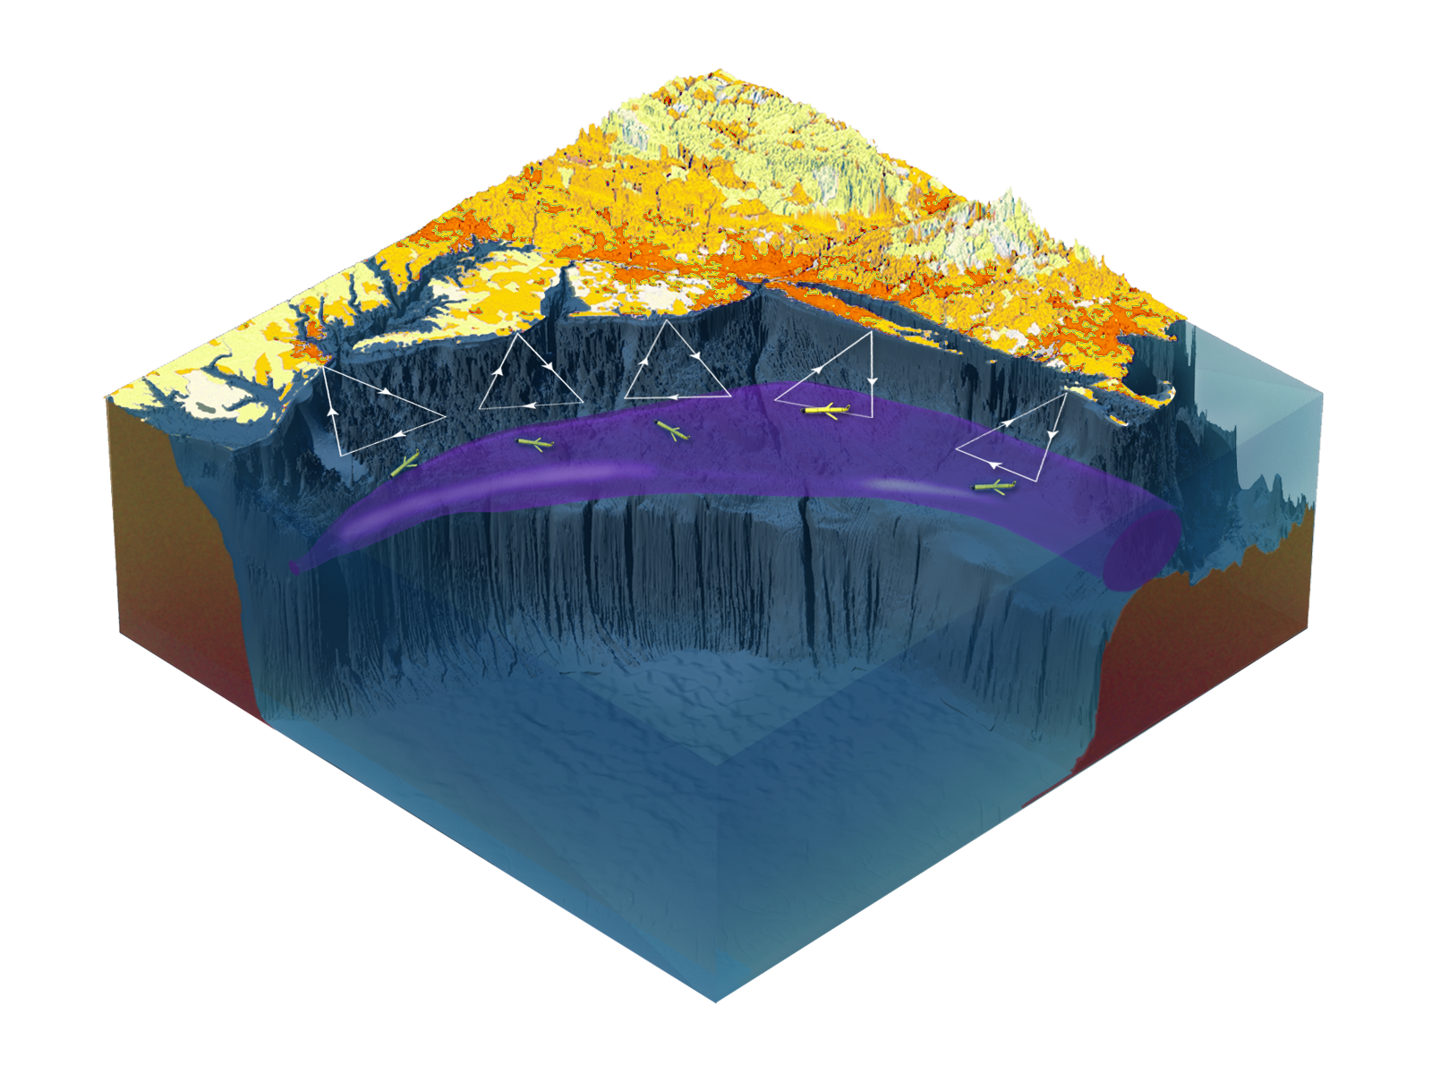

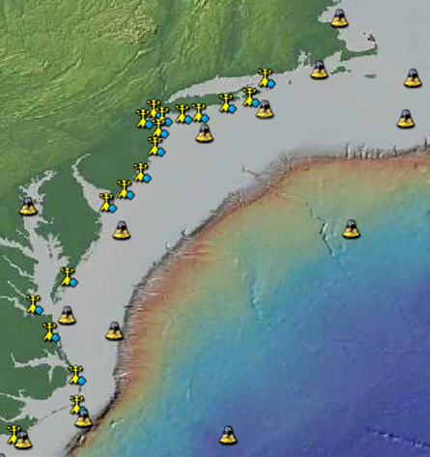
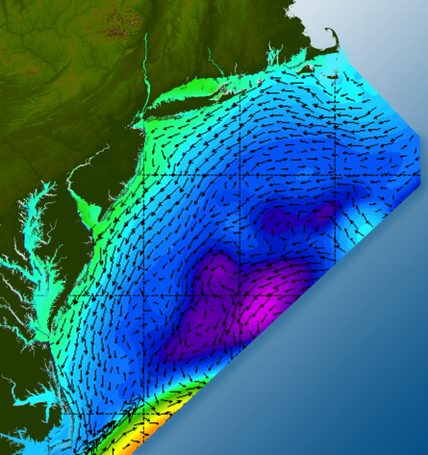

Satellites
HF-Radar
Gliders
Drifters
Population Density
To integrate, discover, communicate & apply
new knowledge & understanding
of our coastal ocean
Weather Stations
Atmosphere & Ocean Forecast Ensembles
Notes:
Need to cut off cold pool in south and bend offshore
Need to experiment with dulling down the colors in the pop density. Maybe orange/tan to white like the box I put in?
Put gliders just below the lines in 3 of them, and increase their angles facing up and down randomly. I stuck in cheesy examples
I already put the shadow and 80% clear line around the two new maps in the upper right, so we are good there.

Slide 11
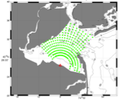
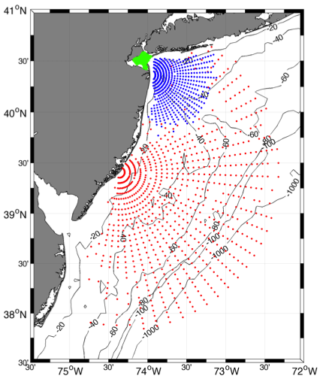
Each HF Radar produces a map of the radial component of the current velocity
25 MHz
Radar λ: 12 m Ocean λ: 6 m
Range: 30 km Resolution: 1 km
13 MHz
Radar λ: 23 m Ocean λ: 12 m
Range: 80 km Resolution: 3 km
05 MHz
Radar λ: 60m Ocean λ: 30 m
Range: 180 km Resolution: 6 km

Slide 12
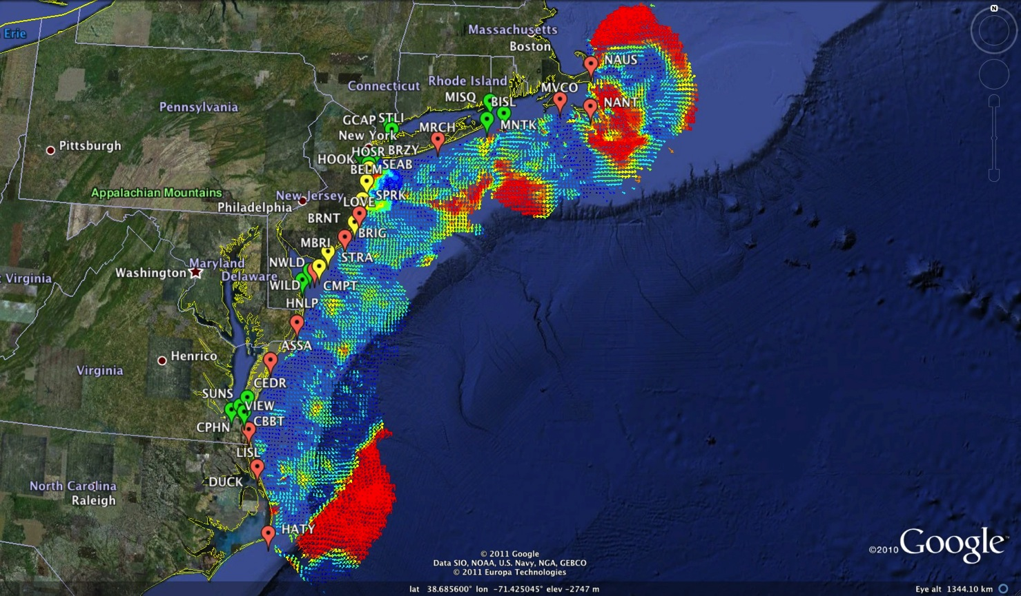
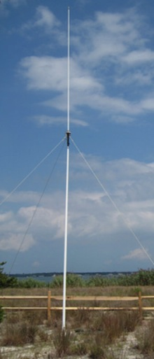
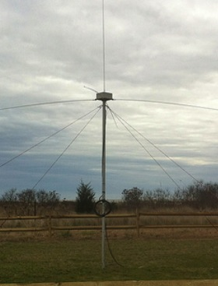
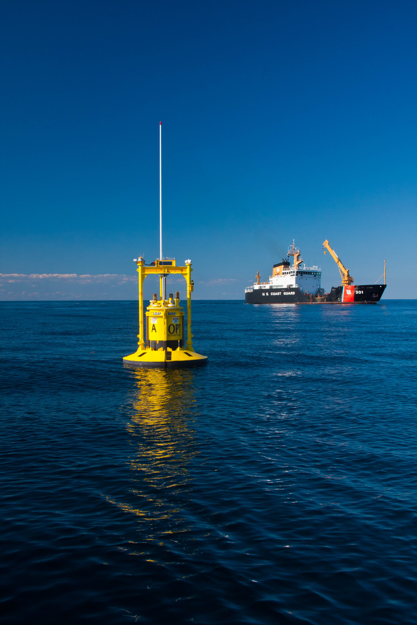
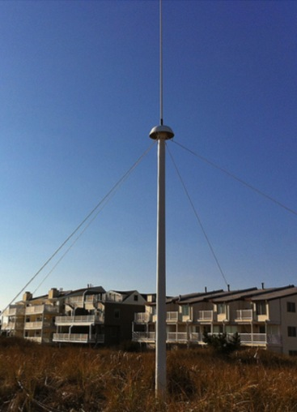

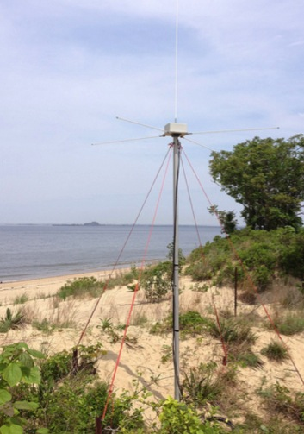
Mid-Atlantic Bight HF Radar Network
1000 km
Cape to Cape
Mid-Atlantic HF Radar Network
18 Long-Range CODARs
8 Medium-Range CODARs
20 Short-Range CODARs
46 Total
Triple Nested, Multi-static, Multi-use
Industry Partner: CODAR Ocean Sensors

Slide 13
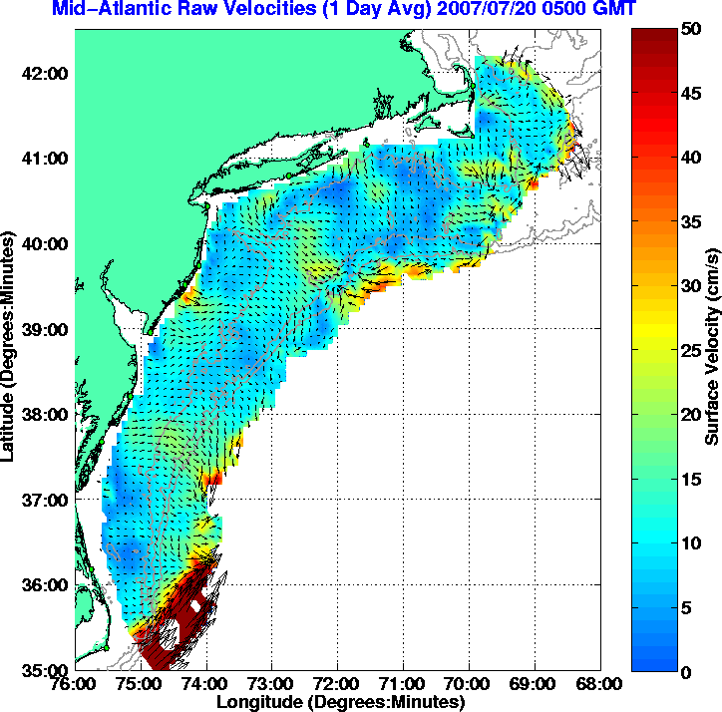
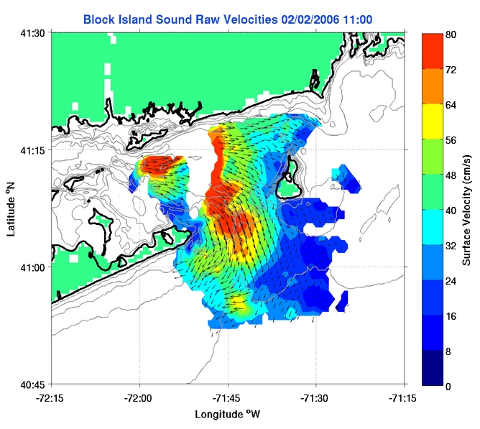
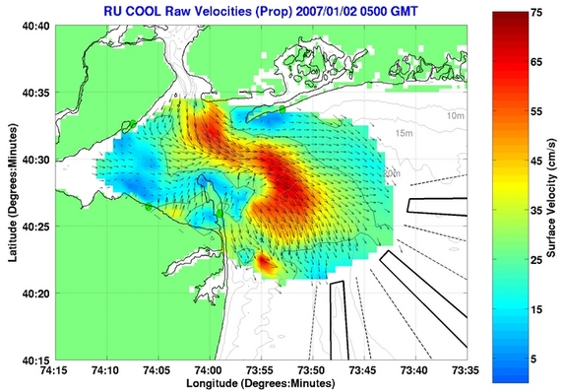
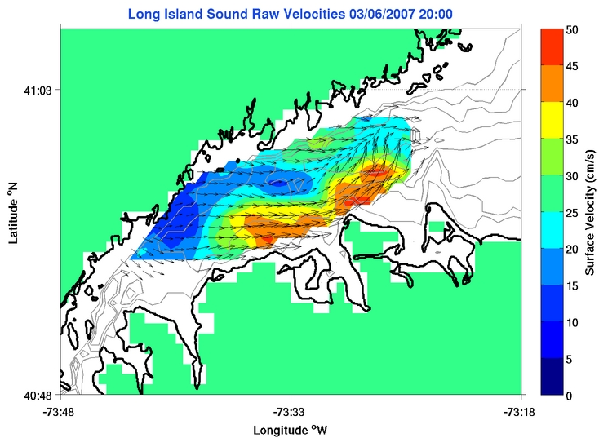
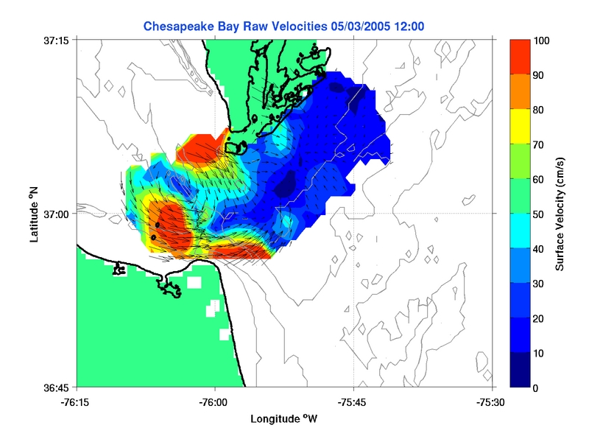
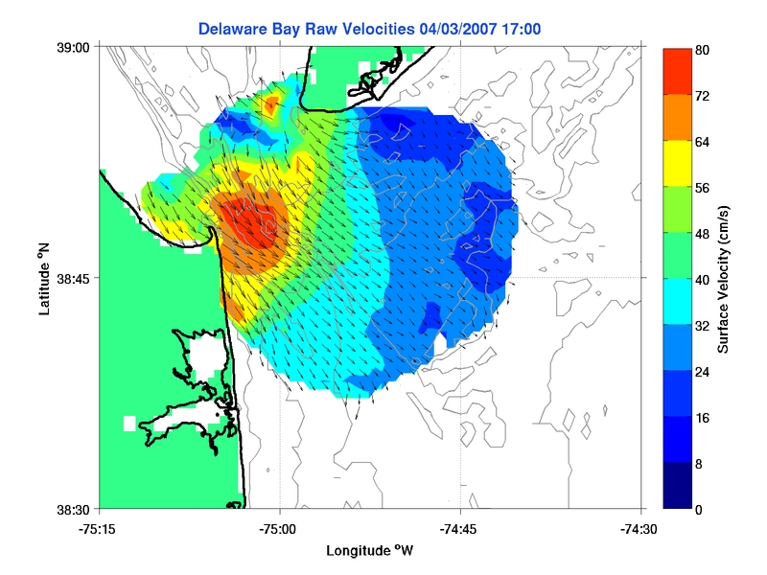

Slide 14
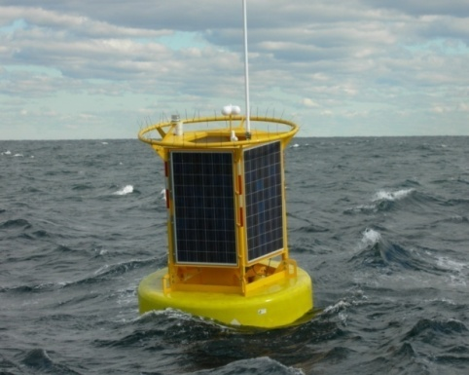
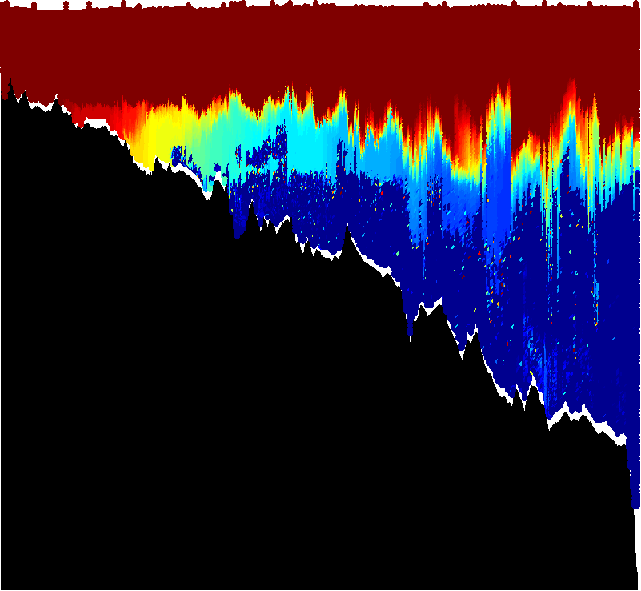
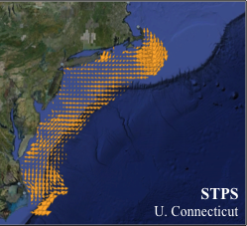
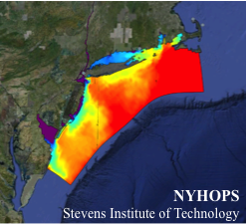
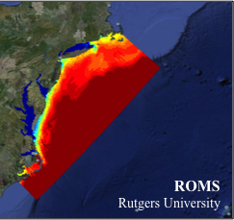
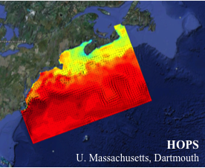
Regional Ocean Observing System
Satellites
HF radar
Gliders
Fixed Platforms
Ensemble of Assimilation Models

Slide 15
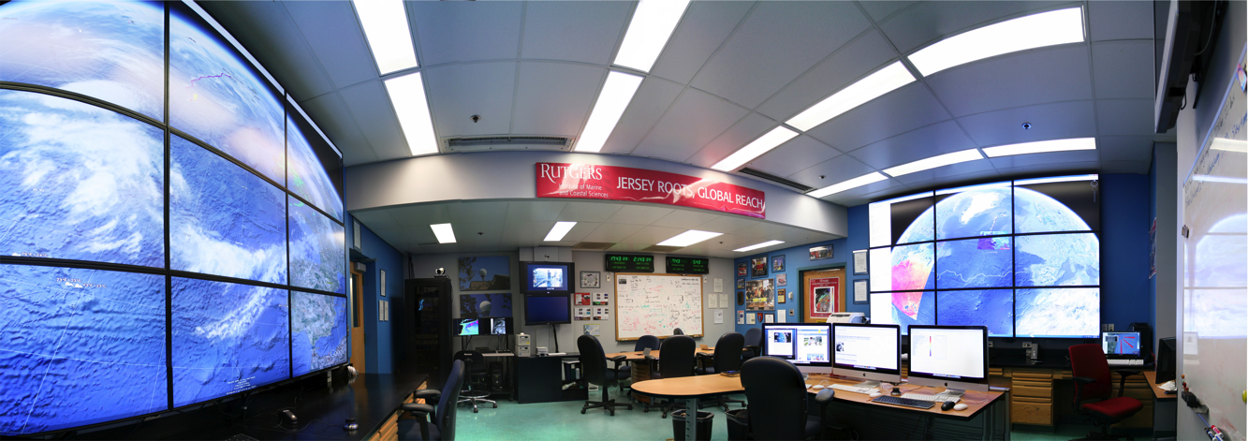





Rutgers - Center for Ocean Observing Leadership:
Observatory Operations Center
Satellite Data Acquisition Stations
CODAR Network
Glider Fleet
3-D Forecasts

Slide 16






Integrating Data, Products and Services for Societal Goals
Regional Priority Themes | Regional Observation & Modeling Capabilities
 | Weather Mesonet | HF Radar Network | Statistical STPS | Satellite Imagery | Glider Surveys | Dynamical Ocean Forecasts
Theme 1. Maritime Safety | Operational Input to USCG SAROPS | Operational input to USCG SAROPS | Operational input to USCG SAROPS | SST for survivability planning | Assimilation dataset for forecast models | Surface currents for SAROPS
Theme 2. Ecological Decision Support | Weather forecast ensemble validation | Circulation and divergence maps for habitat |  | SST & Color for habitat | Subsurface T & S for habitat | 3-D fields of T, S, circulation for habitat
Theme 3. Water Quality | Winds for transport, river plumes, & upwelling | Surface currents for floatables, bacteria, spill response | Surface currents for floatables, bacteria, spill response | Ocean color for river plumes | Nearshore dissolved oxygen surveys | Surface currents for floatables, bacteria, spill response
Theme 4. Coastal Inundation | Weather forecast ensemble validation | Current forecast model validation |  | SSTs assimilation into forecast models | Assimilation dataset for forecast models | Nested forecast ensembles
Theme 5. Offshore Energy | Historical analysis & wind model validation | Historical current analysis & wind model validation |  | Historical analysis surface fronts & plumes for siting | Historical analysis of subsurface fronts & plumes | Coupled ocean-atmosphere models for resource estimates

Slide 17



Success Stories – Making a Difference
Optimizing HF Radar for SAR using USCG Surface Drifters
Art Allen
U.S. Coast Guard
Scott Glenn
Rutgers University
Mid-Atlantic Regional Association
Coastal Ocean Observing System

Slide 18


Status 2004

Slide 19





Use of HF Radar Surface Currents for Search And Rescue:
Operational since May 4, 2009
Surface Currents
Data Acquisition
Data Product Generation & Management
Search And Rescue Optimal Planning System (SAROPS)

Slide 20





Responding to Crisis: Deepwater Horizon
U.S. IOOS partnership demonstrated ability to:
Quickly deploy technologies: Gliders and HF radar, saving resources/improving safety
Models/Imagery ingested into NOAA/Navy models
Data assimilation improved spill response decision-making and public understanding
USM HFR
USF HFR
June 2
HFR validation of SABGOM Forecast combined with satellite detected oil slicks
Briefing Blog
127 Briefs
Web Portal
HFR data informed NOAA
trajectory forecasts

Slide 21


Slide 22


Slide 23


Slide 24


Slide 25






Hurricane Irene August 26-29 2011
#8 with >$15B damage
Track Accurate
Intensity Over-predicted
Two Gliders Deployed

Slide 26





Pre-Irene
Post-Irene
Difference
11C max Cooling
WHAT?
Rutgers
Satellite
Temperature
WHEN? Rutgers Glider Temperature
WHY?
Rutgers Radar
Currents
Eye Passage

Slide 27






Rutgers Atmospheric Forecast Sensitivity Study
Warm Ocean
Boundary Condition
Cat 1 Hurricane
Tropical Storm
Cold Ocean
Boundary Condition
IMPACT?
>10 knots reduction in peak wind speed

Slide 28




Dr. Louis Uccellini, Director, U.S. National Weather Service
Message to Rutgers Students – Marine Weather Forecasts need a good ocean ….
Use your gliders to tell us how our ocean models are doing …
U.S. RTOFS
European MyOcean

Slide 29
Integrating Data, Products and Services for Societal Goals
Regional Priority Themes | Regional Observation & Modeling Capabilities
 | Weather Mesonet | HF Radar Network | Statistical STPS | Satellite Imagery | Glider Surveys | Dynamical Ocean Forecasts
Theme 1. Maritime Safety | Operational Input to USCG SAROPS | Operational input to USCG SAROPS | Operational input to USCG SAROPS | SST for survivability planning | Assimilation dataset for forecast models | Surface currents for SAROPS
Theme 2. Ecological Decision Support | Weather forecast ensemble validation | Circulation and divergence maps for habitat |  | SST & Color for habitat | Subsurface T & S for habitat | 3-D fields of T, S, circulation for habitat
Theme 3. Water Quality | Winds for transport, river plumes, & upwelling | Surface currents for floatables, bacteria, spill response | Surface currents for floatables, bacteria, spill response | Ocean color for river plumes | Nearshore dissolved oxygen surveys | Surface currents for floatables, bacteria, spill response
Theme 4. Coastal Inundation | Weather forecast ensemble validation | Current forecast model validation |  | SSTs assimilation into forecast models | Assimilation dataset for forecast models | Nested forecast ensembles
Theme 5. Offshore Energy | Historical analysis & wind model validation | Historical current analysis & wind model validation |  | Historical analysis surface fronts & plumes for siting | Historical analysis of subsurface fronts & plumes | Coupled ocean-atmosphere models for resource estimates

Slide 30
Integrated Approach
Enabled by New Technologies
Requires Partnerships
CODAR HF Radar on
Mona Island, Puerto Rico

