Slide 1
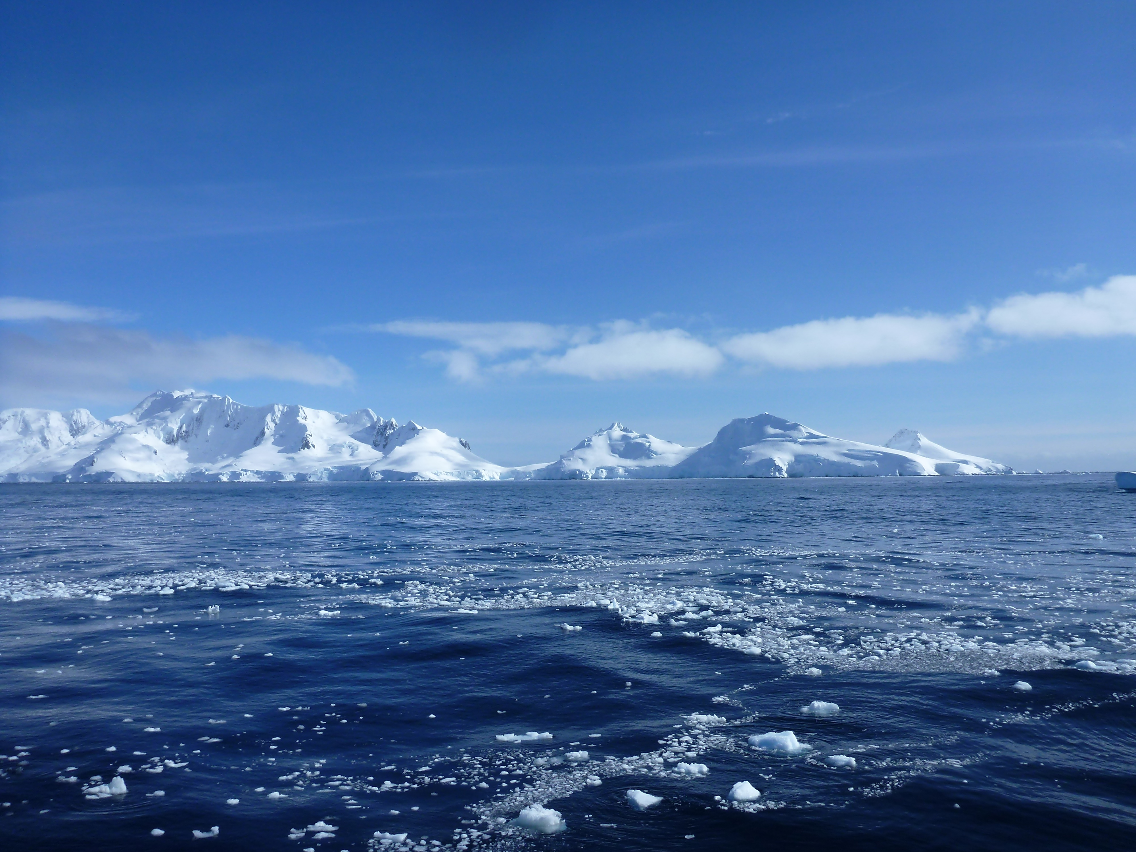
A census of Upper Circumpolar Deep Water on the continental shelf of the West Antarctic Peninsula
Nicole Couto
Department of Marine and
Coastal Sciences
Rutgers University
Gordon Research Seminar
Polar Marine Science
14 March 2015

Slide 2
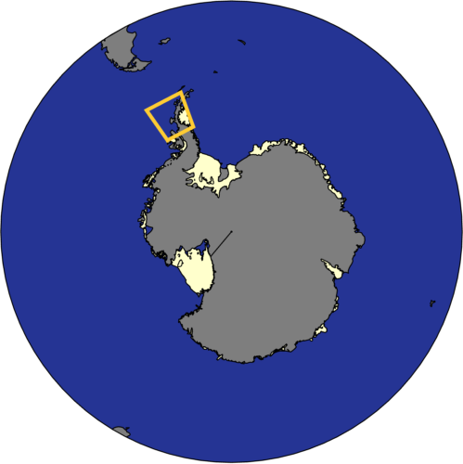
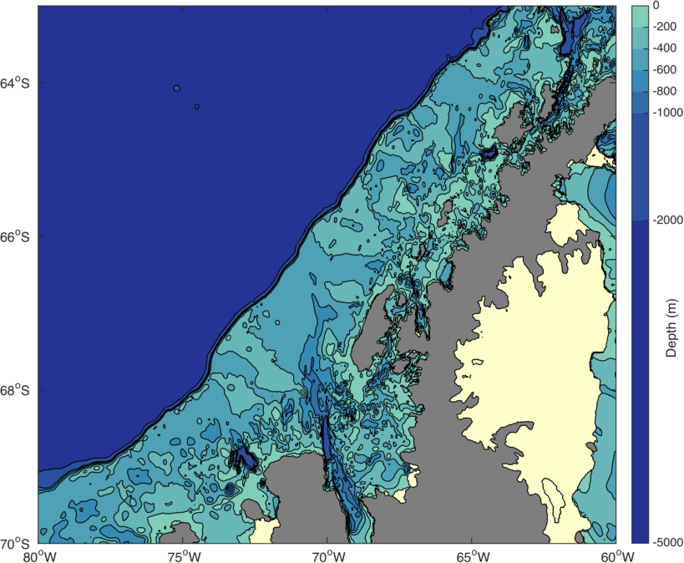
The West Antarctic Peninsula (WAP)
Palmer Deep
Palmer Station
(Anvers Island)
Marguerite Bay
Antarctic Peninsula
Ice Shelf
Rothera
(Adelaide Island)

Slide 3
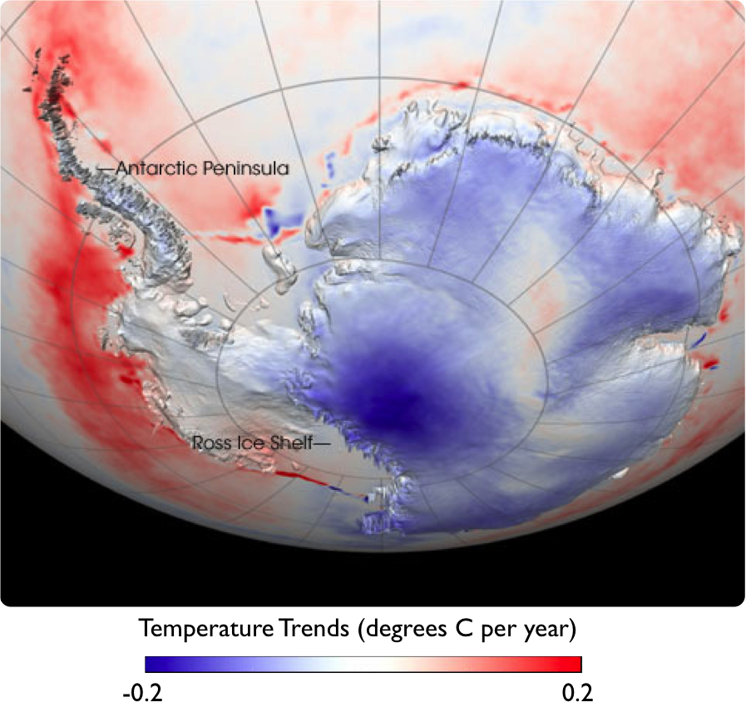
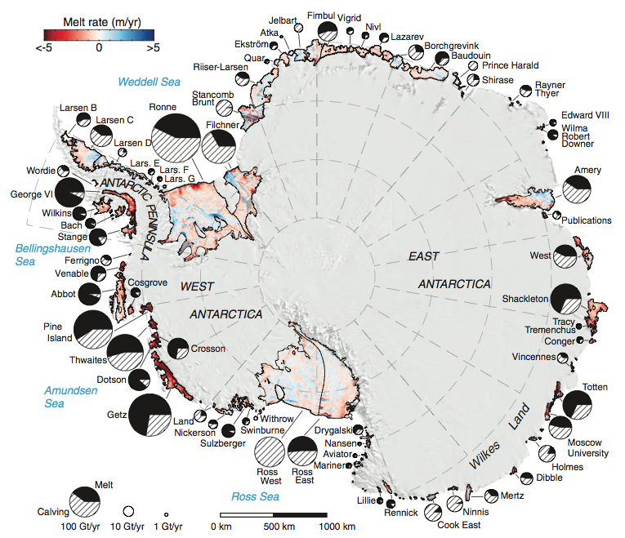
West Antarctic Peninsula is warming and losing ice
Ray Smith, Rignot 2013

Slide 4
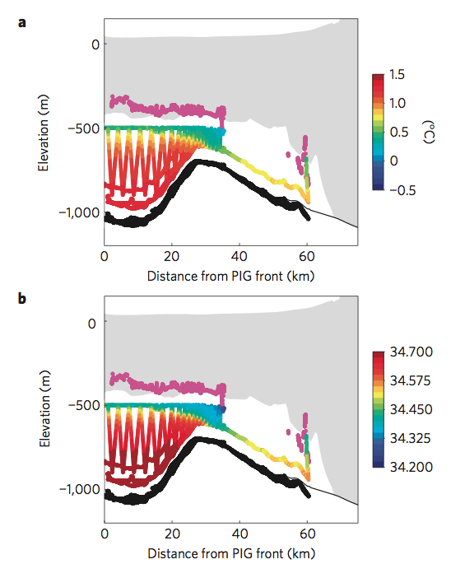
West Antarctic Peninsula is warming and losing ice
Jenkins 2010, Rignot 2013

Slide 5
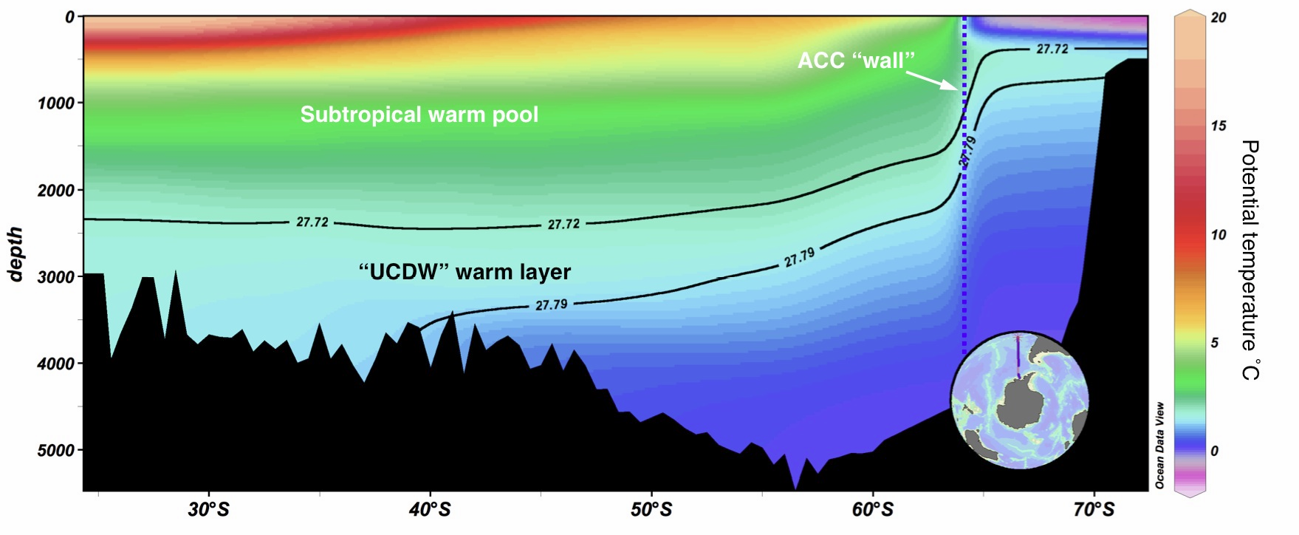
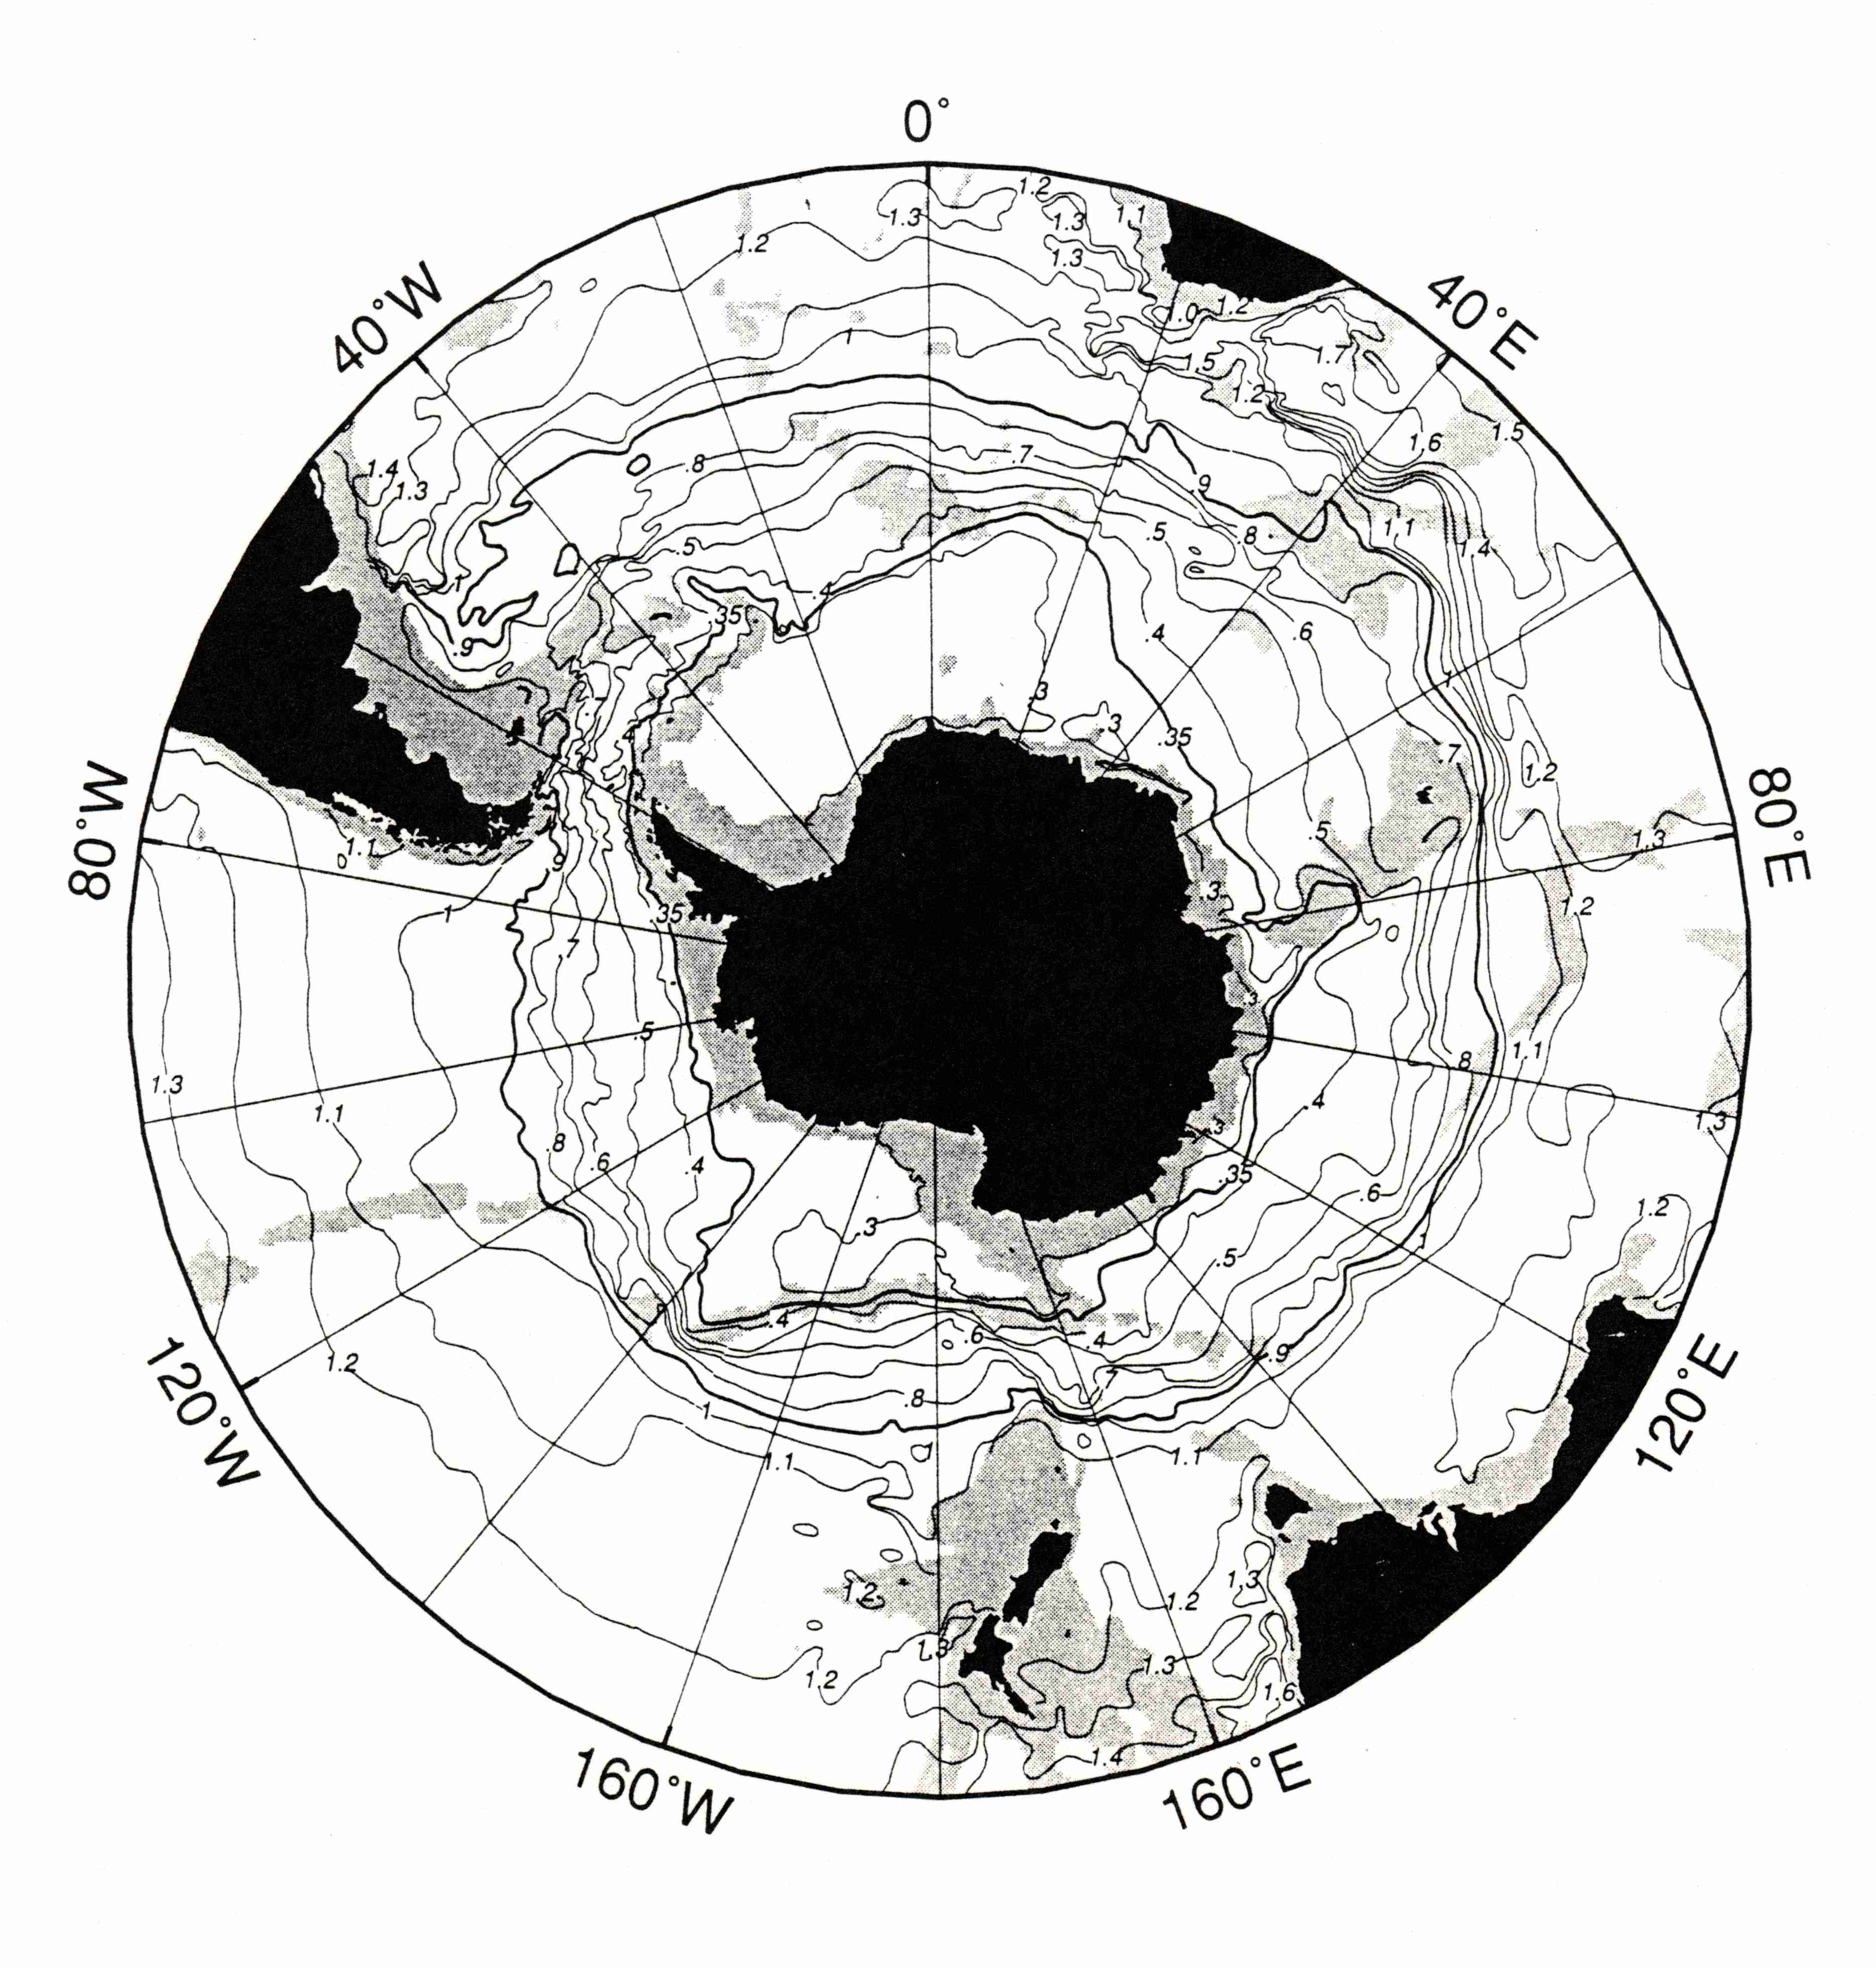
Isopycnals are lifted in response to surface transport
Circumpolar Deep Water
Pacific Deep Water

Slide 6
Questions
How much pure UCDW exists on the shelf?
Where does it intrude?
What are the spatial scales of UCDW intrusions?
How much heat is carried in pure UCDW intrusions?

Slide 7
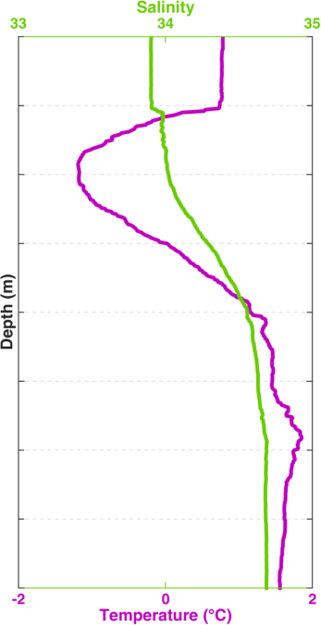
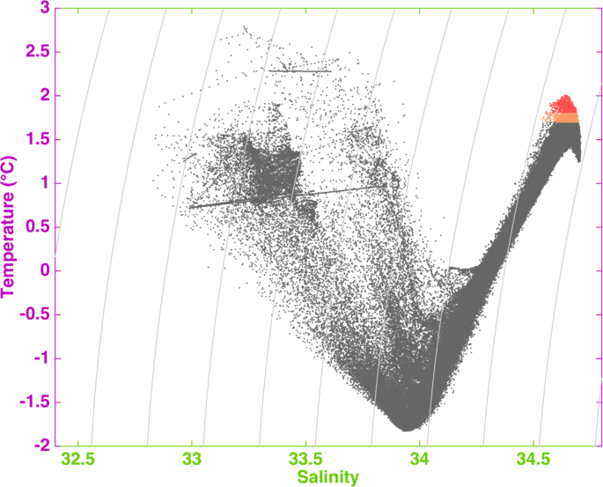
How do we identify Upper Circumpolar Deep Water?
AASW
WW
UCDW
AASW
UCDW
WW

Slide 8
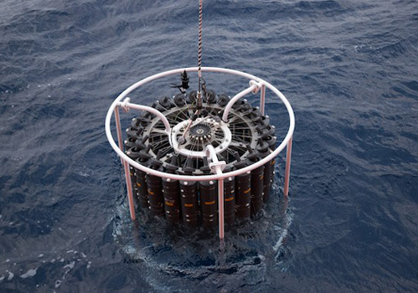
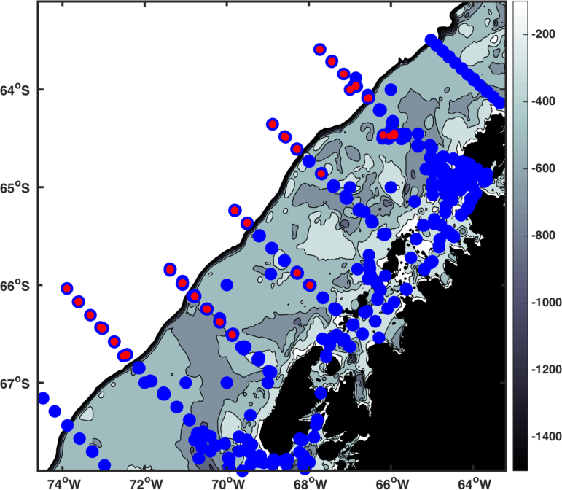
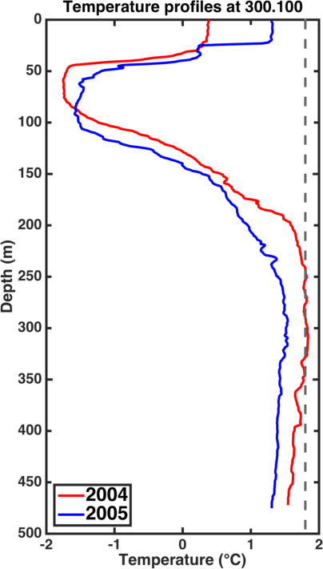
20 years of CTD data

Slide 9
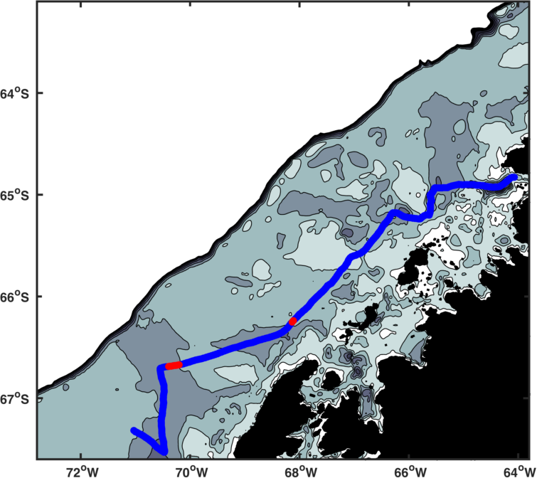
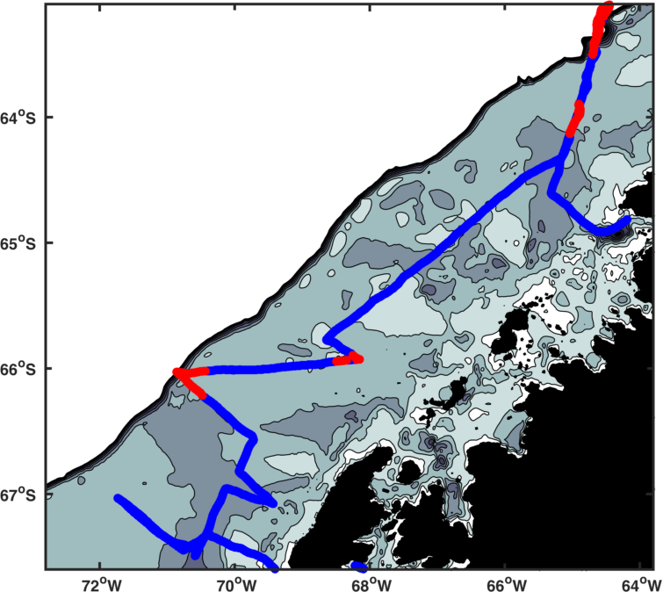
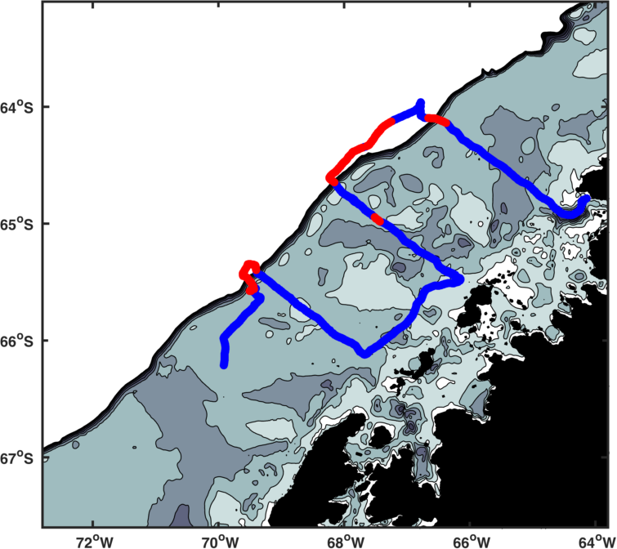
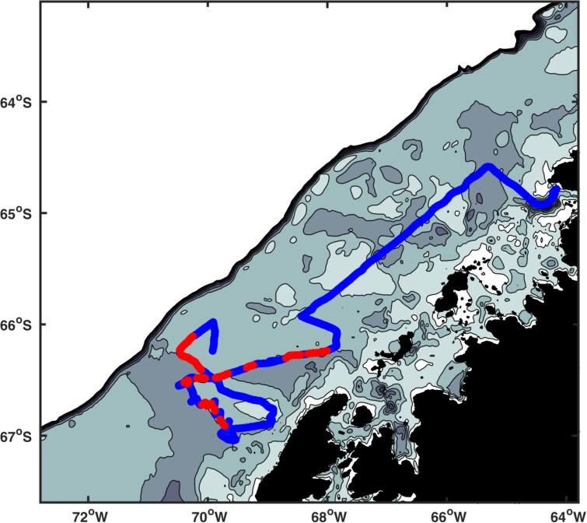
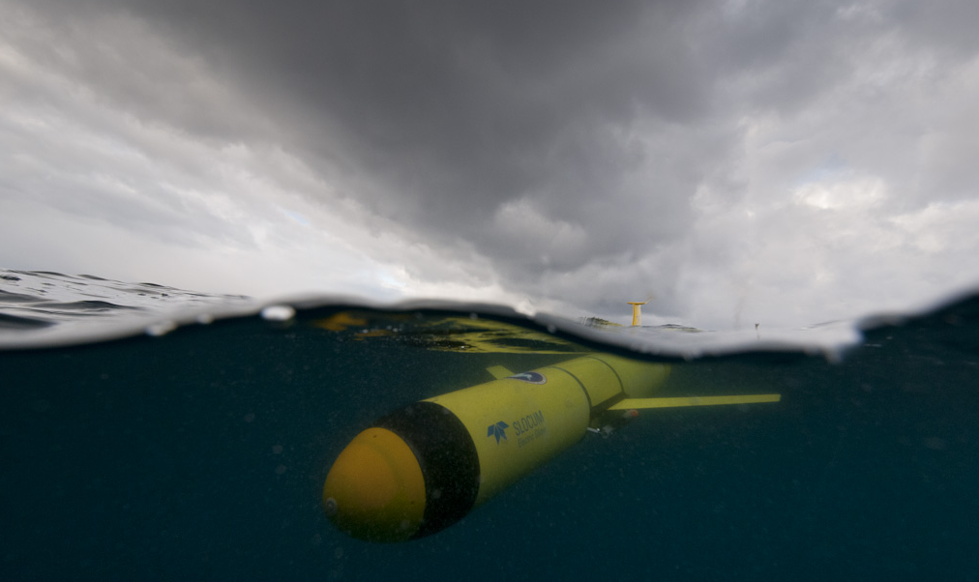
4 glider deployments
2010/11
2011/12
2012/13
2012/13

Slide 10
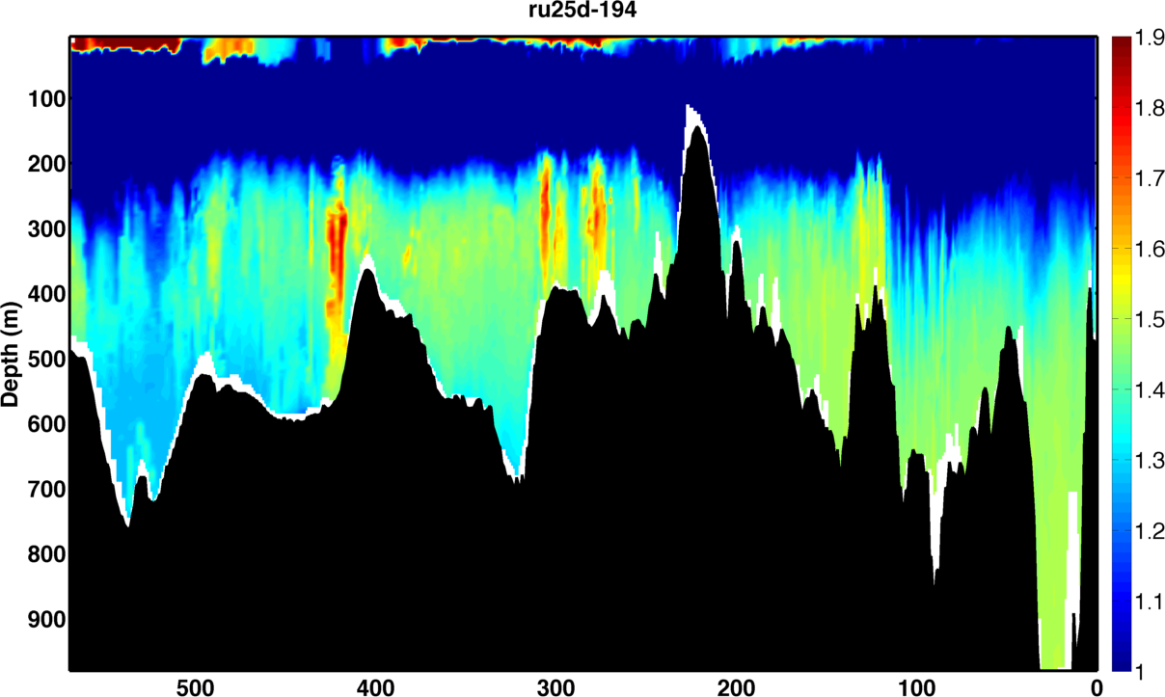
Packets of pure UCDW are on the shelf
Temperature
The Pioneer
Distance (km)

Slide 11
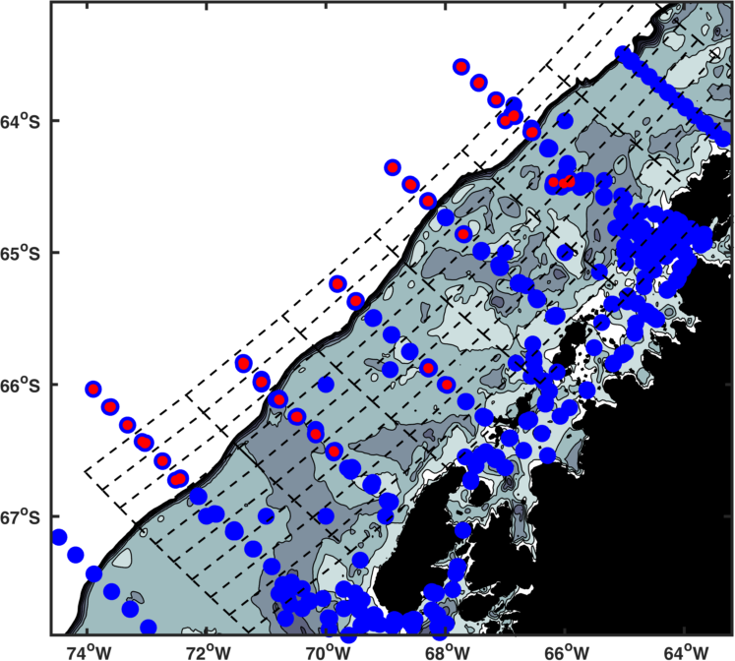
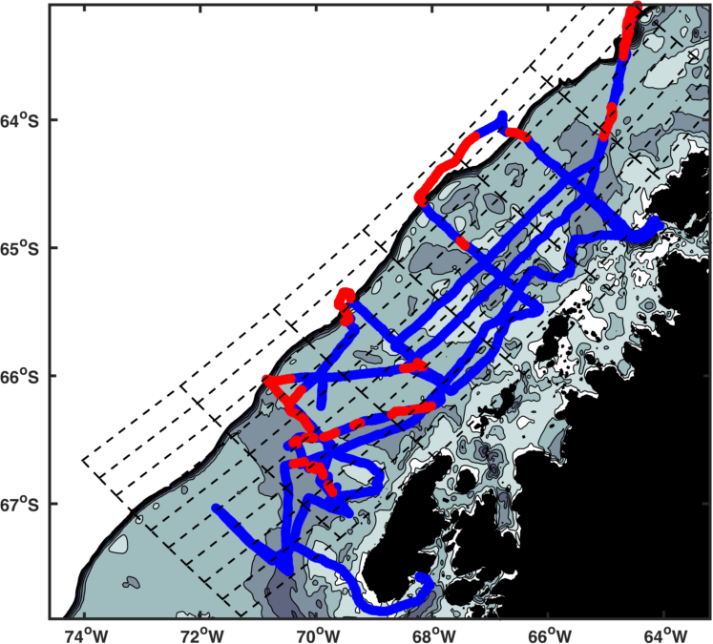
What are the spatial trends in UCDW on the shelf?
20 years of CTD sampling
4 glider deployments

Slide 12
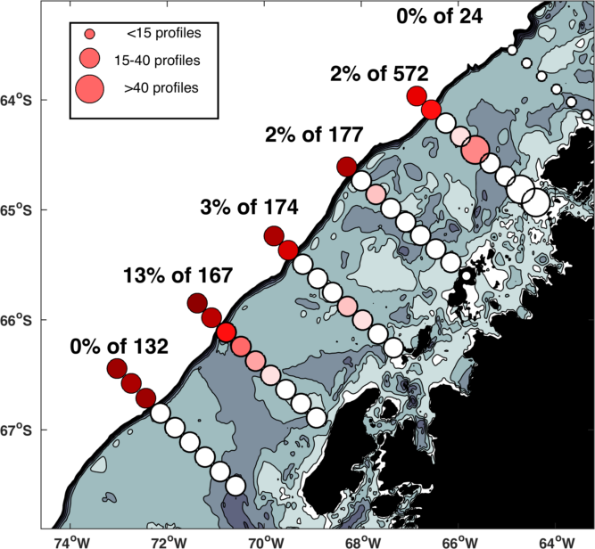
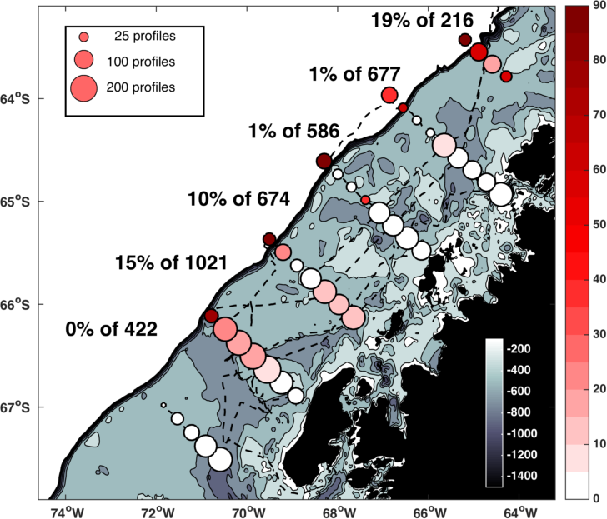
Spatial patterns are similar in CTD and glider datasets
20 years of CTD sampling
4 glider deployments

Slide 13
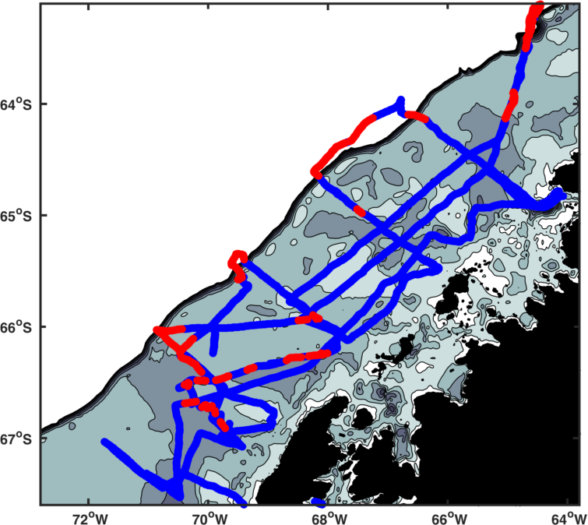
How do UCDW features change
across the shelf?
How does the width change?
How does the height change?
?
How does the heat content change?
?

Slide 14
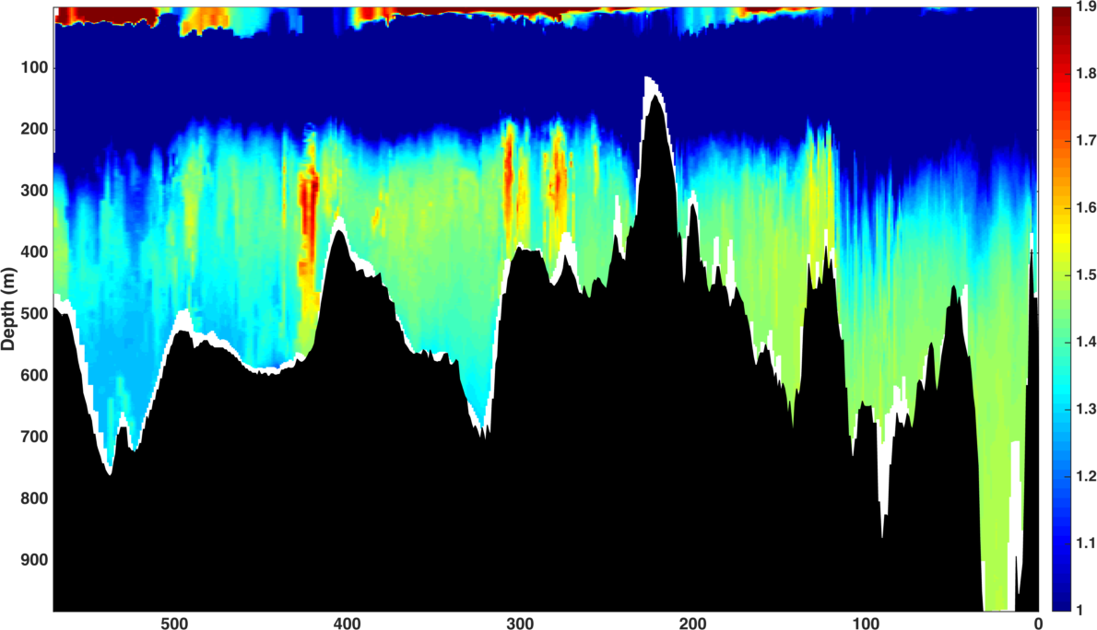
Measuring width
Temperature (°C)
Distance (km)

Slide 15
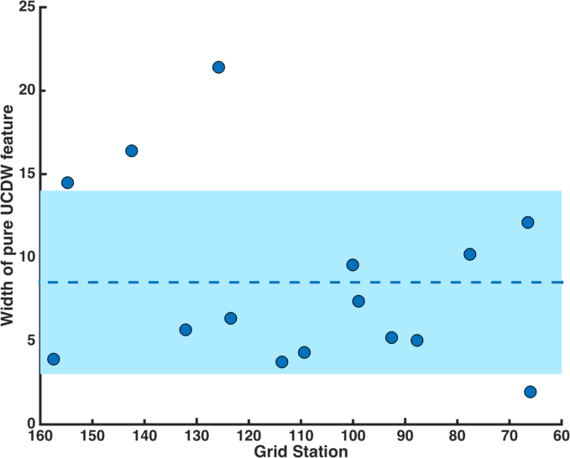
How does the width change?
Shelf break
Coast

Slide 16
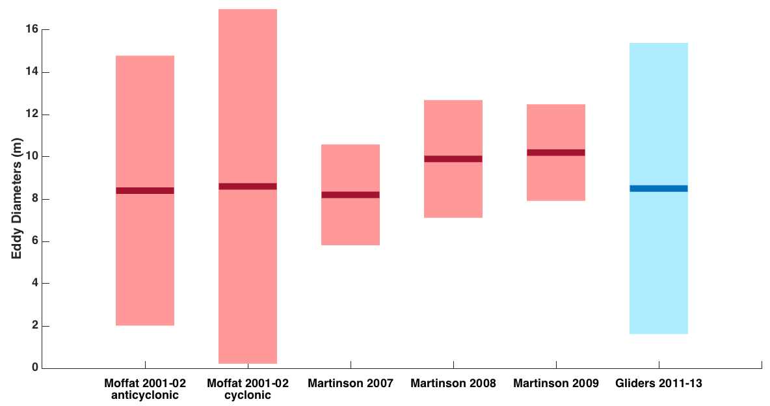
The width of the packets is consistent
with the diameter of eddies
Moffat 2009, Martinson 2012

Slide 17
Measuring height
Temperature (°C)
Distance (km)

Slide 18
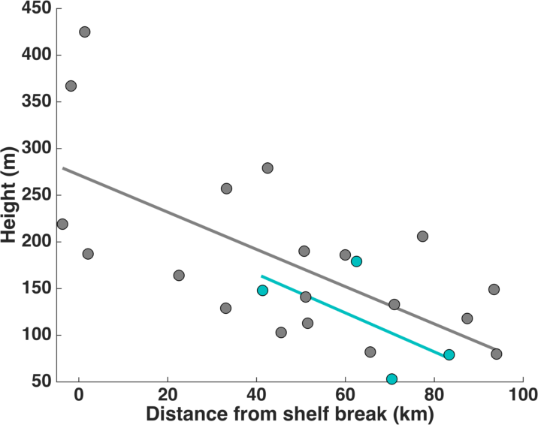
How does the height change?
Coast

Slide 19
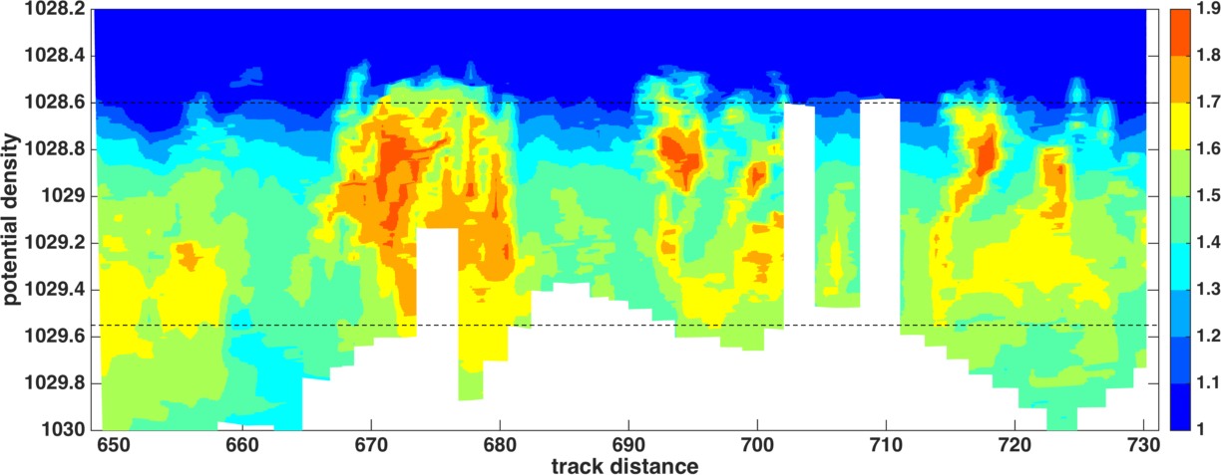
How do UCDW features change
across the shelf?
2012/13

Slide 20
How does the height change?
Coast

Slide 21
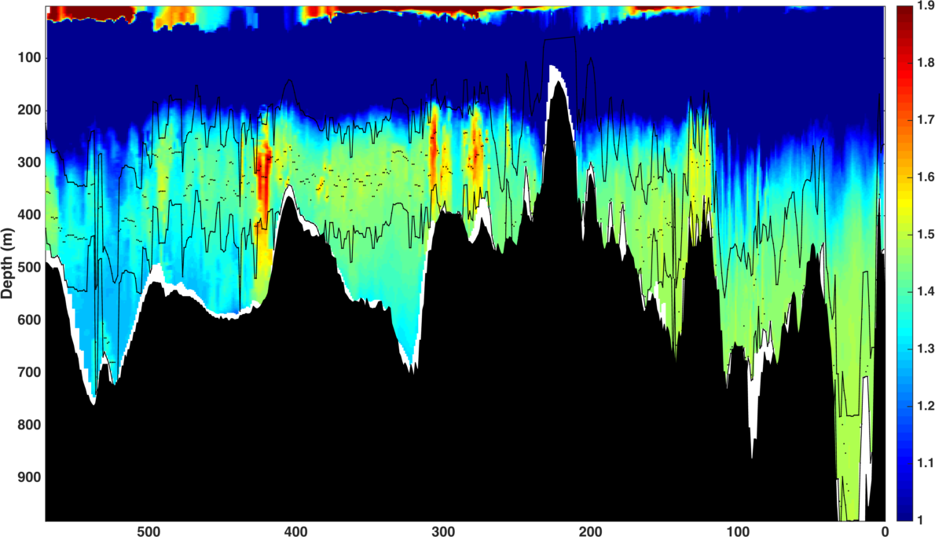
How does heat change?
Temperature (°C)
Distance (km)

Slide 22
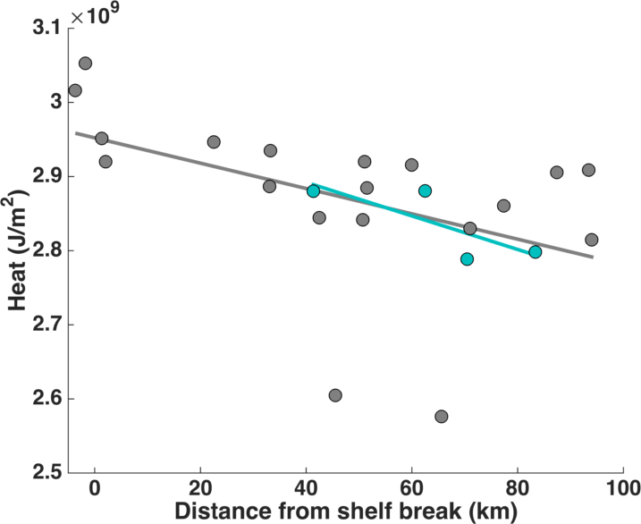
How does heat change?

Slide 23
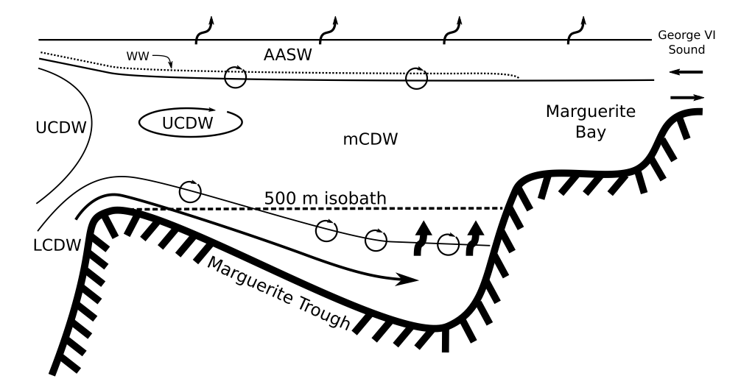
These eddy-like features account for
10-33% of the heat warming the upper ocean
Moffat 2009

Slide 24
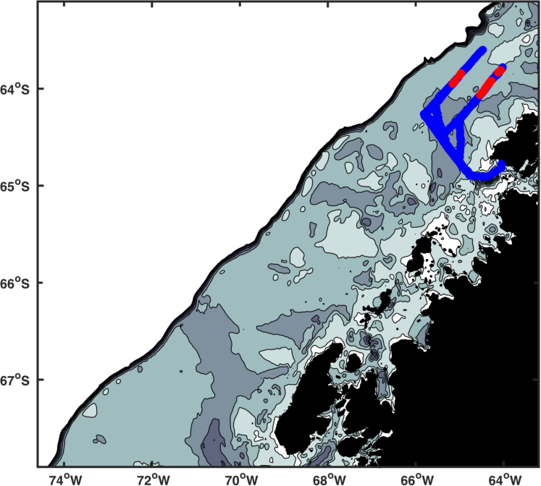
Different mechanisms may be acting
in different regions of the shelf
2014/15

Slide 25
Conclusions
Upper Circumpolar Deep Water is the water mass that brings heat to this region.
Heat is transported primarily through certain channels on the shelf.
One mechanism by which this occurs is through eddies that move onto the shelf and dissipate heat.
Different mechanisms appear to be working in different parts of the WAP.

Slide 26
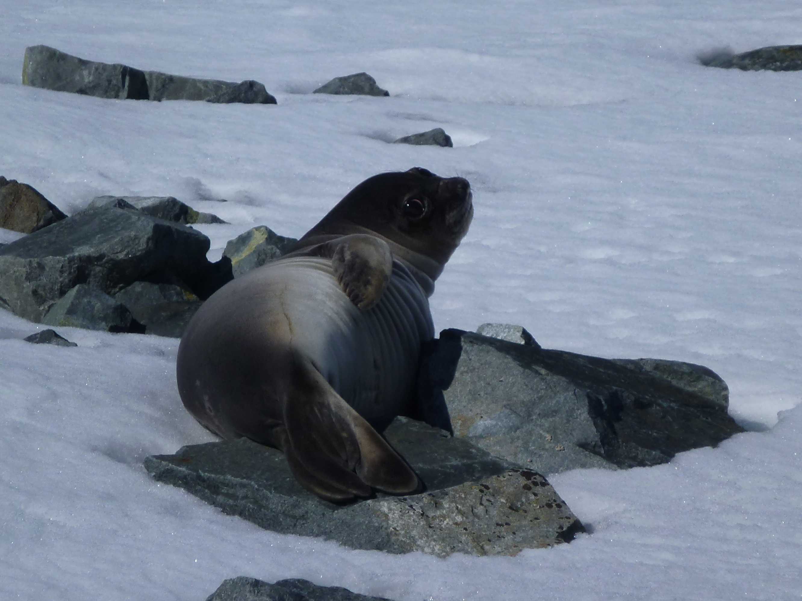
Thank you!
And thanks to:
Oscar Schofield
Josh Kohut
Bob Chant
Doug Martinson
Travis Miles
Darren McKee
Rich Iannuzzi
Tina Haskins
Dave Aragon

