Slide 1
Evaluation of Three Antenna Pattern Measurements for a 25 MHz SeaSonde
Colin Evans, Hugh Roarty, Ethan Handel, Scott Glenn
Rutgers University, USA

Slide 2
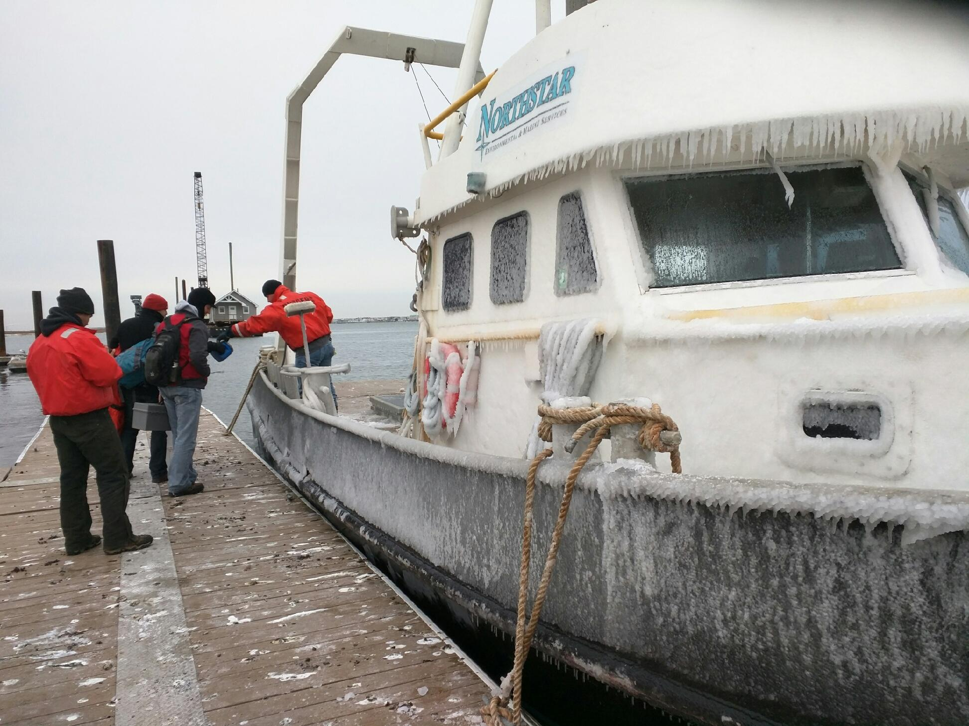

Slide 3
Quick Outline
Motivation for examination
Site overview
Description of antenna pattern calibration methods and processing
New AIS-pattern generation software
Data Reprocessing
Results
Summary

Slide 4
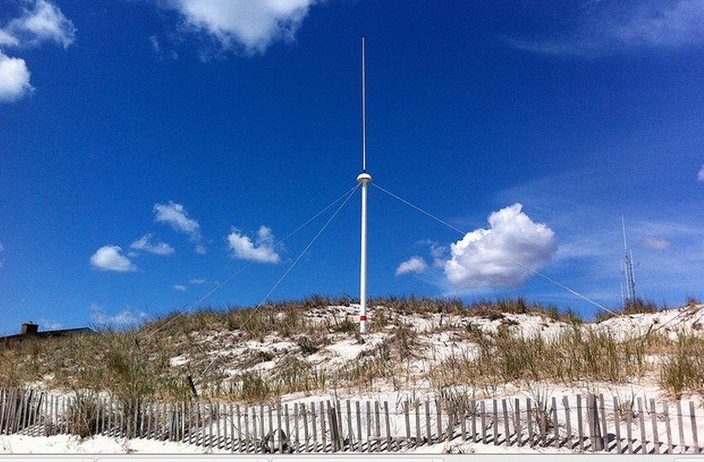
Motivation
Determine any significant differences in velocity measurements at the radial and total level between antenna pattern measurement methods.
Determine advantages and disadvantages between APM methods

Slide 5
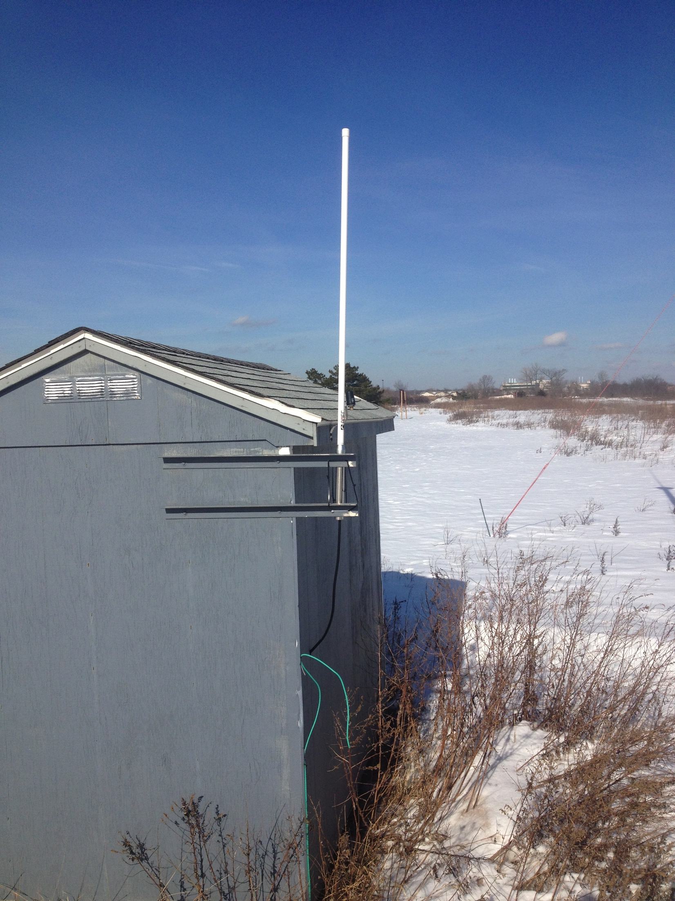
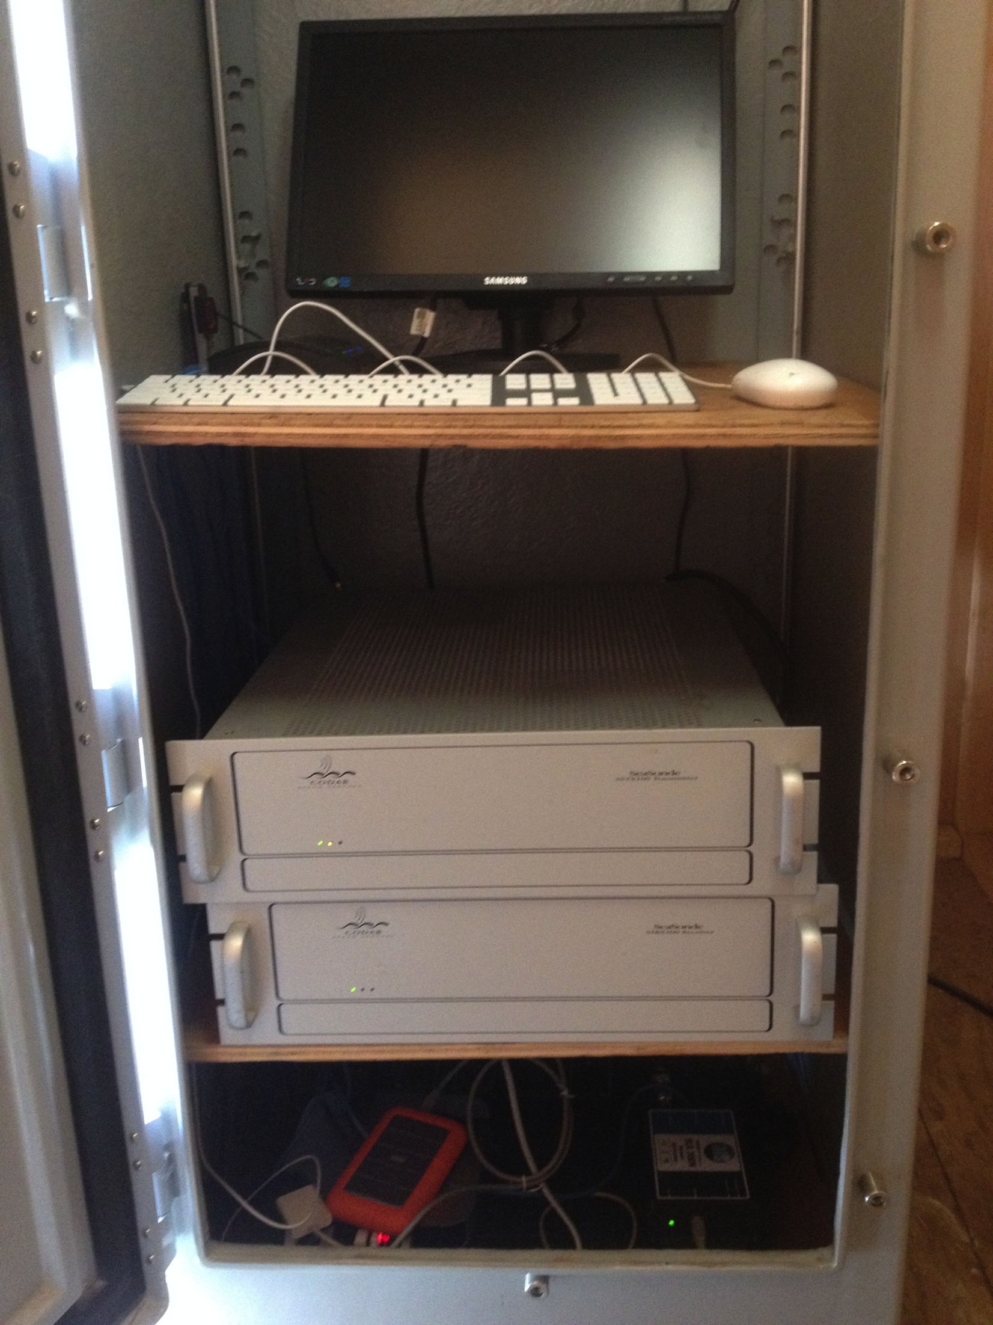
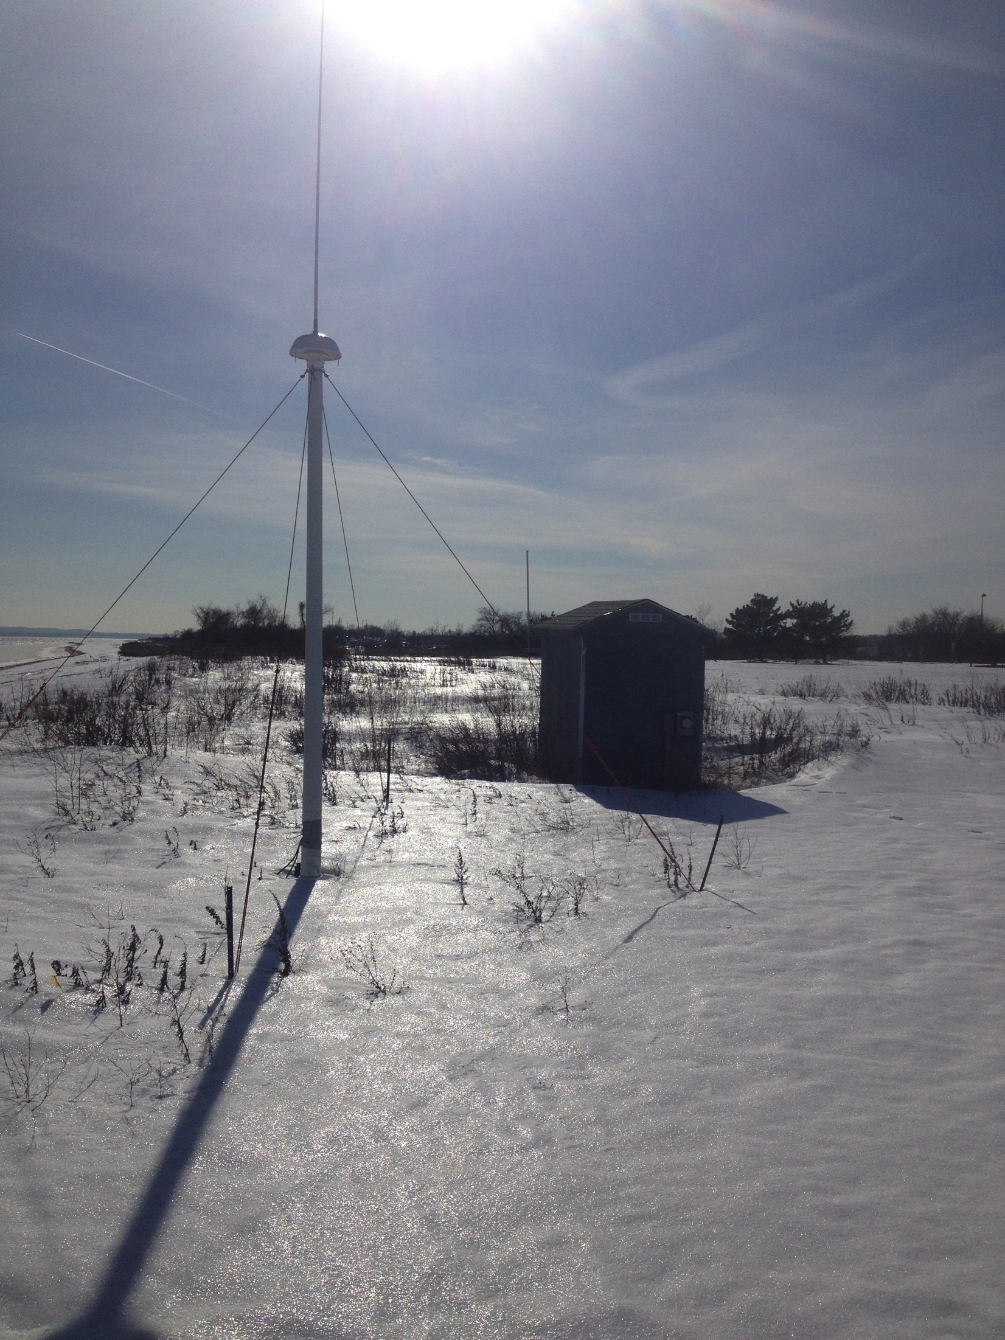
25 MHz SILD System Setup
computer essentials
AIS antenna
shed with climate-controlled enclosure
transmitter
receiver
combine tx/rx antenna
(inside the enclosure)
Data backup
UPS system
AIS receiver

Slide 6
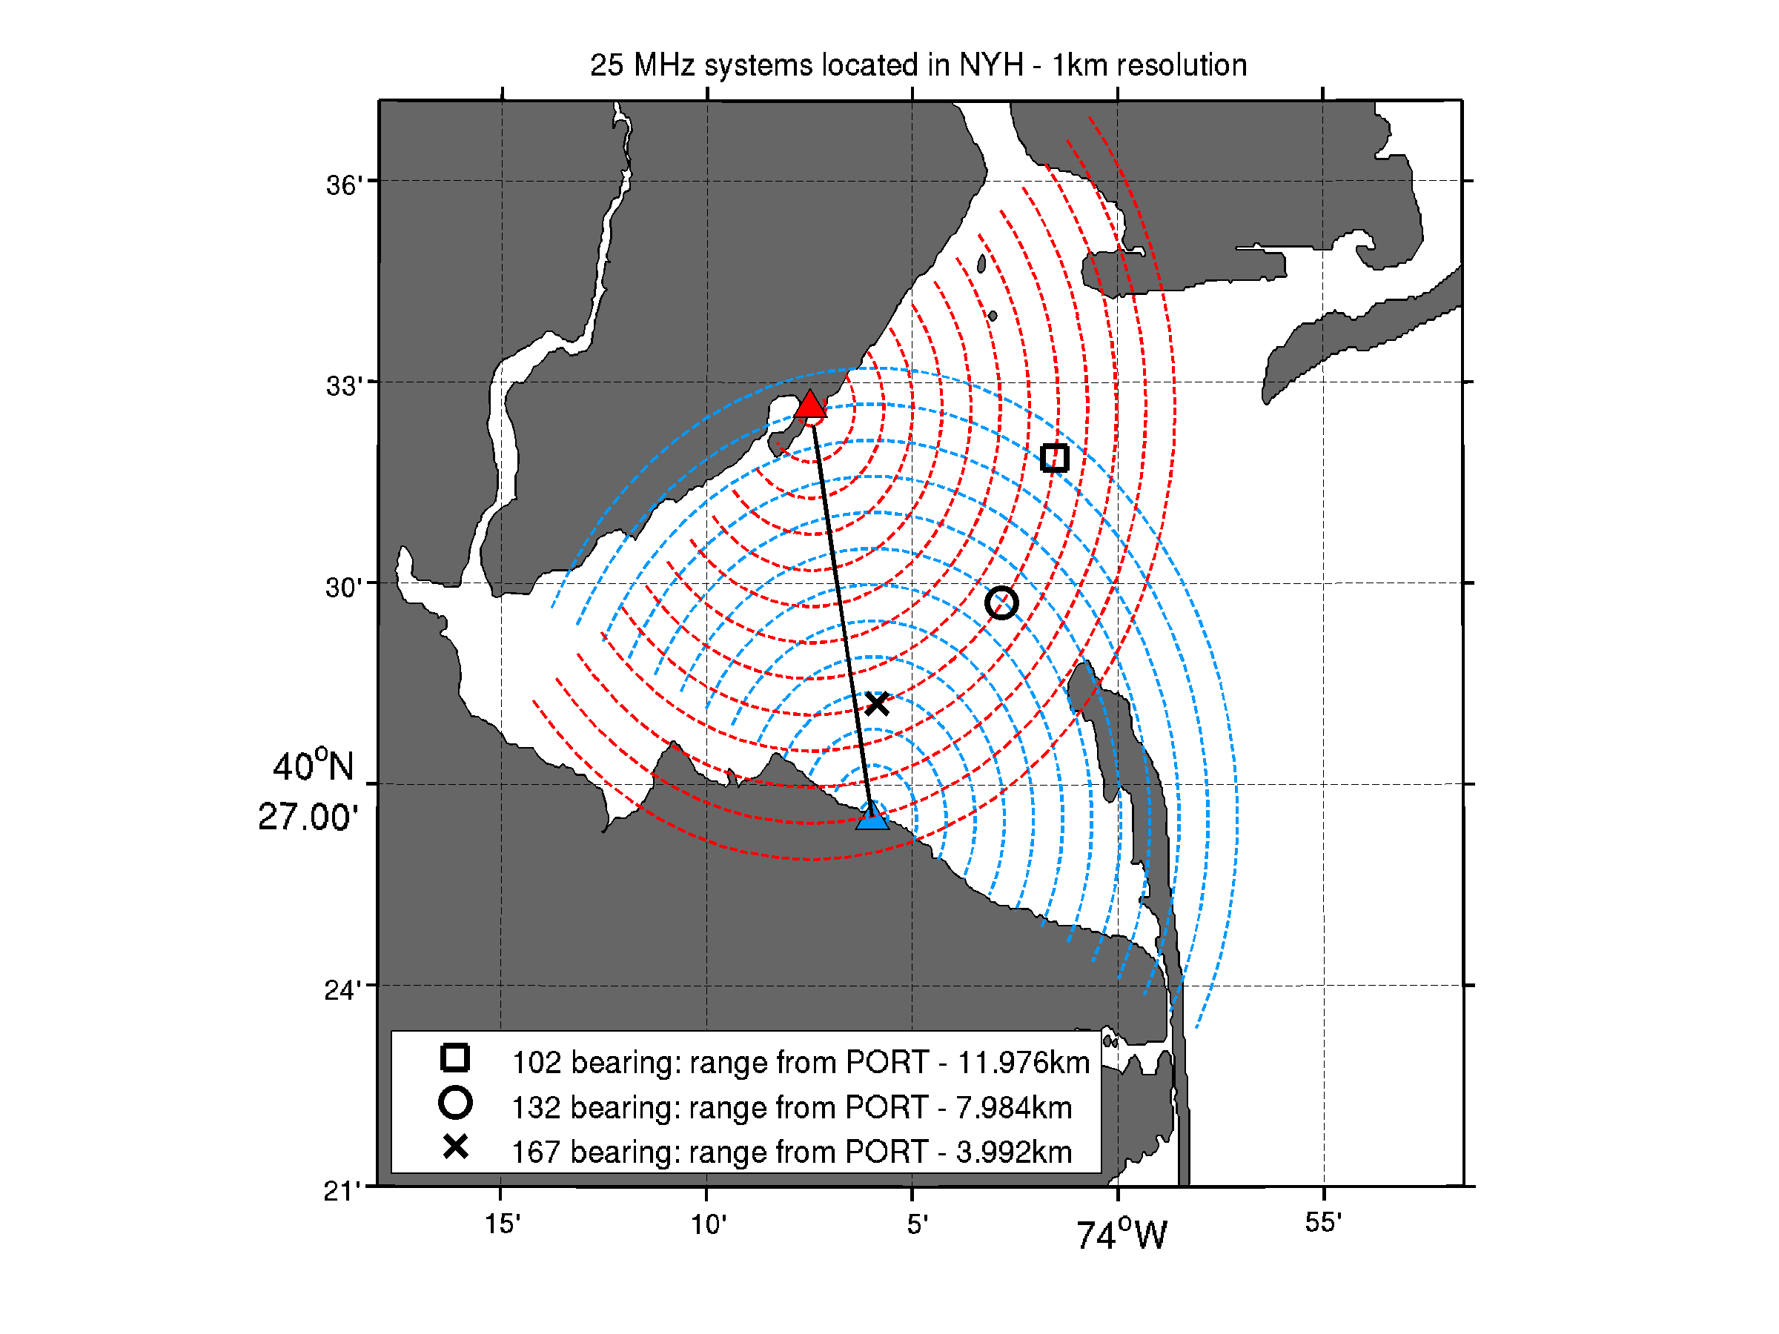
Examination Area and Overview of 25 MHz Network
Baseline from SILD to PORT is 176 degrees.
Bearing values are in SILD range cell 9 (8.998km offshore).
Bearing values 102,132,and 167 are in PORT range cells 12, 8, and 4, respectfully.

Slide 7
Why Do We Measure Patterns?
Corrects for distortions in the magnetic field
Corrects for bearing errors
… which, in turn, corrects for velocity errors
More accurate than assuming ideal pattern
More can be read about antenna pattern measurements on CODAR support page:
http:support.codar.comTechnicians_Information_Page_for_SeaSondes/Training_Files/Day2_PatternMeasurements_2014.pdf

Slide 8
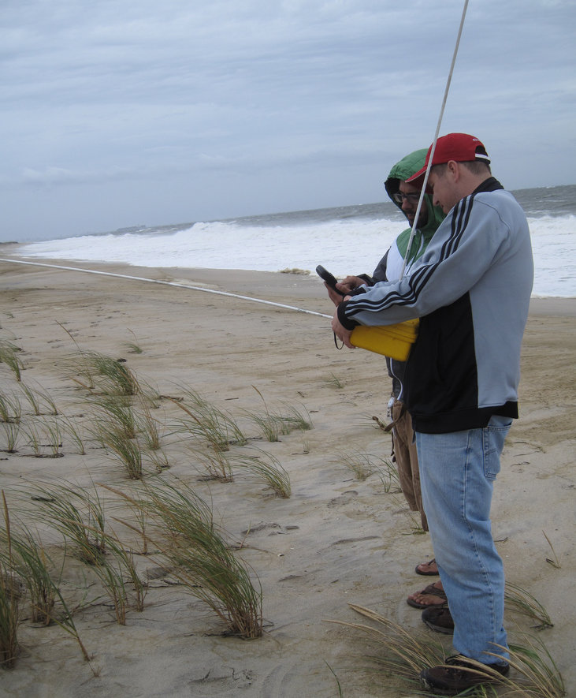
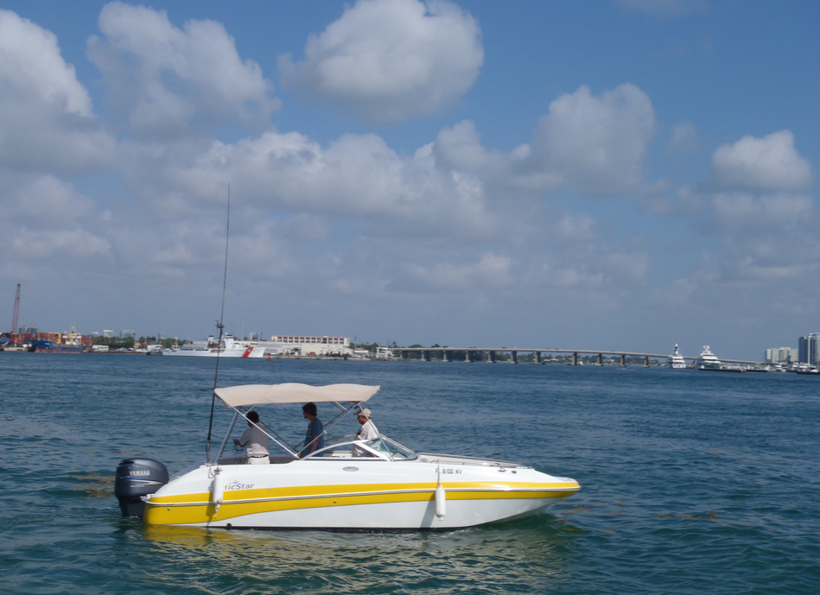
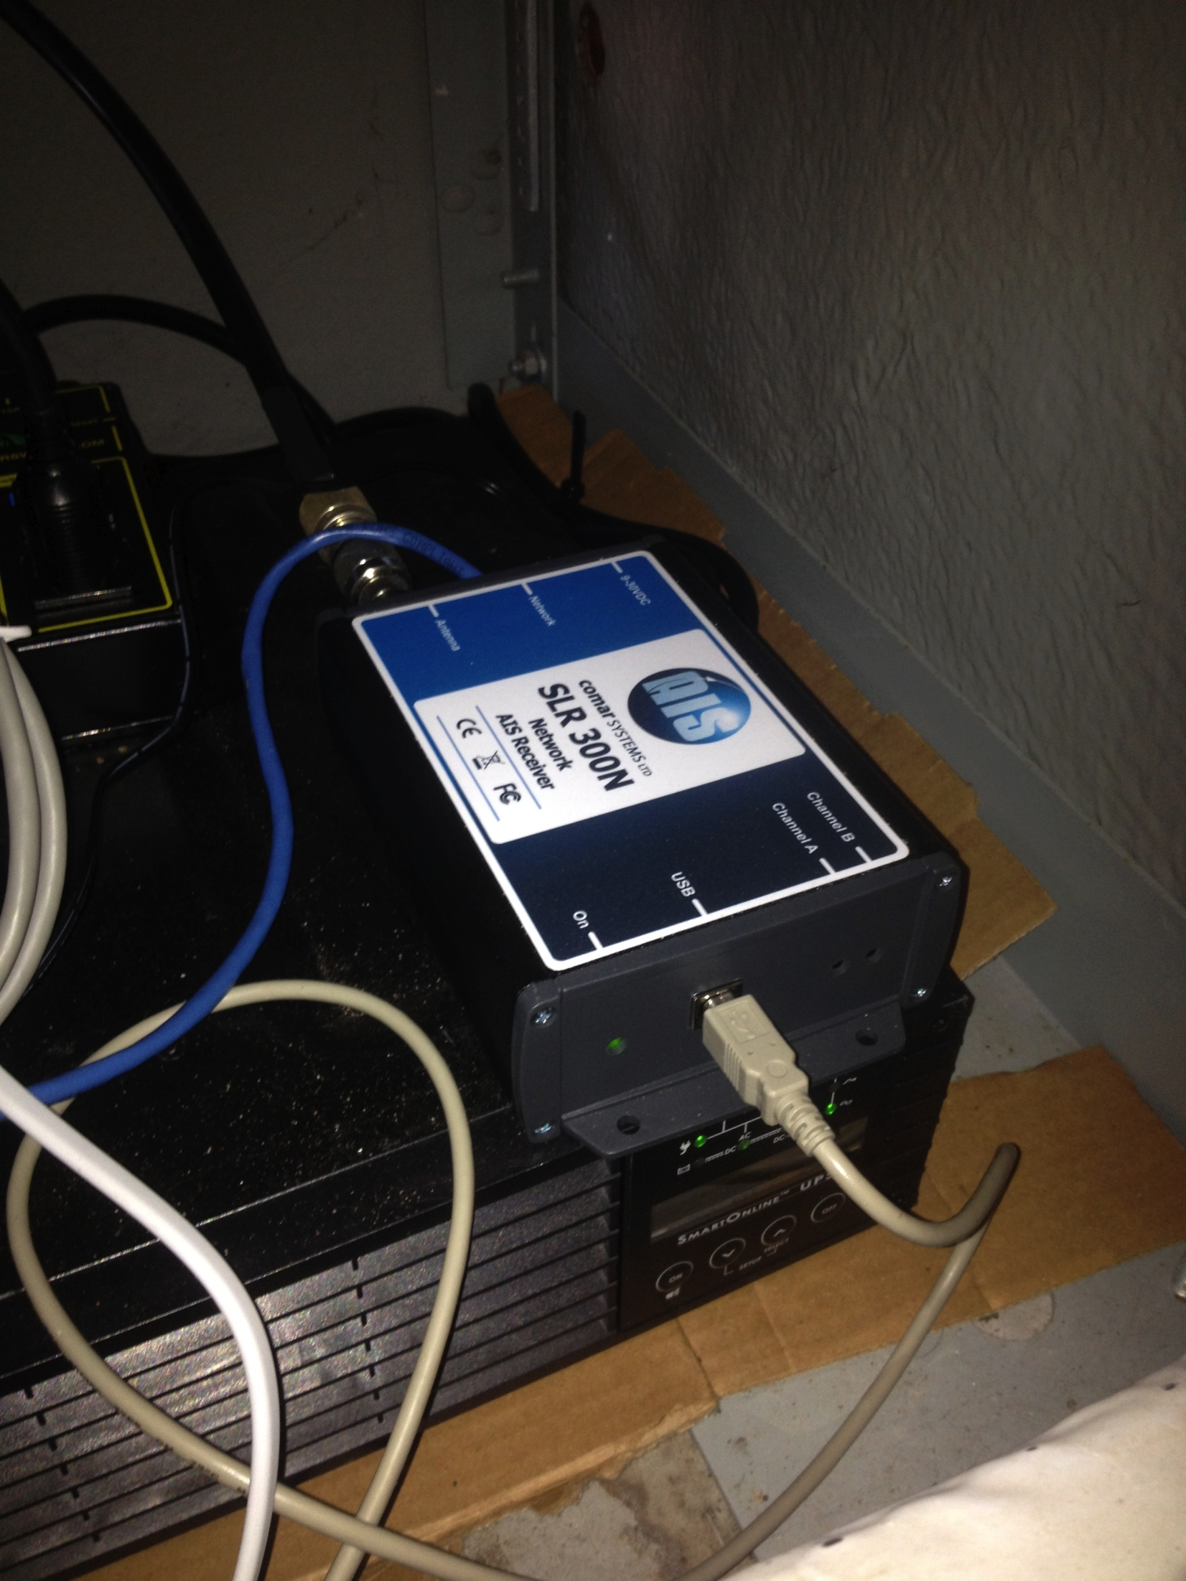
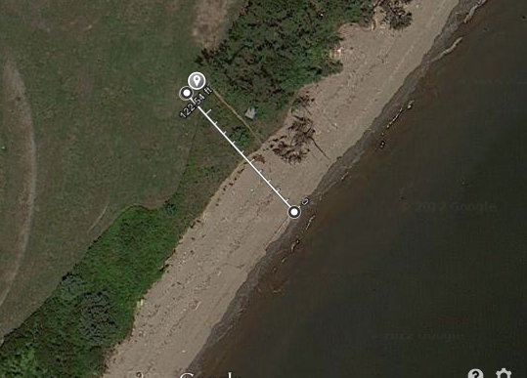
Pattern Methods
Walking
Boat
AIS
- 25 MHz system = ~12 m wavelength
- Rule of thumb suggested by CODAR is to be more than 1 wavelength away from the antenna (and other objects) during pattern calibration
~35 m

Slide 9
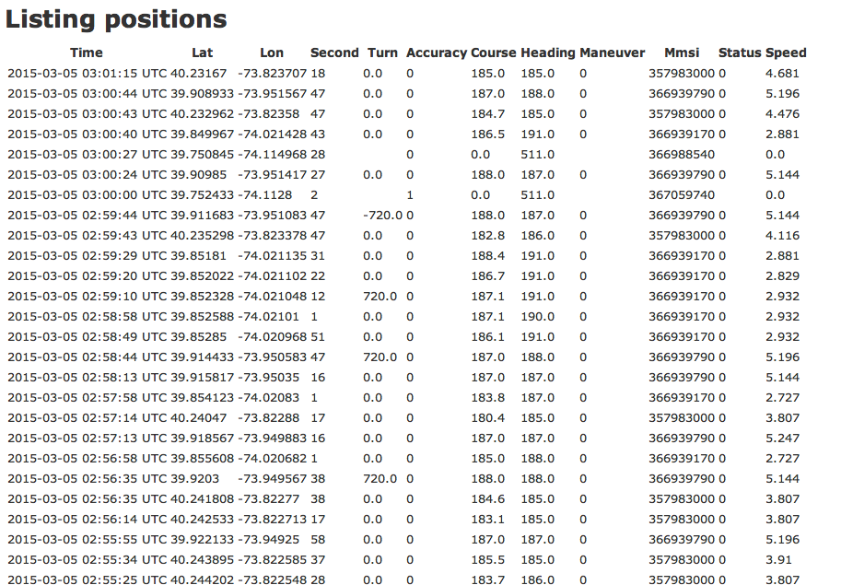
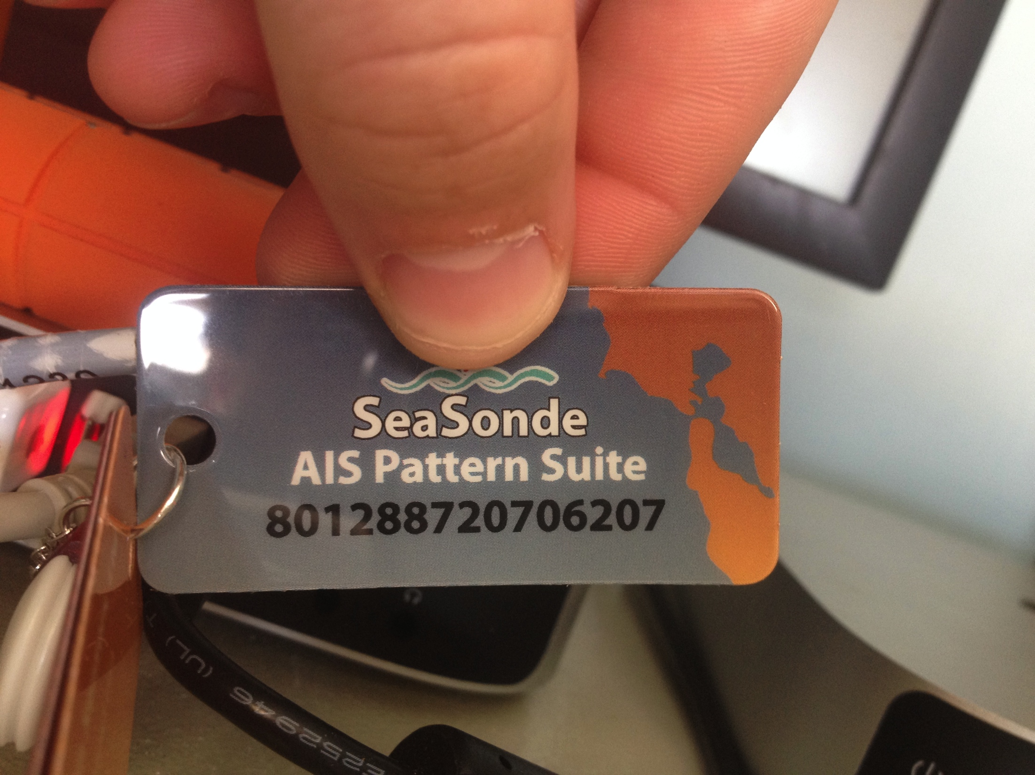
AIS Pattern Generation Software – More Detailed
Two important launch agents:
AIS Logger
AIS Webserver
Trak files created every 10 minutes
Loop files created daily
http://sprk-maracoos.dyndns.org:8241

Slide 10
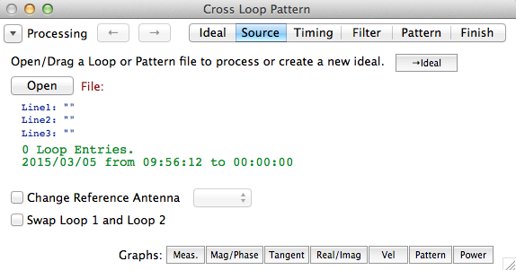
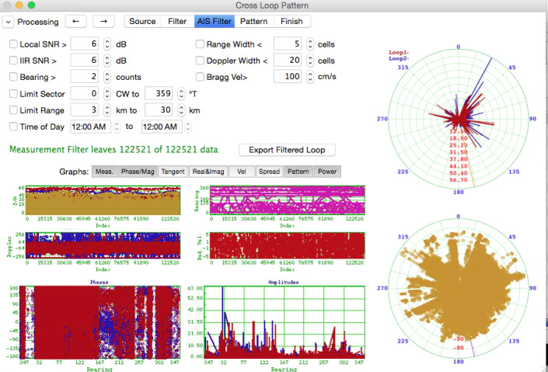
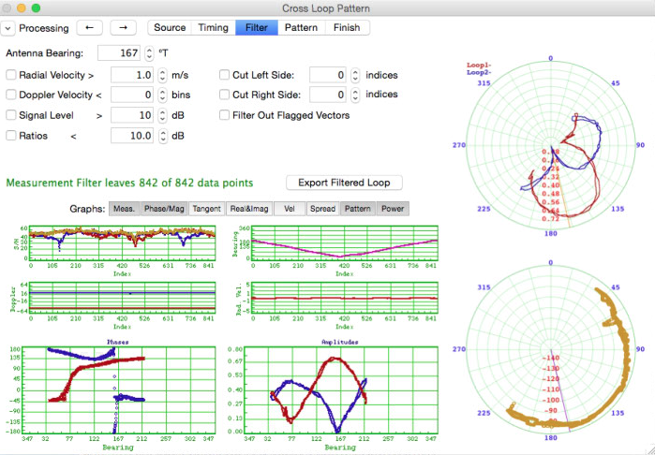
Processing the Patterns
AIS filtering
Walking and Boat filtering

Slide 11
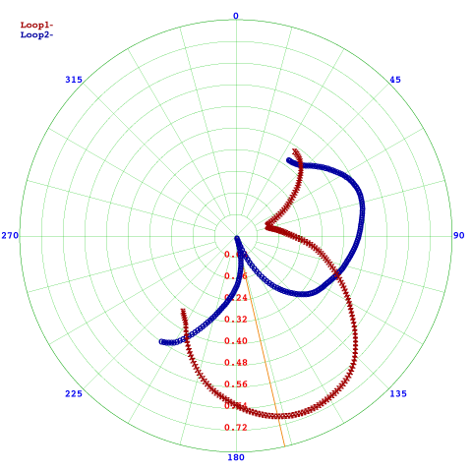
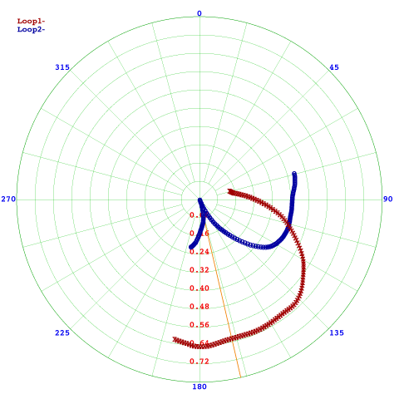
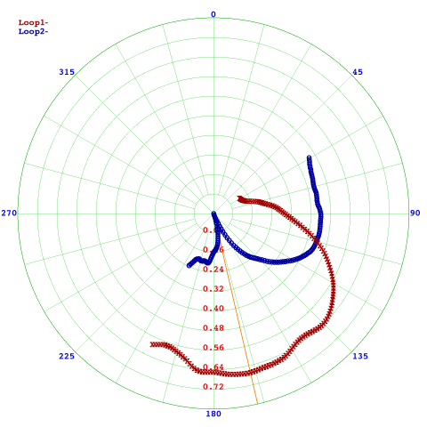
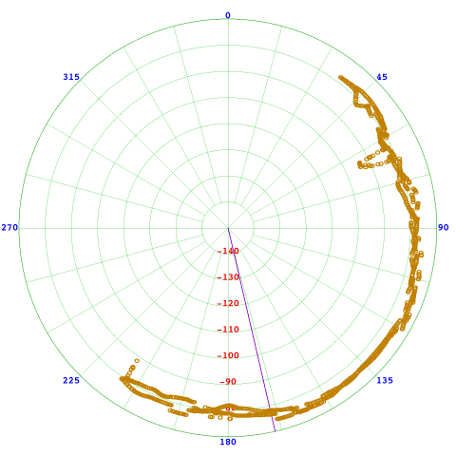
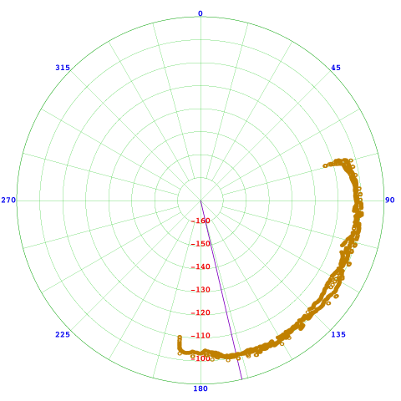
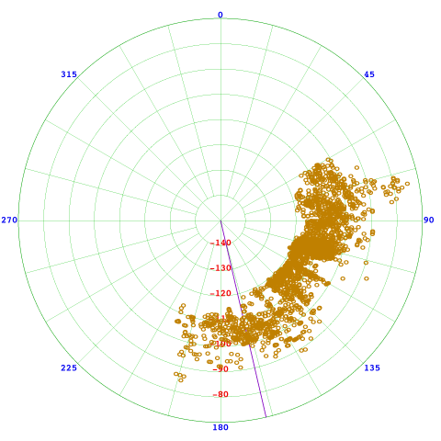
Pattern Results
Walking – 10º smooth
Boat – 10º smooth
AIS – 12º smooth

Slide 12
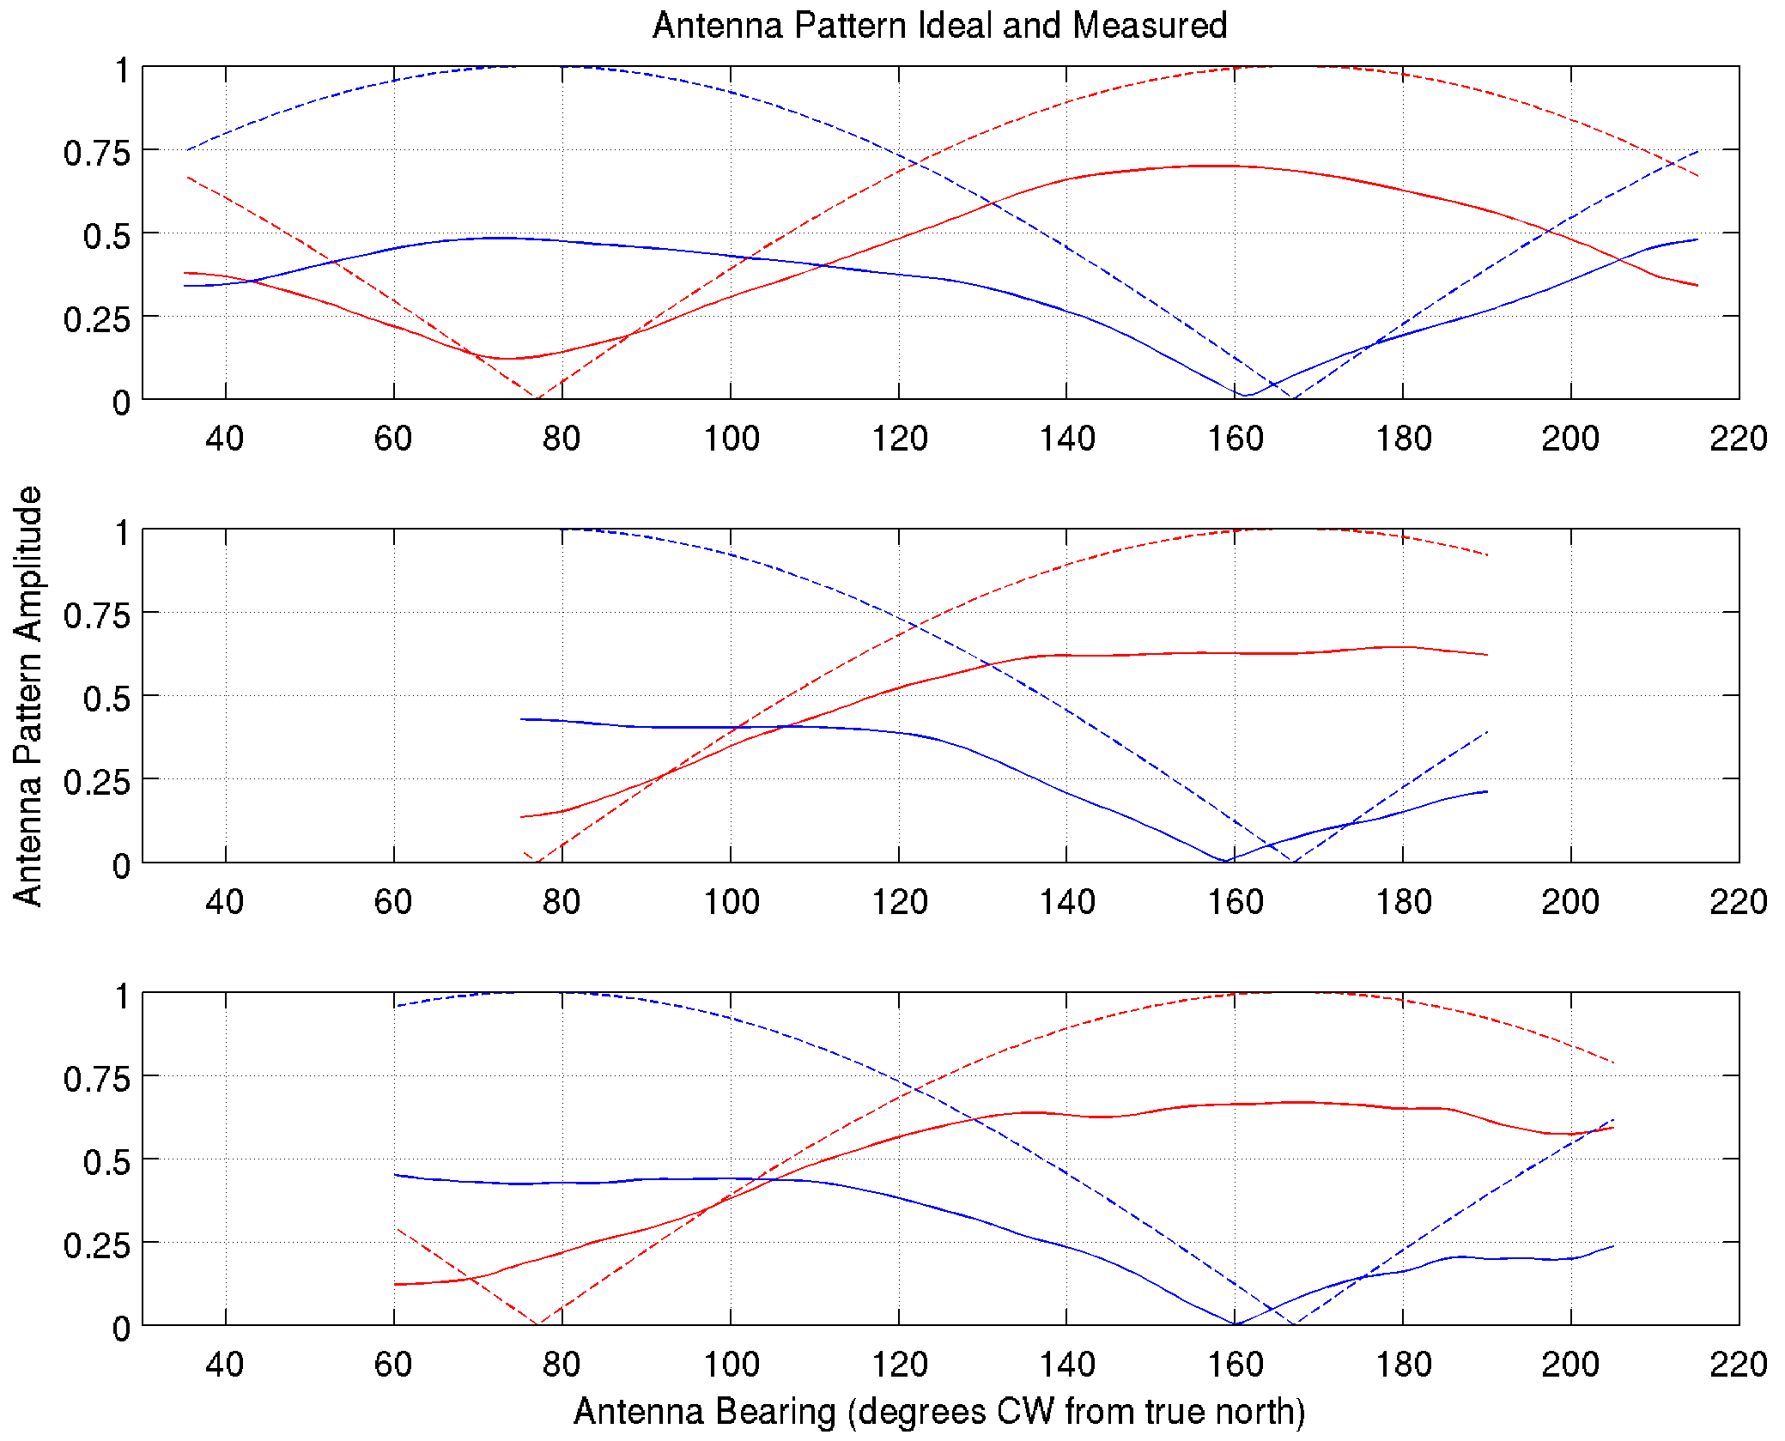
Pattern Amplitudes
Walking
red dashed = ideal L1
blue dashed = ideal L2
red solid = measured L1
blue solid = measured L2
Boat
AIS

Slide 13
Data Reprocessing
Spectra files reprocessed with batch reprocessing application built by CODAR
Outputs
Inputs
Radials
CSS files
Analyze Spectra
Radial Shorts
Radial Configs
Wave data
Walking APM
Boat APM
AIS APM

Slide 14
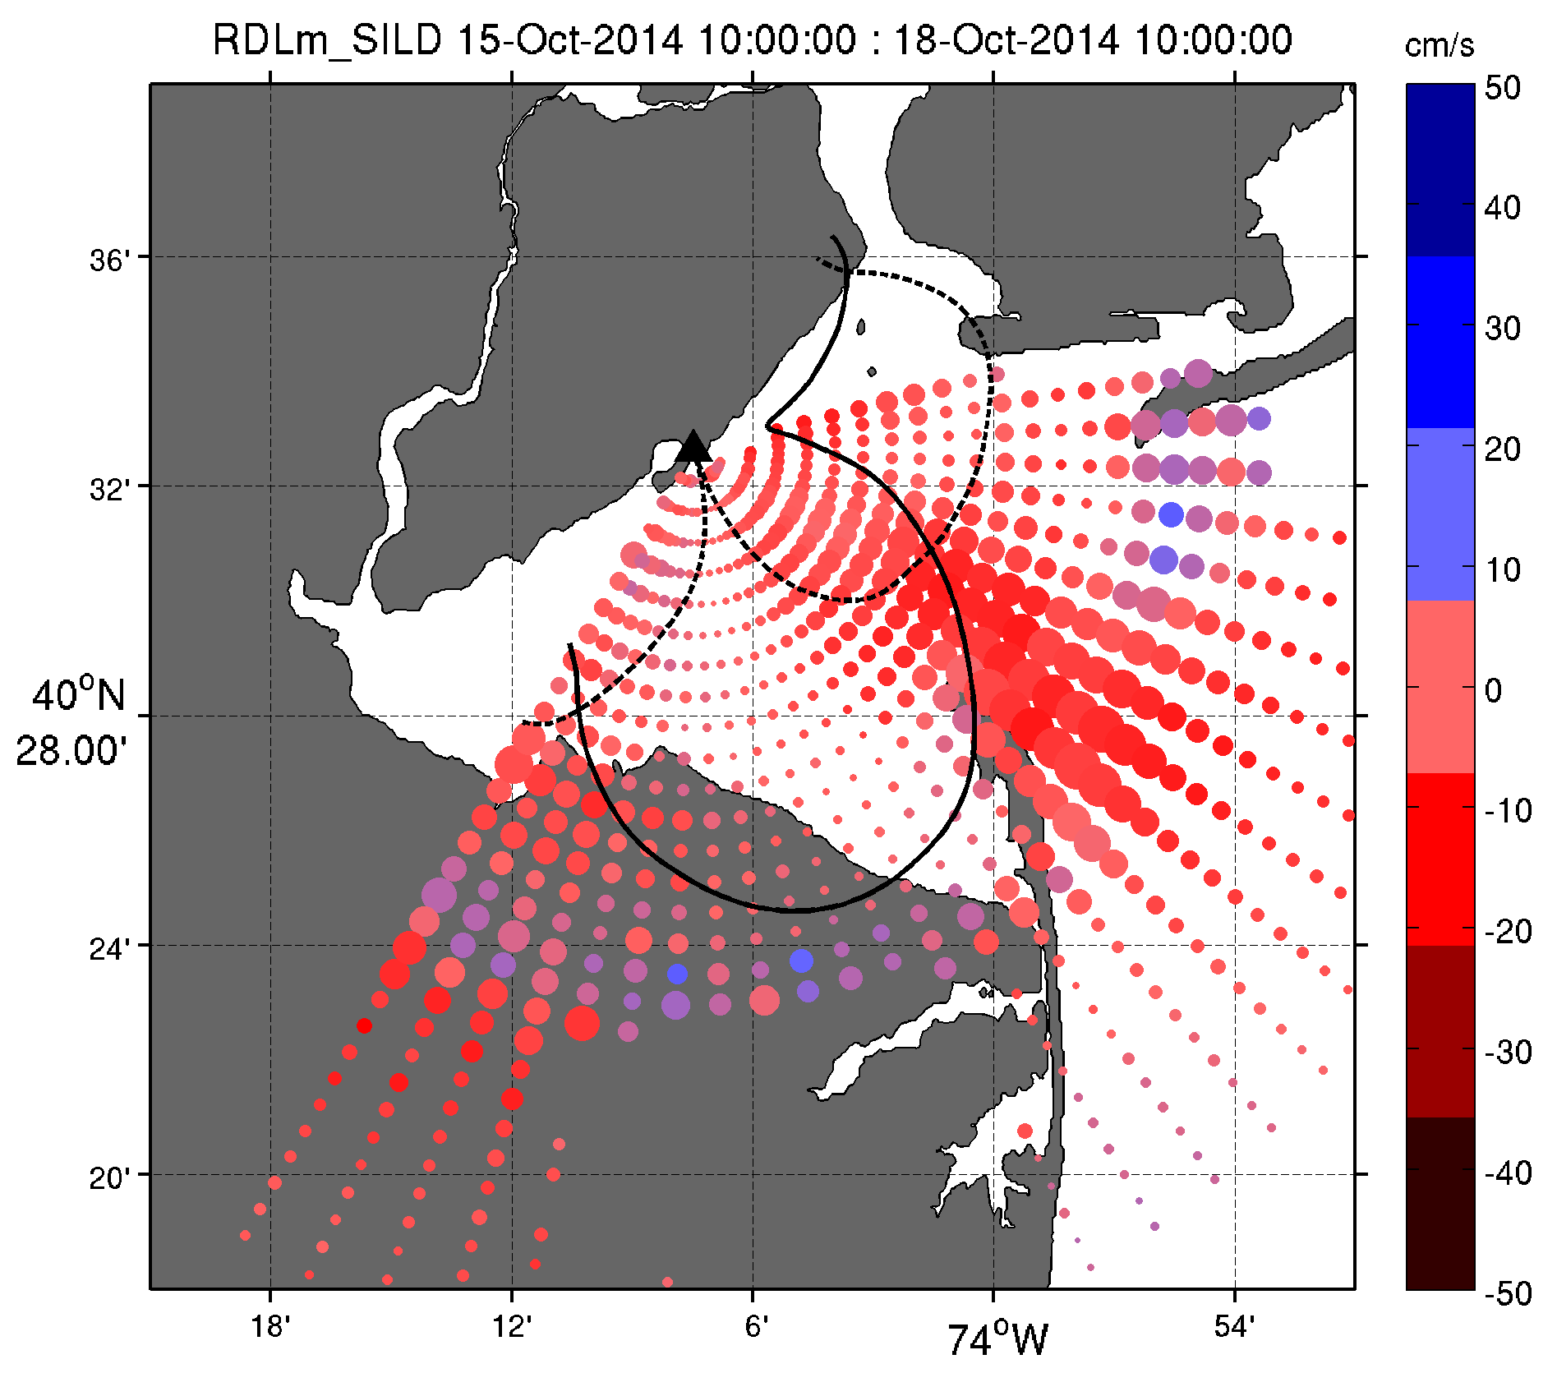
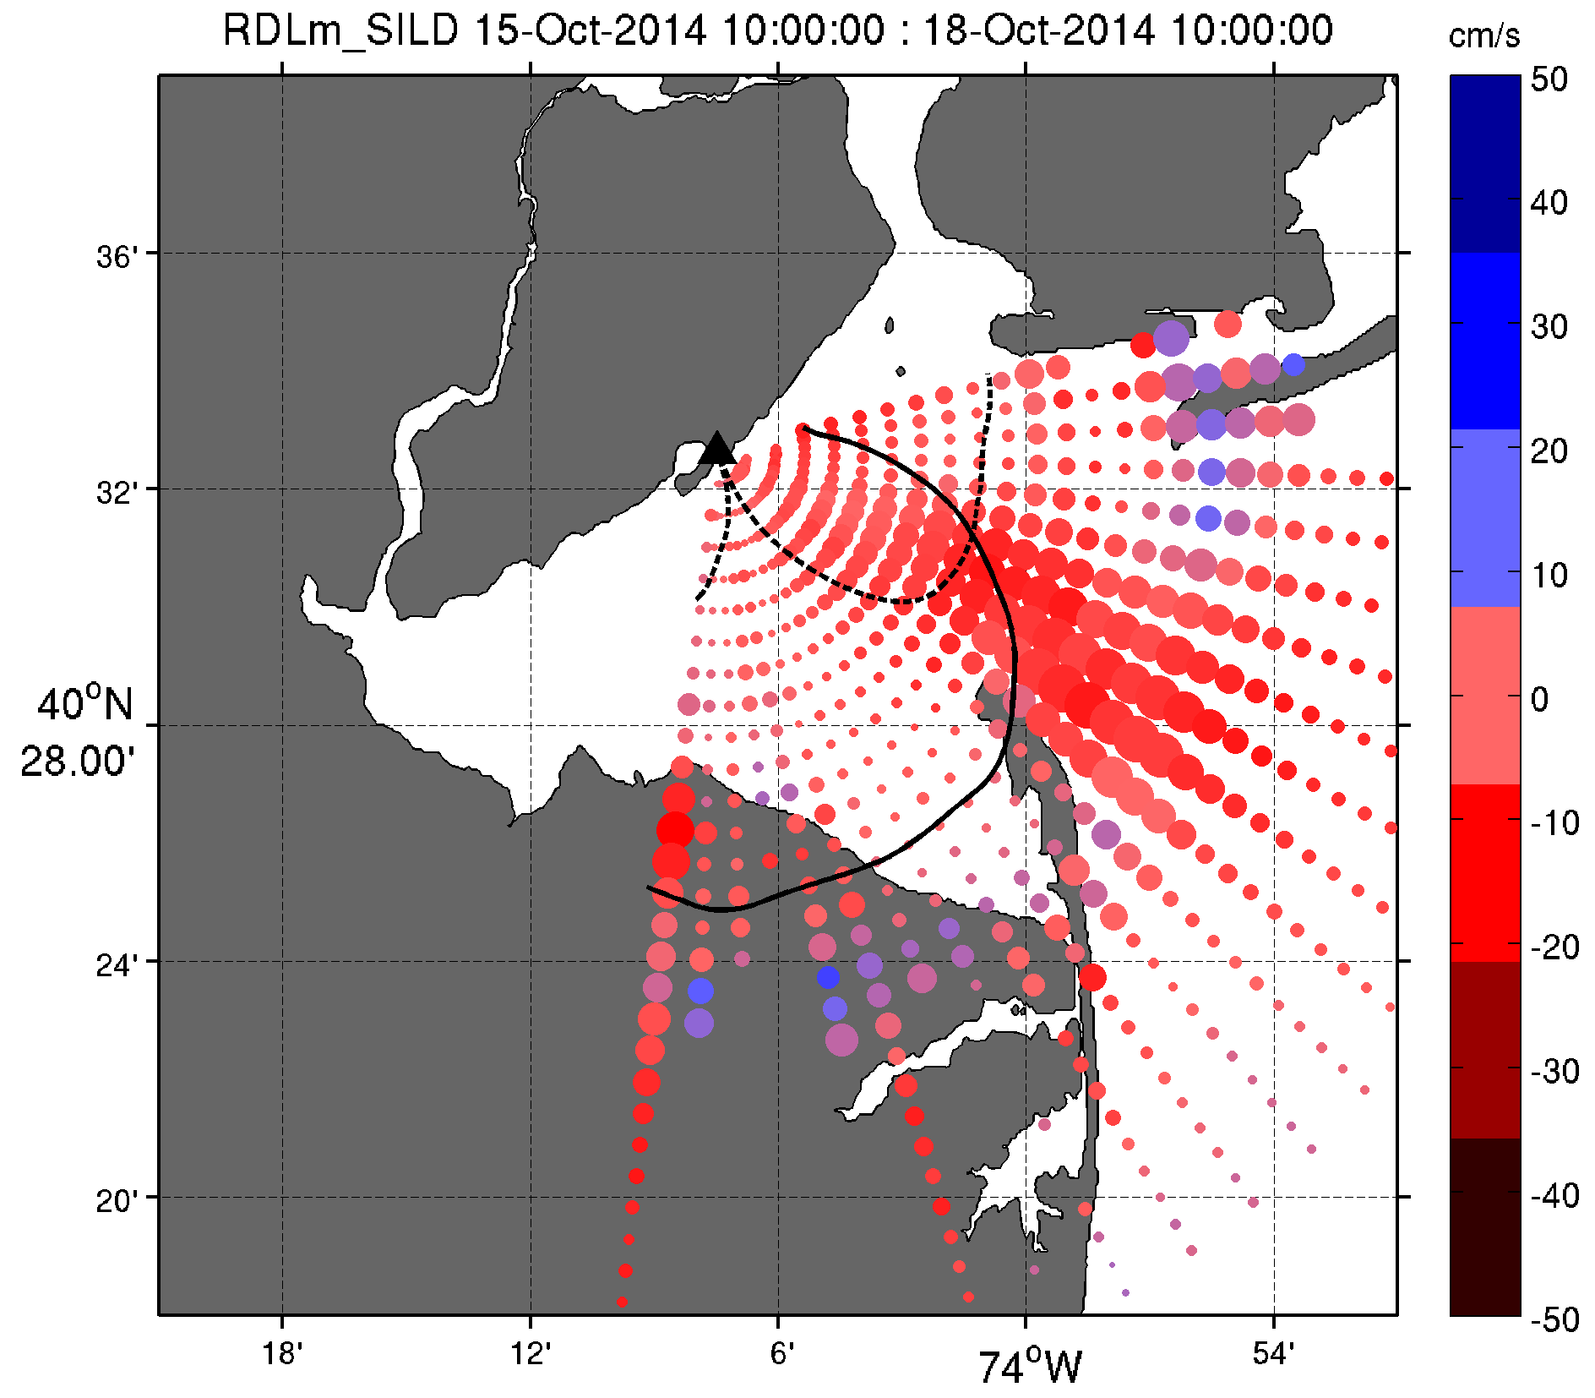
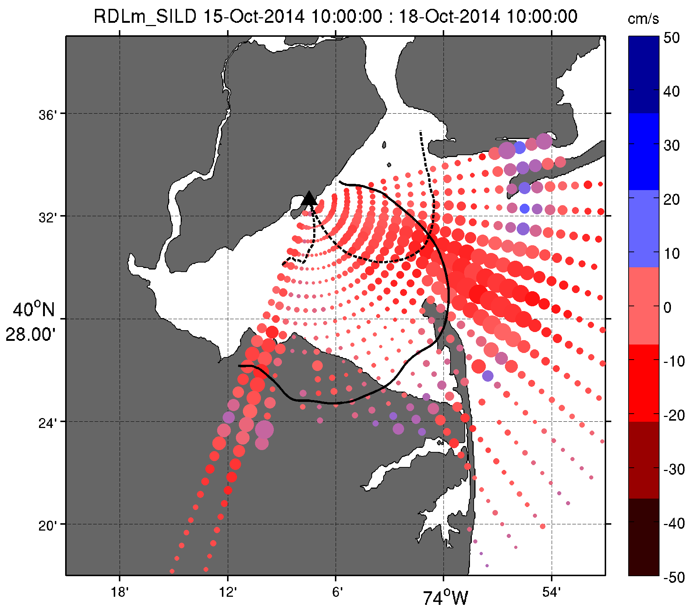
Walking
Boat
AIS software
Pattern Method | Date
Walking | August 26, 2014
Boat | August 28, 2014
AIS | August 20, 2014

Slide 15
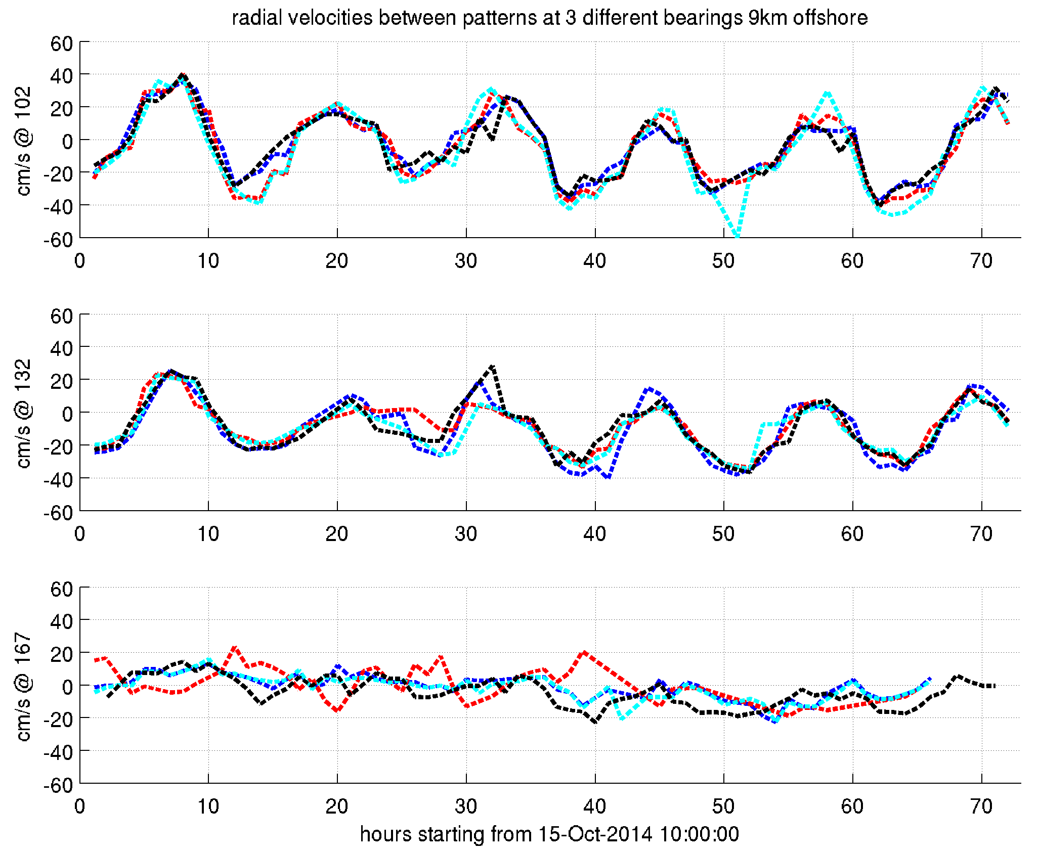
Hourly Velocity Comparisons
Black – Ideal
Blue – Walking
Red – Boat
Light Blue - AIS

Slide 16
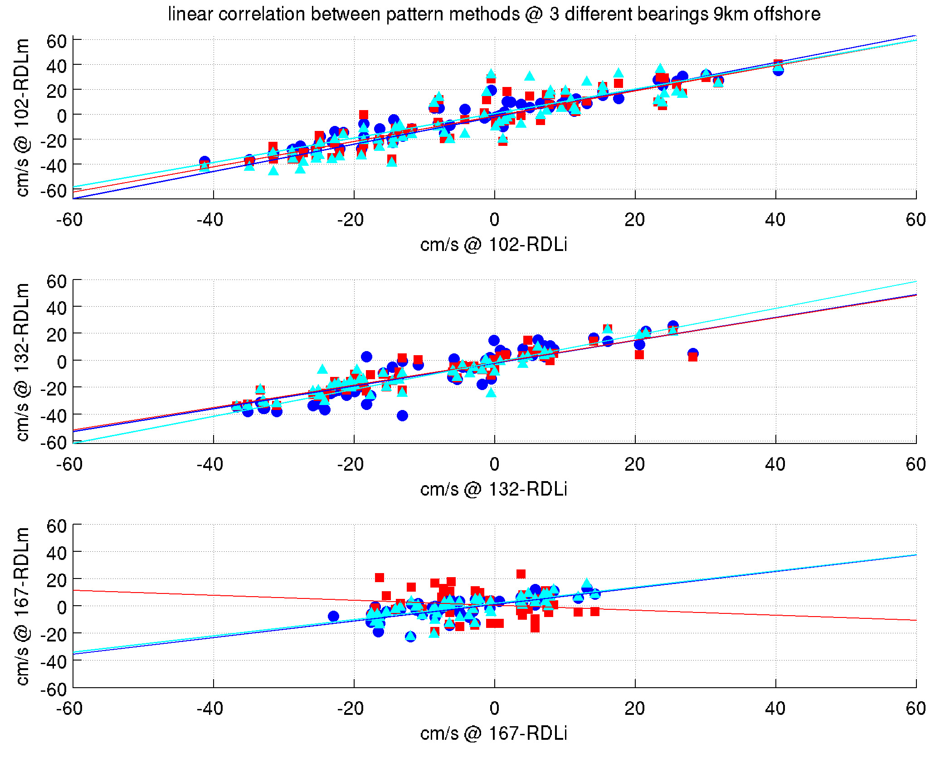
Correlation between SILD Measured and Ideal Radials
R Values
Bearing | Walking | Boat | AIS
102 | 0.96 | 0.90 | 0.89
132 | 0.90 | 0.92 | 0.91
167 | 0.73 | -0.14 | 0.70

Slide 17
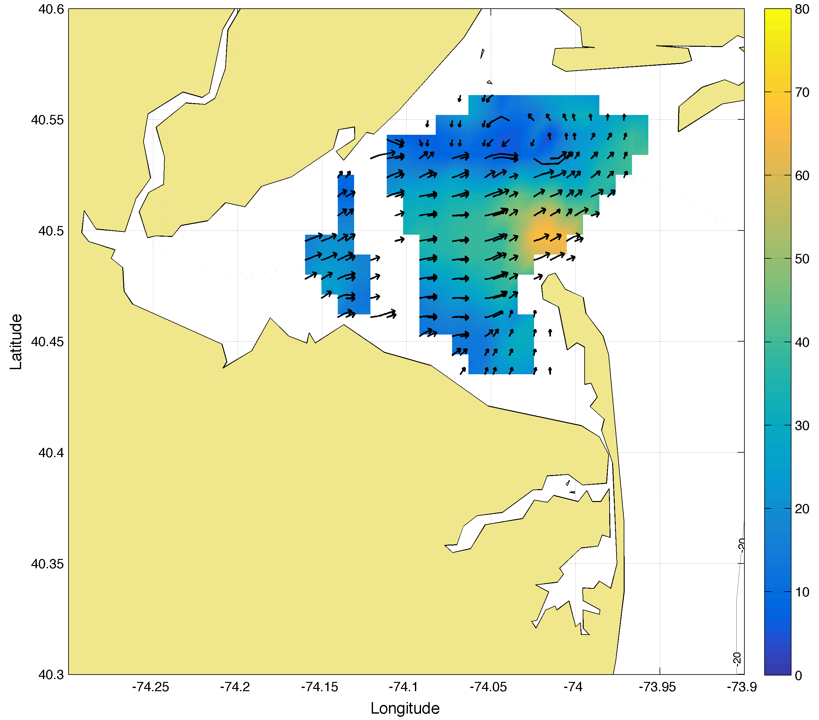
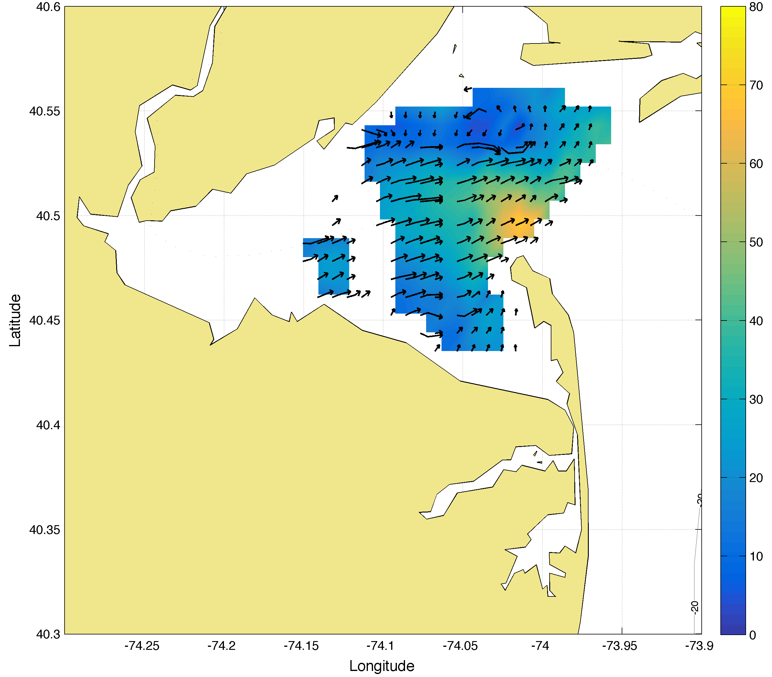
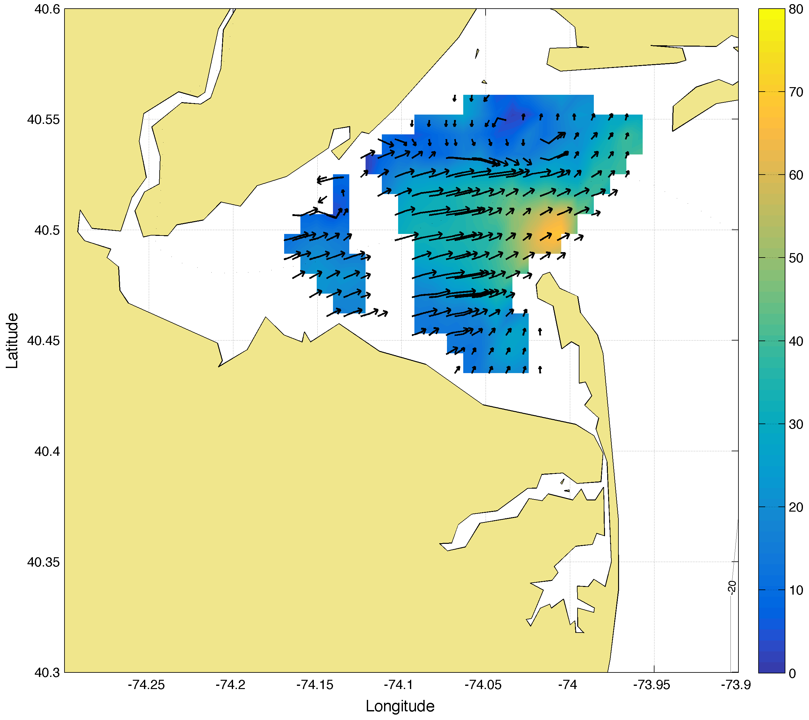
Total Comparisons
Walking
Boat
AIS
2014-10-16 12:00:00

Slide 18
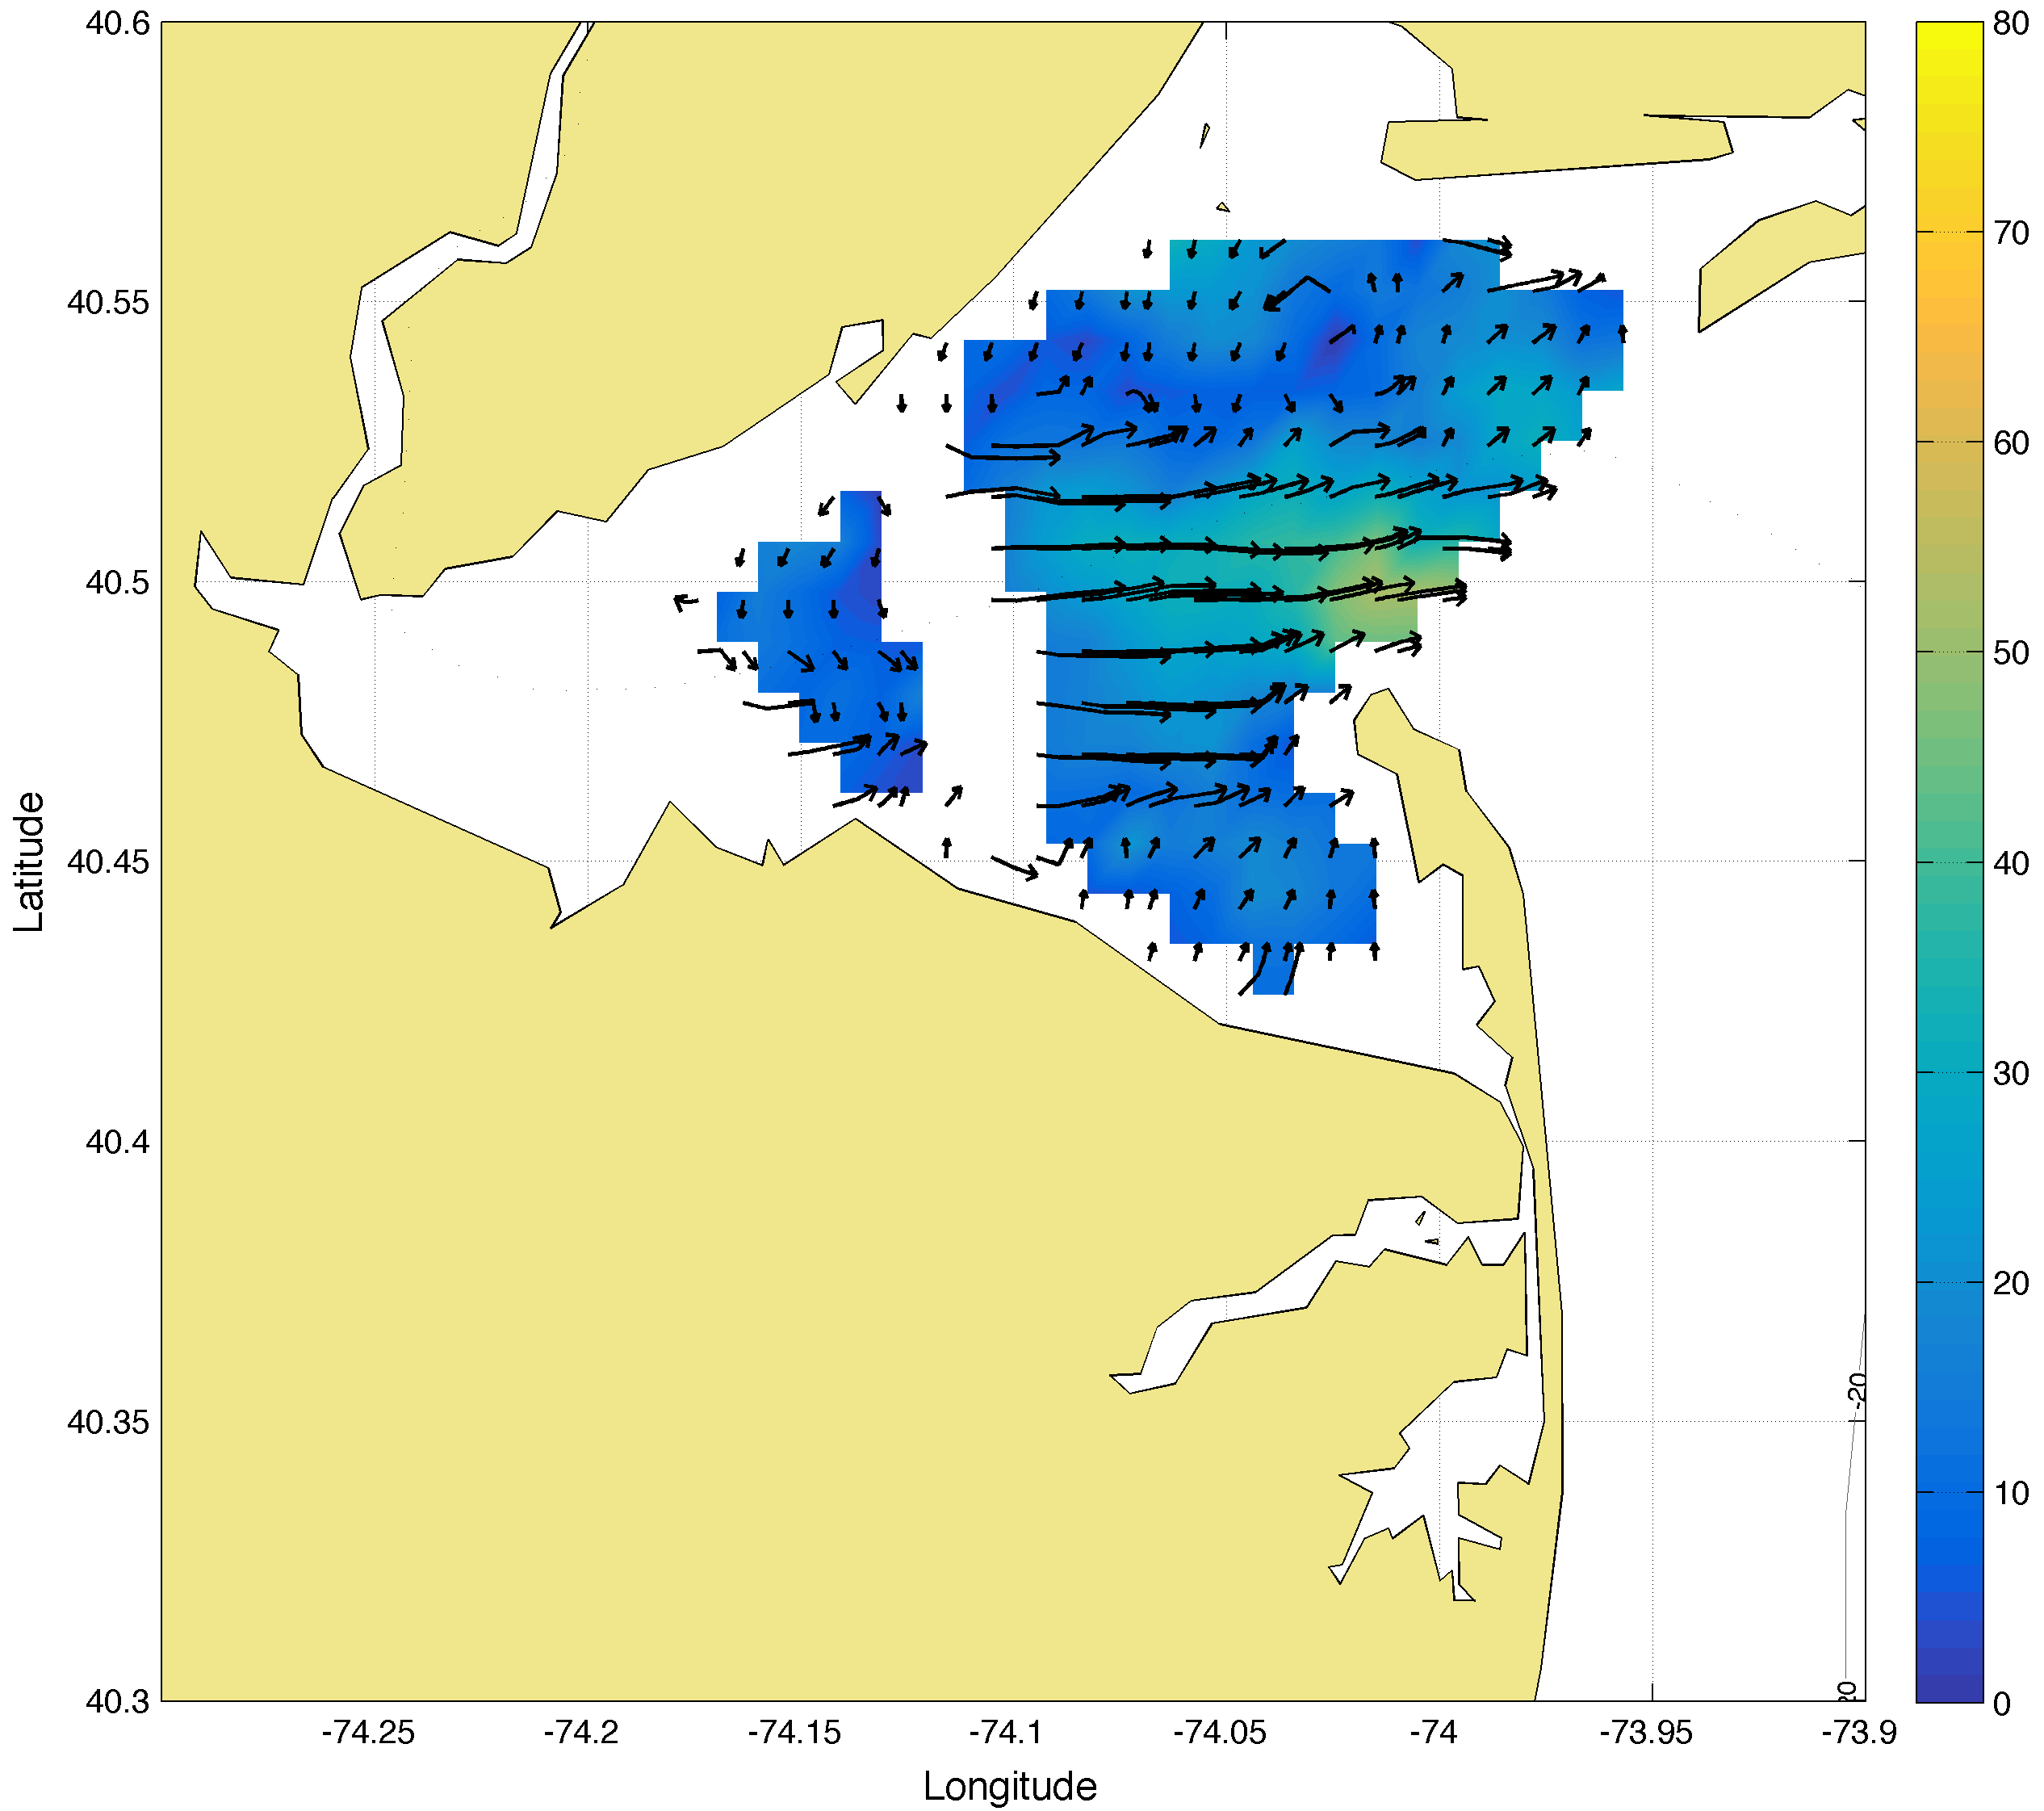
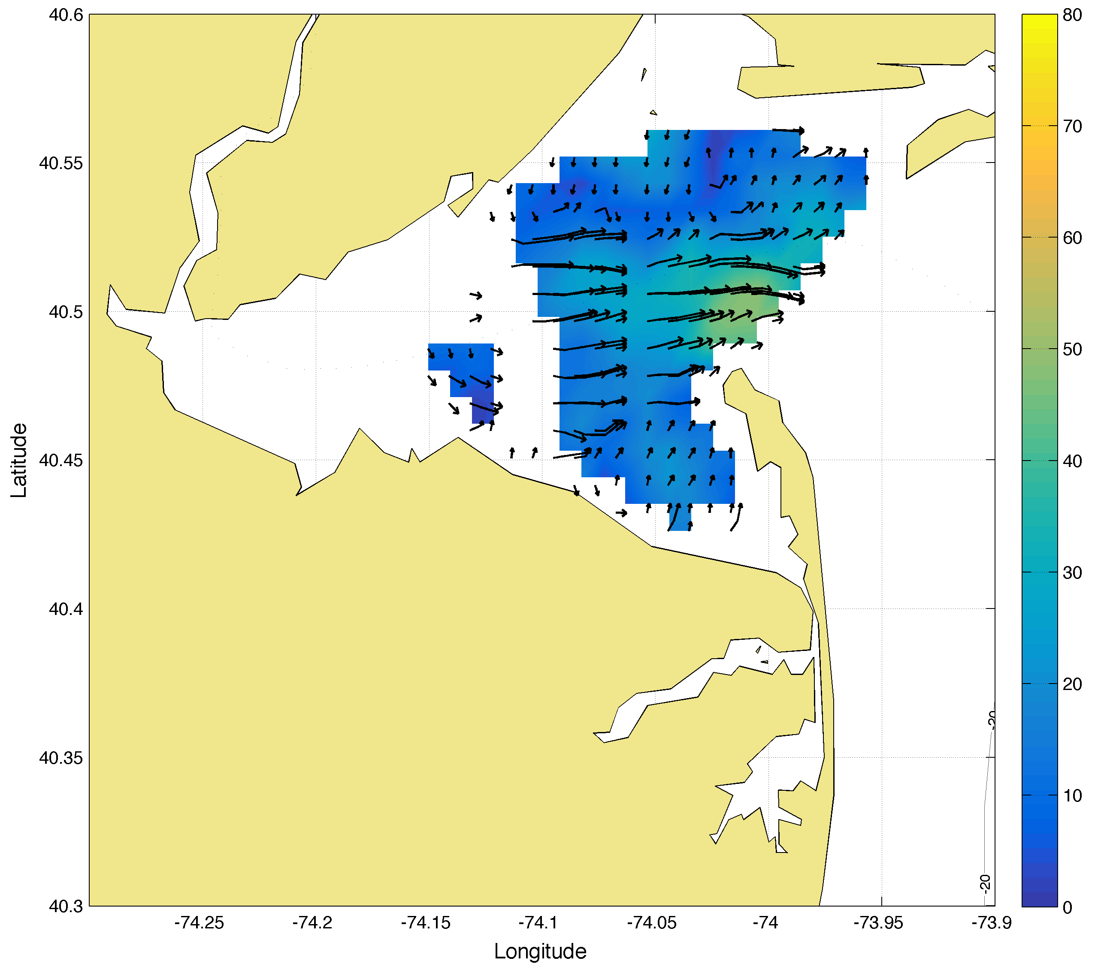
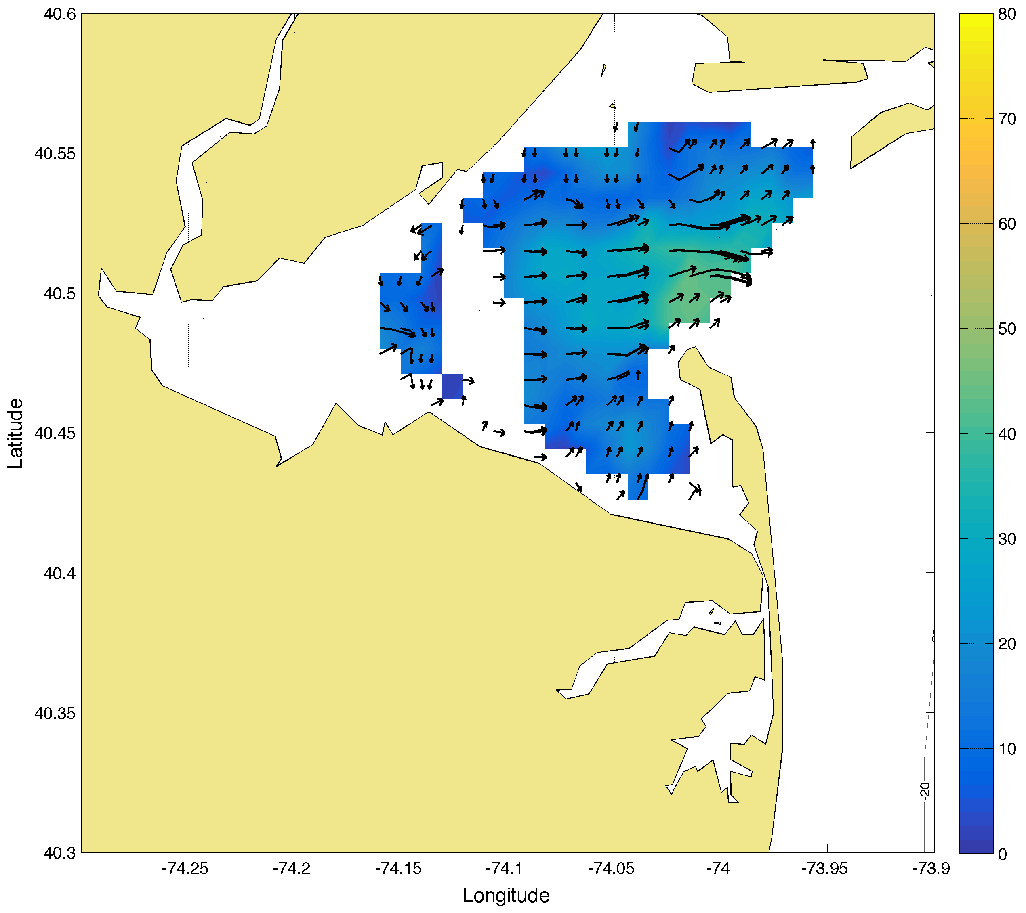
Total Comparisons
Walking
Boat
AIS
2014-10-16 13:00:00

Slide 19
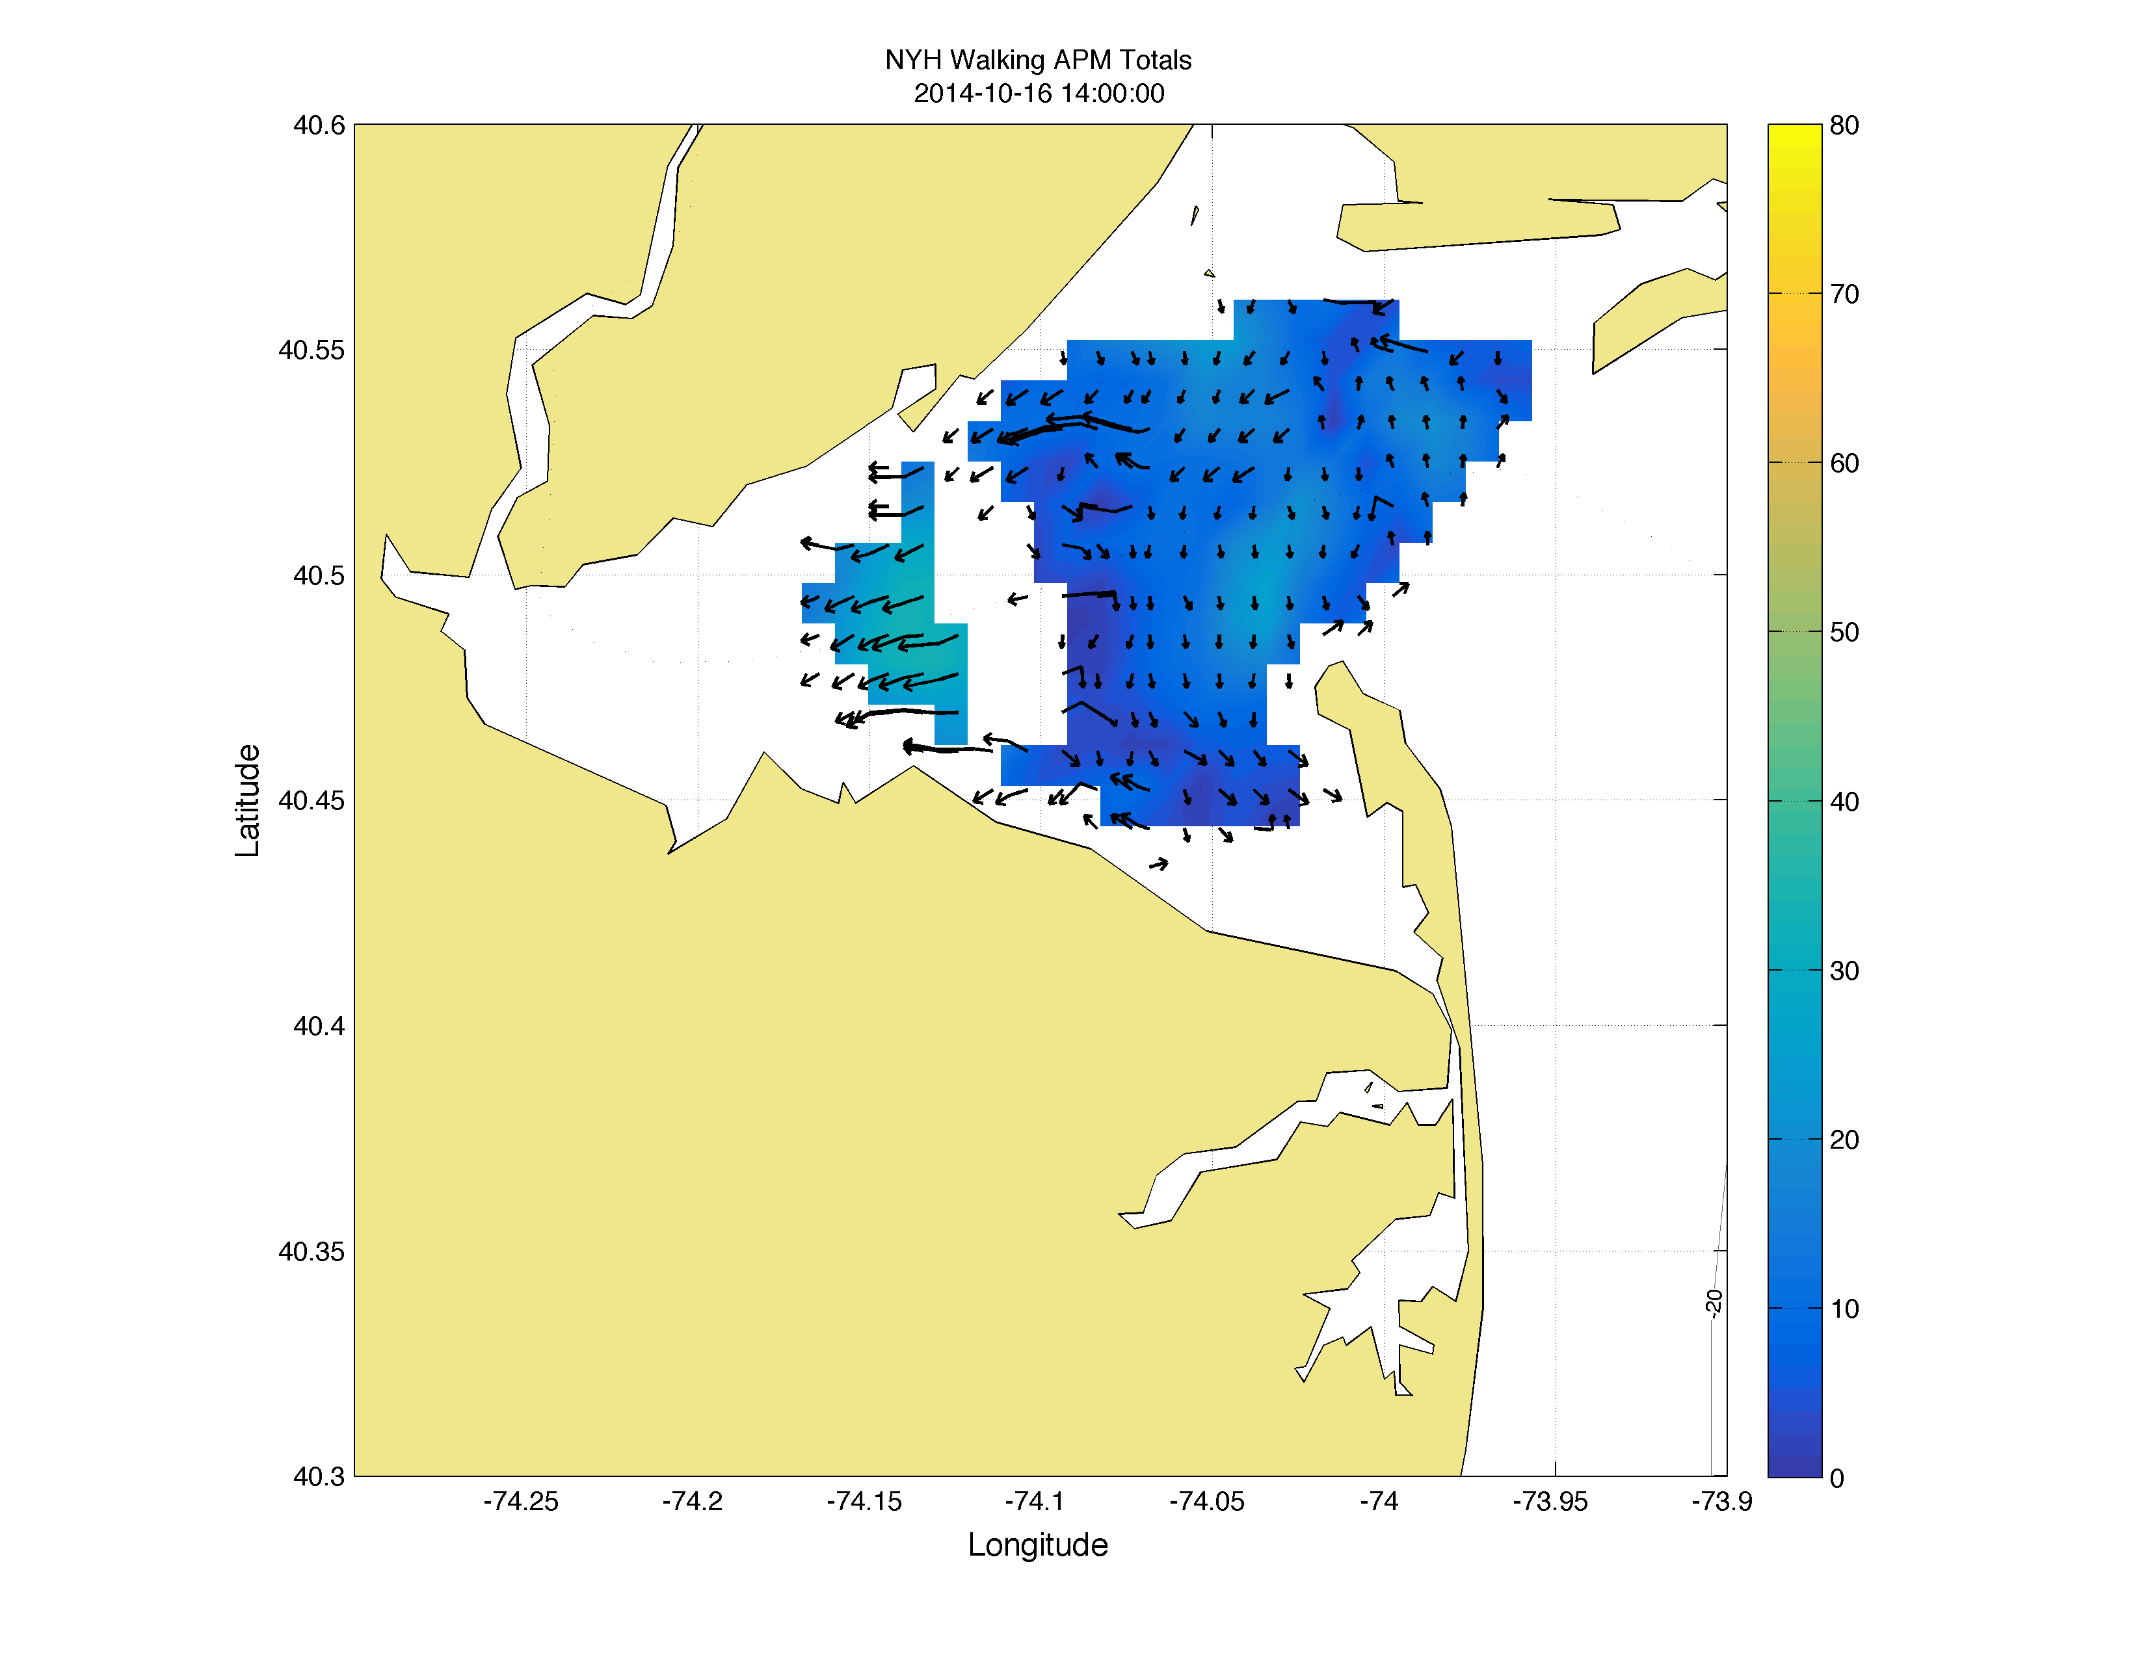
Total Comparisons
Walking
Boat
AIS
2014-10-16 14:00:00

Slide 20
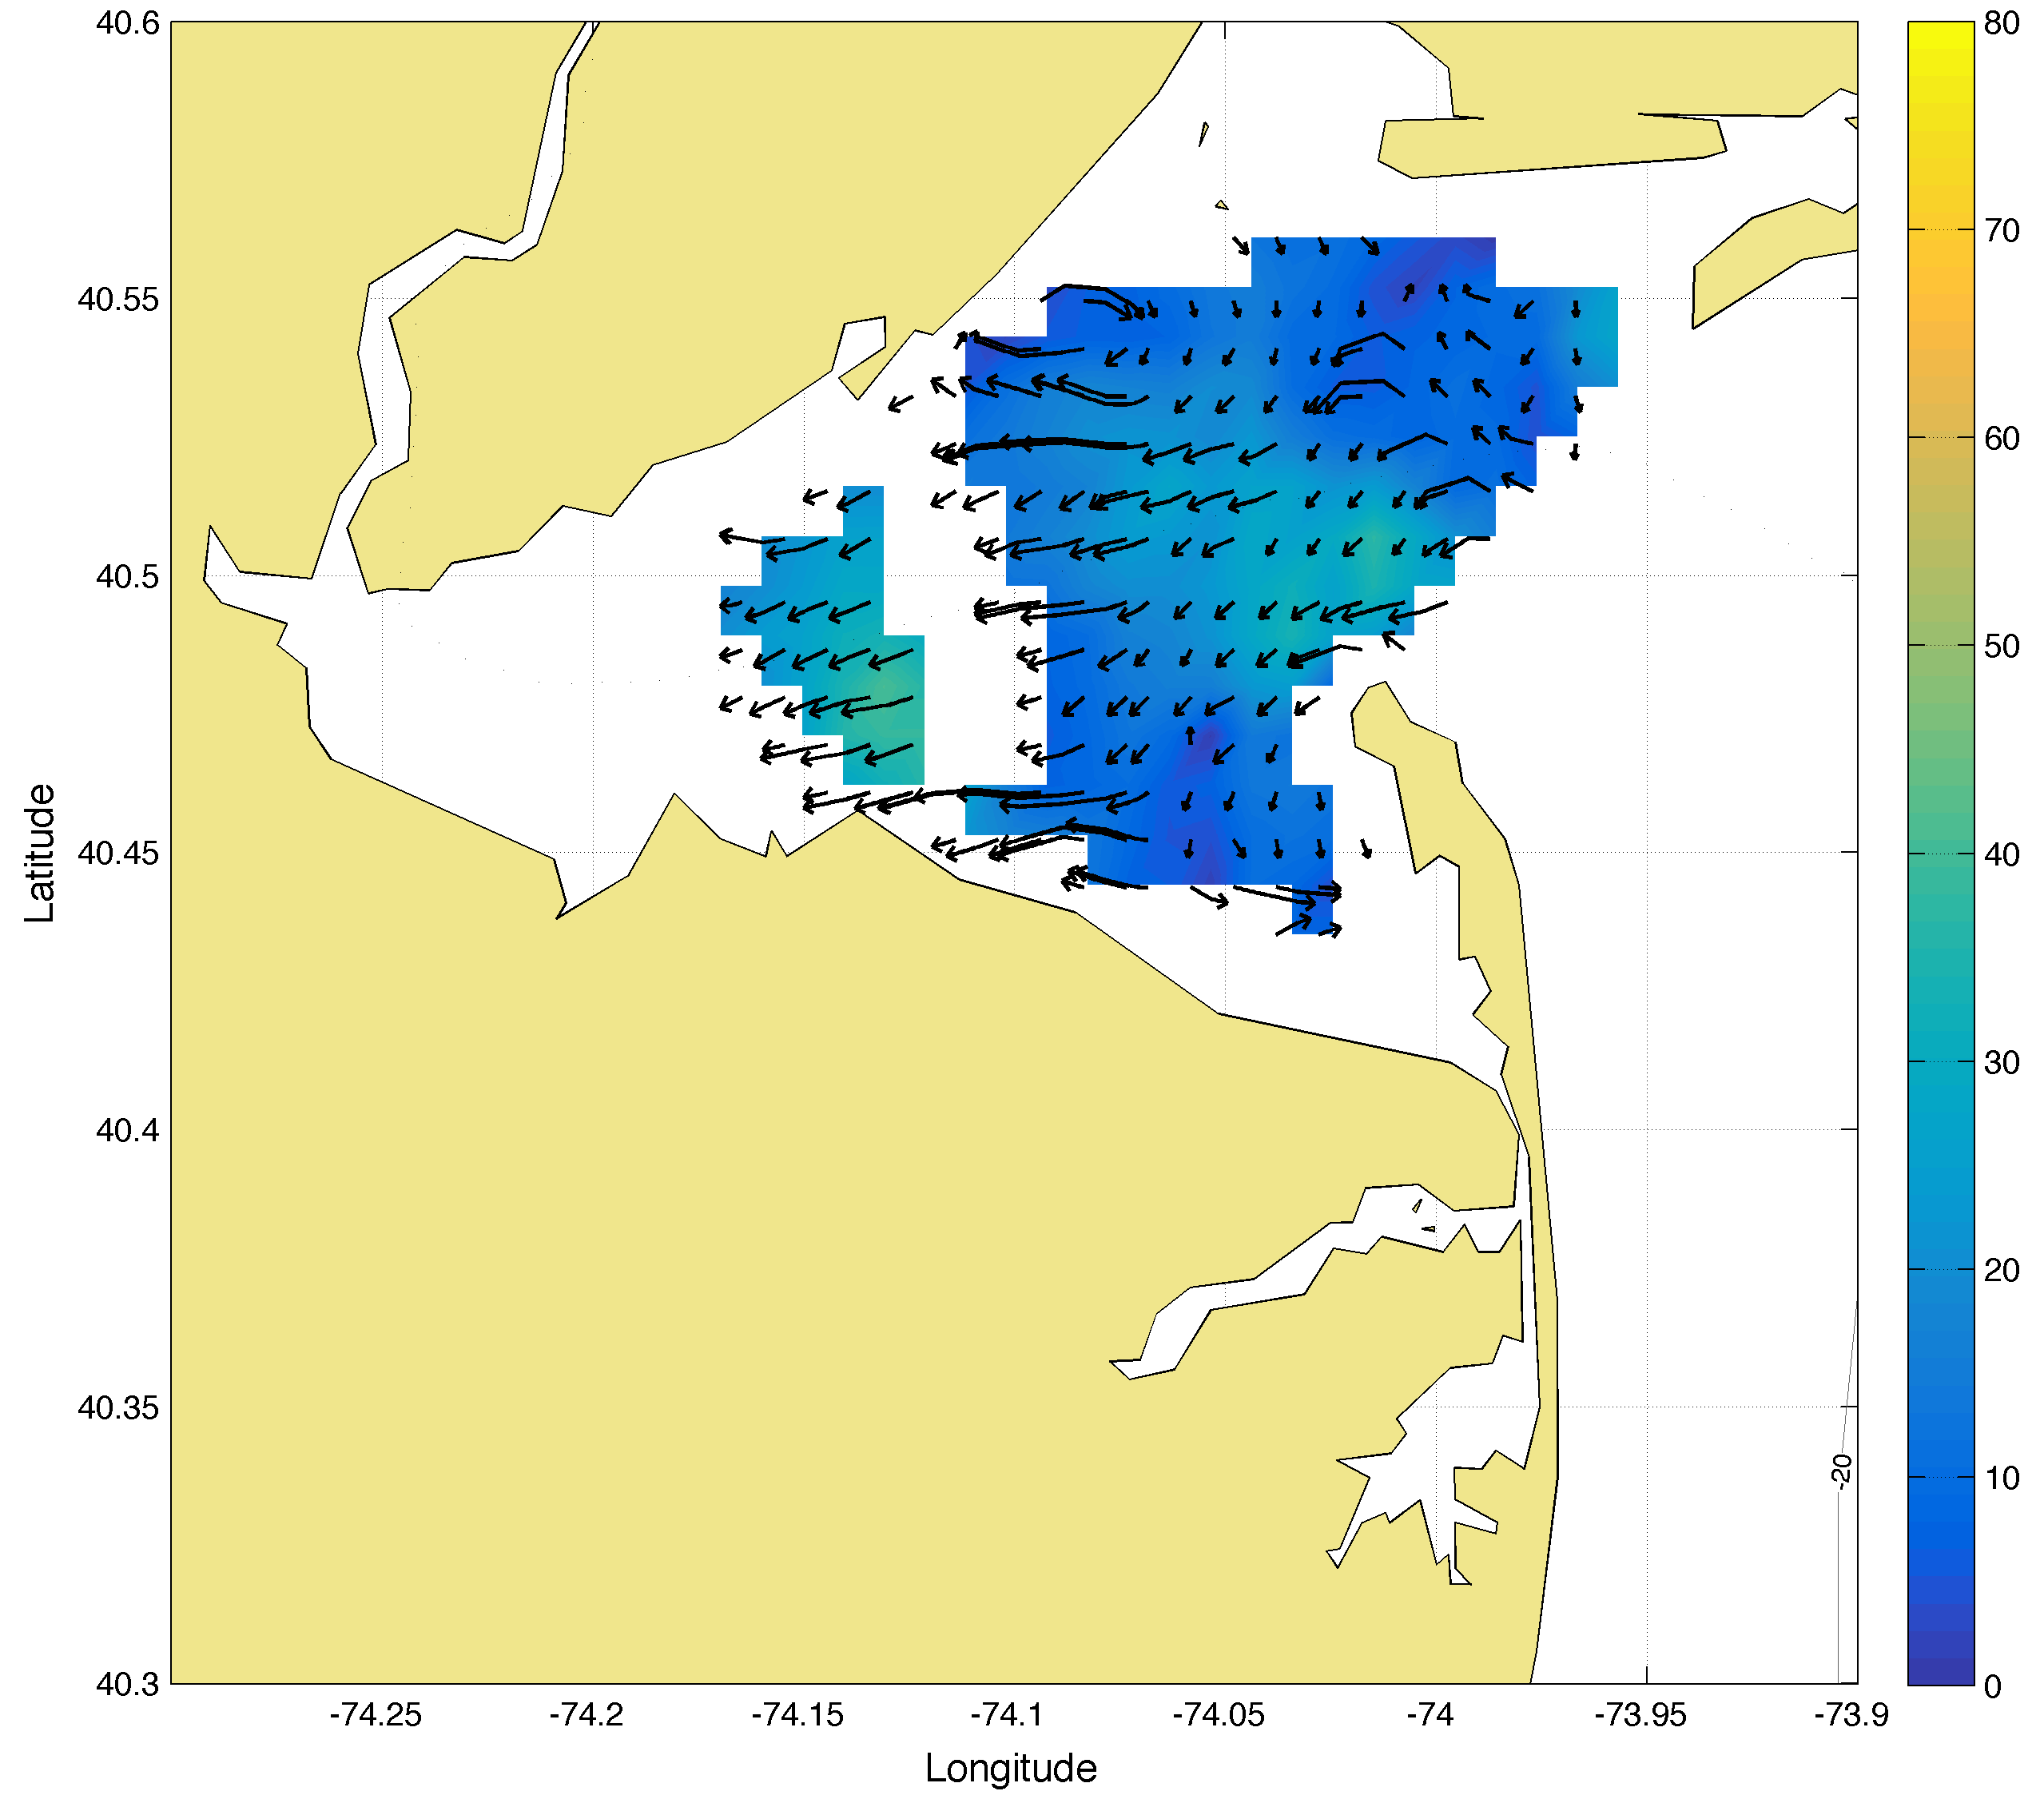
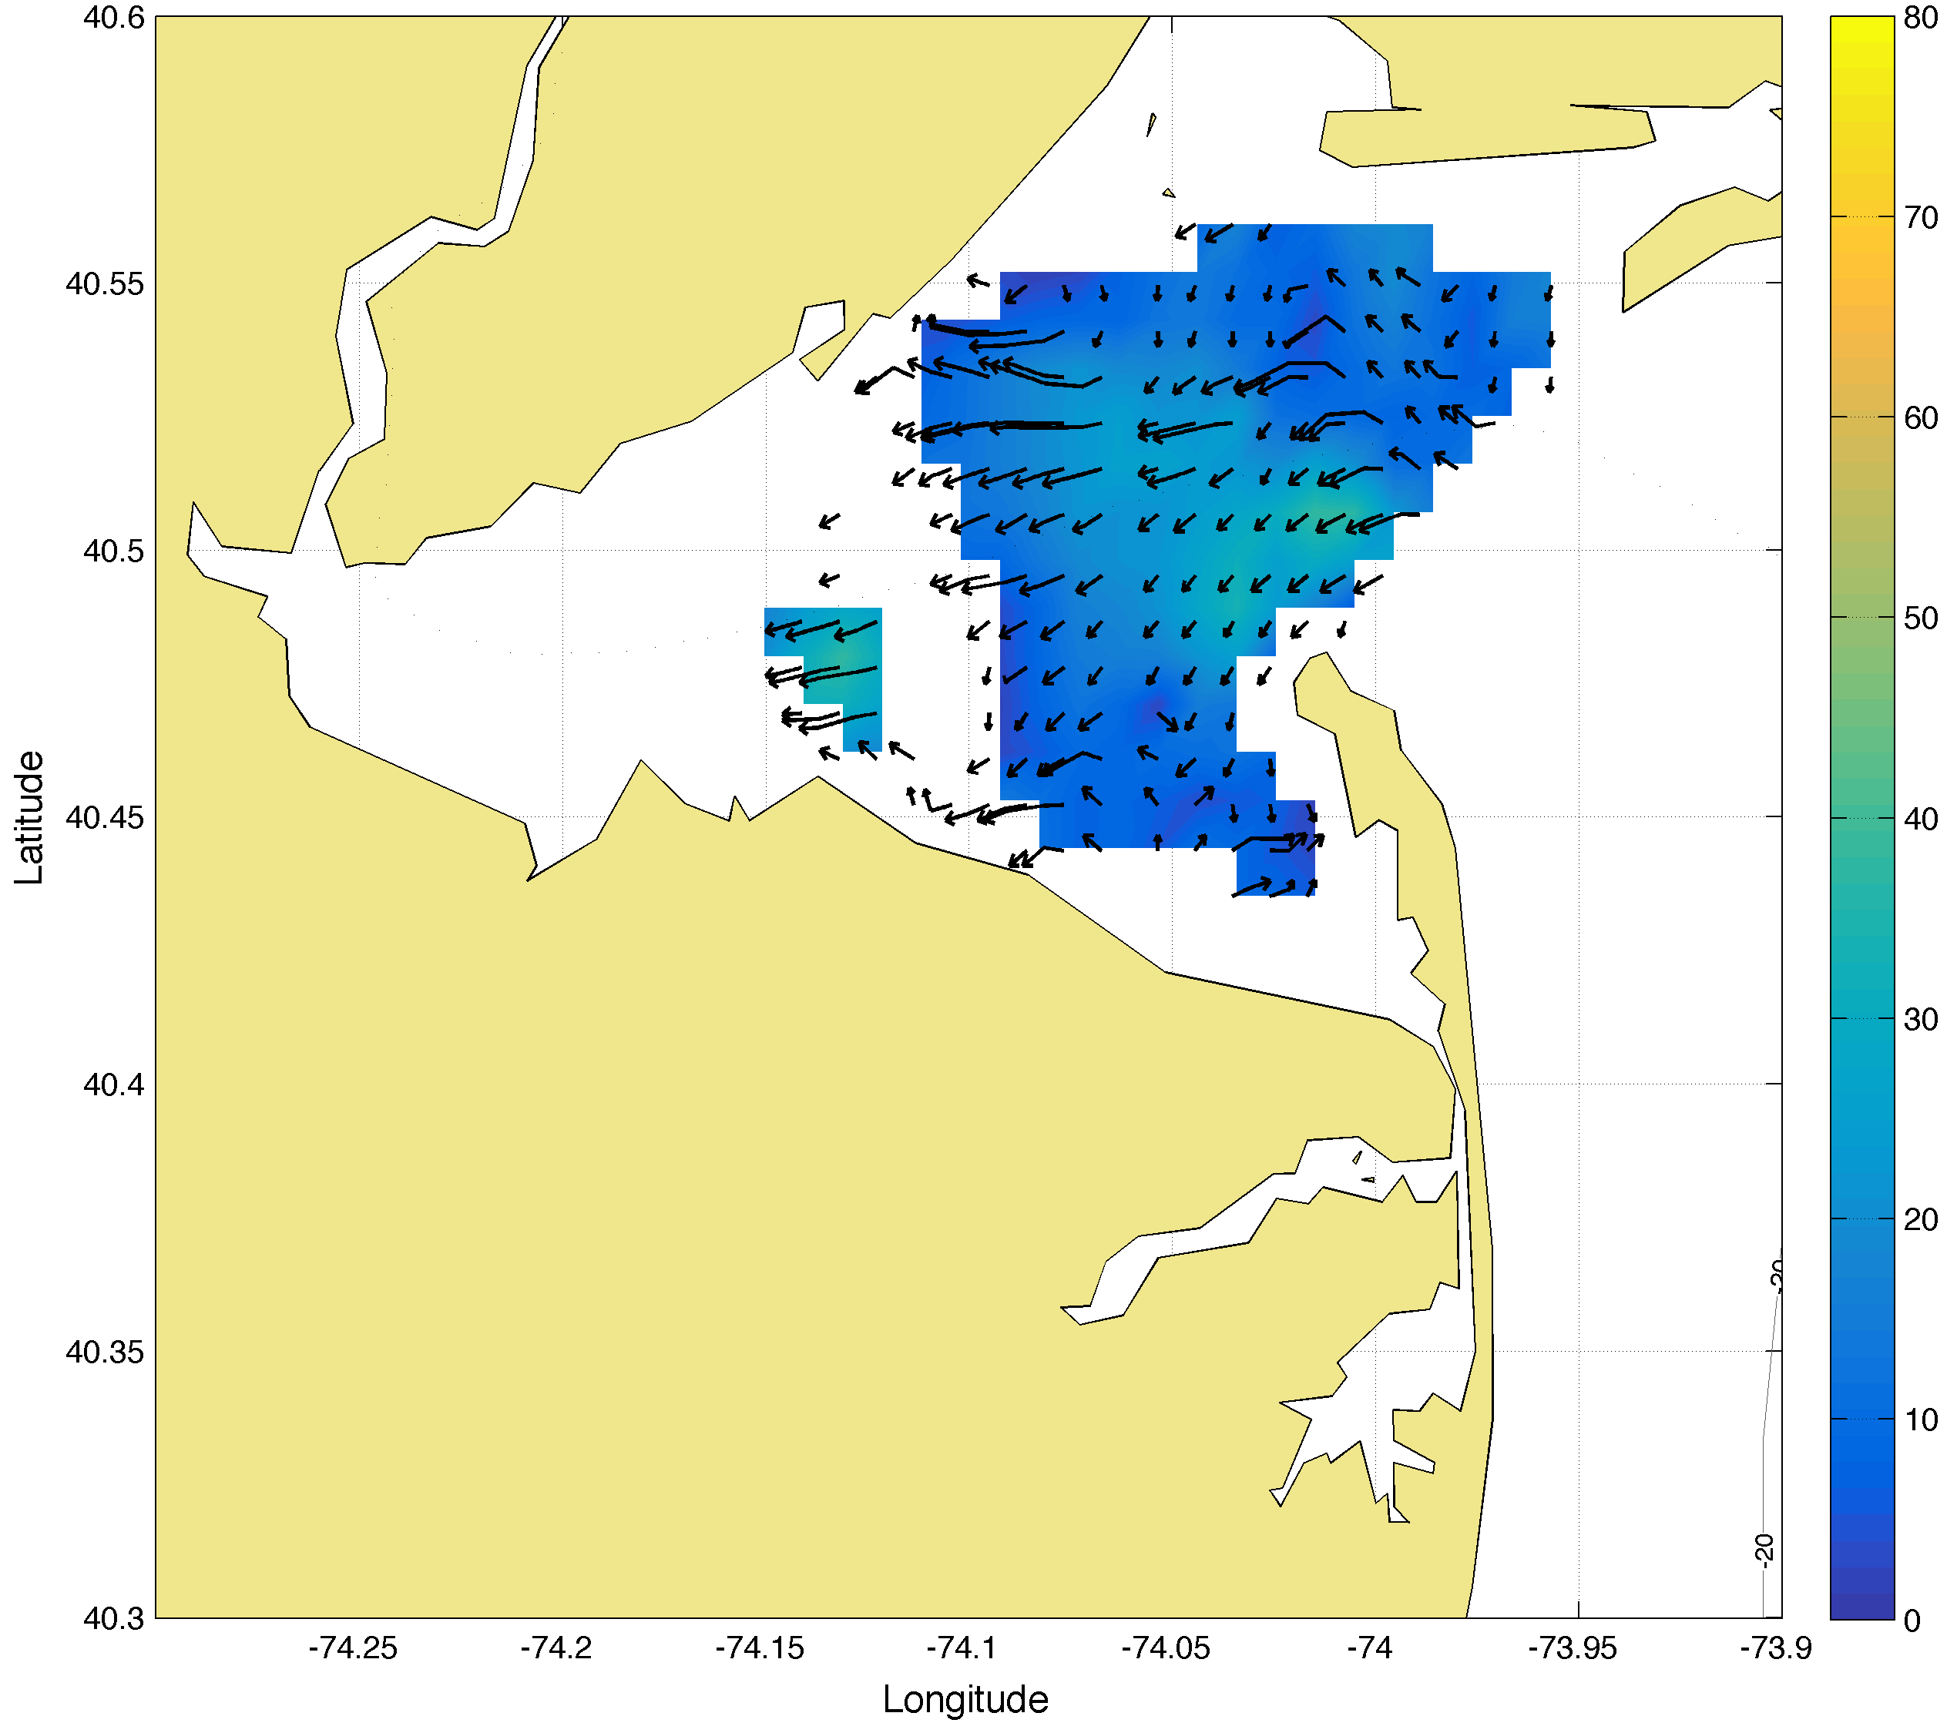
Total Comparisons
Walking
Boat
AIS
2014-10-16 15:00:00

Slide 21
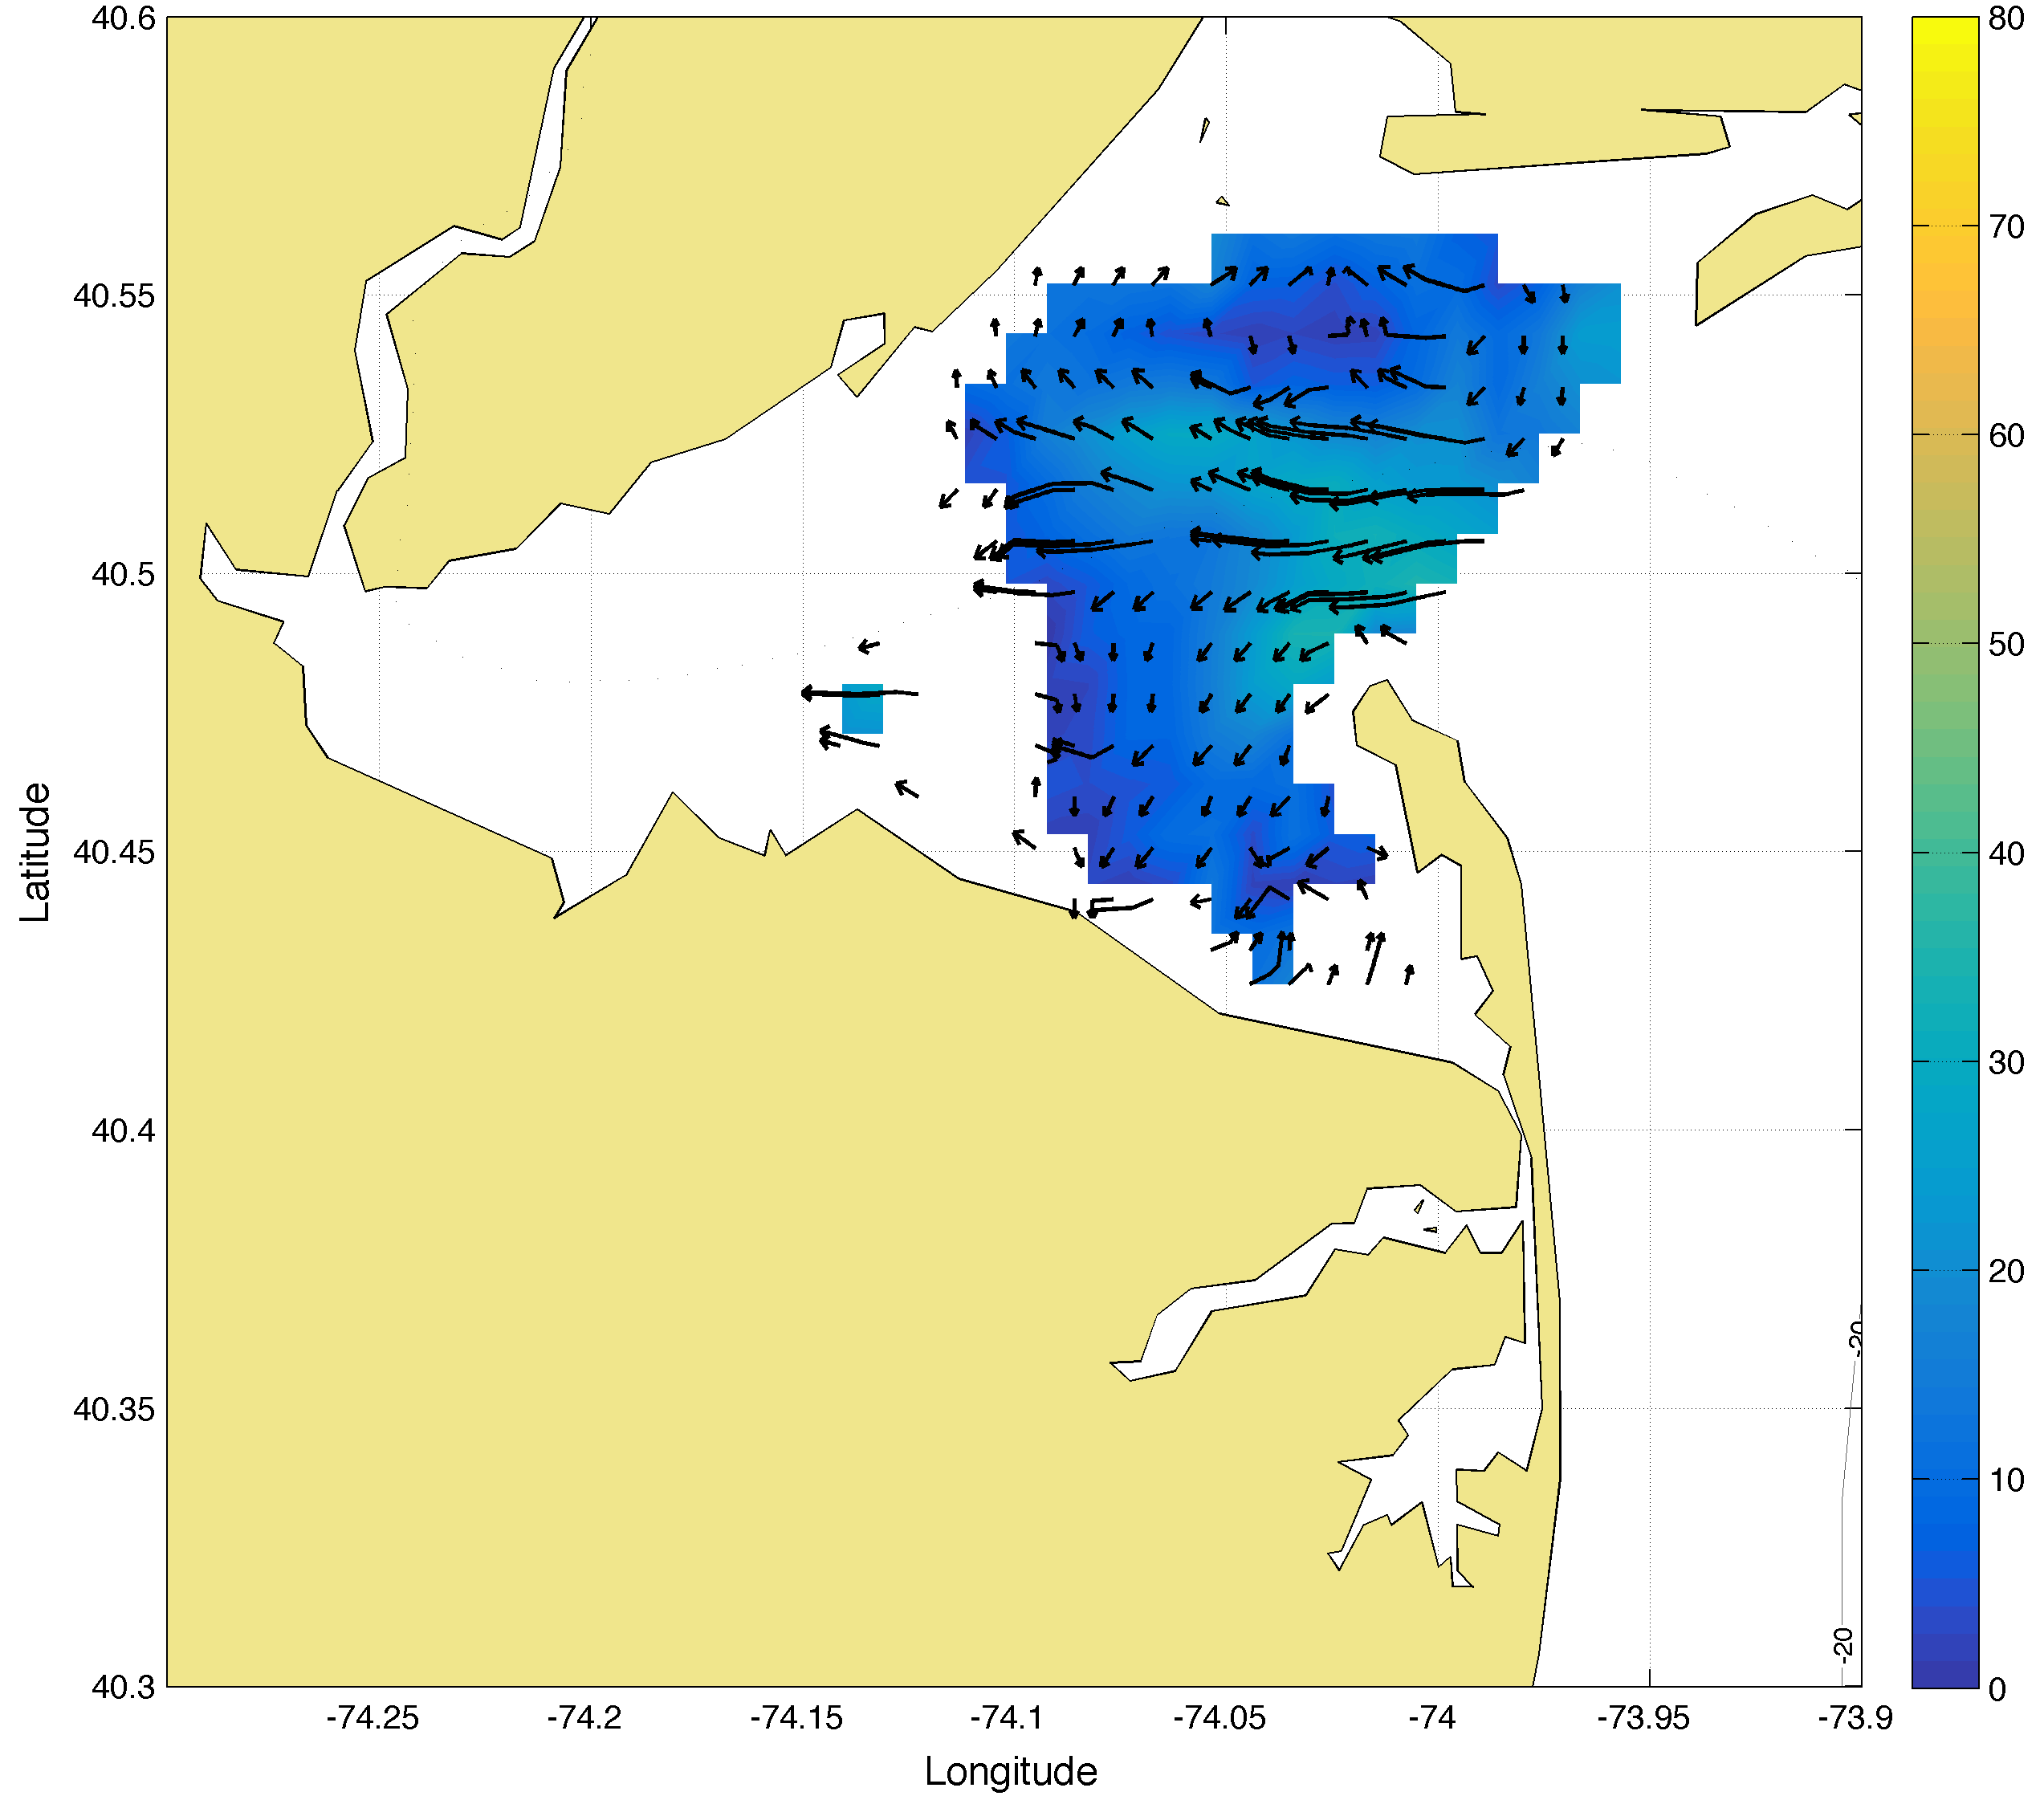
Total Comparisons
Walking
Boat
AIS
2014-10-16 16:00:00

Slide 22
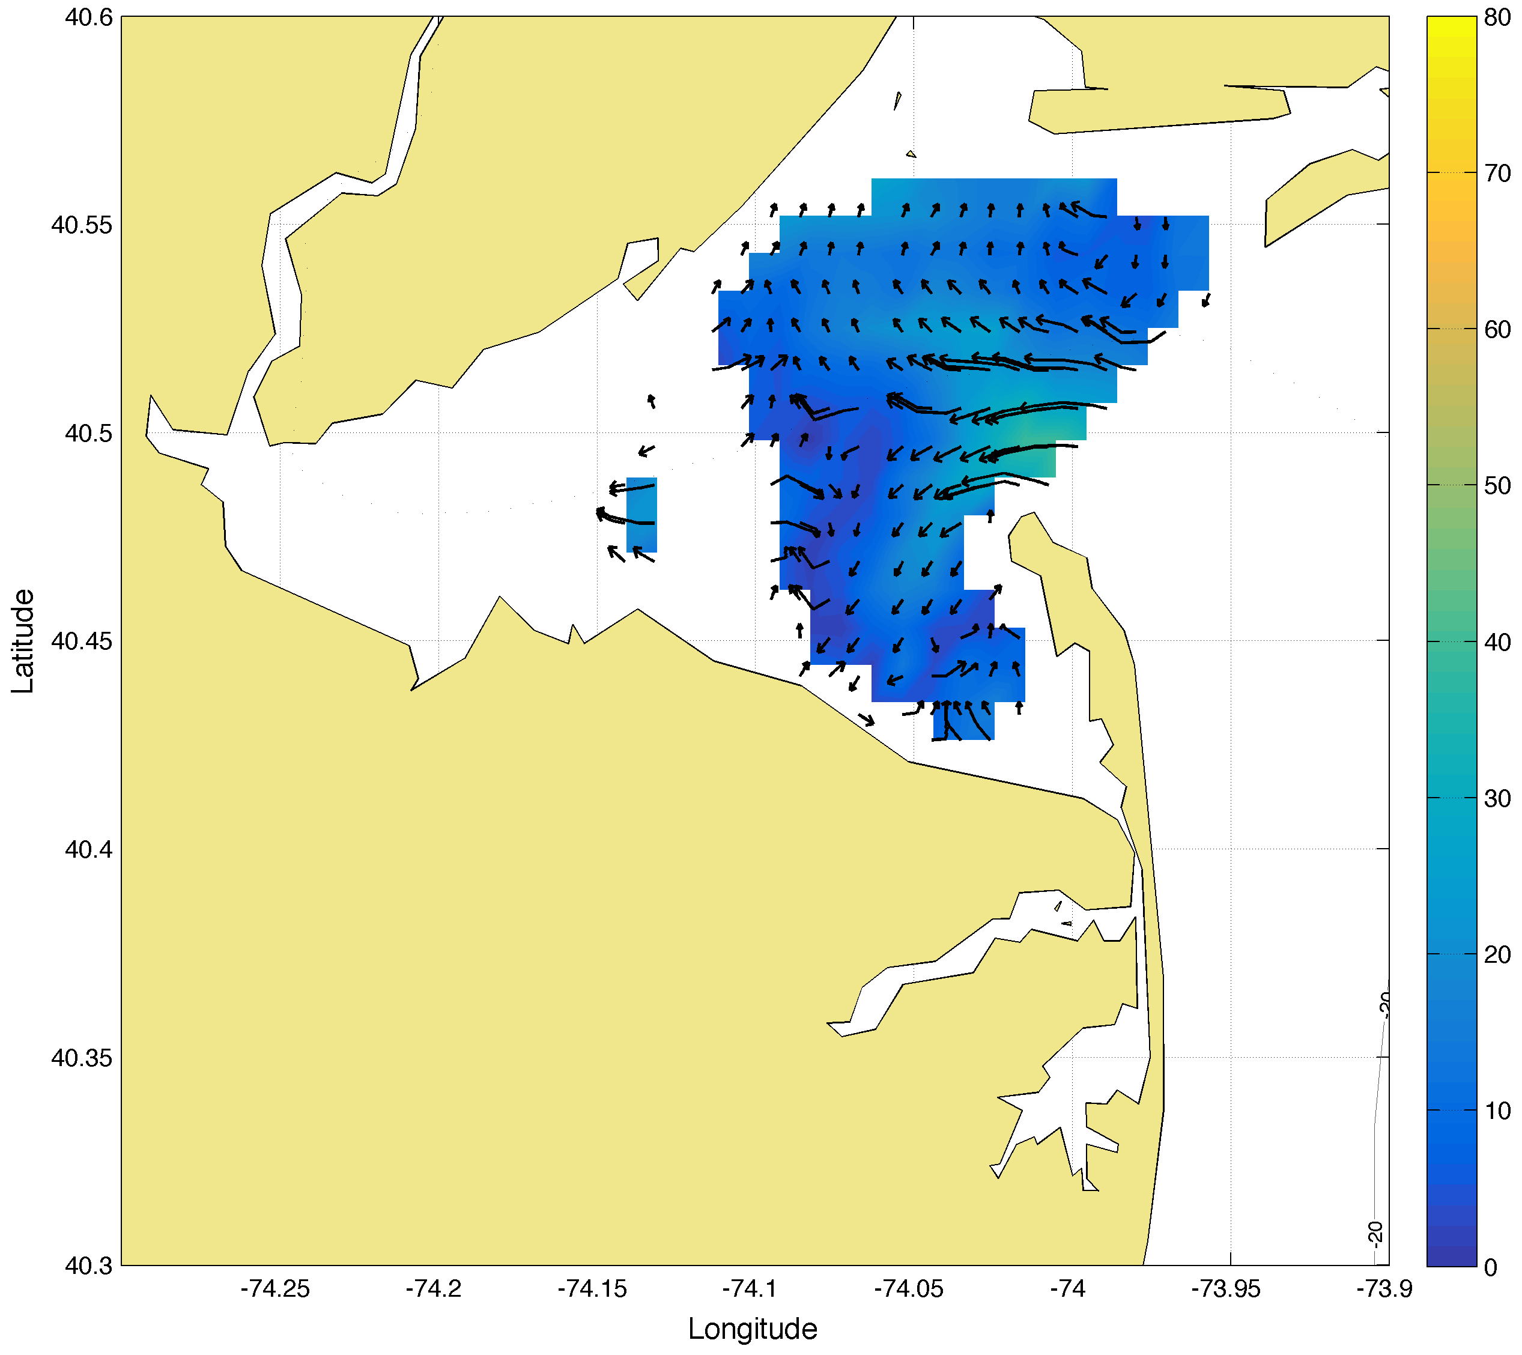
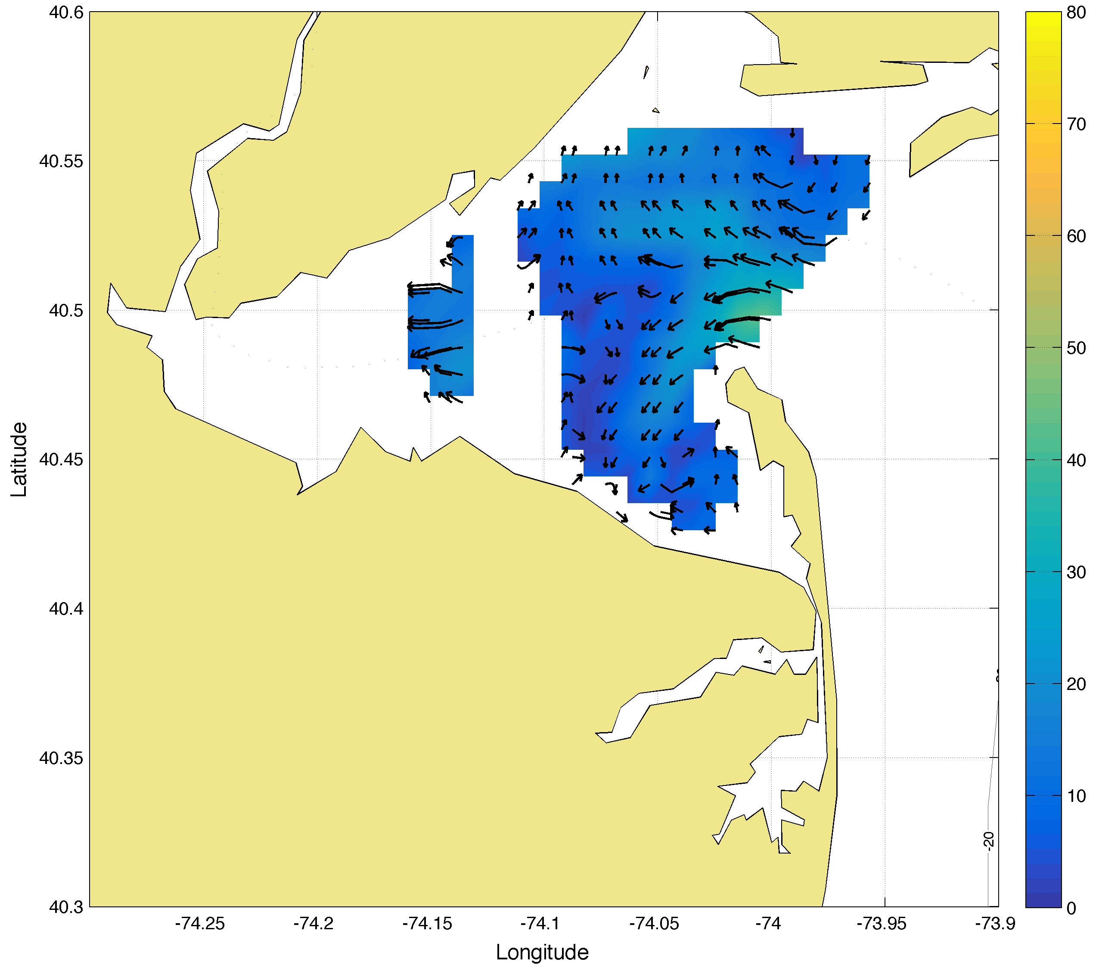
Total Comparisons
Walking
Boat
AIS
2014-10-16 17:00:00

Slide 23
Summary/Review
We found little variation between calibration methods at bearings 102 and 132 on the radial and total level
Decline in correlation at bearing 167
We can rely on several APM methods is one is not possible
Currently in the process of installing a 3rd 25 MHz NYH site to improve baseline currents

