Slide 1
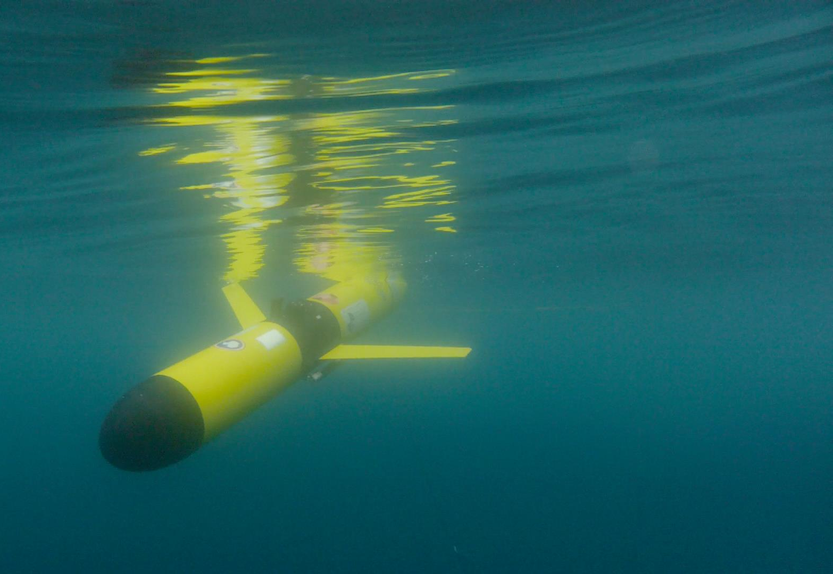
RUCOOL GLIDER
APPLICATIONS
Filipa Carvalho, Oscar Schofield, Josh Kohut
and many (many) others …
VI Glider School, PLOCAN, Gran Canaria
October 22nd, 2015

Slide 2
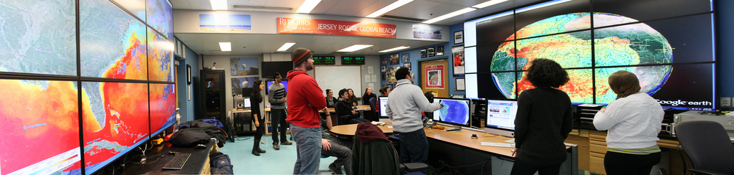
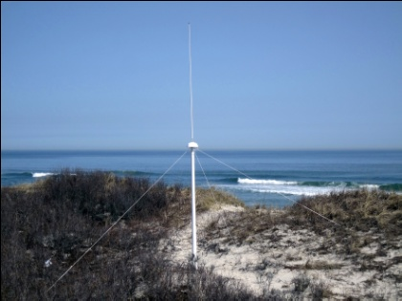
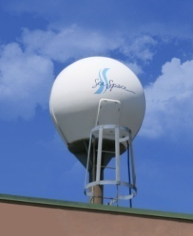
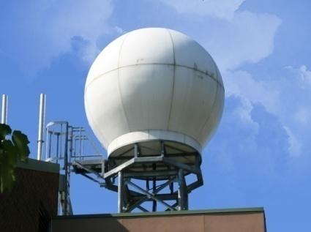
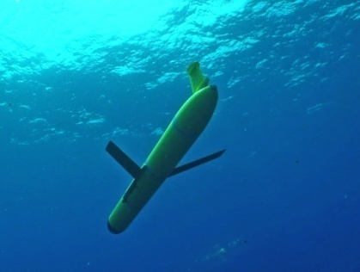
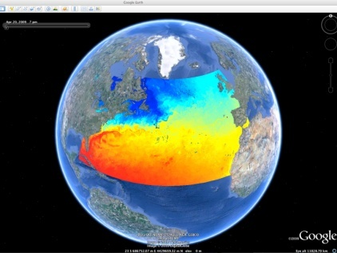
RUTGERS UNIVERSITY
Center for Ocean Observing Leadership
Vessels -
Satellite
Satellite
CODAR
Ships/ Vessels
Glider
REMUS
Data Vis.
Modeling
Security
Leadership
Education
CODAR Network
L-Band & X-Band Satellite Receivers
Glider Fleet
3-D Nowcasts
& Forecasts

Slide 3
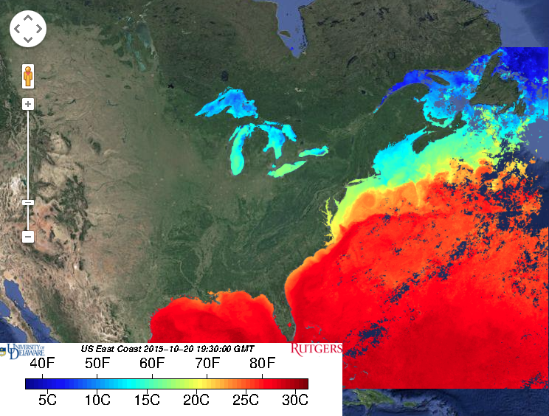
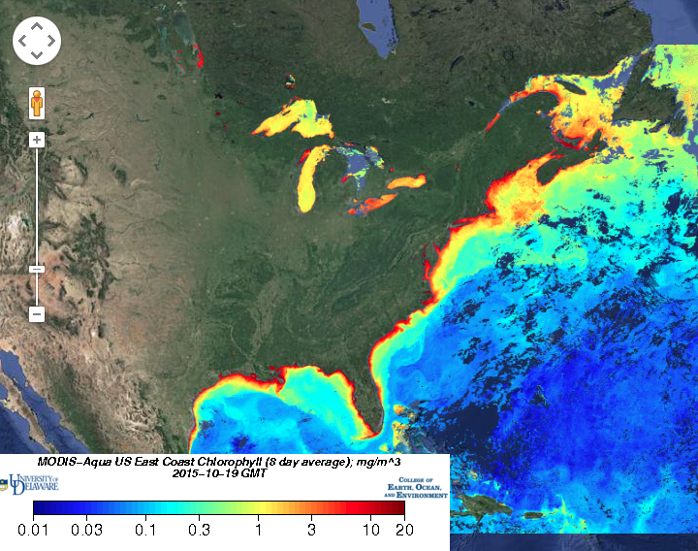
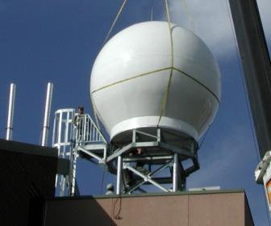
Seeing the ocean in color (satellites) – since 1992
Sea Surface Temperature
Ocean Color
Notes:
3

Slide 4
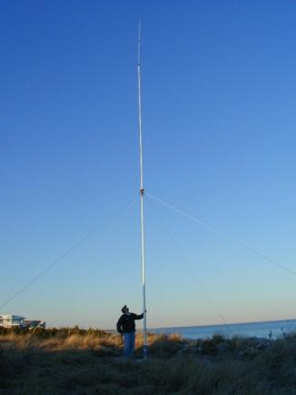
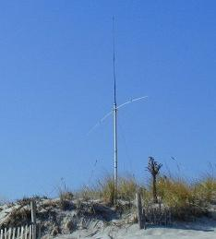
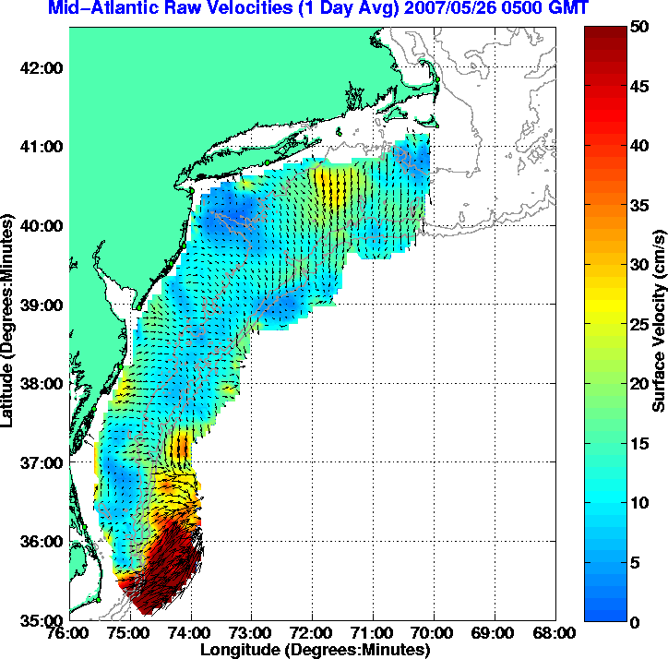
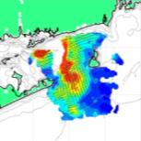
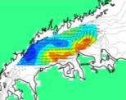
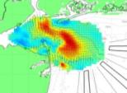
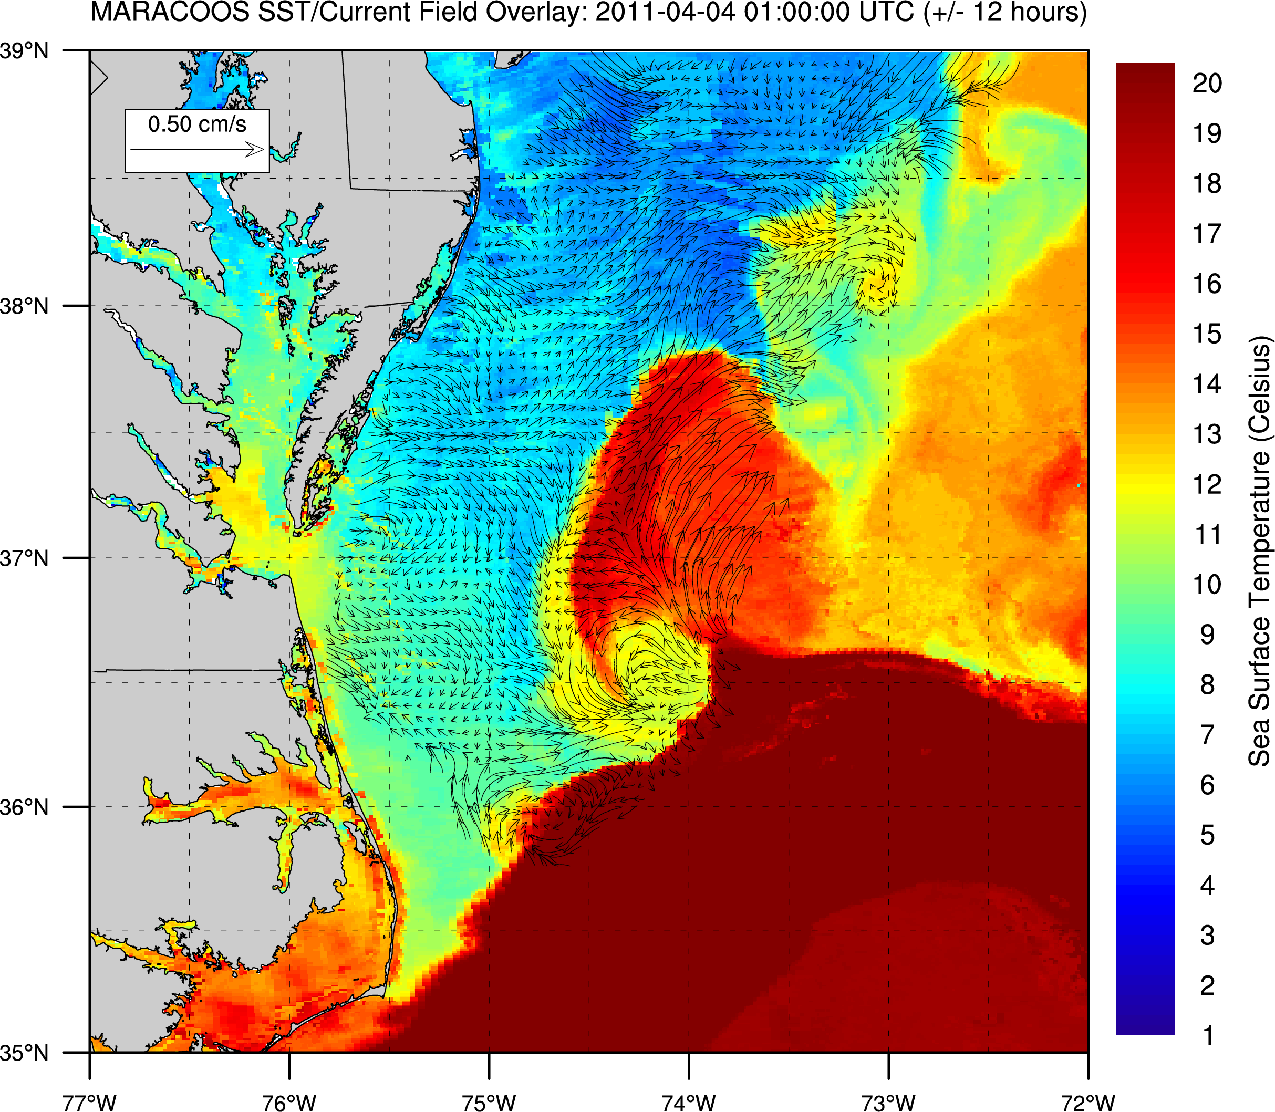
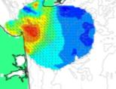
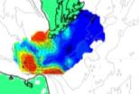
High Frequency Radar – Since 1996
Corporate Partner:
CODAR Ocean Sensors
^ Nested Grids of Hourly Surface Current Maps
Combined CODAR & Satellite Products >
Notes:
4

Slide 5
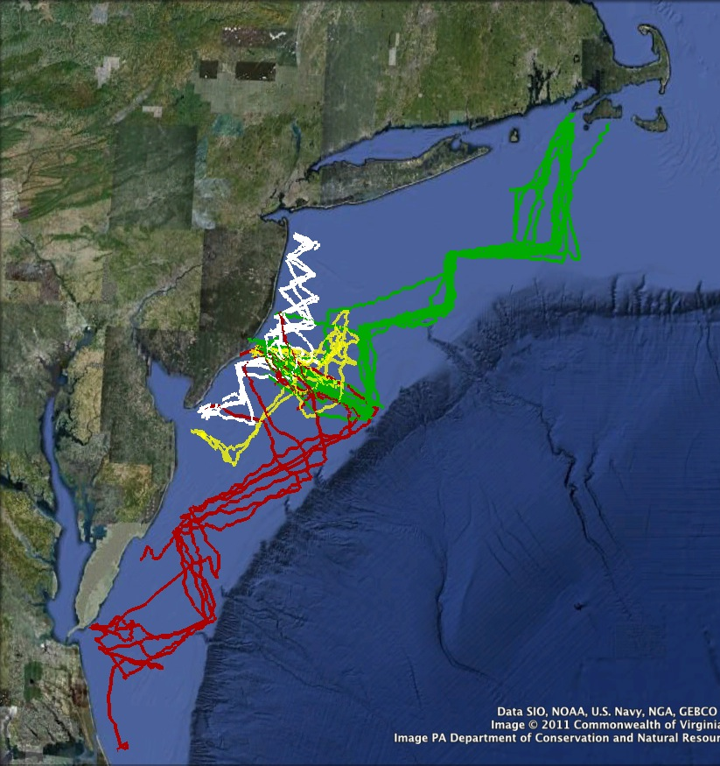
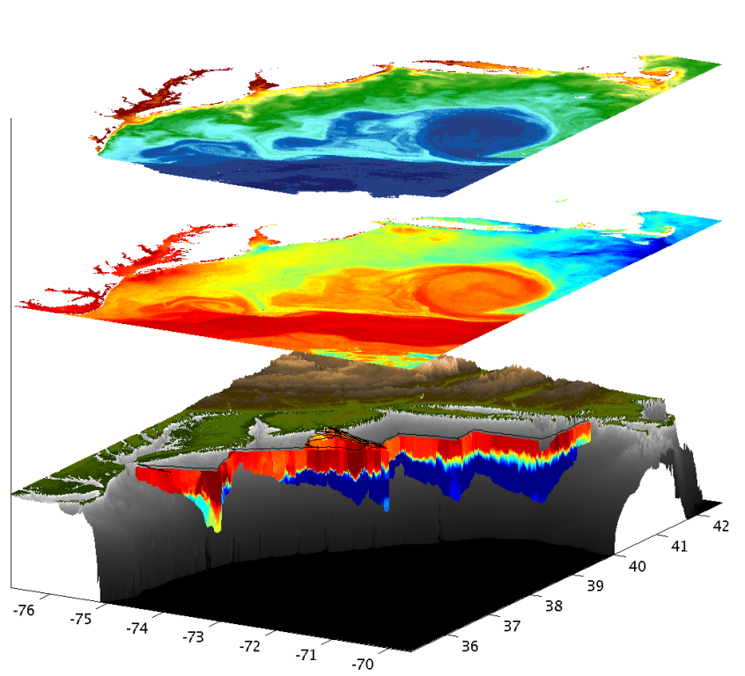
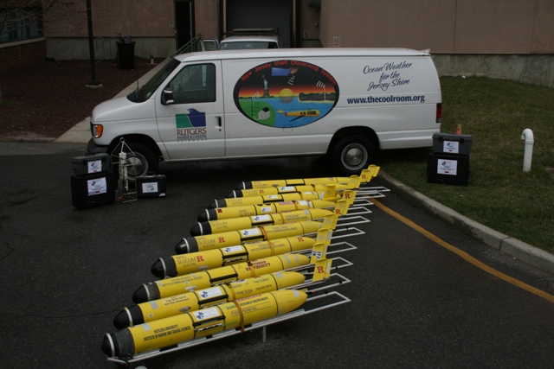
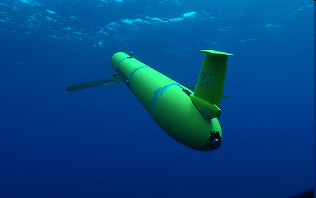
Autonomous Underwater Gliders – Since 1998
Satellite Ocean Color
Satellite SST
Subsurface
Glider Data
Corporate Partner:
Teledyne Webb Research

Slide 6
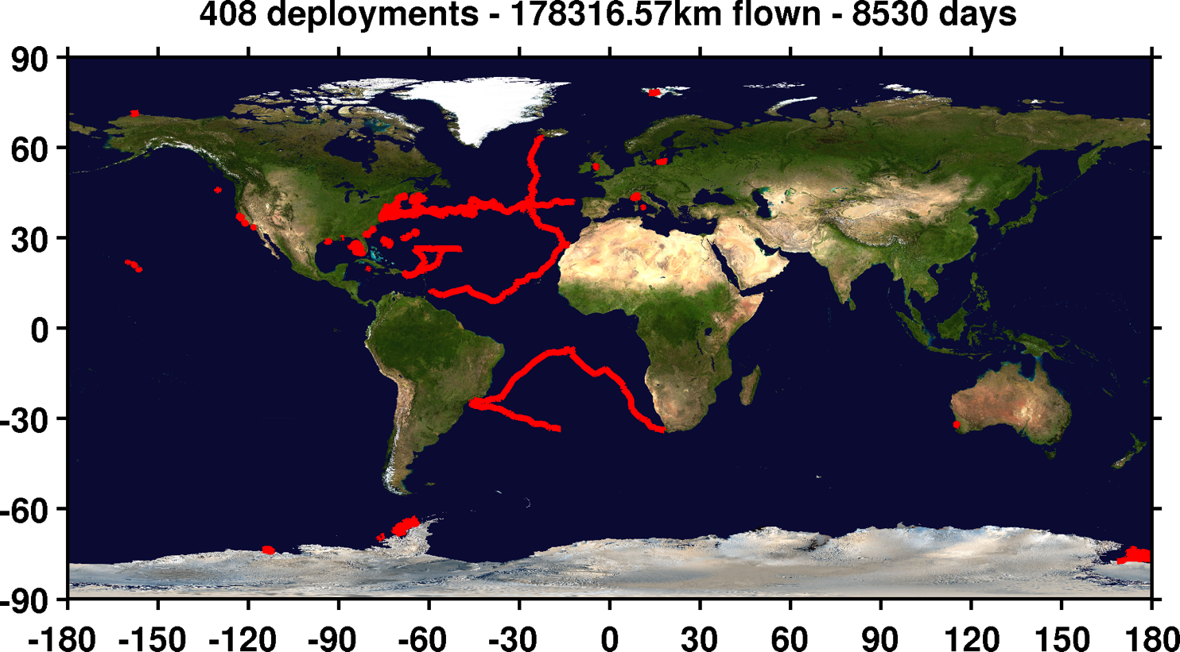
RU-COOL Global Slocum Glider Fleet Deployments

Slide 7
RU-COOL Global Slocum Glider Fleet Deployments
Global deployments:
  Trans-Atlantic Glider (Scarlet Knight)
  Challenger Mission (Silbo, ru29)
Local deployments:
  Fisheries
  Water quality
Extreme environments
  Hurricanes and Nor’easters
  Antarctica

Slide 8
RU-COOL Global Slocum Glider Fleet Deployments
GLOBAL MISSIONS (LONG DURATION)

Slide 9
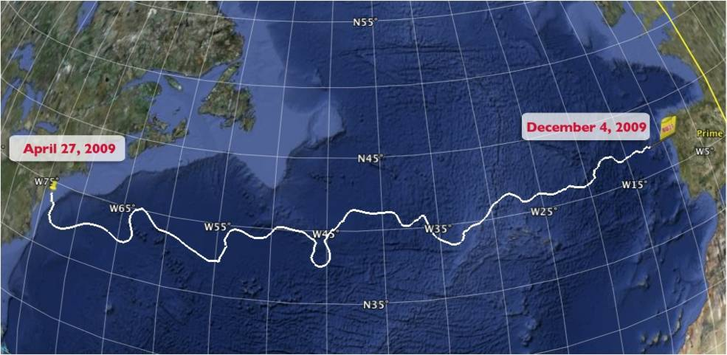
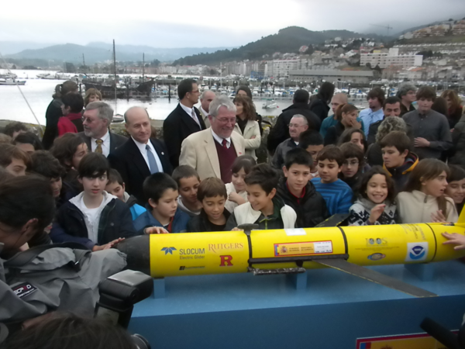
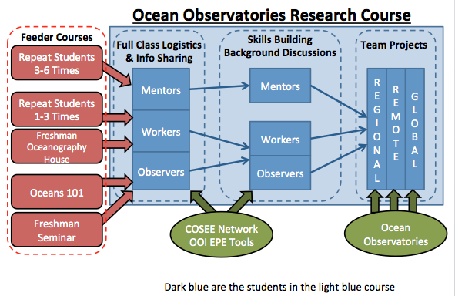
The Trans-Atlantic Glider Challenge
December 9, 2009 – Baiona, Spain
RU27: 7,400 km in 221 days
Trans-Atlantic Glider Challenge

Slide 10
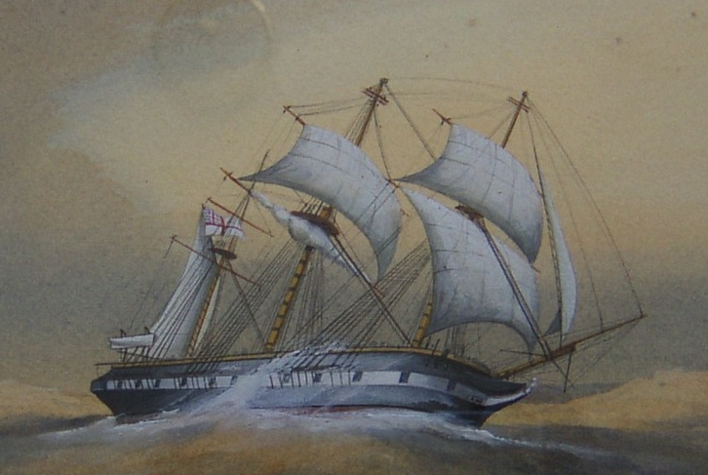
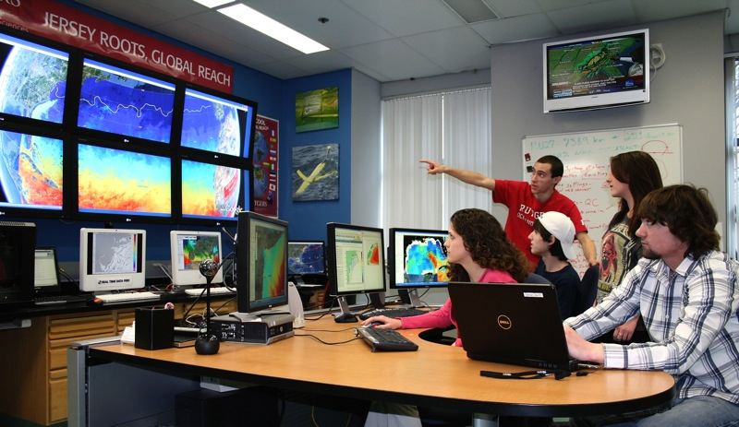
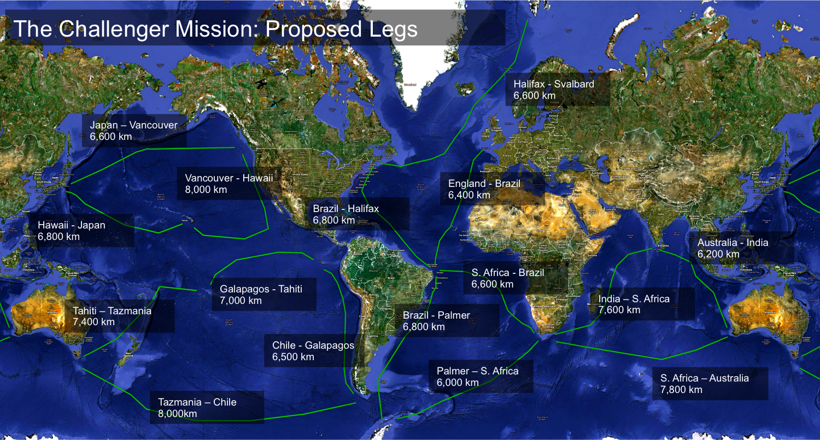
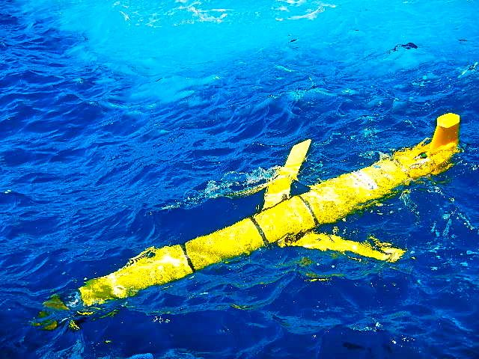
Global Challenger Glider Mission
Creating the Next Generation of Ocean Explorers
16 Legs with
16 Global-Class Gliders

Slide 11
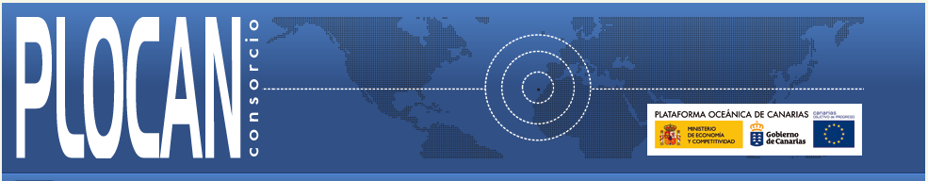


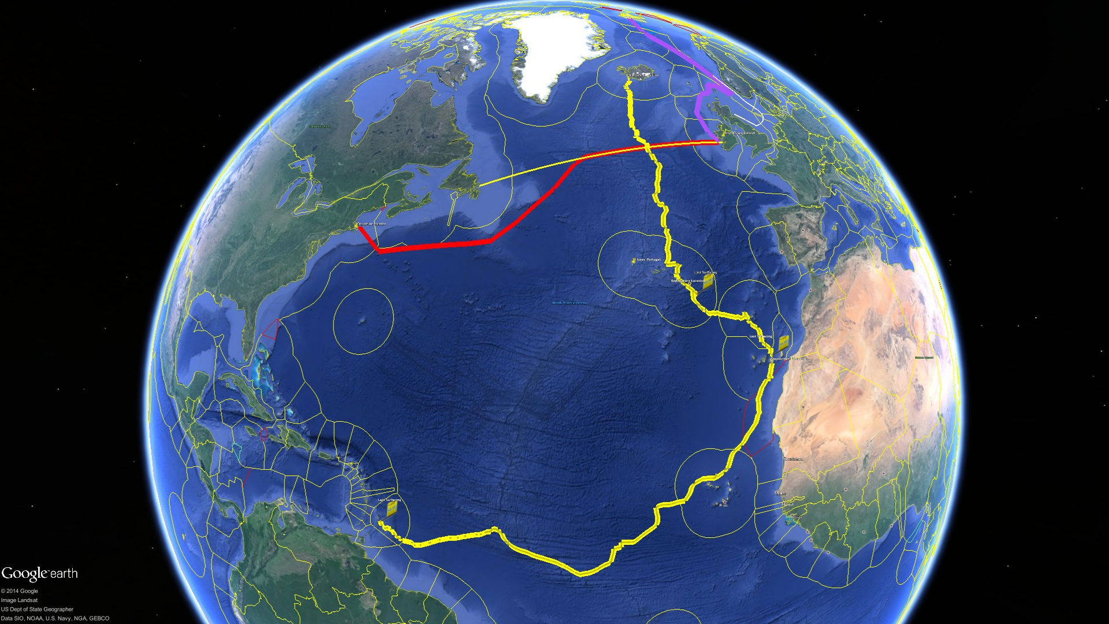
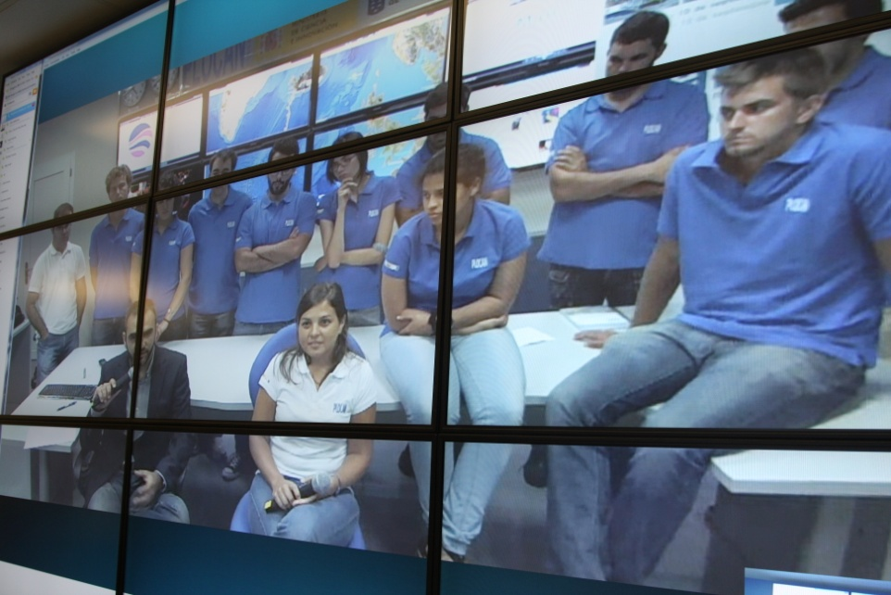
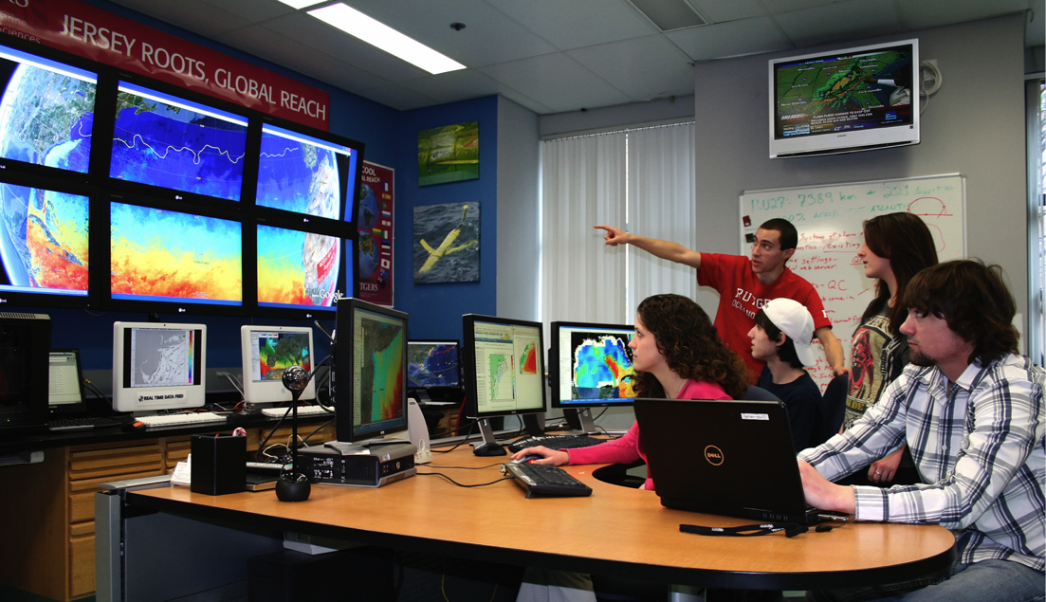
Companion Course at
Plataforma Oceanica de Canarias
Shared Glider Missions – Iceland to Azores; Azores to Canaries; Canaries to Caribbean
Skype Sessions between classes
Two-way International Exchange programs
Students Learn Science from their teachers
Students Learn Culture from their peers
Glider Silbo >10,000 km flown

Slide 12
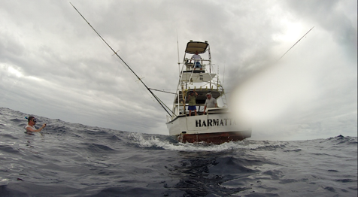
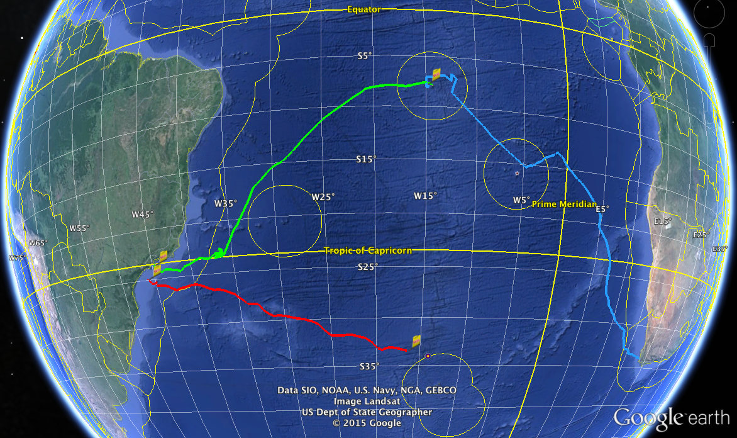

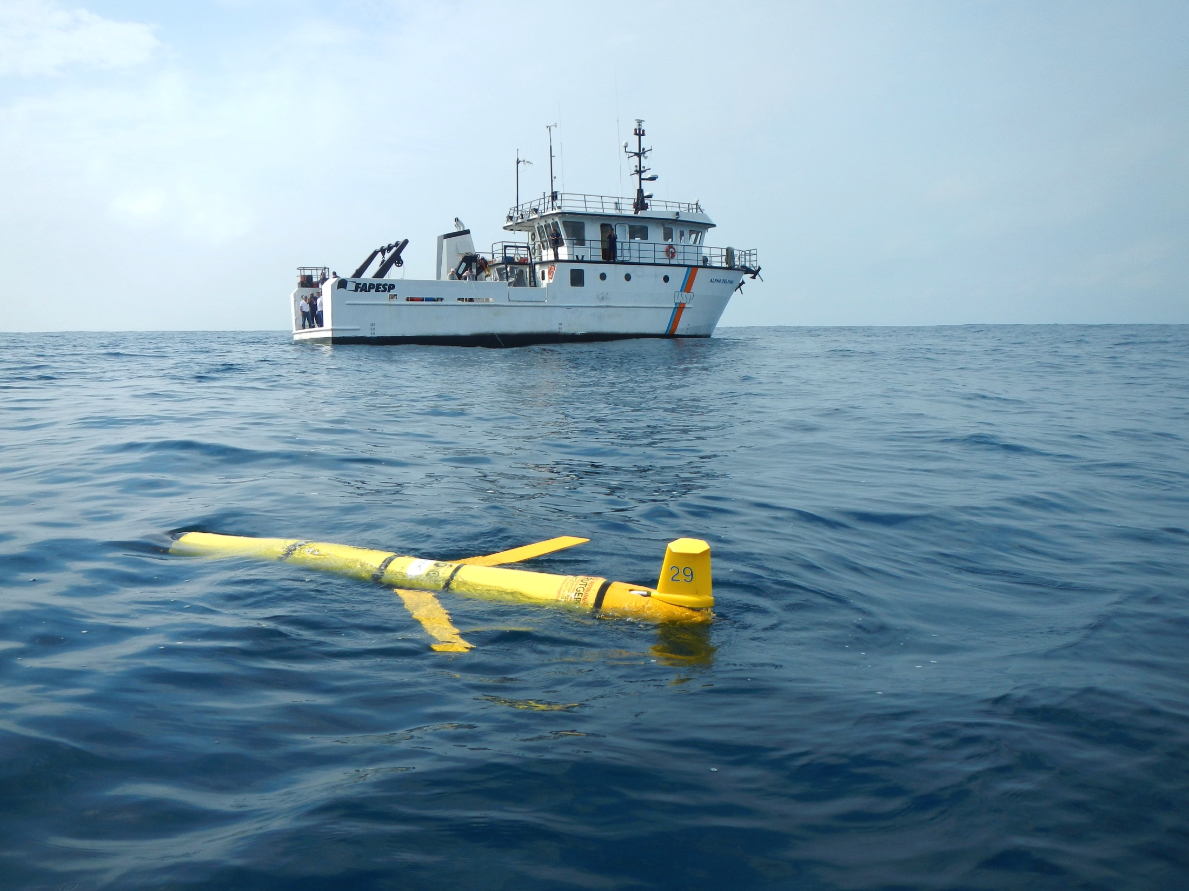
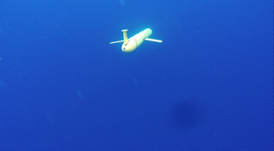
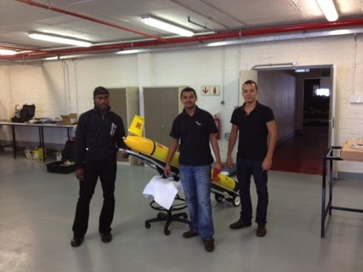

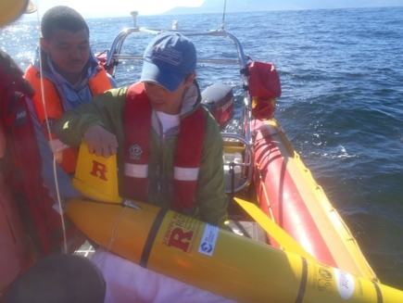



Glider RU29: Launched at Cape Town 11 Jan 2013, flown >13,000 km

Slide 13
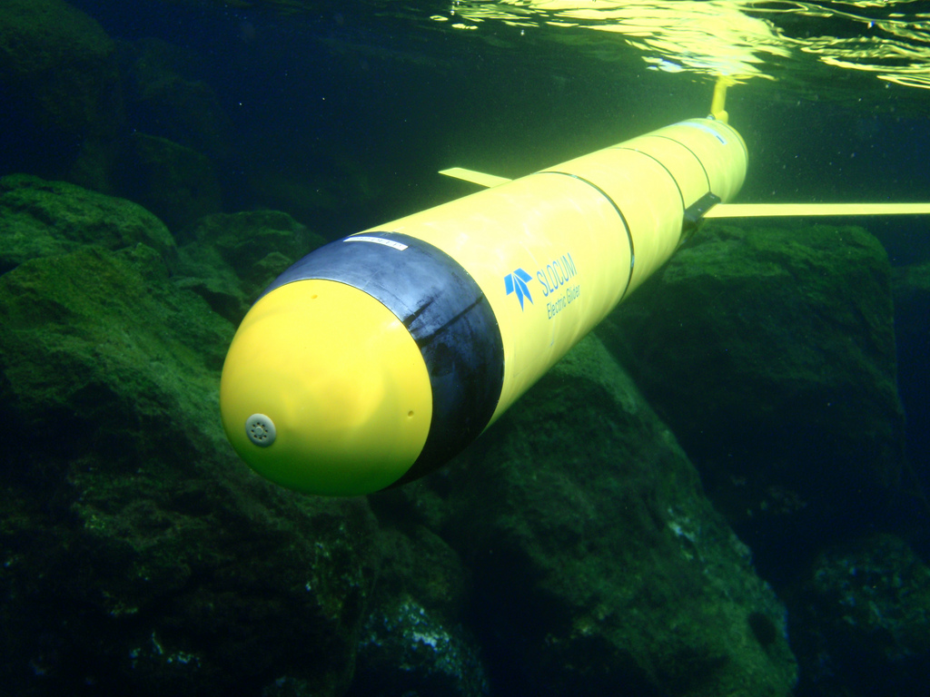
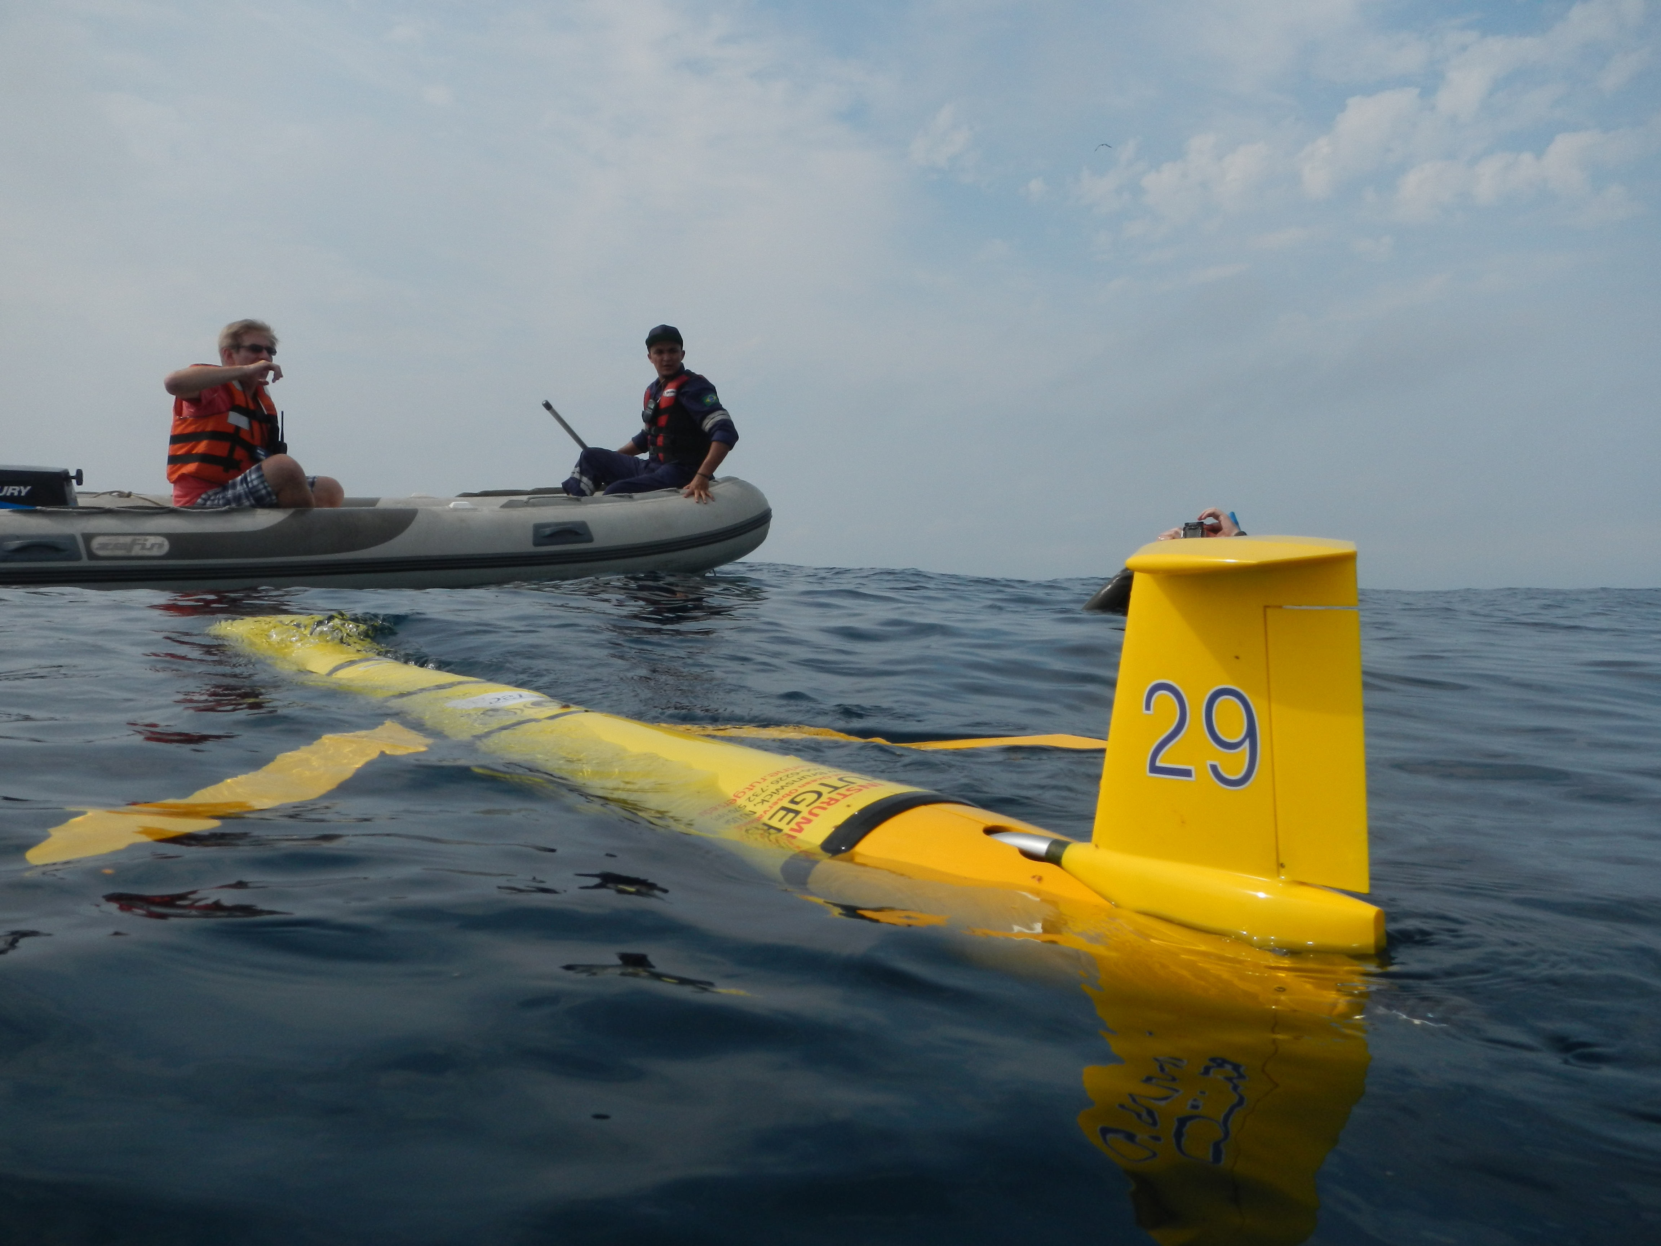
Challenger Mission Totals
GLIDER | START | END | DAYS | KILOMETERS
SILBO LEG 1 | 6/23/2011 | 12/03/2011 | 163.5 | 3,941
SILBO LEG 2 | 3/7/2012 | 5/22/2012 | 76 | 1,706
SILBO LEG 3 | 7/24/2012 | 5/19/2013 | 303 | 4,390
RU 29 LEG 1 | 1/11/2013 | 10/26/2013 | 289 | 5,667
RU29 LEG 2 | 11/10/2013 | 5/18/2014 | 189 | 4,720
RU29 LEG 3 | 6/23/2015 | present | 112 | 2,860
TOTAL: |  |  | 1,020.5 | 20,424

Slide 14

RTOFS and MERCATOR Comparison to RU29
Ascension Island to Ubatuba, Brazil
Turtle Tracks
Deep Eddy
Cabo Frio Eddy
Full Track Temp Difference
Argo Validation
Cabo Frio Coastal Eddy
Deep Ocean Eddy
Mid-Gyre “Turtle Tracks”
Undergraduate
involvement

Slide 15
RU-COOL Global Slocum Glider Fleet Deployments
Local coastal missions

Slide 16
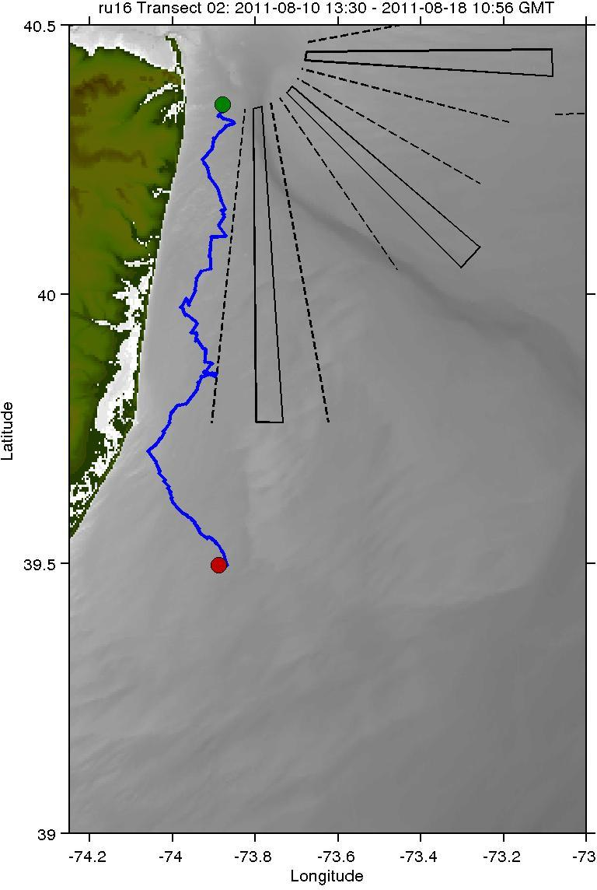


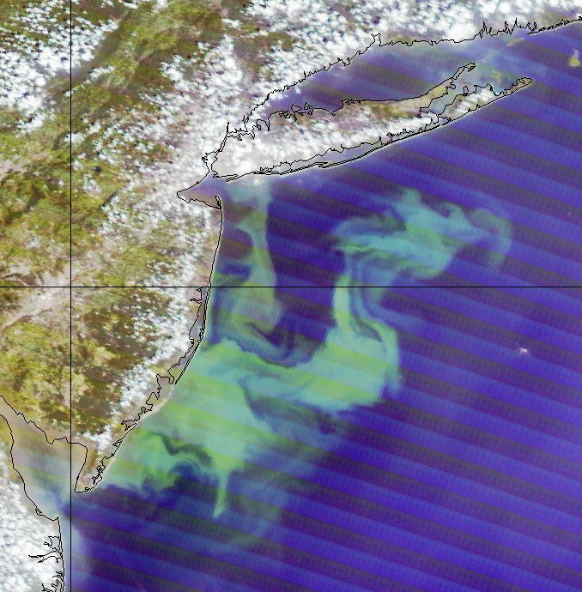
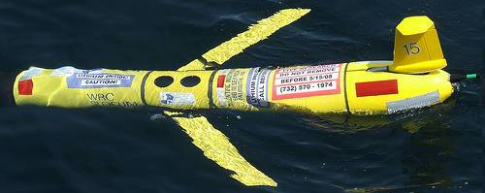
Autonomous Platforms:
Dissolved Oxygen
2010-Present
NJ coast - frequently low dissolved O₂ regions
how the location and size of these low DO regions vary?
what impact that variability has on ecosystem health?

Slide 17
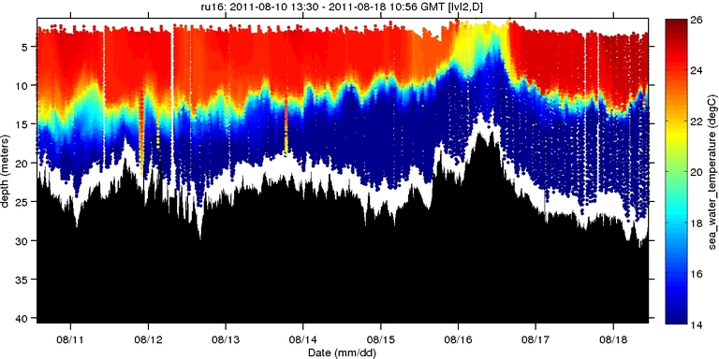
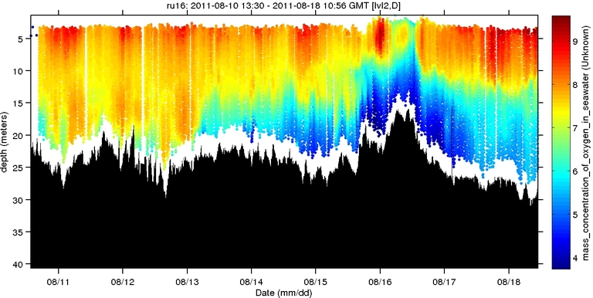
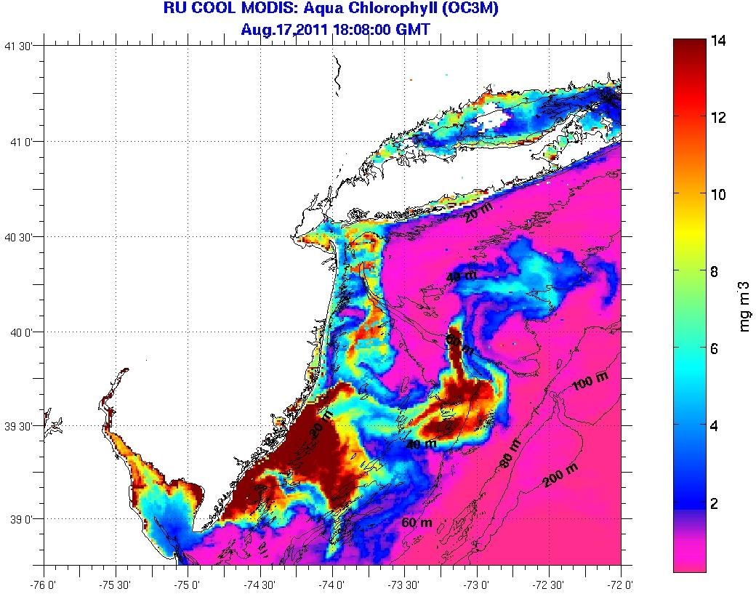
Autonomous Platforms:
Dissolved Oxygen
2011-2012
Temperature (°C)
Dissolved Oxygen (mg/L)

Slide 18
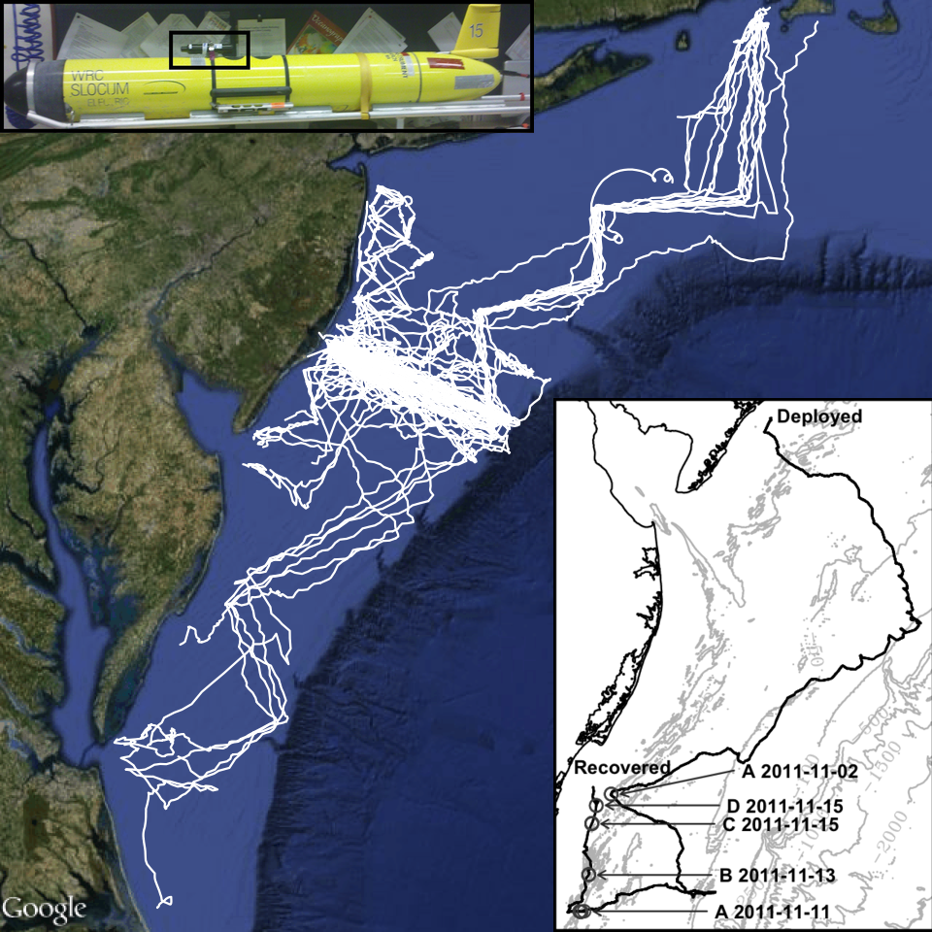


Receiver Integrated Glider
Mobile tracking of offshore environments
Reach currently unmonitored areas
Natural addition to ongoing research
Increase understanding of fisheries interactions

Slide 19

Receiver Integrated Glider
Enables coupling of data sets
  Telemetry data
  Temperature
  Salinity
  Productivity
Moves us beyond fixed arrays
Understand mechanisms that lead to foraging behavior

Slide 20
RU-COOL Global Slocum Glider Fleet Deployments
Extreme Environments

Slide 21

Monitoring the coastal ocean during Hurricanes and Nor’easters

Slide 22



COASTAL OCEAN IMPACT ON HURRICANE IRENE INTENSITY (AUGUST 26-29 2011)

Slide 23



Surface cooling from space
T (°C)
T (°C)
model
time
obs show
MAB cooling is ahead of eye
less SAB cooling
BEFORE
AFTER
COOLING
Why did we over-estimate the hurricane intensity?

Slide 24


Glider revealed “ahead-of-eye” cooling
warm SSTs before storm
passage of eye
T (°C)
thermocline top
Ocean column mixing from leading storm winds cools surface
onshore surface currents
thermocline bottom
offshore bottom currents

Slide 25



Monitoring the coastal ocean during hurricanes
Hurricane Irene August 28, 2011
NOAA/NHC Damage: >$16 Billion.
Track Accurate; Intensity Over-predicted.
Hurricane Sandy October 29, 2012
NOAA/NHC Damage: >$68 Billion
Track Accurate; Impact Under-predicted.
Hurricane Arthur July 4th, 2014
Track Accurate; Intensity well-handled

Slide 26




RAPID-RESPONSE STORM GLIDER
Hurricane Arthur
(4) Storm Glider Deployments
July 3-6, 2014

Slide 27

Antarctica

Slide 28

The Challenge: Sampling hindered by extreme conditions

Slide 29


The Challenge: Sampling hindered by extreme conditions

Slide 30





24 Hour Winds (knots)
40
31
22
13
4

Slide 31




Glider deployments in a unique ecosystem

Slide 32


the power of using gliders to sample an extreme environment
Higher temporal coverage
Higher spatial coverage
~200 water column profiles (in 23+ years)
35 000+ water column profiles (in 6 years)

Slide 33


Deployments in Antarctica
Amundsen
Sea
Ross
Sea
WAP
Ross Sea
Amundsen Sea
WAP
Palmer Deep
Canyon
4 deployments:
3 Shallow; 1 deep
1 515 km flown
68.3 days
3 deployments:
2 Shallow; 1 deep
785 km flown
34.8 days
44 deployments:
39 Shallow; 5 deep
9 315 km flown
531.9 days

Slide 34

Connecting the physics with the Biology
Biology
Physics

Slide 35

connecting the physics with biology through space and time

Slide 36


Gliders allow us to sample at the right scales to connect the physics to the biological responses
Tracking of water masses through time >
< Average profiles of water column physics and biology

Slide 37




Fluorescence Induction and Relaxation Sensor
Using gliders to map phytoplankton physiology
FIRe glider

Slide 38




Adaptive Sampling of Penguin Habitats
Penguin
Foraging
locations
Kahl et al., 2010

Slide 39

New View … New Frontier

Slide 40

Thank You!
http://rucool.marine.rutgers.edu

