Slide 1




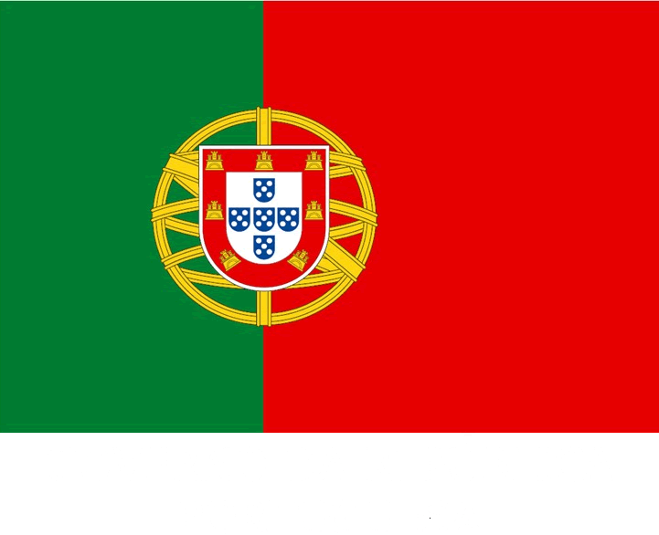



THE LONG-TERM ECOLOGICAL RESEARCH (PAL-LTER) IN THE WEST ANTARCTIC PENINSULA
Filipa Carvalho, Oscar Schofield, Josh Kohut, Hugh Ducklow and many (many) others …
7ª Conferência Portuguesa de Ciências Polares
Évora, Portugal, October 29th, 2015

Slide 2
Contents
Motivation
Intro to PAL-LTER
Main results
Conclusions

Slide 3
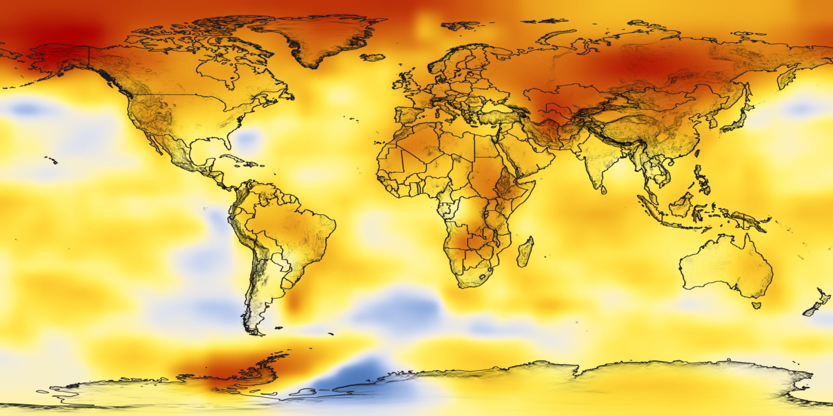
West Antarctic Peninsula is warming and losing ice
NASA, air temperature rise 1880-2005

Slide 4
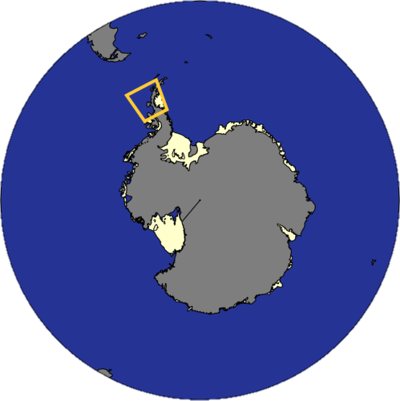
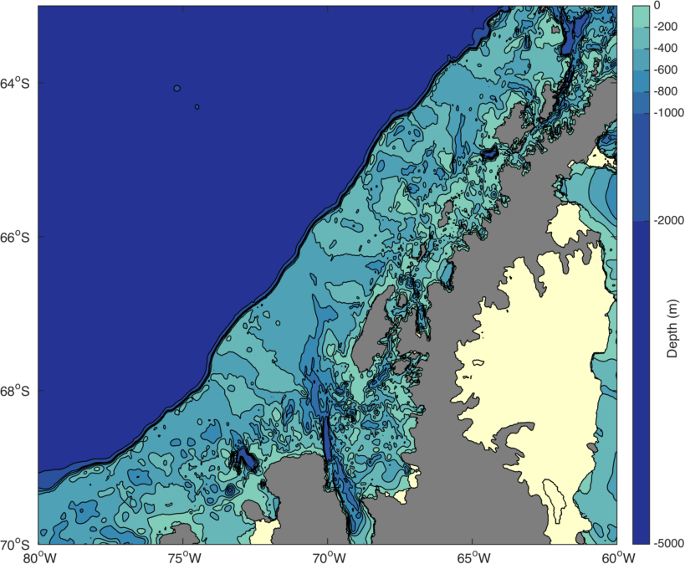
The West Antarctic Peninsula (WAP)
Palmer Station
(Anvers Island)
Antarctic Peninsula
Ice Shelf
Rothera
(Adelaide Island)

Slide 5
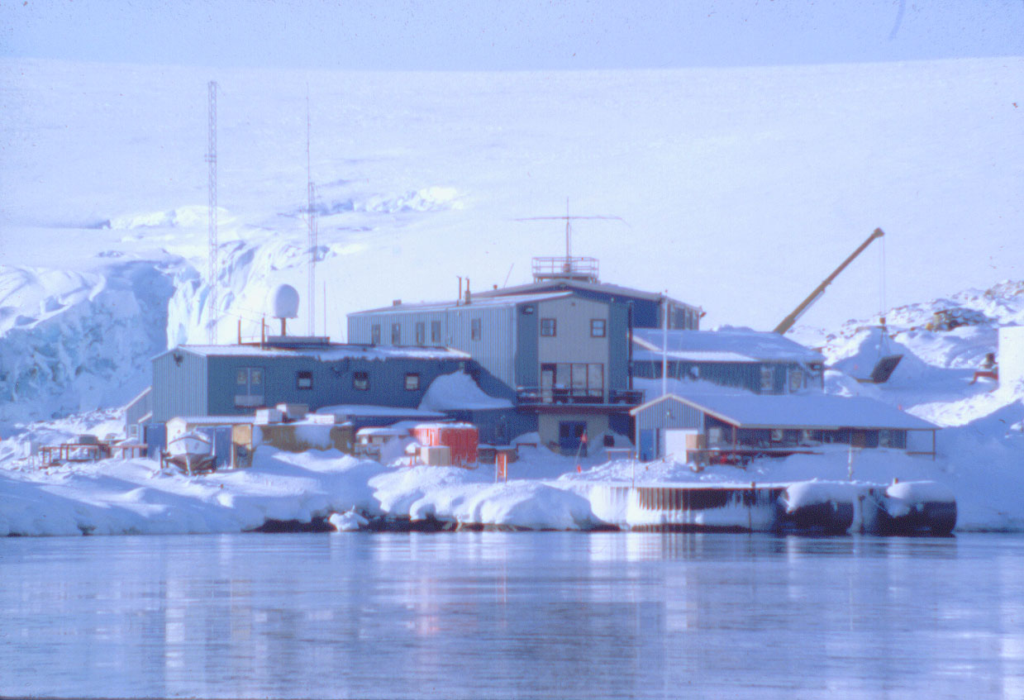
Our research platform – Palmer Station

Slide 6
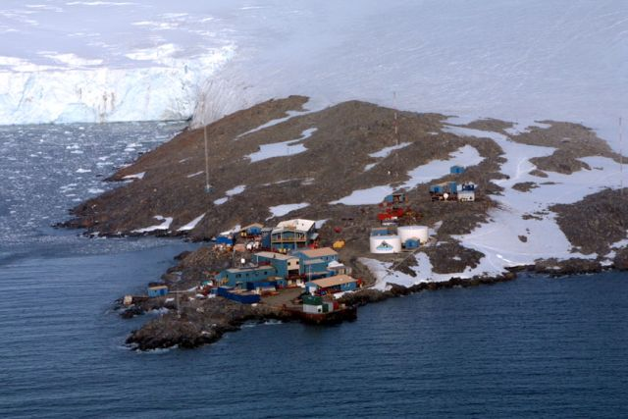
Our research platform – Palmer Station

Slide 7
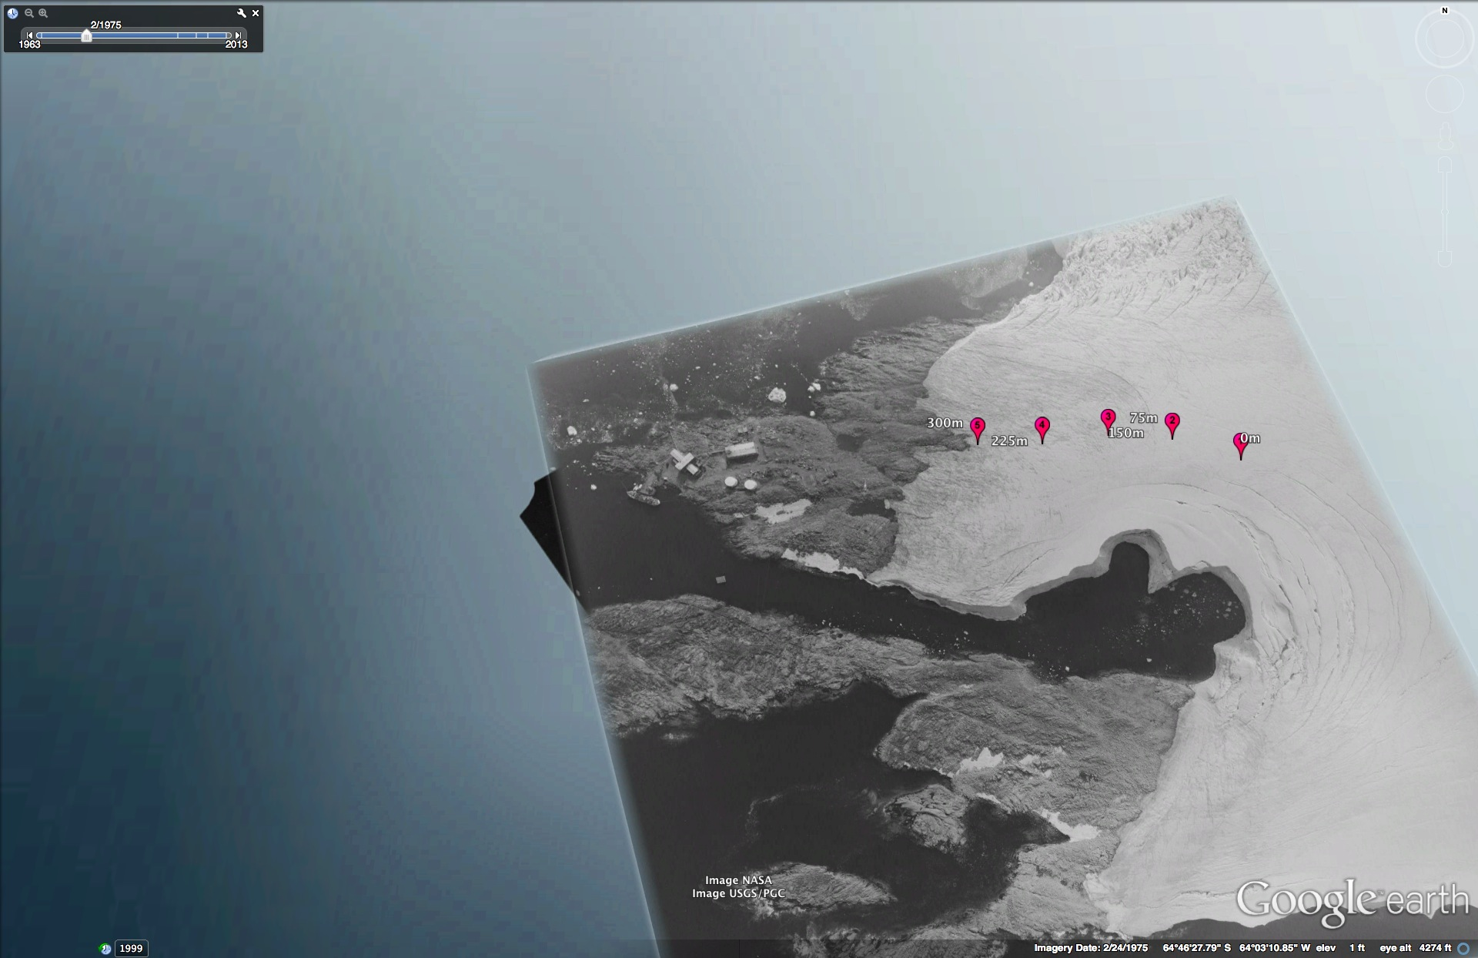
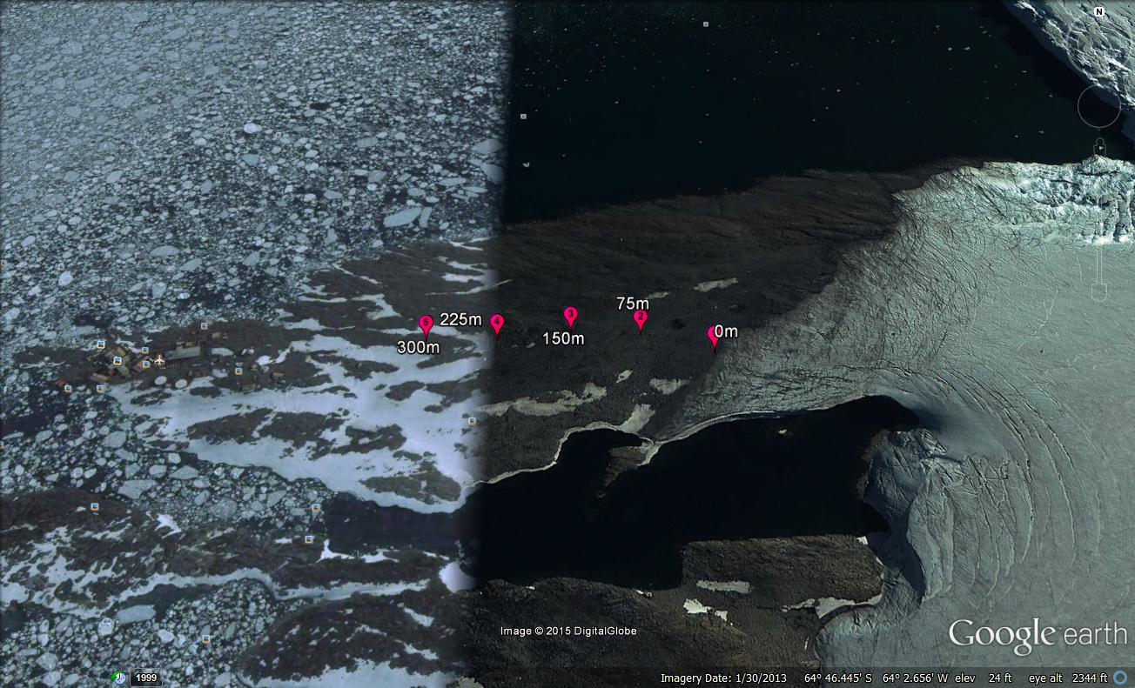
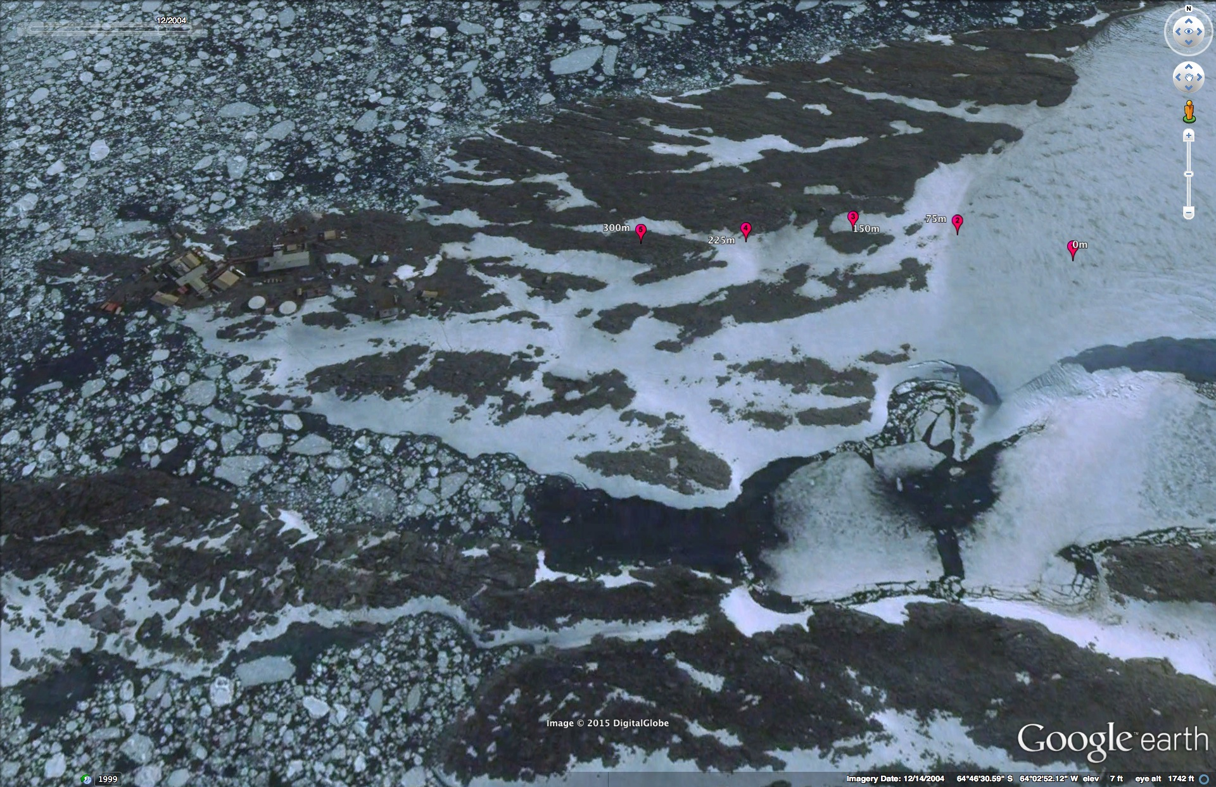
The glacier at Palmer is shrinking
150 m
Year 1974
Palmer
Station
150 m
Year 2004
Year 2013
150 m

Slide 8
Plants at Palmer St.,
Greening of Antarctica

Slide 9
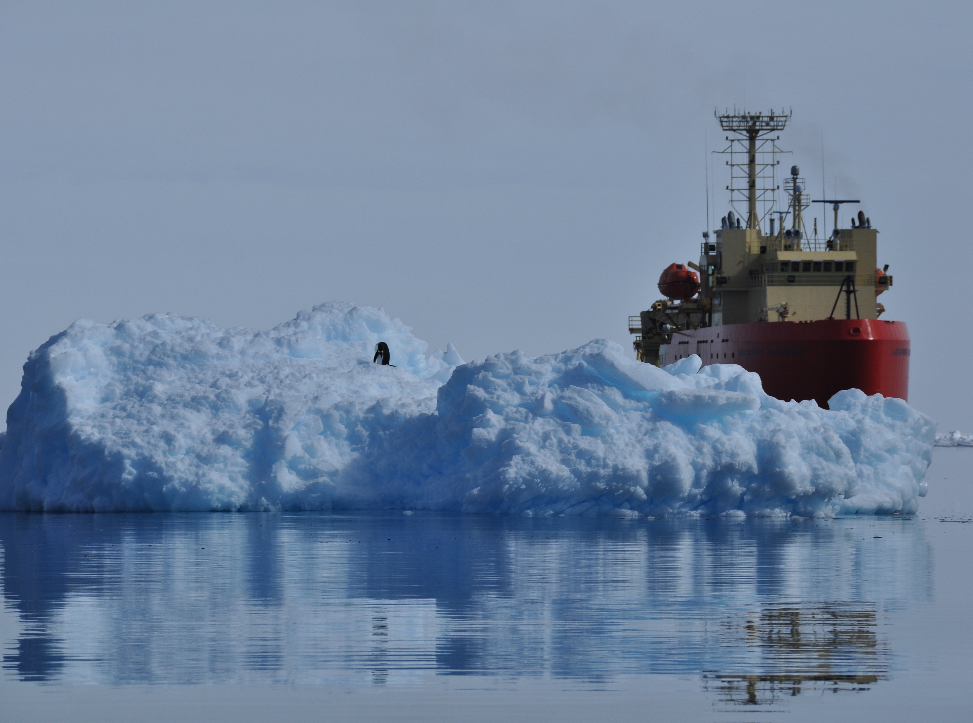

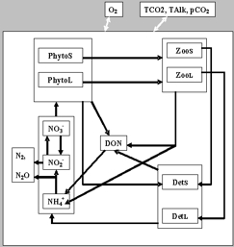
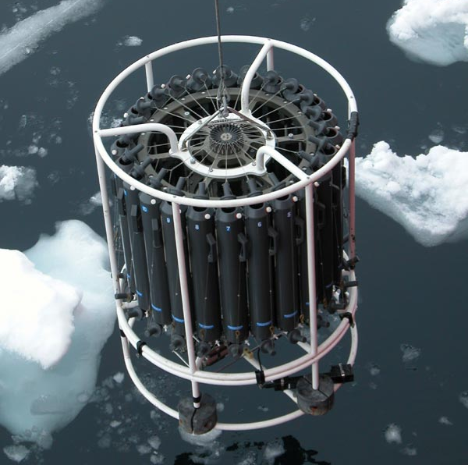
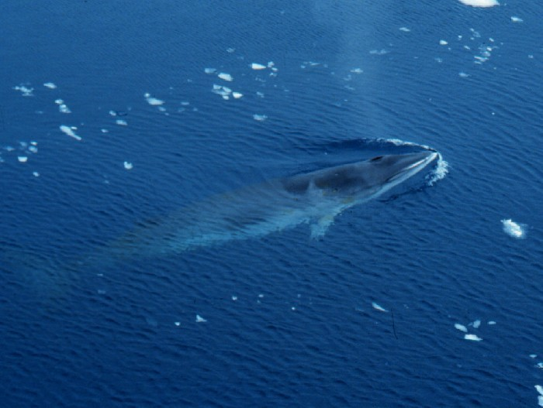
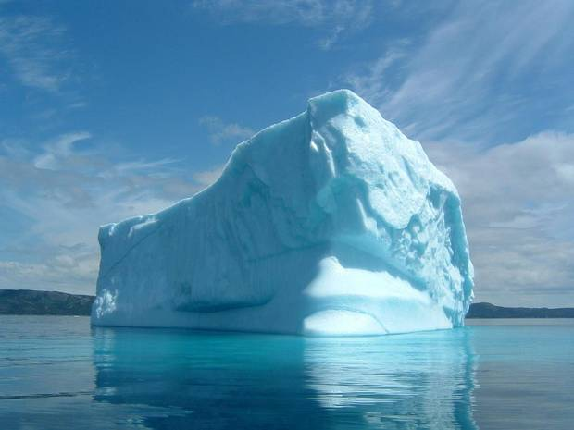
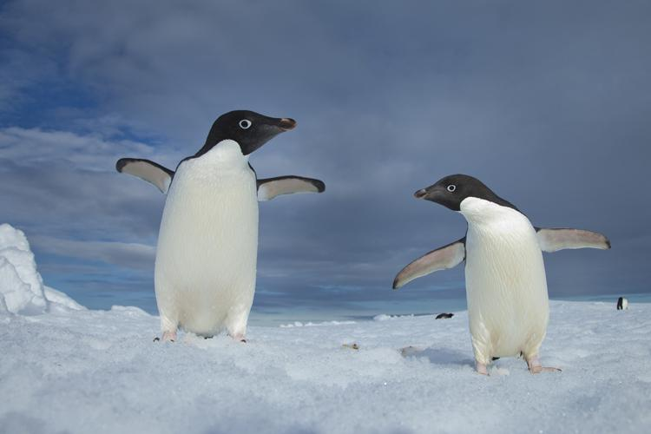
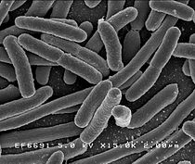
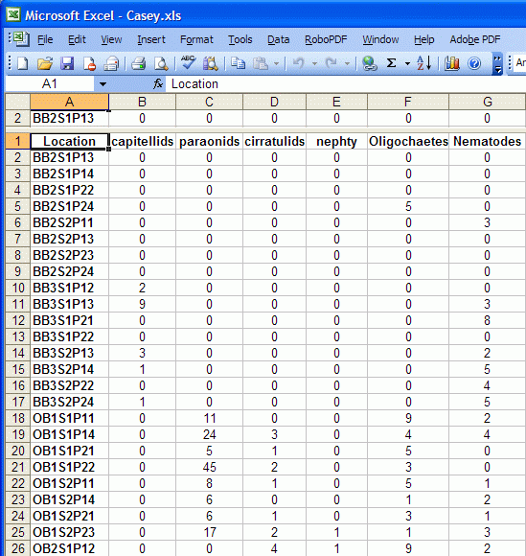

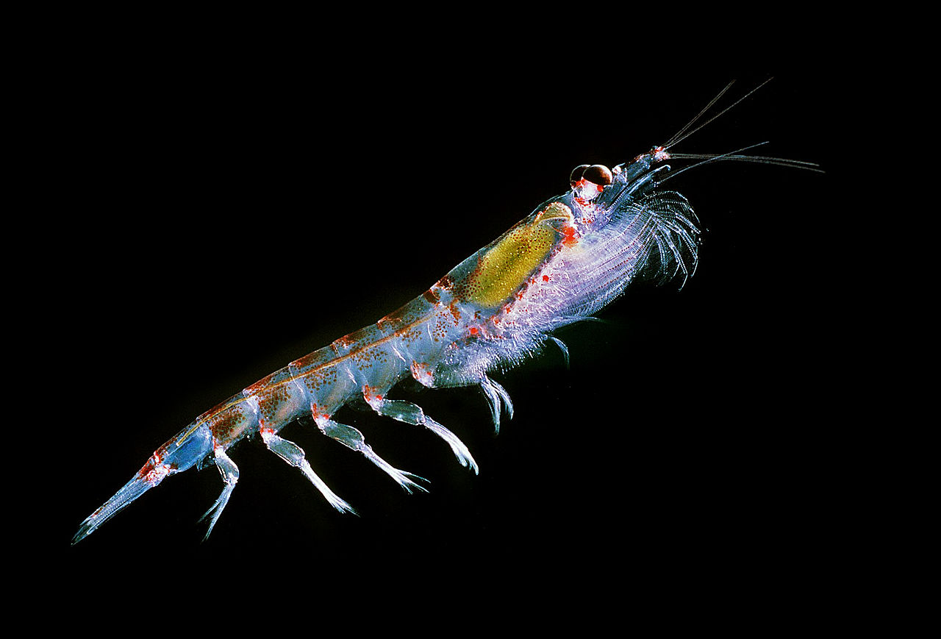
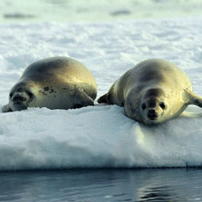
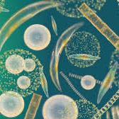
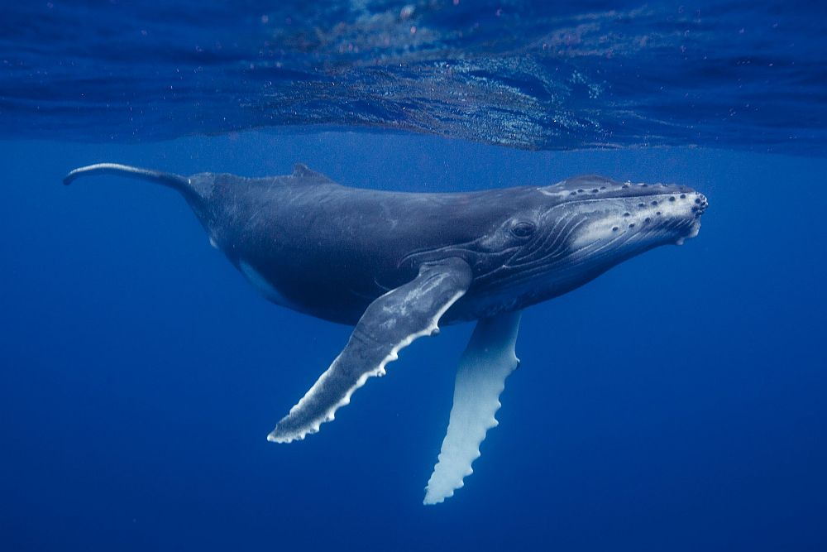
PALMER ANTARCTICA
LONG TERM ECOLOGICAL RESEARCH
Land-Shelf-Ocean Connectivity, Ecosystem Resilience and Transformation in a Sea-Ice Influenced Pelagic Ecosystem

Slide 10
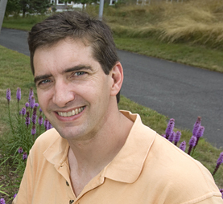
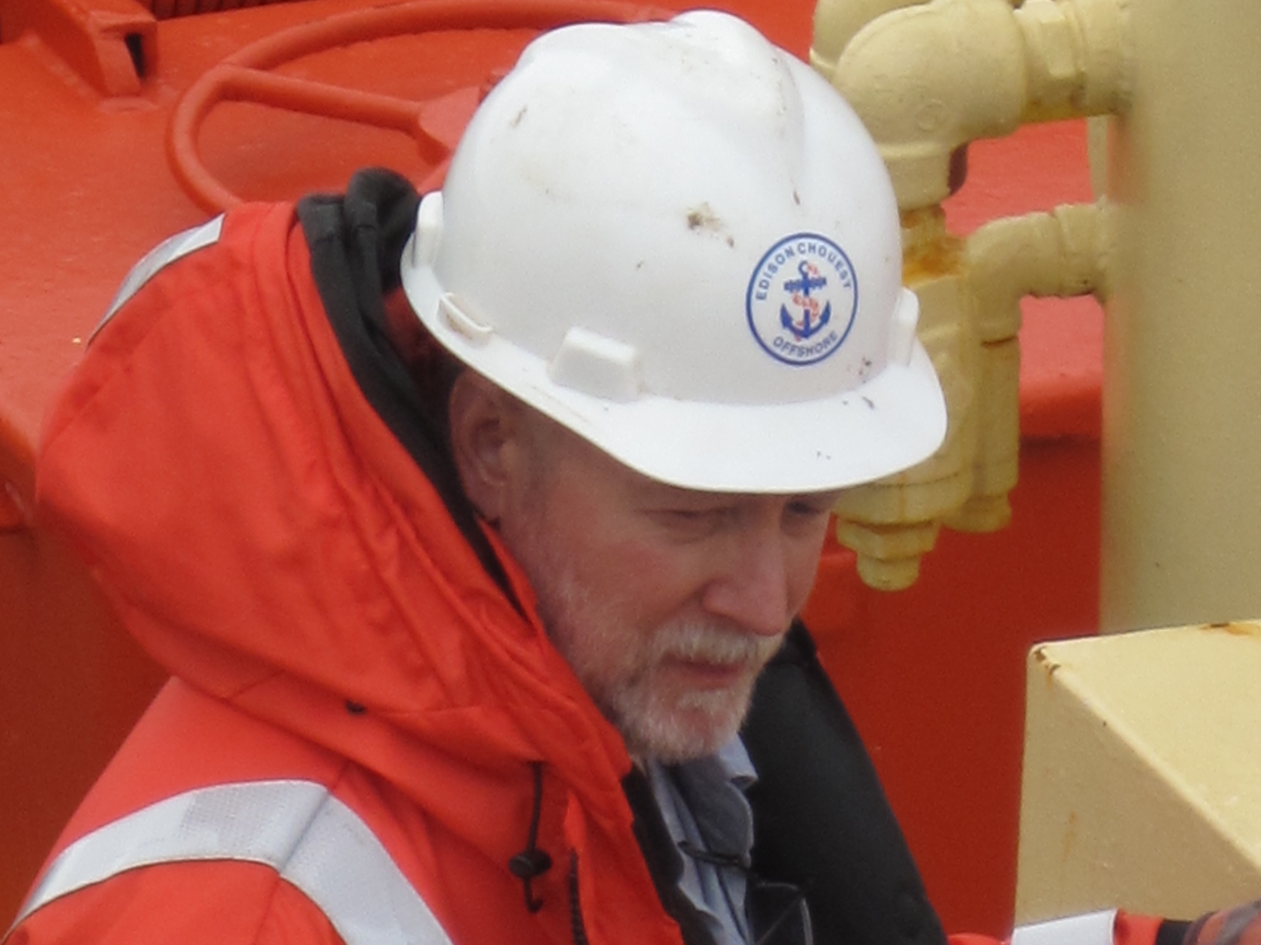
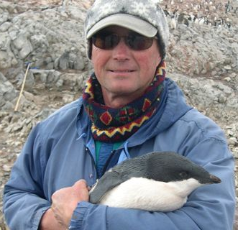
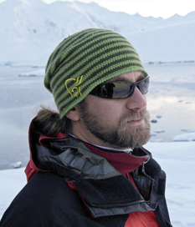
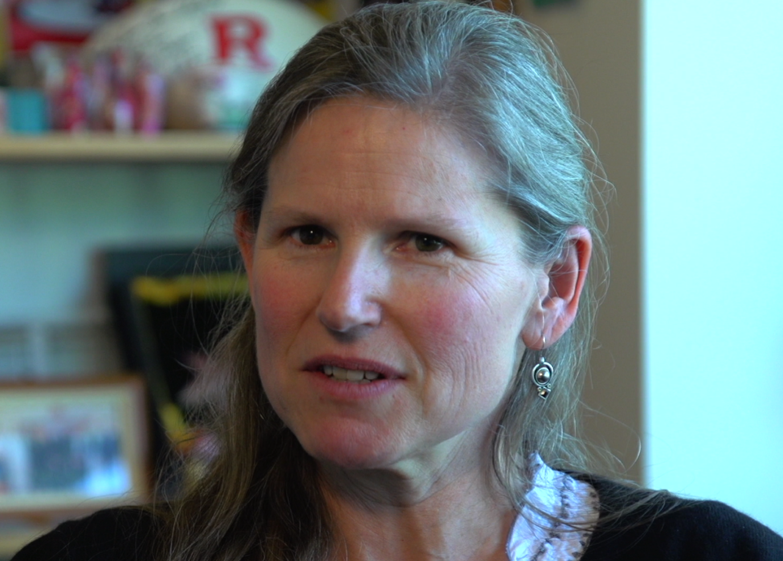
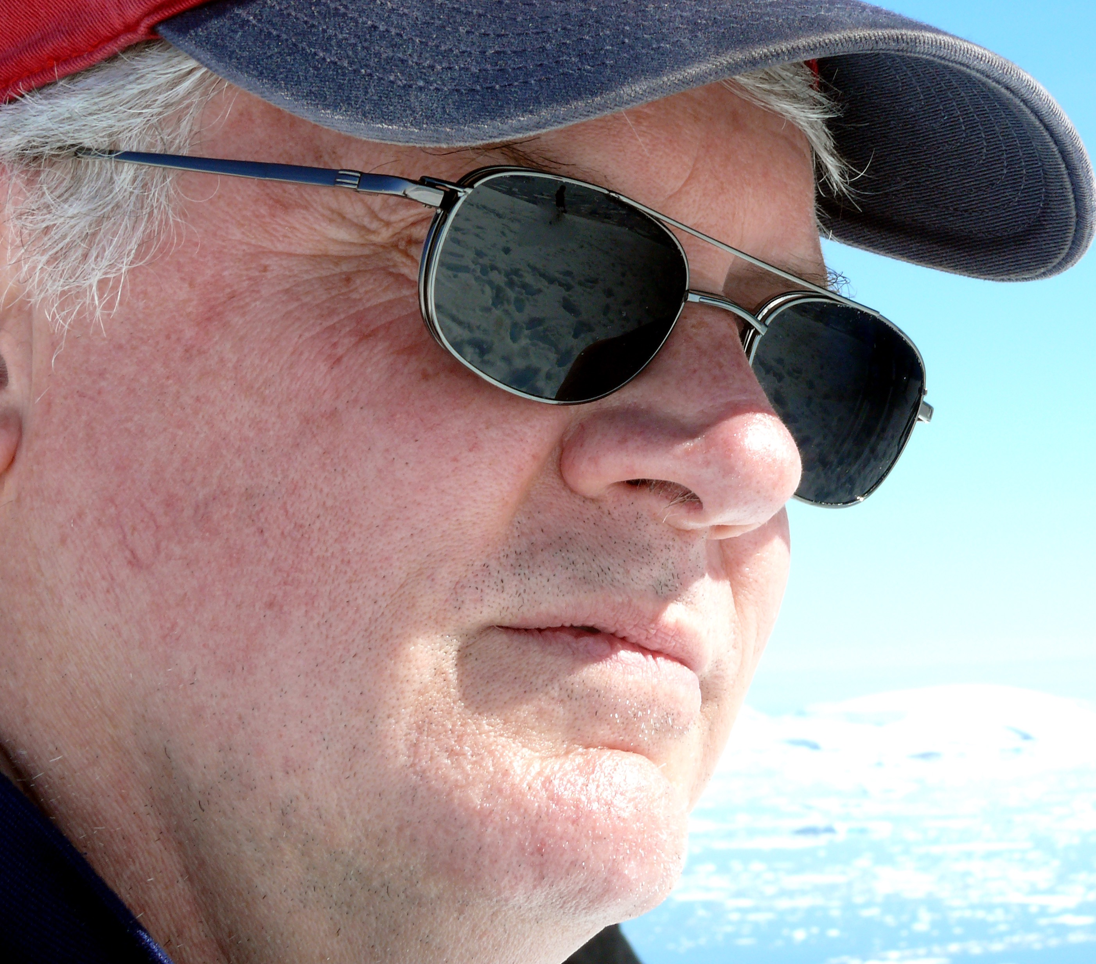
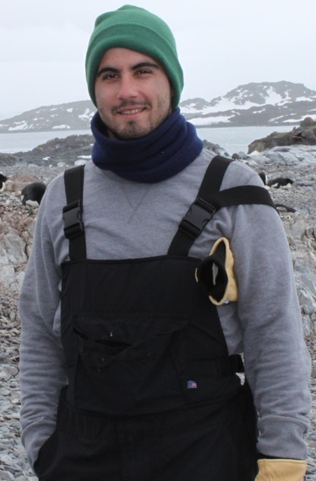
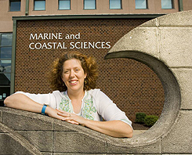
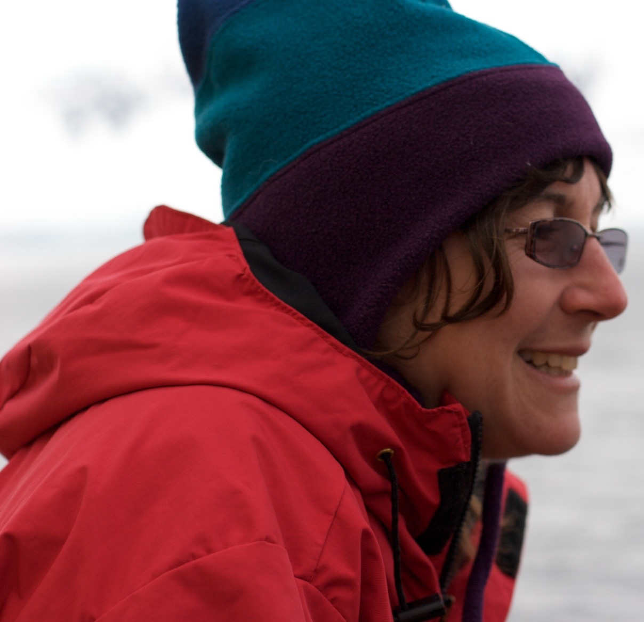
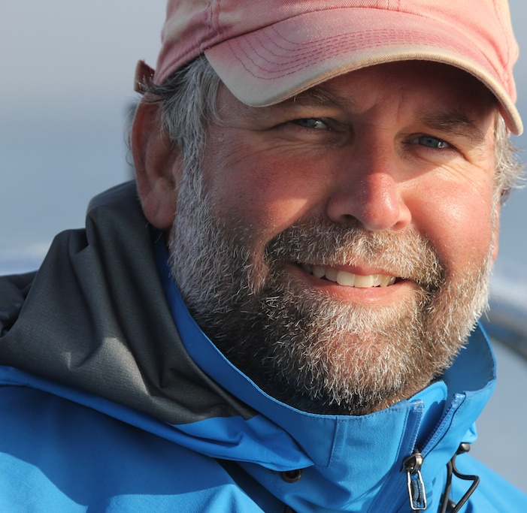
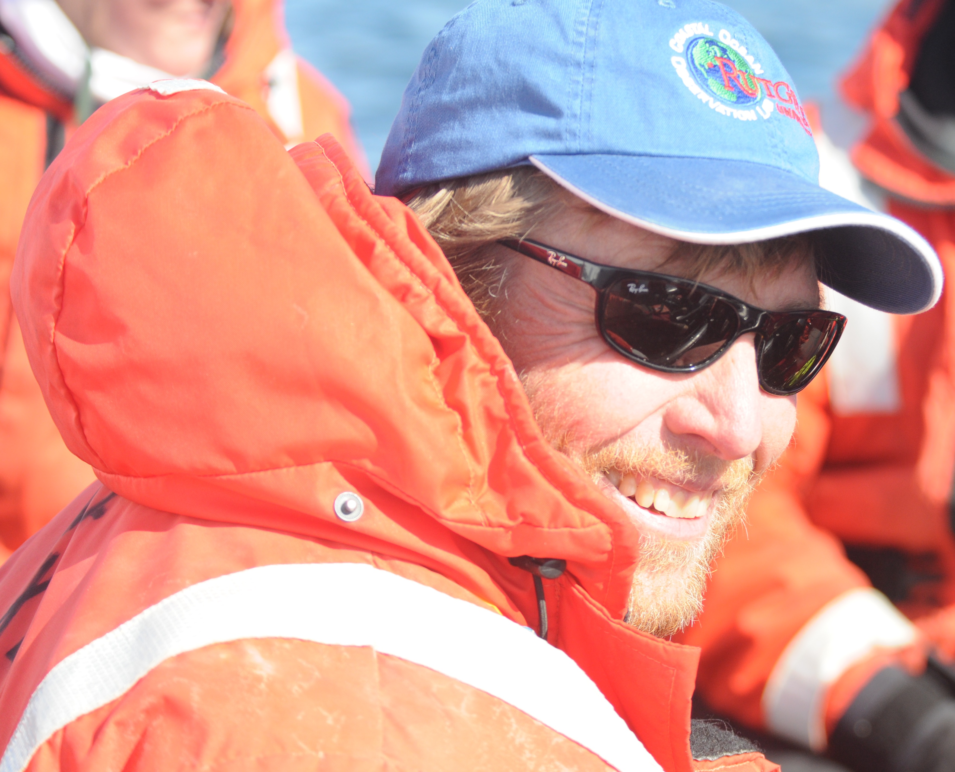

PALMER ANTARCTICA
LONG TERM ECOLOGICAL RESEARCH
Land-Shelf-Ocean Connectivity, Ecosystem Resilience and Transformation in a Sea-Ice Influenced Pelagic Ecosystem
The team (PIs)
Scott Doney
(Models, Biogeochem)
Doug Martinson
(Physical Ocean, Ice)
Sharon Stammerjohn
(Climate, Ice)
Bill Fraser
(Birds)
Ari Friedlaender
(Whales, Seals)
James Connors
(Data)
Dave Johnston
(Whales, Seals)
Oscar Schofield
(Phytoplankton)
Doug Nowacek
(Whales, Seals)
Hugh Ducklow PI
(Bacteria, Biogeochem)
Janice McDonnell
(Outreach)
Debbie Steinberg
(Zooplankton)

Slide 11
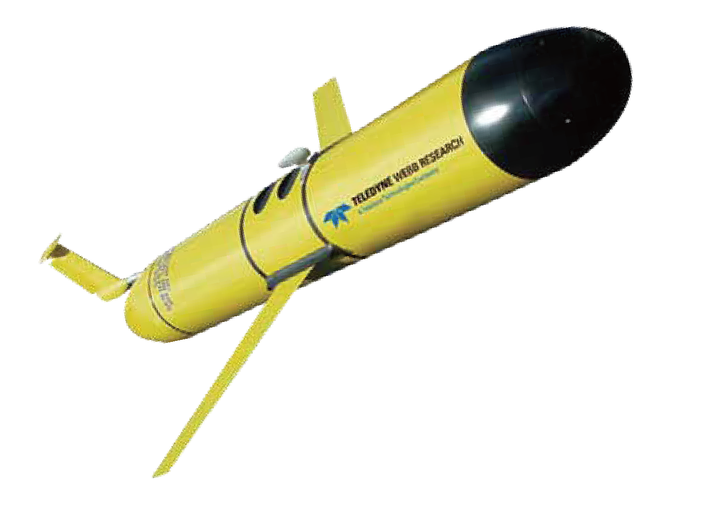
West Antarctic Peninsula LTER Marine Ecosystem

Slide 12
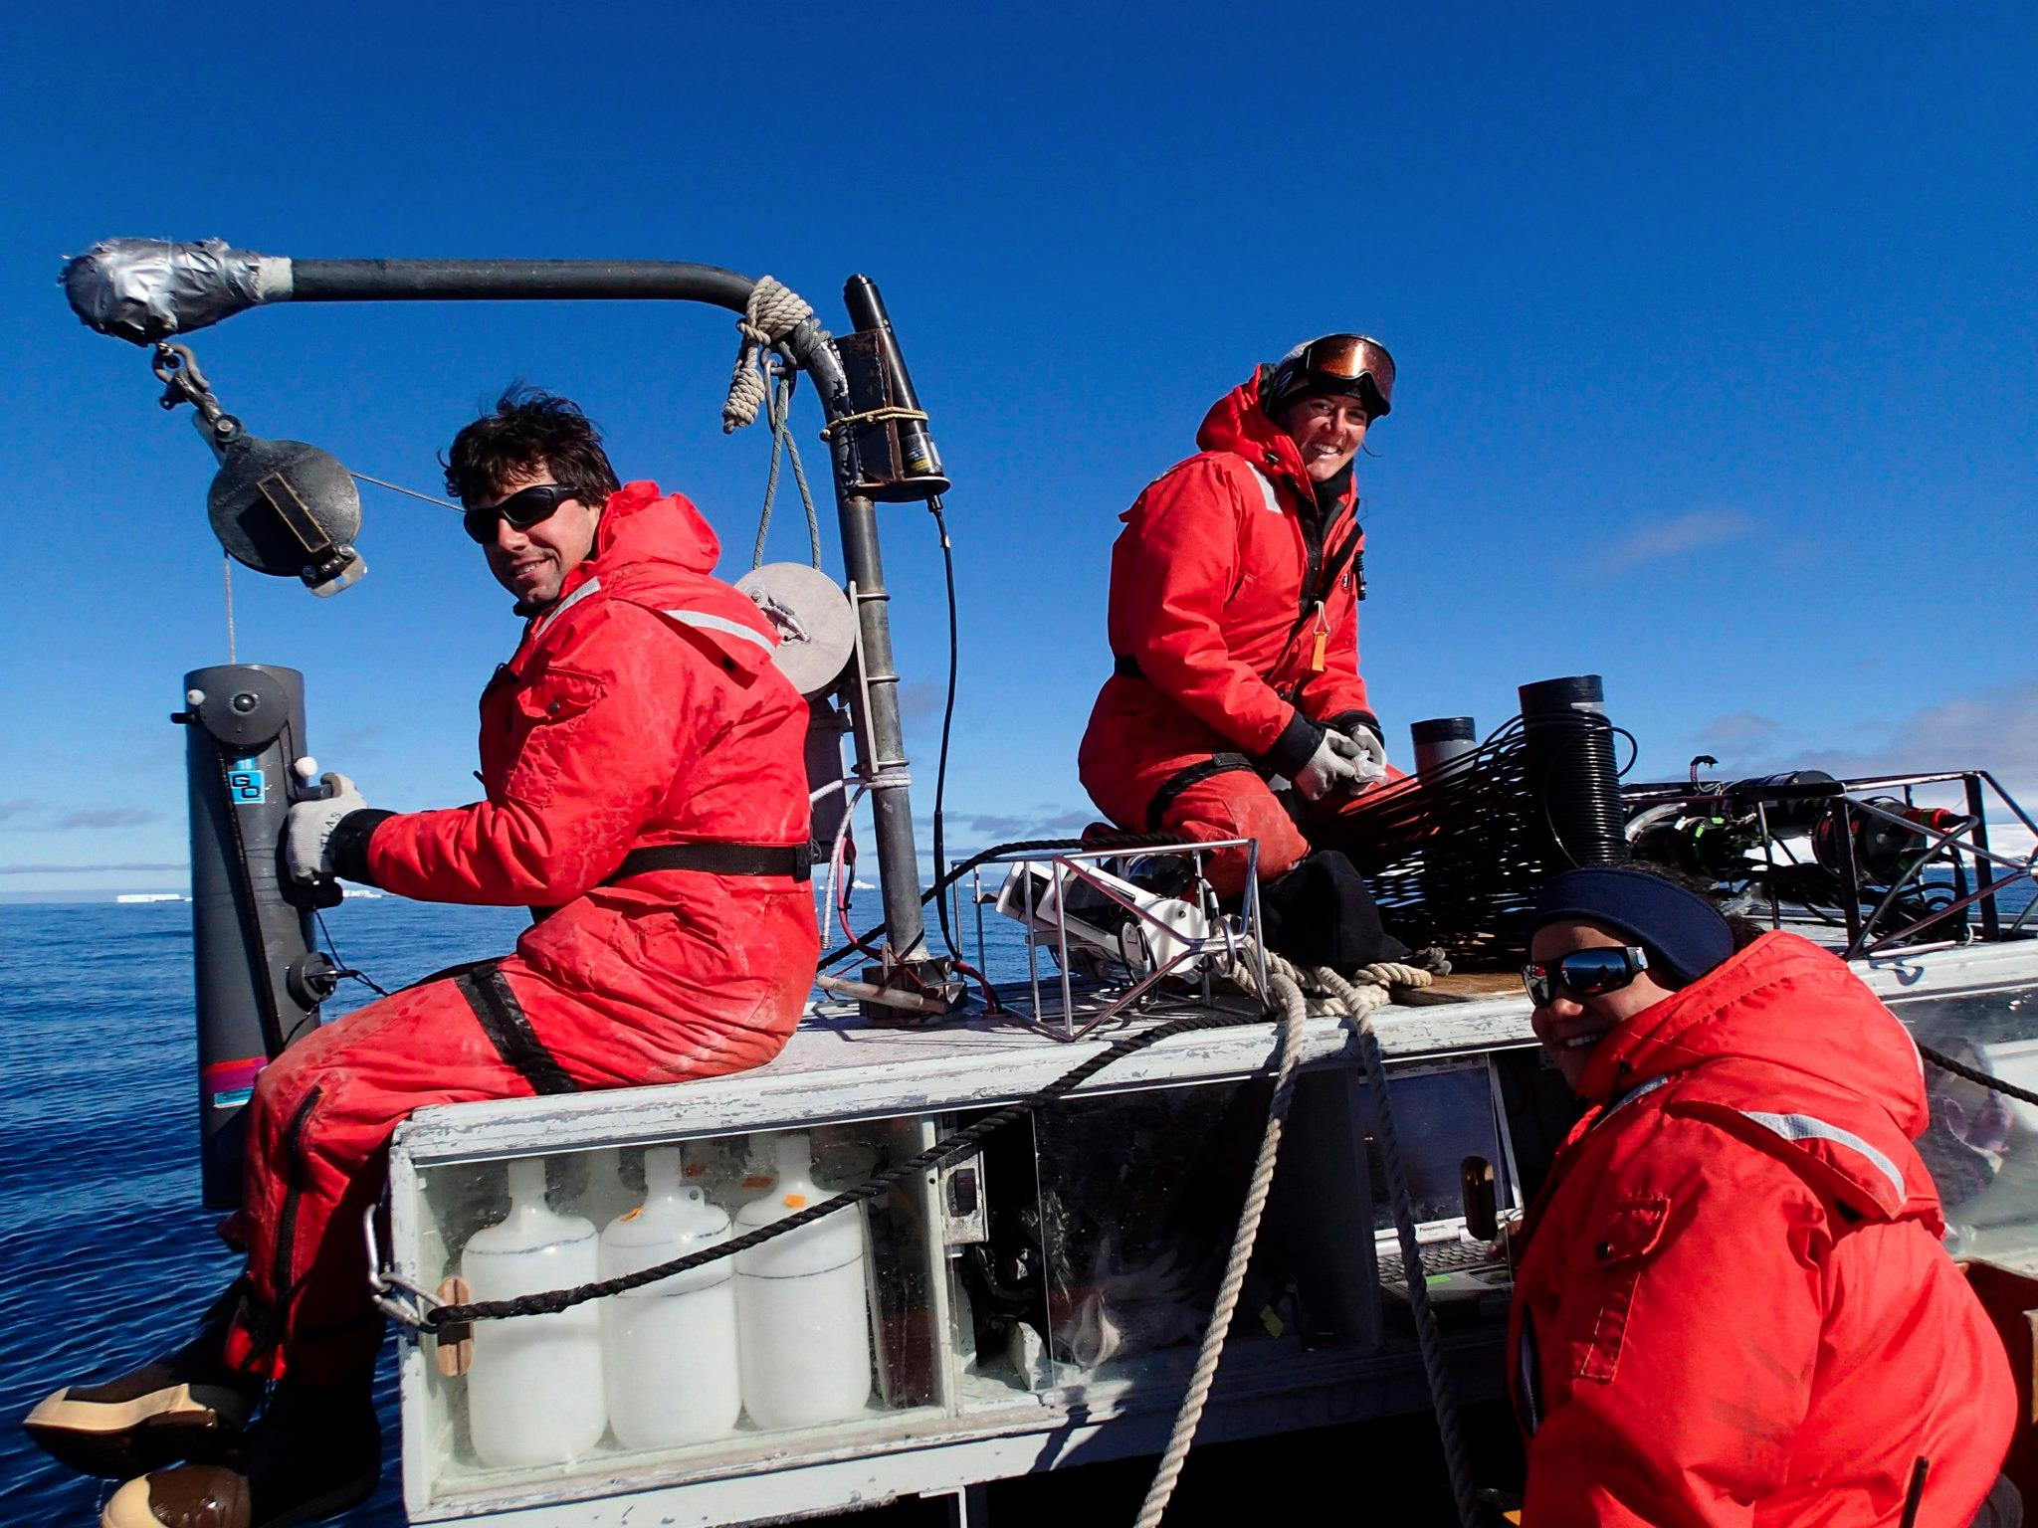
Bi-weekly sampling at station B & E

Slide 13
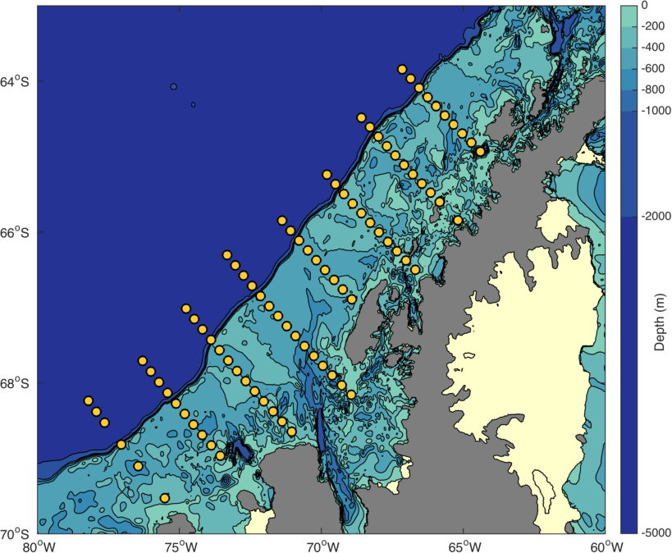
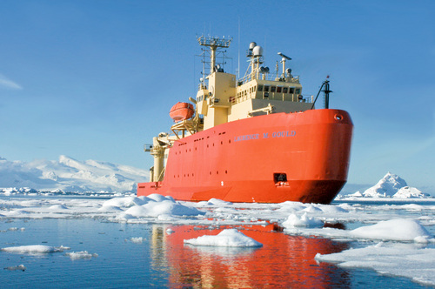
PAL-LTER HAS MAINTAINED A 24 YEAR TIME SERIES ALONG THE WAP
600
500
400
300
200
Antarctic Peninsula
100
0
-100
Our research platform – ARSV Laurence M. Gould

Slide 14
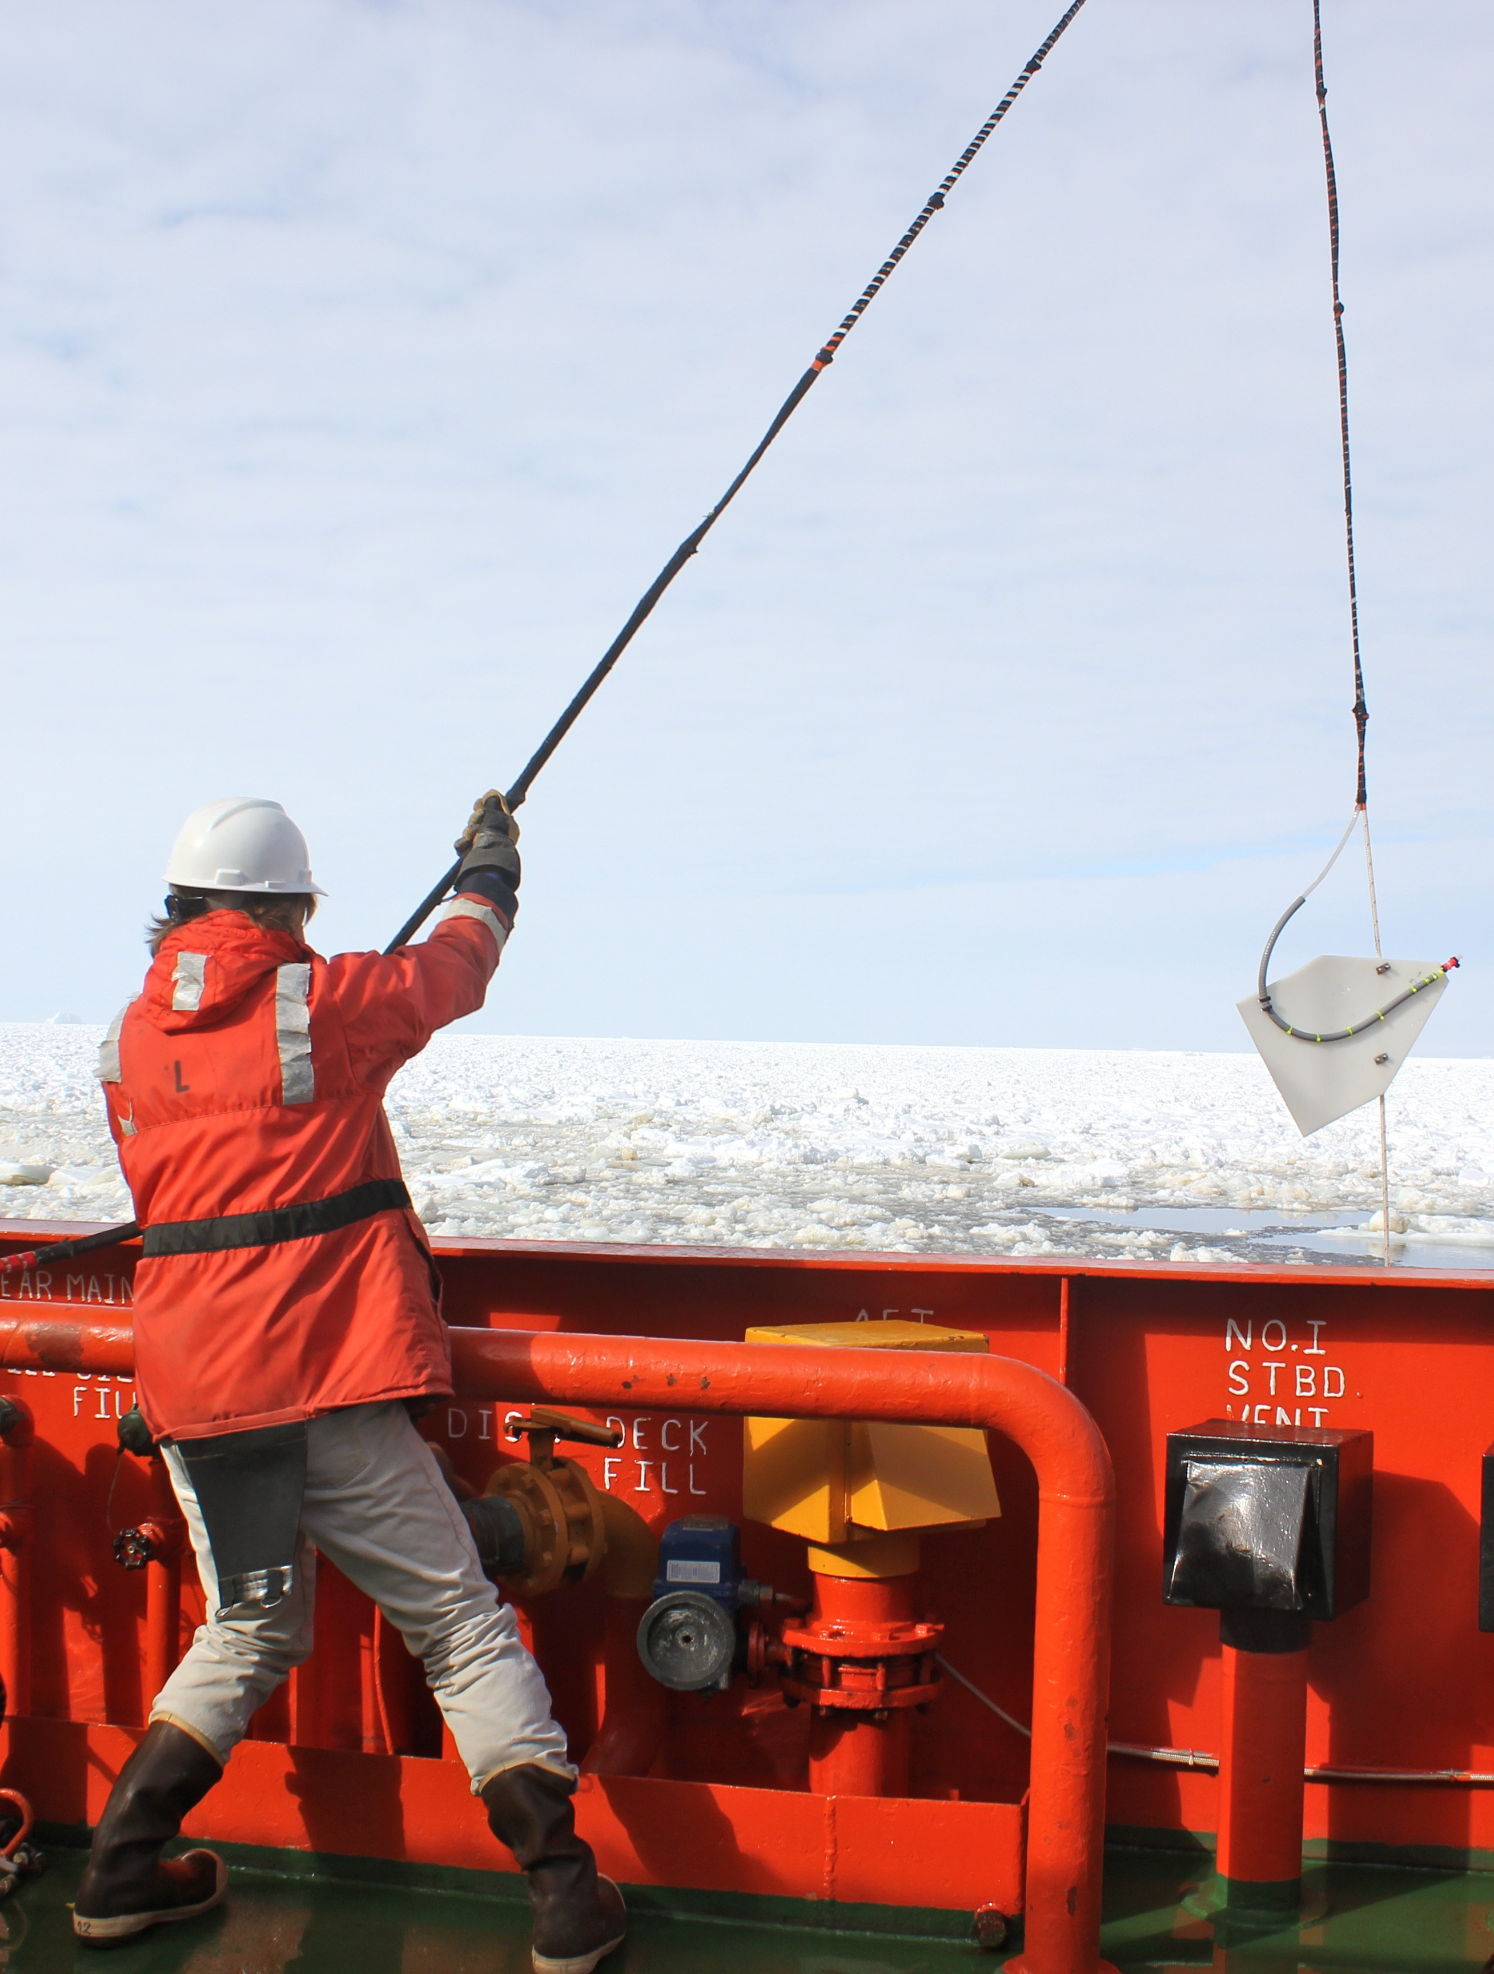
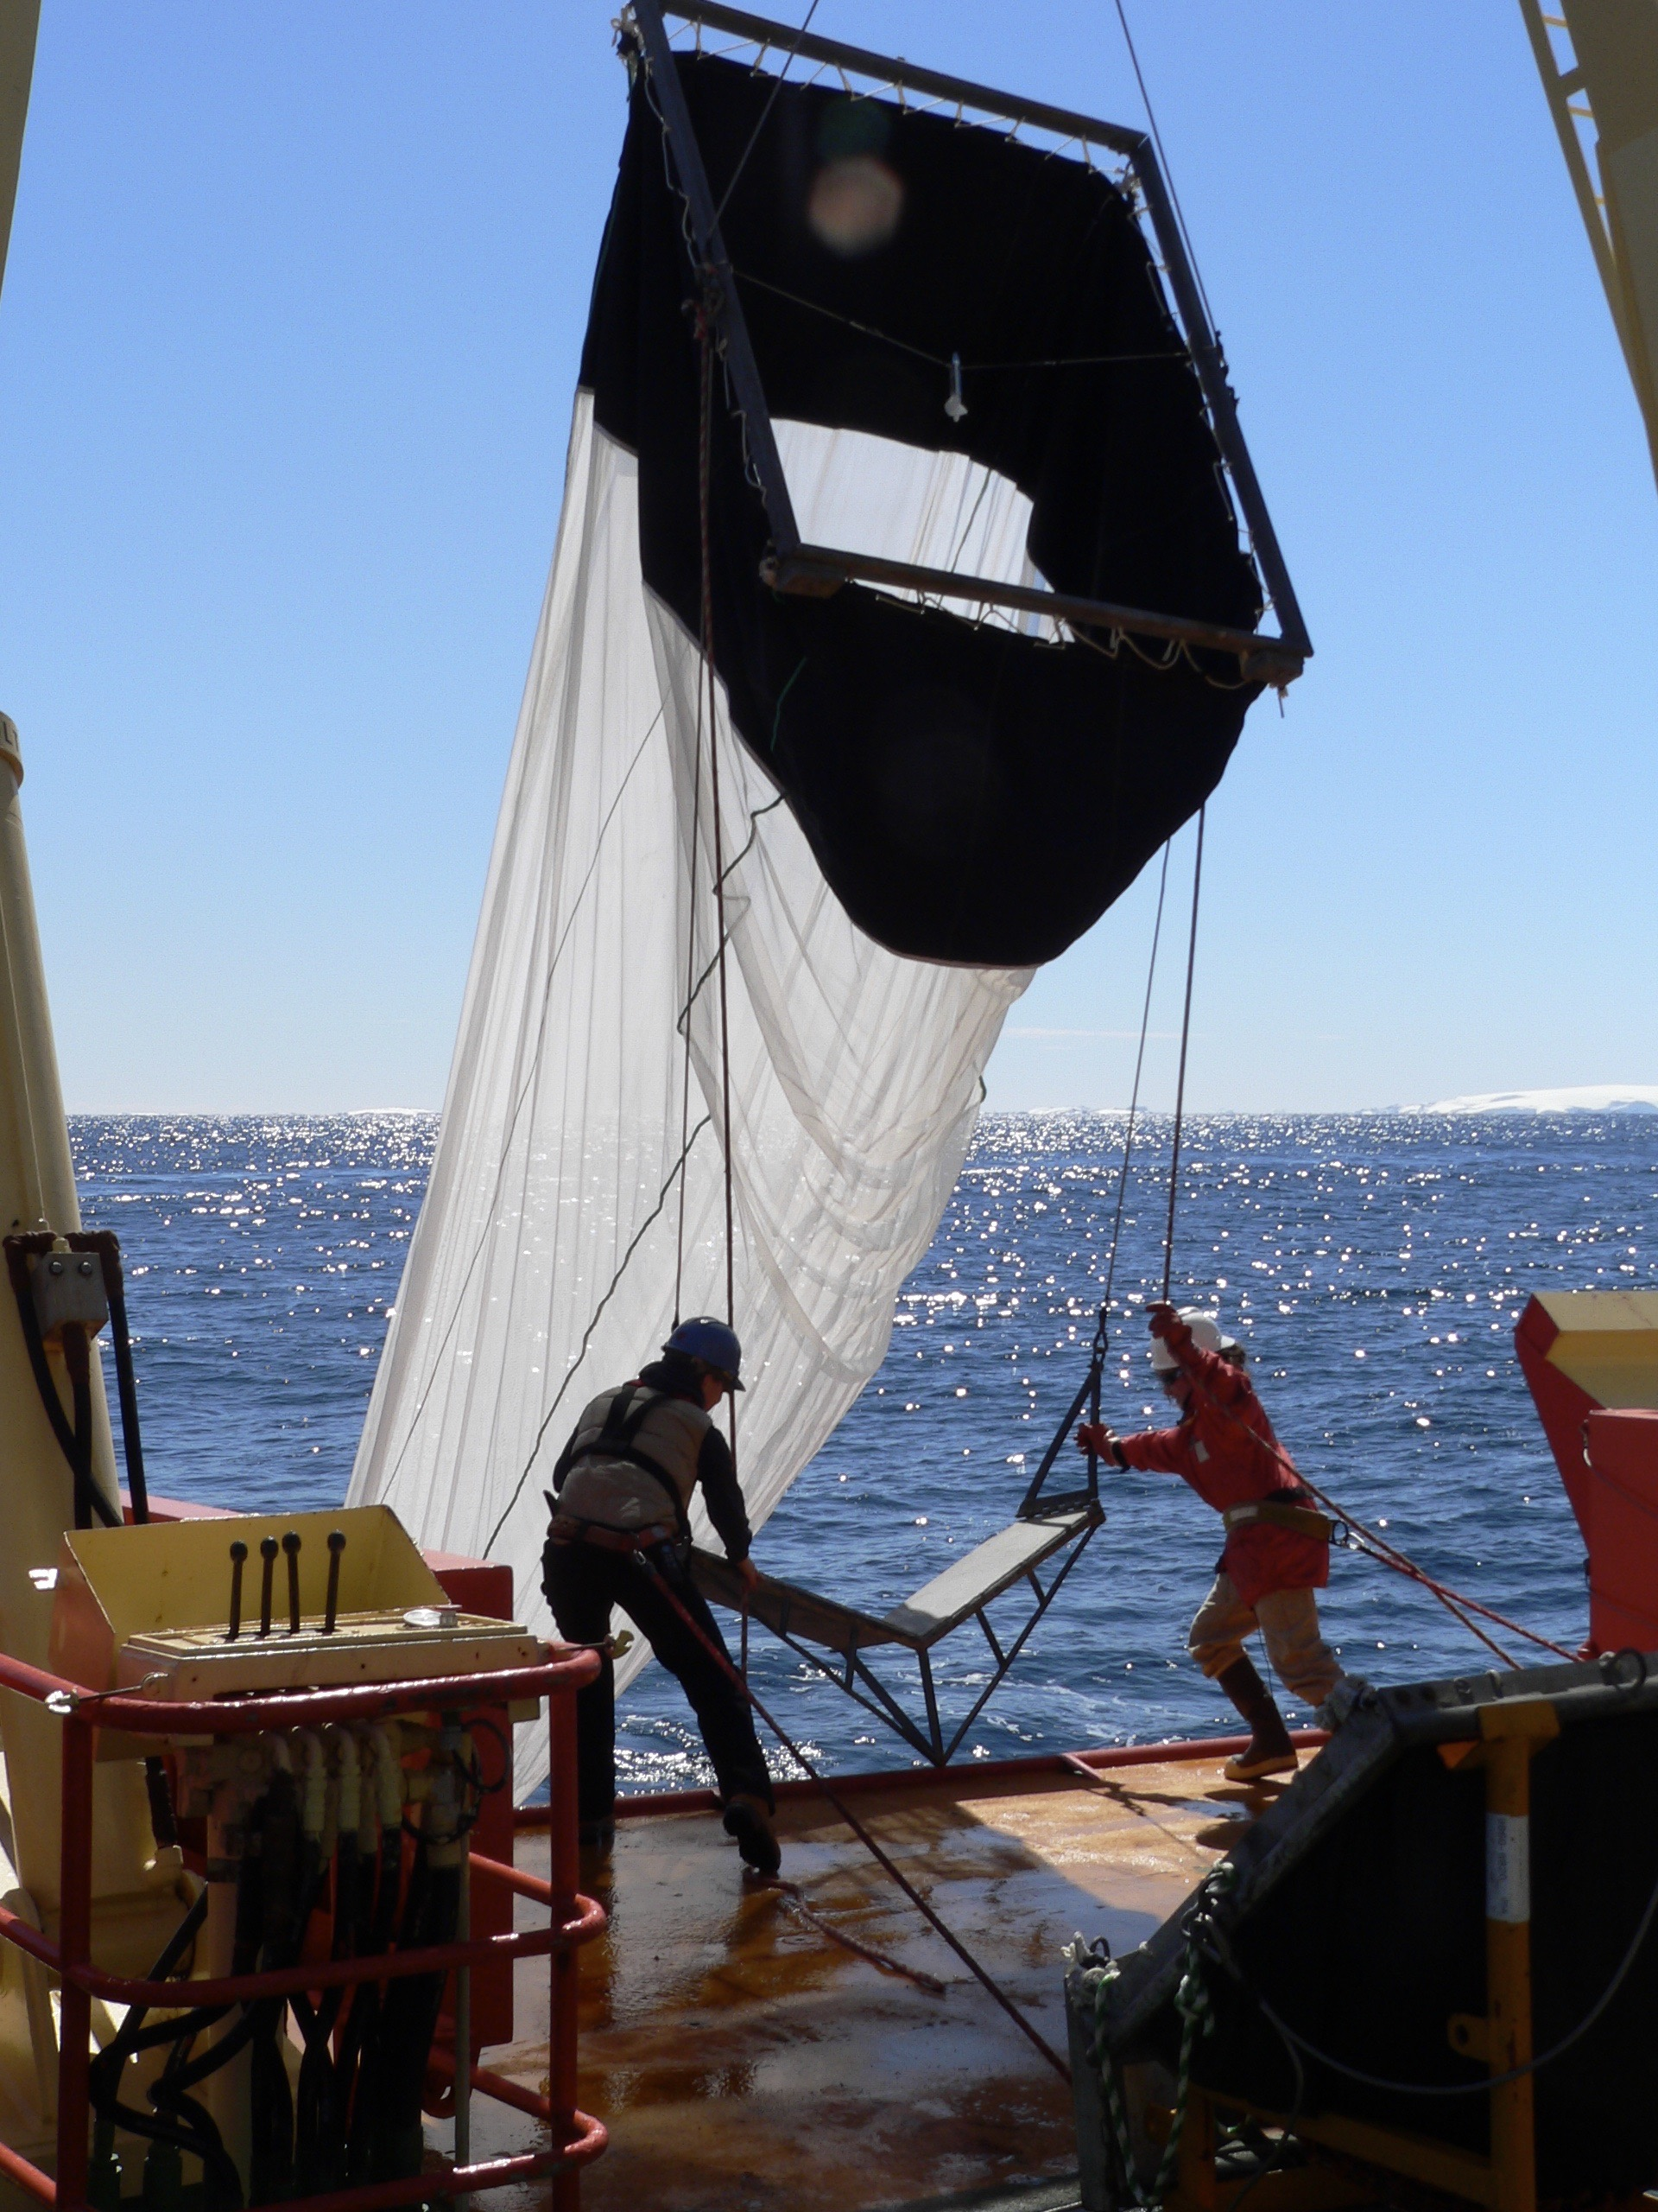
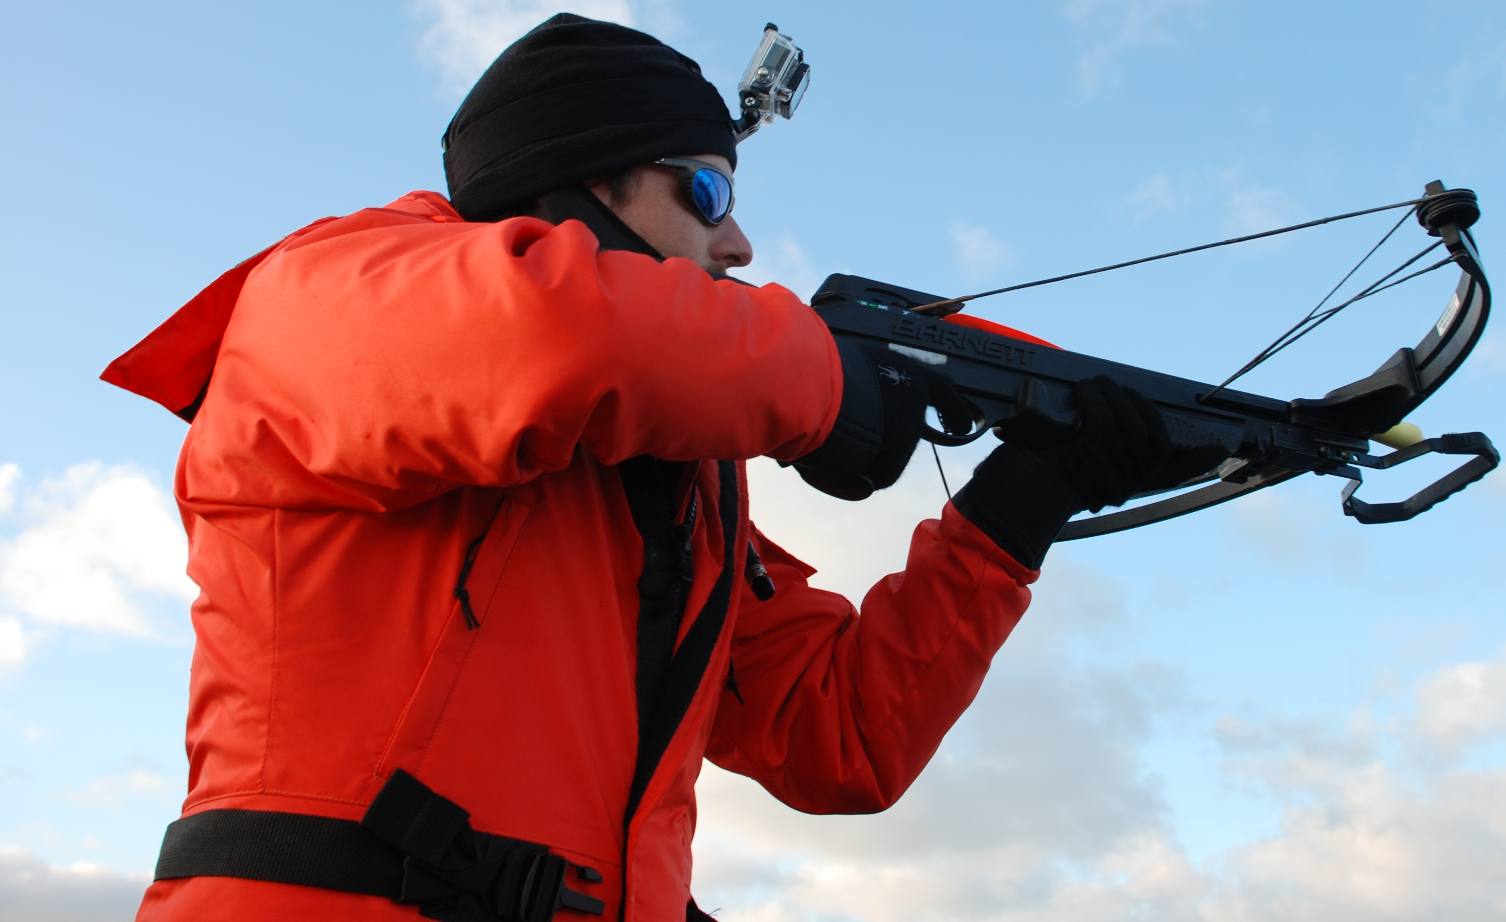
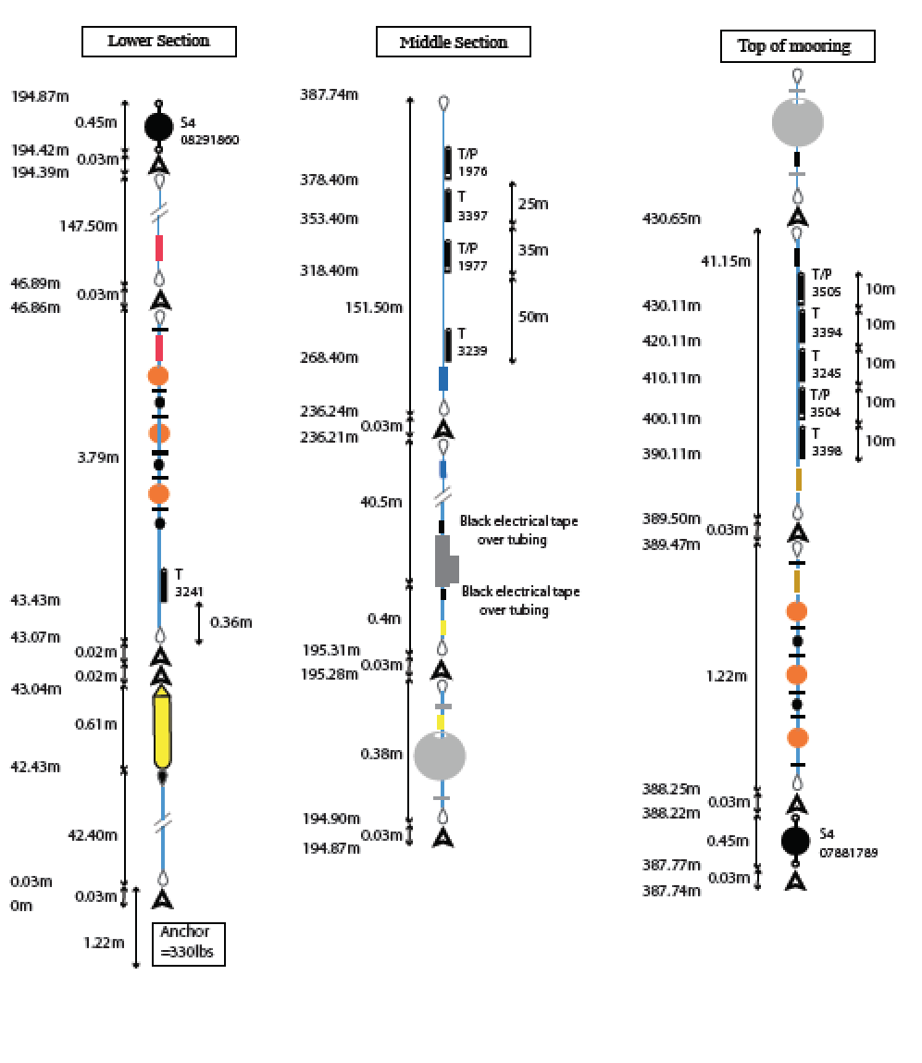
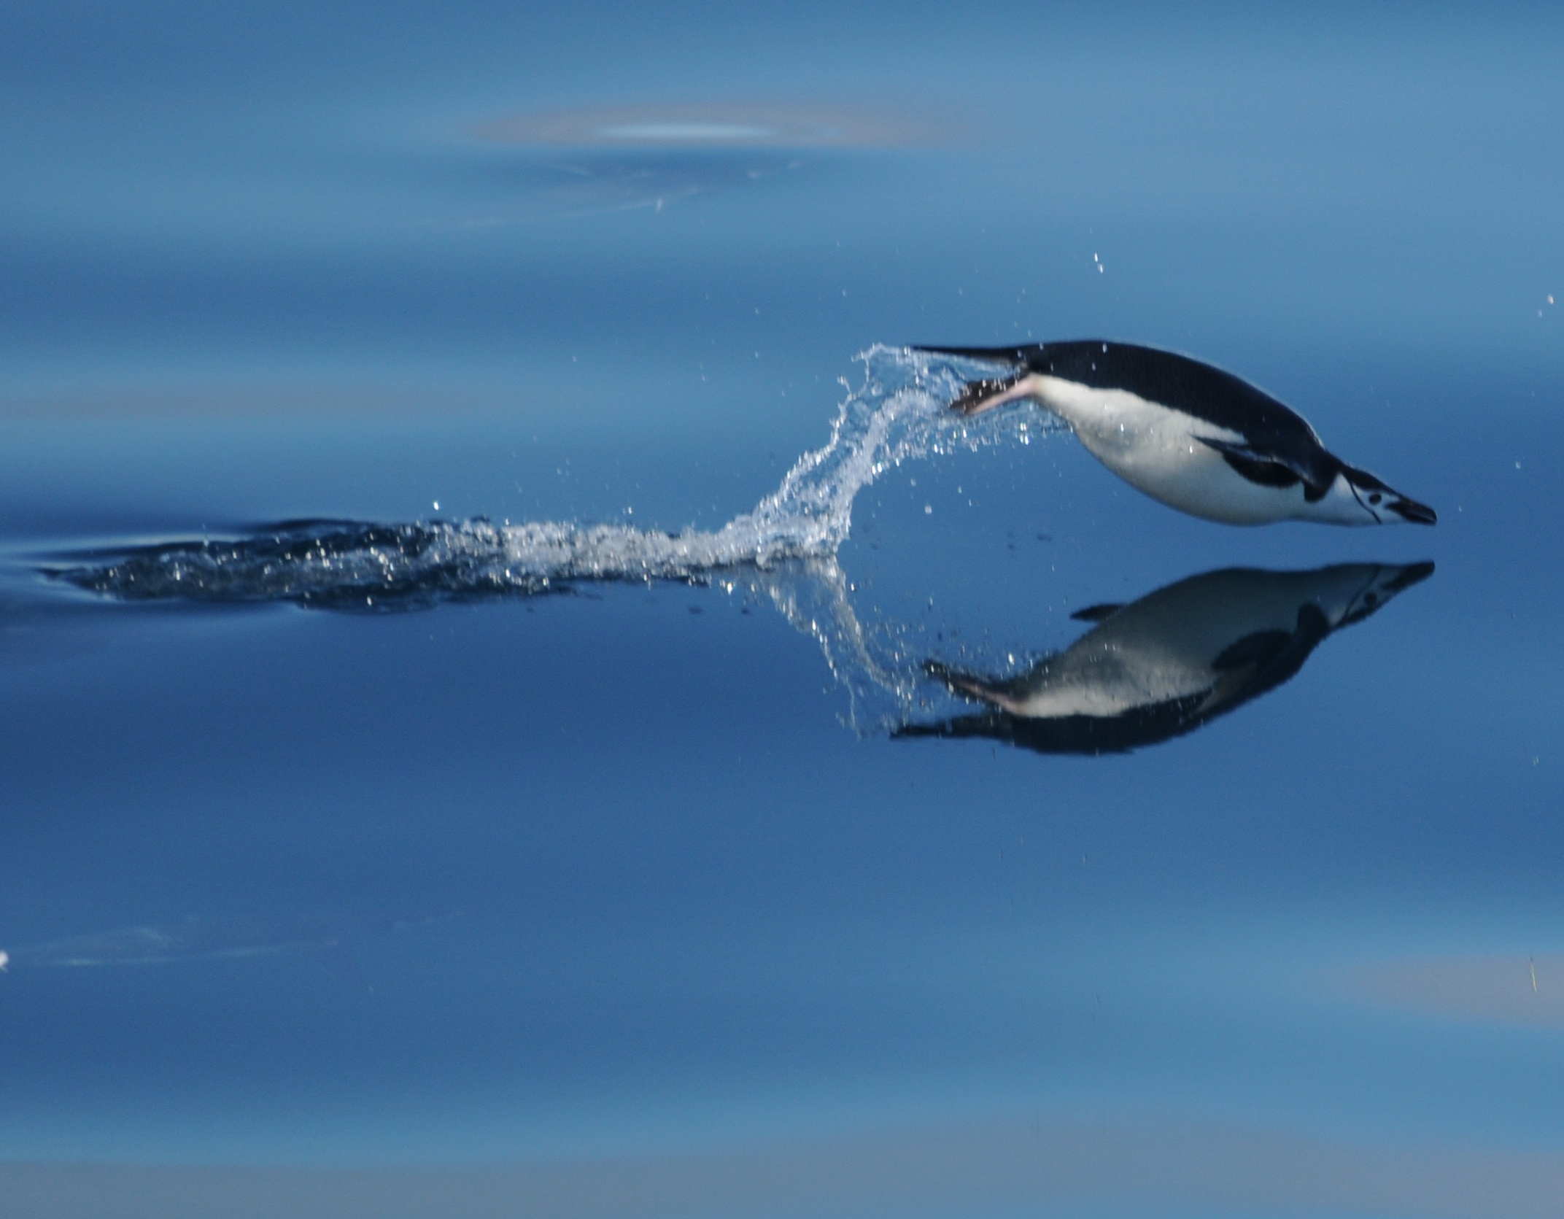
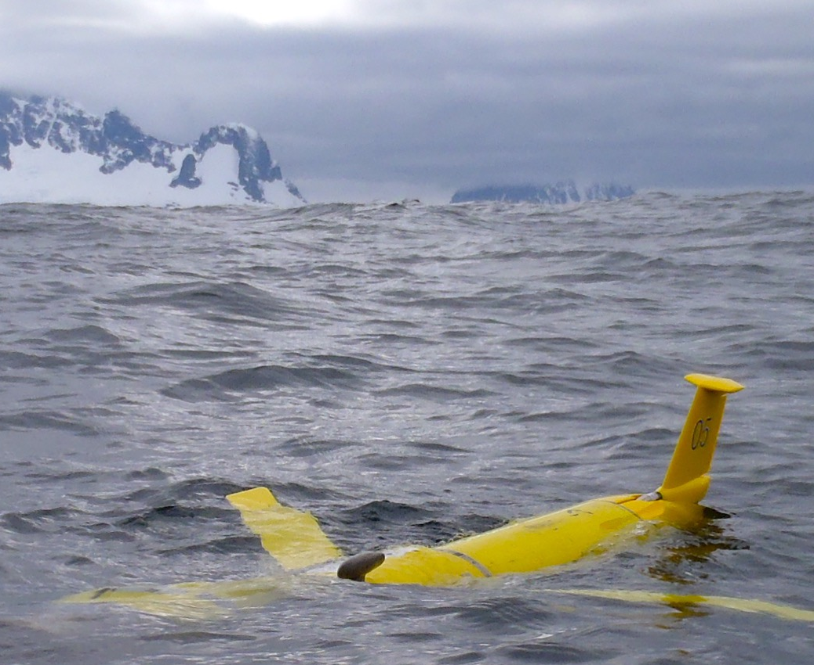
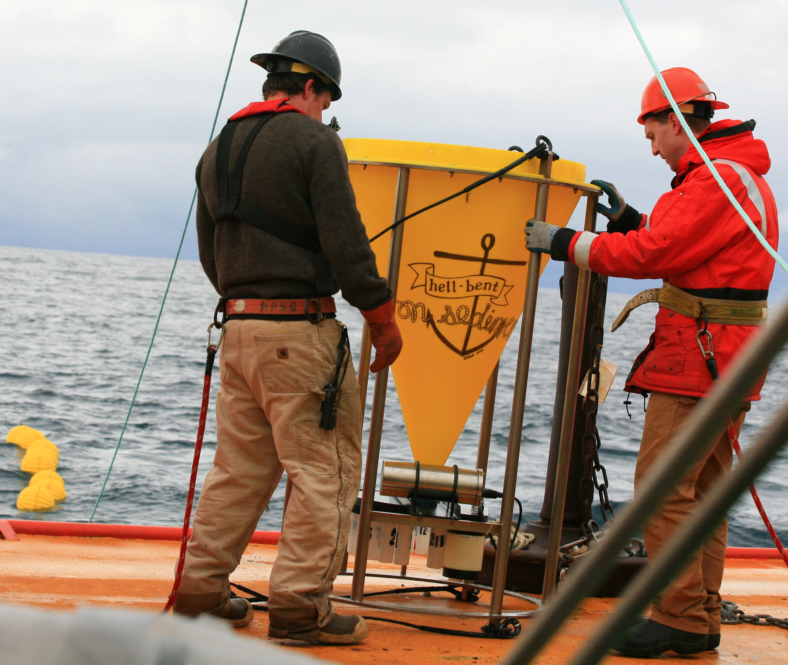
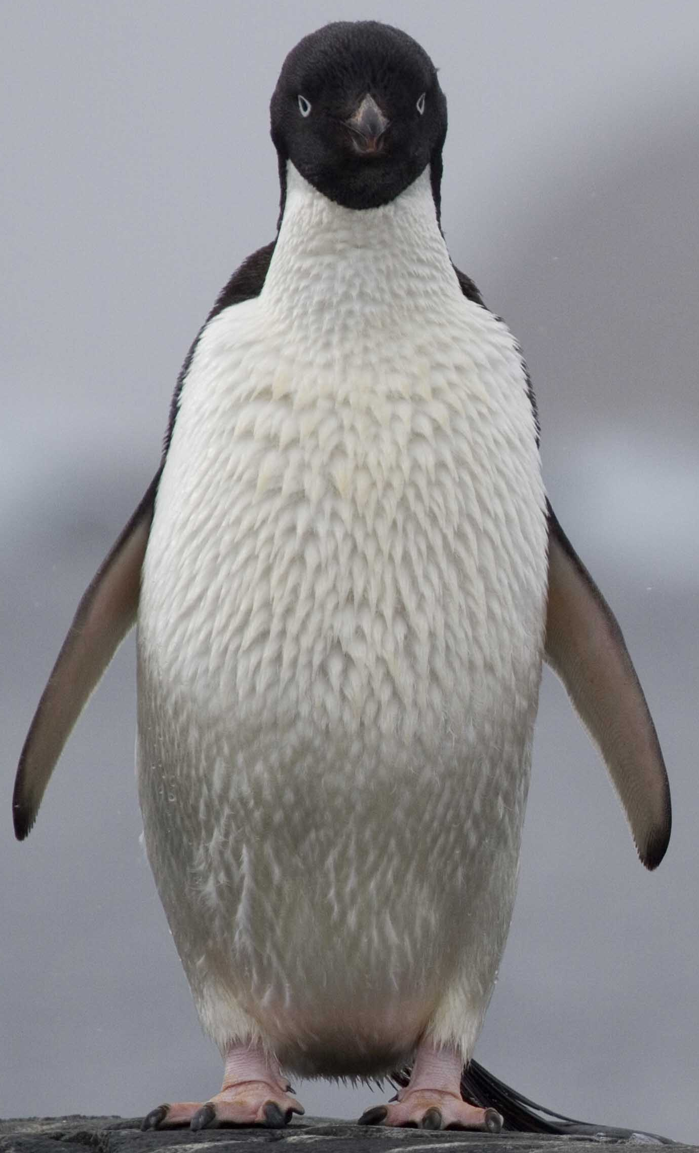
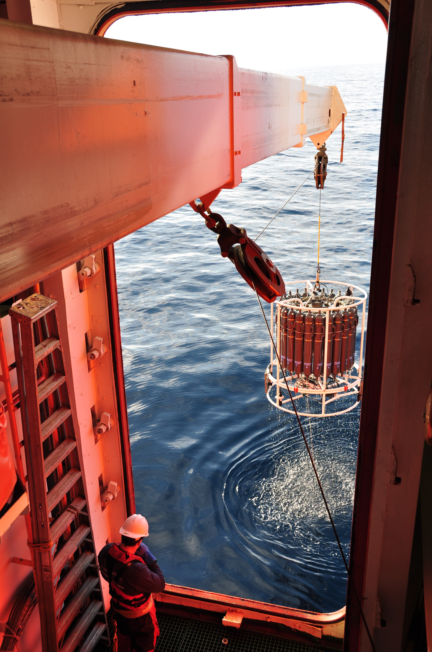
The central hypothesis when the LTER began was that sea ice timing and magnitude structured the productivity and composition of the Antarctic ecosystem. The ice dynamics are driven by large-scale interactions of the atmosphere and ocean.
Palmer Station summer seasons
January cruise
(Traditional PO, CO, BO)
Trace Metals
Whales & Seals
Radio-tagged
animals
Moorings
Penguins
(late 1970’s)
Year Long Sediment
Trap Deployments
Gliders
1990 2000 2010
YEAR

Slide 15
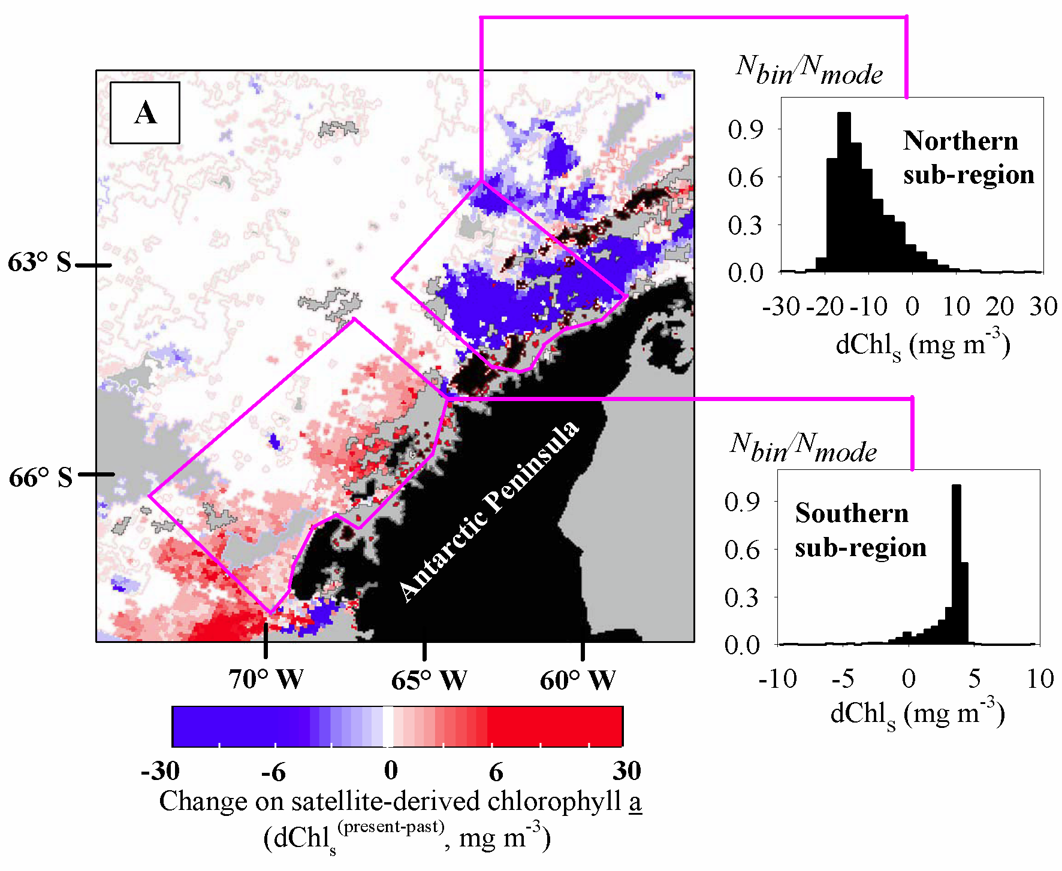
12% decrease in chl
Phytoplankton in the WAP
Two regimes:
  - high chl/large cells (south)
  - low chl/small cells (north)
-90%
+67%
Montes-Hugo et al. Science 2009

Slide 16
Big ice winters drive the larger phytoplankton spring blooms, which primes the food web as a whole
Saba et al.
Nat. Commun, 2014

Slide 17
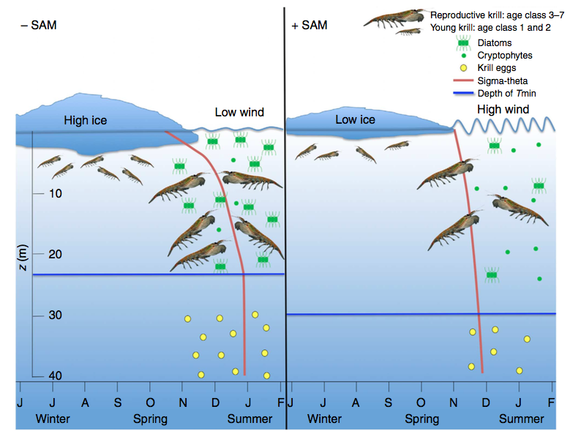
Phytoplankton in the WAP
Saba et al. Nat. Commun, 2014

Slide 18
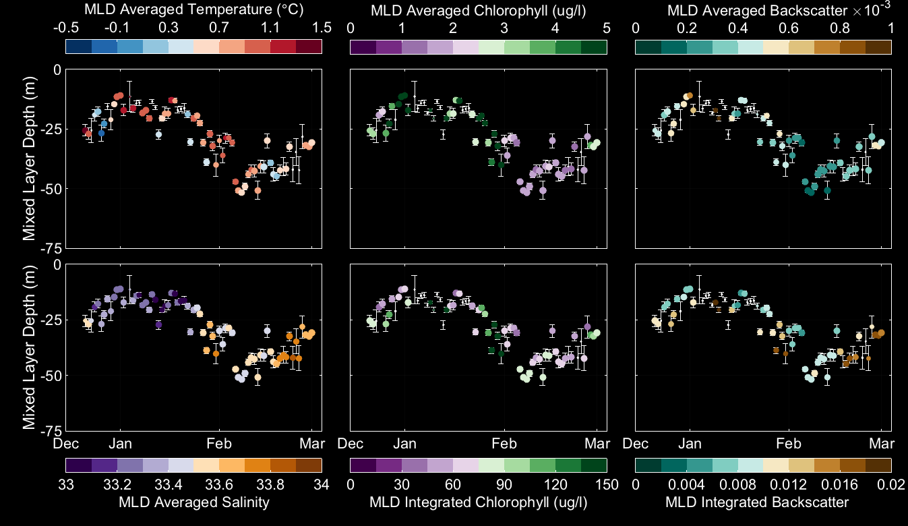
Phytoplankton blooms associated with shallower mixed layer depths
Shallow MLD
Low salinity
High chl
Shallower MLD consistently associated with lower salinity water (glacial and sea ice melt)

Slide 19
Zooplankton ecology
Not as clear in the PAL-LTER
Atkinson et al,
Nature, 2004
Steinberg et al, Deep Sea Res I, 2015

Slide 20
Decadal shifts in highest trophic levels
Changes reflect decrease in food resource, changes in the type
of food (Antarctic silverfish gone), and increase in atmospheric deposition

Slide 21
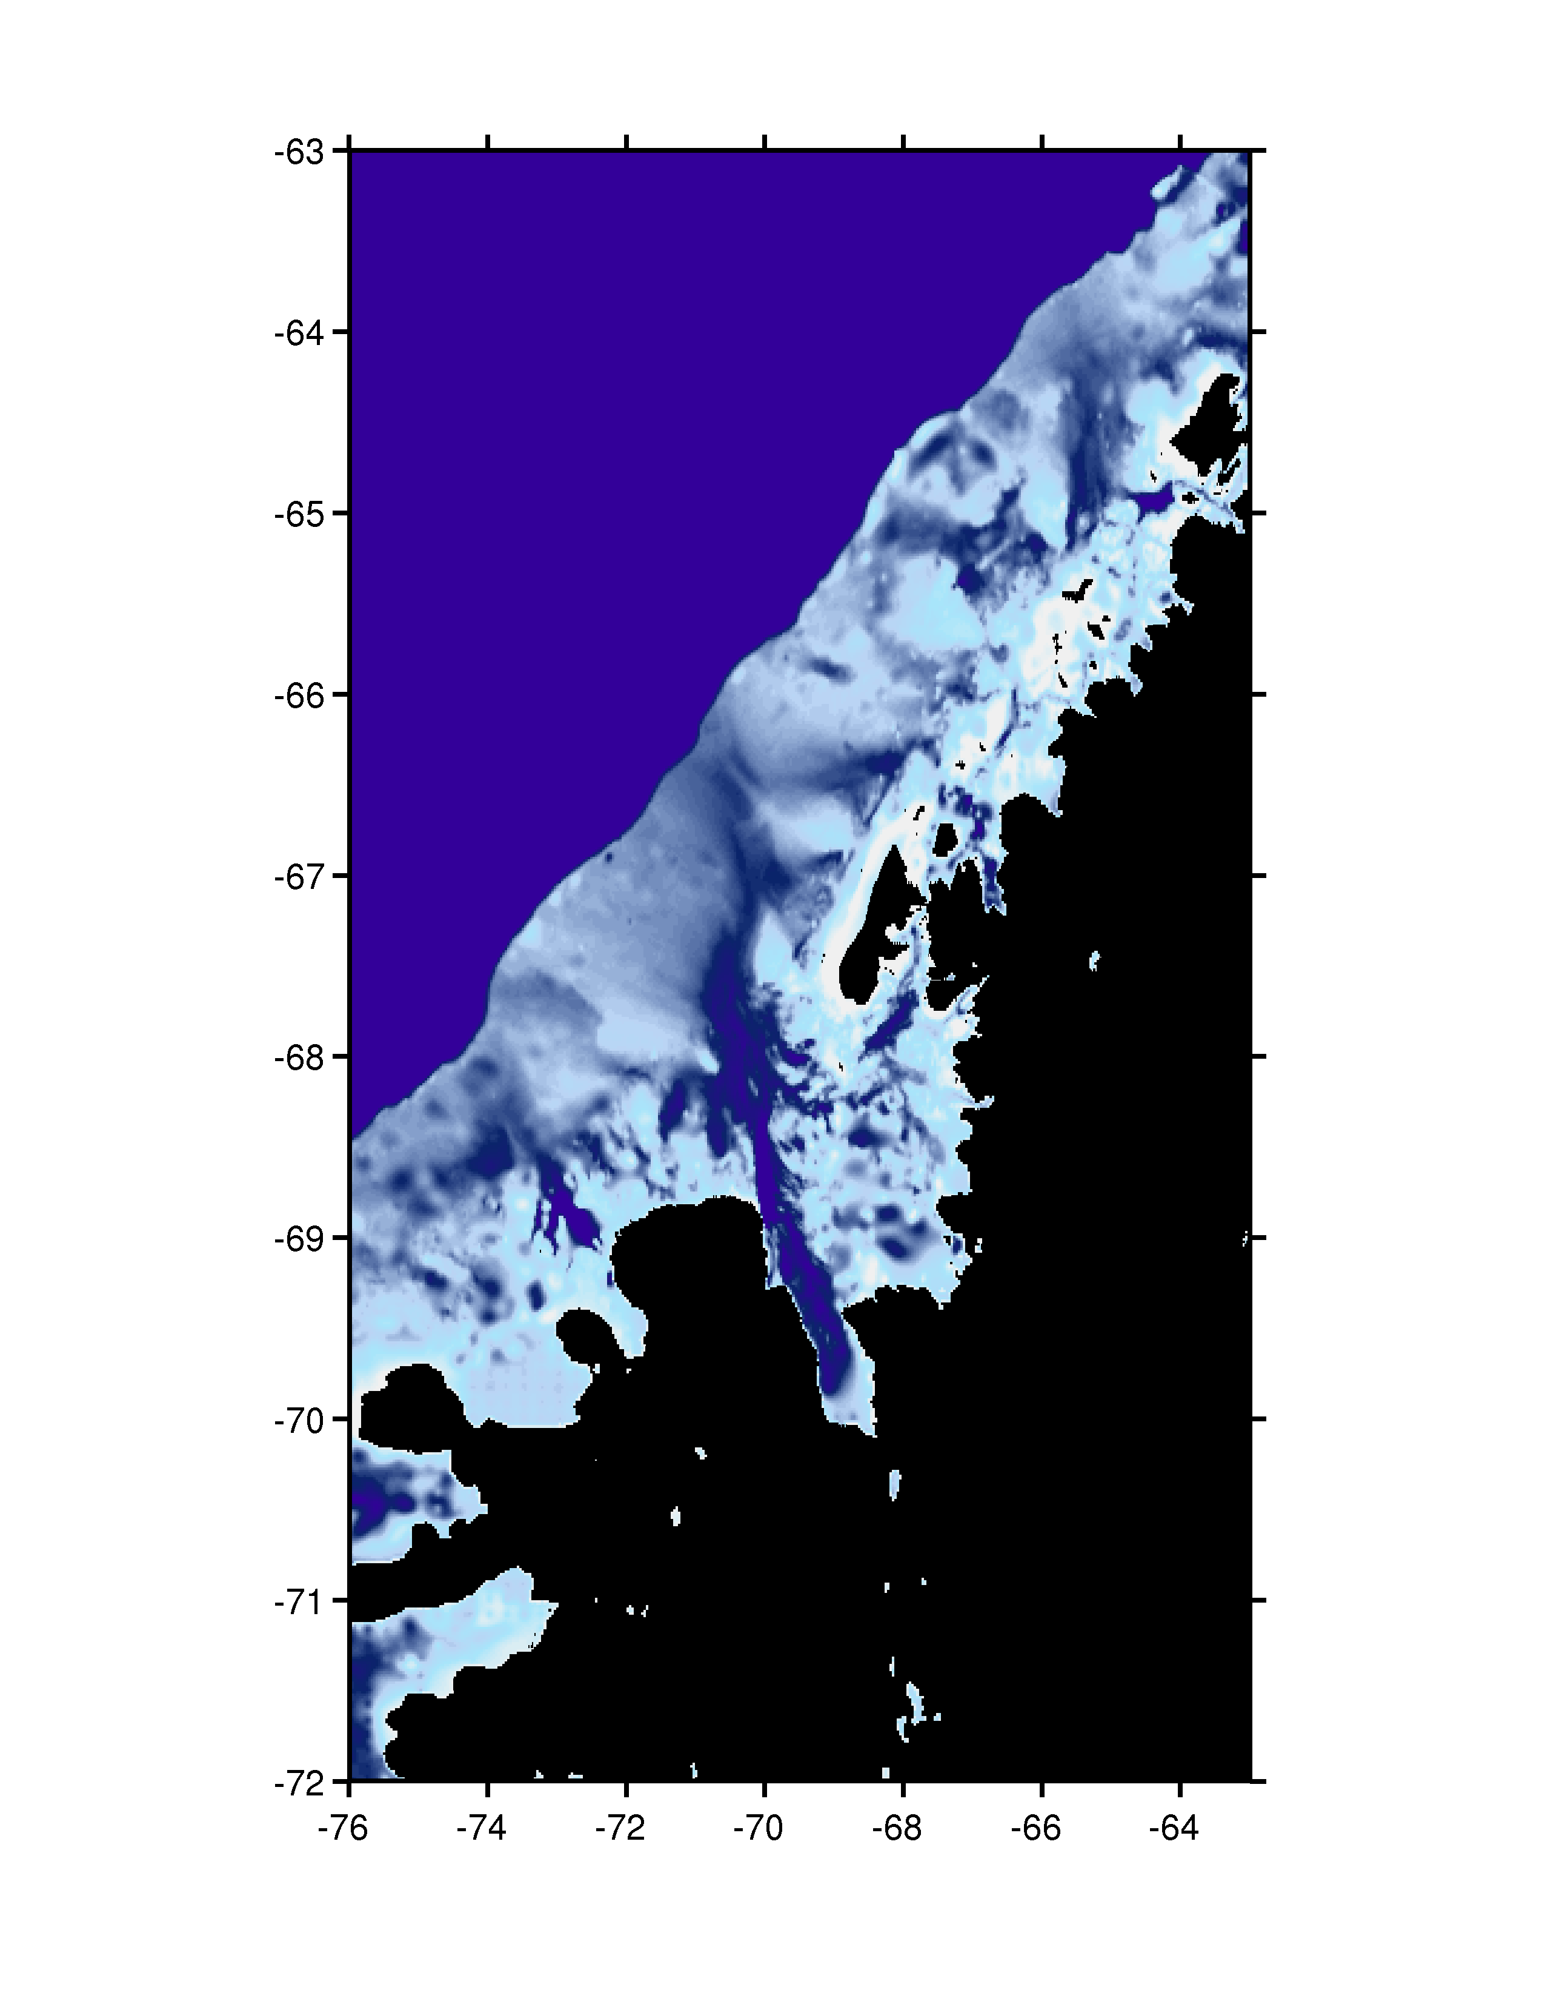

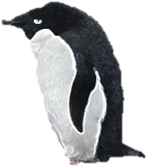













Ice fish range Mid-21st Pal LTER?
Ice fish range Pre-Pal LTER
Ice fish range current Pal LTER
-64
Palmer Station
MIZ Phytoplankton bloom
Pre-Pal LTER
Current LTER
Mid-21st Century?
present
A)
-68
Time
(Relative to
Palmer Station)
Wind
(current)
Wind
(mid 21st
century?)
Penguin Process
Locations
-20 yrs
-72
Wind
(Pre-LTER)
ACC
-40yrs
-76
-64
-66
-68
-70
-72
B) Marine Sub-Polar System
C) Marine Polar System
Adelie Penguin
CO₂
CO₂
Chinstrap
Penguin
Warm North
West Winds
South
Easterly Winds
Heat
Gentoo
Penguin
Upper
Mixed
Layer
Glacial
Melt-water
.
.
Humpback
Whale
.
.
,
.
,
.
,
.
.
.
.
,
,
.
,
.
.
Winter Water
Layer
.
,
,
.
,
,
.
.
.
.
.
Crab-Eater
Seal
,
,
.
.
,
,
,
,
,
Microbial
Loop
.
.
Krill
Organic
Carbon
Silverfish
Organic
Carbon
Salp
Marine Snow
Export Flux
Microzooplankton
Inshore ACC
Diatoms
.
Other Algae
,
Bacteria
(blue denotes ice
obligate species)
Offshore ACC
Land plants

Slide 22

New View … New Frontier

Slide 23

Conclusions
WAP is undergoing changes driven by the circumpolar current communication to the continental shelf.
The north is transitioning to a sub-polar marine system with an increased importance of the microbial loop.
The changes in the northern system are reflected in higher trophic levels

Slide 24

Thank You!
http://rucool.marine.rutgers.edu

Slide 25

What is Mixed Layer Depth (MLD)?
How does it affect Primary Productivity?.
Well-lit
Zone
Gille, 2010 (Nature Geosciences)

Slide 26

Phytoplankton in the WAP
Courtesy of Zina Deretsky / NSF

Slide 27

WAP Canyons: “Biological Hotspots”
“Biological Hotspots” along the Peninsula associated with deep undersea canyons.
Palmer Deep Canyon
(near Anvers Island)
Margarite Trough
(near Avian Island)
newly discovered canyon
(near Charcot Island)
Notes:
Moving on to the next slide we have a coastline of the WAP, where we see Anvers Is, where Palmer Station is, Adeleide Is where Rothera (the UK station) is. Highlighted are 3 canyon systems which are known biological hotspots in the WAP, Palmer Deep, Margarite Trough and Canyon near Charcot Is.

