Slide 1




Application of radial and elliptical surface current measurements to better resolve coastal features
Robert K. Forney, Hugh Roarty, Scott Glenn
March 5th, 2015
Notes:
In this talk I will be presenting findings on how a non-standard oceanographic radar configuration can make it more possible to resolve finer-scale features of coastal phenomena.

Slide 2
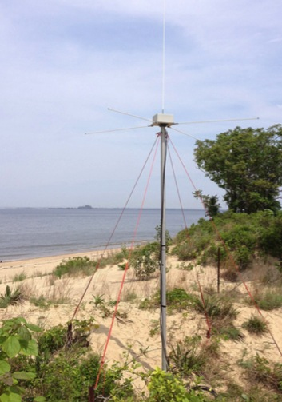
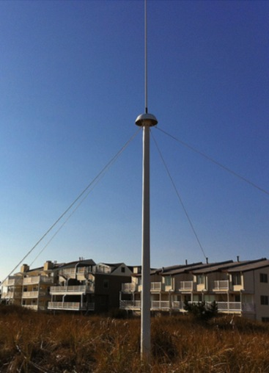
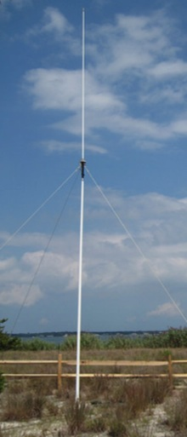
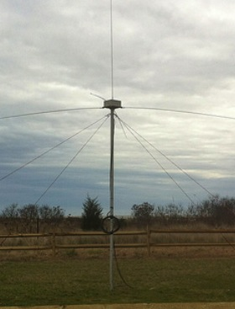
CODAR Compact HF Radar Antennas
25 MHz
13 MHz
5 MHz
Combined Transmitter & Receiver
Separate Transmitter & Receiver
Notes:
We measure ocean surface currents with CODAR SeaSonde high-frequency (HF) radar systems. They come in three frequencies, which correspond to three different ranges and resolutions (since lower-frequency signals propagate farther with lower resolution). 25 MHz is the short-range and often used to get high-resolution maps of currents in harbors; 5 MHz is the long-range used to capture large-scale phenomena; and the 13-MHz mid-range radar is what we will be focusing on in this study. CODAR HF radar systems can operate in monostatic mode, transmitting and receiving at the same location, or in bistatic mode, with separate transmit and receive antennas. Radar units can operate in both modes at the same time with little loss of data. Despite this, bistatic systems are not yet in vogue.

Slide 3
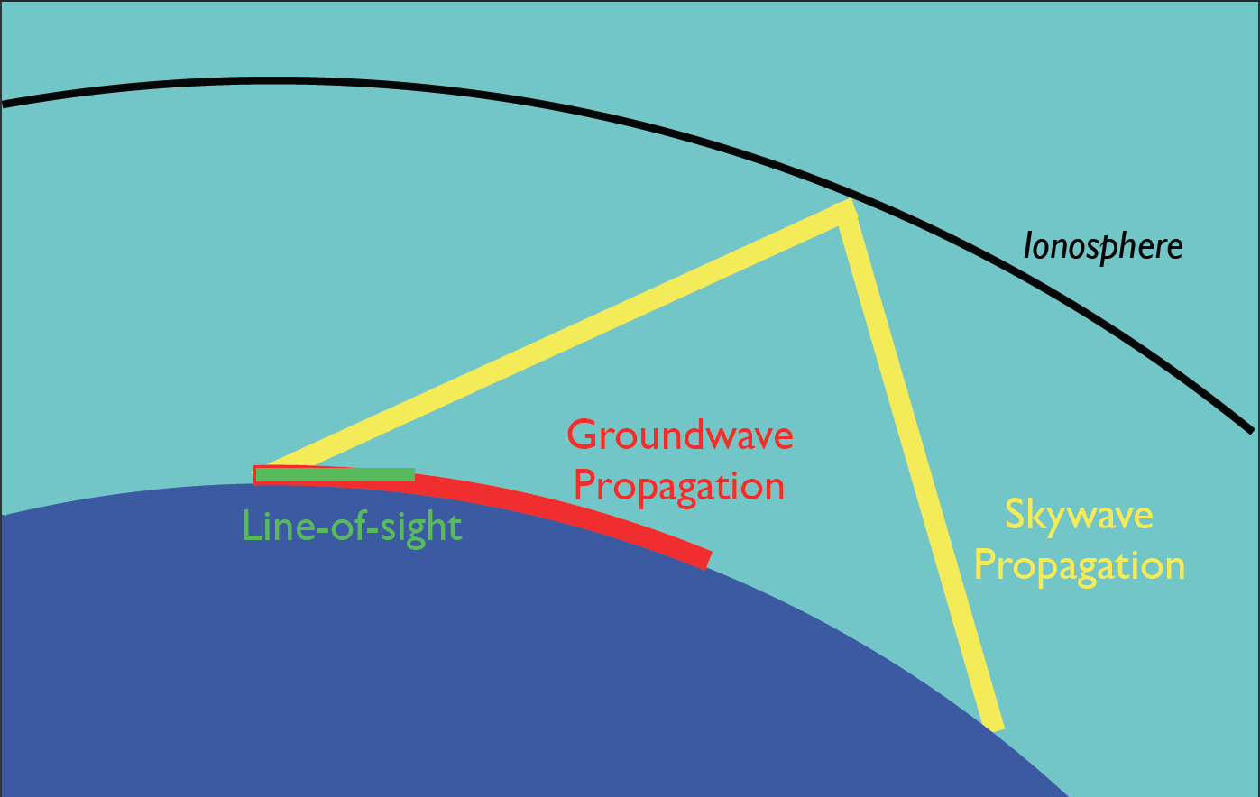
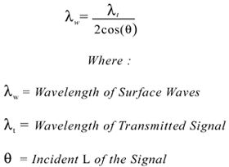
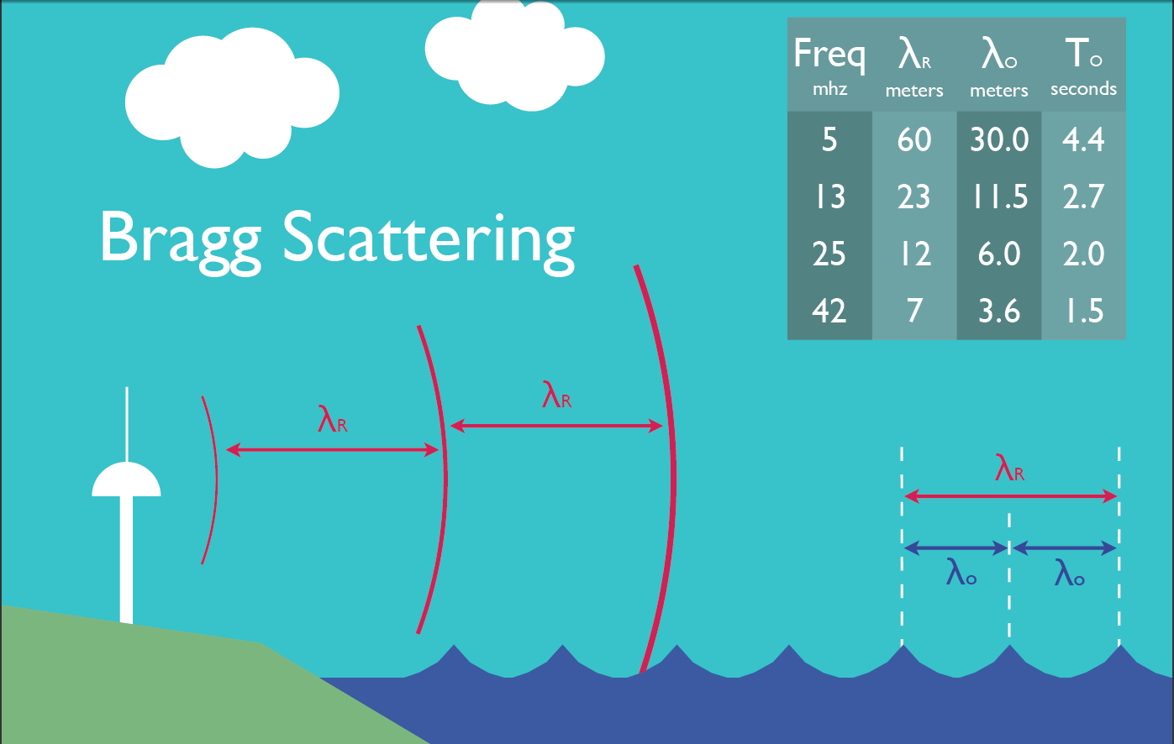
Notes:
All HF radar systems operate based on the physical principle of Bragg scattering. When light scatters off of objects a distance of lambda/2 apart, the light scattered back towards the origin constructively interferes and results in a high-amplitude returned signal. 13-MHz HF radar systems have a wavelength of 25-m and so 12.5-m wavelength waves give a high return. The location of the detected wave is calculated by the CODAR SeaSonde unit based on the time delay between the frequency-modulated pulse and returned echo and a direction-finding algorithm. The component of surface currents perpendicular to contours of constant time delay can be extracted by analyzing the Doppler shift of the waves.

Slide 4
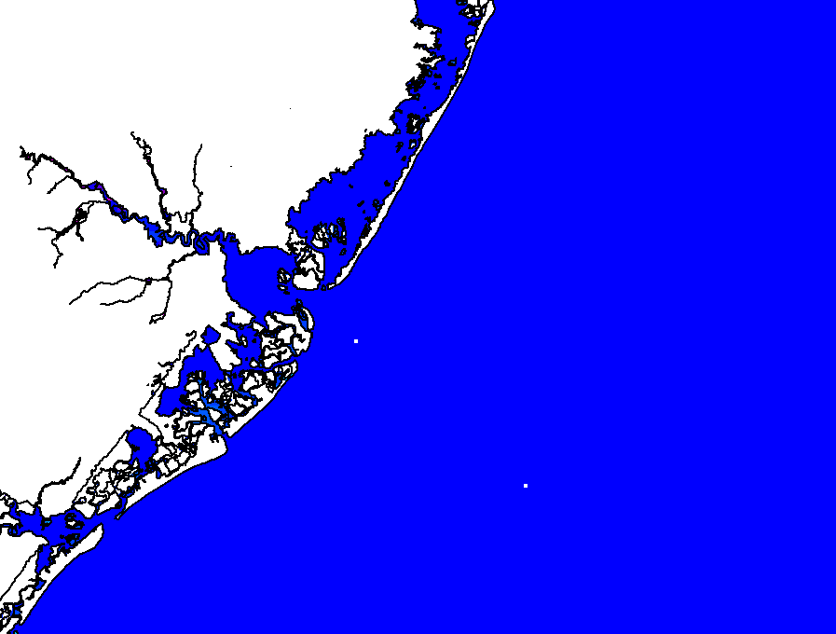
CODAR Total Vector Calculation
Kilometers
CODAR North
Little
Egg
Harbor
0 5 10
CODAR
Central
Site
Great
Bay
LEO-15
A T L A N T I C O C E A N
Atlantic City
Notes:
Since a single radar unit cannot see the component of the current that is parallel to its contours of constant time delay (“zero isodop problem”), at least two units are needed to calculate total surface currents. Radars use the buddy system to produce total vectors.

Slide 5
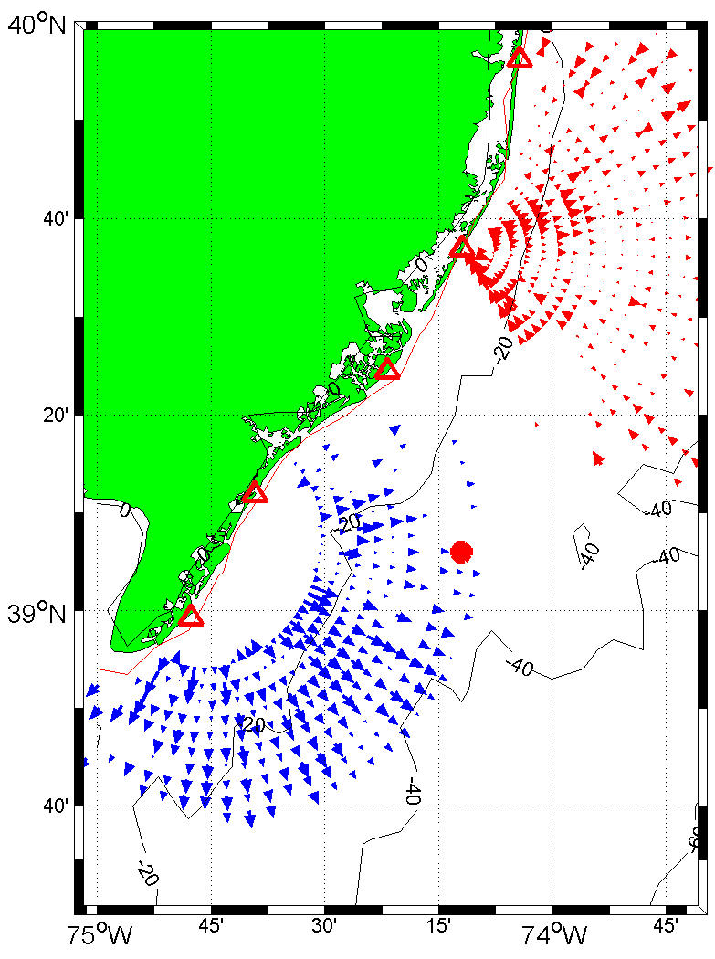
Monostatic vs. bistatic geometry
Notes:
The standard oceanographic radar (red) operates in a monostatic mode: it has colocated transmit and receive antennas. Reflected signals from ocean waves come back along the same path as the transmitted signal, and contours of constant time delay are circular. In this study, existing radars operating in monostatic mode were configured to collect data in bistatic mode (blue) as well. Bistatic systems have separated transmit and receive antennas so their contours of constant time delay are elliptical. As a result, they provide an view of the ocean surface currents that is linearly independent of the radial perspective—while using the same instruments. In our study we validated the elliptical data as a measure of surface current velocity, which suggests that the bistatic mode can powerfully enhance existing oceanographic radars.

Slide 6
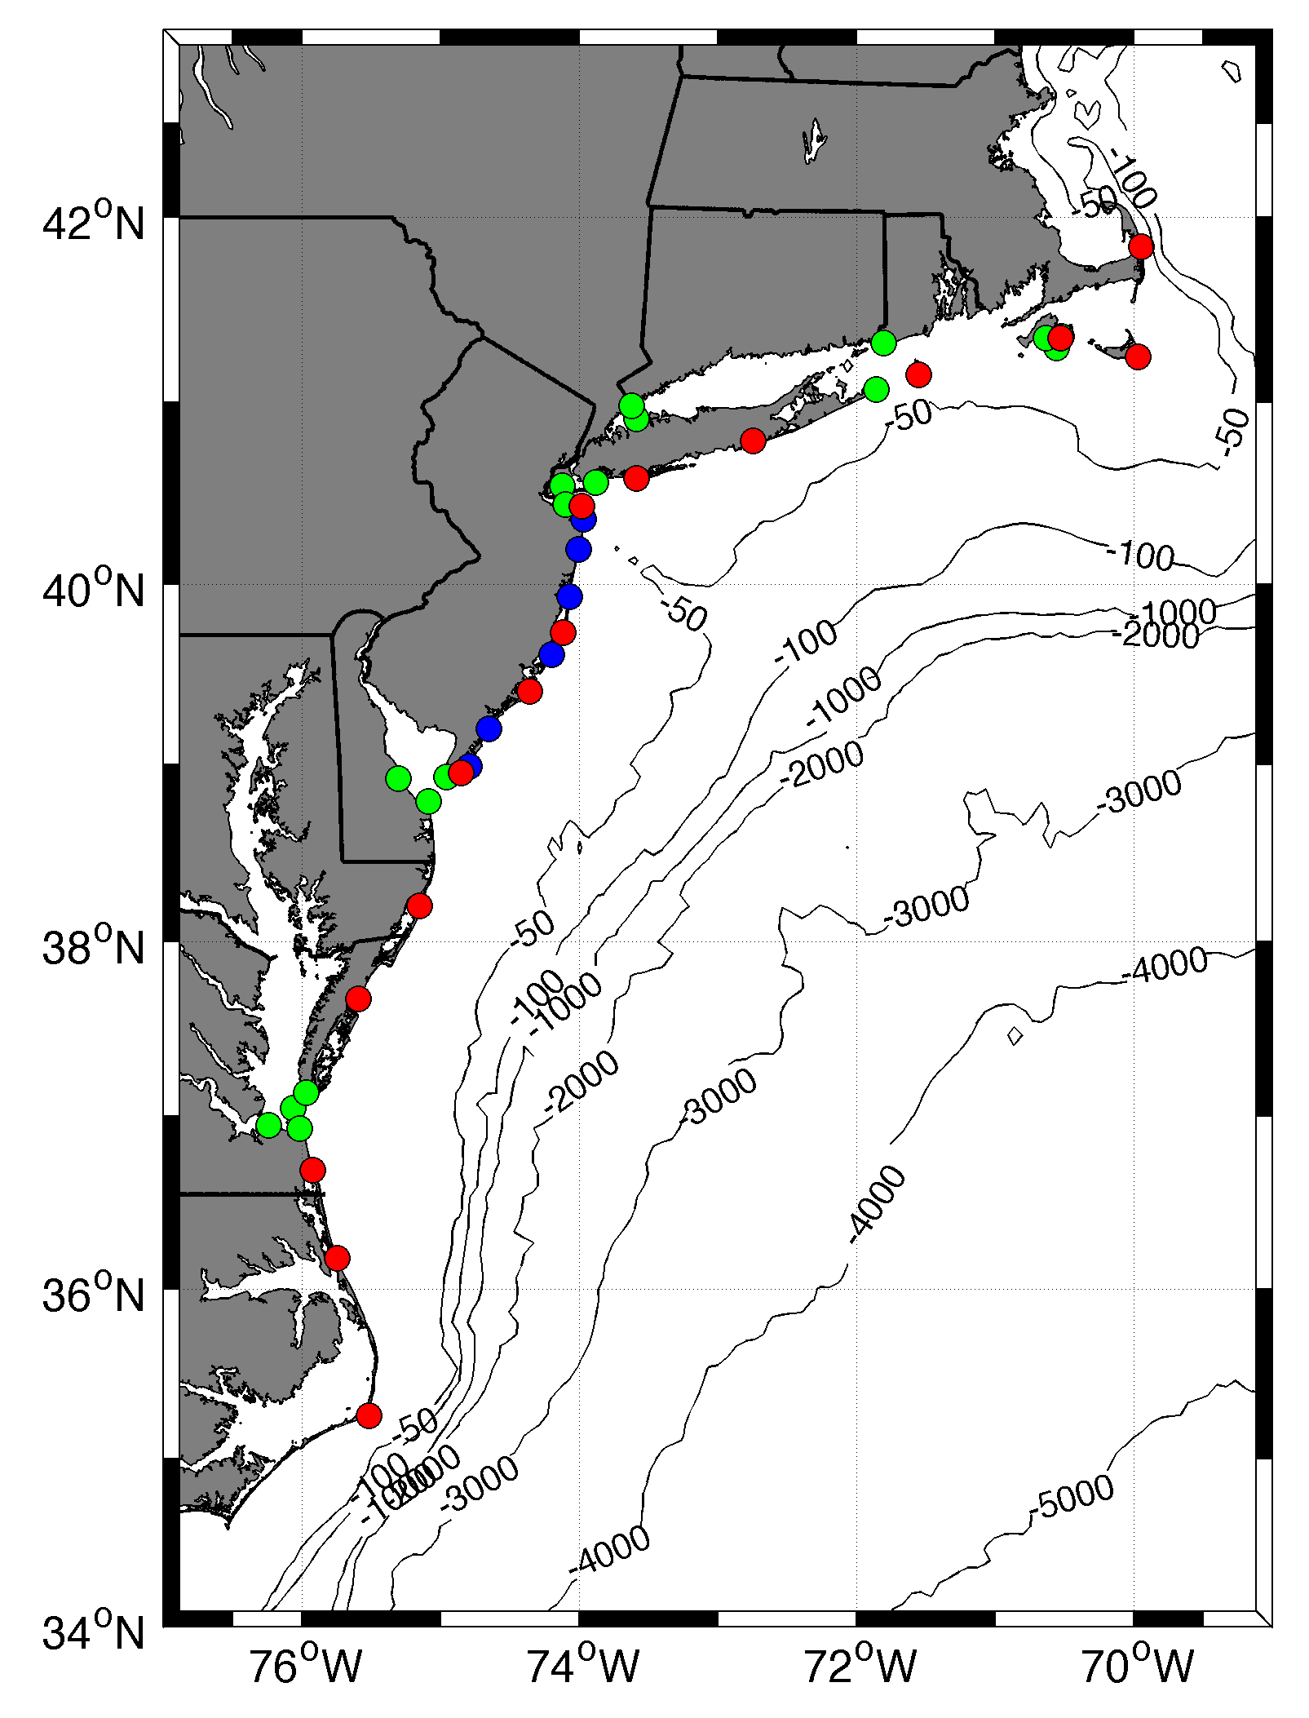





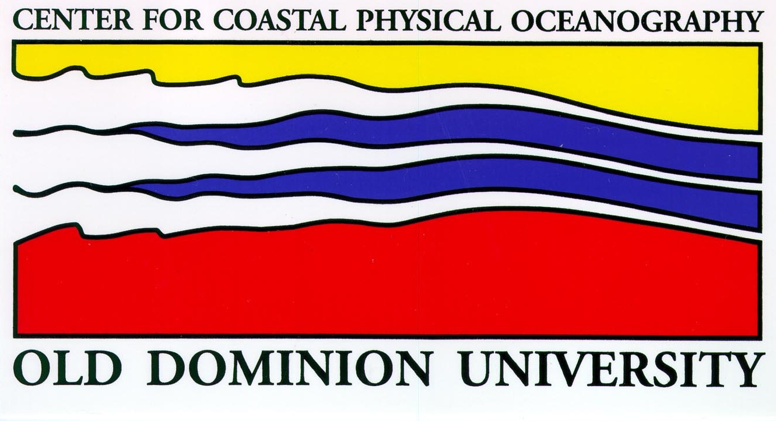




MARACOOS HF RADAR NETWORK
 | 5 MHz | 13 MHz | 25 MHz
U Mass
WHOI
U Conn
URI
Stevens
Rutgers
Delaware
ODU/CIT
UNC
9 | 17 | 8 | 17
46 Stations in Total
Notes:
Oceanographic radars are operated jointly by several institutions along the entire coast of the Mid-Atlantic Bight. Rutgers operates the only mid-range HF radar network along the coast of NJ.

Slide 7
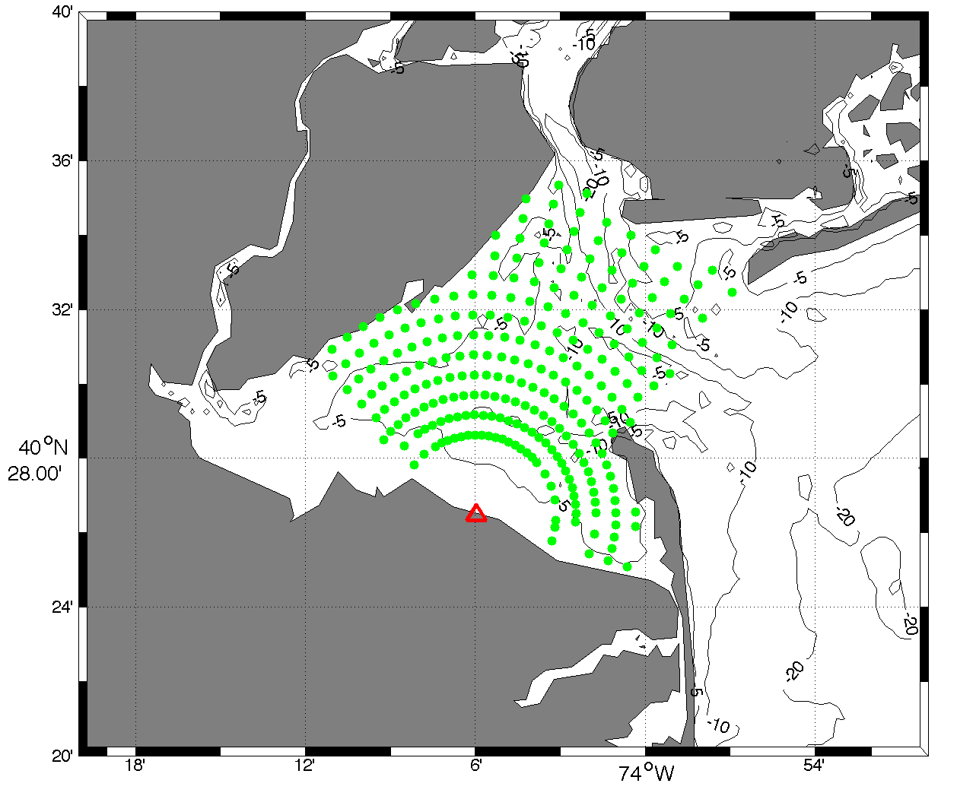
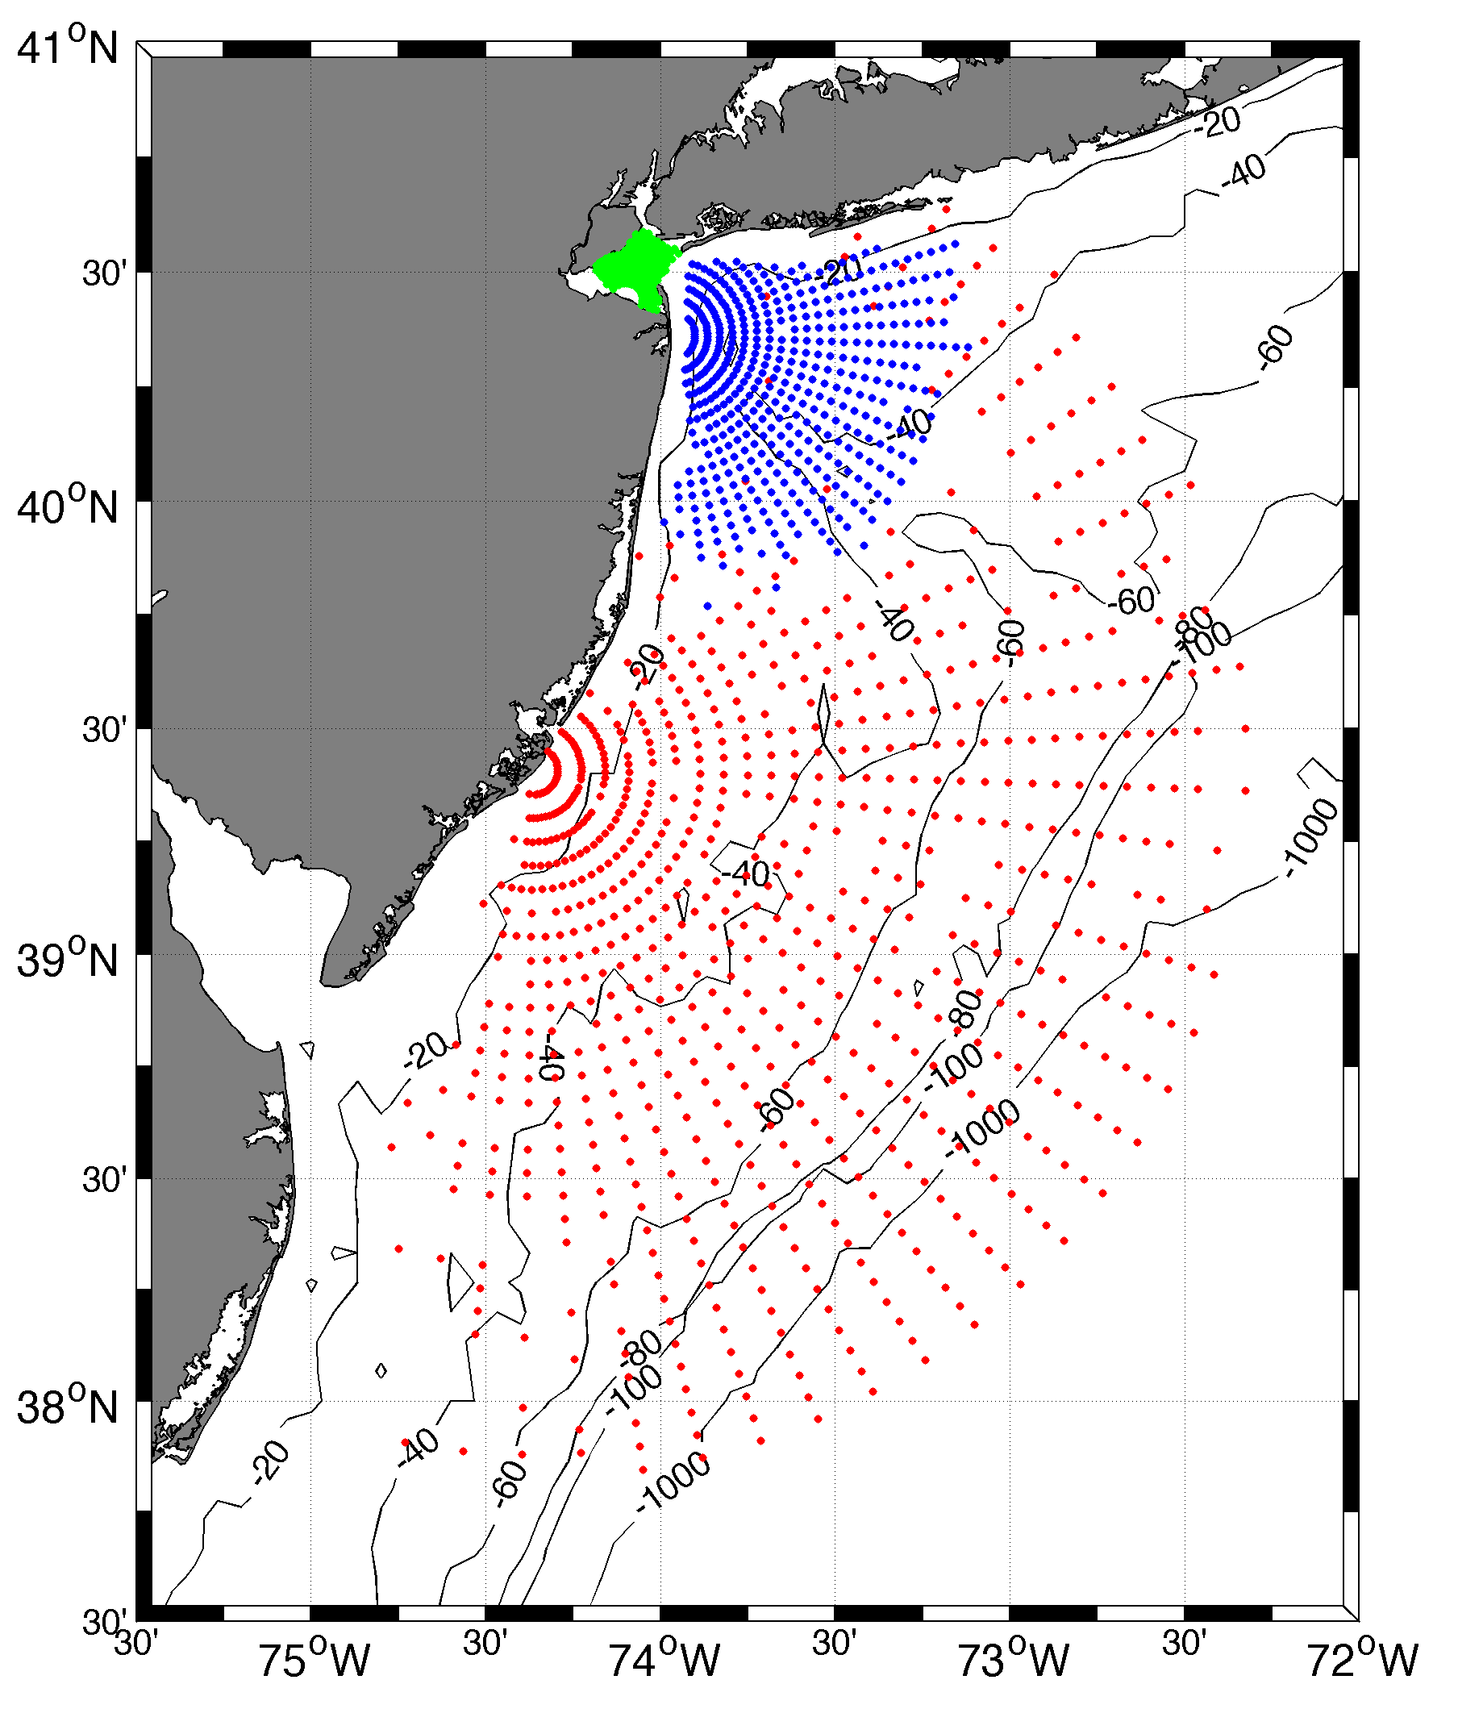
Surface Current Mapping Capability
25 MHz
Radar λ: 12 m Ocean λ: 6 m
Range: 30 km Resolution: 1 km
13 MHz
Radar λ: 23 m Ocean λ: 12 m
Range: 80 km Resolution: 3 km
05 MHz
Radar λ: 60m Ocean λ: 30 m
Range: 180 km Resolution: 6 km
Notes:
The many stations work together to build total vector maps of ocean surface currents, which have diverse applications in oceanographic research as well as for the Coast Guard and Homeland Security.

Slide 8
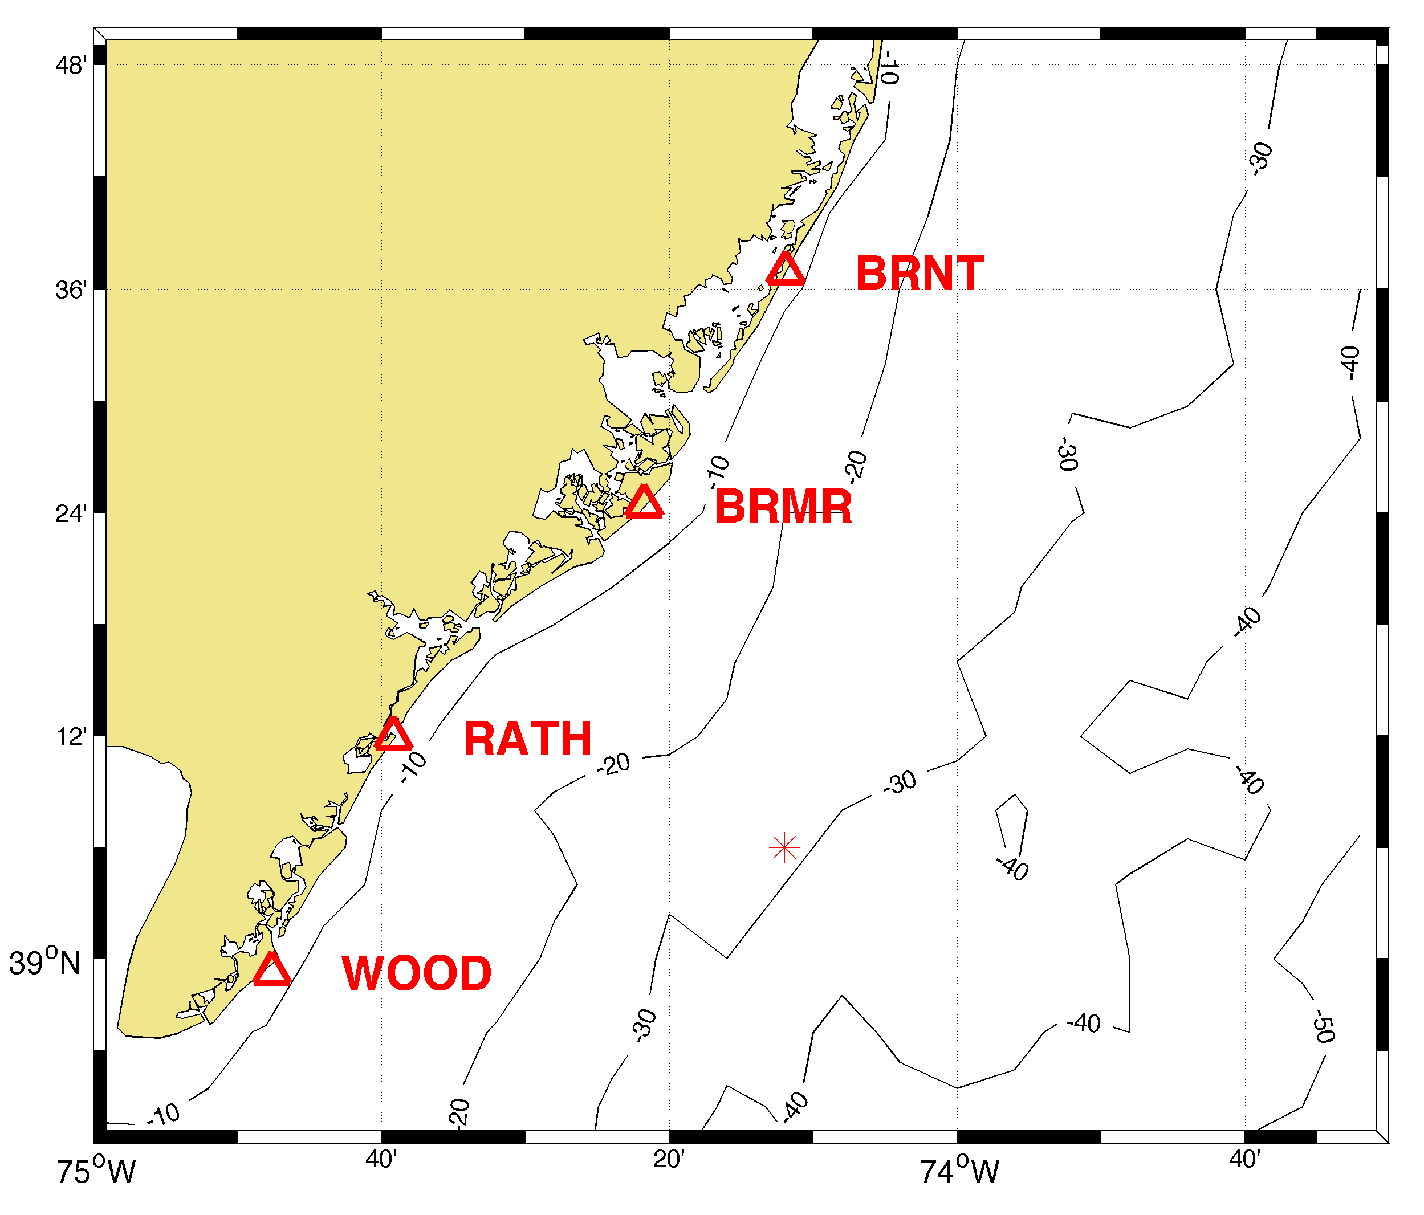
Study domain
Notes:
The study was conducted on the continental shelf due east of Atlantic City, NJ. Coastal Ocean Dynamics Applications Radar (CODAR) systems are installed along the NJ coast operating at multiple frequencies but in our study we focused on four 13-MHz high-frequency (HF) radar systems located in Wildwood, Strathmere, Brigantine and Brant Beach, which have overlapping coverage on the shelf. All four produced radial data in a monostatic setup, and two pairs produced elliptical data in a bistatic setup (RAWO and RABR).

Slide 9
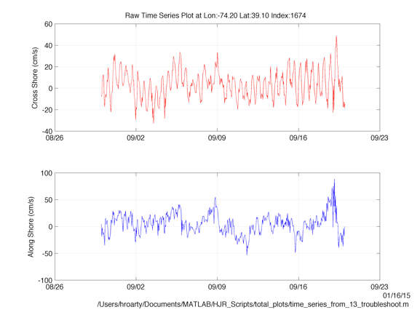
Radial raw measurements
Notes:
Ellipticals have been validated as a measure of surface currents in the past, but just to be sure we validated our own elliptical data. We compared surface current calculations with radial measurements only to surface current calculations with combined radial and elliptical data. If our ellipticals are good, there should not be a statistically significant difference between the radial-only and composite measurements.

Slide 10
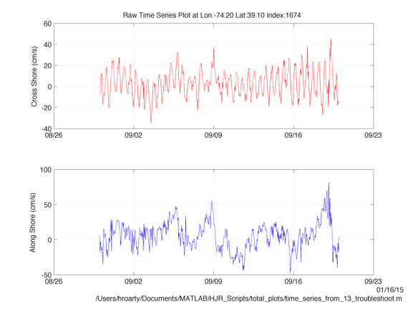
Composite raw measurements
Notes:
The composites are well within a standard deviation of the radials.

Slide 11
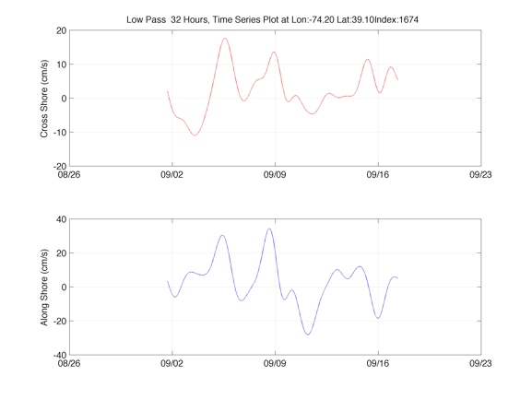
Radials lowpassed
Notes:
We also compared the lowpassed radials and lowpassed combined radials and ellipticals to see if they resolved low-frequency signals in similar ways.

Slide 12
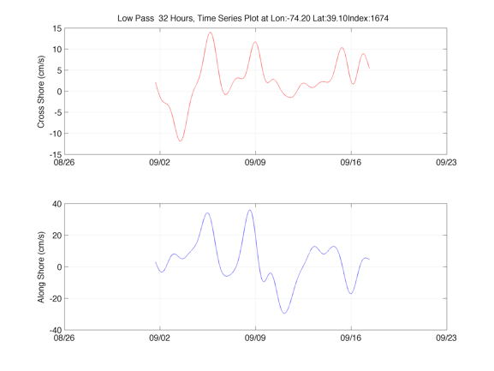
Composite lowpassed
Notes:
The differences between the two are quite small, but since the composite surface current calculations were based on more samples (combined radial and elliptical), we have reason to believe that it provides a better measure of surface currents.

Slide 13
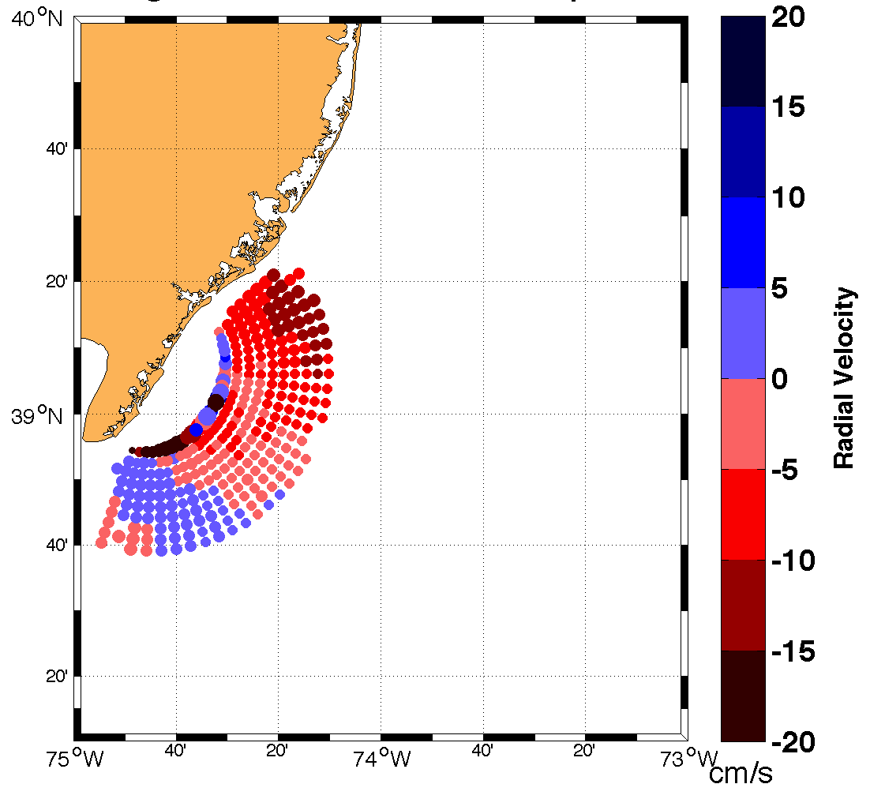
RABR ELTm mean/std

Slide 14
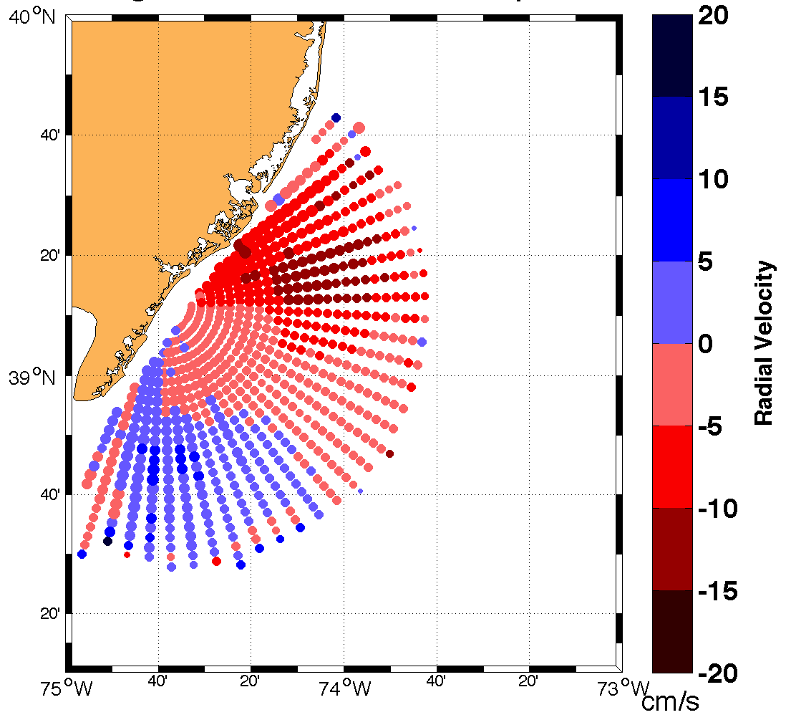
RATH RDLm mean/std

Slide 15
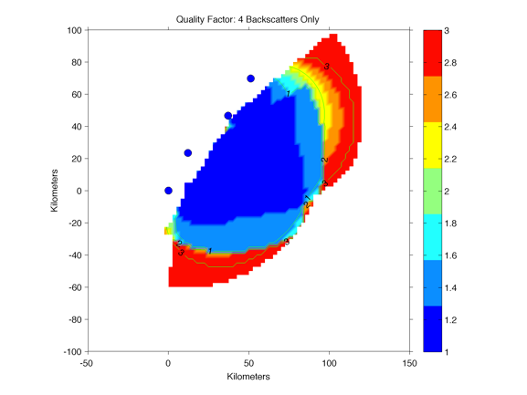
Geometrical dilution of statistical accuracy (GDOSA)
Notes:
More observations is always better than fewer for reducing error and increasing coverage in surface current measurements. Quality of radar observations decreases with distance from the center of the coverage area. In this figure color represents the total quality of the surface current measurements observed by four monostatic systems, with blue being higher quality and red being lower. In radar we are most accustomed to discussing GDOP; GDOSA is essentially the same as GDOP but with the essential inclusion of effects due to the number of statistical samples available for vector calculation. The GDOP derived and applied in Chapman et. al. (1997) is not very useful without this, since with GDOP ranging as sin(angle between radars) implies perfect estimation of U and V right up to the baseline without it.

Slide 16
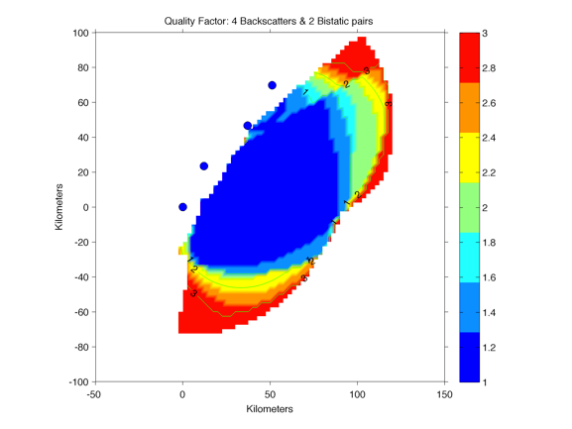
Improvement of GDOSA with bistatic
Notes:
This is the same location with the same radar units, but with two pairs of them operating in a bistatic mode. Notice that the overall quality of observations increases with the inclusion of the two bistatic pairs.

Slide 17
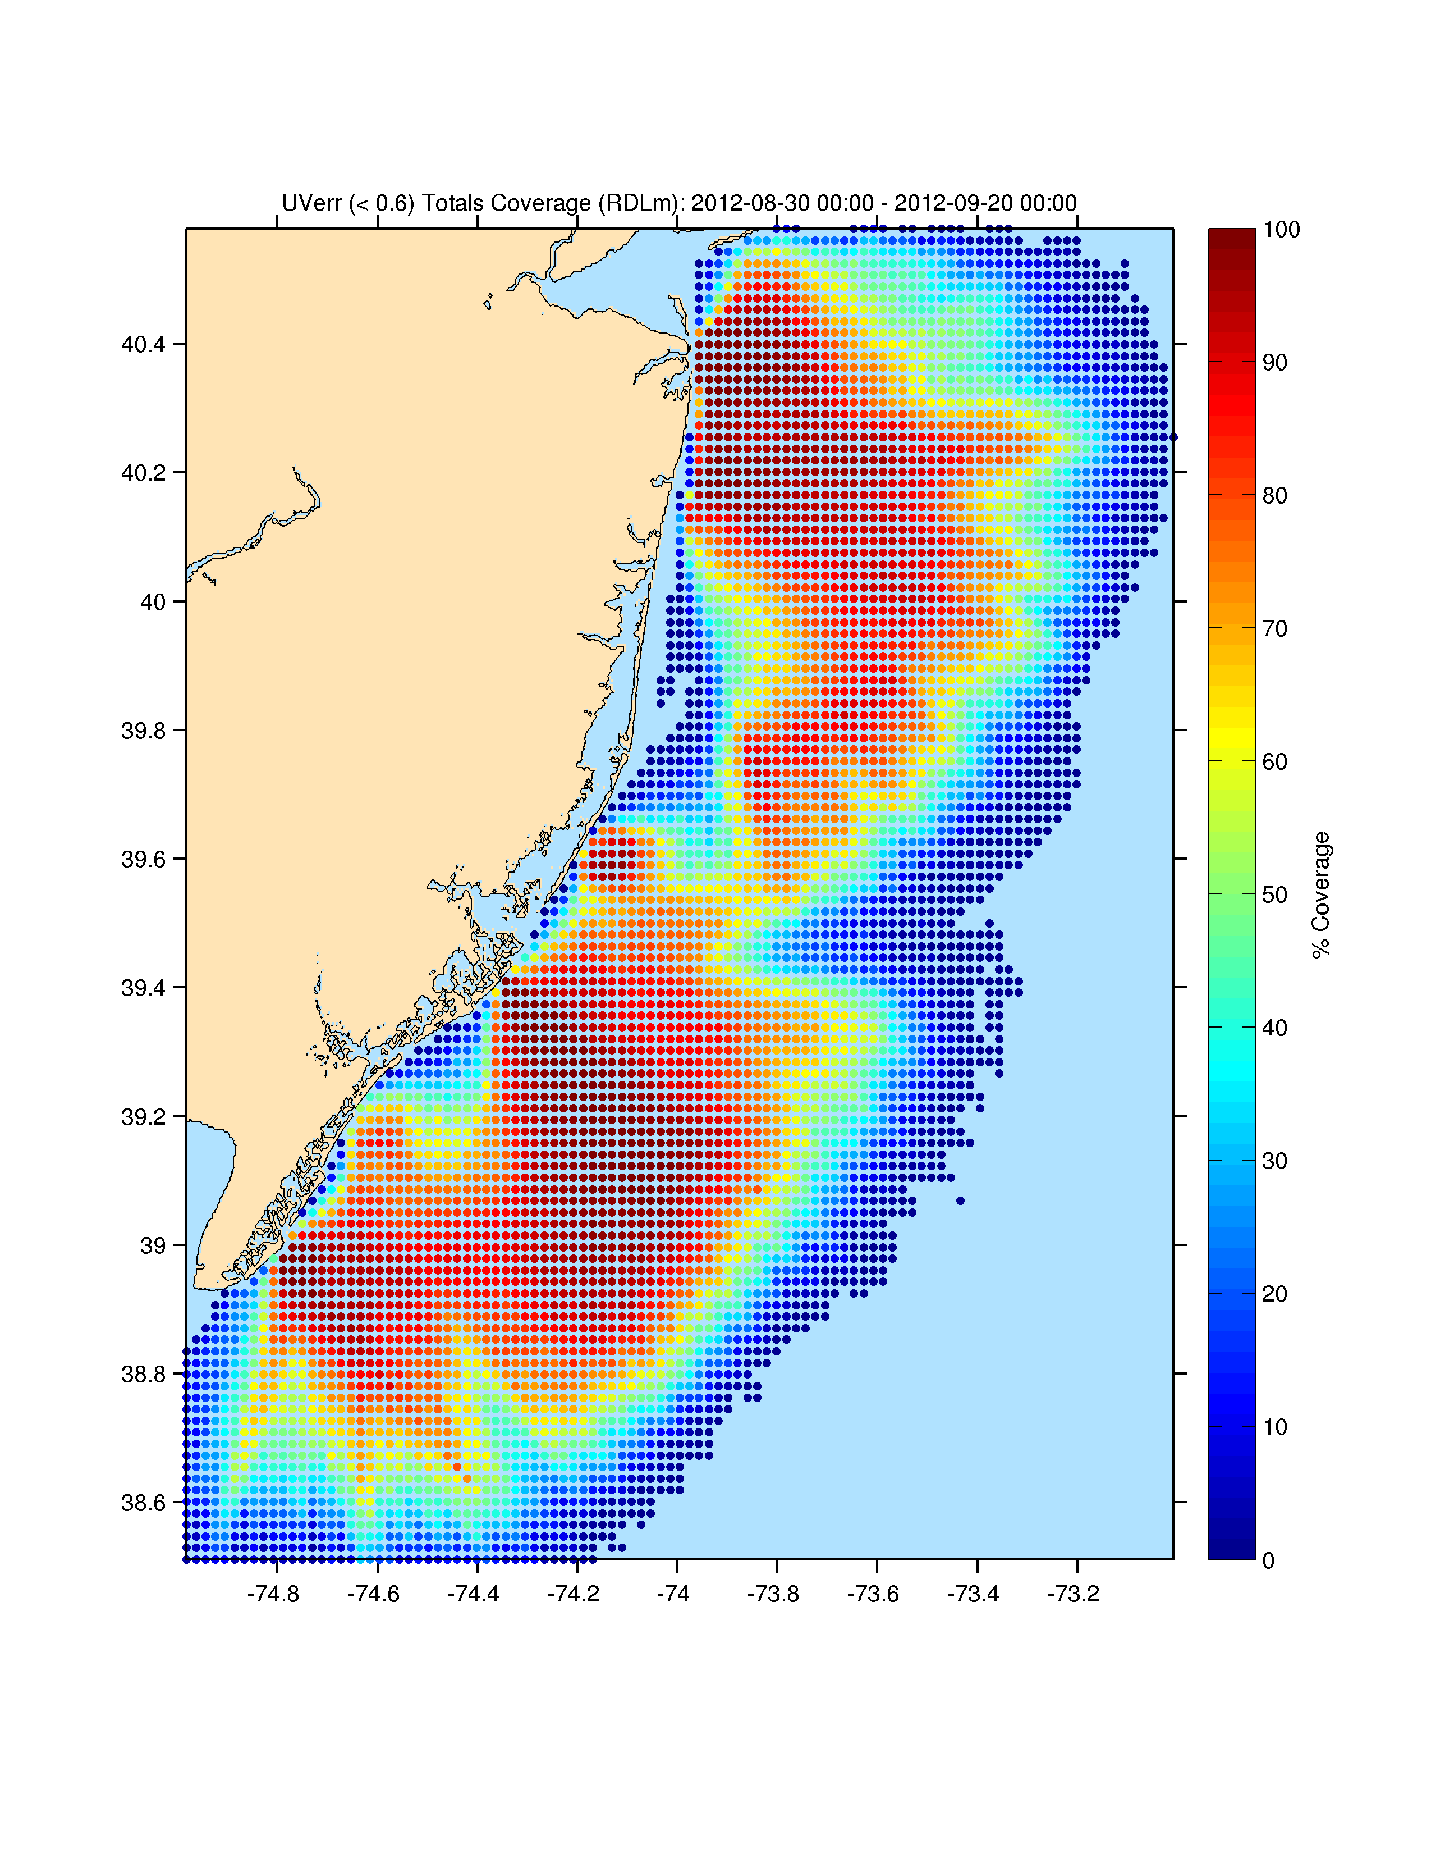
Total coverage monostatic
Notes:
HF radar units along the coast of NJ provide surface current measurements

Slide 18
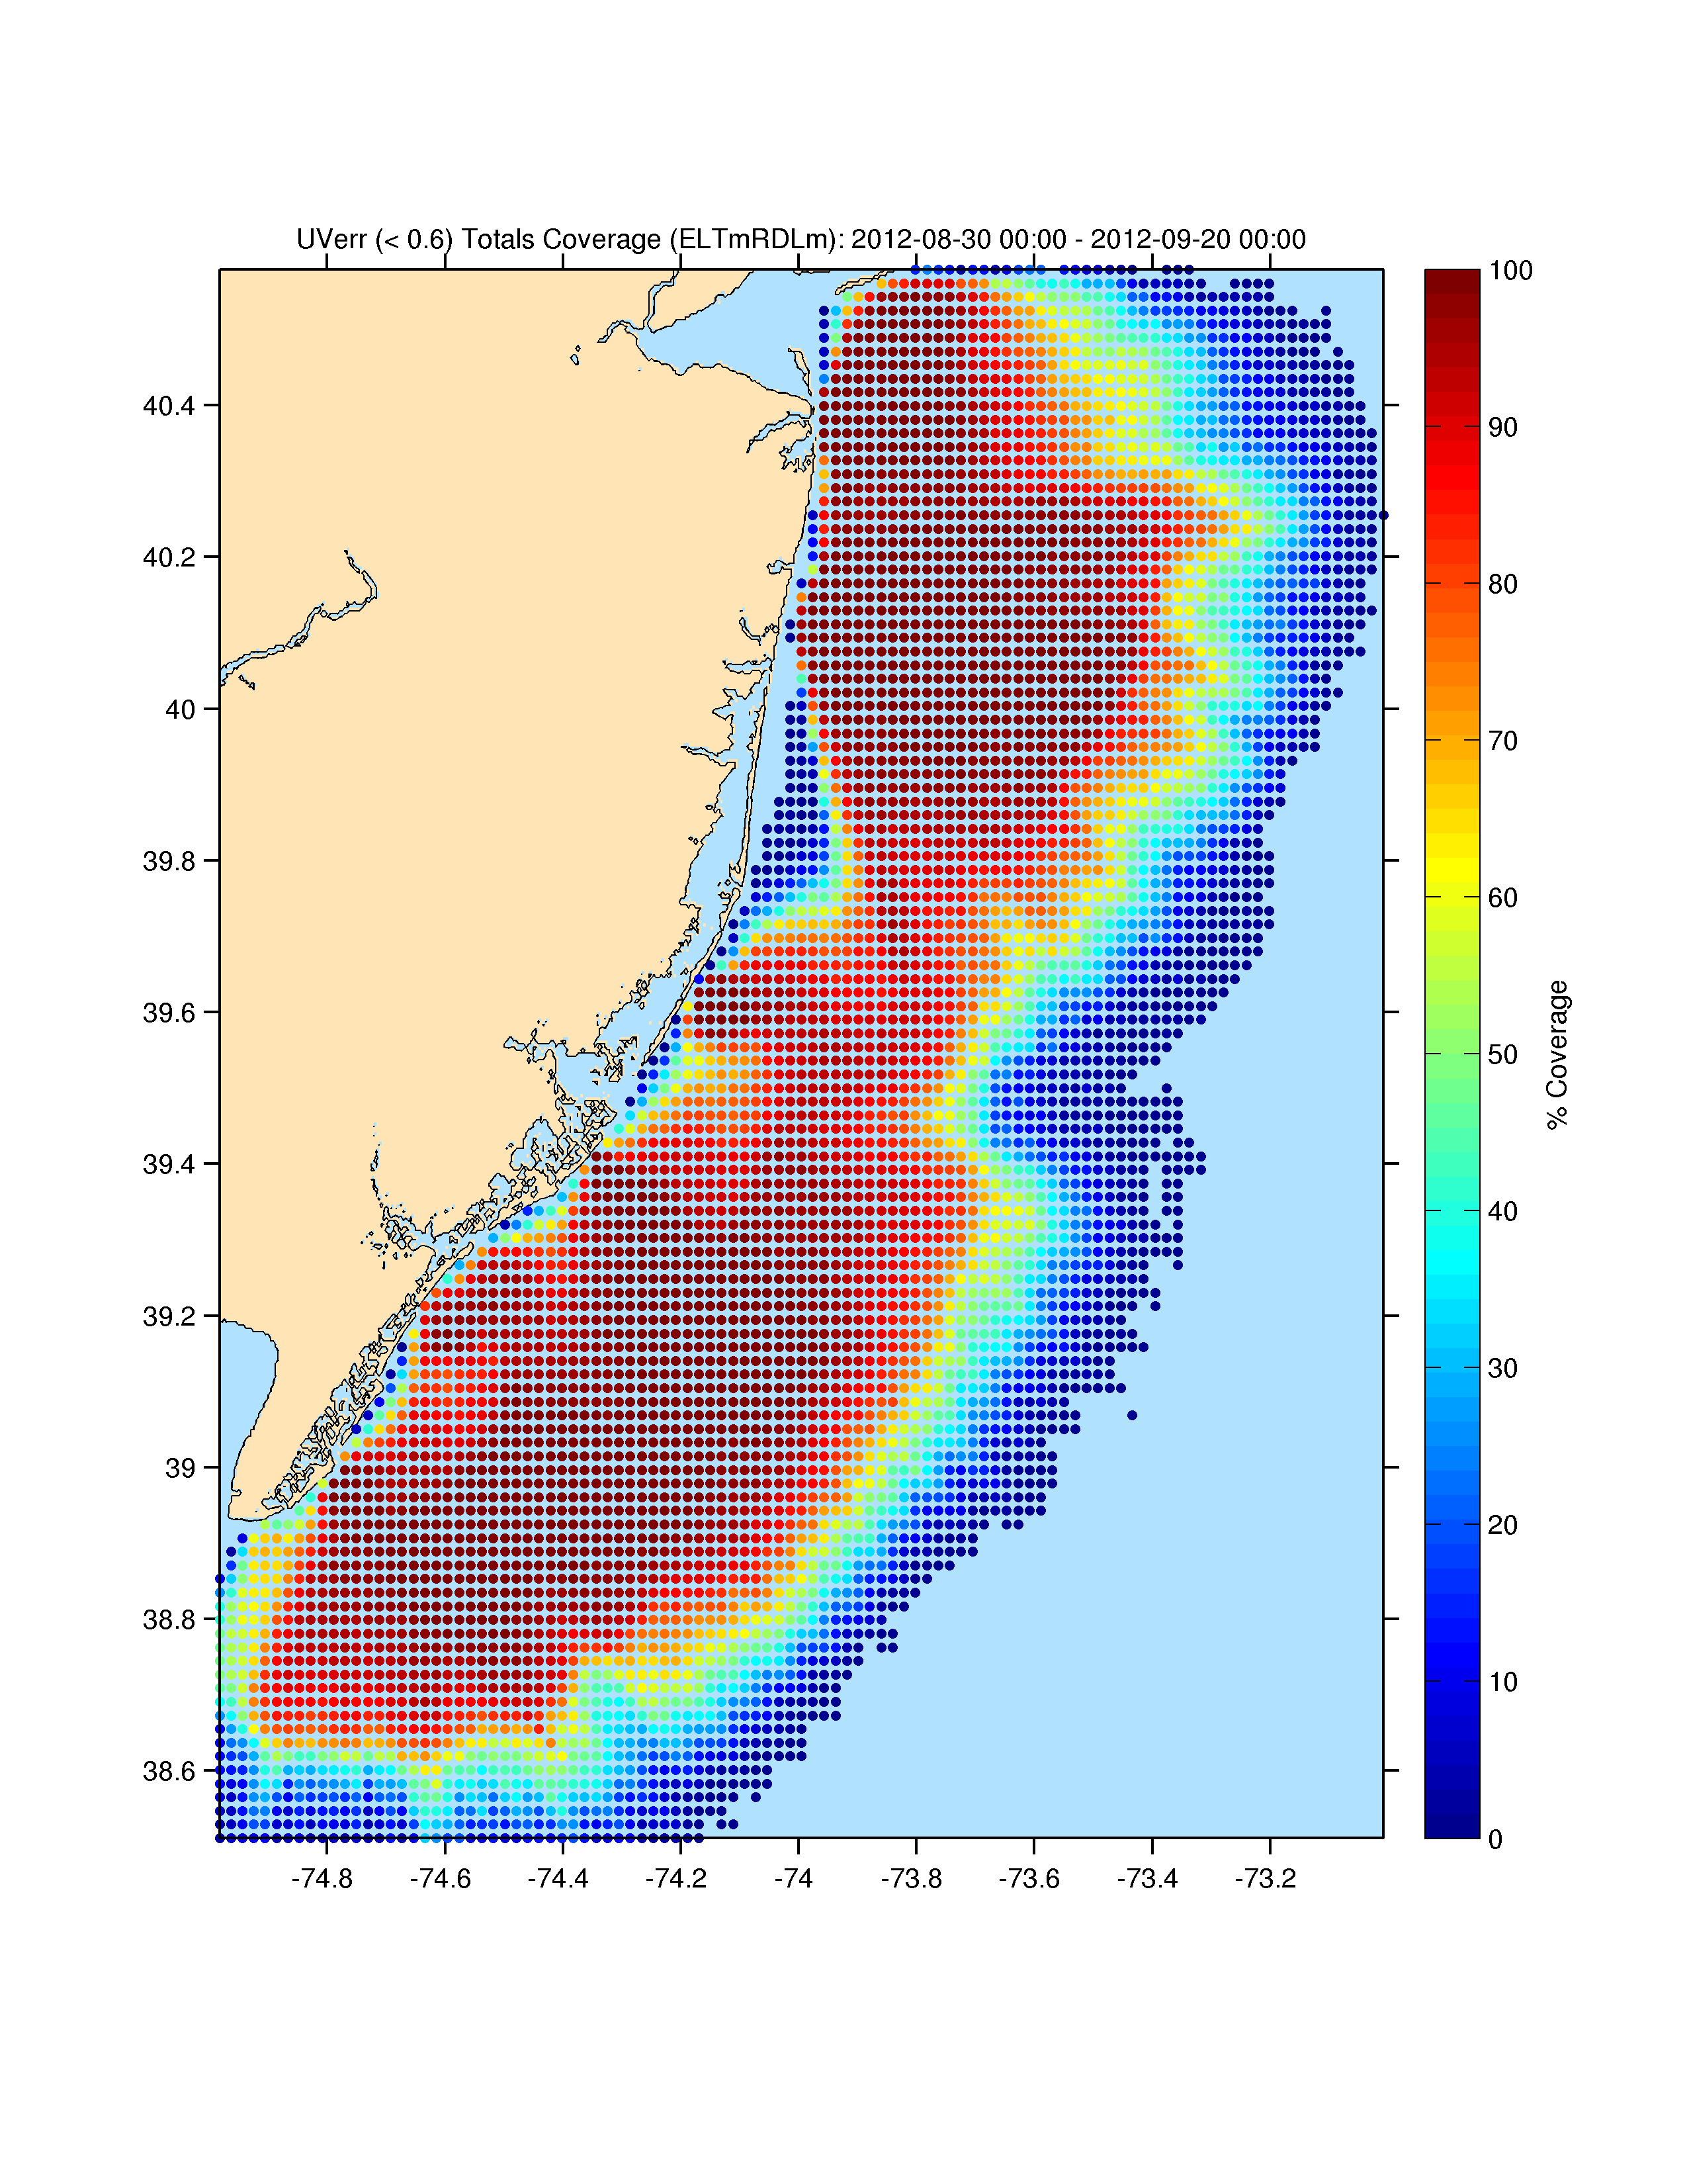
Total coverage with bistatic
Notes:
Total coverage along the whole NJ coast improves with the inclusion of bistatic data.

Slide 19
Conclusions
Elliptical data provides an additional independent view of ocean surface currents
Inclusion of bistatic decreases the overall error of surface current measurements
Bistatic also increases percent coverage
Use of measured patterns in vector-placement algorithm improves both monostatic and bistatic maps
Notes:
Next steps:
-Change grid size to utilize increased data density, resolve finer scale features
-Assess errors in bistatic

