Slide 1
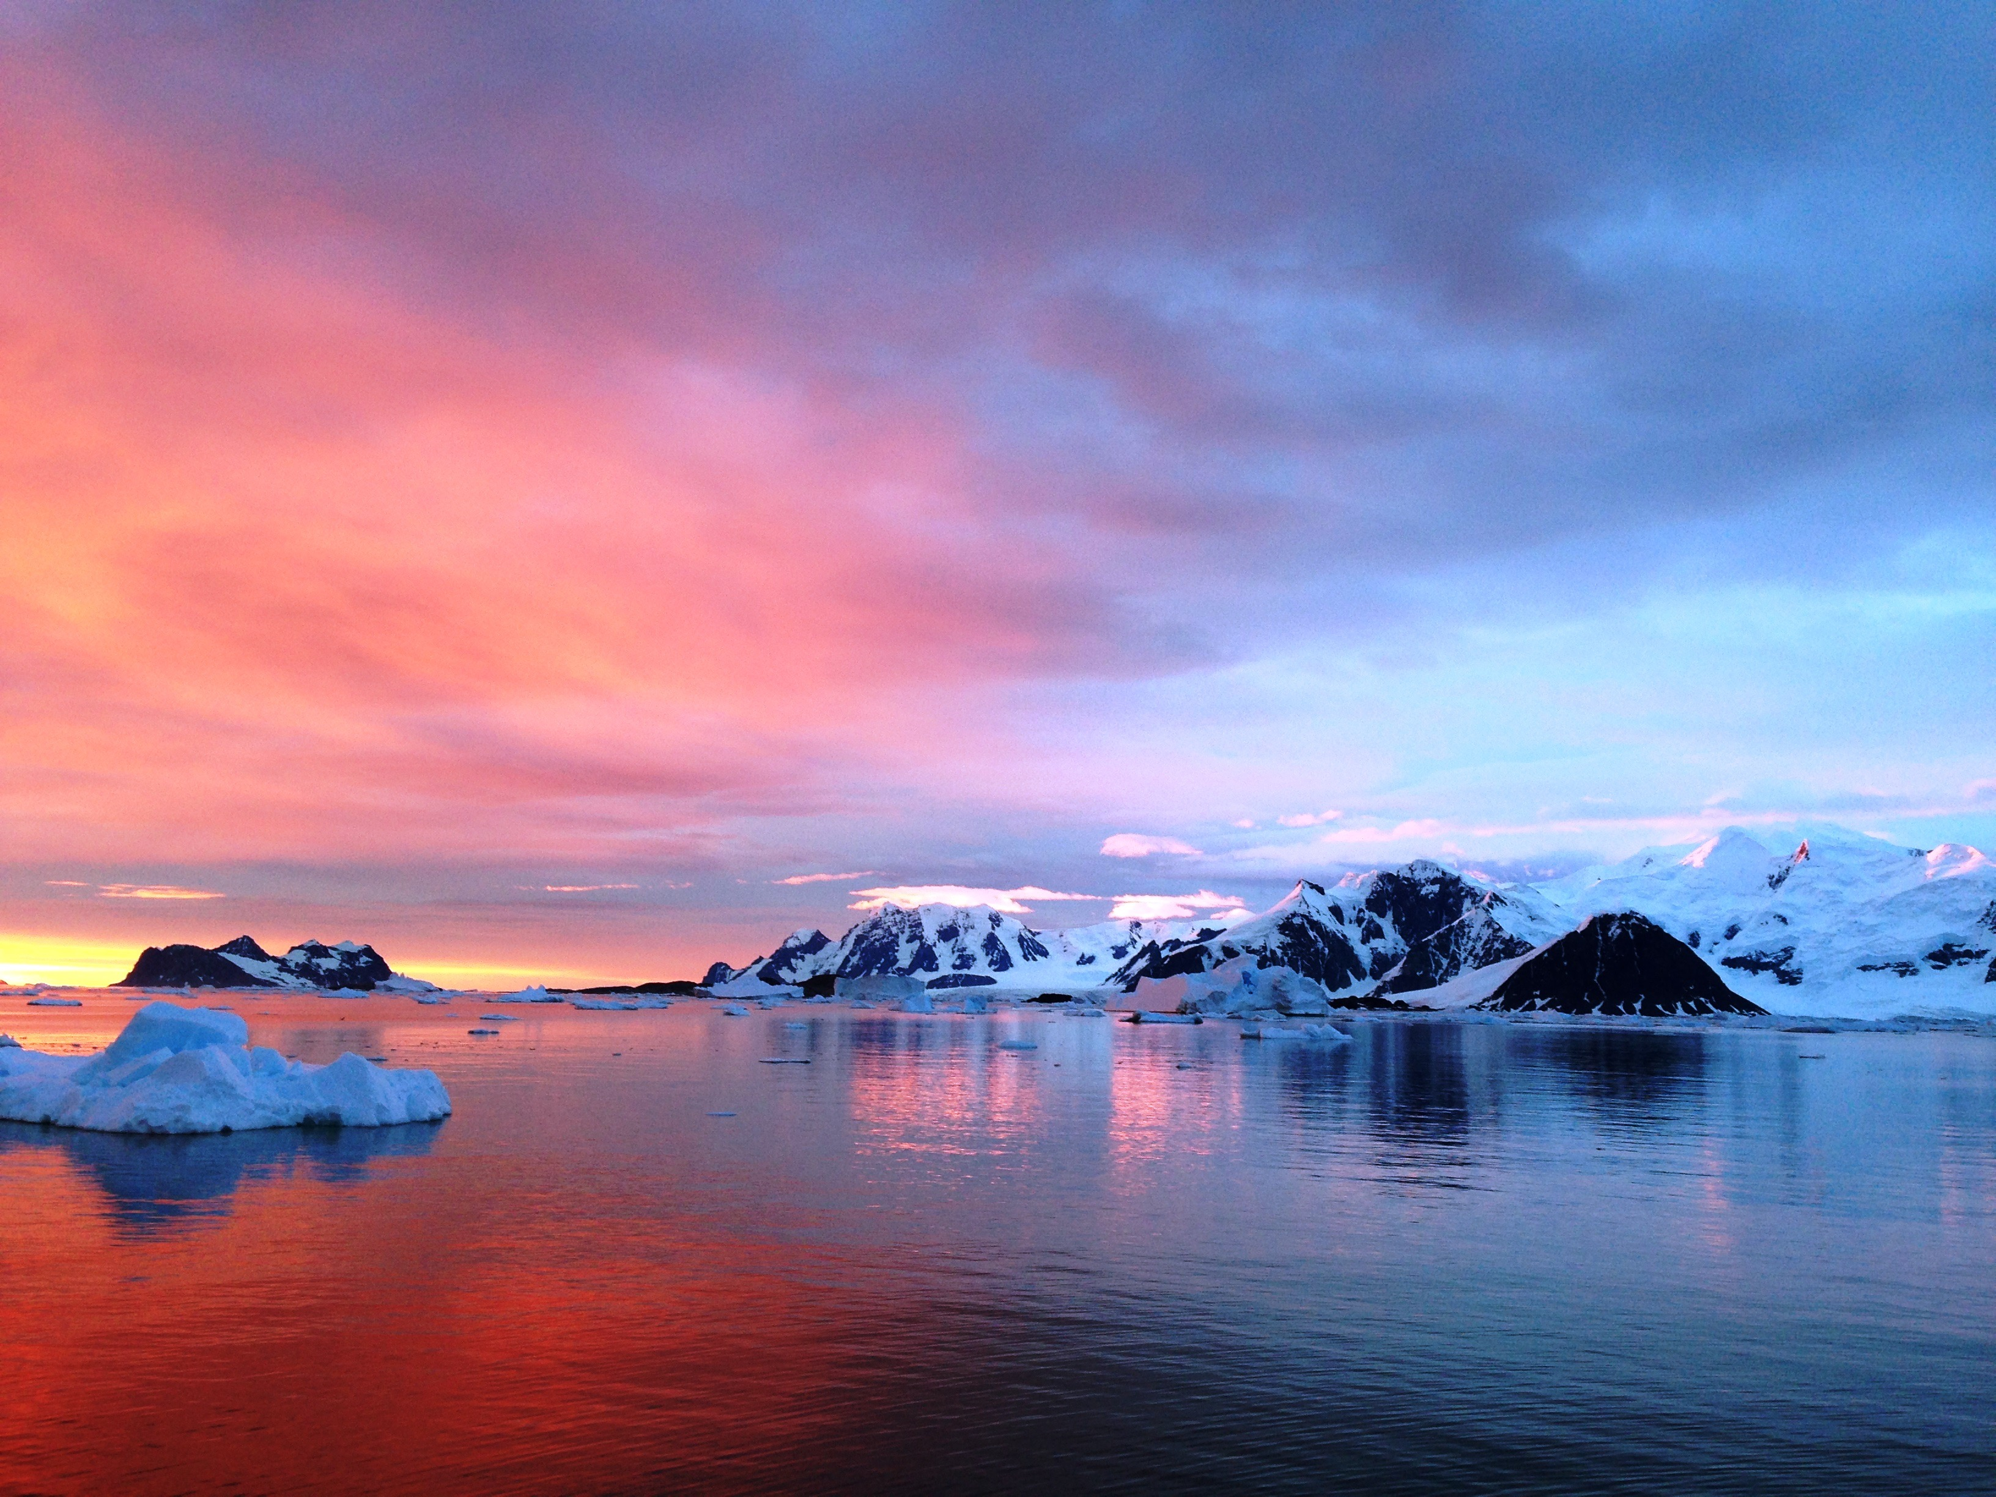

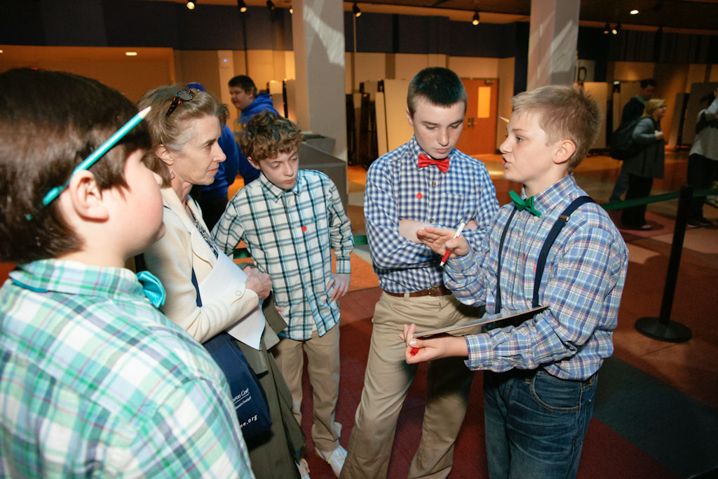
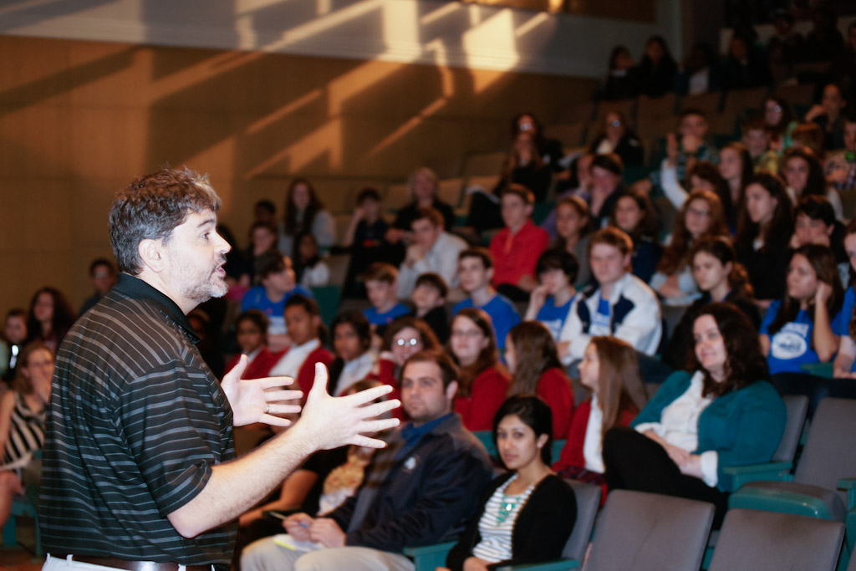
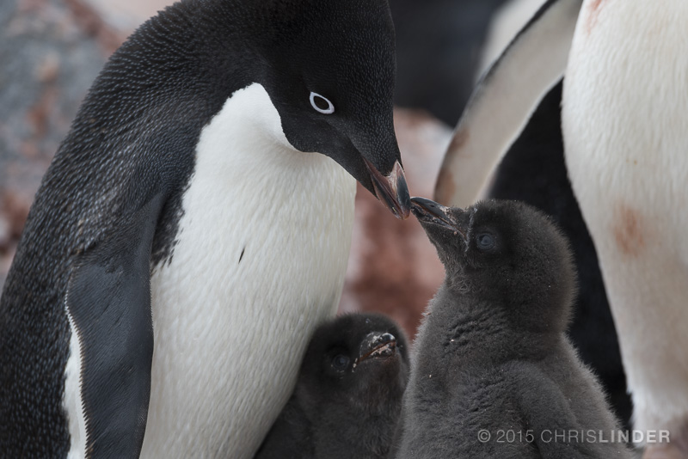
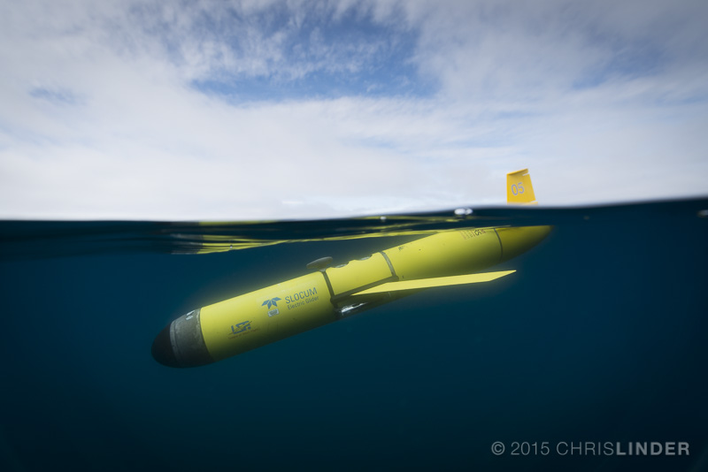
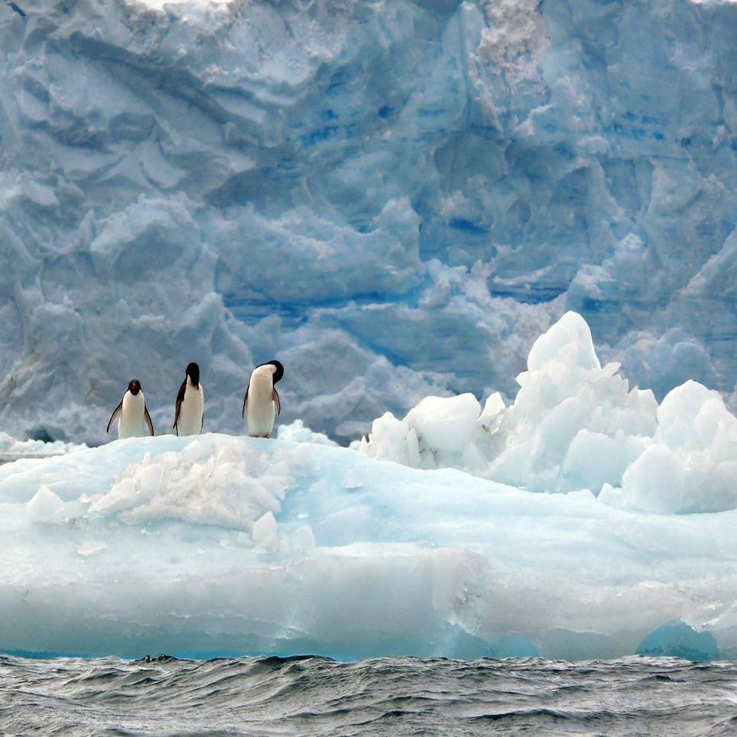
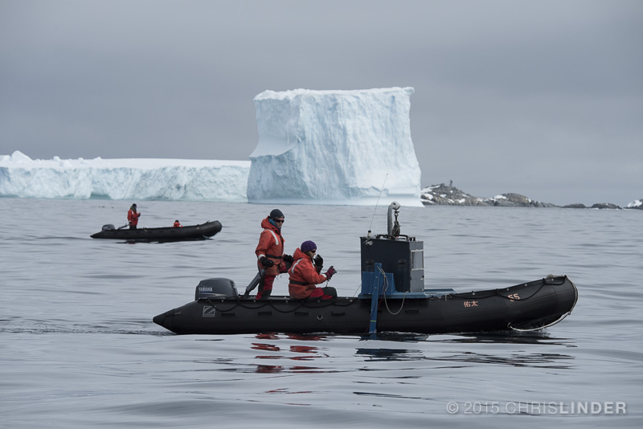
Bringing Society to a Changing Polar Ocean: Polar Interdisciplinary Coordinated Education (ICE)
Funded by NSF grant
#1525635
A program designed to connect scientists, educators, and students using data and research from the Arctic and Antarctic regions.
Project Team: Oscar Schofield, Janice McDonnell, Kristin Hunter Thomson, Sage Litchenwalner, Carrie Ferraro, Rutgers University; George Matsumoto, MBARI; Corey Garza, Bridgette Clarkson, University of California – Monterey Bay; Liesl Hotaling, EIDOS; Joan Middlendorf, University of Indiana; and Ari Shapiro, Open Minds Media
The Polar ICE team is a group of educators and scientists working together to share scientific research from the Arctic and Antarctica with middle school students. We partner both with scientists to communicate their science beyond their colleagues and academic peers, and collaborate with educators to bring polar science to the classroom highlighting the science research practices required for the Next Generation Science Standards (NGSS).
Changes in climate appear to be accelerating and scientists are trying to understand both the patterns and resulting impacts. Antarctica is the fastest warming place on Earth. Antarctica’s continental seas are critical water masses that play an important role in the transport of heat and carbon around the global ocean.
During the past half-century, along the midwinter surface atmospheric temperatures have increased by 6°C (5.4 times the global average) and 87% of the glaciers are in retreat. Polar ICE will engage students in polar research, and provide insight on the climate and environmental changes occurring at the Poles. Our efforts are focused the exploration of research data.
Who We Are:
What We Do:
Join Our Team:
Our mission is to connect Polar scientists with broader audiences to further the impact of their research, while connecting educators and students with data and cutting edge science.
Our work focuses on sharing the story of how polar science is done by highlighting the science skills and practices, explore science data, and make meaning from scientific information.
Scientists are welcome to join our team by:
l Participating in our professional workshops.
Writing Criterion II/Broader Impact Statements to collaborate on creating/supporting education and outreach programs.
Scientists will work with the Polar ICE staff to develop a science communication approach for their selected outreach event. Scientists can participate in: a) Ask a Polar Scientist for the Polar ICE website b) Present at an education conference or webinar with Polar ICE staff; c) Participate in an educator professional development workshop, d) Engage with underserved and underrepresented students at one of four Polar ICE Student Research Symposiums.
One of Polar ICE’s signature programs will be Student Research Symposia where middle and high school students work with research scientists to learn about oceanographic research taking place at the poles. Participating educators attend a summer professional development program and teach data focused classroom lessons. Students attend a Spring Research Symposium, where they will create science posters and meet the scientists.
Polar ICE is designed to:
Build capacity of polar scientists to communicate with diverse audiences.
Polar ICE will provide 60 polar scientists, including late-stage graduate students, post doctoral researchers, and principal investigators, with a blended learning opportunity consisting of a face-to face workshop, follow-up webinars, and hands-on opportunities to apply the new skills. The workshop includes cultural competency training; deconstructing and decoding science for non-expert audiences; and the art of telling science stories. Scientists will have opportunities to network with members of the education and outreach community and improve their communication skills.
Create opportunities for educators and students to engage with polar scientists and their research. Polar ICE will offer a variety of professional development programs for middle and high school educators and students interested in virtually joining polar science missions. There are numerous pathways for connecting to polar research including access to data visualizations, data activities, educator workshops and webinars. Educators can work side-by- side with scientists to develop data activities through the EARTH workshop or participate in the Science Investigation (Sci-I) workshop and bring students to a Student Research Symposium.
Evaluate Polar ICE and contribute to our broader understanding of science education practices. Polar ICE will explore the evidence of student engagement in data-focused classroom activities, and their ability to access a personal identity as a scientist. Our evaluation program will include surveys of both educators and scientist collaborators.
Educators are welcome to join our team by:
Participating in our workshops or webinars.
Helping us design and implement activities and programs focused on bringing polar research and the science practices to the classroom. Polar ICE will offer two types of professional development opportunities:
EARTH Program, developed and sponsored by MBARI, will engage educators in the development of innovative lessons plans that use authentic polar data.
Science Investigation Educator (Si-I) workshops are designed to increase student skills in designing and conducting science investigations as well as analyzing and interpreting data in alignment with NGSS requirements. Educators participating in the Si-I workshops will be invited to attend the Student Polar Research Symposia, where students develop science posters and meet polar scientists.

