Slide 1
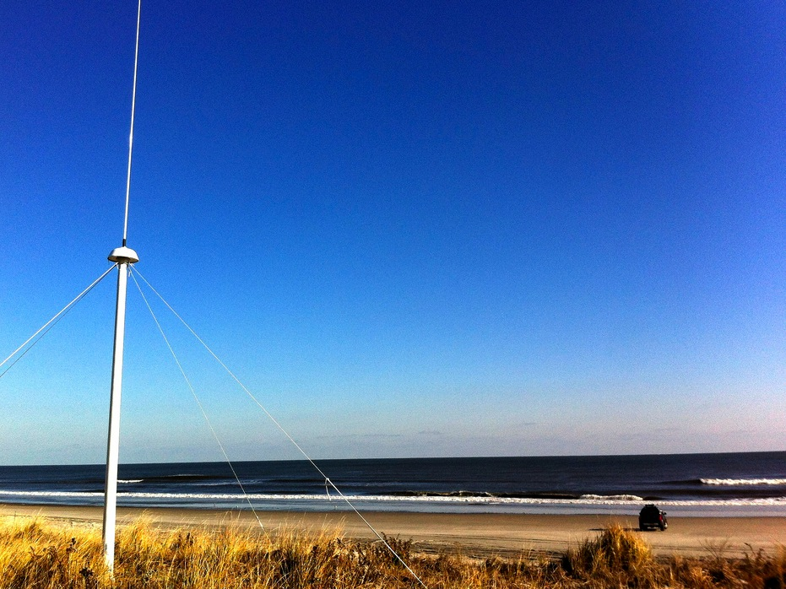




Measuring Waves with a Compact HF Radar
Mr. Robert Forney
Dr. Hugh Roarty
Dr. Scott Glenn
MTS/IEEE OCEANS15
October 2015
Washington DC

Slide 2
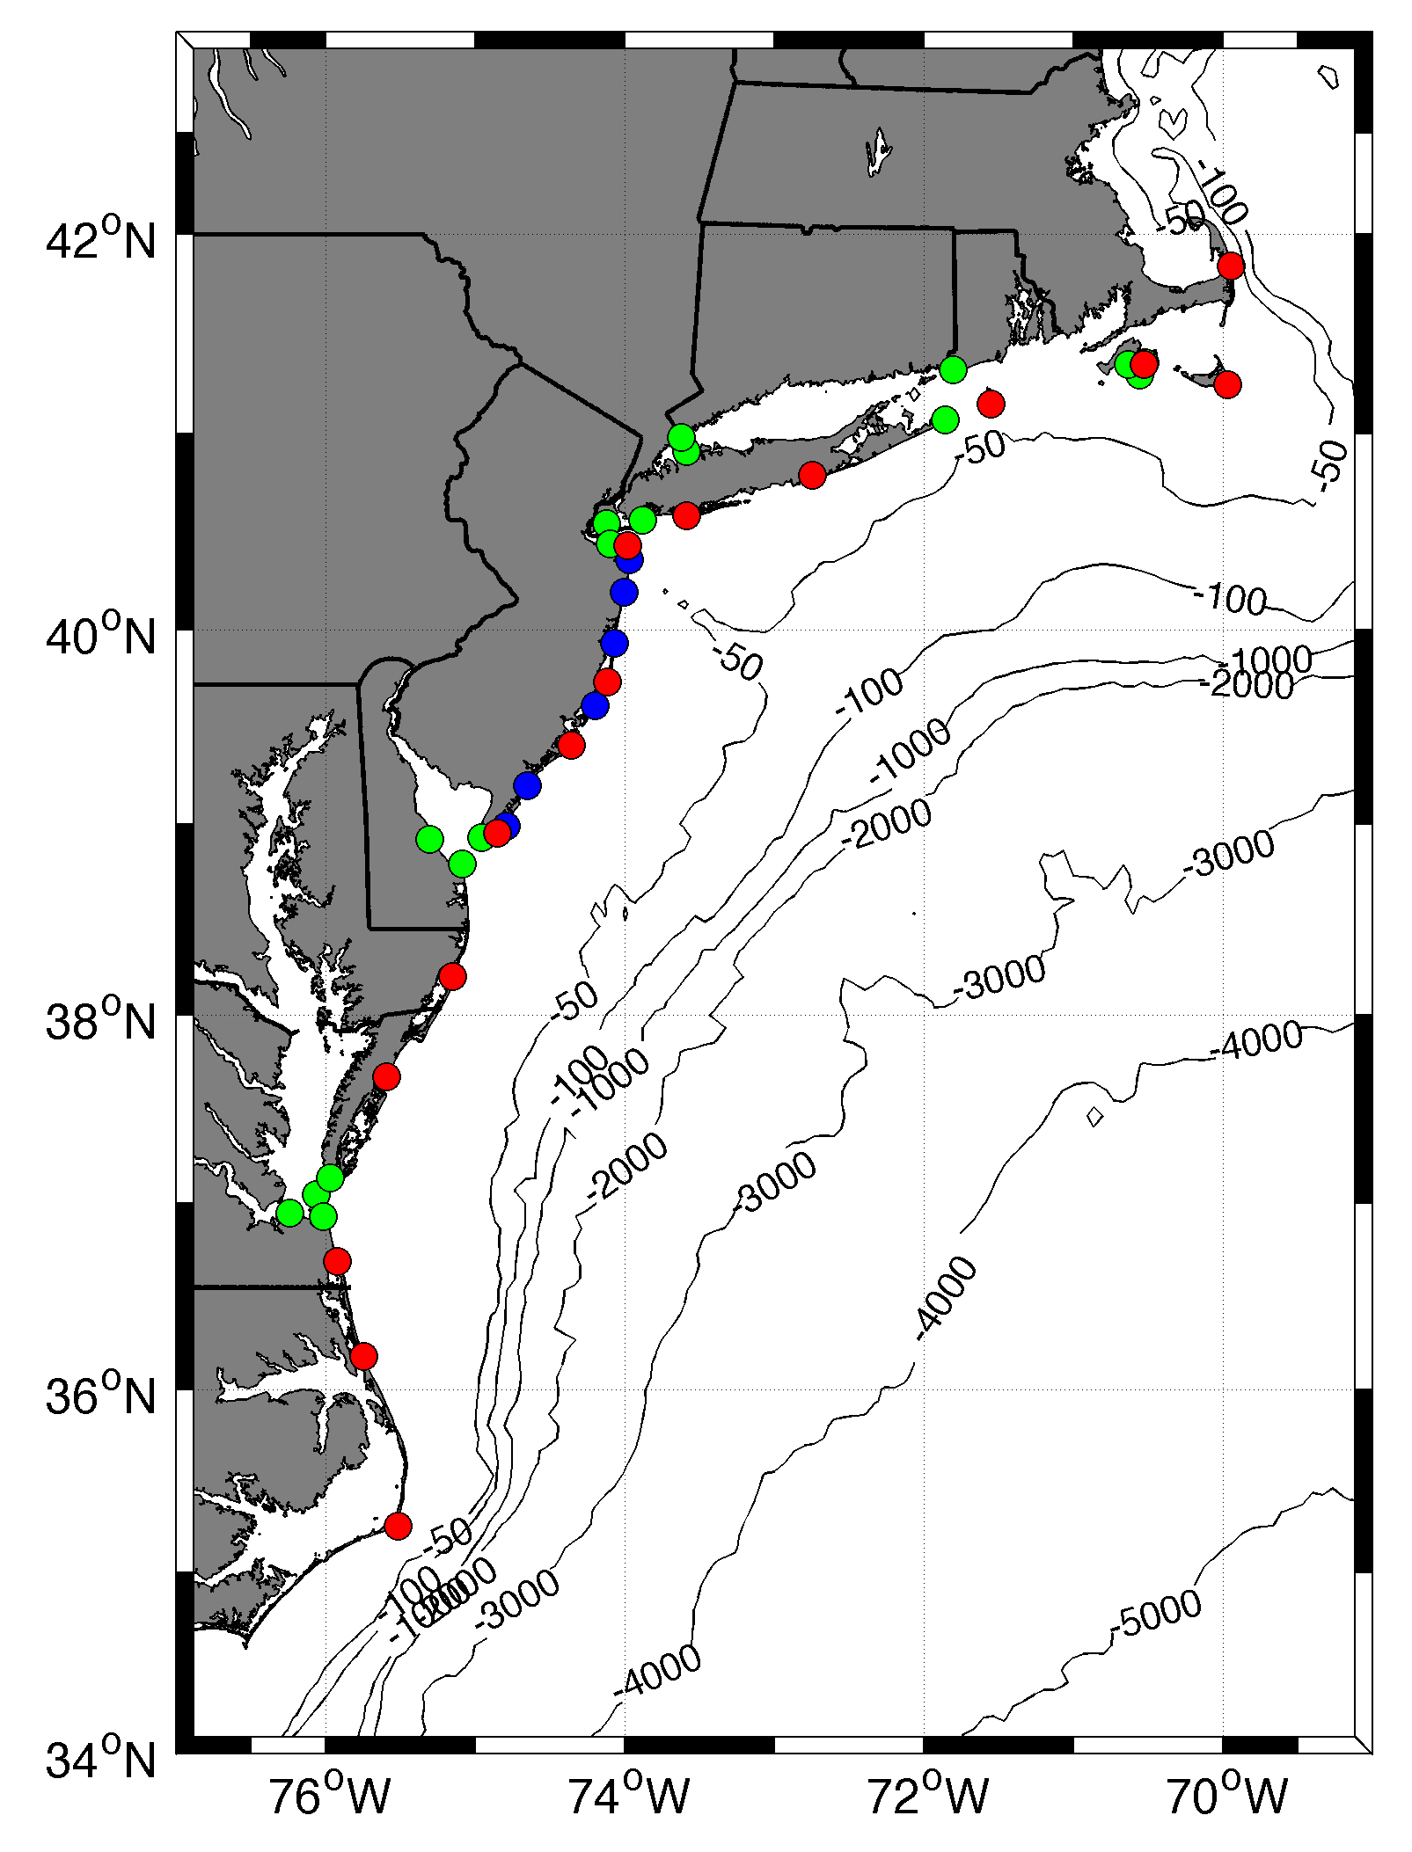










MARACOOS HF RADAR NETWORK
 | 5 MHz | 13 MHz | 25 MHz
U Mass
WHOI
U Conn
URI
Stevens
Rutgers
Delaware
ODU/CIT
UNC
9 | 17 | 8 | 17
42 Stations in Total

Slide 3
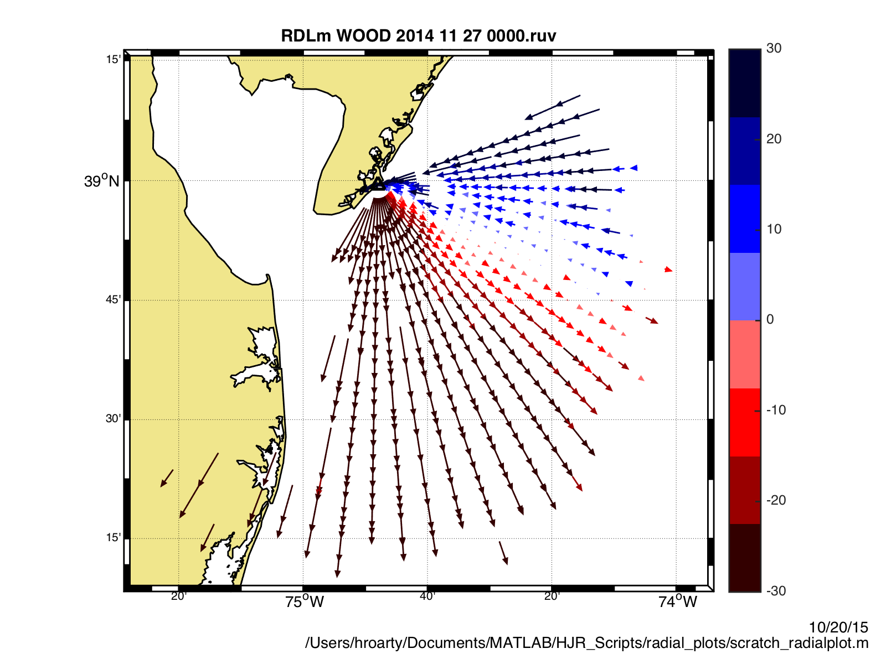
Radial Velocity Measurement

Slide 4
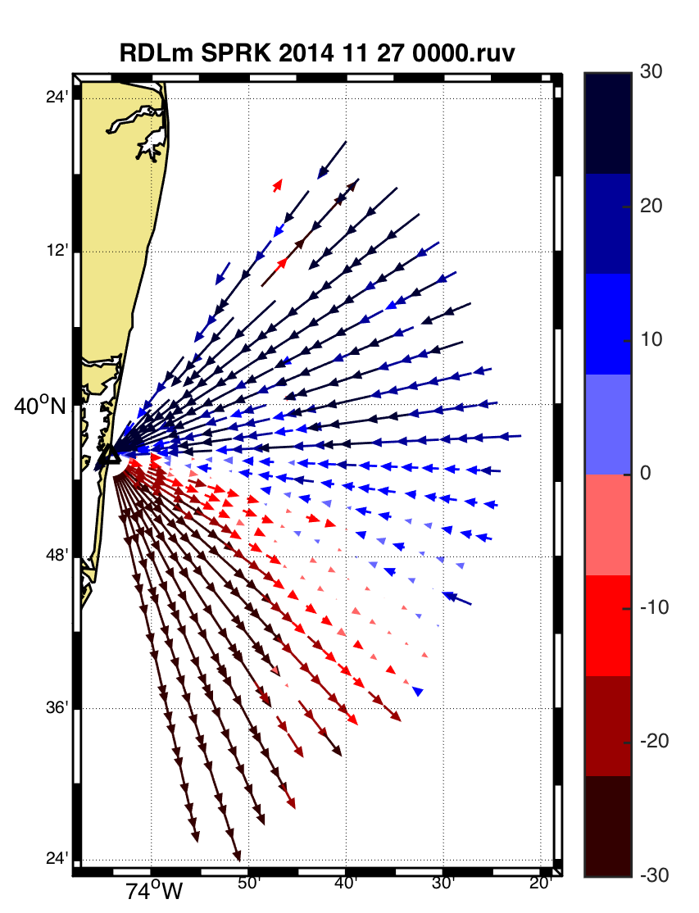
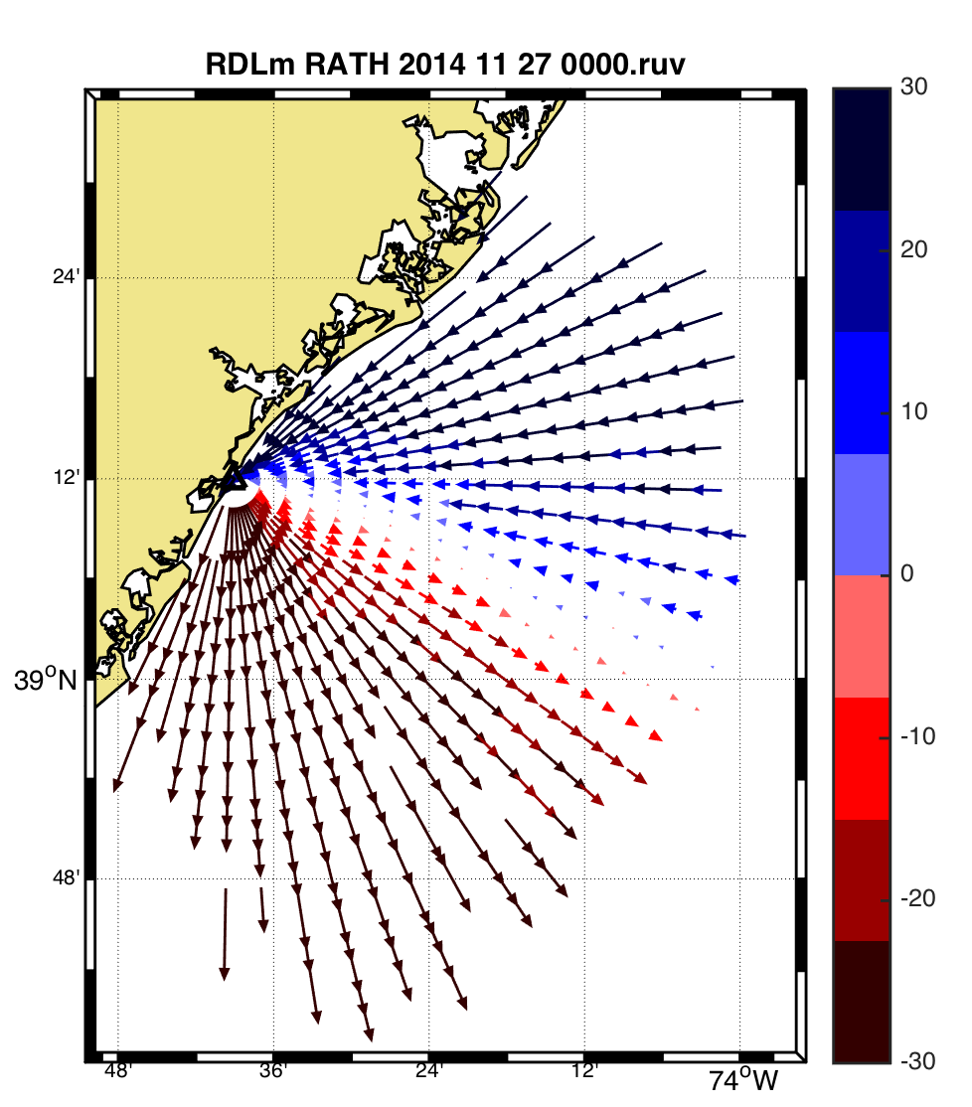
Combine Radial Velocity Measurements

Slide 5
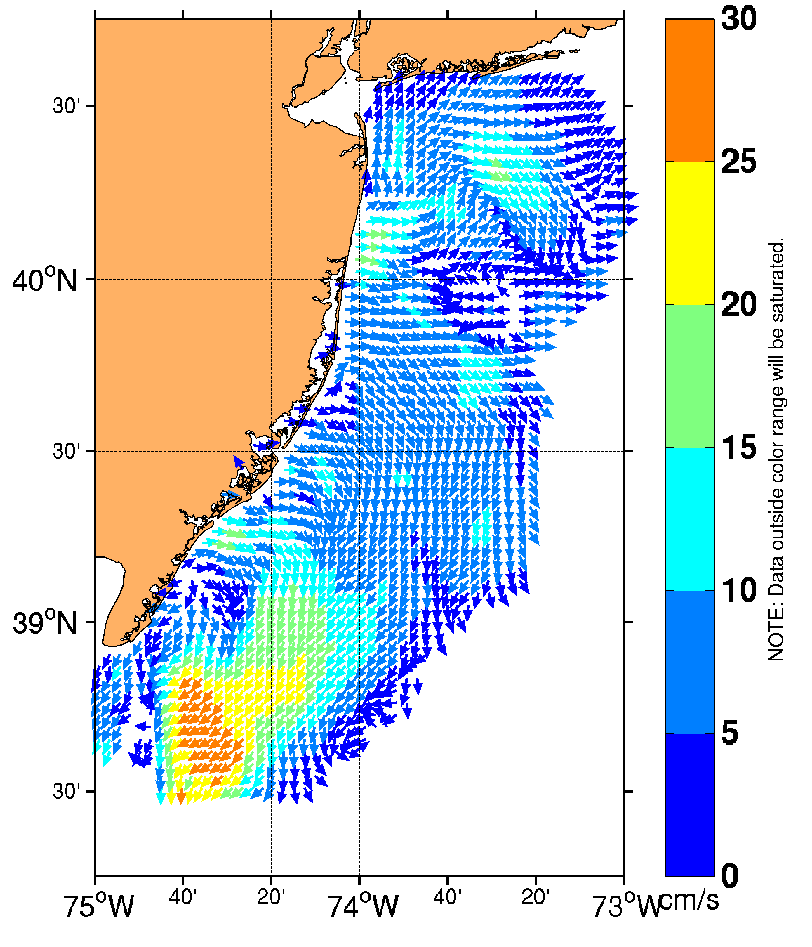
Total Vector
Surface Current Measurements

Slide 6
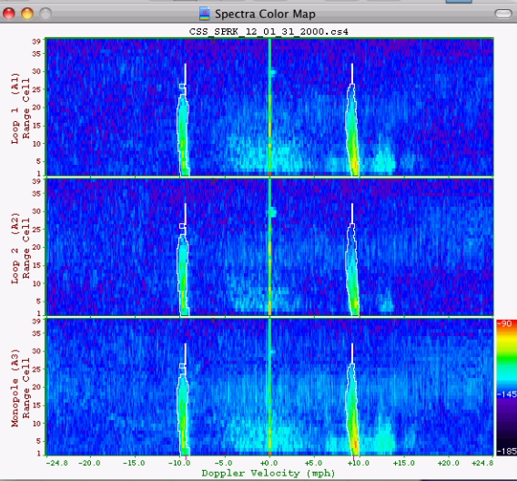
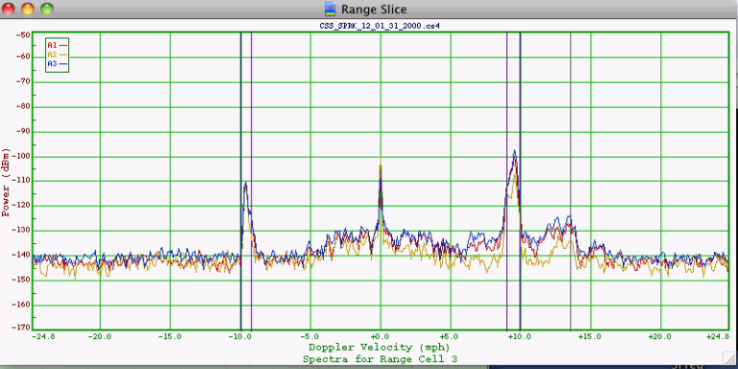
Spectra From the Radar

Slide 7
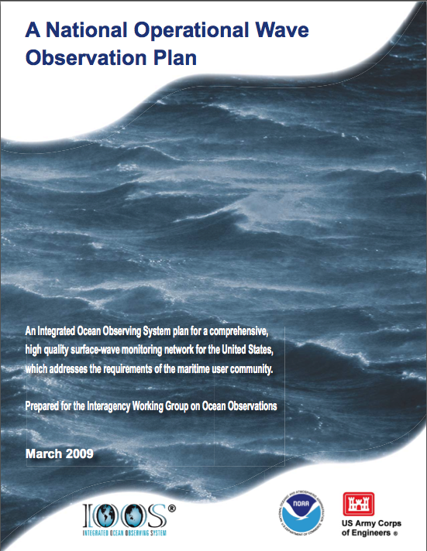
National Waves Plan
Location | New Sensors | Total Acquisition Cost | Unit Acquisition Cost
Offshore | 13 | $3.9M | $300,000
Outer Shelf | 17 | $3.9M | $229,000
Inner Shelf | 19 | $2.3M | $120,000
Coastal | 66 | $7.9M | $120,000

Slide 8
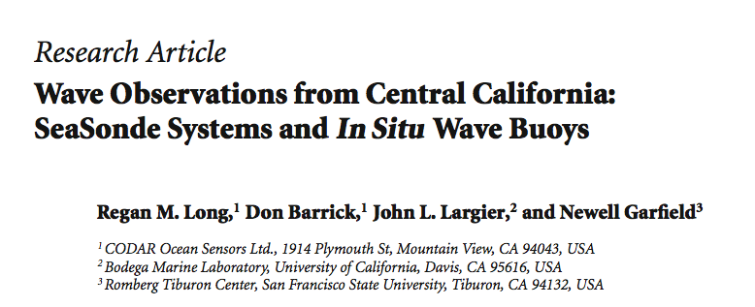
West Coast HF Radar Measurements
2011 Journal of Sensors
Average correlation with wave buoys: 0.88
Root mean square difference: 0.53 m
Standard Deviation of difference: 0.48 m

Slide 9
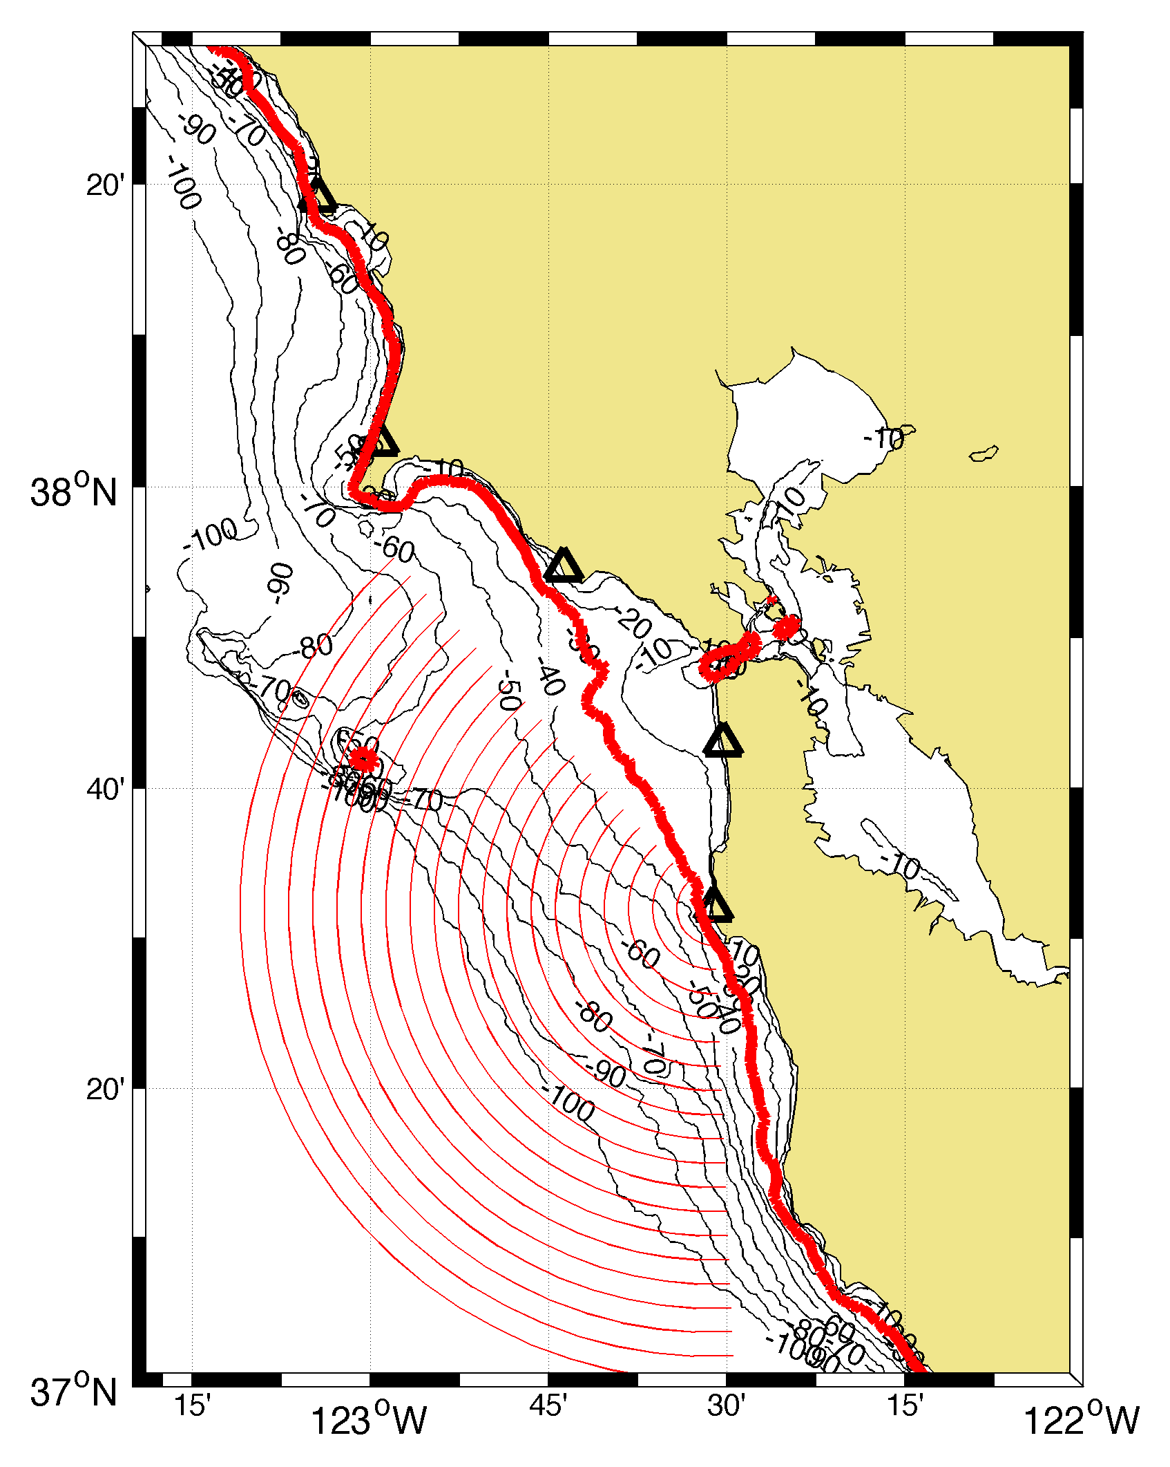
West Coast Bathymetry
Long (2011) used five 13 MHz HF Radars along California coast
30 meter isobath

Slide 10
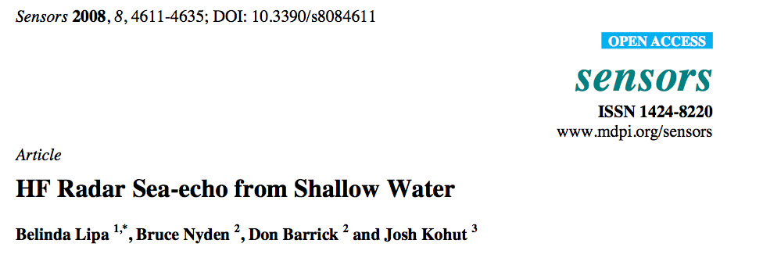
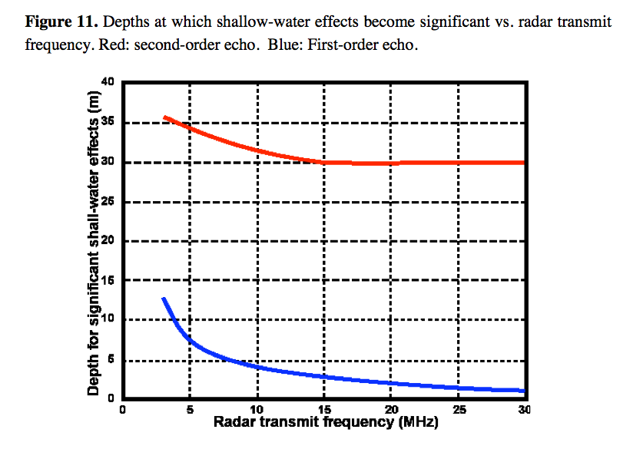
Second Order - Waves
First Order - Currents

Slide 11
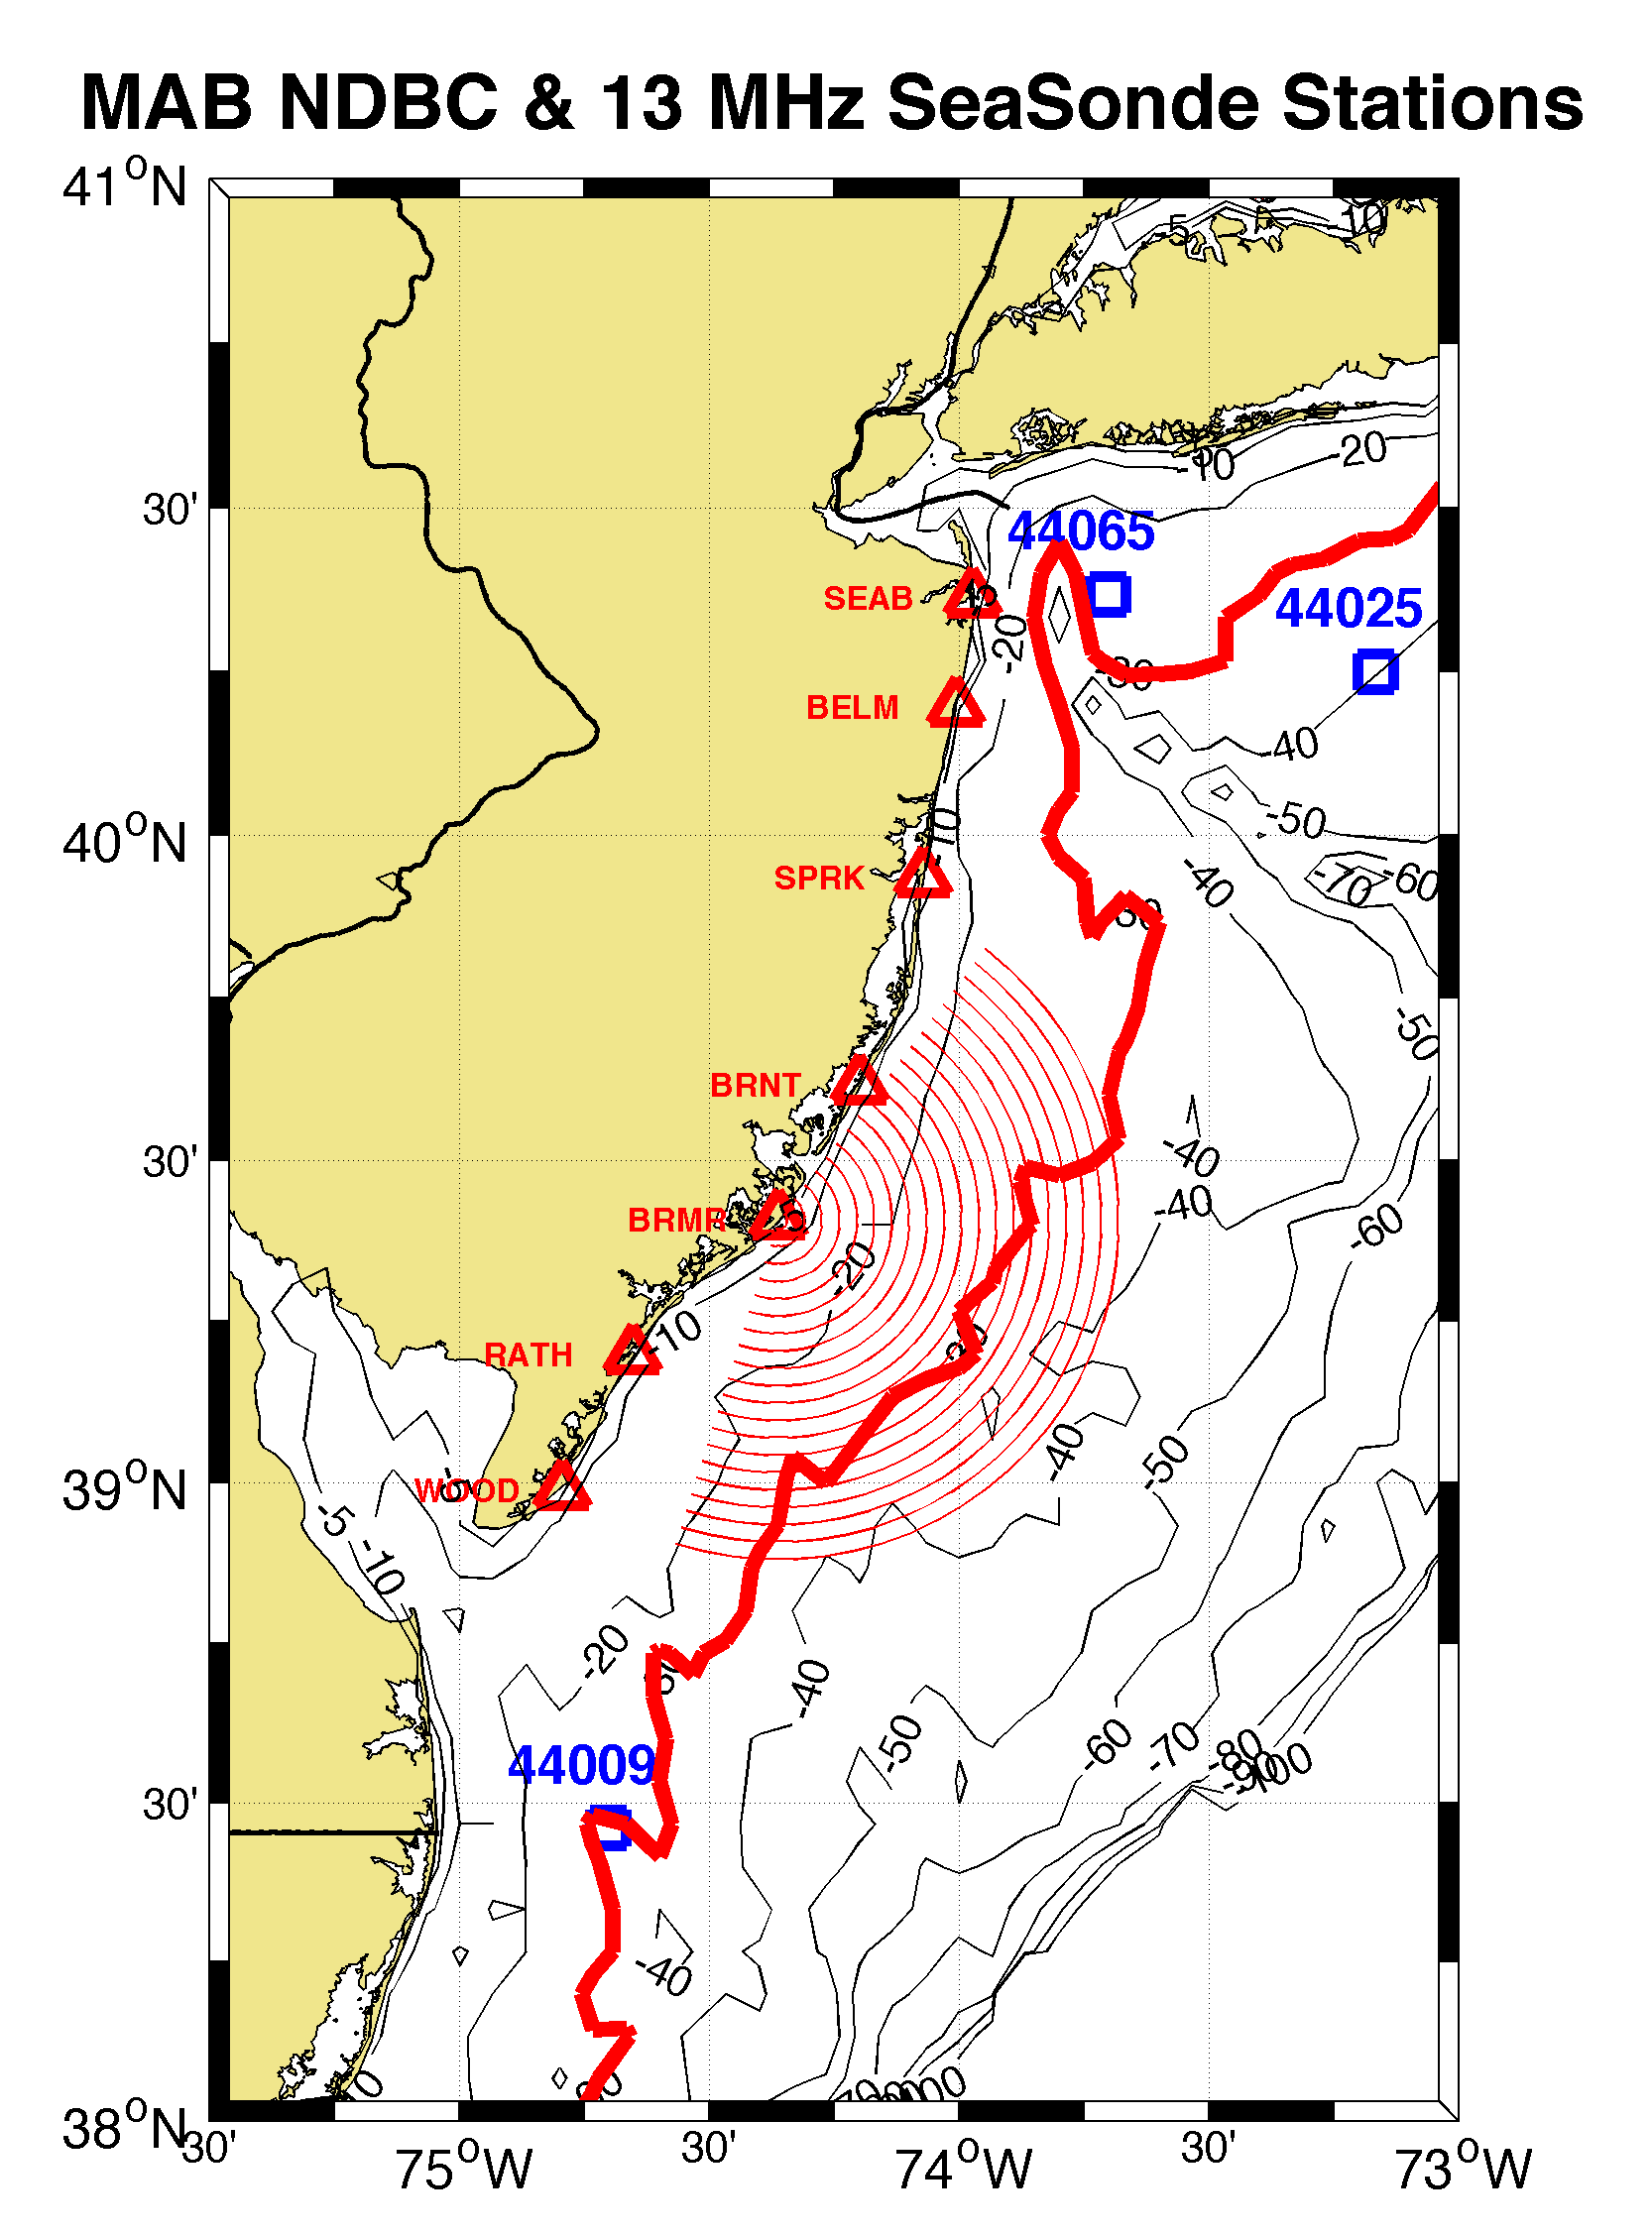
New Jersey Study Area 13 MHz
BRAD
30 meter isobath

Slide 12
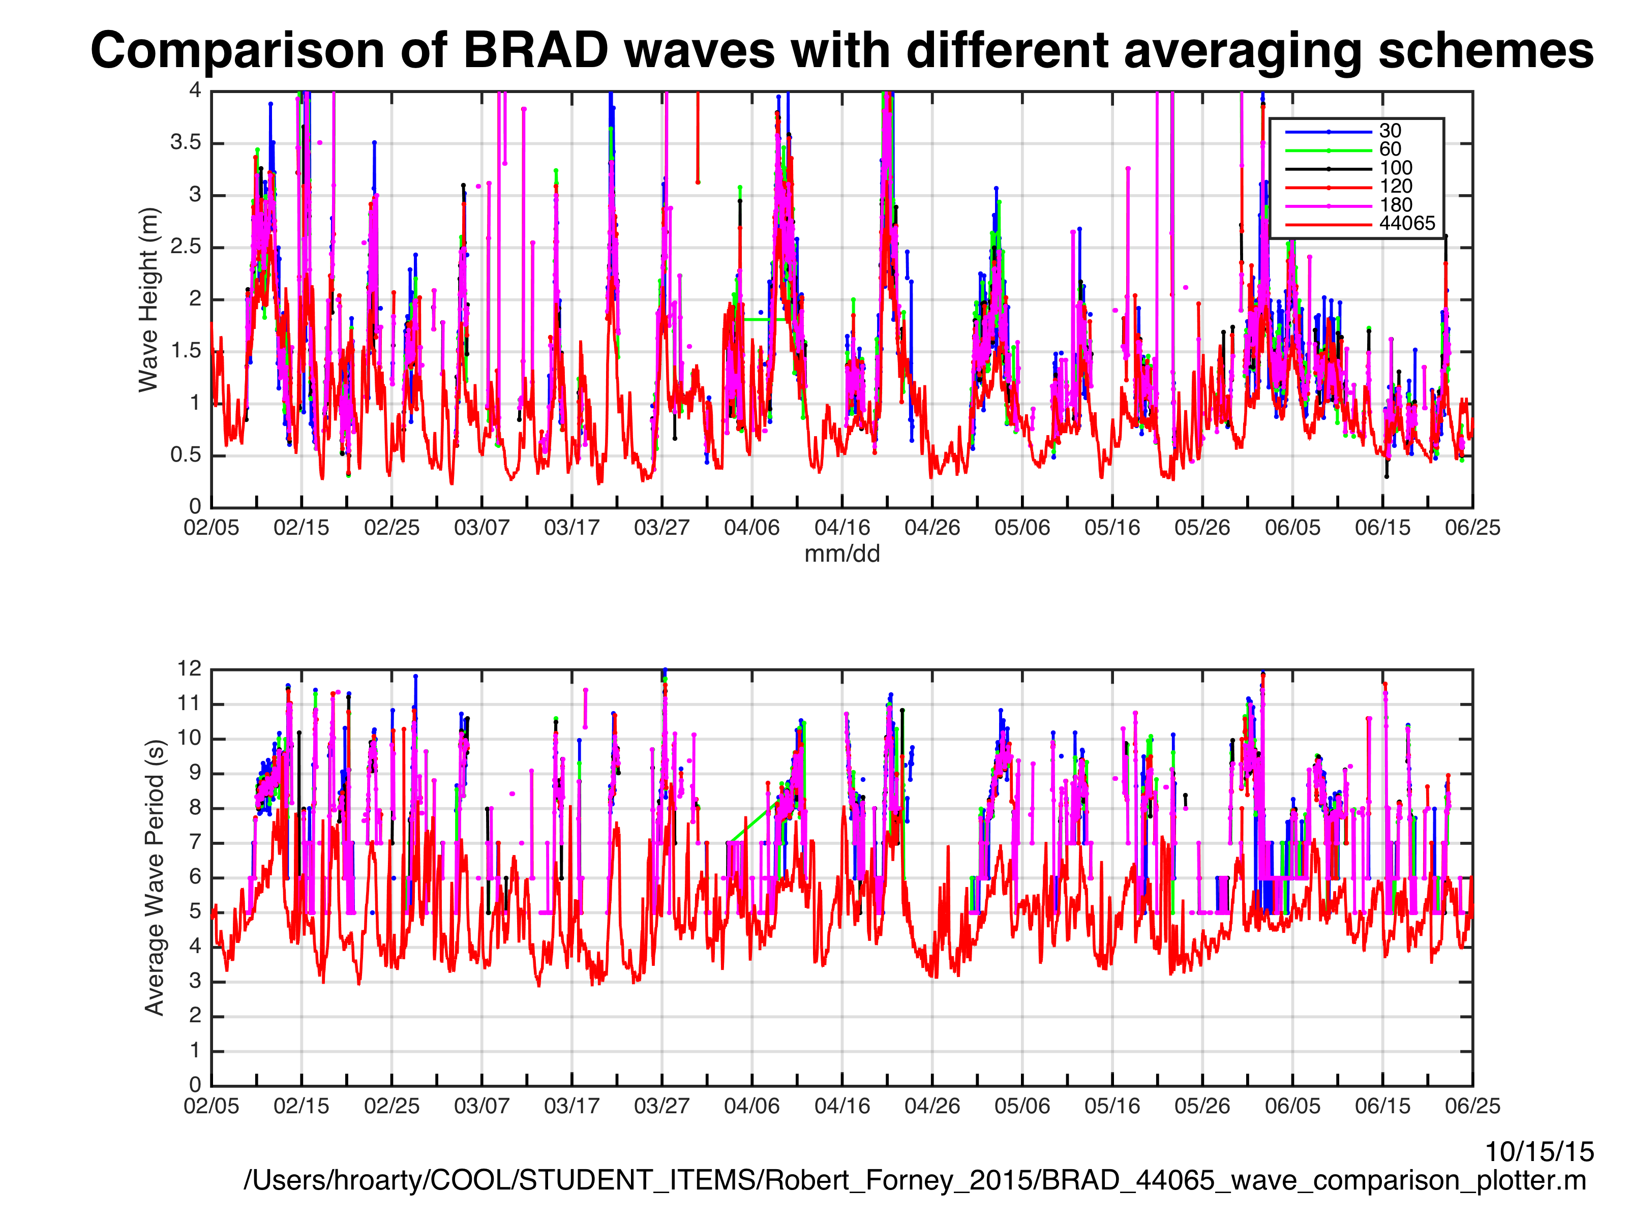
Range Cell 2 for all HF radar measurements

Slide 13
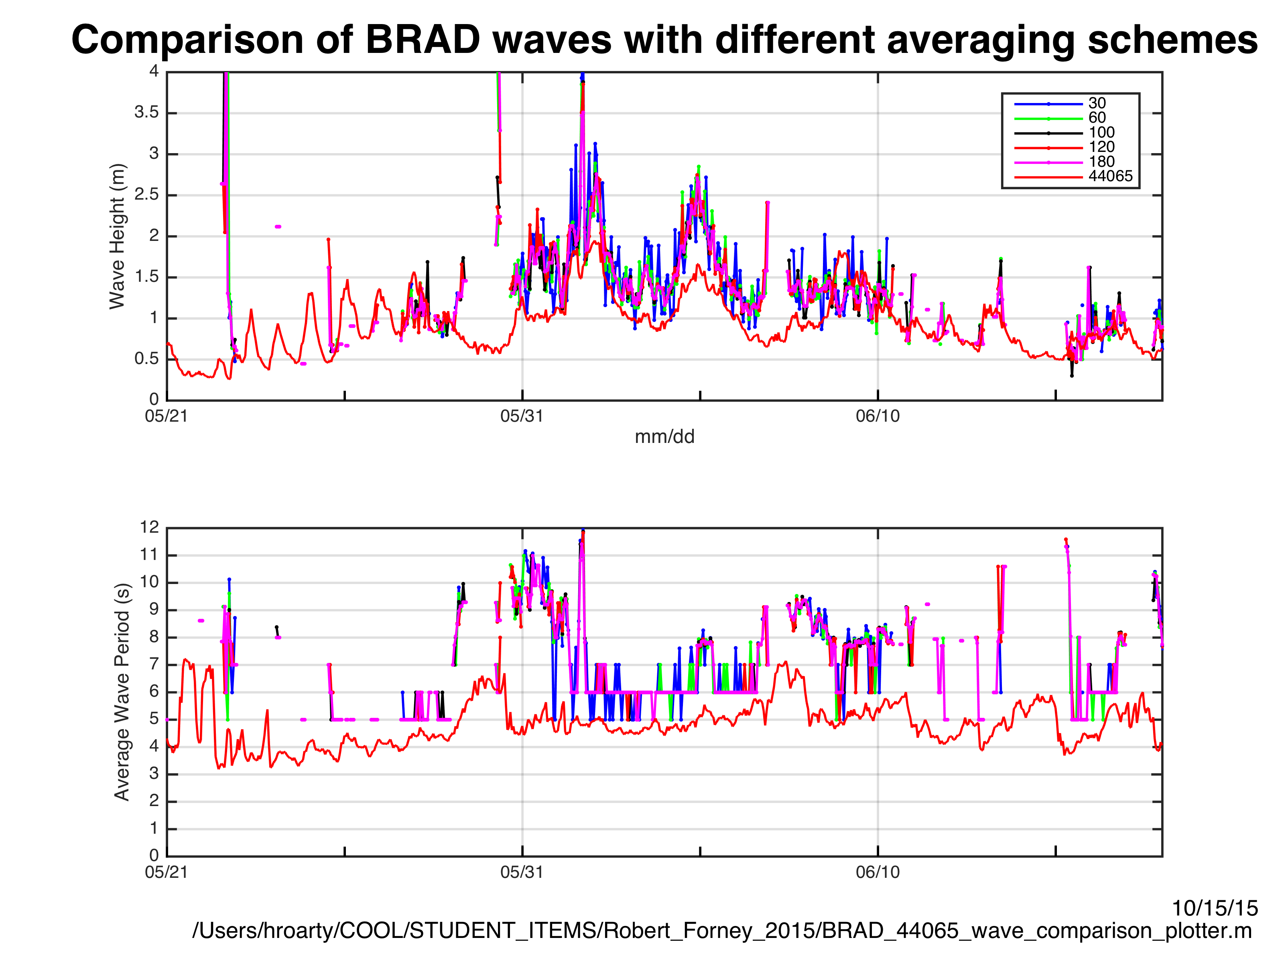
Bragg Period at 13.5 MHz is XX

Slide 14
Temporal Coverage Feb-Jun 2015
Averaging Time (minutes) | Temporal Coverage
30 | 32%
60 | 40%
100 | 43%
120 | 45%
180 | 49%

Slide 15
Existing SeaSonde Settings
SeaSonde Acquisition
CSPro
Analyze Spectra
Frequency (MHz) | Sweep Rate (Hz) | Doppler Bins | Time FFT | CSS Avg/Out | Radial Avg/Out | CSS per Radial File
5 | 1 | 1024 | 17m 04s | 60/30 | 180/60 | 5
13 | 2 | 512 | 04m 16s | 15/10 | 75/60 | 7
25 | 2 | 512 | 04m 16s | 15/10 | 75/30 | 7

Slide 16
Radio Frequency (MHz) | Radio Wavelength (m) | Bragg Wavelength (m) | Ocean Wave Period (s) | Deep Water Depth (m) | Wave Height Saturation (m)
5 | 60 | 30 | 4.4 | 15 | 20
13 | 23 | 12 | 2.7 | 6 | 7
25 | 12 | 6 | 2.0 | 3 | 4
Radio Frequency (MHz) | Radio Wavelength (ft) | Bragg Wavelength (ft) | Ocean Wave Period (s) | Deep Water Depth (ft) | Wave Height Saturation (ft)
5 | 200 | 100 | 4.4 | 50 | 66
13 | 75 | 38 | 2.7 | 19 | 23
25 | 40 | 20 | 2.0 | 10 | 13

Slide 17
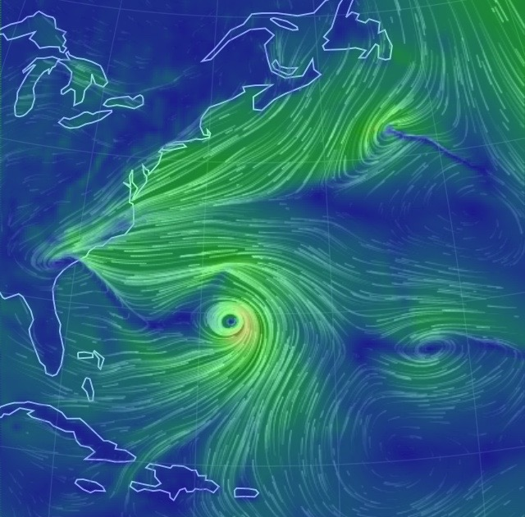
Nor’easter
Hurricane Joaquin
October 4, 2015

Slide 18
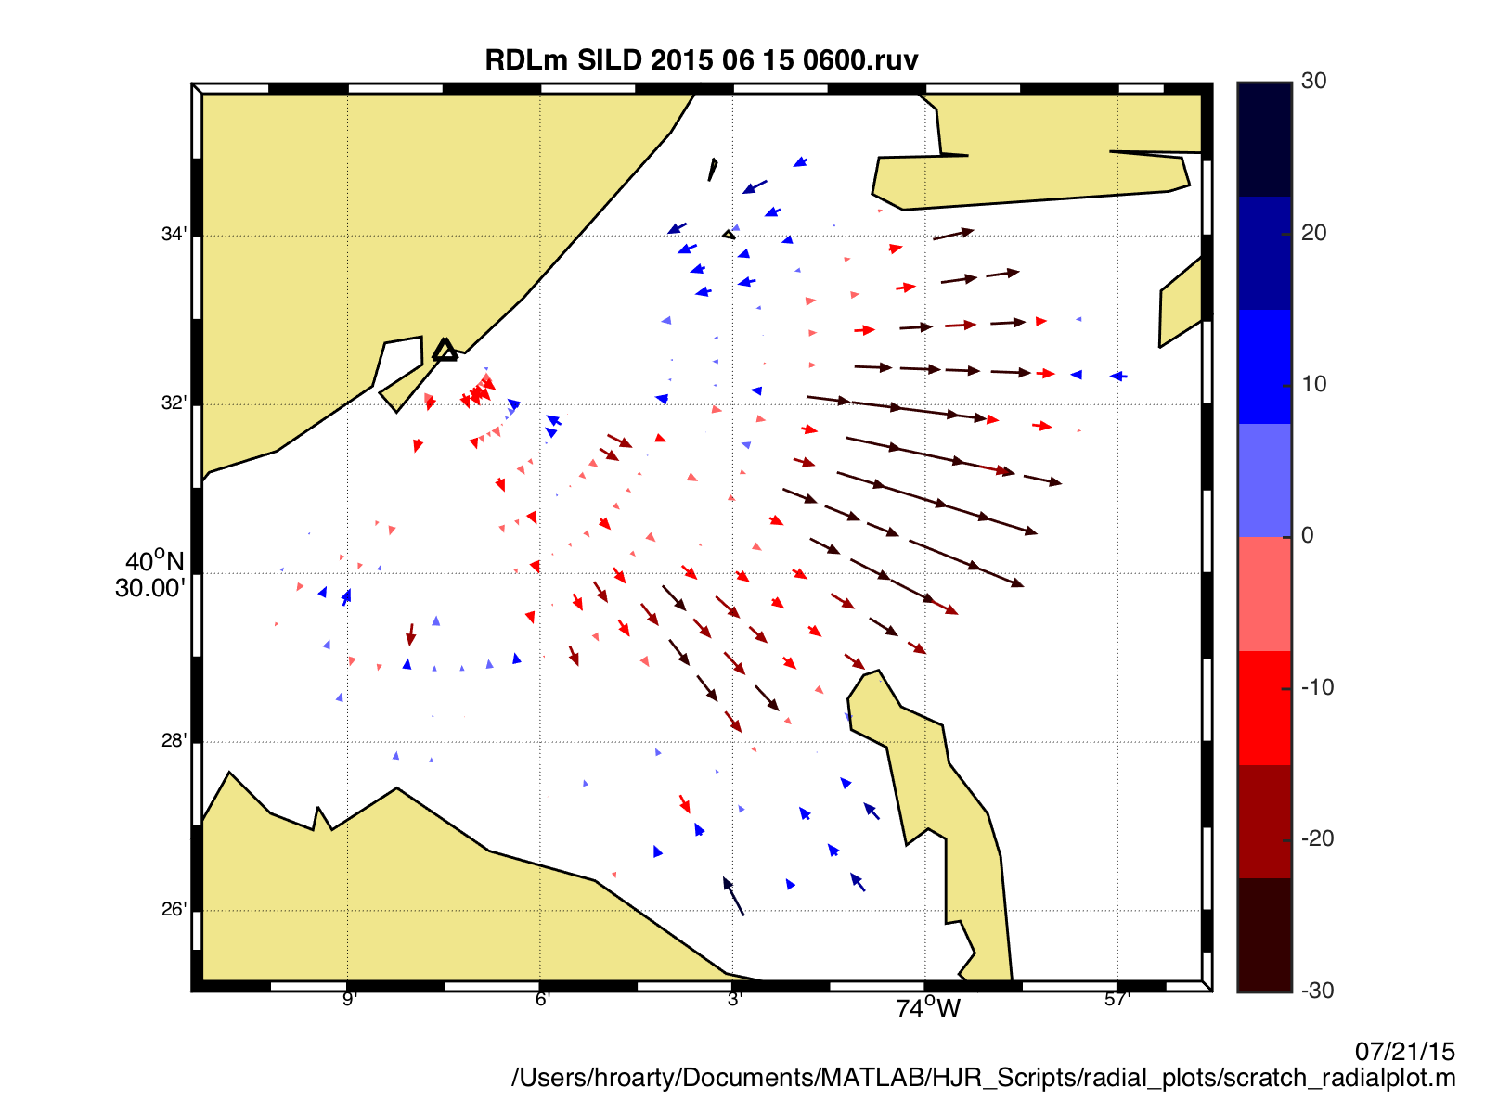
SILD 25 MHz

Slide 19
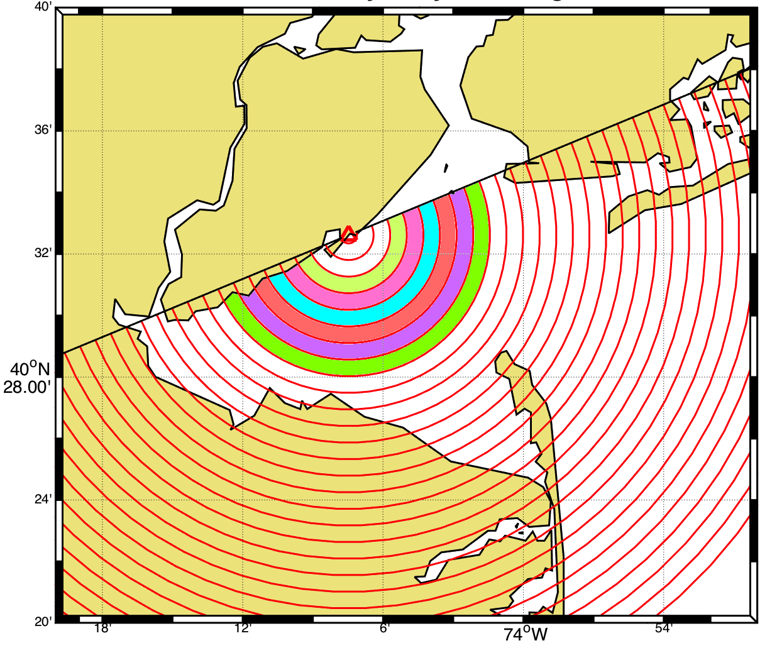
SILD 25 MHz

Slide 20
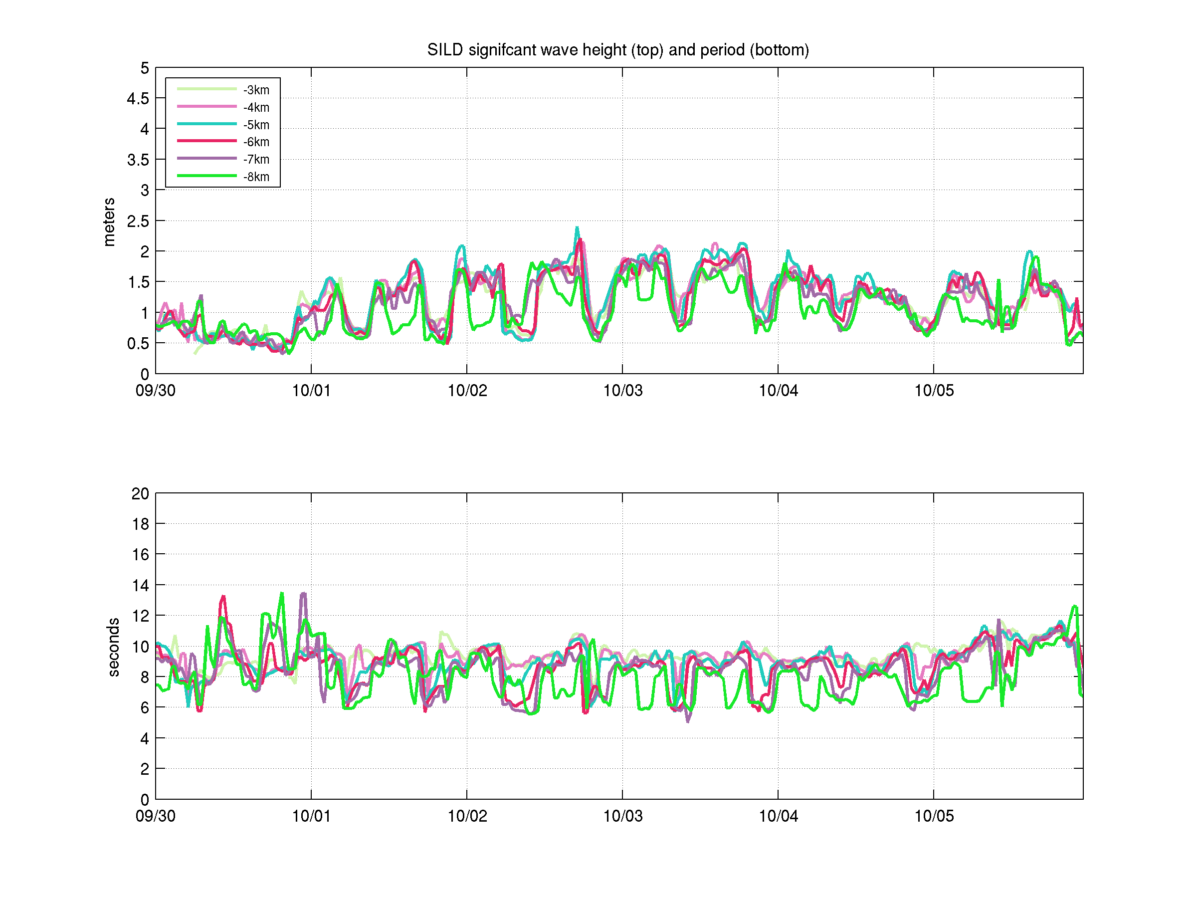
Wave Height
Wave Period

Slide 21
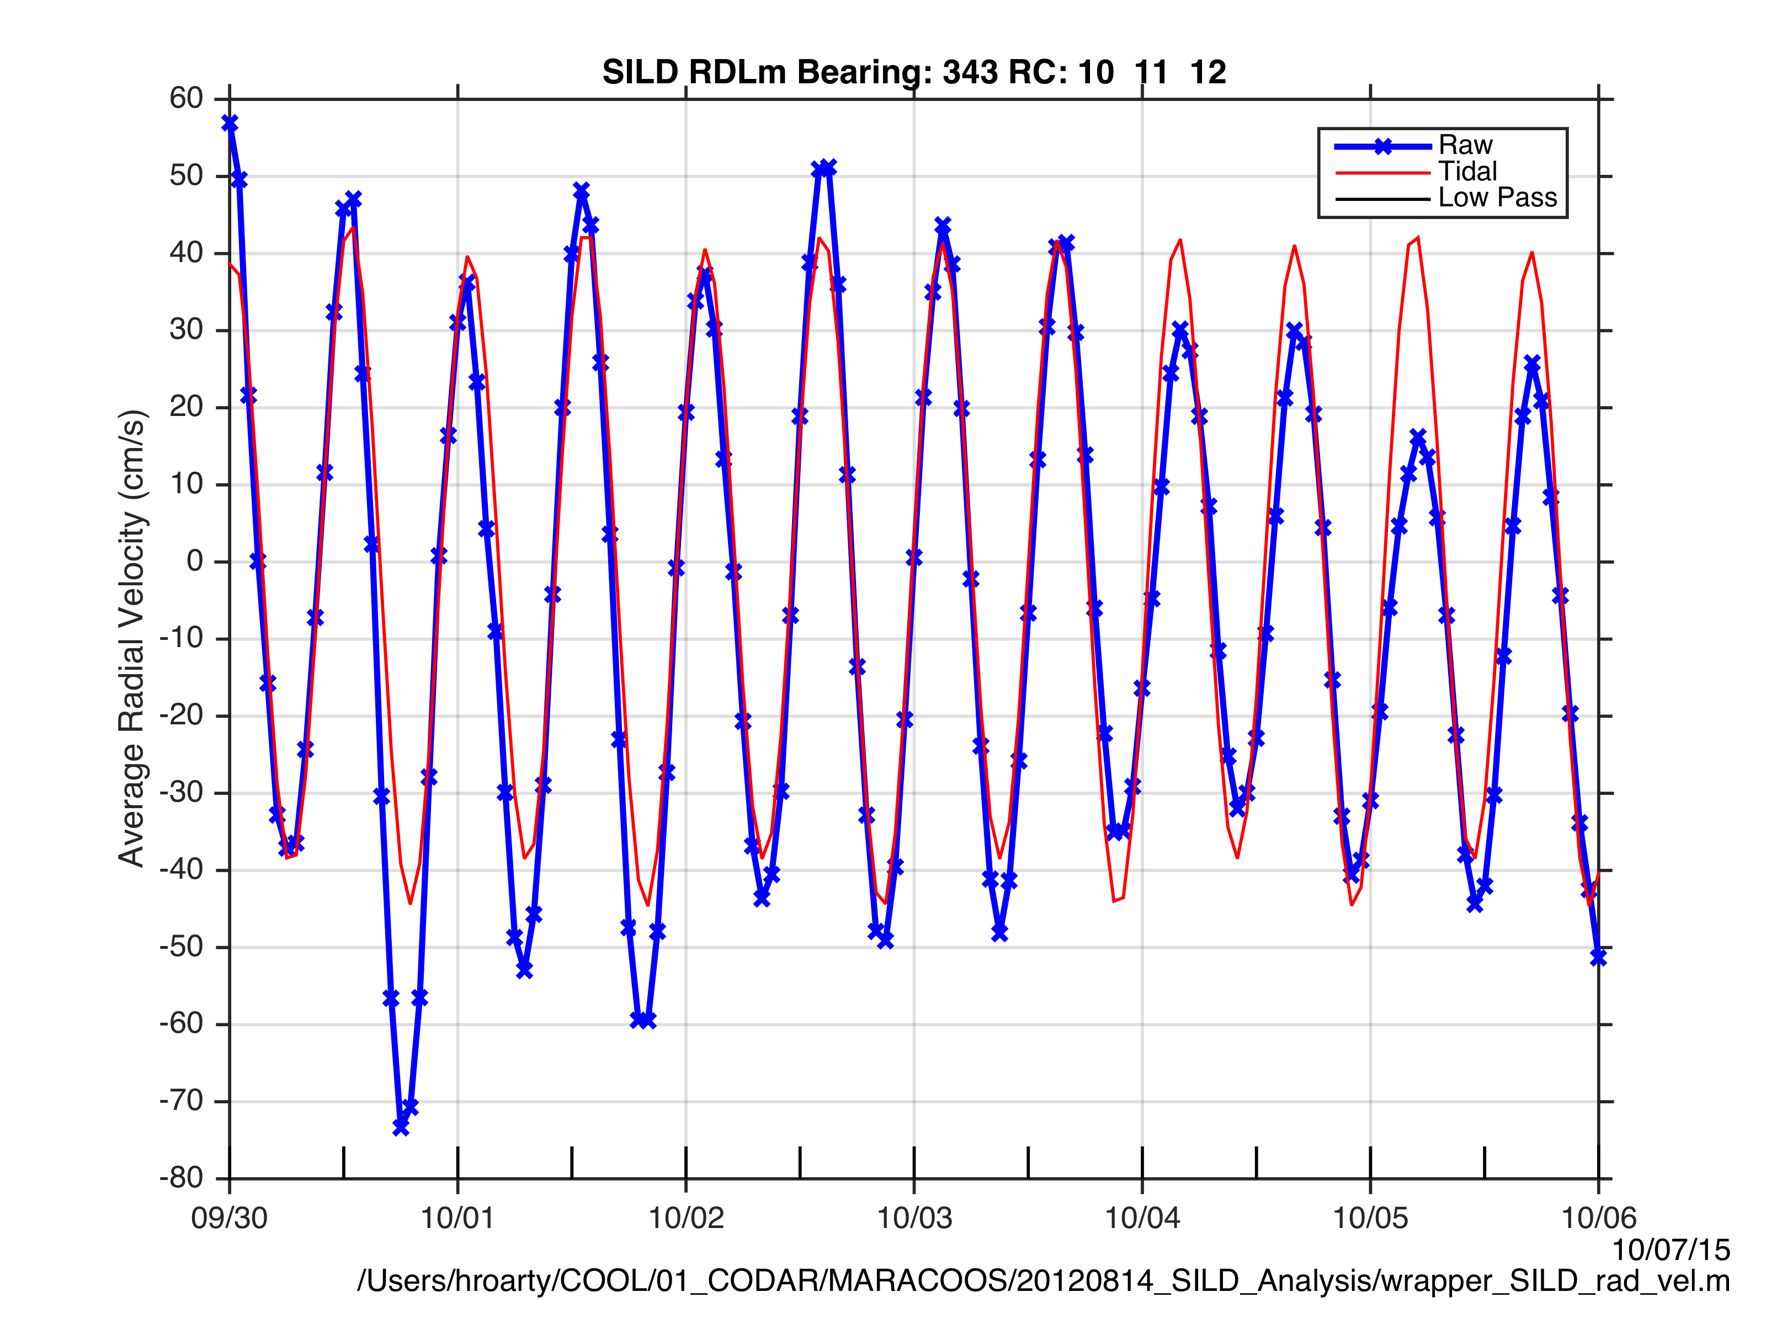

Slide 23
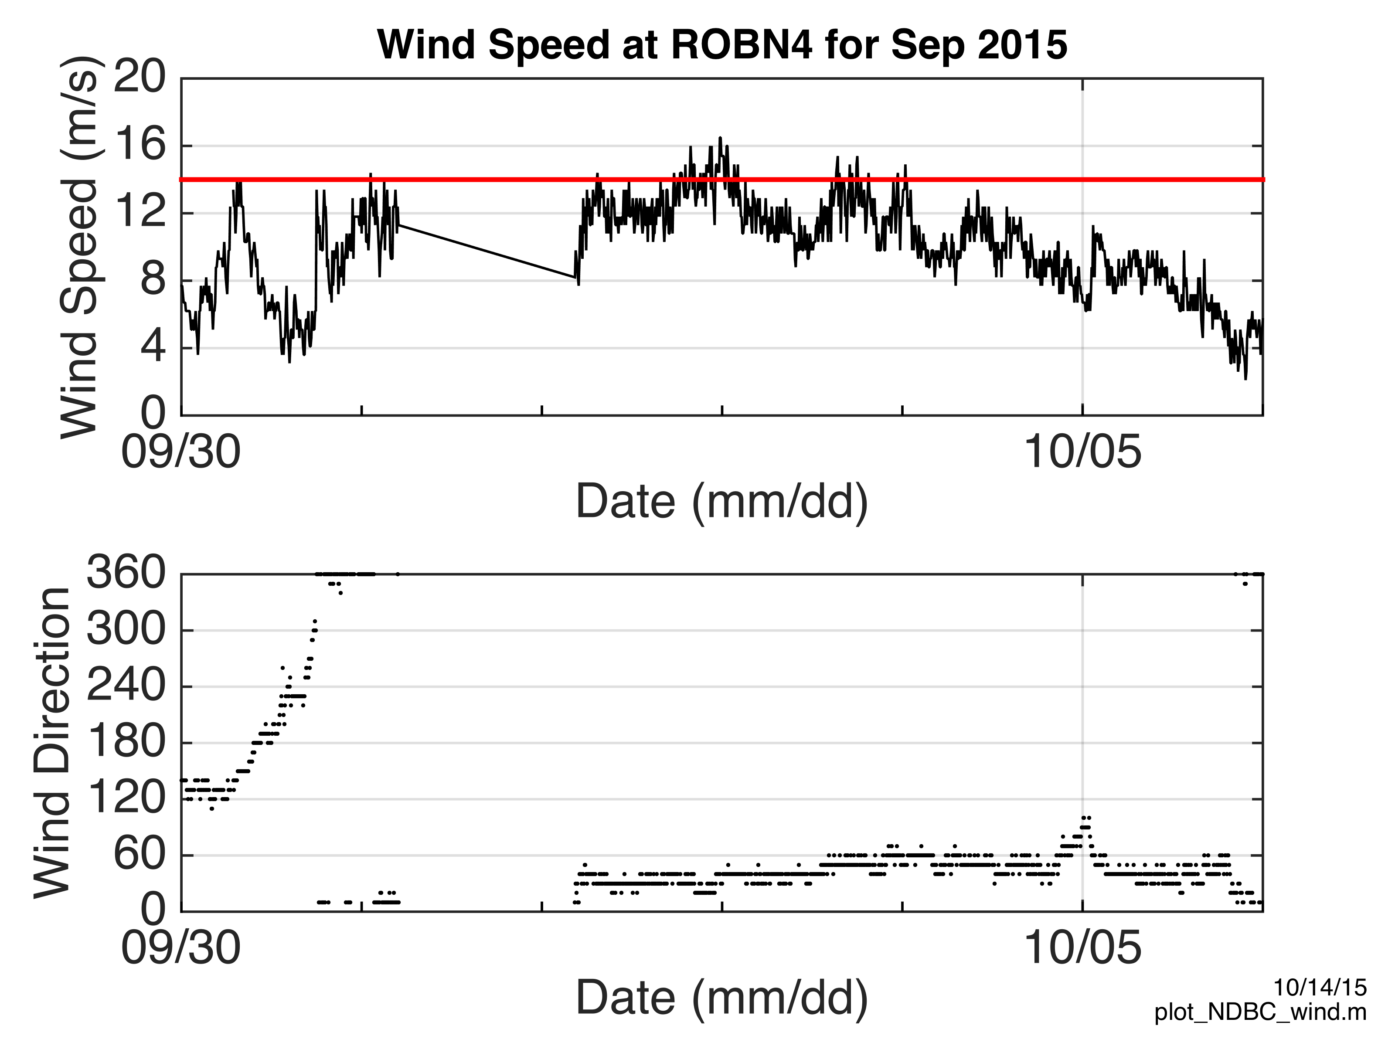

Slide 24
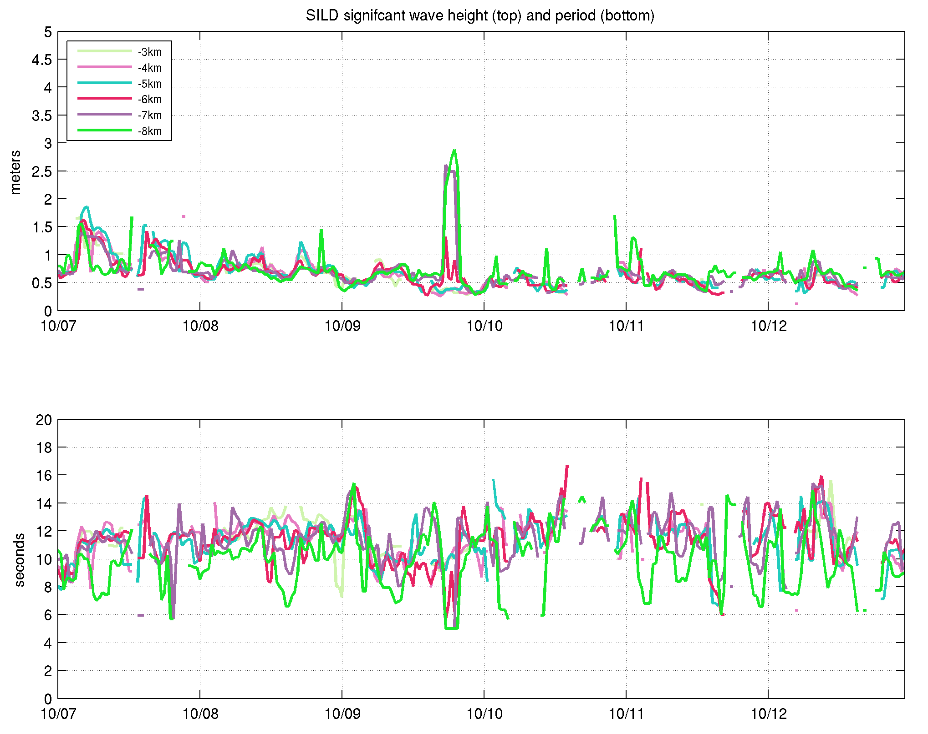
Wave Height
Wave Period

Slide 25
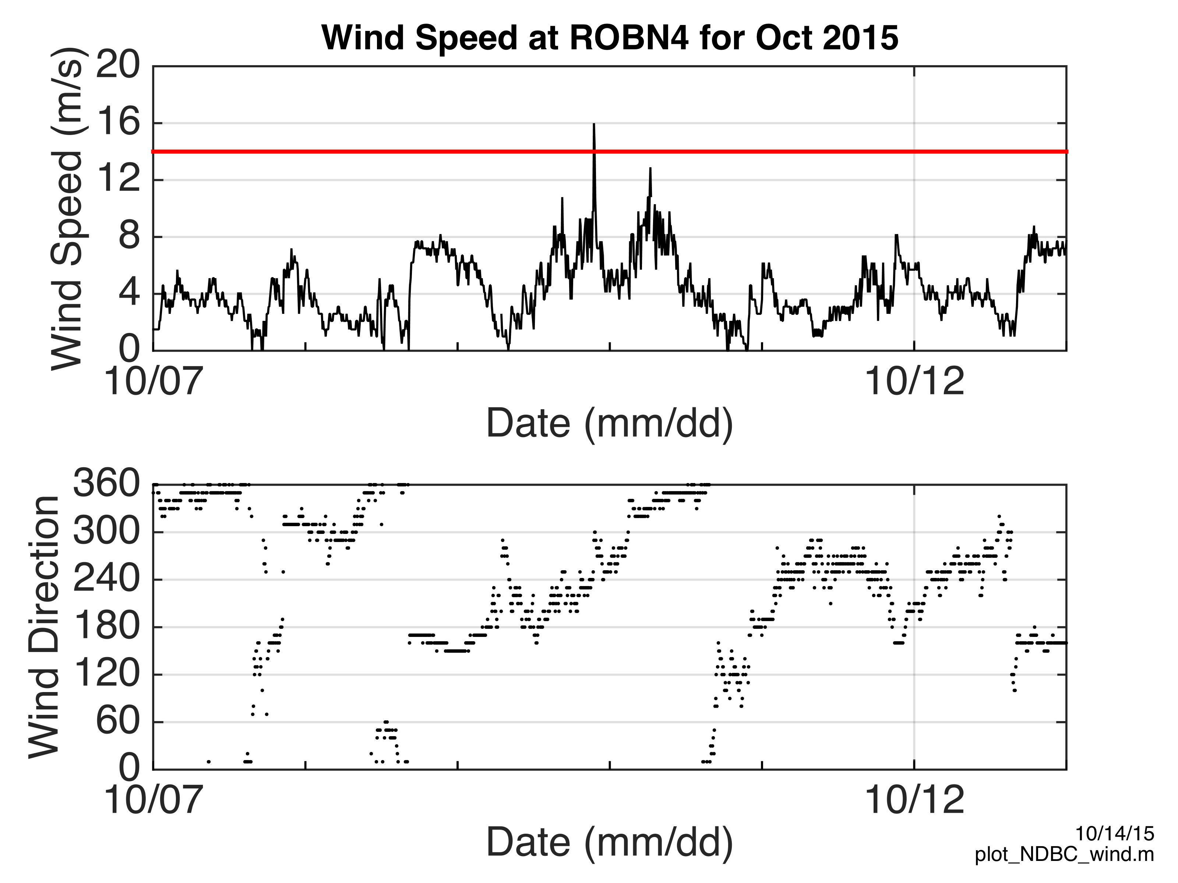

Slide 26
SILD 25 MHz
Wind
Current

Slide 27
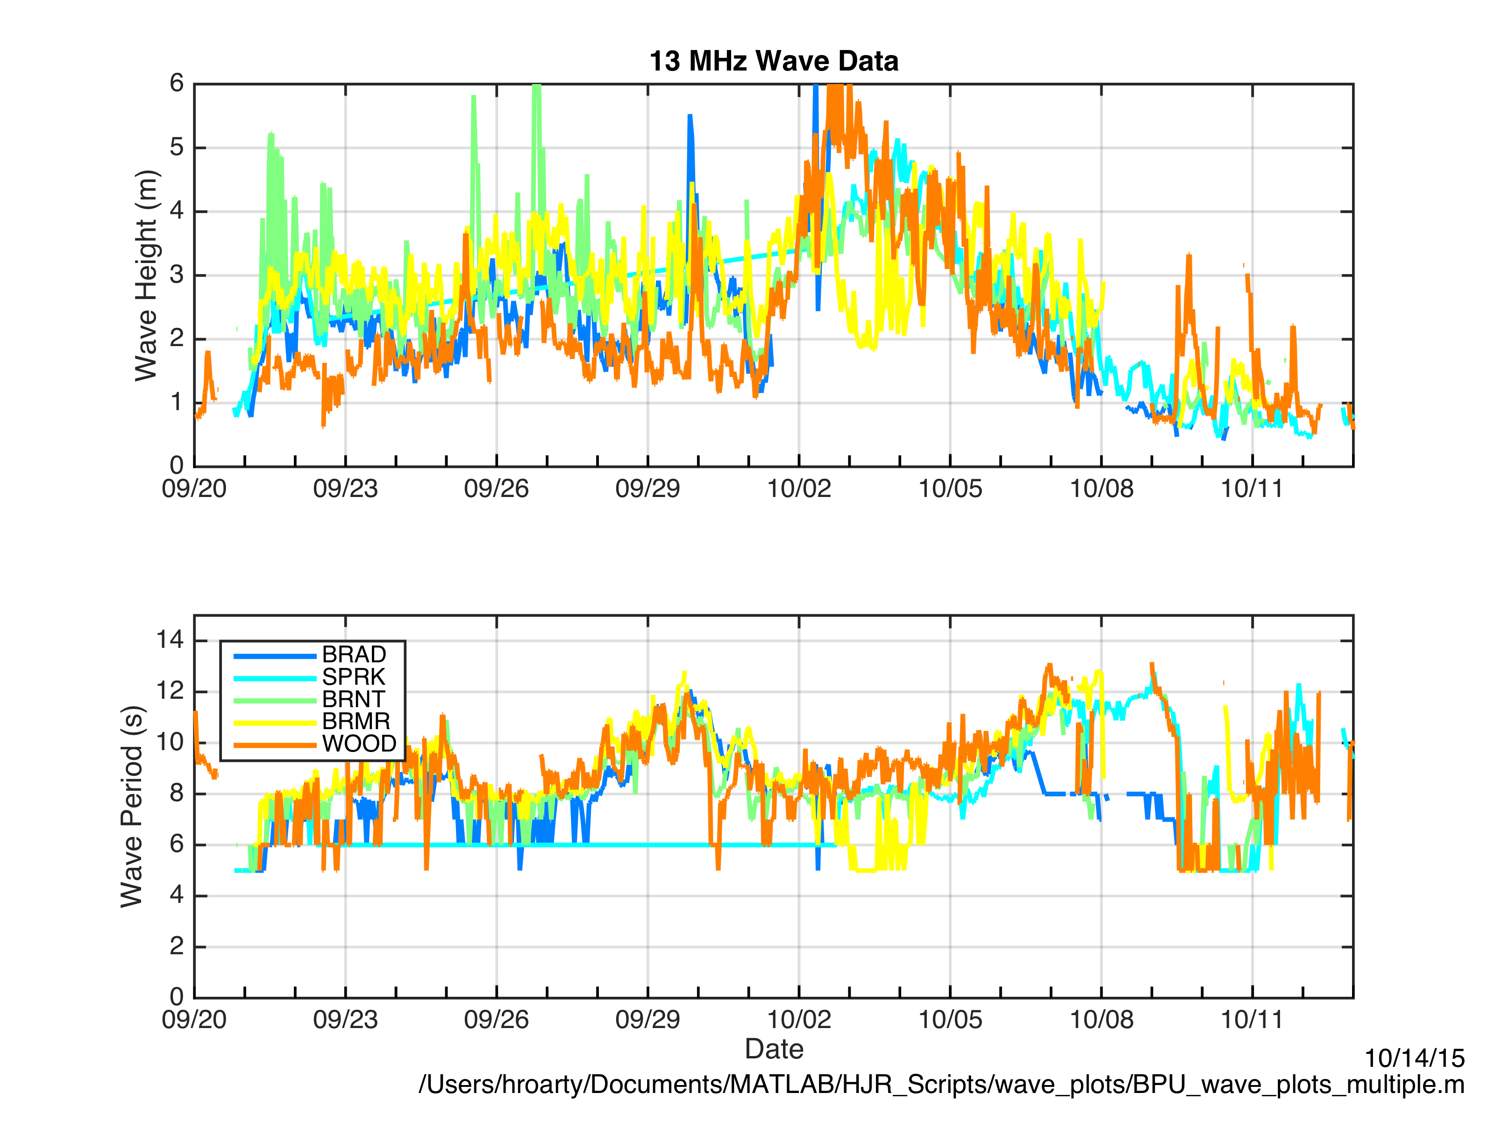
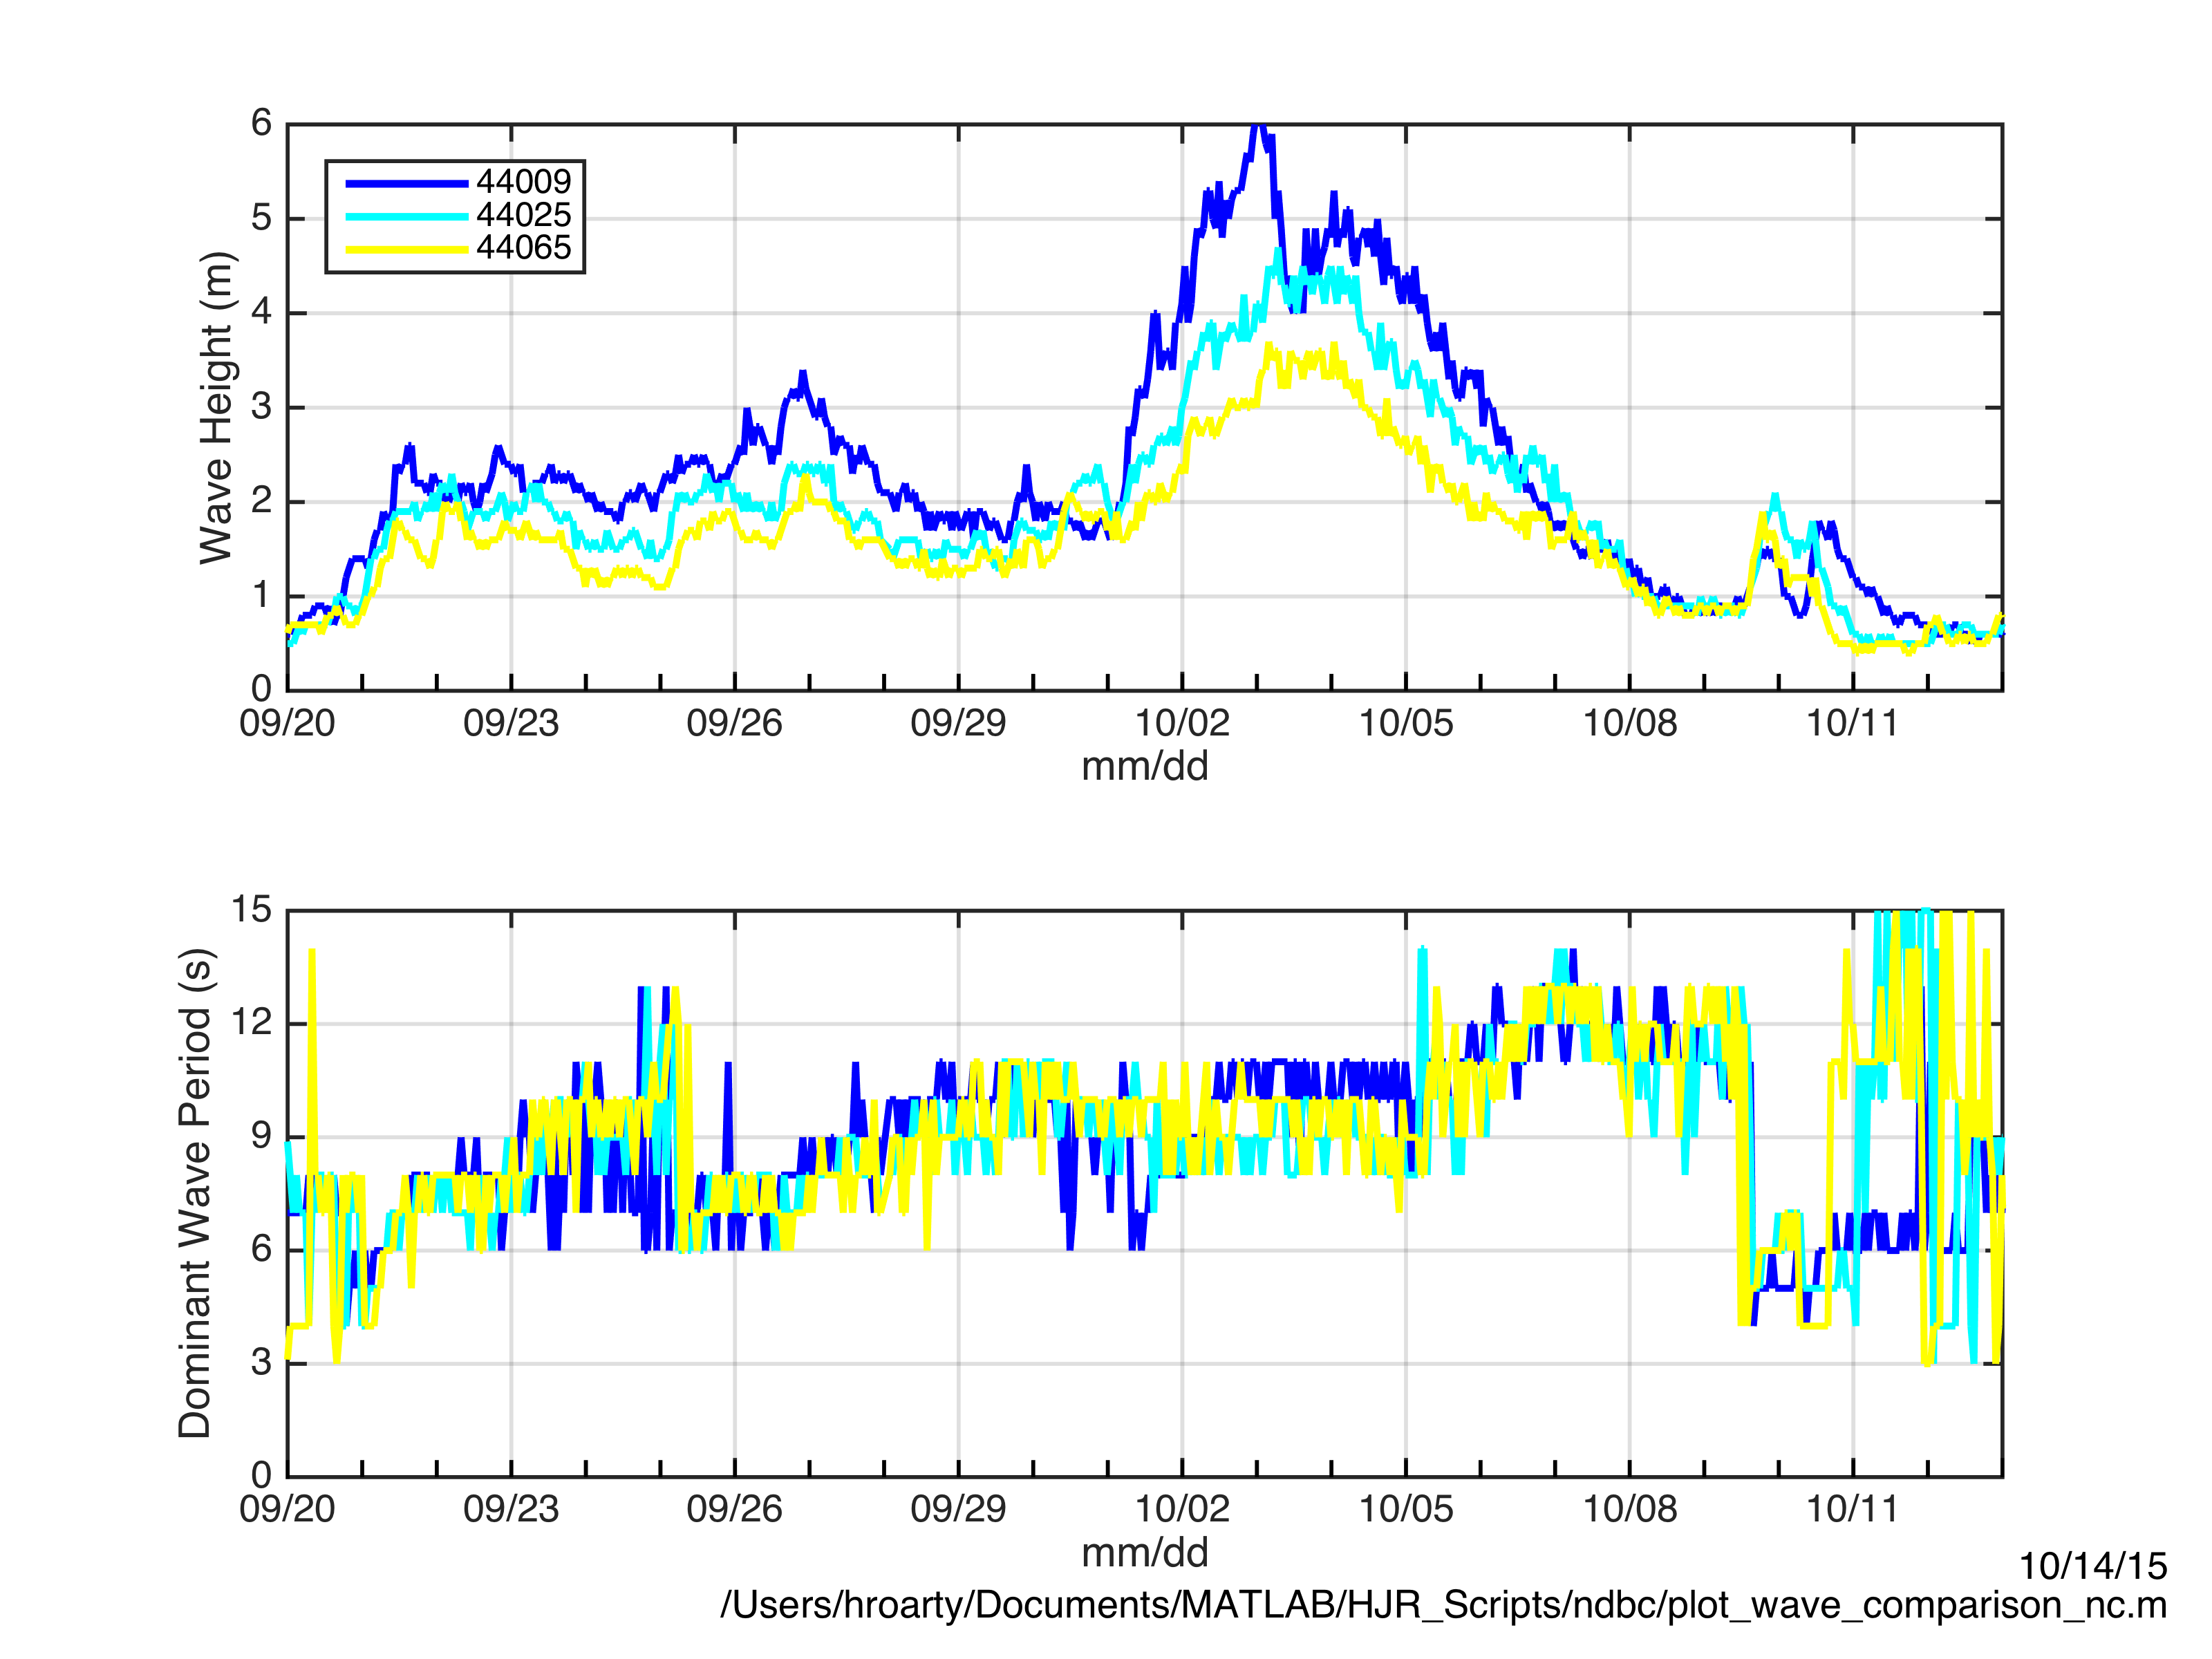

Slide 29
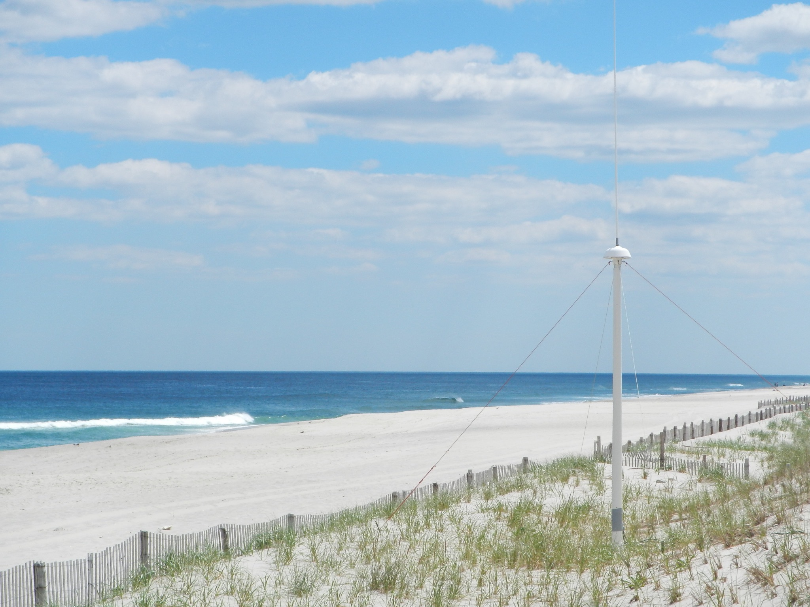
RESULTS
HF Radars are operating throughout Mid Atlantic and other regions of the US
Main focus is for measuring surface currents
Secondary application can be for measuring near shore waves

