Slide 1
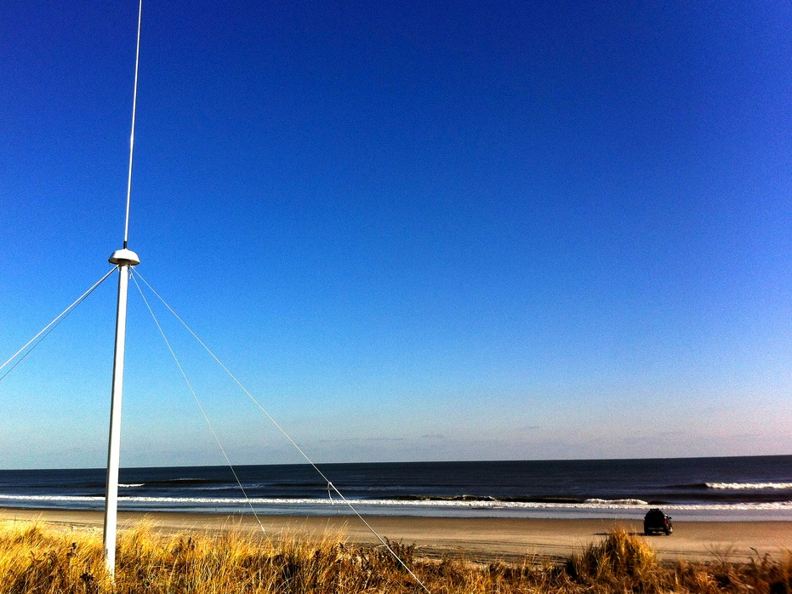
Assessing HF Radar Data in NY Harbor: Comparison with Wind, Stream Gauge and Ocean Model Data Sources
Mr. Joe Gradone
Dr. Hugh Roarty
Mr. Colin Evans
Dr. Scott Glenn
Mr. Ethan Handel
Ms. Chloe Baskin
Dr. Greg Dusek
Mr. Chris Paternostro
MTS/IEEE OCEANS15
October 2015
Washington DC

Slide 2
RESULTS
HF Radars are operating again in NY Harbor
Data is provided to NOAA PORTS for nowcasts and forecasts
Surface current measurements correlate with local wind and rainfall events

Slide 3
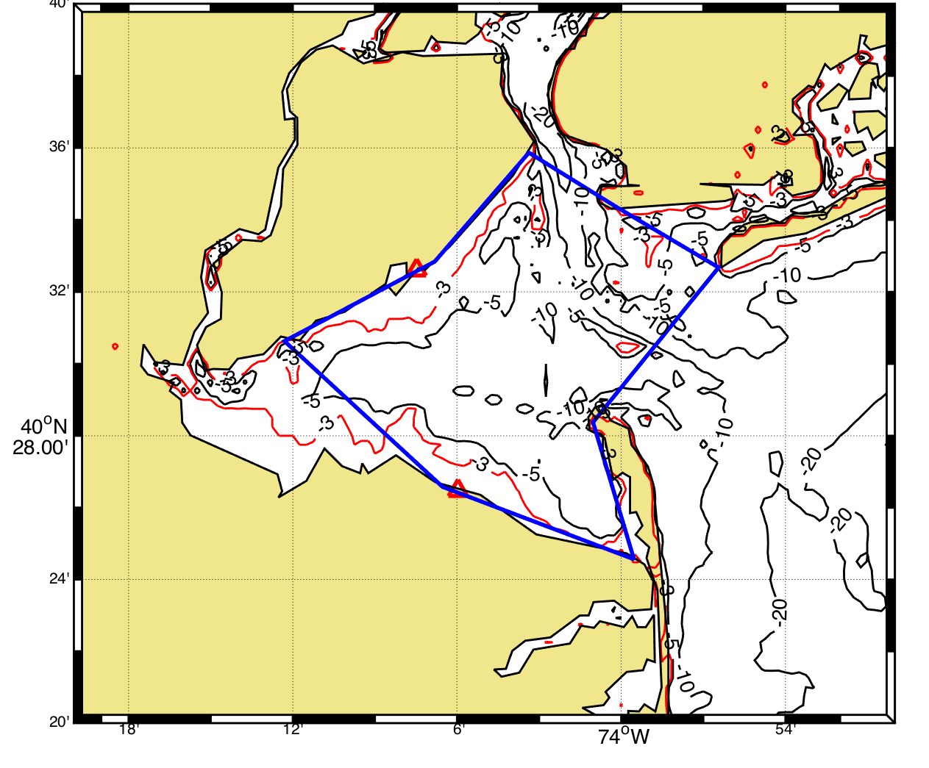
Study Area
SILD
PORT

Slide 4
Staten ISLAND

Slide 5
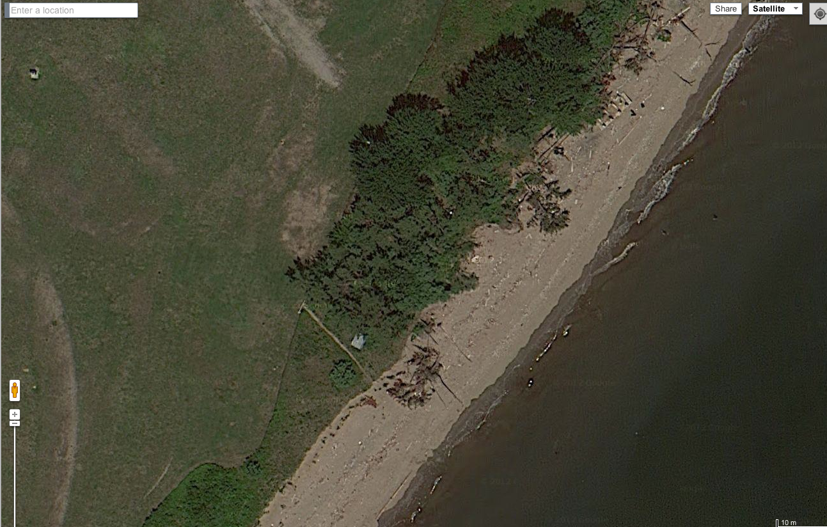
SILD Pre Sandy

Slide 6
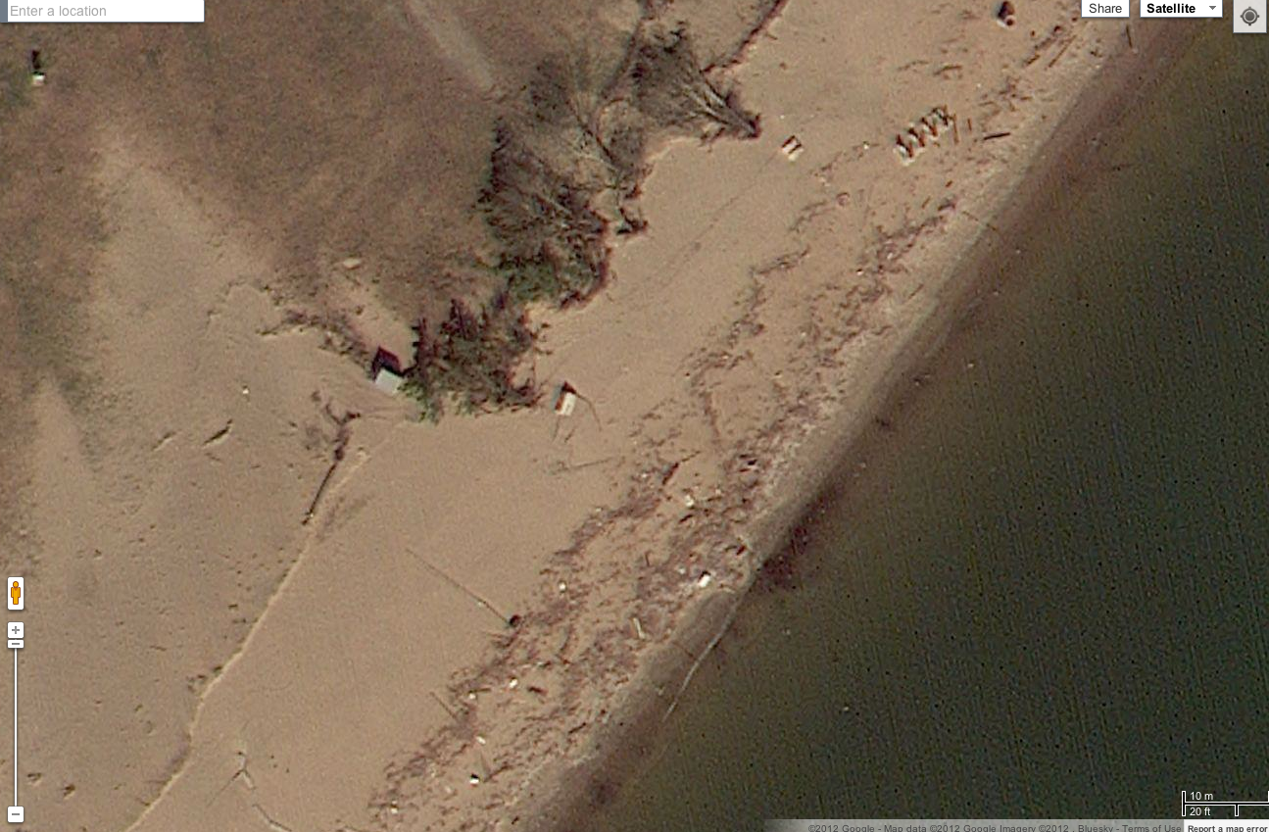
SILD Post Sandy

Slide 7
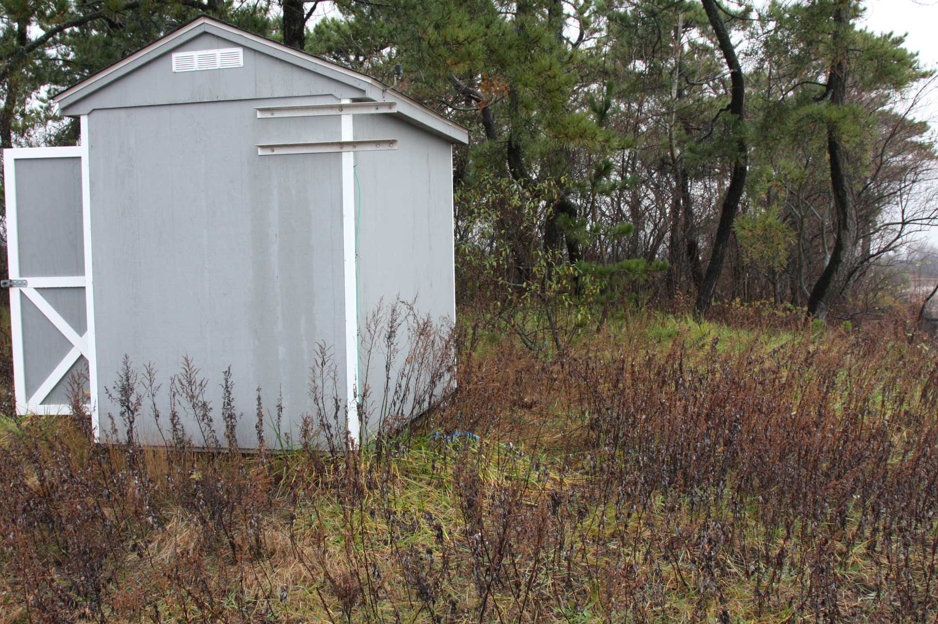
SILD Pre Sandy

Slide 8
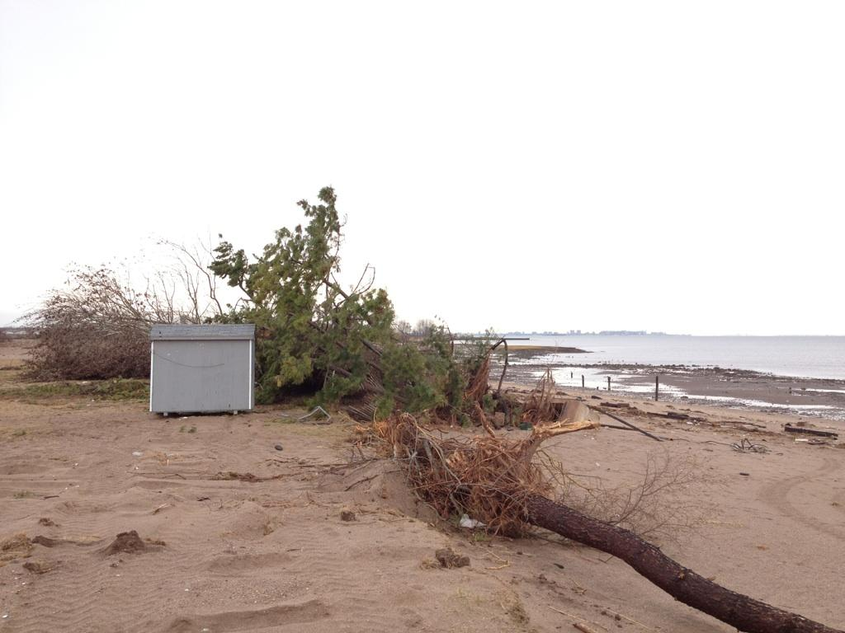
SILD Post Sandy

Slide 9
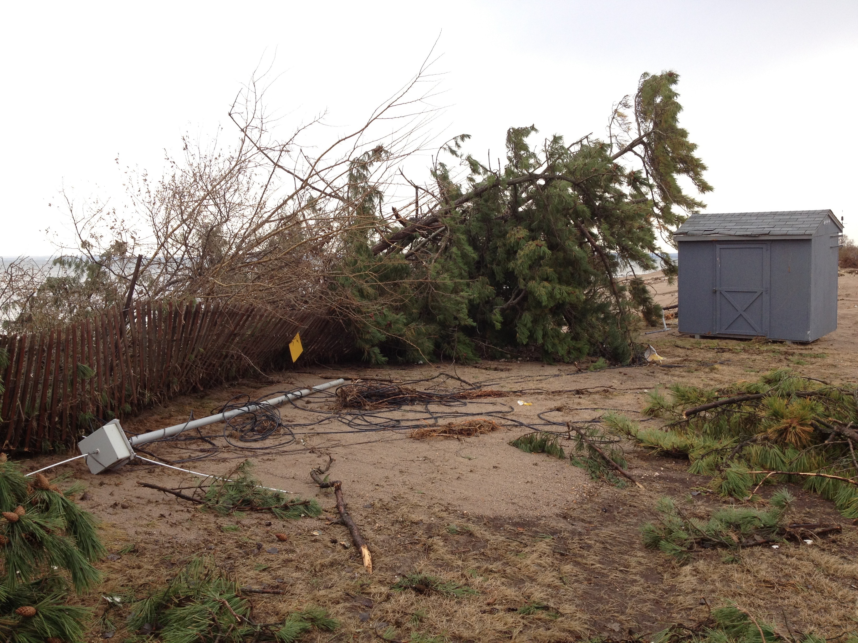

Slide 10
PORT MONMOUTH

Slide 11
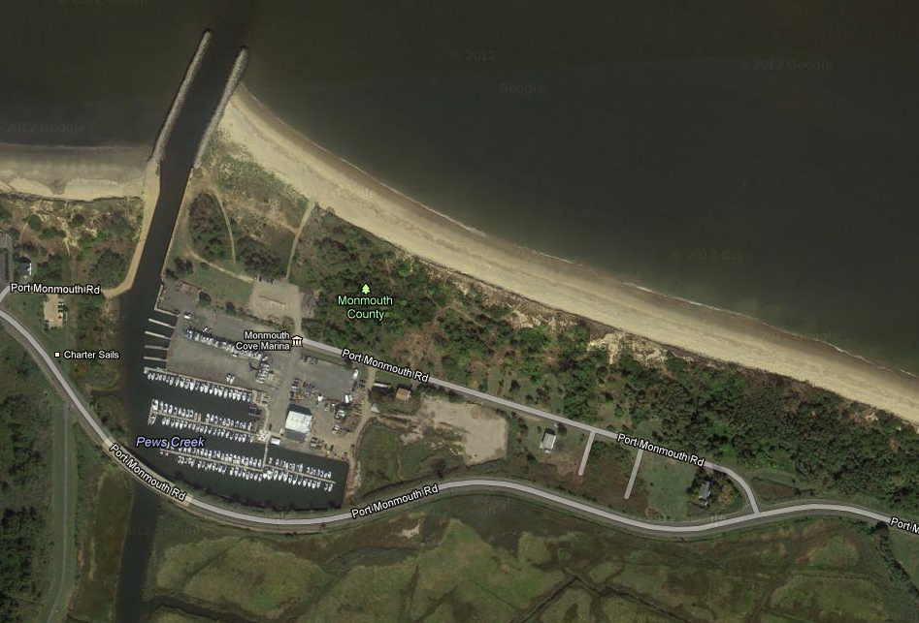
200 m

Slide 12
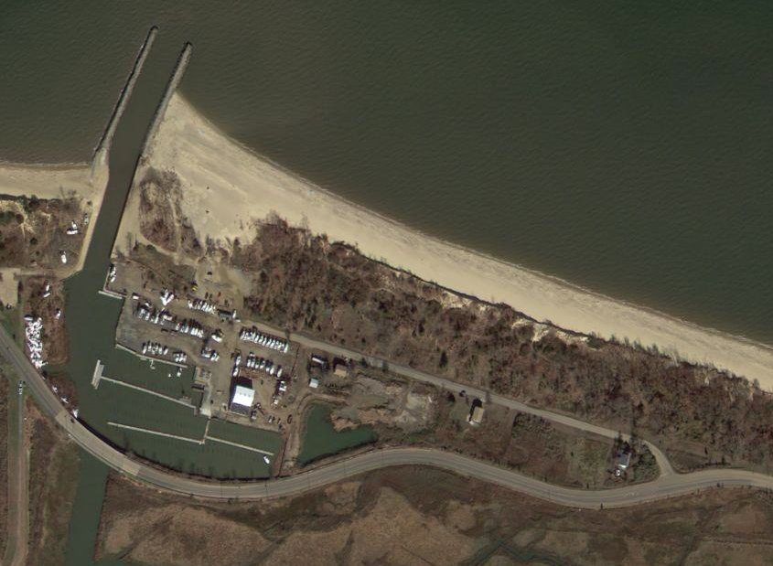

Slide 13
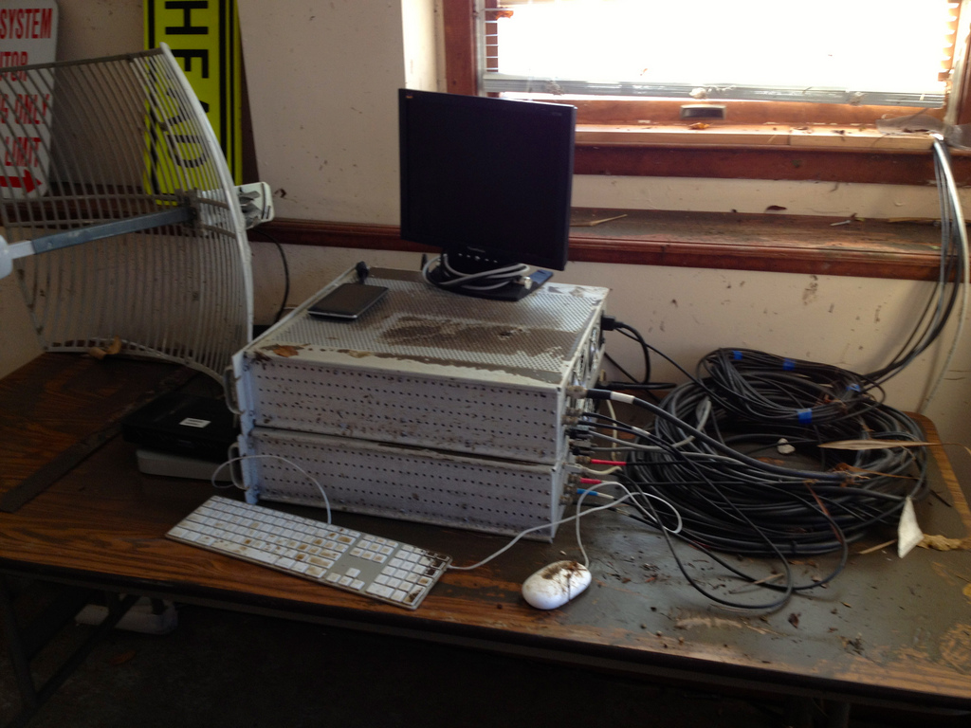

Slide 14
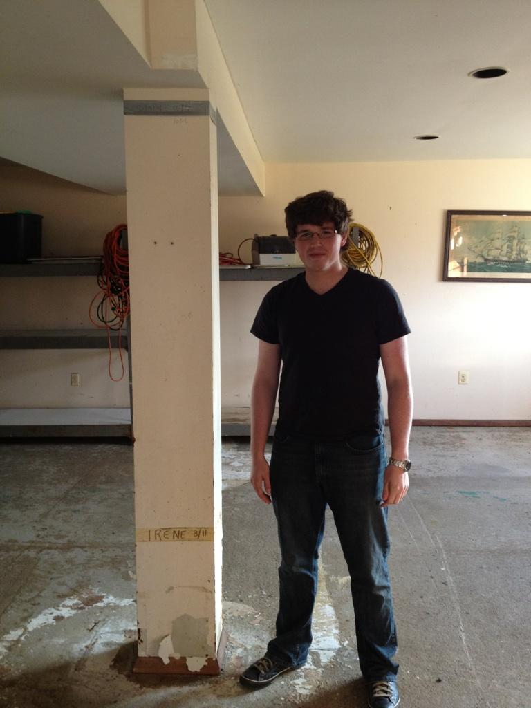
Sandy
2012
Irene
2011

Slide 15
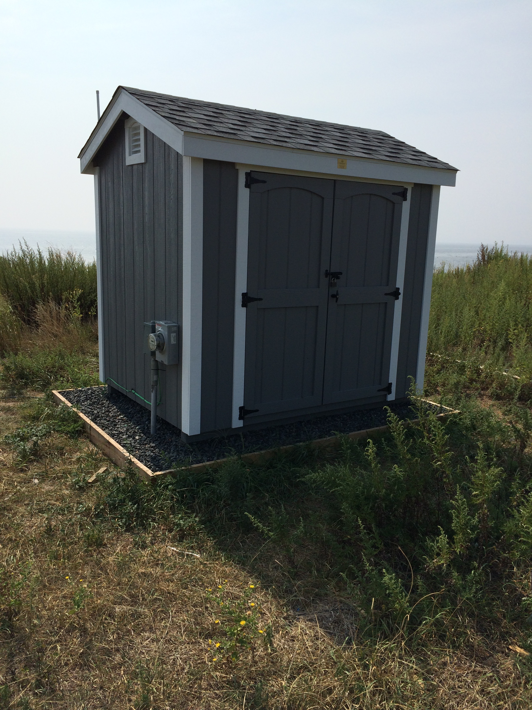
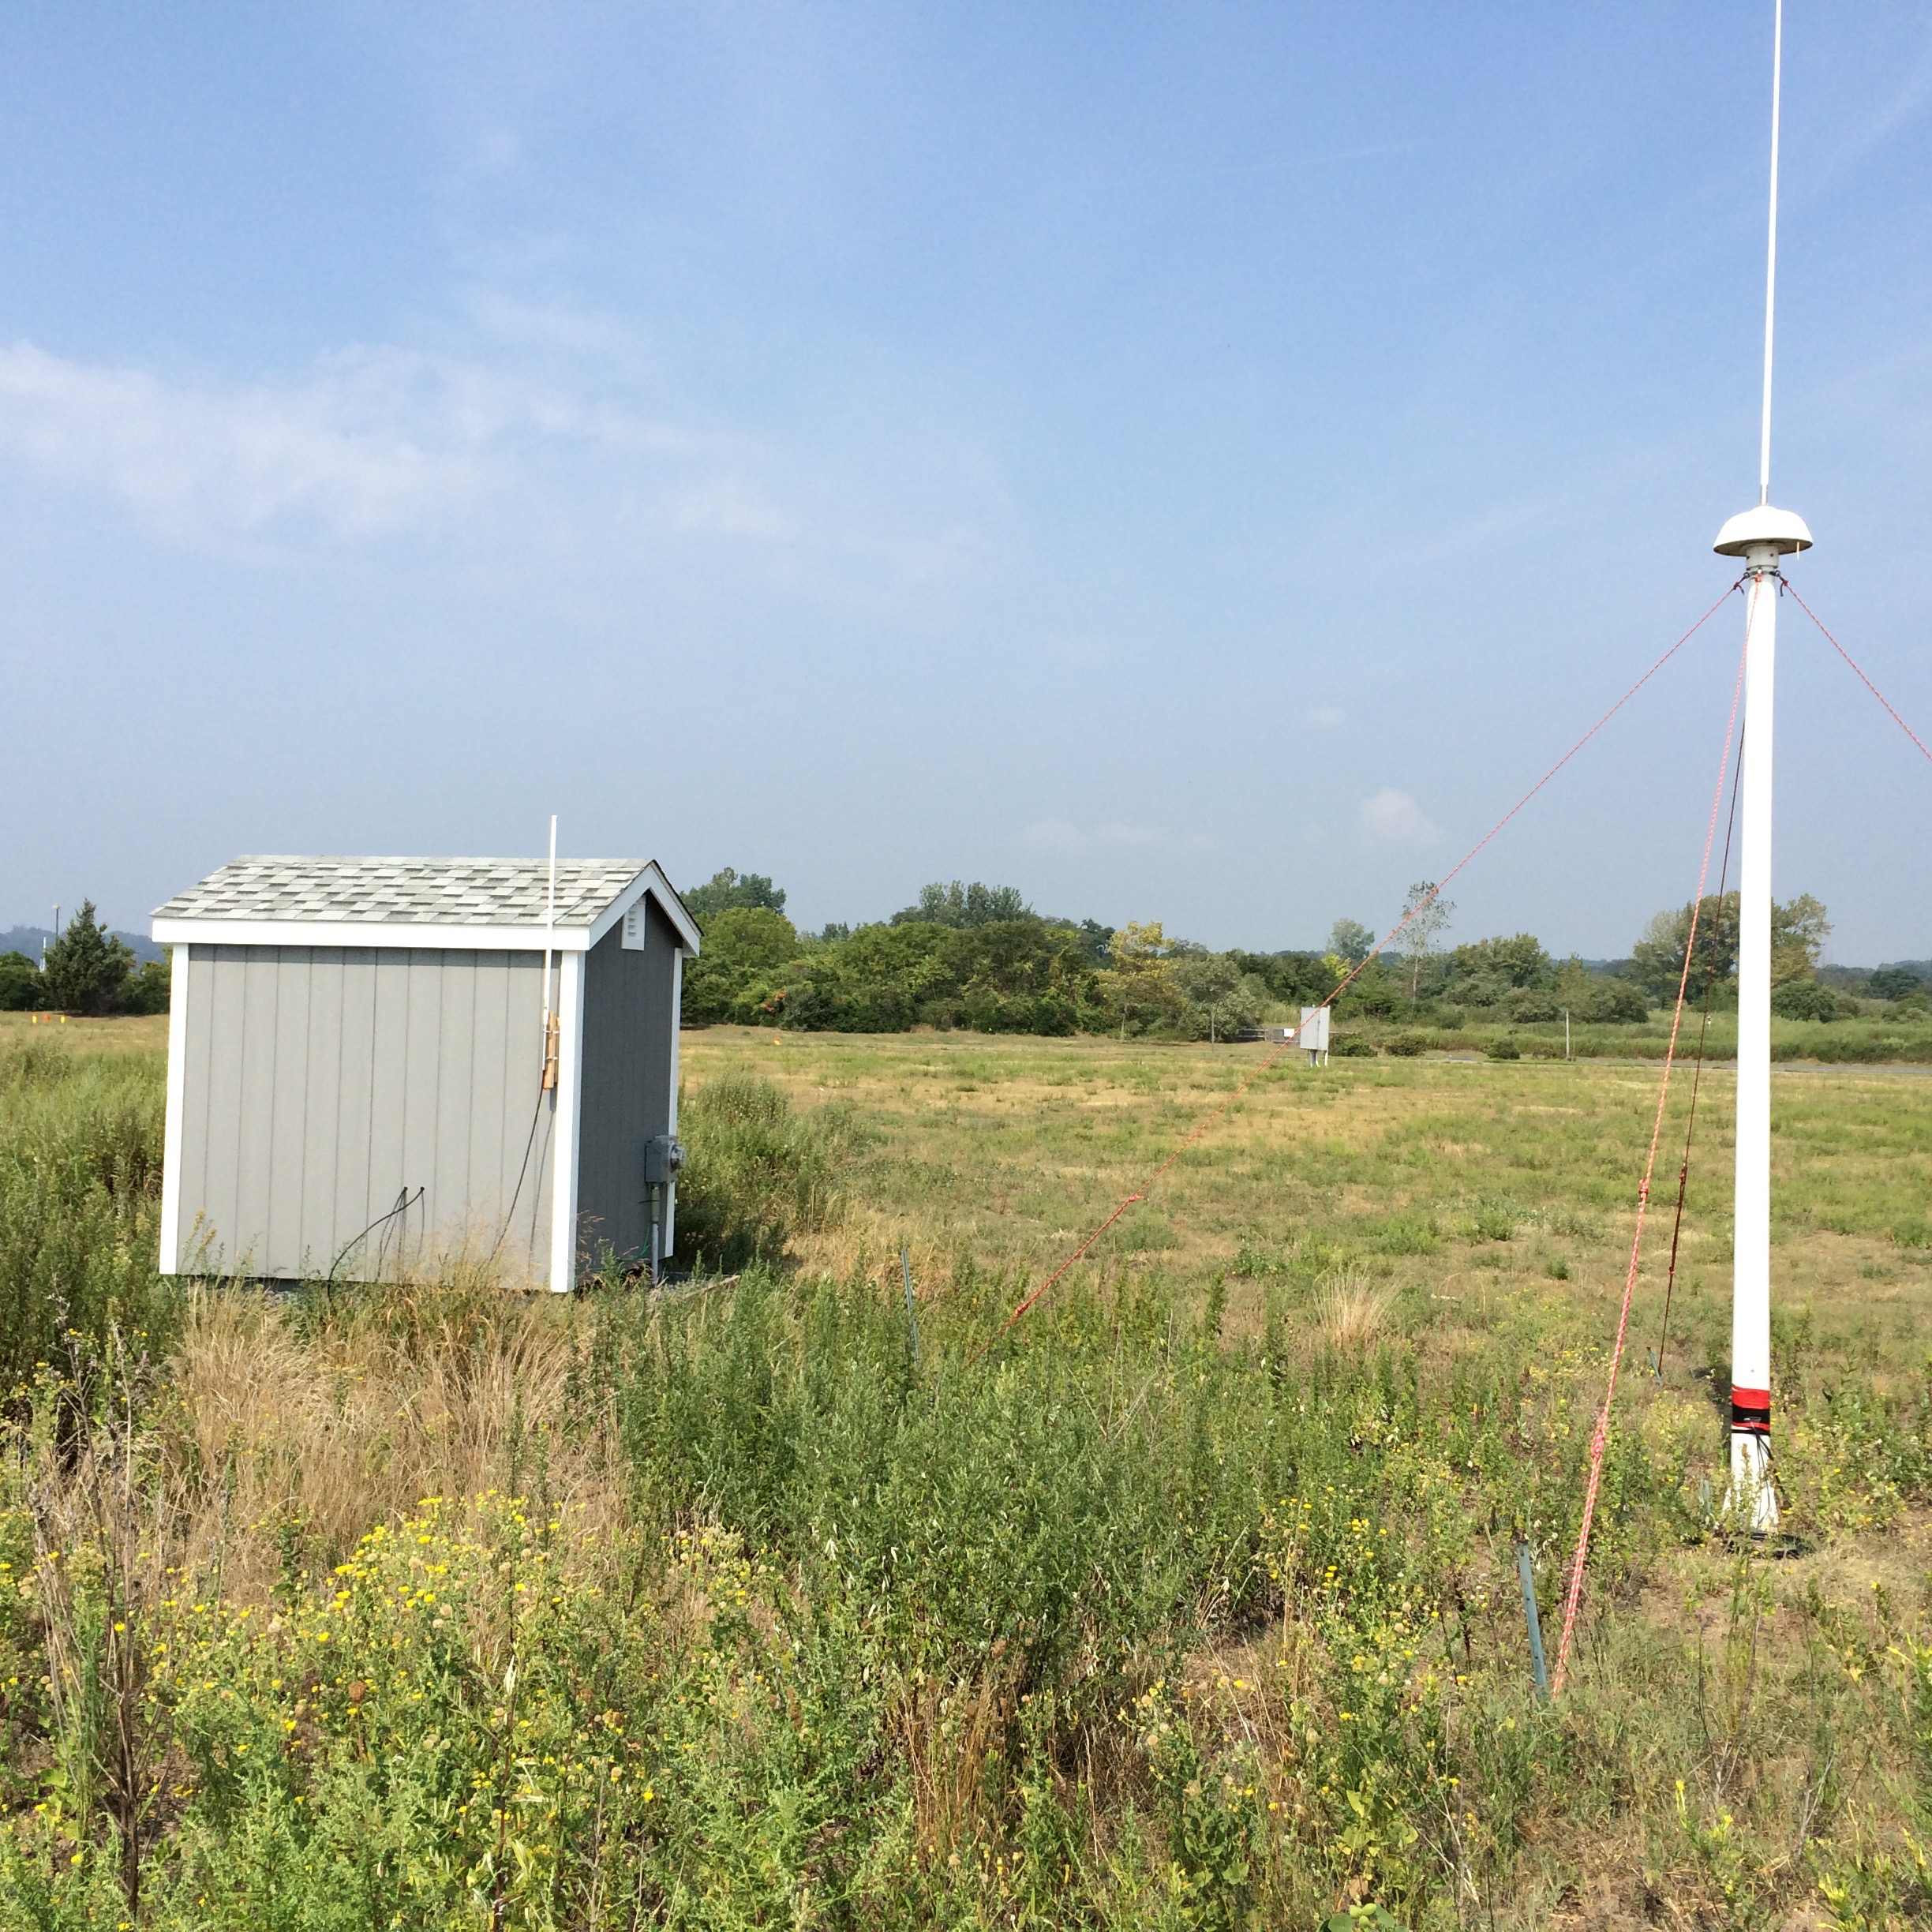
SILD 2015

Slide 16
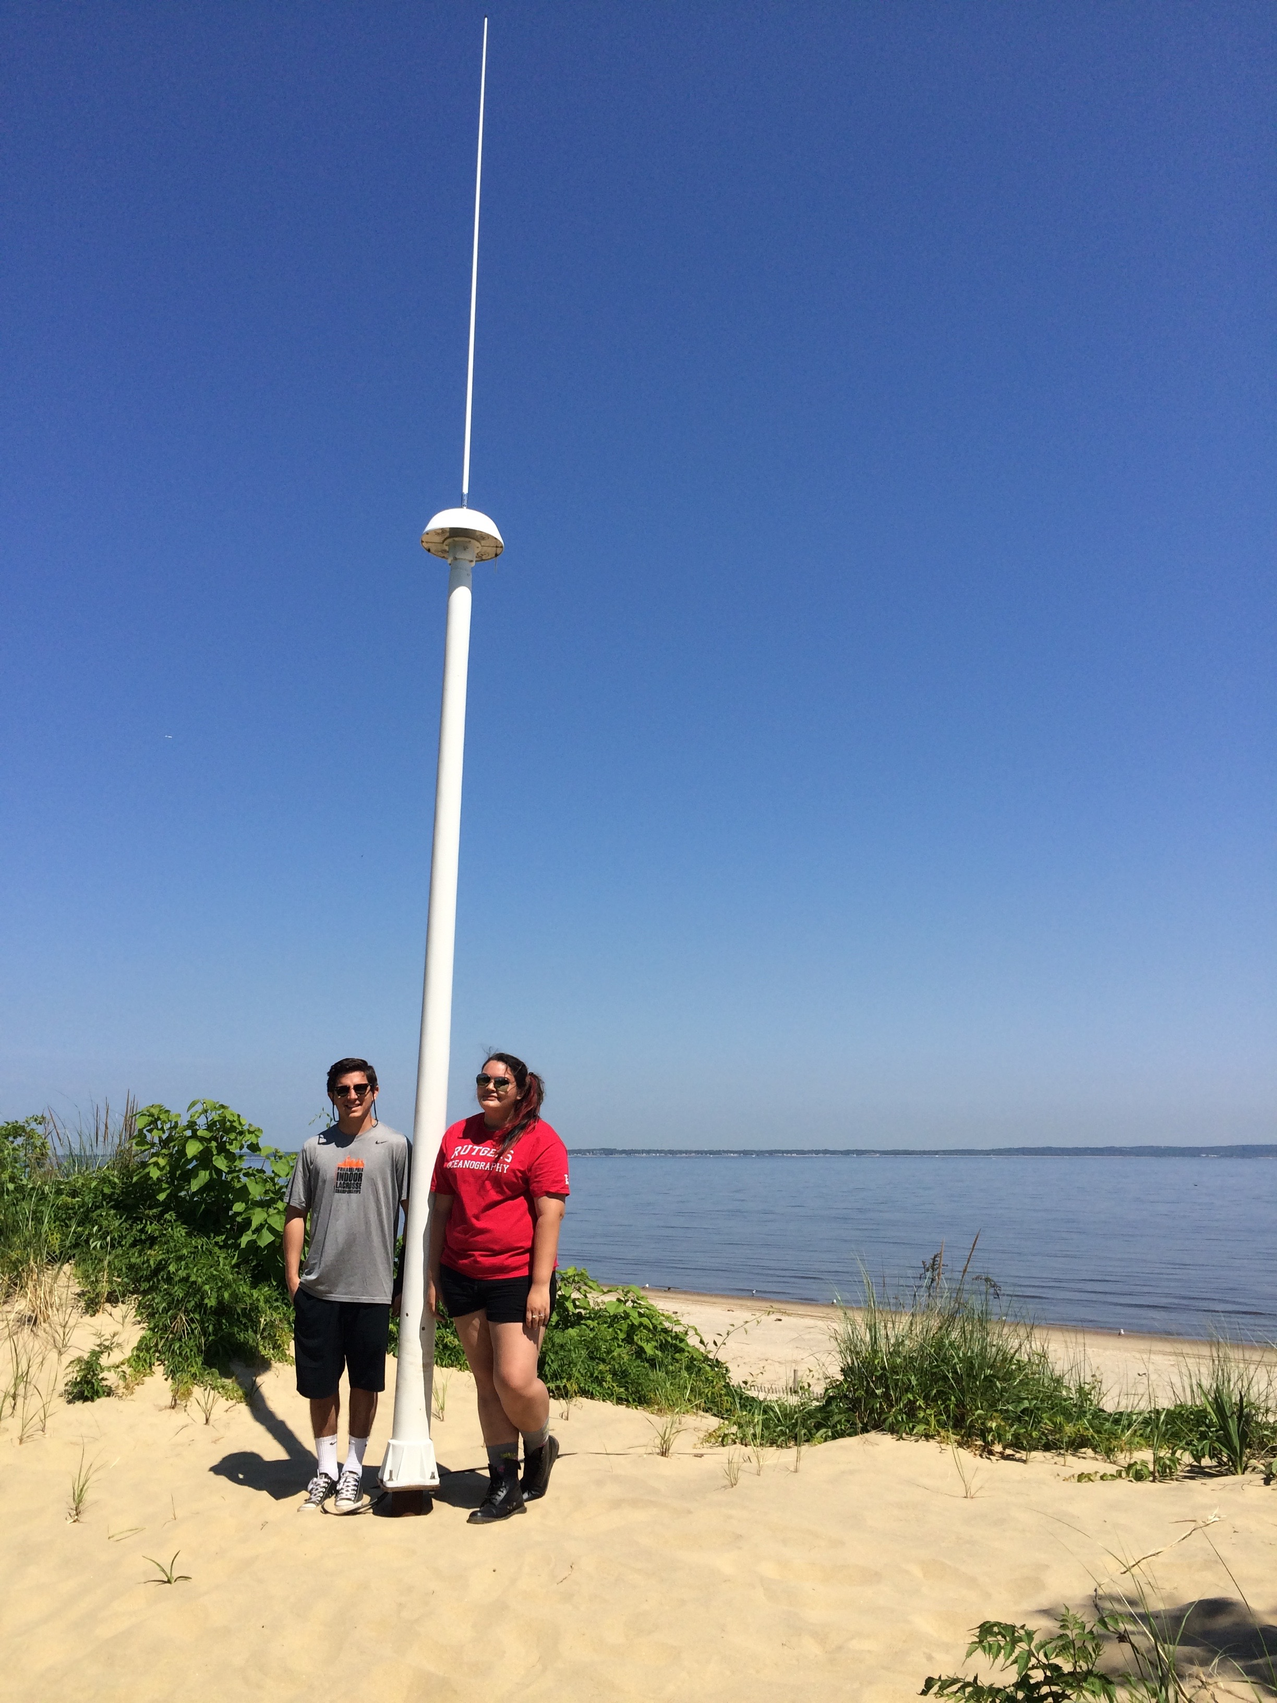
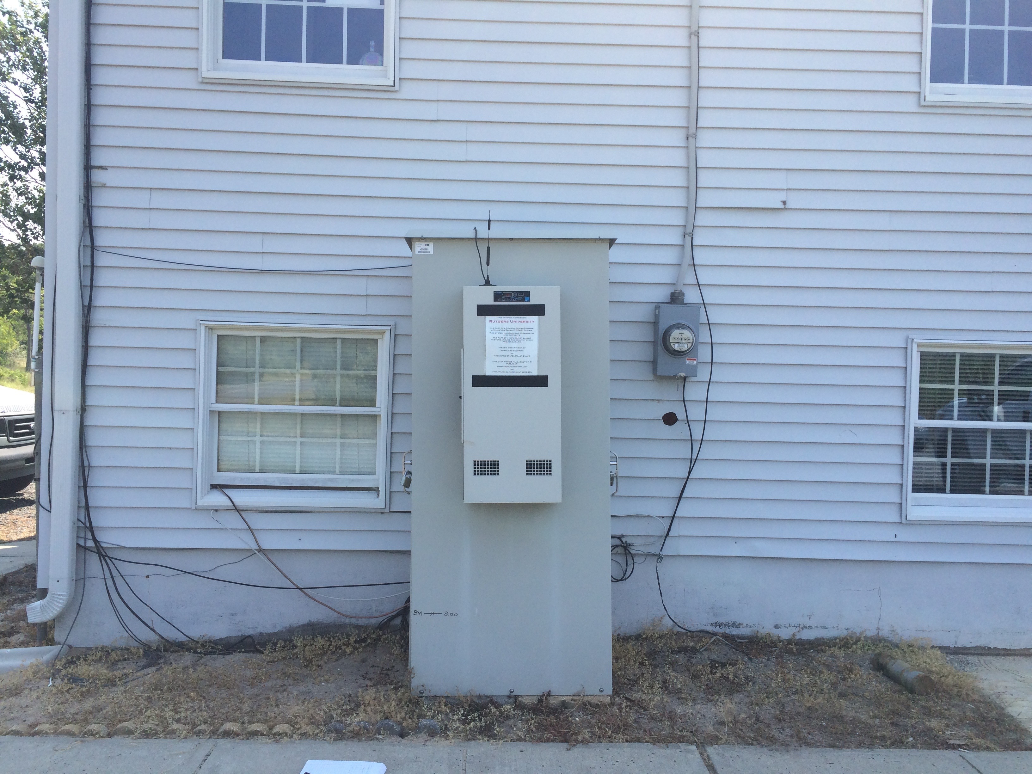
PORT 2015

Slide 17
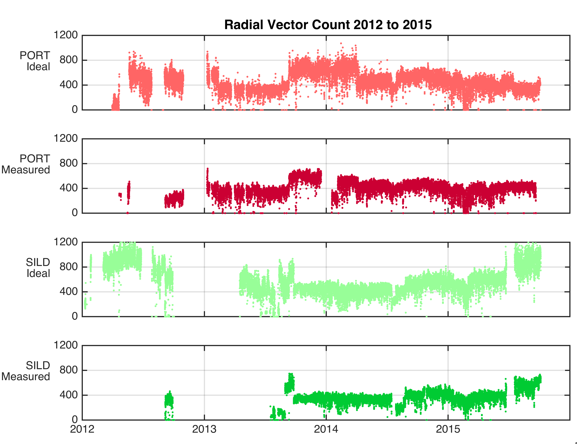
Hurricane Sandy

Slide 18
SILD
PORT

Slide 19
SILD
PORT

Slide 20
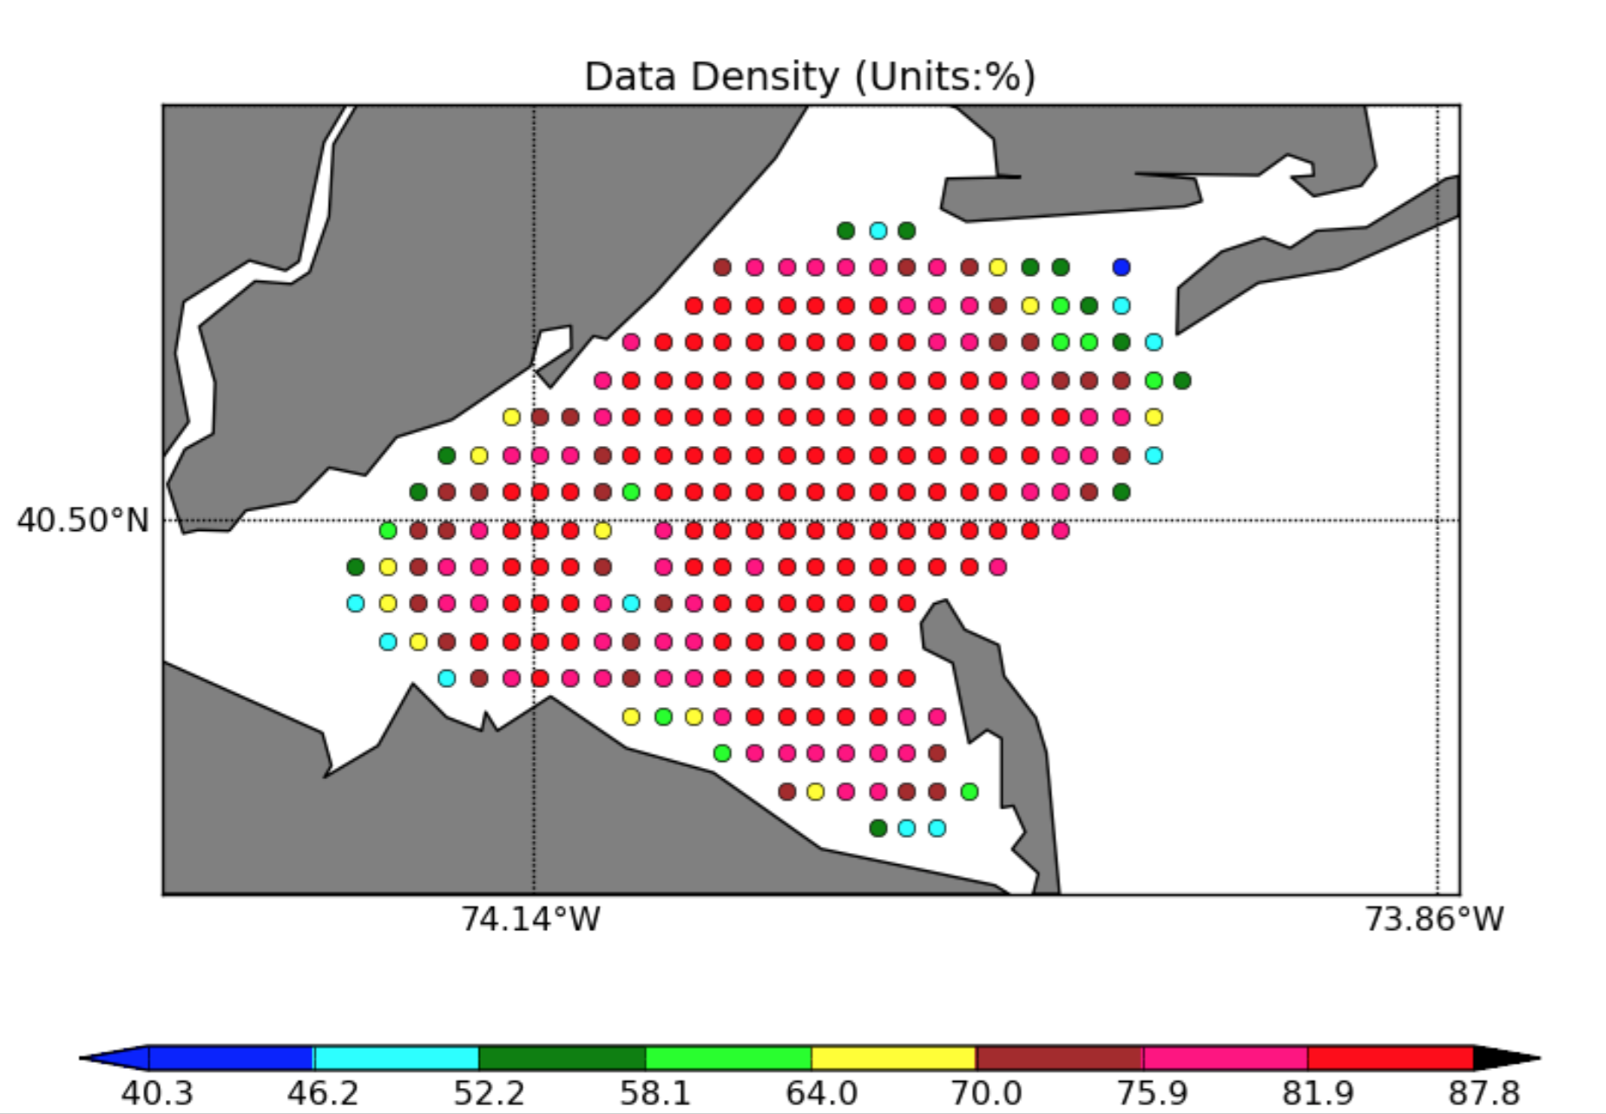
Data Density July 14, 2013 to July 14, 2014
SILD
PORT

Slide 21
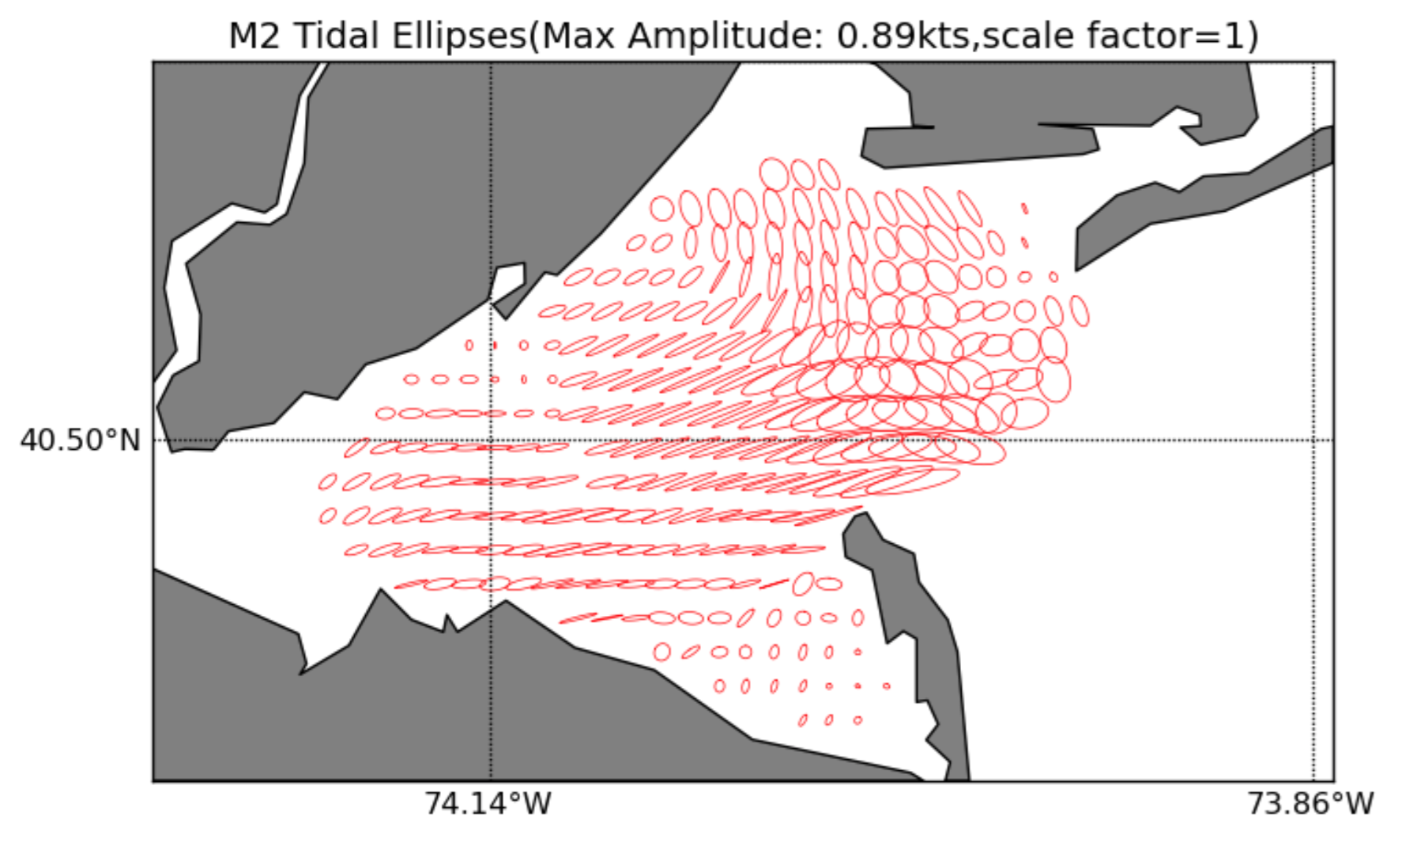
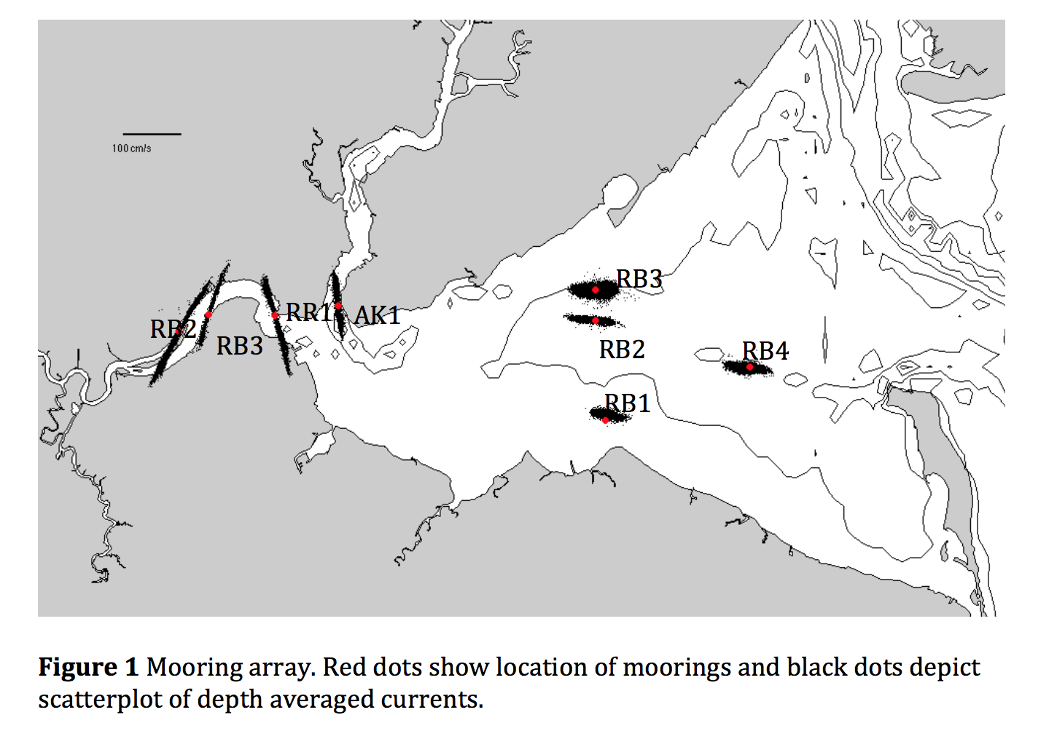

Slide 22
Quality Control
A grid point was labelled as questionable if
Data Density < 50%
GDOP > 0.7
Major Axis Residual Variance > 50%

Slide 23
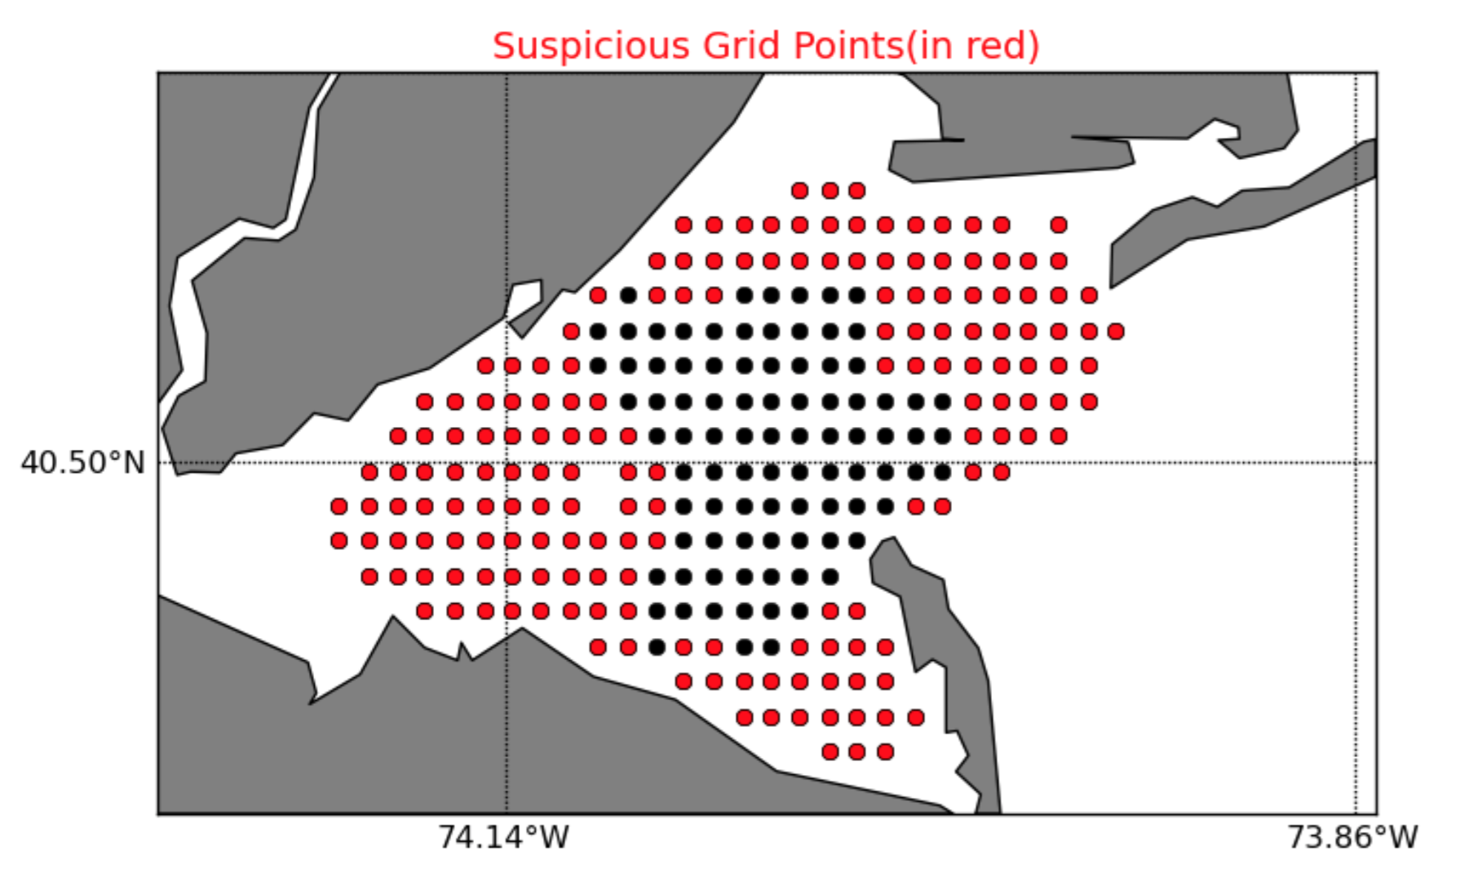
Flagged Grid Points in Red
SILD
PORT

Slide 24
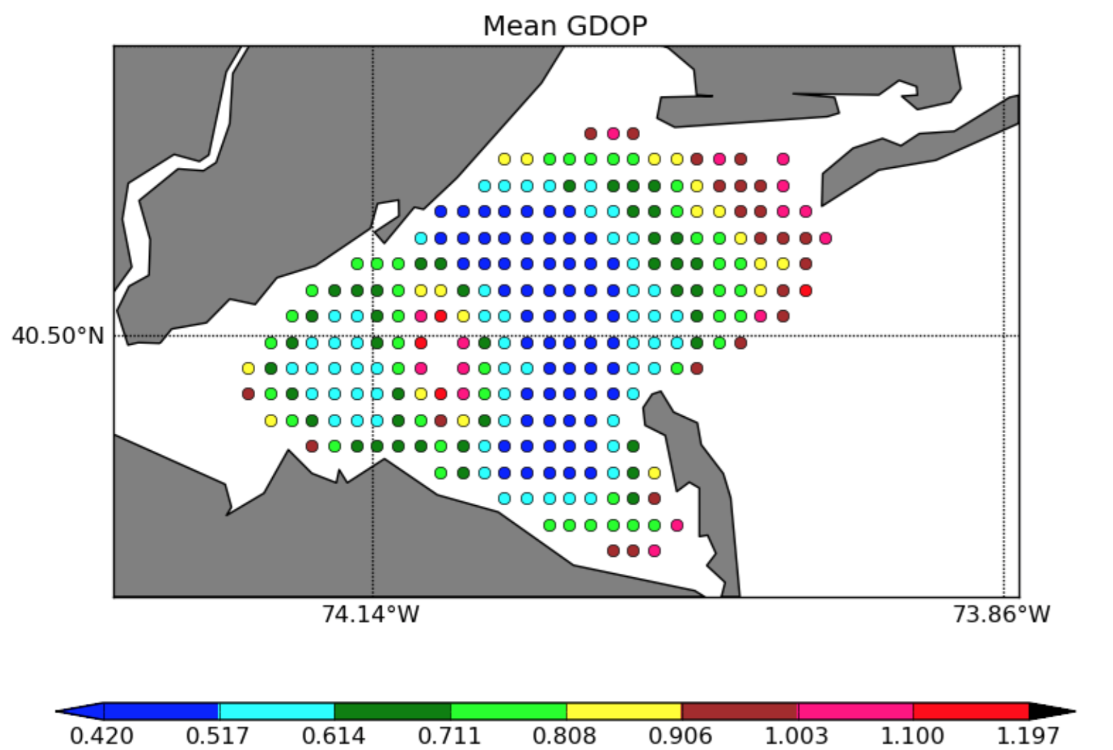

Slide 25
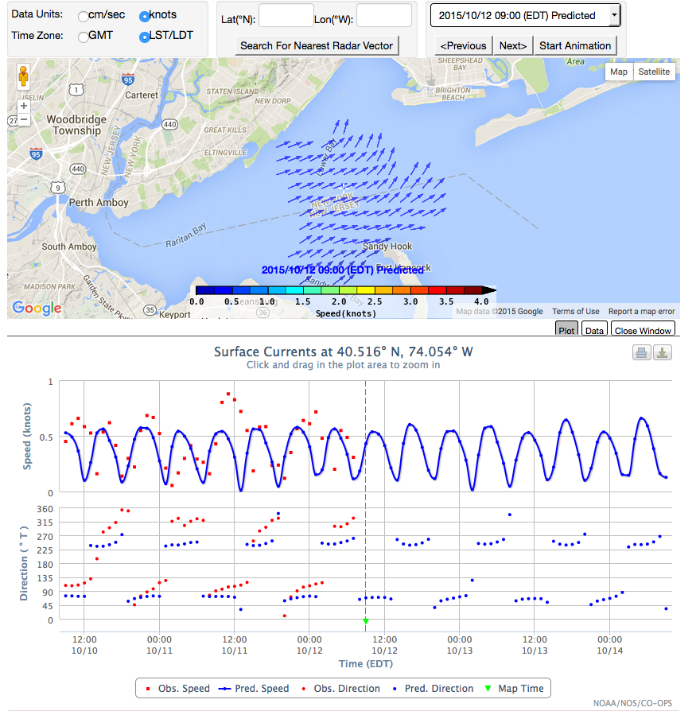
NOAA NOS CO-OPS
PORTS System
High Frequency RADAR
Surface Currents
Hourly maps of the surface current velocity can be viewed for the previous 24 hours (observed currents) and next 24 hours (predicted tidal currents)
Each point is clickable and will bring up time series plots of observed and predicted speed and direction (pictured)
Text output of time series will also be available
Searchable to find nearest grid point to entered latitude and longitude values
http://tidesandcurrents.noaa.gov/hfradar/

Slide 26
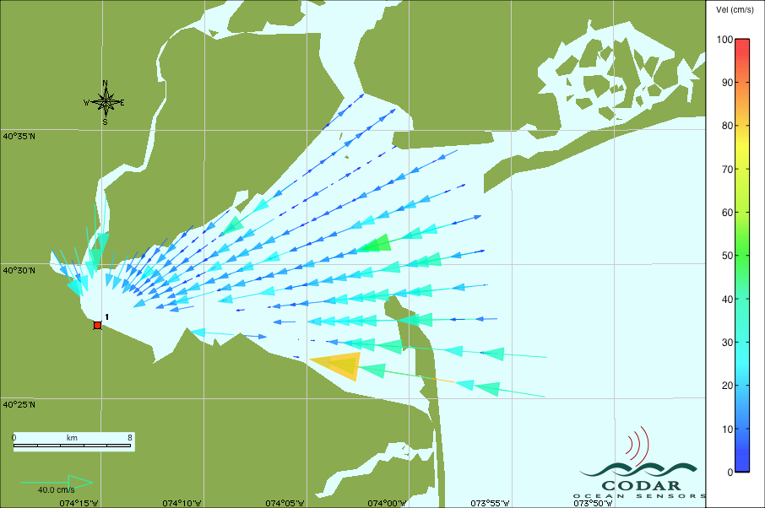
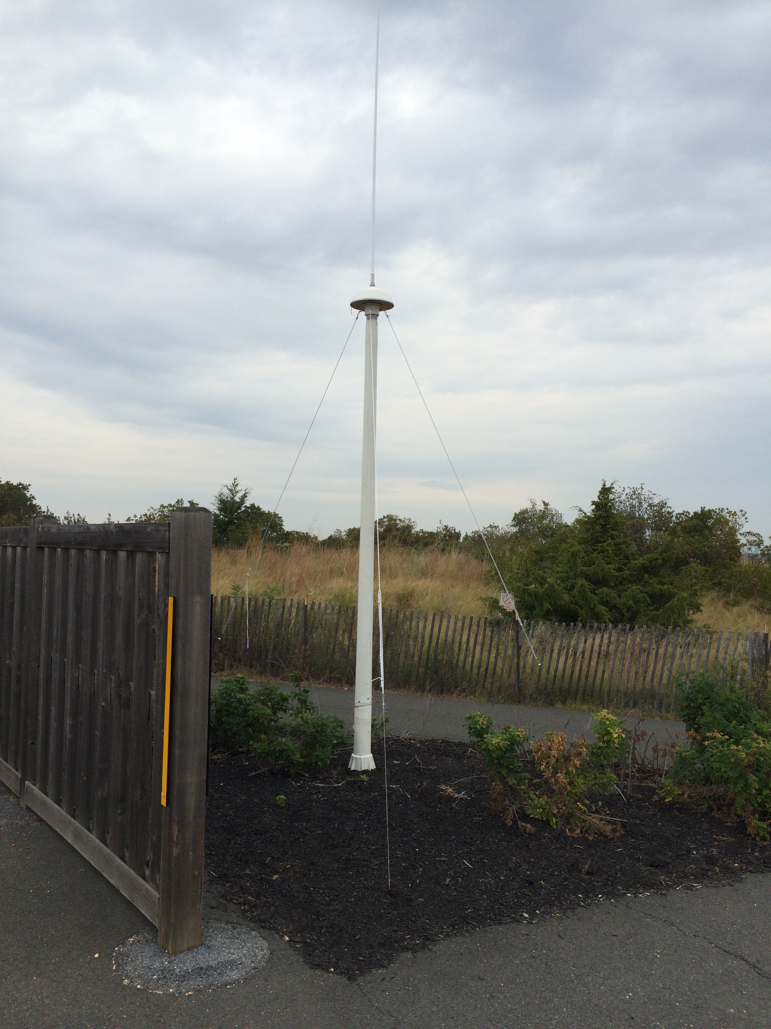
Third Site in NY Harbor
RDLi_OLDB_2015_10_21_0300.ruv

Slide 27
Radial Product

Slide 28
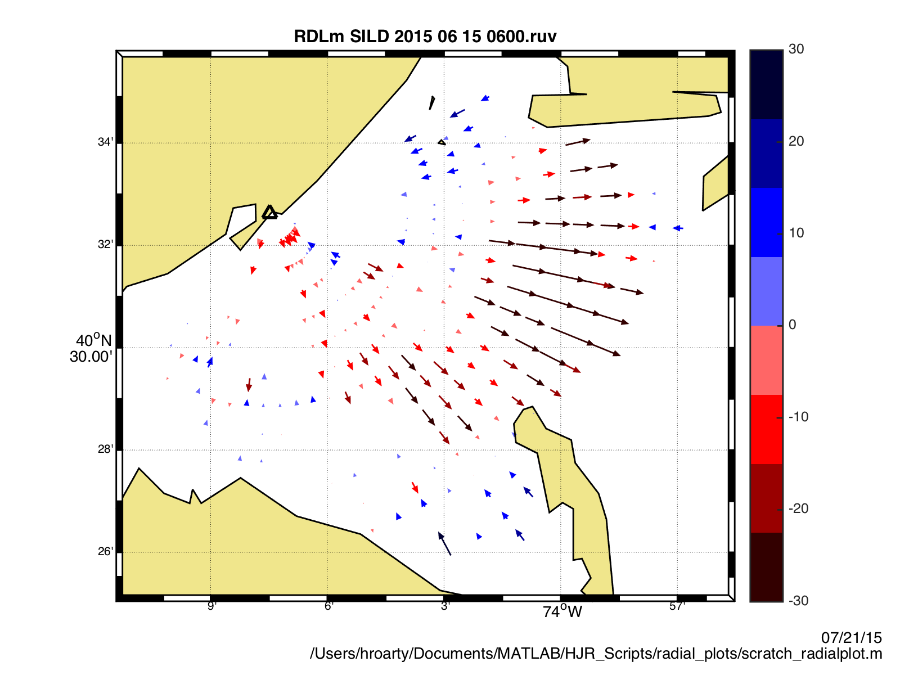

Slide 29
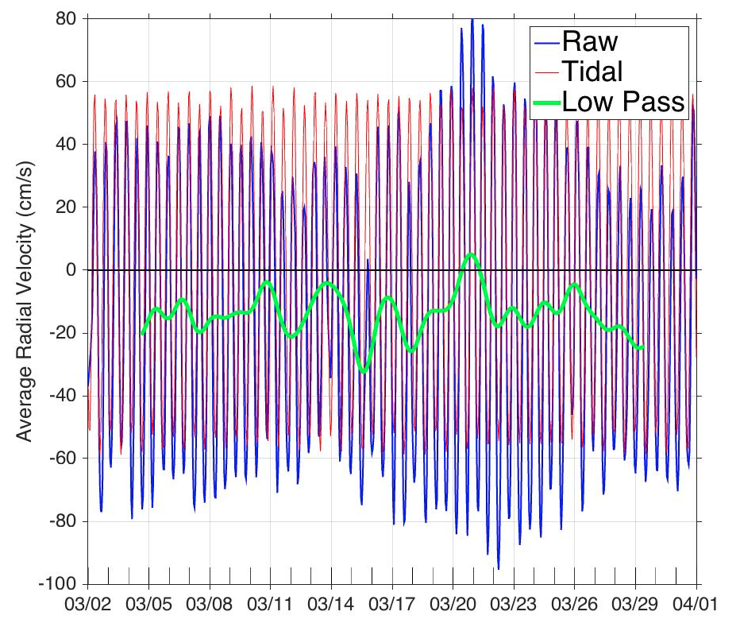

Slide 30
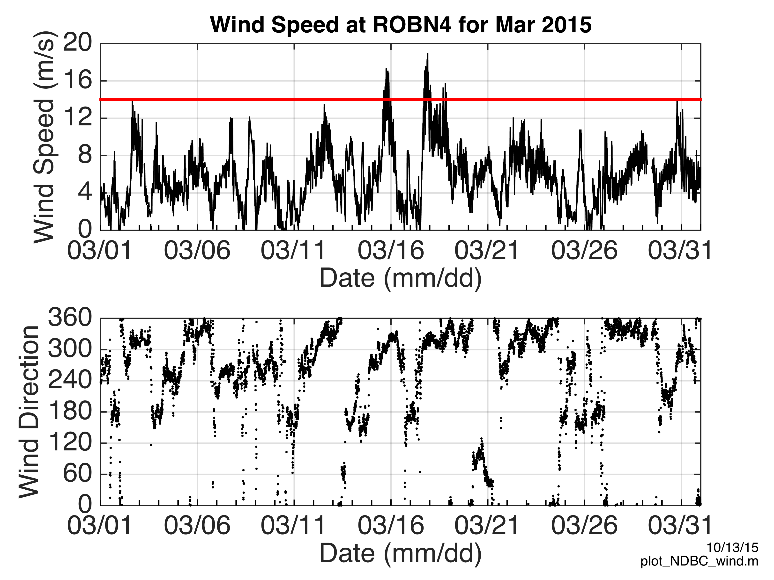

Slide 31
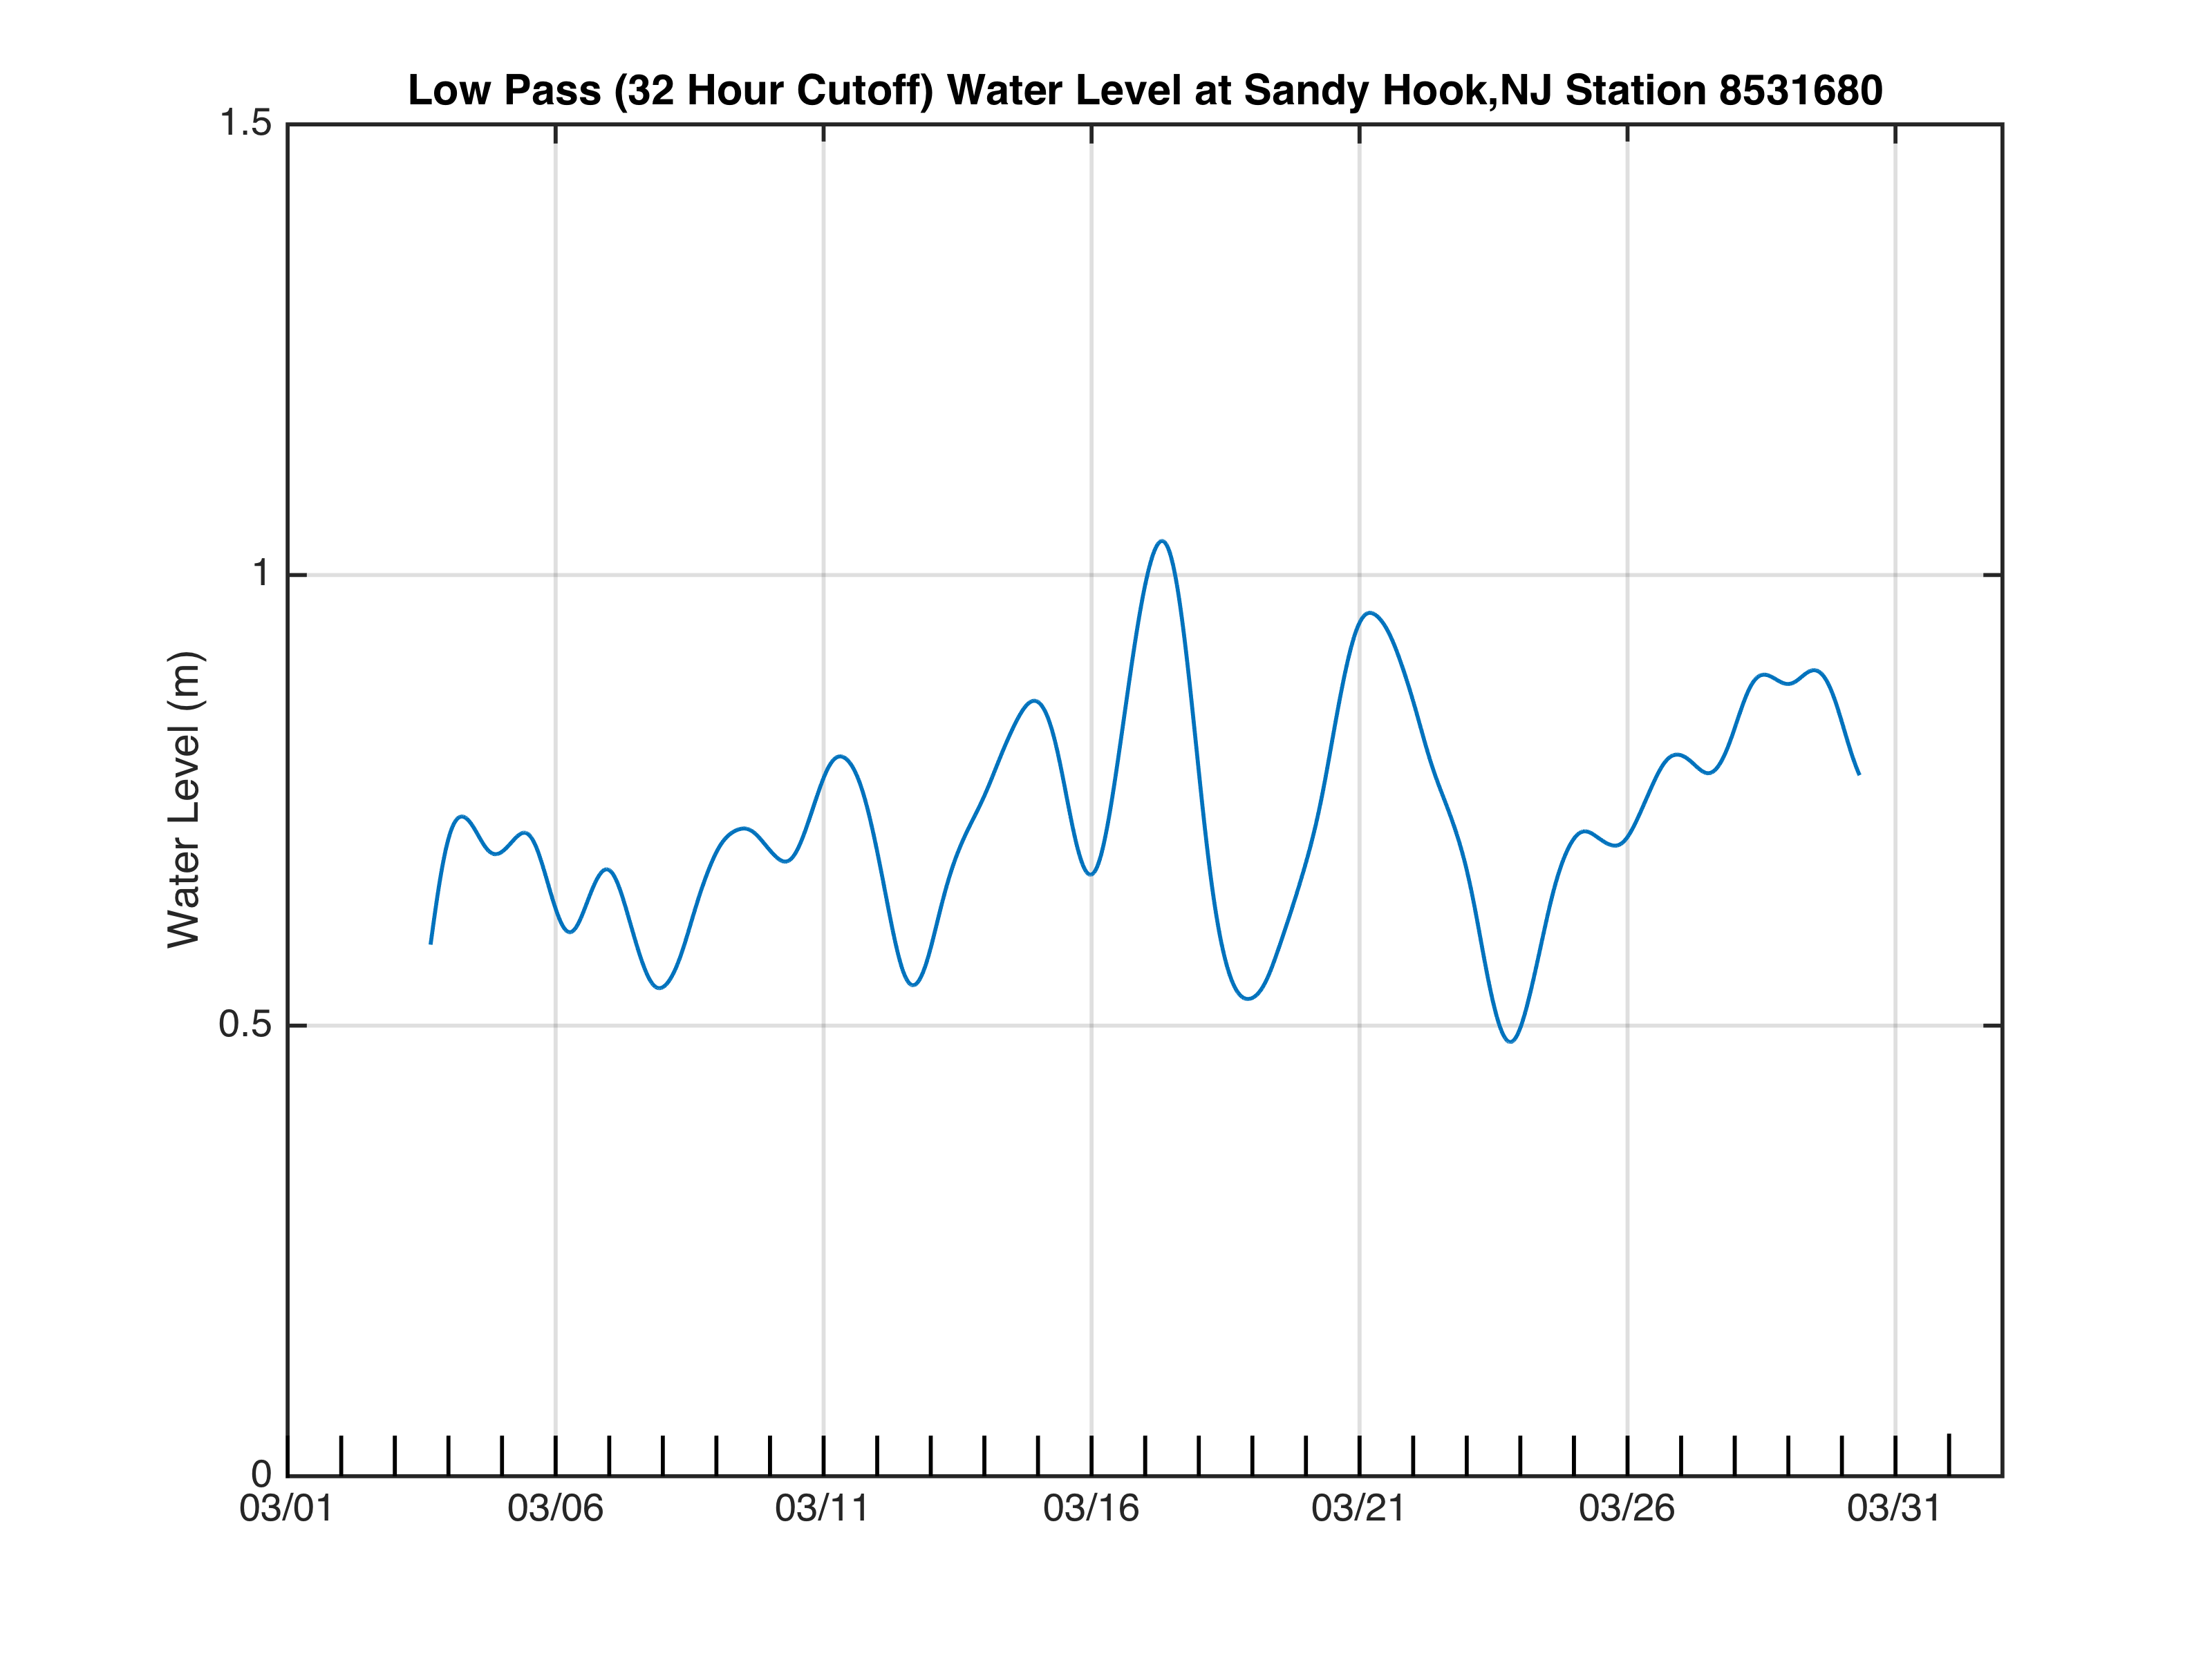

Slide 33
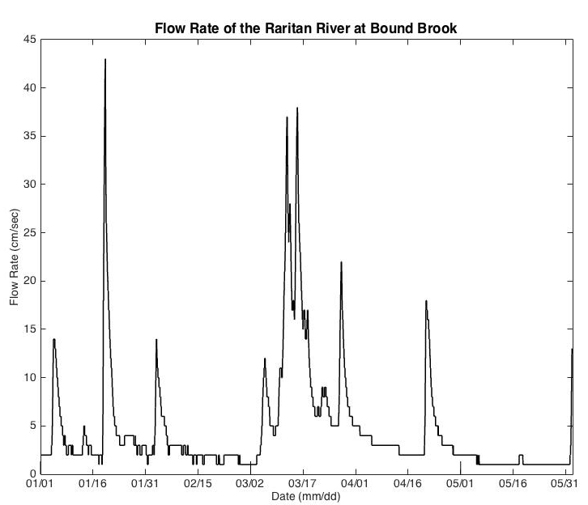

Slide 34
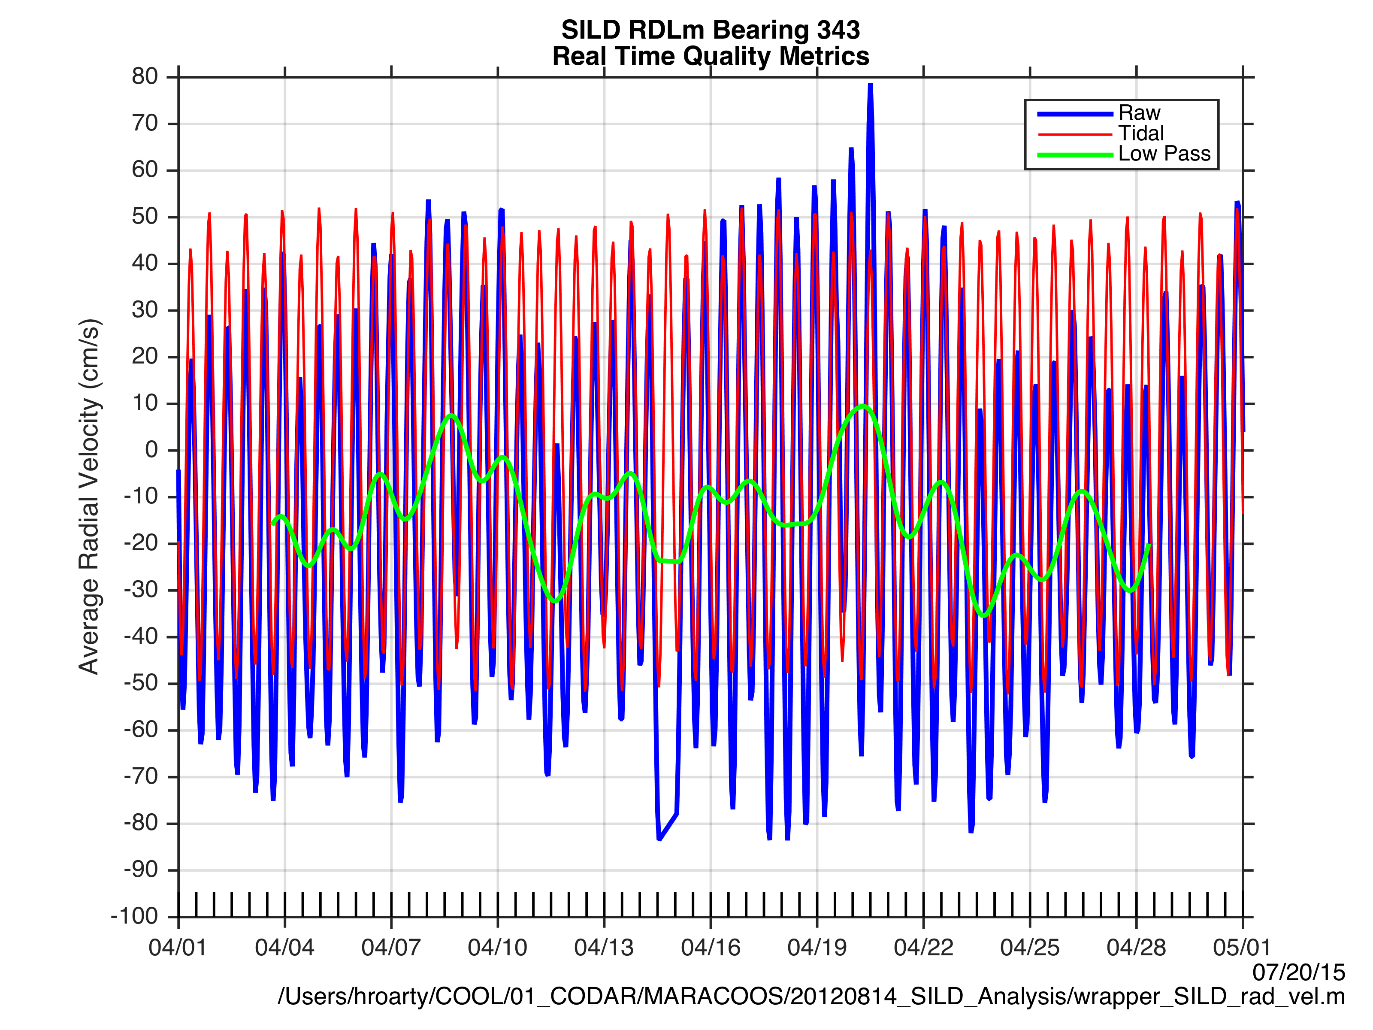

Slide 35
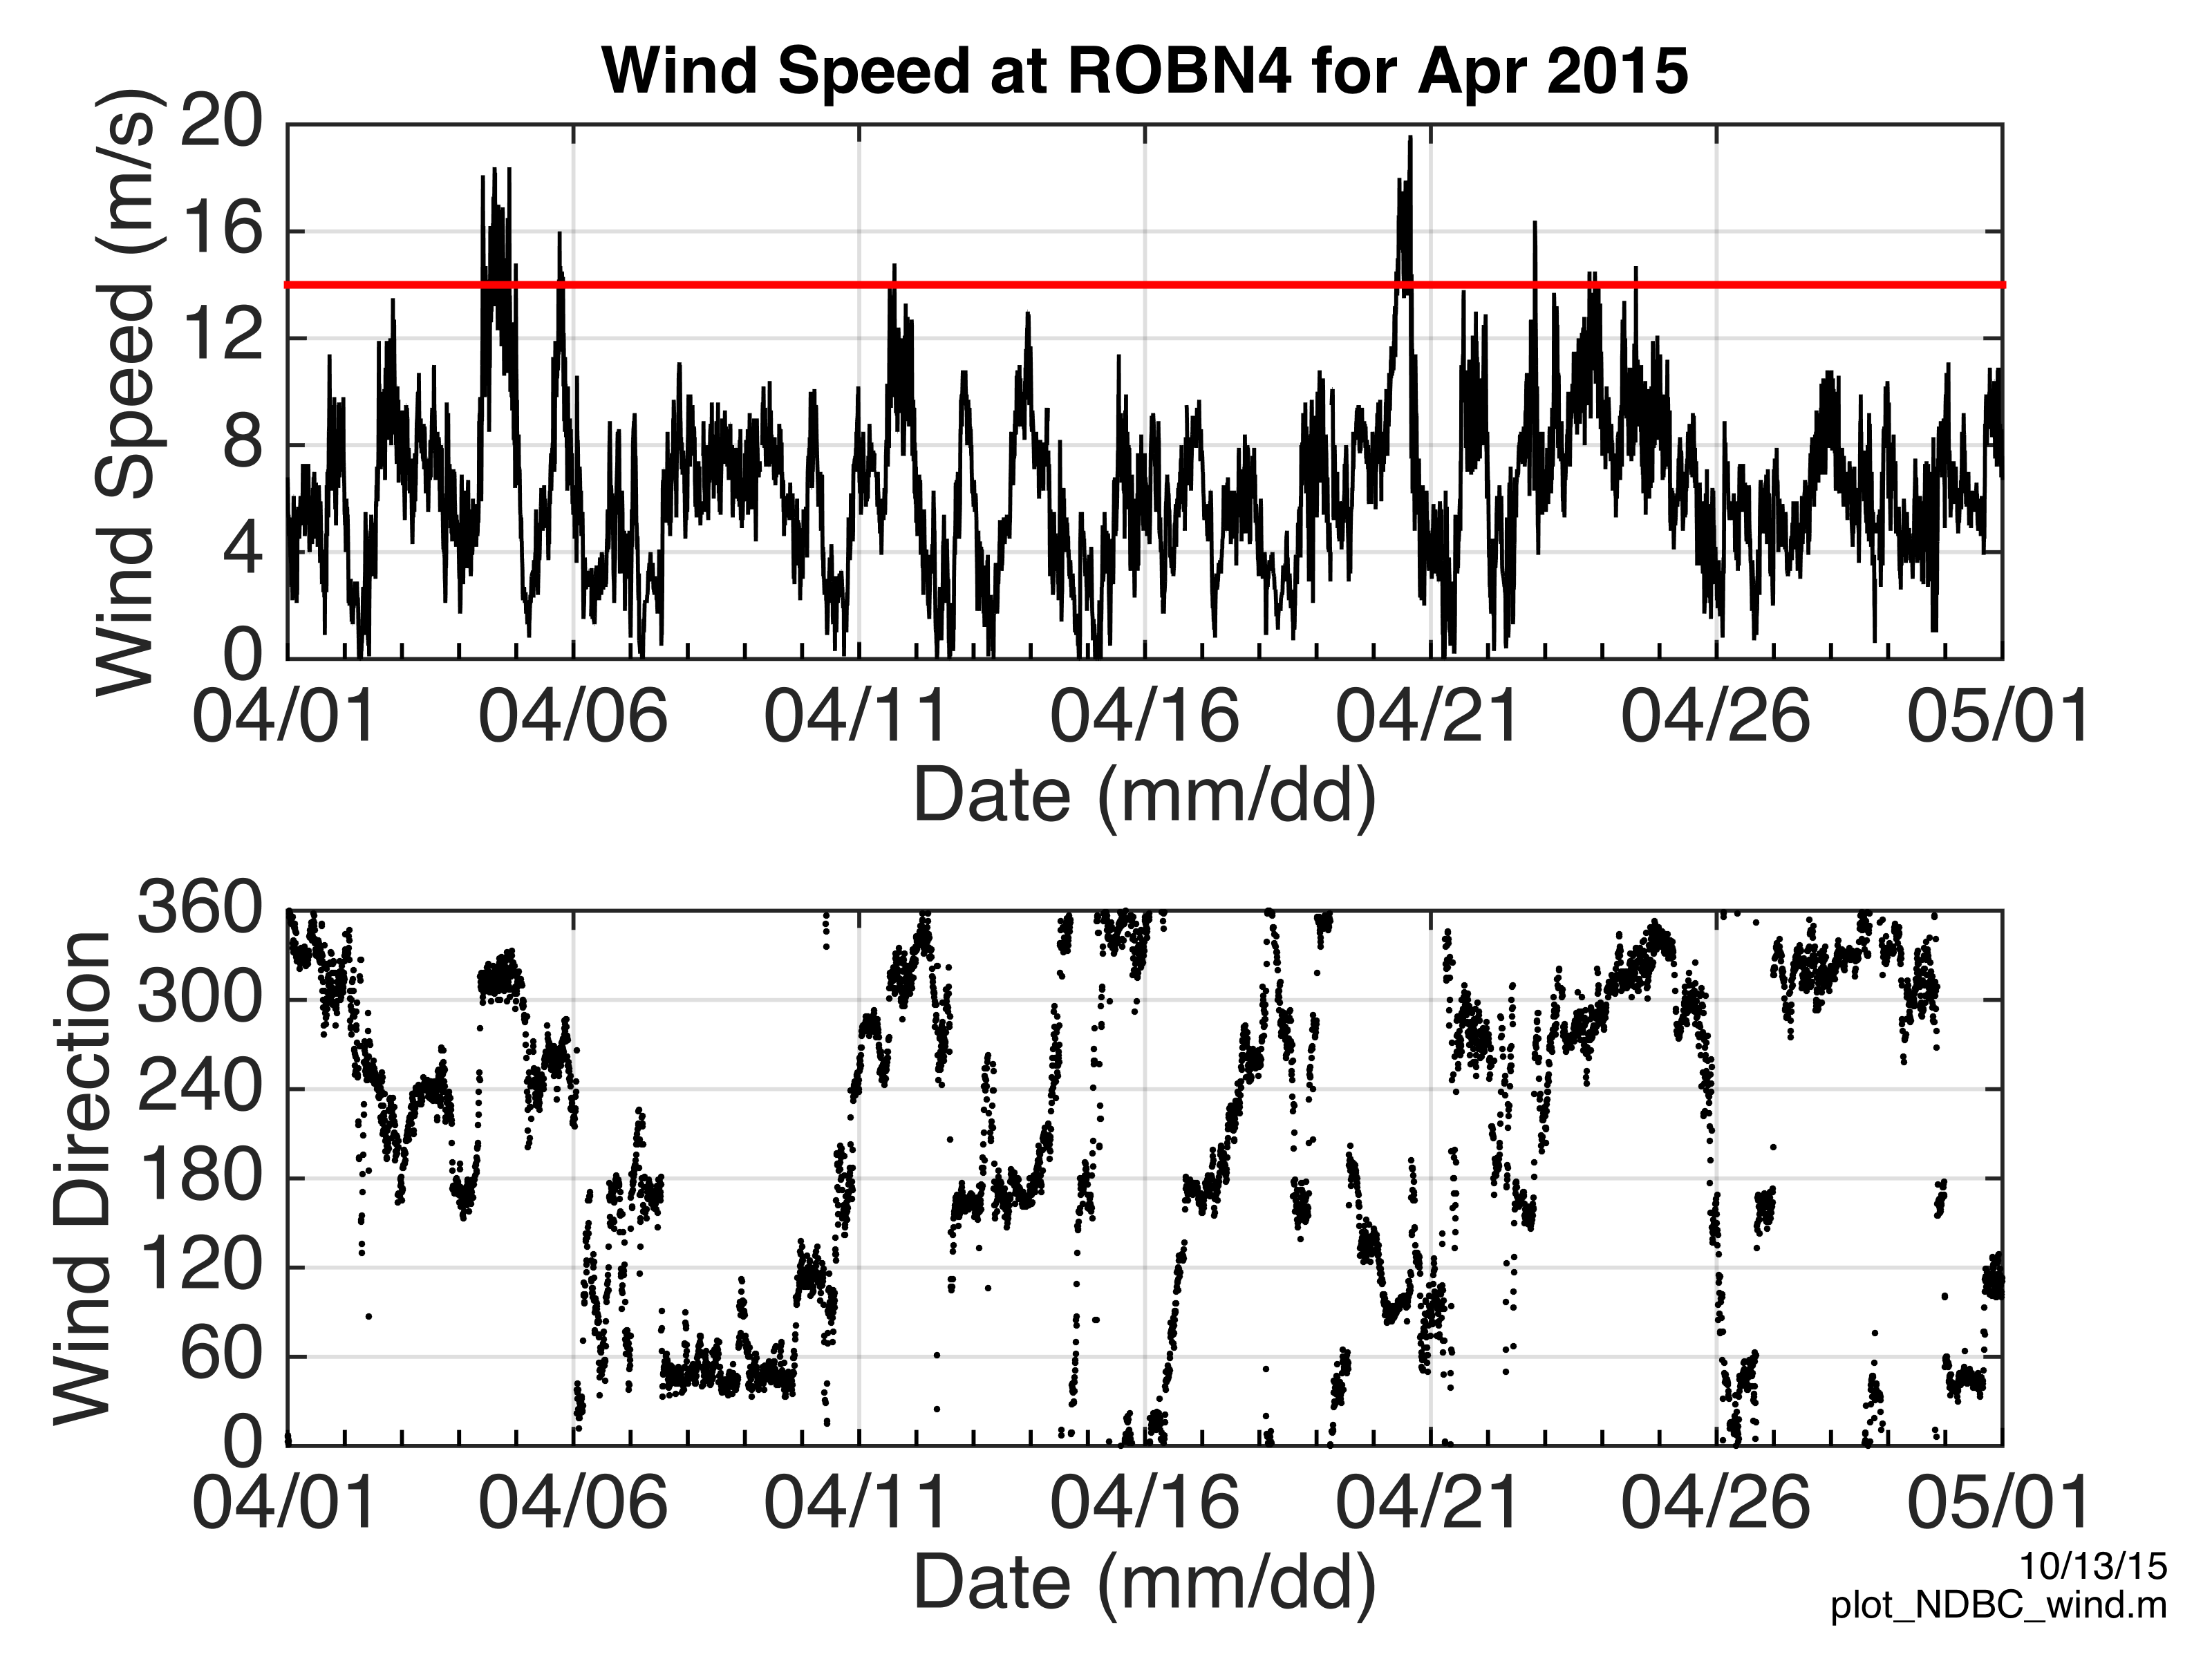

Slide 36
RESULTS
HF Radars are operating again in NY Harbor
Data is provided to NOAA PORTS for nowcasts and forecasts
Surface current measurements correlate with local wind and rainfall events

