Slide 1
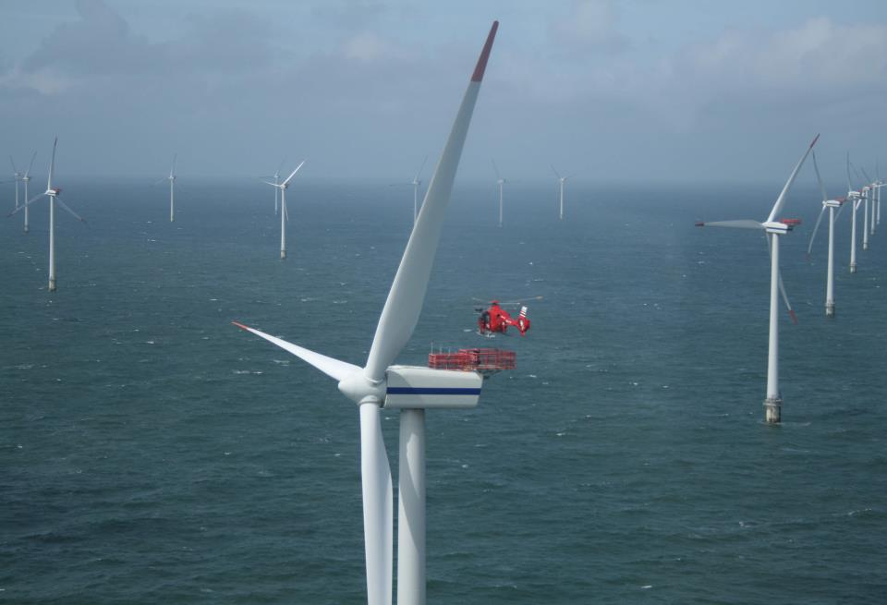





How coastal upwelling can affect the offshore component of the sea breeze:
WRF simulations for offshore wind energy
Greg Seroka*, Rich Dunk,
Louis Bowers, Scott Glenn
January 6, 2015
98th Annual AMS

Slide 2
Introduction
On July 21, 2014, BOEM issued Proposed Sale Notice for NJ
  Nearly 344,000 acres for leasing offshore wind (OSW)
  Auction to take place in (early?) 2015
OSW developer(s) who win (2-3) lease zones will submit application to develop to NJ Board of Public Utilities (NJ BPU)

Slide 3
Introduction
NJ BPU Offshore Wind Rules state:
  “Applications shall account for…the coincidence between time of generation for the project and
  peak electricity demand.”
NJ sea breeze and coastal upwelling coincident with peak electricity demand
Relative Load
Frequency
Notes:
-Sea breeze time of day (afternoon/evening) is coincident with peak demand time of day (5-7 pm)

Slide 4
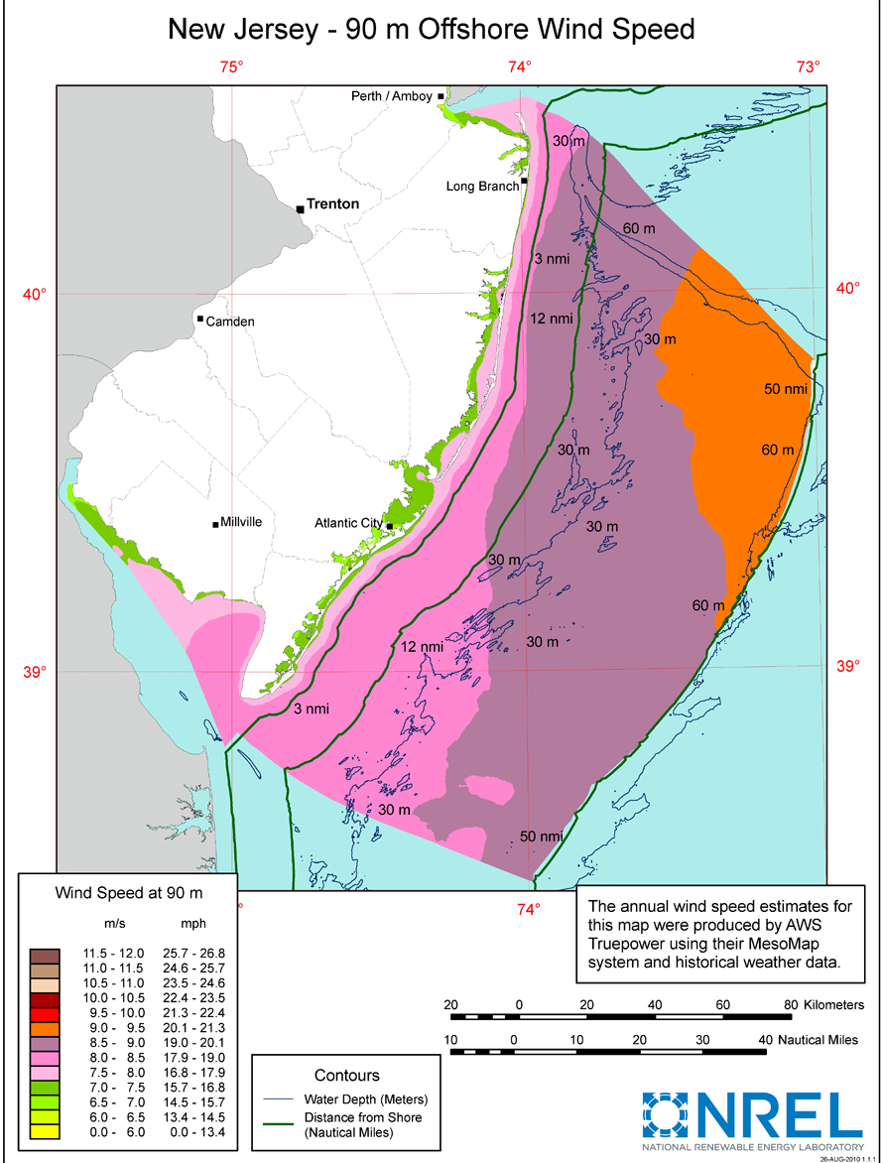
Introduction
Many existing wind resource maps fail to represent variability
Sea breeze = sig. source of OSW variability, during peak electricity demand
Question: how does upwelling affect sea breeze, esp. offshore?
  Bowers (2004): NJ onshore sea breeze, upwelling
  Steele et al. (2012, 2014) and others: UK offshore sea breeze, no upwelling

Slide 5
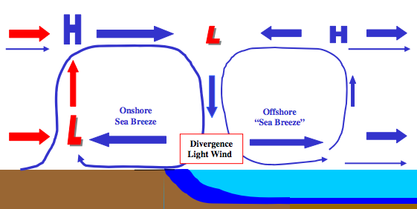
Hypothesis:
Sea breeze with upwelling
Cold upwelling
Notes:
Cut-out speed of OSW turbines of 4 m/s (calm zone?)

Slide 6
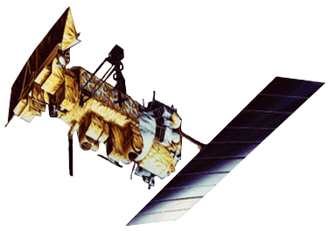
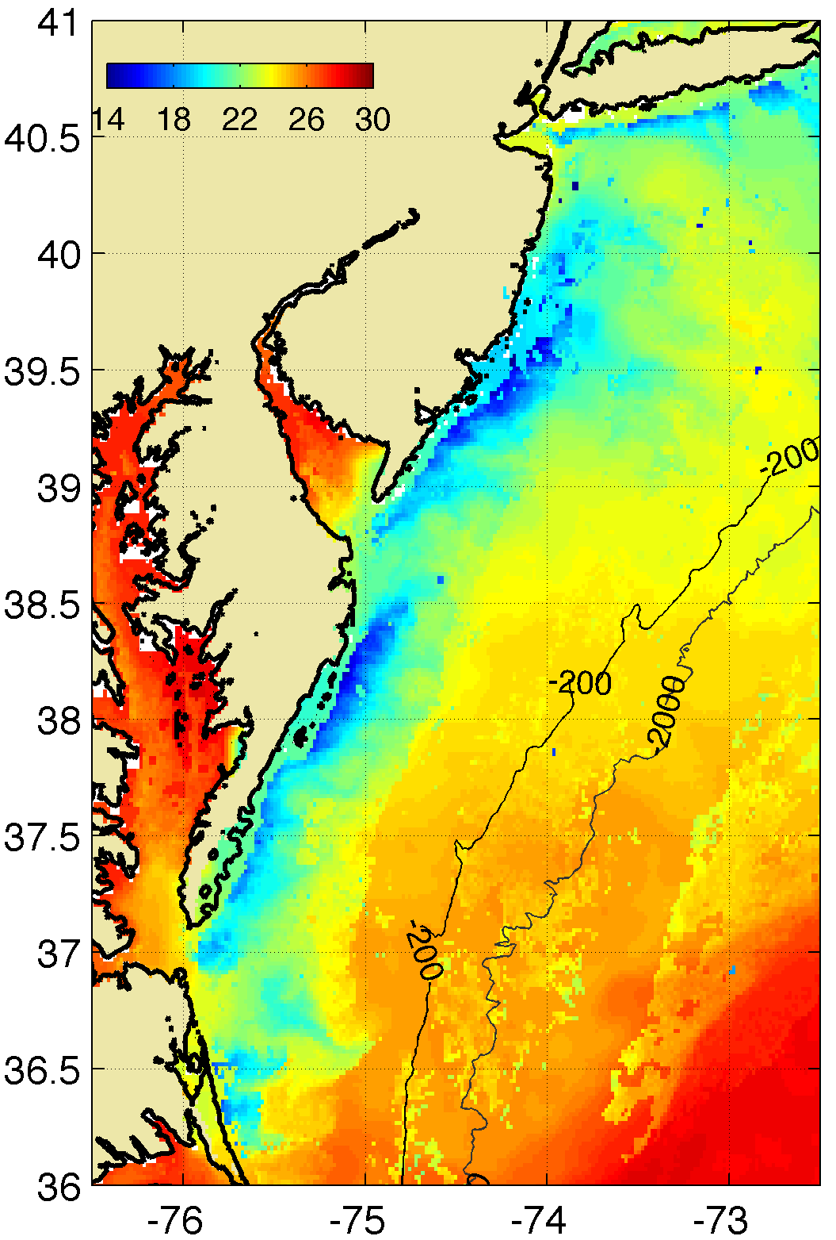


Materials and Methods
Satellite: state-of-the-science declouding technique designed by Rutgers to determine SST and resolve coastal upwelling
Model: 3km, 600m WRF-ARW 3.6.1; YSU PBL; MM5 Monin-Obukhov surface layer
Advantages (vs. offshore met tower): cost, spatial variability, prediction
Cases:
20130707: sea breeze, upwelling
20140731: sea breeze, no upwelling
3-4. Switch SST between runs
Coastal upwelling
Notes:
Satellite: High res in space and time
Previous satellite SST products low in spatial or temporal resolution and are often warmest pixel composites for declouding; cannot resolve coastal upwelling
SST product is IR/near IR (AVHRR); SPoRT is IR/near IR as well
Model: NAM12km for boundary conditions
Cases: largest and longest lasting upwelling in NJ 2012-2014
20140731 case has similar ambient (outside upwelling) water T to 20130707

Slide 7
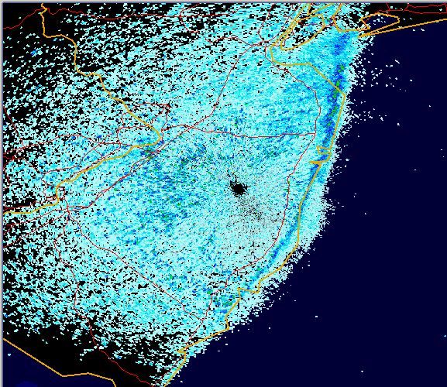
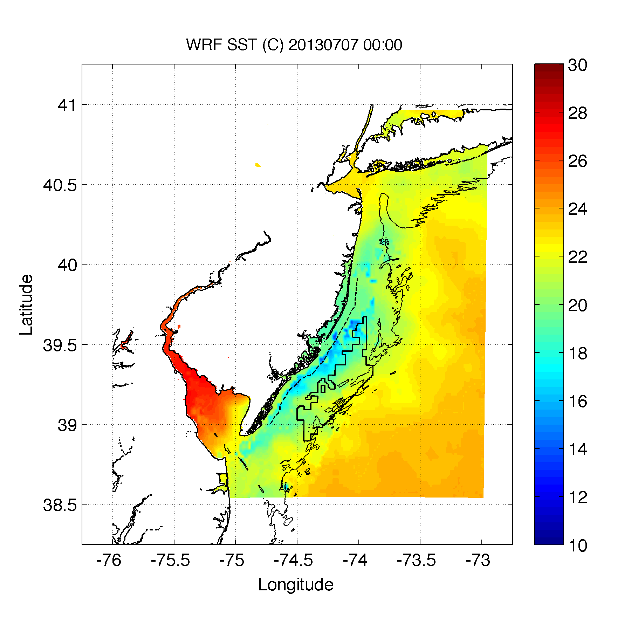
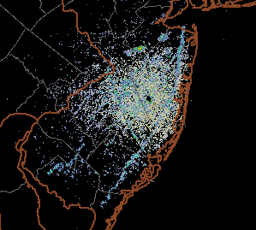
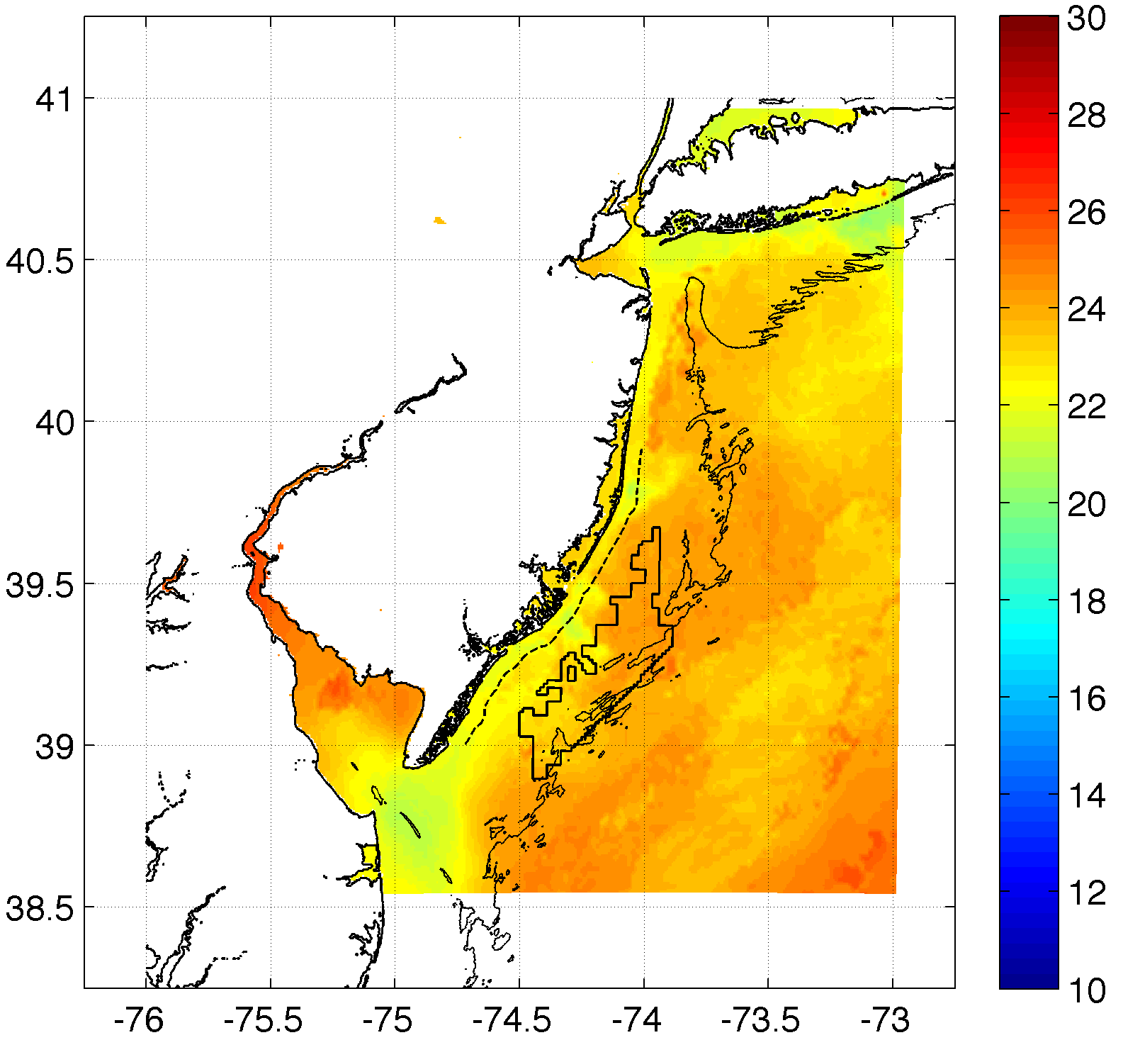
Case 1
Cases 3-4
Case 2

Slide 8
Results
No secondary circulation at offshore upwelling front
Calm zone offshore dependent on synoptic flow
Upwelling produces a strong atmospheric inversion, significantly increasing 100m hub height winds and decreasing 10m winds

Slide 9
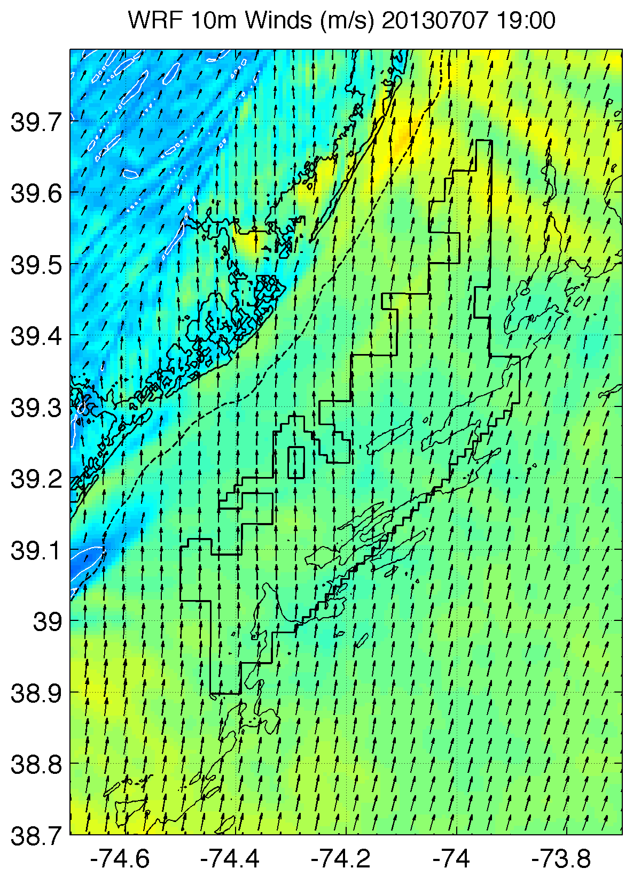
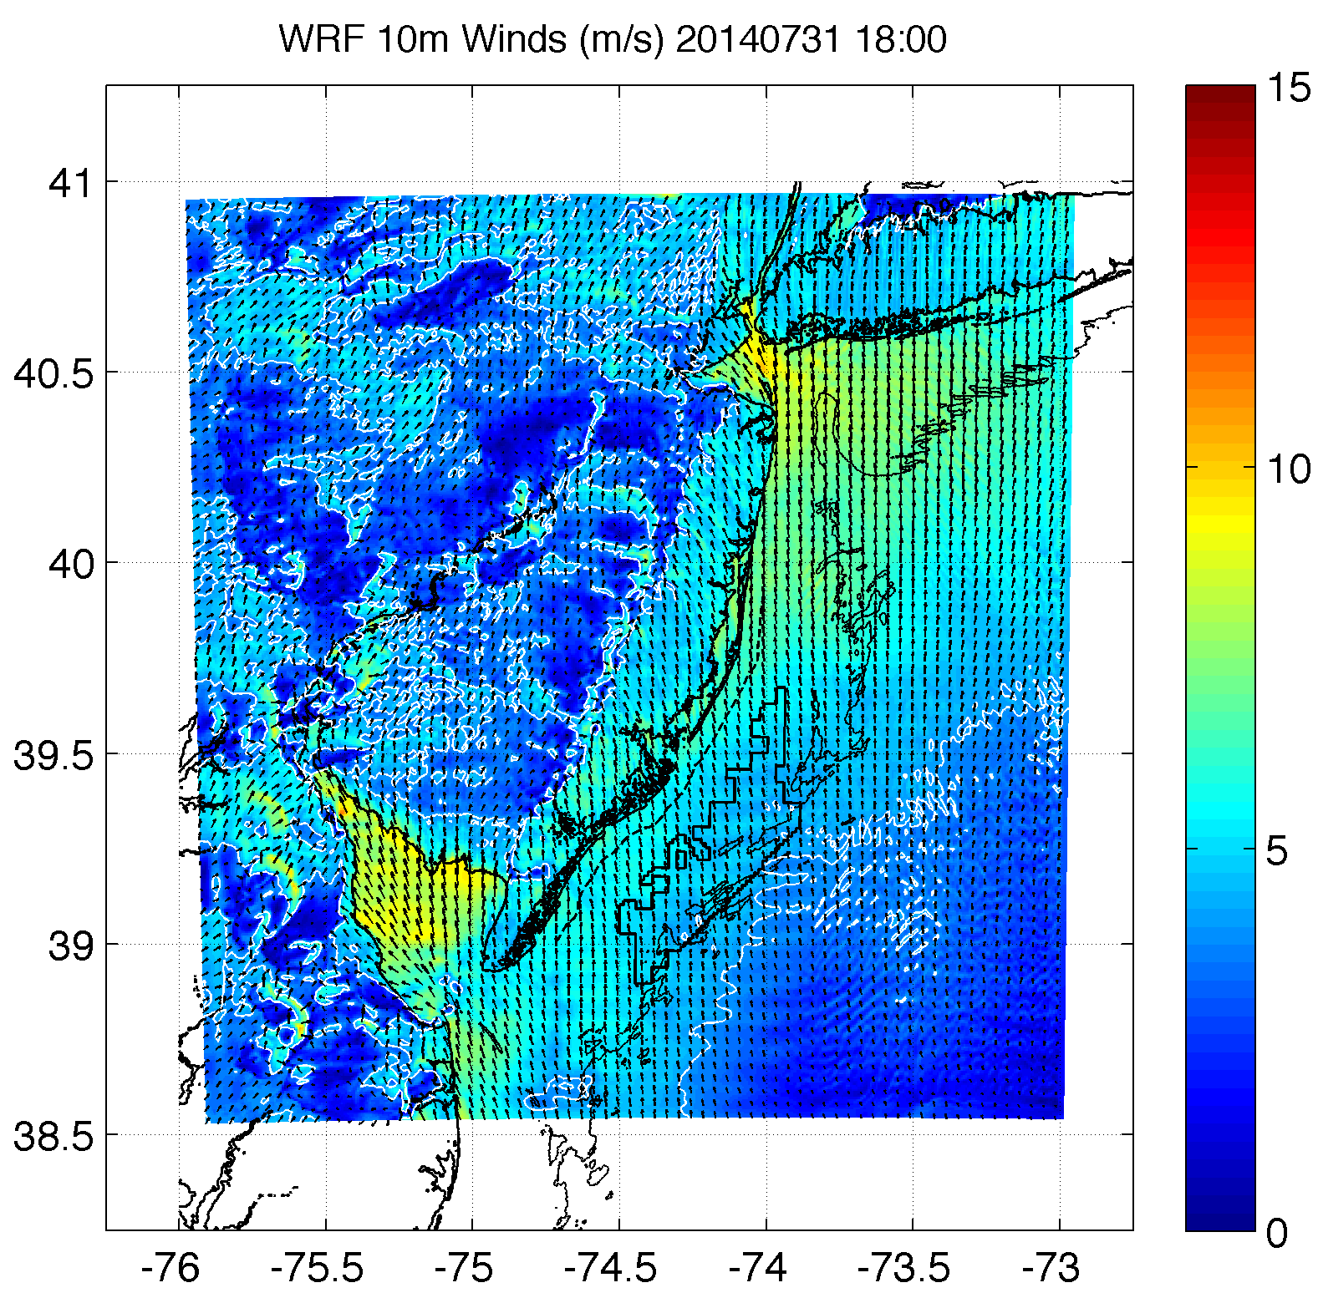
1. No secondary sea breeze circulation/front at offshore upwelling front
“Natural” upwelling
“Forced” upwelling
SST
Strong synoptic flow
Weaker synoptic flow
Notes:
Not dependent on synoptic flow- even in weaker synoptic flow, no offshore sea breeze circulation apparent

Slide 10
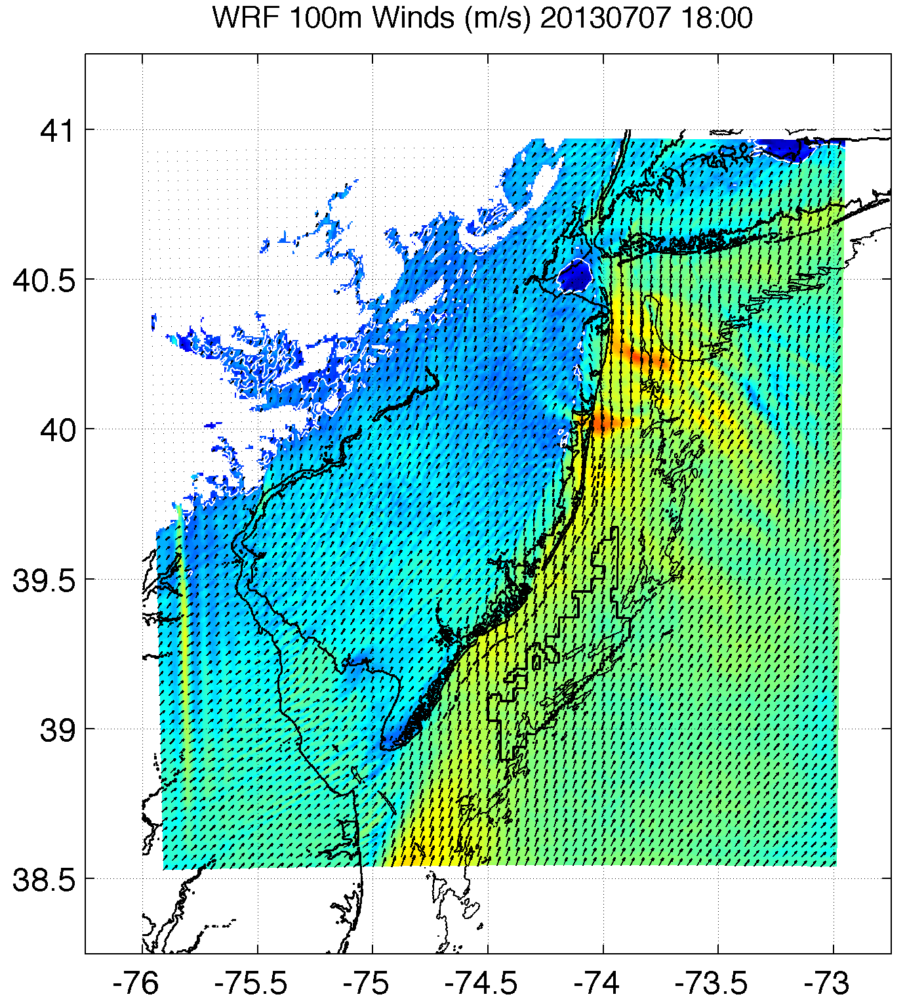
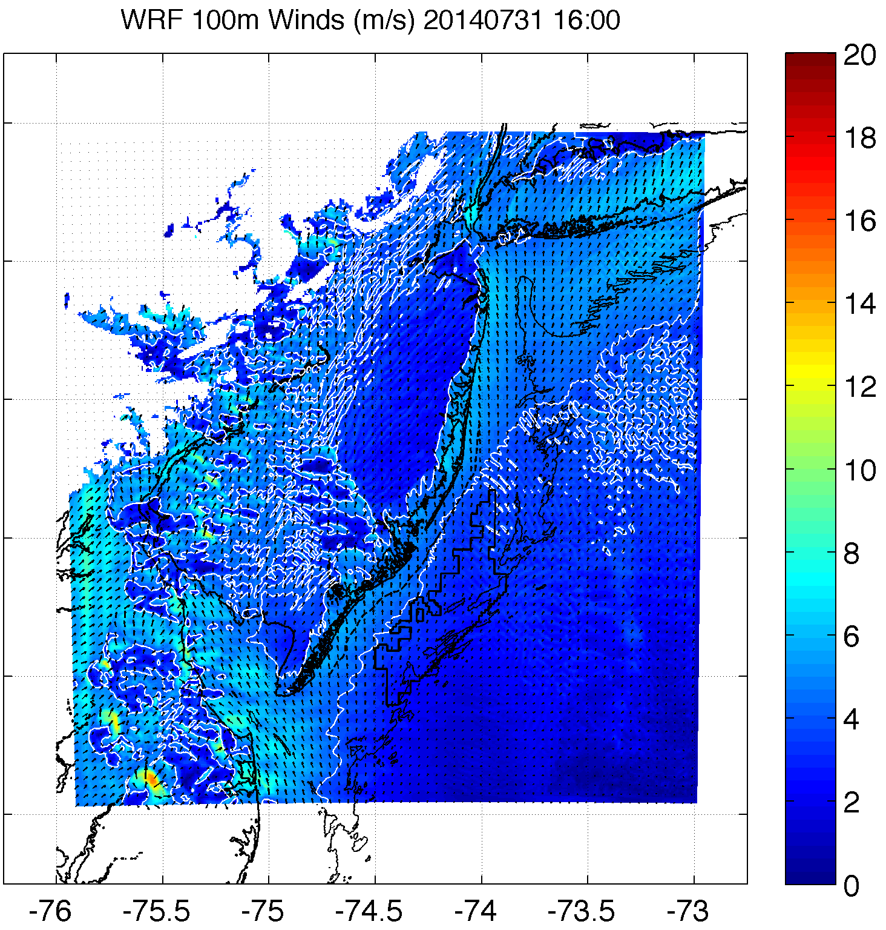
2. Offshore calm zone dependent on synoptic winds
“Forced” non-upwelling
“Natural” non-upwelling
Sea breeze
calm zone?
Strong synoptic flow
Weaker synoptic flow
  Consistent with Bowers (2004): strong winds “wash out” calm zone
Notes:
Is calm zone related to sea breeze circulation or just large scale patterns?
Plots of 100m!

Slide 11
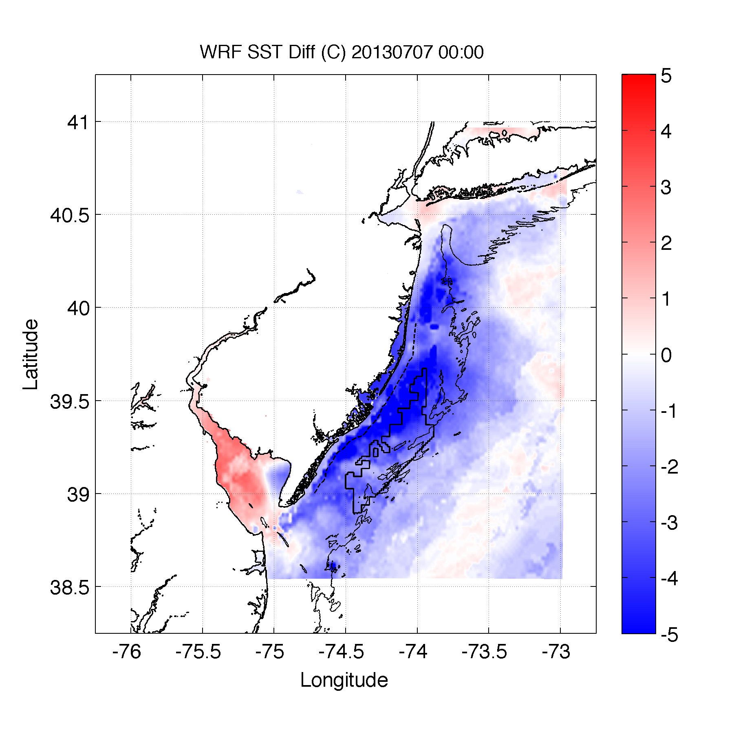
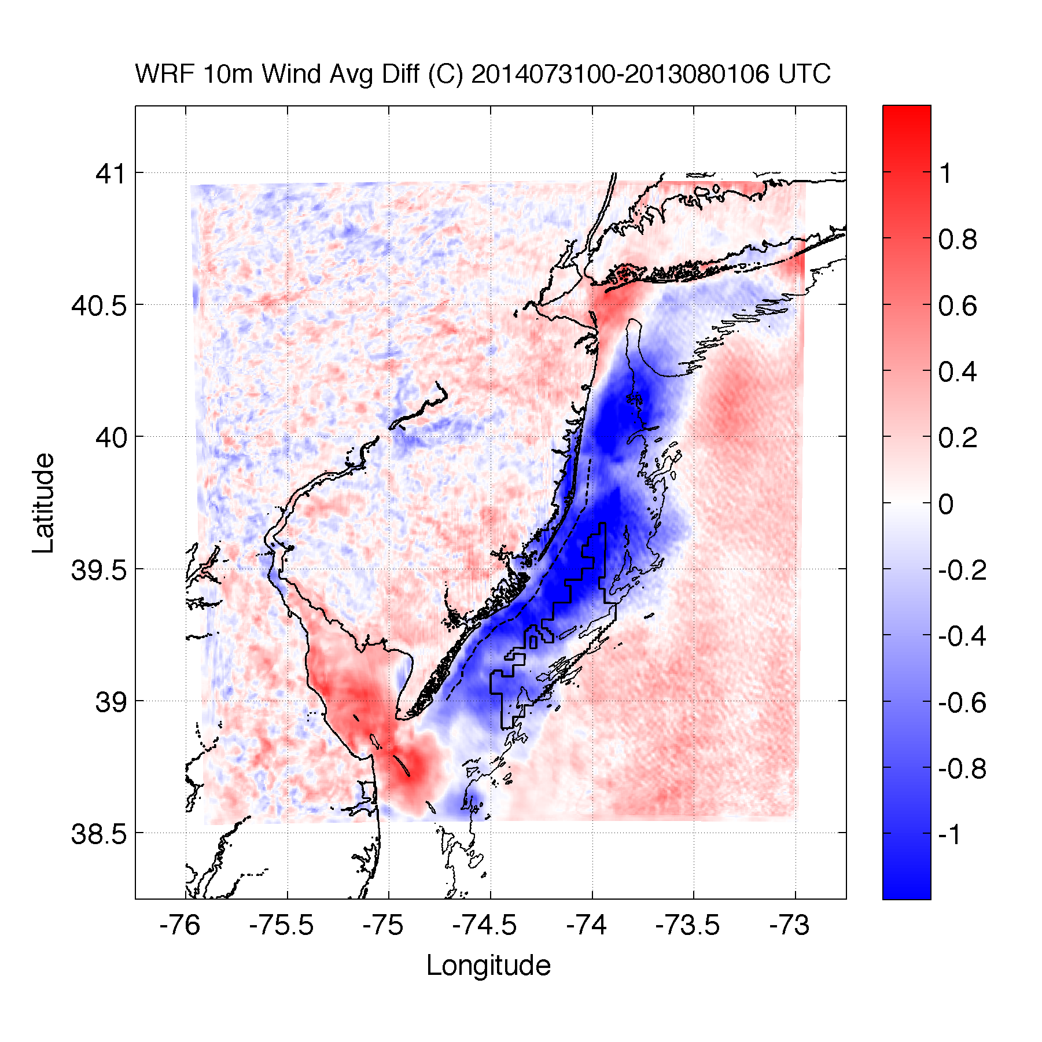
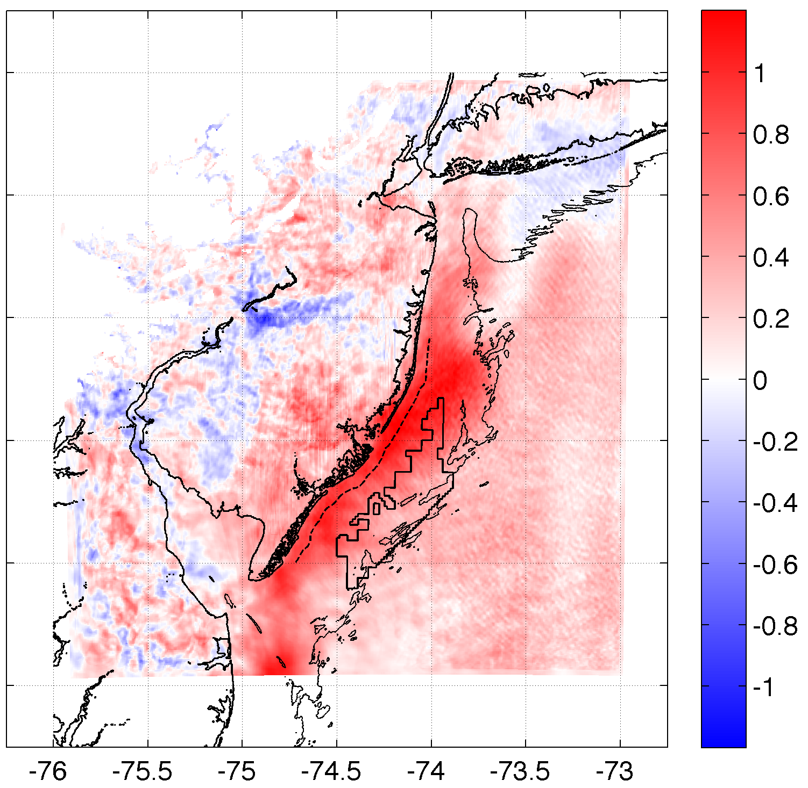
3. Upwelling produces an inversion, increasing 100m hub height winds
SST Diff.
10m Wind Speed Diff.
100m Wind Speed Diff.
r²=0.61
r²=0.58
Case 2: 20140731

Slide 12
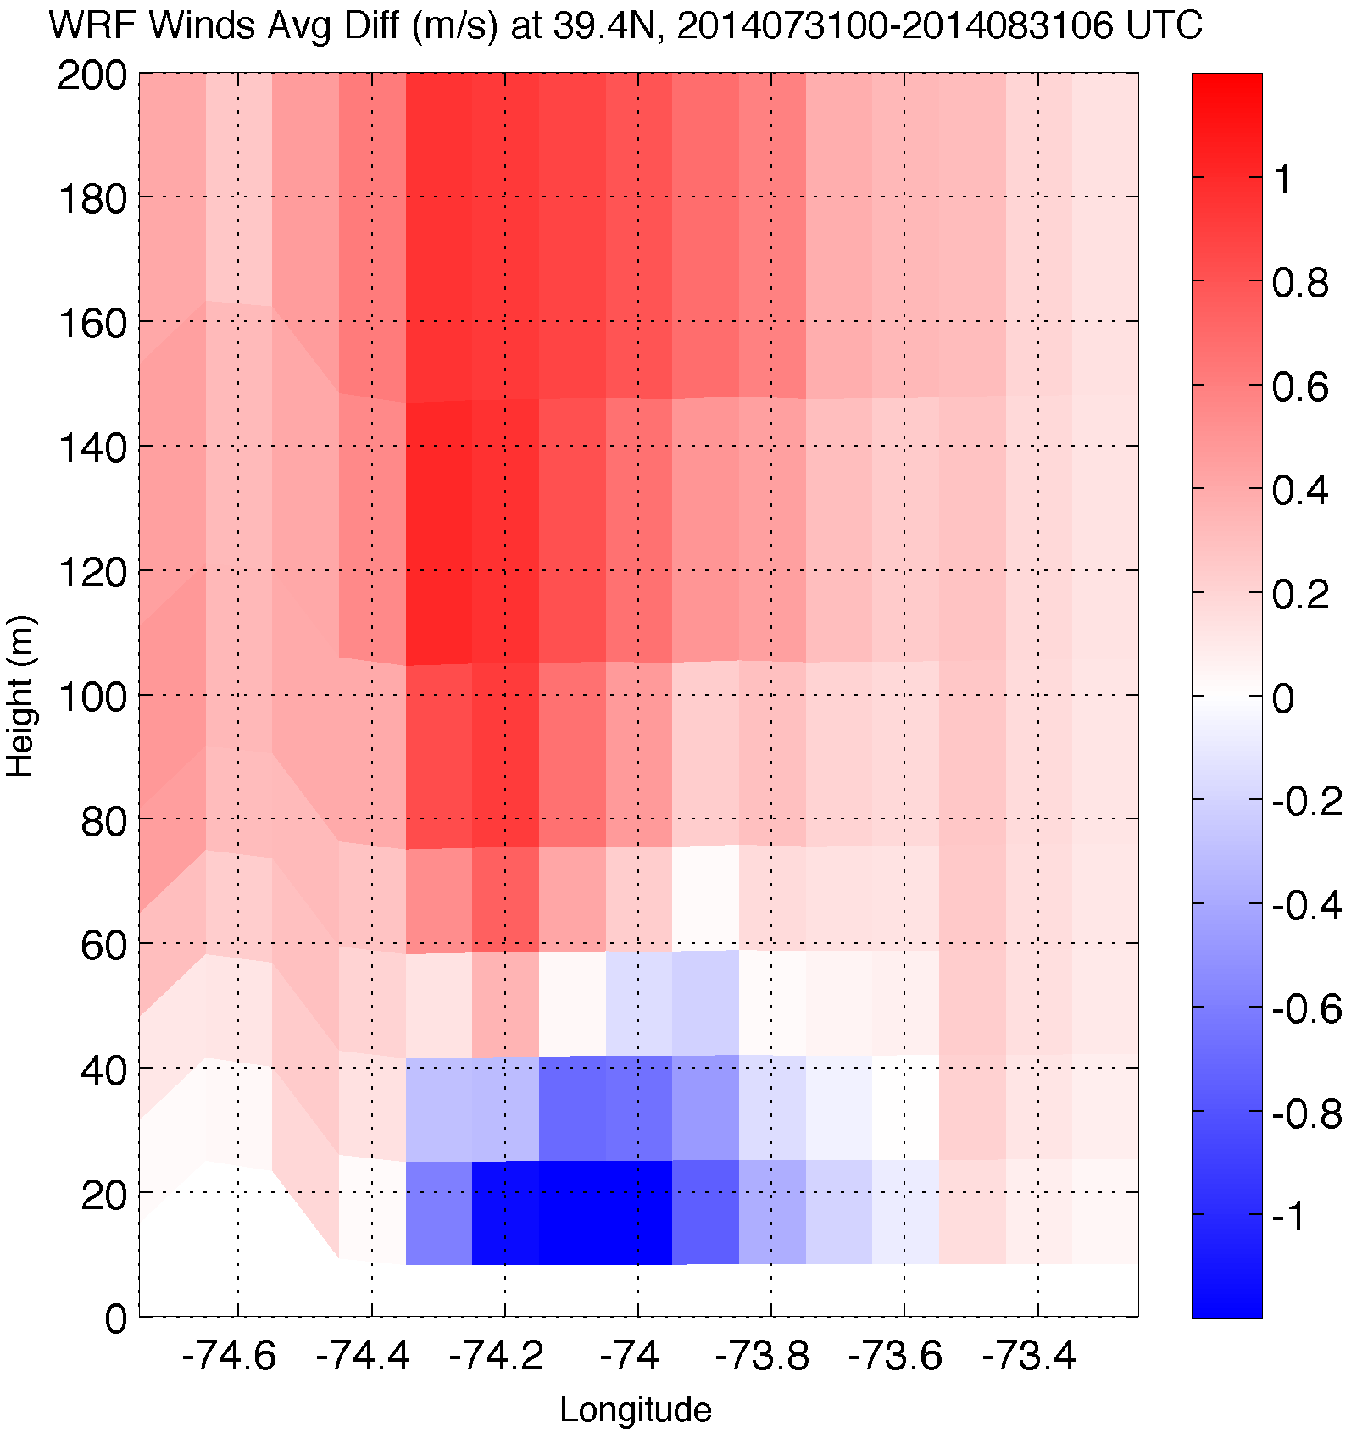

3. Upwelling produces an inversion, increasing 100m hub height winds
Wind Speed Difference
Case 2: 20140731

Slide 13
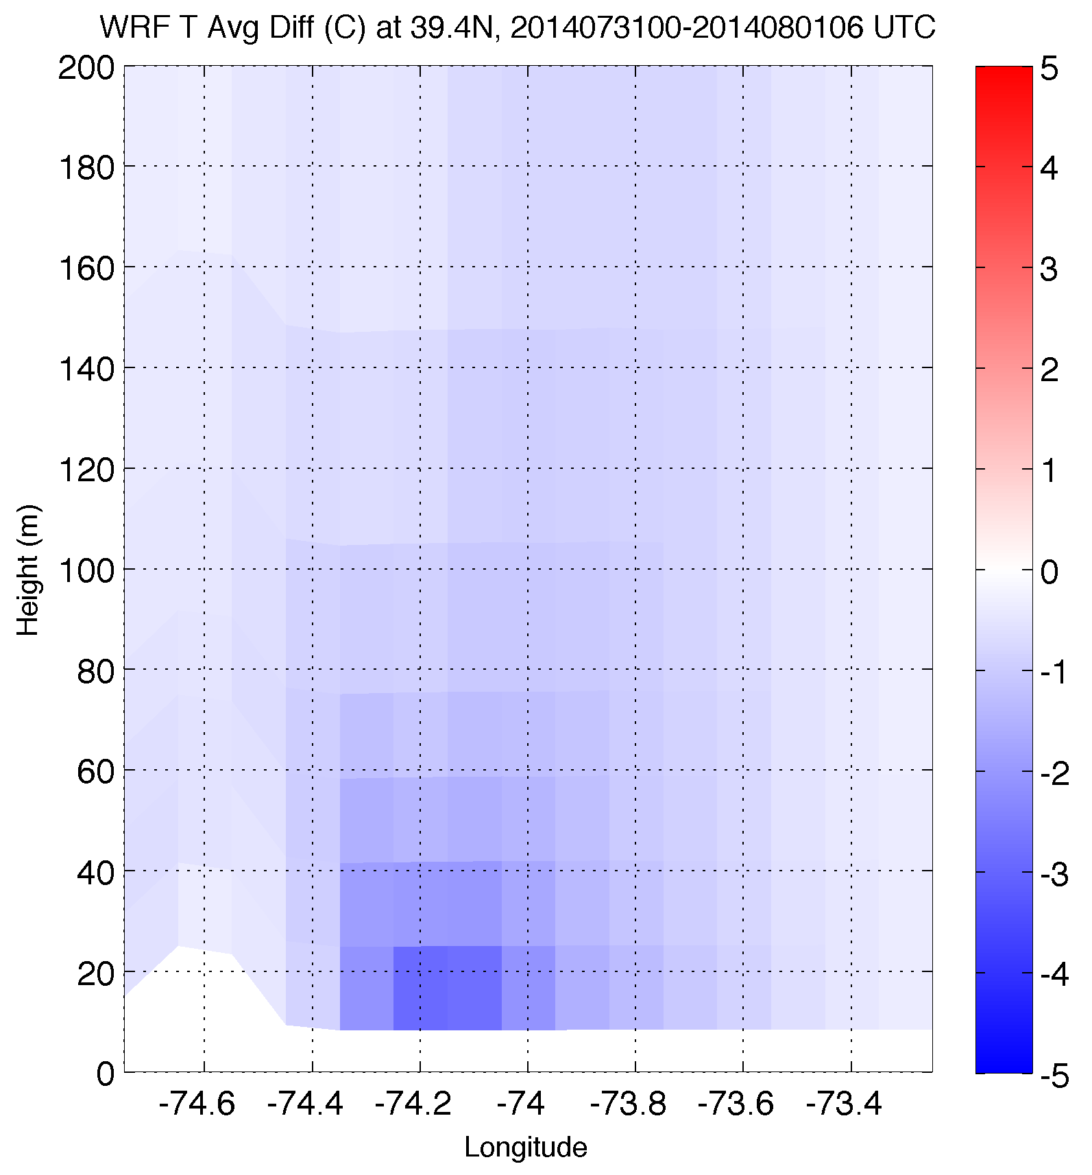
3. Upwelling produces an inversion, increasing 100m hub height winds
Temperature Difference
Case 2: 20140731

Slide 14
Conclusions
Microscale (600m) WRF simulations with innovative satellite SST product allows for new study of upwelling-sea breeze interaction
Hypothesis nullified (no secondary sea breeze circulation at offshore upwelling front)
  Could be dependent on synoptic flow
Offshore calm zone (surface divergence) dependent on
large scale flow
Upwelling causes inversion, increasing winds at 100m hub hgt
Accurate coupled ocean-atmosphere model needed to diagnose and forecast upwelling and sea breeze interaction

Slide 15
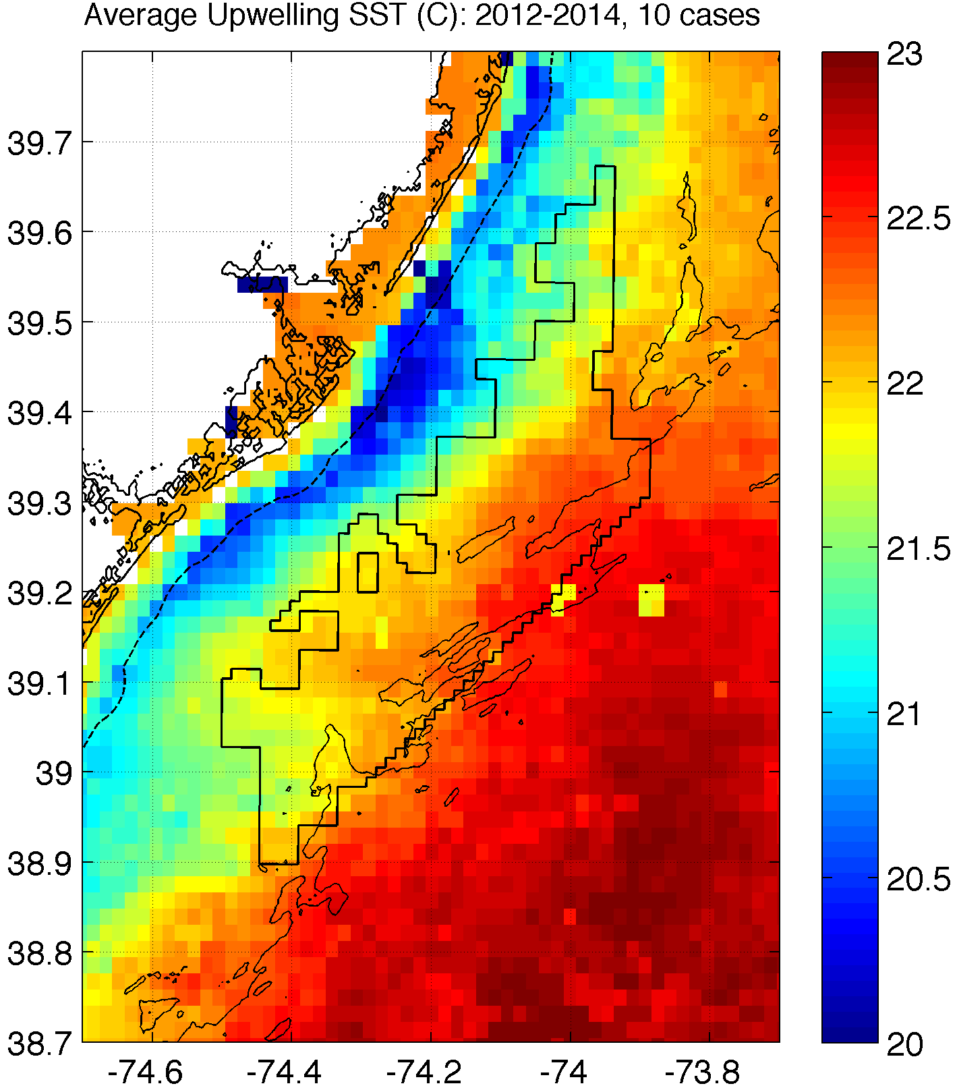
How will coastal upwelling affect the NJ WEA?
Notes:
Could expect similar inversions, impact on 100m winds over upwelling in this structure (affects NJ WEA!)
Need good ocean model to predict this correctly!

Slide 16
Thank You

Slide 17
Extra Slides

Slide 18
Future work
Model evaluation for cases
  Coastal SODAR, Wind Cube LIDAR (TI), and 60m tower
WRF-related:
  PBL scheme sensitivity
  Wind turbine parameterization
  LES
  More cases
Coupled modeling w/ satellite SST, underwater glider validation of ocean model (for upwelling)
SST improvements with DINEOF
Link with economic models

Slide 19
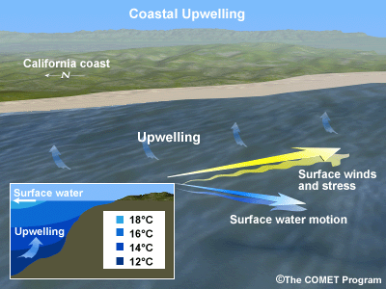
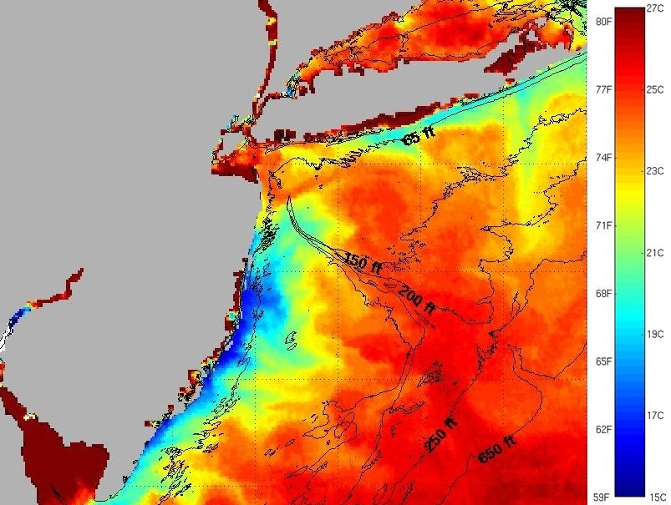
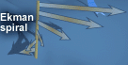
Coastal Upwelling
Schematic
Sea surface temperatures

Slide 20
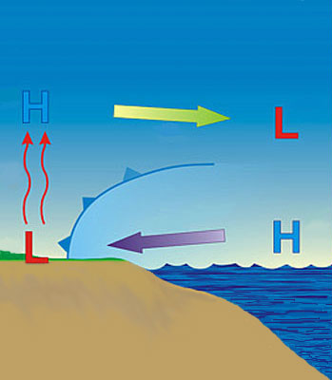
Sea Breeze
?
?
Cold upwelling
Notes:
-day: warmer over land, cooler over water→ seabreeze
-night: cooler over land, relatively warmer over water→ landbreeze
-little known about offshore component of sea/land breeze due to dearth of observations/monitoring
-coastal upwelling changes dynamics

Slide 21
Materials and Methods
Satellite (“Rutgers SST”): 3-day coldest dark pixel composite (preserve upwelling) of declouded ~1km AVHRR scans; NASA SPoRT 2km SST for cloudy gaps
Model: 3km, 600m WRF-ARW 3.6.1; YSU PBL; MM5 Monin-Obukhov surface layer
Advantages (vs. offshore met tower): cost, spatial variability, prediction
Cases:
20130707: sea breeze, upwelling
20140731: sea breeze, no upwelling
3-4. Switch SST between runs
Coastal upwelling
Notes:
Satellite: High res in space and time
Previous satellite SST products low in spatial or temporal resolution and are often warmest pixel composites for declouding; cannot resolve coastal upwelling
SST product is IR/near IR (AVHRR); SPoRT is IR/near IR as well
Model: NAM12km for boundary conditions
Cases: largest and longest lasting upwelling in NJ 2012-2014
20140731 case has similar ambient (outside upwelling) water T to 20130707

Slide 22
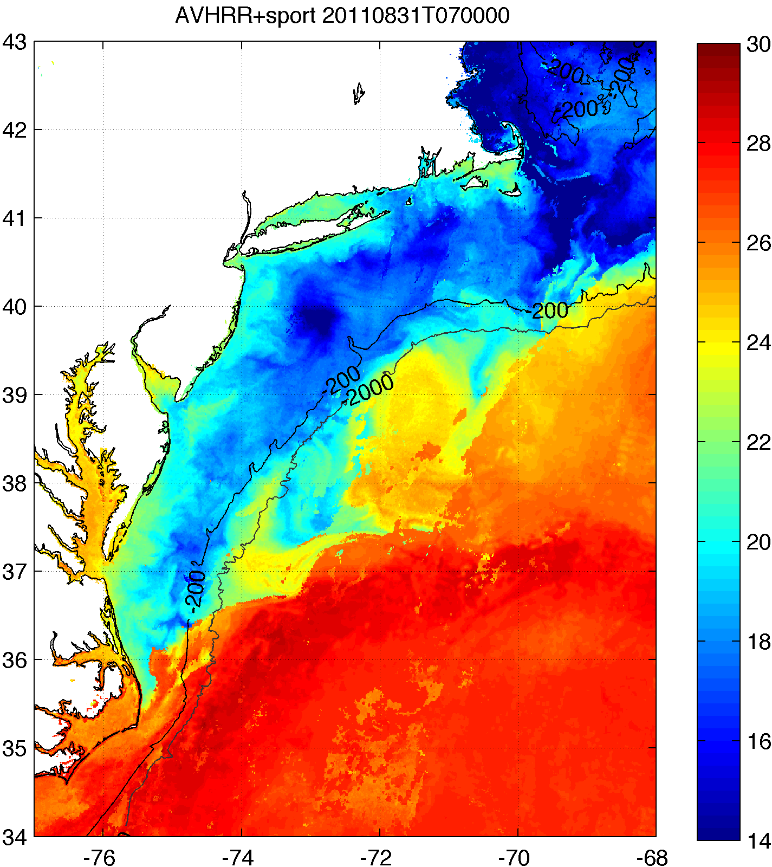
“Rutgers SST” Satellite Composite
Clean up AVHRR scans
  Remove sun glint, data close to edge
Decloud (specific to MAB)
  AVHRR Channel 2 (0.725-1 μm) tests:
    Remove if near IR albedo > 2.3%
    Remove if Δnear IR albedo > 0.15% within 3km x 3km box
  AVHRR Channel 4 (10.3-11.3 μm) tests:
    Remove if T < 5°C (summer), 3.5°C (winter)
    Remove if ΔT > 1°C within ~3km x 3km box
3-day coldest pixel composite with NASA SPoRT 2km SST
  Keep only coldest pixel between SPoRT SST and 12-17 UTC AVHRR scans
    AVHRR Channel 2 needs daytime
Hurricane cooling
Coastal upwelling

Slide 23
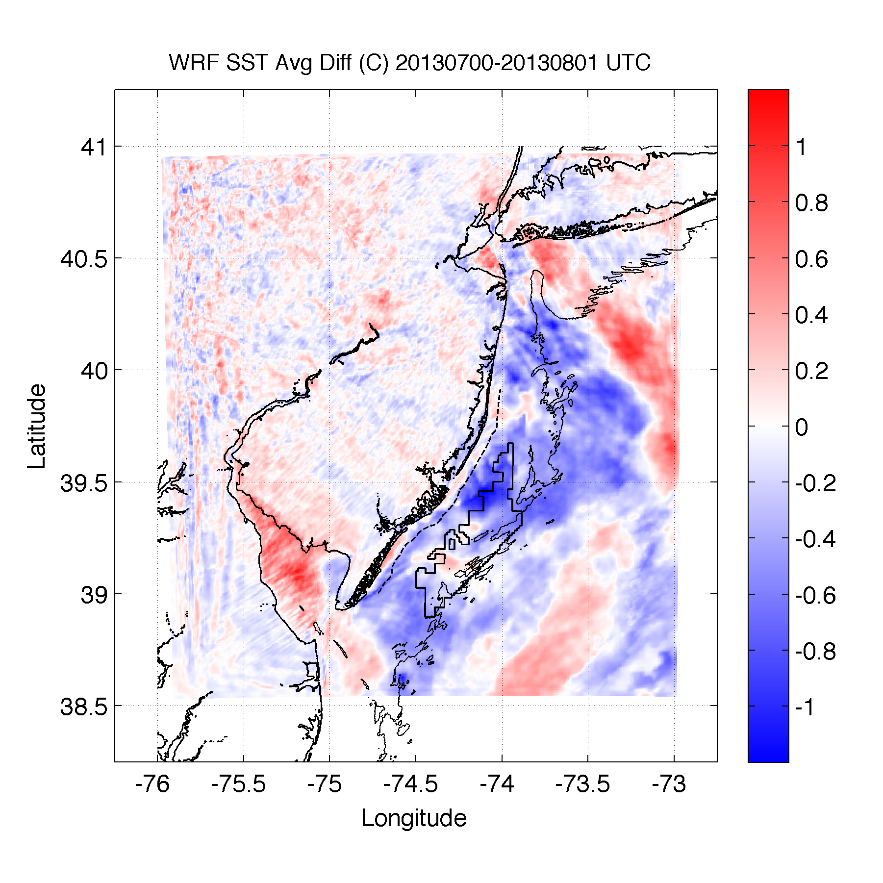
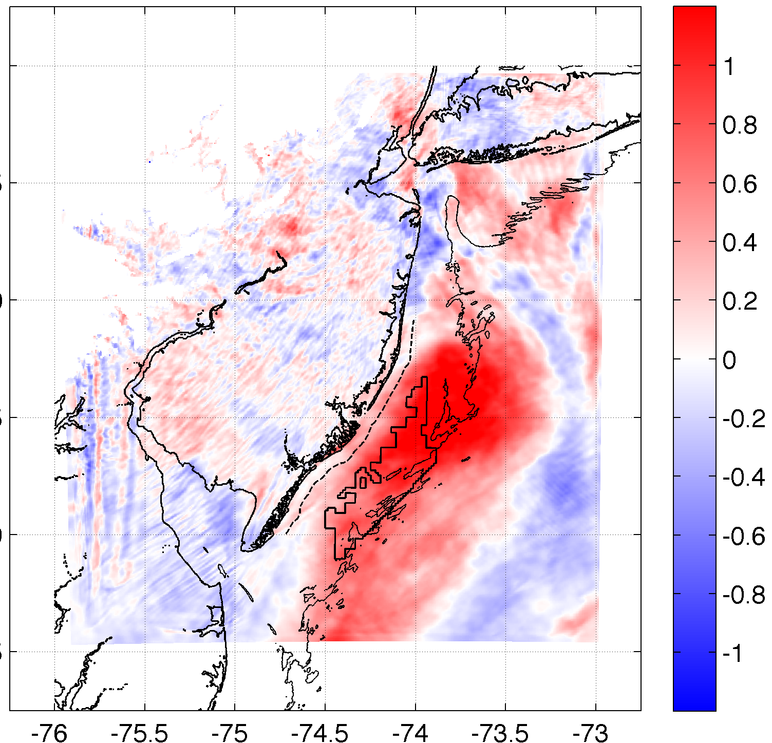
3. Upwelling produces an inversion, increasing 100m hub height winds
SST Diff.
10m Wind Diff.
100m Wind Diff.
r²=0.44
r²=0.41
Case 1: 20130707

Slide 24
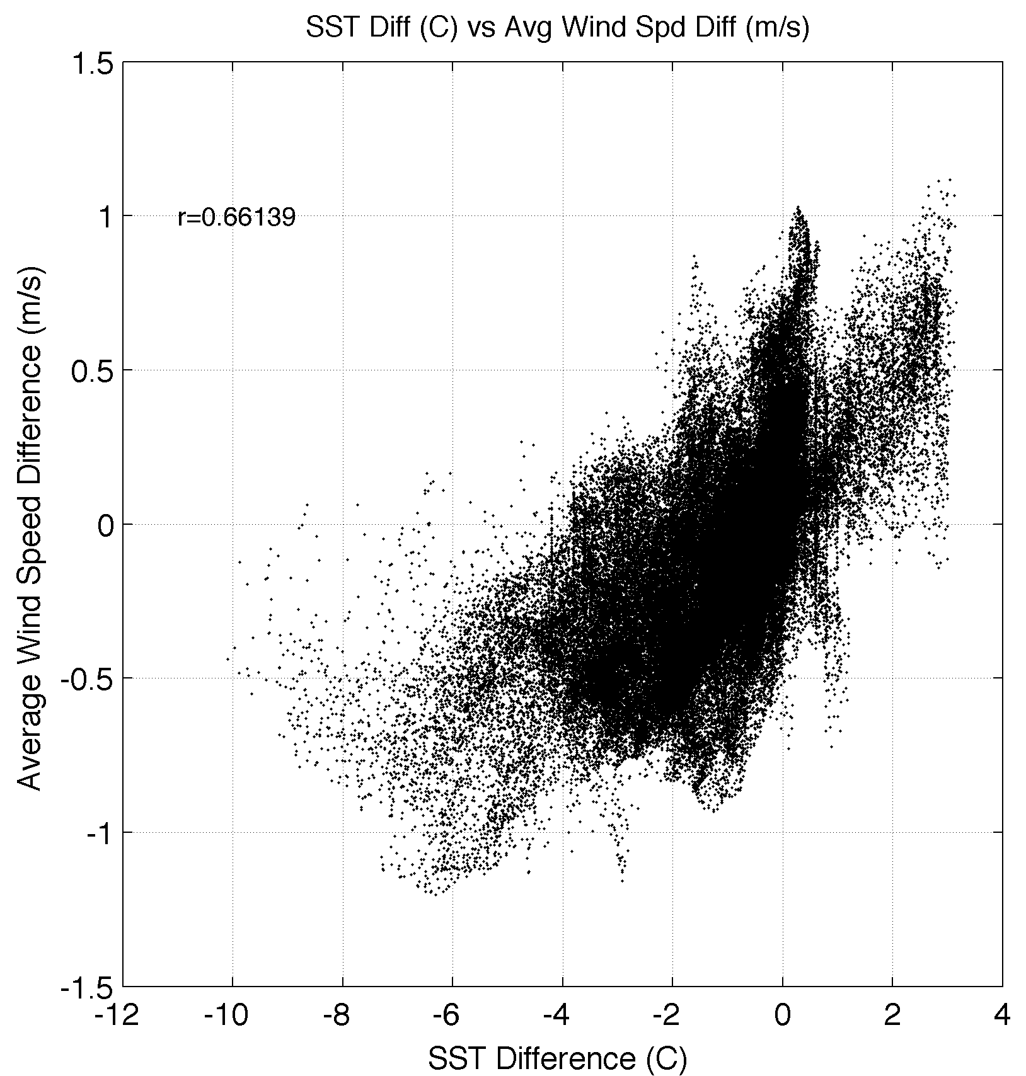
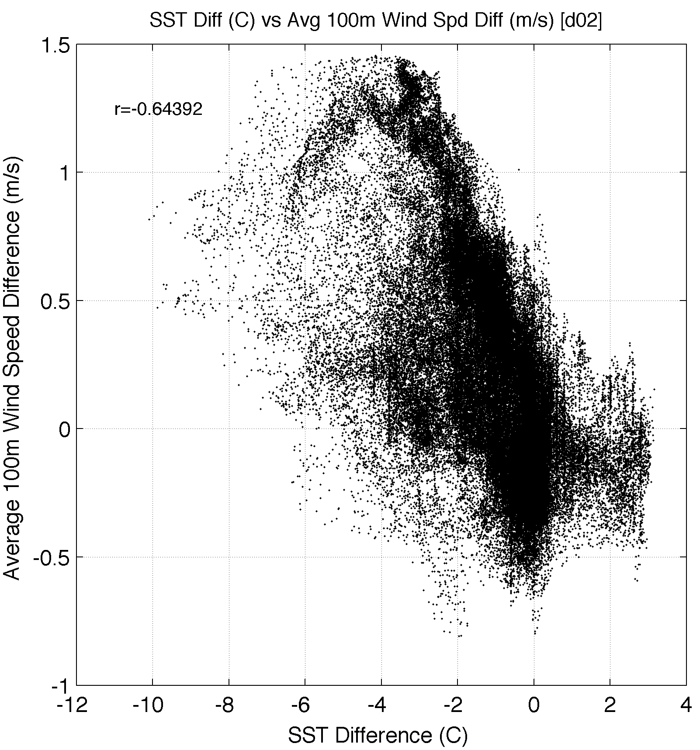
Correlation between change in SST
and change in Wind Speed
10m
100m
r²=0.41
r²=0.44
Case 1: 20130707

Slide 25
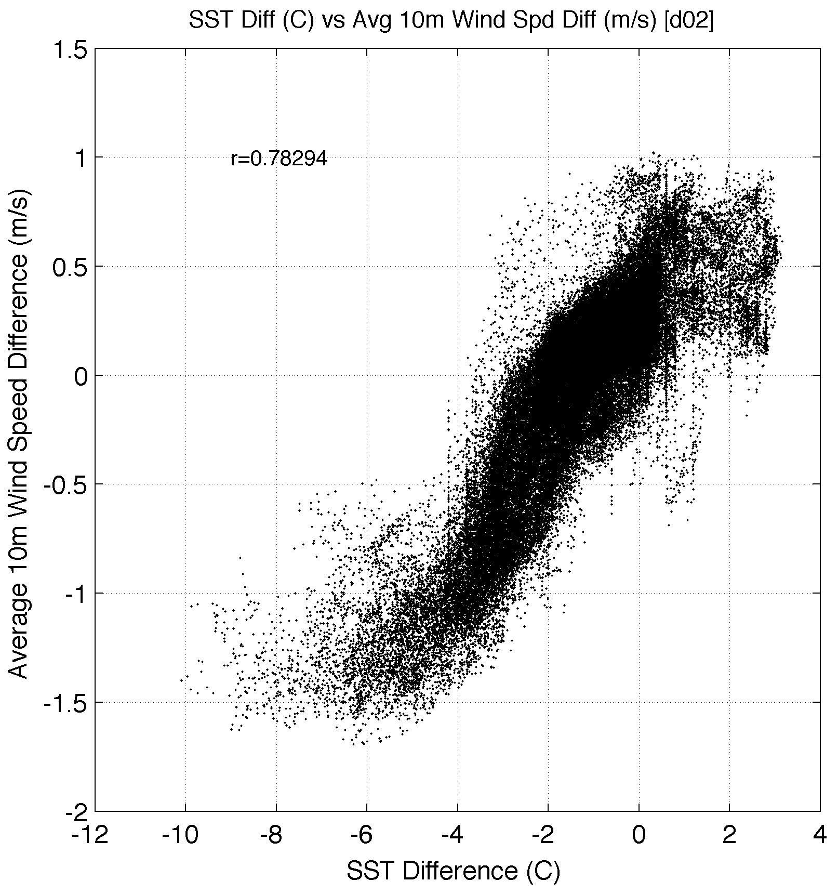
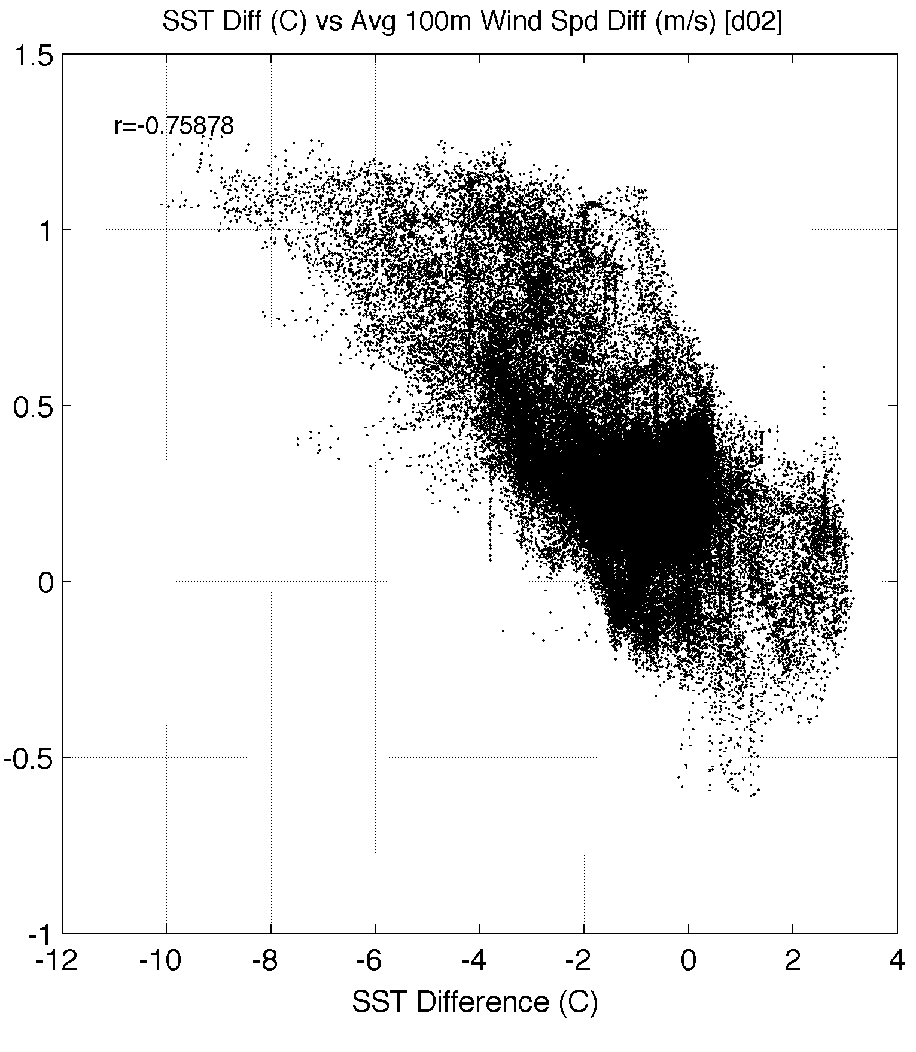
Correlation between change in SST
and change in Wind Speed
10m
100m
r²=0.58
r²=0.61
Case 2: 20140731

Slide 26
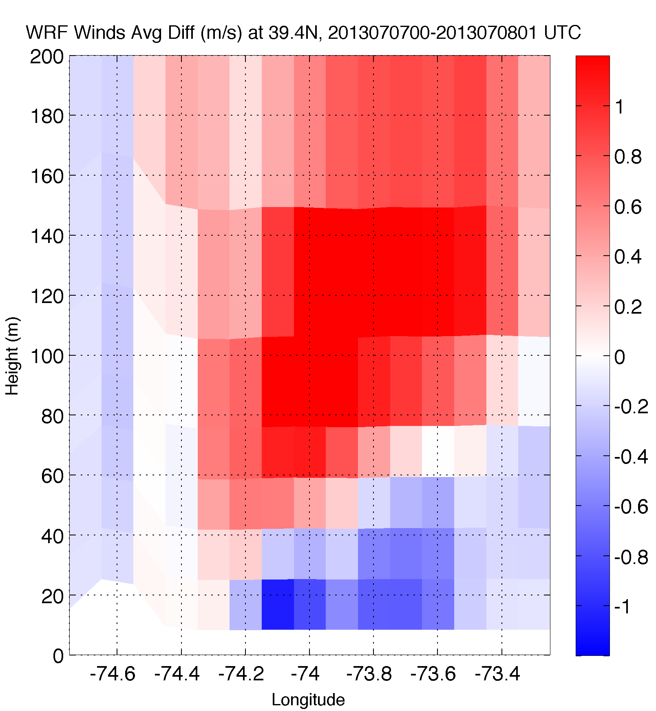
3. Upwelling produces an inversion, increasing 100m hub height winds
Wind Speed
Case 1: 20130707

Slide 27
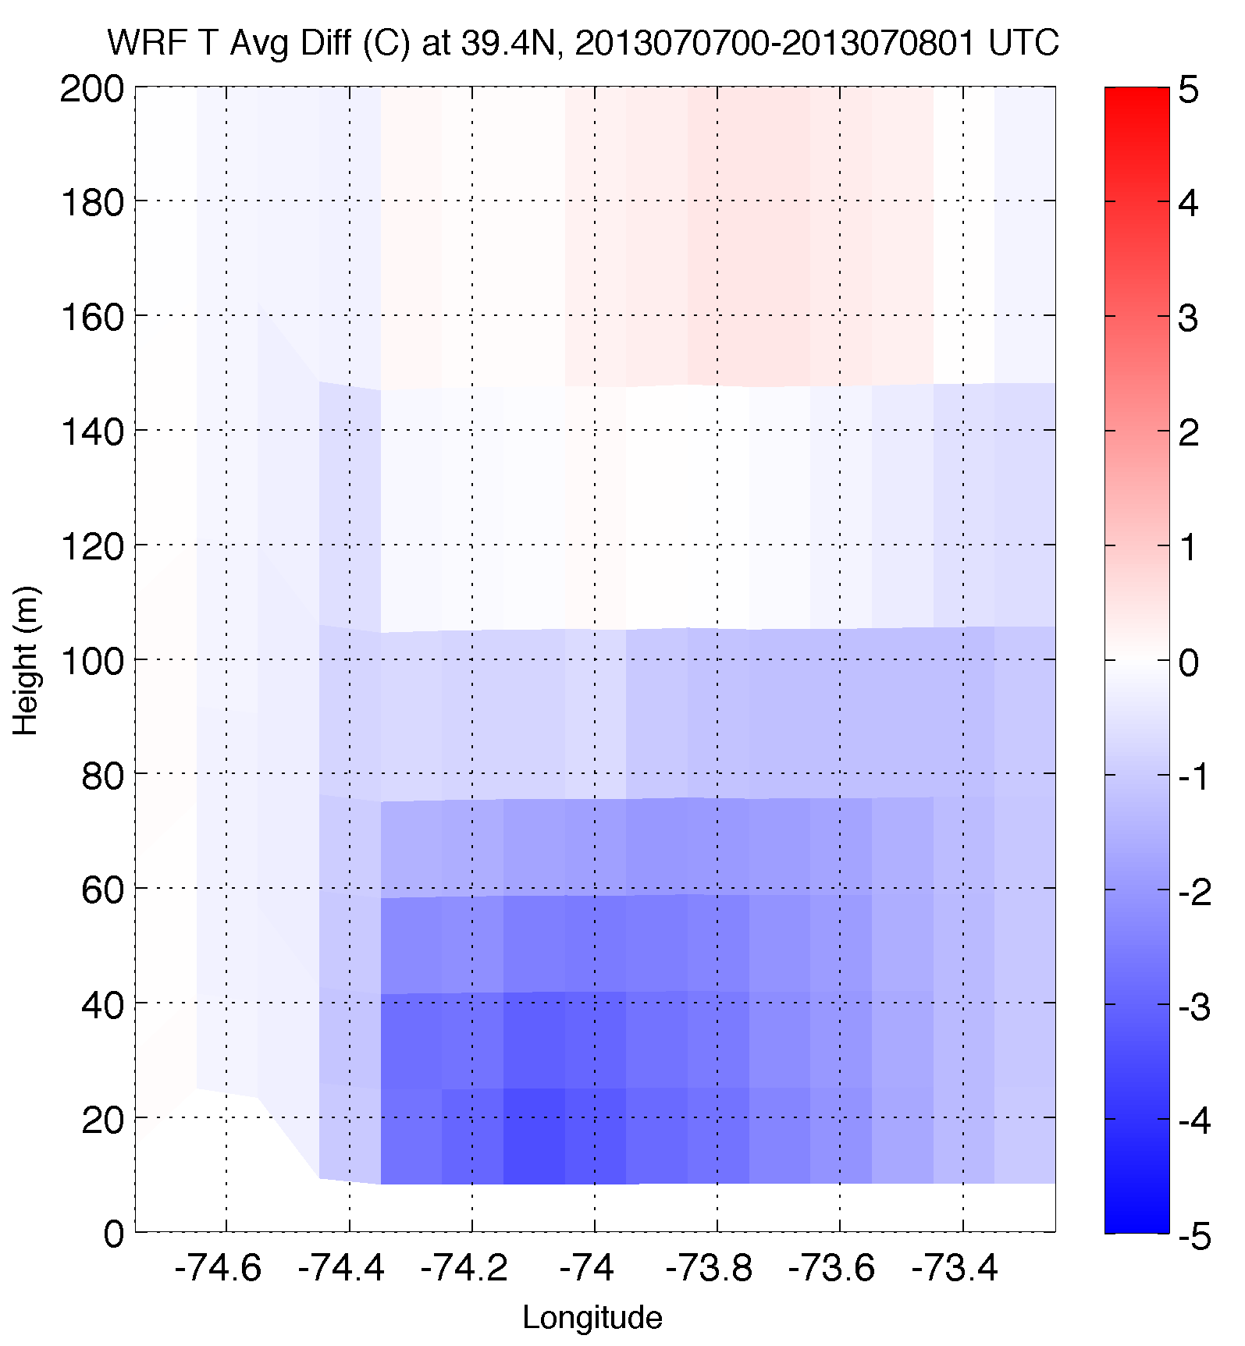
3. Upwelling produces an inversion, increasing 100m hub height winds
Temperature
Case 1: 20130707

Slide 28
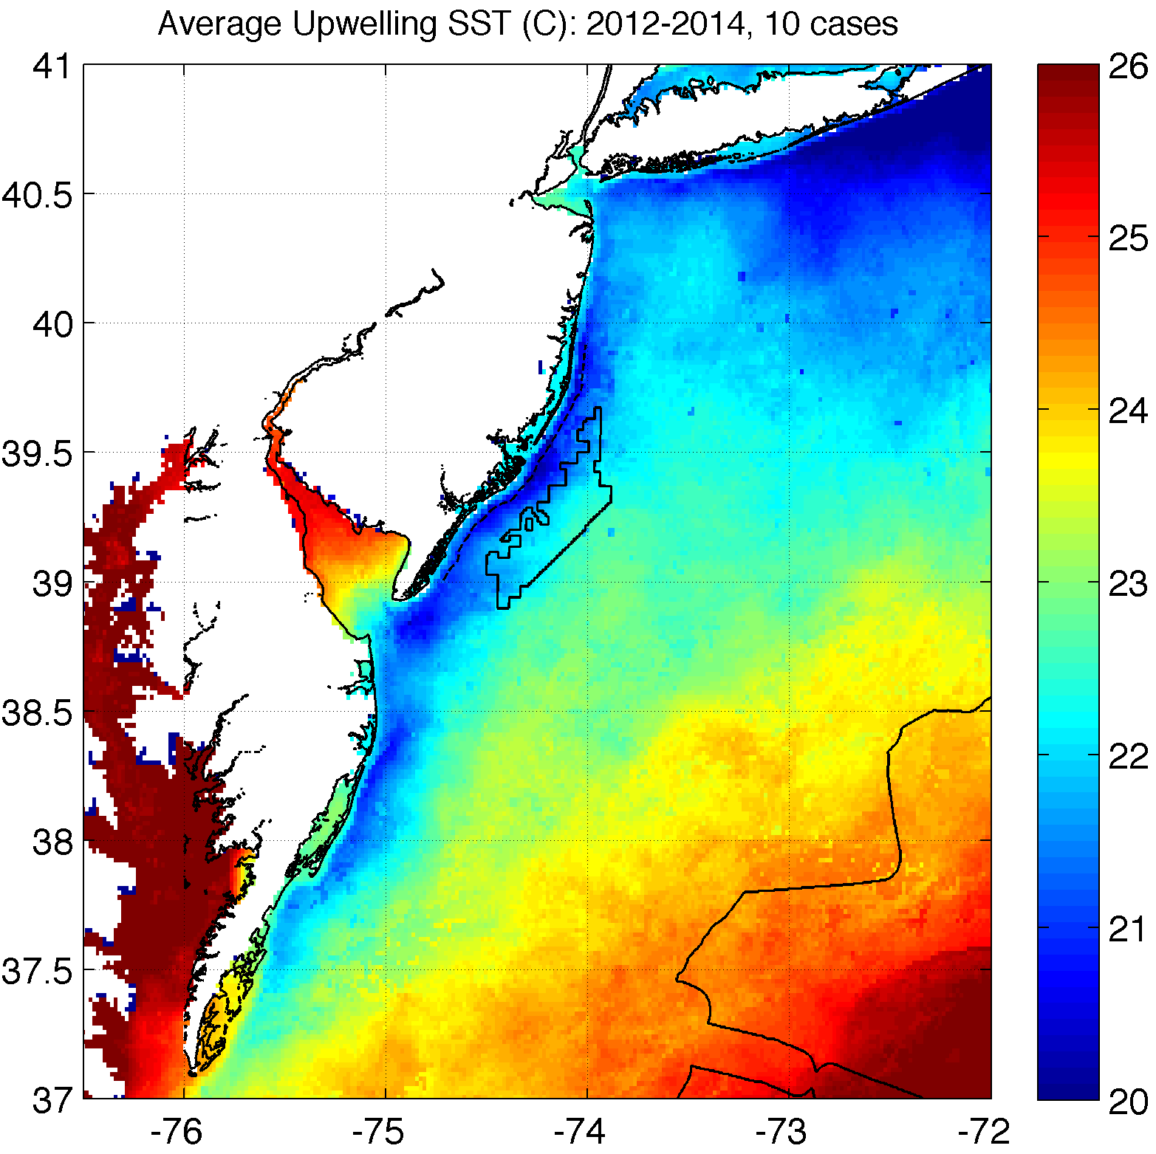
How will coastal upwelling affect the NJ WEA?
Notes:
Could expect similar inversions, impact on 100m winds over upwelling in this structure (affects NJ WEA!)
Need good ocean model to predict this correctly!

