Slide 1
HF Radar Network (HFRNet)
Data Management and Applications
Lisa Hazard and Hugh Roarty
Scripps Institution of Oceanography and Rutgers University

Slide 2
Agenda
Overview
Data Acquisition
Site Diagnostics
Data Distribution

Slide 3
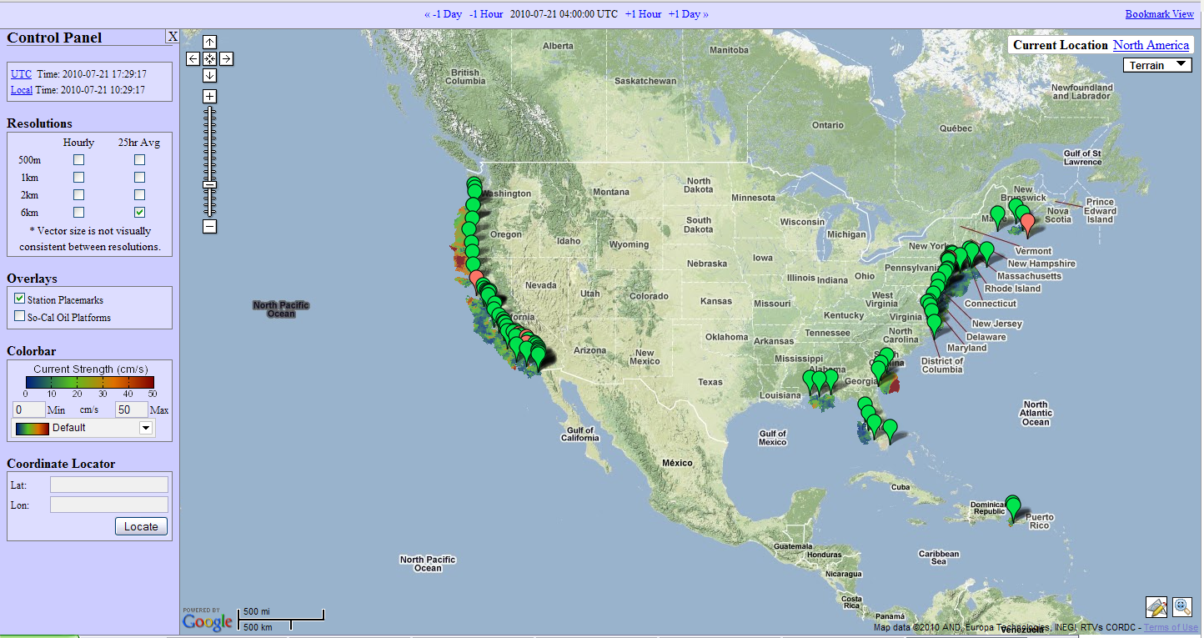
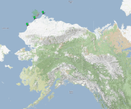
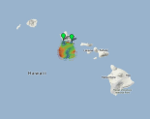
Overview
Years of Operation: 9 years Participating Organizations: 31
Number of files: >7 million Number of Physical Sites: >130

Slide 4
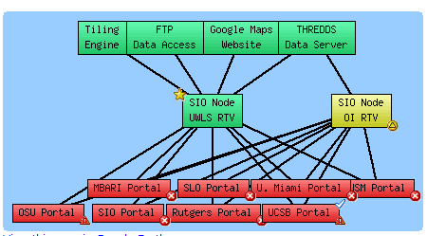
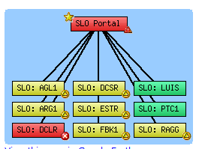
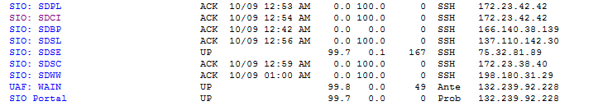
Network Architecture
Data Acquisition
Example Node to Site Aggregator communications
Example Site Aggregator to Site communications
  Site - the individual field installations of HF radar equipment
  Portal or Site Aggregator - a local regional operations center which maintains multiple installations
  Node - Centralized locations which aggregate data from multiple regions
Notes:
We recently changed the name of a “portal” to “Site Aggregator” so it didn’t get confused with a web portal.

Slide 5
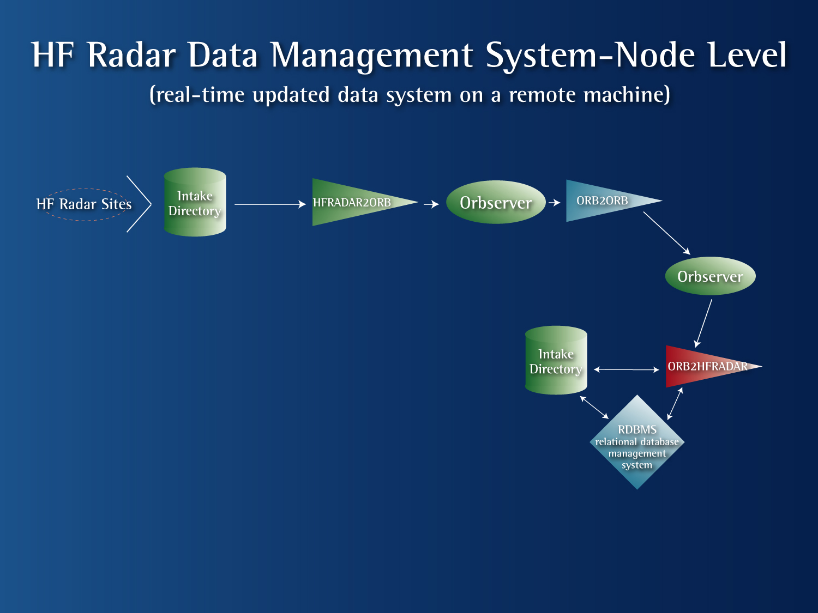
Scripps and NDBC
West Coast Repository & Engine
RUTGERS
East Coast Repository
“Portals”
“Portals”
ORB2ORB
ORB2ORB
“Node Server”
“Node Server ”
Radials and metadata,
Real-time vector (RTV),
graphics
“Storage Resource”
PUBLIC ACCESS
Web Servers

Slide 6
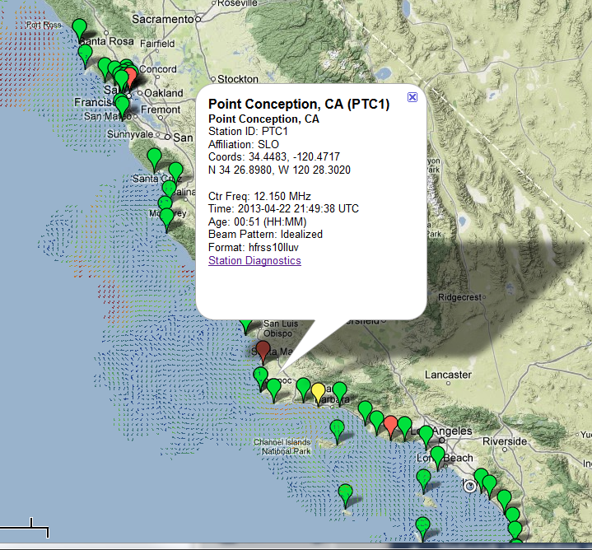
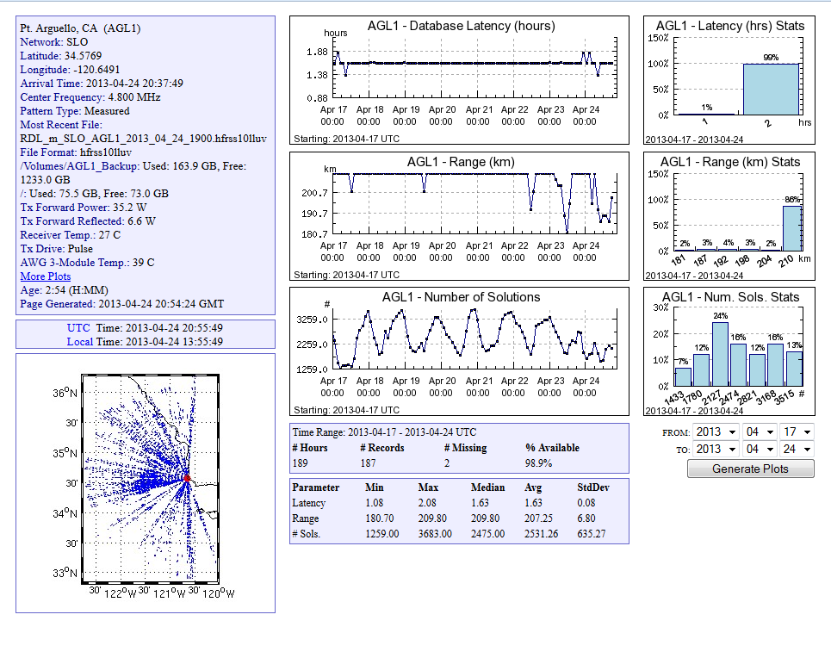
Diagnostics
Radial Diagnostics
Radial diagnostics are summarized in a balloon with a link to the most recent radial image, file information and time histories of latencies and radial solutions

Slide 7
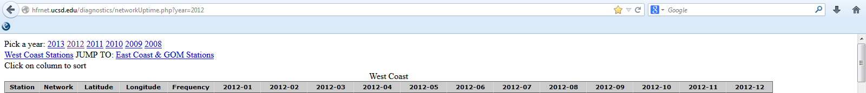
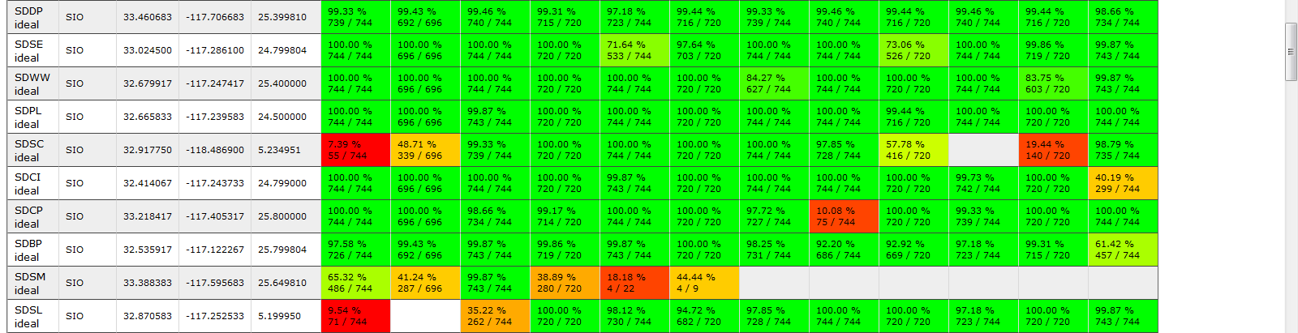
Diagnostics
Network Diagnostics
Network diagnostics are summarized monthly based on file acquisition

Slide 8
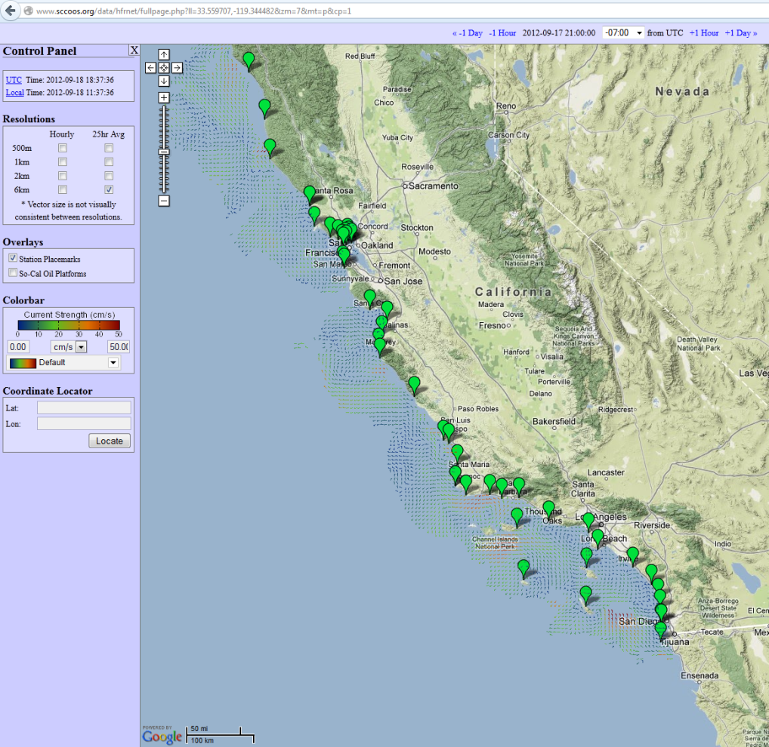
Data Distribution
HFRNet Data Availability
Online Visualization – http://cordc.ucsd.edu/projects/mapping/maps/fullpage.php Online visualization of HF radar surface currents with ability to change date, resolution, colorbar, and station information
Web Overlays - http://cordc.ucsd.edu/projects/mapping/api/ Application programming interface (api) that allows programmers to overlay the currents into any website
THREDDS Data Server (TDS) access - http://sdf.ndbc.noaa.gov:8080/thredds/catalog.html http://hfrnet.ucsd.edu/thredds/catalog.html
TDS service that allows folks to acquire or used the data via thredds for processing and/or visualization.
Data Archiving – HFRNet (NDBC): Totals and Radials
      - Operators: Range Series and beam pattern
      - Future: All above through
Notes:
When you publish your product, how do you reference SCCOOS?

Slide 9
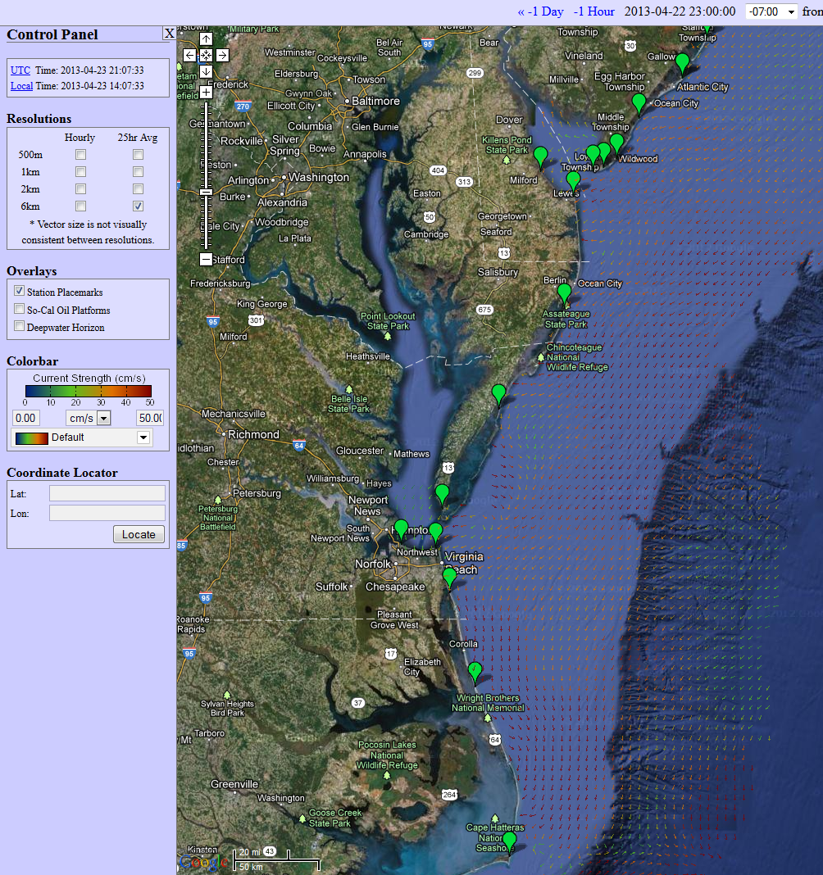
6km grid
Data Distribution
Google Maps Visualization
Features include:
12 zoom levels
Coordinate Locator
Site Diagnostics
Total Vectors at 500m, 1km, 2km & 6km
Hourly and 25 Hour Averaged Data

Slide 10
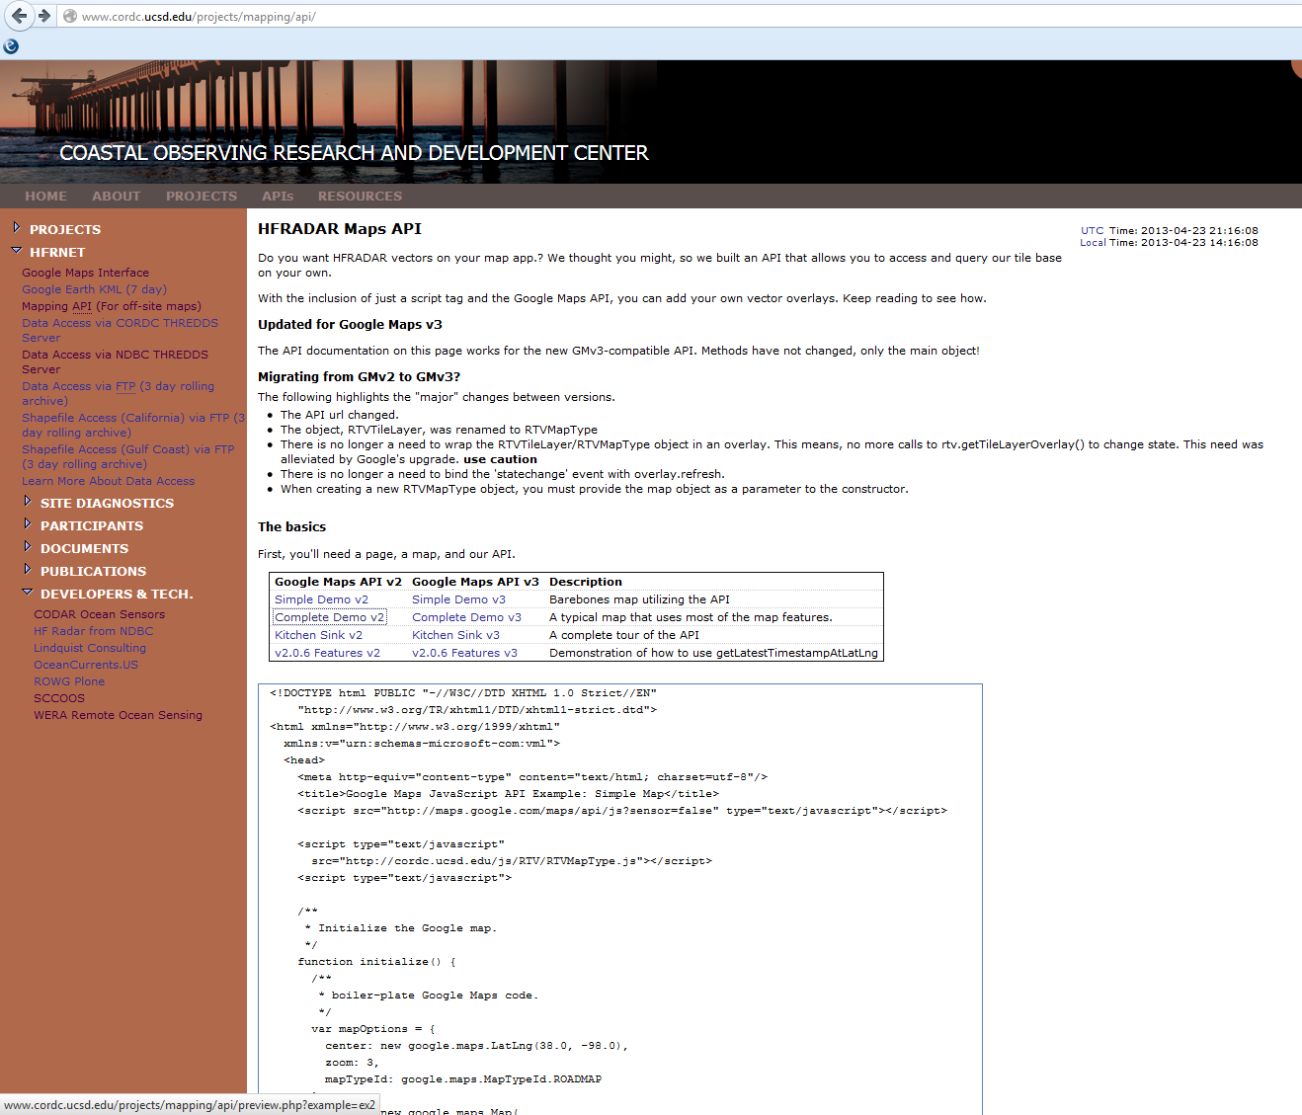
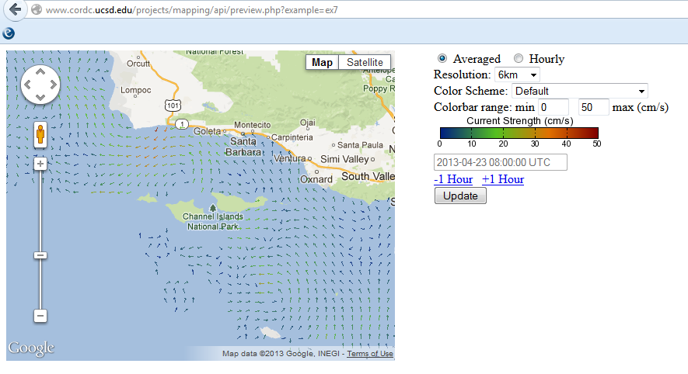
http://www.cordc.ucsd.edu/projects/mapping/api/
Data Distribution
Google Maps API

Slide 11
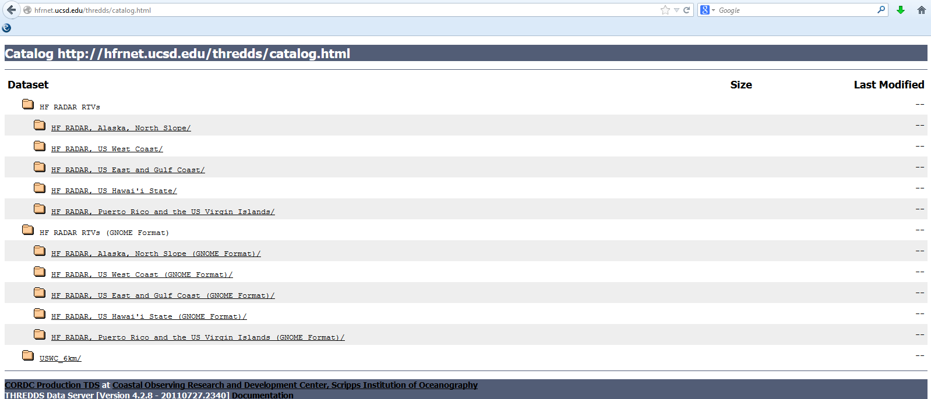
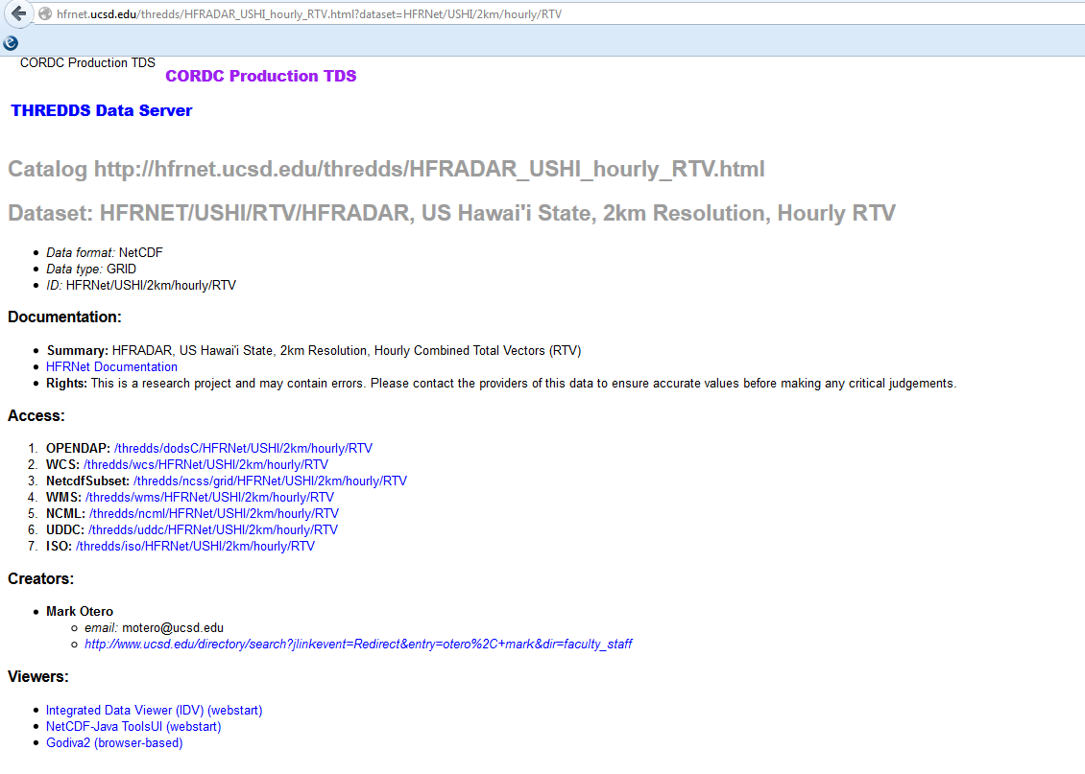
Data Distribution
THREDDS
http://hfrnet.ucsd.edu/thredds/catalog.html

Slide 12
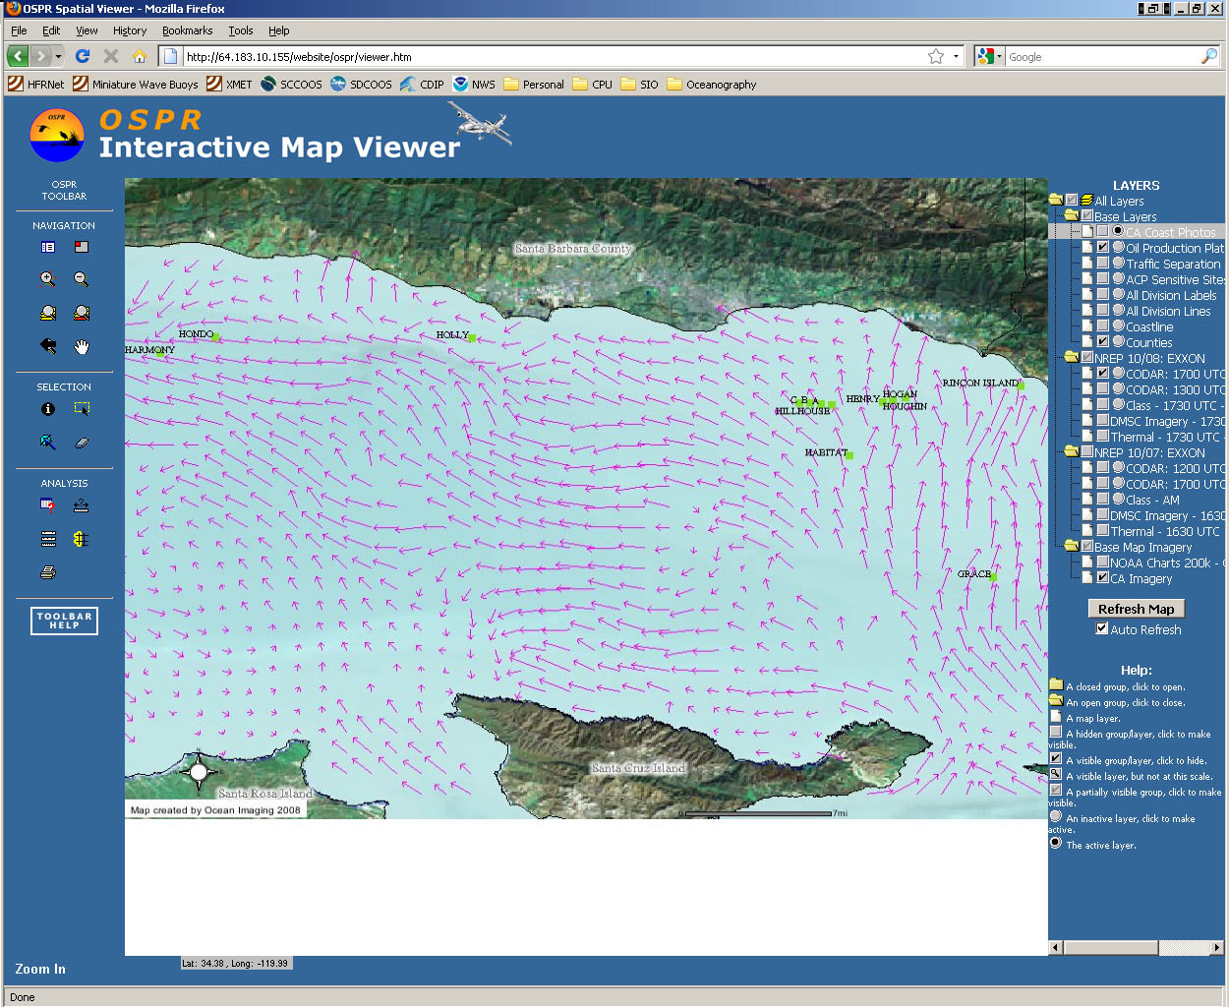
Data Distribution
Total Velocities

Slide 13
Application:
Search and rescue

Slide 14
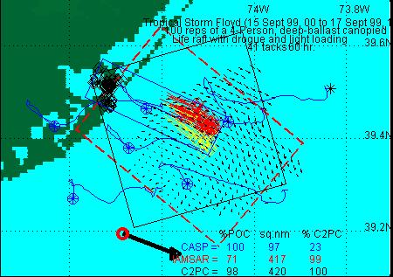
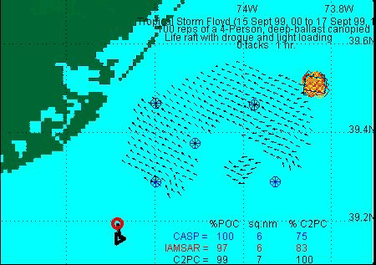
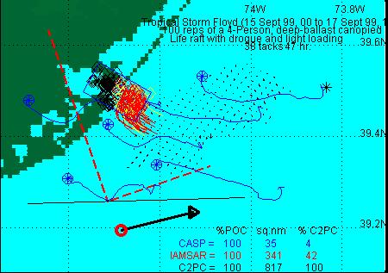
Application to Search and Rescue
United States Coast Guard
Office of Search and Rescue
Point measurement vs. Field of measurements:
Hurricane Floyd Simulation
O(4)
O(>10)
Search area reduced by factor of 4 (>10)
Courtesy Art Allen, USCG Office of SAR

Slide 15
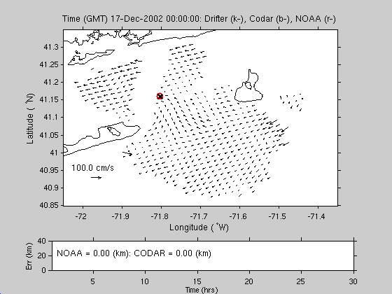
25 MHz Status 2002

Slide 16
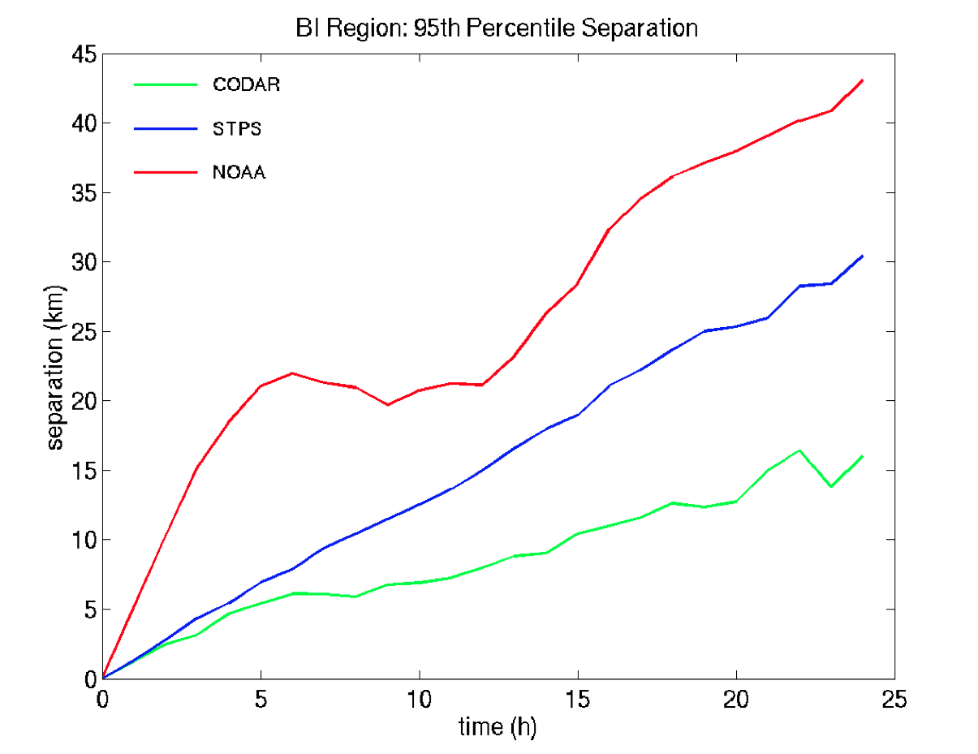
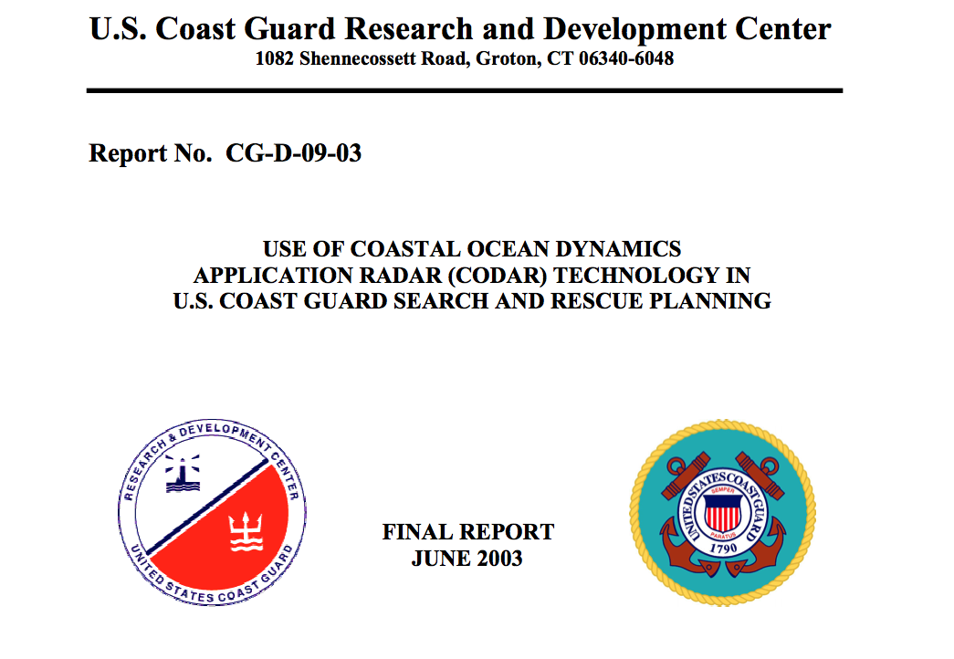
25 MHz Status 2002

Slide 17
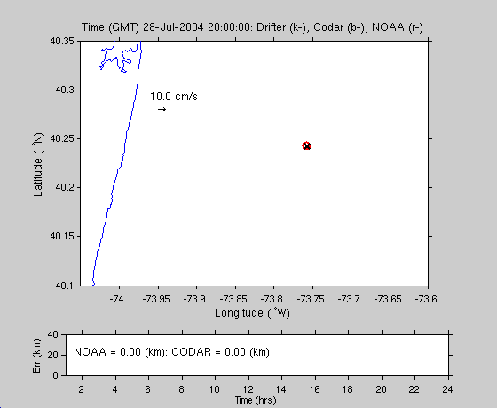
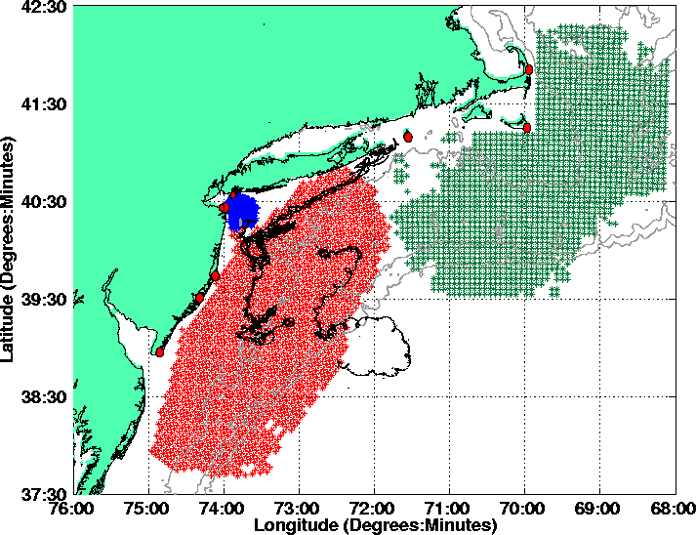
5 MHz Status 2004

Slide 18
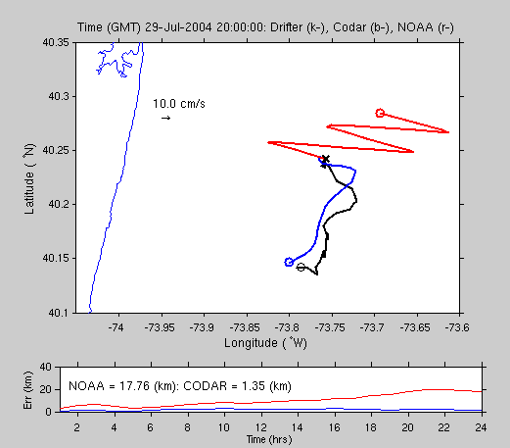
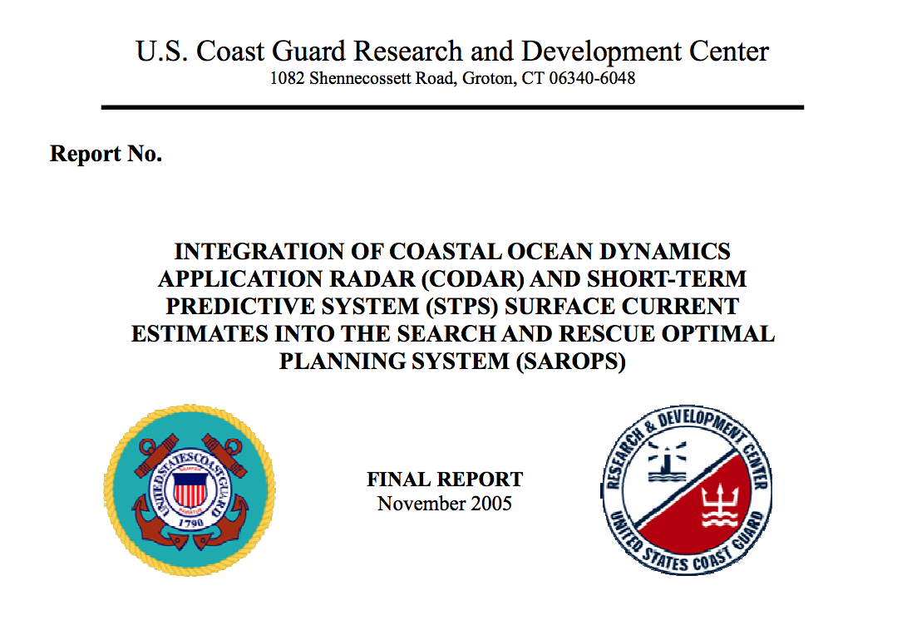
Status 2004

Slide 19
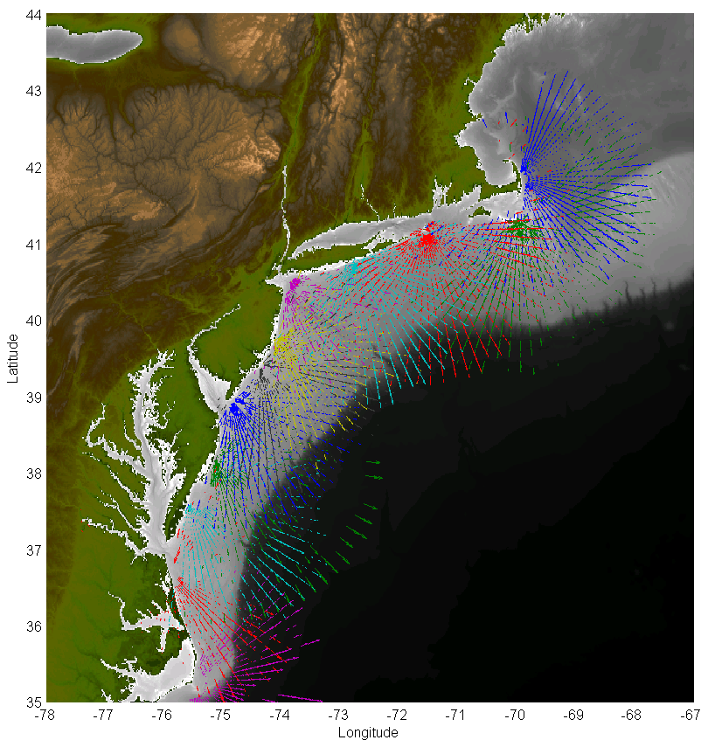





LONG RANGE NETWORK
2003
2003
2001
2010
2003
2012
2013
2000
2007
2001
2001
2006
2006
2009
2003
2003
2014

Slide 20
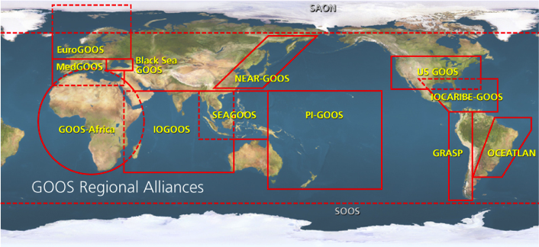

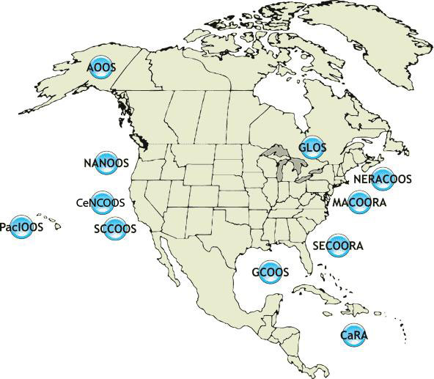




U.S. Integrated Ocean Observing System
IOOS Relationships
International Component
National Component
Regional Component
Global Ocean Observing System
Vessels -
Satellite
Satellite
CODAR
Ships/ Vessels
Glider
REMUS
Data Vis.
Modeling
Security
Leadership
Education
11 Regional Associations
18 U.S. Federal Agencies

Slide 21
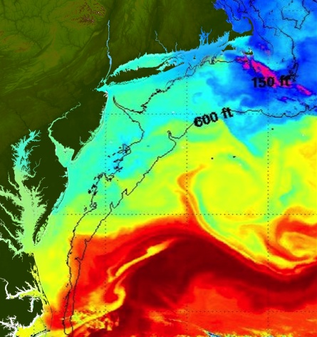
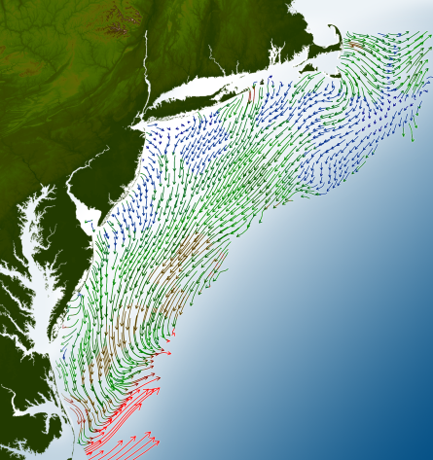
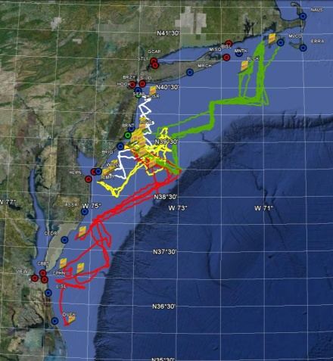
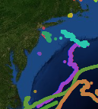
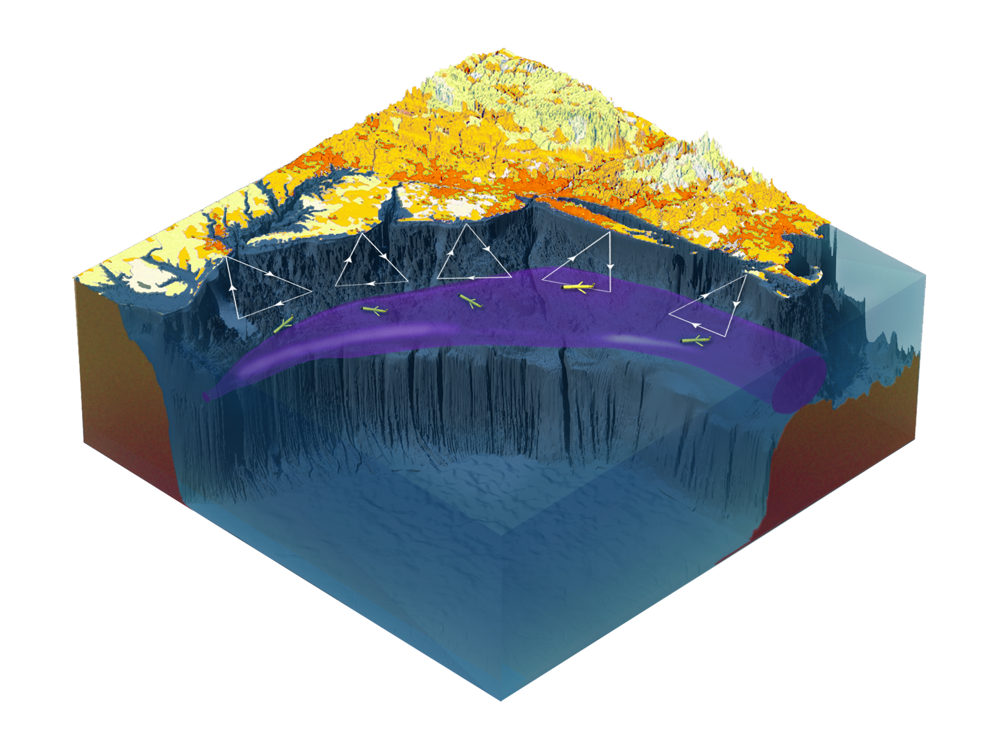

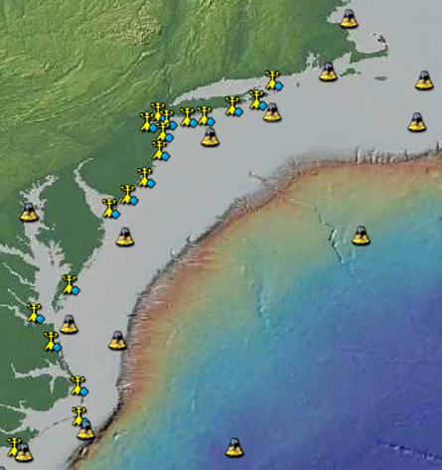
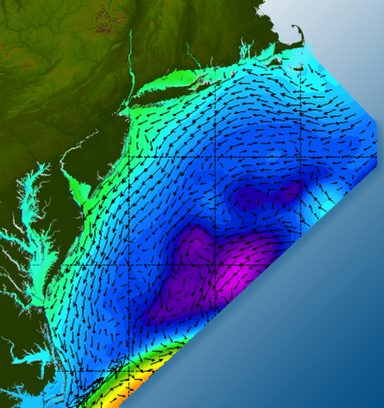

Satellites
HF-Radar
Gliders
Drifters
Population Density
To seek, discover & apply
new knowledge & understanding
of our coastal ocean
Weather Stations
Ocean Forecast Ensemble
Notes:
Need to cut off cold pool in south and bend offshore
Need to experiment with dulling down the colors in the pop density. Maybe orange/tan to white like the box I put in?
Put gliders just below the lines in 3 of them, and increase their angles facing up and down randomly. I stuck in cheesy examples
I already put the shadow and 80% clear line around the two new maps in the upper right, so we are good there.

Slide 22
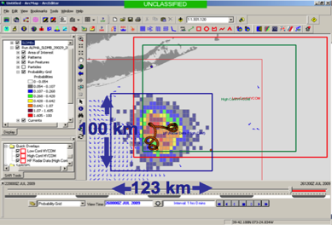
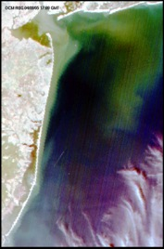
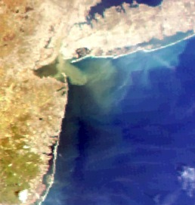
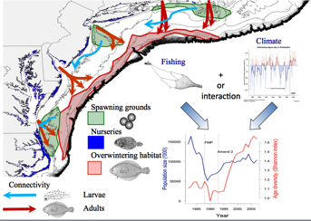
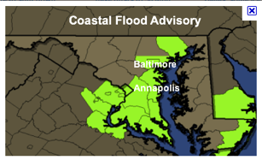
MARACOOS REGIONAL THEMES & SUCCESS STORIES
1) Maritime Operations – Safety at Sea
3) Water Quality – a) Floatables, b) Hypoxia, c) Nutrients
2) Ecosystem Decision Support - Fisheries
5) Energy – Offshore Wind
4) Coastal Inundation - Flooding
Since 2007

Slide 23
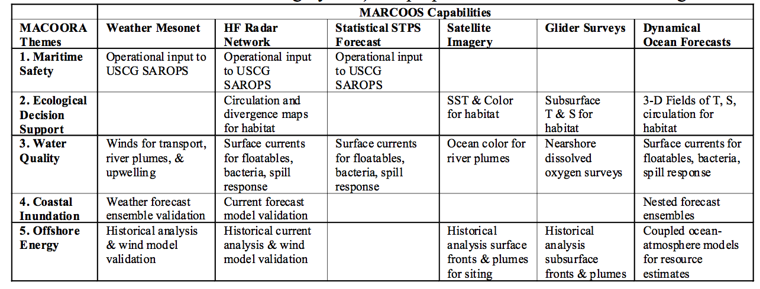
Themes and Capabilities

Slide 24
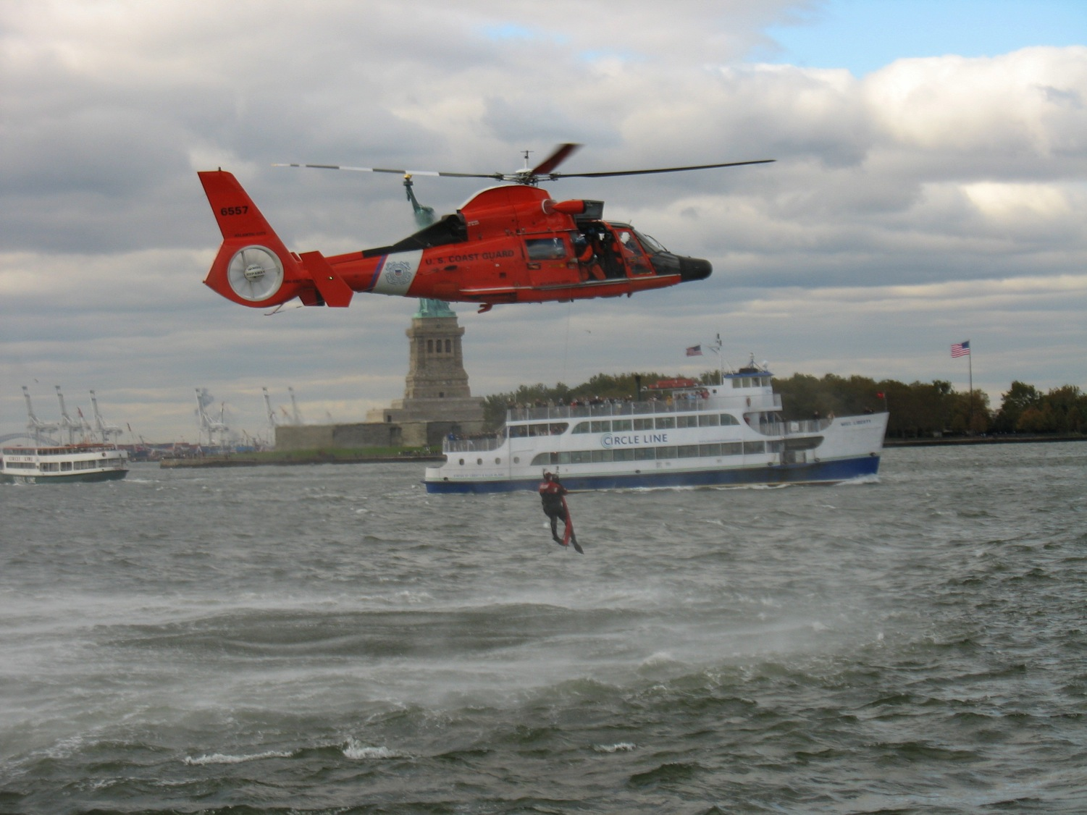



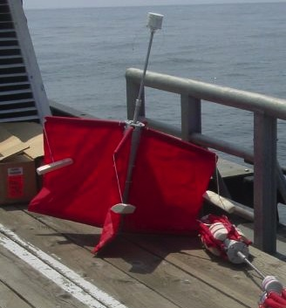
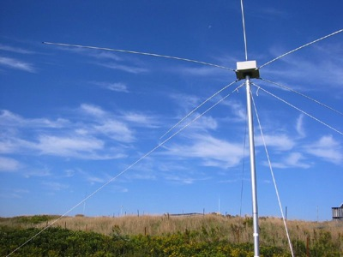
Success Stories – Making a Difference
Optimizing HF Radar for SAR using USCG Surface Drifters
Art Allen
U.S. Coast Guard
Scott Glenn
Rutgers University
and the Mid-Atlantic Regional
Coastal Ocean Observing System

Slide 25
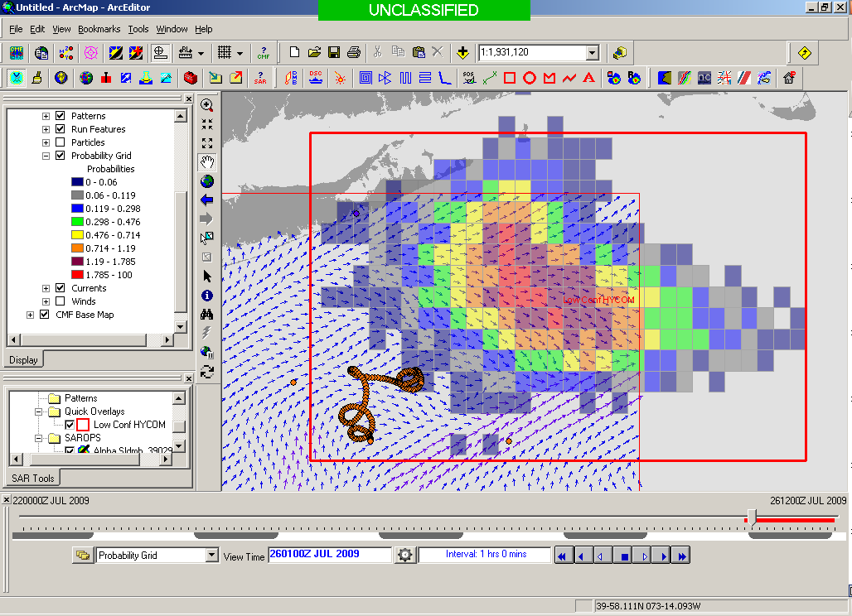
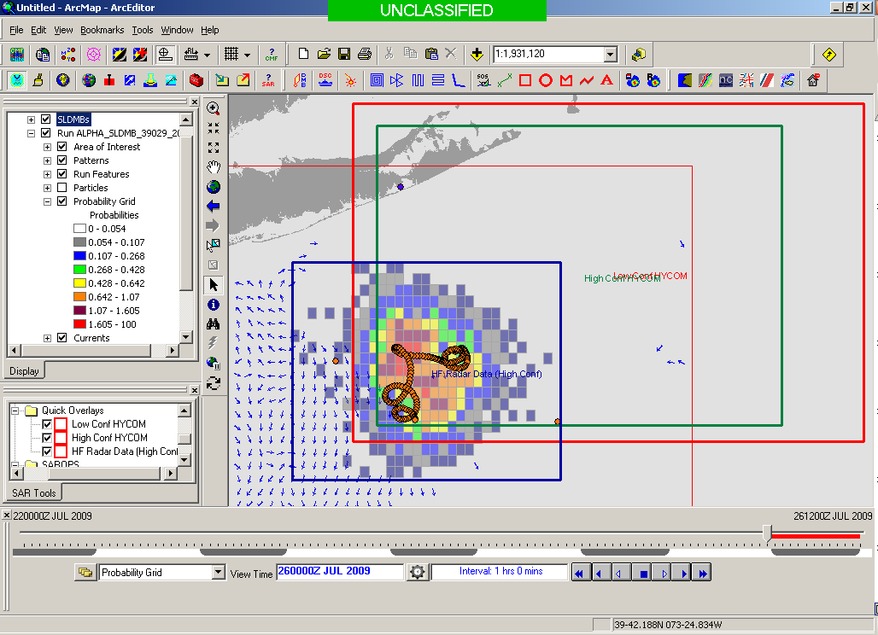
Search Area After 96 Hours
154 km
100 km
232 km
123 km
HYCOM
36,000 km²
CODAR
12,000 km²
Notes:
HYCOM (Low Conf) 48 hours

Slide 26
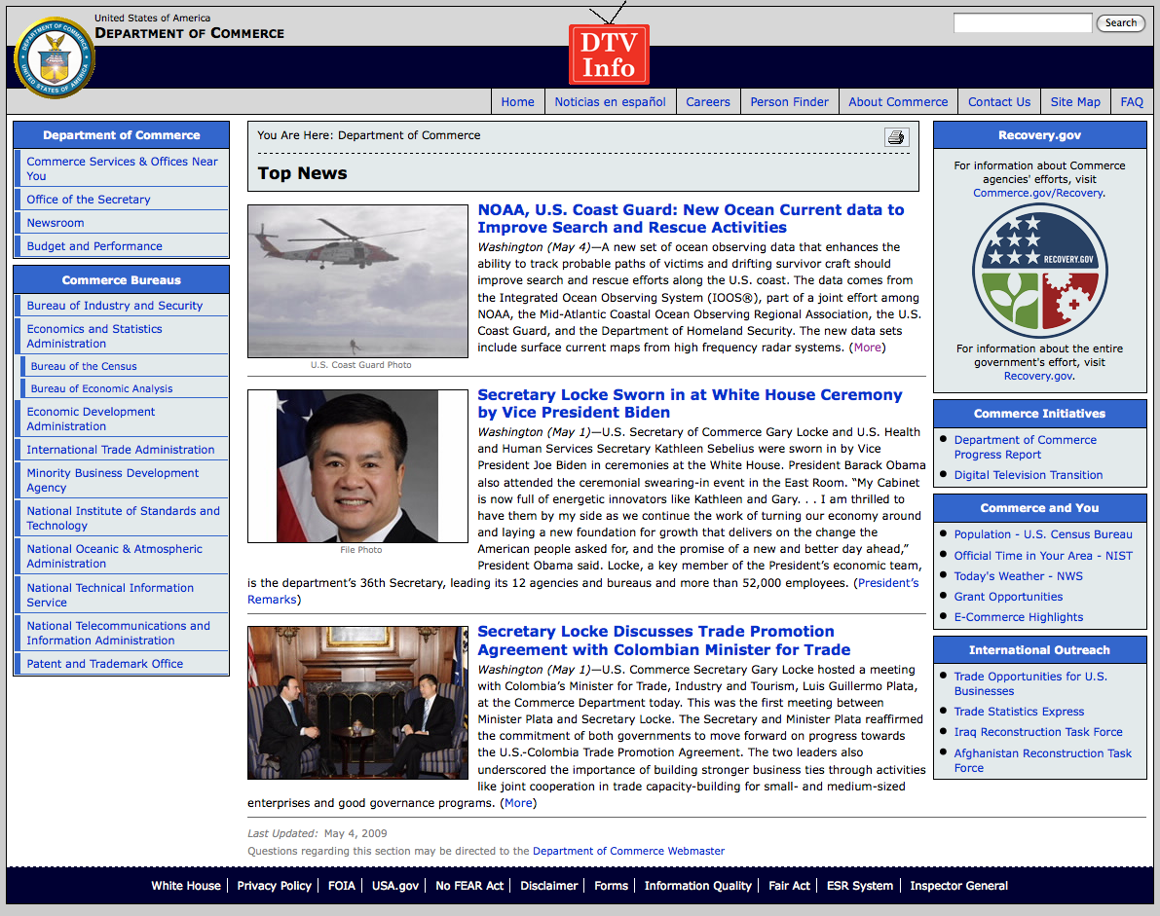
May 4, 2009: After a year of testing, NOAA Announces on
U.S. Department of Commerce Website that
MARACOOS CODAR is Operational in SAROPS
U.S. IOOS Goal for 2010-2011:
Bring all
sustained regional-scale HFR networks up to operational status in USCG SAROPS
3 West Coast Regions for
California & Oregon

Slide 27












HFR Current Mapping Product Development
Road Map for Search and Rescue
First Standard Range Codar deployed on East Coast near Atlantic City, NJ
Mid Atlantic HF Radar Network Operational with US Coast Guard
Long Range Network Shown to be Effective in Second Coast Guard SAROPS tool
“A Plan to Meet the Nations Surface Current Mapping Needs” Implemented
Hurricane Floyd Simulation Predicts Factor of 4 Reduction in Search Area Using Field of Currents vs. Point Measurement
MARCOOS Establishes First Regional High Frequency Radar Network
Radial and Total Sensitivity Study Undertaken to Provide Best Data to Environmental Data Server
Standard Range Network Proves to be Useful in Coast Guard Research and Development Pilot Study
Optimal Interpolation Combination Method Effective in Filling Spatial Gaps in Mid Atlantic Tests
National HF Radar Network Operational with US Coast Guard
1998
1999
2000
2001
2002
2003
2004
2005
2006
2007
2008
2009
2010
2011
2012
2013
2014
2015

Slide 28


Thank You

