Slide 1


The Role of Regional-Scale Ocean Observations for Improved Hurricane Intensity and Impact Forecasts
Scott Glenn, Greg Seroka,
Travis Miles, Yi Xu, Hugh Roarty,
Josh Kohut, Oscar Schofield
Rutgers University, USA

Slide 2

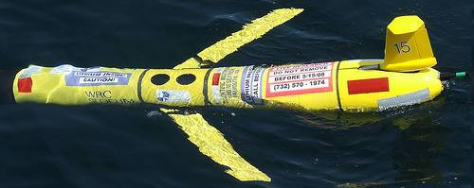
International Typhoon Workshop, Hangzhou, China, 2013
Figure 3
Figure 1

Slide 3
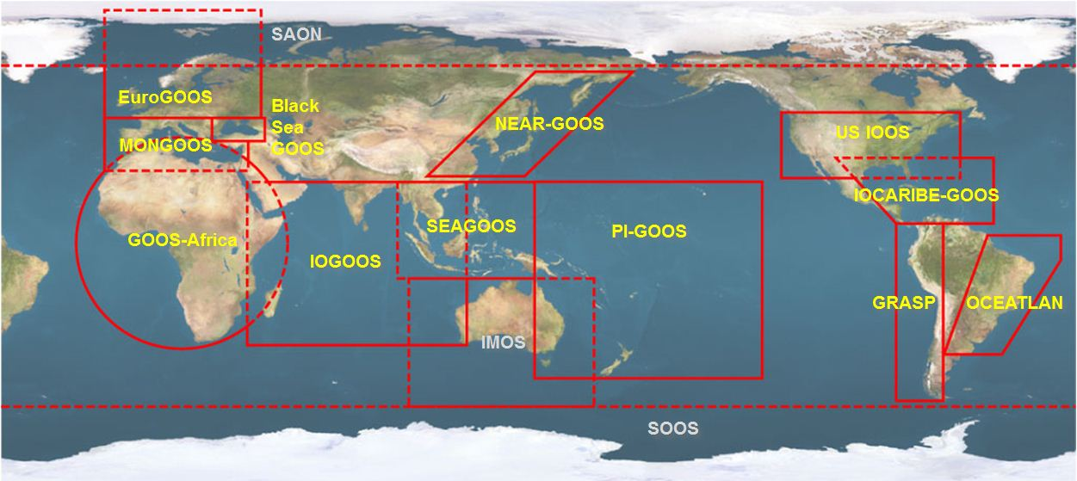





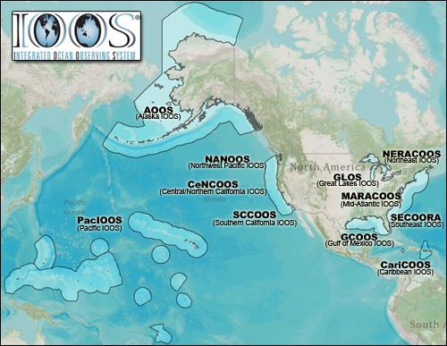













U.S. Integrated Ocean Observing System (IOOS)
Global Component
National Component
Regional Component
15 Regional Alliances in GOOS
Vessels -
Satellite
Satellite
CODAR
Ships/ Vessels
Glider
REMUS
Data Vis.
Modeling
Security
Leadership
Education
11 Regional Associations
17 U.S. Federal Agencies
Informing Decisions & Enhancing Science

Slide 4
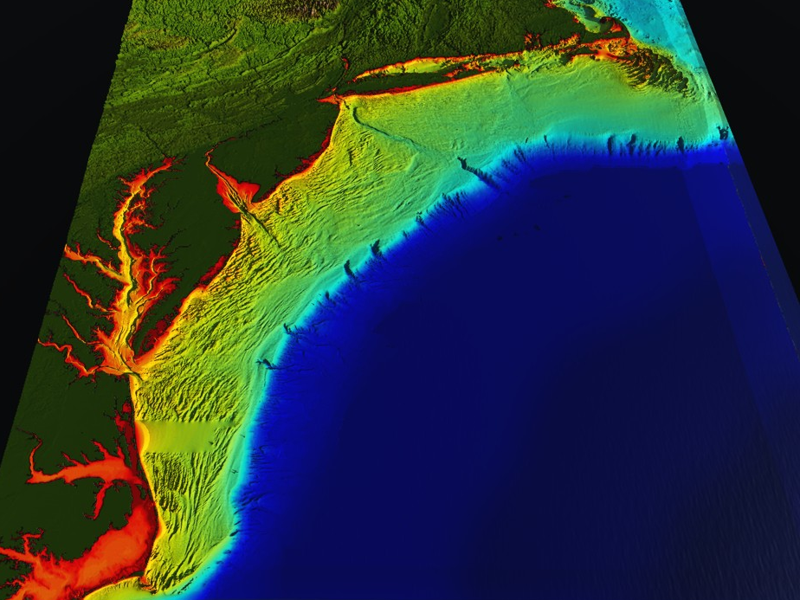















RI
U..
Middle Atlantic
Regional Association
Coastal
Ocean Observing System
10 States - 76 Million People
1000 km Cape to Cape
CT
Cape
Cod
MA
NY
PA
NJ
U.S. IOOS
Responds to
Hurricanes Irene
and Sandy
DE
MD
Sandy
>40 PIs
>20 Institutions
>50 Members
>2000 Contacts
Irene
Scott Glenn + Many
VA
NC
Cape
Hatteras
Notes:
4

Slide 5
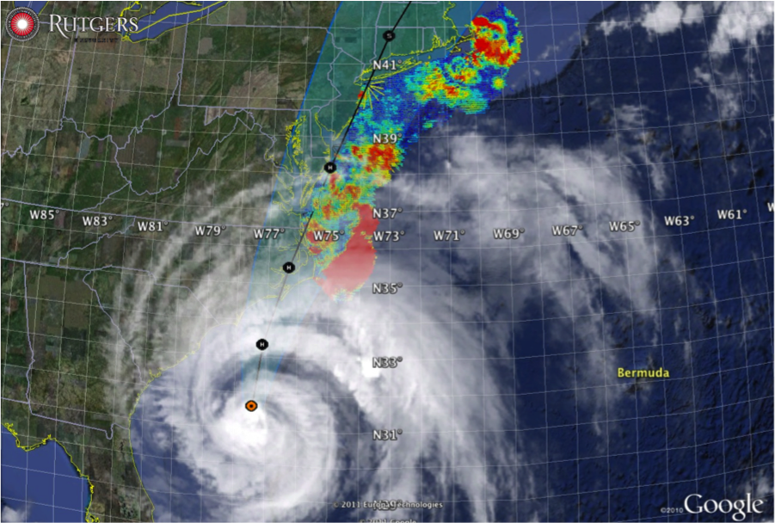
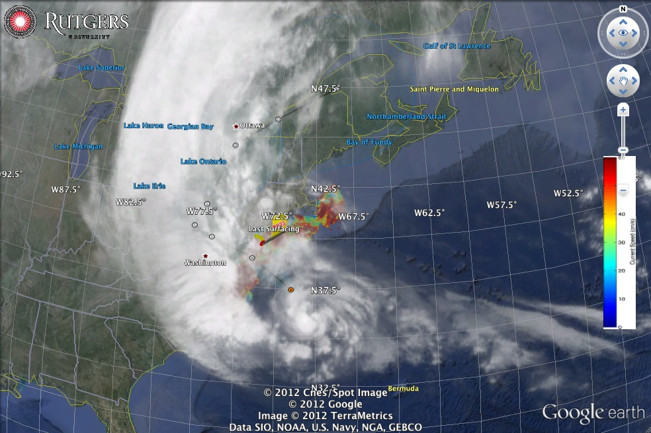
Hurricane Irene
August 28, 2011
NOAA/NHC Damage:
#7 with >$16 Billion.
Track Accurate;
Intensity Over-predicted.
Hurricane Sandy
October 29, 2012
NOAA/NHC Damage:
#2 with >$68 Billion.
Track Accurate;
Impact Under-predicted.

Slide 6
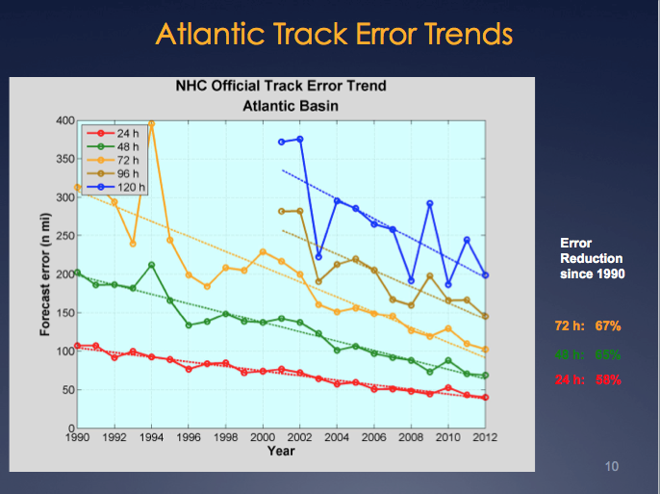
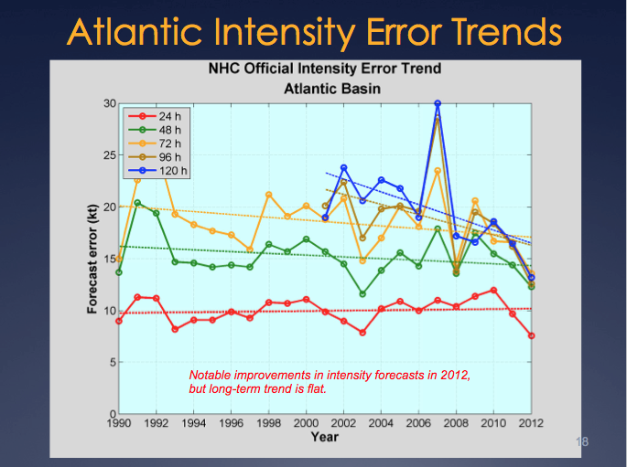
National Hurricane Center: Track & Intensity Error Trends
Track Error: 20-Year Trend Decreases Intensity Error: - “Long-term trend is flat”
Track: Improvements attributed to Global Forecast Models & the Super-Ensemble.
Intensity: “…upper-ocean thermal structure can affect the evolution of storm intensity, …Unfortunately, the paucity of subsurface measurements limits our ability to assess the effect of upper-ocean variability on tropical cyclone intensity evolution.”
– Emanuel et al., (2004)
Production Suite Review: December 4, 2012

Slide 7
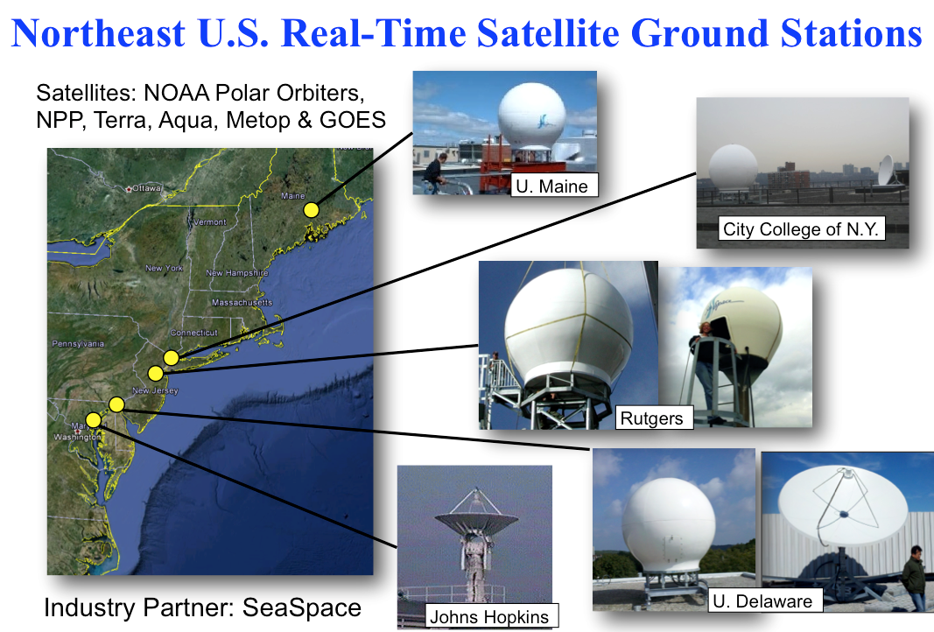
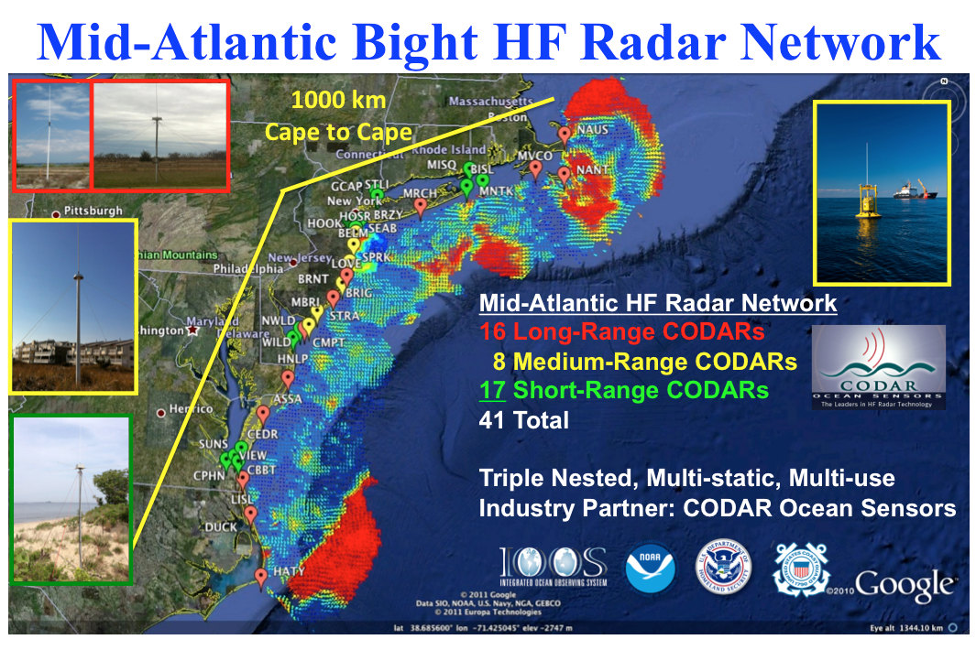
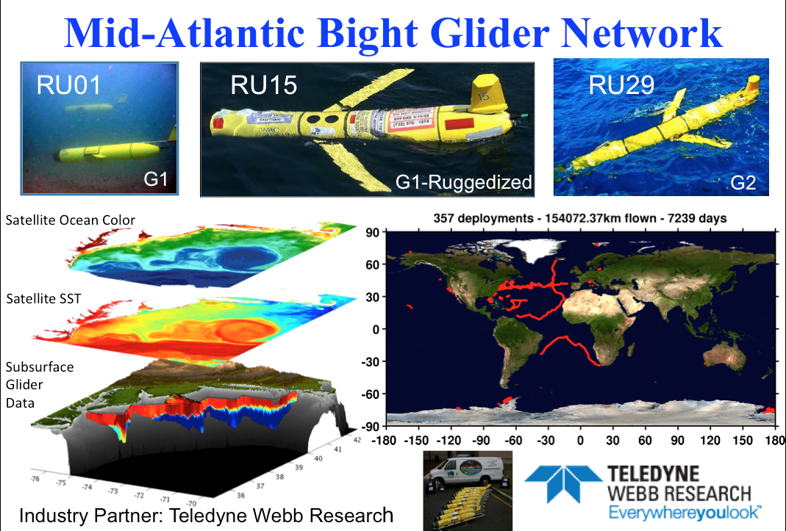
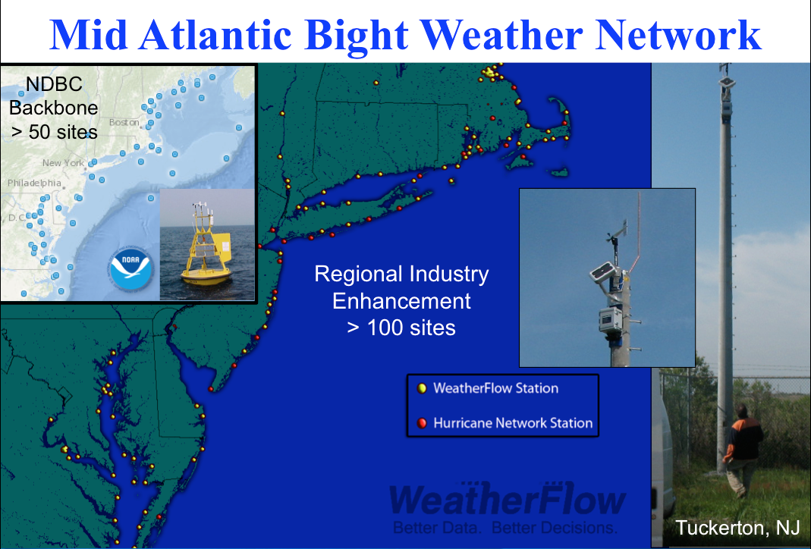
Mid-Atlantic Regional-Scale Observation Network

Slide 8
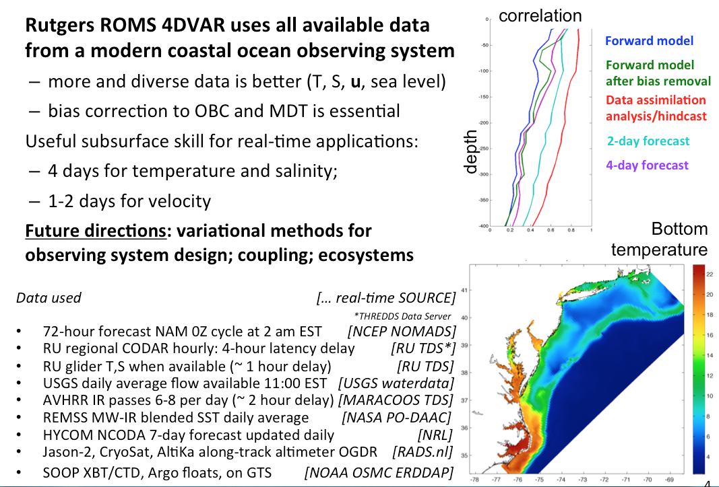
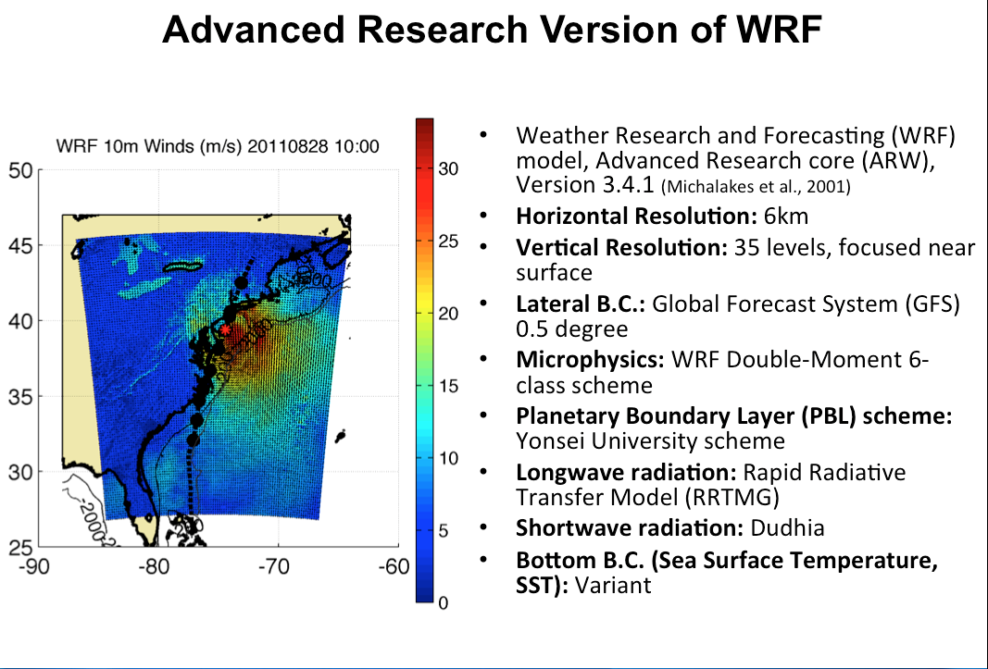
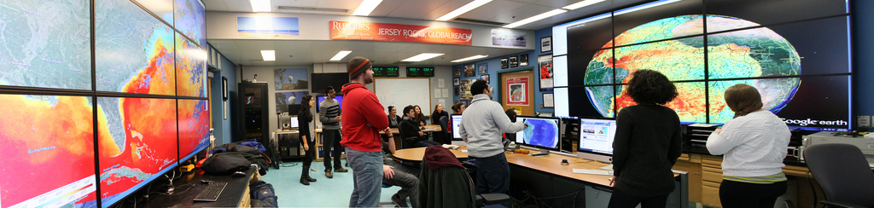
Mid-Atlantic Ensemble of Forecast Models Include:
Mid-Atlantic Operations Center @ Rutgers

Slide 9
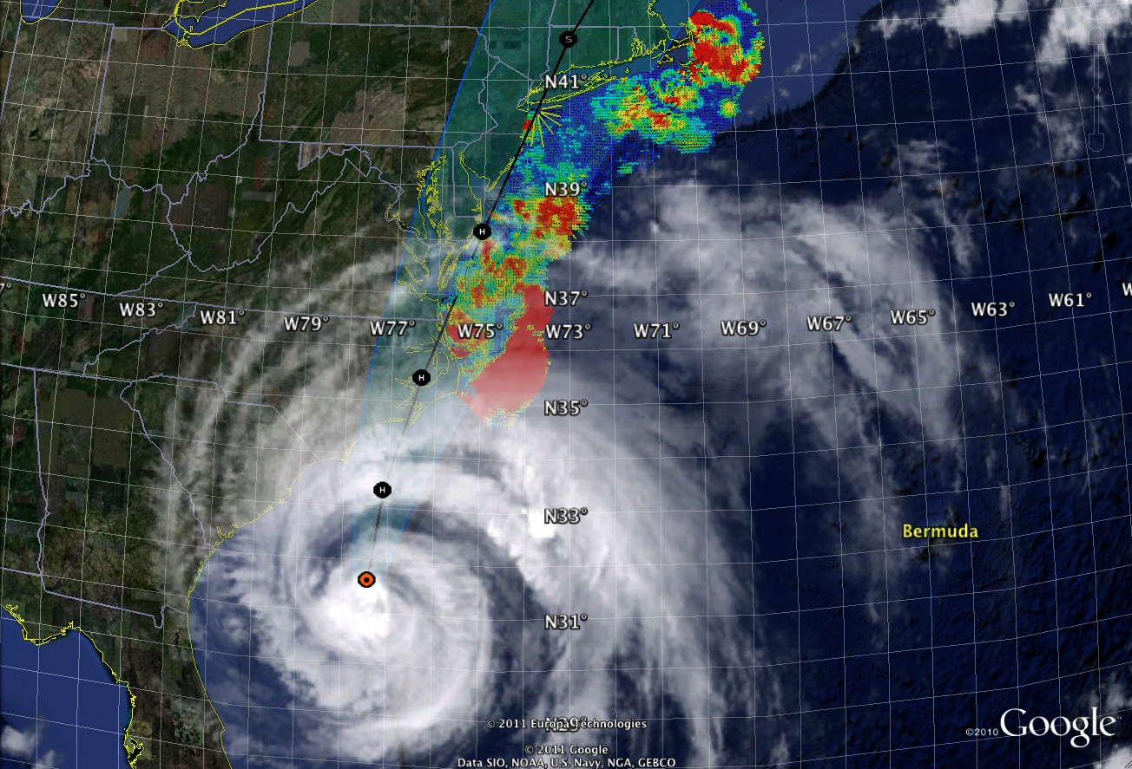
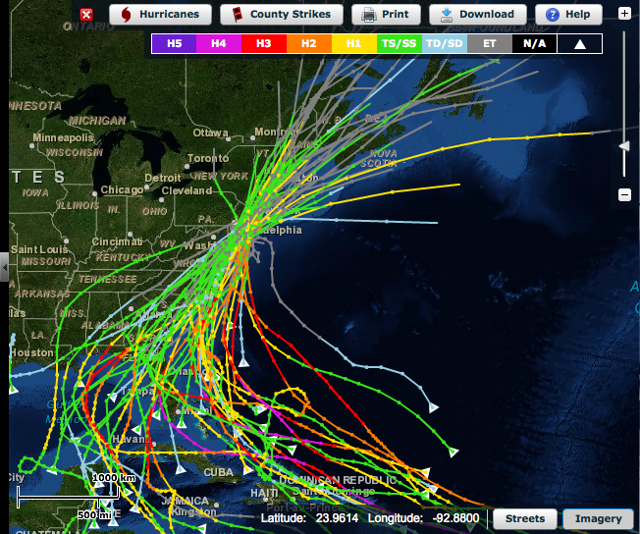
Hurricane Irene Track August 26-29 2011
Historical Hurricane Tracks
within 120 km of Atlantic City, NJ
Peak Activity:
Mid-August to Mid-September

Slide 10
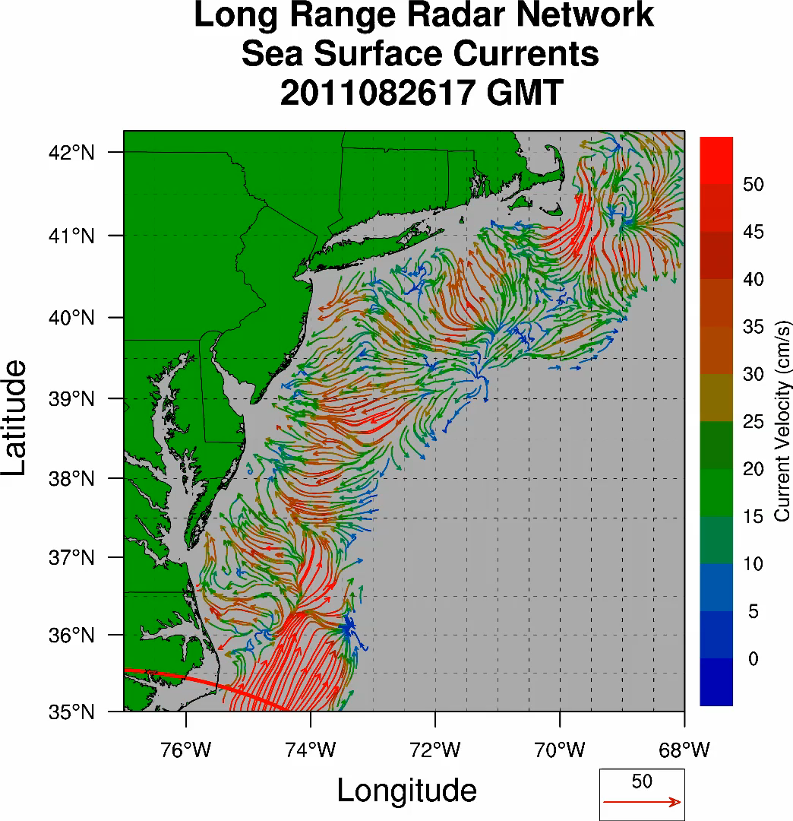
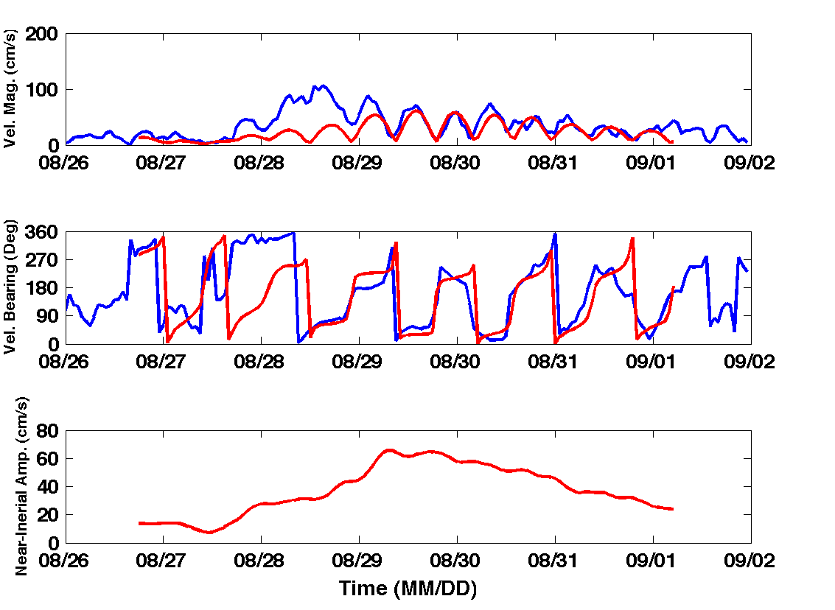
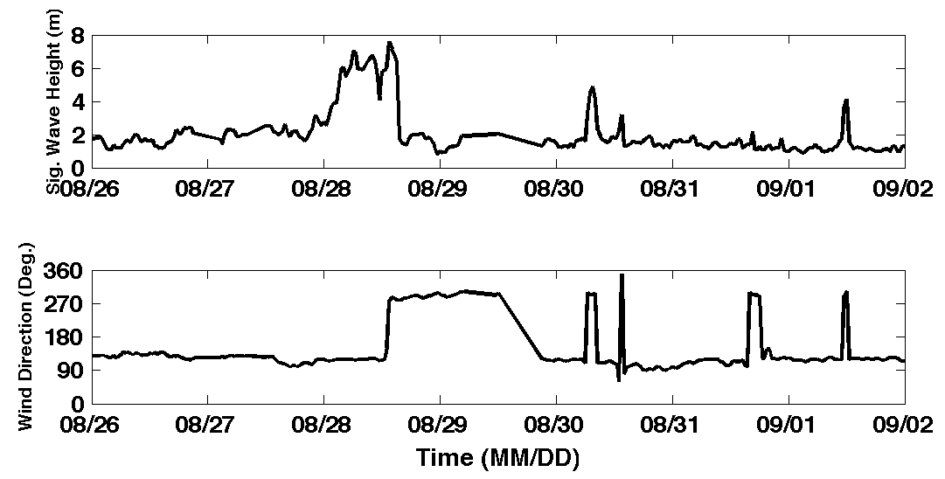
Hurricane Irene
39.5N 73W Surface Current Time Series
Total Current Near-Inertial Current
Wave & Wind Direction Time Series
Eye crosses NJ mid-day on Aug 28

Slide 11
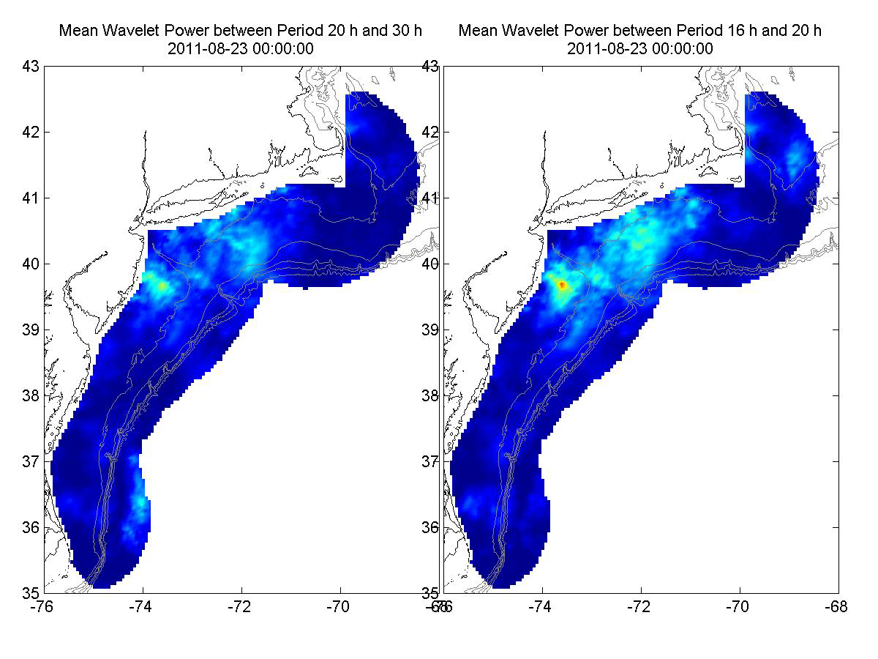
Hurricane Irene Surface Current Wavelet Analysis
Direct Wind Forcing
Inertial Response
Aug 27 Aug 28 Aug 29 Aug 30 Aug 31 Sep 01
Frontside Eye Backside Inertial Inertial Inertial

Slide 12
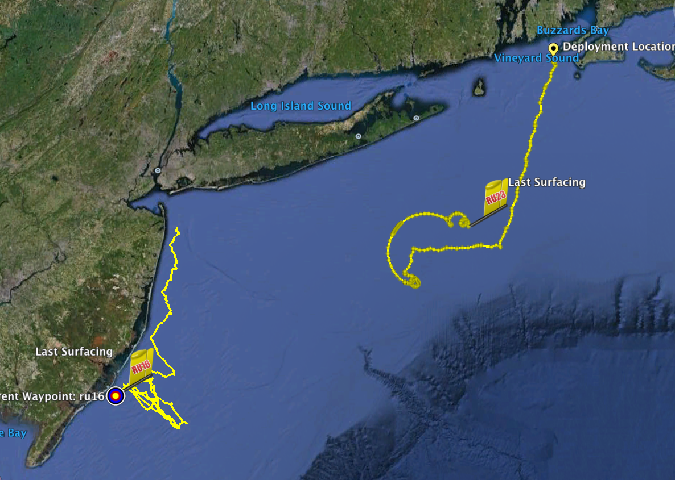
Hurricane Irene Glider Sampling
RU23
Deployed for MARACOOS.
Map subsurface T/S structure for fisheries.
Damaged early - drifter
Recovered by fisherman
Provided data on inertial currents during storm.
RU16
Deployed for EPA.
Map bottom dissolved oxygen.
Provided data on mixing during storm.

Slide 13
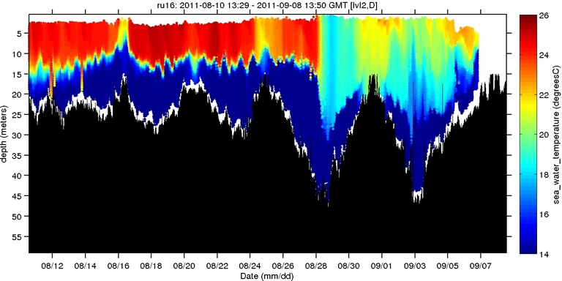
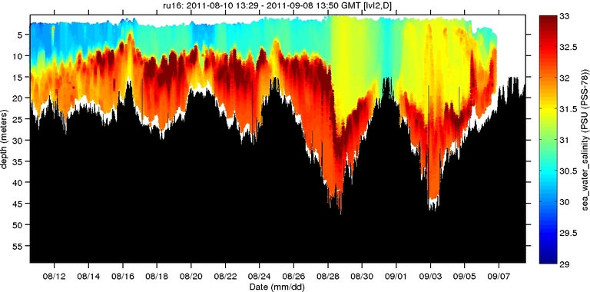
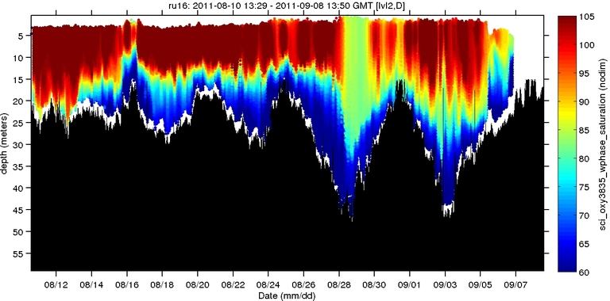
Hurricane Irene Glider Sampling
Hurricane Irene
0
26
depth
Temperature
55
14
0
33
depth
RU23
Deployed for MARACOOS.
Map subsurface T/S structure for fisheries.
Damaged early - drifter
Recovered by fisherman
Provided data on inertial currents during storm.
Salinity
55
29
RU16
Deployed for EPA.
Map bottom dissolved oxygen.
Provided data on mixing during storm.
0
105
depth
% Saturation
(DO)
55
60
Aug 12
Sep 07

Slide 14
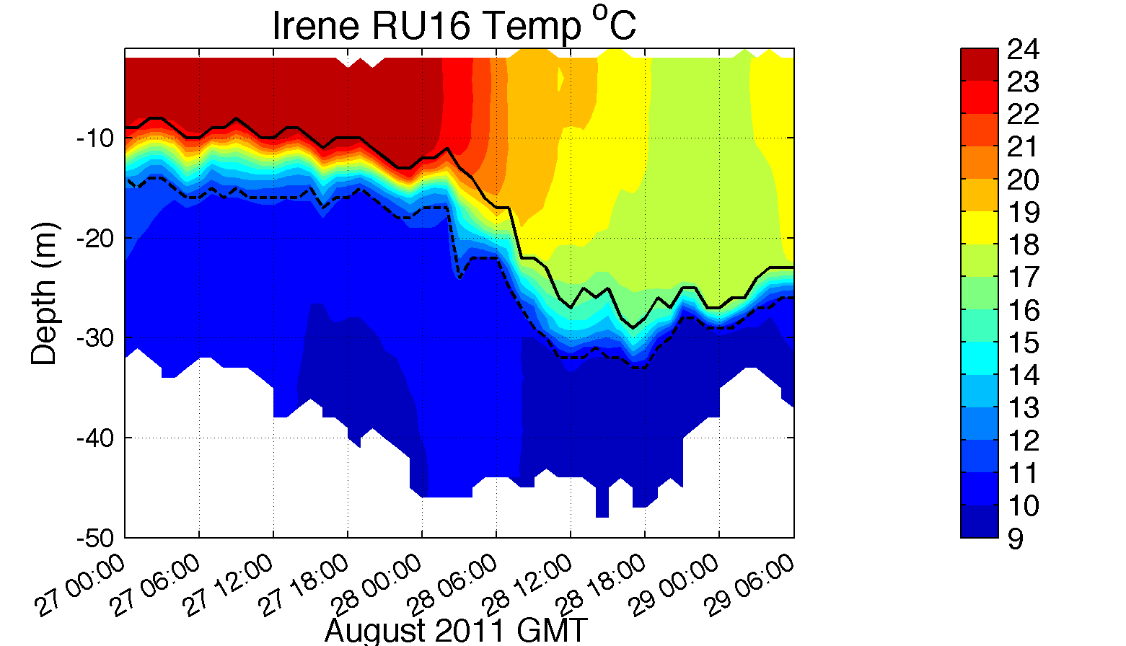
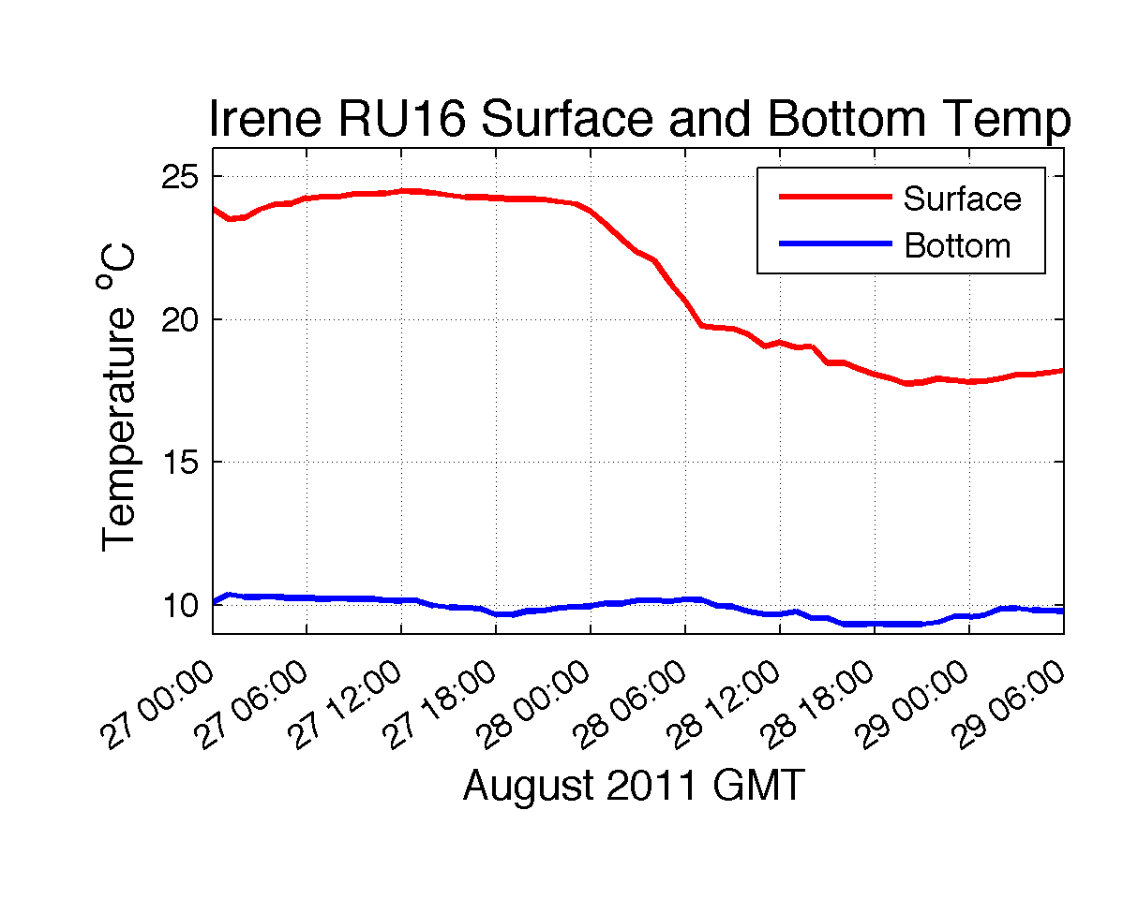
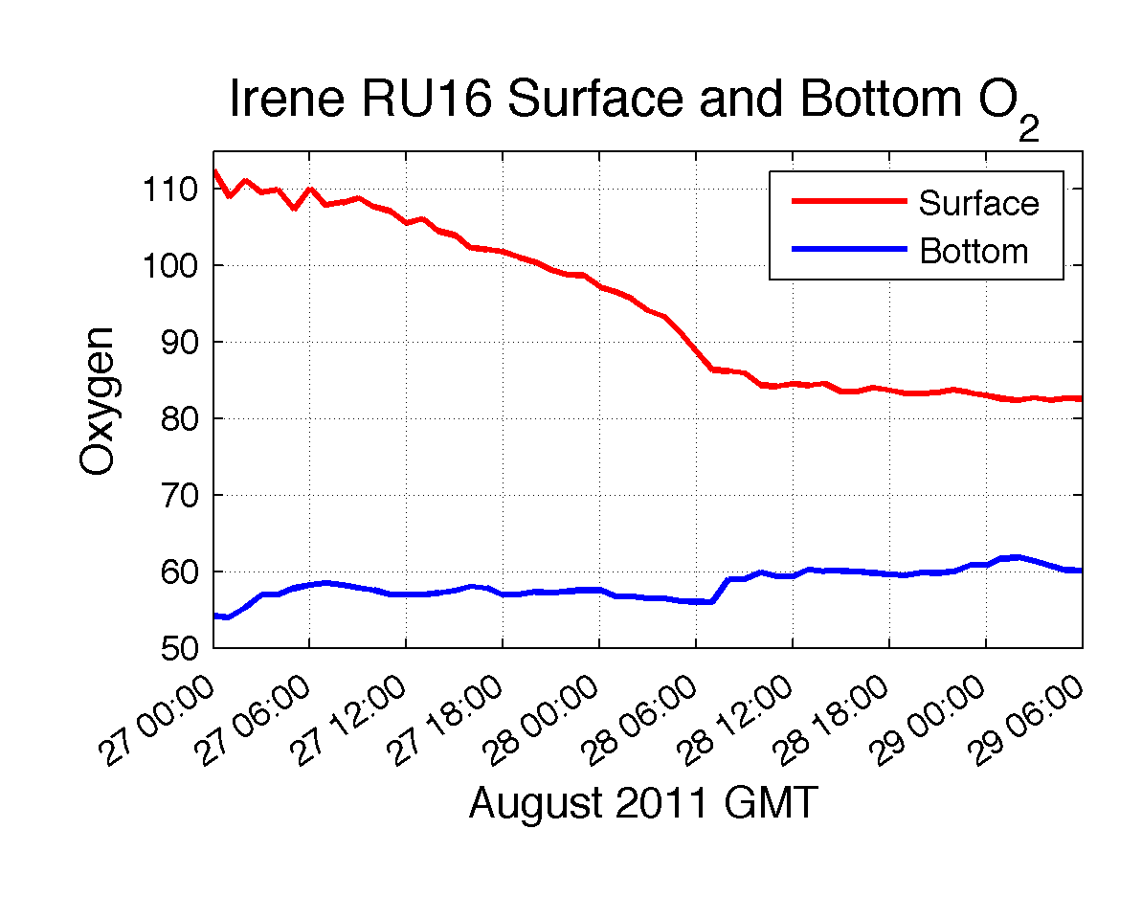
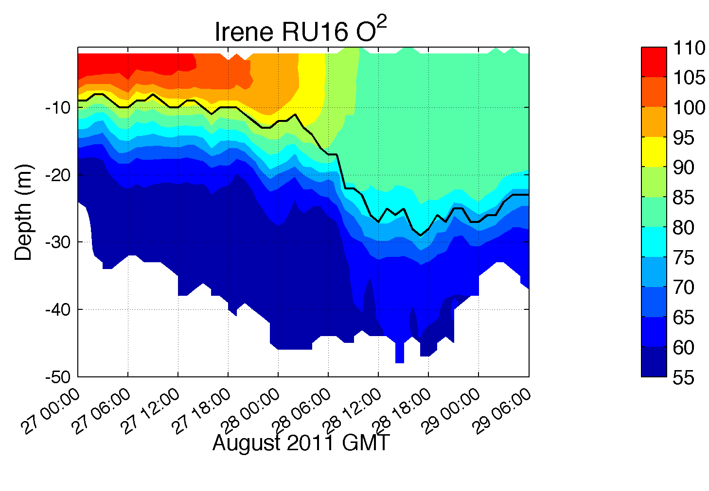
Hurricane Irene: Glider Sampling Through the Storm
Glider observes “ahead-of-eye” cooling

Slide 15
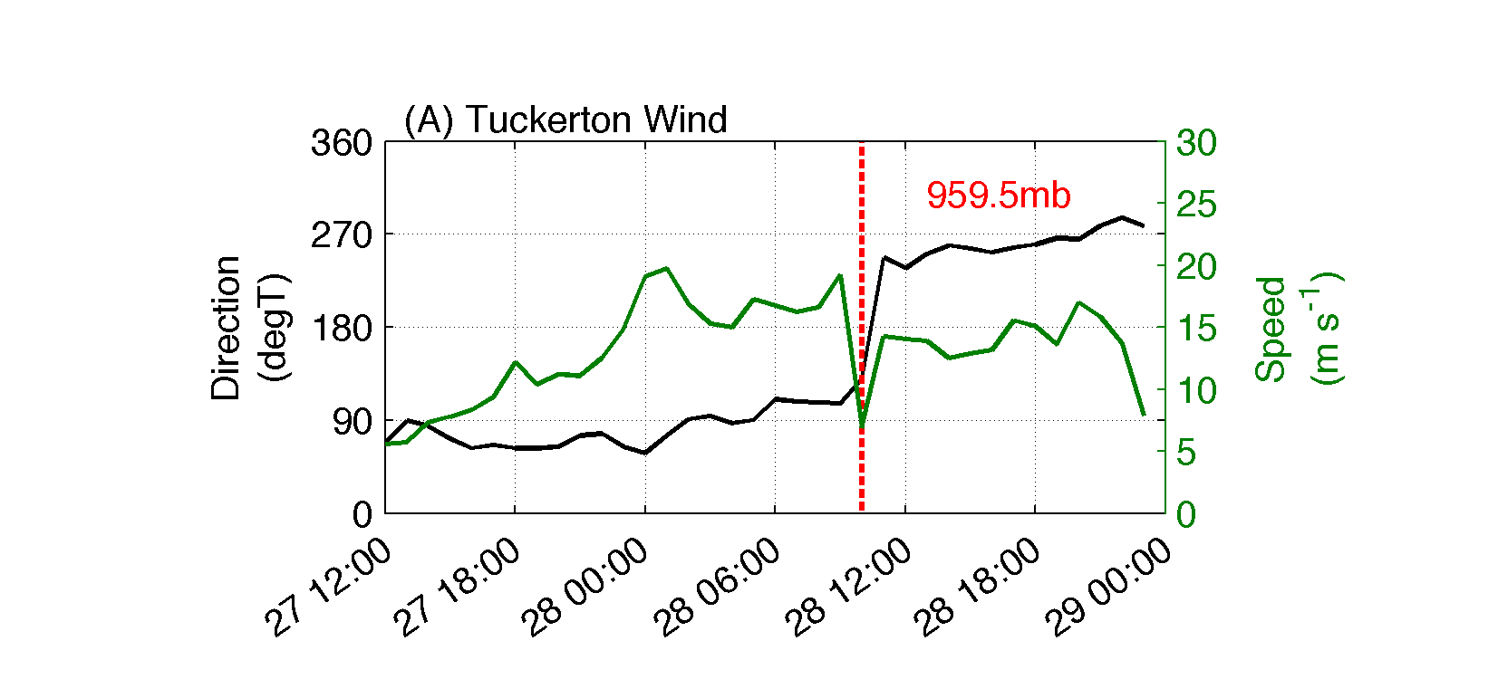
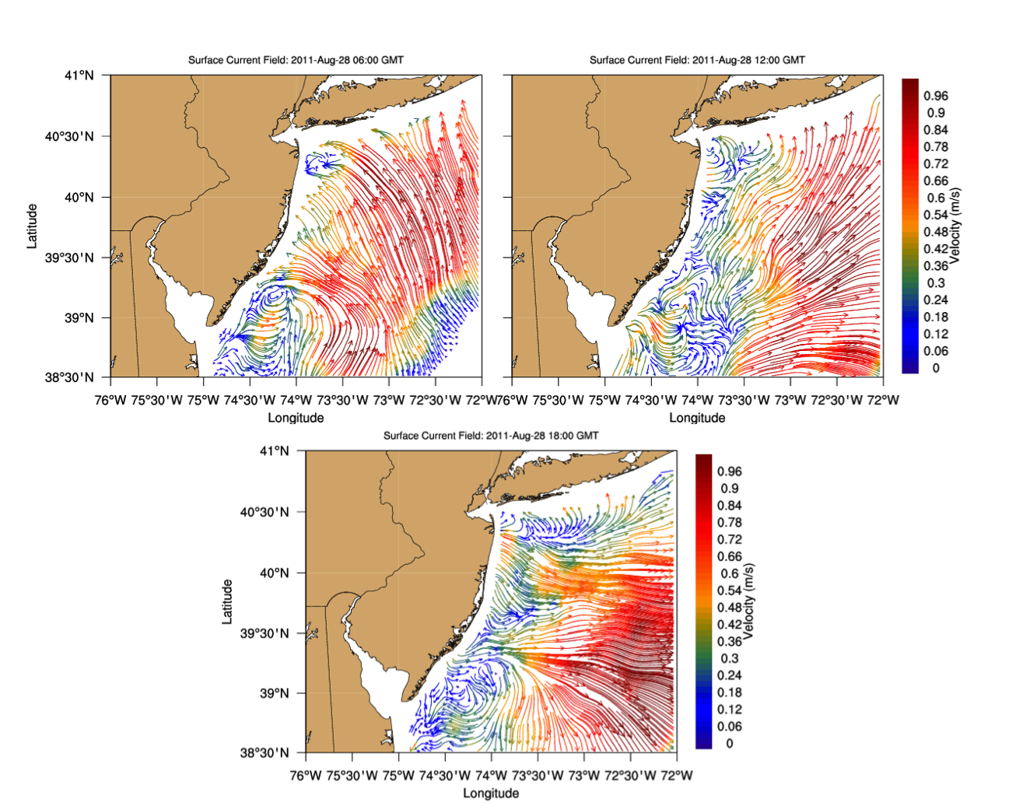
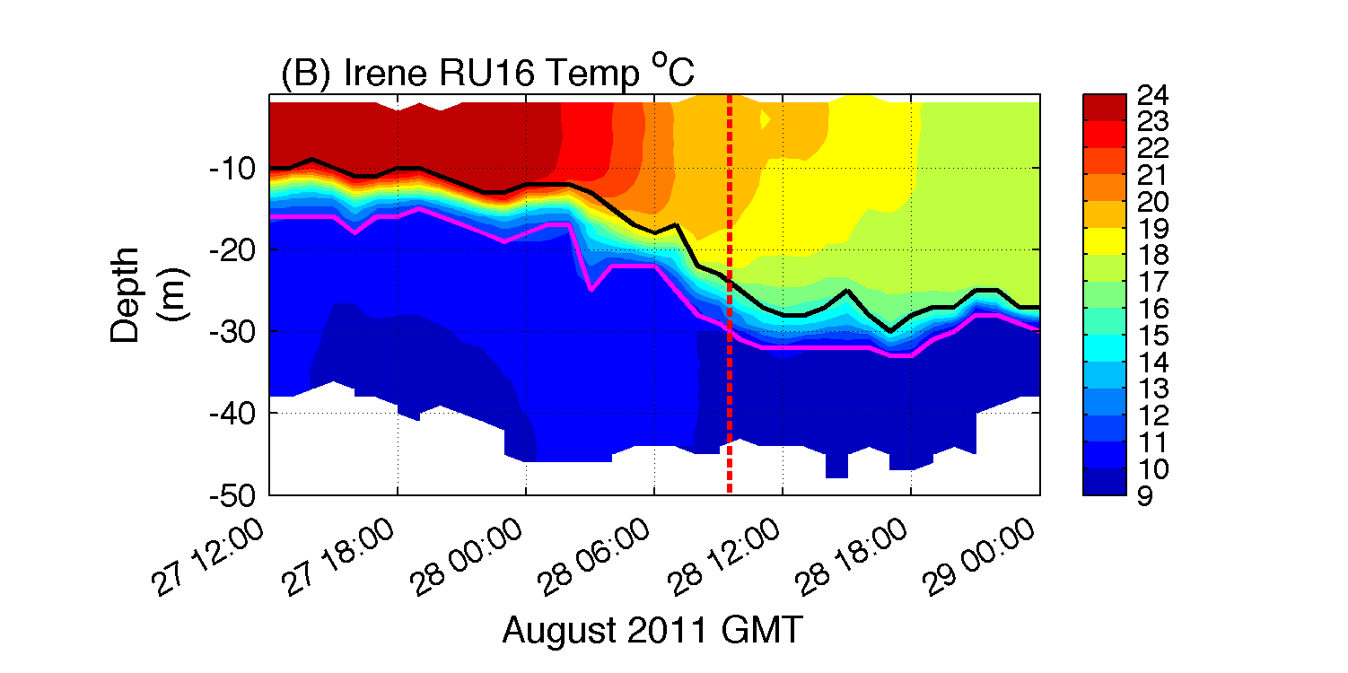
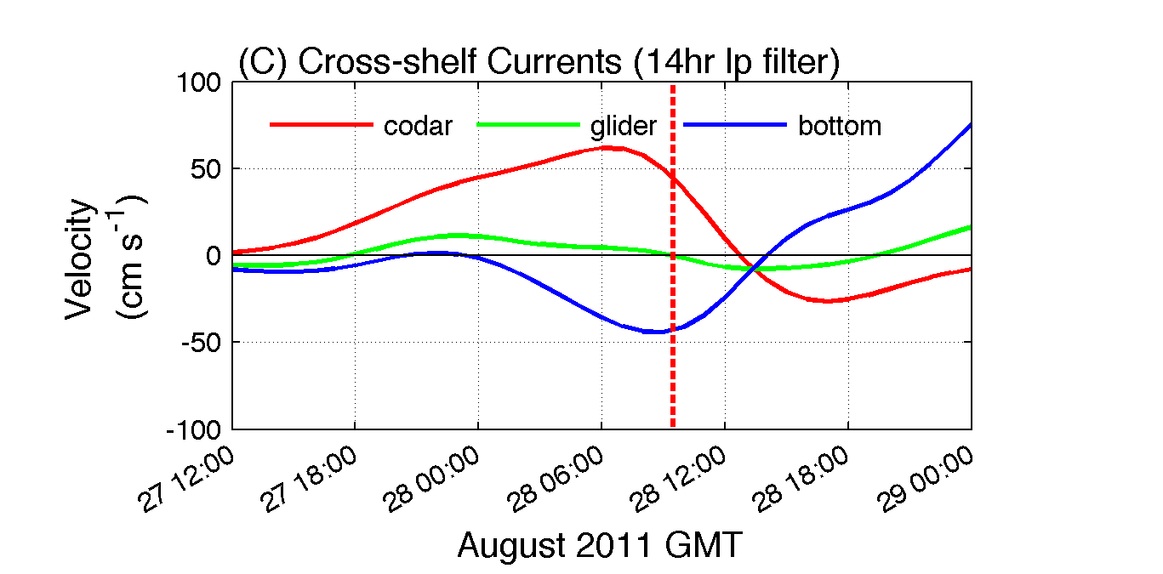
Glider + CODAR Observe 3-D Structure
Before
After
Onshore
Offshore

Slide 16
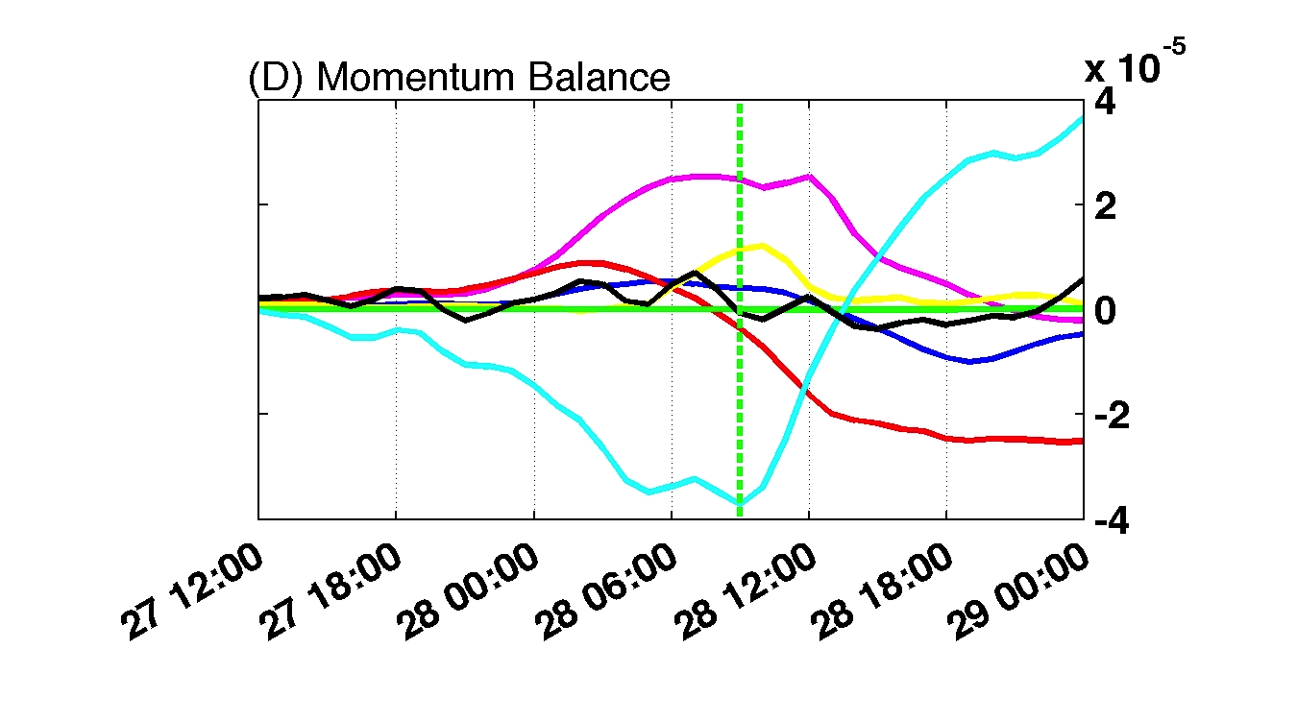
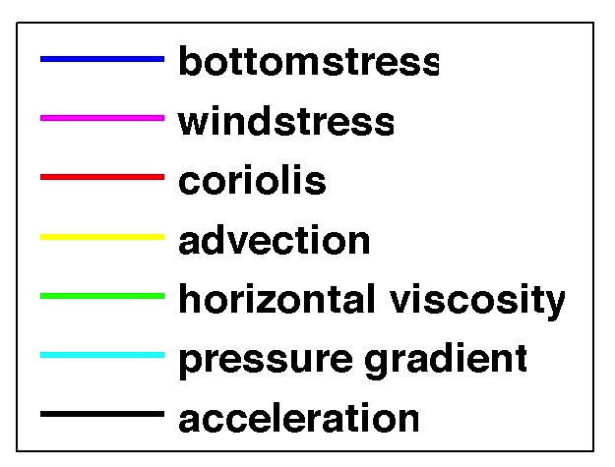
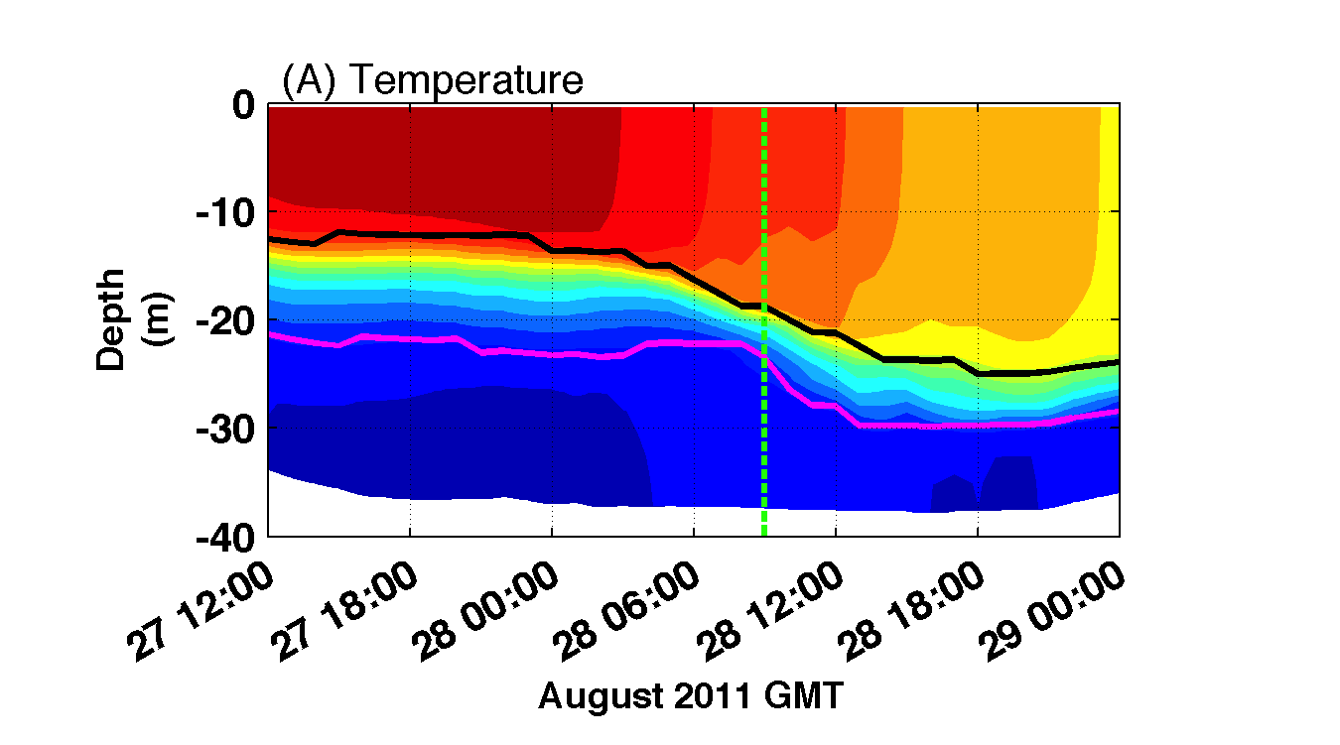
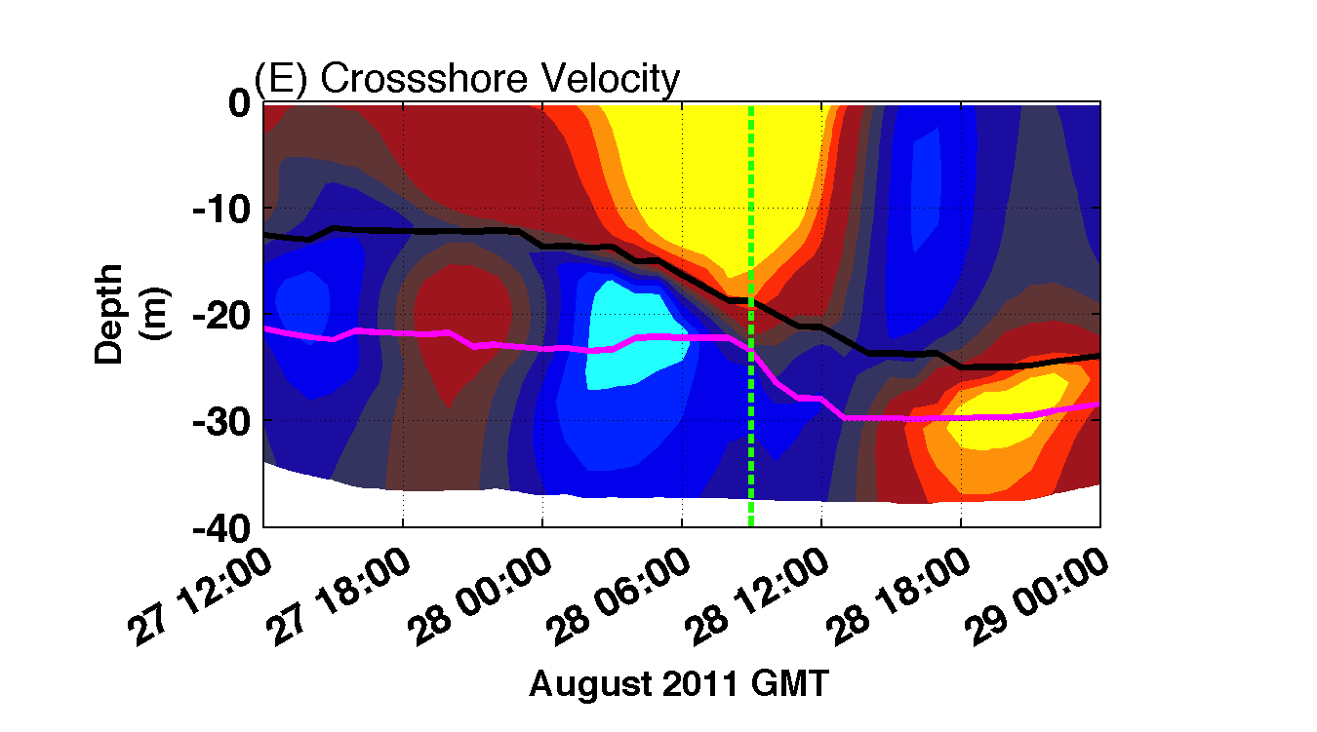
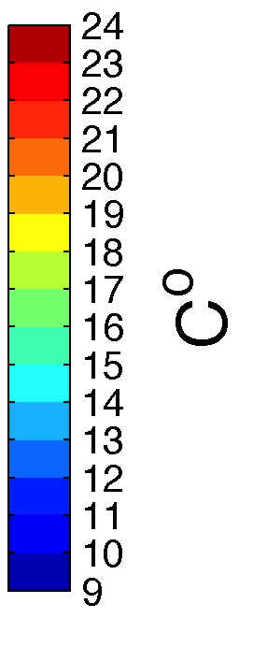
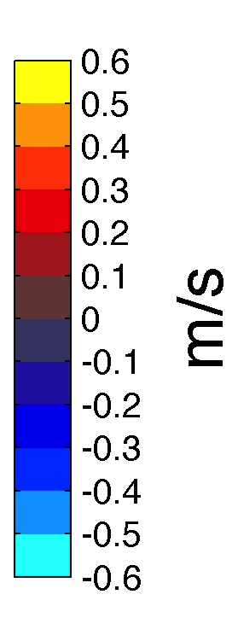
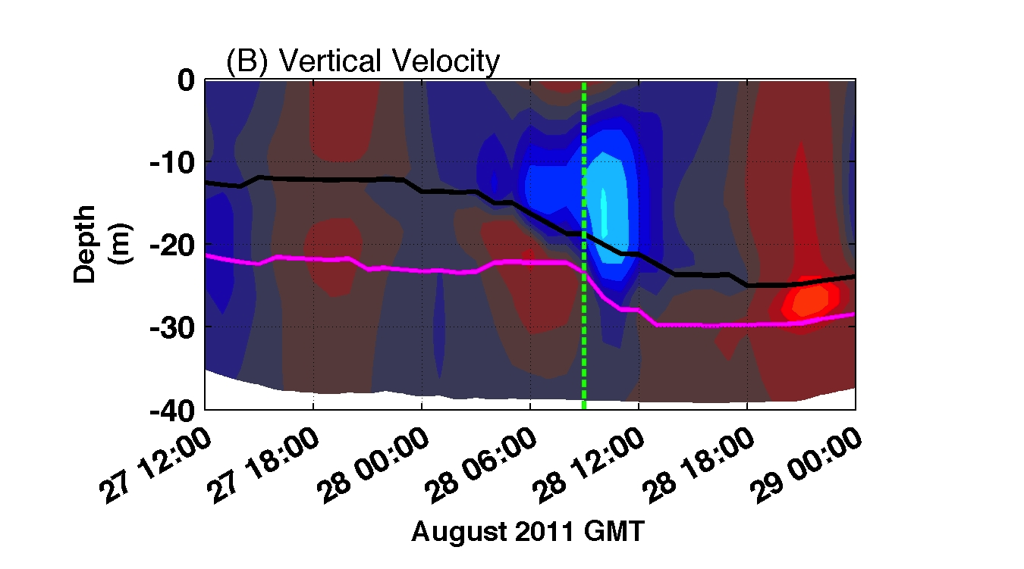
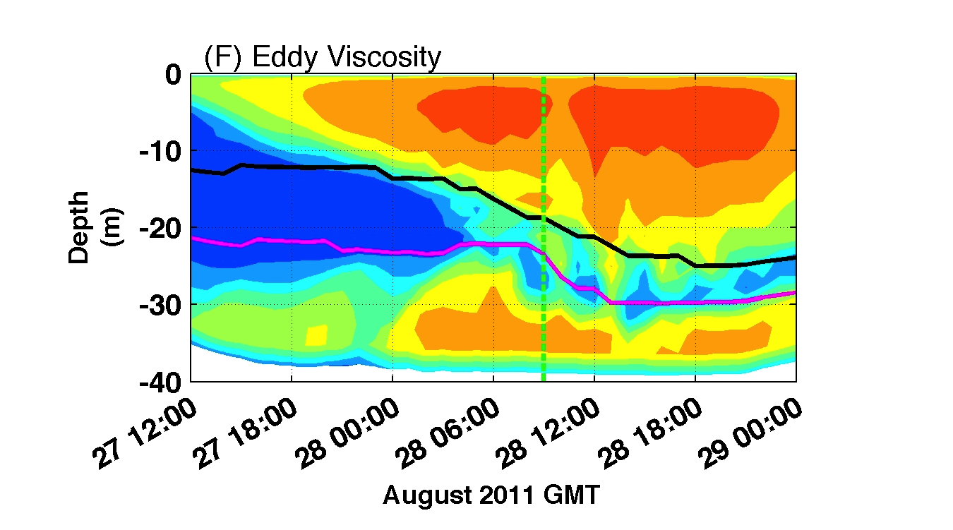
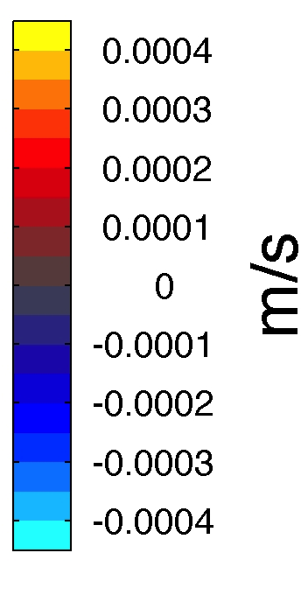
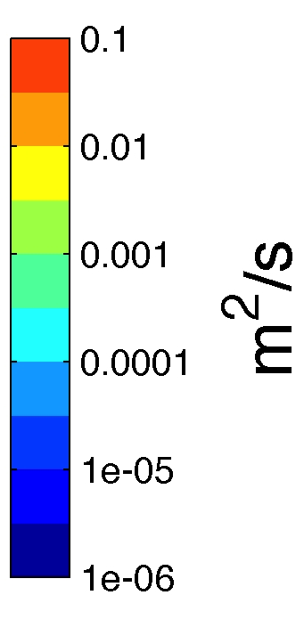
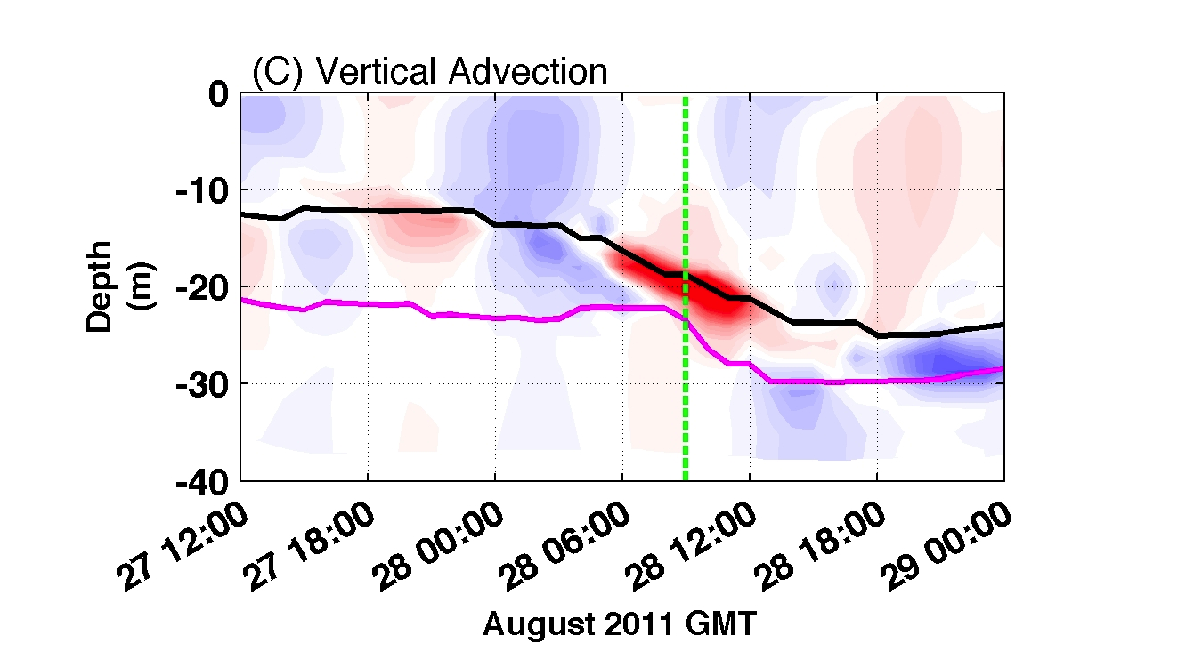
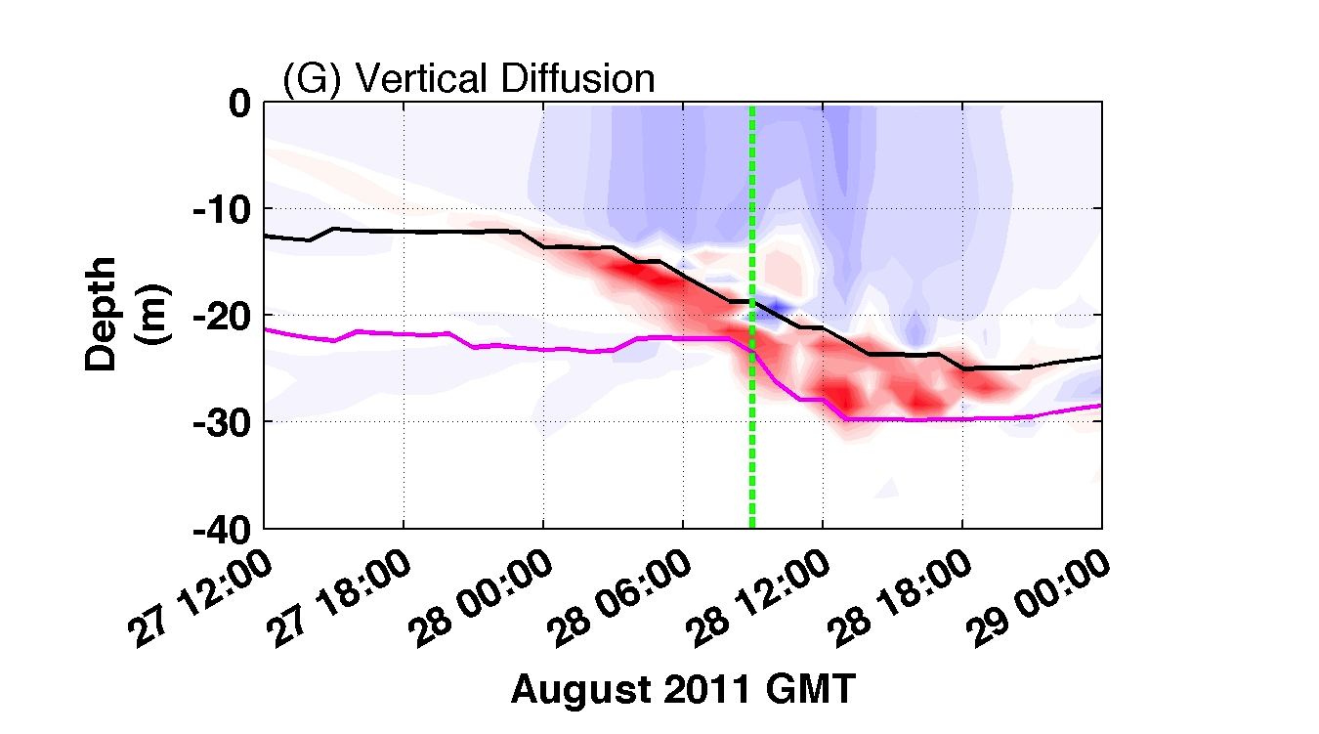
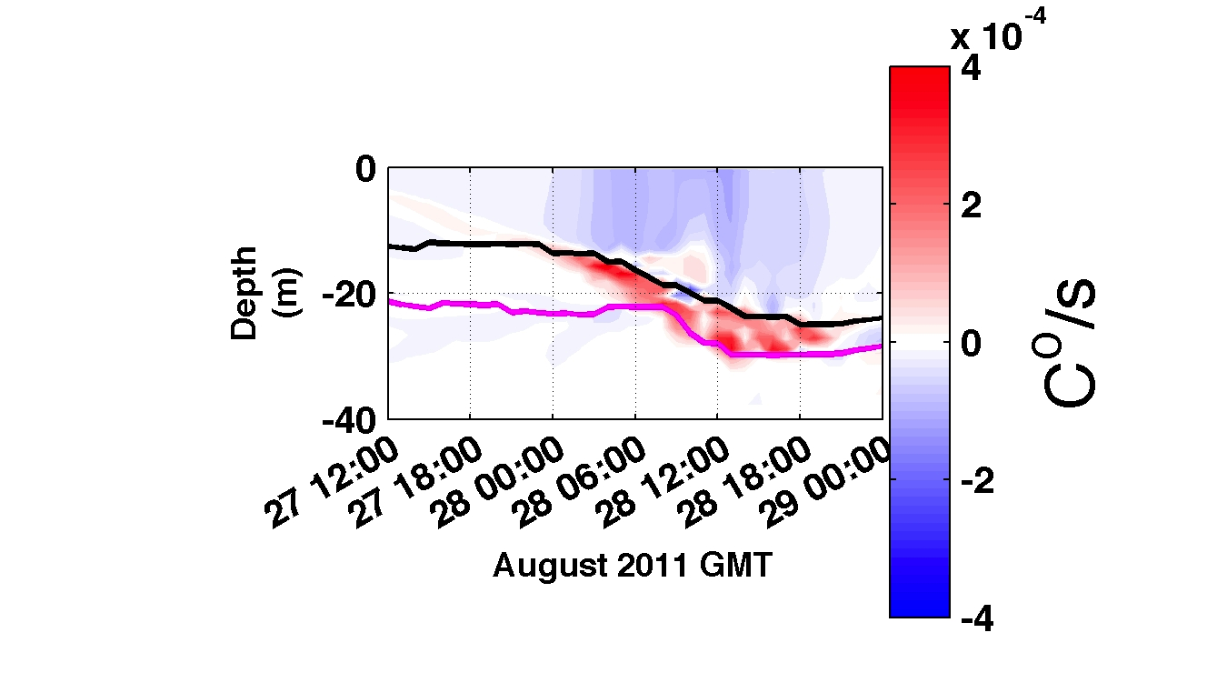
Hurricane Irene:
Regional Ocean
Modeling System
ROMS
Wind Stress =
Pressure Grad.
--------------------
Pressure Grad.
= Coriolis Force
Onshore
Offshore
Onshore
Offshore
Model Identifies Dominant 3-D Processes
Vertical Diffusion
> Vertical Advection > Other Terms

Slide 17
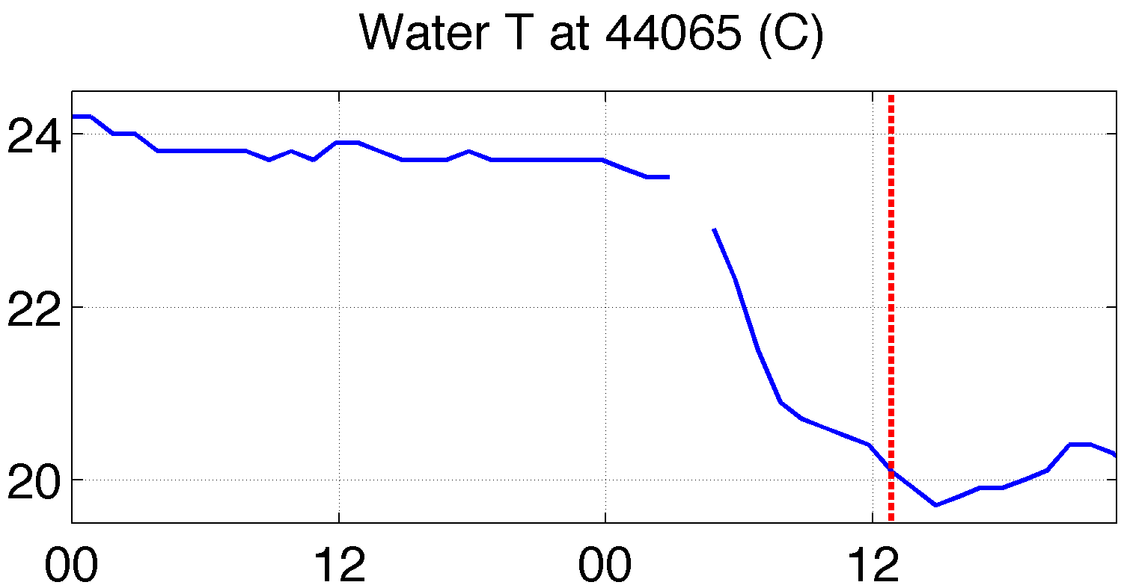
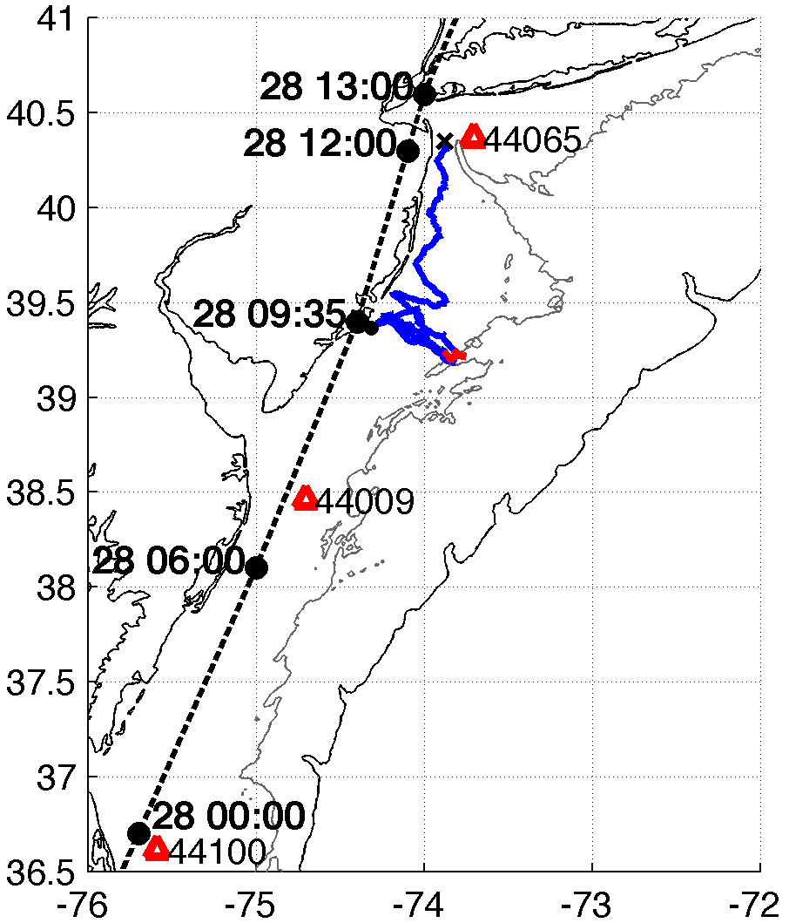
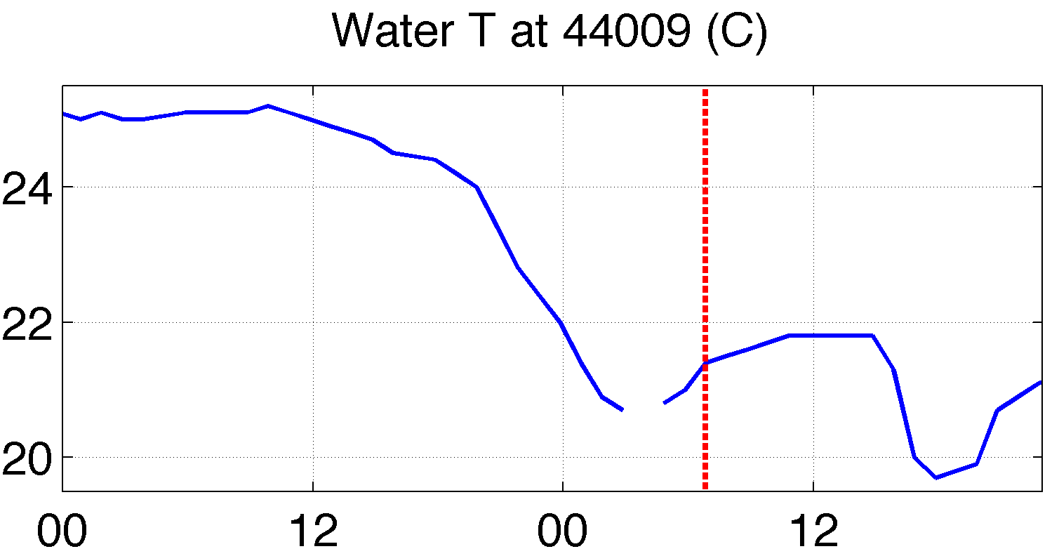
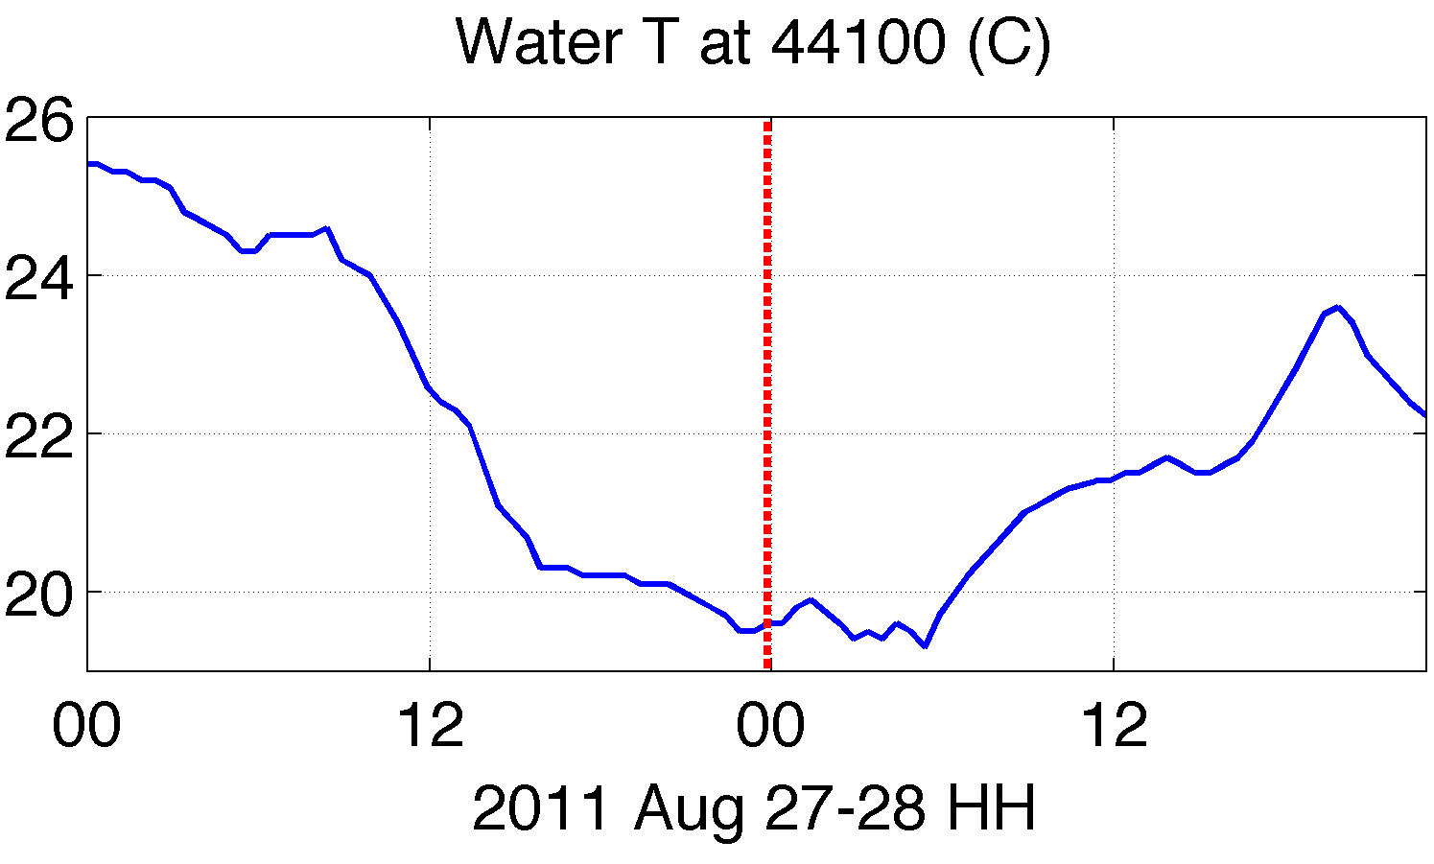

Buoys corroborate “ahead-of-eye” surface cooling
along entire hurricane track in MAB
passage of eye
passage of eye
4
3
4
3
2
2
MAB
1
1

Slide 18





Rutgers Coldest Dark Pixel SST Composite
T (°C)
T (°C)
MAB
SAB
BEFORE
AFTER
COOLING
Ahead-of-eye Cooling intense throughout MAB
Due to mixing with subsurface Cold Pool
SAB
MAB
Notes:
-model initialized 27/0600 (first 6 hours over SAB)
-cooling over SAB much less than over MAB
-with buoys and glider showing majority of cooling ahead of eye, use post-storm SST (Rutgers) compared to pre-storm SST (RTG)

Slide 19








Improved satellite SST product revealed ahead-of-eye cooling was not captured by:
standard satellite product
ocean models used for forecasting hurricane intensity
Rutgers SST
RTG HR SST
NAM model
HWRF-POM
low res
HWRF-HYCOM
medium res
BEFORE IRENE
AFTER IRENE
Notes:
Caveats: different atmospheric forcing, etc.
Rutgers SST: 2km, RTG: 1/12 deg, ~9 km, HWRF-POM: 18km, HWRF-HYCOM: 1/12 deg, ~9km

Slide 20



Global Models & the Mid-Atlantic Shelf Cold Pool
Cold Pool
Glider Data compared to Global Model Forecasts
Summer 2013:
Mid-Atlantic
Temperature
Cold Pool?

Slide 21



But “Ahead-of-eye” Cooling was captured by data assimilative regional ocean model
Rutgers composite showed that cooler SSTs are captured relatively well by high res coastal ocean models not specifically used for forecasting hurricanes
Rutgers SST
ROMS ESPreSSO
BEFORE
RIGHT AFTER
AFTER
Notes:
Caveats: -ROMS ESPreSSO run shown initialized 8/27/11 00Z, while HWRF-POM and HWRF-HYCOM initialized 8/26/11 00Z, 24 hrs earlier
-Satellite SST product is 3-day composite, so possible that post-storm cooling did not persist as long as satellite shows
ROMS resolution: 5 km

Slide 22






Rutgers AWRF Atmospheric Forecast Sensitivity Study
Warm SST
Boundary Condition
Cold
SST
Boundary Condition
Notes:
Can provide model setup parameters for WRF runs (namelist) if requested

Slide 23


>120 Hurricane Irene sensitivity tests demonstrate:
cold SST produces better match to observed intensity
intensity most sensitive to “ahead-of-eye” SST cooling
Over Mid-Atlantic Bight
& NY Harbor
NJ landfall
NHC Best Track
Warm pre-storm SST, WRF isftcflx=2
Warm pre-storm SST, isftcflx=1
Warm pre-storm SST, isftcflx=0
Cold post-storm SST, isftcflx=2
Cold post-storm SST, isftcflx=1
Cold post-storm SST, isftcflx=0
Sensitivity to SST
(warm minus cold), isftcflx=2
Sensitivity to air-sea flux parameterization (isftcflx=1 minus isftcflx=0), warm SST
Sensitivity to air-sea flux parameterization (isftcflx=1 minus isftcflx=0), cold SST
Notes:
See extra slides for air-sea flux parameterization explanation (and what we are changing in the equations when we change SST)
See extra slide for time series of wind time series (and NHC over-prediction), 1D ocean mixed layer model results (and issues)

Slide 24
Hurricane Irene
August 28, 2011
Science Summary:
Strong stratification
Limited storm surge
Mixing cooled surface
Cooling “ahead-of-eye”
Limited storm intensity
Operational Conclusions:
Greatest sensitivity was to “ahead-of-eye” ocean cooling
Not detected or forecast by standard satellite products,
1-D ocean mixed-layer model, or large-scale ocean models
Was forecast by the data-assimilative regional ocean model
2-D storm surge models inadequate for impact

