Slide 1
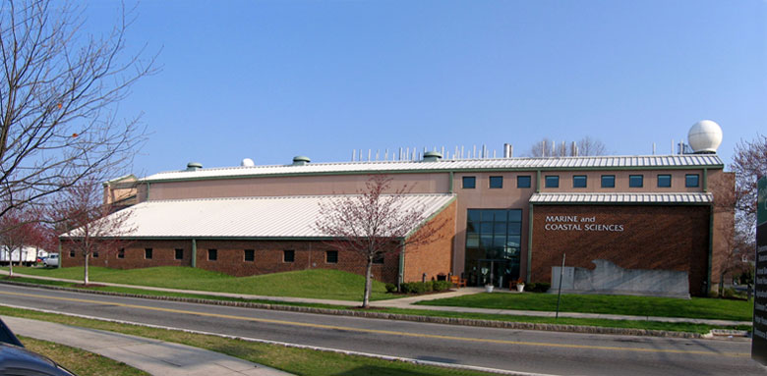
24 Years of Ocean Observing at:
Rutgers University (RU)
Coastal Ocean Observation Lab (COOL)
Institute of Marine and Coastal Sciences (IMCS)
School of Environmental and Biological Sciences (SEBS)
71 Dudley Road, New Brunswick, New Jersey, USA
http://rucool.marine.rutgers.edu
Dr. Scott Glenn
Distinguished Professor
MARACOOS Principal Investigator
U.S. National HFR Network
Dr. Hugh Roarty
Operations Center Director
MARACOOS HFR Coordinator
Global HFR Network

Slide 2
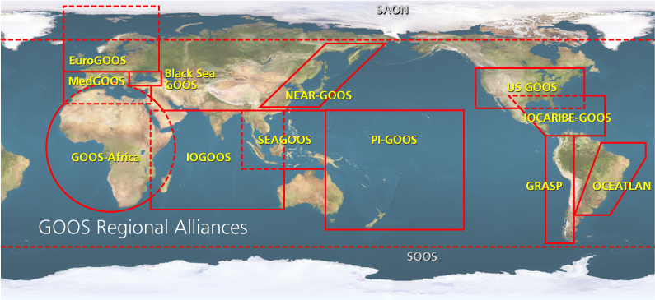

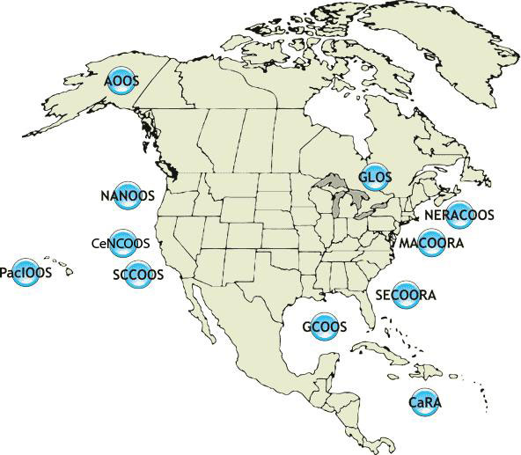






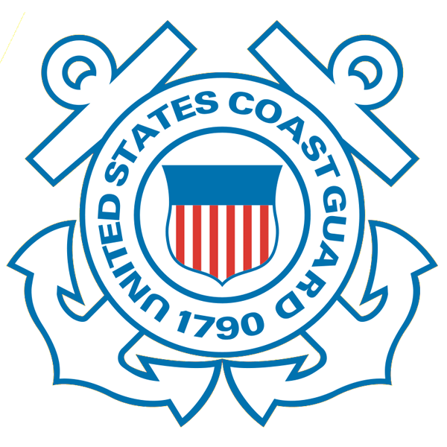










U.S. Integrated Ocean Observing System (IOOS)
International Component
National Component
Regional Component
14 Regional Alliances in GOOS
Vessels -
Satellite
Satellite
CODAR
Ships/ Vessels
Glider
REMUS
Data Vis.
Modeling
Security
Leadership
Education
11 Regional Associations
17 U.S. Federal Agencies
Supports Science & Decisions
http://ioos.gov

Slide 3
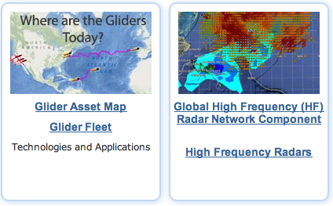
U.S. Integrated Ocean Observing System (IOOS)
International Component
National Component
Regional Component
Globally Coordinated Initiatives
Vessels -
Satellite
Satellite
CODAR
Ships/ Vessels
Glider
REMUS
Data Vis.
Modeling
Security
Leadership
Education
11 Regional Associations
17 U.S. Federal Agencies
Supports Science & Decisions
http://ioos.gov

Slide 4
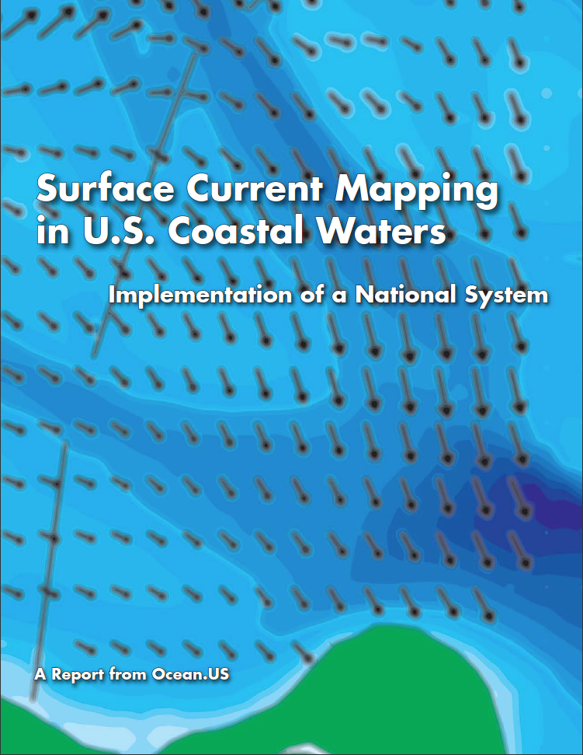
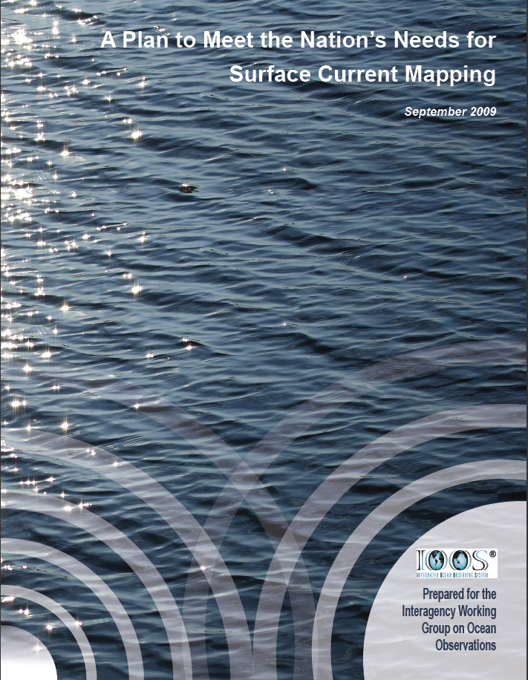
U.S. Integrated Ocean Observing System (IOOS)
International Component
National Component
Regional Component
2013
2011
Globally Coordinated Initiatives
Vessels -
Satellite
2004
2009
11 Regional Associations
Nationally Coordinated Initiatives
Supports Science & Decisions
http://ioos.gov

Slide 5
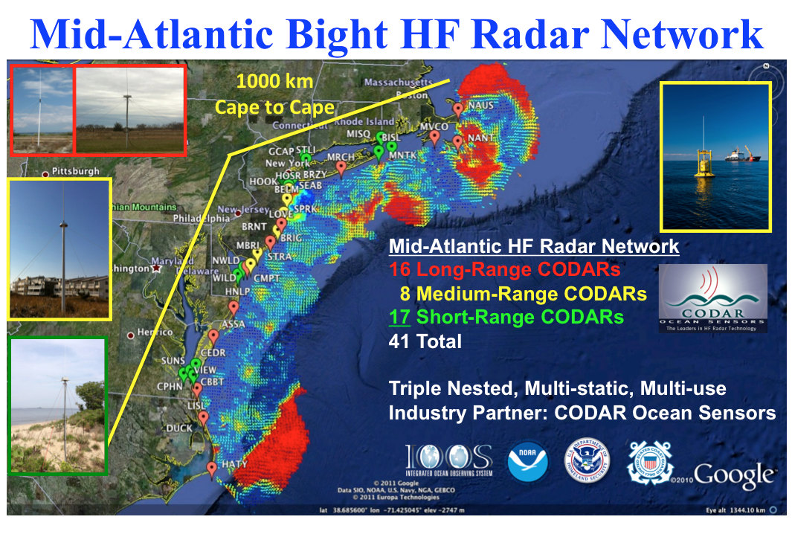
U.S. Integrated Ocean Observing System (IOOS)
International Component
National Component
Regional Component
2013
2011
Globally Coordinated Initiatives
Vessels -
Satellite
2004
2009
Regionally Coordinated Network
Nationally Coordinated Initiatives
Supports Science & Decisions
http://ioos.gov

Slide 6
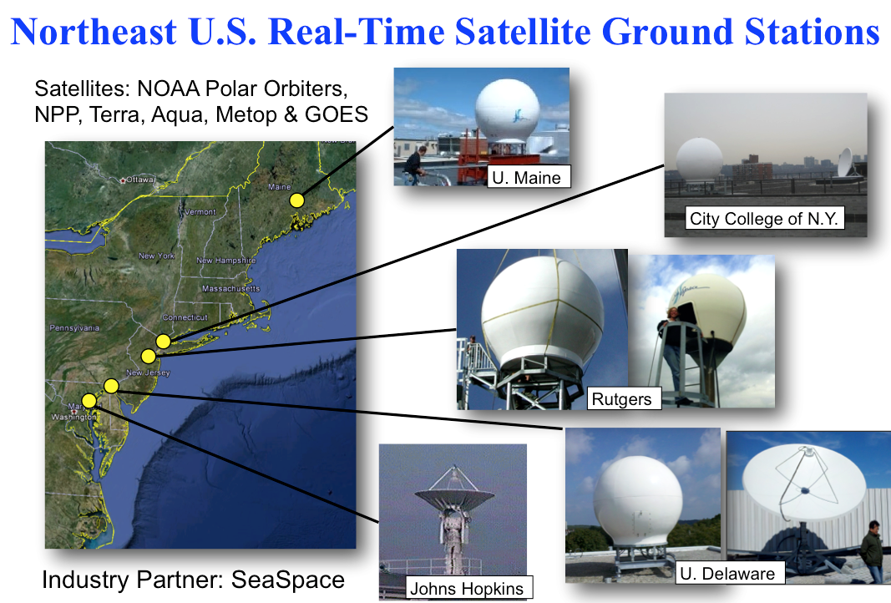
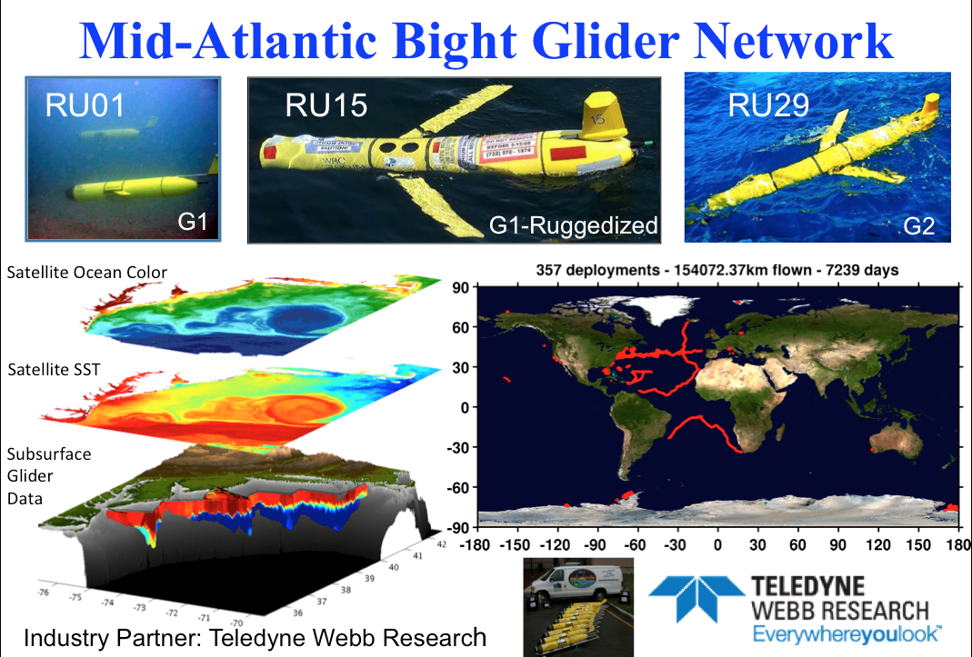
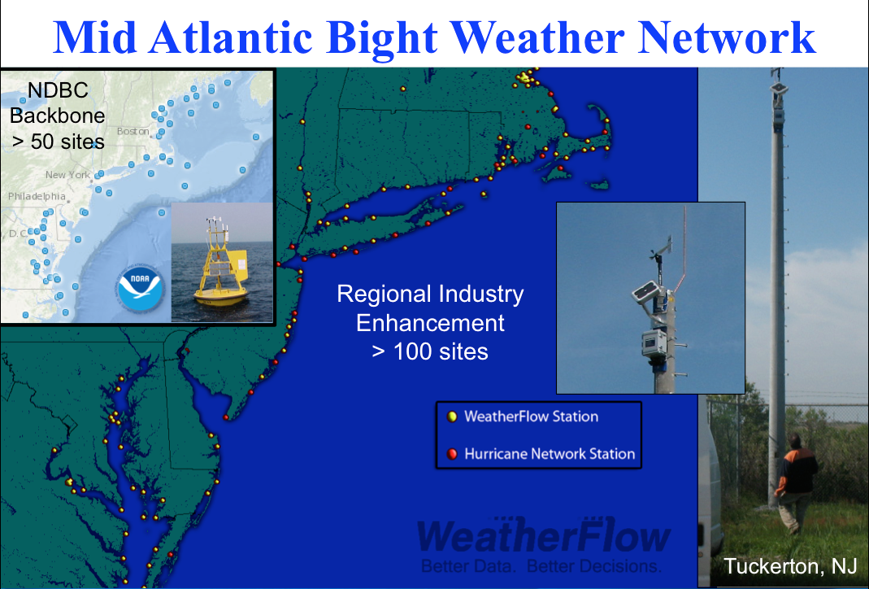
Mid-Atlantic Regional-Scale Observation Network

Slide 7
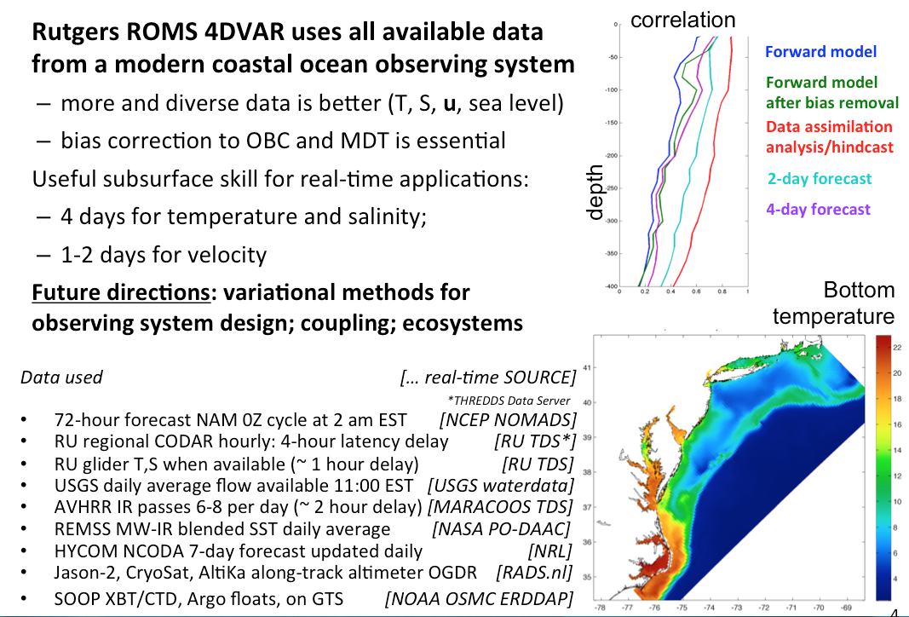
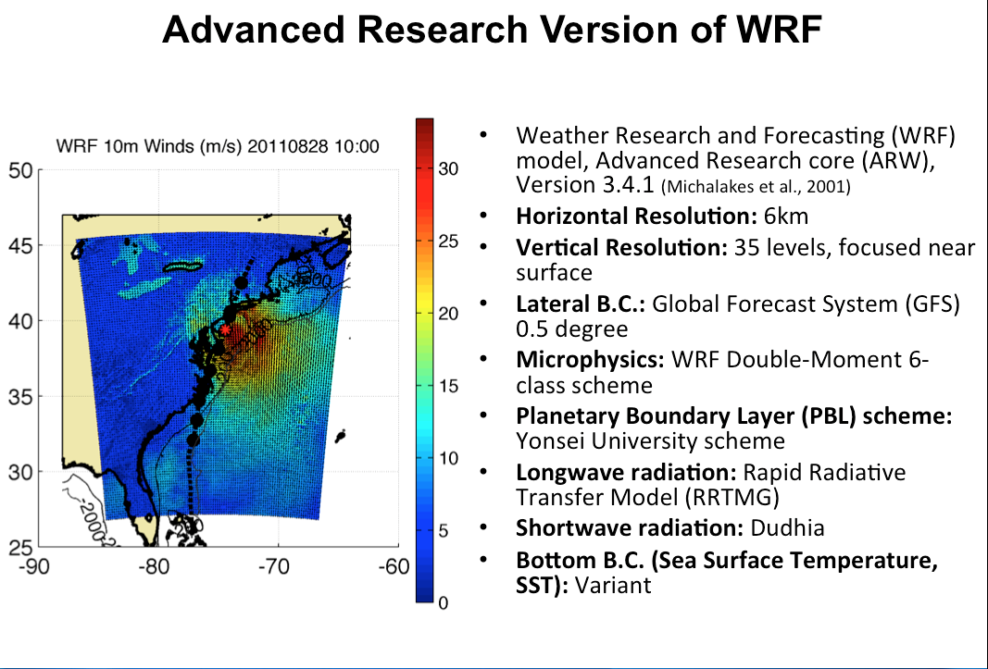
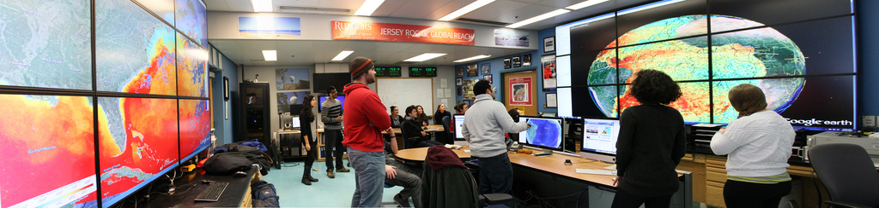
Mid-Atlantic Ensemble of Forecast Models Include:
Mid-Atlantic Operations Center @ Rutgers

Slide 8






Leveraging Data & Products for Societal Goals
Regional Priority Themes | Regional Observation & Modeling Capabilities
 | Weather Mesonet | HF Radar Network | Statistical STPS | Satellite Imagery | Glider Surveys | Dynamical Ocean Forecasts
Theme 1. Maritime Safety | Operational Input to USCG SAROPS | Operational input to USCG SAROPS | Operational input to USCG SAROPS | SST for survivability planning | Assimilation dataset for forecast models | Surface currents for SAROPS
Theme 2. Ecological Decision Support | Weather forecast ensemble validation | Circulation and divergence maps for habitat |  | SST & Color for habitat | Subsurface T & S for habitat | 3-D fields of T, S, circulation for habitat
Theme 3. Water Quality | Winds for transport, river plumes, & upwelling | Surface currents for flotables, bacteria, spill response | Surface currents for flotables, bacteria, spill response | Ocean color for river plumes | Nearshore dissolved oxygen surveys | Surface currents for floatables, bacteria, spill response
Theme 4. Coastal Inundation | Weather forecast ensemble validation | Current forecast model validation |  | SSTs assimilation into forecast models | Assimilation dataset for forecast models | Nested forecast ensembles
Theme 5. Offshore Energy | Historical analysis & wind model validation | Historical current analysis & wind model validation |  | Historical analysis surface fronts & plumes for siting | Historical analysis of subsurface fronts & plumes | Coupled ocean-atmosphere models for resource estimates

Slide 9
Leveraging Data & Products for Societal Goals
Regional Priority Themes | Regional Observation & Modeling Capabilities
 | Weather Mesonet | HF Radar Network | Statistical STPS | Satellite Imagery | Glider Surveys | Dynamical Ocean Forecasts
Theme 1. Maritime Safety | Operational Input to USCG SAROPS | Operational input to USCG SAROPS | Operational input to USCG SAROPS | SST for survivability planning | Assimilation dataset for forecast models | Surface currents for SAROPS
Theme 2. Ecological Decision Support | Weather forecast ensemble validation | Circulation and divergence maps for habitat |  | SST & Color for habitat | Subsurface T & S for habitat | 3-D fields of T, S, circulation for habitat
Theme 3. Water Quality | Winds for transport, river plumes, & upwelling | Surface currents for flotables, bacteria, spill response | Surface currents for flotables, bacteria, spill response | Ocean color for river plumes | Nearshore dissolved oxygen surveys | Surface currents for floatables, bacteria, spill response
Theme 4. Coastal Inundation | Weather forecast ensemble validation | Current forecast model validation |  | SSTs assimilation into forecast models | Assimilation dataset for forecast models | Nested forecast ensembles
Theme 5. Offshore Energy | Historical analysis & wind model validation | Historical current analysis & wind model validation |  | Historical analysis surface fronts & plumes for siting | Historical analysis of subsurface fronts & plumes | Coupled ocean-atmosphere models for resource estimates

Slide 10
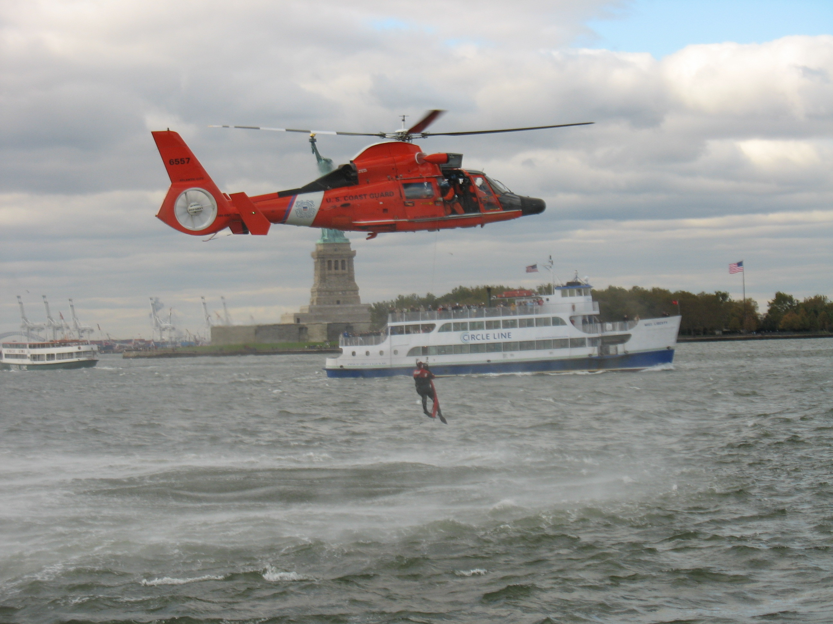

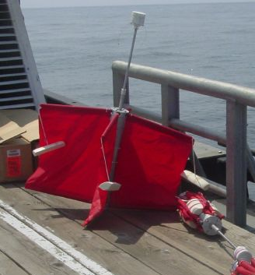
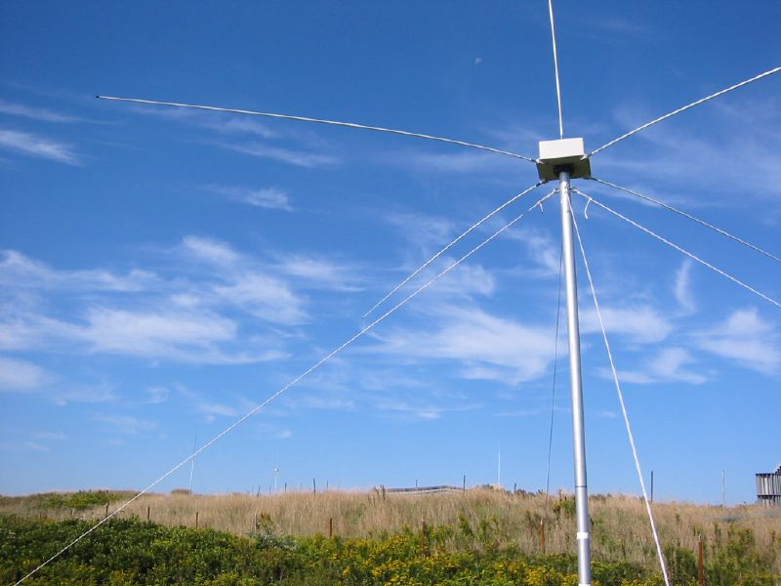
Success Stories – Making a Difference
Optimizing HF Radar for SAR using USCG Surface Drifters
Art Allen
U.S. Coast Guard
Scott Glenn
Rutgers University
Mid-Atlantic Regional Association
Coastal Ocean Observing System

Slide 11
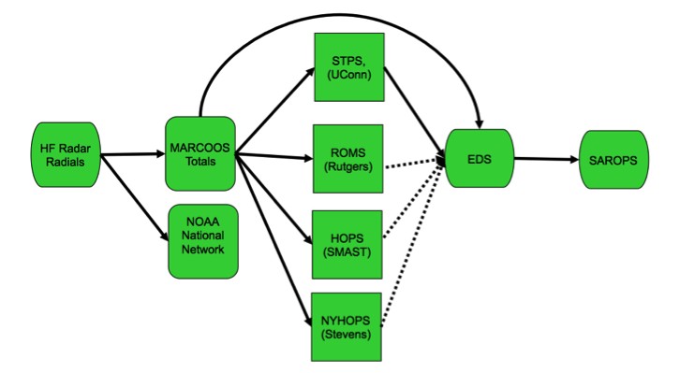
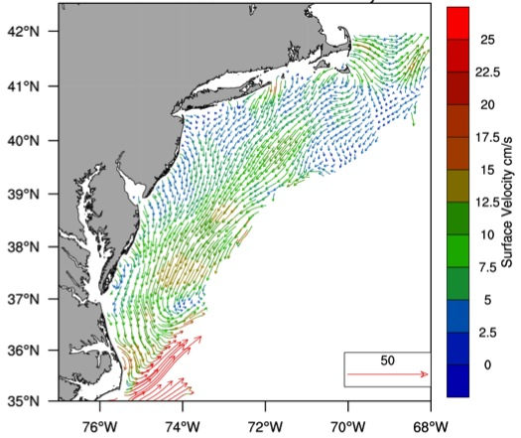

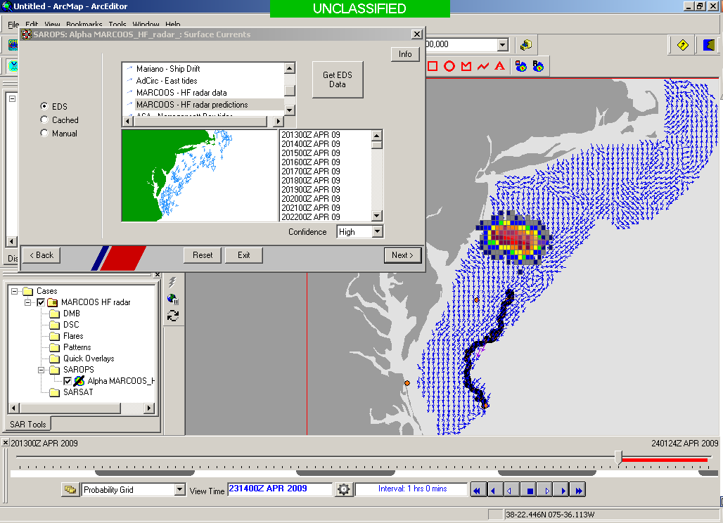
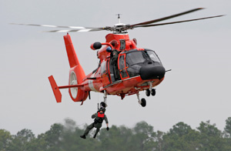

Transition Objective –
Operational Use of HF Radar Surface Currents for Search And Rescue
Surface Currents
Data Acquisition
Data Product Generation & Management
Search And Rescue Optimal Planning System (SAROPS)

Slide 12

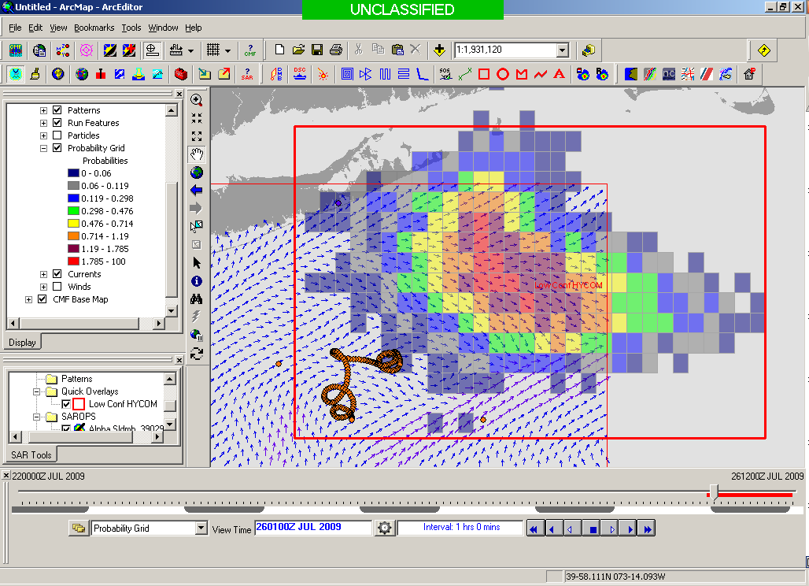
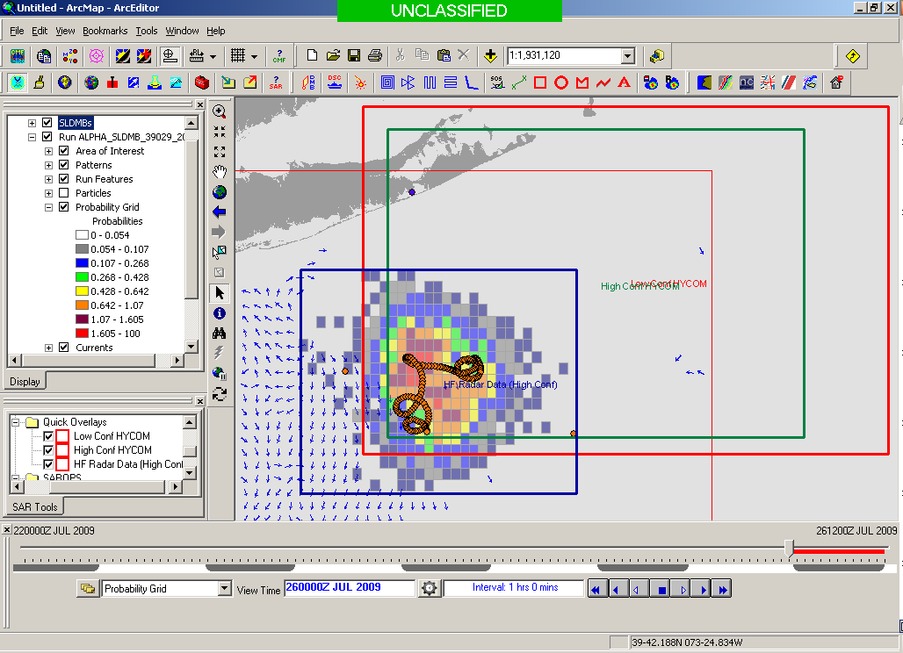
5000 Virtual Drifters –
Search Area After 96 Hours
154 km
100 km
232 km
123 km
HYCOM
36,000 km²
CODAR
12,000 km²
Notes:
HYCOM (Low Conf) 48 hours

Slide 13
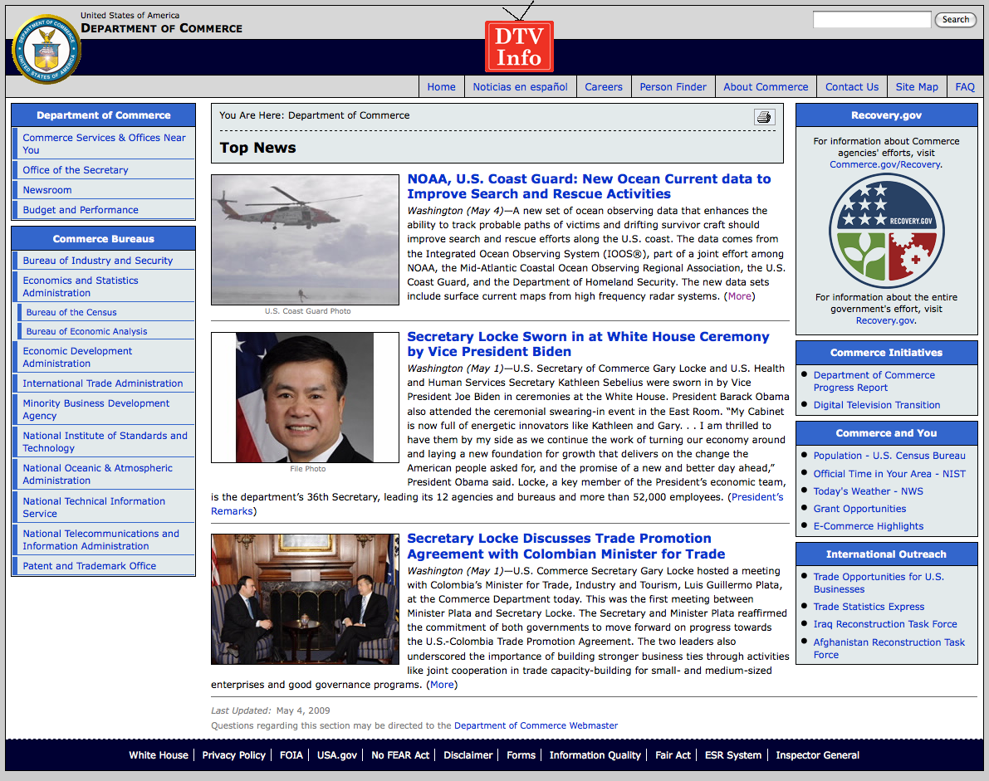
May 4, 2009: After a year of testing, NOAA Announces on
U.S. Department of Commerce Website that
MARACOOS CODAR is Operational in SAROPS
2009-2010 Activity:
Bring all
sustained regional-scale HFR networks up to operational status in USCG SAROPS
3 West Coast Regions for
California & Oregon are ready.

Slide 14
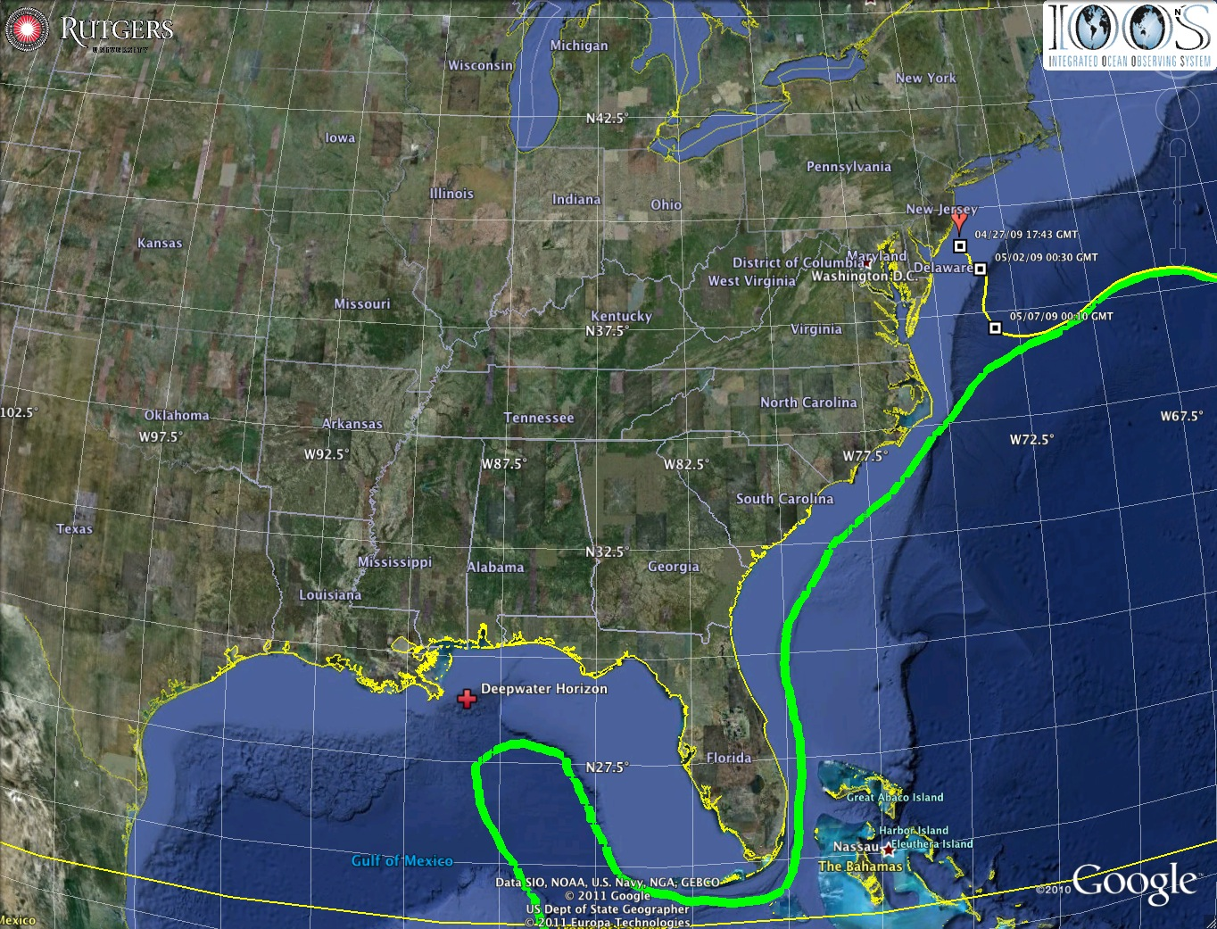
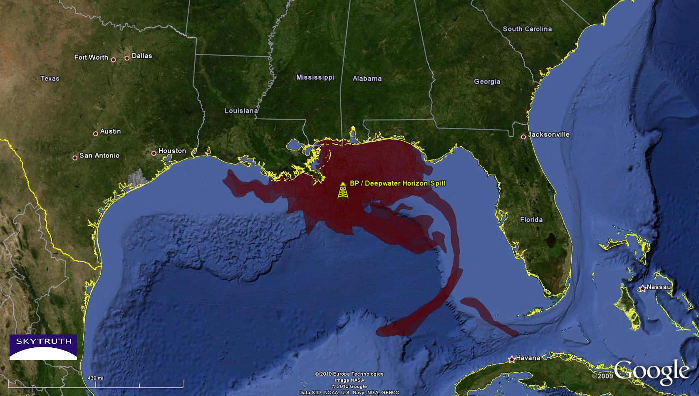
2010 Deepwater Horizon Oil Spill
Oil Transport Questions: Will the oil….
Come ashore in Louisiana?
Spread east to Texas or west to Mississippi, Alabama and Florida pan handle in the wind-driven coastal currents?
Enter the Loop Current and be transported downstream?
Hit the Florida Shelf and be driven shoreward by winds?
Ride the Loop Current south and hit the Florida Keys?
Be transported out of the Gulf of Mexico by the Gulf Stream and impact the East Coast?
Gulf of Mexico

Slide 15
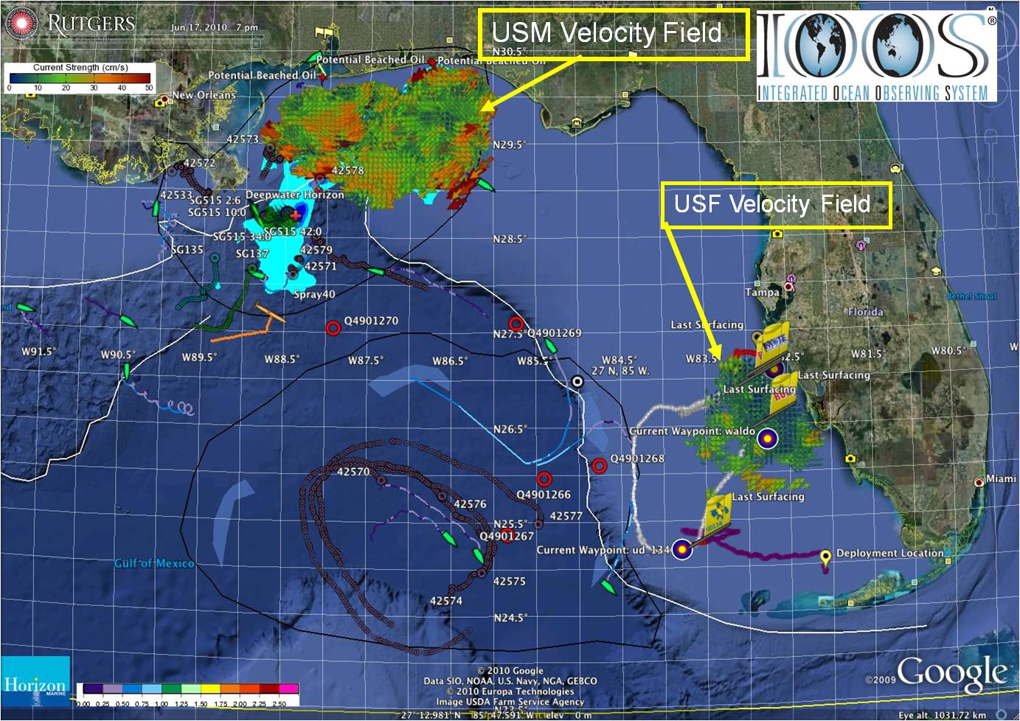
Oil Spill Trajectory Forecasting
Ingested & distributed by IOOS national HF radar data servers at Scripps & NOAA/NDBC
Collected using CODAR SeaSonde® HF radar systems (USM, USF)
Chronology
2003 2006
2007
20 Apr
30 Apr
2 May
2 May – Cap of DWH Well
HFR support to COSCO Busan
HFR used daily for trajectory forecasting
Safe Seas Exercise West Coast
Data received by IOOS National Servers & NOAA/OR&R/ERD
Safe Seas Exercise East Coast
USM: radars restored
2 of 3 USM radars: not operational, scheduled maintenance

Slide 16
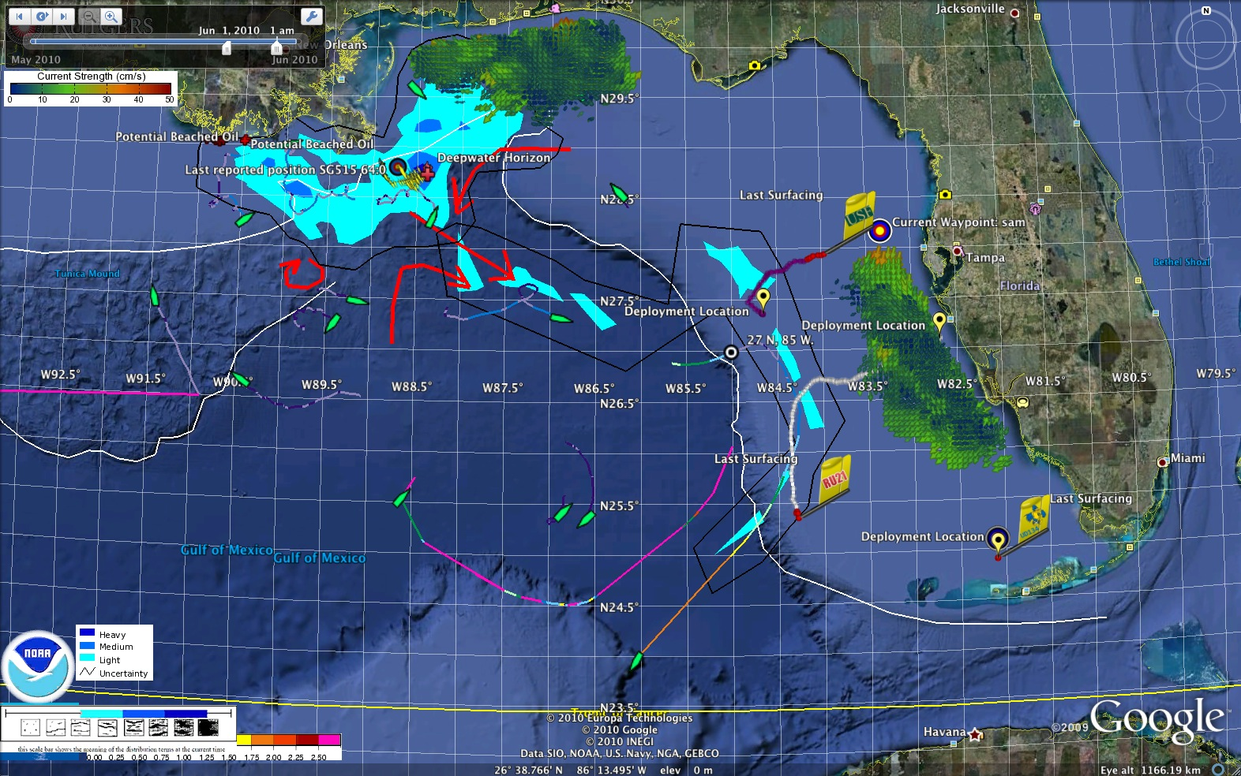
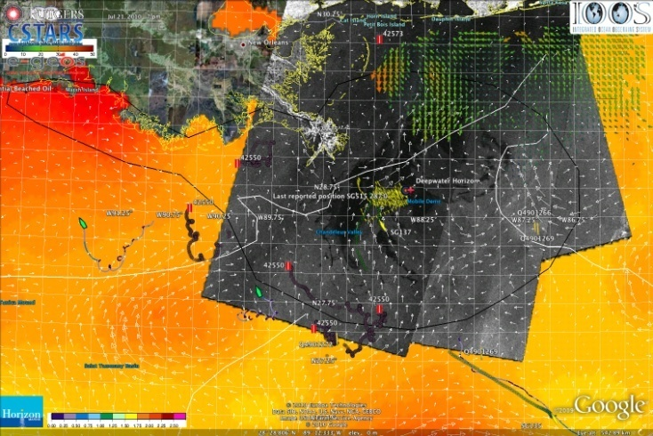
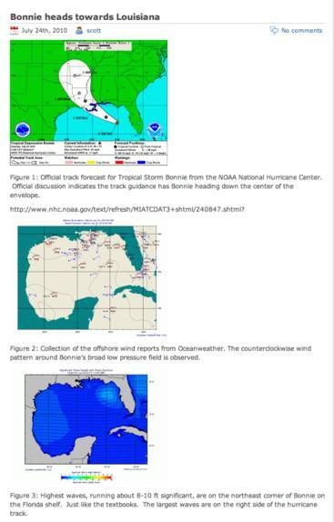
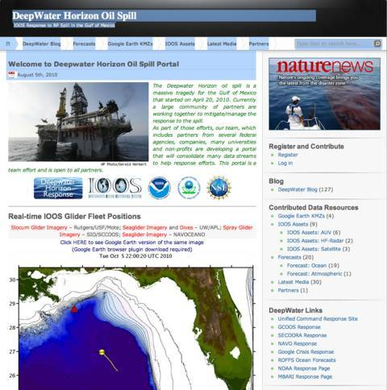
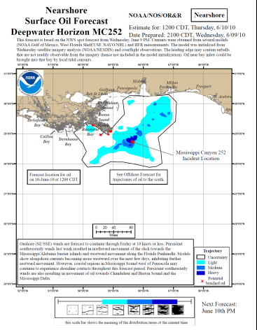
Responding to Crisis: Deepwater Horizon
U.S. IOOS partnership demonstrated ability to:
Quickly deploy technologies: Gliders and HF radar, saving resources/improving safety
Models/Imagery ingested into NOAA/Navy models
Data assimilation improved spill response decision-making and public understanding
USM HFR
USF HFR
June 2
HFR validation of SABGOM Forecast combined with satellite detected oil slicks
Briefing Blog
127 Briefs
Web Portal
HFR data informed NOAA
trajectory forecasts

Slide 17
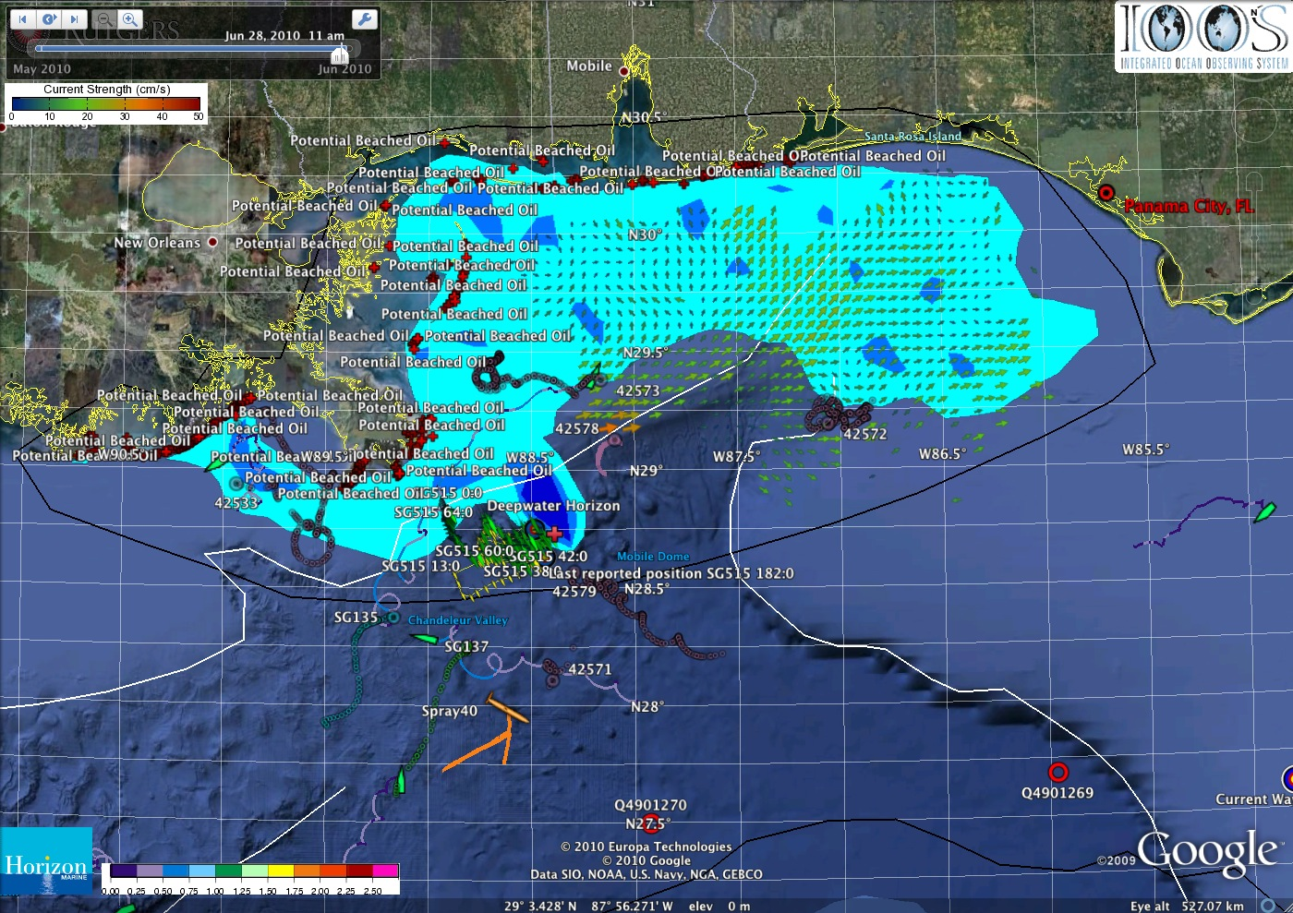
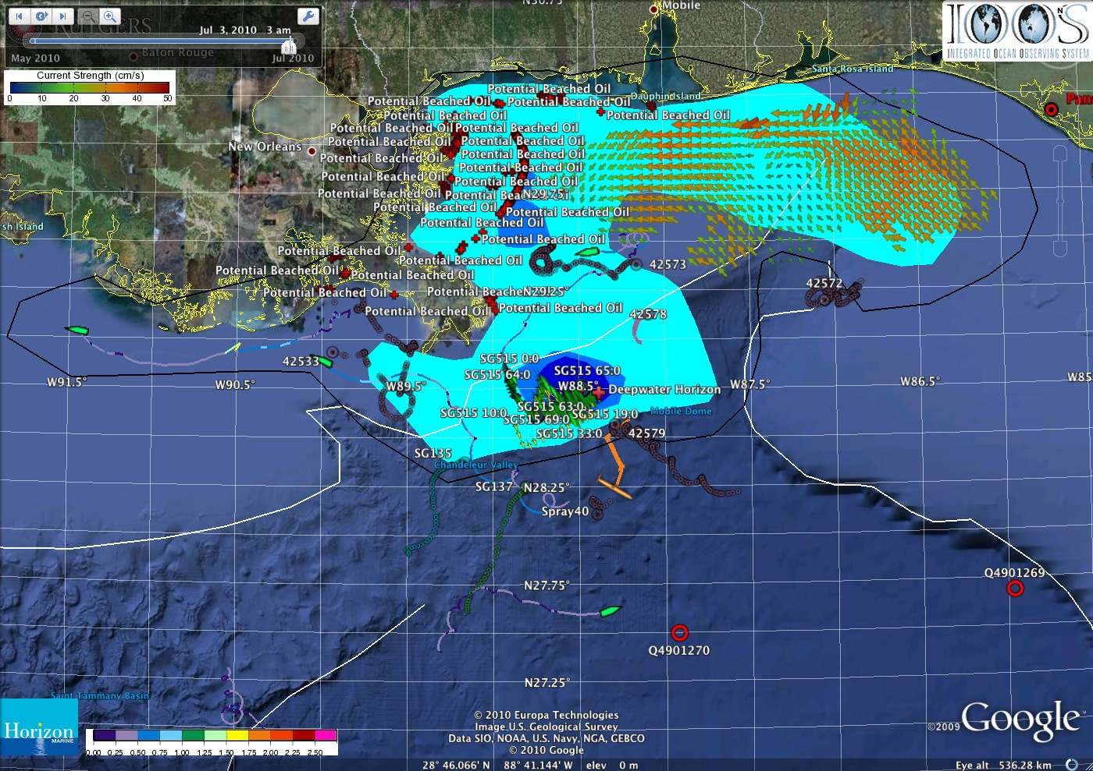
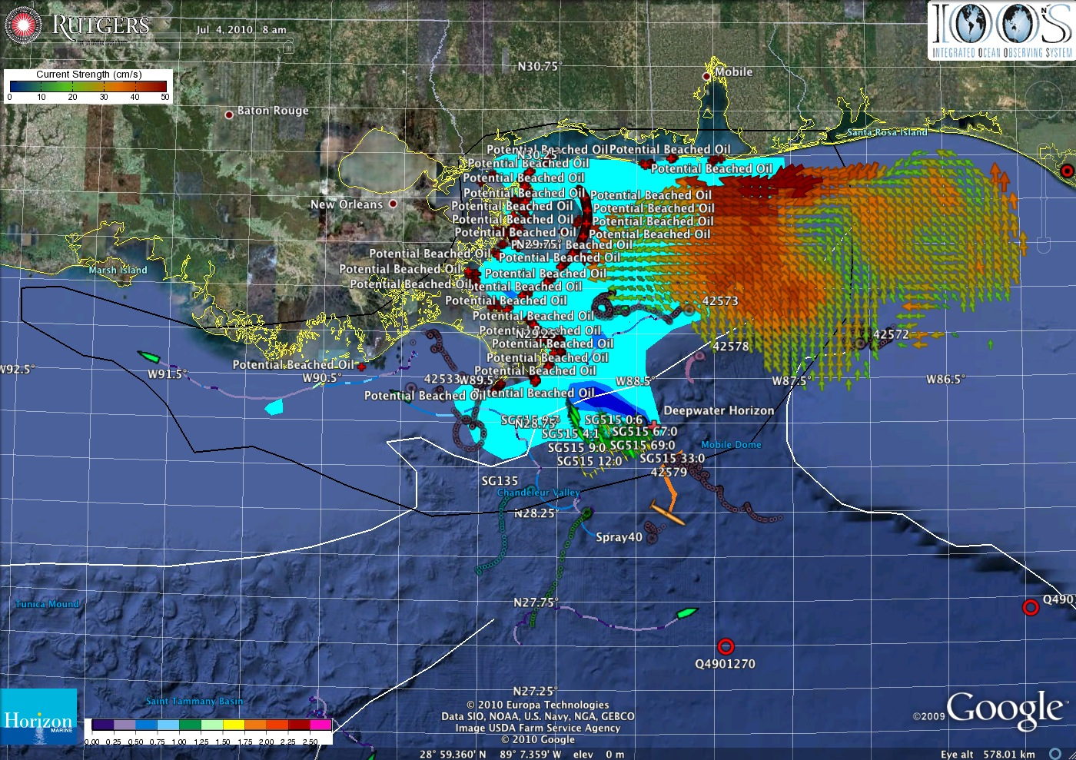
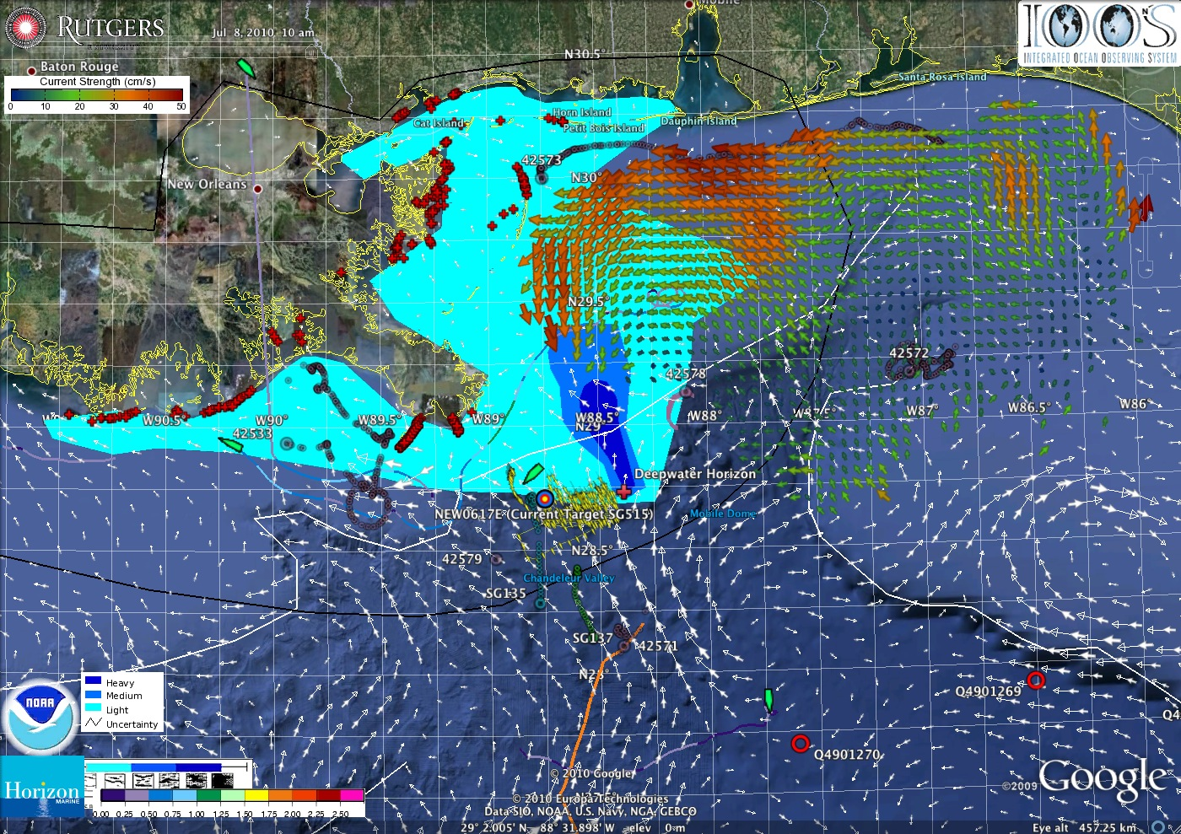
Deepwater Horizon Oil Spill Response: Near Field Environmental Analyses
Oil response to a major wind shift
July 3
June 29
July 4
July 7

Slide 18
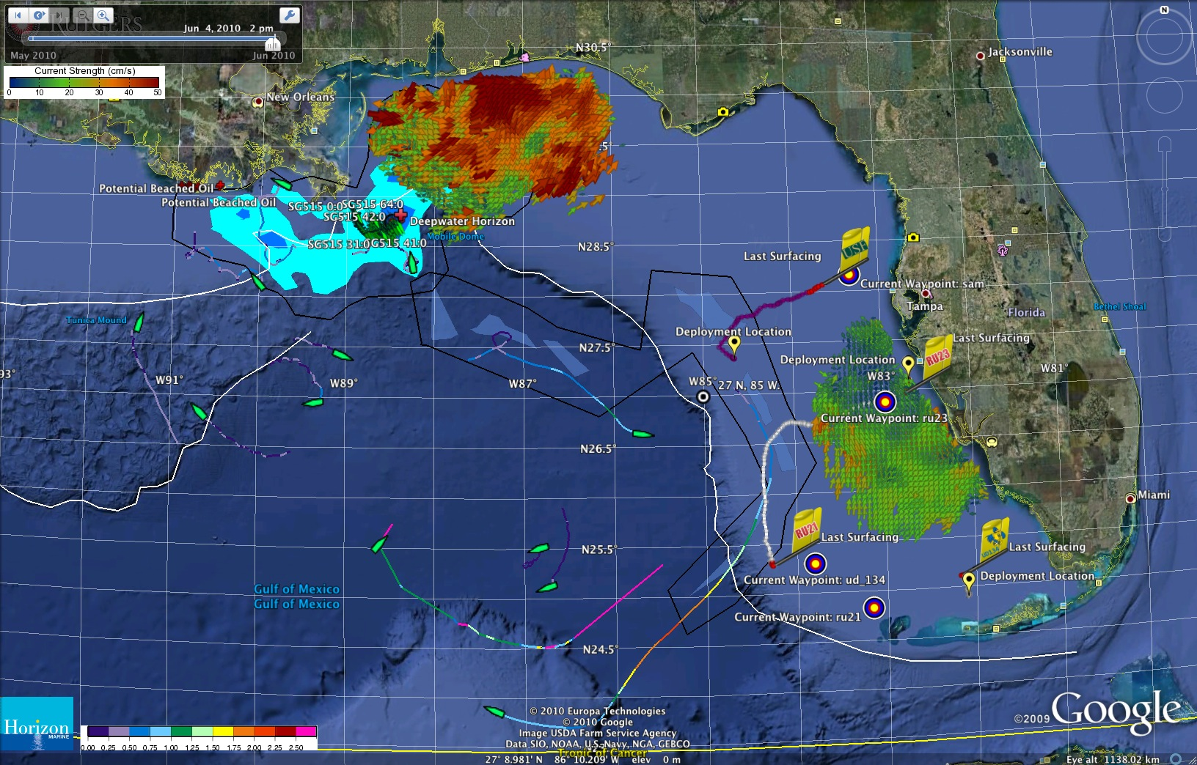
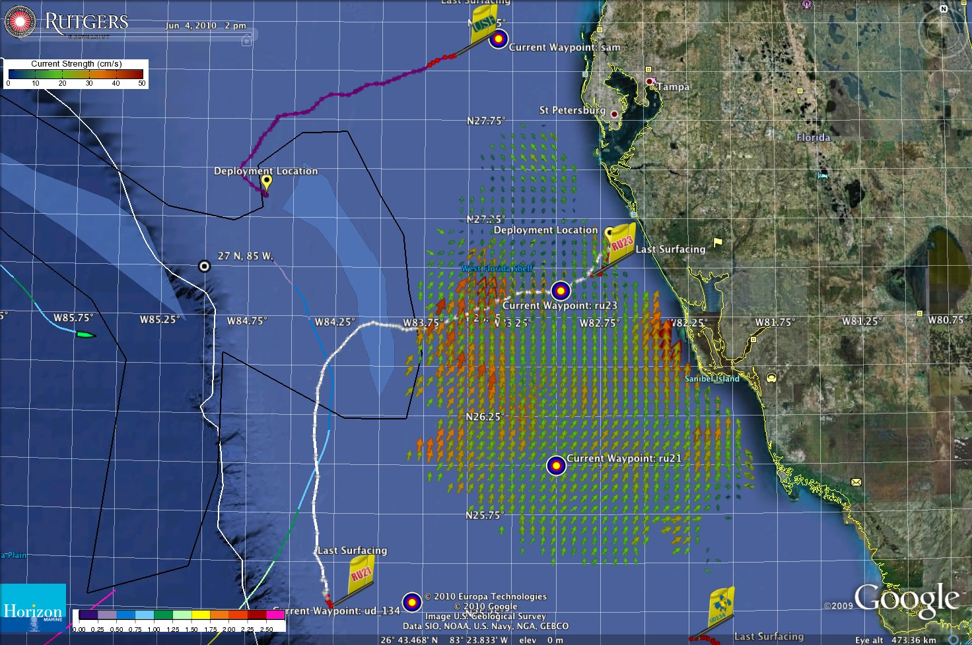
Deepwater Horizon Oil Spill Response: Approach to West Florida Shelf
Close Approach to
West Florida Shelf
June 3
June 4

Slide 19
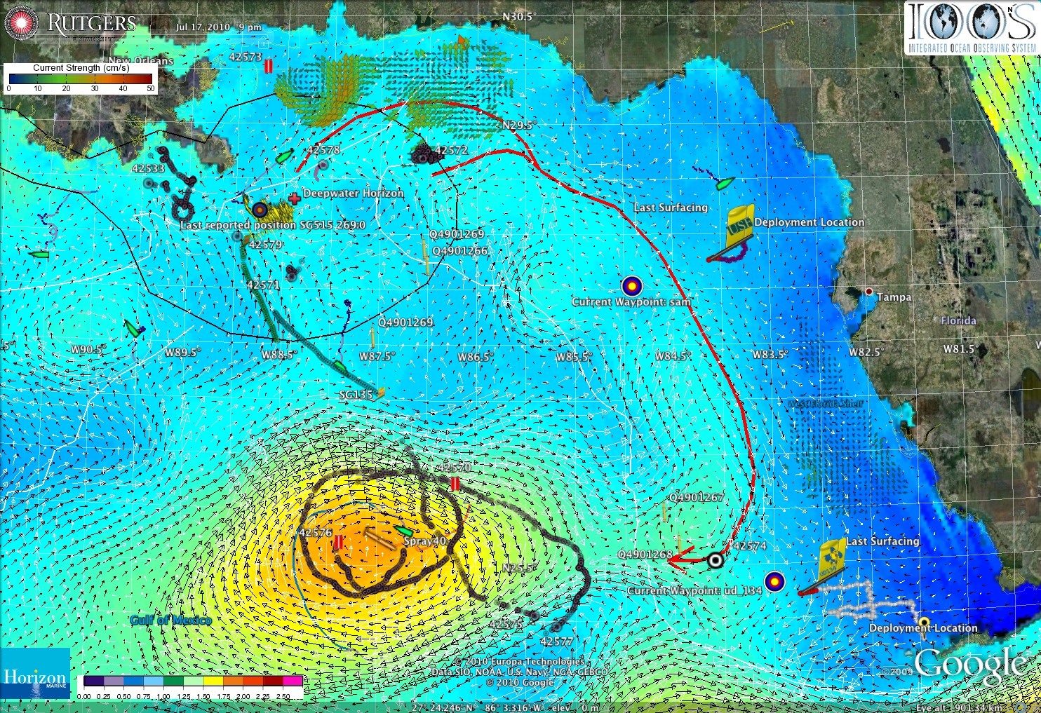
18 July 2010 Blog Entry - 2010-2020: The Ocean Forecasting Decade

Slide 20
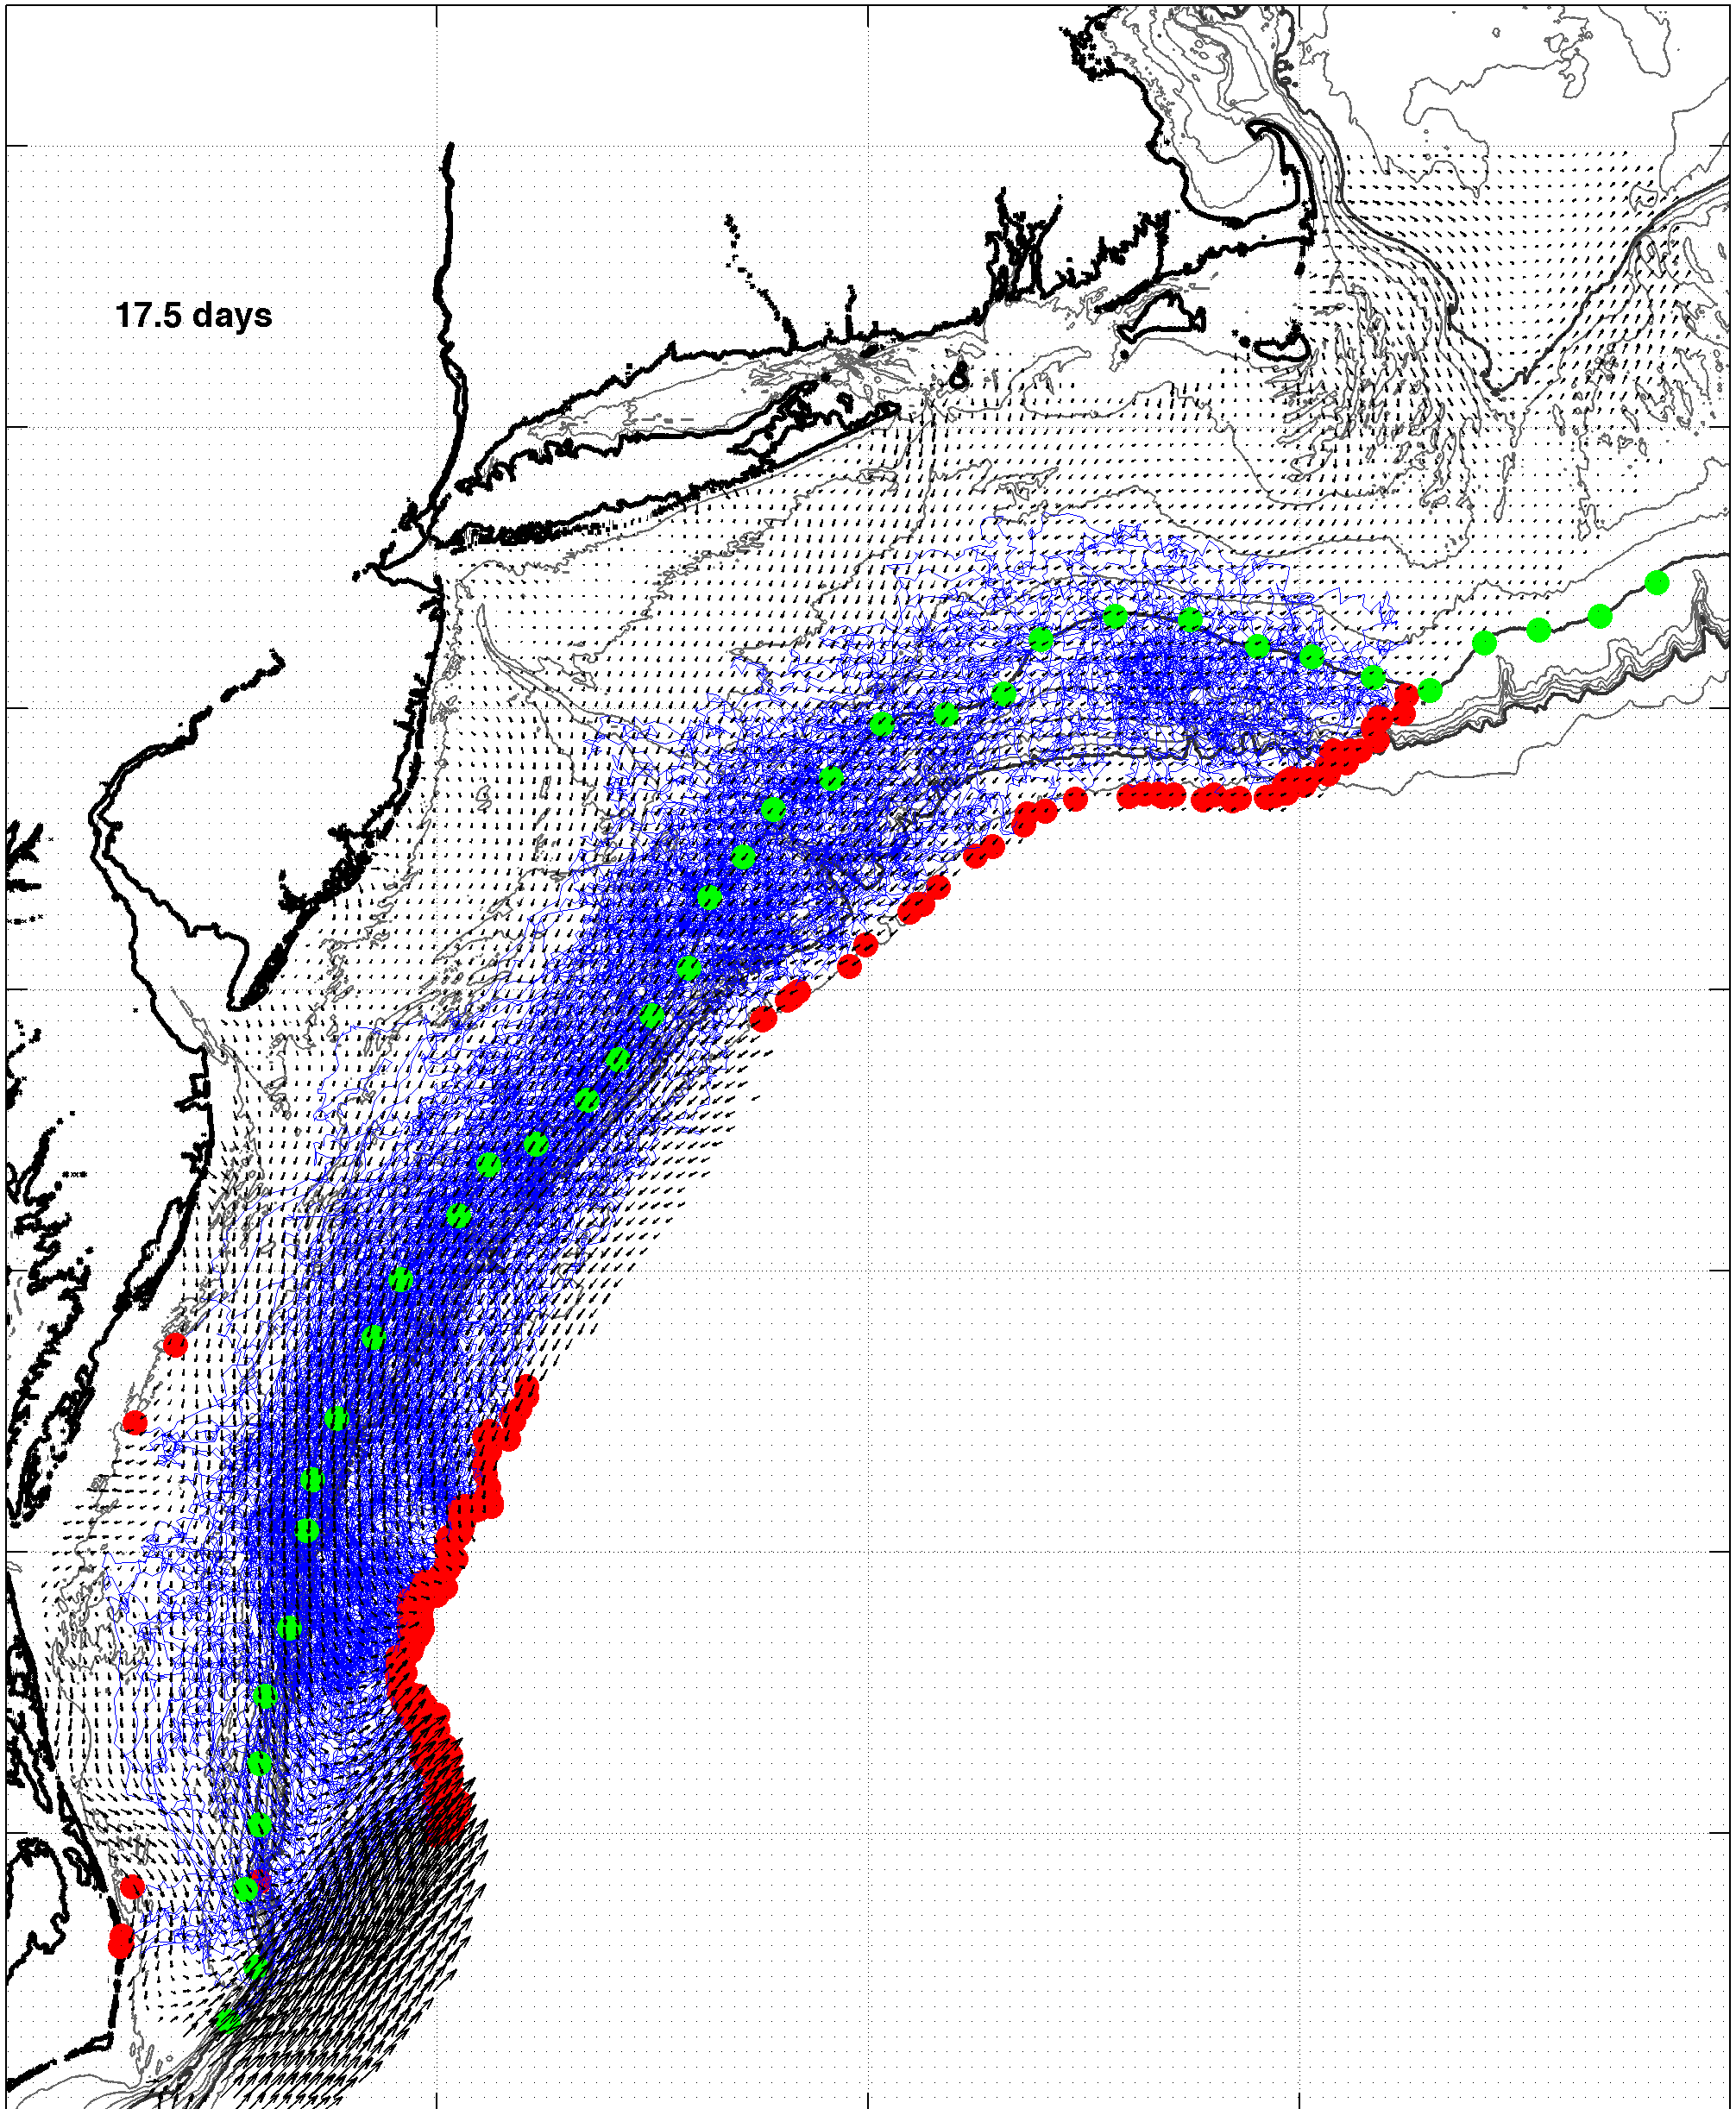
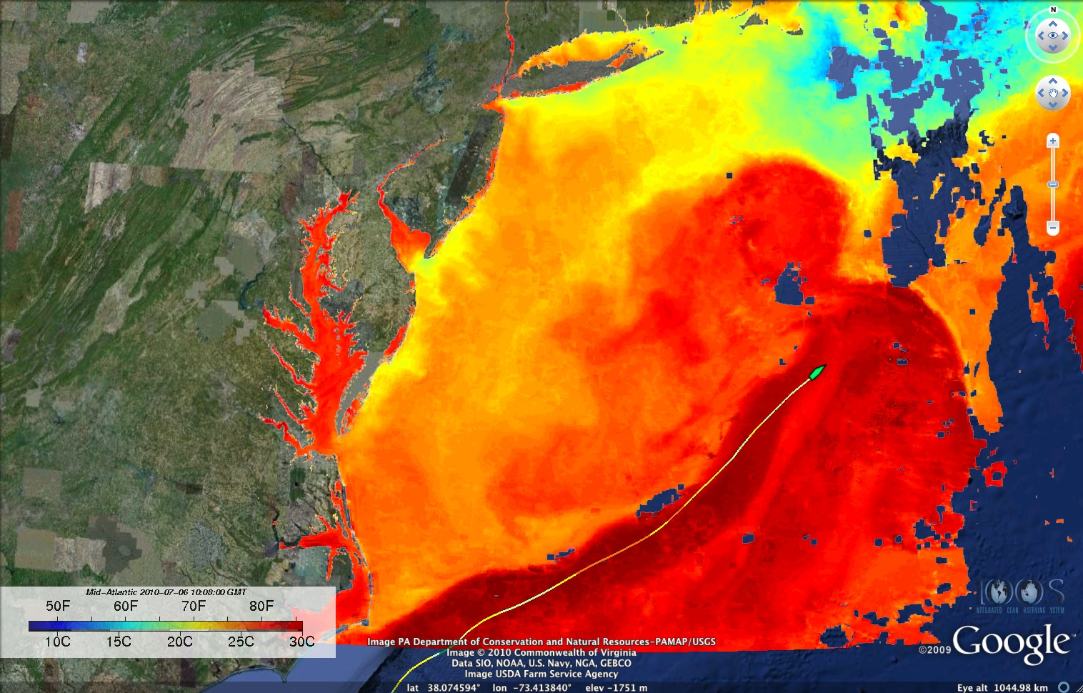
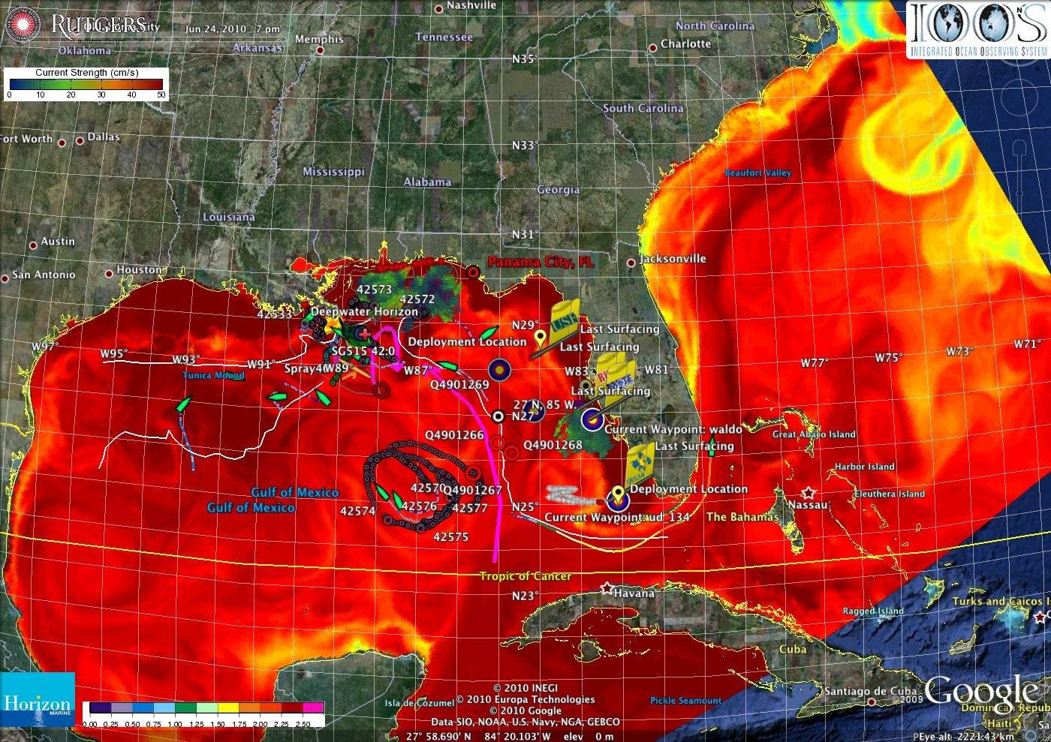
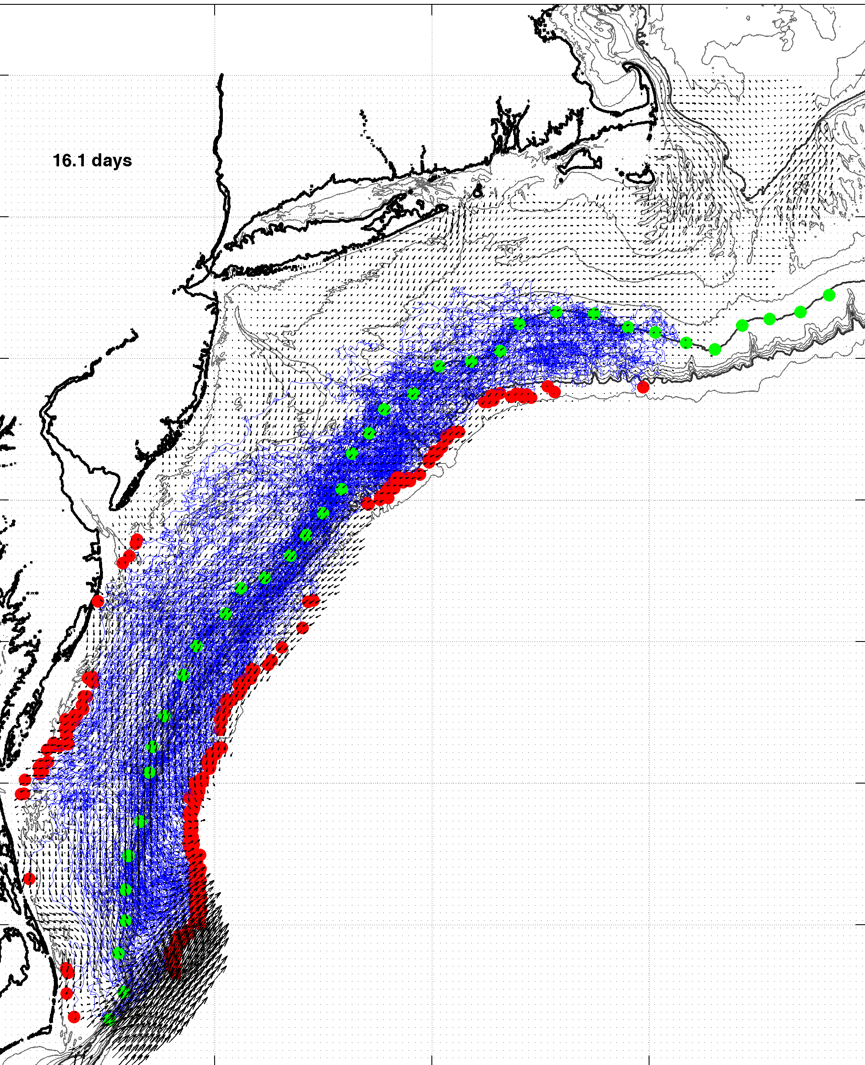
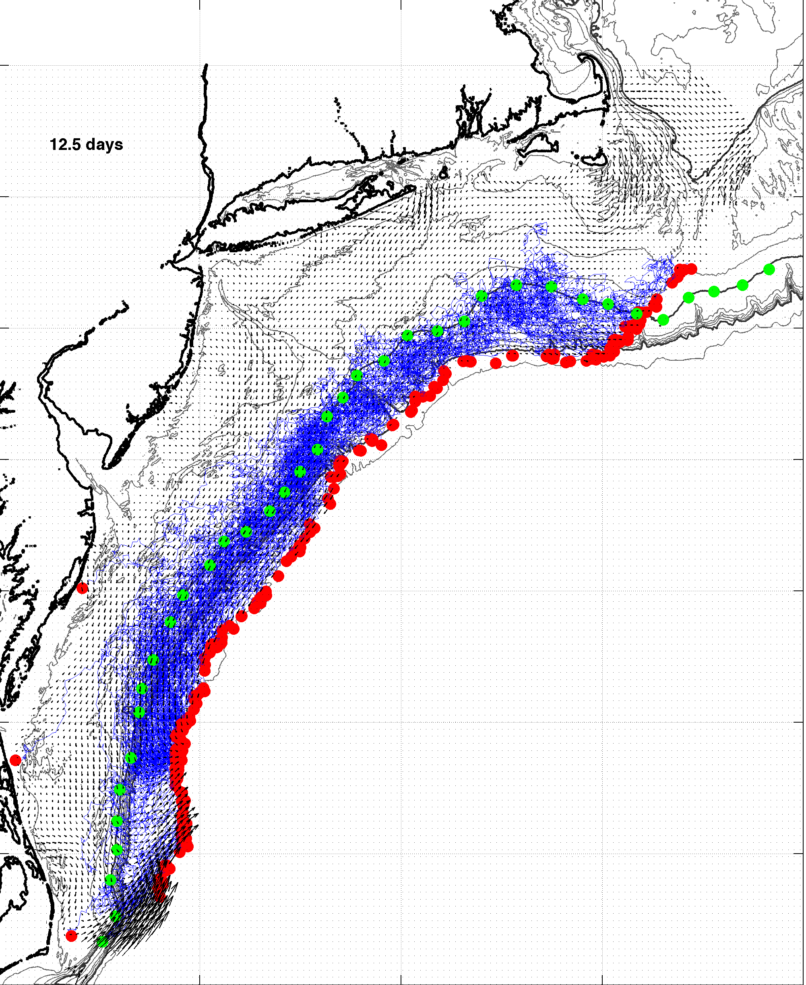
July, 2009
Deepwater Horizon
Response: East Coast Assessments of Risk
July 6
August, 2009
September, 2009
June 25

Slide 21
Feedback from the Deepwater Horizon
Incident Command Center
Composite of Satellite Observed Oil Spill Locations
“All - Greetings from Unified Area Command in New Orleans. I couldn't agree more - the IOOS community has acquitted itself very well during this entire incident. Not only has everyone provided valuable information - you have done it without getting in the way of the ongoing operations. It's been a pleasure to represent IOOS here and see all the great contributions from the larger IOOS community. “
- Sam Walker (IOOS representative to Deepwater Horizon Unified Command Center), June 18, 2010
“… AWESOME JOB - that call that we had last week was a very good thing. You are taking a huge burden off of the team here who is trying to simply capture the deluge of assets now being deployed. “
- Sam Walker (IOOS representative to Deepwater Horizon Unified Command Center), July 2, 2010
“…Thanks to everyone for all of your efforts to support the Response and the very professional and competent manner in which you have executed your efforts. IOOS has played a huge role in informing the modeling teams and the Unified Command through your extraordinary service. “
- Sam Walker (IOOS representative to Deepwater Horizon Unified Command Center), August 6, 2010

Slide 22
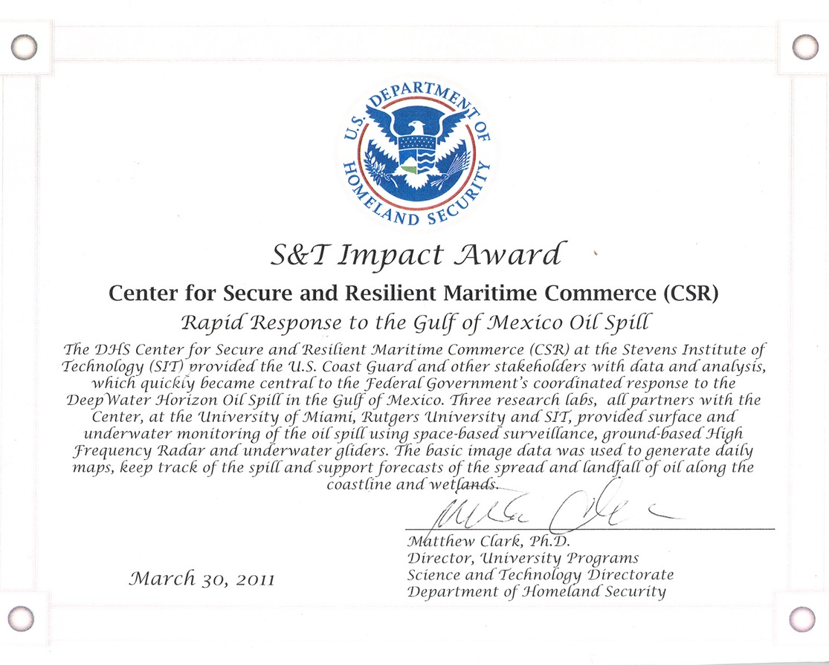
Feedback from the Deepwater Horizon
Incident Command Center
Composite of Satellite Observed Oil Spill Locations
“All - Greetings from Unified Area Command in New Orleans. I couldn't agree more - the IOOS community has acquitted itself very well during this entire incident. Not only has everyone provided valuable information - you have done it without getting in the way of the ongoing operations. It's been a pleasure to represent IOOS here and see all the great contributions from the larger IOOS community. “
- Sam Walker (IOOS representative to Deepwater Horizon Unified Command Center), June 18, 2010
We did not get in the way
“… AWESOME JOB - that call that we had last week was a very good thing. You are taking a huge burden off of the team here who is trying to simply capture the deluge of assets now being deployed. “
- Sam Walker (IOOS representative to Deepwater Horizon Unified Command Center), July 2, 2010
We reduced the burden
“…Thanks to everyone for all of your efforts to support the Response and the very professional and competent manner in which you have executed your efforts. IOOS has played a huge role in informing the modeling teams and the Unified Command through your extraordinary service. “
- Sam Walker (IOOS representative to Deepwater Horizon Unified Command Center), August 6, 2010
We informed modeling teams & leadership

Slide 23
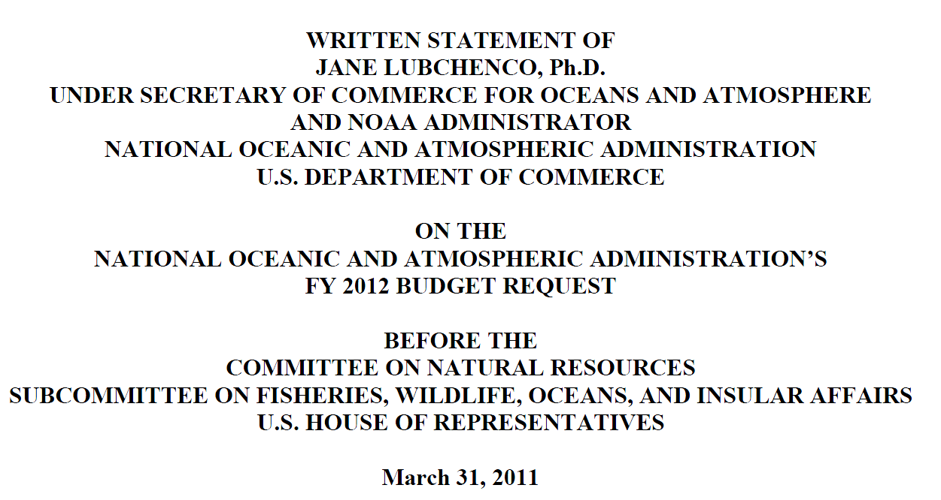
From Page 10:
Also in support of oil spill response, NOAA requests a $5.0 million increase to implement the U.S. Integrated Ocean Observing System (IOOS®) Surface Current Mapping Plan using high frequency (HF) radar surface current measurements. HF radar provides information vital to oil spill response, national defense, homeland security, search and rescue operations, safe marine transportation, water quality and pollutant tracking, and harmful algal bloom forecasting.
www.legislative.noaa.gov/Testimony/Lubchenco033111.pdf

Slide 24
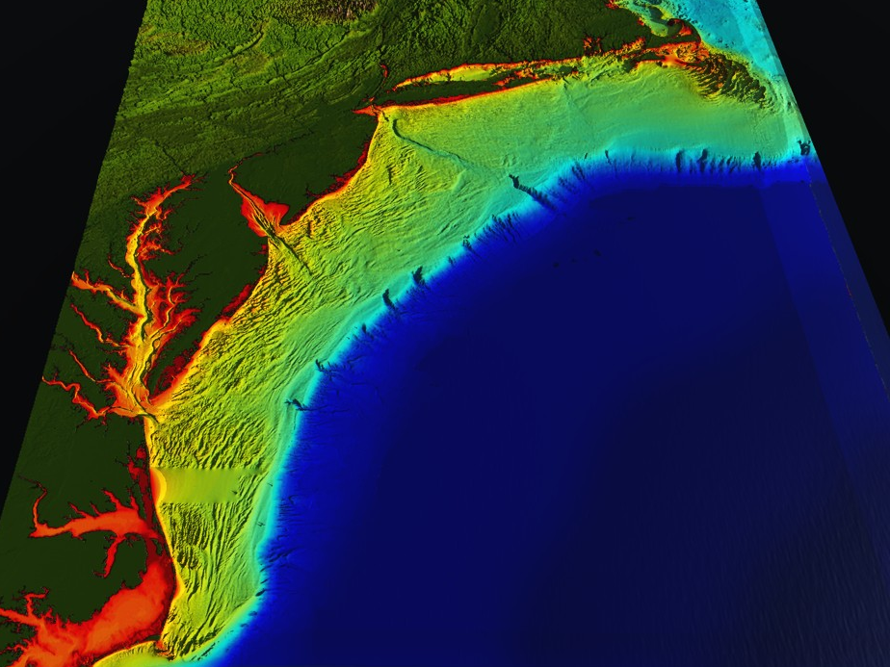










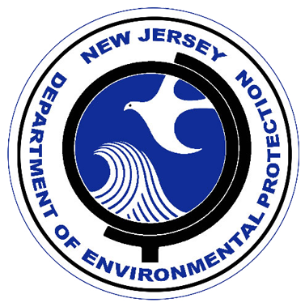


RI
U..
Middle Atlantic
Regional Association
Coastal
Ocean Observing System
10 States
76 Million People
CT
Cape
Cod
MA
NY
PA
NJ
U.S. IOOS
Responds to
Hurricanes Irene
and Sandy
MD
DE
Sandy
>40 PIs
>20 Institutions
>50 Members
>2000 Contacts
Irene
VA
NC
Cape
Hatteras
Notes:
24

Slide 25
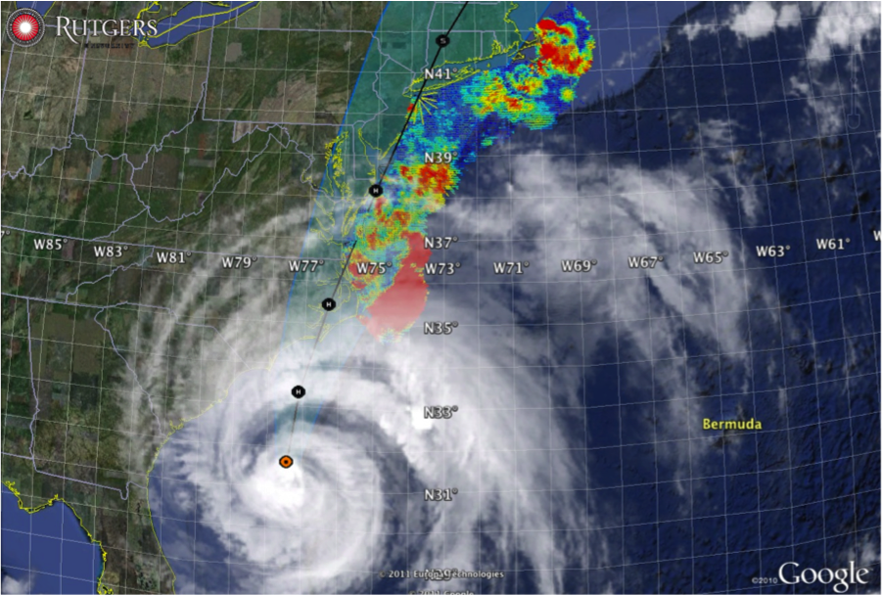
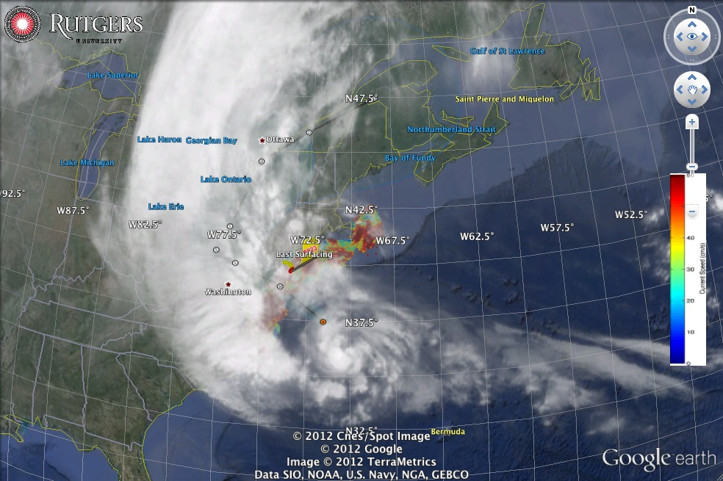
Hurricane Irene
August 28, 2011
NOAA/NHC Damage:
#7 with >$16 Billion.
Track Accurate;
Intensity Over-predicted.
Hurricane Sandy
October 29, 2012
NOAA/NHC Damage:
#2 with >$68 Billion.
Track Accurate;
Impact Under-predicted.

Slide 26


Superstorm Sandy: 2 Days Before Landfall

Slide 27

Superstorm Sandy: 1 Day Before Landfall

Slide 28

Superstorm Sandy: Morning Before Landfall

Slide 29

Superstorm Sandy: Landfall (20:00 Local)

Slide 30




HF Radar Storm Damage
Keyport
S
HF Radar Shed floats 0.85 km across barrier island & river
I

Slide 31
Hurricane Irene
August 28, 2011
Strong Stratification
Limited storm surge
Mixing cooled surface
Limited intensity
Hurricane Sandy
October 29, 2012
After fall transition
Single layer ocean
No mixing/cooling
No escape for surge
$2.5 M Repair
$5.5 M Science

Slide 32


Annual Coverage and Mean
2006 to 2012

Slide 33

Grid Points for USCG 80-80 Metric

Slide 34

2009
2010
2008

Slide 35

U.S. National HF Radar Network
Table 4: Full 5-Year Buildout. Estimated acquisition & maintenance costs.
Technician fully encumbered salary is
estimated at $130,000;
Purchase and deployment for DF HFRs,
LPA HFRs are $160,000 and $300,000,
respectively.
Two technicians for each 7 DF HFRs,
4 LPA HFRs, respectively.
September 2009
http://www.ioos.gov/hfradar/
Notes:
100 people for DF, 175 people for LPA.

Slide 36



Resilient CODAR Shore Site:
Shed, Enclosure, Tx/Rx, Comms, Power, GPS, AIS
monitor
computer & external hard drive
A.C. unit
UPS system
transmitter
receiver
Two lines of Communication
Shed
Enclosure
Lightning Protection

Slide 37
Loveladies Power Configuration
Electricity Grid Power
SeaSonde Transmitter
SeaSonde Receiver
Macintosh Computer
Load 1
TrippLite Surge Strip
AIS Receiver
TrippLite UPS
Linksys Router
Power Stone
Cable Modem
Load 2
Monitor
Air Conditioner
External Hard Drive
Roarty et al. (2010) MTS Journal

Slide 38
Loveladies Communication Configuration
Tripp LIte UPS
Cable Modem
Linksys Router
AIS Receiver
Internet
Macintosh Computer
SeaSonde Receiver
SeaSonde Transmitter
Telephone Network
Power Stone
Telephone
Ethernet
USB
Serial
Roarty et al. (2010) MTS Journal

Slide 39

Acquisition & Installation and
Annual Technician Support cost
estimates based on the U.S.
National HF Radar Network
design parameters.
Active Spares Approach
Spares used to fill the largest gaps, improving the quality of the data when all are running and improving the resiliency of the network when one site goes down.
HFR Network Design Example:
1000 km / ( 75 km/segment )
= 13 Segments of Coast
Segment Color Key
Red > 90 km
90 km > Orange > 70 km
70 km > Green

Slide 40

Through Improved Site Resiliency & An Active Spares Approach, MARACOOS has exceeded the USCG’s 80-80 Coverage Target with 1/3 of the Recommended Technician Support

Slide 41


Monostatic
Radials
Bistatic
Ellipticals

Slide 42

Total Surface Currents
Three Weeks
August 30 – September 20, 2013
6 Radial Stations

Slide 43

Total Surface Currents
Three Weeks
August 30 – September 20, 2013
6 Radial Stations
&
5 Elliptical Pairs

Slide 44



Dual Transmitter Test
25% Increase
Transmitter Installed
234 km
187 km

Slide 45




HF Radar Network Highlights
Achieved 80/80 coverage in December 2012 – June 2013 progress period
Three radars stations in NJ detected the June 13, 2013 meteo-tsunami
HF Radar data into NOAA PORTS scheduled for release in early 2014

Slide 46















The Center for Secure and Resilient Maritime Commerce (CSR)
DHS Center of Excellence for Port Security
11 Institutions – Maritime Domain Awareness & Resiliency
Maritime Domain Awareness
Approach –
Dual Use Technologies
Demonstrate Nested Vessel Detection
Global > Approaches > Port
University of Miami –
Global Satellite Coverage,
Visible & Microwave
Rutgers University –
Over-the-Horizon Compact
High Frequency Radar Networks
Stevens Institute of Technology –
Local High-Resolution Optics &
Shallow Underwater Acoustics

Slide 47








The Center for Secure and Resilient Maritime Commerce (CSR)
HF Radar Team
Rutgers University -
Scott Glenn, Josh Kohut, Hugh Roarty,
Mike Crowley, John Kerfoot, Ethan
Handel, Mike Smith, Colin Evans
CODAR Ocean Sensors -
Don Barrick, Pete Lilleboe, Chad Whelan
Belinda Lipa, Bill Rector, Jimmy Isaacson
University or Puerto Rico – Mayaguez
Jorge Corredor, Julio Morell, Miguel Canals
Applied Mathematics, Inc -
Bill Browning
University of Alaska – Fairbanks
Tom Weingarter, Hank Statscewich
Ocean Power Technologies –
Debbie Montagna, Bruce Downie
Naval Research Laboratory
Michael Lovellette, Dan Newton
Norwegian Defence Research Establishment (FFI)
Terje Johnsen, Walther Asen
CODARNor
Anton Kjelaas
Rutgers University – CODAR Ocean Sensors
Academic – Industry Partnership since 1998
ONR - 2004
27 Researchers @ 9 Institutions

Slide 48





Vessel Detection Capability
25 MHz
Range: 11 nmi
Height >10 ft
13 MHz
Range: 43 nmi
Size: >19 ft
05 MHz
Range: 65 nmi
Size: >49 ft

Slide 49

Doppler Spectra from all Range Cells
with Detection Threshold above Background Applied
Fixed Objects & Direct Signals
Bragg Waves
Bragg Waves
Vessel
Vessel
Range
Doppler Frequency
(Target Speed)

Slide 50


The Center for Secure and Resilient Maritime Commerce (CSR)

Slide 51

The Center for Secure and Resilient Maritime Commerce (CSR)

Slide 52

The Center for Secure and Resilient Maritime Commerce (CSR)

Slide 53
The Center for Secure and Resilient Maritime Commerce (CSR)

Slide 54

The Center for Secure and Resilient Maritime Commerce (CSR)

Slide 55

The Center for Secure and Resilient Maritime Commerce (CSR)

Slide 56

The Center for Secure and Resilient Maritime Commerce (CSR)

Slide 57

The Center for Secure and Resilient Maritime Commerce (CSR)

Slide 58

The Center for Secure and Resilient Maritime Commerce (CSR)

Slide 59

The Center for Secure and Resilient Maritime Commerce (CSR)

Slide 60

The Center for Secure and Resilient Maritime Commerce (CSR)

Slide 61

The Center for Secure and Resilient Maritime Commerce (CSR)

Slide 62

The Center for Secure and Resilient Maritime Commerce (CSR)

Slide 63

The Center for Secure and Resilient Maritime Commerce (CSR)

Slide 64

The Center for Secure and Resilient Maritime Commerce (CSR)

Slide 65

DOLPHIN
Median Method FFT 256 Threshold 11 dB
Range (km)
Step 1
Raw Detections
From each HFR:
Radial Velocity (most accurate)
Range
Bearing (least accurate)
Radial Velocity (m/s)
Bearing (°CWN)

Slide 66

Adjusting the Signal to Noise

Slide 67

Step 1 Detection:
Range (km)
Radial Velocity (m/s)
Bearing (°CWN)

Slide 68

Step 1 Detection:
Range (km)
Radial Velocity (m/s)
Bearing (°CWN)

Slide 69



Step 2 Association:
MAAS TRADER
DOLPHIN

Slide 70


TGT Files: Calusa Coast

Slide 71


Level 1 Association:
ASC1 Files: Calusa Coast

Slide 72


Level 2 Association
SEAB – Monostatic
SEBE – Bistatic
Rx SEAB
Tx BELM
SPRK – Monostatic

Slide 73

Step 3 Track Fitting: M/V Victorius
M/V VICTORIOUS: GPS Track, CODAR Data, and Ship Tracker Solution with Uncertainty Ellipses

Slide 74


Trackers from a
Network of HF Radars
Tokyo Express
November 23, 2013
15:30 – 18:30
AIS – Red
Radar - Orange, Green, Blue

Slide 75

Vessels Detected by HF Radar
Stationary Vessels
AIS at 16:49 GMT
November 23, 2013
2
1
3
13
4
15
5
1 Liberty Service
2 Sarah Dann
3 Lady B
4 Shelby
5 Elizabeth
6 Glenn Edwards
7 Stuyvesant
8 Maersk Chicago
9 Tokyo Express
10 Pilot No. 1
11 NYK Rumina
12 Hyundai Supreme
13 Handy Tanker Spirit
14 Kastos
15 Chemtrans Star
16 Prisco Elena
16
10
14
7
8
9
6
11
12

Slide 76

Station | Detection Time (Minutes) | Samples
HEMP (5 MHz) | 139 | 9
PORT (25 MHz) | 33 | 11
SILD (25 MHz) | 58 | 11
Optical Satellite Pass at 16:49 GMT

Slide 77

Maximum Distance of AIS vs. HFR Targets
August 8, 2013 00:00 – 23:59 GMT
44 km
77 km

Slide 78




Data Flow to Operational Centers
SAROPS
USCG
EDS
NRL

Slide 79







Mid-Atlantic Bight HF Radar Network
1000 km
Cape to Cape
Mid-Atlantic HF Radar Network
16 Long-Range CODARs
8 Medium-Range CODARs
17 Short-Range CODARs
41 Total (Pre-Sandy)
Triple Nested, Multi-static, Multi-use
Industry Partner: CODAR Ocean Sensors

