Slide 1
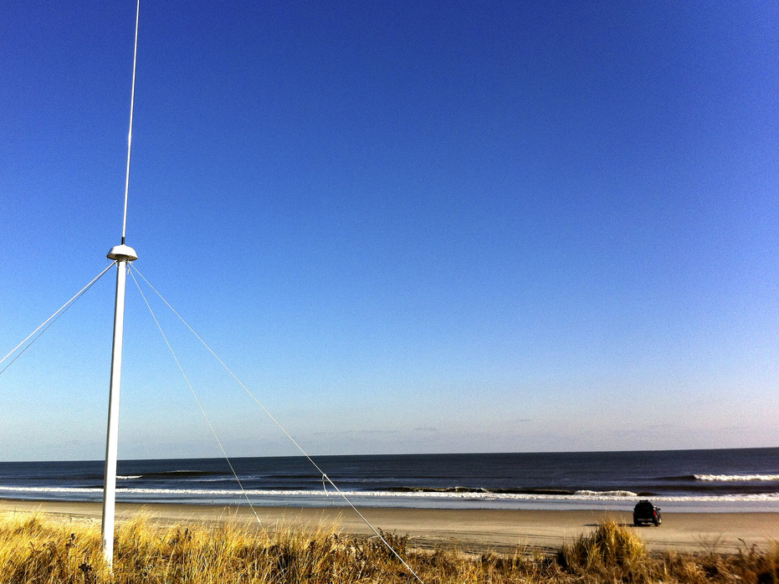

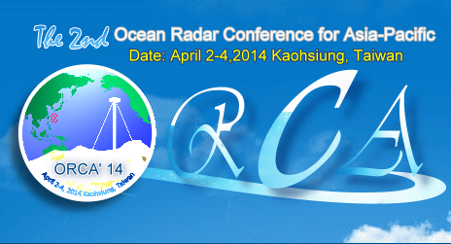




Quality Control for a Network of High Frequency Radars
Dr. Hugh Roarty
Dr. Scott Glenn
Dr. Josh Kohut
Mr. Michael Smith
Mr. Ethan Handel
Mr. Colin Evans

Slide 2
Outline
Quality Control on the National Level
Mid Atlantic Structure
Radial Quality Control
Total Quality Control

Slide 3
1. Quality control on the national level

Slide 4
26 US IOOS core variables
Acidity
Bathymetry
Bottom Character
Colored Dissolved Organic Matter
Contaminants
Dissolved Nutrients
Dissolved Oxygen
Fish Abundance
Fish Species
Heat Flux
Ice Distribution
Ocean Color
Optical Properties
Partial Pressure of CO2
Pathogens
Phytoplankton Species
Salinity
Sea Level
Stream Flow
Surface Currents
Surface Waves
Temperature
Total Suspended Matter
Wind Speed and Direction
Zooplankton Abundance
Zooplankton Species.

Slide 5

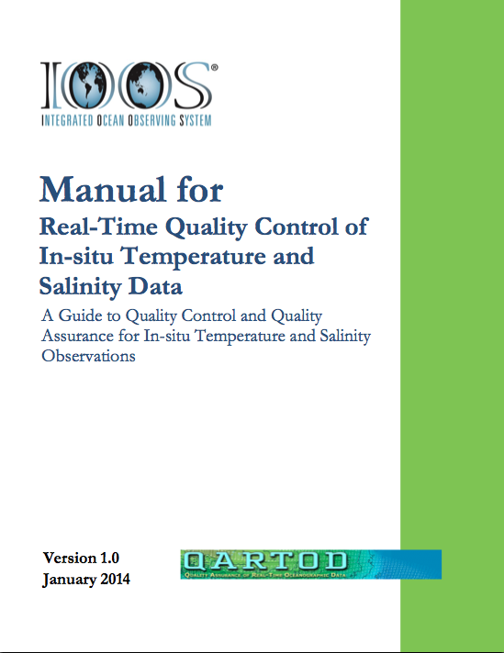

Slide 6
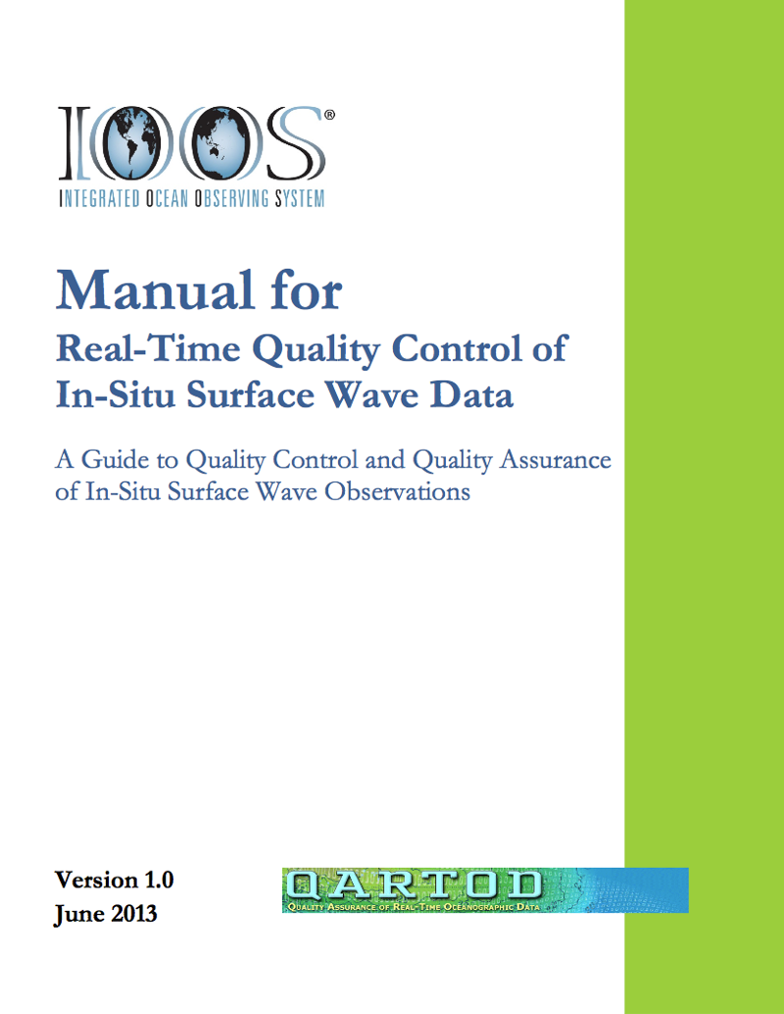
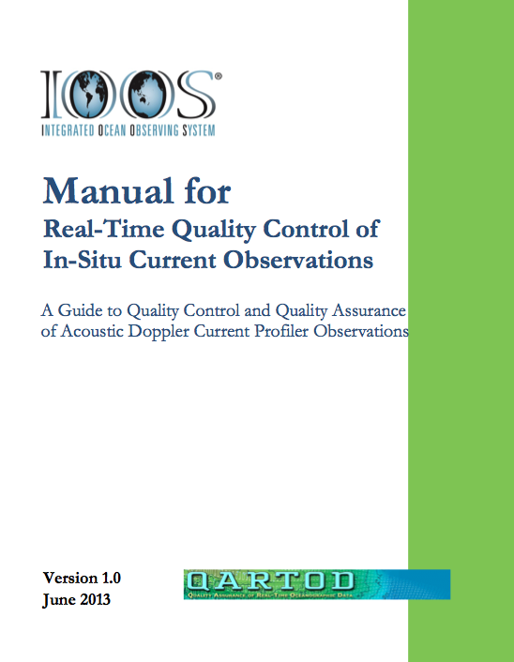

Slide 7
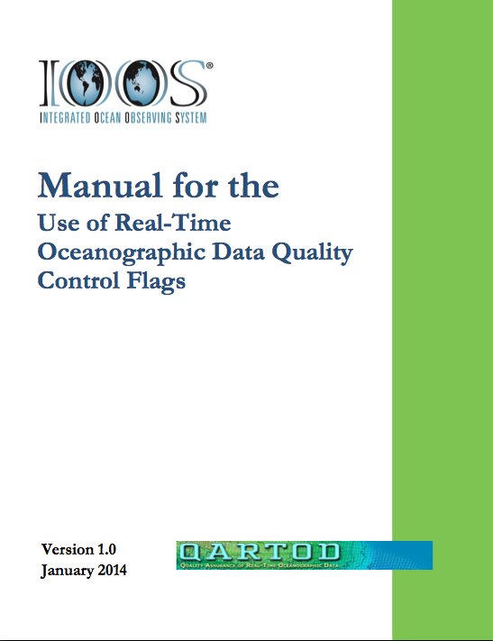
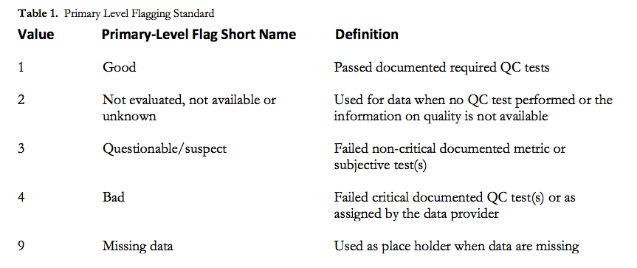

Slide 8


I 2003 December
II 2005 March
III 2005 November
IV 2006 June
V 2009 November
I 2005 February
II 2006 March
III 2007 September
IV 2009 June
V 2011 April
VI 2012 November
VII 2014 March

Slide 9
2. MARACOOS HF Radar Network

Slide 10
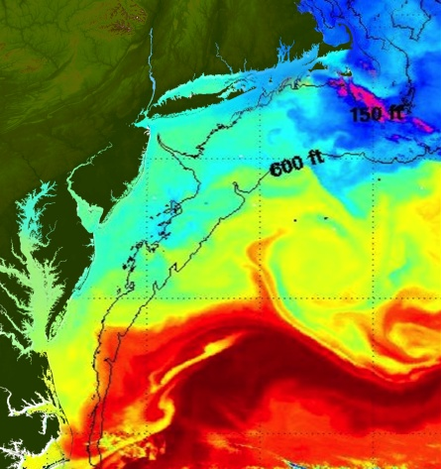
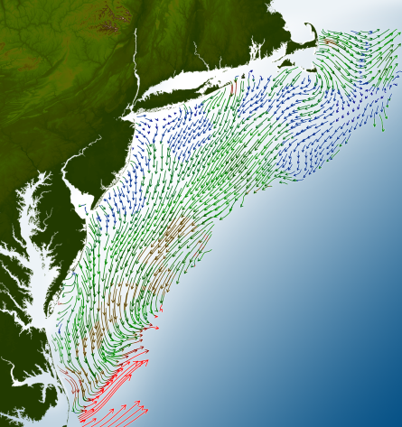
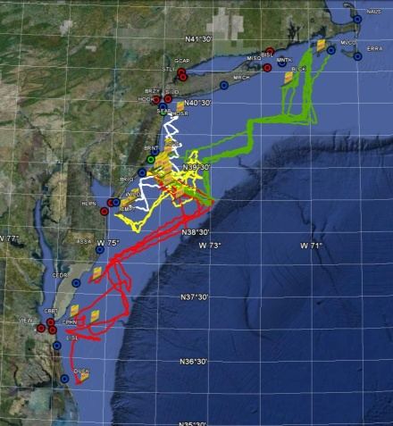
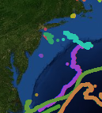
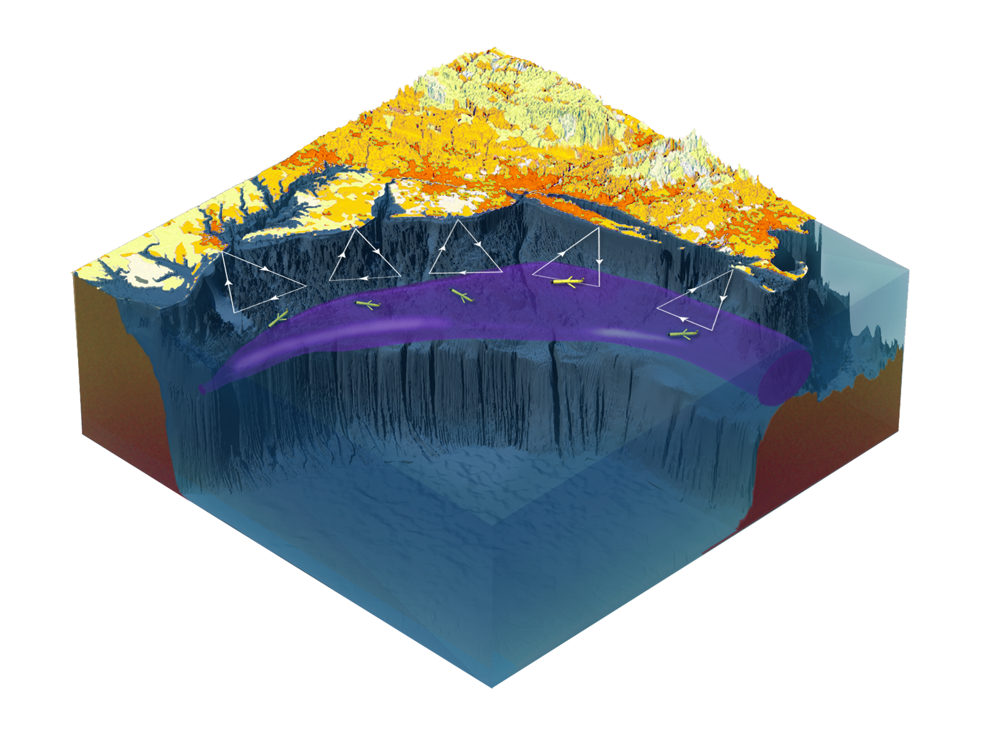

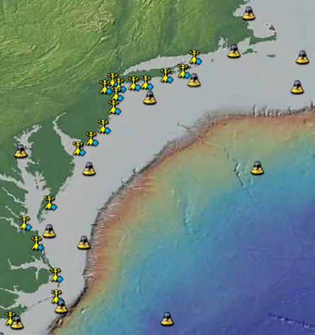
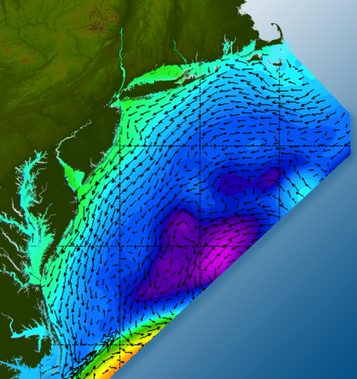

Satellites
HF-Radar
Gliders
Drifters
Population Density
To seek, discover & apply
new knowledge & understanding
of our coastal ocean
Weather Stations
Ocean Forecast Ensemble
Notes:
Need to cut off cold pool in south and bend offshore
Need to experiment with dulling down the colors in the pop density. Maybe orange/tan to white like the box I put in?
Put gliders just below the lines in 3 of them, and increase their angles facing up and down randomly. I stuck in cheesy examples
I already put the shadow and 80% clear line around the two new maps in the upper right, so we are good there.

Slide 11
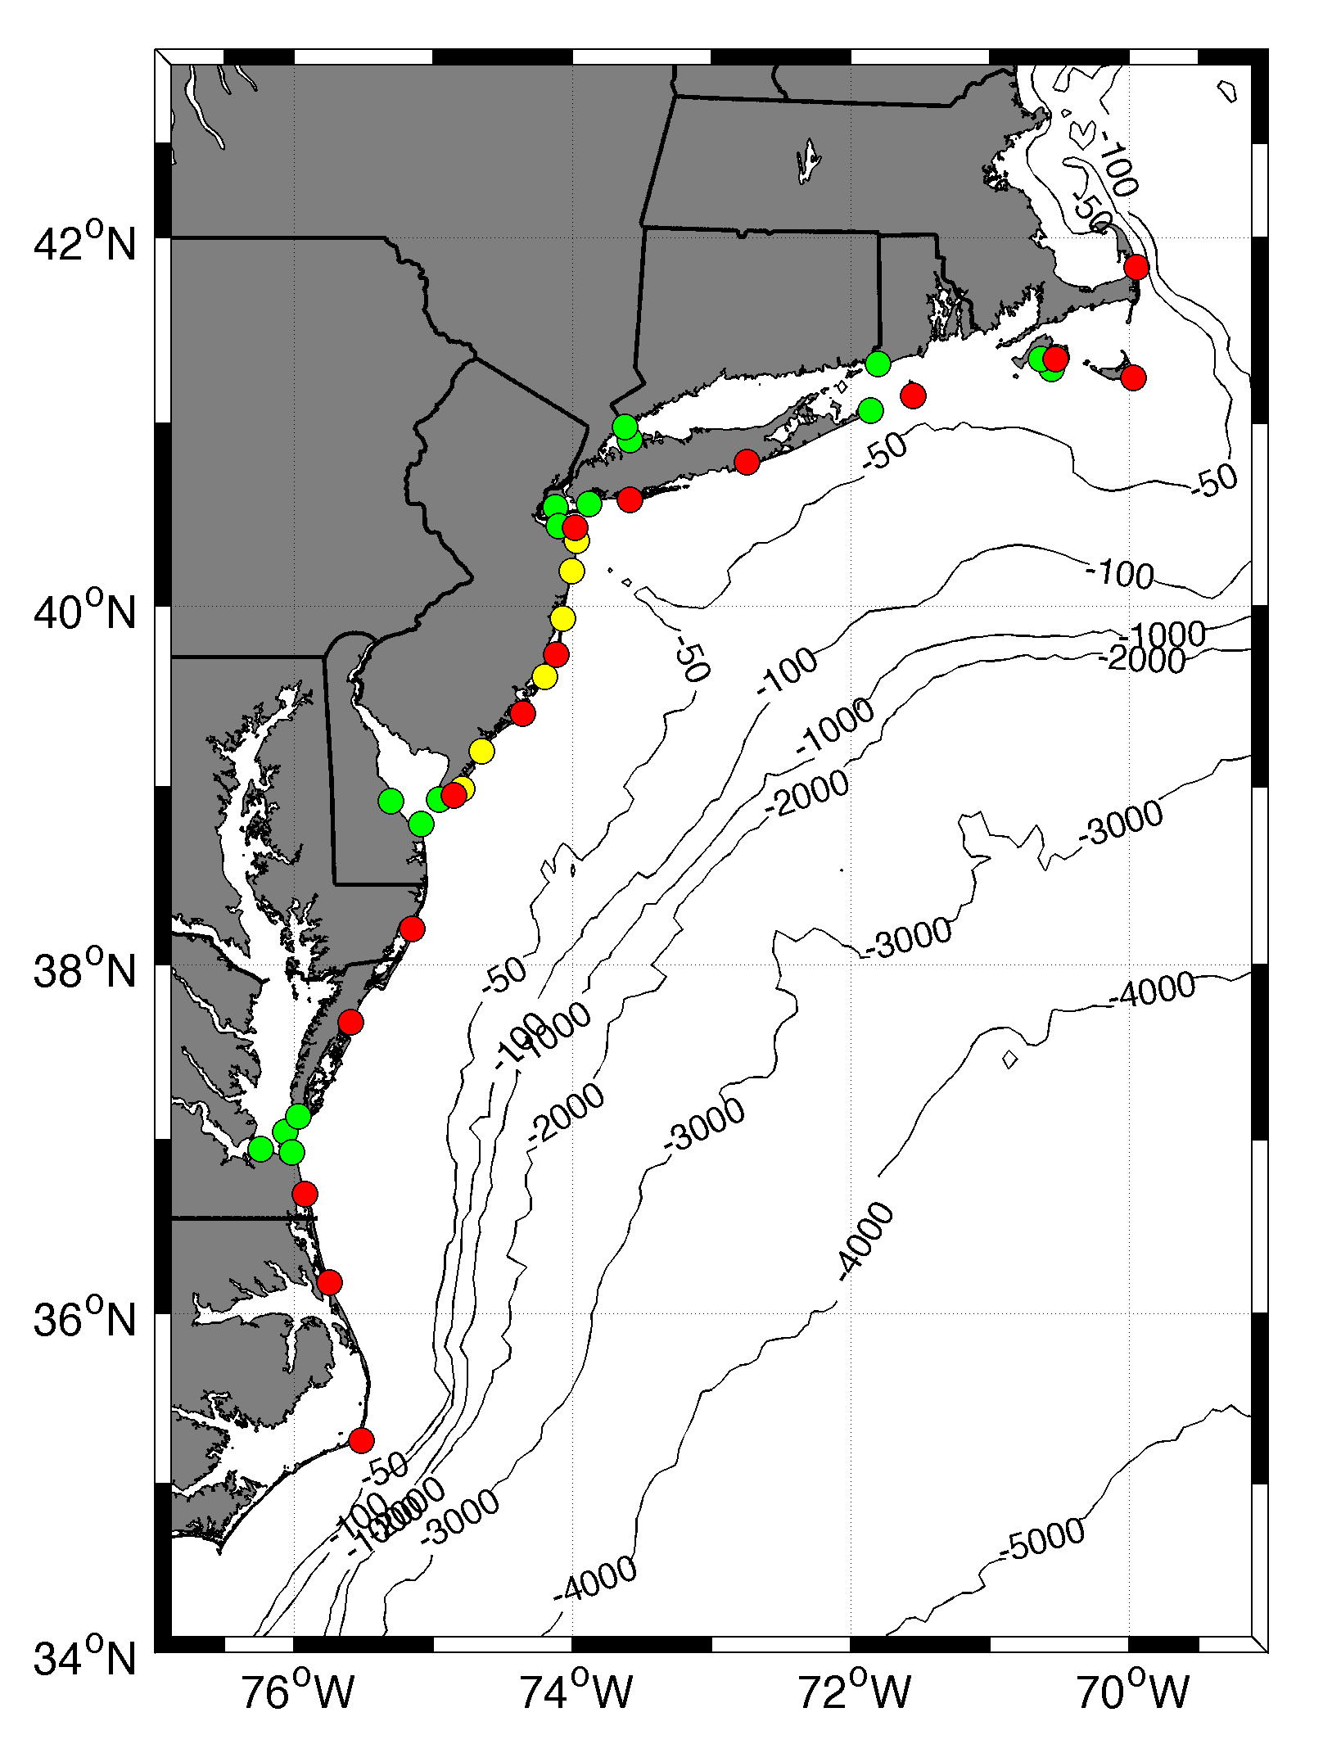









MARACOOS HF RADAR NETWORK
 | 5 MHz | 13 MHz | 25 MHz
U Mass
WHOI
U Conn
URI
Stevens
Rutgers
Delaware
ODU/CIT
UNC
9 | 17 | 8 | 17
41 Stations in Total

Slide 12
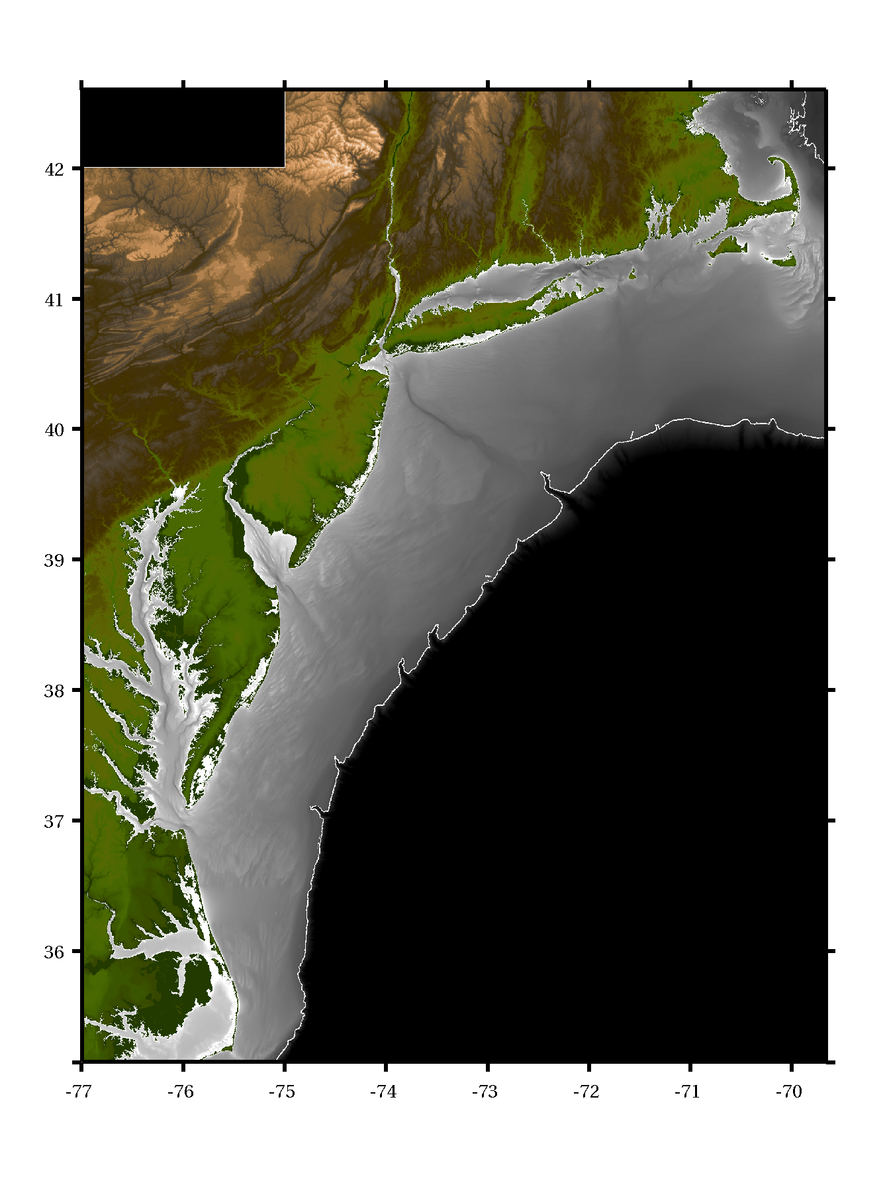
Management
Regional Coordinator
Hugh Roarty
Distributed Technicians
Chris Jakubiak
Todd Fake
Ethan Handel
Teresa Updyke
Northern
Operator
Central
Operator
Southern
Operator

Slide 13
3. Radial Quality control

Slide 14
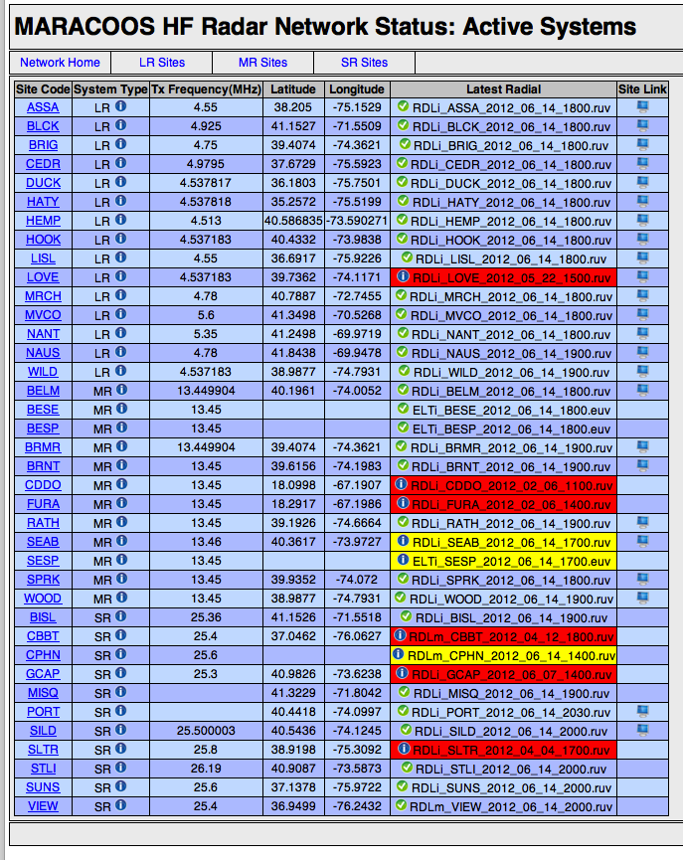
Radial Database
Central location to monitor region
Automatic reprocessing of totals with new radials

Slide 15
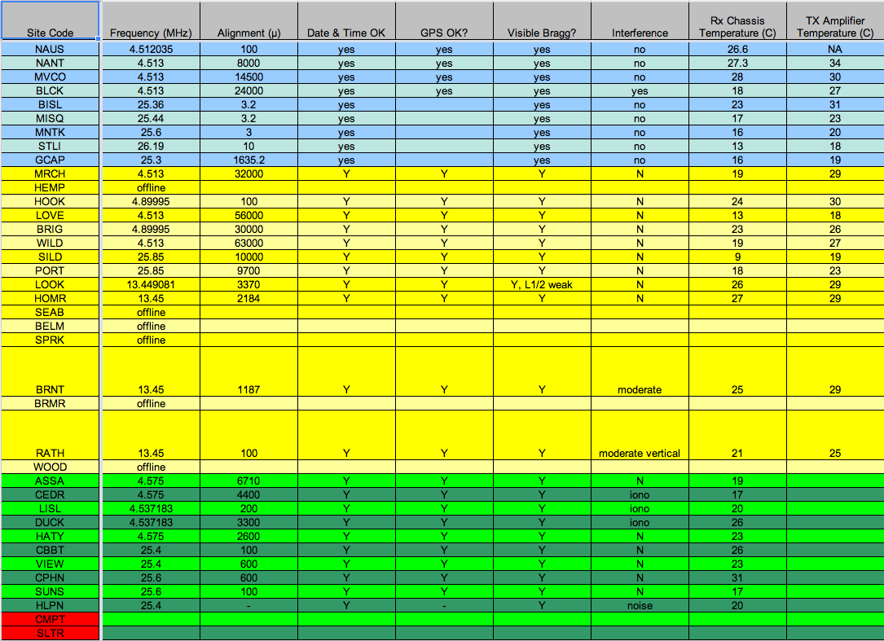
Weekly Site Inspections – 17 Checks

Slide 16
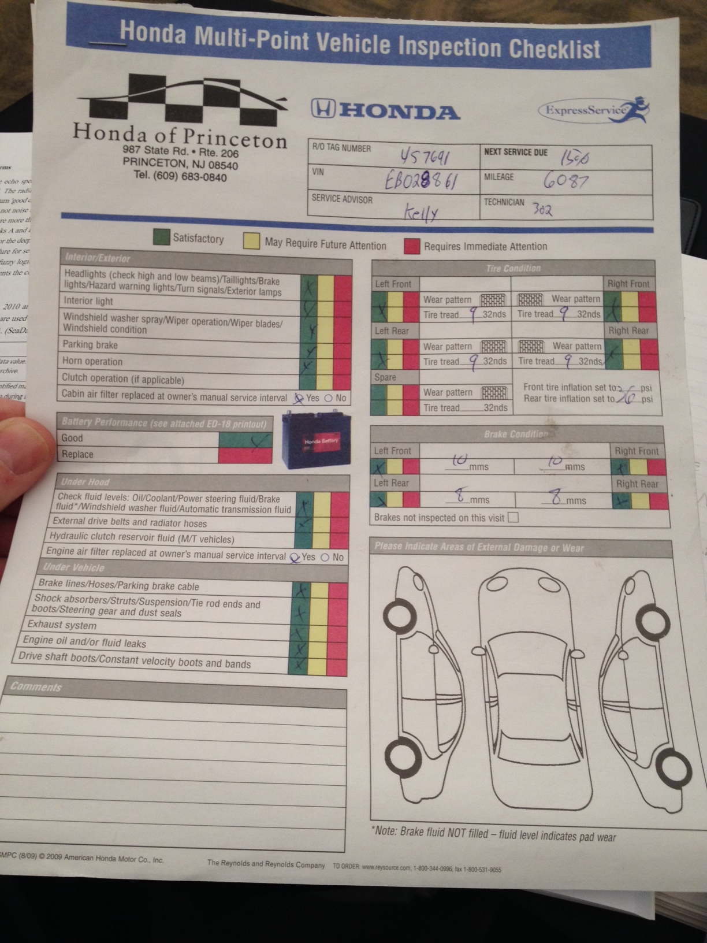
26 Point Inspection

Slide 17
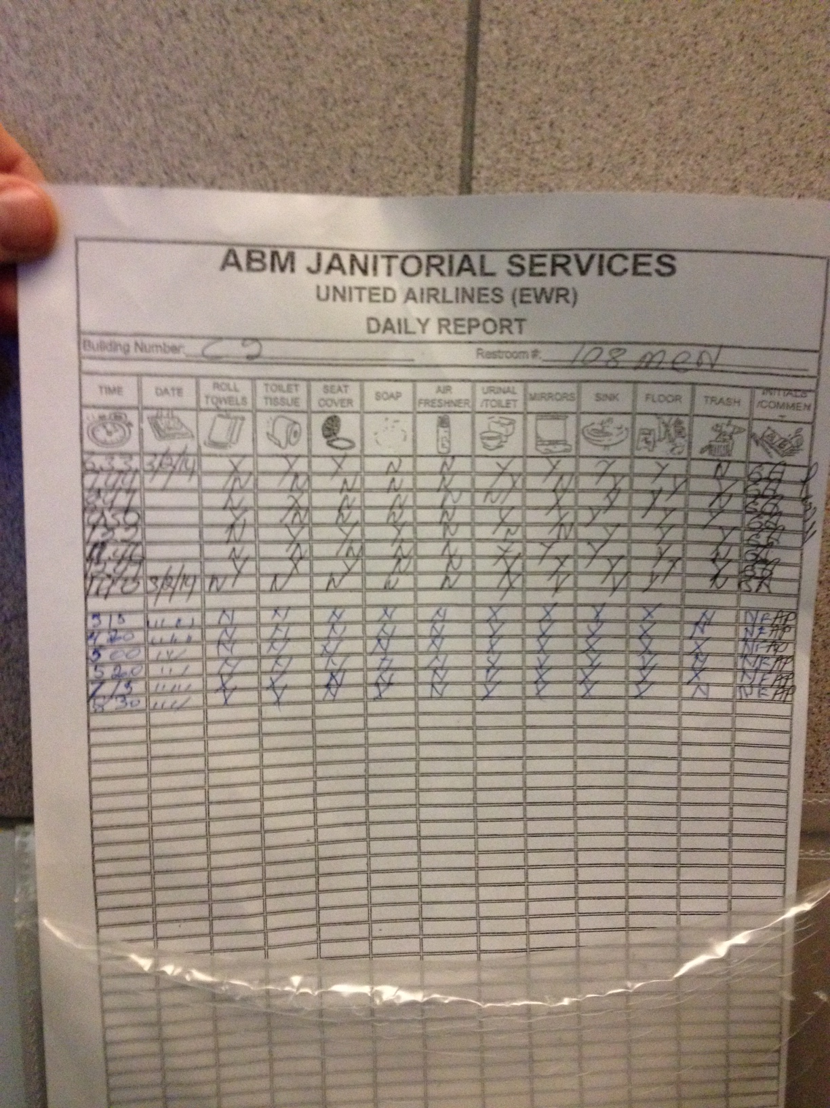
11 Point Inspection

Slide 18
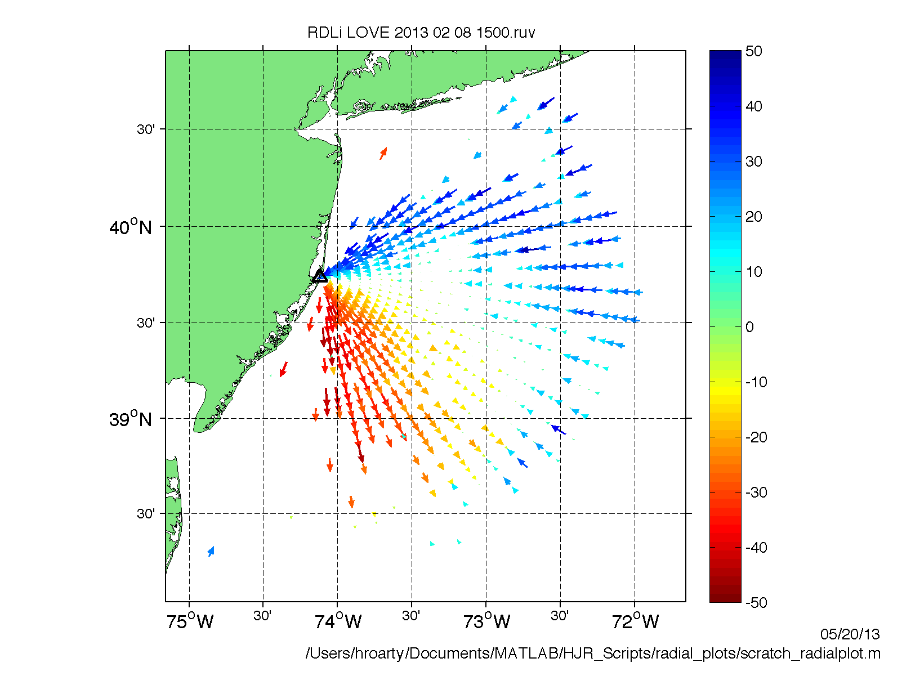

Slide 19
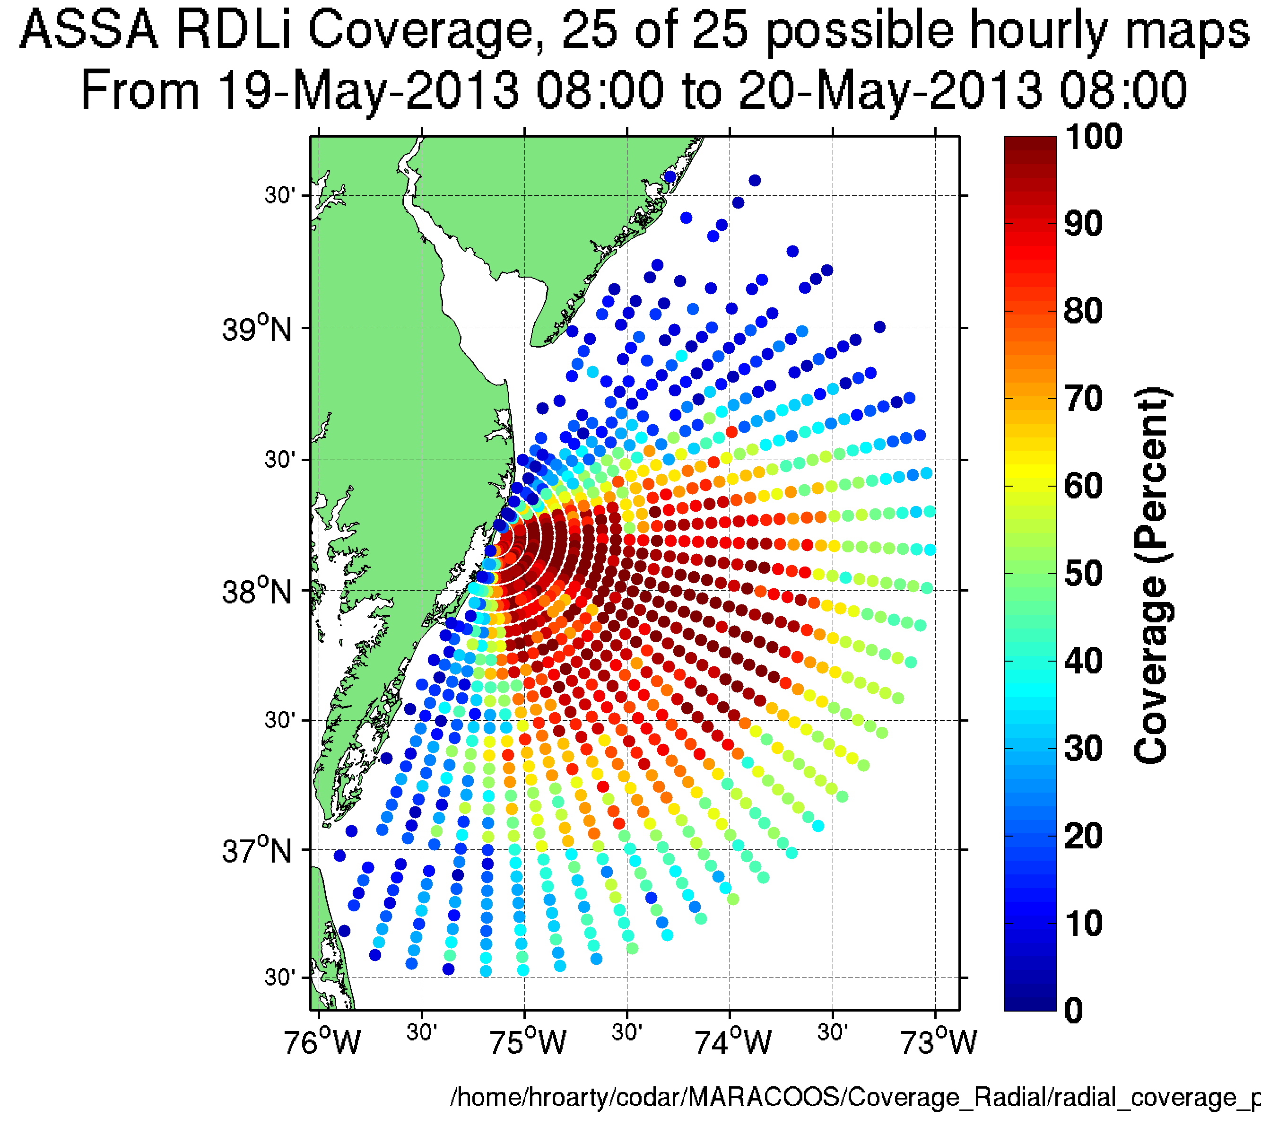
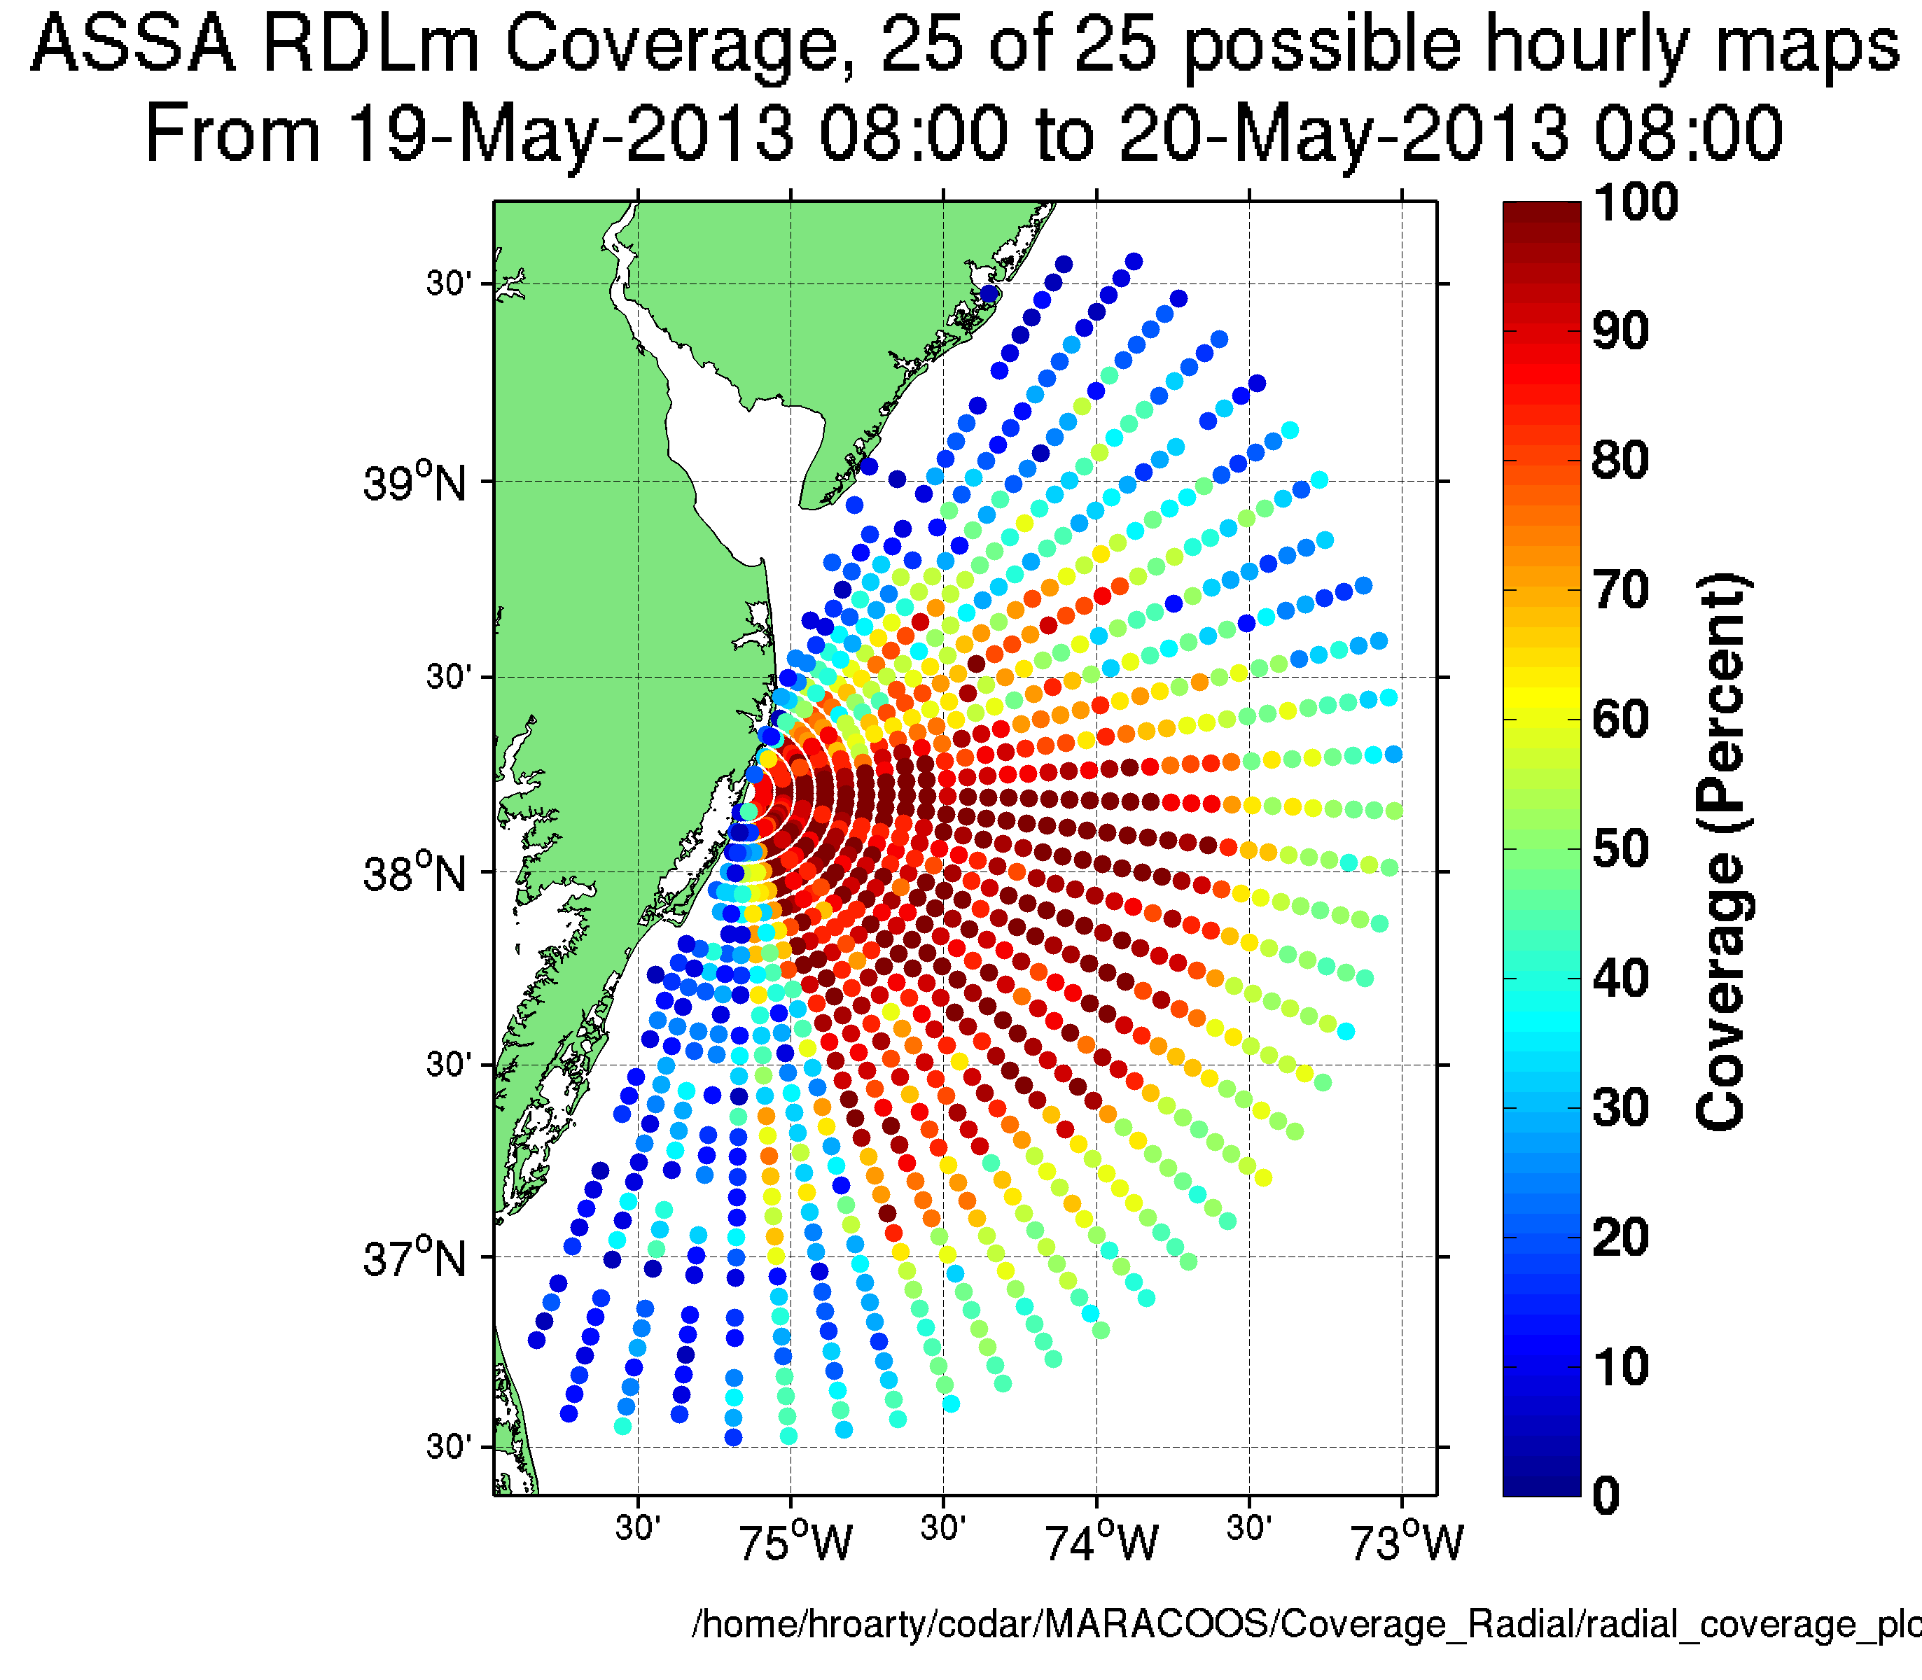
24 Hour Radial Coverage
http://marine.rutgers.edu/~hroarty/maracoos/radial_coverage/

Slide 20
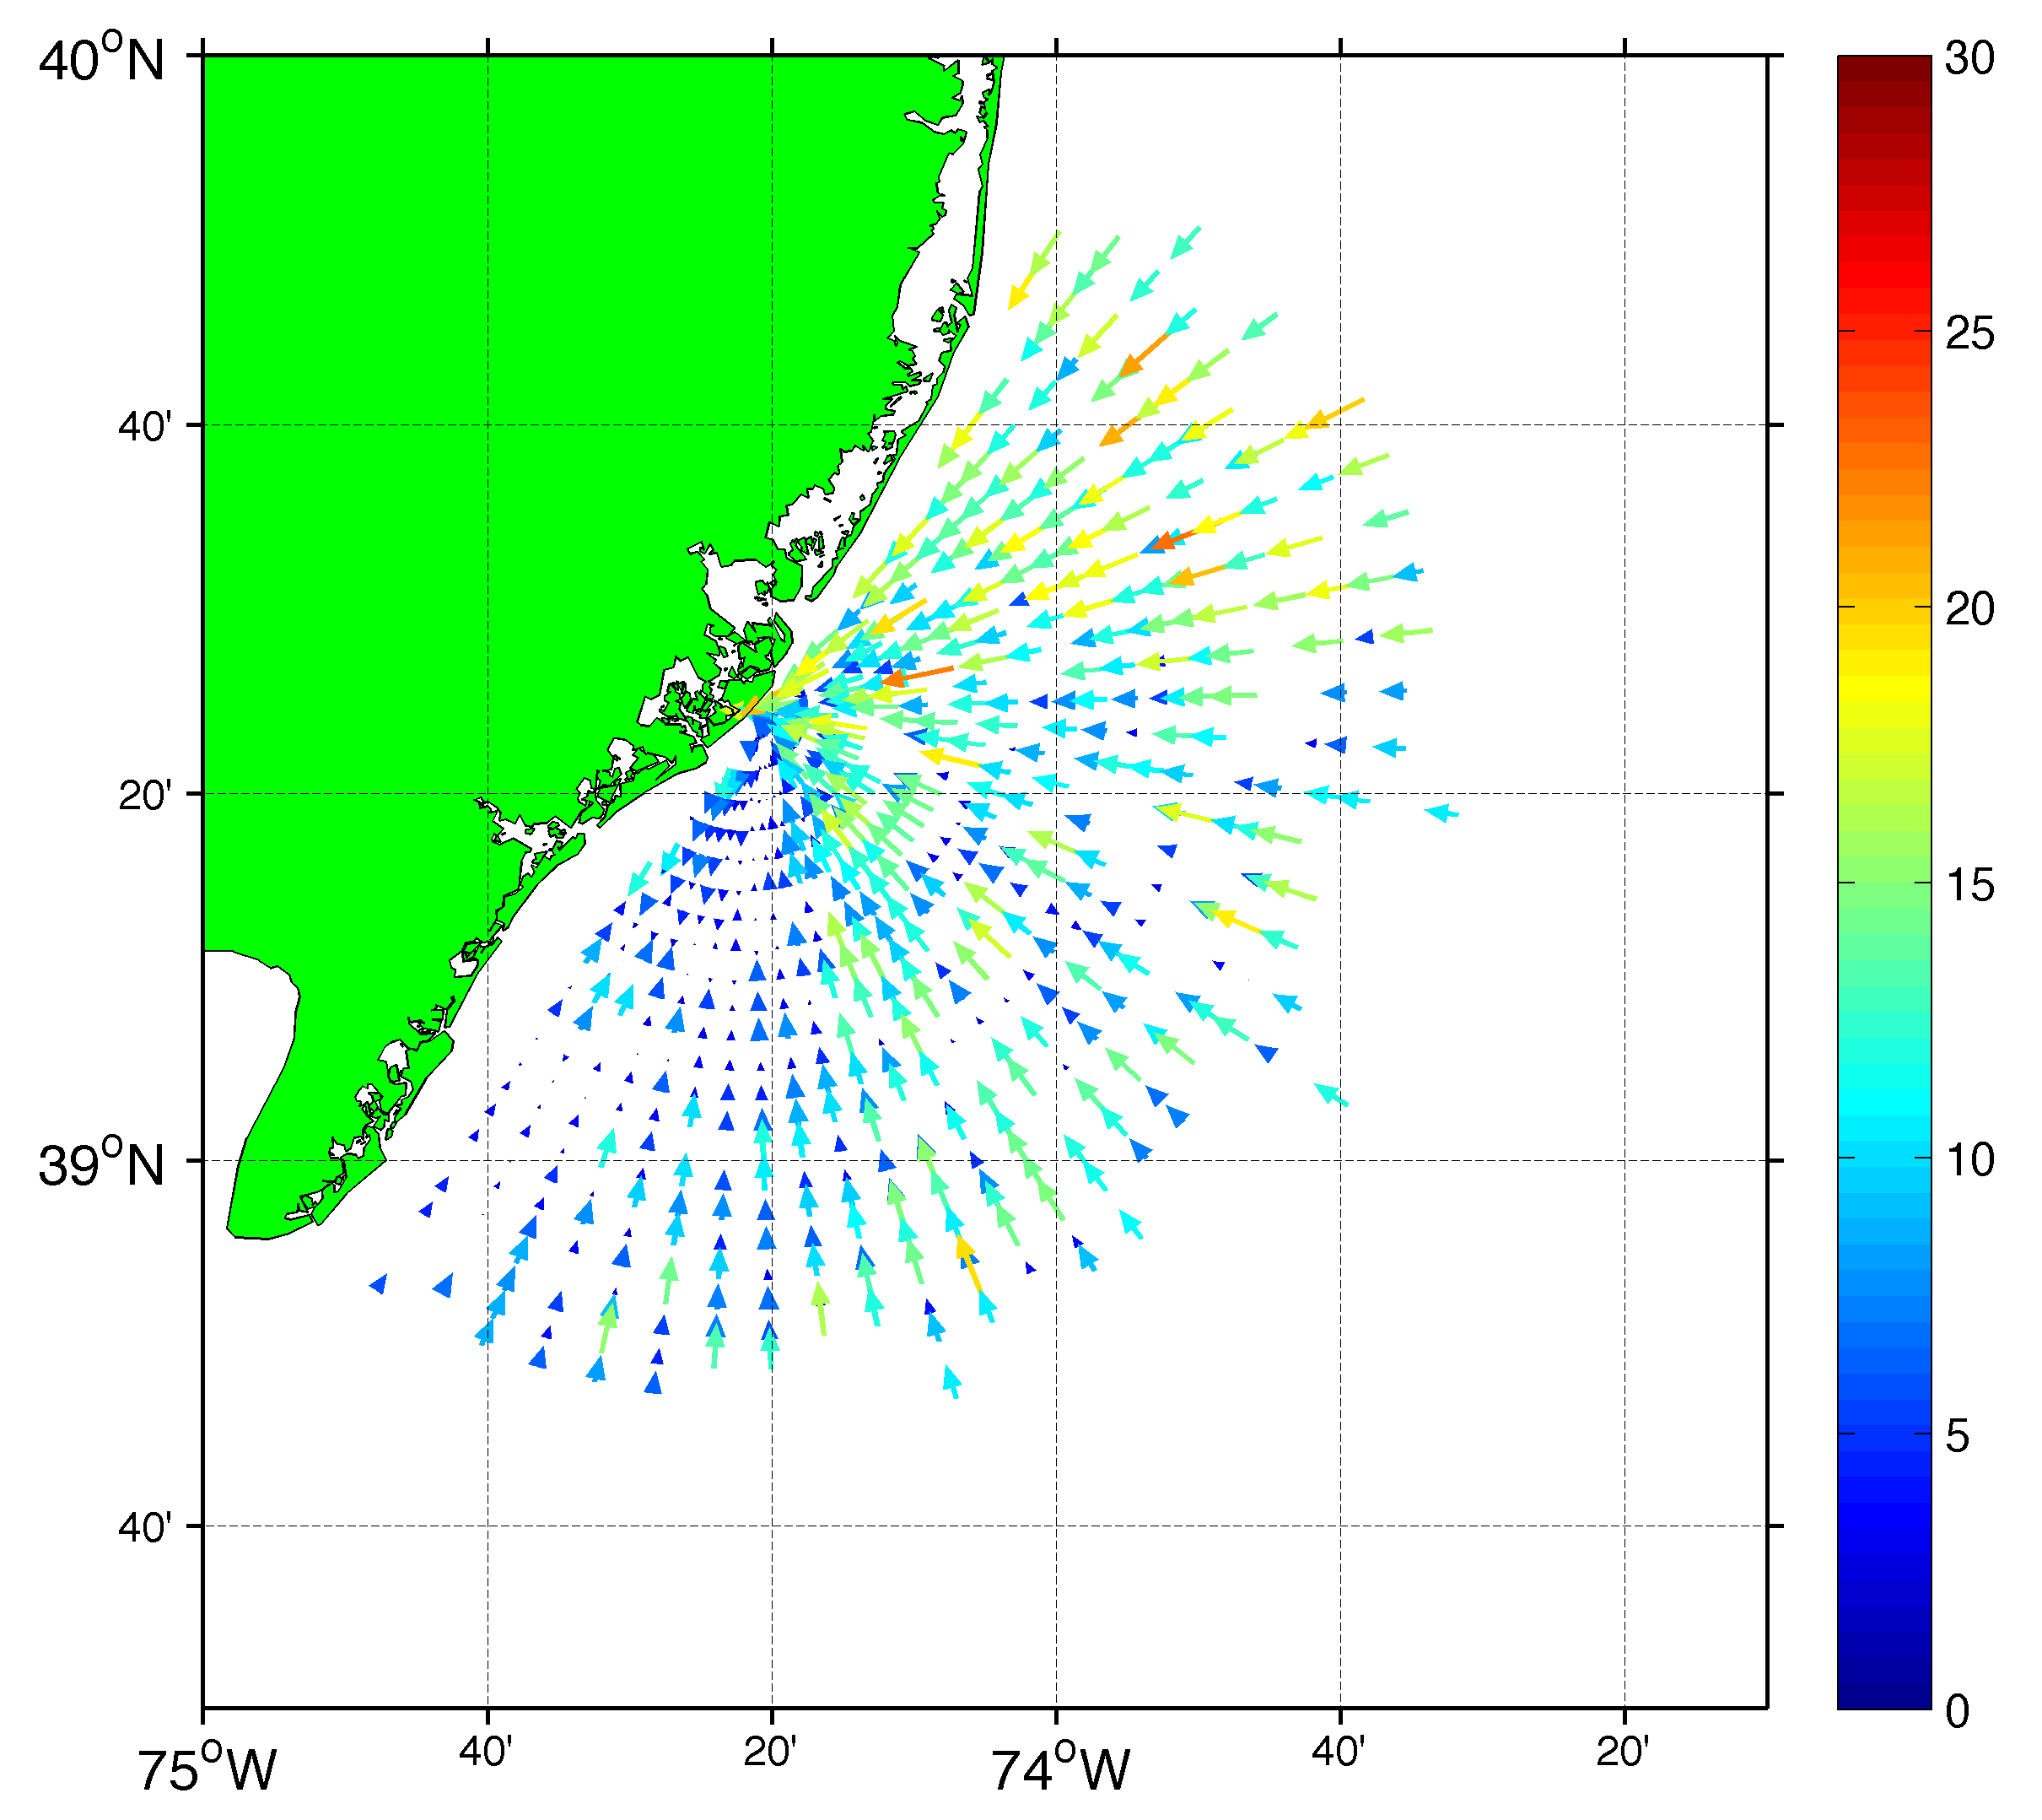
Radial Average Bearing
AND
Comparison Between Measured and Ideal Radials
Shore Parallel
Shore Normal

Slide 21
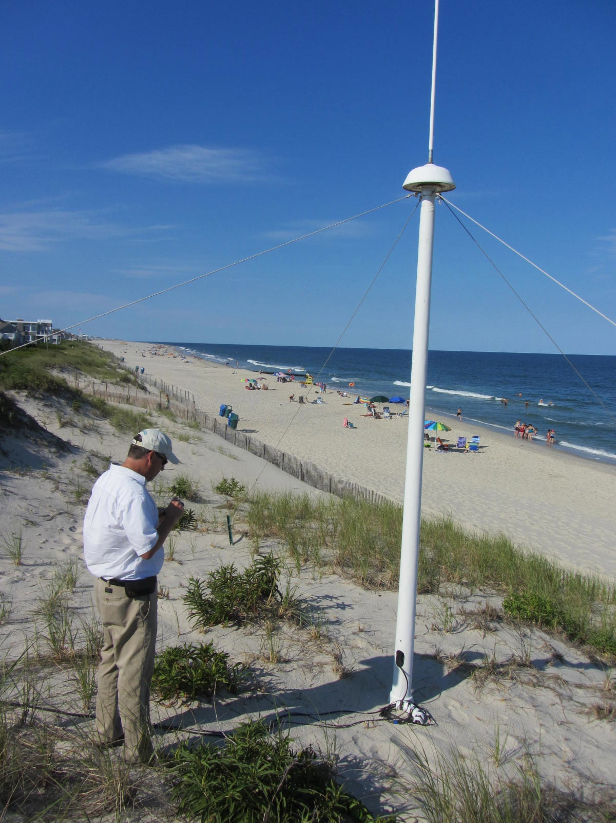
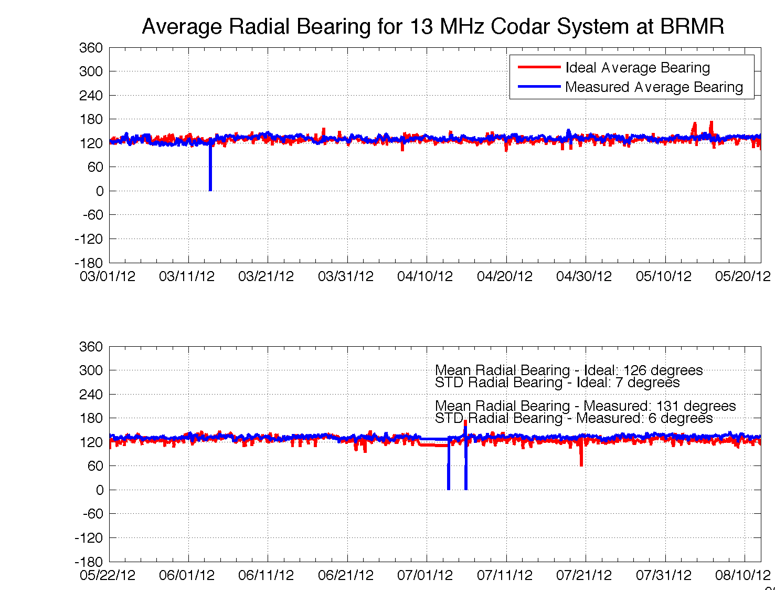
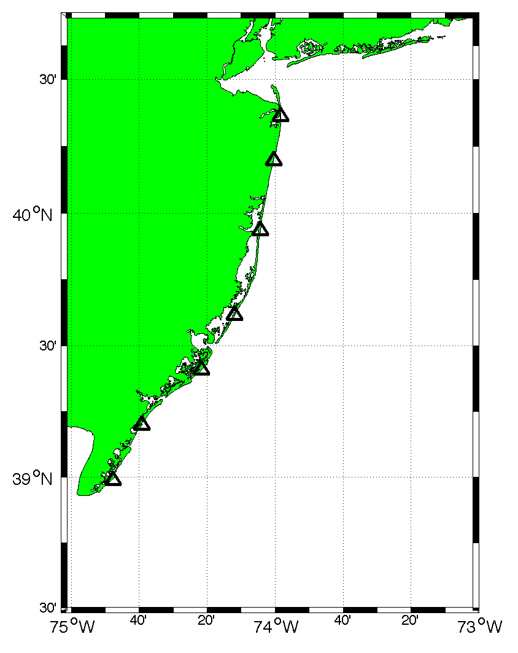
13 MHz BRMR Site
40°
BRMR
130°
220°

Slide 22
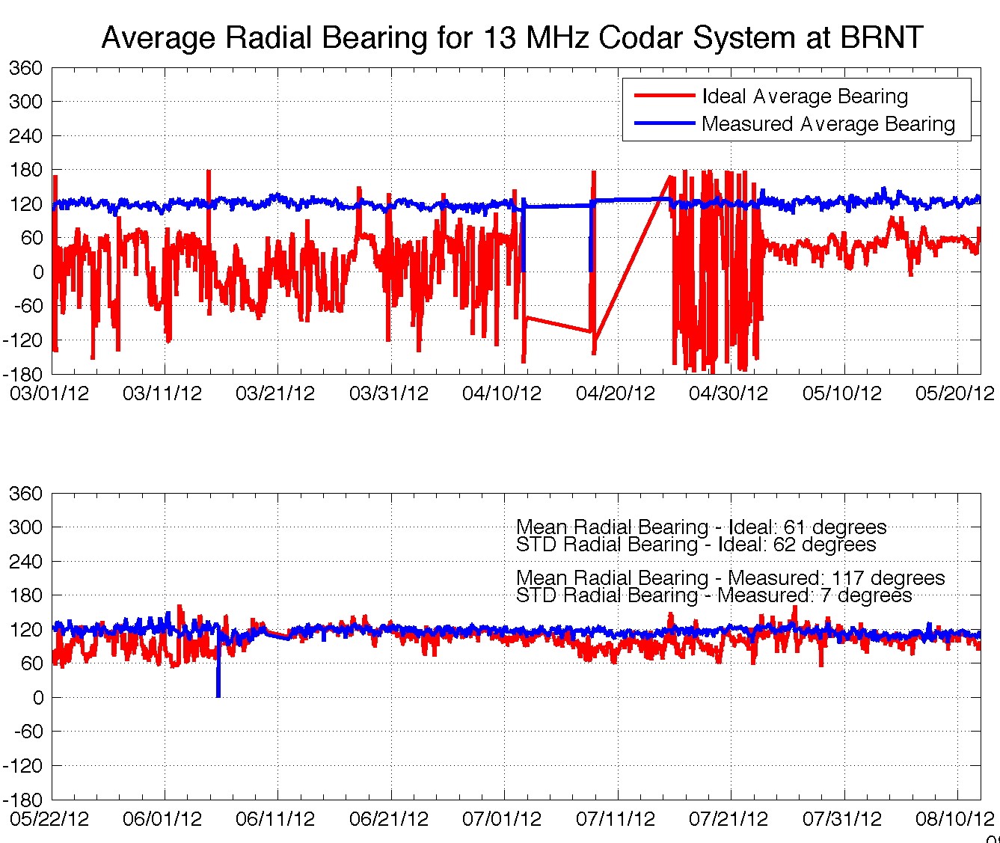
Antenna Problem at BRNT Site
30°
BRNT
120°
Replaced Antenna June 8
210°

Slide 23
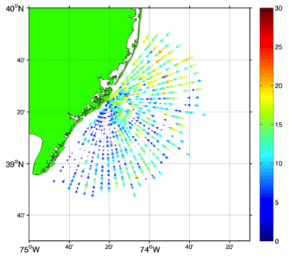
Average Radial Velocity
RDLi_BRMR_2012_08_1300
RDLi_BRMR_2012_08_1400
RDLi_BRMR_2012_08_1500
5 cm/s
7 cm/s
10 cm/s

Slide 24
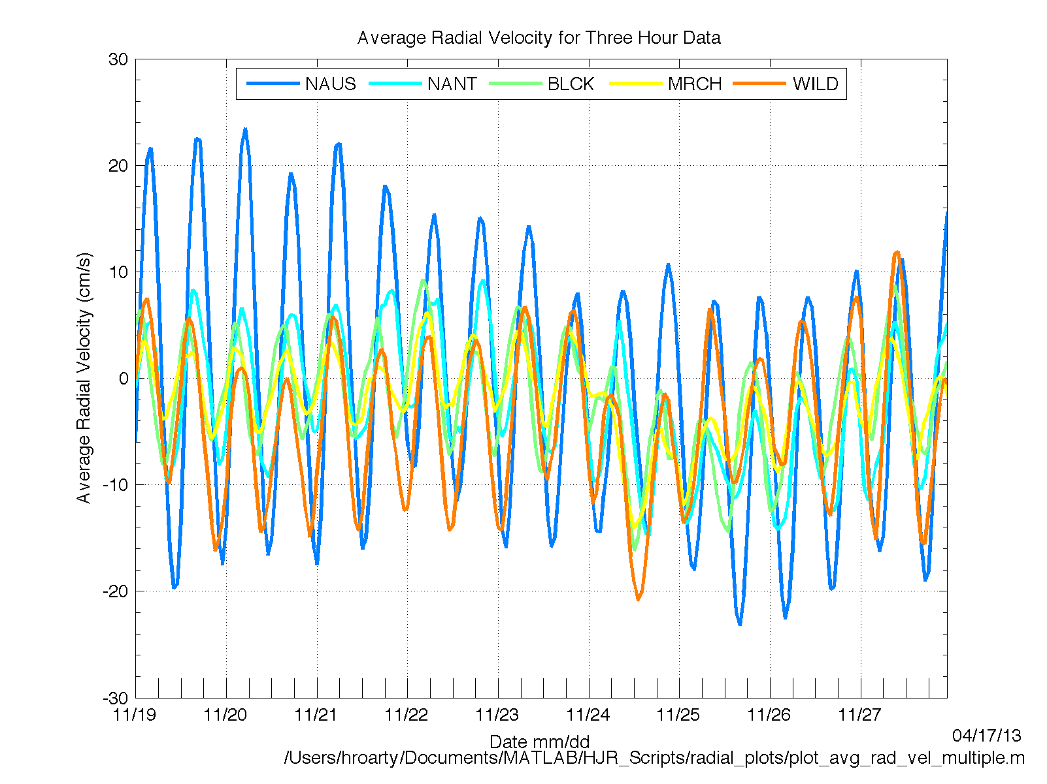

Slide 25
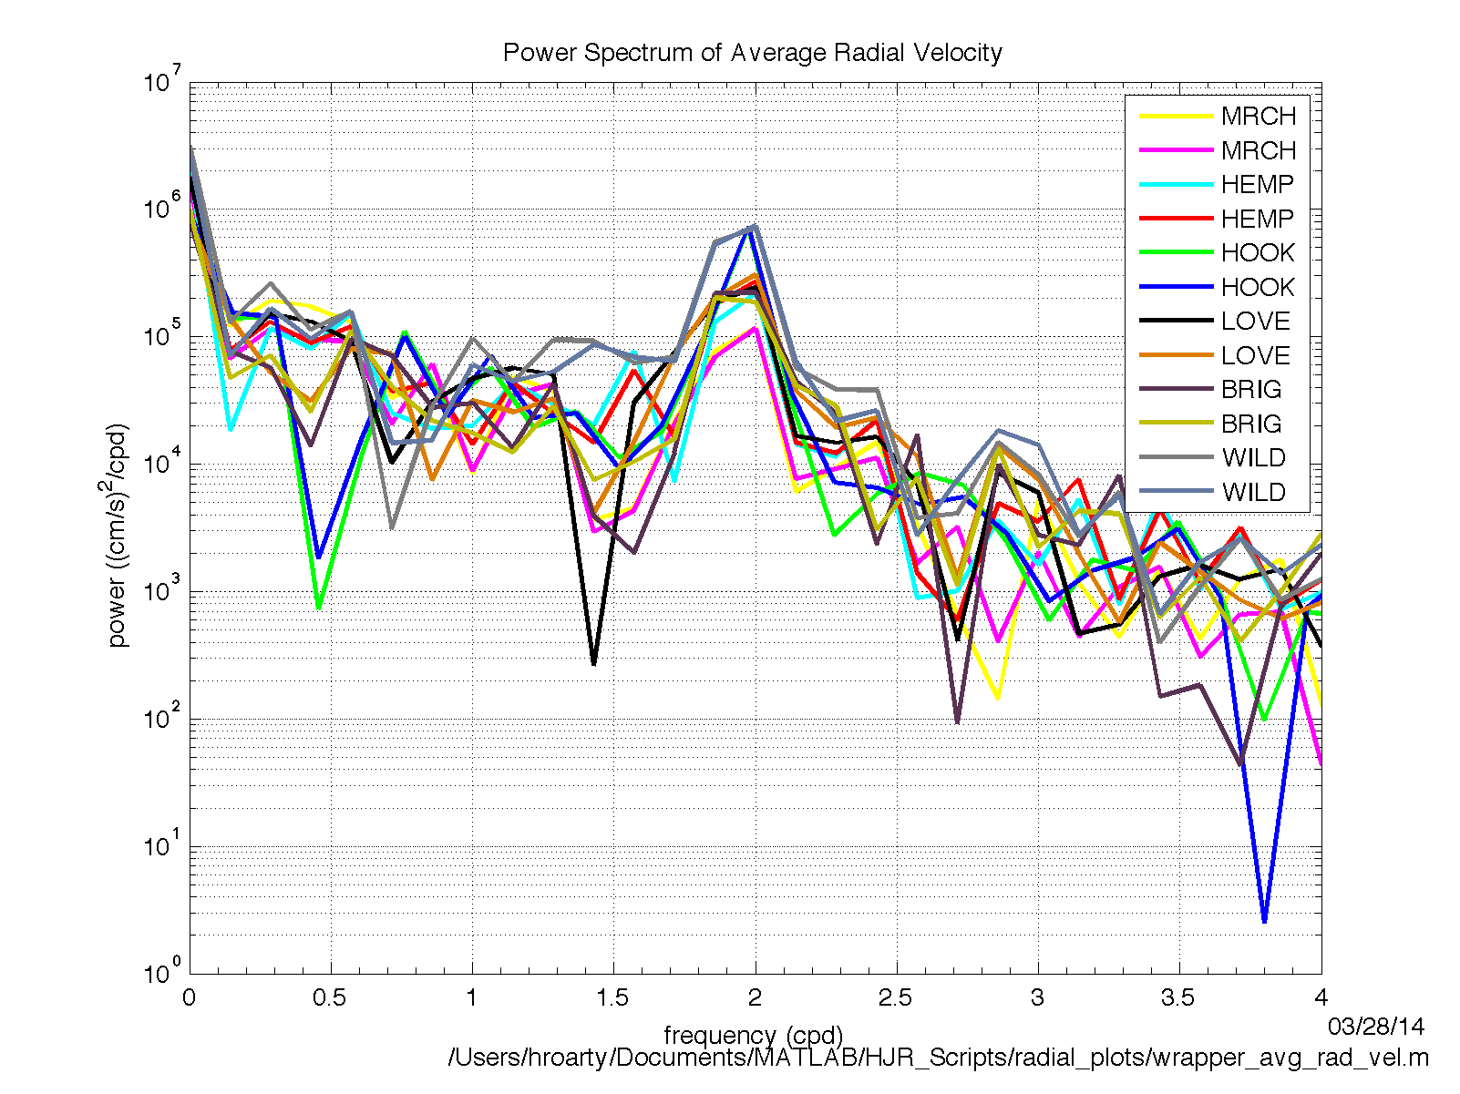

Slide 26
Radial Inspection Algorithm
Load the Radial File
No
24 hour Radial Coverage Test
Yes
No
Radial Bearing Steady and Shore Normal
Yes
No
Average Radial Velocity M2 Peak and Power Level
Yes
Radial Site Is Cleared for Total Generation

Slide 27
4. Total quality control

Slide 28
24 Hour Coverage and Mean

Slide 29
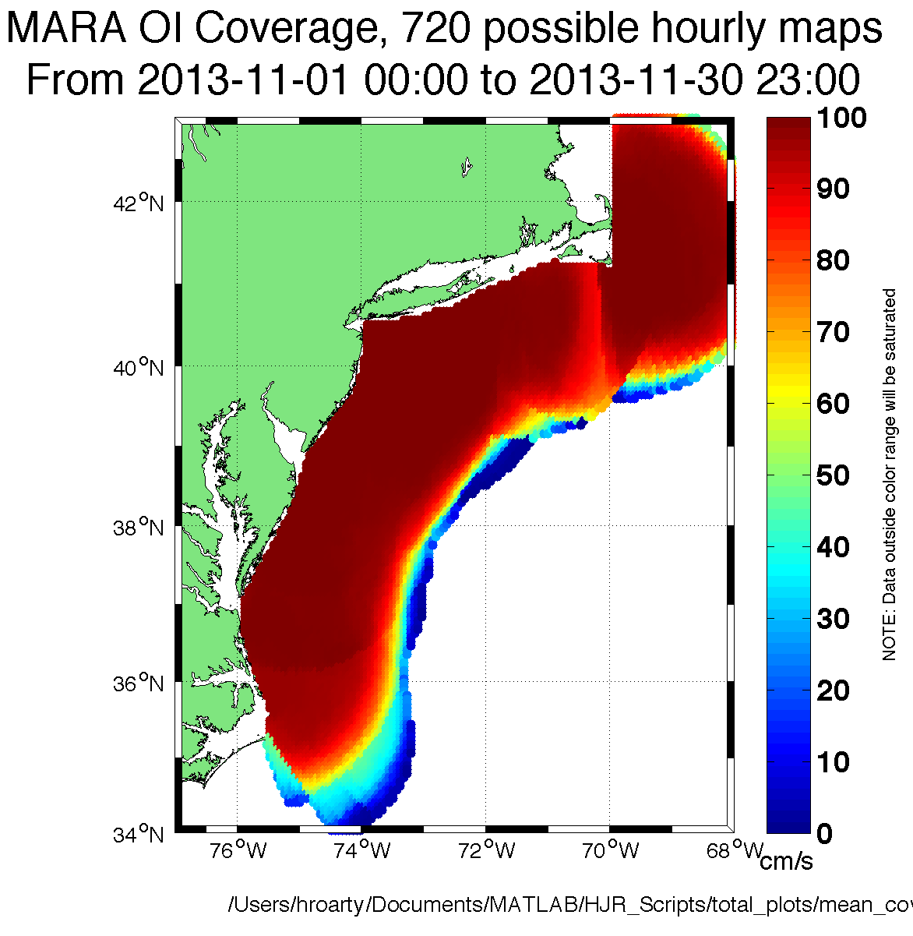
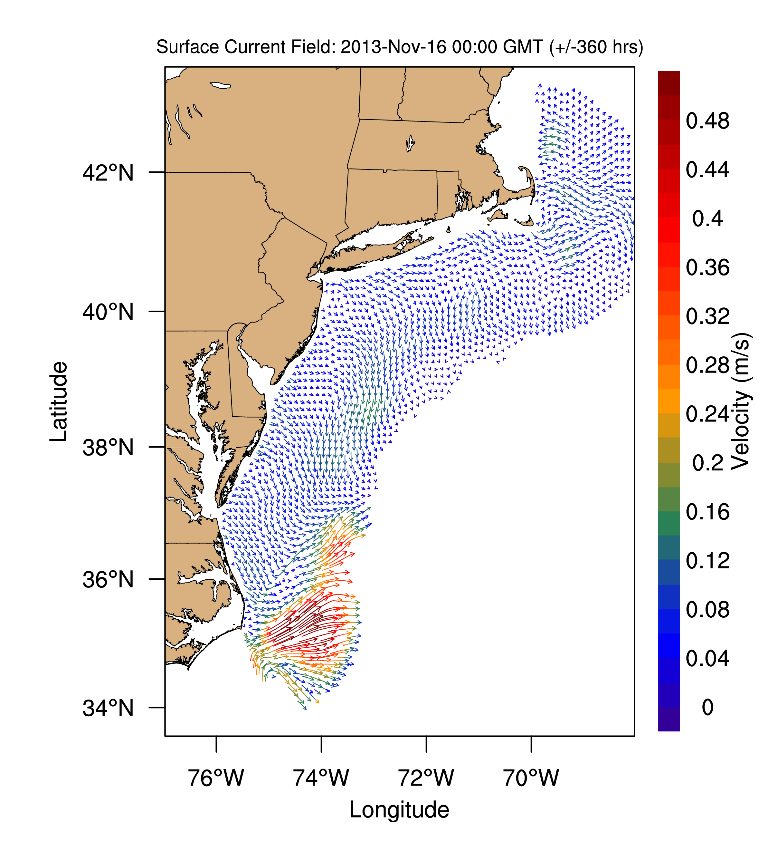
Monthly Coverage and Mean

Slide 30
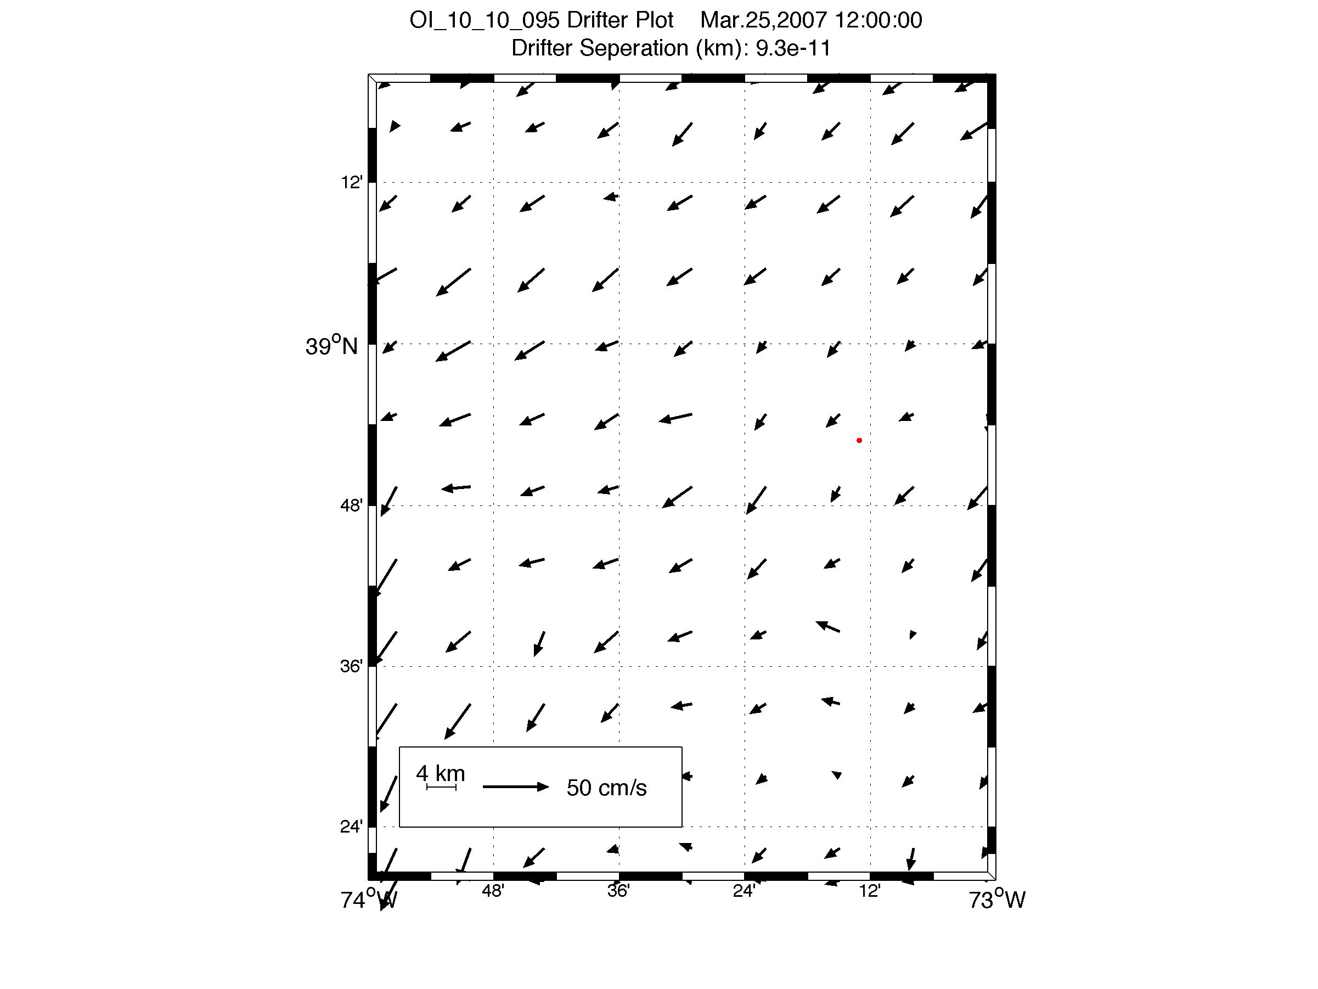
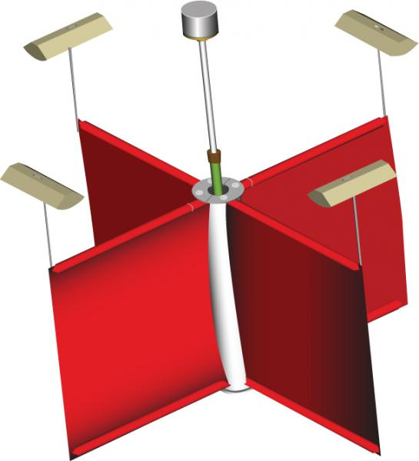
Kohut et al. (2012) Ocean Dynamics

Slide 31
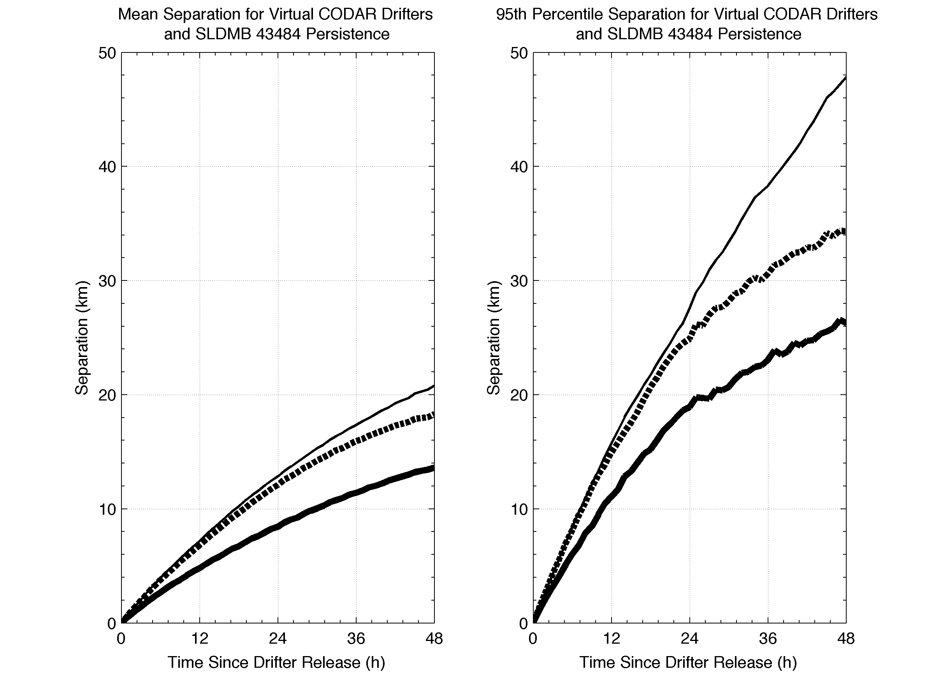
Mean Separation
Centroid of Particles and Drifter
95th Percentile Separation
Centroid of Particles and Drifter
Persistence
UWLS
OI
Persistence
UWLS
OI
Kohut et al. (2012) Ocean Dynamics

Slide 32
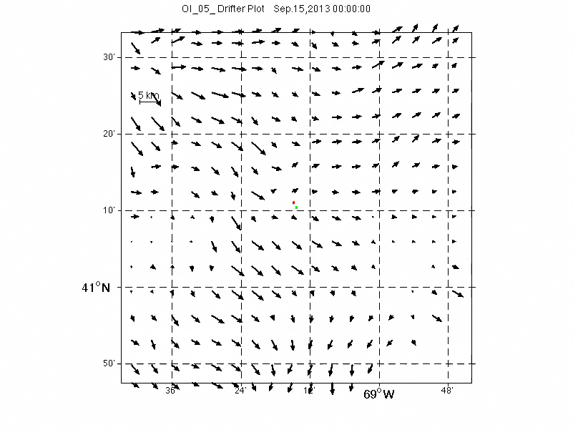
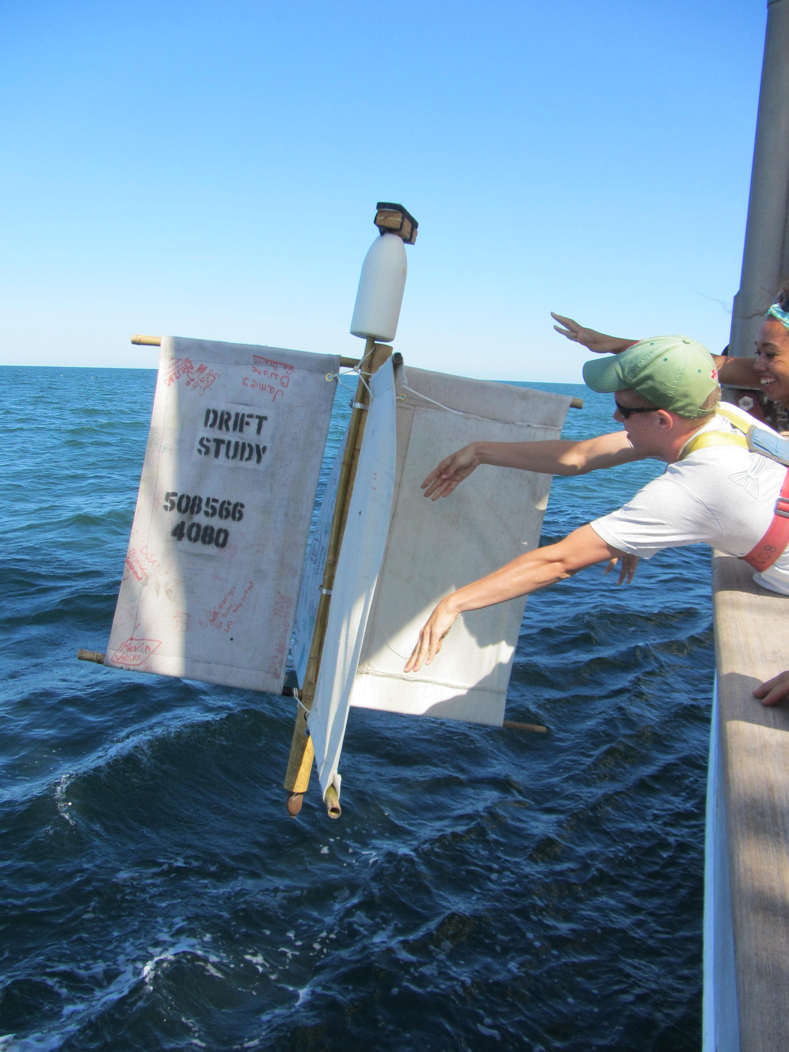

Slide 33
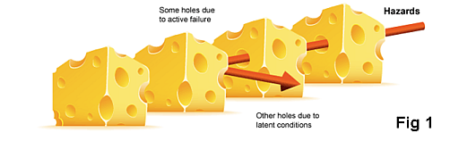
Conclusions
Technicians are the first layer of QC
Algorithms are the second layer
Inspecting total vectors are the third layer

