Slide 1





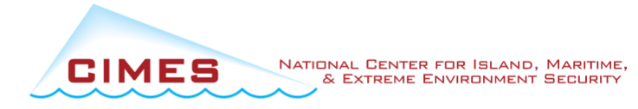
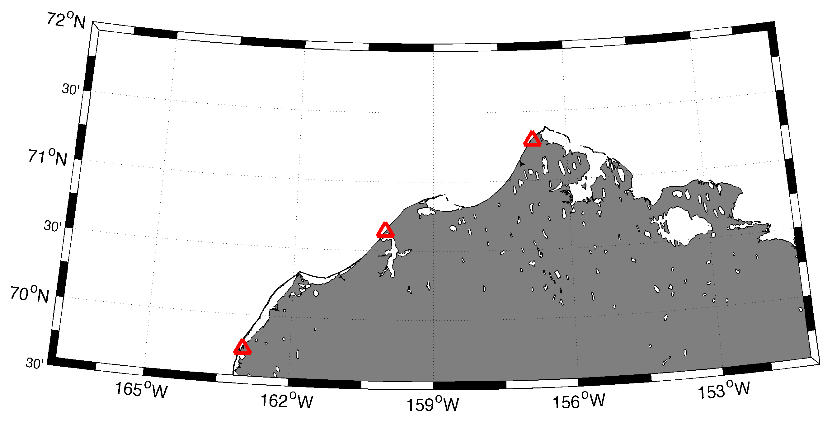
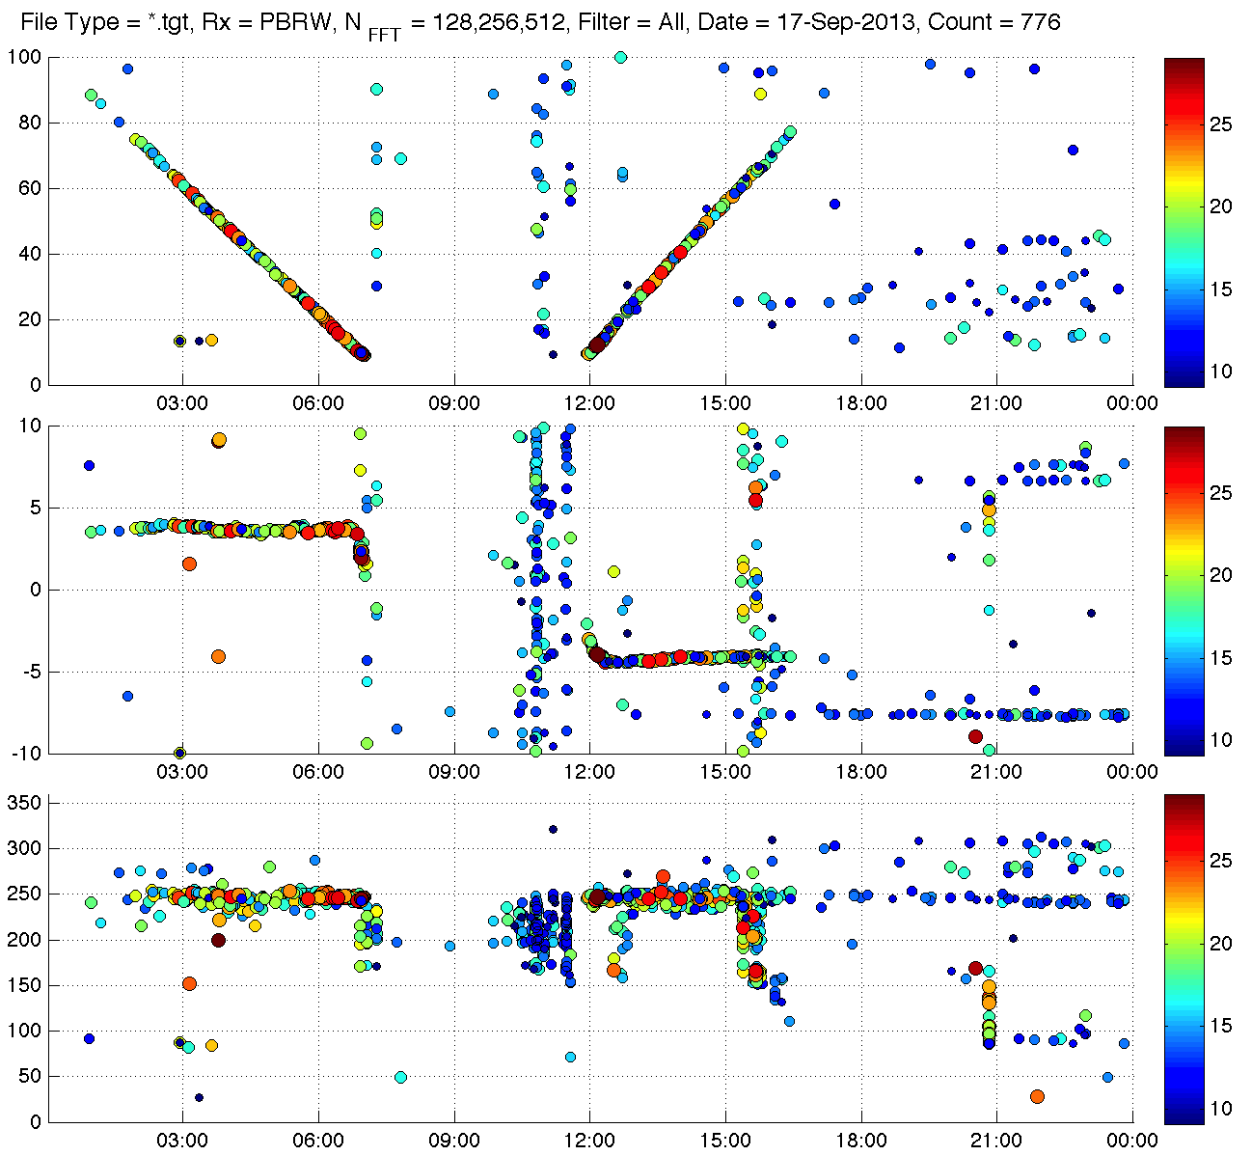
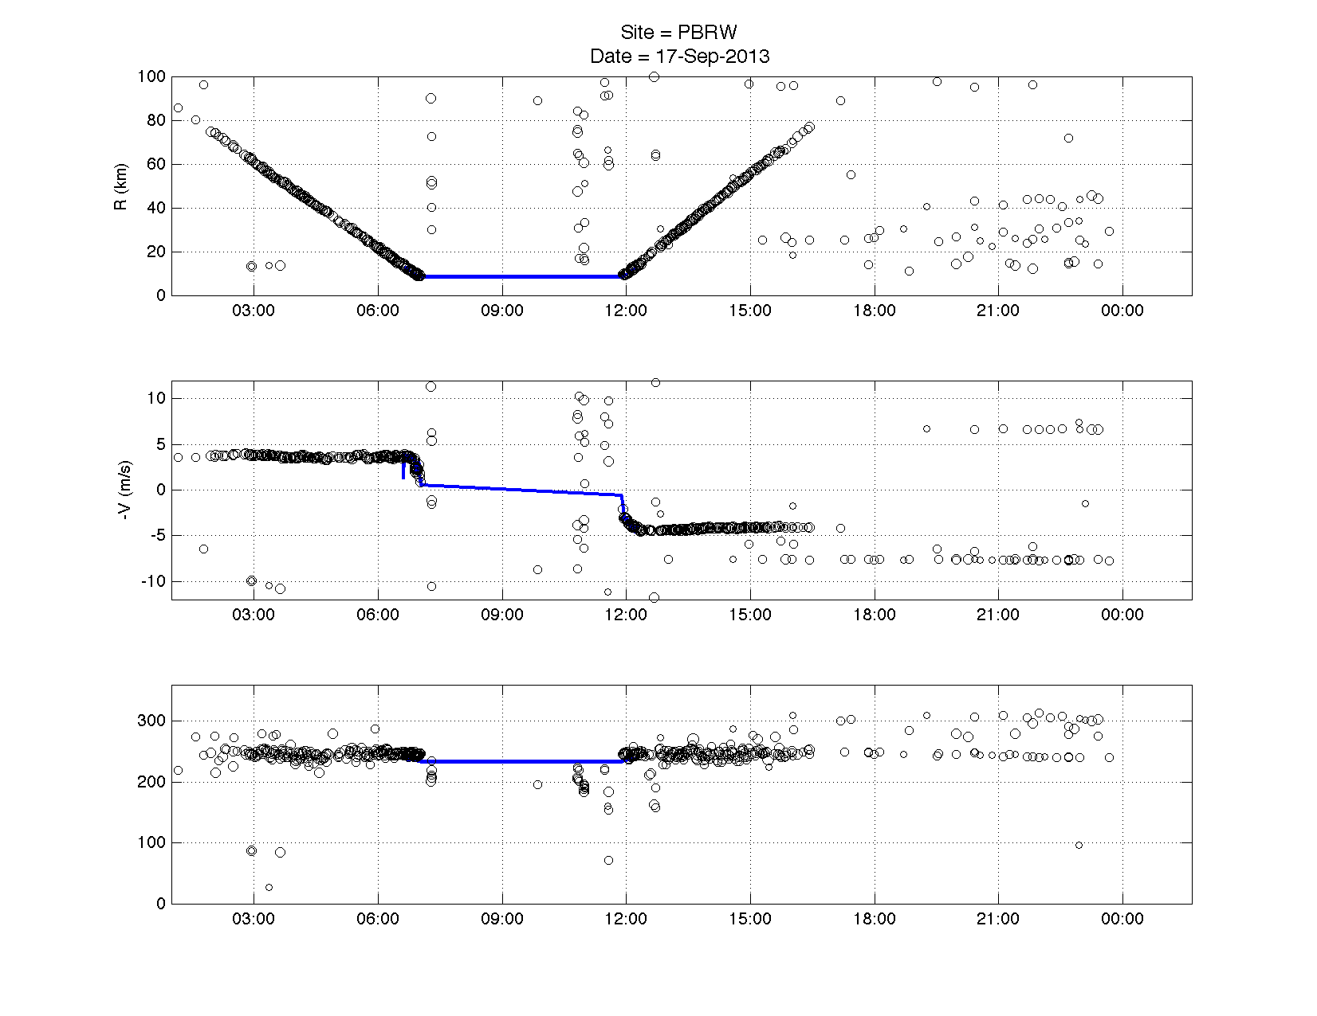
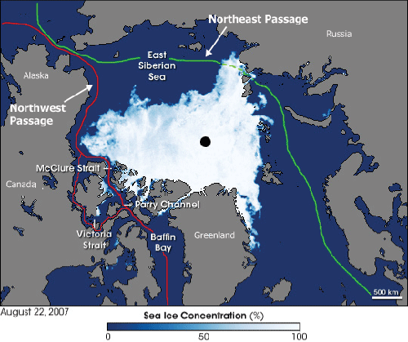
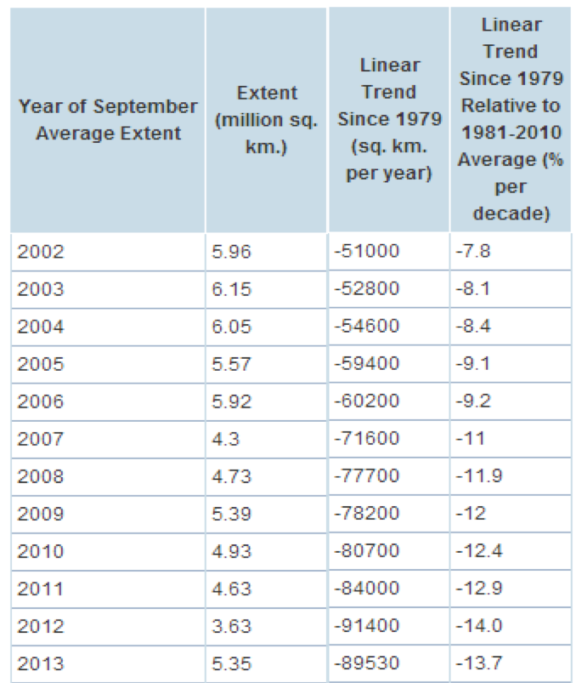
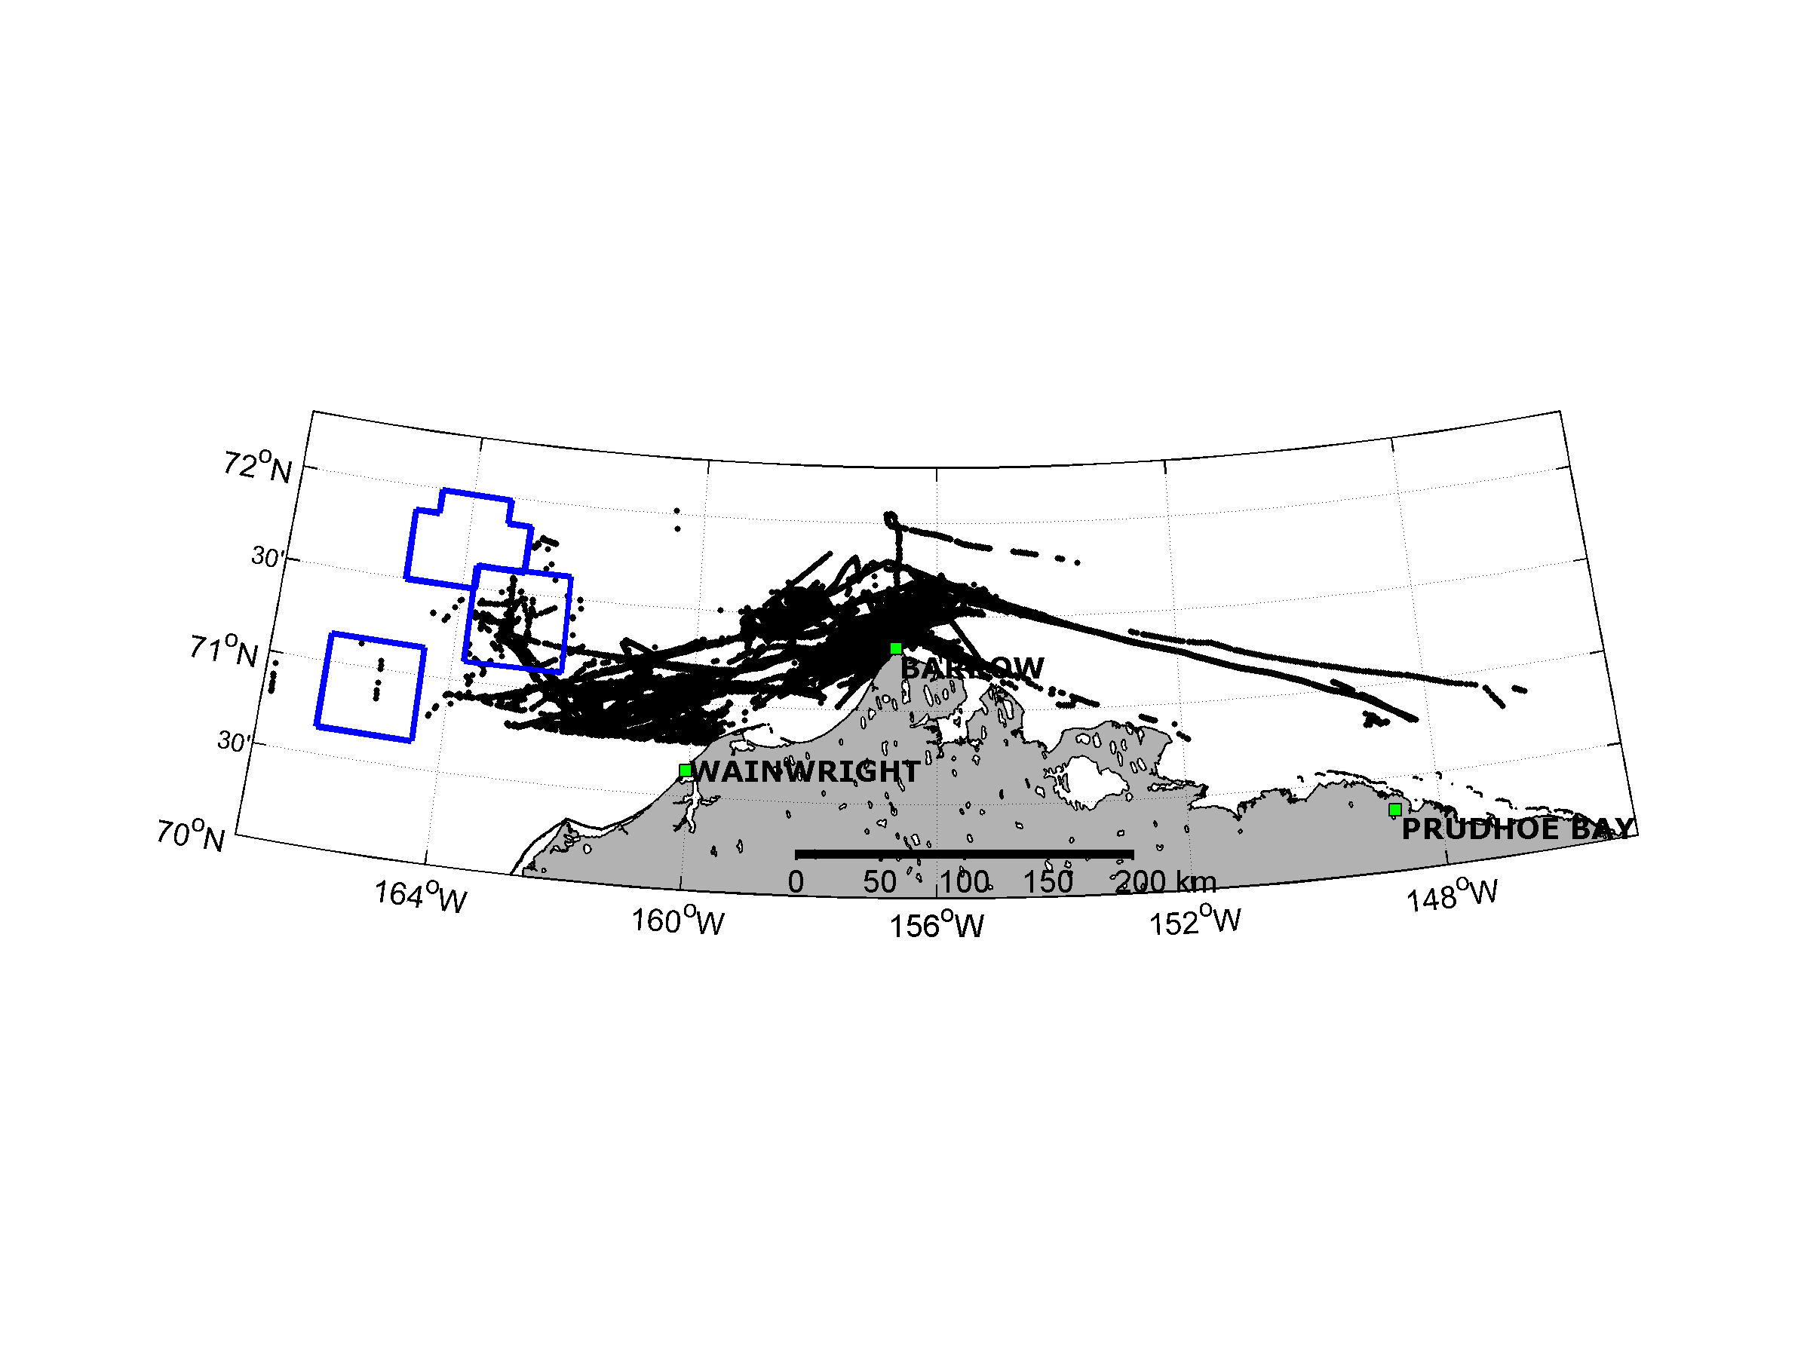
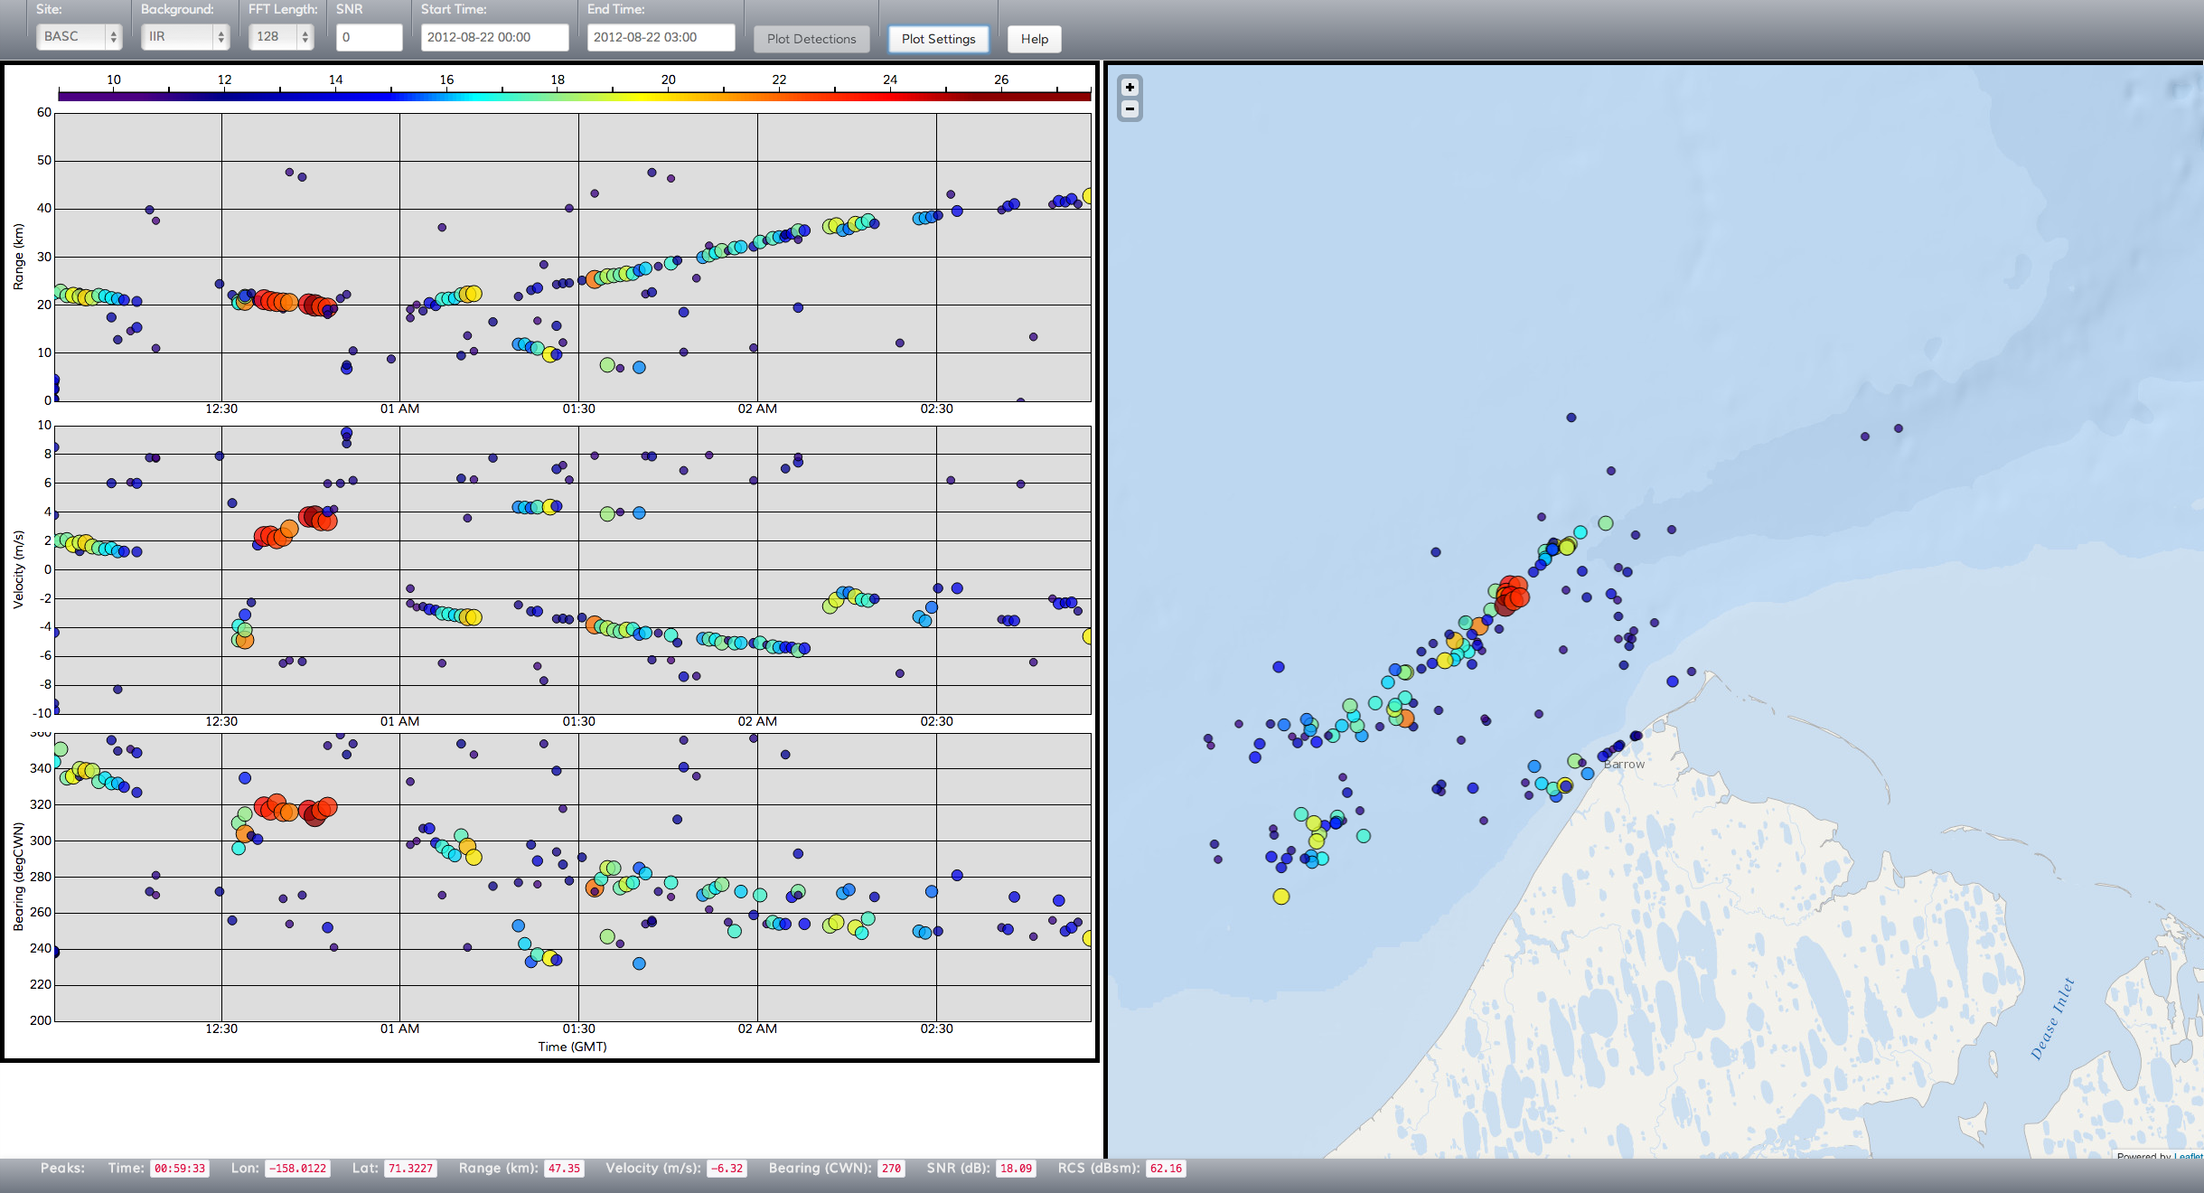
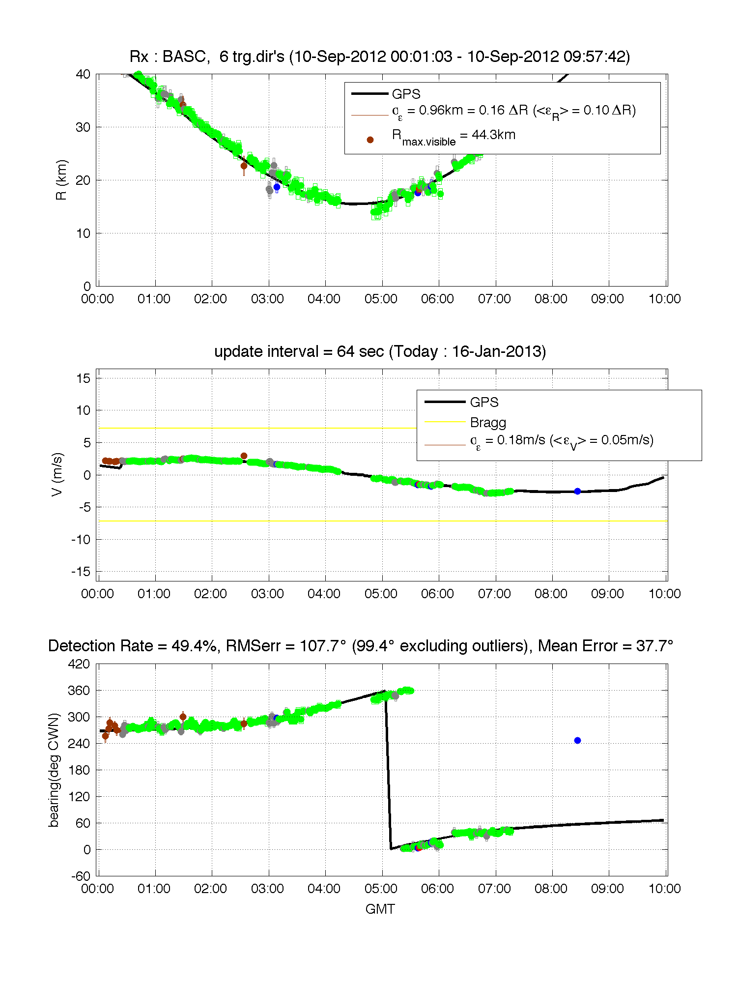
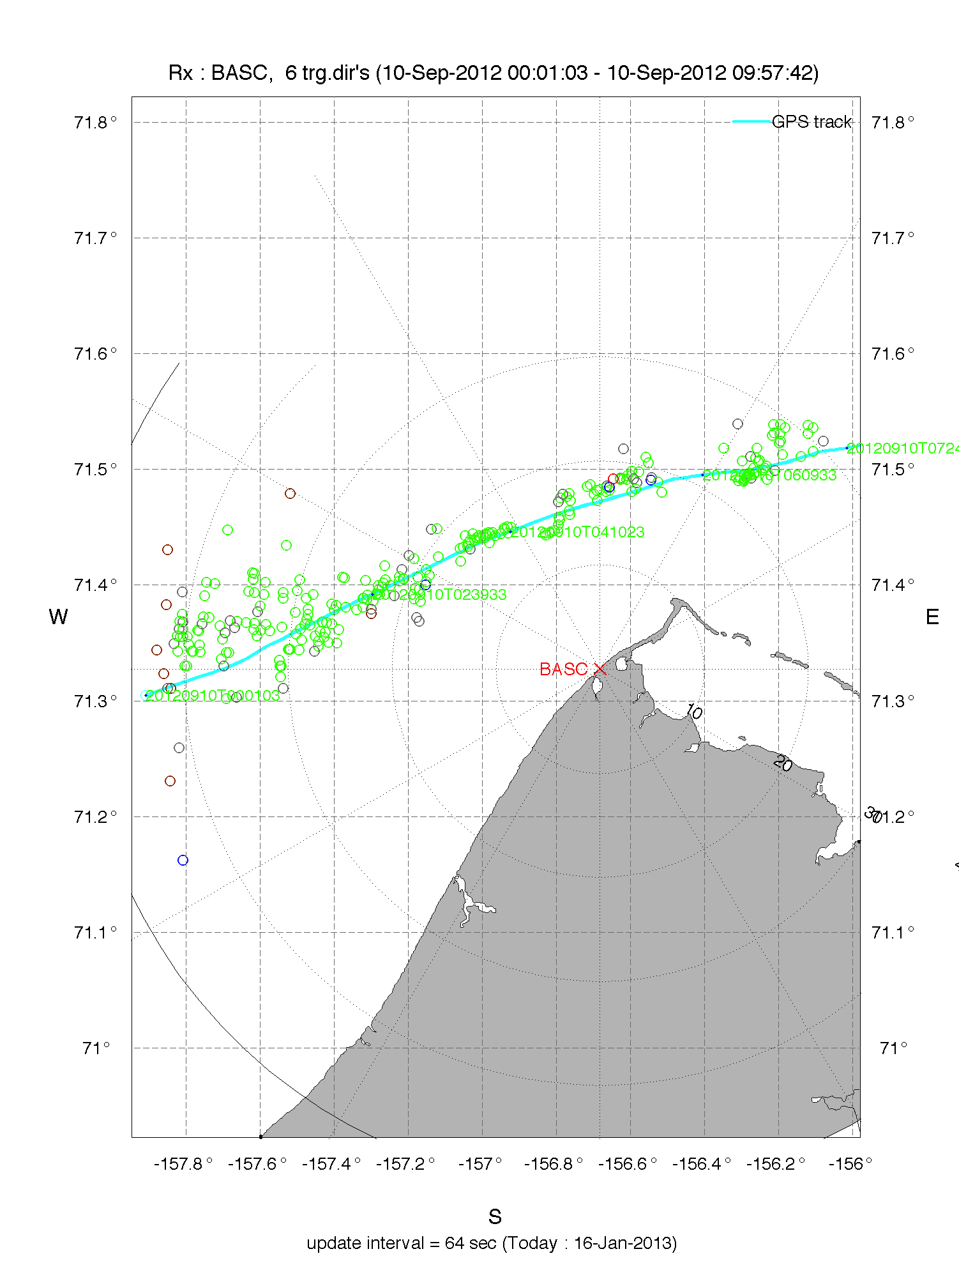
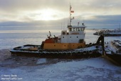
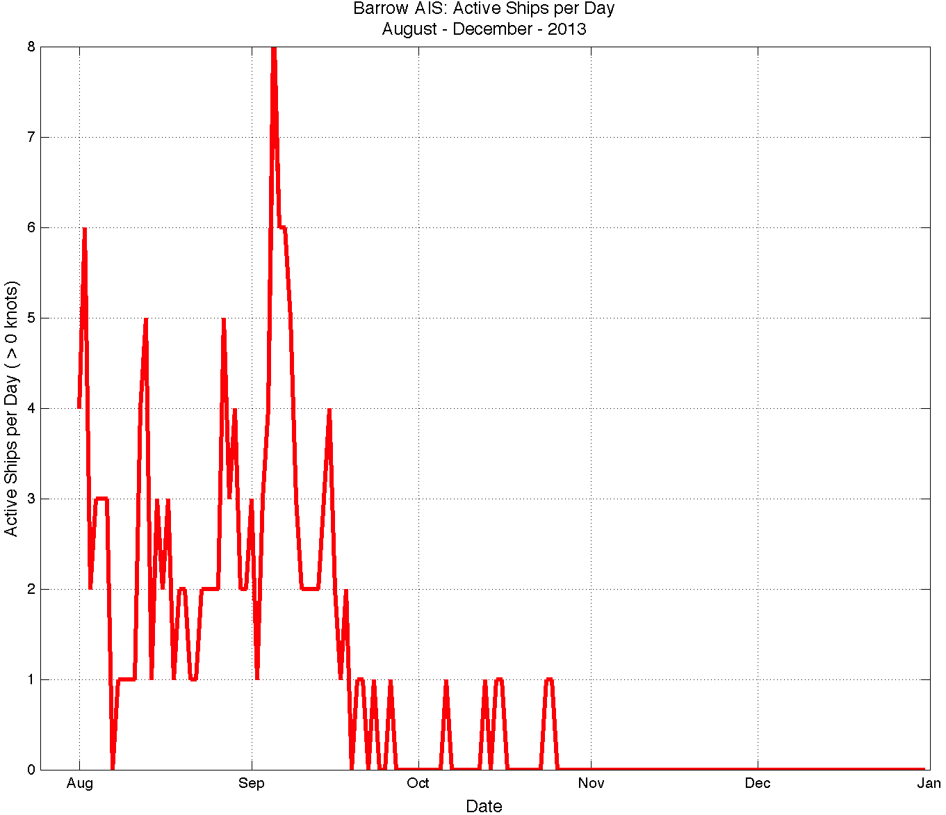
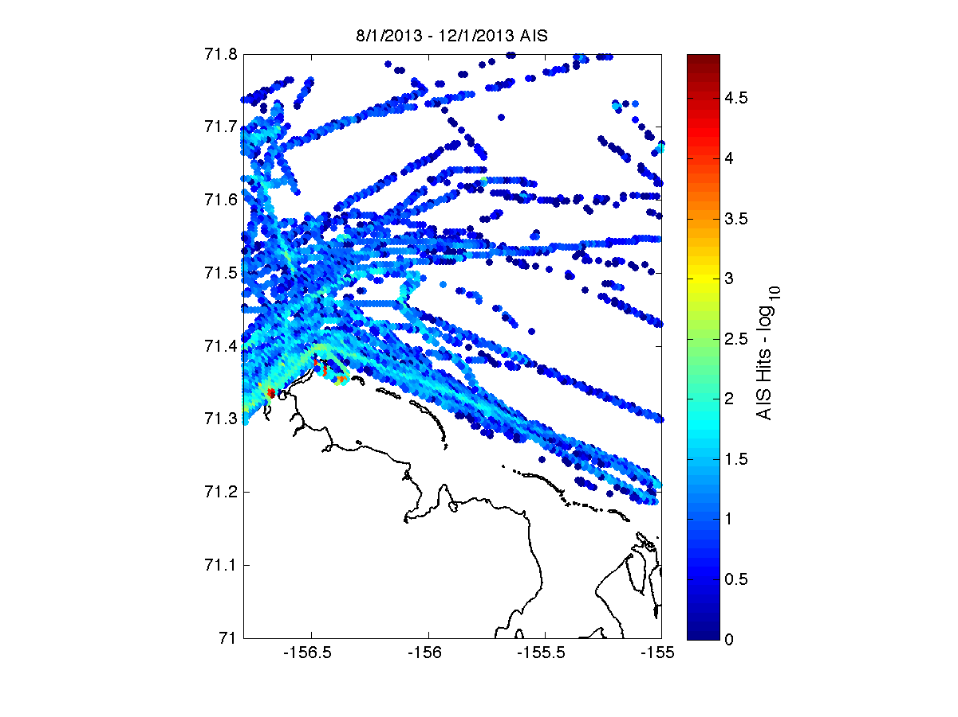
Real-time Vessel Detection on the North Slope of Alaska
Michael Smith¹, Collin Dobson¹, Hugh Roarty¹, Scott Glenn¹, Donald Barrick², Chad Whelan², Hank Statscewich³, Tom Weingartner³, Ed Page⁴
¹Rutgers University, ²Codar Ocean Sensors,. Inc., ^{3.}University of Alaska – Fairbanks, ⁴Marine Exchange of Alaska
Introduction
Arctic HF-Radar Testbed
Summer – Fall 2013
Remotely powered SeaSonde High Frequency (HF) radars were installed along the remote northwest corner of Alaska from July to December 2012 and 2013. These radars were able to make simultaneous measurements of ocean surface currents as well as measure the position and velocity of vessels passing by the radar. The ability to monitor traffic along the Northwest Passage is hindered by lack of sensors, communication, and power and this successful demonstration proves that HF radar can be a valuable tool for providing maritime domain awareness and persistent surveillance capabilities in the Arctic.
During the summer ice-free season, The University of Alaska - Fairbanks operates Long and Standard range CODAR SeaSonde High Frequency Radars along the North Slope of Alaska at Point Lay, Wainwright, Cape Simpson and Pt. Barrow. These high frequency radars are installed for the purpose of mapping ocean surface currents and wave heights.
Thirty-two vessels were analyzed as part of our study. Detected vessel sizes ranged from 19m to 190m in length. Approximately 70% of the vessels in site of the radar were detected by the HF Radar.
Point Barrow
Cape Simpson
Wainwright
Point Lay
Figure 4: Locations of all the UAF SeaSonde systems.
A.
B.
Vessel detection software from CODAR Ocean Sensors was installed between July and December in 2012 and 2013, running real-time in parallel with current mapping software on the SeaSonde radars. In 2012, PeakPicker vessel detection software was installed at the BASC 5 MHz and PBRW 25 MHz sites located in Barrow, Alaska. In 2013, the software was installed at PBRW 5 MHz site located in Barrow, Alaska and the SIMP 5 MHz site located in Cape Simpson, Alaska. These sites were able to simultaneously generate measurements of ocean surface currents along with vessel detections.
Figure 6: PeakPicker data compared to the GPS track of the tugboat, Nunaniq.
One excellent example that showed the benefits of the real-time dual use capability of the SeaSonde HF Radar was the vessel, Nunaniq. In figure 6B, the AIS of the Nunaniq was either not picked up or turned off about 20 km from the receiver. The PBRW radar system was able to detect the vessel out to approximately 90km, well beyond the distance where the AIS lost communication with the vessel.
The real-time dual use capability of the SeaSonde HF radar provides an ability to assess environmental security and shipping activity in a manner that reduces risk and enhances response.
A.
B.
Figure 1: September Sea-ice Extents – In the summer of 2007 vessels could transit the Northwest Passage without the need of an icebreaker. By 2040, the Northwest Passage may be entirely ice-free during the summer.
Results
Known Vessel Traffic in the Arctic
Vessels were analyzed based on periods of high traffic. Vessel detection was based on three observables, range, range rate, and bearing. The vessel detection data was compared against ground truth AIS data. During both years, the sea ice retreated late during the summer, allowing vessels to transit through Barrow Canyon until November.
Real-time Display
Summer – Fall 2012
Figure 2: AIS Data from August 10th, 2012 – September 10, 2012
Figure 7: Real-time vessel detection display on the web using d3.js. The data is uploaded in real-time to a MySQL database where it is accessed by this JavaScript based tool.
Acknowledgement. “This material is based upon work supported by the U.S. Department of Homeland Security under Grant Award Number 2008.ST-061-ML0001.”
Disclaimer. “The views and conclusions contained in this document are those of the authors and should not be interpreted as necessarily representing the official policies, either expressed or implied, of the U.S. Department of Homeland Security.”
Figure 5: PeakPicker data compared to the GPS track of the tugboat, Point Oliktok.
A.
B.
Fourteen vessels were analyzed as part of our study. The average detection rate during the study was 51% with a maximum of 88% for the ice breaker USCG Healy on August 22nd. data. The maximum detection range was 82 km.
Figure 3: AIS Data from August – December 2013. Figure B shows the activity of vessels through time. Vessel activity picked up in mid-August and decreased in mid-September. Figure B shows the prevalence of ships at specific locations on a map

