Slide 1
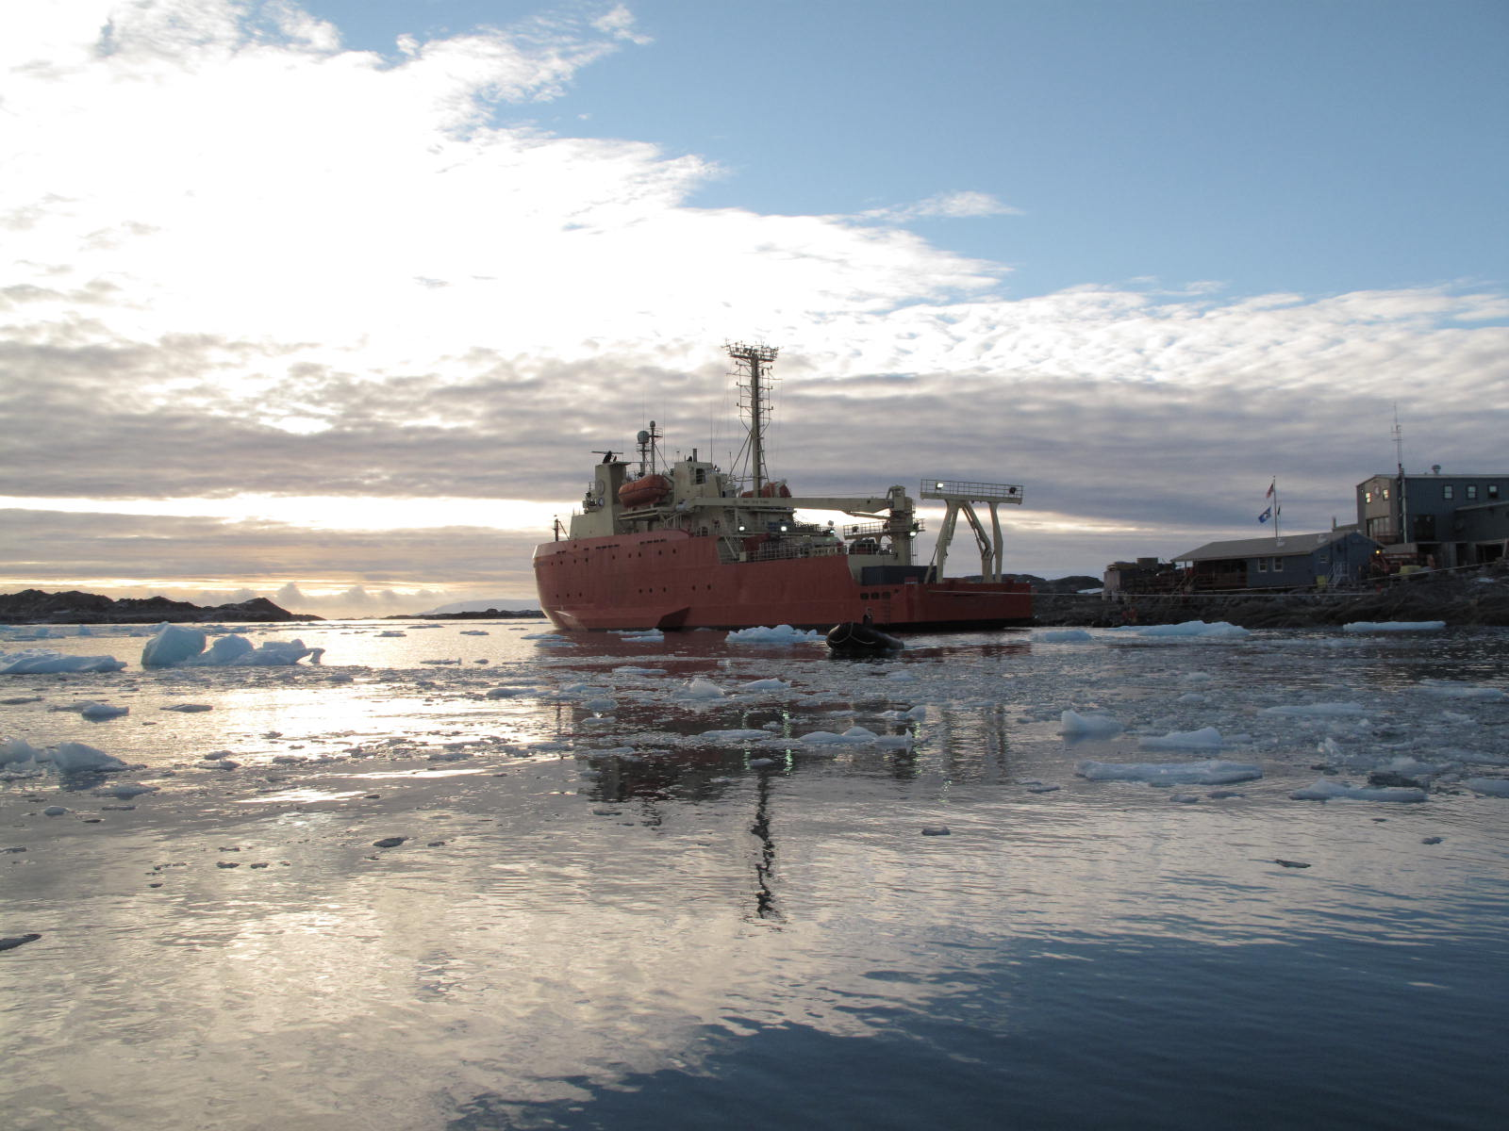
SOOS Working Groups and Pilot Programs
What is a SOOS working group? What is a SOOS pilot program?
What is their relationship? What are the steps from
Working group to pilot program?

Slide 2
Philosophy
BE AS OPEN AS POSSIBLE TO THE WIDEST CROSS SECTION AS POSSIBLE ESPECIALLY IN THE EARLY YEARS
Enable “grass-roots” working groups. Goal to develop wider community contribution by developing intellectual home for critical parts of SOOS. Working groups should be sharing results, materials, and provide feedback to SOOS. Working groups do not necessarily have a specific life time, as it can be an intellectual or development group. SOOS could assist in outreach to potential members for a Working group across the international community. Groups might reach out for SOOS assistance in raising funding, venues to access, etc.
Should working groups be approved by SSC? Yes
Ensures working groups have enough specificity so as to be a specific contribution
Not redundant with other working groups, if so it might be asked to join a working group
Has an international cross-section to ensure it fulfills SOOS goals
Small groups with great ideas could be a working group
Working groups could have a regional focus, technical focus, process focus, education/outreach focus, cyberinfrastructure/data focus
Goal of Working group? Develop either a product of high value and/or provide a basis for a program that might be funded by national programs and/or foundations, etc.

Slide 3
Candidate Working Groups?
Sea-Ice Working group (lead, team?)
eEOV work groups (3) (SSC lead, team?)
Data management group (lead, team?)
Regional groups (WAP, Scotia Arc, Ross Sea, Amundsen working group, Indian sector, Weddell working group) (leads, teams?)
Satellite working group (lead, team?)
SO Education working group (lead, team?)
Missing WG? What which ones do we need?
Can flesh out so readily locatable via the web site?

Slide 4
Pilot Programs are the deployment of SOOS, how do we define and assist in deployments?
Pilot programs. Pilot programs deploy ocean observing systems to meet the varied science themes identified by SOOS. The pilot programs span the flagship, enhanced regional and regionally constrained programs. As SOOS is not a funding agency, the sequencing of these projects will be dependent on the national funding agencies. SOOS will hopefully enable those researchers develop pilot program, through the development of the useful working group products, external recognition of the critical need for the program, and assist in the outreach and coordination between national efforts.
What might make a field program a SOOS project?
Measures key eEOV variables
Open access data?
Has an international cross-section to ensure it fulfills SOOS goals
Addresses key science themes with SOOS science plan
Through a maturing cyberinfrastructure provide a toolbox to allow pilot program coordination, outreach, and open access to community data synthesis.
Candidate Pilot Programs?

Slide 5
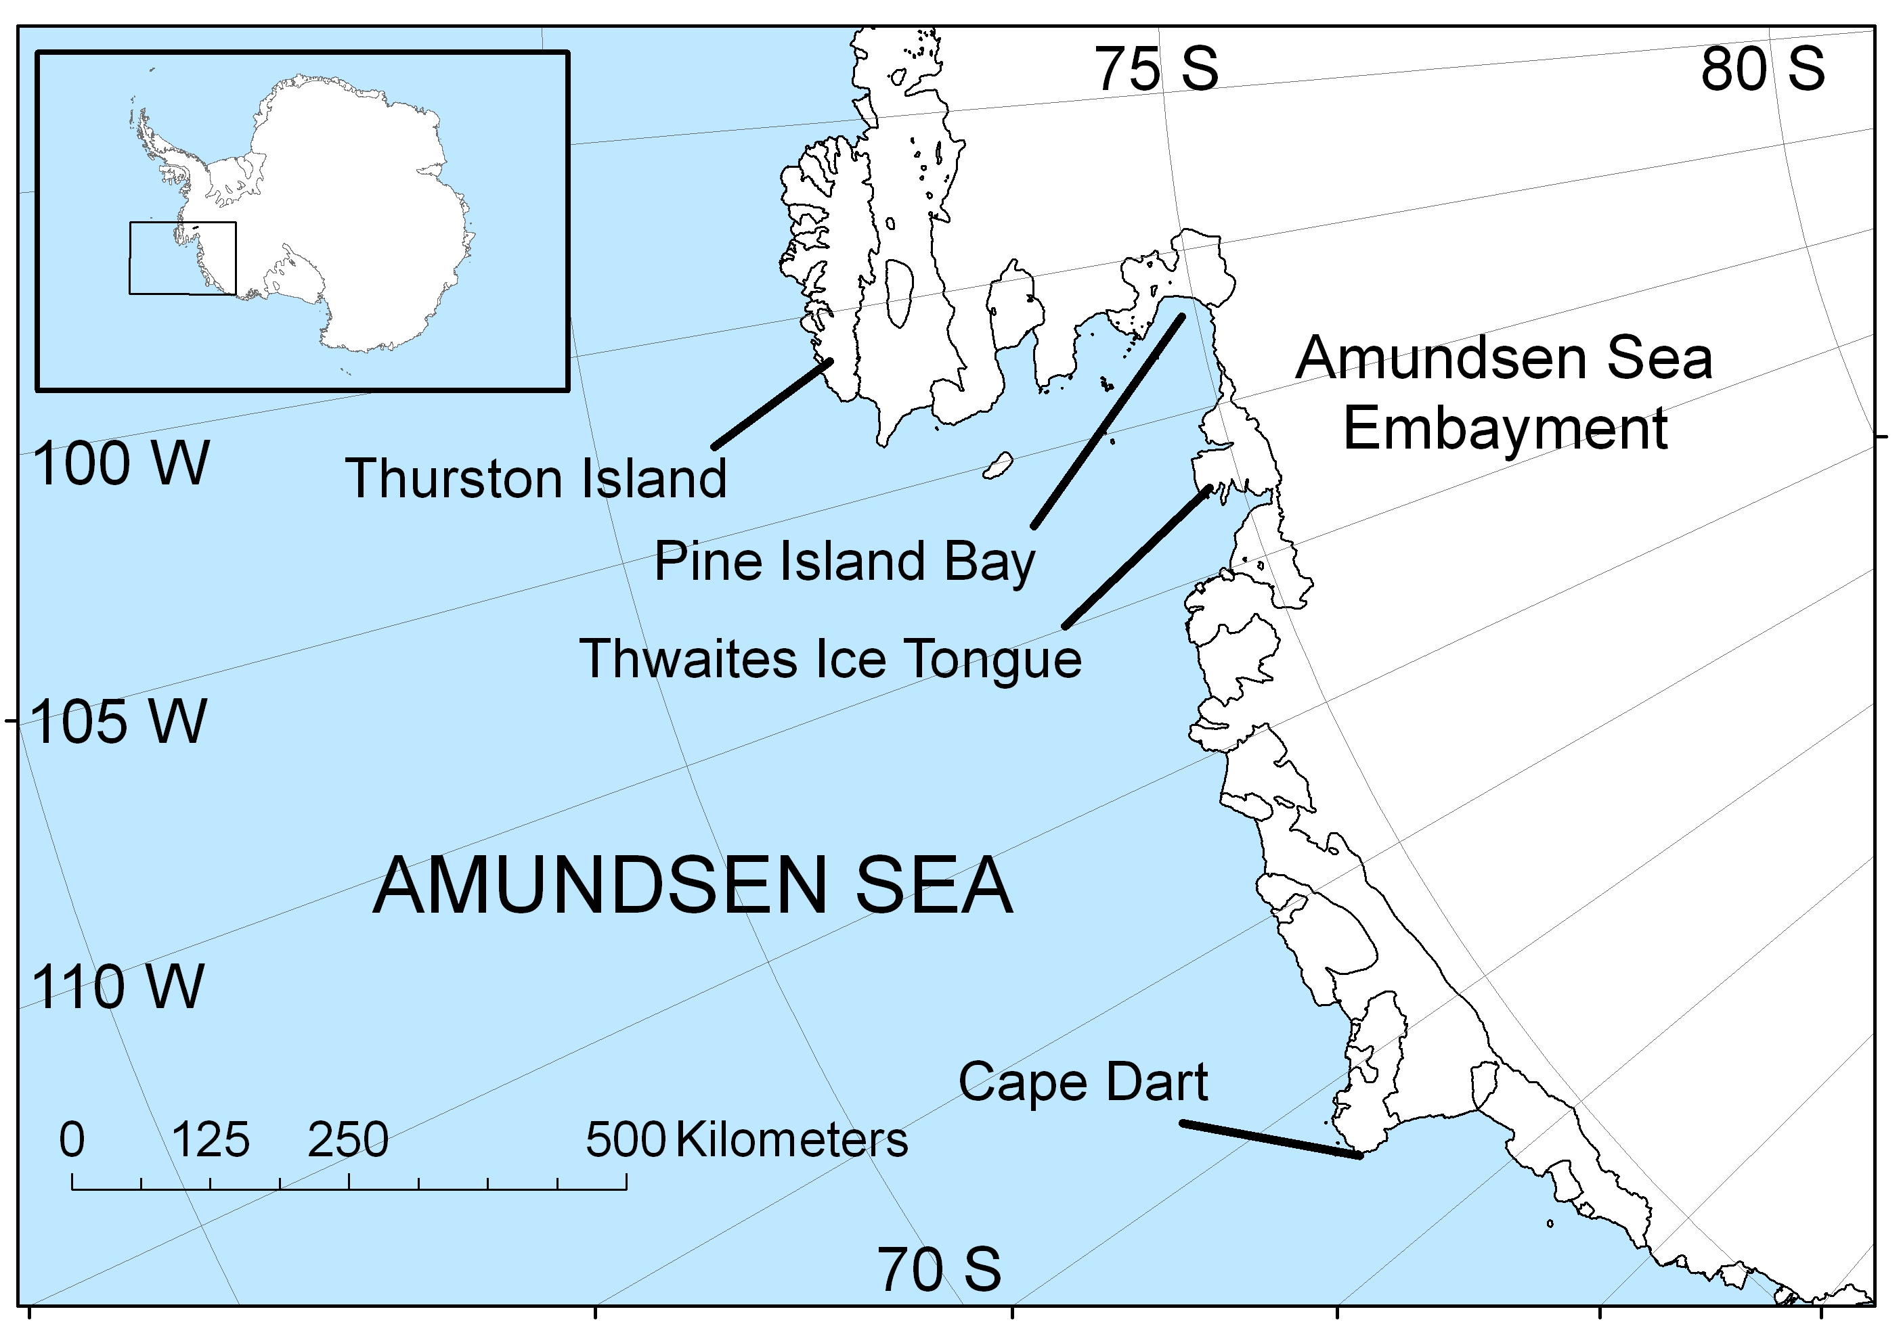
Flagship Projects: Focused on a chronically under-sampled region, little or no existing infrastructure, extensive international coordination of logistics required.
Benefits: As little is known about the region, any level of observation enhancement will significantly increase our understanding
Amundsen Sea
3rd largest ice drainage basin of WAIS
Area of high primary production in polynyas
Significant glacial retreat and melt input, and decrease in sea-ice extent.
Region may be a weak link in stability of WAIS.
No Antarctic bases nearby, no regular ship transects – therefore logistically demanding
Researchers from a number of nations now looking to enhance observations in this critical area – will need significant logistical and operational support

Slide 6
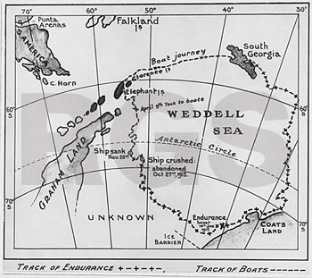
Flagship Projects: Focused on a chronically under-sampled region, little or no existing infrastructure, extensive international coordination of logistics required.
Benefits: As little is known about the region, any level of observation enhancement will significantly increase our understanding
Weddell Sea
Critical region for thermohaline circulation
Important region to understand sea ice-ice sheet dynamcis
Limited access and very difficult operating area
Researchers (AWI particularly interested) from a number of nations now looking to enhance observations in this critical area – will need significant logistical and operational support

Slide 7
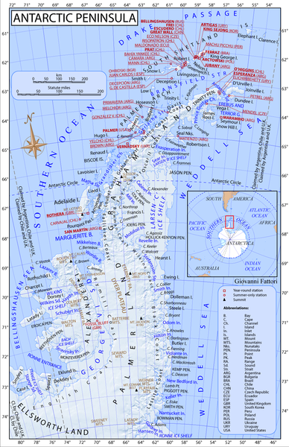
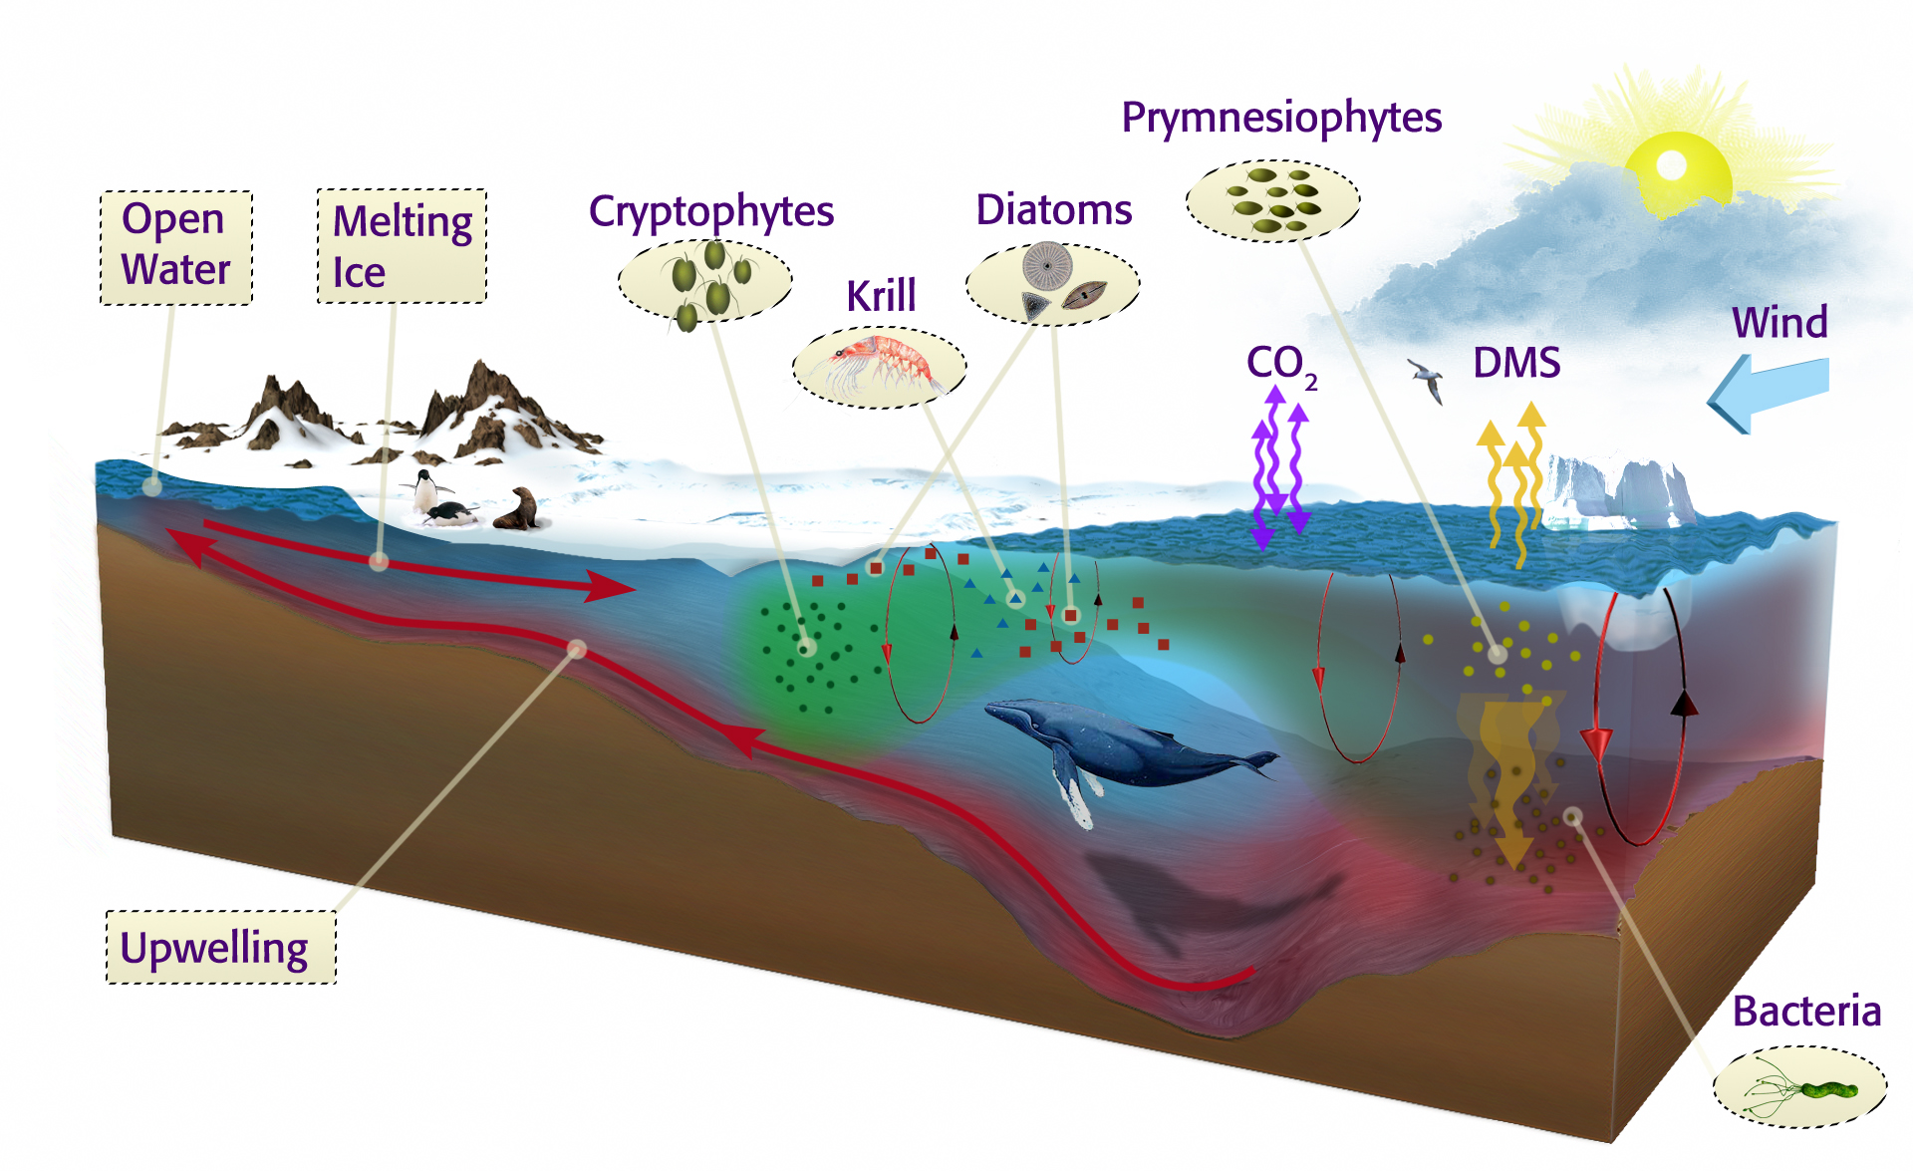
Enhanced Regional Study: Focused on a region with significant history of observations, has existing infrastructure and potential for many nations to be involved.
Benefits: Logistically “easy”, high potential to push the envelope with regard to the technology, will provide a “test-case” for SOOS vision
Antarctic Peninsula
Significant levels of infrastructure present
Many nations already work in region, therefore many international efforts that can be pulled together
Area of rapid change from physics to ecosystems driven by deep ocean.
Region of rapid climate change

Slide 8
Regionally Constrained Study: Region is constrained by unique physical feature, important biological/chemical/physical problems, variable logistical cooperation required.
Benefits: Logistical considerations are secondary, driven by a specific science question
Kerguelen Plateau – Ecosystem Study
Iron fertilisation from Plateau driving observed variability in productivity
Transects designed to sample upstream, on and downstream of the Kerguelen Plateau
Current project plans are ecosystem-based, but huge potential for international collaboration for a total-system study
Micronutrient control with potential geoengineering considerations
Mean Chlorophyll-a

Slide 9
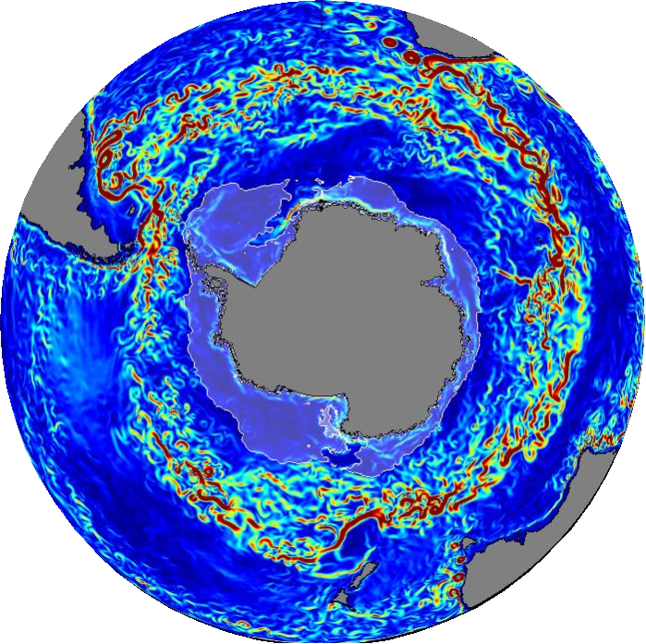
Regionally UnConstrained Study: Region is constrained by unique physical feature, important biological/chemical/physical problems, variable logistical cooperation required.
Benefits: Logistical considerations are secondary, driven by a specific science question
Circumpolar Circulation and Carbon Dynamics
Circulation drives heat budget of coastal sreas around the continent
Disproportionately important for global carbon dynamics
Critical to global climate system
SOCUM would not qualify as a pilot program alone as it a single nation contribution?

