Slide 1
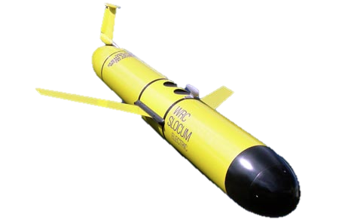
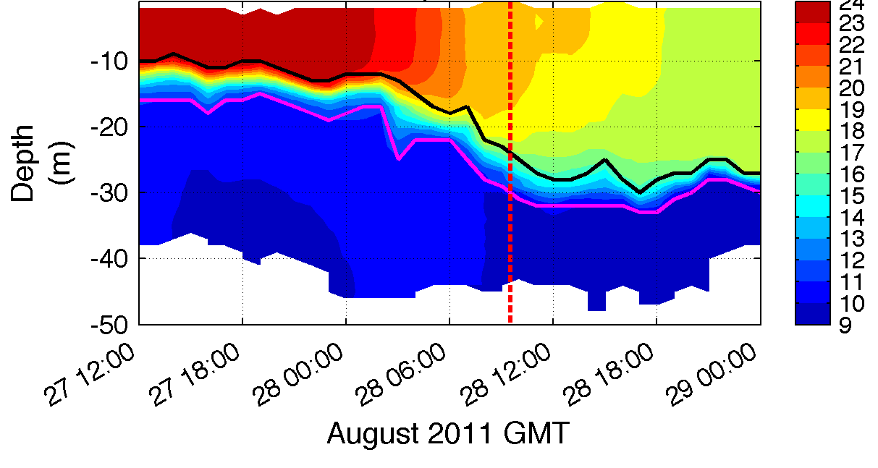
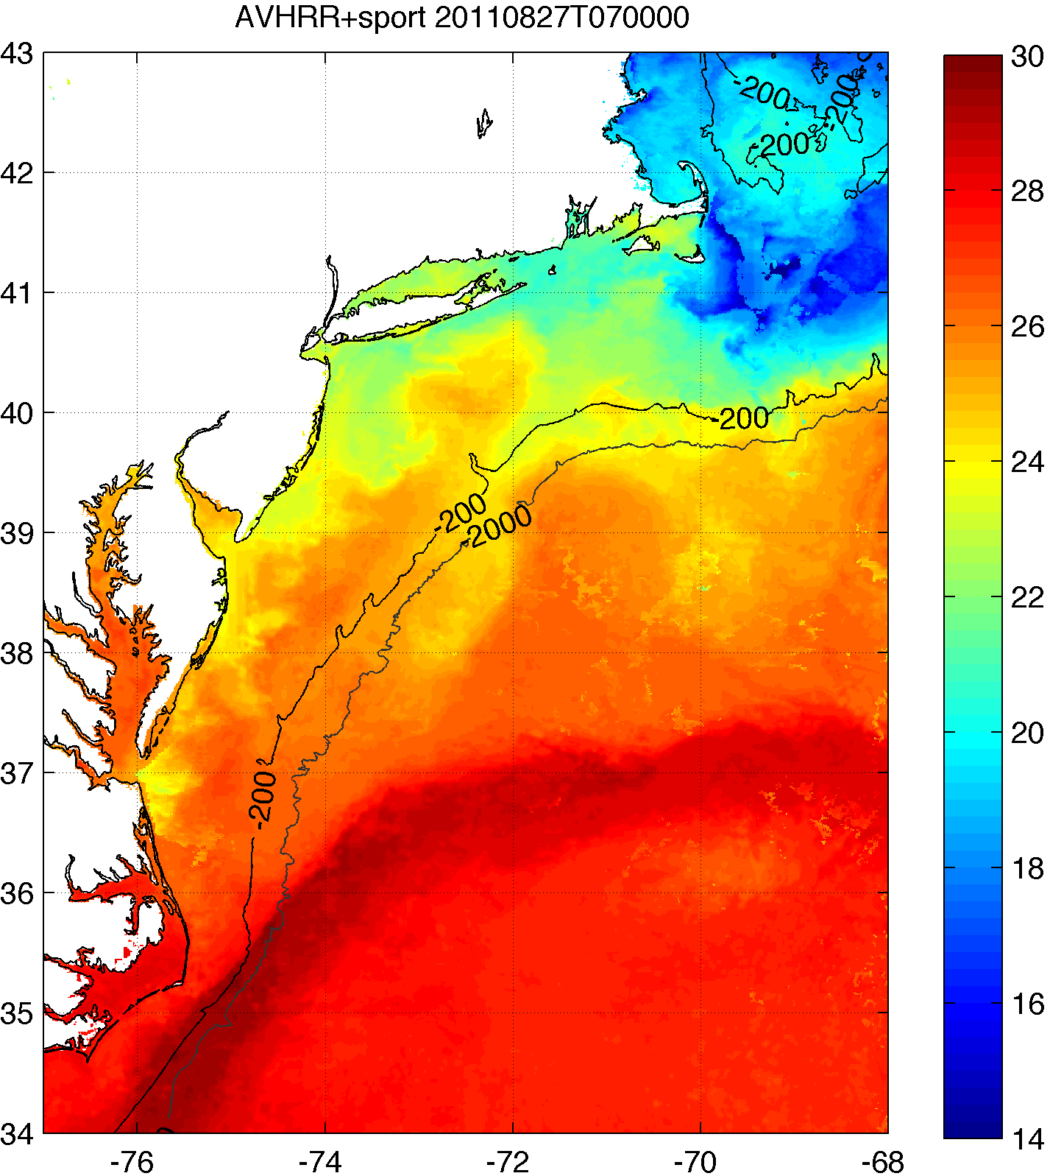
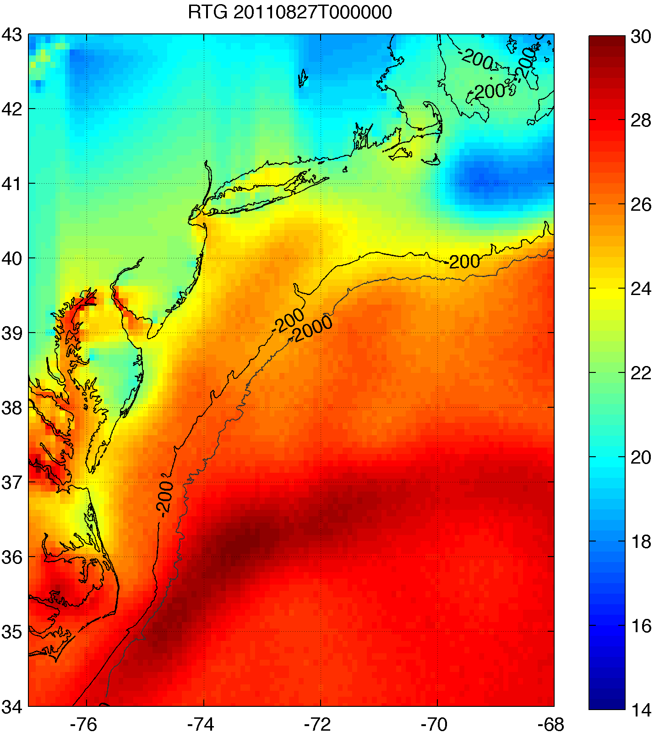
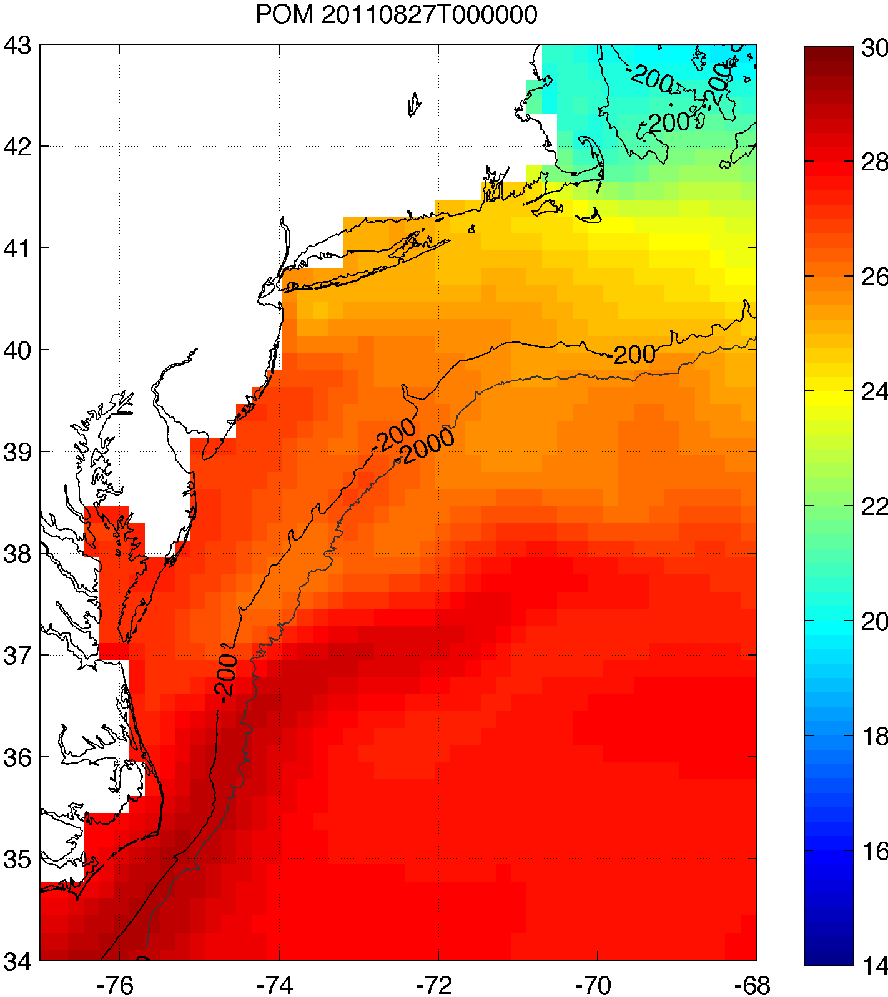
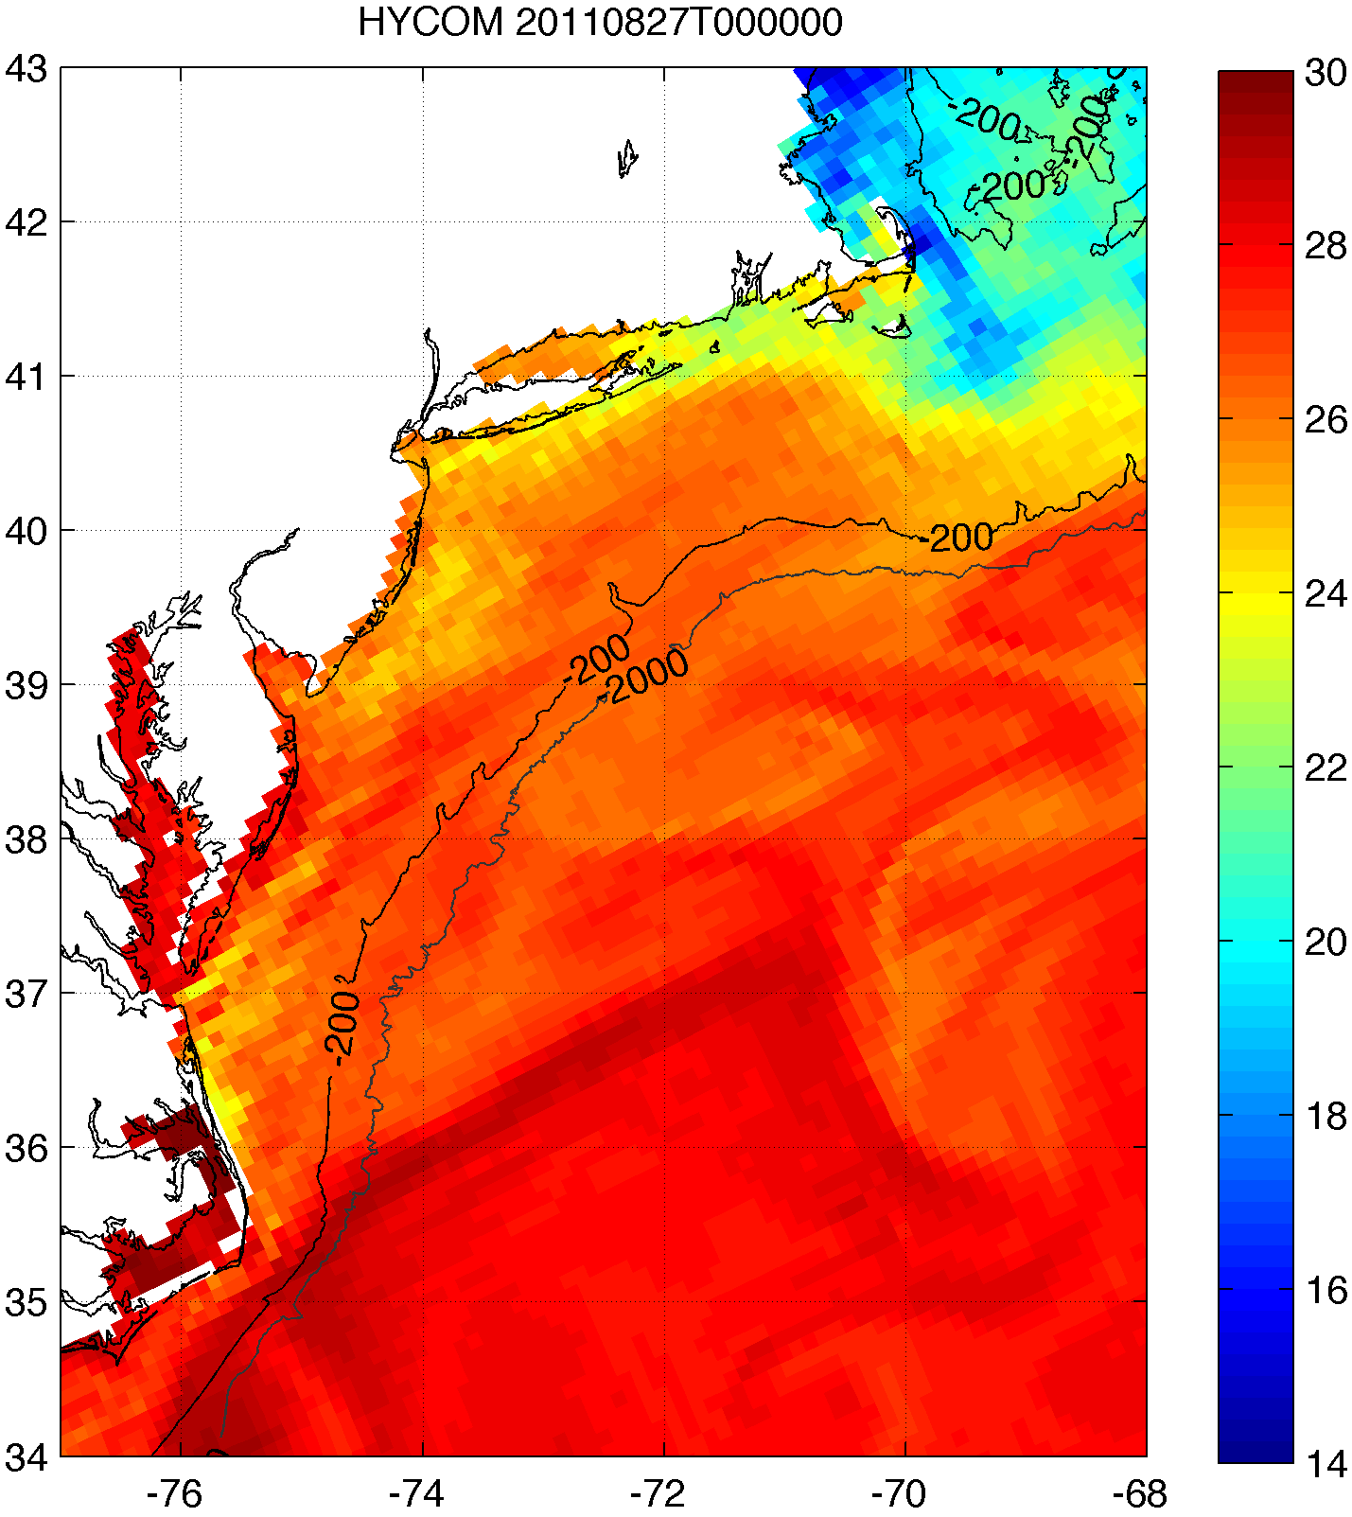
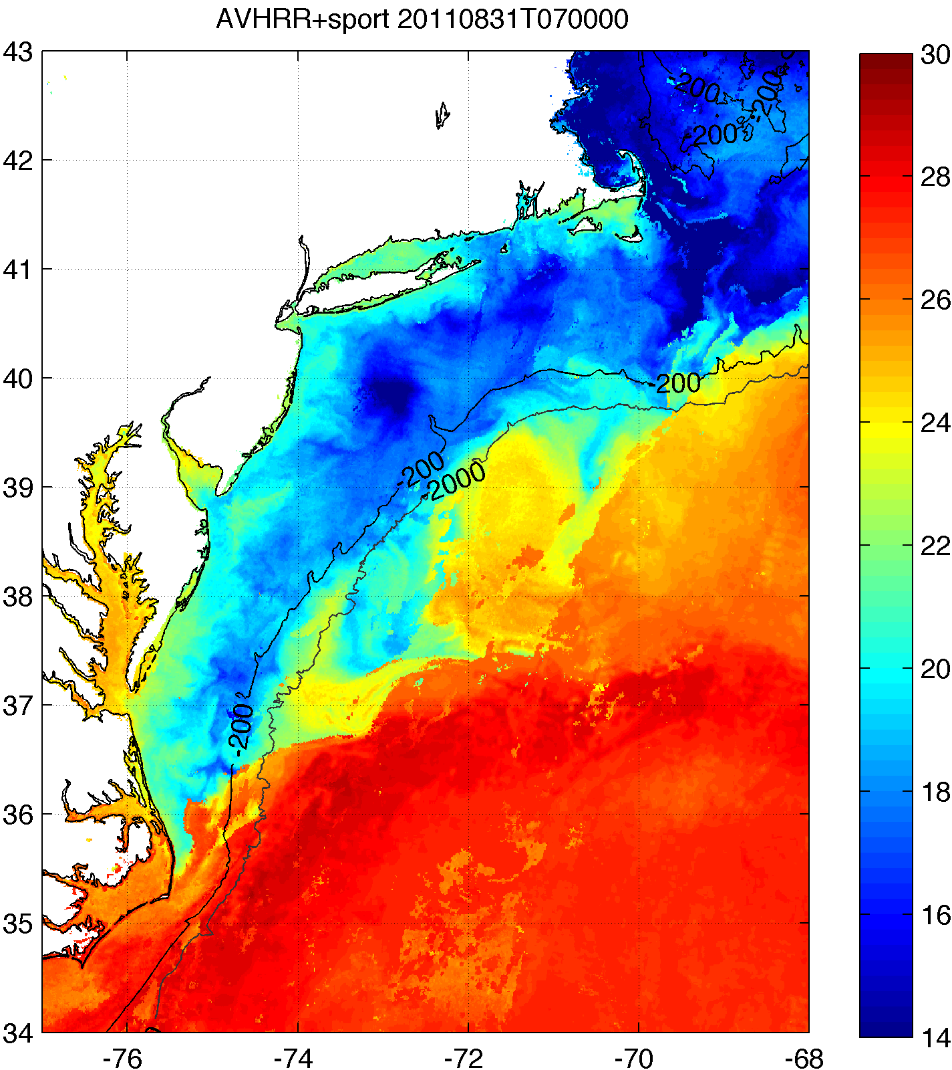
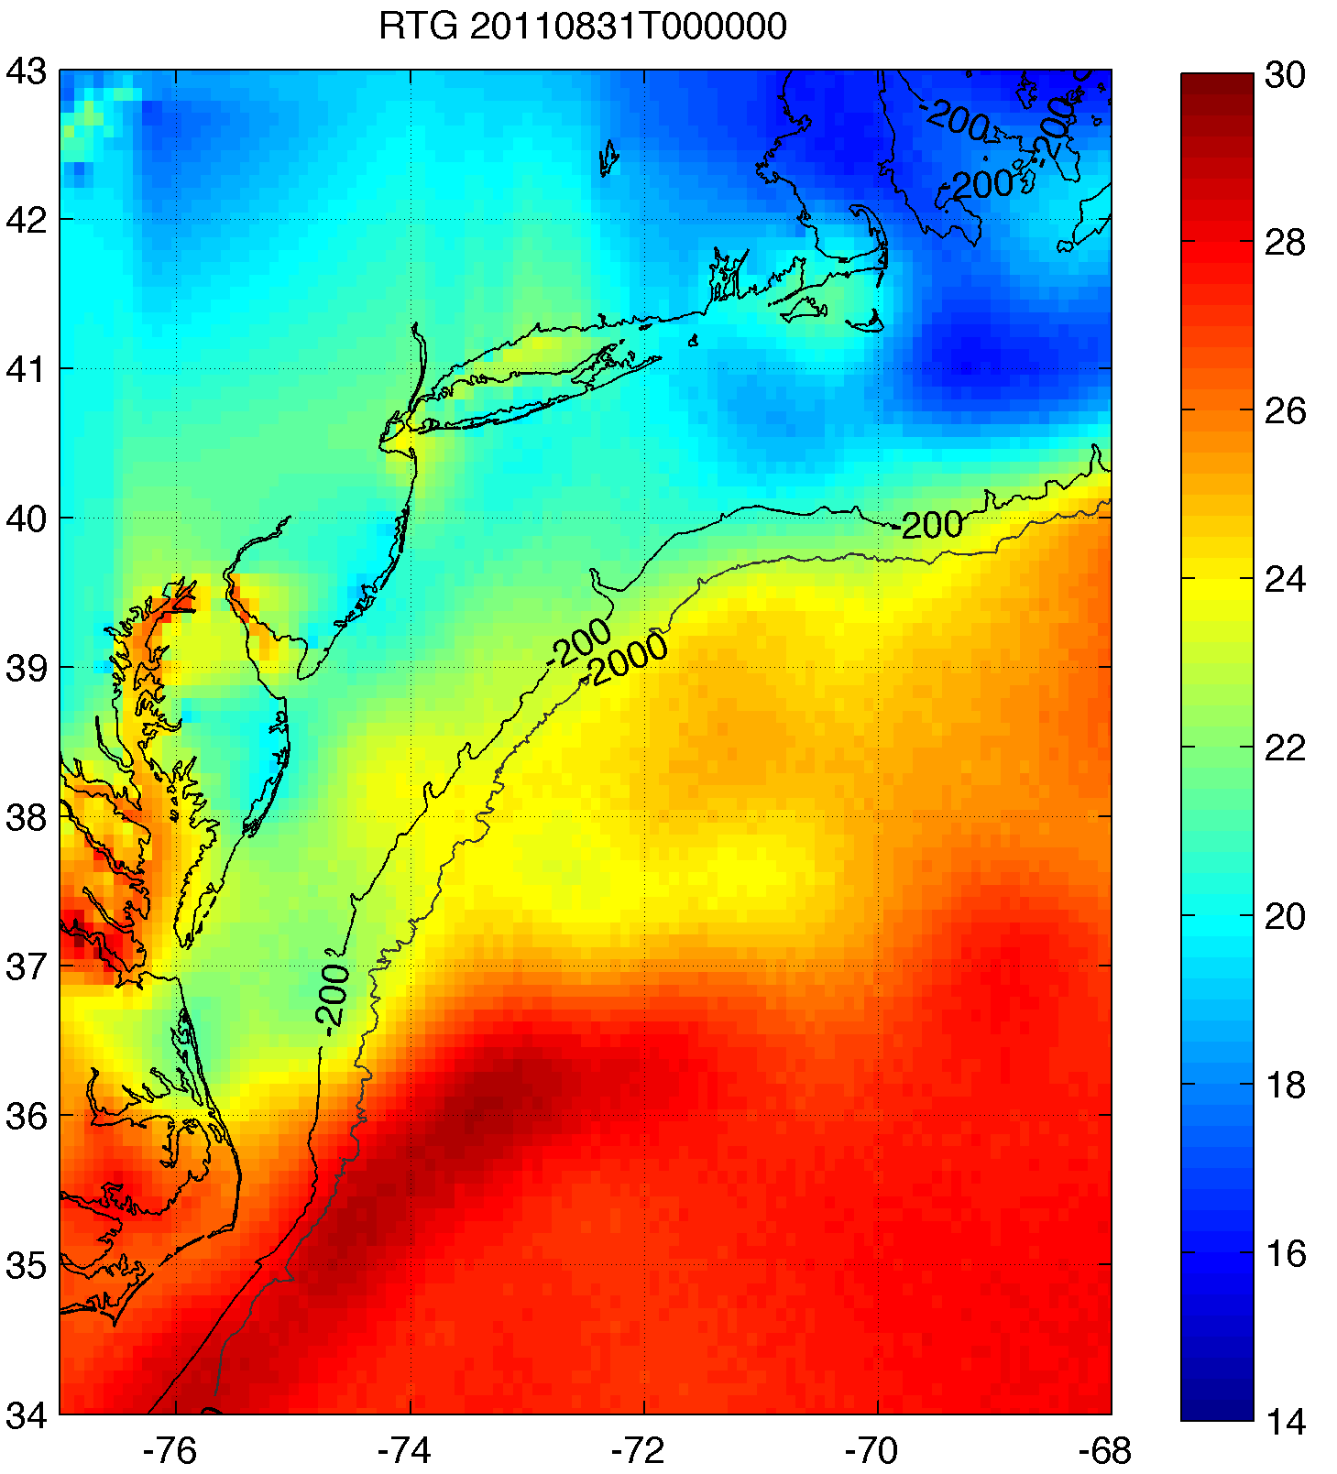
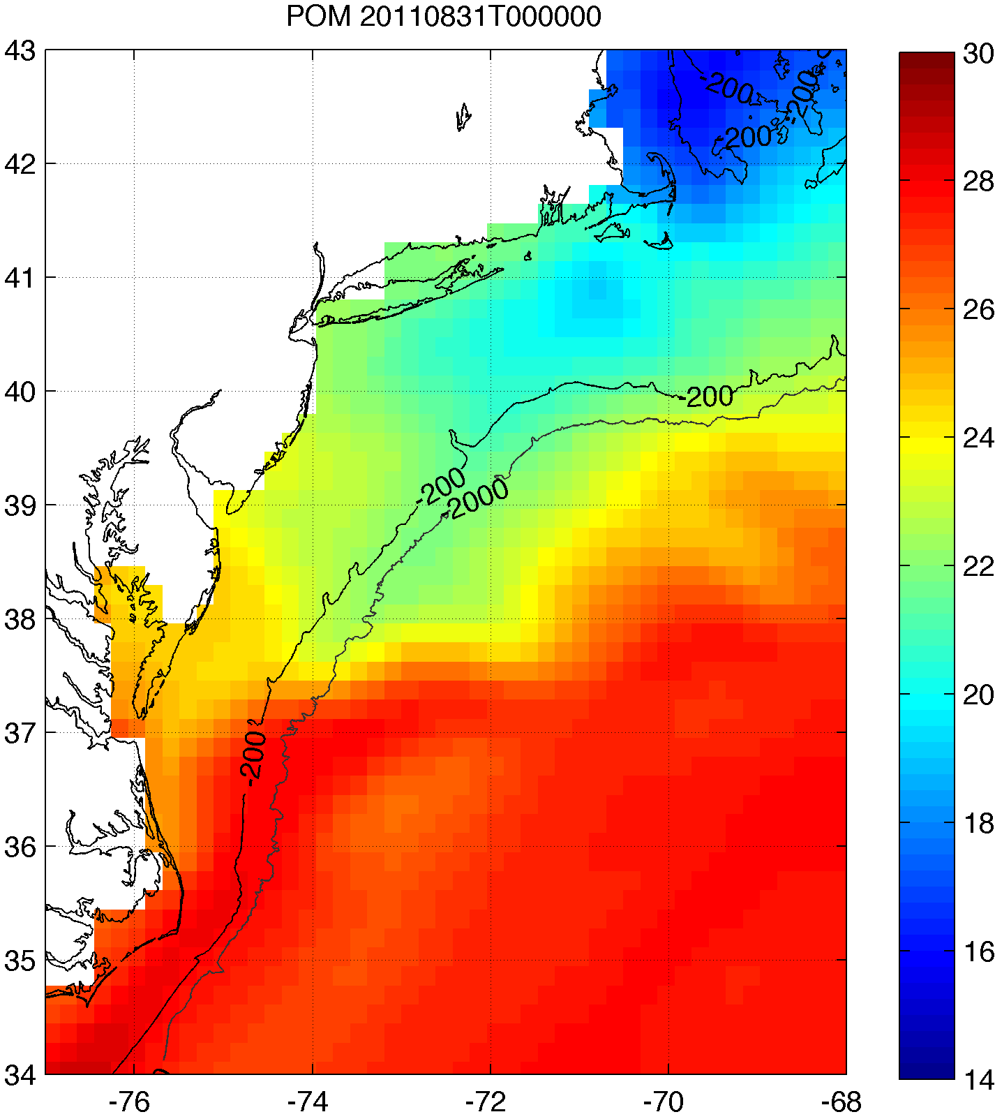
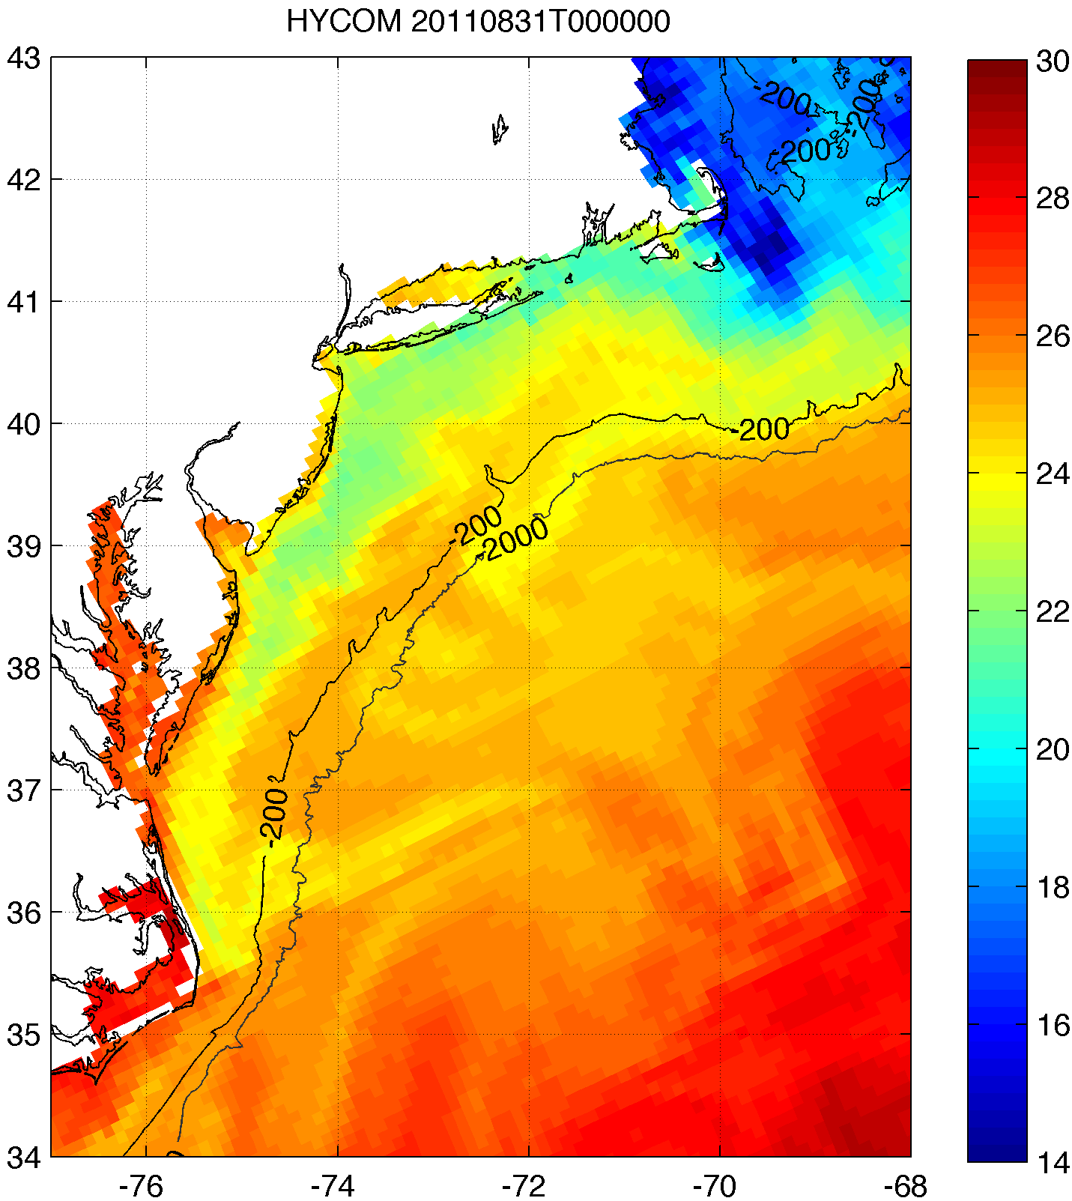
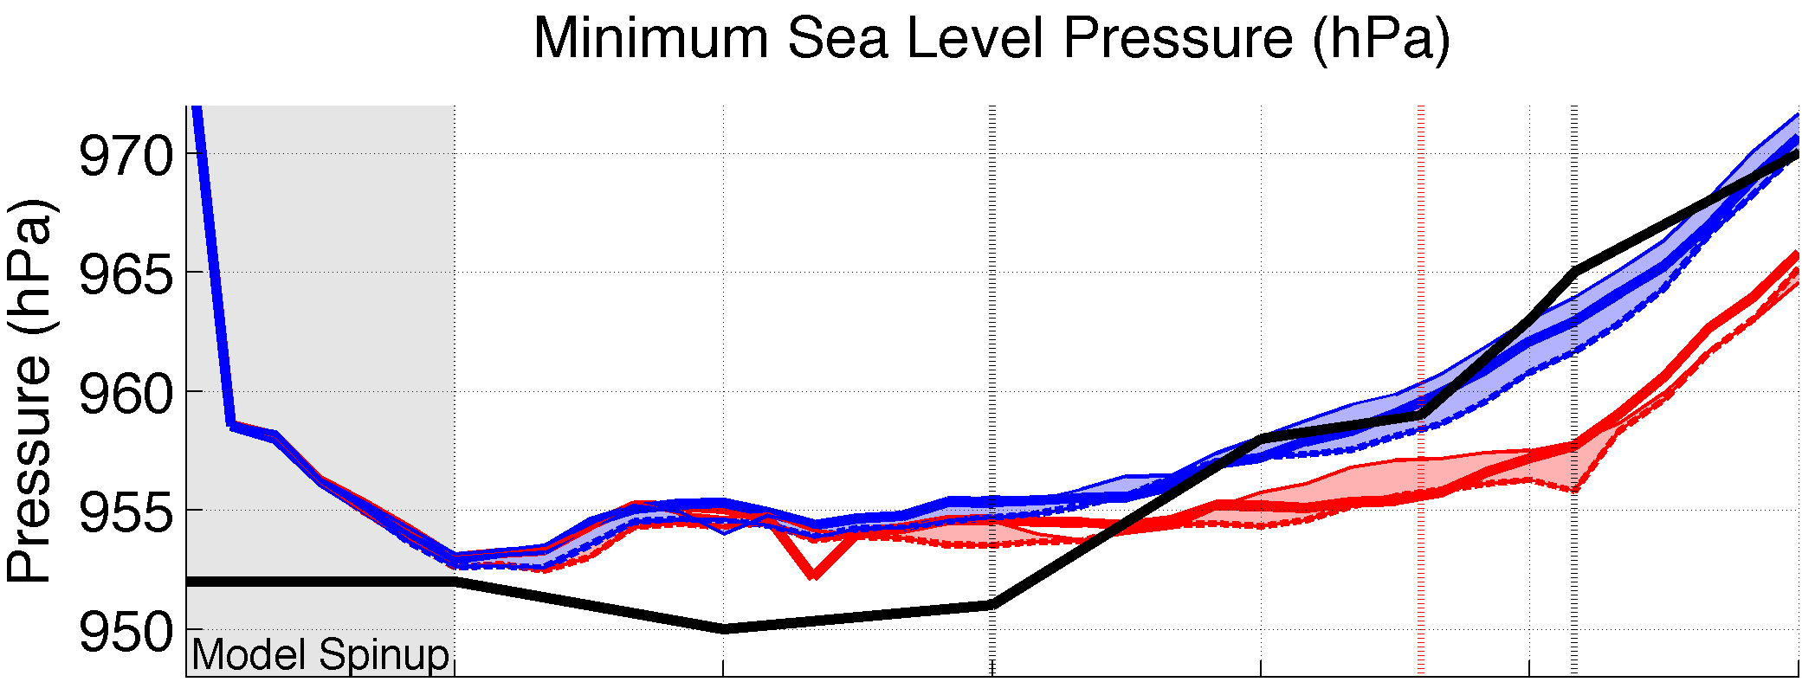
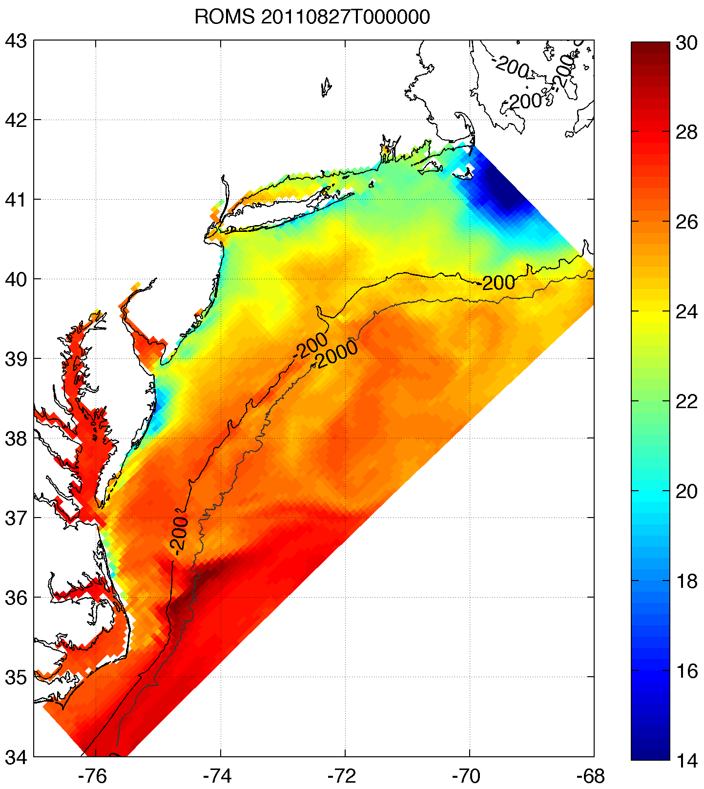
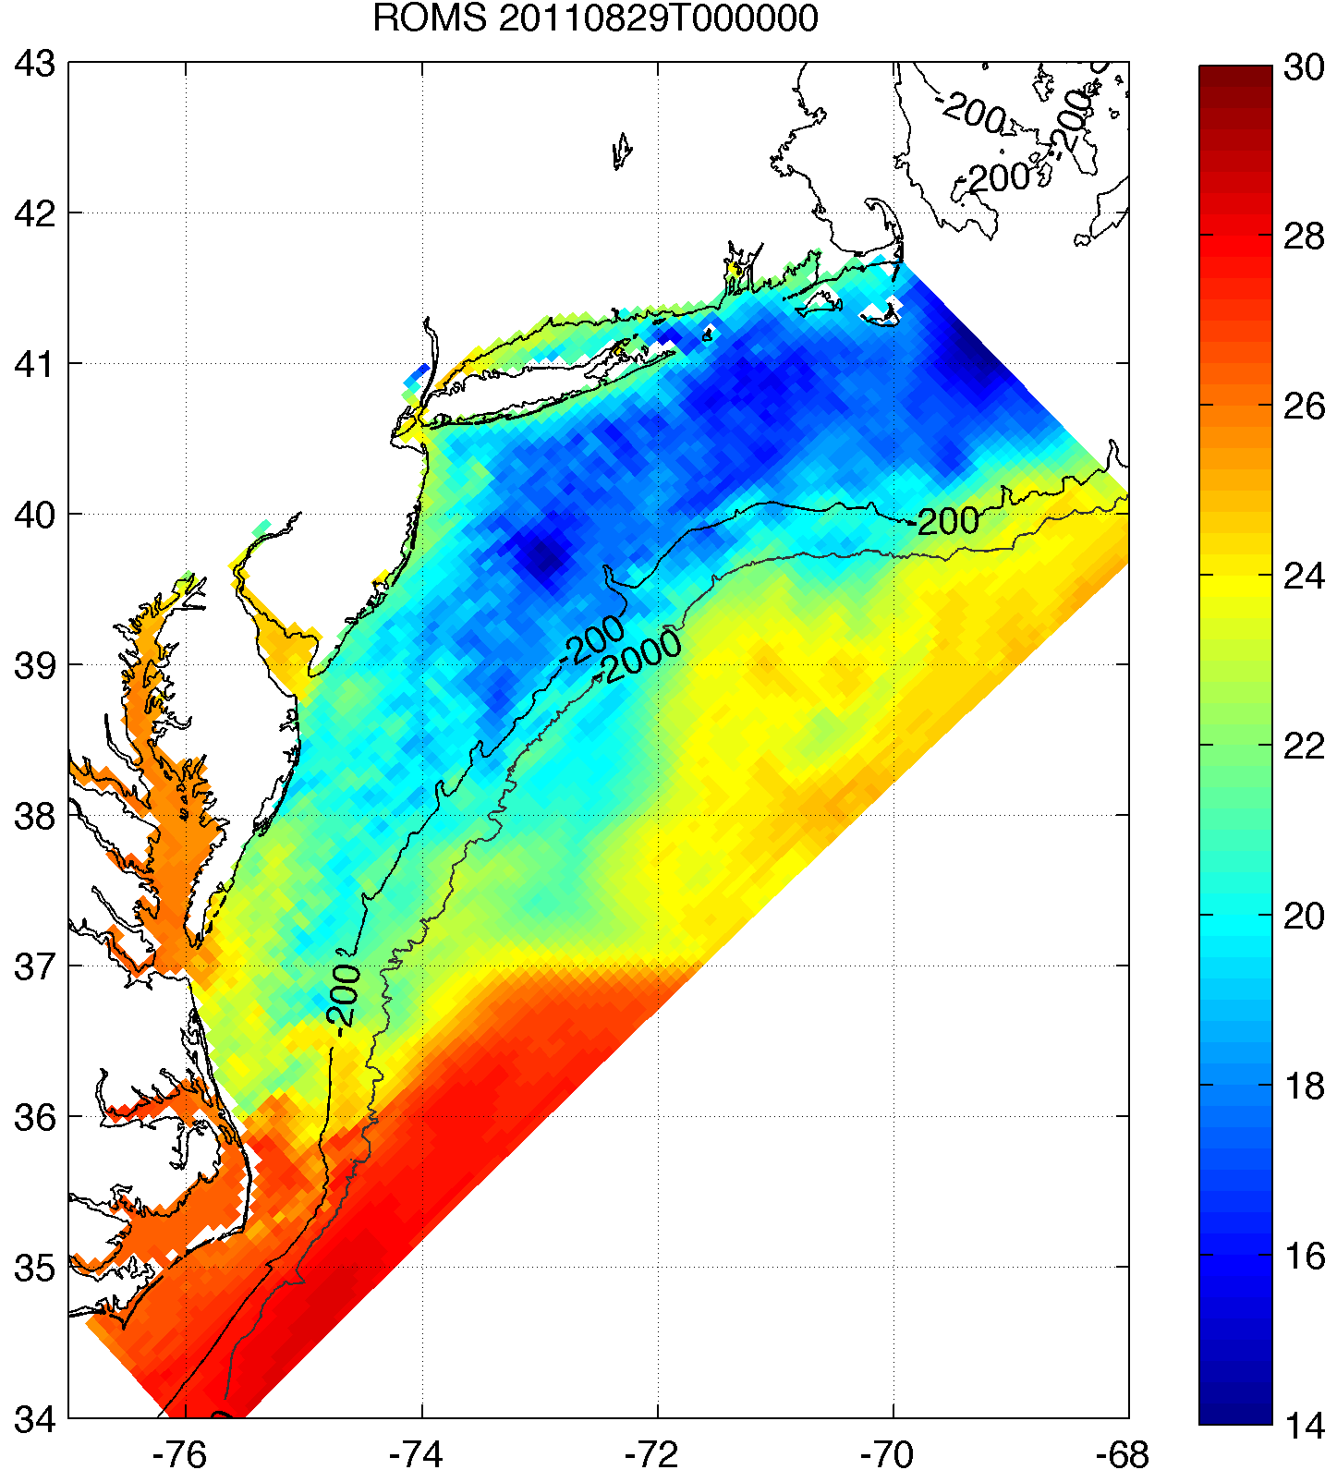
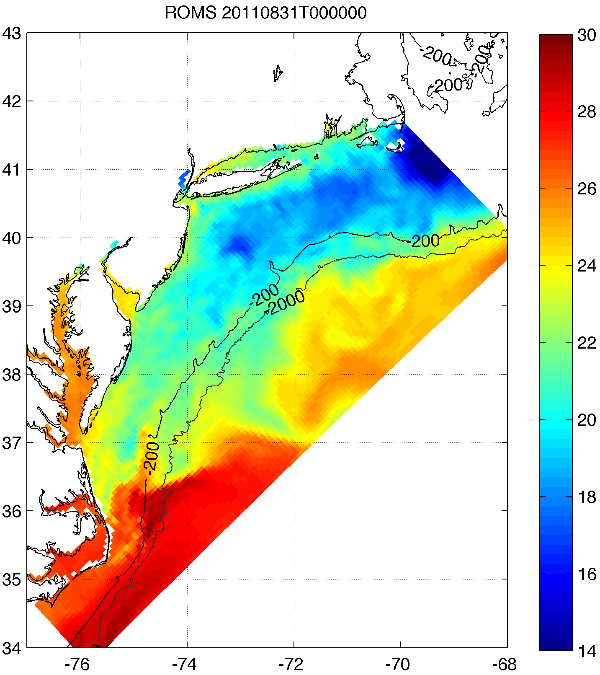
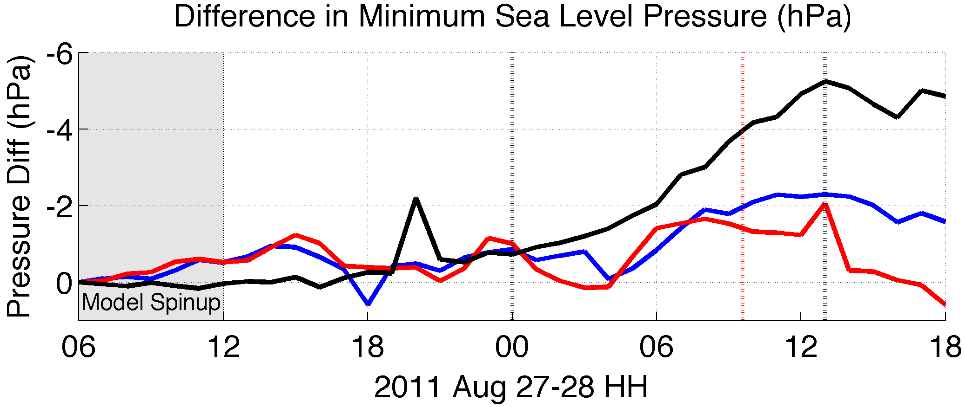
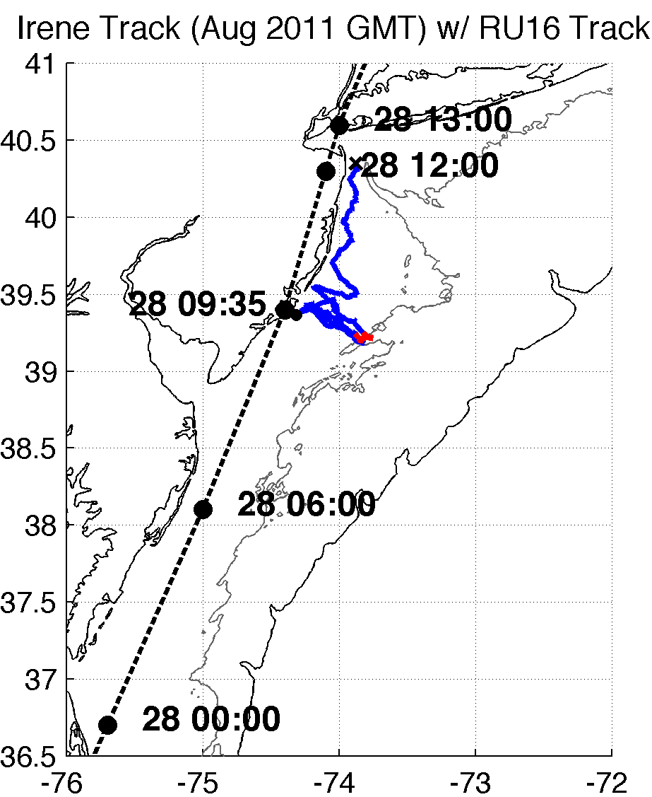
Coastal Ocean Impact on Hurricane Irene (2011) Intensity
Poster #1195
Greg Seroka (seroka@marine.rutgers.edu), Scott Glenn, Oscar Schofield, Travis Miles, Yi Xu
Rutgers Institute of Marine and Coastal Sciences
1. BACKGROUND
4. RESULTS
In August 2011, Hurricane Irene’s intensity was over-predicted by several hurricane models and over-forecast by the National Hurricane Center
Governing factors of hurricane intensity include:
Glider data revealed that ocean mixing and subsequent surface cooling preceded the passing of the eye
Improved satellite SST product revealed that this surface ocean cooling was not captured by:
i. basic satellite product
ii. ocean models used for forecasting hurricane intensity
warm SSTs before storm
passage of eye
dry air intrusion
thermocline top
onshore surface currents
Rutgers SST
RTG HR SST
used by NAM model
HWRF-POM
low res
HWRF-HYCOM
medium res
thermocline bottom
Ocean column mixing from storm cools the surface
vertical wind shear
offshore bottom currents
T (°C)
upper ocean thermal structure and evolution
BEFORE IRENE
hurricane track
What is the impact of the upper ocean thermal evolution (SST) on Irene’s intensity, as compared to other model parameters, such as resolution, microphysics, & air-sea flux parameterizations?
AFTER IRENE
Over 100 sensitivity tests showed that Hurricane Irene intensity is very sensitive to this “ahead-of-eye” SST cooling
2. HYPOTHESIS
NJ landfall
NHC Best Track
Warm pre-storm SST, WRF isftcflx=2
Warm pre-storm SST, isftcflx=1
Warm pre-storm SST, isftcflx=0
Cold post-storm SST, isftcflx=2
Cold post-storm SST, isftcflx=1
Cold post-storm SST, isftcflx=0
However, Rutgers product showed that cooler SSTs are captured relatively well by high res coastal ocean models not used for forecasting hurricanes
We hypothesize that the models handled the track, vertical wind shear, and dry air intrusion well, but handled the upper ocean thermal structure (and evolution) poorly.
Over Mid-Atlantic Bight & NY Harbor
ROMS ESPreSSO
Atmosphere tends to receive more attention in modeling
Models resolve large-scale processes fairly well
Models have improved considerably on predicting tracks
Sensitivity to SST (warm minus cold), isftcflx=2
Sensitivity to air-sea flux parameterization (isftcflx=1 minus isftcflx=0), warm SST
Sensitivity to air-sea flux parameterization (isftcflx=1 minus isftcflx=0), cold SST
3. OBSERVATIONS & MODEL
BEFORE
RIGHT AFTER
AFTER
RU16 Glider: at 40m isobath, right of eye track
Satellite: 1km AVHRR 3-day coldest dark pixel SST composite (preserve cold wake); NASA SPoRT 2km SST for cloudy gaps
Model: 6km WRF-ARW, boundary conditions to get track correct (important because close to coast)
5. CONCLUSIONS
6. FUTURE WORK
Large majority of SST cooling occurred ahead of Irene’s eye
We determined max impact of this cooling on storm intensity (fixed cold vs. fixed warm SST)
One of the largest among tested model parameters
Some surface cooling occurred during/after eye passage
Actual impact of SST cooling on storm intensity may be slightly lower
A high res ocean model (e.g. ROMS) nested within a larger scale ocean model could add significant value to tropical cyclone prediction in the coastal ocean—the last several hours before landfall
Improve model spinup issues
Validate wind shear and dry air intrusion (see Background and Hypothesis sections)
Evaluate storm size and structure
Compare modeled to observed heat fluxes
Move towards accurate fully coupled WRF-ROMS system
WRF w/ hourly ROMS SST
WRF coupled w/ 3D Price-Weller-Pinkel ocean model
WRF-ROMS
Acknowledgements:
Full RU16 Glider Track
Irene RU16 Glider Track
40m isobath
200m isobath (shelf break)
ACKNOWLEDGEMENTS: This work was supported by the NJ Board of Public Utilities and NOAA IOOS (MARACOOS).

