Slide 1
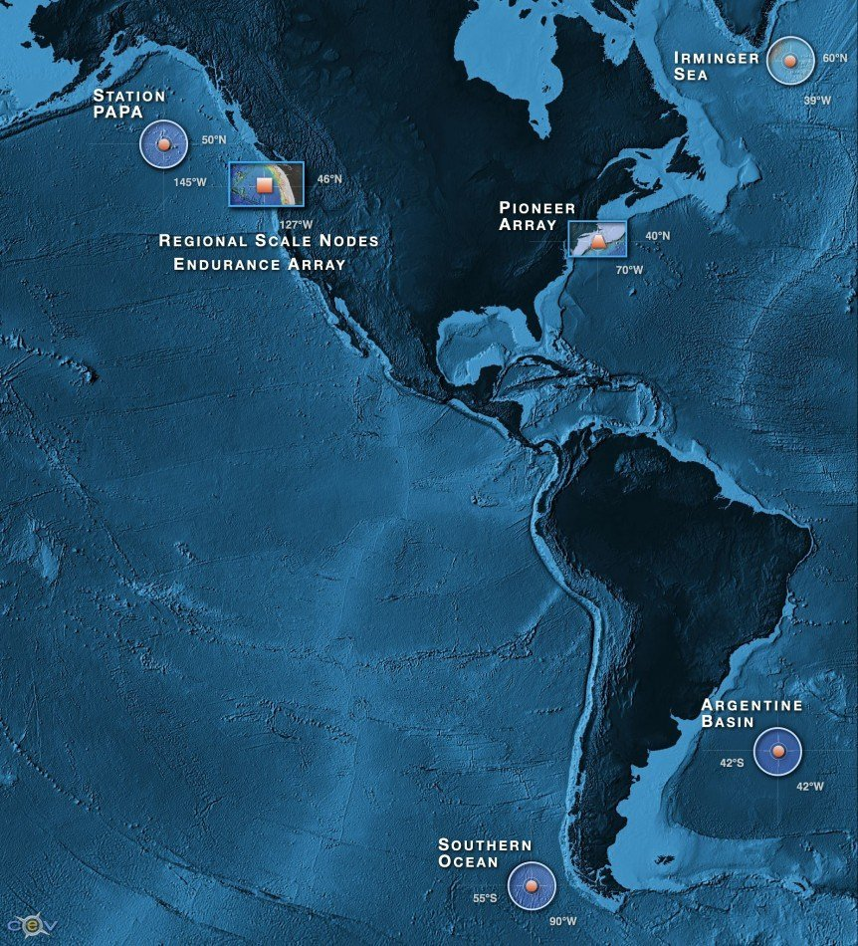
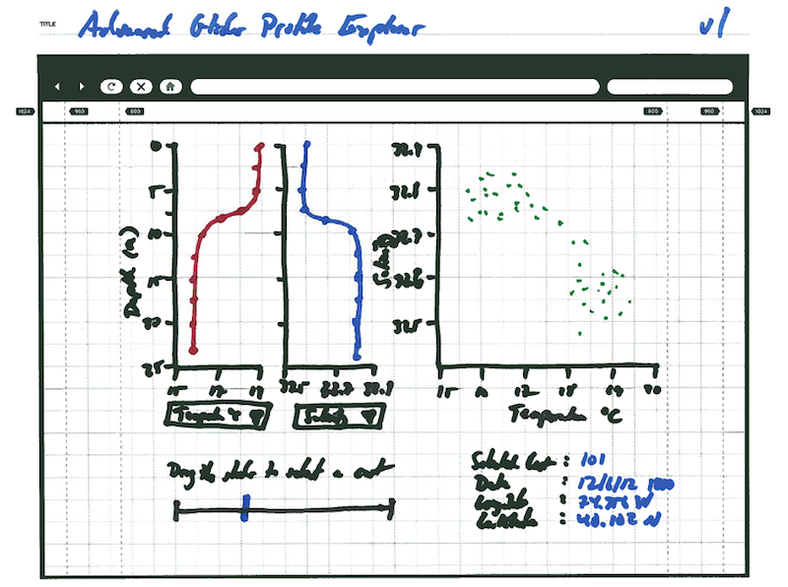
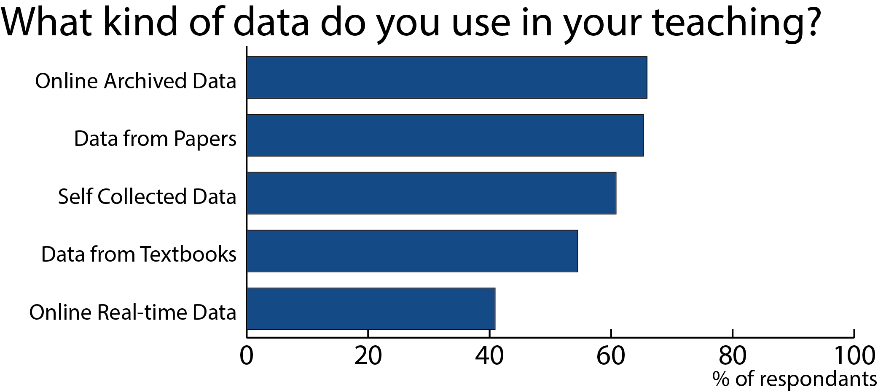
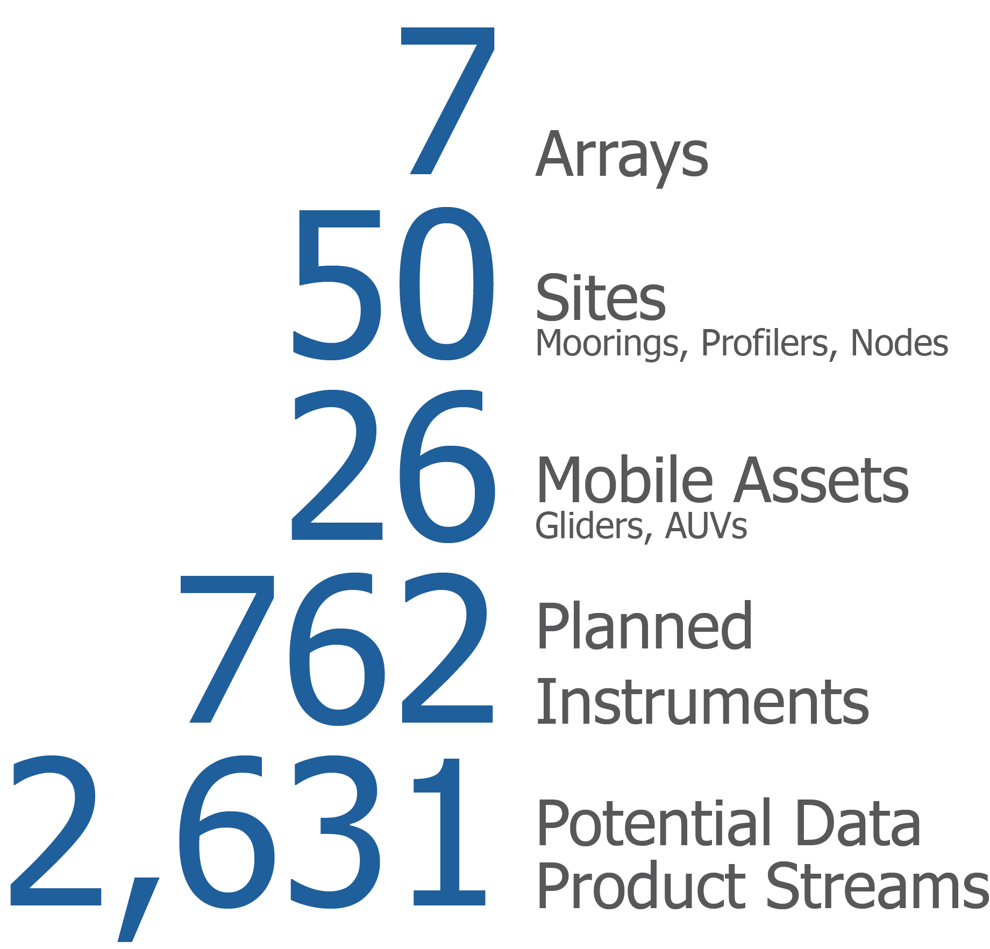
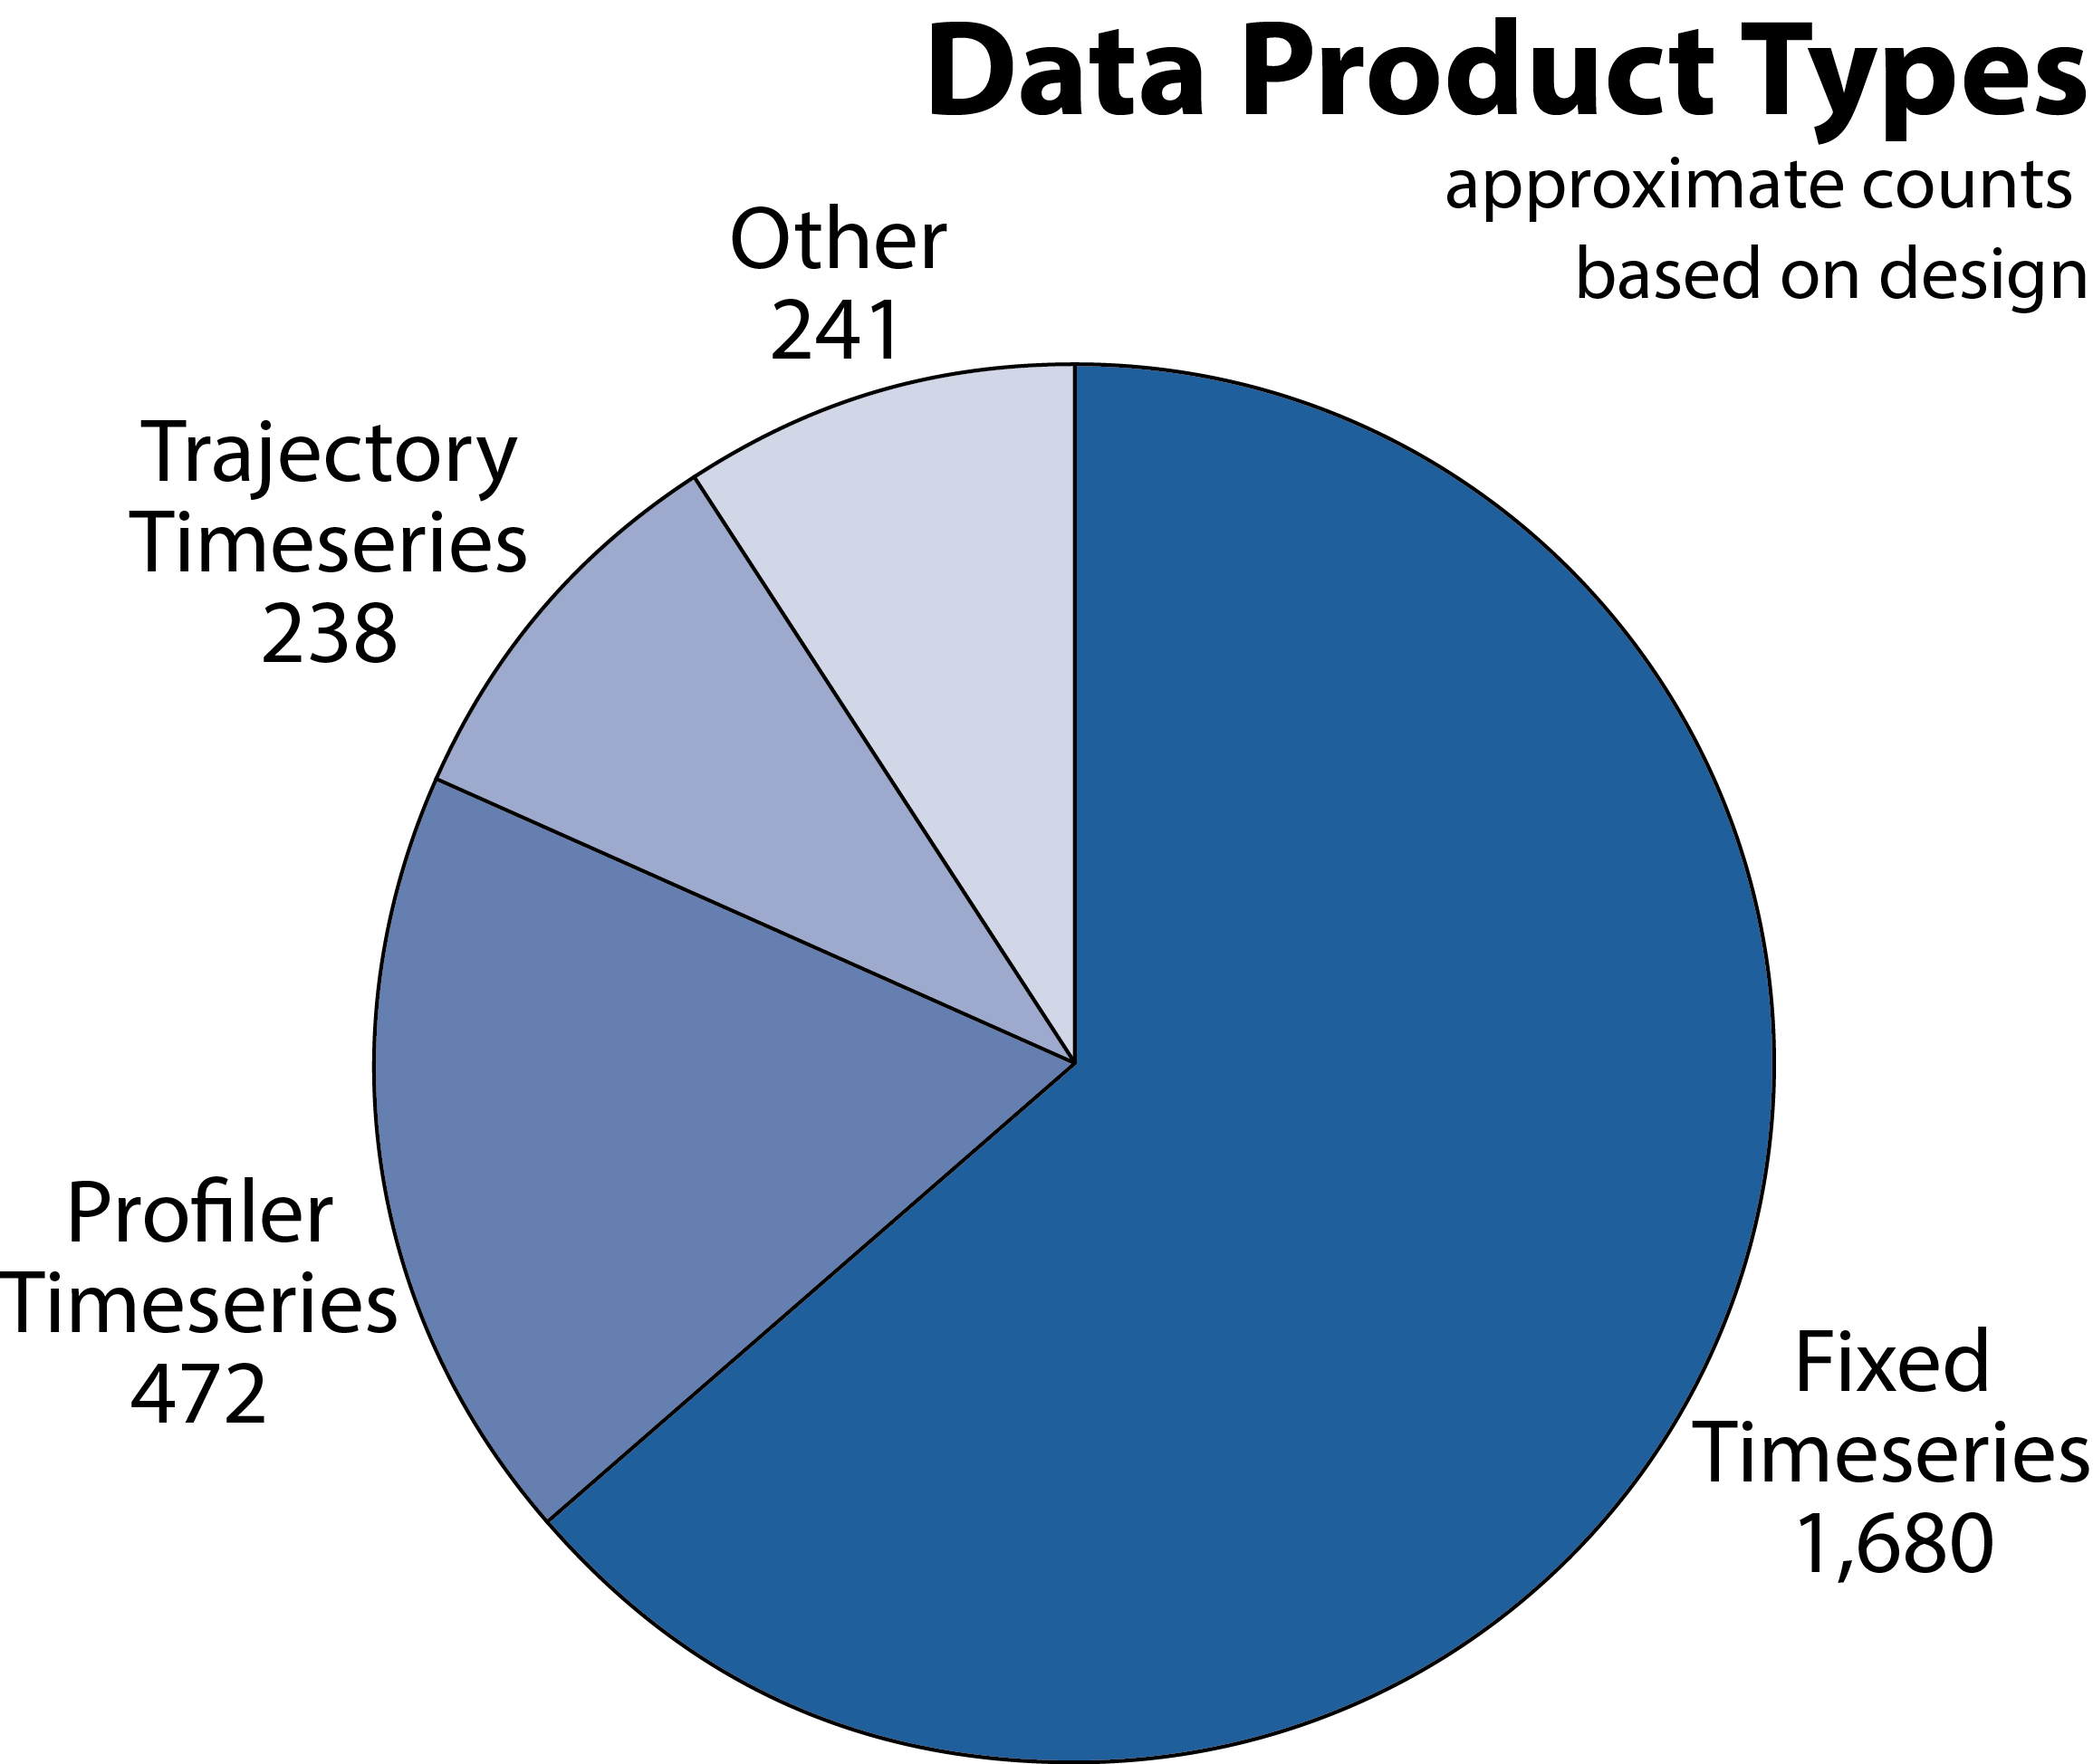
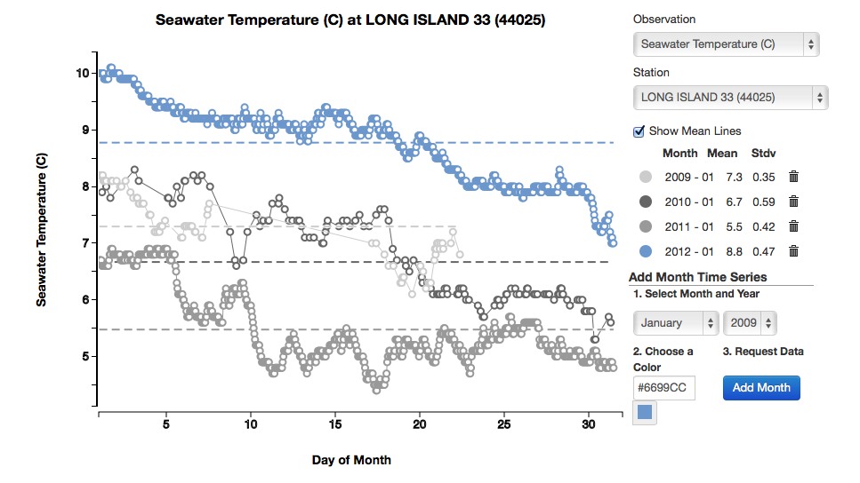
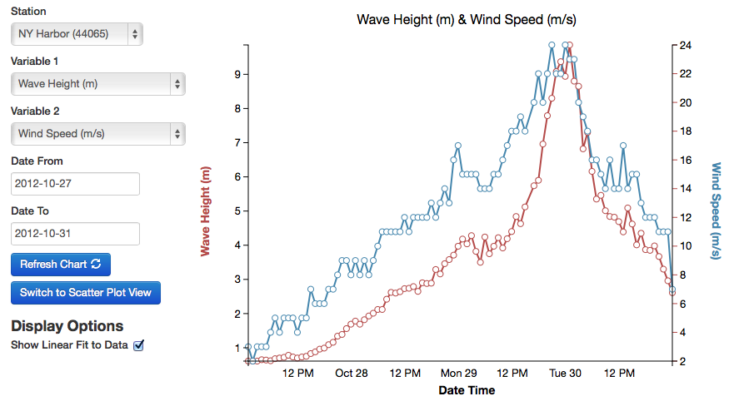
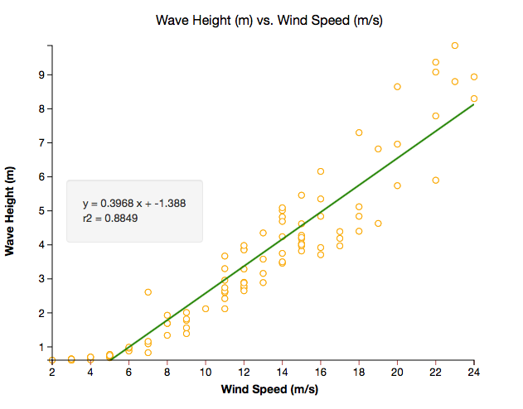
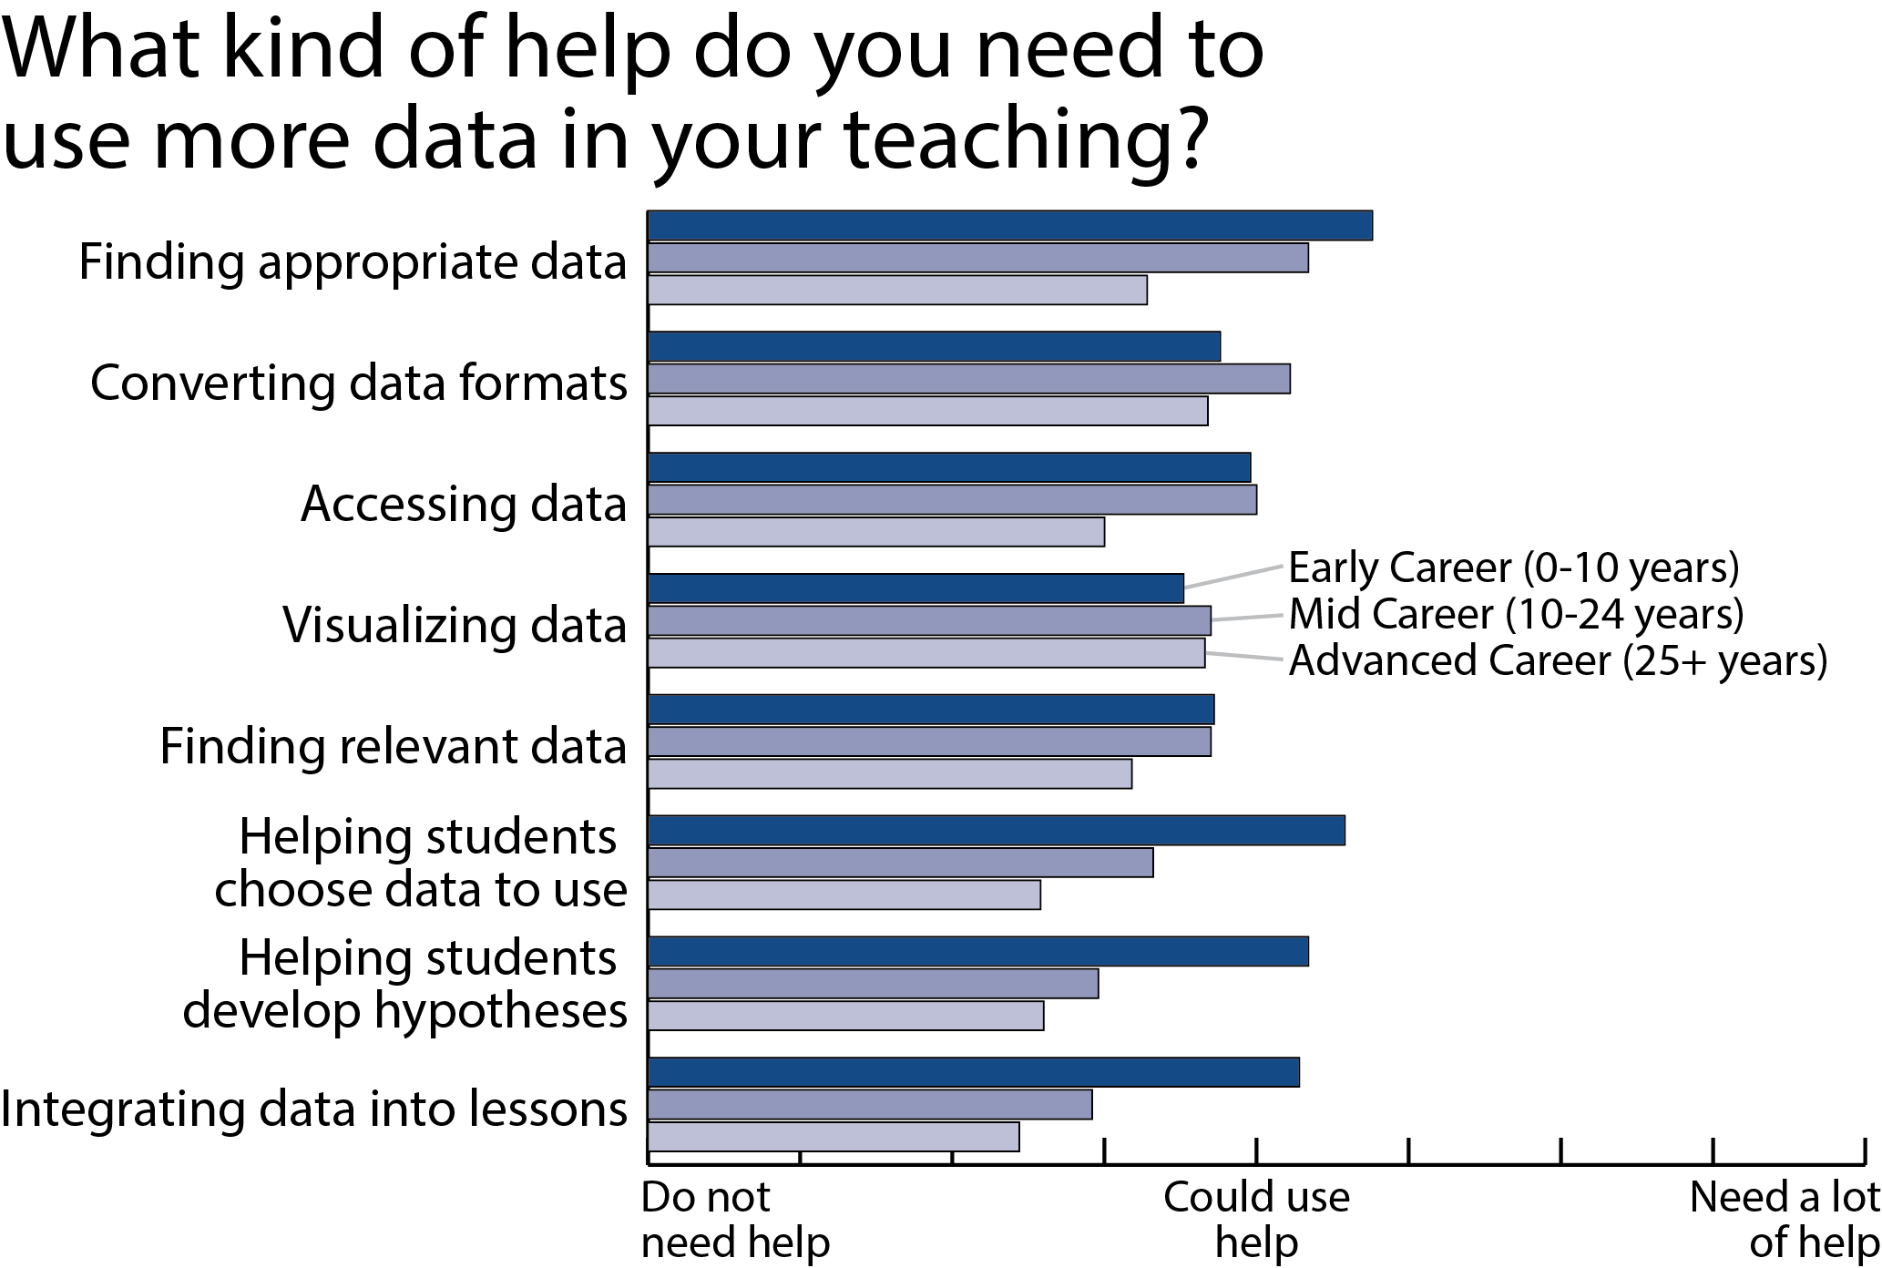
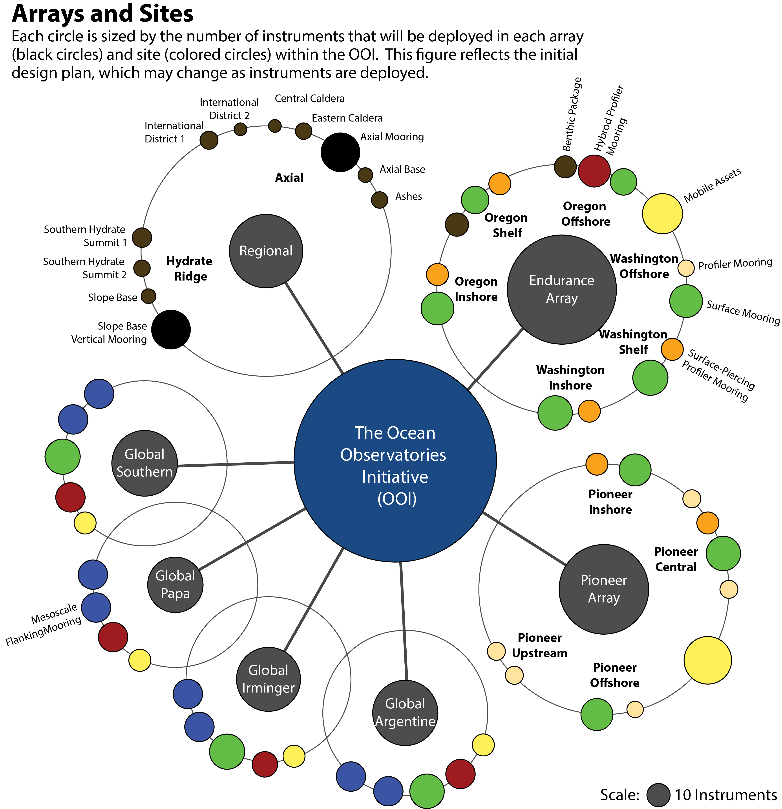
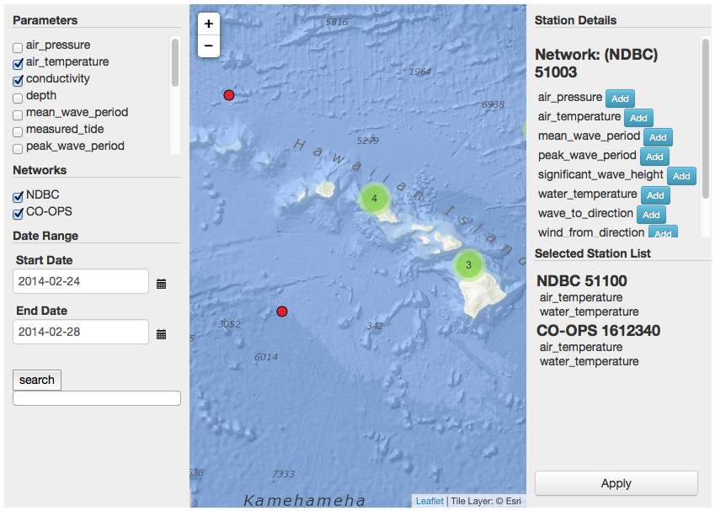
Educational Visualization: Supporting Student Knowledge Development with Online Interactive Data Tools
Poster #1763
C. Sage Lichtenwalner, J. McDonnell, M. Mills, M. Crowley, S. Glenn
Rutgers University Institute of Marine & Coastal Sciences
The Challenge
The stories of science are written with data. Ocean observing systems (OOS) are advancing our understanding of the natural world by amassing large quantities of data to address ever more complex processes, however, students often lack the ability to adequately analyze and synthesize these data into scientific understanding. Students learn best when provided with inquiry-driven learning opportunities, in which they can conduct their own research and develop their own questions (Adams 2008). Unfortunately, to make meaning from oceanographic datasets, they must also be able to create and interpret graphs, which has traditionally required students to learn complex software or programming languages to do so.
“When I put up a formula or a graph, it’s like the air is sucked out of the room. It’s almost like they turn off, even though reading a formula is like reading a sentence.” – Undergraduate Professor
Undergraduate Student and Educator Needs
In 2012, we conducted a community survey (179 responses) to assess the use of data in undergraduate teaching environments.
Desired Dataset Characteristics:
Simple clearly defined variables that are easy to understand
Visualization tools that allow easy exploration and analysis
Classroom tested by peers
Applicable to the learning objectives of the course
Notable Quotes from Undergraduate Professors
“[We need] access to tools to get students interacting with data - most of what I use on a day to day basis (i.e. Matlab) is proprietary and not appropriate for an intro class.”
“Even though students are accessing remote data, it’s still important to connect them to where the measurements are being taken.”
“Using near real-time data in the classroom can be time consuming because students don’t necessarily have the skills to process data into something useful that they can then analyze and interpret.”
The Ocean Observatories Initiative
The Ocean Observatories Initiative (OOI) is designed to transform the way ocean science is conducted, and will provide a rich opportunity to reshape ocean science education as well.
The OOI program will design,
deploy and operate a large
array of transformative
research platforms and
sensors. These sensors will
collect datasets necessary to
understand the complex
processes and challenges
facing today's changing
ocean. As a whole, the OOI
will provide ocean scientists
with an invaluable resource
to conduct cutting-edge and
cost-effective science.
But most importantly, the OOI will provide abundant research experiences for the next generation of ocean scientists and their students, who will hopefully enter the ocean science workforce themselves.
The statistics and graphs here give a sense of the scope and complexity of the planned OOI instrumentation that will come online over the next year. Our team’s challenge is to make the data accessible to students and the public so they can understand and participate in the science.
Design Philosophy
The OOI’s Ocean Education Portal provides a platform for educational users, including students and teachers, to explore and analyze oceanographic datasets from the OOI and other observatories. We use a “design thinking” approach to inform the development of our educational visualization tools with the following characteristics to support student learning.
1) Simple
Visualization tools must be intuitive and easy to use for their intended audience. Simple, but not necessarily simplistic.
Many data portals and software tools, like the glider piloting interface above, are designed for experienced and skilled users who understand the data, data formats, data displays, interface controls and the underlying science.
2) Interactive
Interactive tools can support deeper understanding. They allow users to play with the data and investigate their own questions. Animation, when used effectively, also helps build cognitive links between different views or datasets (Heer 2007).
The “Monthly Comparator” tool allows users to plot multiple months on top of each other. As new months are added, the other lines animate up or down accordingly.
3) Customizable
Visualization tools should be customizable by educators so they can support specific learning objectives and scaffolding.
The “Data Product Browser” lets users select individual stations and parameters to use in a custom visualization tool, allowing educators to adapt the tool to support their learning goal.
4) Embeddable
Visualizations are only as effective as the context students have to understand them. Users will be able to embed custom visualization tools on their own web pages (a la YouTube videos) so they can be used to support their own teaching materials. Users can also use the Data Investigation Builder to build their own investigations (McDonnell 2014).
5) Focused
Tools should be driven
by learning outcomes,
not by data (Krumhansl
2013).
This is an initial sketch
of the “Advanced Glider
Profile Explorer,” which
allows students to
compare profiles of 2
variables from the same location. The tool includes simple controls to change the displayed variables and selected profile, and 2 basic profile plots and a scatterplot that help students investigate and learn about the vertical structure and potential relationships between variables.
6) Educational
Our primary goal is to aid students’ analysis and understanding of scientific processes, so they can spend more time learning oceanographic principles and less time struggling with data formats, programming and graphing.
This interactive time series
tool lets students switch
between time-series and
scatterplot modes (with an
animated transition), so they
can study trends in time and
investigate possible correlations.
References
Adams, L. and G. Matsumoto (2009). Enhancing Ocean Literacy Using Real-Time Data. Oceanography.
Heer, J. and G. Robertson (2007). Animated Transitions in Statistical Data Graphics. IEEE InfoVis.
Krumhansl, R. et al (2013). Visualizing Oceans of Data: Educational Interface Design.
McDonnell, J. et al (2012). An Assessment of Real-Time Data Use in Undergraduate Classrooms. Ocean Sciences 2012.
McDonnell, J. et al (2014). Developing Problem Based Learning with Undergraduates Using a Web-Based Lab Lesson Builder Software Tool. Ocean Sciences 2014. (See Poster #1965.)
Parsons, C. (2006). SWMP/IOOS Real-Time Data in K-12 Classrooms: A Front-end Evaluation.
Try it out today!
The “beta” version of the OOI Ocean Education Portal is now live and includes the “Simple Time Series” visualization tool. Additional tools and datasets will be added incrementally over the next year.
We invite you log onto the site, play with the tools and let us know what you think. Your feedback will help us build the best site possible.
http://education.oceanobservatories.org
For more information, please contact sage@marine.rutgers.edu
Winds & Waves
During
Hurricane Sandy

